Slide 1
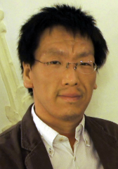
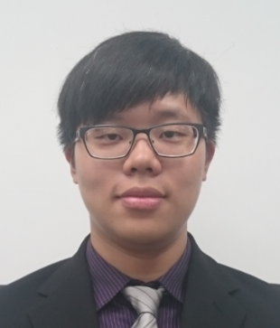
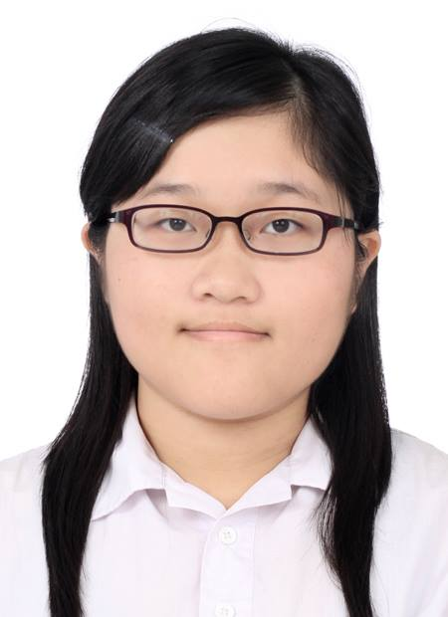
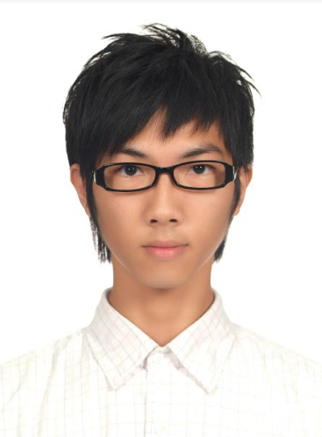
Welcome Prof. Yoshinobu Kano, Shizuoka University, Japan Visiting Tamkang University, Taiwan
Tamkang University
Time: 13:10-17:00, November 30, 2016 (Wed)
Place: B302b, Business and Management Building, TKU
Min-Yuh Day
Assistant Professor, IM, TKU
Yue-Da Lin
MBA Student,
IM, TKU
Chou-Yu Chen
MBA Student,
IM, TKU
Jheng-Gang Li
MBA Student,
ECON, TKU

Slide 2
Challenges in Natural Language Processing: Question Answering and Dialog System
Invited Talk at Tamkang University, Taiwan Time: 15:10-17:00, November 30, 2016 (Wed)
Place: B302b, Business and Management Building, TKU
Yoshinobu Kano (狩野 芳伸) Associate Professor (准教授) Faculty of Informatics (情報学部) Shizuoka University, Japan (静岡大学)

Slide 3
Program of Shizuoka-Tamkang Symposium November 30, 2016 (Wed) Place: 302b, Business and Management Building, TKU
12:00-13:10 Lunch (The Way Kitchen & Cafe) [樂味小館]
13:10-14:00 Mini Symposium Session 1
14:00-14:10 Break
14:10-15:00 Mini Symposium Session 2
15:00-15:10 Break
15:10-17:00 Challenges in Natural Language Processing: Question Answering and Dialog System, Prof. Yoshinobu Kano (Associate Professor, Faculty of Informatics, Shizuoka University, Japan)
17:00-17:30 Break
17:30-19:30 Dinner (Red Castle 1899)[淡水紅樓餐廳]

Slide 4
Yoshinobu Kano Associate Professor, Faculty of Informatics, Shizuoka University, Japan
BS in physics (2001), MSc (2003) and PhD (2011) in information science and technology from the University of Tokyo.
A research associate in University of Tokyo (2009), JST PRESTO researcher (2011), an associate professor (PI) in Shizuoka Univerity (2014-).
Current research theme includes more human-like dialog system (AIwerewolf, copy generation), examination question answering (social, medical, and legal), medical NLP (EHRs, MedNLP), text mining for neuroscience papers, serving as organizers for these different projects individually.
kano@inf.shizuoka.ac.jp
http://kanolab.net/kano/index.en.html

Slide 5
Shizuoka University-Tamkang University Mini Symposium Sessions November 30, 2016 (Wed), Place: 302b, Business and Management Building, TKU
Prof. Yoshinobu Kano, Associate Professor, Faculty of Informatics, Shizuoka University, Japan
Masahito Sakishita, Faculty of Informatics, Shizuoka University, Japan
Fuma Masako, Faculty of Informatics, Shizuoka University, Japan
Takashi Minowa, Faculty of Informatics, Shizuoka University, Japan
Ryosuke Taniguchi, Faculty of Informatics, Shizuoka University, Japan
Mitsuru Hattori, Faculty of Informatics, Shizuoka University, Japan
Shohei Shimada, Faculty of Informatics, Shizuoka University, Japan
Prof. Min-Yuh Day, Assistant Professor, Department of Information Management, Tamkang University
Yue-Da Lin, MBA Student, Department of Information Management, Tamkang University
Chao-Yu Chen, MBA Student, Department of Information Management, Tamkang University
Jheng-Gang Li, MBA Student, Department of Economics, Tamkang University

Slide 6
Mini Symposium Session 1 (13:10 ~14:00 ) Moderator : Mitsuru Hattori and Shohei Shimada Shizuoka University November 30, 2016 (Wed), Place: 302b, Business and Management Building, TKU
13:10~13:20
My Research "NLP on Medical Field" / Masahito Sakishita
13:20~13:30
Timing Prediction and Evaluation for Giving Responses System / Fuma Masako
13:30~13:40
Automatic Conversion from Natural Language to the Protocol in AIWolf / Takashi Minowa
13:40~13:50
Legal Yes/No Question Answering System using Case-Role Analysis / Ryosuke Taniguchi

Slide 7
Mini Symposium Session 2 (14:10 ~ 15:00) Moderator : Masahito Sakishita and Takashi Minowa Shizuoka University November 30, 2016 (Wed), Place: 302b, Business and Management Building, TKU
14:10 ~14:20
HMM-based Speech Synthesis / Mitsuru Hattori
14:20 ~14:30
Building Voice Recognition System using Virtual Reality / Shohei Shimada

Slide 8
Mini Symposium Session 2 (14:10 ~ 15:00) Moderator : Masahito Sakishita and Takashi Minowa Tamkang University November 30, 2016 (Wed), Place: 302b, Business and Management Building, TKU
14:30~14:40
Sentiment Analysis with Deep learning for Consumer Review on Social Media (Yue-Da Lin, TKU)
14:40~14:50
Deep Learning for Robo-Advisors in Portfolio Optimization: An Extension of Black-Litterman Model and Ross Recovery Theorem (Jheng-Gang Li, TKU)
14:50~15:00
Deep Learning for Question Answering System with Dynamic Memory Networks (Chao-Yu Chen, TKU)

Slide 9
Sentiment Analysis with Deep learning for Consumer Review on Social Media
Tamkang University
Yue-Da Lin
MBA Student,
IM, TKU
Min-Yuh Day
Assistant Professor, IM, TKU

Slide 10
Deep Learning for Robo-Advisors in Portfolio Optimization: An Extension of Black-Litterman Model and Ross Recovery Theorem
Tamkang University
Jheng-Gang Li
MBA Student,
ECON, TKU
Min-Yuh Day
Assistant Professor, IM, TKU

Slide 11
Deep Learning for Question Answering System with Dynamic Memory Networks
Tamkang University
Chou-Yu Chen
MBA Student,
IM, TKU
Min-Yuh Day
Assistant Professor, IM, TKU

Slide 12
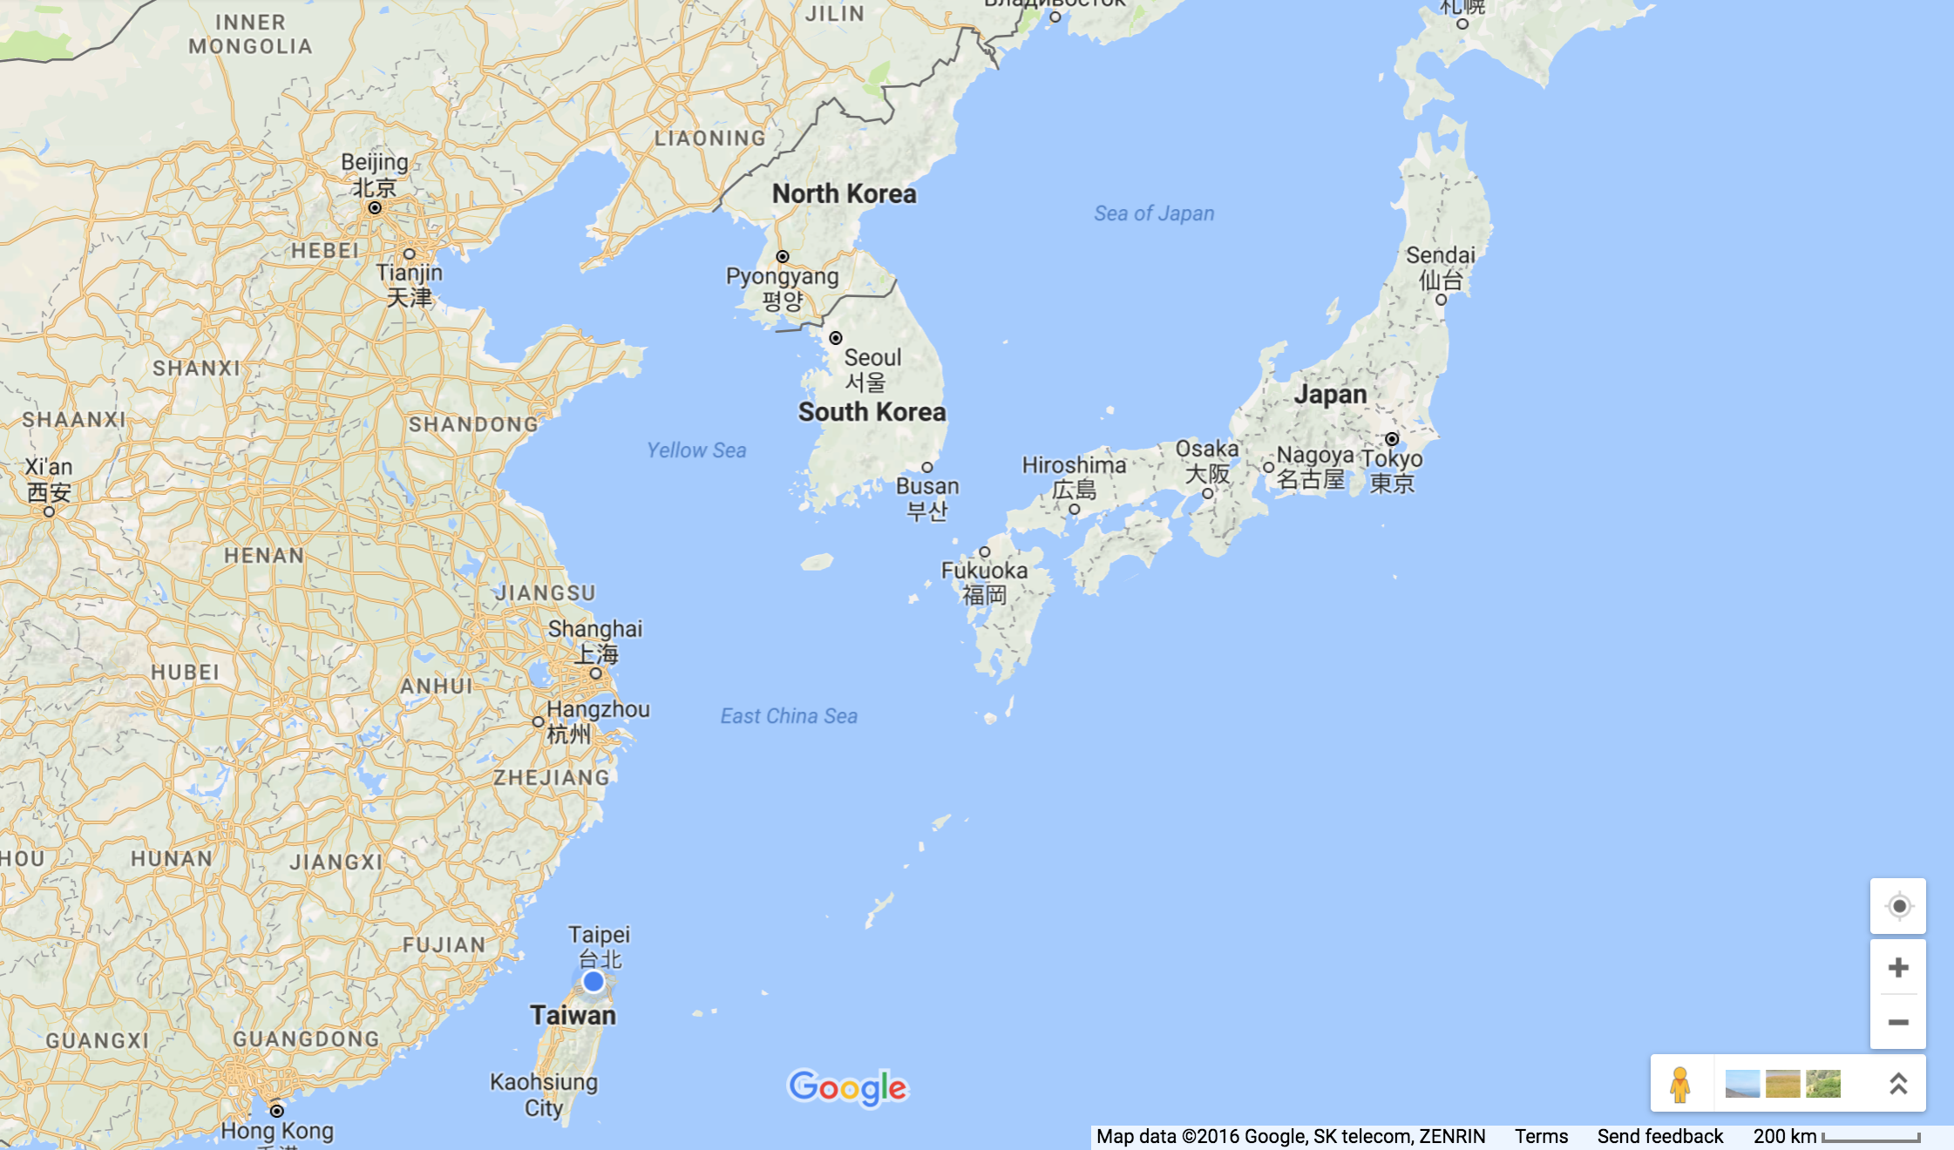
Shizuoka University, Japan Tamkang University, Taiwan

Slide 13
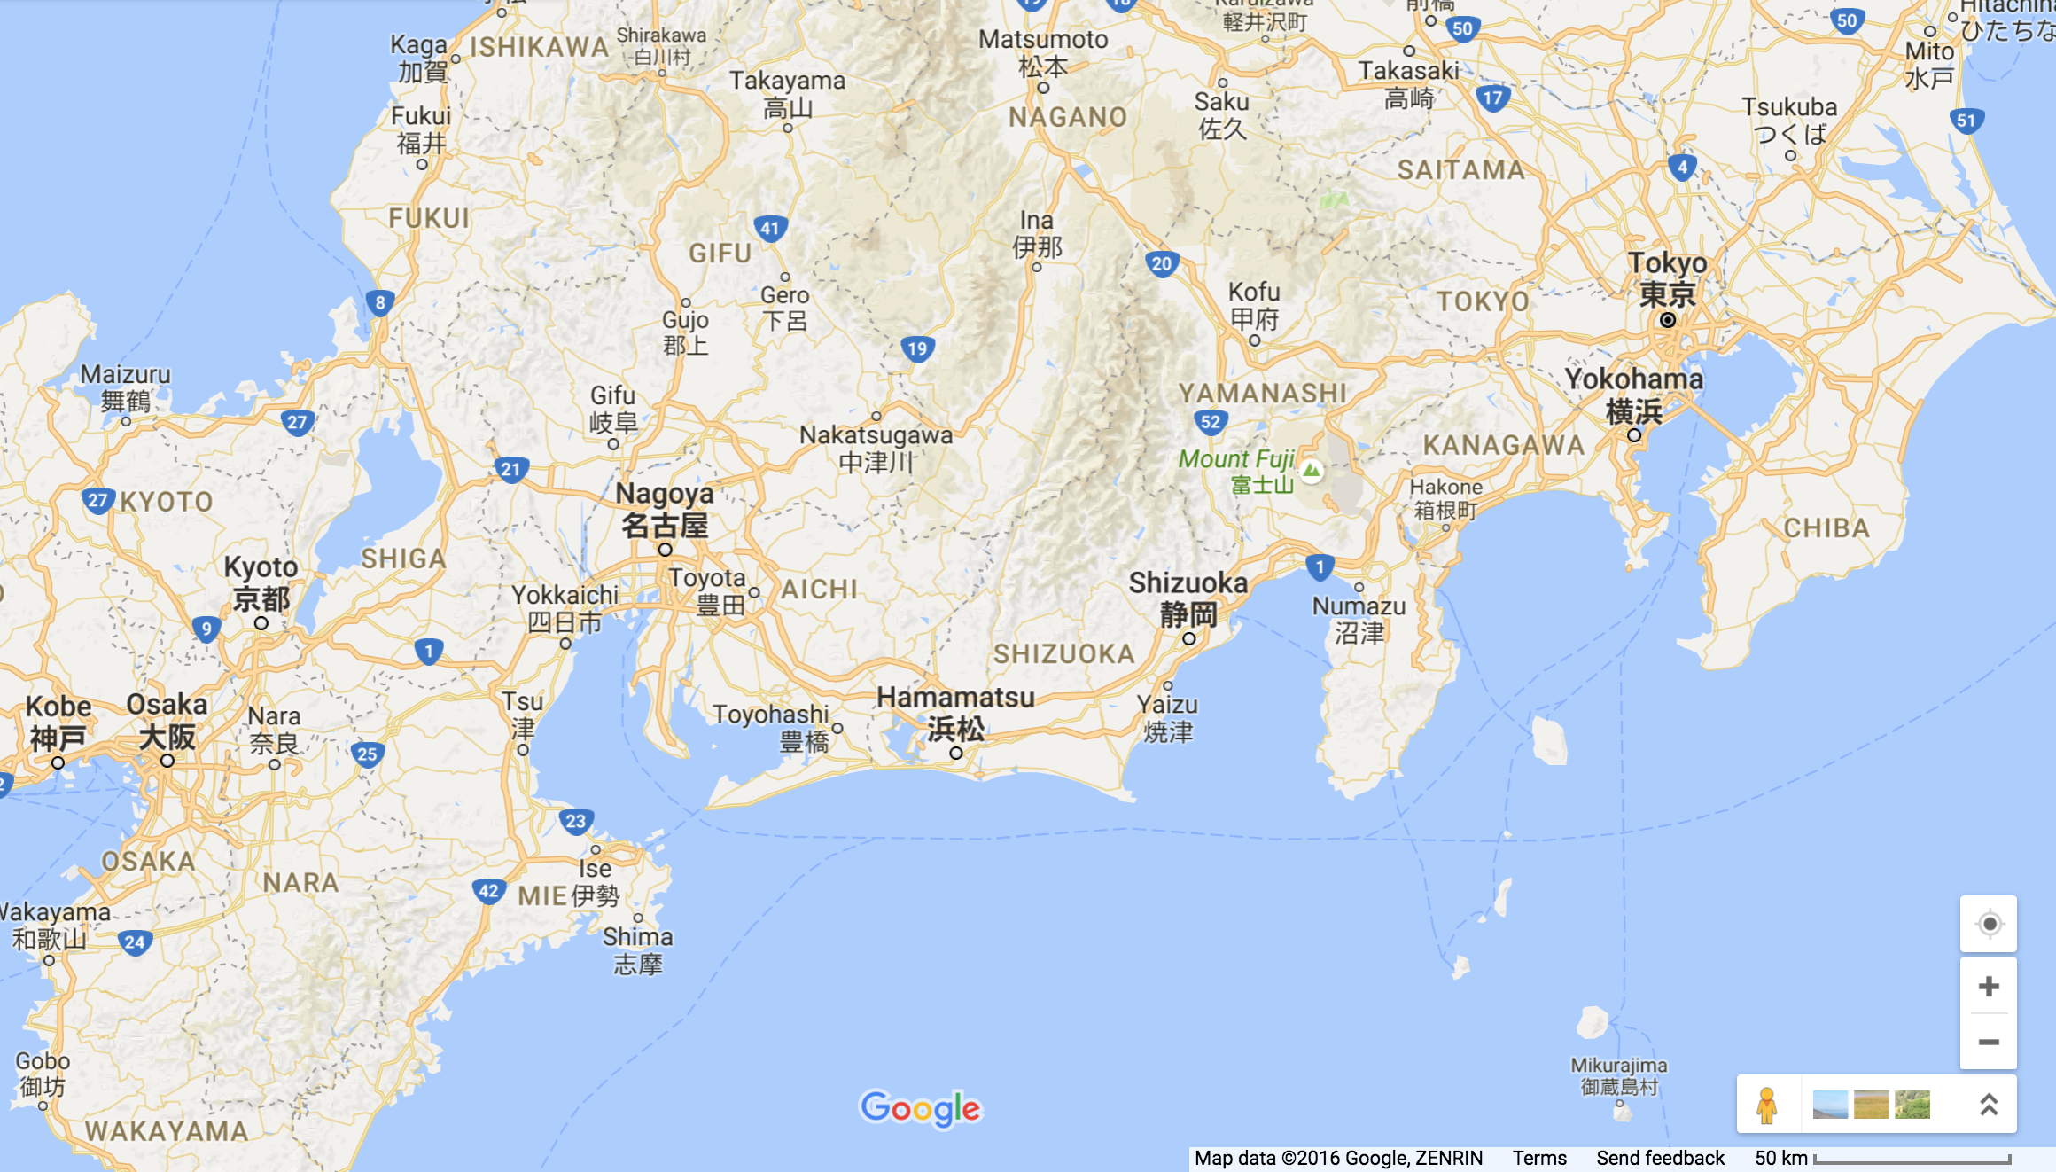
Shizuoka University, Japan

Slide 14
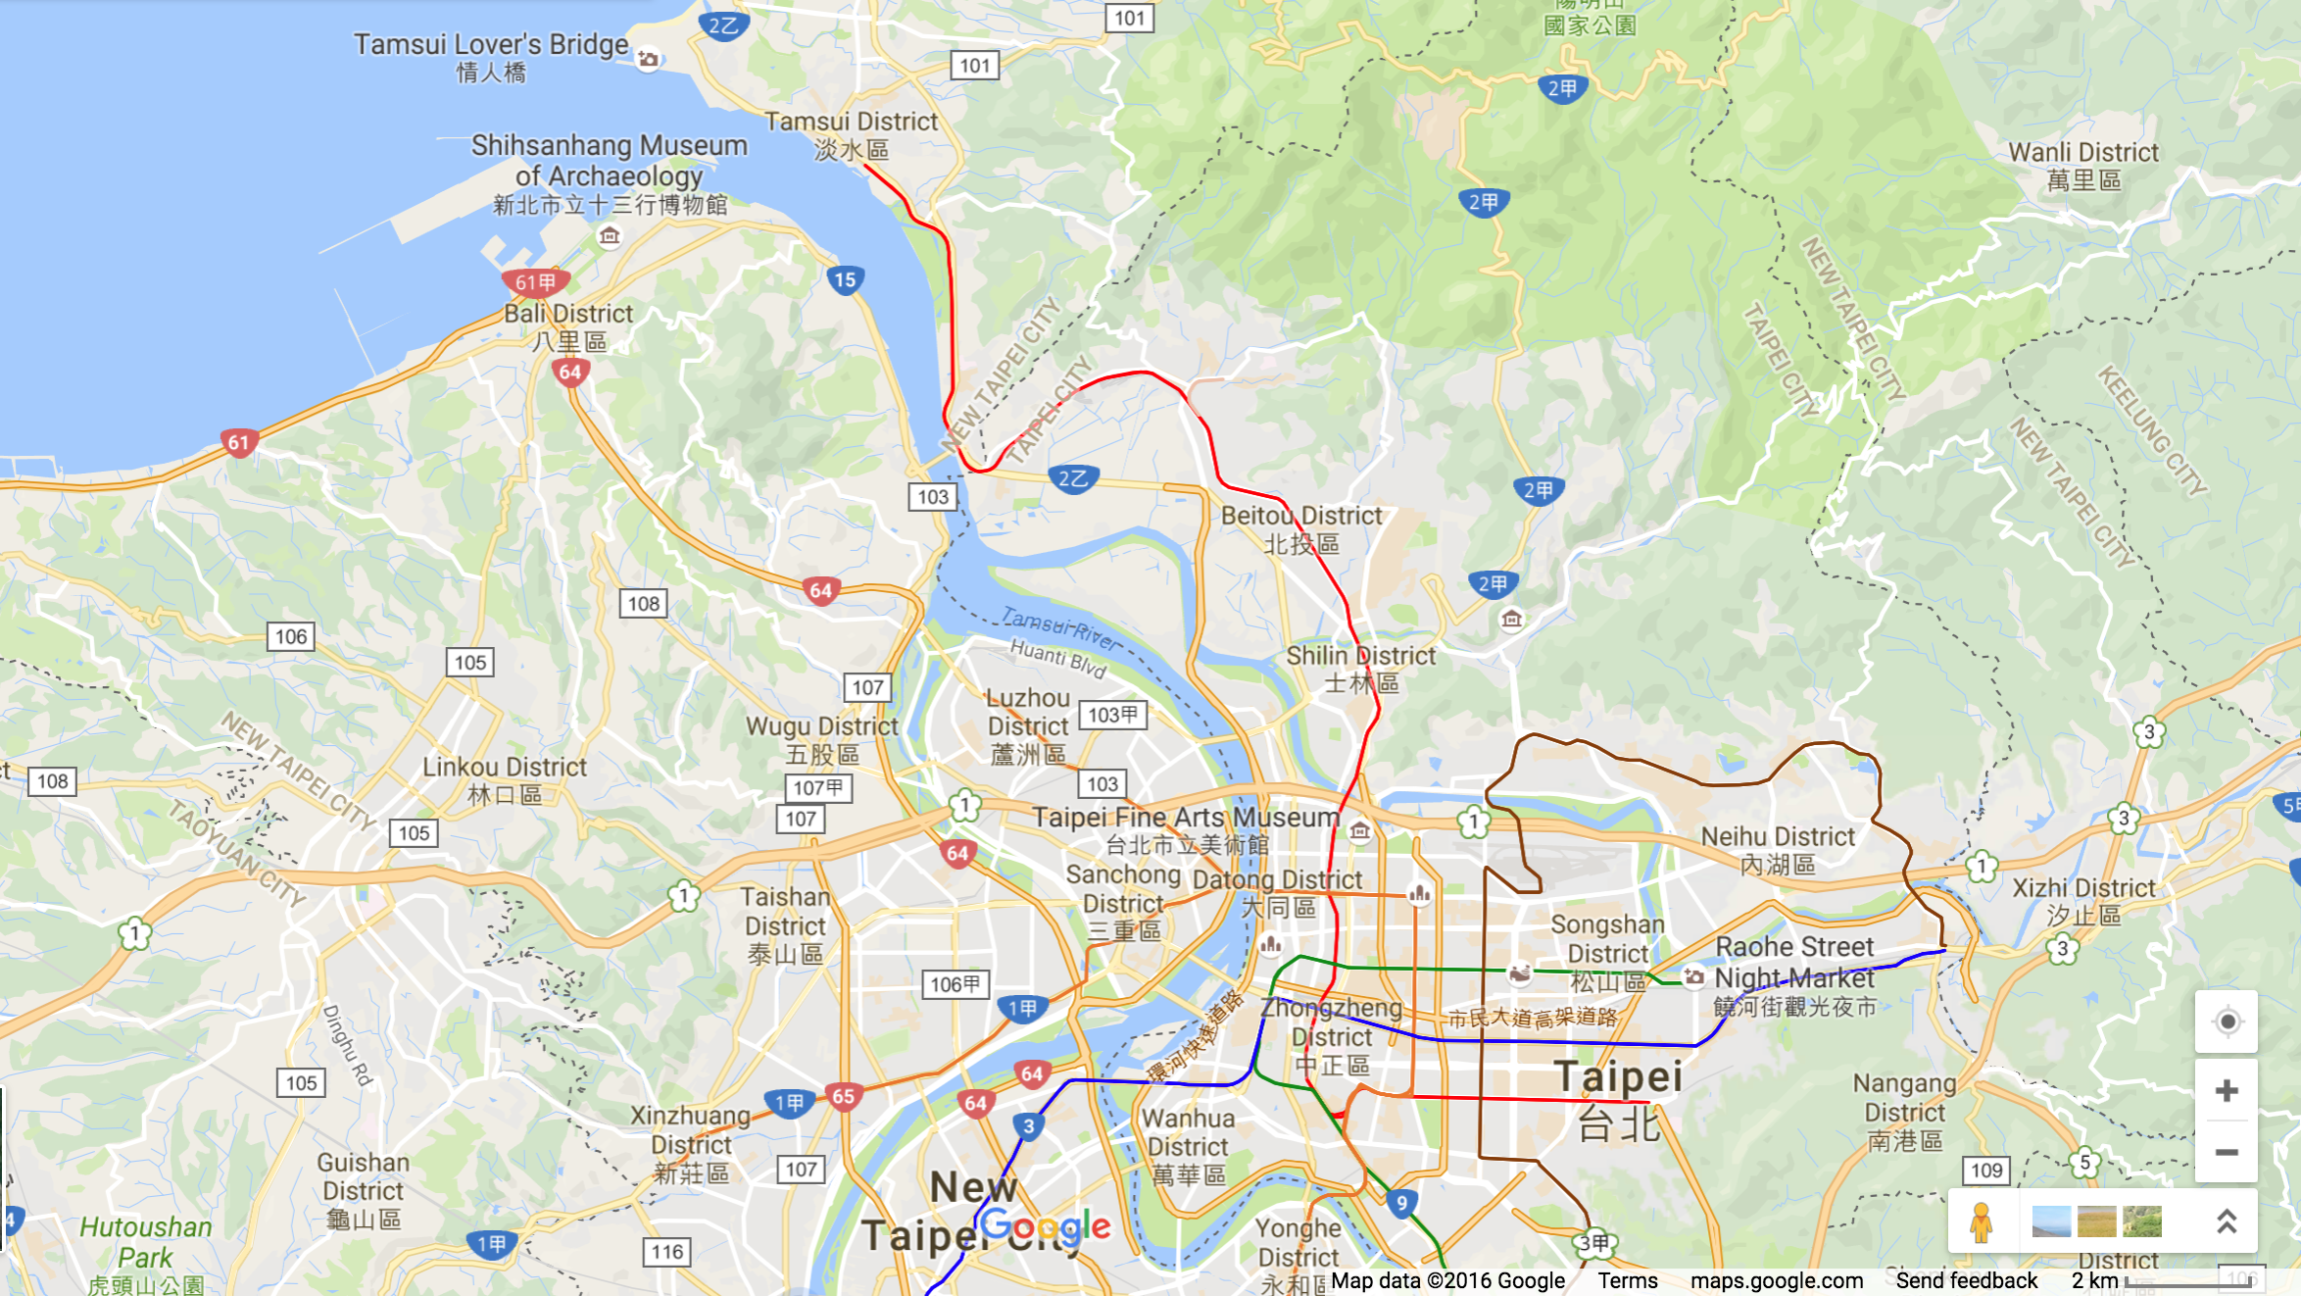
Tamkang University, Taiwan

Slide 15
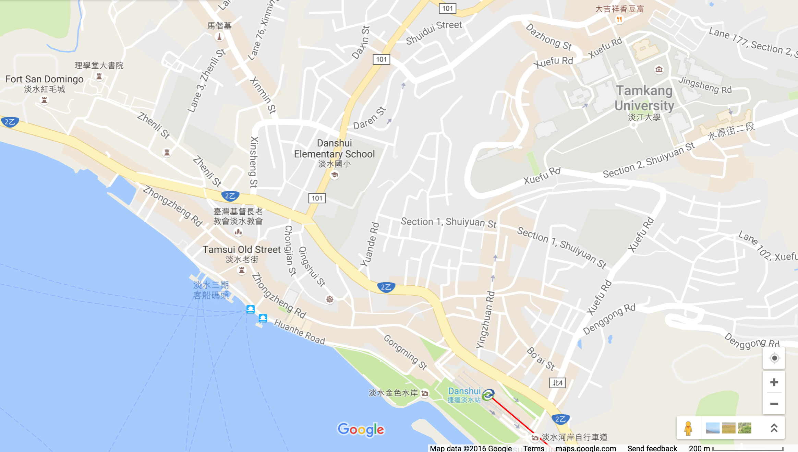
Shizuoka-Tamkang Symposium
Tamkang University, Taiwan
Lunch Time: 12:00-13:10, November 30, 2016 (Wed)
Place: The Way Kitchen & Cafe [樂味小館]
2
1
Time: 13:10-17:00, November 30, 2016 (Wed)
Place: B302b, Business and Management Building, TKU
Dinner Time: 17:30-19:30, November 30, 2016 (Wed)
Place: Red Castle 1899 [淡水紅樓餐廳]
3

Slide 16
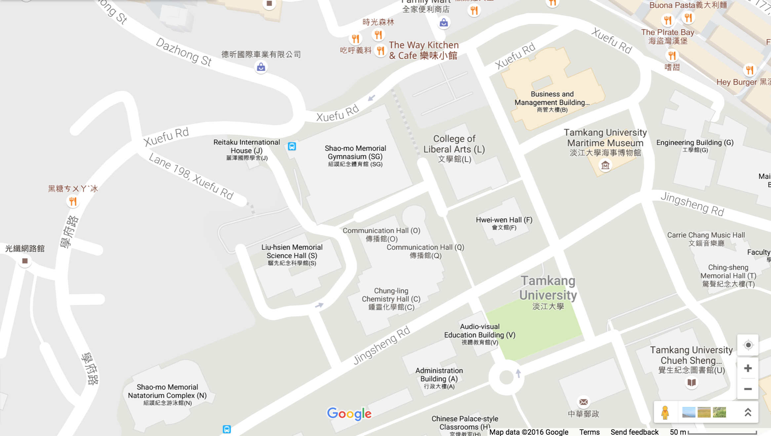
Shizuoka-Tamkang Symposium
Time: 13:10-17:00, November 30, 2016 (Wed)
Place: B302b, Business and Management Building, TKU
No. 151, Yingzhuan Rd, Tamsui District, New Taipei City, 251
2
1
https://www.google.com.tw/maps/@25.17597,121.4485382,18z?hl=en

Slide 17
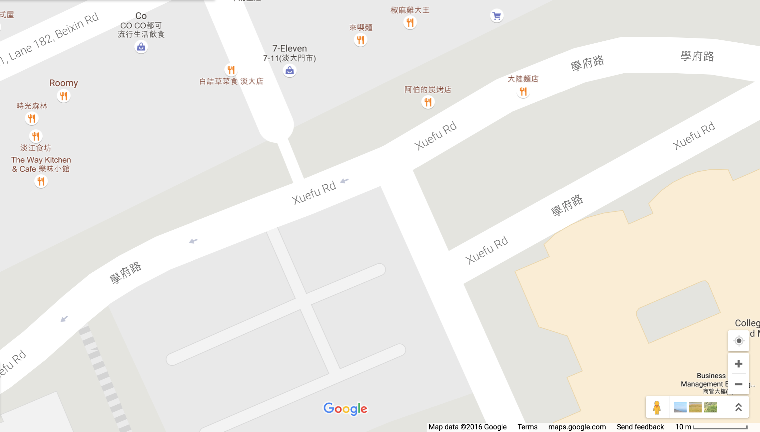
Shizuoka-Tamkang Symposium
Lunch Time: 12:00-13:10, November 30, 2016 (Wed)
Place: The Way Kitchen & Cafe [樂味小館]
251, New Taipei City, Tamsui District, 新北市淡水區北新路182巷5弄49號
2
https://www.google.com.tw/maps/@25.1769321,121.4493361,20z?hl=en

Slide 18
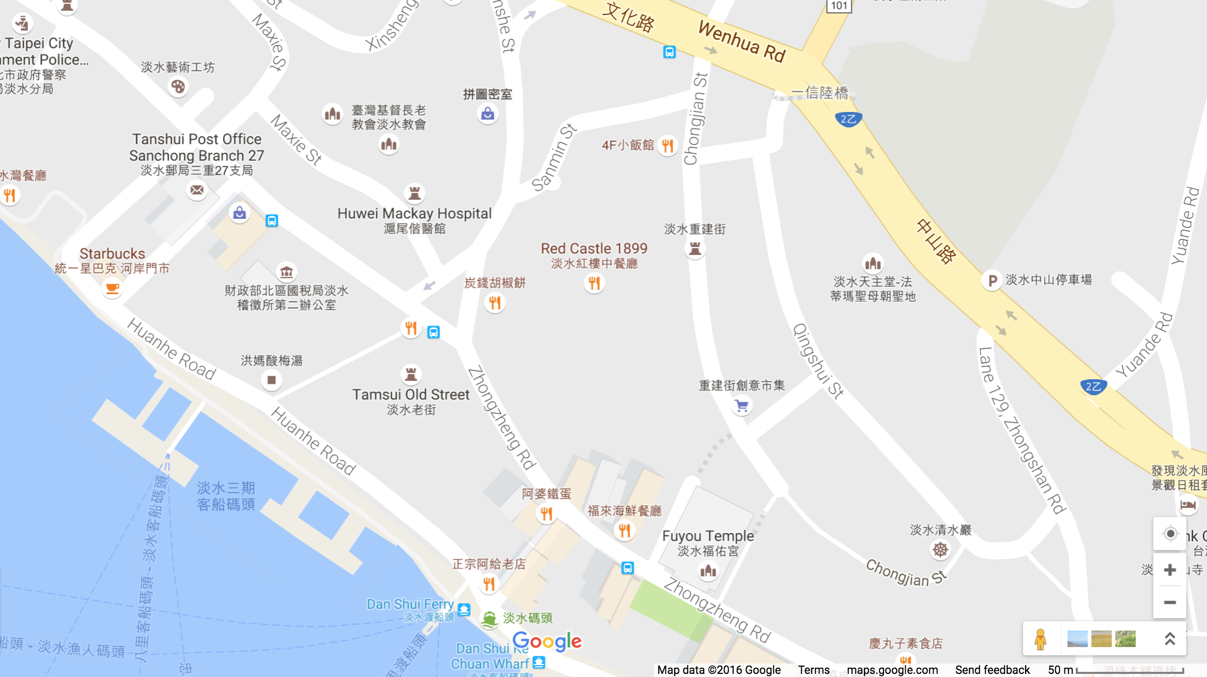
Shizuoka-Tamkang Symposium
Dinner Time: 17:30-19:30, November 30, 2016 (Wed)
Place: Red Castle 1899 [淡水紅樓餐廳]
251, New Taipei City, Tamsui District, 新北市淡水區三民街2巷6號1樓
3
https://www.google.com.tw/maps/@25.1713321,121.4391904,18z?hl=en

