Slide 1




AI Task-Oriented Dialogue System
for Conversational Commerce
in FinTech
Host: Prof. Kuan-Yu Menphis Chen
Computer Science and Information Engineering, National Taiwan University of Science and Technology
Time: 14:00-15:00, May 10, 2021 (Monday)
Place: CSIE, NTUST
Address: No.43, Keelung Rd., Sec.4, Da'an Dist., Taipei, Taiwan
Min-Yuh Day
戴敏育
Associate Professor
副教授
Institute of Information Management, National Taipei University
國立臺北大學 資訊管理研究所
https://web.ntpu.edu.tw/~myday
2021-05-10

Slide 2



戴敏育 博士
(Min-Yuh Day, Ph.D.)
國立台北大學 資訊管理研究所 副教授
中央研究院 資訊科學研究所 訪問學人
國立台灣大學 資訊管理 博士
Publications Co-Chairs, IEEE/ACM International Conference on
Advances in Social Networks Analysis and Mining (ASONAM 2013- )
Program Co-Chair, IEEE International Workshop on
Empirical Methods for Recognizing Inference in TExt (IEEE EM-RITE 2012- )
Publications Chair, The IEEE International Conference on
Information Reuse and Integration (IEEE IRI)

Slide 3
Outline
Artificial Intelligence
FinTech
Conversational Commerce
Task Oriented Dialogue System

Slide 4
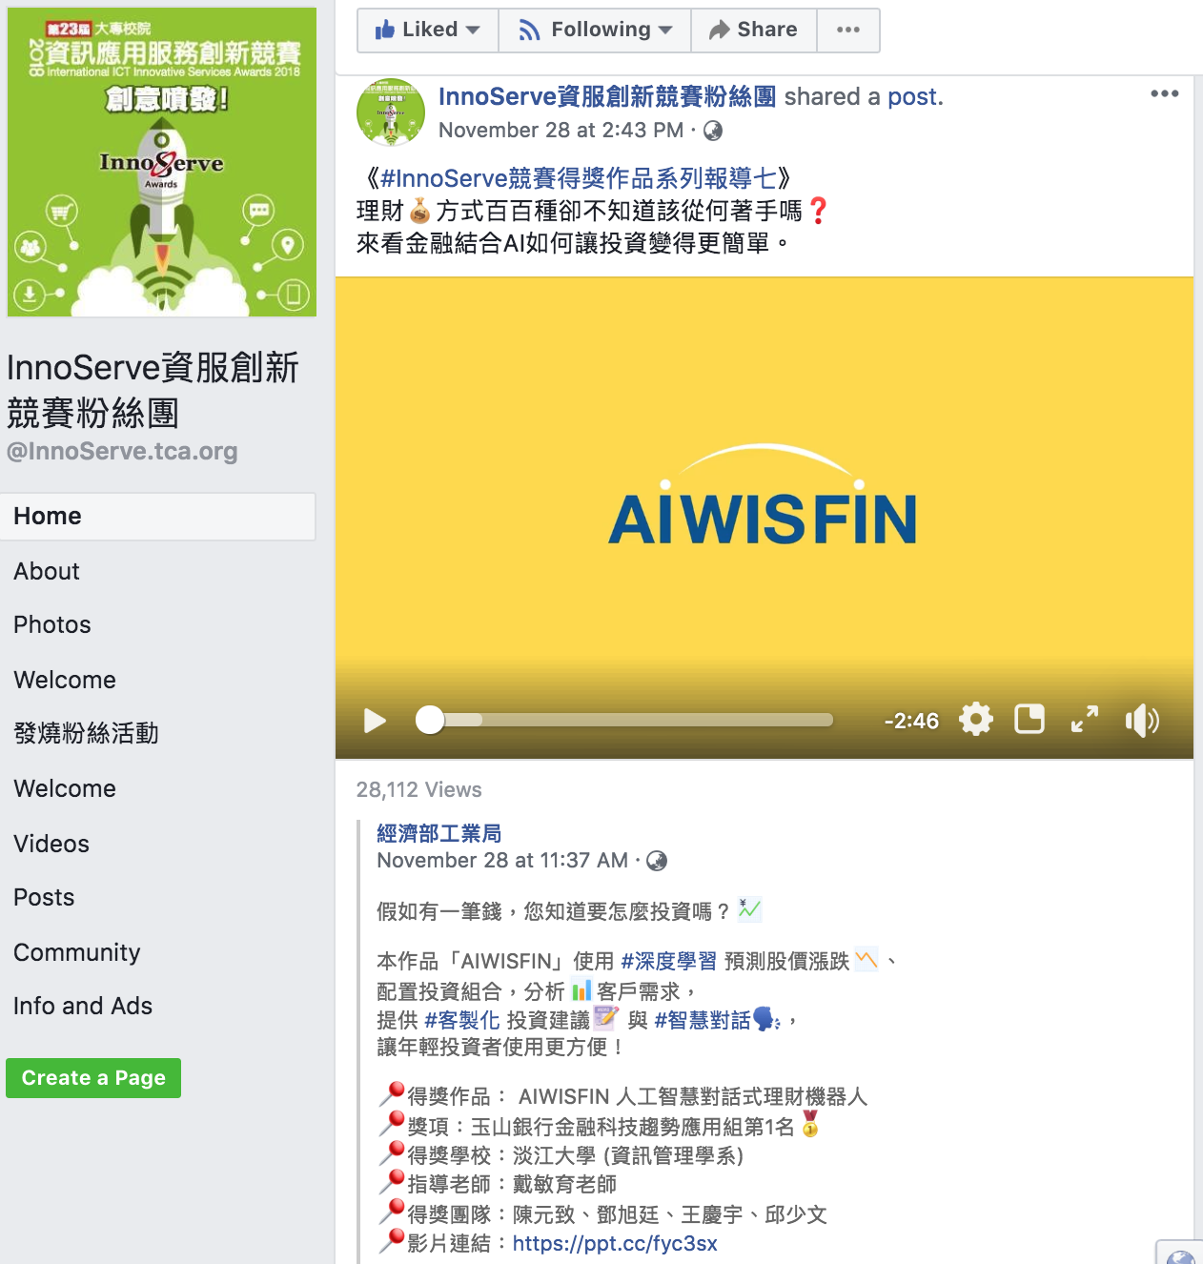
AIWISFIN
AI Conversational Robo-Advisor
(人工智慧對話式理財機器人)
First Place, InnoServe Awards 2018
https://www.youtube.com/watch?v=sEhmyoTXmGk

Slide 5

2018 The 23th International ICT
Innovative Services Awards
(InnoServe Awards 2018)
Annual ICT application competition held for university and college students
The largest and the most significant contest in Taiwan.
More than ten thousand teachers and students from over one hundred universities and colleges have participated in the Contest.
https://innoserve.tca.org.tw/award.aspx

Slide 6
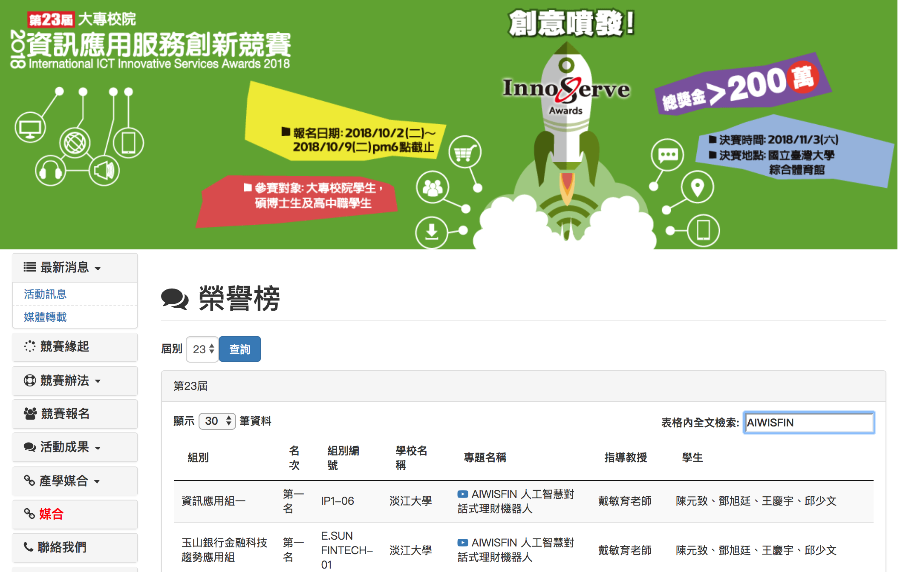
2018 International ICT Innovative Services Awards (InnoServe Awards 2018)
(2018第23屆大專校院資訊應用服務創新競賽)
https://innoserve.tca.org.tw/award.aspx

Slide 7
AI

Slide 8
The Rise of AI
Source: DHL (2018), Artificial Intelligence in Logistics,
http://www.globalhha.com/doclib/data/upload/doc_con/5e50c53c5bf67.pdf/

Slide 9
Definition of
Artificial Intelligence (A.I.)

Slide 10
Artificial Intelligence
“… the science and engineering of making intelligent machines”
(John McCarthy, 1955)
Source: https://digitalintelligencetoday.com/artificial-intelligence-defined-useful-list-of-popular-definitions-from-business-and-science/

Slide 11
Artificial Intelligence
“… technology that thinks and acts like humans”
Source: https://digitalintelligencetoday.com/artificial-intelligence-defined-useful-list-of-popular-definitions-from-business-and-science/

Slide 12
Artificial Intelligence
“… intelligence exhibited by machines or software”
Source: https://digitalintelligencetoday.com/artificial-intelligence-defined-useful-list-of-popular-definitions-from-business-and-science/

Slide 13
4 Approaches of AI
Thinking Humanly | Thinking Rationally
Acting Humanly | Acting Rationally
Source: Stuart Russell and Peter Norvig (2020), Artificial Intelligence: A Modern Approach, 4th Edition, Pearson

Slide 14
4 Approaches of AI
2. Thinking Humanly: The Cognitive Modeling Approach | 3. Thinking Rationally: The “Laws of Thought” Approach
1. Acting Humanly: The Turing Test Approach (1950) | 4. Acting Rationally: The Rational Agent Approach
Source: Stuart Russell and Peter Norvig (2020), Artificial Intelligence: A Modern Approach, 4th Edition, Pearson

Slide 15
AI Acting Humanly:
The Turing Test Approach
(Alan Turing, 1950)
Knowledge Representation
Automated Reasoning
Machine Learning (ML)
  Deep Learning (DL)
Computer Vision (Image, Video)
Natural Language Processing (NLP)
Robotics
Source: Stuart Russell and Peter Norvig (2020), Artificial Intelligence: A Modern Approach, 4th Edition, Pearson

Slide 16



Tamkang University
2011
Tamkang
University
IMTKU Textual Entailment System for
Recognizing Inference in Text
at NTCIR-9 RITE
Department of Information Management
Tamkang University, Taiwan
Min-Yuh Day
Chun Tu
myday@mail.tku.edu.tw
NTCIR-9 Workshop, December 6-9, 2011, Tokyo, Japan

Slide 17



IMTKU Textual Entailment System for
Recognizing Inference in Text at NTCIR-10 RITE-2
Tamkang University
2013
Tamkang
University
Department of Information Management
Tamkang University, Taiwan
Min-Yuh Day
Chun Tu
Hou-Cheng Vong
Shih-Wei Wu
Shih-Jhen Huang
myday@mail.tku.edu.tw
NTCIR-10 Conference, June 18-21, 2013, Tokyo, Japan

Slide 18
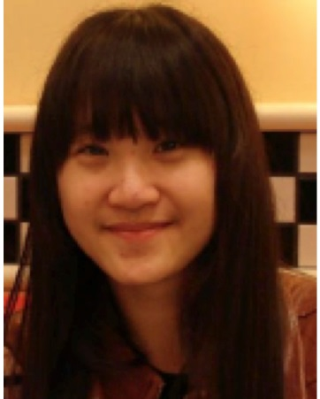




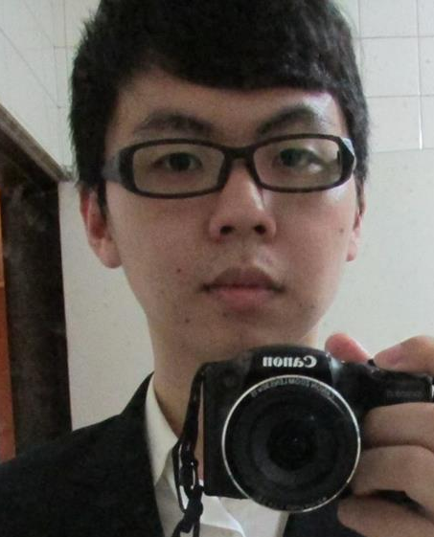


IMTKU Textual Entailment System for
Recognizing Inference in Text at NTCIR-11 RITE-VAL
2014
Tamkang University
Min-Yuh Day
Ya-Jung Wang
Che-Wei Hsu
En-Chun Tu
Huai-Wen Hsu
Yu-An Lin
Shang-Yu Wu
Yu-Hsuan Tai
Cheng-Chia Tsai
NTCIR-11 Conference, December 8-12, 2014, Tokyo, Japan

Slide 19


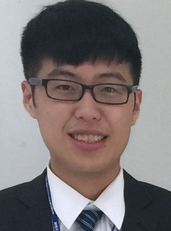
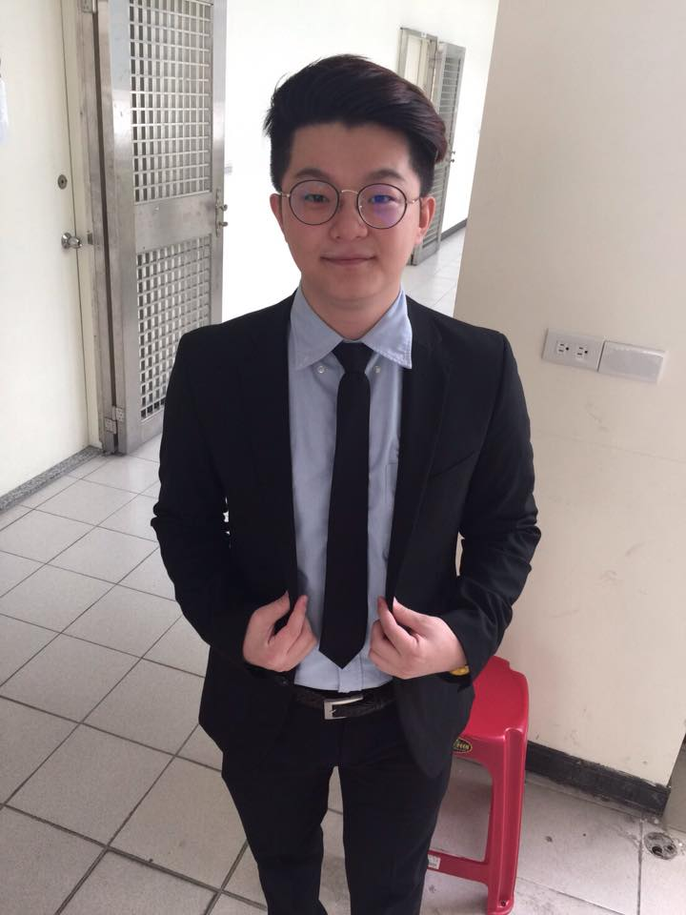
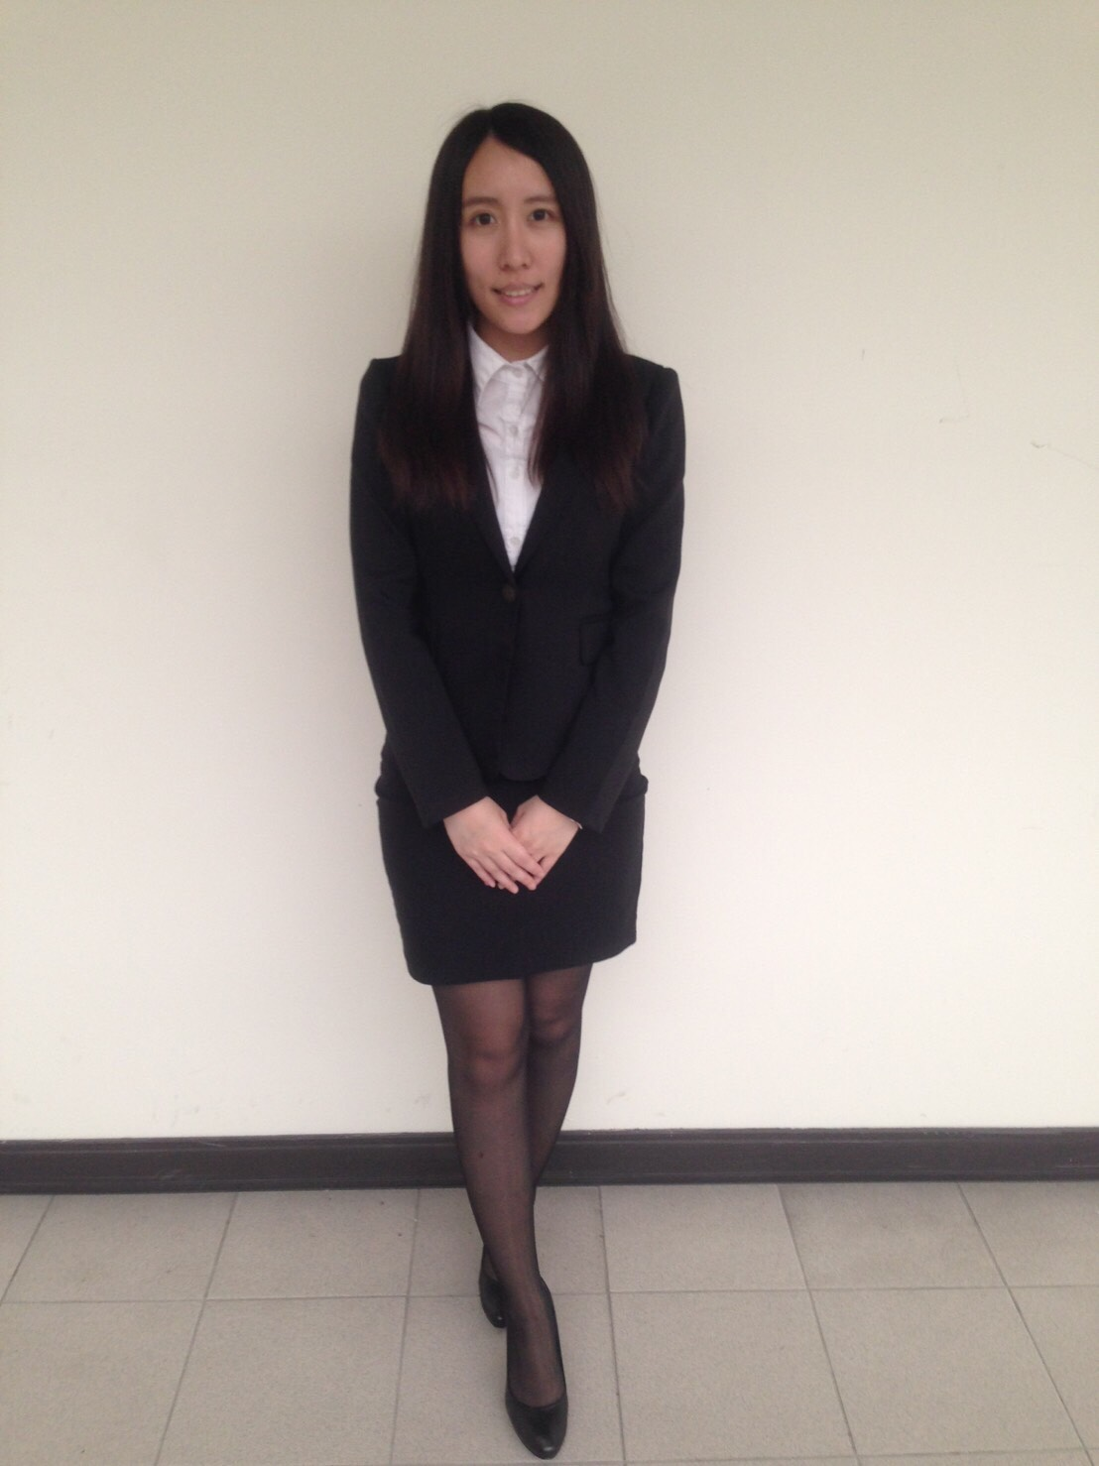
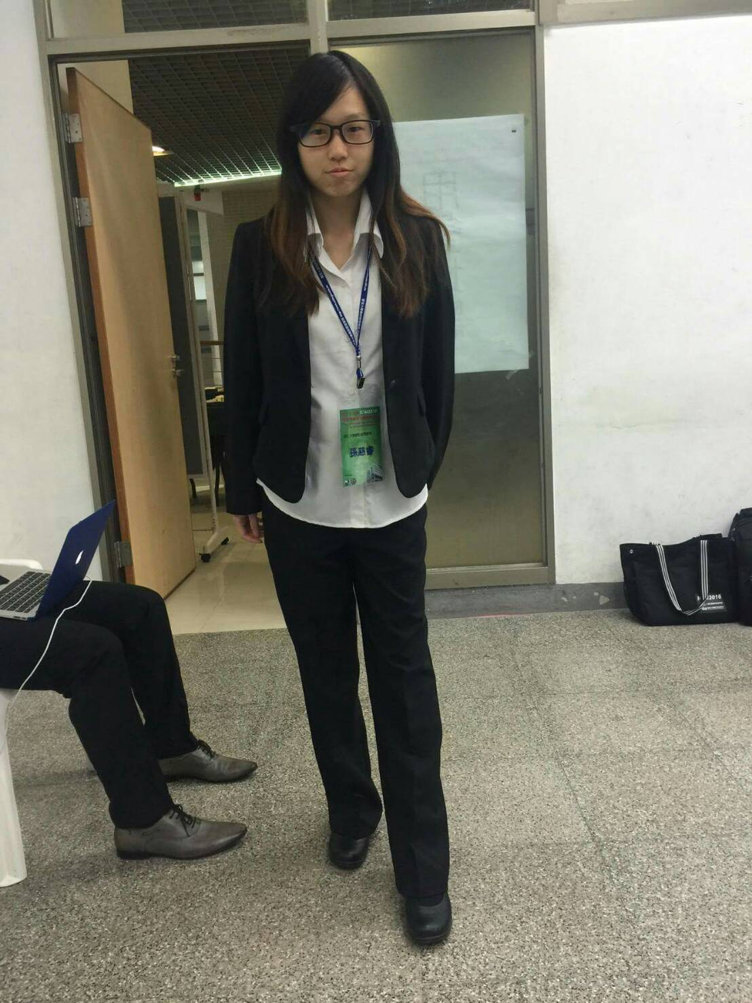
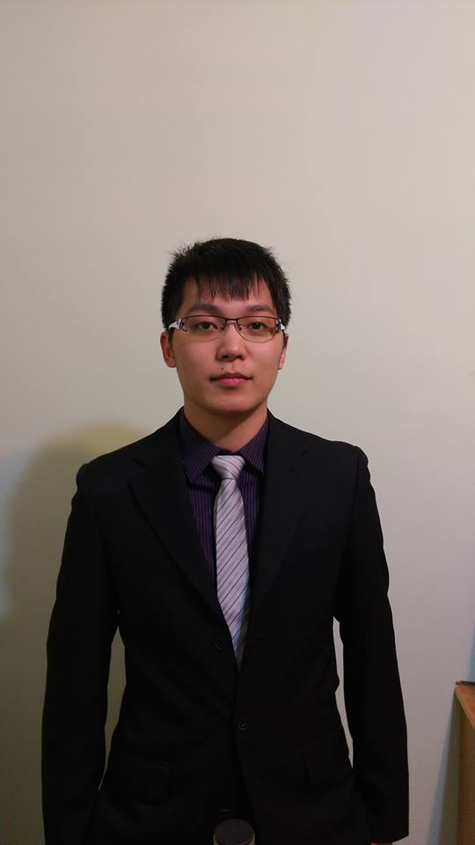
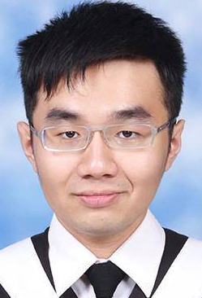
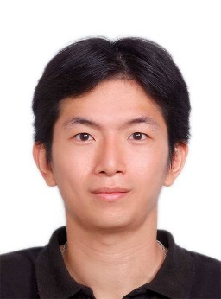
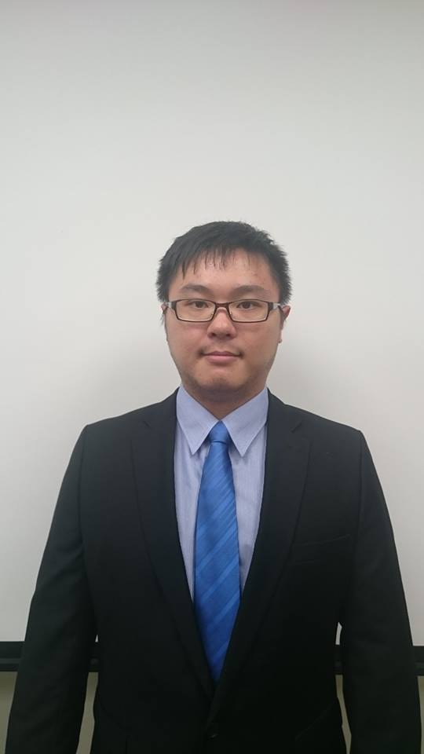
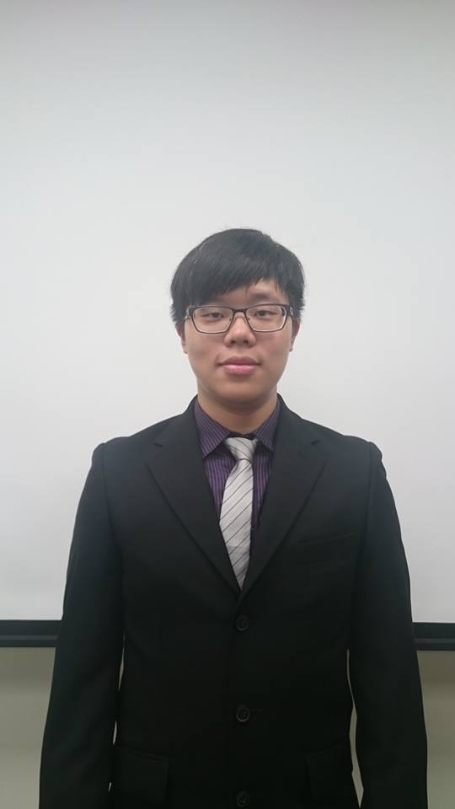
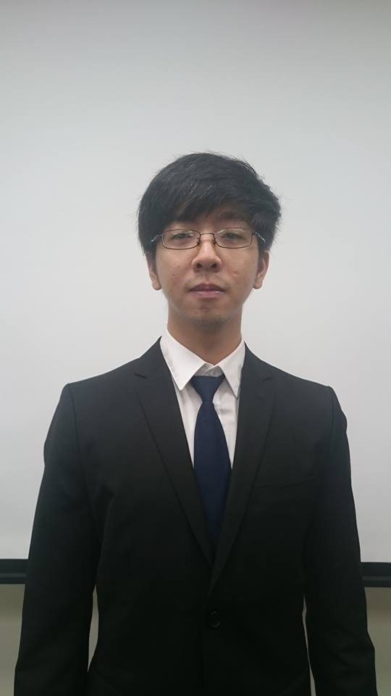
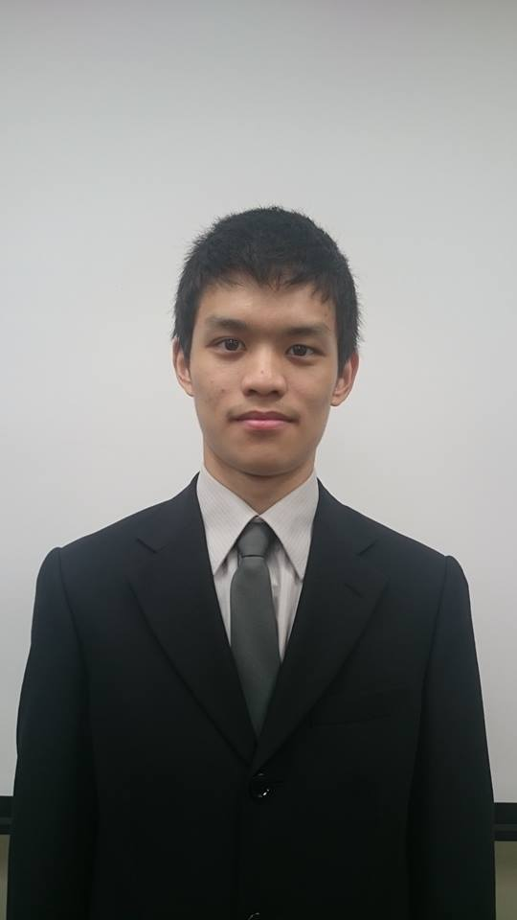
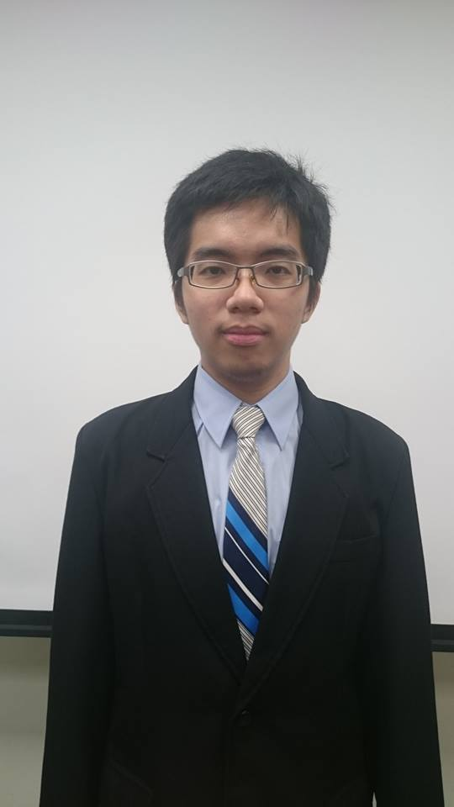
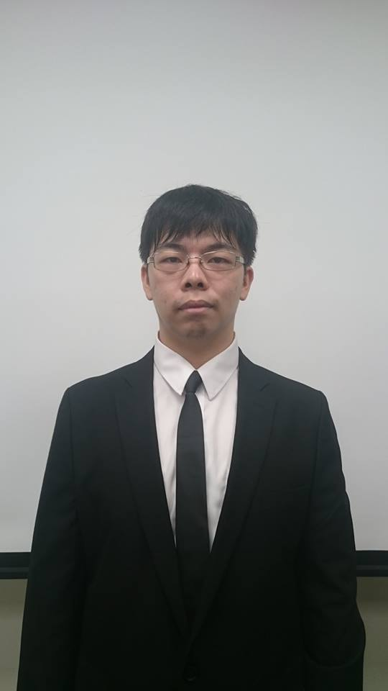
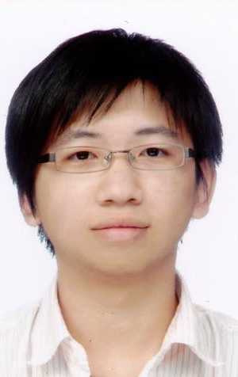
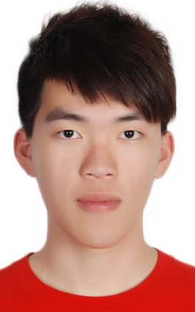
IMTKU Question Answering System for
World History Exams at NTCIR-12 QA Lab2
2016
Tamkang University
Department of Information Management
Tamkang University, Taiwan
Sagacity Technology
Min-Yuh Day
Cheng-Chia Tsai
Wei-Chun Chung
Hsiu-Yuan Chang
Tzu-Jui Sun
Yuan-Jie Tsai
Jin-Kun Lin
Cheng-Hung Lee
Yu-Ming Guo
Yue-Da Lin
Wei-Ming Chen
Yun-Da Tsai
Cheng-Jhih Han
Yi-Jing Lin
Yi-Heng Chiang
Ching-Yuan Chien
myday@mail.tku.edu.tw
NTCIR-12 Conference, June 7-10, 2016, Tokyo, Japan

Slide 20
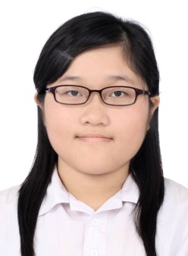

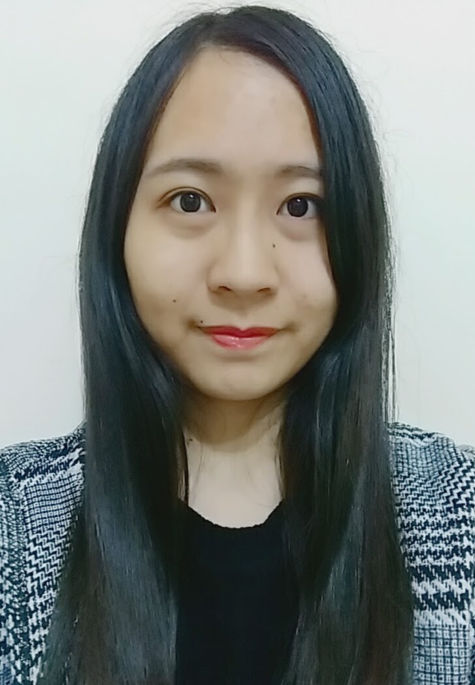

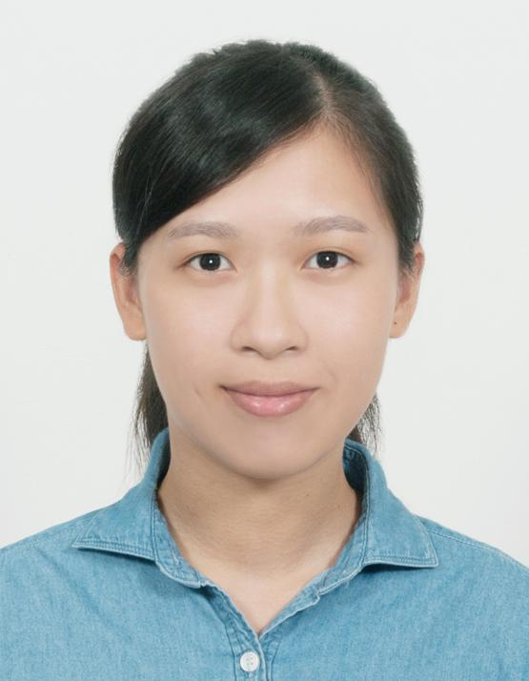
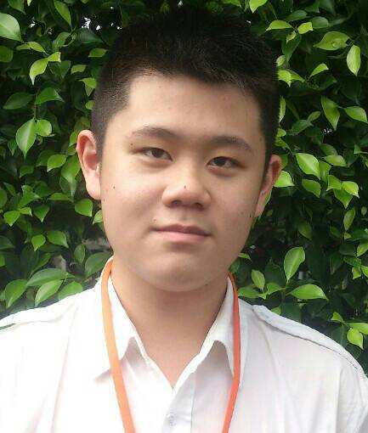
IMTKU Question Answering System for
World History Exams at NTCIR-13 QALab-3
2017
Tamkang University
Department of Information Management
Tamkang University, Taiwan
Min-Yuh Day
Chao-Yu Chen
Wanchu Huang
Shi-Ya Zheng
I-Hsuan Huang
Tz-Rung Chen
Min-Chun Kuo
Yue-Da Lin
Yi-Jing Lin
myday@mail.tku.edu.tw
NTCIR-13 Conference, December 5-8, 2017, Tokyo, Japan

Slide 21
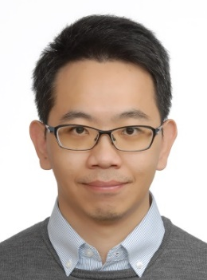
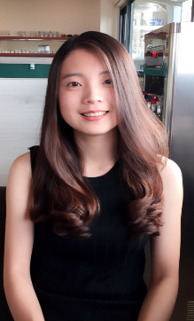

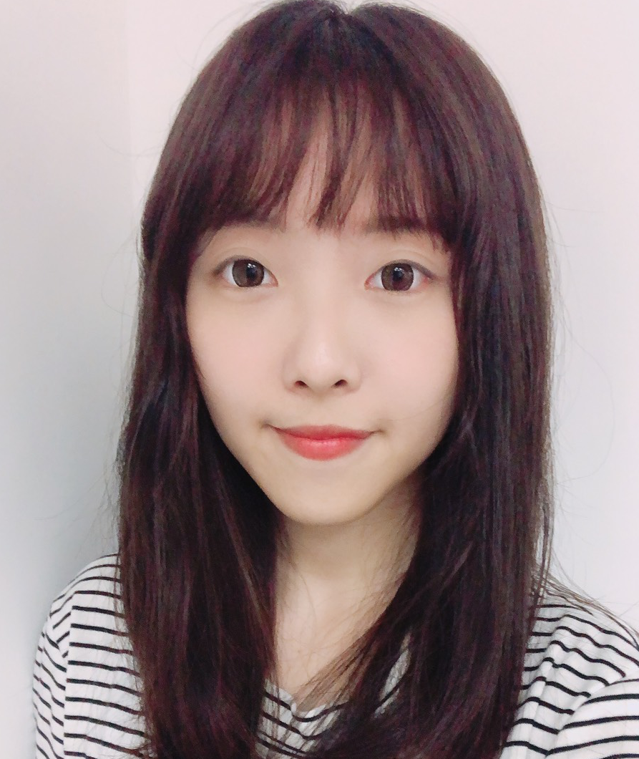
IMTKU Emotional Dialogue System for
Short Text Conversation at NTCIR-14 STC-3 (CECG) Task
2019
Tamkang University
Department of Information Management
Tamkang University, Taiwan
Min-Yuh Day
Chi-Sheng Hung
Yi-Jun Xie
Jhih-Yi Chen
Yu-Ling Kuo
Jian-Ting Lin
myday@mail.tku.edu.tw
NTCIR-14 Conference, June 10-13, 2019, Tokyo, Japan

Slide 22

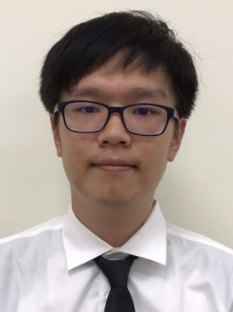
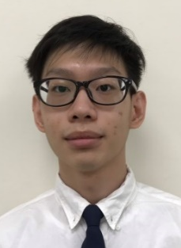
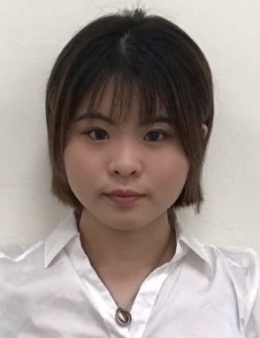
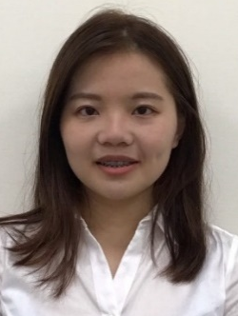
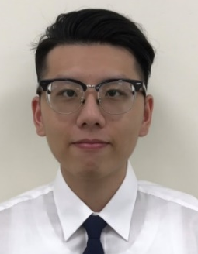
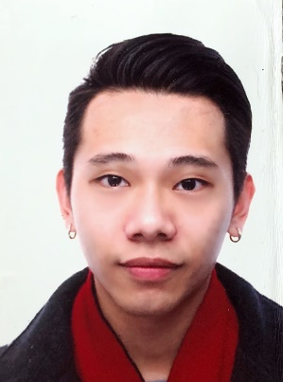

IMTKU Multi-Turn Dialogue System Evaluation at the NTCIR-15 DialEval-1
Dialogue Quality and Nugget Detection
2020
Tamkang University
¹ Zeals Co., Ltd. Tokyo, Japan
² Information Management, Tamkang University, Taiwan
³ Information Management, National Taipei University, Taiwan
Mike Tian-Jian Jiang¹
Zhao-Xian Gu²
Cheng-Jhe Chiang²
Yueh-Chia Wu²
Yu-Chen Huang²
Cheng-Han Chiu²
Sheng-Ru Shaw²
Min-Yuh Day³
NTCIR-15 Conference, December 8-11, 2020, Tokyo, Japan

Slide 23
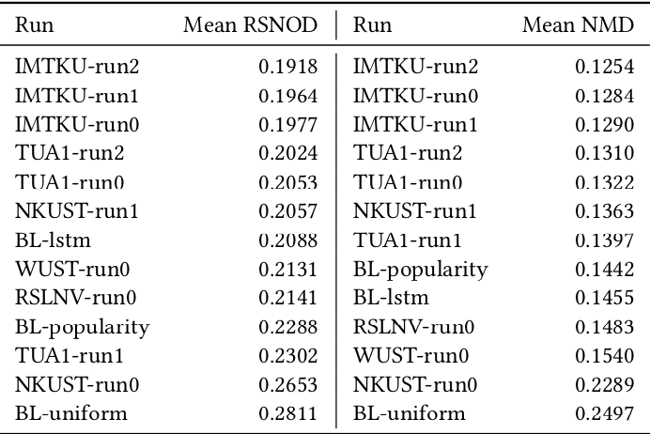
NTCIR-15 Dialogue Evaluation (DialEval-1) Task
Dialogue Quality (DQ) and Nugget Detection (ND)
Chinese Dialogue Quality (S-score) Results (Zeng et al., 2020)
2020
Source: Zeng, Zhaohao, Sosuke Kato, Tetsuya Sakai, and Inho Kang (2020), “Overview of the NTCIR-15 Dialogue Evaluation (DialEval-1) Task”, Proceedings of NTCIR-15, 2020

Slide 24
Transformer-based
Models Selection
Fine-tuning Techniques
FinNum-2
BERT
DialEval-1
Discriminative Fine-tuning
Transfer
Learning
RoBERTa
One-cycle Policy
XLM-RoBERTa
Optimization
Tokenization Tricks
Pre-trained Models
Source: Jiang, Mike Tian-Jian, Shih-Hung Wu, Yi-Kun Chen, Zhao-Xian Gu, Cheng-Jhe Chiang, Yueh-Chia Wu, Yu-Chen Huang, Cheng-Han Chiu, Sheng-Ru Shaw, and Min-Yuh Day (2020). "Fine-tuning techniques and data augmentation on transformer-based models for conversational texts and noisy user-generated content." In 2020 IEEE/ACM International Conference on Advances in Social Networks Analysis and Mining (ASONAM), pp. 919-925. IEEE, 2020.

Slide 25
IMTKU Emotional Dialogue System Architecture
1
3
4
Retrieval-Based Model
Emotion Classification
Model
Response
Ranking
Generation-Based Model
2
NTCIR-14 Conference, June 10-13, 2019, Tokyo, Japan

Slide 26
Short Text Conversation Task
(STC-3)
Chinese Emotional Conversation Generation (CECG) Subtask
Source: http://coai.cs.tsinghua.edu.cn/hml/challenge.html

Slide 27
NTCIR Short Text Conversation
STC-1, STC-2, STC-3
Source: https://waseda.app.box.com/v/STC3atNTCIR-14

Slide 28
AI Humanoid
Robo-Advisor

Slide 29
AI Humanoid Robo-Advisor for Multi-channel Conversational Commerce
AI Portfolio
Asset Allocation
Multichannel
Platforms
Web
LINE
Facebook
Humanoid Robot
AI Conversation
Dialog System

Slide 30
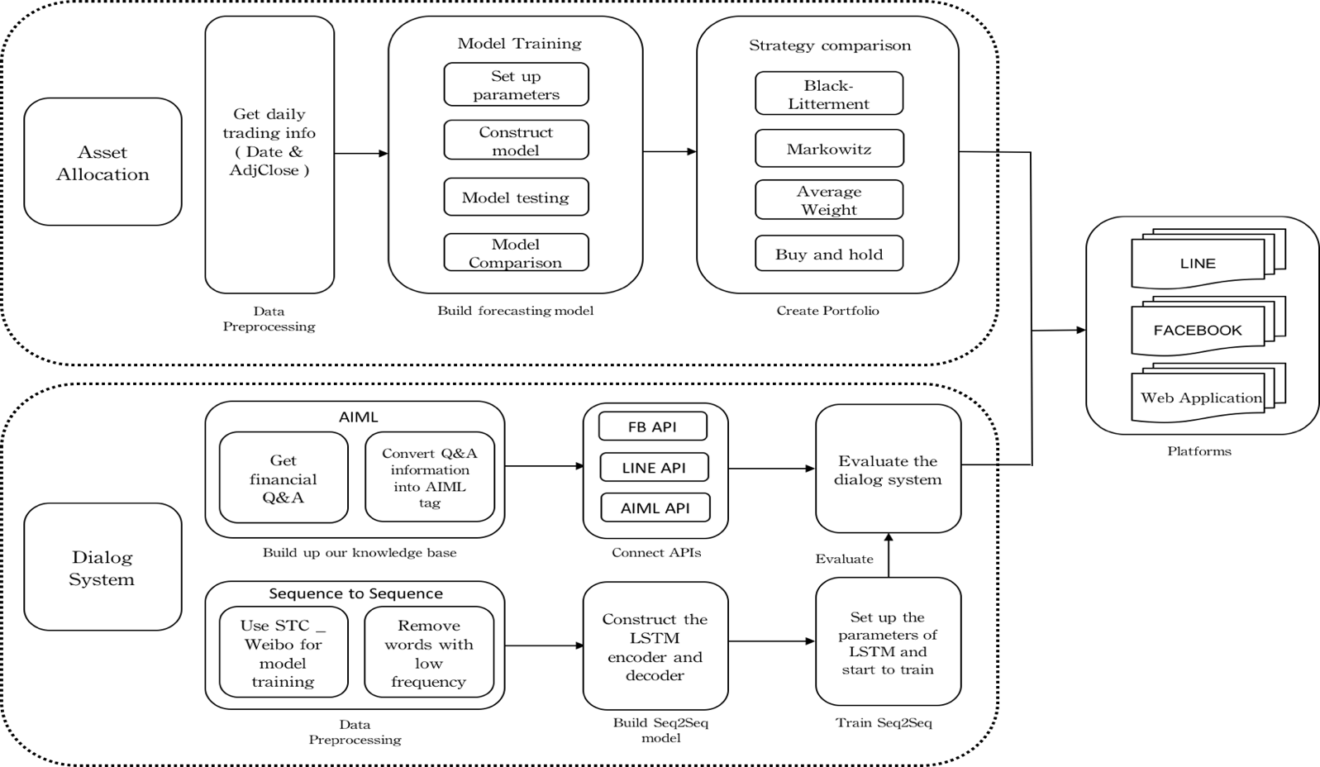
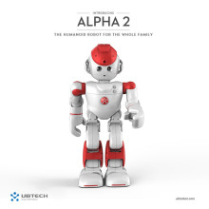
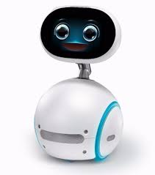
System Architecture of
AI Humanoid Robo-Advisor
AI Humanoid
Robo-advisor

Slide 31
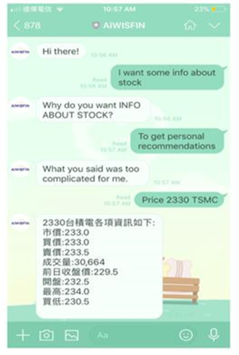
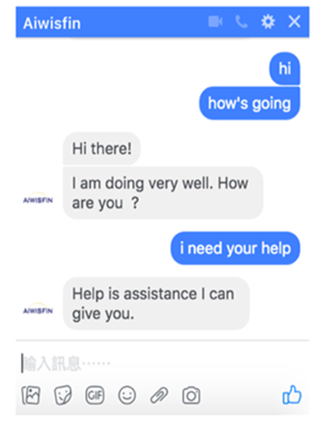
Conversational Model
(LINE, FB Messenger)

Slide 32

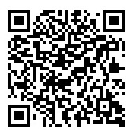
Conversational Robo-Advisor
Multichannel UI/UX
Robots
ALPHA 2
ZENBO

Slide 33
FinTech

Slide 34
Financial Technology
FinTech
“providing
financial services
by making use of software and
modern technology”
Source: https://www.fintechweekly.com/fintech-definition

Slide 35
Financial Services

Slide 36

Financial Services
Source: http://www.crackitt.com/7-reasons-why-your-fintech-startup-needs-visual-marketing/

Slide 37
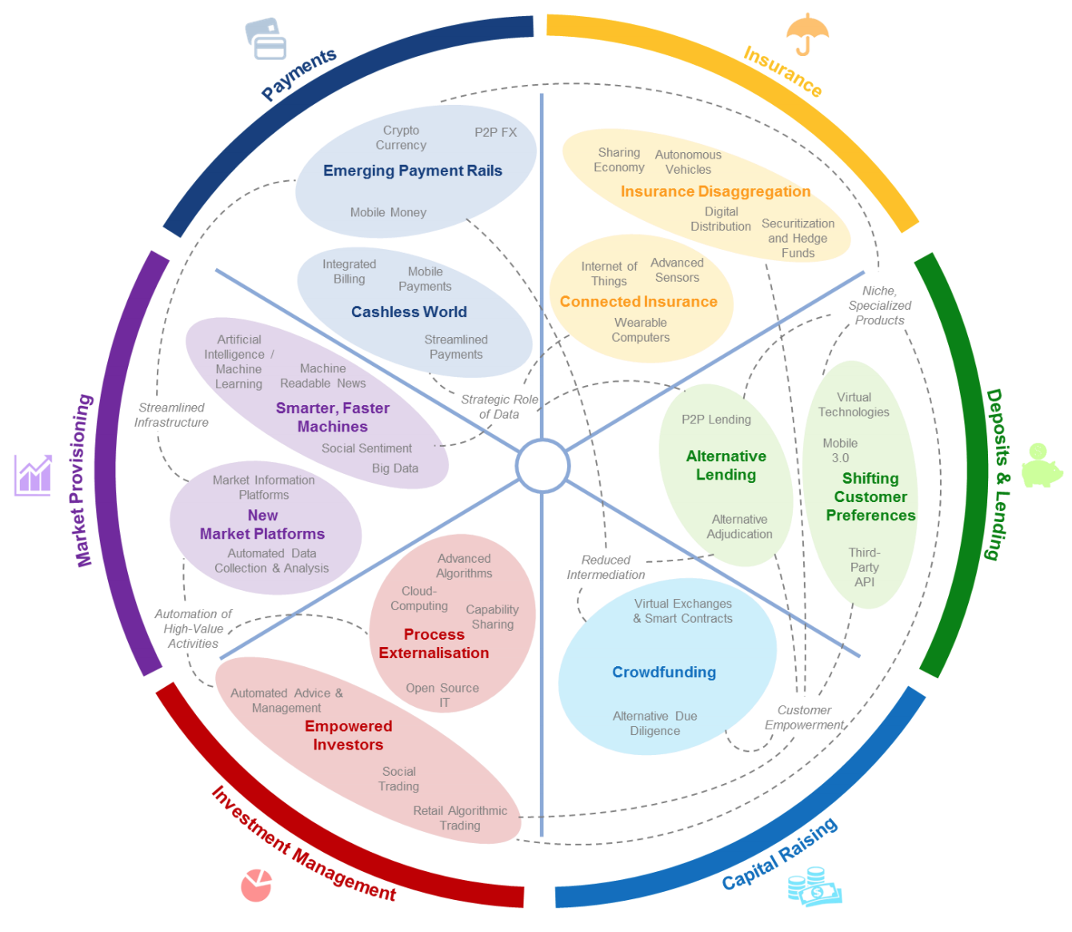
FinTech: Financial Services Innovation
Source: http://www3.weforum.org/docs/WEF_The_future__of_financial_services.pdf

Slide 38
FinTech:
Financial Services Innovation
1. Payments
2. Insurance
3. Deposits & Lending
4. Capital Raising
5. Investment Management
6. Market Provisioning
Source: http://www3.weforum.org/docs/WEF_The_future__of_financial_services.pdf

Slide 39
FinTech: Investment Management
5
Source: http://www3.weforum.org/docs/WEF_The_future__of_financial_services.pdf

Slide 40
FinTech: Market Provisioning
6
Source: http://www3.weforum.org/docs/WEF_The_future__of_financial_services.pdf

Slide 41
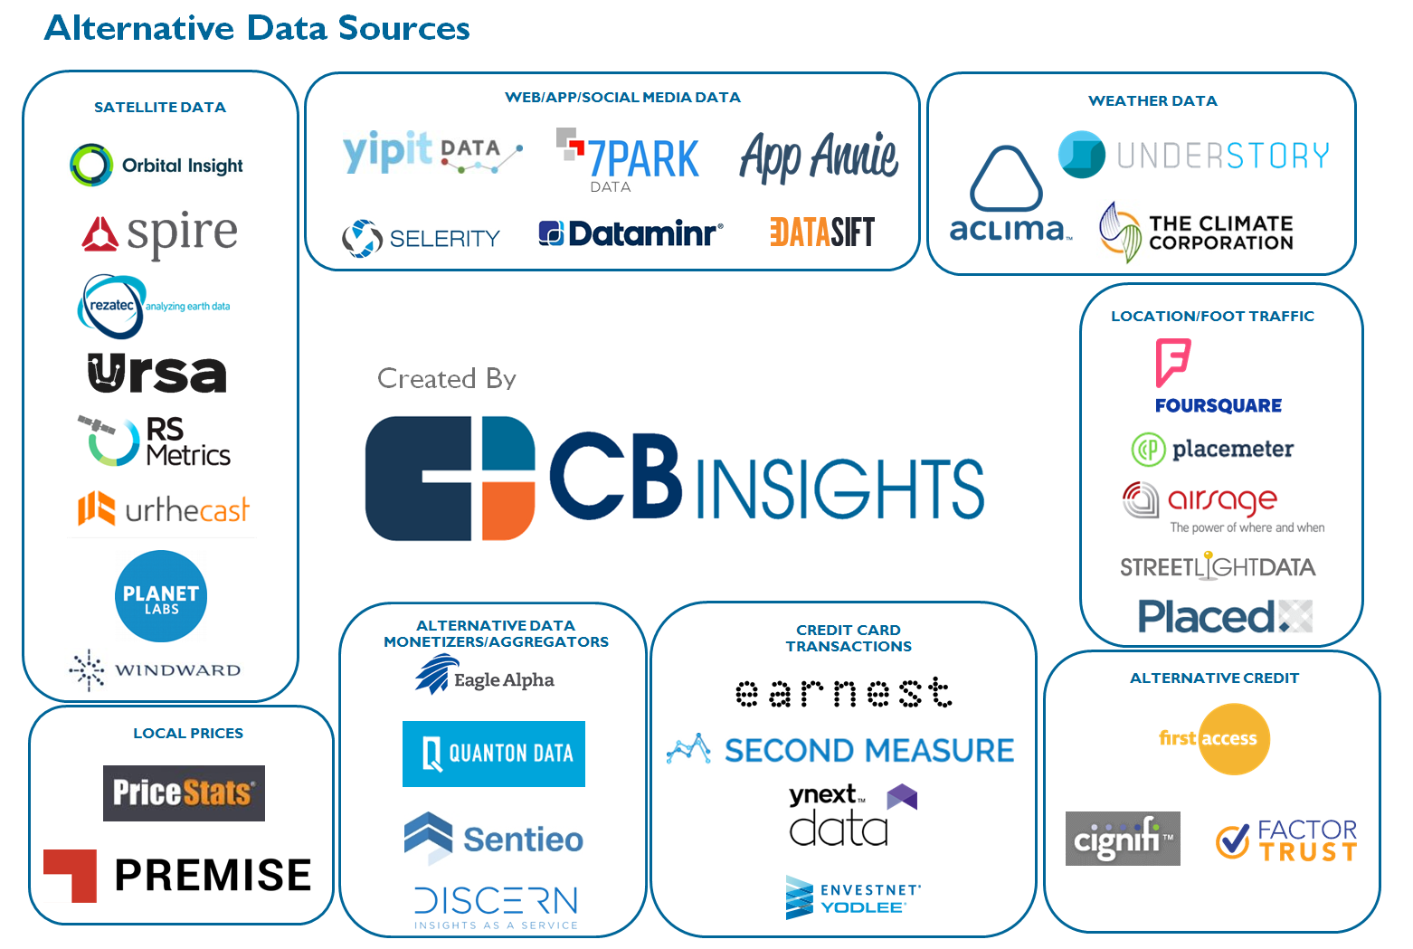
The New Alpha: 30+ Startups Providing Alternative Data For Sophisticated Investors
Source: https://www.cbinsights.com/blog/alternative-data-startups-market-map-company-list/

Slide 42
AI in
FinTech

Slide 43
AI, Big Data, Cloud Computing
Evolution of Decision Support, Business Intelligence, and Analytics
AI
AI
Cloud Computing
Big Data
DM
BI
Source: Ramesh Sharda, Dursun Delen, and Efraim Turban (2017),
Business Intelligence, Analytics, and Data Science: A Managerial Perspective, 4th Edition, Pearson

Slide 44
Robo-Advisors

Slide 45
FinTech high-level classification
Lending
Payments
Robo Advisors
Analytics
Others
Profile
Advice
Re-Balance
Indexing
Source: Paolo Sironi (2016), “FinTech Innovation: From Robo-Advisors to Goal Based Investing and Gamification”, Wiley.

Slide 46

Wealthfront
Financial Planning & Robo-Investing for Millennials
https://www.wealthfront.com/

Slide 47
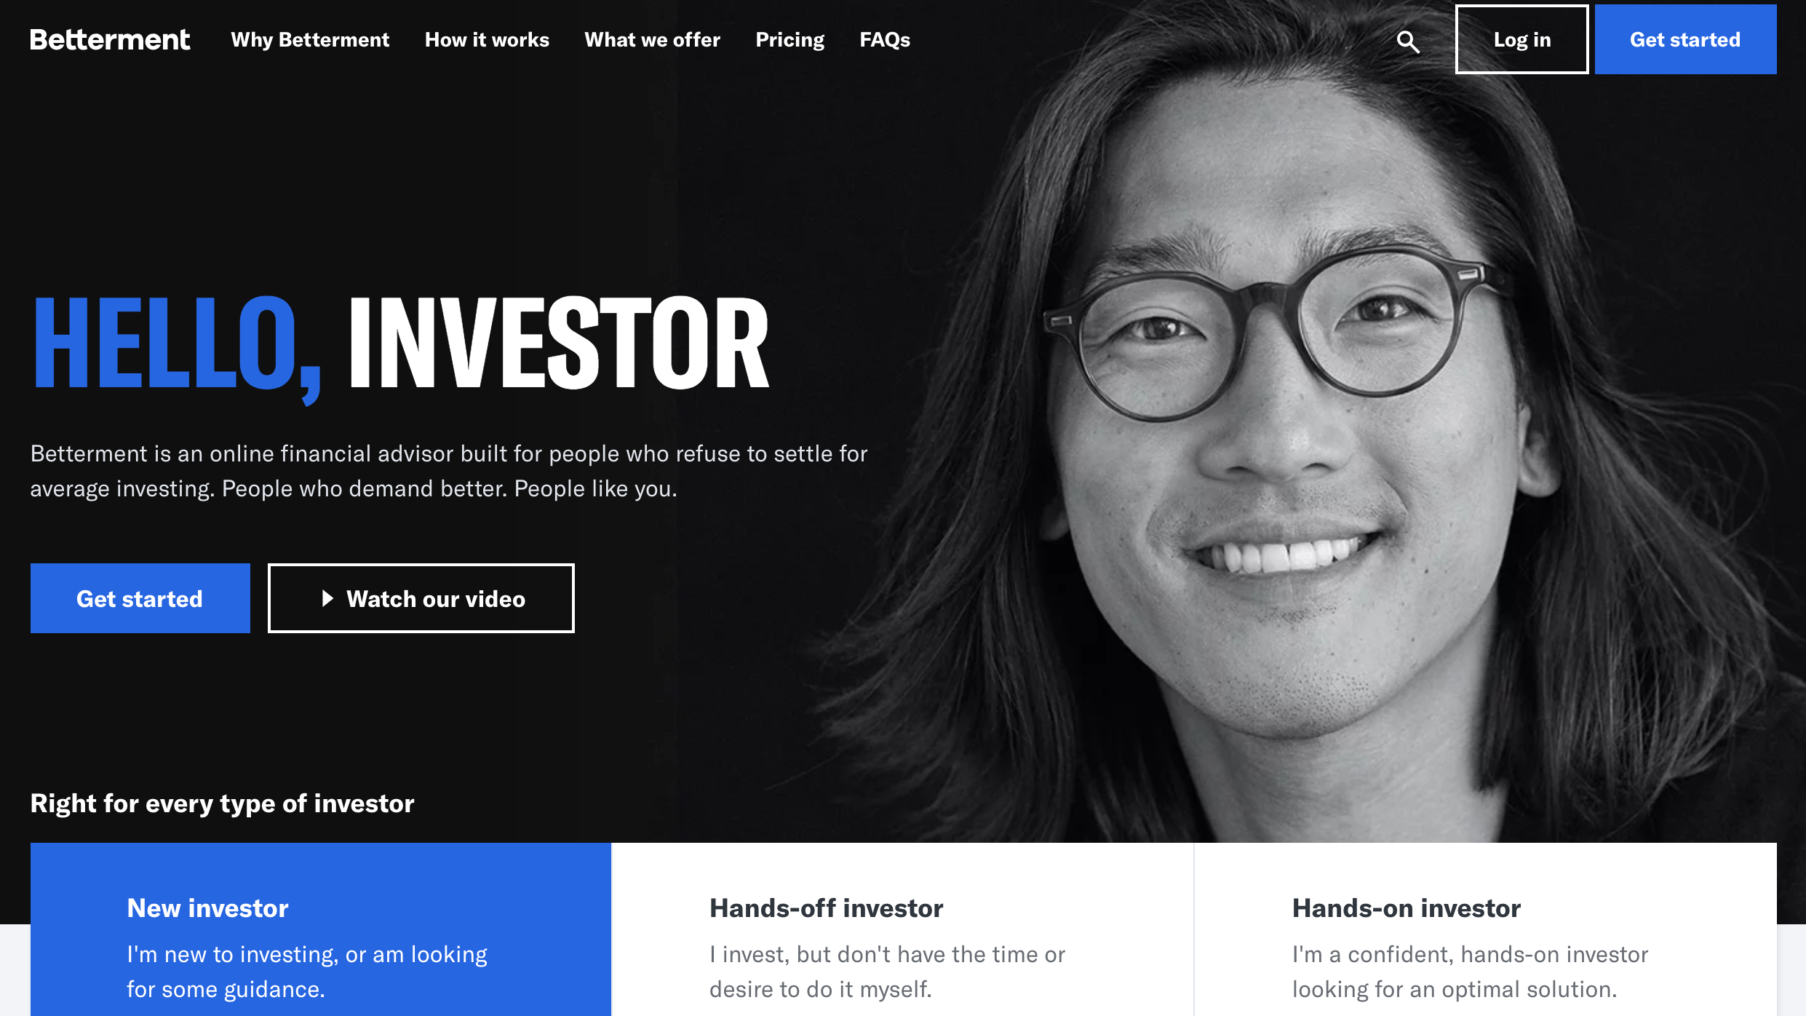
Betterment
Online Financial Advisor
https://www.betterment.com/

Slide 48
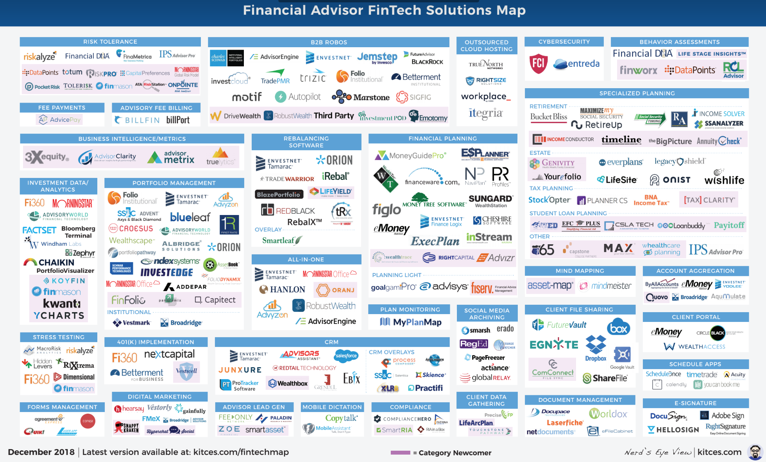
Financial Advisor FinTech Solutions
Source: https://www.kitces.com/fintechmap

Slide 49
From Algorithmic Trading to Personal Finance Bots: 41 Startups Bringing
AI to Fintech
Source: https://www.cbinsights.com/blog/artificial-intelligence-fintech-market-map-company-list/

Slide 50
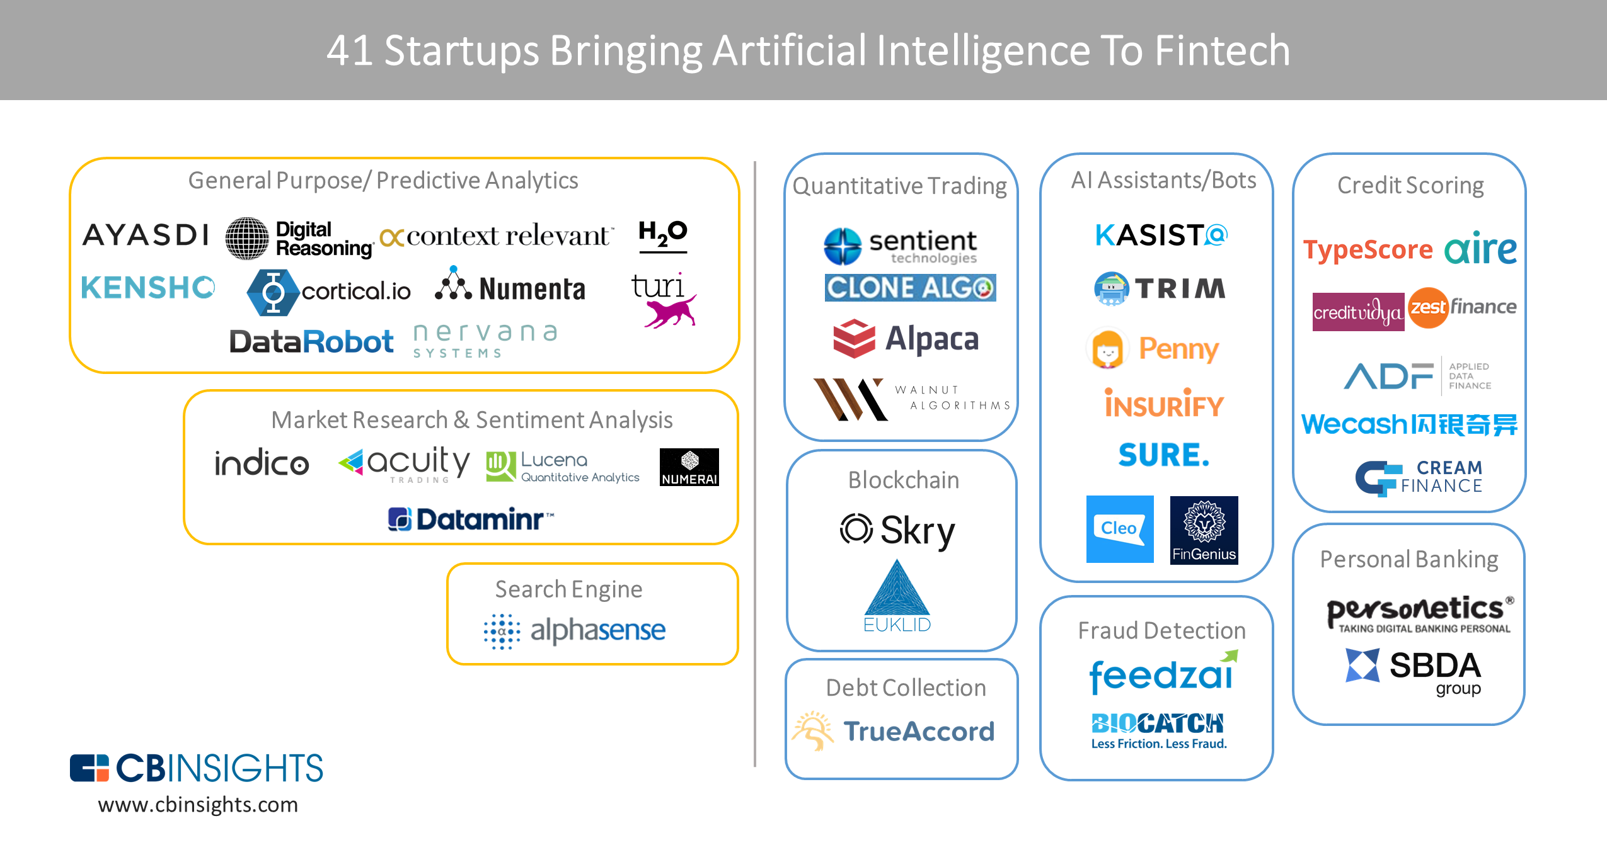
From Algorithmic Trading To Personal Finance Bots: 41 Startups Bringing AI To Fintech
AI in Fintech
Source: https://www.cbinsights.com/blog/artificial-intelligence-fintech-market-map-company-list/

Slide 51
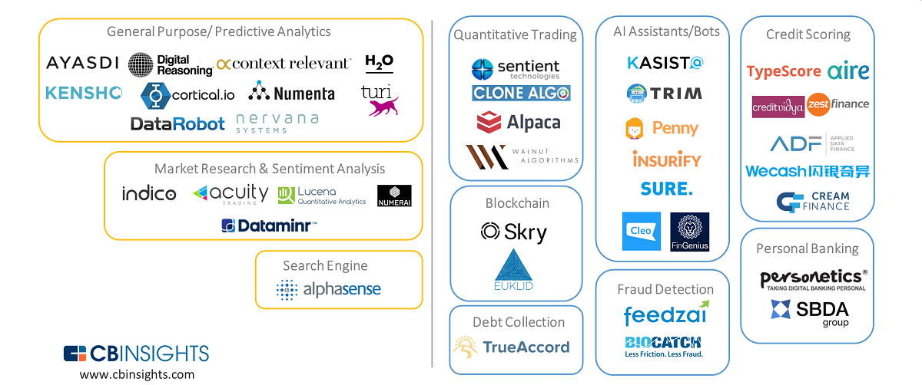
Artificial Intelligence (AI) in Fintech
Source: https://www.cbinsights.com/blog/artificial-intelligence-fintech-market-map-company-list/

Slide 52
Artificial Intelligence (AI) in Fintech
Source: https://www.cbinsights.com/blog/artificial-intelligence-fintech-market-map-company-list/

Slide 53
Conversational Commerce

Slide 54
Chatbot
Dialogue System
Intelligent Agent

Slide 55
Chatbots: Evolution of UI/UX
Source: https://bbvaopen4u.com/en/actualidad/want-know-how-build-conversational-chatbot-here-are-some-tools

Slide 56
From
E-Commerce to
Conversational Commerce: Chatbots and
Virtual Assistants
Source: http://www.guided-selling.org/from-e-commerce-to-conversational-commerce/

Slide 57
Conversational Commerce: eBay AI Chatbots
Source: https://www.forbes.com/sites/rachelarthur/2017/07/19/conversational-commerce-ebay-ai-chatbot/

Slide 58
Hotel Chatbot
Intent Detection
Slot Filling
Source: https://sdtimes.com/amazon/guest-view-capitalize-amazon-lex-available-general-public/

Slide 59
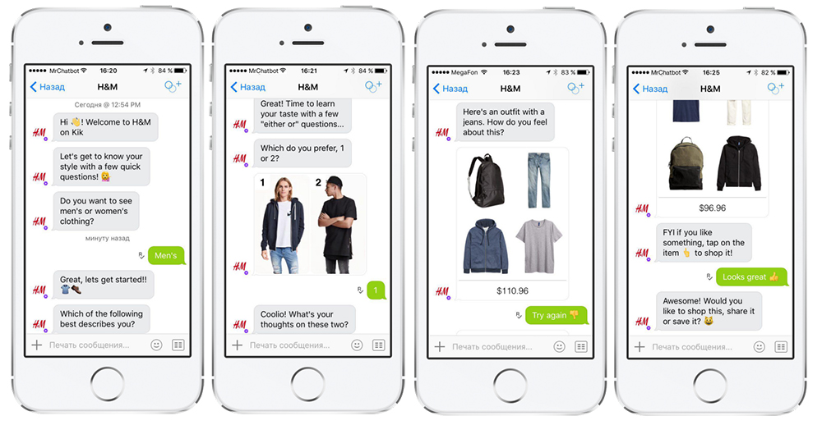
H&M’s Chatbot on Kik
Source: http://www.guided-selling.org/from-e-commerce-to-conversational-commerce/

Slide 60
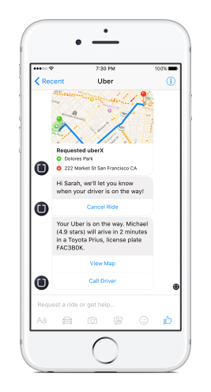
Uber’s Chatbot on Facebook’s Messenger
Uber’s chatbot on Facebook’s messenger
- one main benefit: it loads much faster than the Uber app
Source: http://www.guided-selling.org/from-e-commerce-to-conversational-commerce/

Slide 61
Chatbot
Source: https://www.mdsdecoded.com/blog/the-rise-of-chatbots/

Slide 62
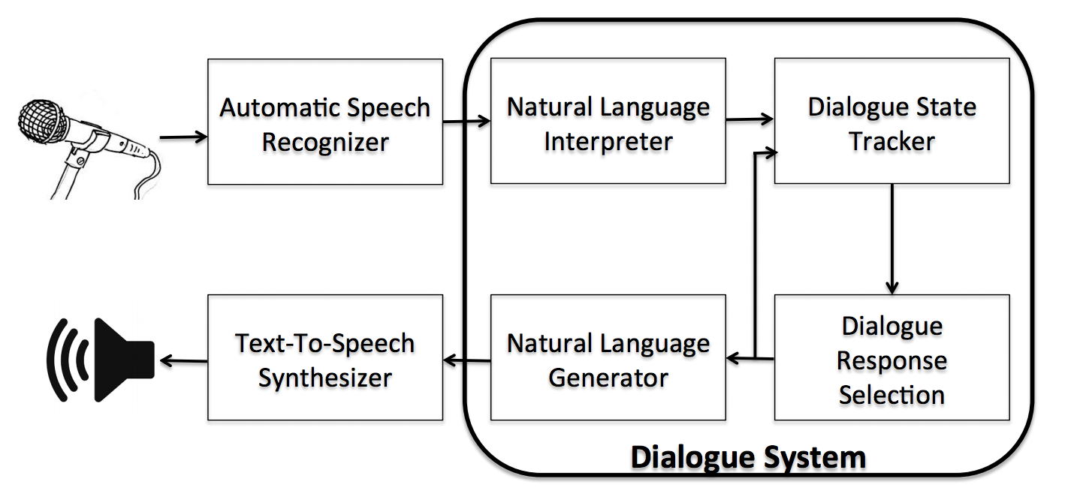
Dialogue System
Source: Serban, I. V., Lowe, R., Charlin, L., & Pineau, J. (2015). A survey of available corpora for building data-driven dialogue systems. arXiv preprint arXiv:1512.05742.

Slide 63
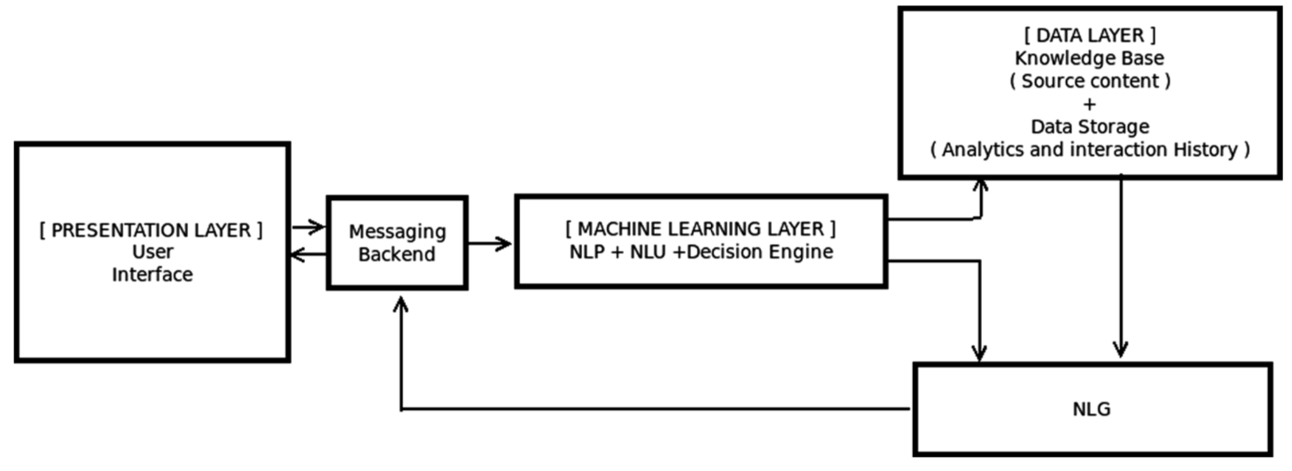
Overall Architecture of
Intelligent Chatbot
Source: Borah, Bhriguraj, Dhrubajyoti Pathak, Priyankoo Sarmah, Bidisha Som, and Sukumar Nandi. "Survey of Textbased Chatbot in Perspective of Recent Technologies." In International Conference on Computational Intelligence, Communications, and Business Analytics, pp. 84-96. Springer, Singapore, 2018.

Slide 64
Can machines think?
(Alan Turing ,1950)
Source: Cahn, Jack. "CHATBOT: Architecture, Design, & Development."
PhD diss., University of Pennsylvania, 2017.

Slide 65
Chatbot
“online human-computer dialog system with natural language.”
Source: Cahn, Jack. "CHATBOT: Architecture, Design, & Development."
PhD diss., University of Pennsylvania, 2017.

Slide 66
Chatbot Conversation Framework
Source: https://chatbotslife.com/ultimate-guide-to-leveraging-nlp-machine-learning-for-you-chatbot-531ff2dd870c

Slide 67
Chatbots
Bot Maturity Model
Customers want to have simpler means to interact with businesses and
get faster response to a question or complaint.
Source: https://www.capgemini.com/2017/04/how-can-chatbots-meet-expectations-introducing-the-bot-maturity/

Slide 68
Task-Oriented Dialogue System

Slide 69
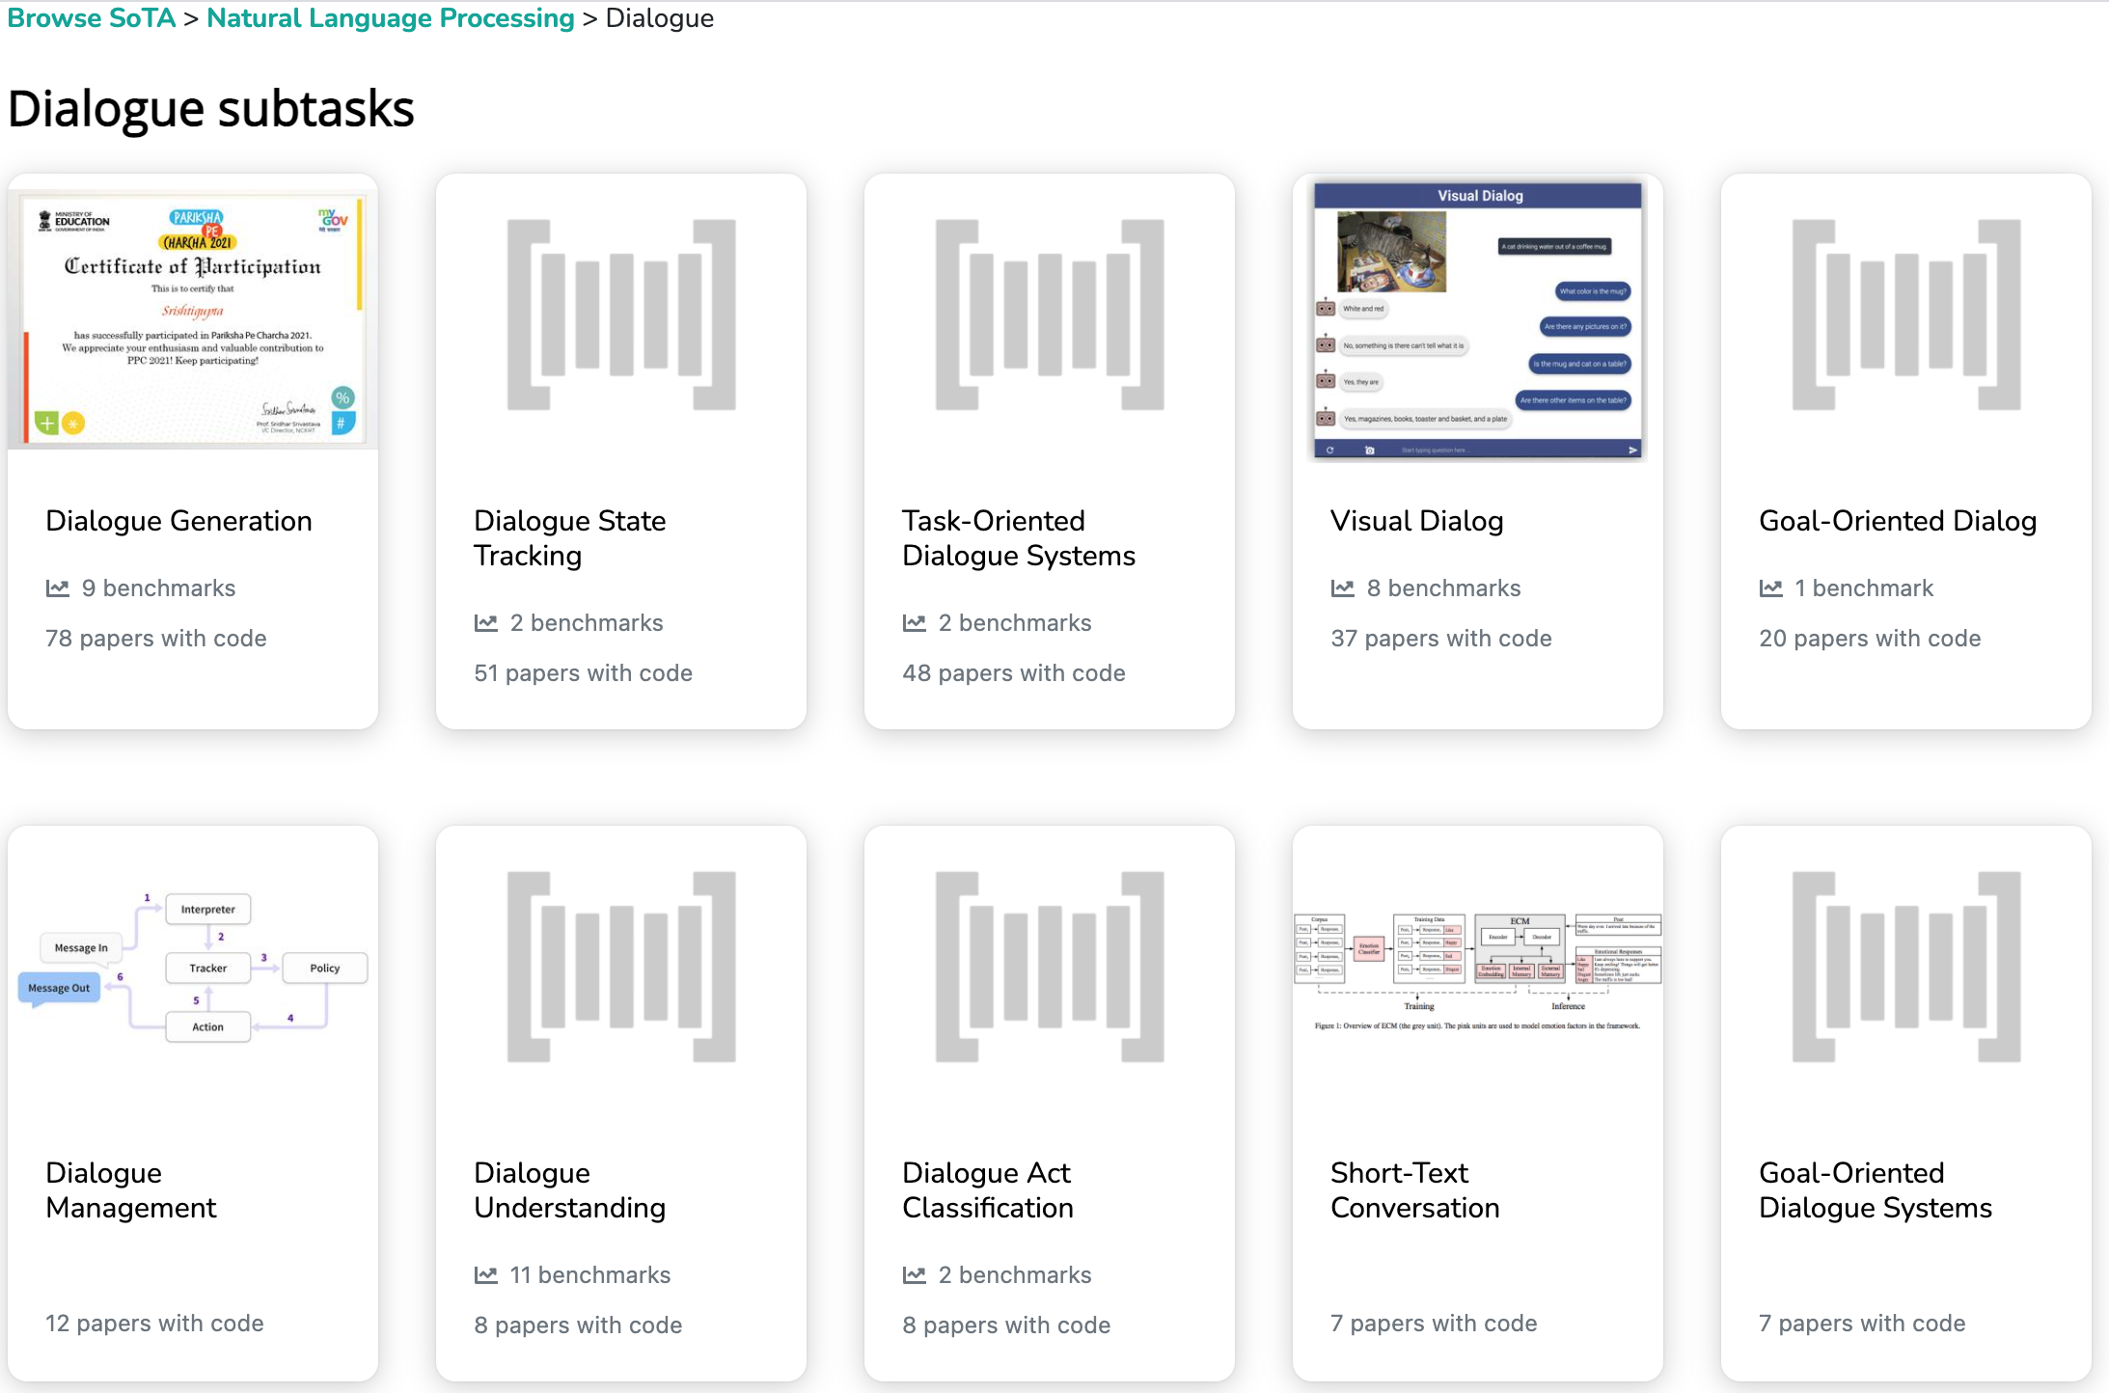
Dialogue Subtasks
Dialogue Generation
Task-Oriented Dialogue Systems
Short-Text Conversation
Source: https://paperswithcode.com/area/natural-language-processing/dialogue

Slide 70

Task-Oriented Dialogue System
(Deriu et al., 2021)
Source: Deriu, Jan, Alvaro Rodrigo, Arantxa Otegi, Guillermo Echegoyen, Sophie Rosset, Eneko Agirre, and Mark Cieliebak (2021). "Survey on evaluation methods for dialogue systems." Artificial Intelligence Review 54, no. 1 (2021): 755-810.

Slide 71

Task-Oriented Dialogue Systems
(Zhang et al., 2020)
Source: Zhang, Zheng, Ryuichi Takanobu, Qi Zhu, Minlie Huang, and Xiaoyan Zhu (2020).
"Recent advances and challenges in task-oriented dialog systems." Science China Technological Sciences (2020): 1-17.

Slide 72

Dialog State Tracker (DST)
Source: Deriu, Jan, Alvaro Rodrigo, Arantxa Otegi, Guillermo Echegoyen, Sophie Rosset, Eneko Agirre, and Mark Cieliebak (2021). "Survey on evaluation methods for dialogue systems." Artificial Intelligence Review 54, no. 1 (2021): 755-810.

Slide 73

Dialogue Acts
(Young et al., 2010)
Source: Deriu, Jan, Alvaro Rodrigo, Arantxa Otegi, Guillermo Echegoyen, Sophie Rosset, Eneko Agirre, and Mark Cieliebak (2021). "Survey on evaluation methods for dialogue systems." Artificial Intelligence Review 54, no. 1 (2021): 755-810.

Slide 74

Sample Dialogue Acts
Source: Deriu, Jan, Alvaro Rodrigo, Arantxa Otegi, Guillermo Echegoyen, Sophie Rosset, Eneko Agirre, and Mark Cieliebak (2021). "Survey on evaluation methods for dialogue systems." Artificial Intelligence Review 54, no. 1 (2021): 755-810.

Slide 75

Transformer (Attention is All You Need)
(Vaswani et al., 2017)
Source: Vaswani, Ashish, Noam Shazeer, Niki Parmar, Jakob Uszkoreit, Llion Jones, Aidan N. Gomez, Łukasz Kaiser, and Illia Polosukhin. "Attention is all you need." In Advances in neural information processing systems, pp. 5998-6008. 2017.

Slide 76

BERT: Pre-training of Deep Bidirectional Transformers for Language Understanding
BERT (Bidirectional Encoder Representations from Transformers)
Overall pre-training and fine-tuning procedures for BERT
Source: Devlin, Jacob, Ming-Wei Chang, Kenton Lee, and Kristina Toutanova (2018).
"Bert: Pre-training of deep bidirectional transformers for language understanding." arXiv preprint arXiv:1810.04805.

Slide 77

BERT: Pre-training of Deep Bidirectional Transformers for Language Understanding
BERT (Bidirectional Encoder Representations from Transformers)
BERT input representation
Source: Devlin, Jacob, Ming-Wei Chang, Kenton Lee, and Kristina Toutanova (2018).
"Bert: Pre-training of deep bidirectional transformers for language understanding." arXiv preprint arXiv:1810.04805.

Slide 78

BERT, OpenAI GPT, ELMo
Source: Devlin, Jacob, Ming-Wei Chang, Kenton Lee, and Kristina Toutanova (2018).
"Bert: Pre-training of deep bidirectional transformers for language understanding." arXiv preprint arXiv:1810.04805.

Slide 79

Fine-tuning BERT on Different Tasks
Source: Devlin, Jacob, Ming-Wei Chang, Kenton Lee, and Kristina Toutanova (2018).
"Bert: Pre-training of deep bidirectional transformers for language understanding." arXiv preprint arXiv:1810.04805.

Slide 80
Fine-tuning BERT on
Question Answering (QA)
Source: Devlin, Jacob, Ming-Wei Chang, Kenton Lee, and Kristina Toutanova (2018).
"Bert: Pre-training of deep bidirectional transformers for language understanding." arXiv preprint arXiv:1810.04805.

Slide 81
Fine-tuning BERT on Dialogue
Intent Detection (ID; Classification)
Source: Devlin, Jacob, Ming-Wei Chang, Kenton Lee, and Kristina Toutanova (2018).
"Bert: Pre-training of deep bidirectional transformers for language understanding." arXiv preprint arXiv:1810.04805.

Slide 82
Fine-tuning BERT on Dialogue
Slot Filling (SF)
Source: Devlin, Jacob, Ming-Wei Chang, Kenton Lee, and Kristina Toutanova (2018).
"Bert: Pre-training of deep bidirectional transformers for language understanding." arXiv preprint arXiv:1810.04805.

Slide 83

Pre-trained Language Model (PLM)
Source: https://github.com/thunlp/PLMpapers

Slide 84
Transformers
State-of-the-art Natural Language Processing for TensorFlow 2.0 and PyTorch
Transformers
  pytorch-transformers
  pytorch-pretrained-bert
provides state-of-the-art general-purpose architectures
  (BERT, GPT-2, RoBERTa, XLM, DistilBert, XLNet, CTRL...)
  for Natural Language Understanding (NLU) and
  Natural Language Generation (NLG)
  with over 32+ pretrained models
  in 100+ languages
  and deep interoperability between
  TensorFlow 2.0 and
  PyTorch.
Source: https://github.com/huggingface/transformers

Slide 85
Dialogue on
Airline Travel Information System (ATIS)

Slide 86

The ATIS
(Airline Travel Information System)
Dataset
https://www.kaggle.com/siddhadev/atis-dataset-from-ms-cntk
Training samples: 4978
Testing samples: 893
Vocab size: 943
Slot count: 129
Intent count: 26
Source: Haihong, E., Peiqing Niu, Zhongfu Chen, and Meina Song. "A novel bi-directional interrelated model for joint intent detection and slot filling." In Proceedings of the 57th Annual Meeting of the Association for Computational Linguistics, pp. 5467-5471. 2019.

Slide 87

SF-ID Network (E et al., 2019)
Slot Filling (SF)
Intent Detection (ID)
A Novel Bi-directional Interrelated Model for Joint Intent Detection and Slot Filling
Source: Haihong, E., Peiqing Niu, Zhongfu Chen, and Meina Song. "A novel bi-directional interrelated model for joint intent detection and slot filling." In Proceedings of the 57th Annual Meeting of the Association for Computational Linguistics, pp. 5467-5471. 2019.

Slide 88

PARAdigm for DIalog System Evaluation
PARADISE Framework (Walker et al. 1997)
Source: Deriu, Jan, Alvaro Rodrigo, Arantxa Otegi, Guillermo Echegoyen, Sophie Rosset, Eneko Agirre, and Mark Cieliebak (2021). "Survey on evaluation methods for dialogue systems." Artificial Intelligence Review 54, no. 1 (2021): 755-810.

Slide 89

Interaction Quality procedure (Schmitt and Ultes, 2015)
Source: Deriu, Jan, Alvaro Rodrigo, Arantxa Otegi, Guillermo Echegoyen, Sophie Rosset, Eneko Agirre, and Mark Cieliebak (2021). "Survey on evaluation methods for dialogue systems." Artificial Intelligence Review 54, no. 1 (2021): 755-810.

Slide 90

Datasets for task-oriented dialogue systems
Source: Deriu, Jan, Alvaro Rodrigo, Arantxa Otegi, Guillermo Echegoyen, Sophie Rosset, Eneko Agirre, and Mark Cieliebak (2021). "Survey on evaluation methods for dialogue systems." Artificial Intelligence Review 54, no. 1 (2021): 755-810.

Slide 91
Restaurants Dialogue Datasets
MIT Restaurant Corpus
  https://groups.csail.mit.edu/sls/downloads/restaurant/
CamRest676
(Cambridge restaurant dialogue domain dataset)
  https://www.repository.cam.ac.uk/handle/1810/260970
DSTC2 (Dialog State Tracking Challenge 2 & 3)
  http://camdial.org/~mh521/dstc/

Slide 92

CrossWOZ:
A Large-Scale Chinese Cross-Domain Task-Oriented Dialogue Dataset
Source: Zhu, Qi, Kaili Huang, Zheng Zhang, Xiaoyan Zhu, and Minlie Huang. "Crosswoz: A large-scale chinese cross-domain task-oriented dialogue dataset." arXiv preprint arXiv:2002.11893 (2020).

Slide 93

CrossWOZ:
A Large-Scale Chinese Cross-Domain Task-Oriented Dialogue Dataset
Source: Zhu, Qi, Kaili Huang, Zheng Zhang, Xiaoyan Zhu, and Minlie Huang. "Crosswoz: A large-scale chinese cross-domain task-oriented dialogue dataset." arXiv preprint arXiv:2002.11893 (2020).

Slide 94


Task-Oriented Dialogue
Source: Zhu, Qi, Kaili Huang, Zheng Zhang, Xiaoyan Zhu, and Minlie Huang. "Crosswoz: A large-scale chinese cross-domain task-oriented dialogue dataset." arXiv preprint arXiv:2002.11893 (2020).

Slide 95
任務型對話系統
The Evaluation of Chinese Human-Computer Dialogue Technology, SMP2019-ECDT
自然語言理解
Natural Language Understanding (NLU)
對話管理
Dialog Management (DM)
自然語言生成
Natural Language Generation (NLG)
Source: http://conference.cipsc.org.cn/smp2019/evaluation.html
https://github.com/OnionWang/SMP2019-ECDT-NLU

Slide 96

Python in Google Colab (Python101)
https://colab.research.google.com/drive/1FEG6DnGvwfUbeo4zJ1zTunjMqf2RkCrT
Question Answering and
Dialogue Systems
https://tinyurl.com/aintpupython101

Slide 97

Python in Google Colab (Python101)
https://colab.research.google.com/drive/1FEG6DnGvwfUbeo4zJ1zTunjMqf2RkCrT
https://tinyurl.com/aintpupython101

Slide 98

Python in Google Colab (Python101)
https://colab.research.google.com/drive/1FEG6DnGvwfUbeo4zJ1zTunjMqf2RkCrT
https://tinyurl.com/aintpupython101

Slide 99
Summary
Artificial Intelligence
FinTech
Conversational Commerce
Task Oriented Dialogue System

Slide 100
References
Stuart Russell and Peter Norvig (2020), Artificial Intelligence: A Modern Approach, 4th Edition, Pearson
Deriu, Jan, Alvaro Rodrigo, Arantxa Otegi, Guillermo Echegoyen, Sophie Rosset, Eneko Agirre, and Mark Cieliebak (2021). "Survey on evaluation methods for dialogue systems." Artificial Intelligence Review 54, no. 1 (2021): 755-810.
Zhang, Zheng, Ryuichi Takanobu, Qi Zhu, Minlie Huang, and Xiaoyan Zhu (2020). "Recent advances and challenges in task-oriented dialog systems." Science China Technological Sciences (2020): 1-17.
Jiang, Mike Tian-Jian, Shih-Hung Wu, Yi-Kun Chen, Zhao-Xian Gu, Cheng-Jhe Chiang, Yueh-Chia Wu, Yu-Chen Huang, Cheng-Han Chiu, Sheng-Ru Shaw, and Min-Yuh Day (2020). "Fine-tuning techniques and data augmentation on transformer-based models for conversational texts and noisy user-generated content." In 2020 IEEE/ACM International Conference on Advances in Social Networks Analysis and Mining (ASONAM), pp. 919-925. IEEE, 2020.
Jiang, Mike Tian-Jian, Zhao-Xian Gu, Cheng-Jhe Chiang, Yueh-Chia Wu, Yu-Chen Huang, Cheng-Han Chiu, Sheng-Ru Shaw, and Min-Yuh Day (2020), "IMTKU Multi-Turn Dialogue System Evaluation at the NTCIR-15 DialEval-1 Dialogue Quality and Nugget Detection", in Proceedings of the 15th NTCIR Conference on Evaluation of Information Access Technologies (NTCIR-15), Tokyo Japan, December 8-11, 2020, pp. 68-74.
Day, Min-Yuh and Chi-Sheng Hung, "AI Affective Conversational Robot with Hybrid Generative-based and Retrieval-based Dialogue Models", in Proceedings of The 20th IEEE International Conference on Information Reuse and Integration for Data Science (IEEE IRI 2019), Los Angeles, CA, USA, July 30 - August 1, 2019.
Day, Min-Yuh, Chi-Sheng Hung, Yi-Jun Xie, Jhih-Yi Chen, Yu-Ling Kuo and Jian-Ting Lin (2019), "IMTKU Emotional Dialogue System for Short Text Conversation at NTCIR-14 STC-3 (CECG) Task", The 14th NTCIR Conference on Evaluation of Information Access Technologies (NTCIR-14), Tokyo, Japan, June 10-13, 2019.
Zhou, Hao, Minlie Huang, Tianyang Zhang, Xiaoyan Zhu, and Bing Liu. "Emotional chatting machine: emotional conversation generation with internal and external memory." arXiv preprint arXiv:1704.01074 (2017).
Yu, Kai, Zijian Zhao, Xueyang Wu, Hongtao Lin, and Xuan Liu. "Rich Short Text Conversation Using Semantic Key Controlled Sequence Generation." IEEE/ACM Transactions on Audio, Speech, and Language Processing (2018).
Borah, Bhriguraj, Dhrubajyoti Pathak, Priyankoo Sarmah, Bidisha Som, and Sukumar Nandi. "Survey of Textbased Chatbot in Perspective of Recent Technologies." In International Conference on Computational Intelligence, Communications, and Business Analytics, pp. 84-96. Springer, Singapore, 2018.
Haihong, E., Peiqing Niu, Zhongfu Chen, and Meina Song. "A novel bi-directional interrelated model for joint intent detection and slot filling." In Proceedings of the 57th Annual Meeting of the Association for Computational Linguistics, pp. 5467-5471. 2019.
Zhu, Qi, Kaili Huang, Zheng Zhang, Xiaoyan Zhu, and Minlie Huang. "Crosswoz: A large-scale chinese cross-domain task-oriented dialogue dataset." arXiv preprint arXiv:2002.11893 (2020).
Zeng, Zhaohao, Sosuke Kato, Tetsuya Sakai, and Inho Kang (2020), “Overview of the NTCIR-15 Dialogue Evaluation (DialEval-1) Task”, Proceedings of NTCIR-15, 2020.
Apoorv Nandan (2020), BERT (from HuggingFace Transformers) for Text Extraction, https://keras.io/examples/nlp/text_extraction_with_bert/
Olivier Grisel (2020), Transformers (BERT fine-tuning): Joint Intent Classification and Slot Filling, https://m2dsupsdlclass.github.io/lectures-labs/
HuggingFace (2020), Transformers Notebook, https://huggingface.co/transformers/notebooks.html
The Super Duper NLP Repo, https://notebooks.quantumstat.com/
Min-Yuh Day (2021), Python 101, https://tinyurl.com/aintpupython101

Slide 101
Q & A
AI Task-Oriented Dialogue System
for Conversational Commerce
in FinTech
Host: Prof. Kuan-Yu Menphis Chen
Computer Science and Information Engineering, National Taiwan University of Science and Technology
Time: 14:00-15:00, May 10, 2021 (Monday)
Place: CSIE, NTUST
Address: No.43, Keelung Rd., Sec.4, Da'an Dist., Taipei, Taiwan
Min-Yuh Day
戴敏育
Associate Professor
副教授
Institute of Information Management, National Taipei University
國立臺北大學 資訊管理研究所
https://web.ntpu.edu.tw/~myday
2021-05-10

