Slide 1








智慧金融量化分析
Artificial Intelligence in Finance and Quantitative Analysis
Host: Prof. Yi-Ling Chen
Computer Science and Information Engineering, National Taiwan University of Science and Technology
Time: 14:00-15:00, Dec. 6, 2021 (Monday)
Place: AU-101, CSIE, NTUST
Address: No.43, Keelung Rd., Sec.4, Da'an Dist., Taipei, Taiwan
戴敏育 副教授
Min-Yuh Day, Ph.D, Associate Professor
國立臺北大學 資訊管理研究所
Institute of Information Management, National Taipei University
https://web.ntpu.edu.tw/~myday
2021-12-06

Slide 2


戴敏育 博士
(Min-Yuh Day, Ph.D.)
1
國立臺北大學 資訊管理研究所 副教授
中央研究院 資訊科學研究所 訪問學人
國立臺灣大學 資訊管理 博士
Publications Co-Chairs, IEEE/ACM International Conference on
Advances in Social Networks Analysis and Mining (ASONAM 2013- )
Program Co-Chair, IEEE International Workshop on
Empirical Methods for Recognizing Inference in TExt (IEEE EM-RITE 2012- )
Publications Chair, The IEEE International Conference on
Information Reuse and Integration for Data Science (IEEE IRI)

Slide 3
Outline
AI in FinTech: Financial Services Innovation and Application
Artificial Intelligence for Knowledge Graphs of Cryptocurrency Anti-money Laundering in Fintech

Slide 4
AI in Finance and Quantitative Analysis
  AI in FinTech: Financial Services Innovation and Application
  Investing Psychology and Behavioral Finance
  Event Studies in Finance
  Finance Theory
  Data-Driven Finance
  Financial Econometrics
  AI-First Finance
  Deep Learning in Finance
  Reinforcement Learning in Finance
  Algorithmic Trading, Risk Management
  Trading Bot and Event-Based Backtesting
  Case Study on AI in Finance and Quantitative Analysis

Slide 5
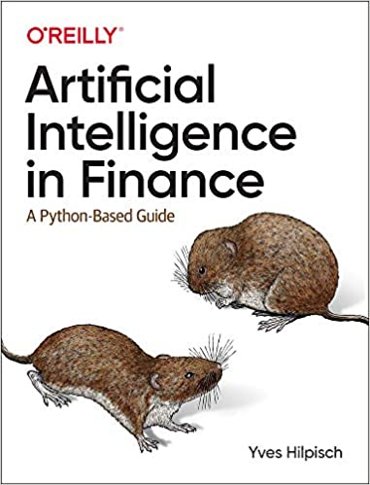
Yves Hilpisch (2020),
Artificial Intelligence in Finance:
A Python-Based Guide,
O’Reilly
Source: https://www.amazon.com/Artificial-Intelligence-Finance-Python-Based-Guide/dp/1492055433

Slide 6
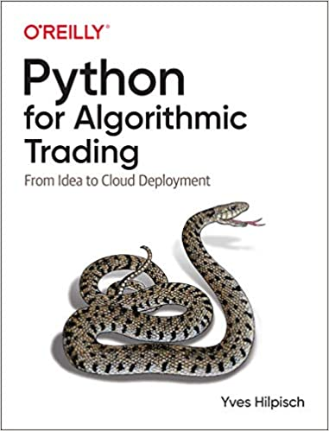
Yves Hilpisch (2020),
Python for Algorithmic Trading:
From Idea to Cloud Deployment,
O’Reilly
Source: https://www.amazon.com/Python-Algorithmic-Trading-Cloud-Deployment/dp/149205335X

Slide 7

Yves Hilpisch (2021),
Financial Theory with Python:
A Gentle Introduction,
O’Reilly
Source: https://www.amazon.com/Financial-Theory-Python-Gentle-Introduction/dp/1098104358

Slide 8
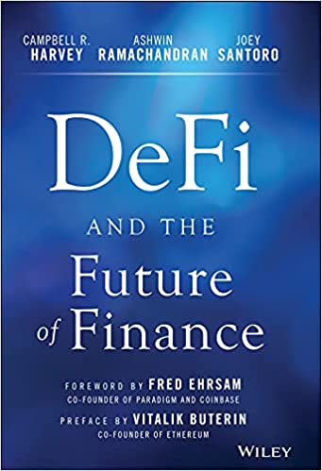
Campbell R. Harvey, Ashwin Ramachandran, Joey Santoro, Fred Ehrsam (2021),
DeFi and the Future of Finance,
Wiley
Source: https://www.amazon.com/DeFi-Future-Finance-Campbell-Harvey-ebook/dp/B09DJV2QLC

Slide 9
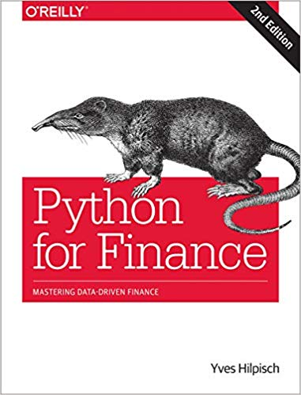
Yves Hilpisch (2018),
Python for Finance: Mastering Data-Driven Finance, O'Reilly
Source: https://www.amazon.com/Python-Finance-Mastering-Data-Driven/dp/1492024333

Slide 10
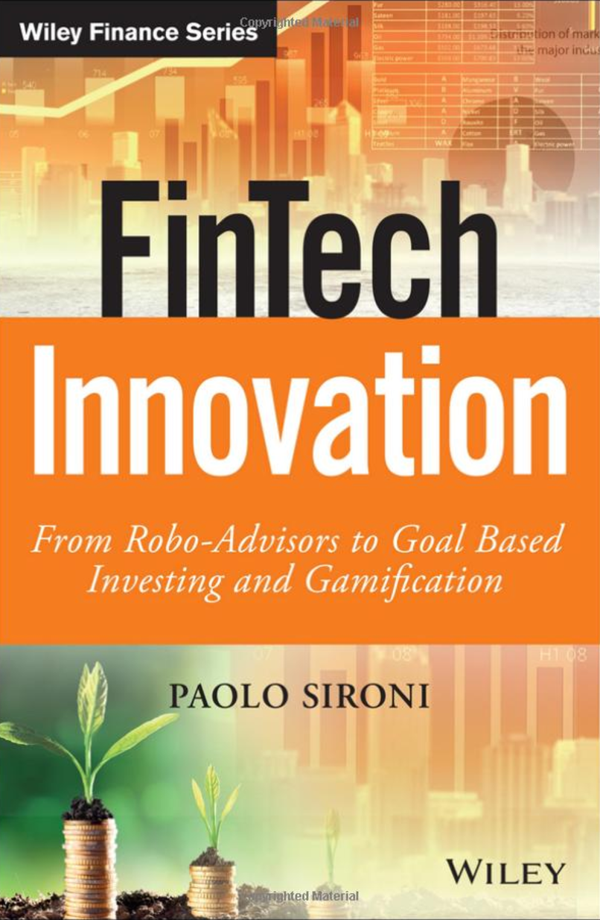
Paolo Sironi (2016)
FinTech Innovation:
From Robo-Advisors to Goal Based Investing and Gamification,
Wiley
Source: https://www.amazon.com/FinTech-Innovation-Robo-Advisors-Investing-Gamification/dp/1119226988

Slide 11
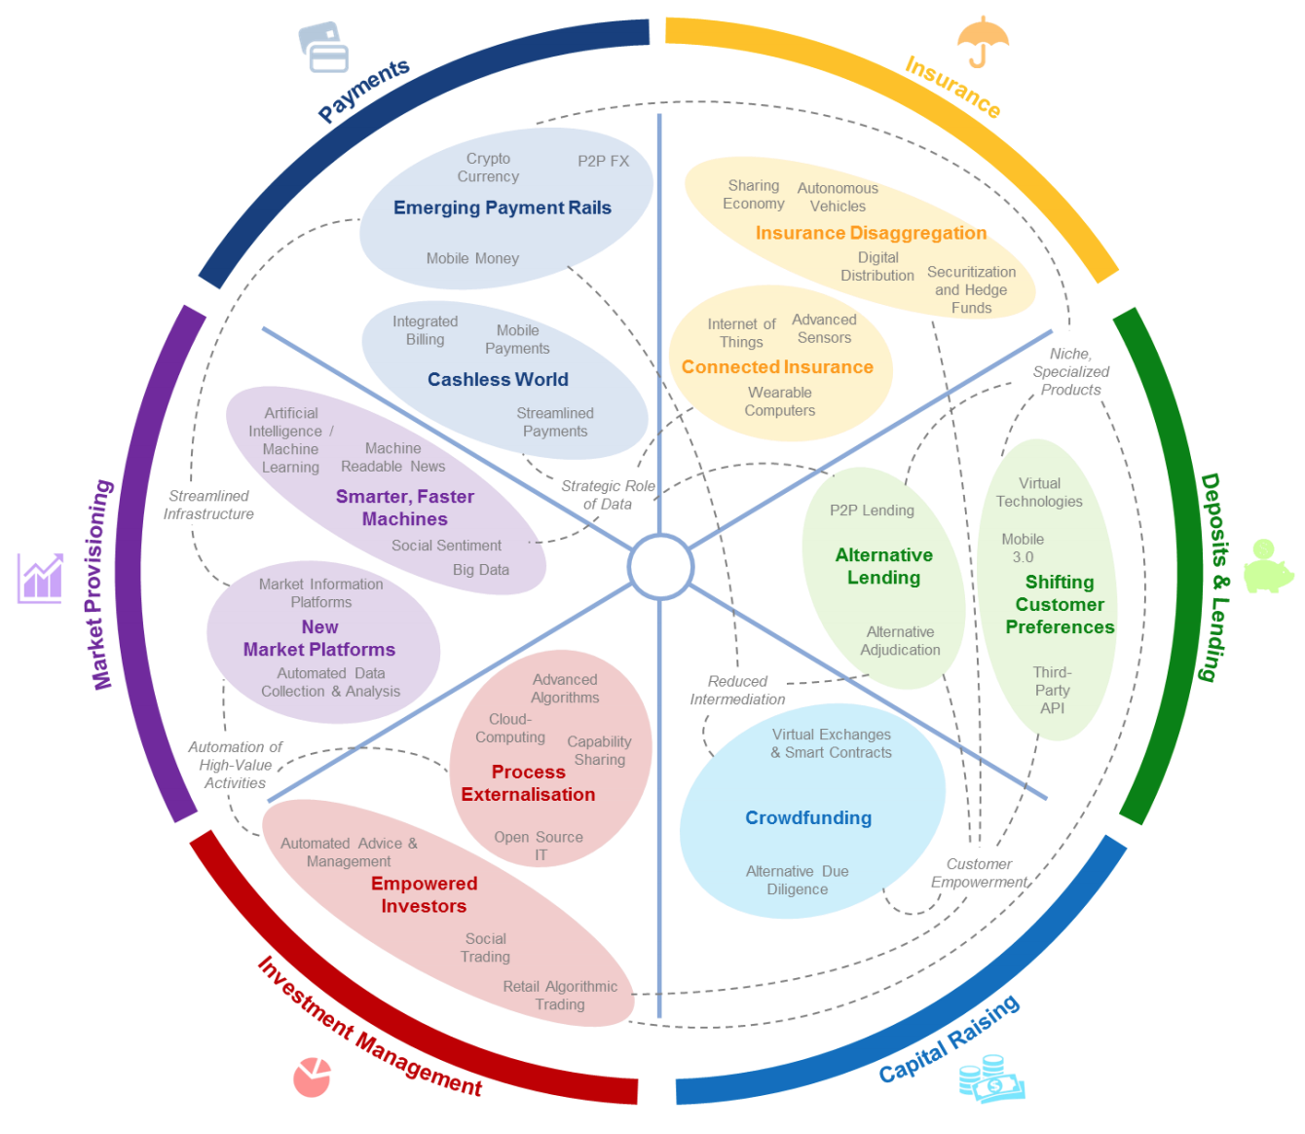
FinTech: Financial Services Innovation
Source: http://www3.weforum.org/docs/WEF_The_future__of_financial_services.pdf

Slide 12
FinTech:
Financial Services Innovation
1. Payments
2. Insurance
3. Deposits & Lending
4. Capital Raising
5. Investment Management
6. Market Provisioning
Source: http://www3.weforum.org/docs/WEF_The_future__of_financial_services.pdf

Slide 13
FinTech: Investment Management
5
Source: http://www3.weforum.org/docs/WEF_The_future__of_financial_services.pdf

Slide 14
FinTech: Market Provisioning
6
Source: http://www3.weforum.org/docs/WEF_The_future__of_financial_services.pdf

Slide 15
AI in FinTech:
Financial Services
Innovation and
Application

Slide 16
FinTech ABCD
AI
Block Chain
Cloud Computing
Big Data

Slide 17
Decentralized Finance (DeFi)
Block Chain Financial Technology
Block Chain & Bitcoin
(BTC)
Smart Contract & Ethereum
(ETH)
Decentralized Application
(DApp)

Slide 18
FinTech

Slide 19
Financial Technology
FinTech
“providing
financial services
by making use of software and
modern technology”
Source: https://www.fintechweekly.com/fintech-definition

Slide 20
Financial Services

Slide 21

Financial Services
Source: http://www.crackitt.com/7-reasons-why-your-fintech-startup-needs-visual-marketing/

Slide 22
AI, Big Data, Cloud Computing
Evolution of Decision Support, Business Intelligence, and Analytics
AI
AI
Cloud Computing
Big Data
DM
BI
Source: Ramesh Sharda, Dursun Delen, and Efraim Turban (2017),
Business Intelligence, Analytics, and Data Science: A Managerial Perspective, 4th Edition, Pearson

Slide 23
AI, ML, DL
Artificial Intelligence (AI)
Machine Learning (ML)
Supervised
Learning
Unsupervised Learning
Deep Learning (DL)
CNN
RNN LSTM GRU
GAN
Semi-supervised Learning
Reinforcement Learning
Source: https://leonardoaraujosantos.gitbooks.io/artificial-inteligence/content/deep_learning.html

Slide 24
AI Acting Humanly:
The Turing Test Approach
(Alan Turing, 1950)
Knowledge Representation
Automated Reasoning
Machine Learning (ML)
  Deep Learning (DL)
Computer Vision (Image, Video)
Natural Language Processing (NLP)
Robotics
Source: Stuart Russell and Peter Norvig (2020), Artificial Intelligence: A Modern Approach, 4th Edition, Pearson

Slide 25
AI in
FinTech

Slide 26
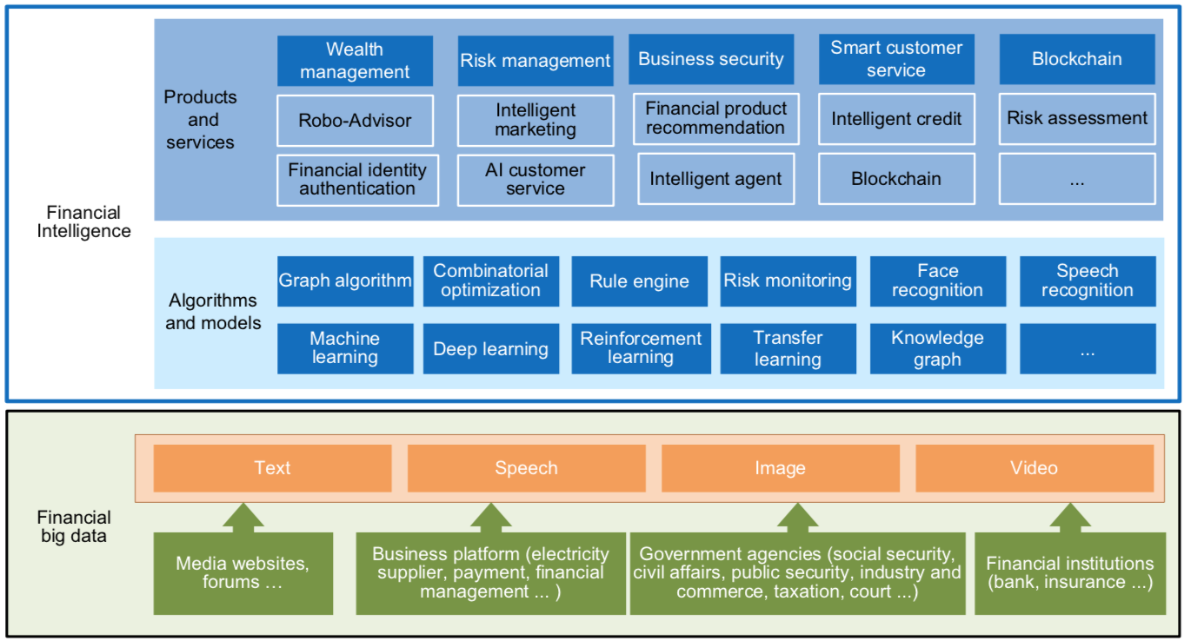
FinBrain: when Finance meets AI 2.0
(Zheng et al., 2019)
Source: Xiao-lin Zheng, Meng-ying Zhu, Qi-bing Li, Chao-chao Chen, and Yan-chao Tan (2019), "Finbrain: When finance meets AI 2.0." Frontiers of Information Technology & Electronic Engineering 20, no. 7, pp. 914-924

Slide 27
Technology-driven
Financial Industry Development
Development stage | Driving technology | Main landscape | Inclusive finance | Relationship between technology and finance
Fintech 1.0 (financial IT) | Computer | Credit card, ATM, and CRMS | Low | Technology as a tool
Fintech 2.0 (Internet finance) | Mobile Internet | Marketplace lending, third-party payment, crowdfunding, and Internet insurance | Medium | Technology-driven change
Fintech 3.0 (financial intelligence) | AI, Big Data, Cloud Computing, Blockchain | Intelligent finance | High | Deep fusion
Source: Xiao-lin Zheng, Meng-ying Zhu, Qi-bing Li, Chao-chao Chen, and Yan-chao Tan (2019), "Finbrain: When finance meets AI 2.0." Frontiers of Information Technology & Electronic Engineering 20, no. 7, pp. 914-924

Slide 28
AI-driven Marketing
(Ma and Sun, 2020)
Interactive &
media-rich
Personalization
Real-time
automation
Customer-
journey
focus
Industry Trends
Marketing
Mix
Engagement
Search
Recommendation
Attribution
Marketing Actions
AI & Machine Learning
Source: Liye Ma and Baohong Sun (2020), "Machine learning and AI in marketing – Connecting computing power to human insights." International Journal of Research in Marketing, 37, no. 3, 481-504.

Slide 29
Deep learning for financial applications:
A survey
Applied Soft Computing (2020)
Source:
Ahmet Murat Ozbayoglu, Mehmet Ugur Gudelek, and Omer Berat Sezer (2020). "Deep learning for financial applications: A survey."
Applied Soft Computing (2020): 106384.

Slide 30
Financial time series forecasting with deep learning:
A systematic literature review:
2005–2019
Applied Soft Computing (2020)
Source:
Omer Berat Sezer, Mehmet Ugur Gudelek, and Ahmet Murat Ozbayoglu (2020), "Financial time series forecasting with deep learning: A systematic literature review: 2005–2019." Applied Soft Computing 90 (2020): 106181.

Slide 31
Deep learning for financial applications: Topics
Source: Ahmet Murat Ozbayoglu, Mehmet Ugur Gudelek, and Omer Berat Sezer (2020). "Deep learning for financial applications: A survey." Applied Soft Computing (2020): 106384.

Slide 32
Deep learning for financial applications: Deep Learning Models
Source: Ahmet Murat Ozbayoglu, Mehmet Ugur Gudelek, and Omer Berat Sezer (2020). "Deep learning for financial applications: A survey." Applied Soft Computing (2020): 106384.

Slide 33
Deep learning for financial applications: Topic-Model Heatmap
Source: Ahmet Murat Ozbayoglu, Mehmet Ugur Gudelek, and Omer Berat Sezer (2020). "Deep learning for financial applications: A survey." Applied Soft Computing (2020): 106384.

Slide 34
Deep learning for financial applications: Topic-Feature Heatmap
Source: Ahmet Murat Ozbayoglu, Mehmet Ugur Gudelek, and Omer Berat Sezer (2020). "Deep learning for financial applications: A survey." Applied Soft Computing (2020): 106384.

Slide 35
Deep learning for financial applications: Topic-Dataset Heatmap
Source: Ahmet Murat Ozbayoglu, Mehmet Ugur Gudelek, and Omer Berat Sezer (2020). "Deep learning for financial applications: A survey." Applied Soft Computing (2020): 106384.

Slide 36
Deep learning for financial applications:
Algo-trading applications embedded with time series forecasting models
Source: Ahmet Murat Ozbayoglu, Mehmet Ugur Gudelek, and Omer Berat Sezer (2020). "Deep learning for financial applications: A survey." Applied Soft Computing (2020): 106384.

Slide 37
Deep learning for financial applications:
Algo-trading applications embedded with time series forecasting models
Source: Ahmet Murat Ozbayoglu, Mehmet Ugur Gudelek, and Omer Berat Sezer (2020). "Deep learning for financial applications: A survey." Applied Soft Computing (2020): 106384.

Slide 38
Deep learning for financial applications:
Classification (buy–sell signal, or trend detection) based algo-trading models
Source: Ahmet Murat Ozbayoglu, Mehmet Ugur Gudelek, and Omer Berat Sezer (2020). "Deep learning for financial applications: A survey." Applied Soft Computing (2020): 106384.

Slide 39
Deep learning for financial applications:
Stand-alone and/or other algorithmic models
Source: Ahmet Murat Ozbayoglu, Mehmet Ugur Gudelek, and Omer Berat Sezer (2020). "Deep learning for financial applications: A survey." Applied Soft Computing (2020): 106384.

Slide 40
Deep learning for financial applications:
Credit scoring or classification studies
Source: Ahmet Murat Ozbayoglu, Mehmet Ugur Gudelek, and Omer Berat Sezer (2020). "Deep learning for financial applications: A survey." Applied Soft Computing (2020): 106384.

Slide 41
Deep learning for financial applications:
Financial distress, bankruptcy, bank risk, mortgage risk, crisis forecasting studies.
Source: Ahmet Murat Ozbayoglu, Mehmet Ugur Gudelek, and Omer Berat Sezer (2020). "Deep learning for financial applications: A survey." Applied Soft Computing (2020): 106384.

Slide 42
Deep learning for financial applications:
Fraud detection studies
Source: Ahmet Murat Ozbayoglu, Mehmet Ugur Gudelek, and Omer Berat Sezer (2020). "Deep learning for financial applications: A survey." Applied Soft Computing (2020): 106384.

Slide 43
Deep learning for financial applications:
Portfolio management studies
Source: Ahmet Murat Ozbayoglu, Mehmet Ugur Gudelek, and Omer Berat Sezer (2020). "Deep learning for financial applications: A survey." Applied Soft Computing (2020): 106384.

Slide 44
Deep learning for financial applications:
Asset pricing and derivatives market studies
Source: Ahmet Murat Ozbayoglu, Mehmet Ugur Gudelek, and Omer Berat Sezer (2020). "Deep learning for financial applications: A survey." Applied Soft Computing (2020): 106384.

Slide 45
Deep learning for financial applications:
Cryptocurrency and blockchain studies
Source: Ahmet Murat Ozbayoglu, Mehmet Ugur Gudelek, and Omer Berat Sezer (2020). "Deep learning for financial applications: A survey." Applied Soft Computing (2020): 106384.

Slide 46
Deep learning for financial applications:
Financial sentiment studies coupled with text mining for forecasting
Source: Ahmet Murat Ozbayoglu, Mehmet Ugur Gudelek, and Omer Berat Sezer (2020). "Deep learning for financial applications: A survey." Applied Soft Computing (2020): 106384.

Slide 47
Deep learning for financial applications:
Text mining studies without sentiment analysis for forecasting
Source: Ahmet Murat Ozbayoglu, Mehmet Ugur Gudelek, and Omer Berat Sezer (2020). "Deep learning for financial applications: A survey." Applied Soft Computing (2020): 106384.

Slide 48
Deep learning for financial applications:
Text mining studies without sentiment analysis for forecasting
Source: Ahmet Murat Ozbayoglu, Mehmet Ugur Gudelek, and Omer Berat Sezer (2020). "Deep learning for financial applications: A survey." Applied Soft Computing (2020): 106384.

Slide 49
Deep learning for financial applications:
Financial sentiment studies coupled with text mining without forecasting
Source: Ahmet Murat Ozbayoglu, Mehmet Ugur Gudelek, and Omer Berat Sezer (2020). "Deep learning for financial applications: A survey." Applied Soft Computing (2020): 106384.

Slide 50
Deep learning for financial applications:
Other text mining studies
Source: Ahmet Murat Ozbayoglu, Mehmet Ugur Gudelek, and Omer Berat Sezer (2020). "Deep learning for financial applications: A survey." Applied Soft Computing (2020): 106384.

Slide 51
Deep learning for financial applications:
Other theoretical or conceptual studies
Source: Ahmet Murat Ozbayoglu, Mehmet Ugur Gudelek, and Omer Berat Sezer (2020). "Deep learning for financial applications: A survey." Applied Soft Computing (2020): 106384.

Slide 52
Deep learning for financial applications:
Other financial applications
Source: Ahmet Murat Ozbayoglu, Mehmet Ugur Gudelek, and Omer Berat Sezer (2020). "Deep learning for financial applications: A survey." Applied Soft Computing (2020): 106384.

Slide 53
Financial time series forecasting with deep learning: Topic-model heatmap
Source: Omer Berat Sezer, Mehmet Ugur Gudelek, and Ahmet Murat Ozbayoglu (2020), "Financial time series forecasting with deep learning:
A systematic literature review: 2005–2019." Applied Soft Computing 90 (2020): 106181.

Slide 54
Stock price forecasting using only raw time series data
Source: Omer Berat Sezer, Mehmet Ugur Gudelek, and Ahmet Murat Ozbayoglu (2020), "Financial time series forecasting with deep learning:
A systematic literature review: 2005–2019." Applied Soft Computing 90 (2020): 106181.

Slide 55
Stock price forecasting using various data
Source: Omer Berat Sezer, Mehmet Ugur Gudelek, and Ahmet Murat Ozbayoglu (2020), "Financial time series forecasting with deep learning:
A systematic literature review: 2005–2019." Applied Soft Computing 90 (2020): 106181.

Slide 56
Stock Market Movement Forecast:
Phases of the stock market modeling
Source: O. Bustos and A. Pomares-Quimbaya (2020), "Stock Market Movement Forecast: A Systematic Review."
Expert Systems with Applications (2020): 113464.

Slide 57
3 Machine Learning Algorithms
Source: Enrico Galimberti, http://blogs.teradata.com/data-points/tree-machine-learning-algorithms/

Slide 58
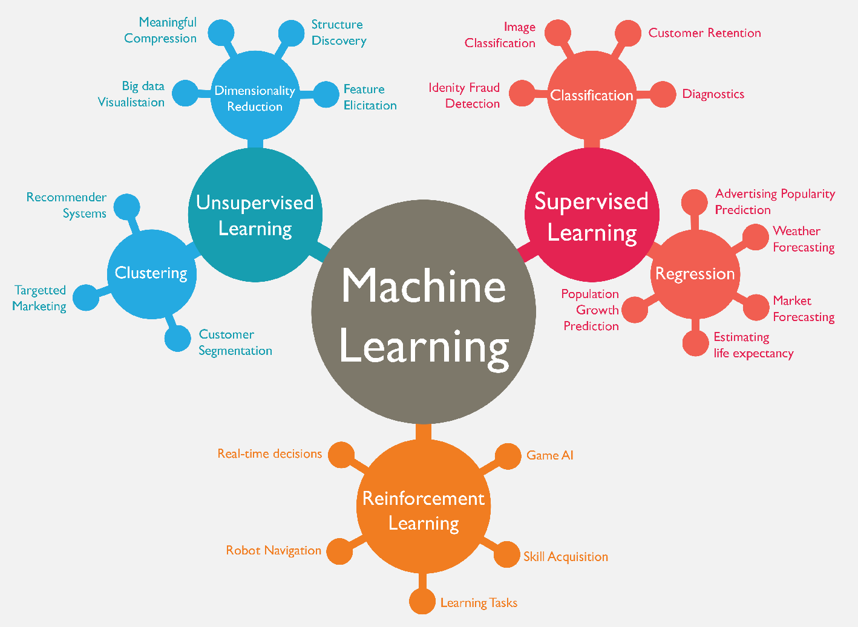
Machine Learning (ML)
Source: https://www.mactores.com/services/aws-big-data-machine-learning-cognitive-services/

Slide 59
Machine Learning Models
Deep Learning
Kernel
Association rules
Ensemble
Decision tree
Dimensionality reduction
Clustering
Regression Analysis
Bayesian
Instance based
Source: Sunila Gollapudi (2016), Practical Machine Learning, Packt Publishing

Slide 60
Machine Learning (ML) / Deep Learning (DL)
Decision Tree Classifiers
Support Vector Machine (SVM)
Supervised Learning
Neural Network (NN)
Linear Classifiers
Deep Learning (DL)
Machine Learning
(ML)
Rule-based Classifiers
Naïve Bayes
(NB)
Unsupervised Learning
Probabilistic Classifiers
Bayesian Network (BN)
Maximum Entropy (ME)
Reinforcement Learning
Source: Jesus Serrano-Guerrero, Jose A. Olivas, Francisco P. Romero, and Enrique Herrera-Viedma (2015),
"Sentiment analysis: A review and comparative analysis of web services," Information Sciences, 311, pp. 18-38.

Slide 61
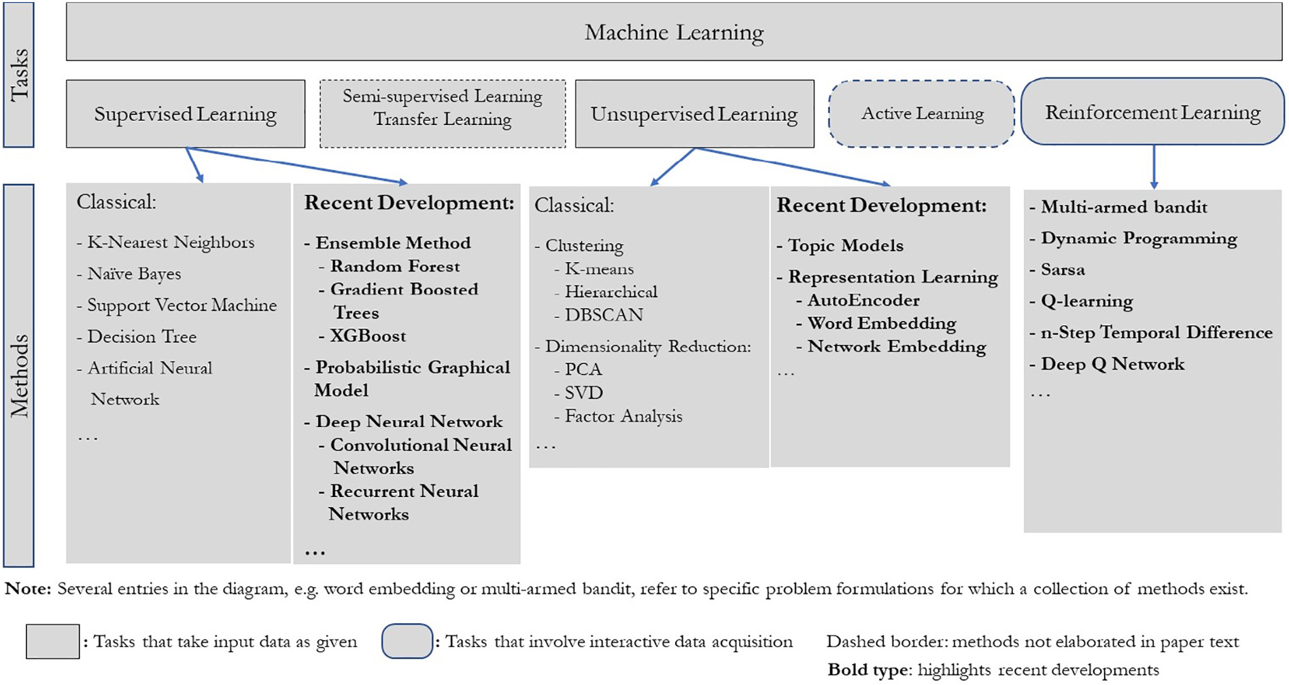
Machine Learning Tasks and Methods
Source: Liye Ma and Baohong Sun (2020), "Machine learning and AI in marketing – Connecting computing power to human insights." International Journal of Research in Marketing, 37, no. 3, 481-504.

Slide 62
Decentralized Finance
(DeFi)
Block Chain FinTech

Slide 63
Decentralized Finance (DeFi)
A global, open alternative to the current financial system.
Products that let you borrow, save, invest, trade, and more.
Based on open-source technology that anyone can program with.
Source: https://ethereum.org/en/defi/

Slide 64
Traditional Finance
Centralized Finance (CeFi)
Some people aren't granted access to set up a bank account or use financial services.
Lack of access to financial services can prevent people from being employable.
Financial services can block you from getting paid.
A hidden charge of financial services is your personal data.
Governments and centralized institutions can close down markets at will.
Trading hours often limited to business hours of specific time zone.
Money transfers can take days due to internal human processes.
There's a premium to financial services because intermediary institutions need their cut.
Source: https://ethereum.org/en/defi/

Slide 65
DeFi vs. CeFi
Decentralized Finance (DeFi) | Traditional Finance (Centralized Finance; CeFi)
You hold your money. | Your money is held by companies.
You control where your money goes and how it's spent. | You have to trust companies not to mismanage your money, like lend to risky borrowers.
Transfers of funds happen in minutes. | Payments can take days due to manual processes.
Transaction activity is pseudonymous. | Financial activity is tightly coupled with your identity.
DeFi is open to anyone. | You must apply to use financial services.
The markets are always open. | Markets close because employees need breaks.
It's built on transparency – anyone can look at a product's data and inspect how the system works. | Financial institutions are closed books: you can't ask to see their loan history, a record of their managed assets, and so on.
Source: https://ethereum.org/en/defi/

Slide 66
(DeFi)
Decentralized Applications (Dapps)
Ethereum-powered tools and services
Dapps are a growing movement of applications that use Ethereum to disrupt business models or invent new ones
Source: https://ethereum.org/en/defi/

Slide 67
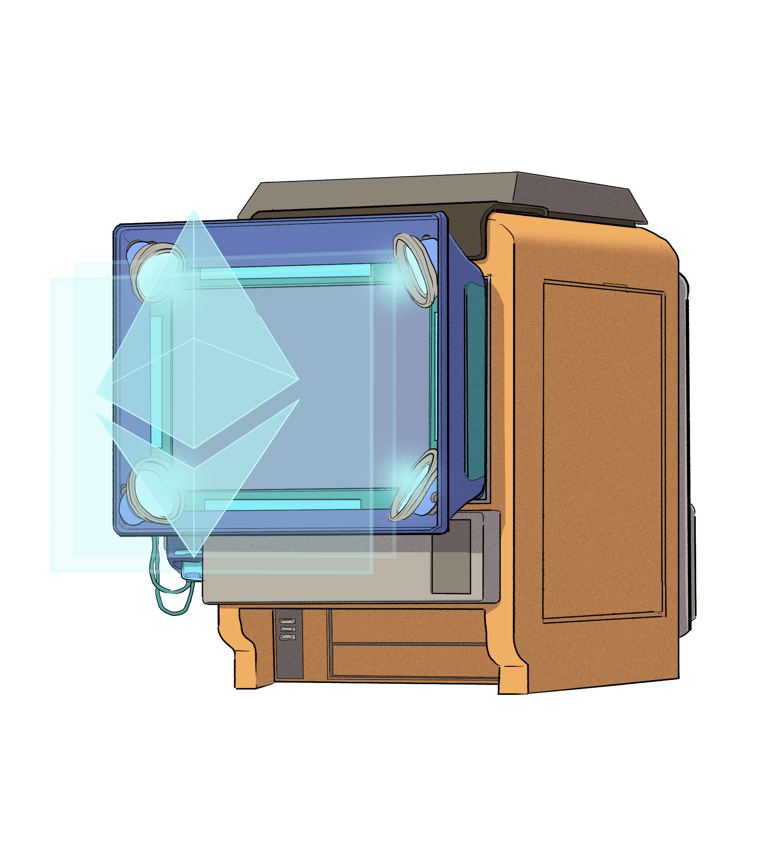
The Internet of Assets
Ethereum isn't just for
digital money.
Anything you can own can be represented,
traded and
put to use as
non-fungible tokens (NFTs).
Source: https://ethereum.org/en/defi/

Slide 68
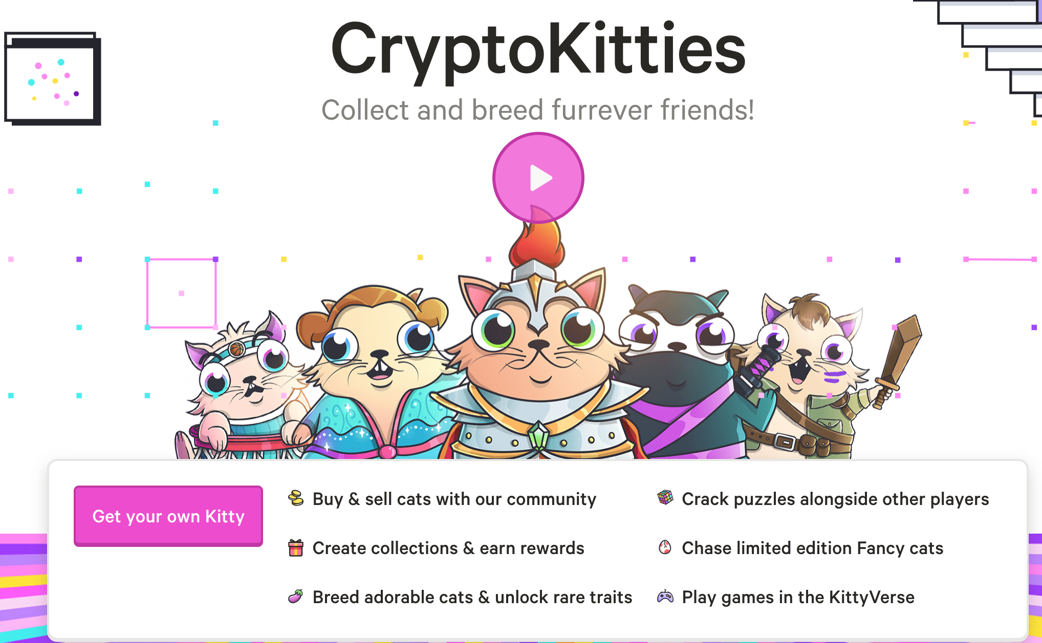
Non-Fungible Tokens (NFT)
CryptoKitties
https://www.cryptokitties.co/
Source: Matt Fortnow and QuHarrison Terry (2021), The NFT Handbook - How to Create, Sell and Buy Non-Fungible Tokens, Wiley

Slide 69
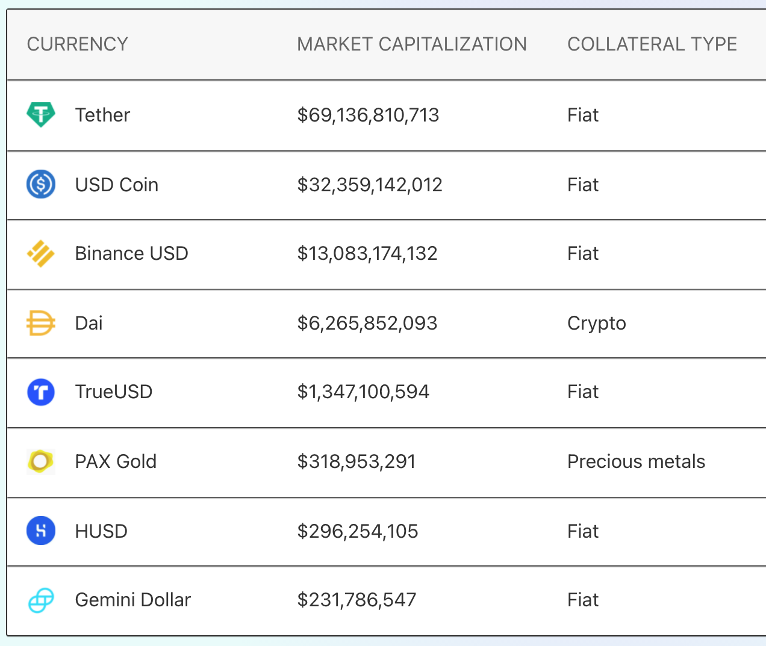
Top Stablecoins
(Tether USDT, USD Coin USDC, Dai)
Digital money for everyday use
Stablecoins are
Ethereum tokens designed to stay at a fixed value,
even when
the price of ETH changes.
Source: https://ethereum.org/en/stablecoins/

Slide 70
Financial Stability Challenges
Crypto Ecosystem
Operational, cyber, and governance risks
Integrity (market and AML/CFT)
(Anti–Money Laundering / Combating the Financing of Terrorism)
Data availability / reliability
Challenges from cross-boarder activites
Stablecoins
How stable are stablecoins?
Domestic and global regulatory and supervisory
approaches
Macro-Financial
Cryptoization, capital flows, and restrictions
Monetary policy transmission
Bank disintermediation
Source: Parma Bains, Mohamed Diaby, Dimitris Drakopoulos, Julia Faltermeier, Federico Grinberg, Evan Papageorgiou, Dmitri Petrov, Patrick Schneider, and Nobu Sugimoto (2021),
The Crypto Ecosystem and Financial Stability Challenges, International Monetary Fund, October 2021

Slide 71
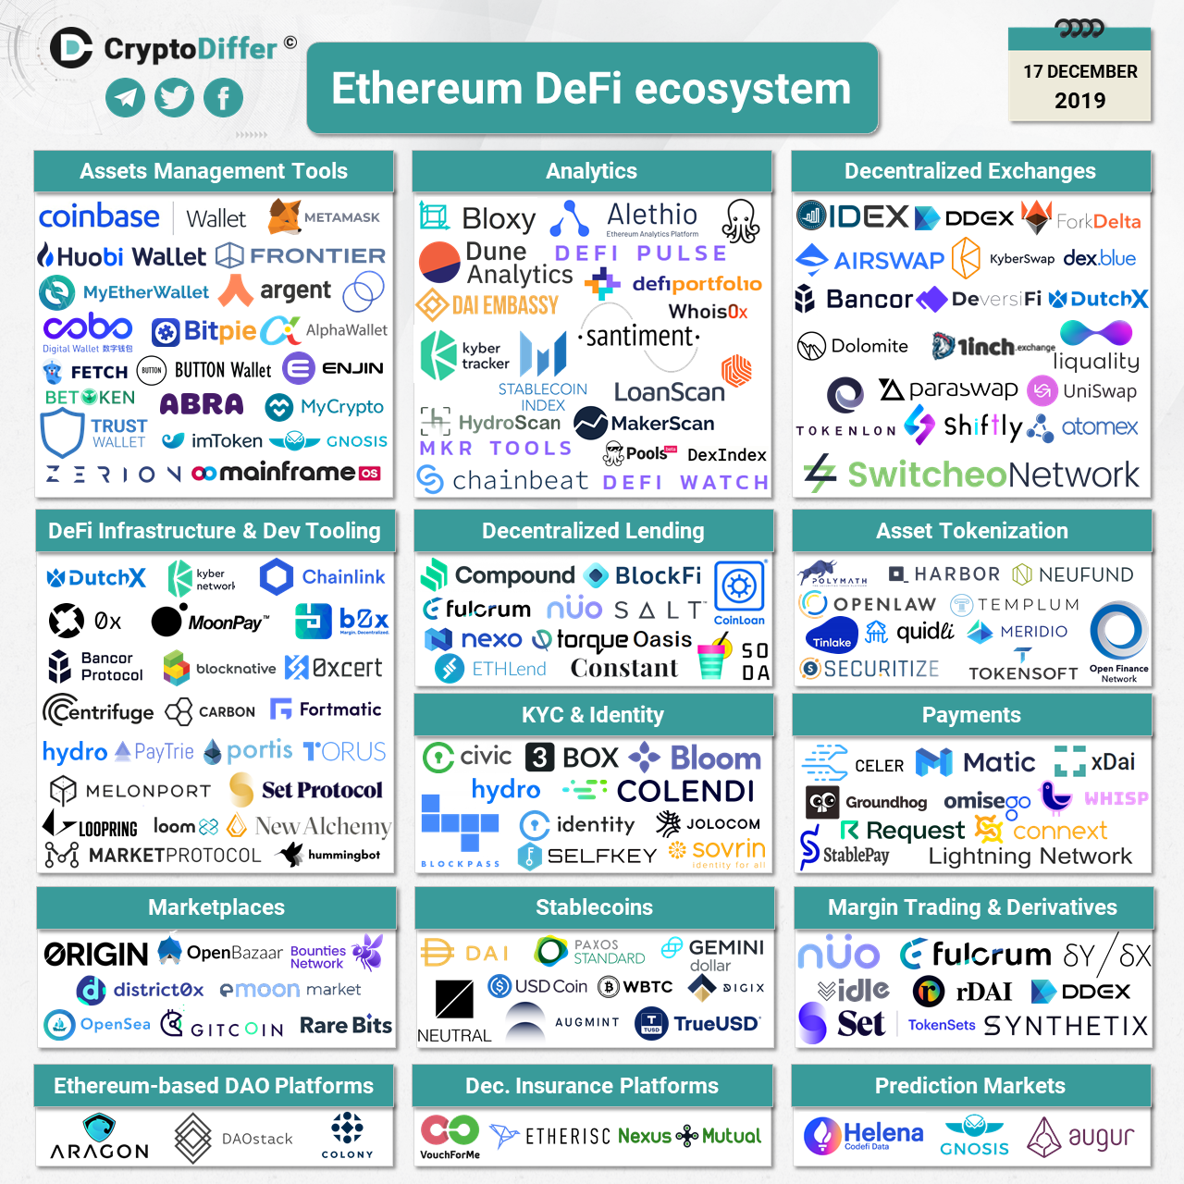
Ethereum DeFi Ecosystem
Source: https://cryptodiffer.com/news/ethereum-defi-ecosystem/

Slide 72
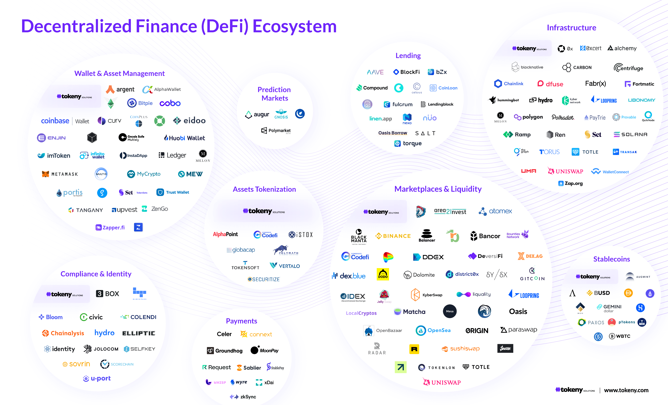
Decentralized Finance (DeFi) Ecosystem
Source: https://tokeny.com/defi-ecosystem/

Slide 73
Outline
AI in FinTech: Financial Services Innovation and Application
Artificial Intelligence for Knowledge Graphs of Cryptocurrency Anti-money Laundering in Fintech

Slide 74

Artificial Intelligence for Knowledge Graphs of Cryptocurrency Anti-money Laundering in Fintech
The 12th International Workshop on Mining and Analyzing Social Networks for Decision Support (MSNDS 2021)
ASONAM 2021, Virtual Event, Netherlands, November 8-11, 2021
Time: November 8, 2021, 14:00 – 15:40 [Amsterdam Time GMT+2] MSNDS 2021 (Room:Tehran)
Min-Yuh Day, Ph.D,
Associate Professor
Graduate Institute of Information Management,
National Taipei University, Taiwan
https://web.ntpu.edu.tw/~myday
The 12th International Workshop on Mining and Analyzing Social Networks for Decision Support (MSNDS 2021),
The 2021 IEEE/ACM International Conference on Advances in Social Networks Analysis and Mining (ASONAM 2021), Virtual Event, Netherlands, November 8-11, 2021

Slide 75
Knowledge Graph (KG)
Knowledge Graph (KG)
  A knowledge graph is a multi-relational graph composed of
  entities and relations, which are regarded as
  nodes and different types of edges, respectively (Ji et al., 2021).
  Represents knowledge as concepts (entities) and
  their relationships (Facts)
  Triple of facts
    SPO: (subject, predicate, object)
    HRT: (head, relation, tail)
Common Knowledge Graph: DBpedia, YAGO, Wikidata

Slide 76
Knowledge Graph, Facts, Triple, Embedding
G
  Knowledge graph
F
  Set of facts
(h, r, t)
  Triple of head, relation, and tail
(h, r, t)
  Embedding of head, relation, and tail
Source: Ji, S., Pan, S., Cambria, E., Marttinen, P., & Philip, S. Y. (2021). A survey on knowledge graphs: Representation, acquisition, and applications.
IEEE Transactions on Neural Networks and Learning Systems.

Slide 77
Knowledge Representation
Factual Triple and Knowledge Graph
Albert Einstein, winner of the 1921 Nobel prize in physics
The Nobel Prize in Physics 1921 was awarded to Albert Einstein "for his services to Theoretical Physics, and especially for his discovery of the law of the photoelectric effect.”
Triple
(Albert Einstein, WinnerOf, Nobel Prize in Physics)
Knowledge Graph
Albert
Einstein
WinnerOf
Nobel Prize
in Physics

Slide 78
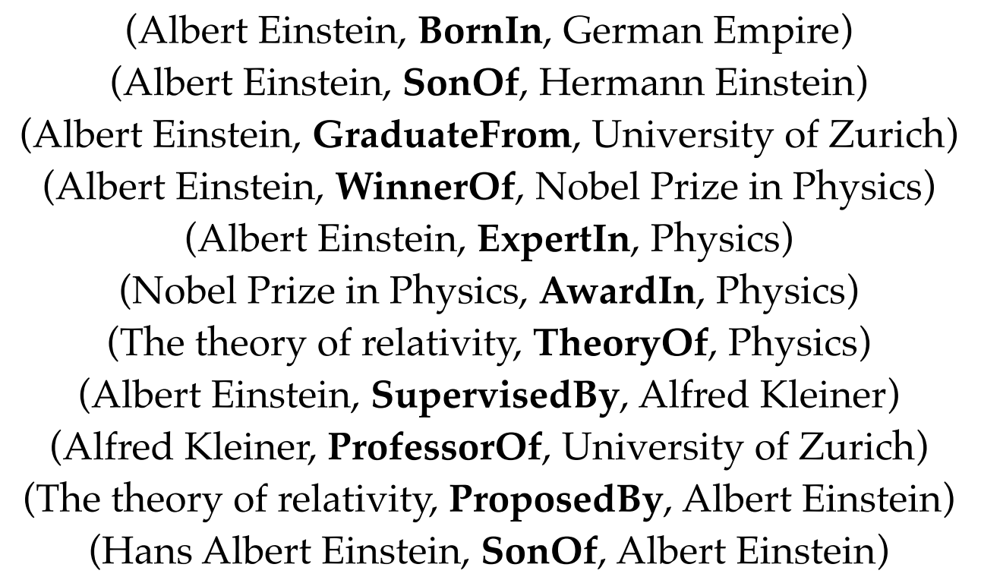
Factual Triples in Knowledge Base
(h, r, t)
Source: Ji, S., Pan, S., Cambria, E., Marttinen, P., & Philip, S. Y. (2021). A survey on knowledge graphs: Representation, acquisition, and applications.
IEEE Transactions on Neural Networks and Learning Systems.

Slide 79
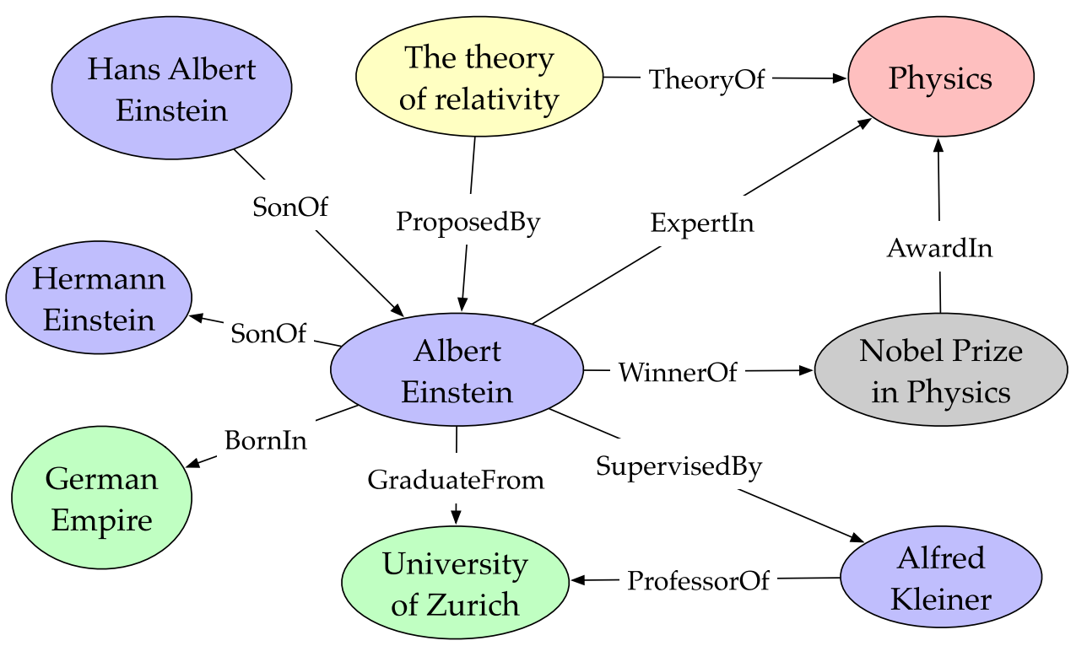
Entities and Relations in Knowledge Graph
(Albert Einstein, WinnerOf, Nobel Prize in Physics)
Source: Ji, S., Pan, S., Cambria, E., Marttinen, P., & Philip, S. Y. (2021). A survey on knowledge graphs: Representation, acquisition, and applications.
IEEE Transactions on Neural Networks and Learning Systems.

Slide 80
knowledge base and knowledge graph
Factual triples in knowledge base
Entities and relations in knowledge graph
(Albert Einstein, WinnerOf, Nobel Prize in Physics)
Source: Ji, S., Pan, S., Cambria, E., Marttinen, P., & Philip, S. Y. (2021). A survey on knowledge graphs: Representation, acquisition, and applications.
IEEE Transactions on Neural Networks and Learning Systems.

Slide 81
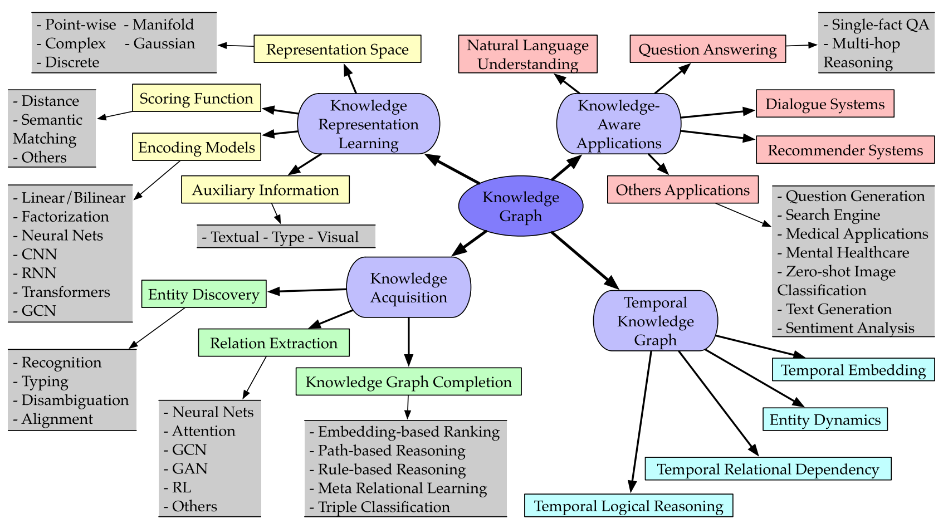
Categorization of Research on Knowledge Graphs
Source: Ji, S., Pan, S., Cambria, E., Marttinen, P., & Philip, S. Y. (2021). A survey on knowledge graphs: Representation, acquisition, and applications.
IEEE Transactions on Neural Networks and Learning Systems.

Slide 82
Knowledge Graph Completion (KGC) Datasets
Knowledge Graph Completion (KGC) Dataset | #Entity | #Relation | #Train | #Valid | #Test | Reference
WN18RR | 40,943 | 11 | 86,835 | 3,034 | 3,134 | Toutanova & Chen (2015); Zhang et al. (2020)
FB15k-237 | 14,541 | 237 | 272,115 | 17,535 | 20,466 | Dettmers et al. (2018); Zhang et al. (2020)
YAGO3-10 | 123,182 | 37 | 1,079,040 | 5,000 | 5,000 | Mahdisoltani et al. (2015); Zhang et al. (2020)

Slide 83
Domain-Specific Knowledge Graph
Domain-Specific Knowledge Graph
  PubMed Knowledge Graph (PKG)
    Extracting biological entities from 29 million PubMed abstracts
  Lynx: Legal Knowledge Graph for Multilingual Compliance Services
    Legal Knowledge Graph (LKG) integrates and links heterogeneous compliance data sources including legislation, case law, standards and other private contracts.

Slide 84
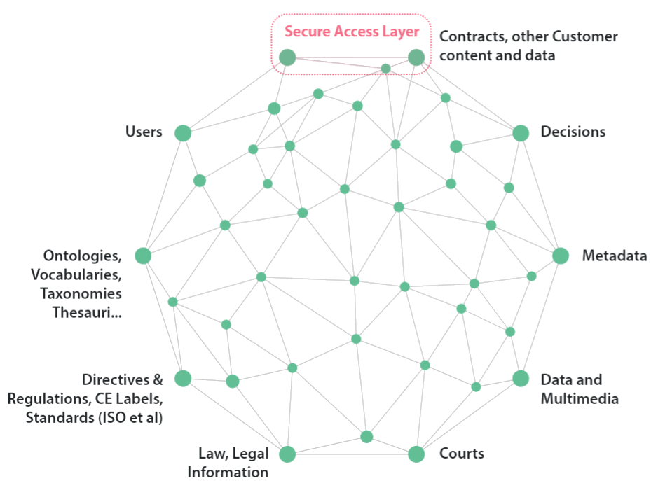
Lynx: Legal Knowledge Graph for
Multilingual Compliance Services
Source: Lynx Legal Knowledge Graph (LKG), https://lynx-project.eu/

Slide 85
System Architecture for
Cryptocurrency Anti-money Laundering (AML) Knowledge Graphs
Open Domain
Knowledge Graphs
Cryptocurrency
Anti-money Laundering (AML)
Knowledge Graphs (KG)
Knowledge Acquisition
Concepts and Entities Recognition (NER)
Attributes and Relations
Link Prediction
Knowledge Fusion
CAML Resources
Legal Documents
Knowledge Graph Completion
Meta-Learning
Few Shot Learning
Source: Min-Yuh Day (2021), "Artificial Intelligence for Knowledge Graphs of Cryptocurrency Anti-money Laundering in Fintech",
in Proceedings of the 2021 IEEE/ACM International Conference on Advances in Social Networks Analysis and Mining (ASONAM 2021), Virtual Event, Netherlands, November 8-11, 2021.

Slide 86
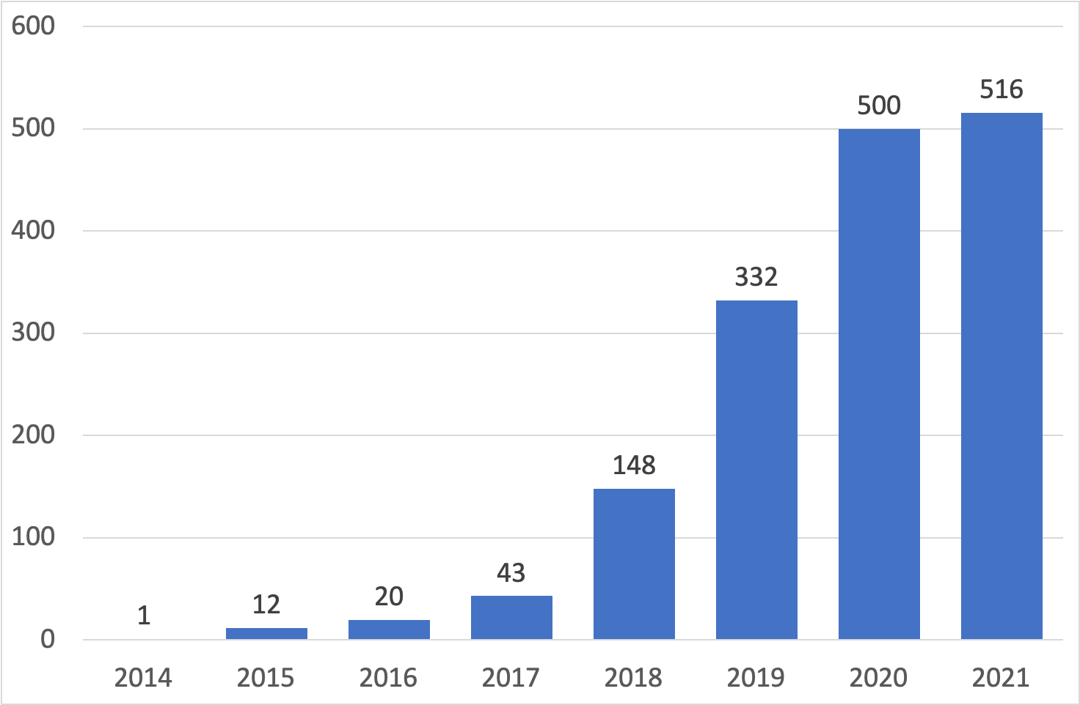
Research Trend of Cryptocurrency Research on Web of Science (2014-2021)
Cryptocurrency
Source: Min-Yuh Day (2021), "Artificial Intelligence for Knowledge Graphs of Cryptocurrency Anti-money Laundering in Fintech",
in Proceedings of the 2021 IEEE/ACM International Conference on Advances in Social Networks Analysis and Mining (ASONAM 2021), Virtual Event, Netherlands, November 8-11, 2021.

Slide 87
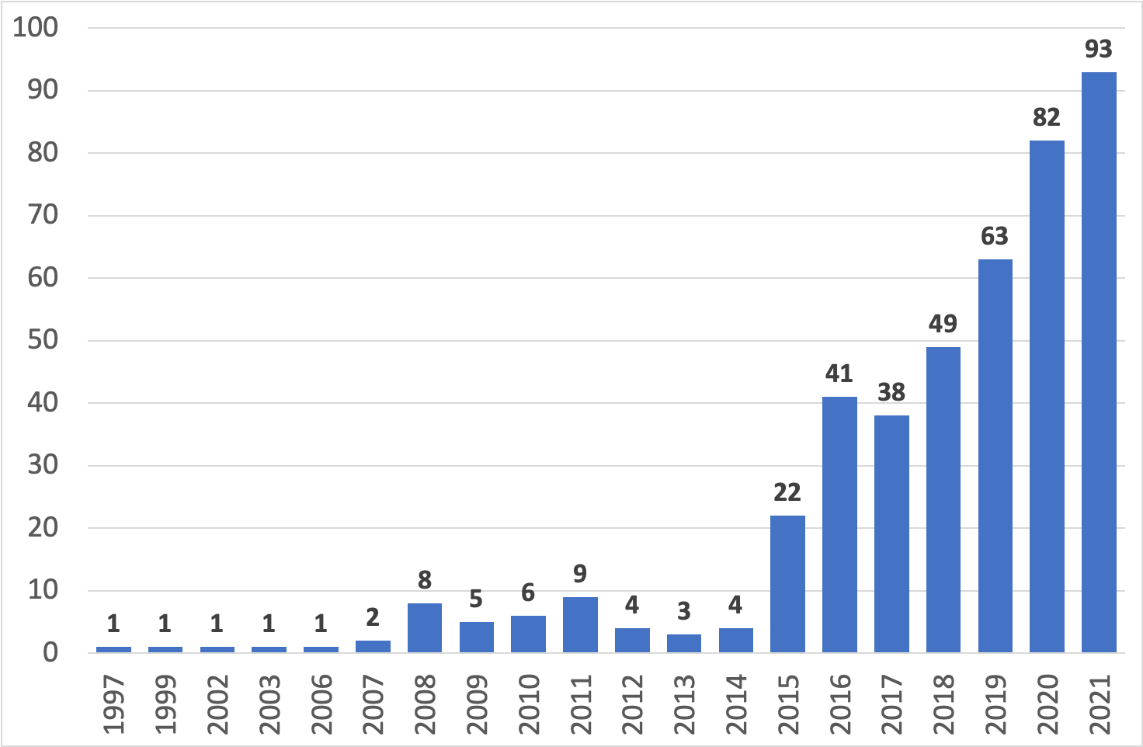
Research Trend of Anti-money Laundering Research on Web of Science (1997-2021)
Anti-money Laundering (AML)
Source: Min-Yuh Day (2021), "Artificial Intelligence for Knowledge Graphs of Cryptocurrency Anti-money Laundering in Fintech",
in Proceedings of the 2021 IEEE/ACM International Conference on Advances in Social Networks Analysis and Mining (ASONAM 2021), Virtual Event, Netherlands, November 8-11, 2021.

Slide 88
Top keywords in Cryptocurrency
Rank | Keyword | Frequency | Percentage
1 | bitcoin | 945 | 6.91%
2 | cryptocurrency | 825 | 6.03%
3 | blockchain | 523 | 3.82%
4 | cryptocurrencies | 247 | 1.81%
5 | volatility | 222 | 1.62%
6 | inefficiency | 148 | 1.08%
7 | gold | 128 | 0.94%
8 | hedge | 88 | 0.64%
9 | ethereum | 85 | 0.62%
10 | economics | 75 | 0.55%
11 | returns | 73 | 0.53%
12 | security | 63 | 0.46%
13 | technology | 59 | 0.43%
14 | internet | 56 | 0.41%
15 | market | 56 | 0.41%
16 | risk | 55 | 0.40%
17 | safe haven | 54 | 0.39%
18 | smart contracts | 53 | 0.39%
19 | garch | 51 | 0.37%
20 | model | 51 | 0.37%
Source: Min-Yuh Day (2021), "Artificial Intelligence for Knowledge Graphs of Cryptocurrency Anti-money Laundering in Fintech",
in Proceedings of the 2021 IEEE/ACM International Conference on Advances in Social Networks Analysis and Mining (ASONAM 2021), Virtual Event, Netherlands, November 8-11, 2021.

Slide 89
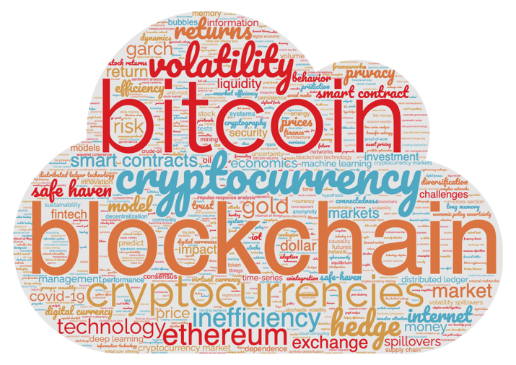
Word Cloud for Cryptocurrency
Source: Min-Yuh Day (2021), "Artificial Intelligence for Knowledge Graphs of Cryptocurrency Anti-money Laundering in Fintech",
in Proceedings of the 2021 IEEE/ACM International Conference on Advances in Social Networks Analysis and Mining (ASONAM 2021), Virtual Event, Netherlands, November 8-11, 2021.

Slide 90
Top keywords in Anti-money Laundering
Rank | Keyword | Frequency | Percentage
1 | money laundering | 173 | 7.15%
2 | anti-money laundering | 91 | 3.76%
3 | compliance | 31 | 1.28%
4 | aml | 26 | 1.07%
5 | corruption | 23 | 0.95%
6 | crime | 20 | 0.83%
7 | fatf | 20 | 0.83%
8 | terrorism | 17 | 0.70%
9 | risk | 15 | 0.62%
10 | governance | 14 | 0.58%
11 | regulation | 13 | 0.54%
12 | anti-money laundering (aml) | 12 | 0.50%
13 | blockchain | 12 | 0.50%
14 | financial action task force | 12 | 0.50%
15 | lawyers | 12 | 0.50%
16 | terrorism financing | 12 | 0.50%
17 | bitcoin | 11 | 0.45%
18 | customer due diligence | 11 | 0.45%
19 | financial crime | 11 | 0.45%
20 | global governance | 11 | 0.45%
Source: Min-Yuh Day (2021), "Artificial Intelligence for Knowledge Graphs of Cryptocurrency Anti-money Laundering in Fintech",
in Proceedings of the 2021 IEEE/ACM International Conference on Advances in Social Networks Analysis and Mining (ASONAM 2021), Virtual Event, Netherlands, November 8-11, 2021.

Slide 91
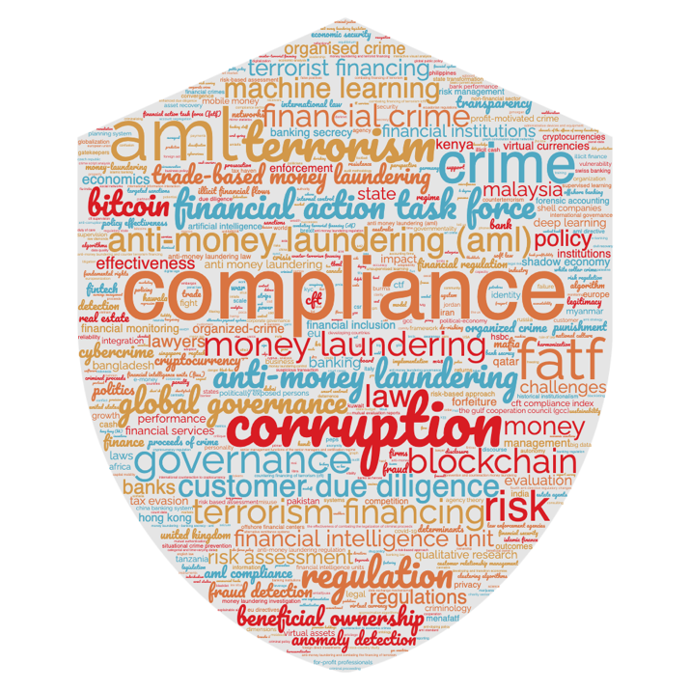
Word Cloud for Anti-money Laundering
Source: Min-Yuh Day (2021), "Artificial Intelligence for Knowledge Graphs of Cryptocurrency Anti-money Laundering in Fintech",
in Proceedings of the 2021 IEEE/ACM International Conference on Advances in Social Networks Analysis and Mining (ASONAM 2021), Virtual Event, Netherlands, November 8-11, 2021.

Slide 92
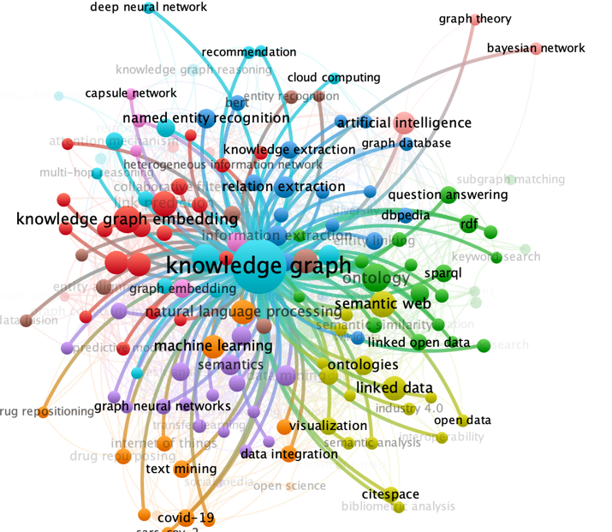
Keyword Co-occurrence of Knowledge Graph
VOSviewer:
Visualizing scientific landscapes
Source: Min-Yuh Day (2021), "Artificial Intelligence for Knowledge Graphs of Cryptocurrency Anti-money Laundering in Fintech",
in Proceedings of the 2021 IEEE/ACM International Conference on Advances in Social Networks Analysis and Mining (ASONAM 2021), Virtual Event, Netherlands, November 8-11, 2021.

Slide 93
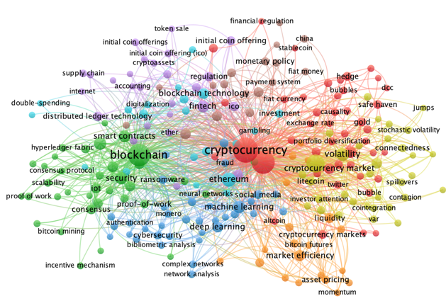
Cryptocurrency
VOSviewer:
Visualizing scientific landscapes
Source: Min-Yuh Day (2021), "Artificial Intelligence for Knowledge Graphs of Cryptocurrency Anti-money Laundering in Fintech",
in Proceedings of the 2021 IEEE/ACM International Conference on Advances in Social Networks Analysis and Mining (ASONAM 2021), Virtual Event, Netherlands, November 8-11, 2021.

Slide 94
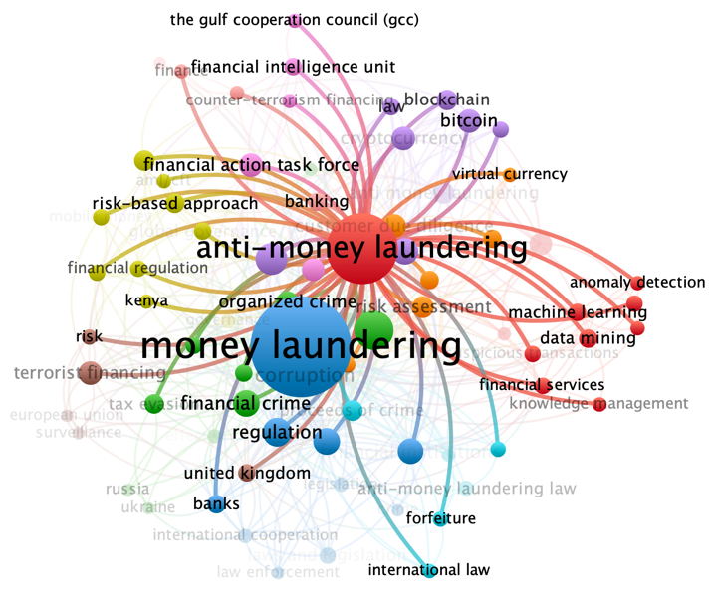
Anti-money Laundering
VOSviewer:
Visualizing scientific landscapes
Source: Min-Yuh Day (2021), "Artificial Intelligence for Knowledge Graphs of Cryptocurrency Anti-money Laundering in Fintech",
in Proceedings of the 2021 IEEE/ACM International Conference on Advances in Social Networks Analysis and Mining (ASONAM 2021), Virtual Event, Netherlands, November 8-11, 2021.

Slide 95
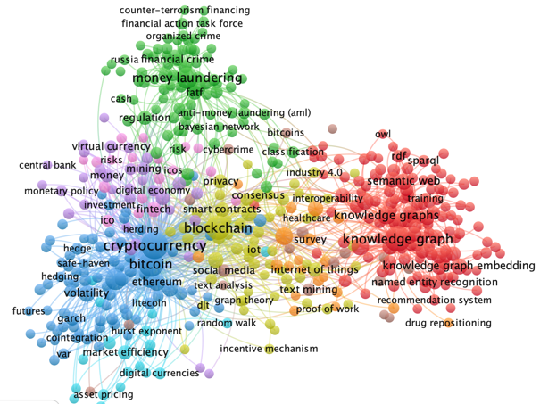
Knowledge Graphs, Cryptocurrency, Anti-money Laundering
VOSviewer:
Visualizing scientific landscapes
Source: Min-Yuh Day (2021), "Artificial Intelligence for Knowledge Graphs of Cryptocurrency Anti-money Laundering in Fintech",
in Proceedings of the 2021 IEEE/ACM International Conference on Advances in Social Networks Analysis and Mining (ASONAM 2021), Virtual Event, Netherlands, November 8-11, 2021.

Slide 96
Top 20 Journal Published Cryptocurrency Research on Web of Science (Total Journals: 1572)
Rank | Journal | Count | Percentage
1 | Finance Research Letters | 82 | 5.22%
2 | IEEE Access | 61 | 3.88%
3 | Journal of Risk and Financial Management | 40 | 2.54%
4 | Physica a-Statistical Mechanics and Its Applications | 39 | 2.48%
5 | Economics Letters | 33 | 2.10%
6 | Research in International Business and Finance | 29 | 1.84%
7 | International Review of Financial Analysis | 28 | 1.78%
8 | Mathematics | 21 | 1.34%
9 | Applied Economics Letters | 20 | 1.27%
10 | Applied Economics | 17 | 1.08%
11 | Journal of Alternative Investments | 16 | 1.02%
12 | Frontiers in Blockchain | 14 | 0.89%
13 | Sustainability | 13 | 0.83%
14 | North American Journal of Economics and Finance | 12 | 0.76%
15 | Plos One | 12 | 0.76%
16 | Future Generation Computer Systems-the International Journal of Escience | 11 | 0.70%
17 | Journal of International Financial Markets Institutions & Money | 11 | 0.70%
18 | Journal of Money Laundering Control | 11 | 0.70%
19 | Technological Forecasting and Social Change | 10 | 0.64%
20 | Chaos Solitons & Fractals | 9 | 0.57%
Source: Min-Yuh Day (2021), "Artificial Intelligence for Knowledge Graphs of Cryptocurrency Anti-money Laundering in Fintech",
in Proceedings of the 2021 IEEE/ACM International Conference on Advances in Social Networks Analysis and Mining (ASONAM 2021), Virtual Event, Netherlands, November 8-11, 2021.

Slide 97
Top 20 Journal Published Anti-money Laundering research on Web of Science (Total Journals: 160)
Rank | Journal | Count | Percentage
1 | Journal of Money Laundering Control | 197 | 45.39%
2 | Crime Law and Social Change | 18 | 4.15%
3 | Trusts & Trustees | 9 | 2.07%
4 | Journal of Financial Regulation and Compliance | 8 | 1.84%
5 | European Journal on Criminal Policy and Research | 6 | 1.38%
6 | Financial and Credit Activity-Problems of Theory and Practice | 6 | 1.38%
7 | IEEE Access | 4 | 0.92%
8 | Journal of Banking Regulation | 4 | 0.92%
9 | International Journal of Disclosure and Governance | 3 | 0.69%
10 | International Review of Law and Economics | 3 | 0.69%
11 | Journal of Criminal Law | 3 | 0.69%
12 | Security Dialogue | 3 | 0.69%
13 | Arab Law Quarterly | 2 | 0.46%
14 | Asian Journal of Accounting and Governance | 2 | 0.46%
15 | Cuestiones Politicas | 2 | 0.46%
16 | Estudios De Economia Aplicada | 2 | 0.46%
17 | European Journal of Crime Criminal Law and Criminal Justice | 2 | 0.46%
18 | European Journal of Law and Economics | 2 | 0.46%
19 | Expert Systems with Applications | 2 | 0.46%
20 | Governance-an International Journal of Policy Administration and Institutions | 2 | 0.46%
Source: Min-Yuh Day (2021), "Artificial Intelligence for Knowledge Graphs of Cryptocurrency Anti-money Laundering in Fintech",
in Proceedings of the 2021 IEEE/ACM International Conference on Advances in Social Networks Analysis and Mining (ASONAM 2021), Virtual Event, Netherlands, November 8-11, 2021.

Slide 98
Summary
AI in FinTech: Financial Services Innovation and Application
Artificial Intelligence for Knowledge Graphs of Cryptocurrency Anti-money Laundering in Fintech

Slide 99
References
Yves Hilpisch (2020), Artificial Intelligence in Finance: A Python-Based Guide, O’Reilly Media.
Yves Hilpisch (2020), Python for Algorithmic Trading: From Idea to Cloud Deployment, O’Reilly
Yves Hilpisch (2021), Financial Theory with Python: A Gentle Introduction, O’Reilly
Yves Hilpisch (2018), Python for Finance: Mastering Data-Driven Finance, 2nd Edition, O'Reilly Media.
Campbell R. Harvey, Ashwin Ramachandran, Joey Santoro, Fred Ehrsam (2021), DeFi and the Future of Finance, Wiley
Aurélien Géron (2019), Hands-On Machine Learning with Scikit-Learn, Keras, and TensorFlow: Concepts, Tools, and Techniques to Build Intelligent Systems, 2nd Edition, O’Reilly Media.
Paolo Sironi (2016), FinTech Innovation: From Robo-Advisors to Goal Based Investing and Gamification, Wiley.
Matt Fortnow and QuHarrison Terry (2021), The NFT Handbook - How to Create, Sell and Buy Non-Fungible Tokens, Wiley
Parma Bains, Mohamed Diaby, Dimitris Drakopoulos, Julia Faltermeier, Federico Grinberg, Evan Papageorgiou, Dmitri Petrov, Patrick Schneider, and Nobu Sugimoto (2021),
The Crypto Ecosystem and Financial Stability Challenges, International Monetary Fund, October 2021
Ramesh Sharda, Dursun Delen, and Efraim Turban (2017), “Business Intelligence, Analytics, and Data Science: A Managerial Perspective”, 4th Edition, Pearson
Frederic S. Mishkin (2015), “The Economics of Money, Banking and Financial Markets”, 11th Edition, Pearson
Xiao-lin Zheng, Meng-ying Zhu, Qi-bing Li, Chao-chao Chen, and Yan-chao Tan (2019), "Finbrain: When finance meets AI 2.0." Frontiers of Information Technology & Electronic Engineering 20, no. 7, pp. 914-924
Liye Ma and Baohong Sun (2020), "Machine learning and AI in marketing – Connecting computing power to human insights." International Journal of Research in Marketing, 37, no. 3, 481-504.
Ahmet Murat Ozbayoglu, Mehmet Ugur Gudelek, and Omer Berat Sezer (2020). "Deep learning for financial applications: A survey." Applied Soft Computing (2020): 106384.
Omer Berat Sezer, Mehmet Ugur Gudelek, and Ahmet Murat Ozbayoglu (2020), "Financial time series forecasting with deep learning: A systematic literature review: 2005–2019." Applied Soft Computing 90 (2020): 106181.
Ji, S., Pan, S., Cambria, E., Marttinen, P., & Philip, S. Y. (2021). “A survey on knowledge graphs: Representation, acquisition, and applications.” IEEE Transactions on Neural Networks and Learning Systems.
Yulu Liao, Min-Yuh Day, Yirung Cheng, Paoyu Huang, and Yensen Ni (2021), "The profitability of Technical Trading for Hotel Stocks Under COVID-19 Pandemic", Journal of Computers, Volume 32, Number 5, October 2021, pp. 44-54.
Yulu Liao, Min-Yuh Day, Yirung Cheng, Paoyu Huang, and Yensen Ni (2021), "Does CBOE volatility index jumped or located at a higher level matter for evaluating DJ 30, NASDAQ, and S&P500 index subsequent performance", Journal of Computers, Volume 32, Number 4, August 2021, pp. 57-66.
Min-Yuh Day, Pao-Yu Huang, Yirung Cheng, Yin-Tzu Lin, and Yensen Ni (2021), "Profitable day trading Bitcoin futures following continuous bullish (bearish) candlesticks", Applied Economics Letters, 16 March 2021, pp. 1-8.
Yensen Ni, Min-Yuh Day, and Paoyu Huang (2020), "Trading Stocks Following Sharp Movements in the USDX, GBP/USD, and USD/CNY", Financial Innovation, Volume 6, 35, 2020, pp. 1-17.
Yensen Ni, Min-Yuh Day, Paoyu Huang, and Shang-Ru Yua (2020), "The profitability of Bollinger Bands: Evidence from the constituent stocks of Taiwan 50", Physica A: Statistical Mechanics and its Applications, Volume 551, 1 August 2020, 124144, pp. 1-14.
Yensen Ni, Paoyu Huang, Yaochia Ku, Yiching Liao, and Min-Yuh Day (2020), "Investing Strategies as Stochastic Oscillator Indicators Staying in Overreaction Zones for Consecutive Days with Big Data Concerns", Journal of Computers, Volume 31, Number 1, February 2020, pp. 1-17.
Yensen Ni, Manhwa Wu, Min-Yuh Day, and Paoyu Huang (2020), "Do sharp movements in oil prices matter for stock markets?", Physica A: Statistical Mechanics and its Applications, Volume 539, 1 February 2020, pp. 1-11.
Min-Yuh Day, Paoyu Huang, and Yensen Ni (2019), "Trading as sharp movements in oil prices and technical trading signals emitted with big data concerns", Physica A: Statistical Mechanics and its Applications, Volume 525, 1 July 2019, pp. 349-372.
Yensen Ni, Min-Yuh Day, and Paoyu Huang (2019), "Does Data Frequency Matter for Trading Signals Emitted by Various Technical Trading Rules? ", Pacific Business Review International, Volume 11, Issue 10, April 2019, pp. 7-17.
Min-Yuh Day, Manhwa Wu, Paoyu Huang, and Yensen Ni (2018), "Investing Strategies as a Sharp Movement in Exchange Rates Occurred– Evidence for the Constituent Stocks of SSE 50 and TW 50", The Journal of Investing, Volume 27, Issue 4, Winter 2018, pp. 58-68.
Min-Yuh Day, Paoyu Huang, Yensen Ni, and Yuhsin Chen (2018), "Do Implicit Phenomena Matter? Evidence from China Stock Index Futures", The Journal of Alternative Investments, Volume 21, Issue 1, Summer 2018, pp. 79-91.
Yensen Ni, Yirung Cheng, Paoyu Huang, and Min-Yuh Day (2018), "Trading strategies in terms of continuous rising (falling) prices or continuous bullish (bearish) candlesticks emitted", Physica A: Statistical Mechanics and its Applications, Volume 501, 1 July 2018, pp. 188-204.
Min-Yuh Day, Paoyu Huang, Yensen Ni, and Yuhsin Chen (2018), "Do Intraday Large Price Changes Matter for Trading Index Futures? Evidence from China Futures Markets", Journal of Financial Studies, Volume 26, Number 2, June 2018, pp. 139-174.
Min-Yuh Day (2021), "Artificial Intelligence for Knowledge Graphs of Cryptocurrency Anti-money Laundering in Fintech", in Proceedings of the 2021 IEEE/ACM International Conference on Advances in Social Networks Analysis and Mining (ASONAM 2021), Virtual Event, Netherlands, November 8-11, 2021.
Min-Yuh Day and Jian-Ting Lin (2019), "Artificial Intelligence for ETF Market Prediction and Portfolio Optimization", in Proceedings of the 2019 IEEE/ACM International Conference on Advances in Social Networks Analysis and Mining (ASONAM 2019), Vancouver, Canada, August 27-30, 2019.
Min-Yuh Day,Tun-Kung Cheng and Jheng-Gang Li (2018), "AI Robo-Advisor with Big Data Analytics for Financial Services", in Proceedings of the 2018 IEEE/ACM International Conference on Advances in Social Networks Analysis and Mining (ASONAM 2018), Barcelona, Spain, August 28-31, 2018.
Min-Yuh Day, Jian-Ting Lin and Yuan-Chih Chen (2018), "Artificial Intelligence for Conversational Robo-Advisor", in Proceedings of the 2018 IEEE/ACM International Conference on Advances in Social Networks Analysis and Mining (ASONAM 2018), Barcelona, Spain, August 28-31, 2018.
Min-Yuh Day and Chia-Chou Lee (2016), "Deep Learning for Financial Sentiment Analysis on Finance News Providers", in Proceedings of the 2016 IEEE/ACM International Conference on Advances in Social Networks Analysis and Mining (ASONAM 2016), San Francisco, California, USA, Aug 18-21, 2016.

Slide 100
智慧金融量化分析
Artificial Intelligence in Finance and Quantitative Analysis
Q & A
Host: Prof. Yi-Ling Chen
Computer Science and Information Engineering, National Taiwan University of Science and Technology
Time: 14:00-15:00, Dec. 6, 2021 (Monday)
Place: AU-101, CSIE, NTUST
Address: No.43, Keelung Rd., Sec.4, Da'an Dist., Taipei, Taiwan
戴敏育 副教授
Min-Yuh Day, Ph.D, Associate Professor
國立臺北大學 資訊管理研究所
Institute of Information Management, National Taipei University
https://web.ntpu.edu.tw/~myday
2021-12-06

