Slide 1








Artificial Intelligence for Text Analytics in FinTech
(金融科技人工智慧文本分析)
Host: 林正偉 教授 (Prof. Jeng-Wei Lin)
Department of Information Management, Tunghai University (THU)
Time: 14:10-16:00, March 10, 2022 (Thursday)
Place: M240, IM, College of Management, THU
Address: No.1727, Sec.4, Taiwan Boulevard, Xitun District, Taichung City 407224, Taiwan
戴敏育 副教授
Min-Yuh Day, Ph.D, Associate Professor
國立臺北大學 資訊管理研究所
Institute of Information Management, National Taipei University
https://web.ntpu.edu.tw/~myday
2022-03-10

Slide 2










戴敏育 博士
(Min-Yuh Day, Ph.D.)
1
國立臺北大學 資訊管理研究所 副教授
中央研究院 資訊科學研究所 訪問學人
國立臺灣大學 資訊管理 博士
Publications Co-Chairs, IEEE/ACM International Conference on
Advances in Social Networks Analysis and Mining (ASONAM 2013- )
Program Co-Chair, IEEE International Workshop on
Empirical Methods for Recognizing Inference in TExt (IEEE EM-RITE 2012- )
Publications Chair, The IEEE International Conference on
Information Reuse and Integration for Data Science (IEEE IRI)

Slide 3
Outline
AI for Text Analytics
FinTech: Financial Services Innovation
Artificial Intelligence for Knowledge Graphs of Cryptocurrency Anti-money Laundering in Fintech

Slide 4
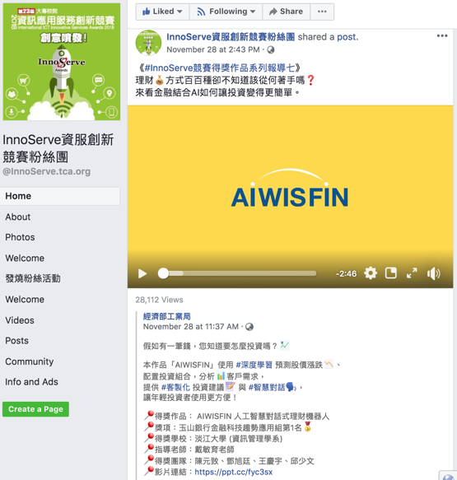
AIWISFIN
AI Conversational Robo-Advisor
(人工智慧對話式理財機器人)
First Place, InnoServe Awards 2018
https://www.youtube.com/watch?v=sEhmyoTXmGk

Slide 5

2018 The 23th International ICT
Innovative Services Awards
(InnoServe Awards 2018)
Annual ICT application competition held for university and college students
The largest and the most significant contest in Taiwan.
More than ten thousand teachers and students from over one hundred universities and colleges have participated in the Contest.
https://innoserve.tca.org.tw/award.aspx

Slide 6
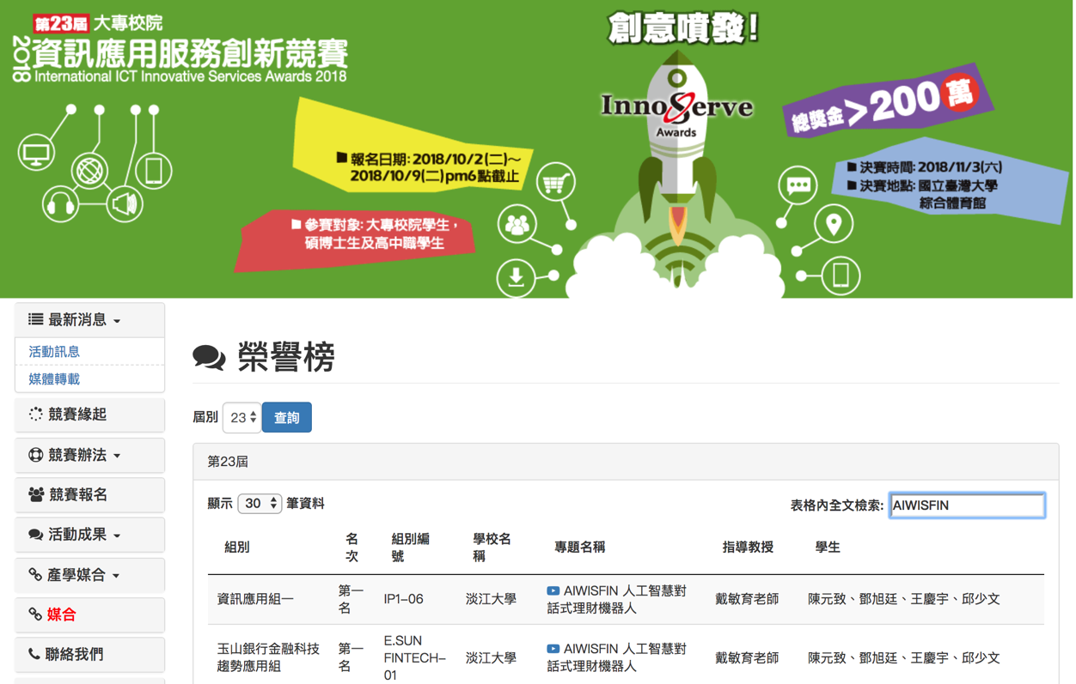
2018 International ICT Innovative Services Awards (InnoServe Awards 2018)
(2018第23屆大專校院資訊應用服務創新競賽)
https://innoserve.tca.org.tw/award.aspx

Slide 7



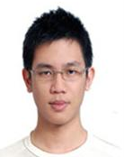
Tamkang University
2011
Tamkang
University
IMTKU Textual Entailment System for
Recognizing Inference in Text
at NTCIR-9 RITE
Department of Information Management
Tamkang University, Taiwan
Min-Yuh Day
Chun Tu
myday@mail.tku.edu.tw
NTCIR-9 Workshop, December 6-9, 2011, Tokyo, Japan

Slide 8



IMTKU Textual Entailment System for
Recognizing Inference in Text at NTCIR-10 RITE-2
Tamkang University
2013
Tamkang
University
Department of Information Management
Tamkang University, Taiwan
Min-Yuh Day
Chun Tu
Hou-Cheng Vong
Shih-Wei Wu
Shih-Jhen Huang
myday@mail.tku.edu.tw
NTCIR-10 Conference, June 18-21, 2013, Tokyo, Japan

Slide 9

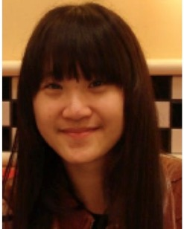
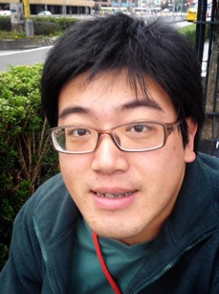
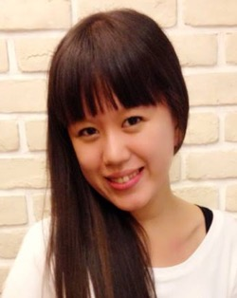

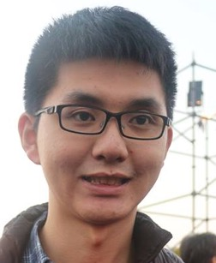

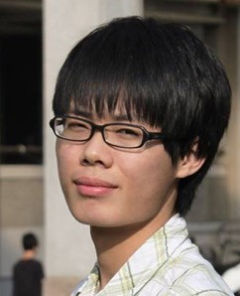

IMTKU Textual Entailment System for
Recognizing Inference in Text at NTCIR-11 RITE-VAL
2014
Tamkang University
Min-Yuh Day
Ya-Jung Wang
Che-Wei Hsu
En-Chun Tu
Huai-Wen Hsu
Yu-An Lin
Shang-Yu Wu
Yu-Hsuan Tai
Cheng-Chia Tsai
NTCIR-11 Conference, December 8-12, 2014, Tokyo, Japan

Slide 10






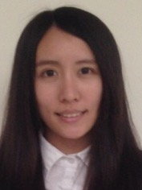
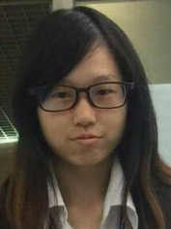
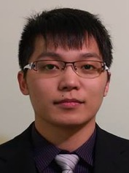

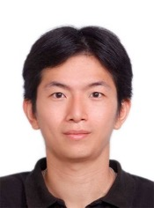
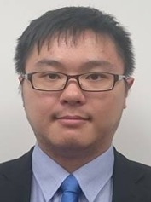
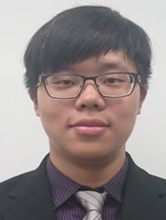

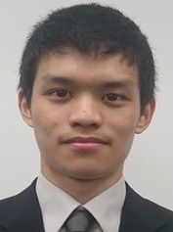

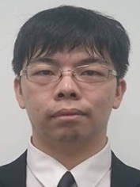

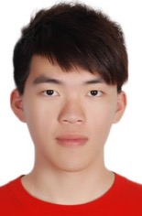
IMTKU Question Answering System for
World History Exams at NTCIR-12 QA Lab2
2016
Tamkang University
Department of Information Management
Tamkang University, Taiwan
Sagacity Technology
Min-Yuh Day
Cheng-Chia Tsai
Wei-Chun Chung
Hsiu-Yuan Chang
Tzu-Jui Sun
Yuan-Jie Tsai
Jin-Kun Lin
Cheng-Hung Lee
Yu-Ming Guo
Yue-Da Lin
Wei-Ming Chen
Yun-Da Tsai
Cheng-Jhih Han
Yi-Jing Lin
Yi-Heng Chiang
Ching-Yuan Chien
myday@mail.tku.edu.tw
NTCIR-12 Conference, June 7-10, 2016, Tokyo, Japan

Slide 11
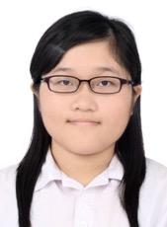



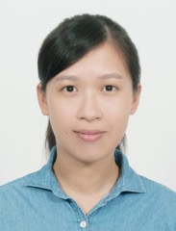



IMTKU Question Answering System for
World History Exams at NTCIR-13 QALab-3
2017
Tamkang University
Department of Information Management
Tamkang University, Taiwan
Min-Yuh Day
Chao-Yu Chen
Wanchu Huang
Shi-Ya Zheng
I-Hsuan Huang
Tz-Rung Chen
Min-Chun Kuo
Yue-Da Lin
Yi-Jing Lin
myday@mail.tku.edu.tw
NTCIR-13 Conference, December 5-8, 2017, Tokyo, Japan

Slide 12
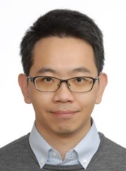
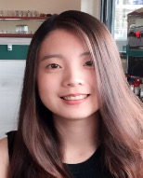
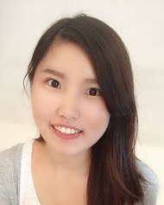
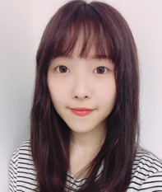
IMTKU Emotional Dialogue System for
Short Text Conversation at NTCIR-14 STC-3 (CECG) Task
2019
Tamkang University
Department of Information Management
Tamkang University, Taiwan
Min-Yuh Day
Chi-Sheng Hung
Yi-Jun Xie
Jhih-Yi Chen
Yu-Ling Kuo
Jian-Ting Lin
myday@mail.tku.edu.tw
NTCIR-14 Conference, June 10-13, 2019, Tokyo, Japan

Slide 13

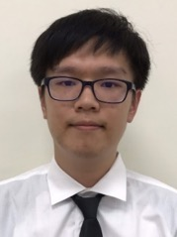
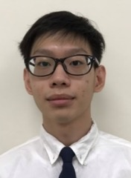
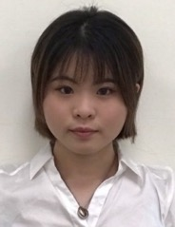
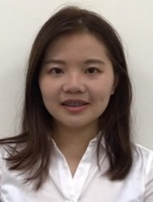

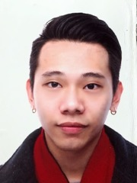

IMTKU Multi-Turn Dialogue System Evaluation at the NTCIR-15 DialEval-1
Dialogue Quality and Nugget Detection
2020
Tamkang University
¹ Zeals Co., Ltd. Tokyo, Japan
² Information Management, Tamkang University, Taiwan
³ Information Management, National Taipei University, Taiwan
Mike Tian-Jian Jiang¹
Zhao-Xian Gu²
Cheng-Jhe Chiang²
Yueh-Chia Wu²
Yu-Chen Huang²
Cheng-Han Chiu²
Sheng-Ru Shaw²
Min-Yuh Day³
NTCIR-15 Conference, December 8-11, 2020, Tokyo, Japan

Slide 14
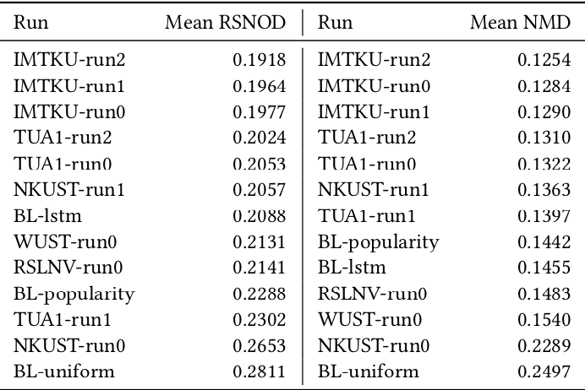
NTCIR-15 Dialogue Evaluation (DialEval-1) Task
Dialogue Quality (DQ) and Nugget Detection (ND)
Chinese Dialogue Quality (S-score) Results (Zeng et al., 2020)
2020
Source: Zeng, Zhaohao, Sosuke Kato, Tetsuya Sakai, and Inho Kang (2020), “Overview of the NTCIR-15 Dialogue Evaluation (DialEval-1) Task”, Proceedings of NTCIR-15, 2020

Slide 15
Transformer-based
Models Selection
Fine-tuning Techniques
FinNum-2
BERT
DialEval-1
Discriminative Fine-tuning
Transfer
Learning
RoBERTa
One-cycle Policy
XLM-RoBERTa
Optimization
Tokenization Tricks
Pre-trained Models
Source: Jiang, Mike Tian-Jian, Shih-Hung Wu, Yi-Kun Chen, Zhao-Xian Gu, Cheng-Jhe Chiang, Yueh-Chia Wu, Yu-Chen Huang, Cheng-Han Chiu, Sheng-Ru Shaw, and Min-Yuh Day (2020). "Fine-tuning techniques and data augmentation on transformer-based models for conversational texts and noisy user-generated content." In 2020 IEEE/ACM International Conference on Advances in Social Networks Analysis and Mining (ASONAM), pp. 919-925. IEEE, 2020.

Slide 16

IMTKU Emotional Dialogue System Architecture
1
3
4
Retrieval-Based Model
Emotion Classification
Model
Response
Ranking
Generation-Based Model
2
NTCIR-14 Conference, June 10-13, 2019, Tokyo, Japan

Slide 17
Short Text Conversation Task
(STC-3)
Chinese Emotional Conversation Generation (CECG) Subtask
Source: http://coai.cs.tsinghua.edu.cn/hml/challenge.html

Slide 18
NTCIR Short Text Conversation
STC-1, STC-2, STC-3
Source: https://waseda.app.box.com/v/STC3atNTCIR-14

Slide 19
AI Humanoid
Robo-Advisor

Slide 20
AI Humanoid Robo-Advisor for Multi-channel Conversational Commerce
AI Portfolio
Asset Allocation
Multichannel
Platforms
Web
LINE
Facebook
Humanoid Robot
AI Conversation
Dialog System

Slide 21
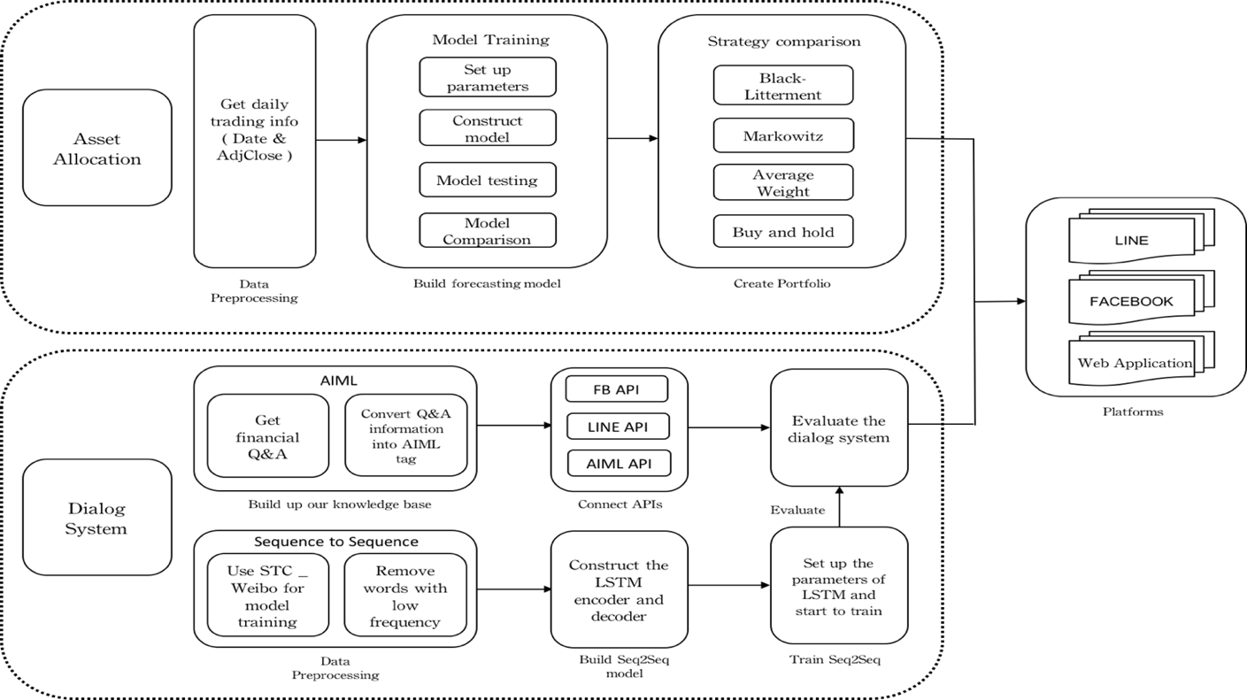
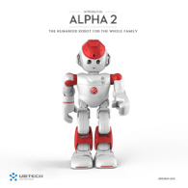

System Architecture of
AI Humanoid Robo-Advisor
AI Humanoid
Robo-advisor

Slide 22
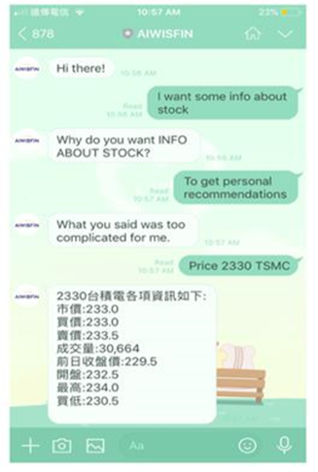
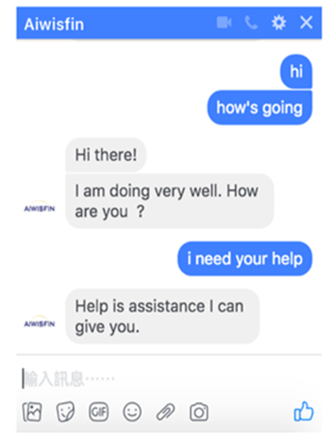
Conversational Model
(LINE, FB Messenger)

Slide 23

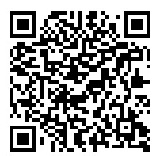


Conversational Robo-Advisor
Multichannel UI/UX
Robots
ALPHA 2
ZENBO

Slide 24
Artificial Intelligence (AI) for
Text Analytics (TA)

Slide 25
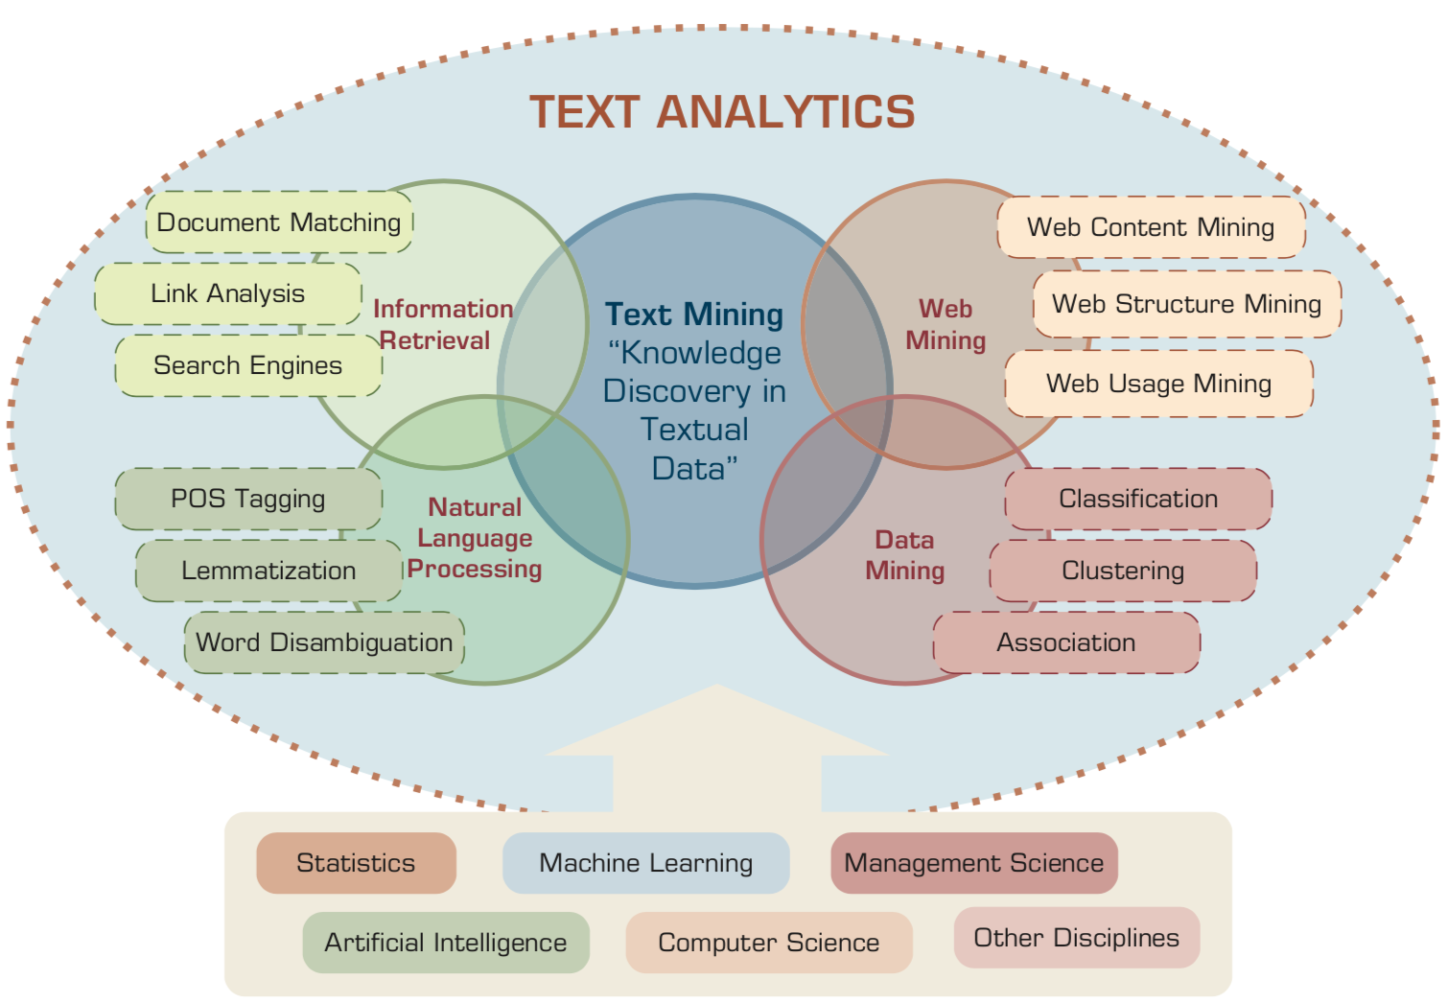
Text Analytics and Text Mining
Source: Ramesh Sharda, Dursun Delen, and Efraim Turban (2017), Business Intelligence, Analytics, and Data Science: A Managerial Perspective, 4th Edition, Pearson

Slide 26
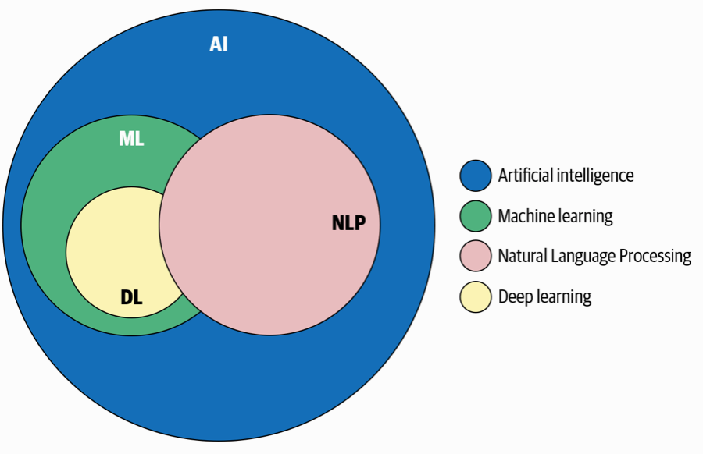
AI, NLP, ML, DL
Source: Sowmya Vajjala, Bodhisattwa Majumder, Anuj Gupta (2020), Practical Natural Language Processing: A Comprehensive Guide to Building Real-World NLP Systems, O'Reilly Media.

Slide 27
Artificial Intelligence
(AI)

Slide 28
AI, Big Data, Cloud Computing
Evolution of Decision Support, Business Intelligence, and Analytics
AI
AI
Cloud Computing
Big Data
DM
BI
Source: Ramesh Sharda, Dursun Delen, and Efraim Turban (2017),
Business Intelligence, Analytics, and Data Science: A Managerial Perspective, 4th Edition, Pearson

Slide 29
The Rise of AI
Source: DHL (2018), Artificial Intelligence in Logistics,
http://www.globalhha.com/doclib/data/upload/doc_con/5e50c53c5bf67.pdf/

Slide 30
Definition of
Artificial Intelligence (A.I.)

Slide 31
Artificial Intelligence
“… the science and engineering of making intelligent machines”
(John McCarthy, 1955)
Source: https://digitalintelligencetoday.com/artificial-intelligence-defined-useful-list-of-popular-definitions-from-business-and-science/

Slide 32
Artificial Intelligence
“… technology that thinks and acts like humans”
Source: https://digitalintelligencetoday.com/artificial-intelligence-defined-useful-list-of-popular-definitions-from-business-and-science/

Slide 33
Artificial Intelligence
“… intelligence exhibited by machines or software”
Source: https://digitalintelligencetoday.com/artificial-intelligence-defined-useful-list-of-popular-definitions-from-business-and-science/

Slide 34
4 Approaches of AI
Thinking Humanly | Thinking Rationally
Acting Humanly | Acting Rationally
Source: Stuart Russell and Peter Norvig (2020), Artificial Intelligence: A Modern Approach, 4th Edition, Pearson

Slide 35
4 Approaches of AI
2. Thinking Humanly: The Cognitive Modeling Approach | 3. Thinking Rationally: The “Laws of Thought” Approach
1. Acting Humanly: The Turing Test Approach (1950) | 4. Acting Rationally: The Rational Agent Approach
Source: Stuart Russell and Peter Norvig (2020), Artificial Intelligence: A Modern Approach, 4th Edition, Pearson

Slide 36
AI Acting Humanly:
The Turing Test Approach
(Alan Turing, 1950)
Knowledge Representation
Automated Reasoning
Machine Learning (ML)
  Deep Learning (DL)
Computer Vision (Image, Video)
Natural Language Processing (NLP)
Robotics
Source: Stuart Russell and Peter Norvig (2020), Artificial Intelligence: A Modern Approach, 4th Edition, Pearson

Slide 37
AI, ML, DL
Artificial Intelligence (AI)
Machine Learning (ML)
Supervised
Learning
Unsupervised Learning
Deep Learning (DL)
CNN
RNN LSTM GRU
GAN
Semi-supervised Learning
Reinforcement Learning
Source: https://leonardoaraujosantos.gitbooks.io/artificial-inteligence/content/deep_learning.html

Slide 38
3 Machine Learning Algorithms
Source: Enrico Galimberti, http://blogs.teradata.com/data-points/tree-machine-learning-algorithms/

Slide 39
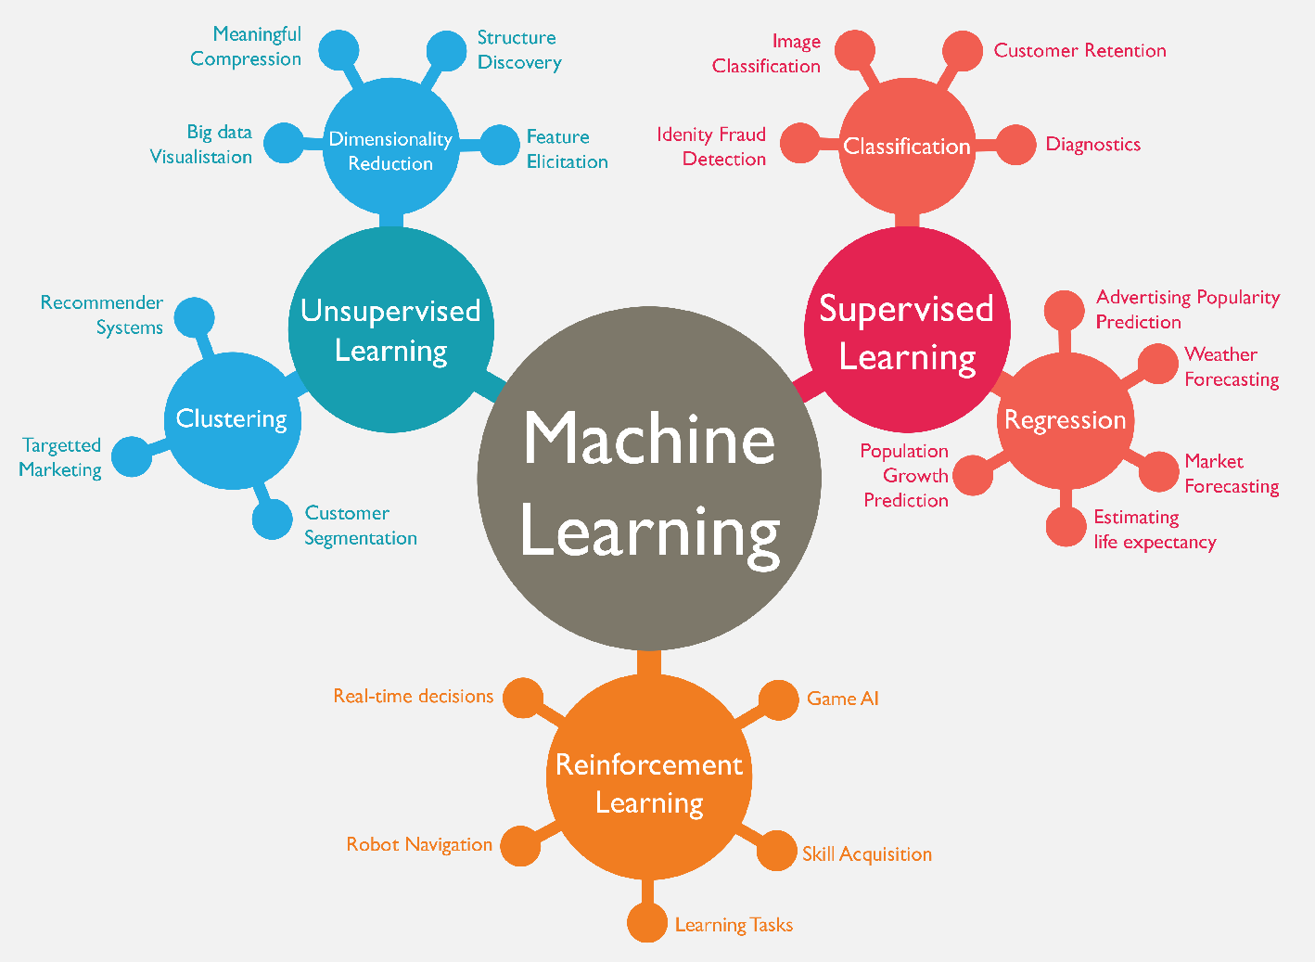
Machine Learning (ML)
Source: https://www.mactores.com/services/aws-big-data-machine-learning-cognitive-services/

Slide 40
Machine Learning Models
Deep Learning
Kernel
Association rules
Ensemble
Decision tree
Dimensionality reduction
Clustering
Regression Analysis
Bayesian
Instance based
Source: Sunila Gollapudi (2016), Practical Machine Learning, Packt Publishing

Slide 41
Machine Learning (ML) / Deep Learning (DL)
Decision Tree Classifiers
Support Vector Machine (SVM)
Supervised Learning
Neural Network (NN)
Linear Classifiers
Deep Learning (DL)
Machine Learning
(ML)
Rule-based Classifiers
Naïve Bayes
(NB)
Unsupervised Learning
Probabilistic Classifiers
Bayesian Network (BN)
Maximum Entropy (ME)
Reinforcement Learning
Source: Jesus Serrano-Guerrero, Jose A. Olivas, Francisco P. Romero, and Enrique Herrera-Viedma (2015),
"Sentiment analysis: A review and comparative analysis of web services," Information Sciences, 311, pp. 18-38.

Slide 42
Text Analytics and
Text Mining

Slide 43
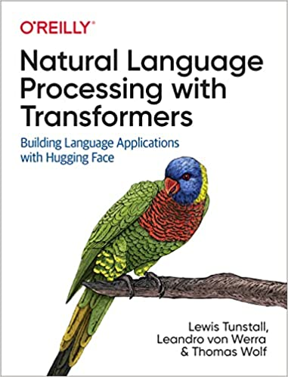
Lewis Tunstall, Leandro von Werra, and Thomas Wolf (2022),
Natural Language Processing with Transformers:
Building Language Applications with Hugging Face,
O'Reilly Media.
Source: https://www.amazon.com/Natural-Language-Processing-Transformers-Applications/dp/1098103246

Slide 44
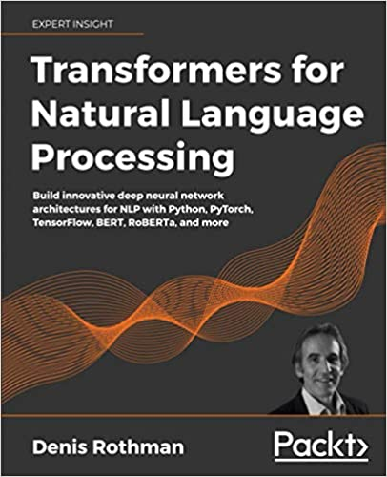
Denis Rothman (2021),
Transformers for Natural Language Processing:
Build innovative deep neural network architectures for NLP with Python, PyTorch, TensorFlow, BERT, RoBERTa, and more,
Packt Publishing.
Source: https://www.amazon.com/Transformers-Natural-Language-Processing-architectures/dp/1800565798

Slide 45
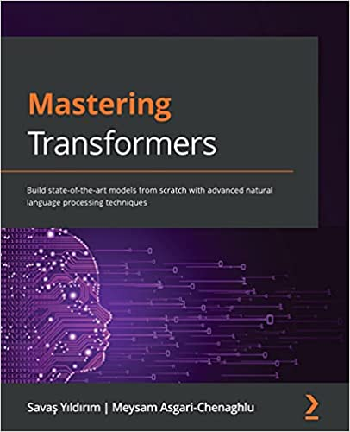
Savaş Yıldırım and Meysam Asgari-Chenaghlu (2021),
Mastering Transformers:
Build state-of-the-art models from scratch with advanced natural language processing techniques,
Packt Publishing.
Source: https://www.amazon.com/Mastering-Transformers-state-art-processing/dp/1801077657/

Slide 46
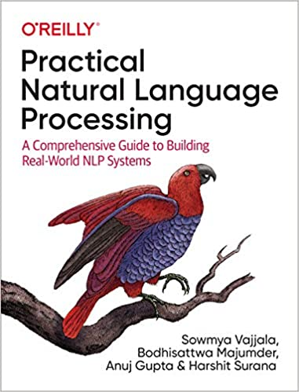
Sowmya Vajjala, Bodhisattwa Majumder, Anuj Gupta (2020), Practical Natural Language Processing:
A Comprehensive Guide to Building Real-World NLP Systems,
O'Reilly Media.
Source: https://www.amazon.com/Practical-Natural-Language-Processing-Pragmatic/dp/1492054054

Slide 47
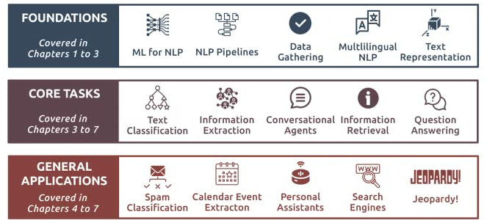
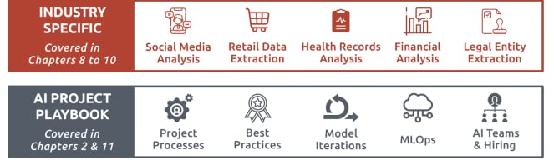
Source: Sowmya Vajjala, Bodhisattwa Majumder, Anuj Gupta (2020), Practical Natural Language Processing: A Comprehensive Guide to Building Real-World NLP Systems, O'Reilly Media.
Source: https://www.amazon.com/Practical-Natural-Language-Processing-Pragmatic/dp/1492054054

Slide 48
Text Analytics
(TA)

Slide 49
Text Analytics
Text Analytics =
Information Retrieval +
Information Extraction +
Data Mining +
Web Mining
Text Analytics =
Information Retrieval +
Text Mining
Source: Ramesh Sharda, Dursun Delen, and Efraim Turban (2017), Business Intelligence, Analytics, and Data Science: A Managerial Perspective, 4th Edition, Pearson

Slide 50
Text Mining
Text Data Mining
Knowledge Discovery in
Textual Databases
Source: Ramesh Sharda, Dursun Delen, and Efraim Turban (2017), Business Intelligence, Analytics, and Data Science: A Managerial Perspective, 4th Edition, Pearson

Slide 51
Text Mining Technologies
Statistics
Machine Learning
Pattern Recognition
Database Systems
Visualization
Text Mining
Natural Language Processing
Algorithms
Information Retrieval
Applications
High-performance Computing
Adapted from: Jiawei Han and Micheline Kamber (2011), Data Mining: Concepts and Techniques, Third Edition, Elsevier

Slide 52
Application Areas of Text Mining
Information extraction
Topic tracking
Summarization
Categorization
Clustering
Concept linking
Question answering
Source: Ramesh Sharda, Dursun Delen, and Efraim Turban (2017), Business Intelligence, Analytics, and Data Science: A Managerial Perspective, 4th Edition, Pearson

Slide 53


Emotions
Love
Anger
Joy
Sadness
Surprise
Fear
Source: Bing Liu (2011) , “Web Data Mining: Exploring Hyperlinks, Contents, and Usage Data,” Springer, 2nd Edition,

Slide 54
Example of Opinion: review segment on iPhone
“I bought an iPhone a few days ago.
It was such a nice phone.
The touch screen was really cool.
The voice quality was clear too.
However, my mother was mad with me as I did not tell her before I bought it.
She also thought the phone was too expensive, and wanted me to return it to the shop. … ”
Source: Bing Liu (2011) , “Web Data Mining: Exploring Hyperlinks, Contents, and Usage Data,” Springer, 2nd Edition,

Slide 55
Example of Opinion:
review segment on iPhone
“(1) I bought an iPhone a few days ago.
(2) It was such a nice phone.
(3) The touch screen was really cool.
(4) The voice quality was clear too.
(5) However, my mother was mad with me as I did not tell her before I bought it.
(6) She also thought the phone was too expensive, and wanted me to return it to the shop. … ”
+Positive Opinion
-Negative Opinion
Source: Bing Liu (2011) , “Web Data Mining: Exploring Hyperlinks, Contents, and Usage Data,” Springer, 2nd Edition,

Slide 56
Sentiment Analysis
Subjectivity
Classification
Polarity Determination
Approaches
Machine Learning based
Sentiment Classification
Vagueness resolution in opinionated text
Lexicon based
Sentiment Analysis
Review Usefulness Measurement
Multi- & Cross- Lingual SC
Hybrid
approaches
Opinion Spam Detection
Cross-domain SC
Lexicon Creation
Ontology based
Tasks
Non-Ontology based
Aspect Extraction
Application
Source: Kumar Ravi and Vadlamani Ravi (2015), "A survey on opinion mining and sentiment analysis: tasks, approaches and applications." Knowledge-Based Systems, 89, pp.14-46.

Slide 57
Sentiment Classification Techniques
Decision Tree Classifiers
Support Vector Machine (SVM)
Supervised Learning
Neural Network (NN)
Machine Learning Approach
Linear Classifiers
Deep Learning (DL)
Rule-based Classifiers
Naïve Bayes
(NB)
Sentiment Analysis
Unsupervised Learning
Probabilistic Classifiers
Bayesian Network (BN)
Dictionary-based Approach
Maximum Entropy (ME)
Lexicon-based Approach
Statistical
Corpus-based Approach
Semantic
Source: Jesus Serrano-Guerrero, Jose A. Olivas, Francisco P. Romero, and Enrique Herrera-Viedma (2015),
"Sentiment analysis: A review and comparative analysis of web services," Information Sciences, 311, pp. 18-38.

Slide 58
Social Analytics
Social analytics is defined as
monitoring, analyzing,
measuring and interpreting
digital interactions and
relationships of people, topics, ideas and content.
Source: Ramesh Sharda, Dursun Delen, and Efraim Turban (2017), Business Intelligence, Analytics, and Data Science: A Managerial Perspective, 4th Edition, Pearson

Slide 59
Branches of Social Analytics
Social Network Analysis (SNA)
Social Analytics
Social Media Analytics
Source: Ramesh Sharda, Dursun Delen, and Efraim Turban (2017), Business Intelligence, Analytics, and Data Science: A Managerial Perspective, 4th Edition, Pearson

Slide 60
Text Mining
Technologies

Slide 61
Natural Language Processing
(NLP)
Text Mining
(TM)

Slide 62
Text mining
Text Data Mining
Intelligent Text Analysis
Knowledge-Discovery in Text (KDT)
Source: Vishal Gupta and Gurpreet S. Lehal (2009), "A survey of text mining techniques and applications,"
Journal of emerging technologies in web intelligence, vol. 1, no. 1, pp. 60-76.

Slide 63
Text Mining
(text data mining)
  the process of
  deriving
  high-quality information
  from text
http://en.wikipedia.org/wiki/Text_mining

Slide 64
Text Mining: the process of extracting interesting and non-trivial information and knowledge from unstructured text.
Source: Vishal Gupta and Gurpreet S. Lehal (2009), "A survey of text mining techniques and applications,"
Journal of emerging technologies in web intelligence, vol. 1, no. 1, pp. 60-76.

Slide 65
Text Mining: discovery by computer of new, previously unknown information, by automatically extracting information from different written resources.
Source: Vishal Gupta and Gurpreet S. Lehal (2009), "A survey of text mining techniques and applications,"
Journal of emerging technologies in web intelligence, vol. 1, no. 1, pp. 60-76.

Slide 66
An example of Text Mining
Knowledge
Analyze Text
Management Information System
Information Extraction
Classification
Summarization
Retrieve and preprocess document
Clustering
Document Collection
Source: Vishal Gupta and Gurpreet S. Lehal (2009), "A survey of text mining techniques and applications,"
Journal of emerging technologies in web intelligence, vol. 1, no. 1, pp. 60-76.

Slide 67
Overview of
Information Extraction based
Text Mining Framework
Text Data Mining
Text
Text
DB
Text
Information Extraction
Data Mining
Rule
Source: Vishal Gupta and Gurpreet S. Lehal (2009), "A survey of text mining techniques and applications,"
Journal of emerging technologies in web intelligence, vol. 1, no. 1, pp. 60-76.

Slide 68
Natural Language Processing (NLP)
Natural language processing (NLP)
is an important component of
text mining and
is a subfield of
artificial intelligence and
computational linguistics.
Source: Ramesh Sharda, Dursun Delen, and Efraim Turban (2017), Business Intelligence, Analytics, and Data Science: A Managerial Perspective, 4th Edition, Pearson

Slide 69
Natural Language Processing (NLP) and Text Mining
Raw text
Sentence Segmentation
Tokenization
Part-of-Speech (POS)
Stop word removal
word’s stem
am → am
having → hav
word’s lemma
am → be
having → have
Stemming / Lemmatization
Dependency Parser
String Metrics & Matching
Source: Nitin Hardeniya (2015), NLTK Essentials, Packt Publishing; Florian Leitner (2015), Text mining - from Bayes rule to dependency parsing

Slide 70
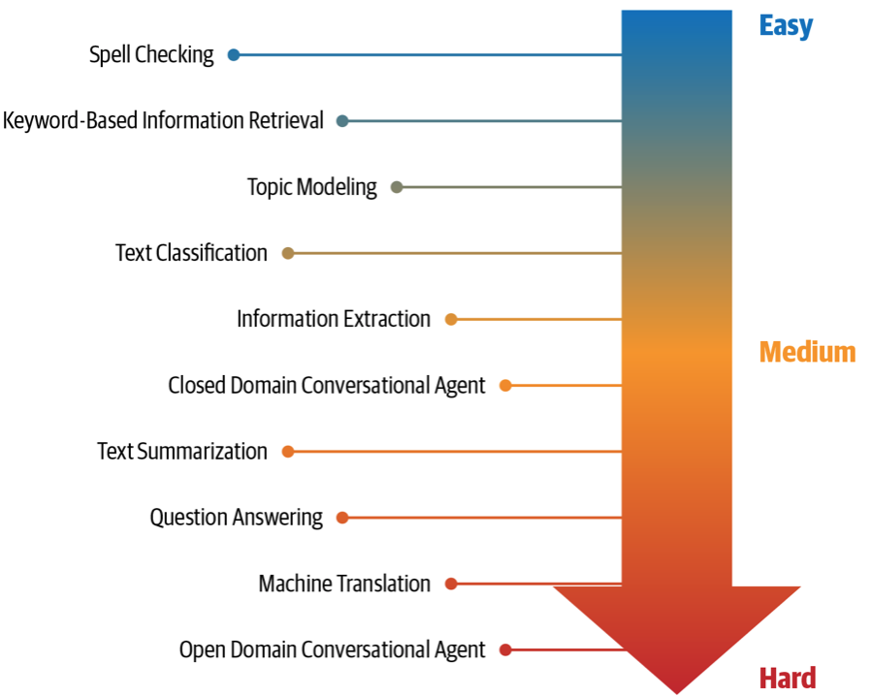
NLP Tasks
Source: Sowmya Vajjala, Bodhisattwa Majumder, Anuj Gupta (2020), Practical Natural Language Processing: A Comprehensive Guide to Building Real-World NLP Systems, O'Reilly Media.

Slide 71
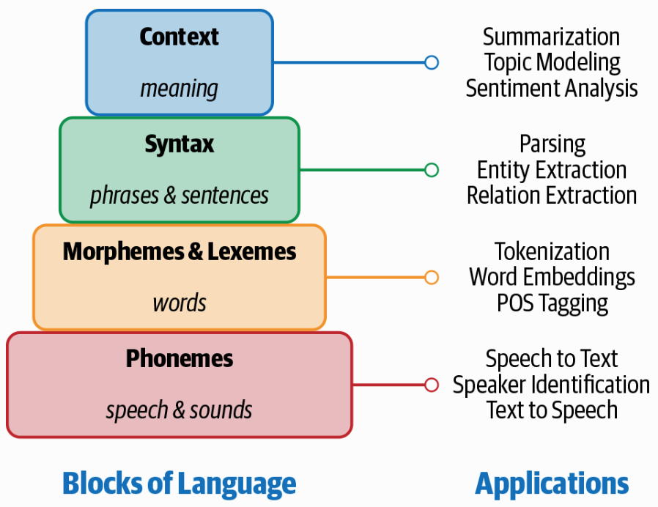
Building Blocks of Language and Applications
Source: Sowmya Vajjala, Bodhisattwa Majumder, Anuj Gupta (2020), Practical Natural Language Processing: A Comprehensive Guide to Building Real-World NLP Systems, O'Reilly Media.

Slide 72
Text Summarization
Text Input
Dictionary / Thesaurus
Pre-processing
Text Structure Analysis
Word Segmentation
Occurrence Statistic
POS Tagging
Keyword Extraction
Weigh Words & Sentences
Sentences Selection
Rough Summary Generation
Smoothing
Summary Output
Source: Vishal Gupta and Gurpreet S. Lehal (2009), "A survey of text mining techniques and applications,"
Journal of emerging technologies in web intelligence, vol. 1, no. 1, pp. 60-76.

Slide 73
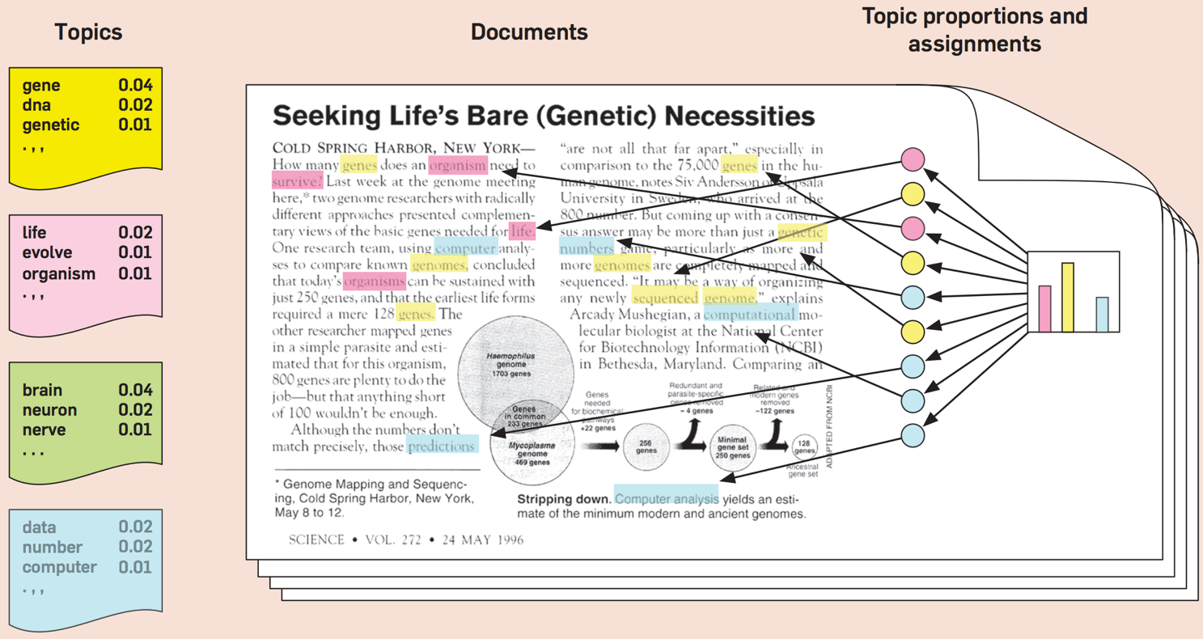
Topic Modeling
Source: Blei, David M. "Probabilistic topic models." Communications of the ACM 55, no. 4 (2012): 77-84.

Slide 74
Natural Language Processing (NLP)
Part-of-speech tagging
Text segmentation
Word sense disambiguation
Syntactic ambiguity
Imperfect or irregular input
Speech acts
Source: Ramesh Sharda, Dursun Delen, and Efraim Turban (2017), Business Intelligence, Analytics, and Data Science: A Managerial Perspective, 4th Edition, Pearson

Slide 75
NLP Tasks
Question answering
Automatic summarization
Natural language generation
Natural language understanding
Machine translation
Foreign language reading
Foreign language writing.
Speech recognition
Text-to-speech
Text proofing
Optical character recognition
Source: Ramesh Sharda, Dursun Delen, and Efraim Turban (2017), Business Intelligence, Analytics, and Data Science: A Managerial Perspective, 4th Edition, Pearson

Slide 76
NLP
Source: http://blog.aylien.com/leveraging-deep-learning-for-multilingual/

Slide 77
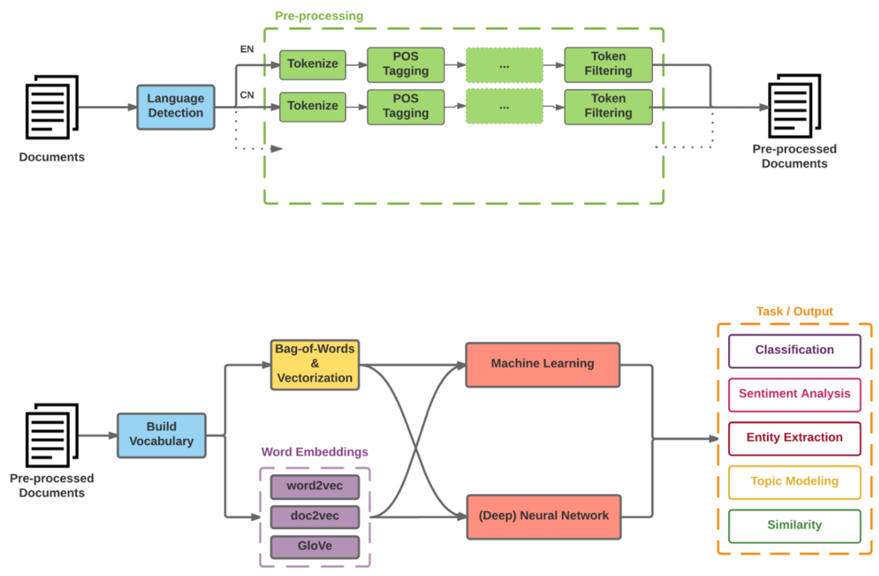
Modern NLP Pipeline
Source: https://github.com/fortiema/talks/blob/master/opendata2016sh/pragmatic-nlp-opendata2016sh.pdf

Slide 78
Modern NLP Pipeline
Source: http://mattfortier.me/2017/01/31/nlp-intro-pt-1-overview/

Slide 79
Deep Learning NLP
Source: http://mattfortier.me/2017/01/31/nlp-intro-pt-1-overview/

Slide 80
Outline
AI for Text Analytics
FinTech: Financial Services Innovation
Artificial Intelligence for Knowledge Graphs of Cryptocurrency Anti-money Laundering in Fintech

Slide 81
FinTech:
Financial Services
Innovation

Slide 82
FinTech

Slide 83
Financial Technology
FinTech
“providing
financial services
by making use of software and
modern technology”
Source: https://www.fintechweekly.com/fintech-definition

Slide 84
Financial Services

Slide 85

Financial Services
Source: http://www.crackitt.com/7-reasons-why-your-fintech-startup-needs-visual-marketing/

Slide 86
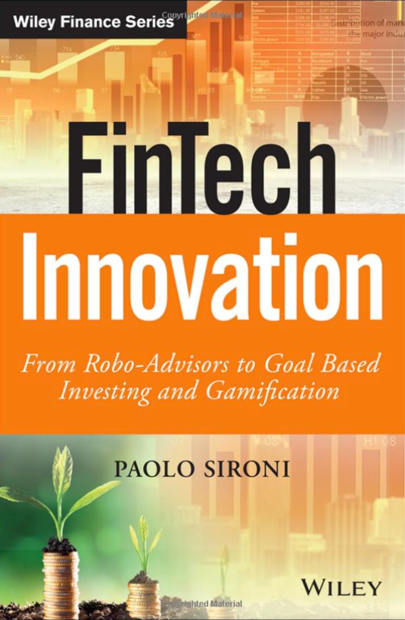
Paolo Sironi (2016)
FinTech Innovation:
From Robo-Advisors to Goal Based Investing and Gamification,
Wiley
Source: https://www.amazon.com/FinTech-Innovation-Robo-Advisors-Investing-Gamification/dp/1119226988

Slide 87
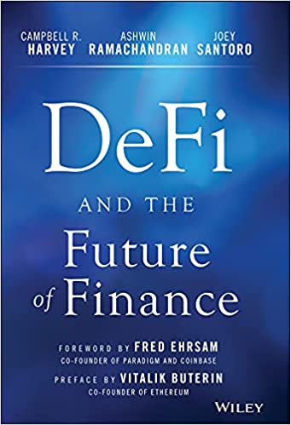
Campbell R. Harvey, Ashwin Ramachandran, Joey Santoro, Fred Ehrsam (2021),
DeFi and the Future of Finance,
Wiley
Source: https://www.amazon.com/DeFi-Future-Finance-Campbell-Harvey-ebook/dp/B09DJV2QLC

Slide 88
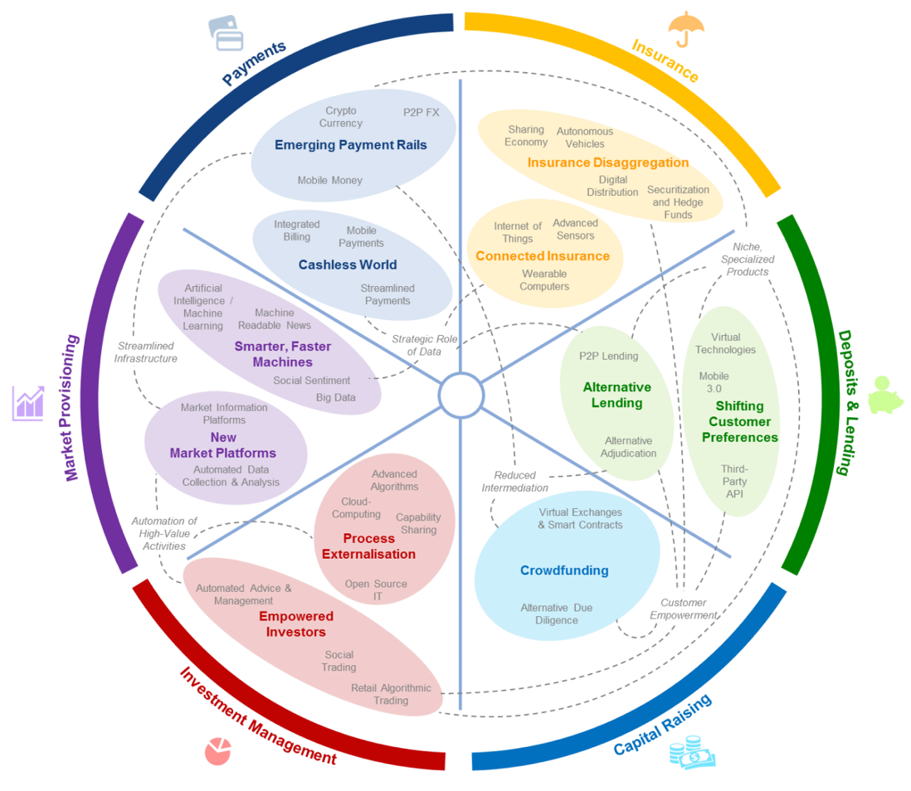
FinTech: Financial Services Innovation
Source: http://www3.weforum.org/docs/WEF_The_future__of_financial_services.pdf

Slide 89
FinTech:
Financial Services Innovation
1. Payments
2. Insurance
3. Deposits & Lending
4. Capital Raising
5. Investment Management
6. Market Provisioning
Source: http://www3.weforum.org/docs/WEF_The_future__of_financial_services.pdf

Slide 90

FinTech: Investment Management
5
Source: http://www3.weforum.org/docs/WEF_The_future__of_financial_services.pdf

Slide 91

FinTech: Market Provisioning
6
Source: http://www3.weforum.org/docs/WEF_The_future__of_financial_services.pdf

Slide 92
FinTech ABCD
AI
Block Chain
Cloud Computing
Big Data

Slide 93
Decentralized Finance (DeFi)
Block Chain Financial Technology
Block Chain & Bitcoin
(BTC)
Smart Contract & Ethereum
(ETH)
Decentralized Application
(DApp)

Slide 94
AI in
FinTech

Slide 95

FinBrain: when Finance meets AI 2.0
(Zheng et al., 2019)
Source: Xiao-lin Zheng, Meng-ying Zhu, Qi-bing Li, Chao-chao Chen, and Yan-chao Tan (2019), "Finbrain: When finance meets AI 2.0." Frontiers of Information Technology & Electronic Engineering 20, no. 7, pp. 914-924

Slide 96
Technology-driven
Financial Industry Development
Development stage | Driving technology | Main landscape | Inclusive finance | Relationship between technology and finance
Fintech 1.0 (financial IT) | Computer | Credit card, ATM, and CRMS | Low | Technology as a tool
Fintech 2.0 (Internet finance) | Mobile Internet | Marketplace lending, third-party payment, crowdfunding, and Internet insurance | Medium | Technology-driven change
Fintech 3.0 (financial intelligence) | AI, Big Data, Cloud Computing, Blockchain | Intelligent finance | High | Deep fusion
Source: Xiao-lin Zheng, Meng-ying Zhu, Qi-bing Li, Chao-chao Chen, and Yan-chao Tan (2019), "Finbrain: When finance meets AI 2.0." Frontiers of Information Technology & Electronic Engineering 20, no. 7, pp. 914-924

Slide 97
AI-driven Marketing
(Ma and Sun, 2020)
Interactive &
media-rich
Personalization
Real-time
automation
Customer-
journey
focus
Industry Trends
Marketing
Mix
Engagement
Search
Recommendation
Attribution
Marketing Actions
AI & Machine Learning
Source: Liye Ma and Baohong Sun (2020), "Machine learning and AI in marketing – Connecting computing power to human insights." International Journal of Research in Marketing, 37, no. 3, 481-504.

Slide 98
Deep learning for financial applications:
A survey
Applied Soft Computing (2020)
Source:
Ahmet Murat Ozbayoglu, Mehmet Ugur Gudelek, and Omer Berat Sezer (2020). "Deep learning for financial applications: A survey."
Applied Soft Computing (2020): 106384.

Slide 99
Financial time series forecasting with deep learning:
A systematic literature review:
2005–2019
Applied Soft Computing (2020)
Source:
Omer Berat Sezer, Mehmet Ugur Gudelek, and Ahmet Murat Ozbayoglu (2020), "Financial time series forecasting with deep learning: A systematic literature review: 2005–2019." Applied Soft Computing 90 (2020): 106181.

Slide 100
Deep learning for financial applications: Topics
Source: Ahmet Murat Ozbayoglu, Mehmet Ugur Gudelek, and Omer Berat Sezer (2020). "Deep learning for financial applications: A survey." Applied Soft Computing (2020): 106384.

Slide 101
Deep learning for financial applications: Deep Learning Models
Source: Ahmet Murat Ozbayoglu, Mehmet Ugur Gudelek, and Omer Berat Sezer (2020). "Deep learning for financial applications: A survey." Applied Soft Computing (2020): 106384.

Slide 102
Deep learning for financial applications: Topic-Model Heatmap
Source: Ahmet Murat Ozbayoglu, Mehmet Ugur Gudelek, and Omer Berat Sezer (2020). "Deep learning for financial applications: A survey." Applied Soft Computing (2020): 106384.

Slide 103
Deep learning for financial applications: Topic-Feature Heatmap
Source: Ahmet Murat Ozbayoglu, Mehmet Ugur Gudelek, and Omer Berat Sezer (2020). "Deep learning for financial applications: A survey." Applied Soft Computing (2020): 106384.

Slide 104
Deep learning for financial applications: Topic-Dataset Heatmap
Source: Ahmet Murat Ozbayoglu, Mehmet Ugur Gudelek, and Omer Berat Sezer (2020). "Deep learning for financial applications: A survey." Applied Soft Computing (2020): 106384.

Slide 105
Deep learning for financial applications:
Financial sentiment studies coupled with text mining for forecasting
Source: Ahmet Murat Ozbayoglu, Mehmet Ugur Gudelek, and Omer Berat Sezer (2020). "Deep learning for financial applications: A survey." Applied Soft Computing (2020): 106384.

Slide 106
Deep learning for financial applications:
Text mining studies without sentiment analysis for forecasting
Source: Ahmet Murat Ozbayoglu, Mehmet Ugur Gudelek, and Omer Berat Sezer (2020). "Deep learning for financial applications: A survey." Applied Soft Computing (2020): 106384.

Slide 107
Deep learning for financial applications:
Text mining studies without sentiment analysis for forecasting
Source: Ahmet Murat Ozbayoglu, Mehmet Ugur Gudelek, and Omer Berat Sezer (2020). "Deep learning for financial applications: A survey." Applied Soft Computing (2020): 106384.

Slide 108
Deep learning for financial applications:
Financial sentiment studies coupled with text mining without forecasting
Source: Ahmet Murat Ozbayoglu, Mehmet Ugur Gudelek, and Omer Berat Sezer (2020). "Deep learning for financial applications: A survey." Applied Soft Computing (2020): 106384.

Slide 109
Deep learning for financial applications:
Other text mining studies
Source: Ahmet Murat Ozbayoglu, Mehmet Ugur Gudelek, and Omer Berat Sezer (2020). "Deep learning for financial applications: A survey." Applied Soft Computing (2020): 106384.

Slide 110
Deep learning for financial applications:
Algo-trading applications embedded with time series forecasting models
Source: Ahmet Murat Ozbayoglu, Mehmet Ugur Gudelek, and Omer Berat Sezer (2020). "Deep learning for financial applications: A survey." Applied Soft Computing (2020): 106384.

Slide 111
Deep learning for financial applications:
Algo-trading applications embedded with time series forecasting models
Source: Ahmet Murat Ozbayoglu, Mehmet Ugur Gudelek, and Omer Berat Sezer (2020). "Deep learning for financial applications: A survey." Applied Soft Computing (2020): 106384.

Slide 112
Deep learning for financial applications:
Classification (buy–sell signal, or trend detection) based algo-trading models
Source: Ahmet Murat Ozbayoglu, Mehmet Ugur Gudelek, and Omer Berat Sezer (2020). "Deep learning for financial applications: A survey." Applied Soft Computing (2020): 106384.

Slide 113
Deep learning for financial applications:
Stand-alone and/or other algorithmic models
Source: Ahmet Murat Ozbayoglu, Mehmet Ugur Gudelek, and Omer Berat Sezer (2020). "Deep learning for financial applications: A survey." Applied Soft Computing (2020): 106384.

Slide 114
Deep learning for financial applications:
Credit scoring or classification studies
Source: Ahmet Murat Ozbayoglu, Mehmet Ugur Gudelek, and Omer Berat Sezer (2020). "Deep learning for financial applications: A survey." Applied Soft Computing (2020): 106384.

Slide 115
Deep learning for financial applications:
Financial distress, bankruptcy, bank risk, mortgage risk, crisis forecasting studies.
Source: Ahmet Murat Ozbayoglu, Mehmet Ugur Gudelek, and Omer Berat Sezer (2020). "Deep learning for financial applications: A survey." Applied Soft Computing (2020): 106384.

Slide 116
Deep learning for financial applications:
Fraud detection studies
Source: Ahmet Murat Ozbayoglu, Mehmet Ugur Gudelek, and Omer Berat Sezer (2020). "Deep learning for financial applications: A survey." Applied Soft Computing (2020): 106384.

Slide 117
Deep learning for financial applications:
Portfolio management studies
Source: Ahmet Murat Ozbayoglu, Mehmet Ugur Gudelek, and Omer Berat Sezer (2020). "Deep learning for financial applications: A survey." Applied Soft Computing (2020): 106384.

Slide 118
Deep learning for financial applications:
Asset pricing and derivatives market studies
Source: Ahmet Murat Ozbayoglu, Mehmet Ugur Gudelek, and Omer Berat Sezer (2020). "Deep learning for financial applications: A survey." Applied Soft Computing (2020): 106384.

Slide 119
Deep learning for financial applications:
Cryptocurrency and blockchain studies
Source: Ahmet Murat Ozbayoglu, Mehmet Ugur Gudelek, and Omer Berat Sezer (2020). "Deep learning for financial applications: A survey." Applied Soft Computing (2020): 106384.

Slide 120
Deep learning for financial applications:
Other theoretical or conceptual studies
Source: Ahmet Murat Ozbayoglu, Mehmet Ugur Gudelek, and Omer Berat Sezer (2020). "Deep learning for financial applications: A survey." Applied Soft Computing (2020): 106384.

Slide 121
Deep learning for financial applications:
Other financial applications
Source: Ahmet Murat Ozbayoglu, Mehmet Ugur Gudelek, and Omer Berat Sezer (2020). "Deep learning for financial applications: A survey." Applied Soft Computing (2020): 106384.

Slide 122
Financial time series forecasting with deep learning: Topic-model heatmap
Source: Omer Berat Sezer, Mehmet Ugur Gudelek, and Ahmet Murat Ozbayoglu (2020), "Financial time series forecasting with deep learning:
A systematic literature review: 2005–2019." Applied Soft Computing 90 (2020): 106181.

Slide 123
Stock price forecasting using only raw time series data
Source: Omer Berat Sezer, Mehmet Ugur Gudelek, and Ahmet Murat Ozbayoglu (2020), "Financial time series forecasting with deep learning:
A systematic literature review: 2005–2019." Applied Soft Computing 90 (2020): 106181.

Slide 124
Stock price forecasting using various data
Source: Omer Berat Sezer, Mehmet Ugur Gudelek, and Ahmet Murat Ozbayoglu (2020), "Financial time series forecasting with deep learning:
A systematic literature review: 2005–2019." Applied Soft Computing 90 (2020): 106181.

Slide 125
Stock Market Movement Forecast:
Phases of the stock market modeling
Source: O. Bustos and A. Pomares-Quimbaya (2020), "Stock Market Movement Forecast: A Systematic Review."
Expert Systems with Applications (2020): 113464.

Slide 126

Machine Learning Tasks and Methods
Source: Liye Ma and Baohong Sun (2020), "Machine learning and AI in marketing – Connecting computing power to human insights." International Journal of Research in Marketing, 37, no. 3, 481-504.

Slide 127
Decentralized Finance
(DeFi)
Block Chain FinTech

Slide 128
Decentralized Finance (DeFi)
A global, open alternative to the current financial system.
Products that let you borrow, save, invest, trade, and more.
Based on open-source technology that anyone can program with.
Source: https://ethereum.org/en/defi/

Slide 129
Traditional Finance
Centralized Finance (CeFi)
Some people aren't granted access to set up a bank account or use financial services.
Lack of access to financial services can prevent people from being employable.
Financial services can block you from getting paid.
A hidden charge of financial services is your personal data.
Governments and centralized institutions can close down markets at will.
Trading hours often limited to business hours of specific time zone.
Money transfers can take days due to internal human processes.
There's a premium to financial services because intermediary institutions need their cut.
Source: https://ethereum.org/en/defi/

Slide 130
DeFi vs. CeFi
Decentralized Finance (DeFi) | Traditional Finance (Centralized Finance; CeFi)
You hold your money. | Your money is held by companies.
You control where your money goes and how it's spent. | You have to trust companies not to mismanage your money, like lend to risky borrowers.
Transfers of funds happen in minutes. | Payments can take days due to manual processes.
Transaction activity is pseudonymous. | Financial activity is tightly coupled with your identity.
DeFi is open to anyone. | You must apply to use financial services.
The markets are always open. | Markets close because employees need breaks.
It's built on transparency – anyone can look at a product's data and inspect how the system works. | Financial institutions are closed books: you can't ask to see their loan history, a record of their managed assets, and so on.
Source: https://ethereum.org/en/defi/

Slide 131
(DeFi)
Decentralized Applications (Dapps)
Ethereum-powered tools and services
Dapps are a growing movement of applications that use Ethereum to disrupt business models or invent new ones
Source: https://ethereum.org/en/defi/

Slide 132

The Internet of Assets
Ethereum isn't just for
digital money.
Anything you can own can be represented,
traded and
put to use as
non-fungible tokens (NFTs).
Source: https://ethereum.org/en/defi/

Slide 133

Non-Fungible Tokens (NFT)
CryptoKitties
https://www.cryptokitties.co/
Source: Matt Fortnow and QuHarrison Terry (2021), The NFT Handbook - How to Create, Sell and Buy Non-Fungible Tokens, Wiley

Slide 134

Top Stablecoins
(Tether USDT, USD Coin USDC, Dai)
Digital money for everyday use
Stablecoins are
Ethereum tokens designed to stay at a fixed value,
even when
the price of ETH changes.
Source: https://ethereum.org/en/stablecoins/

Slide 135
Financial Stability Challenges
Crypto Ecosystem
Operational, cyber, and governance risks
Integrity (market and AML/CFT)
(Anti–Money Laundering / Combating the Financing of Terrorism)
Data availability / reliability
Challenges from cross-boarder activites
Stablecoins
How stable are stablecoins?
Domestic and global regulatory and supervisory
approaches
Macro-Financial
Cryptoization, capital flows, and restrictions
Monetary policy transmission
Bank disintermediation
Source: Parma Bains, Mohamed Diaby, Dimitris Drakopoulos, Julia Faltermeier, Federico Grinberg, Evan Papageorgiou, Dmitri Petrov, Patrick Schneider, and Nobu Sugimoto (2021),
The Crypto Ecosystem and Financial Stability Challenges, International Monetary Fund, October 2021

Slide 136

Ethereum DeFi Ecosystem
Source: https://cryptodiffer.com/news/ethereum-defi-ecosystem/

Slide 137

Decentralized Finance (DeFi) Ecosystem
Source: https://tokeny.com/defi-ecosystem/

Slide 138
Outline
AI for Text Analytics
FinTech: Financial Services Innovation
Artificial Intelligence for Knowledge Graphs of Cryptocurrency Anti-money Laundering in Fintech

Slide 139


Artificial Intelligence for Knowledge Graphs of Cryptocurrency Anti-money Laundering in Fintech
The 12th International Workshop on Mining and Analyzing Social Networks for Decision Support (MSNDS 2021)
ASONAM 2021, Virtual Event, Netherlands, November 8-11, 2021
Time: November 8, 2021, 14:00 – 15:40 [Amsterdam Time GMT+2] MSNDS 2021 (Room:Tehran)
Min-Yuh Day, Ph.D,
Associate Professor
Graduate Institute of Information Management,
National Taipei University, Taiwan
https://web.ntpu.edu.tw/~myday
The 12th International Workshop on Mining and Analyzing Social Networks for Decision Support (MSNDS 2021),
The 2021 IEEE/ACM International Conference on Advances in Social Networks Analysis and Mining (ASONAM 2021), Virtual Event, Netherlands, November 8-11, 2021

Slide 140
Knowledge Graph (KG)
Knowledge Graph (KG)
  A knowledge graph is a multi-relational graph composed of
  entities and relations, which are regarded as
  nodes and different types of edges, respectively (Ji et al., 2021).
  Represents knowledge as concepts (entities) and
  their relationships (Facts)
  Triple of facts
    SPO: (subject, predicate, object)
    HRT: (head, relation, tail)
Common Knowledge Graph: DBpedia, YAGO, Wikidata

Slide 141
Knowledge Graph, Facts, Triple, Embedding
G
  Knowledge graph
F
  Set of facts
(h, r, t)
  Triple of head, relation, and tail
(h, r, t)
  Embedding of head, relation, and tail
Source: Ji, S., Pan, S., Cambria, E., Marttinen, P., & Philip, S. Y. (2021). A survey on knowledge graphs: Representation, acquisition, and applications.
IEEE Transactions on Neural Networks and Learning Systems.

Slide 142
Knowledge Representation
Factual Triple and Knowledge Graph
Albert Einstein, winner of the 1921 Nobel prize in physics
The Nobel Prize in Physics 1921 was awarded to Albert Einstein "for his services to Theoretical Physics, and especially for his discovery of the law of the photoelectric effect.”
Triple
(Albert Einstein, WinnerOf, Nobel Prize in Physics)
Knowledge Graph
Albert
Einstein
WinnerOf
Nobel Prize
in Physics

Slide 143

Factual Triples in Knowledge Base
(h, r, t)
Source: Ji, S., Pan, S., Cambria, E., Marttinen, P., & Philip, S. Y. (2021). A survey on knowledge graphs: Representation, acquisition, and applications.
IEEE Transactions on Neural Networks and Learning Systems.

Slide 144

Entities and Relations in Knowledge Graph
(Albert Einstein, WinnerOf, Nobel Prize in Physics)
Source: Ji, S., Pan, S., Cambria, E., Marttinen, P., & Philip, S. Y. (2021). A survey on knowledge graphs: Representation, acquisition, and applications.
IEEE Transactions on Neural Networks and Learning Systems.

Slide 145

knowledge base and knowledge graph
Factual triples in knowledge base
Entities and relations in knowledge graph
(Albert Einstein, WinnerOf, Nobel Prize in Physics)
Source: Ji, S., Pan, S., Cambria, E., Marttinen, P., & Philip, S. Y. (2021). A survey on knowledge graphs: Representation, acquisition, and applications.
IEEE Transactions on Neural Networks and Learning Systems.

Slide 146

Categorization of Research on Knowledge Graphs
Source: Ji, S., Pan, S., Cambria, E., Marttinen, P., & Philip, S. Y. (2021). A survey on knowledge graphs: Representation, acquisition, and applications.
IEEE Transactions on Neural Networks and Learning Systems.

Slide 147
Knowledge Graph Completion (KGC) Datasets
Knowledge Graph Completion (KGC) Dataset | #Entity | #Relation | #Train | #Valid | #Test | Reference
WN18RR | 40,943 | 11 | 86,835 | 3,034 | 3,134 | Toutanova & Chen (2015); Zhang et al. (2020)
FB15k-237 | 14,541 | 237 | 272,115 | 17,535 | 20,466 | Dettmers et al. (2018); Zhang et al. (2020)
YAGO3-10 | 123,182 | 37 | 1,079,040 | 5,000 | 5,000 | Mahdisoltani et al. (2015); Zhang et al. (2020)

Slide 148
Domain-Specific Knowledge Graph
Domain-Specific Knowledge Graph
  PubMed Knowledge Graph (PKG)
    Extracting biological entities from 29 million PubMed abstracts
  Lynx: Legal Knowledge Graph for Multilingual Compliance Services
    Legal Knowledge Graph (LKG) integrates and links heterogeneous compliance data sources including legislation, case law, standards and other private contracts.

Slide 149

Lynx: Legal Knowledge Graph for
Multilingual Compliance Services
Source: Lynx Legal Knowledge Graph (LKG), https://lynx-project.eu/

Slide 150
System Architecture for
Cryptocurrency Anti-money Laundering (AML) Knowledge Graphs
Open Domain
Knowledge Graphs
Cryptocurrency
Anti-money Laundering (AML)
Knowledge Graphs (KG)
Knowledge Acquisition
Concepts and Entities Recognition (NER)
Attributes and Relations
Link Prediction
Knowledge Fusion
CAML Resources
Legal Documents
Knowledge Graph Completion
Meta-Learning
Few Shot Learning
Source: Min-Yuh Day (2021), "Artificial Intelligence for Knowledge Graphs of Cryptocurrency Anti-money Laundering in Fintech",
in Proceedings of the 2021 IEEE/ACM International Conference on Advances in Social Networks Analysis and Mining (ASONAM 2021), Virtual Event, Netherlands, November 8-11, 2021.

Slide 151

Research Trend of Cryptocurrency Research on Web of Science (2014-2021)
Cryptocurrency
Source: Min-Yuh Day (2021), "Artificial Intelligence for Knowledge Graphs of Cryptocurrency Anti-money Laundering in Fintech",
in Proceedings of the 2021 IEEE/ACM International Conference on Advances in Social Networks Analysis and Mining (ASONAM 2021), Virtual Event, Netherlands, November 8-11, 2021.

Slide 152

Research Trend of Anti-money Laundering Research on Web of Science (1997-2021)
Anti-money Laundering (AML)
Source: Min-Yuh Day (2021), "Artificial Intelligence for Knowledge Graphs of Cryptocurrency Anti-money Laundering in Fintech",
in Proceedings of the 2021 IEEE/ACM International Conference on Advances in Social Networks Analysis and Mining (ASONAM 2021), Virtual Event, Netherlands, November 8-11, 2021.

Slide 153
Top keywords in Cryptocurrency
Rank | Keyword | Frequency | Percentage
1 | bitcoin | 945 | 6.91%
2 | cryptocurrency | 825 | 6.03%
3 | blockchain | 523 | 3.82%
4 | cryptocurrencies | 247 | 1.81%
5 | volatility | 222 | 1.62%
6 | inefficiency | 148 | 1.08%
7 | gold | 128 | 0.94%
8 | hedge | 88 | 0.64%
9 | ethereum | 85 | 0.62%
10 | economics | 75 | 0.55%
11 | returns | 73 | 0.53%
12 | security | 63 | 0.46%
13 | technology | 59 | 0.43%
14 | internet | 56 | 0.41%
15 | market | 56 | 0.41%
16 | risk | 55 | 0.40%
17 | safe haven | 54 | 0.39%
18 | smart contracts | 53 | 0.39%
19 | garch | 51 | 0.37%
20 | model | 51 | 0.37%
Source: Min-Yuh Day (2021), "Artificial Intelligence for Knowledge Graphs of Cryptocurrency Anti-money Laundering in Fintech",
in Proceedings of the 2021 IEEE/ACM International Conference on Advances in Social Networks Analysis and Mining (ASONAM 2021), Virtual Event, Netherlands, November 8-11, 2021.

Slide 154

Word Cloud for Cryptocurrency
Source: Min-Yuh Day (2021), "Artificial Intelligence for Knowledge Graphs of Cryptocurrency Anti-money Laundering in Fintech",
in Proceedings of the 2021 IEEE/ACM International Conference on Advances in Social Networks Analysis and Mining (ASONAM 2021), Virtual Event, Netherlands, November 8-11, 2021.

Slide 155
Top keywords in Anti-money Laundering
Rank | Keyword | Frequency | Percentage
1 | money laundering | 173 | 7.15%
2 | anti-money laundering | 91 | 3.76%
3 | compliance | 31 | 1.28%
4 | aml | 26 | 1.07%
5 | corruption | 23 | 0.95%
6 | crime | 20 | 0.83%
7 | fatf | 20 | 0.83%
8 | terrorism | 17 | 0.70%
9 | risk | 15 | 0.62%
10 | governance | 14 | 0.58%
11 | regulation | 13 | 0.54%
12 | anti-money laundering (aml) | 12 | 0.50%
13 | blockchain | 12 | 0.50%
14 | financial action task force | 12 | 0.50%
15 | lawyers | 12 | 0.50%
16 | terrorism financing | 12 | 0.50%
17 | bitcoin | 11 | 0.45%
18 | customer due diligence | 11 | 0.45%
19 | financial crime | 11 | 0.45%
20 | global governance | 11 | 0.45%
Source: Min-Yuh Day (2021), "Artificial Intelligence for Knowledge Graphs of Cryptocurrency Anti-money Laundering in Fintech",
in Proceedings of the 2021 IEEE/ACM International Conference on Advances in Social Networks Analysis and Mining (ASONAM 2021), Virtual Event, Netherlands, November 8-11, 2021.

Slide 156

Word Cloud for Anti-money Laundering
Source: Min-Yuh Day (2021), "Artificial Intelligence for Knowledge Graphs of Cryptocurrency Anti-money Laundering in Fintech",
in Proceedings of the 2021 IEEE/ACM International Conference on Advances in Social Networks Analysis and Mining (ASONAM 2021), Virtual Event, Netherlands, November 8-11, 2021.

Slide 157

Keyword Co-occurrence of Knowledge Graph
VOSviewer:
Visualizing scientific landscapes
Source: Min-Yuh Day (2021), "Artificial Intelligence for Knowledge Graphs of Cryptocurrency Anti-money Laundering in Fintech",
in Proceedings of the 2021 IEEE/ACM International Conference on Advances in Social Networks Analysis and Mining (ASONAM 2021), Virtual Event, Netherlands, November 8-11, 2021.

Slide 158

Cryptocurrency
VOSviewer:
Visualizing scientific landscapes
Source: Min-Yuh Day (2021), "Artificial Intelligence for Knowledge Graphs of Cryptocurrency Anti-money Laundering in Fintech",
in Proceedings of the 2021 IEEE/ACM International Conference on Advances in Social Networks Analysis and Mining (ASONAM 2021), Virtual Event, Netherlands, November 8-11, 2021.

Slide 159

Anti-money Laundering
VOSviewer:
Visualizing scientific landscapes
Source: Min-Yuh Day (2021), "Artificial Intelligence for Knowledge Graphs of Cryptocurrency Anti-money Laundering in Fintech",
in Proceedings of the 2021 IEEE/ACM International Conference on Advances in Social Networks Analysis and Mining (ASONAM 2021), Virtual Event, Netherlands, November 8-11, 2021.

Slide 160

Knowledge Graphs, Cryptocurrency, Anti-money Laundering
VOSviewer:
Visualizing scientific landscapes
Source: Min-Yuh Day (2021), "Artificial Intelligence for Knowledge Graphs of Cryptocurrency Anti-money Laundering in Fintech",
in Proceedings of the 2021 IEEE/ACM International Conference on Advances in Social Networks Analysis and Mining (ASONAM 2021), Virtual Event, Netherlands, November 8-11, 2021.

Slide 161
Top 20 Journal Published Cryptocurrency Research on Web of Science (Total Journals: 1572)
Rank | Journal | Count | Percentage
1 | Finance Research Letters | 82 | 5.22%
2 | IEEE Access | 61 | 3.88%
3 | Journal of Risk and Financial Management | 40 | 2.54%
4 | Physica a-Statistical Mechanics and Its Applications | 39 | 2.48%
5 | Economics Letters | 33 | 2.10%
6 | Research in International Business and Finance | 29 | 1.84%
7 | International Review of Financial Analysis | 28 | 1.78%
8 | Mathematics | 21 | 1.34%
9 | Applied Economics Letters | 20 | 1.27%
10 | Applied Economics | 17 | 1.08%
11 | Journal of Alternative Investments | 16 | 1.02%
12 | Frontiers in Blockchain | 14 | 0.89%
13 | Sustainability | 13 | 0.83%
14 | North American Journal of Economics and Finance | 12 | 0.76%
15 | Plos One | 12 | 0.76%
16 | Future Generation Computer Systems-the International Journal of Escience | 11 | 0.70%
17 | Journal of International Financial Markets Institutions & Money | 11 | 0.70%
18 | Journal of Money Laundering Control | 11 | 0.70%
19 | Technological Forecasting and Social Change | 10 | 0.64%
20 | Chaos Solitons & Fractals | 9 | 0.57%
Source: Min-Yuh Day (2021), "Artificial Intelligence for Knowledge Graphs of Cryptocurrency Anti-money Laundering in Fintech",
in Proceedings of the 2021 IEEE/ACM International Conference on Advances in Social Networks Analysis and Mining (ASONAM 2021), Virtual Event, Netherlands, November 8-11, 2021.

Slide 162
Top 20 Journal Published Anti-money Laundering research on Web of Science (Total Journals: 160)
Rank | Journal | Count | Percentage
1 | Journal of Money Laundering Control | 197 | 45.39%
2 | Crime Law and Social Change | 18 | 4.15%
3 | Trusts & Trustees | 9 | 2.07%
4 | Journal of Financial Regulation and Compliance | 8 | 1.84%
5 | European Journal on Criminal Policy and Research | 6 | 1.38%
6 | Financial and Credit Activity-Problems of Theory and Practice | 6 | 1.38%
7 | IEEE Access | 4 | 0.92%
8 | Journal of Banking Regulation | 4 | 0.92%
9 | International Journal of Disclosure and Governance | 3 | 0.69%
10 | International Review of Law and Economics | 3 | 0.69%
11 | Journal of Criminal Law | 3 | 0.69%
12 | Security Dialogue | 3 | 0.69%
13 | Arab Law Quarterly | 2 | 0.46%
14 | Asian Journal of Accounting and Governance | 2 | 0.46%
15 | Cuestiones Politicas | 2 | 0.46%
16 | Estudios De Economia Aplicada | 2 | 0.46%
17 | European Journal of Crime Criminal Law and Criminal Justice | 2 | 0.46%
18 | European Journal of Law and Economics | 2 | 0.46%
19 | Expert Systems with Applications | 2 | 0.46%
20 | Governance-an International Journal of Policy Administration and Institutions | 2 | 0.46%
Source: Min-Yuh Day (2021), "Artificial Intelligence for Knowledge Graphs of Cryptocurrency Anti-money Laundering in Fintech",
in Proceedings of the 2021 IEEE/ACM International Conference on Advances in Social Networks Analysis and Mining (ASONAM 2021), Virtual Event, Netherlands, November 8-11, 2021.

Slide 163
Summary
AI for Text Analytics
FinTech: Financial Services Innovation
Artificial Intelligence for Knowledge Graphs of Cryptocurrency Anti-money Laundering in Fintech

Slide 164
Acknowledgments: Research Projects
計畫主持人，應用 AI 技術建構加密貨幣反洗錢知識圖譜：少樣本學習模型 (Applying AI technology to construct knowledge graphs of cryptocurrency anti-money laundering: a few-shot learning model)，
  科技部 (人文司 - 商事財經法)，110-2410-H-305-013-MY2，2021/08/01~2023/07/31 [核定經費 (新台幣)：1,022,000]
子計畫共同主持人，深化企業永續-由人工智慧、財務與策略觀點打造企業永續績效 (Deepen Corporate Sustainability: Enhance the Performance of Corporate Sustainability from AI, Financial, and Strategic Perspectives)：子計畫二：人工智慧企業永續評鑑與跨語言永續績效報告書生成式模型 (AI for Corporate Sustainability Assessment and Cross Language Corporate Sustainability Reports Generative Model)
  國立臺北大學，111-NTPU_ORDA-F-001，2022/01/01~2022/12/31 [經費總額 (新台幣)： 3,228,500]
子計畫主持人，人工智慧方法分析企業科技創新導入- 專利文字分析與影像分析應用 (Artificial intelligence methods applied for analyzing the introduction of technological innovation: Patent text analysis and image analysis)：子計畫三：應用人工智慧於專利文本分析金融科技知識圖譜 (Artificial Intelligence for FinTech Knowledge Graph from Patent Textual Analytics)
  國立臺北大學，111-NTPU_ORDA-F-003，2022/01/01~2022/12/31 [經費總額 (新台幣)： 1,291,950]
子計畫共同主持人，企業永續動機、價值攸關性與人工智慧於企業永續績效評比之應用 (Corporate Sustainability: Motivations, Value Relevance, and the Application of AI in the Assessment)：子計畫二：人工智慧 AI 於企業永續評比之應用 (An application of artificial intelligence (AI) in the corporate sustainability assessment)
  國立臺北大學，110-NTPU_ORDA-F-001，2021/01/01~2021/12/31 [經費總額 (新台幣)： 3,240,000]

Slide 165
Artificial Intelligence for Text Analytics in FinTech
(金融科技人工智慧文本分析)
Q & A
Host: 林正偉 教授 (Prof. Jeng-Wei Lin)
Department of Information Management, Tunghai University (THU)
Time: 14:10-16:00, March 10, 2022 (Thursday)
Place: M240, IM, College of Management, THU
Address: No.1727, Sec.4, Taiwan Boulevard, Xitun District, Taichung City 407224, Taiwan
戴敏育 副教授
Min-Yuh Day, Ph.D, Associate Professor
國立臺北大學 資訊管理研究所
Institute of Information Management, National Taipei University
https://web.ntpu.edu.tw/~myday
2022-03-10

Slide 166
References
Lewis Tunstall, Leandro von Werra, and Thomas Wolf (2022), Natural Language Processing with Transformers: Building Language Applications with Hugging Face, O'Reilly Media.
Denis Rothman (2021), Transformers for Natural Language Processing: Build innovative deep neural network architectures for NLP with Python, PyTorch, TensorFlow, BERT, RoBERTa, and more, Packt Publishing.
Savaş Yıldırım and Meysam Asgari-Chenaghlu (2021), Mastering Transformers: Build state-of-the-art models from scratch with advanced natural language processing techniques, Packt Publishing.
Sowmya Vajjala, Bodhisattwa Majumder, Anuj Gupta (2020), Practical Natural Language Processing: A Comprehensive Guide to Building Real-World NLP Systems, O'Reilly Media.
Campbell R. Harvey, Ashwin Ramachandran, Joey Santoro, Fred Ehrsam (2021), DeFi and the Future of Finance, Wiley
Aurélien Géron (2019), Hands-On Machine Learning with Scikit-Learn, Keras, and TensorFlow: Concepts, Tools, and Techniques to Build Intelligent Systems, 2nd Edition, O’Reilly Media.
Paolo Sironi (2016), FinTech Innovation: From Robo-Advisors to Goal Based Investing and Gamification, Wiley.
Matt Fortnow and QuHarrison Terry (2021), The NFT Handbook - How to Create, Sell and Buy Non-Fungible Tokens, Wiley
Parma Bains, Mohamed Diaby, Dimitris Drakopoulos, Julia Faltermeier, Federico Grinberg, Evan Papageorgiou, Dmitri Petrov, Patrick Schneider, and Nobu Sugimoto (2021),
The Crypto Ecosystem and Financial Stability Challenges, International Monetary Fund, October 2021
Ramesh Sharda, Dursun Delen, and Efraim Turban (2017), “Business Intelligence, Analytics, and Data Science: A Managerial Perspective”, 4th Edition, Pearson
Frederic S. Mishkin (2015), “The Economics of Money, Banking and Financial Markets”, 11th Edition, Pearson
Xiao-lin Zheng, Meng-ying Zhu, Qi-bing Li, Chao-chao Chen, and Yan-chao Tan (2019), "Finbrain: When finance meets AI 2.0." Frontiers of Information Technology & Electronic Engineering 20, no. 7, pp. 914-924
Liye Ma and Baohong Sun (2020), "Machine learning and AI in marketing – Connecting computing power to human insights." International Journal of Research in Marketing, 37, no. 3, 481-504.
Ahmet Murat Ozbayoglu, Mehmet Ugur Gudelek, and Omer Berat Sezer (2020). "Deep learning for financial applications: A survey." Applied Soft Computing (2020): 106384.
Omer Berat Sezer, Mehmet Ugur Gudelek, and Ahmet Murat Ozbayoglu (2020), "Financial time series forecasting with deep learning: A systematic literature review: 2005–2019." Applied Soft Computing 90 (2020): 106181.
Ji, S., Pan, S., Cambria, E., Marttinen, P., & Philip, S. Y. (2021). “A survey on knowledge graphs: Representation, acquisition, and applications.” IEEE Transactions on Neural Networks and Learning Systems.
Min-Yuh Day, Yirung Cheng, Paoyu Huang, and Yensen Ni (2022), "The profitability of trading US stocks in Quarter 4 - evidence from trading signals emitted by SOI and RSI", Applied Economics Letters, 17 February 2022, pp. 1-6.
Kuei-Hui Cheng, Min-Yuh Day, and Hsiao-Lun Lin (2021), "The Impact of Revenue Key Audit Matters on the Difference between Self-declared and Audited Revenue", Taiwan Accounting Review, Volume 17, Number 2, December 2021, pp. 309-356.
Yulu Liao, Min-Yuh Day, Yirung Cheng, Paoyu Huang, and Yensen Ni (2021), "The profitability of Technical Trading for Hotel Stocks Under COVID-19 Pandemic", Journal of Computers, Volume 32, Number 5, October 2021, pp. 44-54.
Yulu Liao, Min-Yuh Day, Yirung Cheng, Paoyu Huang, and Yensen Ni (2021), "Does CBOE volatility index jumped or located at a higher level matter for evaluating DJ 30, NASDAQ, and S&P500 index subsequent performance", Journal of Computers, Volume 32, Number 4, August 2021, pp. 57-66.
Min-Yuh Day, Pao-Yu Huang, Yirung Cheng, Yin-Tzu Lin, and Yensen Ni (2021), "Profitable day trading Bitcoin futures following continuous bullish (bearish) candlesticks", Applied Economics Letters, 16 March 2021, pp. 1-8.
Yensen Ni, Min-Yuh Day, and Paoyu Huang (2020), "Trading Stocks Following Sharp Movements in the USDX, GBP/USD, and USD/CNY", Financial Innovation, Volume 6, 35, 2020, pp. 1-17.
Yensen Ni, Min-Yuh Day, Paoyu Huang, and Shang-Ru Yua (2020), "The profitability of Bollinger Bands: Evidence from the constituent stocks of Taiwan 50", Physica A: Statistical Mechanics and its Applications, Volume 551, 1 August 2020, 124144, pp. 1-14.
Yensen Ni, Paoyu Huang, Yaochia Ku, Yiching Liao, and Min-Yuh Day (2020), "Investing Strategies as Stochastic Oscillator Indicators Staying in Overreaction Zones for Consecutive Days with Big Data Concerns", Journal of Computers, Volume 31, Number 1, February 2020, pp. 1-17.
Yensen Ni, Manhwa Wu, Min-Yuh Day, and Paoyu Huang (2020), "Do sharp movements in oil prices matter for stock markets?", Physica A: Statistical Mechanics and its Applications, Volume 539, 1 February 2020, pp. 1-11.
Min-Yuh Day, Paoyu Huang, and Yensen Ni (2019), "Trading as sharp movements in oil prices and technical trading signals emitted with big data concerns", Physica A: Statistical Mechanics and its Applications, Volume 525, 1 July 2019, pp. 349-372.
Yensen Ni, Min-Yuh Day, and Paoyu Huang (2019), "Does Data Frequency Matter for Trading Signals Emitted by Various Technical Trading Rules? ", Pacific Business Review International, Volume 11, Issue 10, April 2019, pp. 7-17.
Min-Yuh Day, Manhwa Wu, Paoyu Huang, and Yensen Ni (2018), "Investing Strategies as a Sharp Movement in Exchange Rates Occurred– Evidence for the Constituent Stocks of SSE 50 and TW 50", The Journal of Investing, Volume 27, Issue 4, Winter 2018, pp. 58-68.
Min-Yuh Day, Paoyu Huang, Yensen Ni, and Yuhsin Chen (2018), "Do Implicit Phenomena Matter? Evidence from China Stock Index Futures", The Journal of Alternative Investments, Volume 21, Issue 1, Summer 2018, pp. 79-91.
Yensen Ni, Yirung Cheng, Paoyu Huang, and Min-Yuh Day (2018), "Trading strategies in terms of continuous rising (falling) prices or continuous bullish (bearish) candlesticks emitted", Physica A: Statistical Mechanics and its Applications, Volume 501, 1 July 2018, pp. 188-204.
Min-Yuh Day, Paoyu Huang, Yensen Ni, and Yuhsin Chen (2018), "Do Intraday Large Price Changes Matter for Trading Index Futures? Evidence from China Futures Markets", Journal of Financial Studies, Volume 26, Number 2, June 2018, pp. 139-174.
Min-Yuh Day (2021), "Artificial Intelligence for Knowledge Graphs of Cryptocurrency Anti-money Laundering in Fintech", in Proceedings of the 2021 IEEE/ACM International Conference on Advances in Social Networks Analysis and Mining (ASONAM 2021), Virtual Event, Netherlands, November 8-11, 2021.
Min-Yuh Day and Jian-Ting Lin (2019), "Artificial Intelligence for ETF Market Prediction and Portfolio Optimization", in Proceedings of the 2019 IEEE/ACM International Conference on Advances in Social Networks Analysis and Mining (ASONAM 2019), Vancouver, Canada, August 27-30, 2019.
Min-Yuh Day,Tun-Kung Cheng and Jheng-Gang Li (2018), "AI Robo-Advisor with Big Data Analytics for Financial Services", in Proceedings of the 2018 IEEE/ACM International Conference on Advances in Social Networks Analysis and Mining (ASONAM 2018), Barcelona, Spain, August 28-31, 2018.
Min-Yuh Day, Jian-Ting Lin and Yuan-Chih Chen (2018), "Artificial Intelligence for Conversational Robo-Advisor", in Proceedings of the 2018 IEEE/ACM International Conference on Advances in Social Networks Analysis and Mining (ASONAM 2018), Barcelona, Spain, August 28-31, 2018.
Min-Yuh Day and Chia-Chou Lee (2016), "Deep Learning for Financial Sentiment Analysis on Finance News Providers", in Proceedings of the 2016 IEEE/ACM International Conference on Advances in Social Networks Analysis and Mining (ASONAM 2016), San Francisco, California, USA, Aug 18-21, 2016.

