Slide 1








Artificial Intelligence in Fintech,
Green Finance, and Sustainability Innovation
(人工智慧應用於金融科技、綠色金融與永續創新)
資訊管理研討
時間：2022/11/28 (一) 19:10-21:30
地點：淡江大學資訊管理研究所 EMBA 城區部 D312
主持人：施盛寶 主任, 淡江大學資訊管理學系
Min-Yuh Day, Ph.D,
Associate Professor
Institute of Information Management, National Taipei University
https://web.ntpu.edu.tw/~myday
2022-11-28

Slide 2










戴敏育 博士
(Min-Yuh Day, Ph.D.)
1
國立臺北大學 資訊管理研究所 副教授
中央研究院 資訊科學研究所 訪問學人
國立臺灣大學 資訊管理 博士
Publications Co-Chairs, IEEE/ACM International Conference on
Advances in Social Networks Analysis and Mining (ASONAM 2013- )
Program Co-Chair, IEEE International Workshop on
Empirical Methods for Recognizing Inference in TExt (IEEE EM-RITE 2012- )
Publications Chair, The IEEE International Conference on
Information Reuse and Integration for Data Science (IEEE IRI)

Slide 3
Outline
AI in FinTech
  Metaverse, Web3, DeFi, NFT
  Financial Services Innovation and Applications
  Technology-driven Financial Industry Development
Green Finance, Sustainability Innovation
  SDGs: Sustainable Development Goals
  CSR: Corporate Social Responsibility
  ESG: Environmental, Social, and Governance

Slide 4


臺北大學 國際發光
【記者王志誠、周貞伶／新北報導】
2022年7月9日 週六 下午8:33
由臺北大學資管所戴敏育副教授領軍的「IMNTPU」跨國團隊，在第十六屆NTCIR國際資訊存取技術評估研討會上榮獲多項大獎。其中在投資者與管理者的細粒度聲明檢測的中文分析報告分項與對話系統評測（DialEval-2）的英文金塊偵測分項EnglishNuggetDetection（ND）子任務，兩項子任務皆拿下第一名的優秀成績。
國立臺北大學資管所在戴敏育副教授帶領IMNTPU跨國團隊，其成員包括資管所碩士班研究生鄧詠薇、邱沛慈與蕭婷云，以及與日本東京Zeals公司AI自然語言科學家姜天戩共同合作，參與2022 NTCIR-16研討會榮獲許多獎項，為臺北大學資管所在NTCIR研討會上，建立良好的國際聲譽。
臺北大學資管所IMNTPU團隊在投資者與管理者的細粒度聲明檢測任務（FinNUM3）中，最終在七支隊伍中脫穎而出，除了在任務中取的平均效能為所有隊伍中最佳榮獲第一名，還囊括多項大獎，包含「口頭報告獎」與「海報展示獎」。不僅在FinNUM3口頭報告中以優秀的國際簡報與問答獲得主辦單位的高度賞識與重視；在海報展示期間，以精美海報展示與生動活潑的解說，吸引大批與會人員前來駐足交流與提問，獲得超高人氣。
戴敏育表示，希望藉由此次在國際研討會的優良成果，鼓勵學生積極參與相關國際競賽，讓學生能與國際接軌。IMNTPU隊長鄧詠薇認為，整個NTCIR-16比賽從拿到資料集、模型建置到最後預測結果，花了近半年的時間，突破重重關卡，到最後甚至能順利的在研討會中發表，這一過程受益良多。從主辦方提供的專業財務分析報告資料集，進一步針對聲明內容作細粒度分析，判斷聲明內容中的數字是否為其中重要資訊，以利相關利益者更能了解數字對於專業財務報告的重要性。
副隊長邱沛慈更談到，能夠在NTCIR-16 FinNUM中文財務分析報告中獲得第一名的績效，除了團隊共同努力外，也非常感謝戴老師與姜天戩博士在過程中給予很多建議與幫助。「經過約半年的努力，IMNTPU團隊在NTCIR-16 Dial-Eval-2對話系統評測任務英文金塊偵測分項能獲得第一名，真的很高興。」副隊長蕭婷云認為，從參與國際資訊競賽的過程中，可學習到許多寶貴經驗。
校方表示，在此次競賽中，透過與來自世界各國的高手較量，展現北大資管所的研究成果，不僅能開闊國際視野，也同時能讓世界各國看到臺灣隊伍的實力。
Source: https://tw.news.yahoo.com/%E8%87%BA%E5%8C%97%E5%A4%A7%E5%AD%B8-%E5%9C%8B%E9%9A%9B%E7%99%BC%E5%85%89-123346251.html

Slide 5





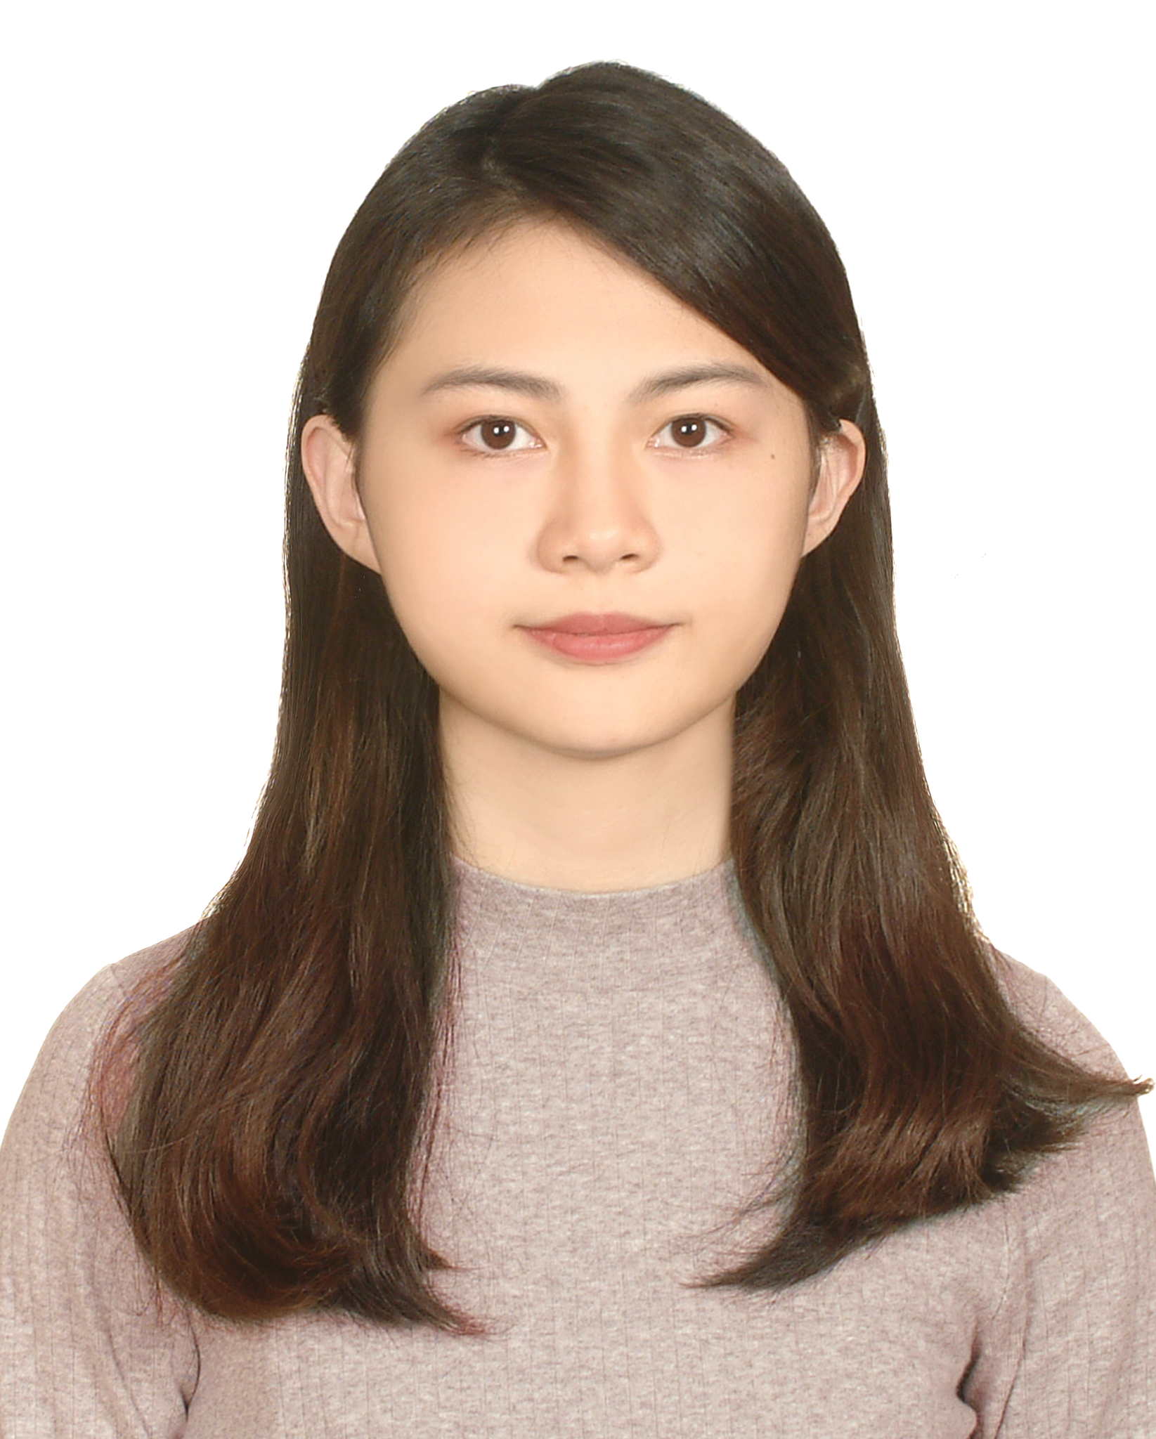
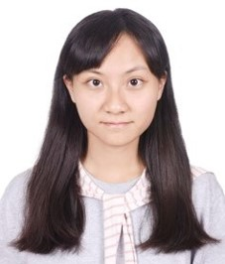
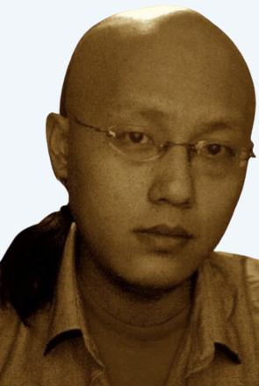
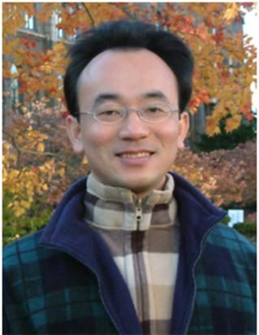
2022
IMNTPU at the NTCIR-16 FinNum-3 Task:
Data Augmentation for Financial Numclaim Classification
¹ Information Management, National Taipei University, New Taipei City, Taiwan
² Zeals Co., Ltd. Tokyo, Japan
Yung-Wei Teng ¹
Pei-Tz Chiu ¹
Ting-Yun Hsiao ¹
Mike Tian-Jian Jiang ²
Min-Yuh Day ^{1,*}
myday@gm.ntpu.edu.tw

Slide 6
2022
IMNTPU Dialogue System Evaluation
at the NTCIR-16 DialEval-2
Dialogue Quality and Nugget Detection
¹ Information Management, National Taipei University, New Taipei City, Taiwan
² Zeals Co., Ltd. Tokyo, Japan
Ting-Yun Hsiao ¹
Yung-Wei Teng ¹
Pei-Tz Chiu ¹
Mike Tian-Jian Jiang ²
Min-Yuh Day ^{1,*}
myday@gm.ntpu.edu.tw

Slide 7
AI in FinTech:
Metaverse,
Web3, DeFi, NFT,
Financial Services
Innovation and Applications

Slide 8
AI in
FinTech

Slide 9
FinTech ABCD
AI
Block Chain
Cloud Computing
Big Data

Slide 10
Decentralized Finance (DeFi)
Block Chain Financial Technology
Block Chain & Bitcoin
(BTC)
Smart Contract & Ethereum
(ETH)
Decentralized Application
(DApp)

Slide 11
Artificial Intelligence
(AI)

Slide 12
AI, Big Data, Cloud Computing
Evolution of Decision Support, Business Intelligence, and Analytics
AI
AI
Cloud Computing
Big Data
DM
BI
Source: Ramesh Sharda, Dursun Delen, and Efraim Turban (2017),
Business Intelligence, Analytics, and Data Science: A Managerial Perspective, 4th Edition, Pearson

Slide 13
AI, ML, DL
Artificial Intelligence (AI)
Machine Learning (ML)
Supervised
Learning
Unsupervised Learning
Deep Learning (DL)
CNN
RNN LSTM GRU
GAN
Semi-supervised Learning
Reinforcement Learning
Source: https://leonardoaraujosantos.gitbooks.io/artificial-inteligence/content/deep_learning.html

Slide 14
Definition of
Artificial Intelligence (A.I.)

Slide 15
Artificial Intelligence
“… the science and engineering of making intelligent machines”
(John McCarthy, 1955)
Source: https://digitalintelligencetoday.com/artificial-intelligence-defined-useful-list-of-popular-definitions-from-business-and-science/

Slide 16
Artificial Intelligence
“… technology that thinks and acts like humans”
Source: https://digitalintelligencetoday.com/artificial-intelligence-defined-useful-list-of-popular-definitions-from-business-and-science/

Slide 17
Artificial Intelligence
“… intelligence exhibited by machines or software”
Source: https://digitalintelligencetoday.com/artificial-intelligence-defined-useful-list-of-popular-definitions-from-business-and-science/

Slide 18
4 Approaches of AI
Thinking Humanly | Thinking Rationally
Acting Humanly | Acting Rationally
Source: Stuart Russell and Peter Norvig (2020), Artificial Intelligence: A Modern Approach, 4th Edition, Pearson

Slide 19
4 Approaches of AI
2. Thinking Humanly: The Cognitive Modeling Approach | 3. Thinking Rationally: The “Laws of Thought” Approach
1. Acting Humanly: The Turing Test Approach (1950) | 4. Acting Rationally: The Rational Agent Approach
Source: Stuart Russell and Peter Norvig (2020), Artificial Intelligence: A Modern Approach, 4th Edition, Pearson

Slide 20
AI Acting Humanly:
The Turing Test Approach
(Alan Turing, 1950)
Knowledge Representation
Automated Reasoning
Machine Learning (ML)
  Deep Learning (DL)
Computer Vision (Image, Video)
Natural Language Processing (NLP)
Robotics
Source: Stuart Russell and Peter Norvig (2020), Artificial Intelligence: A Modern Approach, 4th Edition, Pearson

Slide 21
FinTech

Slide 22
Financial Technology
FinTech
“providing
financial services
by making use of software and
modern technology”
Source: https://www.fintechweekly.com/fintech-definition

Slide 23
Financial Technology

Slide 24
Financial Services

Slide 25
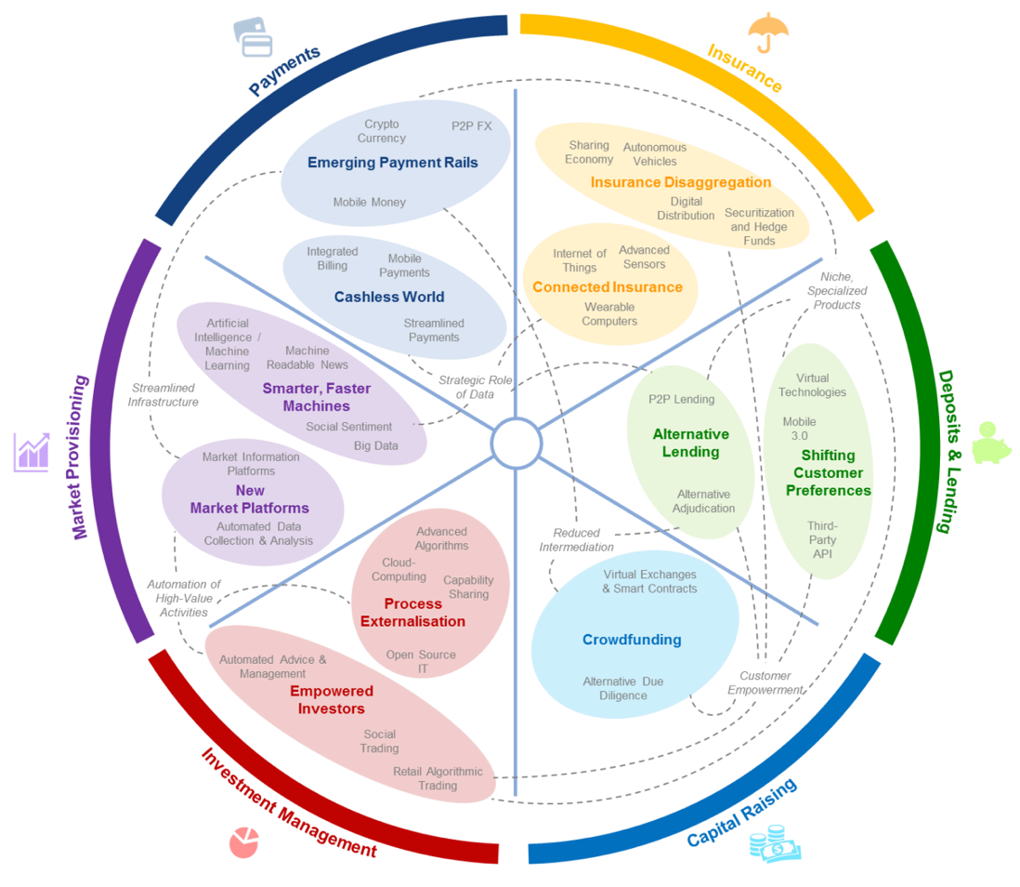
FinTech: Financial Services Innovation
Source: http://www3.weforum.org/docs/WEF_The_future__of_financial_services.pdf

Slide 26
FinTech:
Financial Services Innovation
1. Payments
2. Insurance
3. Deposits & Lending
4. Capital Raising
5. Investment Management
6. Market Provisioning
Source: http://www3.weforum.org/docs/WEF_The_future__of_financial_services.pdf

Slide 27
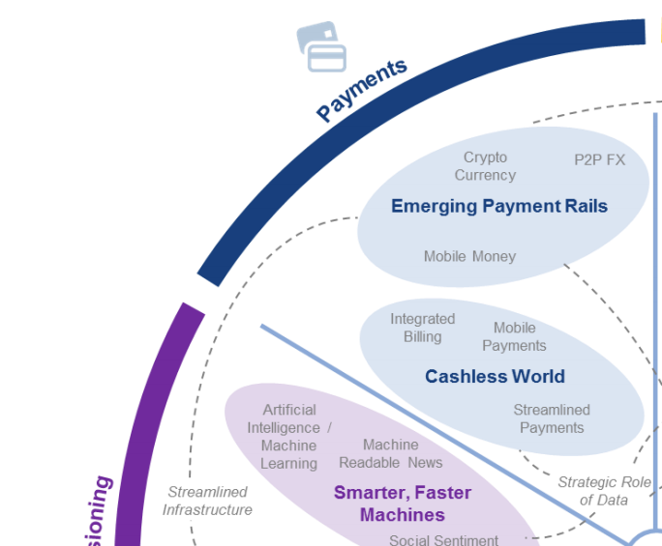
FinTech: Payment
1
Source: http://www3.weforum.org/docs/WEF_The_future__of_financial_services.pdf

Slide 28
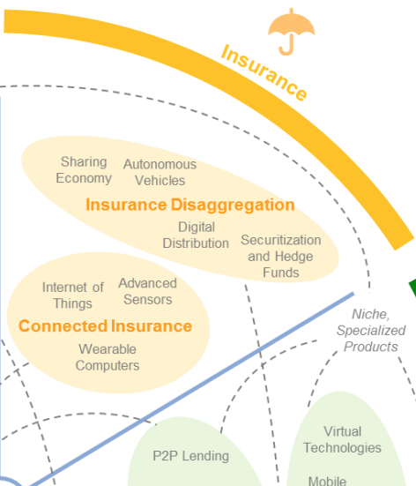
FinTech: Insurance
2
Source: http://www3.weforum.org/docs/WEF_The_future__of_financial_services.pdf

Slide 29
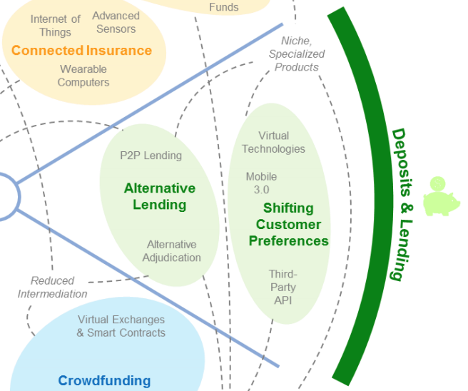
FinTech: Deposits & Lending
3
Source: http://www3.weforum.org/docs/WEF_The_future__of_financial_services.pdf

Slide 30
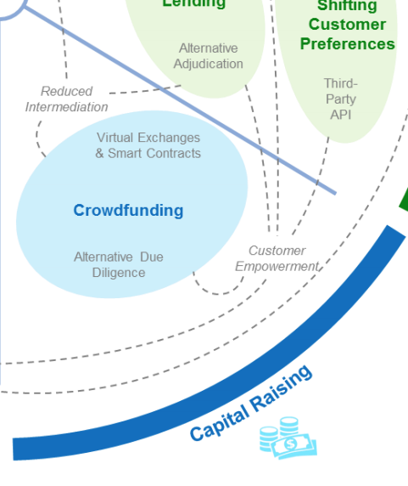
FinTech: Capital Raising
4
Source: http://www3.weforum.org/docs/WEF_The_future__of_financial_services.pdf

Slide 31
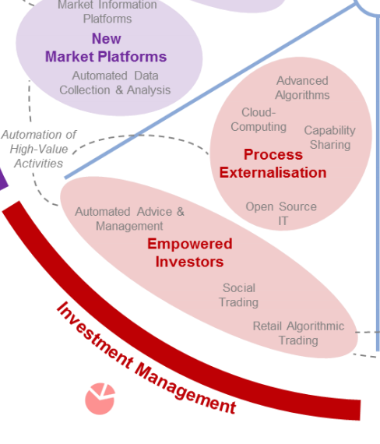
FinTech: Investment Management
5
Source: http://www3.weforum.org/docs/WEF_The_future__of_financial_services.pdf

Slide 32
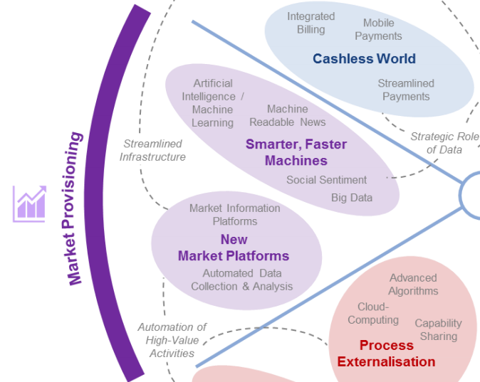
FinTech: Market Provisioning
6
Source: http://www3.weforum.org/docs/WEF_The_future__of_financial_services.pdf

Slide 33
Deep learning for financial applications: Topic-Model Heatmap
Source: Ahmet Murat Ozbayoglu, Mehmet Ugur Gudelek, and Omer Berat Sezer (2020). "Deep learning for financial applications: A survey." Applied Soft Computing (2020): 106384.

Slide 34
Deep learning for financial applications: Topic-Feature Heatmap
Source: Ahmet Murat Ozbayoglu, Mehmet Ugur Gudelek, and Omer Berat Sezer (2020). "Deep learning for financial applications: A survey." Applied Soft Computing (2020): 106384.

Slide 35
Deep learning for financial applications: Topic-Dataset Heatmap
Source: Ahmet Murat Ozbayoglu, Mehmet Ugur Gudelek, and Omer Berat Sezer (2020). "Deep learning for financial applications: A survey." Applied Soft Computing (2020): 106384.

Slide 36
Metaverse
Web3
DeFi
NFT

Slide 37
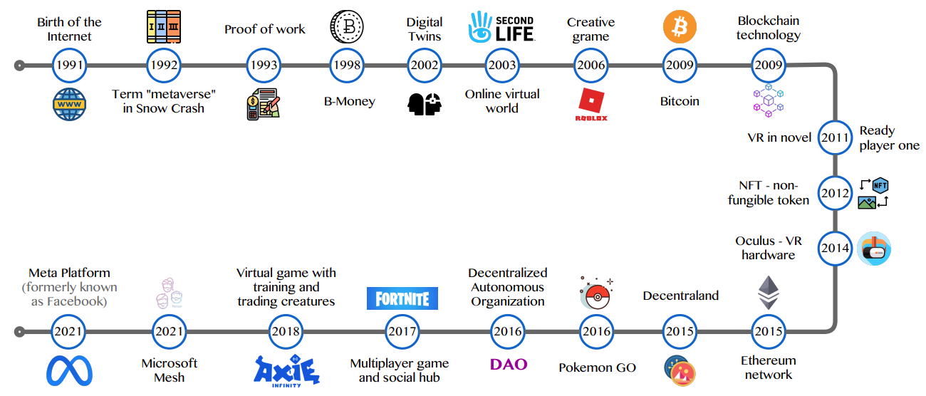
Metaverse Development from 1991 to 2021
Source: Huynh-The, Thien, Quoc-Viet Pham, Xuan-Qui Pham, Thanh Thi Nguyen, Zhu Han, and Dong-Seong Kim (2022).
"Artificial Intelligence for the Metaverse: A Survey." arXiv preprint arXiv:2202.10336.

Slide 38
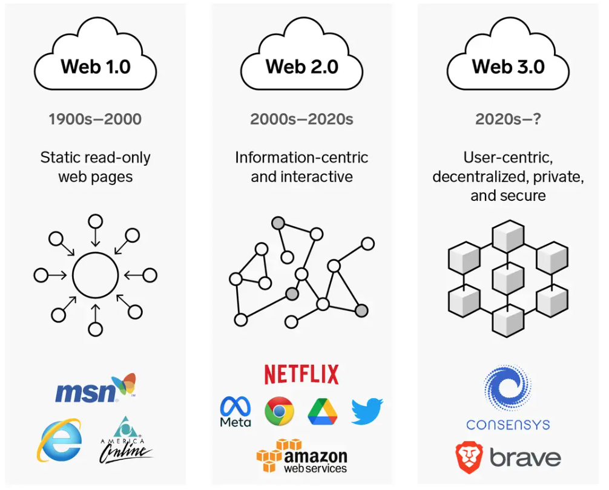
Web3: Decentralized Web
Internet Evolution
1990
2000
2020
Source: https://www.businessinsider.com/personal-finance/what-is-web3

Slide 39
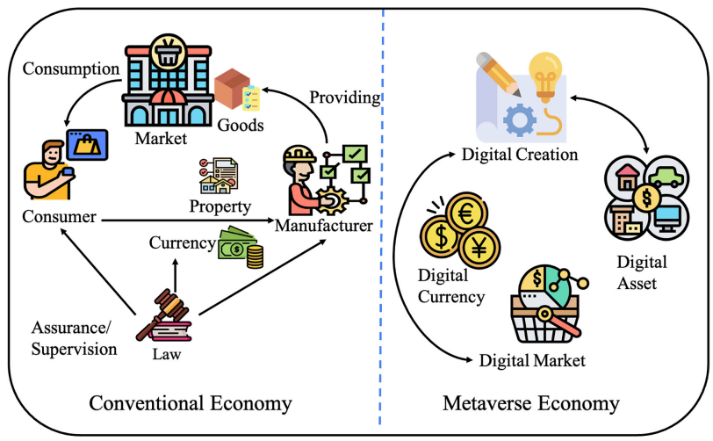
Metaverse Economy
Source: Yang, Qinglin, Yetong Zhao, Huawei Huang, Zehui Xiong, Jiawen Kang, and Zibin Zheng (2022).
"Fusing blockchain and AI with metaverse: A survey." IEEE Open Journal of the Computer Society 3 : 122-136.

Slide 40
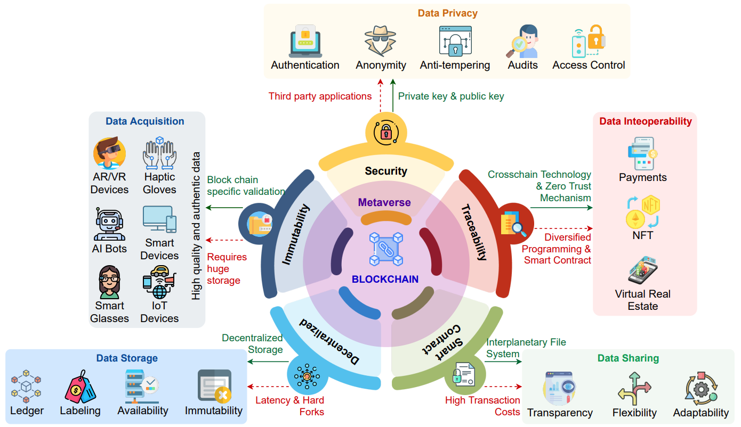
Blockchain in the Metaverse
Source: Gadekallu, Thippa Reddy, Thien Huynh-The, Weizheng Wang, Gokul Yenduri, Pasika Ranaweera, Quoc-Viet Pham, Daniel Benevides da Costa, and Madhusanka Liyanage (2022).
"Blockchain for the Metaverse: A Review." arXiv preprint arXiv:2203.09738..

Slide 41
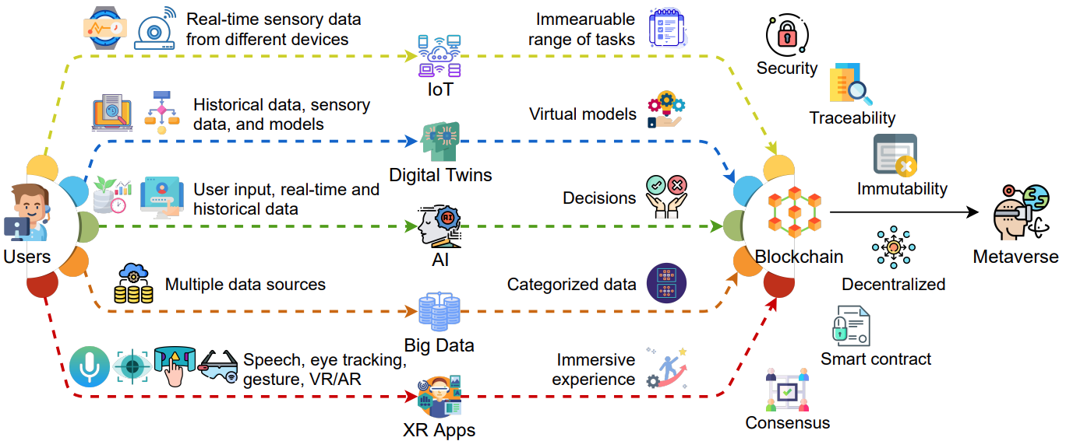
Blockchain for Key Enabling Technologies of the Metaverse
Source: Gadekallu, Thippa Reddy, Thien Huynh-The, Weizheng Wang, Gokul Yenduri, Pasika Ranaweera, Quoc-Viet Pham, Daniel Benevides da Costa, and Madhusanka Liyanage (2022).
"Blockchain for the Metaverse: A Review." arXiv preprint arXiv:2203.09738..

Slide 42
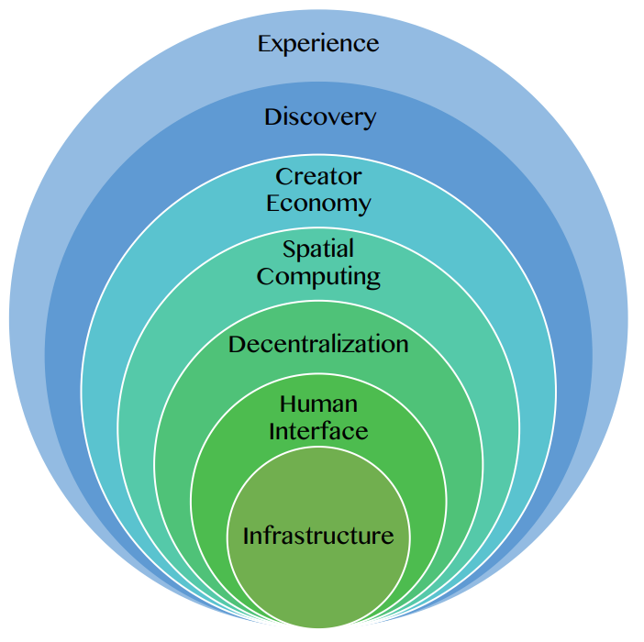
Seven Layers of a Metaverse Platform
Source: Huynh-The, Thien, Quoc-Viet Pham, Xuan-Qui Pham, Thanh Thi Nguyen, Zhu Han, and Dong-Seong Kim (2022).
"Artificial Intelligence for the Metaverse: A Survey." arXiv preprint arXiv:2202.10336.

Slide 43
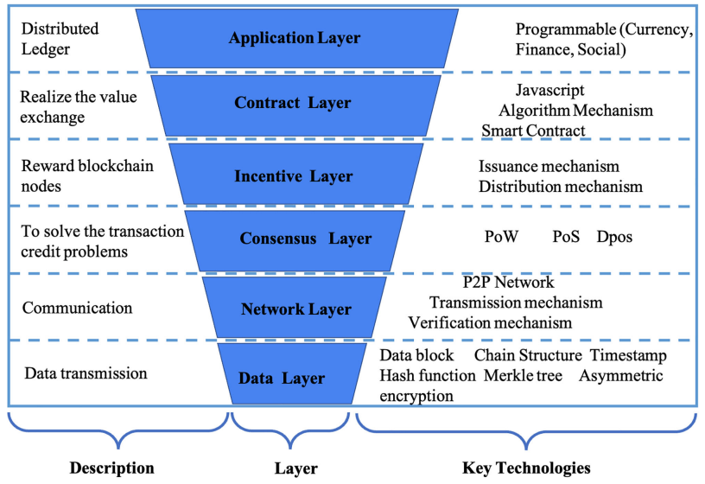
Layered Architecture of Blockchain
Source: Yang, Qinglin, Yetong Zhao, Huawei Huang, Zehui Xiong, Jiawen Kang, and Zibin Zheng (2022).
"Fusing blockchain and AI with metaverse: A survey." IEEE Open Journal of the Computer Society 3 : 122-136.

Slide 44
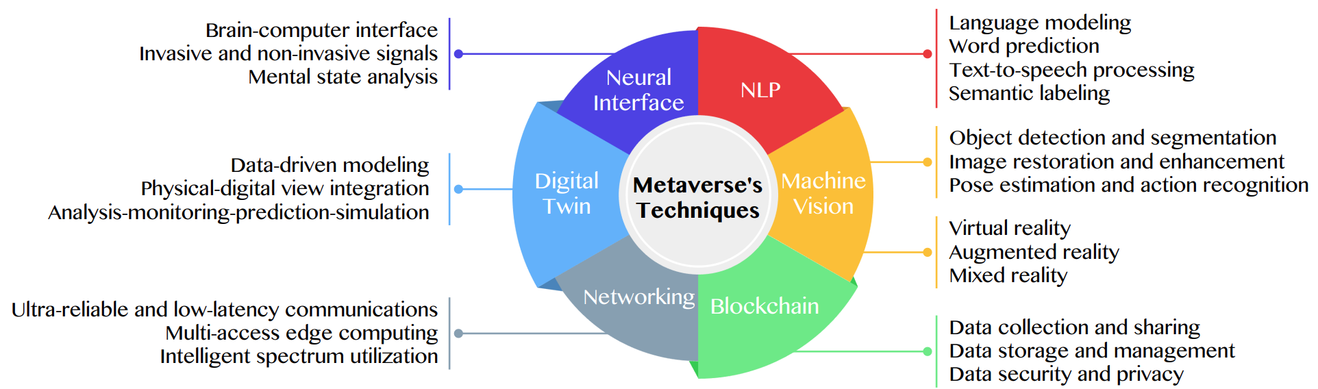
Primary Technical Aspects in the Metaverse
AI with ML algorithms and DL architectures is advancing the user experience in the virtual world
Source: Huynh-The, Thien, Quoc-Viet Pham, Xuan-Qui Pham, Thanh Thi Nguyen, Zhu Han, and Dong-Seong Kim (2022).
"Artificial Intelligence for the Metaverse: A Survey." arXiv preprint arXiv:2202.10336.

Slide 45
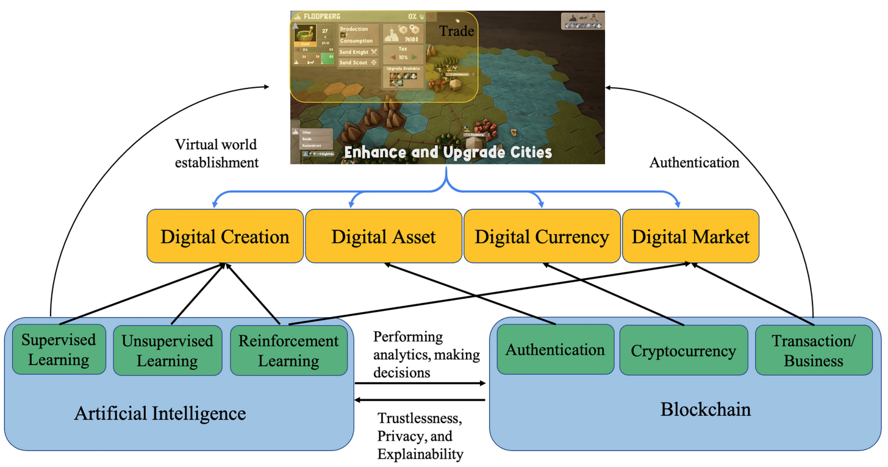
Fusion of AI and Blockchain in Metaverse
Source: Yang, Qinglin, Yetong Zhao, Huawei Huang, Zehui Xiong, Jiawen Kang, and Zibin Zheng (2022).
"Fusing blockchain and AI with metaverse: A survey." IEEE Open Journal of the Computer Society 3 : 122-136.

Slide 46
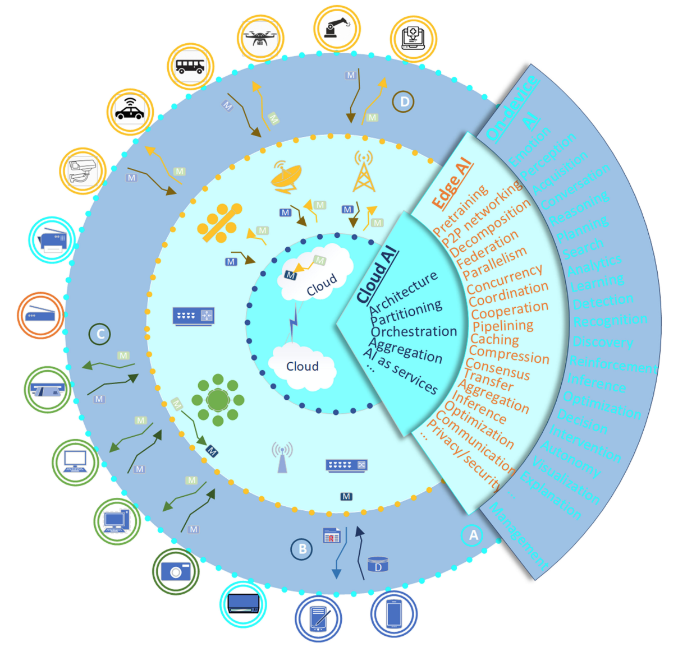
DeAI:
Synthesizing On-device AI, Edge AI, and Cloud AI
Source: Cao, Longbing (2022). "Decentralized ai: Edge intelligence and smart blockchain, metaverse, web3, and desci." IEEE Intelligent Systems 37, no. 3: 6-19.

Slide 47
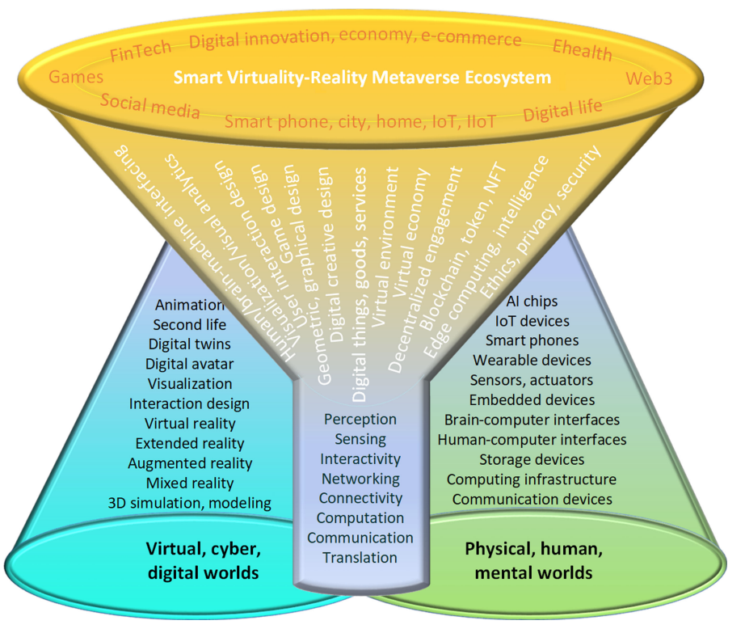
Smart Virtuality-Reality Metaverse Ecosystem: Metasynthesizing DeAI, Metaverse, Blockchain, Web3
Source: Cao, Longbing (2022). "Decentralized ai: Edge intelligence and smart blockchain, metaverse, web3, and desci." IEEE Intelligent Systems 37, no. 3: 6-19.

Slide 48
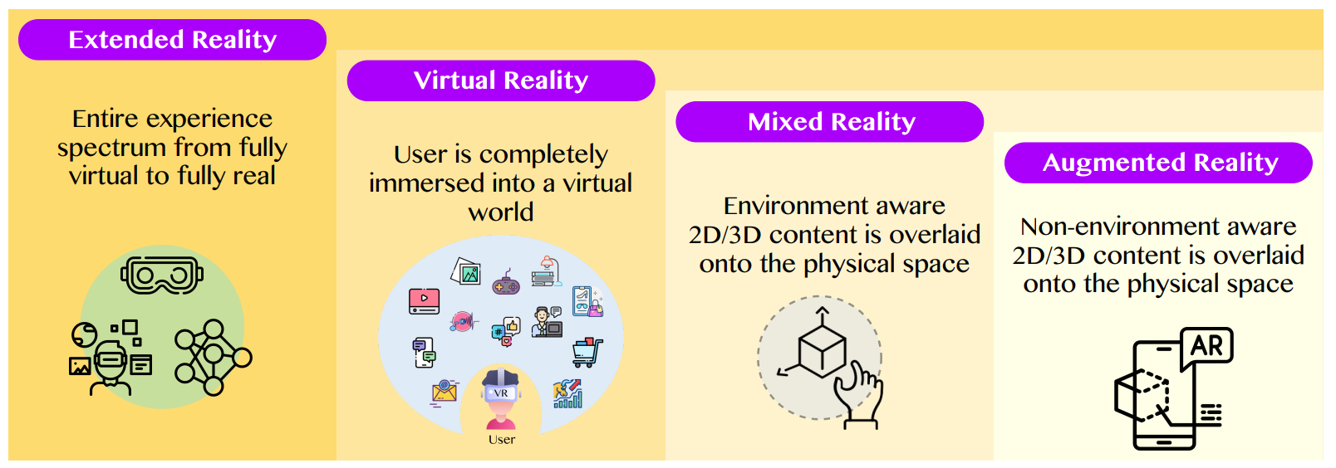
The difference between AR, MR, and VR under the umbrella of XR
XR
VR
MR
AR
Source: Huynh-The, Thien, Quoc-Viet Pham, Xuan-Qui Pham, Thanh Thi Nguyen, Zhu Han, and Dong-Seong Kim (2022).
"Artificial Intelligence for the Metaverse: A Survey." arXiv preprint arXiv:2202.10336.

Slide 49
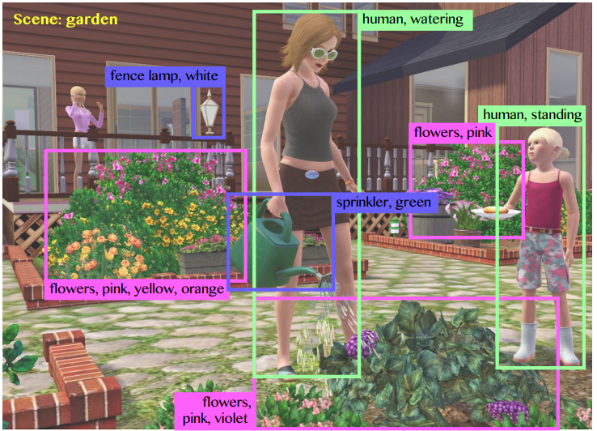
Computer vision in the metaverse with scene understanding, object detection, and human action/activity recognition
Source: Huynh-The, Thien, Quoc-Viet Pham, Xuan-Qui Pham, Thanh Thi Nguyen, Zhu Han, and Dong-Seong Kim (2022).
"Artificial Intelligence for the Metaverse: A Survey." arXiv preprint arXiv:2202.10336.

Slide 50
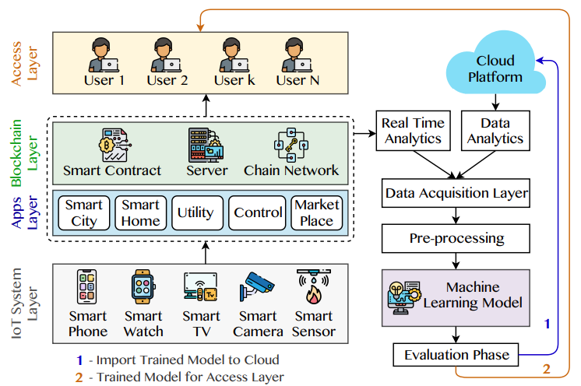
A Blockchain-based IoT Framework with ML to enhance security and privacy
Source: Huynh-The, Thien, Quoc-Viet Pham, Xuan-Qui Pham, Thanh Thi Nguyen, Zhu Han, and Dong-Seong Kim (2022).
"Artificial Intelligence for the Metaverse: A Survey." arXiv preprint arXiv:2202.10336.

Slide 51
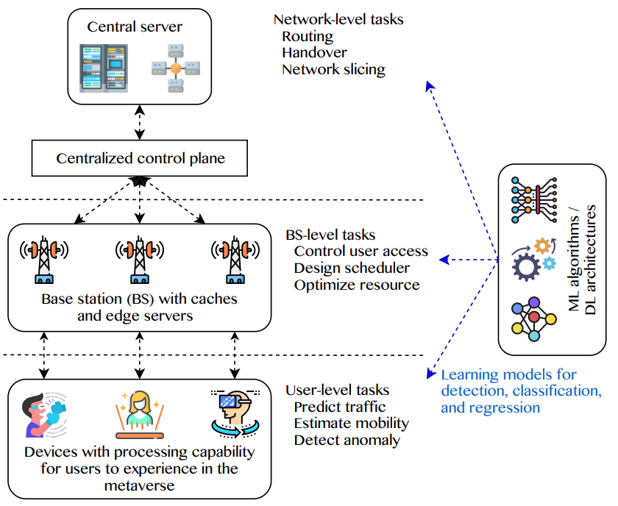
5G and beyond for Metaverse Services
AI with ML algorithms and DL models contribute in multi-level tasks
Source: Huynh-The, Thien, Quoc-Viet Pham, Xuan-Qui Pham, Thanh Thi Nguyen, Zhu Han, and Dong-Seong Kim (2022).
"Artificial Intelligence for the Metaverse: A Survey." arXiv preprint arXiv:2202.10336.

Slide 52
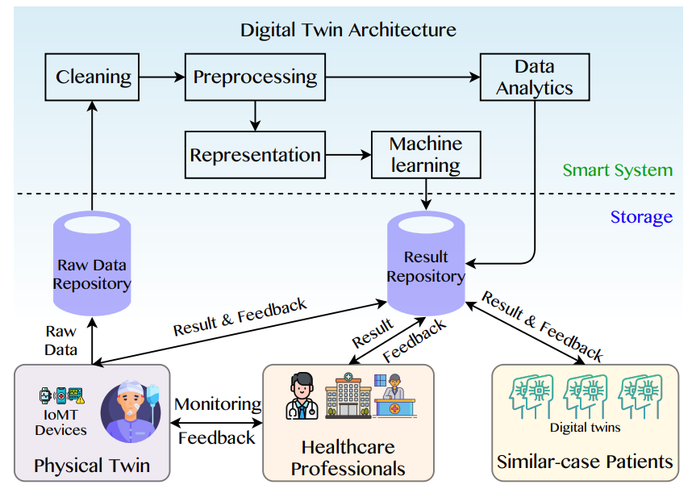
A Data-Driven Digital Twin Architecture for intelligent healthcare systems using ML to process raw data of IoMedicalThings devices
Source: Huynh-The, Thien, Quoc-Viet Pham, Xuan-Qui Pham, Thanh Thi Nguyen, Zhu Han, and Dong-Seong Kim (2022).
"Artificial Intelligence for the Metaverse: A Survey." arXiv preprint arXiv:2202.10336.

Slide 53
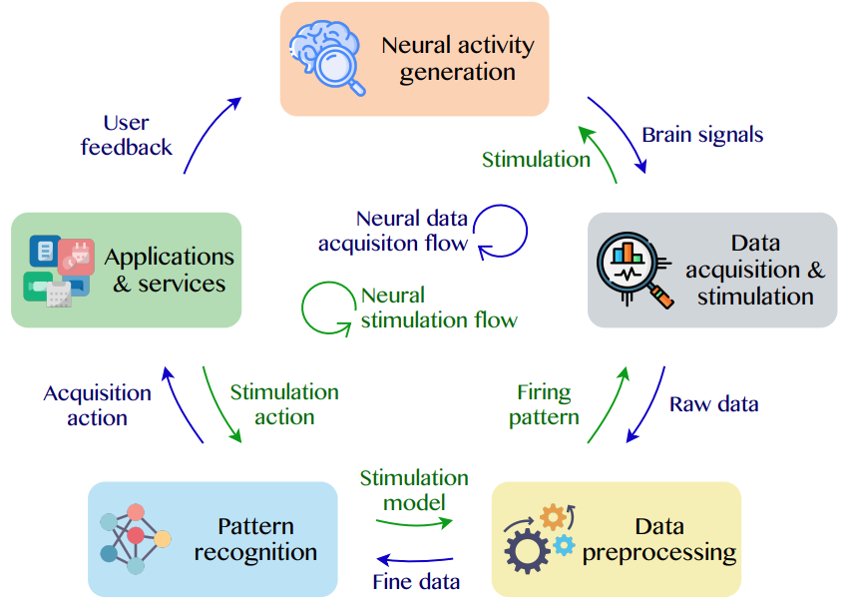
Brain-Machine Interfaces (BMIs) for processing neural signals and responding neural stimulations
Source: Huynh-The, Thien, Quoc-Viet Pham, Xuan-Qui Pham, Thanh Thi Nguyen, Zhu Han, and Dong-Seong Kim (2022).
"Artificial Intelligence for the Metaverse: A Survey." arXiv preprint arXiv:2202.10336.

Slide 54
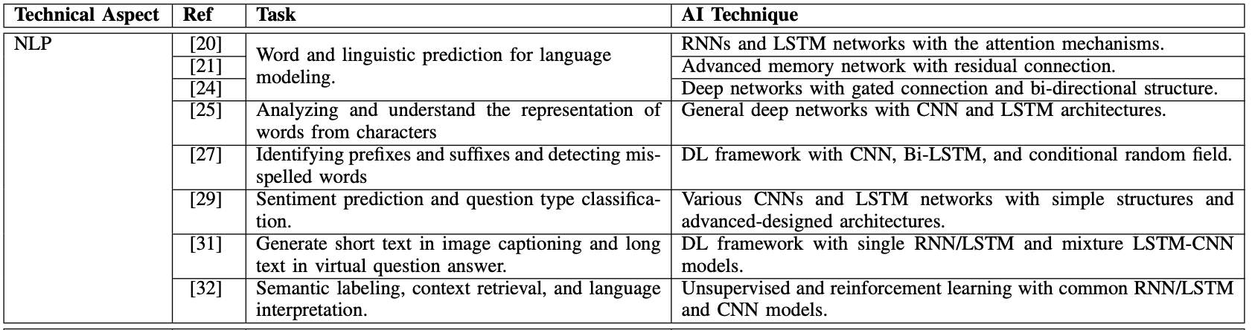
AI for the Metaverse
Source: Huynh-The, Thien, Quoc-Viet Pham, Xuan-Qui Pham, Thanh Thi Nguyen, Zhu Han, and Dong-Seong Kim (2022).
"Artificial Intelligence for the Metaverse: A Survey." arXiv preprint arXiv:2202.10336.

Slide 55
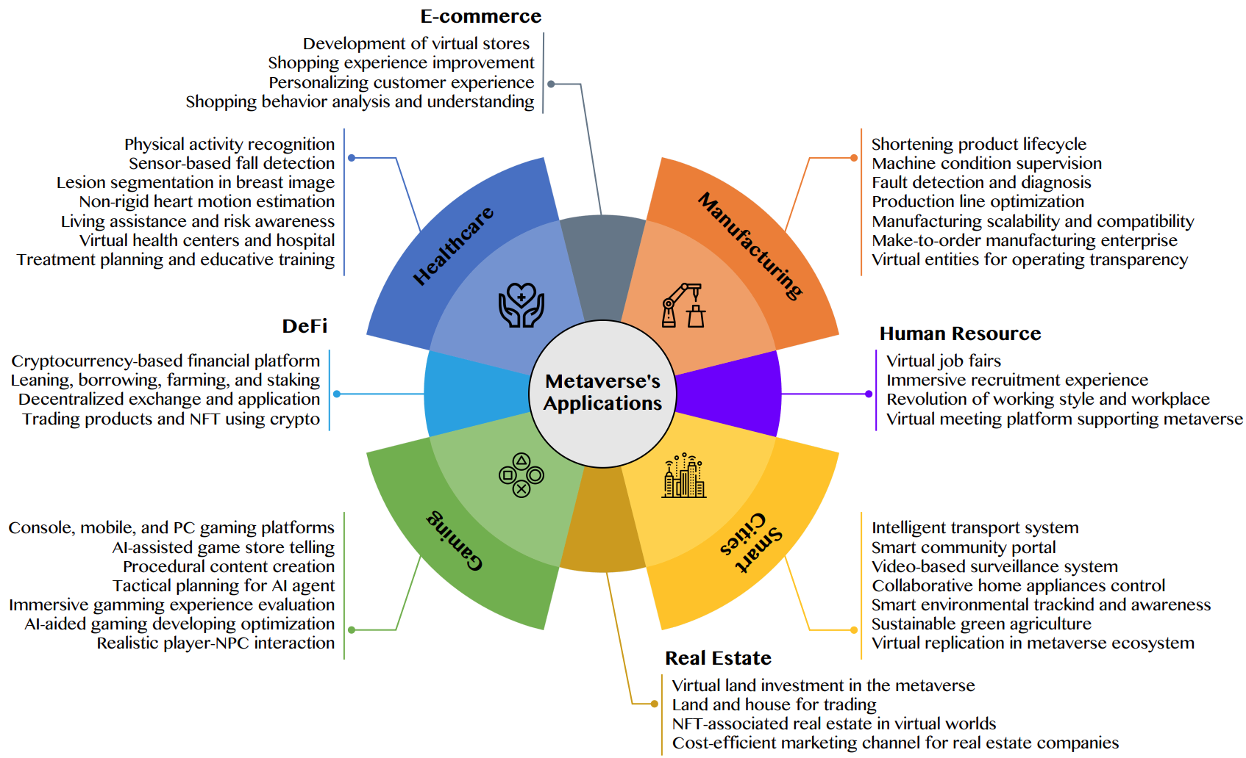
AI for the Metaverse in the Application Aspects healthcare, manufacturing, smart cities, gaming
E-commerce, human resources, real estate, and DeFi
Source: Huynh-The, Thien, Quoc-Viet Pham, Xuan-Qui Pham, Thanh Thi Nguyen, Zhu Han, and Dong-Seong Kim (2022).
"Artificial Intelligence for the Metaverse: A Survey." arXiv preprint arXiv:2202.10336.

Slide 56
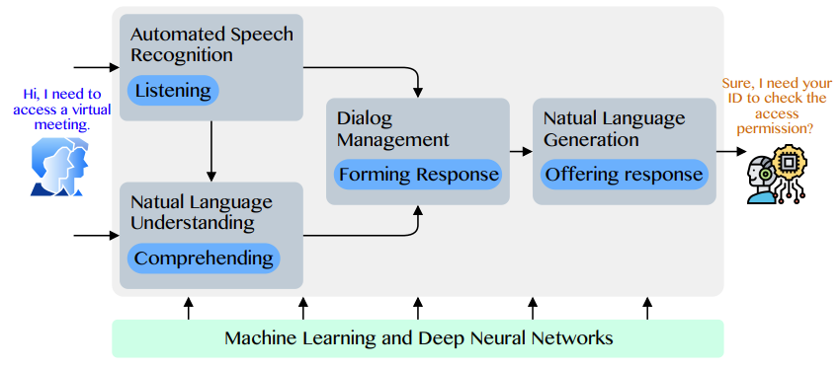
Conversational AI to deliver contextual and personal experience to users
Source: Huynh-The, Thien, Quoc-Viet Pham, Xuan-Qui Pham, Thanh Thi Nguyen, Zhu Han, and Dong-Seong Kim (2022).
"Artificial Intelligence for the Metaverse: A Survey." arXiv preprint arXiv:2202.10336.

Slide 57
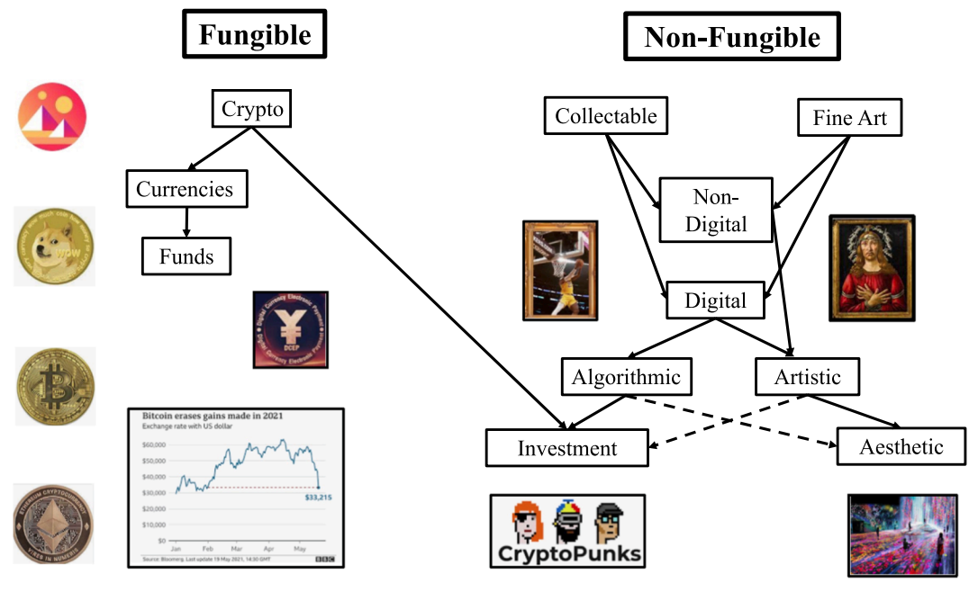
Blockchain-Registered:
Crypto, Collectables, and Art.
Source: Belk, Russell, Mariam Humayun, and Myriam Brouard. (2022)
"Money, possessions, and ownership in the Metaverse: NFTs, cryptocurrencies, Web3 and Wild Markets." Journal of Business Research 153: 198-205.

Slide 58
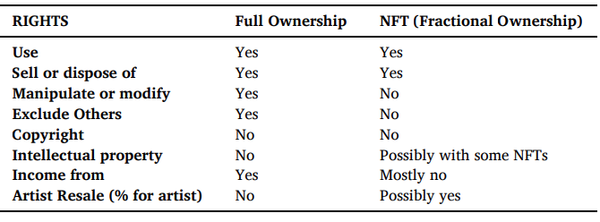
Full Versus Fractional [NFT]
Property Ownership Rights for an Artwork
Source: Belk, Russell, Mariam Humayun, and Myriam Brouard. (2022)
"Money, possessions, and ownership in the Metaverse: NFTs, cryptocurrencies, Web3 and Wild Markets." Journal of Business Research 153: 198-205.

Slide 59
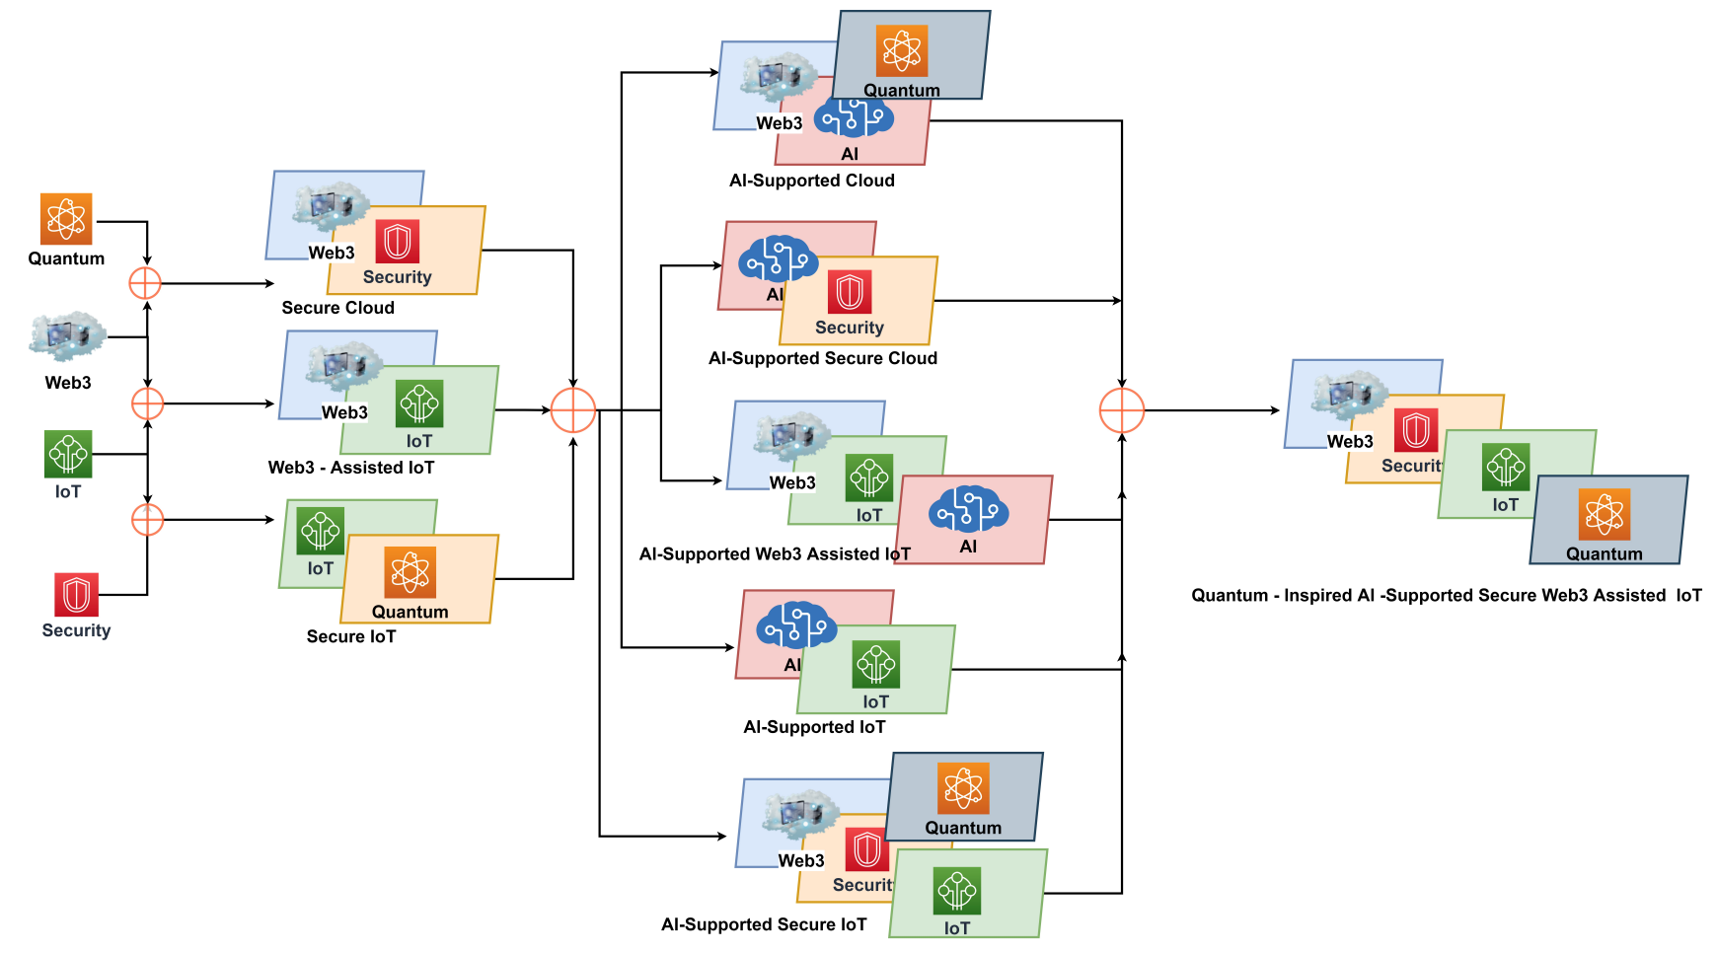
Combination of Web3 with other Technologies
Source: Sheridan, Dan, James Harris, Frank Wear, Jerry Cowell Jr, Easton Wong, and Abbas Yazdinejad. (2022)
"Web3 Challenges and Opportunities for the Market." arXiv preprint arXiv:2209.02446.

Slide 60
Decentralized Finance
(DeFi)
Block Chain FinTech

Slide 61
Decentralized Finance (DeFi)
A global, open alternative to the current financial system.
Products that let you borrow, save, invest, trade, and more.
Based on open-source technology that anyone can program with.
Source: https://ethereum.org/en/defi/

Slide 62
Traditional Finance
Centralized Finance (CeFi)
Some people aren't granted access to set up a bank account or use financial services.
Lack of access to financial services can prevent people from being employable.
Financial services can block you from getting paid.
A hidden charge of financial services is your personal data.
Governments and centralized institutions can close down markets at will.
Trading hours often limited to business hours of specific time zone.
Money transfers can take days due to internal human processes.
There's a premium to financial services because intermediary institutions need their cut.
Source: https://ethereum.org/en/defi/

Slide 63
DeFi vs. CeFi
Decentralized Finance (DeFi) | Traditional Finance (Centralized Finance; CeFi)
You hold your money. | Your money is held by companies.
You control where your money goes and how it's spent. | You have to trust companies not to mismanage your money, like lend to risky borrowers.
Transfers of funds happen in minutes. | Payments can take days due to manual processes.
Transaction activity is pseudonymous. | Financial activity is tightly coupled with your identity.
DeFi is open to anyone. | You must apply to use financial services.
The markets are always open. | Markets close because employees need breaks.
It's built on transparency – anyone can look at a product's data and inspect how the system works. | Financial institutions are closed books: you can't ask to see their loan history, a record of their managed assets, and so on.
Source: https://ethereum.org/en/defi/

Slide 64
(DeFi)
Decentralized Applications (Dapps)
Ethereum-powered tools and services
Dapps are a growing movement of applications that use Ethereum to disrupt business models or invent new ones
Source: https://ethereum.org/en/defi/

Slide 65
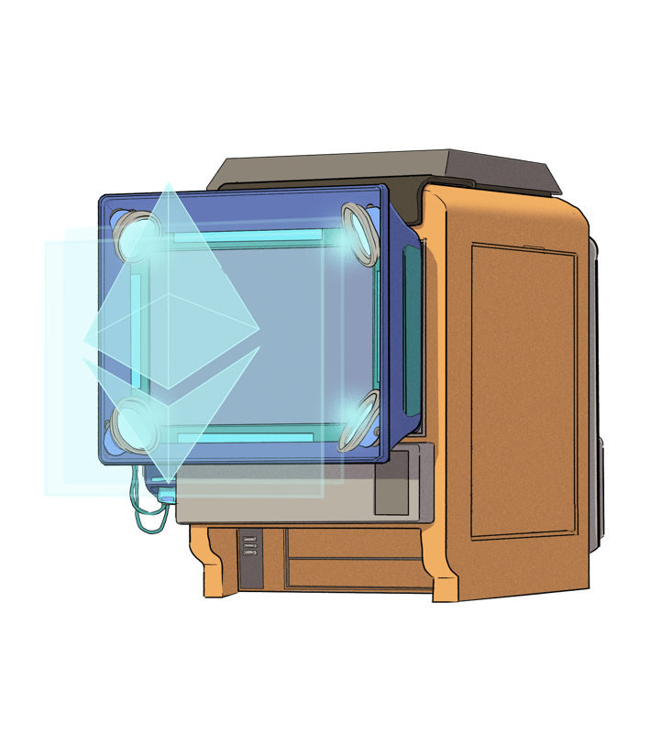
The Internet of Assets
Ethereum isn't just for
digital money.
Anything you can own can be represented,
traded and
put to use as
non-fungible tokens (NFTs).
Source: https://ethereum.org/en/defi/

Slide 66
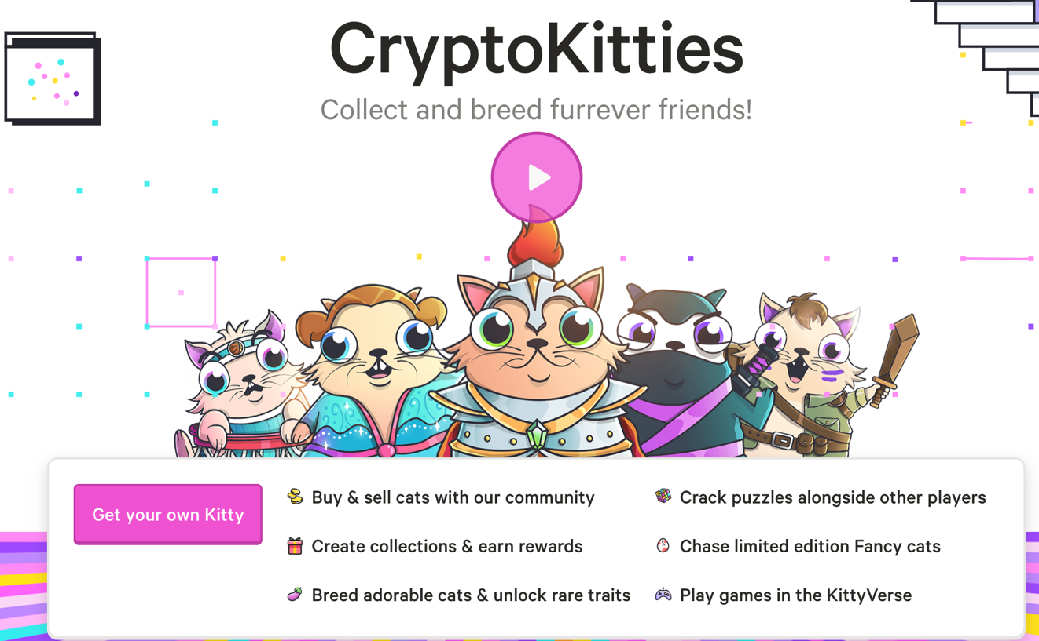
Non-Fungible Tokens (NFT)
CryptoKitties
https://www.cryptokitties.co/
Source: Matt Fortnow and QuHarrison Terry (2021), The NFT Handbook - How to Create, Sell and Buy Non-Fungible Tokens, Wiley

Slide 67
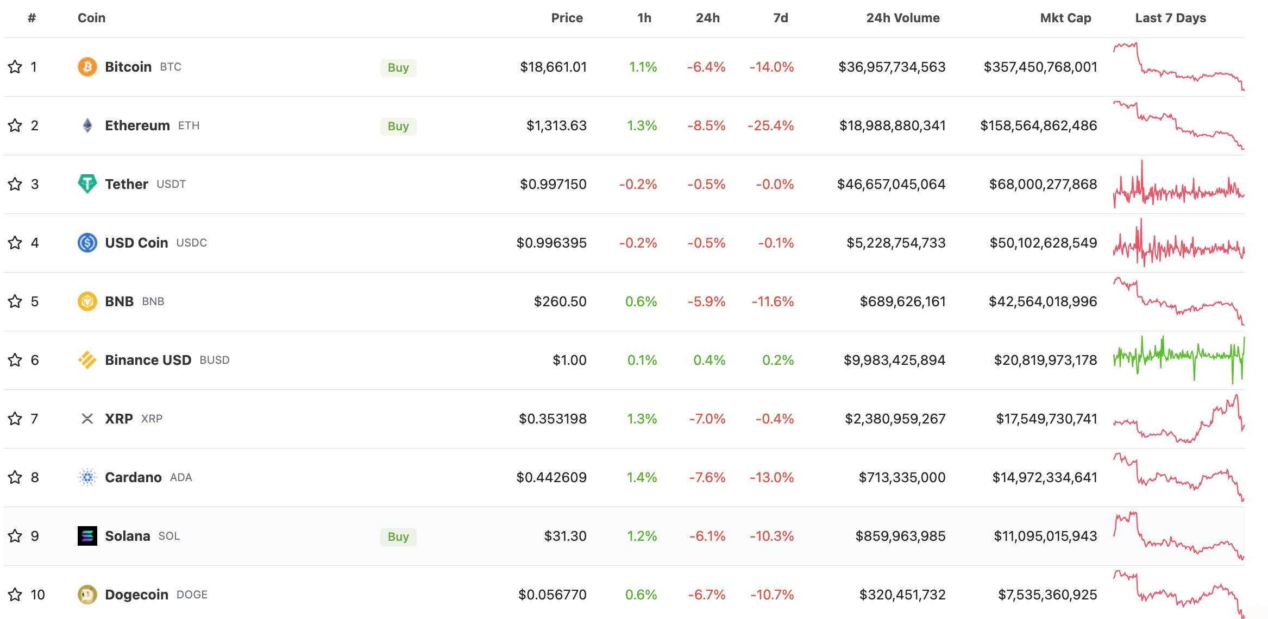
Top 10 Cryptocurrency Prices by Market Cap
The global cryptocurrency market cap today is $949 Billion (2022/09/19)
Source: https://www.coingecko.com/en

Slide 68
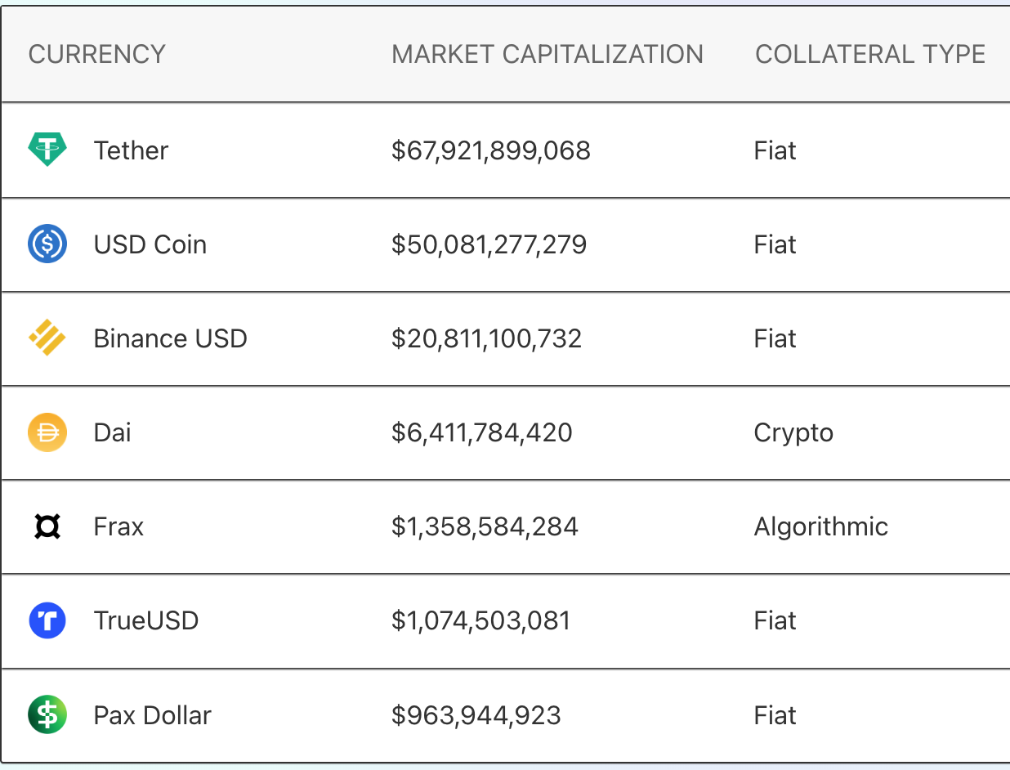
Top Stablecoins
(Tether USDT, USD Coin USDC, Dai)
Digital money for everyday use
Stablecoins are
Ethereum tokens designed to stay at a fixed value,
even when
the price of ETH changes.
Source: https://ethereum.org/en/stablecoins/

Slide 69
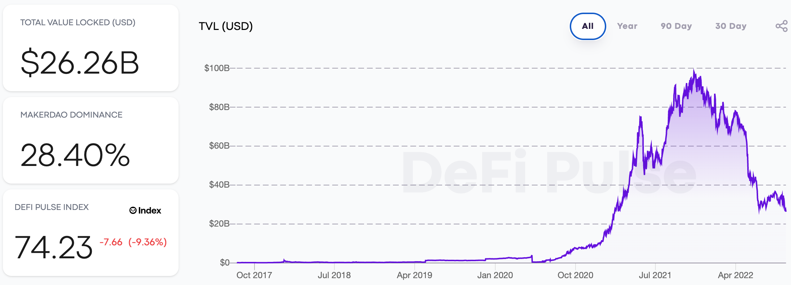
DeFi Total Value Locked (USD)
(DeFi Pulse)
Source: https://defipulse.com/

Slide 70
Top 10 DeFi Applications (DApps)
(DeFi Pulse)
Lending
DEXes (Decentralized Exchanges)
Derivatives
Assets
Payments
# | NAME | CHAIN | SECTOR | TVL (USD)
1 🏆 | MakerDAO | Ethereum | Lending | $7.25B
2 🥈 | Curve | Ethereum | DEXes | $4.22B
3 🥉 | Aave | Ethereum | Lending | $3.98B
4 | Uniswap | Ethereum | DEXes | $3.60B
5 | Compound | Ethereum | Lending | $2.10B
6 | InstaDApp | Ethereum | Lending | $1.19B
7 | Liquity | Ethereum | Lending | $643.3M
8 | Balancer | Ethereum | DEXes | $488.8M
9 | dYdX | Ethereum | Derivatives | $471.3M
10 | SushiSwap | Ethereum | DEXes | $305.1M
Source: https://defipulse.com/

Slide 71
Financial Stability Challenges
Crypto Ecosystem
Operational, cyber, and governance risks
Integrity (market and AML/CFT)
(Anti–Money Laundering / Combating the Financing of Terrorism)
Data availability / reliability
Challenges from cross-boarder activites
Stablecoins
How stable are stablecoins?
Domestic and global regulatory and supervisory
approaches
Macro-Financial
Cryptoization, capital flows, and restrictions
Monetary policy transmission
Bank disintermediation
Source: Parma Bains, Mohamed Diaby, Dimitris Drakopoulos, Julia Faltermeier, Federico Grinberg, Evan Papageorgiou, Dmitri Petrov, Patrick Schneider, and Nobu Sugimoto (2021),
The Crypto Ecosystem and Financial Stability Challenges, International Monetary Fund, October 2021

Slide 72
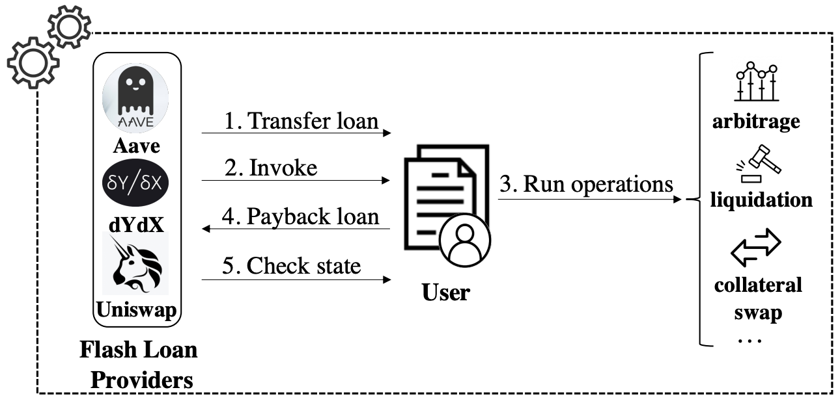
Decentralized Finance Applications (DApps):
Flash Loan Transaction
Source: Wang, Dabao, Siwei Wu, Ziling Lin, Lei Wu, Xingliang Yuan, Yajin Zhou, Haoyu Wang, and Kui Ren (2021). "Towards A First Step to Understand Flash Loan and Its Applications in DeFi Ecosystem." In Proceedings of the Ninth International Workshop on Security in Blockchain and Cloud Computing, pp. 23-28. 2021.

Slide 73
Financial Services

Slide 74
Technology
Innovation

Slide 75
FinTech Innovation
FinTech high-level classification
Lending
Payments
Robo Advisors
Analytics
Others
Profile
Advice
Re-Balance
Indexing
Source: Paolo Sironi (2016), “FinTech Innovation: From Robo-Advisors to Goal Based Investing and Gamification”, Wiley.

Slide 76
Technology-driven
Financial Industry Development

Slide 77
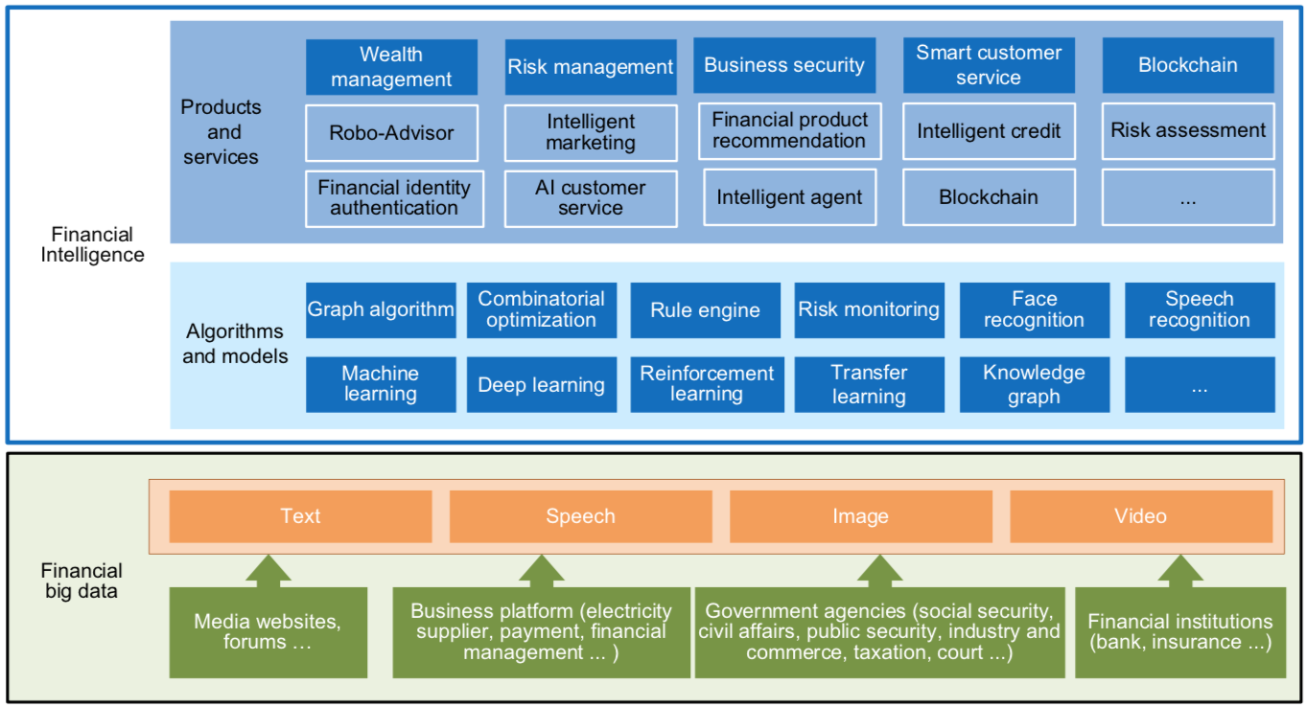
FinBrain: when Finance meets AI 2.0
(Zheng et al., 2019)
Source: Xiao-lin Zheng, Meng-ying Zhu, Qi-bing Li, Chao-chao Chen, and Yan-chao Tan (2019), "Finbrain: When finance meets AI 2.0." Frontiers of Information Technology & Electronic Engineering 20, no. 7, pp. 914-924

Slide 78
AI 2.0
a new generation of AI
based on the
novel information environment of
major changes and
the development of
new goals.
Yunhe Pan (2016), "Heading toward artificial intelligence 2.0." Engineering 2, no. 4, 409-413.

Slide 79
Technology-driven
Financial Industry Development
Development stage | Driving technology | Main landscape | Inclusive finance | Relationship between technology and finance
Fintech 1.0 (financial IT) | Computer | Credit card, ATM, and CRMS | Low | Technology as a tool
Fintech 2.0 (Internet finance) | Mobile Internet | Marketplace lending, third-party payment, crowdfunding, and Internet insurance | Medium | Technology-driven change
Fintech 3.0 (financial intelligence) | AI, Big Data, Cloud Computing, Blockchain | Intelligent finance | High | Deep fusion
Source: Xiao-lin Zheng, Meng-ying Zhu, Qi-bing Li, Chao-chao Chen, and Yan-chao Tan (2019), "Finbrain: When finance meets AI 2.0." Frontiers of Information Technology & Electronic Engineering 20, no. 7, pp. 914-924

Slide 80
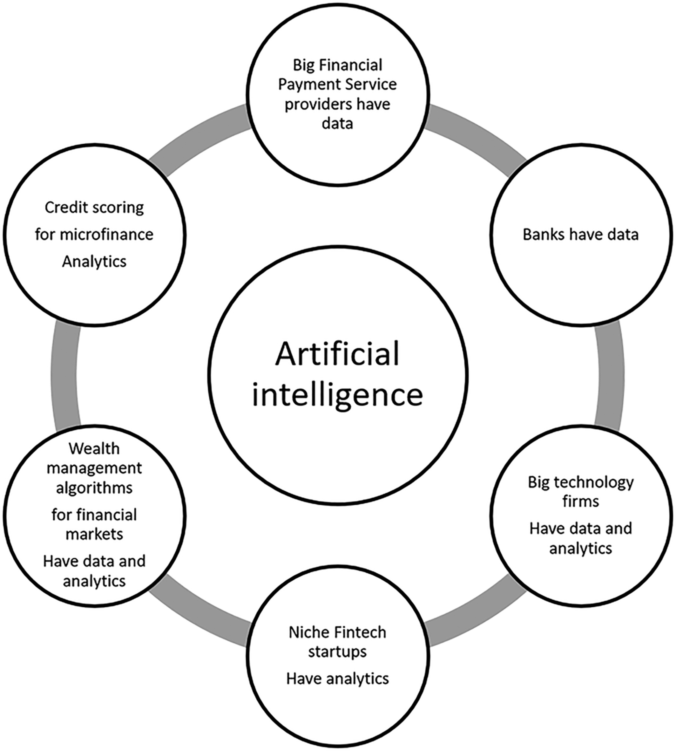
Artificial Intelligence in the Financial Markets
Source: Ashta, Arvind, and Heinz Herrmann (2021). "Artificial intelligence and fintech: An overview of opportunities and risks for banking, investments, and microfinance." Strategic Change 30, no. 3 (2021): 211-222.

Slide 81
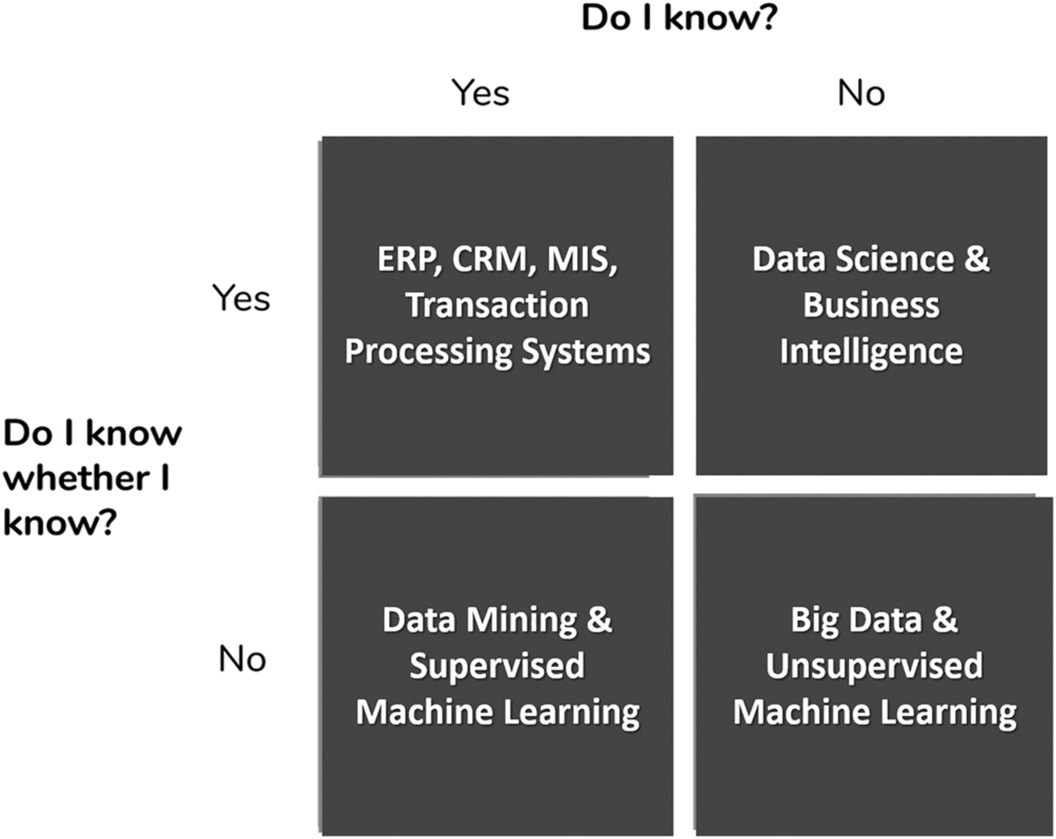
AI in Managerial Blind Spots:
Unknown Knowns and Unknown Unknowns
Source: Ashta, Arvind, and Heinz Herrmann (2021). "Artificial intelligence and fintech: An overview of opportunities and risks for banking, investments, and microfinance." Strategic Change 30, no. 3 (2021): 211-222.

Slide 82
Green Finance

Slide 83
Sustainability
Innovation

Slide 84














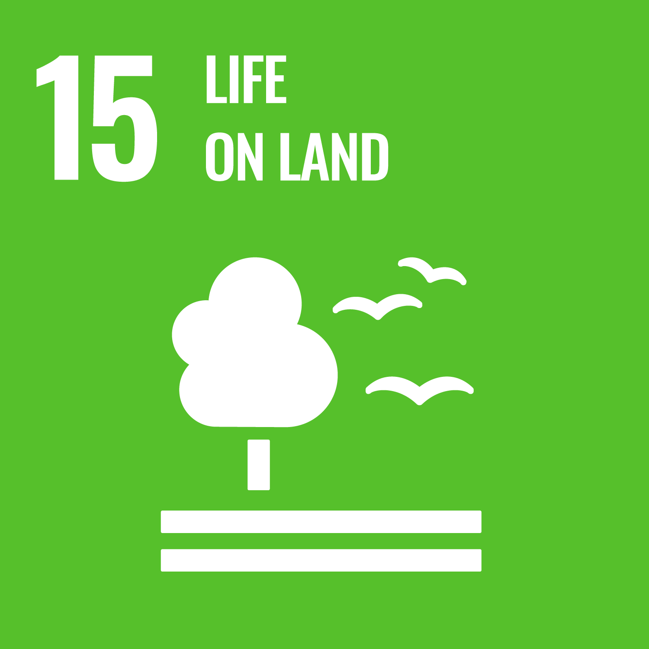



Sustainable Development Goals (SDGs)
Source: https://sdgs.un.org/goals

Slide 85
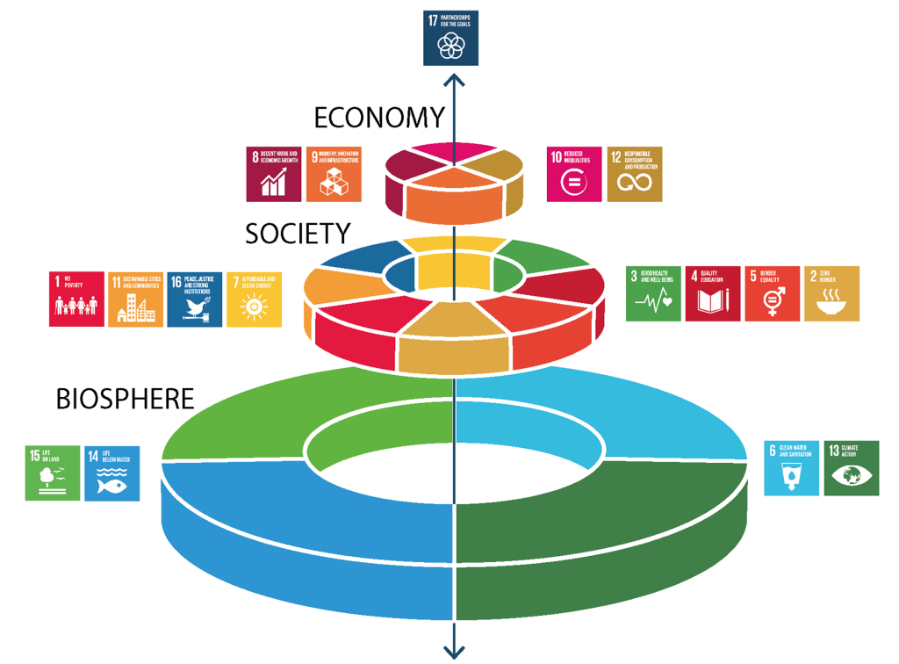
Sustainable Development Goals (SDGs) and 5P
Partnership
Peace
Prosperity
People
Planet
Source: Folke, Carl, Reinette Biggs, Albert V. Norström, Belinda Reyers, and Johan Rockström. "Social-ecological resilience and biosphere-based sustainability science.”Ecology and Society 21, no. 3 (2016).

Slide 86
Green Finance
Generic term implying use or diversion of financial resources to deploy and support projects with long term positive impact on the environment
Source: Bhattacharyya, Rupsha. "Green finance for energy transition, climate action and sustainable development: overview of concepts, applications, implementation and challenges." Green Finance 4, no. 1 (2022): 1-35.

Slide 87
Sustainable Finance
Finances deployed in support of projects that ensure just, sustainable and inclusive growth or attainment of one or more sustainable development goals
Source: Bhattacharyya, Rupsha. "Green finance for energy transition, climate action and sustainable development: overview of concepts, applications, implementation and challenges." Green Finance 4, no. 1 (2022): 1-35.

Slide 88
Carbon Finance and Climate Finance
Carbon Finance
  Financial instruments based on economic value of carbon emissions which an organization cannot avoid but which it offsets by funding other compensatory projects that contribute to carbon emissions reduction
Climate Finance
  Finances deployed in support of low carbon and climate resilient projects that help in climate change mitigation and adaptation efforts, particularly in the energy and infrastructure sectors
Source: Bhattacharyya, Rupsha. "Green finance for energy transition, climate action and sustainable development: overview of concepts, applications, implementation and challenges." Green Finance 4, no. 1 (2022): 1-35.

Slide 89
Impact Investing and ESG Investing
Impact investing
  Investing in projects that solve a social or environmental problem; the focus is on the positive impact rather than the means used to produce that impact
ESG Investing
  Investments considering the broad range of
  environmental (e.g. climate change, pollution biodiversity loss),
  social (e.g. working conditions, human rights, salary or compensation structures)
  and governance (e.g. board composition, diversity and inclusion, taxes) characteristics of the projects or companies being invested in; ethical and business sustainability considerations are integral part of financing
Source: Bhattacharyya, Rupsha. "Green finance for energy transition, climate action and sustainable development: overview of concepts, applications, implementation and challenges." Green Finance 4, no. 1 (2022): 1-35.

Slide 90
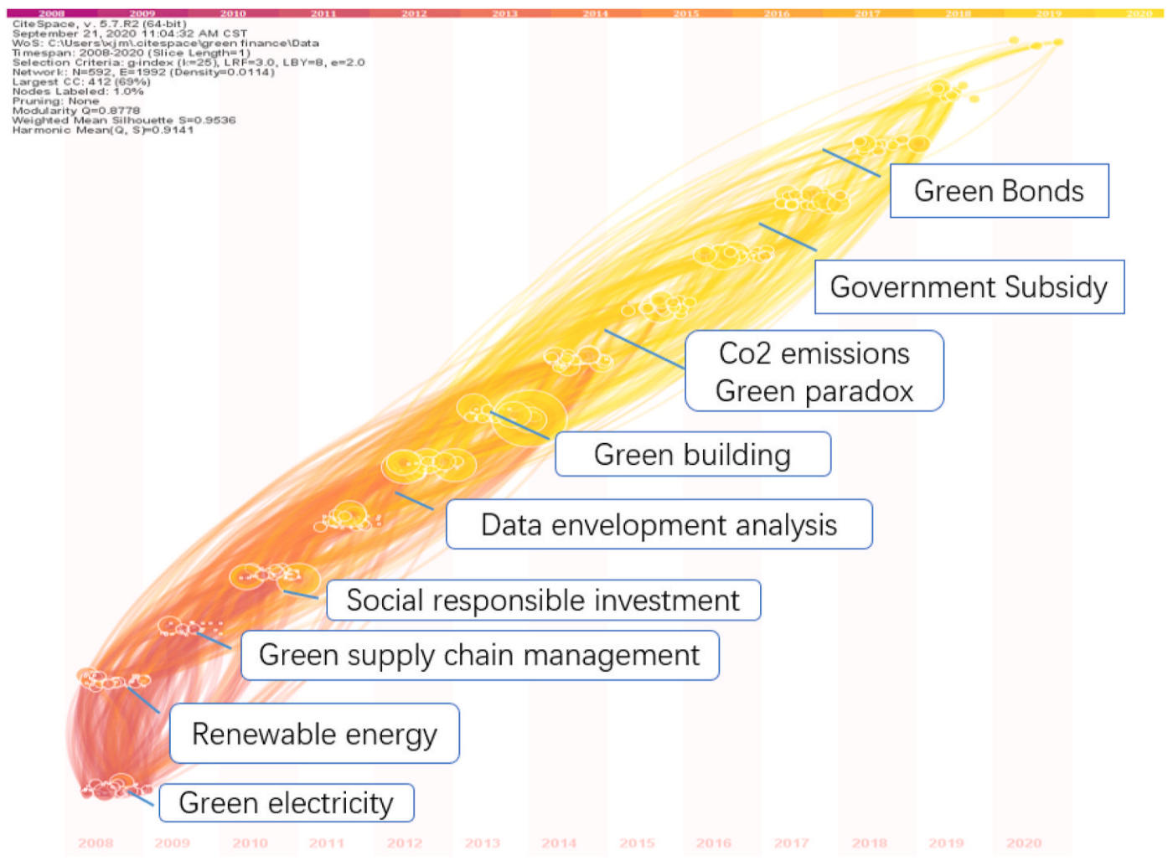
Dynamic Trends of Green Finance and Energy Policy
Source: Wang, Moran, Xuerong Li, and Shouyang Wang. (2021) "Discovering research trends and opportunities of green finance and energy policy: A data-driven scientometric analysis." Energy Policy 154 (2021): 112295.

Slide 91
ESG:
Environmental
Social
Governance

Slide 92
CSR:
Corporate
Social
Responsibility

Slide 93
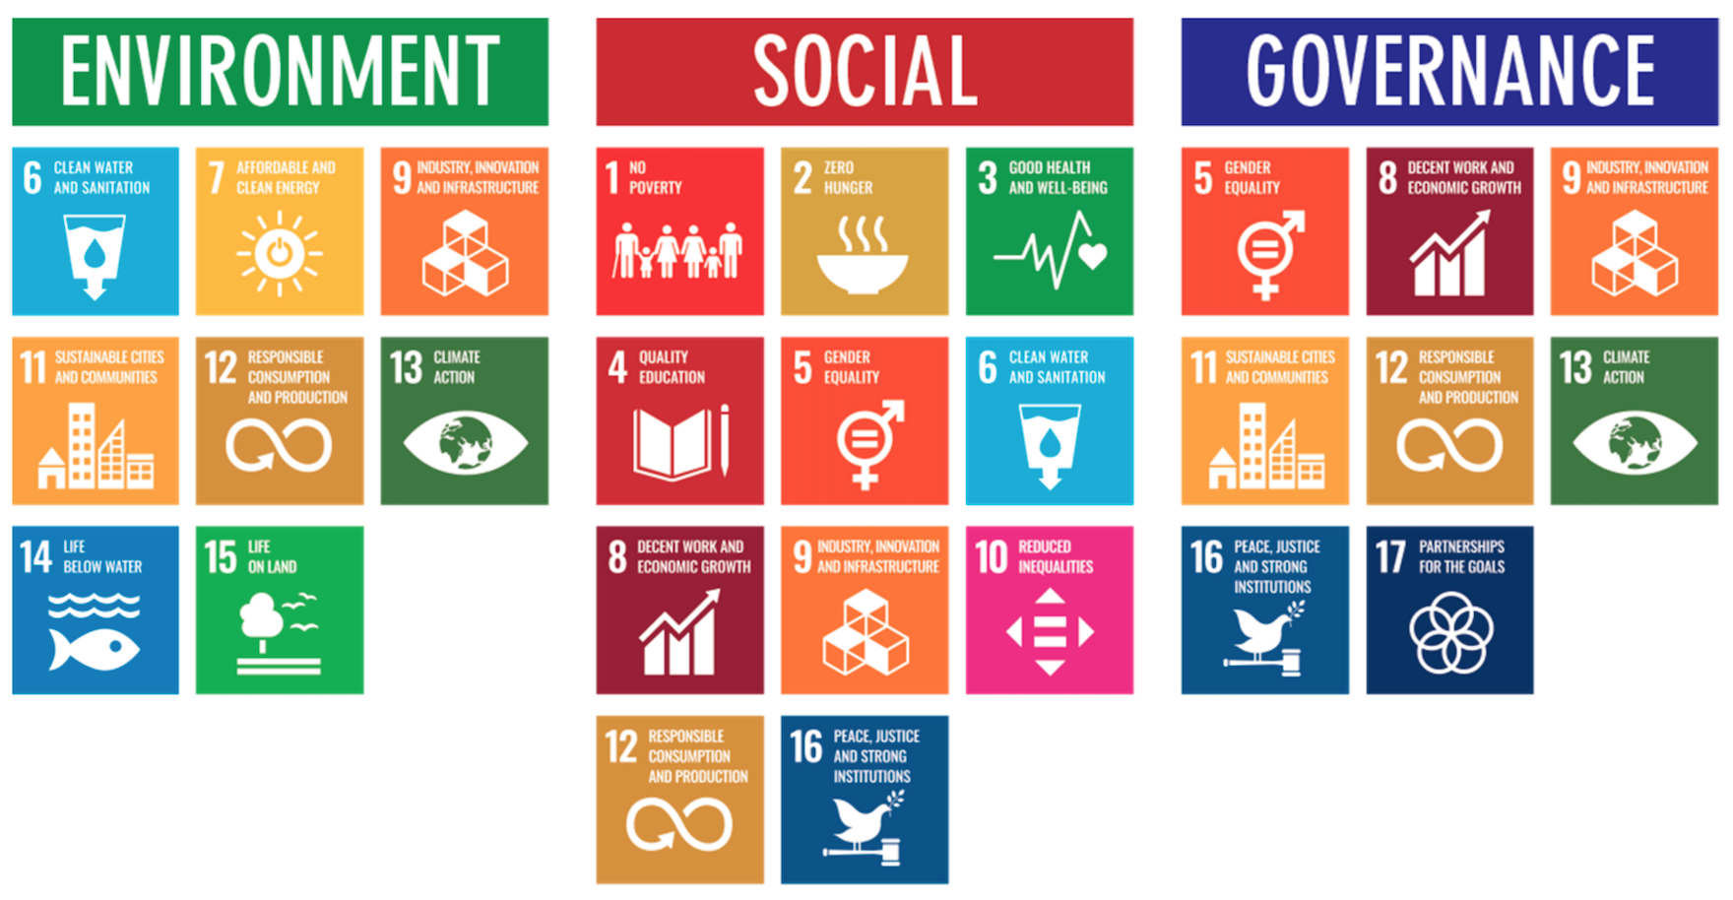
ESG to 17 SDGs
Source: Henrik Skaug Sætra (2021) "A Framework for Evaluating and Disclosing the ESG Related Impacts of AI with the SDGs." Sustainability 13, no. 15 (2021): 8503.

Slide 94
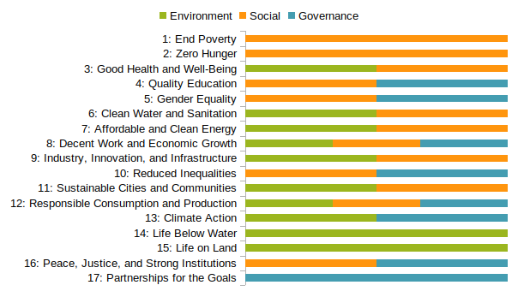
ESG to 17 SDGs
Source: https://sustainometric.com/esg-to-sdgs-connected-paths-to-a-sustainable-future/

Slide 95
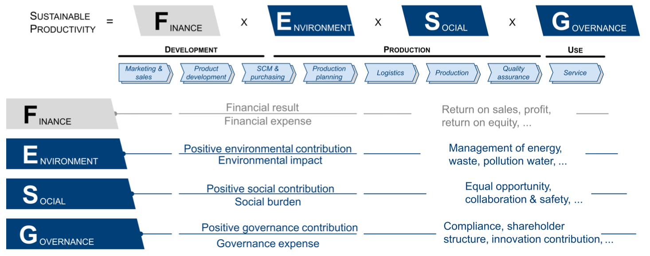
Sustainable Productivity:
Finance ESG
Source: Huang, Ziqi, Yang Shen, Jiayi Li, Marcel Fey, and Christian Brecher (2021). "A survey on AI-driven digital twins in Industry 4.0: Smart manufacturing and advanced robotics." Sensors 21, no. 19: 6340.

Slide 96
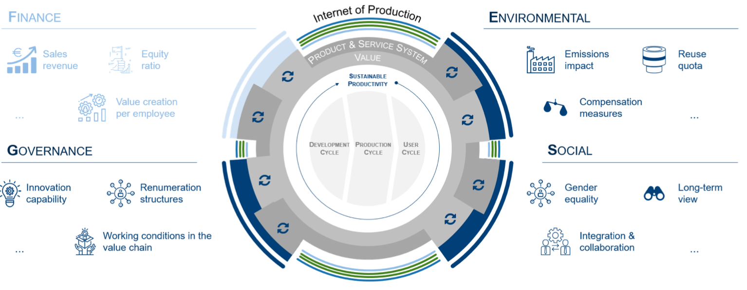
Sustainable Resilient Manufacturing
ESG
Source: Huang, Ziqi, Yang Shen, Jiayi Li, Marcel Fey, and Christian Brecher (2021). "A survey on AI-driven digital twins in Industry 4.0: Smart manufacturing and advanced robotics." Sensors 21, no. 19: 6340.

Slide 97

MSCI ESG Rating Framework
Source: https://www.msci.com/documents/1296102/21901542/ESG-Ratings-Methodology-Exec-Summary.pdf

Slide 98

MSCI ESG Key Issue Hierarchy
Source: https://www.msci.com/documents/1296102/21901542/ESG-Ratings-Methodology-Exec-Summary.pdf

Slide 99

MSCI Governance Model Structure
Source: https://www.msci.com/documents/1296102/21901542/ESG-Ratings-Methodology-Exec-Summary.pdf

Slide 100

MSCI Hierarchy of ESG Scores
Source: https://www.msci.com/documents/1296102/21901542/ESG-Ratings-Methodology-Exec-Summary.pdf

Slide 101
Innovation
Source: https://www.merriam-webster.com/dictionary/innovation

Slide 102
Innovation: a new idea, method, or device
Source: https://www.merriam-webster.com/dictionary/innovation

Slide 103
Innovation: something new
Source: https://www.merriam-webster.com/dictionary/innovation

Slide 104
Novelty : something new or unusual the novelty of a self-driving car
Source: https://www.merriam-webster.com/dictionary/novelty

Slide 105
Creativity is not a new Idea.
Creativity is an old belief you leave behind
Notes:
Creativity is not a new idea. Creativity is an old belief you leave behind.

Slide 106

FinTechs as Service Innovators: Analysing Components of Innovation
Source: Riikkinen, Mikko, Kaisa Still, Saila Saraniemi, and Katri Kallio. "FinTechs as service innovators: analysing components of innovation." In ISPIM Innovation Symposium, The International Society for Professional Innovation Management (ISPIM), 2016.

Slide 107
Innovation
“a process of searching and recombining existing knowledge elements”
Source: Savino, Tommaso, Antonio Messeni Petruzzelli, and Vito Albino. "Search and recombination process to innovate:
A review of the empirical evidence and a research agenda." International Journal of Management Reviews (2017).

Slide 108

Search and recombination process to innovate:
A review of the empirical evidence and a research agenda
Source: Savino, Tommaso, Antonio Messeni Petruzzelli, and Vito Albino. "Search and recombination process to innovate:
A review of the empirical evidence and a research agenda." International Journal of Management Reviews (2017).

Slide 109
Innovation Research in
Economics,
Sociology and Technology Management
Source: Gopalakrishnan, Shanti, and Fariborz Damanpour.
"A review of innovation research in economics, sociology and technology management." Omega 25, no. 1 (1997): 15-28.

Slide 110

Innovation Research in Economics, Sociology and Technology Management
Source: Gopalakrishnan, Shanti, and Fariborz Damanpour.
"A review of innovation research in economics, sociology and technology management." Omega 25, no. 1 (1997): 15-28.

Slide 111
Business,
Innovation, and
Knowledge
Ecosystems
Source: Valkokari, Katri. "Business, innovation, and knowledge ecosystems: how they differ and how to survive and thrive within them." Technology Innovation Management Review 5, no. 8 (2015).

Slide 112

Business, Innovation, and Knowledge Ecosystems
Source: Valkokari, Katri. "Business, innovation, and knowledge ecosystems: how they differ and how to survive and thrive within them." Technology Innovation Management Review 5, no. 8 (2015).

Slide 113
Innovation Ecosystems
Characteristics
 | Business Ecosystems | Innovation Ecosystems | Knowledge Ecosystems
Baseline of Ecosystem | Resource exploitation for customer value | Co-creation of innovation | Knowledge exploration
Relationships and Connectivity | Global business relationships both competitive and co-operative | Geographically clustered actors, different levels of collaboration and openness | Decentralized and disturbed knowledge nodes, synergies through knowledge exchange
Actors and Roles | Suppliers, customers, and focal companies as a core, other actors more loosely involved | Innovation policymakers, local intermediators, innovation brokers, and funding organizations | Research institutes, innovators, and technology entrepreneurs serve as knowledge nodes
Logic of Action | A main actor that operates as a platform sharing resources, assets, and benefits or aggregates other actors together in the networked business operations | Geographically proximate actors interacting around hubs facilitated by intermediating actors | A large number of actors that are grouped around knowledge exchange or a central non-proprietary resource for the benefit of all actors
Source: Valkokari, Katri. "Business, innovation, and knowledge ecosystems: how they differ and how to survive and thrive within them." Technology Innovation Management Review 5, no. 8 (2015).

Slide 114
Diffusion of Innovation Theory
(DOI)
Source: Everett M. Rogers (2003), “Diffusion of Innovations”, Free Press, 5th Edition

Slide 115
Innovation
(Diffusion of Innovation)
1. Relative advantage
2. Compatibility
3. Complexity
4. Trialability
5. Observability
Source: Everett M. Rogers (2003), “Diffusion of Innovations”, Free Press, 5th Edition

Slide 116
Diffusion of Innovation
Source: https://en.wikipedia.org/wiki/Diffusion_of_innovations

Slide 117
Innovation Adoption Process
Initiation
Adoption Decision
Implementation
Source: Pichlak, Magdalena.
"The innovation adoption process: A multidimensional approach." Journal of Management and Organization 22, no. 4 (2016): 476.

Slide 118
Innovation Adoption Process
Initiation
Adoption Decision
Implementation
Environmental Characteristics
Organizational Characteristics
Top Managers Characteristics
Innovation Characteristics
User Acceptance Attributes
TAM=
Technology Acceptance Model
RBV=
Resource-Based View
DOI =
Diffusion of Innovation Theory
Source: Pichlak, Magdalena.
"The innovation adoption process: A multidimensional approach." Journal of Management and Organization 22, no. 4 (2016): 476.

Slide 119

Innovation Adoption Process
TAM=
Technology Acceptance Model
RBV=
Resource-Based View
DOI =
Diffusion of Innovation Theory
Source: Pichlak, Magdalena.
"The innovation adoption process: A multidimensional approach." Journal of Management and Organization 22, no. 4 (2016): 476.

Slide 120
Summary
AI in FinTech
  Metaverse, Web3, DeFi, NFT
  Financial Services Innovation and Applications
  Technology-driven Financial Industry Development
Green Finance, Sustainability Innovation
  SDGs: Sustainable Development Goals
  CSR: Corporate Social Responsibility
  ESG: Environmental, Social, and Governance

Slide 121
Artificial Intelligence in Fintech,
Green Finance, and Sustainability Innovation
(人工智慧應用於金融科技、綠色金融與永續創新)
資訊管理研討
Q & A
時間：2022/11/28 (一) 19:10-21:30
地點：淡江大學資訊管理研究所 EMBA 城區部 D312
主持人：施盛寶 主任, 淡江大學資訊管理學系
Min-Yuh Day, Ph.D,
Associate Professor
Institute of Information Management, National Taipei University
https://web.ntpu.edu.tw/~myday
2022-11-28

Slide 122
References
Longbing Cao (2022). "Decentralized ai: Edge intelligence and smart blockchain, metaverse, web3, and desci." IEEE Intelligent Systems 37, no. 3: 6-19.
Qinglin Yang, Yetong Zhao, Huawei Huang, Zehui Xiong, Jiawen Kang, and Zibin Zheng (2022). "Fusing blockchain and AI with metaverse: A survey." IEEE Open Journal of the Computer Society 3 : 122-136.
Russell Belk, Mariam Humayun, and Myriam Brouard (2022). "Money, possessions, and ownership in the Metaverse: NFTs, cryptocurrencies, Web3 and Wild Markets." Journal of Business Research 153: 198-205.
Thien Huynh-The, Quoc-Viet Pham, Xuan-Qui Pham, Thanh Thi Nguyen, Zhu Han, and Dong-Seong Kim (2022). "Artificial Intelligence for the Metaverse: A Survey." arXiv preprint arXiv:2202.10336.
Thippa Reddy Gadekallu, Thien Huynh-The, Weizheng Wang, Gokul Yenduri, Pasika Ranaweera, Quoc-Viet Pham, Daniel Benevides da Costa, and Madhusanka Liyanage (2022). "Blockchain for the Metaverse: A Review." arXiv preprint arXiv:2203.09738.
Dan Sheridan, James Harris, Frank Wear, Jerry Cowell Jr, Easton Wong, and Abbas Yazdinejad (2022). "Web3 Challenges and Opportunities for the Market." arXiv preprint arXiv:2209.02446.
Yves Hilpisch (2020), Artificial Intelligence in Finance: A Python-Based Guide, O’Reilly Media.
Aurélien Géron (2019), Hands-On Machine Learning with Scikit-Learn, Keras, and TensorFlow: Concepts, Tools, and Techniques to Build Intelligent Systems, 2nd Edition, O’Reilly Media.
Yves Hilpisch (2018), Python for Finance: Mastering Data-Driven Finance, 2nd Edition, O'Reilly Media.
Paolo Sironi (2016), FinTech Innovation: From Robo-Advisors to Goal Based Investing and Gamification, Wiley.
Yuxing Yan (2017), Python for Finance: Apply powerful finance models and quantitative analysis with Python, Second Edition, Packt Publishing
Campbell R. Harvey, Ashwin Ramachandran, Joey Santoro, Fred Ehrsam (2021), DeFi and the Future of Finance, Wiley
Matt Fortnow and QuHarrison Terry (2021), The NFT Handbook - How to Create, Sell and Buy Non-Fungible Tokens, Wiley
Parma Bains, Mohamed Diaby, Dimitris Drakopoulos, Julia Faltermeier, Federico Grinberg, Evan Papageorgiou, Dmitri Petrov, Patrick Schneider, and Nobu Sugimoto (2021),
The Crypto Ecosystem and Financial Stability Challenges, International Monetary Fund, October 2021
Henrik Skaug Sætra (2021) "A Framework for Evaluating and Disclosing the ESG Related Impacts of AI with the SDGs." Sustainability 13, no. 15: 8503
Ramesh Sharda, Dursun Delen, and Efraim Turban (2017), “Business Intelligence, Analytics, and Data Science: A Managerial Perspective”, 4th Edition, Pearson
Frederic S. Mishkin (2015), “The Economics of Money, Banking and Financial Markets”, 11th Edition, Pearson
Susanne Chishti and Janos Barberis (2016), “The FINTECH Book: The Financial Technology Handbook for Investors, Entrepreneurs and Visionaries”, Wiley.
Paolo Sironi (2016), “FinTech Innovation: From Robo-Advisors to Goal Based Investing and Gamification”, Wiley.
Brett King (2014), “Breaking Banks: The Innovators, Rogues, and Strategists Rebooting Banking”, Wiley.
Brett King (2012), “Bank 3.0: Why banking is no longer somewhere you go, but something you do”, John Wiley & Sons
Gopalakrishnan, Shanti, and Fariborz Damanpour (1997). "A review of innovation research in economics, sociology and technology management." Omega 25, no. 1 : 15-28.
Pichlak, Magdalena (2016). "The innovation adoption process: A multidimensional approach." Journal of Management and Organization 22, no. 4 : 476.
Everett M. Rogers (2003), “Diffusion of Innovations”, Free Press, 5th Edition

