Slide 1
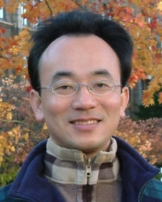
Cambridge English Teacher Online Training and EMI Teaching Experiences Sharing
EMI Workshop, NTPU Bilingual Education Office
2022/11/16 (Wednesday) 12:10 - 13:00
H418, NTPU Bilingual Education Office, NTPU
Min-Yuh Day, Ph.D, Associate Professor
Institute of Information Management, National Taipei University
https://web.ntpu.edu.tw/~myday
2022-11-16

Slide 2
Min-Yuh Day, Ph.D.
Associate Professor, Information Management, NTPU
Visiting Scholar, IIS, Academia Sinica
Ph.D., Information Management, NTU
Director, Intelligent Financial Innovation Technology, IFIT Lab, IM, NTPU
Artificial Intelligence, Financial Technology, Big Data Analytics, Data Mining and Text Mining, Electronic Commerce

Slide 3
Outline
Learning Experiences from Cambridge English Teacher Online Training Course
EMI Teaching Experiences Sharing

Slide 4
EMI Teacher Community AACSB, NTPU

Slide 5
EMI Teacher Community Activities
1. 2022/05/05 (Thursday) 12:00 pm-13:00 pm, B302
Teaching Experiences Sharing of EMI Courses in AI for Business Applications
Min-Yuh Day, National Taipei University,
https://meet.google.com/zuc-yyaw-mnt
2. 2022/05/11 (Wednesday) 9:10 am - 12:00 pm, B313
Agile Principles Patterns and Practices in FinTech and Digital Transformation
Shihyu (Alex) Chu, Senior Industry Analyst/Program Manager, Market Intelligence & Consulting Institute (MIC)
https://docs.google.com/forms/d/e/1FAIpQLScI7zvABRvtffqeZgT-_OWNbOsyIXBOn6Lt_tJ4-SuhZENyRQ/viewform
3. 2022/05/11 (Wednesday) 12:10 pm - 13:00 pm, B313
Professional Business Presentations in English
Shihyu (Alex) Chu, Senior Industry Analyst/Program Manager, Market Intelligence & Consulting Institute (MIC)
https://docs.google.com/forms/d/e/1FAIpQLScA0Qq52qjQ5MDAyEDxHyui7VrVdkIpsOSDzWXAwWi-kKLVAw/viewform
4. 2022/05/18 (Wednesday) 12:10 pm - 13:00 pm, B313
Web 3: From DeFi to WoFi
Prof. Shih-wei Liao, National Taiwan University
https://docs.google.com/forms/d/e/1FAIpQLSdkE-x4CW2w2LAjPEJcHCx25GAx4KYS1cHxUv9iiroda1cXYQ/viewform

Slide 6
Learning Experiences from Cambridge English Teacher Online Training Course

Slide 7
Cambridge English-Certificate in EMI Skills
Your EMI online course (Cambridge English-Certificate in EMI Skills) account is ready to log in.
Please follow the steps below for your access:
1. System link: https://teachercourses.cambridgeenglish.org/login/index.php
2. Log in to the account (your e-mail address): email@gm.ntpu.edu.tw
3. Initial password (please copy and paste): ********
4. Please change your password right after first logging in.
5. Please complete all the eight modules in the course before 2023/6/30.

Slide 8
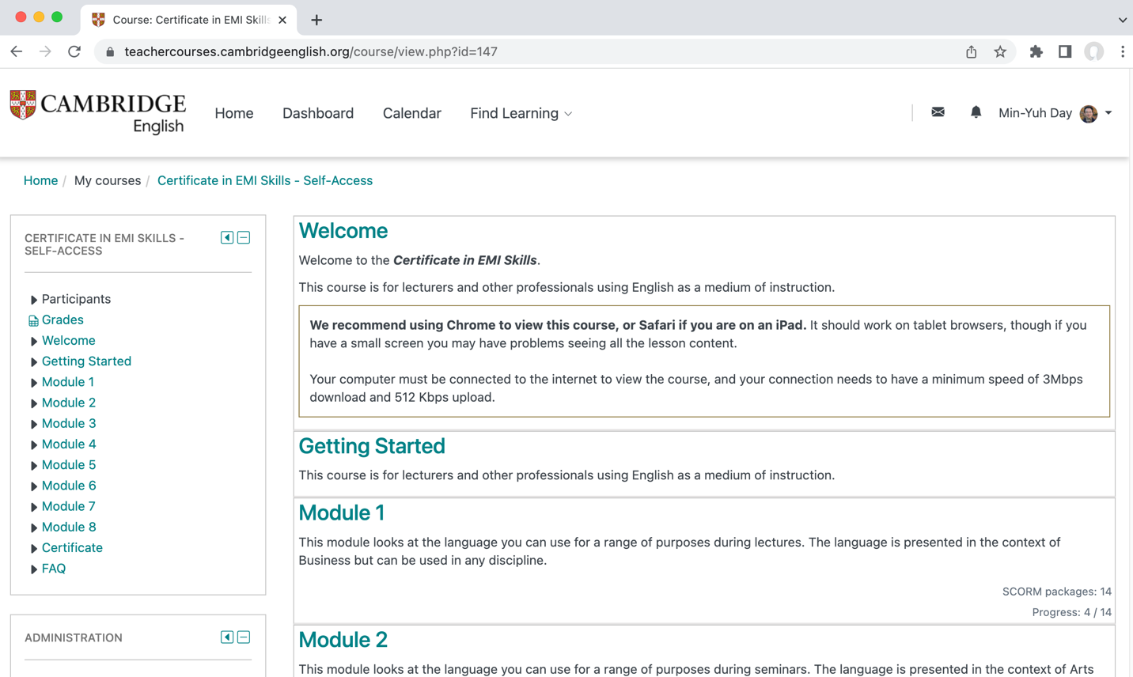
Cambridge English-Certificate in EMI Skills
https://teachercourses.cambridgeenglish.org/login/index.php

Slide 9
Cambridge English-Certificate in EMI Skills
8 Module 112 Sections
Each module consists of an introduction followed by 4 content sections and an ‘over to you’ section for you to review and apply your learning.
Module 1 – Language for lectures
Module 2 – Language for seminars
Module 3 – Language for small groups and practical sessions
Module 4 – Language for tutorials and supervision
Module 5 – Language for online communication
Module 6 – Language for evaluation and feedback
Module 7 – Language for developing and extending professional roles
Module 8 – Language for fulfilling professional responsibilities

Slide 10
Cambridge English-Certificate in EMI Skills
Module 1
SCORM packageM1 S1 L1 Introduction
SCORM packageM1 S2 L1 Enhancing lecture content
SCORM packageM1 S2 L2 Engaging students
SCORM packageM1 S2 L3 Develop your lecture style
SCORM packageM1 S3 L1 Phrases for introducing lectures
SCORM packageM1 S3 L2 Vocabulary for introductions
SCORM packageM1 S3 L3 Develop your lecture introductions
SCORM packageM1 S4 L1 Language for signposting
SCORM packageM1 S4 L2 Cohesion in lectures
SCORM packageM1 S4 L3 Develop your lecture language
SCORM packageM1 S5 L1 Language for conclusions
SCORM packageM1 S5 L2 Giving instructions
SCORM packageM1 S5 L3 Develop your lecture conclusions
SCORM packageM1 S6 L1 Over to you ...

Slide 11
Cambridge English-Certificate in EMI Skills

Slide 12
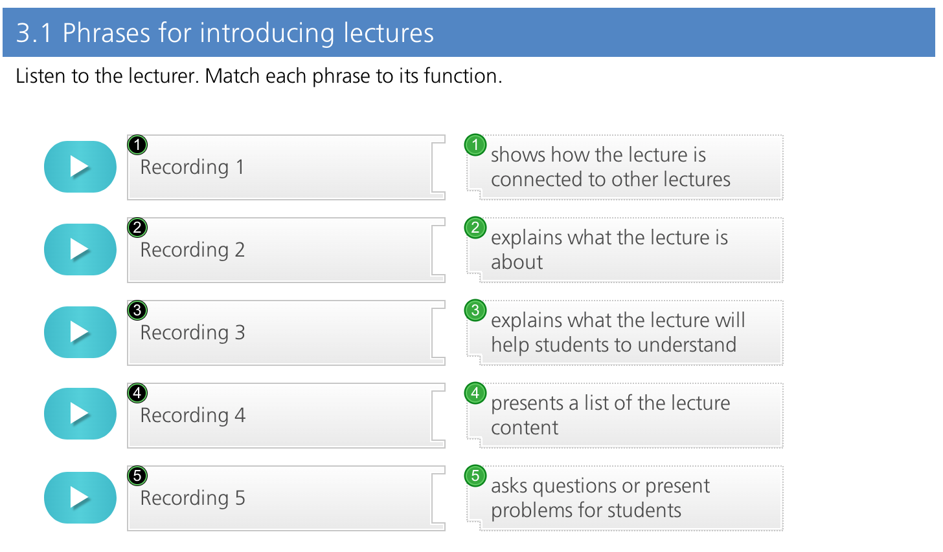
Cambridge English-Certificate in EMI Skills

Slide 13
EMI Teaching Experiences Sharing

Slide 14
EMI Courses in AI for Business Applications
Artificial Intelligence
Fall 2022
Artificial Intelligence in Finance and Quantitative
Fall 2022
Artificial Intelligence for Text Analytics
Spring 2022
Software Engineering
Spring 2022
https://web.ntpu.edu.tw/~myday/teaching.htm

Slide 15
Teaching Experiences (EMI)
Artificial Intelligence for Text Analytics
Spring 2022
Software Engineering
Fall 2020, Fall, 2021, Spring 2022, Spring 2023
Artificial Intelligence in Finance and Quantitative
Fall 2021, Fall 2022
Artificial Intelligence
Spring 2021, Fall 2022
Data Mining
Spring 2021
Big Data Analytics
Fall 2020, Spring 2023
Foundation of Business Cloud Computing
Spring 2021, Spring 2022
https://web.ntpu.edu.tw/~myday/teaching.htm

Slide 16
Teaching Experiences (EMI)
AI in Finance Big Data Analytics (Fall 2019)
MBA, DBETKU (3 Credits, Elective) [Full English Course] [Distance Learning]
Big Data Mining (Fall 2018)
MBA, DBETKU (3 Credits, Required) [Full English Course]
Social Media Apps Programming (Fall 2013 - Fall 2018)
MBA, IMTKU (2 Credits, Elective) [Full English Course]
Fall 2018, Fall 2017 , Fall 2016 , Fall 2015 , Fall 2014 , Fall 2013
https://web.ntpu.edu.tw/~myday/teaching.htm

Slide 17
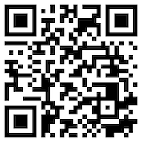
Introduction to Artificial Intelligence
Artificial Intelligence
1111AI01
MBA, IM, NTPU (M6132) (Fall 2022) Wed 2, 3, 4 (9:10-12:00) (B8F40)
Min-Yuh Day, Ph.D, Associate Professor
Institute of Information Management, National Taipei University
https://web.ntpu.edu.tw/~myday
https://meet.google.com/miy-fbif-max
2022-09-14

Slide 18
Course Syllabus National Taipei University Academic Year 111, 1st Semester (Fall 2022)
Course Title: Artificial Intelligence
Instructor: Min-Yuh Day
Course Class: MBA, IM, NTPU (3 Credits, Elective)
Details
In-Class and Distance Learning EMI Course (3 Credits, Elective, One Semester) (M6132)
Time & Place: Wed, 2, 3, 4, (9:10-12:00) (B8F40)
Google Meet: https://meet.google.com/miy-fbif-max
https://meet.google.com/miy-fbif-max

Slide 19
Course Objectives
Understand the fundamental concepts and research issues of Artificial Intelligence.
Equip with Hands-on practices of Artificial Intelligence.
Conduct information systems research in the context of Artificial Intelligence.

Slide 20
Course Outline
This course introduces the fundamental concepts, research issues, and hands-on practices of Artificial Intelligence.
Topics include:
Introduction to Artificial Intelligence
Artificial Intelligence and Intelligent Agents
Problem Solving
Knowledge, Reasoning and Knowledge Representation, Uncertain Knowledge and Reasoning
Machine Learning: Supervised and Unsupervised Learning
The Theory of Learning and Ensemble Learning
Deep Learning, Reinforcement Learning
Deep Learning for Natural Language Processing
Computer Vision and Robotics
Philosophy and Ethics of AI and the Future of AI
Case Study on AI

Slide 21
Core Competence
Exploring new knowledge in information technology, system development and application 80 %
Internet marketing planning ability 10 %
Thesis writing and independent research skills 10 %

Slide 22
Four Fundamental Qualities
Professionalism
Creative thinking and Problem-solving 40 %
Comprehensive Integration 30 %
Interpersonal Relationship
Communication and Coordination 5 %
Teamwork 5 %
Ethics
Honesty and Integrity 5 %
Self-Esteem and Self-reflection 5 %
International Vision
Caring for Diversity 5 %
Interdisciplinary Vision 5 %

Slide 23
College Learning Goals
Ethics/Corporate Social Responsibility
Global Knowledge/Awareness
Communication
Analytical and Critical Thinking

Slide 24
Department Learning Goals
Information Technologies and System Development Capabilities
Internet Marketing Management Capabilities
Research capabilities

Slide 25
Syllabus
Week Date Subject/Topics
1 2022/09/14 Introduction to Artificial Intelligence
2 2022/09/21 Artificial Intelligence and Intelligent Agents
3 2022/09/28 Problem Solving
4 2022/10/05 Knowledge, Reasoning and Knowledge Representation; Uncertain Knowledge and Reasoning
5 2022/10/12 Case Study on Artificial Intelligence I
6 2022/10/19 Machine Learning: Supervised and Unsupervised Learning

Slide 26
Syllabus
Week Date Subject/Topics
7 2022/10/26 The Theory of Learning and Ensemble Learning
8 2022/11/02 Midterm Project Report
9 2022/11/09 Deep Learning and Reinforcement Learning
10 2022/11/16 Deep Learning for Natural Language Processing
11 2022/11/23 Invited Talk: AI for Information Retrieval
12 2022/11/30 Case Study on Artificial Intelligence II

Slide 27
Syllabus
Week Date Subject/Topics
13 2022/12/07 Computer Vision and Robotics
14 2022/12/14 Philosophy and Ethics of AI and the Future of AI
15 2022/12/21 Final Project Report I
16 2022/12/28 Final Project Report II
17 2023/01/04 Self-learning
18 2023/01/11 Self-learning

Slide 28
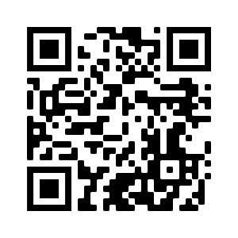
Introduction to Artificial Intelligence in Finance and Quantitative Analysis
Artificial Intelligence in Finance and Quantitative Analysis
1111AIFQA01
MBA, IM, NTPU (M6132) (Fall 2022) Tue 2, 3, 4 (9:10-12:00) (B8F40)
Min-Yuh Day, Ph.D, Associate Professor
Institute of Information Management, National Taipei University
https://web.ntpu.edu.tw/~myday
https://meet.google.com/paj-zhhj-mya
2022-09-13

Slide 29
Syllabus
Week Date Subject/Topics
1 2022/09/13 Introduction to Artificial Intelligence in Finance and Quantitative Analysis
2 2022/09/20 AI in FinTech: Metaverse, Web3, DeFi, NFT, Financial Services Innovation and Applications
3 2022/09/27 Investing Psychology and Behavioral Finance
4 2022/10/04 Event Studies in Finance
5 2022/10/11 Case Study on AI in Finance and Quantitative Analysis I
6 2022/10/18 Finance Theory

Slide 30
Syllabus
Week Date Subject/Topics
7 2022/10/25 Data-Driven Finance
8 2022/11/01 Midterm Project Report
9 2022/11/08 Financial Econometrics and Machine Learning
10 2022/11/15 AI-First Finance
11 2022/11/22 Industry Practices of AI in Finance and Quantitative Analysis
12 2022/11/29 Case Study on AI in Finance and Quantitative Analysis II

Slide 31
Syllabus
Week Date Subject/Topics
13 2022/12/06 Deep Learning in Finance; Reinforcement Learning in Finance
14 2022/12/13 Algorithmic Trading; Risk Management; Trading Bot and Event-Based Backtesting
15 2022/12/20 Final Project Report I
16 2022/12/27 Final Project Report II
17 2023/01/03 Self-learning
18 2023/01/10 Self-learning

Slide 32
Introduction to Artificial Intelligence for Text Analytics
Artificial Intelligence for Text Analytics
1102AITA01
MBA, IM, NTPU (M5026) (Spring 2022) Tue 2, 3, 4 (9:10-12:00) (B8F40)
Min-Yuh Day, Ph.D, Associate Professor
Institute of Information Management, National Taipei University
https://web.ntpu.edu.tw/~myday
https://meet.google.com/paj-zhhj-mya
2022-02-22

Slide 33
Syllabus
Week Date Subject/Topics
1 2022/02/22 Introduction to Artificial Intelligence for Text Analytics
2 2022/03/01 Foundations of Text Analytics: Natural Language Processing (NLP)
3 2022/03/08 Python for Natural Language Processing
4 2022/03/15 Natural Language Processing with Transformers
5 2022/03/22 Case Study on Artificial Intelligence for Text Analytics I
6 2022/03/29 Text Classification and Sentiment Analysis

Slide 34
Syllabus
Week Date Subject/Topics
7 2022/04/05 Tomb-Sweeping Day (Holiday, No Classes)
8 2022/04/12 Midterm Project Report
9 2022/04/19 Multilingual Named Entity Recognition (NER), Text Similarity and Clustering
10 2022/04/26 Text Summarization and Topic Models
11 2022/05/03 Text Generation
12 2022/05/10 Case Study on Artificial Intelligence for Text Analytics II

Slide 35
Syllabus
Week Date Subject/Topics
13 2022/05/17 Question Answering and Dialogue Systems
14 2022/05/24 Deep Learning, Transfer Learning, Zero-Shot, and Few-Shot Learning for Text Analytics
15 2022/05/31 Final Project Report I
16 2022/06/07 Final Project Report II
17 2022/06/14 Self-learning
18 2022/06/21 Self-learning

Slide 36
Language Models Sizes (GPT-3, PaLM, BLOOM)
Source: https://lifearchitect.ai/models/

Slide 37
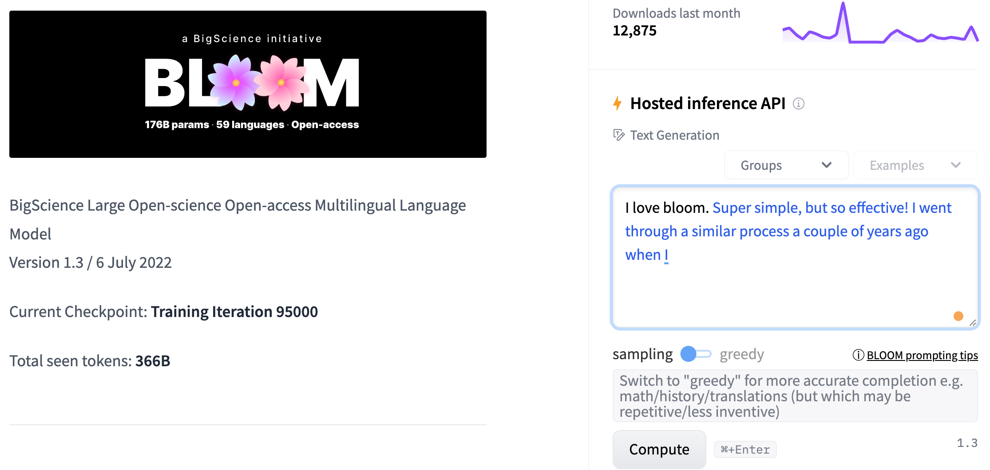
BLOOM BigScience Large Open-science Open-access Multilingual Language Model
Source: https://huggingface.co/bigscience/bloom

Slide 38
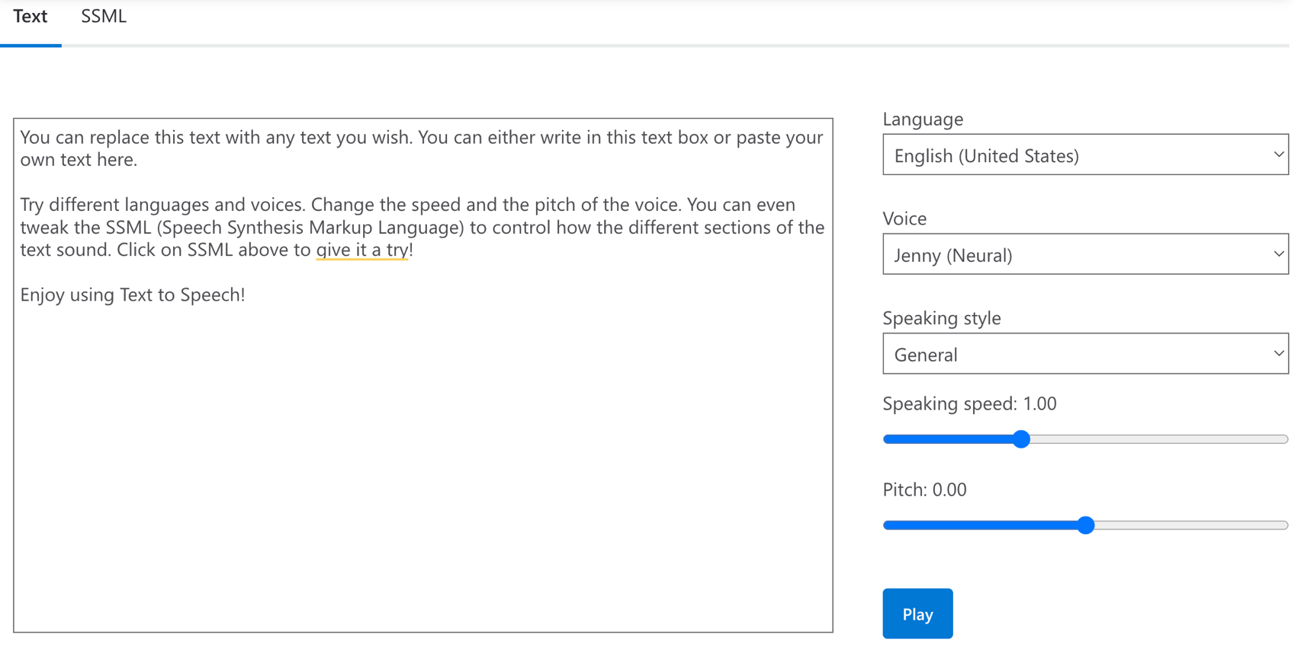
Microsoft Azure Text to Speech (TTS)
Source: https://azure.microsoft.com/en-gb/products/cognitive-services/text-to-speech/

Slide 39
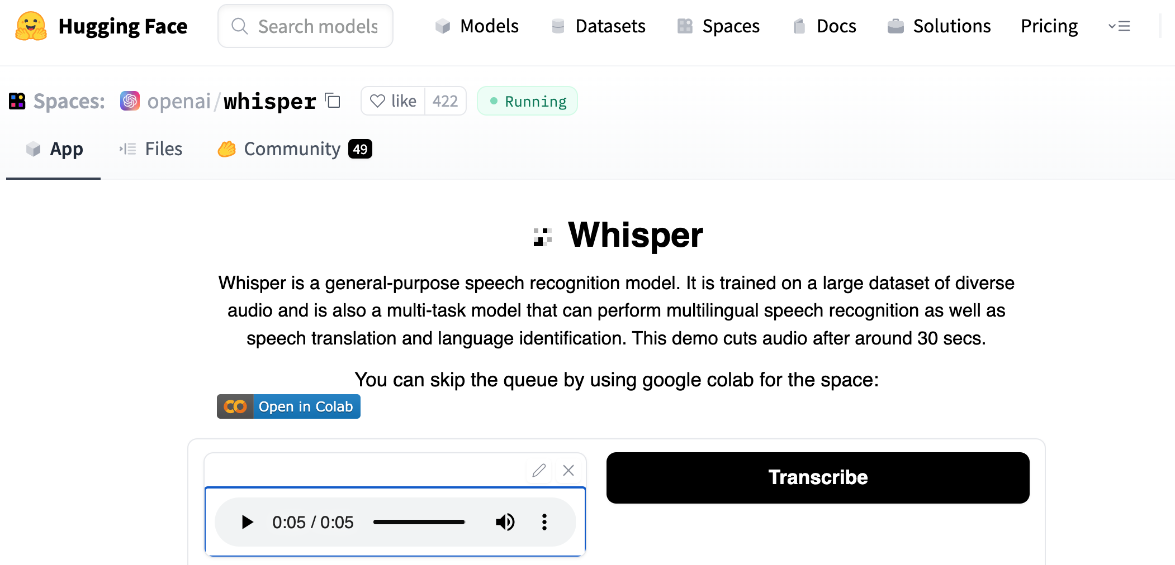
OpenAI Whisper
Source: https://huggingface.co/spaces/openai/whisper

Slide 40
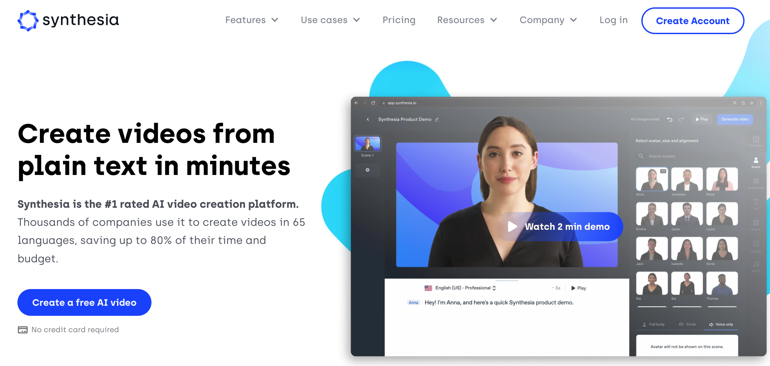
Synthesia AI Video Generation
Source: https://www.synthesia.io/

Slide 41
大學全英語授課：900句課堂情境句型與應用（美式發音MP3免費下載） 作者： 廖柏森, 朱雯琪, 李明哲, 金瑄桓 出版社：眾文 出版日期：2021/01/20
Source: https://www.books.com.tw/products/0010881647

Slide 42
Summary
Learning Experiences from Cambridge English Teacher Online Training Course
EMI Teaching Experiences Sharing

Slide 43
Cambridge English Teacher Online Training and EMI Teaching Experiences Sharing
EMI Workshop, NTPU Bilingual Education Office
Q & A
2022/11/16 (Wednesday) 12:10 - 13:00
H418, NTPU Bilingual Education Office, NTPU
Min-Yuh Day, Ph.D, Associate Professor
Institute of Information Management, National Taipei University
https://web.ntpu.edu.tw/~myday
2022-11-16

