Slide 1
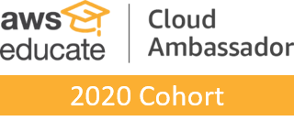
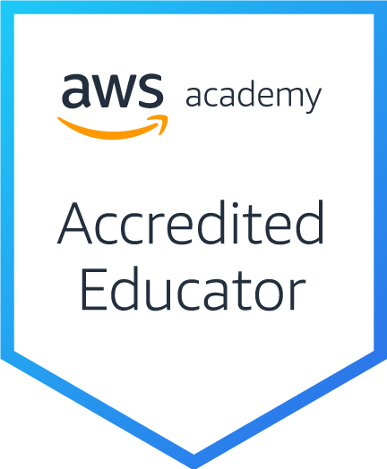
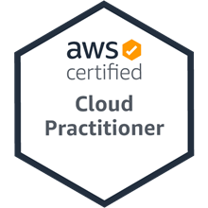
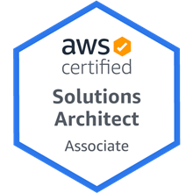
Introduction to Amazon Web Services (AWS) Certifications Roadmap
Host: 陳仁偉 教授 (Prof. Jen Wel Chen)
Information Management, SEC, Chinese Culture University Time: 2022/3/13 (Sunday) 13:00-15:00
Place: 202教室 大夏館 台北市建國南路二段231號
戴敏育 副教授
Min-Yuh Day, Ph.D, Associate Professor
國立臺北大學 資訊管理研究所
Institute of Information Management, National Taipei University
https://web.ntpu.edu.tw/~myday
2022-03-13

Slide 2
戴敏育 博士 (Min-Yuh Day, Ph.D.)
1
國立臺北大學 資訊管理研究所 副教授
中央研究院 資訊科學研究所 訪問學人
國立臺灣大學 資訊管理 博士
Publications Co-Chairs, IEEE/ACM International Conference on Advances in Social Networks Analysis and Mining (ASONAM 2013- )
Program Co-Chair, IEEE International Workshop on Empirical Methods for Recognizing Inference in TExt (IEEE EM-RITE 2012- )
Publications Chair, The IEEE International Conference on Information Reuse and Integration for Data Science (IEEE IRI)

Slide 3
Outline
Amazon Web Services (AWS)
AWS Certifications Roadmap

Slide 4
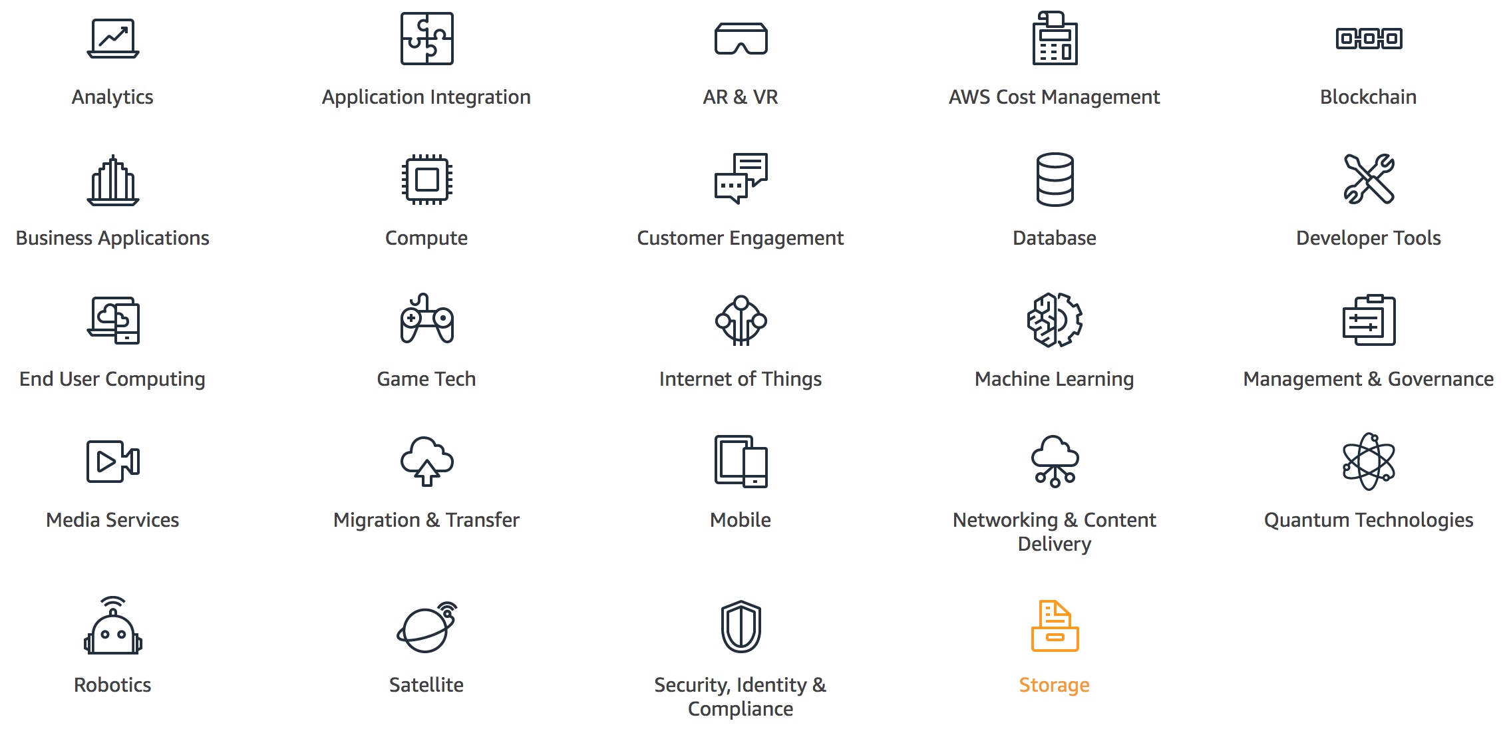
AWS Products and Services
Source: https://aws.amazon.com/

Slide 5
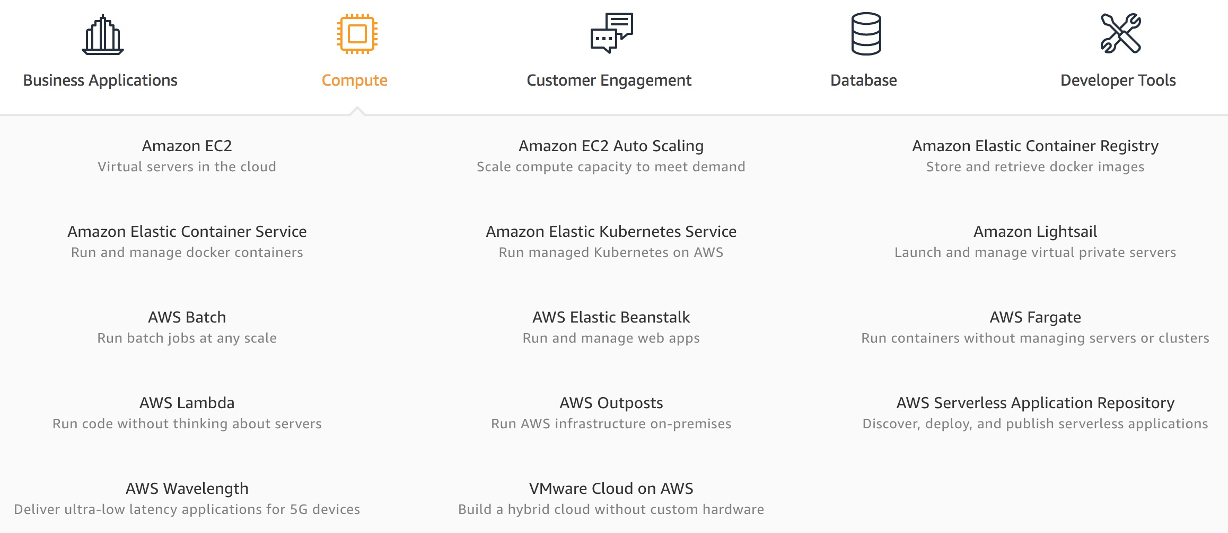
AWS Compute
Source: https://aws.amazon.com/

Slide 6
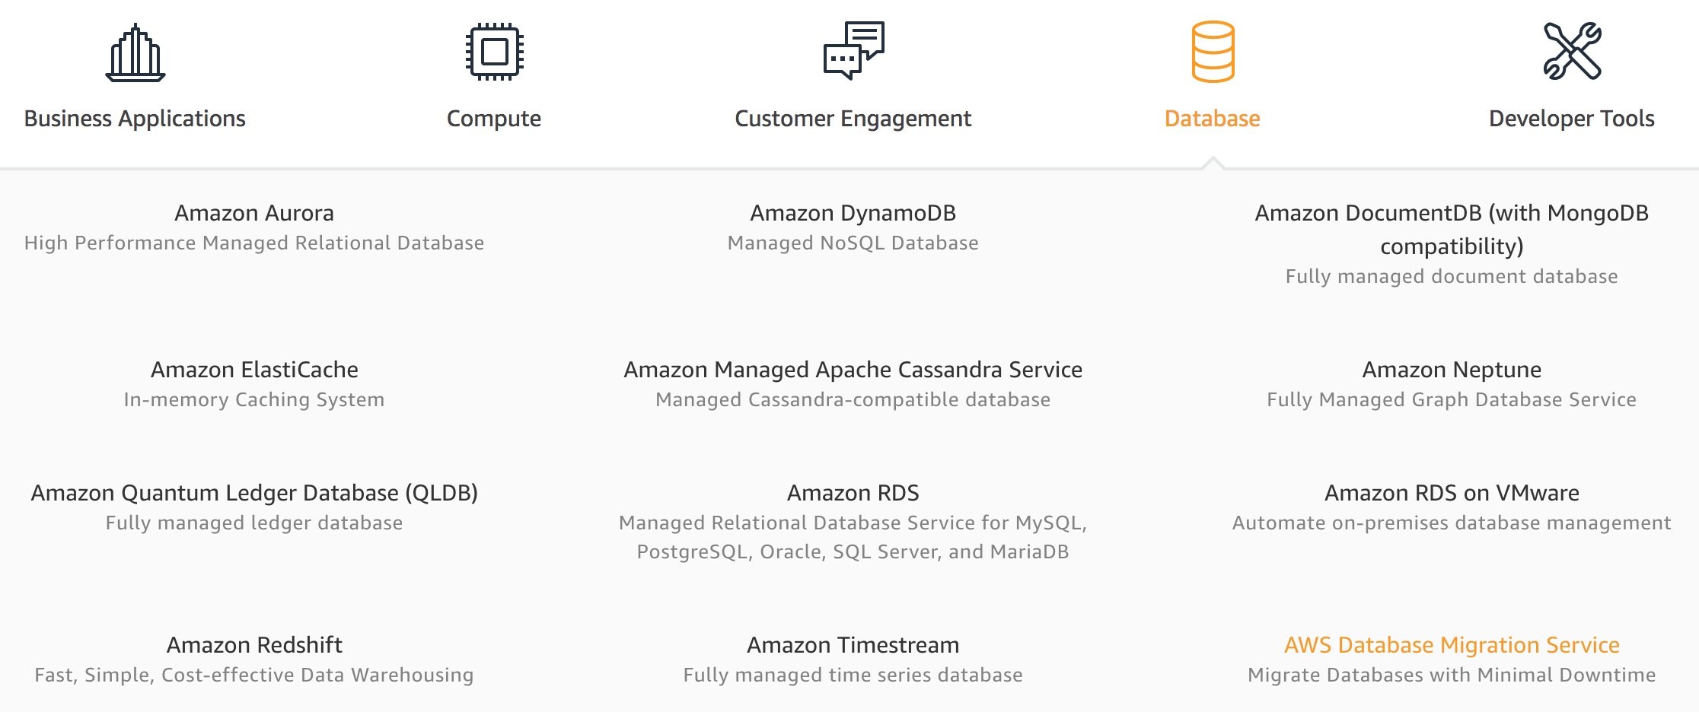
AWS Database
Source: https://aws.amazon.com/

Slide 7
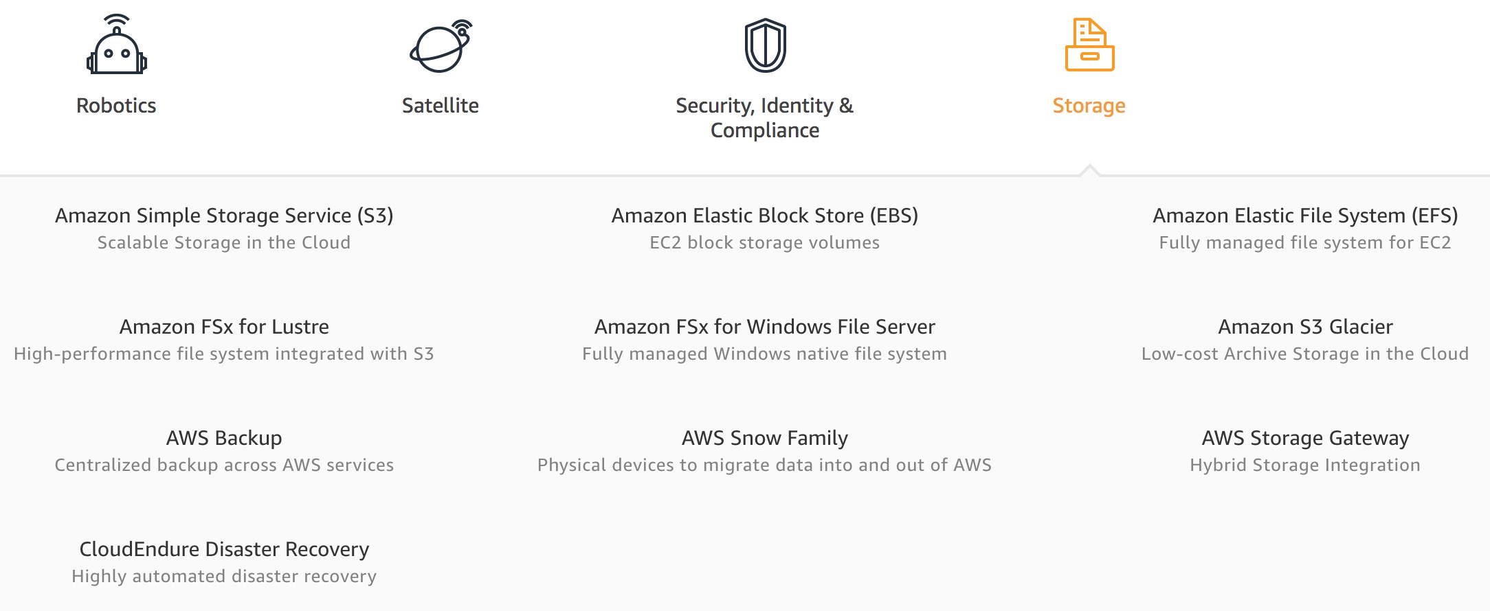
AWS Storage
Source: https://aws.amazon.com/

Slide 8
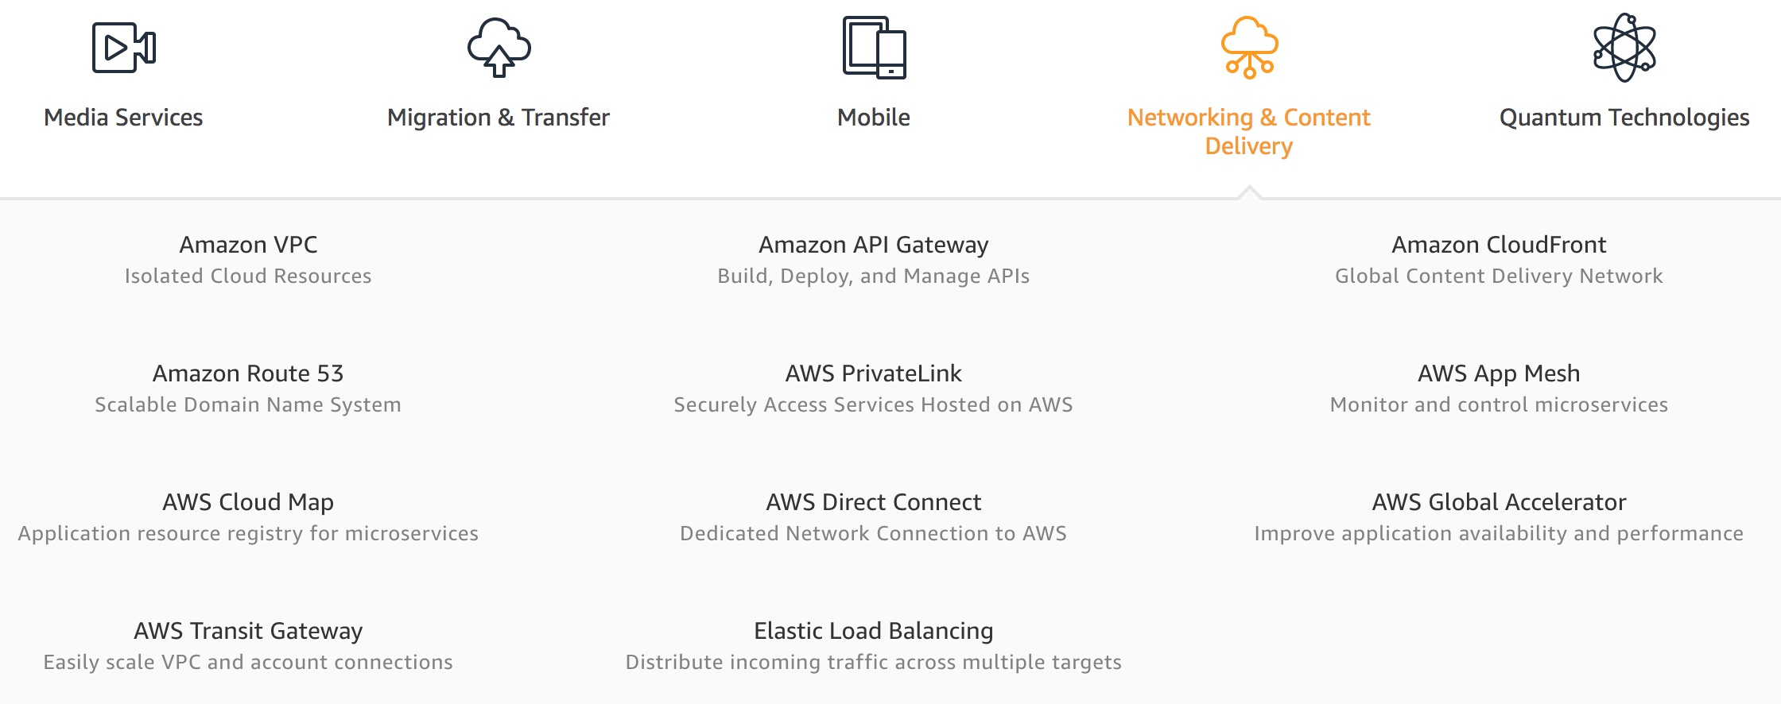
AWS Networking & Content Dilivery
Source: https://aws.amazon.com/

Slide 9
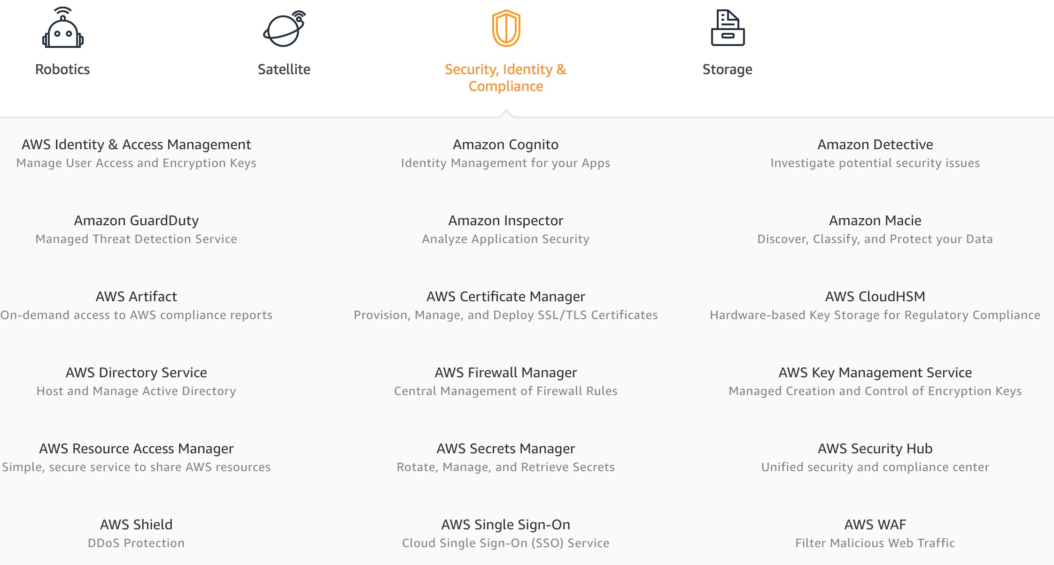
AWS Security, Identity & Compliance
Source: https://aws.amazon.com/

Slide 10
AWS Cost Management
Source: https://aws.amazon.com/

Slide 11
AWS Services
Amazon EC2
Virtual servers in the cloud
Amazon Simple Storage Service (S3)
Scalable storage in the cloud
Amazon Aurora
High performance managed relational database
Amazon DynamoDB
Managed NoSQL database
Amazon RDS
Managed relational database service for MySQL, PostgreSQL, Oracle, SQL Server, and MariaDB
Source: https://aws.amazon.com/

Slide 12
AWS Services
AWS Lambda
Run code without thinking about servers
AWS Elastic Beanstalk
Run and manage web apps
Amazon VPC
Isolated cloud resources
Amazon Lightsail
Launch and manage virtual private servers
Amazon SageMaker
Build, train, and deploy machine learning models at scale
Source: https://aws.amazon.com/

Slide 13
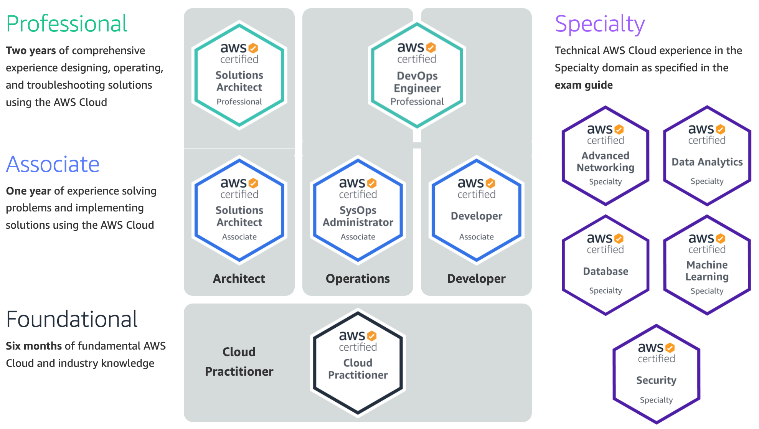
Available AWS Certifications
3
SAP
2
SAA
1
CLF
https://aws.amazon.com/certification/

Slide 14
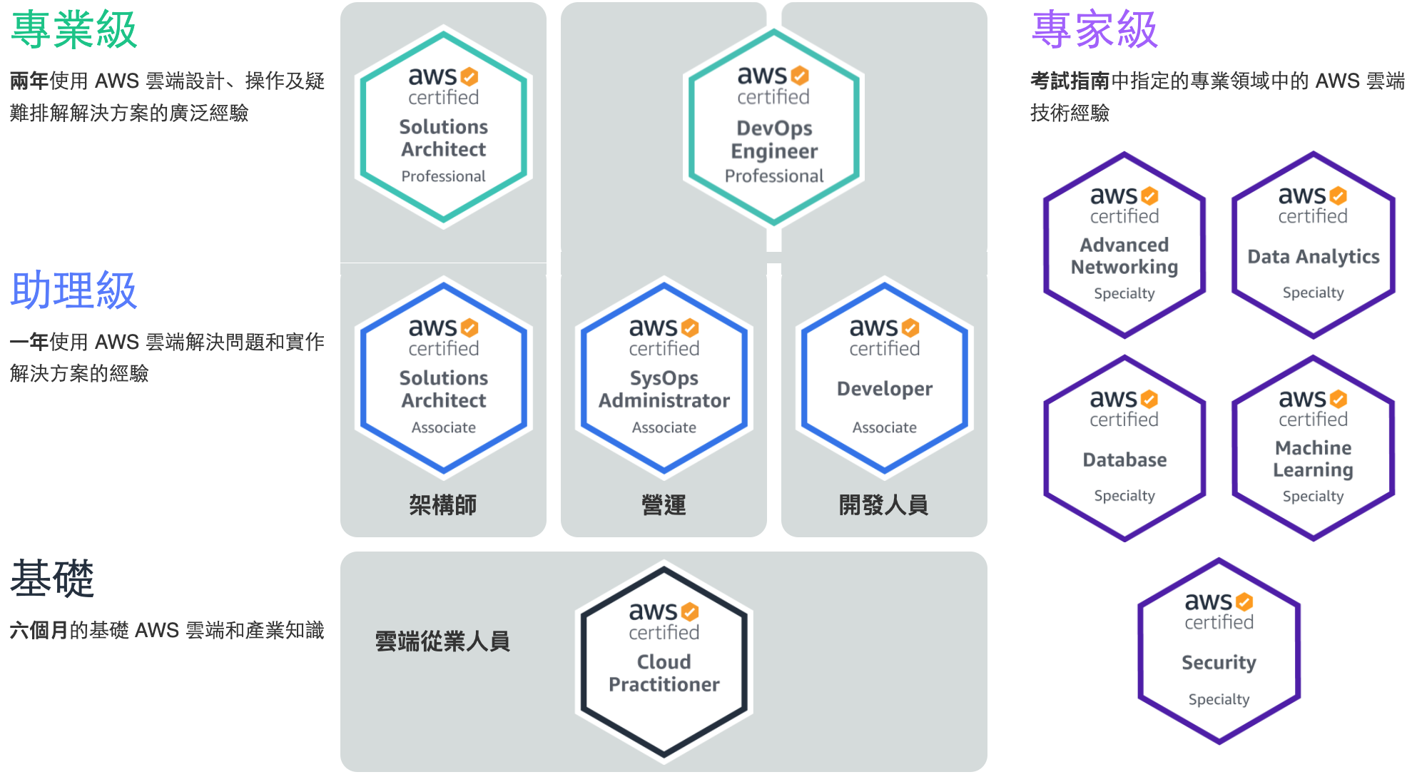
Available AWS Certifications
3
SAP
2
SAA
1
CLF
https://aws.amazon.com/certification/

Slide 15
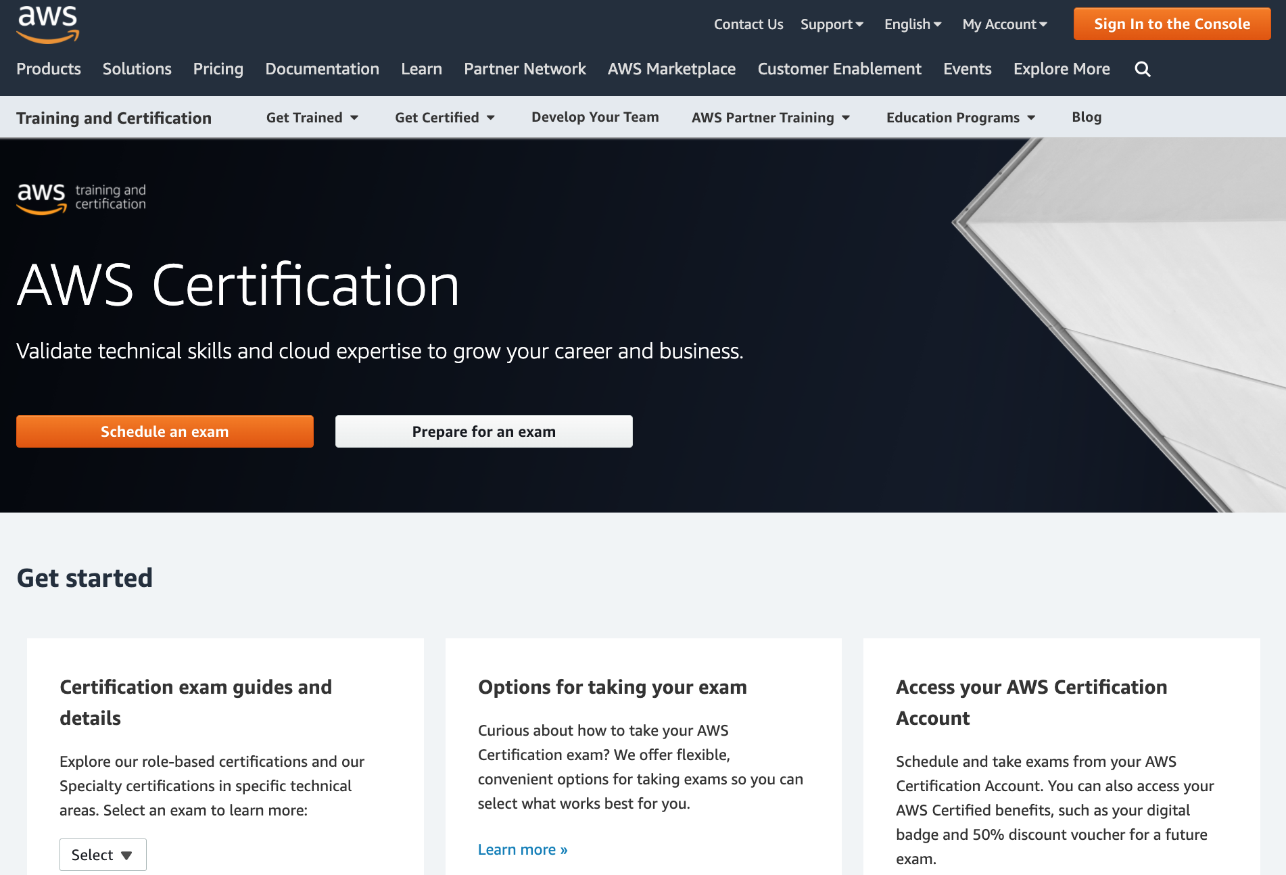
AWS Certification
https://aws.amazon.com/certification/

Slide 16
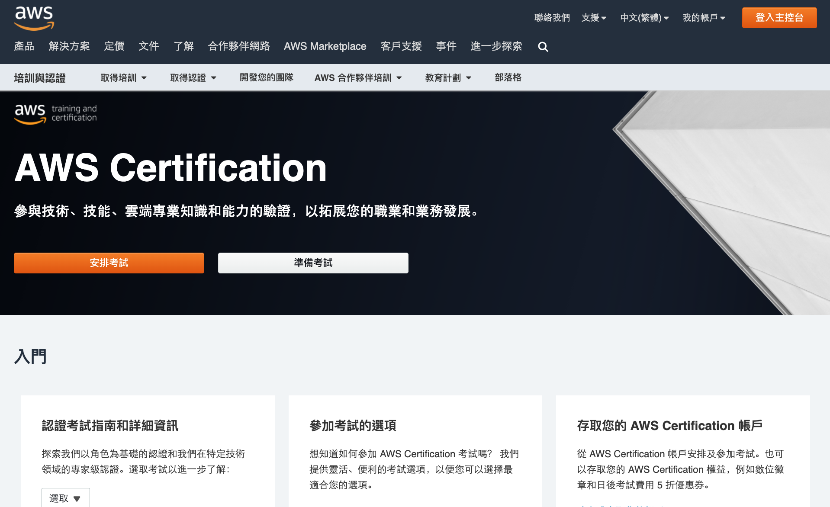
AWS Certification
https://aws.amazon.com/certification/

Slide 17
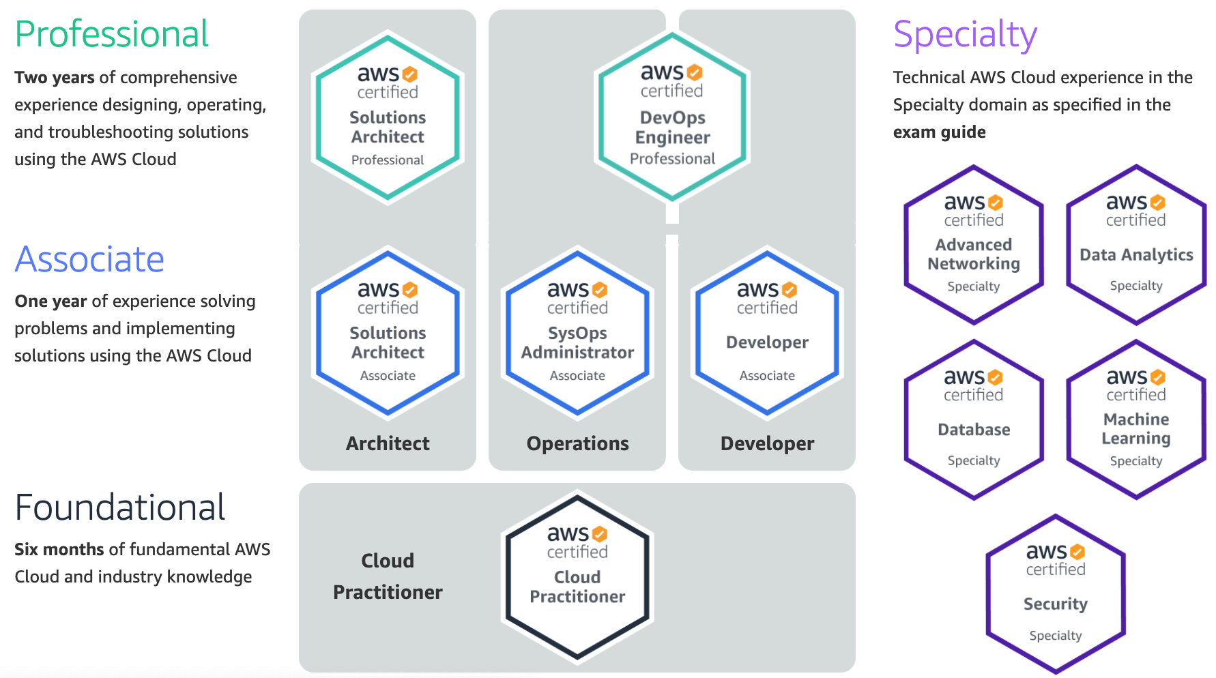
AWS Certification
2
SAA
1
CLF
https://aws.amazon.com/certification/

Slide 18
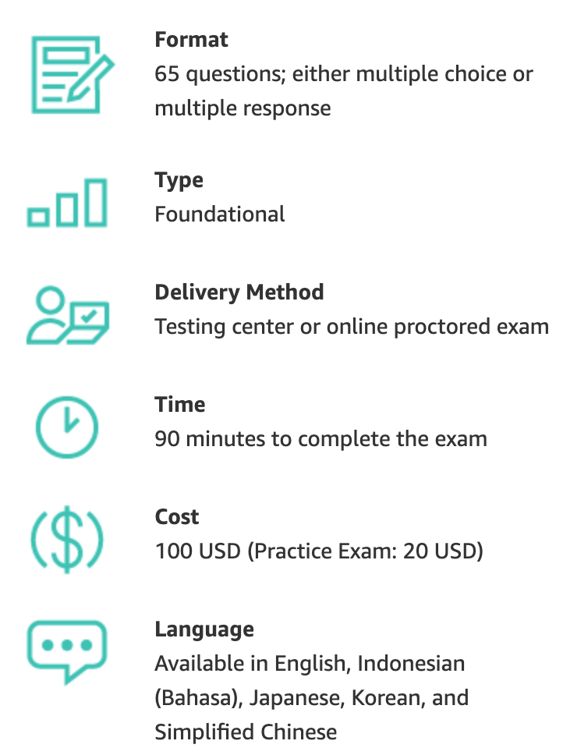
AWS Certification
https://aws.amazon.com/certification/

Slide 19
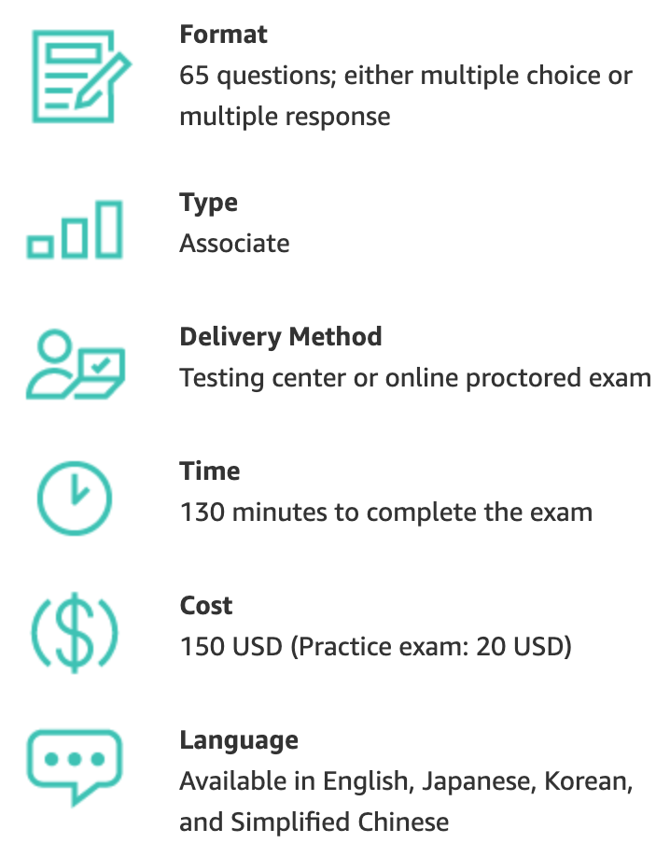
AWS Certification
https://aws.amazon.com/certification/

Slide 20
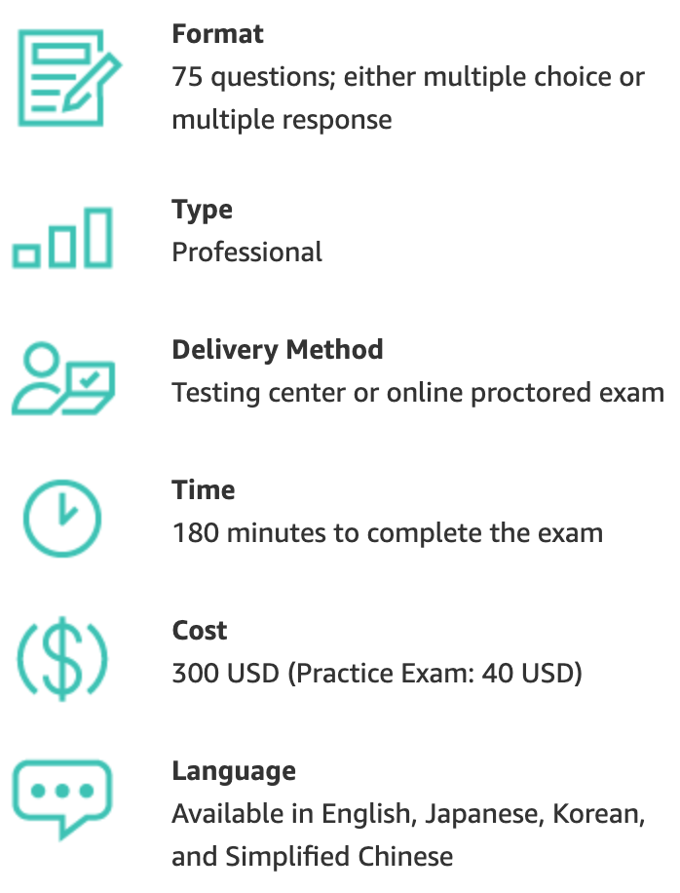
AWS Certification
https://aws.amazon.com/certification/

Slide 21
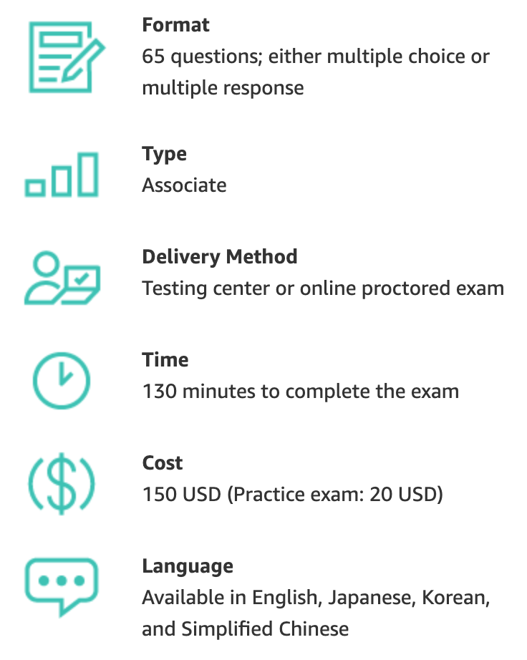
AWS Certification
https://aws.amazon.com/certification/

Slide 22
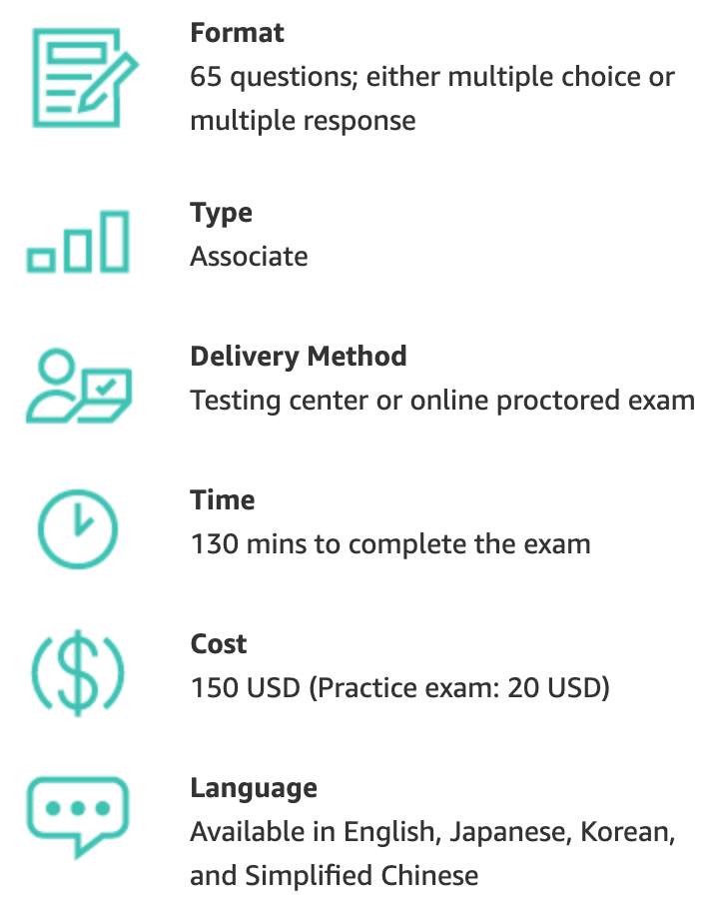
AWS Certification
https://aws.amazon.com/certification/

Slide 23
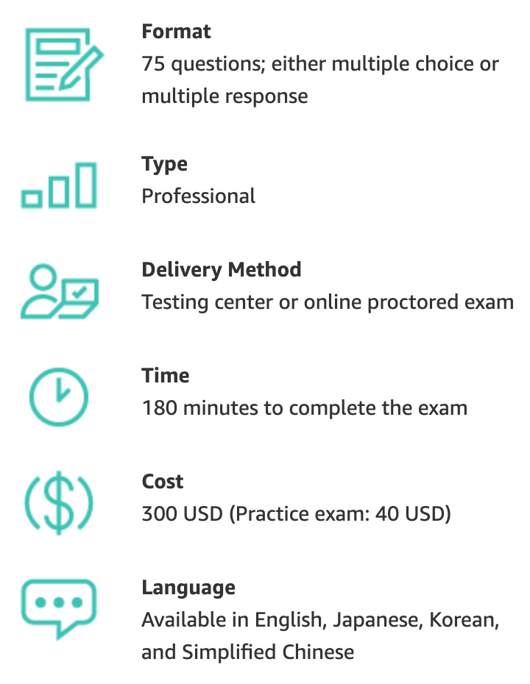
AWS Certification
https://aws.amazon.com/certification/

Slide 24
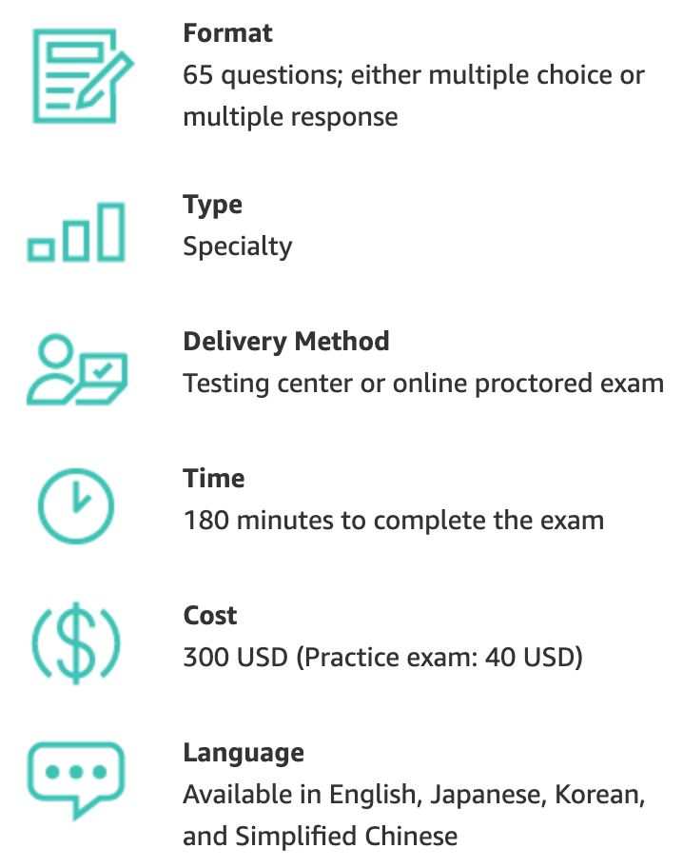
AWS Certification
https://aws.amazon.com/certification/

Slide 25
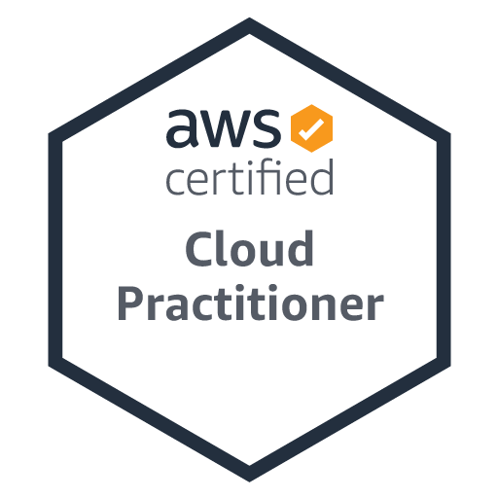
AWS Certified Cloud Practitioner
Level: Foundational
Length: 90 minutes to complete the exam
Cost: 100 USD
Format: 65 questions; either multiple choice or multiple response
Delivery method: Pearson VUE and PSI; testing center or online proctored exam
https://aws.amazon.com/certification/certified-cloud-practitioner/

Slide 26
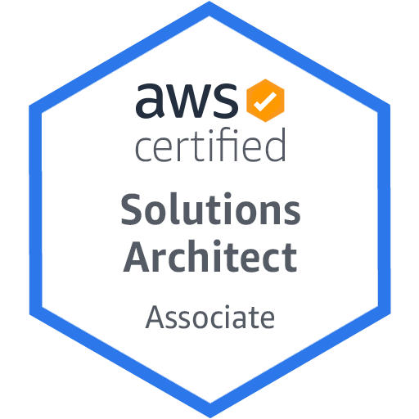
AWS Certified Solutions Architect – Associate
Level: Associate
Length: 130 minutes to complete the exam
Cost: 150 USD
Format: 65 questions; either multiple choice or multiple response
Delivery method: Pearson VUE and PSI; testing center or online proctored exam
https://aws.amazon.com/certification/certified-solutions-architect-associate/

Slide 27
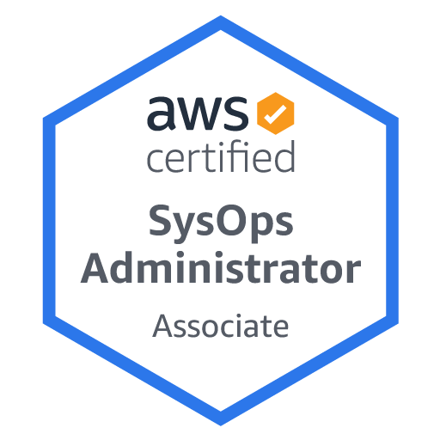
AWS Certified SysOps Administrator - Associate
Level: Associate
Length: 180 minutes to complete the exam
Cost: 150 USD
Format: 65 scoring opportunities that may be multiple choice, multiple response, or exam lab
Delivery method: Pearson VUE and PSI; testing center or online proctored exam
https://aws.amazon.com/certification/certified-sysops-admin-associate

Slide 28
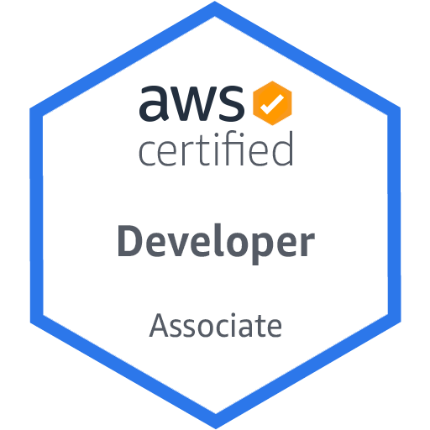
AWS Certified Solutions Architect – Associate
Level: Associate
Length: 130 minutes to complete the exam
Cost: 150 USD
Format: 65 questions; either multiple choice or multiple response
Delivery method: Pearson VUE and PSI; testing center or online proctored exam
https://aws.amazon.com/certification/certified-developer-associate

Slide 29
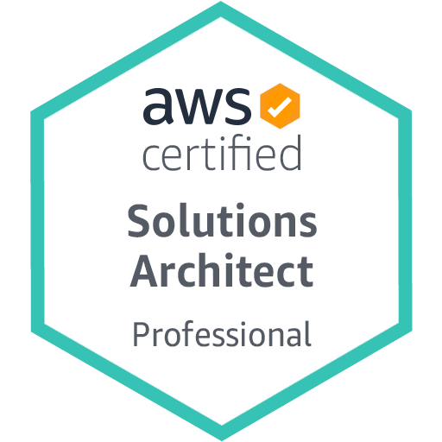
AWS Certified Solutions Architect - Professional
Level: Professional
Length: 180 minutes to complete the exam
Cost: 300 USD
Format: 75 questions; either multiple choice or multiple response
Delivery method: Pearson VUE and PSI; testing center or online proctored exam
https://aws.amazon.com/certification/certified-solutions-architect-professional

Slide 30
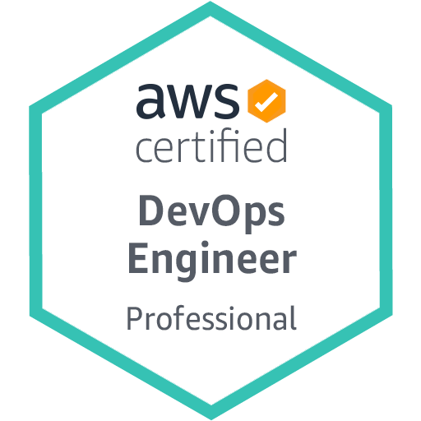
AWS Certified DevOps Engineer - Professional
Level: Professional
Length: 180 minutes to complete the exam
Cost: 300 USD
Format: 75 questions; either multiple choice or multiple response
Delivery method: Pearson VUE and PSI; testing center or online proctored exam
https://aws.amazon.com/certification/certified-devops-engineer-professional

Slide 31
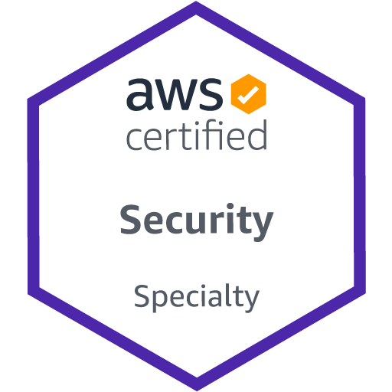
AWS Certified Security - Specialty
Level: Specialty
Length: 170 minutes to complete the exam
Cost: 300 USD
Format: 65 questions; either multiple choice or multiple response
Delivery method: Pearson VUE and PSI; testing center or online proctored exam
https://aws.amazon.com/certification/certified-security-specialty

Slide 32
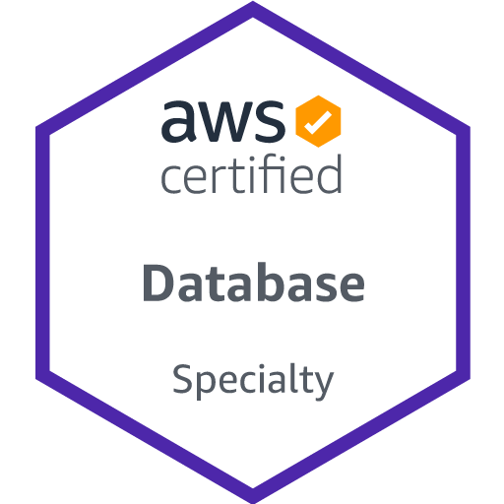
AWS Certified Database - Specialty
Level: Specialty
Length: 180 minutes to complete the exam
Cost: 300 USD
Format: 65 questions; either multiple choice or multiple response
Delivery method: Pearson VUE and PSI; testing center or online proctored exam
https://aws.amazon.com/certification/certified-database-specialty

Slide 33
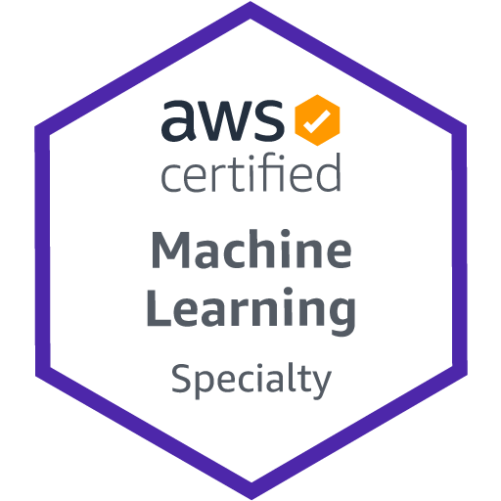
AWS Certified Machine Learning – Specialty
Level: Specialty
Length: 180 minutes to complete the exam
Cost: 300 USD
Format: 65 questions; either multiple choice or multiple response
Delivery method: Pearson VUE and PSI; testing center or online proctored exam
https://aws.amazon.com/certification/certified-machine-learning-specialty/

Slide 34
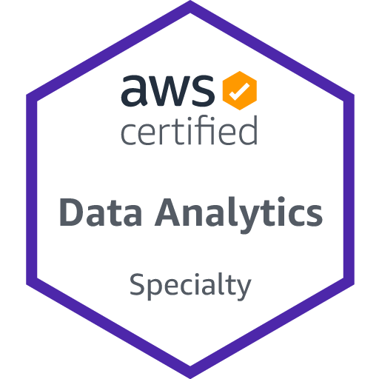
AWS Certified Data Analytics - Specialty
Level: Specialty
Length: 180 minutes to complete the exam
Cost: 300 USD
Format: 65 questions; either multiple choice or multiple response
Delivery method: Pearson VUE and PSI; testing center or online proctored exam
https://aws.amazon.com/certification/certified-data-analytics-specialty

Slide 35
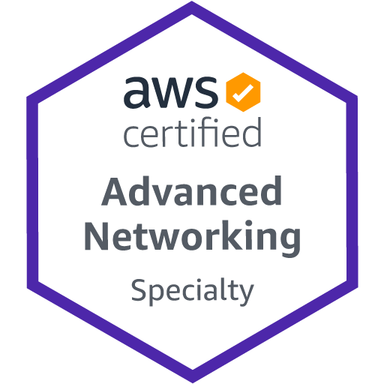
AWS Certified Advanced Networking - Specialty
Level: Specialty
Length: 170 minutes to complete the exam
Cost: 300 USD
Format: 65 questions; either multiple choice or multiple response
Delivery method: Pearson VUE and PSI; testing center or online proctored exam
https://aws.amazon.com/certification/certified-advanced-networking-specialty

Slide 36
AWS Certifications Roadmap
https://aws.amazon.com/certification/

Slide 37
AWS Certifications Roadmap Cloud Architect
https://aws.amazon.com/certification/

Slide 38
AWS Certifications Roadmap Cloud Developer
https://aws.amazon.com/certification/

Slide 39
AWS Certifications Roadmap DevOps
https://aws.amazon.com/certification/

Slide 40
AWS Certifications Roadmap Data Analytics / Machine Learning
https://aws.amazon.com/certification/

Slide 41
AWS Certifications Roadmap Security
https://aws.amazon.com/certification/

Slide 42
AWS Certified Cloud Practitioner (CLF-C01)
Source: https://aws.amazon.com/certification/certified-cloud-practitioner/

Slide 43
AWS Certified Cloud Practitioner
This certification provides individuals in a larger variety of cloud and technology roles with a way to validate their AWS Cloud knowledge and enhance their professional credibility.
This exam covers four domains, including cloud concepts, security, technology, and billing and pricing.
https://aws.amazon.com/certification/certified-cloud-practitioner/

Slide 44
AWS Certified Solutions Architect – Associate (SAA-C02)
Source: https://aws.amazon.com/certification/certified-solutions-architect-associate

Slide 45
AWS Certified Solutions Architect – Associate
This certification validates your ability to effectively demonstrate knowledge of how to architect and deploy secure and robust applications on AWS technologies.
This exam is for anyone with at least one year of hands-on experience designing available, cost-efficient, fault-tolerant, and scalable and distributed systems on AWS.
https://aws.amazon.com/certification/certified-solutions-architect-associate/

Slide 46
AWS Academy and Certifications
1
AWS Academy Cloud Foundations (ACF)
AWS Certified Cloud Practitioner (CLF-C01)
https://aws.amazon.com/certification/certified-cloud-practitioner/
AWS Academy Cloud Architecting (ACA)
AWS Certified Solutions Architect – Associate (SAA-C02)
https://aws.amazon.com/certification/certified-solutions-architect-associate/
2
https://aws.amazon.com/training/awsacademy/

Slide 47
AWS Certified Cloud Practitioner (CLF-C01)
Domain | % of Examination
Domain 1: Cloud Concepts | 26%
Domain 2: Security and Compliance | 25%
Domain 3: Technology | 33%
Domain 4: Billing and Pricing | 16%
TOTAL | 100%
Source: https://aws.amazon.com/certification/certified-cloud-practitioner/

Slide 48
AWS Certified Solutions Architect – Associate (SAA-C02)
Domain | % of Examination
Domain 1: Design Resilient Architectures | 30%
Domain 2: Design High-Performing Architectures | 28%
Domain 3: Specify Secure Applications and Architectures | 24%
Domain 4: Design Cost-Optimized Architectures | 18%
TOTAL | 100%
Source: https://aws.amazon.com/certification/certified-solutions-architect-associate

Slide 49
AWS Certified Cloud Practitioner (CLF-C01)
Source: https://aws.amazon.com/certification/certified-cloud-practitioner/

Slide 50
AWS Certified Cloud Practitioner (CLF-C01)
Domain 1: Cloud Concepts
1.1 Define the AWS Cloud and its value proposition
1.2 Identify aspects of AWS Cloud economics
1.3 List the different cloud architecture design principles
Source: https://aws.amazon.com/certification/certified-cloud-practitioner/

Slide 51
AWS Certified Cloud Practitioner (CLF-C01)
Domain 2: Security and Compliance
2.1 Define the AWS shared responsibility model
2.2 Define AWS Cloud security and compliance concepts
2.3 Identify AWS access management capabilities
2.4 Identify resources for security support
Source: https://aws.amazon.com/certification/certified-cloud-practitioner/

Slide 52
AWS Certified Cloud Practitioner (CLF-C01)
Domain 3: Technology
3.1 Define methods of deploying and operating in the AWS Cloud
3.2 Define the AWS global infrastructure
3.3 Identify the core AWS services
3.4 Identify resources for technology support
Source: https://aws.amazon.com/certification/certified-cloud-practitioner/

Slide 53
AWS Certified Cloud Practitioner (CLF-C01)
Domain 4: Billing and Pricing
4.1 Compare and contrast the various pricing models for AWS
4.2 Recognize the various account structures in relation to AWS billing and pricing
4.3 Identify resources available for billing support
Source: https://aws.amazon.com/certification/certified-cloud-practitioner/

Slide 54
AWS Certified Solutions Architect – Associate (SAA-C02)
Source: https://aws.amazon.com/certification/certified-solutions-architect-associate

Slide 55
AWS Certified Solutions Architect – Associate (SAA-C02)
Domain 1: Design Resilient Architectures
1.1 Design a multi-tier architecture solution
1.2 Design highly available and/or fault-tolerant architectures
1.3 Design decoupling mechanisms using AWS services
1.4 Choose appropriate resilient storage
Source: https://aws.amazon.com/certification/certified-solutions-architect-associate

Slide 56
AWS Certified Solutions Architect – Associate (SAA-C02)
Domain 2: Design High-Performing Architectures
2.1 Identify elastic and scalable compute solutions for a workload
2.2 Select high-performing and scalable storage solutions for a workload
2.3 Select high-performing networking solutions for a workload
2.4 Choose high-performing database solutions for a workload
Source: https://aws.amazon.com/certification/certified-solutions-architect-associate

Slide 57
AWS Certified Solutions Architect – Associate (SAA-C02)
Domain 3: Design Secure Applications and Architectures
3.1 Design secure access to AWS resources
3.2 Design secure application tiers
3.3 Select appropriate data security options
Source: https://aws.amazon.com/certification/certified-solutions-architect-associate

Slide 58
AWS Certified Solutions Architect – Associate (SAA-C02)
Domain 4: Design Cost-Optimized Architectures
4.1 Identify cost-effective storage solutions
4.2 Identify cost-effective compute and database services
4.3 Design cost-optimized network architectures
Source: https://aws.amazon.com/certification/certified-solutions-architect-associate

Slide 59
AWS Certifications Exam Pricing
Exam Type | Price in USD
Foundational | $100
Associate | $150
Professional | $300
Specialty | $300

Slide 60
AWS Certified Security – Specialty validates expertise in securing data and workloads in the AWS Cloud

Slide 61
AWS Certified Security - Specialty
AWS Certified Security – Specialty is intended for individuals who perform a security role and have at least two years of hands-on experience securing AWS workloads.
Five years of IT security experience in designing and implementing security solutions and at least two years of hands-on experience in securing AWS workloads
Working knowledge of AWS security services and features of services to provide a secure production environment and an understanding of security operations and risks
Knowledge of the AWS shared responsibility model and its application; security controls for workloads on AWS; logging and monitoring strategies; cloud security threat models; patch management and security automation; ways to enhance AWS security services with third-party tools and services; and disaster recovery controls, including BCP and backups, encryption, access control, and data retention
Understanding of specialized data classifications and AWS data protection mechanisms, data-encryption methods and AWS mechanisms to implement them, and secure internet protocols and AWS mechanisms to implement them
Ability to make tradeoff decisions with regard to cost, security, and deployment complexity to meet a set of application requirements
https://aws.amazon.com/certification/certified-security-specialty

Slide 62
AWS Certified Security - Specialty
AWS Certified Security – Specialty 適用於曾擔任安全角色而且至少兩年保護 AWS 工作負載實務經驗的個人。
具備五年的安全解決方案設計與實作相關 IT 安全工作經驗，以及至少兩年的 AWS 工作負載安全保護實務經驗。
具有 AWS 安全服務和服務功能的工作知識，可提供安全的生產環境且理解安全作業和風險
了解 AWS 共同的責任模型及其應用；AWS 上工作負載的安全控制；日誌記錄和監控策略；雲端安全威脅模型；修補程式管理和安全自動化；使用第三方工具和服務增強 AWS 安全服務的方法；以及災難復原控制，包括 BCP 和備份、加密、存取控制和資料保留
了解專門的資料分類和 AWS 資料保護機制、資料加密方法和實施它們的 AWS 機制，以及安全的網際網路通訊協定和實作它們的 AWS 機制
能夠根據成本、安全性和部署複雜性做出權衡的決策，滿足一組應用程式需求
https://aws.amazon.com/certification/certified-security-specialty

Slide 63
企業雲端運算入門 (Foundation of Business Cloud Computing)
雲端概念概述 (Cloud Concepts Overview)
企業雲端運算入門 (Foundation of Business Cloud Computing) (BA4, NTPU) (Spring 2022)
(AWS Academy Cloud Foundations; ACF) (AWS Certified Cloud Practitioner)
(BA4, NTPU) (3 Credits, Elective) (U4010) (自主學習課程)(商業智慧與大數據分析學士學分學程)
(1102) (國立台北大學企管系4A, 4B) (選修3學分) (授課教師：謝榮桂，戴敏育) (2022.02 - 2022.06)
(週三 Wed, 6, 7, 8, 14:10-17:00) (台北大學三峽校區 商3F10)
謝榮桂 (Jung-Kuei Hsieh), 戴敏育 (Min-Yuh Day)
National Taipei University
國立臺北大學
2022-02-23

Slide 65
教學目標
本課程主要介紹亞馬遜公司的雲端運算服務 Amazon Web Services (AWS)， 對於想要全面瞭解企業雲端運算概念的同學， 本課程將詳細介紹 雲概念、 AWS 核心服務、 安全性、 架構、 定價和相關支援等服務， 並以通過認證 AWS Certified Cloud Practitioner為目標。

Slide 66
Course Objectives
This course introduces Amazon Web Services (AWS), the cloud computing service of Amazon.
For students who want to fully understand the concept of enterprise cloud computing, this course will introduce the AWS Academy Cloud Foundations.
Topics include Cloud Concepts Overview, Cloud Economics and Billing, AWS Global Infrastructure Overview, AWS Cloud Security, Networking and Content Delivery, Cloud Compute, Cloud Storage, Cloud Databases, Cloud Architecture, Cloud Automatic Scaling and Monitoring.
The course objective is training students to pass the certification of AWS Certified Cloud Practitioner.

Slide 67
內容綱要
說明如何使用 AWS 帳戶的最佳實務
說明AWS架構完善的框架和設計原則
說明AWS高可用性和可靠性
描述AWS設計決策的業務影響
描述AWS如何設置組織結構以簡化帳單和提高帳戶可見性
說明AWS替代支援選項和功能

Slide 68
Course Outline
Cloud Concepts Overview
Cloud Economics and Billing
AWS Global Infrastructure Overview
AWS Cloud Security
Networking and Content Delivery
Cloud Compute
Cloud Storage
Cloud Databases
Cloud Architecture
Cloud Automatic Scaling and Monitoring

Slide 69
課程大綱 (Syllabus)
週次 (Week) 日期 (Date) 內容 (Subject/Topics)
1 2022/02/23 雲端概念概述 (Cloud Concepts Overview)
2 2022/03/02 雲端經濟與計費 (Cloud Economics and Billing)
3 2022/03/09 AWS全球基礎設施概述 (AWS Global Infrastructure Overview)
4 2022/03/16 AWS雲端安全 (AWS Cloud Security)
5 2022/03/23 網路和內容交付 (Networking and Content Delivery)
6 2022/03/30 雲端計算 (Cloud Compute)

Slide 70
課程大綱 (Syllabus)
週次 (Week) 日期 (Date) 內容 (Subject/Topics)
7 2022/04/06 放假一天 (Make-up Holiday, No Classes)
8 2022/04/13 雲端儲存 (Cloud Storage)
9 2022/04/20 雲端數據庫 (Cloud Databases)
10 2022/04/27 雲端架構 (Cloud Architecture)
11 2022/05/04 雲端自動擴展和監控 (Cloud Automatic Scaling and Monitoring)
12 2022/05/11 學生自主學習 (Self-learning)

Slide 71
課程大綱 (Syllabus)
週次 (Week) 日期 (Date) 內容 (Subject/Topics)
13 2022/05/18 學生自主學習 (Self-learning)
14 2022/05/25 雲端專案成果報告與討論 (Cloud Project Presentation and Discussion)
15 2022/06/01 學生自主學習 (Self-learning)
16 2022/06/08 期末專案成果報告 (Final Project Presentation)
17 2022/06/15 學生自主學習 (Self-learning)
18 2022/06/22 學生自主學習 (Self-learning)

Slide 72
AWS Certified Cloud Practitioner
This certification provides individuals in a larger variety of cloud and technology roles with a way to validate their AWS Cloud knowledge and enhance their professional credibility.
This exam covers four domains, including cloud concepts, security, technology, and billing and pricing.
https://aws.amazon.com/certification/certified-cloud-practitioner/

Slide 73
AWS Certified Solutions Architect – Associate
This certification validates your ability to effectively demonstrate knowledge of how to architect and deploy secure and robust applications on AWS technologies.
This exam is for anyone with at least one year of hands-on experience designing available, cost-efficient, fault-tolerant, and scalable and distributed systems on AWS.
https://aws.amazon.com/certification/certified-solutions-architect-associate/

Slide 74
Web Application with AWS Core Services

Slide 75
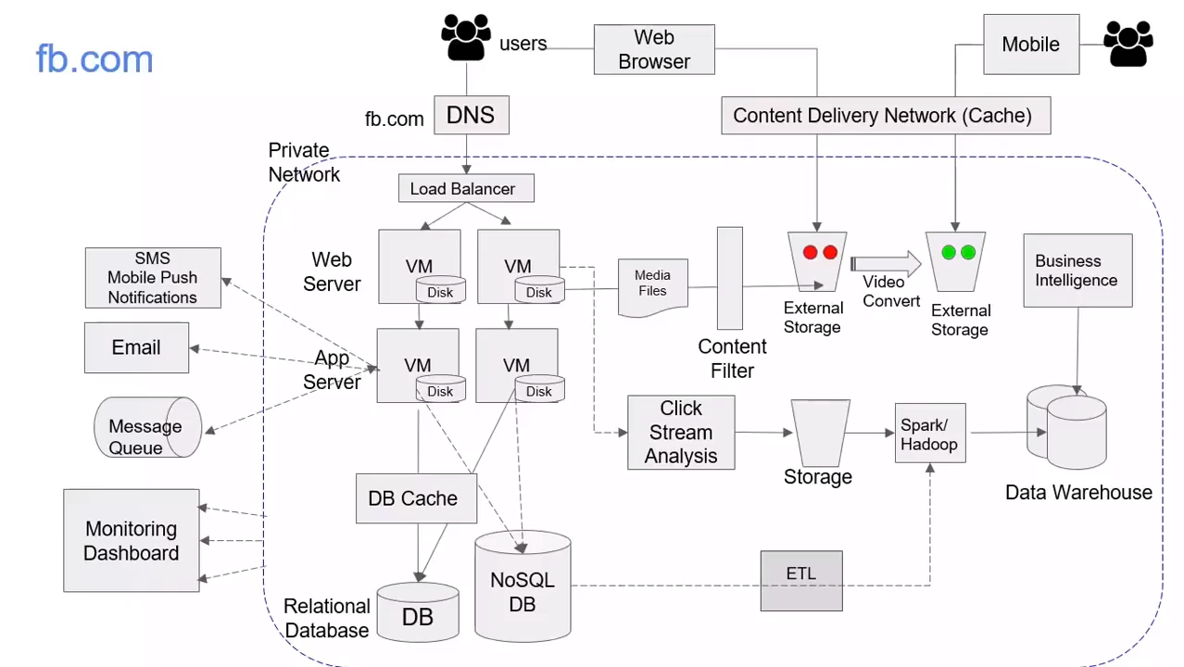
Source: AWS Training Center (2019), Introduction to AWS Services, https://youtu.be/Z3SYDTMP3ME

Slide 76
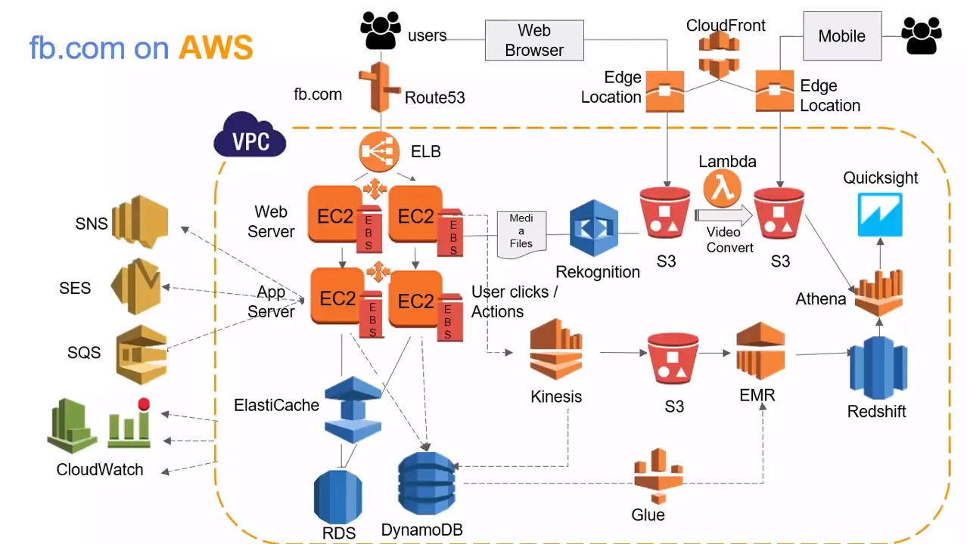
Source: AWS Training Center (2019), Introduction to AWS Services, https://youtu.be/Z3SYDTMP3ME

Slide 77
Source: AWS Training Center (2019), Introduction to AWS Services, https://youtu.be/Z3SYDTMP3ME

Slide 78
Source: AWS Training Center (2019), Introduction to AWS Services, https://youtu.be/Z3SYDTMP3ME

Slide 79
Source: AWS Training Center (2019), Introduction to AWS Services, https://youtu.be/Z3SYDTMP3ME

Slide 80
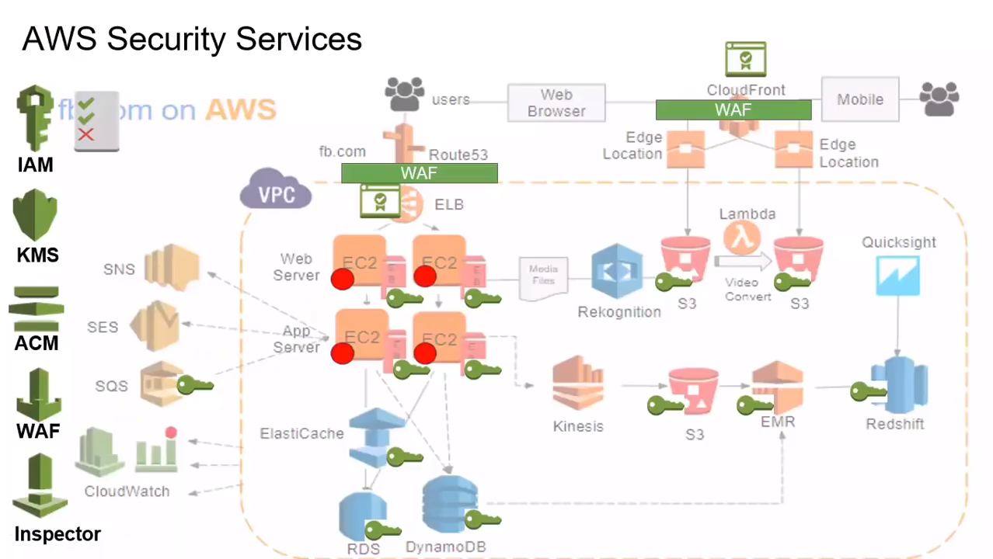
Source: AWS Training Center (2019), Introduction to AWS Services, https://youtu.be/Z3SYDTMP3ME

Slide 81
Source: AWS Training Center (2019), Introduction to AWS Services, https://youtu.be/Z3SYDTMP3ME

Slide 82
AWS Serverless Architecture

Slide 83
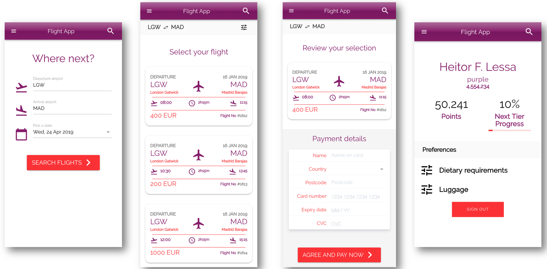
AWS Serverless Airline Booking
Source: https://github.com/aws-samples/aws-serverless-airline-booking

Slide 84
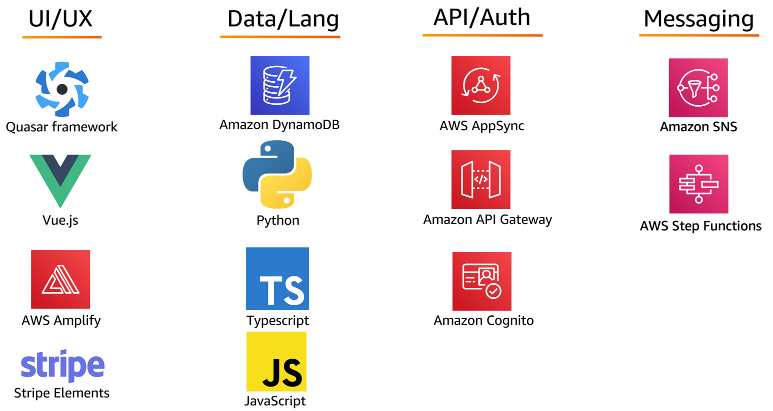
AWS Serverless Airline Booking Stack
Source: https://github.com/aws-samples/aws-serverless-airline-booking

Slide 85
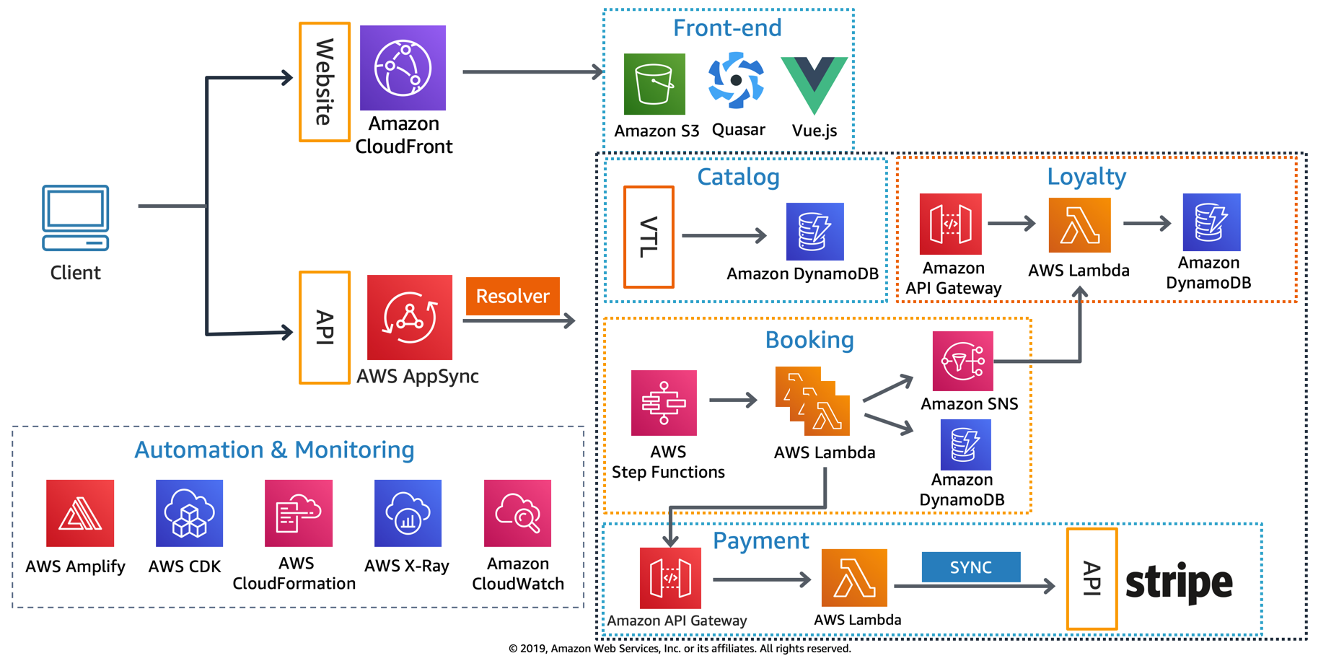
AWS Serverless Airline Booking High level infrastructure architecture
Source: https://github.com/aws-samples/aws-serverless-airline-booking

Slide 86
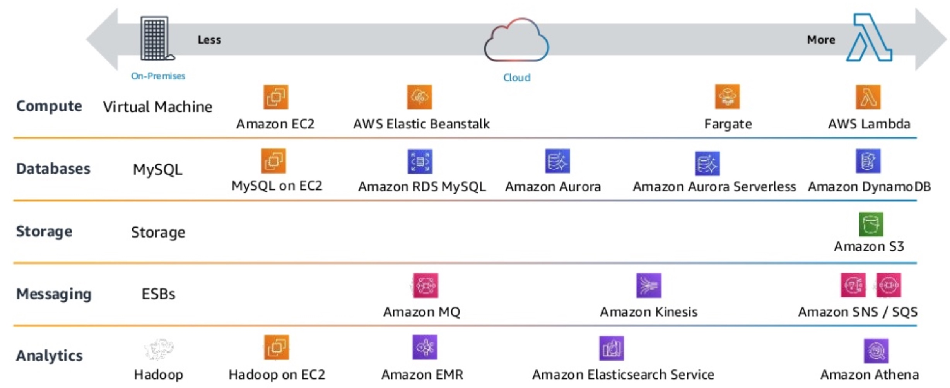
AWS Serverless Architecture AWS Operational Responsibility Models
Source: Heitor Lessa (2019), How to build a full stack serverless airline ticketing web app, https://www.youtube.com/watch?v=MyoOeHTp2pg

Slide 87
Build a Serverless Web Application

Slide 88
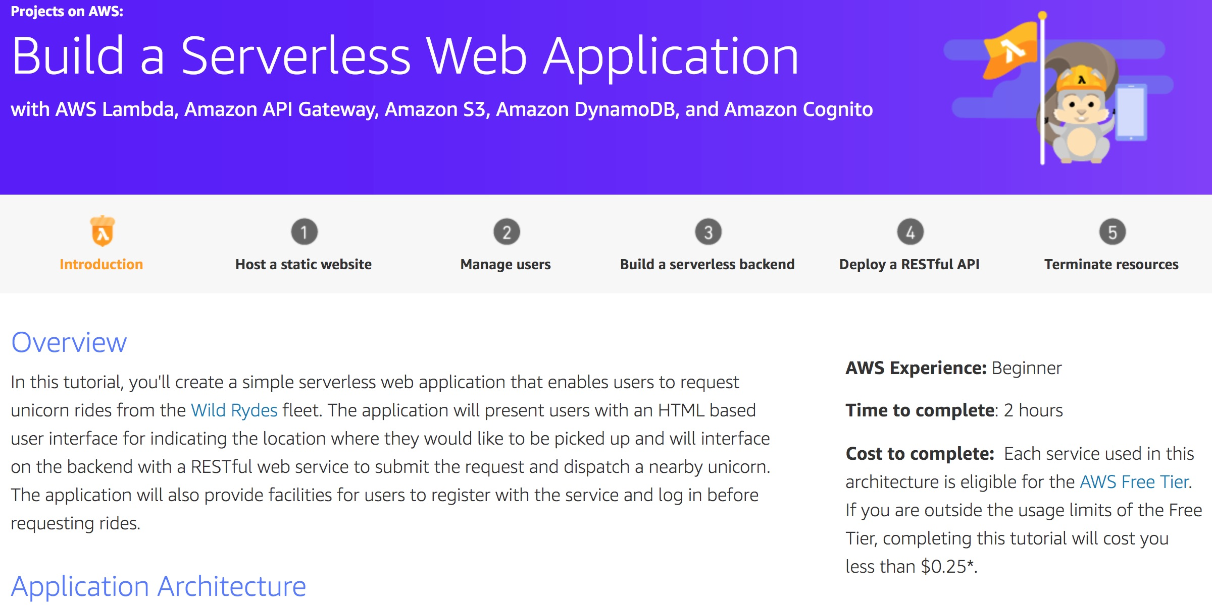
Build a Serverless Web Application
Source: https://aws.amazon.com/getting-started/projects/build-serverless-web-app-lambda-apigateway-s3-dynamodb-cognito/

Slide 89
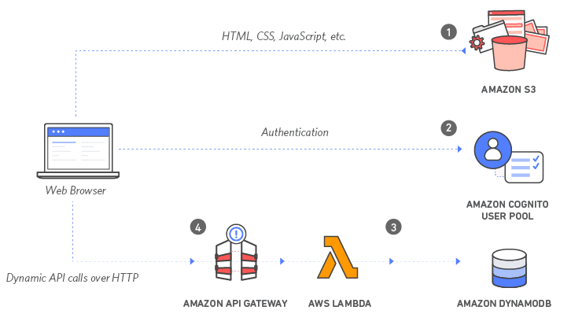
Build a Serverless Web Application with Amazon S3, AWS Lambda, Amazon API Gateway, Amazon DynamoDB, and Amazon Cognito
Source: https://aws.amazon.com/getting-started/projects/build-serverless-web-app-lambda-apigateway-s3-dynamodb-cognito/

Slide 90
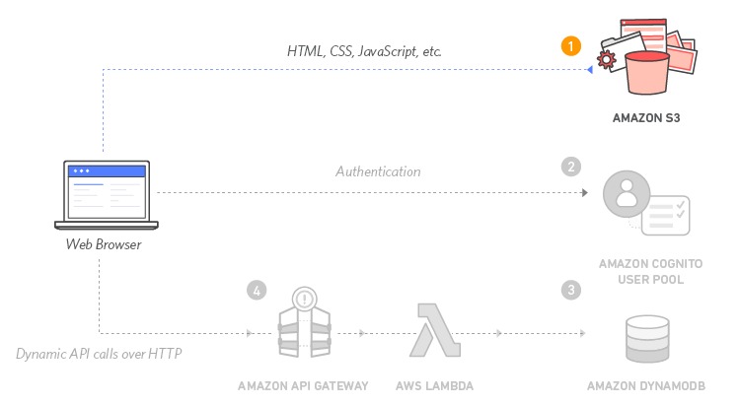
Build a Serverless Web Application with Amazon S3, AWS Lambda, Amazon API Gateway, Amazon DynamoDB, and Amazon Cognito
1
Source: https://aws.amazon.com/getting-started/projects/build-serverless-web-app-lambda-apigateway-s3-dynamodb-cognito/

Slide 91
Build a Serverless Web Application with Amazon S3, AWS Lambda, Amazon API Gateway, Amazon DynamoDB, and Amazon Cognito
1
Static Web Hosting
Amazon S3 hosts static web resources including HTML, CSS, JavaScript, and image files which are loaded in the user's browser.
Source: https://aws.amazon.com/getting-started/projects/build-serverless-web-app-lambda-apigateway-s3-dynamodb-cognito/

Slide 92
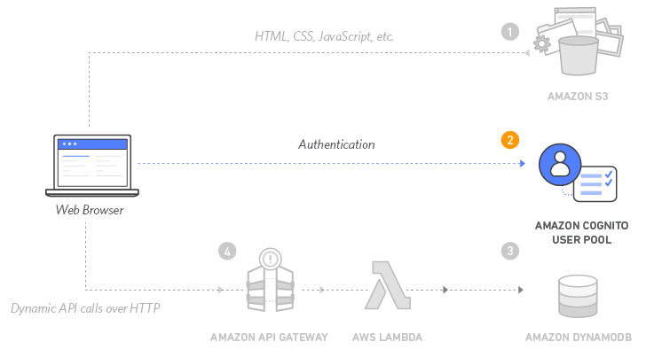
Build a Serverless Web Application with Amazon S3, AWS Lambda, Amazon API Gateway, Amazon DynamoDB, and Amazon Cognito
2
Source: https://aws.amazon.com/getting-started/projects/build-serverless-web-app-lambda-apigateway-s3-dynamodb-cognito/

Slide 93
Build a Serverless Web Application with Amazon S3, AWS Lambda, Amazon API Gateway, Amazon DynamoDB, and Amazon Cognito
2
User Management
Amazon Cognito provides user management and authentication functions to secure the backend API.
Source: https://aws.amazon.com/getting-started/projects/build-serverless-web-app-lambda-apigateway-s3-dynamodb-cognito/

Slide 94
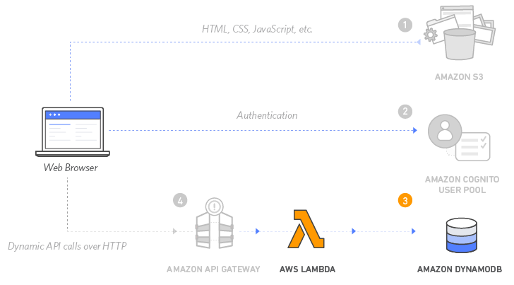
Build a Serverless Web Application with Amazon S3, AWS Lambda, Amazon API Gateway, Amazon DynamoDB, and Amazon Cognito
3
Source: https://aws.amazon.com/getting-started/projects/build-serverless-web-app-lambda-apigateway-s3-dynamodb-cognito/

Slide 95
Build a Serverless Web Application with Amazon S3, AWS Lambda, Amazon API Gateway, Amazon DynamoDB, and Amazon Cognito
3
Serverless Backend
Amazon DynamoDB provides a persistence layer where data can be stored by the API's Lambda function.
Source: https://aws.amazon.com/getting-started/projects/build-serverless-web-app-lambda-apigateway-s3-dynamodb-cognito/

Slide 96
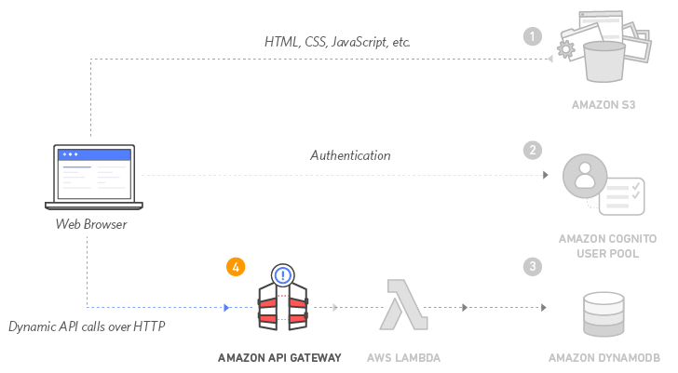
Build a Serverless Web Application with Amazon S3, AWS Lambda, Amazon API Gateway, Amazon DynamoDB, and Amazon Cognito
4
Source: https://aws.amazon.com/getting-started/projects/build-serverless-web-app-lambda-apigateway-s3-dynamodb-cognito/

Slide 97
Build a Serverless Web Application with Amazon S3, AWS Lambda, Amazon API Gateway, Amazon DynamoDB, and Amazon Cognito
4
RESTful API
JavaScript executed in the browser sends and receives data from a public backend API built using Lambda and API Gateway.
Source: https://aws.amazon.com/getting-started/projects/build-serverless-web-app-lambda-apigateway-s3-dynamodb-cognito/

Slide 98
Build a Serverless Web Application with Amazon S3, AWS Lambda, Amazon API Gateway, Amazon DynamoDB, and Amazon Cognito
5
Terminate resources
Resource Cleanup
You will terminate an Amazon S3 bucket, an Amazon Cognito User Pool, an AWS Lambda function, an IAM role, a DynamoDB table, a REST API, and a CloudWatch Log. It is a best practice to delete resources you are no longer using to avoid unwanted charges.
Source: https://aws.amazon.com/getting-started/projects/build-serverless-web-app-lambda-apigateway-s3-dynamodb-cognito/

Slide 99
References
https://aws.amazon.com/certification/
https://www.aws.training/
https://aws.amazon.com/training/awsacademy/
https://aws.amazon.com/education/awseducate/
AWS Certified Cloud Practitioner
https://aws.amazon.com/certification/certified-cloud-practitioner/
AWS Certified Solutions Architect – Associate
https://aws.amazon.com/certification/certified-solutions-architect-associate/
AWS Cloud Practitioner Essentials (Second Edition)
https://aws.amazon.com/training/course-descriptions/cloud-practitioner-essentials/
Architecting on AWS
https://aws.amazon.com/training/course-descriptions/architect/

Slide 100
Introduction to Amazon Web Services (AWS) Certifications Roadmap
Q & A
Host: 陳仁偉 教授 (Prof. Jen Wel Chen)
Information Management, SEC, Chinese Culture University Time: 2022/3/13 (Sunday) 13:00-15:00
Place: 202教室 大夏館 台北市建國南路二段231號
戴敏育 副教授
Min-Yuh Day, Ph.D, Associate Professor
國立臺北大學 資訊管理研究所
Institute of Information Management, National Taipei University
https://web.ntpu.edu.tw/~myday
2022-03-13

