Slide 1
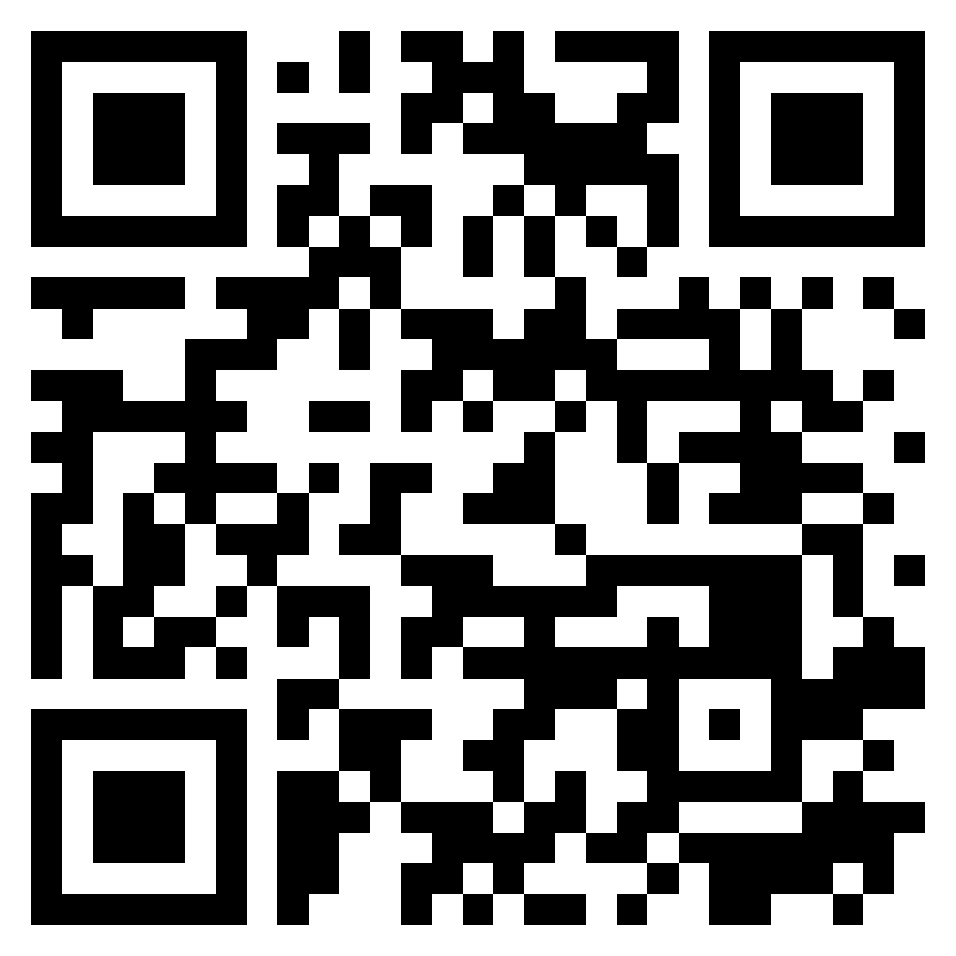
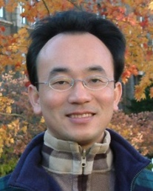
Teaching Experiences Sharing of EMI Courses in AI for Business Applications
EMI Teacher Community, AACSB, NTPU
2022/5/5 (Thursday) 12:10 - 13:00
B302, AACSB, National Taipei University
Min-Yuh Day, Ph.D, Associate Professor
Institute of Information Management, National Taipei University
https://web.ntpu.edu.tw/~myday
https://meet.google.com/zuc-yyaw-mnt
2022-05-05

Slide 2
Min-Yuh Day, Ph.D.
Associate Professor, Information Management, NTPU
Visiting Scholar, IIS, Academia Sinica
Ph.D., Information Management, NTU
Director, Intelligent Financial Innovation Technology, IFIT Lab, IM, NTPU
Artificial Intelligence, Financial Technology, Big Data Analytics, Data Mining and Text Mining, Electronic Commerce

Slide 3
Outline
EMI Teacher Community, AACSB, NTPU
EMI Courses in AI for Business Applications
Teaching Experiences Sharing

Slide 4
EMI Teacher Community AACSB, NTPU

Slide 5
EMI Teacher Community Activities
1. 2022/05/05 (Thursday) 12:00 pm-13:00 pm, B302
Teaching Experiences Sharing of EMI Courses in AI for Business Applications
Min-Yuh Day, National Taipei University,
https://meet.google.com/zuc-yyaw-mnt
2. 2022/05/11 (Wednesday) 9:10 am - 12:00 pm, B313
Agile Principles Patterns and Practices in FinTech and Digital Transformation
Shihyu (Alex) Chu, Senior Industry Analyst/Program Manager, Market Intelligence & Consulting Institute (MIC)
https://docs.google.com/forms/d/e/1FAIpQLScI7zvABRvtffqeZgT-_OWNbOsyIXBOn6Lt_tJ4-SuhZENyRQ/viewform
3. 2022/05/11 (Wednesday) 12:10 pm - 13:00 pm, B313
Professional Business Presentations in English
Shihyu (Alex) Chu, Senior Industry Analyst/Program Manager, Market Intelligence & Consulting Institute (MIC)
https://docs.google.com/forms/d/e/1FAIpQLScA0Qq52qjQ5MDAyEDxHyui7VrVdkIpsOSDzWXAwWi-kKLVAw/viewform
4. 2022/05/18 (Wednesday) 12:10 pm - 13:00 pm, B313
Web 3: From DeFi to WoFi
Prof. Shih-wei Liao, National Taiwan University
https://docs.google.com/forms/d/e/1FAIpQLSdkE-x4CW2w2LAjPEJcHCx25GAx4KYS1cHxUv9iiroda1cXYQ/viewform

Slide 6
EMI Courses in AI for Business Applications

Slide 7
EMI Courses in AI for Business Applications
Artificial Intelligence for Text Analytics
Spring 2022
Software Engineering
Spring 2022
https://web.ntpu.edu.tw/~myday/teaching.htm

Slide 8
Teaching Experiences Sharing

Slide 9
Teaching Experiences (EMI)
Artificial Intelligence for Text Analytics
Spring 2022
Software Engineering
Fall 2020, Fall, 2021, Spring 2022
Artificial Intelligence in Finance and Quantitative
Fall 2021
Artificial Intelligence
Spring 2021
Data Mining
Spring 2021
Big Data Analytics
Fall 2020
Foundation of Business Cloud Computing
Spring 2021, Spring 2022
https://web.ntpu.edu.tw/~myday/teaching.htm

Slide 10
Teaching Experiences (EMI)
AI in Finance Big Data Analytics (Fall 2019)
MBA, DBETKU (3 Credits, Elective) [Full English Course] [Distance Learning]
Big Data Mining (Fall 2018)
MBA, DBETKU (3 Credits, Required) [Full English Course]
Social Media Apps Programming (Fall 2013 - Fall 2018)
MBA, IMTKU (2 Credits, Elective) [Full English Course]
Fall 2018, Fall 2017 , Fall 2016 , Fall 2015 , Fall 2014 , Fall 2013
https://web.ntpu.edu.tw/~myday/teaching.htm

Slide 11
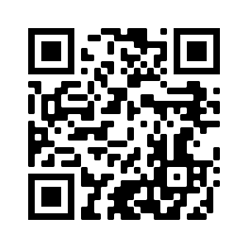
Introduction to Artificial Intelligence for Text Analytics
Artificial Intelligence for Text Analytics
1102AITA01
MBA, IM, NTPU (M5026) (Spring 2022) Tue 2, 3, 4 (9:10-12:00) (B8F40)
Min-Yuh Day, Ph.D, Associate Professor
Institute of Information Management, National Taipei University
https://web.ntpu.edu.tw/~myday
https://meet.google.com/paj-zhhj-mya
2022-02-22

Slide 12
Course Syllabus National Taipei University Academic Year 110, 2nd Semester (Spring 2022)
Course Title: Artificial Intelligence for Text Analytics
Instructor: Min-Yuh Day
Course Class: MBA, IM, NTPU (3 Credits, Elective)
Details
In-Class and Distance Learning EMI Course (3 Credits, Elective, One Semester) (M5026)
Time & Place: Tue, 2, 3, 4, (9:10-12:00) (B8F40)
Google Meet: https://meet.google.com/paj-zhhj-mya
https://meet.google.com/paj-zhhj-mya

Slide 13
Course Objectives
Understand the fundamental concepts and research issues of Artificial Intelligence for Text Analytics.
Equip with Hands-on practices of Artificial Intelligence for Text Analytics.
Conduct information systems research in the context of Artificial Intelligence for Text Analytics.

Slide 14
Course Outline
This course introduces the fundamental concepts, research issues, and hands-on practices of Artificial Intelligence for Text Analytics.
Topics include:
Introduction to Introduction to Artificial Intelligence for Text Analytics
Foundations of Text Analytics: Natural Language Processing (NLP)
Python for Natural Language Processing
Natural Language Processing with Transformers
Text Classification and Sentiment Analysis
Multilingual Named Entity Recognition (NER), Text Similarity and Clustering
Text Summarization and Topic Models
Text Generation
Question Answering and Dialogue Systems
Deep Learning, Transfer Learning, Zero-Shot, and Few-Shot Learning for Text Analytics
Case Study on Artificial Intelligence for Text Analytics

Slide 15
Core Competence
Exploring new knowledge in information technology, system development and application 80 %
Internet marketing planning ability 10 %
Thesis writing and independent research skills 10 %

Slide 16
Four Fundamental Qualities
Professionalism
Creative thinking and Problem-solving 40 %
Comprehensive Integration 40 %
Interpersonal Relationship
Communication and Coordination 10 %
Teamwork 5 %
Ethics
Honesty and Integrity 0 %
Self-Esteem and Self-reflection 0 %
International Vision
Caring for Diversity 0 %
Interdisciplinary Vision 5 %

Slide 17
College Learning Goals
Ethics/Corporate Social Responsibility
Global Knowledge/Awareness
Communication
Analytical and Critical Thinking

Slide 18
Department Learning Goals
Information Technologies and System Development Capabilities
Internet Marketing Management Capabilities
Research capabilities

Slide 19
Syllabus
Week Date Subject/Topics
1 2022/02/22 Introduction to Artificial Intelligence for Text Analytics
2 2022/03/01 Foundations of Text Analytics: Natural Language Processing (NLP)
3 2022/03/08 Python for Natural Language Processing
4 2022/03/15 Natural Language Processing with Transformers
5 2022/03/22 Case Study on Artificial Intelligence for Text Analytics I
6 2022/03/29 Text Classification and Sentiment Analysis

Slide 20
Syllabus
Week Date Subject/Topics
7 2022/04/05 Tomb-Sweeping Day (Holiday, No Classes)
8 2022/04/12 Midterm Project Report
9 2022/04/19 Multilingual Named Entity Recognition (NER), Text Similarity and Clustering
10 2022/04/26 Text Summarization and Topic Models
11 2022/05/03 Text Generation
12 2022/05/10 Case Study on Artificial Intelligence for Text Analytics II

Slide 21
Syllabus
Week Date Subject/Topics
13 2022/05/17 Question Answering and Dialogue Systems
14 2022/05/24 Deep Learning, Transfer Learning, Zero-Shot, and Few-Shot Learning for Text Analytics
15 2022/05/31 Final Project Report I
16 2022/06/07 Final Project Report II
17 2022/06/14 Self-learning
18 2022/06/21 Self-learning

Slide 22
Teaching Methods and Activities
Lecture
Discussion
Practicum

Slide 23
Evaluation Methods
Individual Presentation 60 %
Group Presentation 10 %
Case Report 10 %
Class Participation 10 %
Assignment 10 %

Slide 24
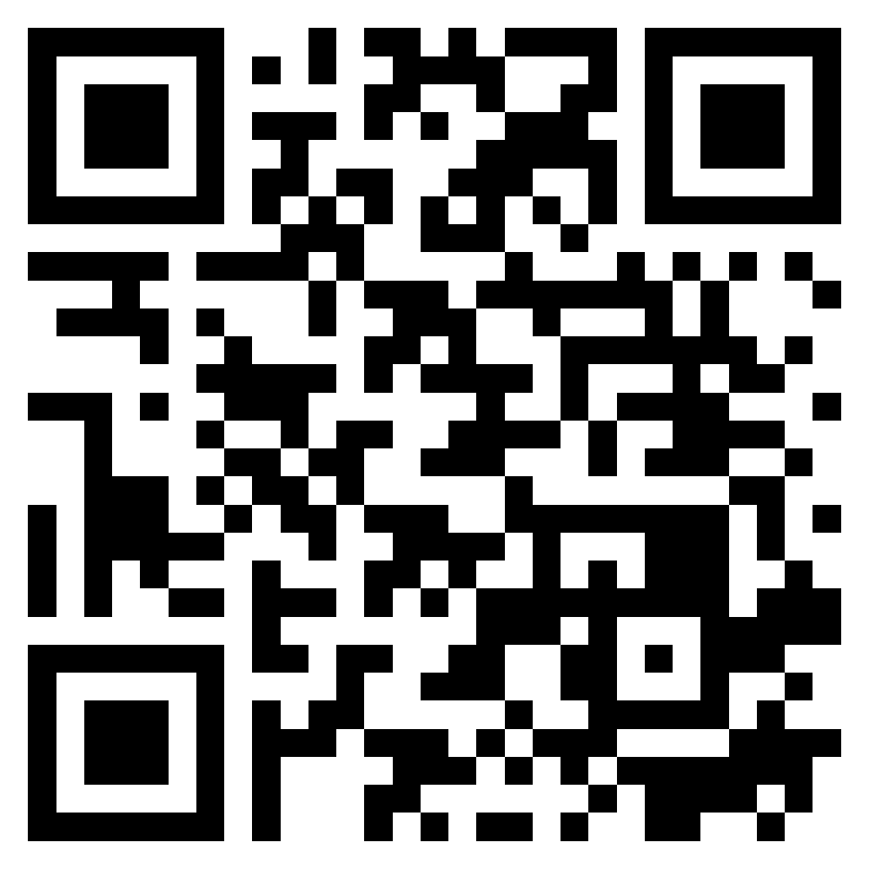
Introduction to Software Engineering
Software Engineering
1102SE01
MBA, IM, NTPU (M5010) (Spring 2022) Wed 2, 3, 4 (9:10-12:00) (B8F40)
Min-Yuh Day, Ph.D, Associate Professor
Institute of Information Management, National Taipei University
https://web.ntpu.edu.tw/~myday
https://meet.google.com/ish-gzmy-pmo
2022-02-23

Slide 25
Course Syllabus National Taipei University Academic Year 110, 2nd Semester (Spring 2022)
Course Title: Software Engineering
Instructor: Min-Yuh Day
Course Class: MBA, IM, NTPU (3 Credits, Elective)
Details
In-Person and Distance Learning EMI Course (3 Credits, Elective, One Semester) (M5010)
Time & Place: Wed, 2, 3, 4, (9:10-12:00) (B8F40)
Google Meet: https://meet.google.com/ish-gzmy-pmo
https://meet.google.com/ish-gzmy-pmo

Slide 26
Course Objectives
Understand the fundamental concepts and research issues of software engineering.
Equip with Hands-on practices of software engineering.
Conduct information systems research in the context of software engineering.

Slide 27
Course Outline
This course introduces the fundamental concepts, research issues, and hands-on practices of software engineering.
Topics include:
Introduction to Software Engineering
Software Products and Project Management: Software product management and prototyping
Agile Software Engineering: Agile methods, Scrum, and Extreme Programming
Features, Scenarios, and Stories
Software Architecture: Architectural design, System decomposition, and Distribution architecture
Cloud-Based Software: Virtualization and containers, Everything as a service, Software as a service
Cloud Computing and Cloud Software Architecture
Microservices Architecture, RESTful services, Service deployment
Security and Privacy; Reliable Programming
Testing: Functional testing, Test automation, Test-driven development, and Code reviews
DevOps and Code Management: Code management and DevOps automation
Case Study on Software Engineering

Slide 28
Core Competence
Exploring new knowledge in information technology, system development and application 80 %
Internet marketing planning ability 10 %
Thesis writing and independent research skills 10 %

Slide 29
Four Fundamental Qualities
Professionalism
Creative thinking and Problem-solving 30 %
Comprehensive Integration 30 %
Interpersonal Relationship
Communication and Coordination 10 %
Teamwork 10 %
Ethics
Honesty and Integrity 5 %
Self-Esteem and Self-reflection 5 %
International Vision
Caring for Diversity 5 %
Interdisciplinary Vision 5 %

Slide 30
College Learning Goals
Ethics/Corporate Social Responsibility
Global Knowledge/Awareness
Communication
Analytical and Critical Thinking

Slide 31
Department Learning Goals
Information Technologies and System Development Capabilities
Internet Marketing Management Capabilities
Research capabilities

Slide 32
Syllabus
Week Date Subject/Topics
1 2022/02/23 Introduction to Software Engineering
2 2022/03/02 Software Products and Project Management: Software product management and prototyping
3 2022/03/09 Agile Software Engineering: Agile methods, Scrum, and Extreme Programming
4 2022/03/16 Features, Scenarios, and Stories
5 2022/03/23 Case Study on Software Engineering I
6 2022/03/30 Software Architecture: Architectural design, System decomposition, and Distribution architecture

Slide 33
Syllabus
Week Date Subject/Topics
7 2022/04/06 Make-up holiday (No Classes)
8 2022/04/13 Midterm Project Report
9 2022/04/20 Cloud-Based Software: Virtualization and containers, Everything as a service, Software as a service
10 2022/04/27 Cloud Computing and Cloud Software Architecture
11 2022/05/04 Microservices Architecture, RESTful services, Service deployment
12 2022/05/11 Industry Practices of Software Engineering

Slide 34
Syllabus
Week Date Subject/Topics
13 2022/05/18 Case Study on Software Engineering II
14 2022/05/25 Security and Privacy; Reliable Programming; Testing: Test-driven development, and Code reviews; DevOps and Code Management: DevOps automation
15 2022/06/01 Final Project Report I
16 2022/06/08 Final Project Report II
17 2022/06/15 Self-learning
18 2022/06/22 Self-learning

Slide 35
Teaching Methods and Activities
Lecture
Discussion
Practicum

Slide 36
Evaluation Methods
Individual Presentation 60 %
Group Presentation 10 %
Case Report 10 %
Class Participation 10 %
Assignment 10 %

Slide 37
Summary
EMI Teacher Community, AACSB, NTPU
EMI Courses in AI for Business Applications
Teaching Experiences Sharing

Slide 38
Teaching Experiences Sharing of EMI Courses in AI for Business Applications
EMI Teacher Community, AACSB, NTPU
Q & A
2022/5/5 (Thursday) 12:10 - 13:00
B302, AACSB, National Taipei University
Min-Yuh Day, Ph.D, Associate Professor
Institute of Information Management, National Taipei University
https://web.ntpu.edu.tw/~myday
https://meet.google.com/zuc-yyaw-mnt
2022-05-05

