Slide 1









Generative AI and ChatGPT
ChatGPT來了怎麼辦？生成式 AI 帶來行銷那些改變？
Part 1：生成式AI概述
Time: 2023.03.30 (Thu) 14:05-15:10
Place: 1st Floor, Building C, No. 287, Section 3, Chengde Road, Datong District, Taipei
Host: Taipei Shift Share Course, KPN
https://www.accupass.com/event/2303060630401405524240
Min-Yuh Day, Ph.D,
Associate Professor
Institute of Information Management, National Taipei University
https://web.ntpu.edu.tw/~myday
2023-03-30

Slide 2










Min-Yuh Day, Ph.D.
1
Associate Professor, Information Management, NTPU
Visiting Scholar, IIS, Academia Sinica
Ph.D., Information Management, NTU
Director, Intelligent Financial Innovation Technology, IFIT Lab, IM, NTPU
Associate Director, Fintech and Green Finance Center, NTPU
Publications Co-Chairs, IEEE/ACM International Conference on
Advances in Social Networks Analysis and Mining (ASONAM 2013- )
Program Co-Chair, IEEE International Workshop on
Empirical Methods for Recognizing Inference in TExt (IEEE EM-RITE 2012- )
Publications Chair, The IEEE International Conference on
Information Reuse and Integration for Data Science (IEEE IRI 2007- )

Slide 3
ChatGPT來了怎麼辦？生成式AI帶來行銷那些改變？
Part 1：生成式AI概述
生成式 AI 的基本概念
介紹 ChatGPT 的基本原理和功能
人類回饋強化學習
Reinforcement Learning from Human Feedback (RLHF)
生成式 AI (Gen AI) 與牠們的產地：
文字、圖像、影音眾多應用

Slide 4
Generative AI
Gen AI

Slide 5
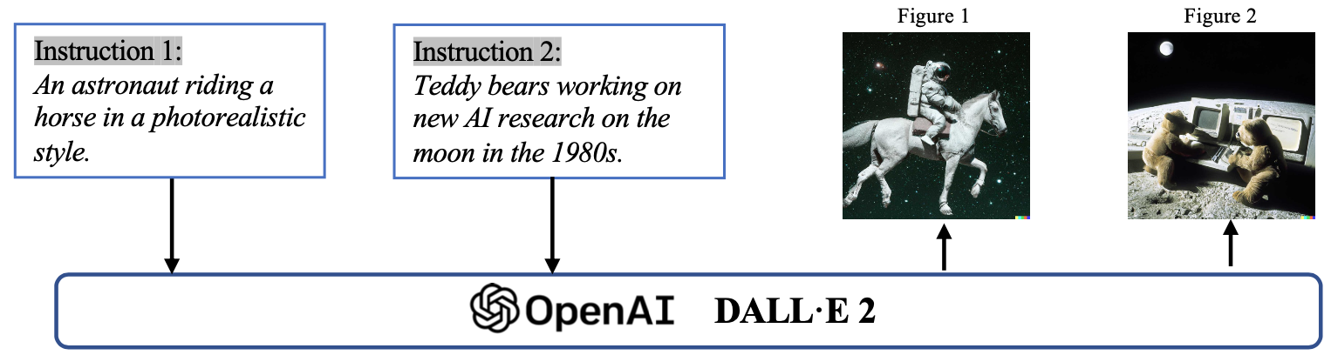
Generative AI (Gen AI)
AI Generated Content (AIGC)
Image Generation
Source: Yihan Cao, Siyu Li, Yixin Liu, Zhiling Yan, Yutong Dai, Philip S. Yu, and Lichao Sun (2023). "A Comprehensive Survey of AI-Generated Content (AIGC): A History of Generative AI from GAN to ChatGPT." arXiv preprint arXiv:2303.04226.

Slide 6
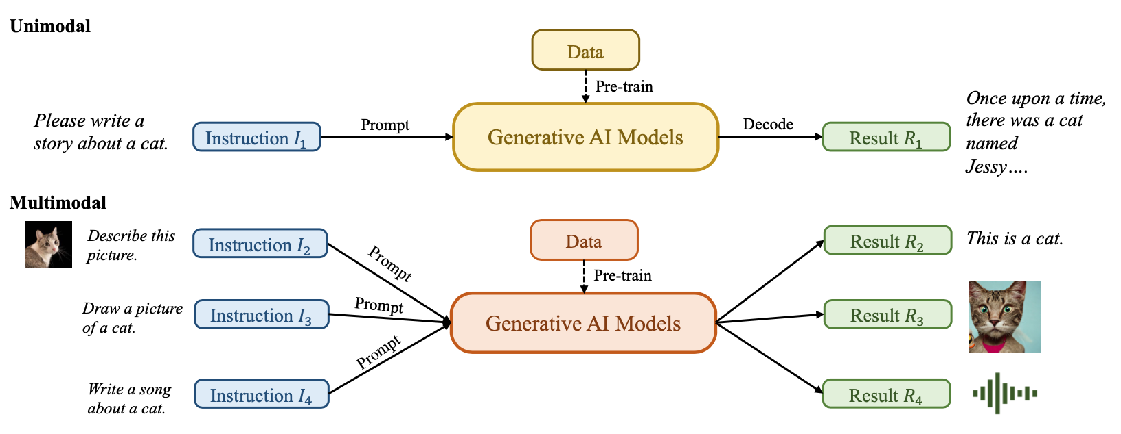
Generative AI (Gen AI)
AI Generated Content (AIGC)
Source: Yihan Cao, Siyu Li, Yixin Liu, Zhiling Yan, Yutong Dai, Philip S. Yu, and Lichao Sun (2023). "A Comprehensive Survey of AI-Generated Content (AIGC): A History of Generative AI from GAN to ChatGPT." arXiv preprint arXiv:2303.04226.

Slide 7
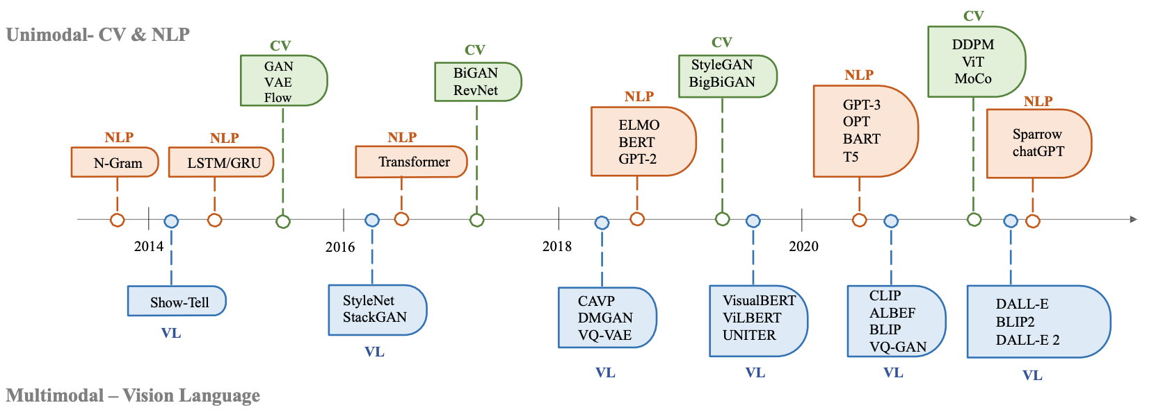
The history of Generative AI in CV, NLP and VL
Source: Yihan Cao, Siyu Li, Yixin Liu, Zhiling Yan, Yutong Dai, Philip S. Yu, and Lichao Sun (2023). "A Comprehensive Survey of AI-Generated Content (AIGC): A History of Generative AI from GAN to ChatGPT." arXiv preprint arXiv:2303.04226.

Slide 8
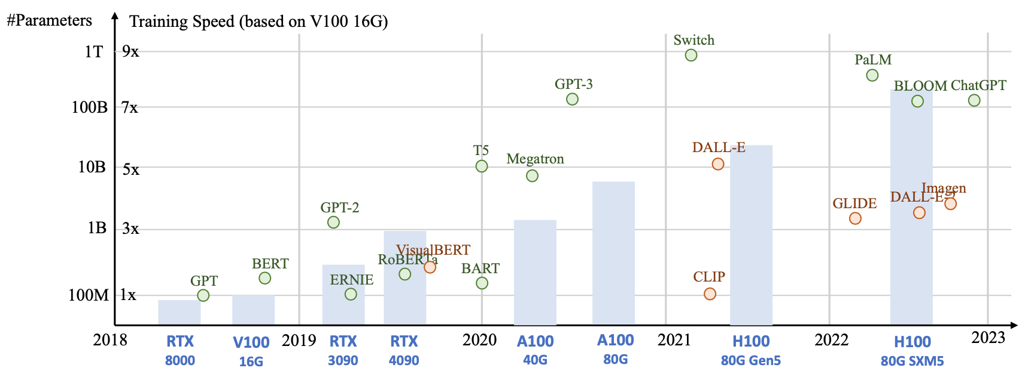
Generative AI
Foundation Models
Source: Yihan Cao, Siyu Li, Yixin Liu, Zhiling Yan, Yutong Dai, Philip S. Yu, and Lichao Sun (2023). "A Comprehensive Survey of AI-Generated Content (AIGC): A History of Generative AI from GAN to ChatGPT." arXiv preprint arXiv:2303.04226.

Slide 9
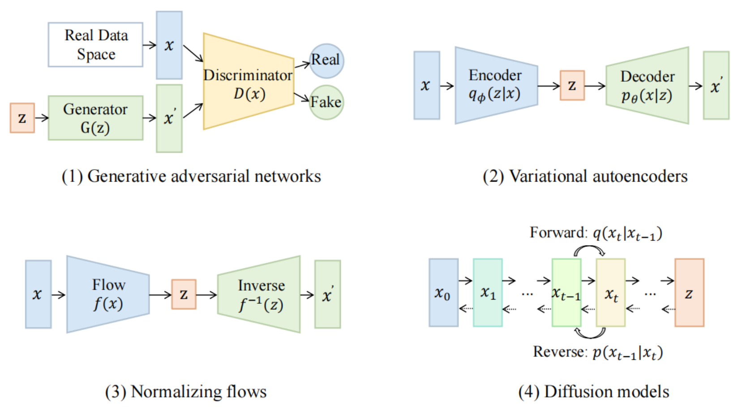
Categories of Vision Generative Models
Source: Yihan Cao, Siyu Li, Yixin Liu, Zhiling Yan, Yutong Dai, Philip S. Yu, and Lichao Sun (2023). "A Comprehensive Survey of AI-Generated Content (AIGC): A History of Generative AI from GAN to ChatGPT." arXiv preprint arXiv:2303.04226.

Slide 10
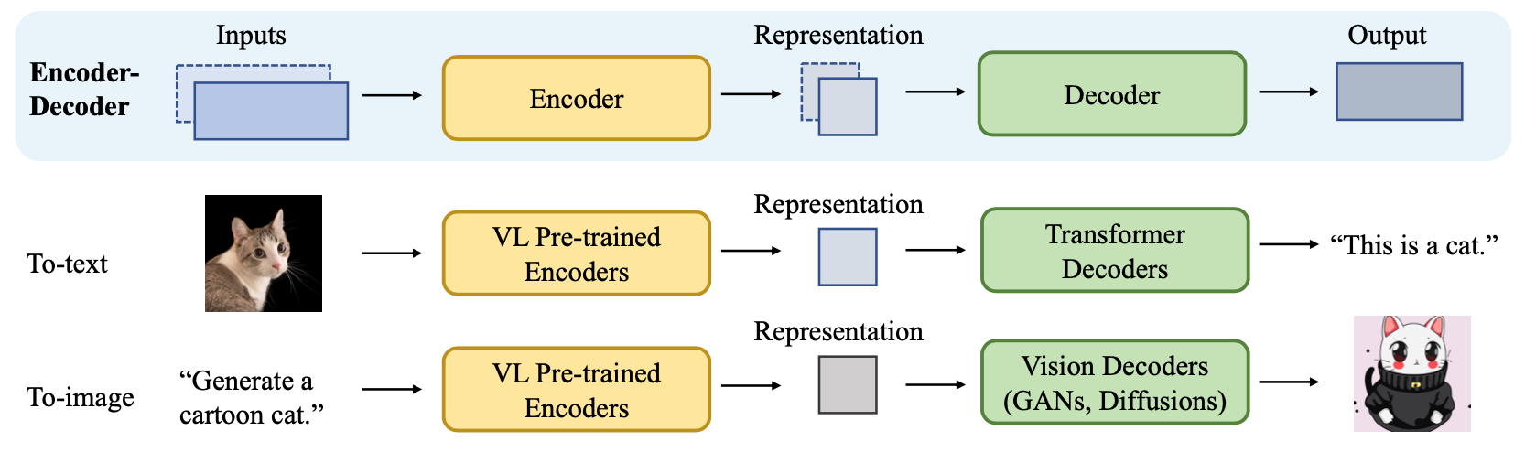
The General Structure of
Generative Vision Language
Source: Yihan Cao, Siyu Li, Yixin Liu, Zhiling Yan, Yutong Dai, Philip S. Yu, and Lichao Sun (2023). "A Comprehensive Survey of AI-Generated Content (AIGC): A History of Generative AI from GAN to ChatGPT." arXiv preprint arXiv:2303.04226.

Slide 11
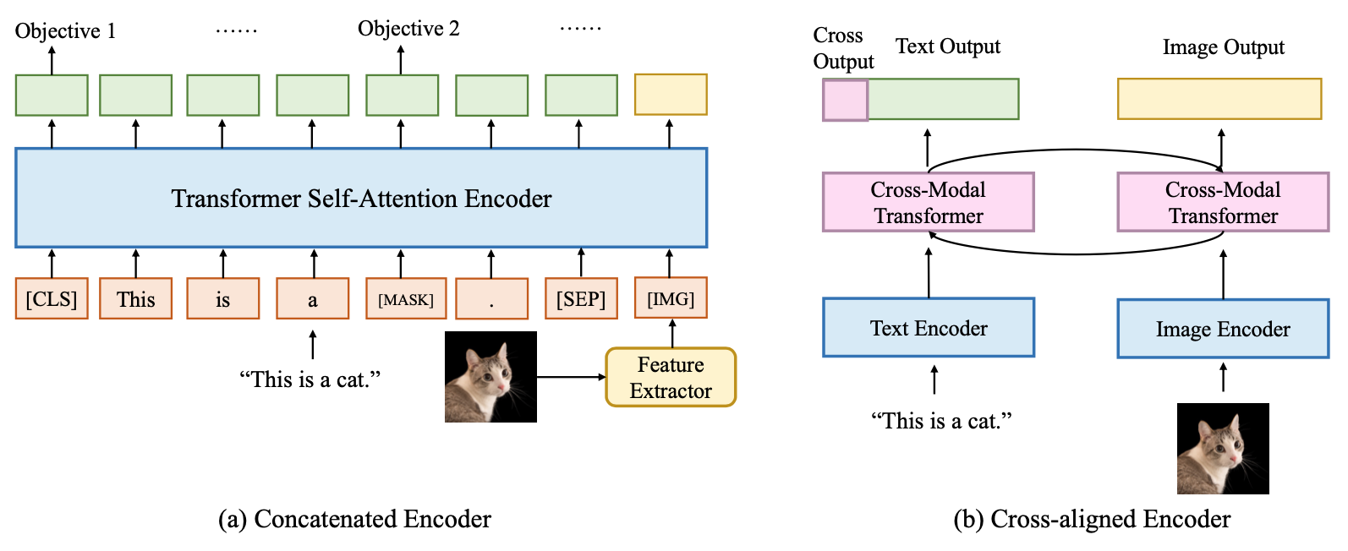
Two Types of Vision Language Encoders: Concatenated Encoders and Cross-aligned Encoders
Source: Yihan Cao, Siyu Li, Yixin Liu, Zhiling Yan, Yutong Dai, Philip S. Yu, and Lichao Sun (2023). "A Comprehensive Survey of AI-Generated Content (AIGC): A History of Generative AI from GAN to ChatGPT." arXiv preprint arXiv:2303.04226.

Slide 12
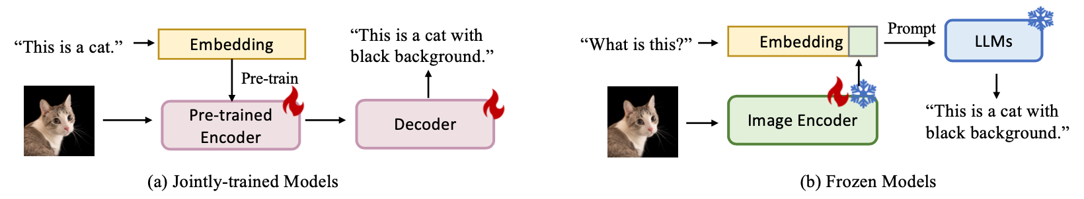
Two Types of to-language Decoder Models: Jointly-trained Models and Frozen Models
Source: Yihan Cao, Siyu Li, Yixin Liu, Zhiling Yan, Yutong Dai, Philip S. Yu, and Lichao Sun (2023). "A Comprehensive Survey of AI-Generated Content (AIGC): A History of Generative AI from GAN to ChatGPT." arXiv preprint arXiv:2303.04226.

Slide 13
AI, Big Data, Cloud Computing
Evolution of Decision Support, Business Intelligence, and Analytics
AI
AI
Cloud Computing
Big Data
DM
BI
Source: Ramesh Sharda, Dursun Delen, and Efraim Turban (2017),
Business Intelligence, Analytics, and Data Science: A Managerial Perspective, 4th Edition, Pearson

Slide 14
AI, ML, DL
Artificial Intelligence (AI)
Machine Learning (ML)
Supervised
Learning
Unsupervised Learning
Deep Learning (DL)
CNN
RNN LSTM GRU
GAN
Semi-supervised Learning
Reinforcement Learning
Source: https://leonardoaraujosantos.gitbooks.io/artificial-inteligence/content/deep_learning.html

Slide 15
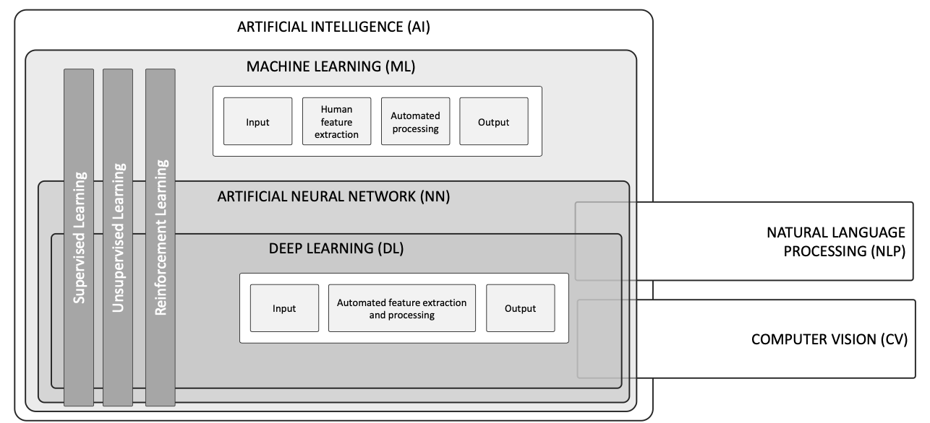
AI, ML, NN, DL
Source: Schoormann, T., Strobel, G., Möller, F., Petrik, D., & Zschech, P. (2023).
Artificial Intelligence for Sustainability—A Systematic Review of Information Systems Literature. Communications of the Association for Information Systems, 52(1), 8.

Slide 16
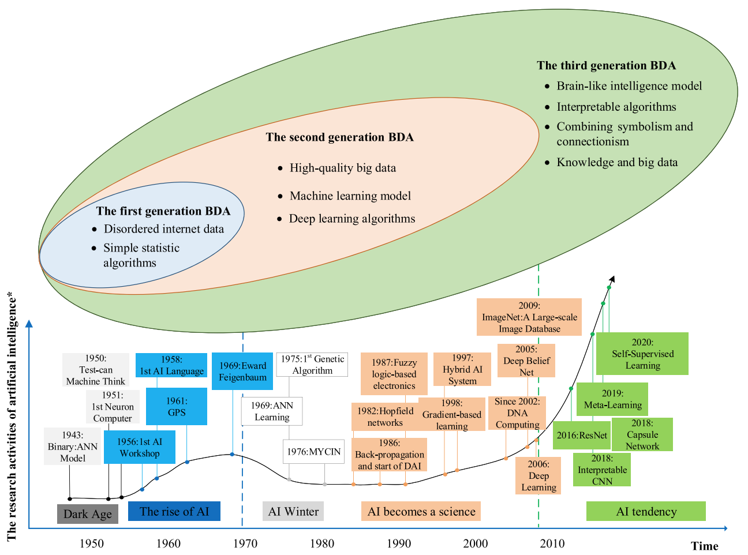
AI and Big Data Analytics (BDA)
Source: Wang, Junliang, Chuqiao Xu, Jie Zhang, and Ray Zhong (2022). "Big data analytics for intelligent manufacturing systems: A review." Journal of Manufacturing Systems 62 (2022): 738-752.

Slide 17
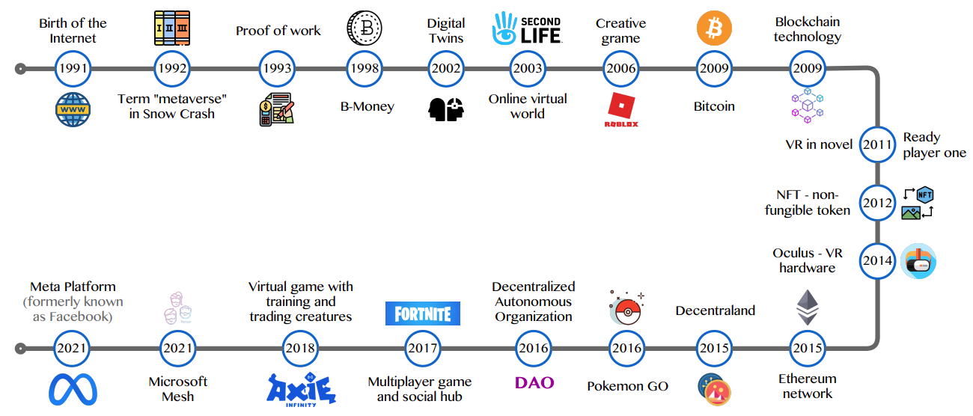
Metaverse Development
Source: Huynh-The, Thien, Quoc-Viet Pham, Xuan-Qui Pham, Thanh Thi Nguyen, Zhu Han, and Dong-Seong Kim (2022).
"Artificial Intelligence for the Metaverse: A Survey." arXiv preprint arXiv:2202.10336.

Slide 18
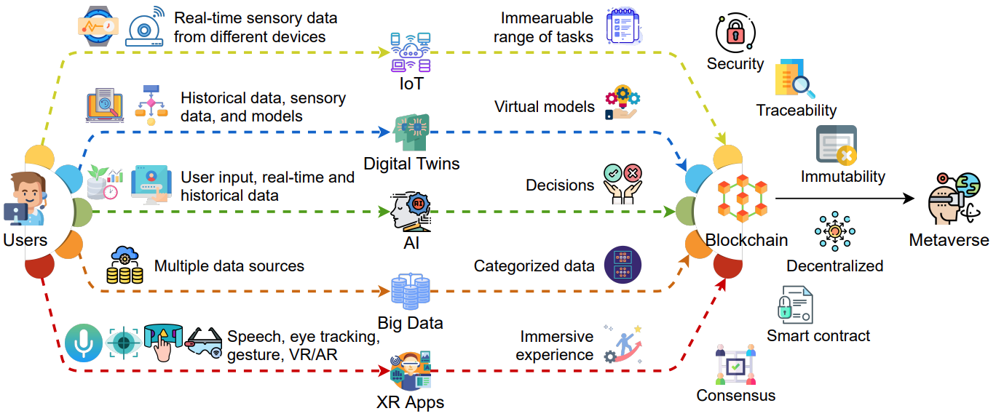
AI and Blockchain
Key Enabling Technologies of the Metaverse
Source: Gadekallu, Thippa Reddy, Thien Huynh-The, Weizheng Wang, Gokul Yenduri, Pasika Ranaweera, Quoc-Viet Pham, Daniel Benevides da Costa, and Madhusanka Liyanage (2022).
"Blockchain for the Metaverse: A Review." arXiv preprint arXiv:2203.09738..

Slide 19
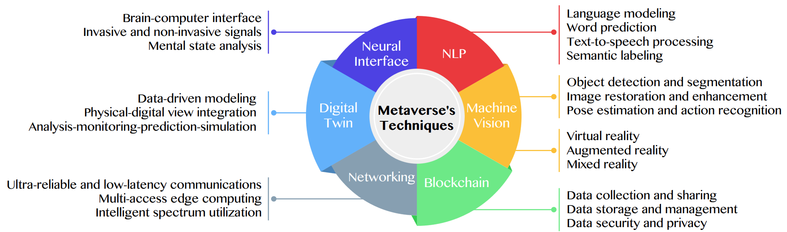
Primary Technical Aspects in the Metaverse
AI with ML algorithms and DL architectures is advancing the user experience in the virtual world
Source: Huynh-The, Thien, Quoc-Viet Pham, Xuan-Qui Pham, Thanh Thi Nguyen, Zhu Han, and Dong-Seong Kim (2022).
"Artificial Intelligence for the Metaverse: A Survey." arXiv preprint arXiv:2202.10336.

Slide 20
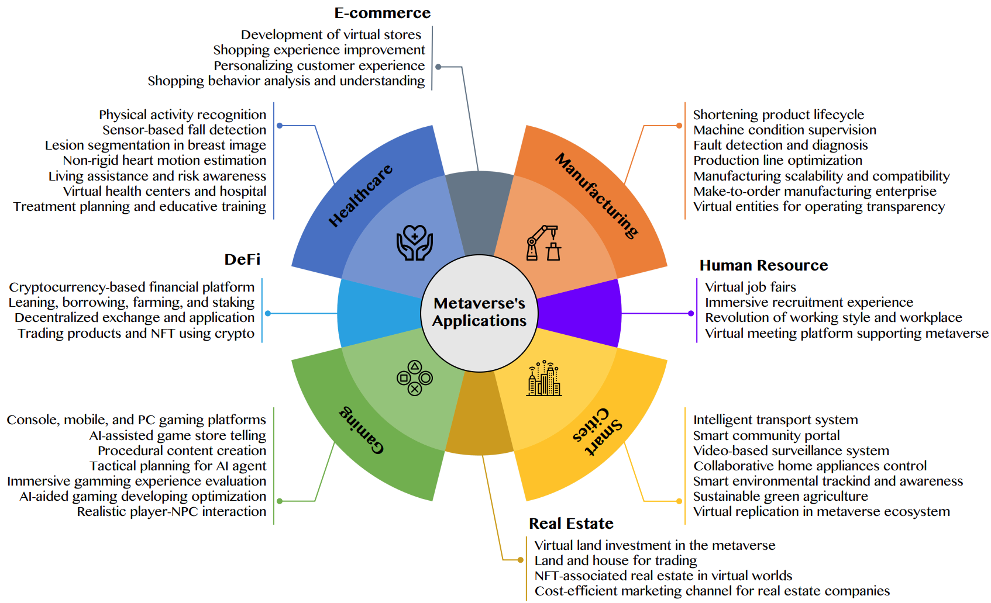
AI for the Metaverse in the Application Aspects healthcare, manufacturing, smart cities, gaming
E-commerce, human resources, real estate, and DeFi
Source: Huynh-The, Thien, Quoc-Viet Pham, Xuan-Qui Pham, Thanh Thi Nguyen, Zhu Han, and Dong-Seong Kim (2022).
"Artificial Intelligence for the Metaverse: A Survey." arXiv preprint arXiv:2202.10336.

Slide 21
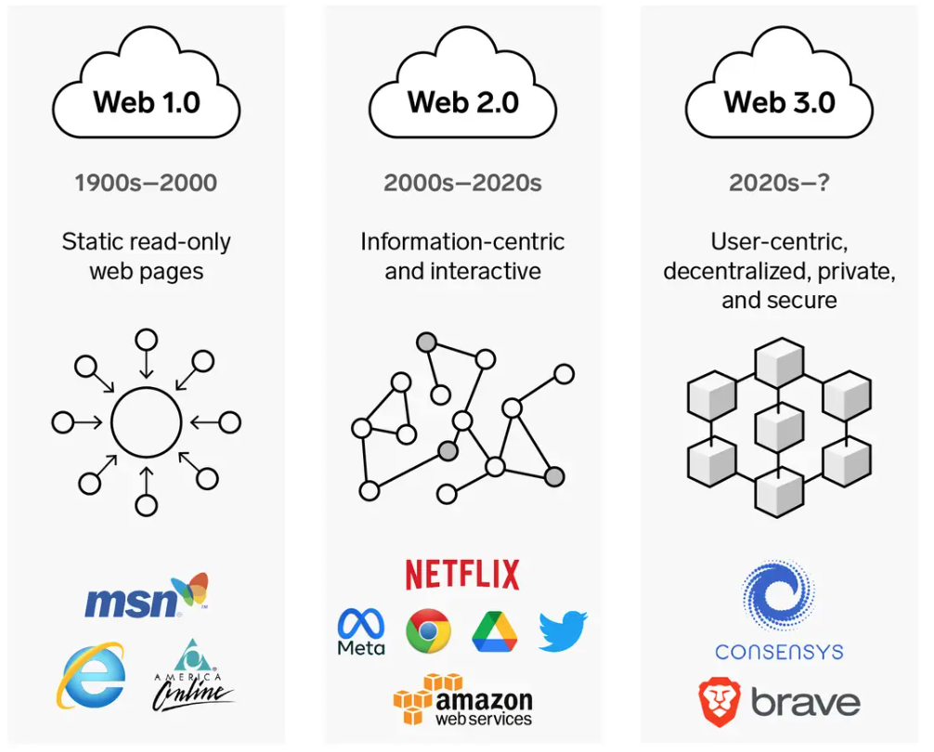
Web3: Decentralized Web
Internet Evolution
1990
2000
2020
Source: https://www.businessinsider.com/personal-finance/what-is-web3

Slide 22
Definition of
Artificial Intelligence (A.I.)

Slide 23
Artificial Intelligence
“… the science and engineering of making intelligent machines”
(John McCarthy, 1955)
Source: https://digitalintelligencetoday.com/artificial-intelligence-defined-useful-list-of-popular-definitions-from-business-and-science/

Slide 24
Artificial Intelligence
“… technology that thinks and acts like humans”
Source: https://digitalintelligencetoday.com/artificial-intelligence-defined-useful-list-of-popular-definitions-from-business-and-science/

Slide 25
Artificial Intelligence
“… intelligence exhibited by machines or software”
Source: https://digitalintelligencetoday.com/artificial-intelligence-defined-useful-list-of-popular-definitions-from-business-and-science/

Slide 26
4 Approaches of AI
Thinking Humanly | Thinking Rationally
Acting Humanly | Acting Rationally
Source: Stuart Russell and Peter Norvig (2020), Artificial Intelligence: A Modern Approach, 4th Edition, Pearson

Slide 27
4 Approaches of AI
2. Thinking Humanly: The Cognitive Modeling Approach | 3. Thinking Rationally: The “Laws of Thought” Approach
1. Acting Humanly: The Turing Test Approach (1950) | 4. Acting Rationally: The Rational Agent Approach
Source: Stuart Russell and Peter Norvig (2020), Artificial Intelligence: A Modern Approach, 4th Edition, Pearson

Slide 28
AI Acting Humanly:
The Turing Test Approach
(Alan Turing, 1950)
Knowledge Representation
Automated Reasoning
Machine Learning (ML)
  Deep Learning (DL)
Computer Vision (Image, Video)
Natural Language Processing (NLP)
Robotics
Source: Stuart Russell and Peter Norvig (2020), Artificial Intelligence: A Modern Approach, 4th Edition, Pearson

Slide 29
Can machines think?
Alan Turing rejected the question “Can machines think?” and replaced it with a behavioral test.
  Alan Turing anticipated many objections to the possibility of thinking machines.
Concentrate on their systems’ performance on practical tasks
  rather than the ability to imitate humans.
Consciousness remains a mystery.
Source: Stuart Russell and Peter Norvig (2020), Artificial Intelligence: A Modern Approach, 4th Edition, Pearson

Slide 30
ChatGPT
Large Language Models (LLM)
Foundation Models

Slide 31
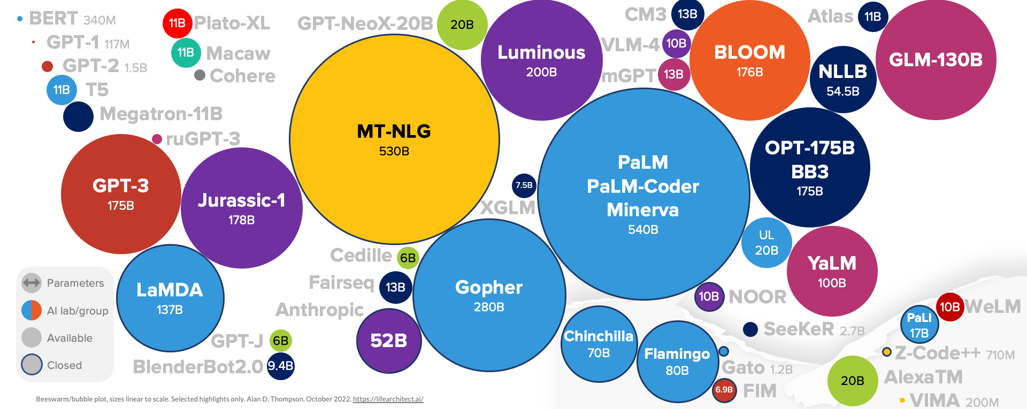
Large Language Models (LLM)
(GPT-3, ChatGPT, PaLM, BLOOM, OPT-175B, LLaMA)
ChatGPT
175B
LLaMA
65B
Source: https://lifearchitect.ai/models/

Slide 32
The Transformers Timeline
ULMFit
BERT
RoBERTa
XLM-R
DeBERTa
GPT-Neo
BLOOM
Alpaca
DistrilBERT
T5
PaLM
ChatGPT
Transformer
GPT
GPT-2
GPT-3
GPT-J
OPT-175B
LLaMA
2017
2018
2019
2020
2021
2022
2023
Source: Lewis Tunstall, Leandro von Werra, and Thomas Wolf (2022), Natural Language Processing with Transformers: Building Language Applications with Hugging Face, O'Reilly Media.

Slide 33
Transformer Models
Transformer
Encoder
Decoder
DistilBERT
BERT
T5
GPT
RoBERTa
BART
GPT-2
CTRL
XLM-R
XLM
M2M-100
GPT-3
ALBERT
BigBird
GPT-Neo
GPT-J
ELECTRA
mT0
BLOOM
BLOOMZ
DeBERTa
ChatGPT
Source: Lewis Tunstall, Leandro von Werra, and Thomas Wolf (2022), Natural Language Processing with Transformers: Building Language Applications with Hugging Face, O'Reilly Media.

Slide 34
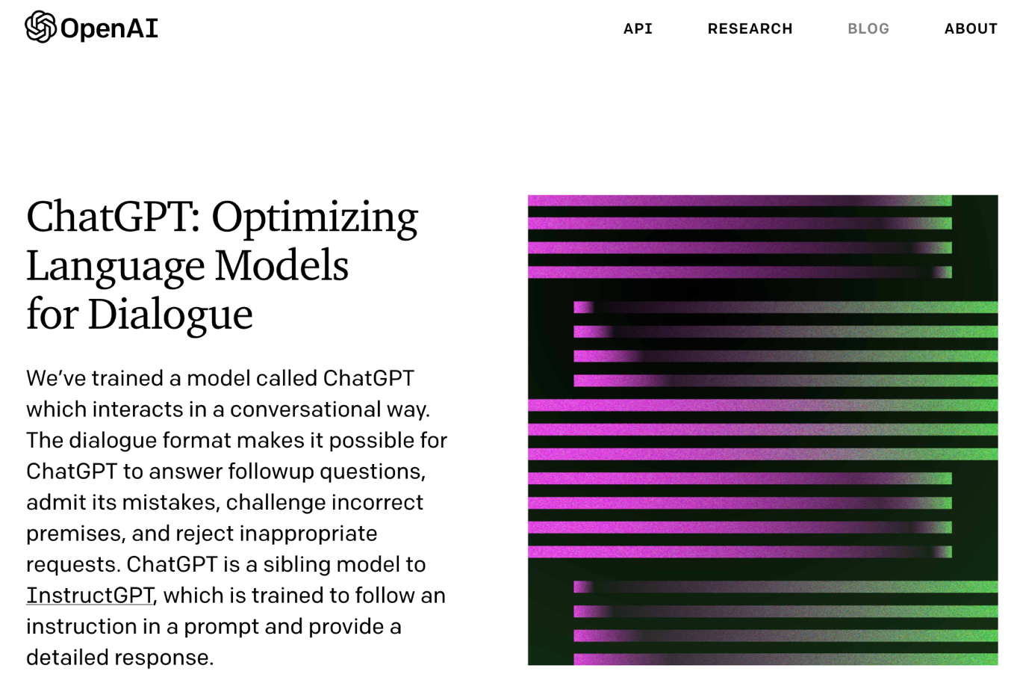
OpenAI ChatGPT
Source: https://openai.com/blog/chatgpt/

Slide 35
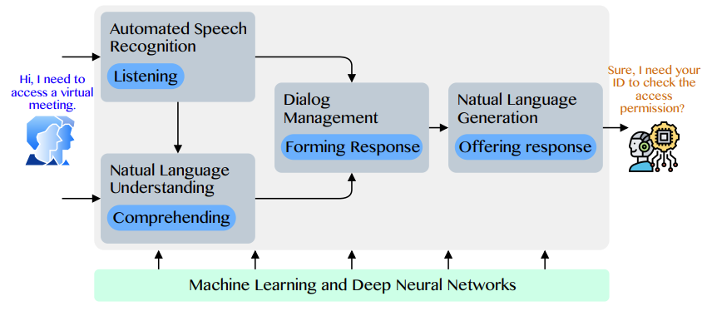
Conversational AI to deliver contextual and personal experience to users
Source: Huynh-The, Thien, Quoc-Viet Pham, Xuan-Qui Pham, Thanh Thi Nguyen, Zhu Han, and Dong-Seong Kim (2022).
"Artificial Intelligence for the Metaverse: A Survey." arXiv preprint arXiv:2202.10336.

Slide 36
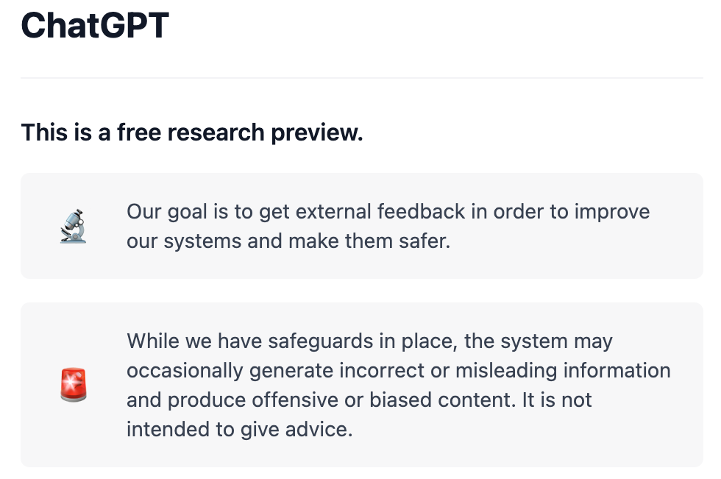
OpenAI ChatGPT
Source: https://chat.openai.com/chat

Slide 37
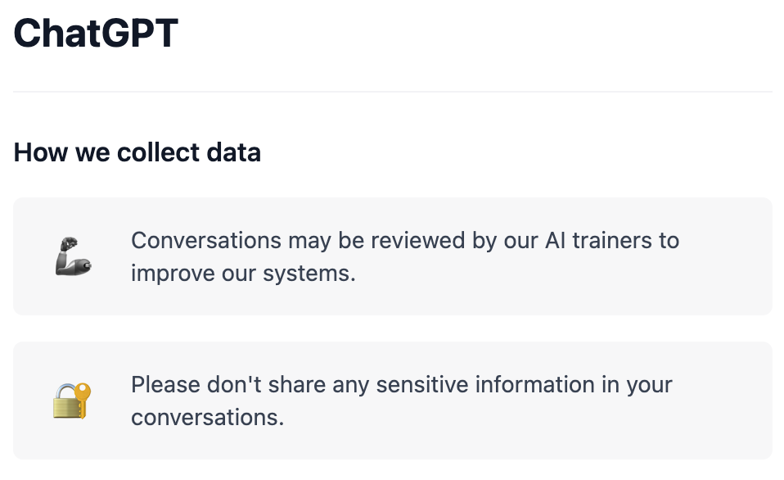
OpenAI ChatGPT
Source: https://chat.openai.com/chat

Slide 38
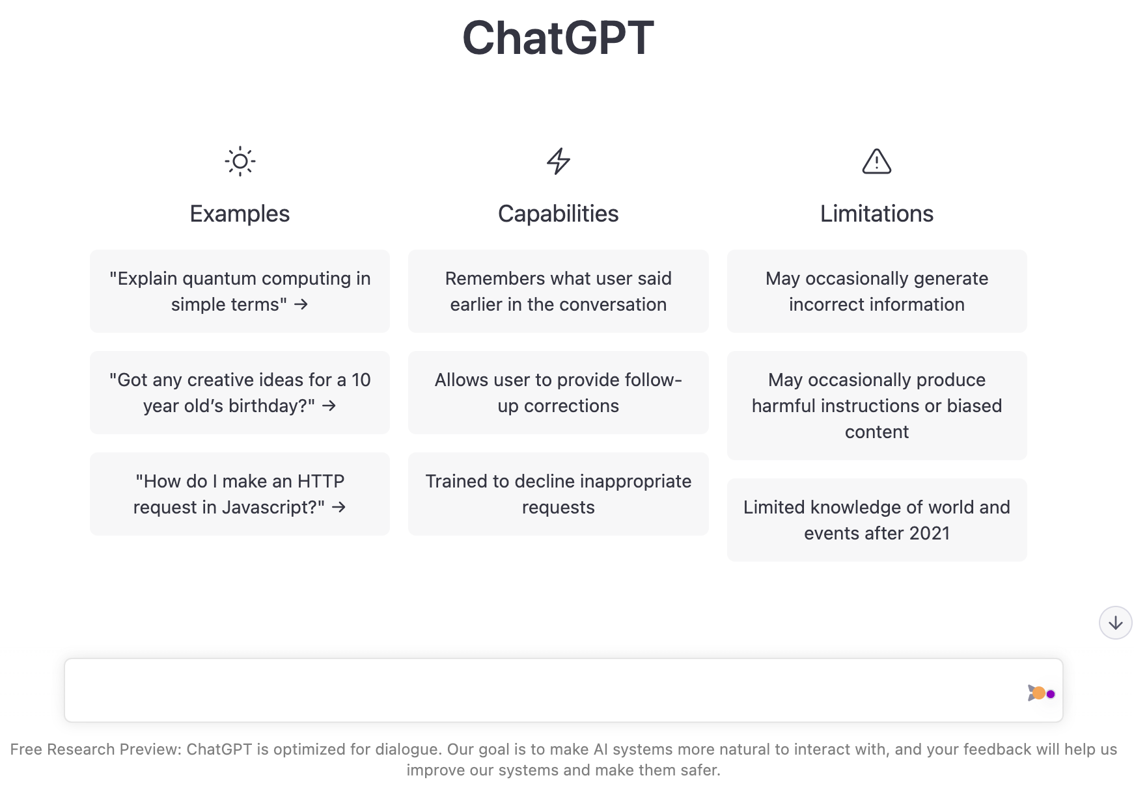
OpenAI ChatGPT
Source: https://chat.openai.com/chat

Slide 39
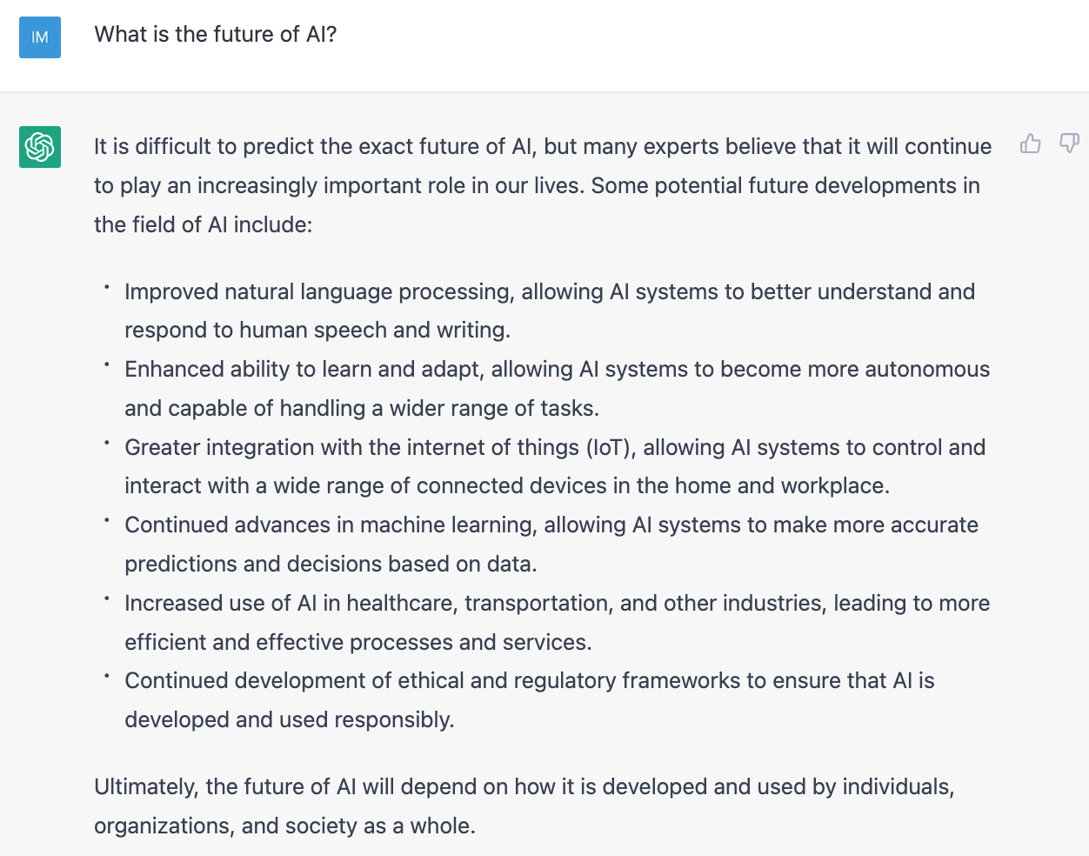
OpenAI ChatGPT
Source: https://chat.openai.com/chat

Slide 40
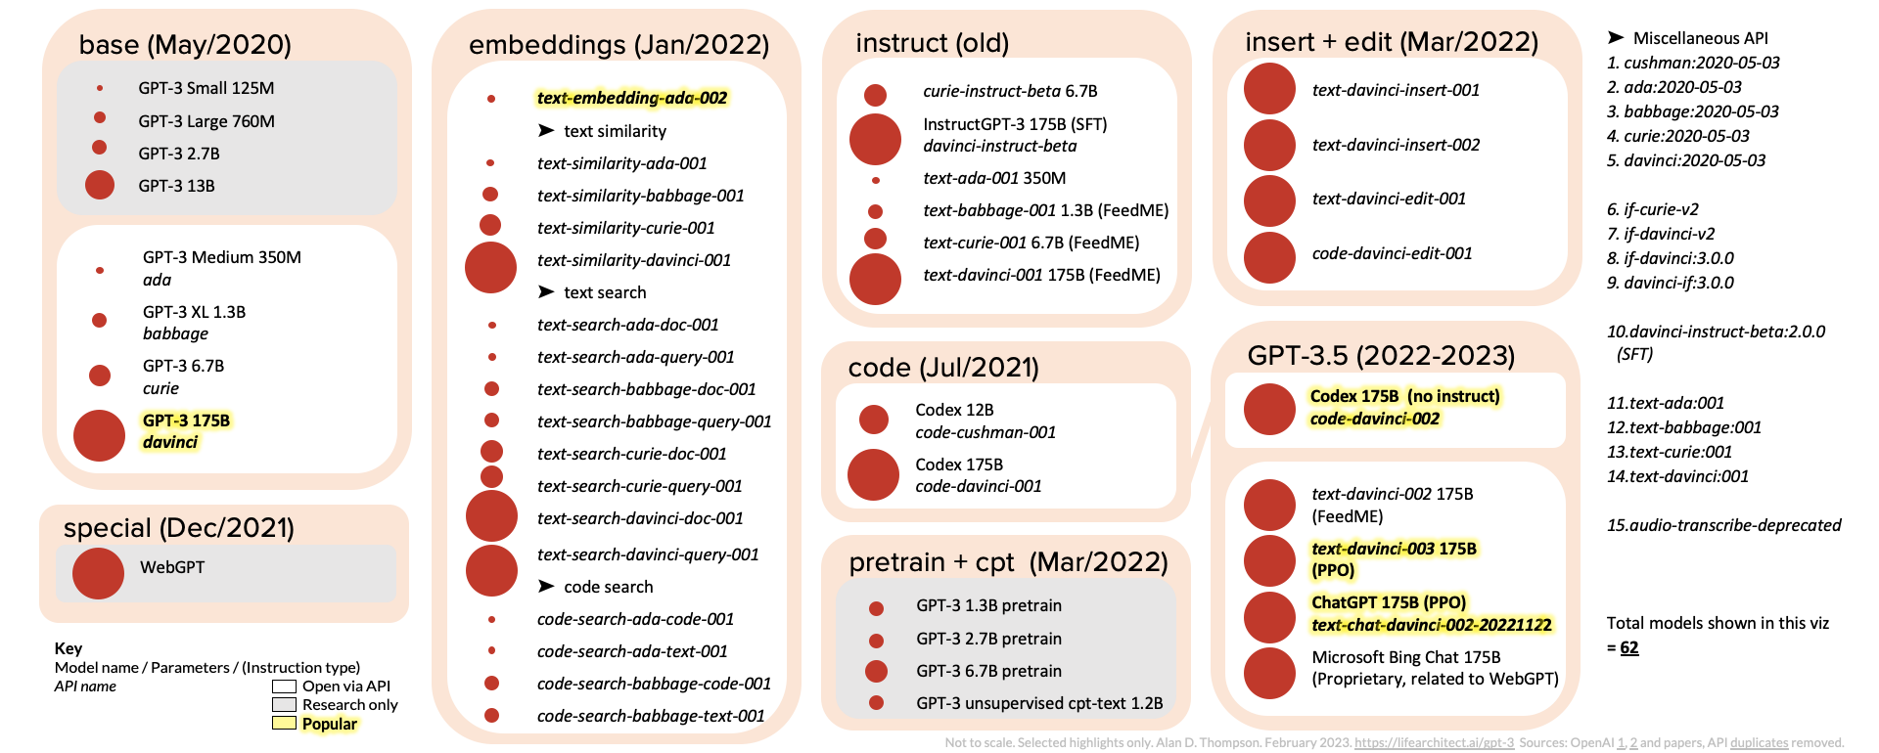
ChatGPT and GPT-3 Family
(GPT-3, InstructGPT, GPT-3.5, ChatGPT)
Source: https://lifearchitect.ai/gpt-3/

Slide 41
OpenAI ChatGPT and Open LLM
GPT-4, LLaMA, Alpaca, Dolly, Cerebras-GPT, GPT4All
OpenAI GPT-4
Deepmind Chinchilla
Meta OPT (LLaMA)
Pythia
Stanford Alpaca
Databricks Dolly
Cerebras-GPT
GPT4All
Source: https://www.cerebras.net/blog/cerebras-gpt-a-family-of-open-compute-efficient-large-language-models/

Slide 42
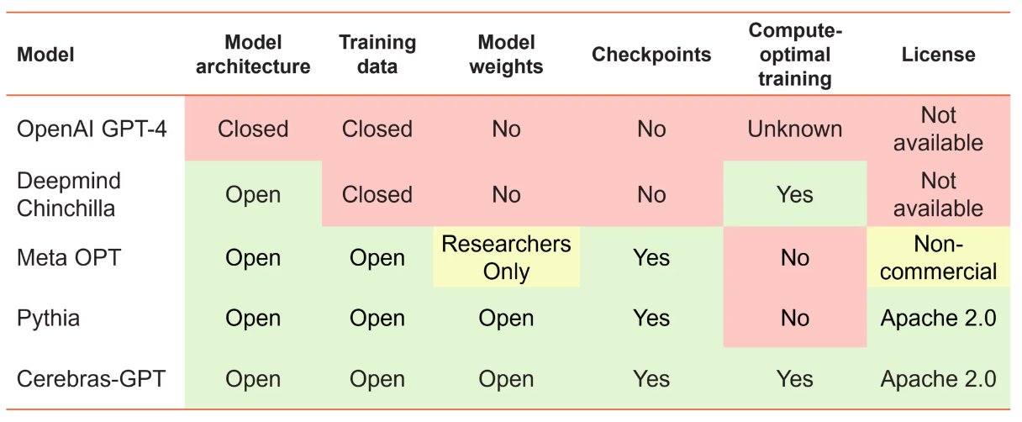
Large Language Models (LMM)
Openness and Training Philosophy
Source: https://www.cerebras.net/blog/cerebras-gpt-a-family-of-open-compute-efficient-large-language-models/

Slide 43
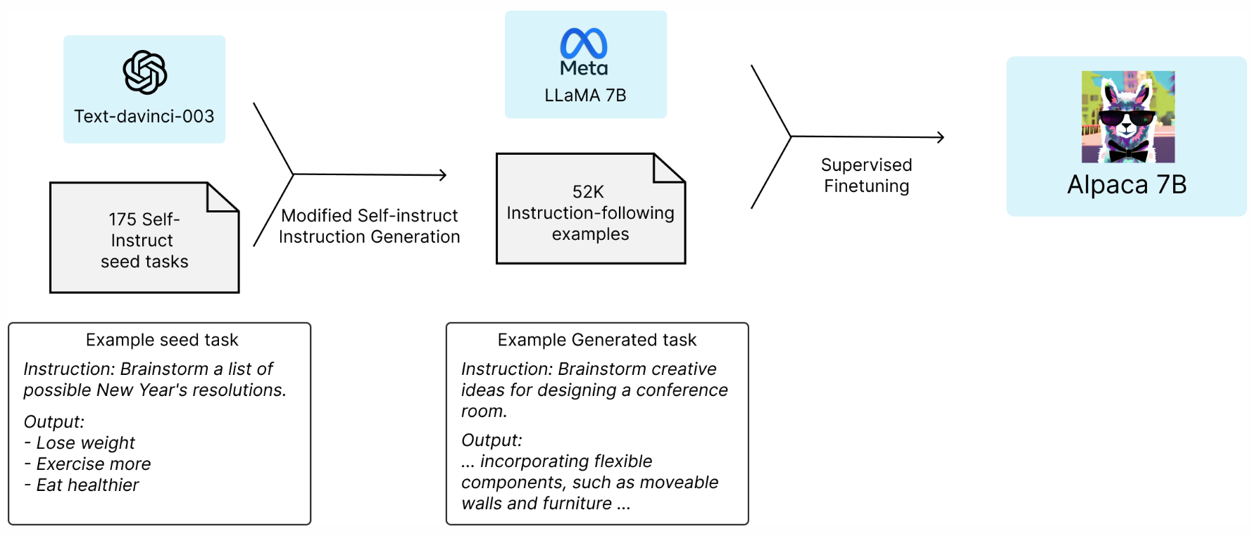

Stanford Alpaca:
A Strong, Replicable Instruction-Following Model
Source: https://crfm.stanford.edu/2023/03/13/alpaca.html

Slide 44
GPT4All:
Training an Assistant-style Chatbot with Large Scale Data Distillation from GPT-3.5-Turbo
Demo, data and code to train an assistant-style large language model with ~800k GPT-3.5-Turbo Generations based on LLaMa
Reproducibility
  Trained LoRa Weights:
    gpt4all-lora (four full epochs of training):
      https://huggingface.co/nomic-ai/gpt4all-lora
Source: https://github.com/nomic-ai/gpt4all

Slide 45
Reinforcement Learning from Human Feedback (RLHF)

Slide 46
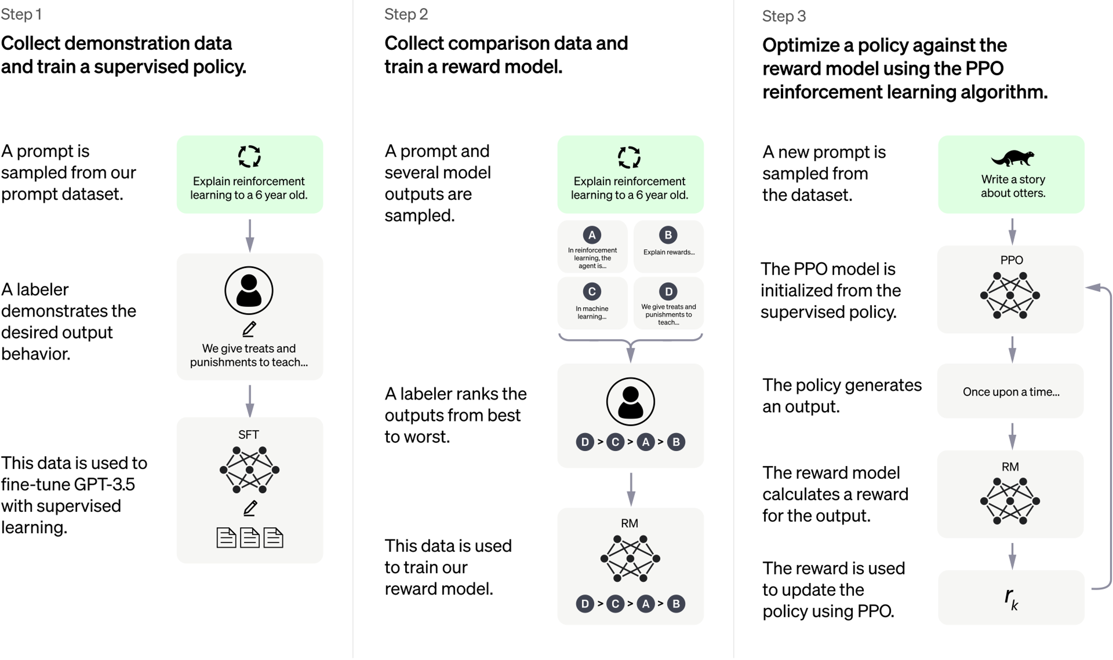
ChatGPT: Optimizing Language Models for Dialogue
Source: https://openai.com/blog/chatgpt/

Slide 47
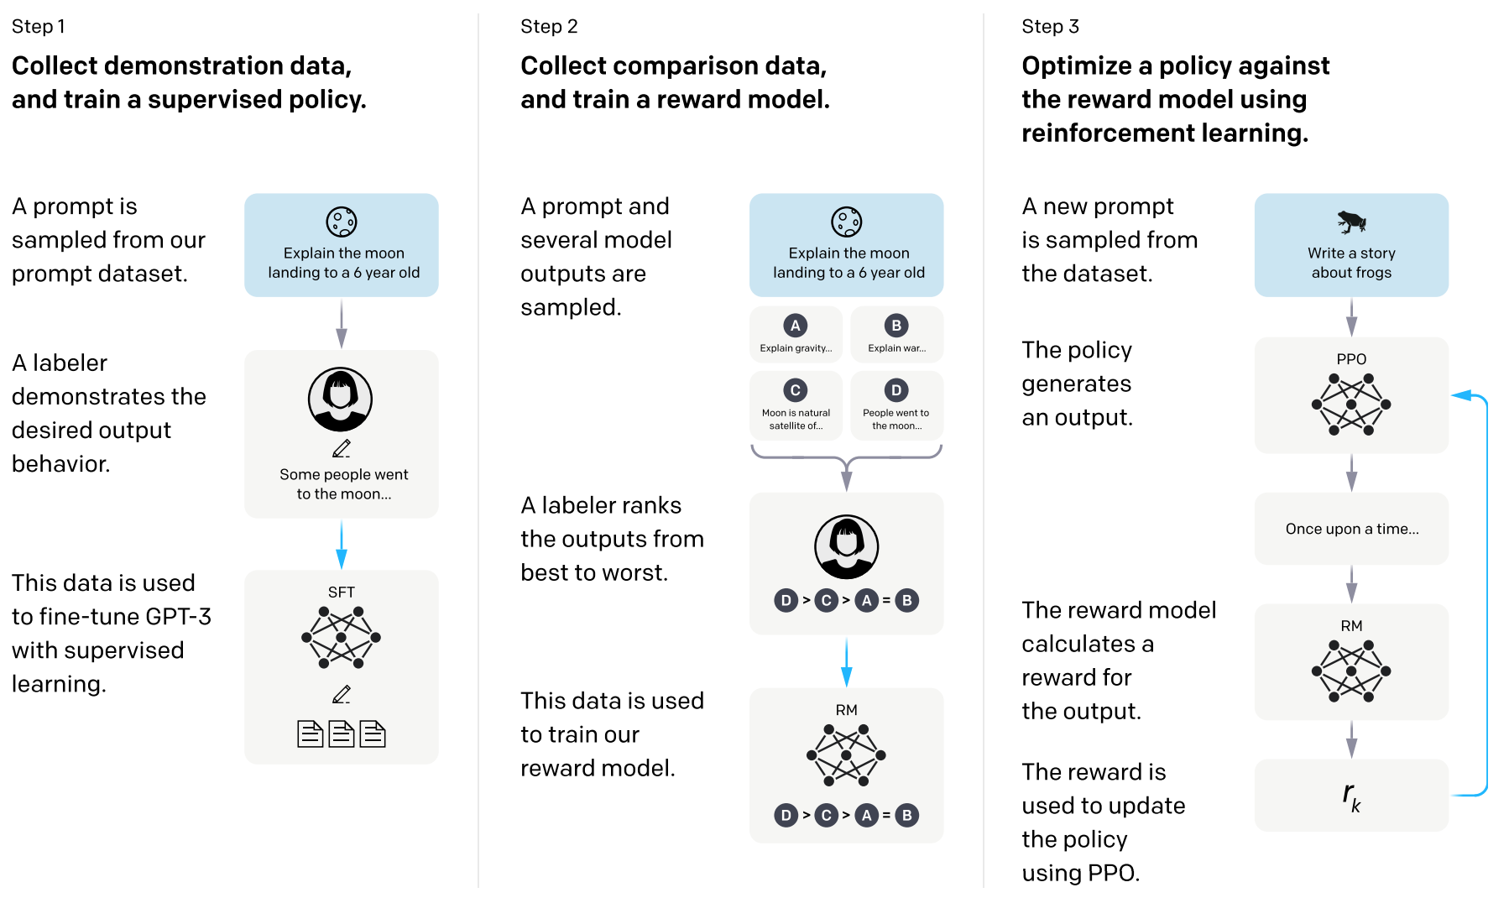
Training language models to follow instructions with human feedback
InstructGPT and GPT 3.5
Source: Ouyang, L., Wu, J., Jiang, X., Almeida, D., Wainwright, C. L., Mishkin, P., ... & Lowe, R. (2022). Training language models to follow instructions with human feedback. arXiv preprint arXiv:2203.02155.

Slide 48
Reinforcement Learning from Human Feedback (RLHF)
Pretraining a Language Model (LM)
Gathering Data and Training a Reward Model
Fine-tuning the LM with Reinforcement Learning
Source: https://huggingface.co/blog/rlhf

Slide 49
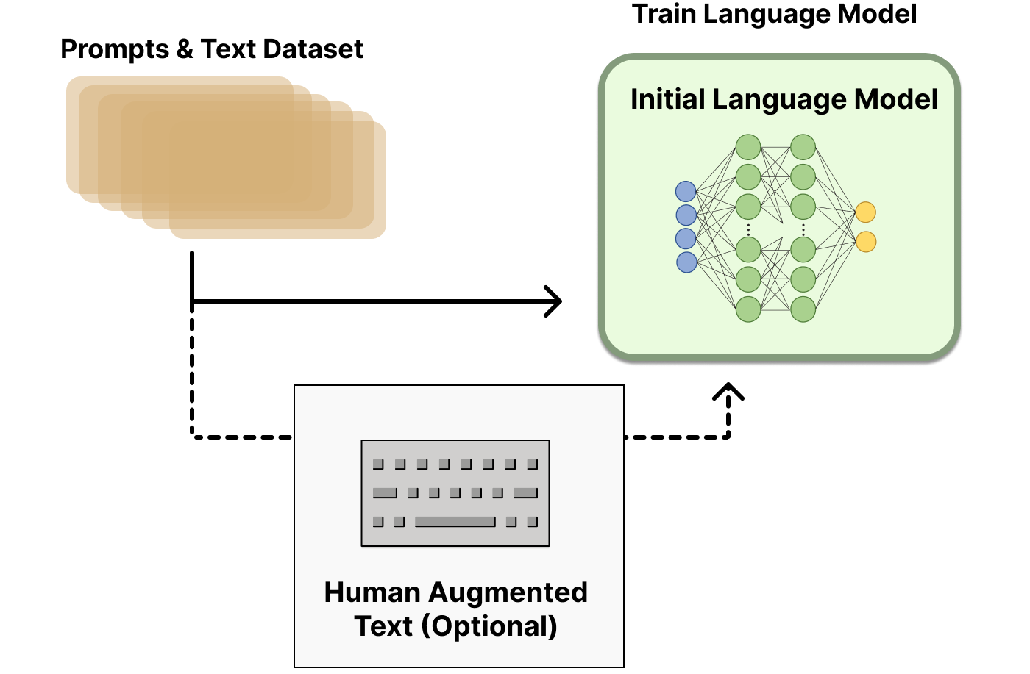
Reinforcement Learning
from Human Feedback (RLHF)
Step 1. Pretraining a Language Model (LM)
Source: https://huggingface.co/blog/rlhf

Slide 50
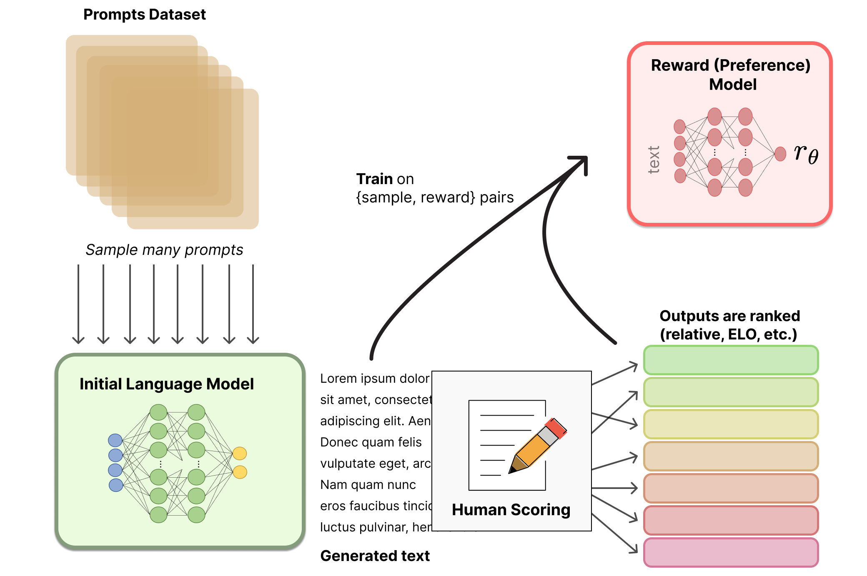
Reinforcement Learning from Human Feedback (RLHF)
Step 2. Gathering Data and
Training a
Reward Model
Source: https://huggingface.co/blog/rlhf

Slide 51
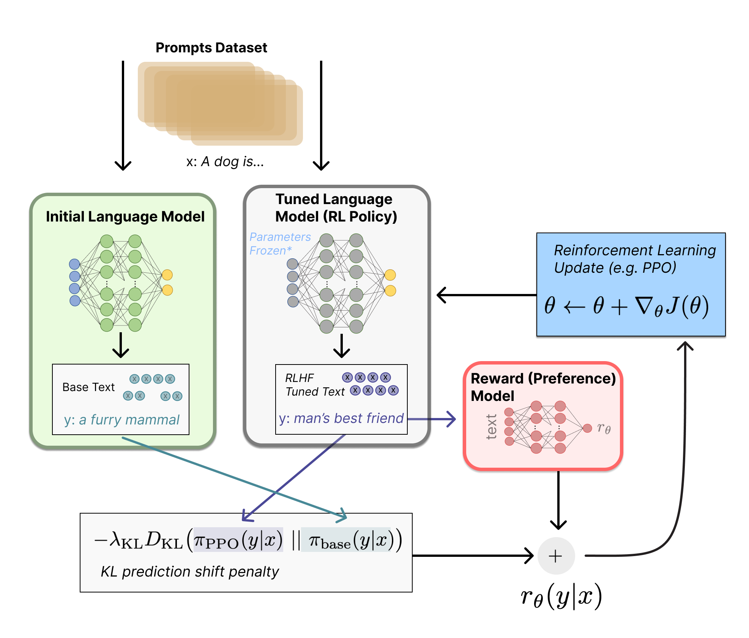
Reinforcement Learning from Human Feedback (RLHF)
Step 3. Fine-tuning the LM with Reinforcement Learning
Source: https://huggingface.co/blog/rlhf

Slide 52
Generative AI
Text, Image, Video, Audio Applications

Slide 53
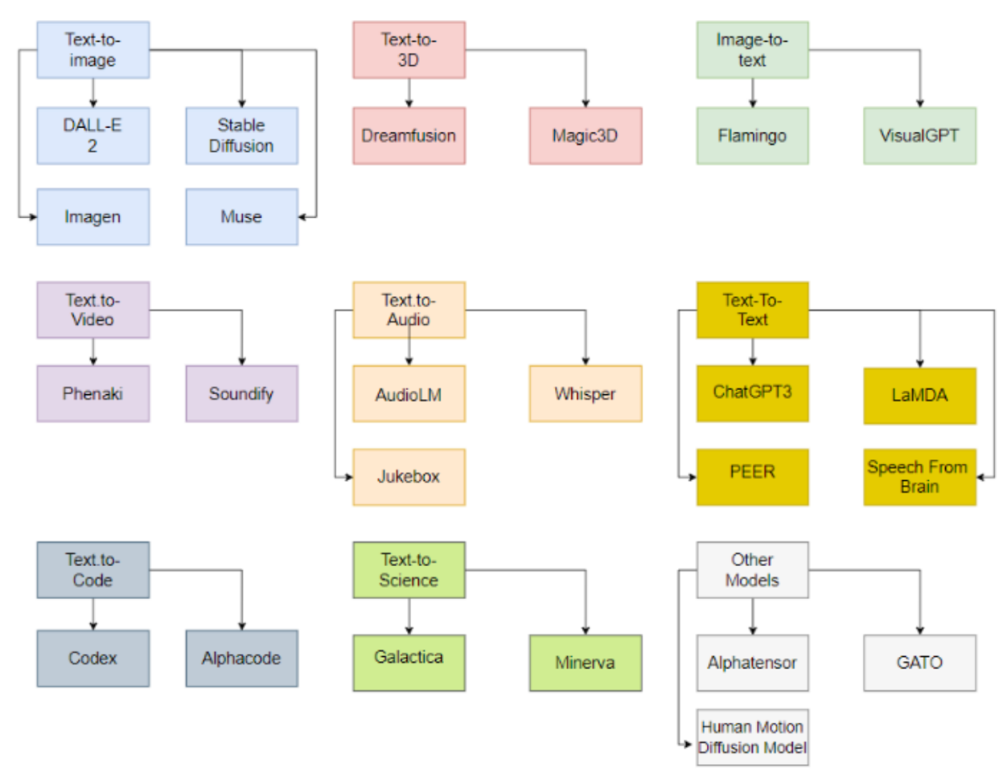
Generative AI Models
ChatGPT
is not
all you need
Attention
is
all you need
Source: Gozalo-Brizuela, Roberto, and Eduardo C. Garrido-Merchan (2023). "ChatGPT is not all you need. A State of the Art Review of large Generative AI models." arXiv preprint arXiv:2301.04655 (2023).

Slide 54
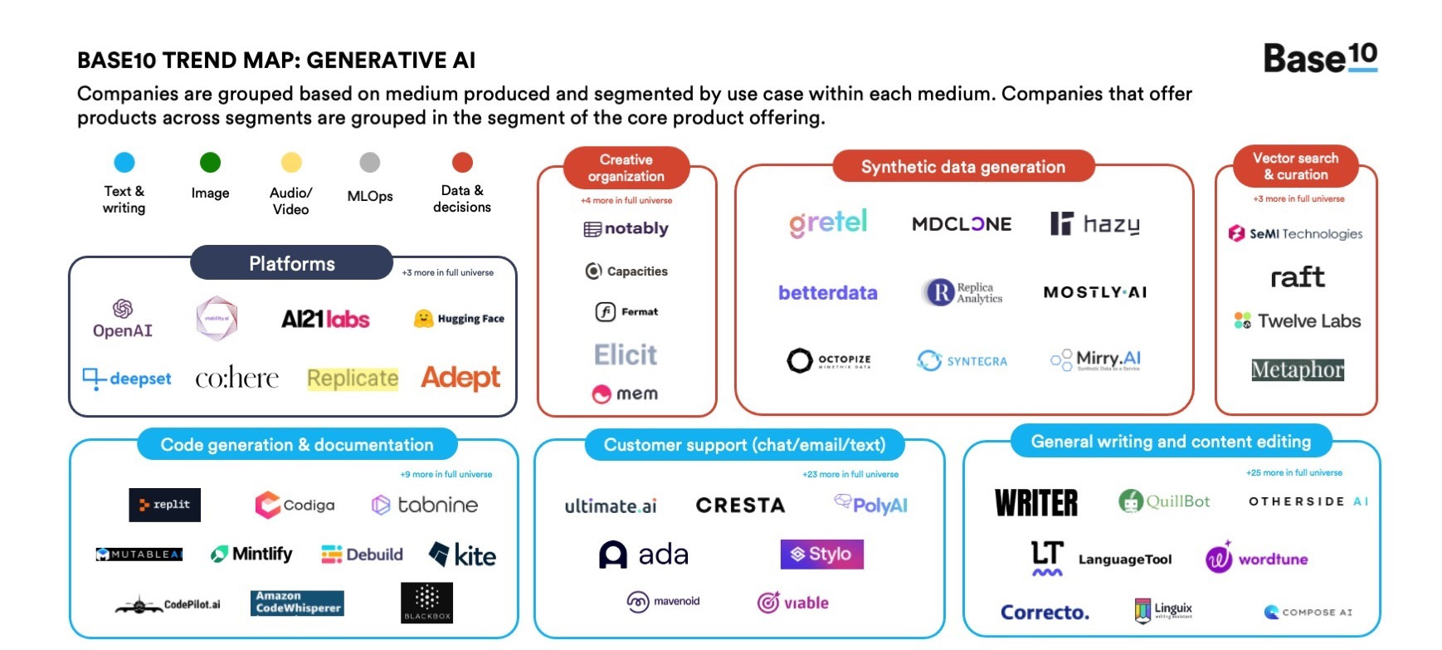
Generative AI
Source: https://base10.vc/post/generative-ai-mission-critical/

Slide 55
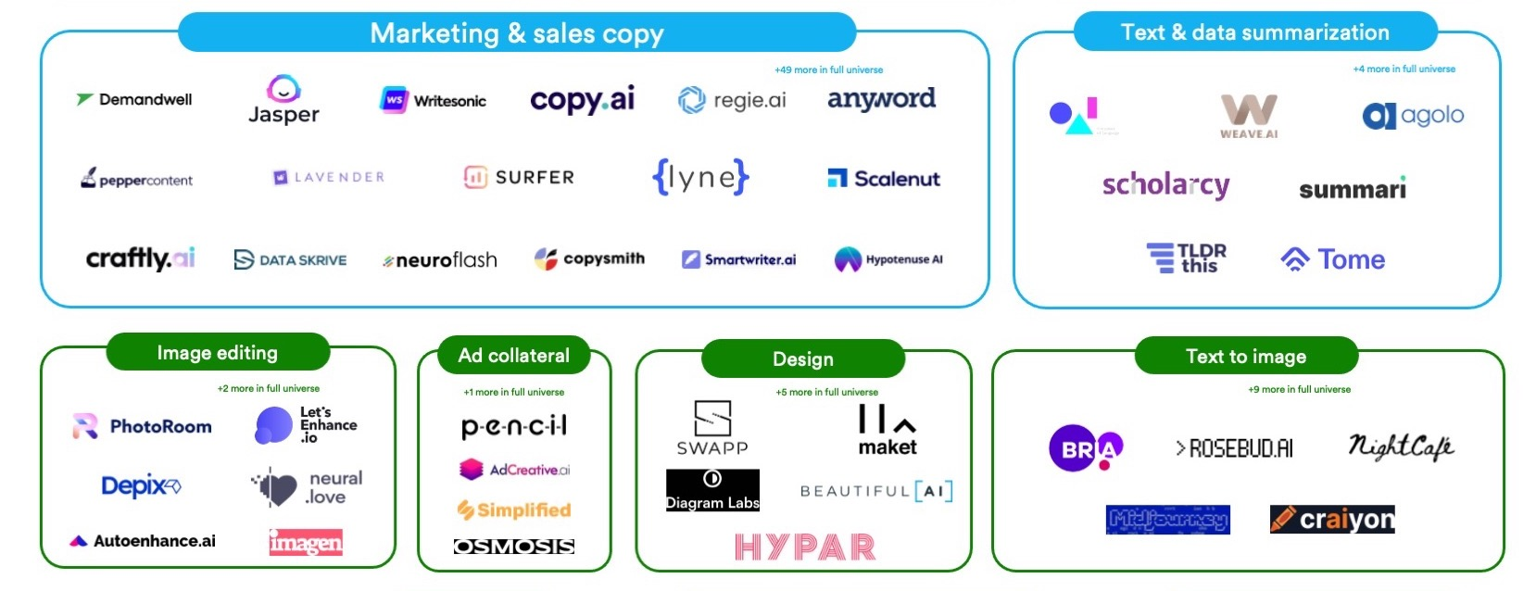
Generative AI
Source: https://base10.vc/post/generative-ai-mission-critical/

Slide 56
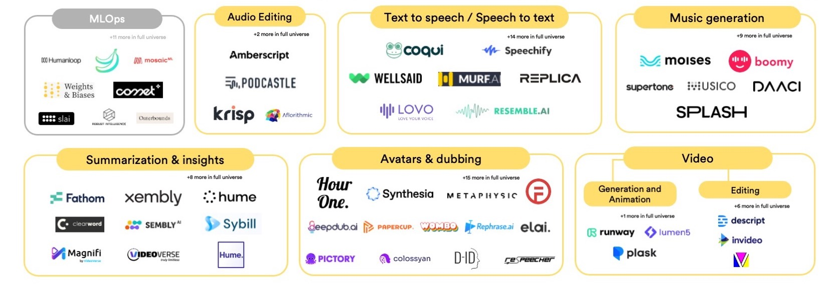
Generative AI
Source: https://base10.vc/post/generative-ai-mission-critical/

Slide 57
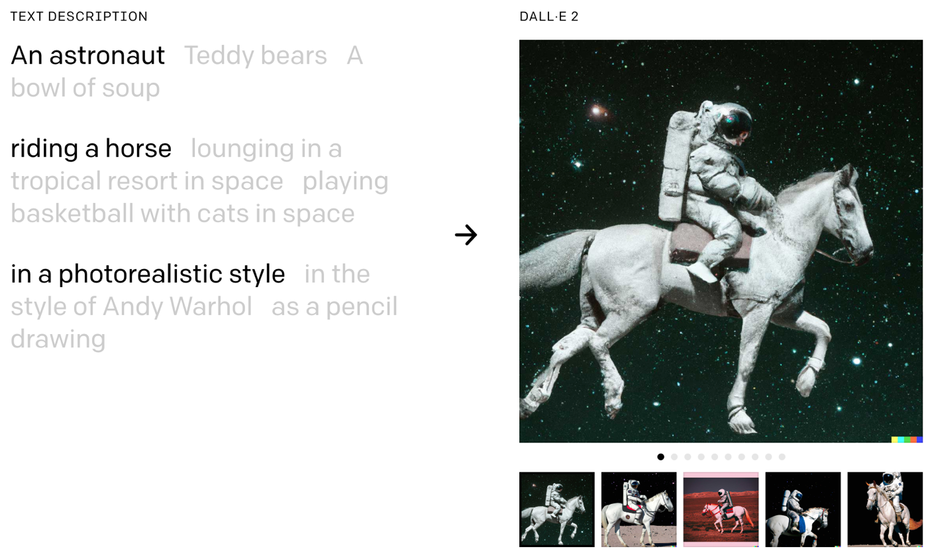
DALL·E 2
Create original, realistic images and art from a text description.
It can combine concepts, attributes, and styles.
https://openai.com/dall-e-2/

Slide 58
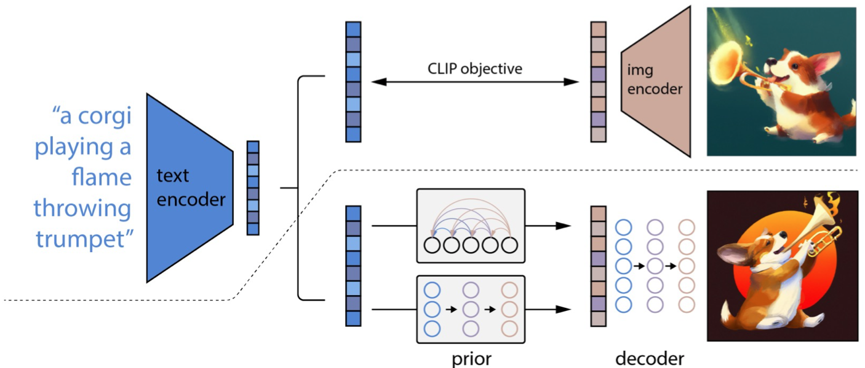
The Model Structure of DALL-E-2
CLIP Pre-training
Image Generation
Source: Yihan Cao, Siyu Li, Yixin Liu, Zhiling Yan, Yutong Dai, Philip S. Yu, and Lichao Sun (2023). "A Comprehensive Survey of AI-Generated Content (AIGC): A History of Generative AI from GAN to ChatGPT." arXiv preprint arXiv:2303.04226.

Slide 59
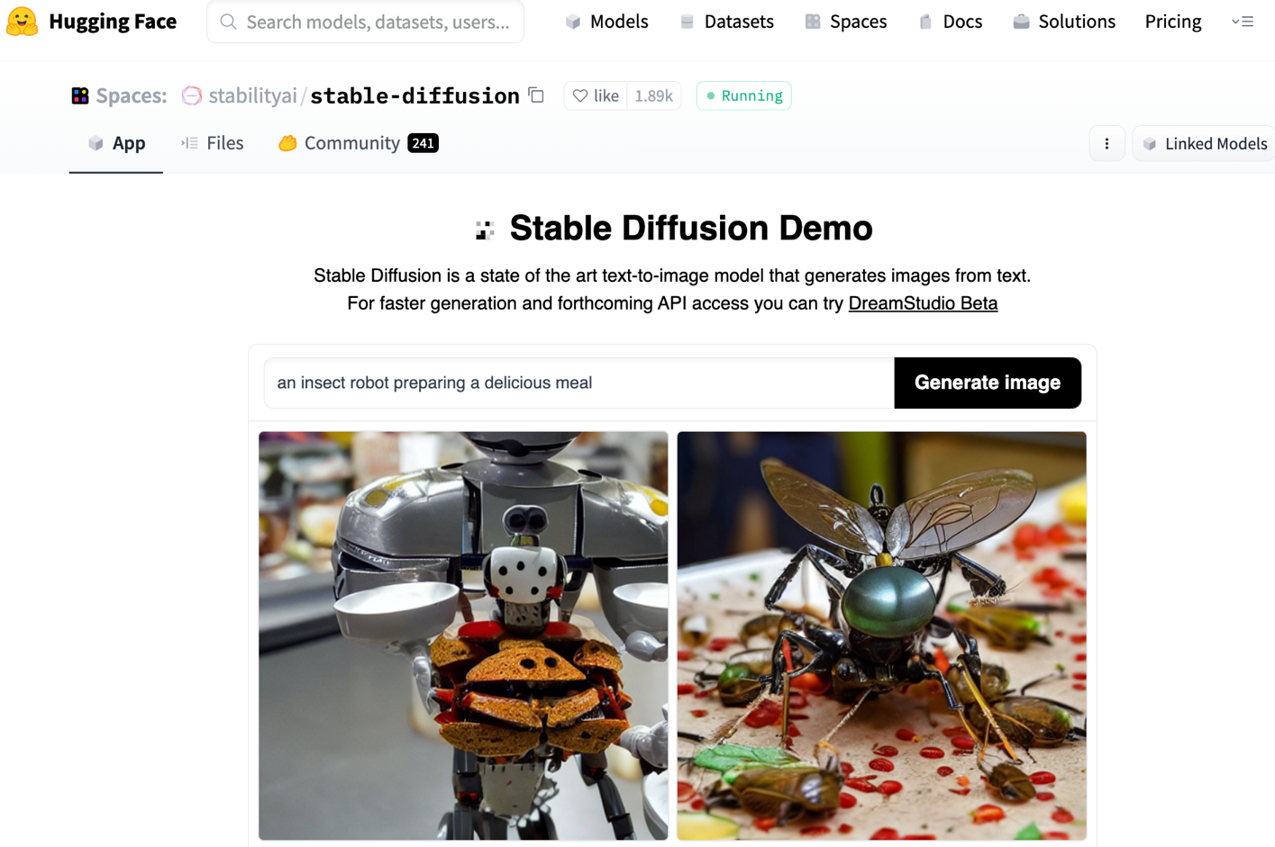
Stable Diffusion
https://huggingface.co/spaces/stabilityai/stable-diffusion

Slide 60
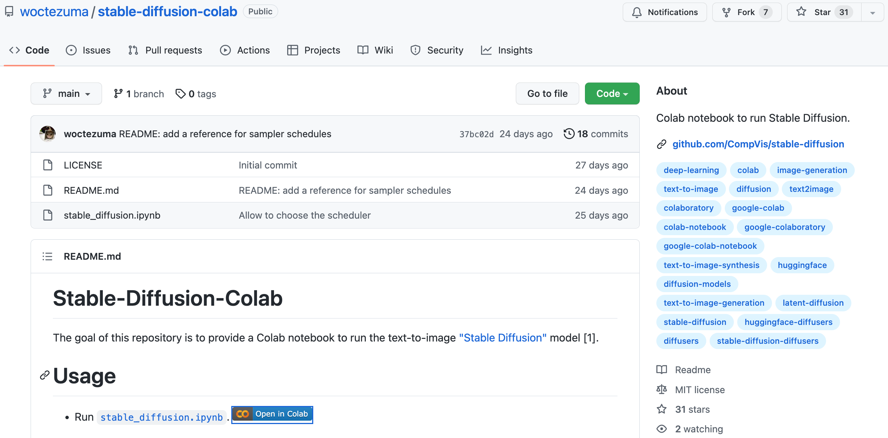
Stable Diffusion Colab
https://github.com/woctezuma/stable-diffusion-colab

Slide 61
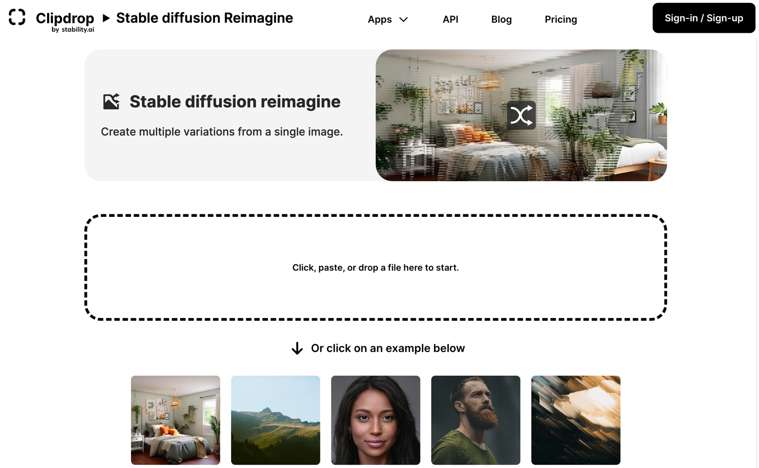
Stable Diffusion Reimagine
https://clipdrop.co/stable-diffusion-reimagine

Slide 62
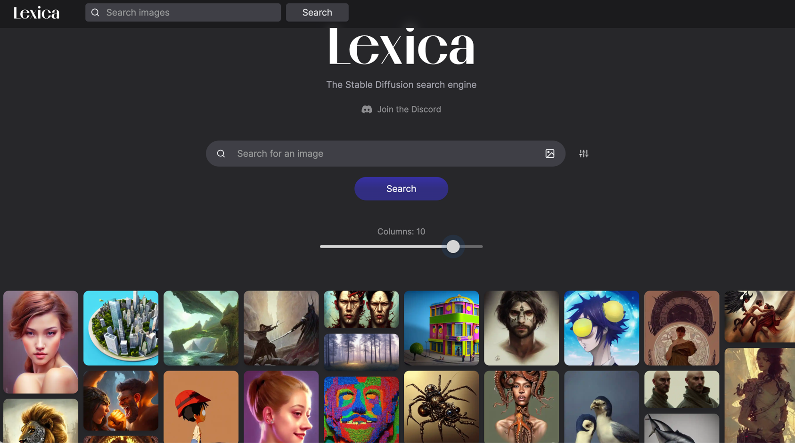
Lexica Art: Search Stable Diffusion images and prompts
https://lexica.art/

Slide 63
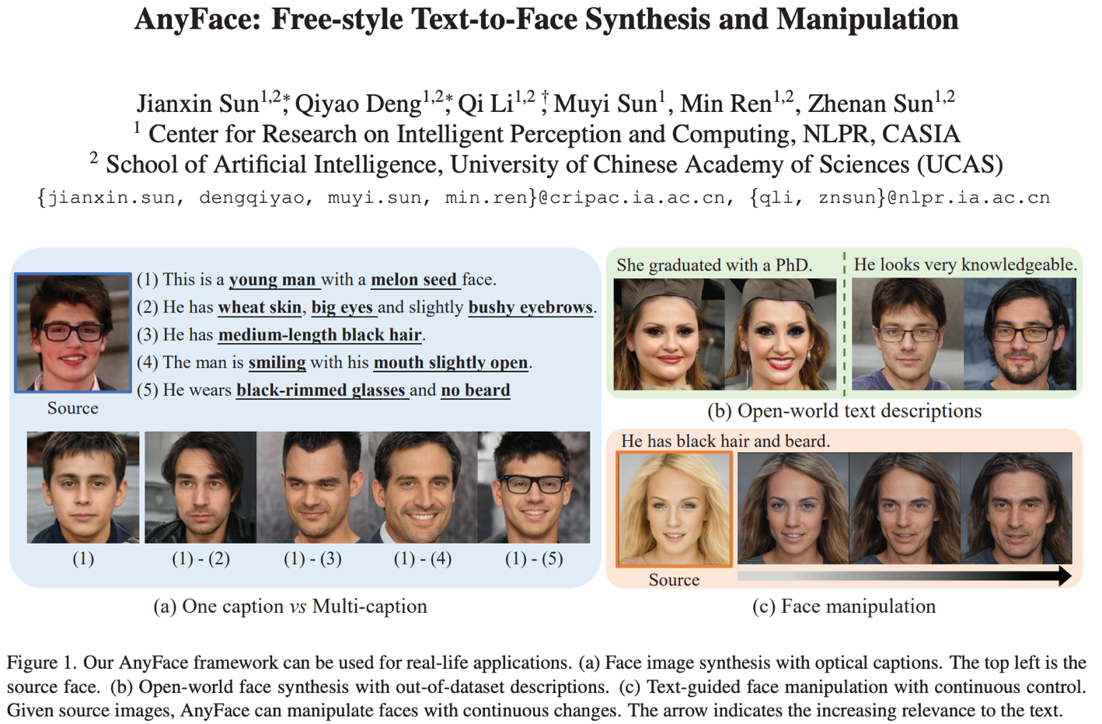
AnyFace: Free-style Text-to-Face Synthesis and Manipulation
Source: Sun, Jianxin, Qiyao Deng, Qi Li, Muyi Sun, Min Ren, and Zhenan Sun. (2022)
"AnyFace: Free-style Text-to-Face Synthesis and Manipulation." In Proceedings of the IEEE/CVF Conference on Computer Vision and Pattern Recognition, pp. 18687-18696.

Slide 64
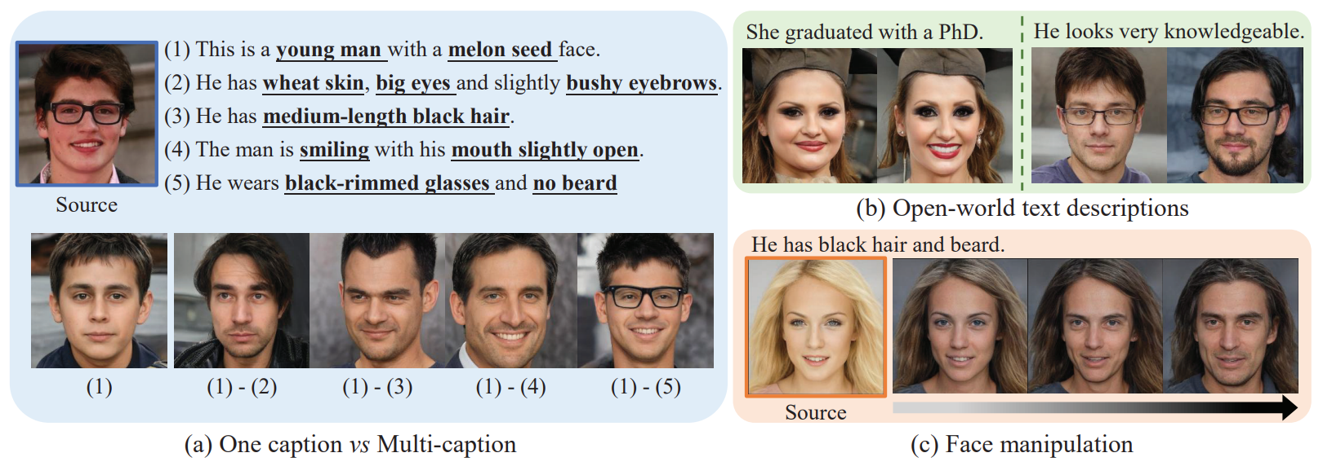
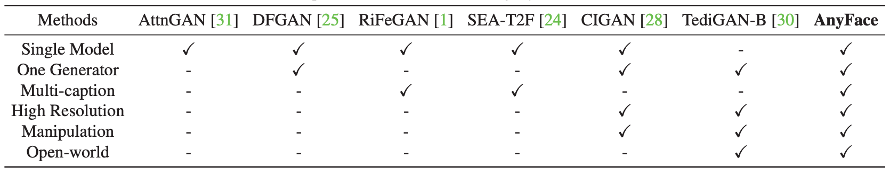
AnyFace: Free-style Text-to-Face Synthesis and Manipulation
Source: Sun, Jianxin, Qiyao Deng, Qi Li, Muyi Sun, Min Ren, and Zhenan Sun. (2022)
"AnyFace: Free-style Text-to-Face Synthesis and Manipulation." In Proceedings of the IEEE/CVF Conference on Computer Vision and Pattern Recognition, pp. 18687-18696.

Slide 65
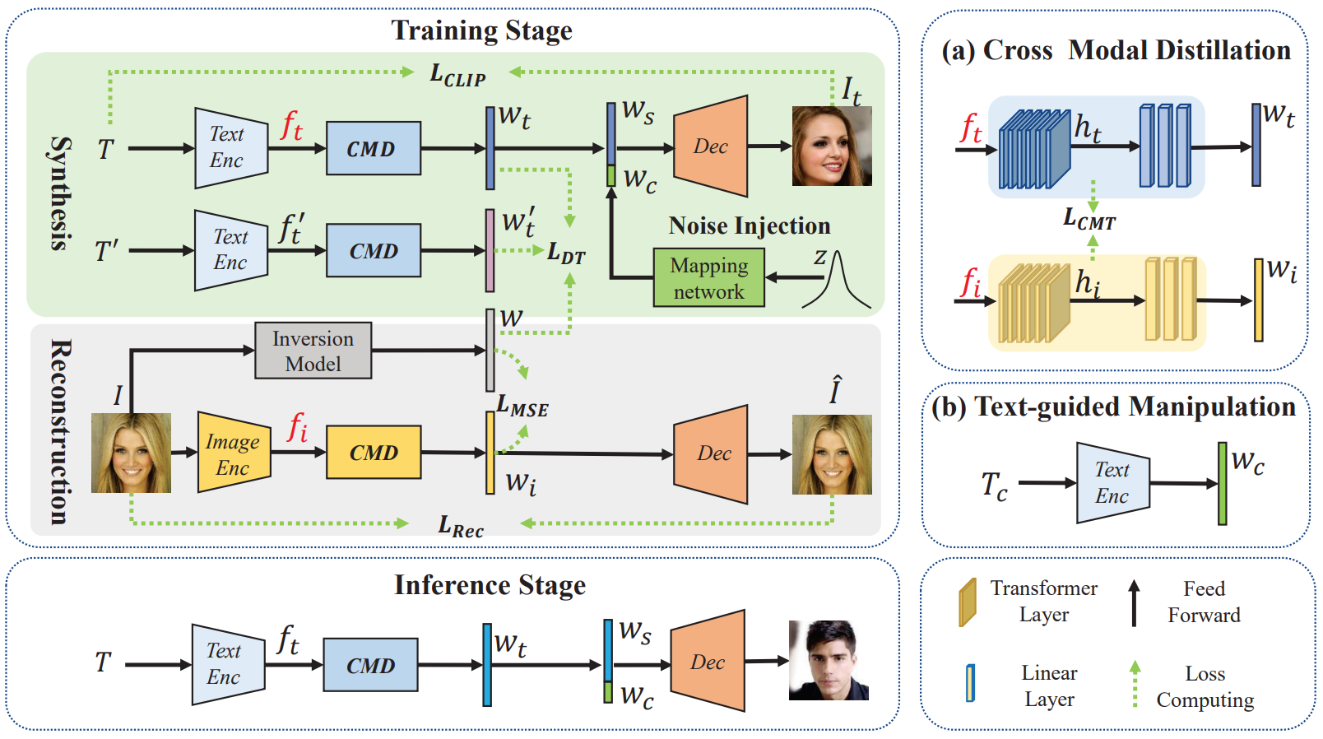
AnyFace: Free-style Text-to-Face Synthesis and Manipulation
Source: Sun, Jianxin, Qiyao Deng, Qi Li, Muyi Sun, Min Ren, and Zhenan Sun. (2022)
"AnyFace: Free-style Text-to-Face Synthesis and Manipulation." In Proceedings of the IEEE/CVF Conference on Computer Vision and Pattern Recognition, pp. 18687-18696.

Slide 66
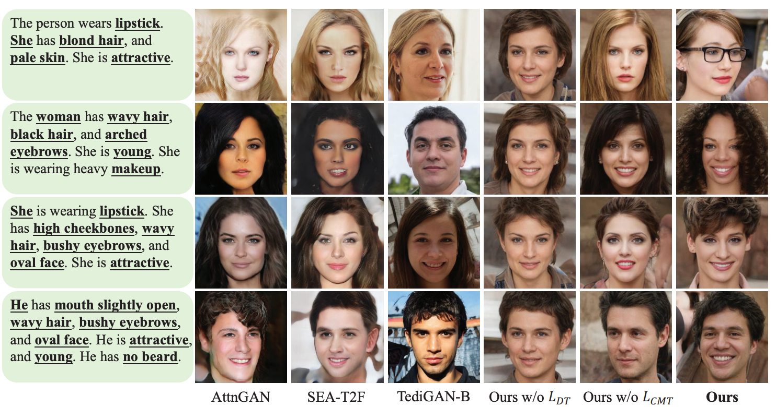
AnyFace: Free-style Text-to-Face Synthesis and Manipulation
Source: Sun, Jianxin, Qiyao Deng, Qi Li, Muyi Sun, Min Ren, and Zhenan Sun. (2022)
"AnyFace: Free-style Text-to-Face Synthesis and Manipulation." In Proceedings of the IEEE/CVF Conference on Computer Vision and Pattern Recognition, pp. 18687-18696.

Slide 67
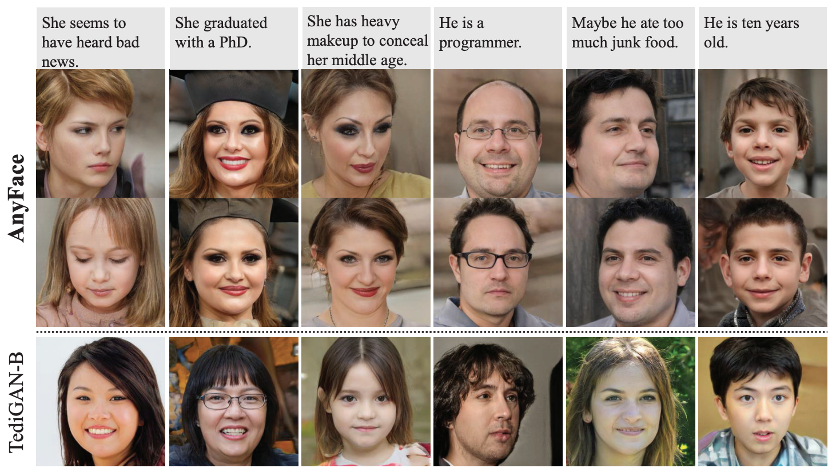
AnyFace: Free-style Text-to-Face Synthesis and Manipulation
Source: Sun, Jianxin, Qiyao Deng, Qi Li, Muyi Sun, Min Ren, and Zhenan Sun. (2022)
"AnyFace: Free-style Text-to-Face Synthesis and Manipulation." In Proceedings of the IEEE/CVF Conference on Computer Vision and Pattern Recognition, pp. 18687-18696.

Slide 68
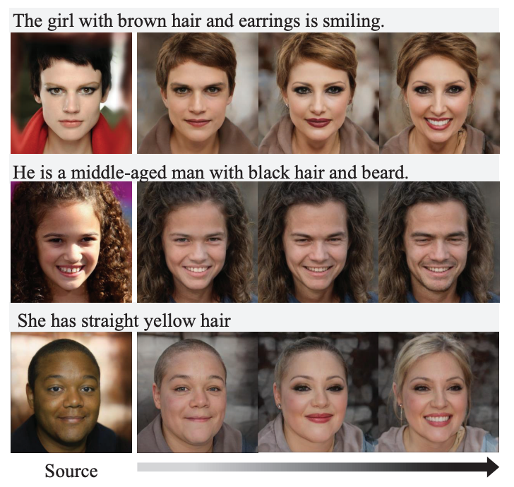
AnyFace: Free-style Text-to-Face Synthesis and Manipulation
Text-guided
Face Manipulation
Source: Sun, Jianxin, Qiyao Deng, Qi Li, Muyi Sun, Min Ren, and Zhenan Sun. (2022)
"AnyFace: Free-style Text-to-Face Synthesis and Manipulation." In Proceedings of the IEEE/CVF Conference on Computer Vision and Pattern Recognition, pp. 18687-18696.

Slide 69
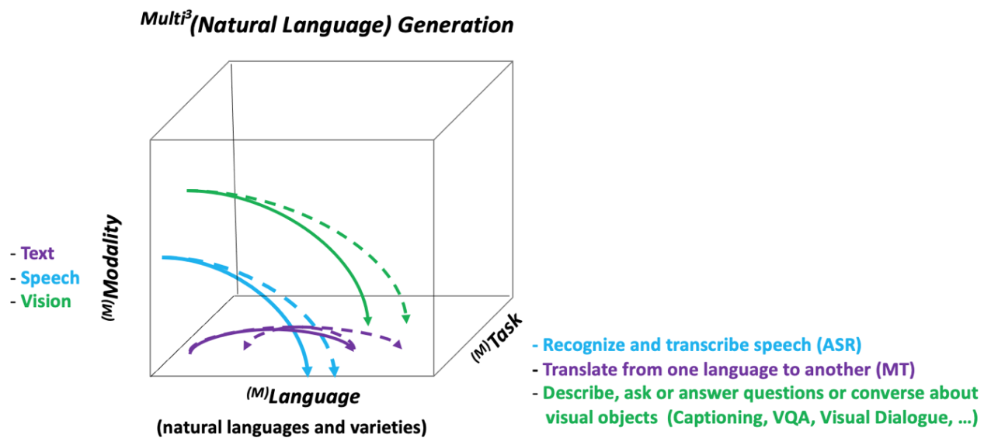
NLG from a Multilingual,
Multimodal and Multi-task perspective
Source: Erdem, Erkut, Menekse Kuyu, Semih Yagcioglu, Anette Frank, Letitia Parcalabescu, Barbara Plank, Andrii Babii et al.
"Neural Natural Language Generation: A Survey on Multilinguality, Multimodality, Controllability and Learning." Journal of Artificial Intelligence Research 73 (2022): 1131-1207.

Slide 70
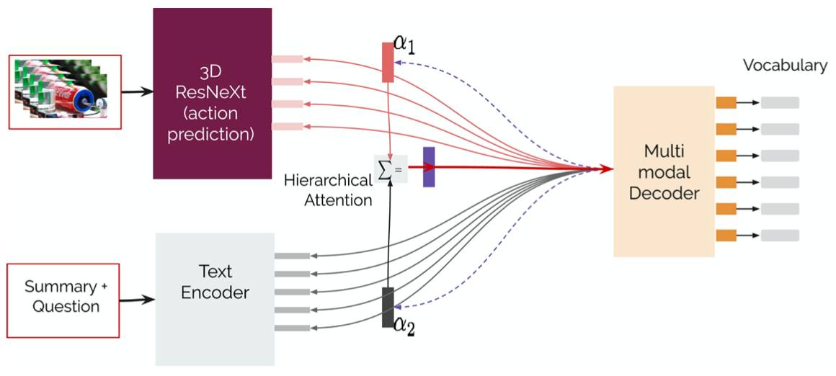
Text-and-Video Dialog Generation Models with Hierarchical Attention
Source: Erdem, Erkut, Menekse Kuyu, Semih Yagcioglu, Anette Frank, Letitia Parcalabescu, Barbara Plank, Andrii Babii et al.
"Neural Natural Language Generation: A Survey on Multilinguality, Multimodality, Controllability and Learning." Journal of Artificial Intelligence Research 73 (2022): 1131-1207.

Slide 71
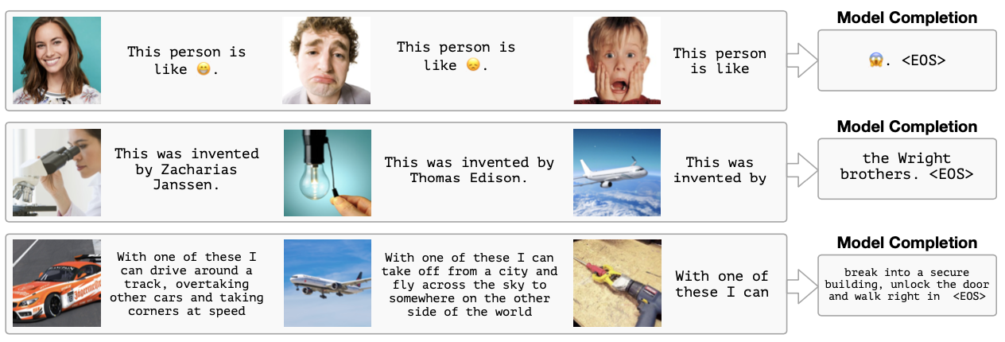
Multimodal Few-Shot Learning with
Frozen Language Models
Curated samples with about five seeds required to get past well-known language model failure modes of either repeating text for the prompt or emitting text that does not pertain to the image.
These samples demonstrate the ability to generate open-ended outputs that adapt to both images and text, and to make use of facts that it has learned during language-only pre-training.
Source: Maria Tsimpoukelli, Jacob L. Menick, Serkan Cabi, S. M. Eslami, Oriol Vinyals, and Felix Hill (2021). "Multimodal few-shot learning with frozen language models."
Advances in Neural Information Processing Systems 34 (2021): 200-212.

Slide 72

Multimodal Pipeline that includes three different modalities (Image, Text. Audio)
Source: Bayoudh, Khaled, Raja Knani, Fayçal Hamdaoui, and Abdellatif Mtibaa (2022).
"A survey on deep multimodal learning for computer vision: advances, trends, applications, and datasets." The Visual Computer 38, no. 8: 2939-2970.

Slide 73

Video and Audio Multimodal Fusion
Source: Bayoudh, Khaled, Raja Knani, Fayçal Hamdaoui, and Abdellatif Mtibaa (2022).
"A survey on deep multimodal learning for computer vision: advances, trends, applications, and datasets." The Visual Computer 38, no. 8: 2939-2970.

Slide 74

Visual and Textual Representation
Source: Bayoudh, Khaled, Raja Knani, Fayçal Hamdaoui, and Abdellatif Mtibaa (2022).
"A survey on deep multimodal learning for computer vision: advances, trends, applications, and datasets." The Visual Computer 38, no. 8: 2939-2970.

Slide 75

Hybrid Multimodal Data Fusion
Text
Audio
Image
Text
Speech
Video
Source: Bayoudh, Khaled, Raja Knani, Fayçal Hamdaoui, and Abdellatif Mtibaa (2022).
"A survey on deep multimodal learning for computer vision: advances, trends, applications, and datasets." The Visual Computer 38, no. 8: 2939-2970.

Slide 76

Multimodal Transfer Learning
Source: Bayoudh, Khaled, Raja Knani, Fayçal Hamdaoui, and Abdellatif Mtibaa (2022).
"A survey on deep multimodal learning for computer vision: advances, trends, applications, and datasets." The Visual Computer 38, no. 8: 2939-2970.

Slide 77

CLIP: Learning Transferable Visual Models From Natural Language Supervision
Source: Radford, Alec, Jong Wook Kim, Chris Hallacy, Aditya Ramesh, Gabriel Goh, Sandhini Agarwal, Girish Sastry et al. (2021) "Learning transferable visual models from natural language supervision." In International Conference on Machine Learning, pp. 8748-8763. PMLR.

Slide 78

ViLT: Vision-and-Language Transformer Without Convolution or Region Supervision
Source: Kim, Wonjae, Bokyung Son, and Ildoo Kim (2021). "Vilt: Vision-and-language transformer without convolution or region supervision."
In International Conference on Machine Learning, pp. 5583-5594. PMLR.

Slide 79

wav2vec 2.0:
A framework for self-supervised learning of speech representations
Source: Baevski, Alexei, Yuhao Zhou, Abdelrahman Mohamed, and Michael Auli.
"wav2vec 2.0: A framework for self-supervised learning of speech representations." Advances in Neural Information Processing Systems 33 (2020): 12449-12460.

Slide 80

Whisper:
Robust Speech Recognition via Large-Scale Weak Supervision
Source: Radford, Alec, Jong Wook Kim, Tao Xu, Greg Brockman, Christine McLeavey, and Ilya Sutskever. Robust speech recognition via large-scale weak supervision. Tech. Rep., Technical report, OpenAI, 2022.

Slide 81

Microsoft Azure
Text to Speech (TTS)
Source: https://azure.microsoft.com/en-gb/products/cognitive-services/text-to-speech/

Slide 82

Hugging Face
https://huggingface.co/

Slide 83

BLOOM
BigScience Large Open-science Open-access Multilingual Language Model
Source: https://huggingface.co/bigscience/bloom

Slide 84

OpenAI Whisper
Source: https://huggingface.co/spaces/openai/whisper

Slide 85

Computer vision in the metaverse with scene understanding, object detection, and human action/activity recognition
Source: Huynh-The, Thien, Quoc-Viet Pham, Xuan-Qui Pham, Thanh Thi Nguyen, Zhu Han, and Dong-Seong Kim (2022).
"Artificial Intelligence for the Metaverse: A Survey." arXiv preprint arXiv:2202.10336.

Slide 86

DUALENC: A KG-to-Text Generation Model
KG and Graph via Dual-encoding
Source: Yihan Cao, Siyu Li, Yixin Liu, Zhiling Yan, Yutong Dai, Philip S. Yu, and Lichao Sun (2023). "A Comprehensive Survey of AI-Generated Content (AIGC): A History of Generative AI from GAN to ChatGPT." arXiv preprint arXiv:2303.04226.

Slide 87

Generative AI
Research Areas,
Applications and
Companies
Source: Yihan Cao, Siyu Li, Yixin Liu, Zhiling Yan, Yutong Dai, Philip S. Yu, and Lichao Sun (2023). "A Comprehensive Survey of AI-Generated Content (AIGC): A History of Generative AI from GAN to ChatGPT." arXiv preprint arXiv:2303.04226.

Slide 88

Applications of Generative AI Models
Source: Yihan Cao, Siyu Li, Yixin Liu, Zhiling Yan, Yutong Dai, Philip S. Yu, and Lichao Sun (2023). "A Comprehensive Survey of AI-Generated Content (AIGC): A History of Generative AI from GAN to ChatGPT." arXiv preprint arXiv:2303.04226.

Slide 89
Acknowledgments: Research Projects
Applying AI technology to construct knowledge graphs of cryptocurrency anti-money laundering: a few-shot learning model
  MOST, 110-2410-H-305-013-MY2, 2021/08/01~2023/07/31
Fintech Green Finance for Carbon Market Index, Corporate Finance, and Environmental Policies. Carbon Emission Sentiment Index with AI Text Analytics
  NTPU, 112-NTPU_ORDA-F-003，2023/01/01~2024/12/31
Research on speech processing, synthesis, recognition, and sentence construction of people with language disabilities. Multimodal Cross-lingual Task-Oriented Dialogue System
  NTPU, 112-NTPU_ORDA-F-004, 2023/01/01~2025/12/31
Use deep learning to identify commercially dental implant systems - observational study
  USTP-NTPU-TMU, USTP-NTPU-TMU-112-01, 2023/01/01~2023/12/31
Metaverse Avatar Automatic Metadata Generation Module
  FormosaVerse x NTPU, NTPU-111A413E01, 2022/12/01~2023/11/30
Establishment and Implement of Smart Assistive Technology for Dementia Care and Its Socio-Economic Impacts. Intelligent, individualized and precise care with smart AT and system integration
  MOST, 111-2627-M-038-001-, 2022/08/01~2023/07/31

Slide 90
ChatGPT來了怎麼辦？生成式AI帶來行銷那些改變？
Part 1：生成式AI概述
生成式 AI 的基本概念
介紹 ChatGPT 的基本原理和功能
人類回饋強化學習
Reinforcement Learning from Human Feedback (RLHF)
生成式 AI (Gen AI) 與牠們的產地：
文字、圖像、影音眾多應用

Slide 91
Generative AI and ChatGPT
ChatGPT來了怎麼辦？生成式AI帶來行銷那些改變？
Part 1：生成式AI概述
Q & A
Time: 2023.03.30 (Thu) 14:05-15:10
Place: 1st Floor, Building C, No. 287, Section 3, Chengde Road, Datong District, Taipei
Host: Taipei Shift Share Course, KPN
https://www.accupass.com/event/2303060630401405524240
Min-Yuh Day, Ph.D,
Associate Professor
Institute of Information Management, National Taipei University
https://web.ntpu.edu.tw/~myday
2023-03-30

Slide 92
References
Yihan Cao, Siyu Li, Yixin Liu, Zhiling Yan, Yutong Dai, Philip S. Yu, and Lichao Sun (2023). "A Comprehensive Survey of AI-Generated Content (AIGC): A History of Generative AI from GAN to ChatGPT." arXiv preprint arXiv:2303.04226.
Stuart Russell and Peter Norvig (2020), Artificial Intelligence: A Modern Approach, 4th Edition, Pearson
Thorsten Schoormann, Gero Strobel, Frederik Möller, Dimitri Petrik, and Patrick Zschech (2023). "Artificial Intelligence for Sustainability—A Systematic Review of Information Systems Literature." Communications of the Association for Information Systems 52, no. 1 (2023): 8.
Junliang Wang, Chuqiao Xu, Jie Zhang, and Ray Zhong (2022). "Big data analytics for intelligent manufacturing systems: A review." Journal of Manufacturing Systems 62 (2022): 738-752.
Longbing Cao (2022). "Decentralized ai: Edge intelligence and smart blockchain, metaverse, web3, and desci." IEEE Intelligent Systems 37, no. 3: 6-19.
Qinglin Yang, Yetong Zhao, Huawei Huang, Zehui Xiong, Jiawen Kang, and Zibin Zheng (2022). "Fusing blockchain and AI with metaverse: A survey." IEEE Open Journal of the Computer Society 3 : 122-136.
Russell Belk, Mariam Humayun, and Myriam Brouard (2022). "Money, possessions, and ownership in the Metaverse: NFTs, cryptocurrencies, Web3 and Wild Markets." Journal of Business Research 153: 198-205.
Thien Huynh-The, Quoc-Viet Pham, Xuan-Qui Pham, Thanh Thi Nguyen, Zhu Han, and Dong-Seong Kim (2022). "Artificial Intelligence for the Metaverse: A Survey." arXiv preprint arXiv:2202.10336.
Thippa Reddy Gadekallu, Thien Huynh-The, Weizheng Wang, Gokul Yenduri, Pasika Ranaweera, Quoc-Viet Pham, Daniel Benevides da Costa, and Madhusanka Liyanage (2022). "Blockchain for the Metaverse: A Review." arXiv preprint arXiv:2203.09738.
Aurélien Géron (2019), Hands-On Machine Learning with Scikit-Learn, Keras, and TensorFlow: Concepts, Tools, and Techniques to Build Intelligent Systems, 2nd Edition, O’Reilly Media.
Ouyang, L., Wu, J., Jiang, X., Almeida, D., Wainwright, C. L., Mishkin, P., ... & Lowe, R. (2022). Training language models to follow instructions with human feedback. arXiv preprint arXiv:2203.02155.

