Slide 1










生成式AI在永續發展的應用
Generative AI and ChatGPT for
ESG and Sustainable Development
2023 NTPU 永續月 【SDGS永續沙龍】
Time: 2023.04.27 (Thu) 12:10-13:30
Place: USR HUB, Office of Sustainability, NTPU
Host: Office of Sustainability, NTPU
https://forms.gle/vYVvYBT6y1ik4RtN7
戴敏育 永續辦公室 社會責任組 組長
Min-Yuh Day, Ph.D, Associate Professor
Institute of Information Management, National Taipei University
https://web.ntpu.edu.tw/~myday
2023-04-27

Slide 2










戴敏育 博士
Min-Yuh Day, Ph.D.
1
Associate Professor, Information Management, NTPU
Visiting Scholar, IIS, Academia Sinica
Ph.D., Information Management, NTU
Director, Intelligent Financial Innovation Technology, IFIT Lab, IM, NTPU
Associate Director, Fintech and Green Finance Center, NTPU
Publications Co-Chairs, IEEE/ACM International Conference on
Advances in Social Networks Analysis and Mining (ASONAM 2013- )
Program Co-Chair, IEEE International Workshop on
Empirical Methods for Recognizing Inference in TExt (IEEE EM-RITE 2012- )
Publications Chair, The IEEE International Conference on
Information Reuse and Integration for Data Science (IEEE IRI 2007- )

Slide 3
Outline
1. 生成式AI的基本概念
Basic Concepts of Generative AI
2. ChatGPT的基本原理和功能
Basic Principles and Functions of ChatGPT
3. 生成式AI在永續發展的應用
Generative AI for ESG and Sustainable Development
4. AI在永續發展上的議題
Issues of AI for Sustainable Development

Slide 4


2023 NTPU 永續月
【SDGS永續沙龍】

Slide 5
AI for
Environmental,
Social, and
Governance
(AI4ESG)
Source: Nenad Tomašev, Julien Cornebise, Frank Hutter, Shakir Mohamed, Angela Picciariello, Bec Connelly, Danielle Belgrave et al. (2020)
"AI for social good: unlocking the opportunity for positive impact." Nature Communications 11, no. 1: 1-6.

Slide 6
AI for
Social Good
(AI4SG)
Source: Nenad Tomašev, Julien Cornebise, Frank Hutter, Shakir Mohamed, Angela Picciariello, Bec Connelly, Danielle Belgrave et al. (2020)
"AI for social good: unlocking the opportunity for positive impact." Nature Communications 11, no. 1: 1-6.

Slide 7
Sustainability
SDGs
CSR
ESG

Slide 8


















Sustainable Development Goals (SDGs)
Source: https://sdgs.un.org/goals

Slide 9
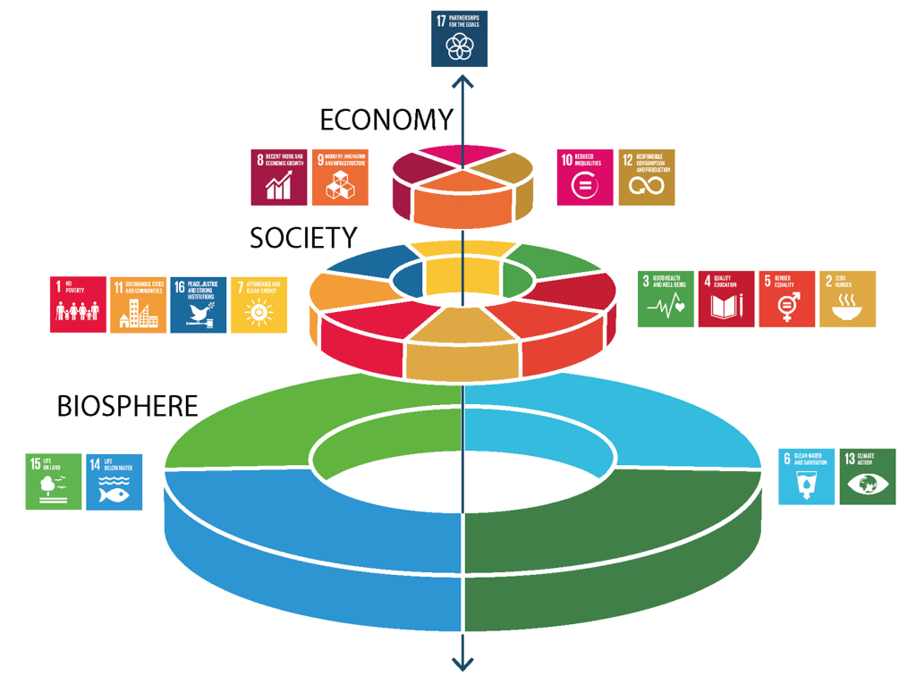
Sustainable Development Goals (SDGs) and 5P
Partnership
Peace
Prosperity
People
Planet
Source: Folke, Carl, Reinette Biggs, Albert V. Norström, Belinda Reyers, and Johan Rockström. "Social-ecological resilience and biosphere-based sustainability science.”Ecology and Society 21, no. 3 (2016).

Slide 10
Evolution of Sustainable Finance Research
Topic
SDGs:
Sustainable Development Goals
SDGs
Innovative Financial Instrument
Impact Investing
ESG: Environmental, Social, and Governance
CSR: Corporate Social Responsibility
Conscious Capitalism
Climate Financing
Carbon Financing
Green Financing
Ethical Investing
Socially Responsible Investing
1986
1995
2005
2015
2020
Source: Kumar, S., Sharma, D., Rao, S., Lim, W. M., & Mangla, S. K. (2022). Past, present, and future of sustainable finance:
Insights from big data analytics through machine learning of scholarly research. Annals of Operations Research, 1-44.

Slide 11
Outline
1. 生成式AI的基本概念
Basic Concepts of Generative AI
2. ChatGPT的基本原理和功能
Basic Principles and Functions of ChatGPT
3. 生成式AI在永續發展的應用
Generative AI for ESG and Sustainable Development
4. AI在永續發展上的議題
Issues of AI for Sustainable Development

Slide 12
Generative AI
Gen AI

Slide 13
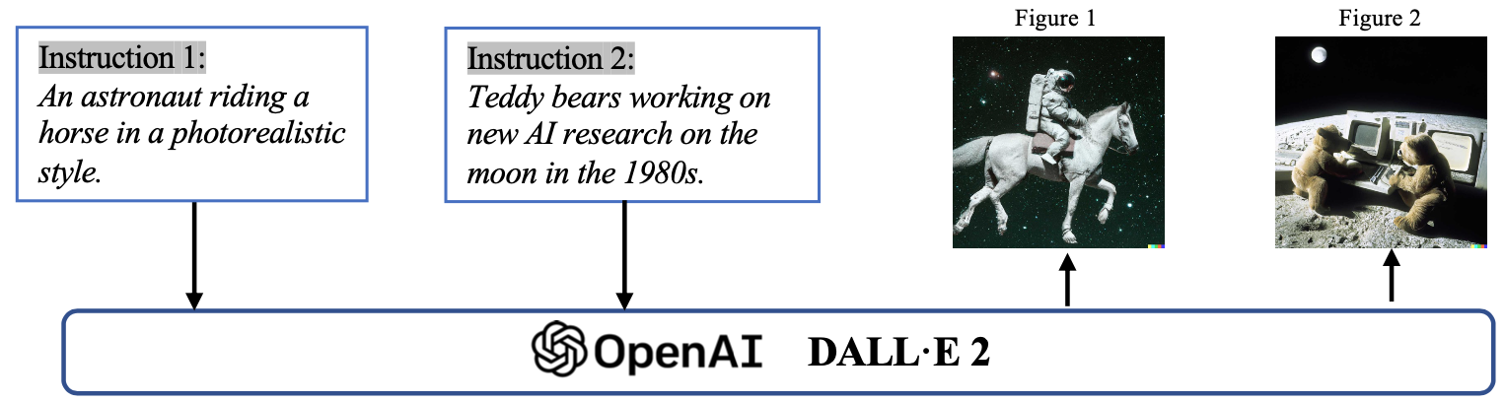
Generative AI (Gen AI)
AI Generated Content (AIGC)
Image Generation
Source: Yihan Cao, Siyu Li, Yixin Liu, Zhiling Yan, Yutong Dai, Philip S. Yu, and Lichao Sun (2023). "A Comprehensive Survey of AI-Generated Content (AIGC): A History of Generative AI from GAN to ChatGPT." arXiv preprint arXiv:2303.04226.

Slide 14
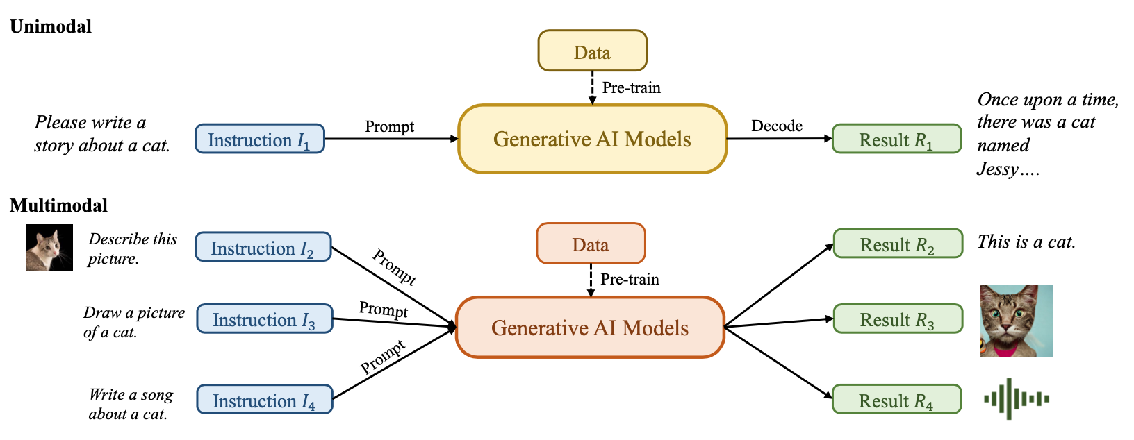
Generative AI (Gen AI)
AI Generated Content (AIGC)
Source: Yihan Cao, Siyu Li, Yixin Liu, Zhiling Yan, Yutong Dai, Philip S. Yu, and Lichao Sun (2023). "A Comprehensive Survey of AI-Generated Content (AIGC): A History of Generative AI from GAN to ChatGPT." arXiv preprint arXiv:2303.04226.

Slide 15
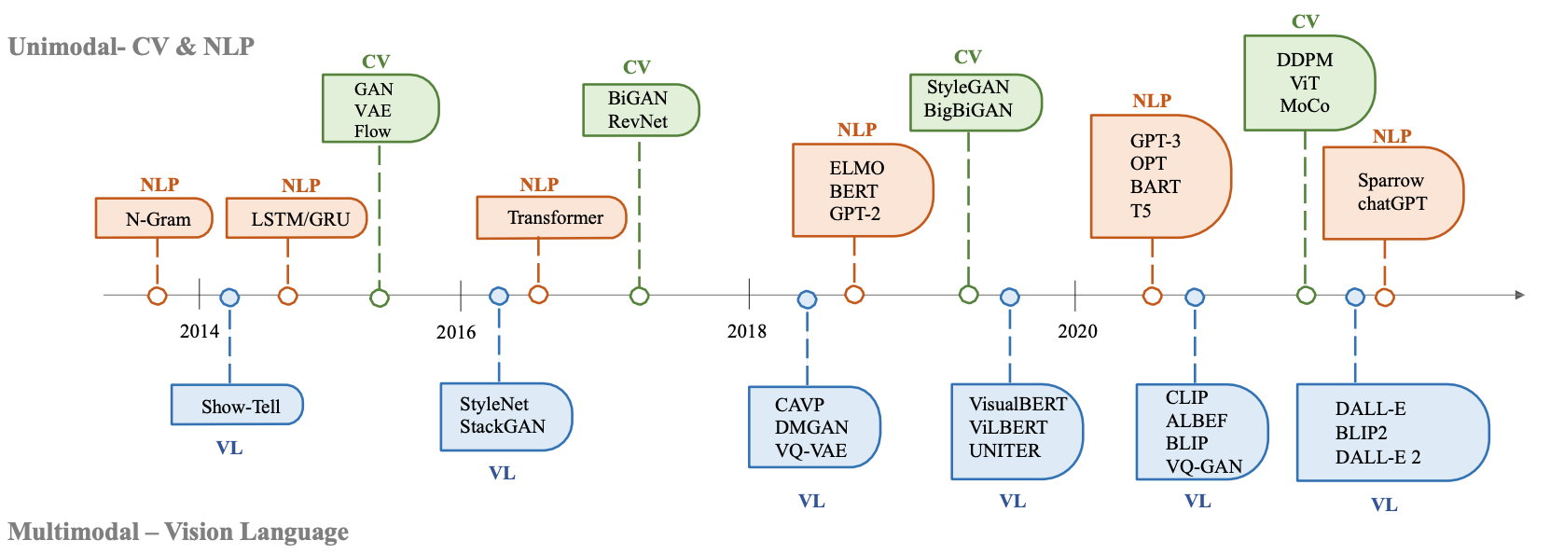
The history of Generative AI in CV, NLP and VL
Source: Yihan Cao, Siyu Li, Yixin Liu, Zhiling Yan, Yutong Dai, Philip S. Yu, and Lichao Sun (2023). "A Comprehensive Survey of AI-Generated Content (AIGC): A History of Generative AI from GAN to ChatGPT." arXiv preprint arXiv:2303.04226.

Slide 16
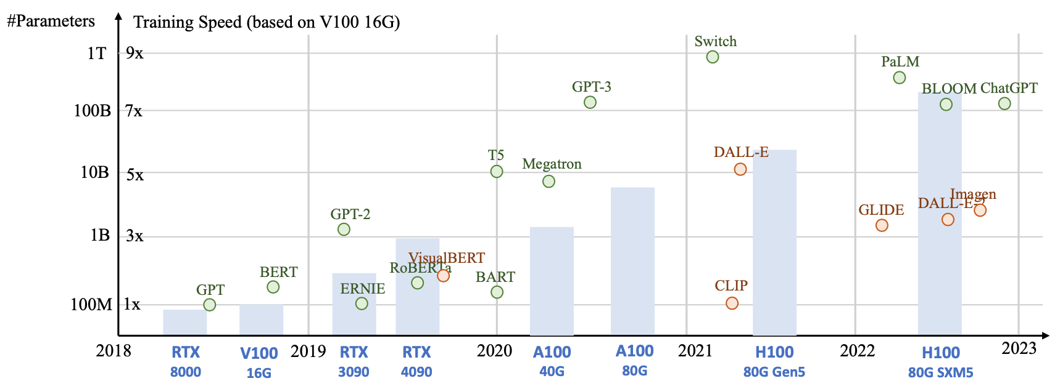
Generative AI
Foundation Models
Source: Yihan Cao, Siyu Li, Yixin Liu, Zhiling Yan, Yutong Dai, Philip S. Yu, and Lichao Sun (2023). "A Comprehensive Survey of AI-Generated Content (AIGC): A History of Generative AI from GAN to ChatGPT." arXiv preprint arXiv:2303.04226.

Slide 17
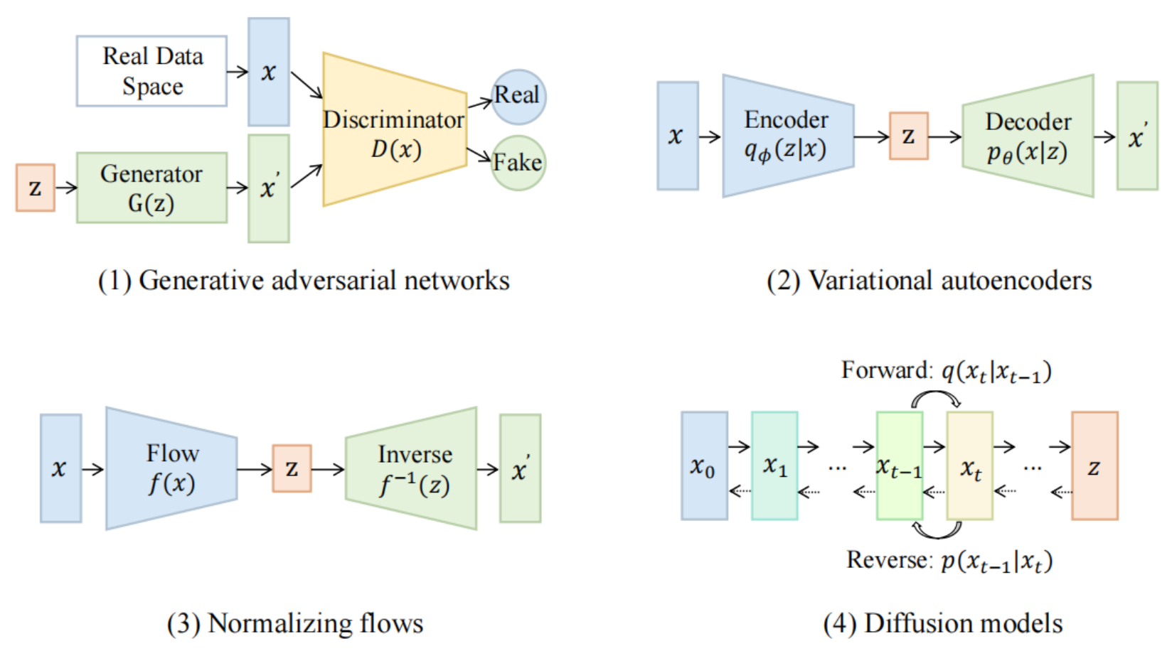
Categories of Vision Generative Models
Source: Yihan Cao, Siyu Li, Yixin Liu, Zhiling Yan, Yutong Dai, Philip S. Yu, and Lichao Sun (2023). "A Comprehensive Survey of AI-Generated Content (AIGC): A History of Generative AI from GAN to ChatGPT." arXiv preprint arXiv:2303.04226.

Slide 18
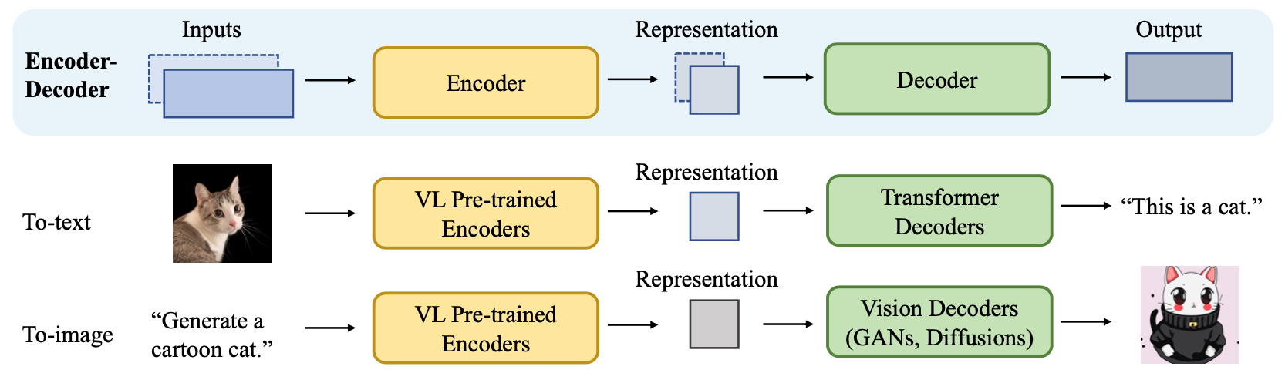
The General Structure of
Generative Vision Language
Source: Yihan Cao, Siyu Li, Yixin Liu, Zhiling Yan, Yutong Dai, Philip S. Yu, and Lichao Sun (2023). "A Comprehensive Survey of AI-Generated Content (AIGC): A History of Generative AI from GAN to ChatGPT." arXiv preprint arXiv:2303.04226.

Slide 19
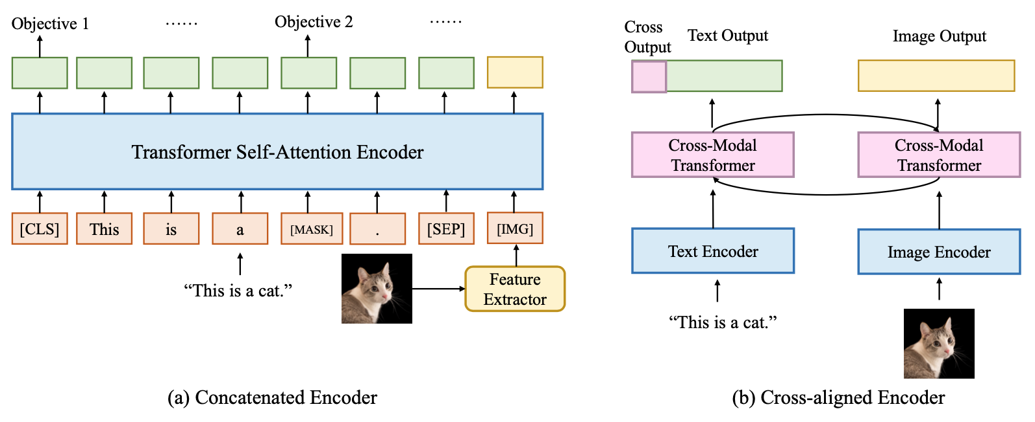
Two Types of Vision Language Encoders: Concatenated Encoders and Cross-aligned Encoders
Source: Yihan Cao, Siyu Li, Yixin Liu, Zhiling Yan, Yutong Dai, Philip S. Yu, and Lichao Sun (2023). "A Comprehensive Survey of AI-Generated Content (AIGC): A History of Generative AI from GAN to ChatGPT." arXiv preprint arXiv:2303.04226.

Slide 20
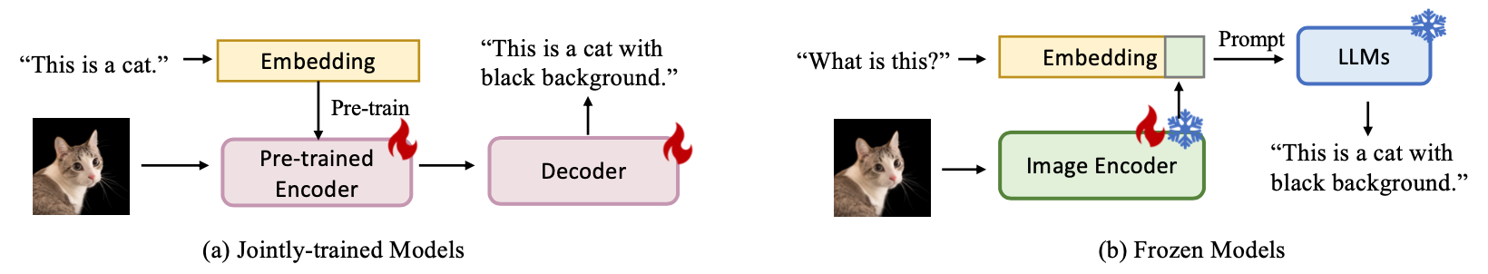
Two Types of to-language Decoder Models: Jointly-trained Models and Frozen Models
Source: Yihan Cao, Siyu Li, Yixin Liu, Zhiling Yan, Yutong Dai, Philip S. Yu, and Lichao Sun (2023). "A Comprehensive Survey of AI-Generated Content (AIGC): A History of Generative AI from GAN to ChatGPT." arXiv preprint arXiv:2303.04226.

Slide 21
AI, Big Data, Cloud Computing
Evolution of Decision Support, Business Intelligence, and Analytics
AI
AI
Cloud Computing
Big Data
DM
BI
Source: Ramesh Sharda, Dursun Delen, and Efraim Turban (2017),
Business Intelligence, Analytics, and Data Science: A Managerial Perspective, 4th Edition, Pearson

Slide 22
AI, ML, DL
Artificial Intelligence (AI)
Machine Learning (ML)
Supervised
Learning
Unsupervised Learning
Deep Learning (DL)
CNN
RNN LSTM GRU
GAN
Semi-supervised Learning
Reinforcement Learning
Source: https://leonardoaraujosantos.gitbooks.io/artificial-inteligence/content/deep_learning.html

Slide 23
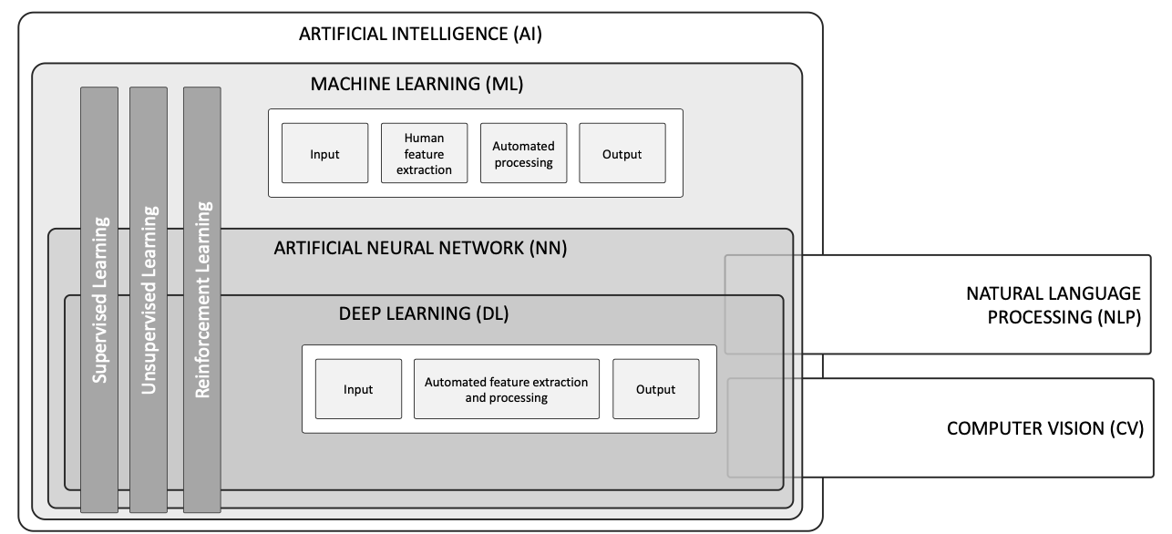
AI, ML, NN, DL
Source: Schoormann, T., Strobel, G., Möller, F., Petrik, D., & Zschech, P. (2023).
Artificial Intelligence for Sustainability—A Systematic Review of Information Systems Literature. Communications of the Association for Information Systems, 52(1), 8.

Slide 24
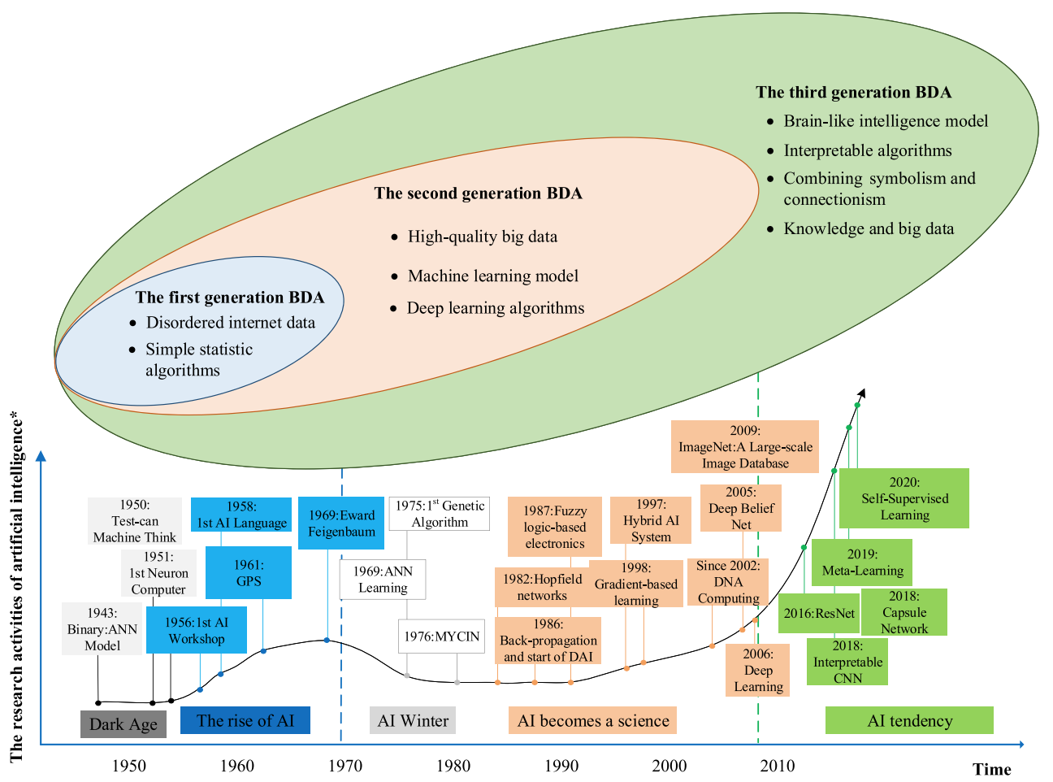
AI and Big Data Analytics (BDA)
Source: Wang, Junliang, Chuqiao Xu, Jie Zhang, and Ray Zhong (2022). "Big data analytics for intelligent manufacturing systems: A review." Journal of Manufacturing Systems 62 (2022): 738-752.

Slide 25
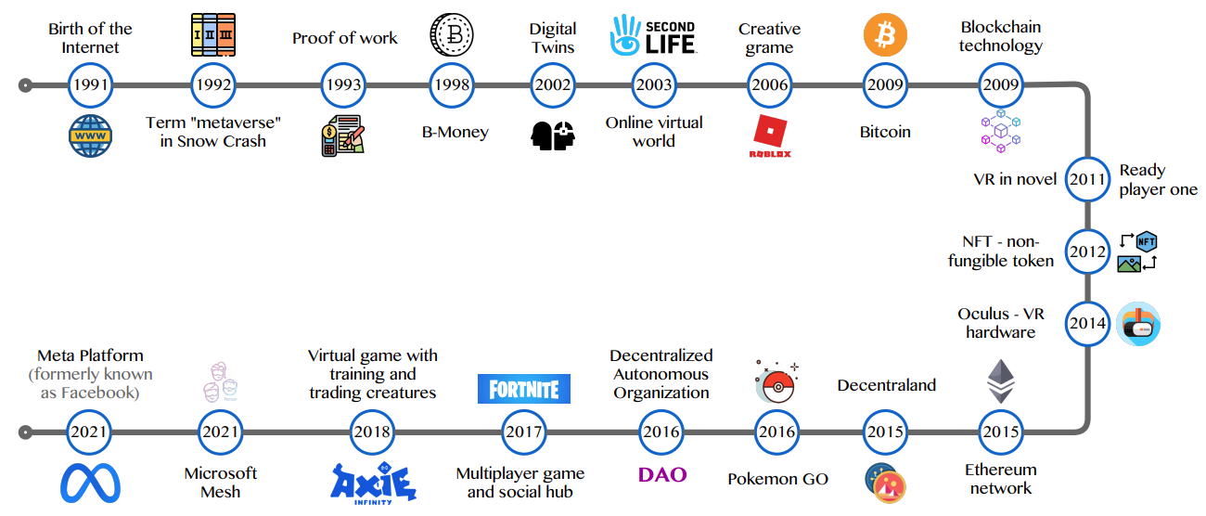
Metaverse Development
Source: Huynh-The, Thien, Quoc-Viet Pham, Xuan-Qui Pham, Thanh Thi Nguyen, Zhu Han, and Dong-Seong Kim (2022).
"Artificial Intelligence for the Metaverse: A Survey." arXiv preprint arXiv:2202.10336.

Slide 26
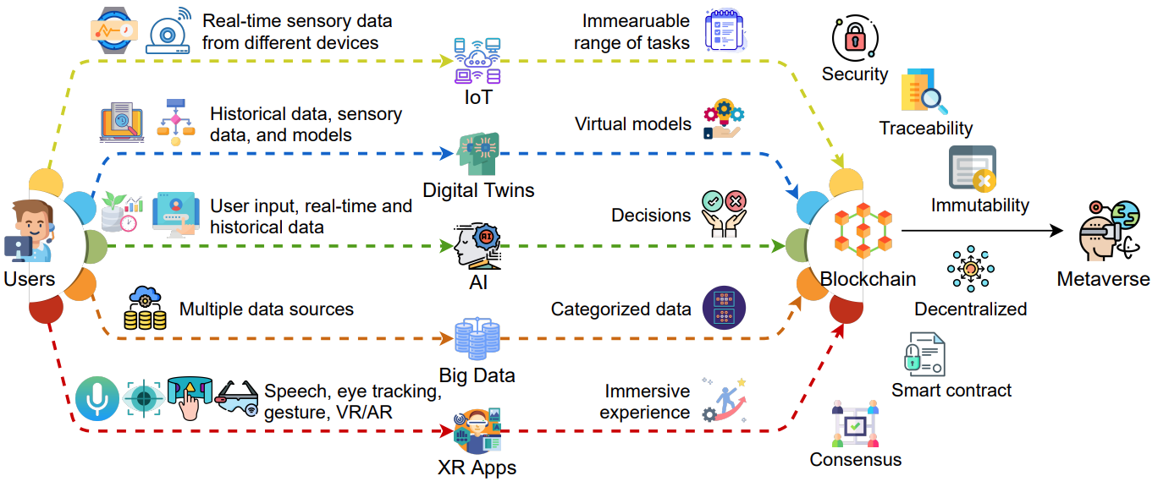
AI and Blockchain
Key Enabling Technologies of the Metaverse
Source: Gadekallu, Thippa Reddy, Thien Huynh-The, Weizheng Wang, Gokul Yenduri, Pasika Ranaweera, Quoc-Viet Pham, Daniel Benevides da Costa, and Madhusanka Liyanage (2022).
"Blockchain for the Metaverse: A Review." arXiv preprint arXiv:2203.09738..

Slide 27
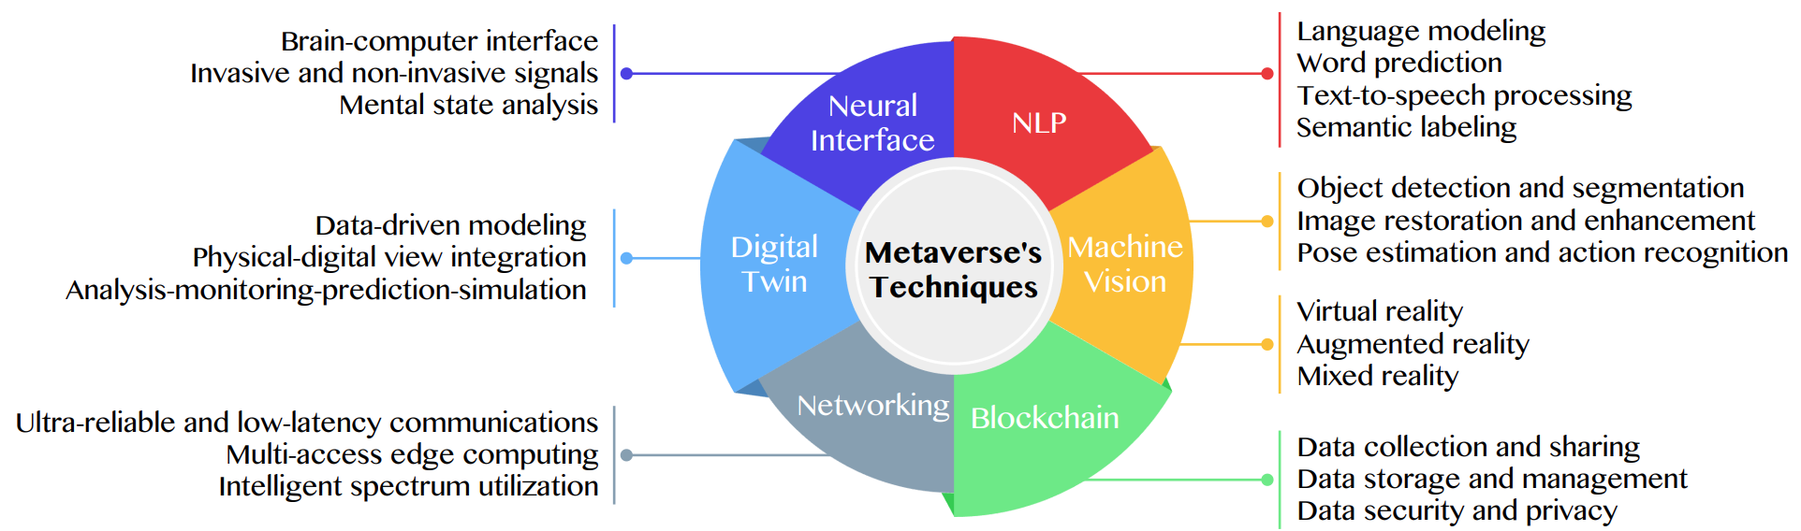
Primary Technical Aspects in the Metaverse
AI with ML algorithms and DL architectures is advancing the user experience in the virtual world
Source: Huynh-The, Thien, Quoc-Viet Pham, Xuan-Qui Pham, Thanh Thi Nguyen, Zhu Han, and Dong-Seong Kim (2022).
"Artificial Intelligence for the Metaverse: A Survey." arXiv preprint arXiv:2202.10336.

Slide 28
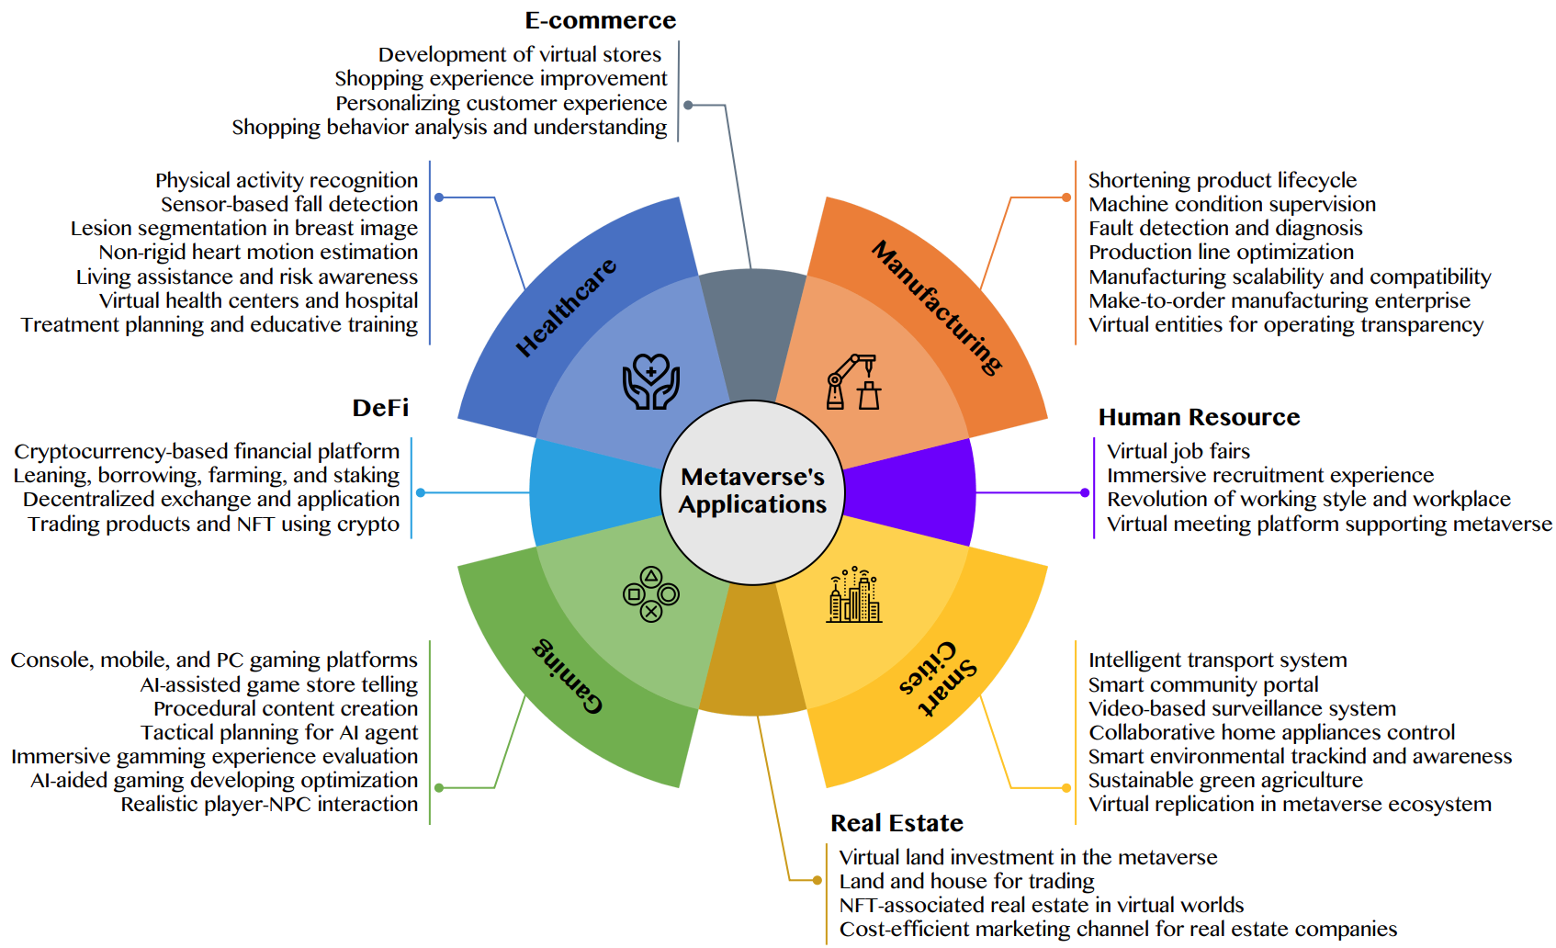
AI for the Metaverse in the Application Aspects healthcare, manufacturing, smart cities, gaming
E-commerce, human resources, real estate, and DeFi
Source: Huynh-The, Thien, Quoc-Viet Pham, Xuan-Qui Pham, Thanh Thi Nguyen, Zhu Han, and Dong-Seong Kim (2022).
"Artificial Intelligence for the Metaverse: A Survey." arXiv preprint arXiv:2202.10336.

Slide 29
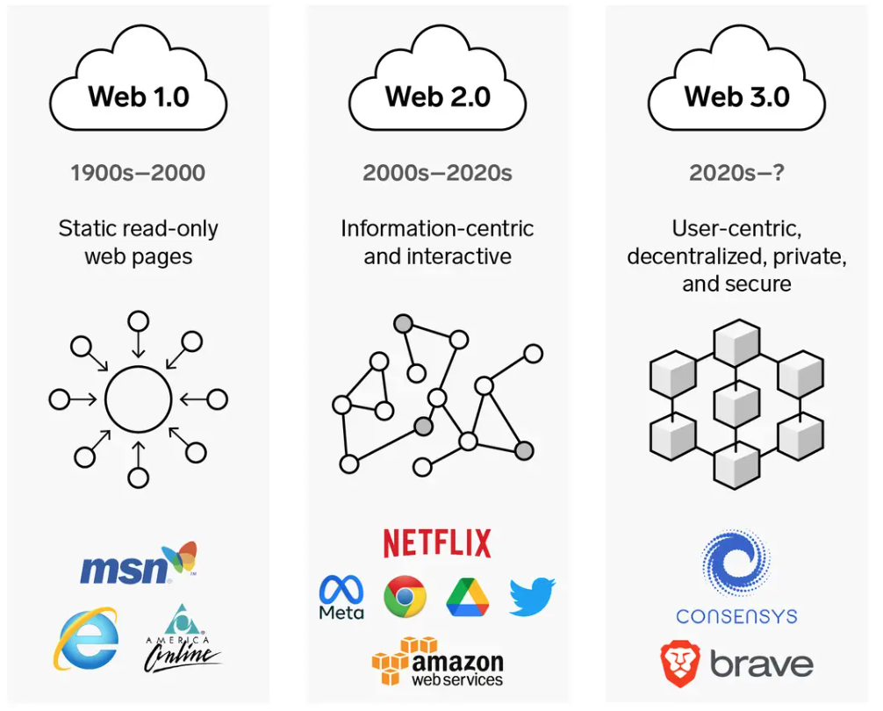
Web3: Decentralized Web
Internet Evolution
1990
2000
2020
Source: https://www.businessinsider.com/personal-finance/what-is-web3

Slide 30
Definition of
Artificial Intelligence (A.I.)

Slide 31
Artificial Intelligence
“… the science and engineering of making intelligent machines”
(John McCarthy, 1955)
Source: https://digitalintelligencetoday.com/artificial-intelligence-defined-useful-list-of-popular-definitions-from-business-and-science/

Slide 32
Artificial Intelligence
“… technology that thinks and acts like humans”
Source: https://digitalintelligencetoday.com/artificial-intelligence-defined-useful-list-of-popular-definitions-from-business-and-science/

Slide 33
Artificial Intelligence
“… intelligence exhibited by machines or software”
Source: https://digitalintelligencetoday.com/artificial-intelligence-defined-useful-list-of-popular-definitions-from-business-and-science/

Slide 34
4 Approaches of AI
Thinking Humanly | Thinking Rationally
Acting Humanly | Acting Rationally
Source: Stuart Russell and Peter Norvig (2020), Artificial Intelligence: A Modern Approach, 4th Edition, Pearson

Slide 35
4 Approaches of AI
2. Thinking Humanly: The Cognitive Modeling Approach | 3. Thinking Rationally: The “Laws of Thought” Approach
1. Acting Humanly: The Turing Test Approach (1950) | 4. Acting Rationally: The Rational Agent Approach
Source: Stuart Russell and Peter Norvig (2020), Artificial Intelligence: A Modern Approach, 4th Edition, Pearson

Slide 36
AI Acting Humanly:
The Turing Test Approach
(Alan Turing, 1950)
Knowledge Representation
Automated Reasoning
Machine Learning (ML)
  Deep Learning (DL)
Computer Vision (Image, Video)
Natural Language Processing (NLP)
Robotics
Source: Stuart Russell and Peter Norvig (2020), Artificial Intelligence: A Modern Approach, 4th Edition, Pearson

Slide 37
Can machines think?
Alan Turing rejected the question “Can machines think?” and replaced it with a behavioral test.
  Alan Turing anticipated many objections to the possibility of thinking machines.
Concentrate on their systems’ performance on practical tasks
  rather than the ability to imitate humans.
Consciousness remains a mystery.
Source: Stuart Russell and Peter Norvig (2020), Artificial Intelligence: A Modern Approach, 4th Edition, Pearson

Slide 38
Outline
1. 生成式AI的基本概念
Basic Concepts of Generative AI
2. ChatGPT的基本原理和功能
Basic Principles and Functions of ChatGPT
3. 生成式AI在永續發展的應用
Generative AI for ESG and Sustainable Development
4. AI在永續發展上的議題
Issues of AI for Sustainable Development

Slide 39
ChatGPT
Large Language Models (LLM)
Foundation Models

Slide 40
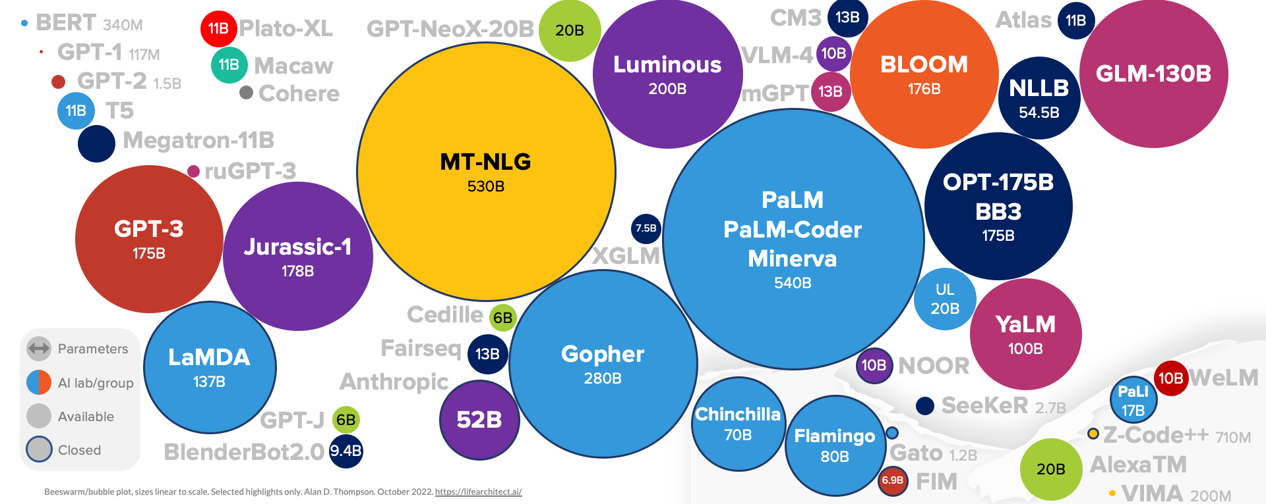
Large Language Models (LLM)
(GPT-3, ChatGPT, PaLM, BLOOM, OPT-175B, LLaMA)
ChatGPT
175B
LLaMA
65B
Source: https://lifearchitect.ai/models/

Slide 41
The Transformers Timeline
ULMFit
BERT
RoBERTa
XLM-R
DeBERTa
GPT-Neo
BLOOM
Alpaca
DistrilBERT
T5
PaLM
ChatGPT
Transformer
GPT
GPT-2
GPT-3
GPT-J
OPT-175B
LLaMA
2017
2018
2019
2020
2021
2022
2023
Source: Lewis Tunstall, Leandro von Werra, and Thomas Wolf (2022), Natural Language Processing with Transformers: Building Language Applications with Hugging Face, O'Reilly Media.

Slide 42
Transformer Models
Transformer
Encoder
Decoder
DistilBERT
BERT
T5
GPT
RoBERTa
BART
GPT-2
CTRL
XLM-R
XLM
M2M-100
GPT-3
ALBERT
BigBird
GPT-Neo
GPT-J
ELECTRA
mT0
BLOOM
BLOOMZ
DeBERTa
ChatGPT
GPT-4
Source: Lewis Tunstall, Leandro von Werra, and Thomas Wolf (2022), Natural Language Processing with Transformers: Building Language Applications with Hugging Face, O'Reilly Media.

Slide 43
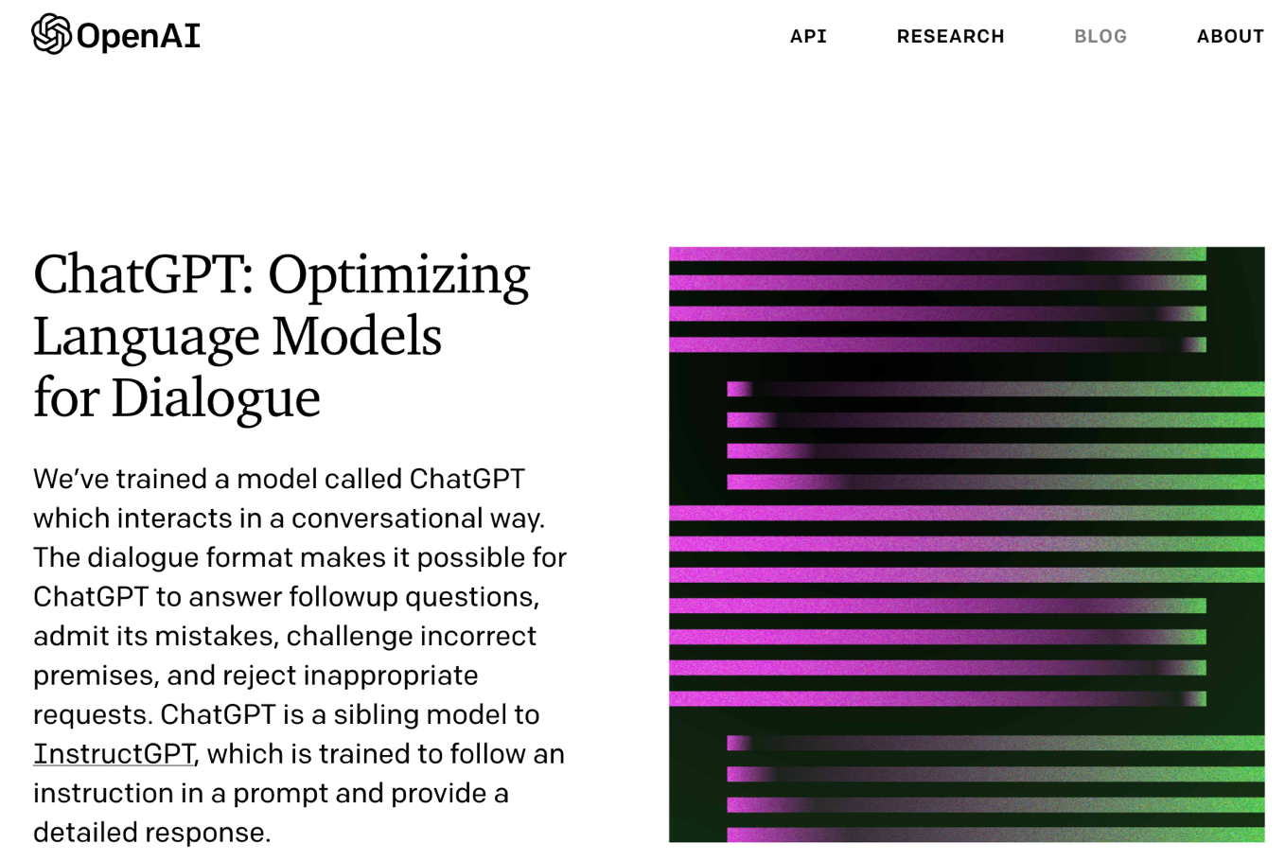
OpenAI ChatGPT
Source: https://openai.com/blog/chatgpt/

Slide 44
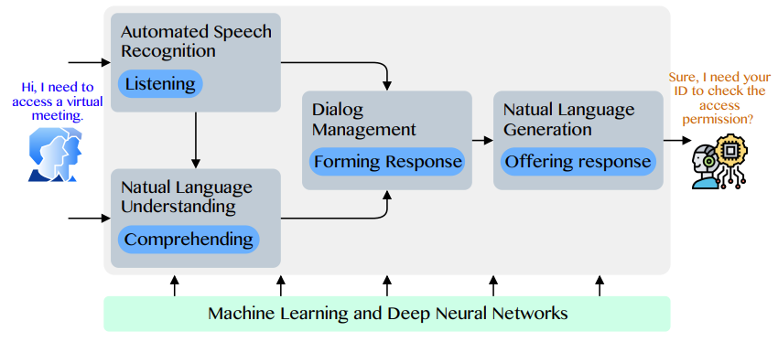
Conversational AI to deliver contextual and personal experience to users
Source: Huynh-The, Thien, Quoc-Viet Pham, Xuan-Qui Pham, Thanh Thi Nguyen, Zhu Han, and Dong-Seong Kim (2022).
"Artificial Intelligence for the Metaverse: A Survey." arXiv preprint arXiv:2202.10336.

Slide 45
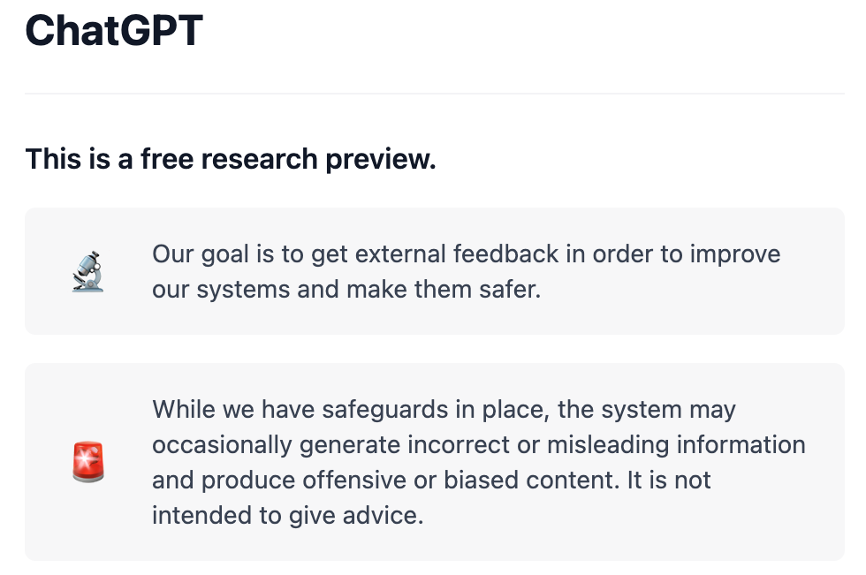
OpenAI ChatGPT
Source: https://chat.openai.com/chat

Slide 46
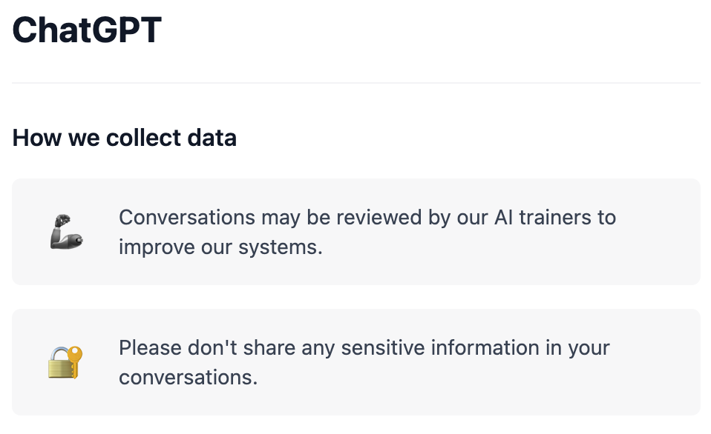
OpenAI ChatGPT
Source: https://chat.openai.com/chat

Slide 47
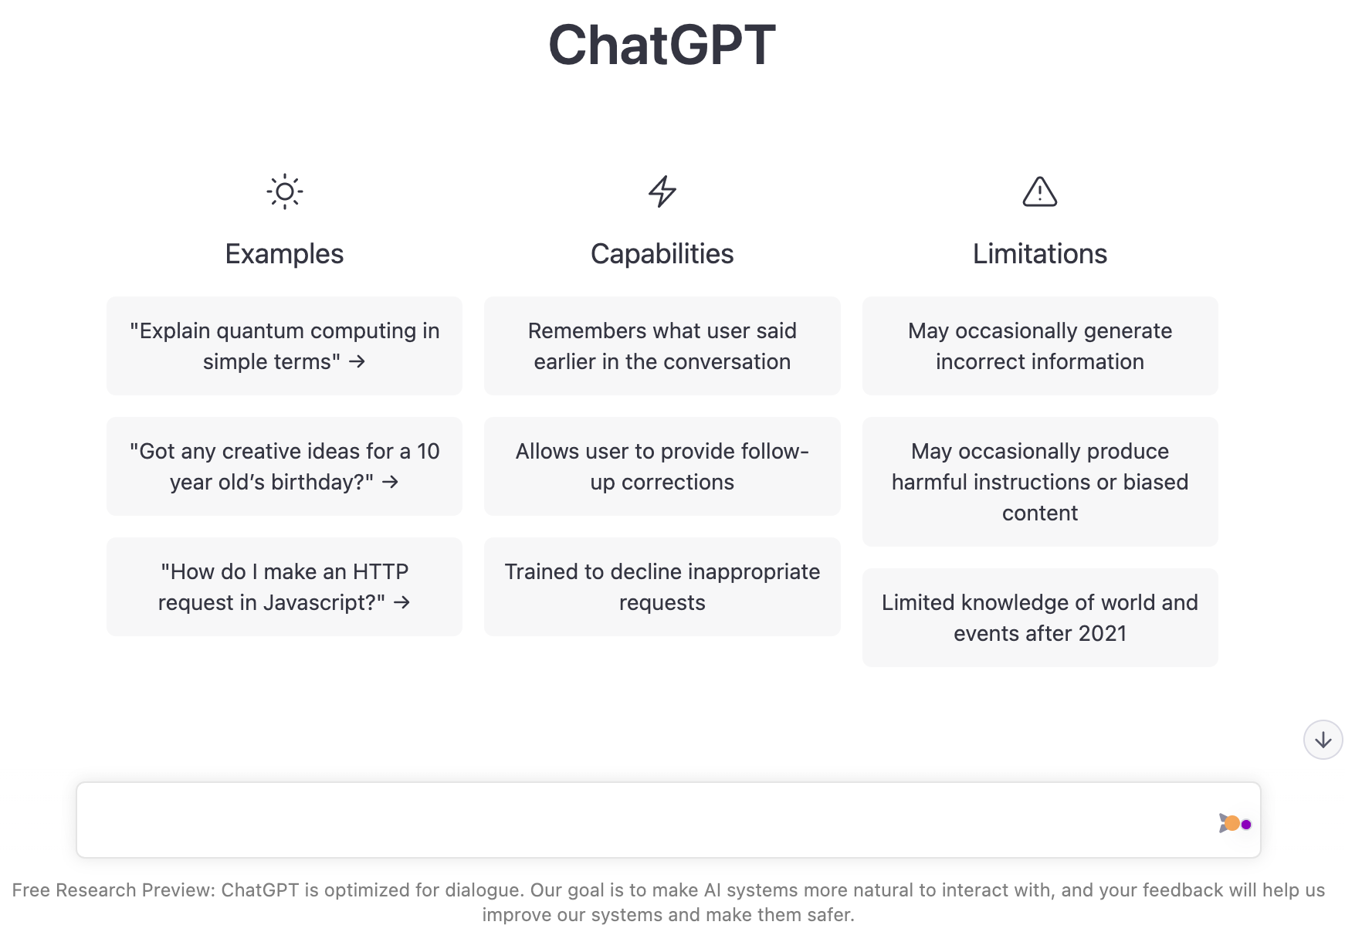
OpenAI ChatGPT
Source: https://chat.openai.com/chat

Slide 48
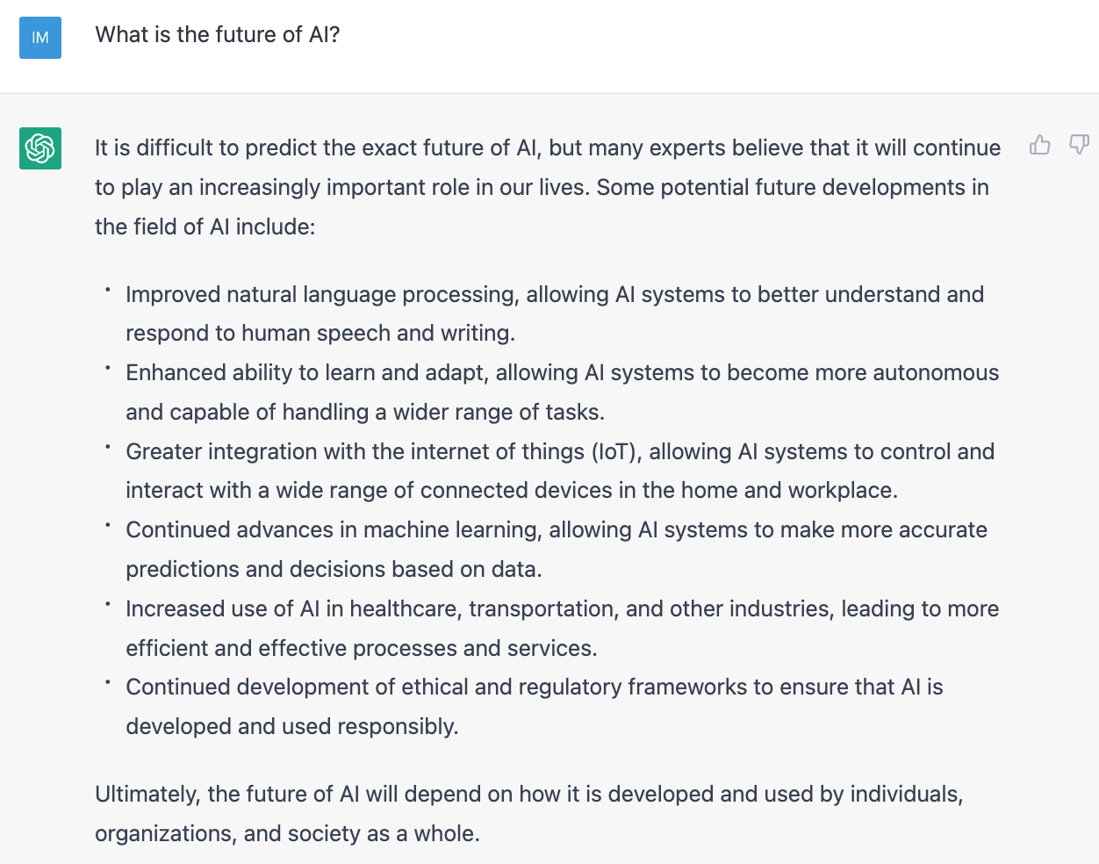
OpenAI ChatGPT
Source: https://chat.openai.com/chat

Slide 49
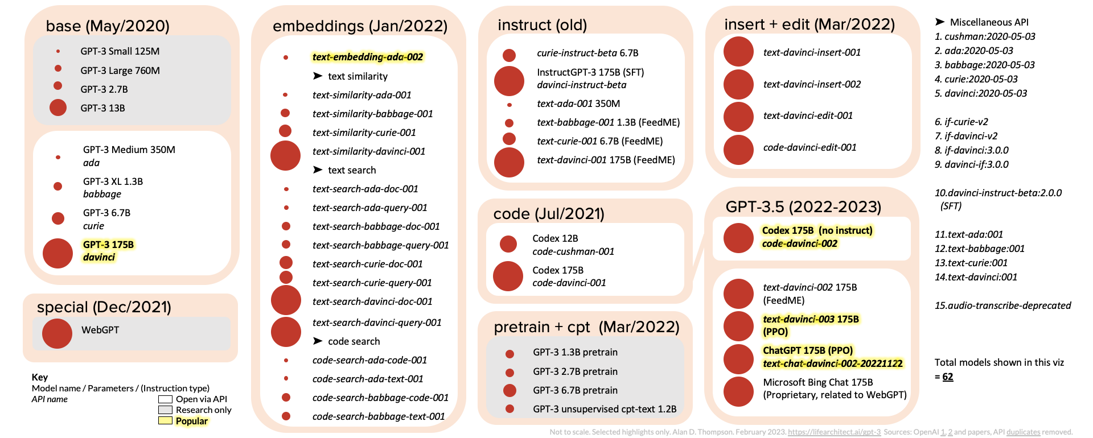
ChatGPT and GPT-3 Family
(GPT-3, InstructGPT, GPT-3.5, ChatGPT)
Source: https://lifearchitect.ai/gpt-3/

Slide 50
OpenAI ChatGPT and Open LLM
GPT-4, LLaMA, Alpaca, Dolly, Cerebras-GPT,
GPT4All, Vicuna, ColossalChat, Koala, Phoenix
OpenAI GPT-4
Deepmind Chinchilla
Meta OPT (LLaMA)
Pythia
Stanford Alpaca
Databricks Dolly
Cerebras-GPT
GPT4All
Vicuna
ColossalChat
BAIR Koala
Source: https://www.cerebras.net/blog/cerebras-gpt-a-family-of-open-compute-efficient-large-language-models/

Slide 51
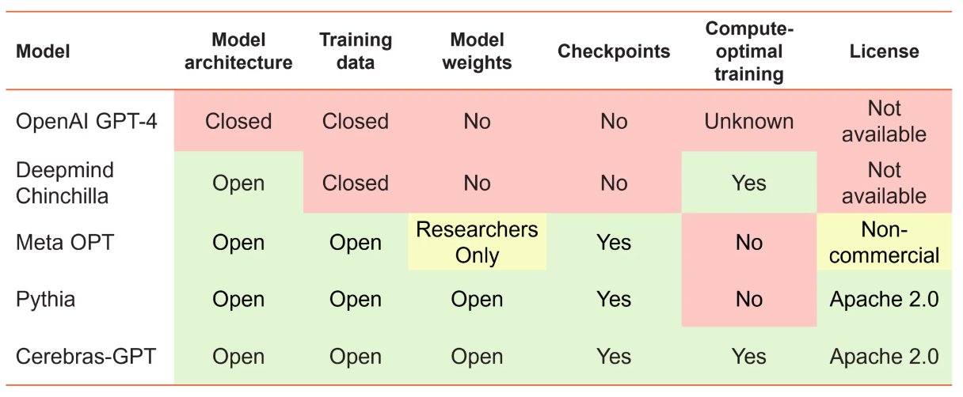
Large Language Models (LMM)
Openness and Training Philosophy
Source: https://www.cerebras.net/blog/cerebras-gpt-a-family-of-open-compute-efficient-large-language-models/

Slide 52

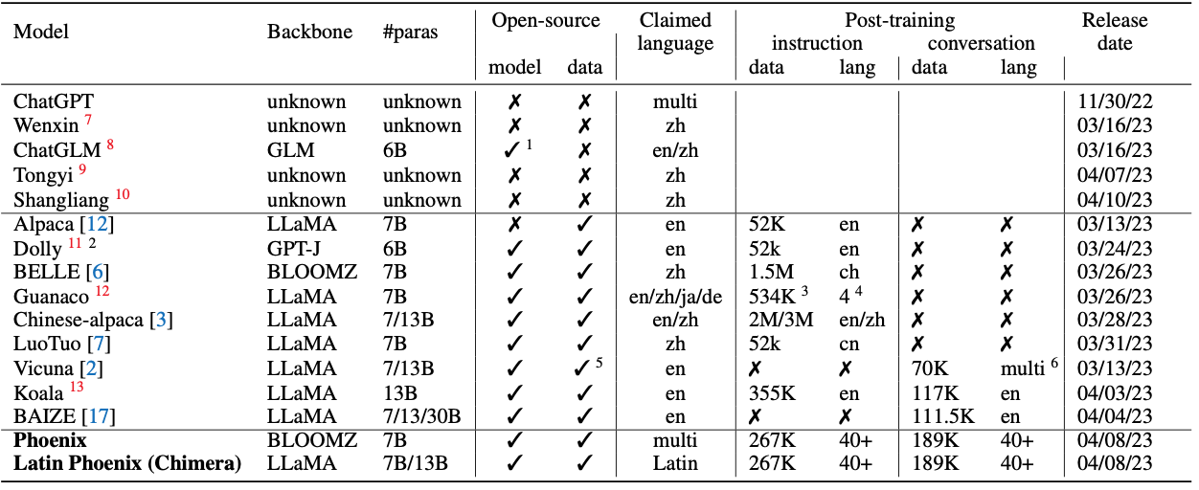
Phoenix: Democratizing ChatGPT across Languages
Source: https://github.com/FreedomIntelligence/LLMZoo

Slide 53
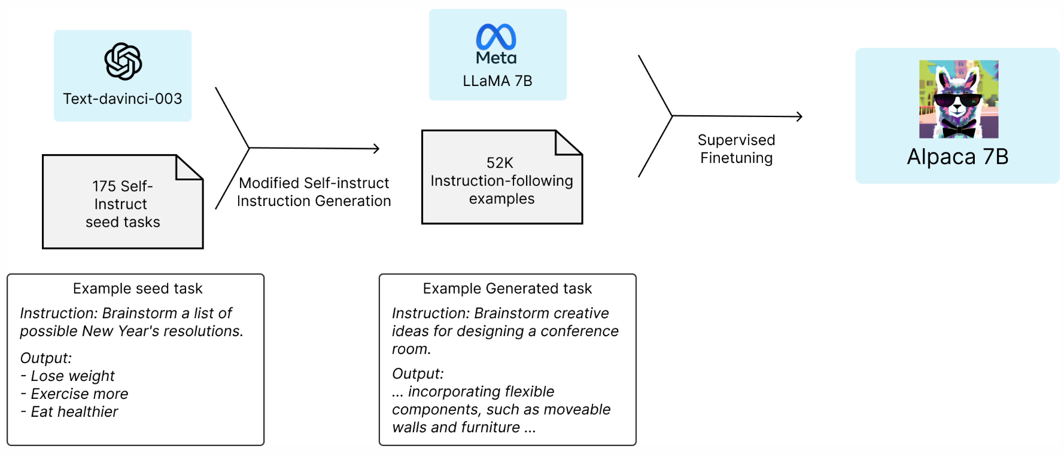

Stanford Alpaca:
A Strong, Replicable Instruction-Following Model
Source: https://crfm.stanford.edu/2023/03/13/alpaca.html

Slide 54
GPT4All:
Training an Assistant-style Chatbot with Large Scale Data Distillation from GPT-3.5-Turbo
Demo, data and code to train an assistant-style large language model with ~800k GPT-3.5-Turbo Generations based on LLaMa
Reproducibility
  Trained LoRa Weights:
    gpt4all-lora (four full epochs of training):
      https://huggingface.co/nomic-ai/gpt4all-lora
Source: https://github.com/nomic-ai/gpt4all

Slide 55
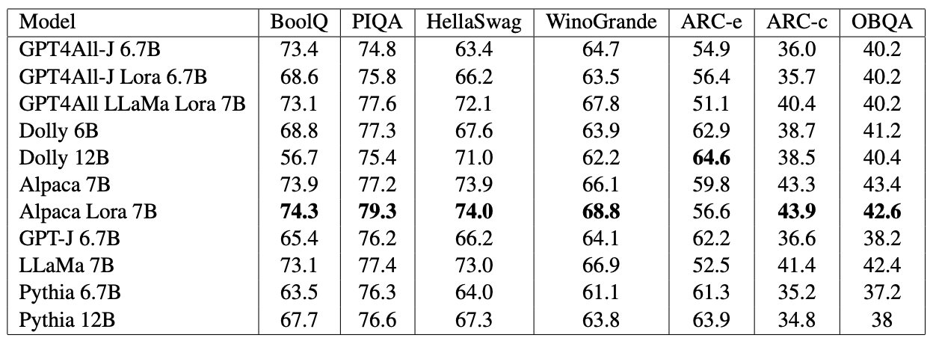
GPT4All-J
An Apache-2 Licensed Assistant-Style Chatbot
GPT4All-J (GPT4All v2) based on Open Source GPT-J model
Source: https://github.com/nomic-ai/gpt4all

Slide 56
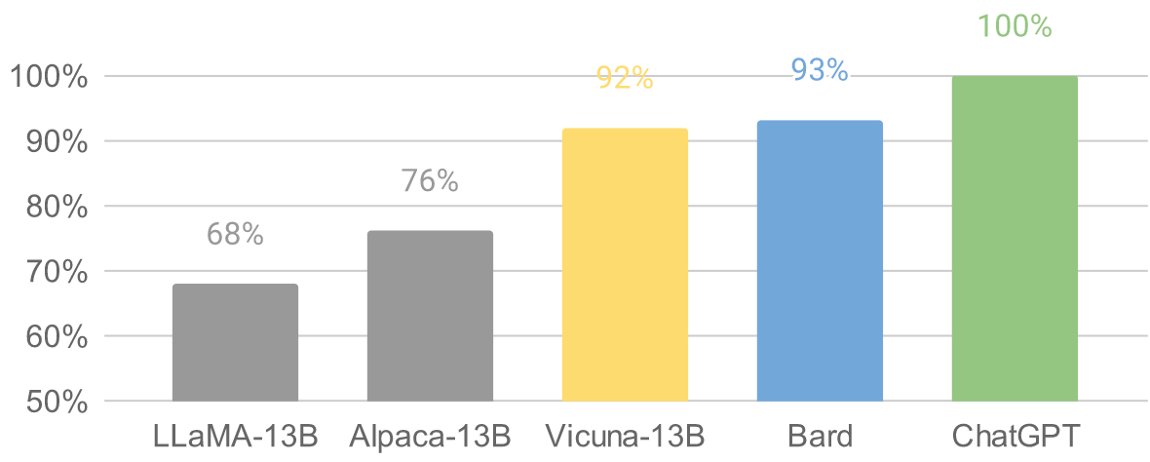
Vicuna: An Open-Source Chatbot
Impressing GPT-4 with 90%* ChatGPT Quality by the Team with members from UC Berkeley, CMU, Stanford, and UC San Diego
Vicuna-13B: an open-source chatbot trained by fine-tuning LLaMA on user-shared conversations collected from ShareGPT.
The cost of training Vicuna-13B is around $300.
Source: https://vicuna.lmsys.org/

Slide 57
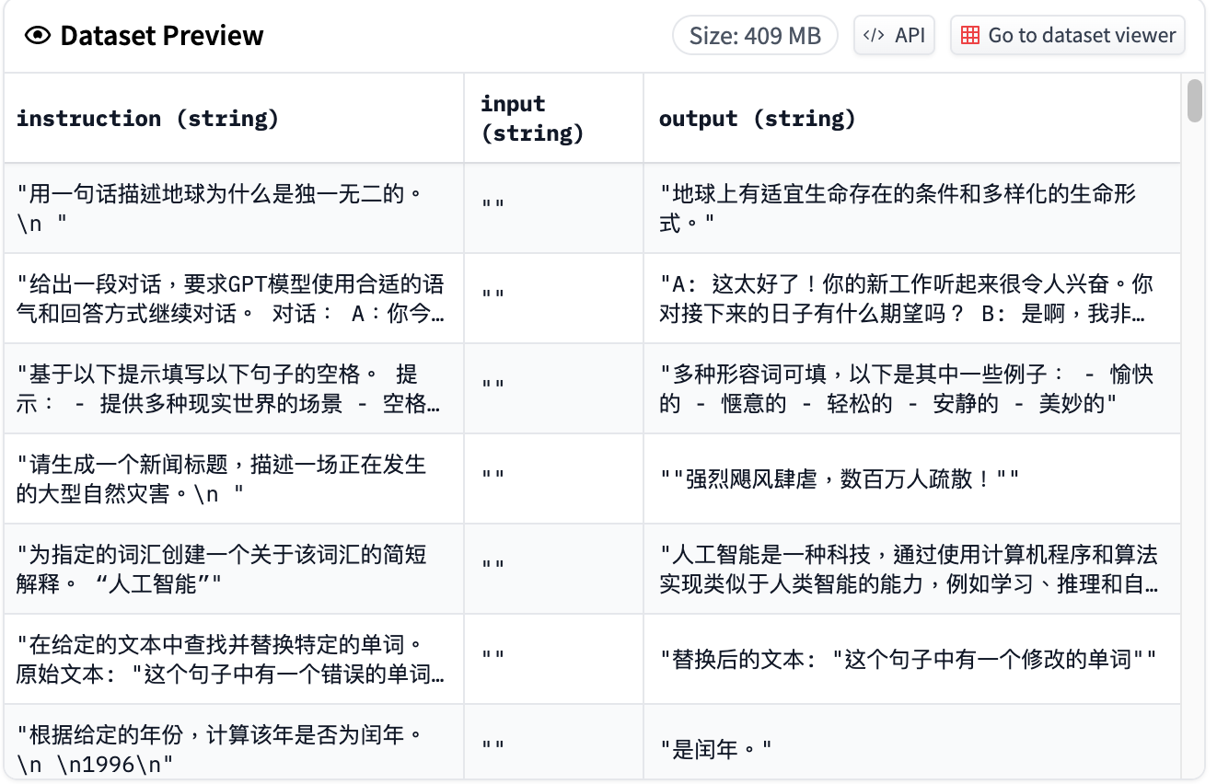
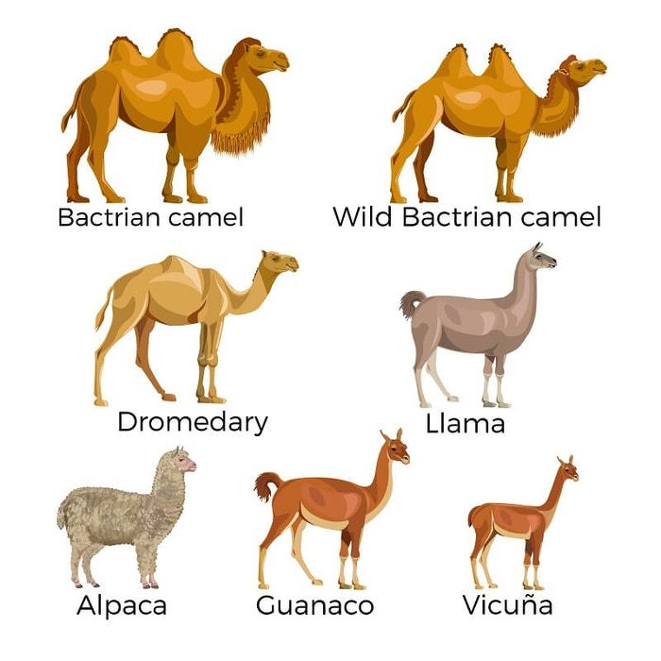
Chinese-Vicuna:
A Chinese Instruction-following LLaMA-based Model
一個中文低資源的 llama+lora方案
Chinese-Vicuna based on Guanaco Dataset and Belle Dataset
Source: https://huggingface.co/datasets/Chinese-Vicuna/guanaco_belle_merge_v1.0
Source: https://github.com/Facico/Chinese-Vicuna

Slide 58

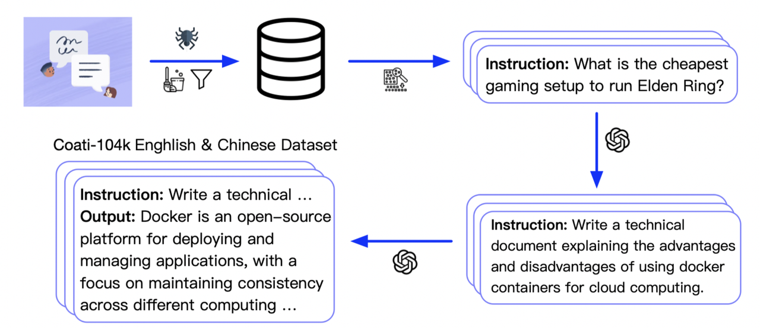
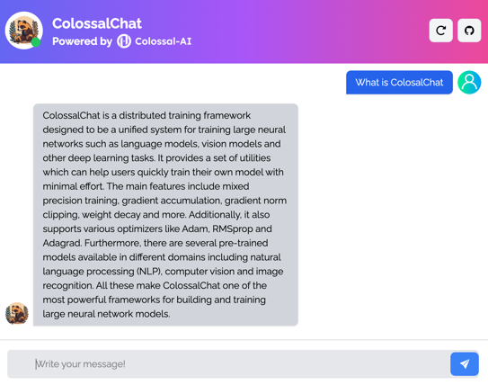
ColossalChat
ColossalChat is the project to implement LLM with RLHF, powered by the Colossal-AI project.
Coati stands for ColossalAI Talking Intelligence.
Source: https://chat.colossalai.org/
https://github.com/hpcaitech/ColossalAI/tree/main/applications/Chat

Slide 59
Dolly v2
Open Source Instruction-Tuned LLM
Databricks’ Dolly is an instruction-following large language model trained on the Databricks machine learning platform that is licensed for commercial use.
Based on pythia-12b, Dolly is trained on ~15k instruction/response fine tuning records databricks-dolly-15k generated by Databricks employees in capability domains from the InstructGPT paper, including brainstorming, classification, closed QA, generation, information extraction, open QA and summarization.
dolly-v2-12b is not a state-of-the-art model, but does exhibit surprisingly high quality instruction following behavior not characteristic of the foundation model on which it is based.
Source: https://github.com/databrickslabs/dolly

Slide 60

StableLM
Stability AI Language Models
StableLM-Alpha models are trained on the new dataset that build on The Pile, which contains 1.5 trillion tokens, roughly 3x the size of The Pile.
  These models will be trained on up to 1.5 trillion tokens.
  The context length for these models is 4096 tokens.
Fine-tuned the model with Stanford Alpaca's procedure using a combination of five recent datasets for conversational agents: Stanford's Alpaca, Nomic-AI's gpt4all, RyokoAI's ShareGPT52K datasets, Databricks labs' Dolly, and Anthropic's HH.
Source: https://github.com/Stability-AI/StableLM

Slide 61
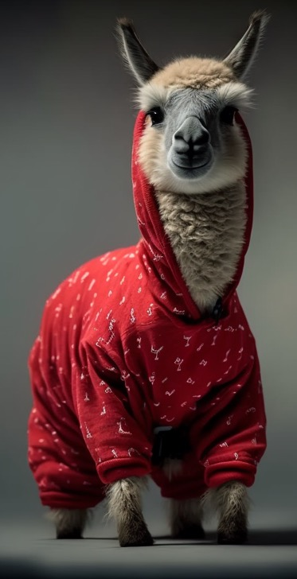
RedPajama a project to create leading open-source models, starts by reproducing LLaMA training dataset of over 1.2 trillion tokens
Dataset | RedPajama | LLaMA*
CommonCrawl | 878 billion | 852 billion
C4 | 175 billion | 190 billion
Github | 59 billion | 100 billion
Books | 26 billion | 25 billion
ArXiv | 28 billion | 33 billion
Wikipedia | 24 billion | 25 billion
StackExchange | 20 billion | 27 billion
Total Tokens | 1.2 trillion | 1.25 trillion
Source: https://github.com/togethercomputer/RedPajama-Data

Slide 62
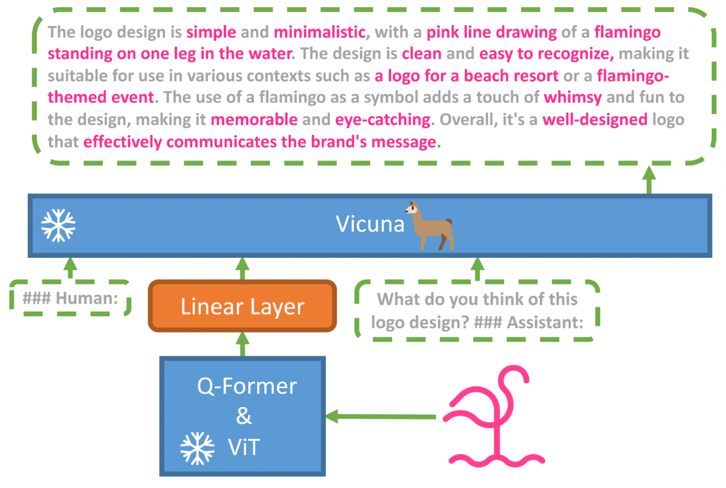
MiniGPT-4:
Enhancing Vision-language Understanding with Advanced Large Language Models
Source: https://minigpt-4.github.io/

Slide 63
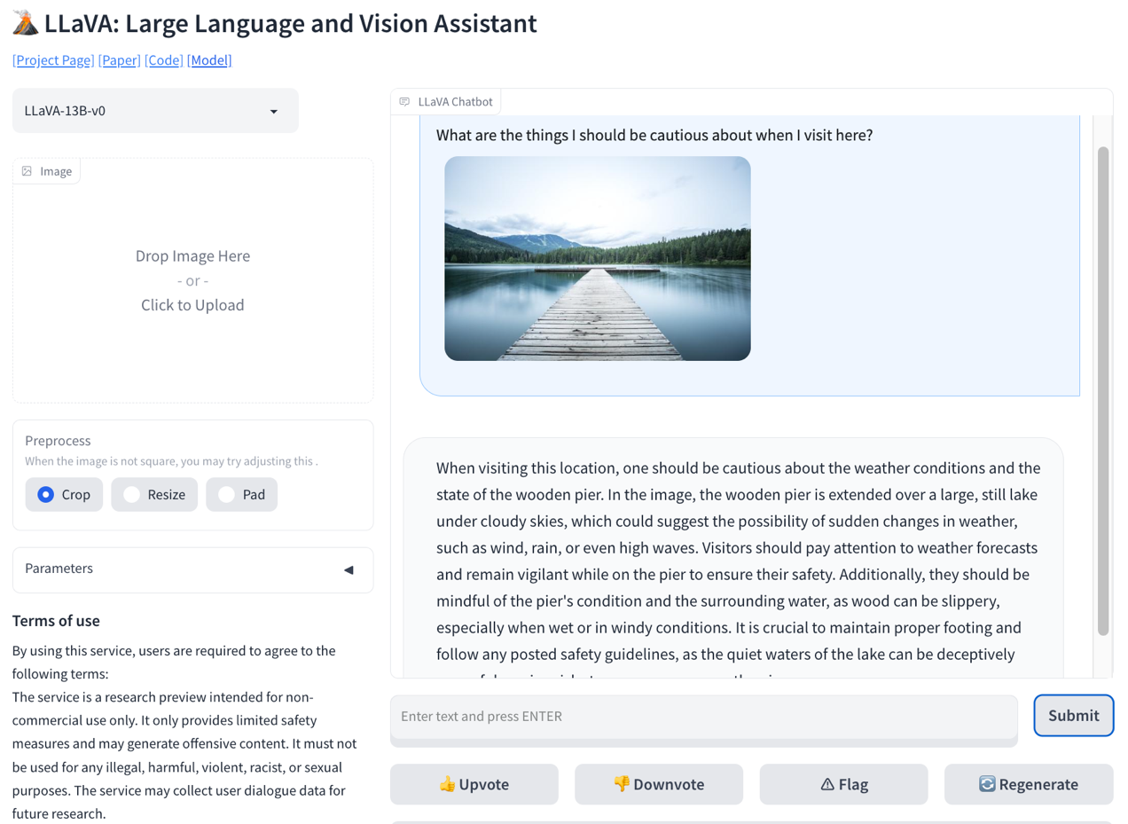
LLaVA: Large Language and Vision Assistant
Source: https://llava-vl.github.io/

Slide 64
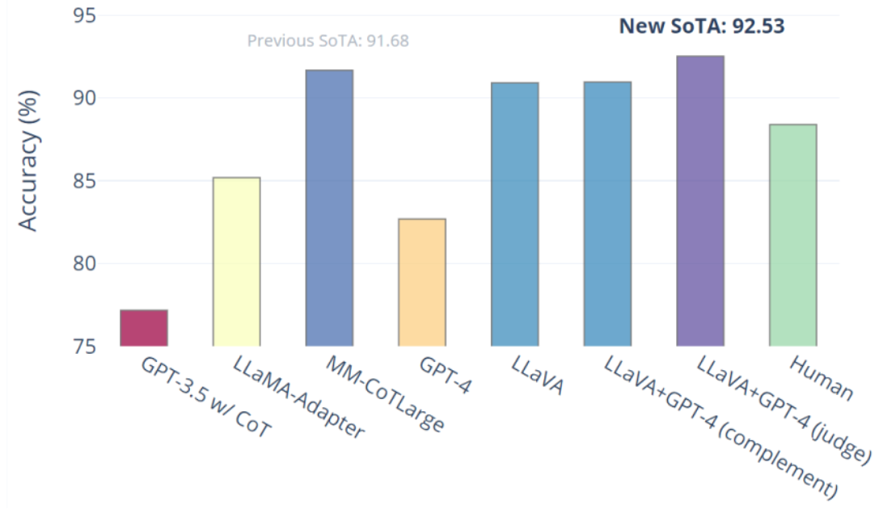
Visual Instruction Tuning
LLaVA: Large Language and Vision Assistant
University of Wisconsin-Madison, Microsoft Research, Columbia University
Science QA: New SoTA with the synergy of LLaVA with GPT-4
LLaVA represents a novel end-to-end trained large multimodal model that combines a vision encoder and Vicuna for general-purpose visual and language understanding, achieving impressive chat capabilities mimicking spirits of the multimodal GPT-4 and setting a new state-of-the-art accuracy on Science QA.
Source: https://llava-vl.github.io/

Slide 65
Large Language Models (LLMs)
Foundation Models

Slide 66
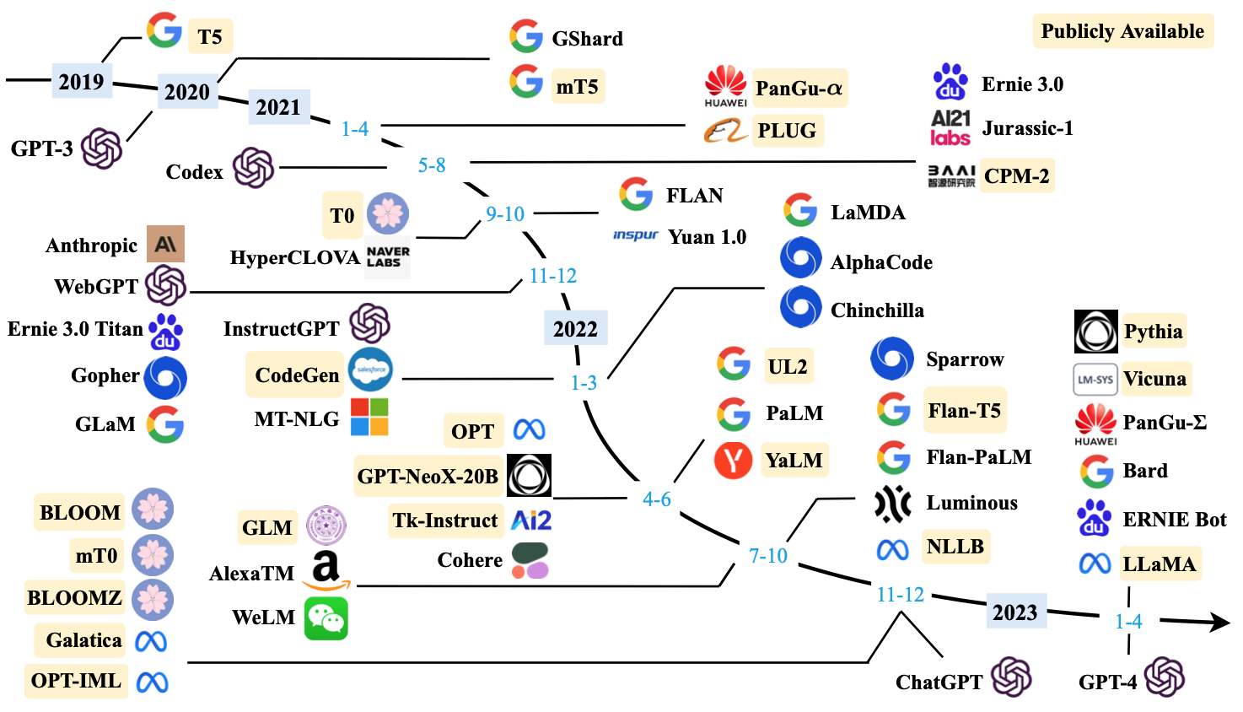
Large Language Models (LLMs) (larger than 10B)
Source: Wayne Xin Zhao, Kun Zhou, Junyi Li, Tianyi Tang, Xiaolei Wang, Yupeng Hou, Yingqian Min et al. (2023) "A Survey of Large Language Models." arXiv preprint arXiv:2303.18223.

Slide 67
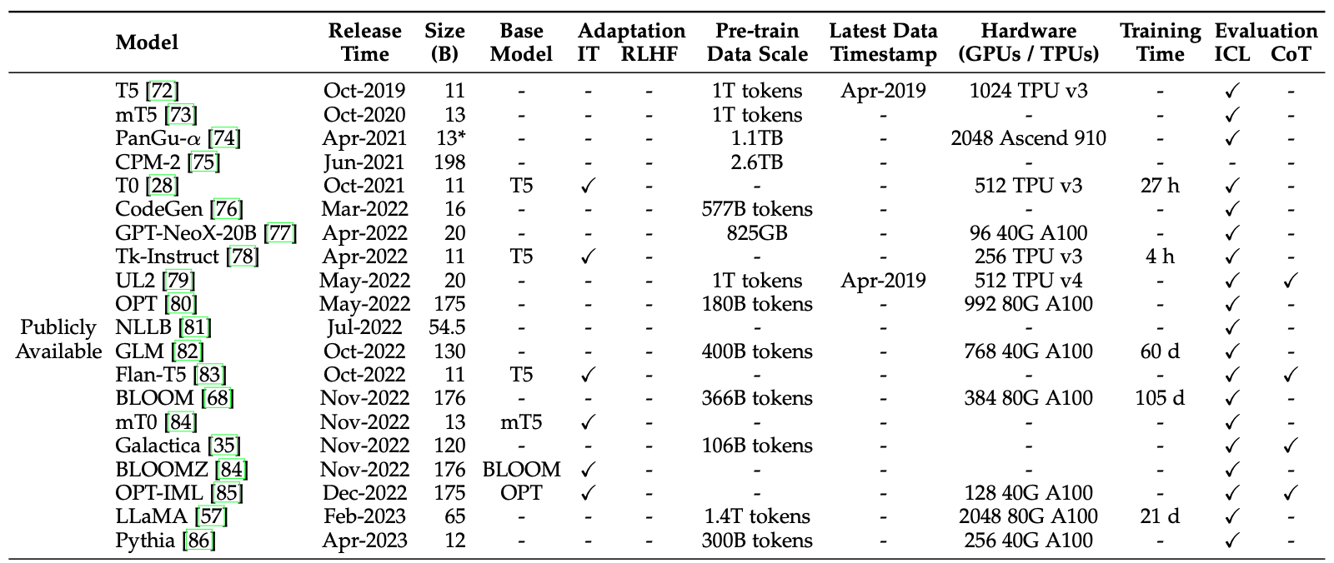
Large Language Models (LLMs) (larger than 10B)
Source: Wayne Xin Zhao, Kun Zhou, Junyi Li, Tianyi Tang, Xiaolei Wang, Yupeng Hou, Yingqian Min et al. (2023) "A Survey of Large Language Models." arXiv preprint arXiv:2303.18223.

Slide 68
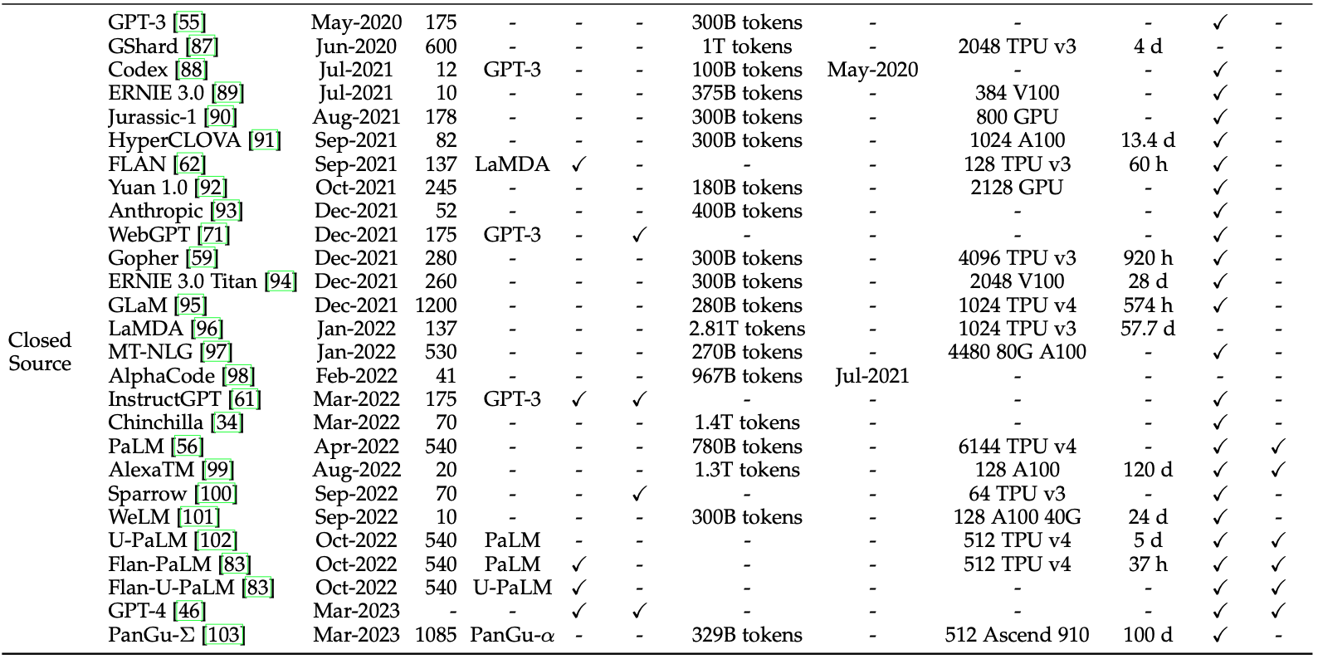
Large Language Models (LLMs) (larger than 10B)
Source: Wayne Xin Zhao, Kun Zhou, Junyi Li, Tianyi Tang, Xiaolei Wang, Yupeng Hou, Yingqian Min et al. (2023) "A Survey of Large Language Models." arXiv preprint arXiv:2303.18223.

Slide 69
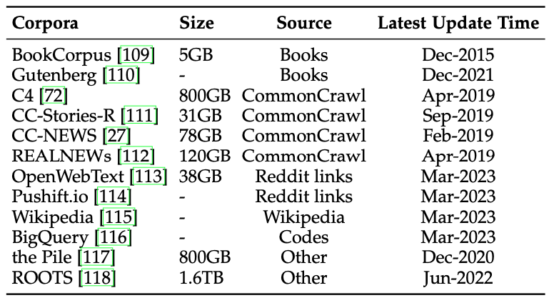
Statistics of Commonly-used Data Sources for LLMs
Source: Wayne Xin Zhao, Kun Zhou, Junyi Li, Tianyi Tang, Xiaolei Wang, Yupeng Hou, Yingqian Min et al. (2023) "A Survey of Large Language Models." arXiv preprint arXiv:2303.18223.

Slide 70
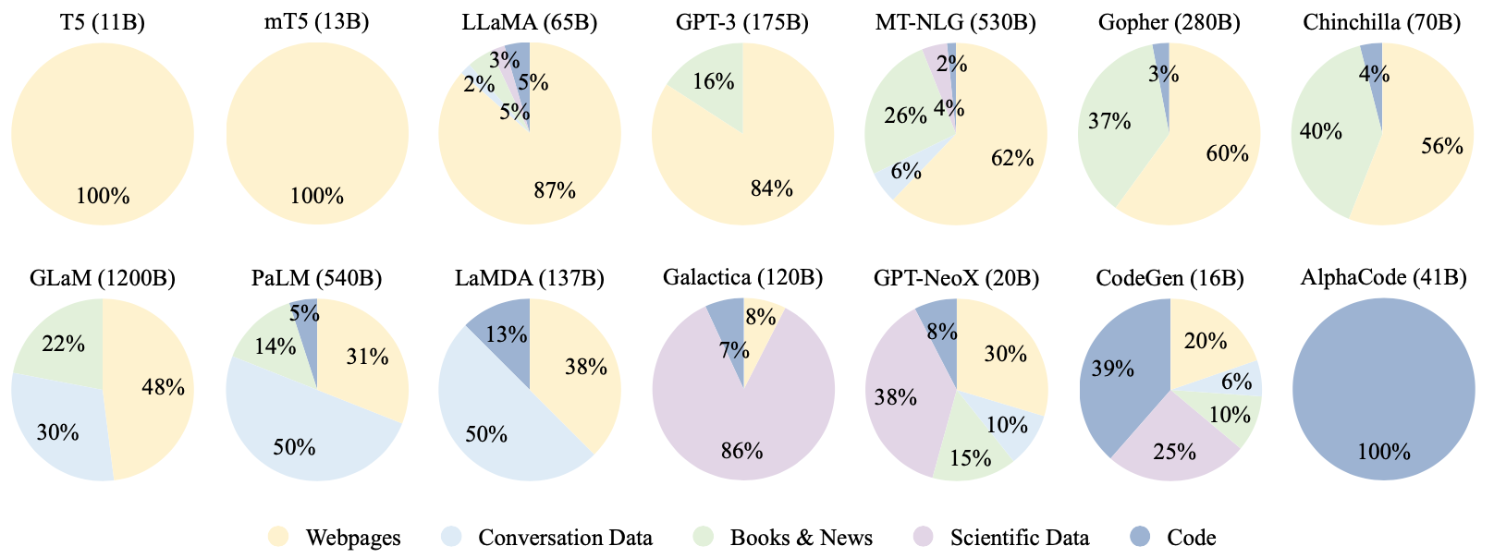
Ratios of various data sources in the pre-training data for existing LLMs
Source: Wayne Xin Zhao, Kun Zhou, Junyi Li, Tianyi Tang, Xiaolei Wang, Yupeng Hou, Yingqian Min et al. (2023) "A Survey of Large Language Models." arXiv preprint arXiv:2303.18223.

Slide 71
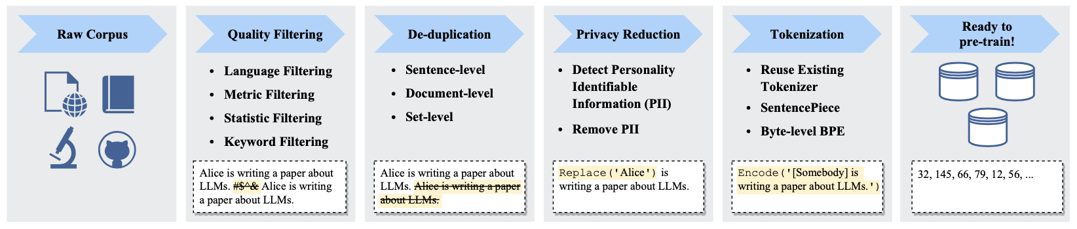
Typical Data Preprocessing Pipeline for
Pre-training Large Language Models (LLMs)
Source: Wayne Xin Zhao, Kun Zhou, Junyi Li, Tianyi Tang, Xiaolei Wang, Yupeng Hou, Yingqian Min et al. (2023) "A Survey of Large Language Models." arXiv preprint arXiv:2303.18223.

Slide 72
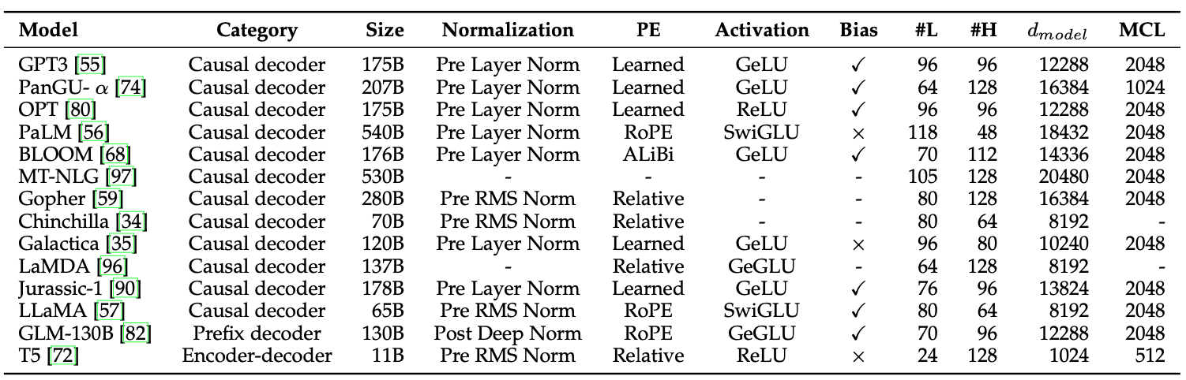
LLMs with Public Configuration Details
Note: PE denotes position embedding, #L denotes the number of layers, #H denotes the number of attention heads,
d_{model} denotes the size of hidden states, and MCL denotes the maximum context length during training.
Source: Wayne Xin Zhao, Kun Zhou, Junyi Li, Tianyi Tang, Xiaolei Wang, Yupeng Hou, Yingqian Min et al. (2023) "A Survey of Large Language Models." arXiv preprint arXiv:2303.18223.

Slide 73
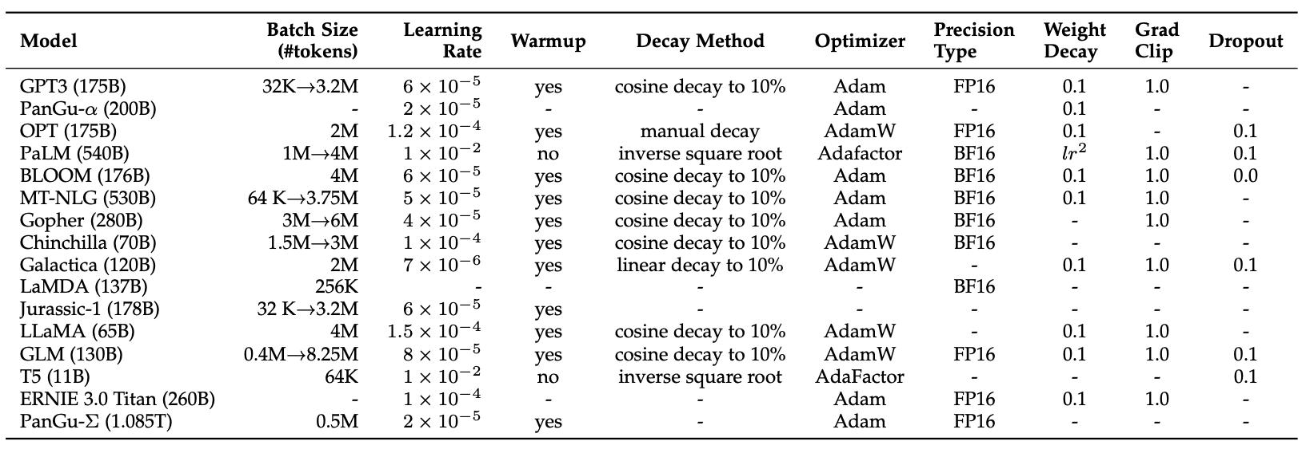
Detailed Optimization Settings of LLMs
Source: Wayne Xin Zhao, Kun Zhou, Junyi Li, Tianyi Tang, Xiaolei Wang, Yupeng Hou, Yingqian Min et al. (2023) "A Survey of Large Language Models." arXiv preprint arXiv:2303.18223.

Slide 74
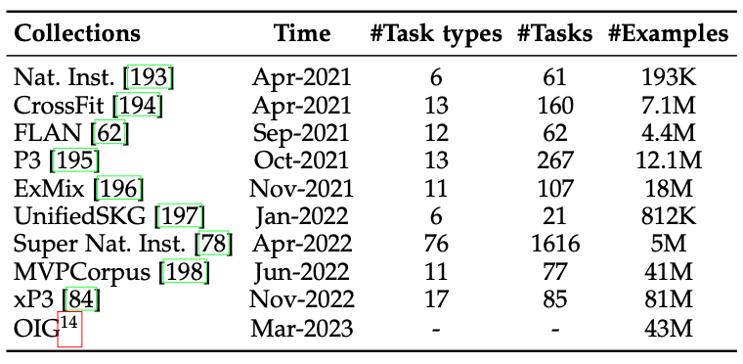
Available Task Collections for Instruction Tuning
Source: Wayne Xin Zhao, Kun Zhou, Junyi Li, Tianyi Tang, Xiaolei Wang, Yupeng Hou, Yingqian Min et al. (2023) "A Survey of Large Language Models." arXiv preprint arXiv:2303.18223.

Slide 75
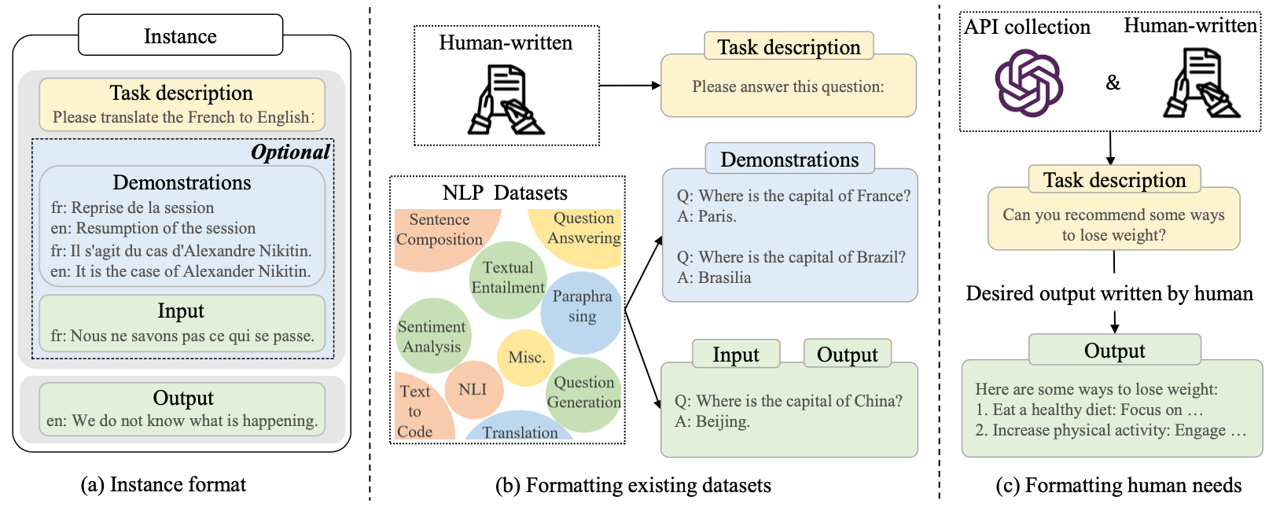
Instance Formatting and Two Different Methods for Constructing the
Instruction-formatted Instances
Source: Wayne Xin Zhao, Kun Zhou, Junyi Li, Tianyi Tang, Xiaolei Wang, Yupeng Hou, Yingqian Min et al. (2023) "A Survey of Large Language Models." arXiv preprint arXiv:2303.18223.

Slide 76
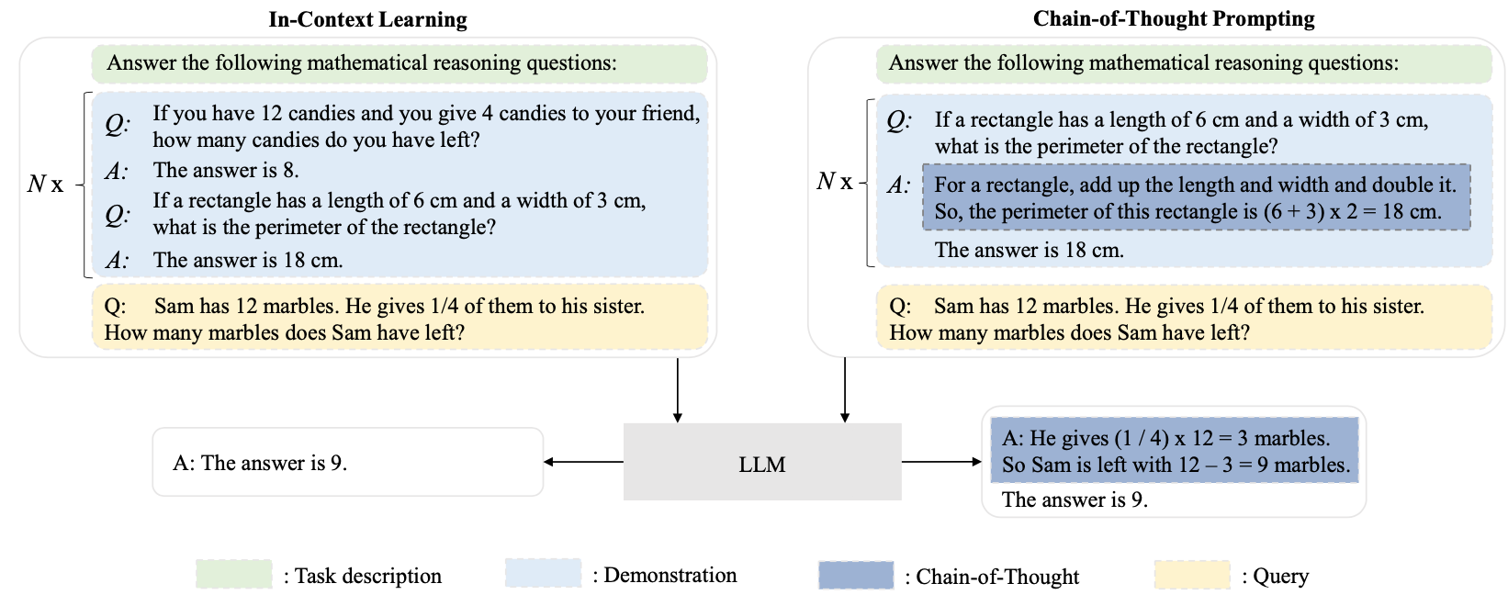
In-context Learning (ICL) and
Chain-of-thought (CoT) Prompting
Source: Wayne Xin Zhao, Kun Zhou, Junyi Li, Tianyi Tang, Xiaolei Wang, Yupeng Hou, Yingqian Min et al. (2023) "A Survey of Large Language Models." arXiv preprint arXiv:2303.18223.

Slide 77
Pre-train,
Prompt, and Predict:
Prompting Methods in Natural Language Processing
(LLMs)
Source: Pengfei Liu, Weizhe Yuan, Jinlan Fu, Zhengbao Jiang, Hiroaki Hayashi, and Graham Neubig. (2023) "Pre-train, prompt, and predict: A systematic survey of prompting methods in natural language processing." ACM Computing Surveys 55, no. 9 (2023): 1-35.

Slide 78
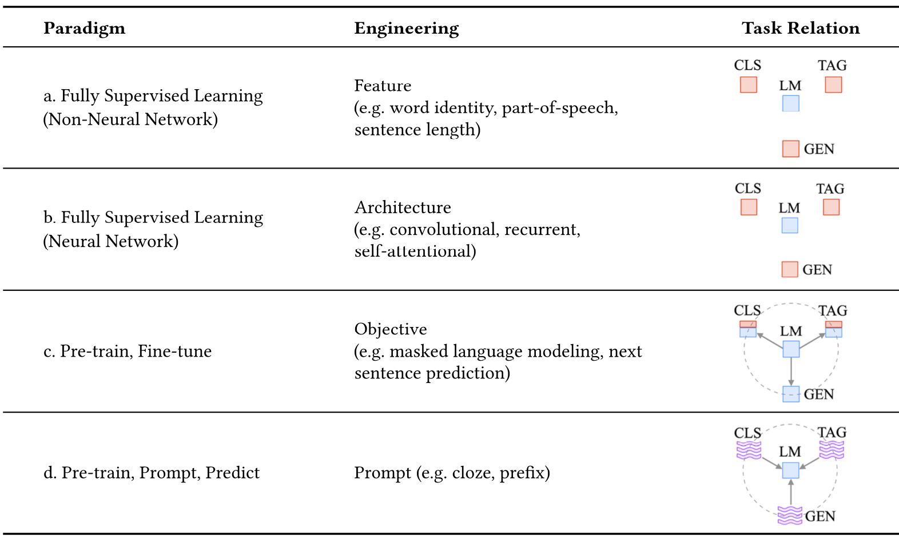
Four Paradigms in NLP
Source: Pengfei Liu, Weizhe Yuan, Jinlan Fu, Zhengbao Jiang, Hiroaki Hayashi, and Graham Neubig. (2023) "Pre-train, prompt, and predict: A systematic survey of prompting methods in natural language processing." ACM Computing Surveys 55, no. 9 (2023): 1-35.

Slide 79
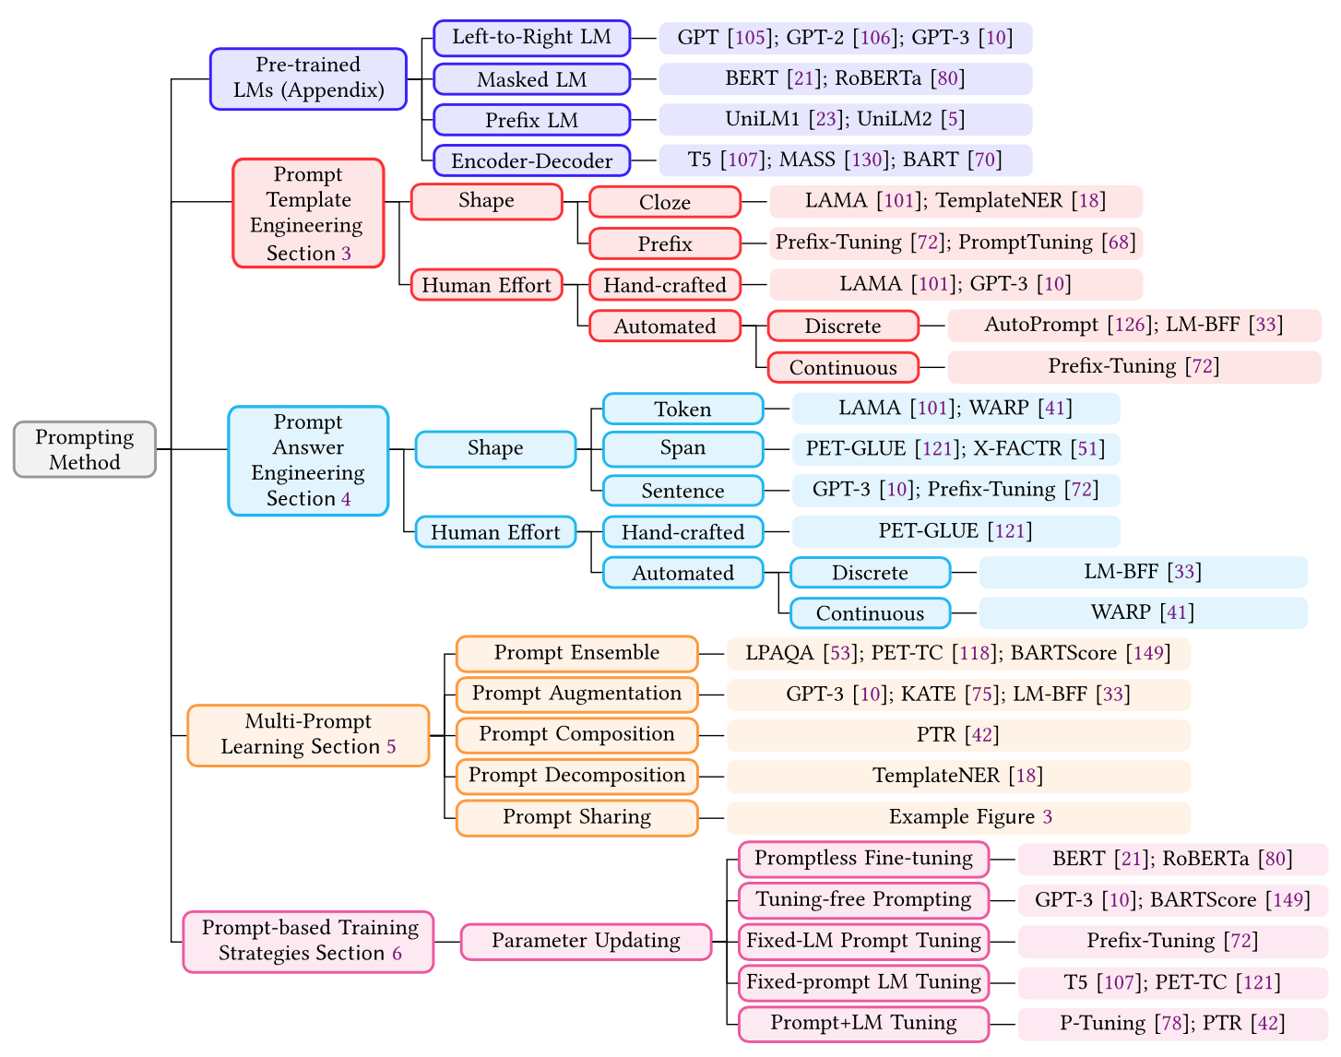
Typology of Prompting Methods
Source: Pengfei Liu, Weizhe Yuan, Jinlan Fu, Zhengbao Jiang, Hiroaki Hayashi, and Graham Neubig. (2023) "Pre-train, prompt, and predict: A systematic survey of prompting methods in natural language processing." ACM Computing Surveys 55, no. 9 (2023): 1-35.

Slide 80

Different Multi-Prompt Learning Strategies
Source: Pengfei Liu, Weizhe Yuan, Jinlan Fu, Zhengbao Jiang, Hiroaki Hayashi, and Graham Neubig. (2023) "Pre-train, prompt, and predict: A systematic survey of prompting methods in natural language processing." ACM Computing Surveys 55, no. 9 (2023): 1-35.

Slide 81

Examples of Input, Template, and Answer for Different Tasks
Source: Pengfei Liu, Weizhe Yuan, Jinlan Fu, Zhengbao Jiang, Hiroaki Hayashi, and Graham Neubig. (2023) "Pre-train, prompt, and predict: A systematic survey of prompting methods in natural language processing." ACM Computing Surveys 55, no. 9 (2023): 1-35.

Slide 82

Characteristics of Different Tuning Strategies
Source: Pengfei Liu, Weizhe Yuan, Jinlan Fu, Zhengbao Jiang, Hiroaki Hayashi, and Graham Neubig. (2023) "Pre-train, prompt, and predict: A systematic survey of prompting methods in natural language processing." ACM Computing Surveys 55, no. 9 (2023): 1-35.

Slide 83

Multi-prompt Learning for
Multi-task, Multi-domain, or Multi-lingual Learning
Source: Pengfei Liu, Weizhe Yuan, Jinlan Fu, Zhengbao Jiang, Hiroaki Hayashi, and Graham Neubig. (2023) "Pre-train, prompt, and predict: A systematic survey of prompting methods in natural language processing." ACM Computing Surveys 55, no. 9 (2023): 1-35.

Slide 84
Reinforcement Learning from Human Feedback (RLHF)

Slide 85

ChatGPT: Optimizing Language Models for Dialogue
Source: https://openai.com/blog/chatgpt/

Slide 86

Training language models to follow instructions with human feedback
InstructGPT and GPT 3.5
Source: Ouyang, L., Wu, J., Jiang, X., Almeida, D., Wainwright, C. L., Mishkin, P., ... & Lowe, R. (2022). Training language models to follow instructions with human feedback. arXiv preprint arXiv:2203.02155.

Slide 87
Reinforcement Learning from Human Feedback (RLHF)
Pretraining a Language Model (LM)
Gathering Data and Training a Reward Model
Fine-tuning the LM with Reinforcement Learning
Source: https://huggingface.co/blog/rlhf

Slide 88

Reinforcement Learning
from Human Feedback (RLHF)
Step 1. Pretraining a Language Model (LM)
Source: https://huggingface.co/blog/rlhf

Slide 89

Reinforcement Learning from Human Feedback (RLHF)
Step 2. Gathering Data and
Training a
Reward Model
Source: https://huggingface.co/blog/rlhf

Slide 90

Reinforcement Learning from Human Feedback (RLHF)
Step 3. Fine-tuning the LM with Reinforcement Learning
Source: https://huggingface.co/blog/rlhf

Slide 91
Outline
1. 生成式AI的基本概念
Basic Concepts of Generative AI
2. ChatGPT的基本原理和功能
Basic Principles and Functions of ChatGPT
3. 生成式AI在永續發展的應用
Generative AI for ESG and Sustainable Development
4. AI在永續發展上的議題
Issues of AI for Sustainable Development

Slide 92
Generative AI for ESG and Sustainable Development

Slide 93
Generative AI
Text, Image, Video, Audio Applications

Slide 94

Generative AI Models
ChatGPT
is not
all you need
Attention
is
all you need
Source: Gozalo-Brizuela, Roberto, and Eduardo C. Garrido-Merchan (2023). "ChatGPT is not all you need. A State of the Art Review of large Generative AI models." arXiv preprint arXiv:2301.04655 (2023).

Slide 95

Generative AI
Tech Stack
Source: Matt Bornstein, Guido Appenzeller, and Martin Casado (2023), Who Owns the Generative AI Platform?, https://a16z.com/2023/01/19/who-owns-the-generative-ai-platform/

Slide 96

Generative AI Software and Business Factors
Source: Jay Alammar (2023), AI is Eating The World, https://txt.cohere.com/ai-is-eating-the-world/

Slide 97

Generative AI
1. Pre-training Foundation (Pre-trained) Model
2. Fine-turning Custom (Fine-tuned) Model
Source: Jay Alammar (2023), AI is Eating The World, https://txt.cohere.com/ai-is-eating-the-world/

Slide 98

Generative AI
Fine-tune Custom Models using Proprietary Data
Source: Jay Alammar (2023), AI is Eating The World, https://txt.cohere.com/ai-is-eating-the-world/

Slide 99

Generative AI
Fine-tune Custom Models using Proprietary Data
Source: Jay Alammar (2023), AI is Eating The World, https://txt.cohere.com/ai-is-eating-the-world/

Slide 100

Generative AI
Source: https://base10.vc/post/generative-ai-mission-critical/

Slide 101

Generative AI
Source: https://base10.vc/post/generative-ai-mission-critical/

Slide 102

Generative AI
Source: https://base10.vc/post/generative-ai-mission-critical/

Slide 103

DALL·E 2
Create original, realistic images and art from a text description.
It can combine concepts, attributes, and styles.
https://openai.com/dall-e-2/

Slide 104

The Model Structure of DALL-E-2
CLIP Pre-training
Image Generation
Source: Yihan Cao, Siyu Li, Yixin Liu, Zhiling Yan, Yutong Dai, Philip S. Yu, and Lichao Sun (2023). "A Comprehensive Survey of AI-Generated Content (AIGC): A History of Generative AI from GAN to ChatGPT." arXiv preprint arXiv:2303.04226.

Slide 105

Stable Diffusion
https://huggingface.co/spaces/stabilityai/stable-diffusion

Slide 106

Stable Diffusion Colab
https://github.com/woctezuma/stable-diffusion-colab

Slide 107

Stable Diffusion Reimagine
https://clipdrop.co/stable-diffusion-reimagine

Slide 108

Lexica Art: Search Stable Diffusion images and prompts
https://lexica.art/

Slide 109

Civitai: Stable Diffusion AI Art Models
https://civitai.com/

Slide 110

AnyFace: Free-style Text-to-Face Synthesis and Manipulation
Source: Sun, Jianxin, Qiyao Deng, Qi Li, Muyi Sun, Min Ren, and Zhenan Sun. (2022)
"AnyFace: Free-style Text-to-Face Synthesis and Manipulation." In Proceedings of the IEEE/CVF Conference on Computer Vision and Pattern Recognition, pp. 18687-18696.

Slide 111


AnyFace: Free-style Text-to-Face Synthesis and Manipulation
Source: Sun, Jianxin, Qiyao Deng, Qi Li, Muyi Sun, Min Ren, and Zhenan Sun. (2022)
"AnyFace: Free-style Text-to-Face Synthesis and Manipulation." In Proceedings of the IEEE/CVF Conference on Computer Vision and Pattern Recognition, pp. 18687-18696.

Slide 112

AnyFace: Free-style Text-to-Face Synthesis and Manipulation
Source: Sun, Jianxin, Qiyao Deng, Qi Li, Muyi Sun, Min Ren, and Zhenan Sun. (2022)
"AnyFace: Free-style Text-to-Face Synthesis and Manipulation." In Proceedings of the IEEE/CVF Conference on Computer Vision and Pattern Recognition, pp. 18687-18696.

Slide 113

AnyFace: Free-style Text-to-Face Synthesis and Manipulation
Source: Sun, Jianxin, Qiyao Deng, Qi Li, Muyi Sun, Min Ren, and Zhenan Sun. (2022)
"AnyFace: Free-style Text-to-Face Synthesis and Manipulation." In Proceedings of the IEEE/CVF Conference on Computer Vision and Pattern Recognition, pp. 18687-18696.

Slide 114

AnyFace: Free-style Text-to-Face Synthesis and Manipulation
Text-guided
Face Manipulation
Source: Sun, Jianxin, Qiyao Deng, Qi Li, Muyi Sun, Min Ren, and Zhenan Sun. (2022)
"AnyFace: Free-style Text-to-Face Synthesis and Manipulation." In Proceedings of the IEEE/CVF Conference on Computer Vision and Pattern Recognition, pp. 18687-18696.

Slide 115

NLG from a Multilingual,
Multimodal and Multi-task perspective
Source: Erdem, Erkut, Menekse Kuyu, Semih Yagcioglu, Anette Frank, Letitia Parcalabescu, Barbara Plank, Andrii Babii et al.
"Neural Natural Language Generation: A Survey on Multilinguality, Multimodality, Controllability and Learning." Journal of Artificial Intelligence Research 73 (2022): 1131-1207.

Slide 116

Text-and-Video Dialog Generation Models with Hierarchical Attention
Source: Erdem, Erkut, Menekse Kuyu, Semih Yagcioglu, Anette Frank, Letitia Parcalabescu, Barbara Plank, Andrii Babii et al.
"Neural Natural Language Generation: A Survey on Multilinguality, Multimodality, Controllability and Learning." Journal of Artificial Intelligence Research 73 (2022): 1131-1207.

Slide 117

Multimodal Few-Shot Learning with
Frozen Language Models
Curated samples with about five seeds required to get past well-known language model failure modes of either repeating text for the prompt or emitting text that does not pertain to the image.
These samples demonstrate the ability to generate open-ended outputs that adapt to both images and text, and to make use of facts that it has learned during language-only pre-training.
Source: Maria Tsimpoukelli, Jacob L. Menick, Serkan Cabi, S. M. Eslami, Oriol Vinyals, and Felix Hill (2021). "Multimodal few-shot learning with frozen language models."
Advances in Neural Information Processing Systems 34 (2021): 200-212.

Slide 118

Multimodal Pipeline that includes three different modalities (Image, Text. Audio)
Source: Bayoudh, Khaled, Raja Knani, Fayçal Hamdaoui, and Abdellatif Mtibaa (2022).
"A survey on deep multimodal learning for computer vision: advances, trends, applications, and datasets." The Visual Computer 38, no. 8: 2939-2970.

Slide 119

Video and Audio Multimodal Fusion
Source: Bayoudh, Khaled, Raja Knani, Fayçal Hamdaoui, and Abdellatif Mtibaa (2022).
"A survey on deep multimodal learning for computer vision: advances, trends, applications, and datasets." The Visual Computer 38, no. 8: 2939-2970.

Slide 120

Visual and Textual Representation
Source: Bayoudh, Khaled, Raja Knani, Fayçal Hamdaoui, and Abdellatif Mtibaa (2022).
"A survey on deep multimodal learning for computer vision: advances, trends, applications, and datasets." The Visual Computer 38, no. 8: 2939-2970.

Slide 121

Hybrid Multimodal Data Fusion
Text
Audio
Image
Text
Speech
Video
Source: Bayoudh, Khaled, Raja Knani, Fayçal Hamdaoui, and Abdellatif Mtibaa (2022).
"A survey on deep multimodal learning for computer vision: advances, trends, applications, and datasets." The Visual Computer 38, no. 8: 2939-2970.

Slide 122

Multimodal Transfer Learning
Source: Bayoudh, Khaled, Raja Knani, Fayçal Hamdaoui, and Abdellatif Mtibaa (2022).
"A survey on deep multimodal learning for computer vision: advances, trends, applications, and datasets." The Visual Computer 38, no. 8: 2939-2970.

Slide 123

CLIP: Learning Transferable Visual Models From Natural Language Supervision
Source: Radford, Alec, Jong Wook Kim, Chris Hallacy, Aditya Ramesh, Gabriel Goh, Sandhini Agarwal, Girish Sastry et al. (2021) "Learning transferable visual models from natural language supervision." In International Conference on Machine Learning, pp. 8748-8763. PMLR.

Slide 124

ViLT: Vision-and-Language Transformer Without Convolution or Region Supervision
Source: Kim, Wonjae, Bokyung Son, and Ildoo Kim (2021). "Vilt: Vision-and-language transformer without convolution or region supervision."
In International Conference on Machine Learning, pp. 5583-5594. PMLR.

Slide 125

wav2vec 2.0:
A framework for self-supervised learning of speech representations
Source: Baevski, Alexei, Yuhao Zhou, Abdelrahman Mohamed, and Michael Auli.
"wav2vec 2.0: A framework for self-supervised learning of speech representations." Advances in Neural Information Processing Systems 33 (2020): 12449-12460.

Slide 126

Whisper:
Robust Speech Recognition via Large-Scale Weak Supervision
Source: Radford, Alec, Jong Wook Kim, Tao Xu, Greg Brockman, Christine McLeavey, and Ilya Sutskever. Robust speech recognition via large-scale weak supervision. Tech. Rep., Technical report, OpenAI, 2022.

Slide 127

Microsoft Azure
Text to Speech (TTS)
Source: https://azure.microsoft.com/en-gb/products/cognitive-services/text-to-speech/

Slide 128

Hugging Face
https://huggingface.co/

Slide 129

BLOOM
BigScience Large Open-science Open-access Multilingual Language Model
Source: https://huggingface.co/bigscience/bloom

Slide 130

OpenAI Whisper
Source: https://huggingface.co/spaces/openai/whisper

Slide 131

Computer vision in the metaverse with scene understanding, object detection, and human action/activity recognition
Source: Huynh-The, Thien, Quoc-Viet Pham, Xuan-Qui Pham, Thanh Thi Nguyen, Zhu Han, and Dong-Seong Kim (2022).
"Artificial Intelligence for the Metaverse: A Survey." arXiv preprint arXiv:2202.10336.

Slide 132

DUALENC: A KG-to-Text Generation Model
KG and Graph via Dual-encoding
Source: Yihan Cao, Siyu Li, Yixin Liu, Zhiling Yan, Yutong Dai, Philip S. Yu, and Lichao Sun (2023). "A Comprehensive Survey of AI-Generated Content (AIGC): A History of Generative AI from GAN to ChatGPT." arXiv preprint arXiv:2303.04226.

Slide 133

Generative AI
Research Areas,
Applications and
Companies
Source: Yihan Cao, Siyu Li, Yixin Liu, Zhiling Yan, Yutong Dai, Philip S. Yu, and Lichao Sun (2023). "A Comprehensive Survey of AI-Generated Content (AIGC): A History of Generative AI from GAN to ChatGPT." arXiv preprint arXiv:2303.04226.

Slide 134

Applications of Generative AI Models
Source: Yihan Cao, Siyu Li, Yixin Liu, Zhiling Yan, Yutong Dai, Philip S. Yu, and Lichao Sun (2023). "A Comprehensive Survey of AI-Generated Content (AIGC): A History of Generative AI from GAN to ChatGPT." arXiv preprint arXiv:2303.04226.

Slide 135
Outline
1. 生成式AI的基本概念
Basic Concepts of Generative AI
2. ChatGPT的基本原理和功能
Basic Principles and Functions of ChatGPT
3. 生成式AI在永續發展的應用
Generative AI for ESG and Sustainable Development
4. AI在永續發展上的議題
Issues of AI for Sustainable Development

Slide 136
AI for
Sustainable Development

Slide 137
ESG:
Environmental
Social
Governance

Slide 138
CSR:
Corporate
Social
Responsibility

Slide 139

ESG to 17 SDGs
Source: Henrik Skaug Sætra (2021) "A Framework for Evaluating and Disclosing the ESG Related Impacts of AI with the SDGs." Sustainability 13, no. 15 (2021): 8503.

Slide 140

ESG to 17 SDGs
Source: https://sustainometric.com/esg-to-sdgs-connected-paths-to-a-sustainable-future/

Slide 141
AI for
Sustainability

Slide 142

AI and Sustainability Development Goals (SDGs)
Source: Schoormann, T., Strobel, G., Möller, F., Petrik, D., & Zschech, P. (2023).
Artificial Intelligence for Sustainability—A Systematic Review of Information Systems Literature. Communications of the Association for Information Systems, 52(1), 8.

Slide 143

AI for Sustainability
Source: Schoormann, T., Strobel, G., Möller, F., Petrik, D., & Zschech, P. (2023).
Artificial Intelligence for Sustainability—A Systematic Review of Information Systems Literature. Communications of the Association for Information Systems, 52(1), 8.

Slide 144
Research Topics of AI for Sustainability
Building Upon Well-Investigated AI Research
Taking a Holistic View on Sustainability and Closing Blind Spots
Examining Opportunities for Data Collecting and Assembly
Extending the Algorithmic Scope
Exploring (Unintended) Effects from the Application of AI
Source: Schoormann, T., Strobel, G., Möller, F., Petrik, D., & Zschech, P. (2023).
Artificial Intelligence for Sustainability—A Systematic Review of Information Systems Literature. Communications of the Association for Information Systems, 52(1), 8.

Slide 145
Exploring (Unintended) Effects from the Application of AI
Emerging streams of research on ethical principles by design should be considered
  Responsible AI (Wang et al., 2020)
  Trustworthy AI (Thiebes et al., 2021)
  Explainable AI (Bauer et al., 2021; Lukyanenko et al., 2021)
The use of advanced white-box ML models
  such as interpretable neural networks and explainable boosting machines (Zschech et al., 2022).
  Such models can achieve high prediction qualities while providing sufficient transparency, which is a crucial prerequisite to eliminating the social injustices and discrimination effects in AI (Rudin, 2019)
Source: Schoormann, T., Strobel, G., Möller, F., Petrik, D., & Zschech, P. (2023).
Artificial Intelligence for Sustainability—A Systematic Review of Information Systems Literature. Communications of the Association for Information Systems, 52(1), 8.

Slide 146
Artificial Intelligence for Sustainable Finance
Developments in Artificial Intelligence (AI) and machine learning have led to the creation of a new type of ESG data that do not necessarily rely on information provided by companies.
AI in the ESG field
  textual analysis to measure firms’ ESG incidents or verify the credibility of companies’ concrete commitments
  satellite and sensor data to analyse companies’ environmental impact or estimate physical risk exposures
  machine learning to fill missing corporate data (GHG emissions etc.)
Source: Brière, M., Keip, M., & Le Berthe, T. (2022). Artificial Intelligence for Sustainable Finance: Why it May Help. Available at SSRN 4252329.

Slide 147
AI for Sustainable Finance
Developments in AI and machine learning have led to the creation of a new type of ESG data providers that analyse and collect (or “scrape”) large amounts of unstructured data from different internet sources
  Using AI and without necessarily relying on information provided by companies
Source: Brière, M., Keip, M., & Le Berthe, T. (2022). Artificial Intelligence for Sustainable Finance: Why it May Help. Available at SSRN 4252329.

Slide 148
AI for Sustainable Finance
Textual analysis to measure firms’ ESG incidents
Textual analysis to measure/verify the credibility of companies’ concrete commitments
Machine learning to fill missing corporate data (GHG emissions etc.)
Source: Brière, M., Keip, M., & Le Berthe, T. (2022). Artificial Intelligence for Sustainable Finance: Why it May Help. Available at SSRN 4252329.

Slide 149
Textual analysis to measure firms’ ESG incidents
Textual analysis tools (e.g., Natural Language Processing (NLP) and knowledge graphs) help identify controversies and important ESG news.
A large number of textual analysis software has been developed over the last decade, including Reprisk, Truvalue Labs, and others.
  They make it possible to finely measure controversies involving companies on various subjects such as environmental policies, working conditions, child labour, corruption, etc.
  Compared with traditional ratings, they have the advantage of more frequent revisions, incorporating real-time company information.
Source: Brière, M., Keip, M., & Le Berthe, T. (2022). Artificial Intelligence for Sustainable Finance: Why it May Help. Available at SSRN 4252329.

Slide 150
Textual analysis to measure/verify the credibility of companies’ concrete commitments
AI to assess company disclosures
  The Task Force on Climate Related Financial Disclosures (TCFD) has conducted an “AI review,” using a supervised learning approach to identify compliance with the TCFD Recommended Disclosures.
  Analyse climate risks disclosure in 10-K reports using BERT, an advanced language understanding algorithm, and identified an increase in transition risks disclosure that outpaced those of physical risks.
  Use machine learning to automatically identify disclosures of five different types of climate-related risks in companies’ annual reports for more than 300 European firms.
Source: Brière, M., Keip, M., & Le Berthe, T. (2022). Artificial Intelligence for Sustainable Finance: Why it May Help. Available at SSRN 4252329.

Slide 151
Textual analysis to measure/verify the credibility of companies’ concrete commitments
AI to assess company disclosures
  ClimateBERT, a context-based algorithm to identify climate-related financial information from the reports (annual reports, standalone sustainability, climate, or TCFD reports, firms' webpage) of 800 TCFD-supporting companies.
    Whether climate disclosures improved after supporting the TCFD and analyse the development of TCFD disclosures in different sectors and countries.
    Firms tend to cherry-pick disclosures on those TCFD categories containing the least materially relevant information, supporting the idea that TCFD disclosure is currently “cheap talk”.
Source: Brière, M., Keip, M., & Le Berthe, T. (2022). Artificial Intelligence for Sustainable Finance: Why it May Help. Available at SSRN 4252329.

Slide 152
Machine learning to fill missing corporate data (GHG emissions etc.)
Greenhouse gas emissions (GHG emissions) are gases that trap heat in the atmosphere and contribute to global warming.
Large companies report their GHG emissions based on the GHG Protocol of the World Business Council for Sustainable Development (WBCSD).
  According to this Protocol, reporting on Scopes 1 and 2 is mandatory, while reporting on Scope 3 (indirect emissions that occur in the company’s value chain) is optional.
  In some sectors, Scope 3 is often the largest component of companies’ total GHG emissions.
Source: Brière, M., Keip, M., & Le Berthe, T. (2022). Artificial Intelligence for Sustainable Finance: Why it May Help. Available at SSRN 4252329.

Slide 153
Machine learning to fill missing corporate data (GHG emissions etc.)
Estimating total GHG emissions requires to link, for each company, each stage of its industrial processes with their carbon emissions.
  The information required to quantify companies’ use of those processes, or their intensity in the overall annual production chain, is rarely publicly available.
  This makes it difficult to apply such models for calculating company emissions at a global level.
  Specialised data vendors (MSCI ESG CarbonMetrics, Refinitiv ESG Carbon Data, S&P Global Trucost etc.) rely on simple models to predict the likely GHG emissions of some of the companies that do not currently report, based on sector level extrapolations (based on regression models based on the company’s size, number of employees, income generated, etc.).
Source: Brière, M., Keip, M., & Le Berthe, T. (2022). Artificial Intelligence for Sustainable Finance: Why it May Help. Available at SSRN 4252329.

Slide 154

Modelling Strategy to Forecast Carbon Emissions with AI
Source: Brière, M., Keip, M., & Le Berthe, T. (2022). Artificial Intelligence for Sustainable Finance: Why it May Help. Available at SSRN 4252329.
Notes:
Modelling strategy to forecast carbon emisisons with Machine Learning methods
This figure illustrates the modelling framework that is used to train and evaluate the proposed machine learning approach. Block: Data shows the sample selection and data pre-processing process. Block: Prediction Model implements (1) Predictor Selection, where the optimal set of predictors from the listed alternative choices is selected based on OLS regression. (2): Build Base-Learners, where three groups of base-learners are tested, namely linear models, non-linear models, and decision ensembles, and (3) Building Meta-Learners, where predictions are combined using a simple combination or stacked generalization. Finally, block: Model Evaluation: describes the model evaluation with mean absolute error and a set of robustness tests via double-K fold validation.
Source: Nguyen, Diaz-Rainez and Kuruppuarachchi (2021)

Slide 155

Sustainable Productivity:
Finance ESG
Source: Huang, Ziqi, Yang Shen, Jiayi Li, Marcel Fey, and Christian Brecher (2021). "A survey on AI-driven digital twins in Industry 4.0: Smart manufacturing and advanced robotics." Sensors 21, no. 19: 6340.

Slide 156

Sustainable Resilient Manufacturing
ESG
Source: Huang, Ziqi, Yang Shen, Jiayi Li, Marcel Fey, and Christian Brecher (2021). "A survey on AI-driven digital twins in Industry 4.0: Smart manufacturing and advanced robotics." Sensors 21, no. 19: 6340.

Slide 157
ESG Indexes
MSCI ESG Index
Dow Johns Sustainability Indices (DJSI)
FTSE ESG Index

Slide 158

MSCI ESG Rating Framework
Source: https://www.msci.com/documents/1296102/21901542/ESG-Ratings-Methodology-Exec-Summary.pdf

Slide 159

MSCI ESG Key Issue Hierarchy
Source: https://www.msci.com/documents/1296102/21901542/ESG-Ratings-Methodology-Exec-Summary.pdf

Slide 160

MSCI Governance Model Structure
Source: https://www.msci.com/documents/1296102/21901542/ESG-Ratings-Methodology-Exec-Summary.pdf

Slide 161

MSCI Hierarchy of ESG Scores
Source: https://www.msci.com/documents/1296102/21901542/ESG-Ratings-Methodology-Exec-Summary.pdf

Slide 162

FTSE Russell ESG Ratings
Source: https://www.ftserussell.com/data/sustainability-and-esg-data/esg-ratings

Slide 163


Sustainalytics
ESG Risk Ratings
Sustainalytics’ ESG Risk Ratings measure a company’s exposure to industry-specific material ESG risks and how well a company is managing those risks.
Source: https://www.sustainalytics.com/esg-data

Slide 164

Truvalue
ESG Ranks
TruValue Labs
Truvalue Labs applies AI to analyze over 100,000 sources and uncover ESG risks and opportunities hidden in unstructured text.
The ESG Ranks data service produces an overall company rank based on industry percentile leveraging the 26 ESG categories defined by the Sustainability Accounting Standards Board (SASB).
The data feed covers 20,000+ companies with more than 13 years of history.
Source: :https://developer.truvaluelabs.com/data/esg-ranks

Slide 165
AI for
Social Good
(AI4SG)
Source: Nenad Tomašev, Julien Cornebise, Frank Hutter, Shakir Mohamed, Angela Picciariello, Bec Connelly, Danielle Belgrave et al. (2020)
"AI for social good: unlocking the opportunity for positive impact." Nature Communications 11, no. 1: 1-6.

Slide 166
AI for Social Good (AI4SG)
AI for Sustainable Development
AI4SG 10 Guidelines
AI Technology (G1, G2, G3)
Applications (G4, G5, G6, G7, G8)
Data Handling (G9, G10)
Source: Nenad Tomašev, Julien Cornebise, Frank Hutter, Shakir Mohamed, Angela Picciariello, Bec Connelly, Danielle Belgrave et al. (2020)
"AI for social good: unlocking the opportunity for positive impact." Nature Communications 11, no. 1: 1-6.

Slide 167
AI4SG 10 Guidelines
AI Technology (G1, G2, G3)
G1: Expectations of what is possible with AI need to be well-grounded.
G2: There is value in simple solutions.
G3: Applications of AI need to be inclusive and accessible, and reviewed at every stage for ethics and human rights compliance.
Source: Nenad Tomašev, Julien Cornebise, Frank Hutter, Shakir Mohamed, Angela Picciariello, Bec Connelly, Danielle Belgrave et al. (2020)
"AI for social good: unlocking the opportunity for positive impact." Nature Communications 11, no. 1: 1-6.

Slide 168
AI4SG 10 Guidelines
Applications (G4, G5, G6, G7, G8)
G4: Goals and use cases should be clear and well-defined.
G5: Deep, long-term partnerships are required to solve large problems successfully.
G6: Planning needs to align incentives, and factor in the limitations of both communities.
G7: Establishing and maintaining trust is key to overcoming organisational barriers.
G8: Options for reducing the development cost of AI solutions should be explored.
Source: Nenad Tomašev, Julien Cornebise, Frank Hutter, Shakir Mohamed, Angela Picciariello, Bec Connelly, Danielle Belgrave et al. (2020)
"AI for social good: unlocking the opportunity for positive impact." Nature Communications 11, no. 1: 1-6.

Slide 169
AI4SG 10 Guidelines
Data Handling (G9, G10)
G9: Improving data readiness is key.
G10: Data must be processed securely, with utmost respect for human rights and privacy.
Source: Nenad Tomašev, Julien Cornebise, Frank Hutter, Shakir Mohamed, Angela Picciariello, Bec Connelly, Danielle Belgrave et al. (2020)
"AI for social good: unlocking the opportunity for positive impact." Nature Communications 11, no. 1: 1-6.

Slide 170

AI for Social Good (AI4SG)
Domains and Techniques
Source: Zheyuan Shi, Ryan, Claire Wang, and Fei Fang (2020). "Artificial intelligence for social good: A survey." arXiv preprint arXiv:2001.01818.

Slide 171

NLP for Social Good (NLP4SG)
Source: Fernando Gonzalez, Zhijing Jin, Jad Beydoun, Bernhard Schölkopf, Tom Hope, Rada Mihalcea, and Mrinmaya Sachan (2022).
"How Is NLP Addressing the 17 UN Sustainability Goals? A Challenge Set of Social Good Paper Classification and Information Extraction."

Slide 172

NLP for Social Good (NLP4SG)
Visualization
Source: Fernando Gonzalez, Zhijing Jin, Jad Beydoun, Bernhard Schölkopf, Tom Hope, Rada Mihalcea, and Mrinmaya Sachan (2022).
"How Is NLP Addressing the 17 UN Sustainability Goals? A Challenge Set of Social Good Paper Classification and Information Extraction."

Slide 173
Challenges of AI for Sustainable Finance
Transparency
Manipulation risks
Costs
Source: Brière, M., Keip, M., & Le Berthe, T. (2022). Artificial Intelligence for Sustainable Finance: Why it May Help. Available at SSRN 4252329.

Slide 174
Challenges of AI for Sustainable Finance
AI methods can be a black box
  Subject to the same types of revisions in the methodologies as in traditional ESG ratings
  NLP techniques relying on an ontology can be incomplete and revised ex-post.
  The criteria used by Truvalue Labs to assess ESG risks of companies tend to largely overweight certain key issues (the ones that generate the more ESG controversies), defined at the company level and which can fluctuate over time, while for traditional rating providers, the weightings tend to be more stable and evenly distributed
Source: Brière, M., Keip, M., & Le Berthe, T. (2022). Artificial Intelligence for Sustainable Finance: Why it May Help. Available at SSRN 4252329.

Slide 175
Challenges of AI for Sustainable Finance
Alternative ratings based on NLP signals become more of a public “sentiment” indicator.
More prone to manipulation
  When the primary source of data comes from blogs or social media
Corporate disclosure can also be subject to manipulation
  Firms’ communication has been reshaped by machine and AI readership
  Managers are now avoiding words perceived as negative by computational algorithms, exhibiting speech emotion favoured by machine learning software
Source: Brière, M., Keip, M., & Le Berthe, T. (2022). Artificial Intelligence for Sustainable Finance: Why it May Help. Available at SSRN 4252329.

Slide 176
Artificial Intelligence for Sustainable Finance
Why AI may help sustainable finance?
  Brière, M., Keip, M., & Le Berthe, T. (2022). Artificial Intelligence for Sustainable Finance: Why it May Help. Available at SSRN 4252329.
How does artificial intelligence boost sustainable development?
  Schoormann, T., Strobel, G., Möller, F., Petrik, D., & Zschech, P. (2023). Artificial Intelligence for Sustainability—A Systematic Review of Information Systems Literature. Communications of the Association for Information Systems, 52(1), 8.
Does sustainability generate better financial performance?
  Atz, U., Van Holt, T., Liu, Z. Z., & Bruno, C. C. (2023). Does sustainability generate better financial performance? review, meta-analysis, and propositions. Journal of Sustainable Finance & Investment, 13(1), 802-825.
What are the major research topics in AI for Sustainable finance?
  Kumar, S., Sharma, D., Rao, S., Lim, W. M., & Mangla, S. K. (2022). Past, present, and future of sustainable finance: Insights from big data analytics through machine learning of scholarly research. Annals of Operations Research, 1-44.

Slide 177
Acknowledgments: Research Projects
Applying AI technology to construct knowledge graphs of cryptocurrency anti-money laundering: a few-shot learning model
  MOST, 110-2410-H-305-013-MY2, 2021/08/01~2023/07/31
Fintech Green Finance for Carbon Market Index, Corporate Finance, and Environmental Policies. Carbon Emission Sentiment Index with AI Text Analytics
  NTPU, 112-NTPU_ORDA-F-003，2023/01/01~2024/12/31
Research on speech processing, synthesis, recognition, and sentence construction of people with language disabilities. Multimodal Cross-lingual Task-Oriented Dialogue System
  NTPU, 112-NTPU_ORDA-F-004, 2023/01/01~2025/12/31
Use deep learning to identify commercially dental implant systems - observational study
  USTP-NTPU-TMU, USTP-NTPU-TMU-112-01, 2023/01/01~2023/12/31
Metaverse Avatar Automatic Metadata Generation Module
  FormosaVerse x NTPU, NTPU-111A413E01, 2022/12/01~2023/11/30
Establishment and Implement of Smart Assistive Technology for Dementia Care and Its Socio-Economic Impacts. Intelligent, individualized and precise care with smart AT and system integration
  MOST, 111-2627-M-038-001-, 2022/08/01~2023/07/31

Slide 178
Summary
1. 生成式AI的基本概念
Basic Concepts of Generative AI
2. ChatGPT的基本原理和功能
Basic Principles and Functions of ChatGPT
3. 生成式AI在永續發展的應用
Generative AI for ESG and Sustainable Development
4. AI在永續發展上的議題
Issues of AI for Sustainable Development

Slide 179
References
Yihan Cao, Siyu Li, Yixin Liu, Zhiling Yan, Yutong Dai, Philip S. Yu, and Lichao Sun (2023). "A Comprehensive Survey of AI-Generated Content (AIGC): A History of Generative AI from GAN to ChatGPT." arXiv preprint arXiv:2303.04226.
Pengfei Liu, Weizhe Yuan, Jinlan Fu, Zhengbao Jiang, Hiroaki Hayashi, and Graham Neubig. (2023) "Pre-train, prompt, and predict: A systematic survey of prompting methods in natural language processing." ACM Computing Surveys 55, no. 9 (2023): 1-35.
Wayne Xin Zhao, Kun Zhou, Junyi Li, Tianyi Tang, Xiaolei Wang, Yupeng Hou, Yingqian Min et al. (2023) "A Survey of Large Language Models." arXiv preprint arXiv:2303.18223.
Stuart Russell and Peter Norvig (2020), Artificial Intelligence: A Modern Approach, 4th Edition, Pearson
Thorsten Schoormann, Gero Strobel, Frederik Möller, Dimitri Petrik, and Patrick Zschech (2023). "Artificial Intelligence for Sustainability—A Systematic Review of Information Systems Literature." Communications of the Association for Information Systems 52, no. 1 (2023): 8.
Junliang Wang, Chuqiao Xu, Jie Zhang, and Ray Zhong (2022). "Big data analytics for intelligent manufacturing systems: A review." Journal of Manufacturing Systems 62 (2022): 738-752.
Longbing Cao (2022). "Decentralized ai: Edge intelligence and smart blockchain, metaverse, web3, and desci." IEEE Intelligent Systems 37, no. 3: 6-19.
Qinglin Yang, Yetong Zhao, Huawei Huang, Zehui Xiong, Jiawen Kang, and Zibin Zheng (2022). "Fusing blockchain and AI with metaverse: A survey." IEEE Open Journal of the Computer Society 3 : 122-136.
Russell Belk, Mariam Humayun, and Myriam Brouard (2022). "Money, possessions, and ownership in the Metaverse: NFTs, cryptocurrencies, Web3 and Wild Markets." Journal of Business Research 153: 198-205.
Thien Huynh-The, Quoc-Viet Pham, Xuan-Qui Pham, Thanh Thi Nguyen, Zhu Han, and Dong-Seong Kim (2022). "Artificial Intelligence for the Metaverse: A Survey." arXiv preprint arXiv:2202.10336.
Thippa Reddy Gadekallu, Thien Huynh-The, Weizheng Wang, Gokul Yenduri, Pasika Ranaweera, Quoc-Viet Pham, Daniel Benevides da Costa, and Madhusanka Liyanage (2022). "Blockchain for the Metaverse: A Review." arXiv preprint arXiv:2203.09738.
Aurélien Géron (2019), Hands-On Machine Learning with Scikit-Learn, Keras, and TensorFlow: Concepts, Tools, and Techniques to Build Intelligent Systems, 2nd Edition, O’Reilly Media.
Ouyang, L., Wu, J., Jiang, X., Almeida, D., Wainwright, C. L., Mishkin, P., ... & Lowe, R. (2022). Training language models to follow instructions with human feedback. arXiv preprint arXiv:2203.02155.

Slide 180
生成式AI在永續發展的應用
Generative AI and ChatGPT for
ESG and Sustainable Development
2023 NTPU 永續月 【SDGS永續沙龍】
Q & A
Time: 2023.04.27 (Thu) 12:10-13:30
Place: USR HUB, Office of Sustainability, NTPU
Host: Office of Sustainability, NTPU
https://forms.gle/vYVvYBT6y1ik4RtN7
戴敏育 永續辦公室 社會責任組 組長
Min-Yuh Day, Ph.D, Associate Professor
Institute of Information Management, National Taipei University
https://web.ntpu.edu.tw/~myday
2023-04-27

