Slide 1








Generative AI and
Large Language Models for
Dialogue Systems
Time: 15:10-16:50, Thursday, September 14, 2023
Place: Room 301, Daren Building, Computer Science, National Chengchi University (NCCU)
Host: Prof. Chao-Lin Liu
Min-Yuh Day, Ph.D,
Associate Professor
Institute of Information Management, National Taipei University
https://web.ntpu.edu.tw/~myday
2023-09-14

Slide 2










戴敏育 博士
Min-Yuh Day, Ph.D.
1
Associate Professor, Information Management, NTPU
Visiting Scholar, IIS, Academia Sinica
Ph.D., Information Management, NTU
Director, Intelligent Financial Innovation Technology, IFIT Lab, IM, NTPU
Associate Director, Fintech and Green Finance Center, NTPU
Publications Co-Chairs, IEEE/ACM International Conference on
Advances in Social Networks Analysis and Mining (ASONAM 2013- )
Program Co-Chair, IEEE International Workshop on
Empirical Methods for Recognizing Inference in TExt (IEEE EM-RITE 2012- )
Publications Chair, The IEEE International Conference on
Information Reuse and Integration for Data Science (IEEE IRI 2007- )

Slide 3
Outline
Overview of Generative AI
Overview of Large Language Models (LLMs)
Fine-tuning LLM for Dialogue System
Challenges and Limitations of Generative AI
for Dialogue Systems

Slide 4
Overview of Generative AI

Slide 5
Generative AI
(Gen AI)
AI Generated Content (AIGC)

Slide 6
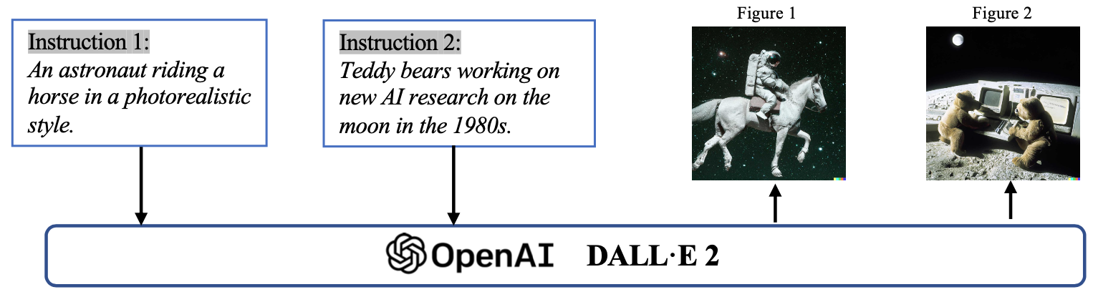
Generative AI (Gen AI)
AI Generated Content (AIGC)
Image Generation
Source: Yihan Cao, Siyu Li, Yixin Liu, Zhiling Yan, Yutong Dai, Philip S. Yu, and Lichao Sun (2023). "A Comprehensive Survey of AI-Generated Content (AIGC): A History of Generative AI from GAN to ChatGPT." arXiv preprint arXiv:2303.04226.

Slide 7
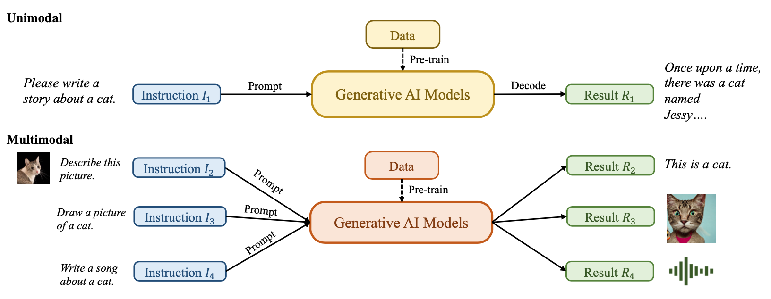
Generative AI (Gen AI)
AI Generated Content (AIGC)
Source: Yihan Cao, Siyu Li, Yixin Liu, Zhiling Yan, Yutong Dai, Philip S. Yu, and Lichao Sun (2023). "A Comprehensive Survey of AI-Generated Content (AIGC): A History of Generative AI from GAN to ChatGPT." arXiv preprint arXiv:2303.04226.

Slide 8
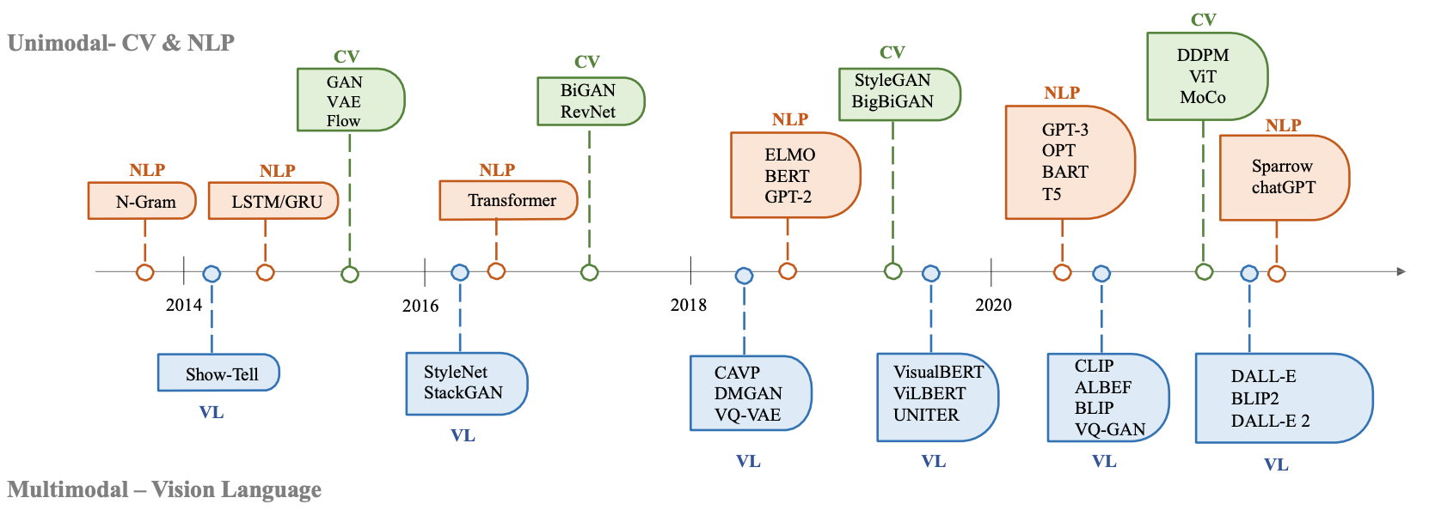
The history of Generative AI in CV, NLP and VL
Source: Yihan Cao, Siyu Li, Yixin Liu, Zhiling Yan, Yutong Dai, Philip S. Yu, and Lichao Sun (2023). "A Comprehensive Survey of AI-Generated Content (AIGC): A History of Generative AI from GAN to ChatGPT." arXiv preprint arXiv:2303.04226.

Slide 9
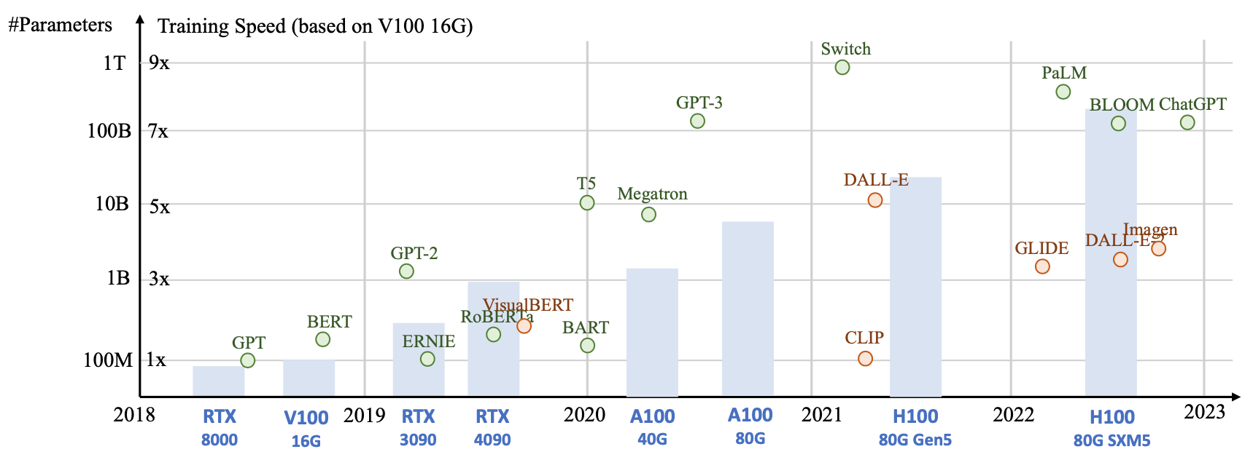
Generative AI
Foundation Models
Source: Yihan Cao, Siyu Li, Yixin Liu, Zhiling Yan, Yutong Dai, Philip S. Yu, and Lichao Sun (2023). "A Comprehensive Survey of AI-Generated Content (AIGC): A History of Generative AI from GAN to ChatGPT." arXiv preprint arXiv:2303.04226.

Slide 10
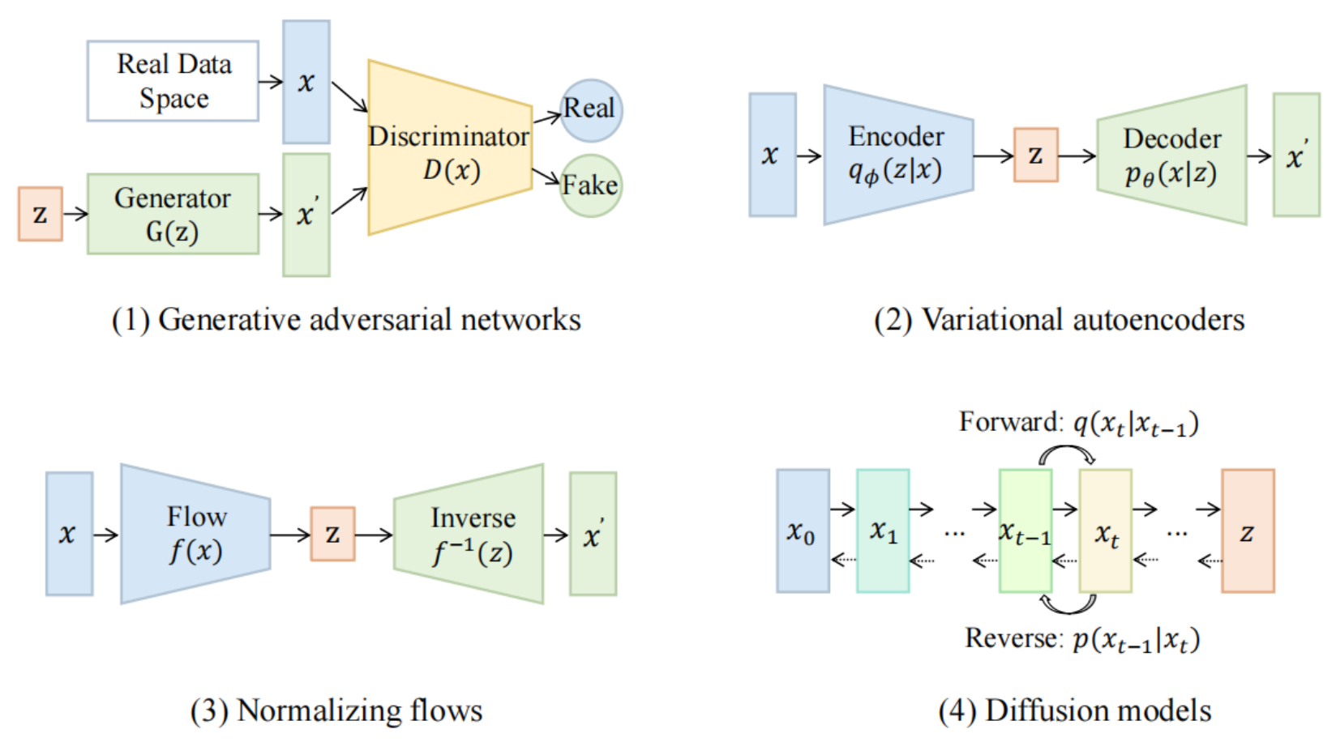
Categories of Vision Generative Models
Source: Yihan Cao, Siyu Li, Yixin Liu, Zhiling Yan, Yutong Dai, Philip S. Yu, and Lichao Sun (2023). "A Comprehensive Survey of AI-Generated Content (AIGC): A History of Generative AI from GAN to ChatGPT." arXiv preprint arXiv:2303.04226.

Slide 11
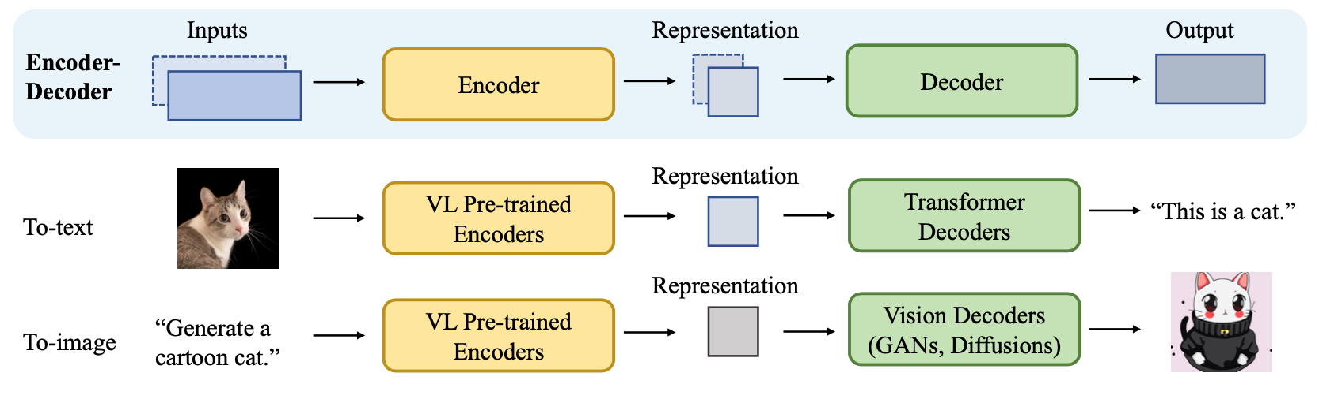
The General Structure of
Generative Vision Language
Source: Yihan Cao, Siyu Li, Yixin Liu, Zhiling Yan, Yutong Dai, Philip S. Yu, and Lichao Sun (2023). "A Comprehensive Survey of AI-Generated Content (AIGC): A History of Generative AI from GAN to ChatGPT." arXiv preprint arXiv:2303.04226.

Slide 12
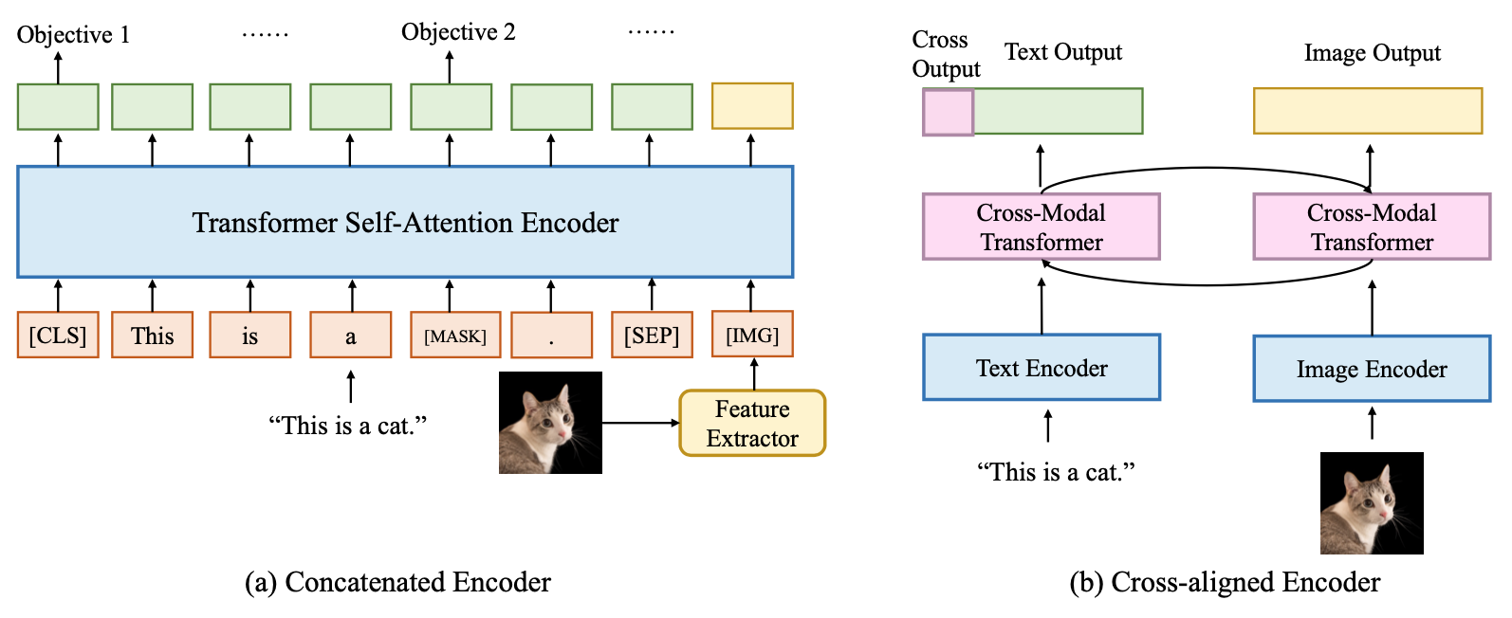
Two Types of Vision Language Encoders: Concatenated Encoders and Cross-aligned Encoders
Source: Yihan Cao, Siyu Li, Yixin Liu, Zhiling Yan, Yutong Dai, Philip S. Yu, and Lichao Sun (2023). "A Comprehensive Survey of AI-Generated Content (AIGC): A History of Generative AI from GAN to ChatGPT." arXiv preprint arXiv:2303.04226.

Slide 13
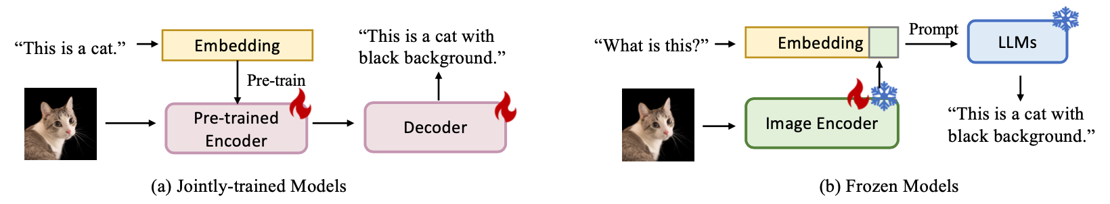
Two Types of to-language Decoder Models: Jointly-trained Models and Frozen Models
Source: Yihan Cao, Siyu Li, Yixin Liu, Zhiling Yan, Yutong Dai, Philip S. Yu, and Lichao Sun (2023). "A Comprehensive Survey of AI-Generated Content (AIGC): A History of Generative AI from GAN to ChatGPT." arXiv preprint arXiv:2303.04226.

Slide 14
Generative AI
Text, Image, Video, Audio Applications

Slide 15
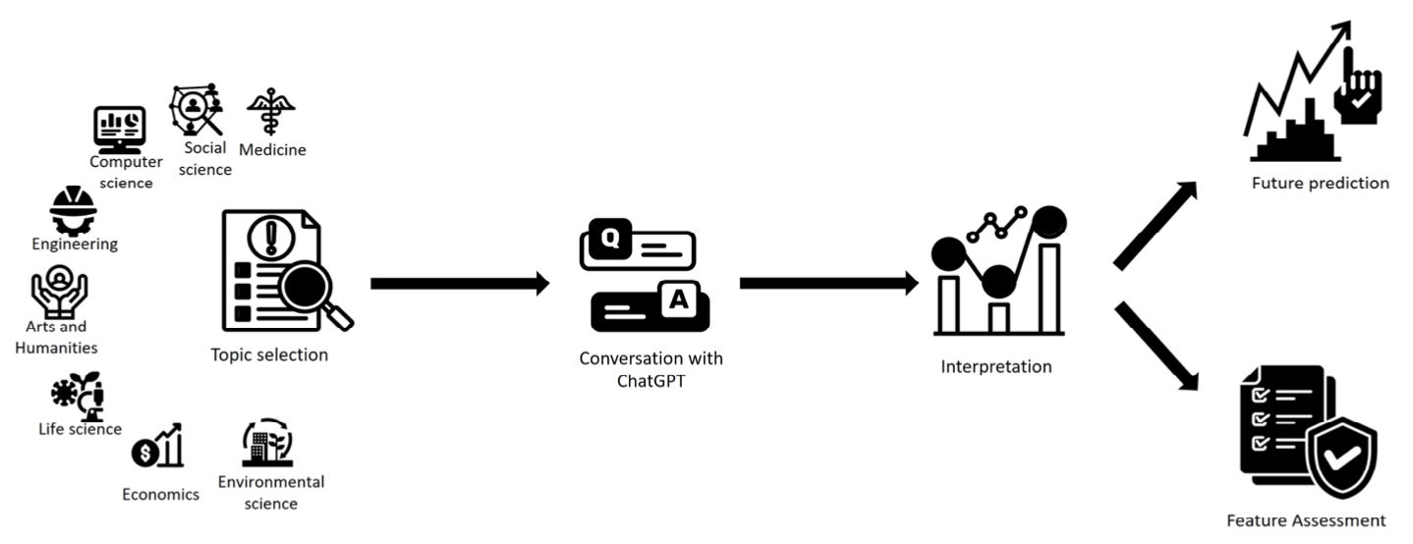
ChatGPT Research
A common trend identified in the reported chatGPT research
Source: Sohail, Shahab Saquib, Faiza Farhat, Yassine Himeur, Mohammad Nadeem, Dag Øivind Madsen, Yashbir Singh, Shadi Atalla, and Wathiq Mansoor. "The Future of GPT: A Taxonomy of Existing ChatGPT Research, Current Challenges, and Possible Future Directions." Current Challenges, and Possible Future Directions (April 8, 2023) (2023).

Slide 16
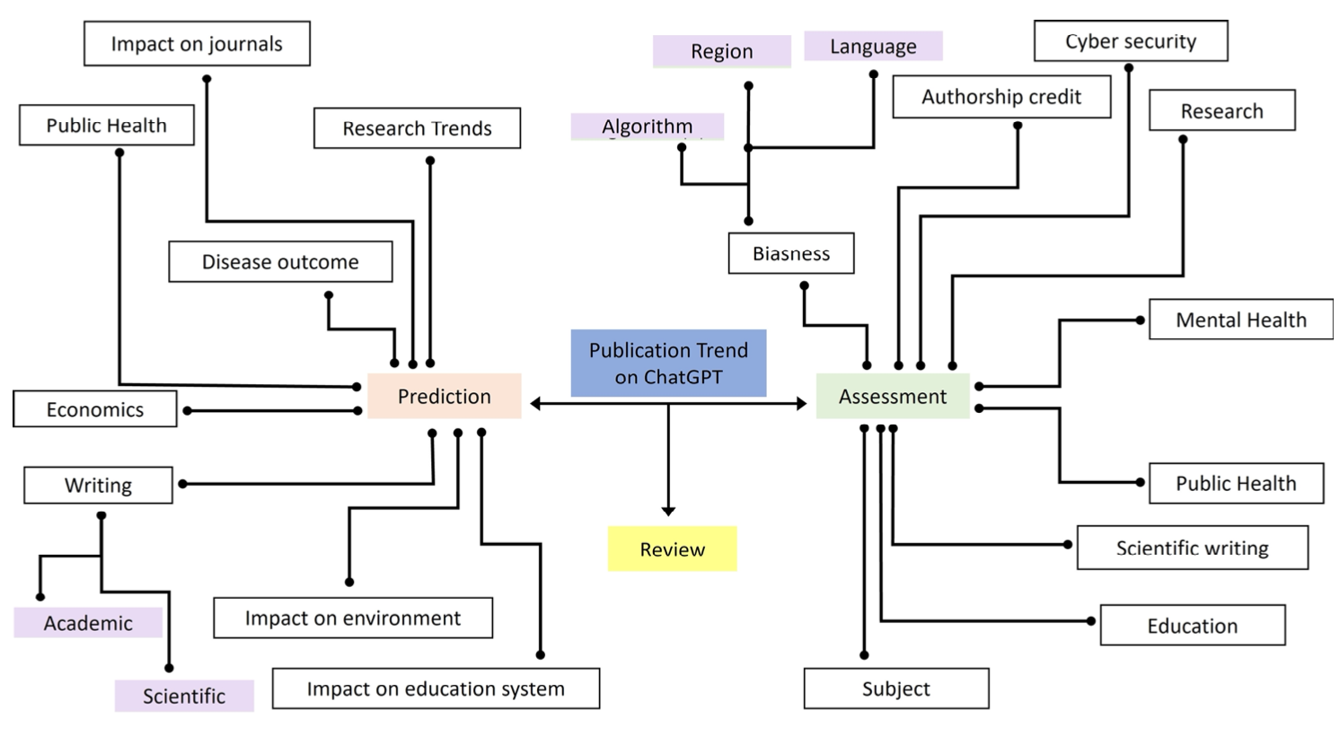
Taxonomy of Literature on ChatGPT
Source: Sohail, Shahab Saquib, Faiza Farhat, Yassine Himeur, Mohammad Nadeem, Dag Øivind Madsen, Yashbir Singh, Shadi Atalla, and Wathiq Mansoor. "The Future of GPT: A Taxonomy of Existing ChatGPT Research, Current Challenges, and Possible Future Directions." Current Challenges, and Possible Future Directions (April 8, 2023) (2023).

Slide 17
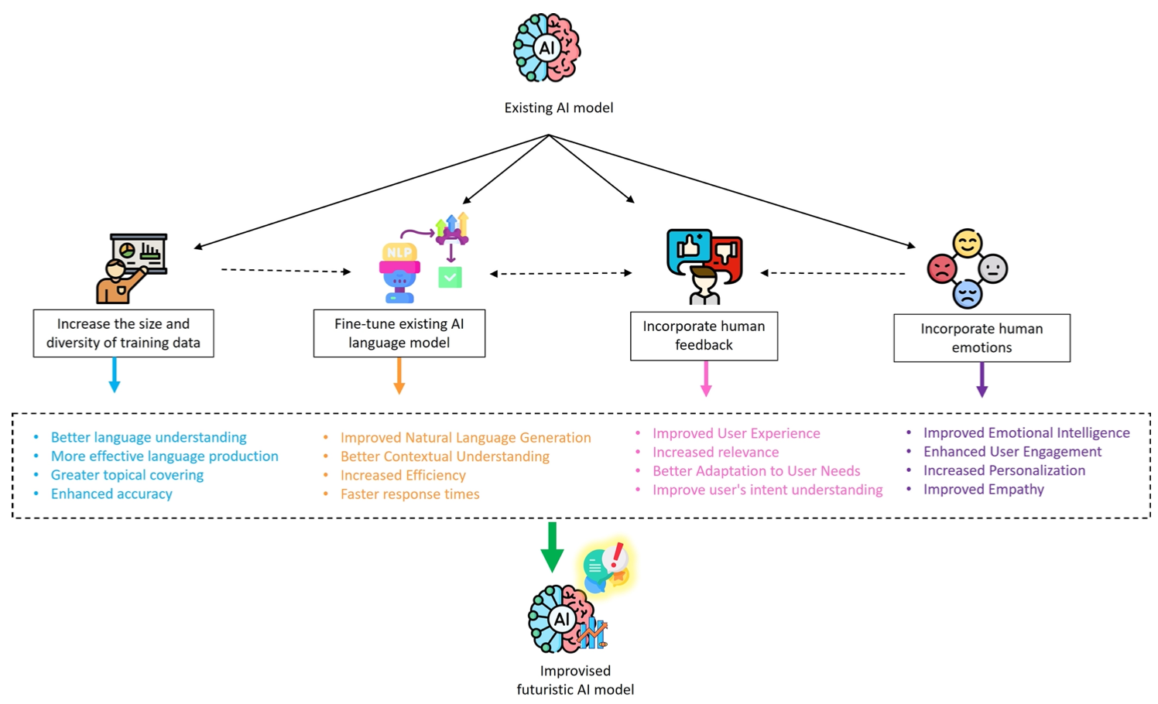
Enhancing the Conversational Ability of ChatGPT
Source: Sohail, Shahab Saquib, Faiza Farhat, Yassine Himeur, Mohammad Nadeem, Dag Øivind Madsen, Yashbir Singh, Shadi Atalla, and Wathiq Mansoor. "The Future of GPT: A Taxonomy of Existing ChatGPT Research, Current Challenges, and Possible Future Directions." Current Challenges, and Possible Future Directions (April 8, 2023) (2023).

Slide 18
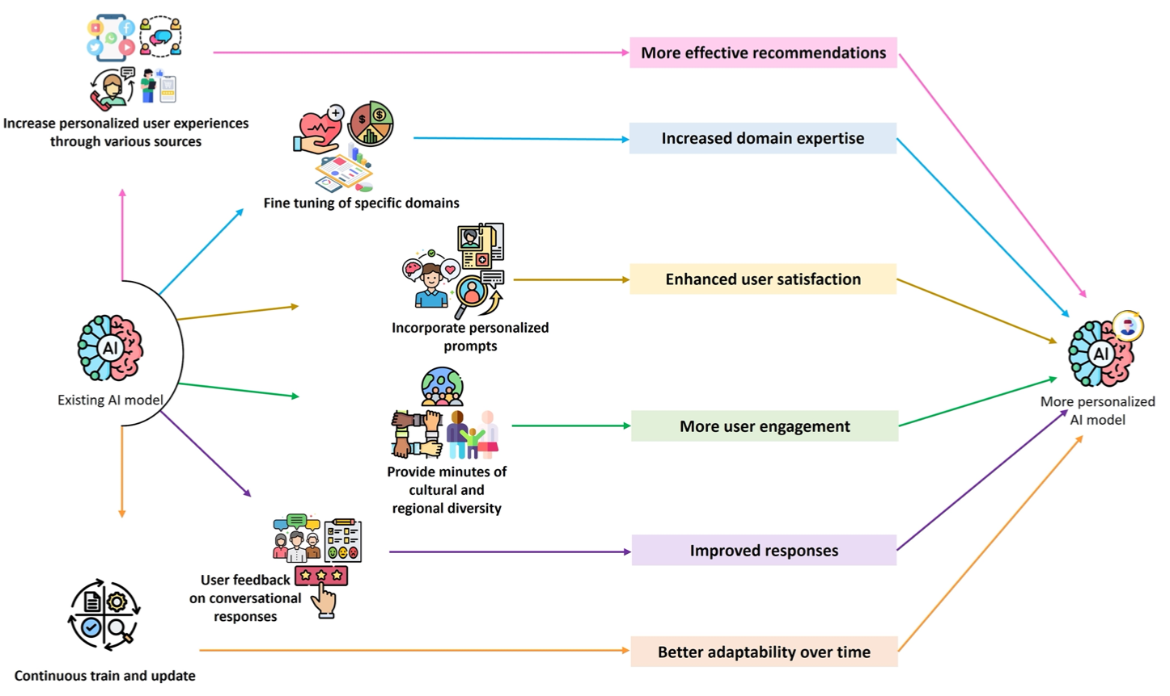
Domain/Person Specific Personalization of ChatGPT
Source: Sohail, Shahab Saquib, Faiza Farhat, Yassine Himeur, Mohammad Nadeem, Dag Øivind Madsen, Yashbir Singh, Shadi Atalla, and Wathiq Mansoor. "The Future of GPT: A Taxonomy of Existing ChatGPT Research, Current Challenges, and Possible Future Directions." Current Challenges, and Possible Future Directions (April 8, 2023) (2023).

Slide 19
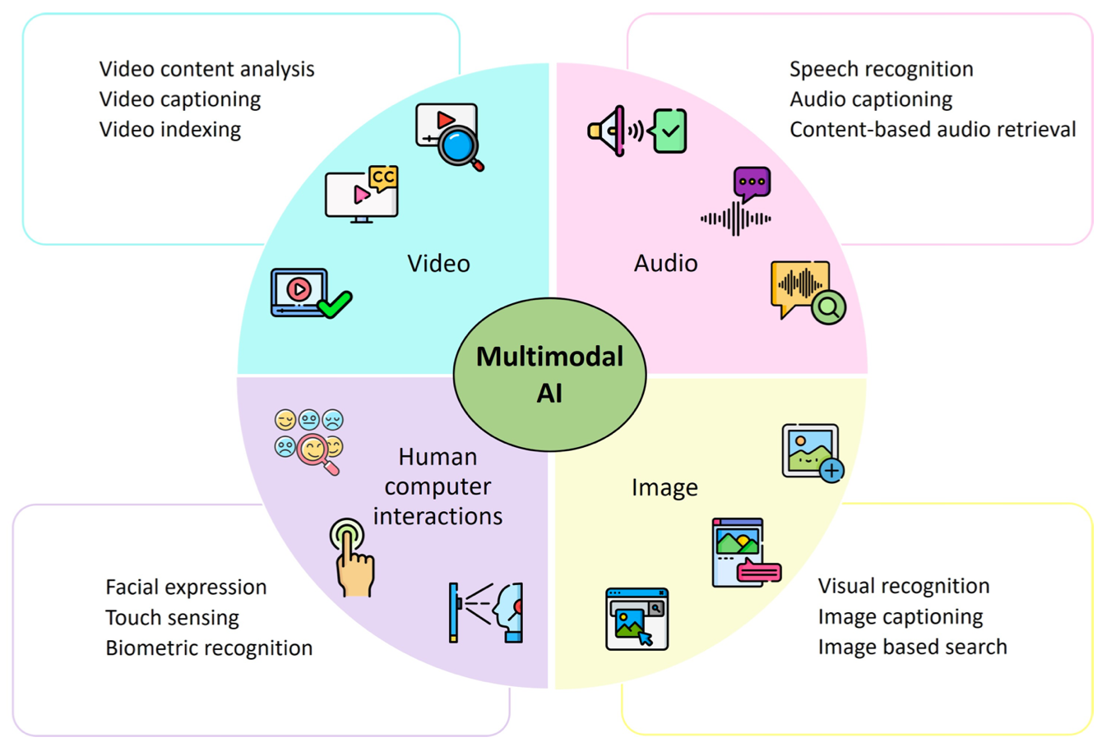
Technological Integration for Multimodal AI
Source: Sohail, Shahab Saquib, Faiza Farhat, Yassine Himeur, Mohammad Nadeem, Dag Øivind Madsen, Yashbir Singh, Shadi Atalla, and Wathiq Mansoor. "The Future of GPT: A Taxonomy of Existing ChatGPT Research, Current Challenges, and Possible Future Directions." Current Challenges, and Possible Future Directions (April 8, 2023) (2023).

Slide 20
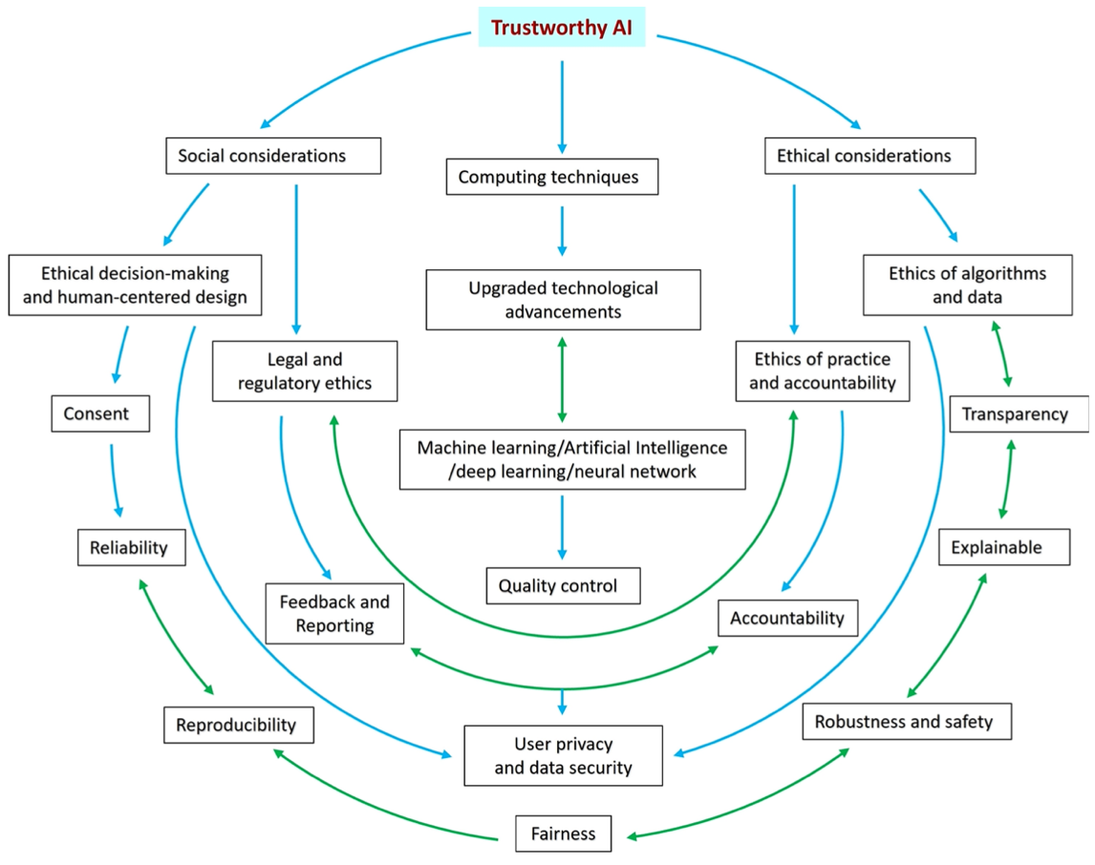
Trustworthy AI: Interplay of Various Factors
Source: Sohail, Shahab Saquib, Faiza Farhat, Yassine Himeur, Mohammad Nadeem, Dag Øivind Madsen, Yashbir Singh, Shadi Atalla, and Wathiq Mansoor. "The Future of GPT: A Taxonomy of Existing ChatGPT Research, Current Challenges, and Possible Future Directions." Current Challenges, and Possible Future Directions (April 8, 2023) (2023).

Slide 21
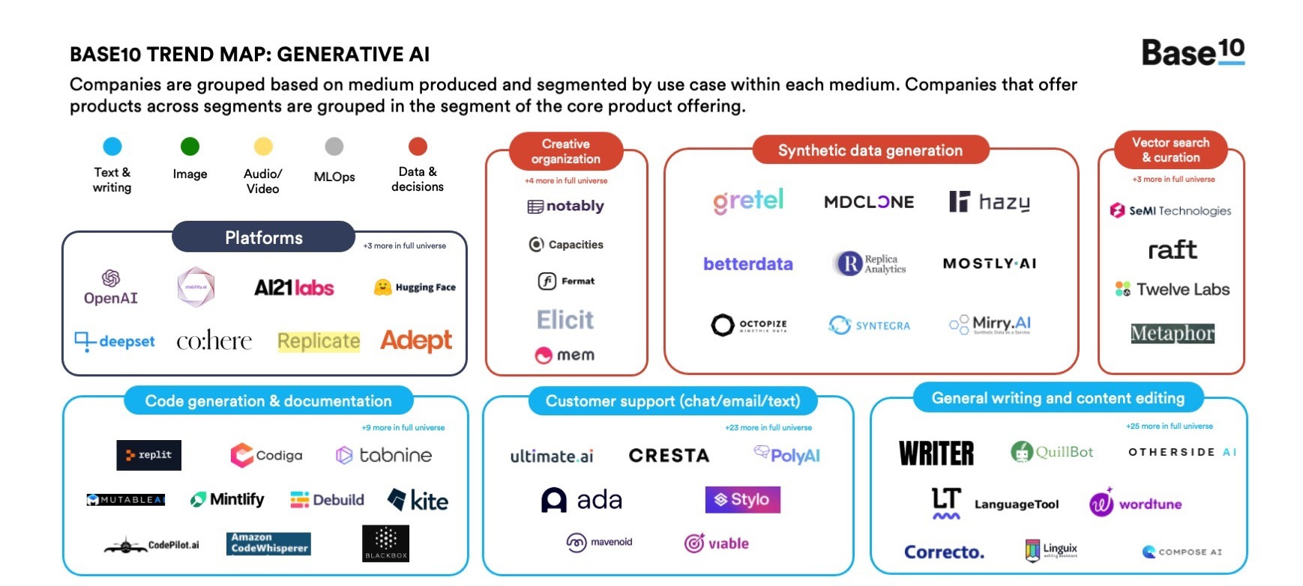
Generative AI
Source: https://base10.vc/post/generative-ai-mission-critical/

Slide 22
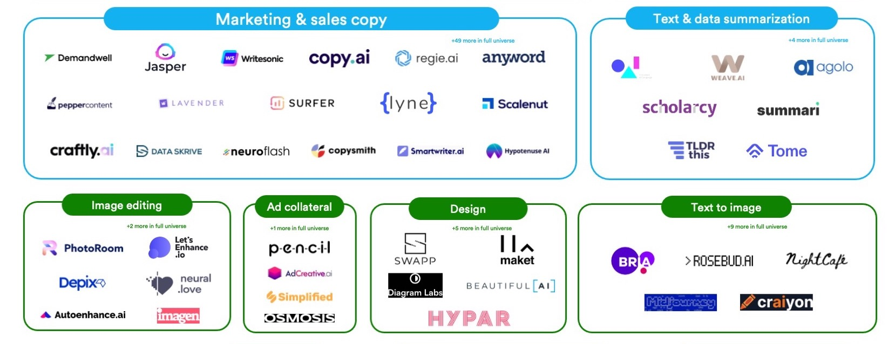
Generative AI
Source: https://base10.vc/post/generative-ai-mission-critical/

Slide 23
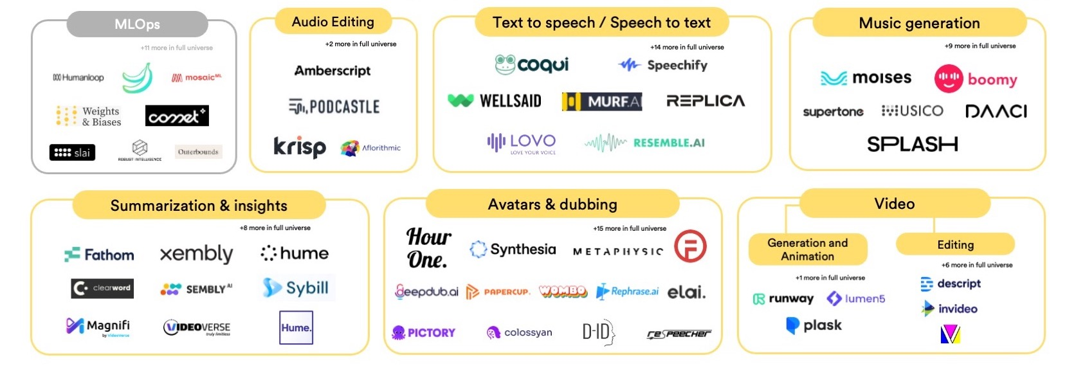
Generative AI
Source: https://base10.vc/post/generative-ai-mission-critical/

Slide 24
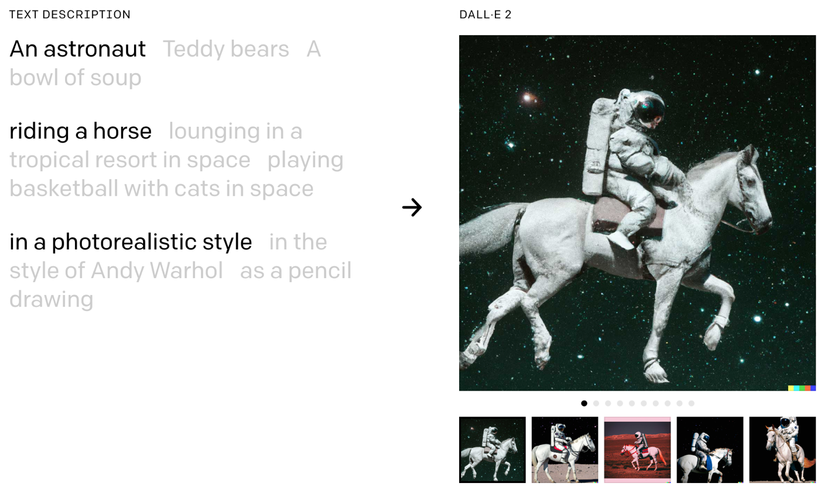
DALL·E 2
Create original, realistic images and art from a text description.
It can combine concepts, attributes, and styles.
https://openai.com/dall-e-2/

Slide 25
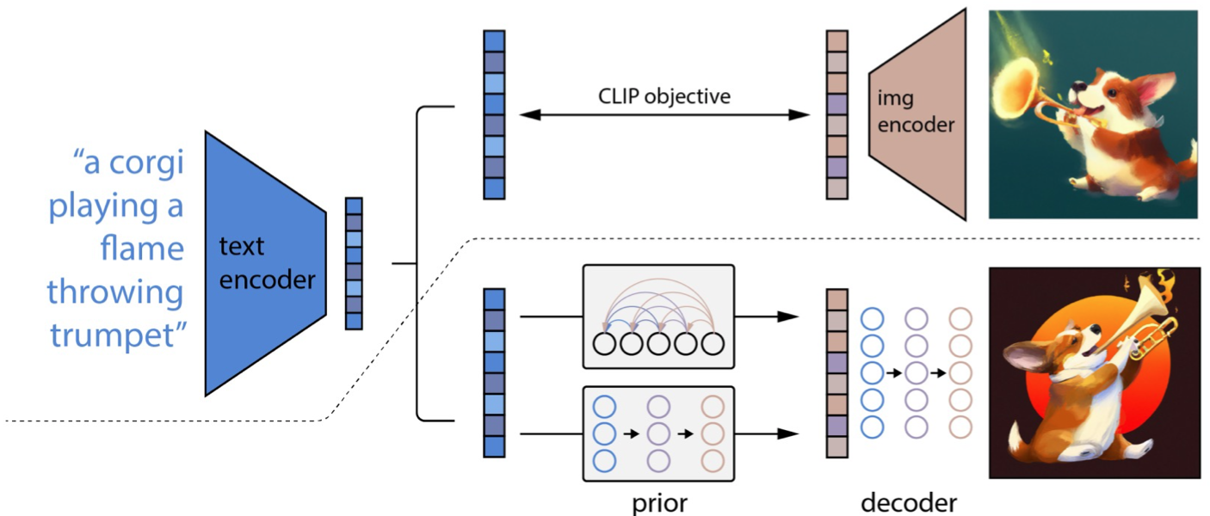
The Model Structure of DALL-E-2
CLIP Pre-training
Image Generation
Source: Yihan Cao, Siyu Li, Yixin Liu, Zhiling Yan, Yutong Dai, Philip S. Yu, and Lichao Sun (2023). "A Comprehensive Survey of AI-Generated Content (AIGC): A History of Generative AI from GAN to ChatGPT." arXiv preprint arXiv:2303.04226.

Slide 26
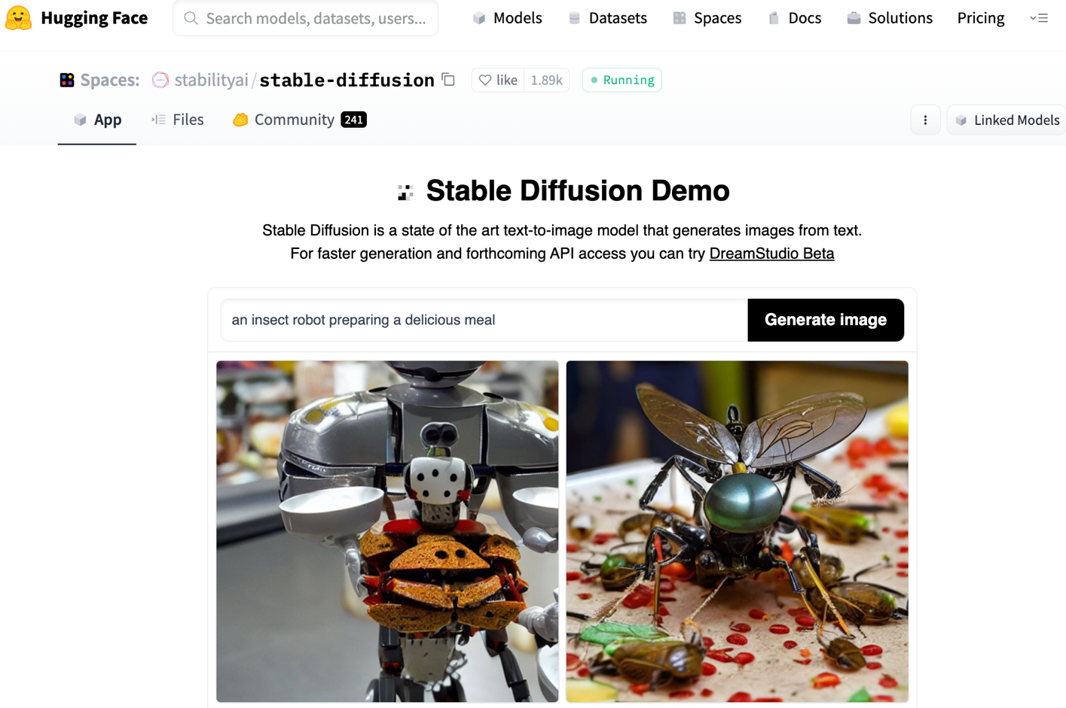
Stable Diffusion
https://huggingface.co/spaces/stabilityai/stable-diffusion

Slide 27
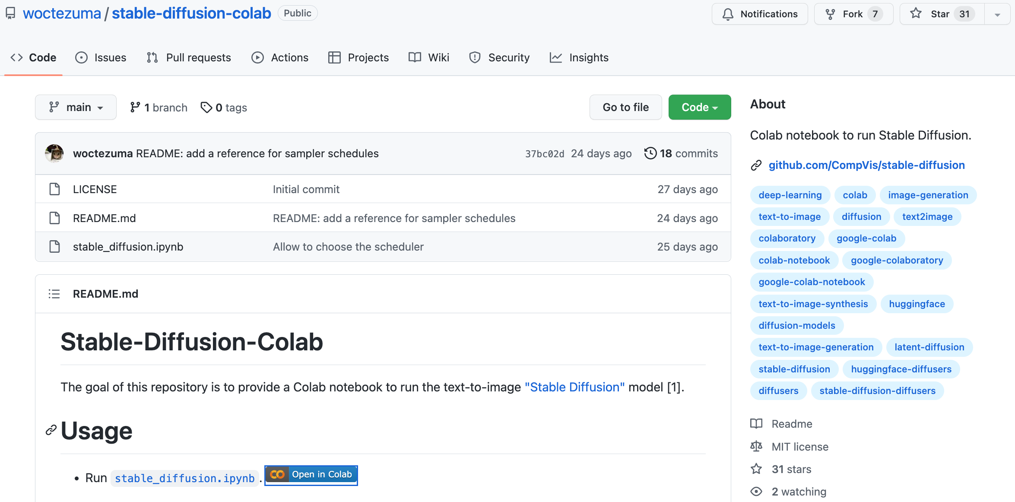
Stable Diffusion Colab
https://github.com/woctezuma/stable-diffusion-colab

Slide 28
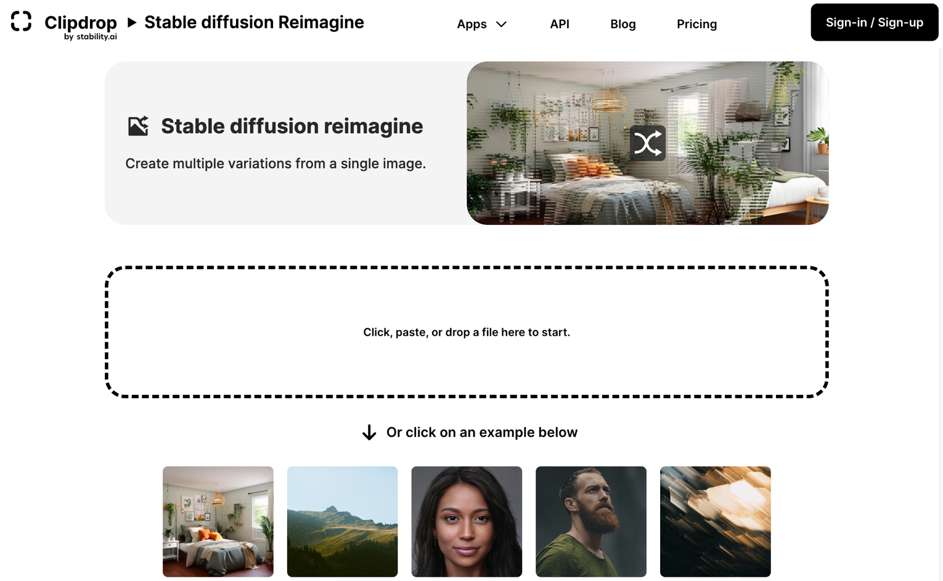
Stable Diffusion Reimagine
https://clipdrop.co/stable-diffusion-reimagine

Slide 29
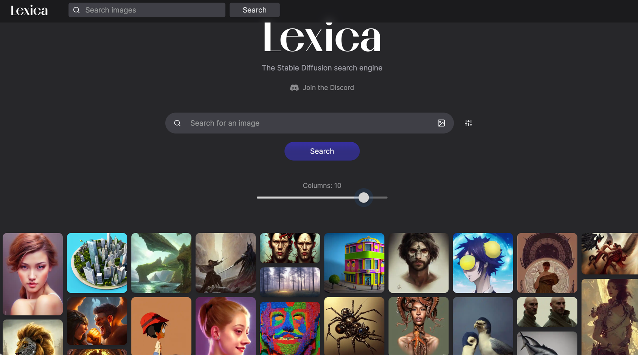
Lexica Art: Search Stable Diffusion images and prompts
https://lexica.art/

Slide 30

Civitai: Stable Diffusion AI Art Models
https://civitai.com/

Slide 31
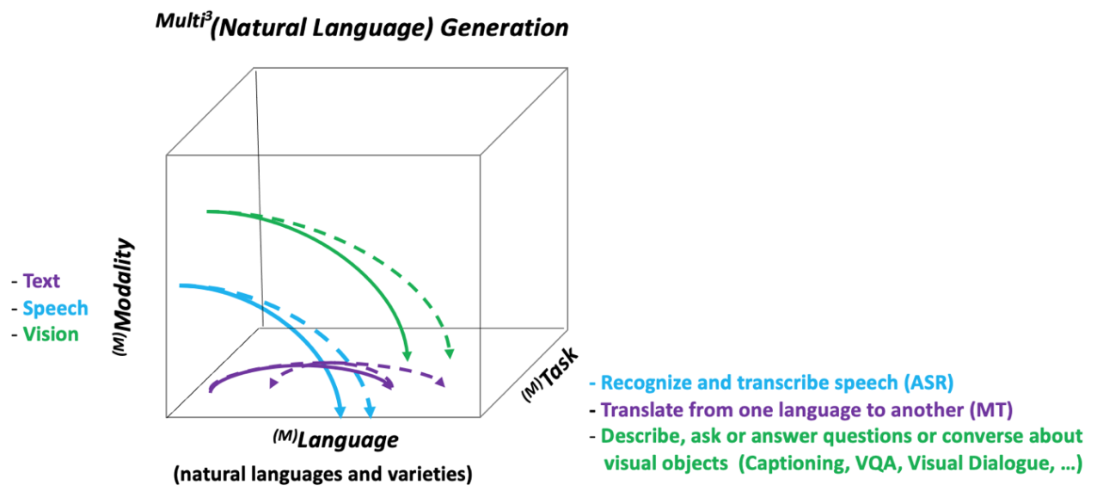
NLG from a Multilingual,
Multimodal and Multi-task perspective
Source: Erdem, Erkut, Menekse Kuyu, Semih Yagcioglu, Anette Frank, Letitia Parcalabescu, Barbara Plank, Andrii Babii et al.
"Neural Natural Language Generation: A Survey on Multilinguality, Multimodality, Controllability and Learning." Journal of Artificial Intelligence Research 73 (2022): 1131-1207.

Slide 32
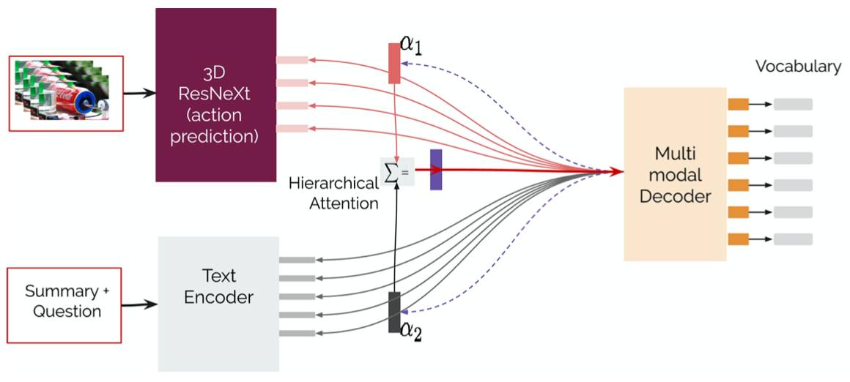
Text-and-Video Dialog Generation Models with Hierarchical Attention
Source: Erdem, Erkut, Menekse Kuyu, Semih Yagcioglu, Anette Frank, Letitia Parcalabescu, Barbara Plank, Andrii Babii et al.
"Neural Natural Language Generation: A Survey on Multilinguality, Multimodality, Controllability and Learning." Journal of Artificial Intelligence Research 73 (2022): 1131-1207.

Slide 33
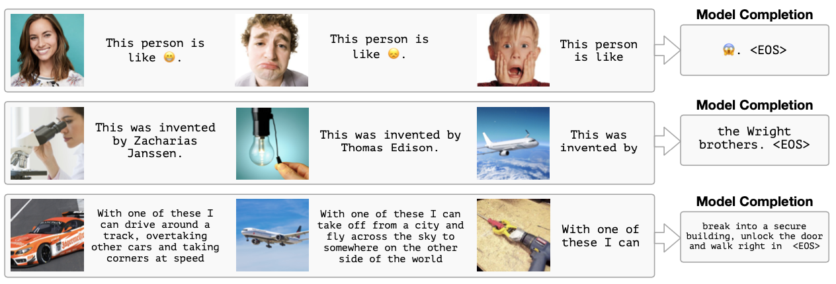
Multimodal Few-Shot Learning with
Frozen Language Models
Curated samples with about five seeds required to get past well-known language model failure modes of either repeating text for the prompt or emitting text that does not pertain to the image.
These samples demonstrate the ability to generate open-ended outputs that adapt to both images and text, and to make use of facts that it has learned during language-only pre-training.
Source: Maria Tsimpoukelli, Jacob L. Menick, Serkan Cabi, S. M. Eslami, Oriol Vinyals, and Felix Hill (2021). "Multimodal few-shot learning with frozen language models."
Advances in Neural Information Processing Systems 34 (2021): 200-212.

Slide 34
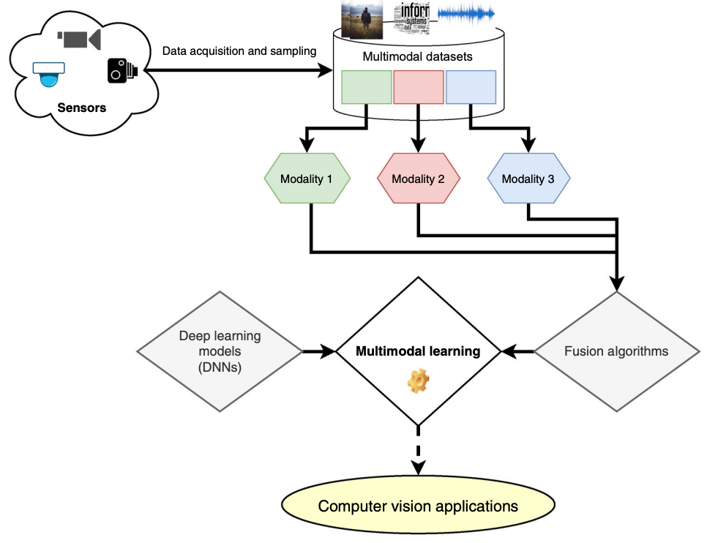
Multimodal Pipeline that includes three different modalities (Image, Text. Audio)
Source: Bayoudh, Khaled, Raja Knani, Fayçal Hamdaoui, and Abdellatif Mtibaa (2022).
"A survey on deep multimodal learning for computer vision: advances, trends, applications, and datasets." The Visual Computer 38, no. 8: 2939-2970.

Slide 35
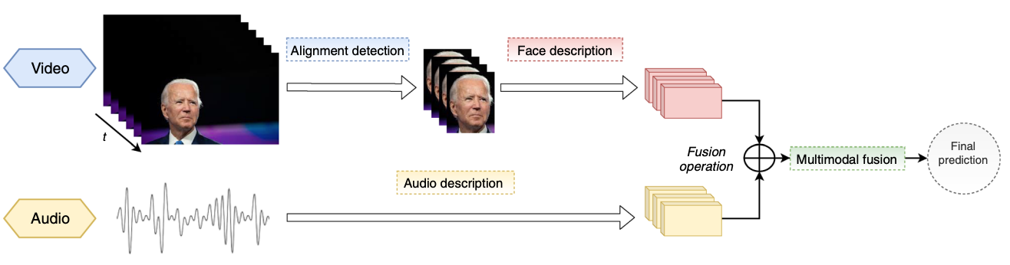
Video and Audio Multimodal Fusion
Source: Bayoudh, Khaled, Raja Knani, Fayçal Hamdaoui, and Abdellatif Mtibaa (2022).
"A survey on deep multimodal learning for computer vision: advances, trends, applications, and datasets." The Visual Computer 38, no. 8: 2939-2970.

Slide 36
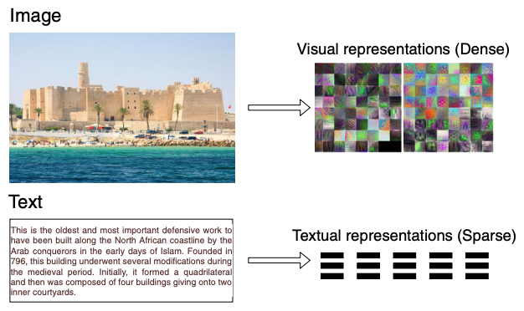
Visual and Textual Representation
Source: Bayoudh, Khaled, Raja Knani, Fayçal Hamdaoui, and Abdellatif Mtibaa (2022).
"A survey on deep multimodal learning for computer vision: advances, trends, applications, and datasets." The Visual Computer 38, no. 8: 2939-2970.

Slide 37
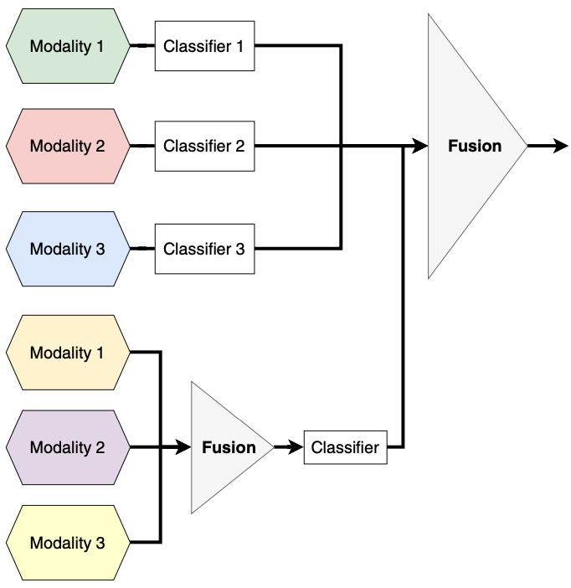
Hybrid Multimodal Data Fusion
Text
Audio
Image
Text
Speech
Video
Source: Bayoudh, Khaled, Raja Knani, Fayçal Hamdaoui, and Abdellatif Mtibaa (2022).
"A survey on deep multimodal learning for computer vision: advances, trends, applications, and datasets." The Visual Computer 38, no. 8: 2939-2970.

Slide 38
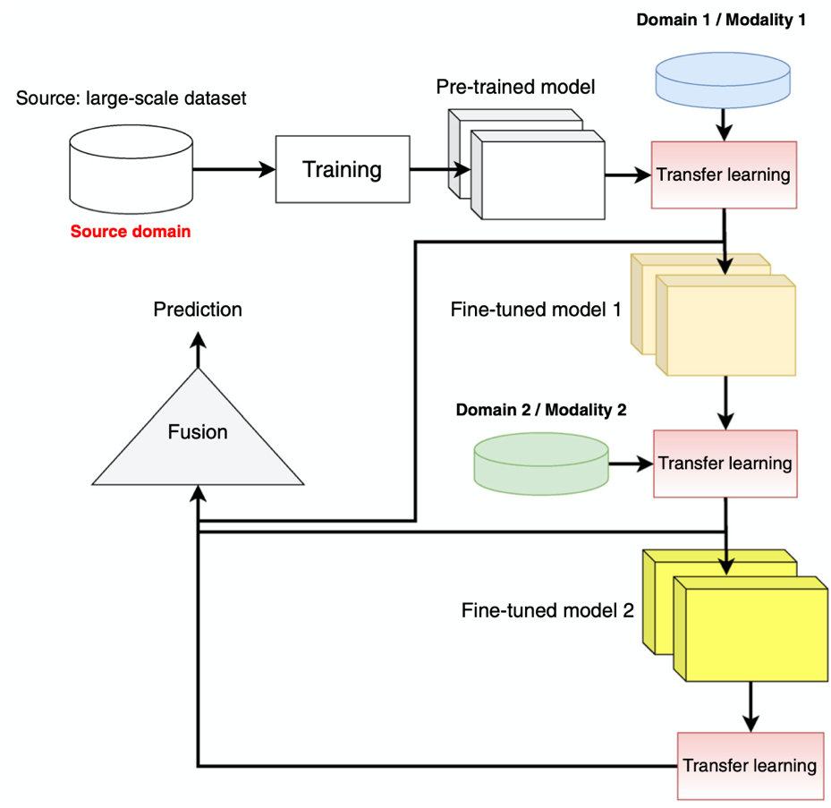
Multimodal Transfer Learning
Source: Bayoudh, Khaled, Raja Knani, Fayçal Hamdaoui, and Abdellatif Mtibaa (2022).
"A survey on deep multimodal learning for computer vision: advances, trends, applications, and datasets." The Visual Computer 38, no. 8: 2939-2970.

Slide 39
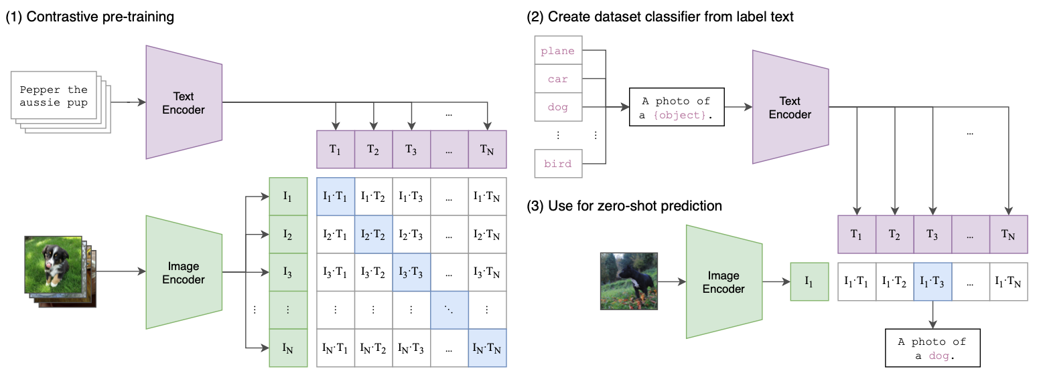
CLIP: Learning Transferable Visual Models From Natural Language Supervision
Source: Radford, Alec, Jong Wook Kim, Chris Hallacy, Aditya Ramesh, Gabriel Goh, Sandhini Agarwal, Girish Sastry et al. (2021) "Learning transferable visual models from natural language supervision." In International Conference on Machine Learning, pp. 8748-8763. PMLR.

Slide 40
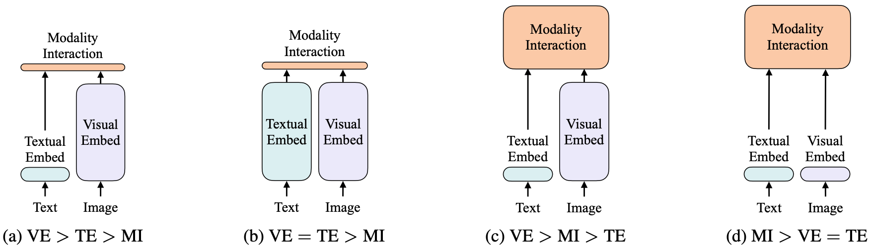
ViLT: Vision-and-Language Transformer Without Convolution or Region Supervision
Source: Kim, Wonjae, Bokyung Son, and Ildoo Kim (2021). "Vilt: Vision-and-language transformer without convolution or region supervision."
In International Conference on Machine Learning, pp. 5583-5594. PMLR.

Slide 41
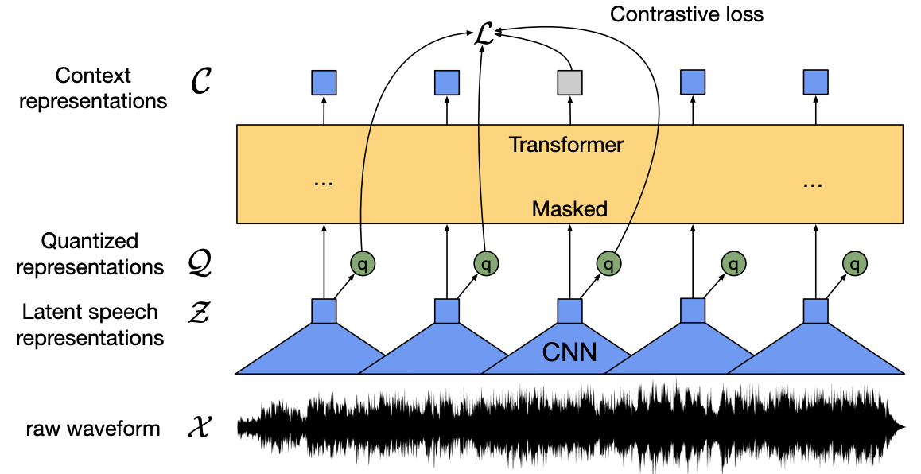
wav2vec 2.0:
A framework for self-supervised learning of speech representations
Source: Baevski, Alexei, Yuhao Zhou, Abdelrahman Mohamed, and Michael Auli.
"wav2vec 2.0: A framework for self-supervised learning of speech representations." Advances in Neural Information Processing Systems 33 (2020): 12449-12460.

Slide 42
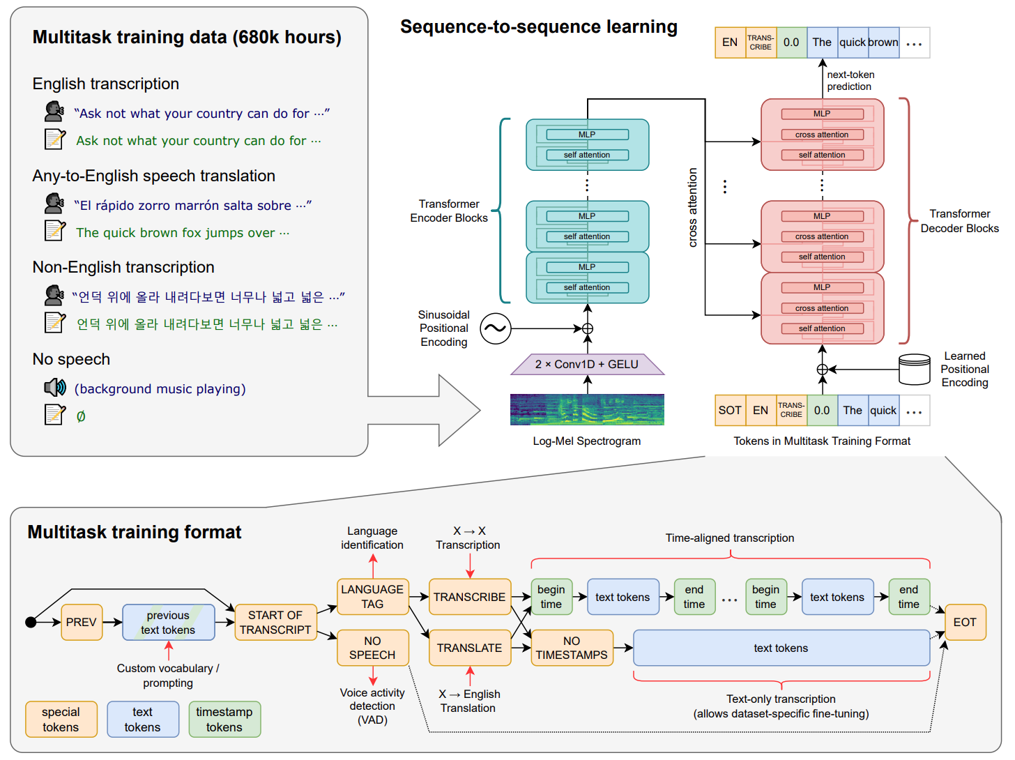
Whisper:
Robust Speech Recognition via Large-Scale Weak Supervision
Source: Radford, Alec, Jong Wook Kim, Tao Xu, Greg Brockman, Christine McLeavey, and Ilya Sutskever. Robust speech recognition via large-scale weak supervision. Tech. Rep., Technical report, OpenAI, 2022.

Slide 43
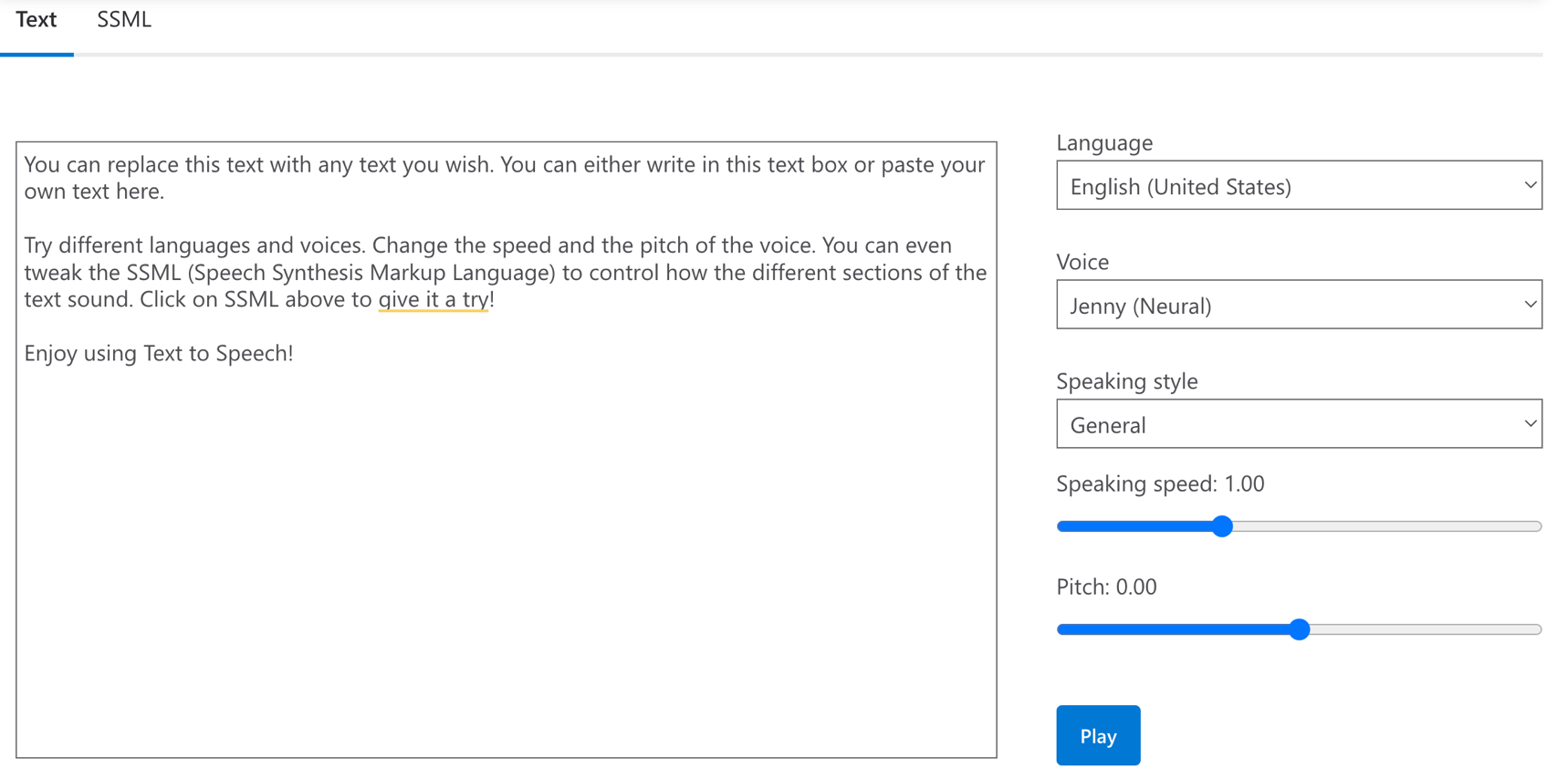
Microsoft Azure
Text to Speech (TTS)
Source: https://azure.microsoft.com/en-gb/products/cognitive-services/text-to-speech/

Slide 44
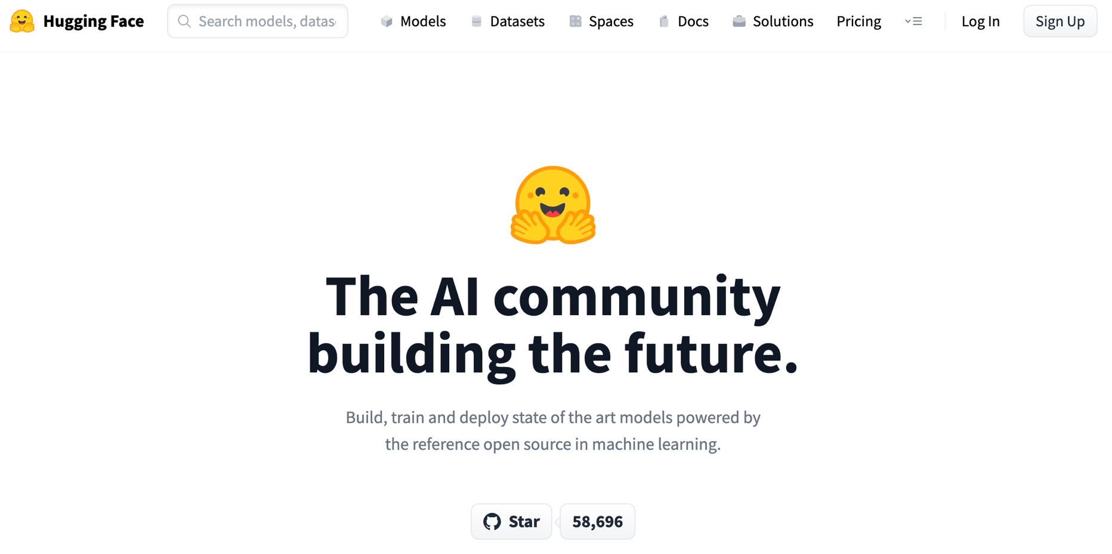
Hugging Face
https://huggingface.co/

Slide 45
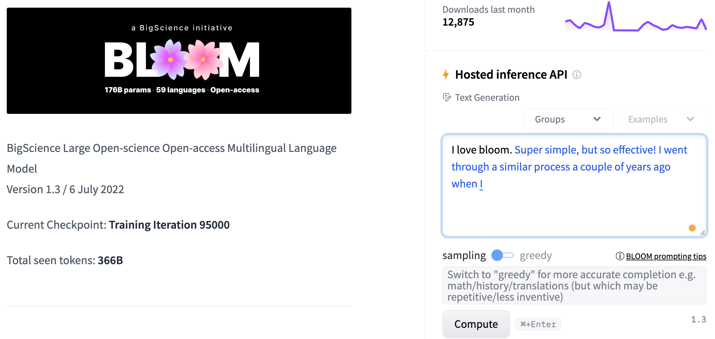
BLOOM
BigScience Large Open-science Open-access Multilingual Language Model
Source: https://huggingface.co/bigscience/bloom

Slide 46
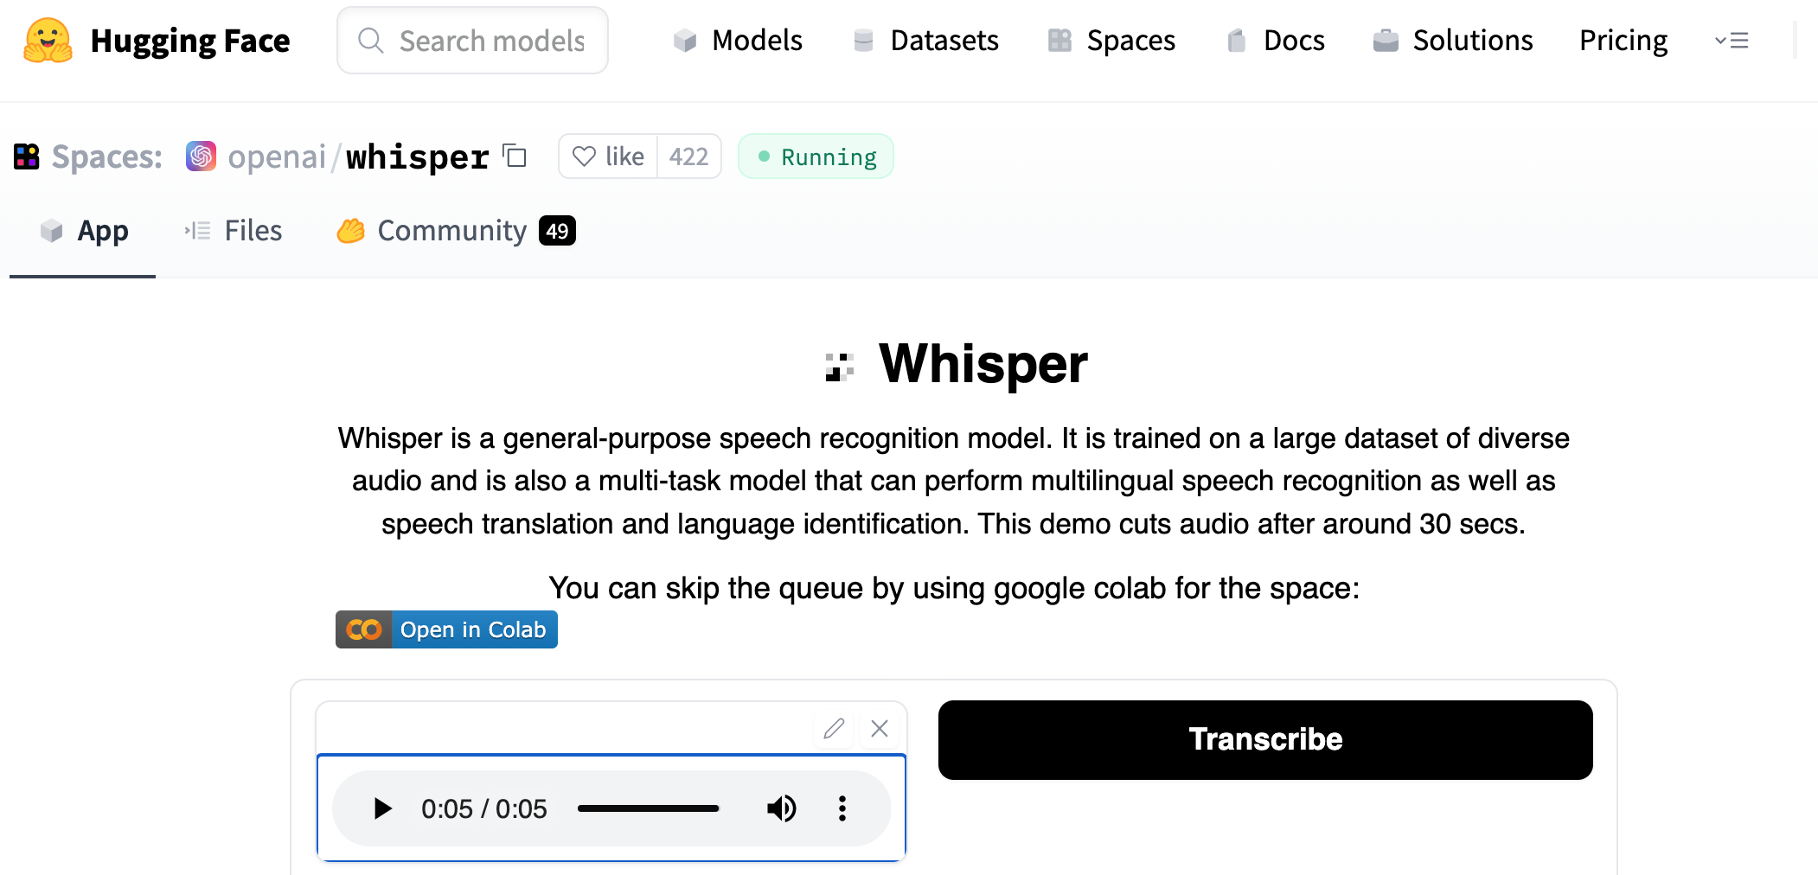
OpenAI Whisper
Source: https://huggingface.co/spaces/openai/whisper

Slide 47
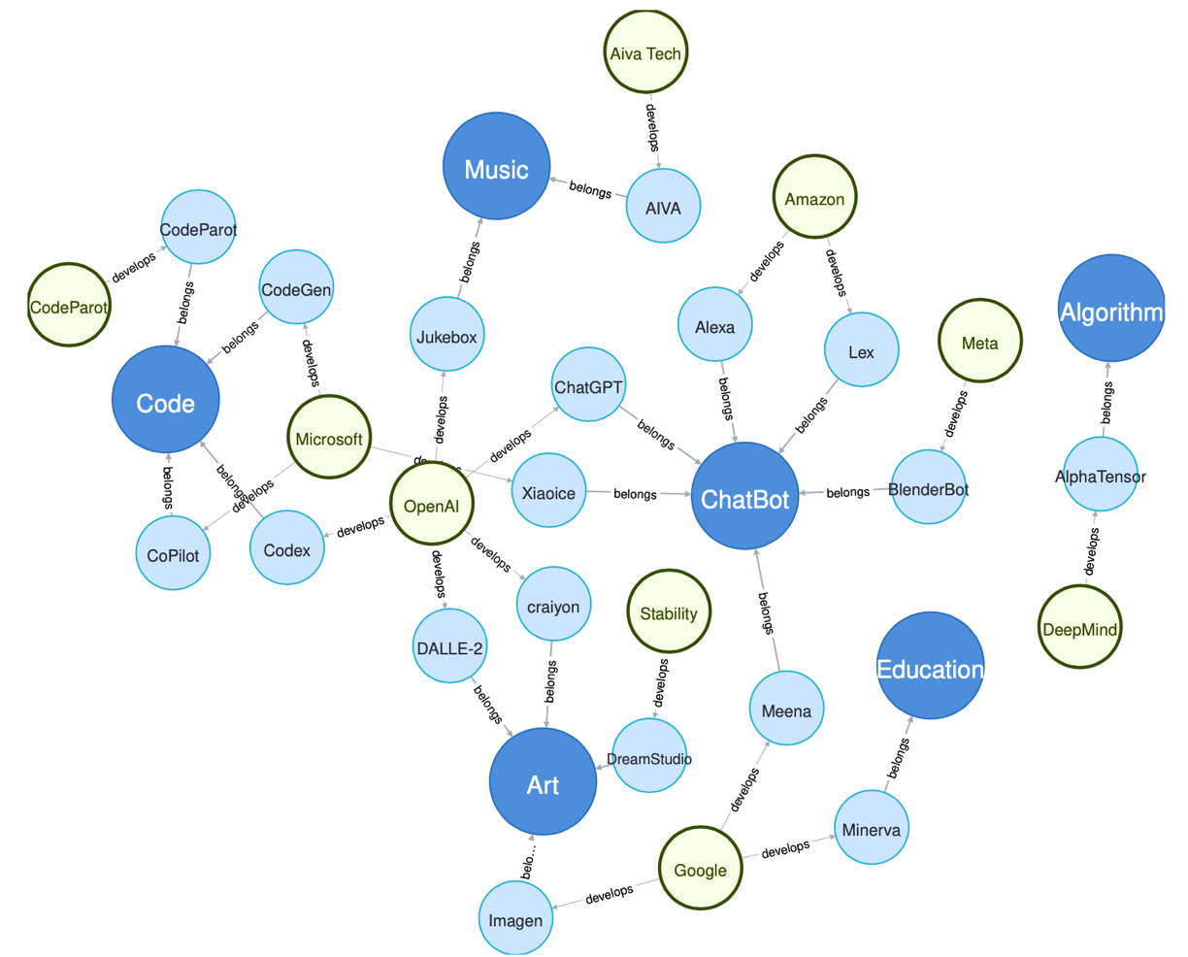
Generative AI
Research Areas,
Applications and
Companies
Source: Yihan Cao, Siyu Li, Yixin Liu, Zhiling Yan, Yutong Dai, Philip S. Yu, and Lichao Sun (2023). "A Comprehensive Survey of AI-Generated Content (AIGC): A History of Generative AI from GAN to ChatGPT." arXiv preprint arXiv:2303.04226.

Slide 48
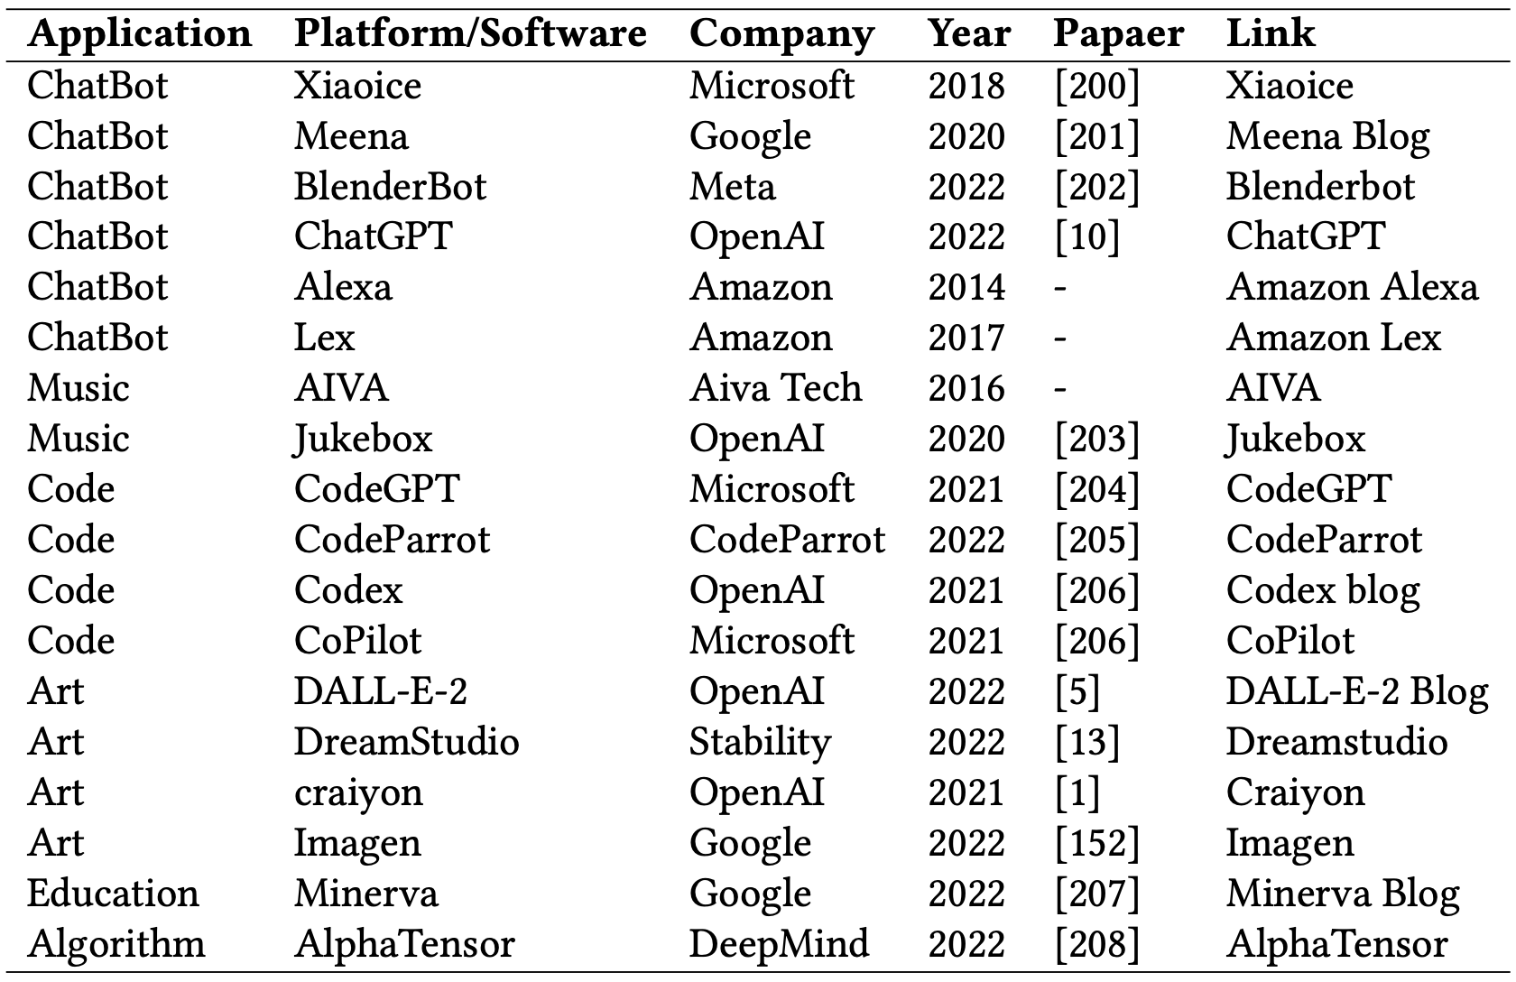
Applications of Generative AI Models
Source: Yihan Cao, Siyu Li, Yixin Liu, Zhiling Yan, Yutong Dai, Philip S. Yu, and Lichao Sun (2023). "A Comprehensive Survey of AI-Generated Content (AIGC): A History of Generative AI from GAN to ChatGPT." arXiv preprint arXiv:2303.04226.

Slide 49
Outline
Overview of Generative AI
Overview of Large Language Models (LLMs)
Fine-tuning LLM for Dialogue System
Challenges and Limitations of Generative AI
for Dialogue Systems

Slide 50
Large Language Models (LLMs)
Foundation Models

Slide 51
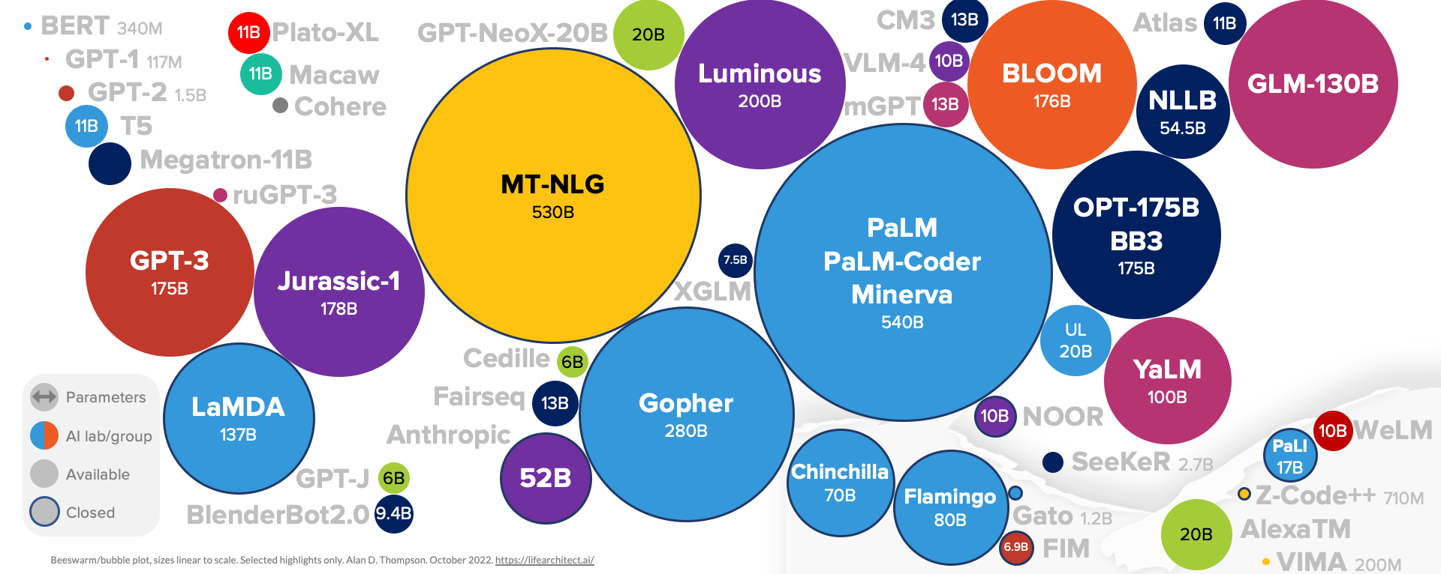
Large Language Models (LLM)
(GPT-3, ChatGPT, PaLM, BLOOM, OPT-175B, LLaMA)
ChatGPT
175B
LLaMA
65B
Source: https://lifearchitect.ai/models/

Slide 52
The Transformers Timeline
ULMFit
BERT
RoBERTa
XLM-R
DeBERTa
GPT-Neo
BLOOM
Alpaca
DistrilBERT
T5
PaLM
ChatGPT
Llama2
Transformer
GPT
GPT-2
GPT-3
GPT-J
OPT-175B
Llama
2017
2018
2019
2020
2021
2022
2023
Source: Lewis Tunstall, Leandro von Werra, and Thomas Wolf (2022), Natural Language Processing with Transformers: Building Language Applications with Hugging Face, O'Reilly Media.

Slide 53
Transformer Models
Transformer
Encoder
Decoder
DistilBERT
BERT
T5
GPT
RoBERTa
BART
GPT-2
CTRL
XLM-R
XLM
M2M-100
GPT-3
ALBERT
BigBird
GPT-Neo
GPT-J
ELECTRA
mT0
BLOOM
BLOOMZ
DeBERTa
ChatGPT
GPT-4
Source: Lewis Tunstall, Leandro von Werra, and Thomas Wolf (2022), Natural Language Processing with Transformers: Building Language Applications with Hugging Face, O'Reilly Media.

Slide 54
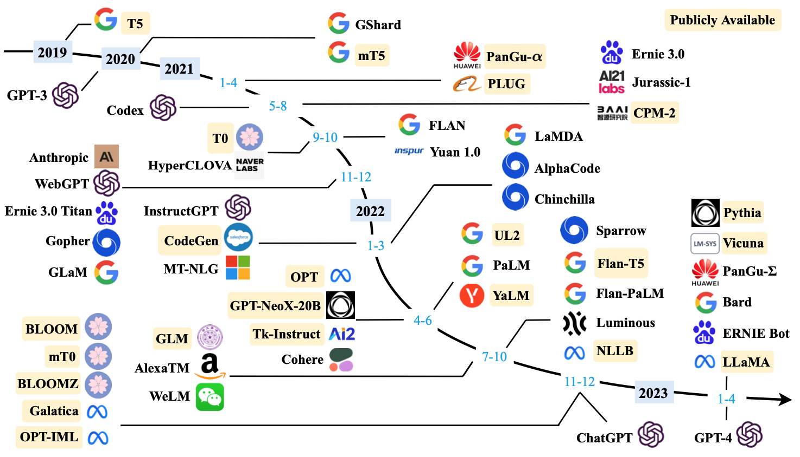
Large Language Models (LLMs) (larger than 10B)
Source: Wayne Xin Zhao, Kun Zhou, Junyi Li, Tianyi Tang, Xiaolei Wang, Yupeng Hou, Yingqian Min et al. (2023) "A Survey of Large Language Models." arXiv preprint arXiv:2303.18223.

Slide 55
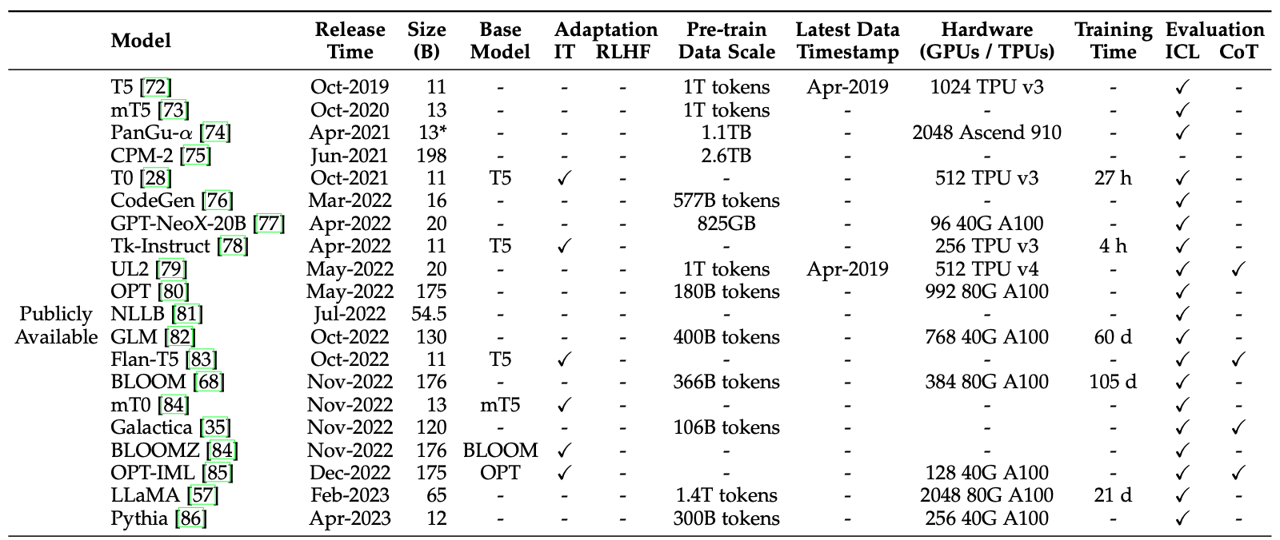
Large Language Models (LLMs) (larger than 10B)
Source: Wayne Xin Zhao, Kun Zhou, Junyi Li, Tianyi Tang, Xiaolei Wang, Yupeng Hou, Yingqian Min et al. (2023) "A Survey of Large Language Models." arXiv preprint arXiv:2303.18223.

Slide 56
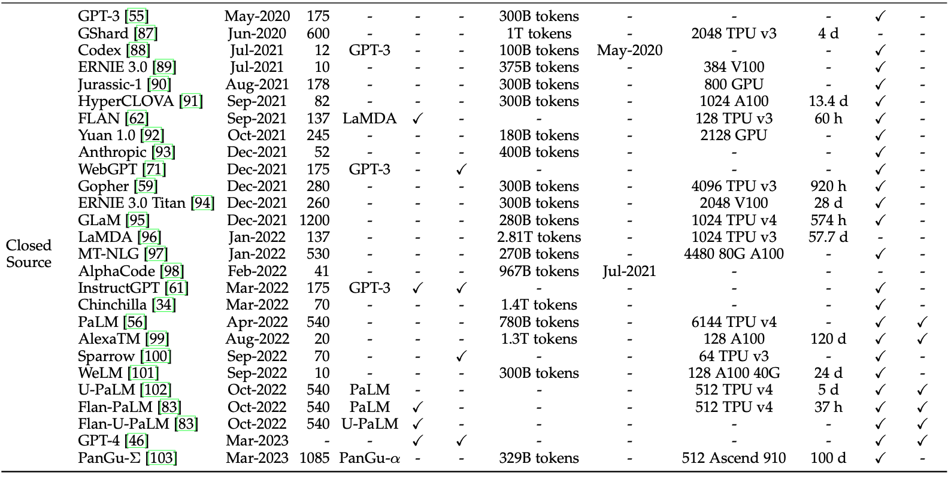
Large Language Models (LLMs) (larger than 10B)
Source: Wayne Xin Zhao, Kun Zhou, Junyi Li, Tianyi Tang, Xiaolei Wang, Yupeng Hou, Yingqian Min et al. (2023) "A Survey of Large Language Models." arXiv preprint arXiv:2303.18223.

Slide 57
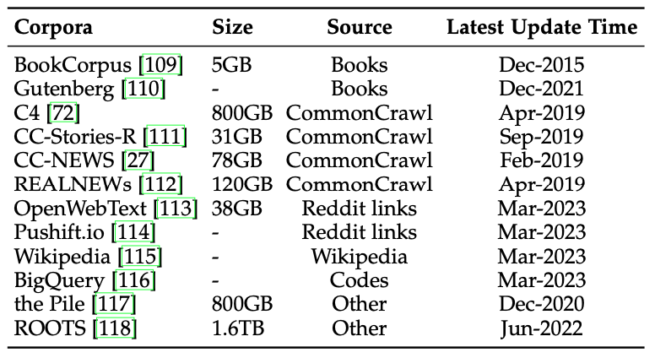
Statistics of Commonly-used Data Sources for LLMs
Source: Wayne Xin Zhao, Kun Zhou, Junyi Li, Tianyi Tang, Xiaolei Wang, Yupeng Hou, Yingqian Min et al. (2023) "A Survey of Large Language Models." arXiv preprint arXiv:2303.18223.

Slide 58
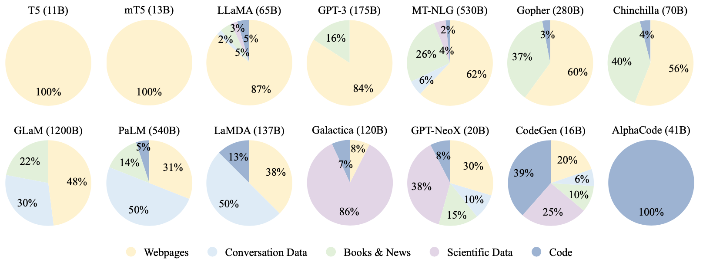
Ratios of various data sources in the pre-training data for existing LLMs
Source: Wayne Xin Zhao, Kun Zhou, Junyi Li, Tianyi Tang, Xiaolei Wang, Yupeng Hou, Yingqian Min et al. (2023) "A Survey of Large Language Models." arXiv preprint arXiv:2303.18223.

Slide 59
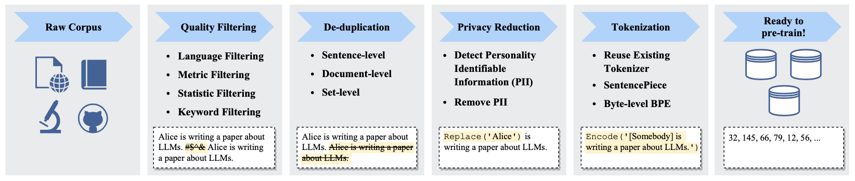
Typical Data Preprocessing Pipeline for
Pre-training Large Language Models (LLMs)
Source: Wayne Xin Zhao, Kun Zhou, Junyi Li, Tianyi Tang, Xiaolei Wang, Yupeng Hou, Yingqian Min et al. (2023) "A Survey of Large Language Models." arXiv preprint arXiv:2303.18223.

Slide 60
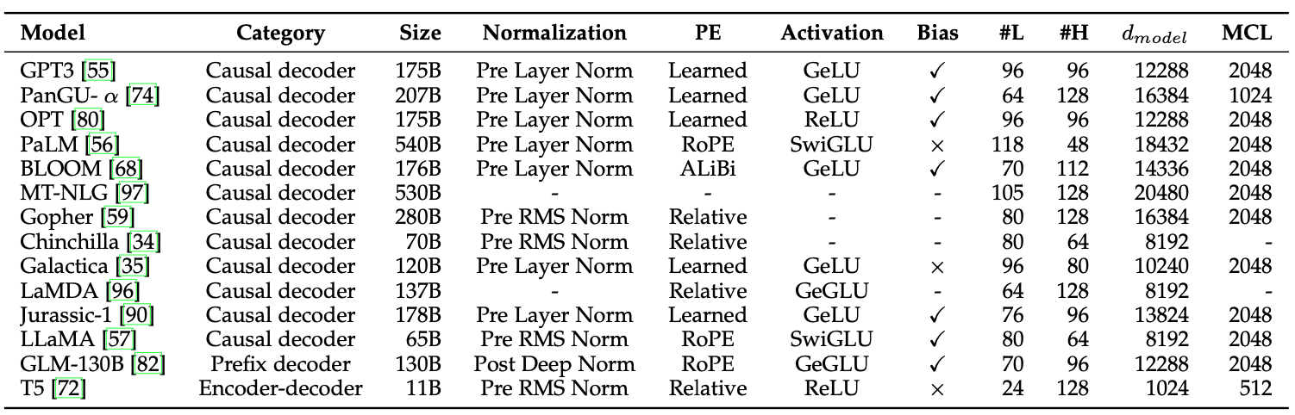
LLMs with Public Configuration Details
Note: PE denotes position embedding, #L denotes the number of layers, #H denotes the number of attention heads,
d_{model} denotes the size of hidden states, and MCL denotes the maximum context length during training.
Source: Wayne Xin Zhao, Kun Zhou, Junyi Li, Tianyi Tang, Xiaolei Wang, Yupeng Hou, Yingqian Min et al. (2023) "A Survey of Large Language Models." arXiv preprint arXiv:2303.18223.

Slide 61
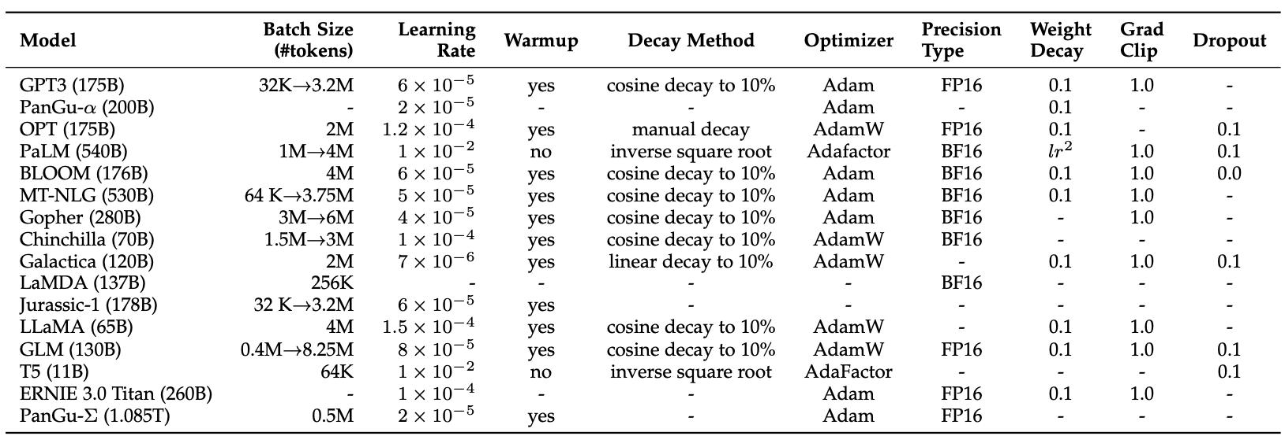
Detailed Optimization Settings of LLMs
Source: Wayne Xin Zhao, Kun Zhou, Junyi Li, Tianyi Tang, Xiaolei Wang, Yupeng Hou, Yingqian Min et al. (2023) "A Survey of Large Language Models." arXiv preprint arXiv:2303.18223.

Slide 62

OpenAI ChatGPT
Source: https://openai.com/blog/chatgpt/

Slide 63

Conversational AI to deliver contextual and personal experience to users
Source: Huynh-The, Thien, Quoc-Viet Pham, Xuan-Qui Pham, Thanh Thi Nguyen, Zhu Han, and Dong-Seong Kim (2022).
"Artificial Intelligence for the Metaverse: A Survey." arXiv preprint arXiv:2202.10336.

Slide 64

ChatGPT and GPT-3 Family
(GPT-3, InstructGPT, GPT-3.5, ChatGPT)
Source: https://lifearchitect.ai/gpt-3/

Slide 65

Evolutionary of ChatGPT Models
GPT-3
GPT-3.5
Source: Ye, Junjie, Xuanting Chen, Nuo Xu, Can Zu, Zekai Shao, Shichun Liu, Yuhan Cui et al. "A comprehensive capability analysis of gpt-3 and gpt-3.5 series models." arXiv preprint arXiv:2303.10420 (2023).

Slide 66


Stanford Alpaca:
A Strong, Replicable Instruction-Following Model
Source: https://crfm.stanford.edu/2023/03/13/alpaca.html

Slide 67
GPT4All:
Training an Assistant-style Chatbot with Large Scale Data Distillation from GPT-3.5-Turbo
Demo, data and code to train an assistant-style large language model with ~800k GPT-3.5-Turbo Generations based on LLaMa
Reproducibility
  Trained LoRa Weights:
    gpt4all-lora (four full epochs of training):
      https://huggingface.co/nomic-ai/gpt4all-lora
Source: https://github.com/nomic-ai/gpt4all

Slide 68

Vicuna: An Open-Source Chatbot
Impressing GPT-4 with 90%* ChatGPT Quality by the Team with members from UC Berkeley, CMU, Stanford, and UC San Diego
Vicuna-13B: an open-source chatbot trained by fine-tuning LLaMA on user-shared conversations collected from ShareGPT.
The cost of training Vicuna-13B is around $300.
Source: https://vicuna.lmsys.org/

Slide 69


Chinese-Vicuna:
A Chinese Instruction-following LLaMA-based Model
一個中文低資源的 llama+lora方案
Chinese-Vicuna based on Guanaco Dataset and Belle Dataset
Source: https://huggingface.co/datasets/Chinese-Vicuna/guanaco_belle_merge_v1.0
Source: https://github.com/Facico/Chinese-Vicuna

Slide 70

StableLM
Stability AI Language Models
StableLM-Alpha models are trained on the new dataset that build on The Pile, which contains 1.5 trillion tokens, roughly 3x the size of The Pile.
  These models will be trained on up to 1.5 trillion tokens.
  The context length for these models is 4096 tokens.
Fine-tuned the model with Stanford Alpaca's procedure using a combination of five recent datasets for conversational agents: Stanford's Alpaca, Nomic-AI's gpt4all, RyokoAI's ShareGPT52K datasets, Databricks labs' Dolly, and Anthropic's HH.
Source: https://github.com/Stability-AI/StableLM

Slide 71

RedPajama a project to create leading open-source models, starts by reproducing LLaMA training dataset of over 1.2 trillion tokens
Dataset | RedPajama | LLaMA*
CommonCrawl | 878 billion | 852 billion
C4 | 175 billion | 190 billion
Github | 59 billion | 100 billion
Books | 26 billion | 25 billion
ArXiv | 28 billion | 33 billion
Wikipedia | 24 billion | 25 billion
StackExchange | 20 billion | 27 billion
Total Tokens | 1.2 trillion | 1.25 trillion
Source: https://github.com/togethercomputer/RedPajama-Data

Slide 72

Chat with Open Large Language Models
chat.lmsys.org
https://chat.lmsys.org/

Slide 73

Chat with
Open
Large Language Models:
Chatbot Arena
https://chat.lmsys.org/

Slide 74

Chat with
Open
Large Language Models:
Leaderboard
https://chat.lmsys.org/

Slide 75

ChatPDF
www.chatpdf.com
https://www.chatpdf.com/

Slide 76

Perplexity.ai
https://www.perplexity.ai/

Slide 77

MiniGPT-4:
Enhancing Vision-language Understanding with Advanced Large Language Models
Source: https://minigpt-4.github.io/

Slide 78

LLaVA: Large Language and Vision Assistant
llava-vl.github.io
Source: https://llava-vl.github.io/

Slide 79

Visual Instruction Tuning
LLaVA: Large Language and Vision Assistant
University of Wisconsin-Madison, Microsoft Research, Columbia University
Science QA: New SoTA with the synergy of LLaVA with GPT-4
LLaVA represents a novel end-to-end trained large multimodal model that combines a vision encoder and Vicuna for general-purpose visual and language understanding, achieving impressive chat capabilities mimicking spirits of the multimodal GPT-4 and setting a new state-of-the-art accuracy on Science QA.
Source: https://llava-vl.github.io/

Slide 80

MPT-7B-StoryWriter-65k+
Source: https://www.mosaicml.com/blog/mpt-7b

Slide 81


MPT-30B, MPT-7B
LLaMa-30B, LLaMa-7B
Source: https://www.mosaicml.com/blog/mpt-30b

Slide 82


Orca: Progressive Learning from Complex Explanation Traces of GPT-4
Source: Mukherjee, Subhabrata, Arindam Mitra, Ganesh Jawahar, Sahaj Agarwal, Hamid Palangi, and Ahmed Awadallah. "Orca: Progressive Learning from Complex Explanation Traces of GPT-4." arXiv preprint arXiv:2306.02707 (2023).

Slide 83

Orca-13B and ChatGPT for GRE and GMAT
Source: Mukherjee, Subhabrata, Arindam Mitra, Ganesh Jawahar, Sahaj Agarwal, Hamid Palangi, and Ahmed Awadallah. "Orca: Progressive Learning from Complex Explanation Traces of GPT-4." arXiv preprint arXiv:2306.02707 (2023).

Slide 84

Meta Llama-2 70B: Best Open Source and Commercial LLM (Llama-2, Falcon, MPT)
Source: https://ai.meta.com/llama/

Slide 85

Meta Llama-2 70B: Best Open Source and Commercial LLM (Llama-2, Falcon, MPT)
Llama 2 pretrained models are trained on 2 trillion tokens, and have double the context length than Llama 1.
Its fine-tuned models have been trained on over 1 million human annotations.
Source: https://ai.meta.com/llama/

Slide 86

Meta
Llama-2 70B:
Best
Open Source and Commercial LLM
(Llama-2, Falcon, MPT)
Llama 2 outperforms other open source language models on many external benchmarks,
including reasoning, coding, proficiency, and knowledge tests.
Source: https://ai.meta.com/llama/

Slide 87

Llama-2: Comparison to closed-source models (GPT-3.5, GPT-4, PaLM) on academic benchmarks
Results for GPT-3.5 and GPT-4 are from OpenAI (2023).
Results for the PaLM model are from Chowdhery et al. (2022).
Results for the PaLM-2-L are from Anil et al. (2023).
Source: Touvron, Hugo, Louis Martin, Kevin Stone, Peter Albert, Amjad Almahairi, Yasmine Babaei, Nikolay Bashlykov et al. (2023) "Llama 2: Open Foundation and Fine-Tuned Chat Models." arXiv preprint arXiv:2307.09288 (2023).

Slide 88

Llama 2:
Open Foundation and Fine-Tuned Chat Models
Source: Touvron, Hugo, Louis Martin, Kevin Stone, Peter Albert, Amjad Almahairi, Yasmine Babaei, Nikolay Bashlykov et al. (2023) "Llama 2: Open Foundation and Fine-Tuned Chat Models." arXiv preprint arXiv:2307.09288 (2023).

Slide 89


Falcon 180B
Source: https://huggingface.co/blog/falcon-180b

Slide 90

Falcon 180B, LLaMA 65B, MPT 30B
Source: https://huggingface.co/blog/falcon-180b

Slide 91

Falcon 180B
Hardware requirements
NVIDIA A100 80 GB: $16,135
Source: https://huggingface.co/blog/falcon-180b

Slide 92

InstructBLIP
Vision-Language Models with Instruction Tuning
Source: Dai, Wenliang, Junnan Li, Dongxu Li, Anthony Meng Huat Tiong, Junqi Zhao, Weisheng Wang, Boyang Li, Pascale Fung, and Steven Hoi.
"InstructBLIP: Towards General-purpose Vision-Language Models with Instruction Tuning." arXiv preprint arXiv:2305.06500 (2023).

Slide 93

Model Architecture of InstructBLIP
Vision-Language Models with Instruction Tuning
Source: Dai, Wenliang, Junnan Li, Dongxu Li, Anthony Meng Huat Tiong, Junqi Zhao, Weisheng Wang, Boyang Li, Pascale Fung, and Steven Hoi.
"InstructBLIP: Towards General-purpose Vision-Language Models with Instruction Tuning." arXiv preprint arXiv:2305.06500 (2023).

Slide 94

Vision-Language Instruction Tuning: Datasets
Source: Dai, Wenliang, Junnan Li, Dongxu Li, Anthony Meng Huat Tiong, Junqi Zhao, Weisheng Wang, Boyang Li, Pascale Fung, and Steven Hoi.
"InstructBLIP: Towards General-purpose Vision-Language Models with Instruction Tuning." arXiv preprint arXiv:2305.06500 (2023).

Slide 95

Instruction Tuning vs. Multitask Learning based on BLIP-2 FlanT5XL
Source: Dai, Wenliang, Junnan Li, Dongxu Li, Anthony Meng Huat Tiong, Junqi Zhao, Weisheng Wang, Boyang Li, Pascale Fung, and Steven Hoi.
"InstructBLIP: Towards General-purpose Vision-Language Models with Instruction Tuning." arXiv preprint arXiv:2305.06500 (2023).

Slide 96

Finetuning BLIP-2 and InstructBLIP on downstream datasets
Source: Dai, Wenliang, Junnan Li, Dongxu Li, Anthony Meng Huat Tiong, Junqi Zhao, Weisheng Wang, Boyang Li, Pascale Fung, and Steven Hoi.
"InstructBLIP: Towards General-purpose Vision-Language Models with Instruction Tuning." arXiv preprint arXiv:2305.06500 (2023).

Slide 97

InstructBLIP
Vision-Language Models with Instruction Tuning
LLaVA
Large Language and Vision Assistant
MiniGPT-4
Source: Dai, Wenliang, Junnan Li, Dongxu Li, Anthony Meng Huat Tiong, Junqi Zhao, Weisheng Wang, Boyang Li, Pascale Fung, and Steven Hoi.
"InstructBLIP: Towards General-purpose Vision-Language Models with Instruction Tuning." arXiv preprint arXiv:2305.06500 (2023).

Slide 98

Instruction Tuning Datasets
Source: Dai, Wenliang, Junnan Li, Dongxu Li, Anthony Meng Huat Tiong, Junqi Zhao, Weisheng Wang, Boyang Li, Pascale Fung, and Steven Hoi.
"InstructBLIP: Towards General-purpose Vision-Language Models with Instruction Tuning." arXiv preprint arXiv:2305.06500 (2023).

Slide 99

Instruction Tuning Datasets
Source: Dai, Wenliang, Junnan Li, Dongxu Li, Anthony Meng Huat Tiong, Junqi Zhao, Weisheng Wang, Boyang Li, Pascale Fung, and Steven Hoi.
"InstructBLIP: Towards General-purpose Vision-Language Models with Instruction Tuning." arXiv preprint arXiv:2305.06500 (2023).

Slide 100

Instruction Templates
Image Captioning
VQA
Vision Question Answering
VQG
Vision Question Generation
Source: Dai, Wenliang, Junnan Li, Dongxu Li, Anthony Meng Huat Tiong, Junqi Zhao, Weisheng Wang, Boyang Li, Pascale Fung, and Steven Hoi.
"InstructBLIP: Towards General-purpose Vision-Language Models with Instruction Tuning." arXiv preprint arXiv:2305.06500 (2023).

Slide 101

X-LLM:
Bootstrapping Advanced Large Language Models by
Treating Multi-Modalities as Foreign Languages
Source: Chen, Feilong, Minglun Han, Haozhi Zhao, Qingyang Zhang, Jing Shi, Shuang Xu, and Bo Xu. "X-LLM: Bootstrapping Advanced Large Language Models by Treating Multi-Modalities as Foreign Languages."
arXiv preprint arXiv:2305.04160 (2023).

Slide 102
Outline
Overview of Generative AI
Overview of Large Language Models (LLMs)
Fine-tuning LLM for Dialogue System
Challenges and Limitations of Generative AI
for Dialogue Systems

Slide 103




Tamkang University
2011
Tamkang
University
IMTKU Textual Entailment System for
Recognizing Inference in Text
at NTCIR-9 RITE
Department of Information Management
Tamkang University, Taiwan
Min-Yuh Day
Chun Tu
myday@mail.tku.edu.tw
NTCIR-9 Workshop, December 6-9, 2011, Tokyo, Japan

Slide 104



IMTKU Textual Entailment System for
Recognizing Inference in Text at NTCIR-10 RITE-2
Tamkang University
2013
Tamkang
University
Department of Information Management
Tamkang University, Taiwan
Min-Yuh Day
Chun Tu
Hou-Cheng Vong
Shih-Wei Wu
Shih-Jhen Huang
myday@mail.tku.edu.tw
NTCIR-10 Conference, June 18-21, 2013, Tokyo, Japan

Slide 105









IMTKU Textual Entailment System for
Recognizing Inference in Text at NTCIR-11 RITE-VAL
2014
Tamkang University
Min-Yuh Day
Ya-Jung Wang
Che-Wei Hsu
En-Chun Tu
Huai-Wen Hsu
Yu-An Lin
Shang-Yu Wu
Yu-Hsuan Tai
Cheng-Chia Tsai
NTCIR-11 Conference, December 8-12, 2014, Tokyo, Japan

Slide 106



















IMTKU Question Answering System for
World History Exams at NTCIR-12 QA Lab2
2016
Tamkang University
Department of Information Management
Tamkang University, Taiwan
Sagacity Technology
Min-Yuh Day
Cheng-Chia Tsai
Wei-Chun Chung
Hsiu-Yuan Chang
Tzu-Jui Sun
Yuan-Jie Tsai
Jin-Kun Lin
Cheng-Hung Lee
Yu-Ming Guo
Yue-Da Lin
Wei-Ming Chen
Yun-Da Tsai
Cheng-Jhih Han
Yi-Jing Lin
Yi-Heng Chiang
Ching-Yuan Chien
myday@mail.tku.edu.tw
NTCIR-12 Conference, June 7-10, 2016, Tokyo, Japan

Slide 107








IMTKU Question Answering System for
World History Exams at NTCIR-13 QALab-3
2017
Tamkang University
Department of Information Management
Tamkang University, Taiwan
Min-Yuh Day
Chao-Yu Chen
Wanchu Huang
Shi-Ya Zheng
I-Hsuan Huang
Tz-Rung Chen
Min-Chun Kuo
Yue-Da Lin
Yi-Jing Lin
myday@mail.tku.edu.tw
NTCIR-13 Conference, December 5-8, 2017, Tokyo, Japan

Slide 108




IMTKU Emotional Dialogue System for
Short Text Conversation at NTCIR-14 STC-3 (CECG) Task
2019
Tamkang University
Department of Information Management
Tamkang University, Taiwan
Min-Yuh Day
Chi-Sheng Hung
Yi-Jun Xie
Jhih-Yi Chen
Yu-Ling Kuo
Jian-Ting Lin
myday@mail.tku.edu.tw
NTCIR-14 Conference, June 10-13, 2019, Tokyo, Japan

Slide 109








IMTKU Multi-Turn Dialogue System Evaluation at the NTCIR-15 DialEval-1
Dialogue Quality and Nugget Detection
2020
Tamkang University
¹ Zeals Co., Ltd. Tokyo, Japan
² Information Management, Tamkang University, Taiwan
³ Information Management, National Taipei University, Taiwan
Mike Tian-Jian Jiang¹
Zhao-Xian Gu²
Cheng-Jhe Chiang²
Yueh-Chia Wu²
Yu-Chen Huang²
Cheng-Han Chiu²
Sheng-Ru Shaw²
Min-Yuh Day³
NTCIR-15 Conference, December 8-11, 2020, Tokyo, Japan

Slide 110

NTCIR-15 Dialogue Evaluation (DialEval-1) Task
Dialogue Quality (DQ) and Nugget Detection (ND)
Chinese Dialogue Quality (S-score) Results (Zeng et al., 2020)
2020
Source: Zeng, Zhaohao, Sosuke Kato, Tetsuya Sakai, and Inho Kang (2020), “Overview of the NTCIR-15 Dialogue Evaluation (DialEval-1) Task”, Proceedings of NTCIR-15, 2020

Slide 111
Transformer-based
Models Selection
Fine-tuning Techniques
FinNum-2
BERT
DialEval-1
Discriminative Fine-tuning
Transfer
Learning
RoBERTa
One-cycle Policy
XLM-RoBERTa
Optimization
Tokenization Tricks
Pre-trained Models
Source: Jiang, Mike Tian-Jian, Shih-Hung Wu, Yi-Kun Chen, Zhao-Xian Gu, Cheng-Jhe Chiang, Yueh-Chia Wu, Yu-Chen Huang, Cheng-Han Chiu, Sheng-Ru Shaw, and Min-Yuh Day (2020). "Fine-tuning techniques and data augmentation on transformer-based models for conversational texts and noisy user-generated content." In 2020 IEEE/ACM International Conference on Advances in Social Networks Analysis and Mining (ASONAM), pp. 919-925. IEEE, 2020.

Slide 112
Dialogue Systems

Slide 113
Chatbot
Dialogue System
Intelligent Agent

Slide 114

Dialogue Subtasks
Dialogue Generation
Task-Oriented Dialogue Systems
Short-Text Conversation
Source: https://paperswithcode.com/area/natural-language-processing/dialogue

Slide 115
Conversational Commerce: eBay AI Chatbots
Source: https://www.forbes.com/sites/rachelarthur/2017/07/19/conversational-commerce-ebay-ai-chatbot/

Slide 116
Hotel Chatbot
Intent Detection
Slot Filling
Source: https://sdtimes.com/amazon/guest-view-capitalize-amazon-lex-available-general-public/

Slide 117

Fine-tuning BERT on Dialogue
Intent Detection (ID; Classification)
Source: Devlin, Jacob, Ming-Wei Chang, Kenton Lee, and Kristina Toutanova (2018).
"Bert: Pre-training of deep bidirectional transformers for language understanding." arXiv preprint arXiv:1810.04805.

Slide 118

Fine-tuning BERT on Dialogue
Slot Filling (SF)
Source: Devlin, Jacob, Ming-Wei Chang, Kenton Lee, and Kristina Toutanova (2018).
"Bert: Pre-training of deep bidirectional transformers for language understanding." arXiv preprint arXiv:1810.04805.

Slide 119

Dialogue System
Source: Serban, I. V., Lowe, R., Charlin, L., & Pineau, J. (2015). A survey of available corpora for building data-driven dialogue systems. arXiv preprint arXiv:1512.05742.

Slide 120

Overall Architecture of
Intelligent Chatbot
Source: Borah, Bhriguraj, Dhrubajyoti Pathak, Priyankoo Sarmah, Bidisha Som, and Sukumar Nandi. "Survey of Textbased Chatbot in Perspective of Recent Technologies." In International Conference on Computational Intelligence, Communications, and Business Analytics, pp. 84-96. Springer, Singapore, 2018.

Slide 121
Chatbot Conversation Framework
Source: https://chatbotslife.com/ultimate-guide-to-leveraging-nlp-machine-learning-for-you-chatbot-531ff2dd870c

Slide 122
Chatbots
Bot Maturity Model
Customers want to have simpler means to interact with businesses and
get faster response to a question or complaint.
Source: https://www.capgemini.com/2017/04/how-can-chatbots-meet-expectations-introducing-the-bot-maturity/

Slide 123
Task-Oriented Dialogue System

Slide 124

Task-Oriented Dialogue System
(Deriu et al., 2021)
Source: Deriu, Jan, Alvaro Rodrigo, Arantxa Otegi, Guillermo Echegoyen, Sophie Rosset, Eneko Agirre, and Mark Cieliebak (2021). "Survey on evaluation methods for dialogue systems." Artificial Intelligence Review 54, no. 1 (2021): 755-810.

Slide 125

Task-Oriented Dialogue Systems
(Zhang et al., 2020)
Source: Zhang, Zheng, Ryuichi Takanobu, Qi Zhu, Minlie Huang, and Xiaoyan Zhu (2020).
"Recent advances and challenges in task-oriented dialog systems." Science China Technological Sciences (2020): 1-17.

Slide 126

Dialog State Tracker (DST)
Source: Deriu, Jan, Alvaro Rodrigo, Arantxa Otegi, Guillermo Echegoyen, Sophie Rosset, Eneko Agirre, and Mark Cieliebak (2021). "Survey on evaluation methods for dialogue systems." Artificial Intelligence Review 54, no. 1 (2021): 755-810.

Slide 127

Dialogue Acts
(Young et al., 2010)
Source: Deriu, Jan, Alvaro Rodrigo, Arantxa Otegi, Guillermo Echegoyen, Sophie Rosset, Eneko Agirre, and Mark Cieliebak (2021). "Survey on evaluation methods for dialogue systems." Artificial Intelligence Review 54, no. 1 (2021): 755-810.

Slide 128

Sample Dialogue Acts
Source: Deriu, Jan, Alvaro Rodrigo, Arantxa Otegi, Guillermo Echegoyen, Sophie Rosset, Eneko Agirre, and Mark Cieliebak (2021). "Survey on evaluation methods for dialogue systems." Artificial Intelligence Review 54, no. 1 (2021): 755-810.

Slide 129
Dialogue on
Airline Travel Information System (ATIS)

Slide 130

The ATIS
(Airline Travel Information System)
Dataset
https://www.kaggle.com/siddhadev/atis-dataset-from-ms-cntk
Training samples: 4978
Testing samples: 893
Vocab size: 943
Slot count: 129
Intent count: 26
Source: Haihong, E., Peiqing Niu, Zhongfu Chen, and Meina Song. "A novel bi-directional interrelated model for joint intent detection and slot filling." In Proceedings of the 57th Annual Meeting of the Association for Computational Linguistics, pp. 5467-5471. 2019.

Slide 131

SF-ID Network (E et al., 2019)
Slot Filling (SF)
Intent Detection (ID)
A Novel Bi-directional Interrelated Model for Joint Intent Detection and Slot Filling
Source: Haihong, E., Peiqing Niu, Zhongfu Chen, and Meina Song. "A novel bi-directional interrelated model for joint intent detection and slot filling." In Proceedings of the 57th Annual Meeting of the Association for Computational Linguistics, pp. 5467-5471. 2019.

Slide 132

Datasets for task-oriented dialogue systems
Source: Deriu, Jan, Alvaro Rodrigo, Arantxa Otegi, Guillermo Echegoyen, Sophie Rosset, Eneko Agirre, and Mark Cieliebak (2021). "Survey on evaluation methods for dialogue systems." Artificial Intelligence Review 54, no. 1 (2021): 755-810.

Slide 133
Restaurants Dialogue Datasets
MIT Restaurant Corpus
  https://groups.csail.mit.edu/sls/downloads/restaurant/
CamRest676
(Cambridge restaurant dialogue domain dataset)
  https://www.repository.cam.ac.uk/handle/1810/260970
DSTC2 (Dialog State Tracking Challenge 2 & 3)
  http://camdial.org/~mh521/dstc/

Slide 134

CrossWOZ:
A Large-Scale Chinese Cross-Domain
Task-Oriented Dialogue Dataset
Source: Zhu, Qi, Kaili Huang, Zheng Zhang, Xiaoyan Zhu, and Minlie Huang. "Crosswoz: A large-scale chinese cross-domain task-oriented dialogue dataset." arXiv preprint arXiv:2002.11893 (2020).

Slide 135

CrossWOZ:
A Large-Scale Chinese Cross-Domain
Task-Oriented Dialogue Dataset
Source: Zhu, Qi, Kaili Huang, Zheng Zhang, Xiaoyan Zhu, and Minlie Huang. "Crosswoz: A large-scale chinese cross-domain task-oriented dialogue dataset." arXiv preprint arXiv:2002.11893 (2020).

Slide 136



Task-Oriented Dialogue
Source: Zhu, Qi, Kaili Huang, Zheng Zhang, Xiaoyan Zhu, and Minlie Huang. "Crosswoz: A large-scale chinese cross-domain task-oriented dialogue dataset." arXiv preprint arXiv:2002.11893 (2020).

Slide 137

An example dialog from the test set for MultiWOZ
(en→zh) sub-task

Slide 138
Fine-tuning LLM for
Dialogue System
Reinforcement Learning from
Human Feedback (RLHF)
ChatGPT:
Optimizing Language Models for Dialogue

Slide 139
Reinforcement Learning from Human Feedback (RLHF)

Slide 140

ChatGPT: Optimizing Language Models for Dialogue
Source: https://openai.com/blog/chatgpt/

Slide 141

Training language models to follow instructions with human feedback
InstructGPT and GPT 3.5
Source: Ouyang, L., Wu, J., Jiang, X., Almeida, D., Wainwright, C. L., Mishkin, P., ... & Lowe, R. (2022). Training language models to follow instructions with human feedback. arXiv preprint arXiv:2203.02155.

Slide 142
Reinforcement Learning from Human Feedback (RLHF)
Pretraining a Language Model (LM)
Gathering Data and Training a Reward Model
Fine-tuning the LM with Reinforcement Learning
Source: https://huggingface.co/blog/rlhf

Slide 143

Reinforcement Learning
from Human Feedback (RLHF)
Step 1. Pretraining a Language Model (LM)
Source: https://huggingface.co/blog/rlhf

Slide 144

Reinforcement Learning from Human Feedback (RLHF)
Step 2. Gathering Data and
Training a
Reward Model
Source: https://huggingface.co/blog/rlhf

Slide 145

Reinforcement Learning from Human Feedback (RLHF)
Step 3. Fine-tuning the LM with Reinforcement Learning
Source: https://huggingface.co/blog/rlhf

Slide 146

Llama-2-chat uses RLHF to ensure safety and helpfulness
Source: https://ai.meta.com/resources/models-and-libraries/llama/

Slide 147

QLoRA: Efficient Finetuning of Quantized LLMs
Source: Dettmers, Tim, Artidoro Pagnoni, Ari Holtzman, and Luke Zettlemoyer. "QLoRA: Efficient Finetuning of Quantized LLMs." arXiv preprint arXiv:2305.14314 (2023).

Slide 148

QLoRA: Efficient Finetuning of Quantized LLMs
QLoRA reduces the average memory requirements of finetuning a 65B parameter model from >780GB of GPU memory to <48GB
Source: Dettmers, Tim, Artidoro Pagnoni, Ari Holtzman, and Luke Zettlemoyer. "QLoRA: Efficient Finetuning of Quantized LLMs." arXiv preprint arXiv:2305.14314 (2023).

Slide 149

QLoRA: Efficient Finetuning of Quantized LLMs
Source: Dettmers, Tim, Artidoro Pagnoni, Ari Holtzman, and Luke Zettlemoyer. "QLoRA: Efficient Finetuning of Quantized LLMs." arXiv preprint arXiv:2305.14314 (2023).

Slide 150

Prompt Engineering with ChatGPT for NLP
Source: https://www.predera.com/blog/prompt-engineering-for-nlp-tasks

Slide 151

Generative AI
Tech Stack
Source: Matt Bornstein, Guido Appenzeller, and Martin Casado (2023), Who Owns the Generative AI Platform?, https://a16z.com/2023/01/19/who-owns-the-generative-ai-platform/

Slide 152

Generative AI Software and Business Factors
Source: Jay Alammar (2023), AI is Eating The World, https://txt.cohere.com/ai-is-eating-the-world/

Slide 153

Generative AI
1. Pre-training Foundation (Pre-trained) Model
2. Fine-turning Custom (Fine-tuned) Model
Source: Jay Alammar (2023), AI is Eating The World, https://txt.cohere.com/ai-is-eating-the-world/

Slide 154

Generative AI
Fine-tune Custom Models using Proprietary Data
Source: Jay Alammar (2023), AI is Eating The World, https://txt.cohere.com/ai-is-eating-the-world/

Slide 155

Generative AI
Fine-tune Custom Models using Proprietary Data
Source: Jay Alammar (2023), AI is Eating The World, https://txt.cohere.com/ai-is-eating-the-world/

Slide 156

Pipeline of Instruction Tuning LLMs
Source: Wang, Yidong, Zhuohao Yu, Zhengran Zeng, Linyi Yang, Cunxiang Wang, Hao Chen, Chaoya Jiang et al. "PandaLM: An Automatic Evaluation Benchmark for LLM Instruction Tuning Optimization." arXiv preprint arXiv:2306.05087 (2023).

Slide 157

Available Task Collections for Instruction Tuning
Source: Wayne Xin Zhao, Kun Zhou, Junyi Li, Tianyi Tang, Xiaolei Wang, Yupeng Hou, Yingqian Min et al. (2023) "A Survey of Large Language Models." arXiv preprint arXiv:2303.18223.

Slide 158

Instance Formatting and Two Different Methods for Constructing the
Instruction-formatted Instances
Source: Wayne Xin Zhao, Kun Zhou, Junyi Li, Tianyi Tang, Xiaolei Wang, Yupeng Hou, Yingqian Min et al. (2023) "A Survey of Large Language Models." arXiv preprint arXiv:2303.18223.

Slide 159

In-context Learning (ICL) and
Chain-of-thought (CoT) Prompting
Source: Wayne Xin Zhao, Kun Zhou, Junyi Li, Tianyi Tang, Xiaolei Wang, Yupeng Hou, Yingqian Min et al. (2023) "A Survey of Large Language Models." arXiv preprint arXiv:2303.18223.

Slide 160
Pre-train,
Prompt, and Predict:
Prompting Methods in Natural Language Processing
(LLMs)
Source: Pengfei Liu, Weizhe Yuan, Jinlan Fu, Zhengbao Jiang, Hiroaki Hayashi, and Graham Neubig. (2023) "Pre-train, prompt, and predict: A systematic survey of prompting methods in natural language processing." ACM Computing Surveys 55, no. 9 (2023): 1-35.

Slide 161

Four Paradigms in NLP
Source: Pengfei Liu, Weizhe Yuan, Jinlan Fu, Zhengbao Jiang, Hiroaki Hayashi, and Graham Neubig. (2023) "Pre-train, prompt, and predict: A systematic survey of prompting methods in natural language processing." ACM Computing Surveys 55, no. 9 (2023): 1-35.

Slide 162

Typology of Prompting Methods
Source: Pengfei Liu, Weizhe Yuan, Jinlan Fu, Zhengbao Jiang, Hiroaki Hayashi, and Graham Neubig. (2023) "Pre-train, prompt, and predict: A systematic survey of prompting methods in natural language processing." ACM Computing Surveys 55, no. 9 (2023): 1-35.

Slide 163

Different Multi-Prompt Learning Strategies
Source: Pengfei Liu, Weizhe Yuan, Jinlan Fu, Zhengbao Jiang, Hiroaki Hayashi, and Graham Neubig. (2023) "Pre-train, prompt, and predict: A systematic survey of prompting methods in natural language processing." ACM Computing Surveys 55, no. 9 (2023): 1-35.

Slide 164

Examples of Input, Template, and Answer for Different Tasks
Source: Pengfei Liu, Weizhe Yuan, Jinlan Fu, Zhengbao Jiang, Hiroaki Hayashi, and Graham Neubig. (2023) "Pre-train, prompt, and predict: A systematic survey of prompting methods in natural language processing." ACM Computing Surveys 55, no. 9 (2023): 1-35.

Slide 165

Characteristics of Different Tuning Strategies
Source: Pengfei Liu, Weizhe Yuan, Jinlan Fu, Zhengbao Jiang, Hiroaki Hayashi, and Graham Neubig. (2023) "Pre-train, prompt, and predict: A systematic survey of prompting methods in natural language processing." ACM Computing Surveys 55, no. 9 (2023): 1-35.

Slide 166

Multi-prompt Learning for
Multi-task, Multi-domain, or Multi-lingual Learning
Source: Pengfei Liu, Weizhe Yuan, Jinlan Fu, Zhengbao Jiang, Hiroaki Hayashi, and Graham Neubig. (2023) "Pre-train, prompt, and predict: A systematic survey of prompting methods in natural language processing." ACM Computing Surveys 55, no. 9 (2023): 1-35.

Slide 167
Prompt Engineering
Prompts For FLAN models
  Longpre, S., Hou, L., Vu, T., Webson, A., Chung, H. W., Tay, Y., ... & Roberts, A. (2023). The flan collection: Designing data and methods for effective instruction tuning. arXiv preprint arXiv:2301.13688.
MNLI, NLI-FEVER, VitaminC:
  "Premise: {premise}\n\nHypothesis: {hypothesis}\n\nDoes the premise entail the hypothesis?\n\nA yes\nB it is not possible to tell\nC no"
ANLI:
  "{context}\n\nBased on the paragraph above can we conclude that\"{hypothesis}\"?\n\nA Yes\nB It’s impossible to say\nC No"
SNLI:
  "If \"{premise}\", does this mean that \"{hypothesis}\"?\n\nA yes\nB it is not possible to tell\nC no"

Slide 168
Outline
Overview of Generative AI
Overview of Large Language Models (LLMs)
Fine-tuning LLM for Dialogue System
Challenges and Limitations of Generative AI
for Dialogue Systems

Slide 169
Challenges and Limitations of
Generative AI for QA and Dialogue Systems
Understanding and Contextualization
Consistency
Data Dependence and Bias
Sensitivity to Input Phrasing
Ethical and Privacy Concerns

Slide 170
Understanding and Contextualization
Generative AI models like ChatGPT can understand and generate human-like text, but they struggle with maintaining context and a deep understanding of complex subjects over a long conversation.
LLMs might not grasp the underlying connotations, cultural references, or subtle humor in a conversation.
LLMs are also limited by the information they were trained on and cannot learn or acquire new information

Slide 171
Consistency
Despite significant improvements in generating relevant responses, LLMs can still be inconsistent.
LLMs might provide different answers to slight rephrasings of the same question or forget previously mentioned information in a conversation.
This is because LLMs lack a persistent memory and are unable to reason about facts in the way humans do.

Slide 172
Data Dependence and Bias
The quality of generative AI's responses largely depends on the data it was trained on.
If the training data contains biases, misinformation, or low-quality information, the model can reproduce those.
As a result, LLMs might propagate harmful stereotypes, misinformation, or inappropriate responses.

Slide 173
Sensitivity to Input Phrasing
Generative AI model's responses can be very sensitive to how a question or statement is phrased.
Slight changes in input phrasing can lead to substantially different responses.
This can make the interaction with Generative AI models unpredictable and unreliable.

Slide 174
Ethical and Privacy Concerns
With the ability to generate human-like text, there's a risk that these systems could be used maliciously, like generating deepfakes or disinformation.
Generative AI models might inadvertently generate sensitive or personal information which they learned during training, even though they are designed to avoid doing so.
Balancing the benefits of these systems with the need to prevent misuse is a significant challenge.

Slide 175

Llama-2 Chat: Helpfulness Human Evaluation
Source: Touvron, Hugo, Louis Martin, Kevin Stone, Peter Albert, Amjad Almahairi, Yasmine Babaei, Nikolay Bashlykov et al. (2023) "Llama 2: Open Foundation and Fine-Tuned Chat Models." arXiv preprint arXiv:2307.09288 (2023).

Slide 176
Acknowledgments: Research Projects
Applying AI technology to construct knowledge graphs of cryptocurrency anti-money laundering: a few-shot learning model
  MOST, 110-2410-H-305-013-MY2, 2021/08/01~2023/07/31
Fintech Green Finance for Carbon Market Index, Corporate Finance, and Environmental Policies. Carbon Emission Sentiment Index with AI Text Analytics
  NTPU, 112-NTPU_ORDA-F-003，2023/01/01~2024/12/31
Digital Support, Unimpeded Communication: The Development, Support and Promotion of AI-assisted Communication Assistive Devices for Speech Impairment. Multimodal Cross-lingual Task-Oriented Dialogue System for Inclusive Communication Support
  NSTC 112-2425-H-305-002-, 2023/05/01-2026/04/30
Establishment and Implement of Smart Assistive Technology for Dementia Care and Its Socio-Economic Impacts. Intelligent, individualized and precise care with smart AT and system integration
  NSTC, NSTC, 112-2627-M-038-001-, 2023/08/01~2024/07/31
Use deep learning to identify commercially dental implant systems - observational study
  USTP-NTPU-TMU, USTP-NTPU-TMU-112-01, 2023/01/01~2023/12/31
Metaverse AI Multimodal Cross-Language Task-Oriented Dialogue System
  ATEC Group x NTPU, NTPU-112A413E01, 2023/05/01~2026/04/30
Metaverse Avatar Automatic Metadata Generation Module
  FormosaVerse x NTPU, NTPU-111A413E01, 2022/12/01~2023/11/30
Pilot Study on Universal Data Processing for Code Generation Engine
  III x NTPU, NTPU-112A513E01, 2023/08/01~2023/12/22
https://web.ntpu.edu.tw/~myday/cindex.htm#projects

Slide 177
Summary
Overview of Generative AI
Overview of Large Language Models (LLMs)
Fine-tuning LLM for Dialogue System
Challenges and Limitations of Generative AI
for Dialogue Systems

Slide 178
References
Yihan Cao, Siyu Li, Yixin Liu, Zhiling Yan, Yutong Dai, Philip S. Yu, and Lichao Sun (2023). "A Comprehensive Survey of AI-Generated Content (AIGC): A History of Generative AI from GAN to ChatGPT." arXiv preprint arXiv:2303.04226.
Pengfei Liu, Weizhe Yuan, Jinlan Fu, Zhengbao Jiang, Hiroaki Hayashi, and Graham Neubig. (2023) "Pre-train, prompt, and predict: A systematic survey of prompting methods in natural language processing." ACM Computing Surveys 55, no. 9 (2023): 1-35.
Wayne Xin Zhao, Kun Zhou, Junyi Li, Tianyi Tang, Xiaolei Wang, Yupeng Hou, Yingqian Min et al. (2023) "A Survey of Large Language Models." arXiv preprint arXiv:2303.18223.
Touvron, Hugo, Louis Martin, Kevin Stone, Peter Albert, Amjad Almahairi, Yasmine Babaei, Nikolay Bashlykov et al. (2023) "Llama 2: Open Foundation and Fine-Tuned Chat Models." arXiv preprint arXiv:2307.09288 (2023).
Junliang Wang, Chuqiao Xu, Jie Zhang, and Ray Zhong (2022). "Big data analytics for intelligent manufacturing systems: A review." Journal of Manufacturing Systems 62 (2022): 738-752.
Ouyang, L., Wu, J., Jiang, X., Almeida, D., Wainwright, C. L., Mishkin, P., ... & Lowe, R. (2022). Training language models to follow instructions with human feedback. arXiv preprint arXiv:2203.02155.
Gozalo-Brizuela, Roberto, and Eduardo C. Garrido-Merchan (2023). "ChatGPT is not all you need. A State of the Art Review of large Generative AI models." arXiv preprint arXiv:2301.04655 (2023).
Wenliang Dai, Junnan Li, Dongxu Li, Anthony Meng Huat Tiong, Junqi Zhao, Weisheng Wang, Boyang Li, Pascale Fung, and Steven Hoi. (2023) "InstructBLIP: Towards General-purpose Vision-Language Models with Instruction Tuning." arXiv preprint arXiv:2305.06500 (2023).
Shahab Saquib Sohail, Faiza Farhat, Yassine Himeur, Mohammad Nadeem, Dag Øivind Madsen, Yashbir Singh, Shadi Atalla, and Wathiq Mansoor (2023). "The Future of GPT: A Taxonomy of Existing ChatGPT Research, Current Challenges, and Possible Future Directions." Current Challenges, and Possible Future Directions (April 8, 2023) (2023).
Longbing Cao (2022). "Decentralized ai: Edge intelligence and smart blockchain, metaverse, web3, and desci." IEEE Intelligent Systems 37, no. 3: 6-19.
Qinglin Yang, Yetong Zhao, Huawei Huang, Zehui Xiong, Jiawen Kang, and Zibin Zheng (2022). "Fusing blockchain and AI with metaverse: A survey." IEEE Open Journal of the Computer Society 3 : 122-136.
Russell Belk, Mariam Humayun, and Myriam Brouard (2022). "Money, possessions, and ownership in the Metaverse: NFTs, cryptocurrencies, Web3 and Wild Markets." Journal of Business Research 153: 198-205.
Thien Huynh-The, Quoc-Viet Pham, Xuan-Qui Pham, Thanh Thi Nguyen, Zhu Han, and Dong-Seong Kim (2022). "Artificial Intelligence for the Metaverse: A Survey." arXiv preprint arXiv:2202.10336.
Thippa Reddy Gadekallu, Thien Huynh-The, Weizheng Wang, Gokul Yenduri, Pasika Ranaweera, Quoc-Viet Pham, Daniel Benevides da Costa, and Madhusanka Liyanage (2022). "Blockchain for the Metaverse: A Review." arXiv preprint arXiv:2203.09738.
Ouyang, L., Wu, J., Jiang, X., Almeida, D., Wainwright, C. L., Mishkin, P., ... & Lowe, R. (2022). Training language models to follow instructions with human feedback. arXiv preprint arXiv:2203.02155.

Slide 179
Generative AI and
Large Language Models for
Dialogue Systems
Q & A
Time: 15:10-16:50, Thursday, September 14, 2023
Place: Room 301, Daren Building, Computer Science, National Chengchi University (NCCU)
Host: Prof. Chao-Lin Liu
Min-Yuh Day, Ph.D,
Associate Professor
Institute of Information Management, National Taipei University
https://web.ntpu.edu.tw/~myday
2023-09-14

