Slide 1
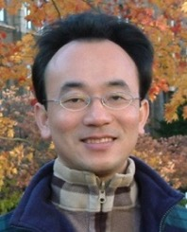
生成式AI在教學上的應用 Generative AI in Educational Applications
NTPU 112-1數位增能研習
Digital Empowerment Workshop, Fall 2023, NTPU
Time: 12:00-13:30, Thursday, October 26, 2023
Place: Online https://meet.google.com/ufp-jsju-diu
University System of Taipei (USTP), International Oriented Open Online Instructors (IOOOI)
Host: Prof. Chun-Yi Wei, NTPU
戴敏育 副教授
Min-Yuh Day, Ph.D, Associate Professor
Institute of Information Management, National Taipei University
https://web.ntpu.edu.tw/~myday
2023-10-26

Slide 2
戴敏育 博士 Min-Yuh Day, Ph.D.
1
Associate Professor, Information Management, NTPU
Visiting Scholar, IIS, Academia Sinica
Ph.D., Information Management, NTU
Director, Intelligent Financial Innovation Technology, IFIT Lab, IM, NTPU
Associate Director, Fintech and Green Finance Center, NTPU
Publications Co-Chairs, IEEE/ACM International Conference on Advances in Social Networks Analysis and Mining (ASONAM 2013- )
Program Co-Chair, IEEE International Workshop on Empirical Methods for Recognizing Inference in TExt (IEEE EM-RITE 2012- )
Publications Chair, The IEEE International Conference on Information Reuse and Integration for Data Science (IEEE IRI 2007- )

Slide 3
Outline
Introduction
Generative AI Foundations
Popular Generative AI
Key Generative AI Applications in Education
Challenges of Generative AI in Innovative Learning

Slide 4
Introduction
Generative AI in Education
Innovative Learning
Digital Empowerment in Teaching Workshop

Slide 5
Generative AI in ESG
Interlinking AI with ESG
Sustainable Development
Fintech
Green Finance
Sustainable Finance

Slide 6
Outline
Introduction
Generative AI Foundations
Popular Generative AI
Key Generative AI Applications in Education
Challenges of Generative AI in Innovative Learning

Slide 7
Generative AI Foundations
Principles of Generative AI
Core concepts and the science behind it
Generative AI and other AI forms

Slide 8
Generative AI (Gen AI) AI Generated Content (AIGC)

Slide 9
Generative AI (Gen AI) AI Generated Content (AIGC)
Image Generation
Source: Yihan Cao, Siyu Li, Yixin Liu, Zhiling Yan, Yutong Dai, Philip S. Yu, and Lichao Sun (2023). "A Comprehensive Survey of AI-Generated Content (AIGC): A History of Generative AI from GAN to ChatGPT." arXiv preprint arXiv:2303.04226.

Slide 10
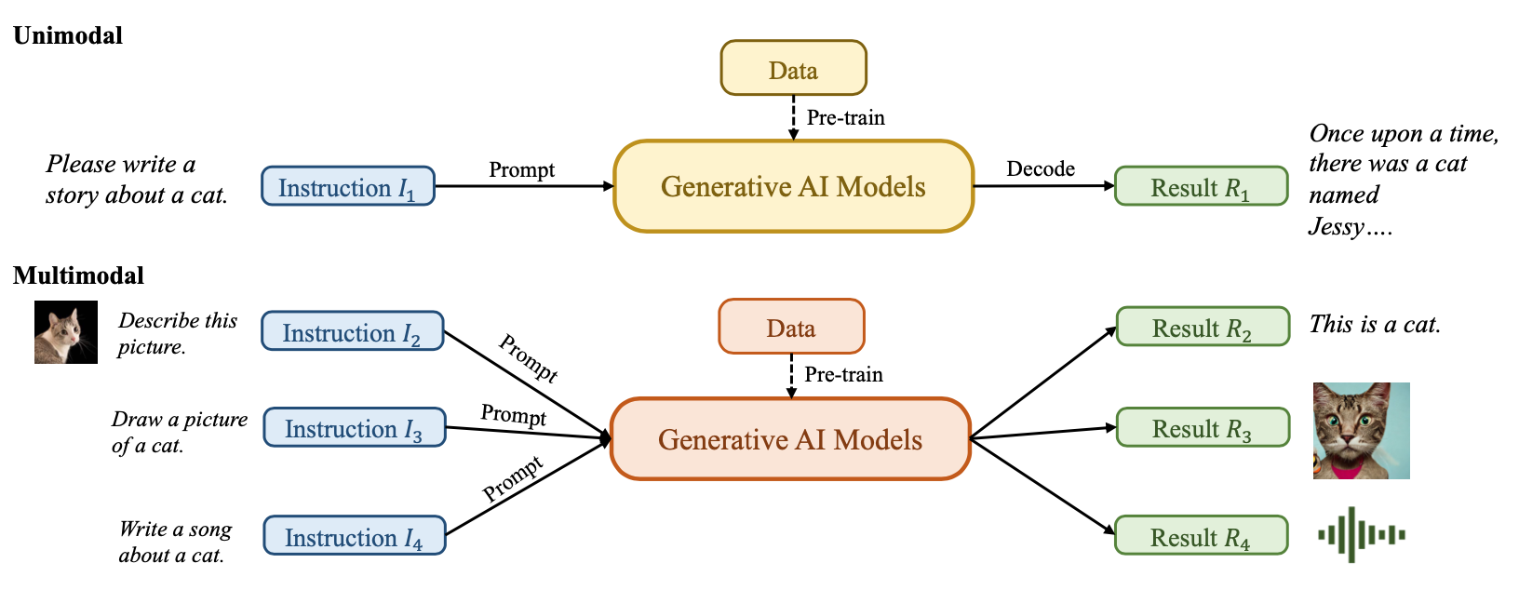
Generative AI (Gen AI) AI Generated Content (AIGC)
Source: Yihan Cao, Siyu Li, Yixin Liu, Zhiling Yan, Yutong Dai, Philip S. Yu, and Lichao Sun (2023). "A Comprehensive Survey of AI-Generated Content (AIGC): A History of Generative AI from GAN to ChatGPT." arXiv preprint arXiv:2303.04226.

Slide 11
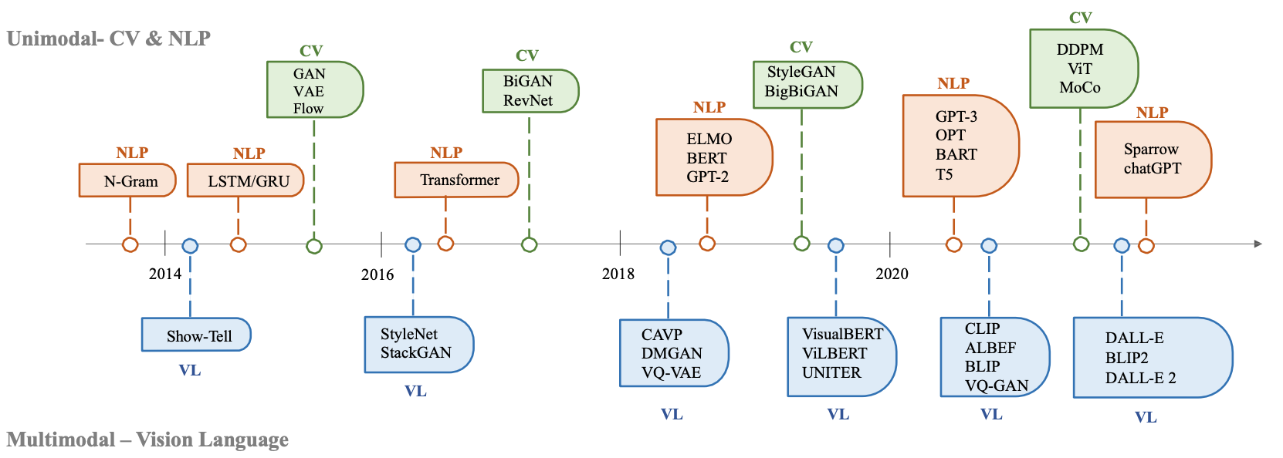
The history of Generative AI in CV, NLP and VL
Source: Yihan Cao, Siyu Li, Yixin Liu, Zhiling Yan, Yutong Dai, Philip S. Yu, and Lichao Sun (2023). "A Comprehensive Survey of AI-Generated Content (AIGC): A History of Generative AI from GAN to ChatGPT." arXiv preprint arXiv:2303.04226.

Slide 12
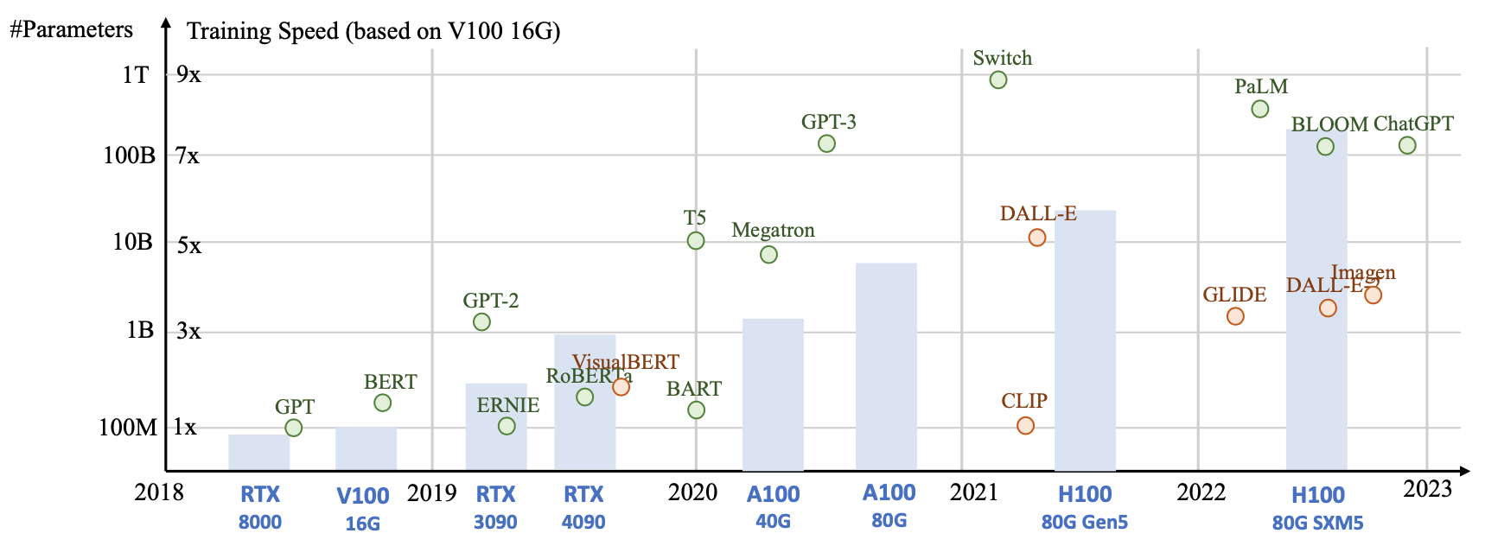
Generative AI Foundation Models
Source: Yihan Cao, Siyu Li, Yixin Liu, Zhiling Yan, Yutong Dai, Philip S. Yu, and Lichao Sun (2023). "A Comprehensive Survey of AI-Generated Content (AIGC): A History of Generative AI from GAN to ChatGPT." arXiv preprint arXiv:2303.04226.

Slide 13
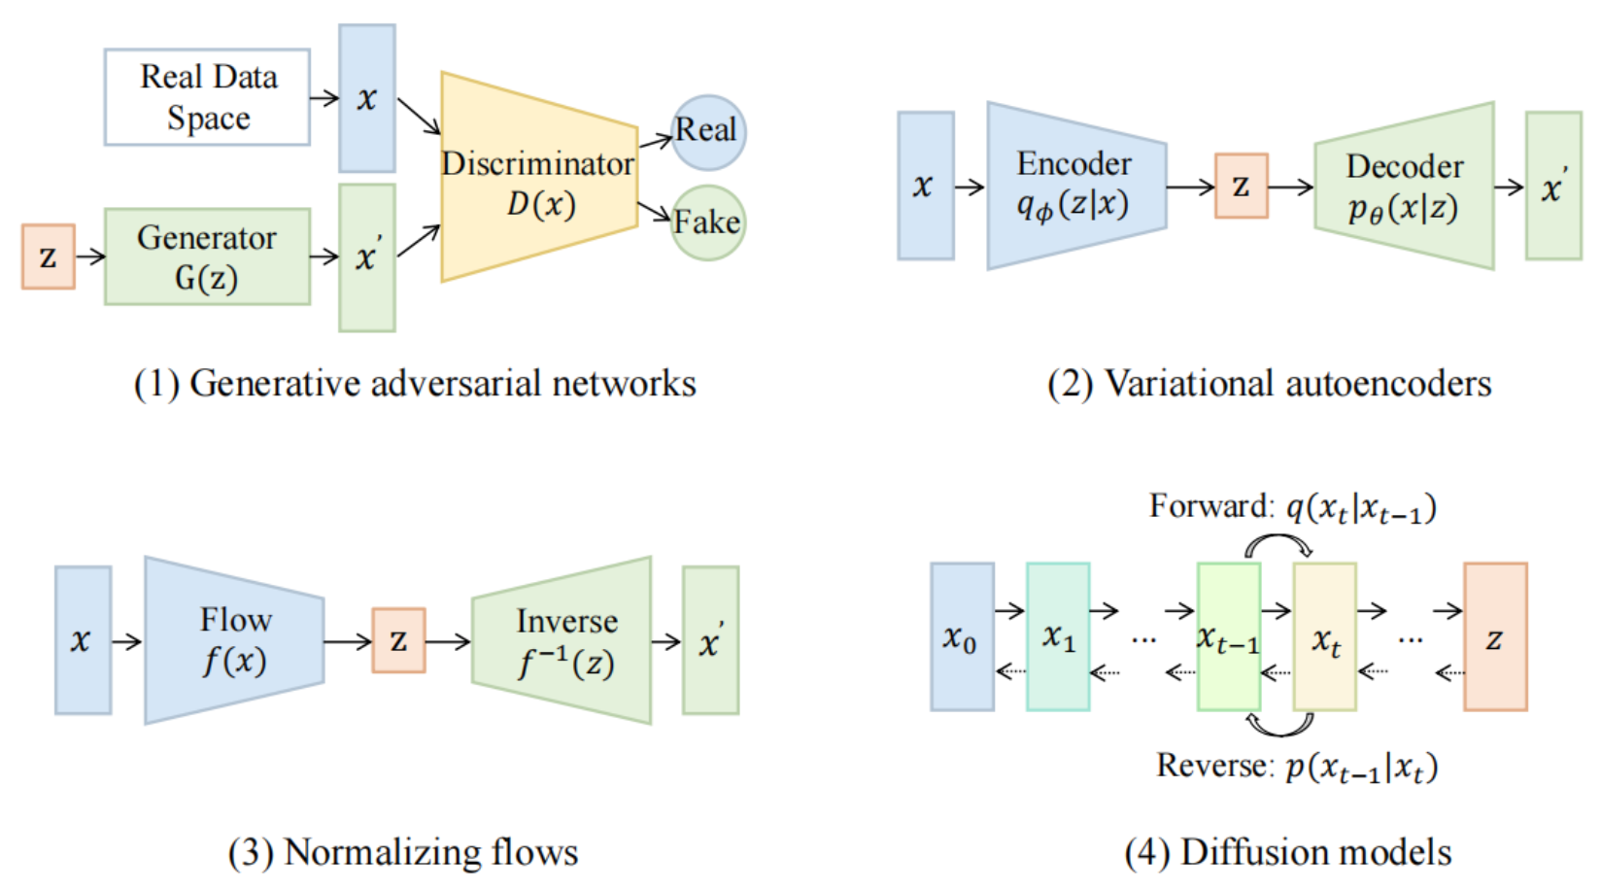
Categories of Vision Generative Models
Source: Yihan Cao, Siyu Li, Yixin Liu, Zhiling Yan, Yutong Dai, Philip S. Yu, and Lichao Sun (2023). "A Comprehensive Survey of AI-Generated Content (AIGC): A History of Generative AI from GAN to ChatGPT." arXiv preprint arXiv:2303.04226.

Slide 14
The General Structure of Generative Vision Language
Source: Yihan Cao, Siyu Li, Yixin Liu, Zhiling Yan, Yutong Dai, Philip S. Yu, and Lichao Sun (2023). "A Comprehensive Survey of AI-Generated Content (AIGC): A History of Generative AI from GAN to ChatGPT." arXiv preprint arXiv:2303.04226.

Slide 15
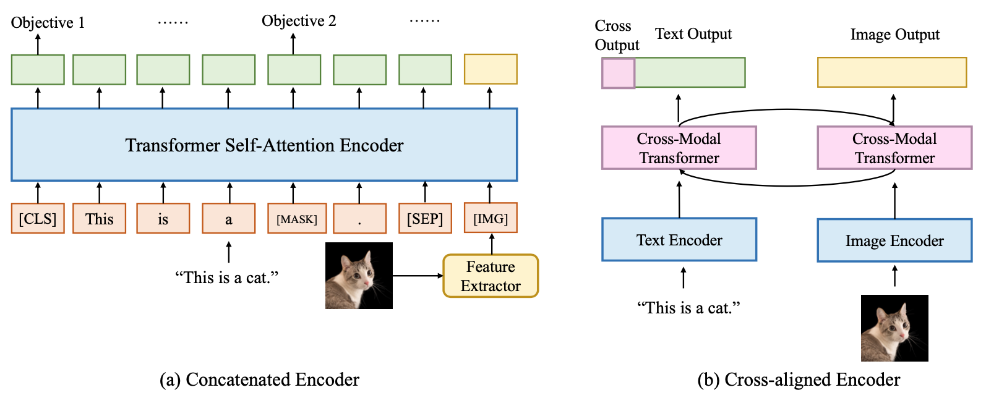
Two Types of Vision Language Encoders: Concatenated Encoders and Cross-aligned Encoders
Source: Yihan Cao, Siyu Li, Yixin Liu, Zhiling Yan, Yutong Dai, Philip S. Yu, and Lichao Sun (2023). "A Comprehensive Survey of AI-Generated Content (AIGC): A History of Generative AI from GAN to ChatGPT." arXiv preprint arXiv:2303.04226.

Slide 16
Two Types of to-language Decoder Models: Jointly-trained Models and Frozen Models
Source: Yihan Cao, Siyu Li, Yixin Liu, Zhiling Yan, Yutong Dai, Philip S. Yu, and Lichao Sun (2023). "A Comprehensive Survey of AI-Generated Content (AIGC): A History of Generative AI from GAN to ChatGPT." arXiv preprint arXiv:2303.04226.

Slide 17
ChatGPT Large Language Models (LLMs) Foundation Models

Slide 18
Large Language Models (LLM) (GPT-3, ChatGPT, PaLM, BLOOM, OPT-175B, LLaMA)
ChatGPT
175B
LLaMA
65B
Source: https://lifearchitect.ai/models/

Slide 19
The Transformers Timeline
ULMFit
BERT
RoBERTa
XLM-R
DeBERTa
GPT-Neo
BLOOM
Alpaca
DistrilBERT
T5
PaLM
ChatGPT
Llama2
Transformer
GPT
GPT-2
GPT-3
GPT-J
OPT-175B
Llama
2017
2018
2019
2020
2021
2022
2023
Source: Lewis Tunstall, Leandro von Werra, and Thomas Wolf (2022), Natural Language Processing with Transformers: Building Language Applications with Hugging Face, O'Reilly Media.

Slide 20
Transformer Models
Transformer
Encoder
Decoder
DistilBERT
BERT
T5
GPT
RoBERTa
BART
GPT-2
CTRL
XLM-R
XLM
M2M-100
GPT-3
ALBERT
BigBird
GPT-Neo
GPT-J
ELECTRA
mT0
BLOOM
BLOOMZ
DeBERTa
ChatGPT
GPT-4
Source: Lewis Tunstall, Leandro von Werra, and Thomas Wolf (2022), Natural Language Processing with Transformers: Building Language Applications with Hugging Face, O'Reilly Media.

Slide 21
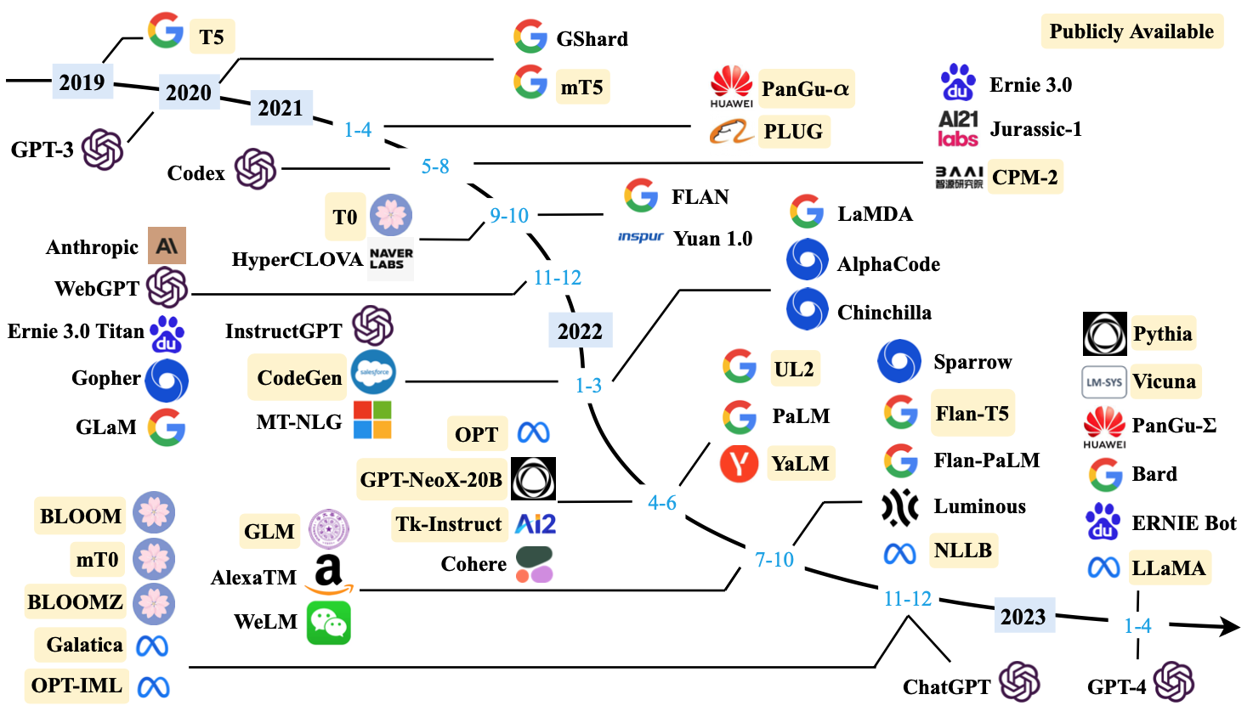
Large Language Models (LLMs) (larger than 10B)
Source: Wayne Xin Zhao, Kun Zhou, Junyi Li, Tianyi Tang, Xiaolei Wang, Yupeng Hou, Yingqian Min et al. (2023) "A Survey of Large Language Models." arXiv preprint arXiv:2303.18223.

Slide 22
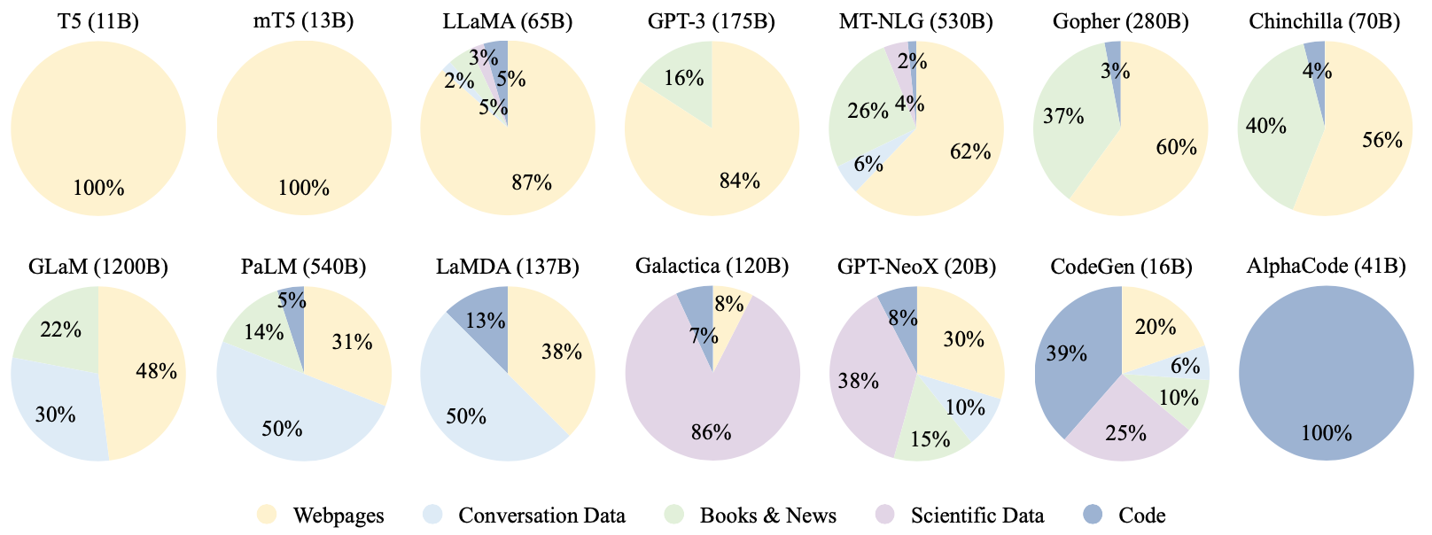
Ratios of various data sources in the pre-training data for existing LLMs
Source: Wayne Xin Zhao, Kun Zhou, Junyi Li, Tianyi Tang, Xiaolei Wang, Yupeng Hou, Yingqian Min et al. (2023) "A Survey of Large Language Models." arXiv preprint arXiv:2303.18223.

Slide 23
Typical Data Preprocessing Pipeline for Pre-training Large Language Models (LLMs)
Source: Wayne Xin Zhao, Kun Zhou, Junyi Li, Tianyi Tang, Xiaolei Wang, Yupeng Hou, Yingqian Min et al. (2023) "A Survey of Large Language Models." arXiv preprint arXiv:2303.18223.

Slide 24
Outline
Introduction
Generative AI Foundations
Popular Generative AI
Key Generative AI Applications in Education
Challenges of Generative AI in Innovative Learning

Slide 25
Popular Generative AI
OpenAI ChatGPT (GPT-3.5, GPT-4)
OpenAI DALL·E 3
Perplexity.ai
Chat.LMSys.org
Llama 2, Mistral, Zephyr, Vicuna, MPT, Falcon
ChatPDF
Stable Diffusion
Video: D-ID, Synthesia
Audio: Speechify

Slide 26
Generative AI Text, Image, Video, Audio Applications

Slide 27
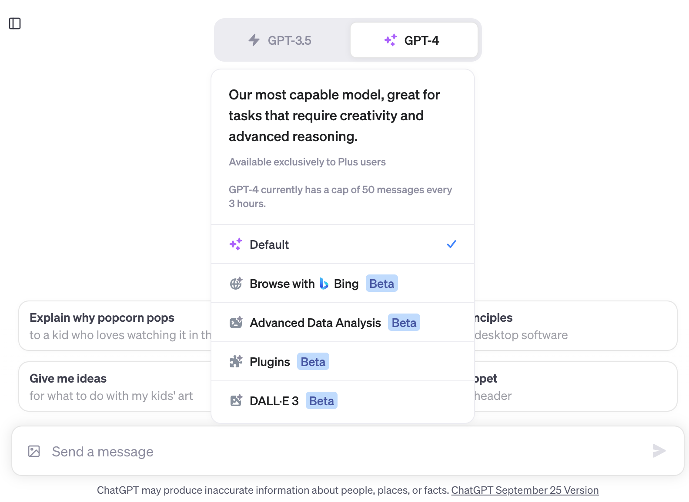
OpenAI ChatGPT (GPT-3.5, GPT-4)
https://chat.openai.com/
https://chat.openai.com/

Slide 28
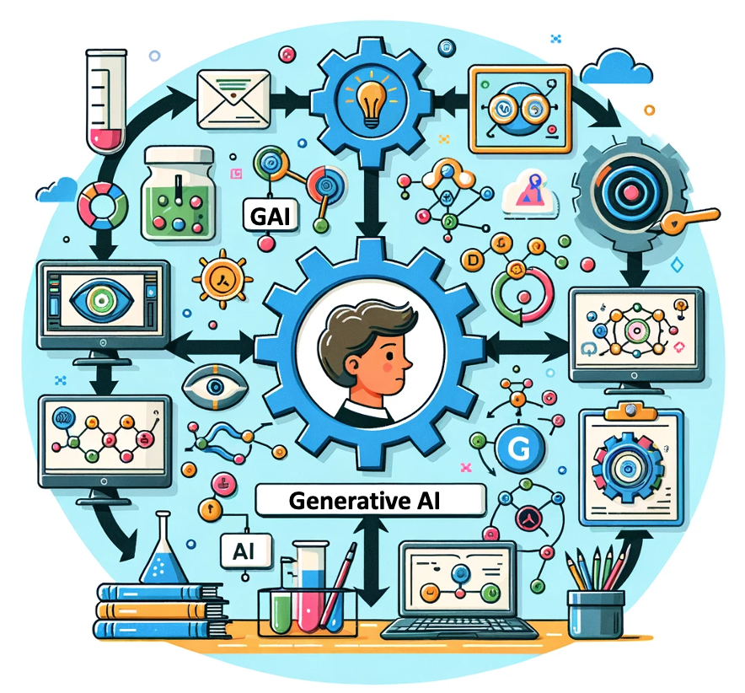
OpenAI ChatGPT (GPT-4) DALL·E 3
Vector graphic of a flowchart depicting the integration of generative AI in the education process, from content creation to virtual experiments, personalized learning, and innovative learning.
https://chat.openai.com/

Slide 29
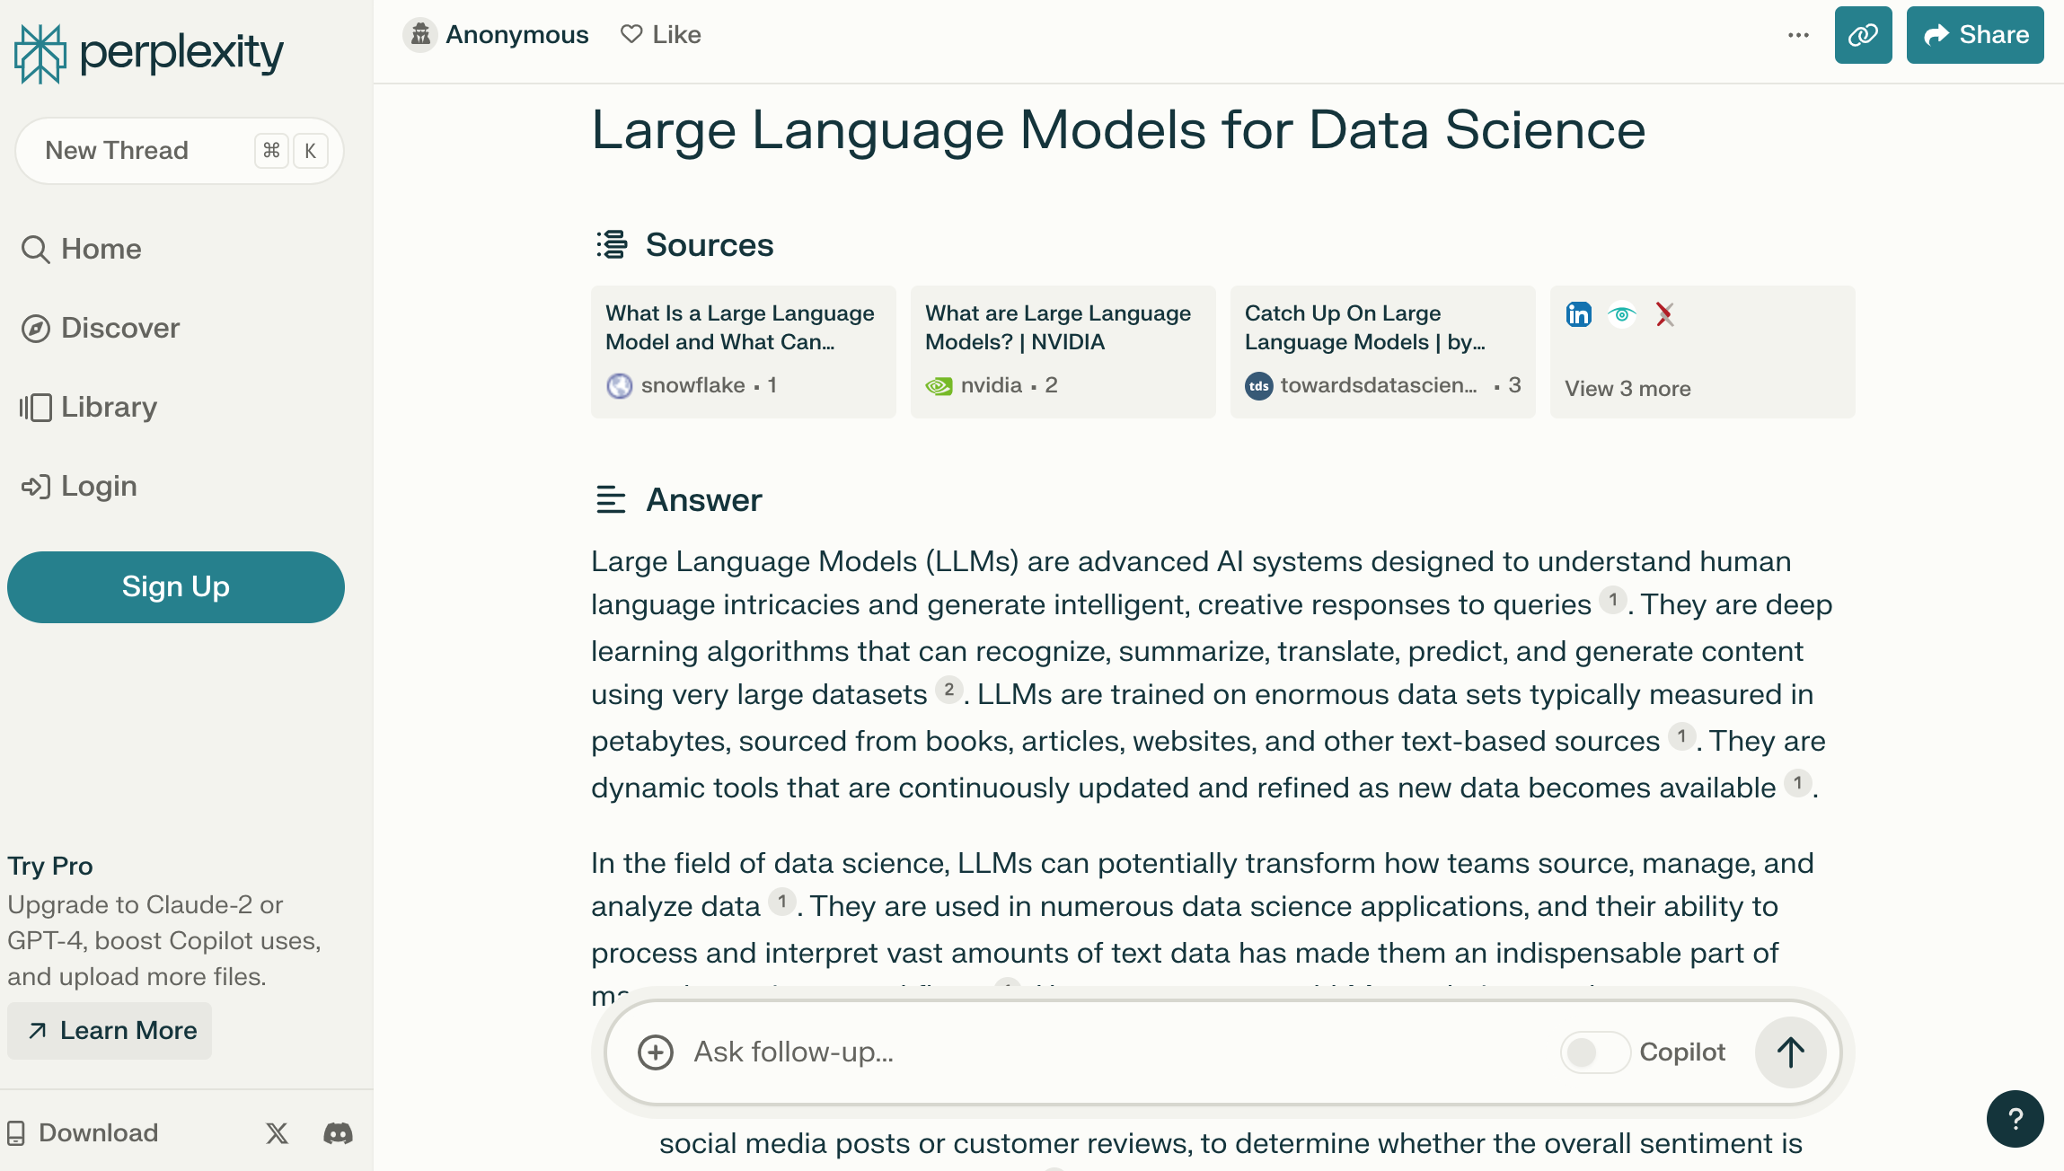
Perplexity.ai
https://www.perplexity.ai/

Slide 30
Chat with Open Large Language Models:
https://chat.lmsys.org/
Llama 2: open foundation and fine-tuned chat models by Meta
Mistral: a large language model by Mistral AI team
WizardLM: an instruction-following LLM using evol-instruct by Microsoft
Zephyr: a chatbot fine-tuned from Mistral by Hugging Face
Code Llama: open foundation models for code by Meta
ChatGLM: an open bilingual dialogue language model by Tsinghua University
Qwen: a large language model by Alibaba Cloud
Vicuna: a chat assistant fine-tuned on user-shared conversations by LMSYS
Falcon: TII’s flagship series of large language models

Slide 31
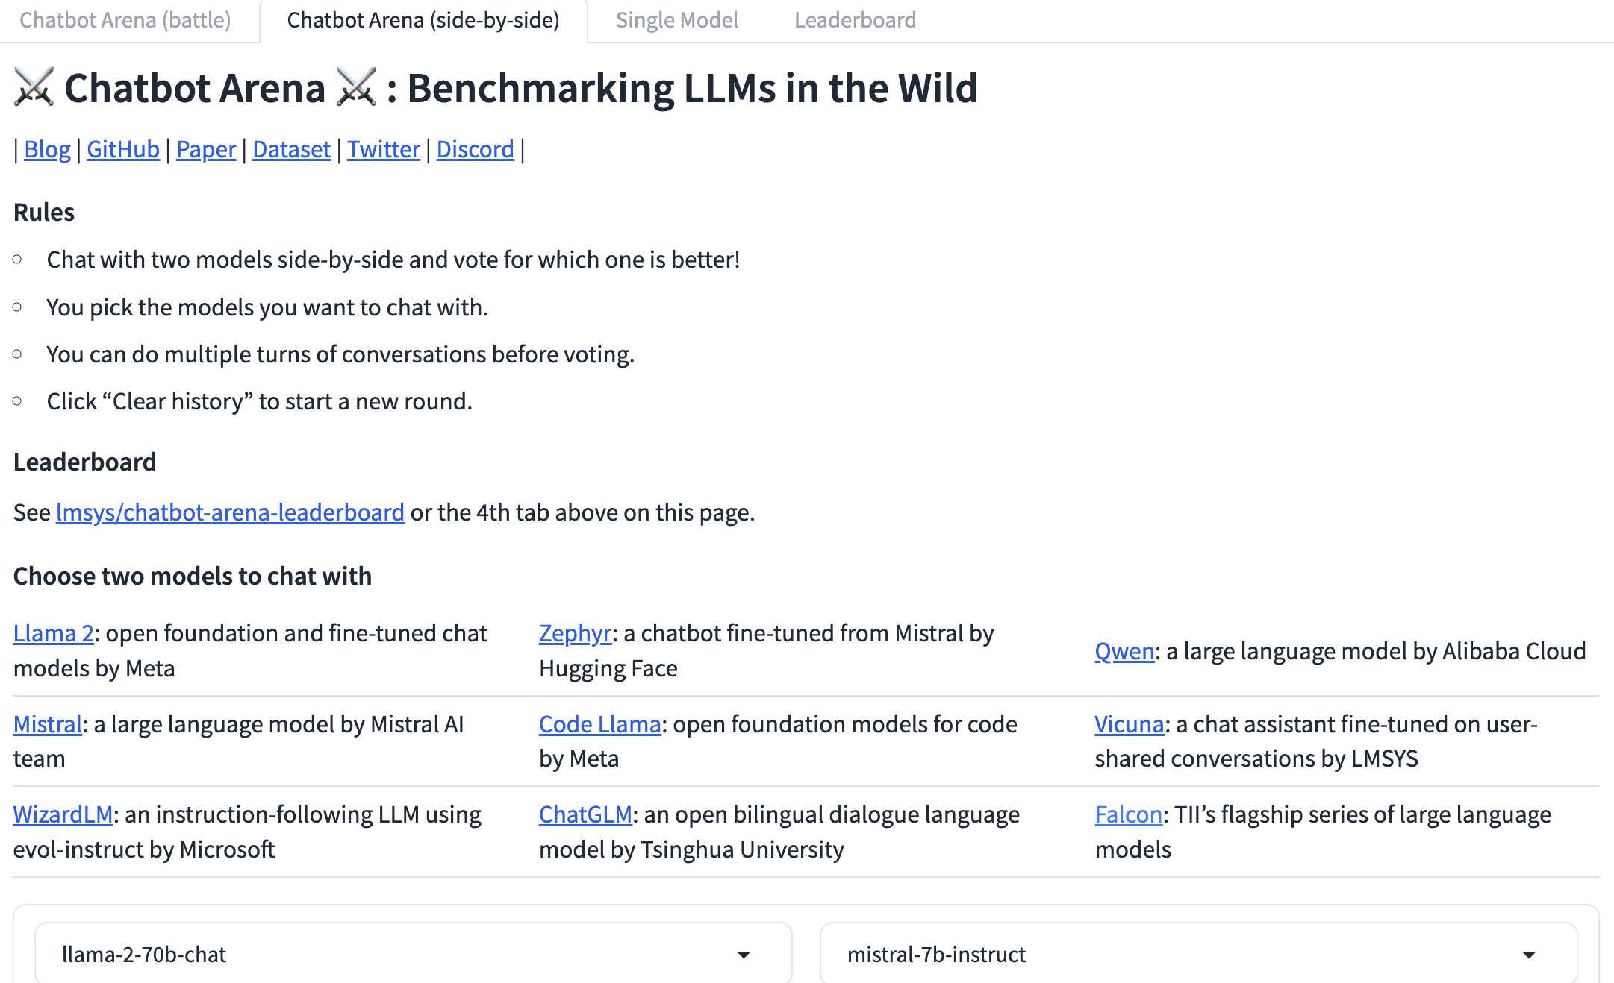
Chat with Open Large Language Models
chat.lmsys.org
https://chat.lmsys.org/

Slide 32
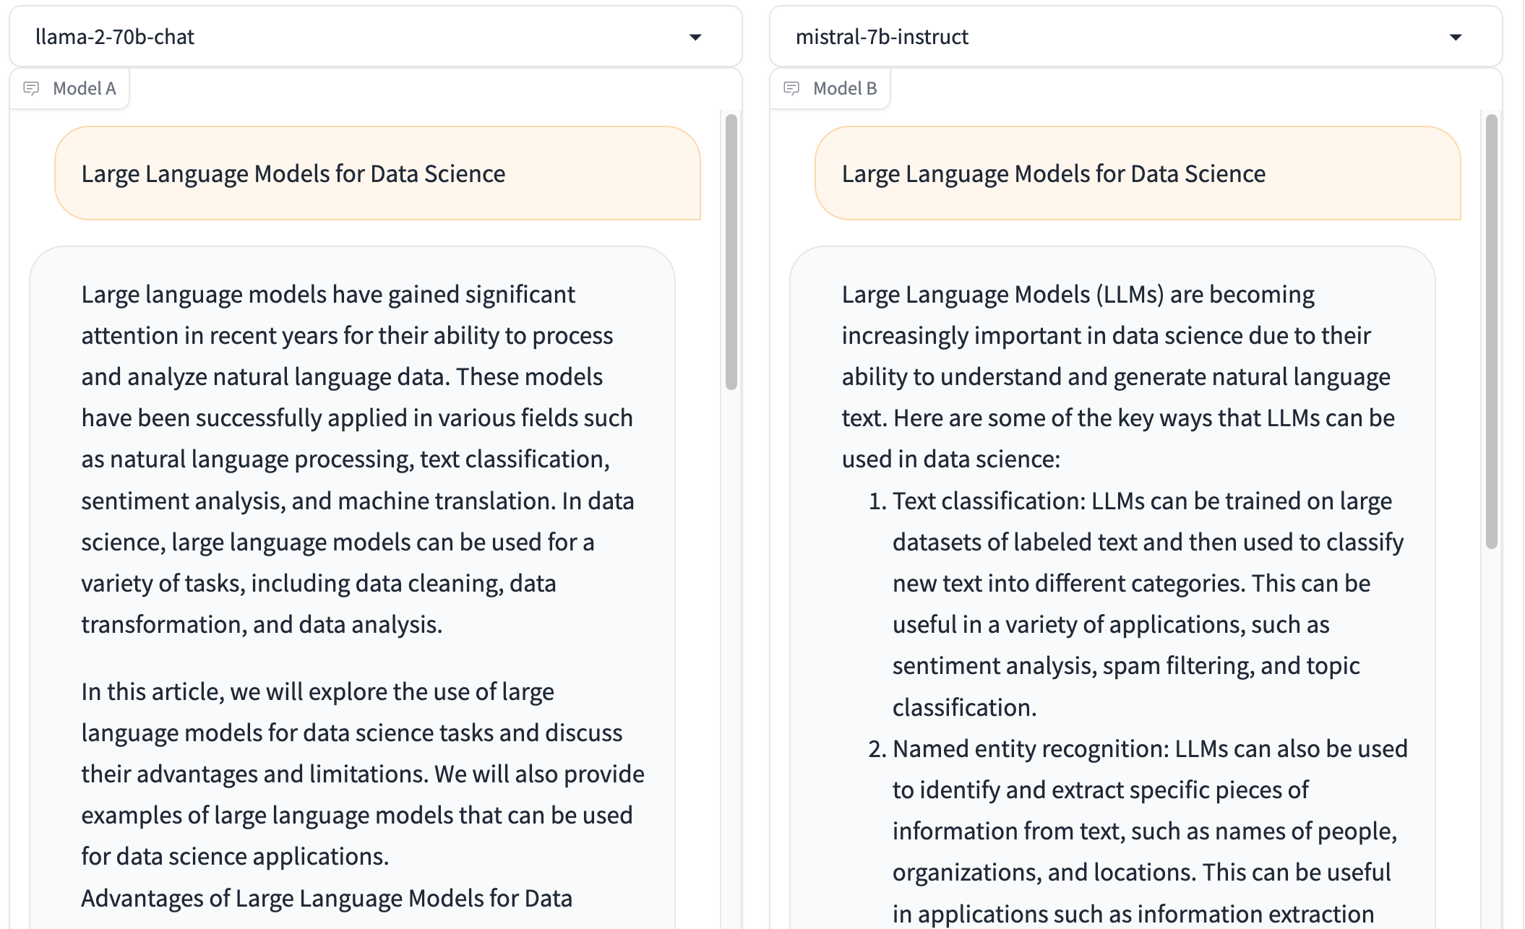
Chat with Open Large Language Models: Chatbot Arena
Large Language Models for Data Science
Llama 2-70b-chat
Mistral-7b-instruct
https://chat.lmsys.org/

Slide 33
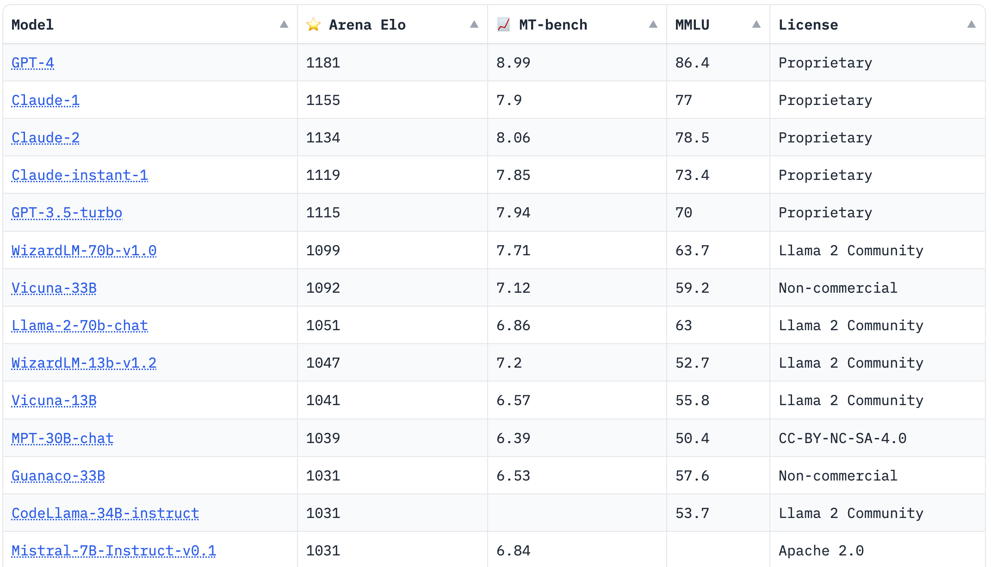
Chat with Open Large Language Models: Leaderboard
https://chat.lmsys.org/

Slide 34
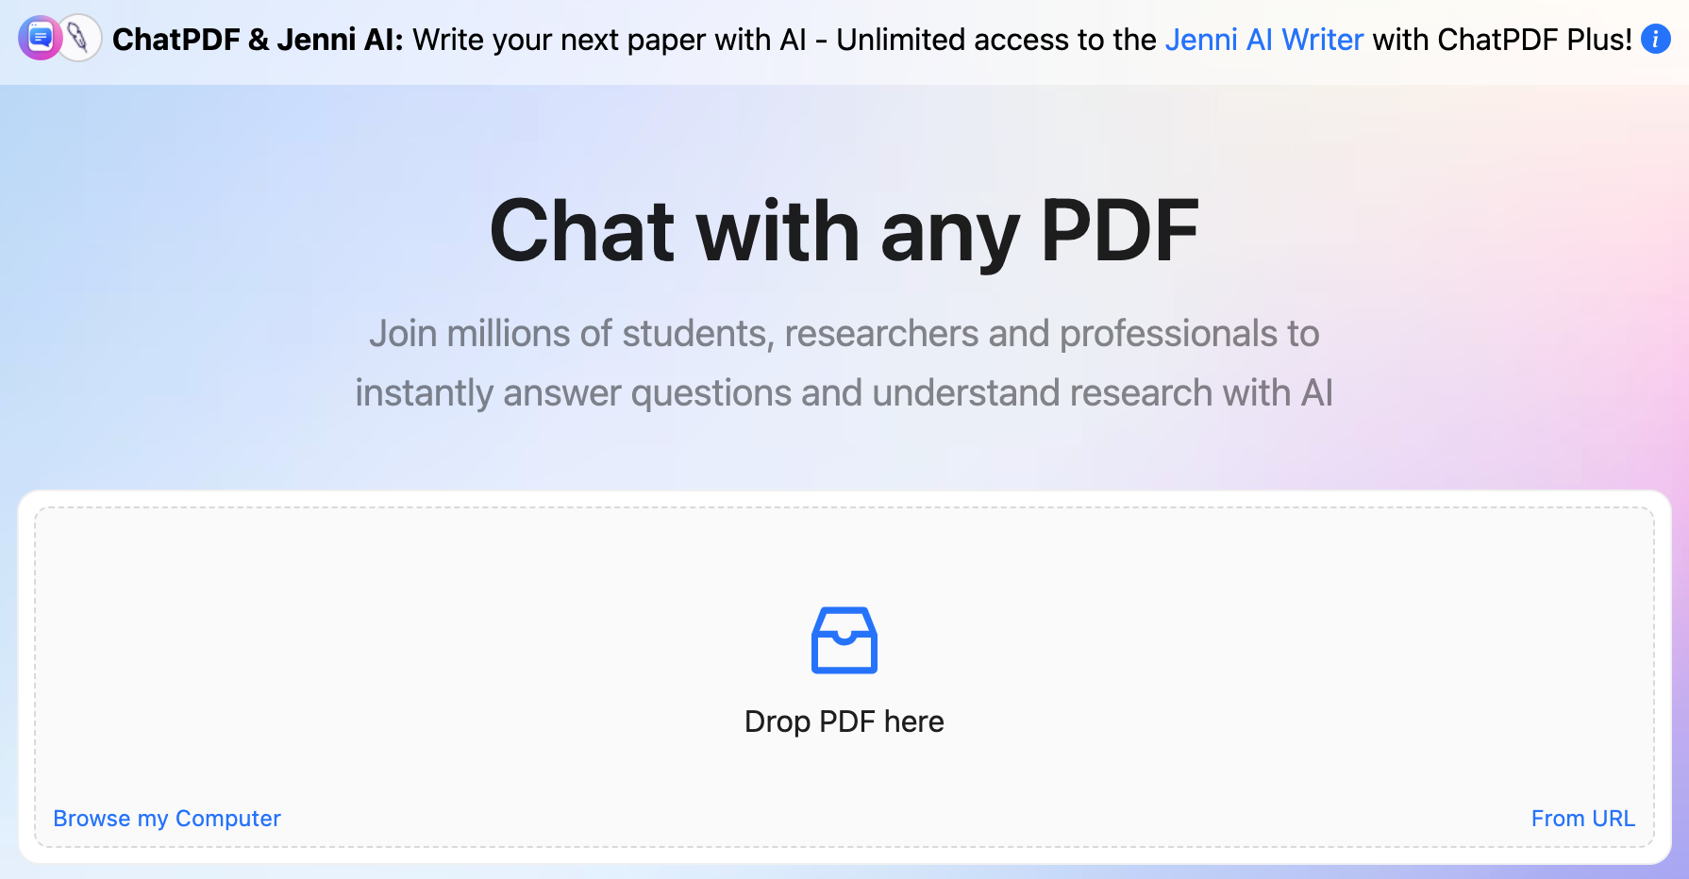
ChatPDF
www.chatpdf.com
https://www.chatpdf.com/

Slide 35
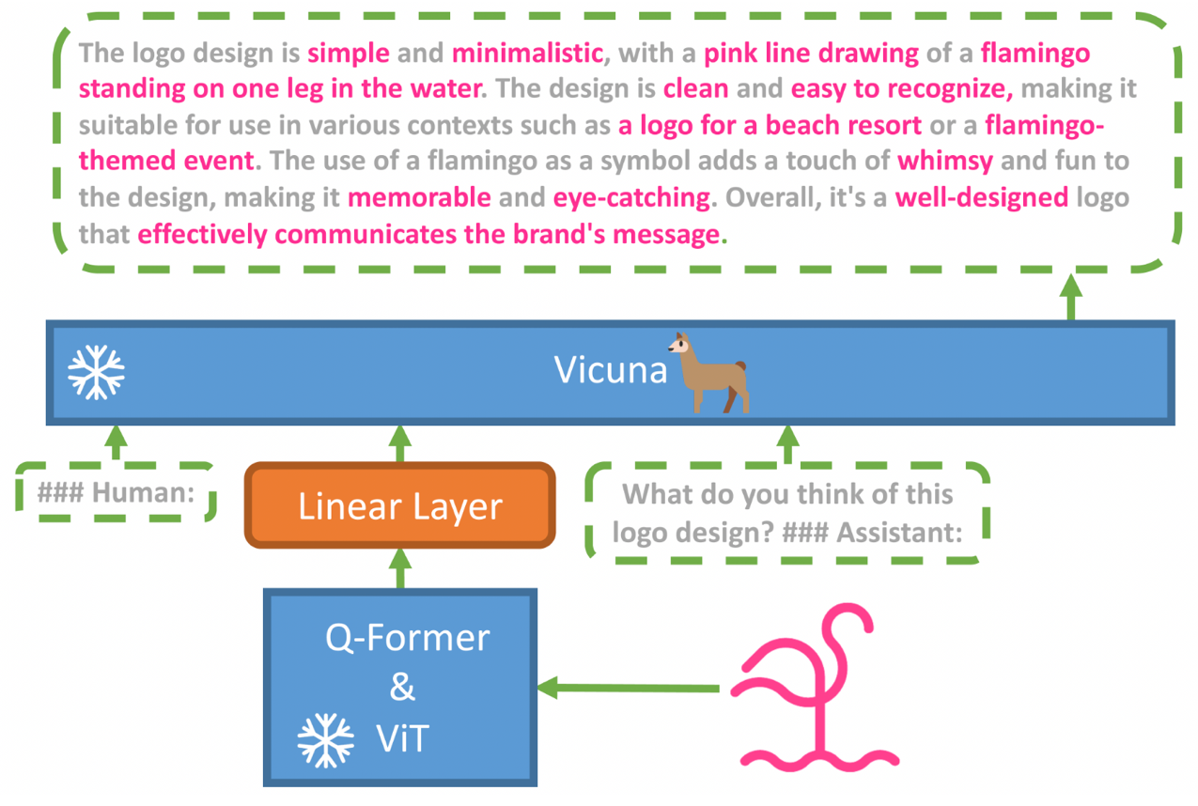
MiniGPT-4: Enhancing Vision-language Understanding with Advanced Large Language Models
Source: https://minigpt-4.github.io/

Slide 36
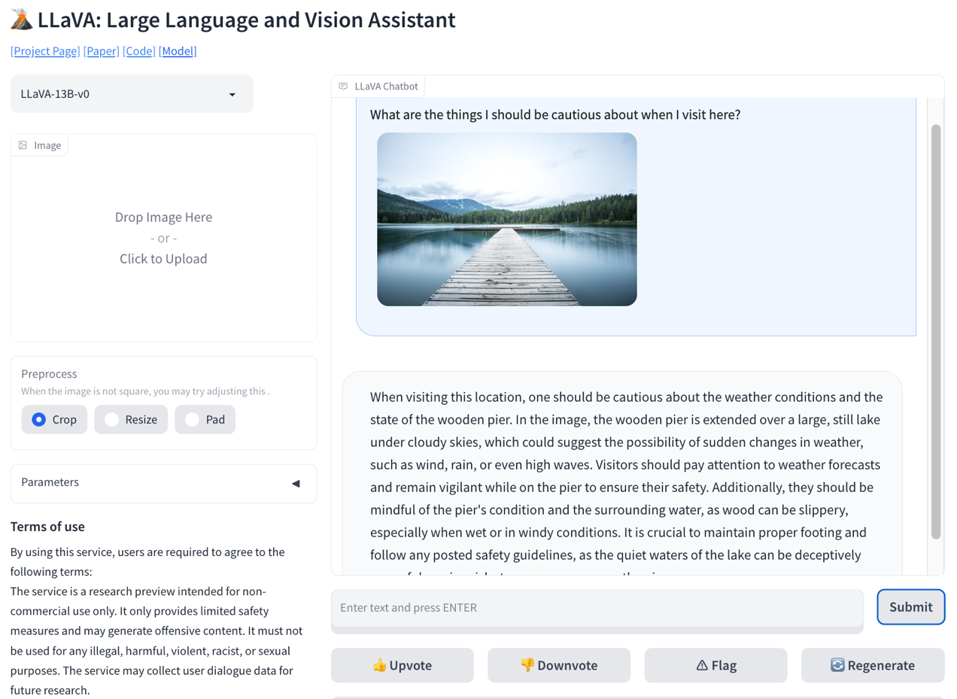
LLaVA: Large Language and Vision Assistant
llava-vl.github.io
Source: https://llava-vl.github.io/

Slide 37
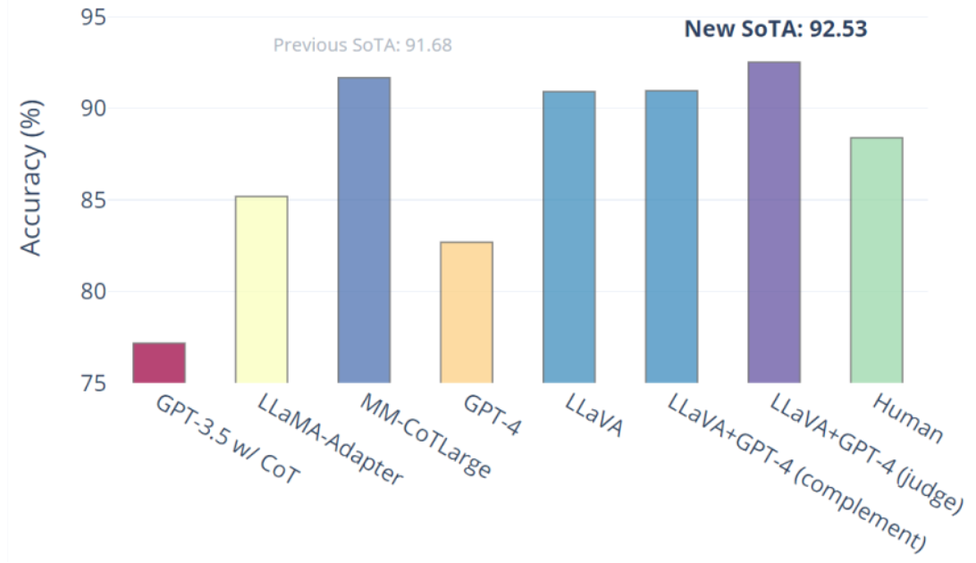
Visual Instruction Tuning LLaVA: Large Language and Vision Assistant University of Wisconsin-Madison, Microsoft Research, Columbia University
Science QA: New SoTA with the synergy of LLaVA with GPT-4
LLaVA represents a novel end-to-end trained large multimodal model that combines a vision encoder and Vicuna for general-purpose visual and language understanding, achieving impressive chat capabilities mimicking spirits of the multimodal GPT-4 and setting a new state-of-the-art accuracy on Science QA.
Source: https://llava-vl.github.io/

Slide 38
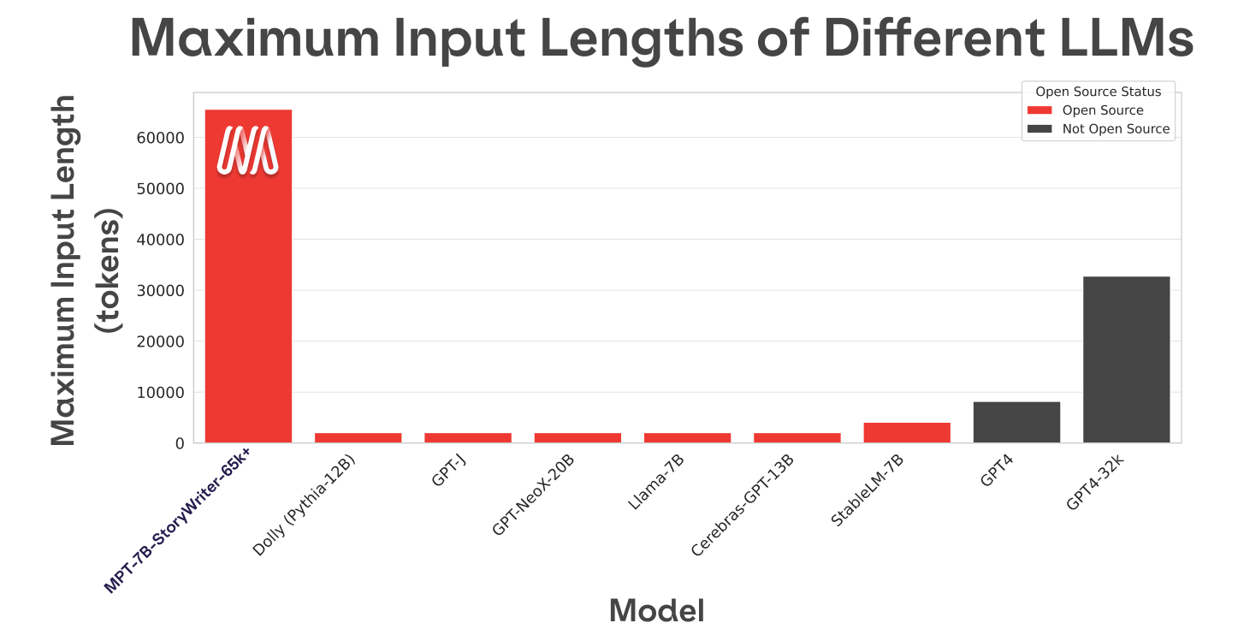
MPT-7B-StoryWriter-65k+
Source: https://www.mosaicml.com/blog/mpt-7b

Slide 39
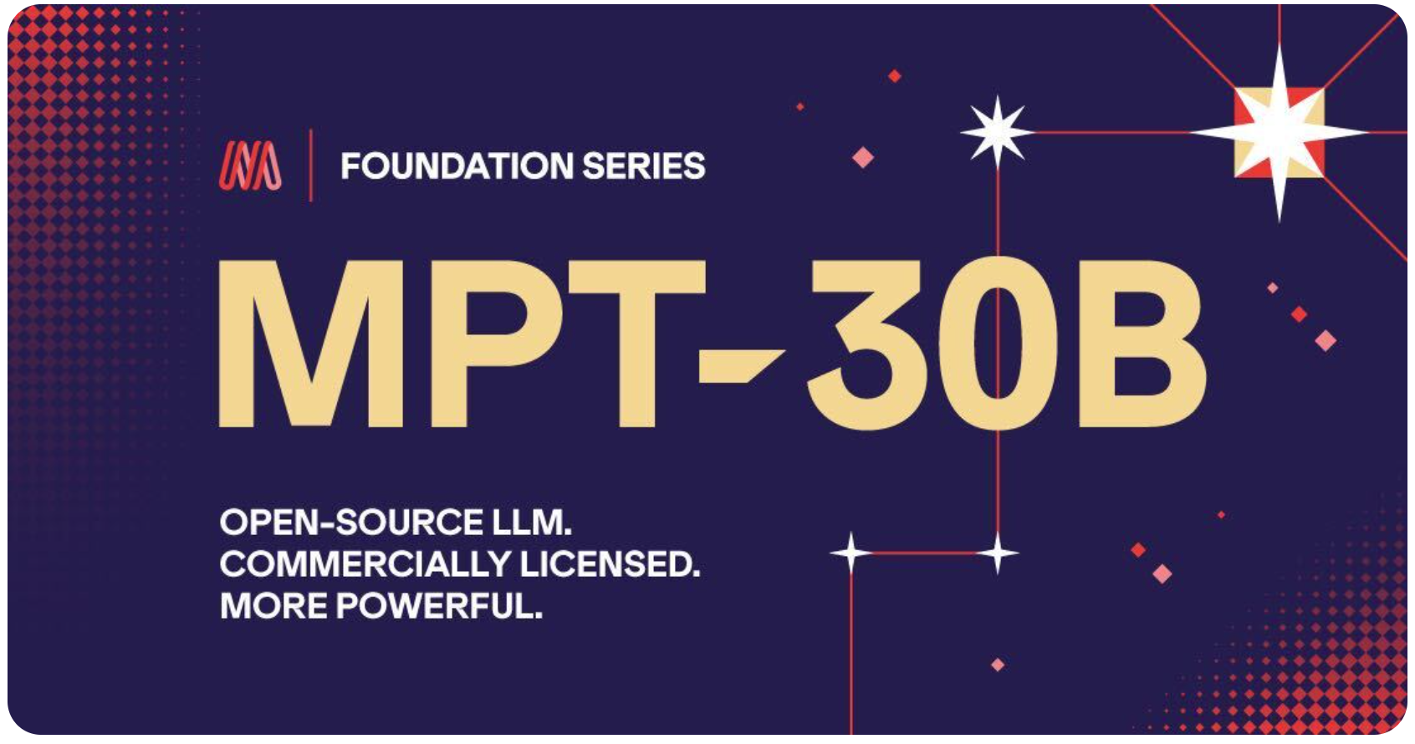
MPT-30B, MPT-7B LLaMa-30B, LLaMa-7B
Source: https://www.mosaicml.com/blog/mpt-30b

Slide 40
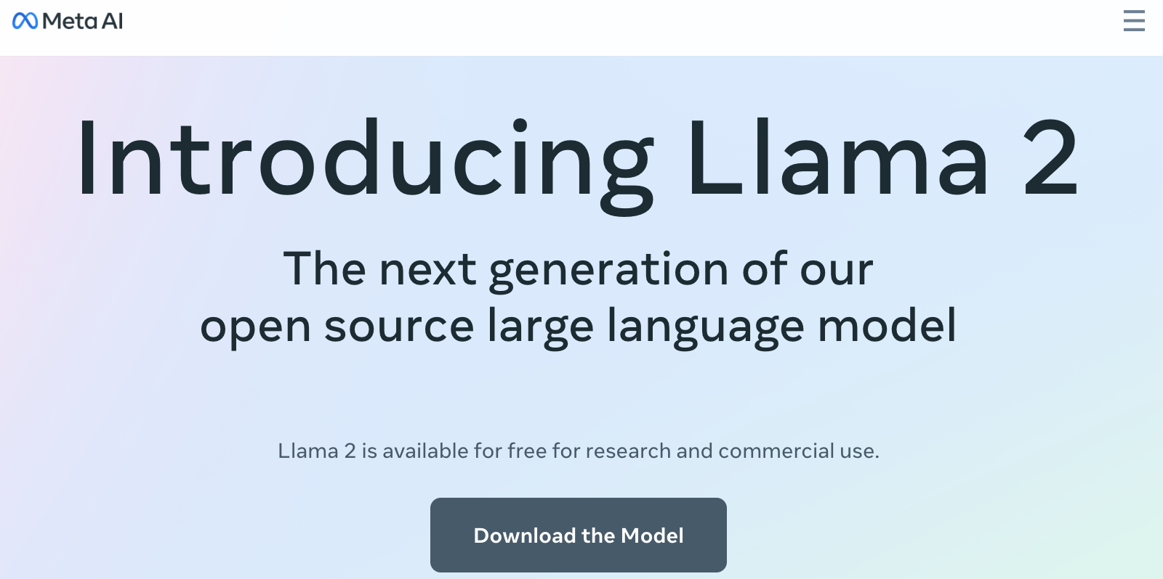
Meta Llama-2 70B: Best Open Source and Commercial LLM (Llama-2, Falcon, MPT)
Source: https://ai.meta.com/llama/

Slide 41
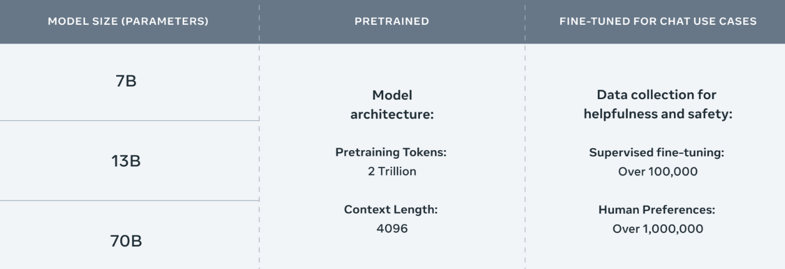
Meta Llama-2 70B: Best Open Source and Commercial LLM (Llama-2, Falcon, MPT)
Llama 2 pretrained models are trained on 2 trillion tokens, and have double the context length than Llama 1. Its fine-tuned models have been trained on over 1 million human annotations.
Source: https://ai.meta.com/llama/

Slide 42
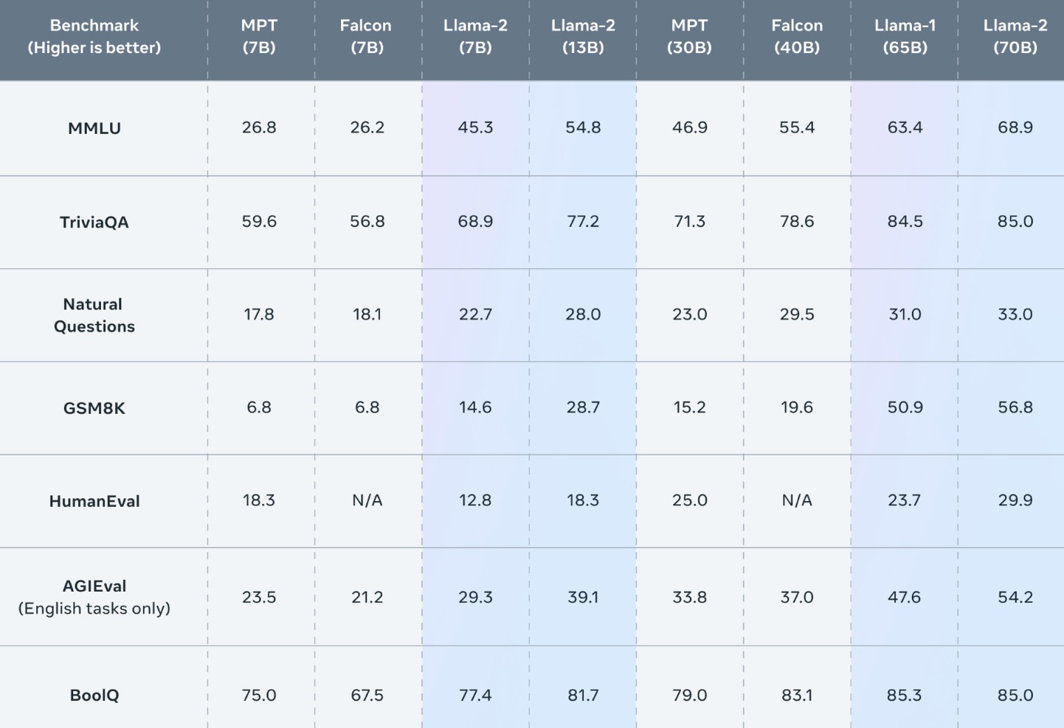
Meta Llama-2 70B: Best Open Source and Commercial LLM (Llama-2, Falcon, MPT)
Llama 2 outperforms other open source language models on many external benchmarks, including reasoning, coding, proficiency, and knowledge tests.
Source: https://ai.meta.com/llama/

Slide 43
Llama-2: Comparison to closed-source models (GPT-3.5, GPT-4, PaLM) on academic benchmarks
Results for GPT-3.5 and GPT-4 are from OpenAI (2023).
Results for the PaLM model are from Chowdhery et al. (2022).
Results for the PaLM-2-L are from Anil et al. (2023).
Source: Touvron, Hugo, Louis Martin, Kevin Stone, Peter Albert, Amjad Almahairi, Yasmine Babaei, Nikolay Bashlykov et al. (2023) "Llama 2: Open Foundation and Fine-Tuned Chat Models." arXiv preprint arXiv:2307.09288 (2023).

Slide 44
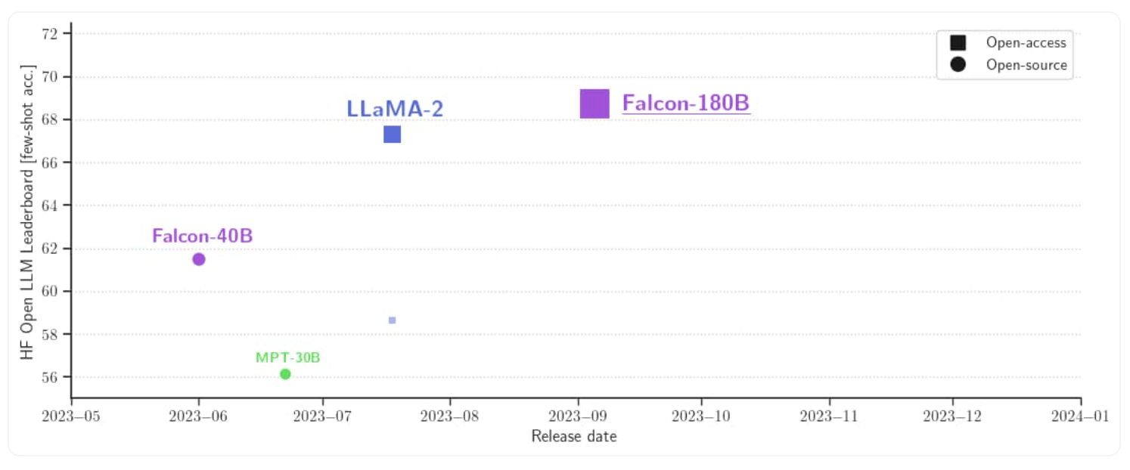
Falcon 180B
Source: https://huggingface.co/blog/falcon-180b

Slide 45
Falcon 180B, LLaMA 65B, MPT 30B
Source: https://huggingface.co/blog/falcon-180b

Slide 46
Falcon 180B Hardware requirements
NVIDIA A100 80 GB: $16,135
Source: https://huggingface.co/blog/falcon-180b

Slide 47
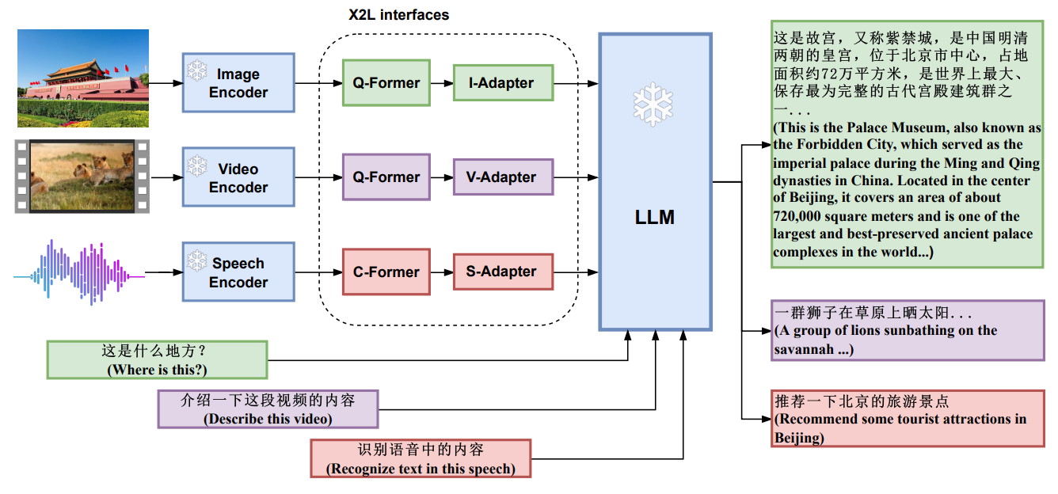
X-LLM: Bootstrapping Advanced Large Language Models by Treating Multi-Modalities as Foreign Languages
Source: Chen, Feilong, Minglun Han, Haozhi Zhao, Qingyang Zhang, Jing Shi, Shuang Xu, and Bo Xu. "X-LLM: Bootstrapping Advanced Large Language Models by Treating Multi-Modalities as Foreign Languages." arXiv preprint arXiv:2305.04160 (2023).

Slide 48
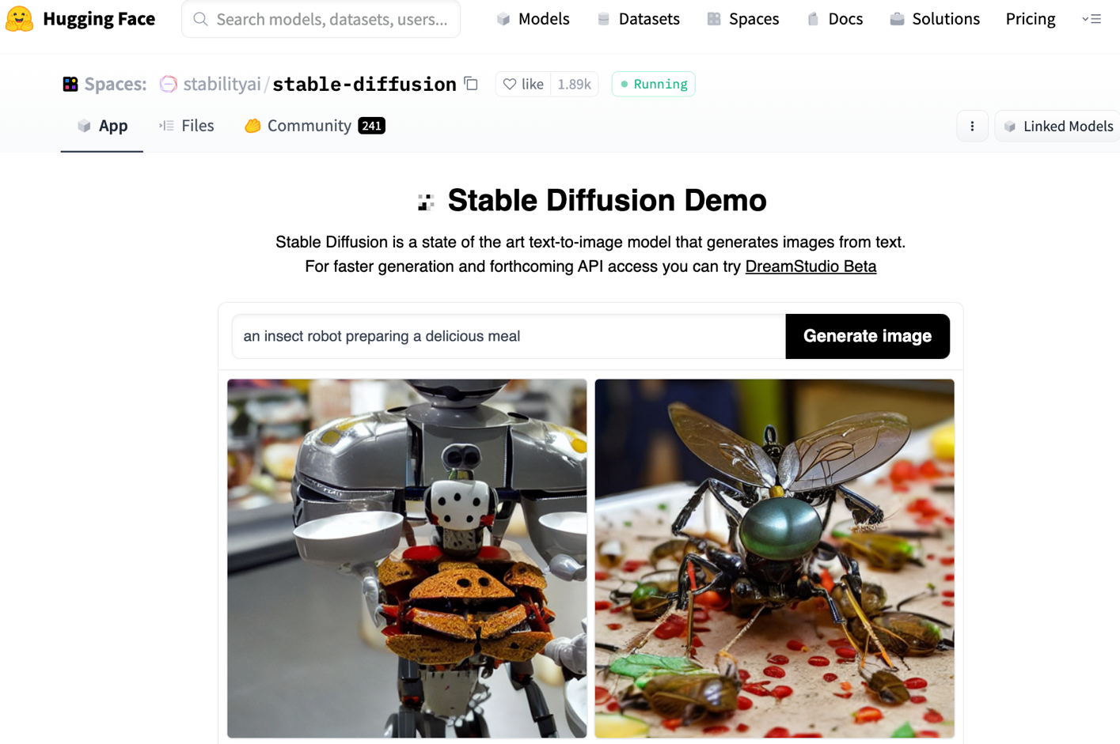
Stable Diffusion
https://huggingface.co/spaces/stabilityai/stable-diffusion

Slide 49
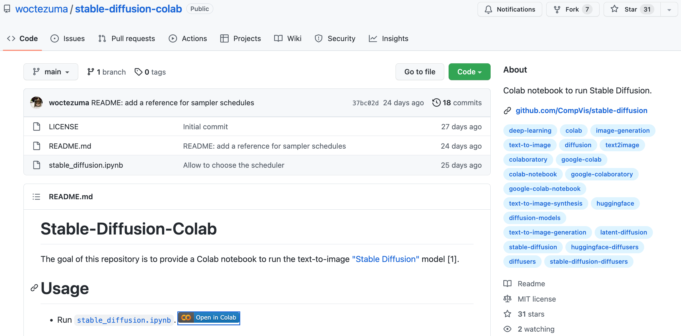
Stable Diffusion Colab
https://github.com/woctezuma/stable-diffusion-colab

Slide 50
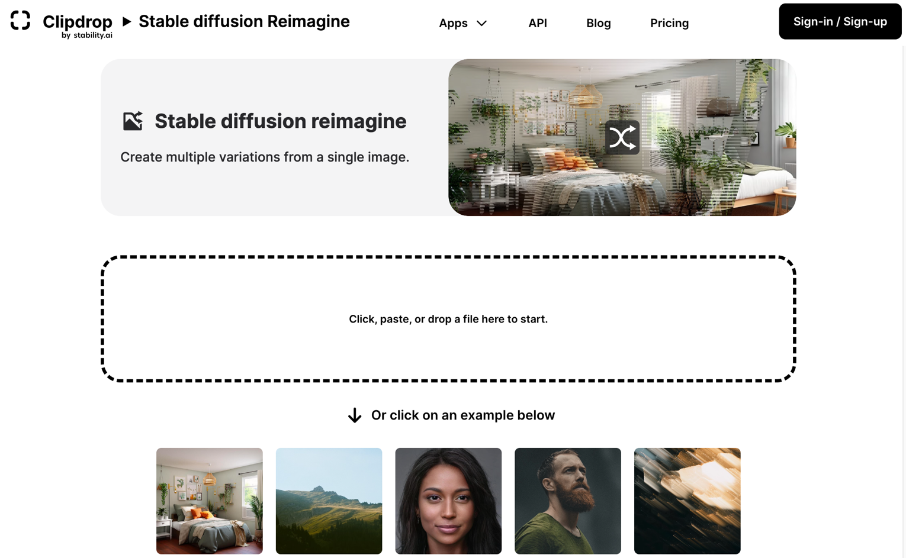
Stable Diffusion Reimagine
https://clipdrop.co/stable-diffusion-reimagine

Slide 51
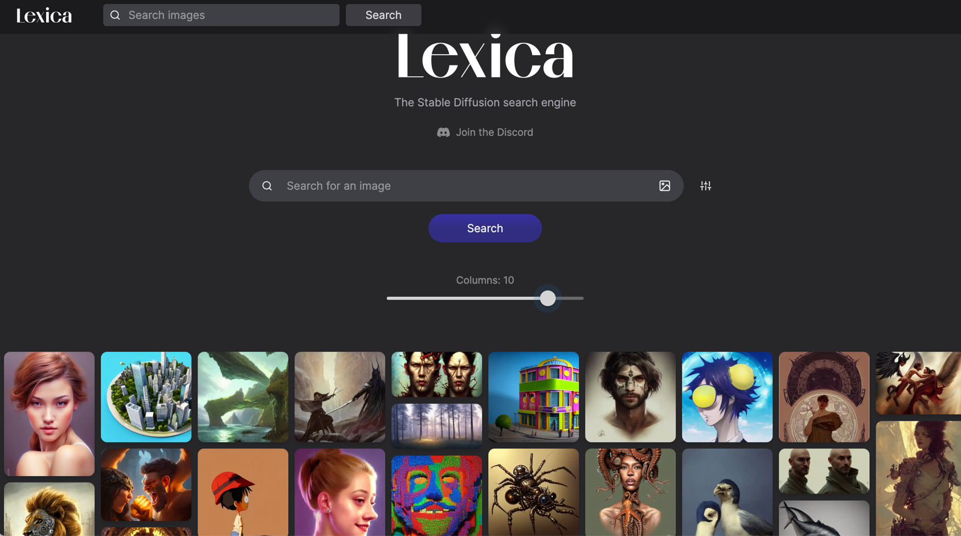
Lexica Art: Search Stable Diffusion images and prompts
https://lexica.art/

Slide 52
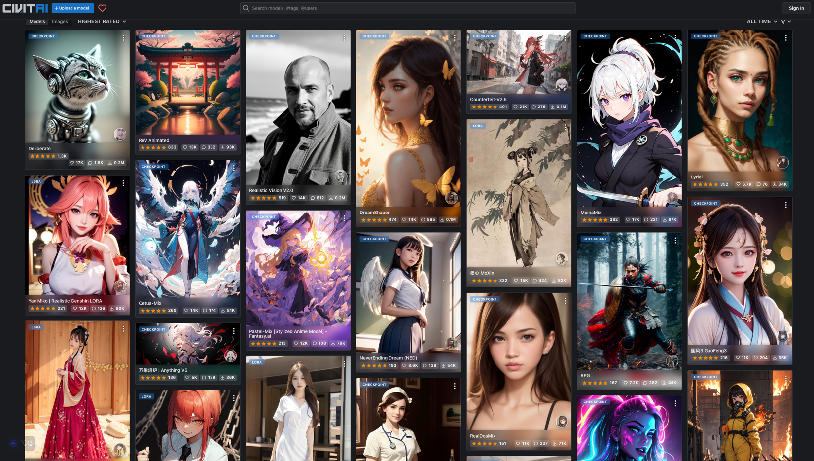
Civitai: Stable Diffusion AI Art Models
https://civitai.com/

Slide 53
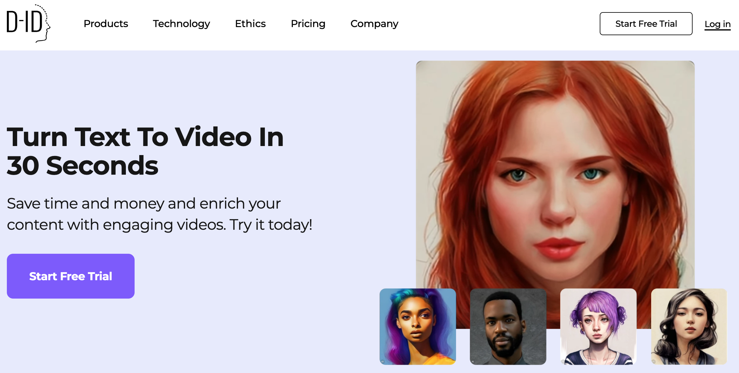
D-ID Text to Video
https://www.d-id.com/text-to-video/

Slide 54
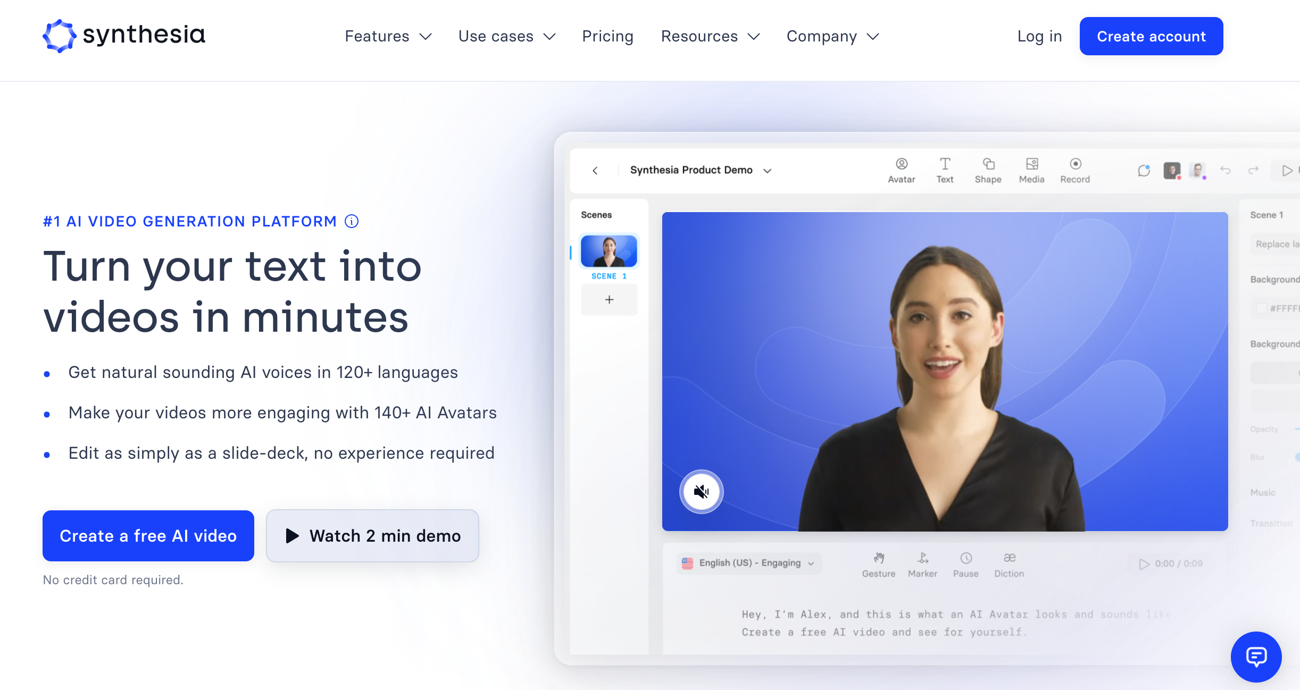
Synthesia: #1 AI Video Generation
https://www.synthesia.io/

Slide 55
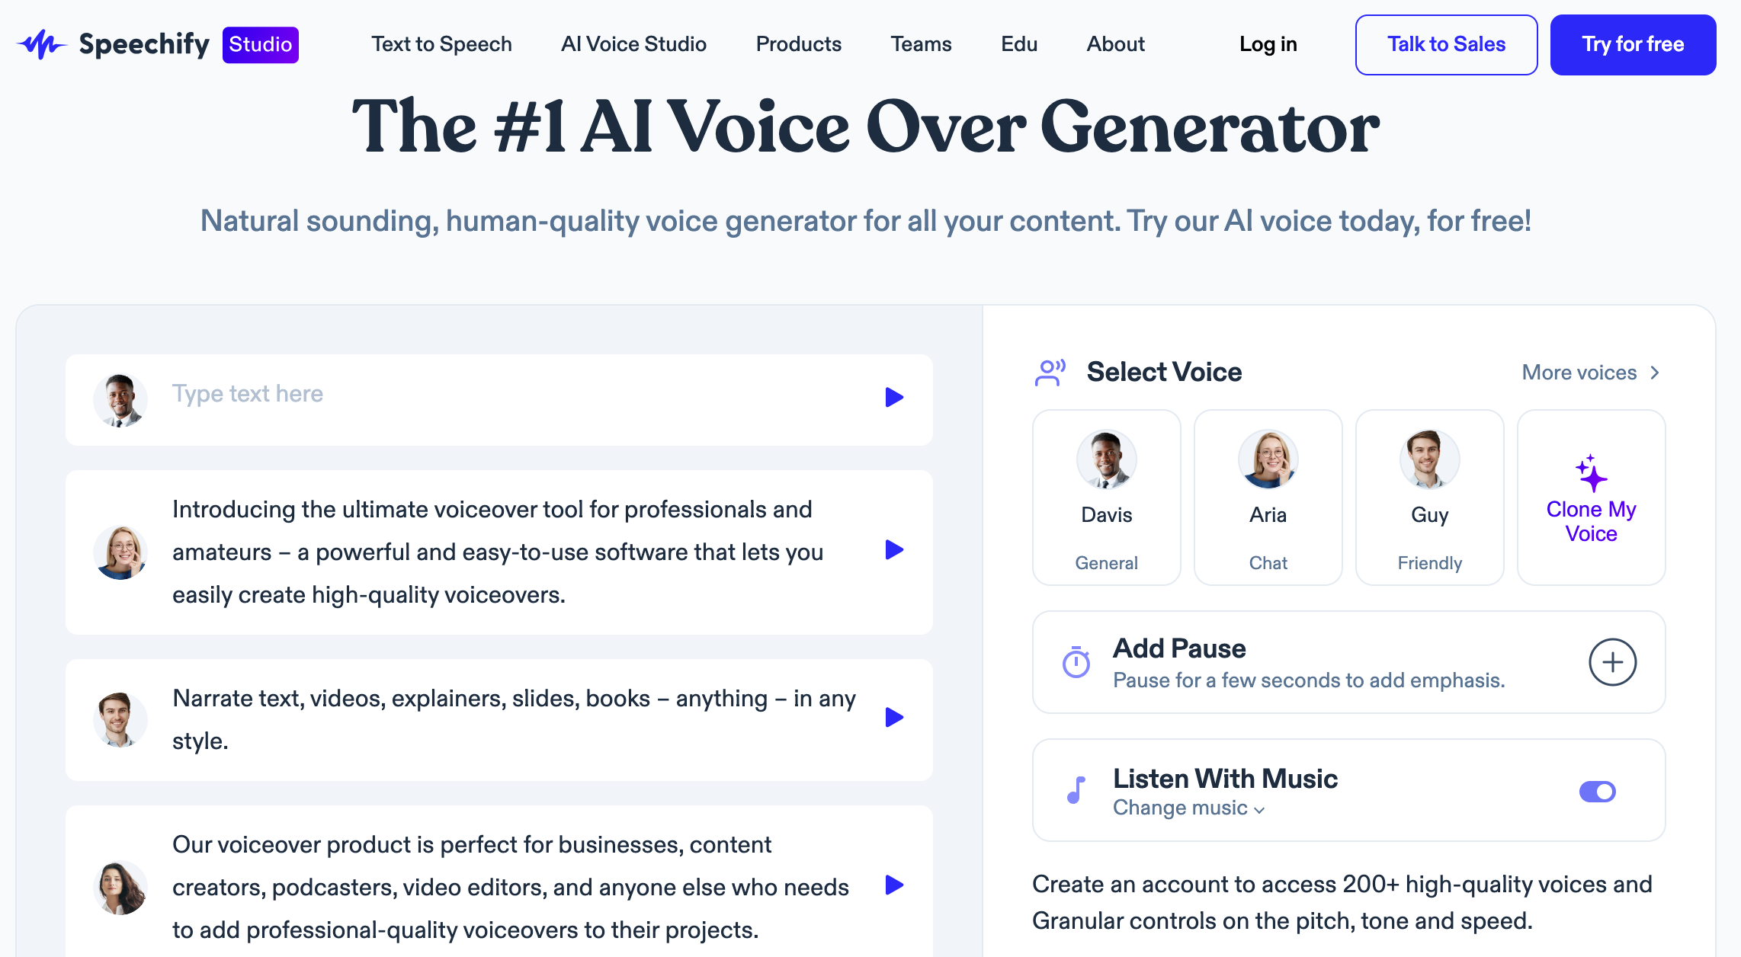
Speechify: #1 AI Voice Over Generator
https://speechify.com/voiceover/

Slide 56
Outline
Introduction
Generative AI Foundations
Popular Generative AI
Key Generative AI Applications in Education
Challenges of Generative AI in Innovative Learning

Slide 57
Key Generative AI Applications in Education
Content Generation and Personalization
Simulations and Virtual Environments
Automated Feedback and Tutoring

Slide 58
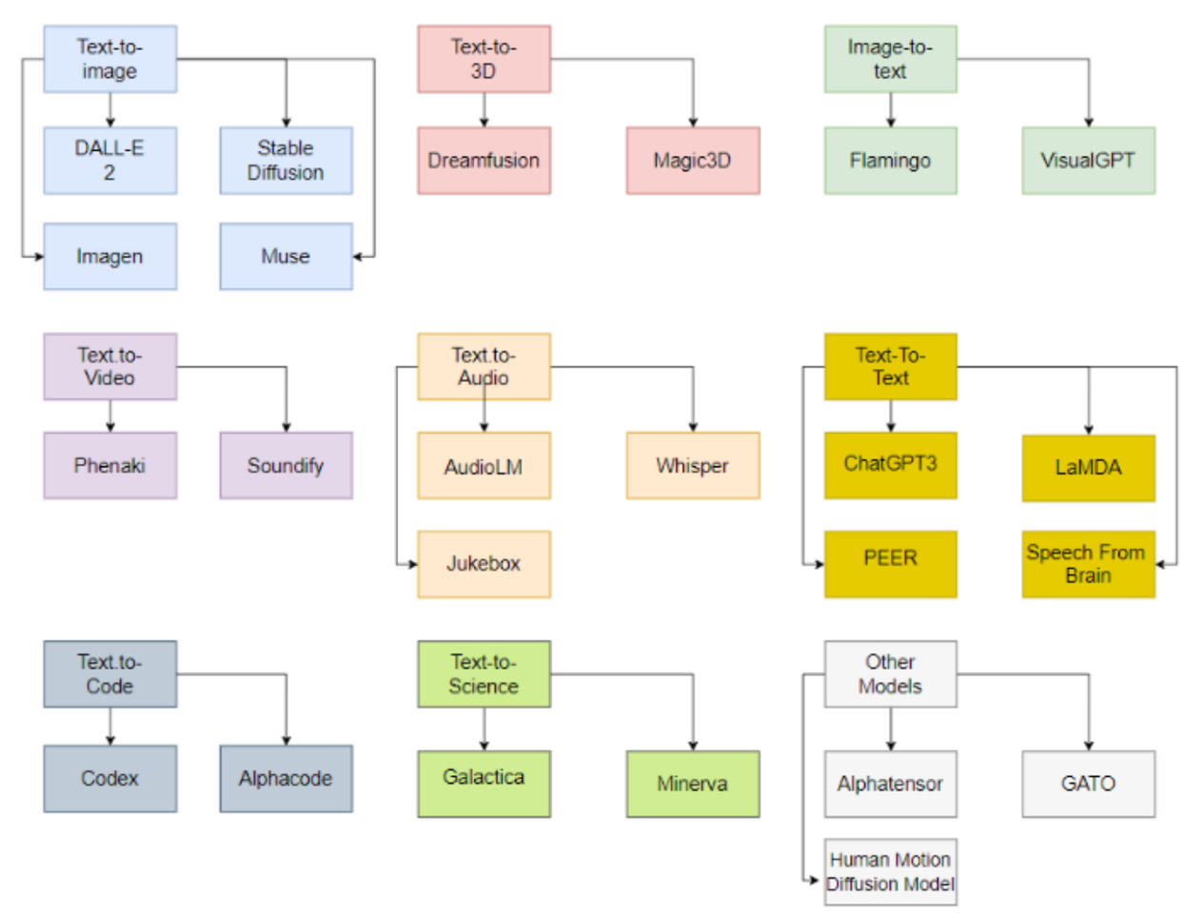
Generative AI Models
ChatGPT is not all you need
Attention is all you need
Source: Gozalo-Brizuela, Roberto, and Eduardo C. Garrido-Merchan (2023). "ChatGPT is not all you need. A State of the Art Review of large Generative AI models." arXiv preprint arXiv:2301.04655 (2023).

Slide 59
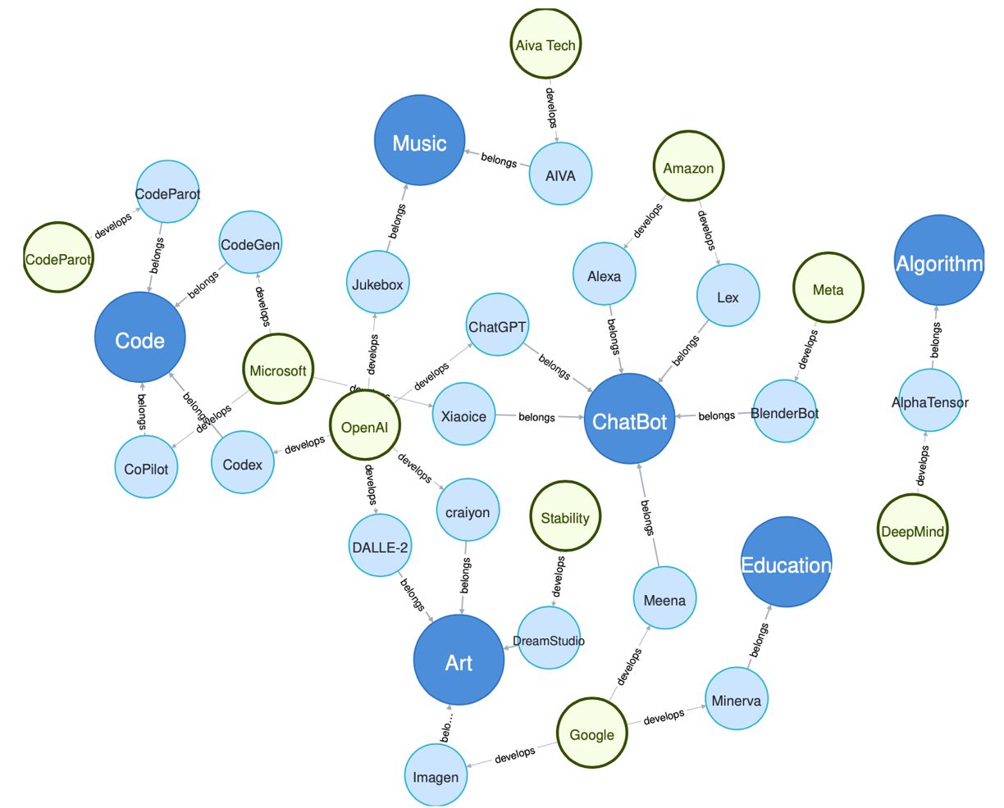
Generative AI Research Areas, Applications and Companies
Source: Yihan Cao, Siyu Li, Yixin Liu, Zhiling Yan, Yutong Dai, Philip S. Yu, and Lichao Sun (2023). "A Comprehensive Survey of AI-Generated Content (AIGC): A History of Generative AI from GAN to ChatGPT." arXiv preprint arXiv:2303.04226.

Slide 60
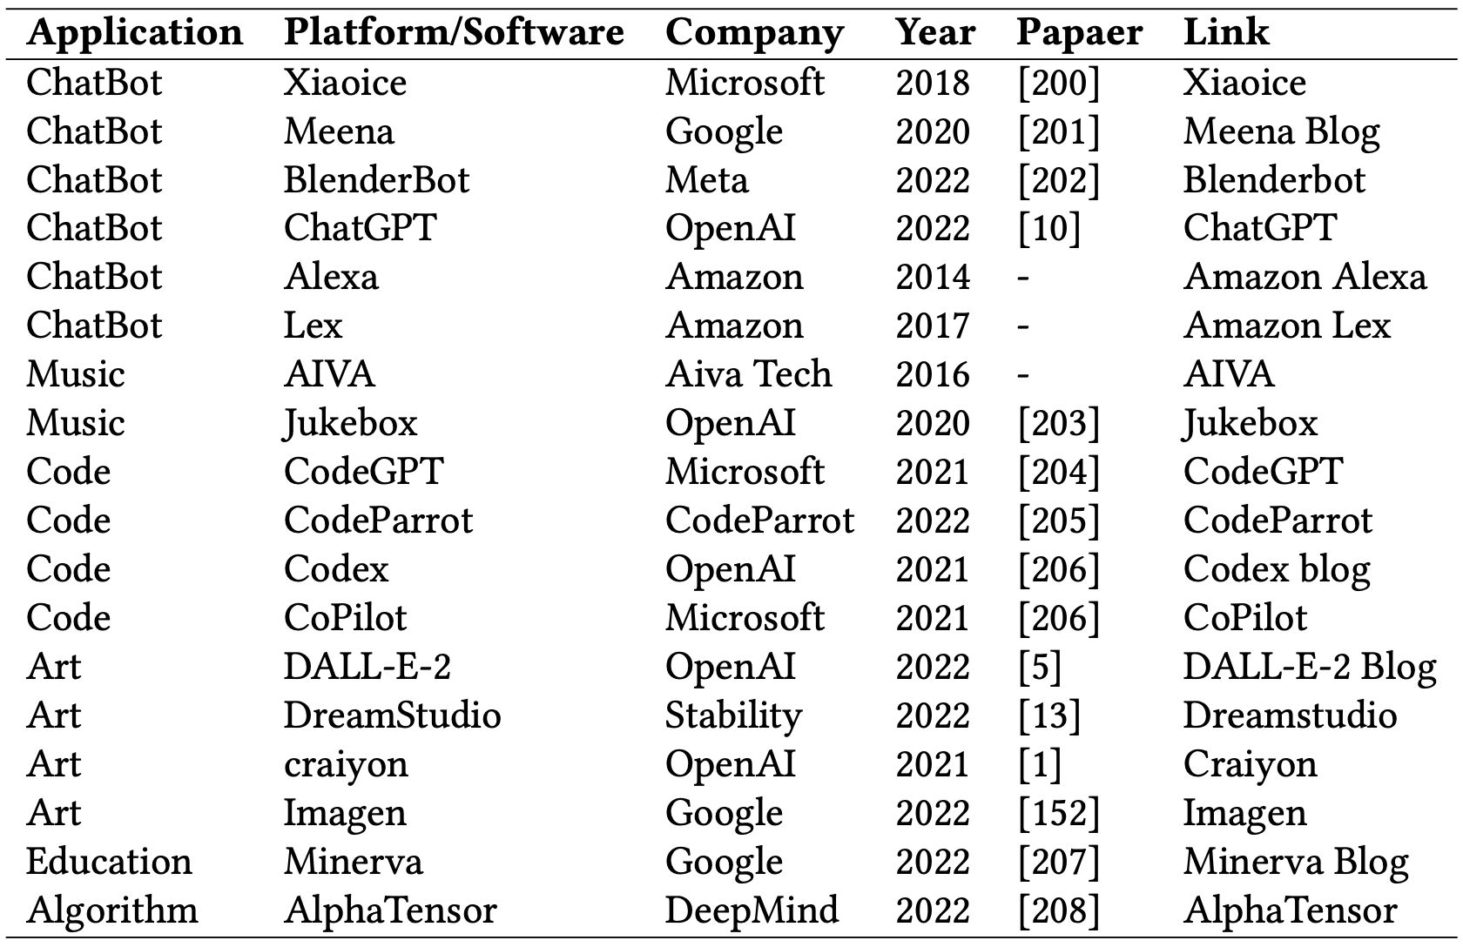
Applications of Generative AI Models
Source: Yihan Cao, Siyu Li, Yixin Liu, Zhiling Yan, Yutong Dai, Philip S. Yu, and Lichao Sun (2023). "A Comprehensive Survey of AI-Generated Content (AIGC): A History of Generative AI from GAN to ChatGPT." arXiv preprint arXiv:2303.04226.

Slide 61
Content Generation and Personalization
Customized learning materials
Personalized assessment creation

Slide 62
Simulations and Virtual Environments
Building immersive learning scenarios
Enhancing real-world application and understanding

Slide 63
Automated Feedback and Tutoring
Real-time feedback mechanisms
Adaptive tutoring based on student performance

Slide 64
Outline
Introduction
Generative AI Foundations
Popular Generative AI
Key Generative AI Applications in Education
Challenges of Generative AI in Innovative Learning

Slide 65
Challenges of Generative AI in Innovative Learning
Addressing the human element in education
Balancing AI with Human Interaction
Data Ethics and Bias

Slide 66
Balancing AI with Human Interaction
Addressing the human element in education
Potential pitfalls of over-relying on AI

Slide 67
Data Ethics and Bias
Privacy concerns with generative AI tools
Mitigating potential biases in generated content

Slide 68
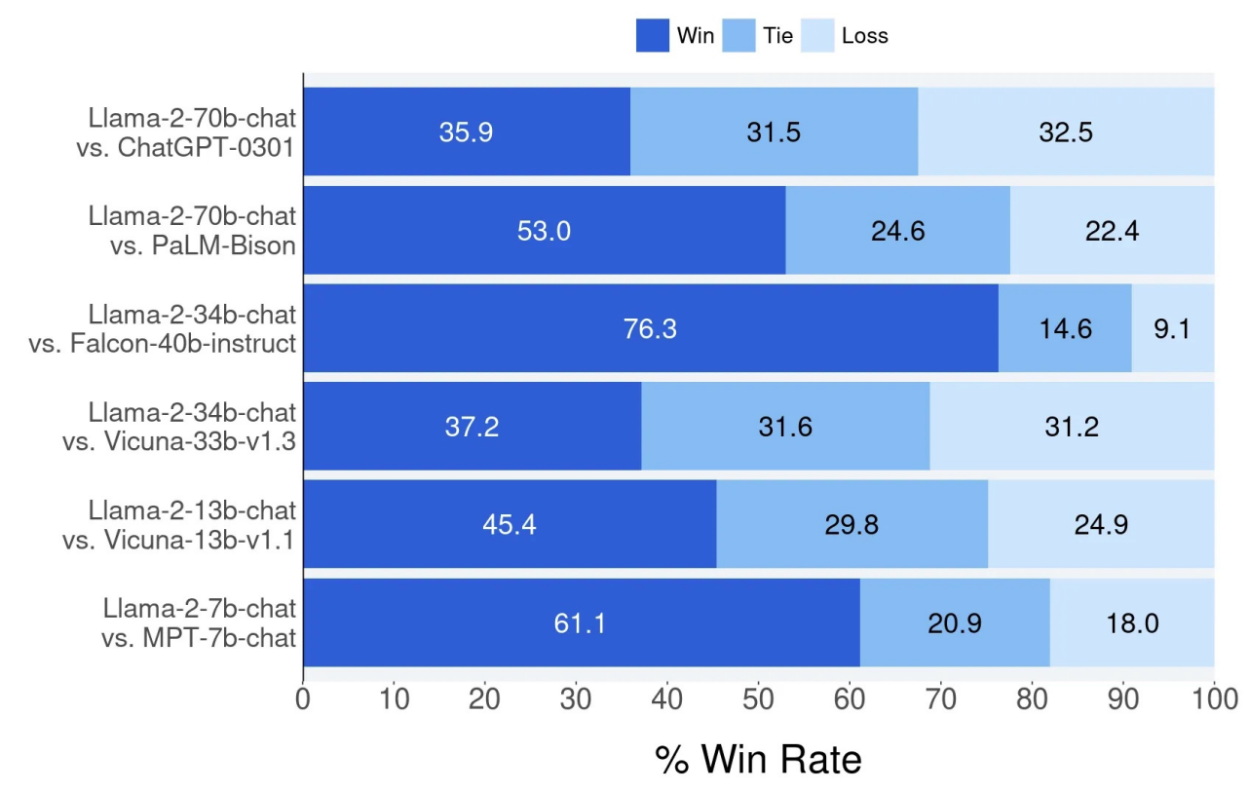
Llama-2 Chat: Helpfulness Human Evaluation
Source: Touvron, Hugo, Louis Martin, Kevin Stone, Peter Albert, Amjad Almahairi, Yasmine Babaei, Nikolay Bashlykov et al. (2023) "Llama 2: Open Foundation and Fine-Tuned Chat Models." arXiv preprint arXiv:2307.09288 (2023).

Slide 69
Summary
Introduction
Generative AI Foundations
Popular Generative AI
Key Generative AI Applications in Education
Challenges of Generative AI in Innovative Learning

Slide 70
Acknowledgments: Research Projects
Applying AI technology to construct knowledge graphs of cryptocurrency anti-money laundering: a few-shot learning model
MOST, 110-2410-H-305-013-MY2, 2021/08/01~2023/07/31
Fintech Green Finance for Carbon Market Index, Corporate Finance, and Environmental Policies. Carbon Emission Sentiment Index with AI Text Analytics
NTPU, 112-NTPU_ORDA-F-003，2023/01/01~2024/12/31
Digital Support, Unimpeded Communication: The Development, Support and Promotion of AI-assisted Communication Assistive Devices for Speech Impairment. Multimodal Cross-lingual Task-Oriented Dialogue System for Inclusive Communication Support
NSTC 112-2425-H-305-002-, 2023/05/01-2026/04/30
Establishment and Implement of Smart Assistive Technology for Dementia Care and Its Socio-Economic Impacts. Intelligent, individualized and precise care with smart AT and system integration
NSTC, NSTC, 112-2627-M-038-001-, 2023/08/01~2024/07/31
Use deep learning to identify commercially dental implant systems - observational study
USTP-NTPU-TMU, USTP-NTPU-TMU-112-01, 2023/01/01~2023/12/31
Metaverse AI Multimodal Cross-Language Task-Oriented Dialogue System
ATEC Group x NTPU, NTPU-112A413E01, 2023/05/01~2026/04/30
Metaverse Avatar Automatic Metadata Generation Module
FormosaVerse x NTPU, NTPU-111A413E01, 2022/12/01~2023/11/30
Pilot Study on Universal Data Processing for Code Generation Engine
III x NTPU, NTPU-112A513E01, 2023/08/01~2023/12/22
https://web.ntpu.edu.tw/~myday/cindex.htm#projects

Slide 71
References
Yihan Cao, Siyu Li, Yixin Liu, Zhiling Yan, Yutong Dai, Philip S. Yu, and Lichao Sun (2023). "A Comprehensive Survey of AI-Generated Content (AIGC): A History of Generative AI from GAN to ChatGPT." arXiv preprint arXiv:2303.04226.
Pengfei Liu, Weizhe Yuan, Jinlan Fu, Zhengbao Jiang, Hiroaki Hayashi, and Graham Neubig. (2023) "Pre-train, prompt, and predict: A systematic survey of prompting methods in natural language processing." ACM Computing Surveys 55, no. 9 (2023): 1-35.
Wayne Xin Zhao, Kun Zhou, Junyi Li, Tianyi Tang, Xiaolei Wang, Yupeng Hou, Yingqian Min et al. (2023) "A Survey of Large Language Models." arXiv preprint arXiv:2303.18223.
Touvron, Hugo, Louis Martin, Kevin Stone, Peter Albert, Amjad Almahairi, Yasmine Babaei, Nikolay Bashlykov et al. (2023) "Llama 2: Open Foundation and Fine-Tuned Chat Models." arXiv preprint arXiv:2307.09288 (2023).
Junliang Wang, Chuqiao Xu, Jie Zhang, and Ray Zhong (2022). "Big data analytics for intelligent manufacturing systems: A review." Journal of Manufacturing Systems 62 (2022): 738-752.
Ouyang, L., Wu, J., Jiang, X., Almeida, D., Wainwright, C. L., Mishkin, P., ... & Lowe, R. (2022). Training language models to follow instructions with human feedback. arXiv preprint arXiv:2203.02155.
Gozalo-Brizuela, Roberto, and Eduardo C. Garrido-Merchan (2023). "ChatGPT is not all you need. A State of the Art Review of large Generative AI models." arXiv preprint arXiv:2301.04655 (2023).
Wenliang Dai, Junnan Li, Dongxu Li, Anthony Meng Huat Tiong, Junqi Zhao, Weisheng Wang, Boyang Li, Pascale Fung, and Steven Hoi. (2023) "InstructBLIP: Towards General-purpose Vision-Language Models with Instruction Tuning." arXiv preprint arXiv:2305.06500 (2023).
Shahab Saquib Sohail, Faiza Farhat, Yassine Himeur, Mohammad Nadeem, Dag Øivind Madsen, Yashbir Singh, Shadi Atalla, and Wathiq Mansoor (2023). "The Future of GPT: A Taxonomy of Existing ChatGPT Research, Current Challenges, and Possible Future Directions." Current Challenges, and Possible Future Directions (April 8, 2023) (2023).
Longbing Cao (2022). "Decentralized ai: Edge intelligence and smart blockchain, metaverse, web3, and desci." IEEE Intelligent Systems 37, no. 3: 6-19.
Qinglin Yang, Yetong Zhao, Huawei Huang, Zehui Xiong, Jiawen Kang, and Zibin Zheng (2022). "Fusing blockchain and AI with metaverse: A survey." IEEE Open Journal of the Computer Society 3 : 122-136.
Russell Belk, Mariam Humayun, and Myriam Brouard (2022). "Money, possessions, and ownership in the Metaverse: NFTs, cryptocurrencies, Web3 and Wild Markets." Journal of Business Research 153: 198-205.
Thien Huynh-The, Quoc-Viet Pham, Xuan-Qui Pham, Thanh Thi Nguyen, Zhu Han, and Dong-Seong Kim (2022). "Artificial Intelligence for the Metaverse: A Survey." arXiv preprint arXiv:2202.10336.
Thippa Reddy Gadekallu, Thien Huynh-The, Weizheng Wang, Gokul Yenduri, Pasika Ranaweera, Quoc-Viet Pham, Daniel Benevides da Costa, and Madhusanka Liyanage (2022). "Blockchain for the Metaverse: A Review." arXiv preprint arXiv:2203.09738.
Ouyang, L., Wu, J., Jiang, X., Almeida, D., Wainwright, C. L., Mishkin, P., ... & Lowe, R. (2022). Training language models to follow instructions with human feedback. arXiv preprint arXiv:2203.02155.

Slide 72
生成式AI在教學上的應用 Generative AI in Educational Applications
NTPU 112-1數位增能研習
Digital Empowerment Workshop, Fall 2023, NTPU
Q & A
Time: 12:00-13:30, Thursday, October 26, 2023
Place: Online https://meet.google.com/ufp-jsju-diu
University System of Taipei (USTP), International Oriented Open Online Instructors (IOOOI)
Host: Prof. Chun-Yi Wei, NTPU
戴敏育 副教授
Min-Yuh Day, Ph.D, Associate Professor
Institute of Information Management, National Taipei University
https://web.ntpu.edu.tw/~myday
2023-10-26

