Slide 1
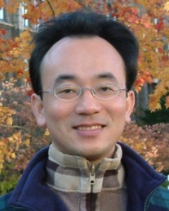
Innovative Strategies for Successful English-Medium Instruction (EMI) Implementation
2023/11/23 (Thu) 12:10 - 14:00
Host: Prof. Cheng-Zen Yang, Department of Computer Science and Engineering, Yuan Ze University (YZU), Taiwan
Place: R1102, Yuan Ze University (YZU), Taiwan
戴敏育 副教授
Min-Yuh Day, Ph.D, Associate Professor
Institute of Information Management, National Taipei University
https://web.ntpu.edu.tw/~myday
2023-11-23

Slide 2
戴敏育 博士 Min-Yuh Day, Ph.D.
1
Associate Professor, Information Management, NTPU
Visiting Scholar, IIS, Academia Sinica
Ph.D., Information Management, NTU
Director, Intelligent Financial Innovation Technology, IFIT Lab, IM, NTPU
Associate Director, Fintech and Green Finance Center, NTPU
Publications Co-Chairs, IEEE/ACM International Conference on Advances in Social Networks Analysis and Mining (ASONAM 2013- )
Program Co-Chair, IEEE International Workshop on Empirical Methods for Recognizing Inference in TExt (IEEE EM-RITE 2012- )
Publications Chair, The IEEE International Conference on Information Reuse and Integration for Data Science (IEEE IRI 2007- )

Slide 3
Outline
Introduction
English-Medium Instruction (EMI)
Innovative Strategies for EMI Implementation
Challenges in EMI
Q&A

Slide 4
English-Medium Instruction (EMI)

Slide 5
English-Medium Instruction (EMI) Teaching Experiences

Slide 6
Teaching Experiences (EMI)
Artificial Intelligence for Text Analytics
Spring 2022, Fall 2023
Artificial Intelligence in Finance and Quantitative Analysis
Fall 2021, Fall 2022, Fall 2023
Software Engineering
Fall 2020, Fall, 2021, Spring 2022, Spring 2023
Artificial Intelligence
Spring 2021, Fall 2022
Big Data Analytics
Fall 2020, Spring 2023
Data Mining
Spring 2021
Foundation of Business Cloud Computing
Spring 2021, Spring 2022, Spring 2023
Python for Accounting Applications
Fall 2023
https://web.ntpu.edu.tw/~myday/teaching.htm

Slide 7
Teaching Experiences (EMI)
AI in Finance Big Data Analytics (Fall 2019)
MBA, DBETKU (3 Credits, Elective) [Full English Course] [Distance Learning]
Big Data Mining (Fall 2018)
MBA, DBETKU (3 Credits, Required) [Full English Course]
Social Media Apps Programming (Fall 2013 - Fall 2018)
MBA, IMTKU (2 Credits, Elective) [Full English Course]
Fall 2018, Fall 2017 , Fall 2016 , Fall 2015 , Fall 2014 , Fall 2013
https://web.ntpu.edu.tw/~myday/teaching.htm

Slide 8
EMI Courses in AI for Business Applications
Artificial Intelligence in Finance and Quantitative Analysis
Fall 2023, Fall 2022
Artificial Intelligence for Text Analytics
Fall 2023, Spring 2022
Artificial Intelligence
Fall 2022
Software Engineering
Spring 2023, Spring 2022
Big Data Analysis
Spring 2023
https://web.ntpu.edu.tw/~myday/teaching.htm

Slide 9
Innovative Strategies for EMI Implementation

Slide 10
Innovative Strategies for EMI Implementation
1. Curriculum Design
2. Teaching Methodologies
3. Faculty Training and Development
4. Assessment and Evaluation

Slide 11
Innovative Strategies for EMI Implementation
1. Curriculum Design
Designing EMI curricula that align with AACSB standards.
Explore interdisciplinary approaches and integrating business concepts with language learning.

Slide 12
Innovative Strategies for EMI Implementation
2. Teaching Methodologies
Explore active learning strategies suitable for EMI in business education.
Integration of technology and AI (e.g., simulation tools, language software).

Slide 13
Innovative Strategies for EMI Implementation
3. Faculty Training and Development
Emphasize the need for continuous faculty development in EMI pedagogy.
Present strategies for non-native English-speaking faculty to excel in EMI settings.

Slide 14
Innovative Strategies for EMI Implementation
4. Assessment and Evaluation
Assessing business content knowledge and English proficiency simultaneously.
Share innovative assessment methods that align with AACSB expectations.

Slide 15
Challenges in English-Medium Instruction (EMI)

Slide 16
EMI Teacher Community II AACSB, NTPU 2022-2023

Slide 17
EMI Teacher Community Activities
1. 2022/05/05 (Thursday) 12:00 pm-13:00 pm, B302
Teaching Experiences Sharing of EMI Courses in AI for Business Applications
Min-Yuh Day, National Taipei University,
2. 2022/05/11 (Wednesday) 9:10 am - 12:00 pm, Google Meet ONLINE
Agile Principles Patterns and Practices in FinTech and Digital Transformation
Shihyu (Alex) Chu, Senior Industry Analyst/Program Manager, Market Intelligence & Consulting Institute (MIC)
3. 2022/05/11 (Wednesday) 12:10 pm - 13:00 pm, Google Meet ONLINE
Professional Business Presentations in English
Shihyu (Alex) Chu, Senior Industry Analyst/Program Manager, Market Intelligence & Consulting Institute (MIC)
4. 2022/05/18 (Wednesday) 12:10 pm - 13:00 pm, Google Meet ONLINE
Web 3: From DeFi to WoFi
Prof. Shih-wei Liao, National Taiwan University
5. 2022/05/27 (Friday) 12:00 pm - 13:00 pm, Google Meet ONLINE
Experiences Sharing of NTPU EMI Teaching Community II
Professors of EMI Teaching Community II, National Taipei University

Slide 18
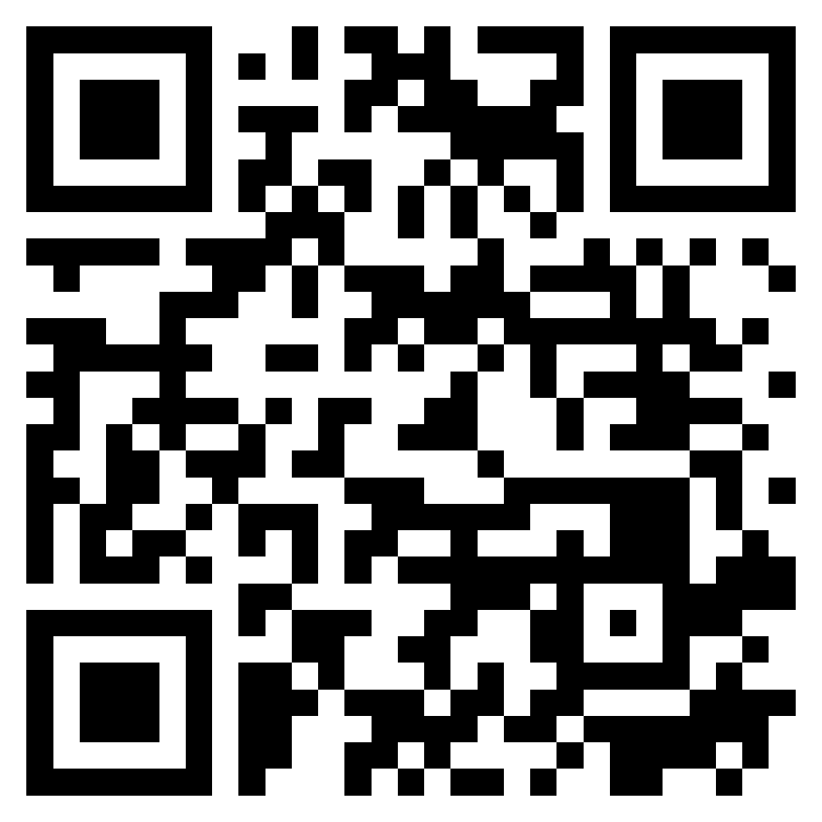
Teaching Experiences Sharing of EMI Courses in AI for Business Applications
EMI Teacher Community, AACSB, NTPU
1
Spring 2022
2022/5/5 (Thursday) 12:10 - 13:00
B302, AACSB, National Taipei University
Min-Yuh Day, Ph.D, Associate Professor
Institute of Information Management, National Taipei University
https://web.ntpu.edu.tw/~myday
https://meet.google.com/zuc-yyaw-mnt
2022-05-05

Slide 19
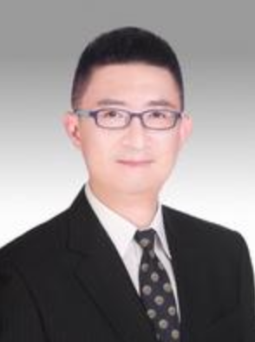
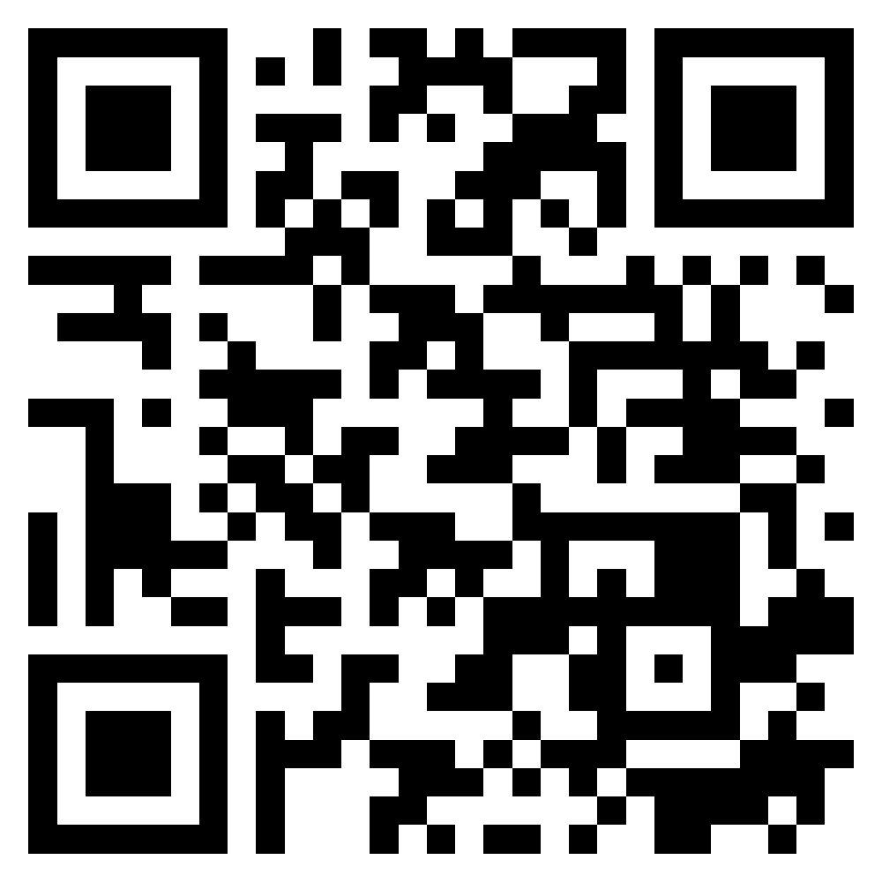
Agile Principles Patterns and Practices in FinTech and Digital Transformation
FinTech x EMI AACSB NTPU
2
Spring 2022
Shihyu (Alex) Chu
Senior Industry Analyst/Program Manager Market Intelligence & Consulting Institute (MIC)
https://meet.google.com/ish-gzmy-pmo
9:10 - 12:00, May 11, 2022 (Wednesday)

Slide 20
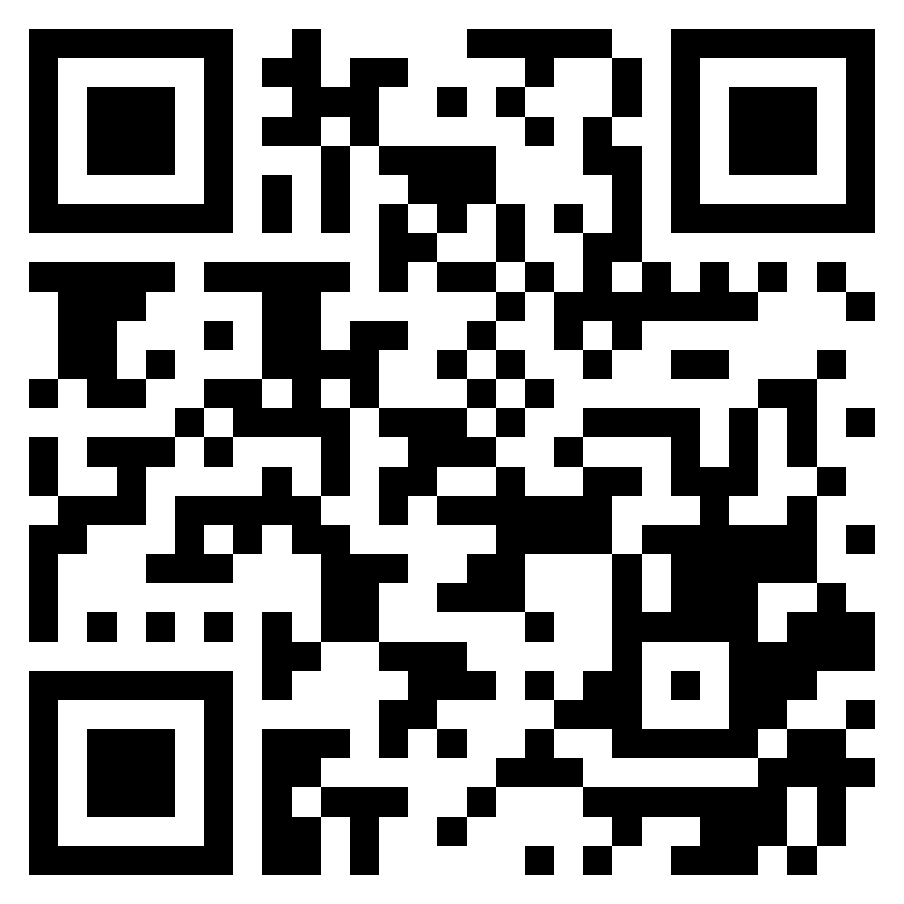
Professional Business Presentations in English
FinTech x EMI AACSB NTPU
3
Spring 2022
Shihyu (Alex) Chu
Senior Industry Analyst/Program Manager Market Intelligence & Consulting Institute (MIC)
http://meet.google.com/uaq-vmjj-vff
12:10 - 13:00, May 11, 2022 (Wednesday)

Slide 21
Web 3: From DeFi to WoFi
FinTech x EMI AACSB NTPU
4
Spring 2022
Prof. Shih-wei Liao National Taiwan University
http://meet.google.com/uaq-vmjj-vff
12:10 - 13:00, May 18, 2022 (Wednesday)

Slide 22
Experiences Sharing of NTPU EMI Teaching Community II
EMI AACSB NTPU
5
Spring 2022
Professors of EMI Teaching Community II
National Taipei University
http://meet.google.com/uaq-vmjj-vff
12:00 - 13:00, May 27, 2022 (Friday)

Slide 23
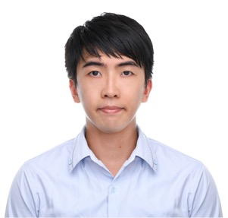
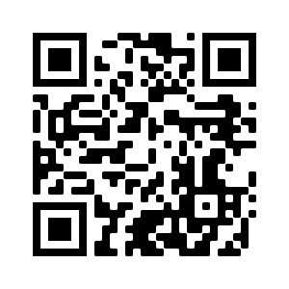
FinTech for Social Good
EMI x FinTech x IM AACSB NTPU
1
Fall 2022
Dr. Chung-Chi Chen Researcher, Artificial Intelligence Research Center, National Institute of Advanced Industrial Science and Technology, Japan
https://meet.google.com/paj-zhhj-mya
12:10 - 14:00, Oct. 19, 2022 (Wednesday)

Slide 24
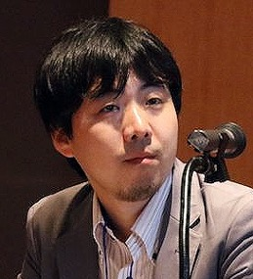
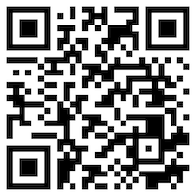
Matching Texts with Data for Evidence-based Information Retrieval
EMI x FinTech x IM AACSB NTPU
2
Fall 2022
Prof. Makoto P. Kato Faculty of Library, Information and Media Science
University of Tsukuba, Japan
https://meet.google.com/miy-fbif-max
9:10 - 12:00, Nov. 23, 2022 (Wednesday)
(Hybrid) B8F40, National Taipei University, Taiwan

Slide 25
The Truth of Crypto & NFT Economy (虛擬貨幣與NFT經濟老實說)
EMI x FinTech x IM AACSB NTPU
3
Fall 2022
Mu Jou (周書丞) CTO of Infinitas NFT
GM of Asiania
https://meet.google.com/paj-zhhj-mya
12:10 - 14:00, Nov. 30, 2022 (Wednesday)
(Hybrid) B3F02, National Taipei University, Taiwan

Slide 26
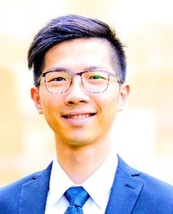
Index Design – Methodology, Data Analysis and the Application of Quantitative Investing
EMI x FinTech x IM AACSB NTPU
4
Fall 2022
Jervis J.G. Li
Fund Manager, Yuanta SITC
https://meet.google.com/paj-zhhj-mya
9:10 - 12:00, Dec. 6, 2022 (Tuesday)
(Hybrid) B8F40, National Taipei University, Taiwan

Slide 27
Agile Principles Patterns and Practices using AI and ChatGPT
EMI x USR x FinTech x IM AACSB NTPU
1
Spring 2023
Shihyu (Alex) Chu
Division Director, Software Industry Research Market Intelligence & Consulting Institute (MIC)
https://meet.google.com/ish-gzmy-pmo
9:10 - 12:00, May 17, 2023 (Wednesday)
(Hybrid) B8F40, National Taipei University, Taiwan

Slide 28
國際碳中和產業趨勢與數位轉型永續發展 (International Carbon Neutral Industry Trends and Digital Transformation for Sustainable Development)
EMI x USR x FinTech x IM AACSB NTPU
2
Spring 2023
Shihyu (Alex) Chu (朱師右)
Division Director, Software Industry Research Market Intelligence & Consulting Institute (MIC)
https://meet.google.com/paj-zhhj-mya
12:10 - 13:00, May 17, 2023 (Wednesday)
(Hybrid) B302, National Taipei University, Taiwan

Slide 29
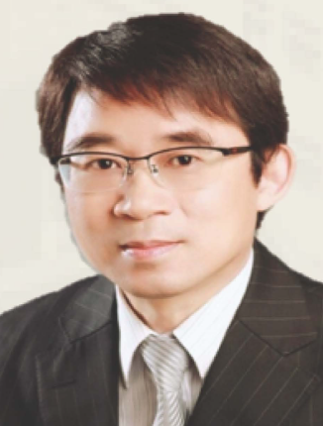
綠色金融科技－金融數位轉型的趨勢與商機 (Green Financial Technology: Trends and Business Opportunities of Financial Digital Transformation)
EMI x USR x FinTech x Stat x IM AACSB NTPU
3
Spring 2023
周振豊 董事長 (Jones Chou) 捷鵬國際金融服務集團創辦人
12:10 - 13:30, May 25, 2023 (Thursday)
B313, National Taipei University, Taiwan

Slide 30
EMI Courses in AI for Business Applications

Slide 31
Introduction to Artificial Intelligence for Text Analytics
Artificial Intelligence for Text Analytics
1121AITA01
MBA, IM, NTPU (M5265) (Fall 2023) Tue 2, 3, 4 (9:10-12:00) (B3F17)
Min-Yuh Day, Ph.D, Associate Professor
Institute of Information Management, National Taipei University
https://web.ntpu.edu.tw/~myday
https://meet.google.com/miy-fbif-max
2023-09-13

Slide 32
Course Syllabus National Taipei University Academic Year 112, 1st Semester (Fall 2023)
Course Title: Artificial Intelligence for Text Analytics
Instructor: Min-Yuh Day
Course Class: MBA, IM, NTPU (3 Credits, Elective)
Details
EMI Course (3 Credits, Elective, One Semester) (M5265)
Time & Place: Wed, 2, 3, 4, (9:10-12:00) (B3F17)
Google Meet: https://meet.google.com/miy-fbif-max
https://meet.google.com/miy-fbif-max

Slide 33
Course Objectives
Understand the fundamental concepts and research issues of Artificial Intelligence for Text Analytics.
Equip with Hands-on practices of Artificial Intelligence for Text Analytics.
Conduct information systems research in the context of Artificial Intelligence for Text Analytics.

Slide 34
Course Outline
This course introduces the fundamental concepts, research issues, and hands-on practices of Artificial Intelligence for Text Analytics.
Topics include:
Introduction to Introduction to Artificial Intelligence for Text Analytics
Foundations of Text Analytics: Natural Language Processing (NLP)
Python for Natural Language Processing
Natural Language Processing with Transformers
Text Classification and Sentiment Analysis
Multilingual Named Entity Recognition (NER), Text Similarity and Clustering
Text Summarization and Topic Models
Text Generation with Large Language Models (LLMs)
Question Answering and Dialogue Systems
Deep Learning, Generative AI, Transfer Learning, Zero-Shot, and Few-Shot Learning for Text Analytics
Case Study on Artificial Intelligence for Text Analytics

Slide 35
Core Competence
Exploring new knowledge in information technology, system development and application 80 %
Internet marketing planning ability 10 %
Thesis writing and independent research skills 10 %

Slide 36
Four Fundamental Qualities
Professionalism
Creative thinking and Problem-solving 40 %
Comprehensive Integration 40 %
Interpersonal Relationship
Communication and Coordination 10 %
Teamwork 5 %
Ethics
Honesty and Integrity 0 %
Self-Esteem and Self-reflection 0 %
International Vision
Caring for Diversity 0 %
Interdisciplinary Vision 5 %

Slide 37
College Learning Goals
Ethics/Corporate Social Responsibility
Global Knowledge/Awareness
Communication
Analytical and Critical Thinking

Slide 38
Department Learning Goals
Information Technologies and System Development Capabilities
Internet Marketing Management Capabilities
Research capabilities

Slide 39
Syllabus
Week Date Subject/Topics
1 2023/09/13 Introduction to Artificial Intelligence for Text Analytics
2 2023/09/20 Foundations of Text Analytics: Natural Language Processing (NLP)
3 2023/09/27 Python for Natural Language Processing
4 2023/10/04 Natural Language Processing with Transformers
5 2023/10/11 Case Study on Artificial Intelligence for Text Analytics I
6 2023/10/18 Text Classification and Sentiment Analysis

Slide 40
Syllabus
Week Date Subject/Topics
7 2023/10/25 Multilingual Named Entity Recognition (NER)
8 2023/11/01 Midterm Project Report
9 2023/11/08 Text Similarity and Clustering
10 2023/11/15 Text Summarization and Topic Models
11 2023/11/22 Text Generation with Large Language Models (LLMs)
12 2023/11/29 Case Study on Artificial Intelligence for Text Analytics II

Slide 41
Syllabus
Week Date Subject/Topics
13 2023/12/06 Question Answering and Dialogue Systems
14 2023/12/13 Deep Learning, Generative AI, Transfer Learning, Zero-Shot, and Few-Shot Learning for Text Analytics
15 2023/12/20 Final Project Report I
16 2023/12/27 Final Project Report II

Slide 42
Teaching Methods and Activities
Lecture
Discussion
Practicum

Slide 43
Evaluation Methods
Individual Presentation 60 %
Group Presentation 10 %
Case Report 10 %
Class Participation 10 %
Assignment 10 %

Slide 44
Introduction to Artificial Intelligence in Finance and Quantitative Analysis
Artificial Intelligence in Finance and Quantitative Analysis
1121AIFQA01
MBA, IM, NTPU (M5276) (Fall 2023) Tue 2, 3, 4 (9:10-12:00) (B3F17)
Min-Yuh Day, Ph.D, Associate Professor
Institute of Information Management, National Taipei University
https://web.ntpu.edu.tw/~myday
https://meet.google.com/paj-zhhj-mya
2023-09-12

Slide 45
Course Syllabus National Taipei University Academic Year 112, 1st Semester (Fall 2023)
Course Title: Artificial Intelligence in Finance and Quantitative Analysis
Instructor: Min-Yuh Day
Course Class: MBA, IM, NTPU (3 Credits, Elective)
Details
EMI Course (3 Credits, Elective, One Semester) (M5276)
Time & Place: Tue, 2, 3, 4, (9:10-12:00) (B3F17)
Google Meet: https://meet.google.com/paj-zhhj-mya
https://meet.google.com/paj-zhhj-mya

Slide 46
Course Objectives
Understand the fundamental concepts and research issues of Artificial Intelligence in Finance and Quantitative Analysis.
Equip with Hands-on practices of Artificial Intelligence in Finance and Quantitative Analysis.
Conduct information systems research in the context of Artificial Intelligence in Finance and Quantitative Analysis.

Slide 47
Course Outline
This course introduces the fundamental concepts, research issues, and hands-on practices of AI in Finance and Quantitative Analysis.
Topics include:
Introduction to Artificial Intelligence in Finance and Quantitative Analysis
AI in FinTech: Metaverse, Web3, DeFi, NFT, Financial Services Innovation and Applications
Investing Psychology and Behavioral Finance
Event Studies in Finance
Finance Theory
Data-Driven Finance
Financial Econometrics
AI-First Finance
Deep Learning in Finance
Reinforcement Learning in Finance
Algorithmic Trading, Risk Management, Trading Bot and Event-Based Backtesting
Case Study on AI in Finance and Quantitative Analysis.

Slide 48
Syllabus
Week Date Subject/Topics
1 2023/09/12 Introduction to Artificial Intelligence in Finance and Quantitative Analysis
2 2023/09/19 AI in FinTech: Metaverse, Web3, DeFi, NFT, Financial Services Innovation and Applications
3 2023/09/26 Investing Psychology and Behavioral Finance
4 2023/10/03 Event Studies in Finance
5 2023/10/10 National Day (Day off)
6 2023/10/17 Case Study on AI in Finance and Quantitative Analysis I

Slide 49
Syllabus
Week Date Subject/Topics
7 2023/10/24 Finance Theory and Data-Driven Finance
8 2023/10/31 Midterm Project Report
9 2023/11/07 Financial Econometrics
10 2023/11/14 AI-First Finance
11 2023/11/21 Industry Practices of AI in Finance and Quantitative Analysis
12 2023/11/28 Case Study on AI in Finance and Quantitative Analysis II

Slide 50
Syllabus
Week Date Subject/Topics
13 2023/12/05 Deep Learning in Finance; Reinforcement Learning in Finance
14 2023/12/12 Algorithmic Trading; Risk Management; Trading Bot and Event-Based Backtesting
15 2023/12/19 Final Project Report I
16 2023/12/26 Final Project Report II

Slide 51
Introduction to Python for Accounting Applications
Python for Accounting Applications
1121PAA01
ACC2, NTPU (M5265) (Fall 2023) Wed 6, 7, 8, (14:10-17:00) (9:10-12:00) (B3F10)
Min-Yuh Day, Ph.D, Associate Professor
Institute of Information Management, National Taipei University
https://web.ntpu.edu.tw/~myday
2023-09-13

Slide 52
Course Syllabus National Taipei University Academic Year 112, 1st Semester (Fall 2023)
Course Title: Python for Accounting Applications
Instructor: Min-Yuh Day
Course Class: ACC2, NTPU (3 Credits, Elective)
Details
EMI Course (3 Credits, Elective, One Semester) (U2004)
Time & Place: Wed. 6, 7, 8, 14:10-17:00(B3F17)
Google Meet: https://meet.google.com/ofh-iosa-ehd

Slide 53
Course Objectives
Understand the fundamental concepts of Python for Accounting Applications.
Equip with Hands-on practices of Python for Accounting Applications.

Slide 54
Course Outline
This course introduces the fundamental concepts and hands-on practices of Python for Accounting Applications.
Topics include
Introduction to Python for Accounting Applications,
Python Programming and Data Science,
Foundations of Python Programming,
Data Structures,
Control Logic and Loops,
Functions and Modules,
Files and Exception Handling,
Data Analytics and Visualization with Python,
Obtaining Data From the Web with Python,
Statistical Analysis with Python,
Machine Learning with Python,
Text Analytics with Python and Large Language Models (LLMs),
Applications of Accounting Data Analytics with Python, and
Applications of ESG Data Analytics with Python.

Slide 55
Syllabus
Week Date Subject/Topics
1 2023/09/13 Introduction to Python for Accounting Applications
2 2023/09/20 Python Programming and Data Science
3 2023/09/27 Foundations of Python Programming
4 2023/10/04 Data Structures
5 2023/10/11 Control Logic and Loops
6 2023/10/18 Functions and Modules
7 2023/10/25 Files and Exception Handling
8 2023/11/01 Midterm Project Report

Slide 56
Syllabus
Week Date Subject/Topics
9 2023/11/08 Data Analytics and Visualization with Python
10 2023/11/15 Obtaining Data From the Web with Python
11 2023/11/22 Statistical Analysis with Python
12 2023/11/29 Machine Learning with Python
13 2023/12/06 Text Analytics with Python and Large Language Models (LLMs)
14 2023/12/13 Applications of Accounting Data Analytics with Python
15 2023/12/20 Applications of ESG Data Analytics with Python
16 2023/12/27 Final Project Report

Slide 57
Introduction to Big Data Analysis
Big Data Analysis
1112BDA01
MBA, IM, NTPU (M6031) (Spring 2023) Tue 2, 3, 4 (9:10-12:00) (B8F40)
Min-Yuh Day, Ph.D, Associate Professor
Institute of Information Management, National Taipei University
https://web.ntpu.edu.tw/~myday
https://meet.google.com/paj-zhhj-mya
2023-02-21

Slide 58
Course Syllabus National Taipei University Academic Year 111, 2nd Semester (Spring 2023)
Course Title: Big Data Analysis
Instructor: Min-Yuh Day
Course Class: MBA, IM, NTPU (3 Credits, Elective)
Details
In-Class and Distance Learning EMI Course (3 Credits, Elective, One Semester) (M6031)
Time & Place: Tue, 2, 3, 4, (9:10-12:00) (B8F40)
Google Meet: https://meet.google.com/paj-zhhj-mya
https://meet.google.com/paj-zhhj-mya

Slide 59
Course Objectives
Understand the fundamental concepts and research issues of Big Data Analysis.
Equip with Hands-on practices of Big Data Analysis.
Conduct information systems research in the context of Big Data Analysis.

Slide 60
Course Outline
This course introduces the fundamental concepts, research issues, and hands-on practices of Big Data Analysis.
Topics include:
Introduction to Big Data Analysis
AI, Data Science and Big Data Analysis
Foundations of Big Data Analysis in Python
Machine Learning: SAS Viya, Data Preparation and Algorithm Selection
Machine Learning: Decision Trees and Ensembles of Trees
Machine Learning: Neural Networks (NN) and Support Vector Machines (SVM)
Machine Learning: Model Assessment and Deployment
ChatGPT and Large Language Models (LLM) for Big Data Analysis
Deep Learning for Finance Big Data Analysis
Case Study on Big Data Analysis

Slide 61
Syllabus
Week Date Subject/Topics
1 2023/02/21 Introduction to Big Data Analysis
2 2023/02/28 (Day Off)
3 2023/03/07 AI, Data Science and Big Data Analysis
4 2023/03/14 Foundations of Big Data Analysis in Python
5 2023/03/21 Case Study on Big Data Analysis I
6 2023/03/28 Machine Learning: SAS Viya, Data Preparation and Algorithm Selection

Slide 62
Syllabus
Week Date Subject/Topics
7 2023/04/04 (Children's Day) (Day off)
8 2023/04/11 Midterm Project Report
9 2023/04/18 Machine Learning: Decision Trees and Ensembles of Trees
10 2023/04/25 Machine Learning: Neural Networks (NN) and Support Vector Machines (SVM)
11 2023/05/02 Case Study on Big Data Analysis II
12 2023/05/09 Machine Learning: Model Assessment and Deployment

Slide 63
Syllabus
Week Date Subject/Topics
13 2023/05/16 ChatGPT and Large Language Models (LLM) for Big Data Analysis
14 2023/05/23 Deep Learning for Finance Big Data Analysis
15 2023/05/30 Final Project Report I
16 2023/06/06 Final Project Report II
17 2023/06/13 Self-learning
18 2023/06/20 Self-learning

Slide 64
Introduction to Software Engineering
Software Engineering
1112SE01
MBA, IM, NTPU (M5010) (Spring 2023) Wed 2, 3, 4 (9:10-12:00) (B8F40)
Min-Yuh Day, Ph.D, Associate Professor
Institute of Information Management, National Taipei University
https://web.ntpu.edu.tw/~myday
https://meet.google.com/ish-gzmy-pmo
2023-02-22

Slide 65
Course Syllabus National Taipei University Academic Year 111, 2nd Semester (Spring 2023)
Course Title: Software Engineering
Instructor: Min-Yuh Day
Course Class: MBA, IM, NTPU (3 Credits, Elective)
Details
In-Person and Distance Learning EMI Course (3 Credits, Elective, One Semester) (M5010)
Time & Place: Wed, 2, 3, 4, (9:10-12:00) (B8F40)
Google Meet: https://meet.google.com/ish-gzmy-pmo
https://meet.google.com/ish-gzmy-pmo

Slide 66
Course Objectives
Understand the fundamental concepts and research issues of software engineering.
Equip with Hands-on practices of software engineering.
Conduct information systems research in the context of software engineering.

Slide 67
Course Outline
This course introduces the fundamental concepts, research issues, and hands-on practices of software engineering.
Topics include:
Introduction to Software Engineering
Software Products and Project Management: Software product management and prototyping
Agile Software Engineering: Agile methods, Scrum, and Extreme Programming
Features, Scenarios, and Stories
Software Architecture: Architectural design, System decomposition, and Distribution architecture
Cloud-Based Software: Virtualization and containers, Everything as a service, Software as a service
Cloud Computing and Cloud Software Architecture
Microservices Architecture, RESTful services, Service deployment
Security and Privacy; Reliable Programming
Testing: Functional testing, Test automation, Test-driven development, and Code reviews
DevOps and Code Management: Code management and DevOps automation
Case Study on Software Engineering

Slide 68
Syllabus
Week Date Subject/Topics
1 2023/02/22 Introduction to Software Engineering
2 2023/03/01 Software Products and Project Management: Software product management and prototyping
3 2023/03/08 Agile Software Engineering: Agile methods, Scrum, and Extreme Programming
4 2023/03/15 Features, Scenarios, and Stories
5 2023/03/22 Case Study on Software Engineering I
6 2023/03/29 Software Architecture: Architectural design, System decomposition, and Distribution architecture

Slide 69
Syllabus
Week Date Subject/Topics
7 2023/04/05 Tomb-Sweeping Day (Holiday, No Classes)
8 2023/04/12 Midterm Project Report
9 2023/04/19 Cloud-Based Software: Virtualization and containers, Everything as a service, Software as a service
10 2023/04/26 Cloud Computing and Cloud Software Architecture
11 2023/05/03 Microservices Architecture, RESTful services, Service deployment
12 2023/05/10 Security and Privacy; Reliable Programming; Testing: Test-driven development, and Code reviews; DevOps and Code Management: DevOps automation

Slide 70
Syllabus
Week Date Subject/Topics
13 2023/05/17 Industry Practices of Software Engineering
[Agile Principles Patterns and Practices using AI and ChatGPT, Invited Speaker: Shihyu (Alex) Chu, Division Director, Software Industry Research Center, Market Intelligence & Consulting Institute (MIC)]
14 2023/05/24 Case Study on Software Engineering II
15 2023/05/31 Final Project Report I
16 2023/06/07 Final Project Report II
17 2023/06/14 Self-learning
18 2023/06/21 Self-learning

Slide 71
Introduction to Artificial Intelligence
Artificial Intelligence
1111AI01
MBA, IM, NTPU (M6132) (Fall 2022) Wed 2, 3, 4 (9:10-12:00) (B8F40)
Min-Yuh Day, Ph.D, Associate Professor
Institute of Information Management, National Taipei University
https://web.ntpu.edu.tw/~myday
https://meet.google.com/miy-fbif-max
2022-09-14

Slide 72
Course Syllabus National Taipei University Academic Year 111, 1st Semester (Fall 2022)
Course Title: Artificial Intelligence
Instructor: Min-Yuh Day
Course Class: MBA, IM, NTPU (3 Credits, Elective)
Details
In-Class and Distance Learning EMI Course (3 Credits, Elective, One Semester) (M6132)
Time & Place: Wed, 2, 3, 4, (9:10-12:00) (B8F40)
Google Meet: https://meet.google.com/miy-fbif-max
https://meet.google.com/miy-fbif-max

Slide 73
Course Objectives
Understand the fundamental concepts and research issues of Artificial Intelligence.
Equip with Hands-on practices of Artificial Intelligence.
Conduct information systems research in the context of Artificial Intelligence.

Slide 74
Course Outline
This course introduces the fundamental concepts, research issues, and hands-on practices of Artificial Intelligence.
Topics include:
Introduction to Artificial Intelligence
Artificial Intelligence and Intelligent Agents
Problem Solving
Knowledge, Reasoning and Knowledge Representation, Uncertain Knowledge and Reasoning
Machine Learning: Supervised and Unsupervised Learning
The Theory of Learning and Ensemble Learning
Deep Learning, Reinforcement Learning
Deep Learning for Natural Language Processing
Computer Vision and Robotics
Philosophy and Ethics of AI and the Future of AI
Case Study on AI

Slide 75
Syllabus
Week Date Subject/Topics
1 2022/09/14 Introduction to Artificial Intelligence
2 2022/09/21 Artificial Intelligence and Intelligent Agents
3 2022/09/28 Problem Solving
4 2022/10/05 Knowledge, Reasoning and Knowledge Representation; Uncertain Knowledge and Reasoning
5 2022/10/12 Case Study on Artificial Intelligence I
6 2022/10/19 Machine Learning: Supervised and Unsupervised Learning

Slide 76
Syllabus
Week Date Subject/Topics
7 2022/10/26 The Theory of Learning and Ensemble Learning
8 2022/11/02 Midterm Project Report
9 2022/11/09 Deep Learning and Reinforcement Learning
10 2022/11/16 Deep Learning for Natural Language Processing
11 2022/11/23 Invited Talk: AI for Information Retrieval
12 2022/11/30 Case Study on Artificial Intelligence II

Slide 77
Syllabus
Week Date Subject/Topics
13 2022/12/07 Computer Vision and Robotics
14 2022/12/14 Philosophy and Ethics of AI and the Future of AI
15 2022/12/21 Final Project Report I
16 2022/12/28 Final Project Report II
17 2023/01/04 Self-learning
18 2023/01/11 Self-learning

Slide 78
Project-based Learning (PBL)

Slide 79
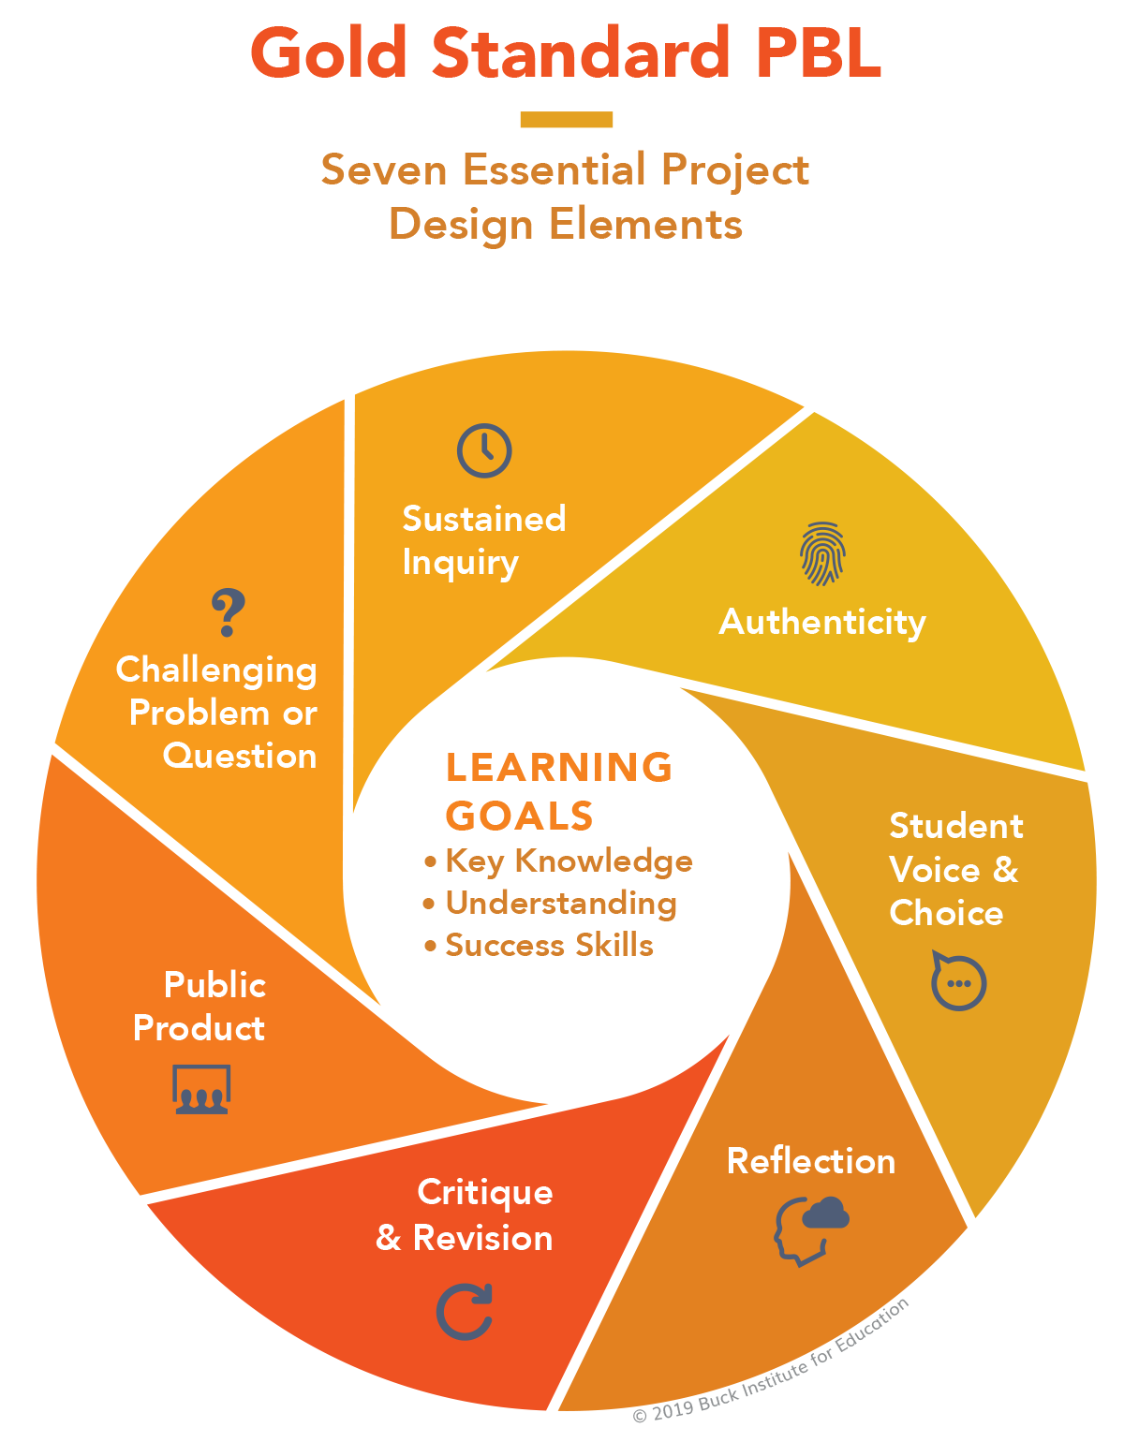
PBL Design Teaching
2
2
1
1
3
3
7
7
4
4
6
6
5
5

Slide 80
Information Management (MIS) Information Systems
Organizations
Technology
Information Systems
Management

Slide 81
Fundamental MIS Concepts
Business Challenges
Management
Organization
Information System
Business Solutions
Technology

Slide 82
Agile Software Engineering

Slide 83
Software Engineering and Project Management
Analyze
Requirements definition
Design
System and Software design
Build
Implementation and
unit testing
Test
Integration and system testing
Deliver
Operation and maintenance
Project Management

Slide 84
Software Development Life Cycle (SDLC) The waterfall model
Requirements definition
System and Software design
Implementation and unit testing
Integration and system testing
Operation and maintenance

Slide 85
Plan-based and Agile development
Plan-based development
Requirements engineering
Requirements specification
Design and implementation
Requirements change requests
Agile development
Requirements engineering
Design and implementation

Slide 86
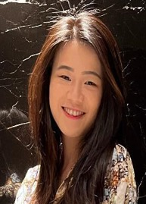
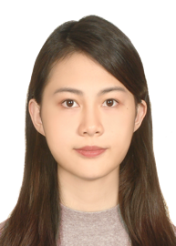
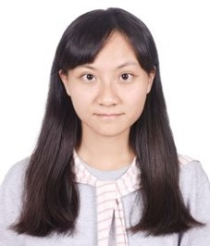
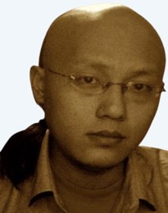
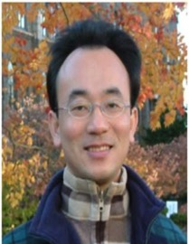
2022
IMNTPU at the NTCIR-16 FinNum-3 Task: Data Augmentation for Financial Numclaim Classification
¹ Information Management, National Taipei University, New Taipei City, Taiwan
² Zeals Co., Ltd. Tokyo, Japan
Yung-Wei Teng ¹
Pei-Tz Chiu ¹
Ting-Yun Hsiao ¹
Mike Tian-Jian Jiang ²
Min-Yuh Day ^{1,*}
myday@gm.ntpu.edu.tw

Slide 87
2022
IMNTPU Dialogue System Evaluation
at the NTCIR-16 DialEval-2
Dialogue Quality and Nugget Detection
¹ Information Management, National Taipei University, New Taipei City, Taiwan
² Zeals Co., Ltd. Tokyo, Japan
Ting-Yun Hsiao ¹
Yung-Wei Teng ¹
Pei-Tz Chiu ¹
Mike Tian-Jian Jiang ²
Min-Yuh Day ^{1,*}
myday@gm.ntpu.edu.tw

Slide 88
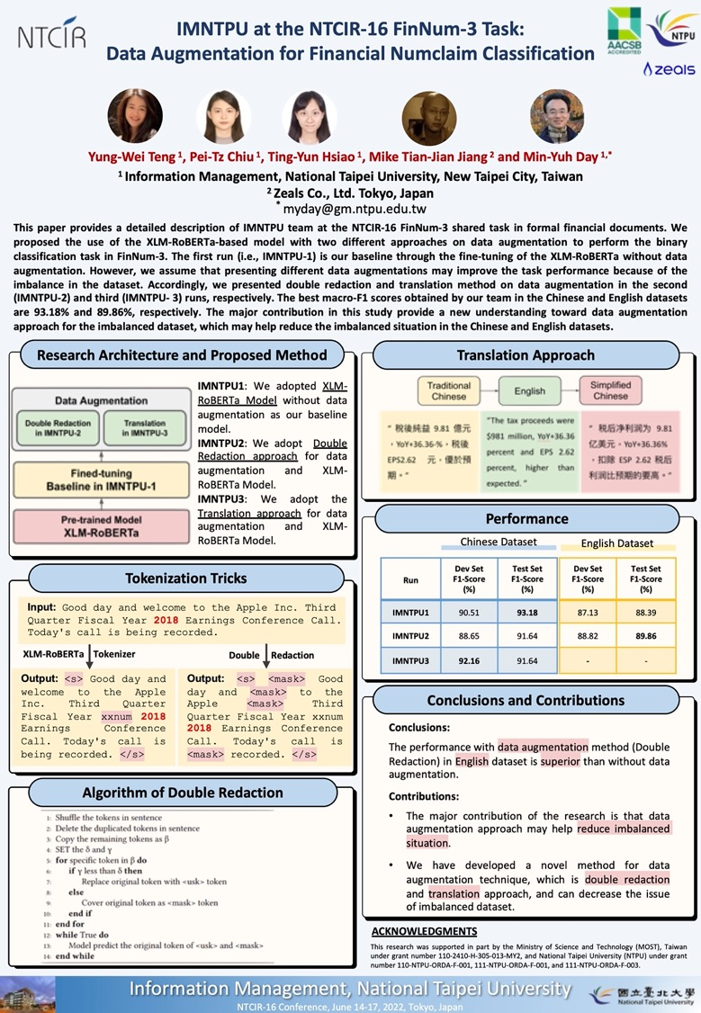
2022
NTCIR-16 Best Poster Presentation Award

Slide 89
Summary
Introduction
English-Medium Instruction (EMI)
Innovative Strategies for EMI Implementation
Challenges in EMI
Q&A

Slide 90
Acknowledgments: Research Projects
Applying AI technology to construct knowledge graphs of cryptocurrency anti-money laundering: a few-shot learning model
MOST, 110-2410-H-305-013-MY2, 2021/08/01~2023/07/31
Fintech Green Finance for Carbon Market Index, Corporate Finance, and Environmental Policies. Carbon Emission Sentiment Index with AI Text Analytics
NTPU, 112-NTPU_ORDA-F-003，2023/01/01~2024/12/31
Digital Support, Unimpeded Communication: The Development, Support and Promotion of AI-assisted Communication Assistive Devices for Speech Impairment. Multimodal Cross-lingual Task-Oriented Dialogue System for Inclusive Communication Support
NSTC 112-2425-H-305-002-, 2023/05/01-2026/04/30
Establishment and Implement of Smart Assistive Technology for Dementia Care and Its Socio-Economic Impacts. Intelligent, individualized and precise care with smart AT and system integration
NSTC, NSTC, 112-2627-M-038-001-, 2023/08/01~2024/07/31
Use deep learning to identify commercially dental implant systems - observational study
USTP-NTPU-TMU, USTP-NTPU-TMU-112-01, 2023/01/01~2023/12/31
Metaverse AI Multimodal Cross-Language Task-Oriented Dialogue System
ATEC Group x NTPU, NTPU-112A413E01, 2023/05/01~2026/04/30
Metaverse Avatar Automatic Metadata Generation Module
FormosaVerse x NTPU, NTPU-111A413E01, 2022/12/01~2023/11/30
Pilot Study on Universal Data Processing for Code Generation Engine
III x NTPU, NTPU-112A513E01, 2023/08/01~2023/12/22
https://web.ntpu.edu.tw/~myday/cindex.htm#projects

Slide 91
Innovative Strategies for Successful English-Medium Instruction (EMI) Implementation
Q & A
2023/11/23 (Thu) 12:10 - 14:00
Host: Prof. Cheng-Zen Yang, Department of Computer Science and Engineering, Yuan Ze University (YZU), Taiwan
Place: R1102, Yuan Ze University (YZU), Taiwan
戴敏育 副教授
Min-Yuh Day, Ph.D, Associate Professor
Institute of Information Management, National Taipei University
https://web.ntpu.edu.tw/~myday
2023-11-23

