Slide 1









Generative AI for ESG Data Analytics and Sustainability Innovation
Tsukuba x NTPU
Bilateral Academic Exchange Program
International Workshop on Information Management and Media Science (IWIMMS 2024)
Min-Yuh Day, Ph.D.
Professor, Institute of information Management
Director, Fintech and Green Finance Center (FGFC)
Division Director, Sustainable Development, Sustainability Office
National Taipei University
https://web.ntpu.edu.tw/~myday
International Workshop on Information Management and Media Science (IWIMMS 2024), University of Tsukuba, Japan, November 7, 2024

Slide 2









Professor Min-Yuh Day
1
Professor, Information Management, NTPU
Director, Intelligent Financial Innovation Technology, IFIT Lab, IM, NTPU
Director, Fintech and Green Finance Center (FGFC), NTPU
Division Director, Sustainable Development, Sustainability Office, NTPU
Visiting Scholar, IIS, Academia Sinica
Ph.D., Information Management, NTU
Publications Co-Chairs, International Conference on Advances in Social Networks Analysis and Mining
(ASONAM 2013- )
Program Co-Chair, IEEE International Workshop on Empirical Methods for Recognizing Inference in TExt
(IEEE EM-RITE 2012- )
Publications Chair, The IEEE International Conference on Information Reuse and Integration for Data Science
(IEEE IRI 2007- )

Slide 3


Outline
Overview of ESG
  Environmental, Social, Governance
Challenges in ESG Data Analytics
  Fragmented, Unstructured, Diverse
Generative AI as a Solution
  Synthesis, Reporting, and Prediction
Sustainability Innovation

Slide 4
Evolution of Sustainable Finance Research
Topic
SDGs:
Sustainable Development Goals
SDGs
Innovative Financial Instrument
Impact Investing
ESG: Environmental, Social, and Governance
CSR: Corporate Social Responsibility
Conscious Capitalism
Climate Financing
Carbon Financing
Green Financing
Ethical Investing
Socially Responsible Investing
1986
1995
2005
2015
2020
Source: Kumar, S., Sharma, D., Rao, S., Lim, W. M., & Mangla, S. K. (2022). Past, present, and future of sustainable finance:
Insights from big data analytics through machine learning of scholarly research. Annals of Operations Research, 1-44.

Slide 5


















Sustainable Development Goals (SDGs)
Source: https://sdgs.un.org/goals

Slide 6

Sustainable Development Goals (SDGs) and 5P
Partnership
Peace
Prosperity
People
Planet
Source: Folke, Carl, Reinette Biggs, Albert V. Norström, Belinda Reyers, and Johan Rockström. "Social-ecological resilience and biosphere-based sustainability science.”Ecology and Society 21, no. 3 (2016).

Slide 7

ESG to 17 SDGs
Source: Henrik Skaug Sætra (2021) "A Framework for Evaluating and Disclosing the ESG Related Impacts of AI with the SDGs." Sustainability 13, no. 15 (2021): 8503.

Slide 8

ESG to 17 SDGs
Source: https://sustainometric.com/esg-to-sdgs-connected-paths-to-a-sustainable-future/

Slide 9
Net-Zero Transformation
Ambition
  Aligned to achieving global net zero by no later than 2050 & to limit warming to 1.5°C
Governance
  Accountability driven from the top
Strategy
  Embedded and aligned net zero into company strategy
Enterprise
  Key operating model changes in support of transformation
Supply chains
  Transformed net zero supply chains
Innovation
  Developed innovation and technologies to deliver net zero
Finance
  Financing the net zero transformation
Transparency
  Communicating action
Engagement
  Enhancing the pace and scale of net zero action
Source: https://www.pwc.com/us/en/services/esg/library/building-blocks-for-net-zero-transformation.html

Slide 10
ESG Challenges and Opportunities
Challenges
  Fragmented and unstructured ESG data.
  Lack of standardization and transparency.
  Timeliness of data availability.
Opportunities
  Rising demand for actionable ESG insights.
  Innovation in sustainable solutions and policies.
  Generative AI as a tool for transformation.

Slide 11
Generative AI
Powering
Digital Sustainability Transformation

Slide 12
Generative AI-Driven ESG Report
Generation Technology
Industrial Technology Research Institute (ITRI),
Fintech and Green Finance Center (FGFC, NTPU),
NTPU-113A513E01, 2024/03/01~2024/12/31

Slide 13

Sustainability and ESG Data Analytics

Slide 14
Generative AI for ESG Data Analytics
Data Integration and Enrichment:
  Synthesizing structured and unstructured ESG data.
Automated Reporting and Insight Generation:
  Tailored ESG reports and insights for stakeholders.
Scenario Modeling and Forecasting:
  Simulating potential risks and opportunities.
Addressing Bias and Ensuring Accountability:
  Transparent, fair, and ethical AI deployment.

Slide 15

Generative AI and LLMs for Sustainability and
ESG Data Analytics

Slide 16
Sustainability Innovation with Generative AI
Sustainable Product Design:
  Eco-friendly designs minimizing waste and energy.
Policy Formulation and Implementation:
  AI-driven simulations for effective policies.
Stakeholder Engagement and Awareness:
  Communicating ESG strategies with compelling AI-driven visuals.

Slide 17

Generative AI for ESG Rating and Reporting Generation

Slide 18
Future Directions
Integrating blockchain, IoT, and digital twins.
Democratizing AI tools for all stakeholders.
Promoting collaboration among experts and communities.

Slide 19
Conclusion
Generative AI is transforming ESG analytics and sustainability innovation.
Collaboration among researchers, policymakers, and innovators is key.
Generative AI to build a sustainable future.

Slide 20




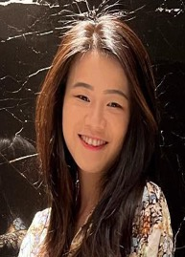
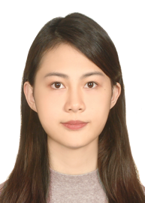
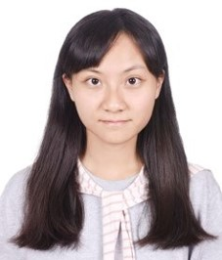

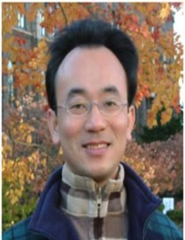
2022
IMNTPU at the NTCIR-16 FinNum-3 Task:
Data Augmentation for Financial Numclaim Classification
¹ Information Management, National Taipei University, New Taipei City, Taiwan
² Zeals Co., Ltd. Tokyo, Japan
Yung-Wei Teng ¹
Pei-Tz Chiu ¹
Ting-Yun Hsiao ¹
Mike Tian-Jian Jiang ²
Min-Yuh Day ^{1,*}
myday@gm.ntpu.edu.tw

Slide 21
2022
IMNTPU Dialogue System Evaluation
at the NTCIR-16 DialEval-2
Dialogue Quality and Nugget Detection
¹ Information Management, National Taipei University, New Taipei City, Taiwan
² Zeals Co., Ltd. Tokyo, Japan
Ting-Yun Hsiao ¹
Yung-Wei Teng ¹
Pei-Tz Chiu ¹
Mike Tian-Jian Jiang ²
Min-Yuh Day ^{1,*}
myday@gm.ntpu.edu.tw

Slide 22
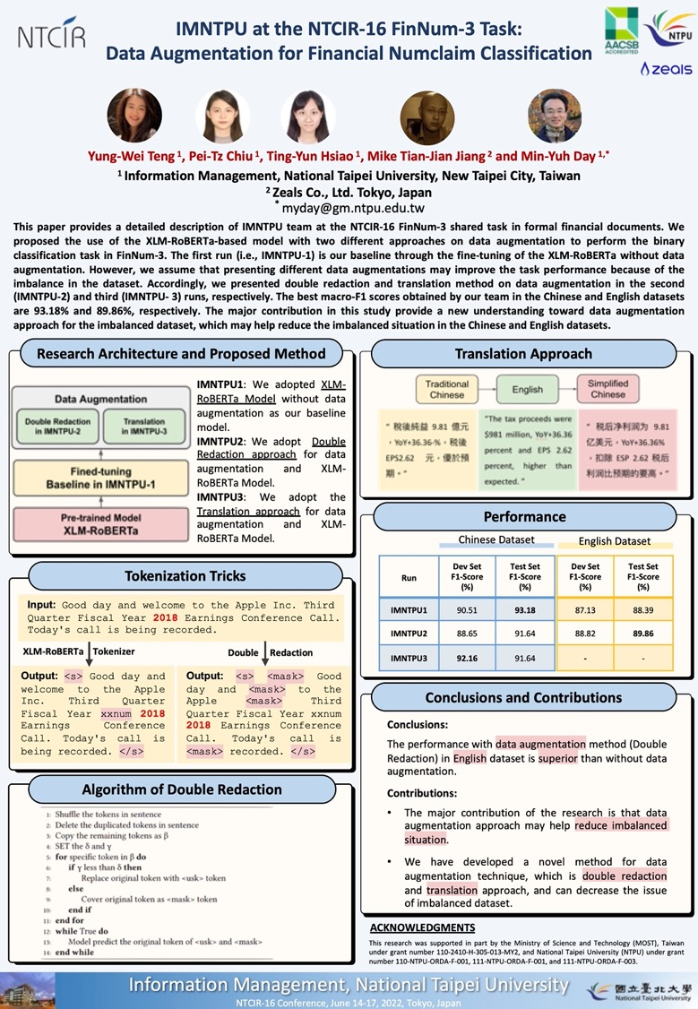
NTCIR-16
FinNum-3
2022
NTCIR-16
Best Poster Presentation Award

Slide 23
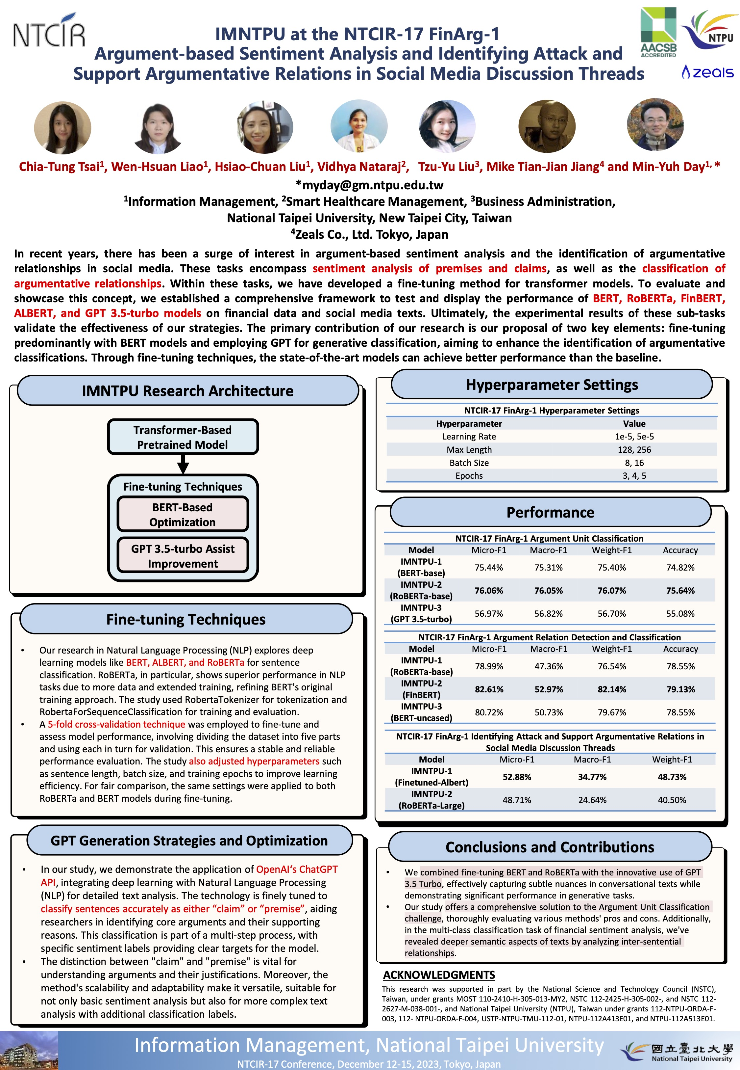
NTCIR-17
FinArg-1
1
2023
NTCIR-17
Best Poster Presentation Award

Slide 24
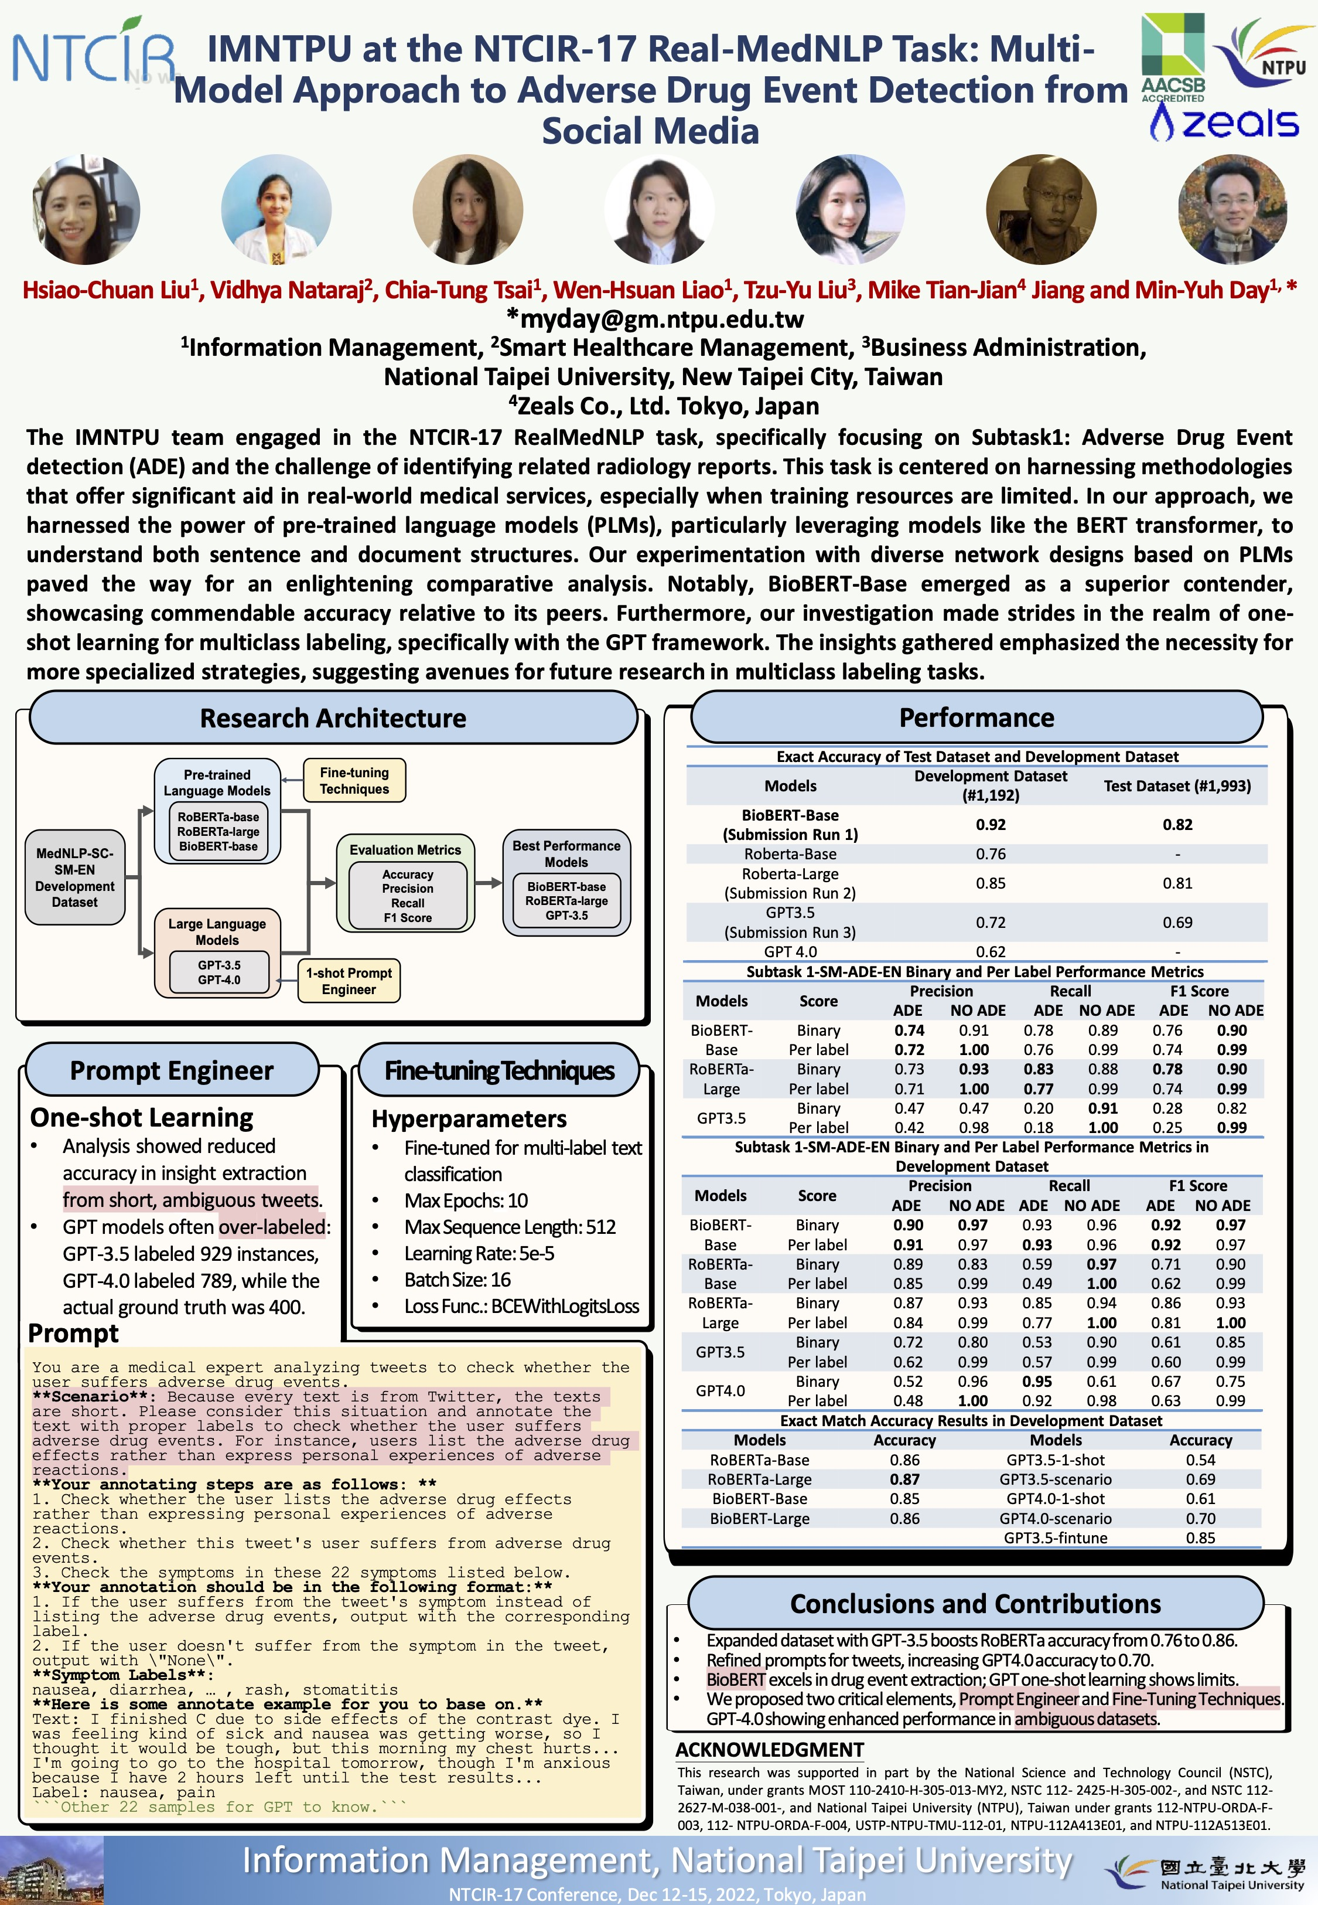
NTCIR-17
Real MedNLP
2
2023
NTCIR-17
Best Poster Presentation Award

Slide 25



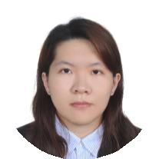
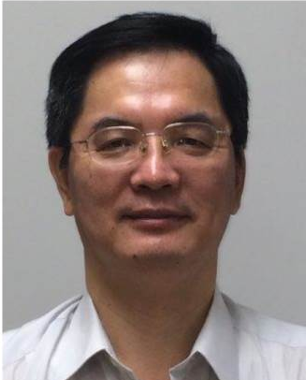

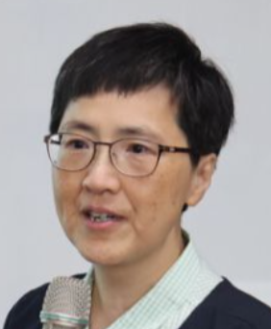
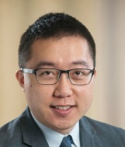

2024
Generative AI in
Multimodal Cross-Lingual Dialogue System for Inclusive Communication Support
Vidhya Nataraj
Wen-Hsuan Liao
Yue-Shan Chang
Chen-Yu Chiang
Chao-Yin Lin
Yu-An Lin
Min-Yuh Day*
* myday@gm.ntpu.edu.tw
Institute of Information Management,
National Taipei University, Taiwan
IEEE EM-RITE 2024, IEEE IRI 2024, San Jose, CA, USA, August 7-9, 2024

Slide 26

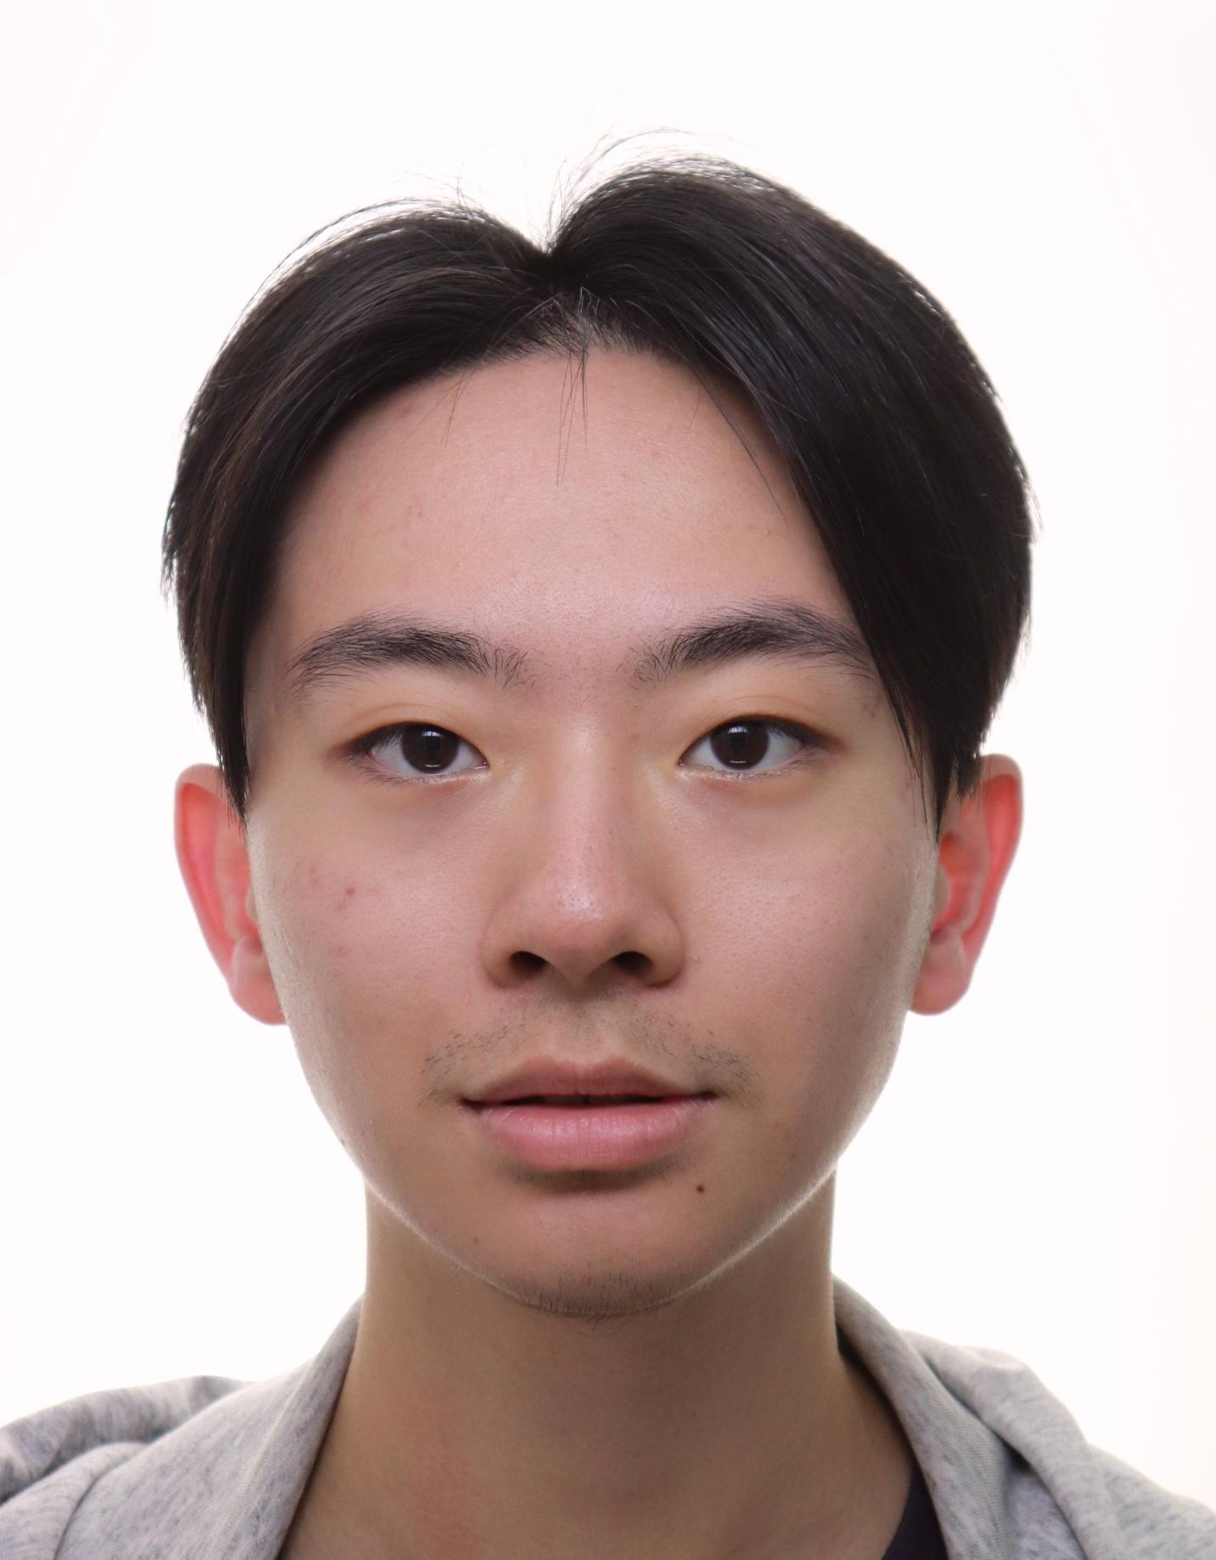
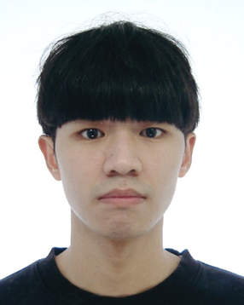
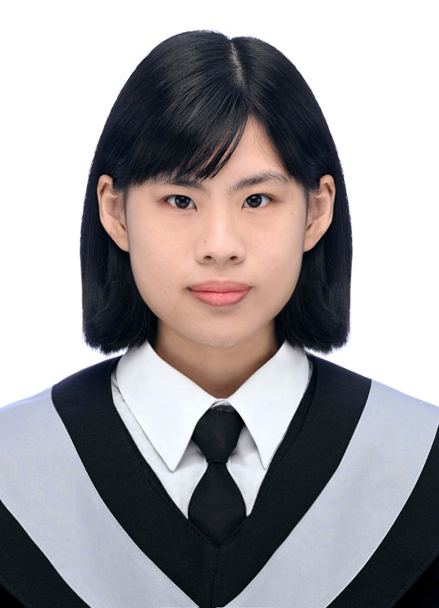
2024
Smart City Large Language Model Agent System
Min-Yuh Day *
Xin-Ting Lu
Xu-Yu Lan
Bor-Jen Chen
* myday@gm.ntpu.edu.tw
Institute of Information Management,
National Taipei University, Taiwan

Slide 27




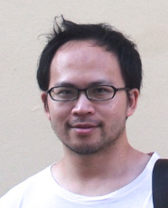
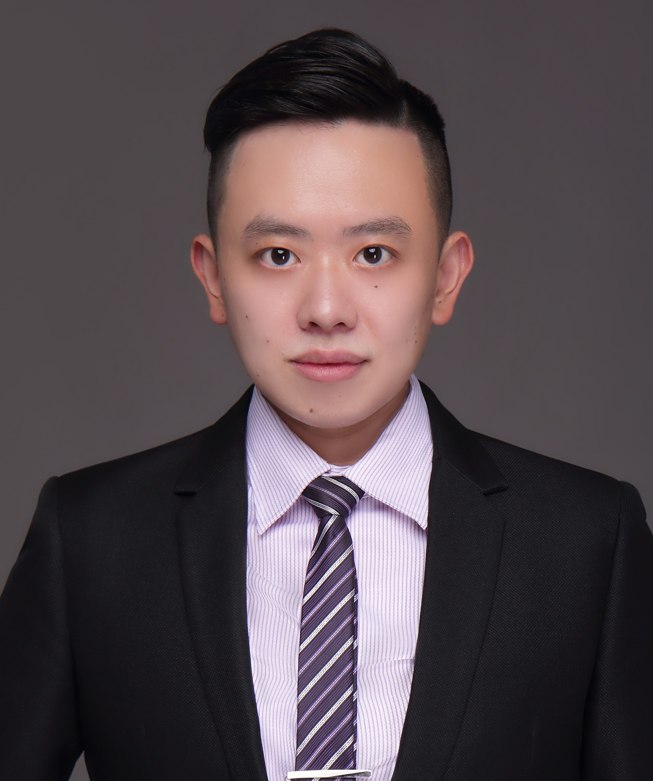
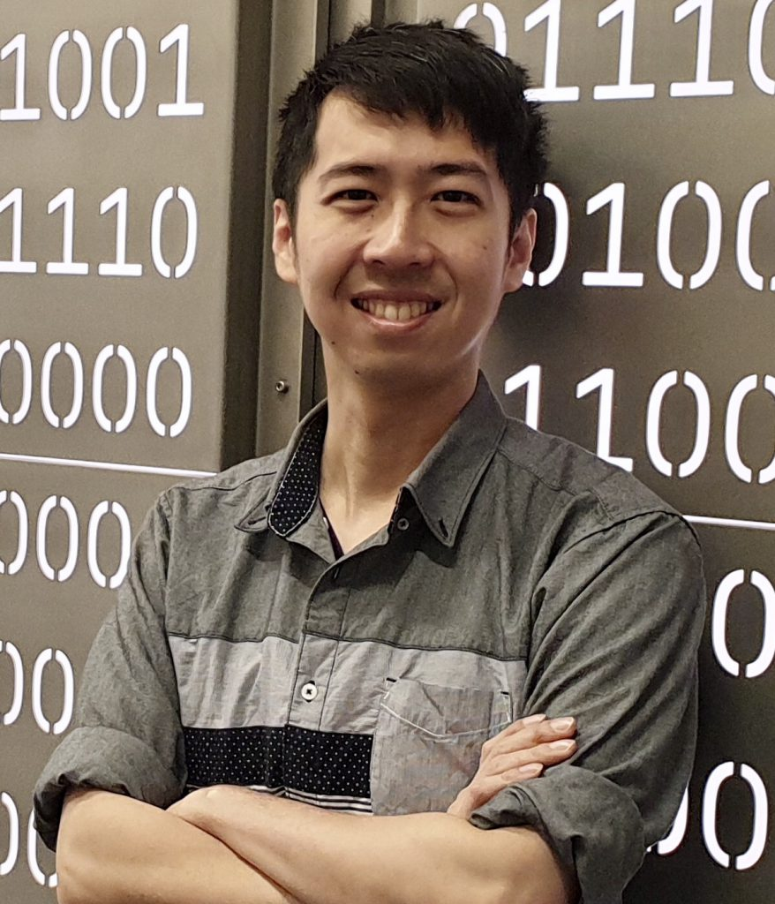
Fintech Green Finance for Carbon Market Index,
Corporate Finance, and Environmental Policies
（金融科技綠色金融於碳市場指標與公司環境策略）
Fintech and Green Finance Center (FGFC), NTPU
戴敏育
資管所教授
顏汝芳
統計系副教授
游擱嘉
企管系助理教授
翁新傑
統計系助理教授
黃懷陞
資管所助理教授
研究中心主任
研究中心副主任
研究中心執行長
研究中心課程組組長
研究中心產學組組長
http://www.aacsb.ntpu.edu.tw/fintech/
FinTech Taipei 2024, November 1-2, 2024, Taipei

Slide 28
Summary
Overview of ESG
  Environmental, Social, Governance
Challenges in ESG Data Analytics
  Fragmented, Unstructured, Diverse
Generative AI as a Solution
  Synthesis, Reporting, and Prediction
Sustainability Innovation

Slide 29

Acknowledgments: Research Projects
Fintech Green Finance for Carbon Market Index, Corporate Finance, and Environmental Policies.
Carbon Emission Sentiment Index with AI Text Analytics
  NTPU, 113-NTPU_ORDA-F-003, 2023/01/01~2024/12/31
Digital Support, Unimpeded Communication: The Development, Support and Promotion of AI-assisted Communication Assistive Devices for Speech Impairment (2/3).
Multimodal Cross-lingual Task-Oriented Dialogue System for Inclusive Communication Support
  NSTC 113-2425-H-305-002-, 3 Years (2023/05/01-2026/04/30) Year 1: 2024/05/01~2025/04/30
Research on speech processing, synthesis, recognition, and sentence construction of people with language disabilities. Multimodal Cross-lingual Task-Oriented Dialogue System
  NTPU, 113-NTPU_ORDA-F-004, 2023/01/01~2025/12/31
Metaverse AI Multimodal Cross-Language Task-Oriented Dialogue System
  ATEC Group, Fintech and Green Finance Center (FGFC, NTPU), NTPU-112A413E01, 3 Years (2023/05/01~2026/04/30)
Generative AI-Driven ESG Report Generation Technology
  Industrial Technology Research Institute (ITRI), Fintech and Green Finance Center (FGFC, NTPU), NTPU-113A513E01, 2024/03/01~2024/12/31
Establishment and Implement of Smart Assistive Technology for Dementia Care and Its Socio-Economic Impacts (3/3). Intelligent, individualized and precise care with smart AT and system integration
  NSTC, 113-2627-M-038-001-, 2024/08/01~2025/07/31
Prospective longitudinal study on peri-implant bone loss associated with peri-implantitis
  USTP (NTPU, TMU), USTP-NTPU-TMU-113-03, 2024/01/01~2024/12/31
https://web.ntpu.edu.tw/~myday/cindex.htm#projects

Slide 30
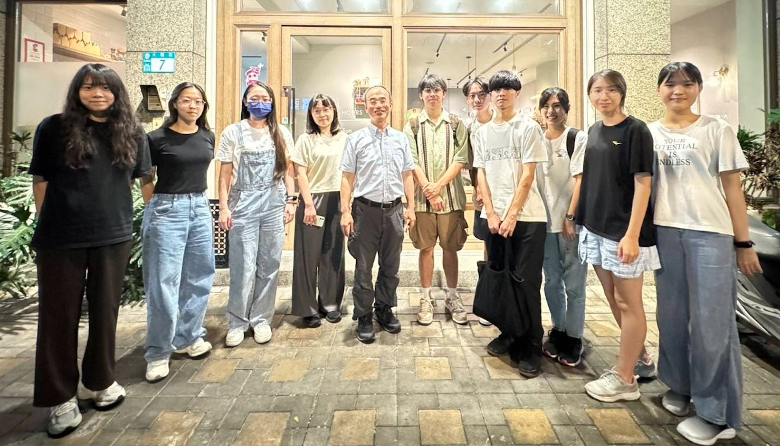
Acknowledgments: IFIT Lab Members
Intelligent Financial Innovation Technology, IFIT Lab, IM, NTPU

Slide 31
References
Cino Robin Castelli, Cyril Shmatov (2022), Quantitative Methods for ESG Finance, Wiley
Simon Thompson (2023), Green and Sustainable Finance: Principles and Practice in Banking, Investment and Insurance, 2nd Edition, Kogan Page.
Chrissa Pagitsas (2023), Chief Sustainability Officers At Work: How CSOs Build Successful Sustainability and ESG Strategies, Apress.
Yihan Cao, Siyu Li, Yixin Liu, Zhiling Yan, Yutong Dai, Philip S. Yu, and Lichao Sun (2023). "A Comprehensive Survey of AI-Generated Content (AIGC): A History of Generative AI from GAN to ChatGPT." arXiv preprint arXiv:2303.04226.
Pengfei Liu, Weizhe Yuan, Jinlan Fu, Zhengbao Jiang, Hiroaki Hayashi, and Graham Neubig. (2023) "Pre-train, prompt, and predict: A systematic survey of prompting methods in natural language processing." ACM Computing Surveys 55, no. 9 (2023): 1-35.
Wayne Xin Zhao, Kun Zhou, Junyi Li, Tianyi Tang, Xiaolei Wang, Yupeng Hou, Yingqian Min et al. (2023) "A Survey of Large Language Models." arXiv preprint arXiv:2303.18223.
Touvron, Hugo, Louis Martin, Kevin Stone, Peter Albert, Amjad Almahairi, Yasmine Babaei, Nikolay Bashlykov et al. (2023) "Llama 2: Open Foundation and Fine-Tuned Chat Models." arXiv preprint arXiv:2307.09288 (2023).
Rafailov, R., Sharma, A., Mitchell, E., Ermon, S., Manning, C. D., & Finn, C. (2023). Direct preference optimization: Your language model is secretly a reward model. arXiv preprint arXiv:2305.18290.
Tunstall, Lewis, Edward Beeching, Nathan Lambert, Nazneen Rajani, Kashif Rasul, Younes Belkada, Shengyi Huang et al. "Zephyr: Direct Distillation of LM Alignment." arXiv preprint arXiv:2310.16944 (2023).
Ouyang, L., Wu, J., Jiang, X., Almeida, D., Wainwright, C. L., Mishkin, P., ... & Lowe, R. (2022). Training language models to follow instructions with human feedback. arXiv preprint arXiv:2203.02155.
Gozalo-Brizuela, Roberto, and Eduardo C. Garrido-Merchan (2023). "ChatGPT is not all you need. A State of the Art Review of large Generative AI models." arXiv preprint arXiv:2301.04655 (2023).
Wenliang Dai, Junnan Li, Dongxu Li, Anthony Meng Huat Tiong, Junqi Zhao, Weisheng Wang, Boyang Li, Pascale Fung, and Steven Hoi. (2023) "InstructBLIP: Towards General-purpose Vision-Language Models with Instruction Tuning." arXiv preprint arXiv:2305.06500 (2023).
Shahab Saquib Sohail, Faiza Farhat, Yassine Himeur, Mohammad Nadeem, Dag Øivind Madsen, Yashbir Singh, Shadi Atalla, and Wathiq Mansoor (2023). "The Future of GPT: A Taxonomy of Existing ChatGPT Research, Current Challenges, and Possible Future Directions." Current Challenges, and Possible Future Directions (April 8, 2023) (2023).
Longbing Cao (2022). "Decentralized ai: Edge intelligence and smart blockchain, metaverse, web3, and desci." IEEE Intelligent Systems 37, no. 3: 6-19.
Qinglin Yang, Yetong Zhao, Huawei Huang, Zehui Xiong, Jiawen Kang, and Zibin Zheng (2022). "Fusing blockchain and AI with metaverse: A survey." IEEE Open Journal of the Computer Society 3 : 122-136.
Ouyang, L., Wu, J., Jiang, X., Almeida, D., Wainwright, C. L., Mishkin, P., ... & Lowe, R. (2022). Training language models to follow instructions with human feedback. arXiv preprint arXiv:2203.02155.

Slide 32
Generative AI for ESG Data Analytics and Sustainability Innovation
Tsukuba x NTPU
Bilateral Academic Exchange Program
International Workshop on Information Management and Media Science (IWIMMS 2024)
Q & A
Min-Yuh Day, Ph.D.
Professor, Institute of information Management
Director, Fintech and Green Finance Center (FGFC)
Division Director, Sustainable Development, Sustainability Office
National Taipei University
https://web.ntpu.edu.tw/~myday
International Workshop on Information Management and Media Science (IWIMMS 2024), University of Tsukuba, Japan, November 7, 2024

