Slide 1
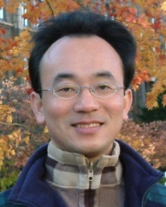
Sharing EMI Teaching Experiences in the EMI Teacher Community II
EMI x USR x FinTech x IM AACSB NTPU
Time: 12:10 - 13:00, March 27, 2024 (Wednesday)
Place: B302, National Taipei University, Taiwan
戴敏育 教授
Min-Yuh Day, Ph.D, Professor
Institute of Information Management, National Taipei University
https://web.ntpu.edu.tw/~myday
2024-03-27

Slide 2
戴敏育 教授 Min-Yuh Day, Ph.D.
1
Professor, Information Management, NTPU
Visiting Scholar, IIS, Academia Sinica
Ph.D., Information Management, NTU
Director, Intelligent Financial Innovation Technology, IFIT Lab, IM, NTPU
Associate Director, Fintech and Green Finance Center, NTPU
Publications Co-Chairs, IEEE/ACM International Conference on Advances in Social Networks Analysis and Mining (ASONAM 2013- )
Program Co-Chair, IEEE International Workshop on Empirical Methods for Recognizing Inference in TExt (IEEE EM-RITE 2012- )
Publications Chair, The IEEE International Conference on Information Reuse and Integration for Data Science (IEEE IRI 2007- )

Slide 3
Outline
English-Medium Instruction (EMI) Teaching Experiences
Innovative Strategies for EMI Implementation
EMI Teacher Community II, AACSB, NTPU
Q&A

Slide 4
English-Medium Instruction (EMI) Teaching Experiences

Slide 5
Teaching Experiences (EMI)
Big Data Analytics
Fall 2020, Spring 2023, Spring 2024
Software Engineering
Fall 2020, Fall, 2021, Spring 2022, Spring 2023, Spring 2024
Artificial Intelligence in Finance and Quantitative
Fall 2021, Fall 2022, Fall 2023
Artificial Intelligence
Spring 2021, Fall 2022
Artificial Intelligence for Text Analytics
Spring 2022, Fall 2023
Sustainability and ESG Data Analytics
Spring 2024, Fall 2024
Python for Accounting Applications
Fall 2023
Foundation of Business Cloud Computing
Spring 2021, Spring 2022, Spring 2023, Spring 2024
https://web.ntpu.edu.tw/~myday/teaching.htm

Slide 6
Teaching Experiences (EMI)
AI in Finance Big Data Analytics (Fall 2019)
MBA, DBETKU (3 Credits, Elective) [Full English Course] [Distance Learning]
Big Data Mining (Fall 2018)
MBA, DBETKU (3 Credits, Required) [Full English Course]
Social Media Apps Programming (Fall 2013 - Fall 2018)
MBA, IMTKU (2 Credits, Elective) [Full English Course]
Fall 2018, Fall 2017 , Fall 2016 , Fall 2015 , Fall 2014 , Fall 2013
https://web.ntpu.edu.tw/~myday/teaching.htm

Slide 7
EMI Courses in AI for Business Applications
Artificial Intelligence in Finance and Quantitative Analysis
Fall 2023, Fall 2022
Artificial Intelligence for Text Analytics
Fall 2023, Spring 2022
Artificial Intelligence
Fall 2022
Software Engineering
Spring 2023, Spring 2022
Big Data Analysis
Spring 2023
https://web.ntpu.edu.tw/~myday/teaching.htm

Slide 8
Innovative Strategies for EMI Implementation

Slide 9
Innovative Strategies for EMI Implementation
1. Curriculum Design
2. Teaching Methodologies
3. Faculty Training and Development
4. Assessment and Evaluation

Slide 10
Innovative Strategies for EMI Implementation
1. Curriculum Design
Designing EMI curricula that align with AACSB standards.
Explore interdisciplinary approaches and integrating business concepts with language learning.

Slide 11
Innovative Strategies for EMI Implementation
2. Teaching Methodologies
Explore active learning strategies suitable for EMI in business education.
Integration of technology and AI (e.g., simulation tools, language software).

Slide 12
Innovative Strategies for EMI Implementation
3. Faculty Training and Development
Emphasize the need for continuous faculty development in EMI pedagogy.
Present strategies for non-native English-speaking faculty to excel in EMI settings.

Slide 13
Innovative Strategies for EMI Implementation
4. Assessment and Evaluation
Assessing business content knowledge and English proficiency simultaneously.
Share innovative assessment methods that align with AACSB expectations.

Slide 14
EMI Teacher Community II AACSB, NTPU 2022-2024

Slide 15
EMI Teacher Community Activities
Spring 2022
1. 2022/05/05 (Thursday) 12:00 pm-13:00 pm, B302
Teaching Experiences Sharing of EMI Courses in AI for Business Applications
Min-Yuh Day, National Taipei University,
2. 2022/05/11 (Wednesday) 9:10 am - 12:00 pm, Google Meet ONLINE
Agile Principles Patterns and Practices in FinTech and Digital Transformation
Shihyu (Alex) Chu, Senior Industry Analyst/Program Manager, Market Intelligence & Consulting Institute (MIC)
3. 2022/05/11 (Wednesday) 12:10 pm - 13:00 pm, Google Meet ONLINE
Professional Business Presentations in English
Shihyu (Alex) Chu, Senior Industry Analyst/Program Manager, Market Intelligence & Consulting Institute (MIC)
4. 2022/05/18 (Wednesday) 12:10 pm - 13:00 pm, Google Meet ONLINE
Web 3: From DeFi to WoFi
Prof. Shih-wei Liao, National Taiwan University
5. 2022/05/27 (Friday) 12:00 pm - 13:00 pm, Google Meet ONLINE
Experiences Sharing of NTPU EMI Teaching Community II
Professors of EMI Teaching Community II, National Taipei University

Slide 16
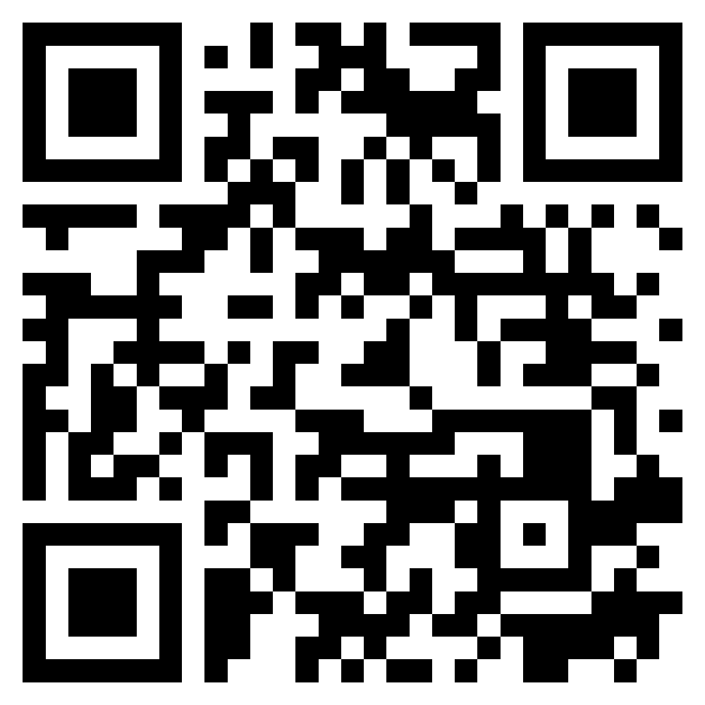
Teaching Experiences Sharing of EMI Courses in AI for Business Applications
EMI Teacher Community, AACSB, NTPU
1
Spring 2022
2022/5/5 (Thursday) 12:10 - 13:00
B302, AACSB, National Taipei University
Min-Yuh Day, Ph.D, Associate Professor
Institute of Information Management, National Taipei University
https://web.ntpu.edu.tw/~myday
https://meet.google.com/zuc-yyaw-mnt
2022-05-05

Slide 17
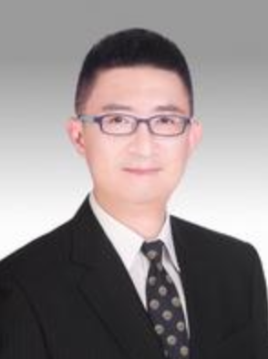
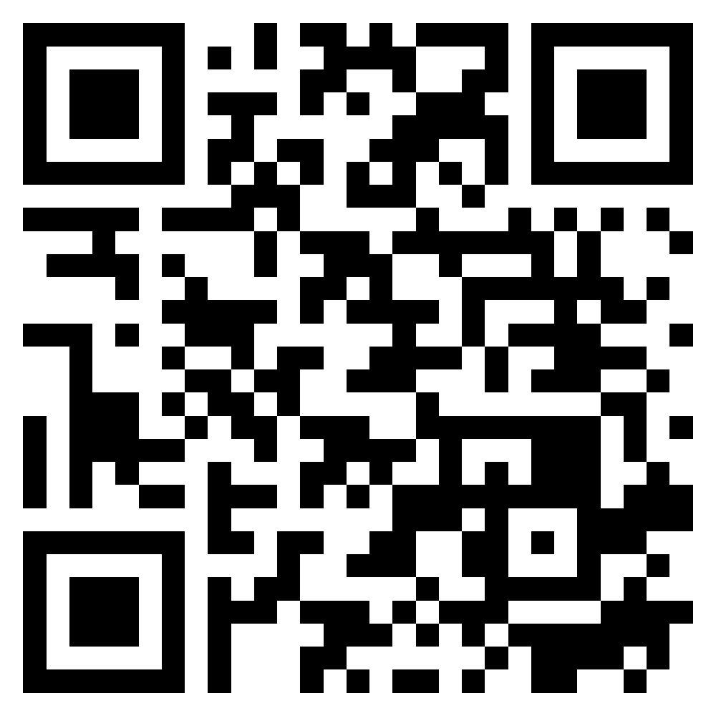
Agile Principles Patterns and Practices in FinTech and Digital Transformation
FinTech x EMI AACSB NTPU
2
Spring 2022
Shihyu (Alex) Chu
Senior Industry Analyst/Program Manager Market Intelligence & Consulting Institute (MIC)
https://meet.google.com/ish-gzmy-pmo
9:10 - 12:00, May 11, 2022 (Wednesday)

Slide 18
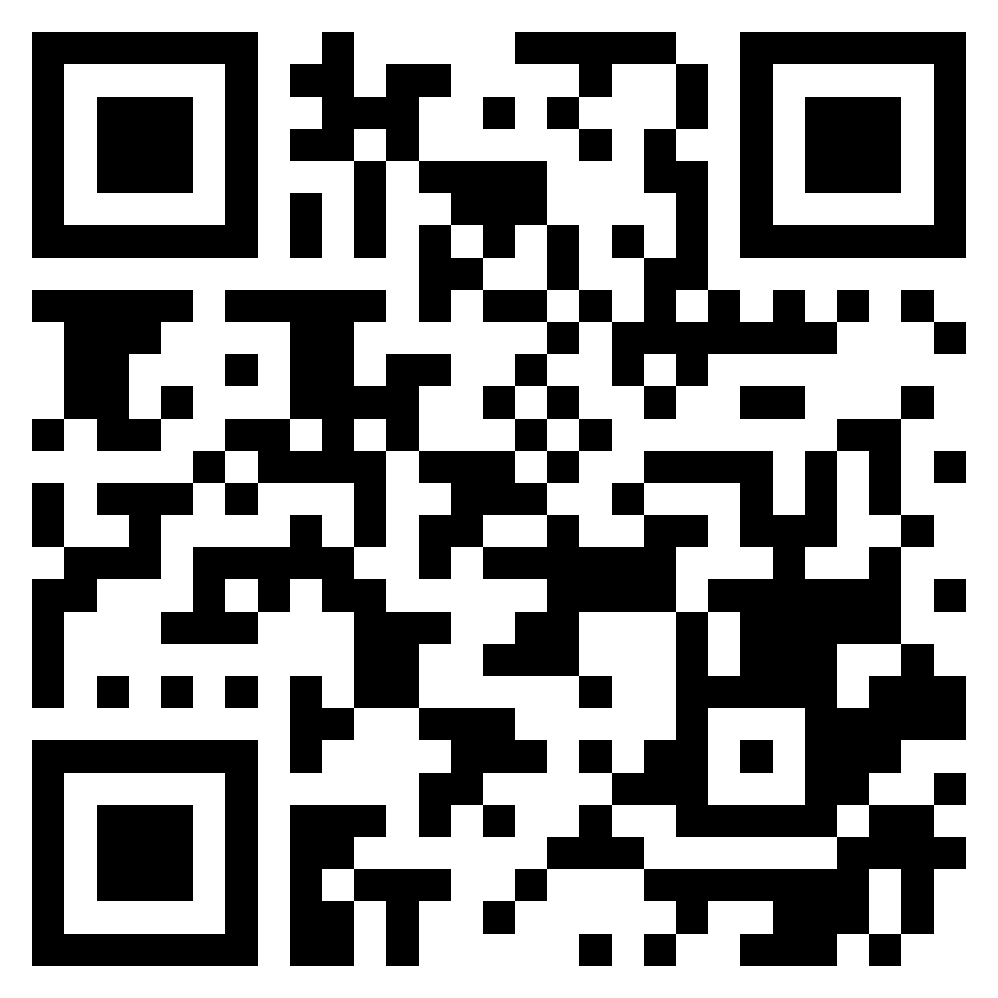
Professional Business Presentations in English
FinTech x EMI AACSB NTPU
3
Spring 2022
Shihyu (Alex) Chu
Senior Industry Analyst/Program Manager Market Intelligence & Consulting Institute (MIC)
http://meet.google.com/uaq-vmjj-vff
12:10 - 13:00, May 11, 2022 (Wednesday)

Slide 19
Web 3: From DeFi to WoFi
FinTech x EMI AACSB NTPU
4
Spring 2022
Prof. Shih-wei Liao National Taiwan University
http://meet.google.com/uaq-vmjj-vff
12:10 - 13:00, May 18, 2022 (Wednesday)

Slide 20
Experiences Sharing of NTPU EMI Teaching Community II
EMI AACSB NTPU
5
Spring 2022
Professors of EMI Teaching Community II
National Taipei University
http://meet.google.com/uaq-vmjj-vff
12:00 - 13:00, May 27, 2022 (Friday)

Slide 21
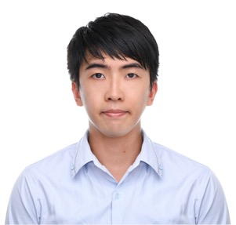
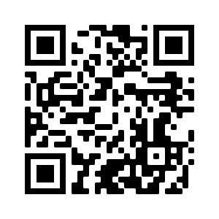
FinTech for Social Good
EMI x FinTech x IM AACSB NTPU
1
Fall 2022
Dr. Chung-Chi Chen Researcher, Artificial Intelligence Research Center, National Institute of Advanced Industrial Science and Technology, Japan
https://meet.google.com/paj-zhhj-mya
12:10 - 14:00, Oct. 19, 2022 (Wednesday)

Slide 22
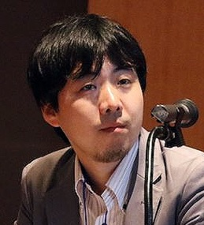
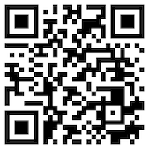
Matching Texts with Data for Evidence-based Information Retrieval
EMI x FinTech x IM AACSB NTPU
2
Fall 2022
Prof. Makoto P. Kato Faculty of Library, Information and Media Science
University of Tsukuba, Japan
https://meet.google.com/miy-fbif-max
9:10 - 12:00, Nov. 23, 2022 (Wednesday)
(Hybrid) B8F40, National Taipei University, Taiwan

Slide 23
The Truth of Crypto & NFT Economy (虛擬貨幣與NFT經濟老實說)
EMI x FinTech x IM AACSB NTPU
3
Fall 2022
Mu Jou (周書丞) CTO of Infinitas NFT
GM of Asiania
https://meet.google.com/paj-zhhj-mya
12:10 - 14:00, Nov. 30, 2022 (Wednesday)
(Hybrid) B3F02, National Taipei University, Taiwan

Slide 24
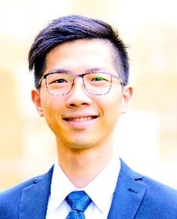
Index Design – Methodology, Data Analysis and the Application of Quantitative Investing
EMI x FinTech x IM AACSB NTPU
4
Fall 2022
Jervis J.G. Li
Fund Manager, Yuanta SITC
https://meet.google.com/paj-zhhj-mya
9:10 - 12:00, Dec. 6, 2022 (Tuesday)
(Hybrid) B8F40, National Taipei University, Taiwan

Slide 25
Agile Principles Patterns and Practices using AI and ChatGPT
EMI x USR x FinTech x IM AACSB NTPU
1
Spring 2023
Shihyu (Alex) Chu
Division Director, Software Industry Research Market Intelligence & Consulting Institute (MIC)
https://meet.google.com/ish-gzmy-pmo
9:10 - 12:00, May 17, 2023 (Wednesday)
(Hybrid) B8F40, National Taipei University, Taiwan

Slide 26
國際碳中和產業趨勢與數位轉型永續發展 (International Carbon Neutral Industry Trends and Digital Transformation for Sustainable Development)
EMI x USR x FinTech x IM AACSB NTPU
2
Spring 2023
Shihyu (Alex) Chu (朱師右)
Division Director, Software Industry Research Market Intelligence & Consulting Institute (MIC)
https://meet.google.com/paj-zhhj-mya
12:10 - 13:00, May 17, 2023 (Wednesday)
(Hybrid) B302, National Taipei University, Taiwan

Slide 27
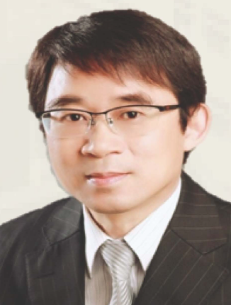
綠色金融科技－金融數位轉型的趨勢與商機 (Green Financial Technology: Trends and Business Opportunities of Financial Digital Transformation)
EMI x USR x FinTech x Stat x IM AACSB NTPU
3
Spring 2023
周振豊 董事長 (Jones Chou) 捷鵬國際金融服務集團創辦人
12:10 - 13:30, May 25, 2023 (Thursday)
B313, National Taipei University, Taiwan

Slide 28
Index Design – Methodology, Data Analysis and the Application of Quantitative Investing
EMI x USR x FinTech x IM AACSB NTPU
1
Fall 2023
Jervis J.G. Li
Fund Manager, Yuanta SITC
9:10 - 12:00, Dec. 5, 2023 (Tuesday)
B3F17, National Taipei University, Taiwan

Slide 29
EMI Teacher Community Activities
Spring 2024
1. March 27, 2024 (Wednesday) 12:10-13:00
Sharing EMI Teaching Experiences in the EMI Teacher Community II
Min-Yuh Day, National Taipei University
2. April 16, 2024 (Tuesday) 12:10-13:00
Experience Sharing on EMI Teaching Promotion in the College of Business, NTPU
Pu-Tai Yang, National Taipei University
3. April 24, 2024 (Wednesday) 12:10-13:00
Experiences Sharing of NTPU EMI Teaching Community II
Professors of EMI Teaching Community II, National Taipei University
4. May 2, 2024 (Tuesday) 12:10-13:00
Experience Sharing on EMI Teaching in Finance and Banking
Ko-Chia Yu, National Taipei University
5. May 22, 2024 (Wednesday) 9:10-12:00
Agile Principles Patterns and Practices using Generative AI for Sustainable Digital Transformation
Shihyu (Alex) Chu, Division Director, Software Industry Research Center, Market Intelligence & Consulting Institute (MIC)

Slide 30
Sharing EMI Teaching Experiences in the EMI Teacher Community II
EMI x USR x FinTech x IM AACSB NTPU
1
Spring 2024
Time: 12:10 - 13:00, March 27, 2024 (Wednesday)
Place: B302, National Taipei University, Taiwan
戴敏育 教授
Min-Yuh Day, Ph.D, Professor
Institute of Information Management, National Taipei University
https://web.ntpu.edu.tw/~myday
2024-03-27

Slide 31
EMI Courses in AI for Business Applications

Slide 32
Introduction to Artificial Intelligence for Text Analytics
Artificial Intelligence for Text Analytics
1121AITA01
MBA, IM, NTPU (M5265) (Fall 2023) Tue 2, 3, 4 (9:10-12:00) (B3F17)
Min-Yuh Day, Ph.D, Associate Professor
Institute of Information Management, National Taipei University
https://web.ntpu.edu.tw/~myday
https://meet.google.com/miy-fbif-max
2023-09-13

Slide 33
Course Syllabus National Taipei University Academic Year 112, 1st Semester (Fall 2023)
Course Title: Artificial Intelligence for Text Analytics
Instructor: Min-Yuh Day
Course Class: MBA, IM, NTPU (3 Credits, Elective)
Details
EMI Course (3 Credits, Elective, One Semester) (M5265)
Time & Place: Wed, 2, 3, 4, (9:10-12:00) (B3F17)
Google Meet: https://meet.google.com/miy-fbif-max
https://meet.google.com/miy-fbif-max

Slide 34
Course Objectives
Understand the fundamental concepts and research issues of Artificial Intelligence for Text Analytics.
Equip with Hands-on practices of Artificial Intelligence for Text Analytics.
Conduct information systems research in the context of Artificial Intelligence for Text Analytics.

Slide 35
Course Outline
This course introduces the fundamental concepts, research issues, and hands-on practices of Artificial Intelligence for Text Analytics.
Topics include:
Introduction to Introduction to Artificial Intelligence for Text Analytics
Foundations of Text Analytics: Natural Language Processing (NLP)
Python for Natural Language Processing
Natural Language Processing with Transformers
Text Classification and Sentiment Analysis
Multilingual Named Entity Recognition (NER), Text Similarity and Clustering
Text Summarization and Topic Models
Text Generation with Large Language Models (LLMs)
Question Answering and Dialogue Systems
Deep Learning, Generative AI, Transfer Learning, Zero-Shot, and Few-Shot Learning for Text Analytics
Case Study on Artificial Intelligence for Text Analytics

Slide 36
Core Competence
Exploring new knowledge in information technology, system development and application 80 %
Internet marketing planning ability 10 %
Thesis writing and independent research skills 10 %

Slide 37
Four Fundamental Qualities
Professionalism
Creative thinking and Problem-solving 40 %
Comprehensive Integration 40 %
Interpersonal Relationship
Communication and Coordination 10 %
Teamwork 5 %
Ethics
Honesty and Integrity 0 %
Self-Esteem and Self-reflection 0 %
International Vision
Caring for Diversity 0 %
Interdisciplinary Vision 5 %

Slide 38
College Learning Goals
Ethics/Corporate Social Responsibility
Global Knowledge/Awareness
Communication
Analytical and Critical Thinking

Slide 39
Department Learning Goals
Information Technologies and System Development Capabilities
Internet Marketing Management Capabilities
Research capabilities

Slide 40
Syllabus
Week Date Subject/Topics
1 2023/09/13 Introduction to Artificial Intelligence for Text Analytics
2 2023/09/20 Foundations of Text Analytics: Natural Language Processing (NLP)
3 2023/09/27 Python for Natural Language Processing
4 2023/10/04 Natural Language Processing with Transformers
5 2023/10/11 Case Study on Artificial Intelligence for Text Analytics I
6 2023/10/18 Text Classification and Sentiment Analysis

Slide 41
Syllabus
Week Date Subject/Topics
7 2023/10/25 Multilingual Named Entity Recognition (NER)
8 2023/11/01 Midterm Project Report
9 2023/11/08 Text Similarity and Clustering
10 2023/11/15 Text Summarization and Topic Models
11 2023/11/22 Text Generation with Large Language Models (LLMs)
12 2023/11/29 Case Study on Artificial Intelligence for Text Analytics II

Slide 42
Syllabus
Week Date Subject/Topics
13 2023/12/06 Question Answering and Dialogue Systems
14 2023/12/13 Deep Learning, Generative AI, Transfer Learning, Zero-Shot, and Few-Shot Learning for Text Analytics
15 2023/12/20 Final Project Report I
16 2023/12/27 Final Project Report II

Slide 43
Teaching Methods and Activities
Lecture
Discussion
Practicum

Slide 44
Evaluation Methods
Individual Presentation 60 %
Group Presentation 10 %
Case Report 10 %
Class Participation 10 %
Assignment 10 %

Slide 45
Introduction to Artificial Intelligence in Finance and Quantitative Analysis
Artificial Intelligence in Finance and Quantitative Analysis
1121AIFQA01
MBA, IM, NTPU (M5276) (Fall 2023) Tue 2, 3, 4 (9:10-12:00) (B3F17)
Min-Yuh Day, Ph.D, Associate Professor
Institute of Information Management, National Taipei University
https://web.ntpu.edu.tw/~myday
https://meet.google.com/paj-zhhj-mya
2023-09-12

Slide 46
Course Syllabus National Taipei University Academic Year 112, 1st Semester (Fall 2023)
Course Title: Artificial Intelligence in Finance and Quantitative Analysis
Instructor: Min-Yuh Day
Course Class: MBA, IM, NTPU (3 Credits, Elective)
Details
EMI Course (3 Credits, Elective, One Semester) (M5276)
Time & Place: Tue, 2, 3, 4, (9:10-12:00) (B3F17)
Google Meet: https://meet.google.com/paj-zhhj-mya
https://meet.google.com/paj-zhhj-mya

Slide 47
Course Objectives
Understand the fundamental concepts and research issues of Artificial Intelligence in Finance and Quantitative Analysis.
Equip with Hands-on practices of Artificial Intelligence in Finance and Quantitative Analysis.
Conduct information systems research in the context of Artificial Intelligence in Finance and Quantitative Analysis.

Slide 48
Course Outline
This course introduces the fundamental concepts, research issues, and hands-on practices of AI in Finance and Quantitative Analysis.
Topics include:
Introduction to Artificial Intelligence in Finance and Quantitative Analysis
AI in FinTech: Metaverse, Web3, DeFi, NFT, Financial Services Innovation and Applications
Investing Psychology and Behavioral Finance
Event Studies in Finance
Finance Theory
Data-Driven Finance
Financial Econometrics
AI-First Finance
Deep Learning in Finance
Reinforcement Learning in Finance
Algorithmic Trading, Risk Management, Trading Bot and Event-Based Backtesting
Case Study on AI in Finance and Quantitative Analysis.

Slide 49
Syllabus
Week Date Subject/Topics
1 2023/09/12 Introduction to Artificial Intelligence in Finance and Quantitative Analysis
2 2023/09/19 AI in FinTech: Metaverse, Web3, DeFi, NFT, Financial Services Innovation and Applications
3 2023/09/26 Investing Psychology and Behavioral Finance
4 2023/10/03 Event Studies in Finance
5 2023/10/10 National Day (Day off)
6 2023/10/17 Case Study on AI in Finance and Quantitative Analysis I

Slide 50
Syllabus
Week Date Subject/Topics
7 2023/10/24 Finance Theory and Data-Driven Finance
8 2023/10/31 Midterm Project Report
9 2023/11/07 Financial Econometrics
10 2023/11/14 AI-First Finance
11 2023/11/21 Industry Practices of AI in Finance and Quantitative Analysis
12 2023/11/28 Case Study on AI in Finance and Quantitative Analysis II

Slide 51
Syllabus
Week Date Subject/Topics
13 2023/12/05 Deep Learning in Finance; Reinforcement Learning in Finance
14 2023/12/12 Algorithmic Trading; Risk Management; Trading Bot and Event-Based Backtesting
15 2023/12/19 Final Project Report I
16 2023/12/26 Final Project Report II

Slide 52
Introduction to Big Data Analysis
Big Data Analysis
1122BDA01
MBA, IM, NTPU (M6031) (Spring 2024) Tue 2, 3, 4 (9:10-12:00) (B3F17)
Min-Yuh Day, Ph.D, Associate Professor
Institute of Information Management, National Taipei University
https://web.ntpu.edu.tw/~myday
https://meet.google.com/paj-zhhj-mya
2024-02-20

Slide 53
Course Syllabus National Taipei University Academic Year 112, 2nd Semester (Spring 2024)
Course Title: Big Data Analysis
Instructor: Min-Yuh Day
Course Class: MBA, IM, NTPU (3 Credits, Elective)
Details
In-Class and Distance Learning EMI Course (3 Credits, Elective, One Semester) (M6031)
Time & Place: Tue, 2, 3, 4, (9:10-12:00) (B3F17)
Google Meet: https://meet.google.com/paj-zhhj-mya
https://meet.google.com/paj-zhhj-mya

Slide 54
Course Objectives
Understand the fundamental concepts and research issues of Big Data Analysis.
Equip with Hands-on practices of Big Data Analysis.
Conduct information systems research in the context of Big Data Analysis.

Slide 55
Course Outline
This course introduces the fundamental concepts, research issues, and hands-on practices of Big Data Analysis.
Topics include:
Introduction to Big Data Analysis
AI, Data Science and Big Data Analysis
Foundations of Big Data Analysis in Python
Machine Learning: SAS Viya, Data Preparation and Algorithm Selection
Machine Learning: Decision Trees and Ensembles of Trees
Machine Learning: Neural Networks (NN) and Support Vector Machines (SVM)
Machine Learning: Model Assessment and Deployment
Generative AI and Large Language Models (LLM) for Big Data Analysis
Deep Learning for ESG and Finance Big Data Analysis
Industry Practices of Big Data Analysis
Case Study on Big Data Analysis

Slide 56
Syllabus
Week Date Subject/Topics
1 2024/02/20 Introduction to Big Data Analysis
2 2024/02/27 AI, Data Science and Big Data Analysis
3 2024/03/05 Foundations of Big Data Analysis in Python
4 2024/03/12 Case Study on Big Data Analysis I
5 2024/03/19 Machine Learning: SAS Viya, Data Preparation and Algorithm Selection
6 2024/03/26 Machine Learning: Decision Trees and Ensembles of Trees
7 2024/04/02 Self-study
8 2024/04/09 Midterm Project Report

Slide 57
Syllabus
Week Date Subject/Topics
9 2024/04/16 Machine Learning: Neural Networks (NN) and Support Vector Machines (SVM)
10 2024/04/23 Machine Learning: Model Assessment and Deployment
11 2024/04/30 Case Study on Big Data Analysis II
12 2024/05/07 Generative AI and Large Language Models (LLM) for Big Data Analysis
13 2024/05/14 Industry Practices of Big Data Analysis
14 2024/05/21 Deep Learning for ESG and Finance Big Data Analysis
15 2024/05/28 Final Project Report I
16 2024/06/04 Final Project Report II

Slide 58
Introduction to Software Engineering
Software Engineering
1122SE01
MBA, IM, NTPU (M5010) (Spring 2024) Wed 2, 3, 4 (9:10-12:00) (B3F17)
Min-Yuh Day, Ph.D, Associate Professor
Institute of Information Management, National Taipei University
https://web.ntpu.edu.tw/~myday
https://meet.google.com/ish-gzmy-pmo
2024-02-21

Slide 59
Course Syllabus National Taipei University Academic Year 112, 2nd Semester (Spring 2024)
Course Title: Software Engineering
Instructor: Min-Yuh Day
Course Class: MBA, IM, NTPU (3 Credits, Elective) GMBA in Finance; SHM; IPUG
Details
In-Person and Distance Learning EMI Course (3 Credits, Elective, One Semester) (M5010)
Time & Place: Wed, 2, 3, 4, (9:10-12:00) (B3F17)
Google Meet: https://meet.google.com/ish-gzmy-pmo
https://meet.google.com/ish-gzmy-pmo

Slide 60
Course Objectives
Understand the fundamental concepts and research issues of software engineering.
Equip with Hands-on practices of software engineering.
Conduct information systems research in the context of software engineering.

Slide 61
Course Outline
This course introduces the fundamental concepts, research issues, and hands-on practices of software engineering.
Topics include:
Introduction to Software Engineering
Software Products and Project Management: Software product management and prototyping
Agile Software Engineering: Agile methods, Scrum, and Extreme Programming
Features, Scenarios, and Stories
Software Architecture: Architectural design, System decomposition, and Distribution architecture
Cloud-Based Software: Virtualization and containers, Everything as a service, Software as a service
Cloud Computing and Cloud Software Architecture
Microservices Architecture, RESTful services, Service deployment
Security and Privacy; Reliable Programming
Testing: Functional testing, Test automation, Test-driven development, and Code reviews
DevOps and Code Management: Code management and DevOps automation
Case Study on Software Engineering

Slide 62
Syllabus
Week Date Subject/Topics
1 2024/02/21 Introduction to Software Engineering
2 2024/02/28 Peace Memorial Day (Day Off)
3 2024/03/06 Software Products and Project Management: Software product management and prototyping
4 2024/03/13 Agile Software Engineering: Agile methods, Scrum, and Extreme Programming
5 2024/03/20 Case Study on Software Engineering I
6 2024/03/27 Features, Scenarios, and Stories
7 2024/04/03 Make-up holiday for NTPU Sports Day (No Classes)
8 2024/04/10 Midterm Project Report

Slide 63
Syllabus
Week Date Subject/Topics
9 2024/04/17 Software Architecture: Architectural design, System decomposition, and Distribution architecture
10 2024/04/24 Cloud-Based Software: Virtualization and containers, Everything as a service, Software as a service; Cloud Computing and Cloud Software Architecture
11 2024/05/01 Case Study on Software Engineering II
12 2024/05/08 Microservices Architecture, RESTful services, Service deployment
13 2024/05/15 Industry Practices of Software Engineering

Slide 64
Syllabus
Week Date Subject/Topics
14 2024/05/22 Security and Privacy; Reliable Programming; Testing: Functional testing, Test automation, Test-driven development, and Code reviews; DevOps and Code Management: Code management and DevOps automation
15 2024/05/29 Final Project Report I
16 2024/06/05 Final Project Report II

Slide 65
Introduction to Artificial Intelligence
Artificial Intelligence
1111AI01
MBA, IM, NTPU (M6132) (Fall 2022) Wed 2, 3, 4 (9:10-12:00) (B8F40)
Min-Yuh Day, Ph.D, Associate Professor
Institute of Information Management, National Taipei University
https://web.ntpu.edu.tw/~myday
https://meet.google.com/miy-fbif-max
2022-09-14

Slide 66
Course Syllabus National Taipei University Academic Year 111, 1st Semester (Fall 2022)
Course Title: Artificial Intelligence
Instructor: Min-Yuh Day
Course Class: MBA, IM, NTPU (3 Credits, Elective)
Details
In-Class and Distance Learning EMI Course (3 Credits, Elective, One Semester) (M6132)
Time & Place: Wed, 2, 3, 4, (9:10-12:00) (B8F40)
Google Meet: https://meet.google.com/miy-fbif-max
https://meet.google.com/miy-fbif-max

Slide 67
Course Objectives
Understand the fundamental concepts and research issues of Artificial Intelligence.
Equip with Hands-on practices of Artificial Intelligence.
Conduct information systems research in the context of Artificial Intelligence.

Slide 68
Course Outline
This course introduces the fundamental concepts, research issues, and hands-on practices of Artificial Intelligence.
Topics include:
Introduction to Artificial Intelligence
Artificial Intelligence and Intelligent Agents
Problem Solving
Knowledge, Reasoning and Knowledge Representation, Uncertain Knowledge and Reasoning
Machine Learning: Supervised and Unsupervised Learning
The Theory of Learning and Ensemble Learning
Deep Learning, Reinforcement Learning
Deep Learning for Natural Language Processing
Computer Vision and Robotics
Philosophy and Ethics of AI and the Future of AI
Case Study on AI

Slide 69
Syllabus
Week Date Subject/Topics
1 2022/09/14 Introduction to Artificial Intelligence
2 2022/09/21 Artificial Intelligence and Intelligent Agents
3 2022/09/28 Problem Solving
4 2022/10/05 Knowledge, Reasoning and Knowledge Representation; Uncertain Knowledge and Reasoning
5 2022/10/12 Case Study on Artificial Intelligence I
6 2022/10/19 Machine Learning: Supervised and Unsupervised Learning

Slide 70
Syllabus
Week Date Subject/Topics
7 2022/10/26 The Theory of Learning and Ensemble Learning
8 2022/11/02 Midterm Project Report
9 2022/11/09 Deep Learning and Reinforcement Learning
10 2022/11/16 Deep Learning for Natural Language Processing
11 2022/11/23 Invited Talk: AI for Information Retrieval
12 2022/11/30 Case Study on Artificial Intelligence II

Slide 71
Syllabus
Week Date Subject/Topics
13 2022/12/07 Computer Vision and Robotics
14 2022/12/14 Philosophy and Ethics of AI and the Future of AI
15 2022/12/21 Final Project Report I
16 2022/12/28 Final Project Report II
17 2023/01/04 Self-learning
18 2023/01/11 Self-learning

Slide 72
Project-based Learning (PBL)

Slide 73
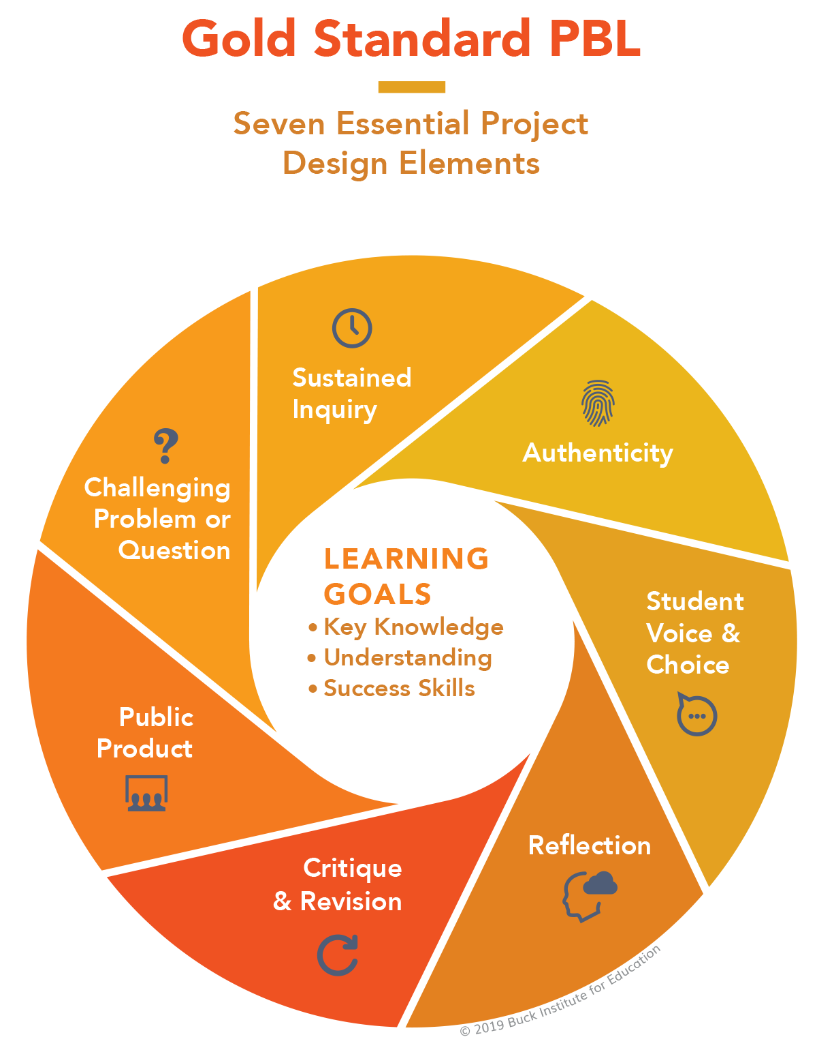
PBL Design Teaching
2
2
1
1
3
3
7
7
4
4
6
6
5
5

Slide 74
Information Management (MIS) Information Systems
Organizations
Technology
Information Systems
Management

Slide 75
Fundamental MIS Concepts
Business Challenges
Management
Organization
Information System
Business Solutions
Technology

Slide 76
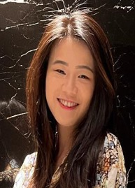
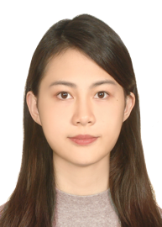
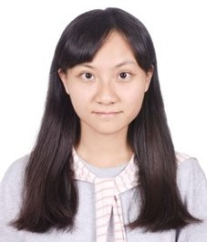
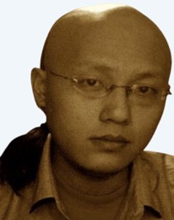
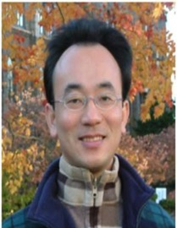
2022
IMNTPU at the NTCIR-16 FinNum-3 Task: Data Augmentation for Financial Numclaim Classification
¹ Information Management, National Taipei University, New Taipei City, Taiwan
² Zeals Co., Ltd. Tokyo, Japan
Yung-Wei Teng ¹
Pei-Tz Chiu ¹
Ting-Yun Hsiao ¹
Mike Tian-Jian Jiang ²
Min-Yuh Day ^{1,*}
myday@gm.ntpu.edu.tw

Slide 77
2022
IMNTPU Dialogue System Evaluation
at the NTCIR-16 DialEval-2
Dialogue Quality and Nugget Detection
¹ Information Management, National Taipei University, New Taipei City, Taiwan
² Zeals Co., Ltd. Tokyo, Japan
Ting-Yun Hsiao ¹
Yung-Wei Teng ¹
Pei-Tz Chiu ¹
Mike Tian-Jian Jiang ²
Min-Yuh Day ^{1,*}
myday@gm.ntpu.edu.tw

Slide 78
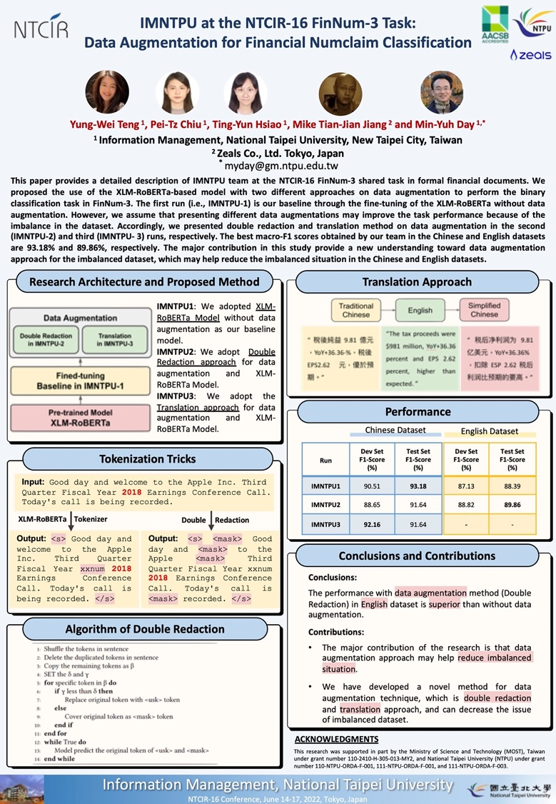
NTCIR-16 FinNum-3
2022
NTCIR-16 Best Poster Presentation Award

Slide 79
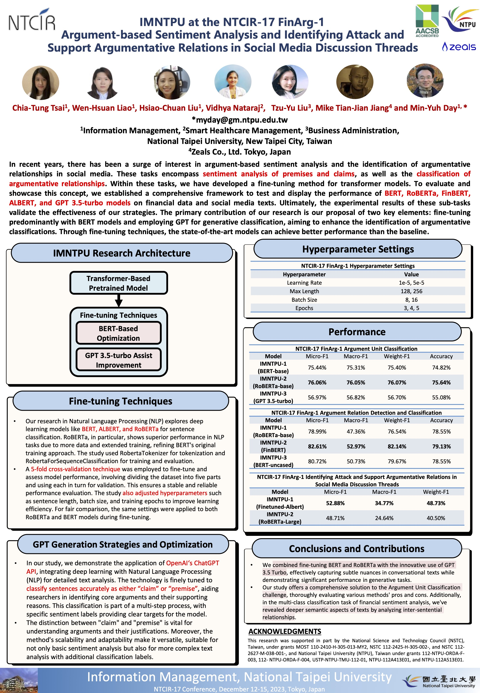
NTCIR-17 FinArg-1
1
2023
NTCIR-17 Best Poster Presentation Award

Slide 80
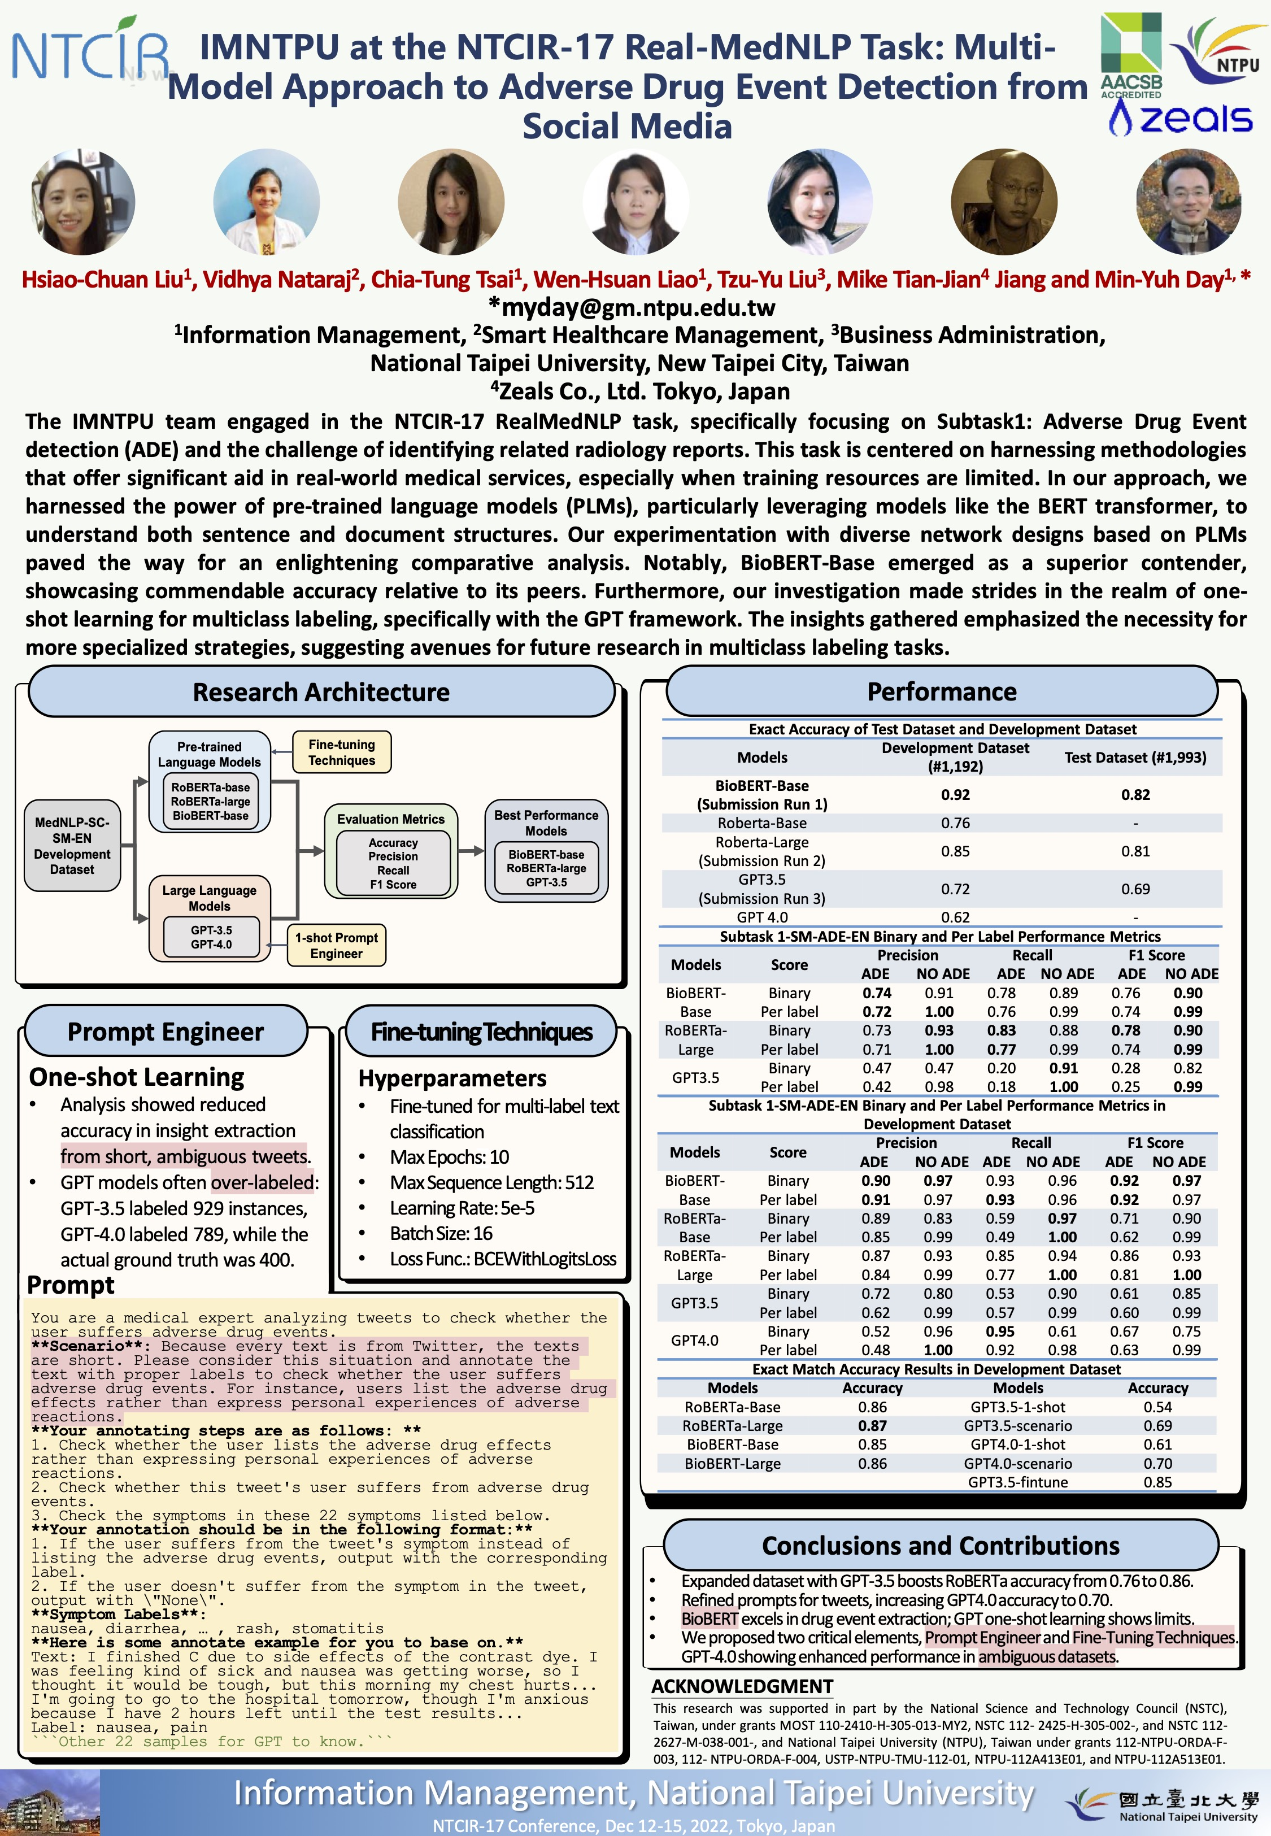
NTCIR-17 Real MedNLP
2
2023
NTCIR-17 Best Poster Presentation Award

Slide 81
Summary
English-Medium Instruction (EMI) Teaching Experiences
Innovative Strategies for EMI Implementation
EMI Teacher Community II, AACSB, NTPU
Q&A

Slide 82
Acknowledgments: Research Projects
Fintech Green Finance for Carbon Market Index, Corporate Finance, and Environmental Policies. Carbon Emission Sentiment Index with AI Text Analytics
NTPU, 113-NTPU_ORDA-F-003，2023/01/01~2024/12/31
Digital Support, Unimpeded Communication: The Development, Support and Promotion of AI-assisted Communication Assistive Devices for Speech Impairment (1/3). Multimodal Cross-lingual Task-Oriented Dialogue System for Inclusive Communication Support
NSTC 112-2425-H-305-002-, 3 Years (2023/05/01-2026/04/30) Year 1: 2023/05/01~2024/04/30
Research on speech processing, synthesis, recognition, and sentence construction of people with language disabilities. Multimodal Cross-lingual Task-Oriented Dialogue System
NTPU, 113-NTPU_ORDA-F-004, 2023/01/01~2025/12/31
Metaverse AI Multimodal Cross-Language Task-Oriented Dialogue System
ATEC Group, Fintech and Green Finance Center (FGFC, NTPU), NTPU-112A413E01, 3 Years (2023/05/01~2026/04/30)
Establishment and Implement of Smart Assistive Technology for Dementia Care and Its Socio-Economic Impacts (2/3). Intelligent, individualized and precise care with smart AT and system integration
NSTC, 112-2627-M-038-001-, 2023/08/01~2024/07/31
Prospective longitudinal study on peri-implant bone loss associated with peri-implantitis
USTP (NTPU, TMU), USTP-NTPU-TMU-113-03, 2024/01/01~2024/12/31
https://web.ntpu.edu.tw/~myday/cindex.htm#projects

Slide 83
Sharing EMI Teaching Experiences in the EMI Teacher Community II
EMI x USR x FinTech x IM AACSB NTPU
Q & A
Time: 12:10 - 13:00, March 27, 2024 (Wednesday)
Place: B302, National Taipei University, Taiwan
戴敏育 教授
Min-Yuh Day, Ph.D, Professor
Institute of Information Management, National Taipei University
https://web.ntpu.edu.tw/~myday
2024-03-27

