Slide 1









Agentic AI for ESG and
Digital Sustainability Innovation
(代理式 AI 於 ESG 與數位永續創新)
臺北市立大學資訊科學系
碩士班Seminar
Time: 13:10-15:00, Wednesday, April 30, 2025
Place: R314, Gongcheng Building, Department of Computer Science, University of Taipei
Host: Prof. Ching-Tai Chen
University Ambassador
戴敏育 教授 (Prof. Min-Yuh Day)
國立臺北大學 資訊管理研究所 教授
金融科技暨綠色金融研究中心 主任
永續辦公室 永續發展組 組長
Certified Instructor
2025-04-30

Slide 2










戴敏育 教授
Prof. Min-Yuh Day
1
University Ambassador
Certified Instructor
Professor, Information Management, NTPU
Director, Intelligent Financial Innovation Technology, IFIT Lab, IM, NTPU
Director, Fintech and Green Finance Center (FGFC), NTPU
Division Director, Sustainable Development, Sustainability Office, NTPU
Visiting Scholar, IIS, Academia Sinica
Ph.D., Information Management, NTU
Publications Co-Chairs, International Conference on Advances in Social Networks Analysis and Mining
(ASONAM 2013- )
Program Co-Chair, IEEE International Workshop on Empirical Methods for Recognizing Inference in TExt
(IEEE EM-RITE 2012- )
Publications Chair, The IEEE International Conference on Information Reuse and Integration for Data Science
(IEEE IRI 2007- )

Slide 3
Outline
1. Agentic AI
2. ESG Data Analytics
3. Digital Sustainability Innovation

Slide 4


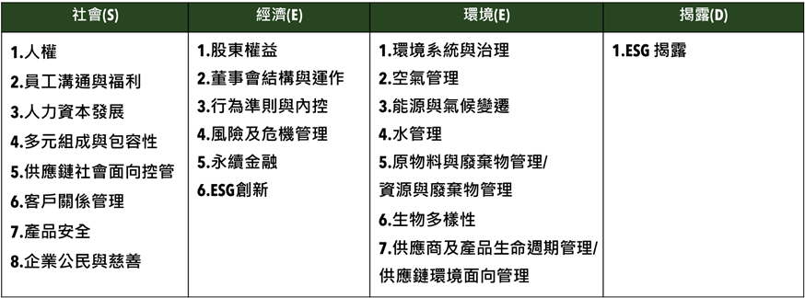
衡量企業永續關鍵指標
臺北大學獨創ESG永續評鑑系統
Source: https://www.aacsb.ntpu.edu.tw/twsvi/view.php?id=Nzc=

Slide 5
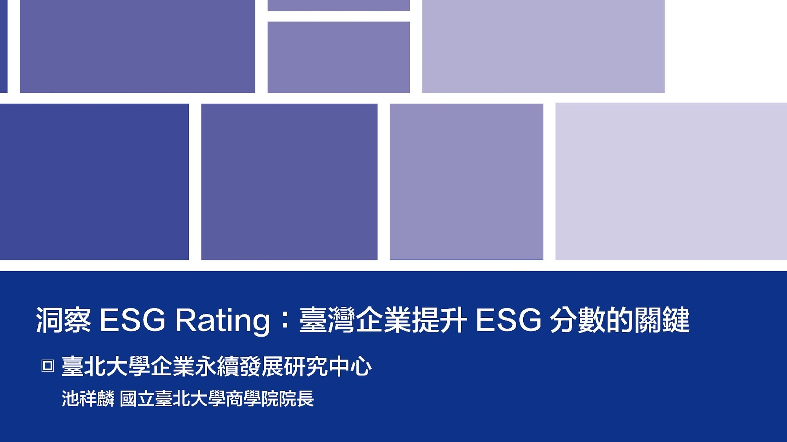






台灣永續評鑑
國立臺北大學商學院企業永續發展研究團隊

Slide 6
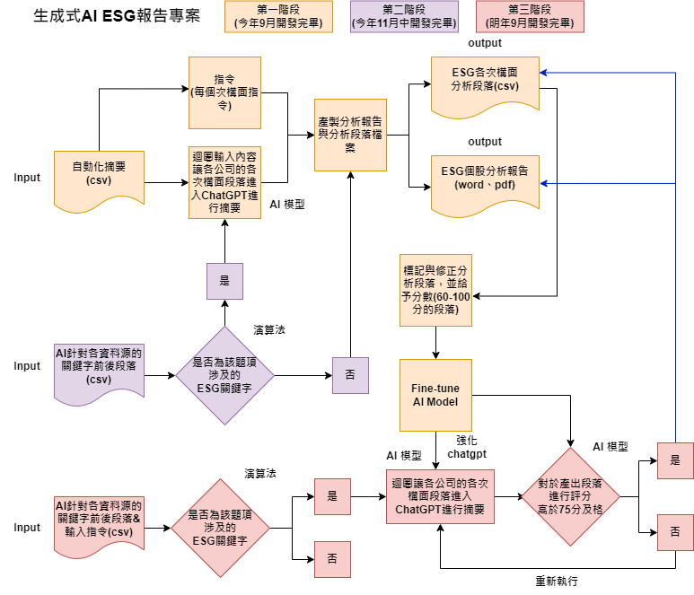
透過 AI SEED 提升評鑑效率
為使評鑑效率提升，與國立臺北大學資管所及資工所合作，開發相關程式，
已有25%題項自動或半自動化，大幅提升評鑑效率，並持續開發機械學習，持續透過AI 輔助評鑑進行。
另也透過AI SEED團隊持續將部分流程自動化，提升評鑑正確性，減少人力出錯可能。
題號 | 題目關鍵字 | 完成度
2-1-15 | 僅分派董監酬勞未分派股利 | 100%
2-2-3 | 獨董達董事席次1/2以上 | 100%
2-2-4 | 至少兩名獨董任期不超過9年 | 100%
2-2-14 | 設提名委員會且半數以上為獨董 | 100%
2-2-30 | 董事長兼任總經理 | 100%
2-2-31 | 1/3以上董事任期超過15年 | 100%
2-3-8 | 破產／面臨下市 | 100%
2-3-15 | 資安長或資訊安全委員會 | 100%
2-4-7 | 無保留意見 | 100%

Slide 7
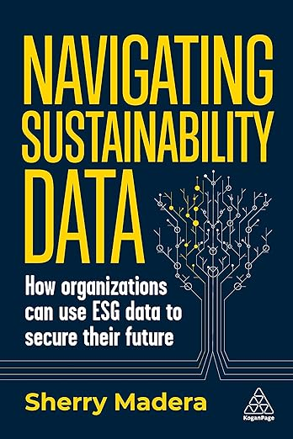
Sherry Madera (2024),
Navigating Sustainability Data: How Organizations can use ESG Data to Secure Their Future, Kogan Page
Source: https://www.amazon.com/Navigating-Sustainability-Data-Organizations-Secure/dp/1398612243/

Slide 8
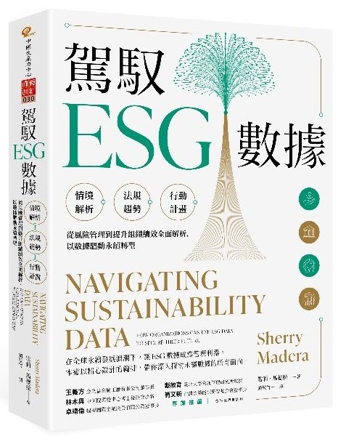
雪莉．馬德拉 (Sherry Madera) (顏敏竹 譯) (2024),
駕馭ESG數據 (Navigating Sustainability Data),
財團法人中國生產力中心
專業推薦：
王義方
（金全益金屬工廠有限公司董事長）
林木興
（中研院環變中心博士後研究學者）
卓靖倫
（揚秦國際企業股份有限公司董事長）
戴敏育
（國立臺北大學資訊管理研究所教授）
簡又新
（台灣永續能源研究基金會董事長）
Source: https://www.eslite.com/product/10012011762682688929002

Slide 9


Innovative Agentic AI Technology for Autonomous
ESG Report Generation
Industrial Technology Research Institute (ITRI),
Fintech and Green Finance Center (FGFC, NTPU),
NTPU-114A513E01, 2025/03/01~2025/12/31

Slide 10
Generative AI-Driven ESG Report
Generation Technology
Industrial Technology Research Institute (ITRI),
Fintech and Green Finance Center (FGFC, NTPU),
NTPU-113A513E01, 2024/03/01~2024/12/31

Slide 11
Agentic AI
Powering
Digital Sustainability Innovation

Slide 12
Generative AI, Agentic AI, Physical AI
Physical AI
Self-driving cars
General robotics
Agentic AI
Coding assistants
Customer service
Patient care
Generative AI
Digital marketing
Content creation
Perception AI
Speech recognition
Deep recommender systems
Medical imaging
2012 AlexNet
Deep learning breakthrough
Source: NVIDIA (2025), GTC March 2025 Keynote with NVIDIA CEO Jensen Huang, https://www.youtube.com/watch?v=_waPvOwL9Z8

Slide 13
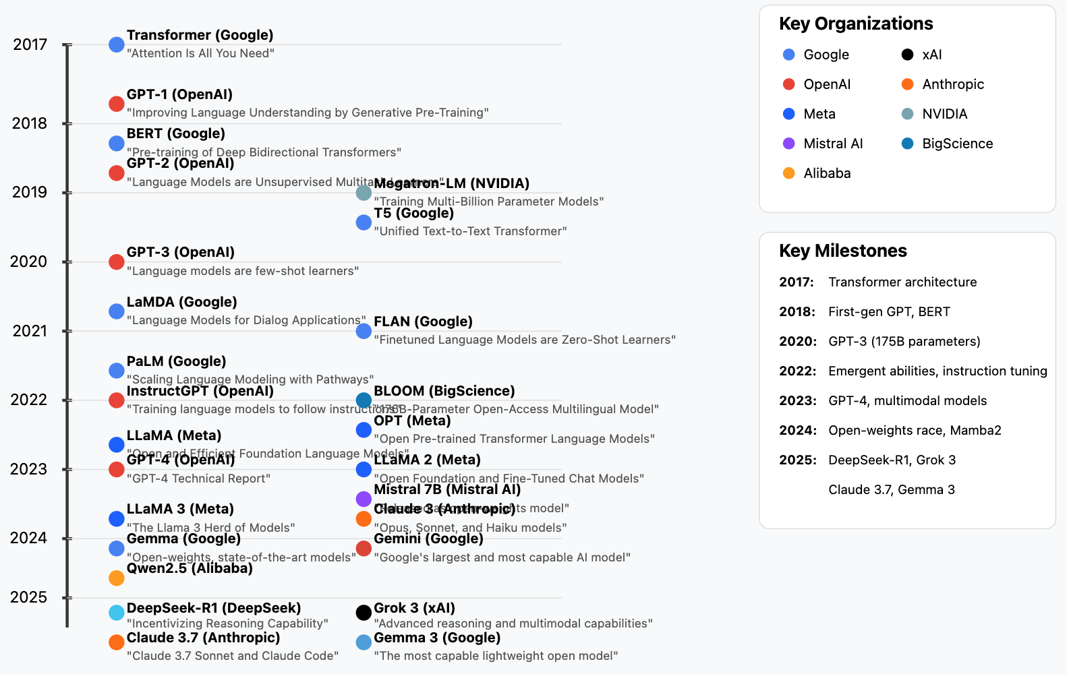
Generative AI LLMs (2017-2025)
Source: https://github.com/Hannibal046/Awesome-LLM

Slide 14

LLM-powered Multimodal Agents
Large Multimodal Agents (LMAs)
2022
2023
2024
Source: Xie, Junlin, Zhihong Chen, Ruifei Zhang, Xiang Wan, and Guanbin Li. "Large Multimodal Agents: A Survey." arXiv preprint arXiv:2402.15116 (2024).

Slide 15

Large Language Model (LLM) based Agents
Source: Xi, Z., Chen, W., Guo, X., He, W., Ding, Y., Hong, B., ... & Gui, T. (2023). The rise and potential of large language model based agents: A survey. arXiv preprint arXiv:2309.07864.

Slide 16

LLM-based Agents
Source: Cheng, Yuheng, Ceyao Zhang, Zhengwen Zhang, Xiangrui Meng, Sirui Hong, Wenhao Li, Zihao Wang et al. "Exploring large language model based intelligent agents: Definitions, methods, and prospects." arXiv preprint arXiv:2401.03428 (2024).

Slide 17

Large Multimodal Agents (LMA)
Source: Xie, J., Chen, Z., Zhang, R., Wan, X., & Li, G. (2024). Large Multimodal Agents: A Survey. ArXiv, abs/2402.15116.

Slide 18

Large Multimodal Agents (LMA)
Source: Xie, J., Chen, Z., Zhang, R., Wan, X., & Li, G. (2024). Large Multimodal Agents: A Survey. ArXiv, abs/2402.15116.

Slide 19
Agentic AI Cloud Architecture
Microservices and Serverless Architecture
Containers (Docker, Kubernetes)
Serverless platforms (AWS Lambda, Google Cloud Functions)
APIs and Tooling Integration via MCP
Agents access tools (e.g., databases, APIs, CRMs, payment gateways)
using Model Context Protocol (MCP)
Enhances tool-using behavior of LLM agents
Tools and Frameworks
LangChain, AutoGen, CrewAI: for orchestrating LLM agents
Anthropic’s MCP, Google’s A2A: communication protocols
Vector DBs (Pinecone, Weaviate): for agent memory

Slide 20
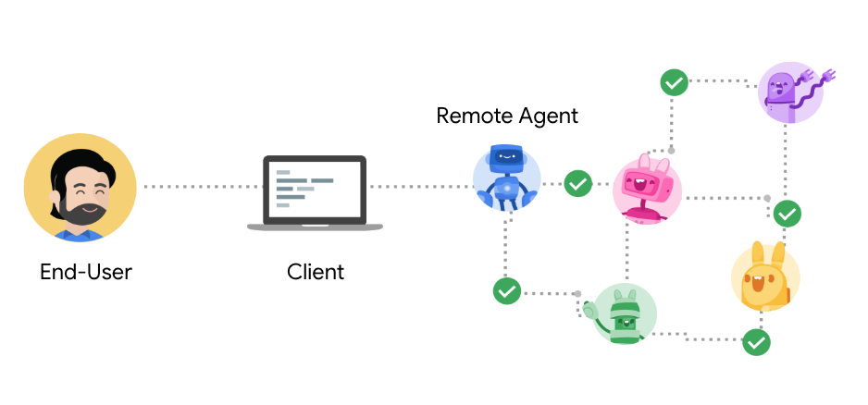
Agent2Agent Protocol (A2A)
An open protocol enabling Agent-to-Agent interoperability, bridging the gap between opaque agentic systems
Source: https://google.github.io/A2A/

Slide 21
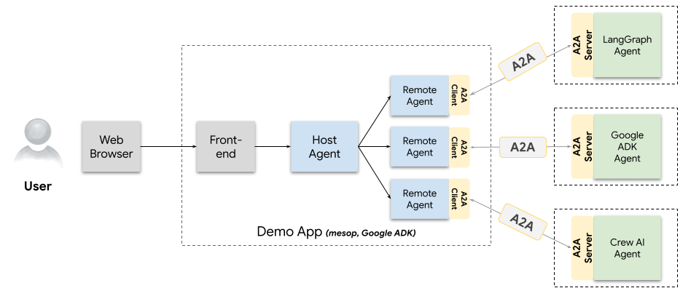
A2A Demo Web App
Agents talking to other agents over A2A
Source: https://github.com/google/A2A/blob/main/demo/README.md

Slide 22
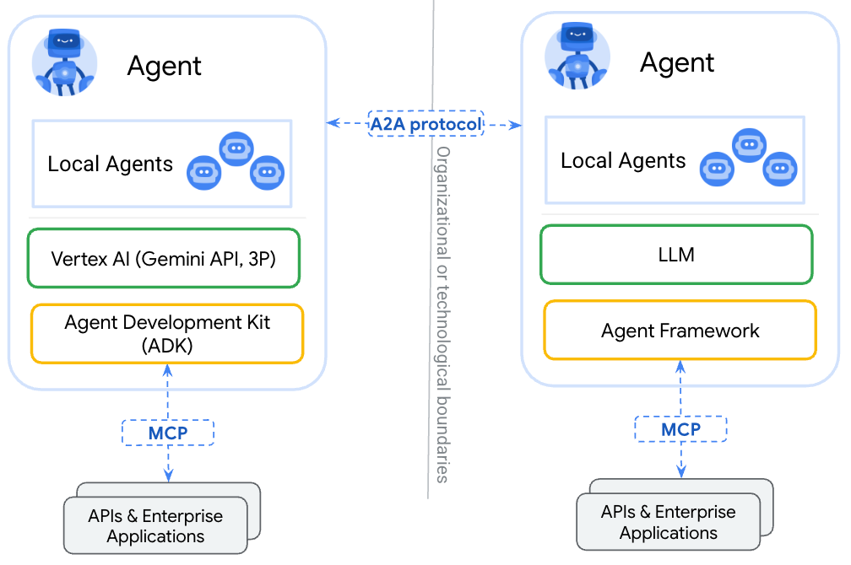
A2A
(Agent2Agent Protocol) for agent-agent collaboration
MCP
(Model Context Protocol) for tools and resources
Source: https://google.github.io/A2A/

Slide 23
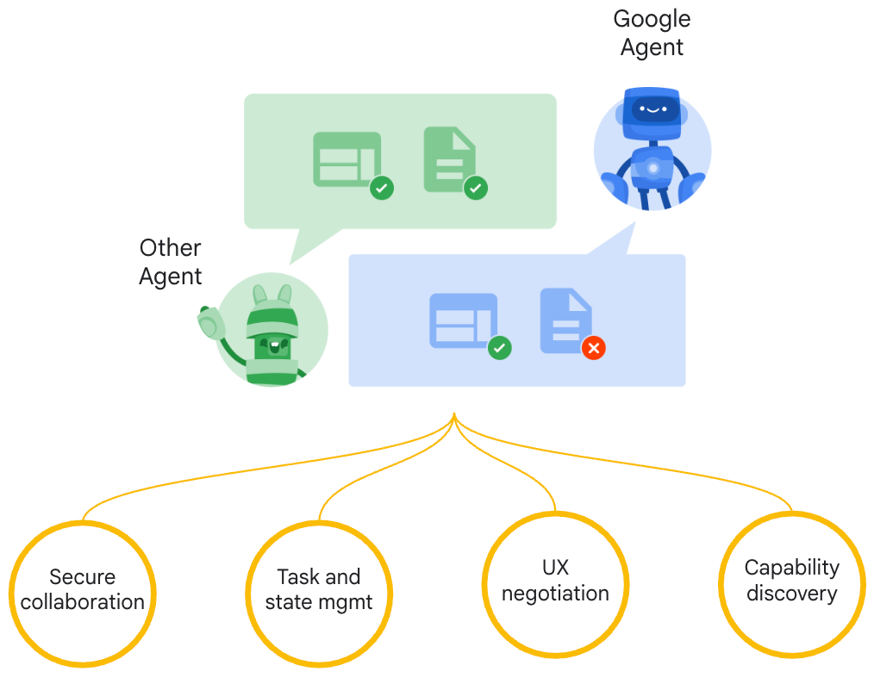
Google A2A (Agent2Agent Protocol)
Seamless Agent Collaboration
Simplifies Enterprise
Agent Integration
Supports Key
Enterprise Requirements
Source: https://google.github.io/A2A/

Slide 24
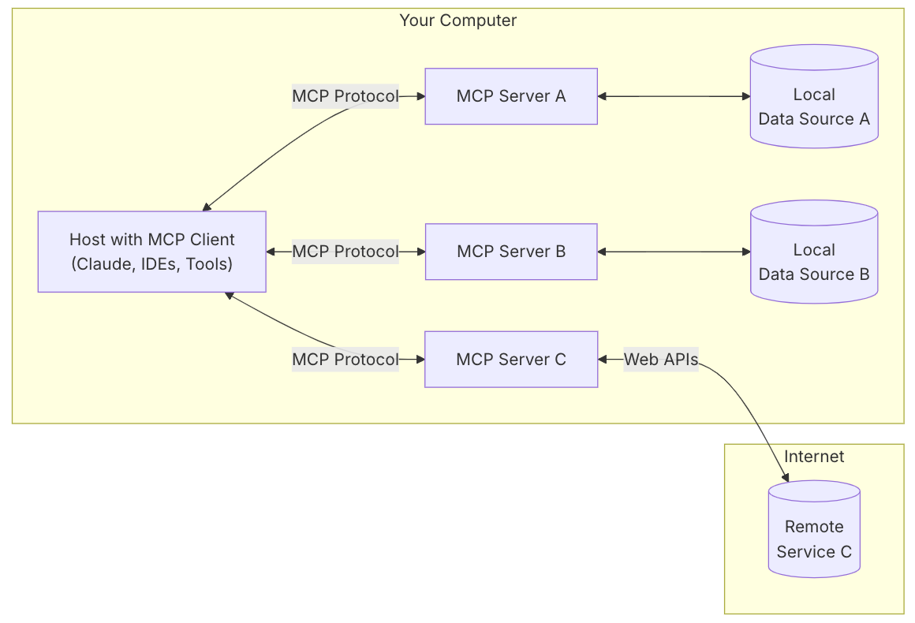
MCP (Model Context Protocol)
MCP is a open protocol that standardizes how applications provide context to LLMs.
MCP: USB-C port for AI applications.
Source: https://modelcontextprotocol.io/introduction

Slide 25
MCP and A2A
MCP (Model Context Protocol) for tools and resources
  Connect agents to tools, APIs, and resources with structured inputs/outputs.
  Google ADK supports MCP tools. Enabling wide range of MCP servers to be used with agents.
A2A (Agent2Agent Protocol) for agent-agent collaboration
  Dynamic, multimodal communication between different agents without sharing memory, resources, and tools
  Open standard driven by community.
  Samples available using Google ADK, LangGraph, Crew.AI
Source: https://google.github.io/A2A/

Slide 26
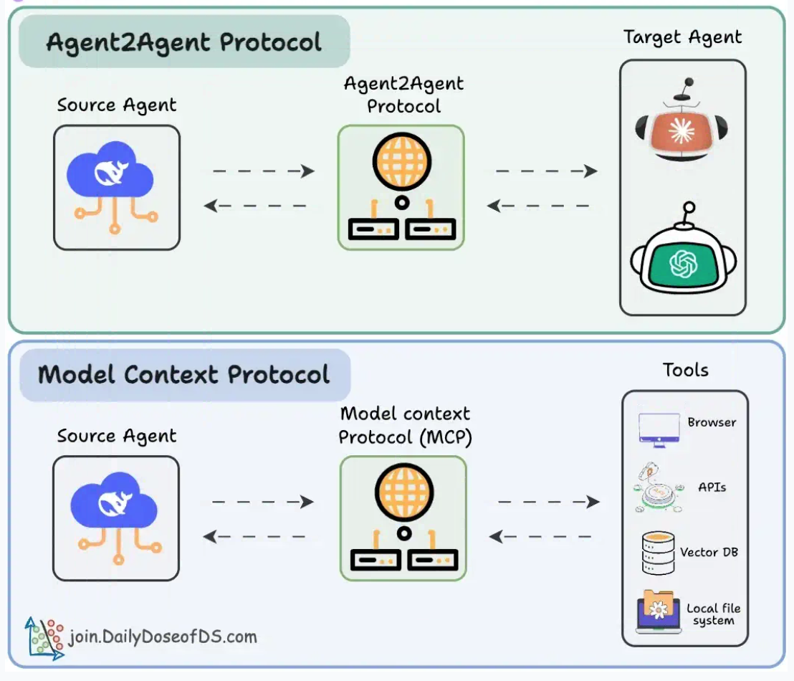
Agentic applications require both A2A and MCP
A2A allows agents to connect with other agents and collaborate in teams.
MCP provides agents with access to tools
Source: https://blog.dailydoseofds.com/p/a-visual-guide-to-agent2agent-a2a

Slide 27
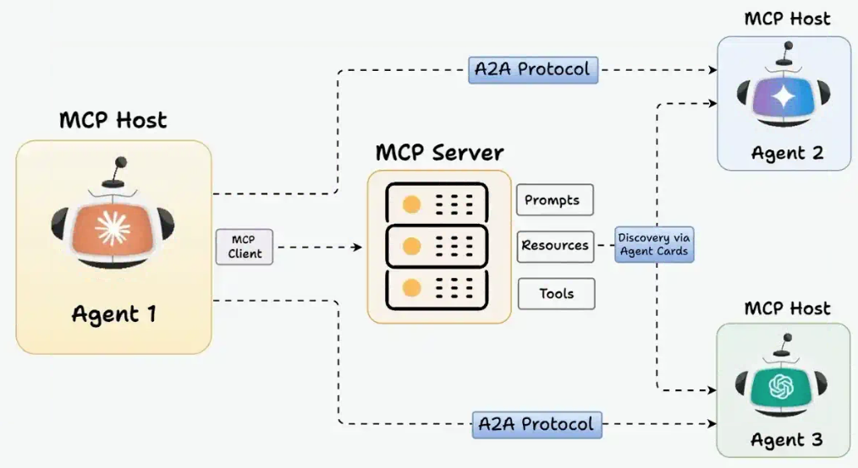
MCP and A2A Protocol for AI Agents
Source: https://blog.dailydoseofds.com/p/a-visual-guide-to-agent2agent-a2a

Slide 28
Generative AI
(Gen AI)
AI Generated Content (AIGC)

Slide 29

Generative AI (Gen AI)
AI Generated Content (AIGC)
Source: Yihan Cao, Siyu Li, Yixin Liu, Zhiling Yan, Yutong Dai, Philip S. Yu, and Lichao Sun (2023). "A Comprehensive Survey of AI-Generated Content (AIGC): A History of Generative AI from GAN to ChatGPT." arXiv preprint arXiv:2303.04226.

Slide 30

AI, ML, DL, Generative AI
Source: Jeong, Cheonsu. "A Study on the Implementation of Generative AI Services Using an Enterprise Data-Based LLM Application Architecture." arXiv preprint arXiv:2309.01105 (2023).

Slide 31
Definition of
Artificial Intelligence (A.I.)

Slide 32
Artificial Intelligence
“… the science and engineering of making intelligent machines”
(John McCarthy, 1955)
Source: https://digitalintelligencetoday.com/artificial-intelligence-defined-useful-list-of-popular-definitions-from-business-and-science/

Slide 33
Artificial Intelligence
“… technology that thinks and acts like humans”
Source: https://digitalintelligencetoday.com/artificial-intelligence-defined-useful-list-of-popular-definitions-from-business-and-science/

Slide 34
Artificial Intelligence
“… intelligence exhibited by machines or software”
Source: https://digitalintelligencetoday.com/artificial-intelligence-defined-useful-list-of-popular-definitions-from-business-and-science/

Slide 35
4 Approaches of AI
2. Thinking Humanly: The Cognitive Modeling Approach | 3. Thinking Rationally: The “Laws of Thought” Approach
1. Acting Humanly: The Turing Test Approach (1950) | 4. Acting Rationally: The Rational Agent Approach
Source: Stuart Russell and Peter Norvig (2020), Artificial Intelligence: A Modern Approach, 4th Edition, Pearson

Slide 36
AI Acting Humanly:
The Turing Test Approach
(Alan Turing, 1950)
Knowledge Representation
Automated Reasoning
Machine Learning (ML)
  Deep Learning (DL)
Computer Vision (Image, Video)
Natural Language Processing (NLP)
Robotics
Source: Stuart Russell and Peter Norvig (2020), Artificial Intelligence: A Modern Approach, 4th Edition, Pearson

Slide 37
AI, ML, DL
Artificial Intelligence (AI)
Machine Learning (ML)
Supervised
Learning
Unsupervised Learning
Deep Learning (DL)
CNN
RNN LSTM GRU
GAN
Semi-supervised Learning
Reinforcement Learning
Source: https://leonardoaraujosantos.gitbooks.io/artificial-inteligence/content/deep_learning.html

Slide 38
Comparison of Generative AI and Traditional AI
Feature | Generative AI | Traditional AI
Output type | New content | Classification/Prediction
Creativity | High | Low
Interactivity | Usually more natural | Limited

Slide 39
Generative AI
Generative AI: The Art of Creation
Definition: AI systems capable of creating new content
Characteristics: Creativity, interactivity

Slide 40
Generative AI
Large Language Models (LLMs)
Foundation Models

Slide 41
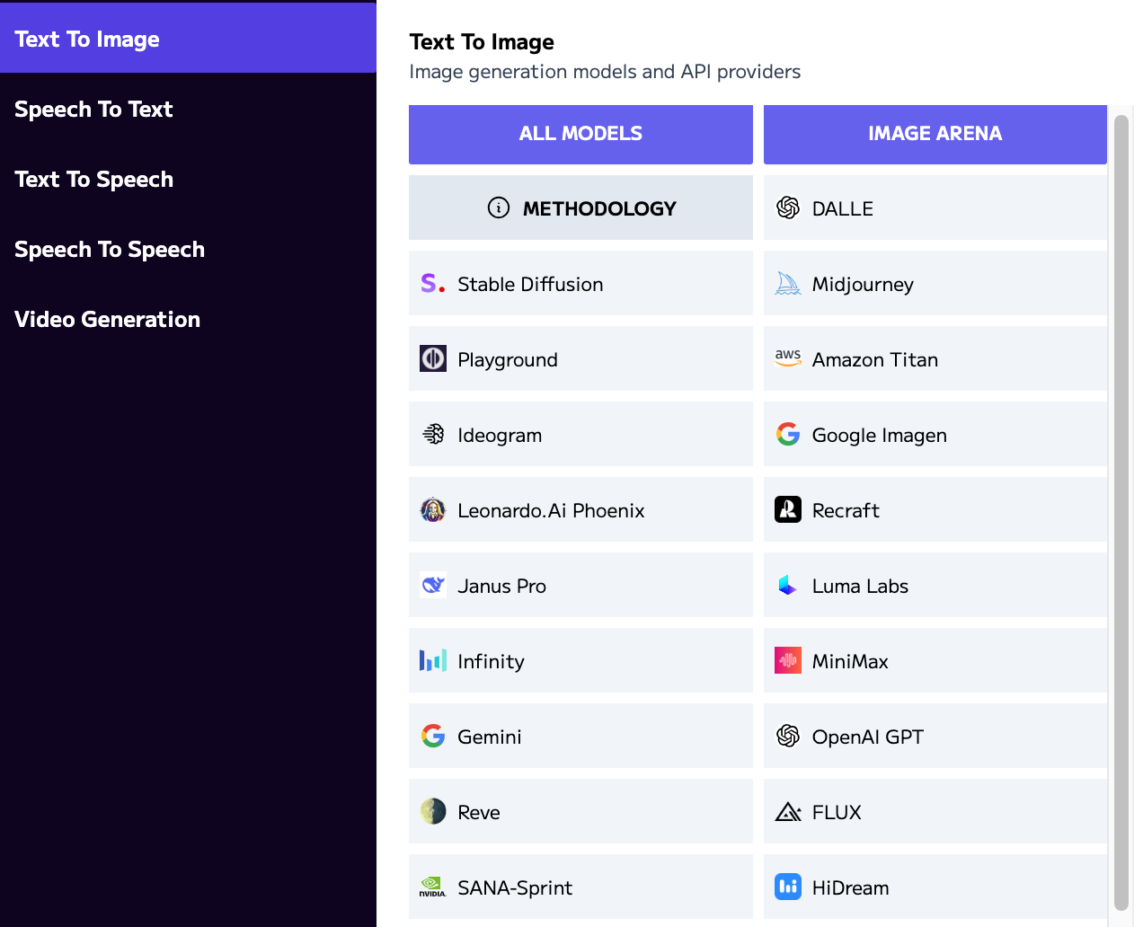
Language
Models
Text
Image
Speech
Video
Models
https://artificialanalysis.ai/

Slide 42

Generative AI (Gen AI)
AI Generated Content (AIGC)
Image Generation
Source: Yihan Cao, Siyu Li, Yixin Liu, Zhiling Yan, Yutong Dai, Philip S. Yu, and Lichao Sun (2023). "A Comprehensive Survey of AI-Generated Content (AIGC): A History of Generative AI from GAN to ChatGPT." arXiv preprint arXiv:2303.04226.

Slide 43
Generative AI (Gen AI)
AI Generated Content (AIGC)
Source: Yihan Cao, Siyu Li, Yixin Liu, Zhiling Yan, Yutong Dai, Philip S. Yu, and Lichao Sun (2023). "A Comprehensive Survey of AI-Generated Content (AIGC): A History of Generative AI from GAN to ChatGPT." arXiv preprint arXiv:2303.04226.

Slide 44
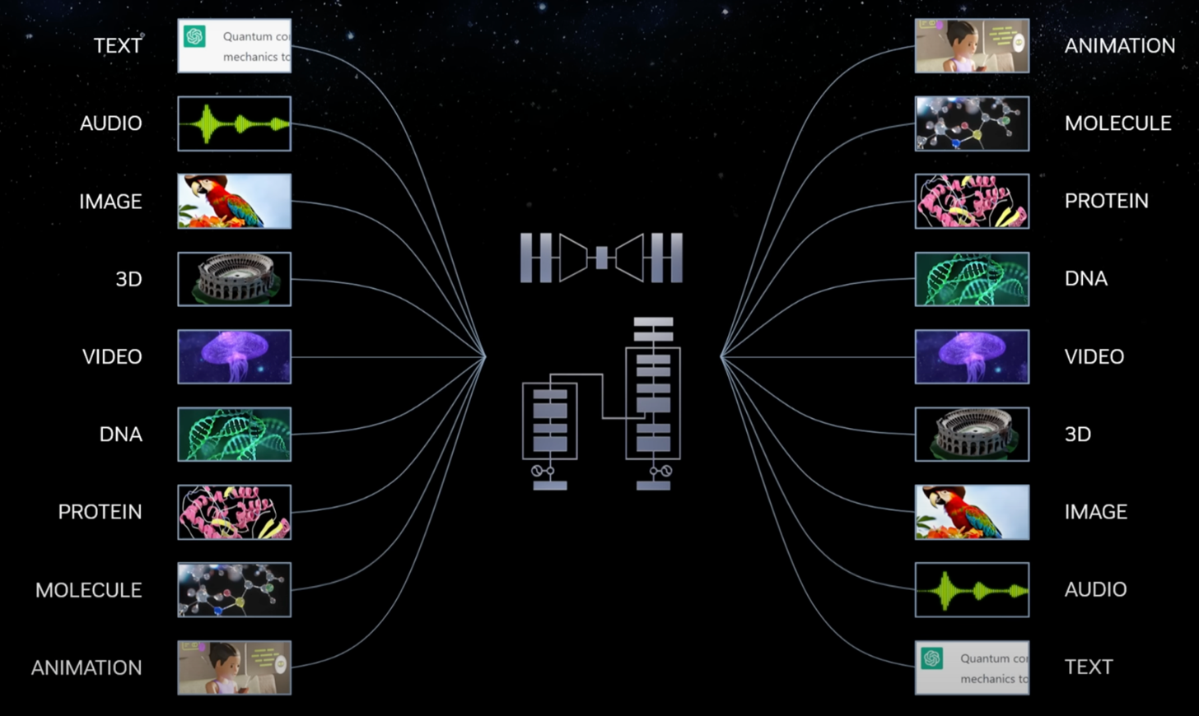
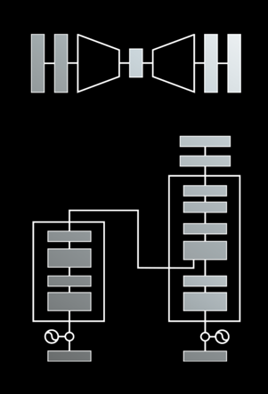
Modular Modalities
Where Can The Transformer Fit?
Source: NVIDIA DLI (2025), Rapid Application Development with Large Language Models (LLMs), https://learn.nvidia.com/courses/course-detail?course_id=course-v1:DLI+S-FX-26+V1

Slide 45

The history of Generative AI in CV, NLP and VL
Source: Yihan Cao, Siyu Li, Yixin Liu, Zhiling Yan, Yutong Dai, Philip S. Yu, and Lichao Sun (2023). "A Comprehensive Survey of AI-Generated Content (AIGC): A History of Generative AI from GAN to ChatGPT." arXiv preprint arXiv:2303.04226.

Slide 46

Categories of Vision Generative Models
Source: Yihan Cao, Siyu Li, Yixin Liu, Zhiling Yan, Yutong Dai, Philip S. Yu, and Lichao Sun (2023). "A Comprehensive Survey of AI-Generated Content (AIGC): A History of Generative AI from GAN to ChatGPT." arXiv preprint arXiv:2303.04226.

Slide 47

The General Structure of
Generative Vision Language
Source: Yihan Cao, Siyu Li, Yixin Liu, Zhiling Yan, Yutong Dai, Philip S. Yu, and Lichao Sun (2023). "A Comprehensive Survey of AI-Generated Content (AIGC): A History of Generative AI from GAN to ChatGPT." arXiv preprint arXiv:2303.04226.

Slide 48
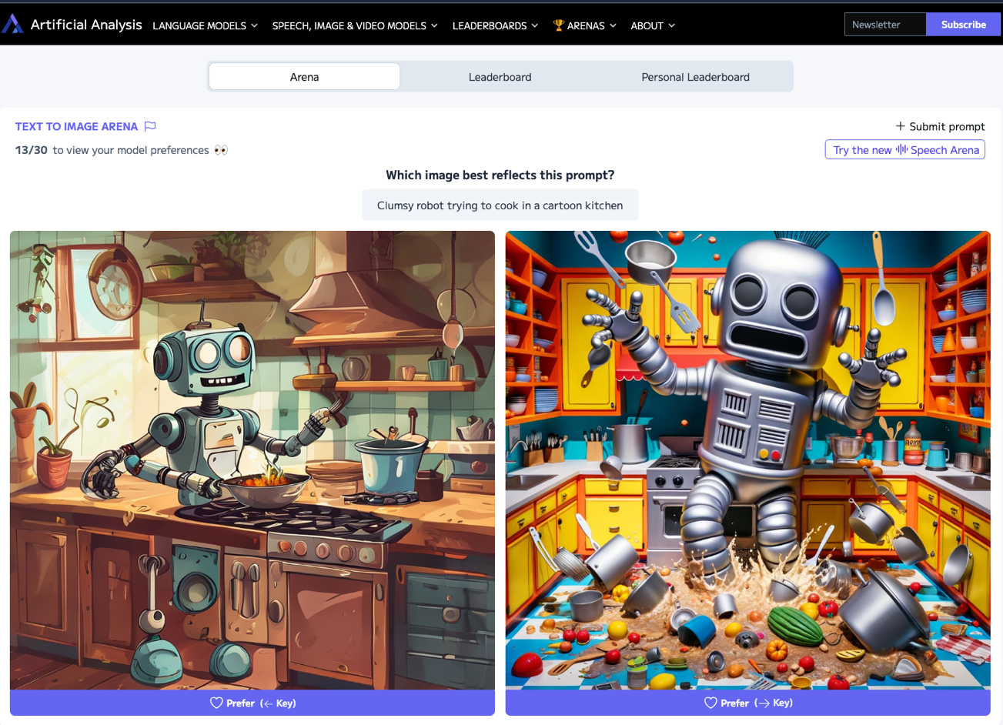
Artificial Analysis Text to Image Arena
Source: https://artificialanalysis.ai/text-to-image/arena

Slide 49
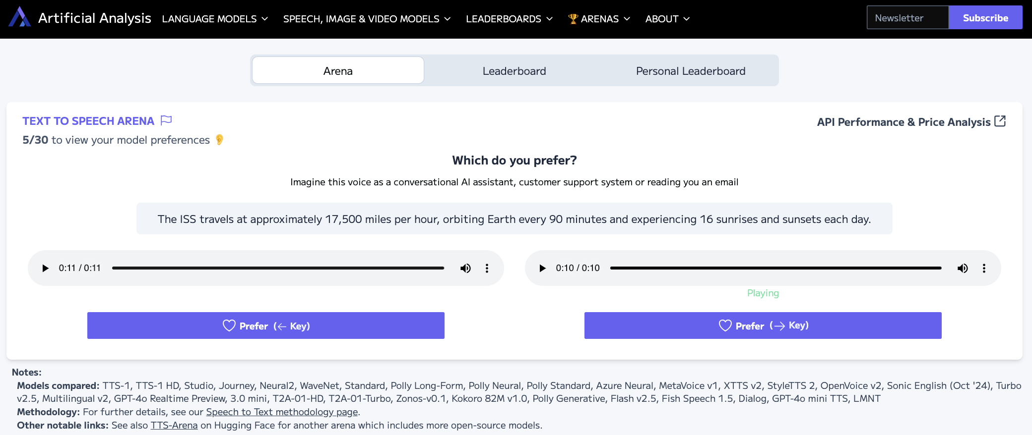
Artificial Analysis Text to Speech Arena
Source: https://artificialanalysis.ai/text-to-speech/arena

Slide 50
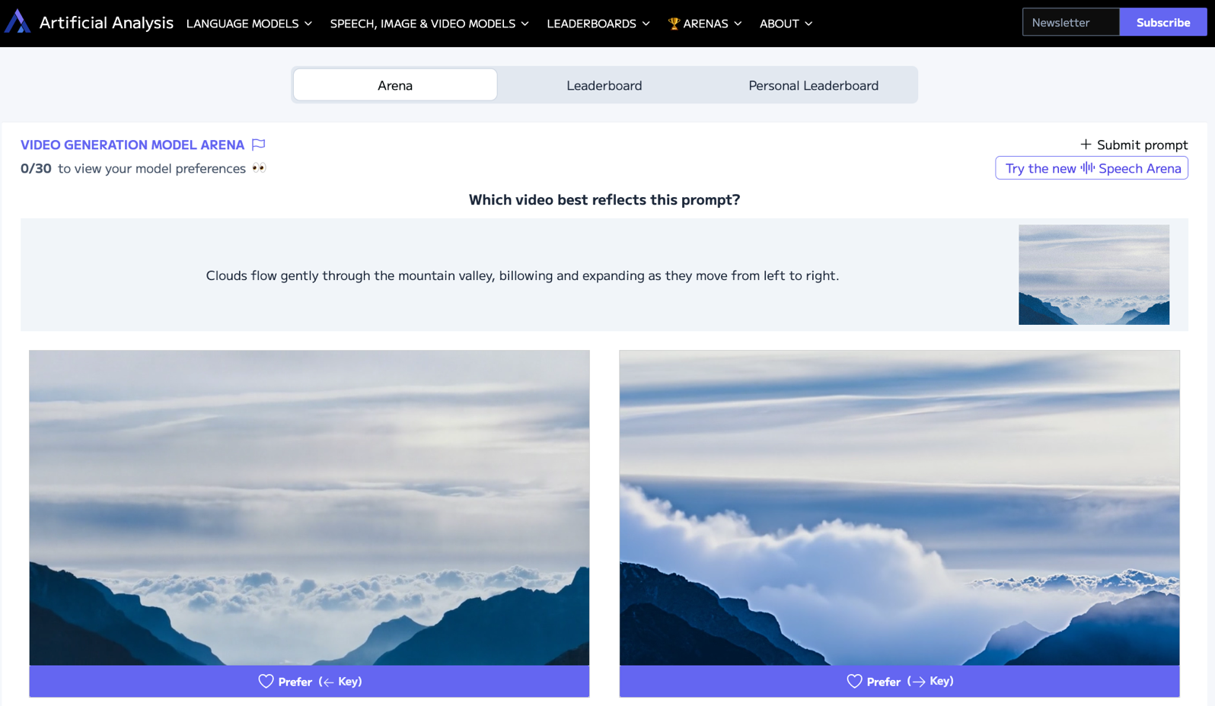
Artificial Analysis Video Generation Model Arena
Source: https://artificialanalysis.ai/text-to-video/arena

Slide 51
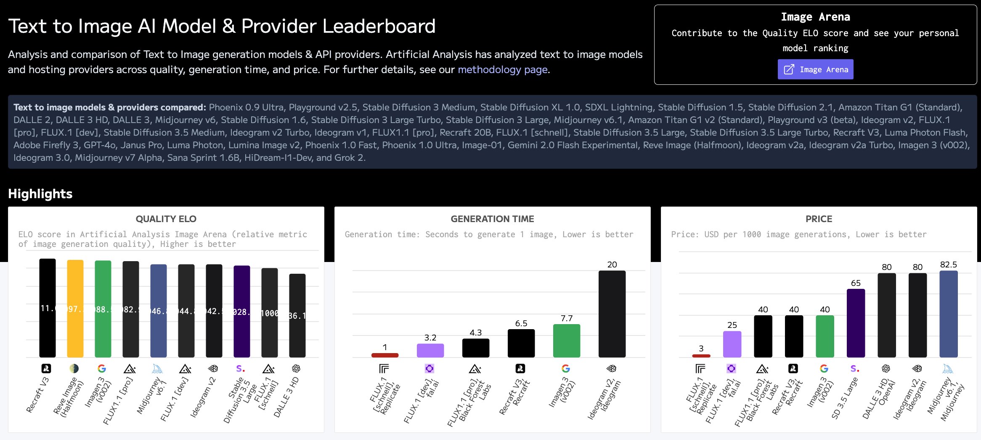
Artificial Analysis Text to Image Leaderboard
Source: https://artificialanalysis.ai/text-to-image

Slide 52
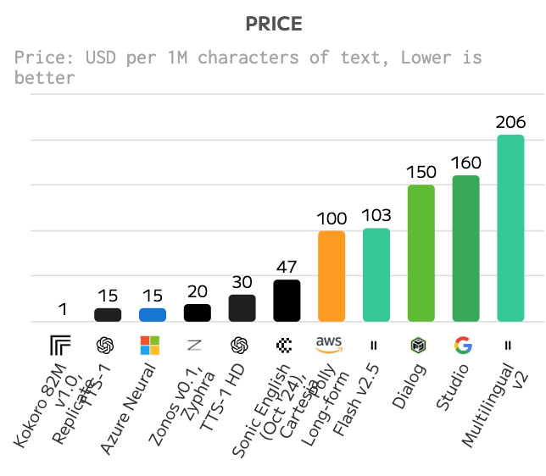
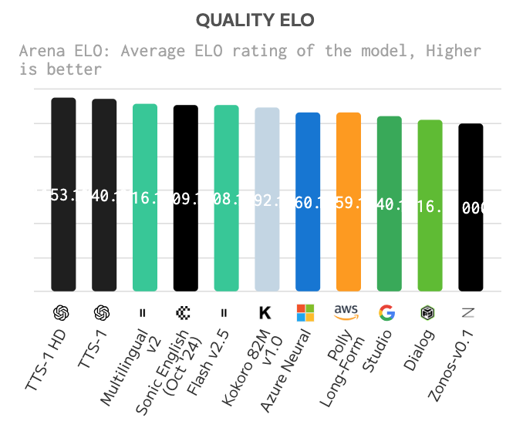
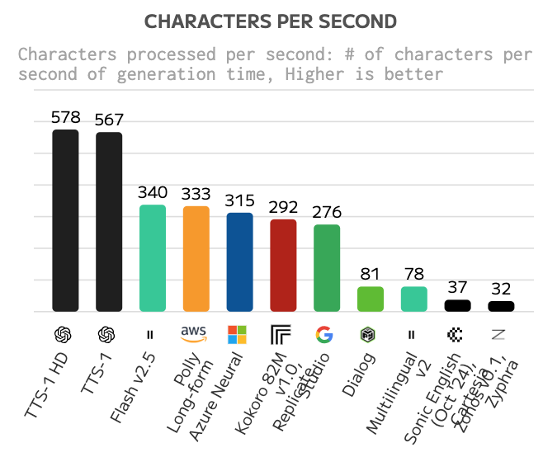
Text to Speech (TTS) AI Model & Provider Leaderboard
Text to speech models & providers compared: TTS-1, TTS-1 HD, Studio, Journey, Neural2, WaveNet, Standard, Polly Long-Form, Polly Neural, Polly Standard, Azure Neural, MetaVoice v1, XTTS v2, StyleTTS 2, OpenVoice v2, Sonic English (Oct '24), 3.0 mini, Turbo v2.5, Multilingual v2, T2A-01-HD, T2A-01-Turbo, Zonos-v0.1, Kokoro 82M v1.0, Polly Generative, Flash v2.5, Dialog, Murf Speech Gen 2, and Step TTS Mini.
Source: https://artificialanalysis.ai/text-to-speech

Slide 53
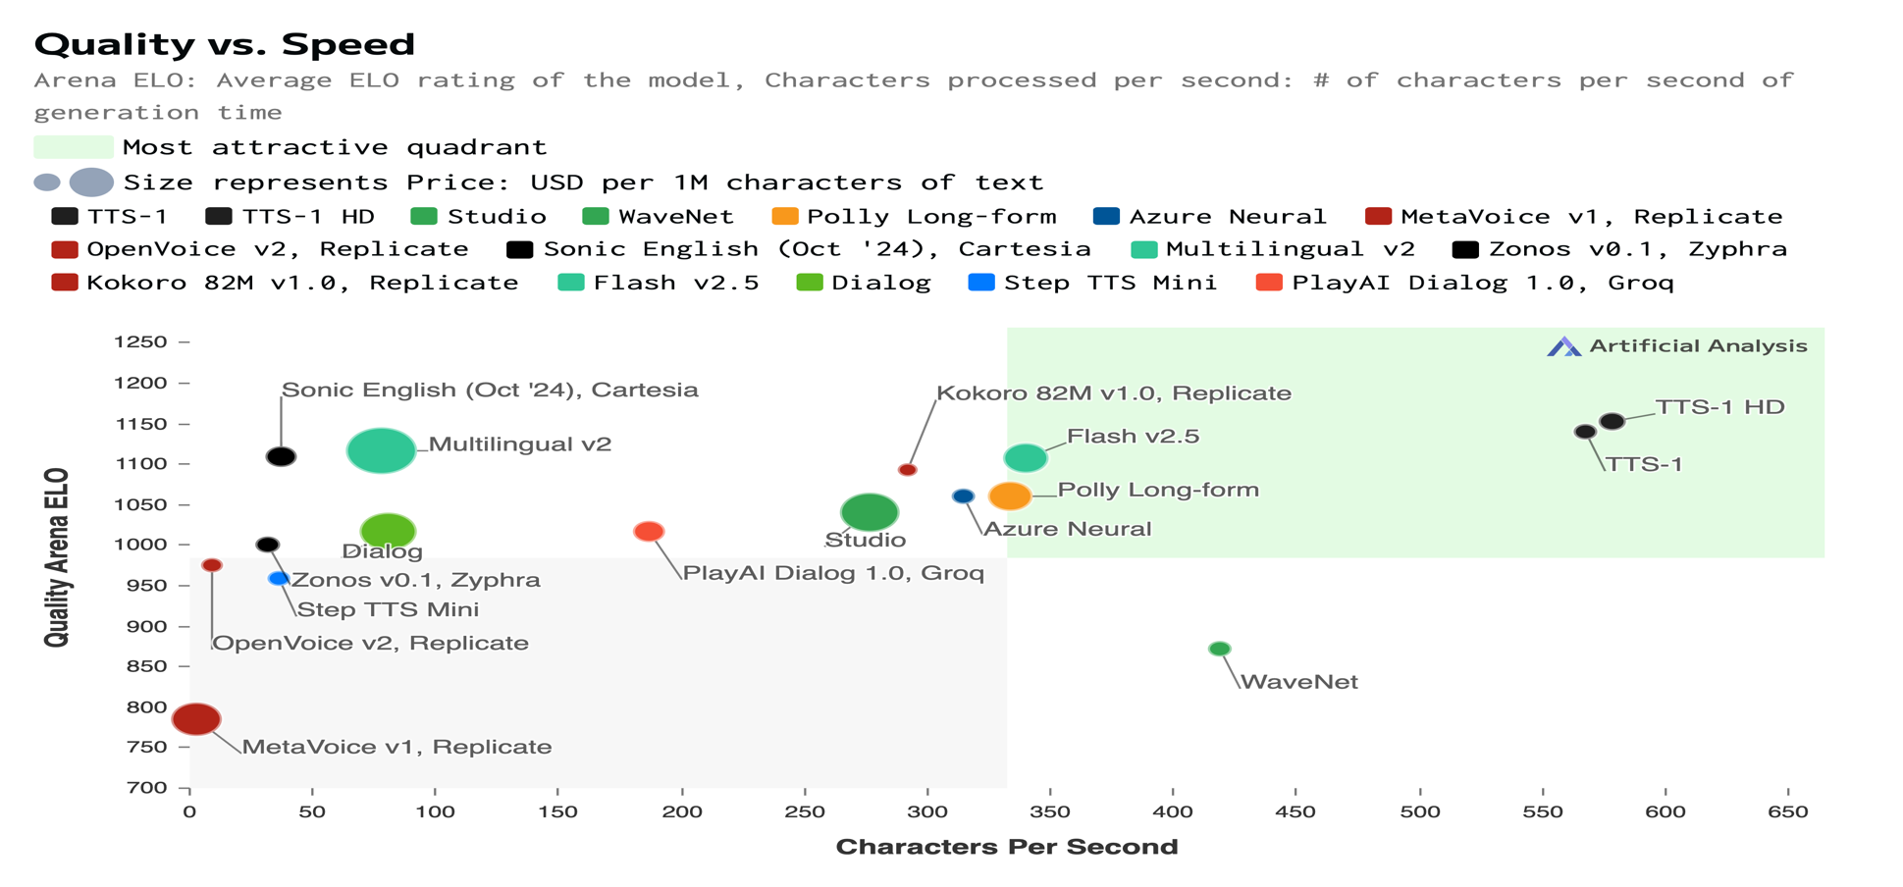
Text to Speech (TTS) AI Model & Provider Leaderboard
Source: https://artificialanalysis.ai/text-to-speech

Slide 54
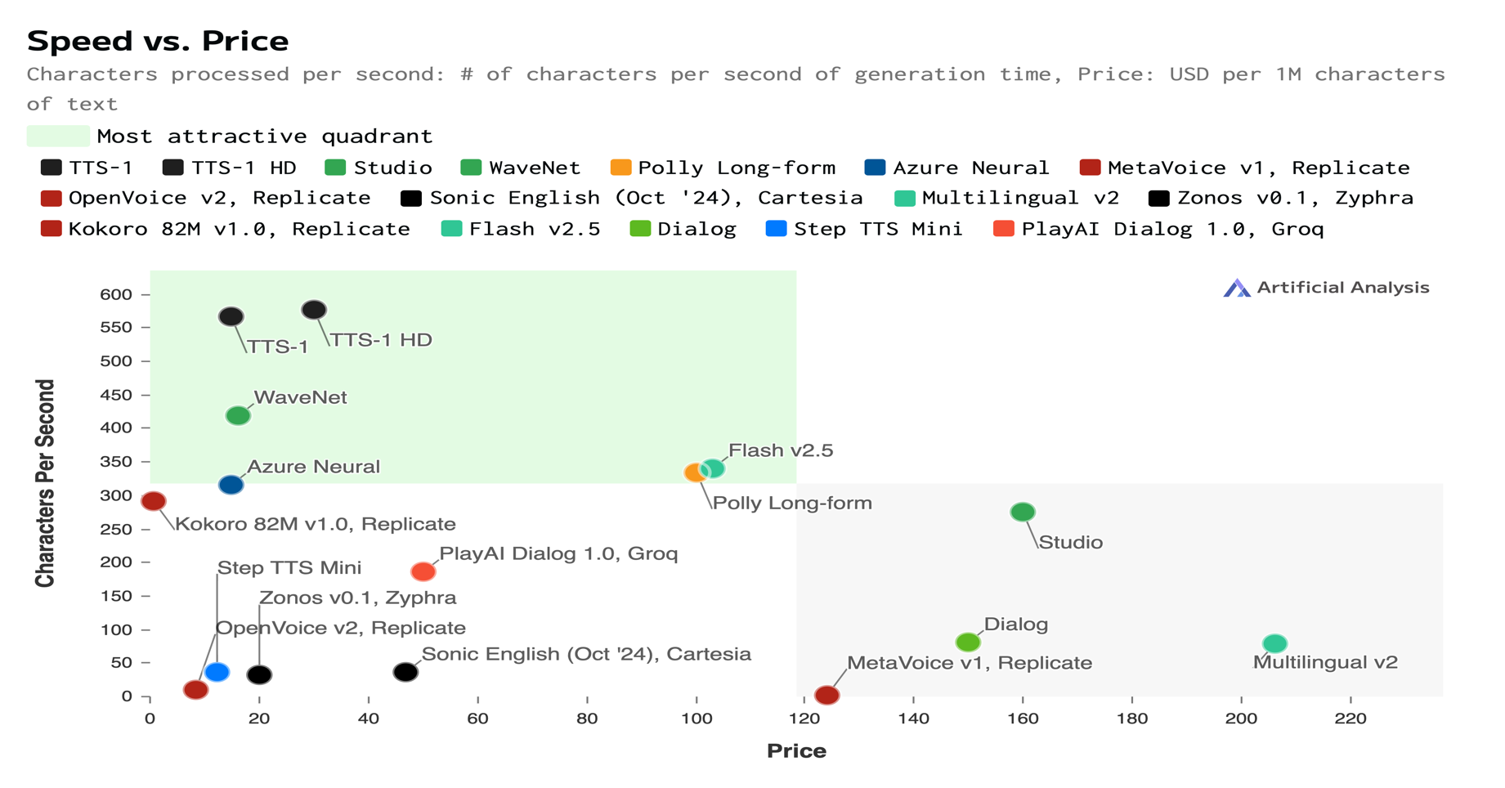
Text to Speech (TTS) AI Model & Provider Leaderboard
Source: https://artificialanalysis.ai/text-to-speech

Slide 55
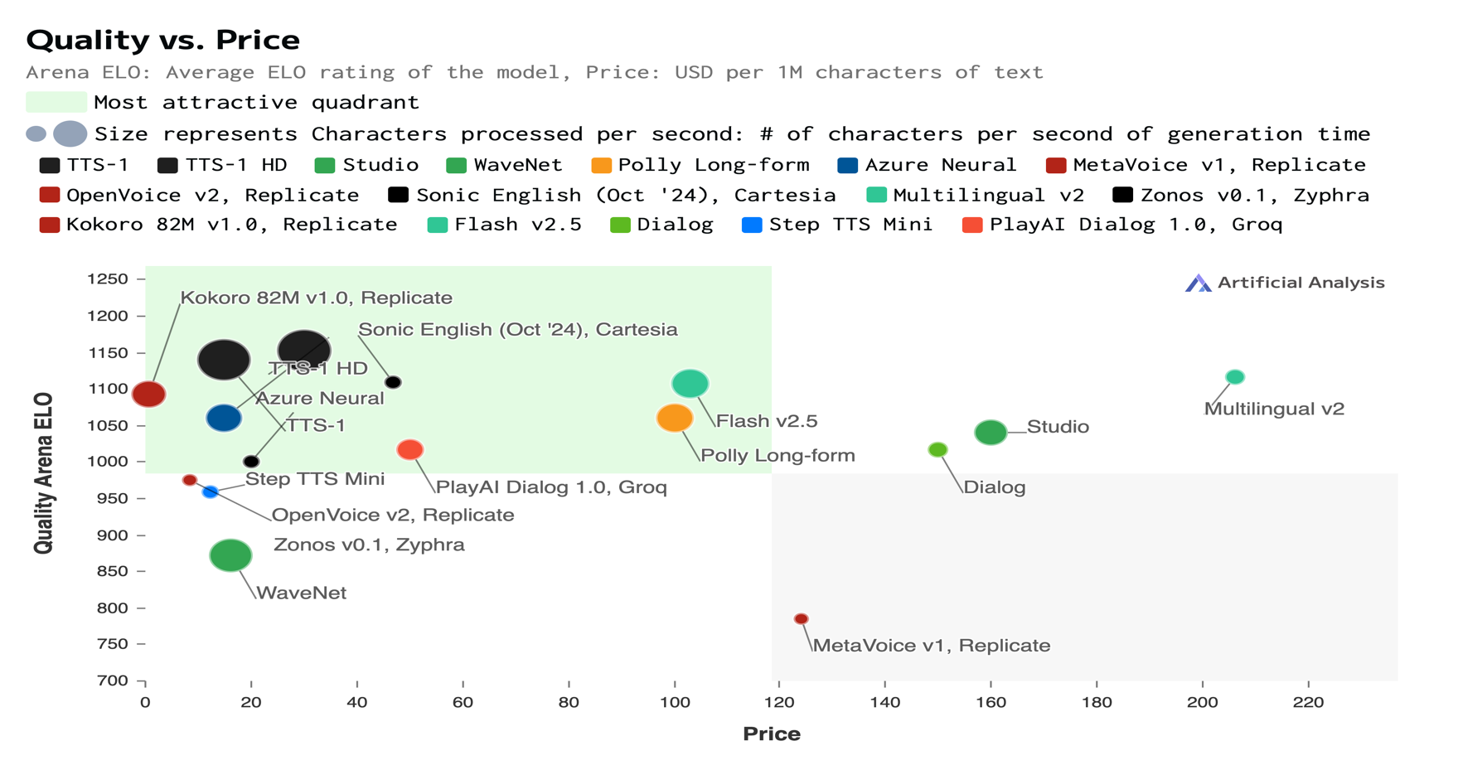
Text to Speech (TTS) AI Model & Provider Leaderboard
Source: https://artificialanalysis.ai/text-to-speech

Slide 56
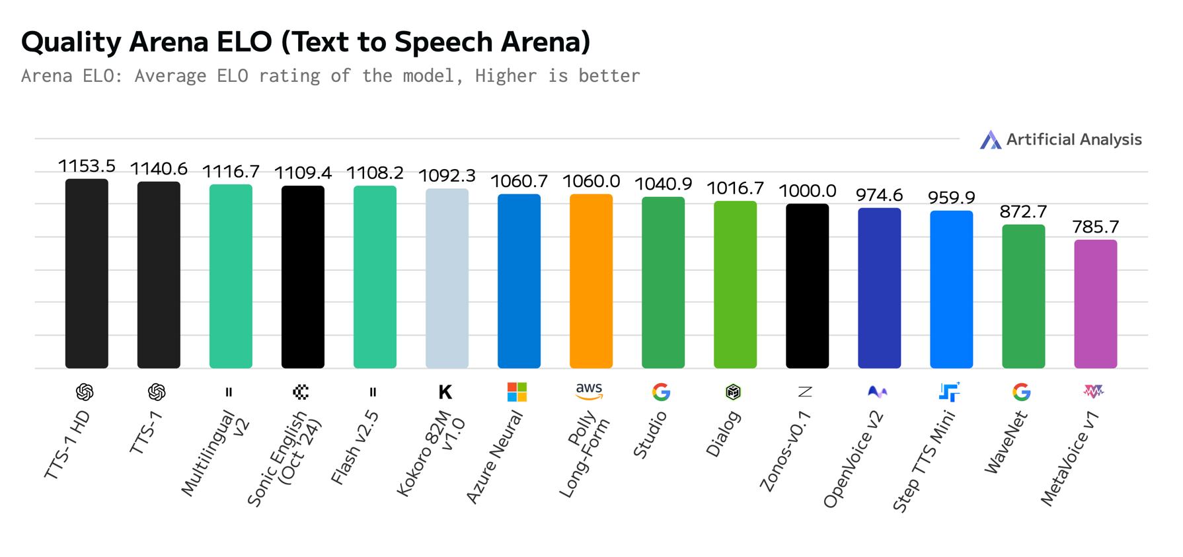
Text to Speech (TTS) AI Model & Provider Leaderboard
Source: https://artificialanalysis.ai/text-to-speech

Slide 57
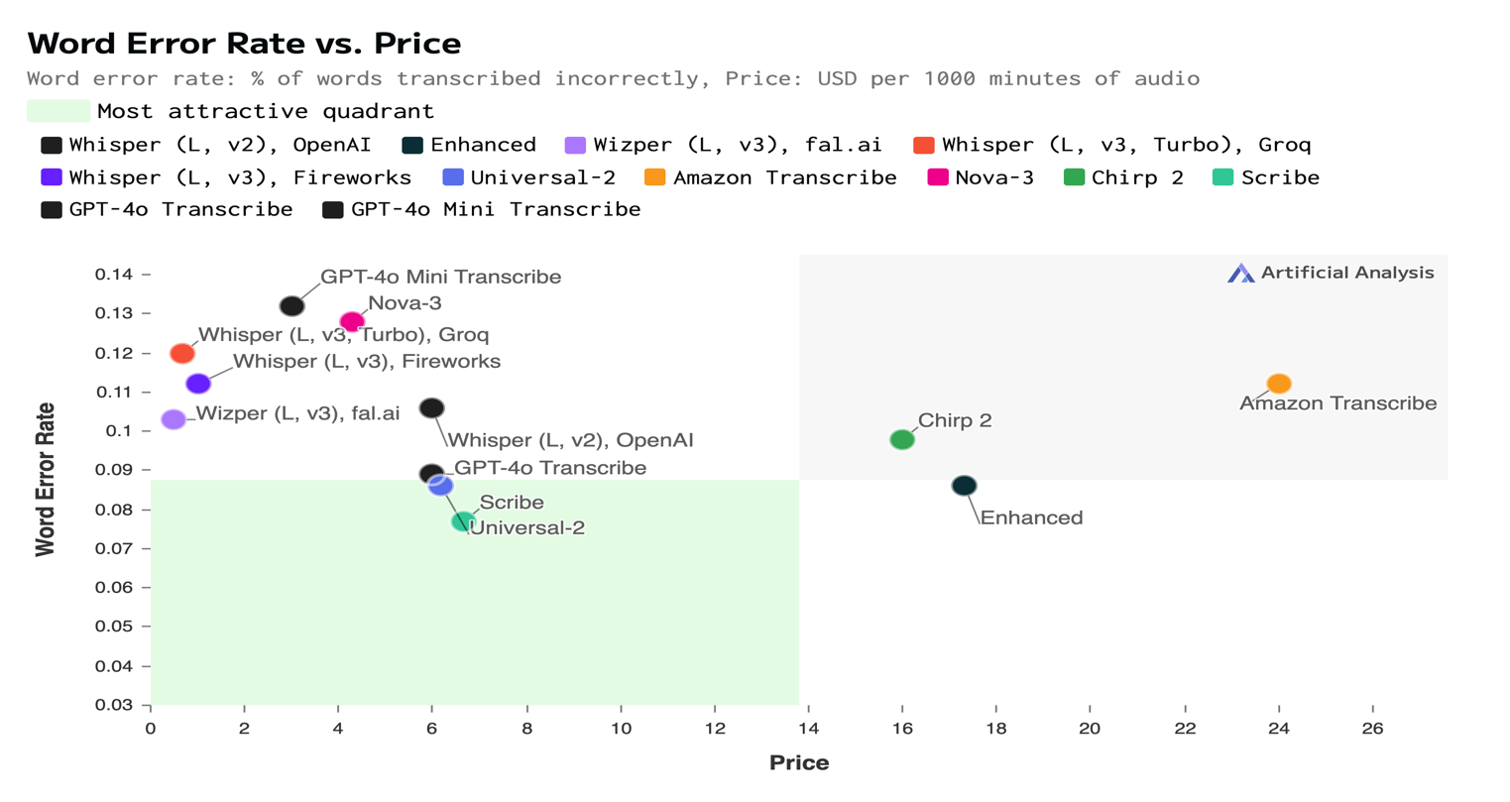
Speech to Text (STT) AI Model & Provider Leaderboard
Speech-to-text models & providers compared: Whisper (L, v2), OpenAI, Universal-1, Standard, Whisper (L, v2), Azure, Enhanced, Nano, Wizper (L, v3), fal.ai, Incredibly Fast Whisper, Replicate, Nova-2, Whisper (L, v2), Replicate, Whisper (L, v3), Replicate, Base, WhisperX, Replicate, Whisper (L v2), Deepgram, Gladia, Whisper (L, v3), Groq, Distil-Whisper, Groq, Whisper (L, v3), fal.ai, Whisper (L, v3), Deepinfra, Whisper (L, v3, Turbo), Groq, Whisper (L, v3), Fireworks, Whisper (L, v3, Turbo), Fireworks, Universal-2, Amazon Transcribe, Fish Speech to Text, Nova-3, Chirp, Chirp 2, Scribe, GPT-4o Transcribe, and GPT-4o Mini Transcribe.
Source: https://artificialanalysis.ai/speech-to-text

Slide 58
Speech to Text (STT) AI Model & Provider Leaderboard
Speech-to-text models & providers compared: Whisper (L, v2), OpenAI, Universal-1, Standard, Whisper (L, v2), Azure, Enhanced, Nano, Wizper (L, v3), fal.ai, Incredibly Fast Whisper, Replicate, Nova-2, Whisper (L, v2), Replicate, Whisper (L, v3), Replicate, Base, WhisperX, Replicate, Whisper (L v2), Deepgram, Gladia, Whisper (L, v3), Groq, Distil-Whisper, Groq, Whisper (L, v3), fal.ai, Whisper (L, v3), Deepinfra, Whisper (L, v3, Turbo), Groq, Whisper (L, v3), Fireworks, Whisper (L, v3, Turbo), Fireworks, Universal-2, Amazon Transcribe, Fish Speech to Text, Nova-3, Chirp, Chirp 2, Scribe, GPT-4o Transcribe, and GPT-4o Mini Transcribe.
Source: https://artificialanalysis.ai/speech-to-text

Slide 59
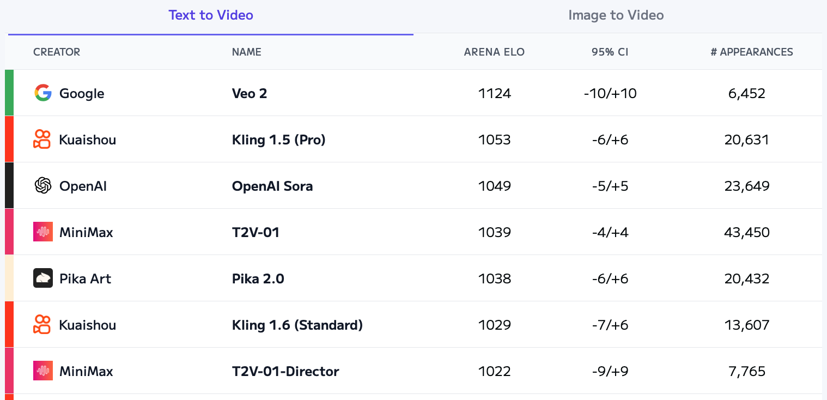
Artificial Analysis Text to Video Leaderboard
Source: https://artificialanalysis.ai/text-to-video/arena?tab=Leaderboard&leaderboard_tab=t2v

Slide 60
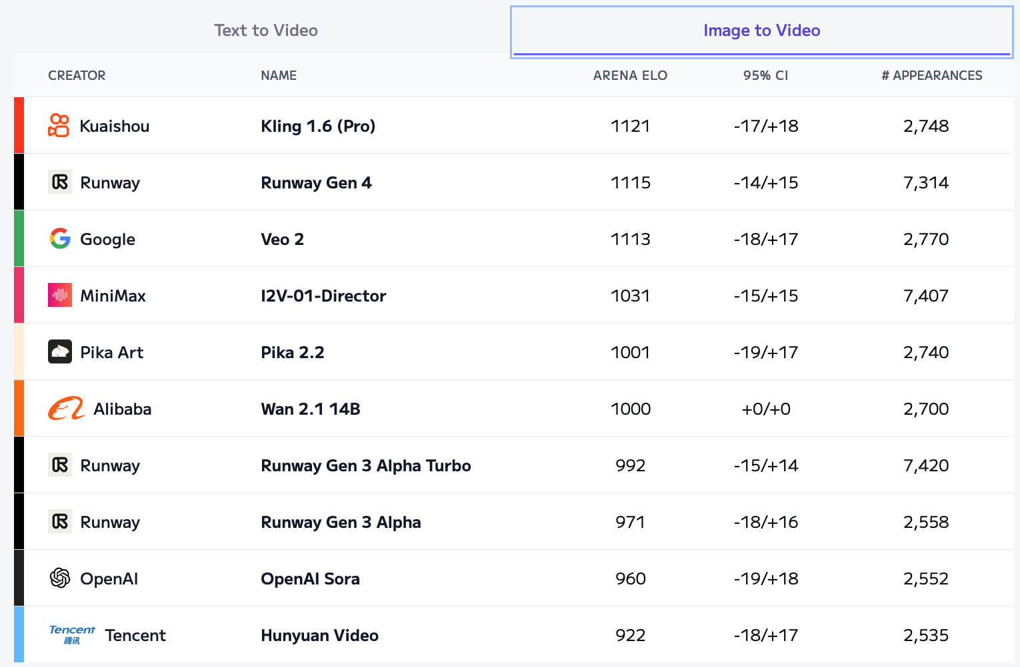
Artificial Analysis Image to Video Leaderboard
Source: https://artificialanalysis.ai/text-to-video/arena?tab=Leaderboard&leaderboard_tab=t2v

Slide 61
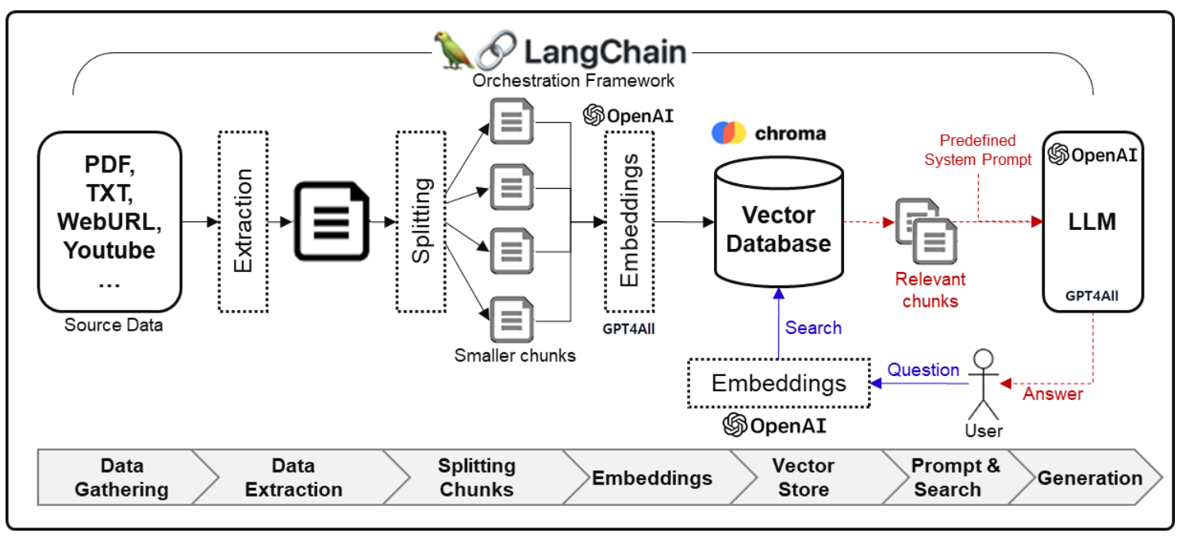
Framework for Implementing Generative AI Services using RAG Model
Source: Jeong, Cheonsu. "A Study on the Implementation of Generative AI Services Using an Enterprise Data-Based LLM Application Architecture." arXiv preprint arXiv:2309.01105 (2023).

Slide 62
Spring 2025
Generative AI
Innovative Applications

Slide 63

https://learn.nvidia.com/certificates?id=cCFh1ZWWTvqKTq7dcKkEWw

Slide 64

https://learn.nvidia.com/certificates?id=OVmqY4cSSya0BdMQBWHxzw

Slide 65

https://learn.nvidia.com/certificates?id=ed-qOCIMQaatzU8SNUNxgw

Slide 66

https://learn.nvidia.com/certificates?id=q3oo-oBhTQKtyCCote2E-Q

Slide 67

NVIDIA
Certified Instructors
(12 from Taiwan)
https://www.nvidia.com/en-us/training/instructor-directory/search/

Slide 68
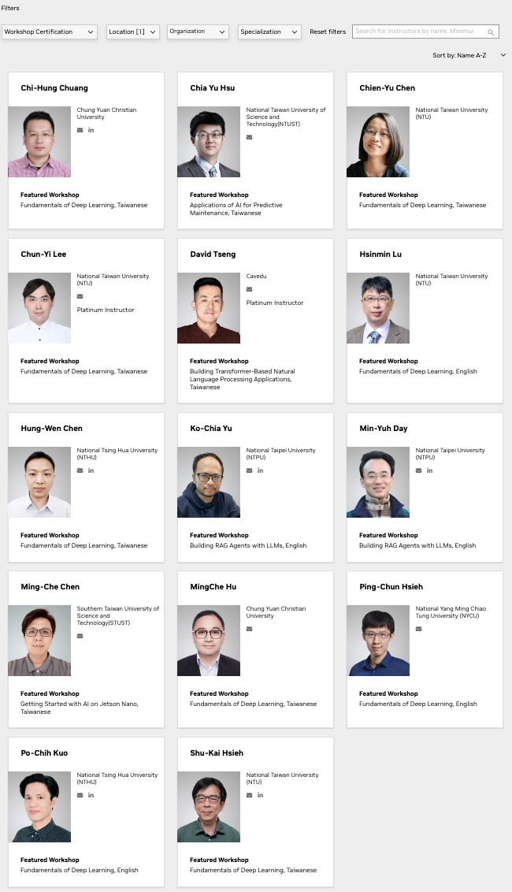
NVIDIA
Certified Instructors
(14 from Taiwan)
(2 from NTPU)(April 2025)
https://www.nvidia.com/en-us/training/instructor-directory/search/

Slide 69
NVIDIA Developer Program
NVIDIA
Deep Learning Institute (DLI)
https://developer.nvidia.com/join-nvidia-developer-program
https://learn.nvidia.com/

Slide 70
Get NVIDIA DLI Certificate
Step 1. Join NVIDIA Developer Program (Free)
https://developer.nvidia.com/join-nvidia-developer-program
Step 2. Visit NVIDIA Deep Learning Institute (DLI)
https://learn.nvidia.com/
Step 3. Enroll "Generative AI with Diffusion Models"
Self-Paced Course ($90)
https://learn.nvidia.com/courses/course-detail?course_id=course-v1:DLI+S-FX-14+V1

Slide 71

Join the NVIDIA Developer Program take one of the complimentary technical self-paced courses
(worth up to $90)
https://developer.nvidia.com/join-nvidia-developer-program

Slide 72
NVIDIA Deep Learning Institute (DLI)
Self-Paced Course
Generative AI Explained
Free
2 hours
Self-Paced Course
Getting Started With Deep Learning
Certificate available
$90
8 hours
Instructor-Led Workshop
Fundamentals of Deep Learning
Certificate available
$500
8 hours
Self-Paced Course
Introduction to Transformer-Based Natural Language Processing
Certificate available
$30
6 hours
Self-Paced Course
Building RAG Agents With LLMs
Certificate available
Free
8 hours
Instructor-Led Workshop
Building RAG Agents With LLMs
Certificate available
$500
8 hours
Self-Paced Course
Generative AI with Diffusion Models
Certificate available
$90
8 hours
Instructor-Led Workshop
Generative AI with Diffusion Models
Certificate available
$500
8 hours
https://www.nvidia.com/en-us/learn/learning-path/generative-ai-llm/

Slide 73

NVIDIA Deep Learning Institute (DLI)
Generative AI
https://learn.nvidia.com/en-us/training/find-training?q=Generative+AI

Slide 74

Generative AI Explained
https://learn.nvidia.com/courses/course-detail?course_id=course-v1:DLI+S-FX-15+V1

Slide 75

Building RAG Agents with LLMs
https://learn.nvidia.com/courses/course-detail?course_id=course-v1:DLI+S-FX-15+V1

Slide 76
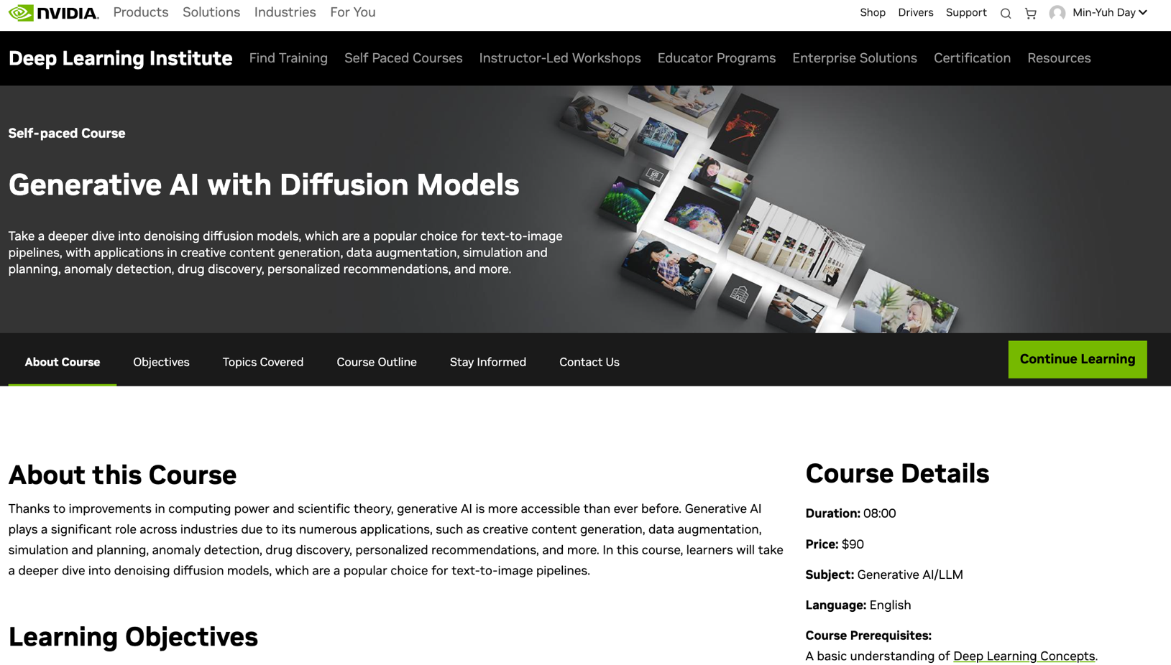
Generative AI with Diffusion Models
https://learn.nvidia.com/courses/course-detail?course_id=course-v1:DLI+S-FX-14+V1

Slide 77
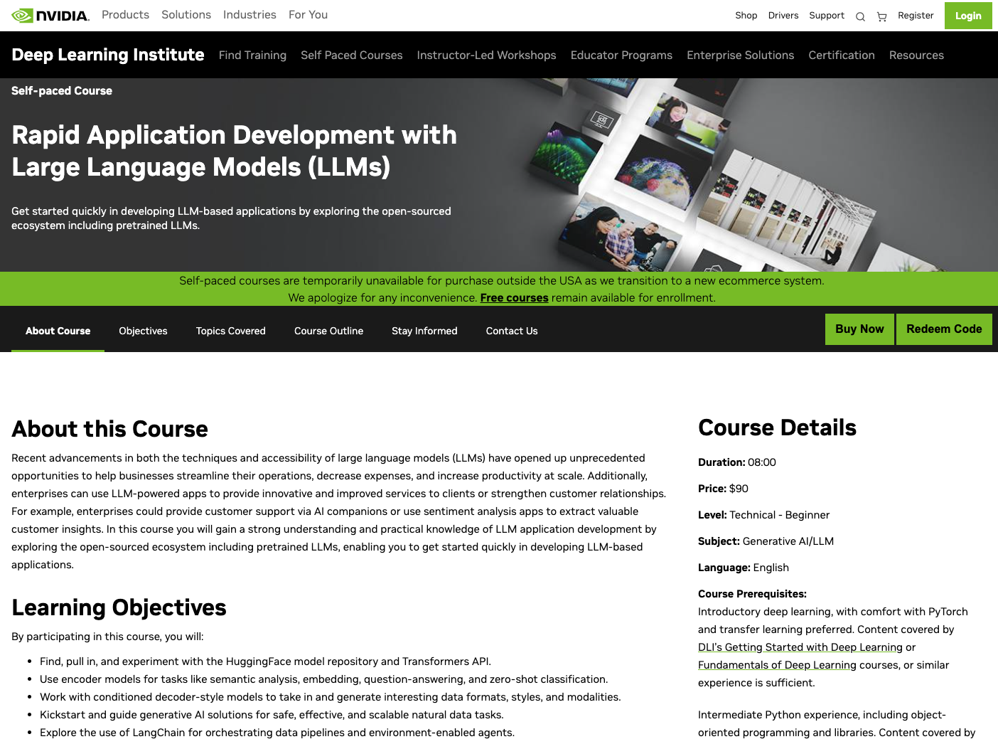
Rapid Application Development with Large Language Models (LLMs)
https://learn.nvidia.com/courses/course-detail?course_id=course-v1:DLI+S-FX-26+V1

Slide 78


Deep Learning Institute (DLI)
https://learn.nvidia.com/my-learning

Slide 79
https://learn.nvidia.com/certificates?id=ed-qOCIMQaatzU8SNUNxgw

Slide 80

NVIDIA Deep Learning Institute (DLI)
https://learn.nvidia.com/en-us/training/self-paced-courses

Slide 81

Building RAG Agents with LLMs
Source: NVIDIA DLI (2024), Building RAG Agents with LLMs, https://learn.nvidia.com/courses/course-detail?course_id=course-v1:DLI+S-FX-15+V1

Slide 82

Building RAG Agents with LLMs
https://learn.nvidia.com/courses/course?course_id=course-v1:DLI+S-FX-15+V1

Slide 83

Building RAG Agents with LLMs
https://learn.nvidia.com/courses/course?course_id=course-v1:DLI+S-FX-15+V1

Slide 84

Building RAG Agents with LLMs
https://learn.nvidia.com/courses/course?course_id=course-v1:DLI+S-FX-15+V1

Slide 85
Digital Sustainability Transformation
ESG Data Analytics

Slide 86
ESG:
Environmental
Social
Governance

Slide 87
CSR:
Corporate
Social
Responsibility

Slide 88
Evolution of Sustainable Finance Research
Topic
SDGs:
Sustainable Development Goals
SDGs
Innovative Financial Instrument
Impact Investing
ESG: Environmental, Social, and Governance
CSR: Corporate Social Responsibility
Conscious Capitalism
Climate Financing
Carbon Financing
Green Financing
Ethical Investing
Socially Responsible Investing
1986
1995
2005
2015
2020
Source: Kumar, S., Sharma, D., Rao, S., Lim, W. M., & Mangla, S. K. (2022). Past, present, and future of sustainable finance:
Insights from big data analytics through machine learning of scholarly research. Annals of Operations Research, 1-44.

Slide 89


















Sustainable Development Goals (SDGs)
Source: https://sdgs.un.org/goals

Slide 90

Sustainable Development Goals (SDGs) and 5P
Partnership
Peace
Prosperity
People
Planet
Source: Folke, Carl, Reinette Biggs, Albert V. Norström, Belinda Reyers, and Johan Rockström. "Social-ecological resilience and biosphere-based sustainability science.”Ecology and Society 21, no. 3 (2016).

Slide 91

ESG to 17 SDGs
Source: Henrik Skaug Sætra (2021) "A Framework for Evaluating and Disclosing the ESG Related Impacts of AI with the SDGs." Sustainability 13, no. 15 (2021): 8503.

Slide 92

ESG to 17 SDGs
Source: https://sustainometric.com/esg-to-sdgs-connected-paths-to-a-sustainable-future/

Slide 93
Net-Zero Transformation
Ambition
  Aligned to achieving global net zero by no later than 2050 & to limit warming to 1.5°C
Governance
  Accountability driven from the top
Strategy
  Embedded and aligned net zero into company strategy
Enterprise
  Key operating model changes in support of transformation
Supply chains
  Transformed net zero supply chains
Innovation
  Developed innovation and technologies to deliver net zero
Finance
  Financing the net zero transformation
Transparency
  Communicating action
Engagement
  Enhancing the pace and scale of net zero action
Source: https://www.pwc.com/us/en/services/esg/library/building-blocks-for-net-zero-transformation.html

Slide 94
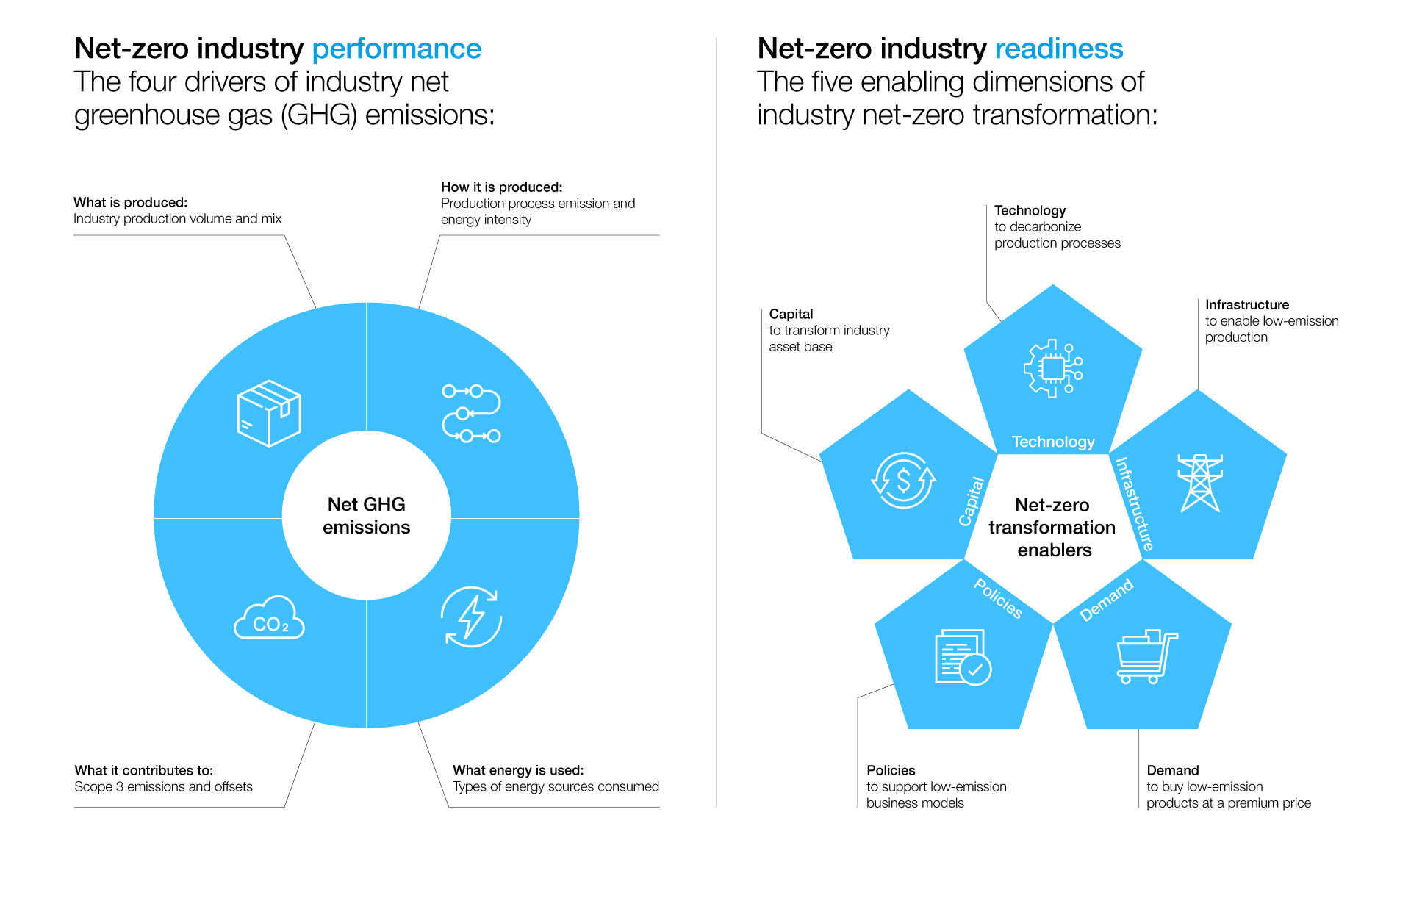
Net-Zero Transformation Enablers
Source: https://www.weforum.org/agenda/2022/07/net-zero-tracker/

Slide 95
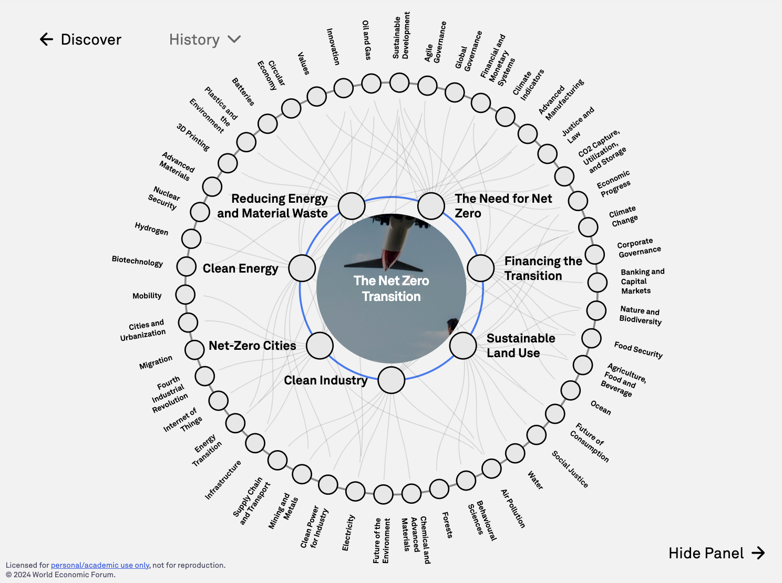
The
Net Zero Transition
Source: https://intelligence.weforum.org/topics/a1G680000004C93EAE

Slide 96
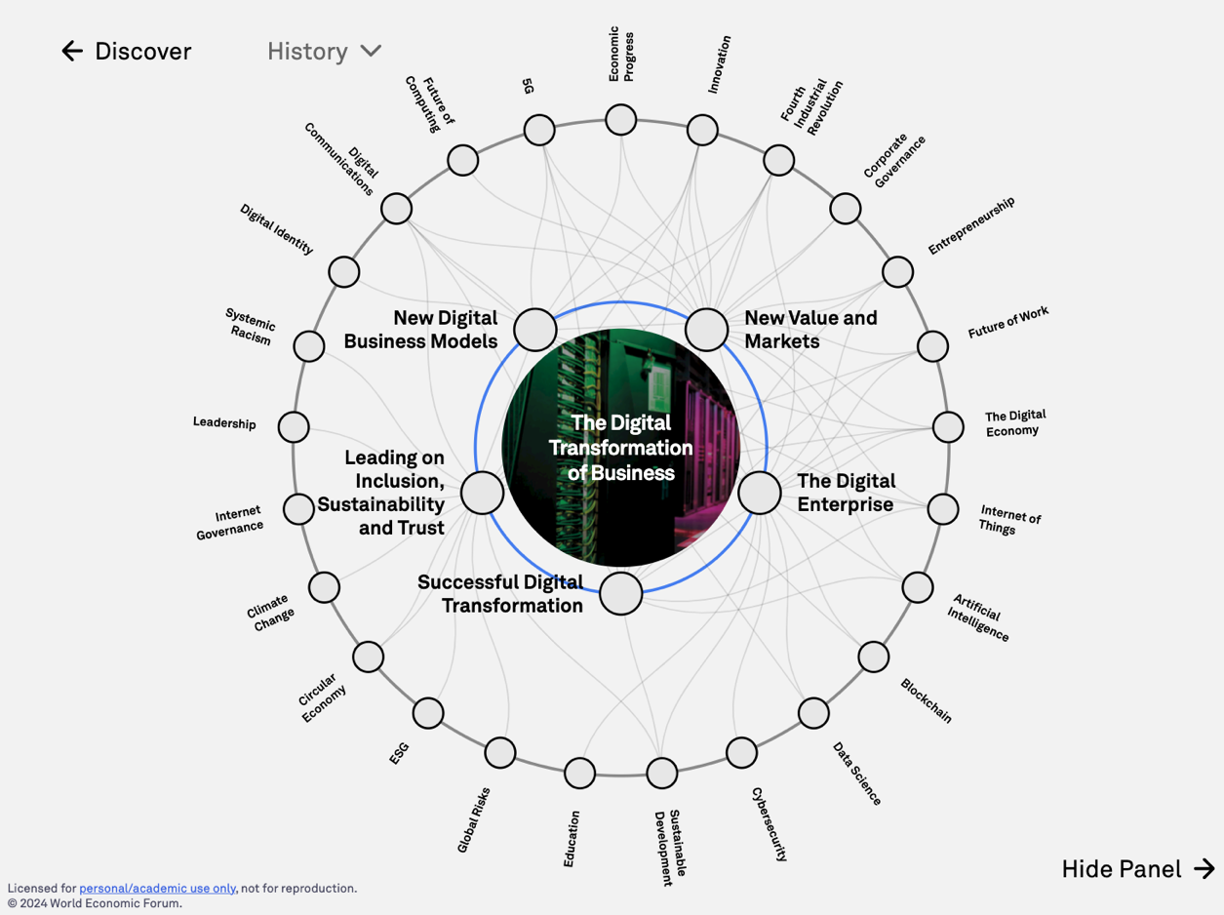
The
Digital Transformation of Business
Source: https://intelligence.weforum.org/topics/a1G0X000006DIDZUA4

Slide 97
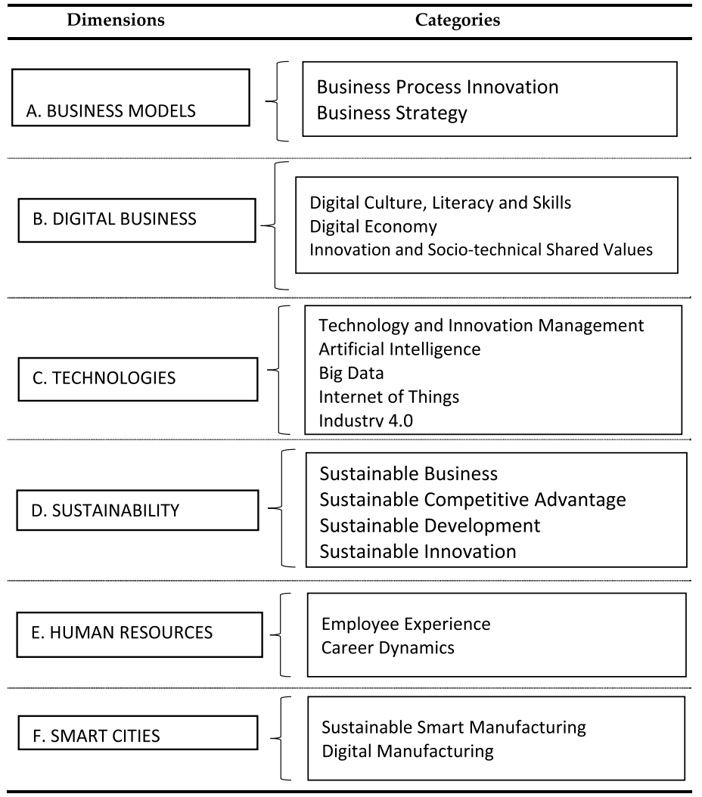
Digital Transformation
Source: Reis, João, and Nuno Melão (2023). "Digital transformation: A meta-review and guidelines for future research." Heliyon (2023).

Slide 98
ESG Challenges and Opportunities
Challenges
  Fragmented and unstructured ESG data.
  Lack of standardization and transparency.
  Timeliness of data availability.
Opportunities
  Rising demand for actionable ESG insights.
  Innovation in sustainable solutions and policies.
  Generative AI as a tool for transformation.

Slide 99

Sustainability and ESG Data Analytics

Slide 100
Generative AI for ESG Data Analytics
Data Integration and Enrichment:
  Synthesizing structured and unstructured ESG data.
Automated Reporting and Insight Generation:
  Tailored ESG reports and insights for stakeholders.
Scenario Modeling and Forecasting:
  Simulating potential risks and opportunities.
Addressing Bias and Ensuring Accountability:
  Transparent, fair, and ethical AI deployment.

Slide 101

Generative AI and LLMs for Sustainability and
ESG Data Analytics

Slide 102
Sustainability Innovation with Generative AI
Sustainable Product Design:
  Eco-friendly designs minimizing waste and energy.
Policy Formulation and Implementation:
  AI-driven simulations for effective policies.
Stakeholder Engagement and Awareness:
  Communicating ESG strategies with compelling AI-driven visuals.

Slide 103
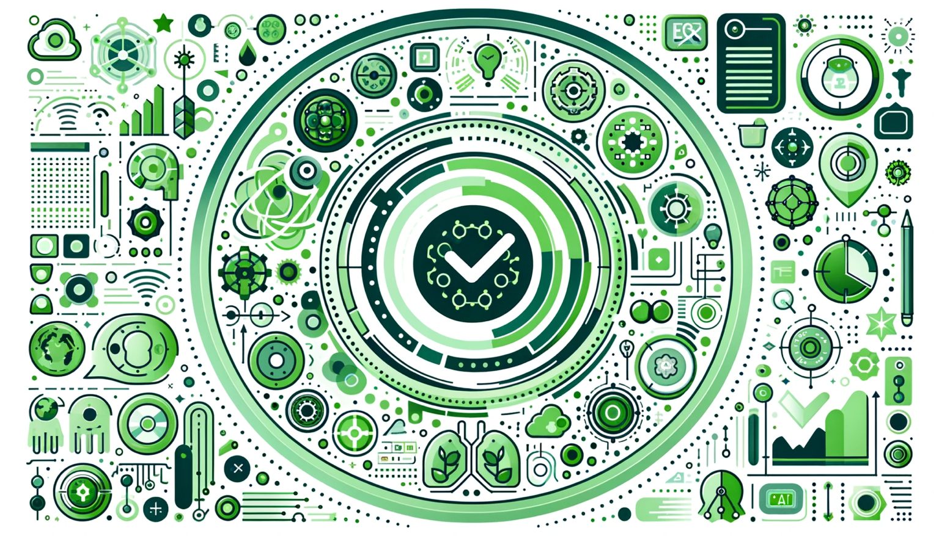
Generative AI for ESG Rating and Reporting Generation

Slide 104
Mapping the ESG Standards Landscape
The most prevalent ESG reporting frameworks
  GRI (Global Report Initiative)
  CDP (Carbon Disclosure Project)
  SASB (Sustainability Accounting Standards Board
  ISSB (International Sustainability Standards Board)
  TCFD (Task Force on Climate-related Financial Disclosures
How companies choose
  Materiality, industry-specific standards, investor alignment

Slide 105
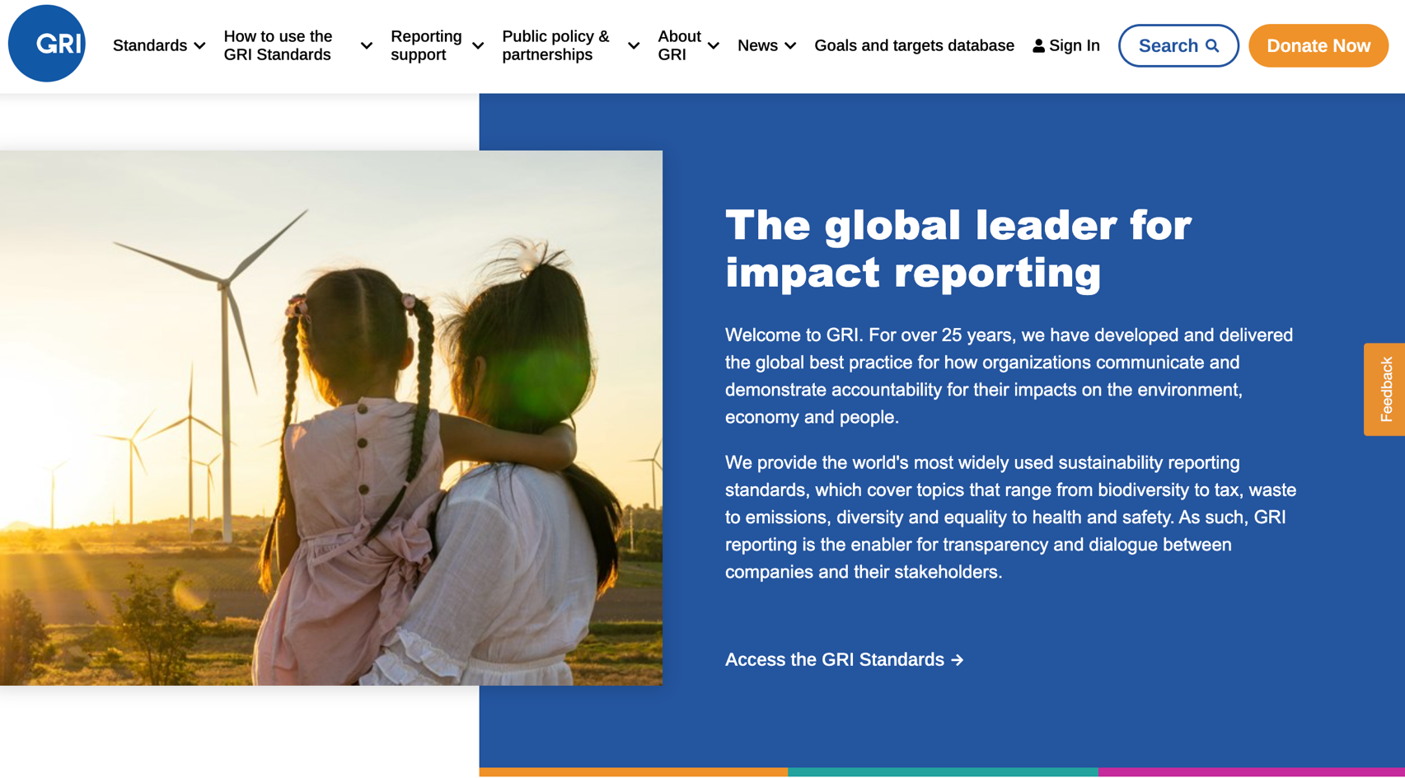
GRI (Global Report Initiative)
https://www.globalreporting.org/

Slide 106

CDP (Carbon Disclosure Project)
https://www.cdp.net/

Slide 107

SASB (Sustainability Accounting Standards Board)
https://sasb.org/

Slide 108

ISSB (International Sustainability Standards Board)
https://www.ifrs.org/groups/international-sustainability-standards-board/

Slide 109

TCFD
(Task Force on Climate-related Financial Disclosures)
https://www.ifrs.org/sustainability/tcfd/
https://www.fsb-tcfd.org/

Slide 110

Sustainable Productivity:
Finance ESG
Source: Huang, Ziqi, Yang Shen, Jiayi Li, Marcel Fey, and Christian Brecher (2021). "A survey on AI-driven digital twins in Industry 4.0: Smart manufacturing and advanced robotics." Sensors 21, no. 19: 6340.

Slide 111

Sustainable Resilient Manufacturing
ESG
Source: Huang, Ziqi, Yang Shen, Jiayi Li, Marcel Fey, and Christian Brecher (2021). "A survey on AI-driven digital twins in Industry 4.0: Smart manufacturing and advanced robotics." Sensors 21, no. 19: 6340.

Slide 112
ESG Indexes
MSCI ESG Index
Dow Jones Sustainability Indices (DJSI)
FTSE ESG Index

Slide 113

MSCI ESG Rating Framework
Source: https://www.msci.com/documents/1296102/21901542/ESG-Ratings-Methodology-Exec-Summary.pdf

Slide 114

MSCI ESG Key Issue Hierarchy
Source: https://www.msci.com/documents/1296102/21901542/ESG-Ratings-Methodology-Exec-Summary.pdf

Slide 115

MSCI Governance Model Structure
Source: https://www.msci.com/documents/1296102/21901542/ESG-Ratings-Methodology-Exec-Summary.pdf

Slide 116

MSCI Hierarchy of ESG Scores
Source: https://www.msci.com/documents/1296102/21901542/ESG-Ratings-Methodology-Exec-Summary.pdf

Slide 117

DJSI S&P Global ESG Score
Source: DJSI, S&P Global Corporate Sustainability Assessment (CSA), https://www.spglobal.com/esg/solutions/data-intelligence-esg-scores

Slide 118

FTSE Russell ESG Ratings
Source: https://www.ftserussell.com/data/sustainability-and-esg-data/esg-ratings

Slide 119


Sustainalytics
ESG Risk Ratings
Analyst-based
approach
Sustainalytics’ ESG Risk Ratings measure a company’s exposure to industry-specific material ESG risks and how well a company is managing those risks.
Source: https://www.sustainalytics.com/esg-data

Slide 120

Truvalue
ESG Ranks
TruValue Labs
Machine-based approach
Truvalue Labs applies AI to analyze over 100,000 sources and uncover ESG risks and opportunities hidden in unstructured text.
The ESG Ranks data service produces an overall company rank based on industry percentile leveraging the 26 ESG categories defined by the Sustainability Accounting Standards Board (SASB).
The data feed covers 20,000+ companies with more than 13 years of history.
Source: :https://developer.truvaluelabs.com/data/esg-ranks

Slide 121

Analyst-driven vs. AI-driven ESG
Sustainalytics
Truvalue Labs
Source: Mark Tulay (2020), Man vs. machine: A tale of two sustainability ratings systems, GreenBiz, https://www.greenbiz.com/article/man-vs-machine-tale-two-sustainability-ratings-systems

Slide 122

Analyst based
ESG Research
AI based
ESG Research
Source: https://www.esganalytics.io/insights/how-data-is-accelerating-esg

Slide 123

ESG Analytics: NLP Taxonomy
Source: https://www.esganalytics.io/insights/how-data-is-accelerating-esg

Slide 124

Top
ESG Reporting Software
Environmental, Social and Governance (ESG) Reporting software or Sustainability software helps organizations manage their operational data, evaluate their impact on the environment and provide reporting to perform audits.
Source: https://www.softwarereviews.com/categories/environmental-social-and-governance-reporting

Slide 125
Future Directions
Integrating blockchain, IoT, and digital twins.
Democratizing AI tools for all stakeholders.
Promoting collaboration among experts and communities.

Slide 126
Conclusion
Agentic AI is transforming ESG analytics and sustainability innovation.
Collaboration among researchers, policymakers, and innovators is key.
Agentic AI to build a sustainable future.

Slide 127
Summary
1. Agentic AI
2. ESG Data Analytics
3. Digital Sustainability Innovation

Slide 128



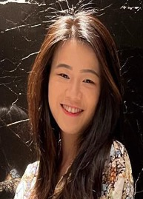
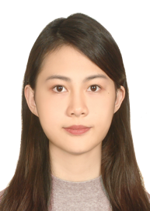
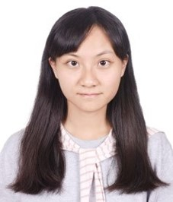


2022
IMNTPU at the NTCIR-16 FinNum-3 Task:
Data Augmentation for Financial Numclaim Classification
¹ Information Management, National Taipei University, New Taipei City, Taiwan
² Zeals Co., Ltd. Tokyo, Japan
Yung-Wei Teng ¹
Pei-Tz Chiu ¹
Ting-Yun Hsiao ¹
Mike Tian-Jian Jiang ²
Min-Yuh Day ^{1,*}
myday@gm.ntpu.edu.tw

Slide 129
2022
IMNTPU Dialogue System Evaluation
at the NTCIR-16 DialEval-2
Dialogue Quality and Nugget Detection
¹ Information Management, National Taipei University, New Taipei City, Taiwan
² Zeals Co., Ltd. Tokyo, Japan
Ting-Yun Hsiao ¹
Yung-Wei Teng ¹
Pei-Tz Chiu ¹
Mike Tian-Jian Jiang ²
Min-Yuh Day ^{1,*}
myday@gm.ntpu.edu.tw

Slide 130
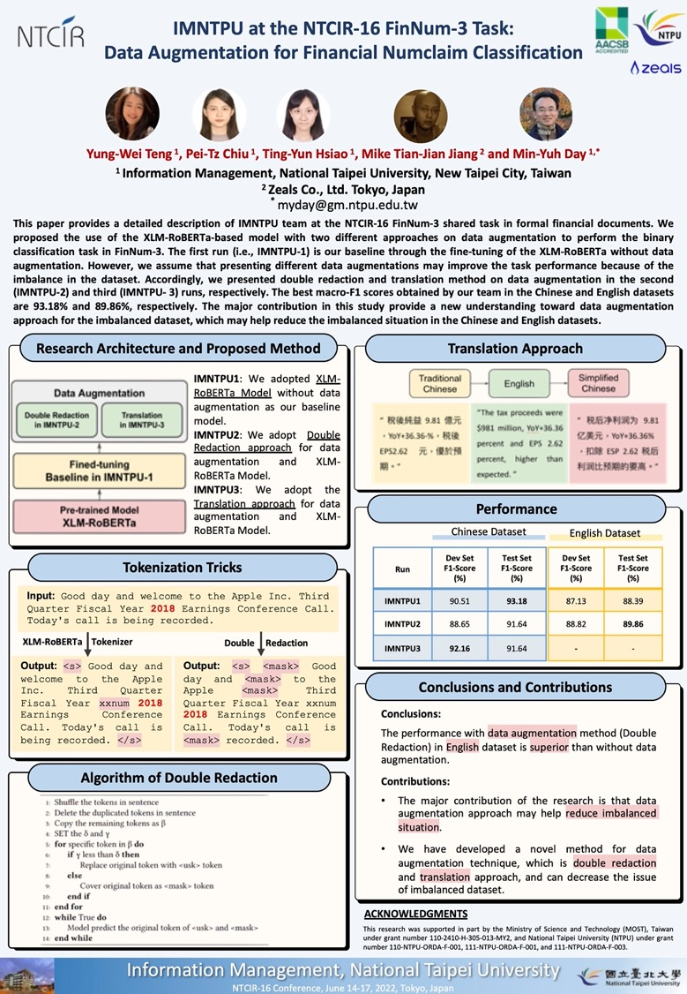
NTCIR-16
FinNum-3
2022
NTCIR-16
Best Poster Presentation Award

Slide 131
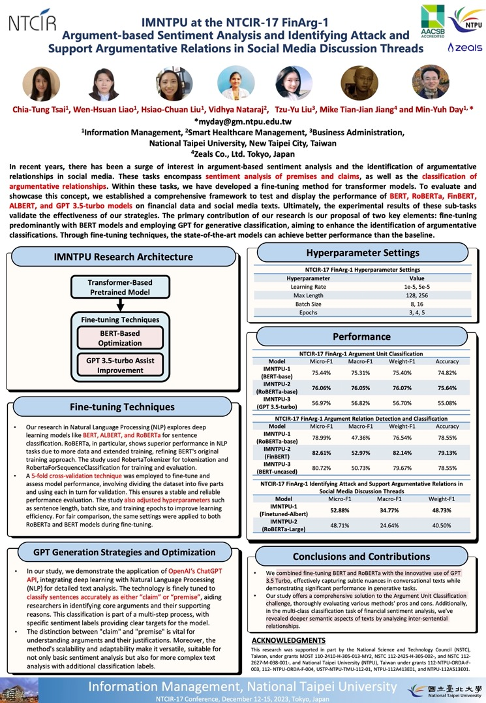
NTCIR-17
FinArg-1
1
2023
NTCIR-17
Best Poster Presentation Award

Slide 132
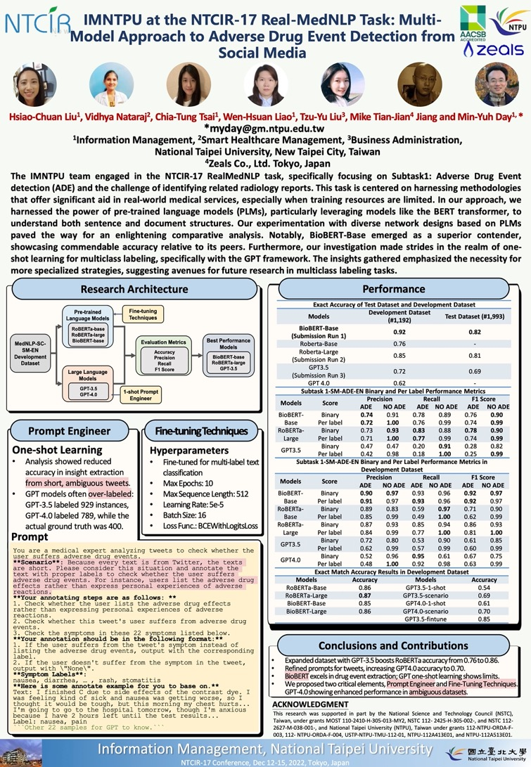
NTCIR-17
Real MedNLP
2
2023
NTCIR-17
Best Poster Presentation Award

Slide 133

Acknowledgments: Research Projects
Fintech Green Finance for Carbon Market Index, Corporate Finance, and Environmental Policies.
Carbon Emission Sentiment Index with AI Text Analytics
  NTPU, 113-NTPU_ORDA-F-003, 2023/01/01~2024/12/31
Innovative Agentic AI Technology for Autonomous ESG Report Generation
  Industrial Technology Research Institute (ITRI), Fintech and Green Finance Center (FGFC, NTPU), NTPU-114A513E01, 2025/03/01~2025/12/31
Development of a Deep Learning for Dental Implant Detection in Panoramic Radiographs
  University System of Taipei Joint Research Program (NTPU, TMU), USTP-NTPU-TMU-114-02, 2025/01/01~2025/12/31
Digital Support, Unimpeded Communication: The Development, Support and Promotion of AI-assisted Communication Assistive Devices for Speech Impairment (2/3).
Multimodal Cross-lingual Task-Oriented Dialogue System for Inclusive Communication Support
  NSTC 113-2425-H-305-002-, 3 Years (2023/05/01-2026/04/30) Year 1: 2024/05/01~2025/04/30
Research on speech processing, synthesis, recognition, and sentence construction of people with language disabilities. Multimodal Cross-lingual Task-Oriented Dialogue System
  NTPU, 113-NTPU_ORDA-F-004, 2023/01/01~2025/12/31
Metaverse AI Multimodal Cross-Language Task-Oriented Dialogue System
  ATEC Group, Fintech and Green Finance Center (FGFC, NTPU), NTPU-112A413E01, 3 Years (2023/05/01~2026/04/30)
Establishment and Implement of Smart Assistive Technology for Dementia Care and Its Socio-Economic Impacts (3/3). Intelligent, individualized and precise care with smart AT and system integration
  NSTC, 113-2627-M-038-001-, 2024/08/01~2025/07/31
https://web.ntpu.edu.tw/~myday/cindex.htm#projects

Slide 134
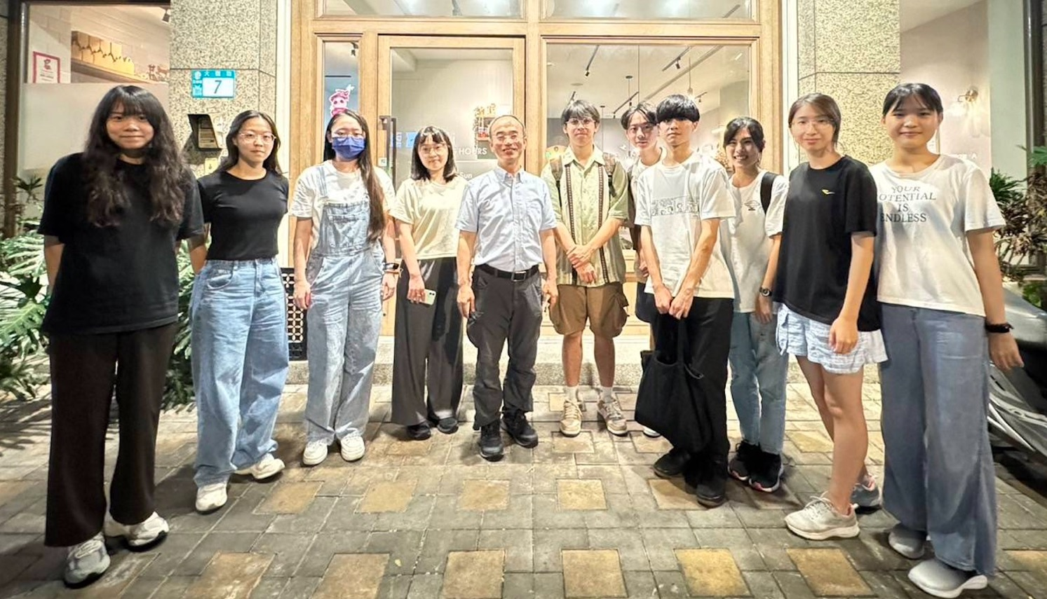
Acknowledgments: IFIT Lab Members
Intelligent Financial Innovation Technology, IFIT Lab, IM, NTPU

Slide 135
References
Stuart Russell and Peter Norvig (2020), Artificial Intelligence: A Modern Approach, 4th Edition, Pearson.
Numa Dhamani and Maggie Engler (2024), Introduction to Generative AI, Manning
Denis Rothman (2024), Transformers for Natural Language Processing and Computer Vision - Third Edition: Explore Generative AI and Large Language Models with Hugging Face, ChatGPT, GPT-4V, and DALL-E 3, 3rd ed. Edition, Packt Publishing
NVIDIA DLI (2024), Building RAG Agents with LLMs, https://learn.nvidia.com/courses/course-detail?course_id=course-v1:DLI+S-FX-15+V1
NVIDIA DLI (2024), Generative AI with Diffusion Models, https://learn.nvidia.com/courses/course-detail?course_id=course-v1:DLI+S-FX-14+V1
Denis Rothman (2024), Transformers for Natural Language Processing and Computer Vision: Explore Generative AI and Large Language Models with Hugging Face, ChatGPT, GPT-4V, and DALL-E 3, 3rd Edition, Packt Publishing
Denis Rothman (2024), RAG-Driven Generative AI: Build custom retrieval augmented generation pipelines with LlamaIndex, Deep Lake, and Pinecone, Packt Publishing
Jay Alammar and Maarten Grootendorst (2024), Hands-On Large Language Models: Language Understanding and Generation, O'Reilly Media
Simon Thompson (2023), Green and Sustainable Finance: Principles and Practice in Banking, Investment and Insurance, 2nd Edition, Kogan Page.
Chrissa Pagitsas (2023), Chief Sustainability Officers At Work: How CSOs Build Successful Sustainability and ESG Strategies, Apress.
Yihan Cao, Siyu Li, Yixin Liu, Zhiling Yan, Yutong Dai, Philip S. Yu, and Lichao Sun (2023). "A Comprehensive Survey of AI-Generated Content (AIGC): A History of Generative AI from GAN to ChatGPT." arXiv preprint arXiv:2303.04226.
Pengfei Liu, Weizhe Yuan, Jinlan Fu, Zhengbao Jiang, Hiroaki Hayashi, and Graham Neubig. (2023) "Pre-train, prompt, and predict: A systematic survey of prompting methods in natural language processing." ACM Computing Surveys 55, no. 9 (2023): 1-35.
Wayne Xin Zhao, Kun Zhou, Junyi Li, Tianyi Tang, Xiaolei Wang, Yupeng Hou, Yingqian Min et al. (2023) "A Survey of Large Language Models." arXiv preprint arXiv:2303.18223.
Touvron, Hugo, Louis Martin, Kevin Stone, Peter Albert, Amjad Almahairi, Yasmine Babaei, Nikolay Bashlykov et al. (2023) "Llama 2: Open Foundation and Fine-Tuned Chat Models." arXiv preprint arXiv:2307.09288 (2023).
Rafailov, R., Sharma, A., Mitchell, E., Ermon, S., Manning, C. D., & Finn, C. (2023). Direct preference optimization: Your language model is secretly a reward model. arXiv preprint arXiv:2305.18290.
Tunstall, Lewis, Edward Beeching, Nathan Lambert, Nazneen Rajani, Kashif Rasul, Younes Belkada, Shengyi Huang et al. "Zephyr: Direct Distillation of LM Alignment." arXiv preprint arXiv:2310.16944 (2023).
Ouyang, L., Wu, J., Jiang, X., Almeida, D., Wainwright, C. L., Mishkin, P., ... & Lowe, R. (2022). Training language models to follow instructions with human feedback. arXiv preprint arXiv:2203.02155.
Gozalo-Brizuela, Roberto, and Eduardo C. Garrido-Merchan (2023). "ChatGPT is not all you need. A State of the Art Review of large Generative AI models." arXiv preprint arXiv:2301.04655 (2023).
Wenliang Dai, Junnan Li, Dongxu Li, Anthony Meng Huat Tiong, Junqi Zhao, Weisheng Wang, Boyang Li, Pascale Fung, and Steven Hoi. (2023) "InstructBLIP: Towards General-purpose Vision-Language Models with Instruction Tuning." arXiv preprint arXiv:2305.06500 (2023).
Shahab Saquib Sohail, Faiza Farhat, Yassine Himeur, Mohammad Nadeem, Dag Øivind Madsen, Yashbir Singh, Shadi Atalla, and Wathiq Mansoor (2023). "The Future of GPT: A Taxonomy of Existing ChatGPT Research, Current Challenges, and Possible Future Directions." Current Challenges, and Possible Future Directions (April 8, 2023) (2023).
Longbing Cao (2022). "Decentralized ai: Edge intelligence and smart blockchain, metaverse, web3, and desci." IEEE Intelligent Systems 37, no. 3: 6-19.
Qinglin Yang, Yetong Zhao, Huawei Huang, Zehui Xiong, Jiawen Kang, and Zibin Zheng (2022). "Fusing blockchain and AI with metaverse: A survey." IEEE Open Journal of the Computer Society 3 : 122-136.
Ouyang, L., Wu, J., Jiang, X., Almeida, D., Wainwright, C. L., Mishkin, P., ... & Lowe, R. (2022). Training language models to follow instructions with human feedback. arXiv preprint arXiv:2203.02155.

Slide 136
Agentic AI for ESG and
Digital Sustainability Innovation
(代理式 AI 於 ESG 與數位永續創新)
臺北市立大學資訊科學系
碩士班Seminar
Q & A
Time: 13:10-15:00, Wednesday, April 30, 2025
Place: R314, Gongcheng Building, Department of Computer Science, University of Taipei
Host: Prof. Ching-Tai Chen
University Ambassador
戴敏育 教授 (Prof. Min-Yuh Day)
國立臺北大學 資訊管理研究所 教授
金融科技暨綠色金融研究中心 主任
永續辦公室 永續發展組 組長
Certified Instructor
2025-04-30

