Slide 1









AI及生成式AI的應用
(Applications of AI and Generative AI)
國父紀念館
AI 知能教育訓練
時間：2025/7/15(二) 14:00 - 16:30
地點：光復國小視聽教室 (國父紀念館旁)
主辦：國立國父紀念館 人事室 陳世源
University Ambassador
戴敏育 教授 (Prof. Min-Yuh Day)
國立臺北大學 資訊管理研究所 教授
金融科技暨綠色金融研究中心 主任
永續辦公室 永續發展組 組長
Certified Instructor
https://web.ntpu.edu.tw/~myday

Slide 2











戴敏育 教授
Prof. Min-Yuh Day
1
University Ambassador
Certified Instructor
Professor, Information Management, NTPU
Director, Intelligent Financial Innovation Technology, IFIT Lab, IM, NTPU
Director, Fintech and Green Finance Center (FGFC), NTPU
Division Director, Sustainable Development, Sustainability Office, NTPU
Visiting Scholar, IIS, Academia Sinica
Ph.D., Information Management, NTU
Publications Co-Chairs, International Conference on Advances in Social Networks Analysis and Mining
(ASONAM 2013- )
Program Co-Chair, IEEE International Workshop on Empirical Methods for Recognizing Inference in TExt
(IEEE EM-RITE 2012- )
Publications Chair, The IEEE International Conference on Information Reuse and Integration for Data Science
(IEEE IRI 2007- )

Slide 3


課程目標
國父紀念館
AI及生成式AI的應用
認識人工智慧與生成式AI基本概念與趨勢
掌握ChatGPT基礎操作與應用
學習有效提示詞技巧與實務案例
啟發AI應用於提升工作效能的思考

Slide 4
國父紀念館
AI及生成式AI的應用
1
單元1：人工智慧與生成式AI簡介
單元2：生成式AI在公務領域的應用
單元3：生成式AI在公務領域的實作
2
3

Slide 5
人工智慧與生成式AI簡介
1
1. 人工智慧的基本概念與發展歷程回顧
2. 生成式AI的基本概念與應用場景
3. ChatGPT、GPT-4o等大型語言模型 (LLM)
基本概念和工作原理
4. AI應用現況與未來展望

Slide 6
什麼是人工智慧?
(What is Artificial Intelligence?)
AI定義：模仿人類智慧的機器或系統
(AI definition: Machines or systems that mimic human intelligence)
關鍵能力：學習、推理、解決問題、感知、語言理解
(Key capabilities: Learning, reasoning, problem-solving, perception, language understanding)

Slide 7

AI, ML, DL, Generative AI
Source: Jeong, Cheonsu. "A Study on the Implementation of Generative AI Services Using an Enterprise Data-Based LLM Application Architecture." arXiv preprint arXiv:2309.01105 (2023).

Slide 8
Generative AI, Agentic AI, Physical AI
Physical AI
Self-driving cars
General robotics
Agentic AI
Coding assistants
Customer service
Patient care
Generative AI
Digital marketing
Content creation
Perception AI
Speech recognition
Deep recommender systems
Medical imaging
2012 AlexNet
Deep learning breakthrough
Source: NVIDIA (2025), GTC March 2025 Keynote with NVIDIA CEO Jensen Huang, https://www.youtube.com/watch?v=_waPvOwL9Z8

Slide 9
Generative AI
Computing
Generative AI
Data
Algorithms

Slide 10

From Generative AI to Agentic AI
Source: Schneider, Johannes. "Generative to Agentic AI: Survey, Conceptualization, and Challenges." arXiv preprint arXiv:2504.18875 (2025).

Slide 11



Generative AI (Gen AI)
AI Generated Content (AIGC)
Source: Yihan Cao, Siyu Li, Yixin Liu, Zhiling Yan, Yutong Dai, Philip S. Yu, and Lichao Sun (2023). "A Comprehensive Survey of AI-Generated Content (AIGC): A History of Generative AI from GAN to ChatGPT." arXiv preprint arXiv:2303.04226.

Slide 12
Definition of
Artificial Intelligence (A.I.)

Slide 13
Artificial Intelligence
“… the science and engineering of making intelligent machines”
(John McCarthy, 1955)
Source: https://digitalintelligencetoday.com/artificial-intelligence-defined-useful-list-of-popular-definitions-from-business-and-science/

Slide 14
Artificial Intelligence
“… technology that thinks and acts like humans”
Source: https://digitalintelligencetoday.com/artificial-intelligence-defined-useful-list-of-popular-definitions-from-business-and-science/

Slide 15
Artificial Intelligence
“… intelligence exhibited by machines or software”
Source: https://digitalintelligencetoday.com/artificial-intelligence-defined-useful-list-of-popular-definitions-from-business-and-science/

Slide 16
AI的歷史里程碑
(Historical Milestones of AI)
1956年：達特茅斯會議， “AI 人工智慧” 術語誕生
(1956: Dartmouth Conference, birth of the term "Artificial Intelligence”)
1960s-1970s：早期AI發展，如下棋程式
(1960s-1970s: Early AI development, e.g., chess programs)
1980s-1990s：專家系統興起
(1980s-1990s: Rise of expert systems)
2000s：機器學習和深度學習崛起
(2000s: Emergence of machine learning and deep learning)
2010s至今：大數據時代，AI應用廣泛普及
(2010s to present: Big data era, widespread AI applications)

Slide 17
AI的主要分支
(Main Branches of AI)
機器學習 (Machine Learning)
自然語言處理 (Natural Language Processing)
計算機視覺 (Computer Vision)
機器人學 (Robotics)
專家系統 (Expert Systems)

Slide 18
機器學習與深度學習
(Machine Learning and Deep Learning)
機器學習：讓計算機系統自動學習和改進的方法 (Machine Learning : Methods allowing computer systems to automatically learn and improve)
深度學習：機器學習的子集，使用多層神經網絡 (Deep Learning: A subset of machine learning using multi-layer neural networks)

Slide 19
AI, ML, DL
Artificial Intelligence (AI)
Machine Learning (ML)
Supervised
Learning
Unsupervised Learning
Deep Learning (DL)
CNN
RNN LSTM GRU
GAN
Semi-supervised Learning
Reinforcement Learning
Source: https://leonardoaraujosantos.gitbooks.io/artificial-inteligence/content/deep_learning.html

Slide 20
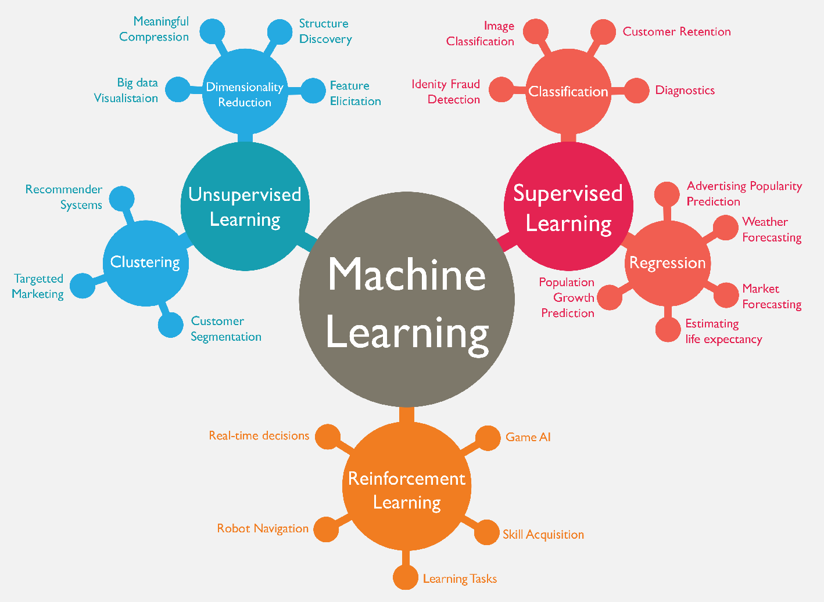
Machine Learning (ML)
Source: https://www.mactores.com/services/aws-big-data-machine-learning-cognitive-services/

Slide 21
機器學習的流程
(Machine Learning Process)
1. 數據收集 (Data collection)
2. 數據預處理 (Data preprocessing)
3. 選擇模型 (Model selection)
4. 訓練模型 (Model training)
5. 評估模型 (Model evaluation)
6. 參數調優 (Parameter tuning)
7. 預測 (Prediction)

Slide 22
常見機器學習方法比較
(Comparison of Common Machine Learning Methods)
監督學習：如垃圾郵件分類
(Supervised Learning: e.g., spam email classification)
無監督學習：如客戶分群
(Unsupervised Learning: e.g., customer segmentation)
強化學習：如遊戲AI
(Reinforcement Learning: e.g., game AI)

Slide 23
神經網絡結構
(Neural Network Architecture)
輸入層 (Input layer)
隱藏層 (Hidden layer(s))
輸出層 (Output layer)
神經元連接 (Neuron connections)

Slide 24
人工智慧與生成式AI簡介
1
1. 人工智慧的基本概念與發展歷程回顧
2. 生成式AI的基本概念與應用場景
3. ChatGPT、GPT-4o等大型語言模型 (LLM)
基本概念和工作原理
4. AI應用現況與未來展望

Slide 25
什麼是生成式AI?
(What is Generative AI?)
生成式AI：創造的藝術
(Generative AI: The Art of Creation)
定義：能夠創造新內容的AI系統
(Definition: AI systems capable of creating new content)
特點：創造力、互動性
(Characteristics: Creativity, interactivity)

Slide 26
生成式AI (Generative AI)
能夠創造全新、原創內容的人工智慧
分析現有數據，生成新的文本、圖像、音訊、影片、程式碼。
會創作的AI
AI界的莎士比亞、畢卡索
運作原理 ：
  學習大量資料 -> 理解模式與結構 -> 創造新內容
  (例如：讀了幾萬本書的學生，開始自己寫文章)

Slide 27
生成式AI與傳統AI的區別
(Comparison of Generative AI and Traditional AI)
特徵 (Feature) | 生成式AI (Generative AI) | 傳統AI (Traditional AI)
輸出類型 (Output type) | 新內容 (New content) | 分類/預測 (Classification/Prediction)
創造性 (Creativity) | 高 (High) | 低 (Low)
互動性 (Interactivity) | 通常更自然 (Usually more natural) | 有限 (Limited)

Slide 28
生成式AI主要應用領域
(Main Application Areas of Generative AI)
內容創作 (Content creation)
藝術創作 (Art creation)
產品設計 (Product design)
藥物發現 (Drug discovery)
虛擬助手 (Virtual assistants)
遊戲開發 (Game development)

Slide 29
Artificial Intelligence
Practical Applications

Slide 30
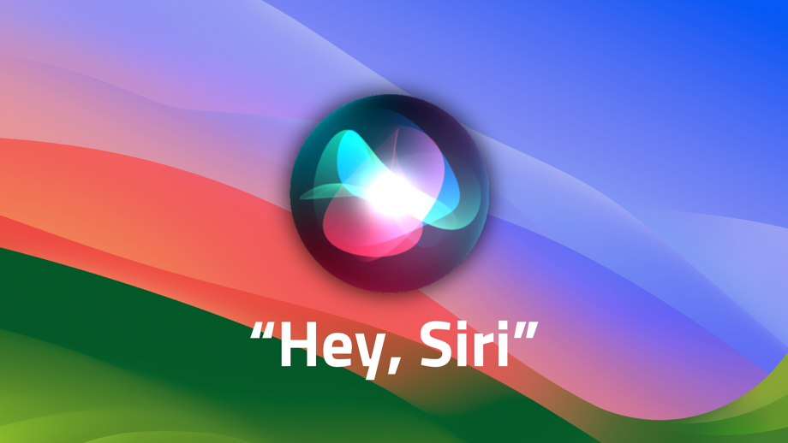
AI Practical Applications - SIRI
Speech Recognition and Virtual Assistants:
AI enables devices like Siri to understand and respond to voice commands, streamlining tasks such as managing schedules, controlling smart devices, and searching the web.

Slide 31

AI Practical Applications – Google Photo
Image Recognition and Analysis:
AI-powered image recognition is used in applications like Google Photos to automatically tag people, identify objects, and categorize images. It also powers facial recognition systems for security and biometric verification.

Slide 32


AI Practical Applications – NetFlix, Spotify
Personalized Content Recommendations:
AI algorithms used by platforms like Netflix, Spotify analyze user behavior to recommend personalized content, such as movies, music, or videos.

Slide 33
文本生成
(Text Generation)
文本生成應用 (Text Generation Applications)
新聞文章生成 (News article generation)
聊天機器人對話 (Chatbot conversations)
程式碼自動生成 (Automatic code generation)
機器翻譯 (Machine translation)

Slide 34
影像生成
(Image Generation)
AI生成的藝術作品 (AI-Generated Artworks)
AI繪畫作品 (AI-generated paintings)
AI設計的產品概念 (AI-designed product concepts)
AI生成的音樂作品 (AI-generated music compositions)

Slide 35
聲音生成
(Audio Generation)
AI合成音樂 (AI-Synthesized Music)
AI生成的音樂片段 (AI-generated music clips)
不同風格的音樂 (various music styles)

Slide 36
Generative AI and
Large Language Models (LLMs):
Popular Generative AI Applications

Slide 37
Generative AI
Text, Image, Video, Audio Applications

Slide 38
Spring 2025
Generative AI
Innovative Applications

Slide 39

https://learn.nvidia.com/certificates?id=cCFh1ZWWTvqKTq7dcKkEWw

Slide 40
NVIDIA Developer Program
NVIDIA
Deep Learning Institute (DLI)
https://developer.nvidia.com/join-nvidia-developer-program
https://learn.nvidia.com/

Slide 41
Get NVIDIA DLI Certificate
Before the NVIDIA Workshop
Step 1. Join NVIDIA Developer Program (Free)
https://developer.nvidia.com/join-nvidia-developer-program
Step 2. Visit NVIDIA Deep Learning Institute (DLI)
https://learn.nvidia.com/
Step 3. Enroll "Building RAG Agents with LLMs" Self-Paced Course (Free)
https://learn.nvidia.com/courses/course-detail?course_id=course-v1:DLI+S-FX-15+V1

Slide 42

Get NVIDIA Certificate
https://learn.nvidia.com/certificates?id=ed-qOCIMQaatzU8SNUNxgw

Slide 43

Join the NVIDIA Developer Program take one of the complimentary technical self-paced courses
(worth up to $90)
https://developer.nvidia.com/join-nvidia-developer-program

Slide 44
NVIDIA Deep Learning Institute (DLI)
Self-Paced Course
Generative AI Explained
Free
2 hours
Self-Paced Course
Getting Started With Deep Learning
Certificate available
$90
8 hours
Instructor-Led Workshop
Fundamentals of Deep Learning
Certificate available
$500
8 hours
Self-Paced Course
Introduction to Transformer-Based Natural Language Processing
Certificate available
$30
6 hours
Self-Paced Course
Building RAG Agents With LLMs
Certificate available
Free
8 hours
Instructor-Led Workshop
Building RAG Agents With LLMs
Certificate available
$500
8 hours
Self-Paced Course
Generative AI with Diffusion Models
Certificate available
$90
8 hours
Instructor-Led Workshop
Generative AI with Diffusion Models
Certificate available
$500
8 hours
https://www.nvidia.com/en-us/learn/learning-path/generative-ai-llm/

Slide 45

NVIDIA Deep Learning Institute (DLI)
Generative AI
https://learn.nvidia.com/en-us/training/find-training?q=Generative+AI

Slide 46

Generative AI Explained
https://learn.nvidia.com/courses/course-detail?course_id=course-v1:DLI+S-FX-15+V1

Slide 47

Building RAG Agents with LLMs
https://learn.nvidia.com/courses/course-detail?course_id=course-v1:DLI+S-FX-15+V1

Slide 48


Deep Learning Institute (DLI)
https://learn.nvidia.com/my-learning

Slide 49

NVIDIA Deep Learning Institute (DLI)
https://learn.nvidia.com/en-us/training/self-paced-courses

Slide 50

Building RAG Agents with LLMs
Source: NVIDIA DLI (2024), Building RAG Agents with LLMs, https://learn.nvidia.com/courses/course-detail?course_id=course-v1:DLI+S-FX-15+V1

Slide 51

Building RAG Agents with LLMs
https://learn.nvidia.com/courses/course?course_id=course-v1:DLI+S-FX-15+V1

Slide 52

Building RAG Agents with LLMs
https://learn.nvidia.com/courses/course?course_id=course-v1:DLI+S-FX-15+V1

Slide 53

Building RAG Agents with LLMs
https://learn.nvidia.com/courses/course?course_id=course-v1:DLI+S-FX-15+V1

Slide 54

Generative AI (Gen AI)
AI Generated Content (AIGC)
Image Generation
Source: Yihan Cao, Siyu Li, Yixin Liu, Zhiling Yan, Yutong Dai, Philip S. Yu, and Lichao Sun (2023). "A Comprehensive Survey of AI-Generated Content (AIGC): A History of Generative AI from GAN to ChatGPT." arXiv preprint arXiv:2303.04226.

Slide 55

The history of Generative AI in CV, NLP and VL
Source: Yihan Cao, Siyu Li, Yixin Liu, Zhiling Yan, Yutong Dai, Philip S. Yu, and Lichao Sun (2023). "A Comprehensive Survey of AI-Generated Content (AIGC): A History of Generative AI from GAN to ChatGPT." arXiv preprint arXiv:2303.04226.

Slide 56

Categories of Vision Generative Models
Source: Yihan Cao, Siyu Li, Yixin Liu, Zhiling Yan, Yutong Dai, Philip S. Yu, and Lichao Sun (2023). "A Comprehensive Survey of AI-Generated Content (AIGC): A History of Generative AI from GAN to ChatGPT." arXiv preprint arXiv:2303.04226.

Slide 57

The General Structure of
Generative Vision Language
Source: Yihan Cao, Siyu Li, Yixin Liu, Zhiling Yan, Yutong Dai, Philip S. Yu, and Lichao Sun (2023). "A Comprehensive Survey of AI-Generated Content (AIGC): A History of Generative AI from GAN to ChatGPT." arXiv preprint arXiv:2303.04226.

Slide 58
lmarena.ai Chatbot Arena Leaderboard
Rank* (UB) | Rank (StyleCtrl) | Model | Arena Score | Votes | Organization | License | Knowledge Cutoff
1 | 1 | Gemini-2.5-Pro-Preview-05-06 | 1446 | 6115 | Google | Proprietary | Unknown
2 | 3 | Gemini-2.5-Flash-Preview-05-20 | 1418 | 3892 | Google | Proprietary | Unknown
2 | 1 | o3-2025-04-16 | 1409 | 7921 | OpenAI | Proprietary | Unknown
2 | 2 | ChatGPT-4o-latest (2025-03-26) | 1405 | 10280 | OpenAI | Proprietary | Unknown
3 | 6 | Grok-3-Preview-02-24 | 1399 | 14840 | xAI | Proprietary | Unknown
4 | 3 | GPT-4.5-Preview | 1394 | 15276 | OpenAI | Proprietary | Unknown
6 | 6 | Gemini-2.5-Flash-Preview-04-17 | 1387 | 6938 | Google | Proprietary | Unknown
8 | 6 | DeepSeek-V3-0324 | 1368 | 9741 | DeepSeek | MIT | Unknown
8 | 6 | GPT-4.1-2025-04-14 | 1365 | 6094 | OpenAI | Proprietary | Unknown
8 | 13 | Hunyuan-Turbos-20250416 | 1356 | 5111 | Tencent | Proprietary | Unknown
9 | 9 | DeepSeek-R1 | 1354 | 19339 | DeepSeek | MIT | Unknown
10 | 18 | Gemini-2.0-Flash-001 | 1351 | 24928 | Google | Proprietary | Unknown
10 | 13 | Mistral Medium 3 | 1343 | 3327 | Mistral | Proprietary | Unknown
10 | 6 | o4-mini-2025-04-16 | 1343 | 6102 | OpenAI | Proprietary | Unknown
11 | 9 | o1-2024-12-17 | 1346 | 29041 | OpenAI | Proprietary | Unknown
13 | 18 | Gemma-3-27B-it | 1339 | 12989 | Google | Gemma | Unknown
https://huggingface.co/spaces/lmarena-ai/chatbot-arena-leaderboard

Slide 59
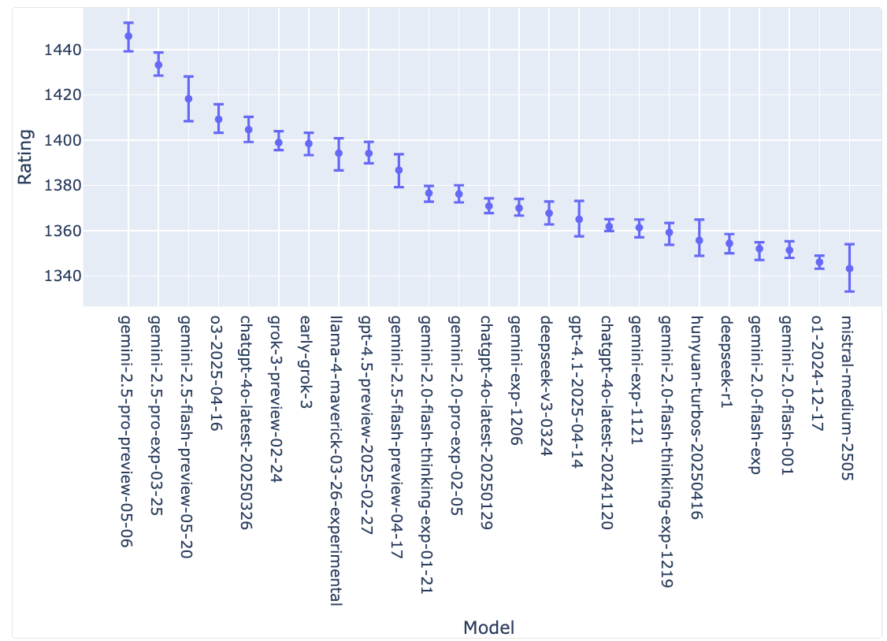
lmarena.ai Chatbot Arena Leaderboard
Confidence Intervals on Model Strength (via Bootstrapping)
https://huggingface.co/spaces/lmarena-ai/chatbot-arena-leaderboard

Slide 60
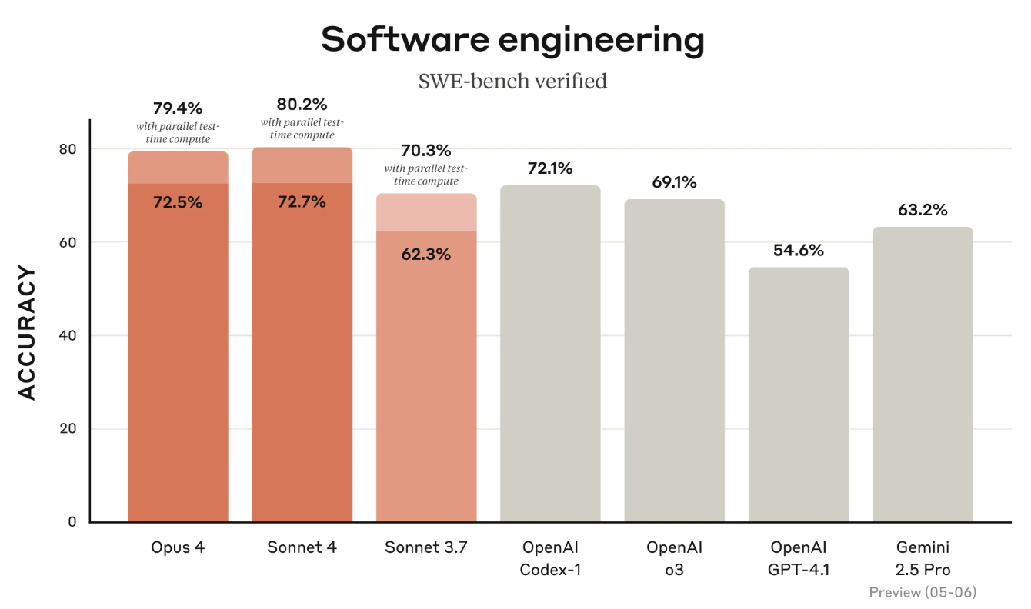
Claude 4 Opus and Sonnet
Source: https://www.anthropic.com/news/claude-4

Slide 61
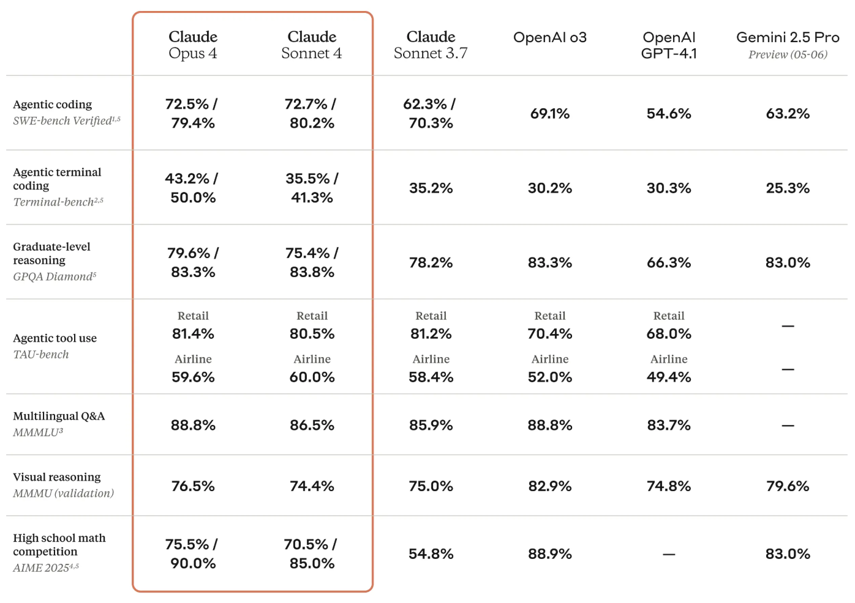
Claude Opus 4, Claude Sonnet 4, OpenAI o3,
OpenAI GPT-4.1
Gemini 2.5 Pro
Source: https://www.anthropic.com/news/claude-4

Slide 62
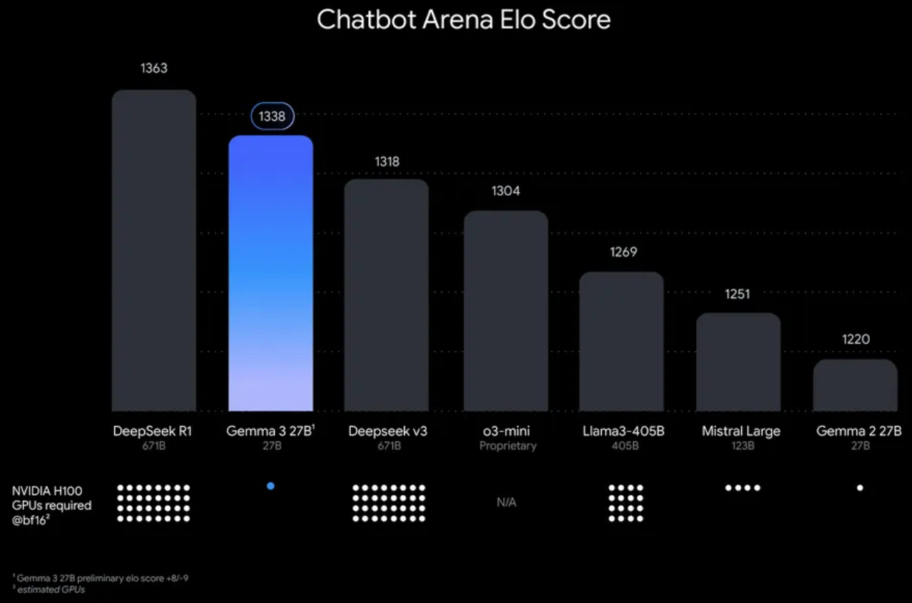
Google Gemma 3 27B
The most capable model you can run on a single GPU or TPU
Source: https://blog.google/technology/developers/gemma-3/

Slide 63
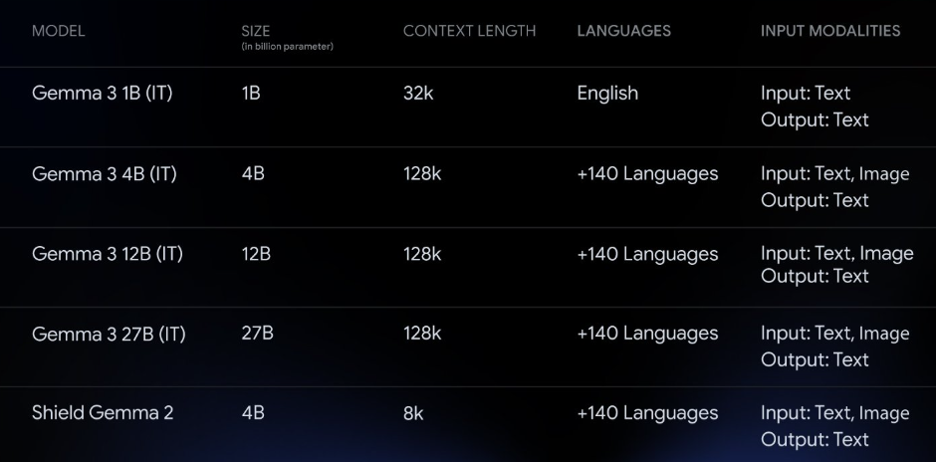
Google Gemma 3 Multimodality
(vision-language input and text outputs)
Source: https://developers.googleblog.com/en/introducing-gemma3/

Slide 64
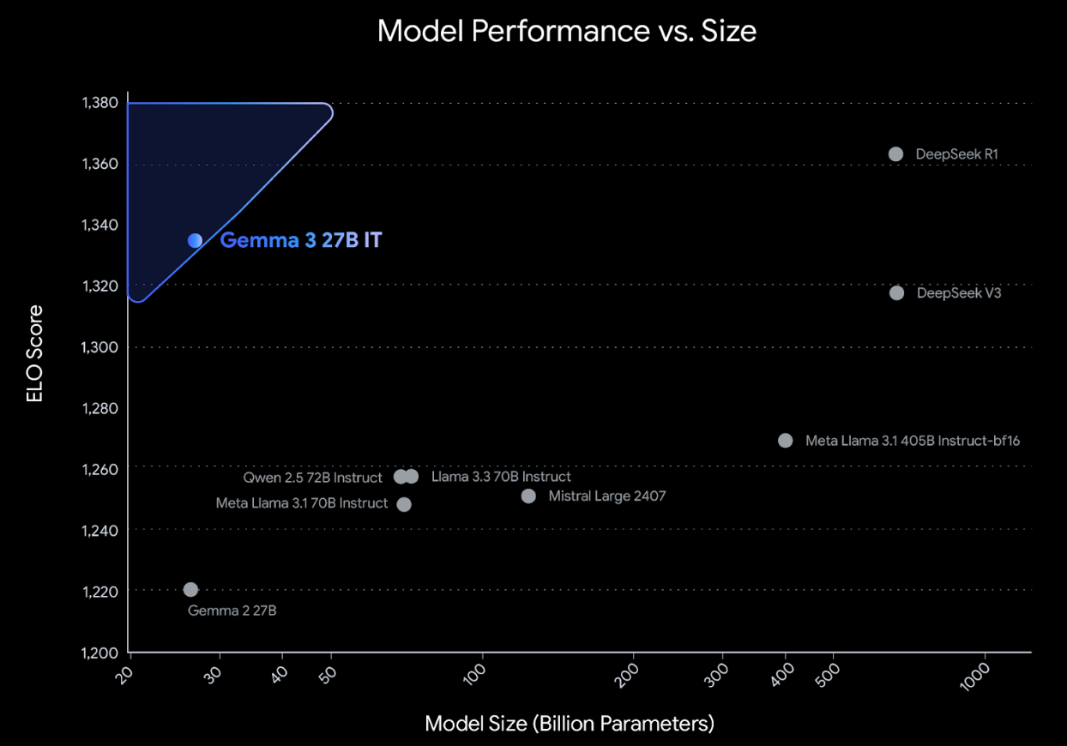
Google Gemma 3: Pre-training and Post-training
(distillation, reinforcement learning, and model merging)
Source: https://developers.googleblog.com/en/introducing-gemma3/

Slide 65
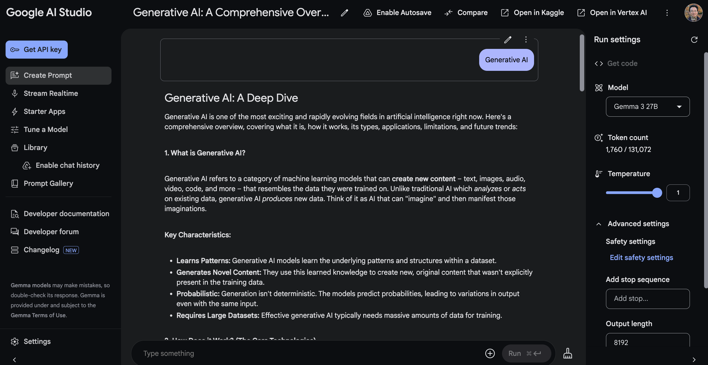
Google AI Studio (Gemma 3 27B)
Source: https://aistudio.google.com/

Slide 66
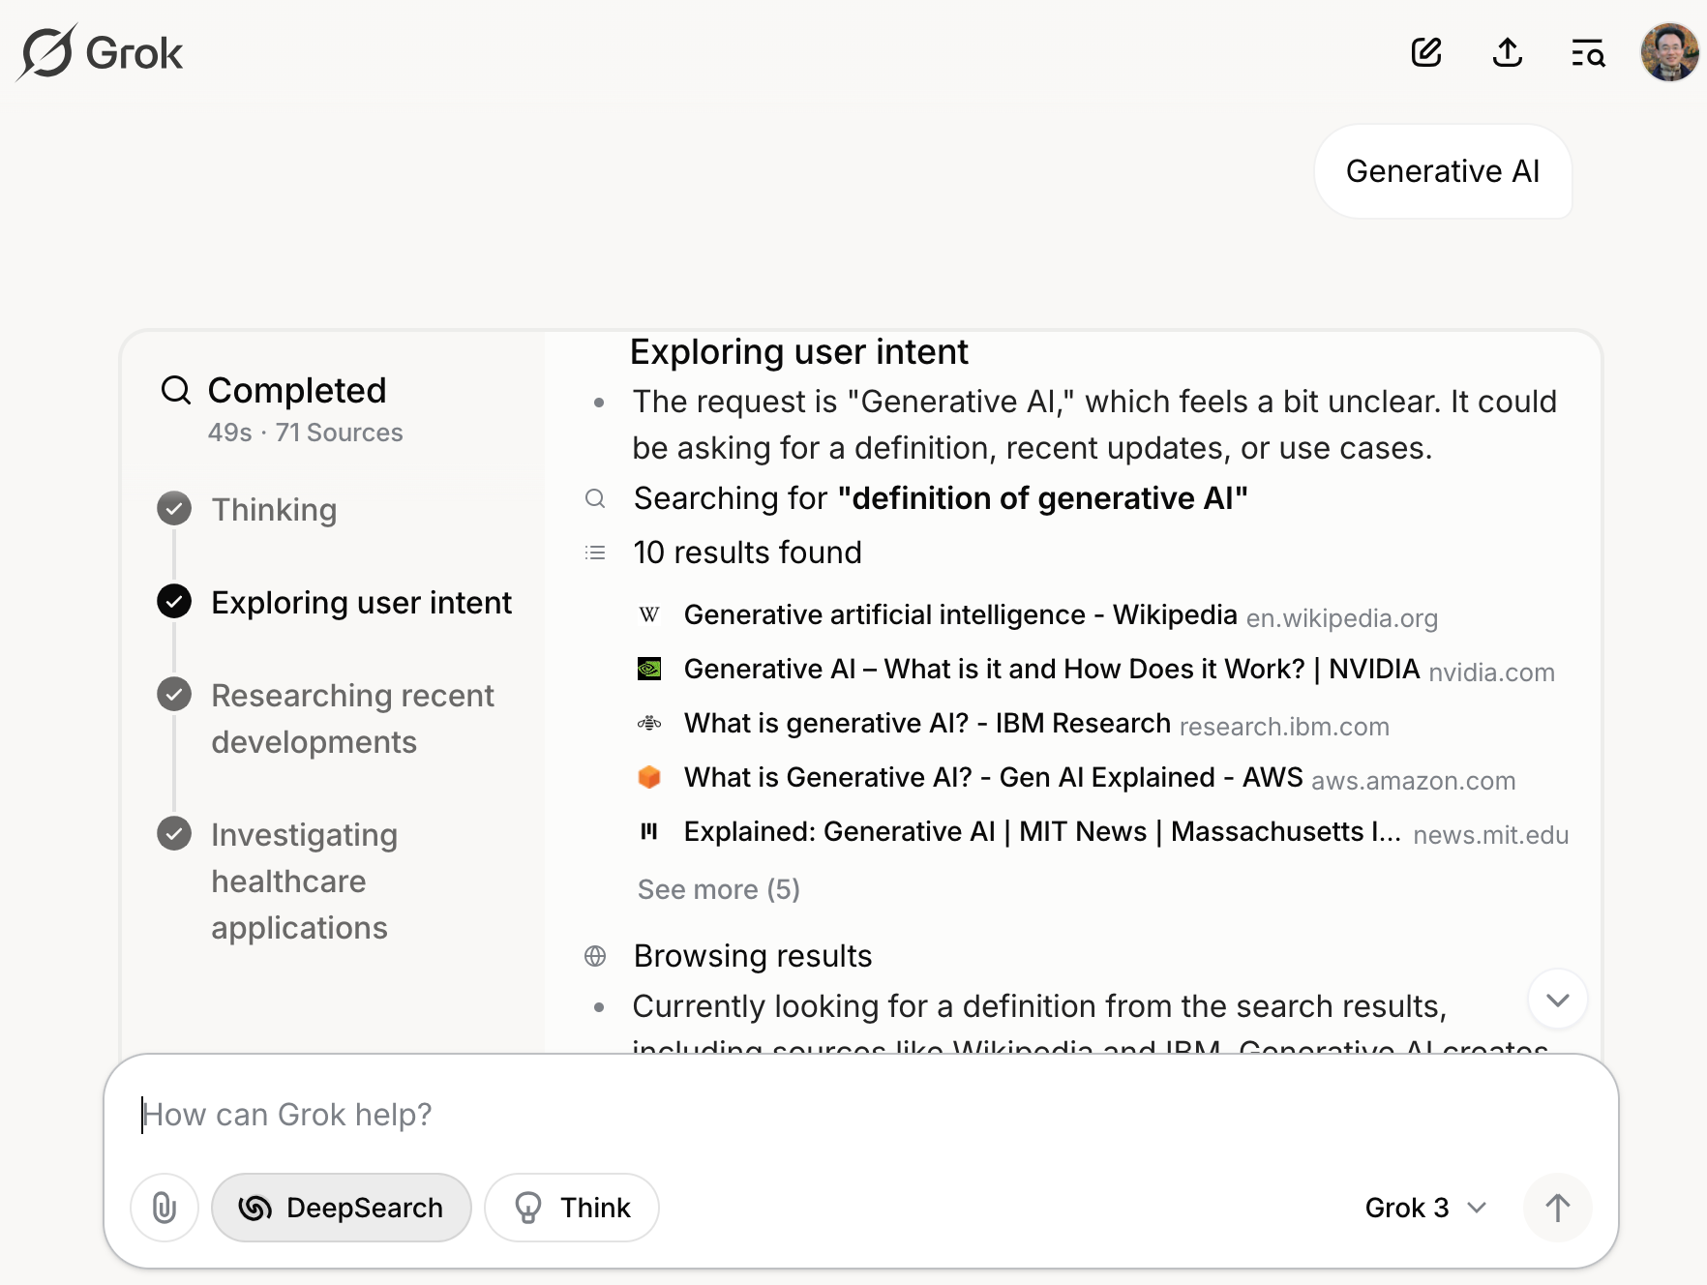
Grok 3 Deep Search
Source: https://grok.com/chat

Slide 67
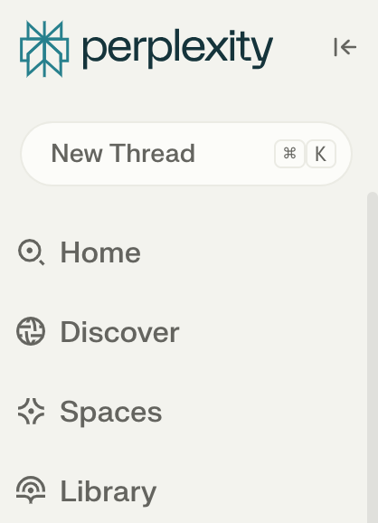
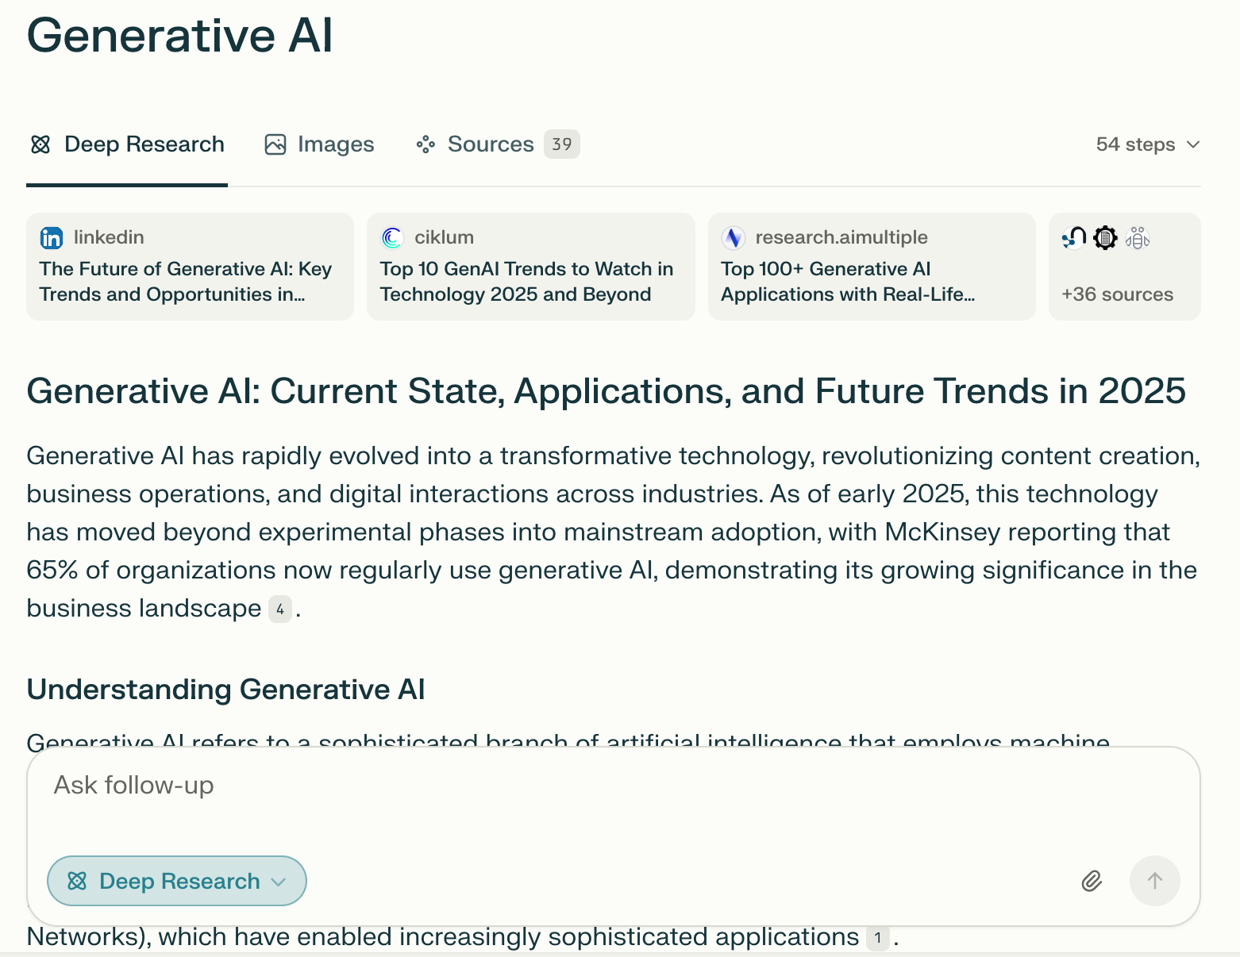
Perplexity.ai Deep Research
Source: https://www.perplexity.ai/

Slide 68
人工智慧與生成式AI簡介
1
1. 人工智慧的基本概念與發展歷程回顧
2. 生成式AI的基本概念與應用場景
3. ChatGPT、GPT-4o等大型語言模型 (LLM)
基本概念和工作原理
4. AI應用現況與未來展望

Slide 69
大型語言模型：AI的語言大腦
(Large Language Models (LLMs): AI's Linguistic Brain)
定義：基於深度學習的語言處理AI模型
(Definition: Deep learning-based AI models for language processing)
代表：ChatGPT, GPT-4
(Representatives: ChatGPT, GPT-4)

Slide 70
LLM工作原理
(LLM Working Principle)
1. 預訓練 (Pre-training)
2. 理解上下文 (Context understanding)
3. 生成回應 (Response generation)
4. 微調和強化 (Fine-tuning and reinforcement)

Slide 71

What is ChatGPT ?
G – Generative (生成）
P – Pre-trained (預訓練)
T – Transformer

Slide 72

Transformer (Attention is All You Need)
(Vaswani et al., 2017)
Source: Vaswani, Ashish, Noam Shazeer, Niki Parmar, Jakob Uszkoreit, Llion Jones, Aidan N. Gomez, Łukasz Kaiser, and Illia Polosukhin. "Attention is all you need." In Advances in neural information processing systems, pp. 5998-6008. 2017.

Slide 73
Core Functionality of all
Large Language models (LLMs)
ChatGPT is fundamentally performing a task of predicting and generating text based on the input it receives.
In simple terms
文字接龍

Slide 74
Core Functionality of all
Large Language models (LLMs)
For example:
新北
市
大 (20%)
車 (30%)
市 (30%)
捷 (20%)
臺北
臺北大
學
ANS:臺北大學

Slide 75
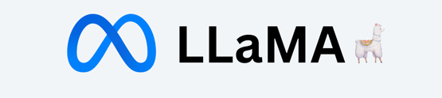




Famous Large Language models (LLMs)
Proprietary LLMs:
Open-Source LLMs:

Slide 76
LLM 的優勢
(Advantages of LLMs)
多功能性 (Versatility)
上下文理解 (Context understanding)
知識整合 (Knowledge integration)
創造性 (Creativity)

Slide 77
LLM 的局限性
(Limitations of LLMs)
幻覺問題 (Hallucination issues)
潛在偏見 (Potential biases)
知識時效性 (Knowledge timeliness)
理解深度限制 (Limits in depth of understanding)

Slide 78

LLM Capabilities
Source: Minaee, Shervin, Tomas Mikolov, Narjes Nikzad, Meysam Chenaghlu, Richard Socher, Xavier Amatriain, and Jianfeng Gao. (2024) "Large language models: A survey." arXiv preprint arXiv:2402.06196 (2024).

Slide 79
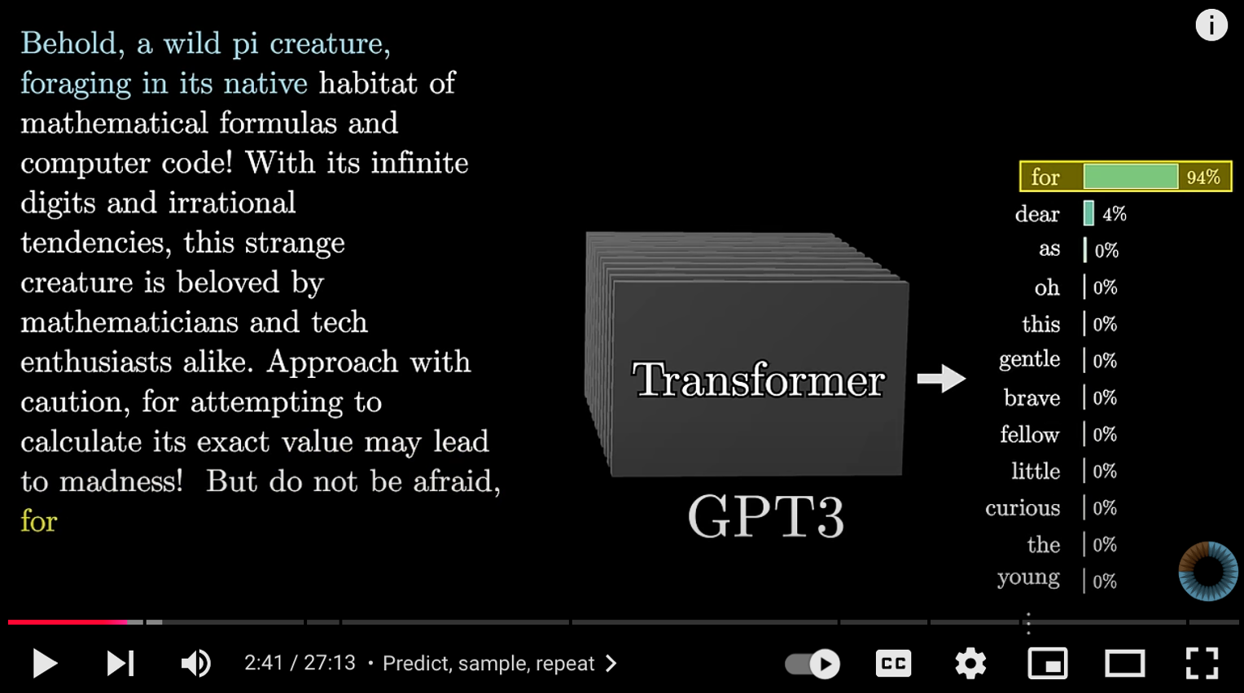
Transformers (how LLMs work)
Source: 3Blue1Brown (2024), Transformers (how LLMs work) explained visually | DL5, https://www.youtube.com/watch?v=wjZofJX0v4M

Slide 80
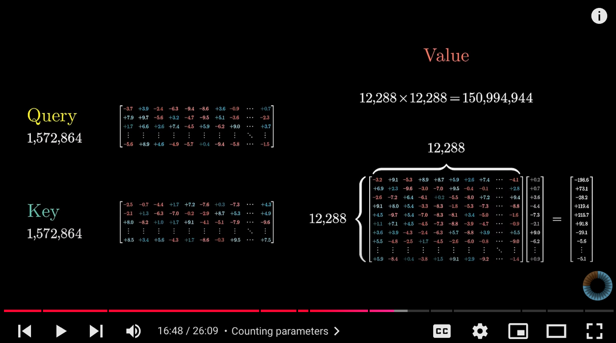
Attention in Transformers
Source: 3Blue1Brown (2024), Attention in transformers, visually explained | DL6, https://www.youtube.com/watch?v=eMlx5fFNoYc

Slide 81
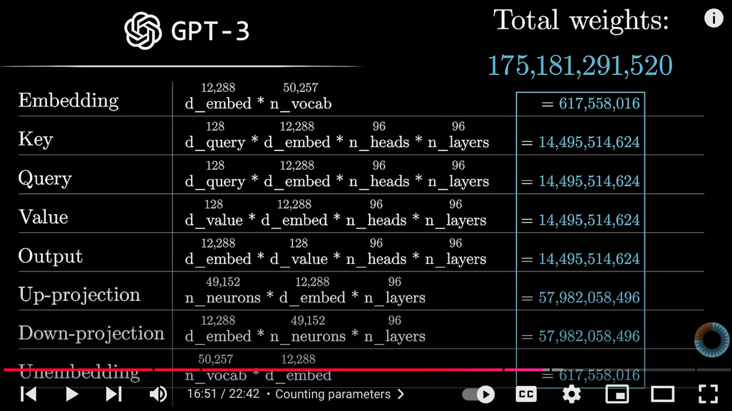
How might LLMs store facts
Source: 3Blue1Brown (2024), How might LLMs store facts | DL7,
https://www.youtube.com/watch?v=9-Jl0dxWQs8

Slide 82
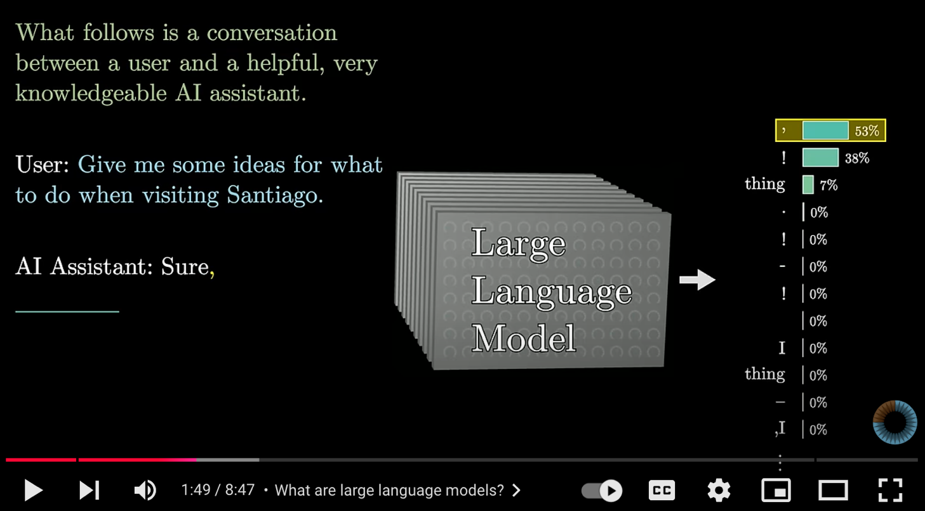
Large Language Models explained briefly
Source: 3Blue1Brown (2024), Large Language Models explained briefly, https://www.youtube.com/watch?v=LPZh9BOjkQs

Slide 83
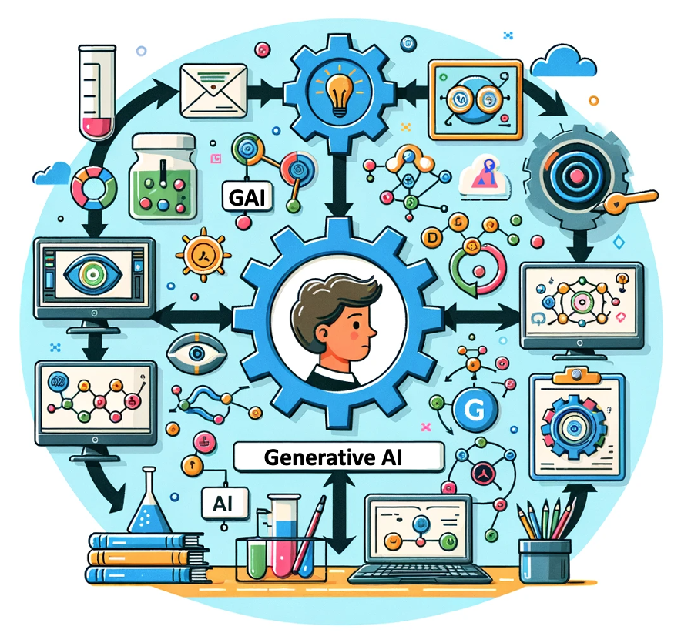
OpenAI ChatGPT (GPT-4) DALL·E 3
Vector graphic of a flowchart depicting the integration of
generative AI in the education process,
from content creation to
virtual experiments,
personalized learning, and innovative learning.
https://chat.openai.com/

Slide 84
人工智慧與生成式AI簡介
1
1. 人工智慧的基本概念與發展歷程回顧
2. 生成式AI的基本概念與應用場景
3. ChatGPT、GPT-4o等大型語言模型 (LLM)
基本概念和工作原理
4. AI應用現況與未來展望

Slide 85
AI技術的主要應用領域
(Main Application Areas of AI Technologies)
醫療健康 (Healthcare)
金融 (Finance)
製造業 (Manufacturing)
零售 (Retail)
交通 (Transportation)
教育 (Education)

Slide 86
AI發展的挑戰
(Challenges of AI Development)
倫理問題 (Ethical issues)
隱私保護 (Privacy protection)
就業影響 (Employment impact)
安全風險 (Security risks)
解釋性問題 (Explainability issues)
法律監管 (Legal regulation)

Slide 87
AI的未來趨勢
(Future Trends of AI)
更強大的多模態AI (More powerful multimodal AI)
自主學習能力 (Autonomous learning capabilities)
人機協作模式 (Human-AI collaboration models)
邊緣AI技術 (Edge AI technology)
可解釋AI系統 (Explainable AI systems)
量子AI發展 (Quantum AI development)

Slide 88
總結與展望
(Summary and Outlook)
AI的潛力與責任
(AI's potential and responsibilities)
跨學科合作的重要性
(Importance of interdisciplinary collaboration)
共同塑造AI的未來
(Shaping the future of AI together)

Slide 89
Summary
人工智慧與生成式AI簡介
1
1. 人工智慧的基本概念與發展歷程回顧
2. 生成式AI的基本概念與應用場景
3. ChatGPT、GPT-4o等大型語言模型 (LLM)
基本概念和工作原理
4. AI應用現況與未來展望

Slide 90
國父紀念館
AI及生成式AI的應用
1
單元1：人工智慧與生成式AI簡介
單元2：生成式AI在公務領域的應用
單元3：生成式AI在公務領域的實作
2
3

Slide 91
生成式AI在公務領域的應用
2
AI於公務領域的應用
生成式AI在公務領域的實務工作應用
智慧客服之最新AI應用方式
文書處理和報告生成
資料分析和摘要

Slide 92
1. AI於公務領域的應用
(Applications of AI in the Public Sector)
1.1 智能文件處理
(Intelligent Document Processing)
1.2 政策分析與報告生成
(Policy Analysis and Report Generation)
1.3 客服和服務自動化
(Public Interaction and Automated Customer Service)

Slide 93
2. 案例分享：生成式AI在公務領域的實務工作應用
(Case Study: Practical Applications of Generative AI in Public Sector)
2.1 案例背景
(Case Background)
2.2 實際應用場景
(Practical Application Scenarios)
2.3 成果與挑戰
(Outcomes and Challenges)

Slide 94
3. 智慧客服之最新AI應用方式
(Latest AI Applications in Smart Customer Service)
3.1 智慧客服的定義與發展
(Definition and Evolution of Smart Customer Service)
3.2 生成式AI在客服中的應用
(Generative AI in Customer Service)
3.3 成功案例分析
(Analysis of Successful Cases)

Slide 95
4. 文書處理和報告生成
(Document Processing and Report Generation)
4.1 文書處理自動化
(Automation of Document Processing)
4.2 報告生成工具介紹
(Introduction to Report Generation Tools)
4.3 AI生成報告的質量控制
(Quality Control in AI-Generated Reports)

Slide 96
5. 資料分析和摘要
(Data Analysis and Summarization)
5.1 資料分析中的生成式AI應用
(Applications of Generative AI in Data Analysis)
5.2 自動化資料摘要技術
(Automated Data Summarization Techniques)
5.3 實際應用案例分享
(Case Studies of Practical Applications)

Slide 97
1. AI於公務領域的應用
(Applications of AI in the Public Sector)
1.1 文件處理工具介紹
(Document Processing Tool Introduction)
1.2 智能文件分析與處理流程
(Smart Document Analysis and Processing Workflow)
1.3 客服和服務自動化
(Public Interaction and Automated Customer Service)

Slide 98

文件處理工具介紹
(Document Processing Tool Introduction)

Slide 99
文件處理工具介紹
(Document Processing Tool Introduction)
Microsoft Lens 介紹：
Microsoft Lens（前稱 Office Lens）是一款由微軟推出的文件掃描和圖片處理應用，能夠將實體文件、筆記、白板內容等快速數位化。該應用支援將照片轉換為 PDF、Word、Excel 和 PowerPoint 文件，並可以直接儲存到 OneDrive、OneNote 或本地設備中。

Slide 100
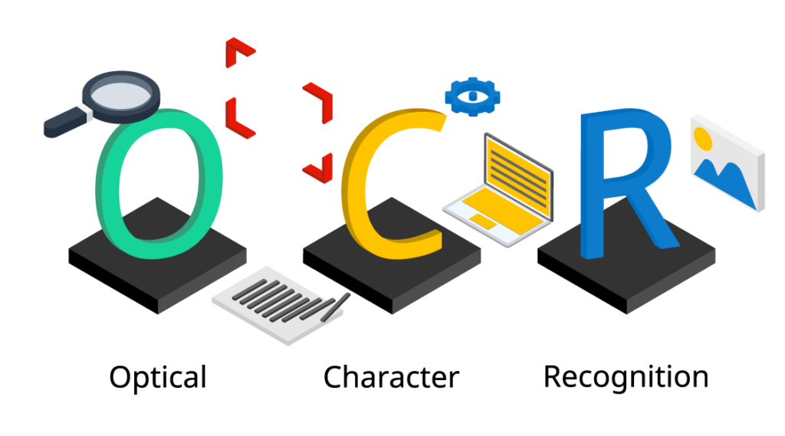
文件處理工具介紹
(Document Processing Tool Introduction)

Slide 101
文件處理工具介紹
(Document Processing Tool Introduction)
OCR 介紹：
光學字符識別（OCR）是一種將圖像中的文字轉換為機器可讀文本的技術。當掃描書籍、照片、名片或文件時，OCR 可識別圖像中的文字，並將其轉換為數位文本格式。這樣用戶可以對文字進行編輯、搜索、儲存，並將其整合至其他應用程序中。

Slide 102


智能文件分析與處理流程
(Smart Document Analysis and Processing Workflow)
1.紙本文件或圖片/電子檔
2.利用智能工具提取文字
3.利用AI工具進行摘要或分析

Slide 103
自動化客服的常見應用場景
(Common Applications of Automated Customer Service)
即時回覆: 自動回應常見問題，處理簡單查詢。
服務查詢: 自動查詢訂單狀態、賬戶資料等。
問題排查: 通過自動化系統進行初步問題診斷。

Slide 104
自動化查詢回覆的成效評估 (Evaluating the Effectiveness of Automated Inquiry Response)
關鍵績效指標（KPIs）: 包括回覆速度、準確率、客戶滿意度等。
數據分析: 利用AI進行客戶回應數據的分析和報告生成。

Slide 105
如何改進AI查詢回覆系統
(Improving AI-Based Inquiry Response Systems)
基於反饋的改進: 根據客戶反饋不斷調整和優化系統。
持續學習與調整: 通過機器學習模型的持續訓練來提高回覆質量。

Slide 106
2. 案例分享：生成式AI在公務領域的實務工作應用
(Case Study: Practical Applications of Generative AI in Public Sector)
2.1 案例背景
(Case Background)
2.2 實際應用場景
(Practical Application Scenarios)
2.3 成果與挑戰
(Outcomes and Challenges)

Slide 107
案例背景：智能革新數位領航計畫
便捷服務
  智慧客服：24/7即時回應
  智慧祕書：個性化精準服務
  智慧櫃臺：協助完成業務申辦流程
效能提升
  發展各種智慧助手
  提升業務處理與審查效率
  降低人為錯誤，提升決策品質
Source: 蘇文彬 (2024), 數位部長黃彥男揭露AI為下階段政府轉型發展關鍵, https://www.ithome.com.tw/news/164732

Slide 108
配套措施
提出政府AI應用發展指引與技術、管理指南
推動政府AI人才培育
建立政府大型語言模型的應用試驗場域
Source: 蘇文彬 (2024), 數位部長黃彥男揭露AI為下階段政府轉型發展關鍵, https://www.ithome.com.tw/news/164732

Slide 109
政府AI人培計畫
持續性、系統性培訓及技術支持
涵蓋各職務公務人員
舉辦AI實務課程、工作坊及應用成果競賽
Source: 蘇文彬 (2024), 數位部長黃彥男揭露AI為下階段政府轉型發展關鍵, https://www.ithome.com.tw/news/164732

Slide 110
政府大型語言模型應用試驗場域
提供10個以上開源或封閉式語言模型
建置AI Bots市集
提供至少20種共通性AI Bots
Source: 蘇文彬 (2024), 數位部長黃彥男揭露AI為下階段政府轉型發展關鍵, https://www.ithome.com.tw/news/164732

Slide 111
生成式AI在公務領域的應用潛力
知識管理
專案管理
資料治理和分析
文件審核和處理
程式碼撰寫
Source: 蘇文彬 (2024), 數位部長黃彥男揭露AI為下階段政府轉型發展關鍵, https://www.ithome.com.tw/news/164732

Slide 112
成果與挑戰
防範4種AI偏誤：
  資料偏差
  關聯偏差
  自動化偏誤
  確認偏誤
數位部成立AI評測中心，進行10項AI評測
Source: 蘇文彬 (2024), 數位部長黃彥男揭露AI為下階段政府轉型發展關鍵, https://www.ithome.com.tw/news/164732

Slide 113
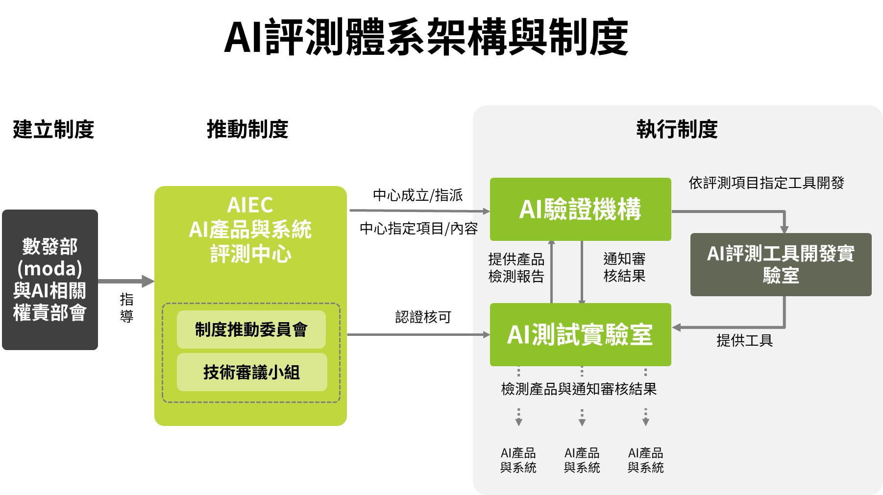
AI產品與系統評測中心
(Artificial Intelligence Evaluation Center)
Source: https://www.aiec.org.tw/AboutUs/EstablishmentBackground

Slide 114
3. 智慧客服之最新AI應用方式
(Latest AI Applications in Smart Customer Service)
3.1 智慧客服的定義與發展
(Definition and Evolution of Smart Customer Service)
3.2 生成式AI在客服中的應用
(Generative AI in Customer Service)
3.3 成功案例分析
(Analysis of Successful Cases)

Slide 115
智慧客服概述
(Overview of Intelligent Customer Service)
智慧客服的基本定義:
智慧客服是一種利用人工智能技術來自動處理客戶 查詢和服務請求的系統。與傳統客服相比，它能夠 24/7全天候提供即時回應，並且能夠進行多任務處理。
智慧客服 V.S. 傳統客服:
智慧客服利用自然語言處理（NLP）和機器學習來 理解 和回應客戶需求，與傳統的人工客服相比，
效率更高，成本更低。

Slide 116
生成式AI如何提升客戶互動
(Enhancing Customer Interactions with Generative AI)
自動化回覆 (Automated Responses)
個性化推薦 (Personalized Recommendations)
情感分析 (Sentiment Analysis)

Slide 117
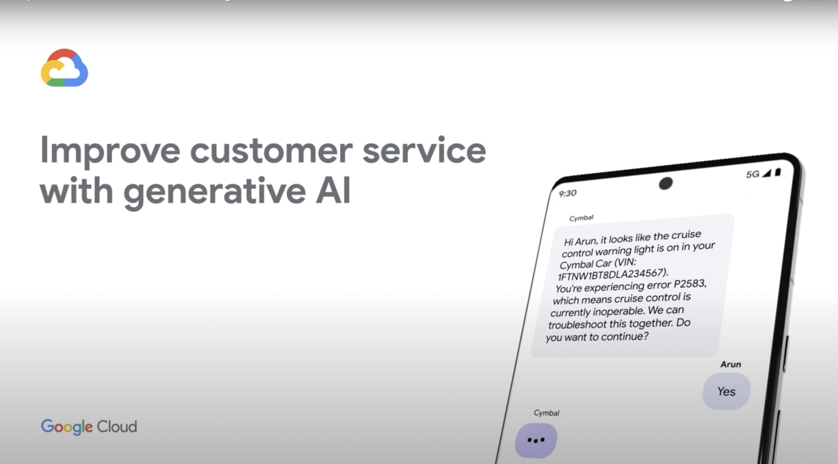
智慧客服案例影片
(Demo video of Intelligent Customer Service)
Source: https://www.youtube.com/watch?v=62C72x0Y6jA

Slide 118
智慧客服中的自然語言處理
(Natural Language Processing in Intelligent Customer Service)
自然語言處理（NLP）在智慧客服中的核心作用:
NLP使智慧客服能夠理解和處理自然語言查詢，
並生成合適的回應。
NLP技術能夠分析客戶情緒，提供更為個性化的服務。

Slide 119
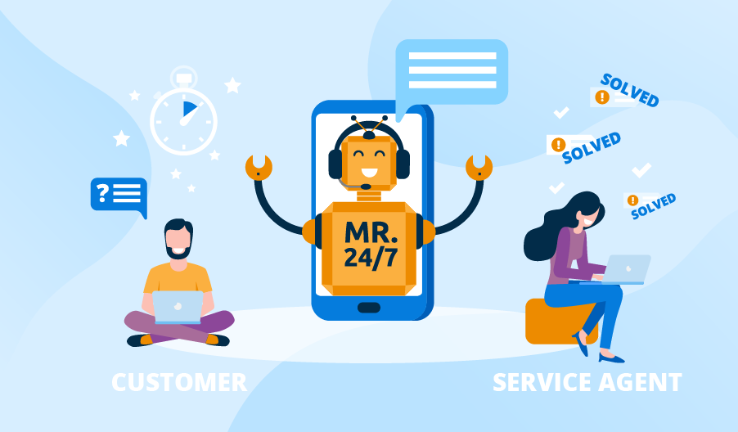
虛擬助手與聊天機器人
(Virtual Assistants and Chatbots)

Slide 120
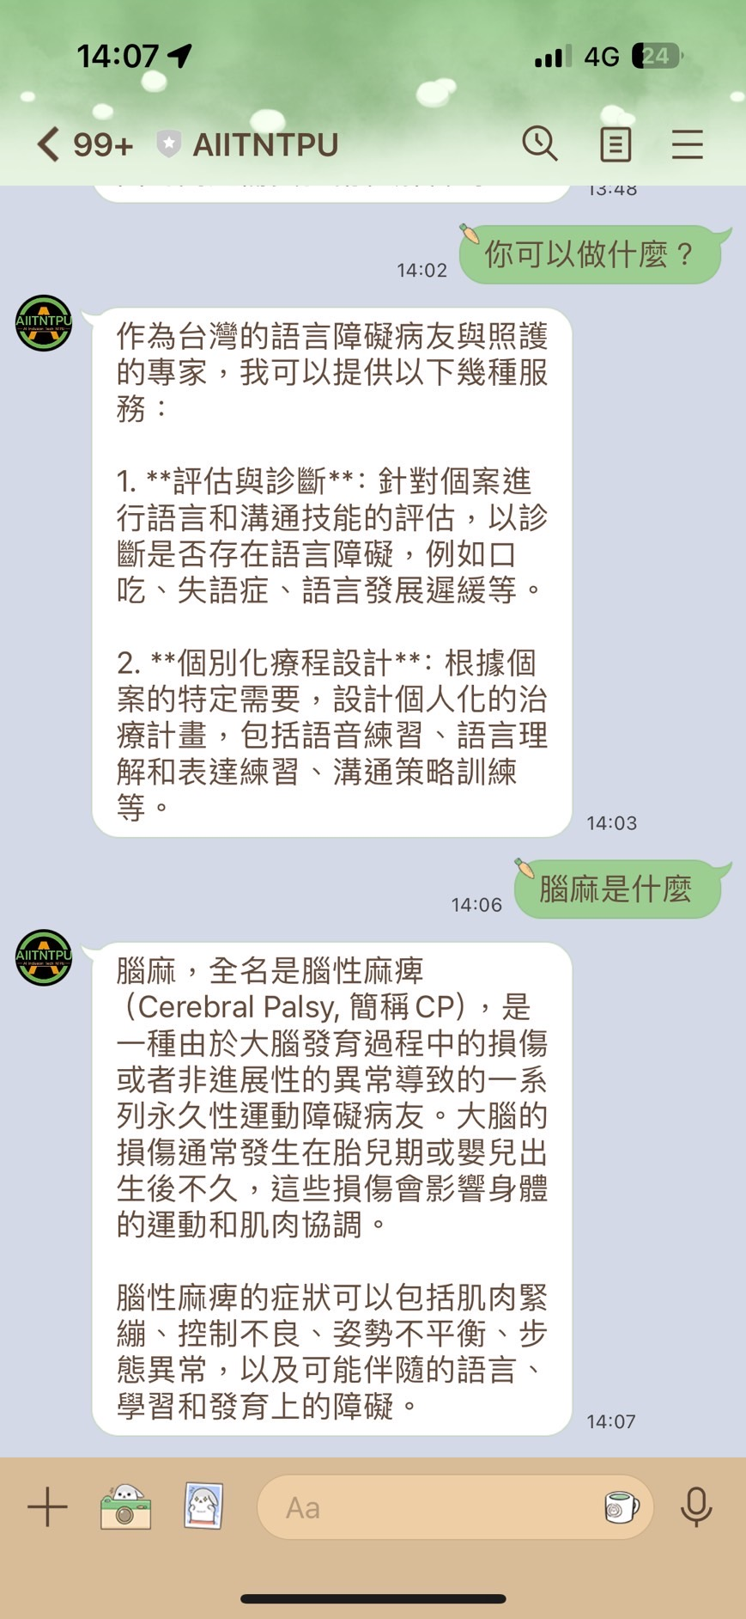
成功案例分享
(Analysis of Successful Cases)
AIITNTPU-Chatbot:包容溝通支持多模態跨語言任務導向對話系統

Slide 121
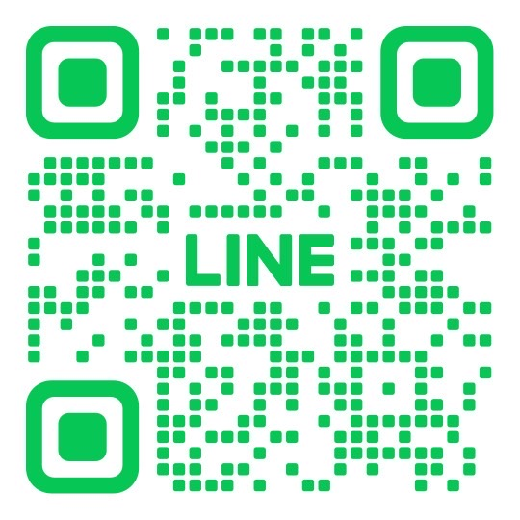
成功案例分享
(Successful Case Studies)
AIITNTPU-Chatbot:
包容溝通支持多模態
跨語言任務導向對話系統
LINE BOT DEMO
Reference: 【包容科技】AI讓語言障礙者「再聲」！, https://www.youtube.com/watch?v=Qf0oYYAMyjI

Slide 122
3. 客戶服務和查詢回覆
(Customer Service and Inquiry Response)
3.1 自動化客戶服務的應用
(Applications of Automated Customer Service)
3.2 查詢回覆系統的生成式AI技術
(Generative AI Techniques in Inquiry Response Systems)
3.3 成效評估與改進
(Effectiveness Evaluation and Improvement)

Slide 123
自動化客服的常見應用場景
(Common Applications of Automated Customer Service)
即時回覆：自動回應常見問題，處理簡單查詢。
服務查詢：自動查詢訂單狀態、帳戶資料等。
問題排查：通過自動化系統進行初步問題診斷。

Slide 124
自動化查詢回覆的成效評估
(Evaluating the Effectiveness of Automated Inquiry Response)
關鍵績效指標（KPIs）:
包括回覆速度、準確率、客戶滿意度等。
數據分析：利用AI進行客戶回應數據的分析和報告生成。

Slide 125
如何改進AI查詢回覆系統
(Improving AI-Based Inquiry Response Systems)
基於回饋的改進：
根據客戶回饋不斷調整和優化系統。
持續學習與調整：
通過機器學習模型的持續訓練來提高回覆質量。

Slide 126
4. 文書處理和報告生成
(Document Processing and Report Generation)
4.1 文書處理自動化
(Automation of Document Processing)
4.2 報告生成工具介紹
(Introduction to Report Generation Tools)
4.3 AI生成報告的質量控制
(Quality Control in AI-Generated Reports)

Slide 127
4. 文書處理和報告生成
(Document Processing and Report Generation)
4.1 文書處理自動化
(Automation of Document Processing)
4.2 報告生成工具介紹
(Introduction to Report Generation Tools)
4.3 AI生成報告的品質控制
(Quality Control in AI-Generated Reports)

Slide 128
文書處理的定義與重要性
(Definition and Importance of Document Processing)
定義：文書處理指的是對各種文本文件的
建立、編輯、管理和存儲。
重要性：在現代辦公環境中，
文書處理是提高效率、確保數據準確性和安全性的關鍵。

Slide 129

常見的報告生成工具
(Common Tools for Report Generation)
Source:https://www.canva.com/

Slide 130
常見的報告生成工具
(Common Tools for Report Generation)
Canva 介紹：
Canva 是一款用於建立視覺內容的線上設計工具
提供豐富的模板、簡單的拖放編輯功能
適合初學者和專業設計師
用於製作報告、簡報和海報等多種設計項目。

Slide 131

常見的報告生成工具
(Common Tools for Report Generation)
Source:https://www.microsoft.com/zh-tw/power-platform/products/power-bi

Slide 132
常見的報告生成工具
(Common Tools for Report Generation)
Power BI 介紹：
Power BI 是微軟推出的商業智慧工具
能夠將多種數據來源整合到一個平台中
通過直觀的儀表板和互動報告提供實時洞察
具有強大的數據分析能力，適合中小型企業及大型組織使用。

Slide 133
常見的報告生成工具
(Common Tools for Report Generation)
Power BI 主要功能：
可自定義儀表板和互動報告： Power BI 允許用戶創建高度自定義的儀表板和報告，並具備互動式的可視化功能。用戶可以通過拖放操作輕鬆設計符合業務需求的報告，而無需擁有深入的技術知識。
集成和數據連接性： Power BI 支持與多種數據來源的集成，包括 Excel、SQL Server、Salesforce、Google Analytics 等。
AI 驅動的洞察： Power BI 利用微軟在人工智能方面的最新進展，提供如 Copilot 等自動報告生成和數據分析工具。這使用戶能夠在最少手動輸入的情況下創建詳細報告，並從結構化和非結構化數據中獲得洞察。
實時數據訪問： Power BI 能夠在儀表板上實時更新數據，使用戶能夠迅速做出明智的決策。

Slide 134
生成式AI在報告中的應用
(Applications of Generative AI in Report Writing)
內容生成：
生成式AI自動撰寫報告的各部分，如摘要、結論和推薦。
自動化校對：
使用AI進行語法和格式的自動校對，確保報告準確無誤。

Slide 135
AI生成報告的品質控制
(Quality Control in AI-Generated Reports)
1. 資料準備：確保輸入數據的準確性和完整性
2. 模型選擇：選擇適合任務的AI模型
3. 人工審核：專家審查AI生成的內容
4. 一致性檢查： 確保報告內部邏輯一致
5. 事實核查：驗證關鍵資訊和數據
6. 格式和風格：確保符合組織標準
7. 持續改進：收集回饋並優化流程

Slide 136
5. 資料分析和摘要
(Data Analysis and Summarization)
5.1 資料分析中的生成式AI應用
(Applications of Generative AI in Data Analysis)
5.2 自動化資料摘要技術
(Automated Data Summarization Techniques)
5.3 實際應用案例分享
(Case Studies of Practical Applications)

Slide 137
生成式AI如何優化資料分析
(How Generative AI Optimizes Data Analysis)
自動化數據處理：
生成式AI可以自動處理和整理大量數據，減少人工。
模式識別與預測：
AI可以識別數據中的模式並進行預測分析，提升準確性。

Slide 138
生成式AI如何自動生成資料摘要
(How Generative AI Automatically Summarizes Data)
關鍵資訊提取：
生成式AI能夠識別數據中的關鍵資訊並自動生成摘要。
多語言支持：
生成式AI可以生成多語言摘要，方便全球化應用。

Slide 139
Summary
生成式AI在公務領域的應用
AI於公務領域的應用
生成式AI在公務領域的實務工作應用
智慧客服之最新AI應用方式
文書處理和報告生成
資料分析和摘要

Slide 140
國父紀念館
AI及生成式AI的應用
1
單元1：人工智慧與生成式AI簡介
單元2：生成式AI在公務領域的應用
單元3：生成式AI在公務領域的實作
2
3

Slide 141
生成式AI在公務領域的實作
3
1. ChatGPT基礎操作與公務應用
2. 生成式AI在公務的進階應用與實作

Slide 142
ChatGPT
由 OpenAI 公司開發的大型語言模型 (Large Language Model, LLM)。
擅長理解人類語言並進行自然流暢的對話。
主要應用：
  回答問題、提供解釋
  撰寫各類文本 (郵件、報告、詩歌、程式碼等)
  內容摘要、重點整理
  語言翻譯
  創意發想、腦力激盪

Slide 143
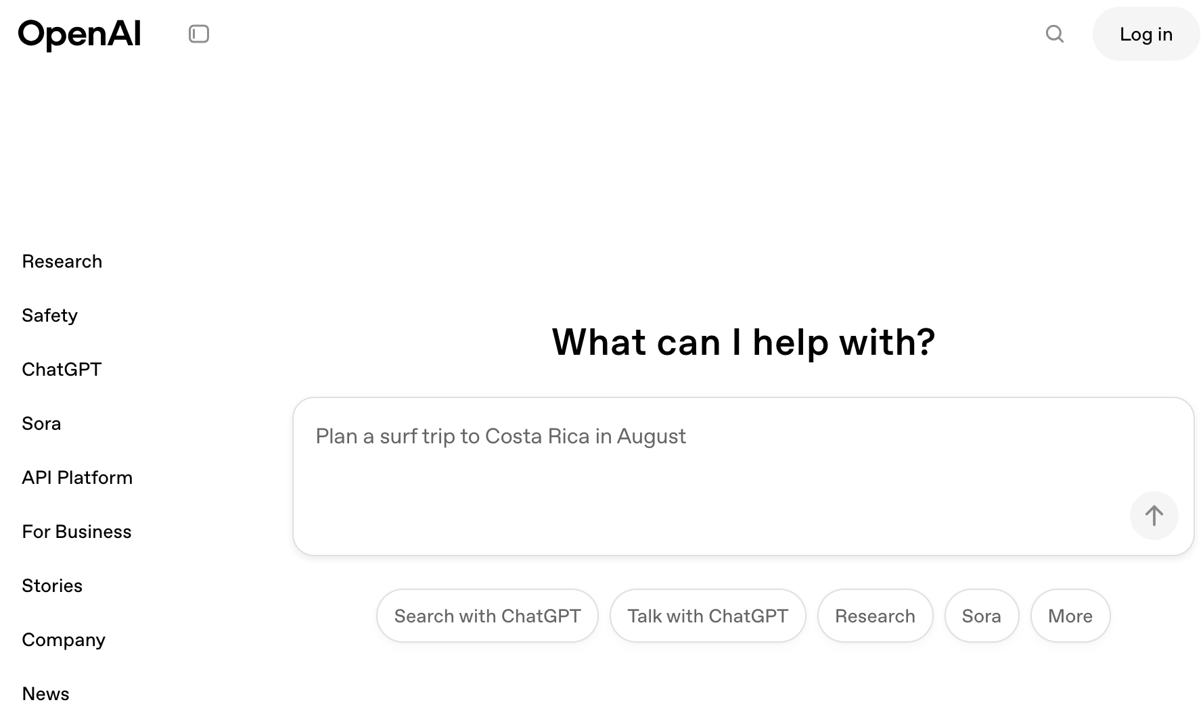
ChatGPT
https://openai.com/

Slide 144
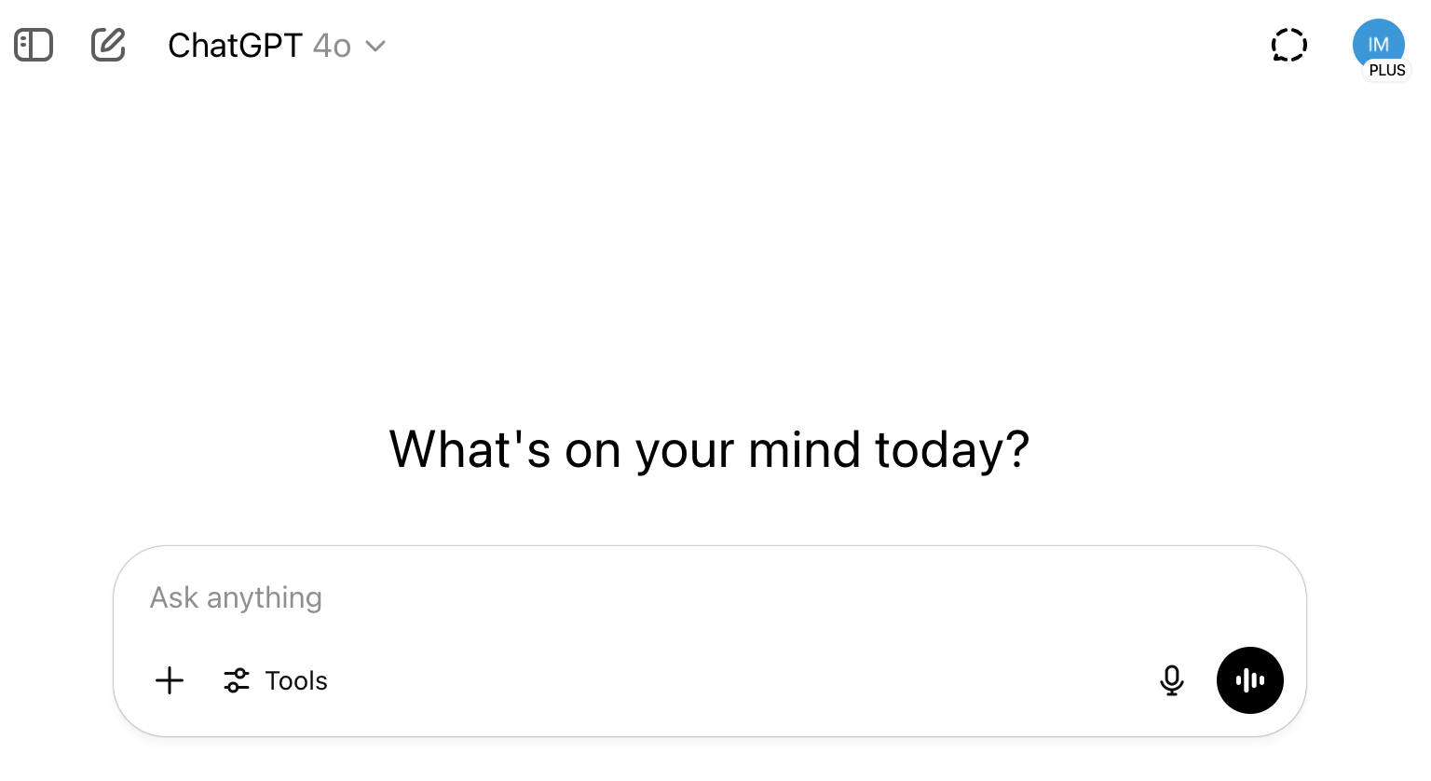
ChatGPT
https://chatgpt.com/

Slide 145
與ChatGPT的基本互動
如何「問」出好答案？
  在輸入框中輸入您的問題或指令
    示範1： 簡單提問「新北市的市花是什麼？」
    示範2： 追問「請用五點條列說明它的特色」
  調整對話風格：
    示範3： 「請用活潑的語氣介紹新北市的財政局主要業務」
開啟新對話：
  不同主題，建議開啟新的對話，避免AI混淆

Slide 146
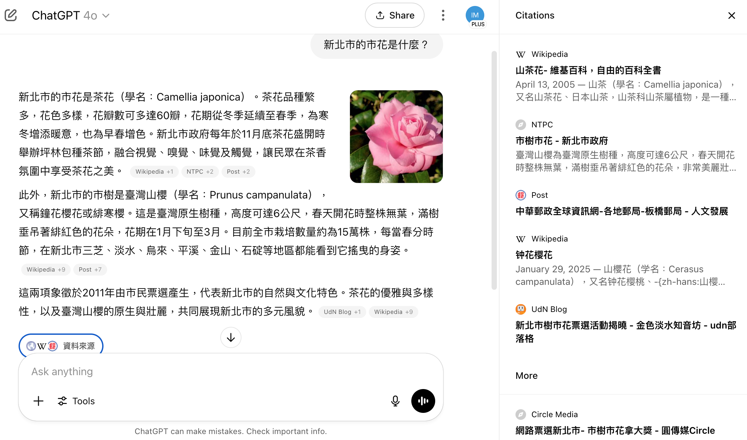
ChatGPT
https://chatgpt.com/

Slide 147
使用 ChatGPT 的 注意事項
1. 隱私第一，公務機密不上傳
2. 資訊真實性，務必查核
3. 潛在偏見，小心判讀
4. 知識截止日期

Slide 148
ChatGPT 在一般公務情境的應用
文書工作小幫手：
  草擬/潤飾： 電子郵件、會議通知、活動新聞稿初稿、政策宣導短文
  摘要/整理： 長篇公開報告或文章的重點摘要 (非機密文件)
資訊查詢與學習：
  快速查詢公開的法規條文 (仍需對照官方版本)
  解釋專業術語或概念 (如：什麼是「開源節流」的具體做法)
創意發想與腦力激盪：
  活動標語、宣導主題、解決方案初步構想
  例如：「為財政局設計一個提升民眾參與度的線上活動點子」
基礎翻譯： (公開、非正式文件可參考)

Slide 149
ChatGPT於公務的應用場景發想
引導問題： 在公務有哪些環節可以嘗試讓ChatGPT來輔助，以提升效率或品質呢？

Slide 150
ChatGPT於公務的應用場景發想
引導問題： 在公務有哪些環節可以嘗試讓ChatGPT來輔助，以提升效率或品質呢？
潛在應用方向：
  民眾服務：
    協助草擬常見公務問題的標準化回覆初稿 (基於公開資訊)。
    撰寫網站FAQ (常見問答) 的內容建議。
  內部行政：
    將會議重點轉為初步的會議記錄草稿。
    為內部訓練課程產生大綱建議。
  政策宣傳：
    將公務條文，轉為民眾易懂的說明文字。
    發想公務知識普及的社群媒體貼文點子。

Slide 151
詠唱的魔法：提示詞 (Prompt) 工程基礎
什麼是提示詞 (Prompt)？
  您給予AI的「指令」或「問題」
  核心概念： 提示詞的品質，直接影響AI生成內容的品質
  「問對問題，事半功倍」
為什麼提示詞很重要？
  引導AI理解您的確切需求
  幫助AI聚焦在特定範圍，產生更相關、更精準的回答

Slide 152
基礎提示詞技巧：
清晰具體、給足資訊、
角色扮演、指定格式、循環優化
1. 清晰明確 (Clear & Specific)
2. 提供足夠的上下文 (Context)
3. 設定角色 (Define a Role/Persona)
4. 指定輸出格式 (Specify Output Format)
5. 循環與優化 (Iterate & Refine)

Slide 153
基礎提示詞技巧：
清晰具體
1. 清晰明確 (Clear & Specific)：
  避免模糊、籠統的指令
  NG範例： 「幫我寫財政報告」 (太模糊)
  OK範例： 「請幫我草擬一份關於台北市政府113年度上半年地方稅收情況的初步分析報告大綱，包含主要稅收來源、與去年同期比較、以及可能的影響因素三個部分」

Slide 154
基礎提示詞技巧：
給足資訊
2. 提供足夠的上下文 (Context)：
  讓AI了解背景資訊，有助於產生更到位的內容
  NG範例： 「總結一下」 (總結什麼？)
  OK範例： 「我將提供一段關於財產管理的會議記錄文字，請你協助將其總結為300字以內的重點摘要」

Slide 155
基礎提示詞技巧：
角色扮演
3. 設定角色 (Define a Role/Persona)：
  讓AI模擬特定專家或身份。
  範例： 「你是一位資深的財經記者，請用中立客觀的語氣，分析近期新台幣匯率波動對地方政府財政的潛在影響」

Slide 156
基礎提示詞技巧 ：
指定格式
4. 指定輸出格式 (Specify Output Format)：
  要求AI以特定形式呈現內容
  (條列、表格、段落、程式碼等)
  範例： 「請將上述影響整理成一個包含『影響層面』和『具體說明』兩欄的表格」
  範例： 「你是一位資深的財經記者，請用中立客觀的語氣，分析近期新台幣匯率波動對地方政府財政的潛在影響。
  請將上述影響整理成一個包含『影響層面』和『具體說明』兩欄的表格」

Slide 157
基礎提示詞技巧：
循環優化
5. 循環與優化 (Iterate & Refine)：
  很少一次就能得到完美結果
  可針對AI的回答進行追問或要求修改
  範例：
  「針對上一點，可以再詳細說明嗎？」
  或
  「請讓語氣更正式一些」

Slide 158
提示詞實戰：財政情境優劣對比
情境一：撰寫政策說明初稿
  劣Prompt：
  「寫個房屋稅說明。」
  優Prompt：
  「你是一位台北市政府財政局的稅務宣導人員，請為首次購屋的市民，草擬一篇關於房屋稅如何計算的說明文稿，約500字。內容需包含稅率、稅基、計算公式，並舉一個簡單易懂的例子。語氣需親切友善。」

Slide 159
提示詞實戰：財政情境優劣對比
情境二：整理會議重點
  劣Prompt：
  「整理會議記錄。」
  優Prompt：
  「以下是一段關於『提升財產活化效益』的內部討論會議錄音文字稿。請協助整理出3-5個主要決議事項，並針對每個事項列出1-2個待辦行動。請用條列式呈現。文字稿內容：…」

Slide 160
Summary
ChatGPT基礎操作與公務應用
  ChatGPT基本操作與重要注意事項
  公務領域與財政局的應用場景
  提升AI回答品質的基礎提示詞技巧

Slide 161
生成式AI在公務領域的實作
3
1. ChatGPT基礎操作與公務應用
2. 生成式AI在公務的進階應用與實作

Slide 162
生成式AI在公務的進階應用與實作
運用生成式AI工具快速分析財務報表與趨勢
AI輔助財產管理的自動化工具與實例
數據視覺化的AI應用與實作示範

Slide 163
生成式AI在財政與財產管理的優勢
快速處理與摘要大量文本/數據
(例如：公開的法規、報告、新聞)
在人類指導下輔助識別初步模式或趨勢
(非取代專業分析)
自動化部分重複性的文書撰擬與溝通任務
(例如：通知、FAQ草稿)
為簡報、報告或宣導活動產生初步的創意點子
  (注意：所有應用都需謹慎評估資安與正確性)

Slide 164
生成式AI與財務報表分析
AI如何「輔助」分析 ：
  摘要重點： 從 (非機敏/已公開/模擬) 財務報表文字描述中提取關鍵資訊
  Prompt範例: 「這是一段 (模擬的) A公司年度損益表摘要文字：『該公司本年度營收較去年成長15%，主要來自新產品線貢獻；然營業成本亦上升10%，導致毛利率略降1%』。請分析其主要財務表現」
解釋名詞： 說明報表中的專業術語或財務比率
  Prompt範例: 「請用簡單易懂的方式解釋什麼是『流動比率』，以及它在評估企業短期償債能力上的意義」

Slide 165
AI輔助財產管理的自動化
AI 如何「輔助」財產管理 ：
  文件自動化： 協助草擬財產盤點通知、維護合約的標準條款建議。
  資訊整理： 從(非機敏)財產維護記錄文字中，摘要常見問題或維護週期。
  圖像辨識 ： 可透過AI辨識財產照片，協助初步分類或盤點 (需專用模型與系統)。

Slide 166
AI輔助財產管理的自動化
財政局應用思考點：
  Prompt範例 (概念性): 「你是一位經驗豐富的國有財產管理專家，請為『提升市有閒置土地活化效益』提供三個創新策略方向，並簡述各策略的優缺點」
  Prompt範例 (文書): 「請草擬一份通知各單位進行年度財產盤點的公文初稿，重點需包含盤點時程、應配合事項及聯絡窗口」

Slide 167
數據視覺化的AI應用與實作示範
AI如何協助數據視覺化？
  建議圖表類型： 根據您想呈現的數據關係，建議適合的圖表 (長條圖、折線圖、圓餅圖等)
    Prompt範例: 「我有一組數據是台北市各行政區過去五年的人口變化，我想呈現各區的增長趨勢並進行比較，建議使用哪種圖表？」
  生成圖表程式碼 (進階)： ChatGPT可以生成Python (使用Matplotlib, Seaborn等套件) 或其他語言的程式碼，來繪製圖表。
    Prompt範例: 「請用Python的Matplotlib套件，生成一個比較A、B、C三個部門預算達成率 (分別為85%, 92%, 78%) 的長條圖程式碼」
  自然語言生成圖表 ： 部分BI工具或AI平台開始支援用自然語言指令直接生成圖表

Slide 168
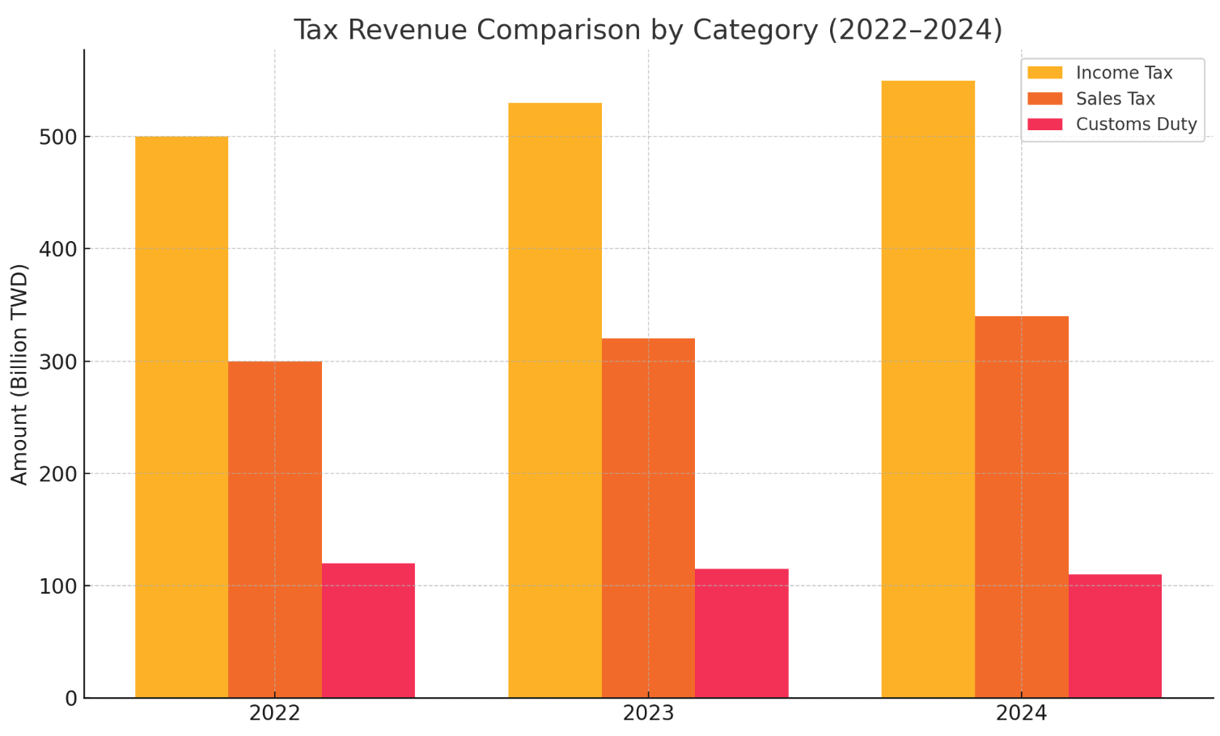
視覺化三種不同稅收項目近三年的金額
import matplotlib.pyplot as plt
import numpy as np
# Reset font settings to use English
plt.rcParams['font.family'] = 'DejaVu Sans'
plt.rcParams['axes.unicode_minus'] = False
# Data
years = ["2022", "2023", "2024"]
income_tax = [500, 530, 550]
sales_tax = [300, 320, 340]
customs_duty = [120, 115, 110]
x = np.arange(len(years))
width = 0.25
# Create the bar chart
fig, ax = plt.subplots()
ax.bar(x - width, income_tax, width, label="Income Tax")
ax.bar(x, sales_tax, width, label="Sales Tax")
ax.bar(x + width, customs_duty, width, label="Customs Duty")
# Add labels and title
ax.set_ylabel("Amount (Billion TWD)")
ax.set_title("Tax Revenue Comparison by Category (2022–2024)")
ax.set_xticks(x)
ax.set_xticklabels(years)
ax.legend()
plt.tight_layout()
plt.show()
Years Inc Tax Sal Tax Cus Tax
2022 500 300 120
2023 530 320 115
2024 550 340 110

Slide 169
實務演練與案例探討 (財政局情境)
情境假設： 財政局近期舉辦了一場「地方財政與您有約」線上座談會，收集到許多民眾透過文字提出的問題與建議
任務：
  初步分類： 如何請ChatGPT將這些民眾提問初步歸類？
  (例如：稅務問題、預算建議、財產活化意見等)
  摘要重點： 如何請ChatGPT摘要各類別中
  民眾最關心的幾個重點？
  草擬FAQ： 如何請ChatGPT協助草擬部分常見問題的FAQ初稿？

Slide 170
地方財政與您有約 線上座談會 提問
市民提問
模擬資料
1. 地價稅為什麼每年都在漲？能不能調整計算方式？
2. 希望明年預算能編更多經費改善老舊社區道路。
3. 市府名下閒置空地太多，能不能釋出讓民間活用？
4. 我想了解營業稅怎麼申報？
5. 建議減少不必要的慶典預算，把錢花在教育上。
6. 地方政府的舊宿舍可以出租或改為青年住宅嗎？
7. 房屋稅率最近會調整嗎？
8. 希望增加公園建設預算，尤其是在南區。
9. 請問遺產稅怎麼計算？
10. 閒置學校建物能否活化再利用？
11. 為什麼去年地價稅比前一年多這麼多？
12. 市府可以公開各局處的年度預算嗎？
13. 建議優先改善北區排水系統，常淹水。
14. 請問我退休後還需要繳房屋稅嗎？
15. 是否可以讓公有市場由民間經營？
16. 請問汽機車燃料費是否可以線上繳納？
17. 建議在預算內多編教育補助，減輕家長負擔。
18. 請問自用住宅稅率與非自用有什麼差別？
19. 我家附近有空置公有地，希望能規劃為停車場。
20. 財政局網站可以增加查稅功能嗎？
21. 去年稅單說明太簡略，能否提供更詳細版本？
22. 市府大樓有空間可以出租辦活動嗎？
23. 能否公布歷年房屋稅調幅與原因？
24. 預算是否可增編社區長照據點設施？
25. 請問土地增值稅是怎麼計算的？
26. 建議活化河岸地區，變成休閒空間。
27. 我繳錯稅了，要怎麼申請退稅？
28. 預算建議多編基層醫療與防災訓練。
29. 養老金有涉及地方財政嗎？
30. 市府財產有無對外公開透明資訊可查？

Slide 171
實務演練與案例探討 (財政局情境)
情境假設： 財政局近期舉辦了一場「地方財政與您有約」線上座談會，
收集到許多民眾透過文字提出的問題與建議
任務：
  初步分類： 如何請ChatGPT將這些民眾提問初步歸類？(例如：稅務問題、預算建議、財產活化意見等)
    Prompt: 「我將提供一批市民對地方財政的提問文字，請協助將它們分類為『稅務諮詢』、『預算編列建議』、『財產管理意見』及『其他』四類。請將分類結果以表格呈現，第一欄為原始問題，第二欄為分類」
  摘要重點： 如何請ChatGPT摘要各類別中民眾最關心的幾個重點？
    Prompt: 「針對上述分類為『稅務諮詢』的民眾提問，請摘要出3個最常被問到的問題核心」
  草擬FAQ： 如何請ChatGPT協助草擬部分常見問題的FAQ初稿？
    Prompt: 「根據摘要出的常見稅務問題『X』，請以財政局名義，用清晰易懂的口吻草擬一則FAQ回覆，約150字」

Slide 172
生成式AI 應用重點：新手同仁
共同目標： 提升工作效率與品質，啟發創新思維。
目標： 熟悉ChatGPT基本操作，克服陌生感，建立信心
應用重點： 從日常文書輔助開始 (潤稿、摘要、簡單提問、郵件草稿)
建議： 多練習、多嘗試不同問法，將AI融入一兩個簡單工作流程

Slide 173
生成式AI 應用重點：有經驗或進階同仁
共同目標： 提升工作效率與品質，啟發創新思維。
目標： 探索AI在更複雜業務、數據洞察、
流程優化上的潛力
應用重點： 更精巧的提示詞設計、
輔助分析 (非機敏) 公開數據、
思考AI如何協助優化現有作業
後續建議： 學習進階提示詞技巧 (如角色鏈、思維鏈)，
關注AI在財政金融領域的專用工具發展 (需符合資安規範)

Slide 174
進階提示詞技巧
1. 思維鏈提示 (Chain-of-Thought Prompting)：
  引導AI「逐步思考」，模仿人類解決複雜問題的過程，以獲得更合理的答案
  範例：
  「財政局希望提升電子繳稅系統的使用率，
  請一步一步思考，
  可以從哪些方面著手？
  (例如：宣傳、易用性、獎勵措施等)，
  並簡述各方面的可能做法。」

Slide 175
進階提示詞技巧
2. 少樣本提示 (Few-Shot Prompting)：
  在提示中給予AI幾個「輸入/輸出」的範例，
  讓它學習您期望的格式或風格。
  範例：
  「請將下列口語化的民眾建議，改寫為較正式的書面建議：
  民眾說：『我覺得那個繳稅網站很難用啦！』
  ->
  書面建議：『建議優化現行線上繳稅系統之使用者介面，提升操作便利性。』
  民眾說：『能不能多辦一些財政講座？』
  ->
  書面建議：『建議增加辦理財政知識相關講座之頻率與多元性。』
  民眾說：『[新的口語化建議]
  』 ->
  書面建議：[AI生成]」

Slide 176
課程總結
生成式AI 是具潛力的技術。
「問對問題」(優良提示詞) 是發揮AI效能的關鍵。
在財政金融、財產管理、數據分析與圖表製作上，
AI可提供有價值的「輔助」，
謹慎並結合專業判斷。
保持好奇、勇於嘗試、持續學習

Slide 177
國父紀念館
AI及生成式AI的應用
1
單元1：人工智慧與生成式AI簡介
單元2：生成式AI在公務領域的應用
單元3：生成式AI在公務領域的實作
2
3

Slide 178
課程目標回顧
國父紀念館
AI及生成式AI的應用
認識人工智慧與生成式AI基本概念與趨勢
掌握ChatGPT基礎操作與應用
學習有效提示詞技巧與實務案例
啟發AI應用於提升工作效能的思考

Slide 179
AI及生成式AI的應用
(Applications of AI and Generative AI)
國父紀念館
AI 知能教育訓練
時間：2025/7/15(二) 14:00 - 16:30
地點：光復國小視聽教室 (國父紀念館旁)
主辦：國立國父紀念館 人事室 陳世源
University Ambassador
戴敏育 教授 (Prof. Min-Yuh Day)
國立臺北大學 資訊管理研究所 教授
金融科技暨綠色金融研究中心 主任
永續辦公室 永續發展組 組長
Certified Instructor
https://web.ntpu.edu.tw/~myday

