Slide 1









人工智慧新趨勢：AI 代理
New Trends in Artificial Intelligence: AI Agent
114年度臺北市政府AI人才培訓班
Time: 2025/7/18 (五) 13:40-16:30
Place: E504電腦教室, 臺北市文山區萬美街二段21巷20號
Organizer: 臺北市政府公務人員訓練處 綜合企劃組 劉雨青
University Ambassador
戴敏育 教授 (Prof. Min-Yuh Day)
國立臺北大學 資訊管理研究所 教授
金融科技暨綠色金融研究中心 主任
永續辦公室 永續發展組 組長
Certified Instructor
2025-07-18

Slide 2










戴敏育 教授
Prof. Min-Yuh Day
1
University Ambassador
Certified Instructor
Professor, Information Management, NTPU
Director, Intelligent Financial Innovation Technology, IFIT Lab, IM, NTPU
Director, Fintech and Green Finance Center (FGFC), NTPU
Division Director, Sustainable Development, Sustainability Office, NTPU
Visiting Scholar, IIS, Academia Sinica
Ph.D., Information Management, NTU
Publications Co-Chairs, International Conference on Advances in Social Networks Analysis and Mining
(ASONAM 2013- )
Program Co-Chair, IEEE International Workshop on Empirical Methods for Recognizing Inference in TExt
(IEEE EM-RITE 2012- )
Publications Chair, The IEEE International Conference on Information Reuse and Integration for Data Science
(IEEE IRI 2007- )

Slide 3
人工智慧新趨勢（AI Agent）
課程目標：
透過智慧代理技術革新臺北市政府服務
深度探索 AI Agent 創新應用
聚焦政府實務操作與服務提升
整合臺北智慧城市創新實證計畫
為成果發表提供專業基礎

Slide 4
Outline
1. AI Agent 基礎與最新趨勢
2. AI Agent 政府應用與智慧城市實作
3. AI Agent 實施策略與治理架構

Slide 5


Innovative Agentic AI Technology for Autonomous
ESG Report Generation
Industrial Technology Research Institute (ITRI),
Fintech and Green Finance Center (FGFC, NTPU),
NTPU-114A513E01, 2025/03/01~2025/12/31

Slide 6
Generative AI-Driven ESG Report
Generation Technology
Industrial Technology Research Institute (ITRI),
Fintech and Green Finance Center (FGFC, NTPU),
NTPU-113A513E01, 2024/03/01~2024/12/31

Slide 7
Agentic AI
Powering
Digital Sustainability Innovation

Slide 8
Generative AI, Agentic AI, Physical AI
Physical AI
Self-driving cars
General robotics
Agentic AI
Coding assistants
Customer service
Patient care
Generative AI
Digital marketing
Content creation
Perception AI
Speech recognition
Deep recommender systems
Medical imaging
2012 AlexNet
Deep learning breakthrough
Source: NVIDIA (2025), GTC March 2025 Keynote with NVIDIA CEO Jensen Huang, https://www.youtube.com/watch?v=_waPvOwL9Z8

Slide 9
AI Agent 定義
從感知到行動的自主決策系統
AI Agent 定義
  能夠感知環境、自主決策並採取行動
  以達成特定目標的智慧系統 (IBM, 2024)
AI Agent 與傳統軟體差異：
  從固定規則轉向動態學習適應 (Ahmed, 2025)

Slide 10

From Generative AI to Agentic AI
Source: Schneider, Johannes. "Generative to Agentic AI: Survey, Conceptualization, and Challenges." arXiv preprint arXiv:2504.18875 (2025).

Slide 11
AI Agent 核心能力
感知能力：自然語言理解、多模態輸入處理
知識基礎：混合式符號-分散式知識表徵系統
推理能力：多步驟邏輯推論與因果分析
行動能力：工具使用、API 整合、即時適應

Slide 12
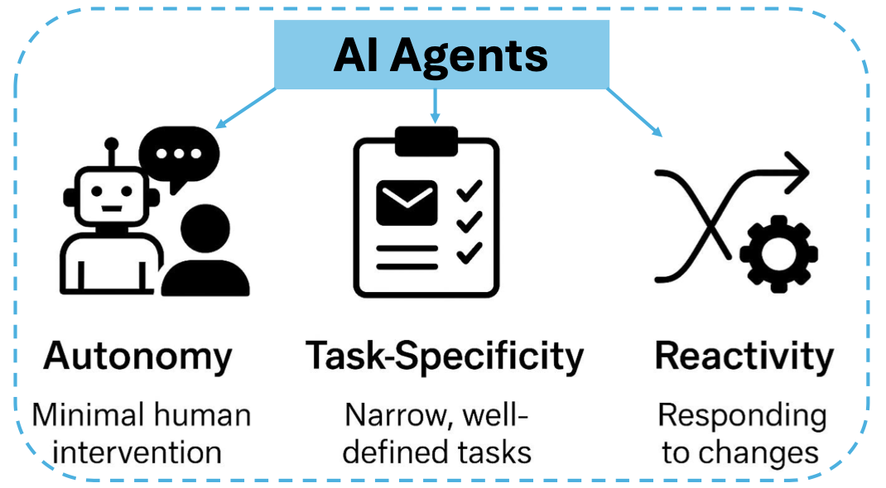
AI Agents
Source: Ranjan Sapkota, Konstantinos I. Roumeliotis, and Manoj Karkee. (2025) "Ai agents vs. agentic ai: A conceptual taxonomy, applications and challenges." arXiv preprint arXiv:2505.10468 (2025).

Slide 13
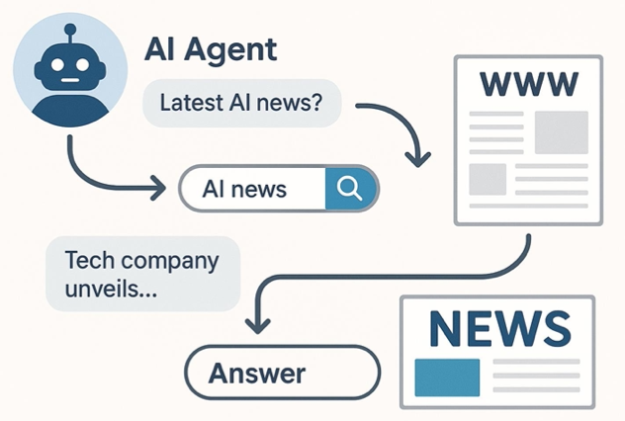
AI Agents
Source: Ranjan Sapkota, Konstantinos I. Roumeliotis, and Manoj Karkee. (2025) "Ai agents vs. agentic ai: A conceptual taxonomy, applications and challenges." arXiv preprint arXiv:2505.10468 (2025).

Slide 14
Comparison of Generative AI and Traditional AI
Feature | Generative AI | Traditional AI
Output type | New content | Classification/Prediction
Creativity | High | Low
Interactivity | Usually more natural | Limited

Slide 15
AI Agent / Agentic AI, Generative AI, Traditional AI
Feature | AI Agent / Agentic AI | Generative AI | Traditional AI
Core Concept | To autonomously perceive its environment, make decisions, and take actions to achieve specific goals. | To create new, original content (text, images, code, etc.) that resembles its training data. | To execute specific tasks based on pre-programmed rules or statistical patterns.
Primary Function | Action & Goal Achievement. Executes a series of tasks to complete an objective (e.g., "Book me a flight to Taipei next Tuesday."). | Creation & Synthesis. Creates novel outputs in response to a prompt (e.g., "Write a poem about rain."). | Classification & Prediction. Answers questions with a known range of outcomes (e.g., "Is this spam?").
Decision Making | Based on a continuous loop: Perceive -> Plan -> Act. It reasons about its goal, breaks it down, and executes steps. | Based on probabilistic patterns learned from massive, unstructured datasets. It predicts the next most likely word, pixel, or note. | Based on explicitly programmed logic (if-then rules) or learned patterns from structured data.
Key Characteristic | Autonomous & Goal-Oriented. Proactively takes steps and can adapt its plan based on new information. | Creative & Probabilistic. Can produce a wide variety of unique outputs from the same prompt. | Deterministic & Logic-Based. Given the same input, it will almost always produce the same output.

Slide 16
AI Agent / Agentic AI, Generative AI, Traditional AI
Feature | AI Agent / Agentic AI | Generative AI | Traditional AI
Interaction Model | Proactive & Interactive. Actively observes its environment (digital or physical) and takes actions to change it. | Responsive. Engages in a dialogue or responds to a user's prompt to generate content. | Reactive. Responds to a direct input or query. It doesn't act on its own.
Example Technologies | Architectural frameworks like ReAct (Reason + Act), and systems that combine LLMs with tools and memory. | Large Language Models (LLMs) like GPT-4, Diffusion Models (for images), Generative Adversarial Networks (GANs). | Expert systems, decision trees, linear regression, traditional machine learning (ML) models.
Common Use Cases | Self-driving cars, autonomous trading bots, smart assistants that manage calendars, customer service agents that process refunds. | ChatGPT, Google Gemini, Midjourney (image generation), Copilot (code generation), music composition. | Spam filters, chess engines, recommendation systems (e.g., Netflix), credit scoring, medical diagnosis from scans.
Relationship to Others | An architecture or system that often uses Generative AI to reason and Traditional AI for specific sub-tasks to accomplish a goal. | Can serve as the "brain" or reasoning engine for an AI Agent, enabling it to understand, plan, and generate actions. | The foundation for modern AI. Its techniques can be components within larger AI systems.

Slide 17
AI Agents vs Agentic AI
Feature | AI Agents | Agentic AI
Definition | Autonomous software programs that perform specific tasks. | Systems of multiple AI agents collaborating to achieve complex goals.
Autonomy Level | High autonomy within specific tasks. | Broad level of autonomy with the ability to manage multi-step, complex tasks and systems.
Task Complexity | Typically handle single, specific tasks. | Handle complex, multi-step tasks requiring coordination.
Collaboration | Operate independently. | Involve multi-agent information sharing, collaboration and cooperation.
Learning and Adaptation | Learn and adapt within their specific domain. | Learn and adapt across a wider range of tasks and environments.
Applications | Customer service chatbots, virtual assistants, automated workflows. | Supply chain management, business process optimization, virtual project managers.
Source: Ranjan Sapkota, Konstantinos I. Roumeliotis, and Manoj Karkee. (2025) "Ai agents vs. agentic ai: A conceptual taxonomy, applications and challenges." arXiv preprint arXiv:2505.10468 (2025).

Slide 18
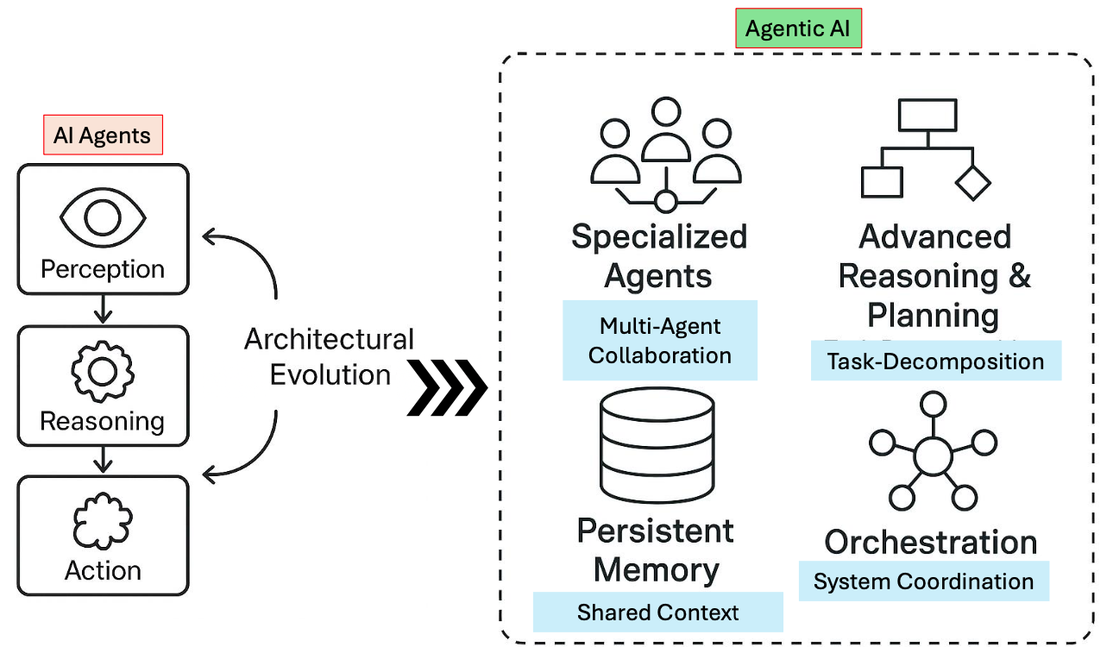
AI Agents vs Agentic AI
Source: Ranjan Sapkota, Konstantinos I. Roumeliotis, and Manoj Karkee. (2025) "Ai agents vs. agentic ai: A conceptual taxonomy, applications and challenges." arXiv preprint arXiv:2505.10468 (2025).

Slide 19
AI Agents and
Large Multimodal Agents (LMAs)

Slide 20
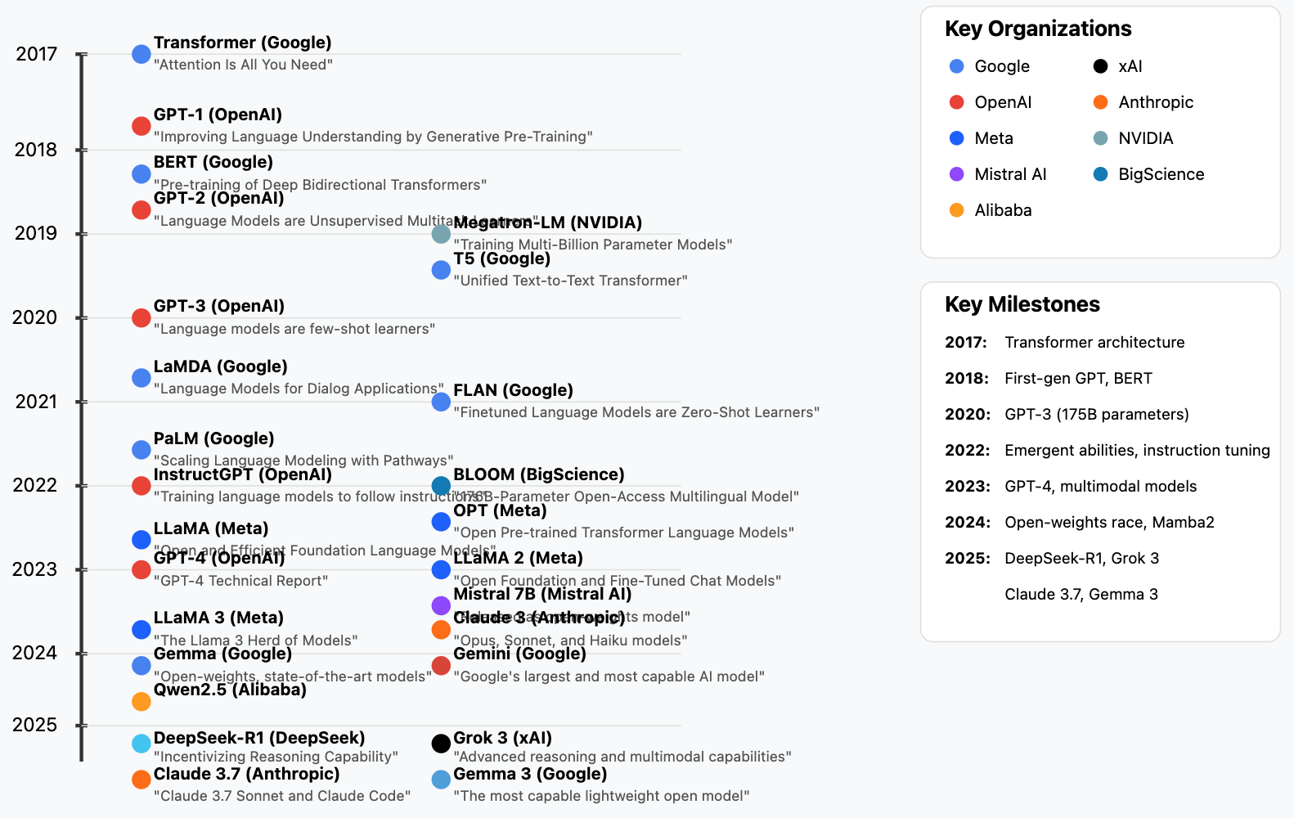
Generative AI LLMs (2017-2025)
Source: https://github.com/Hannibal046/Awesome-LLM

Slide 21

LLM-powered Multimodal Agents
Large Multimodal Agents (LMAs)
2022
2023
2024
Source: Xie, Junlin, Zhihong Chen, Ruifei Zhang, Xiang Wan, and Guanbin Li. "Large Multimodal Agents: A Survey." arXiv preprint arXiv:2402.15116 (2024).

Slide 22

Large Language Model (LLM) based Agents
Source: Xi, Z., Chen, W., Guo, X., He, W., Ding, Y., Hong, B., ... & Gui, T. (2023). The rise and potential of large language model based agents: A survey. arXiv preprint arXiv:2309.07864.

Slide 23

LLM-based Agents
Source: Cheng, Yuheng, Ceyao Zhang, Zhengwen Zhang, Xiangrui Meng, Sirui Hong, Wenhao Li, Zihao Wang et al. "Exploring large language model based intelligent agents: Definitions, methods, and prospects." arXiv preprint arXiv:2401.03428 (2024).

Slide 24

Large Multimodal Agents (LMA)
Source: Xie, J., Chen, Z., Zhang, R., Wan, X., & Li, G. (2024). Large Multimodal Agents: A Survey. ArXiv, abs/2402.15116.

Slide 25

Large Multimodal Agents (LMA)
Source: Xie, J., Chen, Z., Zhang, R., Wan, X., & Li, G. (2024). Large Multimodal Agents: A Survey. ArXiv, abs/2402.15116.

Slide 26
Agentic AI Cloud Architecture
Microservices and Serverless Architecture
Containers (Docker, Kubernetes)
Serverless platforms (AWS Lambda, Google Cloud Functions)
APIs and Tooling Integration via MCP
Agents access tools (e.g., databases, APIs, CRMs, payment gateways)
using Model Context Protocol (MCP)
Enhances tool-using behavior of LLM agents
Tools and Frameworks
LangChain, AutoGen, CrewAI: for orchestrating LLM agents
Anthropic’s MCP, Google’s A2A: communication protocols
Vector DBs (Pinecone, Weaviate): for agent memory

Slide 27
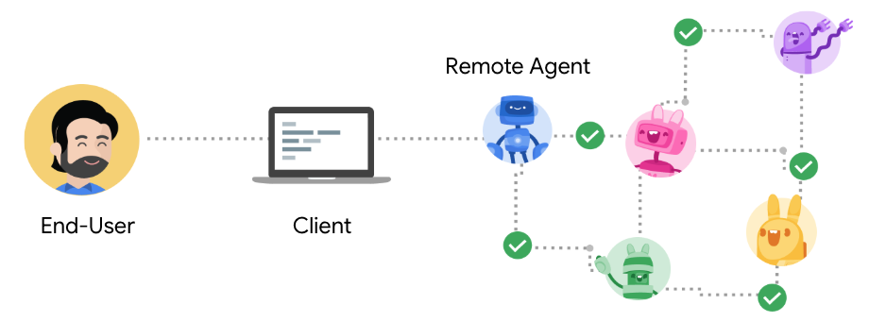
Agent2Agent Protocol (A2A)
An open protocol enabling Agent-to-Agent interoperability, bridging the gap between opaque agentic systems
Source: https://google.github.io/A2A/

Slide 28
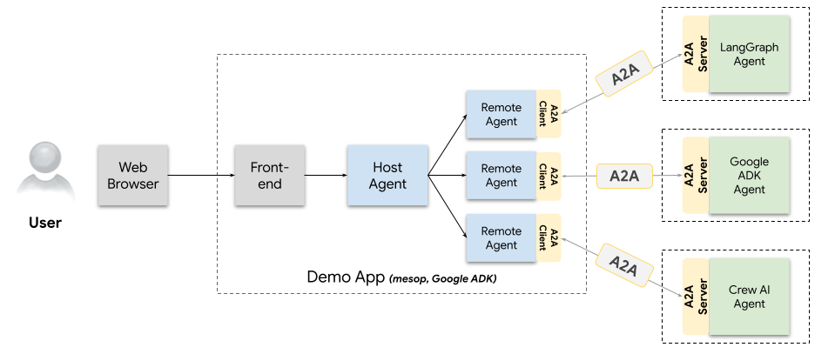
A2A Demo Web App
Agents talking to other agents over A2A
Source: https://github.com/google/A2A/blob/main/demo/README.md

Slide 29
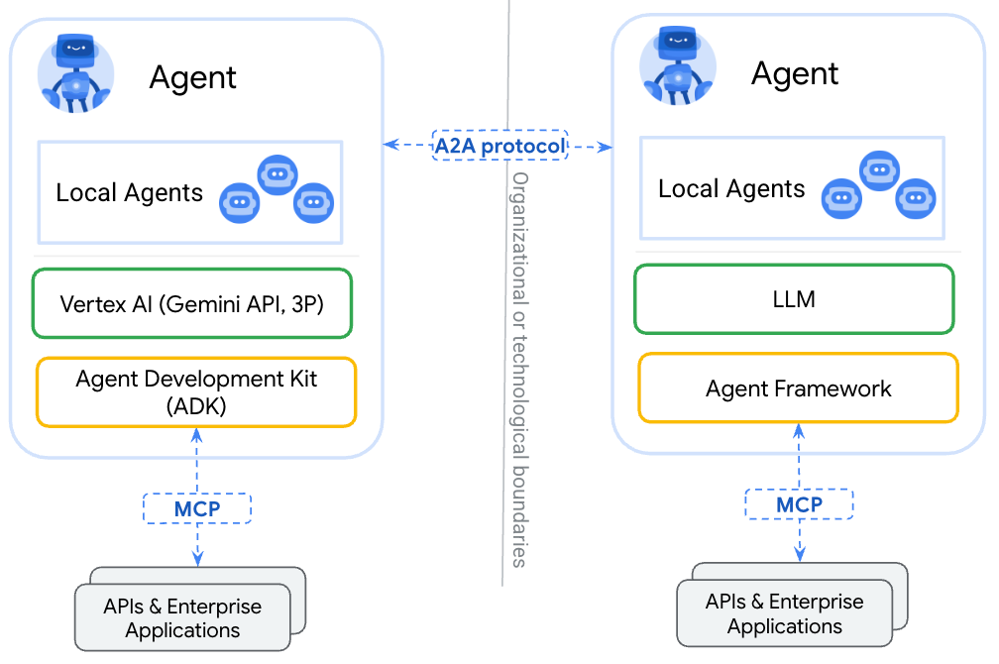
A2A
(Agent2Agent Protocol) for agent-agent collaboration
MCP
(Model Context Protocol) for tools and resources
Source: https://google.github.io/A2A/

Slide 30
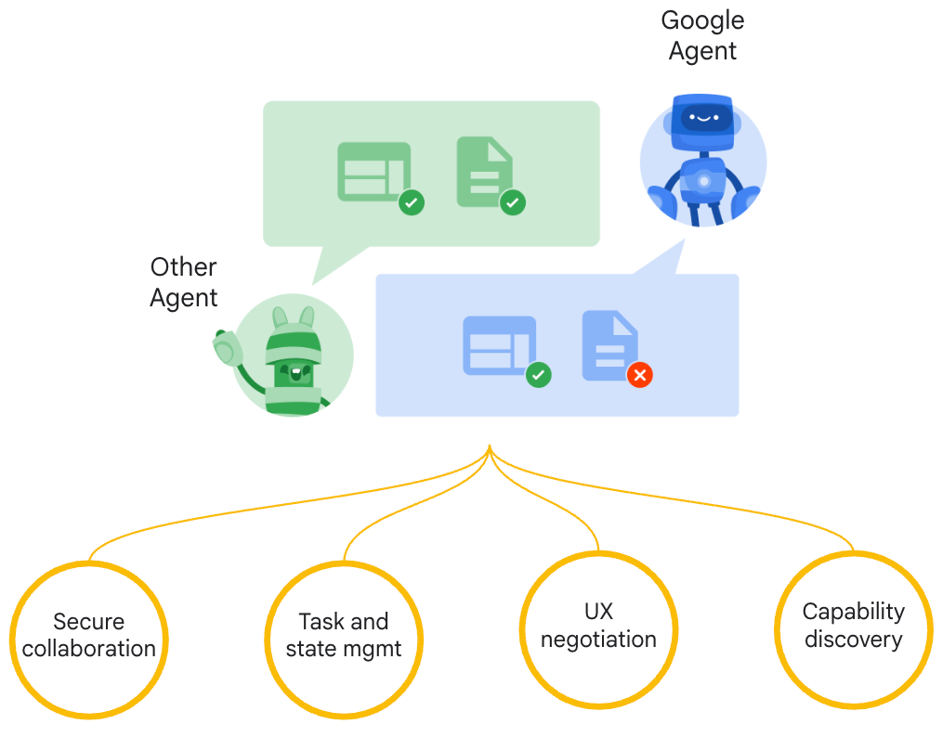
Google A2A (Agent2Agent Protocol)
Seamless Agent Collaboration
Simplifies Enterprise
Agent Integration
Supports Key
Enterprise Requirements
Source: https://google.github.io/A2A/

Slide 31
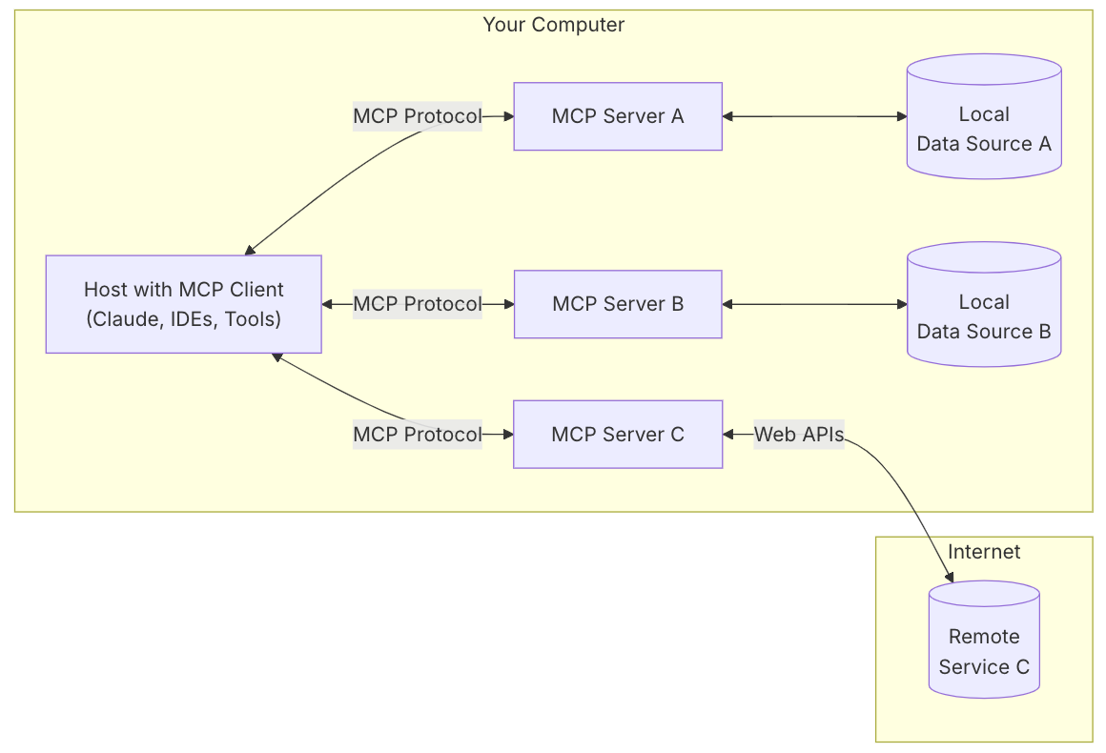
MCP (Model Context Protocol)
MCP is a open protocol that standardizes how applications provide context to LLMs.
MCP: USB-C port for AI applications.
Source: https://modelcontextprotocol.io/introduction

Slide 32
MCP and A2A
MCP (Model Context Protocol) for tools and resources
  Connect agents to tools, APIs, and resources with structured inputs/outputs.
  Google ADK supports MCP tools. Enabling wide range of MCP servers to be used with agents.
A2A (Agent2Agent Protocol) for agent-agent collaboration
  Dynamic, multimodal communication between different agents without sharing memory, resources, and tools
  Open standard driven by community.
  Samples available using Google ADK, LangGraph, Crew.AI
Source: https://google.github.io/A2A/

Slide 33
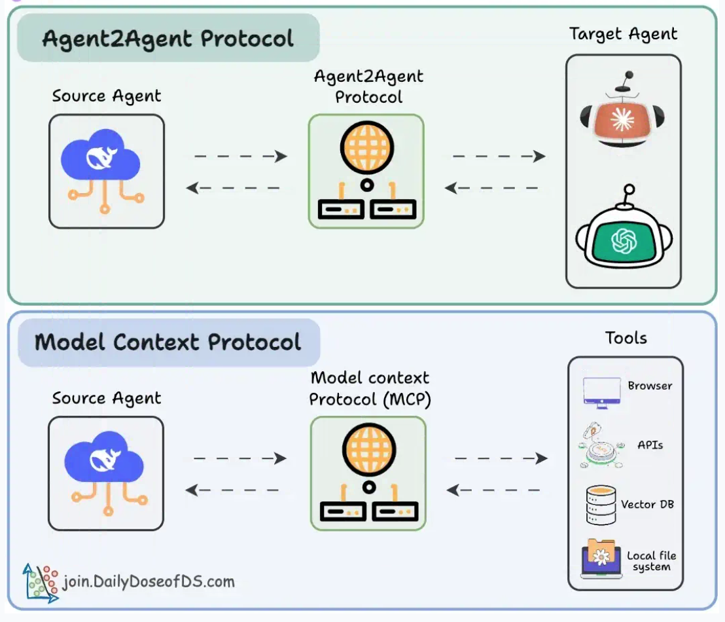
Agentic applications require both A2A and MCP
A2A allows agents to connect with other agents and collaborate in teams.
MCP provides agents with access to tools
Source: https://blog.dailydoseofds.com/p/a-visual-guide-to-agent2agent-a2a

Slide 34
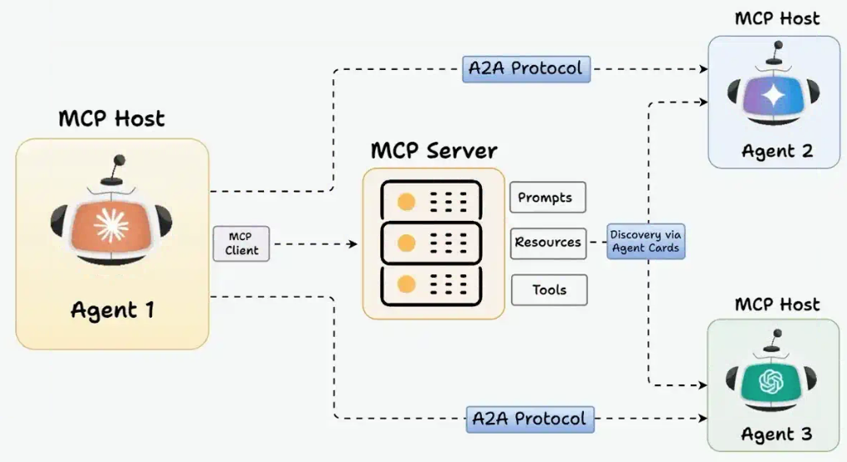
MCP and A2A Protocol for AI Agents
Source: https://blog.dailydoseofds.com/p/a-visual-guide-to-agent2agent-a2a

Slide 35
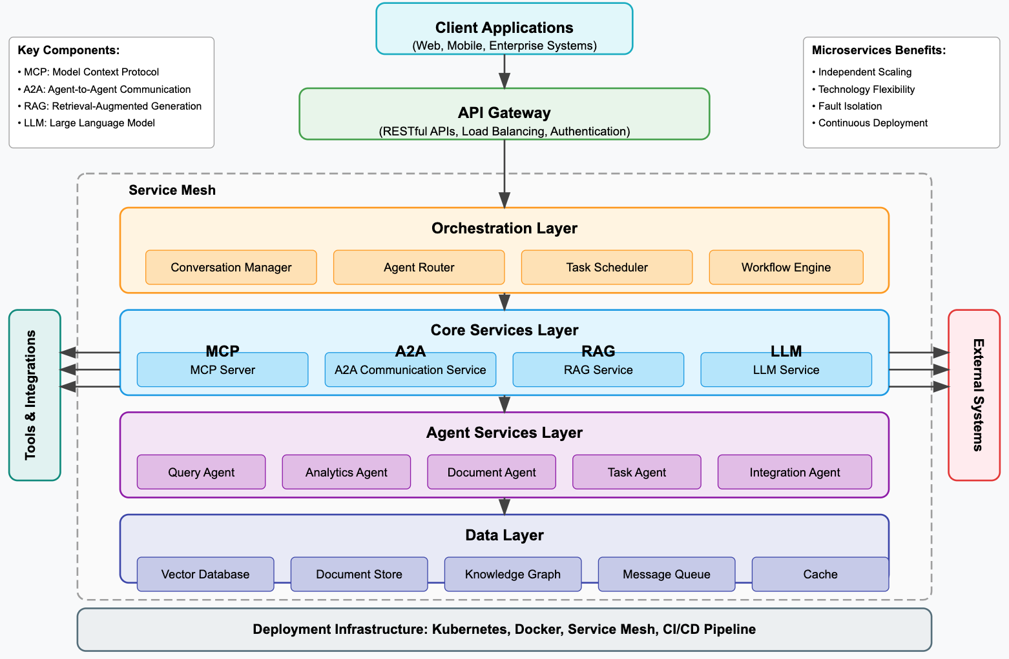
Agentic AI System with Microservices Architecture

Slide 36
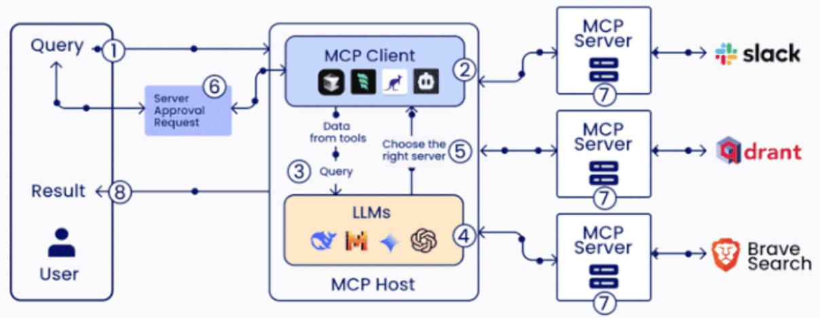
MCP (Model Context Protocol)

Slide 37
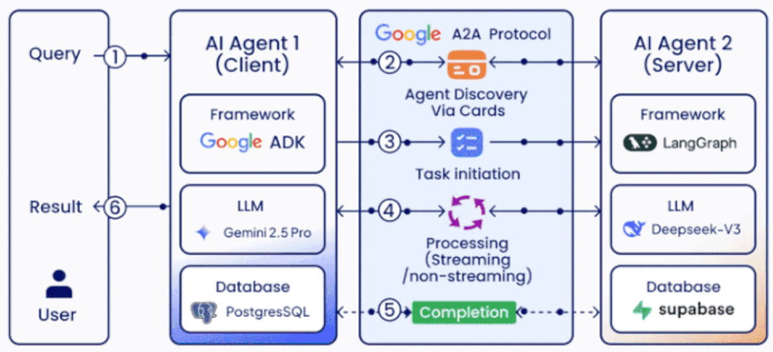
A2A (Agent2Agent Protocol)

Slide 38
Generative AI
Large Language Models (LLMs)
Foundation Models

Slide 39
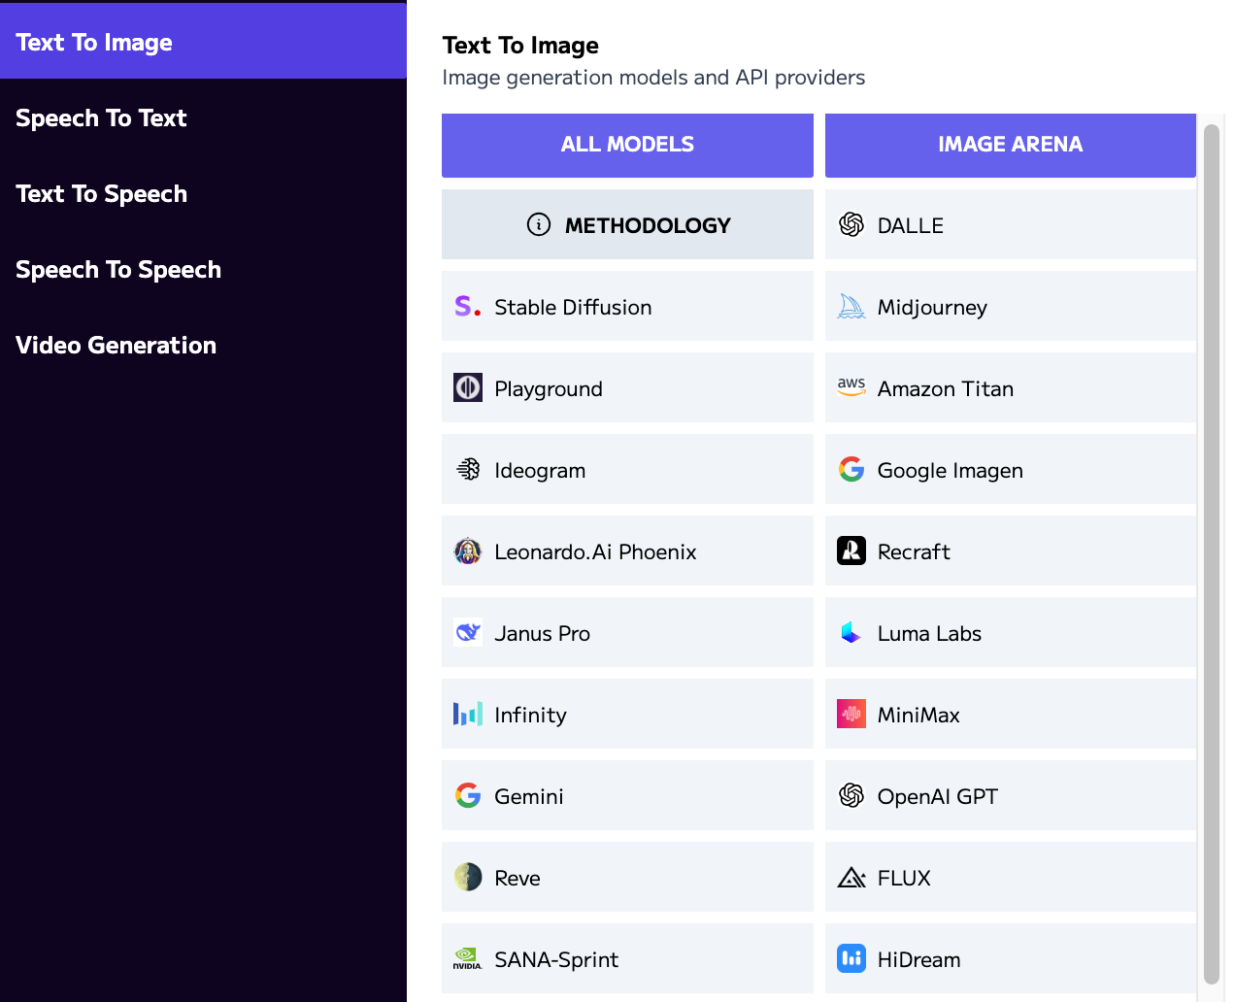
Language
Models
Text
Image
Speech
Video
Models
https://artificialanalysis.ai/

Slide 40

Generative AI (Gen AI)
AI Generated Content (AIGC)
Image Generation
Source: Yihan Cao, Siyu Li, Yixin Liu, Zhiling Yan, Yutong Dai, Philip S. Yu, and Lichao Sun (2023). "A Comprehensive Survey of AI-Generated Content (AIGC): A History of Generative AI from GAN to ChatGPT." arXiv preprint arXiv:2303.04226.

Slide 41

Generative AI (Gen AI)
AI Generated Content (AIGC)
Source: Yihan Cao, Siyu Li, Yixin Liu, Zhiling Yan, Yutong Dai, Philip S. Yu, and Lichao Sun (2023). "A Comprehensive Survey of AI-Generated Content (AIGC): A History of Generative AI from GAN to ChatGPT." arXiv preprint arXiv:2303.04226.

Slide 42
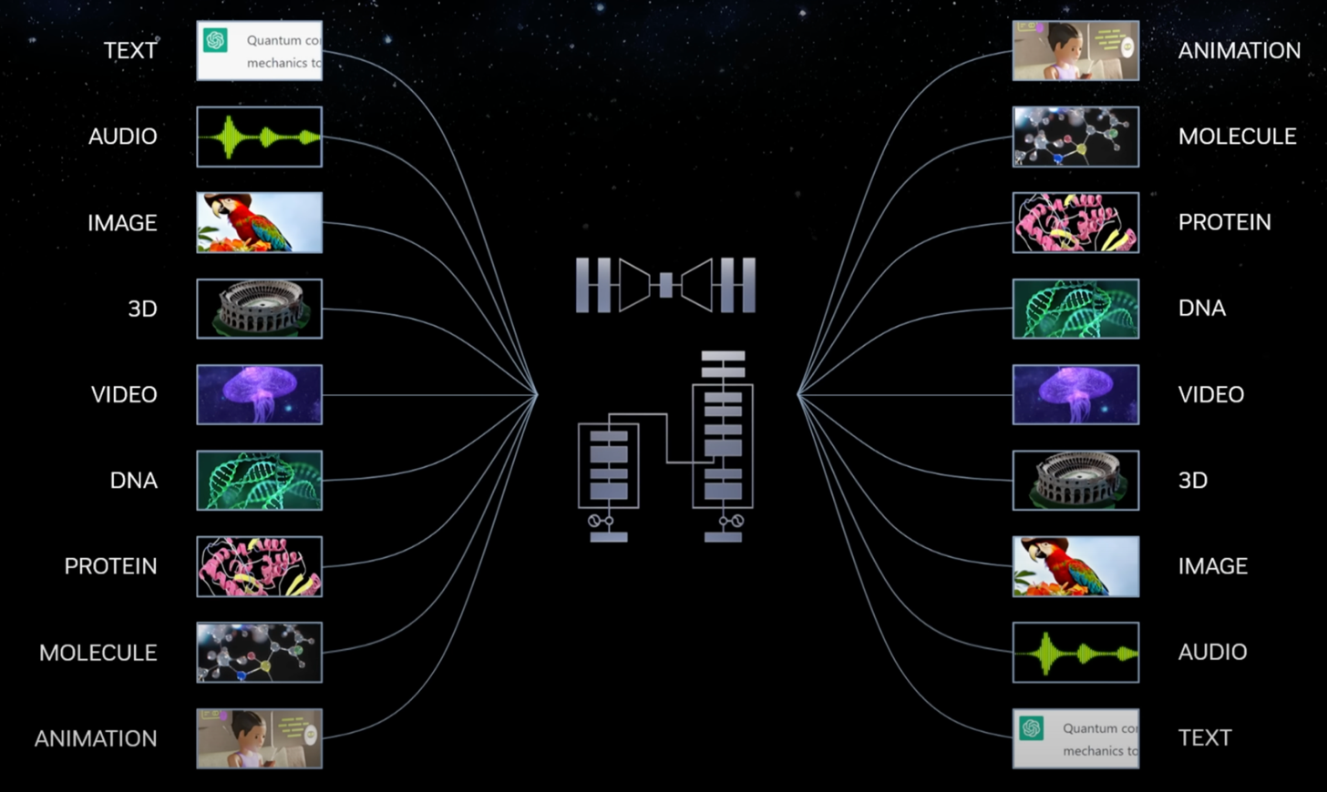
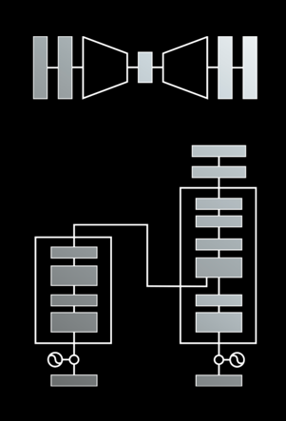
Modular Modalities
Where Can The Transformer Fit?
Source: NVIDIA DLI (2025), Rapid Application Development with Large Language Models (LLMs), https://learn.nvidia.com/courses/course-detail?course_id=course-v1:DLI+S-FX-26+V1

Slide 43

The history of Generative AI in CV, NLP and VL
Source: Yihan Cao, Siyu Li, Yixin Liu, Zhiling Yan, Yutong Dai, Philip S. Yu, and Lichao Sun (2023). "A Comprehensive Survey of AI-Generated Content (AIGC): A History of Generative AI from GAN to ChatGPT." arXiv preprint arXiv:2303.04226.

Slide 44

Categories of Vision Generative Models
Source: Yihan Cao, Siyu Li, Yixin Liu, Zhiling Yan, Yutong Dai, Philip S. Yu, and Lichao Sun (2023). "A Comprehensive Survey of AI-Generated Content (AIGC): A History of Generative AI from GAN to ChatGPT." arXiv preprint arXiv:2303.04226.

Slide 45

The General Structure of
Generative Vision Language
Source: Yihan Cao, Siyu Li, Yixin Liu, Zhiling Yan, Yutong Dai, Philip S. Yu, and Lichao Sun (2023). "A Comprehensive Survey of AI-Generated Content (AIGC): A History of Generative AI from GAN to ChatGPT." arXiv preprint arXiv:2303.04226.

Slide 46
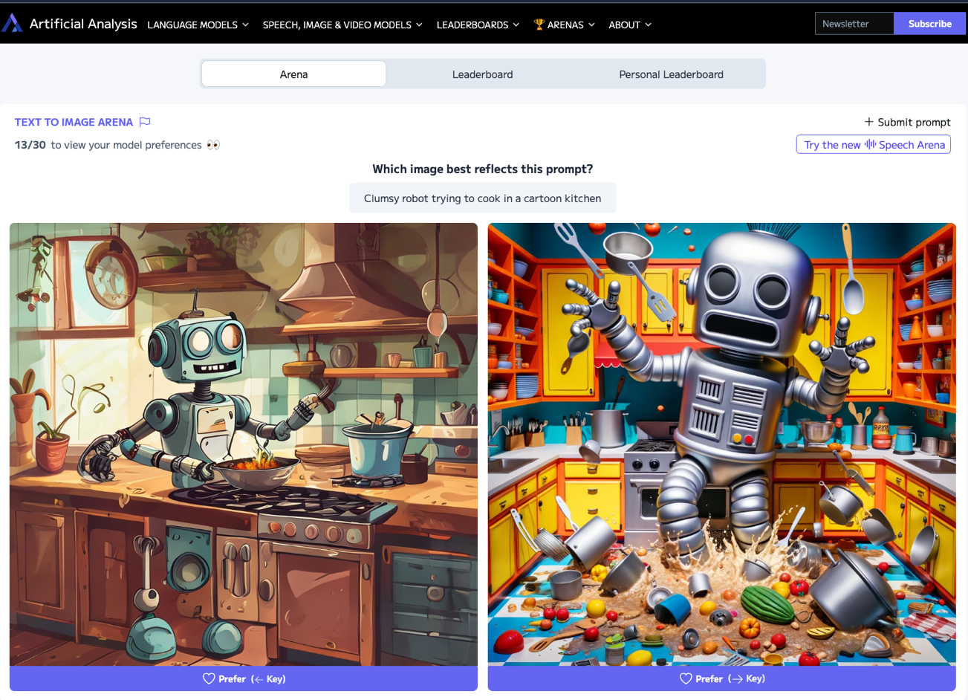
Artificial Analysis Text to Image Arena
Source: https://artificialanalysis.ai/text-to-image/arena

Slide 47
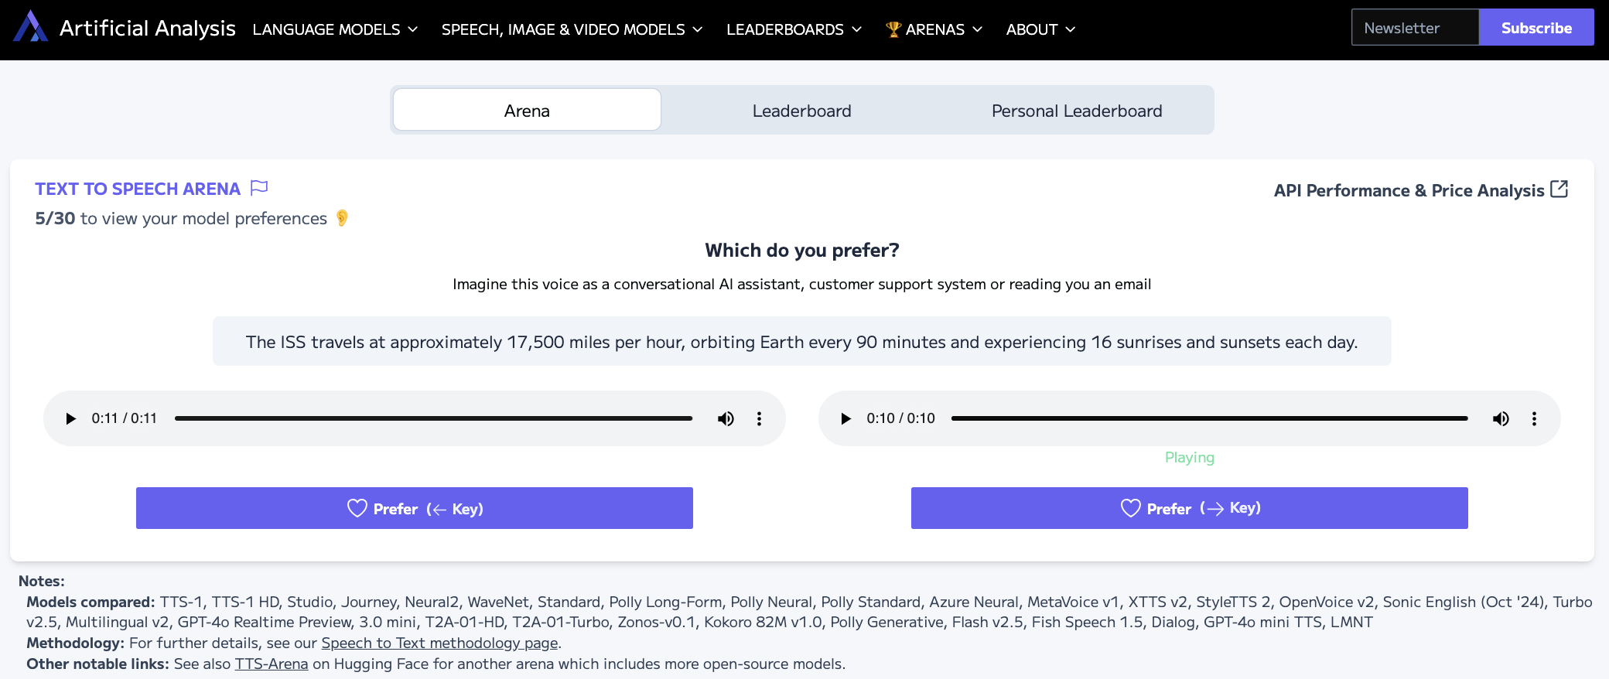
Artificial Analysis Text to Speech Arena
Source: https://artificialanalysis.ai/text-to-speech/arena

Slide 48
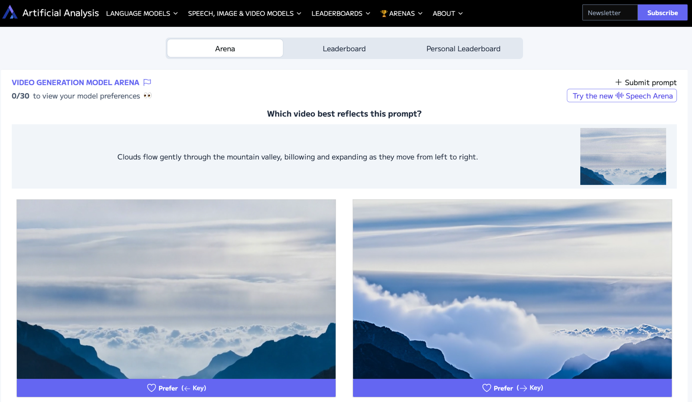
Artificial Analysis Video Generation Model Arena
Source: https://artificialanalysis.ai/text-to-video/arena

Slide 49
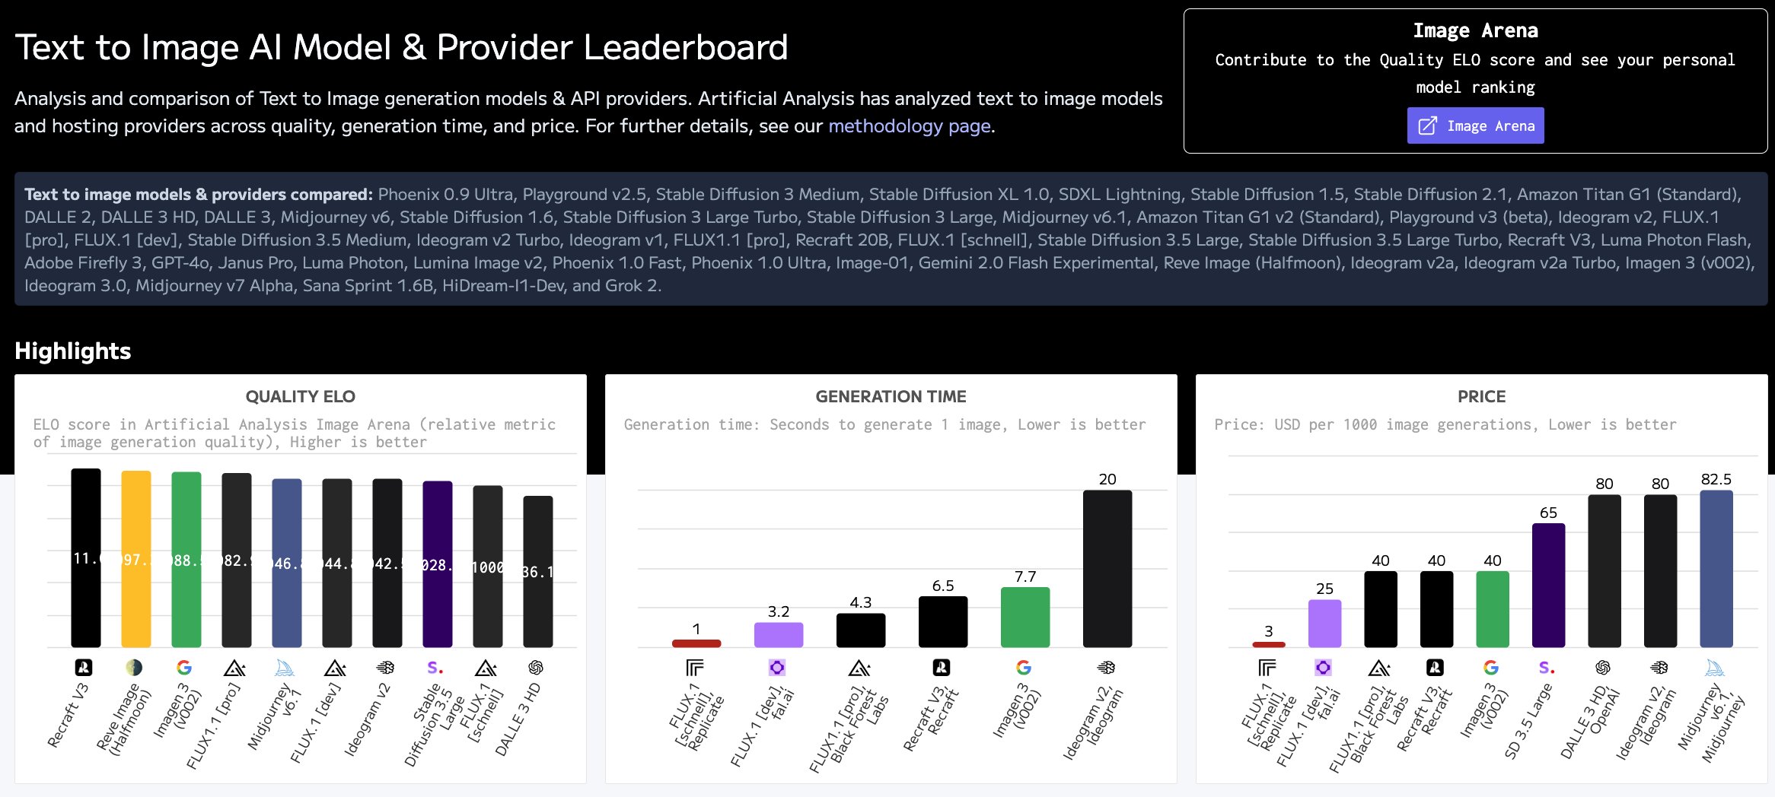
Artificial Analysis Text to Image Leaderboard
Source: https://artificialanalysis.ai/text-to-image

Slide 50
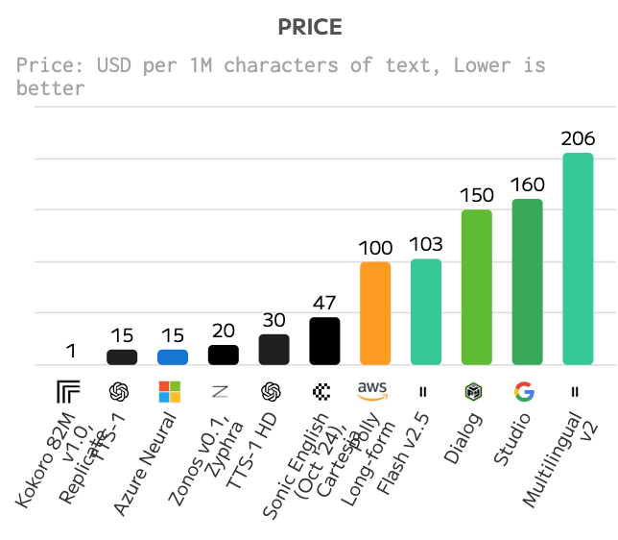
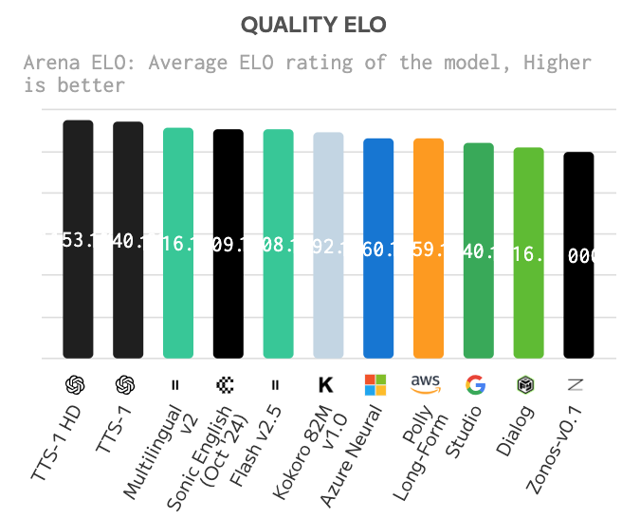
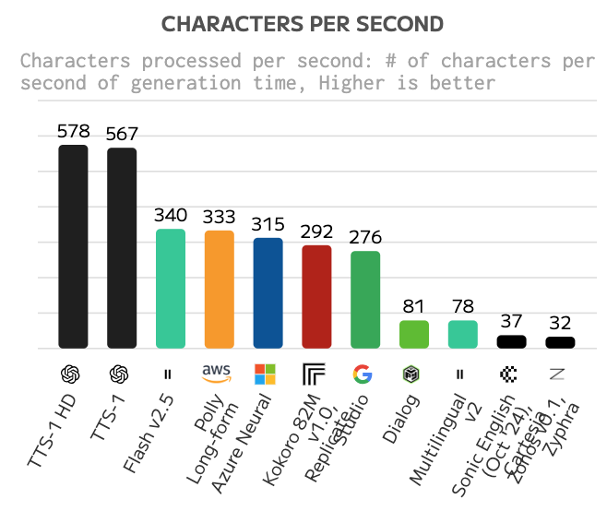
Text to Speech (TTS) AI Model & Provider Leaderboard
Text to speech models & providers compared: TTS-1, TTS-1 HD, Studio, Journey, Neural2, WaveNet, Standard, Polly Long-Form, Polly Neural, Polly Standard, Azure Neural, MetaVoice v1, XTTS v2, StyleTTS 2, OpenVoice v2, Sonic English (Oct '24), 3.0 mini, Turbo v2.5, Multilingual v2, T2A-01-HD, T2A-01-Turbo, Zonos-v0.1, Kokoro 82M v1.0, Polly Generative, Flash v2.5, Dialog, Murf Speech Gen 2, and Step TTS Mini.
Source: https://artificialanalysis.ai/text-to-speech

Slide 51
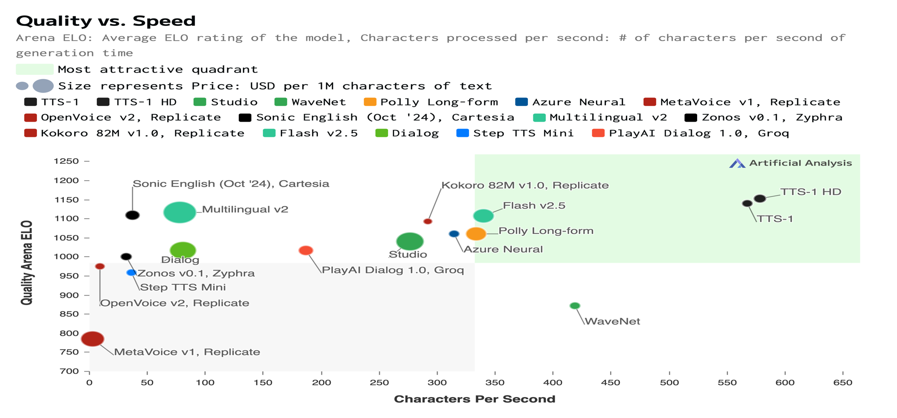
Text to Speech (TTS) AI Model & Provider Leaderboard
Source: https://artificialanalysis.ai/text-to-speech

Slide 52
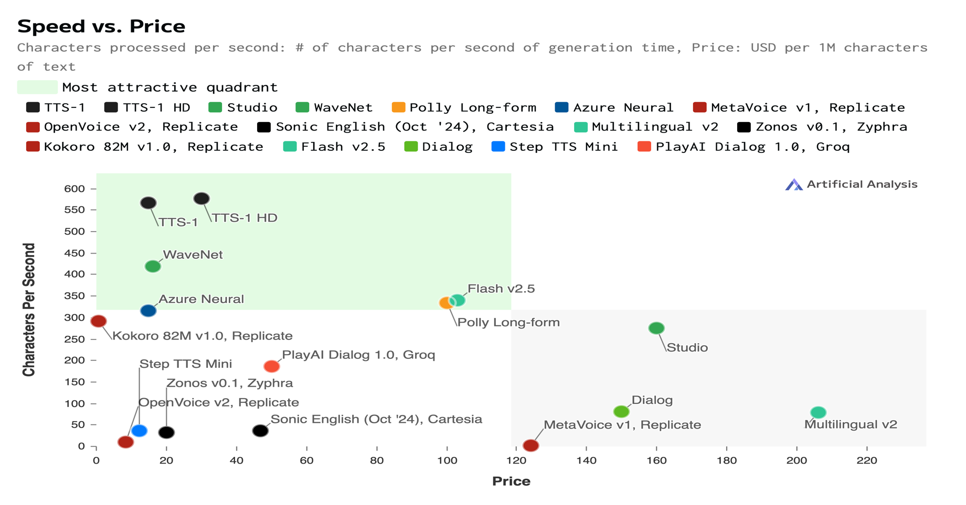
Text to Speech (TTS) AI Model & Provider Leaderboard
Source: https://artificialanalysis.ai/text-to-speech

Slide 53
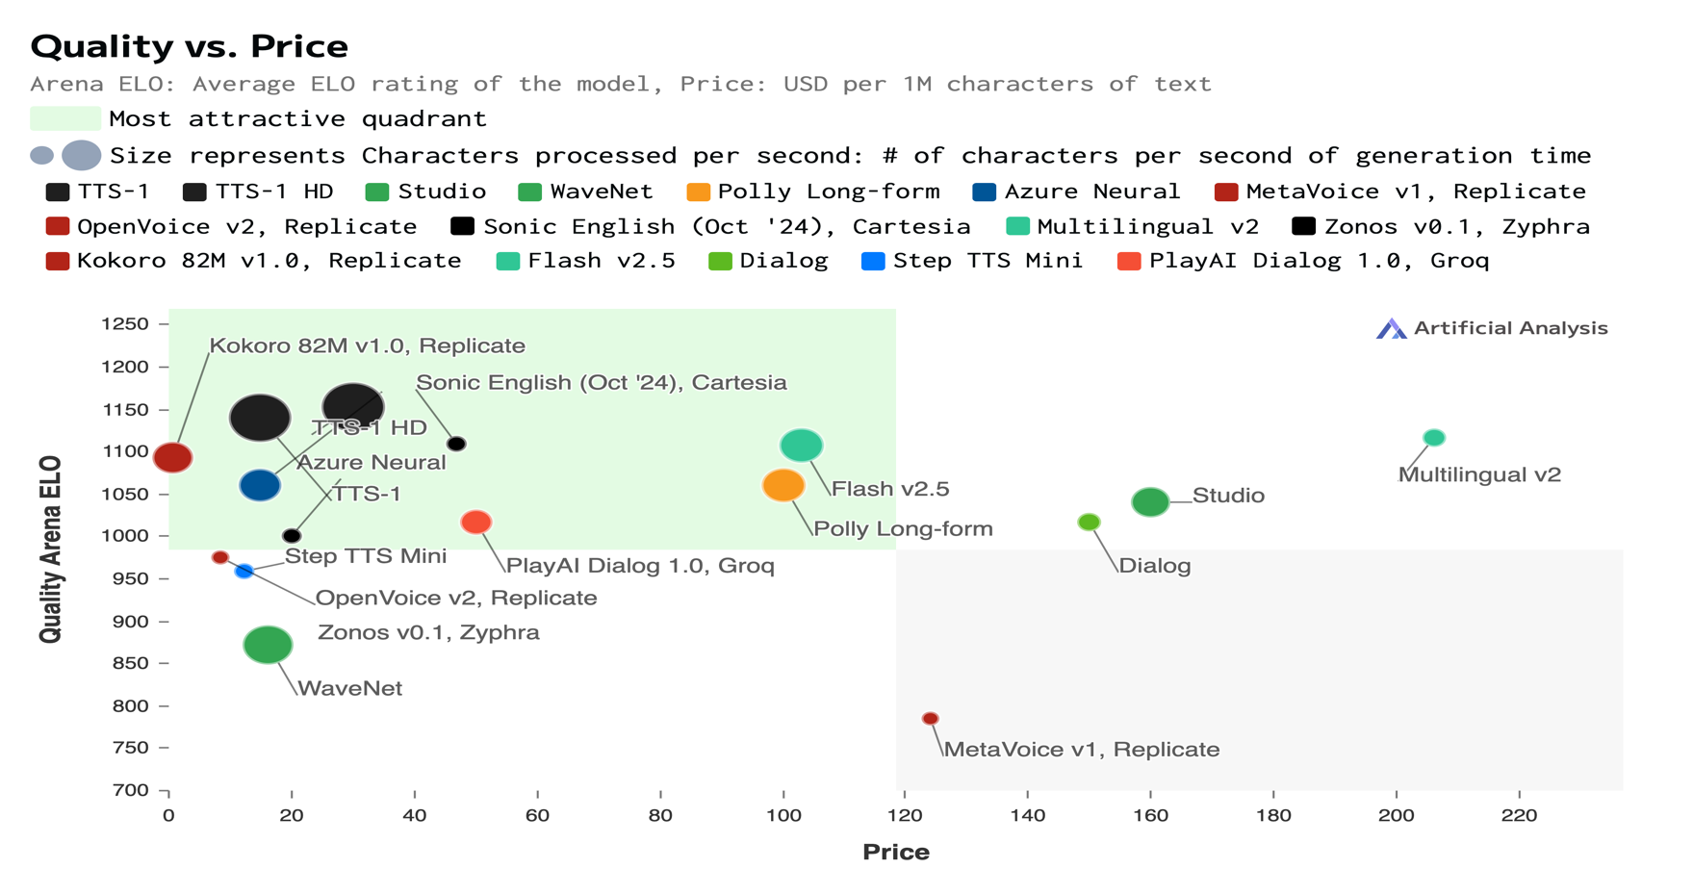
Text to Speech (TTS) AI Model & Provider Leaderboard
Source: https://artificialanalysis.ai/text-to-speech

Slide 54
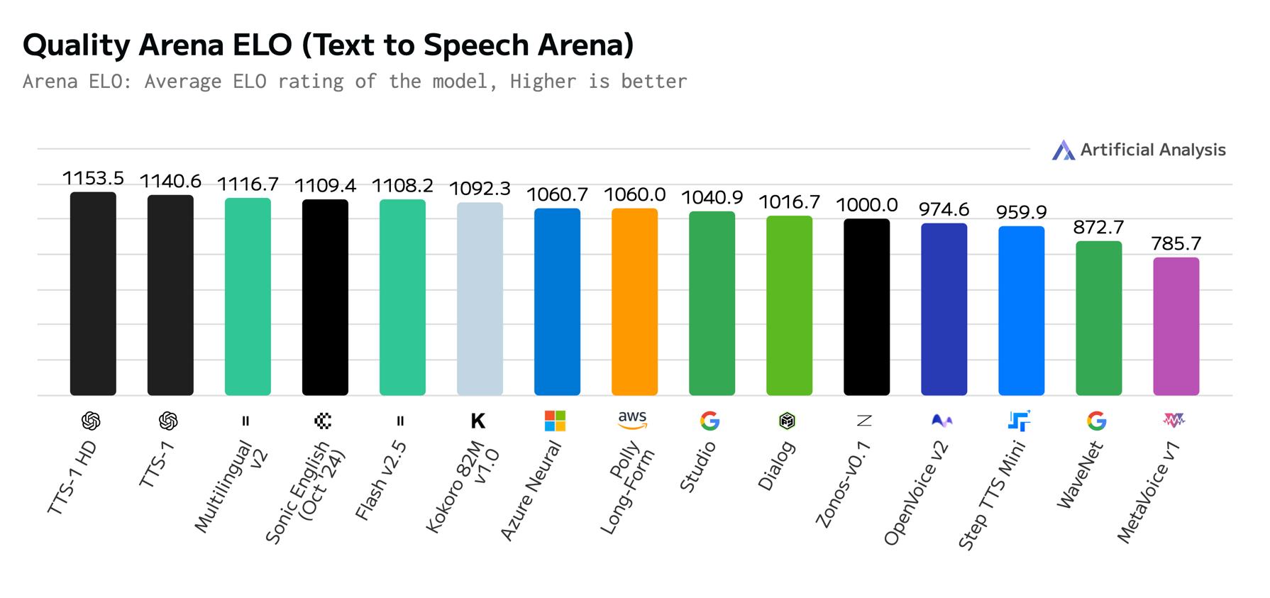
Text to Speech (TTS) AI Model & Provider Leaderboard
Source: https://artificialanalysis.ai/text-to-speech

Slide 55
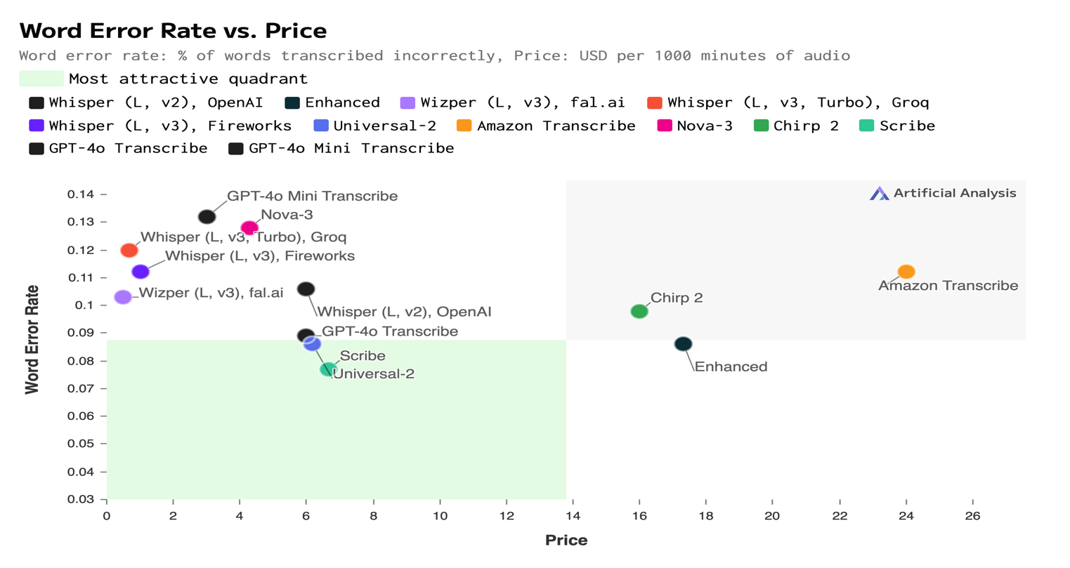
Speech to Text (STT) AI Model & Provider Leaderboard
Speech-to-text models & providers compared: Whisper (L, v2), OpenAI, Universal-1, Standard, Whisper (L, v2), Azure, Enhanced, Nano, Wizper (L, v3), fal.ai, Incredibly Fast Whisper, Replicate, Nova-2, Whisper (L, v2), Replicate, Whisper (L, v3), Replicate, Base, WhisperX, Replicate, Whisper (L v2), Deepgram, Gladia, Whisper (L, v3), Groq, Distil-Whisper, Groq, Whisper (L, v3), fal.ai, Whisper (L, v3), Deepinfra, Whisper (L, v3, Turbo), Groq, Whisper (L, v3), Fireworks, Whisper (L, v3, Turbo), Fireworks, Universal-2, Amazon Transcribe, Fish Speech to Text, Nova-3, Chirp, Chirp 2, Scribe, GPT-4o Transcribe, and GPT-4o Mini Transcribe.
Source: https://artificialanalysis.ai/speech-to-text

Slide 56
Speech to Text (STT) AI Model & Provider Leaderboard
Speech-to-text models & providers compared: Whisper (L, v2), OpenAI, Universal-1, Standard, Whisper (L, v2), Azure, Enhanced, Nano, Wizper (L, v3), fal.ai, Incredibly Fast Whisper, Replicate, Nova-2, Whisper (L, v2), Replicate, Whisper (L, v3), Replicate, Base, WhisperX, Replicate, Whisper (L v2), Deepgram, Gladia, Whisper (L, v3), Groq, Distil-Whisper, Groq, Whisper (L, v3), fal.ai, Whisper (L, v3), Deepinfra, Whisper (L, v3, Turbo), Groq, Whisper (L, v3), Fireworks, Whisper (L, v3, Turbo), Fireworks, Universal-2, Amazon Transcribe, Fish Speech to Text, Nova-3, Chirp, Chirp 2, Scribe, GPT-4o Transcribe, and GPT-4o Mini Transcribe.
Source: https://artificialanalysis.ai/speech-to-text

Slide 57
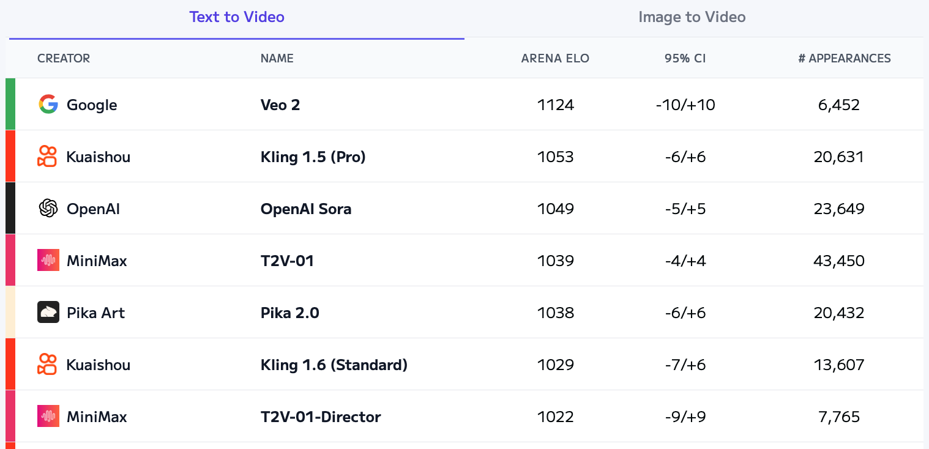
Artificial Analysis Text to Video Leaderboard
Source: https://artificialanalysis.ai/text-to-video/arena?tab=Leaderboard&leaderboard_tab=t2v

Slide 58
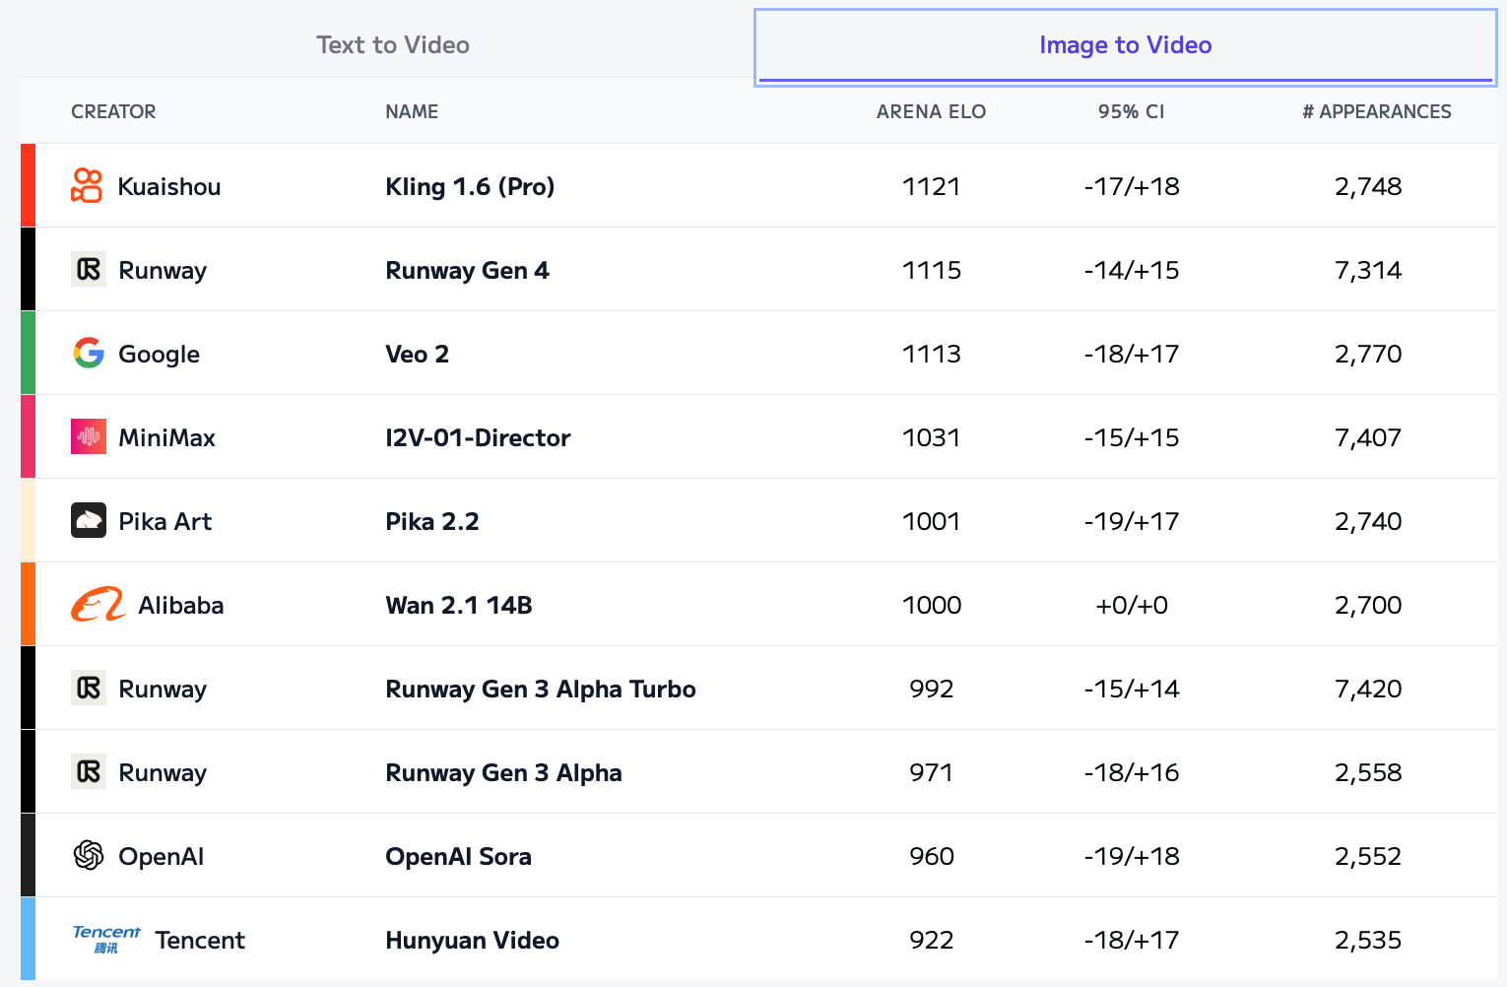
Artificial Analysis Image to Video Leaderboard
Source: https://artificialanalysis.ai/text-to-video/arena?tab=Leaderboard&leaderboard_tab=t2v

Slide 59
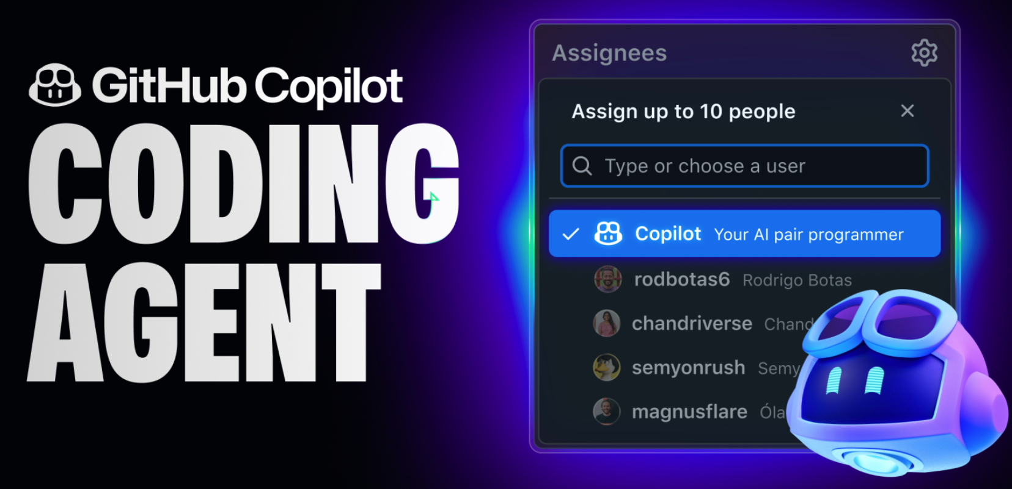
GitHub Copilot CODING AGENT

Slide 60
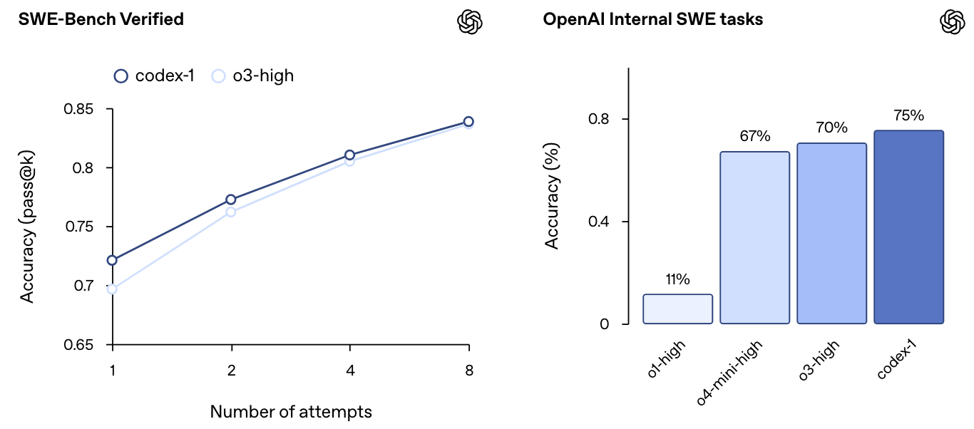
OpenAI Codex
A cloud-based software engineering agent that can work on many tasks in parallel, powered by codex-1

Slide 61
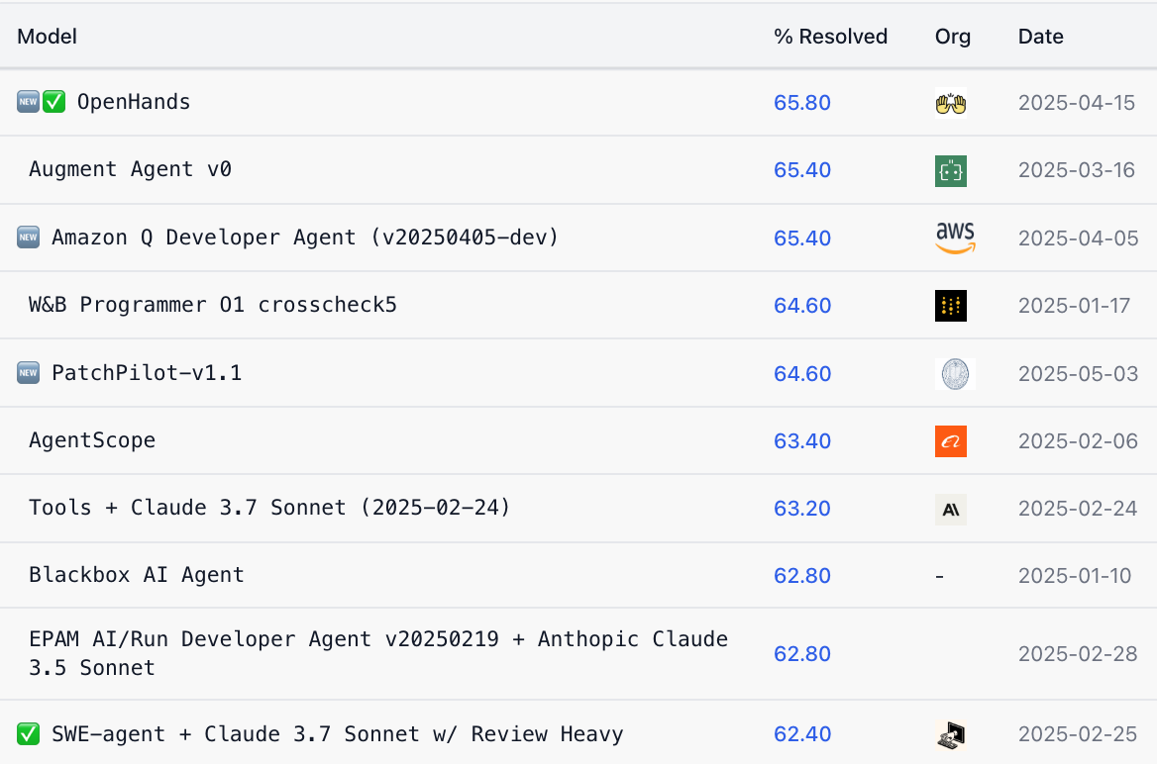
SWE-bench Verified Leaderboard
AI coding agents ranking by software engineering problems resolved rate

Slide 62
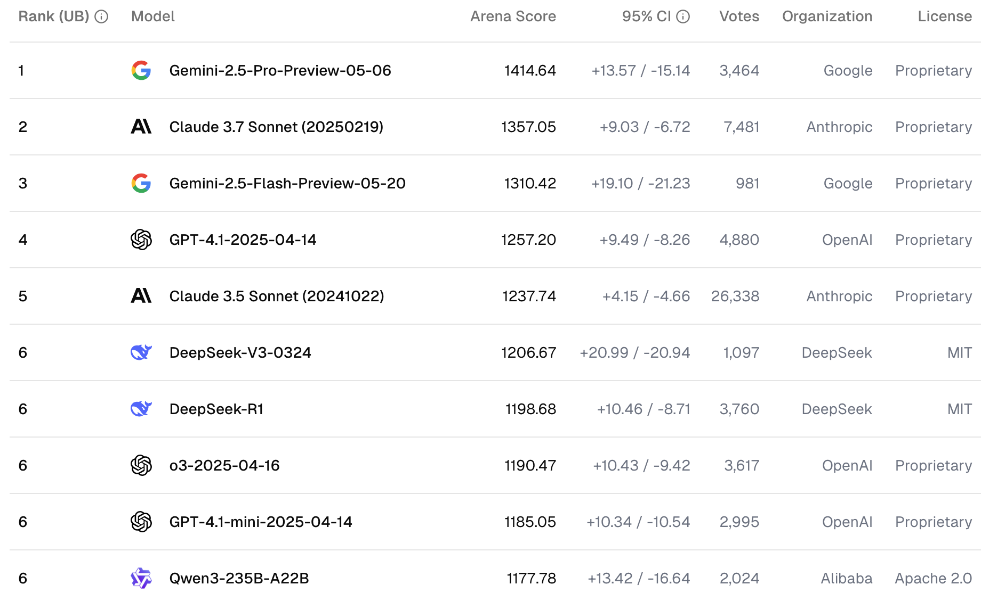
WebDev Arena Leaderboard
AI coding competition in web development challenges

Slide 63
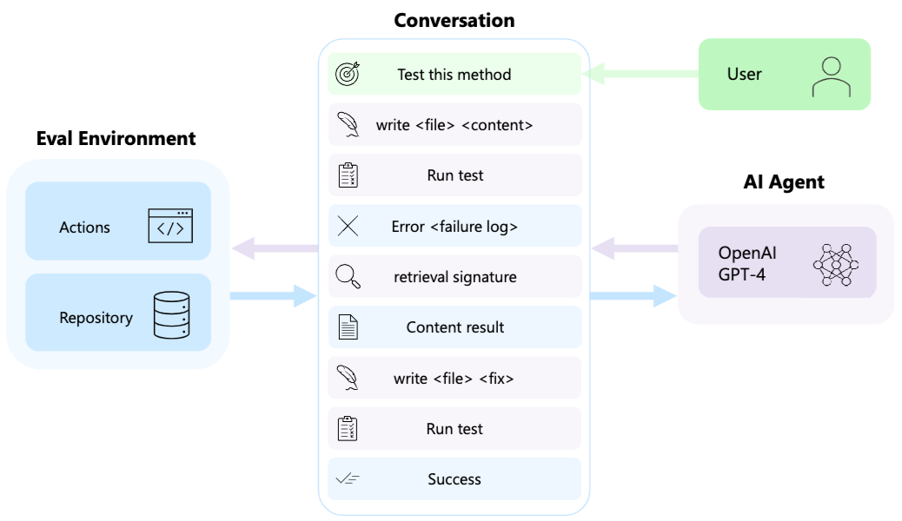
AutoDev: Automated AI-Driven Development

Slide 64
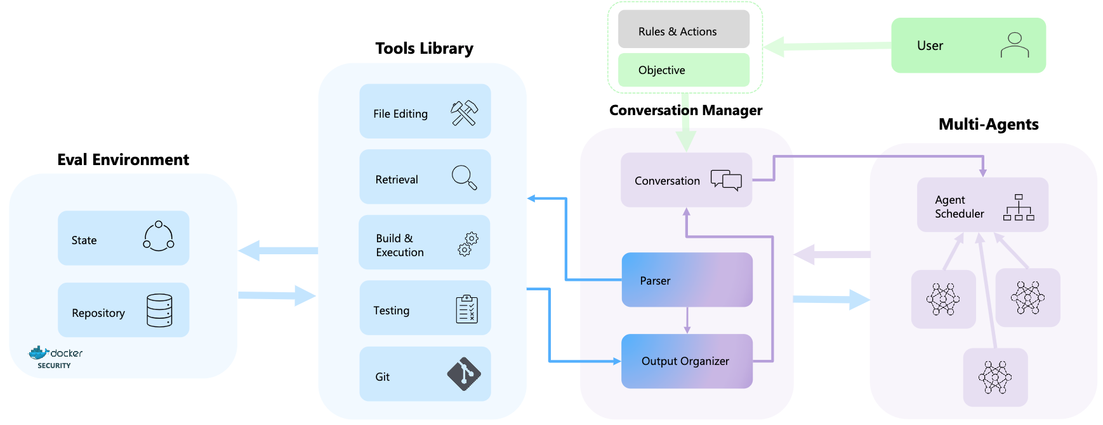
AutoDev: Automated AI-Driven Development

Slide 65
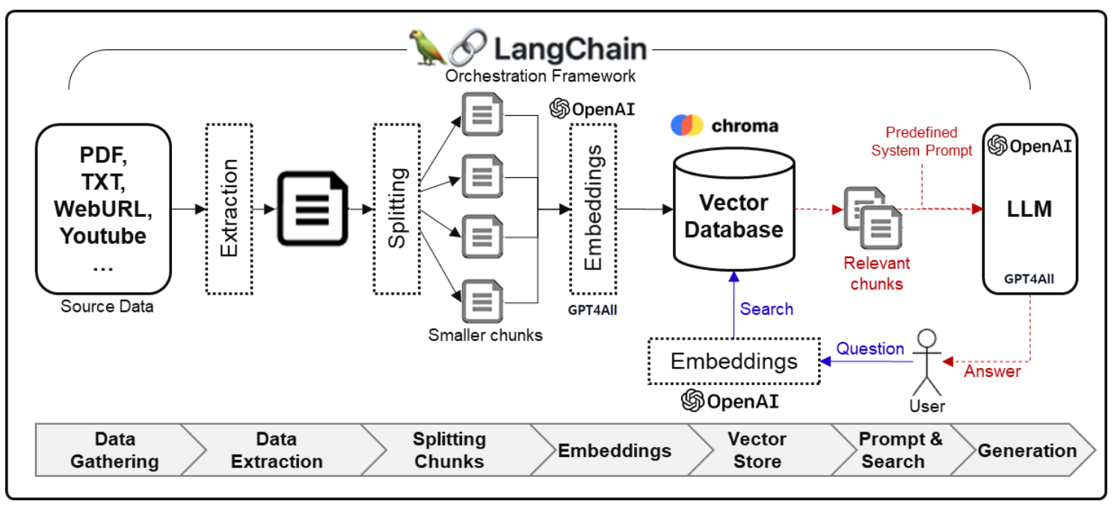
Framework for Implementing Generative AI Services using RAG Model
Source: Jeong, Cheonsu. "A Study on the Implementation of Generative AI Services Using an Enterprise Data-Based LLM Application Architecture." arXiv preprint arXiv:2309.01105 (2023).

Slide 66
Spring 2025
Generative AI
Innovative Applications

Slide 67

https://learn.nvidia.com/certificates?id=cCFh1ZWWTvqKTq7dcKkEWw

Slide 68

https://learn.nvidia.com/certificates?id=OVmqY4cSSya0BdMQBWHxzw

Slide 69

https://learn.nvidia.com/certificates?id=ed-qOCIMQaatzU8SNUNxgw

Slide 70

https://learn.nvidia.com/certificates?id=q3oo-oBhTQKtyCCote2E-Q

Slide 71

NVIDIA
Certified Instructors
(12 from Taiwan)
https://www.nvidia.com/en-us/training/instructor-directory/search/

Slide 72
NVIDIA Developer Program
NVIDIA
Deep Learning Institute (DLI)
https://developer.nvidia.com/join-nvidia-developer-program
https://learn.nvidia.com/

Slide 73
Get NVIDIA DLI Certificate
Step 1. Join NVIDIA Developer Program (Free)
https://developer.nvidia.com/join-nvidia-developer-program
Step 2. Visit NVIDIA Deep Learning Institute (DLI)
https://learn.nvidia.com/
Step 3. Enroll "Generative AI with Diffusion Models"
Self-Paced Course ($90)
https://learn.nvidia.com/courses/course-detail?course_id=course-v1:DLI+S-FX-14+V1

Slide 74

Join the NVIDIA Developer Program take one of the complimentary technical self-paced courses
(worth up to $90)
https://developer.nvidia.com/join-nvidia-developer-program

Slide 75
NVIDIA Deep Learning Institute (DLI)
Self-Paced Course
Generative AI Explained
Free
2 hours
Self-Paced Course
Getting Started With Deep Learning
Certificate available
$90
8 hours
Instructor-Led Workshop
Fundamentals of Deep Learning
Certificate available
$500
8 hours
Self-Paced Course
Introduction to Transformer-Based Natural Language Processing
Certificate available
$30
6 hours
Self-Paced Course
Building RAG Agents With LLMs
Certificate available
Free
8 hours
Instructor-Led Workshop
Building RAG Agents With LLMs
Certificate available
$500
8 hours
Self-Paced Course
Generative AI with Diffusion Models
Certificate available
$90
8 hours
Instructor-Led Workshop
Generative AI with Diffusion Models
Certificate available
$500
8 hours
https://www.nvidia.com/en-us/learn/learning-path/generative-ai-llm/

Slide 76

NVIDIA Deep Learning Institute (DLI)
Generative AI
https://learn.nvidia.com/en-us/training/find-training?q=Generative+AI

Slide 77

Generative AI Explained
https://learn.nvidia.com/courses/course-detail?course_id=course-v1:DLI+S-FX-15+V1

Slide 78

Building RAG Agents with LLMs
https://learn.nvidia.com/courses/course-detail?course_id=course-v1:DLI+S-FX-15+V1

Slide 79
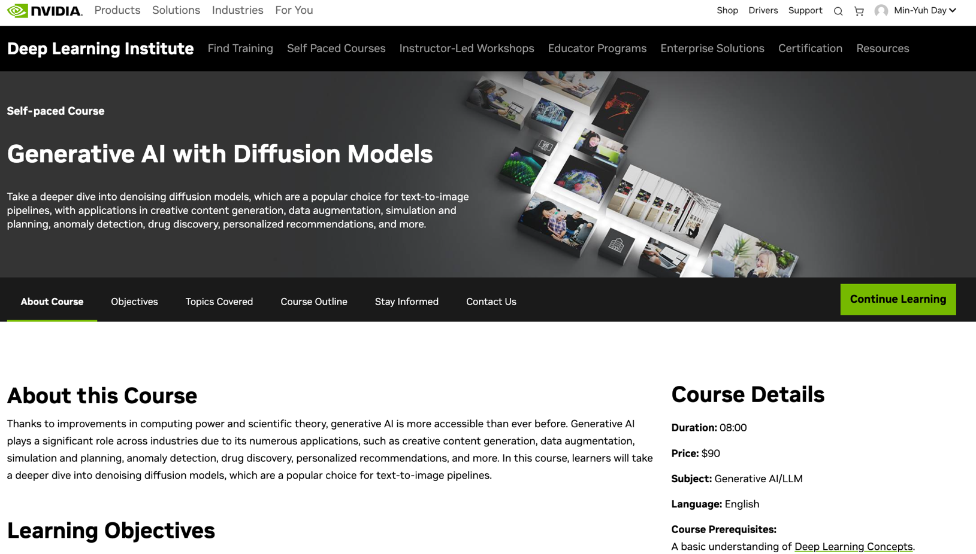
Generative AI with Diffusion Models
https://learn.nvidia.com/courses/course-detail?course_id=course-v1:DLI+S-FX-14+V1

Slide 80
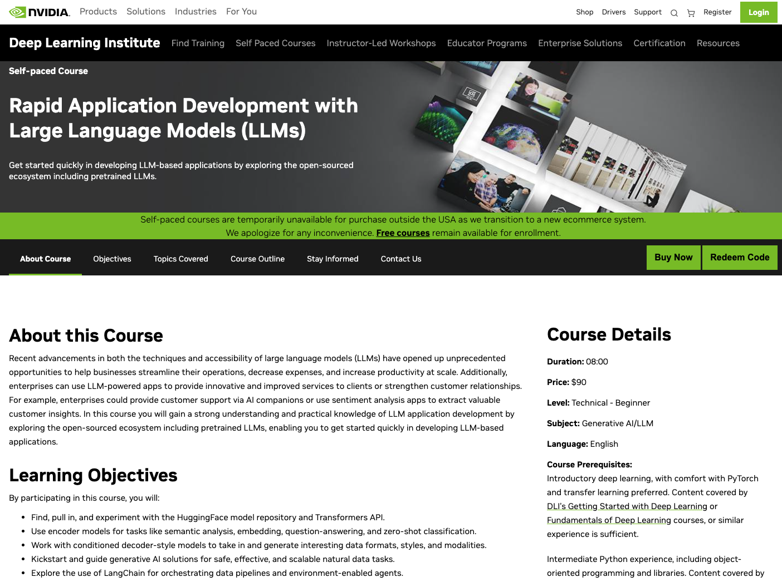
Rapid Application Development with Large Language Models (LLMs)
https://learn.nvidia.com/courses/course-detail?course_id=course-v1:DLI+S-FX-26+V1

Slide 81


Deep Learning Institute (DLI)
https://learn.nvidia.com/my-learning

Slide 82
https://learn.nvidia.com/certificates?id=ed-qOCIMQaatzU8SNUNxgw

Slide 83

NVIDIA Deep Learning Institute (DLI)
https://learn.nvidia.com/en-us/training/self-paced-courses

Slide 84

Building RAG Agents with LLMs
Source: NVIDIA DLI (2024), Building RAG Agents with LLMs, https://learn.nvidia.com/courses/course-detail?course_id=course-v1:DLI+S-FX-15+V1

Slide 85

Building RAG Agents with LLMs
https://learn.nvidia.com/courses/course?course_id=course-v1:DLI+S-FX-15+V1

Slide 86

Building RAG Agents with LLMs
https://learn.nvidia.com/courses/course?course_id=course-v1:DLI+S-FX-15+V1

Slide 87

Building RAG Agents with LLMs
https://learn.nvidia.com/courses/course?course_id=course-v1:DLI+S-FX-15+V1

Slide 88
AI Agent 對政府的核心價值
全球智慧城市投資趨勢與效益分析
市場規模：AI Agent 市場從 51 億美元成長至 2030 年 471 億美元 (Alvarez & Marsal, 2025)
政府投資：全球 66% 城市大力投資 AI 技術 (UN-Habitat, 2024)
投資效益：成功實作案例顯示 3:1 至 5:1 的投資報酬率 (Coolfire Solutions, 2024)
實際案例：
  新加坡：AI 交通管理年省 10 億美元 (Singapore Smart Nation, 2024)
  巴塞隆納：智慧城市 AI 綜合年省 1.45 億美元 (Barcelona City Council, 2024)

Slide 89
多智慧代理系統的技術突破
從文字生成到整合推理系統的演進
Agent-Native 基礎模型（2024-2025）：
  OpenAI o1/o3：內建推理與規劃能力
  Gemini 2.0 Flash：原生多模態介面互動
  Microsoft Copilot Agents：角色專業化與階層協調
技術突破：從文字生成器演進為具備原生代理能力的整合推理系統 (Ahmed, 2025)
協作模式：專業化 Agent 間的無縫協調與資訊交換

Slide 90
大型語言模型整合與檢索增強生成技術
RAG 架構組件 ：
  檢索器：向量搜尋結合 BM25 與密集嵌入
  生成器：LLM 基礎的連貫回應生成
  整合層：內容排序與信心評分

Slide 91
大型語言模型整合與檢索增強生成技術
政府服務優勢：
  即時知識更新，無需重新訓練模型
  透過驗證資料降低幻覺問題
  擴展處理大型政府文件的能力

Slide 92
政府適用的 AI Agent 開發框架
AutoGen (Microsoft)
  企業級可靠性、Docker 容器支援
CrewAI
  快速原型開發、角色導向設計
LangGraph
  圖形化工作流程控制，適合複雜流程
  n8n
  AI Agent 視覺化工作流程自動化平台
  自建或雲端部署選項

Slide 93
AI Agent 技術選擇與評估標準
安全功能與合規要求
擴展性與效能表現
整合能力與 API 支援
技術支援生態系統

Slide 94
Outline
1. AI Agent 基礎與最新趨勢
2. AI Agent 政府應用與智慧城市實作
3. AI Agent 實施策略與治理架構

Slide 95
全球智慧城市 AI 實作成功案例
量化效益與關鍵成功因素分析
新加坡智慧國家計畫：
年省 10 億美元的 AI 交通管理 (Singapore Smart Nation, 2024)
  1,500+ 路口中 80% 由 AI 管理
  尖峰時段延誤減少 20%
  碳排放減少 15%（年減 50 萬噸）

Slide 96
全球智慧城市 AI 實作成功案例
量化效益與關鍵成功因素分析
巴塞隆納智慧城市：
年省 1.45 億美元的綜合效益
(Barcelona City Council, 2024; Harvard Kennedy School, 2024)
  智慧水資源管理：節省 5,800 萬美元
  智慧停車收入：增加 5,000 萬美元
  智慧照明系統：節省 3,700 萬美元

Slide 97
首爾市 AI 基礎行政體系構建計畫
2026年前投資2,064億韓元的全面 AI 轉型
投資規模：2,064億韓元（約1.55億美元）至2026年 (Seoul Metropolitan Government, 2024)
核心應用：
  獨居老人智慧安心服務
  119緊急電話 AI 語音分析
  智慧路口交通最佳化
  1,300位公務員生成式 AI 培訓

Slide 98
首爾市 AI 基礎行政體系構建計畫
2026年前投資2,064億韓元的全面 AI 轉型
治理架構：數位政策室統籌協調，確保跨部門整合 (Seoul Metropolitan Government, 2024)
成功關鍵：高層承諾與系統性人才培育

Slide 99
智慧城市 AI 投資報酬率分析框架
量化效益評估與成本效益計算
量化效益 (Thales Group, 2024; Minnovation Technologies, 2024)：
  交通管理：旅行時間減少 12-25%
  行政效率：處理速度提升最高 50%
  能源管理：消耗量減少 10-25%
  市民滿意度：服務品質提升 35%
投資回報：智慧感測器 5 年期投資報酬率達 24:1 (Coolfire Solutions, 2024)

Slide 100
智慧城市 AI 投資報酬率分析框架
量化效益評估與成本效益計算
成本節約：
  Barcelona 智慧城市實作年省 1.45 億美元
  (Harvard Kennedy School, 2024)
評估標準：
  技術效益、營運效率、市民滿意度、環境影響

Slide 101
全球經驗應用於臺北智慧城市試辦計畫
具體實作策略與預期效益分析
第一組 - 無障礙出行導航：
  借鑑新加坡 ITS 模式：即時無障礙路線規劃
  (Singapore Smart Nation, 2024)
  預期效益：年省 50 萬美元支援服務成本
  (Coolfire Solutions, 2024)

Slide 102
全球經驗應用於臺北智慧城市試辦計畫
具體實作策略與預期效益分析
第二組 - 青年心理支持：
  參考阿姆斯特丹數位參與模式
  與首爾社會服務整合
  (Seoul Metropolitan Government, 2024)
  預期效益：服務回應時間改善 40%

Slide 103
全球經驗應用於臺北智慧城市試辦計畫
具體實作策略與預期效益分析
第三組 - 1999 服務品質：
  結合新加坡 SingPass 數位身分整合
  與巴塞隆納市民服務
  (Singapore Smart Nation, 2024; Barcelona City Council, 2024)
  預期效益：通話處理時間減少 60%

Slide 104
全球經驗應用於臺北智慧城市試辦計畫
具體實作策略與預期效益分析
第四組 - 兒少心理健康：
  適用首爾老人照護 AI 監測模式
  (Seoul Metropolitan Government, 2024)
  預期效益：提早 30% 識別介入需求

Slide 105
三階段 AI Agent 實施策略框架
從基礎建設到全面部署的系統性方法
第一階段：基礎建構（6-12個月）
第二階段：擴展整合（12-18個月）
第三階段：全面部署（持續進行）

Slide 106
三階段 AI Agent 實施策略框架
從基礎建設到全面部署的系統性方法
第一階段：基礎建構（6-12個月）
(Chan, 2023)
  API 優先架構連接既有系統
  主資料管理統一治理
  特定部門試辦計畫

Slide 107
三階段 AI Agent 實施策略框架
從基礎建設到全面部署的系統性方法
第二階段：擴展整合（12-18個月）
(Singapore Smart Nation, 2024)
  微服務架構模組化部署
  即時資料串流提供即時洞察
  跨部門協作機制建立

Slide 108
三階段 AI Agent 實施策略框架
從基礎建設到全面部署的系統性方法
第三階段：全面部署（持續進行）
(Barcelona City Council, 2024)
  雲原生解決方案確保擴展性
  持續監控與改善機制
  全市協調與最佳化

Slide 109
AI Agent 實施風險評估與緩解策略
技術、組織與法規風險的全方位管理
技術風險 (DataGuard, 2024; IBM, 2024)：
  資料品質：透過驗證框架確保
  系統可靠性：透過冗餘機制保障
  資訊安全：透過加密與存取控制防護

Slide 110
AI Agent 實施風險評估與緩解策略
技術、組織與法規風險的全方位管理
組織風險 (Chan, 2023)：
  變革管理：透過培訓計畫推動
  利害關係人參與：透過透明溝通建立
  治理架構：透過明確問責結構確立
評估矩陣：
  高、中、低風險分級與對應緩解措施
  (European Union, 2024)

Slide 111
AI Agent 實作 (n8n + LangChain 實作)
1999 服務 AI 客服代理建構實例
AI Agent 架構：
  市民來電 →
  n8n 工作流程 →
  LangChain 處理 →
  知識庫查詢 →
  回應生成 →
  系統記錄

Slide 112
AI Agent 實作 (n8n + LangChain 實作)
1999 服務 AI 客服代理建構實例
n8n 工作流程節點：
  Webhook 接收器：接收語音轉文字結果
  條件判斷：識別問題類型
  （一般諮詢/緊急事件/轉接需求）
  LangChain 節點：調用 AI 模型進行語意理解
  RAG 檢索：從政府 FAQ 知識庫獲取相關資訊
  回應合成：生成個人化回應
  資料記錄：存儲對話記錄供後續分析

Slide 113
AI Agent 實作 (n8n + LangChain 實作)
1999 服務 AI 客服代理建構實例
LangChain 關鍵組件：
  ConversationMemory：維護對話歷史
  VectorStore：政府政策文件向量化儲存
  RetrievalQA Chain：實現 RAG 檢索問答
  OutputParser：確保回應格式符合政府標準

Slide 114
AI Agent 實作 (n8n + LangChain 實作)
實作練習建議
第一組：
建立無障礙路線查詢 Agent，整合交通即時資訊 API
第二組：
設計青年諮詢 Agent，具備情緒識別和資源推薦功能
第三組：
完整 1999 客服 Agent，包含多語言支援和智慧分流
第四組：
兒少關懷 Agent，具備風險評估和轉介機制

Slide 115
Outline
1. AI Agent 基礎與最新趨勢
2. AI Agent 政府應用與智慧城市實作
3. AI Agent 實施策略與治理架構

Slide 116
政府 AI 應用倫理框架與國際標準
UNESCO 與 OECD 指導原則的實務應用
UNESCO 核心價值 (UNESCO, 2021)：
  人權與人性尊嚴
  和平、公正與互聯社會
  多元性與包容性
  環境與生態系統繁榮

Slide 117
政府 AI 應用倫理框架與國際標準
UNESCO 與 OECD 指導原則的實務應用
OECD AI 原則 (OECD, 2024)：
  包容性成長與福祉
  以人為本的價值與公平性
  透明度與可解釋性
  穩健性、安全性與保障
  問責制

Slide 118
AI 治理結構設計與組織架構
多層級決策機制與監督體系
AI 治理委員會
(Seoul Metropolitan Government, 2024; Singapore Smart Nation, 2024)：
  多方利害關係人組成
  策略監督與政策制定
  定期框架檢討

Slide 119
AI 治理結構設計與組織架構
多層級決策機制與監督體系
AI 倫理委員會 (MIT Technology Review, 2025)：
  獨立諮詢機構
  高風險應用評估
  持續倫理監控

Slide 120
AI 治理結構設計與組織架構
多層級決策機制與監督體系
AI 長角色 (Chan, 2023)：
  行政層級 AI 策略
  跨部門協調
  外部利害關係人介面

Slide 121
基於風險評估的 AI 實施分級管理
從最小風險到不可接受風險的管理框架
風險分級 (European Union, 2024)：
  最小風險：標準合規與文件記錄
  有限風險：透明度要求與 AI 標示
  高風險：全面評估、人工監督、詳細稽核
  不可接受風險：禁止應用（社會評分、操弄等）

Slide 122
基於風險評估的 AI 實施分級管理
從最小風險到不可接受風險的管理框架
政府特定風險
(MIT Technology Review, 2025; DataGuard, 2024)：
  市民服務中的演算法偏見
  資料處理中的隱私侵犯
  關鍵系統的安全漏洞
  自動化決策的問責空隙

Slide 123
AI 系統生命週期治理框架
從設計開發到部署營運的全程管控
第一階段：設計與開發
(UNESCO, 2021; OECD, 2024)
  倫理影響評估
  偏見測試與緩解
  隱私設計原則實施
  人權影響評估

Slide 124
AI 系統生命週期治理框架
從設計開發到部署營運的全程管控
第二階段：測試與驗證
(MIT Technology Review, 2025)
  全面測試協定
  獨立驗證程序
  利害關係人諮詢
  受影響社群試辦測試

Slide 125
AI 系統生命週期治理框架
從設計開發到部署營運的全程管控
第三階段：部署與營運
(Barcelona City Council, 2024)
  分階段推出與監控
  人員培訓計畫
  公眾溝通策略
  持續效能監控

Slide 126
AI 系統效能評估與成效測量框架
Kirkpatrick 四層次模型在政府 AI 的應用
Kirkpatrick 四層次模型
(Kirkpatrick & Kirkpatrick, 2016; Docebo, 2025)：
  第一層次：反應（滿意度、參與度）
  第二層次：學習（知識、技能）
  第三層次：行為（應用、效能）
  第四層次：結果（效率、成果）

Slide 127
AI 系統效能評估與成效測量框架
Kirkpatrick 四層次模型在政府 AI 的應用
政府專用指標 (SafetyCulture, 2024)：
  市民滿意度改善
  服務提供效率提升
  成本節約與投資報酬率測量 (Coolfire Solutions, 2024)
  政策合規與效力評估

Slide 128
建立公眾信任的透明度機制
資訊公開與市民參與的最佳實務
透明度要求 (Inter-Parliamentary Union, 2025)：
  公開 AI 系統登記與清單
  定期透明度報告發布
  主動揭露系統限制
  清楚說明 AI 決策過程

Slide 129
建立公眾信任的透明度機制
資訊公開與市民參與的最佳實務
市民參與策略 (Barcelona City Council, 2024; bee smart city GmbH, 2024)：
  參與式設計流程
  定期公眾諮詢
  回饋機制與申訴管道
  社群基礎監督機制

Slide 130
AI Agent 實施三階段檢核表
確保成功部署的實務指引
即時行動（0-6個月）
(Chan, 2023)：
  建立治理結構
  進行 AI 系統盤點
  發展風險評估能力
  啟動利害關係人參與

Slide 131
AI Agent 實施三階段檢核表
確保成功部署的實務指引
短期行動（6-18個月）
(European Union, 2024; Singapore Smart Nation, 2024)：
  實施核心框架
  部署試辦計畫
  建立監控程序
  進行合規評估

Slide 132
AI Agent 實施三階段檢核表
確保成功部署的實務指引
長期行動（18個月以上） (Barcelona City Council, 2024)：
  擴展成功實施
  持續改善流程
  國際合作交流
  進階能力發展

Slide 133
成果發表會簡報架構
展現專業能力與治理智慧的關鍵要素
問題定義：清楚闡述市民需求
AI 解決方案設計：技術方法與能力
實施策略：時程、資源、風險
預期成果：可測量效益與成功指標
治理計畫：倫理考量與監督機制

Slide 134
成果發表會簡報標準
展現專業能力與治理智慧的關鍵要素
技術可行性與創新性
政府營運實務適用性
倫理考量與風險緩解
利害關係人參與與溝通
可測量成果與永續性

Slide 135
成果發表實作展示指引 n8n + LangChain 原型展示標準
技術展示 ：
  工作流程視覺化：完整的 n8n 流程圖展示
  實際操作演示：現場模擬市民服務情境
  效能指標呈現：回應時間、準確率、用戶滿意度
  錯誤處理機制：異常情況的處理流程

Slide 136
成果發表實作展示指引 n8n + LangChain 原型展示標準
原型功能：
  基本對話能力：理解常見市民問題
  知識庫整合：連接相關政策文件資料庫
  多輪對話支援：維持對話上下文
  人工轉接機制：複雜問題的升級處理

Slide 137
成果發表實作展示指引 n8n + LangChain 原型展示標準
評估標準：
  技術實現度 (30%)：原型完整性與功能性
  創新應用 (25%)：解決方案的創意與實用性
  使用者體驗 (20%)：介面友善度與易用性
  系統整合 (15%)：與現有政府系統的相容性
  擴展潛力 (10%)：未來發展與規模化可能性

Slide 138
成果發表實作展示指引 n8n + LangChain 原型展示標準
實作交付物清單：
  1. n8n 工作流程檔案 (.json)
  2. LangChain 程式碼 (.py)
  3. 知識庫設計文件
  4. 測試案例與結果報告
  5. 部署說明文件
  6. 5 分鐘實作展示影片

Slide 139
第一組 - 無障礙出行導航 AI Agent：
技術要求：
  使用 n8n 建立工作流程，整合臺北市即時交通 API
  實作 LangChain RAG 系統，知識庫包含無障礙設施資訊
  建立路線最佳化演算法，考慮無障礙需求

Slide 140
第一組 - 無障礙出行導航 AI Agent：
核心功能：
  1. 接收使用者位置和目的地
  2. 識別無障礙需求類型（輪椅、視障、聽障等）
  3. 即時查詢交通狀況和設施可用性
  4. 生成個人化無障礙路線建議
  5. 提供語音和視覺雙重輸出

Slide 141
第一組 - 無障礙出行導航 AI Agent：
展示情境：
  輪椅使用者從臺北車站到市政府的最佳路線
  視障者搭乘捷運的詳細導引
  臨時電梯故障時的替代方案推薦

Slide 142
第二組 - 青年心理支持 AI Agent：
技術要求：
  n8n 工作流程整合情緒分析 API
  LangChain 對話系統具備心理諮商知識庫
  實作風險評估與轉介機制

Slide 143
第二組 - 青年心理支持 AI Agent：
核心功能：
  1. 自然語言情緒狀態分析
  2. 基於心理學原理的對話引導
  3. 危機識別與緊急轉介
  4. 資源推薦與追蹤關懷
  5. 隱私保護與資料加密

Slide 144
第二組 - 青年心理支持 AI Agent：
展示情境：
  青年表達學業壓力的對話處理
  識別自殺傾向並啟動緊急程序
  提供客製化心理健康資源推薦

Slide 145
第三組 - 1999 服務品質 AI Agent：
技術要求：
  n8n 多語言語音轉文字工作流程
  LangChain RAG 整合完整政府 FAQ 資料庫
  智慧分流與人工轉接機制

Slide 146
第三組 - 1999 服務品質 AI Agent：
核心功能：
  1. 多語言語音識別與處理
  2. 意圖識別與問題分類
  3. 知識庫檢索與答案生成
  4. 複雜問題智慧分流
  5. 服務品質即時監控

Slide 147
第三組 - 1999 服務品質 AI Agent：
展示情境：
  處理繁體中文、英文、台語混合查詢
  複雜稅務問題的專業轉接
  緊急案件的快速升級處理

Slide 148
第四組 - 兒少心理健康 AI Agent：
技術要求：
  n8n 多源資料整合工作流程
  LangChain 兒童心理發展知識系統
  跨部門協作通報機制

Slide 149
第四組 - 兒少心理健康 AI Agent：
核心功能：
  1. 多模態兒童行為分析
  2. 發展里程碑追蹤評估
  3. 風險因子預警系統
  4. 跨部門資源整合推薦
  5. 家長與教師協作平台

Slide 150
第四組 - 兒少心理健康 AI Agent：
展示情境：
  分析兒童繪畫作品識別情緒問題
  學校通報系統的自動風險評估
  整合社會局、教育局、衛生局資源推薦

Slide 151
開發環境設置
n8n 本地安裝指引與雲端部署選項
LangChain 開發環境配置
臺北市政府 API 存取權限申請
測試資料集與模擬環境

Slide 152
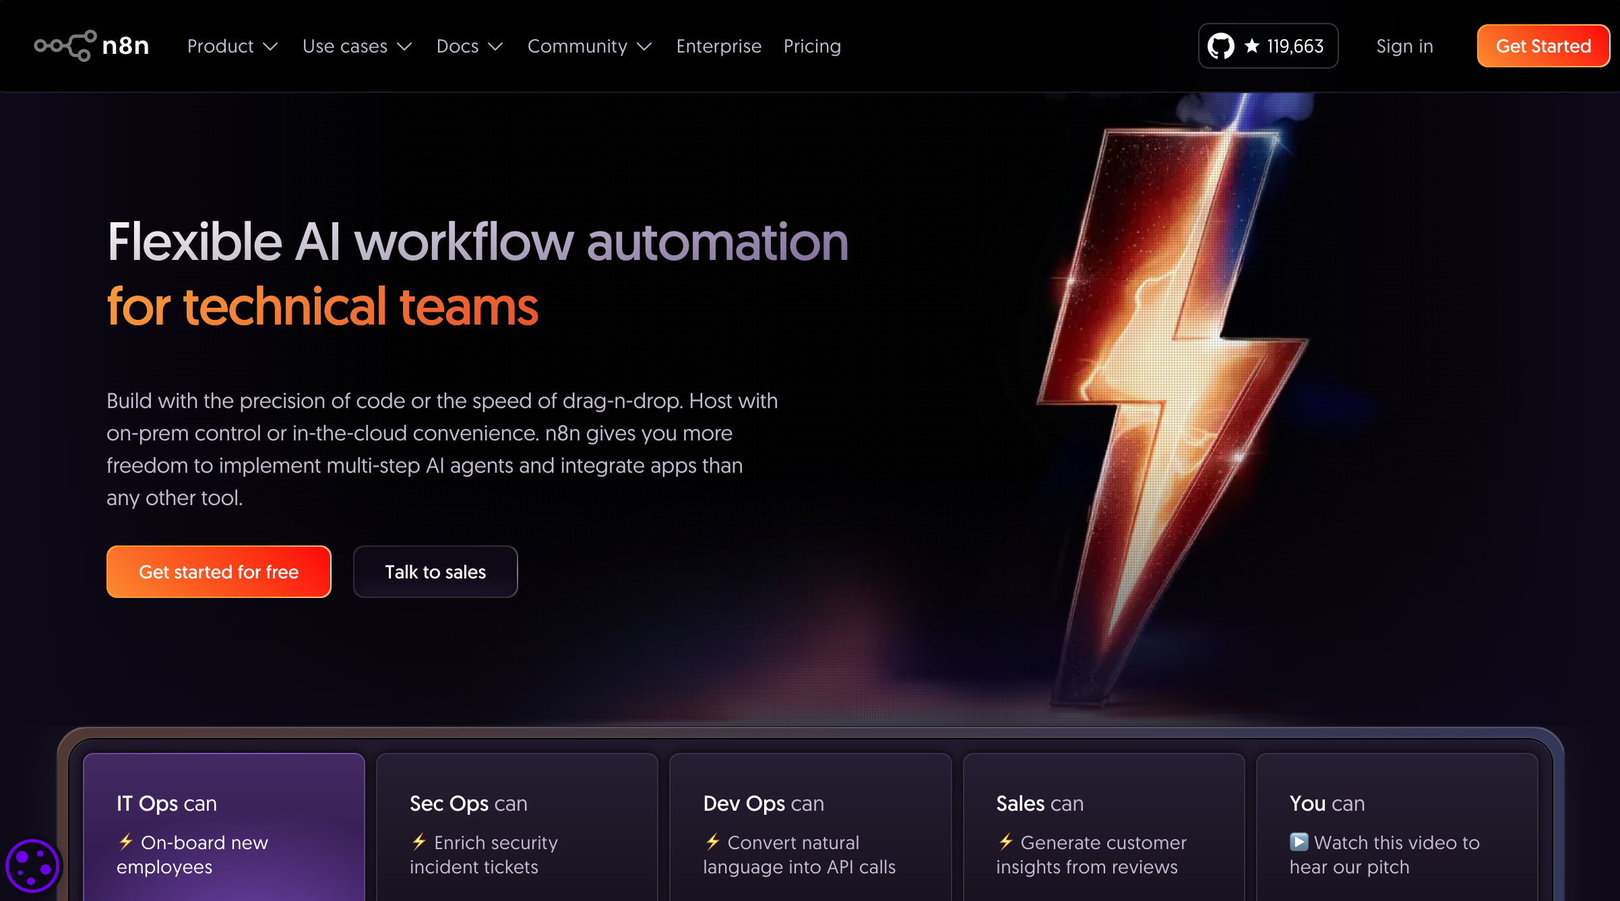
AI Agent with n8n (nodemation)
https://n8n.io/

Slide 153
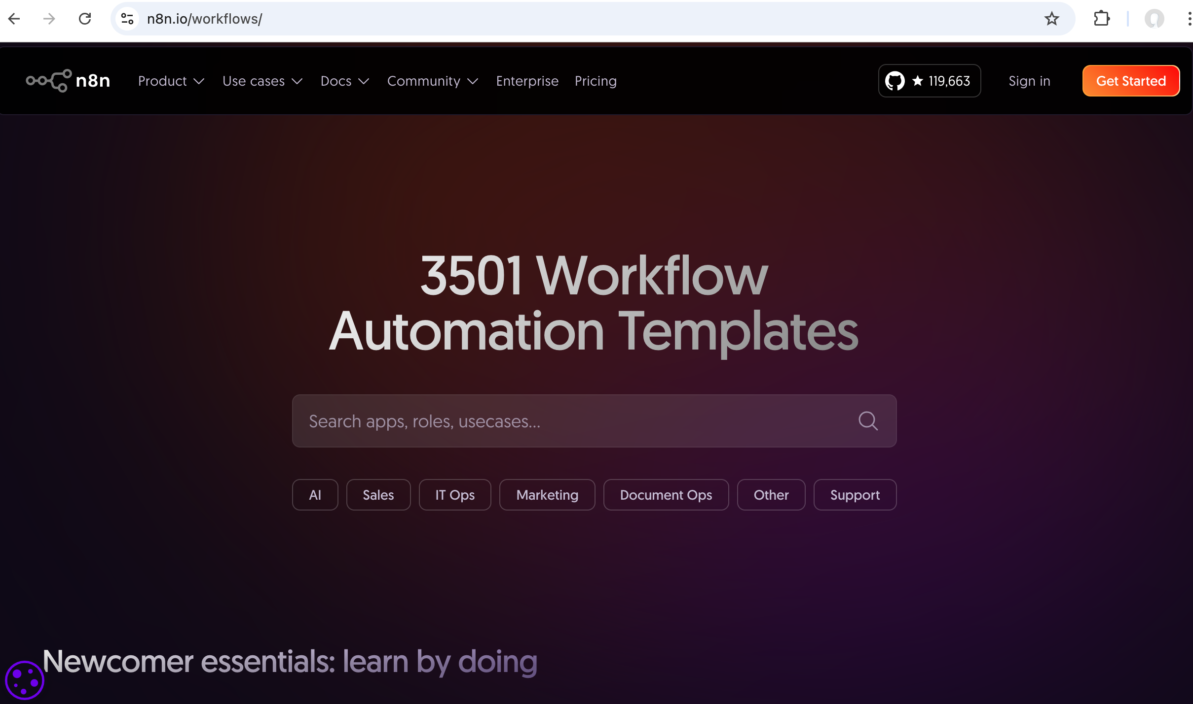
AI Agent with n8n
Workflow Automation Templates
https://n8n.io/workflows/

Slide 154
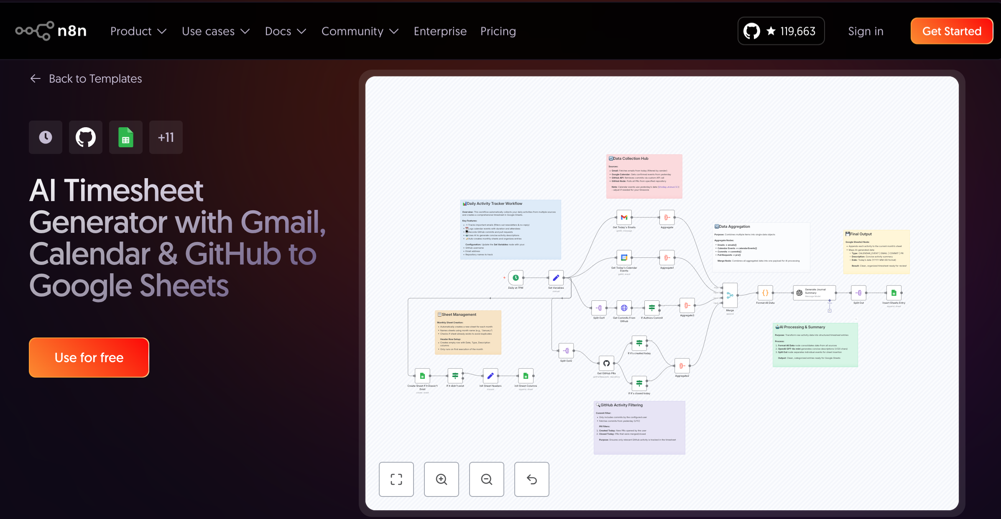
AI Agent with n8n
Workflow Automation Templates
https://n8n.io/workflows/

Slide 155
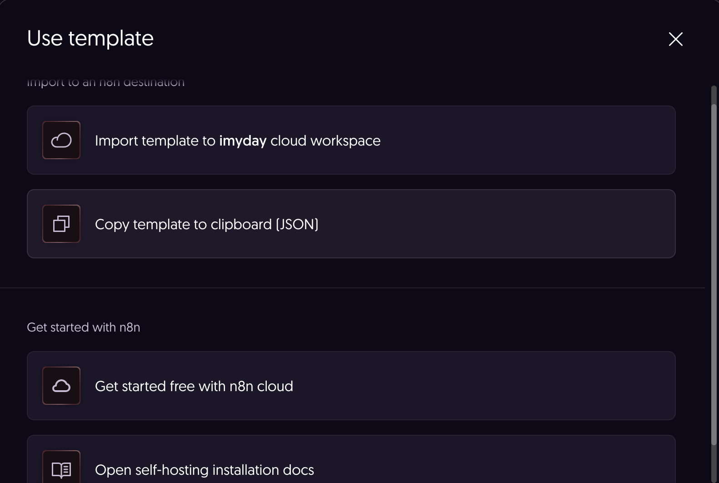
AI Agent with n8n
Workflow Automation Templates
https://n8n.io/workflows/

Slide 156
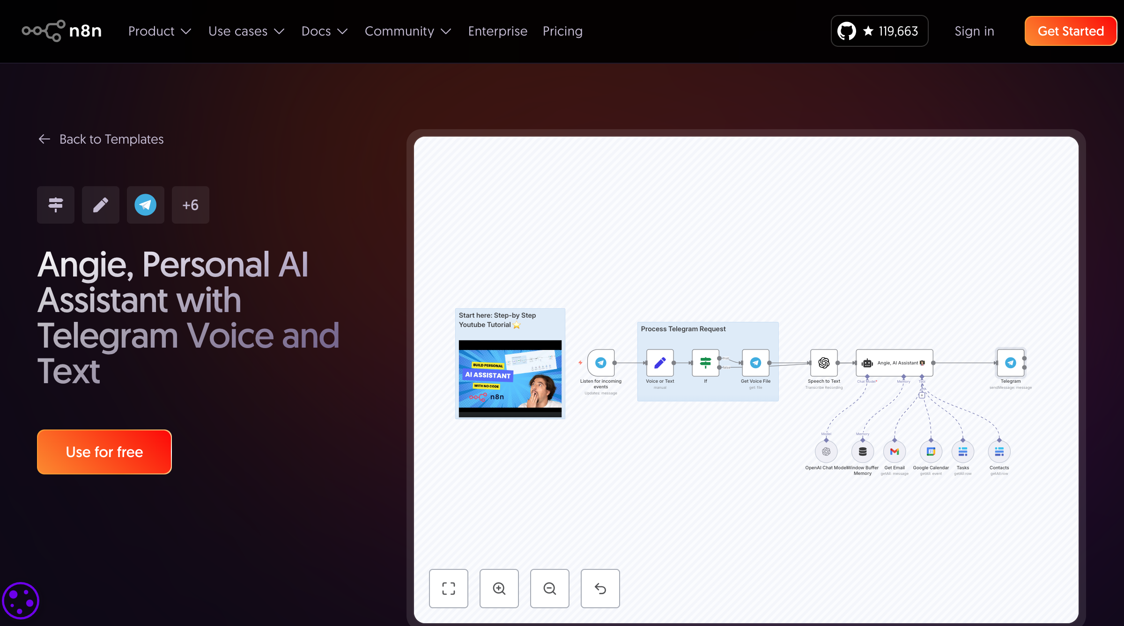
AI Agent with n8n
Workflow Automation Templates
https://n8n.io/workflows/2462-angie-personal-ai-assistant-with-telegram-voice-and-text/

Slide 157
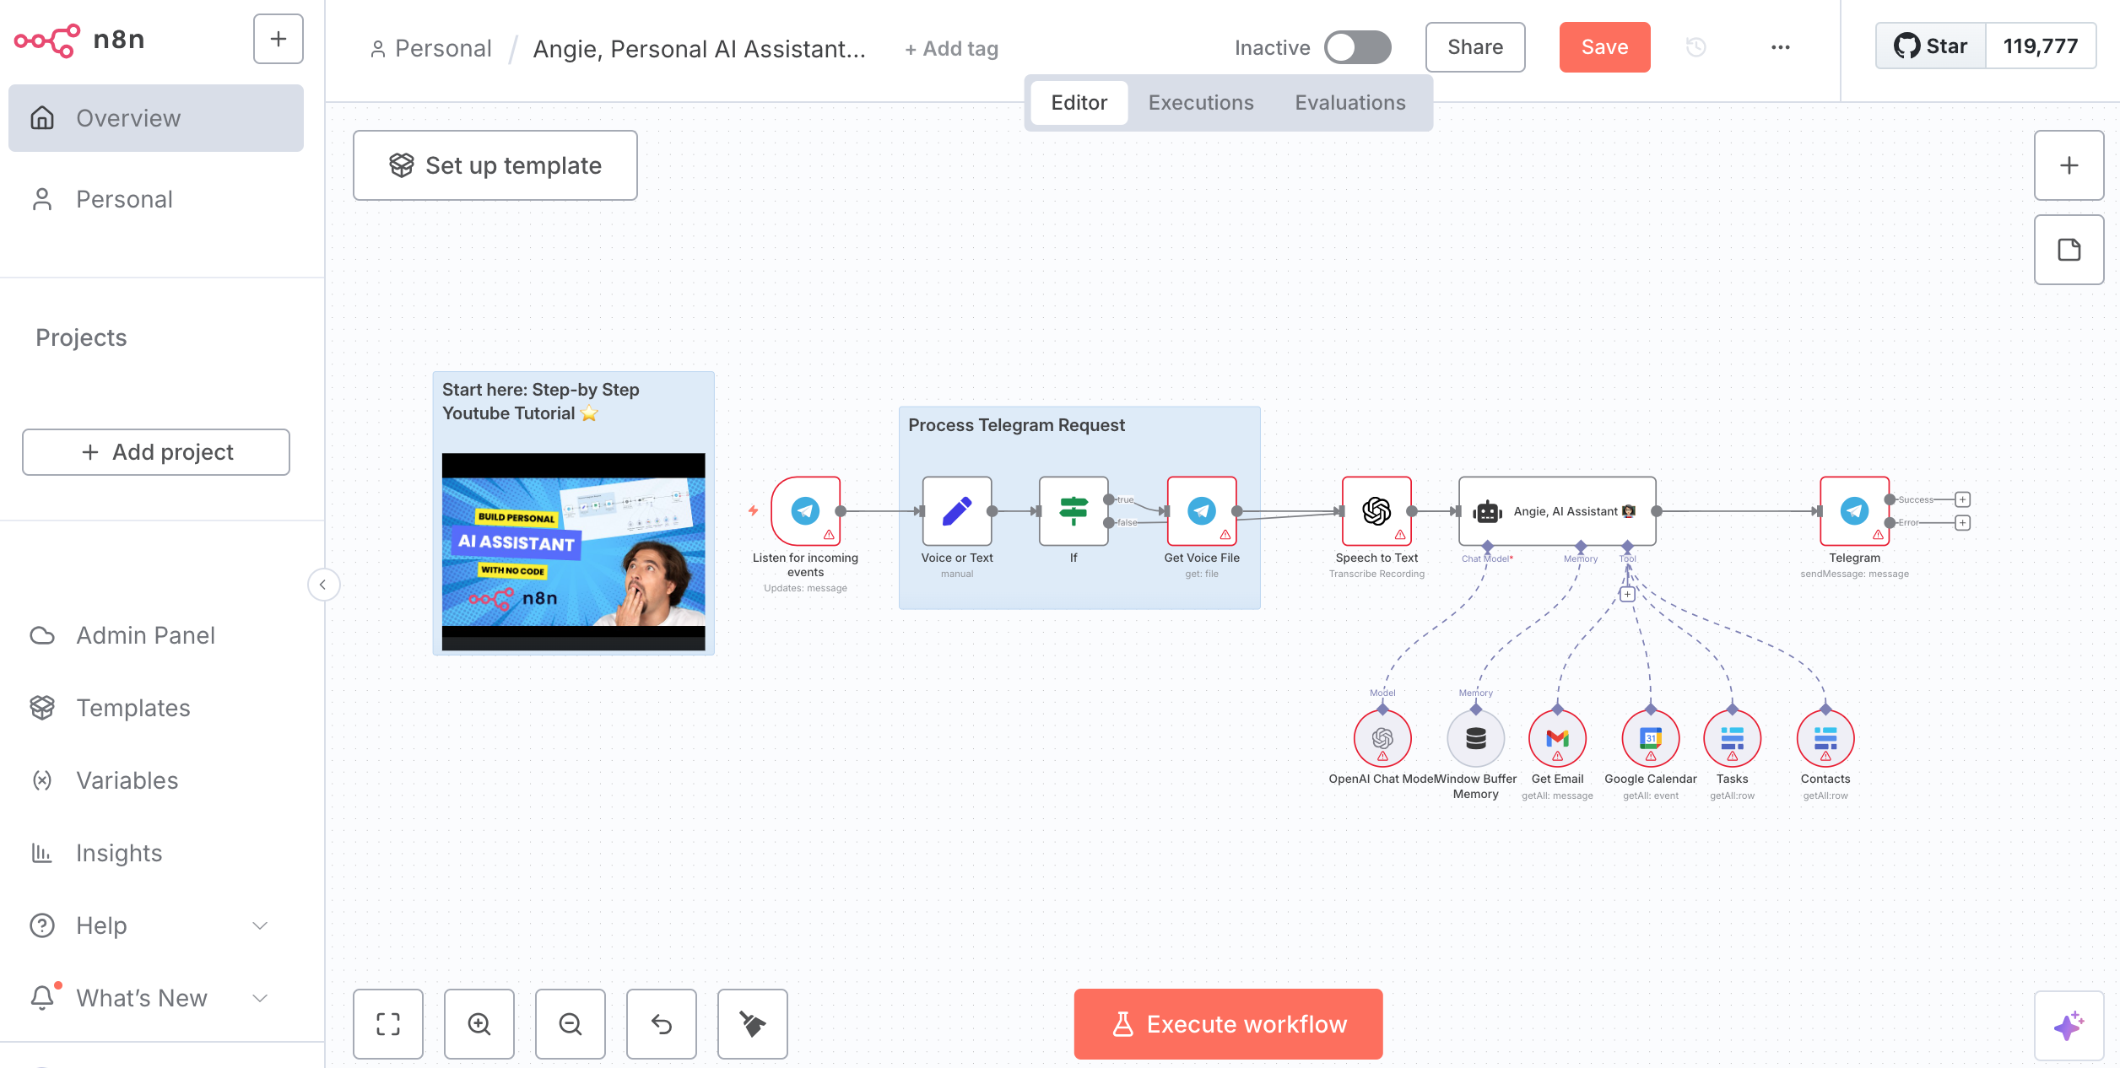
AI Agent with n8n (nodemation)
https://n8n.io

Slide 158
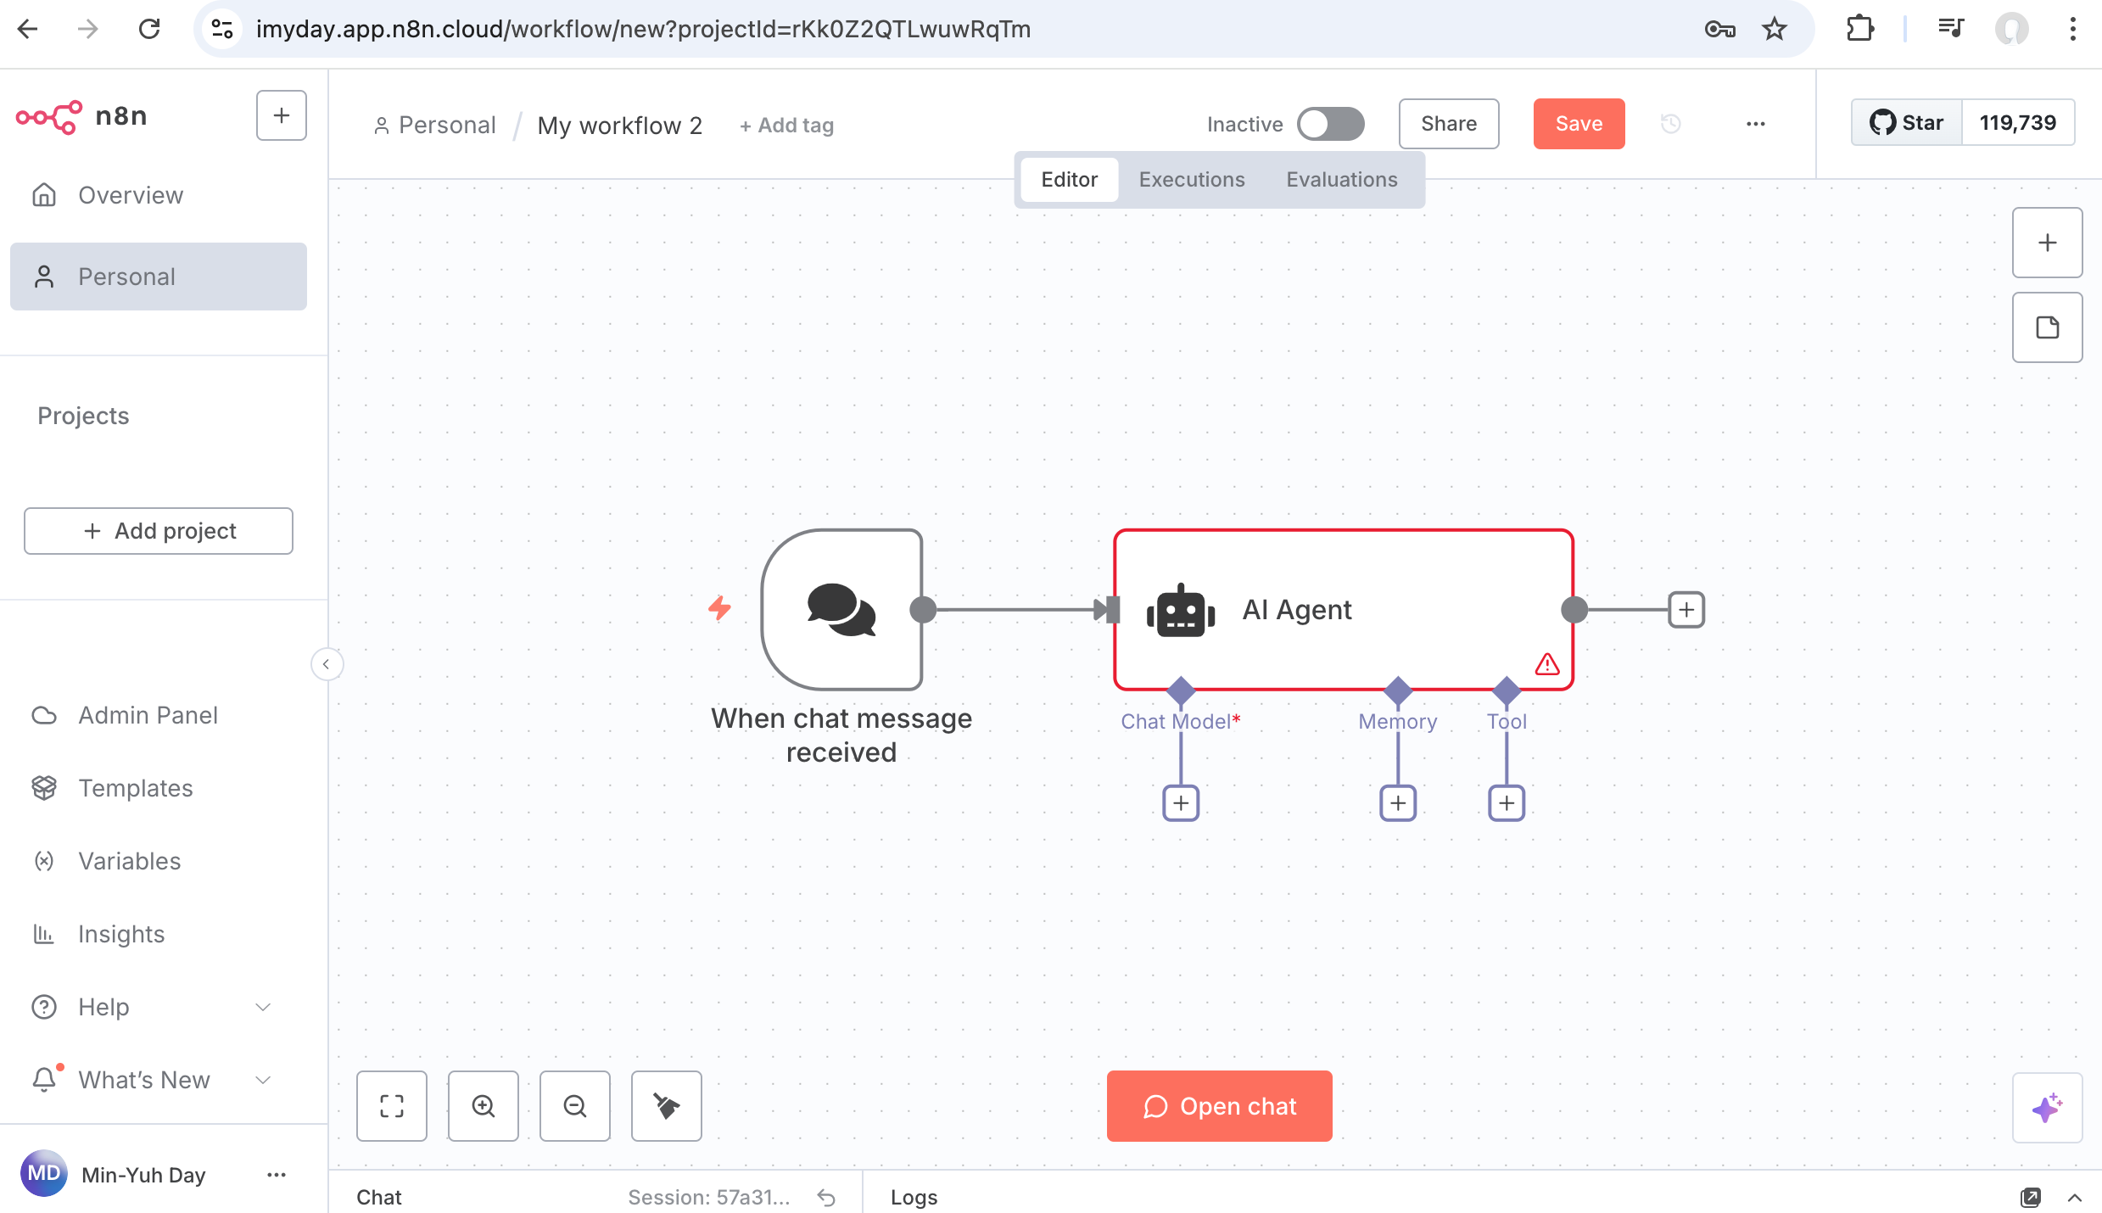
AI Agent with n8n (nodemation)
https://n8n.io

Slide 159
結語：
人工智慧新趨勢（AI Agent）
從學習到實踐的轉換
技術實踐：開發真正解決市民問題的 AI 系統
治理創新：建立負責任的 AI 治理機制
經驗分享：為全球智慧城市發展貢獻台北經驗
持續學習：在快速變化的 AI 世界中保持領先

Slide 160
Summary
1. AI Agent 基礎與最新趨勢
2. AI Agent 政府應用與智慧城市實作
3. AI Agent 實施策略與治理架構

Slide 161
References
Ahmed, S. (2025, January 15). AI agents in 2025: A comprehensive review and future outlook. Medium. https://medium.com/@sahin.samia/current-trends-in-ai-agents-use-cases-and-the-future-ahead-1026c4d753fd
Alvarez & Marsal. (2025). Demystifying AI agents in 2025: Separating hype from reality and navigating market outlook. https://www.alvarezandmarsal.com/thought-leadership/demystifying-ai-agents-in-2025-separating-hype-from-reality-and-navigating-market-outlook
Barcelona City Council. (2024). Smart city Barcelona: IoT integration and citizen engagement. Smart City Hub. https://smartcityhub.com/technology-innnovation/barcelona-showcase-smart-city-dynamics/
California Department of Education. (2024). Learning with AI, learning about AI: Professional learning framework. https://www.cde.ca.gov/ci/pl/aiincalifornia.asp
Chan, C. K. Y. (2023). A comprehensive AI policy education framework for university teaching and learning. International Journal of Educational Technology in Higher Education, 20(1), 38. https://doi.org/10.1186/s41239-023-00408-3
Coolfire Solutions. (2024). Smart city initiatives: Where's the ROI? https://coolfiresolutions.com/blog/measuring-smart-city-roi/
DataGuard. (2024). The growing data privacy concerns with AI: What you need to know. https://www.dataguard.com/blog/growing-data-privacy-concerns-ai/
Dibia, V. (2024, December 28). AI agents 2024 rewind: A year of building and learning. Medium. https://medium.com/@victor.dibia/ai-agents-2024-rewind-a-year-of-building-and-learning-fc6dd490bce2
Docebo. (2025). How to measure training effectiveness: The 2025 framework. https://www.docebo.com/learning-network/blog/how-to-measure-training-effectiveness/
Emerging Tech Brew. (2022, September 21). What cities can learn from Sidewalk and Toronto's failed city of the future. https://www.emergingtechbrew.com/stories/2022/09/21/how-miscommunication-derailed-sidewalk-s-usd1-3-billion-city-of-the-future
European Union. (2024). Regulation (EU) 2024/1689 of the European Parliament and of the Council laying down harmonised rules on artificial intelligence (Artificial Intelligence Act). https://eur-lex.europa.eu/eli/reg/2024/1689/oj
Frontiers. (2022). Social acceptance of smart city projects: Focus on the Sidewalk Toronto case. Frontiers in Environmental Science, 10. https://doi.org/10.3389/fenvs.2022.898922
FutureAGI. (2025). RAG architecture: Enhancing LLM agents with AI retrieval. https://futureagi.com/blogs/rag-architecture-llm-2025
Google for Developers. (2025, January). A2A: A new era of agent interoperability. https://developers.googleblog.com/en/a2a-a-new-era-of-agent-interoperability/
Harrison, C. (2024). LangChain documentation: Building applications with LLMs through composability. LangChain Inc. https://python.langchain.com/docs/
Harvard Kennedy School. (2024). How smart city Barcelona brought the Internet of Things to life. Data-Smart City Solutions. https://datasmart.hks.harvard.edu/news/article/how-smart-city-barcelona-brought-the-internet-of-things-to-life-789
IBM. (2024). What is AI agent evaluation? https://www.ibm.com/think/topics/ai-agent-evaluation
Inter-Parliamentary Union. (2025, February). What AI means for public engagement with parliaments. https://www.ipu.org/news/case-studies/2025-02/what-ai-means-public-engagement-with-parliaments
Kirkpatrick, D. L., & Kirkpatrick, J. D. (2016). Evaluating training programs: The four levels (3rd ed.). Berrett-Koehler Publishers.
Minnovation Technologies. (2024). Example of a smart city: A case study into Barcelona. https://minnovation.com.au/smart-cities-2/example-of-a-smart-city-a-case-study-into-barcelona/

Slide 162
References
MIT Technology Review. (2022, June 29). Toronto wants to kill the smart city forever. https://www.technologyreview.com/2022/06/29/1054005/toronto-kill-the-smart-city/
MIT Technology Review. (2025, June 11). Inside Amsterdam's high-stakes experiment to create fair welfare AI. https://www.technologyreview.com/2025/06/11/1118233/amsterdam-fair-welfare-ai-discriminatory-algorithms-failure/
n8n.io. (2024). n8n documentation: Workflow automation for technical people. n8n GmbH. https://docs.n8n.io/
Organisation for Economic Co-operation and Development. (2024). How countries are implementing the OECD principles for trustworthy AI. OECD.AI. https://oecd.ai/en/wonk/national-policies-2
Policy Options. (2020, May). Sidewalk Labs' city-of-the future in Toronto was a stress test we needed. Institute for Research on Public Policy. https://policyoptions.irpp.org/magazines/may-2020/sidewalk-labs-city-of-the-future-in-toronto-was-a-stress-test-we-needed/
SafetyCulture. (2024). 10 training evaluation methods. SC Training. https://training.safetyculture.com/blog/training-evaluation-methods/
Seoul Metropolitan Government. (2024). Seoul aims to become the best city in AI utilization: AI-based administration to enhance well-being of citizens. https://english.seoul.go.kr/seoul-aims-to-become-the-best-city-in-ai-utilization-ai-based-administration-to-enhance-well-being-of-citizens/
Singapore Smart Nation and Digital Government Office. (2024). National artificial intelligence strategy. https://www.smartnation.gov.sg/initiatives/strategic-national-projects/
Thales Group. (2024). Singapore: The world's smartest city. https://www.thalesgroup.com/en/worldwide-digital-identity-and-security/iot/magazine/singapore-worlds-smartest-city
UNESCO. (2021). Recommendation on the ethics of artificial intelligence. https://www.unesco.org/en/artificial-intelligence/recommendation-ethics
UN-Habitat. (2024). Global assessment of responsible AI in cities: Research and recommendations to leverage AI for people-centred smart cities. https://unhabitat.org/global-assessment-of-responsible-ai-in-cities
Victordibia. (2024). AI agents 2024 rewind: A year of building and learning. https://newsletter.victordibia.com/p/ai-agents-2024-rewind-a-year-of-building
Wiggins, G., & McTighe, J. (2005). Understanding by design (Expanded 2nd ed.). Association for Supervision and Curriculum Development.

Slide 163
人工智慧新趨勢：AI 代理
New Trends in Artificial Intelligence: AI Agent
114年度臺北市政府AI人才培訓班
Q & A
Time: 2025/7/18 (五) 13:40-16:30
Place: E504電腦教室, 臺北市文山區萬美街二段21巷20號
Organizer: 臺北市政府公務人員訓練處 綜合企劃組 劉雨青
University Ambassador
戴敏育 教授 (Prof. Min-Yuh Day)
國立臺北大學 資訊管理研究所 教授
金融科技暨綠色金融研究中心 主任
永續辦公室 永續發展組 組長
Certified Instructor
2025-07-18

