Slide 1





人工智慧文本分析
(AI for Text Analytics)
Tamkang
University
人工智慧文本分析課程介紹
(Course Orientation on
Artificial Intelligence for Text Analytics)
1091AITA01
MBA, IMTKU (M2455) (8418) (Fall 2020)
Thu 3, 4 (10:10-12:00) (B206)
Min-Yuh Day
戴敏育
Associate Professor
副教授
Institute of Information Management, National Taipei University
國立臺北大學 資訊管理研究所
https://web.ntpu.edu.tw/~myday
2020-09-17

Slide 2
人工智慧
文本分析
(Artificial Intelligence for Text Analytics)

Slide 3
淡江大學109學年度第1學期
課程教學計畫表
Fall 2020 (2020.09 - 2021.01)
課程名稱：人工智慧文本分析
(Artificial Intelligence for Text Analytics)
授課教師：戴敏育 (Min-Yuh Day)
開課系級：資管所碩士班 (TLMXM1A)
開課資料：選修 單學期 2 學分 (2 Credits, Elective)
上課時間：週四 3, 4 (10:10-12:00)
上課教室： B206 (淡江大學淡水校園)
遠距非同步課程

Slide 4


資訊管理學系
資訊創新
管理思維
IMTKU

Slide 5
淡江大學資訊管理
系( 所) 教育目標
Tamkang
University
致力於資訊科技
與經營管理知識
之科際整合研究發展，
為國家與社會培育兼具
資訊技術能力與
現代管理知識的中高階人才。

Slide 6
淡江大學資訊管理
系( 所) 核心能力
Tamkang
University
A. 現代管理知識應用。(10%)
B. 邏輯思考。(10%)
C. 關鍵分析。(10%)
D. 結合資訊技術與管理。(30%)
E. 研究與創新。(10%)
F. 資料分析與應用。(20%)
G. 資通安全管理。
H. 言辭與文字表達。(10%)

Slide 7
本課程對應校級
基本素養之項目與比重
Tamkang
University
1. 全球視野 (10%)
2. 資訊運用 (50%)
3. 洞悉未來 (10%)
4. 品德倫理 (10%)
5. 獨立思考 (10%)
7. 團隊合作 (10%)

Slide 8
課程簡介
本課程介紹人工智慧文本分析基本概念與研究議題。
課程內容包括
  文本分析的基礎：自然語言處理 (NLP)
  Python自然語言處理
  處理和理解文本
  文本表達特徵工 程
  文本分類
  文本摘要和主題模型
  文本相似度和分群
  語意分析與命名實體識別 (NER)
  情感分析
  深度學習和通用句子嵌入模型
  問答系統與對話系 統
  文字探勘個案研究

Slide 9
Course Introduction
This course introduces the
fundamental concepts and research issues of
artificial intelligence for text analytics.
Topics include
  Foundations of Text Analytics: Natural Language Processing (NLP)
  Python for NLP
  Processing and Understanding Text
  Feature Engineering for Text Representation
  Text Classification
  Text Summarization and Topic Models
  Text Similarity and Clustering
  Semantic Analysis and Named Entity Recognition
  Sentiment Analysis
  The Promise of Deep Learning and Universal Sentence-Embedding Models
  Question Answering and Dialogue Systems
  Case Study on AI Text Analytics

Slide 10
課程目標
(Objective)
瞭解及應用人工智慧文本分析
基本概念與研究議題。
Understand and apply the fundamental concepts and research issues of
artificial intelligence for text analytics.
進行人工智慧文本分析相關之資訊管理研究。
Conduct information systems research in the context of artificial intelligence for text analytics.

Slide 11
課程大綱 (Syllabus)
週次 (Week) 日期 (Date) 內容 (Subject/Topics)
1 2020/09/17 人工智慧文本分析課程介紹
(Course Orientation on Artificial Intelligence for Text Analytics)
2 2020/09/24 文本分析的基礎：自然語言處理
(Foundations of Text Analytics: Natural Language Processing; NLP)
3 2020/10/01 中秋節 (Mid-Autumn Festival) 放假一天 (Day off)
4 2020/10/08 Python自然語言處理
(Python for Natural Language Processing)
5 2020/10/15 處理和理解文本
(Processing and Understanding Text)
6 2020/10/22 文本表達特徵工程
(Feature Engineering for Text Representation)

Slide 12
課程大綱 (Syllabus)
週次 (Week) 日期 (Date) 內容 (Subject/Topics)
7 2020/10/29 人工智慧文本分析個案研究 I
(Case Study on Artificial Intelligence for Text Analytics I)
8 2020/11/05 文本分類
(Text Classification)
9 2020/11/12 文本摘要和主題模型
(Text Summarization and Topic Models)
10 2020/11/19 期中報告 (Midterm Project Report)
11 2020/11/26 文本相似度和分群
(Text Similarity and Clustering)
12 2020/12/03 語意分析和命名實體識別
(Semantic Analysis and Named Entity Recognition; NER)

Slide 13
課程大綱 (Syllabus)
週次 (Week) 日期 (Date) 內容 (Subject/Topics)
13 2020/12/10 情感分析
(Sentiment Analysis)
14 2020/12/17 人工智慧文本分析個案研究 II
(Case Study on Artificial Intelligence for Text Analytics II)
15 2020/12/24 深度學習和通用句子嵌入模型
(Deep Learning and Universal Sentence-Embedding Models)
16 2020/12/31 問答系統與對話系統
(Question Answering and Dialogue Systems)
17 2021/01/07 期末報告 I (Final Project Presentation I)
18 2021/01/14 期末報告 II (Final Project Presentation II)

Slide 14
教學方法與評量方法
教學方法
  講述、討論、
  發表、實作
評量方法
  討論、實作、報告

Slide 15
教材課本
教材課本
  講義 (Slides)
  人工智慧文本分析相關個案與論文
  (Cases and Papers related to
  AI for Text Analytics)

Slide 16
參考書籍 (References)
Dipanjan Sarkar (2019),
Text Analytics with Python: A Practitioner’s Guide to Natural Language Processing, Second Edition. APress.
Benjamin Bengfort, Rebecca Bilbro, and Tony Ojeda (2018),
Applied Text Analysis with Python:
Enabling Language-Aware Data Products with Machine Learning, O’Reilly.
Charu C. Aggarwal (2018),
Machine Learning for Text, Springer.
Gabe Ignatow and Rada F. Mihalcea (2017),
An Introduction to Text Mining: Research Design, Data Collection, and Analysis, SAGE Publications.

Slide 17
作業與學期成績計算方式
作業篇數
  3篇
學期成績計算方式
  期中評量：30 ％
  期末評量：30 ％
  其他（課堂參與及報告討論表現）： 40 ％

Slide 18
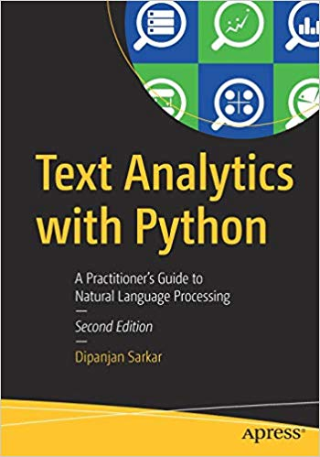
Dipanjan Sarkar (2019),
Text Analytics with Python:
A Practitioner’s Guide to Natural Language Processing,
Second Edition. APress.
Source: https://www.amazon.com/Text-Analytics-Python-Practitioners-Processing/dp/1484243536

Slide 19
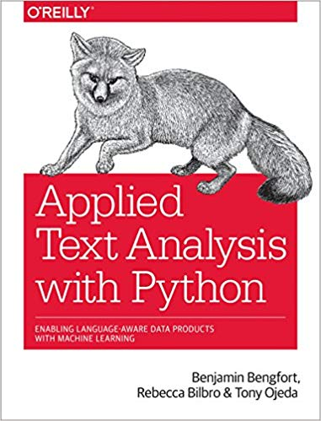
Benjamin Bengfort, Rebecca Bilbro, and Tony Ojeda (2018),
Applied Text Analysis with Python:
Enabling Language-Aware Data Products with Machine Learning, O’Reilly.
Source: https://www.amazon.com/Applied-Text-Analysis-Python-Language-Aware/dp/1491963042

Slide 20
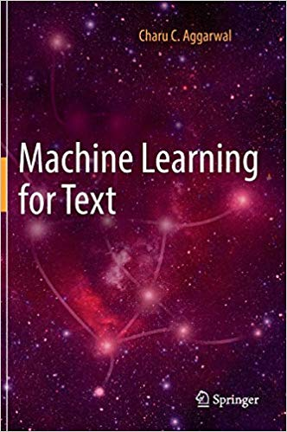
Charu C. Aggarwal (2018),
Machine Learning for Text,
Springer
Source: https://www.amazon.com/Machine-Learning-Text-Charu-Aggarwal/dp/3319735306

Slide 21
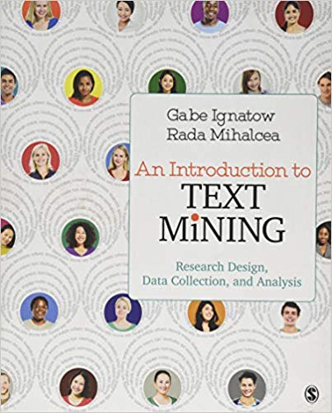
Gabe Ignatow and Rada F. Mihalcea (2017),
An Introduction to Text Mining:
Research Design, Data Collection, and Analysis,
SAGE Publications.
Source: https://www.amazon.com/Introduction-Text-Mining-Research-Collection/dp/1506337007

Slide 22
AI, Big Data, Cloud Computing
Evolution of Decision Support, Business Intelligence, and Analytics
AI
AI
Cloud Computing
Big Data
DM TM
BI
Source: Ramesh Sharda, Dursun Delen, and Efraim Turban (2017),
Business Intelligence, Analytics, and Data Science: A Managerial Perspective, 4th Edition, Pearson

Slide 23
Three Types of Analytics
Source: Ramesh Sharda, Dursun Delen, and Efraim Turban (2017),
Business Intelligence, Analytics, and Data Science: A Managerial Perspective, 4th Edition, Pearson

Slide 24
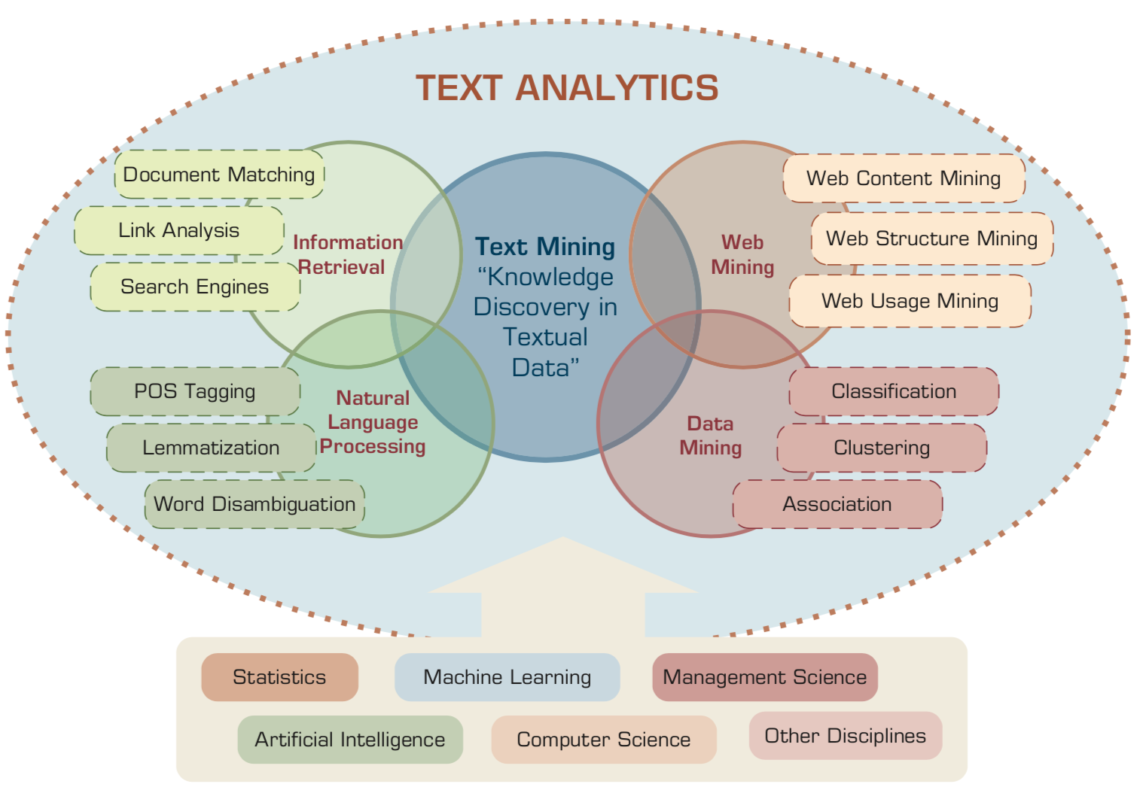
Text Analytics and Text Mining
Source: Ramesh Sharda, Dursun Delen, and Efraim Turban (2017), Business Intelligence, Analytics, and Data Science: A Managerial Perspective, 4th Edition, Pearson

Slide 25
Text Analytics
Text Analytics =
Information Retrieval +
Information Extraction +
Data Mining +
Web Mining
Text Analytics =
Information Retrieval +
Text Mining
Source: Ramesh Sharda, Dursun Delen, and Efraim Turban (2017), Business Intelligence, Analytics, and Data Science: A Managerial Perspective, 4th Edition, Pearson

Slide 26
Text mining
Text Data Mining
Knowledge Discovery in
Textual Databases
Source: Ramesh Sharda, Dursun Delen, and Efraim Turban (2017), Business Intelligence, Analytics, and Data Science: A Managerial Perspective, 4th Edition, Pearson

Slide 27
Application Areas of Text Mining
Information extraction
Topic tracking
Summarization
Categorization
Clustering
Concept linking
Question answering
Source: Ramesh Sharda, Dursun Delen, and Efraim Turban (2017), Business Intelligence, Analytics, and Data Science: A Managerial Perspective, 4th Edition, Pearson

Slide 28
Natural Language Processing (NLP)
Natural language processing (NLP) is an important component of text mining and is a subfield of artificial intelligence and computational linguistics.
Source: Ramesh Sharda, Dursun Delen, and Efraim Turban (2017), Business Intelligence, Analytics, and Data Science: A Managerial Perspective, 4th Edition, Pearson

Slide 29
Natural Language Processing (NLP)
Part-of-speech tagging
Text segmentation
Word sense disambiguation
Syntactic ambiguity
Imperfect or irregular input
Speech acts
Source: Ramesh Sharda, Dursun Delen, and Efraim Turban (2017), Business Intelligence, Analytics, and Data Science: A Managerial Perspective, 4th Edition, Pearson

Slide 30
NLP Tasks
Question answering
Automatic summarization
Natural language generation
Natural language understanding
Machine translation
Foreign language reading
Foreign language writing.
Speech recognition
Text-to-speech
Text proofing
Optical character recognition
Source: Ramesh Sharda, Dursun Delen, and Efraim Turban (2017), Business Intelligence, Analytics, and Data Science: A Managerial Perspective, 4th Edition, Pearson

Slide 31
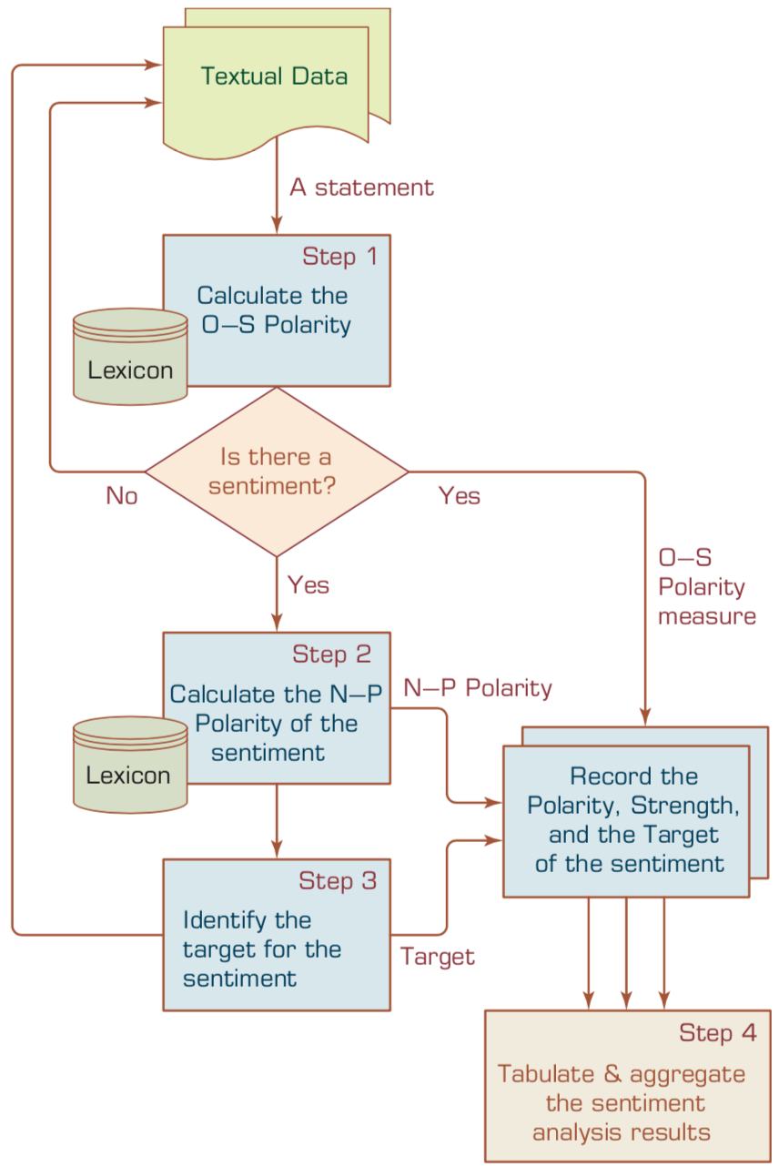
A Multistep Process to Sentiment Analysis
Source: Ramesh Sharda, Dursun Delen, and Efraim Turban (2017), Business Intelligence, Analytics, and Data Science: A Managerial Perspective, 4th Edition, Pearson

Slide 32
Sentiment Analysis
Subjectivity
Classification
Polarity Determination
Approaches
Machine Learning based
Sentiment Classification
Vagueness resolution in opinionated text
Lexicon based
Sentiment Analysis
Review Usefulness Measurement
Multi- & Cross- Lingual SC
Hybrid
approaches
Opinion Spam Detection
Cross-domain SC
Lexicon Creation
Ontology based
Tasks
Non-Ontology based
Aspect Extraction
Application
Source: Kumar Ravi and Vadlamani Ravi (2015), "A survey on opinion mining and sentiment analysis: tasks, approaches and applications." Knowledge-Based Systems, 89, pp.14-46.

Slide 33
Sentiment Classification Techniques
Decision Tree Classifiers
Support Vector Machine (SVM)
Supervised Learning
Neural Network (NN
Machine Learning Approach
Linear Classifiers
Deep Learning (DL)
Rule-based Classifiers
Naïve Bayes
(NB)
Sentiment Analysis
Unsupervised Learning
Probabilistic Classifiers
Bayesian Network (BN)
Dictionary-based Approach
Maximum Entropy (ME)
Lexicon-based Approach
Statistical
Corpus-based Approach
Semantic
Source: Jesus Serrano-Guerrero, Jose A. Olivas, Francisco P. Romero, and Enrique Herrera-Viedma (2015),
"Sentiment analysis: A review and comparative analysis of web services," Information Sciences, 311, pp. 18-38.

Slide 34


Example of Opinion: review segment on iPhone
“I bought an iPhone a few days ago.
It was such a nice phone.
The touch screen was really cool.
The voice quality was clear too.
However, my mother was mad with me as I did not tell her before I bought it.
She also thought the phone was too expensive, and wanted me to return it to the shop. … ”
Source: Bing Liu (2011) , “Web Data Mining: Exploring Hyperlinks, Contents, and Usage Data,” Springer, 2nd Edition,

Slide 35
Example of Opinion:
review segment on iPhone
“(1) I bought an iPhone a few days ago.
(2) It was such a nice phone.
(3) The touch screen was really cool.
(4) The voice quality was clear too.
(5) However, my mother was mad with me as I did not tell her before I bought it.
(6) She also thought the phone was too expensive, and wanted me to return it to the shop. … ”
+Positive Opinion
-Negative Opinion
Source: Bing Liu (2011) , “Web Data Mining: Exploring Hyperlinks, Contents, and Usage Data,” Springer, 2nd Edition,

Slide 36
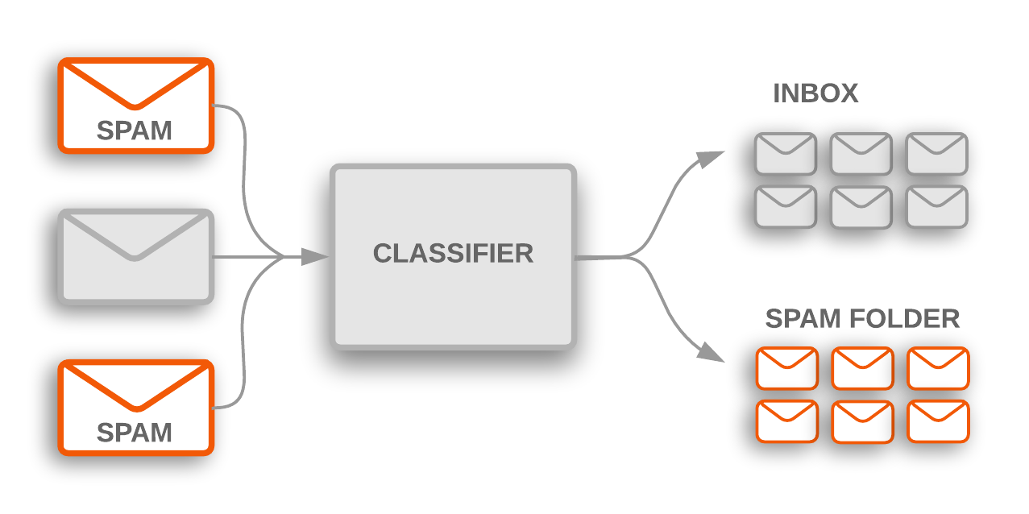
Text Classification
Source: https://developers.google.com/machine-learning/guides/text-classification/

Slide 37
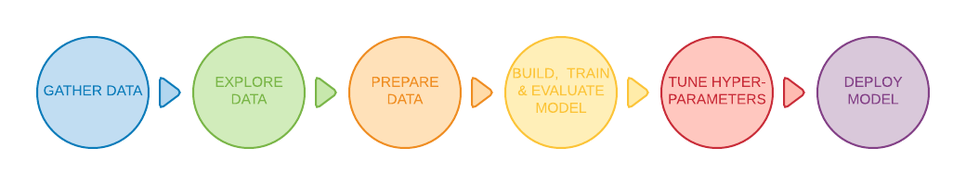
Text Classification Workflow
Step 1: Gather Data
Step 2: Explore Your Data
Step 2.5: Choose a Model*
Step 3: Prepare Your Data
Step 4: Build, Train, and Evaluate Your Model
Step 5: Tune Hyperparameters
Step 6: Deploy Your Model
Source: https://developers.google.com/machine-learning/guides/text-classification/

Slide 38
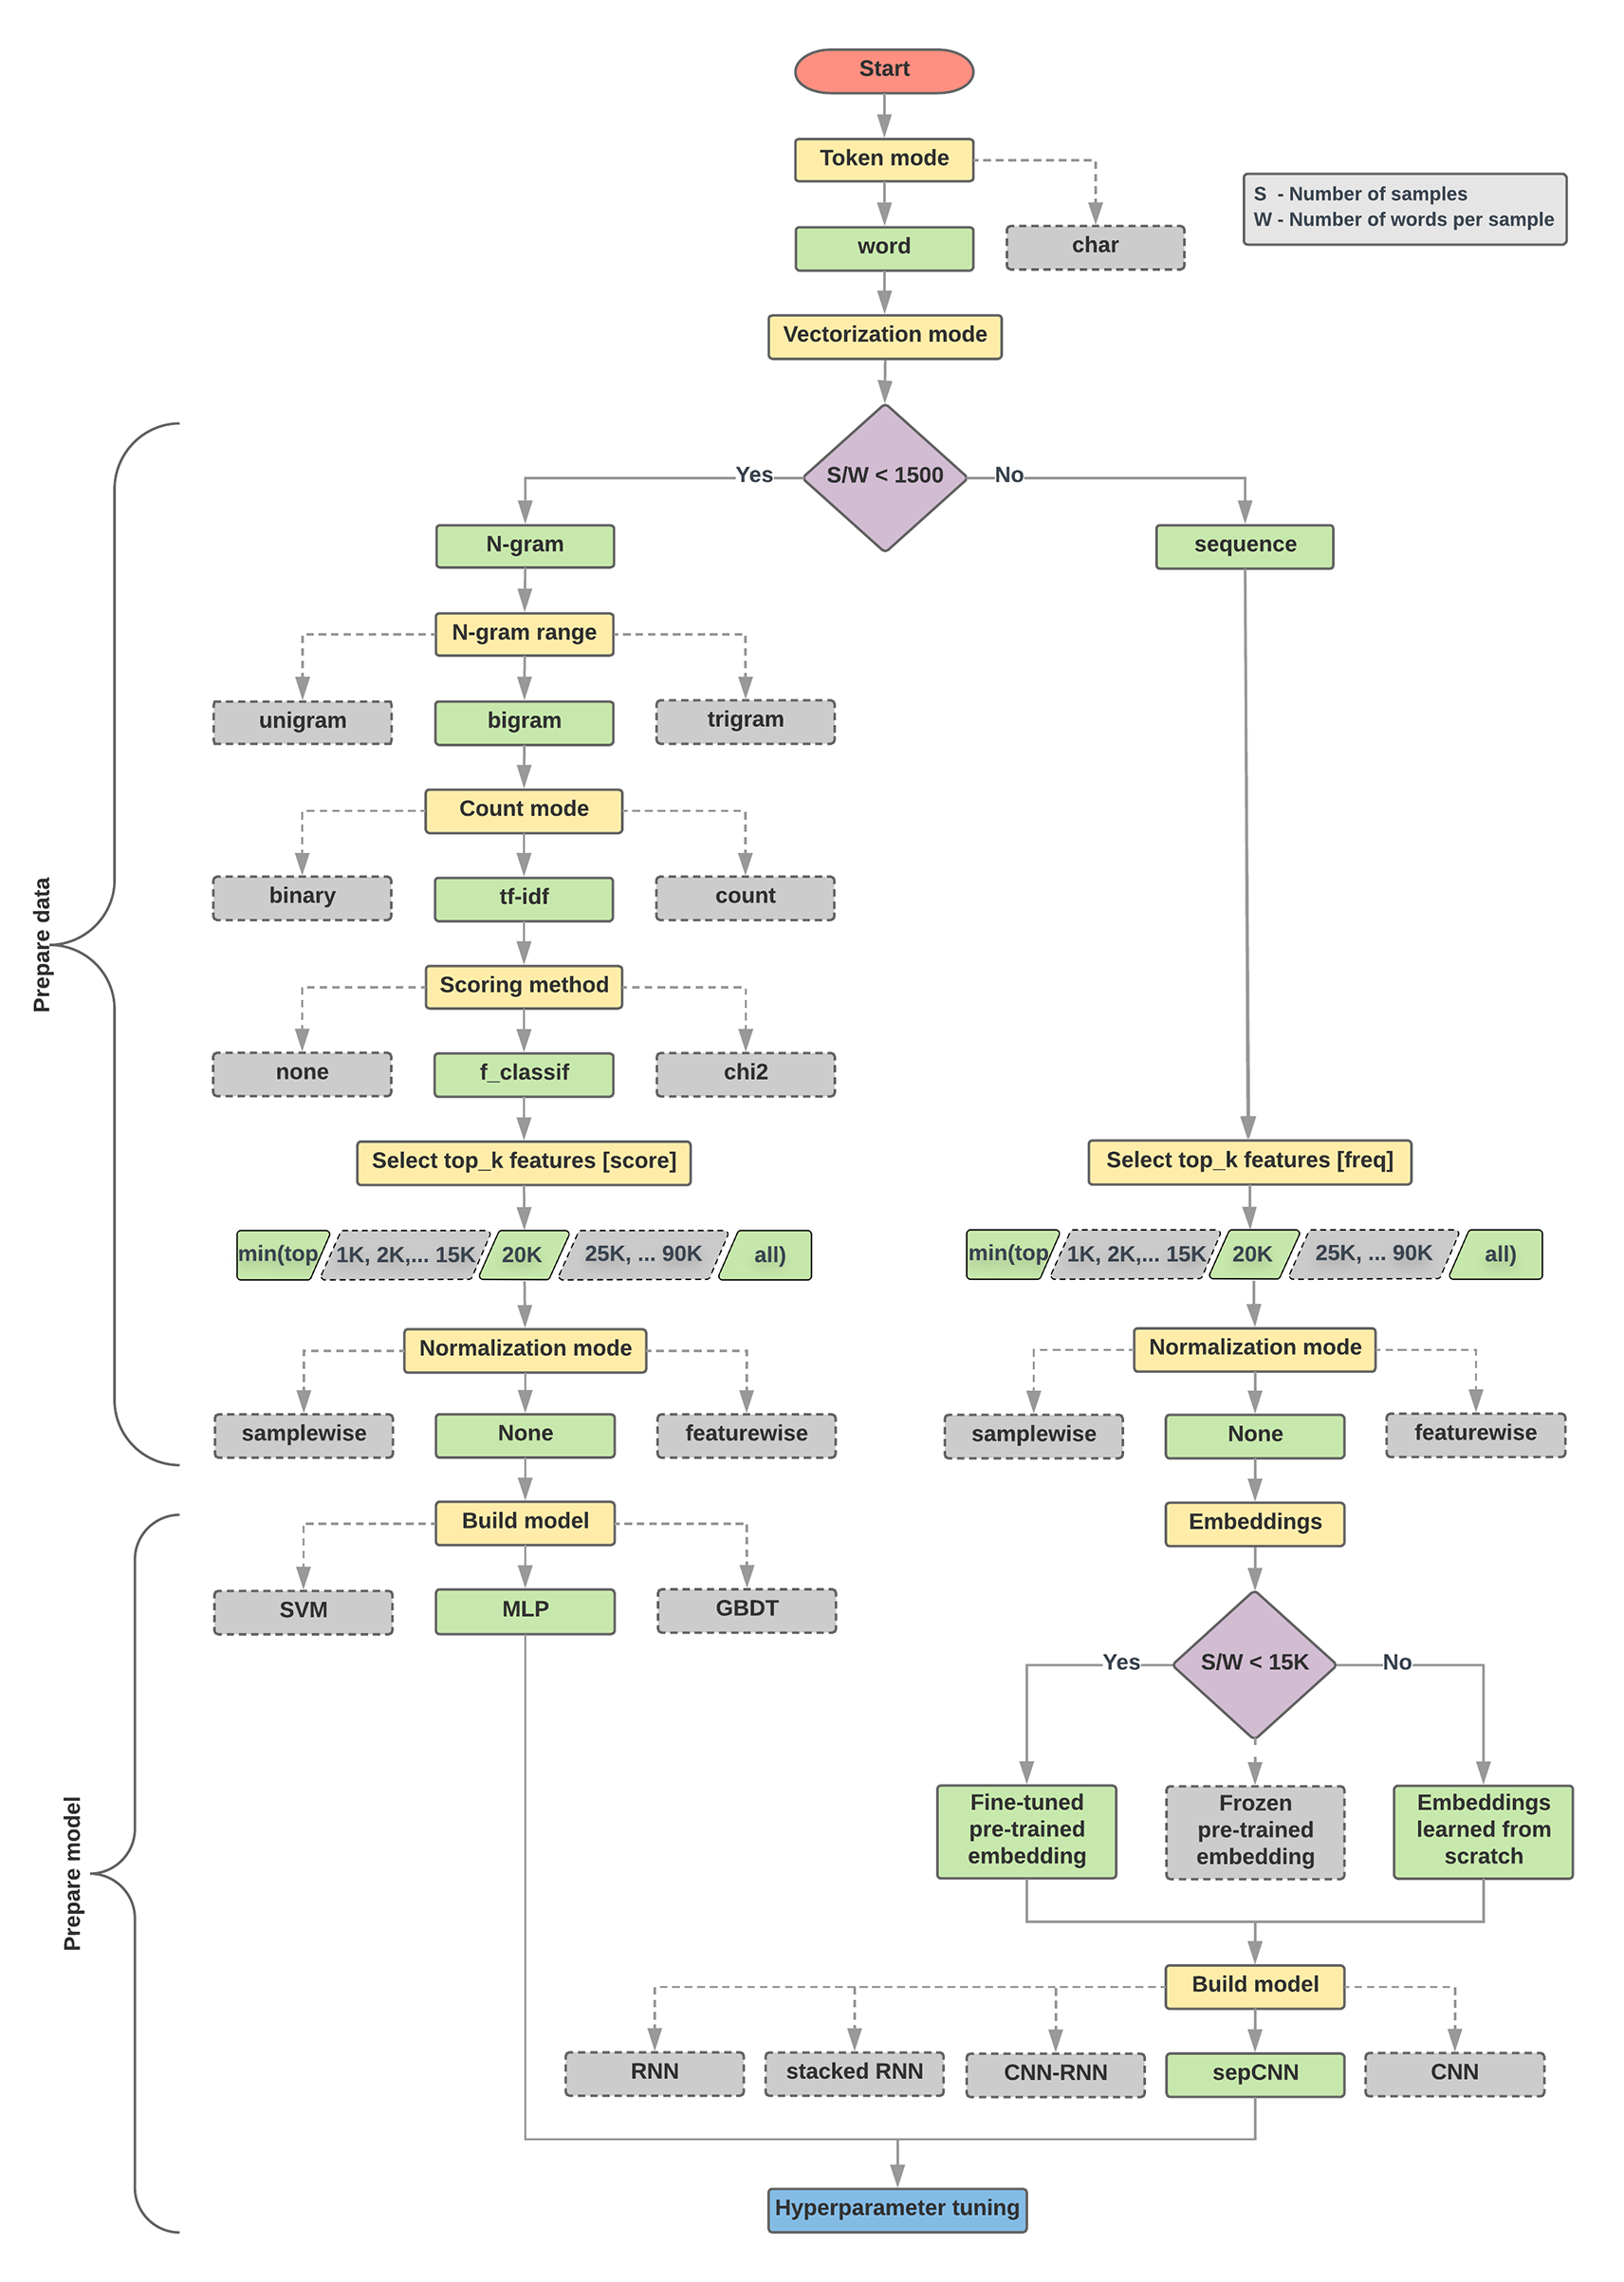
Text Classification Flowchart
Source: https://developers.google.com/machine-learning/guides/text-classification/step-2-5

Slide 39
Text Classification S/W<1500: N-gram
Source: https://developers.google.com/machine-learning/guides/text-classification/step-2-5

Slide 40
Text Classification S/W>=1500: Sequence
Source: https://developers.google.com/machine-learning/guides/text-classification/step-2-5

Slide 41
Step 2.5: Choose a Model
Samples/Words < 1500
150,000/100 = 1500
IMDb review dataset,
the samples/words-per-sample ratio is ~ 144
Source: https://developers.google.com/machine-learning/guides/text-classification/step-2-5

Slide 42
Step 2.5: Choose a Model
Samples/Words < 15,000
1,500,000/100 = 15,000
Source: https://developers.google.com/machine-learning/guides/text-classification/step-2-5

Slide 43
Step 3: Prepare Your Data
Texts:
T1: ’The mouse ran up the clock'
T2: ’The mouse ran down’
Token Index:
{'the': 1, 'mouse’: 2, 'ran': 3, 'up': 4, 'clock': 5, 'down': 6,}.
  NOTE: 'the' occurs most frequently,
  so the index value of 1 is assigned to it.
  Some libraries reserve index 0 for unknown tokens,
  as is the case here.
Sequence of token indexes:
T1: ‘The mouse ran up the clock’ =
[1, 2, 3, 4, 1, 5]
T1: ’The mouse ran down’ =
[1, 2, 3, 6]
Source: https://developers.google.com/machine-learning/guides/text-classification/step-3

Slide 44
One-hot encoding
'The mouse ran up the clock’ =
[ [0, 1, 0, 0, 0, 0, 0],
[0, 0, 1, 0, 0, 0, 0],
[0, 0, 0, 1, 0, 0, 0],
[0, 0, 0, 0, 1, 0, 0],
[0, 1, 0, 0, 0, 0, 0],
[0, 0, 0, 0, 0, 1, 0] ]
The
mouse
ran
up
the
clock
1
2
3
4
1
5
[0, 1, 2, 3, 4, 5, 6]
Source: https://developers.google.com/machine-learning/guides/text-classification/step-3

Slide 45
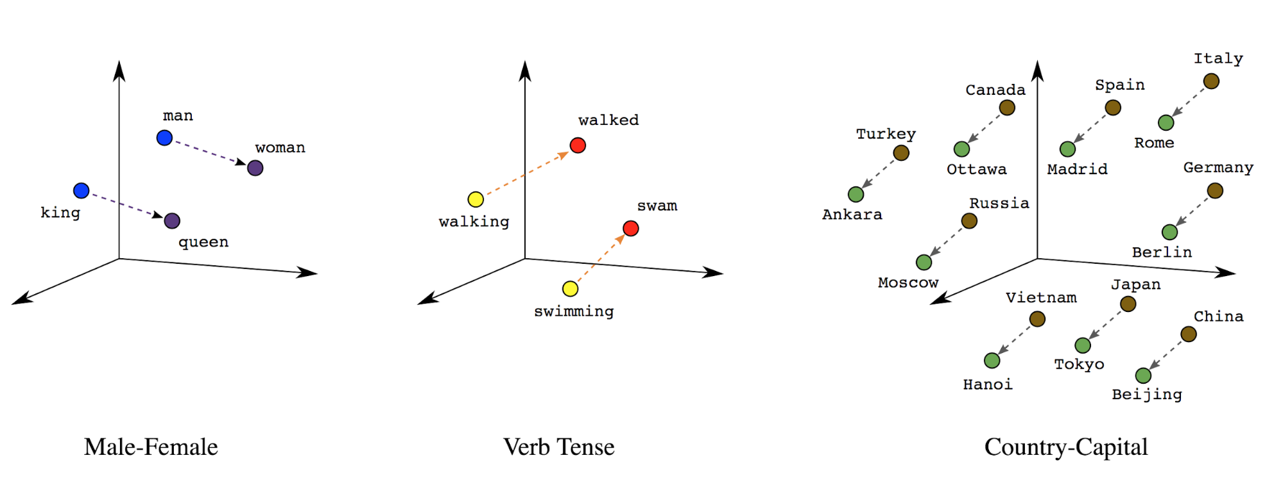
Word embeddings
Source: https://developers.google.com/machine-learning/guides/text-classification/step-3

Slide 46
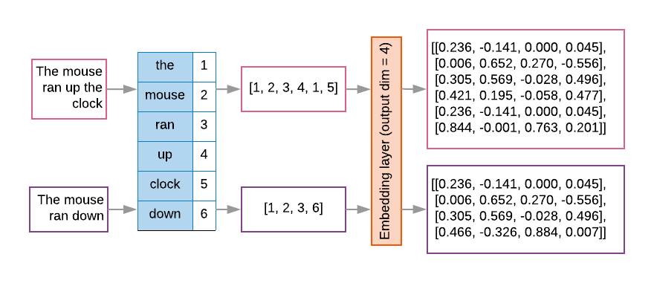
Word embeddings
Source: https://developers.google.com/machine-learning/guides/text-classification/step-3

Slide 47
Sequence to Sequence
(Seq2Seq)
Source: https://google.github.io/seq2seq/

Slide 48
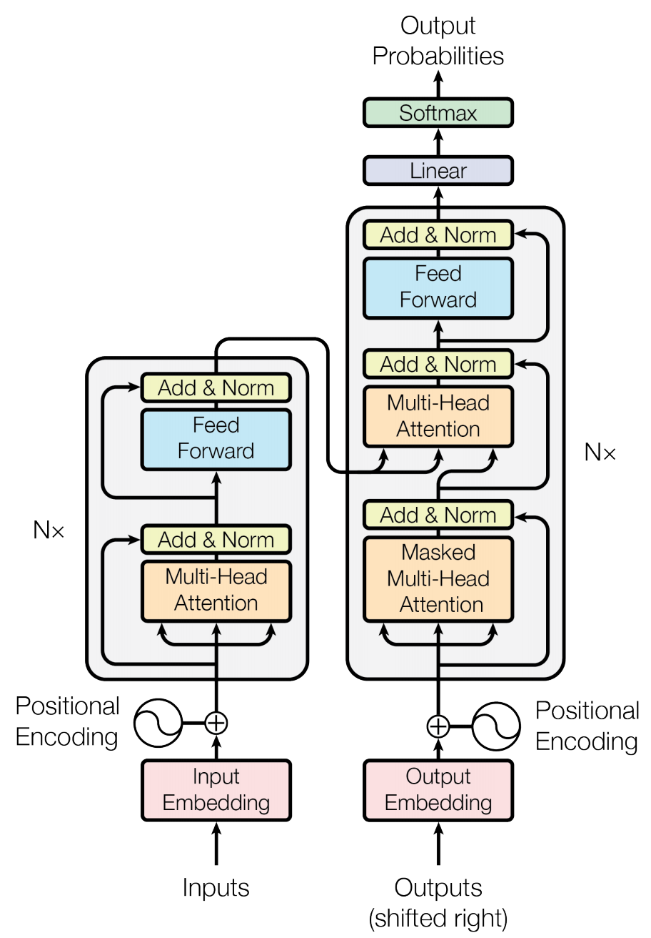
Transformer (Attention is All You Need)
(Vaswani et al., 2017)
Source: Vaswani, Ashish, Noam Shazeer, Niki Parmar, Jakob Uszkoreit, Llion Jones, Aidan N. Gomez, Łukasz Kaiser, and Illia Polosukhin. "Attention is all you need." In Advances in neural information processing systems, pp. 5998-6008. 2017.

Slide 49
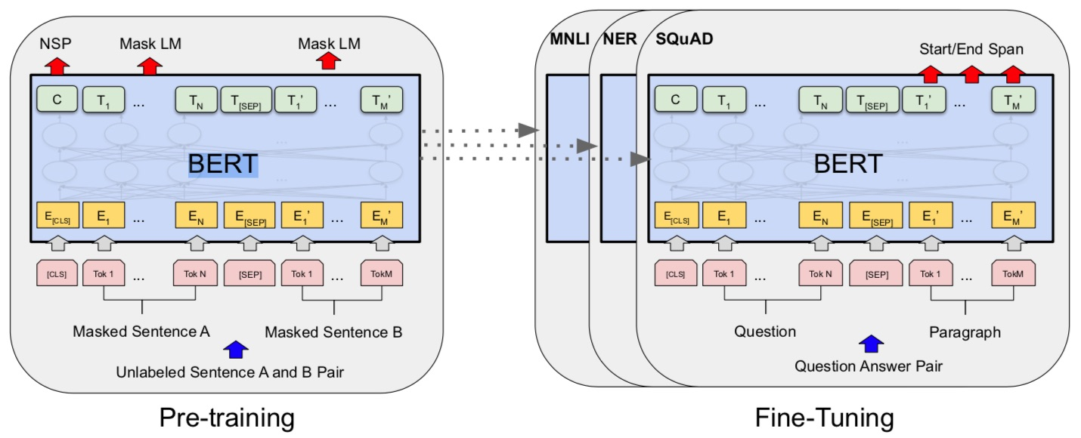
BERT: Pre-training of Deep Bidirectional Transformers for Language Understanding
BERT (Bidirectional Encoder Representations from Transformers)
Overall pre-training and fine-tuning procedures for BERT
Source: Devlin, Jacob, Ming-Wei Chang, Kenton Lee, and Kristina Toutanova (2018).
"Bert: Pre-training of deep bidirectional transformers for language understanding." arXiv preprint arXiv:1810.04805.

Slide 50
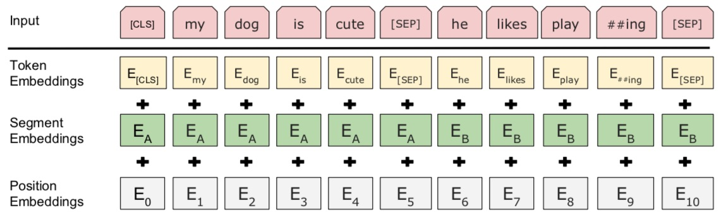
BERT: Pre-training of Deep Bidirectional Transformers for Language Understanding
BERT (Bidirectional Encoder Representations from Transformers)
BERT input representation
Source: Devlin, Jacob, Ming-Wei Chang, Kenton Lee, and Kristina Toutanova (2018).
"Bert: Pre-training of deep bidirectional transformers for language understanding." arXiv preprint arXiv:1810.04805.

Slide 51
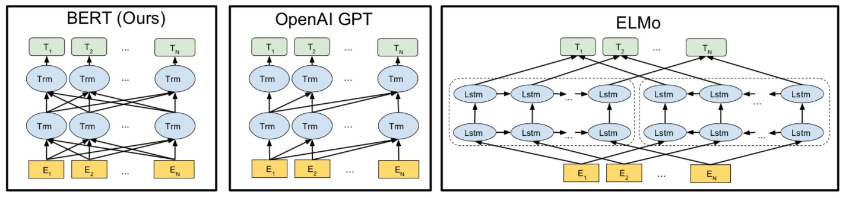
BERT, OpenAI GPT, ELMo
Source: Devlin, Jacob, Ming-Wei Chang, Kenton Lee, and Kristina Toutanova (2018).
"Bert: Pre-training of deep bidirectional transformers for language understanding." arXiv preprint arXiv:1810.04805.

Slide 52
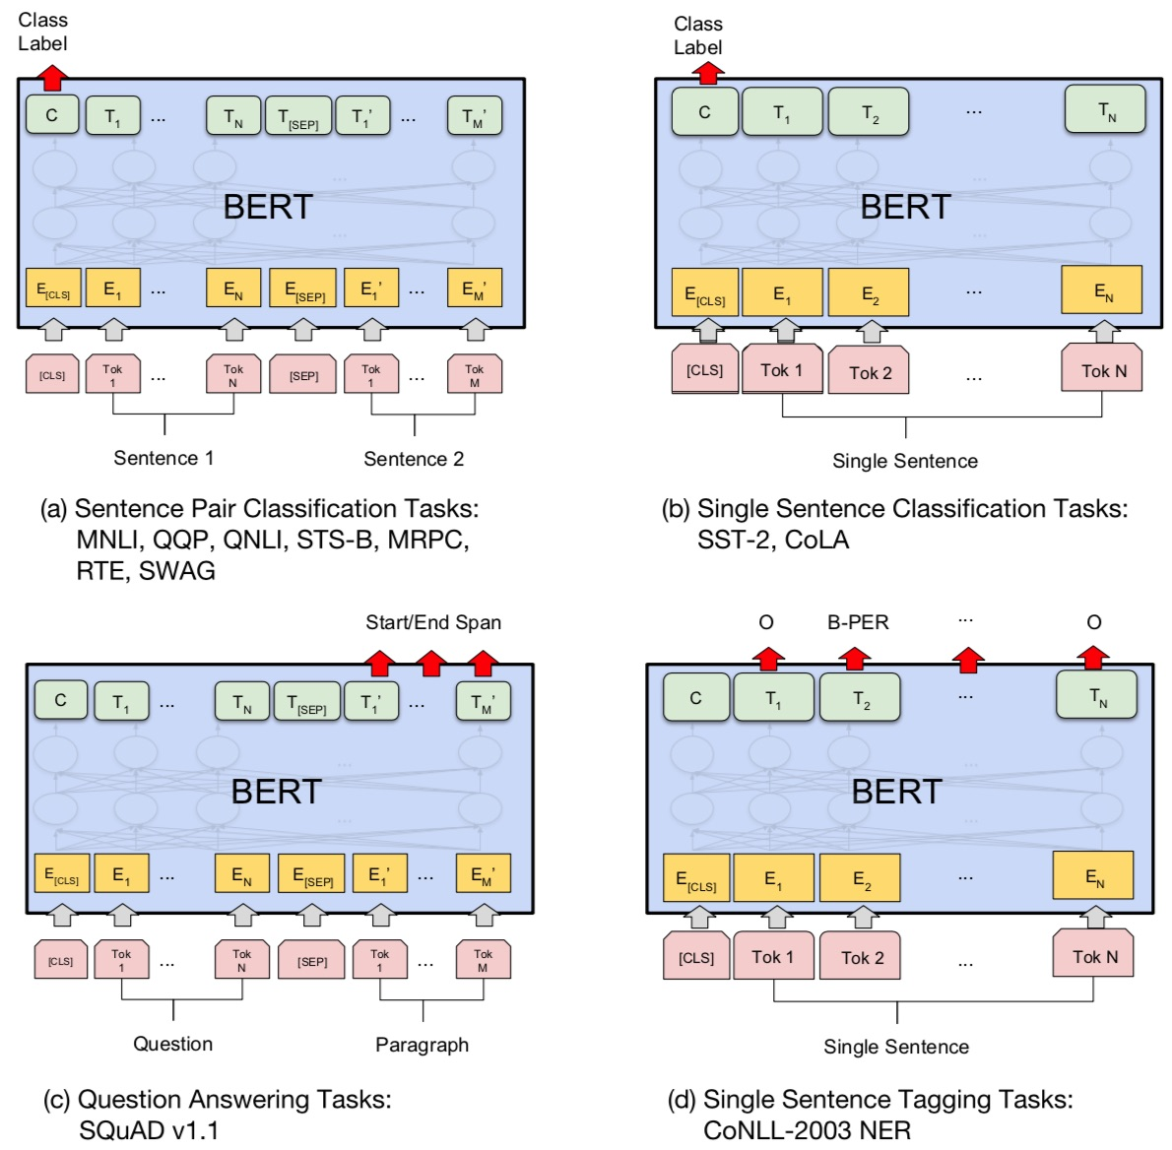
Fine-tuning BERT on Different Tasks
Source: Devlin, Jacob, Ming-Wei Chang, Kenton Lee, and Kristina Toutanova (2018).
"Bert: Pre-training of deep bidirectional transformers for language understanding." arXiv preprint arXiv:1810.04805.

Slide 53
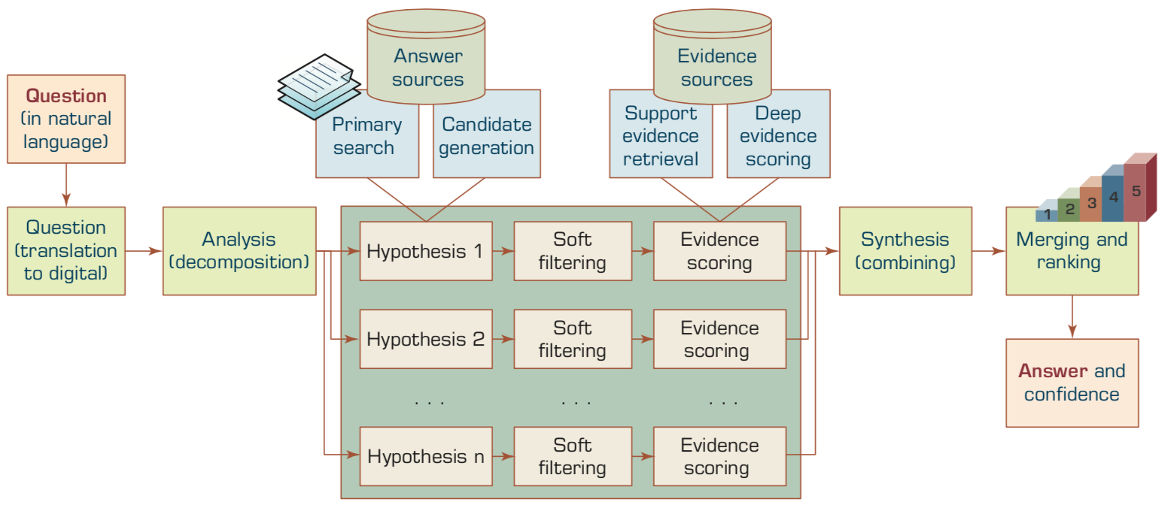
A High-Level Depiction of
DeepQA Architecture
Source: Ramesh Sharda, Dursun Delen, and Efraim Turban (2017), Business Intelligence, Analytics, and Data Science: A Managerial Perspective, 4th Edition, Pearson

Slide 54
Chatbots
Bot Maturity Model
Customers want to have simpler means to interact with businesses and
get faster response to a question or complaint.
Source: https://www.capgemini.com/2017/04/how-can-chatbots-meet-expectations-introducing-the-bot-maturity/

Slide 55
Dialogue on
Airline Travel Information System (ATIS)

Slide 56
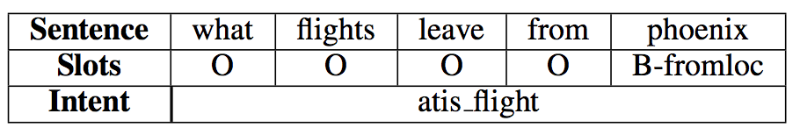
The ATIS
(Airline Travel Information System)
Dataset
https://www.kaggle.com/siddhadev/atis-dataset-from-ms-cntk
Training samples: 4978
Testing samples: 893
Vocab size: 943
Slot count: 129
Intent count: 26
Source: Haihong, E., Peiqing Niu, Zhongfu Chen, and Meina Song. "A novel bi-directional interrelated model for joint intent detection and slot filling." In Proceedings of the 57th Annual Meeting of the Association for Computational Linguistics, pp. 5467-5471. 2019.

Slide 57
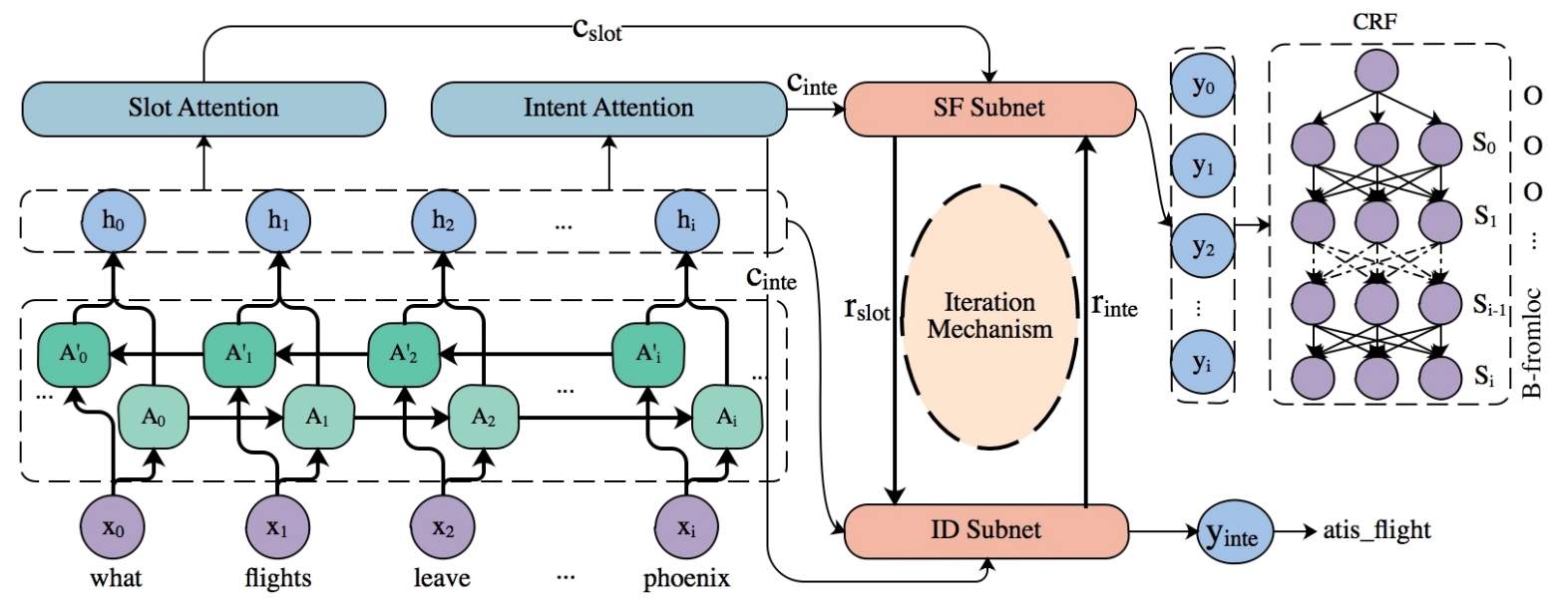
SF-ID Network (E et al., 2019)
Slot Filling (SF)
Intent Detection (ID)
A Novel Bi-directional Interrelated Model for Joint Intent Detection and Slot Filling
Source: Haihong, E., Peiqing Niu, Zhongfu Chen, and Meina Song. "A novel bi-directional interrelated model for joint intent detection and slot filling." In Proceedings of the 57th Annual Meeting of the Association for Computational Linguistics, pp. 5467-5471. 2019.

Slide 58
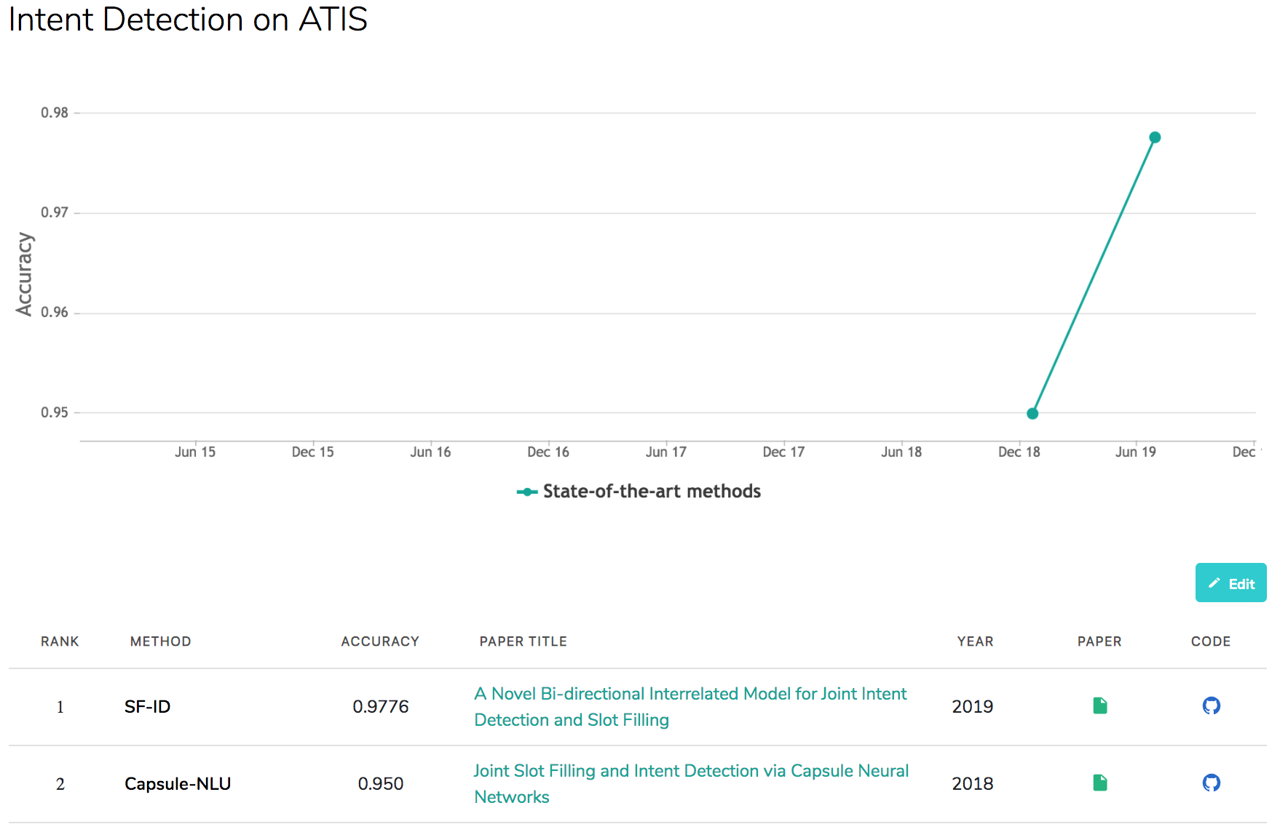
Intent Detection on ATIS
State-of-the-art
Source: https://paperswithcode.com/sota/intent-detection-on-atis

Slide 59
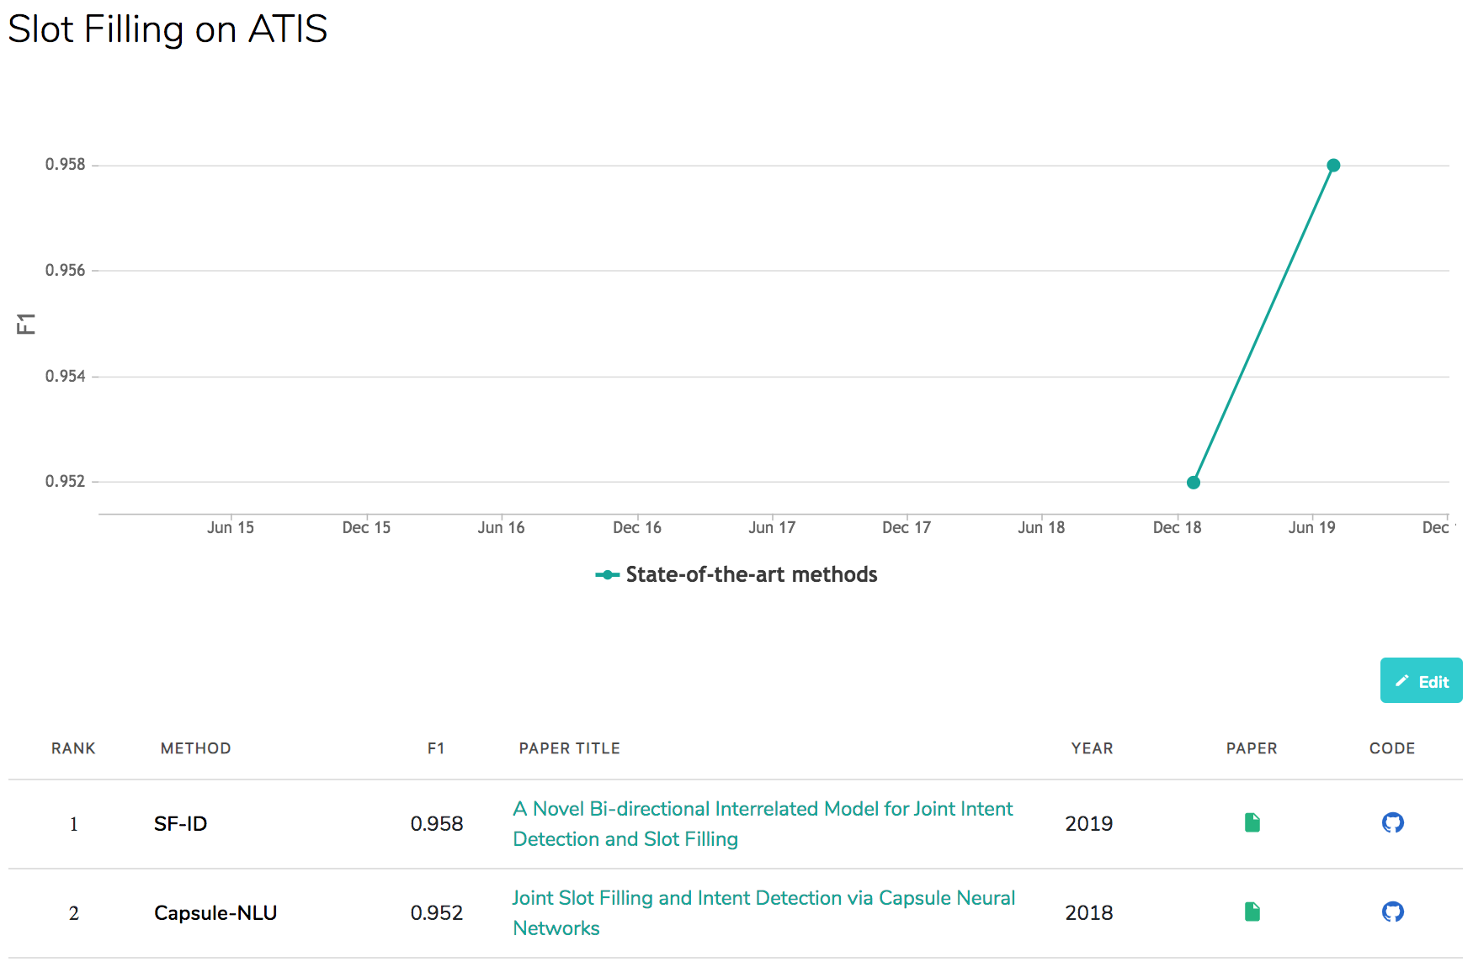
Slot Filling on ATIS
State-of-the-art
Source: https://paperswithcode.com/sota/slot-filling-on-atis

Slide 60
Restaurants Dialogue Datasets
MIT Restaurant Corpus
  https://groups.csail.mit.edu/sls/downloads/restaurant/
CamRest676
(Cambridge restaurant dialogue domain dataset)
  https://www.repository.cam.ac.uk/handle/1810/260970
DSTC2 (Dialog State Tracking Challenge 2 & 3)
  http://camdial.org/~mh521/dstc/

Slide 61
任務型對話系統
The Evaluation of Chinese Human-Computer Dialogue Technology, SMP2019-ECDT
自然語言理解
Natural Language Understanding (NLU)
對話管理
Dialog Management (DM)
自然語言生成
Natural Language Generation (NLG)
Source: http://conference.cipsc.org.cn/smp2019/evaluation.html
https://github.com/OnionWang/SMP2019-ECDT-NLU

Slide 62
Course Introduction
This course introduces the
fundamental concepts and research issues of
artificial intelligence for text analytics.
Topics include
  Foundations of Text Analytics: Natural Language Processing (NLP)
  Python for NLP
  Processing and Understanding Text
  Feature Engineering for Text Representation
  Text Classification
  Text Summarization and Topic Models
  Text Similarity and Clustering
  Semantic Analysis and Named Entity Recognition
  Sentiment Analysis
  The Promise of Deep Learning and Universal Sentence-Embedding Models
  Question Answering and Dialogue Systems
  Case Study on AI Text Analytics

Slide 63




人工智慧文本分析
(AI for Text Analytics)
Contact Information
戴敏育 博士 (Min-Yuh Day, Ph.D.)
副教授 (Associate Professor)
國立臺北大學 資訊管理研究所
Institute of Information Management, National Taipei University
電話： 02-86741111 ext. 66873
研究室： 商8F12
地址： 23741 新北市三峽區大學路 151 號
Email：myday@gm.ntpu.edu.tw
網址：http://web.ntpu.edu.tw/~myday/

