Slide 1
人工智慧文本分析 (AI for Text Analytics)
Tamkang University
文本摘要和主題模型 (Text Summarization and Topic Models)
1091AITA07
MBA, IMTKU (M2455) (8418) (Fall 2020) Thu 3, 4 (10:10-12:00) (B206)
Min-Yuh Day
戴敏育
Associate Professor
副教授
Institute of Information Management, National Taipei University
國立臺北大學 資訊管理研究所
https://web.ntpu.edu.tw/~myday
2020-11-12

Slide 2
課程大綱 (Syllabus)
週次 (Week) 日期 (Date) 內容 (Subject/Topics)
1 2020/09/17 人工智慧文本分析課程介紹 (Course Orientation on Artificial Intelligence for Text Analytics)
2 2020/09/24 文本分析的基礎：自然語言處理 (Foundations of Text Analytics: Natural Language Processing; NLP)
3 2020/10/01 中秋節 (Mid-Autumn Festival) 放假一天 (Day off)
4 2020/10/08 Python自然語言處理 (Python for Natural Language Processing)
5 2020/10/15 處理和理解文本 (Processing and Understanding Text)
6 2020/10/22 文本表達特徵工程 (Feature Engineering for Text Representation)

Slide 3
課程大綱 (Syllabus)
週次 (Week) 日期 (Date) 內容 (Subject/Topics)
7 2020/10/29 人工智慧文本分析個案研究 I (Case Study on Artificial Intelligence for Text Analytics I)
8 2020/11/05 文本分類 (Text Classification)
9 2020/11/12 文本摘要和主題模型 (Text Summarization and Topic Models)
10 2020/11/19 期中報告 (Midterm Project Report)
11 2020/11/26 文本相似度和分群 (Text Similarity and Clustering)
12 2020/12/03 語意分析和命名實體識別 (Semantic Analysis and Named Entity Recognition; NER)

Slide 4
課程大綱 (Syllabus)
週次 (Week) 日期 (Date) 內容 (Subject/Topics)
13 2020/12/10 情感分析 (Sentiment Analysis)
14 2020/12/17 人工智慧文本分析個案研究 II (Case Study on Artificial Intelligence for Text Analytics II)
15 2020/12/24 深度學習和通用句子嵌入模型 (Deep Learning and Universal Sentence-Embedding Models)
16 2020/12/31 問答系統與對話系統 (Question Answering and Dialogue Systems)
17 2021/01/07 期末報告 I (Final Project Presentation I)
18 2021/01/14 期末報告 II (Final Project Presentation II)

Slide 5
Outline
Text Summarization
Topic Models
Topic Modeling
Latent Dirichlet Allocation (LDA)

Slide 6
Text Summarization and Topic Models

Slide 7
NLP
Source: http://blog.aylien.com/leveraging-deep-learning-for-multilingual/

Slide 8
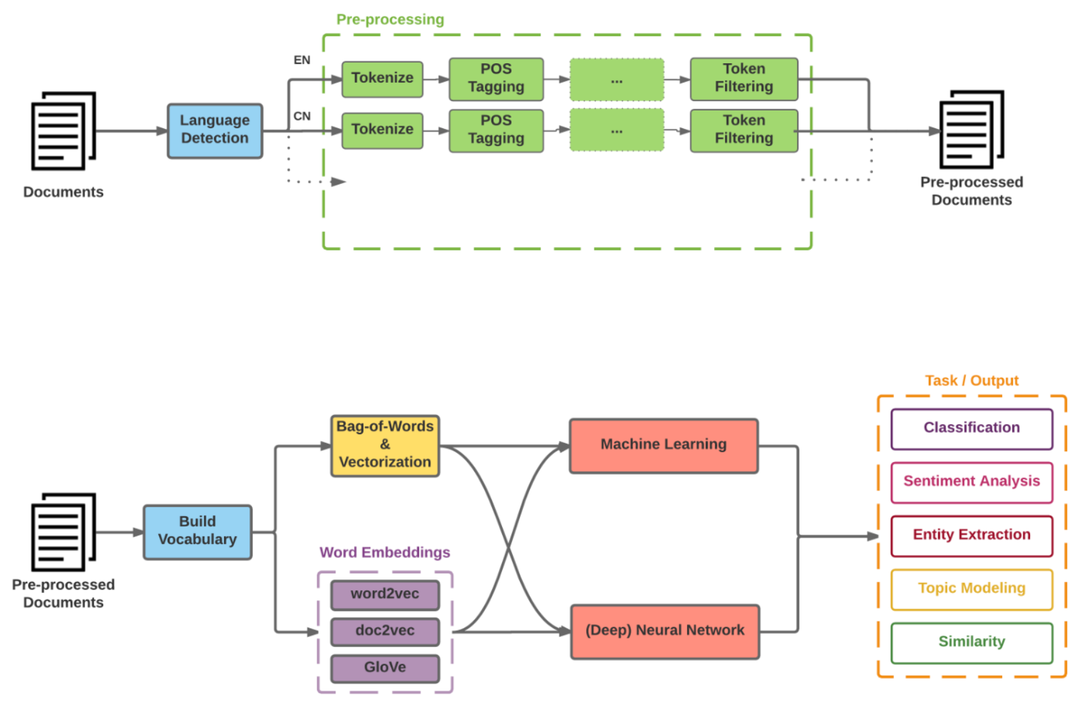
Modern NLP Pipeline
Source: https://github.com/fortiema/talks/blob/master/opendata2016sh/pragmatic-nlp-opendata2016sh.pdf

Slide 9
Modern NLP Pipeline
Source: http://mattfortier.me/2017/01/31/nlp-intro-pt-1-overview/

Slide 10
Deep Learning NLP
Source: http://mattfortier.me/2017/01/31/nlp-intro-pt-1-overview/

Slide 11
Natural Language Processing (NLP) and Text Mining
Raw text
Sentence Segmentation
Tokenization
Part-of-Speech (POS)
Stop word removal
word’s stem
am → am
having → hav
word’s lemma
am → be
having → have
Stemming / Lemmatization
Dependency Parser
String Metrics & Matching
Source: Nitin Hardeniya (2015), NLTK Essentials, Packt Publishing; Florian Leitner (2015), Text mining - from Bayes rule to dependency parsing

Slide 12
Text Summarization
Text Input
Dictionary / Thesaurus
Pre-processing
Text Structure Analysis
Word Segmentation
Occurrence Statistic
POS Tagging
Keyword Extraction
Weigh Words & Sentences
Sentences Selection
Rough Summary Generation
Smoothing
Summary Output
Source: Vishal Gupta and Gurpreet S. Lehal (2009), "A survey of text mining techniques and applications," Journal of emerging technologies in web intelligence, vol. 1, no. 1, pp. 60-76.

Slide 13
Topic Modeling
Source: Blei, David M. "Probabilistic topic models." Communications of the ACM 55, no. 4 (2012): 77-84.

Slide 14
Text Summarization and Information Extraction
Key-phrase extraction
extracting key influential phrases from the documents.
Topic modeling
Extract various diverse concepts or topics present in the documents, retaining the major themes.
Document summarization
Summarize entire text documents to provide a gist that retains the important parts of the whole corpus.
Source: Dipanjan Sarkar (2019), Text Analytics with Python: A Practitioner’s Guide to Natural Language Processing, Second Edition. APress.

Slide 15
Topic Model in Bioinformatics
Source: Liu, Lin, Lin Tang, Wen Dong, Shaowen Yao, and Wei Zhou. "An overview of topic modeling and its current applications in bioinformatics." SpringerPlus 5, no. 1 (2016): 1608.

Slide 16
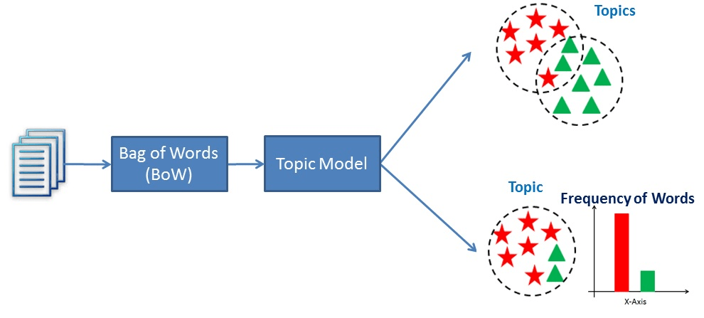
Topic Modeling
Source: Avinash Navlani (2018), Latent Semantic Analysis using Python, https://www.datacamp.com/community/tutorials/discovering-hidden-topics-python

Slide 17
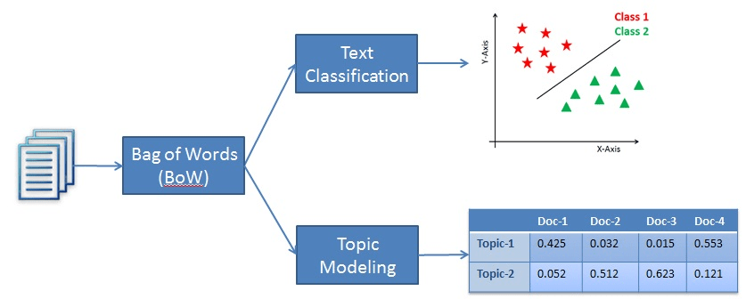
Topic Modeling (Unsupervised Learning) vs. Text Classification (Supervised Learning)
Source: Avinash Navlani (2018), Latent Semantic Analysis using Python, https://www.datacamp.com/community/tutorials/discovering-hidden-topics-python

Slide 18
Topic Modeling Term Document Matrix to Topic Distribution
Source: Avinash Navlani (2018), Latent Semantic Analysis using Python, https://www.datacamp.com/community/tutorials/discovering-hidden-topics-python

Slide 19
Topic Modeling Latent Dirichlet Allocation (LDA)
D documents
N words
K topics
Source: Hoffman, Matthew D., David M. Blei, Chong Wang, and John Paisley. "Stochastic variational inference." The Journal of Machine Learning Research 14, no. 1 (2013): 1303-1347.

Slide 20
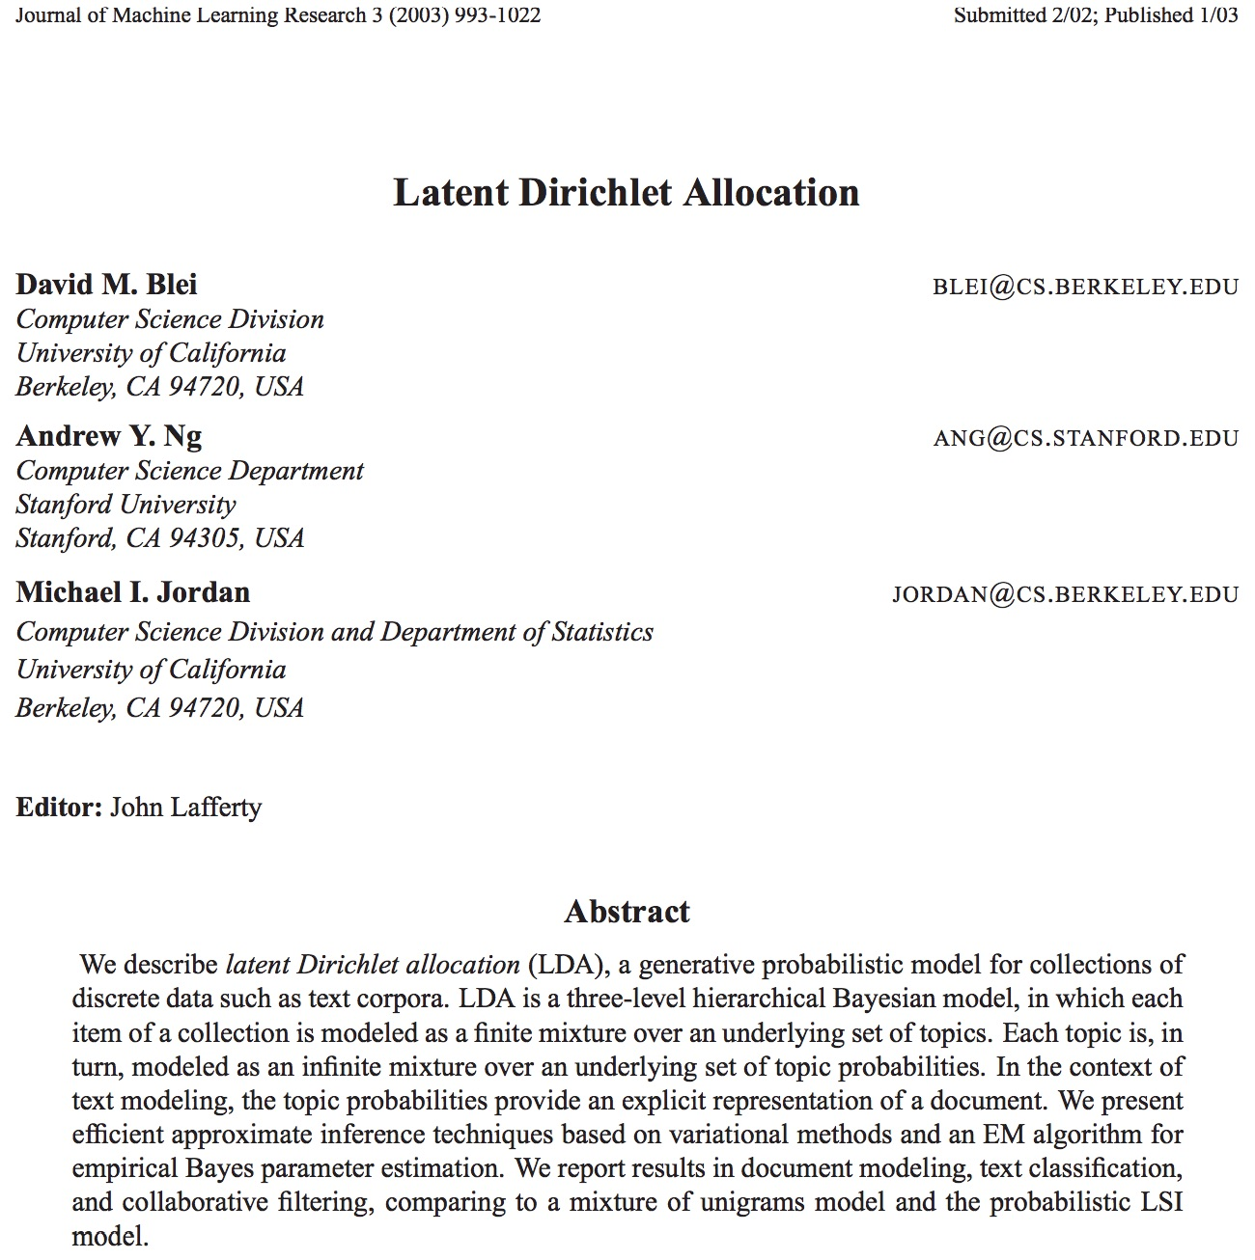
Latent Dirichlet Allocation (Blei et al., 2003)
Source: Blei, David M., Andrew Y. Ng, and Michael I. Jordan. "Latent dirichlet allocation." Journal of machine Learning research 3, no. Jan (2003): 993-1022.

Slide 21
gensim
https://radimrehurek.com/gensim/

Slide 22
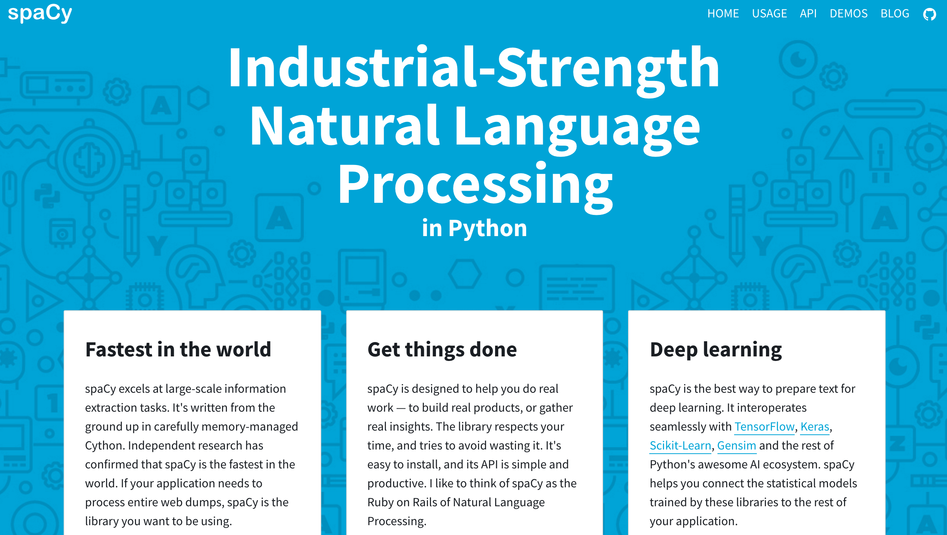
spaCy
https://spacy.io/

Slide 23
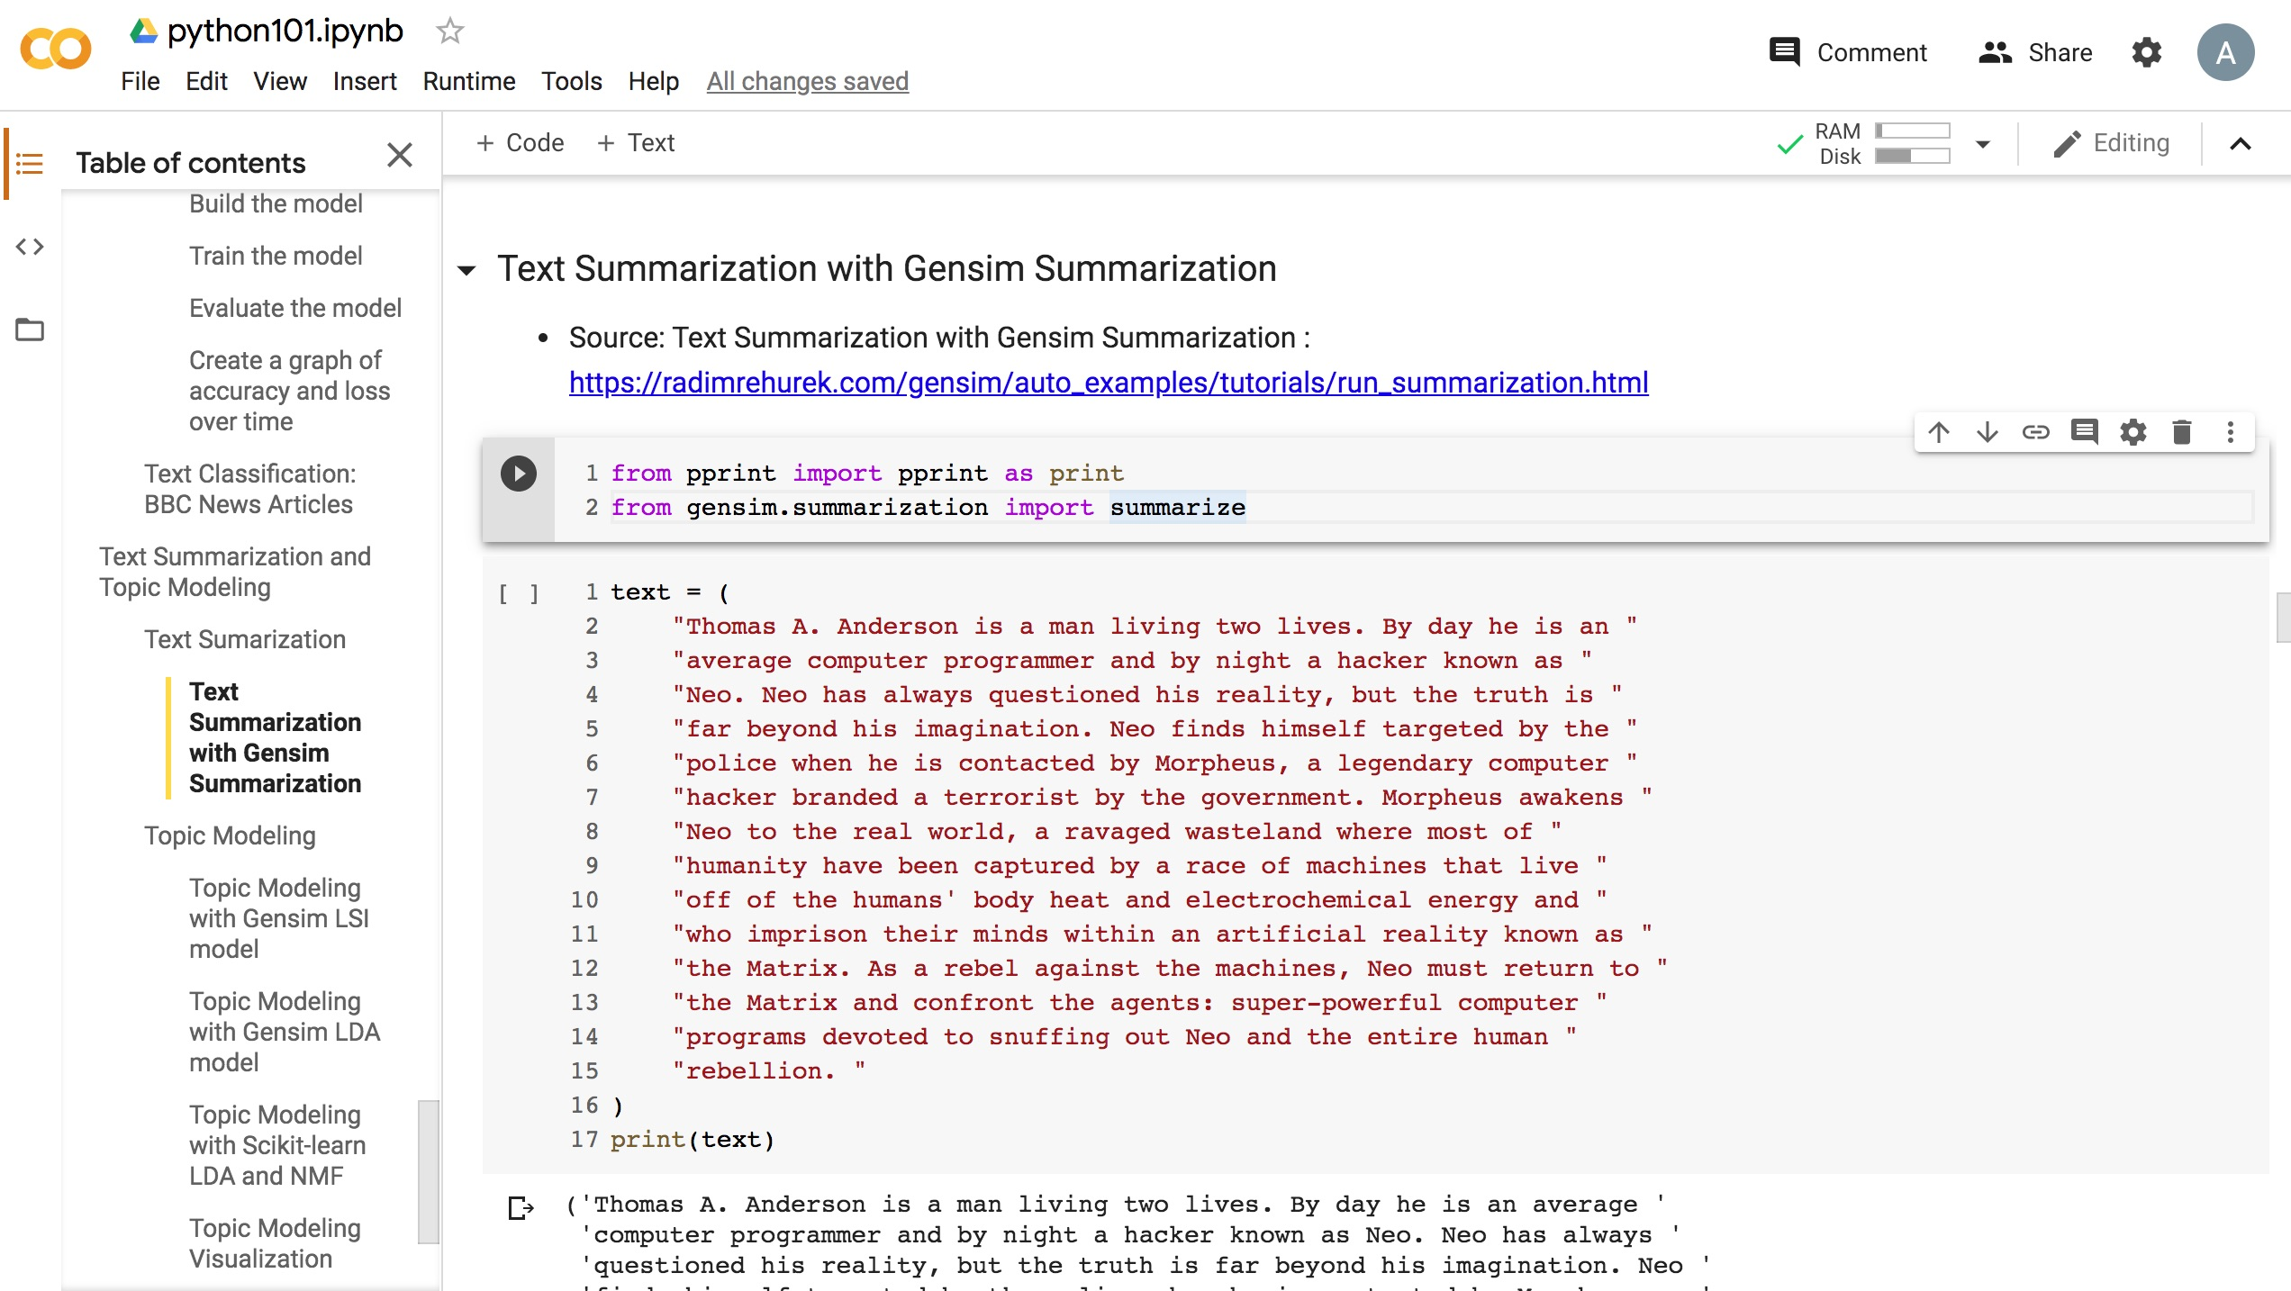
Python in Google Colab (Python101)
https://colab.research.google.com/drive/1FEG6DnGvwfUbeo4zJ1zTunjMqf2RkCrT
https://tinyurl.com/aintpupython101

Slide 24
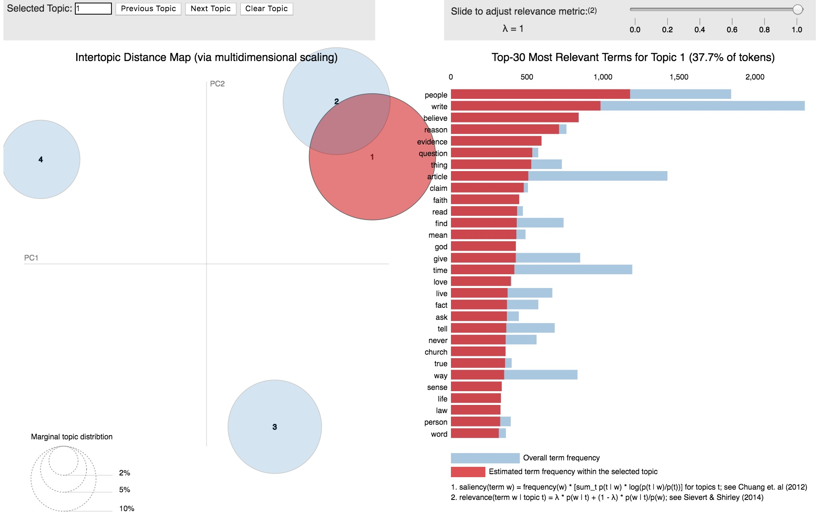
Python in Google Colab (Python101)
https://colab.research.google.com/drive/1FEG6DnGvwfUbeo4zJ1zTunjMqf2RkCrT
https://tinyurl.com/aintpupython101

Slide 25
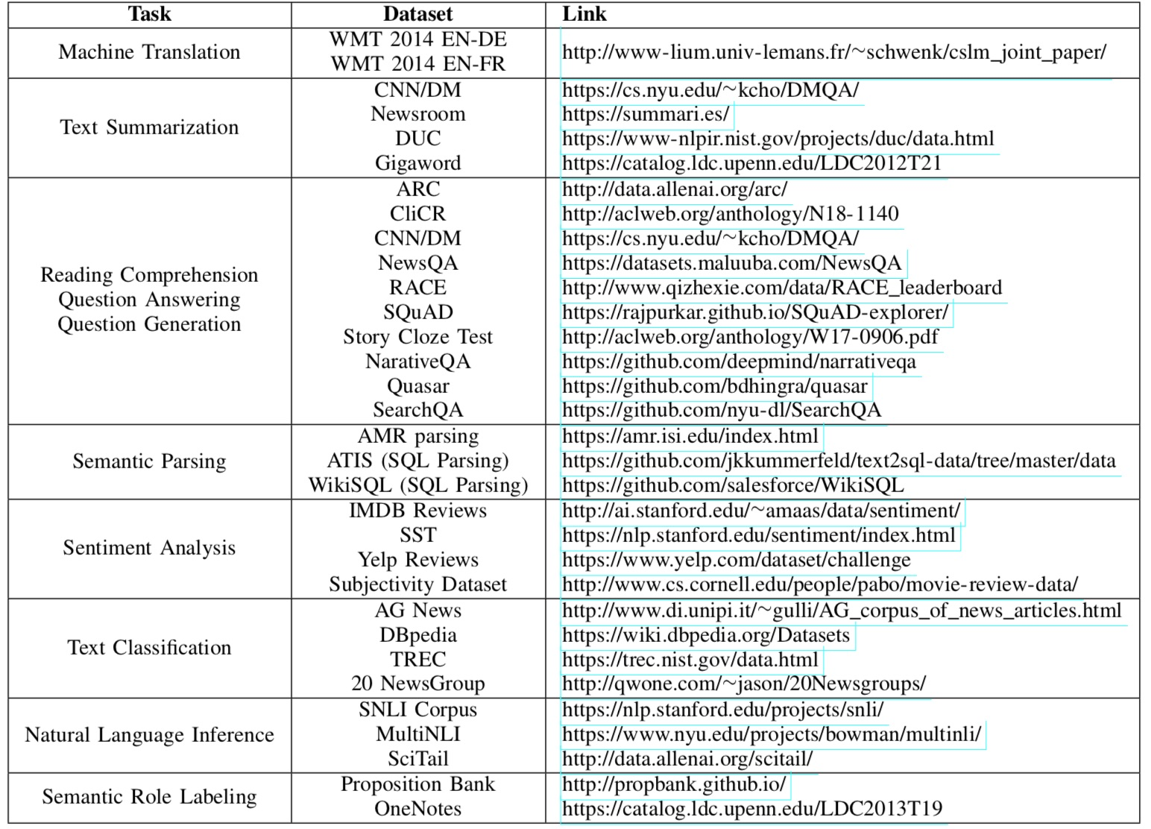
NLP Benchmark Datasets
Source: Amirsina Torfi, Rouzbeh A. Shirvani, Yaser Keneshloo, Nader Tavvaf, and Edward A. Fox (2020). "Natural Language Processing Advancements By Deep Learning: A Survey." arXiv preprint arXiv:2003.01200.

Slide 26
Summary
Text Summarization
Topic Models
Topic Modeling
Latent Dirichlet Allocation (LDA)

Slide 27
References
Dipanjan Sarkar (2019), Text Analytics with Python: A Practitioner’s Guide to Natural Language Processing, Second Edition. APress. https://github.com/Apress/text-analytics-w-python-2e
Benjamin Bengfort, Rebecca Bilbro, and Tony Ojeda (2018), Applied Text Analysis with Python, O'Reilly Media. https://www.oreilly.com/library/view/applied-text-analysis/9781491963036/
Selva Prabhakaran (2020), Topic modeling visualization – How to present the results of LDA models?, https://www.machinelearningplus.com/nlp/topic-modeling-visualization-how-to-present-results-lda-models/
Min-Yuh Day (2020), Python 101, https://tinyurl.com/aintpupython101

