Slide 1
人工智慧文本分析 (AI for Text Analytics)
Tamkang University
語意分析和命名實體識別 (Semantic Analysis and Named Entity Recognition; NER)
1091AITA09
MBA, IMTKU (M2455) (8418) (Fall 2020) Thu 3, 4 (10:10-12:00) (B206)
Min-Yuh Day
戴敏育
Associate Professor
副教授
Institute of Information Management, National Taipei University
國立臺北大學 資訊管理研究所
https://web.ntpu.edu.tw/~myday
2020-12-03

Slide 2
課程大綱 (Syllabus)
週次 (Week) 日期 (Date) 內容 (Subject/Topics)
1 2020/09/17 人工智慧文本分析課程介紹 (Course Orientation on Artificial Intelligence for Text Analytics)
2 2020/09/24 文本分析的基礎：自然語言處理 (Foundations of Text Analytics: Natural Language Processing; NLP)
3 2020/10/01 中秋節 (Mid-Autumn Festival) 放假一天 (Day off)
4 2020/10/08 Python自然語言處理 (Python for Natural Language Processing)
5 2020/10/15 處理和理解文本 (Processing and Understanding Text)
6 2020/10/22 文本表達特徵工程 (Feature Engineering for Text Representation)

Slide 3
課程大綱 (Syllabus)
週次 (Week) 日期 (Date) 內容 (Subject/Topics)
7 2020/10/29 人工智慧文本分析個案研究 I (Case Study on Artificial Intelligence for Text Analytics I)
8 2020/11/05 文本分類 (Text Classification)
9 2020/11/12 文本摘要和主題模型 (Text Summarization and Topic Models)
10 2020/11/19 期中報告 (Midterm Project Report)
11 2020/11/26 文本相似度和分群 (Text Similarity and Clustering)
12 2020/12/03 語意分析和命名實體識別 (Semantic Analysis and Named Entity Recognition; NER)

Slide 4
課程大綱 (Syllabus)
週次 (Week) 日期 (Date) 內容 (Subject/Topics)
13 2020/12/10 情感分析 (Sentiment Analysis)
14 2020/12/17 人工智慧文本分析個案研究 II (Case Study on Artificial Intelligence for Text Analytics II)
15 2020/12/24 深度學習和通用句子嵌入模型 (Deep Learning and Universal Sentence-Embedding Models)
16 2020/12/31 問答系統與對話系統 (Question Answering and Dialogue Systems)
17 2021/01/07 期末報告 I (Final Project Presentation I)
18 2021/01/14 期末報告 II (Final Project Presentation II)

Slide 5
Semantic Analysis and Named Entity Recognition (NER)

Slide 6
Outline
Semantic Analysis
WordNet
Word sense disambiguation
Named Entity Recognition (NER)

Slide 7
Semantic Analysis
Semantics
the study of meaning
Linguistic semantics
the study of meaning in natural language.
Source: Dipanjan Sarkar (2019), Text Analytics with Python: A Practitioner’s Guide to Natural Language Processing, Second Edition. APress.

Slide 8
Semantic Analysis and NER
WordNet and synsets
Analyzing lexical semantic relations
Word sense disambiguation
Named entity recognition
Analyzing semantic representations
Source: Dipanjan Sarkar (2019), Text Analytics with Python: A Practitioner’s Guide to Natural Language Processing, Second Edition. APress.

Slide 9
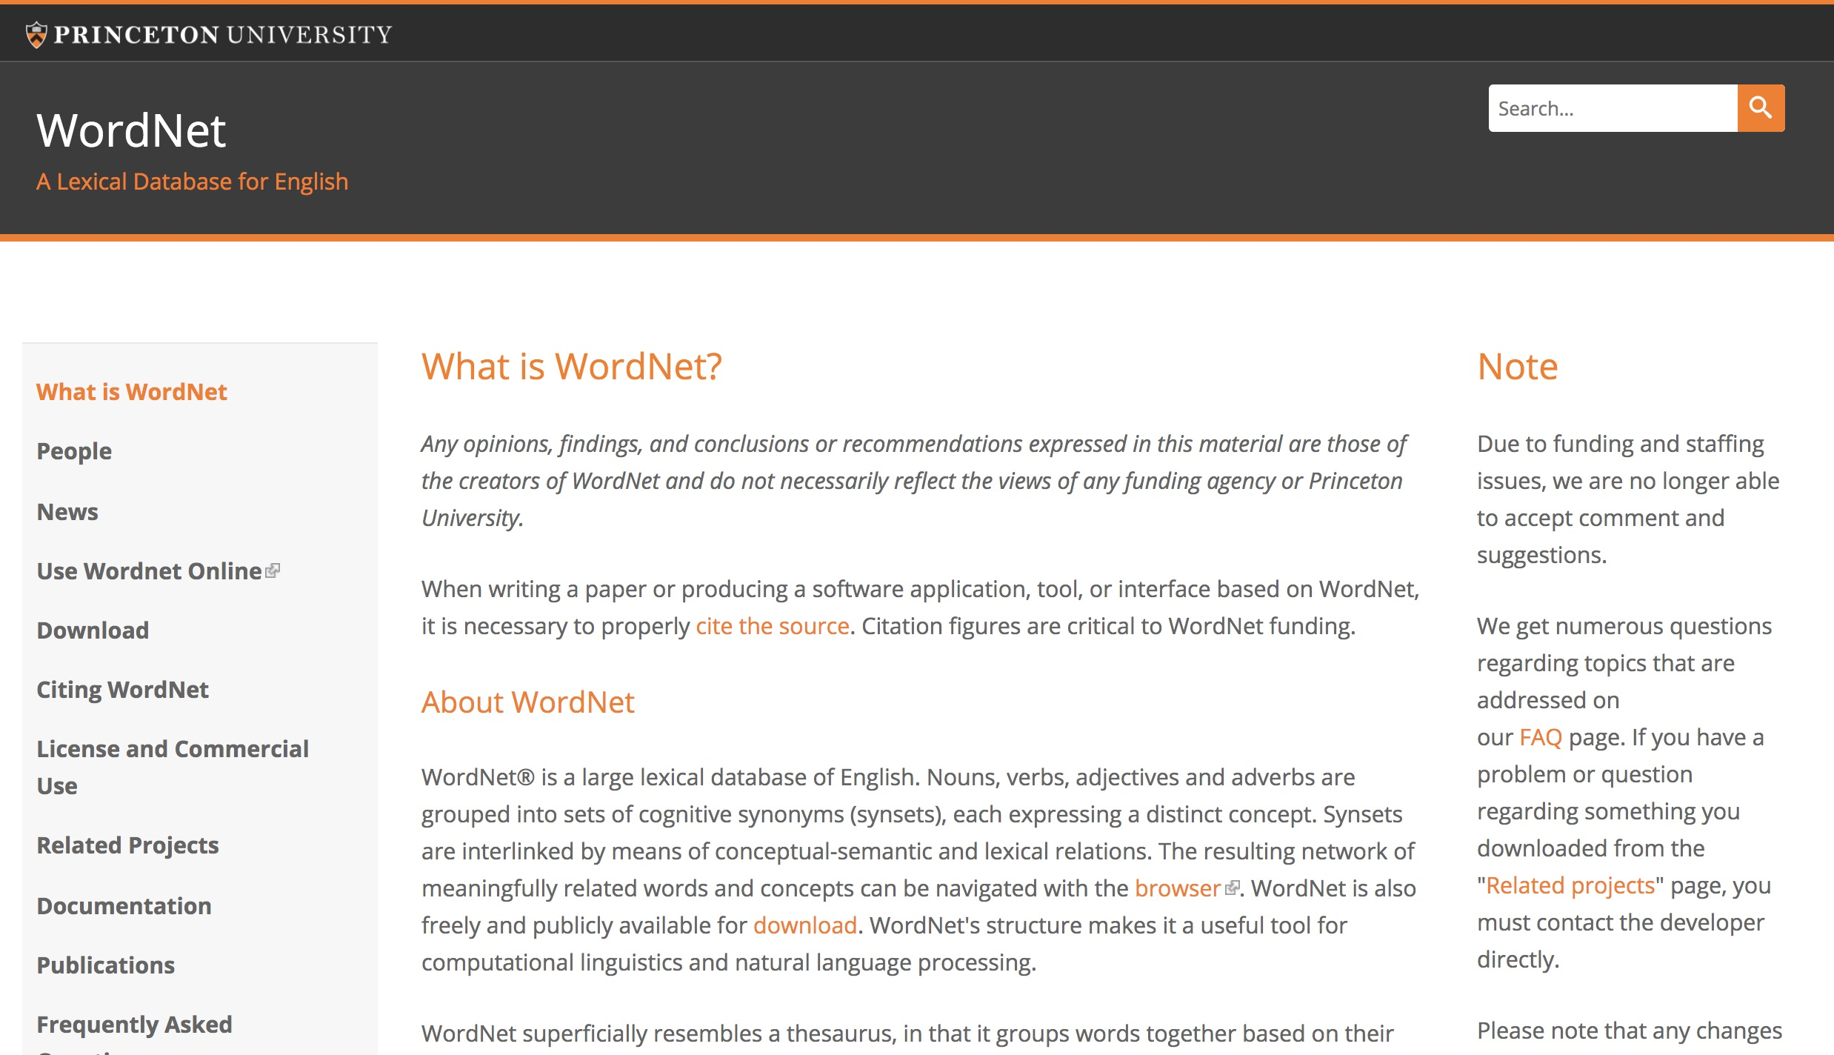
WordNet A Lexical Database for English
https://wordnet.princeton.edu/

Slide 10
NLP
Source: http://blog.aylien.com/leveraging-deep-learning-for-multilingual/

Slide 11
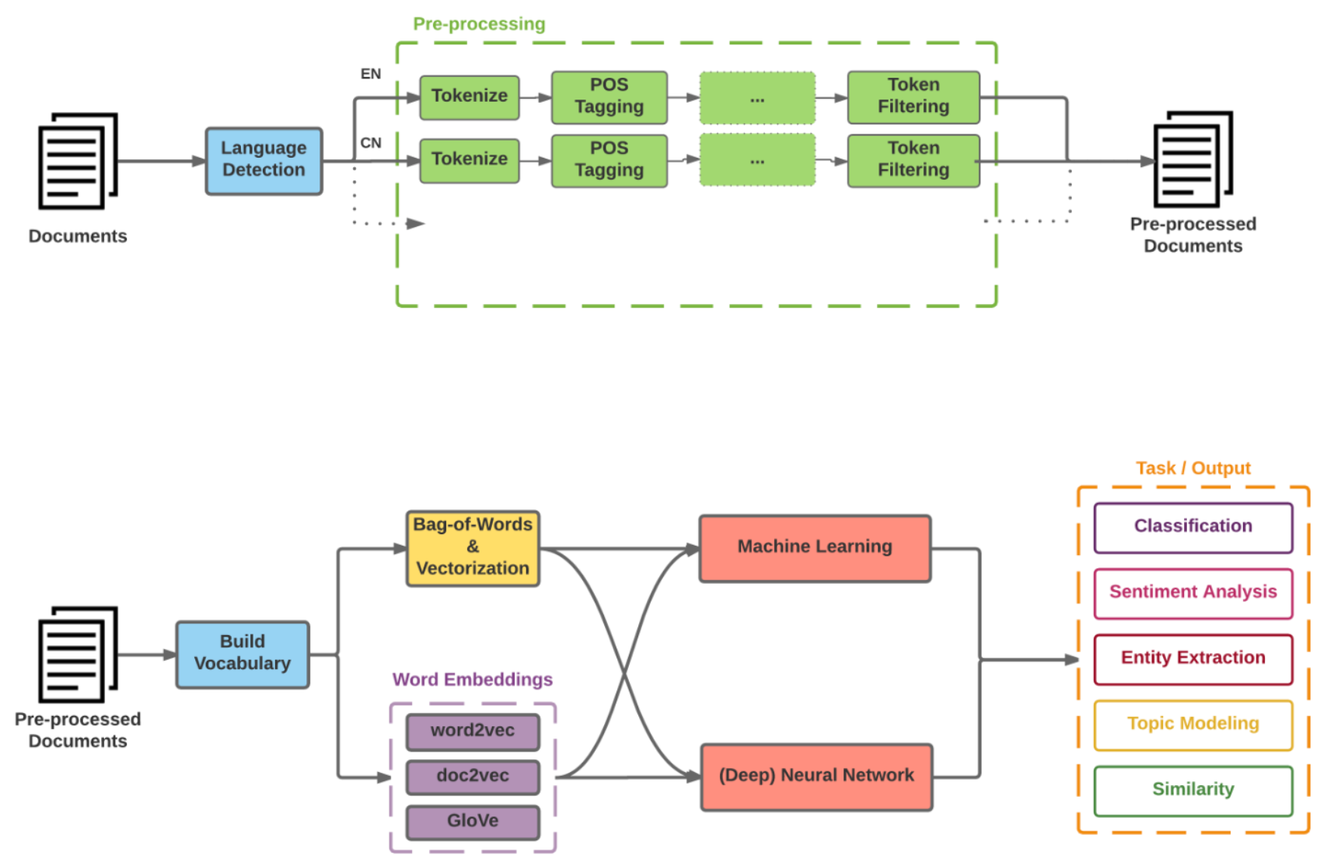
Modern NLP Pipeline
Source: https://github.com/fortiema/talks/blob/master/opendata2016sh/pragmatic-nlp-opendata2016sh.pdf

Slide 12
Modern NLP Pipeline
Source: http://mattfortier.me/2017/01/31/nlp-intro-pt-1-overview/

Slide 13
Deep Learning NLP
Source: http://mattfortier.me/2017/01/31/nlp-intro-pt-1-overview/

Slide 14
Natural Language Processing (NLP) and Text Mining
Raw text
Sentence Segmentation
Tokenization
Part-of-Speech (POS)
Stop word removal
word’s stem
am → am
having → hav
word’s lemma
am → be
having → have
Stemming / Lemmatization
Dependency Parser
String Metrics & Matching
Source: Nitin Hardeniya (2015), NLTK Essentials, Packt Publishing; Florian Leitner (2015), Text mining - from Bayes rule to dependency parsing

Slide 15
Analyzing Lexical Semantic Relationships
Entailments
Homonyms and Homographs
Synonyms and Antonyms
Hyponyms and Hypernyms
Holonyms and Meronyms
Semantic Relationships and Similarity
Source: Dipanjan Sarkar (2019), Text Analytics with Python: A Practitioner’s Guide to Natural Language Processing, Second Edition. APress.

Slide 16
Word Sense Disambiguation
Lesk algorithm (Lesk, 1986)
leverage dictionary or vocabulary definitions for a word we want to disambiguate in a body of text and compare the words in these definitions with a section of text surrounding our word of interest.
The main objective is to return the synset with the maximum number of overlapping words or terms between the context sentence and the different definitions from each synset for the word we target for disambiguation.
Source: Dipanjan Sarkar (2019), Text Analytics with Python: A Practitioner’s Guide to Natural Language Processing, Second Edition. APress.

Slide 17
Named Entity Recognition (NER)
Named entities
represent real-world objects
people, places, organizations
proper names
Named entity recognition
Entity chunking
Entity extraction
Source: Dipanjan Sarkar (2019), Text Analytics with Python: A Practitioner’s Guide to Natural Language Processing, Second Edition. APress.

Slide 18
NER: OntoNotes 5 Named Entities
SID | TYPE | DESCRIPTION
1 | PERSON | People, including fictional.
2 | NORP | Nationalities or religious or political groups.
3 | FAC | Buildings, airports, highways, bridges, etc.
4 | ORG | Companies, agencies, institutions, etc.
5 | GPE | Countries, cities, states.
6 | LOC | Non-GPE locations, mountain ranges, bodies of water.
7 | PRODUCT | Objects, vehicles, foods, etc. (Not services.)
8 | EVENT | Named hurricanes, battles, wars, sports events, etc.
9 | WORK_OF_ART | Titles of books, songs, etc.
10 | LAW | Named documents made into laws.
11 | LANGUAGE | Any named language.
12 | DATE | Absolute or relative dates or periods.
13 | TIME | Times smaller than a day.
14 | PERCENT | Percentage, including ”%“.
15 | MONEY | Monetary values, including unit.
16 | QUANTITY | Measurements, as of weight or distance.
17 | ORDINAL | “first”, “second”, etc.
18 | CARDINAL | Numerals that do not fall under another type.
Source: https://spacy.io/api/annotation#named-entities

Slide 19
NER: Wikipedia Named Entities
SID | TYPE | DESCRIPTION
1 | PER | Named person or family.
2 | LOC | Name of politically or geographically defined location (cities, provinces, countries, international regions, bodies of water, mountains).
3 | ORG | Named corporate, governmental, or other organizational entity.
4 | MISC | Miscellaneous entities, e.g. events, nationalities, products or works of art.
Source: https://spacy.io/api/annotation#named-entities

Slide 20
NER IOB Scheme
TAG | ID | DESCRIPTION
"I" | 1 | Token is inside an entity.
"O" | 2 | Token is outside an entity.
"B" | 3 | Token begins an entity.
"" | 0 | No entity tag is set (missing value).
Source: https://spacy.io/api/annotation#named-entities

Slide 21
NER BILUO Scheme
TAG | DESCRIPTION
BEGIN | The first token of a multi-token entity.
IN | An inner token of a multi-token entity.
LAST | The final token of a multi-token entity.
UNIT | A single-token entity.
OUT | A non-entity token.
Source: https://spacy.io/api/annotation#named-entities

Slide 22
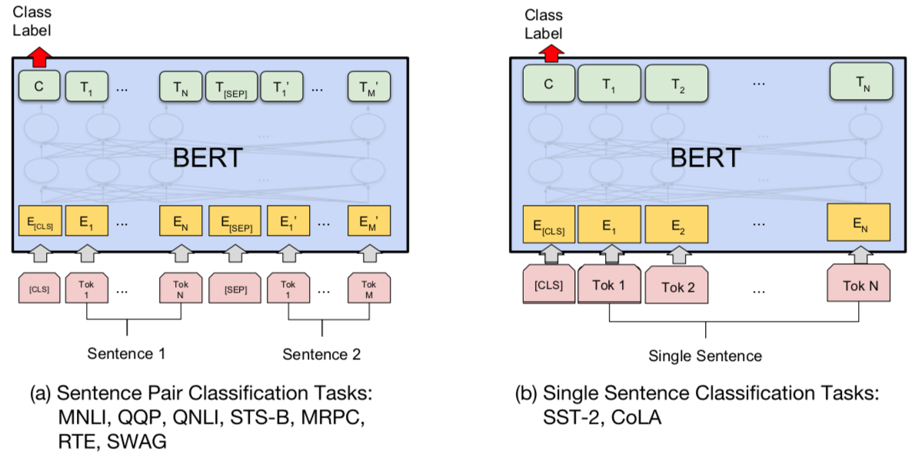
BERT Sequence-level tasks
Source: Devlin, Jacob, Ming-Wei Chang, Kenton Lee, and Kristina Toutanova (2018). "BERT: Pre-training of Deep Bidirectional Transformers for Language Understanding." arXiv preprint arXiv:1810.04805

Slide 23
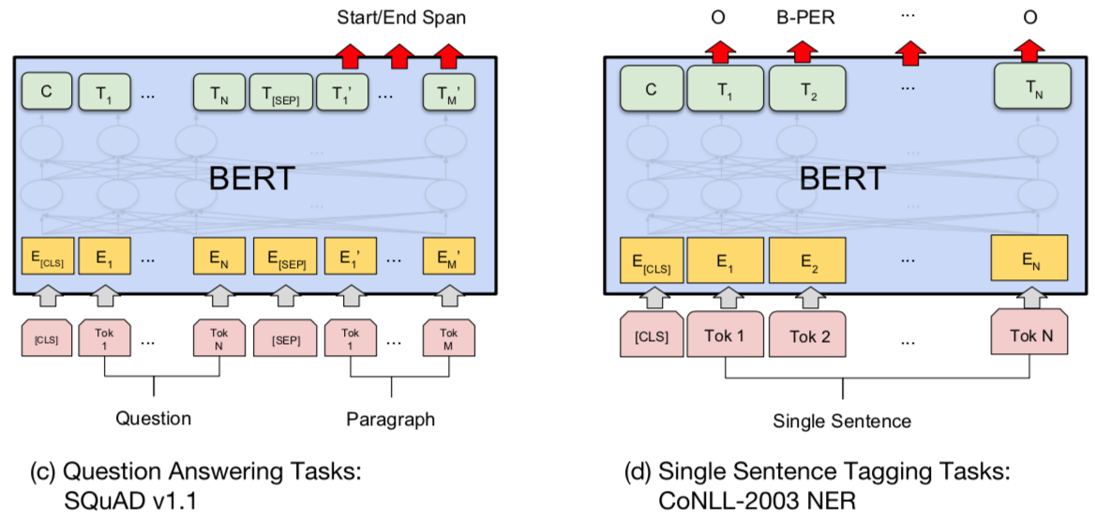
BERT Token-level tasks
Source: Devlin, Jacob, Ming-Wei Chang, Kenton Lee, and Kristina Toutanova (2018). "BERT: Pre-training of Deep Bidirectional Transformers for Language Understanding." arXiv preprint arXiv:1810.04805

Slide 24
NER: Single Sentence Tagging
Source: Devlin, Jacob, Ming-Wei Chang, Kenton Lee, and Kristina Toutanova (2018). "BERT: Pre-training of Deep Bidirectional Transformers for Language Understanding." arXiv preprint arXiv:1810.04805

Slide 25
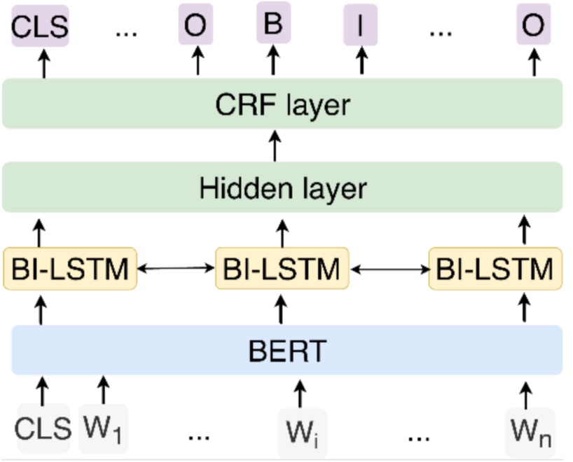
NER: Fine-tuning BERT with Bi-LSTM CRF
Source: Zhang, Xiaohui, Yaoyun Zhang, Qin Zhang, Yuankai Ren, Tinglin Qiu, Jianhui Ma, and Qiang Sun. "Extracting comprehensive clinical information for breast cancer using deep learning methods." International Journal of Medical Informatics 132 (2019): 103985.

Slide 26
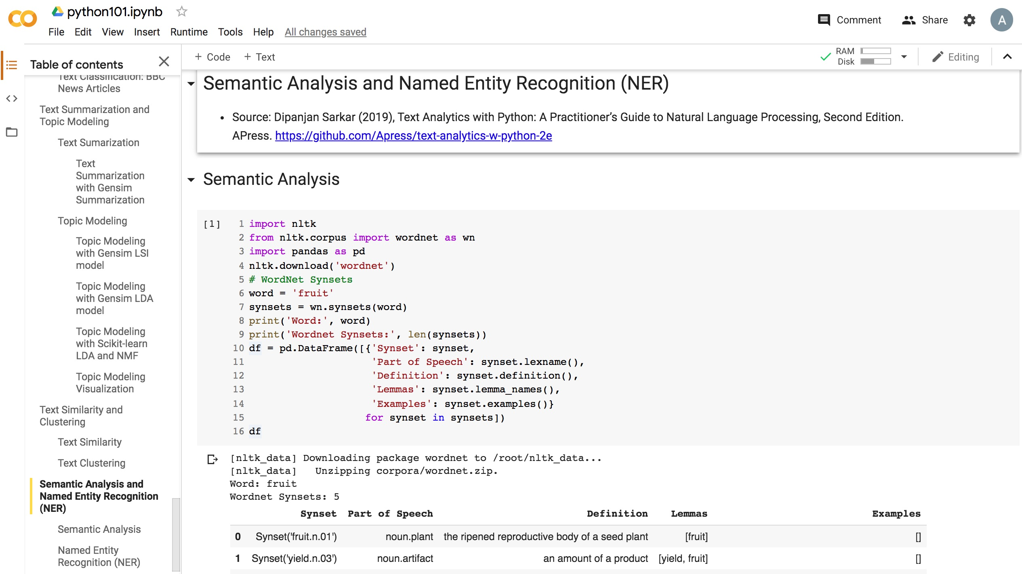
Python in Google Colab (Python101)
https://colab.research.google.com/drive/1FEG6DnGvwfUbeo4zJ1zTunjMqf2RkCrT
https://tinyurl.com/aintpupython101

Slide 27
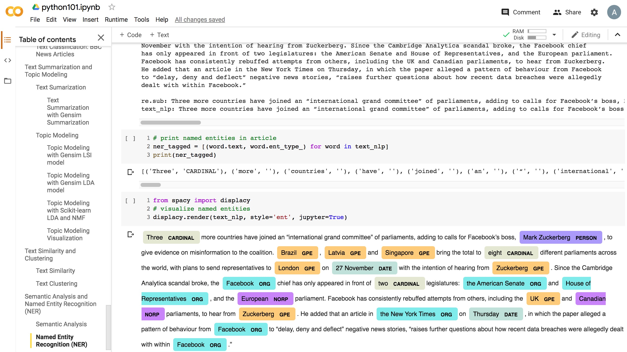
Python in Google Colab (Python101)
https://colab.research.google.com/drive/1FEG6DnGvwfUbeo4zJ1zTunjMqf2RkCrT
https://tinyurl.com/aintpupython101

Slide 28
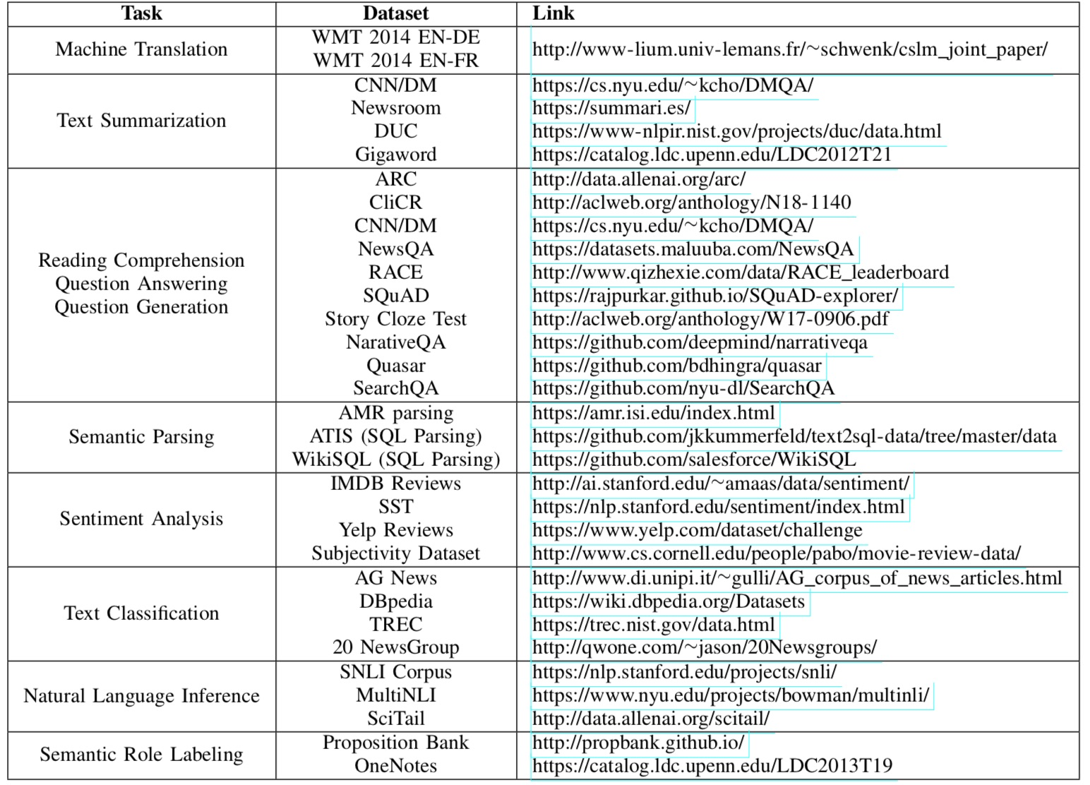
NLP Benchmark Datasets
Source: Amirsina Torfi, Rouzbeh A. Shirvani, Yaser Keneshloo, Nader Tavvaf, and Edward A. Fox (2020). "Natural Language Processing Advancements By Deep Learning: A Survey." arXiv preprint arXiv:2003.01200.

Slide 29
Summary
Semantic Analysis
WordNet
Word sense disambiguation
Named Entity Recognition (NER)

Slide 30
References
Dipanjan Sarkar (2019), Text Analytics with Python: A Practitioner’s Guide to Natural Language Processing, Second Edition. APress. https://github.com/Apress/text-analytics-w-python-2e
Benjamin Bengfort, Rebecca Bilbro, and Tony Ojeda (2018), Applied Text Analysis with Python, O'Reilly Media. https://www.oreilly.com/library/view/applied-text-analysis/9781491963036/
HuggingFace (2020), Transformers Notebook, https://huggingface.co/transformers/notebooks.html
The Super Duper NLP Repo, https://notebooks.quantumstat.com/
Min-Yuh Day (2020), Python 101, https://tinyurl.com/aintpupython101

