Slide 1
人工智慧文本分析 (AI for Text Analytics)
Tamkang University
深度學習和通用句子嵌入模型 (Deep Learning and Universal Sentence-Embedding Models)
1091AITA11
MBA, IMTKU (M2455) (8418) (Fall 2020) Thu 3, 4 (10:10-12:00) (B206)
Min-Yuh Day
戴敏育
Associate Professor
副教授
Institute of Information Management, National Taipei University
國立臺北大學 資訊管理研究所
https://web.ntpu.edu.tw/~myday
2020-12-24

Slide 2
課程大綱 (Syllabus)
週次 (Week) 日期 (Date) 內容 (Subject/Topics)
1 2020/09/17 人工智慧文本分析課程介紹 (Course Orientation on Artificial Intelligence for Text Analytics)
2 2020/09/24 文本分析的基礎：自然語言處理 (Foundations of Text Analytics: Natural Language Processing; NLP)
3 2020/10/01 中秋節 (Mid-Autumn Festival) 放假一天 (Day off)
4 2020/10/08 Python自然語言處理 (Python for Natural Language Processing)
5 2020/10/15 處理和理解文本 (Processing and Understanding Text)
6 2020/10/22 文本表達特徵工程 (Feature Engineering for Text Representation)

Slide 3
課程大綱 (Syllabus)
週次 (Week) 日期 (Date) 內容 (Subject/Topics)
7 2020/10/29 人工智慧文本分析個案研究 I (Case Study on Artificial Intelligence for Text Analytics I)
8 2020/11/05 文本分類 (Text Classification)
9 2020/11/12 文本摘要和主題模型 (Text Summarization and Topic Models)
10 2020/11/19 期中報告 (Midterm Project Report)
11 2020/11/26 文本相似度和分群 (Text Similarity and Clustering)
12 2020/12/03 語意分析和命名實體識別 (Semantic Analysis and Named Entity Recognition; NER)

Slide 4
課程大綱 (Syllabus)
週次 (Week) 日期 (Date) 內容 (Subject/Topics)
13 2020/12/10 情感分析 (Sentiment Analysis)
14 2020/12/17 人工智慧文本分析個案研究 II (Case Study on Artificial Intelligence for Text Analytics II)
15 2020/12/24 深度學習和通用句子嵌入模型 (Deep Learning and Universal Sentence-Embedding Models)
16 2020/12/31 問答系統與對話系統 (Question Answering and Dialogue Systems)
17 2021/01/07 期末報告 I (Final Project Presentation I)
18 2021/01/14 期末報告 II (Final Project Presentation II)

Slide 5
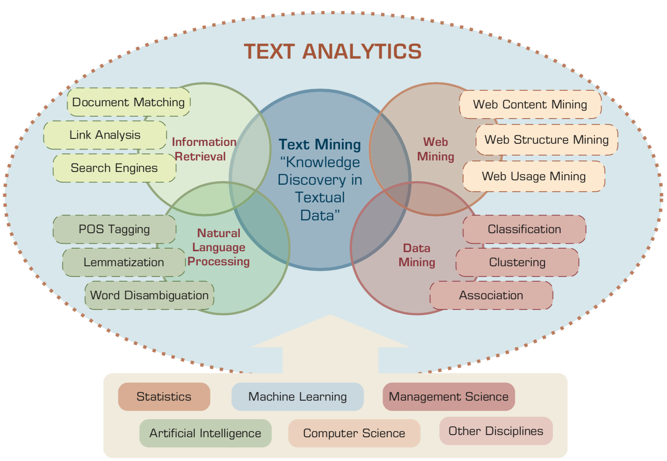
AI for Text Analytics
Source: Ramesh Sharda, Dursun Delen, and Efraim Turban (2017), Business Intelligence, Analytics, and Data Science: A Managerial Perspective, 4th Edition, Pearson

Slide 6
Deep Learning and Universal Sentence-Embedding Models

Slide 7
Outline
Universal Sentence Encoder (USE)
Universal Sentence Encoder Multilingual (USEM)
Semantic Similarity

Slide 8
NLP
Source: http://blog.aylien.com/leveraging-deep-learning-for-multilingual/

Slide 9
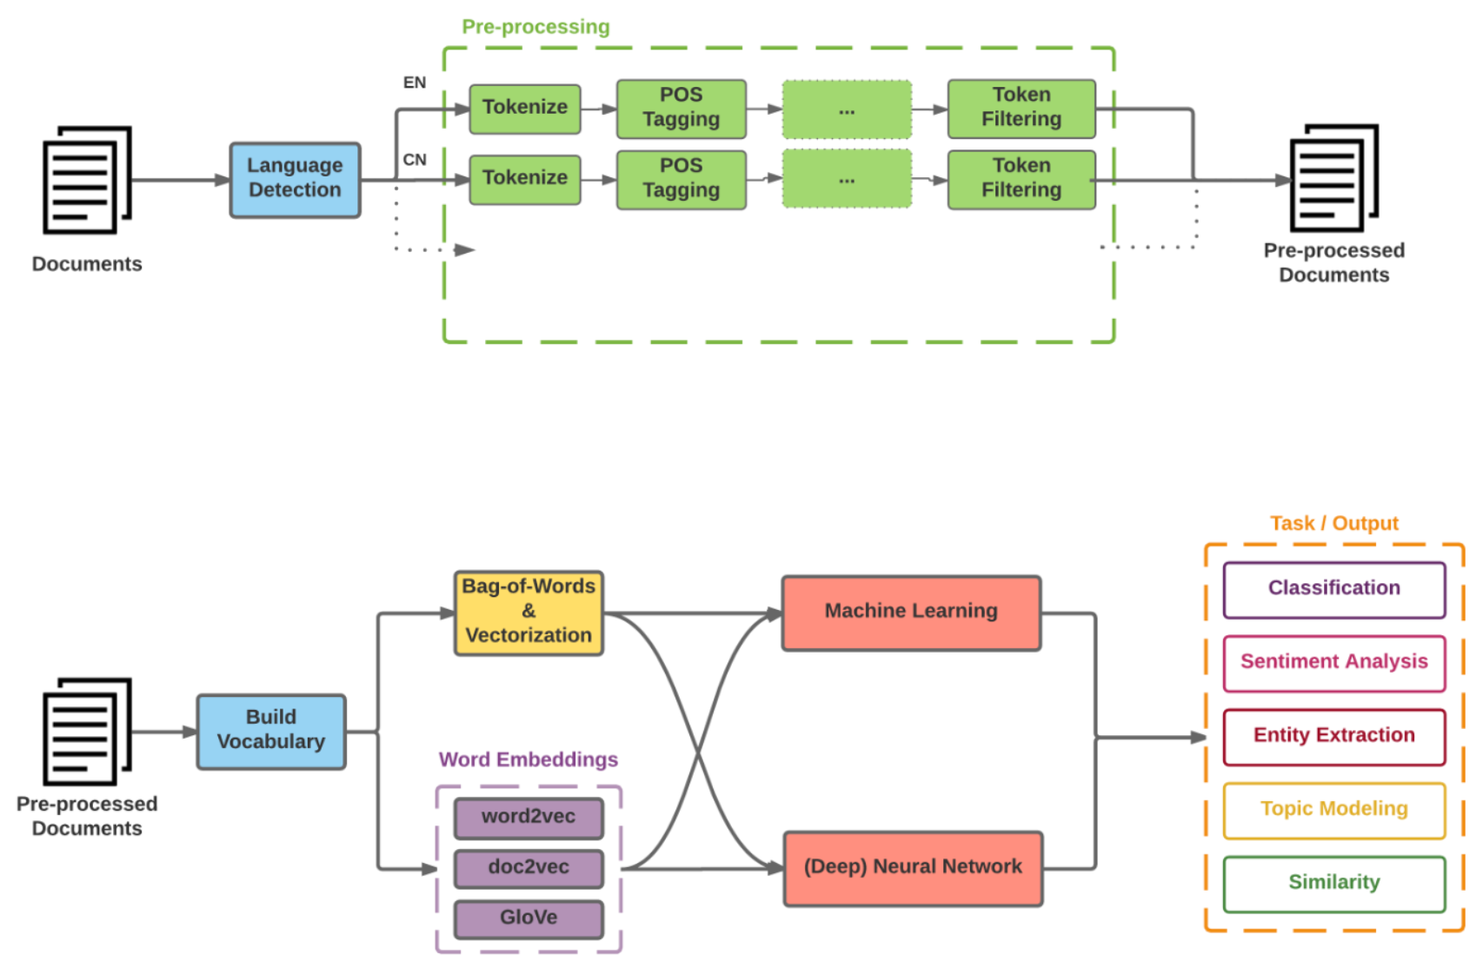
Modern NLP Pipeline
Source: https://github.com/fortiema/talks/blob/master/opendata2016sh/pragmatic-nlp-opendata2016sh.pdf

Slide 10
Modern NLP Pipeline
Source: http://mattfortier.me/2017/01/31/nlp-intro-pt-1-overview/

Slide 11
Deep Learning NLP
Source: http://mattfortier.me/2017/01/31/nlp-intro-pt-1-overview/

Slide 12
Natural Language Processing (NLP) and Text Mining
Raw text
Sentence Segmentation
Tokenization
Part-of-Speech (POS)
Stop word removal
word’s stem
am → am
having → hav
word’s lemma
am → be
having → have
Stemming / Lemmatization
Dependency Parser
String Metrics & Matching
Source: Nitin Hardeniya (2015), NLTK Essentials, Packt Publishing; Florian Leitner (2015), Text mining - from Bayes rule to dependency parsing

Slide 13
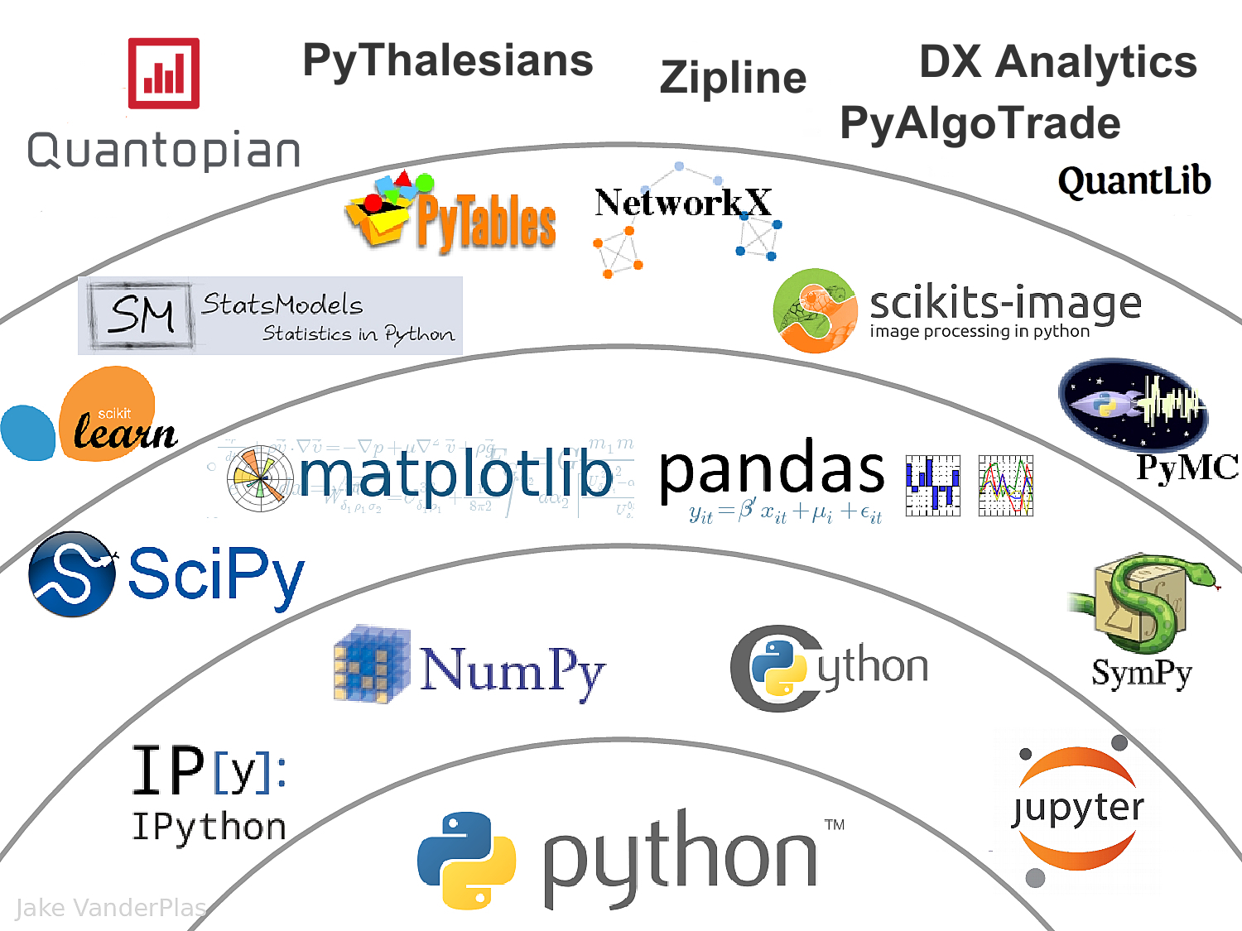
Data Science Python Stack
Source: http://nbviewer.jupyter.org/format/slides/github/quantopian/pyfolio/blob/master/pyfolio/examples/overview_slides.ipynb#/5

Slide 14
Universal Sentence Encoder (USE)
The Universal Sentence Encoder encodes text into high-dimensional vectors that can be used for text classification, semantic similarity, clustering and other natural language tasks.
The universal-sentence-encoder model is trained with a deep averaging network (DAN) encoder.
Source: https://tfhub.dev/google/universal-sentence-encoder/4

Slide 15
Universal Sentence Encoder (USE) Semantic Similarity
Source: https://tfhub.dev/google/universal-sentence-encoder/4

Slide 16
Universal Sentence Encoder (USE) Classification
Source: https://tfhub.dev/google/universal-sentence-encoder/4

Slide 17
Universal Sentence Encoder (USE)
Source: Daniel Cer, Yinfei Yang, Sheng-yi Kong, Nan Hua, Nicole Limtiaco, Rhomni St. John, Noah Constant, Mario Guajardo-Céspedes, Steve Yuan, Chris Tar, Yun-Hsuan Sung, Brian Strope, Ray Kurzweil. Universal Sentence Encoder. arXiv:1803.11175, 2018.

Slide 18
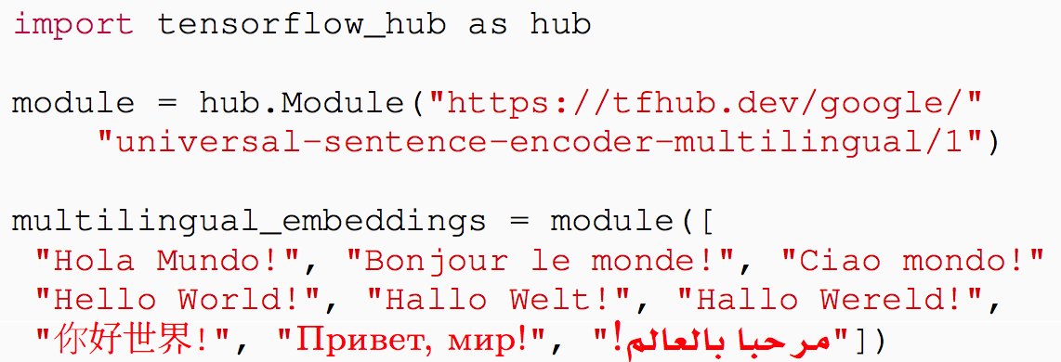
Multilingual Universal Sentence Encoder (MUSE)
Source: Yinfei Yang, Daniel Cer, Amin Ahmad, Mandy Guo, Jax Law, Noah Constant, Gustavo Hernandez Abrego , Steve Yuan, Chris Tar, Yun-hsuan Sung, Ray Kurzweil. Multilingual Universal Sentence Encoder for Semantic Retrieval. July 2019

Slide 19
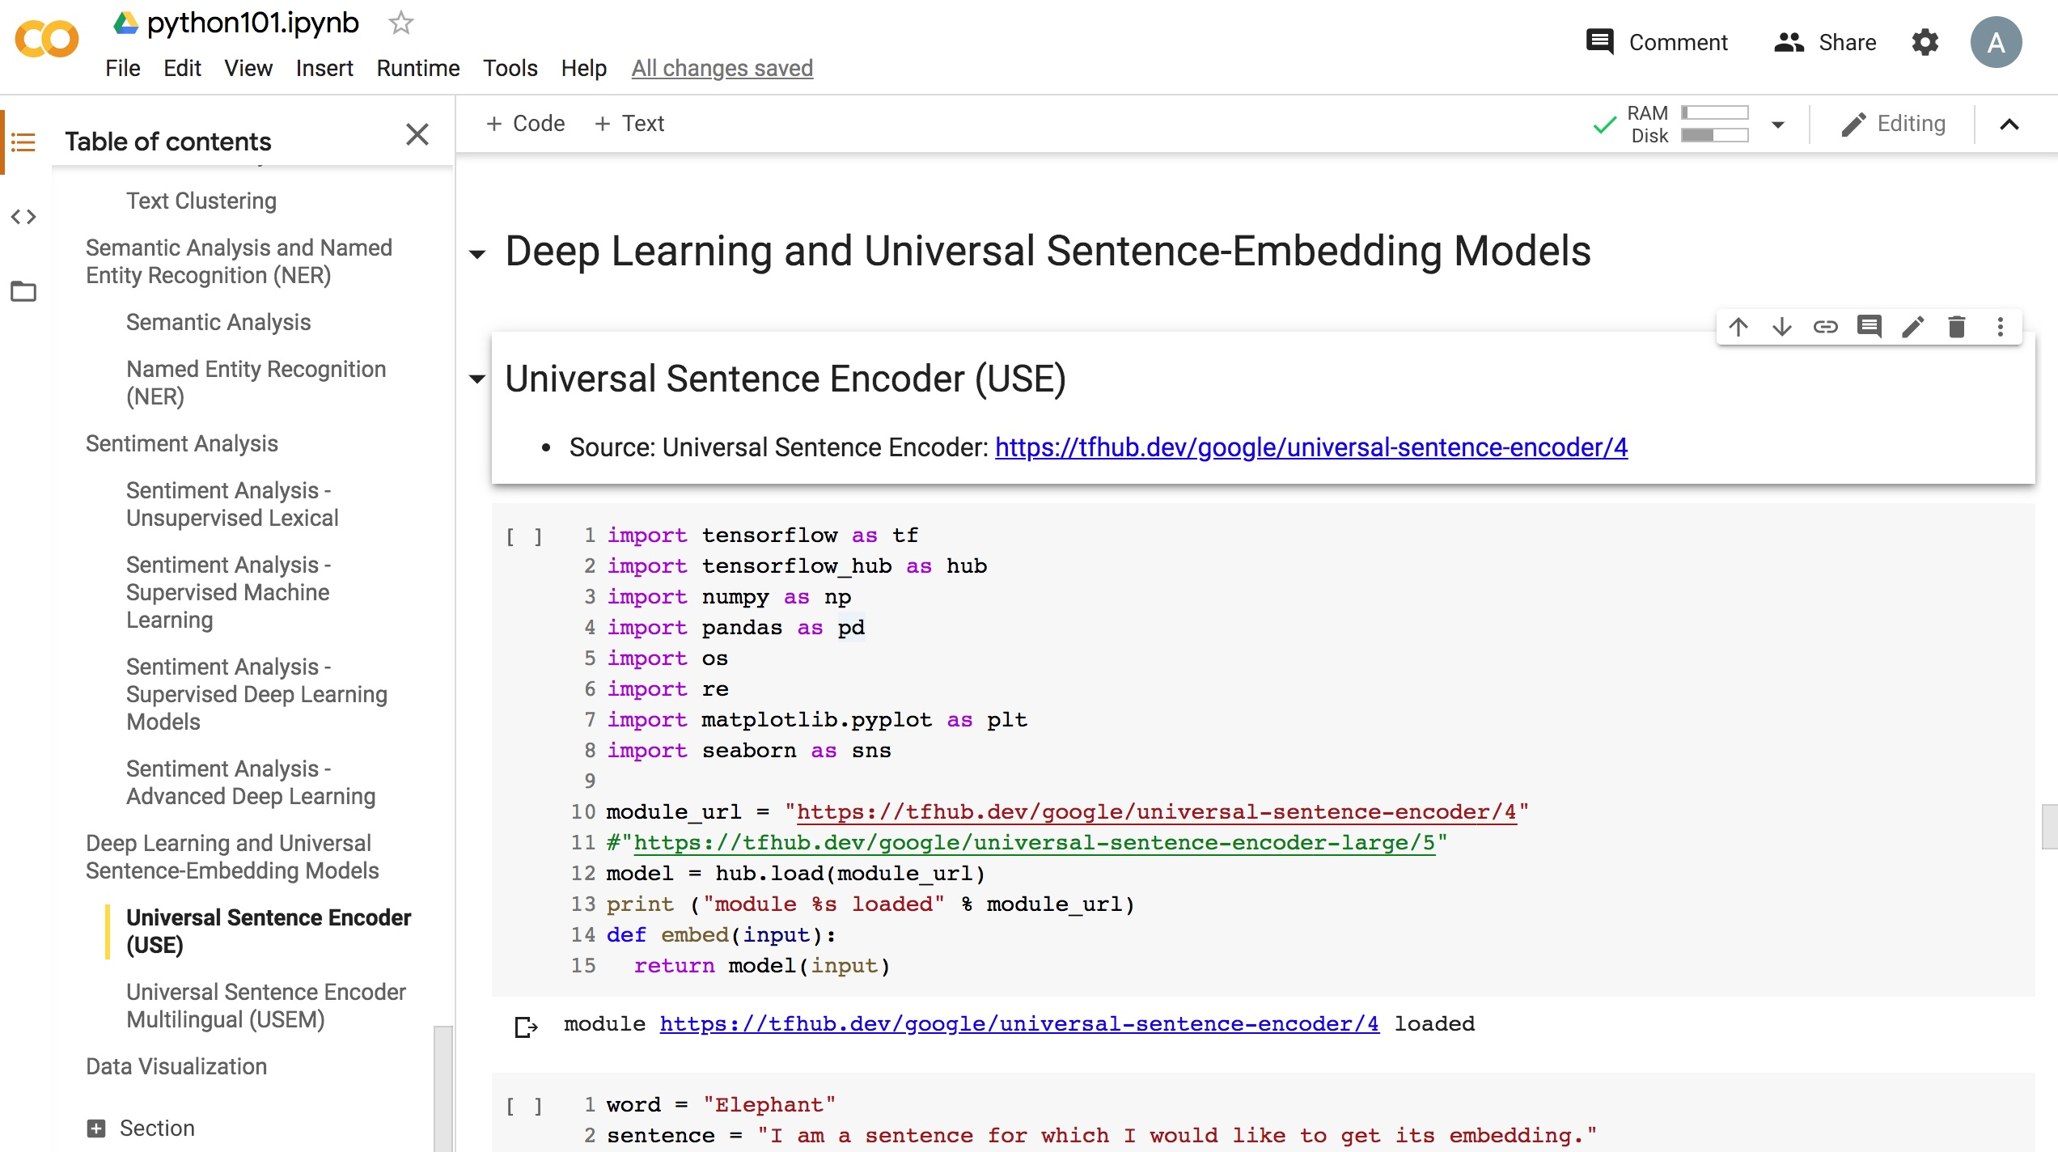
Python in Google Colab (Python101)
https://colab.research.google.com/drive/1FEG6DnGvwfUbeo4zJ1zTunjMqf2RkCrT
https://tinyurl.com/aintpupython101

Slide 20
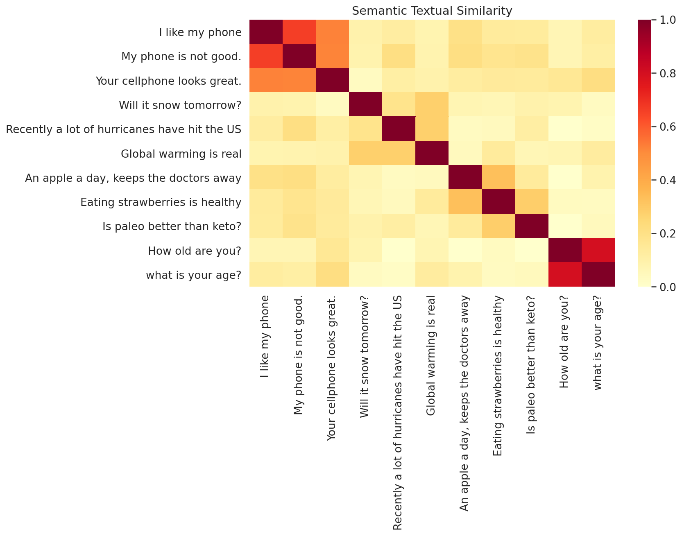
Python in Google Colab (Python101)
https://colab.research.google.com/drive/1FEG6DnGvwfUbeo4zJ1zTunjMqf2RkCrT
https://tinyurl.com/aintpupython101

Slide 21
One-hot encoding
'The mouse ran up the clock’ =
[ [0, 1, 0, 0, 0, 0, 0], [0, 0, 1, 0, 0, 0, 0], [0, 0, 0, 1, 0, 0, 0], [0, 0, 0, 0, 1, 0, 0], [0, 1, 0, 0, 0, 0, 0], [0, 0, 0, 0, 0, 1, 0] ]
The mouse ran up the clock
1 2 3 4
1
5
[0, 1, 2, 3, 4, 5, 6]
Source: https://developers.google.com/machine-learning/guides/text-classification/step-3

Slide 22
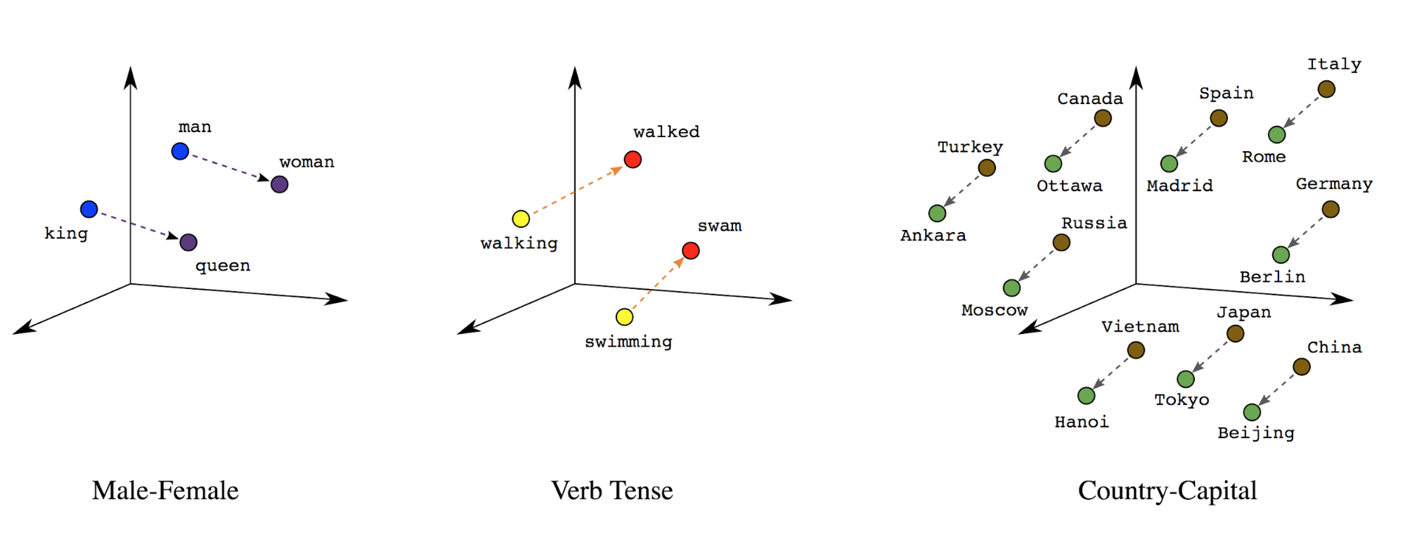
Word embeddings
Source: https://developers.google.com/machine-learning/guides/text-classification/step-3

Slide 23
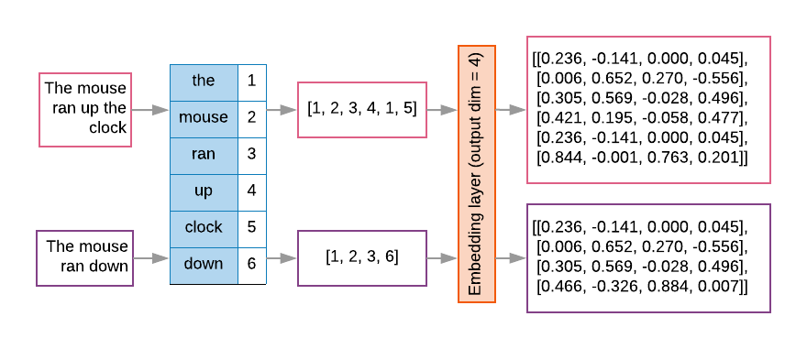
Word embeddings
Source: https://developers.google.com/machine-learning/guides/text-classification/step-3

Slide 24
Sequence to Sequence (Seq2Seq)
Source: https://google.github.io/seq2seq/

Slide 25
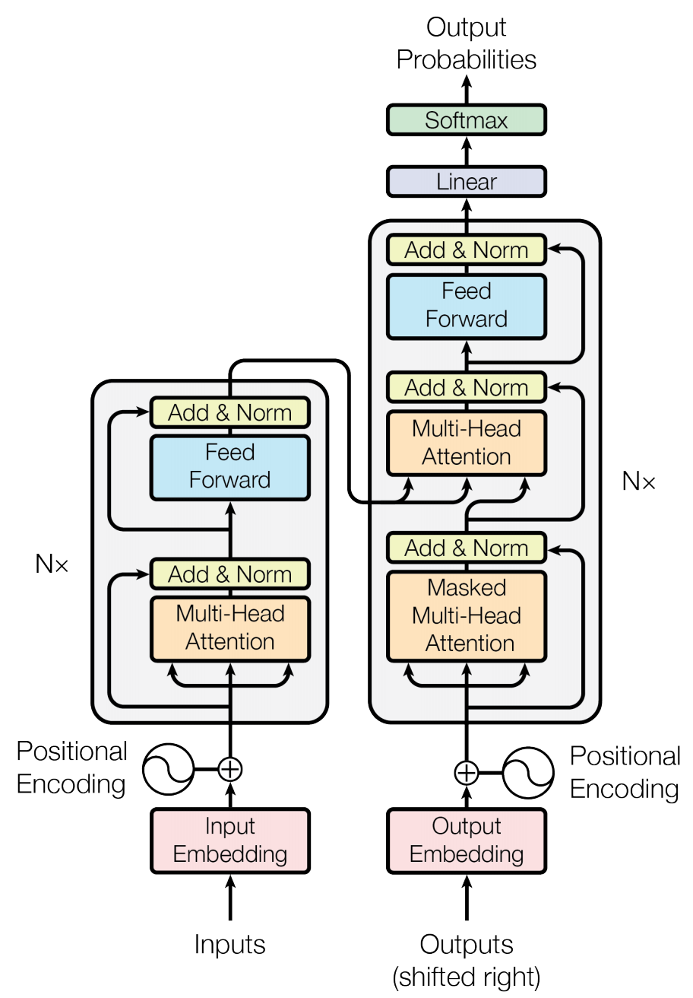
Transformer (Attention is All You Need) (Vaswani et al., 2017)
Source: Vaswani, Ashish, Noam Shazeer, Niki Parmar, Jakob Uszkoreit, Llion Jones, Aidan N. Gomez, Łukasz Kaiser, and Illia Polosukhin. "Attention is all you need." In Advances in neural information processing systems, pp. 5998-6008. 2017.

Slide 26
Transformer
Source: Jay Alammar (2019), The Illustrated Transformer, http://jalammar.github.io/illustrated-transformer/

Slide 27
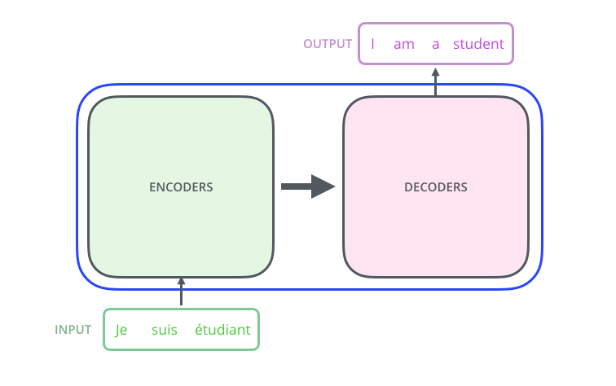
Transformer Encoder Decoder
Source: Jay Alammar (2019), The Illustrated Transformer, http://jalammar.github.io/illustrated-transformer/

Slide 28
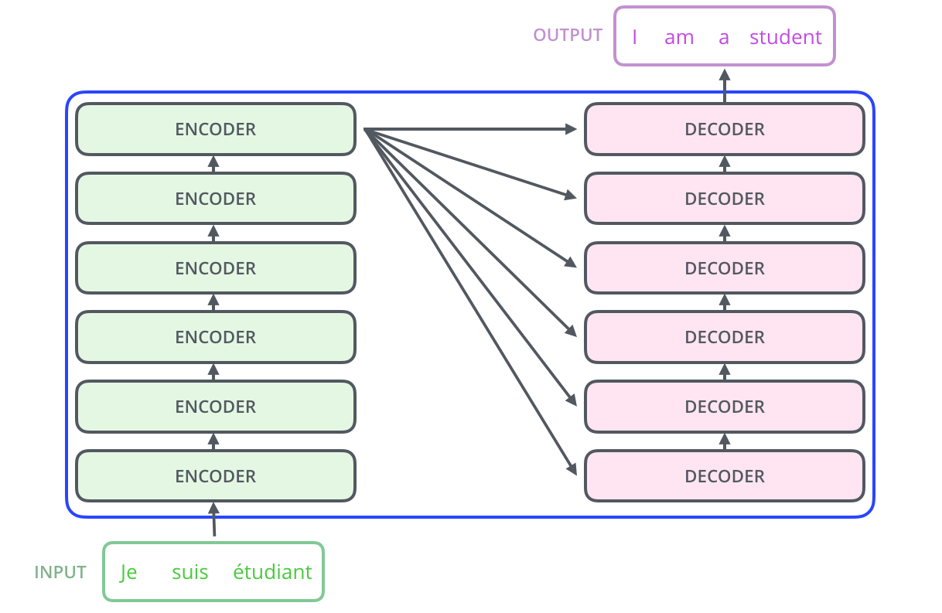
Transformer Encoder Decoder Stack
Source: Jay Alammar (2019), The Illustrated Transformer, http://jalammar.github.io/illustrated-transformer/

Slide 29
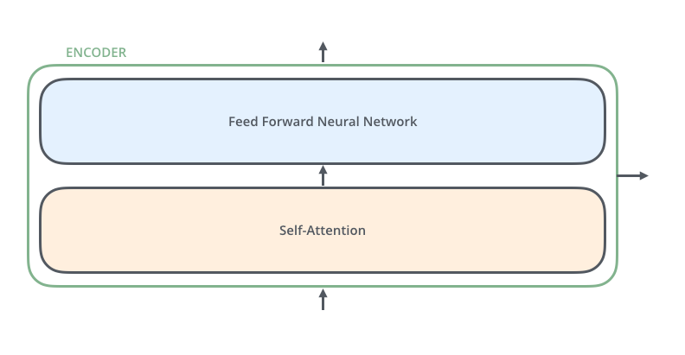
Transformer Encoder Self-Attention
Source: Jay Alammar (2019), The Illustrated Transformer, http://jalammar.github.io/illustrated-transformer/

Slide 30
Transformer Decoder
Source: Jay Alammar (2019), The Illustrated Transformer, http://jalammar.github.io/illustrated-transformer/

Slide 31
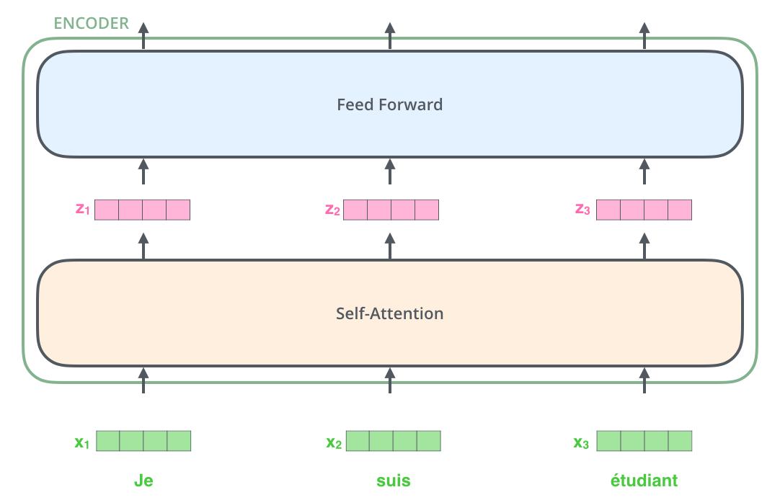
Transformer Encoder with Tensors Word Embeddings
Source: Jay Alammar (2019), The Illustrated Transformer, http://jalammar.github.io/illustrated-transformer/

Slide 32
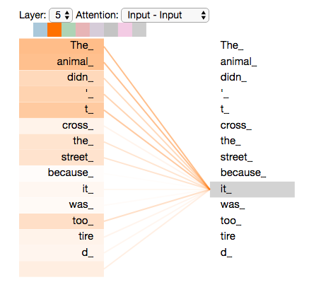
Transformer Self-Attention Visualization
Source: Jay Alammar (2019), The Illustrated Transformer, http://jalammar.github.io/illustrated-transformer/

Slide 33
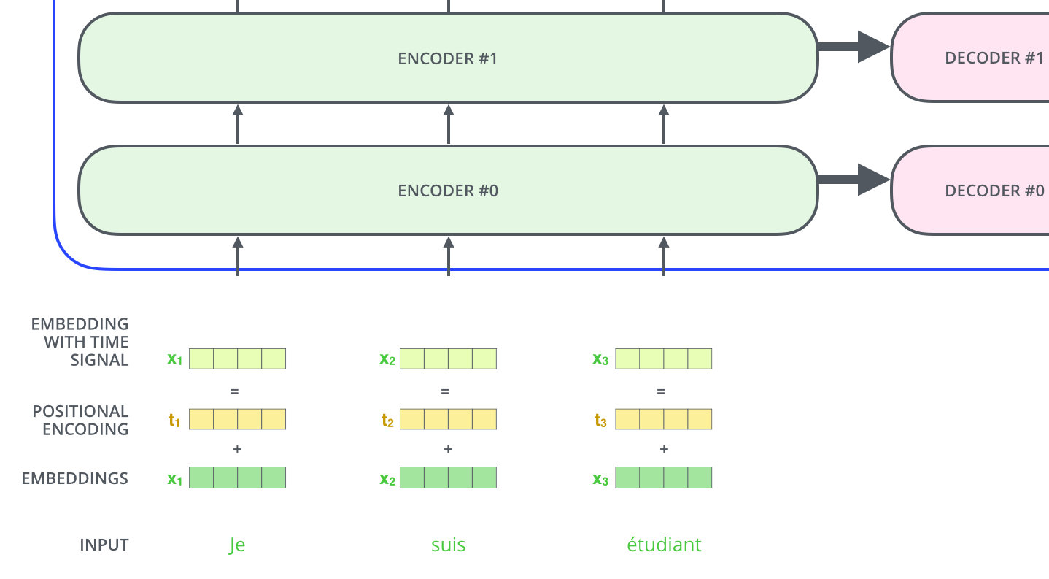
Transformer Positional Encoding Vectors
Source: Jay Alammar (2019), The Illustrated Transformer, http://jalammar.github.io/illustrated-transformer/

Slide 34
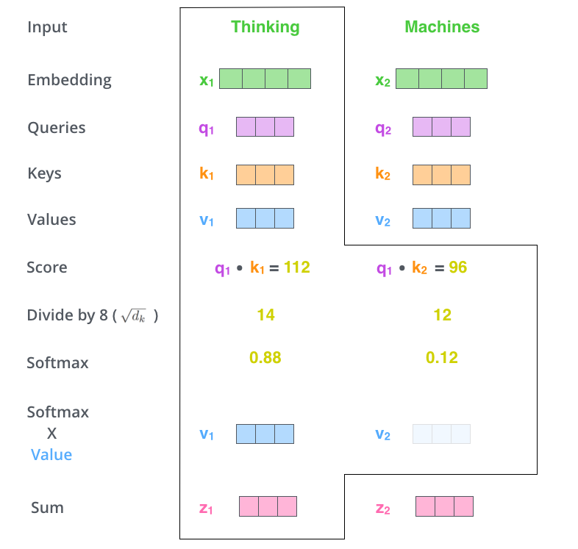
Transformer Self-Attention Softmax Output
Source: Jay Alammar (2019), The Illustrated Transformer, http://jalammar.github.io/illustrated-transformer/

Slide 35
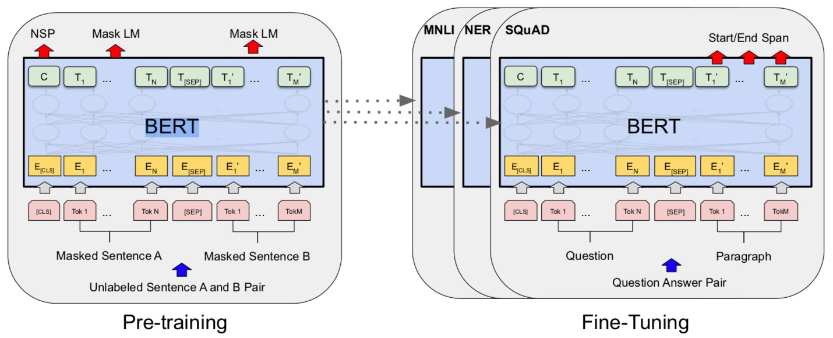
BERT: Pre-training of Deep Bidirectional Transformers for Language Understanding
BERT (Bidirectional Encoder Representations from Transformers)
Overall pre-training and fine-tuning procedures for BERT
Source: Devlin, Jacob, Ming-Wei Chang, Kenton Lee, and Kristina Toutanova (2018). "Bert: Pre-training of deep bidirectional transformers for language understanding." arXiv preprint arXiv:1810.04805.

Slide 36
BERT: Pre-training of Deep Bidirectional Transformers for Language Understanding
BERT (Bidirectional Encoder Representations from Transformers)
BERT input representation
Source: Devlin, Jacob, Ming-Wei Chang, Kenton Lee, and Kristina Toutanova (2018). "Bert: Pre-training of deep bidirectional transformers for language understanding." arXiv preprint arXiv:1810.04805.

Slide 37
BERT, OpenAI GPT, ELMo
Source: Devlin, Jacob, Ming-Wei Chang, Kenton Lee, and Kristina Toutanova (2018). "Bert: Pre-training of deep bidirectional transformers for language understanding." arXiv preprint arXiv:1810.04805.

Slide 38
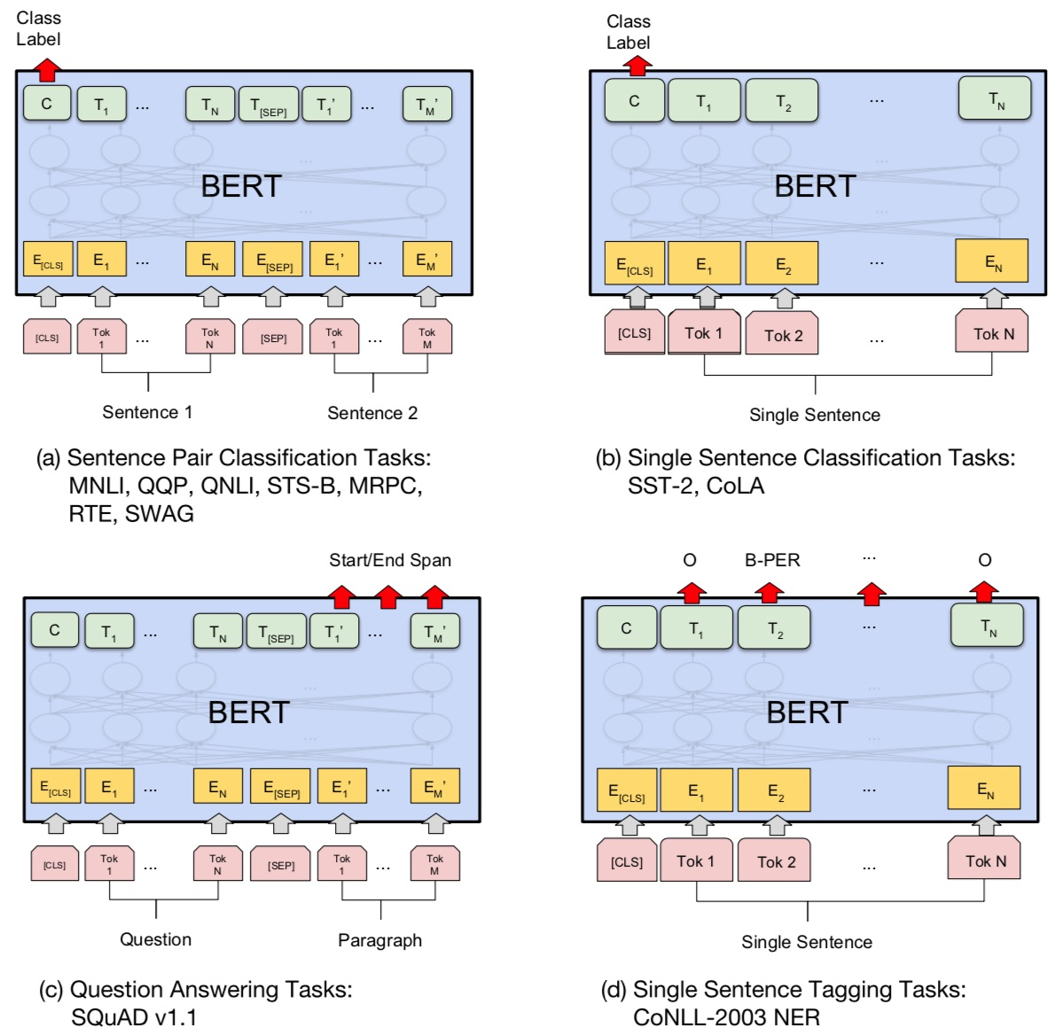
Fine-tuning BERT on Different Tasks
Source: Devlin, Jacob, Ming-Wei Chang, Kenton Lee, and Kristina Toutanova (2018). "Bert: Pre-training of deep bidirectional transformers for language understanding." arXiv preprint arXiv:1810.04805.

Slide 39
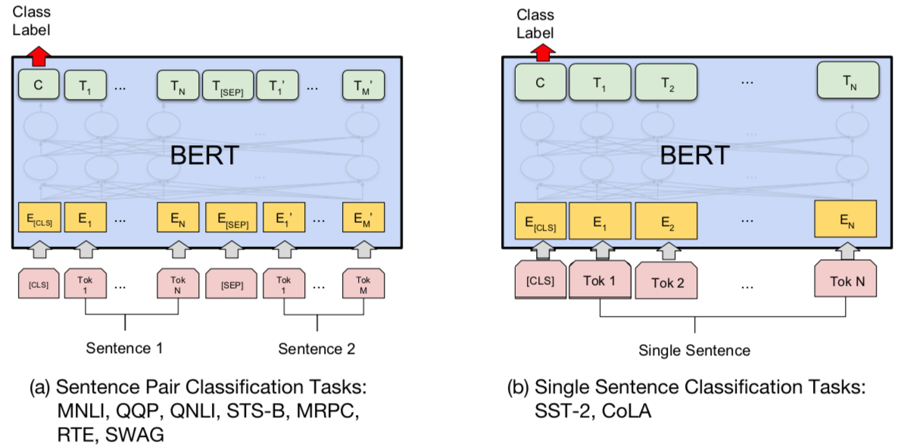
BERT Sequence-level tasks
Source: Devlin, Jacob, Ming-Wei Chang, Kenton Lee, and Kristina Toutanova (2018). "BERT: Pre-training of Deep Bidirectional Transformers for Language Understanding." arXiv preprint arXiv:1810.04805

Slide 40
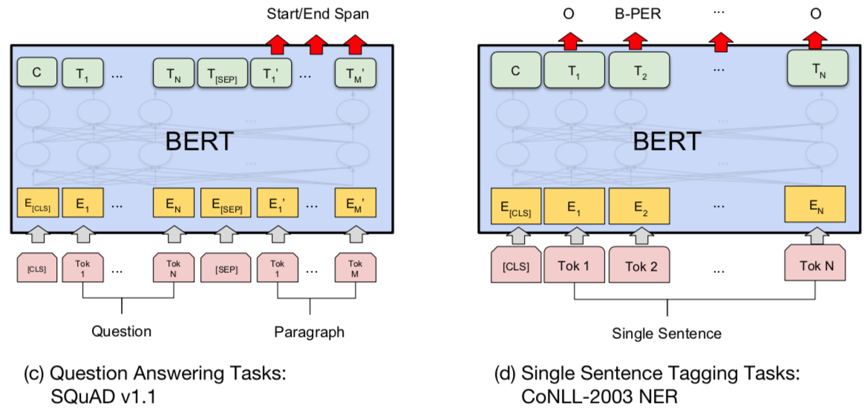
BERT Token-level tasks
Source: Devlin, Jacob, Ming-Wei Chang, Kenton Lee, and Kristina Toutanova (2018). "BERT: Pre-training of Deep Bidirectional Transformers for Language Understanding." arXiv preprint arXiv:1810.04805

Slide 41
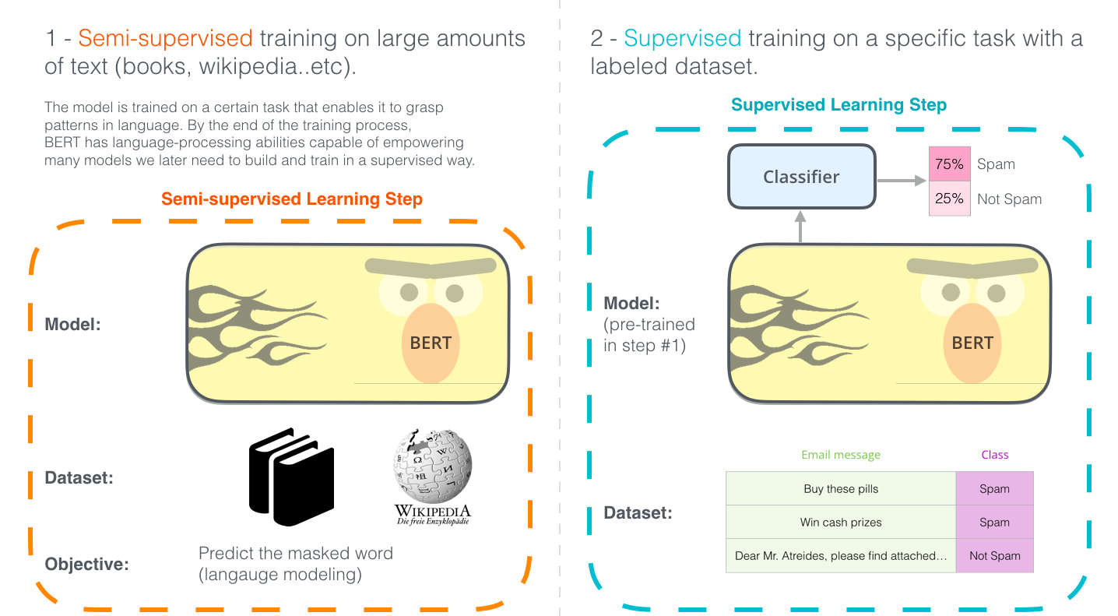
Illustrated BERT
Source: Jay Alammar (2019), The Illustrated BERT, ELMo, and co. (How NLP Cracked Transfer Learning), http://jalammar.github.io/illustrated-bert/

Slide 42
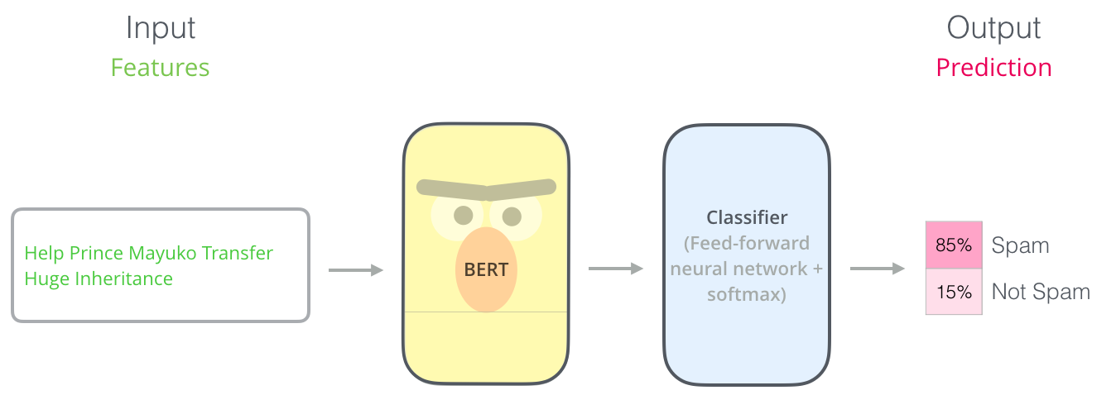
BERT Classification Input Output
Source: Jay Alammar (2019), The Illustrated BERT, ELMo, and co. (How NLP Cracked Transfer Learning), http://jalammar.github.io/illustrated-bert/

Slide 43
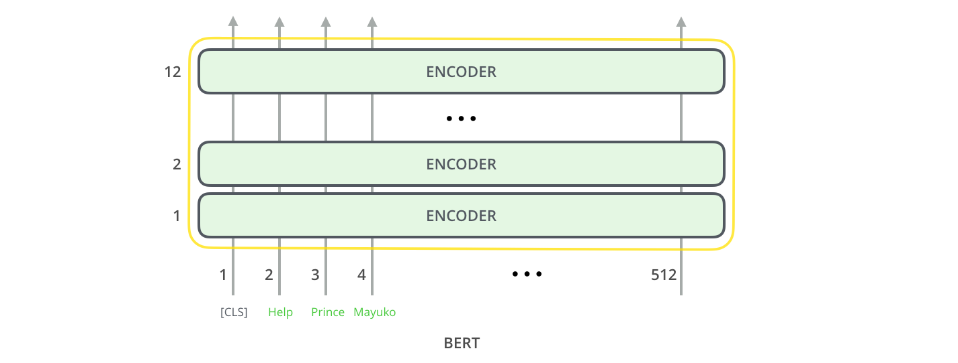
BERT Encoder Input
Source: Jay Alammar (2019), The Illustrated BERT, ELMo, and co. (How NLP Cracked Transfer Learning), http://jalammar.github.io/illustrated-bert/

Slide 44
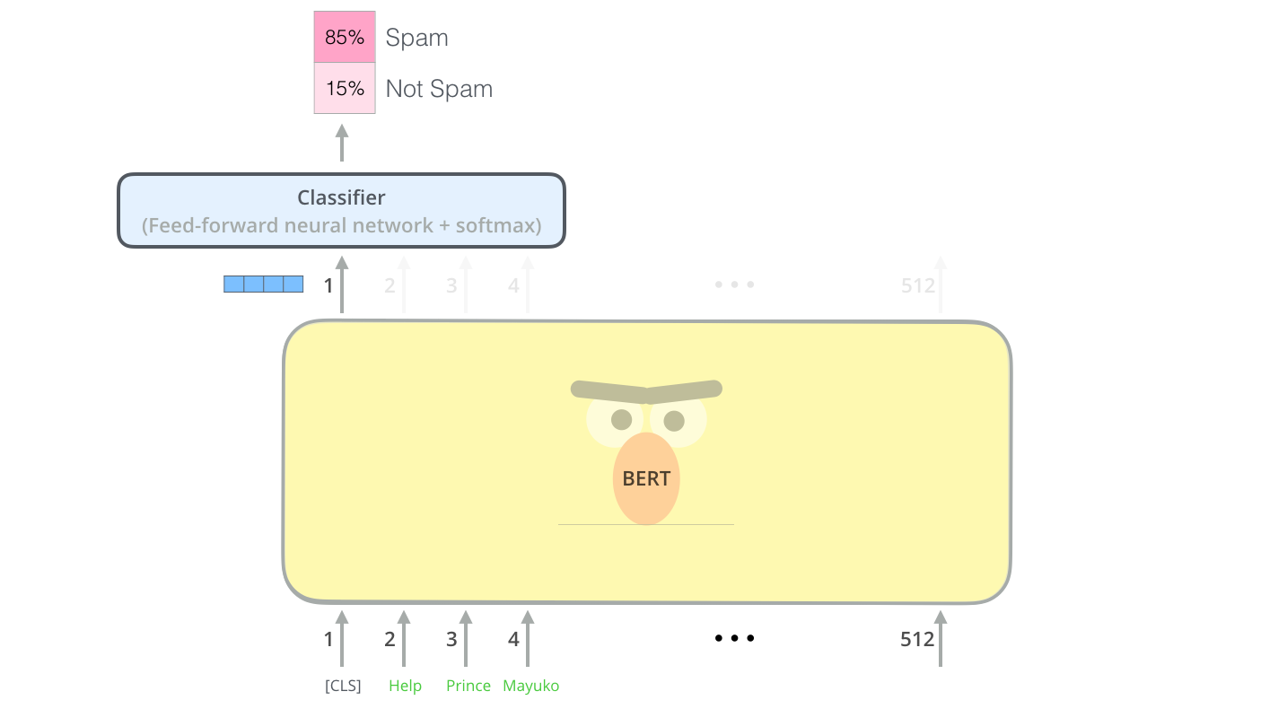
BERT Classifier
Source: Jay Alammar (2019), The Illustrated BERT, ELMo, and co. (How NLP Cracked Transfer Learning), http://jalammar.github.io/illustrated-bert/

Slide 45
Sentiment Analysis: Single Sentence Classification
Source: Devlin, Jacob, Ming-Wei Chang, Kenton Lee, and Kristina Toutanova (2018). "BERT: Pre-training of Deep Bidirectional Transformers for Language Understanding." arXiv preprint arXiv:1810.04805

Slide 46
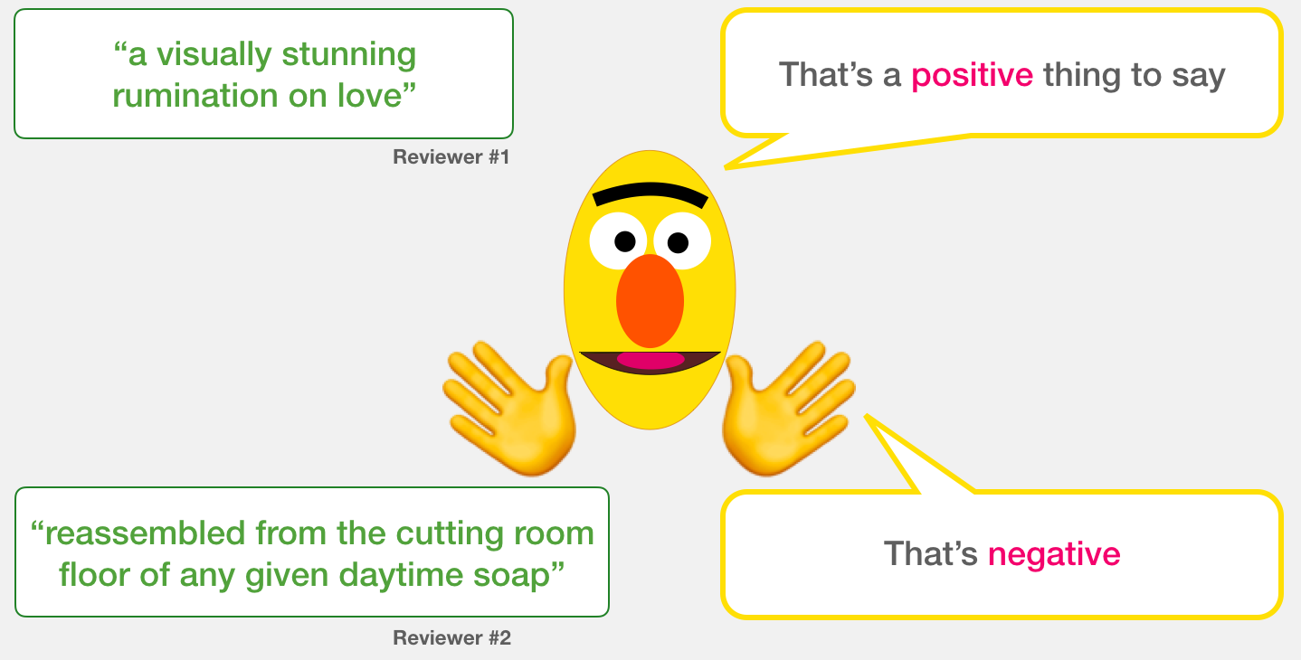
A Visual Guide to Using BERT for the First Time (Jay Alammar, 2019)
Source: Jay Alammar (2019), A Visual Guide to Using BERT for the First Time, http://jalammar.github.io/a-visual-guide-to-using-bert-for-the-first-time/

Slide 47
Sentiment Classification: SST2 Sentences from movie reviews
sentence | label
a stirring , funny and finally transporting re imagining of beauty and the beast and 1930s horror films | 1
apparently reassembled from the cutting room floor of any given daytime soap | 0
they presume their audience won't sit still for a sociology lesson | 0
this is a visually stunning rumination on love , memory , history and the war between art and commerce | 1
jonathan parker 's bartleby should have been the be all end all of the modern office anomie films | 1
Source: Jay Alammar (2019), A Visual Guide to Using BERT for the First Time, http://jalammar.github.io/a-visual-guide-to-using-bert-for-the-first-time/

Slide 48
Movie Review Sentiment Classifier
Source: Jay Alammar (2019), A Visual Guide to Using BERT for the First Time, http://jalammar.github.io/a-visual-guide-to-using-bert-for-the-first-time/

Slide 49
Movie Review Sentiment Classifier
Source: Jay Alammar (2019), A Visual Guide to Using BERT for the First Time, http://jalammar.github.io/a-visual-guide-to-using-bert-for-the-first-time/

Slide 50
Movie Review Sentiment Classifier Model Training
Source: Jay Alammar (2019), A Visual Guide to Using BERT for the First Time, http://jalammar.github.io/a-visual-guide-to-using-bert-for-the-first-time/

Slide 51
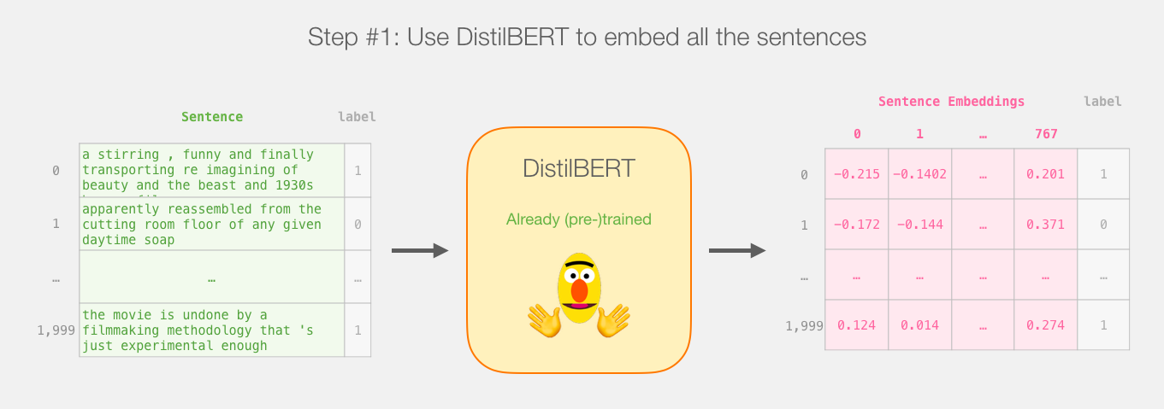
Step # 1 Use distilBERT to Generate Sentence Embeddings
Source: Jay Alammar (2019), A Visual Guide to Using BERT for the First Time, http://jalammar.github.io/a-visual-guide-to-using-bert-for-the-first-time/

Slide 52
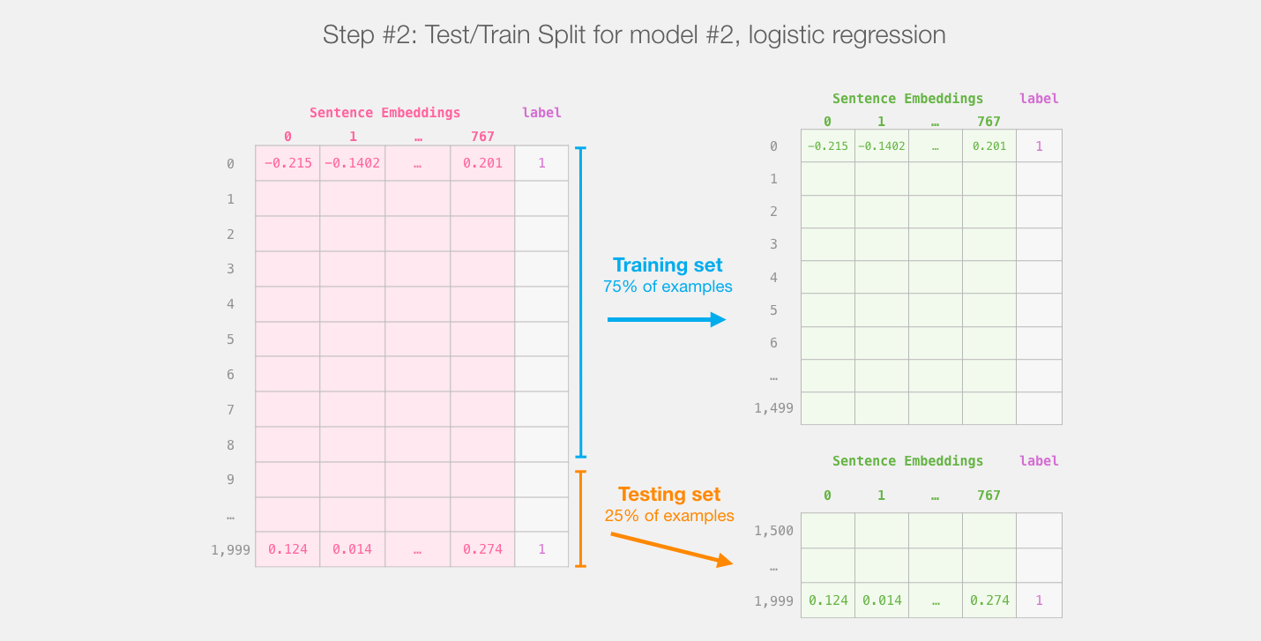
Step #2:Test/Train Split for Model #2, Logistic Regression
Source: Jay Alammar (2019), A Visual Guide to Using BERT for the First Time, http://jalammar.github.io/a-visual-guide-to-using-bert-for-the-first-time/

Slide 53
Step #3 Train the logistic regression model using the training set
Source: Jay Alammar (2019), A Visual Guide to Using BERT for the First Time, http://jalammar.github.io/a-visual-guide-to-using-bert-for-the-first-time/

Slide 54
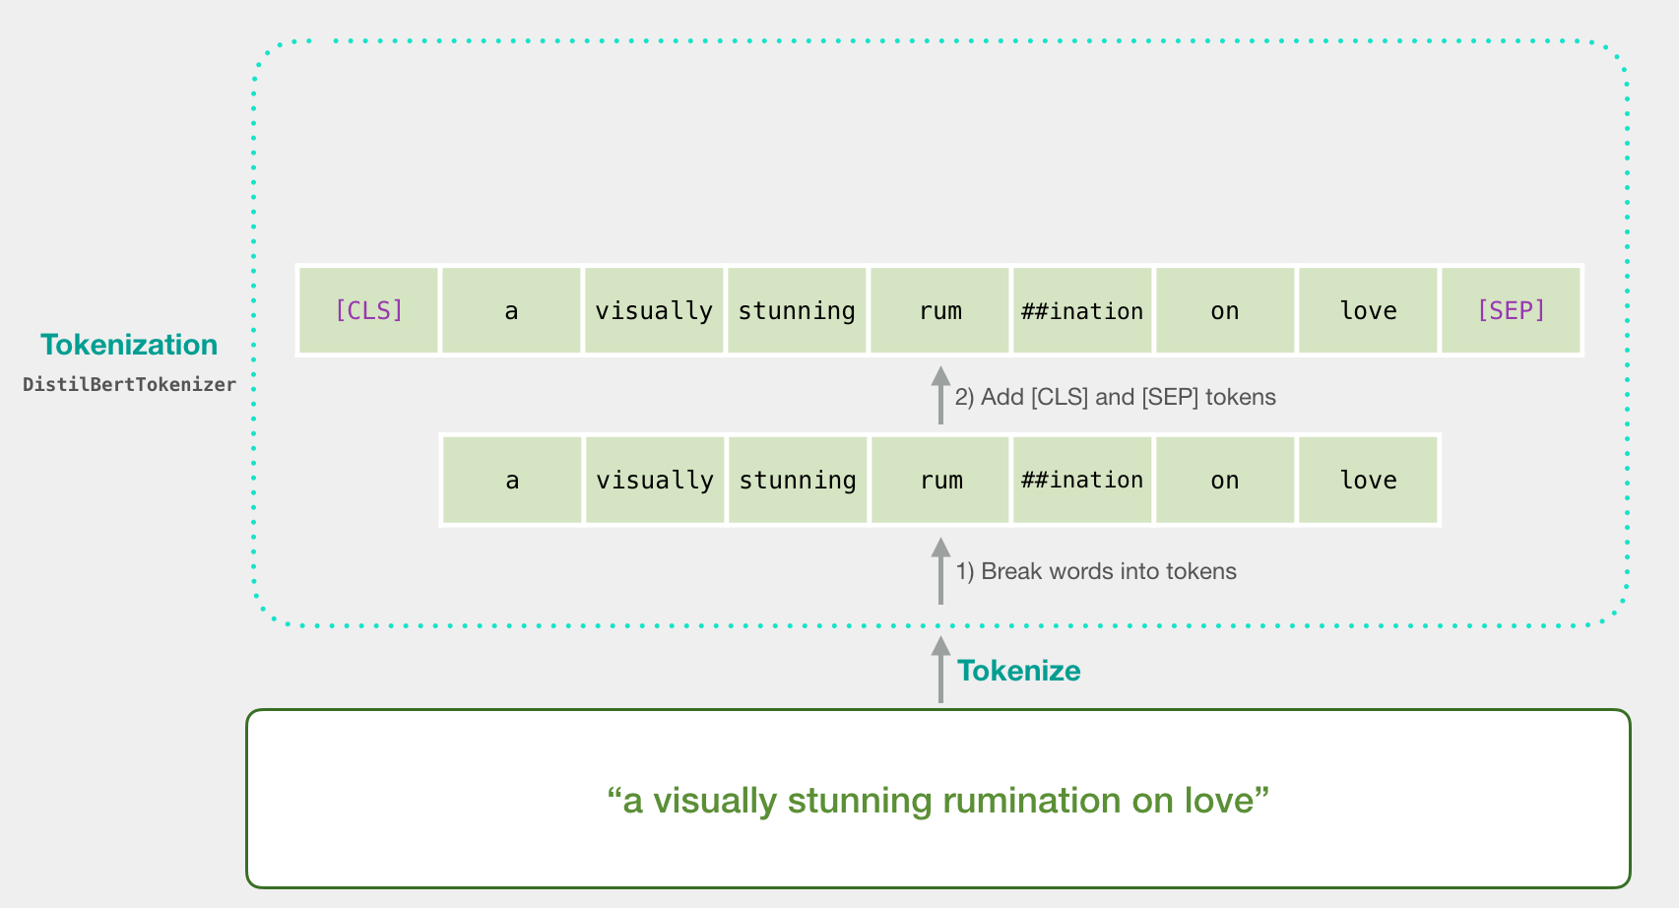
Tokenization
[CLS] a visually stunning rum ##ination on love [SEP]
a visually stunning rumination on love
Source: Jay Alammar (2019), A Visual Guide to Using BERT for the First Time, http://jalammar.github.io/a-visual-guide-to-using-bert-for-the-first-time/

Slide 55
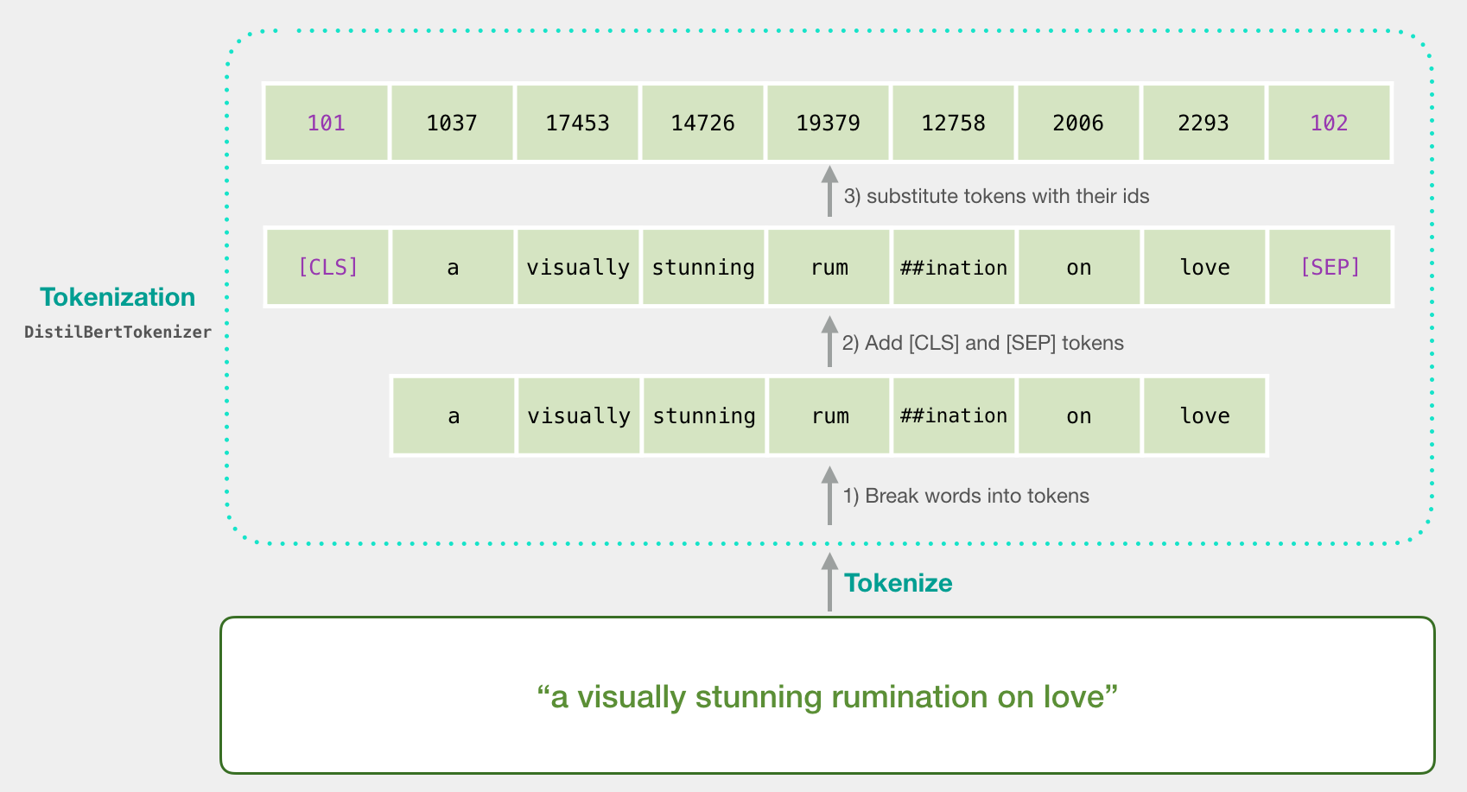
Tokenization
tokenizer.encode("a visually stunning rumination on love", add_special_tokens=True)
Source: Jay Alammar (2019), A Visual Guide to Using BERT for the First Time, http://jalammar.github.io/a-visual-guide-to-using-bert-for-the-first-time/

Slide 56
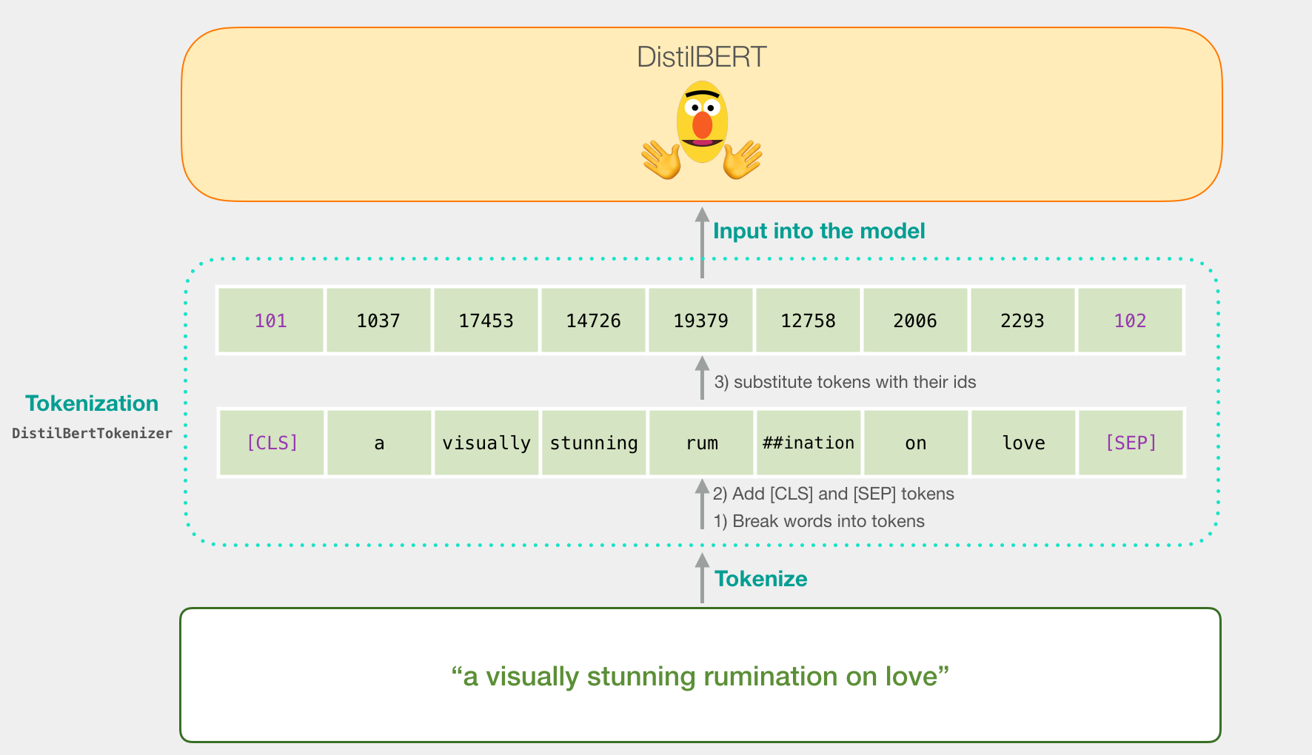
Tokenization for BERT Model
Source: Jay Alammar (2019), A Visual Guide to Using BERT for the First Time, http://jalammar.github.io/a-visual-guide-to-using-bert-for-the-first-time/

Slide 57
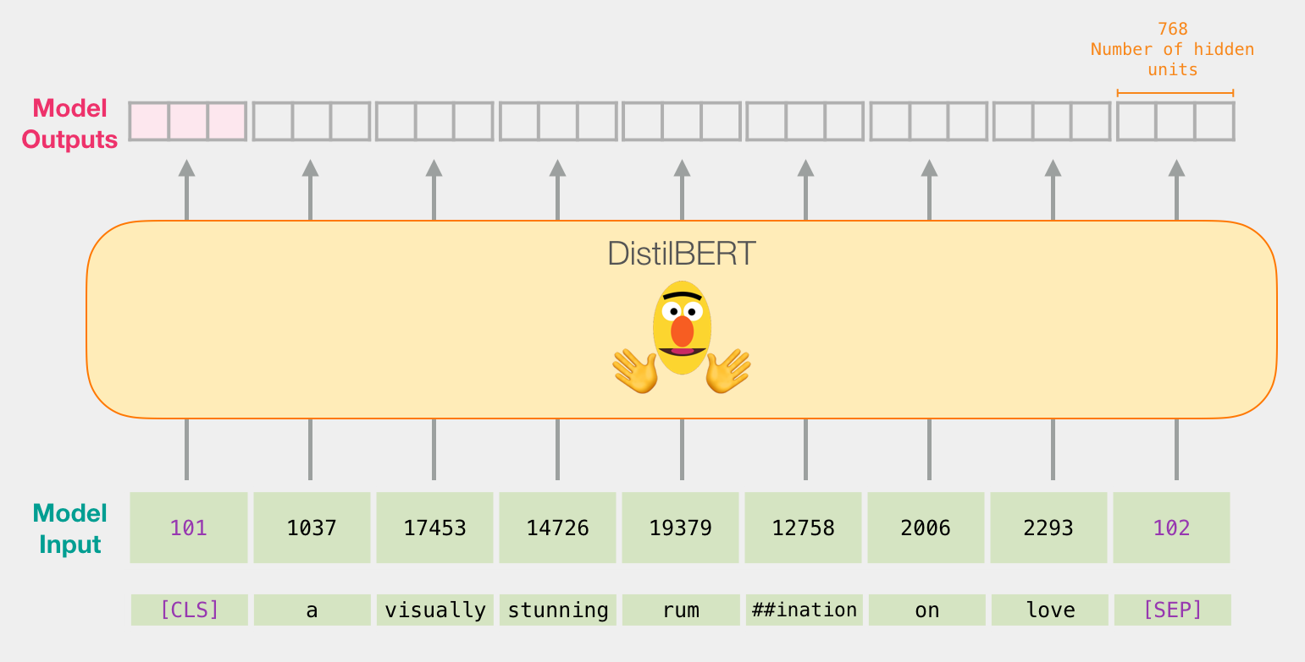
Flowing Through DistilBERT (768 features)
Source: Jay Alammar (2019), A Visual Guide to Using BERT for the First Time, http://jalammar.github.io/a-visual-guide-to-using-bert-for-the-first-time/

Slide 58
Model #1 Output Class vector as Model #2 Input
Source: Jay Alammar (2019), A Visual Guide to Using BERT for the First Time, http://jalammar.github.io/a-visual-guide-to-using-bert-for-the-first-time/

Slide 59
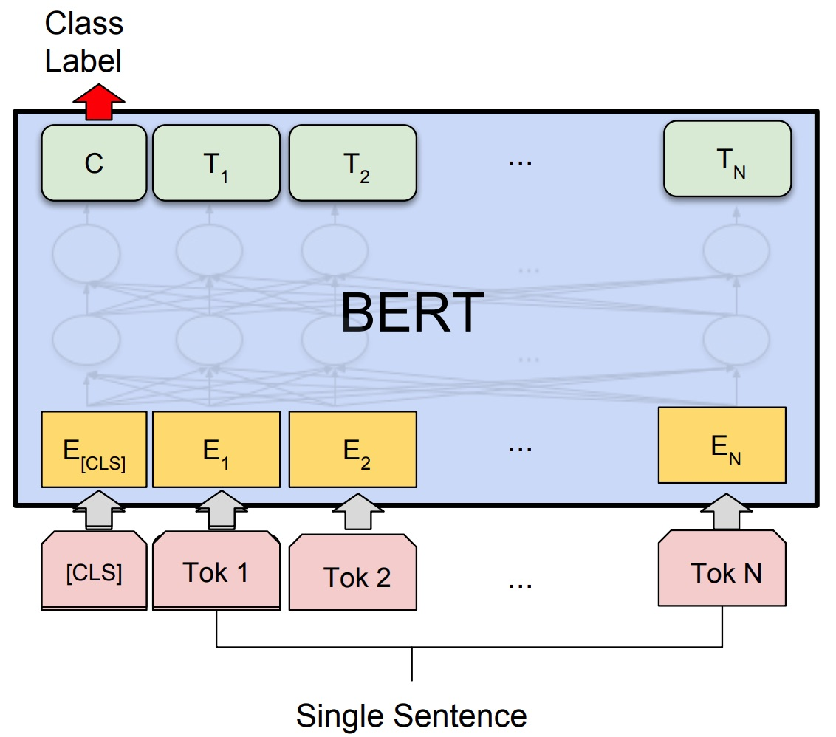
Fine-tuning BERT on Single Sentence Classification Tasks
Source: Devlin, Jacob, Ming-Wei Chang, Kenton Lee, and Kristina Toutanova (2018). "Bert: Pre-training of deep bidirectional transformers for language understanding." arXiv preprint arXiv:1810.04805.

Slide 60
Model #1 Output Class vector as Model #2 Input
Source: Jay Alammar (2019), A Visual Guide to Using BERT for the First Time, http://jalammar.github.io/a-visual-guide-to-using-bert-for-the-first-time/

Slide 61
Logistic Regression Model to classify Class vector
Source: Jay Alammar (2019), A Visual Guide to Using BERT for the First Time, http://jalammar.github.io/a-visual-guide-to-using-bert-for-the-first-time/

Slide 62
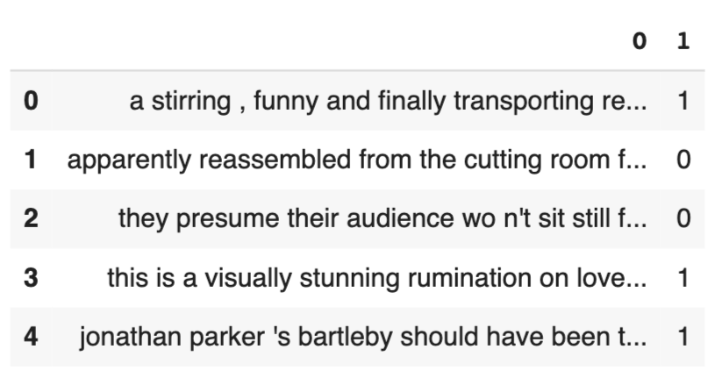
df = pd.read_csv('https://github.com/clairett/pytorch-sentiment-classification/raw/master/data/SST2/train.tsv', delimiter='\t', header=None)
df.head()
Source: Jay Alammar (2019), A Visual Guide to Using BERT for the First Time, http://jalammar.github.io/a-visual-guide-to-using-bert-for-the-first-time/

Slide 63
Tokenization
tokenized = df[0].apply((lambda x: tokenizer.encode(x, add_special_tokens=True)))
Source: Jay Alammar (2019), A Visual Guide to Using BERT for the First Time, http://jalammar.github.io/a-visual-guide-to-using-bert-for-the-first-time/

Slide 64
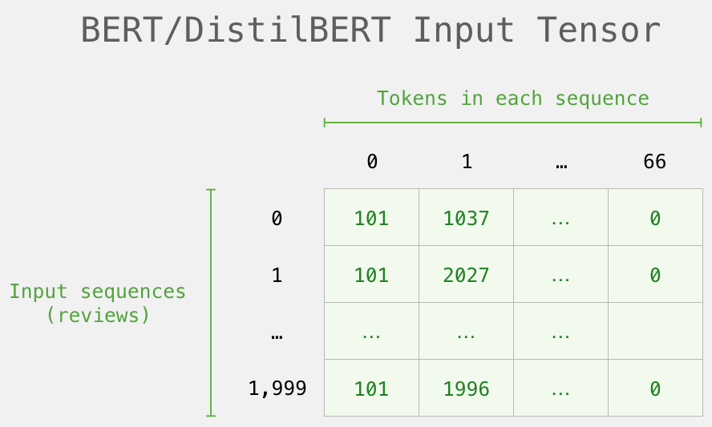
BERT Input Tensor
Source: Jay Alammar (2019), A Visual Guide to Using BERT for the First Time, http://jalammar.github.io/a-visual-guide-to-using-bert-for-the-first-time/

Slide 65
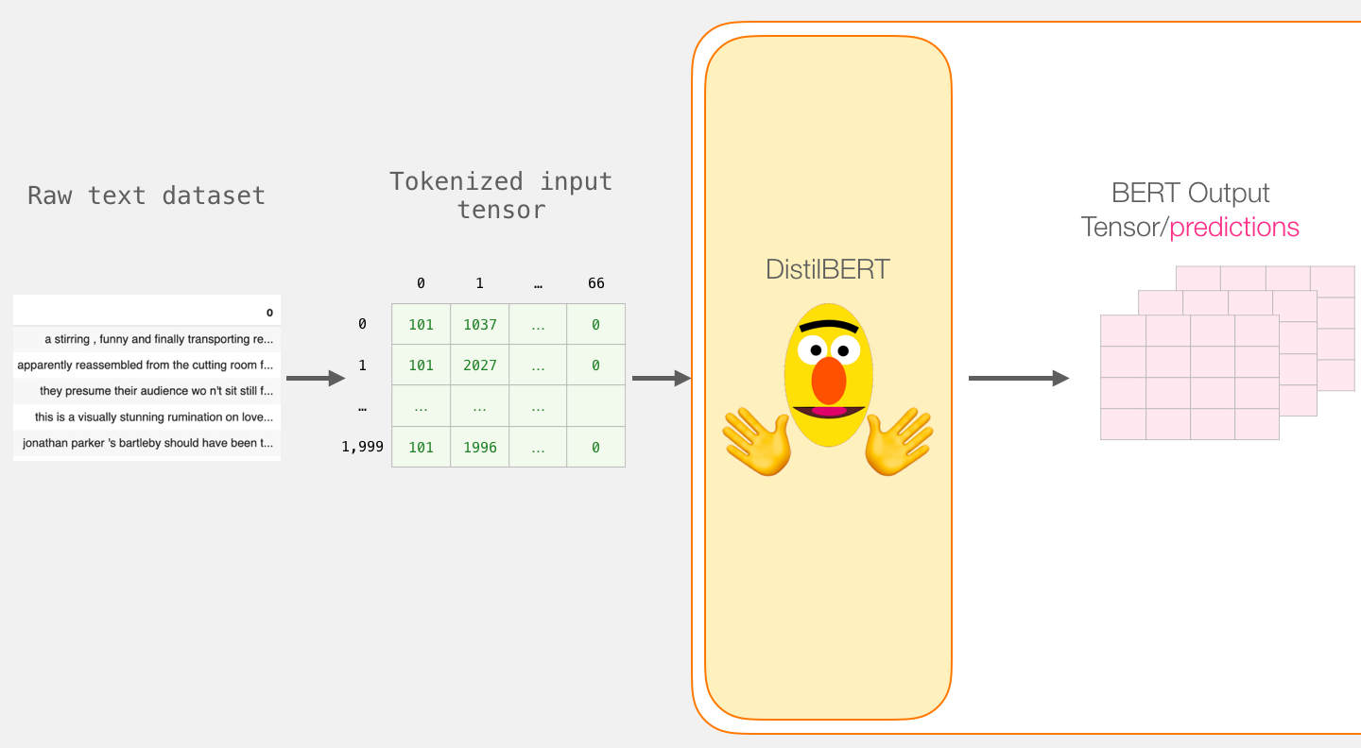
Processing with DistilBERT
input_ids = torch.tensor(np.array(padded))
last_hidden_states = model(input_ids)
Source: Jay Alammar (2019), A Visual Guide to Using BERT for the First Time, http://jalammar.github.io/a-visual-guide-to-using-bert-for-the-first-time/

Slide 66
Unpacking the BERT output tensor
Source: Jay Alammar (2019), A Visual Guide to Using BERT for the First Time, http://jalammar.github.io/a-visual-guide-to-using-bert-for-the-first-time/

Slide 67
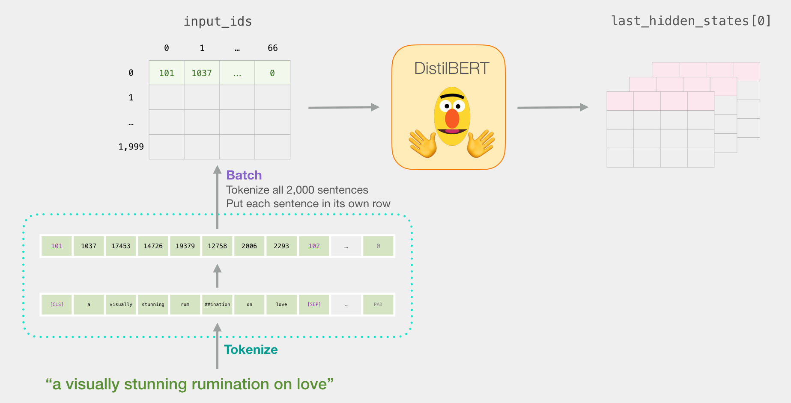
Sentence to last_hidden_state[0]
Source: Jay Alammar (2019), A Visual Guide to Using BERT for the First Time, http://jalammar.github.io/a-visual-guide-to-using-bert-for-the-first-time/

Slide 68
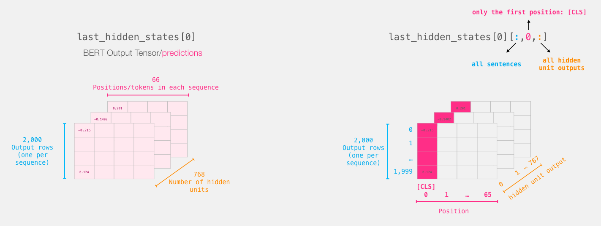
BERT’s output for the [CLS] tokens
# Slice the output for the first position for all the sequences, take all hidden unit outputs
features = last_hidden_states[0][:,0,:].numpy()
Source: Jay Alammar (2019), A Visual Guide to Using BERT for the First Time, http://jalammar.github.io/a-visual-guide-to-using-bert-for-the-first-time/

Slide 69
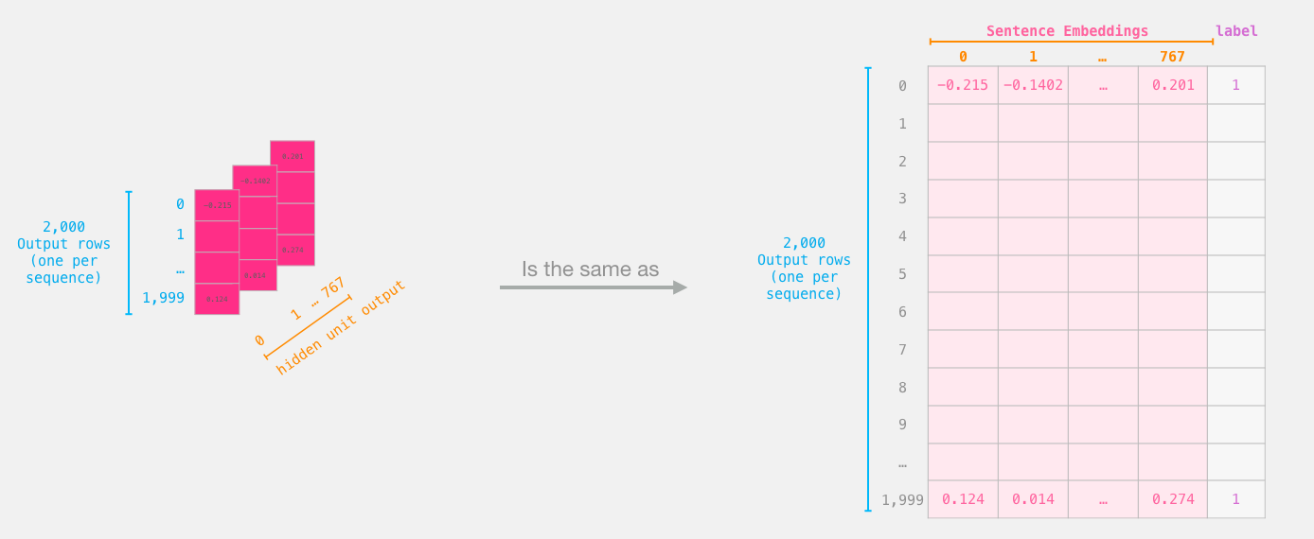
The tensor sliced from BERT's output Sentence Embeddings
Source: Jay Alammar (2019), A Visual Guide to Using BERT for the First Time, http://jalammar.github.io/a-visual-guide-to-using-bert-for-the-first-time/

Slide 70
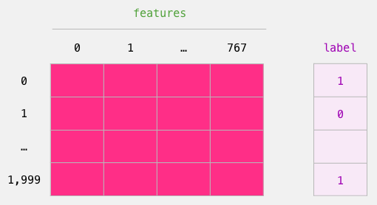
Dataset for Logistic Regression (768 Features)
The features are the output vectors of BERT for the [CLS] token (position #0)
Source: Jay Alammar (2019), A Visual Guide to Using BERT for the First Time, http://jalammar.github.io/a-visual-guide-to-using-bert-for-the-first-time/

Slide 71
labels = df[1]
train_features, test_features, train_labels, test_labels = train_test_split(features, labels)
Source: Jay Alammar (2019), A Visual Guide to Using BERT for the First Time, http://jalammar.github.io/a-visual-guide-to-using-bert-for-the-first-time/

Slide 72
Score Benchmarks Logistic Regression Model on SST-2 Dataset
# Training
lr_clf = LogisticRegression()
lr_clf.fit(train_features, train_labels)
#Testing
lr_clf.score(test_features, test_labels)
# Accuracy: 81%
# Highest accuracy: 96.8%
# Fine-tuned DistilBERT: 90.7%
# Full size BERT model: 94.9%
Source: Jay Alammar (2019), A Visual Guide to Using BERT for the First Time, http://jalammar.github.io/a-visual-guide-to-using-bert-for-the-first-time/

Slide 73
Sentiment Classification: SST2 Sentences from movie reviews
sentence | label
a stirring , funny and finally transporting re imagining of beauty and the beast and 1930s horror films | 1
apparently reassembled from the cutting room floor of any given daytime soap | 0
they presume their audience won't sit still for a sociology lesson | 0
this is a visually stunning rumination on love , memory , history and the war between art and commerce | 1
jonathan parker 's bartleby should have been the be all end all of the modern office anomie films | 1
Source: Jay Alammar (2019), A Visual Guide to Using BERT for the First Time, http://jalammar.github.io/a-visual-guide-to-using-bert-for-the-first-time/

Slide 74
A Visual Notebook to Using BERT for the First Time
https://colab.research.google.com/github/jalammar/jalammar.github.io/blob/master/notebooks/bert/A_Visual_Notebook_to_Using_BERT_for_the_First_Time.ipynb

Slide 75
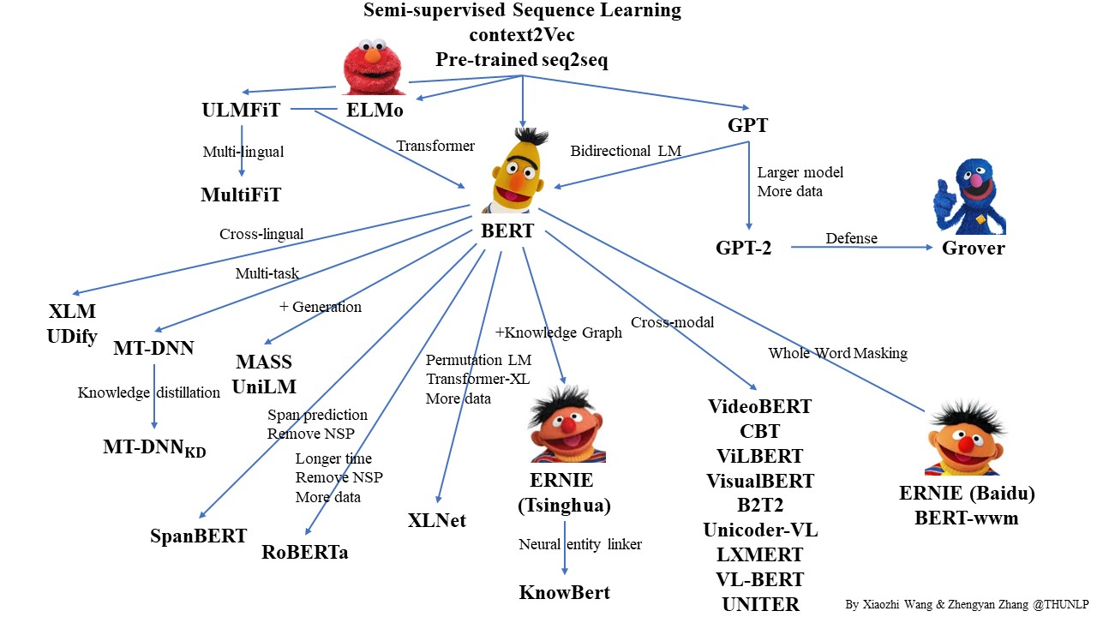
Pre-trained Language Model (PLM)
Source: https://github.com/thunlp/PLMpapers

Slide 76
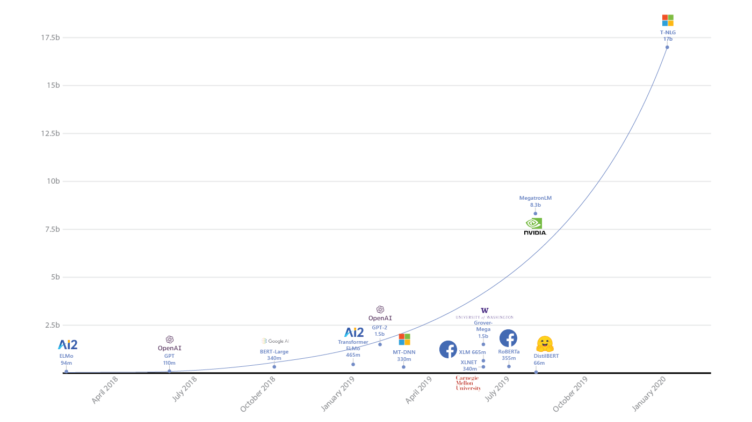
Turing Natural Language Generation (T-NLG)
T-NLG
17b
MegatronLM
8.3b
GPT-2
1.5b
BERT-Large
340m
RoBERTa
355m
DistilBERT
66m
2018
2019
2020
Source: https://www.microsoft.com/en-us/research/blog/turing-nlg-a-17-billion-parameter-language-model-by-microsoft/

Slide 77
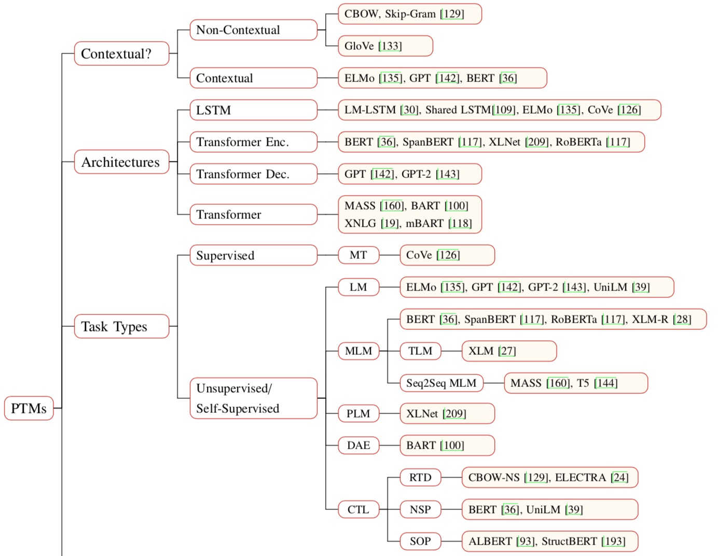
Pre-trained Models (PTM)
Source: Qiu, Xipeng, Tianxiang Sun, Yige Xu, Yunfan Shao, Ning Dai, and Xuanjing Huang. "Pre-trained Models for Natural Language Processing: A Survey." arXiv preprint arXiv:2003.08271 (2020).

Slide 78
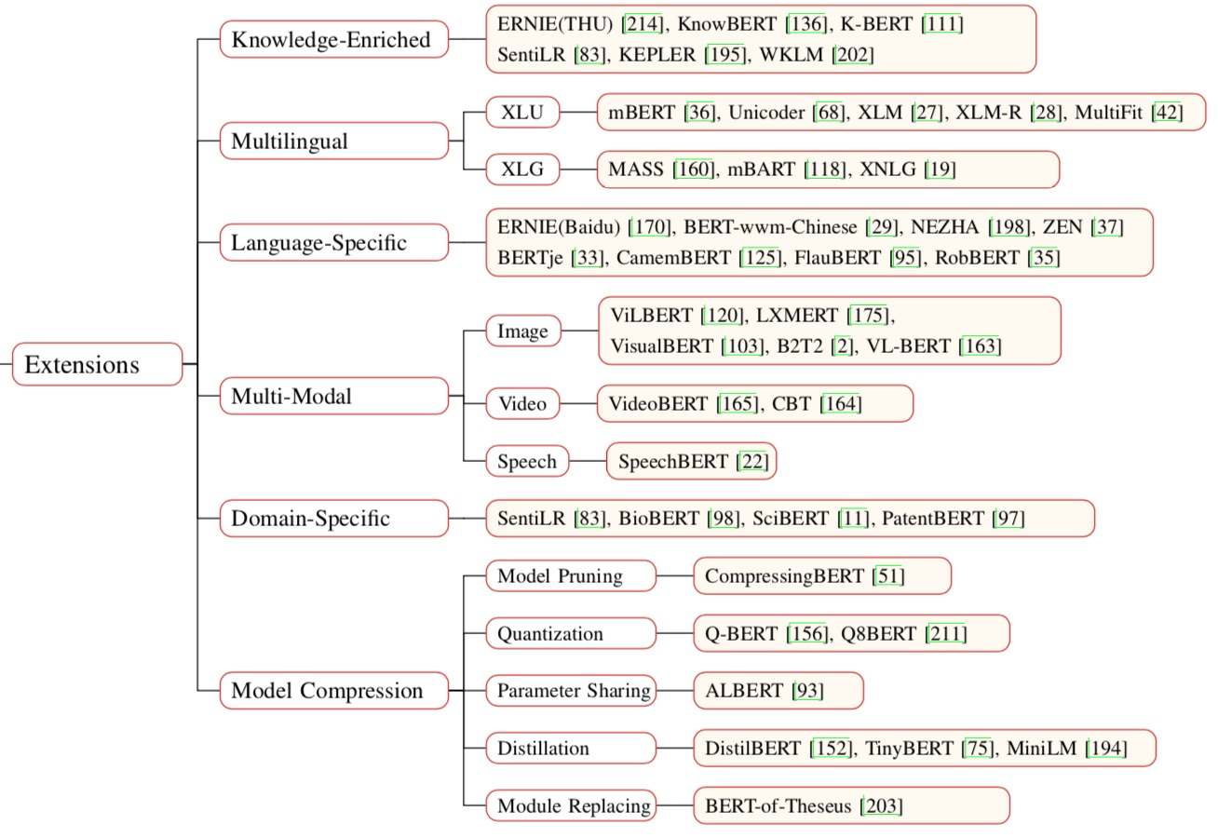
Pre-trained Models (PTM)
Source: Qiu, Xipeng, Tianxiang Sun, Yige Xu, Yunfan Shao, Ning Dai, and Xuanjing Huang. "Pre-trained Models for Natural Language Processing: A Survey." arXiv preprint arXiv:2003.08271 (2020).

Slide 79
Transformers State-of-the-art Natural Language Processing for TensorFlow 2.0 and PyTorch
Transformers
pytorch-transformers
pytorch-pretrained-bert
provides state-of-the-art general-purpose architectures
(BERT, GPT-2, RoBERTa, XLM, DistilBert, XLNet, CTRL...)
for Natural Language Understanding (NLU) and Natural Language Generation (NLG) with over 32+ pretrained models in 100+ languages and deep interoperability between TensorFlow 2.0 and PyTorch.
Source: https://github.com/huggingface/transformers

Slide 80
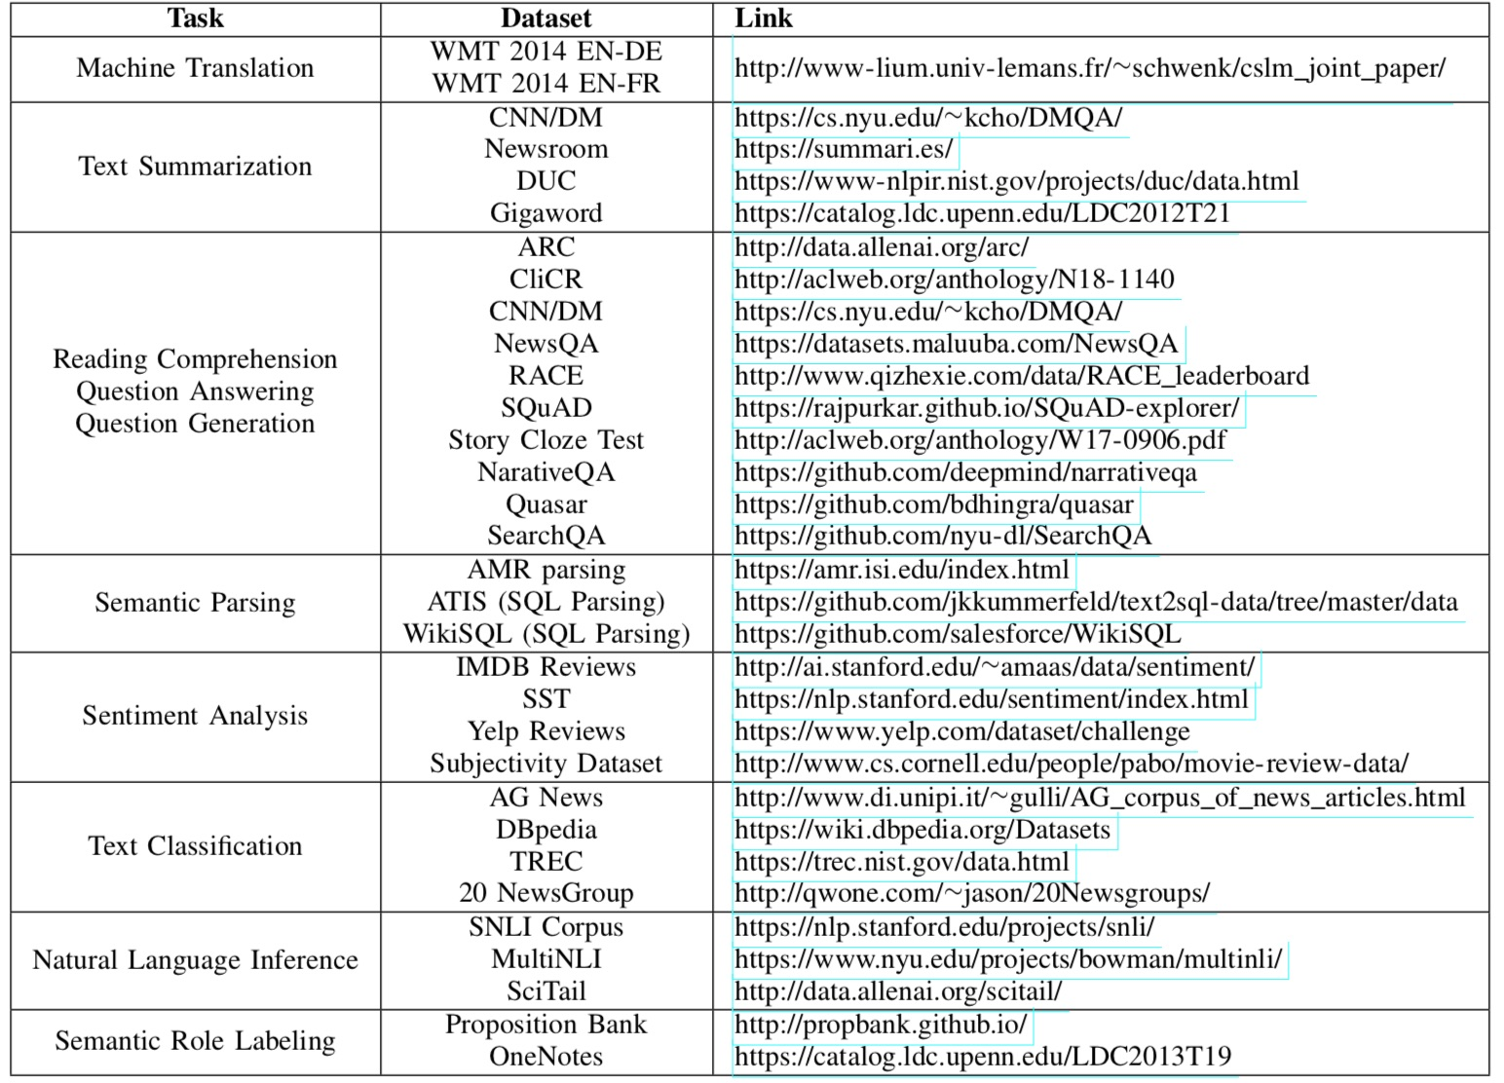
NLP Benchmark Datasets
Source: Amirsina Torfi, Rouzbeh A. Shirvani, Yaser Keneshloo, Nader Tavvaf, and Edward A. Fox (2020). "Natural Language Processing Advancements By Deep Learning: A Survey." arXiv preprint arXiv:2003.01200.

Slide 81
Summary
Universal Sentence Encoder (USE)
Universal Sentence Encoder Multilingual (USEM)
Semantic Similarity

Slide 82
References
Dipanjan Sarkar (2019), Text Analytics with Python: A Practitioner’s Guide to Natural Language Processing, Second Edition. APress. https://github.com/Apress/text-analytics-w-python-2e
Benjamin Bengfort, Rebecca Bilbro, and Tony Ojeda (2018), Applied Text Analysis with Python, O'Reilly Media. https://www.oreilly.com/library/view/applied-text-analysis/9781491963036/
Daniel Cer, Yinfei Yang, Sheng-yi Kong, Nan Hua, Nicole Limtiaco, Rhomni St. John, Noah Constant, Mario Guajardo-Céspedes, Steve Yuan, Chris Tar, Yun-Hsuan Sung, Brian Strope, Ray Kurzweil (2018). Universal Sentence Encoder. arXiv:1803.11175.
Yinfei Yang, Daniel Cer, Amin Ahmad, Mandy Guo, Jax Law, Noah Constant, Gustavo Hernandez Abrego , Steve Yuan, Chris Tar, Yun-hsuan Sung, Ray Kurzweil (2019). Multilingual Universal Sentence Encoder for Semantic Retrieval.
Xipeng Qiu, Tianxiang Sun, Yige Xu, Yunfan Shao, Ning Dai, and Xuanjing Huang (2020). "Pre-trained Models for Natural Language Processing: A Survey." arXiv preprint arXiv:2003.08271.
HuggingFace (2020), Transformers Notebook, https://huggingface.co/transformers/notebooks.html
The Super Duper NLP Repo, https://notebooks.quantumstat.com/
Min-Yuh Day (2020), Python 101, https://tinyurl.com/aintpupython101

