Slide 1



大數據分析
(Big Data Analysis)
大數據分析介紹
(Introduction to Big Data Analysis)
1091BDA01
MBA, IM, NTPU (M5127) (Fall 2020)
Wed 7, ,8, 9 (15:10-18:00) (B8F40)
Min-Yuh Day
戴敏育
Associate Professor
副教授
Institute of Information Management, National Taipei University
國立臺北大學 資訊管理研究所
https://web.ntpu.edu.tw/~myday
2020-09-16

Slide 2



戴敏育 博士
(Min-Yuh Day, Ph.D.)
國立台北大學 資訊管理研究所 副教授
中央研究院 資訊科學研究所 訪問學人
國立台灣大學 資訊管理 博士
Publications Co-Chairs, IEEE/ACM International Conference on
Advances in Social Networks Analysis and Mining (ASONAM 2013- )
Program Co-Chair, IEEE International Workshop on
Empirical Methods for Recognizing Inference in TExt (IEEE EM-RITE 2012- )
Publications Chair, The IEEE International Conference on
Information Reuse and Integration (IEEE IRI)

Slide 3


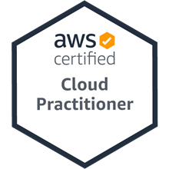
大數據分析
(Big Data Analysis)
Contact Information
戴敏育 博士 (Min-Yuh Day, Ph.D.)
副教授 (Associate Professor)
國立臺北大學 資訊管理研究所
Institute of Information Management, National Taipei University
電話： 02-86741111 ext. 66873
研究室： 商8F12
地址： 23741 新北市三峽區大學路 151 號
Email：myday@gm.ntpu.edu.tw
網址：http://web.ntpu.edu.tw/~myday/

Slide 4
國立臺北大學
109學年度第1學期
課程大綱
Fall 2020 (2020.09 - 2021.01)
課程名稱：大數據分析 (Big Data Analysis)
授課教師：戴敏育 (Min-Yuh Day)
開課系所：資管所碩士班
開課資料：選修 半學年 3 學分 (3 Credits, Elective)
上課時間：週三 7, 8, 9 (15:10-18:00)
上課教室：商8F40 (台北大學三峽校區)

Slide 5
教學目標
瞭解大數據分析基本概念與
研究議題。。
具備大數據分析實務操作能力。
進行大數據分析相關之
資訊管理研究。

Slide 6
Course Objectives
Understand the fundamental concepts and research issues of big data analysis.
Equip with Hands-on practices of big data analysis.
Conduct information systems research in the context of big data analysis.

Slide 7
內容綱要
本課程介紹大數據分析基本概念、研究議題、與實務操作。
課程內容包括
  大數據分析介紹
  AI人工智慧與大數據分析
  Python 大數據分析基礎
  Python Pandas 大數據量化分析
  Python Scikit-Learn 機器學習
  TensorFlow 深度學習金融大數據分析
  AI 機器人理財顧問
  金融科技智慧型交談機器人
  金融科技數位沙盒實作
  大數據分析個案研究

Slide 8
Course Outline
This course introduces the fundamental concepts,
research issues, and hands-on practices of big data analysis.
Topics include
  Introduction to Big Data Analysis
  AI and Big Data Analysis
  Foundations of Big Data Analysis in Python
  Quantitative Big Data Analysis with Pandas in Python
  Machine Learning with Scikit-Learn In Python
  Deep Learning for Finance Big Data Analysis with TensorFlow
  Artificial Intelligence for Robo-Advisors
  Conversational Commerce and Intelligent Chatbots for Fintech
  Hands-on Practices with FintechSpace Digital Sandbox
  Case Study on Big Data Analysis

Slide 9
資訊管理研究所
系核心能力
(Core Competence)
資訊科技新知探索與系統開發應用 80 %
網路行銷企劃能力 10 %
論文寫作與獨立研究能力 10 %

Slide 10
校四大基本素養
(Four Fundamental Qualities)
專業 (Professionalism)
  創意思考與問題解決 (Creative thinking and Problem-solving) 30 %
  綜合統整(Comprehensive Integration) 30 %
人際 (Interpersonal Relationship)
  溝通協調 (Communication and Coordination) 10 %
  團隊合作 (Teamwork) 10 %
倫理 (Ethics)
  誠信正直(Honesty and Integrity) 5 %
  尊重自省(Self-Esteem and Self-reflection) 5 %
國際觀 (International Vision)
  多元關懷 (Caring for Diversity) 5 %
  跨界宏觀 (Interdisciplinary Vision) 5 %

Slide 11
商學院學習目標
(College Learning Goals)
Ethics/Corporate Social Responsibility
Global Knowledge/Awareness
Communication
Analytical and Critical Thinking

Slide 12
系所學習目標
(Department Learning Goals)
Information Technologies and System Development Capabilities
Internet Marketing Management Capabilities
Research capabilities

Slide 13
課程大綱 (Syllabus)
週次 (Week) 日期 (Date) 內容 (Subject/Topics)
1 2020/09/16 大數據分析介紹 (Introduction to Big Data Analysis)
2 2020/09/23 AI人工智慧與大數據分析
(AI and Big Data Analysis)
3 2020/09/30 Python 大數據分析基礎
(Foundations of Big Data Analysis in Python)
4 2020/10/07 數位沙盒第一堂課：數位沙盒服務平台簡介
(Digital Sandbox Lesson 1: Introduction to
FintechSpace Digital Sandbox)
5 2020/10/14 數位沙盒第二堂課：工程師操作說明與實作教學
(Digital Sandbox Lesson 2: Hands-on Practices)
6 2020/10/21 Python Pandas 大數據量化分析
(Quantitative Big Data Analysis with Pandas in Python)

Slide 14
課程大綱 (Syllabus)
週次 (Week) 日期 (Date) 內容 (Subject/Topics)
7 2020/10/28 數位沙盒第三堂課：學生小組討論實作與成果發表
(Digital Sandbox Lesson 3: Learning Teams
Hands-on Project Discussion and Project Presentation)
8 2020/11/04 Python Scikit-Learn 機器學習 I
(Machine Learning with Scikit-Learn In Python I)
9 2020/11/11 期中報告 (Midterm Project Report)
10 2020/11/18 Python Scikit-Learn 機器學習 II
(Machine Learning with Scikit-Learn In Python II)
11 2020/11/25 TensorFlow 深度學習金融大數據分析 I
(Deep Learning for Finance Big Data Analysis with TensorFlow I)
12 2020/12/02 大數據分析個案研究
(Case Study on Big Data Analysis)

Slide 15
課程大綱 (Syllabus)
週次 (Week) 日期 (Date) 內容 (Subject/Topics)
13 2020/12/09 TensorFlow 深度學習金融大數據分析 II
(Deep Learning for Finance Big Data Analysis with TensorFlow II)
14 2020/12/16 TensorFlow 深度學習金融大數據分析 III
(Deep Learning for Finance Big Data Analysis with TensorFlow III)
15 2020/12/23 AI 機器人理財顧問
(Artificial Intelligence for Robo-Advisors)
16 2020/12/30 金融科技智慧型交談機器人
(Conversational Commerce and
Intelligent Chatbots for Fintech)
17 2021/01/06 期末報告 I (Final Project Report I)
18 2021/01/13 期末報告 II (Final Project Report I)

Slide 16
教學方法與教學活動
(Teaching methods and activities)
講授 (Lecture)
討論 (Discussion)
實習 (Practicum)

Slide 17
評量方式
(Evaluation Methods)
個人報告 (Individual Presentation) 60 %
團體報告 (Group Presentation) 10 %
個案分析報告 (Case Report) 10 %
課堂參與 (Class Participation) 10 %
作業 (Assignment) 10 %

Slide 18
指定用書
(Required Texts)
Aurélien Géron (2019),
Hands-On Machine Learning with Scikit-Learn, Keras, and TensorFlow: Concepts, Tools, and Techniques to Build Intelligent Systems,
2nd Edition, O’Reilly Media.

Slide 19
參考書目
(Reference Books)
Yves Hilpisch (2018),
Python for Finance: Mastering Data-Driven Finance, 2nd Edition, O'Reilly Media.
其他參考資料(Other References)：
  Paolo Sironi (2016), FinTech Innovation: From Robo-Advisors to Goal Based Investing and Gamification, Wiley.
  Yuxing Yan (2017), Python for Finance: Apply powerful finance models and quantitative analysis with Python, Second Edition, Packt Publishing

Slide 20

Aurélien Géron (2019),
Hands-On Machine Learning with Scikit-Learn, Keras, and TensorFlow: Concepts, Tools, and Techniques to Build Intelligent Systems, 2nd Edition
O’Reilly Media, 2019
https://github.com/ageron/handson-ml2
Source: https://www.amazon.com/Hands-Machine-Learning-Scikit-Learn-TensorFlow/dp/1492032646/

Slide 21
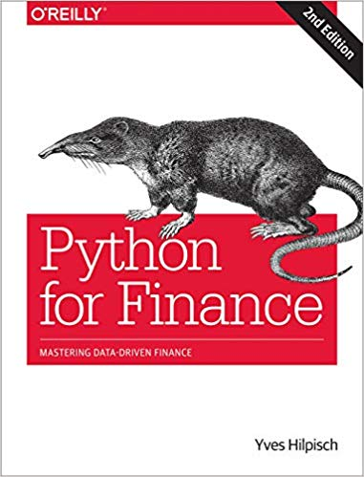
Yves Hilpisch (2018),
Python for Finance: Mastering Data-Driven Finance, O'Reilly
Source: https://www.amazon.com/Python-Finance-Mastering-Data-Driven/dp/1492024333

Slide 22
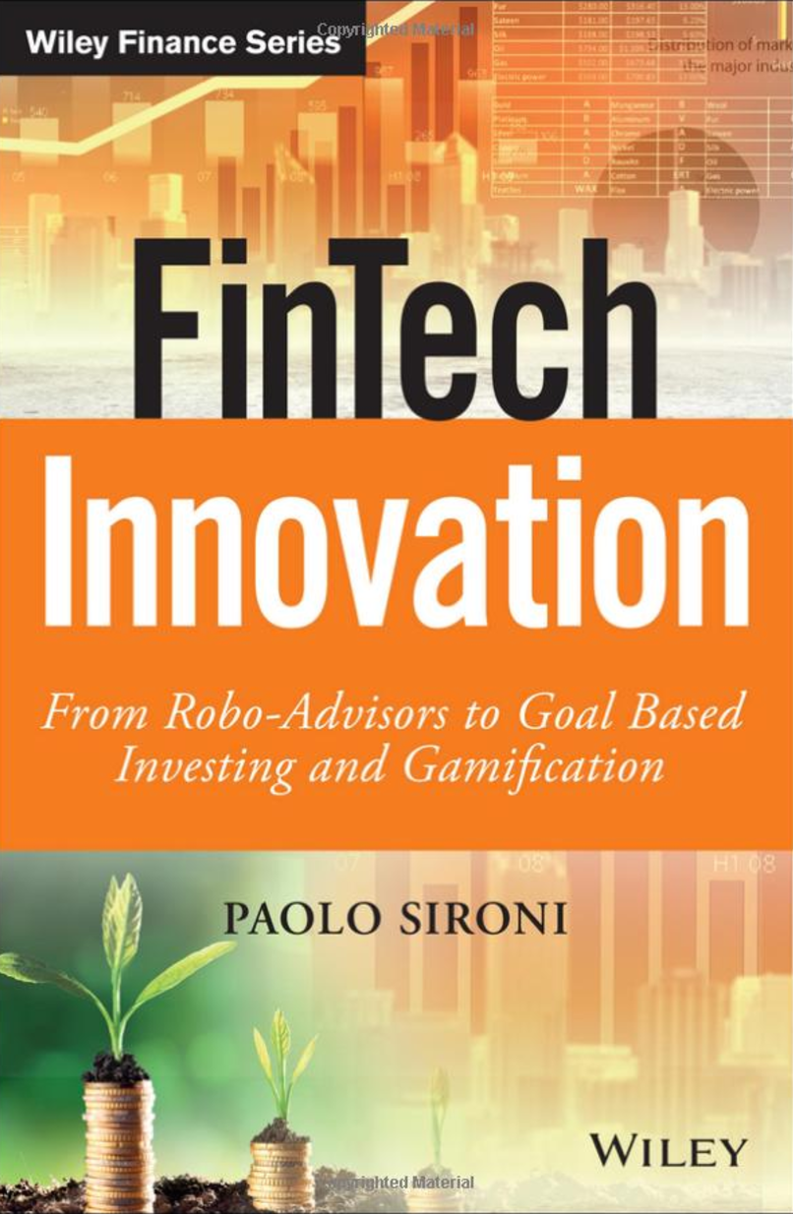
Paolo Sironi (2016)
FinTech Innovation:
From Robo-Advisors to Goal Based Investing and Gamification,
Wiley
Source: https://www.amazon.com/FinTech-Innovation-Robo-Advisors-Investing-Gamification/dp/1119226988

Slide 23
Yuxing Yan (2017),
Python for Finance: Apply powerful finance models and quantitative analysis with Python, Second Edition, Packt Publishing
Source: https://www.amazon.com/Python-Finance-powerful-quantitative-analysis/dp/1787125696

Slide 24
Social Network Based Big Data Analysis and Applications,
Lecture Notes in Social Networks,
Mehmet Kaya, Jalal Kawash, Suheil Khoury, Min-Yuh Day,
Springer International Publishing, 2018.
Source: https://www.amazon.com/Network-Analysis-Applications-Lecture-Networks/dp/3319781952

Slide 25

Hands-On Machine Learning with
Scikit-Learn, Keras, and TensorFlow
Notebooks
The Machine Learning landscape
End-to-end Machine Learning project
Classification
Training Models
Support Vector Machines
Decision Trees
Ensemble Learning and Random Forests
Dimensionality Reduction
Unsupervised Learning Techniques
Artificial Neural Nets with Keras
Training Deep Neural Networks
Custom Models and Training with TensorFlow
Loading and Preprocessing Data
Deep Computer Vision Using Convolutional Neural Networks
Processing Sequences Using RNNs and CNNs
Natural Language Processing with RNNs and Attention
Representation Learning Using Autoencoders
Reinforcement Learning
Training and Deploying TensorFlow Models at Scale
https://github.com/ageron/handson-ml2

Slide 26
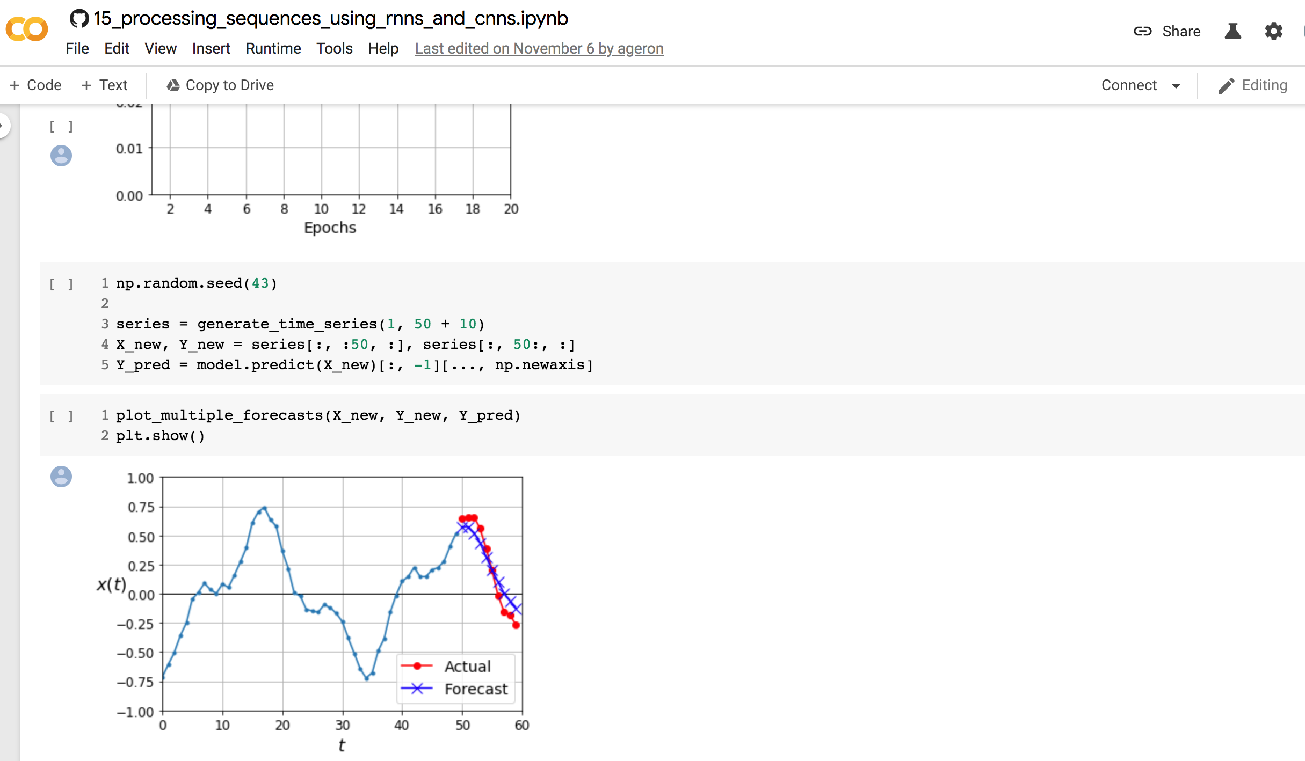
Sequences using RNNs and CNNs
https://colab.research.google.com/github/ageron/handson-ml2/blob/master/15_processing_sequences_using_rnns_and_cnns.ipynb

Slide 27
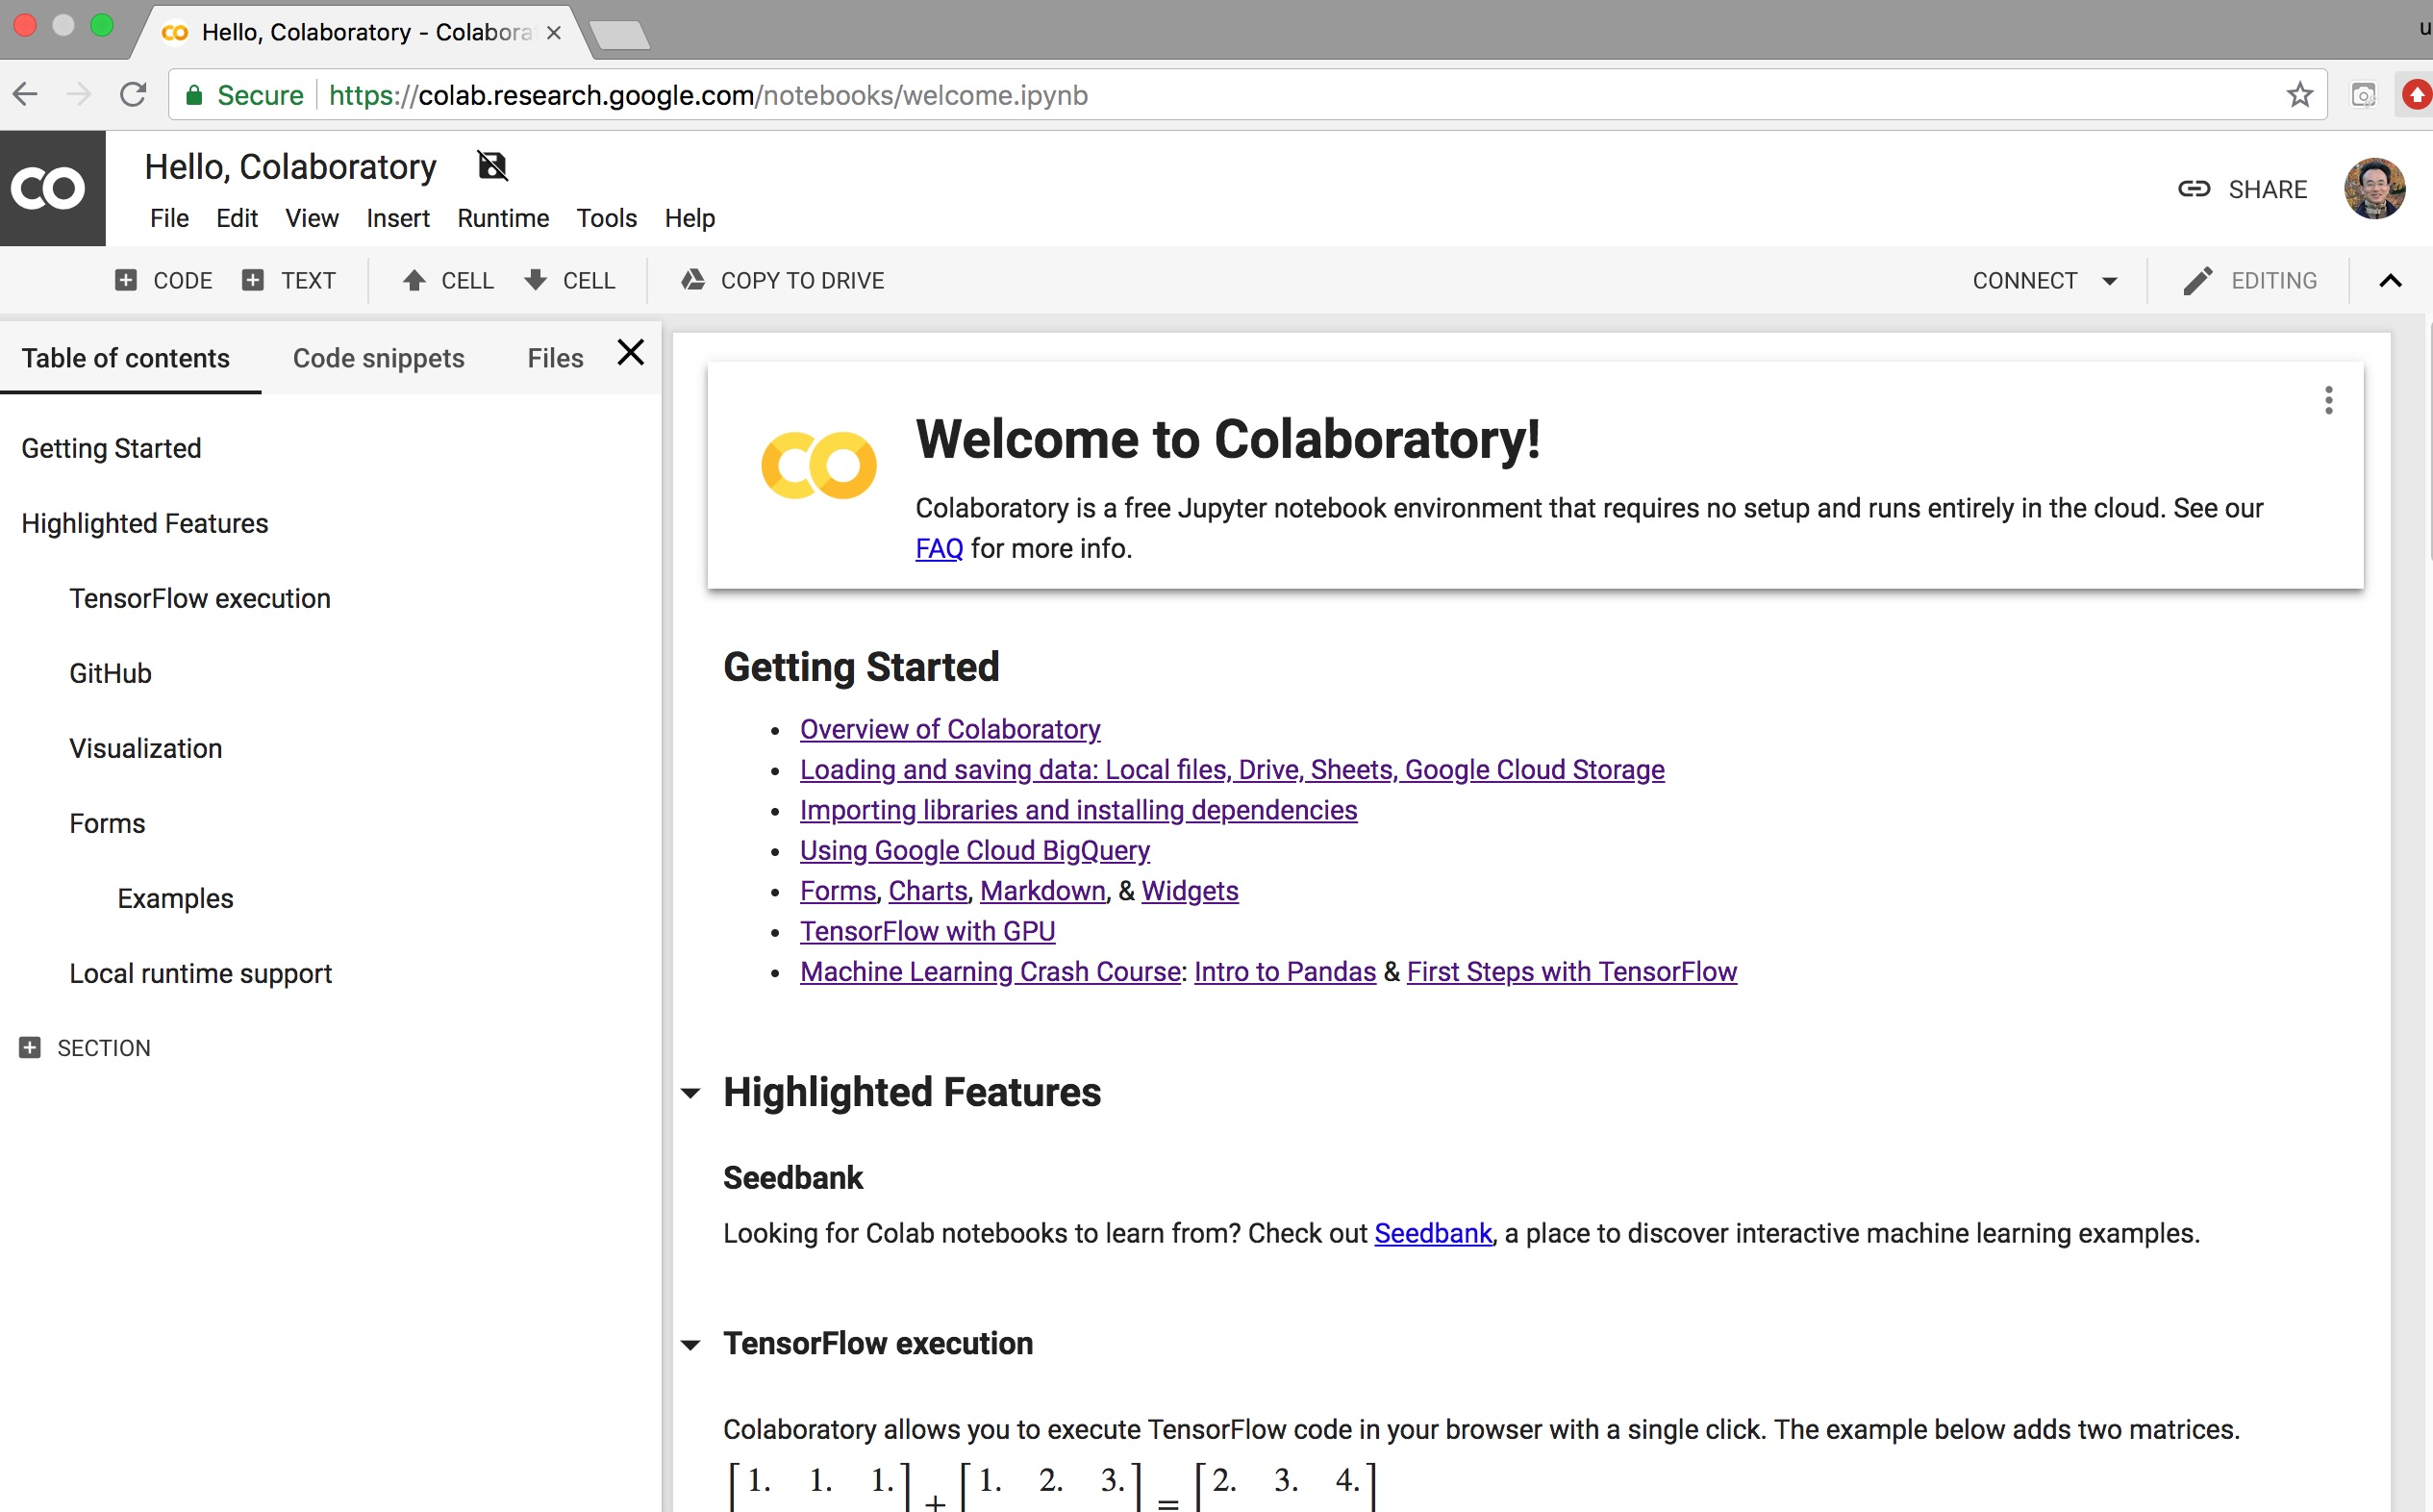
Google Colab
https://colab.research.google.com/notebooks/welcome.ipynb

Slide 28
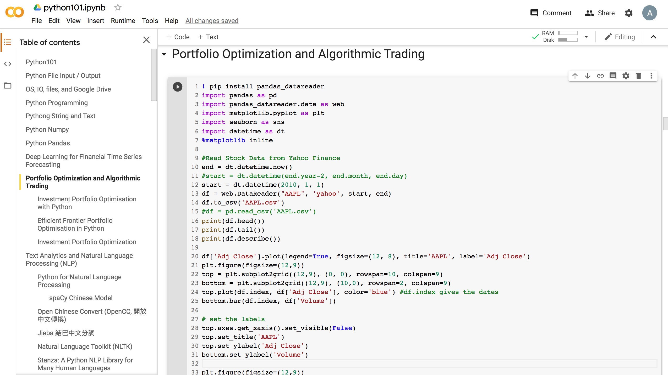
Python in Google Colab (Python101)
https://colab.research.google.com/drive/1FEG6DnGvwfUbeo4zJ1zTunjMqf2RkCrT
http://tinyurl.com/aintpupython101

Slide 29
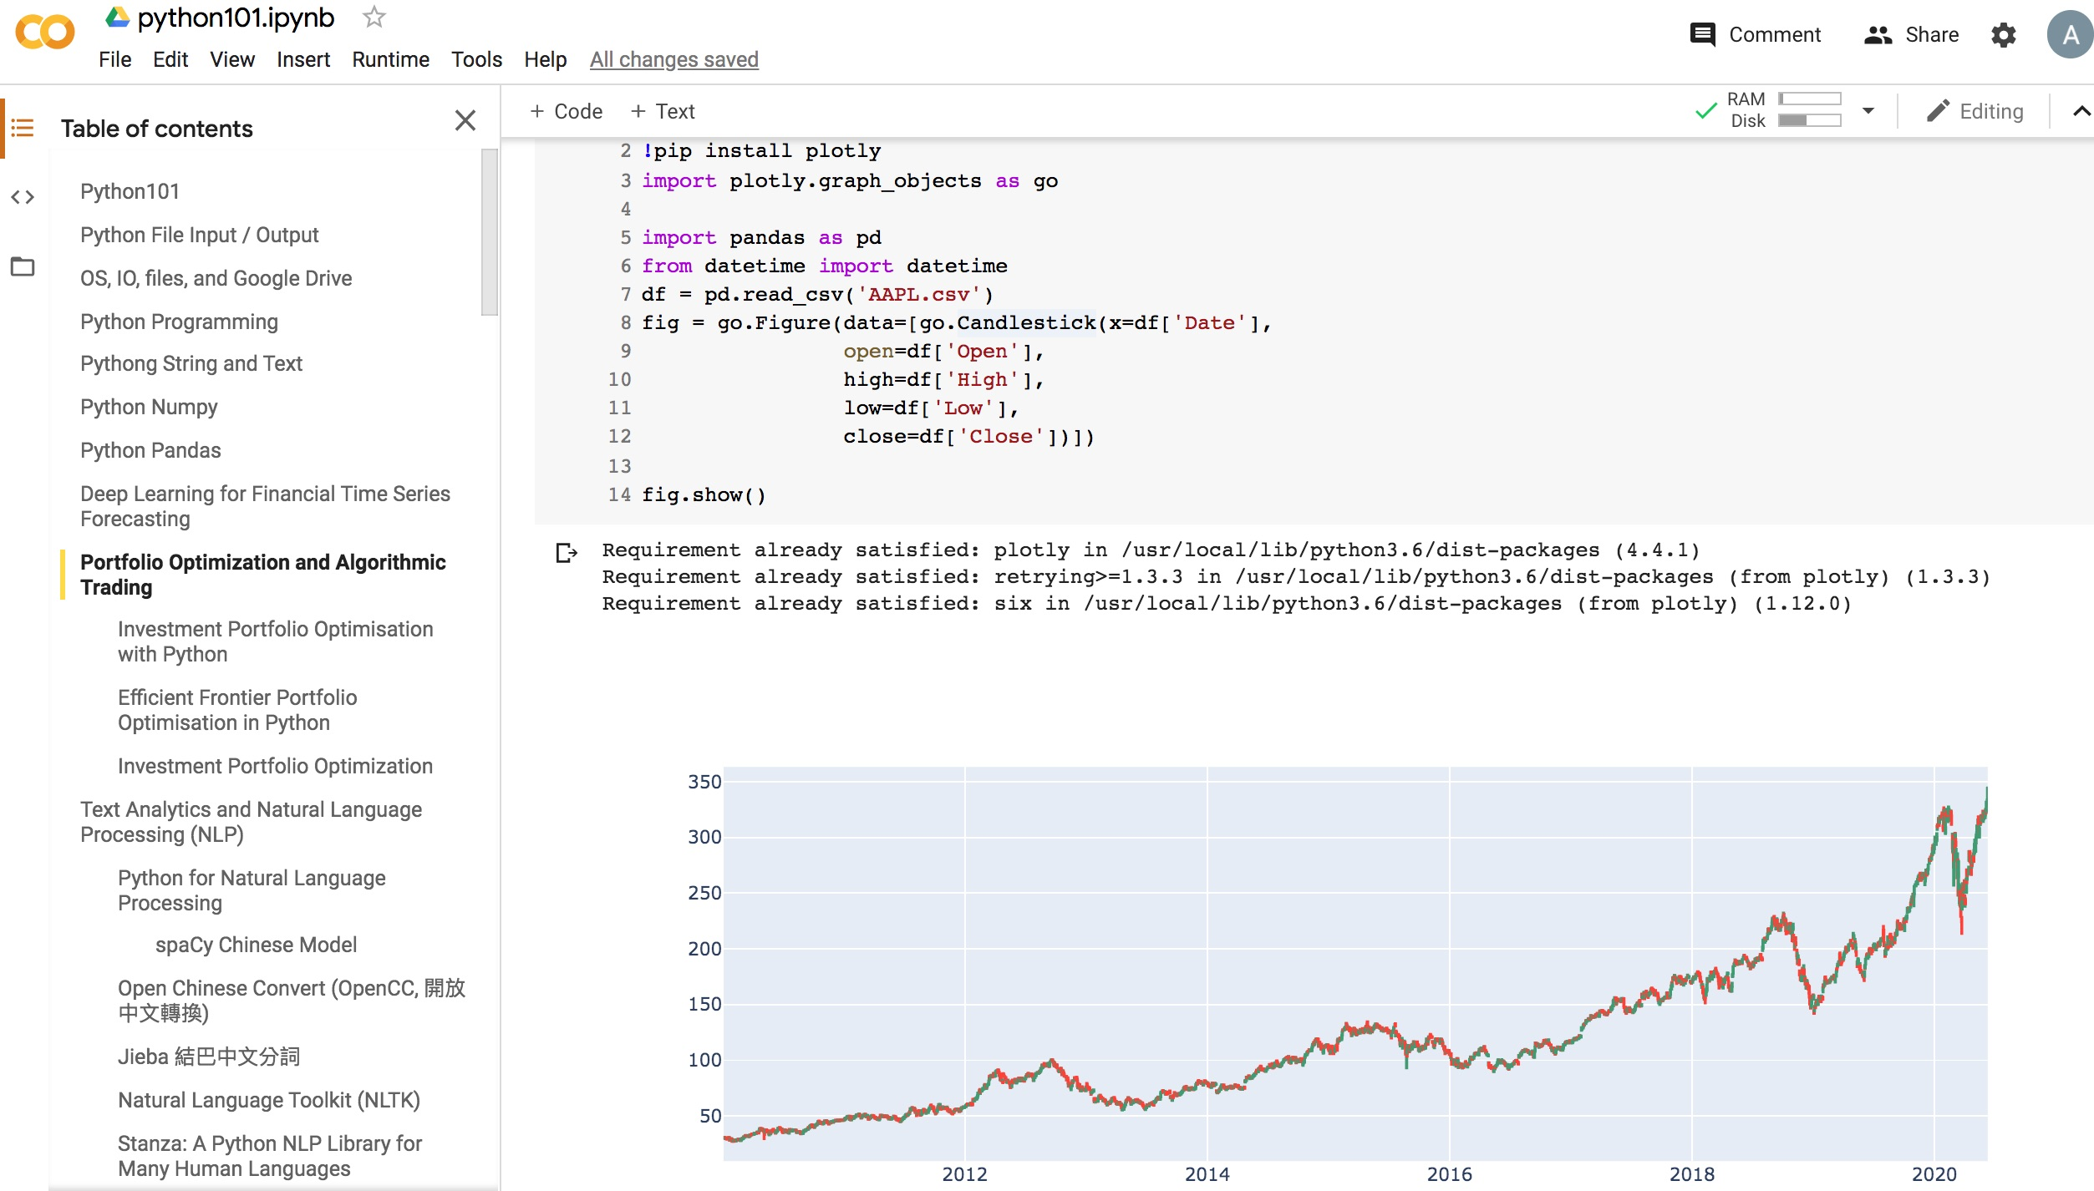
Python in Google Colab (Python101)
https://colab.research.google.com/drive/1FEG6DnGvwfUbeo4zJ1zTunjMqf2RkCrT
http://tinyurl.com/aintpupython101

Slide 30
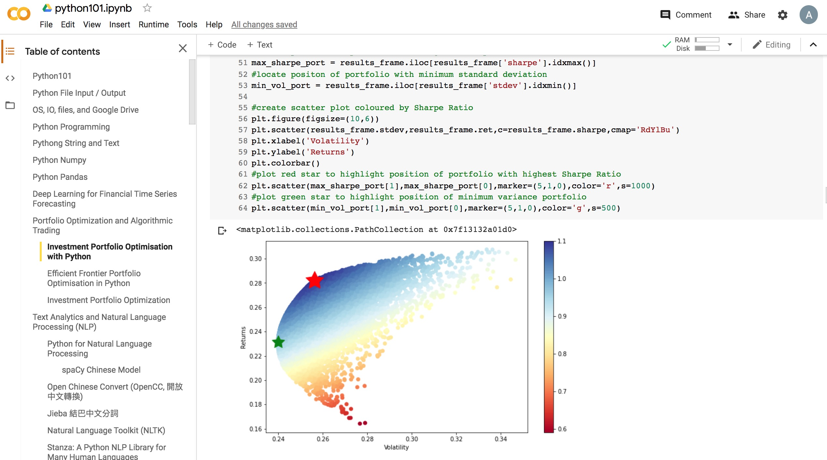
Python in Google Colab (Python101)
https://colab.research.google.com/drive/1FEG6DnGvwfUbeo4zJ1zTunjMqf2RkCrT
http://tinyurl.com/aintpupython101

Slide 31
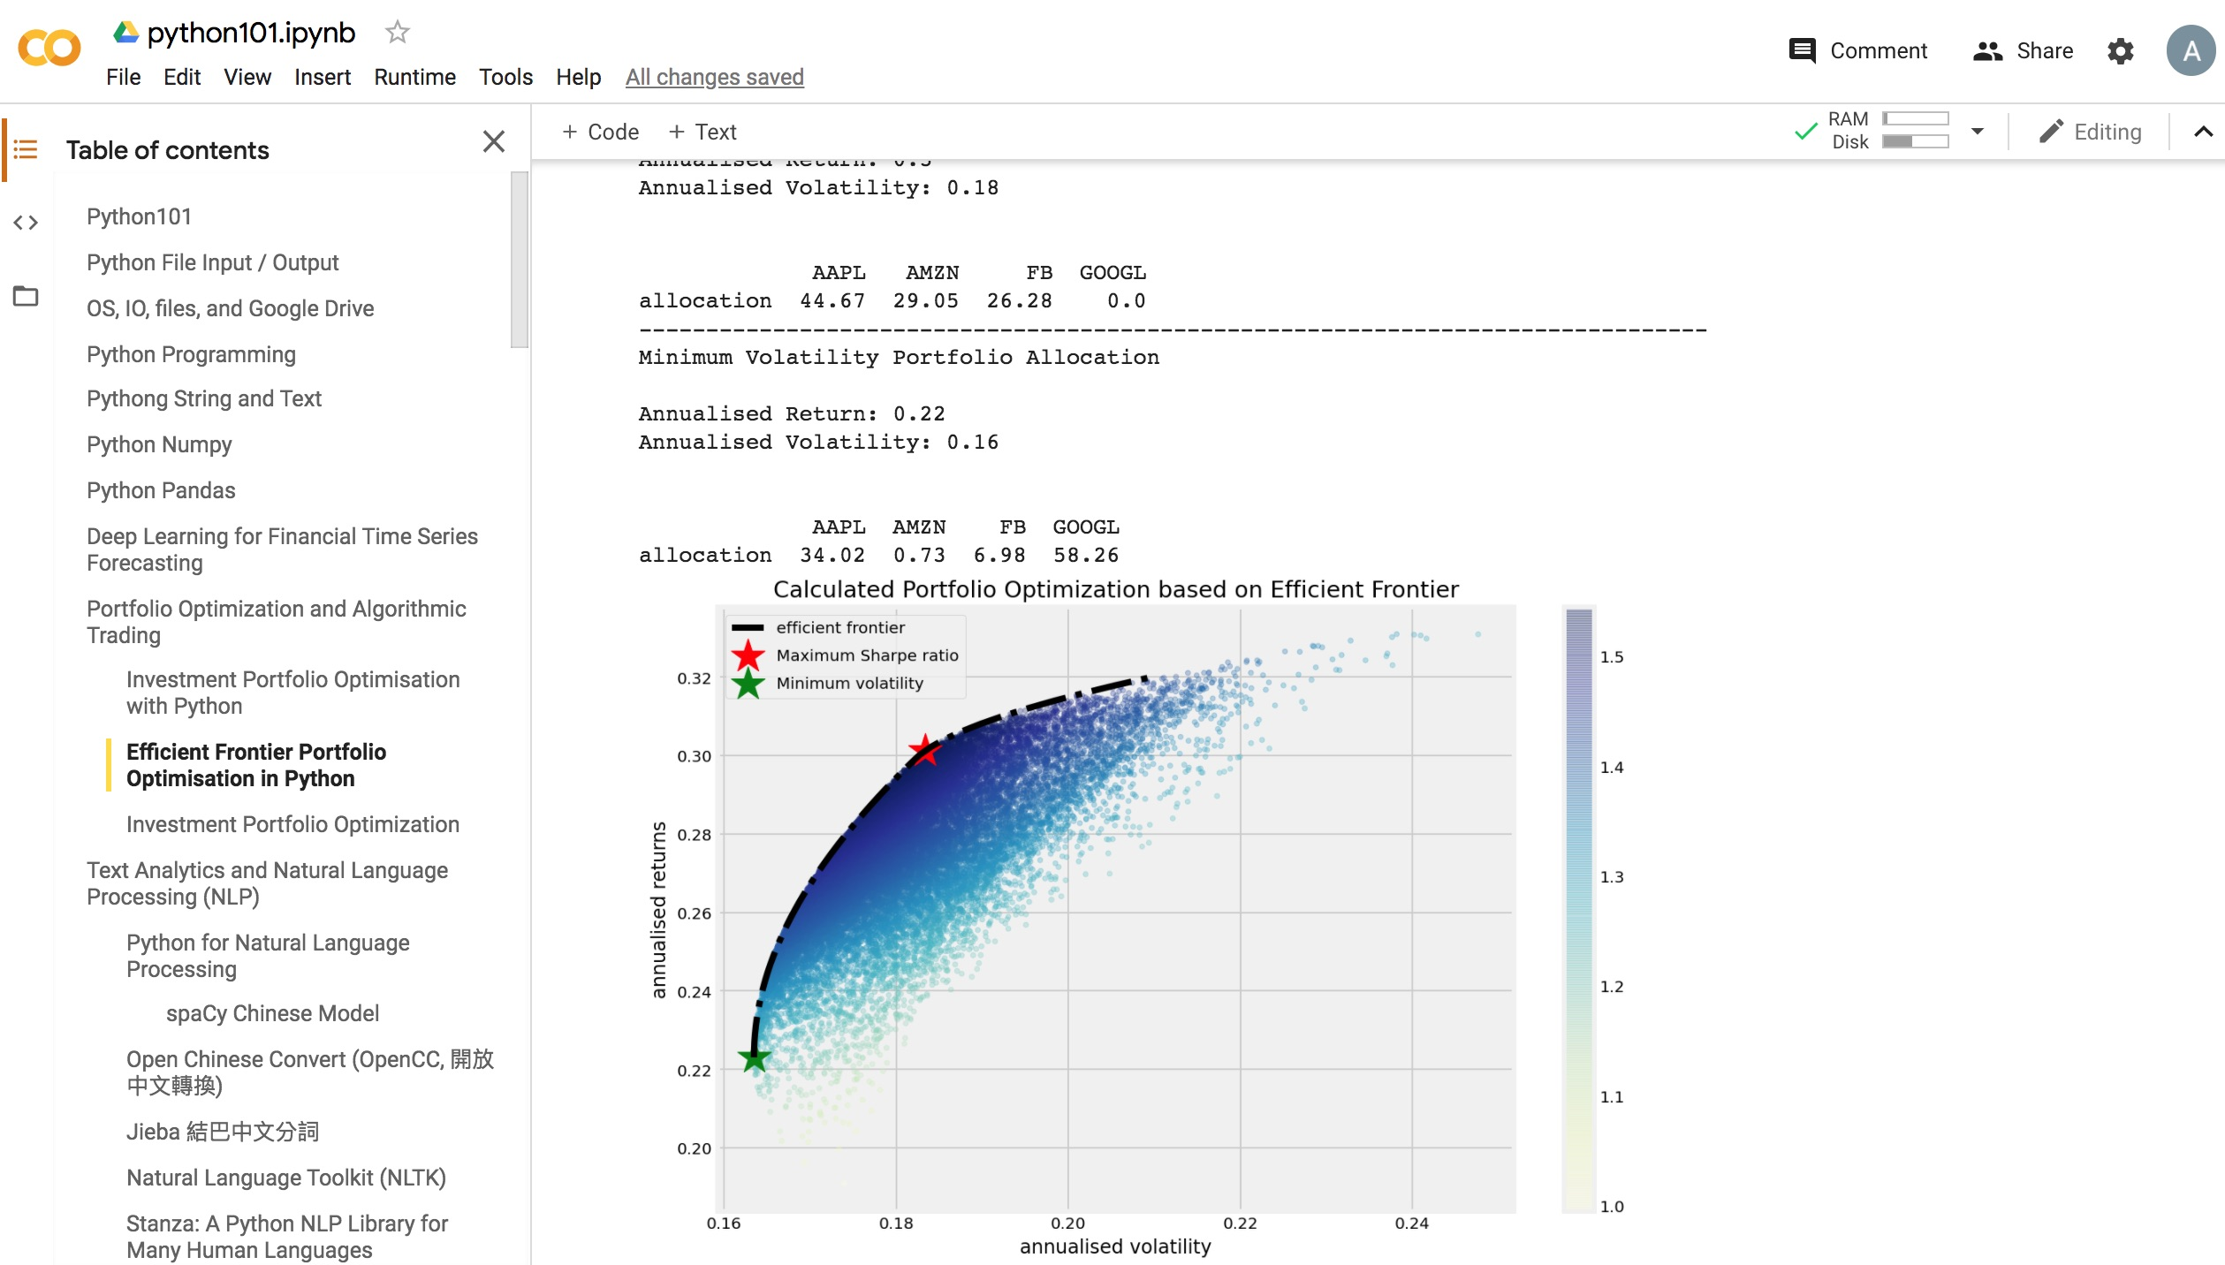
Python in Google Colab (Python101)
https://colab.research.google.com/drive/1FEG6DnGvwfUbeo4zJ1zTunjMqf2RkCrT
http://tinyurl.com/aintpupython101

Slide 32
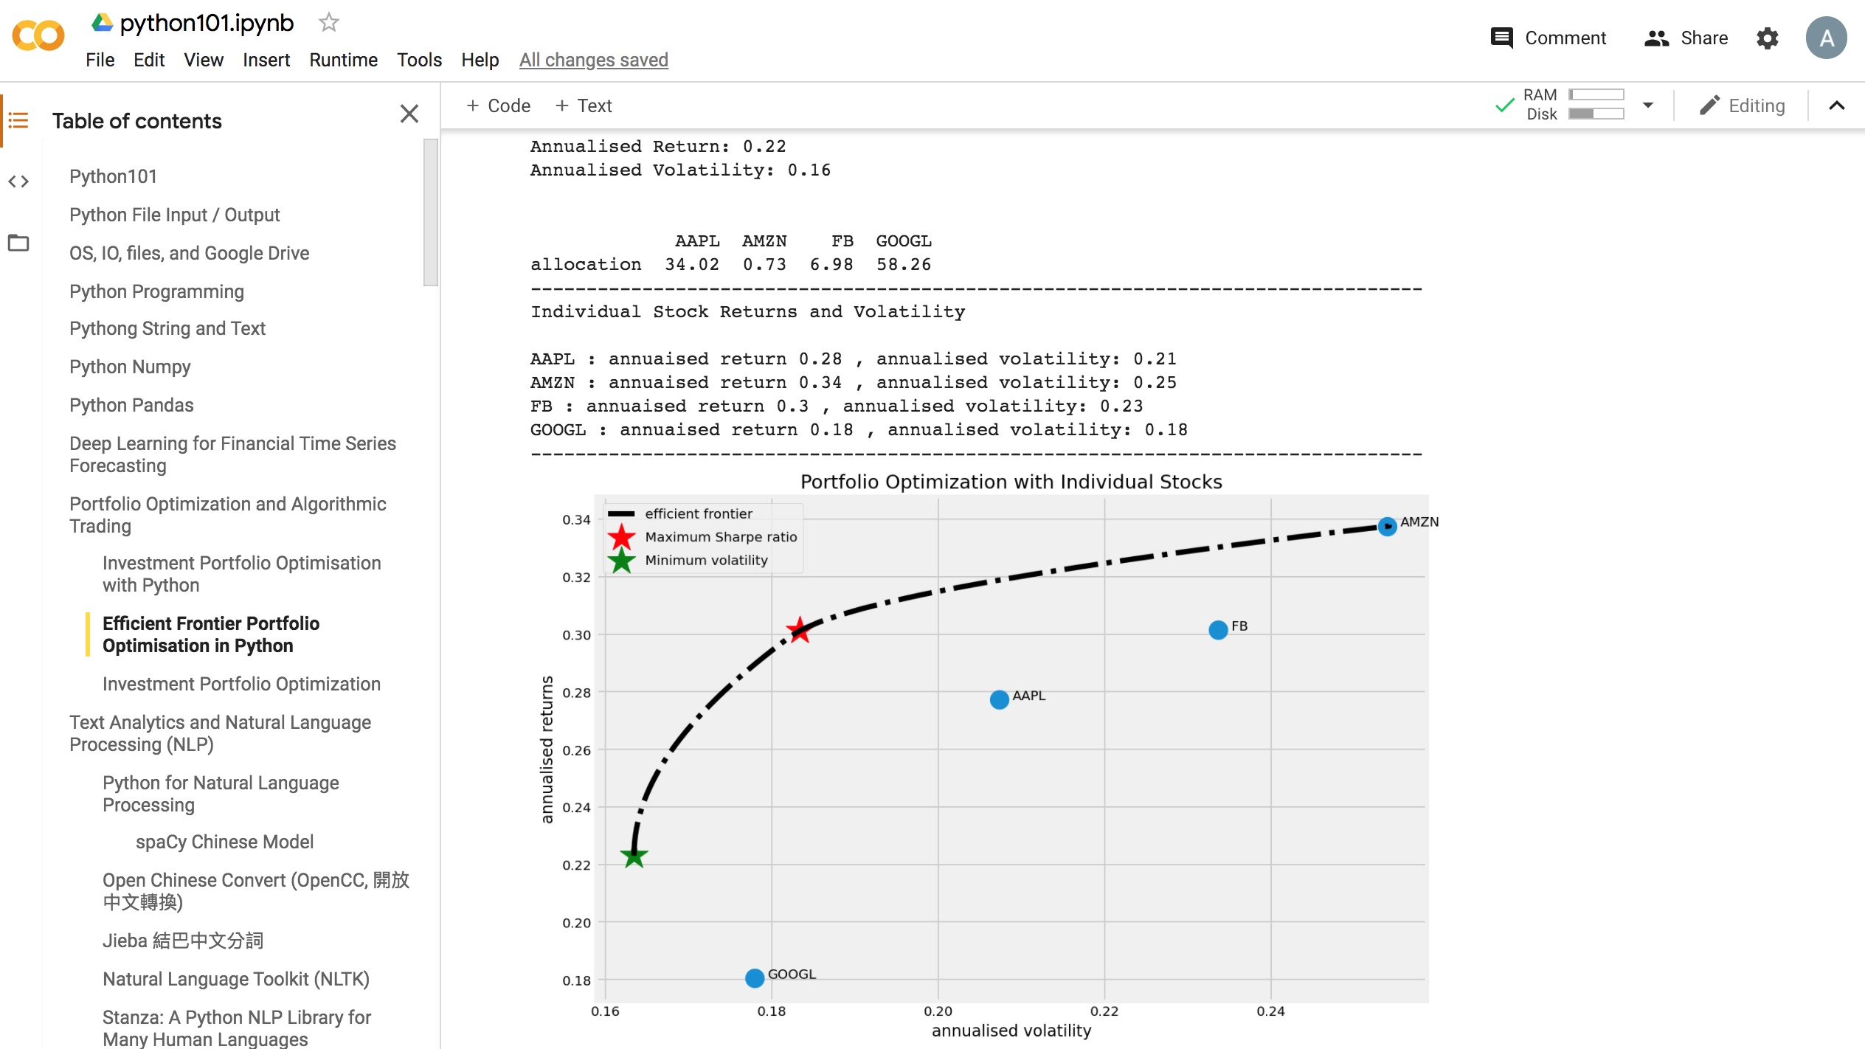
Python in Google Colab (Python101)
https://colab.research.google.com/drive/1FEG6DnGvwfUbeo4zJ1zTunjMqf2RkCrT
http://tinyurl.com/aintpupython101

Slide 33
Big
Data Analysis

Slide 34
AI, Big Data, Cloud Computing
Evolution of Decision Support, Business Intelligence, and Analytics
AI
AI
Cloud Computing
Big Data
DM
BI
Source: Ramesh Sharda, Dursun Delen, and Efraim Turban (2017),
Business Intelligence, Analytics, and Data Science: A Managerial Perspective, 4th Edition, Pearson

Slide 35
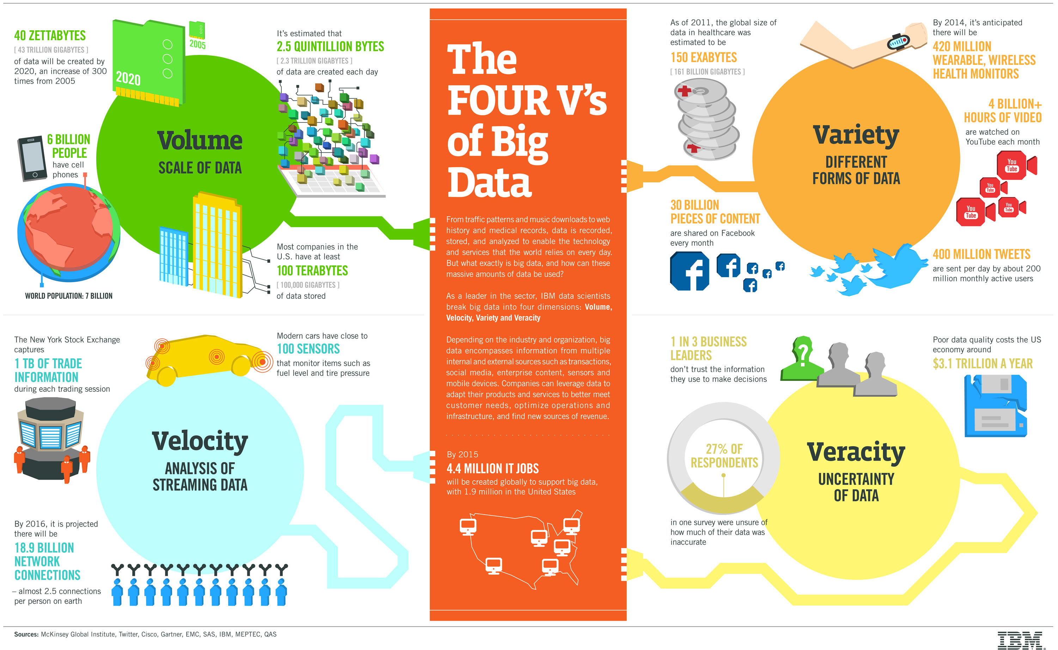
Big Data 4 V
Source: https://www-01.ibm.com/software/data/bigdata/

Slide 36
Value

Slide 37
Artificial Intelligence
Machine Learning & Deep Learning
Source: https://blogs.nvidia.com/blog/2016/07/29/whats-difference-artificial-intelligence-machine-learning-deep-learning-ai/

Slide 38
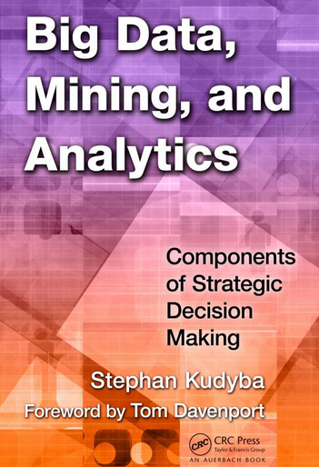
Stephan Kudyba (2014),
Big Data, Mining, and Analytics:
Components of Strategic Decision Making, Auerbach Publications
Source: http://www.amazon.com/gp/product/1466568704

Slide 39
Architecture of Big Data Analytics
Big Data
Analytics
Applications
Big Data
Sources
Big Data
Transformation
Big Data
Platforms & Tools
* Internal
* External
* Multiple formats
* Multiple
locations
* Multiple applications
Middleware
Hadoop
MapReduce
Pig
Hive
Jaql
Zookeeper
Hbase
Cassandra
Oozie
Avro
Mahout
Others
Queries
Raw
Data
Transformed
Data
Big Data
Analytics
Extract Transform Load
Reports
Data Warehouse
OLAP
Traditional Format
CSV, Tables
Data Mining
Source: Stephan Kudyba (2014), Big Data, Mining, and Analytics: Components of Strategic Decision Making, Auerbach Publications

Slide 40
Architecture of Big Data Analytics
Big Data
Analytics
Applications
Big Data
Sources
Big Data
Transformation
Big Data
Platforms & Tools
* Internal
* External
* Multiple formats
* Multiple
locations
* Multiple applications
Data Mining
Big Data Analytics Applications
Middleware
Hadoop
MapReduce
Pig
Hive
Jaql
Zookeeper
Hbase
Cassandra
Oozie
Avro
Mahout
Others
Queries
Raw
Data
Transformed
Data
Big Data
Analytics
Extract Transform Load
Reports
Data Warehouse
OLAP
Traditional Format
CSV, Tables
Data Mining
Source: Stephan Kudyba (2014), Big Data, Mining, and Analytics: Components of Strategic Decision Making, Auerbach Publications

Slide 41
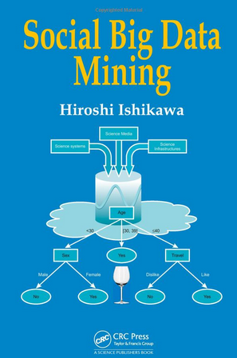
Social Big Data Mining
(Hiroshi Ishikawa, 2015)
Source: http://www.amazon.com/Social-Data-Mining-Hiroshi-Ishikawa/dp/149871093X

Slide 42
Architecture for
Social Big Data Mining
(Hiroshi Ishikawa, 2015)
Enabling Technologies
Analysts
Integrated analysis
Integrated analysis model
Model Construction
Explanation by Model
Conceptual Layer
Natural Language Processing
Information Extraction
Anomaly Detection
Discovery of relationships
among heterogeneous data
Large-scale visualization
Construction and
confirmation
of individual
hypothesis
Description and
execution of
application-specific
task
Data
Mining
Multivariate analysis
Application specific task
Logical Layer
Parallel distrusted processing
Software
Social Data
Hardware
Physical Layer
Source: Hiroshi Ishikawa (2015), Social Big Data Mining, CRC Press

Slide 43
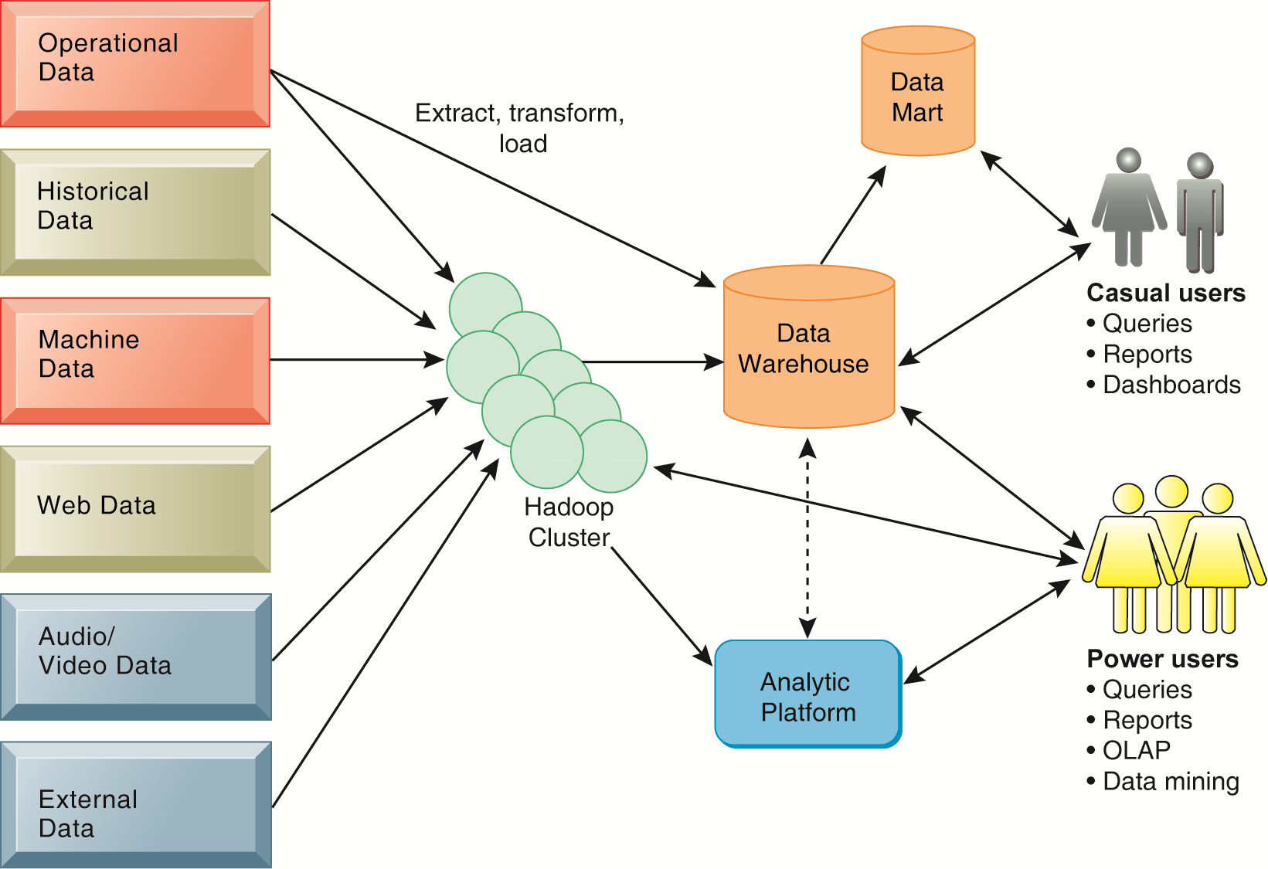
Business Intelligence (BI) Infrastructure

Slide 44
Data Warehouse
Data Mining and Business Intelligence
Increasing potential
to support
business decisions
End User
Decision Making
Data Presentation
Business
Analyst
Visualization Techniques
Data Mining
Data
Analyst
Information Discovery
Data Exploration
Statistical Summary, Querying, and Reporting
Data Preprocessing/Integration, Data Warehouses
Data Sources
DBA
Paper, Files, Web documents, Scientific experiments, Database Systems
Source: Jiawei Han and Micheline Kamber (2006), Data Mining: Concepts and Techniques, Second Edition, Elsevier

Slide 45
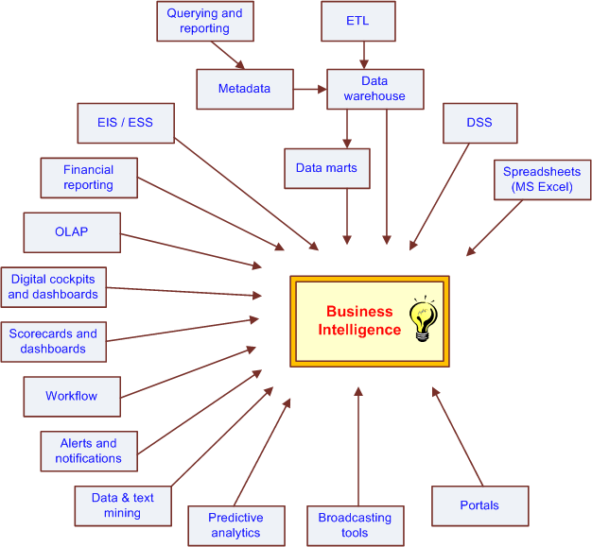
The Evolution of BI Capabilities
Source: Turban et al. (2011), Decision Support and Business Intelligence Systems

Slide 46
Three Types of Analytics
Source: Ramesh Sharda, Dursun Delen, and Efraim Turban (2017),
Business Intelligence, Analytics, and Data Science: A Managerial Perspective, 4th Edition, Pearson

Slide 47
Big Data, Data Mining, and Machine Learning: Value Creation for Business Leaders and Practitioners,
Jared Dean,
Wiley, 2014.
Source: https://www.amazon.com/Data-Mining-Machine-Learning-Practitioners/dp/1118618041

Slide 48
Data Mining at the
Intersection of Many Disciplines
Source: Turban et al. (2011), Decision Support and Business Intelligence Systems

Slide 49
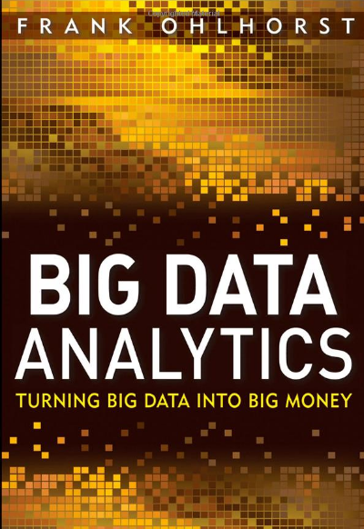
Source: http://www.amazon.com/Big-Data-Analytics-Turning-Money/dp/1118147596

Slide 50
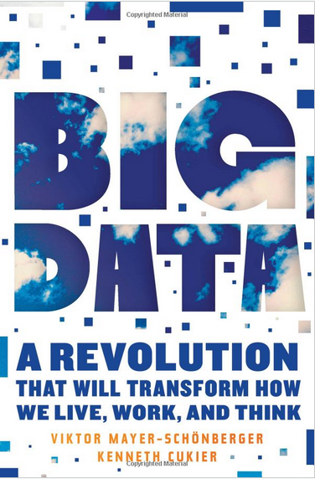
Source: http://www.amazon.com/Big-Data-Revolution-Transform-Mayer-Schonberger/dp/B00D81X2YE

Slide 51
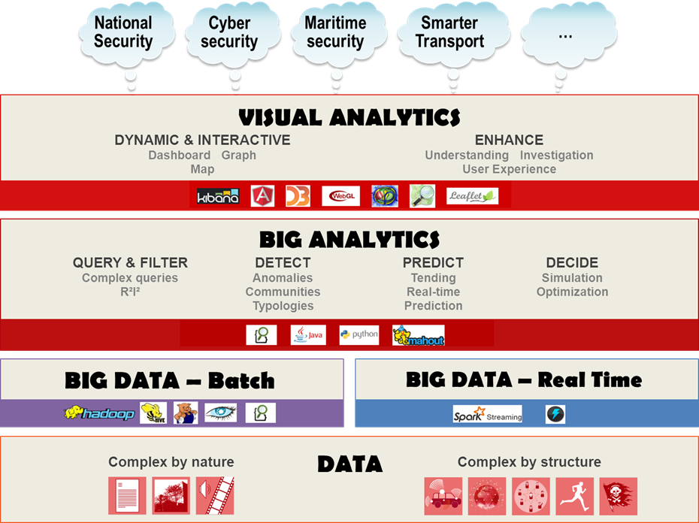
Source: https://www.thalesgroup.com/en/worldwide/big-data/big-data-big-analytics-visual-analytics-what-does-it-all-mean

Slide 52
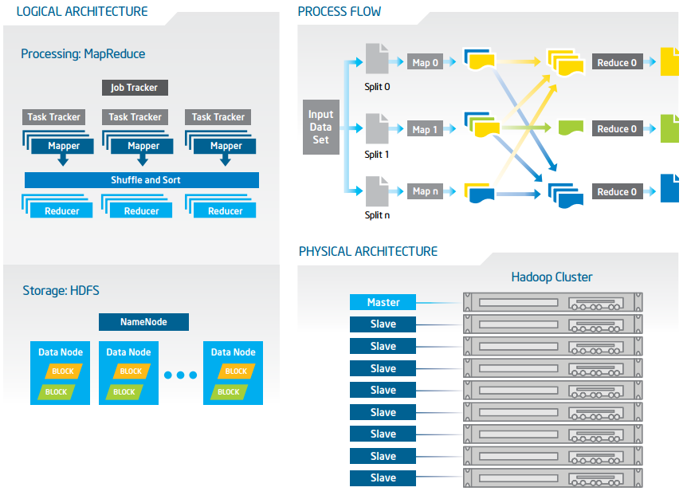
Big Data with Hadoop Architecture
Source: https://software.intel.com/sites/default/files/article/402274/etl-big-data-with-hadoop.pdf

Slide 53
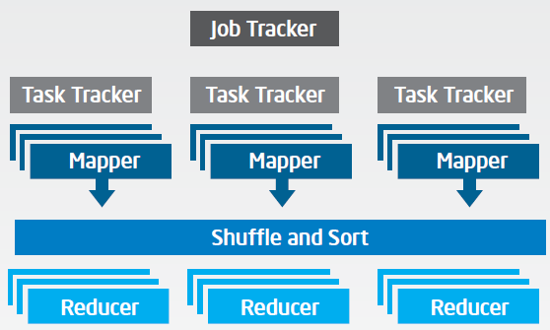
Big Data with Hadoop Architecture
Logical Architecture
Processing: MapReduce
Source: https://software.intel.com/sites/default/files/article/402274/etl-big-data-with-hadoop.pdf

Slide 54
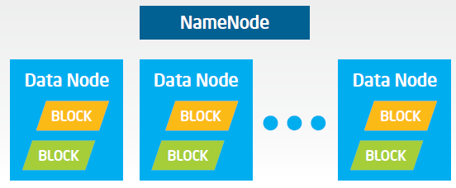
Big Data with Hadoop Architecture
Logical Architecture
Storage: HDFS
Source: https://software.intel.com/sites/default/files/article/402274/etl-big-data-with-hadoop.pdf

Slide 55
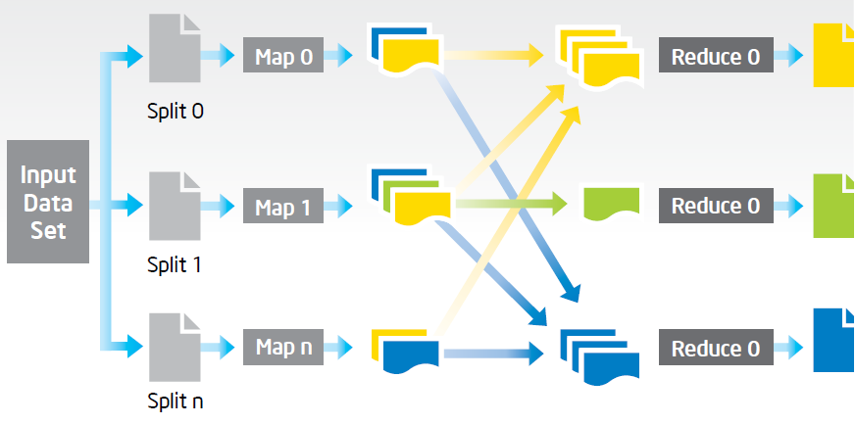
Big Data with Hadoop Architecture
Process Flow
Source: https://software.intel.com/sites/default/files/article/402274/etl-big-data-with-hadoop.pdf

Slide 56
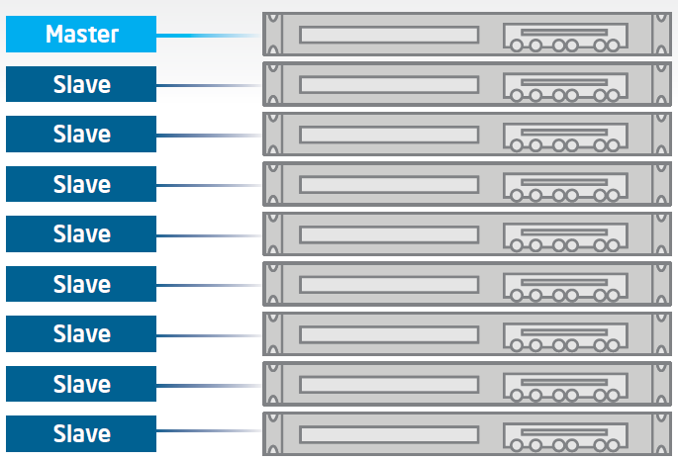
Big Data with Hadoop Architecture
Hadoop Cluster
Source: https://software.intel.com/sites/default/files/article/402274/etl-big-data-with-hadoop.pdf

Slide 57
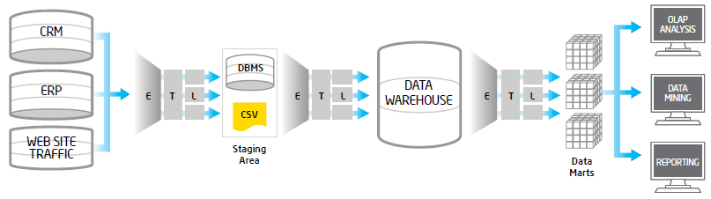
Traditional ETL Architecture
Source: https://software.intel.com/sites/default/files/article/402274/etl-big-data-with-hadoop.pdf

Slide 58
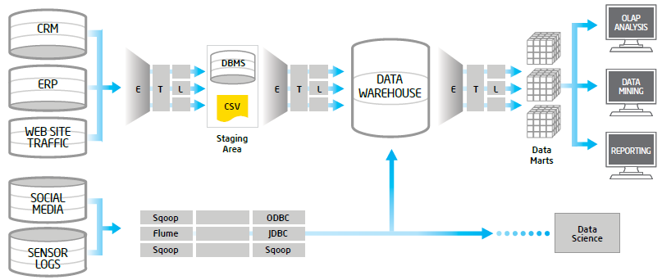
Offload ETL with Hadoop
(Big Data Architecture)
Source: https://software.intel.com/sites/default/files/article/402274/etl-big-data-with-hadoop.pdf

Slide 59
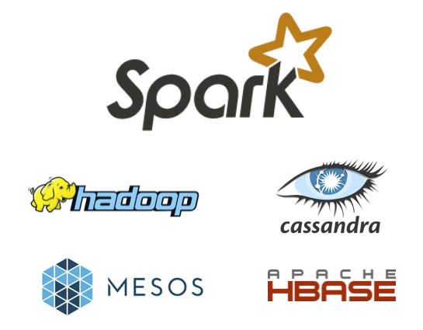
Spark and Hadoop
Source: http://spark.apache.org/

Slide 60
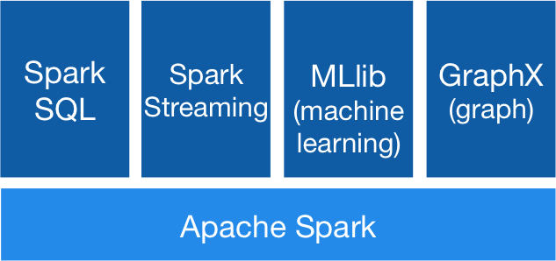
Spark Ecosystem
Source: http://spark.apache.org/

Slide 61
Summary
This course introduces the fundamental concepts, research issues, and hands-on practices of big data analysis.
Topics include
  Introduction to Big Data Analysis
  AI and Big Data Analysis
  Foundations of Big Data Analysis in Python
  Quantitative Big Data Analysis with Pandas in Python
  Machine Learning with Scikit-Learn In Python
  Deep Learning for Finance Big Data Analysis with TensorFlow
  Artificial Intelligence for Robo-Advisors
  Conversational Commerce and Intelligent Chatbots for Fintech
  Hands-on Practices with FintechSpace Digital Sandbox
  Case Study on Big Data Analysis

Slide 62
大數據分析
(Big Data Analysis)
Contact Information
戴敏育 博士 (Min-Yuh Day, Ph.D.)
副教授 (Associate Professor)
國立臺北大學 資訊管理研究所
Institute of Information Management, National Taipei University
電話： 02-86741111 ext. 66873
研究室： 商8F12
地址： 23741 新北市三峽區大學路 151 號
Email：myday@gm.ntpu.edu.tw
網址：http://web.ntpu.edu.tw/~myday/

