Slide 1



大數據分析
(Big Data Analysis)
AI 機器人理財顧問
(Artificial Intelligence for Robo-Advisors)
1091BDA07
MBA, IM, NTPU (M5127) (Fall 2020)
Wed 7, ,8, 9 (15:10-18:00) (B8F40)
Min-Yuh Day
戴敏育
Associate Professor
副教授
Institute of Information Management, National Taipei University
國立臺北大學 資訊管理研究所
https://web.ntpu.edu.tw/~myday
2020-12-23

Slide 2
課程大綱 (Syllabus)
週次 (Week) 日期 (Date) 內容 (Subject/Topics)
1 2020/09/16 大數據分析介紹 (Introduction to Big Data Analysis)
2 2020/09/23 AI人工智慧與大數據分析
(AI and Big Data Analysis)
3 2020/09/30 Python 大數據分析基礎
(Foundations of Big Data Analysis in Python)
4 2020/10/07 數位沙盒第一堂課：數位沙盒服務平台簡介
(Digital Sandbox Lesson 1: Introduction to
FintechSpace Digital Sandbox)
5 2020/10/14 數位沙盒第二堂課：工程師操作說明與實作教學
(Digital Sandbox Lesson 2: Hands-on Practices)
6 2020/10/21 Python Pandas 大數據量化分析
(Quantitative Big Data Analysis with Pandas in Python)

Slide 3
課程大綱 (Syllabus)
週次 (Week) 日期 (Date) 內容 (Subject/Topics)
7 2020/10/28 Python Scikit-Learn 機器學習 I
(Machine Learning with Scikit-Learn in Python I)
8 2020/11/04 數位沙盒第三堂課：學生小組討論實作與成果發表
(Digital Sandbox Lesson 3: Learning Teams
Hands-on Project Discussion and Project Presentation)
9 2020/11/11 期中報告 (Midterm Project Report)
10 2020/11/18 Python Scikit-Learn 機器學習 II
(Machine Learning with Scikit-Learn in Python II)
11 2020/11/25 TensorFlow 深度學習金融大數據分析 I
(Deep Learning for Finance Big Data Analysis with TensorFlow I)
12 2020/12/02 大數據分析個案研究
(Case Study on Big Data Analysis)

Slide 4
課程大綱 (Syllabus)
週次 (Week) 日期 (Date) 內容 (Subject/Topics)
13 2020/12/09 TensorFlow 深度學習金融大數據分析 II
(Deep Learning for Finance Big Data Analysis with TensorFlow II)
14 2020/12/16 TensorFlow 深度學習金融大數據分析 III
(Deep Learning for Finance Big Data Analysis with TensorFlow III)
15 2020/12/23 AI 機器人理財顧問
(Artificial Intelligence for Robo-Advisors)
16 2020/12/30 金融科技智慧型交談機器人
(Conversational Commerce and
Intelligent Chatbots for Fintech)
17 2021/01/06 期末報告 I (Final Project Report I)
18 2021/01/13 期末報告 II (Final Project Report I)

Slide 5
Artificial Intelligence for Robo-Advisors

Slide 6
Robotic
Process
Automation
(RPA)

Slide 7
AI
Robo-Advisor in
FinTech

Slide 8
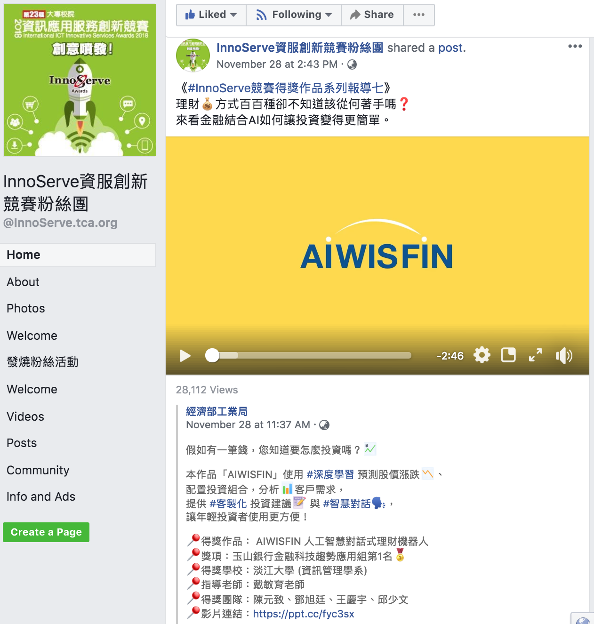
AIWISFIN
AI Conversational Robo-Advisor
(人工智慧對話式理財機器人)
First Place, InnoServe Awards 2018
https://www.youtube.com/watch?v=sEhmyoTXmGk

Slide 9

2018 The 23th International ICT
Innovative Services Awards
(InnoServe Awards 2018)
Annual ICT application competition held for university and college students
The largest and the most significant contest in Taiwan.
More than ten thousand teachers and students from over one hundred universities and colleges have participated in the Contest.
https://innoserve.tca.org.tw/award.aspx

Slide 10
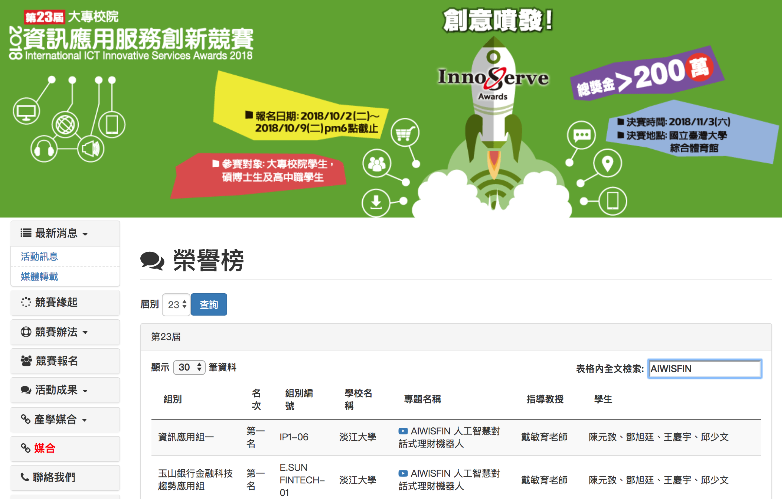
2018 International ICT Innovative Services Awards (InnoServe Awards 2018)
(2018第23屆大專校院資訊應用服務創新競賽)
https://innoserve.tca.org.tw/award.aspx

Slide 11
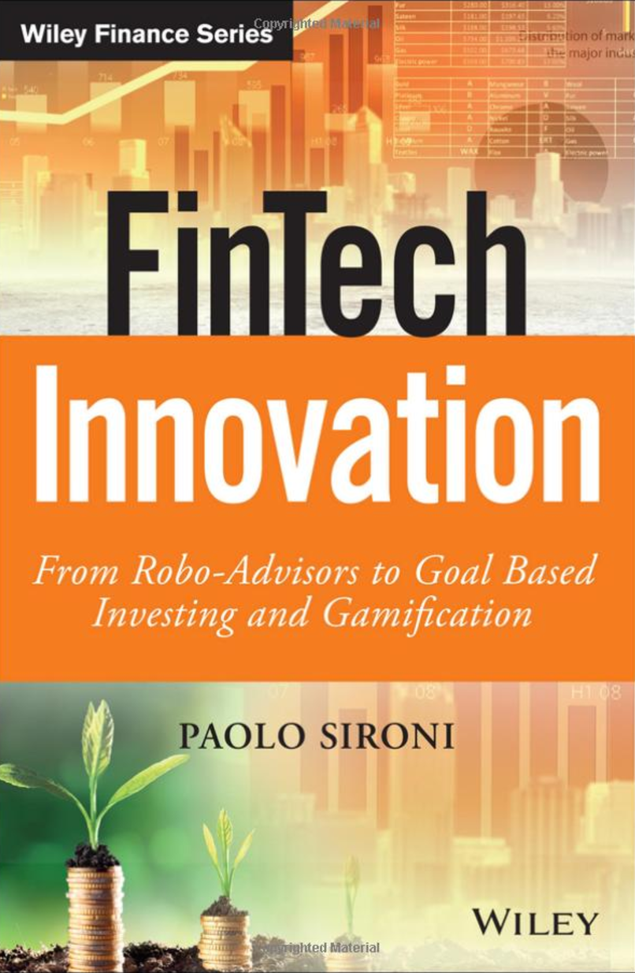
FinTech Innovation:
From Robo-Advisors to Goal Based Investing and Gamification,
Paolo Sironi, Wiley, 2016
Source: https://www.amazon.com/FinTech-Innovation-Robo-Advisors-Investing-Gamification/dp/1119226988

Slide 12
Edwin J. Elton, Martin J. Gruber, Stephen J. Brown, and William N. Goetzmann (2014), Modern Portfolio Theory and Investment Analysis,
9th Edition, Wiley.
Source: https://www.amazon.com/Modern-Portfolio-Theory-Investment-Analysis/dp/1118469941

Slide 13
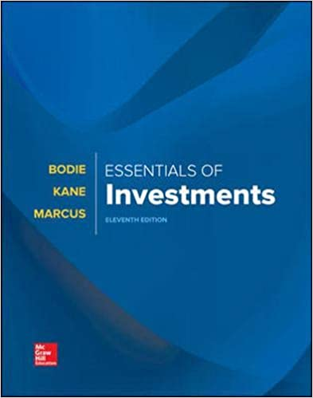
Zvi Bodie, Alex Kane, Alan Marcus (2018),
Essentials of Investments,
11th Edition, McGraw-Hill
Source: https://www.amazon.com/Essentials-Investments-Zvi-Bodie-Professor/dp/1260013928

Slide 14
Charles P. Jones (2012),
Investments: Analysis and Management,
12th Edition, Wiley
Source: https://www.amazon.com/Investments-Analysis-Management-Charles-Jones/dp/1118363299

Slide 15
Artificial Intelligence
(AI)

Slide 16
Investment Analysis

Slide 17
Robo-Advisors

Slide 18
Artificial Intelligence and
Deep Learning for
Fintech

Slide 19
From Algorithmic Trading to Personal Finance Bots: 41 Startups Bringing
AI to Fintech
Source: https://www.cbinsights.com/blog/artificial-intelligence-fintech-market-map-company-list/

Slide 20
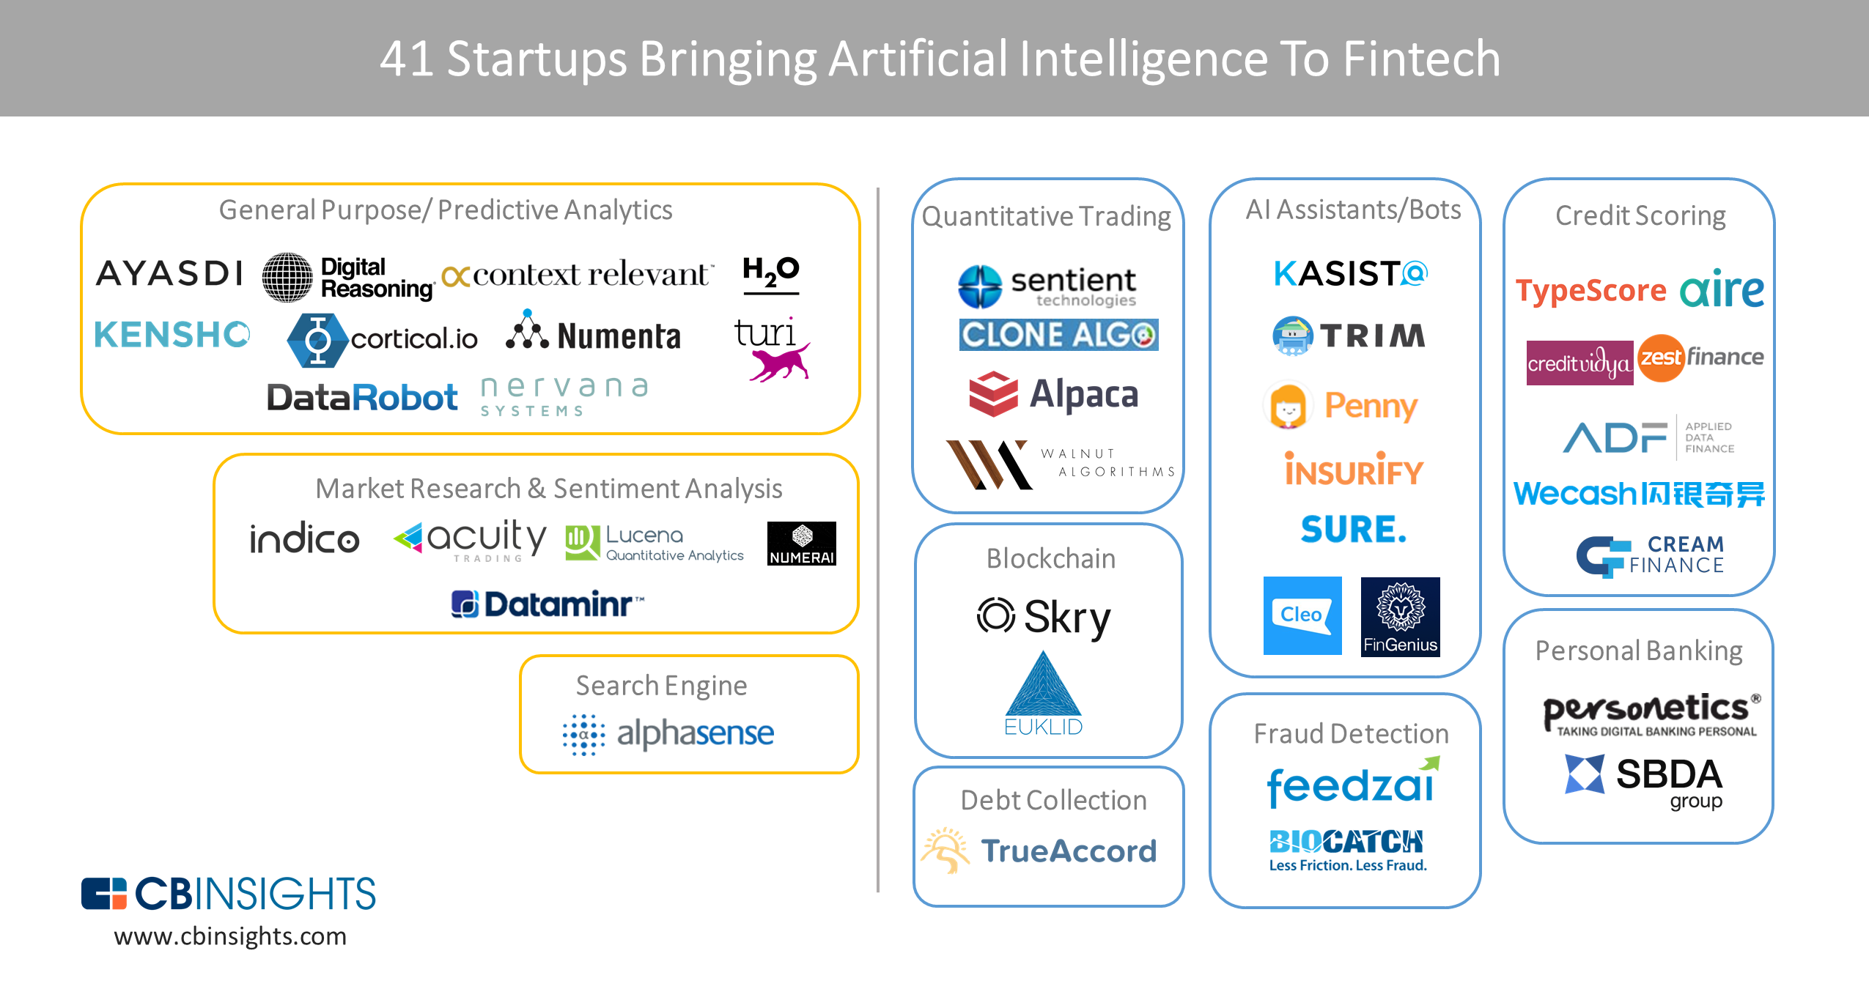
From Algorithmic Trading To Personal Finance Bots: 41 Startups Bringing AI To Fintech
AI in Fintech
Source: https://www.cbinsights.com/blog/artificial-intelligence-fintech-market-map-company-list/

Slide 21
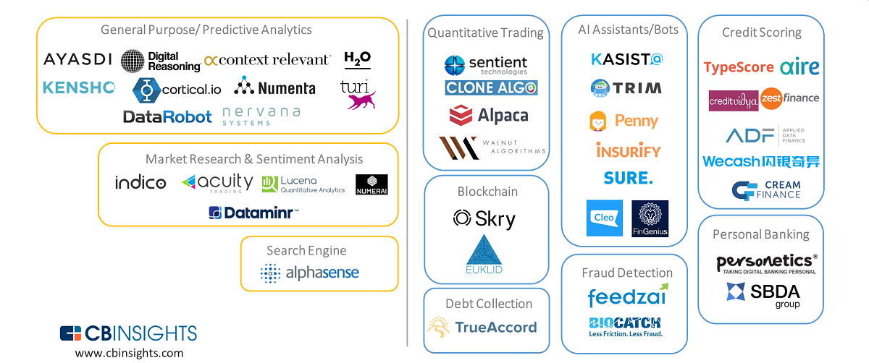
Artificial Intelligence (AI) in Fintech
Source: https://www.cbinsights.com/blog/artificial-intelligence-fintech-market-map-company-list/

Slide 22
Artificial Intelligence (AI) in Fintech
Source: https://www.cbinsights.com/blog/artificial-intelligence-fintech-market-map-company-list/

Slide 23
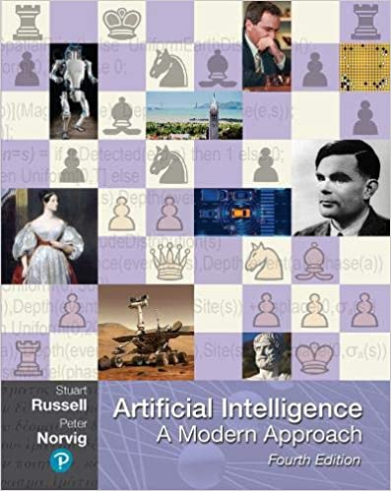
Stuart Russell and Peter Norvig (2020),
Artificial Intelligence: A Modern Approach,
4th Edition, Pearson
Source: Stuart Russell and Peter Norvig (2020), Artificial Intelligence: A Modern Approach, 4th Edition, Pearson
https://www.amazon.com/Artificial-Intelligence-A-Modern-Approach/dp/0134610997/

Slide 24
AI, Big Data, Cloud Computing
Evolution of Decision Support, Business Intelligence, and Analytics
AI
AI
Cloud Computing
Big Data
DM
BI
Source: Ramesh Sharda, Dursun Delen, and Efraim Turban (2017),
Business Intelligence, Analytics, and Data Science: A Managerial Perspective, 4th Edition, Pearson

Slide 25
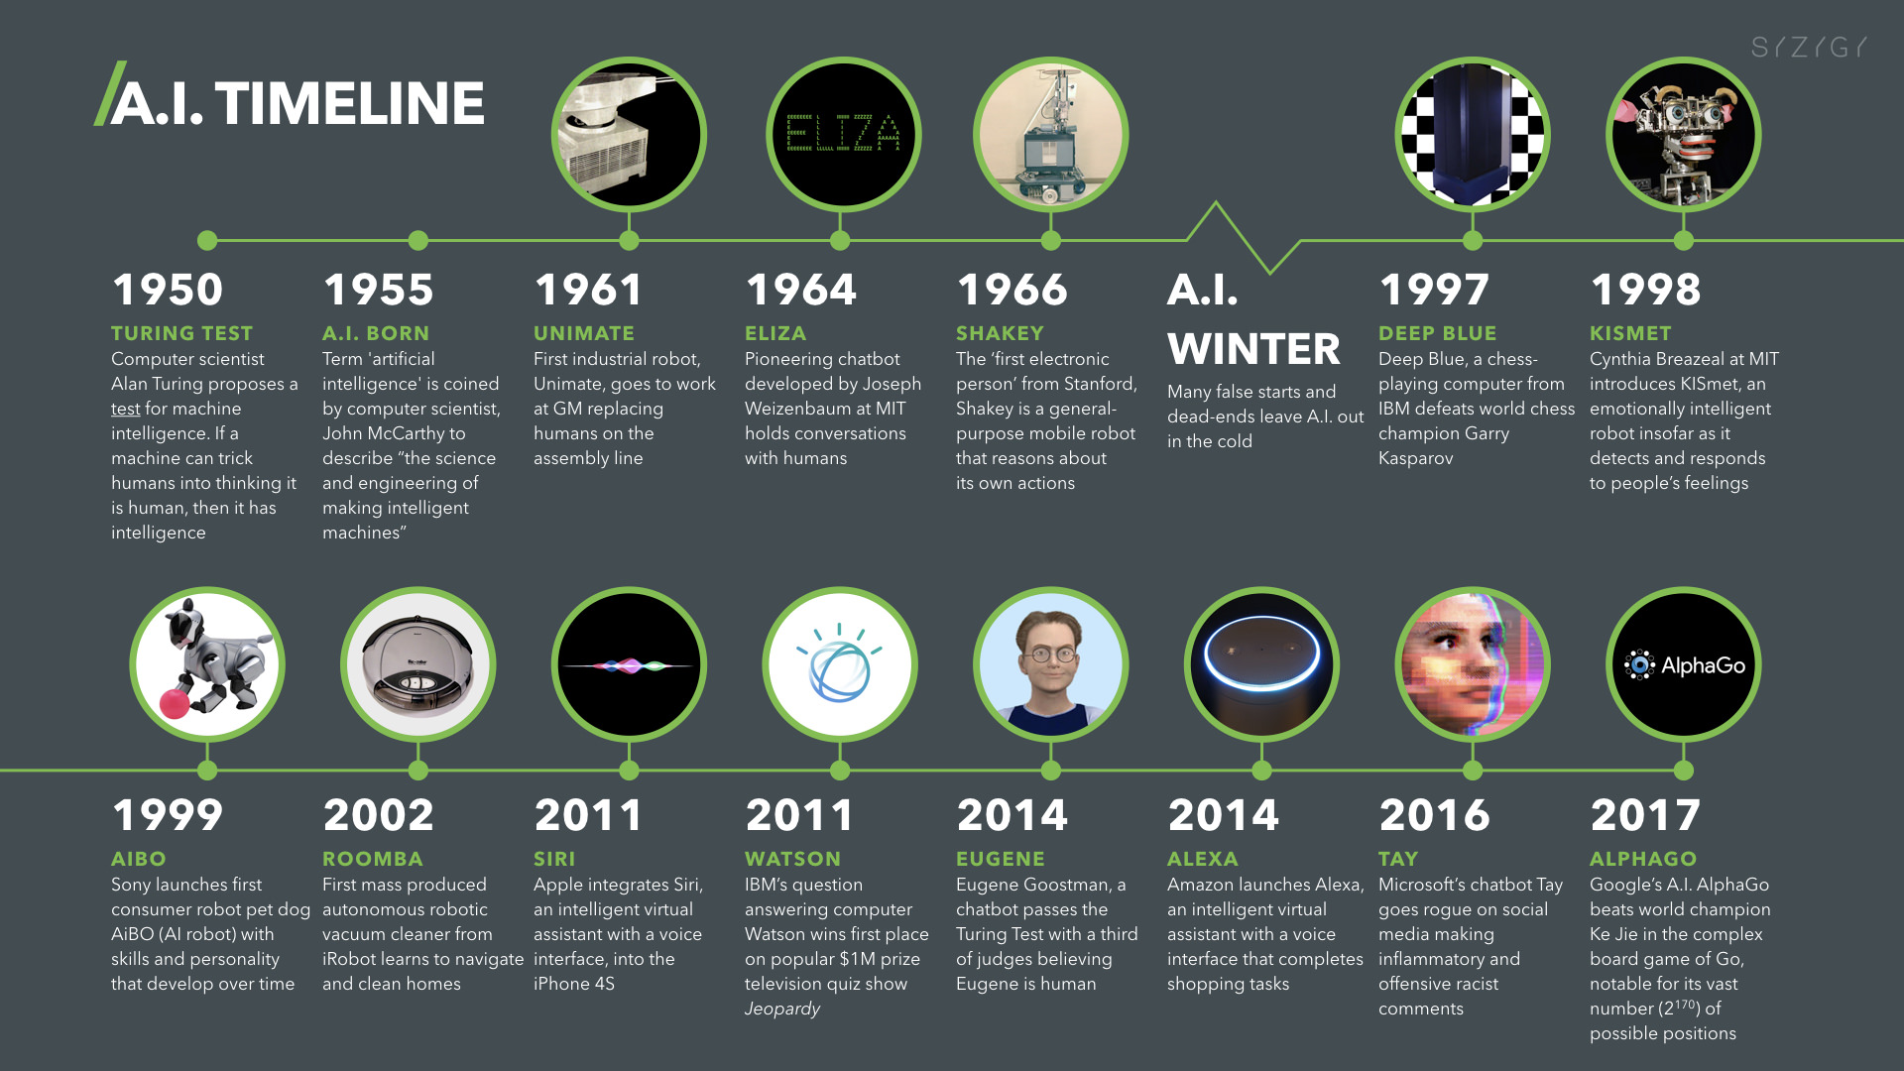
Artificial Intelligence (A.I.) Timeline
Source: https://digitalintelligencetoday.com/artificial-intelligence-timeline-infographic-from-eliza-to-tay-and-beyond/

Slide 26
The Rise of AI
Source: DHL (2018), Artificial Intelligence in Logistics,
http://www.globalhha.com/doclib/data/upload/doc_con/5e50c53c5bf67.pdf/

Slide 27
AI

Slide 28
Definition of
Artificial Intelligence (A.I.)

Slide 29
Artificial Intelligence
“… the science and engineering of making intelligent machines”
(John McCarthy, 1955)
Source: https://digitalintelligencetoday.com/artificial-intelligence-defined-useful-list-of-popular-definitions-from-business-and-science/

Slide 30
Artificial Intelligence
“… technology that thinks and acts like humans”
Source: https://digitalintelligencetoday.com/artificial-intelligence-defined-useful-list-of-popular-definitions-from-business-and-science/

Slide 31
Artificial Intelligence
“… intelligence exhibited by machines or software”
Source: https://digitalintelligencetoday.com/artificial-intelligence-defined-useful-list-of-popular-definitions-from-business-and-science/

Slide 32
4 Approaches of AI
Thinking Humanly | Thinking Rationally
Acting Humanly | Acting Rationally
Source: Stuart Russell and Peter Norvig (2020), Artificial Intelligence: A Modern Approach, 4th Edition, Pearson

Slide 33
4 Approaches of AI
2. Thinking Humanly: The Cognitive Modeling Approach | 3. Thinking Rationally: The “Laws of Thought” Approach
1. Acting Humanly: The Turing Test Approach (1950) | 4. Acting Rationally: The Rational Agent Approach
Source: Stuart Russell and Peter Norvig (2020), Artificial Intelligence: A Modern Approach, 4th Edition, Pearson

Slide 34
AI Acting Humanly:
The Turing Test Approach
(Alan Turing, 1950)
Knowledge Representation
Automated Reasoning
Machine Learning (ML)
  Deep Learning (DL)
Computer Vision (Image, Video)
Natural Language Processing (NLP)
Robotics
Source: Stuart Russell and Peter Norvig (2020), Artificial Intelligence: A Modern Approach, 4th Edition, Pearson

Slide 35
AI and
Cognitive Computing
Source: http://research.ibm.com/cognitive-computing/

Slide 36
Financial Technology
FinTech
“providing
financial services
by making use of software and
modern technology”
Source: https://www.fintechweekly.com/fintech-definition

Slide 37
Financial Services

Slide 38

Financial Services
Source: http://www.crackitt.com/7-reasons-why-your-fintech-startup-needs-visual-marketing/

Slide 39
Money

Slide 40

Money
Source: http://www.wpclipart.com/money/bills/bills_2/stack_of_bills_2.png.html

Slide 41
Money
Makes
Money

Slide 42

Treasure
Source: http://www.wpclipart.com/money/treasure/treasure_chest_3.png.html

Slide 43
Wealth Management

Slide 44
Investment Analysis

Slide 45
Time Value of Money
Risk
Return

Slide 46
Fintech
Robo Advisors

Slide 47
Big Data Driven Disruption:
Robo-Advisor
Source: http://www.vamsitalkstech.com/?p=2329

Slide 48
FinTech high-level classification
Lending
Payments
Robo Advisors
Analytics
Others
Profile
Advice
Re-Balance
Indexing
Source: Paolo Sironi (2016), “FinTech Innovation: From Robo-Advisors to Goal Based Investing and Gamification”, Wiley.

Slide 49
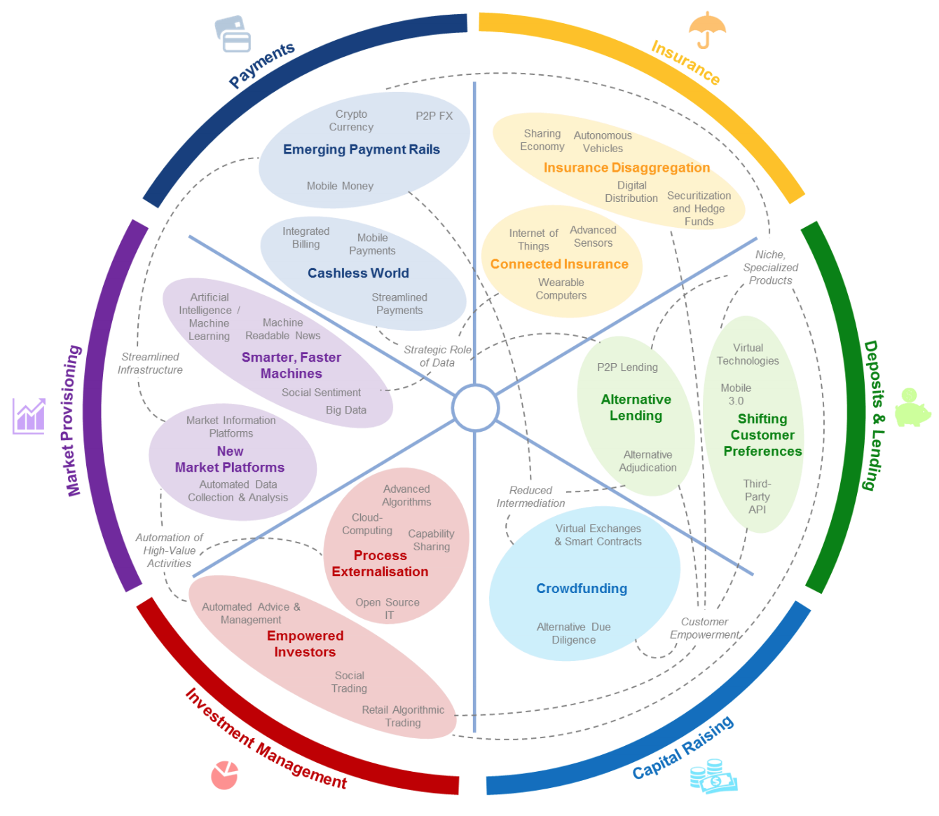
FinTech: Financial Services Innovation
Source: http://www3.weforum.org/docs/WEF_The_future__of_financial_services.pdf

Slide 50
FinTech:
Financial Services Innovation
1. Payments
2. Insurance
3. Deposits & Lending
4. Capital Raising
5. Investment Management
6. Market Provisioning
Source: http://www3.weforum.org/docs/WEF_The_future__of_financial_services.pdf

Slide 51
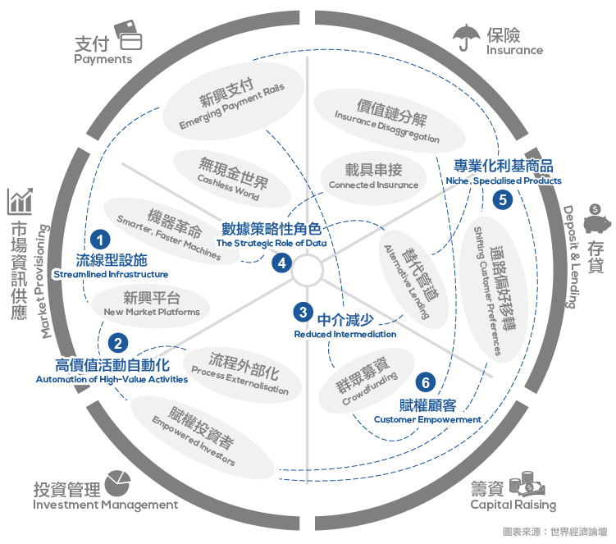
Source: https://www.stockfeel.com.tw/2015年世界經濟論壇－未來的金融服務/

Slide 52
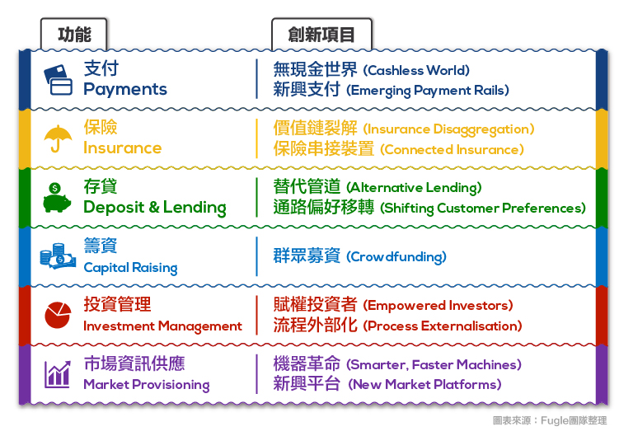
FinTech: Financial Services Innovation
Source: https://www.stockfeel.com.tw/2015年世界經濟論壇－未來的金融服務/

Slide 53
FinTech: Investment Management
5
Source: http://www3.weforum.org/docs/WEF_The_future__of_financial_services.pdf

Slide 54
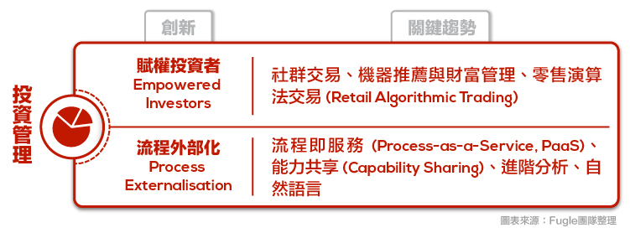
FinTech: Investment Management
Empowered Investors
Process Externalization
5
Source: https://www.stockfeel.com.tw/2015年世界經濟論壇－未來的金融服務/

Slide 55
FinTech: Market Provisioning
6
Source: http://www3.weforum.org/docs/WEF_The_future__of_financial_services.pdf

Slide 56
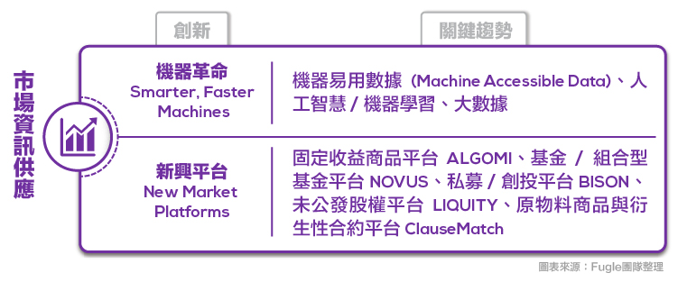
FinTech: Market Provisioning
Smarter, Faster Machines
New Market Platforms
6
Source: https://www.stockfeel.com.tw/2015年世界經濟論壇－未來的金融服務/

Slide 57
Fintech: Financial Technology
Disrupting Banking:
The Fintech Startups
That Are Unbundling Wells Fargo, Citi and Bank of America
Source: https://www.cbinsights.com/blog/industry-market-map-landscape/

Slide 58
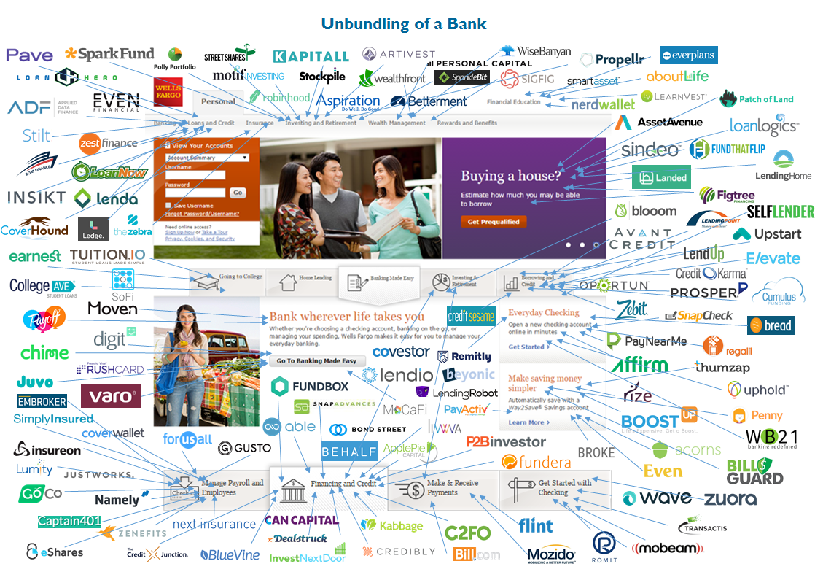
Fintech: Unbunding the Bank
Source: https://www.cbinsights.com/blog/disrupting-banking-fintech-startups-2016/

Slide 59
Fintech: Unbunding the Bank
Wealth Management: Wealthfront
Source: https://www.cbinsights.com/blog/disrupting-banking-fintech-startups-2016/

Slide 60
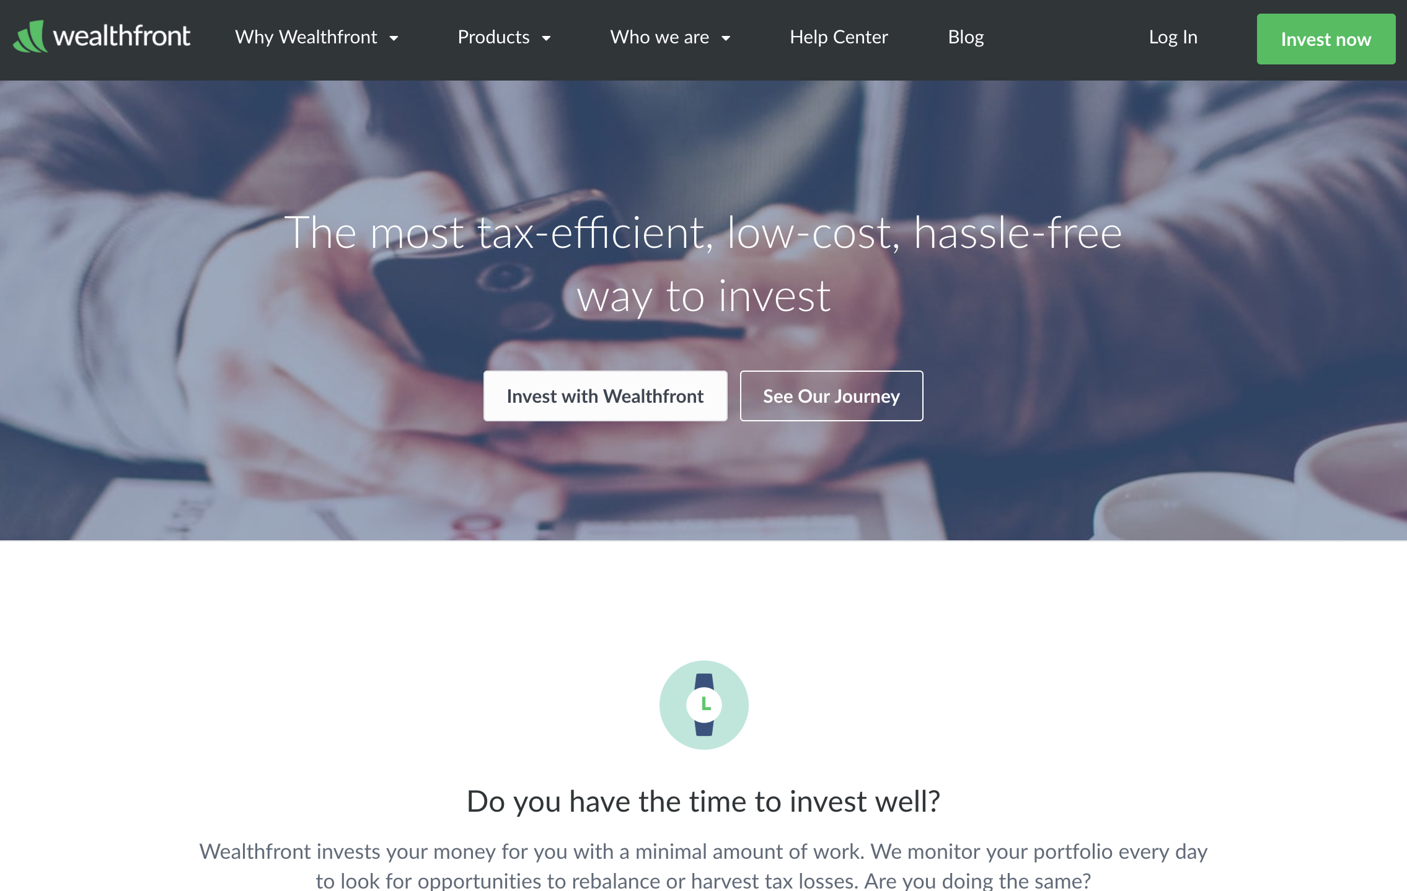
Wealthfront: Fintech Robo Advisor
https://www.wealthfront.com/

Slide 61
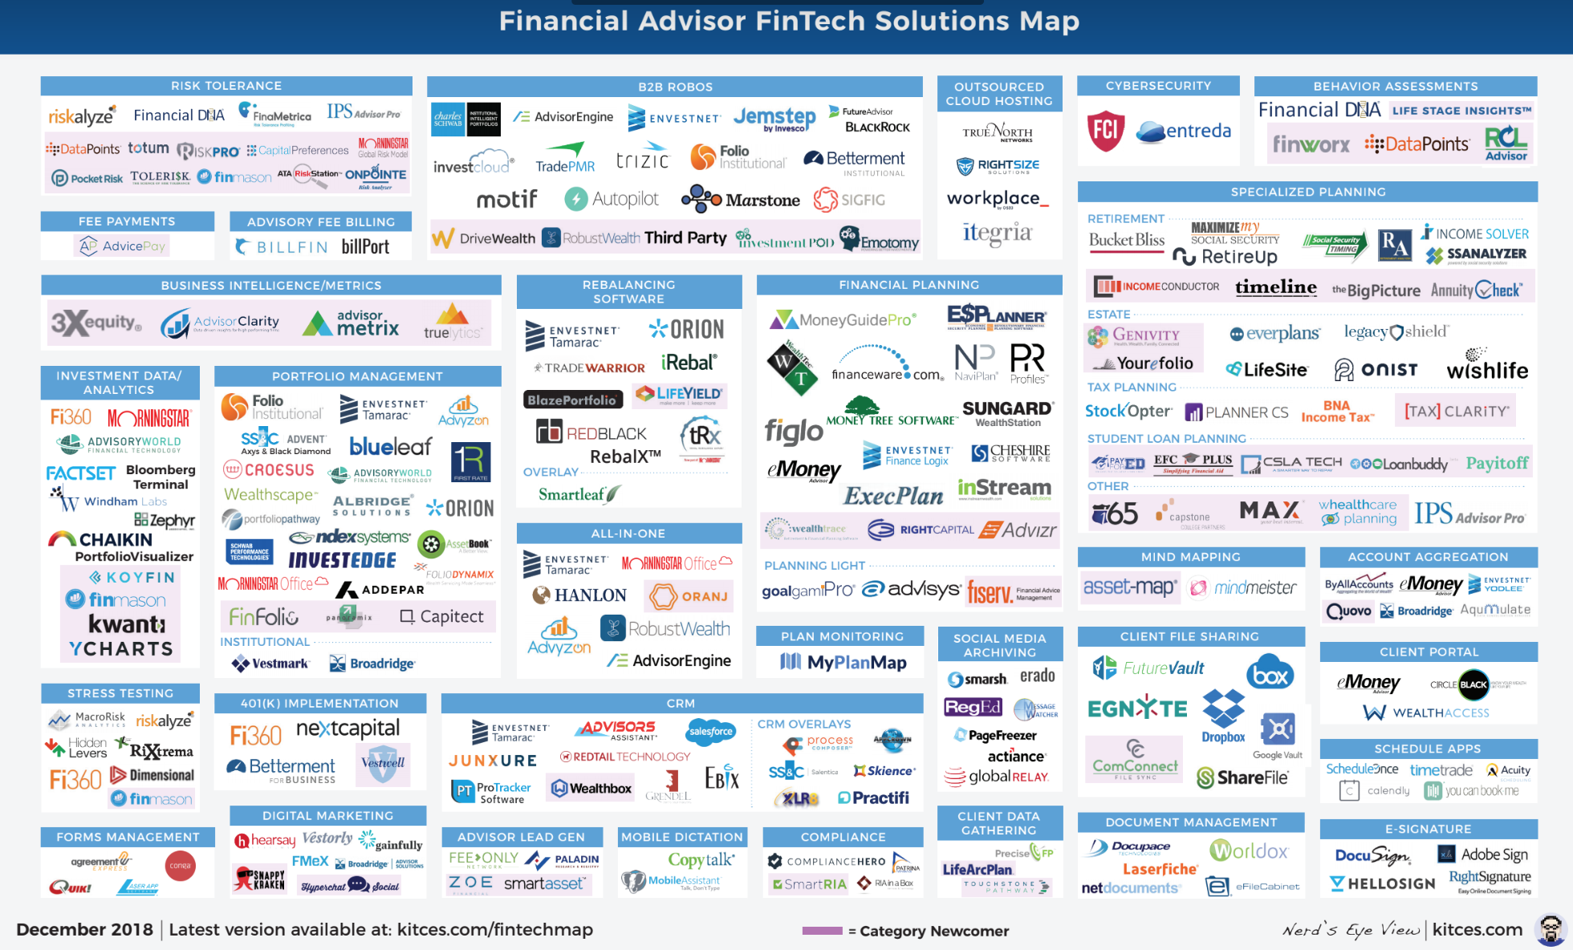
Financial Advisor FinTech Solutions
Source: https://www.kitces.com/fintechmap

Slide 62
A classic workflow for financial recommendations
Source: Musto, C., Semeraro, G., Lops, P., de Gemmis, M., & Lekkas, G. (2015).
Personalized finance advisory through case-based recommender systems and diversification strategies. Decision Support Systems, 77, 100-111.

Slide 63
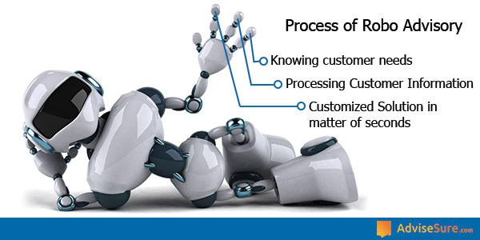
Process of Robo Advisors
Source: https://advisesure.com/blog/what-is-meaning-of-term-robo-advisor-and--their-benefits

Slide 64
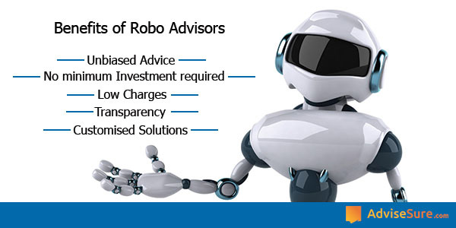
Benefits of Robo Advisors
Source: https://advisesure.com/blog/what-is-meaning-of-term-robo-advisor-and--their-benefits

Slide 65
Robo-Advisor Business Models
Full service online Robo-advisor
  100% automated without any human element
Hybrid Robo-advisor model
  being pioneered by firms like
  Vanguard & Charles Schwab
Pure online advisor
  primarily human in nature
Source: http://www.vamsitalkstech.com/?p=2329

Slide 66
Robo-Advisor Business Models
Full service online Robo-advisor
  100% automated without any human element
Hybrid Robo-advisor model
  being pioneered by firms like
  Vanguard & Charles Schwab
Pure online advisor
  primarily human in nature
Source: http://www.vamsitalkstech.com/?p=2329

Slide 67
Usecases of Robo-Advisors
Determine individual Client profiles & preferences
Identify appropriate financial products
Establish correct Investment Mix for the client’s profile
Using a algorithmic approach, choose the appropriate securities for each client account
Continuously monitor the portfolio & transactions within it to tune performance
Provide value added services
Ensure the best user experience by handling a whole range of financial services
Source: http://www.vamsitalkstech.com/?p=2418

Slide 68
Business Requirements for a Robo-Advisor (RA)
Collect Individual Client Data
Client Segmentation
Algorithm Based Investment Allocation
Portfolio Rebalancing
Tax Loss Harvesting
A Single View of a Client’s Financial History
Source: http://www.vamsitalkstech.com/?p=2354

Slide 69
Algorithms for a Robo-Advisor (RA)
Leverage data science & statistical modeling to automatically allocate client wealth across different asset classes (such as domestic/foreign stocks, bonds & real estate related securities) to automatically rebalance portfolio positions based on changing market conditions or client preferences.
  These investment decisions are also made based on detailed behavioral understanding of a client’s financial journey metrics
  – Age, Risk Appetite & other related information.
Source: http://www.vamsitalkstech.com/?p=2354

Slide 70
Algorithms for a Robo-Advisor (RA)
RA platforms also provide
24×7 tracking of market movements
to use that to track rebalancing decisions
from not just a portfolio standpoint
but also from a taxation standpoint.
Source: http://www.vamsitalkstech.com/?p=2354

Slide 71
Algorithms for a Robo-Advisor (RA)
A mixture of different algorithms
can be used such as
Modern Portfolio Theory (MPT),
Capital Asset Pricing Model (CAPM),
the Black Litterman Model,
the Fama-French etc.
  These are used to allocate assets as well as to adjust positions based on market movements and conditions.
Source: http://www.vamsitalkstech.com/?p=2354

Slide 72
Robo-Advisor (RA) Sample Portfolios
Sample Portfolios – for an aggressive investor
1. Equity – 85%
A) US Domestic Stock (50%)
– Large Cap – 30%, Medium Cap – 10% , Small Cap – 10%, Dividend Stocks – 0%
B) Foreign Stock – (35%)
– Emerging Markets – 18%, Developed Markets – 17%
2. Fixed Income – 5%
A) Developed Market Bonds – 2%
B) US Bonds – 1%
C) International Bonds – 1%
D) Emerging Markets Bonds – 1%
3. Other – 5%
A) Real Estate – 3%
B) Currencies – 0%
C) Gold and Precious Metals – 0%
D) Commodities – 2%
4. Cash – 5%
Source: http://www.vamsitalkstech.com/?p=2354

Slide 73
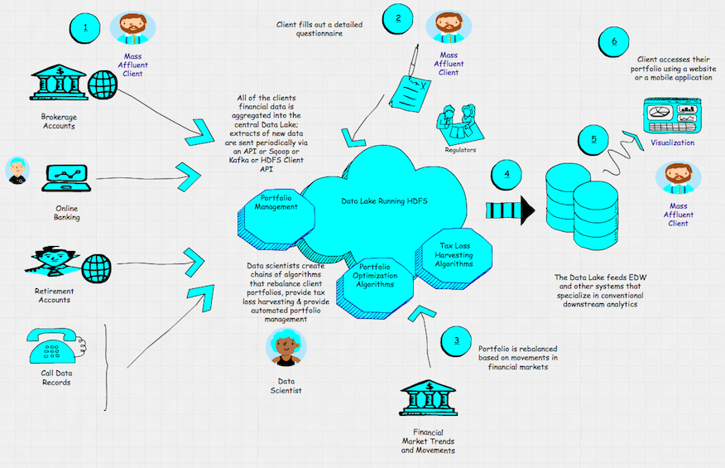
Architecture of a Robo-Advisor (RA)
Source: http://hortonworks.com/blog/architecture-of-a-roboadvisor/

Slide 74


Robo-Advisor

Slide 75
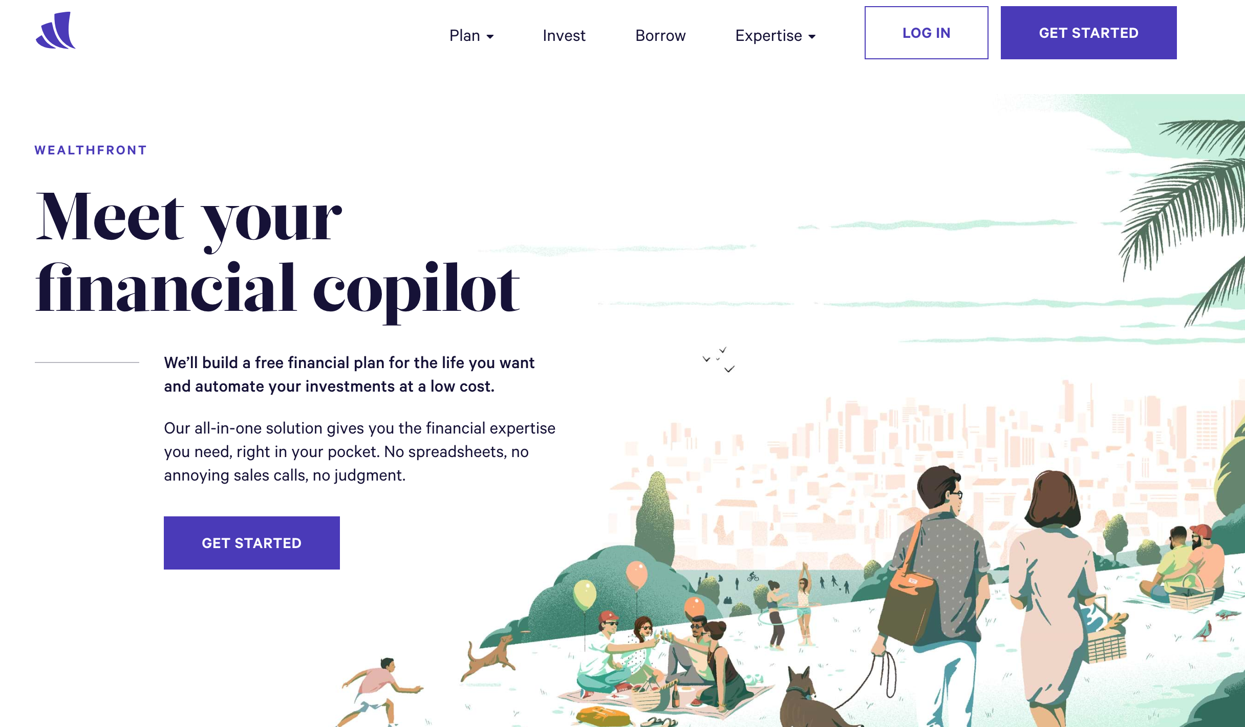
Wealthfront
Financial Planning & Robo-Investing for Millennials
https://www.wealthfront.com/

Slide 76
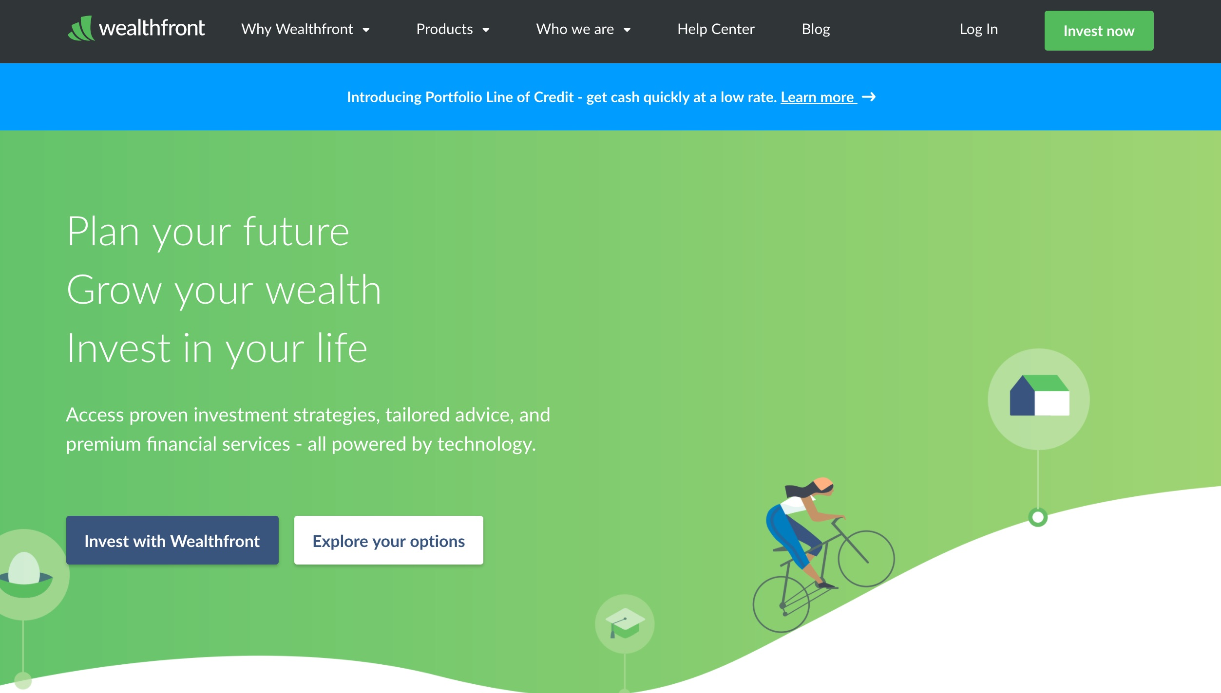
Wealthfront: Fintech Robo Advisor
https://www.wealthfront.com/

Slide 77
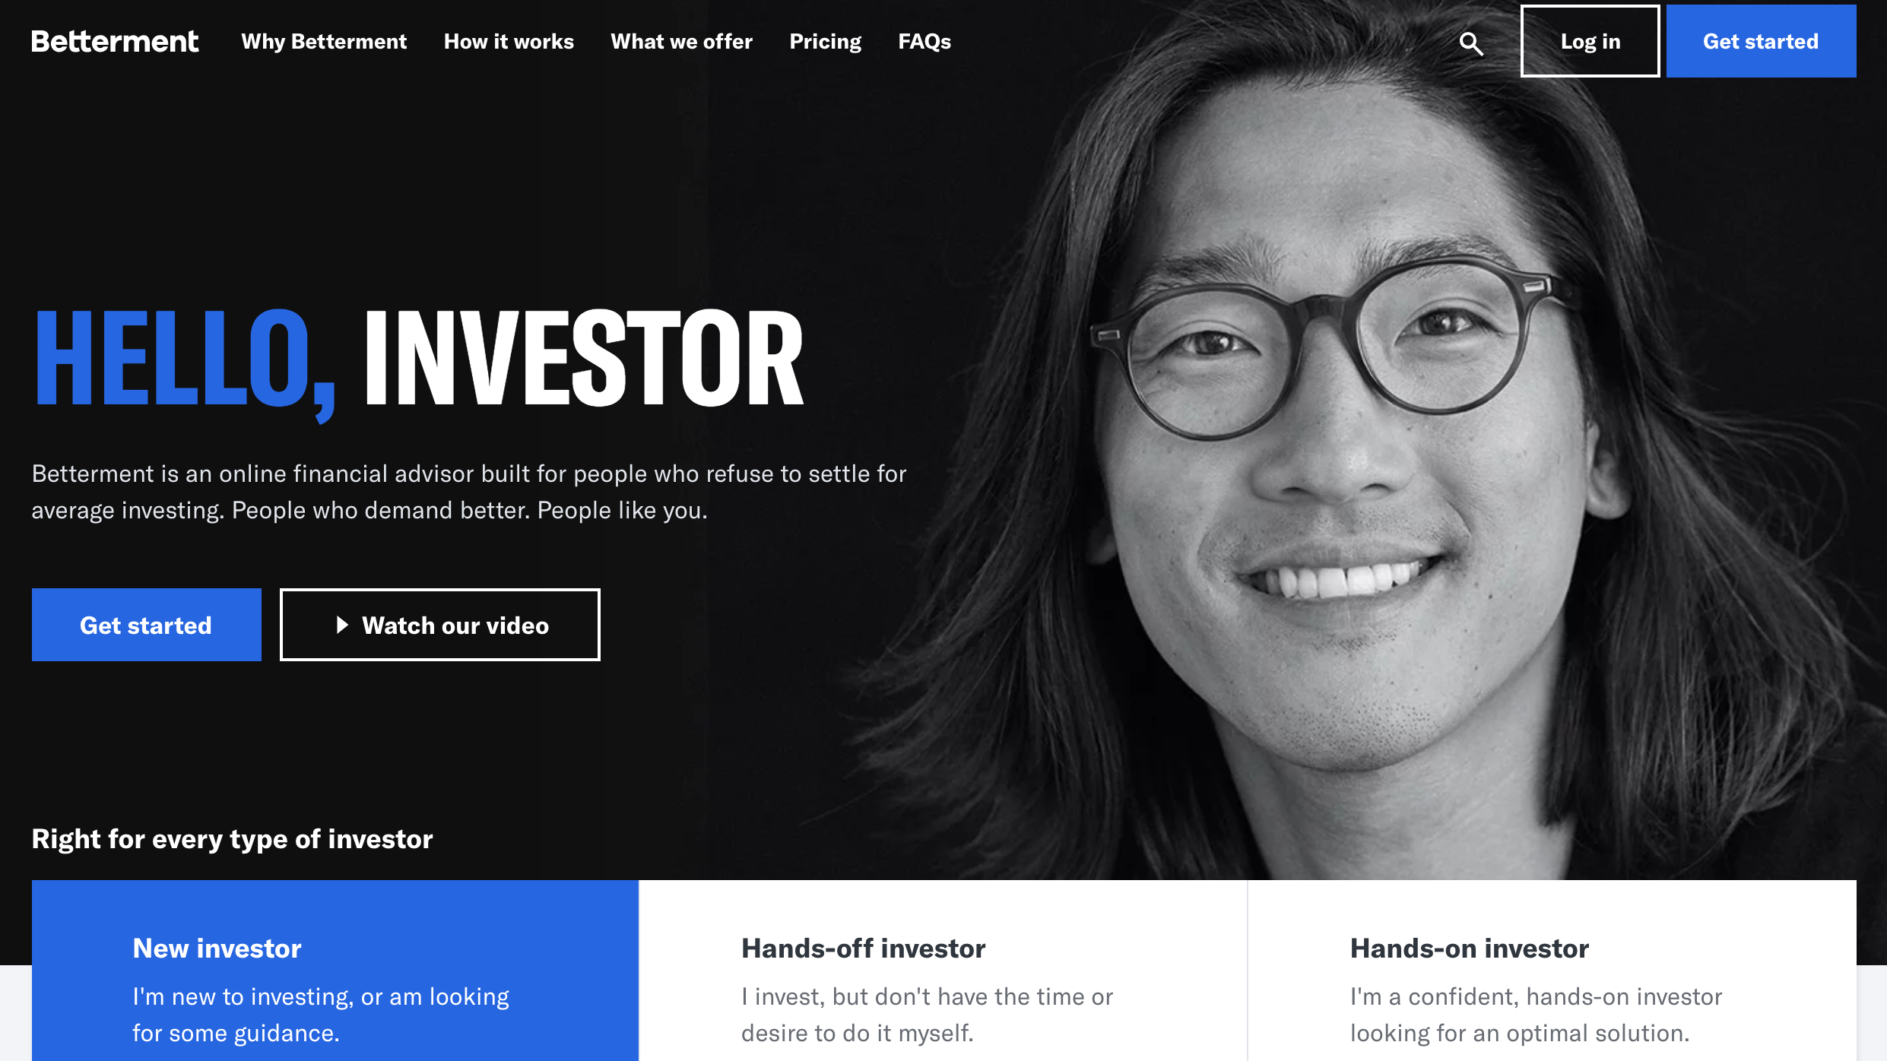
Betterment
Online Financial Advisor
https://www.betterment.com/

Slide 78
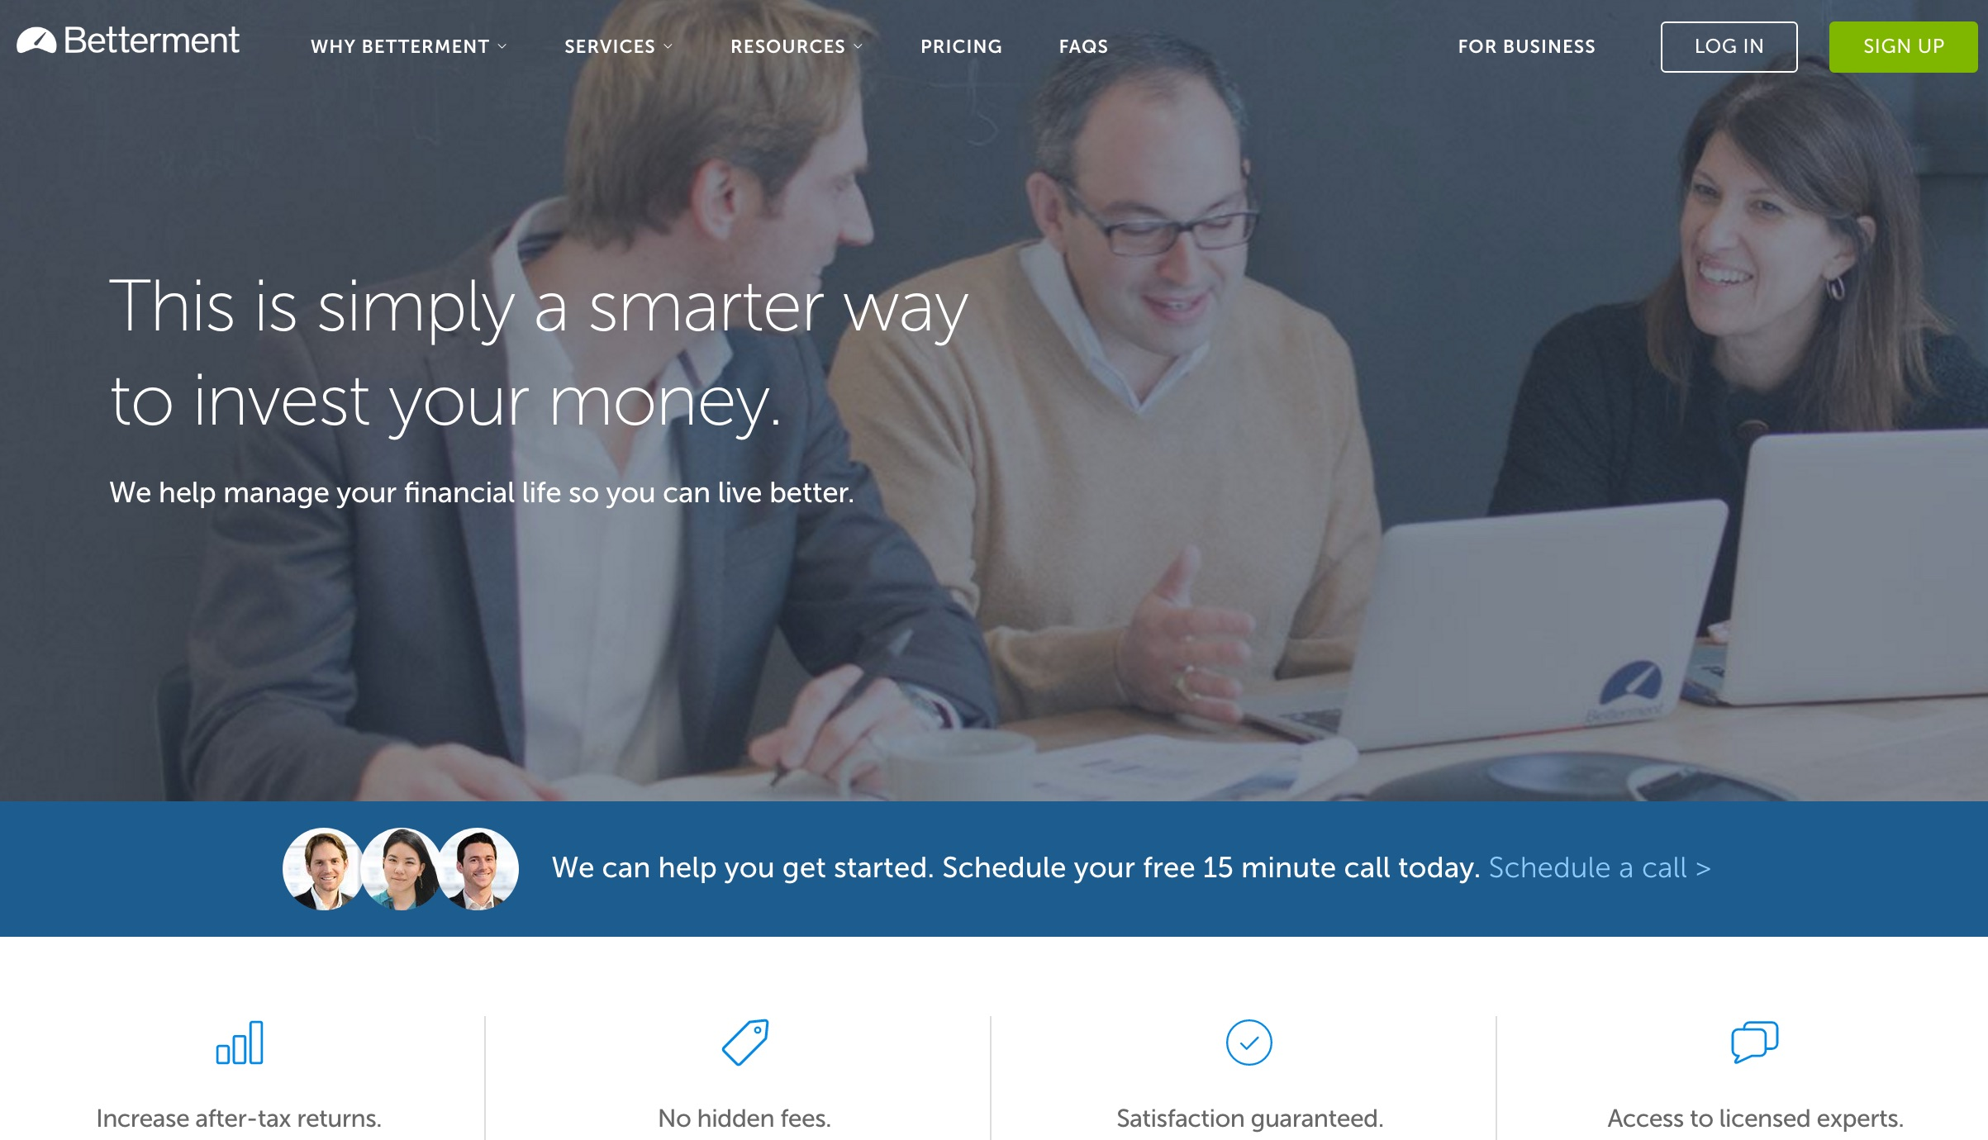
Betterment: Fintech Robo Advisor
Source: https://www.betterment.com/

Slide 79
Betterment vs. Wealthfront
Robo-Advisor | Betterment | Wealthfront
Investor Junkie Rating | 4.5 star | 5 star
Promotions | One Month Free | First $15k for Free
Fees | 0.25%/yr | None first $10k;
 |  | 0.25%/yr for more
Minimum Deposit | None | $500
Human Advisors | Yes — Additional Fee | No
Automatic Rebalancing | Yes | Yes
Tax Loss Harvesting | Yes | Yes
Direct Indexing | No | Yes
Fractional Shares | Yes | No
Assets Under Management | $8.0B | $5.0B
Source: https://investorjunkie.com/36355/betterment-vs-wealthfront/

Slide 80
Wealthfront:
0.25%
Flat annual advisory fee
No trading commissions or hidden fees
Portfolio of low-cost ETFs
Your first $10,000 managed free
Source: https://www.wealthfront.com/

Slide 81

Wealthfront
Powering your financial life with technology
Source: https://www.wealthfront.com/

Slide 82
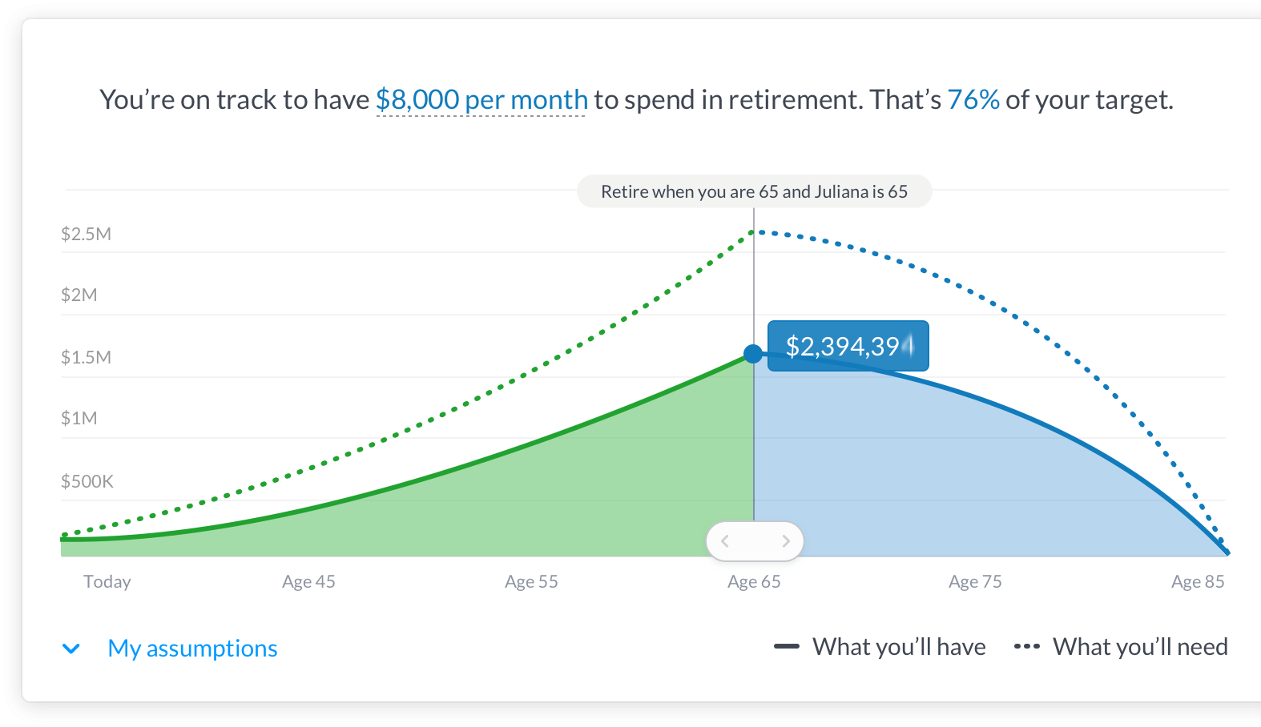
Wealthfront Robo Advisor
Source: https://www.wealthfront.com/

Slide 83
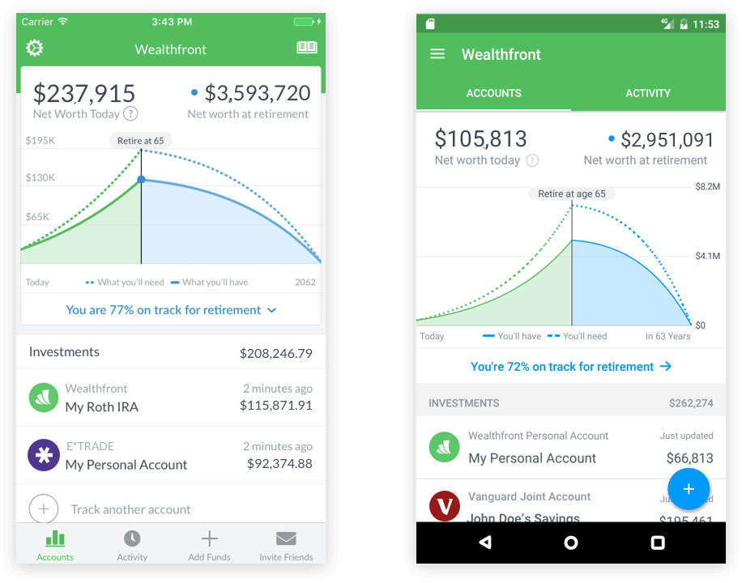
Wealthfront Robo Advisor
Source: https://www.wealthfront.com/

Slide 84
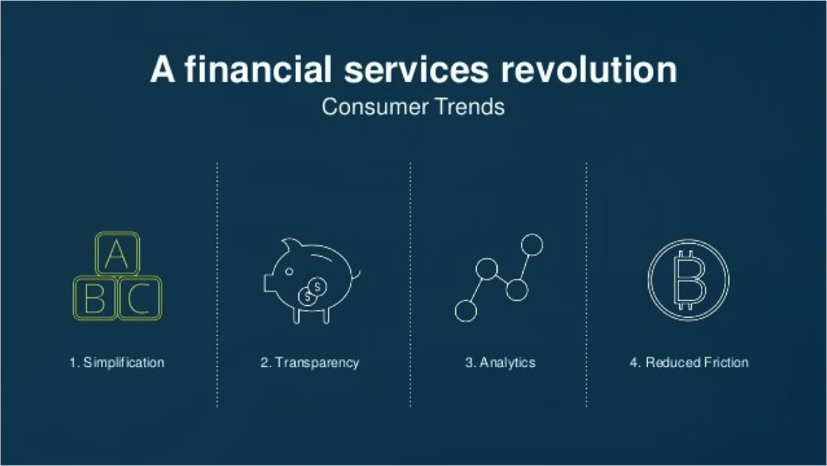
Financial Revolution with Fintech
Source: http://www.hedgethink.com/fintech/european-fintech-top-100/

Slide 85
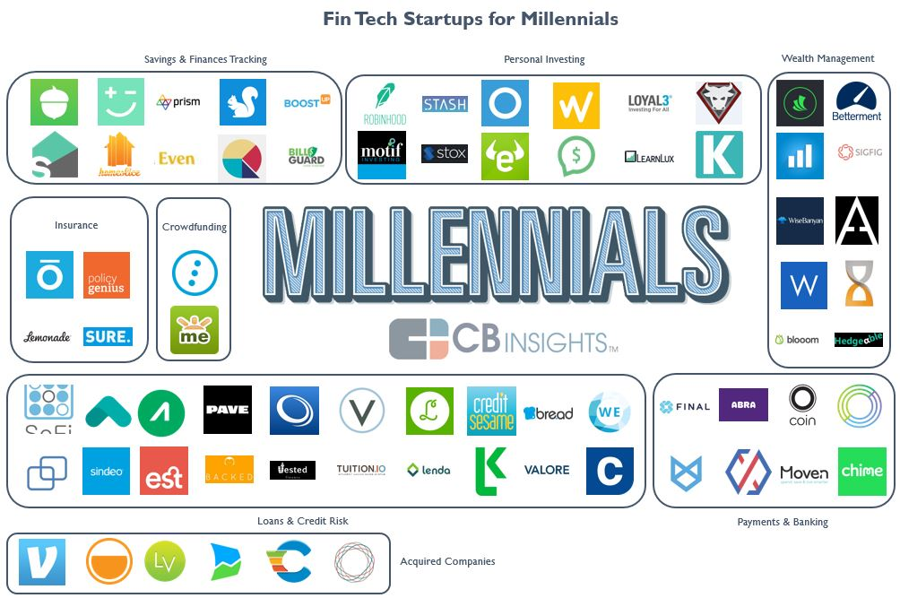
Millennial Personal Finance: 63 Fintech Startups Targeting Millennials
Source: https://www.cbinsights.com/blog/fin-tech-startups-millennials/

Slide 86
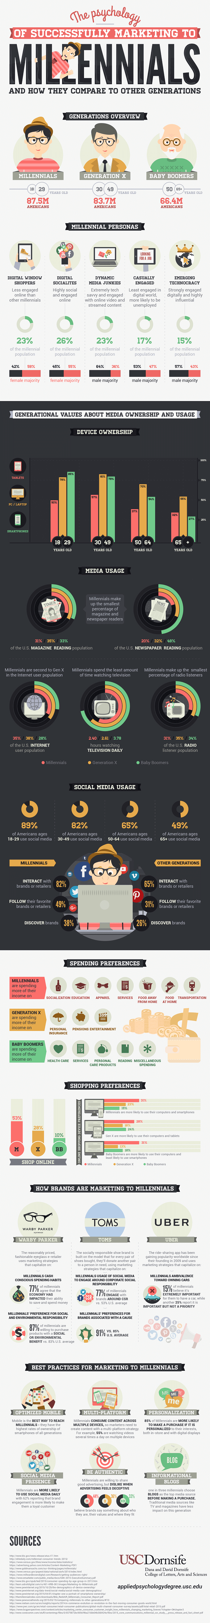
Marketing to Millenials
Source: http://www.digitalinformationworld.com/2016/07/infographic-how-millennials-view-your-site-and-why-it-matters.html?utm_source=feedburner&utm_medium=email&utm_campaign=Feed:+blogspot/qtdAg+(Digital+Information+World)

Slide 87
Marketing to Millenials
Source: http://www.digitalinformationworld.com/2016/07/infographic-how-millennials-view-your-site-and-why-it-matters.html?utm_source=feedburner&utm_medium=email&utm_campaign=Feed:+blogspot/qtdAg+(Digital+Information+World)

Slide 88
Marketing to Millenials
Source: http://www.digitalinformationworld.com/2016/07/infographic-how-millennials-view-your-site-and-why-it-matters.html?utm_source=feedburner&utm_medium=email&utm_campaign=Feed:+blogspot/qtdAg+(Digital+Information+World)

Slide 89
Fintech for Millennials
Fintech Category | #Company
Crowdfunding | 2
Insurance (Non-Health) | 4
Loans & Credit Risk | 20
Mobile Banking & Payments | 8
Personal Investing | 10
Savings & Finances Tracking | 10
Wealth Management | 9
Total | 63
Source: https://www.cbinsights.com/blog/fin-tech-startups-millennials/

Slide 90
Fintech: Wealth Management
Company | Select Investors
Wealthfront | DAG Ventures, Index Ventures, Greylock Partners, The Social+Capital Partnership
Betterment | Bessemer Venture Partners, Athemis Group, Menlo Ventures
SigFig | Doll Capital Management, Union Square Ventures, Bain Capital Ventures
Aspiration | Renren, GSV Capital, Capricorn Investment Group, IGSB
Blooom | Commerce Ventures, DST Systems, Hyde Park VP, QED Investors, UMB Financial
Rebalance IRA | N/A
Hedgeable | SixThirty
WiseBanyan | VegasTech Fund
Personal Capital | Institutional Venture Partners, Venrock, Crosslink Capital
Source: https://www.cbinsights.com/blog/fin-tech-startups-millennials/

Slide 91
Fintech: Personal Investing
Company | Select Investors
eToro | BRM Group, Ping An Ventures, Spark Capital
Openfolio | FinTech Collective
DriveWealth | Route 66 Ventures
Tip’d Off | Raj Parekh, Bill Crane, Shaun Coleman
Kapitall | Bendigo Partners, Linden Venture Fund
Stash | N/A
Stox | SingulariTeam
Robinhood | Google Ventures, Index Ventures, Andreessen Horowitz, Ribbit Capital, NEA
Motif Investing | Norwest Venture Partners, Foundation Capital, Ignition Capital, Goldman Sachs
Loyal3 | DNS Capital
Source: https://www.cbinsights.com/blog/fin-tech-startups-millennials/

Slide 92
Wealthfront
Investment Methodology
Identify an ideal set of asset classes for the current investment environment
Select low cost ETFs to represent each asset class
Determine your risk tolerance to create the appropriate portfolio for you
Apply Modern Portfolio Theory to allocate among the chosen asset classes for your risk tolerance
Monitor and periodically rebalance your portfolio
Source: https://research.wealthfront.com/whitepapers/investment-methodology/

Slide 93
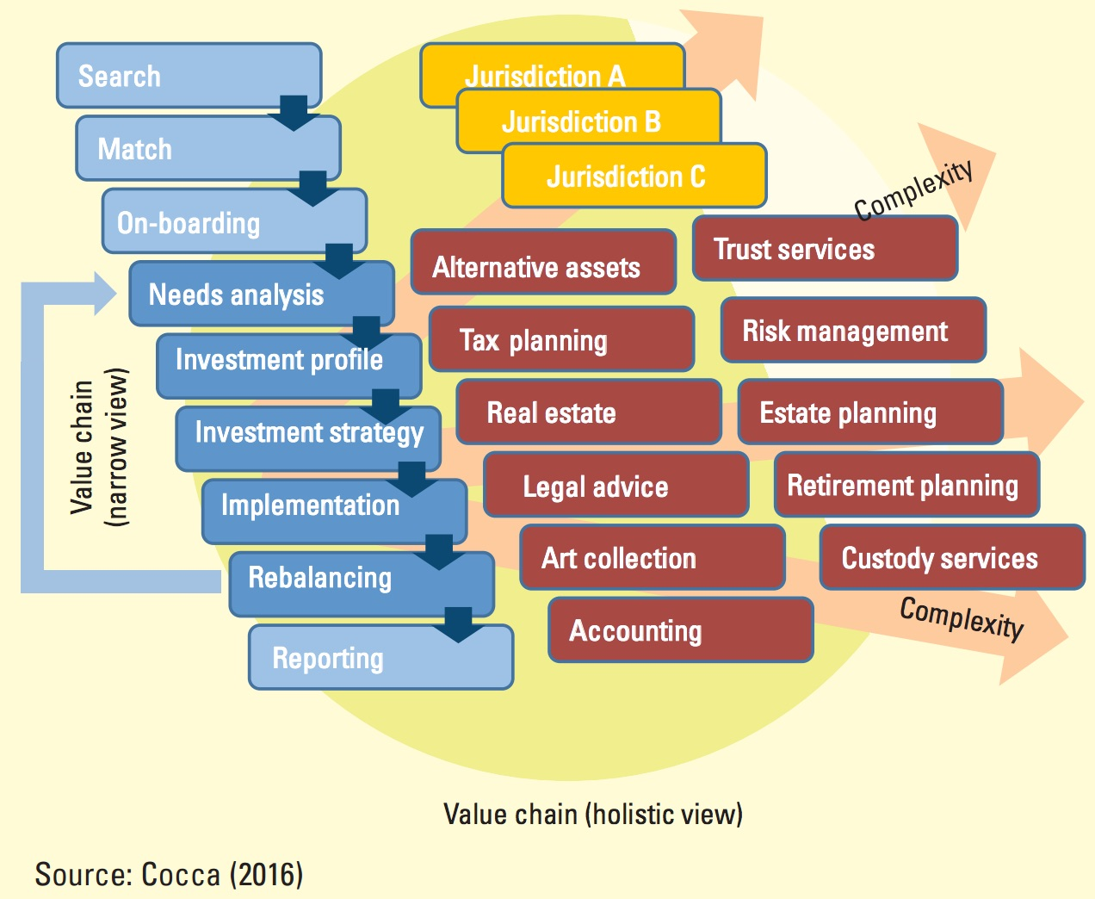
Wealth Management Value Chain
Source: Cocca, Teodoro (2016). "Potential and Limitations of Virtual Advice in Wealth Management." Journal of Financial Transformation, 44, 45-57.

Slide 94
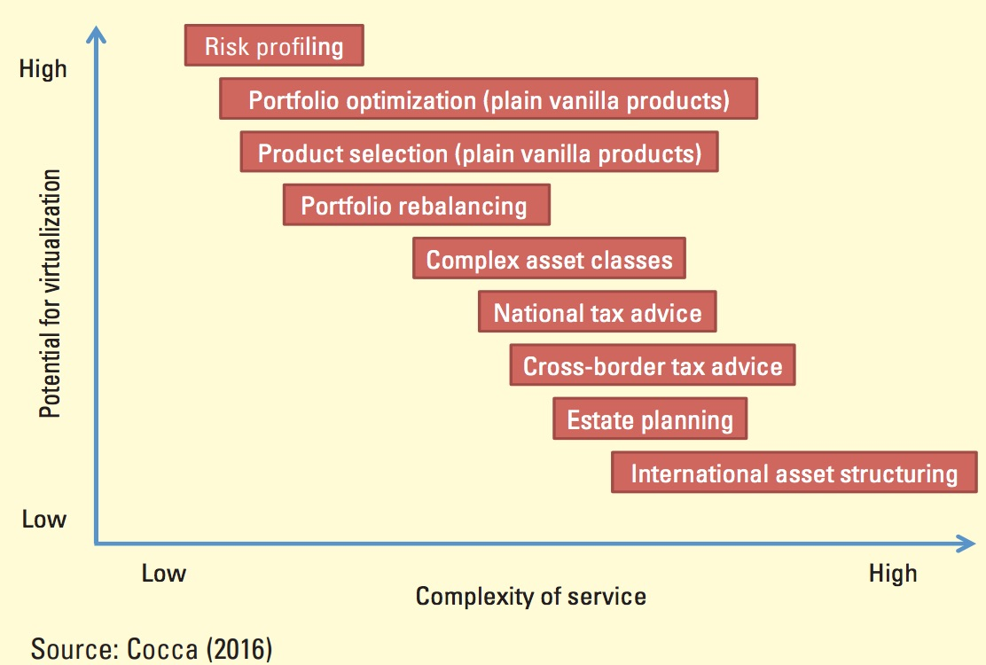
Wealth Management Service and
Potential for virtualization
Source: Cocca, Teodoro (2016). "Potential and Limitations of Virtual Advice in Wealth Management." Journal of Financial Transformation, 44, 45-57.

Slide 95
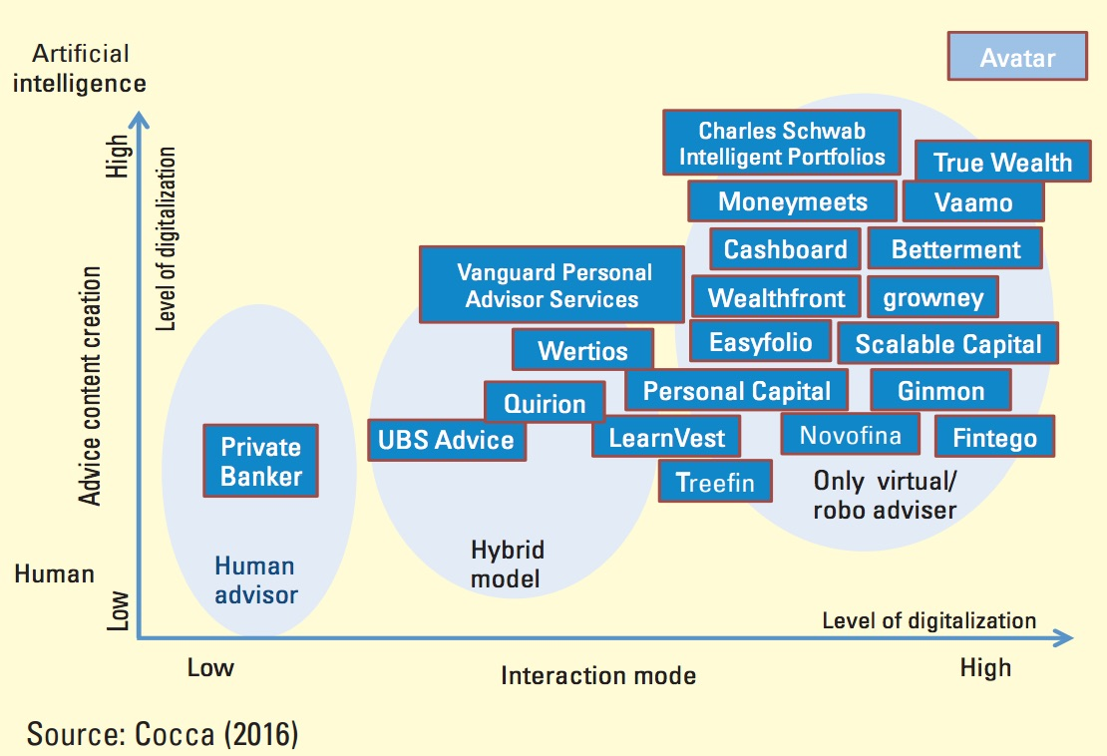
AI and Robo Advisor Virtualization Dimensions
Source: Cocca, Teodoro (2016). "Potential and Limitations of Virtual Advice in Wealth Management." Journal of Financial Transformation, 44, 45-57.

Slide 96
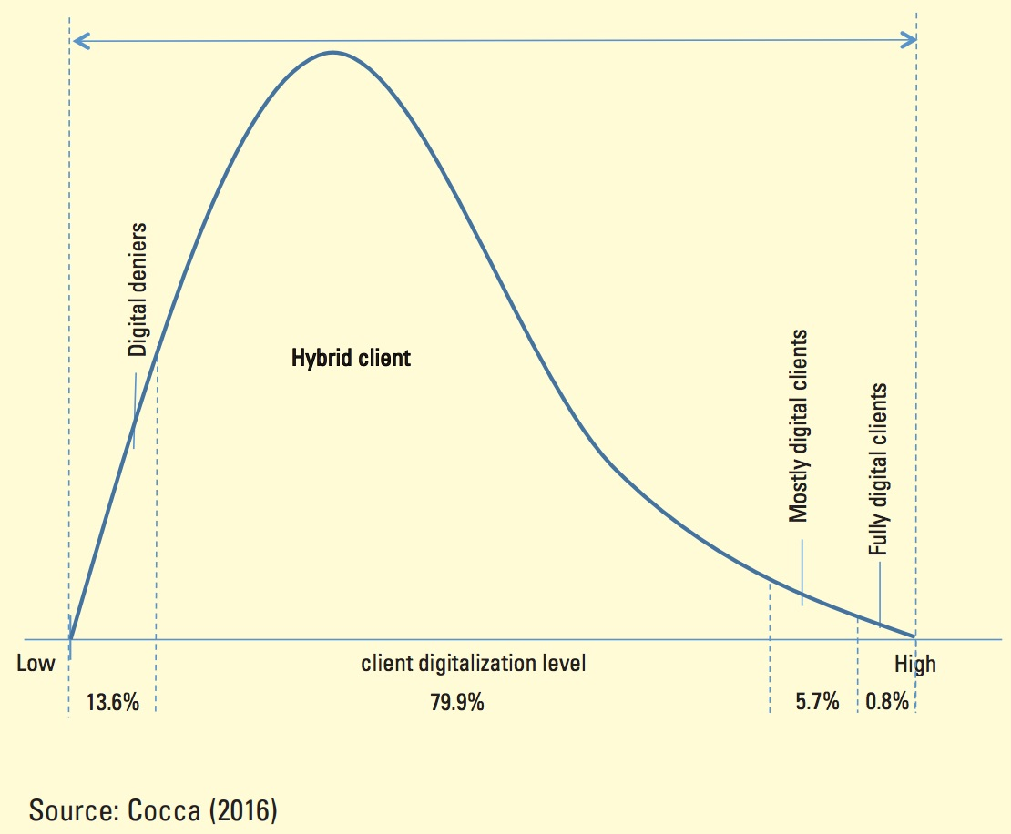
Degree of Digitalization of
Wealth Management Customers
Source: Cocca, Teodoro (2016). "Potential and Limitations of Virtual Advice in Wealth Management." Journal of Financial Transformation, 44, 45-57.

Slide 97
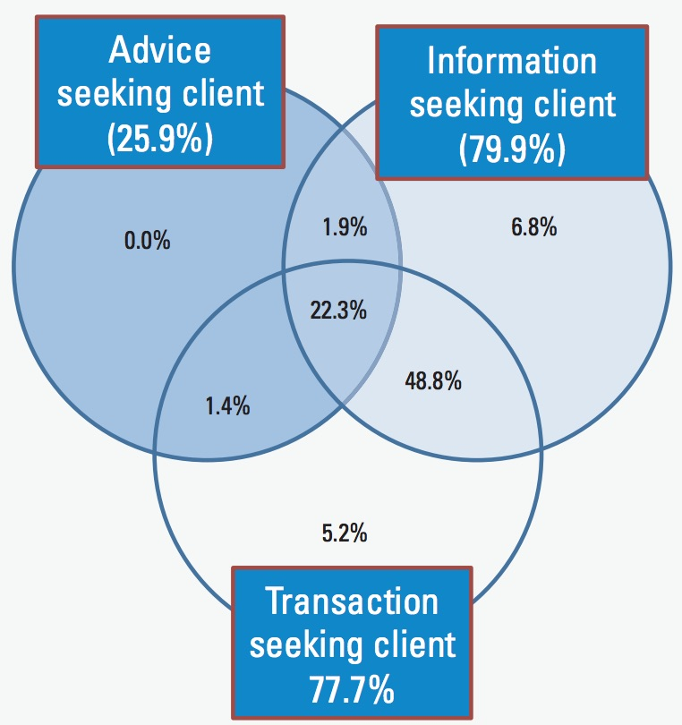
Use of Online Services by
Hybrid Customers
Source: Cocca, Teodoro (2016). "Potential and Limitations of Virtual Advice in Wealth Management." Journal of Financial Transformation, 44, 45-57.

Slide 98
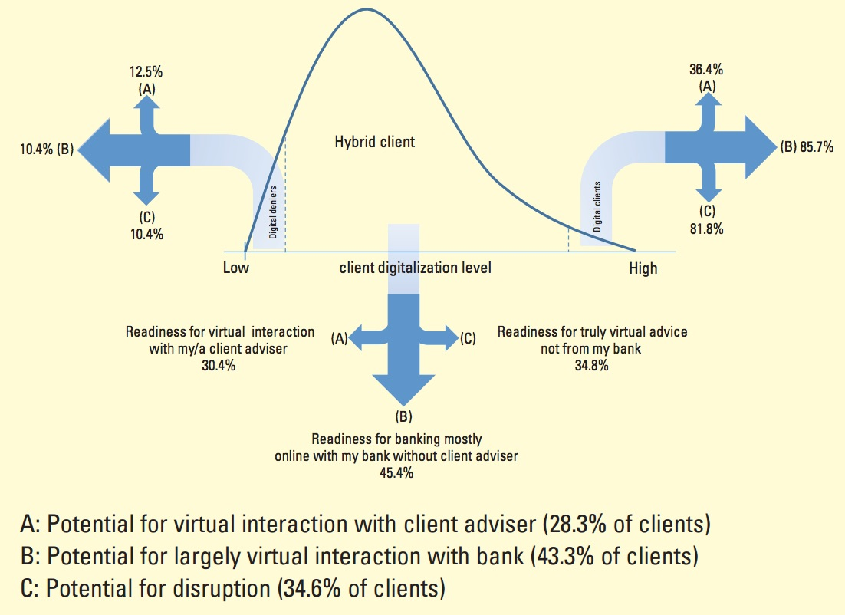
Use of Online Services by
Hybrid Customers
Source: Cocca, Teodoro (2016). "Potential and Limitations of Virtual Advice in Wealth Management." Journal of Financial Transformation, 44, 45-57.

Slide 99
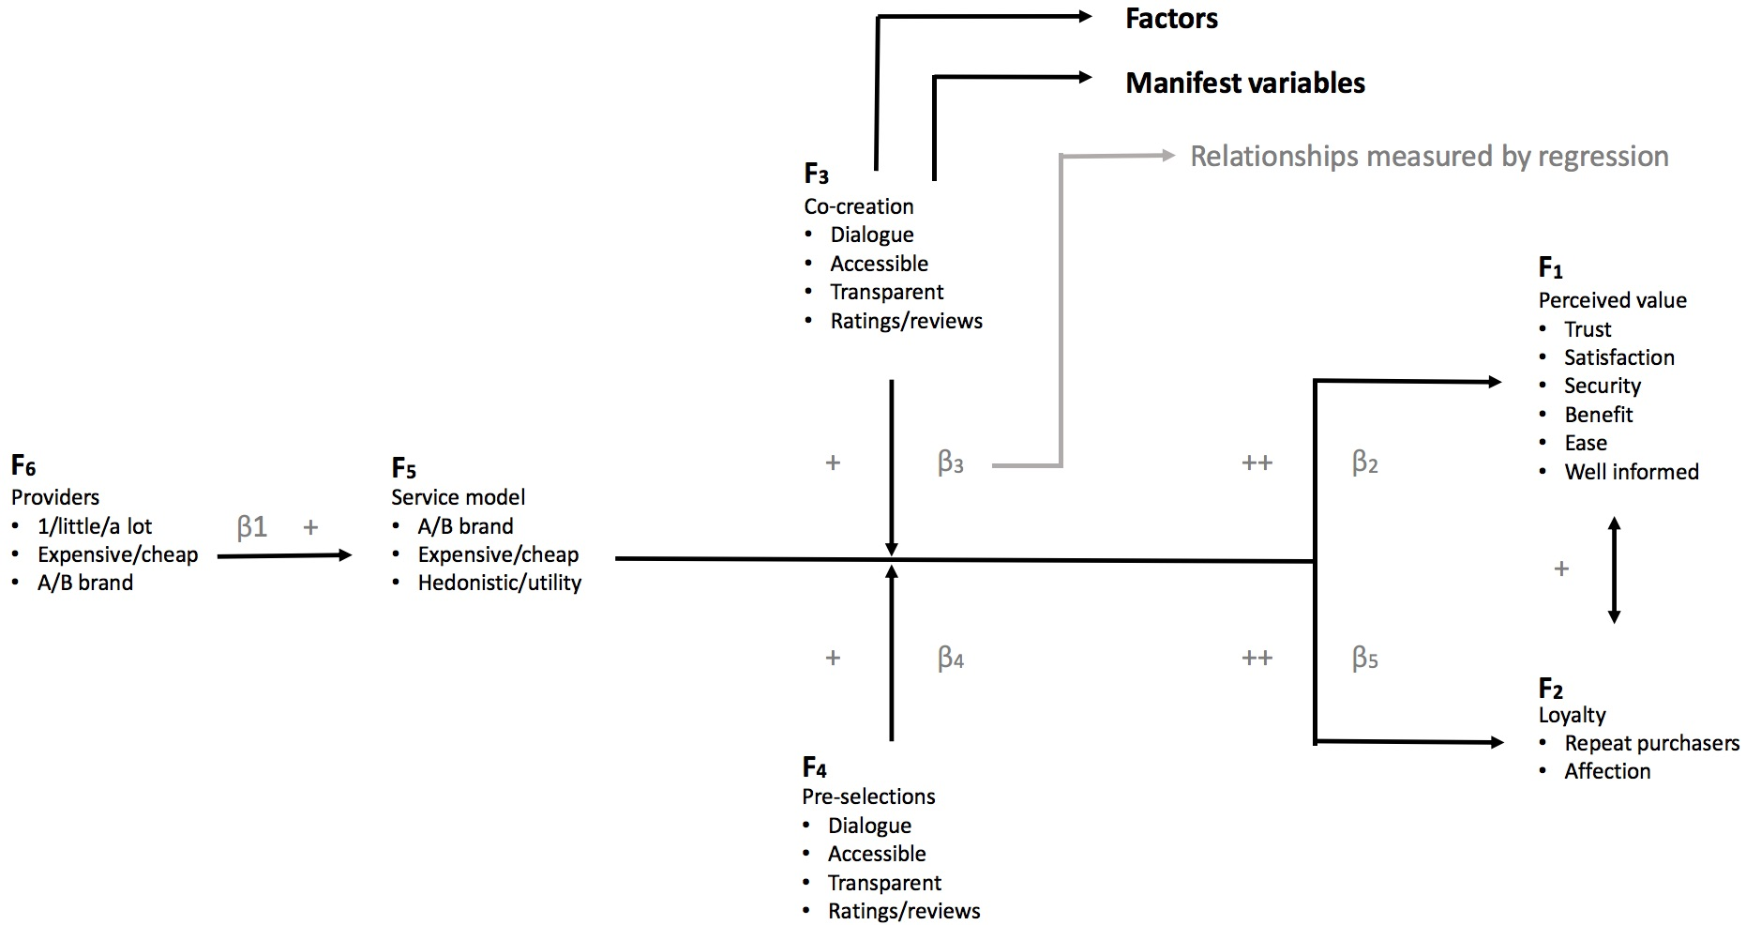
Explaining Customer Experience of Digital Financial Advice
Source: Van Thiel, Diederick, and Fred Van Raaij (2017). "Explaining Customer Experience of Digital Financial Advice." Economics 5, no. 1, 69-84.

Slide 100
Modern Portfolio Theory and Investment Analysis
Financial Securities
Financial Markets
The Characteristics of the Opportunity Set Under Risk
Delineating Efficient Portfolios
Techniques for Calculating the Efficient Frontier
Source: Edwin J. Elton, Martin J. Gruber, Stephen J. Brown, and William N. Goetzmann (2014),
Modern Portfolio Theory and Investment Analysis, 9th Edition, Wiley.

Slide 101
Modern Portfolio Theory and Investment Analysis
The Correlation Structure of Security Returns:
  The Single-Index Model
  Multi-Index Models and Grouping Techniques
Simple Techniques for Determining the Efficient Frontier
Estimating Expected Returns
How to Select Among the Portfolios in the Opportunity Set
Source: Edwin J. Elton, Martin J. Gruber, Stephen J. Brown, and William N. Goetzmann (2014),
Modern Portfolio Theory and Investment Analysis, 9th Edition, Wiley.

Slide 102
Modern Portfolio Theory and Investment Analysis
International Diversification
The Standard Capital Asset Pricing Model
Nonstandard Forms of Capital Asset Pricing Models
Empirical Tests of Equilibrium Models
The Arbitrage Pricing Model APT
  A Multifactor Approach to Explaining Asset Prices
Source: Edwin J. Elton, Martin J. Gruber, Stephen J. Brown, and William N. Goetzmann (2014),
Modern Portfolio Theory and Investment Analysis, 9th Edition, Wiley.

Slide 103
Modern Portfolio Theory and Investment Analysis
Efficient Markets
The Valuation Process
Earnings Estimation
Behavioral Finance, Investor Decision Making, and Asset Prices
Interest Rate Theory and the Pricing of Bonds
The Management of Bond Portfolios
Source: Edwin J. Elton, Martin J. Gruber, Stephen J. Brown, and William N. Goetzmann (2014),
Modern Portfolio Theory and Investment Analysis, 9th Edition, Wiley.

Slide 104
Modern Portfolio Theory and Investment Analysis
Option Pricing Theory
The Valuation and Uses of Financial Futures
Mutual Funds
Evaluation of Portfolio Performance
Evaluation of Security Analysis
Portfolio Management Revisited
Source: Edwin J. Elton, Martin J. Gruber, Stephen J. Brown, and William N. Goetzmann (2014),
Modern Portfolio Theory and Investment Analysis, 9th Edition, Wiley.

Slide 105
The New Alpha: 30+ Startups Providing Alternative Data For Sophisticated Investors
New sources of data mined by startups like Foursquare, Premise, and Orbital Insight are letting investors understand trends before they happen.
Source: https://www.cbinsights.com/blog/alternative-data-startups-market-map-company-list/

Slide 106
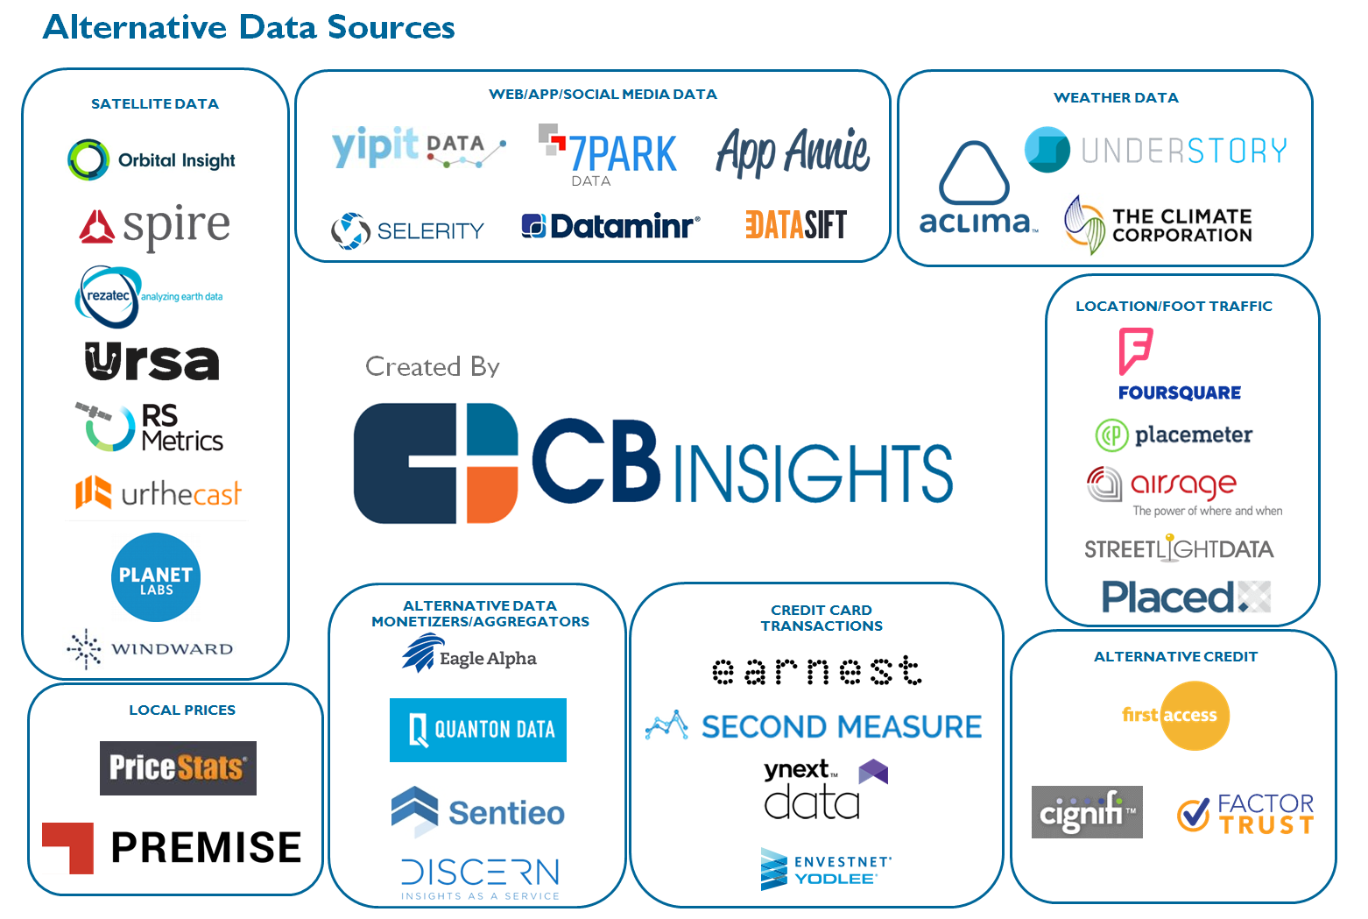
The New Alpha: 30+ Startups Providing Alternative Data For Sophisticated Investors
Source: https://www.cbinsights.com/blog/alternative-data-startups-market-map-company-list/

Slide 107
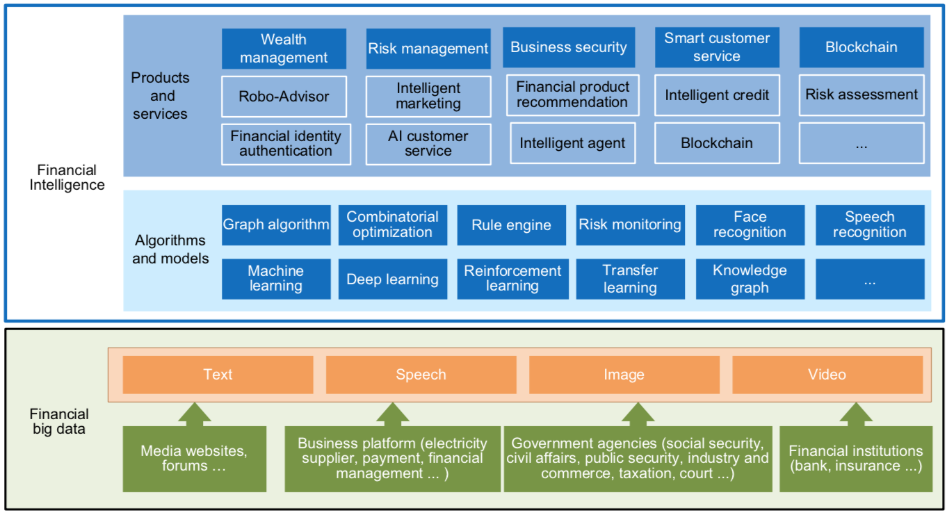
FinBrain: when Finance meets AI 2.0
(Zheng et al., 2019)
Source: Xiao-lin Zheng, Meng-ying Zhu, Qi-bing Li, Chao-chao Chen, and Yan-chao Tan (2019), "Finbrain: When finance meets AI 2.0." Frontiers of Information Technology & Electronic Engineering 20, no. 7, pp. 914-924

Slide 108
Technology-driven
Financial Industry Development
Development stage | Driving technology | Main landscape | Inclusive finance | Relationship between technology and finance
Fintech 1.0 (financial IT) | Computer | Credit card, ATM, and CRMS | Low | Technology as a tool
Fintech 2.0 (Internet finance) | Mobile Internet | Marketplace lending, third-party payment, crowdfunding, and Internet insurance | Medium | Technology-driven change
Fintech 3.0 (financial intelligence) | AI, Big Data, Cloud Computing, Blockchain | Intelligent finance | High | Deep fusion
Source: Xiao-lin Zheng, Meng-ying Zhu, Qi-bing Li, Chao-chao Chen, and Yan-chao Tan (2019), "Finbrain: When finance meets AI 2.0." Frontiers of Information Technology & Electronic Engineering 20, no. 7, pp. 914-924

Slide 109
AI Humanoid
Robo-Advisor

Slide 110
AI Humanoid Robo-Advisor for Multi-channel Conversational Commerce
AI Portfolio
Asset Allocation
Multichannel
Platforms
Web
LINE
Facebook
Humanoid Robot
AI Conversation
Dialog System

Slide 111
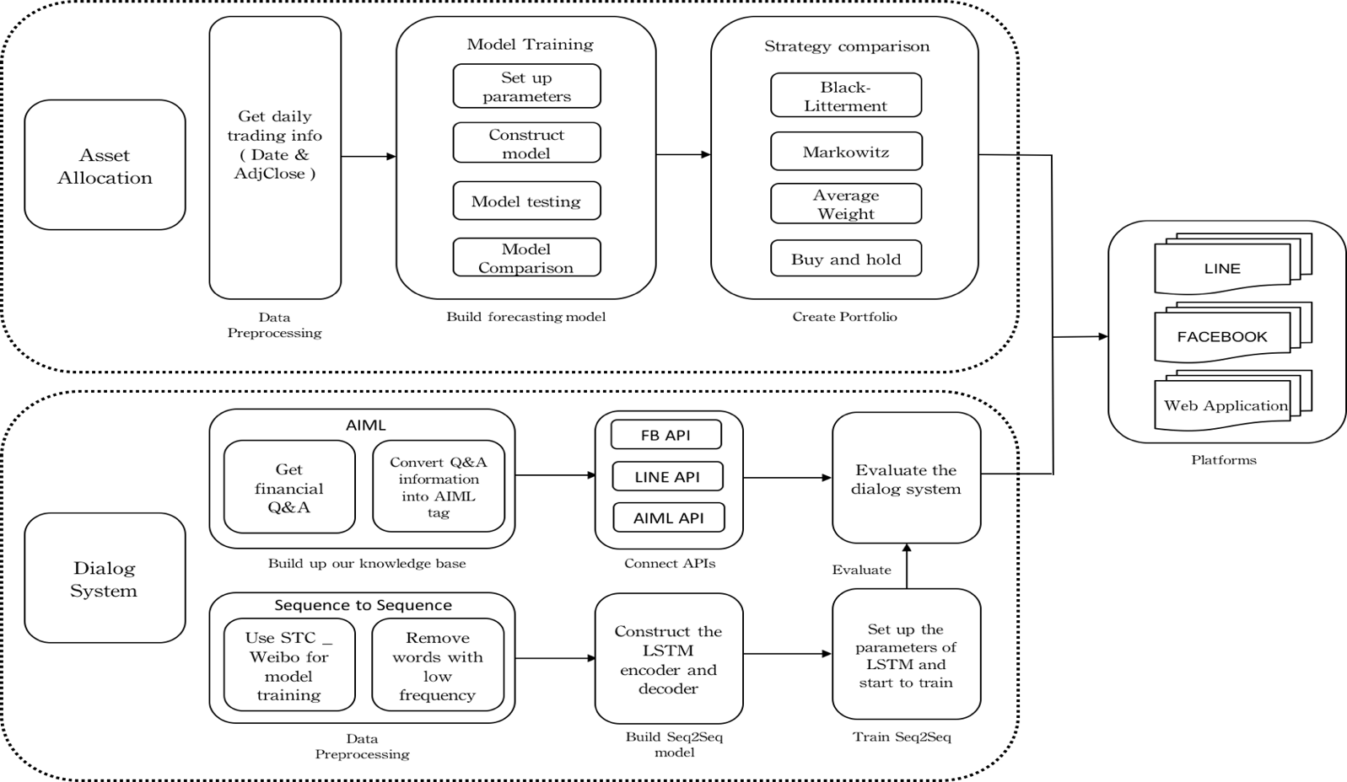
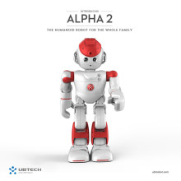

System Architecture of
AI Humanoid Robo-Advisor
AI Humanoid
Robo-advisor

Slide 112
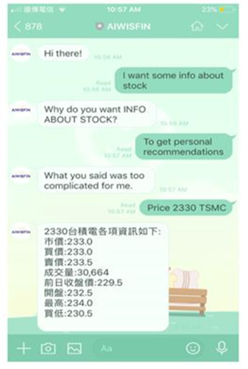
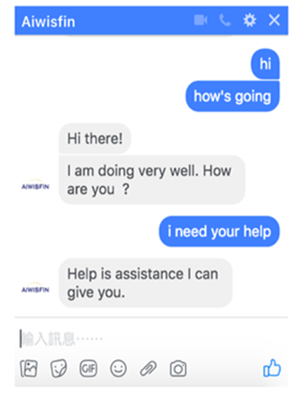
Conversational Model
(LINE, FB Messenger)

Slide 113

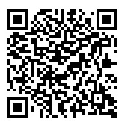
Conversational Robo-Advisor
Multichannel UI/UX
Robots
ALPHA 2
ZENBO

Slide 114
Portfolio Performance in 2016 Annual Portfolio Statistics
 | Black-Litterman Portfolio - the LSTM Investor Views | Markowitz Portfolio | Equally Weighted Portfolio | S&P 500 Index
Annual return | 16.151% | 15.172% | 12.428% | 9.643%
Annual volatility | 13.897% | 14.365% | 15.870% | 13.169%
Sharpe ratio | 1.14697 | 1.05534 | 0.81762 | 0.76492
Stability | 0.82500 | 0.82515 | 0.82514 | 0.78754
Max drawdown | -10.105% | -10.465% | -12.529% | -10.306%
Skew | -0.35652 | -0.52985 | -0.56976 | -0.36795
Kurtosis | 2.49845 | 3.00613 | 2.41894 | 2.21958
Daily value at risk | -1.688% | -1.750% | -1.948% | -1.619%
Alpha | 0.06445 | 0.05354 | 0.02158 | 0.00000
Beta | 1.01485 | 1.04816 | 1.15631 | 1.00000
Information ratio | 0.10935 | 0.09129 | 0.04655 | -
Source: Min-Yuh Day, Tun-Kung Cheng and Jheng-Gang Li (2018), "AI Robo-Advisor with Big Data Analytics for Financial Services", in Proceedings of the 2018 IEEE/ACM International Conference on Advances in Social Networks Analysis and Mining (ASONAM 2018), Barcelona, Spain, August 28-31, 2018.

Slide 115
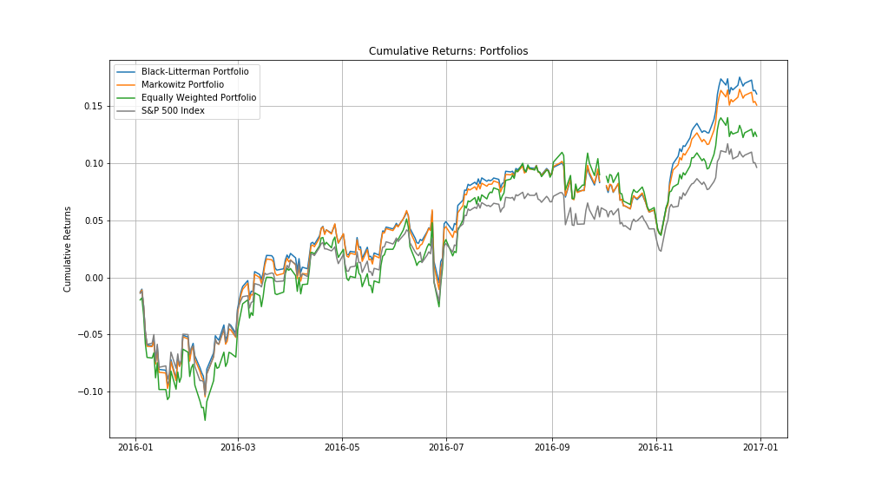
Portfolio Cumulative Returns
Source: Min-Yuh Day, Tun-Kung Cheng and Jheng-Gang Li (2018), "AI Robo-Advisor with Big Data Analytics for Financial Services", in Proceedings of the 2018 IEEE/ACM International Conference on Advances in Social Networks Analysis and Mining (ASONAM 2018), Barcelona, Spain, August 28-31, 2018.

Slide 116
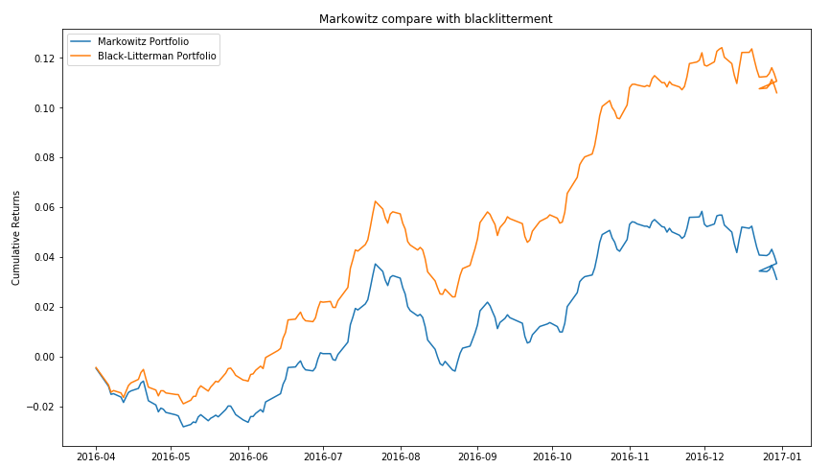
Cumulative Returns
Markowitz v.s. Black-litterment
Source: Min-Yuh Day, Jian-Ting Lin and Yuan-Chih Chen (2018), "Artificial Intelligence for Conversational Robo-Advisor", in Proceedings of the 2018 IEEE/ACM International Conference on Advances in Social Networks Analysis and Mining (ASONAM 2018), Barcelona, Spain, August 28-31, 2018

Slide 117
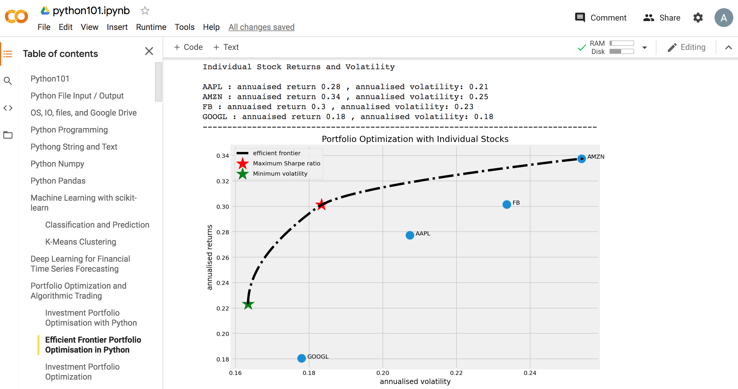
Python in Google Colab (Python101)
https://colab.research.google.com/drive/1FEG6DnGvwfUbeo4zJ1zTunjMqf2RkCrT
Portfolio Optimization and Algorithmic Trading
Efficient Frontier Portfolio Optimisation in Python
https://tinyurl.com/aintpupython101

Slide 118
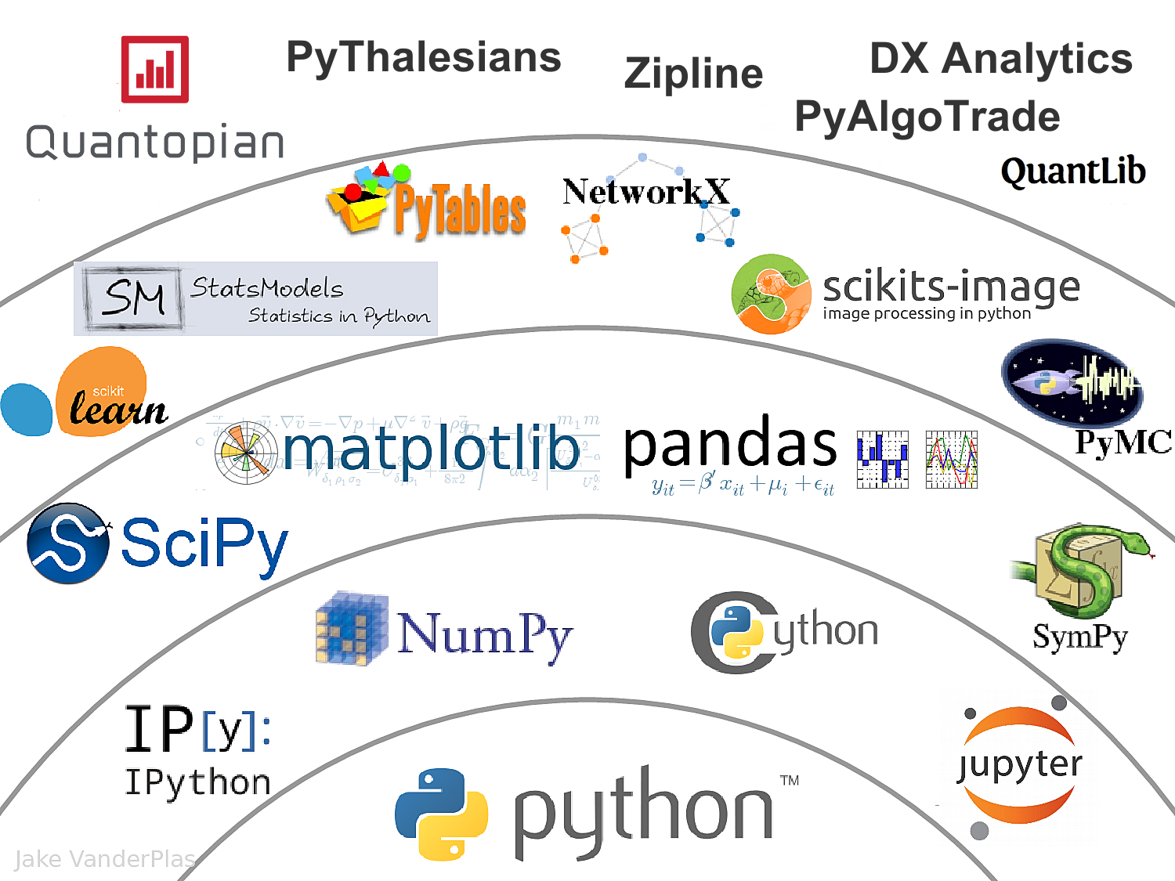
The Quant Finance PyData Stack
Source: http://nbviewer.jupyter.org/format/slides/github/quantopian/pyfolio/blob/master/pyfolio/examples/overview_slides.ipynb#/5

Slide 119
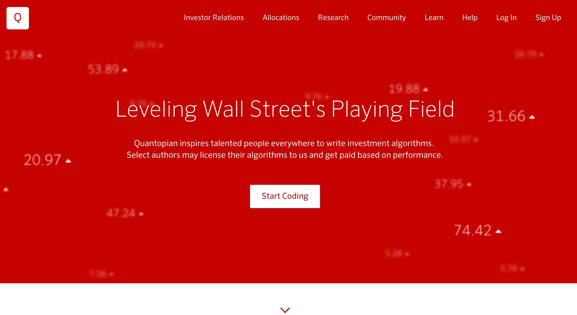
Quantopian
https://www.quantopian.com/

Slide 120
References
Susanne Chishti and Janos Barberis (2016), “The FINTECH Book: The Financial Technology Handbook for Investors, Entrepreneurs and Visionaries”, Wiley.
Paolo Sironi (2016), “FinTech Innovation: From Robo-Advisors to Goal Based Investing and Gamification”, Wiley.
Charles P. Jones (2012), Investments: Analysis and Management, 12th Edition, Wiley.
Edwin J. Elton, Martin J. Gruber, Stephen J. Brown, and William N. Goetzmann (2014), Modern Portfolio Theory and Investment Analysis, 9th Edition, Wiley.
Zvi Bodie, Alex Kane, Alan Marcus (2018), Essentials of Investments, 11th Edition, McGraw-Hill.
Musto, C., Semeraro, G., Lops, P., de Gemmis, M., & Lekkas, G. (2015). Personalized finance advisory through case-based recommender systems and diversification strategies. Decision Support Systems, 77, 100-111.
Rubino, J. (2016). My Favorite Robot. CFA Institute Magazine, 27(3), 43-46.
Cocca, Teodoro (2016). "Potential and Limitations of Virtual Advice in Wealth Management." Journal of Financial Transformation, 44, 45-57.
Van Thiel, Diederick, and Fred Van Raaij (2017). "Explaining Customer Experience of Digital Financial Advice." Economics 5, no. 1, 69-84.
Zheng, Xiao-lin, Meng-ying Zhu, Qi-bing Li, Chao-chao Chen, and Yan-chao Tan (2019), "Finbrain: When finance meets AI 2.0." Frontiers of Information Technology & Electronic Engineering 20, no. 7, pp. 914-924, 2019.
Stuart Russell and Peter Norvig (2020), Artificial Intelligence: A Modern Approach, 4th Edition, Pearson.
Min-Yuh Day and Jian-Ting Lin (2019), "Artificial Intelligence for ETF Market Prediction and Portfolio Optimization", in Proceedings of The 2019 IEEE/ACM International Conference on Advances in Social Networks Analysis and Mining (ASONAM 2019), Vancouver, Canada, August 27-30. 2019.
Min-Yuh Day and Chi-Sheng Hung (2019), "AI Affective Conversational Robot with Hybrid Generative-based and Retrieval-based Dialogue Models", in Proceedings of The 20th IEEE International Conference on Information Reuse and Integration for Data Science (IEEE IRI 2019), Los Angeles, CA, USA, July 30 - August 1, 2019.
Min-Yuh Day, Tun-Kung Cheng and Jheng-Gang Li (2018). “AI Robo-Advisor with Big Data Analytics for Financial Services”, submitted to MSNDS 2018 in the 2018 IEEE/ACM International Conference on Advances in Social Networks Analysis and Mining (ASONAM 2018), Barcelona, Spain, August 28-31. 2018.
Min-Yuh Day, Jian-Ting Lin and Yuan-Chih Chen (2018). “Artificial Intelligence for Conversational Robo-Advisor.” submitted to MSNDS 2018 in the 2018 IEEE/ACM International Conference on Advances in Social Networks Analysis and Mining (ASONAM 2018), Barcelona, Spain, August 28-31, 2018.

