Slide 1
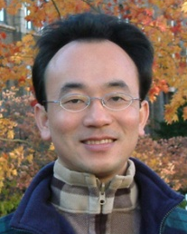
軟體工程 (Software Engineering)
軟體工程概論 (Introduction to Software Engineering)
1091SE01
MBA, IM, NTPU (M5118) (Fall 2020) Tue 2, 3, 4 (9:10-12:00) (B8F40)
Min-Yuh Day
戴敏育
Associate Professor
副教授
Institute of Information Management, National Taipei University
國立臺北大學 資訊管理研究所
https://web.ntpu.edu.tw/~myday
2020-09-15

Slide 2
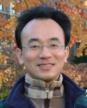
戴敏育 博士 (Min-Yuh Day, Ph.D.)
國立台北大學 資訊管理研究所 副教授
中央研究院 資訊科學研究所 訪問學人
國立台灣大學 資訊管理 博士
Publications Co-Chairs, IEEE/ACM International Conference on Advances in Social Networks Analysis and Mining (ASONAM 2013- )
Program Co-Chair, IEEE International Workshop on Empirical Methods for Recognizing Inference in TExt (IEEE EM-RITE 2012- )
Publications Chair, The IEEE International Conference on Information Reuse and Integration (IEEE IRI)

Slide 3
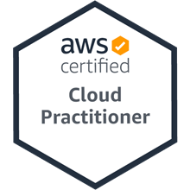
軟體工程 (Software Engineering) Contact Information
戴敏育 博士 (Min-Yuh Day, Ph.D.)
副教授 (Associate Professor)
國立臺北大學 資訊管理研究所
Institute of Information Management, National Taipei University
電話： 02-86741111 ext. 66873
研究室： 商8F12
地址： 23741 新北市三峽區大學路 151 號
Email：myday@gm.ntpu.edu.tw
網址：http://web.ntpu.edu.tw/~myday/

Slide 4
國立臺北大學 109學年度第1學期 課程大綱 Fall 2020 (2020.09 - 2021.01)
課程名稱：軟體工程 (Software Engineering)
授課教師：戴敏育 (Min-Yuh Day)
開課系所：資管所碩士班
開課資料：選修 半學年 3 學分 (3 Credits, Elective)
上課時間：週二 2, 3, 4 (9:10-12:00)
上課教室：商8F40 (台北大學三峽校區)

Slide 5
教學目標
瞭解軟體工程基本概念、 與研究議題。
具備軟體工程實務操作能力。
進行軟體工程相關之 資訊管理研究。

Slide 6
Course Objectives
Understand the fundamental concepts and research issues of software engineering.
Equip with Hands-on practices of software engineering.
Conduct information systems research in the context of software engineering.

Slide 7
內容綱要
本課程介紹軟體工程基本概念、研究議題、與實務操作。
課程內容包括
軟體工程概論
軟體產品與專案管理：軟體產品管理，原型設計
敏捷軟體工程：敏捷方法、Scrum、極限程式設計
功能、場景和故事
軟體架構：架構設計、系統分解、分散式架構
基於雲的軟體：虛擬化和容器、軟體即服務
雲端運算與雲軟體架構
微服務架構：RESTful服務、服務部署
安全和隱私
可靠的程式設計
測試：功能測試、測試自動化、測試驅動的開發、程式審查
DevOps和程式碼管理：程式碼管理和DevOps自動化
軟體工程個案研究

Slide 8
Course Outline
This course introduces the fundamental concepts, research issues, and hands-on practices of software engineering.
Topics include
Introduction to Software Engineering
Software Products and Project Management: Software product management and prototyping
Agile Software Engineering: Agile methods, Scrum, and Extreme Programming
Features, Scenarios, and Stories
Software Architecture: Architectural design, System decomposition, and Distribution architecture
Cloud-Based Software: Virtualization and containers, Everything as a service, Software as a service
Cloud Computing and Cloud Software Architecture
Microservices Architecture, RESTful services, Service deployment
Security and Privacy
Reliable Programming
Testing: Functional testing, Test automation, Test-driven development, and Code reviews
DevOps and Code Management: Code management and DevOps automation
Case Study on Software Engineering

Slide 9
資訊管理研究所 系核心能力 (Core Competence)
資訊科技新知探索與系統開發應用 90 %
網路行銷企劃能力
論文寫作與獨立研究能力 10 %

Slide 10
校四大基本素養 (Four Fundamental Qualities)
專業 (Professionalism)
創意思考與問題解決 (Creative thinking and Problem-solving) 30 %
綜合統整(Comprehensive Integration) 30 %
人際 (Interpersonal Relationship)
溝通協調 (Communication and Coordination) 10 %
團隊合作 (Teamwork) 10 %
倫理 (Ethics)
誠信正直(Honesty and Integrity) 5 %
尊重自省(Self-Esteem and Self-reflection) 5 %
國際觀 (International Vision)
多元關懷 (Caring for Diversity) 5 %
跨界宏觀 (Interdisciplinary Vision) 5 %

Slide 11
商學院學習目標 (College Learning Goals)
Ethics/Corporate Social Responsibility
Global Knowledge/Awareness
Communication
Analytical and Critical Thinking

Slide 12
系所學習目標 (Department Learning Goals)
Information Technologies and System Development Capabilities
Research capabilities

Slide 13
課程大綱 (Syllabus)
週次 (Week) 日期 (Date) 內容 (Subject/Topics)
1 2020/09/15 軟體工程概論 (Introduction to Software Engineering)
2 2020/09/22 軟體產品與專案管理：軟體產品管理，原型設計 (Software Products and Project Management: Software product management and prototyping)
3 2020/09/29 敏捷軟體工程：敏捷方法、Scrum、極限程式設計 (Agile Software Engineering: Agile methods, Scrum, and Extreme Programming)
4 2020/10/06 功能、場景和故事 (Features, Scenarios, and Stories)
5 2020/10/13 軟體架構：架構設計、系統分解、分散式架構 (Software Architecture: Architectural design, System decomposition, and Distribution architecture)
6 2020/10/20 軟體工程個案研究 I (Case Study on Software Engineering I)

Slide 14
課程大綱 (Syllabus)
週次 (Week) 日期 (Date) 內容 (Subject/Topics)
7 2020/10/27 基於雲的軟體：虛擬化和容器、軟體即服務 (Cloud-Based Software: Virtualization and containers, Everything as a service, Software as a service)
8 2020/11/03 雲端運算與雲軟體架構 (Cloud Computing and Cloud Software Architecture)
9 2020/11/10 期中報告 (Midterm Project Report)
10 2020/11/17 微服務架構：RESTful服務、服務部署 (Microservices Architecture, RESTful services, Service deployment)
11 2020/11/24 軟體工程產業實務 (Industry Practices of Software Engineering)
12 2020/12/01 安全和隱私 (Security and Privacy)

Slide 15
課程大綱 (Syllabus)
週次 (Week) 日期 (Date) 內容 (Subject/Topics)
13 2020/12/08 軟體工程個案研究 II (Case Study on Software Engineering II)
14 2020/12/15 可靠的程式設計 (Reliable Programming)
15 2020/12/22 測試：功能測試、測試自動化、 測試驅動的開發、程式碼審查 (Testing: Functional testing, Test automation, Test-driven development, and Code reviews)
16 2020/12/29 DevOps和程式碼管理： 程式碼管理和DevOps自動化 (DevOps and Code Management: Code management and DevOps automation)
17 2021/01/05 期末報告 I (Final Project Report I)
18 2021/01/12 期末報告 II (Final Project Report I)

Slide 16
教學方法與教學活動 (Teaching methods and activities)
講授 (Lecture)
討論 (Discussion)
實習 (Practicum)

Slide 17
評量方式 (Evaluation Methods)
個人報告 (Individual Presentation) 60 %
團體報告 (Group Presentation) 10 %
個案分析報告 (Case Report) 10 %
課堂參與 (Class Participation) 10 %
作業 (Assignment) 10 %

Slide 18
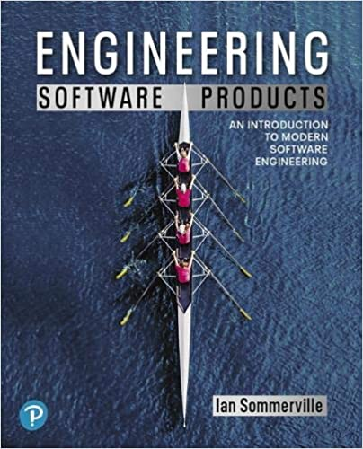
指定用書 (Required Texts)
Ian Sommerville (2019), Engineering Software Products: An Introduction to Modern Software Engineering, Pearson.

Slide 19
參考書目 (Reference Books)
Ian Sommerville (2015), Software Engineering, 10th Edition, Pearson.
Titus Winters, Tom Manshreck, and Hyrum Wright (2020), Software Engineering at Google: Lessons Learned from Programming Over Time, O'Reilly Media.

Slide 20
Ian Sommerville (2019), Engineering Software Products: An Introduction to Modern Software Engineering, Pearson.

Slide 21
Ian Sommerville (2015), Software Engineering, 10th Edition, Pearson.

Slide 22
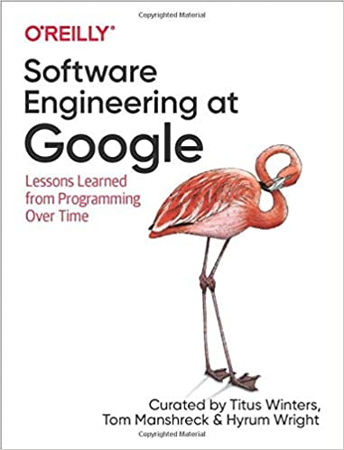
Titus Winters, Tom Manshreck, and Hyrum Wright (2020), Software Engineering at Google: Lessons Learned from Programming Over Time, O'Reilly Media.

Slide 23
Software Engineering

Slide 24
Information Management Management Information Systems (MIS) Information Systems

Slide 25
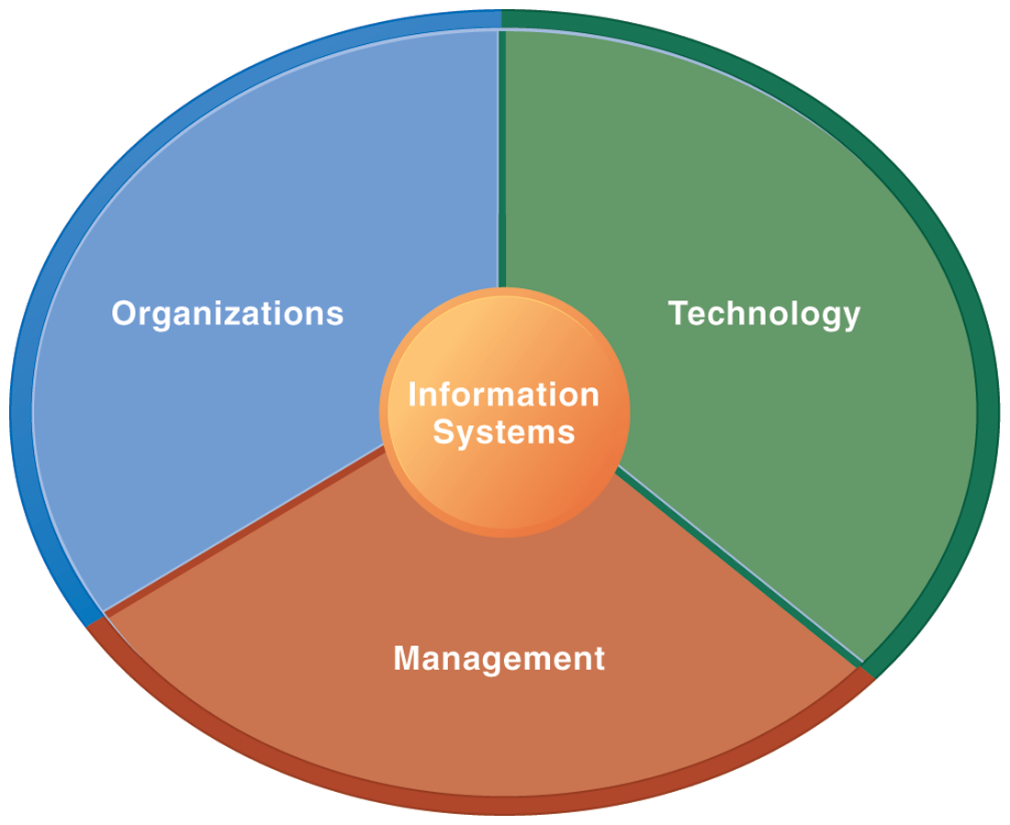
Information Management (MIS) Information Systems

Slide 26
Fundamental MIS Concepts
Business Challenges
Management
Organization
Information System
Business Solutions
Technology

Slide 27
Project-based software engineering
CUSTOMER
Problem
generates
helps-with
Requirements
implemented-by
Software
1
CUSTOMER and DEVELOPER
DEVELOPER

Slide 28
Project-based software engineering
The starting point for the software development is a set of ‘software requirements’ that are owned by an external client and which set out what they want a software system to do to support their business processes.
The software is developed by a software company (the contractor) who design and implement a system that delivers functionality to meet the requirements.
The customer may change the requirements at any time in response to business changes (they usually do). The contractor must change the software to reflect these requirements changes.
Custom software usually has a long-lifetime (10 years or more) and it must be supported over that lifetime.

Slide 29
Product software engineering
DEVELOPER
Opportunity
1
inspires
realizes
Product features
implemented-by
Software
DEVELOPER
DEVELOPER

Slide 30
Product software engineering
The starting point for product development is a business opportunity that is identified by individuals or a company. They develop a software product to take advantage of this opportunity and sell this to customers.
The company who identified the opportunity design and implement a set of software features that realize the opportunity and that will be useful to customers.
The software development company are responsible for deciding on the development timescale, what features to include and when the product should change.
Rapid delivery of software products is essential to capture the market for that type of product.

Slide 31
Software execution models
Stand-alone execution
Hybrid execution
Software as a service
User’s computer
User’s computer
User’s computer
User interface
Product functionality
User data
User interface
Partial functionality
User data
User interface
(browser or app)
Product updates
Additional functionality
User data backups
Product updates
Product functionality
User data
Vendor’s servers
Vendor’s servers
Vendor’s servers

Slide 32
Product management concerns
Business needs
Product manager
Technology constraints
Customer experience

Slide 33
Technical interactions of product managers
Product vision management
Product backlog management
User stories and scenarios
Product manager
Acceptance testing
Customer testing
User interface design

Slide 34
Marketing

Slide 35
Marketing
“Meeting needs profitably”

Slide 36
Marketing
“Marketing is an organizational function and a set of processes for creating, communicating, and delivering value to customers and for managing customer relationships in ways that benefit the organization and its stakeholders.”

Slide 37
Marketing Management

Slide 38
Marketing Management
“Marketing management is the art and science of choosing target markets and getting, keeping, and growing customers through creating, delivering, and communicating superior customer value.”

Slide 39
Marketing Management
1
Understanding Marketing Management
2
Capturing Marketing Insights
3
Connecting with Customers
4
Building Strong Brands
5
Creating Value
6
Delivering Value
7
Communicating Value
8
Conducting Marketing Responsibly for Long-term Success

Slide 40
Summary
This course introduces the fundamental concepts, research issues, and hands-on practices of software engineering.
Topics include
Introduction to Software Engineering
Software Products and Project Management: Software product management and prototyping
Agile Software Engineering: Agile methods, Scrum, and Extreme Programming
Features, Scenarios, and Stories
Software Architecture: Architectural design, System decomposition, and Distribution architecture
Cloud-Based Software: Virtualization and containers, Everything as a service, Software as a service
Cloud Computing and Cloud Software Architecture
Microservices Architecture, RESTful services, Service deployment
Security and Privacy
Reliable Programming
Testing: Functional testing, Test automation, Test-driven development, and Code reviews
DevOps and Code Management: Code management and DevOps automation
Case Study on Software Engineering

Slide 41
軟體工程 (Software Engineering) Contact Information
戴敏育 博士 (Min-Yuh Day, Ph.D.)
副教授 (Associate Professor)
國立臺北大學 資訊管理研究所
Institute of Information Management, National Taipei University
電話： 02-86741111 ext. 66873
研究室： 商8F12
地址： 23741 新北市三峽區大學路 151 號
Email：myday@gm.ntpu.edu.tw
網址：http://web.ntpu.edu.tw/~myday/

