Slide 1



人工智慧
(Artificial Intelligence)
人工智慧和智慧代理人
(Artificial Intelligence and Intelligent Agents)
1092AI02
MBA, IM, NTPU (M5010) (Spring 2021)
Wed 2, 3, 4 (9:10-12:00) (B8F40)
Min-Yuh Day
戴敏育
Associate Professor
副教授
Institute of Information Management, National Taipei University
國立臺北大學 資訊管理研究所
https://web.ntpu.edu.tw/~myday
2021-03-03

Slide 2
課程大綱 (Syllabus)
週次 (Week) 日期 (Date) 內容 (Subject/Topics)
1 2021/02/24 人工智慧概論
(Introduction to Artificial Intelligence)
2 2021/03/03 人工智慧和智慧代理人
(Artificial Intelligence and Intelligent Agents)
3 2021/03/10 問題解決
(Problem Solving)
4 2021/03/17 知識推理和知識表達
(Knowledge, Reasoning and Knowledge Representation)
5 2021/03/24 不確定知識和推理
(Uncertain Knowledge and Reasoning)
6 2021/03/31 人工智慧個案研究 I
(Case Study on Artificial Intelligence I)

Slide 3
課程大綱 (Syllabus)
週次 (Week) 日期 (Date) 內容 (Subject/Topics)
7 2021/04/07 放假一天 (Day off)
8 2021/04/14 機器學習與監督式學習
(Machine Learning and Supervised Learning)
9 2021/04/21 期中報告
(Midterm Project Report)
10 2021/04/28 學習理論與綜合學習
(The Theory of Learning and Ensemble Learning)
11 2021/05/05 深度學習
(Deep Learning)
12 2021/05/12 人工智慧個案研究 II
(Case Study on Artificial Intelligence II)

Slide 4
課程大綱 (Syllabus)
週次 (Week) 日期 (Date) 內容 (Subject/Topics)
13 2021/05/19 強化學習
(Reinforcement Learning)
14 2021/05/26 深度學習自然語言處理
(Deep Learning for Natural Language Processing)
15 2021/06/02 機器人技術
(Robotics)
16 2021/06/09 人工智慧哲學與倫理，人工智慧的未來
(Philosophy and Ethics of AI, The Future of AI)
17 2021/06/16 期末報告 I
(Final Project Report I)
18 2021/06/23 期末報告 II
(Final Project Report II)

Slide 5
Artificial Intelligence and
Intelligent Agents

Slide 6
Outline
Artificial Intelligence
Intelligent Agents

Slide 7
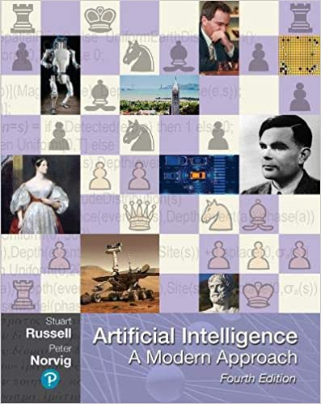
Stuart Russell and Peter Norvig (2020),
Artificial Intelligence: A Modern Approach,
4th Edition, Pearson
Source: Stuart Russell and Peter Norvig (2020), Artificial Intelligence: A Modern Approach, 4th Edition, Pearson
https://www.amazon.com/Artificial-Intelligence-A-Modern-Approach/dp/0134610997/

Slide 8
Artificial Intelligence:
A Modern Approach
Artificial Intelligence
Problem Solving
Knowledge and Reasoning
Uncertain Knowledge and Reasoning
Machine Learning
Communicating, Perceiving, and Acting
Philosophy and Ethics of AI
Source: Stuart Russell and Peter Norvig (2020), Artificial Intelligence: A Modern Approach, 4th Edition, Pearson

Slide 9
Artificial Intelligence:
Intelligent Agents
Source: Stuart Russell and Peter Norvig (2020), Artificial Intelligence: A Modern Approach, 4th Edition, Pearson

Slide 10
Artificial Intelligence:
2. Problem Solving
Solving Problems by Searching
Search in Complex Environments
Adversarial Search and Games
Constraint Satisfaction Problems
Source: Stuart Russell and Peter Norvig (2020), Artificial Intelligence: A Modern Approach, 4th Edition, Pearson

Slide 11
Artificial Intelligence:
3. Knowledge and Reasoning
Logical Agents
First-Order Logic
Inference in First-Order Logic
Knowledge Representation
Automated Planning
Source: Stuart Russell and Peter Norvig (2020), Artificial Intelligence: A Modern Approach, 4th Edition, Pearson

Slide 12
Artificial Intelligence:
4. Uncertain Knowledge and Reasoning
Quantifying Uncertainty
Probabilistic Reasoning
Probabilistic Reasoning over Time
Probabilistic Programming
Making Simple Decisions
Making Complex Decisions
Multiagent Decision Making
Source: Stuart Russell and Peter Norvig (2020), Artificial Intelligence: A Modern Approach, 4th Edition, Pearson

Slide 13
Artificial Intelligence:
5. Machine Learning
Learning from Examples
Learning Probabilistic Models
Deep Learning
Reinforcement Learning
Source: Stuart Russell and Peter Norvig (2020), Artificial Intelligence: A Modern Approach, 4th Edition, Pearson

Slide 14
Artificial Intelligence:
6. Communicating, Perceiving, and Acting
Natural Language Processing
Deep Learning for Natural Language Processing
Computer Vision
Robotics
Source: Stuart Russell and Peter Norvig (2020), Artificial Intelligence: A Modern Approach, 4th Edition, Pearson

Slide 15
Artificial Intelligence:
Philosophy and Ethics of AI
The Future of AI
Source: Stuart Russell and Peter Norvig (2020), Artificial Intelligence: A Modern Approach, 4th Edition, Pearson

Slide 16
Artificial Intelligence
Source: Stuart Russell and Peter Norvig (2020), Artificial Intelligence: A Modern Approach, 4th Edition, Pearson

Slide 17
AI, Big Data, Cloud Computing
Evolution of Decision Support, Business Intelligence, and Analytics
AI
AI
Cloud Computing
Big Data
DM
BI
Source: Ramesh Sharda, Dursun Delen, and Efraim Turban (2017),
Business Intelligence, Analytics, and Data Science: A Managerial Perspective, 4th Edition, Pearson

Slide 18
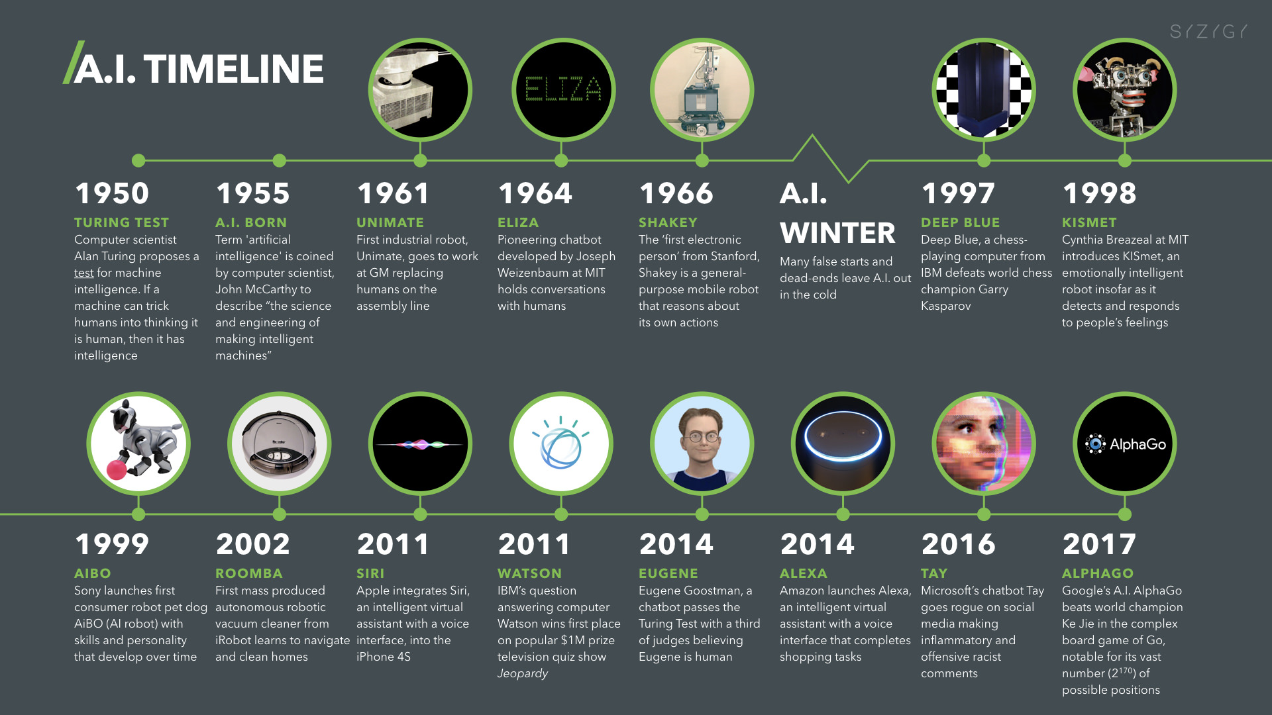
Artificial Intelligence (A.I.) Timeline
Source: https://digitalintelligencetoday.com/artificial-intelligence-timeline-infographic-from-eliza-to-tay-and-beyond/

Slide 19
The Rise of AI
Source: DHL (2018), Artificial Intelligence in Logistics,
http://www.globalhha.com/doclib/data/upload/doc_con/5e50c53c5bf67.pdf/

Slide 20
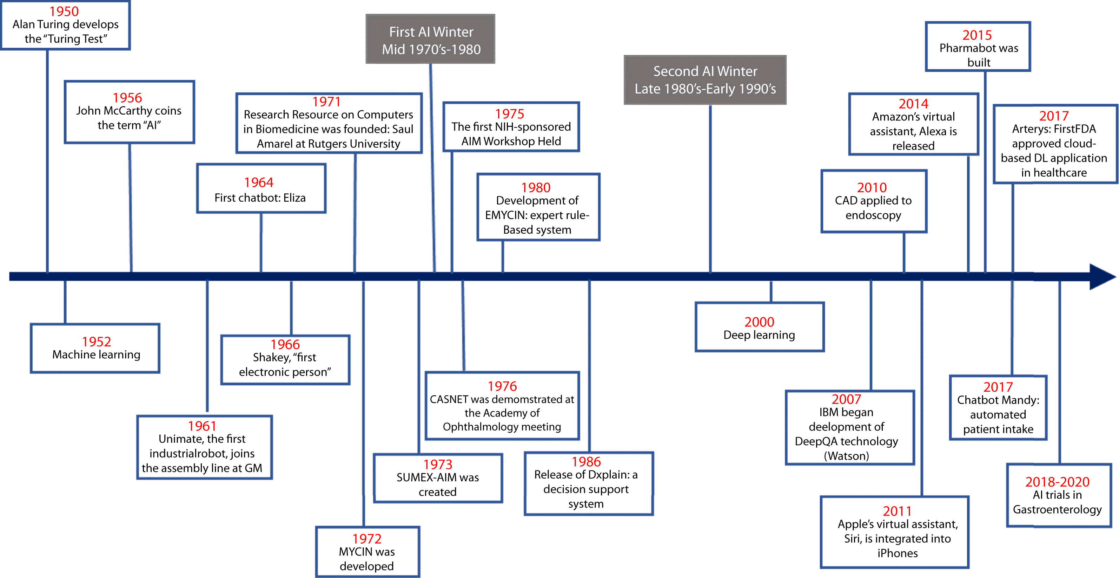
Artificial Intelligence in Medicine
Source: Vivek Kaul, Sarah Enslin, and Seth A. Gross (2020), "The history of artificial intelligence in medicine." Gastrointestinal endoscopy..

Slide 21
AI

Slide 22
Definition of
Artificial Intelligence (A.I.)

Slide 23
Artificial Intelligence
“… the science and engineering of making intelligent machines”
(John McCarthy, 1955)
Source: https://digitalintelligencetoday.com/artificial-intelligence-defined-useful-list-of-popular-definitions-from-business-and-science/

Slide 24
Artificial Intelligence
“… technology that thinks and acts like humans”
Source: https://digitalintelligencetoday.com/artificial-intelligence-defined-useful-list-of-popular-definitions-from-business-and-science/

Slide 25
Artificial Intelligence
“… intelligence exhibited by machines or software”
Source: https://digitalintelligencetoday.com/artificial-intelligence-defined-useful-list-of-popular-definitions-from-business-and-science/

Slide 26
4 Approaches of AI
Thinking Humanly | Thinking Rationally
Acting Humanly | Acting Rationally
Source: Stuart Russell and Peter Norvig (2020), Artificial Intelligence: A Modern Approach, 4th Edition, Pearson

Slide 27
4 Approaches of AI
2. Thinking Humanly: The Cognitive Modeling Approach | 3. Thinking Rationally: The “Laws of Thought” Approach
1. Acting Humanly: The Turing Test Approach (1950) | 4. Acting Rationally: The Rational Agent Approach
Source: Stuart Russell and Peter Norvig (2020), Artificial Intelligence: A Modern Approach, 4th Edition, Pearson

Slide 28
AI Acting Humanly:
The Turing Test Approach
(Alan Turing, 1950)
Knowledge Representation
Automated Reasoning
Machine Learning (ML)
  Deep Learning (DL)
Computer Vision (Image, Video)
Natural Language Processing (NLP)
Robotics
Source: Stuart Russell and Peter Norvig (2020), Artificial Intelligence: A Modern Approach, 4th Edition, Pearson

Slide 29
Acting Rationally:
The Rational Agent Approach
AI has focused on the study and construction of agents that do the right thing.
Standard model
Source: Stuart Russell and Peter Norvig (2020), Artificial Intelligence: A Modern Approach, 4th Edition, Pearson

Slide 30
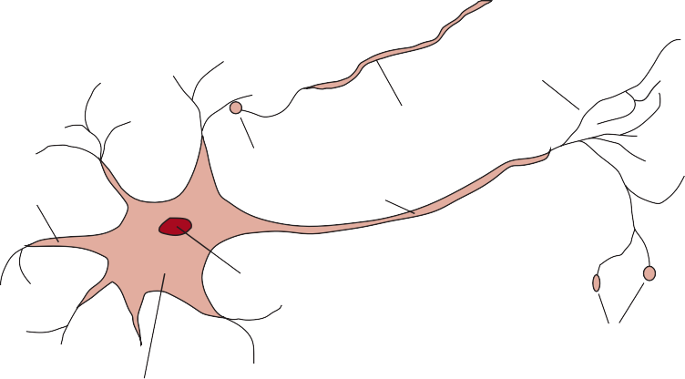
Neuroscience
The parts of a nerve cell or neuron
Axonal arborization
Axon from another cell
Synapse
Dendrite
Axon
Nucleus
Synapses
Cell body or soma
Source: Stuart Russell and Peter Norvig (2020), Artificial Intelligence: A Modern Approach, 4th Edition, Pearson

Slide 31
Comparison of
Computer and Human Brain
 | Supercomputer | Personal Computer | Human Brain
Computational units | 10⁶ GPUs + CPUs | 8 CPU cores | 10⁶ columns
 | 10¹⁵ transistors | 10¹⁰ transistors | 10¹¹ neurons
Storage units | 10¹⁶ bytes RAM | 10¹⁰ bytes RAM | 10¹¹ neurons
 | 10¹⁷ bytes disk | 10¹² bytes disk | 10¹⁴ synapses
Cycle time | 10⁻⁹ sec | 10⁻⁹ sec | 10⁻³ sec
Operations/sec | 10¹⁸ | 10¹⁰ | 10¹⁷
Source: Stuart Russell and Peter Norvig (2020), Artificial Intelligence: A Modern Approach, 4th Edition, Pearson

Slide 32




A scene from the blocks world
Find a block which is taller than the one you are holding and put it in the box.
Source: Stuart Russell and Peter Norvig (2020), Artificial Intelligence: A Modern Approach, 4th Edition, Pearson

Slide 33
Intelligent Agents
Source: Stuart Russell and Peter Norvig (2020), Artificial Intelligence: A Modern Approach, 4th Edition, Pearson

Slide 34
4 Approaches of AI
2. Thinking Humanly: The Cognitive Modeling Approach | 3. Thinking Rationally: The “Laws of Thought” Approach
1. Acting Humanly: The Turing Test Approach (1950) | 4. Acting Rationally: The Rational Agent Approach
Source: Stuart Russell and Peter Norvig (2020), Artificial Intelligence: A Modern Approach, 4th Edition, Pearson

Slide 35
Reinforcement Learning (DL)
Agent
Environment
Source: Richard S. Sutton & Andrew G. Barto (2018), Reinforcement Learning: An Introduction, 2nd Edition, A Bradford Book.

Slide 36
Reinforcement Learning (DL)
1
2
observation
Agent
action
3
reward
Environment
Source: Richard S. Sutton & Andrew G. Barto (2018), Reinforcement Learning: An Introduction, 2nd Edition, A Bradford Book.

Slide 37
Reinforcement Learning (DL)
1
2
observation
Agent
action
O_{t}
A_{t}
3
reward
R_{t}
Environment
Source: Richard S. Sutton & Andrew G. Barto (2018), Reinforcement Learning: An Introduction, 2nd Edition, A Bradford Book.

Slide 38
Agents interact with environments through sensors and actuators
Source: Stuart Russell and Peter Norvig (2020), Artificial Intelligence: A Modern Approach, 4th Edition, Pearson

Slide 39
A vacuum-cleaner world with just two locations
Source: Stuart Russell and Peter Norvig (2020), Artificial Intelligence: A Modern Approach, 4th Edition, Pearson

Slide 40
Partial tabulation of a simple agent function for the vacuum-cleaner world
Source: Stuart Russell and Peter Norvig (2020), Artificial Intelligence: A Modern Approach, 4th Edition, Pearson

Slide 41
PEAS description of the task environment for an automated taxi driver
Source: Stuart Russell and Peter Norvig (2020), Artificial Intelligence: A Modern Approach, 4th Edition, Pearson

Slide 42
Examples of Agent Types and their PEAS descriptions
Source: Stuart Russell and Peter Norvig (2020), Artificial Intelligence: A Modern Approach, 4th Edition, Pearson

Slide 43
Examples of Task Environments and their Characteristics
Source: Stuart Russell and Peter Norvig (2020), Artificial Intelligence: A Modern Approach, 4th Edition, Pearson

Slide 44
The TABLE-DRIVEN-AGENT program is invoked for each new percept and returns an action each time.
It retains the complete percept sequence in memory.
Source: Stuart Russell and Peter Norvig (2020), Artificial Intelligence: A Modern Approach, 4th Edition, Pearson

Slide 45
The agent program for a simple reflex agent in the two-location vacuum environment.
Source: Stuart Russell and Peter Norvig (2020), Artificial Intelligence: A Modern Approach, 4th Edition, Pearson

Slide 46
Schematic Diagram of a Simple Reflex Agent
Source: Stuart Russell and Peter Norvig (2020), Artificial Intelligence: A Modern Approach, 4th Edition, Pearson

Slide 47
Schematic diagram of a simple reflex agent
the current internal state
of the agent’s decision process
Source: Stuart Russell and Peter Norvig (2020), Artificial Intelligence: A Modern Approach, 4th Edition, Pearson

Slide 48
Schematic diagram of a simple reflex agent
the current internal state
of the agent’s decision process
the background information
used in the process
Source: Stuart Russell and Peter Norvig (2020), Artificial Intelligence: A Modern Approach, 4th Edition, Pearson

Slide 49
A Simple Reflex Agent
It acts according to a rule whose condition matches the current state, as defined by the percept.
Source: Stuart Russell and Peter Norvig (2020), Artificial Intelligence: A Modern Approach, 4th Edition, Pearson

Slide 50
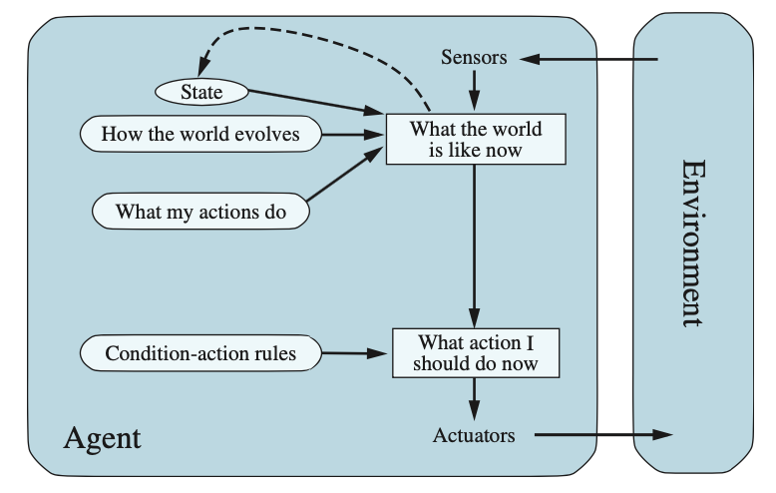
A Model-based Reflex Agent
Source: Stuart Russell and Peter Norvig (2020), Artificial Intelligence: A Modern Approach, 4th Edition, Pearson

Slide 51
A model-based reflex agent
It keeps track of the current state of the world,
using an internal model.
It then chooses an action in the same way as the reflex agent.
Source: Stuart Russell and Peter Norvig (2020), Artificial Intelligence: A Modern Approach, 4th Edition, Pearson

Slide 52
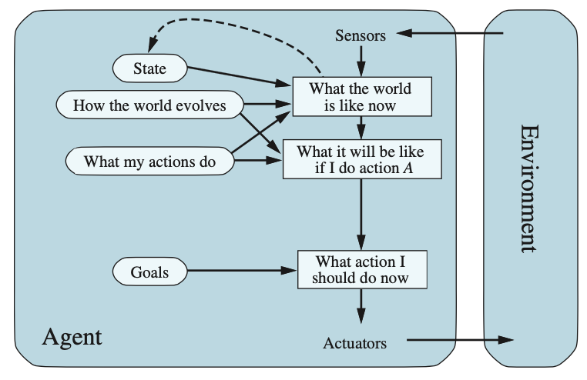
A model-based, goal-based agent
Source: Stuart Russell and Peter Norvig (2020), Artificial Intelligence: A Modern Approach, 4th Edition, Pearson

Slide 53
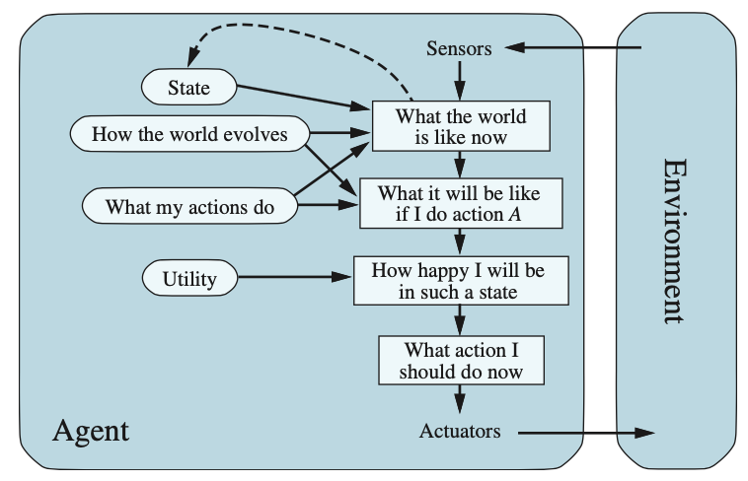
A model-based, utility-based agent
Source: Stuart Russell and Peter Norvig (2020), Artificial Intelligence: A Modern Approach, 4th Edition, Pearson

Slide 54
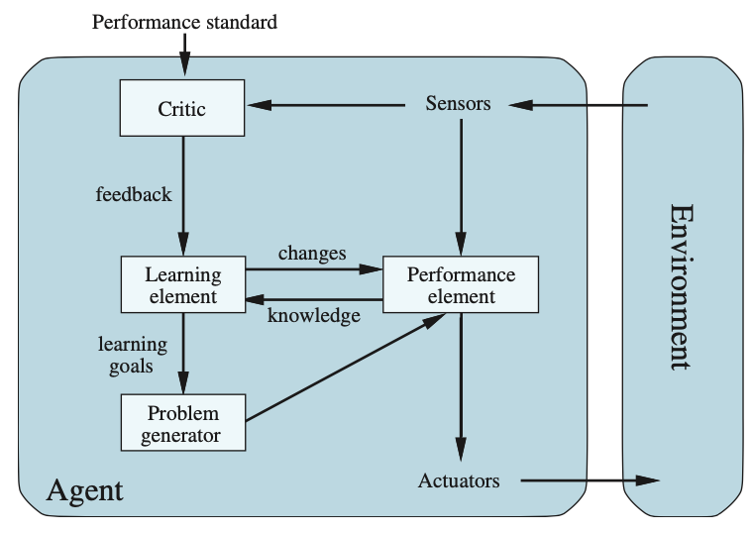
A general learning agent
Source: Stuart Russell and Peter Norvig (2020), Artificial Intelligence: A Modern Approach, 4th Edition, Pearson

Slide 55
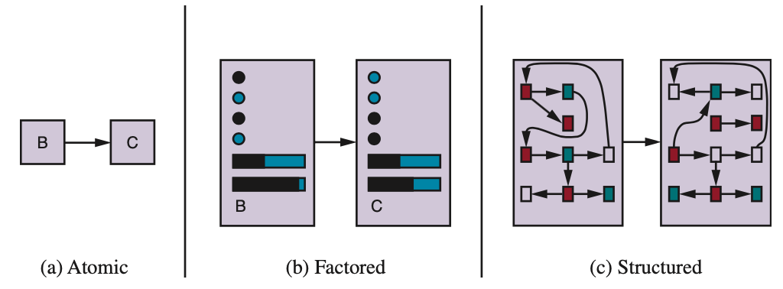
Three ways to represent states and the transitions between them
Source: Stuart Russell and Peter Norvig (2020), Artificial Intelligence: A Modern Approach, 4th Edition, Pearson

Slide 56
Artificial Intelligence
Machine Learning & Deep Learning
Source: https://blogs.nvidia.com/blog/2016/07/29/whats-difference-artificial-intelligence-machine-learning-deep-learning-ai/

Slide 57
AI, ML, DL
Artificial Intelligence (AI)
Machine Learning (ML)
Supervised
Learning
Unsupervised Learning
Deep Learning (DL)
CNN
RNN LSTM GRU
GAN
Semi-supervised Learning
Reinforcement Learning
Source: https://leonardoaraujosantos.gitbooks.io/artificial-inteligence/content/deep_learning.html

Slide 58
3 Machine Learning Algorithms
Source: Enrico Galimberti, http://blogs.teradata.com/data-points/tree-machine-learning-algorithms/

Slide 59
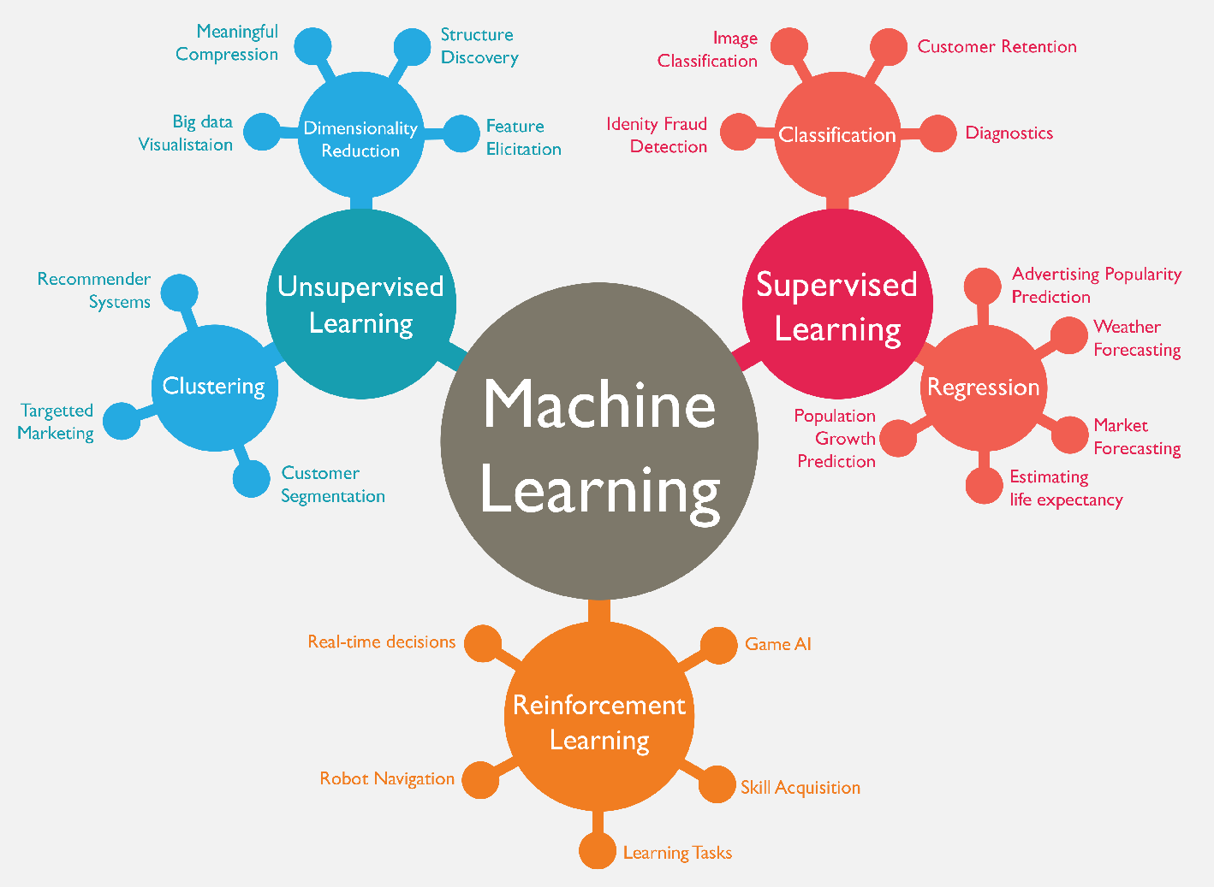
Machine Learning (ML)
Source: https://www.mactores.com/services/aws-big-data-machine-learning-cognitive-services/

Slide 60
Machine Learning (ML) / Deep Learning (DL)
Decision Tree Classifiers
Support Vector Machine (SVM)
Supervised Learning
Neural Network (NN)
Linear Classifiers
Deep Learning (DL)
Machine Learning
(ML)
Rule-based Classifiers
Naïve Bayes
(NB)
Unsupervised Learning
Probabilistic Classifiers
Bayesian Network (BN)
Maximum Entropy (ME)
Reinforcement Learning
Source: Jesus Serrano-Guerrero, Jose A. Olivas, Francisco P. Romero, and Enrique Herrera-Viedma (2015),
"Sentiment analysis: A review and comparative analysis of web services," Information Sciences, 311, pp. 18-38.

Slide 61
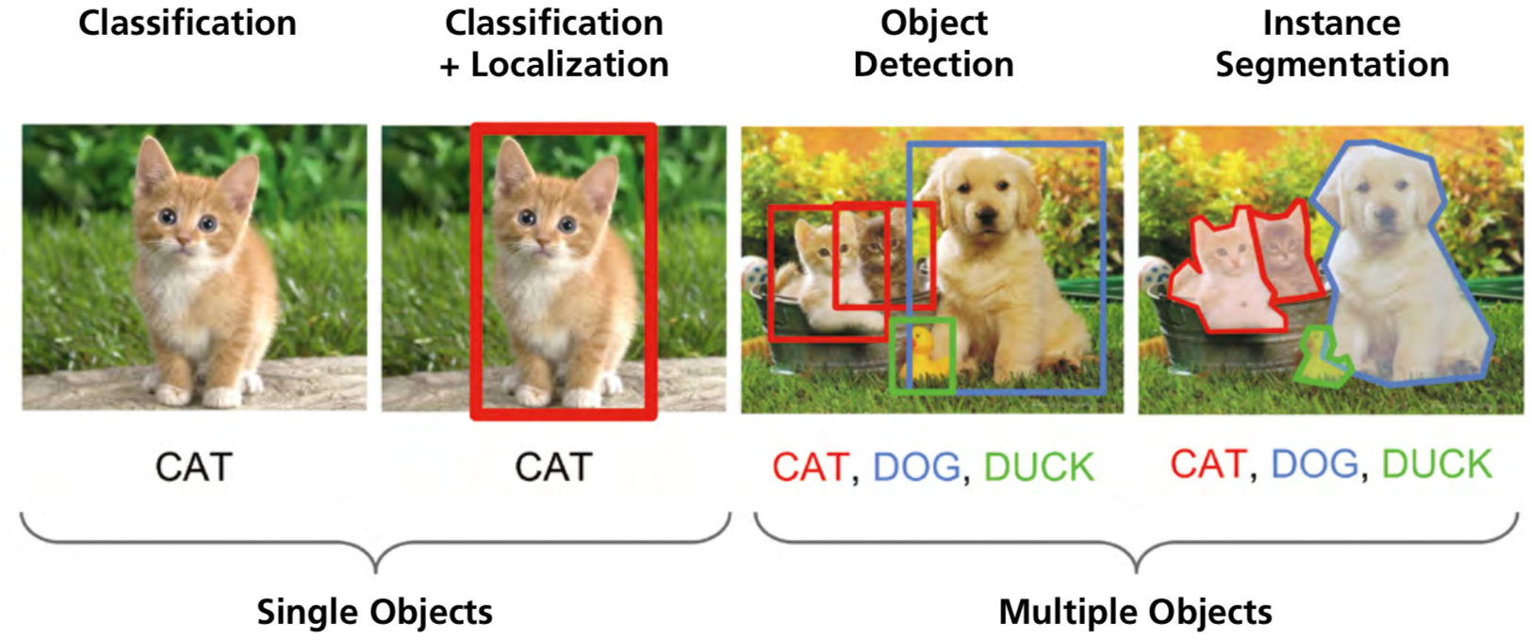
Computer Vision: Image Classification,
Object Detection,
Object Instance Segmentation
Source: DHL (2018), Artificial Intelligence in Logistics,
http://www.globalhha.com/doclib/data/upload/doc_con/5e50c53c5bf67.pdf/

Slide 62
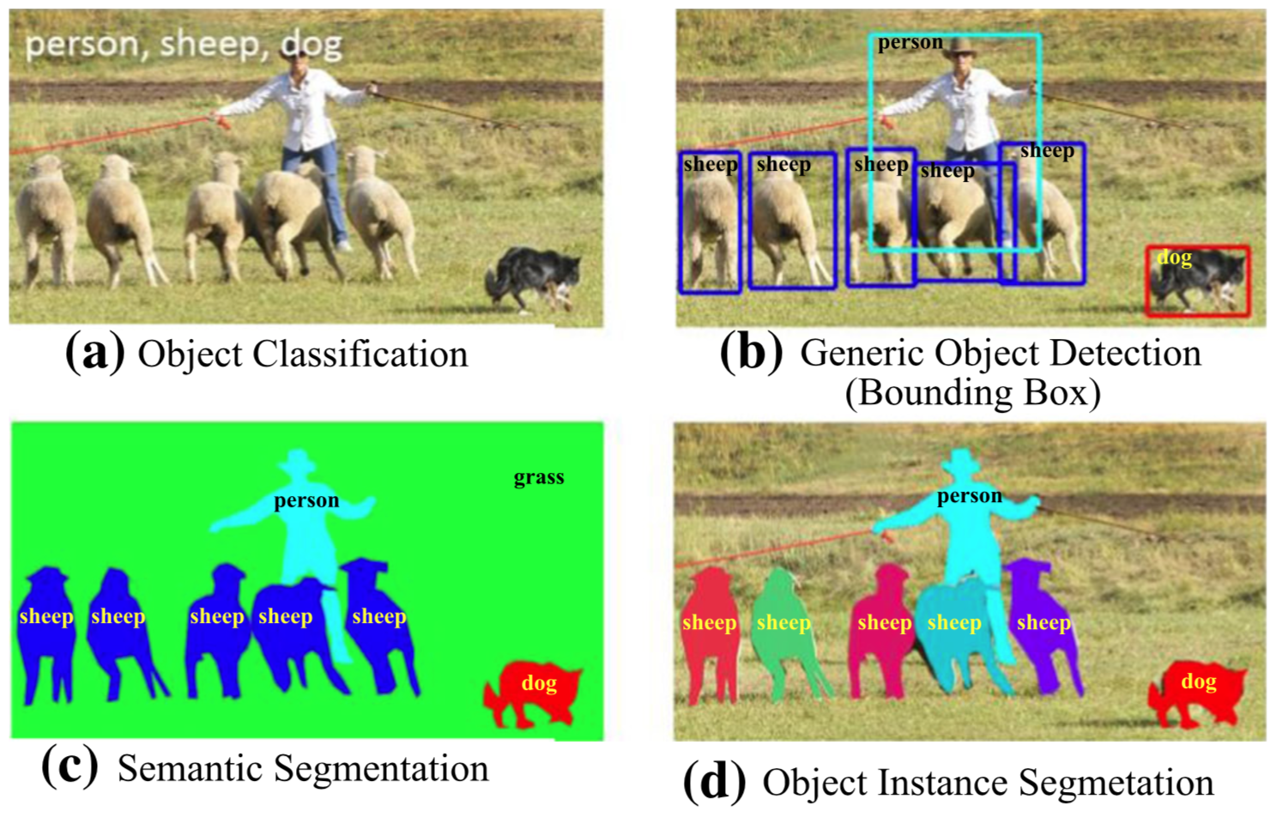
Computer Vision: Object Detection
Source: Li Liu, Wanli Ouyang, Xiaogang Wang, Paul Fieguth, Jie Chen, Xinwang Liu, and Matti Pietikäinen. "Deep learning for generic object detection: A survey." International journal of computer vision 128, no. 2 (2020): 261-318.

Slide 63
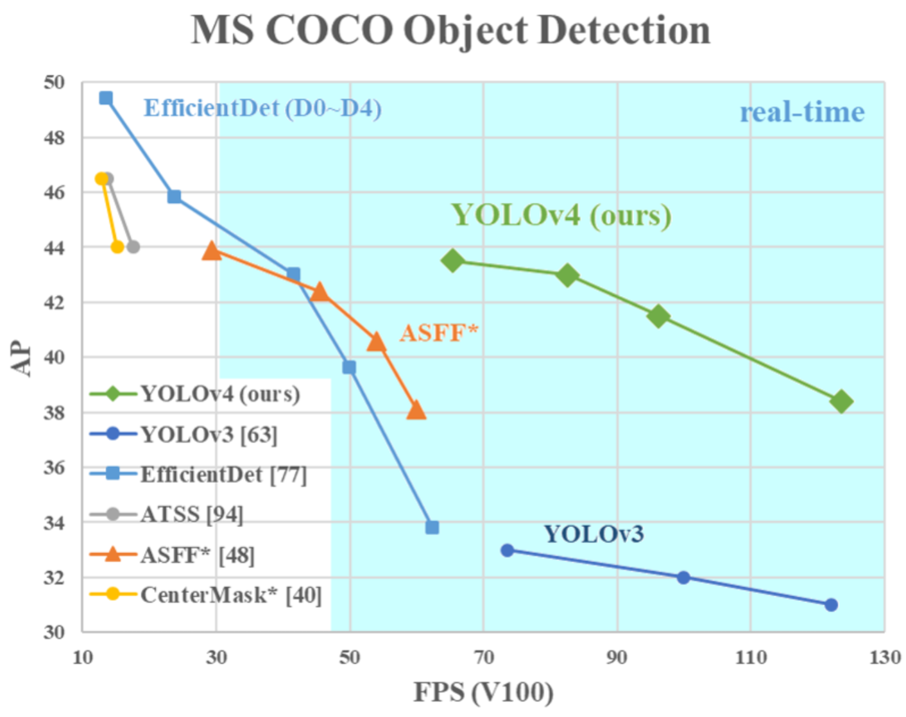
YOLOv4:
Optimal Speed and Accuracy of Object Detection
Source: Alexey Bochkovskiy, Chien-Yao Wang, and Hong-Yuan Mark Liao. "YOLOv4: Optimal Speed and Accuracy of Object Detection." arXiv preprint arXiv:2004.10934 (2020).

Slide 64
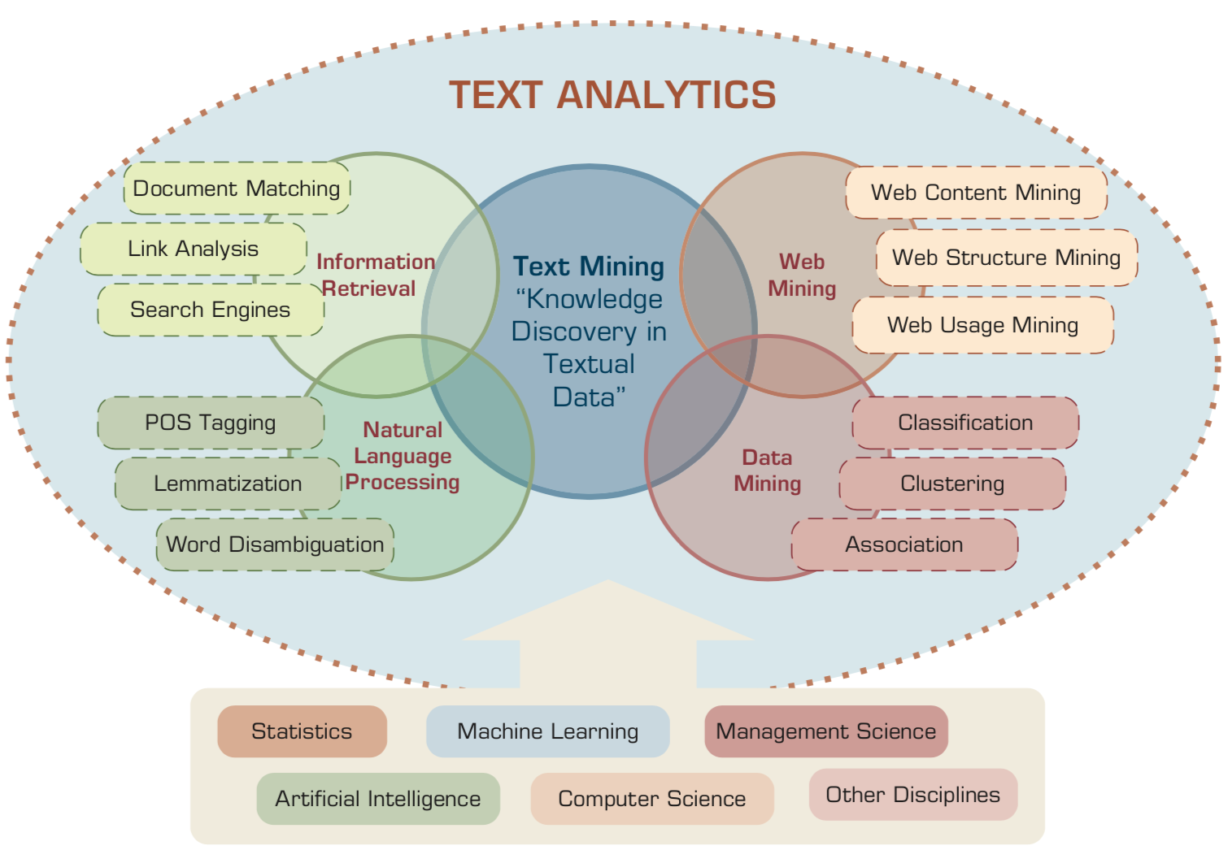
Text Analytics and Text Mining
Source: Ramesh Sharda, Dursun Delen, and Efraim Turban (2017), Business Intelligence, Analytics, and Data Science: A Managerial Perspective, 4th Edition, Pearson

Slide 65

Aurélien Géron (2019),
Hands-On Machine Learning with Scikit-Learn, Keras, and TensorFlow: Concepts, Tools, and Techniques to Build Intelligent Systems, 2nd Edition
O’Reilly Media, 2019
https://github.com/ageron/handson-ml2
Source: https://www.amazon.com/Hands-Machine-Learning-Scikit-Learn-TensorFlow/dp/1492032646/

Slide 66

Hands-On Machine Learning with
Scikit-Learn, Keras, and TensorFlow
Notebooks
The Machine Learning landscape
End-to-end Machine Learning project
Classification
Training Models
Support Vector Machines
Decision Trees
Ensemble Learning and Random Forests
Dimensionality Reduction
Unsupervised Learning Techniques
Artificial Neural Nets with Keras
Training Deep Neural Networks
Custom Models and Training with TensorFlow
Loading and Preprocessing Data
Deep Computer Vision Using Convolutional Neural Networks
Processing Sequences Using RNNs and CNNs
Natural Language Processing with RNNs and Attention
Representation Learning Using Autoencoders
Reinforcement Learning
Training and Deploying TensorFlow Models at Scale
https://github.com/ageron/handson-ml2

Slide 67

Python in Google Colab (Python101)
https://colab.research.google.com/drive/1FEG6DnGvwfUbeo4zJ1zTunjMqf2RkCrT
https://tinyurl.com/aintpupython101

Slide 68
Summary
Artificial Intelligence
Intelligent Agents

Slide 69
References
Stuart Russell and Peter Norvig (2020), Artificial Intelligence: A Modern Approach, 4th Edition, Pearson.
Aurélien Géron (2019), Hands-On Machine Learning with Scikit-Learn, Keras, and TensorFlow: Concepts, Tools, and Techniques to Build Intelligent Systems, 2nd Edition, O’Reilly Media.

