Slide 1



人工智慧
(Artificial Intelligence)
知識推理和知識表達
(Knowledge, Reasoning and
Knowledge Representation)
1092AI04
MBA, IM, NTPU (M5010) (Spring 2021)
Wed 2, 3, 4 (9:10-12:00) (B8F40)
Min-Yuh Day
戴敏育
Associate Professor
副教授
Institute of Information Management, National Taipei University
國立臺北大學 資訊管理研究所
https://web.ntpu.edu.tw/~myday
2021-03-17

Slide 2
課程大綱 (Syllabus)
週次 (Week) 日期 (Date) 內容 (Subject/Topics)
1 2021/02/24 人工智慧概論
(Introduction to Artificial Intelligence)
2 2021/03/03 人工智慧和智慧代理人
(Artificial Intelligence and Intelligent Agents)
3 2021/03/10 問題解決
(Problem Solving)
4 2021/03/17 知識推理和知識表達
(Knowledge, Reasoning and Knowledge Representation)
5 2021/03/24 不確定知識和推理
(Uncertain Knowledge and Reasoning)
6 2021/03/31 人工智慧個案研究 I
(Case Study on Artificial Intelligence I)

Slide 3
課程大綱 (Syllabus)
週次 (Week) 日期 (Date) 內容 (Subject/Topics)
7 2021/04/07 放假一天 (Day off)
8 2021/04/14 機器學習與監督式學習
(Machine Learning and Supervised Learning)
9 2021/04/21 期中報告
(Midterm Project Report)
10 2021/04/28 學習理論與綜合學習
(The Theory of Learning and Ensemble Learning)
11 2021/05/05 深度學習
(Deep Learning)
12 2021/05/12 人工智慧個案研究 II
(Case Study on Artificial Intelligence II)

Slide 4
課程大綱 (Syllabus)
週次 (Week) 日期 (Date) 內容 (Subject/Topics)
13 2021/05/19 強化學習
(Reinforcement Learning)
14 2021/05/26 深度學習自然語言處理
(Deep Learning for Natural Language Processing)
15 2021/06/02 機器人技術
(Robotics)
16 2021/06/09 人工智慧哲學與倫理，人工智慧的未來
(Philosophy and Ethics of AI, The Future of AI)
17 2021/06/16 期末報告 I
(Final Project Report I)
18 2021/06/23 期末報告 II
(Final Project Report II)

Slide 5
Knowledge, Reasoning and
Knowledge Representation

Slide 6
Outline
Logical Agents
First-Order Logic
Inference in First-Order Logic
Knowledge Representation
Automated Planning

Slide 7
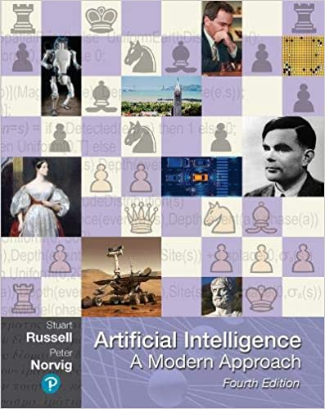
Stuart Russell and Peter Norvig (2020),
Artificial Intelligence: A Modern Approach,
4th Edition, Pearson
Source: Stuart Russell and Peter Norvig (2020), Artificial Intelligence: A Modern Approach, 4th Edition, Pearson
https://www.amazon.com/Artificial-Intelligence-A-Modern-Approach/dp/0134610997/

Slide 8
Artificial Intelligence:
A Modern Approach
Artificial Intelligence
Problem Solving
Knowledge and Reasoning
Uncertain Knowledge and Reasoning
Machine Learning
Communicating, Perceiving, and Acting
Philosophy and Ethics of AI
Source: Stuart Russell and Peter Norvig (2020), Artificial Intelligence: A Modern Approach, 4th Edition, Pearson

Slide 9
Artificial Intelligence:
Knowledge and Reasoning
Source: Stuart Russell and Peter Norvig (2020), Artificial Intelligence: A Modern Approach, 4th Edition, Pearson

Slide 10
Artificial Intelligence:
3. Knowledge and Reasoning
Logical Agents
First-Order Logic
Inference in First-Order Logic
Knowledge Representation
Automated Planning
Source: Stuart Russell and Peter Norvig (2020), Artificial Intelligence: A Modern Approach, 4th Edition, Pearson

Slide 11
Intelligent Agents
Source: Stuart Russell and Peter Norvig (2020), Artificial Intelligence: A Modern Approach, 4th Edition, Pearson

Slide 12
4 Approaches of AI
2. Thinking Humanly: The Cognitive Modeling Approach | 3. Thinking Rationally: The “Laws of Thought” Approach
1. Acting Humanly: The Turing Test Approach (1950) | 4. Acting Rationally: The Rational Agent Approach
Source: Stuart Russell and Peter Norvig (2020), Artificial Intelligence: A Modern Approach, 4th Edition, Pearson

Slide 13
Reinforcement Learning (DL)
Agent
Environment
Source: Richard S. Sutton & Andrew G. Barto (2018), Reinforcement Learning: An Introduction, 2nd Edition, A Bradford Book.

Slide 14
Reinforcement Learning (DL)
1
2
observation
Agent
action
3
reward
Environment
Source: Richard S. Sutton & Andrew G. Barto (2018), Reinforcement Learning: An Introduction, 2nd Edition, A Bradford Book.

Slide 15
Reinforcement Learning (DL)
1
2
observation
Agent
action
O_{t}
A_{t}
3
reward
R_{t}
Environment
Source: Richard S. Sutton & Andrew G. Barto (2018), Reinforcement Learning: An Introduction, 2nd Edition, A Bradford Book.

Slide 16
Agents interact with environments through sensors and actuators
Source: Stuart Russell and Peter Norvig (2020), Artificial Intelligence: A Modern Approach, 4th Edition, Pearson

Slide 17
Logical Agents
Source: Stuart Russell and Peter Norvig (2020), Artificial Intelligence: A Modern Approach, 4th Edition, Pearson

Slide 18
Logical Agents
Knowledge-based Agents
KB Agents
Source: Stuart Russell and Peter Norvig (2020), Artificial Intelligence: A Modern Approach, 4th Edition, Pearson

Slide 19
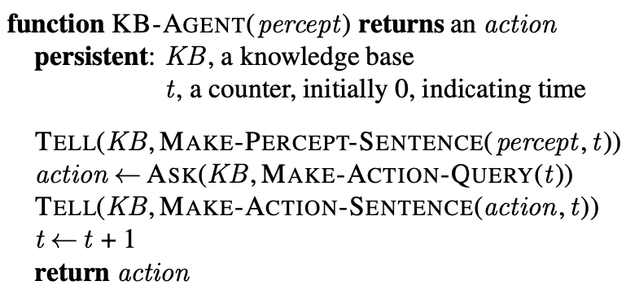
Knowledge-based Agent
(KB Agent)
Source: Stuart Russell and Peter Norvig (2020), Artificial Intelligence: A Modern Approach, 4th Edition, Pearson

Slide 20
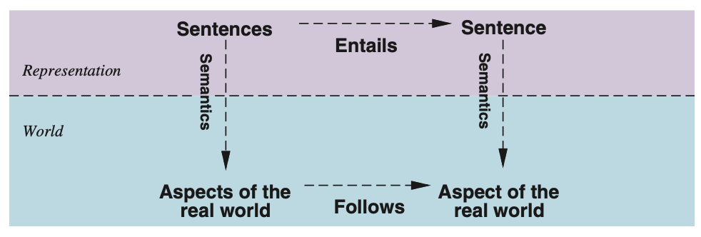
Sentences are physical configurations of the agent
Reasoning is a process of
constructing new physical configurations from old ones
Logical reasoning should ensure that the new configurations represent aspects of the world that actually follow from the aspects that the old configurations represent.
Source: Stuart Russell and Peter Norvig (2020), Artificial Intelligence: A Modern Approach, 4th Edition, Pearson

Slide 21
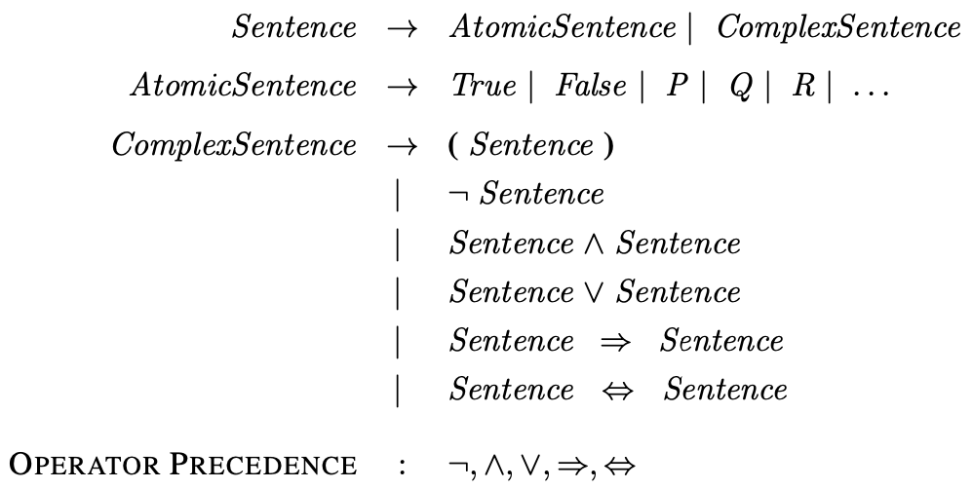
A BNF (Backus–Naur Form) grammar of sentences in propositional logic
Source: Stuart Russell and Peter Norvig (2020), Artificial Intelligence: A Modern Approach, 4th Edition, Pearson

Slide 22
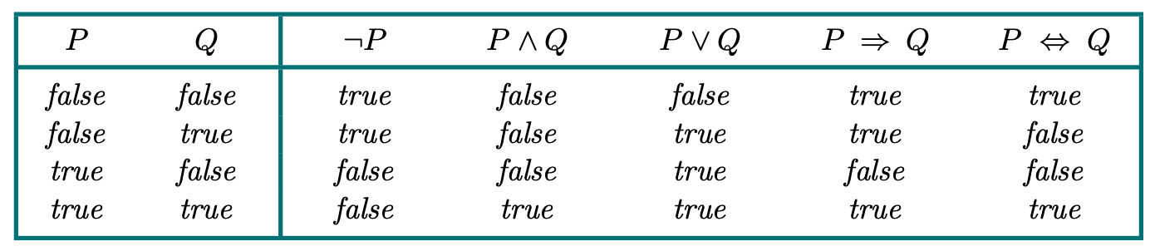
Truth Tables (TT) for the Five Logical Connectives
Source: Stuart Russell and Peter Norvig (2020), Artificial Intelligence: A Modern Approach, 4th Edition, Pearson

Slide 23
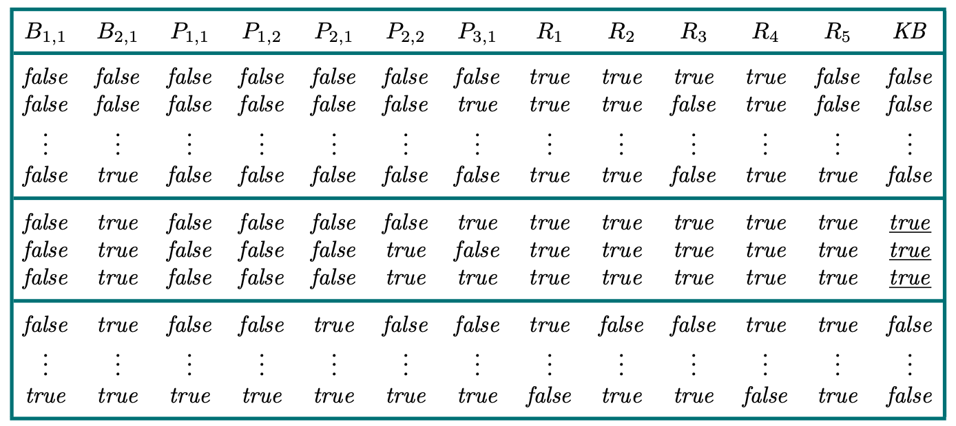
A Truth Table constructed for the knowledge base given in the text
Source: Stuart Russell and Peter Norvig (2020), Artificial Intelligence: A Modern Approach, 4th Edition, Pearson

Slide 24
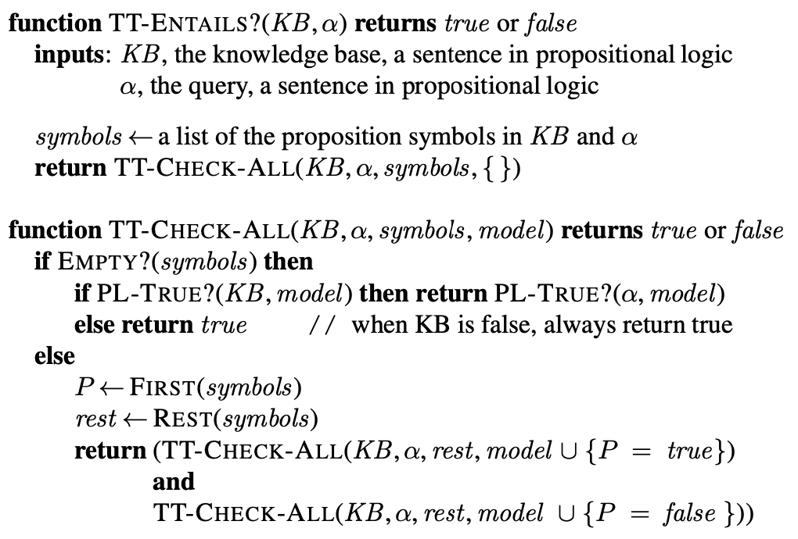
A Truth-Table (TT) enumeration algorithm for deciding propositional entailment
Source: Stuart Russell and Peter Norvig (2020), Artificial Intelligence: A Modern Approach, 4th Edition, Pearson

Slide 25
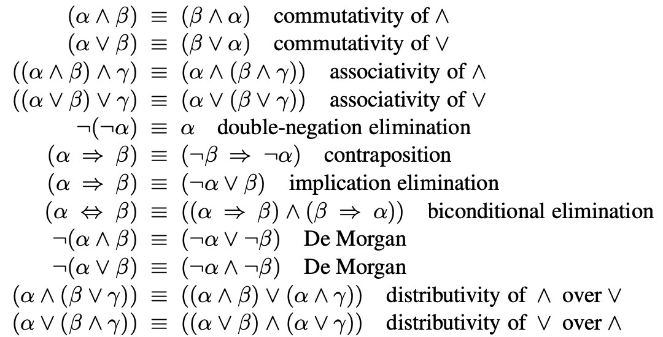
Standard Logical Equivalences
The symbols α, β, and γ stand for
arbitrary sentences of propositional logic.
Source: Stuart Russell and Peter Norvig (2020), Artificial Intelligence: A Modern Approach, 4th Edition, Pearson

Slide 26
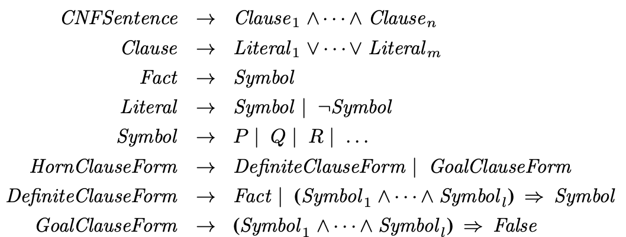
A grammar for
Conjunctive Normal Form (CNF),
Horn clauses, and definite clauses
Source: Stuart Russell and Peter Norvig (2020), Artificial Intelligence: A Modern Approach, 4th Edition, Pearson

Slide 27
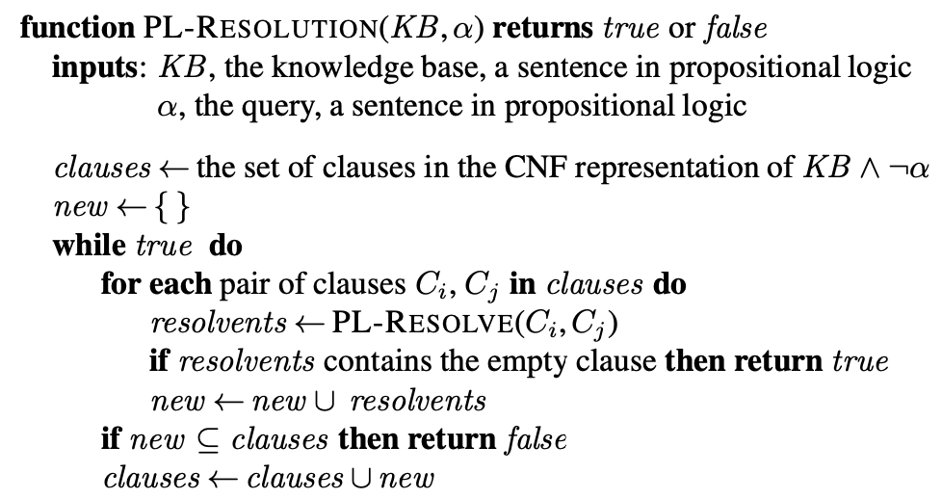
A simple resolution algorithm for propositional logic
Source: Stuart Russell and Peter Norvig (2020), Artificial Intelligence: A Modern Approach, 4th Edition, Pearson

Slide 28
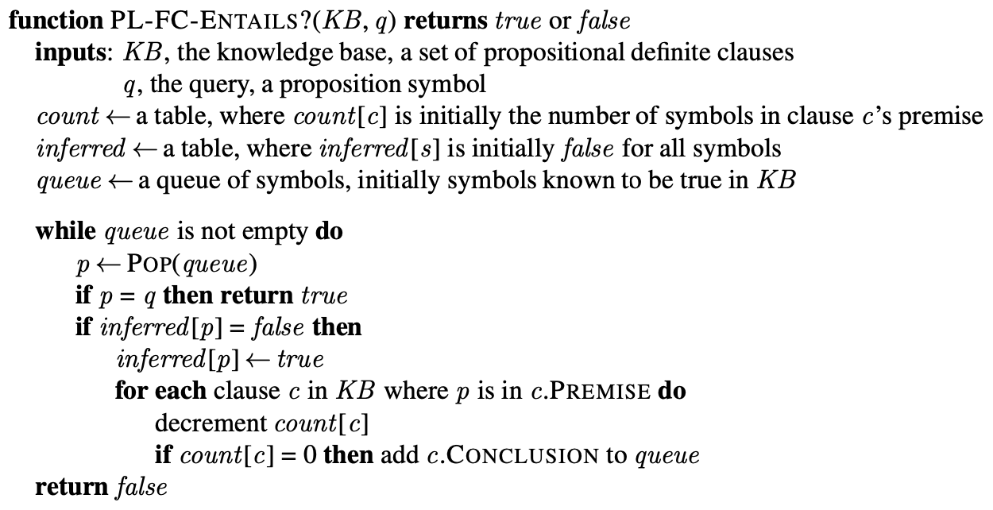
The forward-chaining algorithm for propositional logic
Source: Stuart Russell and Peter Norvig (2020), Artificial Intelligence: A Modern Approach, 4th Edition, Pearson

Slide 29
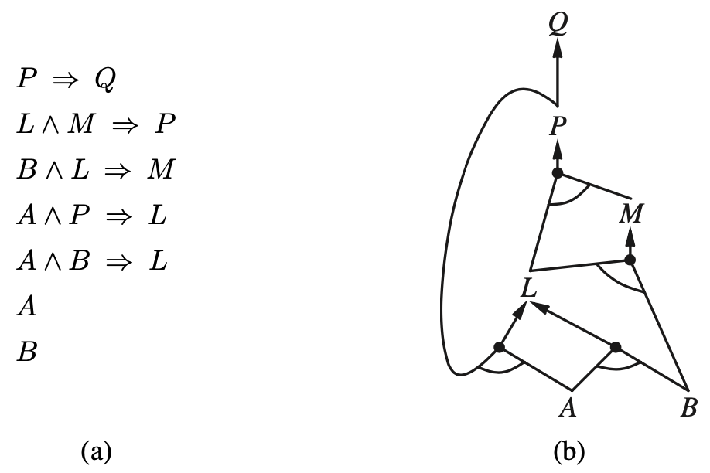
A set of Horn clauses
The corresponding AND–OR graph
Source: Stuart Russell and Peter Norvig (2020), Artificial Intelligence: A Modern Approach, 4th Edition, Pearson

Slide 30
First-Order Logic
Source: Stuart Russell and Peter Norvig (2020), Artificial Intelligence: A Modern Approach, 4th Edition, Pearson

Slide 31
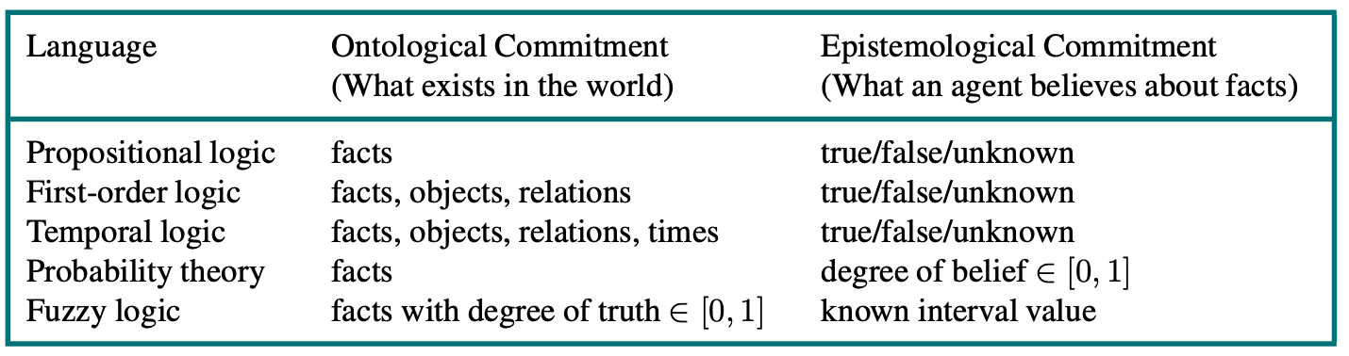
Formal languages and their ontological and epistemological commitments
Source: Stuart Russell and Peter Norvig (2020), Artificial Intelligence: A Modern Approach, 4th Edition, Pearson

Slide 32
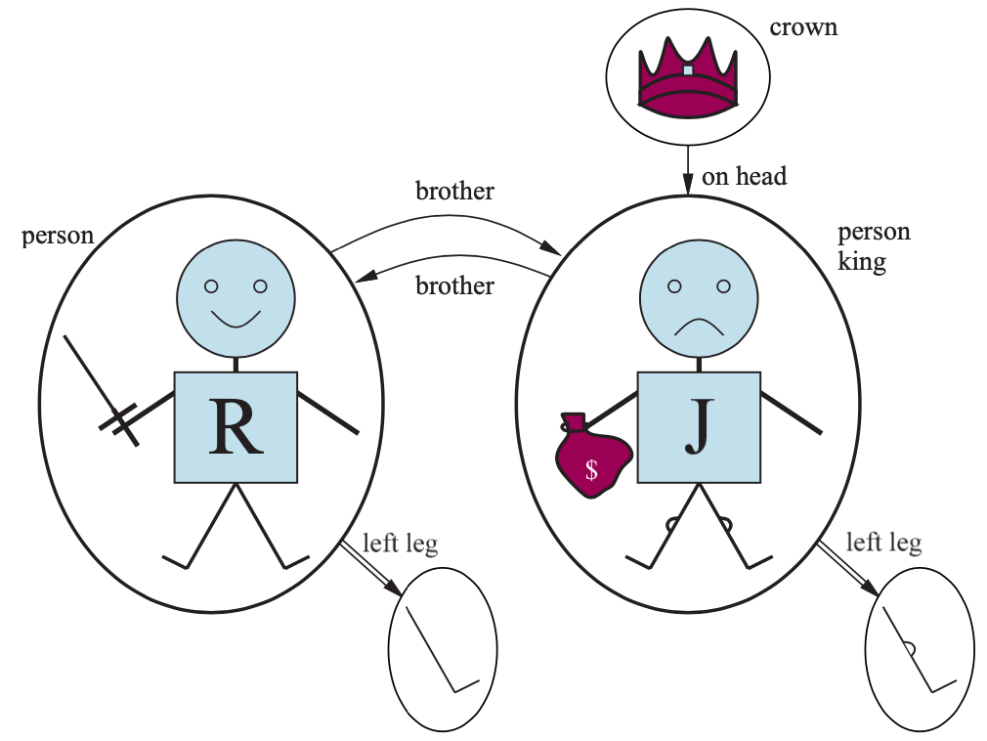
A model containing five objects two binary relations (brother and on-head), three unary relations (person, king, and crown), and one unary function (left-leg).
Source: Stuart Russell and Peter Norvig (2020), Artificial Intelligence: A Modern Approach, 4th Edition, Pearson

Slide 33
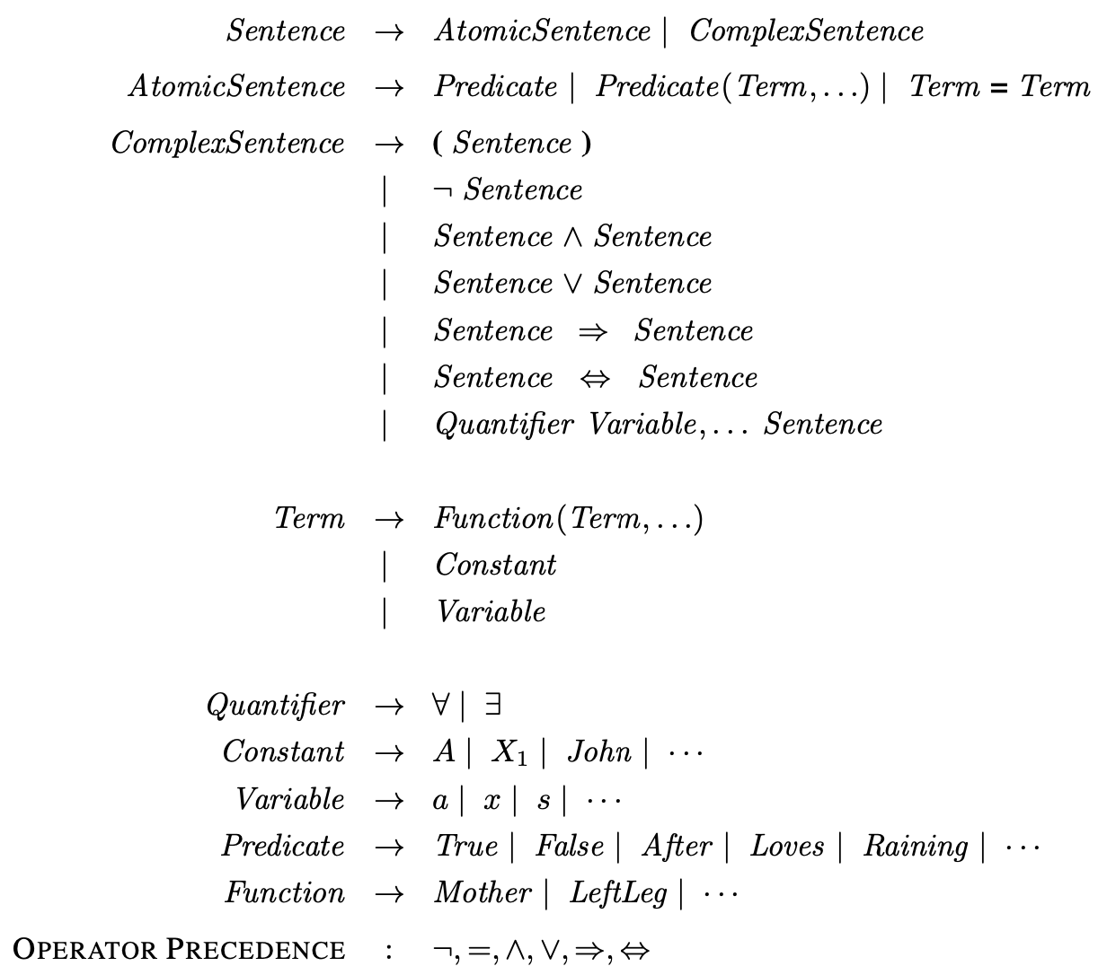
The syntax of first-order logic with equality
Source: Stuart Russell and Peter Norvig (2020), Artificial Intelligence: A Modern Approach, 4th Edition, Pearson

Slide 34
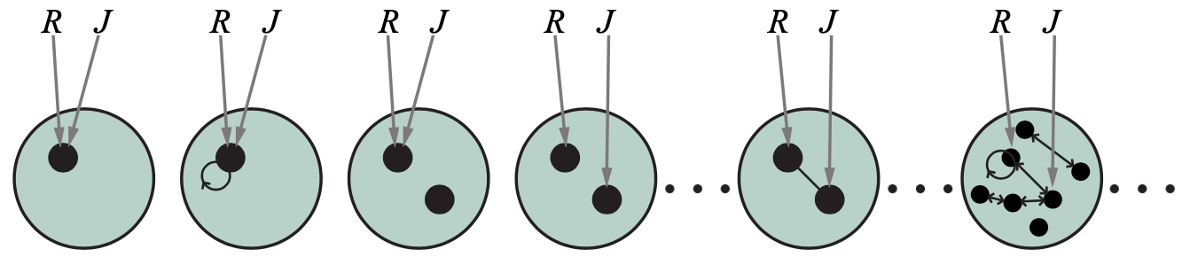
Some members of the set of all models for a language with two constant symbols, R and J, and one binary relation symbol
Source: Stuart Russell and Peter Norvig (2020), Artificial Intelligence: A Modern Approach, 4th Edition, Pearson

Slide 35
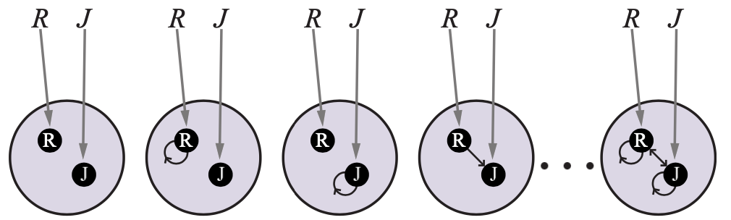
Some members of the set of all models for a language with two constant symbols, R and J, and one binary relation symbol, under database semantics
Source: Stuart Russell and Peter Norvig (2020), Artificial Intelligence: A Modern Approach, 4th Edition, Pearson

Slide 36
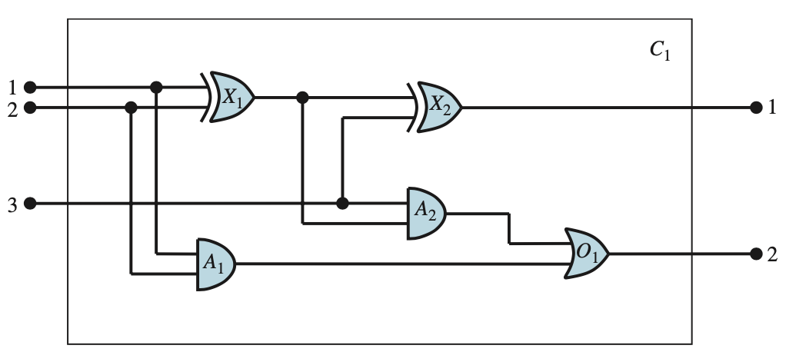
A digital circuit C1, purporting to be a one-bit full adder.
Source: Stuart Russell and Peter Norvig (2020), Artificial Intelligence: A Modern Approach, 4th Edition, Pearson

Slide 37
Inference in
First-Order Logic
Source: Stuart Russell and Peter Norvig (2020), Artificial Intelligence: A Modern Approach, 4th Edition, Pearson

Slide 38
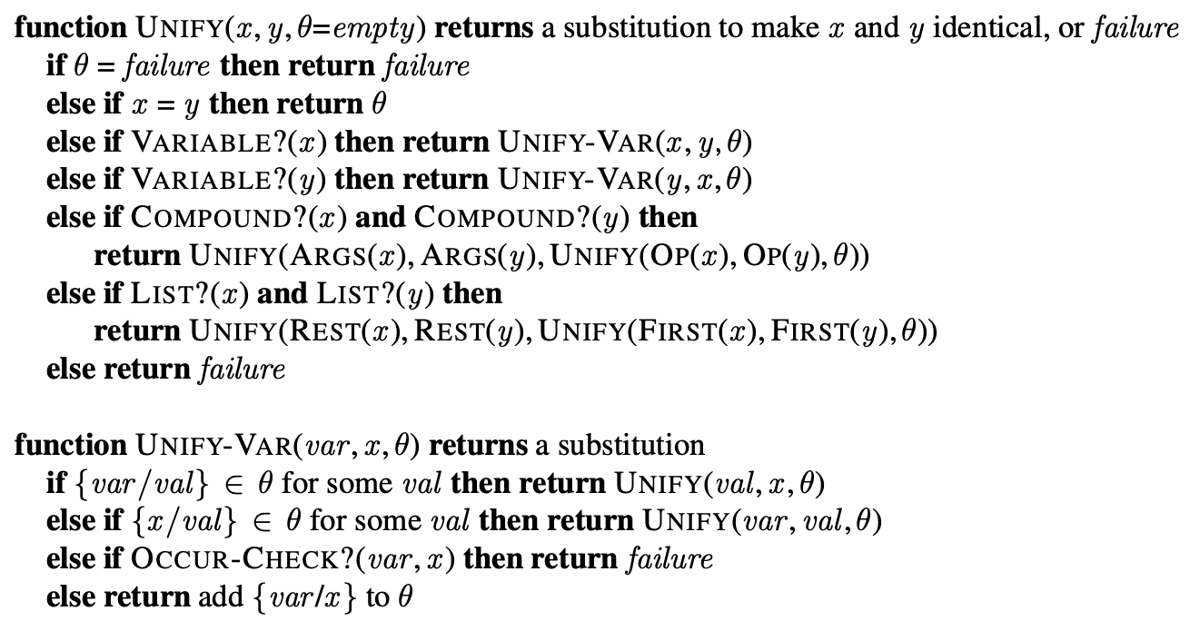
The unification algorithm
Source: Stuart Russell and Peter Norvig (2020), Artificial Intelligence: A Modern Approach, 4th Edition, Pearson

Slide 39
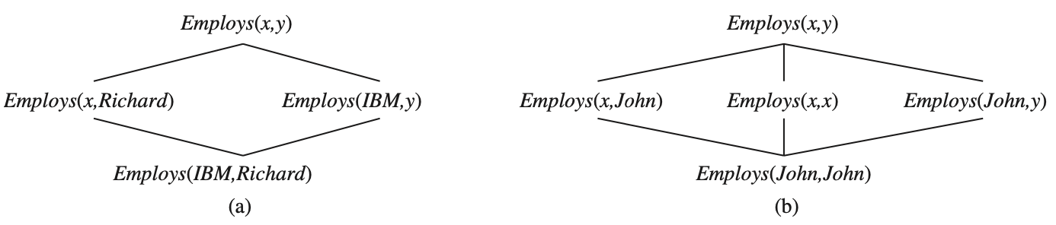
The subsumption lattice whose lowest node is Employs (IBM , Richard )
The subsumption lattice for the sentence Employs (John, John )
Source: Stuart Russell and Peter Norvig (2020), Artificial Intelligence: A Modern Approach, 4th Edition, Pearson

Slide 40
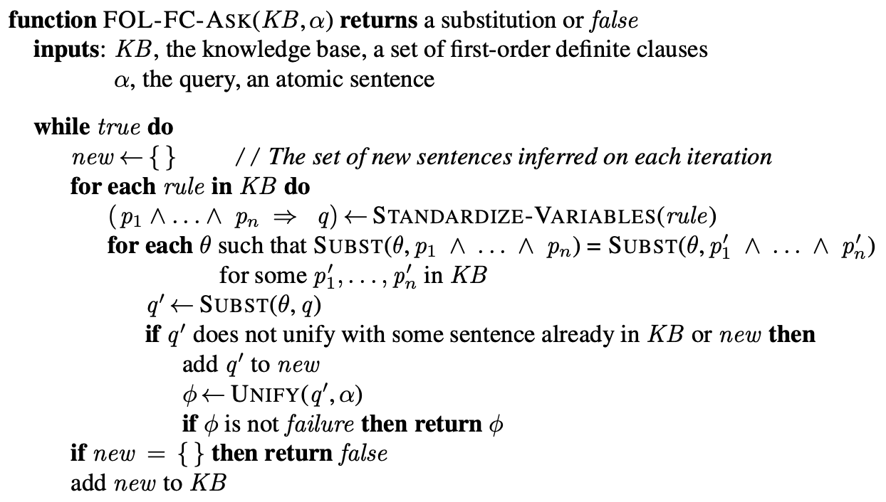
A conceptually straightforward, but inefficient, forward-chaining algorithm
Source: Stuart Russell and Peter Norvig (2020), Artificial Intelligence: A Modern Approach, 4th Edition, Pearson

Slide 41
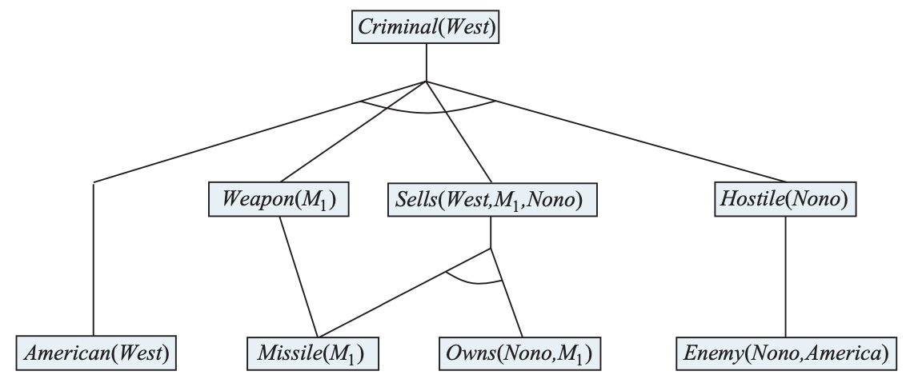
The proof tree generated by forward chaining on the crime example
Source: Stuart Russell and Peter Norvig (2020), Artificial Intelligence: A Modern Approach, 4th Edition, Pearson

Slide 42
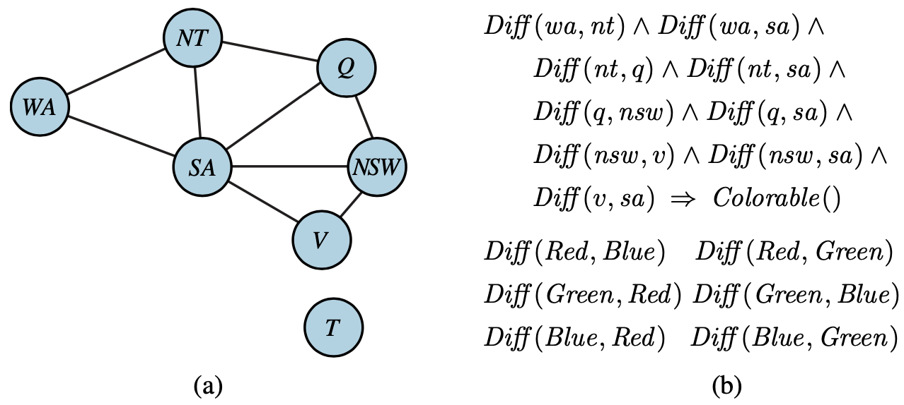
Constraint graph for coloring the map of Australia
Source: Stuart Russell and Peter Norvig (2020), Artificial Intelligence: A Modern Approach, 4th Edition, Pearson

Slide 43
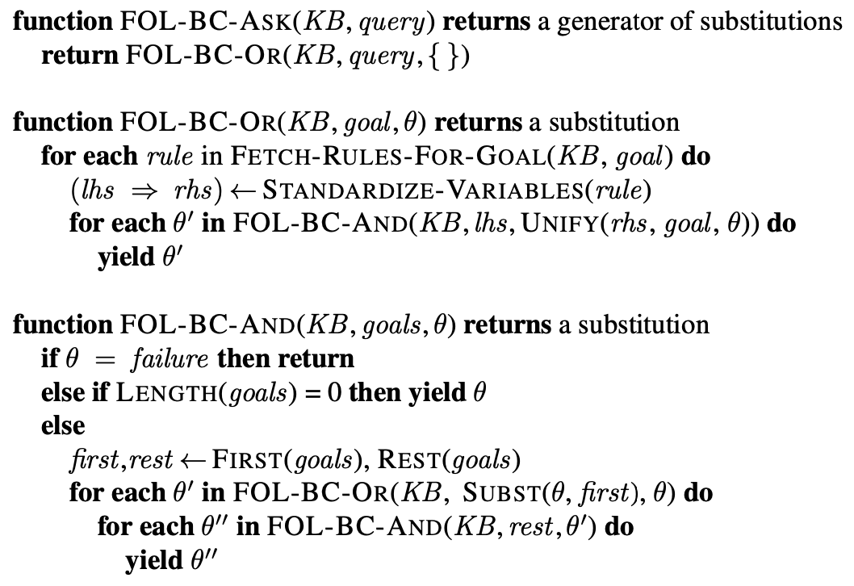
A simple backward-chaining algorithm for first-order knowledge bases
Source: Stuart Russell and Peter Norvig (2020), Artificial Intelligence: A Modern Approach, 4th Edition, Pearson

Slide 44
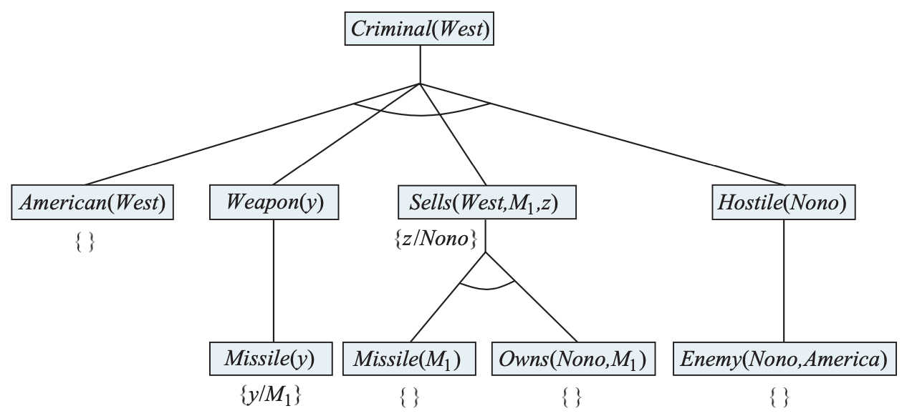
Proof tree constructed by backward chaining t o prove that West is a criminal
Source: Stuart Russell and Peter Norvig (2020), Artificial Intelligence: A Modern Approach, 4th Edition, Pearson

Slide 45
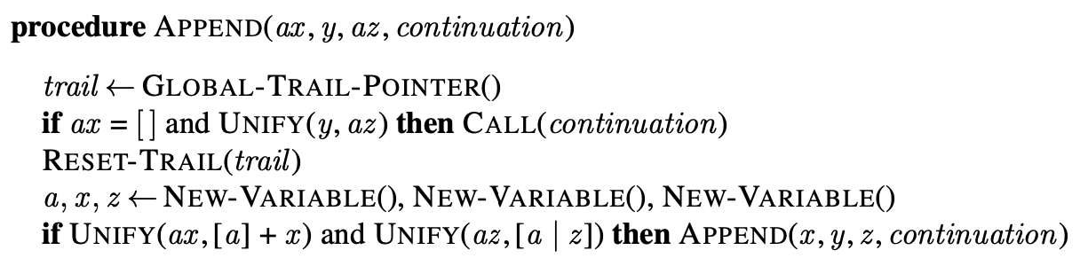
Pseudocode representing the result of compiling the Append predicate
Source: Stuart Russell and Peter Norvig (2020), Artificial Intelligence: A Modern Approach, 4th Edition, Pearson

Slide 46
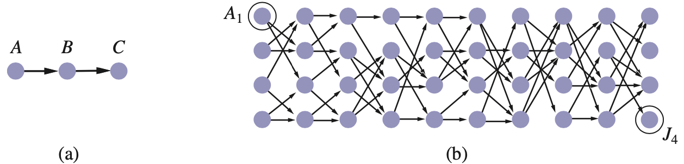
Finding a path from A to C can lead Prolog into an infinite loop.
Source: Stuart Russell and Peter Norvig (2020), Artificial Intelligence: A Modern Approach, 4th Edition, Pearson

Slide 47
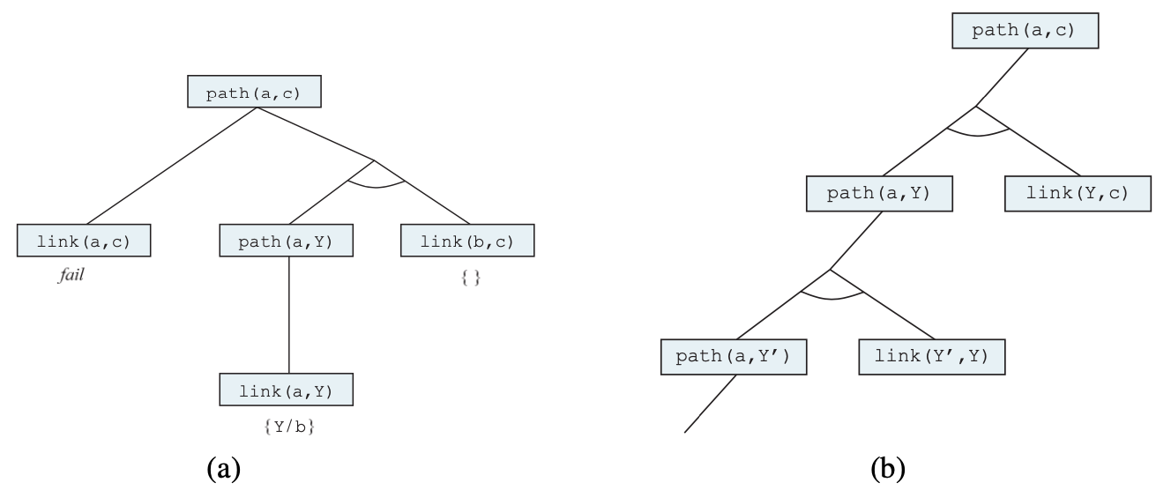
Proof that a path exists from A to C.
Infinite proof tree generated
when the clauses are
in the “wrong” order
Source: Stuart Russell and Peter Norvig (2020), Artificial Intelligence: A Modern Approach, 4th Edition, Pearson

Slide 48
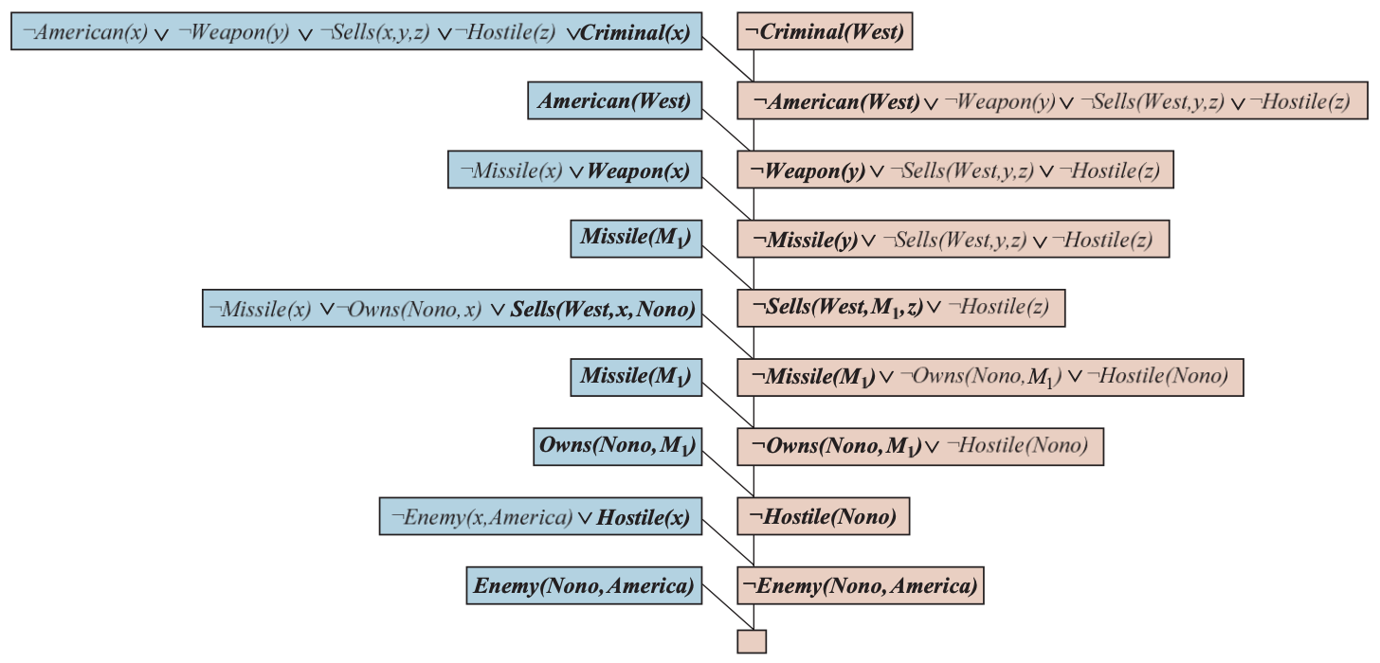
A resolution proof that
West is a criminal
Source: Stuart Russell and Peter Norvig (2020), Artificial Intelligence: A Modern Approach, 4th Edition, Pearson

Slide 49
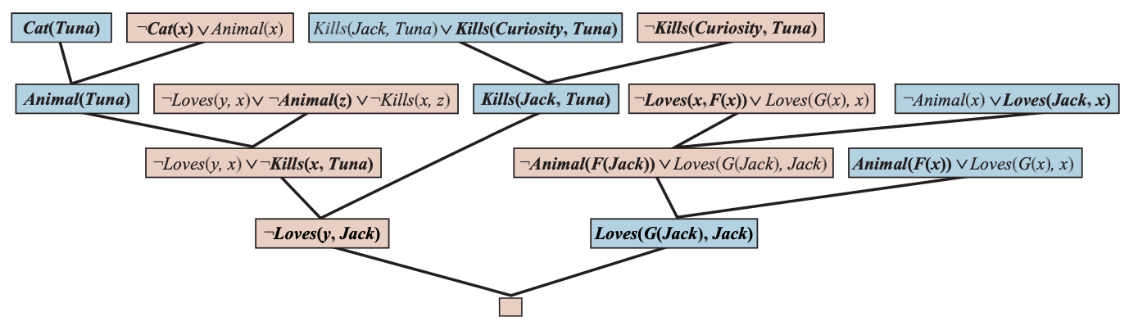
A resolution proof that
Curiosity killed the cat
Source: Stuart Russell and Peter Norvig (2020), Artificial Intelligence: A Modern Approach, 4th Edition, Pearson

Slide 50
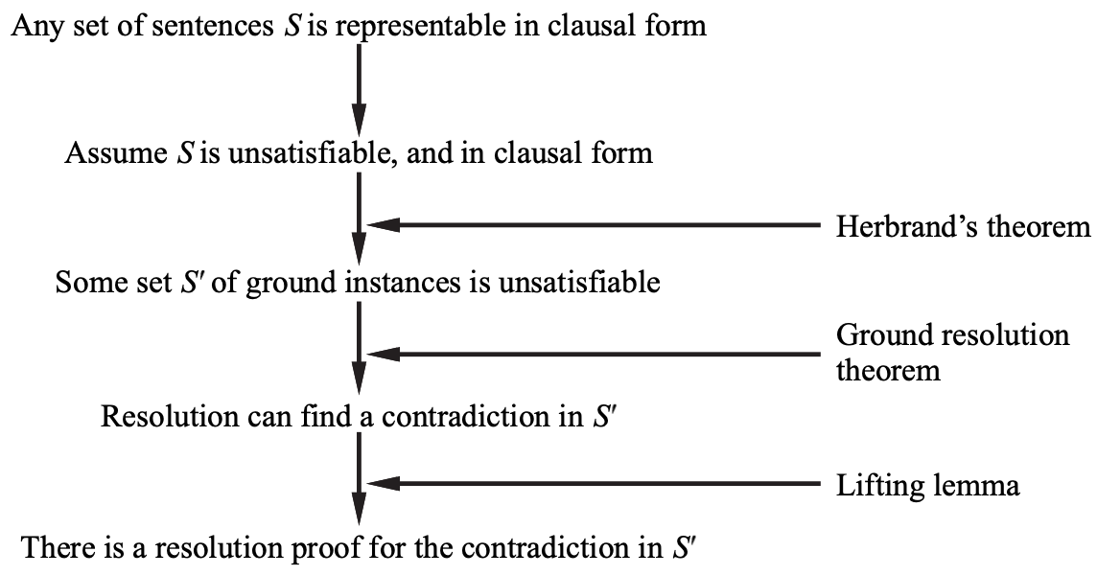
Structure of a completeness proof for resolution
Source: Stuart Russell and Peter Norvig (2020), Artificial Intelligence: A Modern Approach, 4th Edition, Pearson

Slide 51
Knowledge Representation
Source: Stuart Russell and Peter Norvig (2020), Artificial Intelligence: A Modern Approach, 4th Edition, Pearson

Slide 52
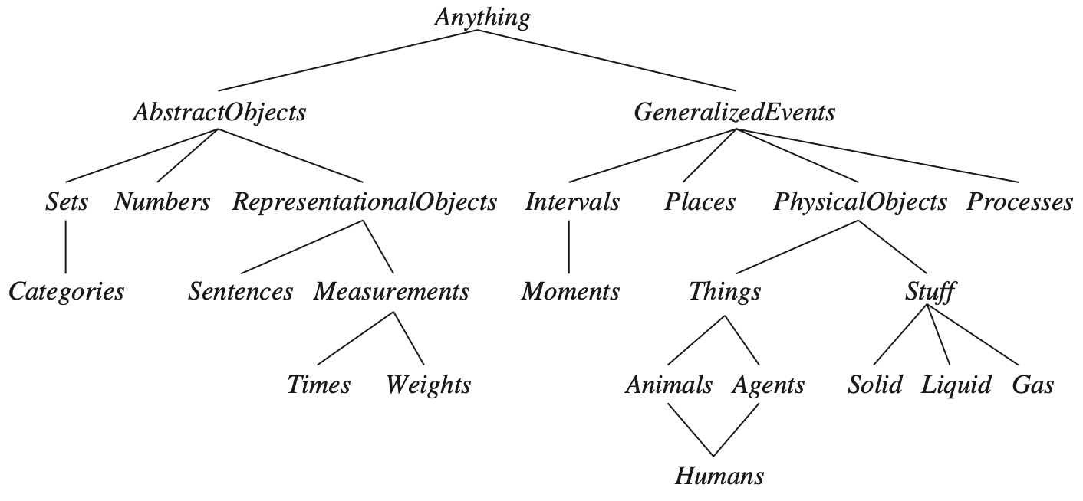
The Upper Ontology of the World
Source: Stuart Russell and Peter Norvig (2020), Artificial Intelligence: A Modern Approach, 4th Edition, Pearson

Slide 53
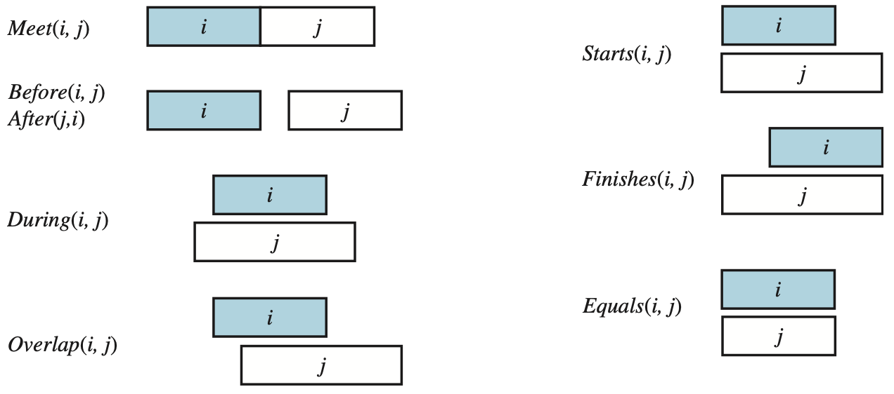
Predicates on time intervals
Source: Stuart Russell and Peter Norvig (2020), Artificial Intelligence: A Modern Approach, 4th Edition, Pearson

Slide 54
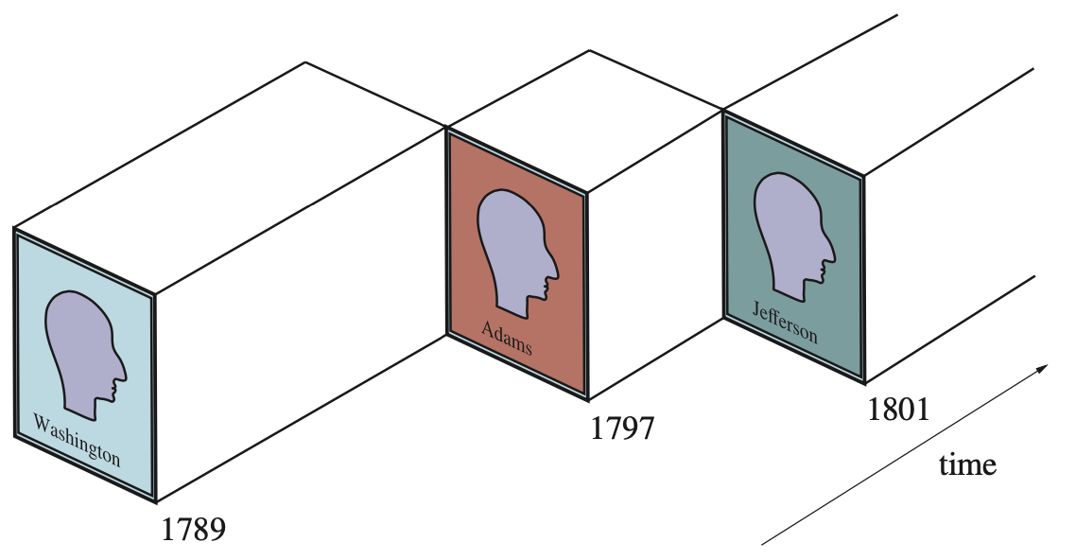
A schematic view of the object President (USA) for the early years
Source: Stuart Russell and Peter Norvig (2020), Artificial Intelligence: A Modern Approach, 4th Edition, Pearson

Slide 55
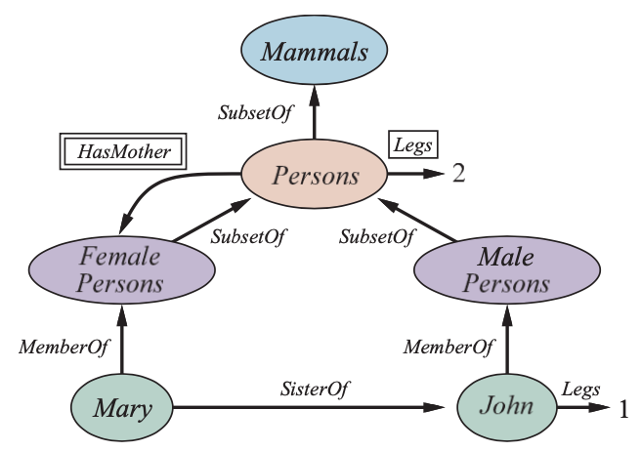
A semantic network with four objects (John, Mary, 1, and 2) and four categories Relations are denoted by labeled links
Source: Stuart Russell and Peter Norvig (2020), Artificial Intelligence: A Modern Approach, 4th Edition, Pearson

Slide 56
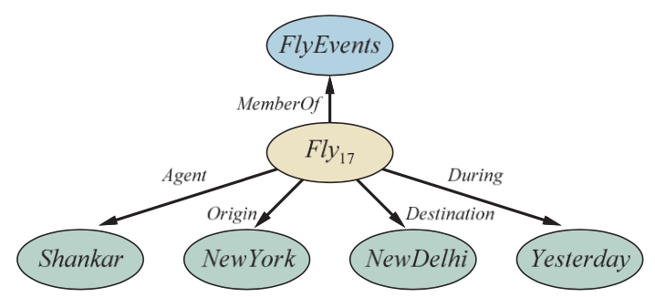
Semantic network
Representation of the logical assertion
Fly (Shankar, NewYork, NewDelhi, Yesterday)
Source: Stuart Russell and Peter Norvig (2020), Artificial Intelligence: A Modern Approach, 4th Edition, Pearson

Slide 57
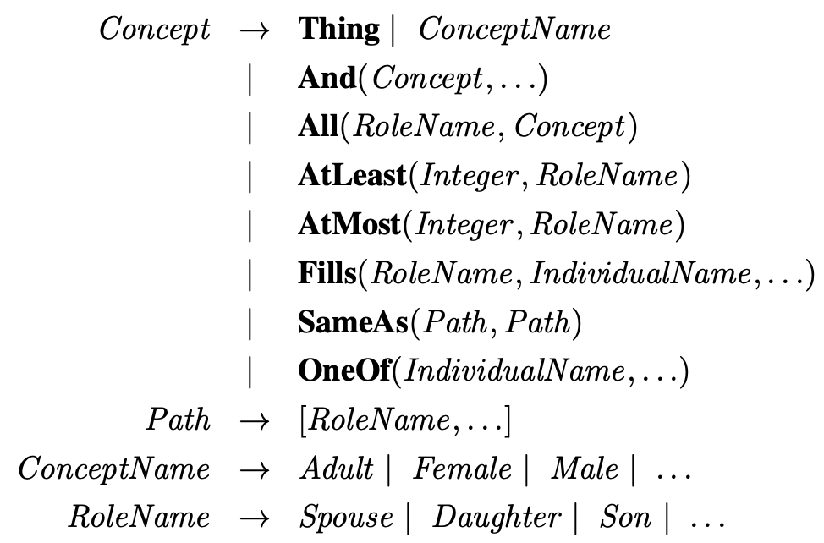
The syntax of descriptions in a subset of the CLASSIC language.
Source: Stuart Russell and Peter Norvig (2020), Artificial Intelligence: A Modern Approach, 4th Edition, Pearson

Slide 58
Automated Planning
Source: Stuart Russell and Peter Norvig (2020), Artificial Intelligence: A Modern Approach, 4th Edition, Pearson

Slide 59
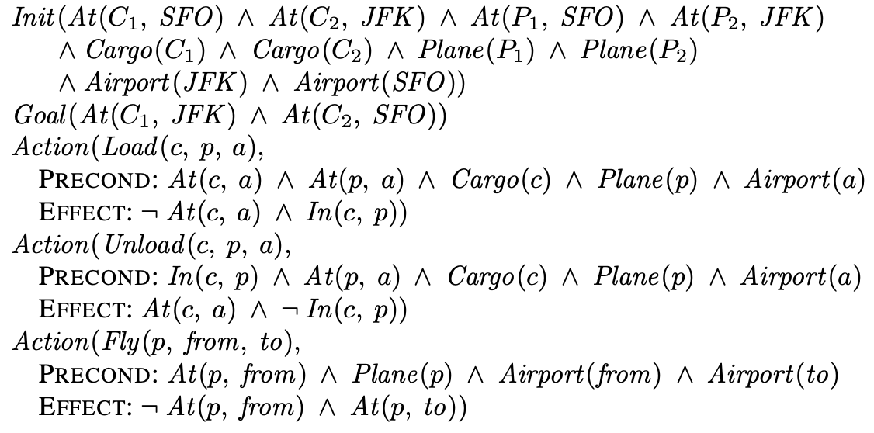
A PDDL description of an air cargo transportation planning problem
Source: Stuart Russell and Peter Norvig (2020), Artificial Intelligence: A Modern Approach, 4th Edition, Pearson

Slide 60
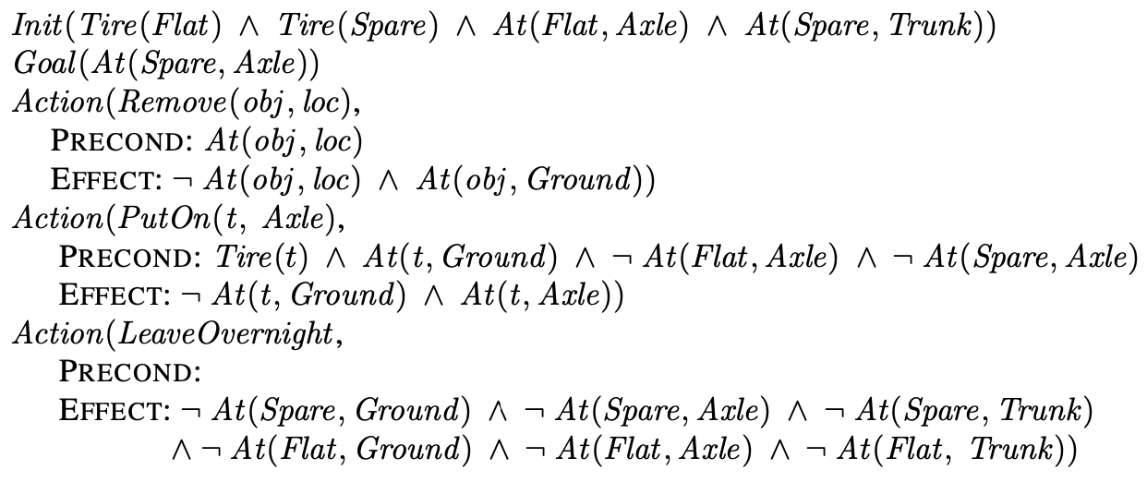
The simple spare tire problem
Source: Stuart Russell and Peter Norvig (2020), Artificial Intelligence: A Modern Approach, 4th Edition, Pearson

Slide 61
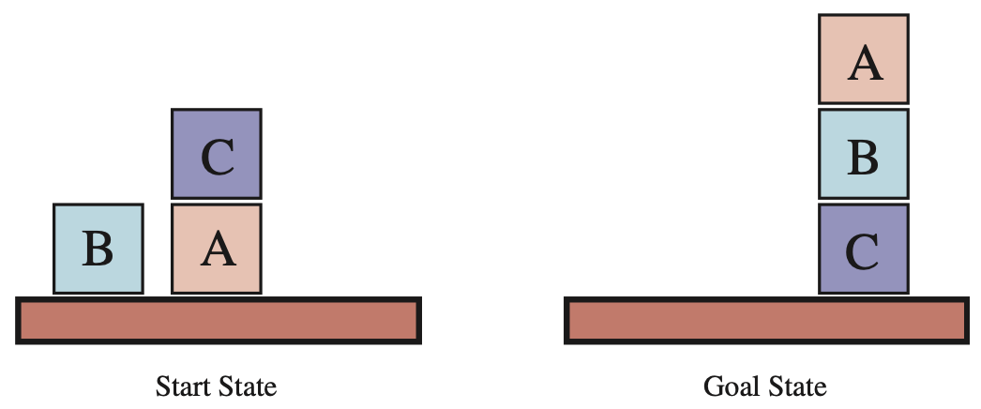
Diagram of the blocks-world problem
Source: Stuart Russell and Peter Norvig (2020), Artificial Intelligence: A Modern Approach, 4th Edition, Pearson

Slide 62
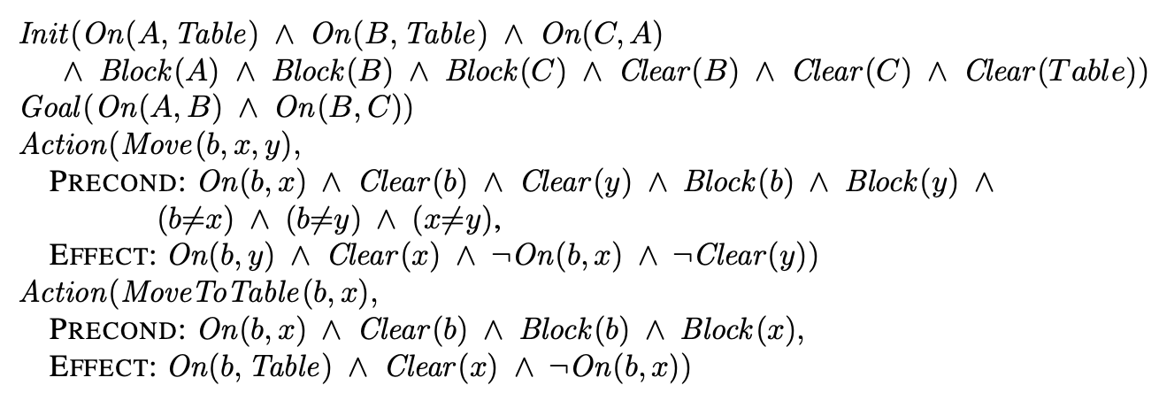
A planning problem in the blocks world: building a three-block tower
Source: Stuart Russell and Peter Norvig (2020), Artificial Intelligence: A Modern Approach, 4th Edition, Pearson

Slide 63
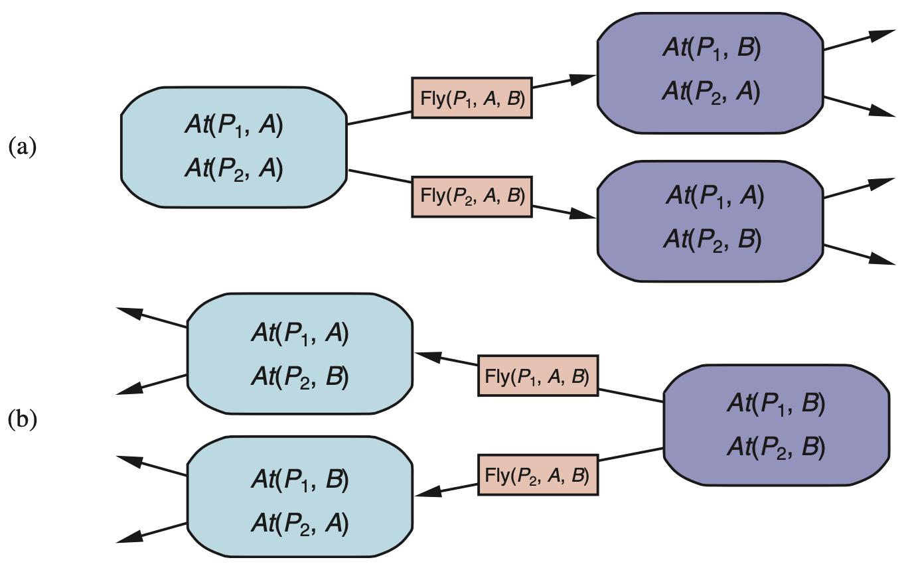
Two approaches to searching for a plan (a) Forward (progression) search
(b) Backward (regression) search
Source: Stuart Russell and Peter Norvig (2020), Artificial Intelligence: A Modern Approach, 4th Edition, Pearson

Slide 64
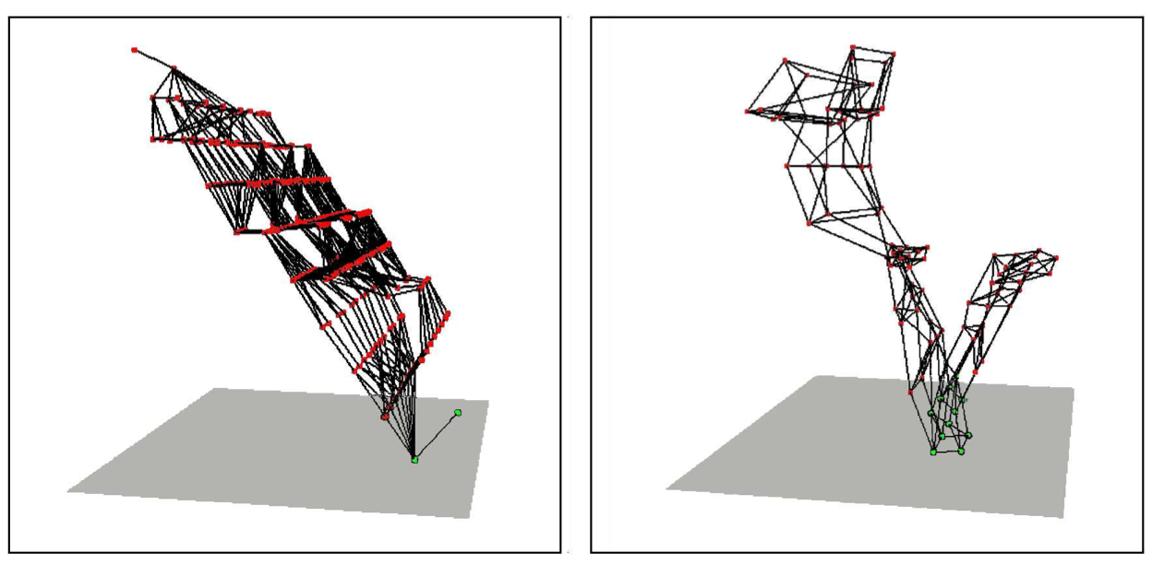
Two state spaces from planning problems with the ignore-delete-lists heuristic
Source: Stuart Russell and Peter Norvig (2020), Artificial Intelligence: A Modern Approach, 4th Edition, Pearson

Slide 65
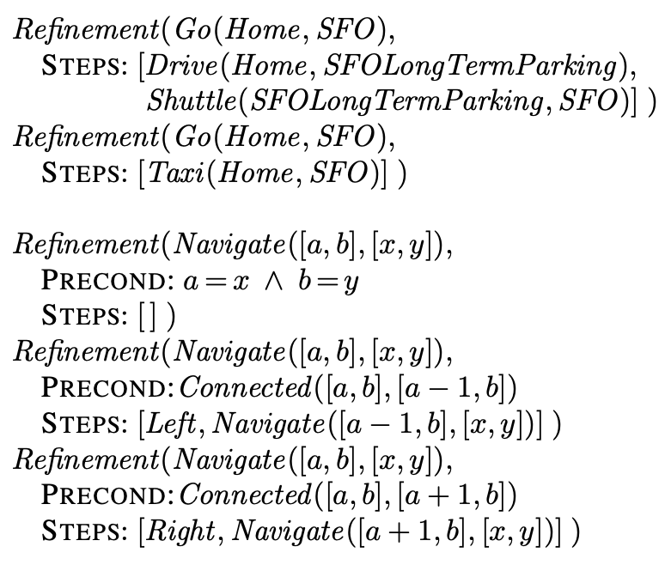
Definitions of possible refinements for two high-level actions
Source: Stuart Russell and Peter Norvig (2020), Artificial Intelligence: A Modern Approach, 4th Edition, Pearson

Slide 66
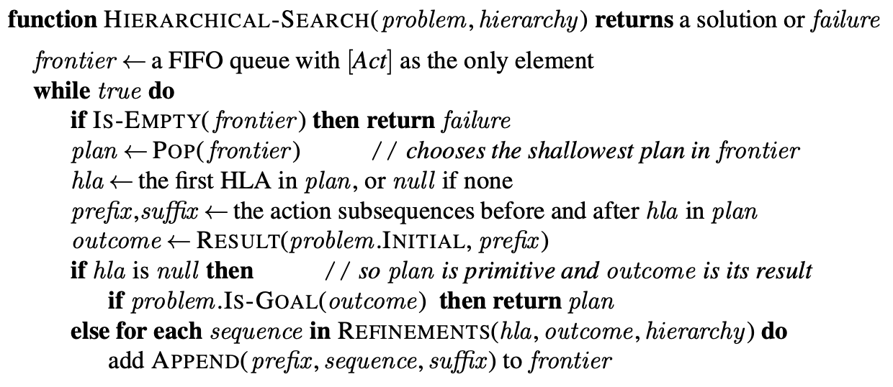
A breadth-first implementation of hierarchical forward planning search
Source: Stuart Russell and Peter Norvig (2020), Artificial Intelligence: A Modern Approach, 4th Edition, Pearson

Slide 67
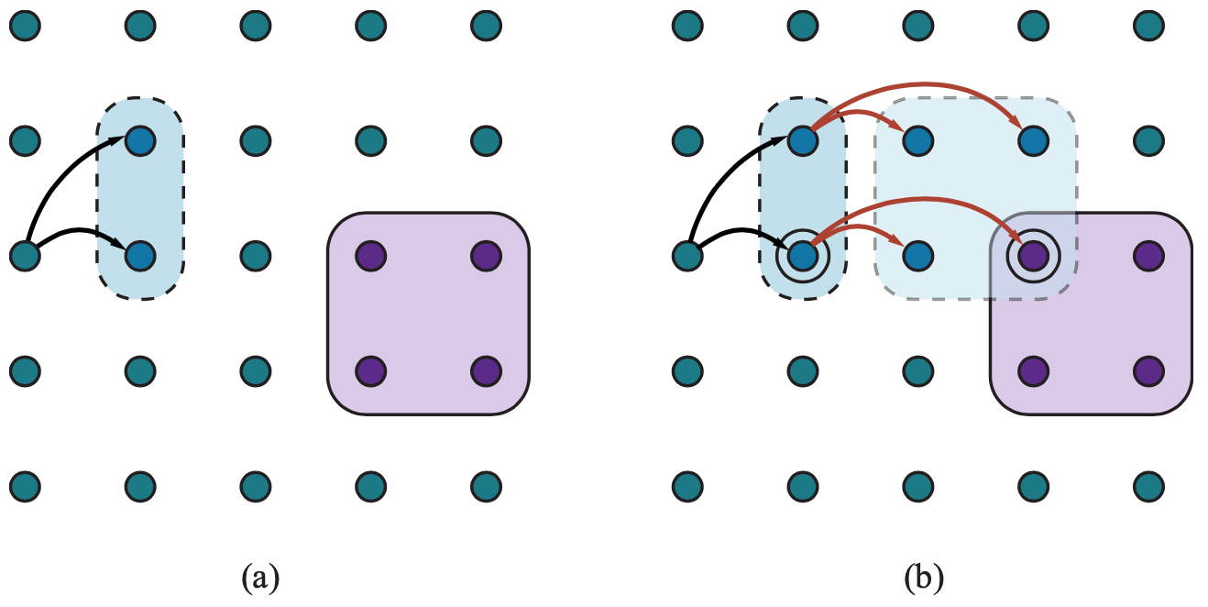
Schematic examples of reachable sets
Source: Stuart Russell and Peter Norvig (2020), Artificial Intelligence: A Modern Approach, 4th Edition, Pearson

Slide 68
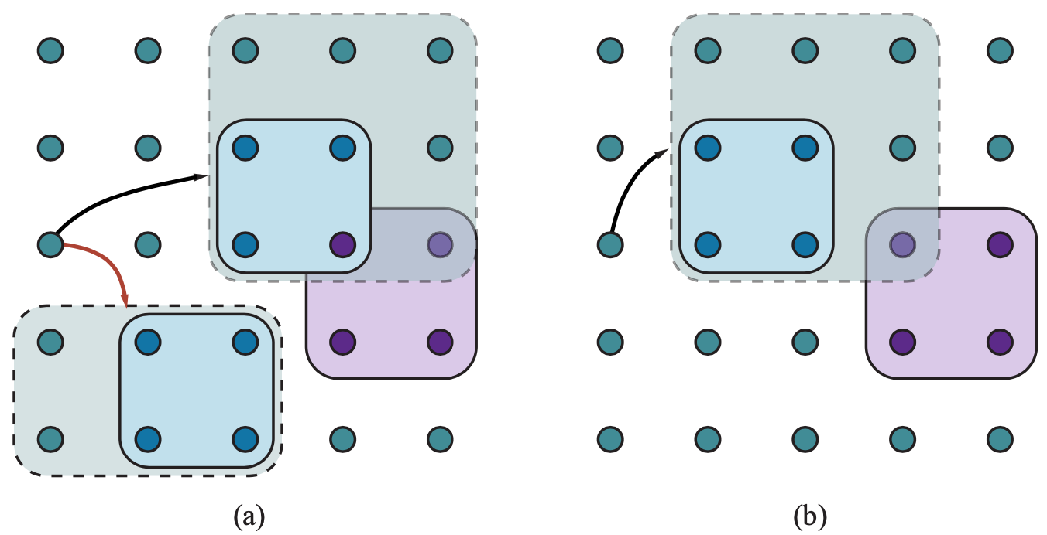
Goal achievement for high-level plans with approximate descriptions
Source: Stuart Russell and Peter Norvig (2020), Artificial Intelligence: A Modern Approach, 4th Edition, Pearson

Slide 69
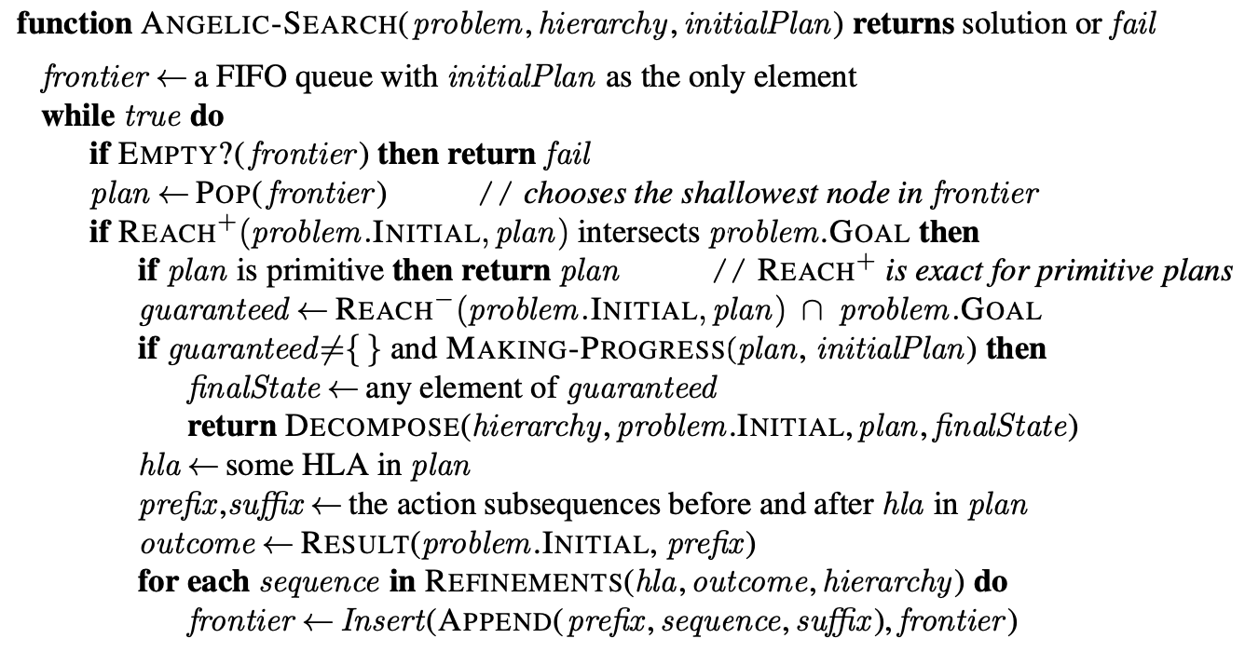
A hierarchical planning algorithm
Source: Stuart Russell and Peter Norvig (2020), Artificial Intelligence: A Modern Approach, 4th Edition, Pearson

Slide 70
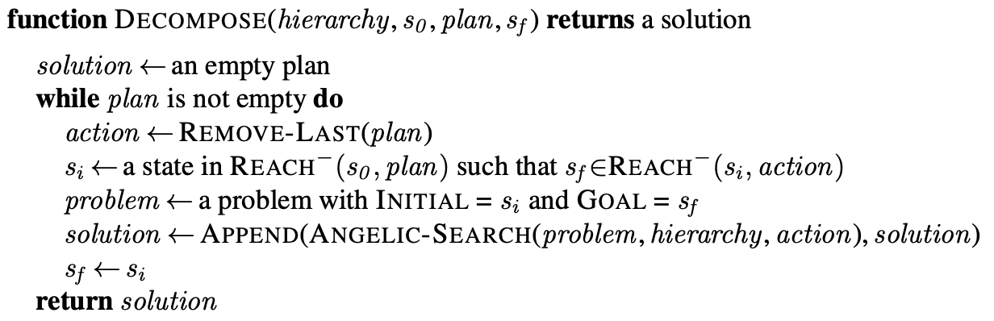
A hierarchical planning algorithm
Decompose solution
Source: Stuart Russell and Peter Norvig (2020), Artificial Intelligence: A Modern Approach, 4th Edition, Pearson

Slide 71
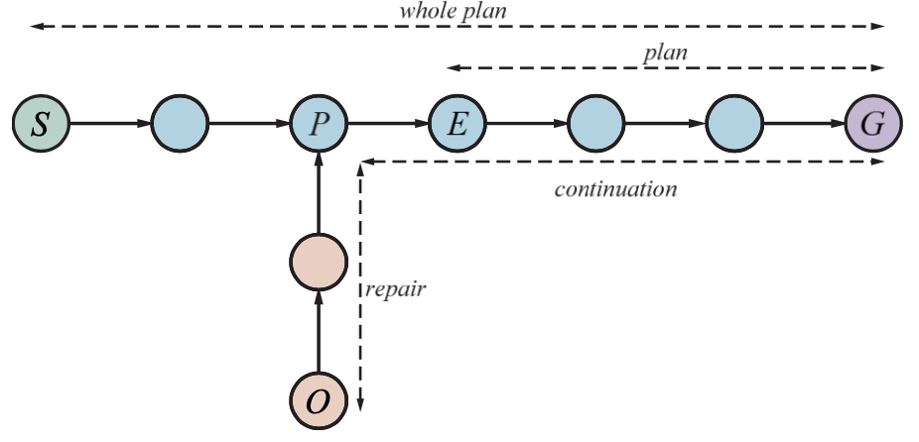
At first, the sequence “whole plan” is expected to get the agent from S to G
Source: Stuart Russell and Peter Norvig (2020), Artificial Intelligence: A Modern Approach, 4th Edition, Pearson

Slide 72

A job-shop scheduling problem for assembling two cars, with resource constraints
Source: Stuart Russell and Peter Norvig (2020), Artificial Intelligence: A Modern Approach, 4th Edition, Pearson

Slide 73

A representation of the temporal constraints for the job-shop scheduling problem
Source: Stuart Russell and Peter Norvig (2020), Artificial Intelligence: A Modern Approach, 4th Edition, Pearson

Slide 74

A solution to the job-shop scheduling problem
Source: Stuart Russell and Peter Norvig (2020), Artificial Intelligence: A Modern Approach, 4th Edition, Pearson

Slide 75
AIMA Python
Artificial Intelligence: A Modern Approach (AIMA)
  http://aima.cs.berkeley.edu/
AIMA Python
  http://aima.cs.berkeley.edu/python/readme.html
Logic, KB Agent
  http://aima.cs.berkeley.edu/python/logic.html
Source: Stuart Russell and Peter Norvig (2020), Artificial Intelligence: A Modern Approach, 4th Edition, Pearson

Slide 76

Python in Google Colab (Python101)
https://colab.research.google.com/drive/1FEG6DnGvwfUbeo4zJ1zTunjMqf2RkCrT
https://tinyurl.com/aintpupython101

Slide 77
Summary
Logical Agents
First-Order Logic
Inference in First-Order Logic
Knowledge Representation
Automated Planning

Slide 78
References
Stuart Russell and Peter Norvig (2020), Artificial Intelligence: A Modern Approach, 4th Edition, Pearson.
Aurélien Géron (2019), Hands-On Machine Learning with Scikit-Learn, Keras, and TensorFlow: Concepts, Tools, and Techniques to Build Intelligent Systems, 2nd Edition, O’Reilly Media.

