Slide 1



人工智慧
(Artificial Intelligence)
機器學習與監督式學習
(Machine Learning and Supervised Learning)
1092AI06
MBA, IM, NTPU (M5010) (Spring 2021)
Wed 2, 3, 4 (9:10-12:00) (B8F40)
Min-Yuh Day
戴敏育
Associate Professor
副教授
Institute of Information Management, National Taipei University
國立臺北大學 資訊管理研究所
https://web.ntpu.edu.tw/~myday
2021-04-14

Slide 2
課程大綱 (Syllabus)
週次 (Week) 日期 (Date) 內容 (Subject/Topics)
1 2021/02/24 人工智慧概論
(Introduction to Artificial Intelligence)
2 2021/03/03 人工智慧和智慧代理人
(Artificial Intelligence and Intelligent Agents)
3 2021/03/10 問題解決
(Problem Solving)
4 2021/03/17 知識推理和知識表達
(Knowledge, Reasoning and Knowledge Representation)
5 2021/03/24 不確定知識和推理
(Uncertain Knowledge and Reasoning)
6 2021/03/31 人工智慧個案研究 I
(Case Study on Artificial Intelligence I)

Slide 3
課程大綱 (Syllabus)
週次 (Week) 日期 (Date) 內容 (Subject/Topics)
7 2021/04/07 放假一天 (Day off)
8 2021/04/14 機器學習與監督式學習
(Machine Learning and Supervised Learning)
9 2021/04/21 期中報告
(Midterm Project Report)
10 2021/04/28 學習理論與綜合學習
(The Theory of Learning and Ensemble Learning)
11 2021/05/05 深度學習
(Deep Learning)
12 2021/05/12 人工智慧個案研究 II
(Case Study on Artificial Intelligence II)

Slide 4
課程大綱 (Syllabus)
週次 (Week) 日期 (Date) 內容 (Subject/Topics)
13 2021/05/19 強化學習
(Reinforcement Learning)
14 2021/05/26 深度學習自然語言處理
(Deep Learning for Natural Language Processing)
15 2021/06/02 機器人技術
(Robotics)
16 2021/06/09 人工智慧哲學與倫理，人工智慧的未來
(Philosophy and Ethics of AI, The Future of AI)
17 2021/06/16 期末報告 I
(Final Project Report I)
18 2021/06/23 期末報告 II
(Final Project Report II)

Slide 5
Machine Learning and
Supervised Learning

Slide 6
Outline
Machine Learning
Supervised Learning

Slide 7
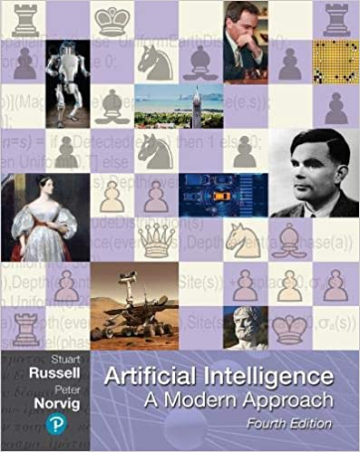
Stuart Russell and Peter Norvig (2020),
Artificial Intelligence: A Modern Approach,
4th Edition, Pearson
Source: Stuart Russell and Peter Norvig (2020), Artificial Intelligence: A Modern Approach, 4th Edition, Pearson
https://www.amazon.com/Artificial-Intelligence-A-Modern-Approach/dp/0134610997/

Slide 8
Artificial Intelligence:
A Modern Approach
Artificial Intelligence
Problem Solving
Knowledge and Reasoning
Uncertain Knowledge and Reasoning
Machine Learning
Communicating, Perceiving, and Acting
Philosophy and Ethics of AI
Source: Stuart Russell and Peter Norvig (2020), Artificial Intelligence: A Modern Approach, 4th Edition, Pearson

Slide 9
Artificial Intelligence:
Machine Learning
Source: Stuart Russell and Peter Norvig (2020), Artificial Intelligence: A Modern Approach, 4th Edition, Pearson

Slide 10
Artificial Intelligence:
5. Machine Learning
Learning from Examples
Learning Probabilistic Models
Deep Learning
Reinforcement Learning
Source: Stuart Russell and Peter Norvig (2020), Artificial Intelligence: A Modern Approach, 4th Edition, Pearson

Slide 11
Reinforcement Learning (DL)
Agent
Environment
Source: Richard S. Sutton & Andrew G. Barto (2018), Reinforcement Learning: An Introduction, 2nd Edition, A Bradford Book.

Slide 12
Reinforcement Learning (DL)
1
2
observation
Agent
action
3
reward
Environment
Source: Richard S. Sutton & Andrew G. Barto (2018), Reinforcement Learning: An Introduction, 2nd Edition, A Bradford Book.

Slide 13
Reinforcement Learning (DL)
1
2
observation
Agent
action
O_{t}
A_{t}
3
reward
R_{t}
Environment
Source: Richard S. Sutton & Andrew G. Barto (2018), Reinforcement Learning: An Introduction, 2nd Edition, A Bradford Book.

Slide 14
Agents interact with environments through sensors and actuators
Source: Stuart Russell and Peter Norvig (2020), Artificial Intelligence: A Modern Approach, 4th Edition, Pearson

Slide 15
Machine Learning
Supervised Learning (Classification)
Learning from Examples
y = f(x)
x
y

Slide 16
Machine Learning
Supervised Learning (Classification)
Learning from Examples
y = f(x)
5.1,3.5,1.4,0.2,Iris-setosa 4.9,3.0,1.4,0.2,Iris-setosa 4.7,3.2,1.3,0.2,Iris-setosa 7.0,3.2,4.7,1.4,Iris-versicolor 6.4,3.2,4.5,1.5,Iris-versicolor 6.9,3.1,4.9,1.5,Iris-versicolor 6.3,3.3,6.0,2.5,Iris-virginica 5.8,2.7,5.1,1.9,Iris-virginica 7.1,3.0,5.9,2.1,Iris-virginica
y
x

Slide 17

Aurélien Géron (2019),
Hands-On Machine Learning with Scikit-Learn, Keras, and TensorFlow: Concepts, Tools, and Techniques to Build Intelligent Systems, 2nd Edition
O’Reilly Media, 2019
https://github.com/ageron/handson-ml2
Source: https://www.amazon.com/Hands-Machine-Learning-Scikit-Learn-TensorFlow/dp/1492032646/

Slide 18

Hands-On Machine Learning with
Scikit-Learn, Keras, and TensorFlow
Notebooks
The Machine Learning landscape
End-to-end Machine Learning project
Classification
Training Models
Support Vector Machines
Decision Trees
Ensemble Learning and Random Forests
Dimensionality Reduction
Unsupervised Learning Techniques
Artificial Neural Nets with Keras
Training Deep Neural Networks
Custom Models and Training with TensorFlow
Loading and Preprocessing Data
Deep Computer Vision Using Convolutional Neural Networks
Processing Sequences Using RNNs and CNNs
Natural Language Processing with RNNs and Attention
Representation Learning Using Autoencoders
Reinforcement Learning
Training and Deploying TensorFlow Models at Scale
https://github.com/ageron/handson-ml2

Slide 19
AI, ML, DL
Artificial Intelligence (AI)
Machine Learning (ML)
Supervised
Learning
Unsupervised Learning
Deep Learning (DL)
CNN
RNN LSTM GRU
GAN
Semi-supervised Learning
Reinforcement Learning
Source: https://leonardoaraujosantos.gitbooks.io/artificial-inteligence/content/deep_learning.html

Slide 20
3 Machine Learning Algorithms
Source: Enrico Galimberti, http://blogs.teradata.com/data-points/tree-machine-learning-algorithms/

Slide 21
Machine Learning Models
Deep Learning
Kernel
Association rules
Ensemble
Decision tree
Dimensionality reduction
Clustering
Regression Analysis
Bayesian
Instance based
Source: Sunila Gollapudi (2016), Practical Machine Learning, Packt Publishing

Slide 22
Machine Learning (ML) / Deep Learning (DL)
Decision Tree Classifiers
Support Vector Machine (SVM)
Supervised Learning
Neural Network (NN)
Linear Classifiers
Deep Learning (DL)
Machine Learning
(ML)
Rule-based Classifiers
Naïve Bayes
(NB)
Unsupervised Learning
Probabilistic Classifiers
Bayesian Network (BN)
Maximum Entropy (ME)
Reinforcement Learning
Source: Jesus Serrano-Guerrero, Jose A. Olivas, Francisco P. Romero, and Enrique Herrera-Viedma (2015),
"Sentiment analysis: A review and comparative analysis of web services," Information Sciences, 311, pp. 18-38.

Slide 23
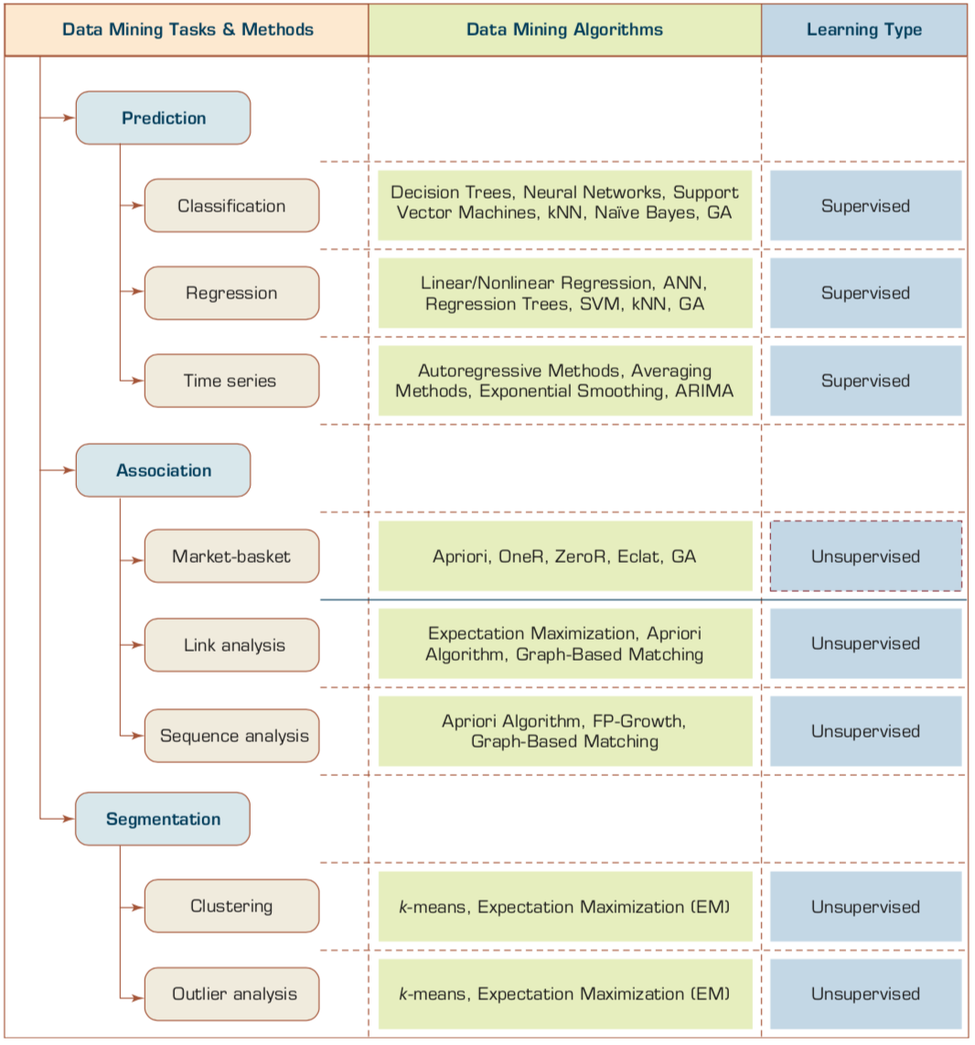
Data Mining Tasks & Methods
Source: Ramesh Sharda, Dursun Delen, and Efraim Turban (2017), Business Intelligence, Analytics, and Data Science: A Managerial Perspective, 4th Edition, Pearson

Slide 24
Data Mining Methods
Classification
  Classification
    Class Label Prediction
  Regression
    Numeric Value Prediction
Clustering
Association
Source: Ramesh Sharda, Dursun Delen, and Efraim Turban (2017), Business Intelligence, Analytics, and Data Science: A Managerial Perspective, 4th Edition, Pearson

Slide 25
Evaluation
(Accuracy of Classification Model)

Slide 26
Assessing the Classification Model
Predictive accuracy
  Hit rate
Speed
  Model building; predicting
Robustness
Scalability
Interpretability
  Transparency, explainability
Source: Ramesh Sharda, Dursun Delen, and Efraim Turban (2017), Business Intelligence, Analytics, and Data Science: A Managerial Perspective, 4th Edition, Pearson

Slide 27
Accuracy
Precision
Validity
Reliability

Slide 29
Accuracy vs. Precision
A
B
High Accuracy
High Precision
Low Accuracy
High Precision
C
D
High Accuracy
Low Precision
Low Accuracy
Low Precision

Slide 30
Accuracy vs. Precision
A
B
High Accuracy
High Precision
Low Accuracy
High Precision
High Validity
High Reliability
Low Validity
High Reliability
C
D
High Accuracy
Low Precision
Low Accuracy
Low Precision
High Validity
Low Reliability
Low Validity
Low Reliability

Slide 31
Accuracy vs. Precision
A
B
High Accuracy
High Precision
Low Accuracy
High Precision
High Validity
High Reliability
Low Validity
High Reliability
C
D
High Accuracy
Low Precision
Low Accuracy
Low Precision
High Validity
Low Reliability
Low Validity
Low Reliability

Slide 32
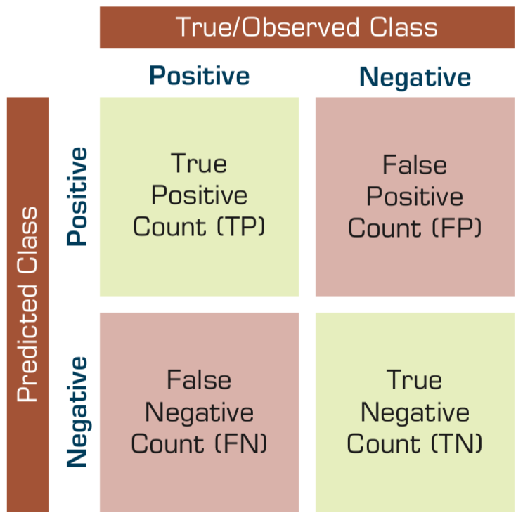
Confusion Matrix for Tabulation of Two-Class Classification Results
Source: Ramesh Sharda, Dursun Delen, and Efraim Turban (2017), Business Intelligence, Analytics, and Data Science: A Managerial Perspective, 4th Edition, Pearson

Slide 33
Sensitivity
Specificity
=True Positive Rate
=True Negative Rate

Slide 34
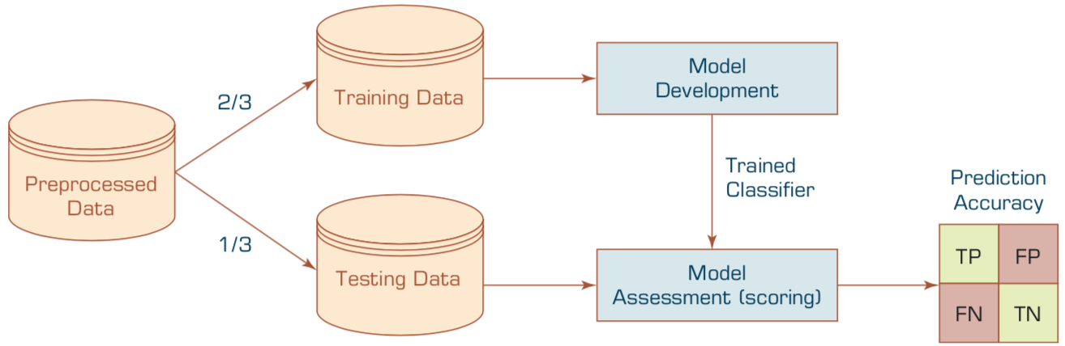
Estimation Methodologies for Classification
Simple split (or holdout or test sample estimation)
  Split the data into 2 mutually exclusive sets
  training (~70%) and testing (30%)
  For ANN, the data is split into three sub-sets
  (training [~60%], validation [~20%], testing [~20%])
Source: Ramesh Sharda, Dursun Delen, and Efraim Turban (2017), Business Intelligence, Analytics, and Data Science: A Managerial Perspective, 4th Edition, Pearson

Slide 35
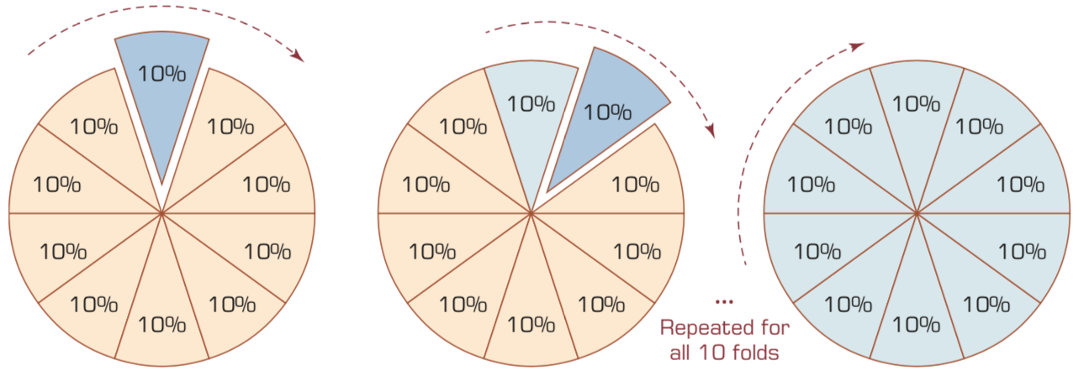
k-Fold Cross-Validation
Source: Ramesh Sharda, Dursun Delen, and Efraim Turban (2017), Business Intelligence, Analytics, and Data Science: A Managerial Perspective, 4th Edition, Pearson

Slide 36
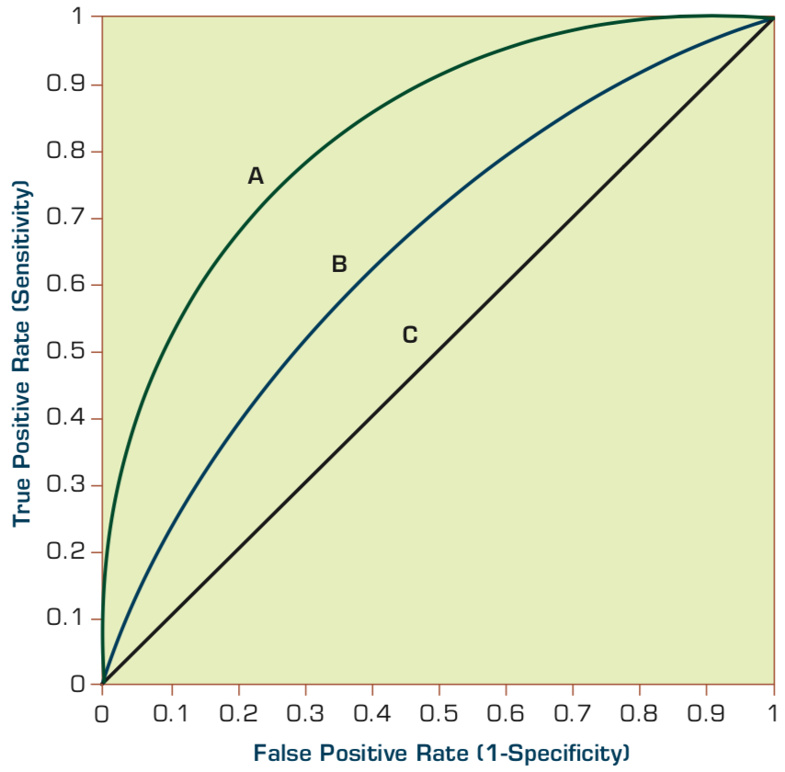
Estimation Methodologies for Classification
Area under the ROC curve
Source: Ramesh Sharda, Dursun Delen, and Efraim Turban (2017), Business Intelligence, Analytics, and Data Science: A Managerial Perspective, 4th Edition, Pearson

Slide 37
True Class
(actual value)
Positive
Negative
total
True
Positive
(TP)
False
Positive
(FP)
Positive
P’
Predictive Class
(prediction outcome)
False
Negative
(FN)
True
Negative
(TN)
Negative
N’
total
P
N
Source: http://en.wikipedia.org/wiki/Receiver_operating_characteristic

Slide 38
True Class
(actual value)
Positive
Negative
total
True
Positive
(TP)
False
Positive
(FP)
Positive
P’
Predictive Class
(prediction outcome)
False
Negative
(FN)
True
Negative
(TN)
Negative
N’
total
P
N
Sensitivity
= True Positive Rate
= Recall
= Hit rate
= TP / (TP + FN)
Source: http://en.wikipedia.org/wiki/Receiver_operating_characteristic

Slide 39
True Class
(actual value)
Positive
Negative
total
True
Positive
(TP)
False
Positive
(FP)
Positive
P’
Predictive Class
(prediction outcome)
False
Negative
(FN)
True
Negative
(TN)
Negative
N’
total
P
N
Specificity
= True Negative Rate
= TN / N
= TN / (TN+ FP)
Source: http://en.wikipedia.org/wiki/Receiver_operating_characteristic

Slide 40
True Class
(actual value)
Precision
= Positive Predictive Value (PPV)
Positive
Negative
total
True
Positive
(TP)
False
Positive
(FP)
Positive
P’
Recall
= True Positive Rate (TPR)
= Sensitivity
= Hit Rate
Predictive Class
(prediction outcome)
False
Negative
(FN)
True
Negative
(TN)
Negative
N’
total
P
N
F1 score (F-score)(F-measure)
is the harmonic mean of precision and recall
= 2TP / (P + P’)
= 2TP / (2TP + FP + FN)
Source: http://en.wikipedia.org/wiki/Receiver_operating_characteristic

Slide 41
A
63
(TP)
28
(FP)
Recall
= True Positive Rate (TPR)
= Sensitivity
= Hit Rate
= TP / (TP + FN)
Specificity
= True Negative Rate
= TN / N
= TN / (TN + FP)
91
37
(FN)
72
(TN)
109
100
100
200
TPR = 0.63
FPR = 0.28
PPV = 0.69
=63/(63+28)
=63/91
Precision
= Positive Predictive Value (PPV)
F1 = 0.66
= 2*(0.63*0.69)/(0.63+0.69)
= (2 * 63) /(100 + 91)
= (0.63 + 0.69) / 2 =1.32 / 2 =0.66
F1 score (F-score)
(F-measure)
is the harmonic mean of precision and recall
= 2TP / (P + P’)
= 2TP / (2TP + FP + FN)
ACC = 0.68
= (63 + 72) / 200
= 135/200 = 67.5
Source: http://en.wikipedia.org/wiki/Receiver_operating_characteristic

Slide 42
A
B
63
(TP)
28
(FP)
77
(TP)
77
(FP)
91
154
37
(FN)
72
(TN)
109
23
(FN)
23
(TN)
46
100
100
200
100
100
200
TPR = 0.63
TPR = 0.77
FPR = 0.77
PPV = 0.50
F1 = 0.61
ACC = 0.50
FPR = 0.28
PPV = 0.69
=63/(63+28)
=63/91
F1 = 0.66
= 2*(0.63*0.69)/(0.63+0.69)
= (2 * 63) /(100 + 91)
= (0.63 + 0.69) / 2 =1.32 / 2 =0.66
Recall
= True Positive Rate (TPR)
= Sensitivity
= Hit Rate
ACC = 0.68
= (63 + 72) / 200
= 135/200 = 67.5
Precision
= Positive Predictive Value (PPV)
Source: http://en.wikipedia.org/wiki/Receiver_operating_characteristic

Slide 43
C
C’
24
(TP)
88
(FP)
76
(TP)
12
(FP)
112
88
76
(FN)
12
(TN)
88
24
(FN)
88
(TN)
112
100
100
200
100
100
200
TPR = 0.24
FPR = 0.88
PPV = 0.21
F1 = 0.22
ACC = 0.18
TPR = 0.76
FPR = 0.12
PPV = 0.86
F1 = 0.81
ACC = 0.82
Recall
= True Positive Rate (TPR)
= Sensitivity
= Hit Rate
Precision
= Positive Predictive Value (PPV)
Source: http://en.wikipedia.org/wiki/Receiver_operating_characteristic

Slide 44
Scikit-Learn
Machine Learning in Python

Slide 45
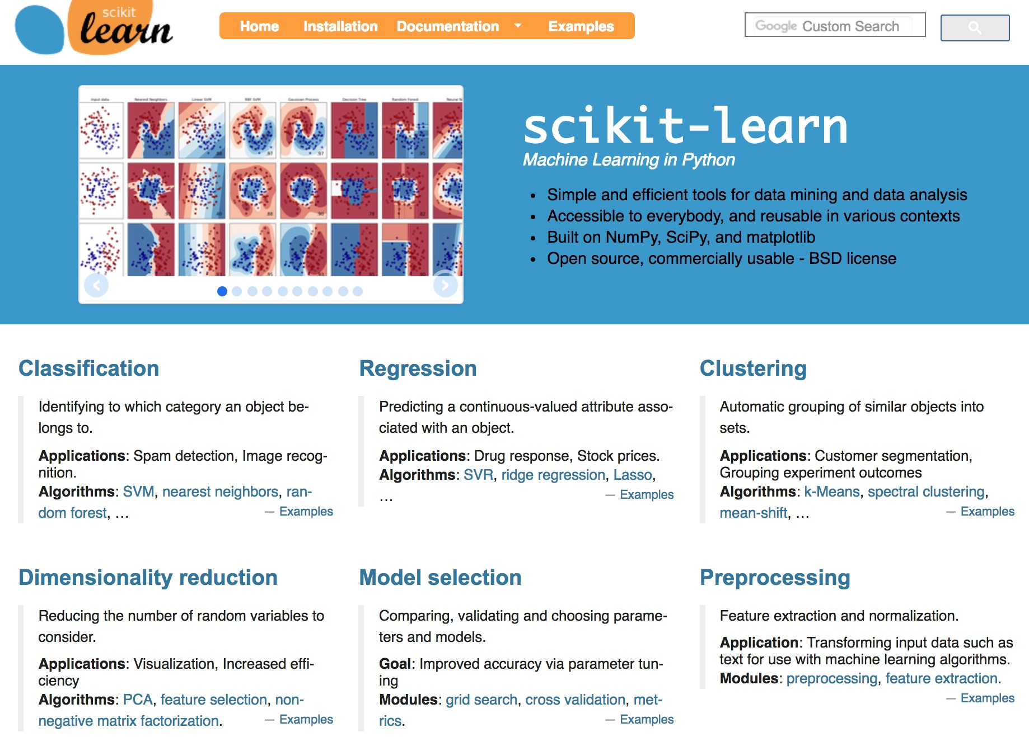
Scikit-Learn
Source: http://scikit-learn.org/

Slide 46
Scikit-Learn Machine Learning Map
Source: http://scikit-learn.org/stable/tutorial/machine_learning_map/index.html

Slide 47
Scikit-Learn Machine Learning Map
Source: http://scikit-learn.org/stable/tutorial/machine_learning_map/index.html

Slide 48
Scikit-Learn Machine Learning Map
Source: http://scikit-learn.org/stable/tutorial/machine_learning_map/index.html

Slide 49
Scikit-Learn Machine Learning Map
Source: http://scikit-learn.org/stable/tutorial/machine_learning_map/index.html

Slide 50
Iris flower data set
setosa
versicolor
virginica
Source: https://en.wikipedia.org/wiki/Iris_flower_data_set
Source: http://suruchifialoke.com/2016-10-13-machine-learning-tutorial-iris-classification/

Slide 51
Iris Classfication
Source: http://suruchifialoke.com/2016-10-13-machine-learning-tutorial-iris-classification/

Slide 52
iris.data
https://archive.ics.uci.edu/ml/machine-learning-databases/iris/iris.data
5.1,3.5,1.4,0.2,Iris-setosa 4.9,3.0,1.4,0.2,Iris-setosa 4.7,3.2,1.3,0.2,Iris-setosa 4.6,3.1,1.5,0.2,Iris-setosa 5.0,3.6,1.4,0.2,Iris-setosa 5.4,3.9,1.7,0.4,Iris-setosa 4.6,3.4,1.4,0.3,Iris-setosa 5.0,3.4,1.5,0.2,Iris-setosa 4.4,2.9,1.4,0.2,Iris-setosa 4.9,3.1,1.5,0.1,Iris-setosa 5.4,3.7,1.5,0.2,Iris-setosa 4.8,3.4,1.6,0.2,Iris-setosa 4.8,3.0,1.4,0.1,Iris-setosa 4.3,3.0,1.1,0.1,Iris-setosa 5.8,4.0,1.2,0.2,Iris-setosa 5.7,4.4,1.5,0.4,Iris-setosa 5.4,3.9,1.3,0.4,Iris-setosa 5.1,3.5,1.4,0.3,Iris-setosa 5.7,3.8,1.7,0.3,Iris-setosa 5.1,3.8,1.5,0.3,Iris-setosa 5.4,3.4,1.7,0.2,Iris-setosa 5.1,3.7,1.5,0.4,Iris-setosa 4.6,3.6,1.0,0.2,Iris-setosa 5.1,3.3,1.7,0.5,Iris-setosa 4.8,3.4,1.9,0.2,Iris-setosa 5.0,3.0,1.6,0.2,Iris-setosa 5.0,3.4,1.6,0.4,Iris-setosa 5.2,3.5,1.5,0.2,Iris-setosa 5.2,3.4,1.4,0.2,Iris-setosa 4.7,3.2,1.6,0.2,Iris-setosa 4.8,3.1,1.6,0.2,Iris-setosa 5.4,3.4,1.5,0.4,Iris-setosa 5.2,4.1,1.5,0.1,Iris-setosa 5.5,4.2,1.4,0.2,Iris-setosa 4.9,3.1,1.5,0.1,Iris-setosa 5.0,3.2,1.2,0.2,Iris-setosa 5.5,3.5,1.3,0.2,Iris-setosa 4.9,3.1,1.5,0.1,Iris-setosa 4.4,3.0,1.3,0.2,Iris-setosa 5.1,3.4,1.5,0.2,Iris-setosa 5.0,3.5,1.3,0.3,Iris-setosa 4.5,2.3,1.3,0.3,Iris-setosa 4.4,3.2,1.3,0.2,Iris-setosa 5.0,3.5,1.6,0.6,Iris-setosa 5.1,3.8,1.9,0.4,Iris-setosa 4.8,3.0,1.4,0.3,Iris-setosa 5.1,3.8,1.6,0.2,Iris-setosa 4.6,3.2,1.4,0.2,Iris-setosa 5.3,3.7,1.5,0.2,Iris-setosa 5.0,3.3,1.4,0.2,Iris-setosa 7.0,3.2,4.7,1.4,Iris-versicolor 6.4,3.2,4.5,1.5,Iris-versicolor 6.9,3.1,4.9,1.5,Iris-versicolor 5.5,2.3,4.0,1.3,Iris-versicolor 6.5,2.8,4.6,1.5,Iris-versicolor 5.7,2.8,4.5,1.3,Iris-versicolor 6.3,3.3,4.7,1.6,Iris-versicolor 4.9,2.4,3.3,1.0,Iris-versicolor 6.6,2.9,4.6,1.3,Iris-versicolor 5.2,2.7,3.9,1.4,Iris-versicolor 5.0,2.0,3.5,1.0,Iris-versicolor 5.9,3.0,4.2,1.5,Iris-versicolor 6.0,2.2,4.0,1.0,Iris-versicolor 6.1,2.9,4.7,1.4,Iris-versicolor 5.6,2.9,3.6,1.3,Iris-versicolor 6.7,3.1,4.4,1.4,Iris-versicolor 5.6,3.0,4.5,1.5,Iris-versicolor 5.8,2.7,4.1,1.0,Iris-versicolor 6.2,2.2,4.5,1.5,Iris-versicolor 5.6,2.5,3.9,1.1,Iris-versicolor 5.9,3.2,4.8,1.8,Iris-versicolor 6.1,2.8,4.0,1.3,Iris-versicolor 6.3,2.5,4.9,1.5,Iris-versicolor 6.1,2.8,4.7,1.2,Iris-versicolor 6.4,2.9,4.3,1.3,Iris-versicolor 6.6,3.0,4.4,1.4,Iris-versicolor 6.8,2.8,4.8,1.4,Iris-versicolor 6.7,3.0,5.0,1.7,Iris-versicolor 6.0,2.9,4.5,1.5,Iris-versicolor 5.7,2.6,3.5,1.0,Iris-versicolor 5.5,2.4,3.8,1.1,Iris-versicolor 5.5,2.4,3.7,1.0,Iris-versicolor 5.8,2.7,3.9,1.2,Iris-versicolor 6.0,2.7,5.1,1.6,Iris-versicolor 5.4,3.0,4.5,1.5,Iris-versicolor 6.0,3.4,4.5,1.6,Iris-versicolor 6.7,3.1,4.7,1.5,Iris-versicolor 6.3,2.3,4.4,1.3,Iris-versicolor 5.6,3.0,4.1,1.3,Iris-versicolor 5.5,2.5,4.0,1.3,Iris-versicolor 5.5,2.6,4.4,1.2,Iris-versicolor 6.1,3.0,4.6,1.4,Iris-versicolor 5.8,2.6,4.0,1.2,Iris-versicolor 5.0,2.3,3.3,1.0,Iris-versicolor 5.6,2.7,4.2,1.3,Iris-versicolor 5.7,3.0,4.2,1.2,Iris-versicolor 5.7,2.9,4.2,1.3,Iris-versicolor 6.2,2.9,4.3,1.3,Iris-versicolor 5.1,2.5,3.0,1.1,Iris-versicolor 5.7,2.8,4.1,1.3,Iris-versicolor 6.3,3.3,6.0,2.5,Iris-virginica 5.8,2.7,5.1,1.9,Iris-virginica 7.1,3.0,5.9,2.1,Iris-virginica 6.3,2.9,5.6,1.8,Iris-virginica 6.5,3.0,5.8,2.2,Iris-virginica 7.6,3.0,6.6,2.1,Iris-virginica 4.9,2.5,4.5,1.7,Iris-virginica 7.3,2.9,6.3,1.8,Iris-virginica 6.7,2.5,5.8,1.8,Iris-virginica 7.2,3.6,6.1,2.5,Iris-virginica 6.5,3.2,5.1,2.0,Iris-virginica 6.4,2.7,5.3,1.9,Iris-virginica 6.8,3.0,5.5,2.1,Iris-virginica 5.7,2.5,5.0,2.0,Iris-virginica 5.8,2.8,5.1,2.4,Iris-virginica 6.4,3.2,5.3,2.3,Iris-virginica 6.5,3.0,5.5,1.8,Iris-virginica 7.7,3.8,6.7,2.2,Iris-virginica 7.7,2.6,6.9,2.3,Iris-virginica 6.0,2.2,5.0,1.5,Iris-virginica 6.9,3.2,5.7,2.3,Iris-virginica 5.6,2.8,4.9,2.0,Iris-virginica 7.7,2.8,6.7,2.0,Iris-virginica 6.3,2.7,4.9,1.8,Iris-virginica 6.7,3.3,5.7,2.1,Iris-virginica 7.2,3.2,6.0,1.8,Iris-virginica 6.2,2.8,4.8,1.8,Iris-virginica 6.1,3.0,4.9,1.8,Iris-virginica 6.4,2.8,5.6,2.1,Iris-virginica 7.2,3.0,5.8,1.6,Iris-virginica 7.4,2.8,6.1,1.9,Iris-virginica 7.9,3.8,6.4,2.0,Iris-virginica 6.4,2.8,5.6,2.2,Iris-virginica 6.3,2.8,5.1,1.5,Iris-virginica 6.1,2.6,5.6,1.4,Iris-virginica 7.7,3.0,6.1,2.3,Iris-virginica 6.3,3.4,5.6,2.4,Iris-virginica 6.4,3.1,5.5,1.8,Iris-virginica 6.0,3.0,4.8,1.8,Iris-virginica 6.9,3.1,5.4,2.1,Iris-virginica 6.7,3.1,5.6,2.4,Iris-virginica 6.9,3.1,5.1,2.3,Iris-virginica 5.8,2.7,5.1,1.9,Iris-virginica 6.8,3.2,5.9,2.3,Iris-virginica 6.7,3.3,5.7,2.5,Iris-virginica 6.7,3.0,5.2,2.3,Iris-virginica 6.3,2.5,5.0,1.9,Iris-virginica 6.5,3.0,5.2,2.0,Iris-virginica 6.2,3.4,5.4,2.3,Iris-virginica 5.9,3.0,5.1,1.8,Iris-virginica
setosa
virginica
versicolor

Slide 53
Machine Learning
Supervised Learning (Classification)
Learning from Examples
5.1,3.5,1.4,0.2,Iris-setosa 4.9,3.0,1.4,0.2,Iris-setosa 4.7,3.2,1.3,0.2,Iris-setosa 7.0,3.2,4.7,1.4,Iris-versicolor 6.4,3.2,4.5,1.5,Iris-versicolor 6.9,3.1,4.9,1.5,Iris-versicolor 6.3,3.3,6.0,2.5,Iris-virginica 5.8,2.7,5.1,1.9,Iris-virginica 7.1,3.0,5.9,2.1,Iris-virginica

Slide 54
Machine Learning
Supervised Learning (Classification)
Learning from Examples
y = f(x)
5.1,3.5,1.4,0.2,Iris-setosa 4.9,3.0,1.4,0.2,Iris-setosa 4.7,3.2,1.3,0.2,Iris-setosa 7.0,3.2,4.7,1.4,Iris-versicolor 6.4,3.2,4.5,1.5,Iris-versicolor 6.9,3.1,4.9,1.5,Iris-versicolor 6.3,3.3,6.0,2.5,Iris-virginica 5.8,2.7,5.1,1.9,Iris-virginica 7.1,3.0,5.9,2.1,Iris-virginica
y
x

Slide 55
Machine Learning
Supervised Learning (Classification)
Learning from Examples
y = f(x)
x
y

Slide 56
Iris Data Visualization
Source: https://seaborn.pydata.org/generated/seaborn.pairplot.html

Slide 57
import seaborn as sns
sns.set(style="ticks", color_codes=True)
iris = sns.load_dataset("iris")
g = sns.pairplot(iris, hue="species")
Source: https://seaborn.pydata.org/generated/seaborn.pairplot.html

Slide 58
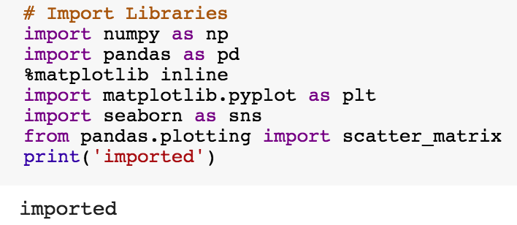
import numpy as np
import pandas as pd
%matplotlib inline
import matplotlib.pyplot as plt
import seaborn as sns
from pandas.plotting import scatter_matrix

Slide 59
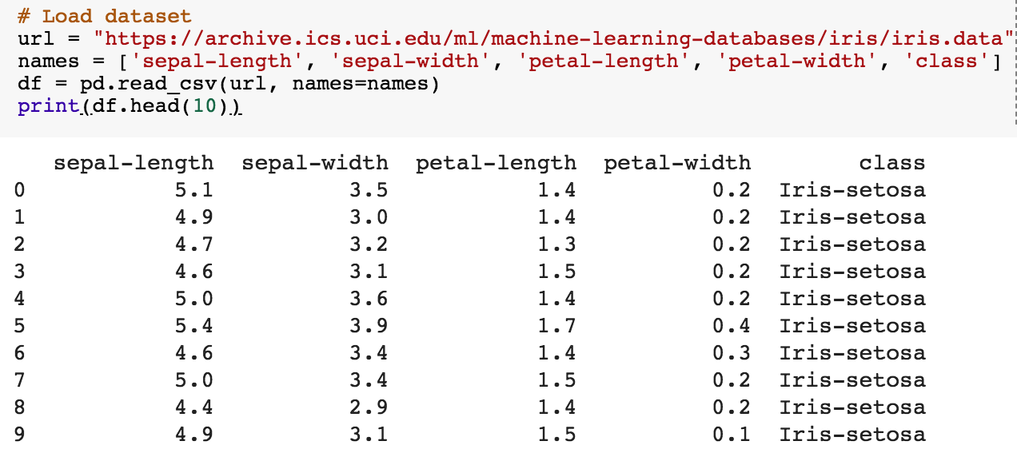
url = "https://archive.ics.uci.edu/ml/machine-learning-databases/iris/iris.data"
names = ['sepal-length', 'sepal-width', 'petal-length', 'petal-width', 'class']
df = pd.read_csv(url, names=names)
print(df.head(10))

Slide 60
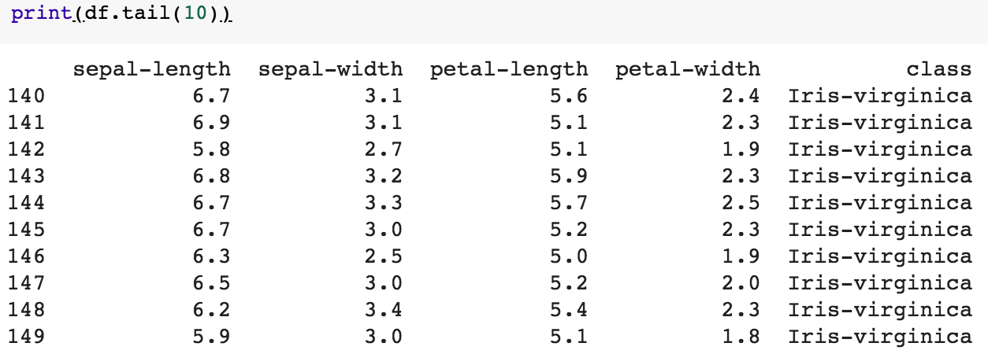
df.tail(10)

Slide 61
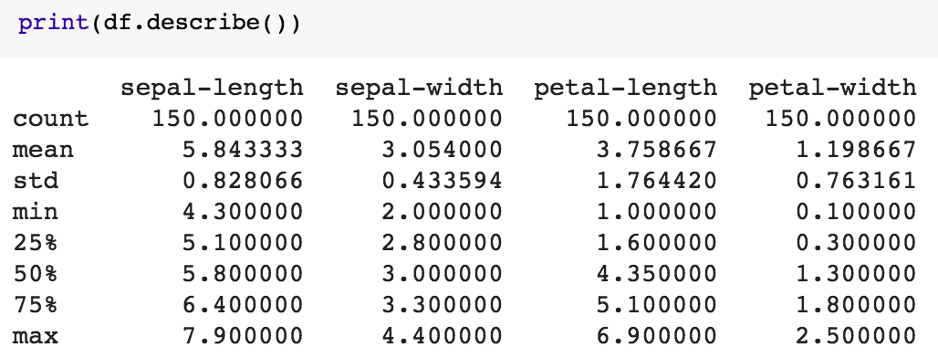
df.describe()

Slide 62
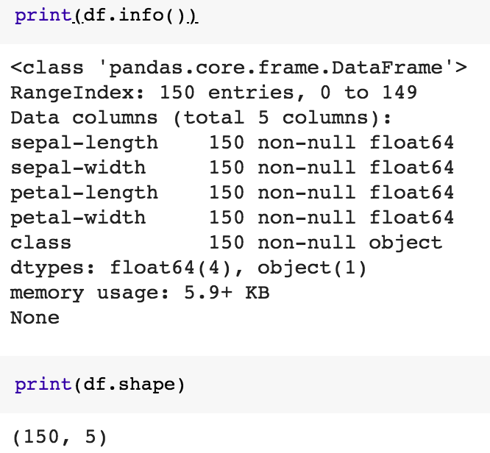
print(df.info())
print(df.shape)

Slide 63
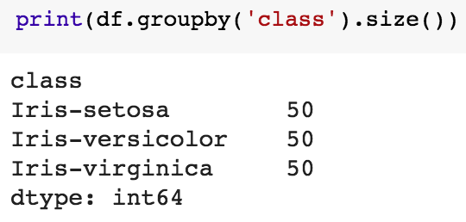
df.groupby('class').size()

Slide 64
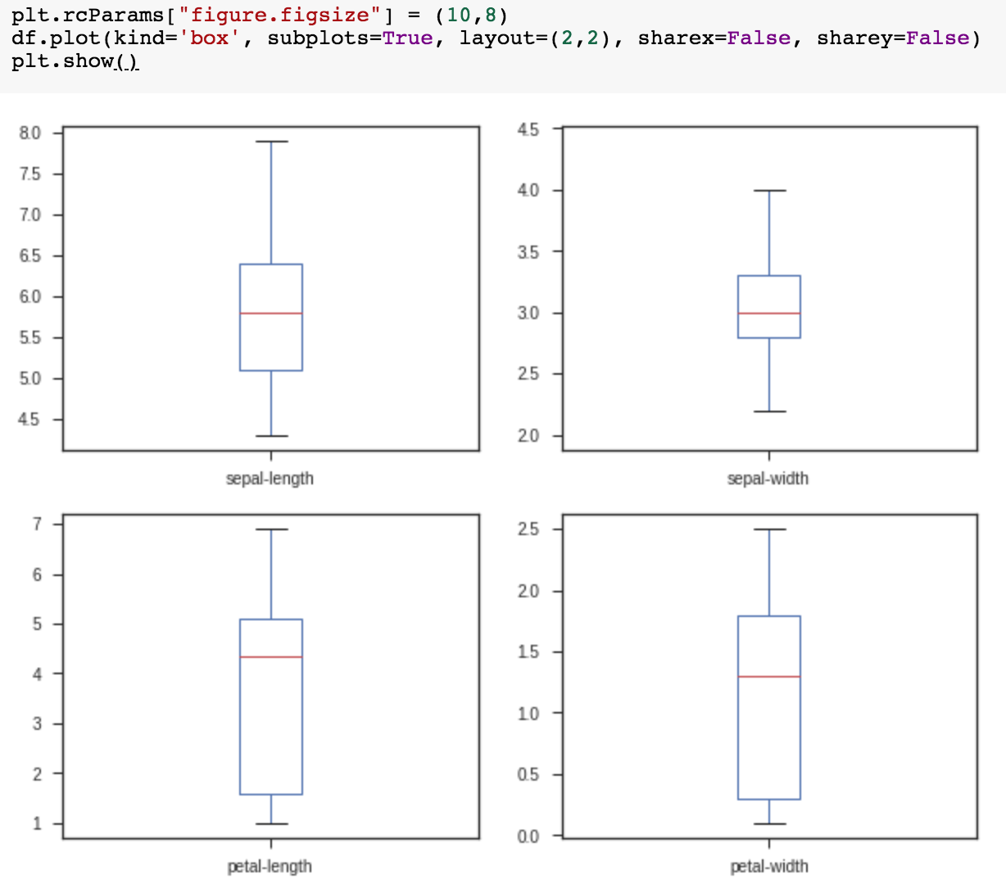
plt.rcParams["figure.figsize"] = (10,8)
df.plot(kind='box', subplots=True, layout=(2,2), sharex=False, sharey=False)
plt.show()

Slide 65
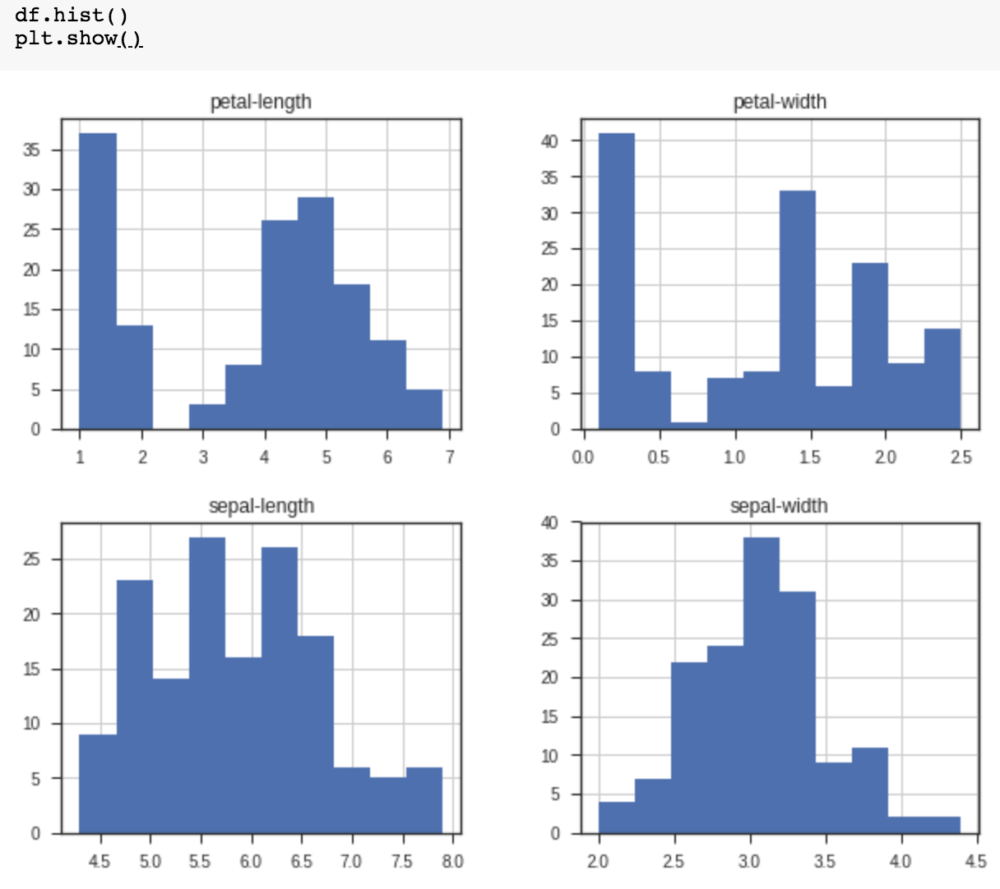
df.hist()
plt.show()

Slide 66
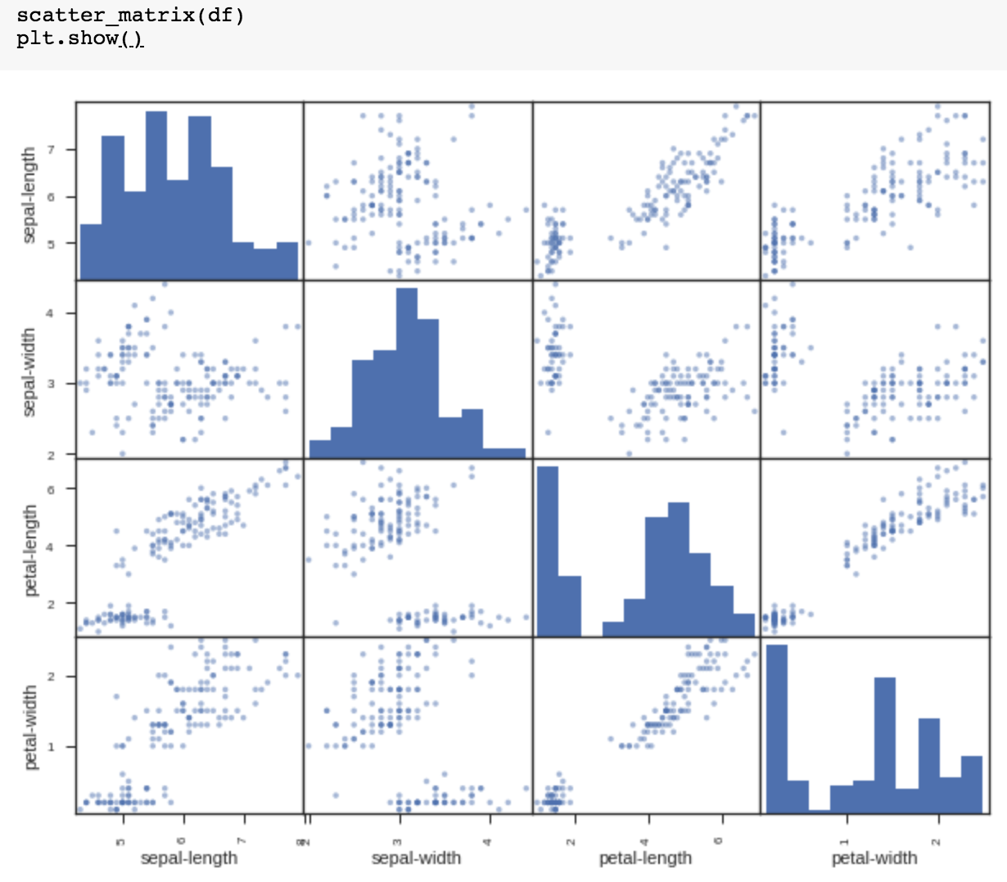
scatter_matrix(df)
plt.show()

Slide 67
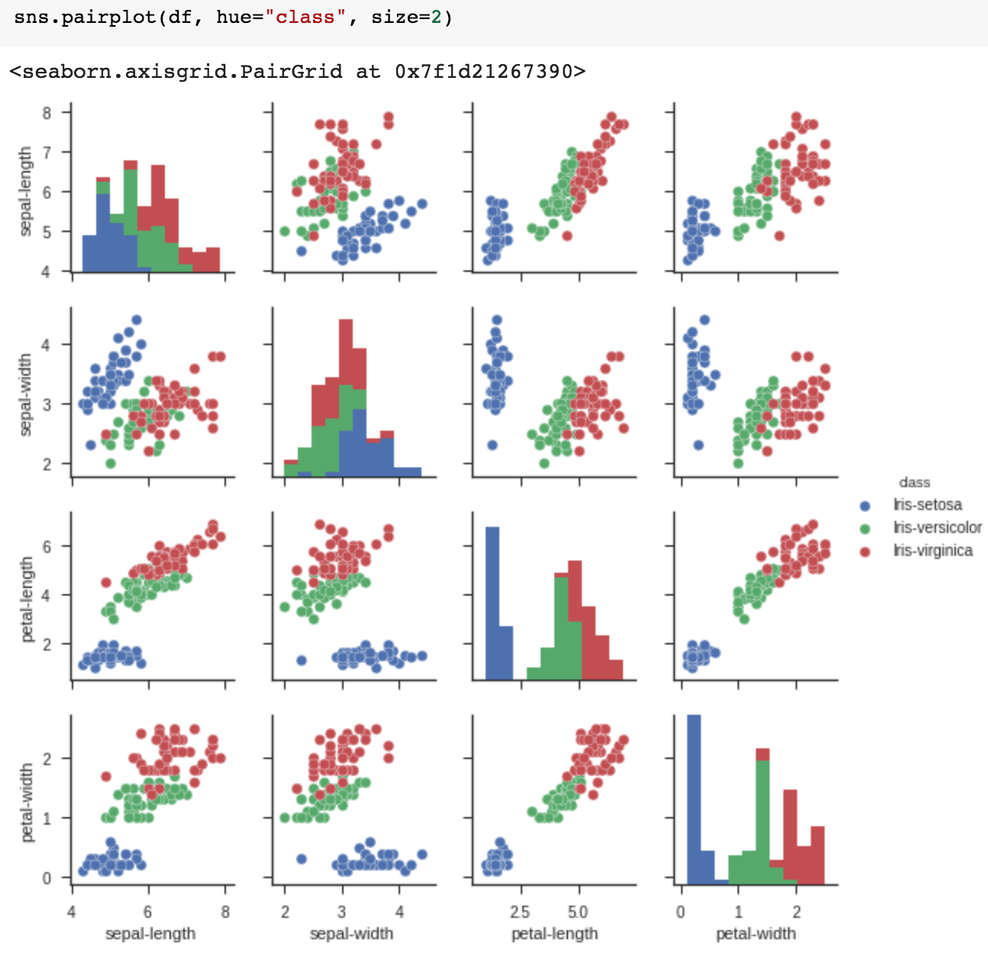
sns.pairplot(df, hue="class", size=2)

Slide 68
Machine Learning
Supervised Learning
Classification and
Prediction

Slide 69
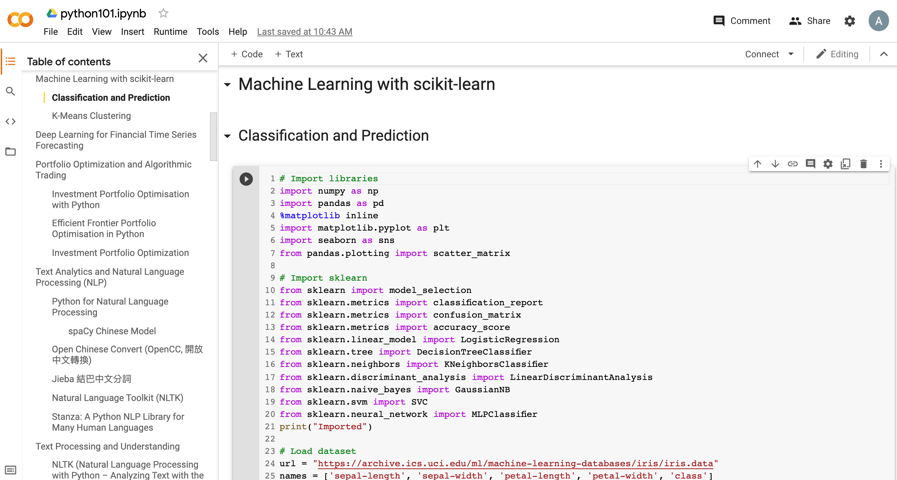
Machine Learning: Supervised Learning
Classification and Prediction
https://tinyurl.com/aintpupython101

Slide 70
# Import sklearn
from sklearn import model_selection
from sklearn.metrics import classification_report
from sklearn.metrics import confusion_matrix
from sklearn.metrics import accuracy_score
from sklearn.linear_model import LogisticRegression
from sklearn.tree import DecisionTreeClassifier
from sklearn.neighbors import KNeighborsClassifier
from sklearn.discriminant_analysis import LinearDiscriminantAnalysis
from sklearn.naive_bayes import GaussianNB
from sklearn.svm import SVC
from sklearn.neural_network import MLPClassifier
print("Imported")
https://tinyurl.com/aintpupython101

Slide 71
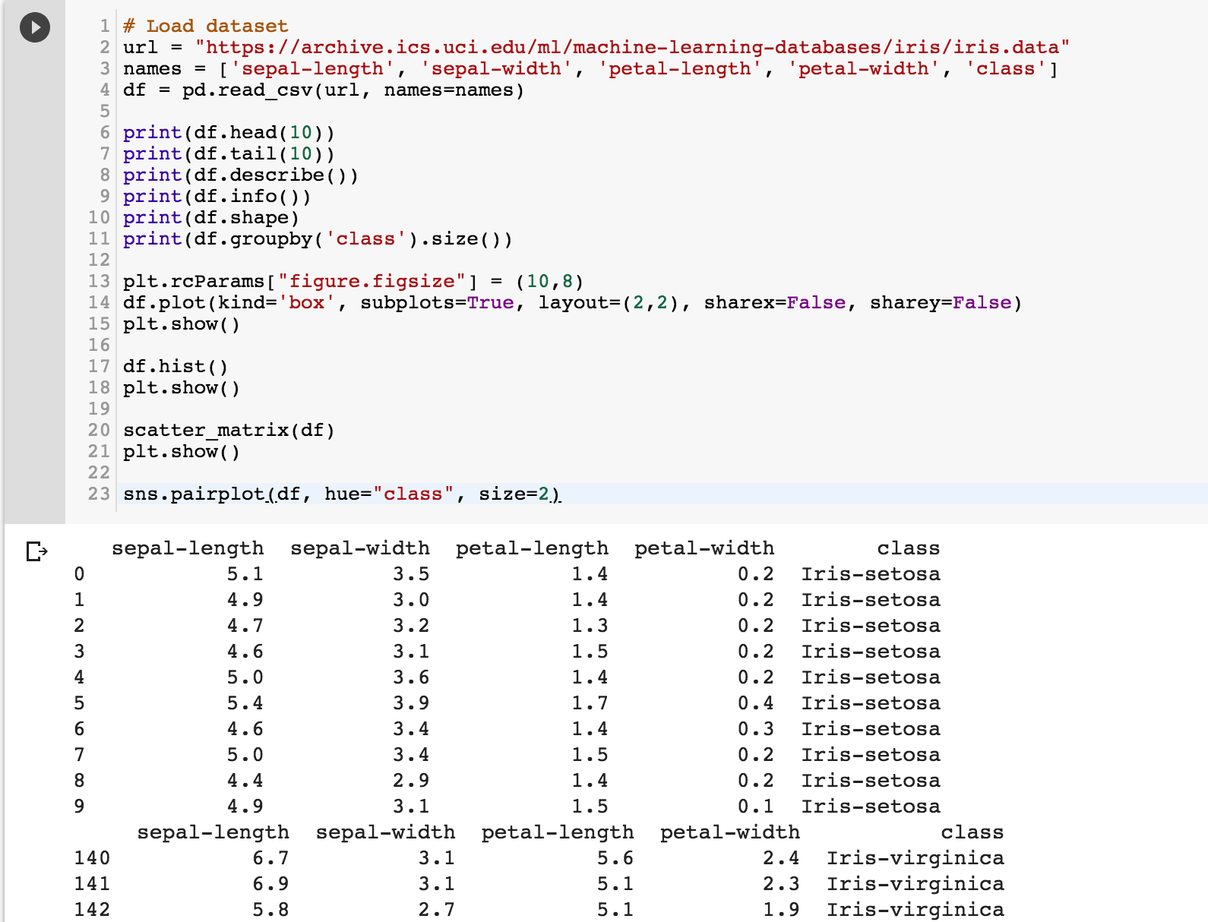
https://tinyurl.com/aintpupython101

Slide 72
https://tinyurl.com/aintpupython101

Slide 73
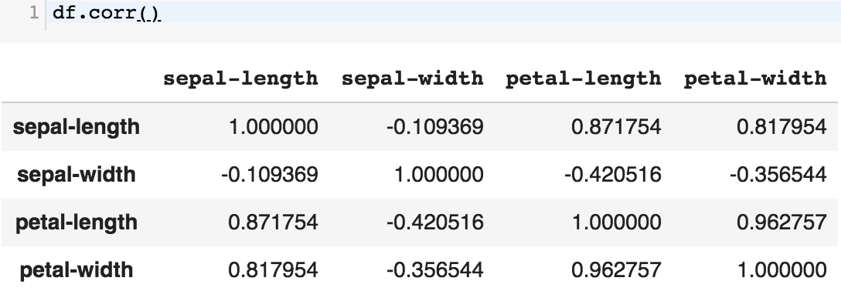
df.corr()
https://tinyurl.com/aintpupython101

Slide 74
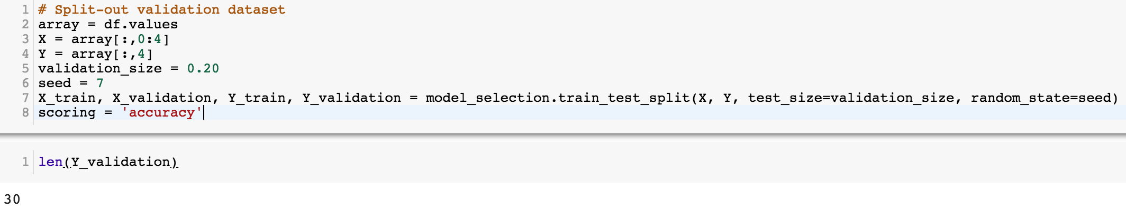
# Split-out validation dataset
array = df.values
X = array[:,0:4]
Y = array[:,4]
validation_size = 0.20
seed = 7
X_train, X_validation, Y_train, Y_validation = model_selection.train_test_split(X, Y, test_size=validation_size, random_state=seed)
scoring = 'accuracy'
https://tinyurl.com/aintpupython101

Slide 75
# Models
models = []
models.append(('LR', LogisticRegression()))
models.append(('LDA', LinearDiscriminantAnalysis()))
models.append(('KNN', KNeighborsClassifier()))
models.append(('DT', DecisionTreeClassifier()))
models.append(('NB', GaussianNB()))
models.append(('SVM', SVC()))
https://tinyurl.com/aintpupython101

Slide 76
# evaluate each model in turn
results = []
names = []
for name, model in models:
kfold = model_selection.KFold(n_splits=10, random_state=seed)
cv_results = model_selection.cross_val_score(model, X_train, Y_train, cv=kfold, scoring=scoring)
results.append(cv_results)
names.append(name)
msg = "%s: %.4f (%.4f)" % (name, cv_results.mean(), cv_results.std())
print(msg)
https://tinyurl.com/aintpupython101

Slide 77
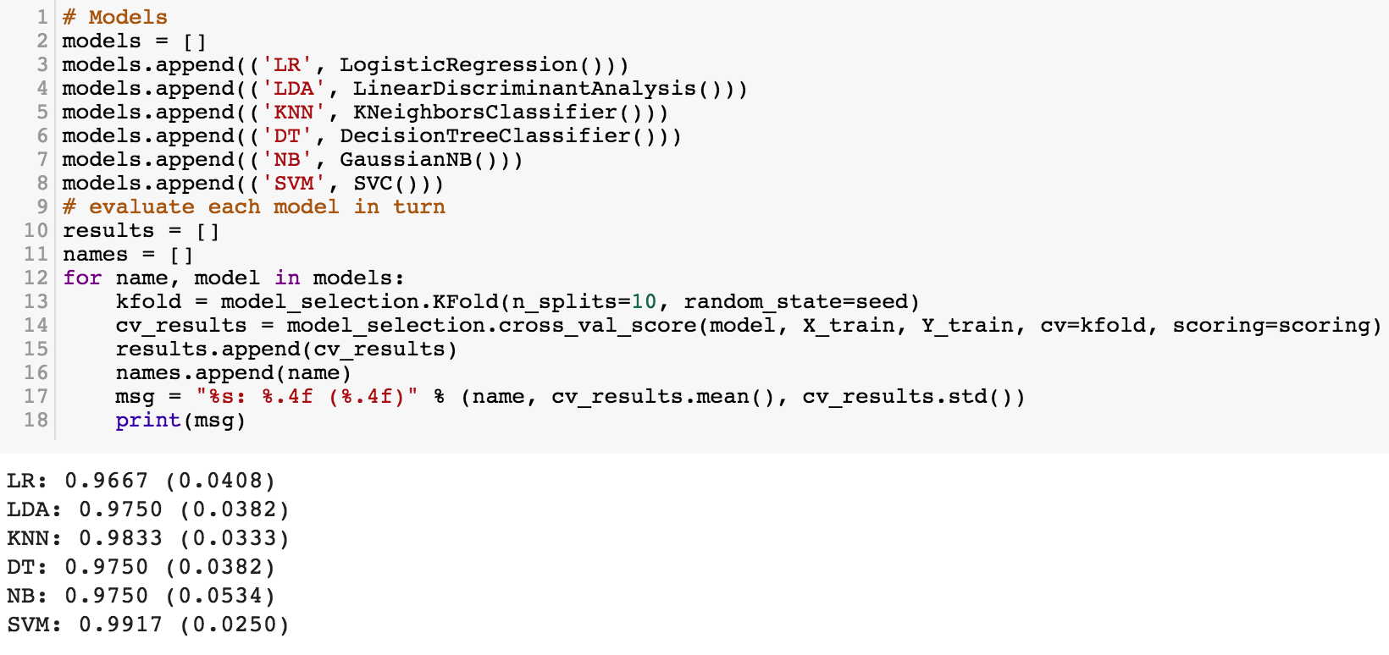
https://tinyurl.com/aintpupython101

Slide 78
# Make predictions on validation dataset
model = KNeighborsClassifier()
model.fit(X_train, Y_train)
predictions = model.predict(X_validation)
print("%.4f" % accuracy_score(Y_validation, predictions))
print(confusion_matrix(Y_validation, predictions))
print(classification_report(Y_validation, predictions))
print(model)
https://tinyurl.com/aintpupython101

Slide 79
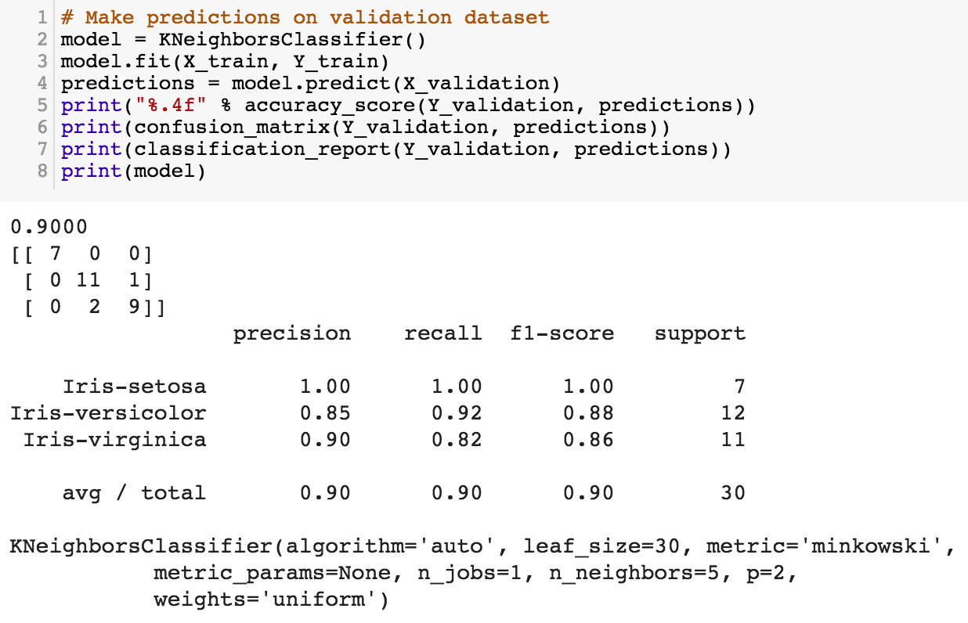
https://tinyurl.com/aintpupython101

Slide 80
# Make predictions on validation dataset
model = SVC()
model.fit(X_train, Y_train)
predictions = model.predict(X_validation)
print("%.4f" % accuracy_score(Y_validation, predictions))
print(confusion_matrix(Y_validation, predictions))
print(classification_report(Y_validation, predictions))
print(model)
https://tinyurl.com/aintpupython101

Slide 81
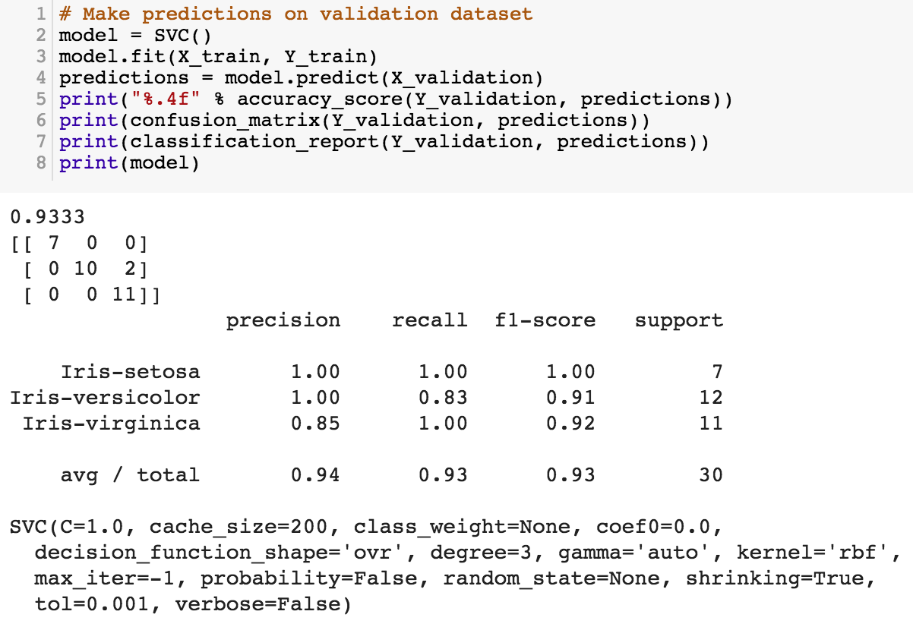
model = SVC()
model.fit(X_train, Y_train)
predictions = model.predict(X_validation)
https://tinyurl.com/aintpupython101

Slide 82
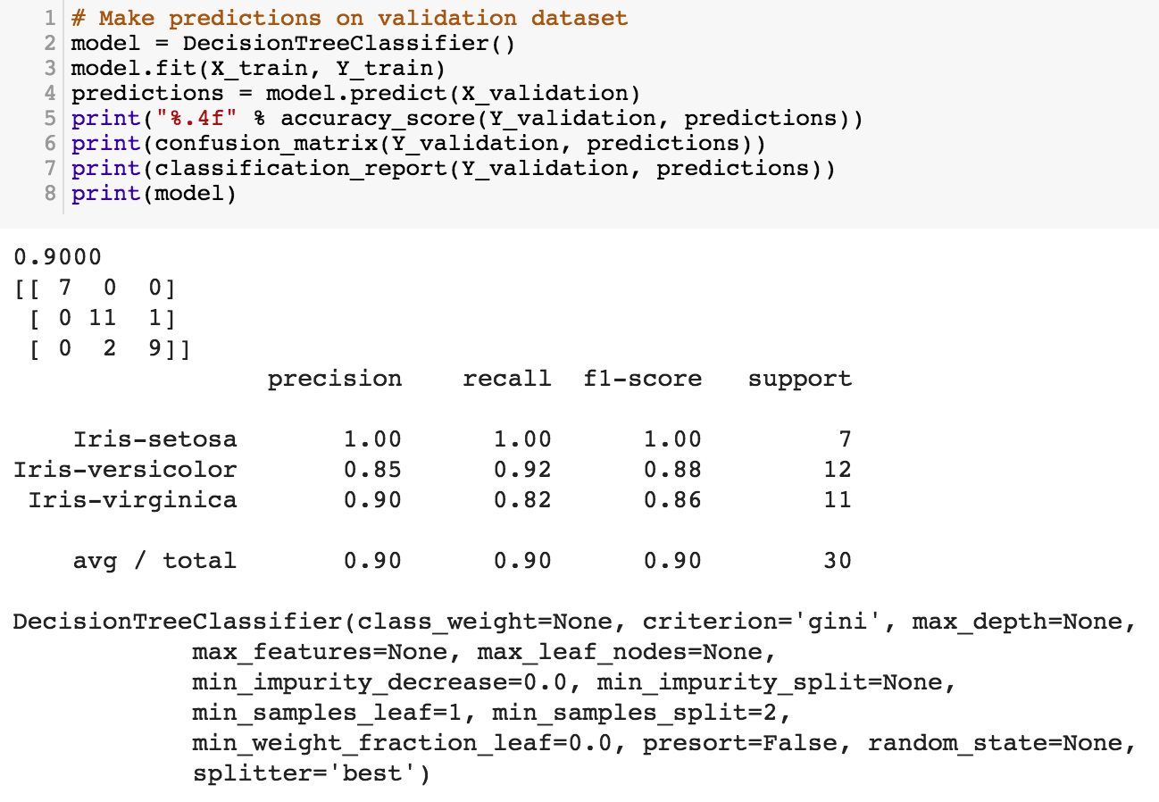
https://tinyurl.com/aintpupython101

Slide 83
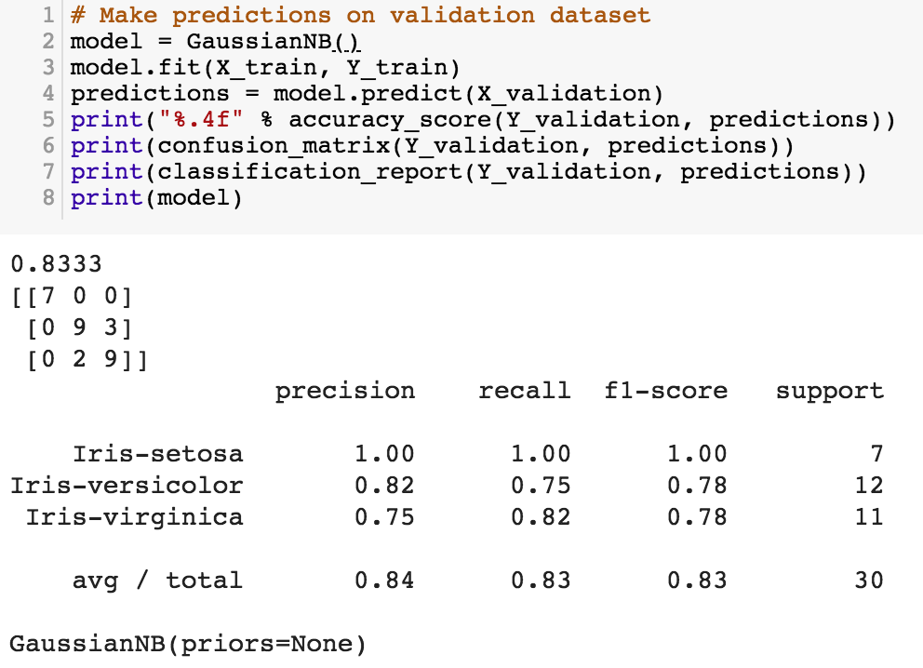
https://tinyurl.com/aintpupython101

Slide 84
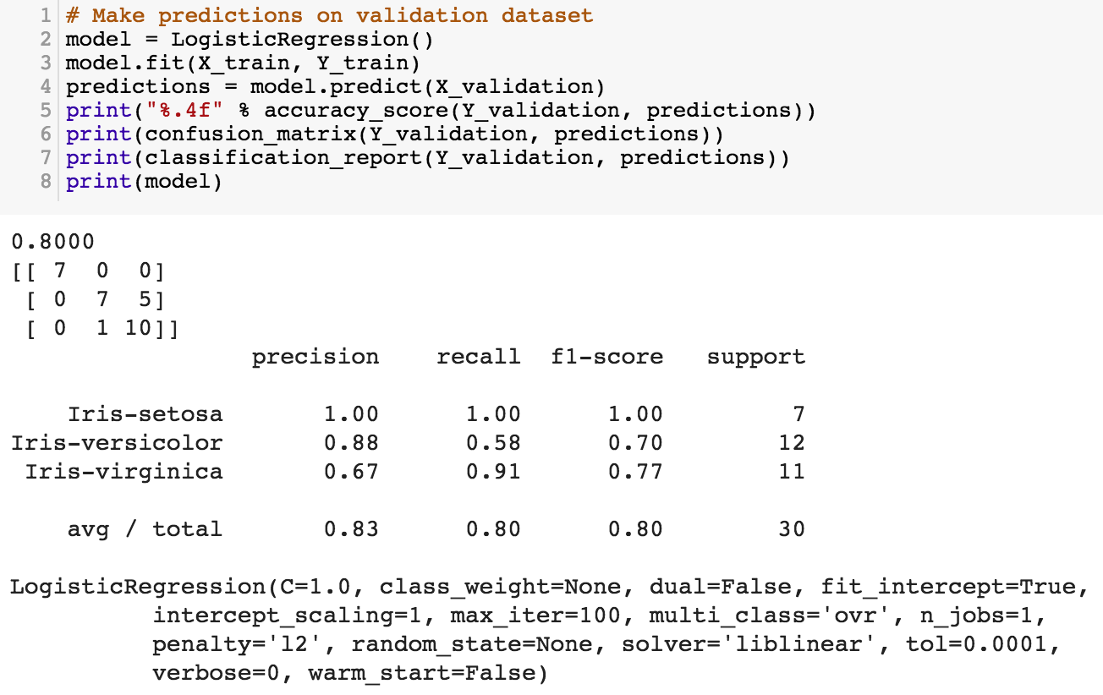
https://tinyurl.com/aintpupython101

Slide 85
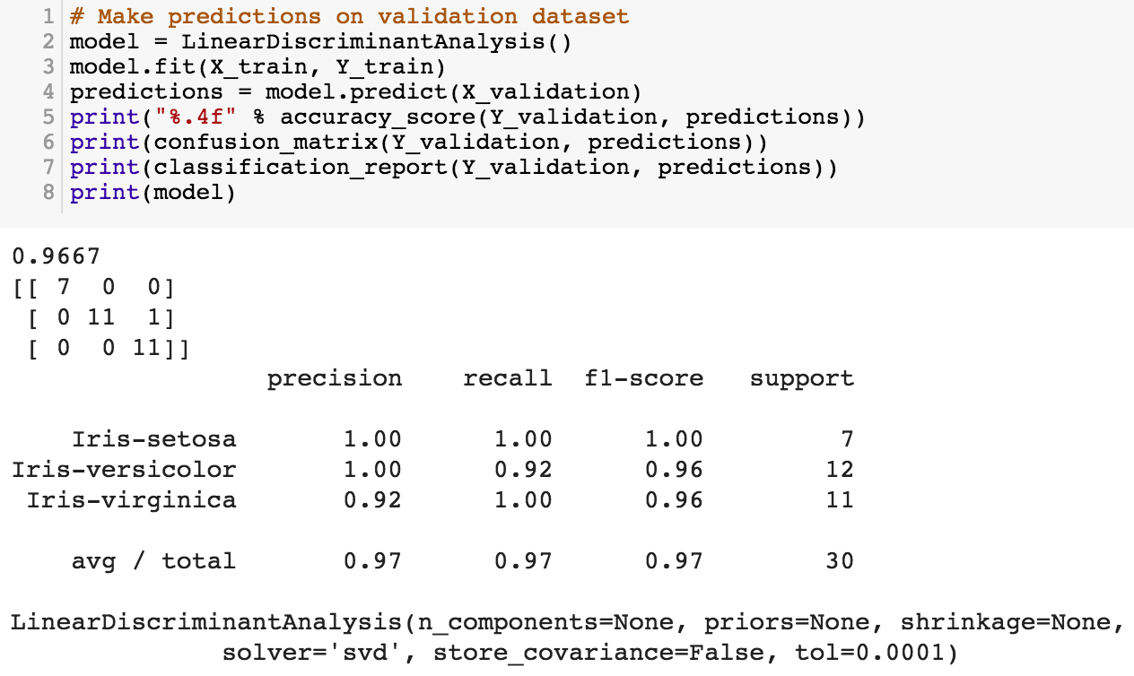
https://tinyurl.com/aintpupython101

Slide 86
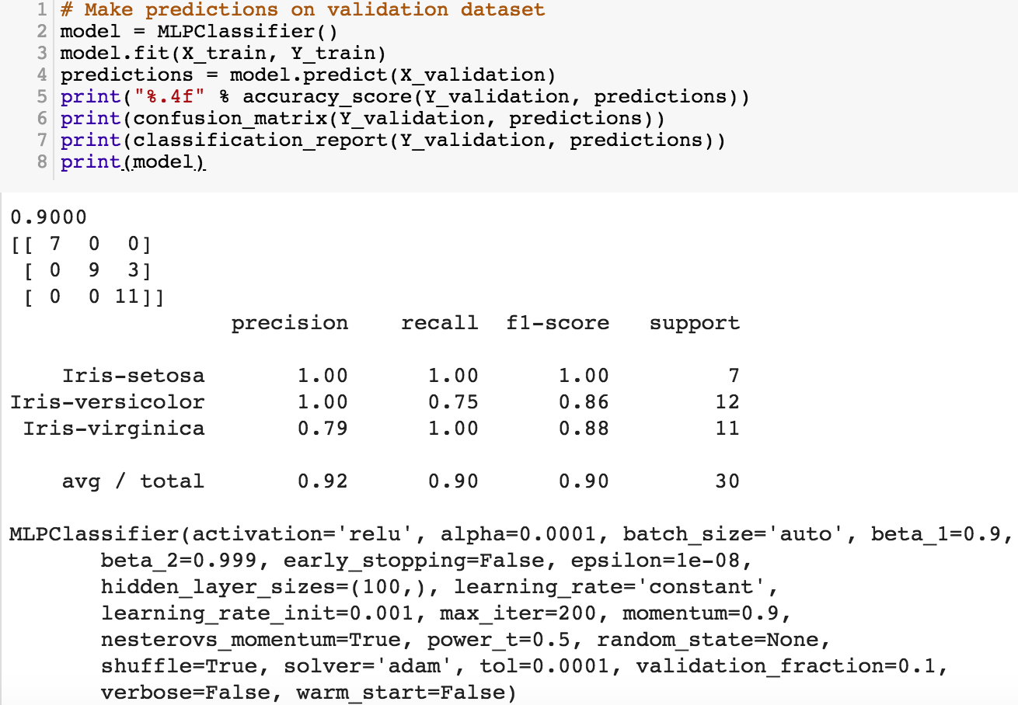
https://tinyurl.com/aintpupython101

Slide 87
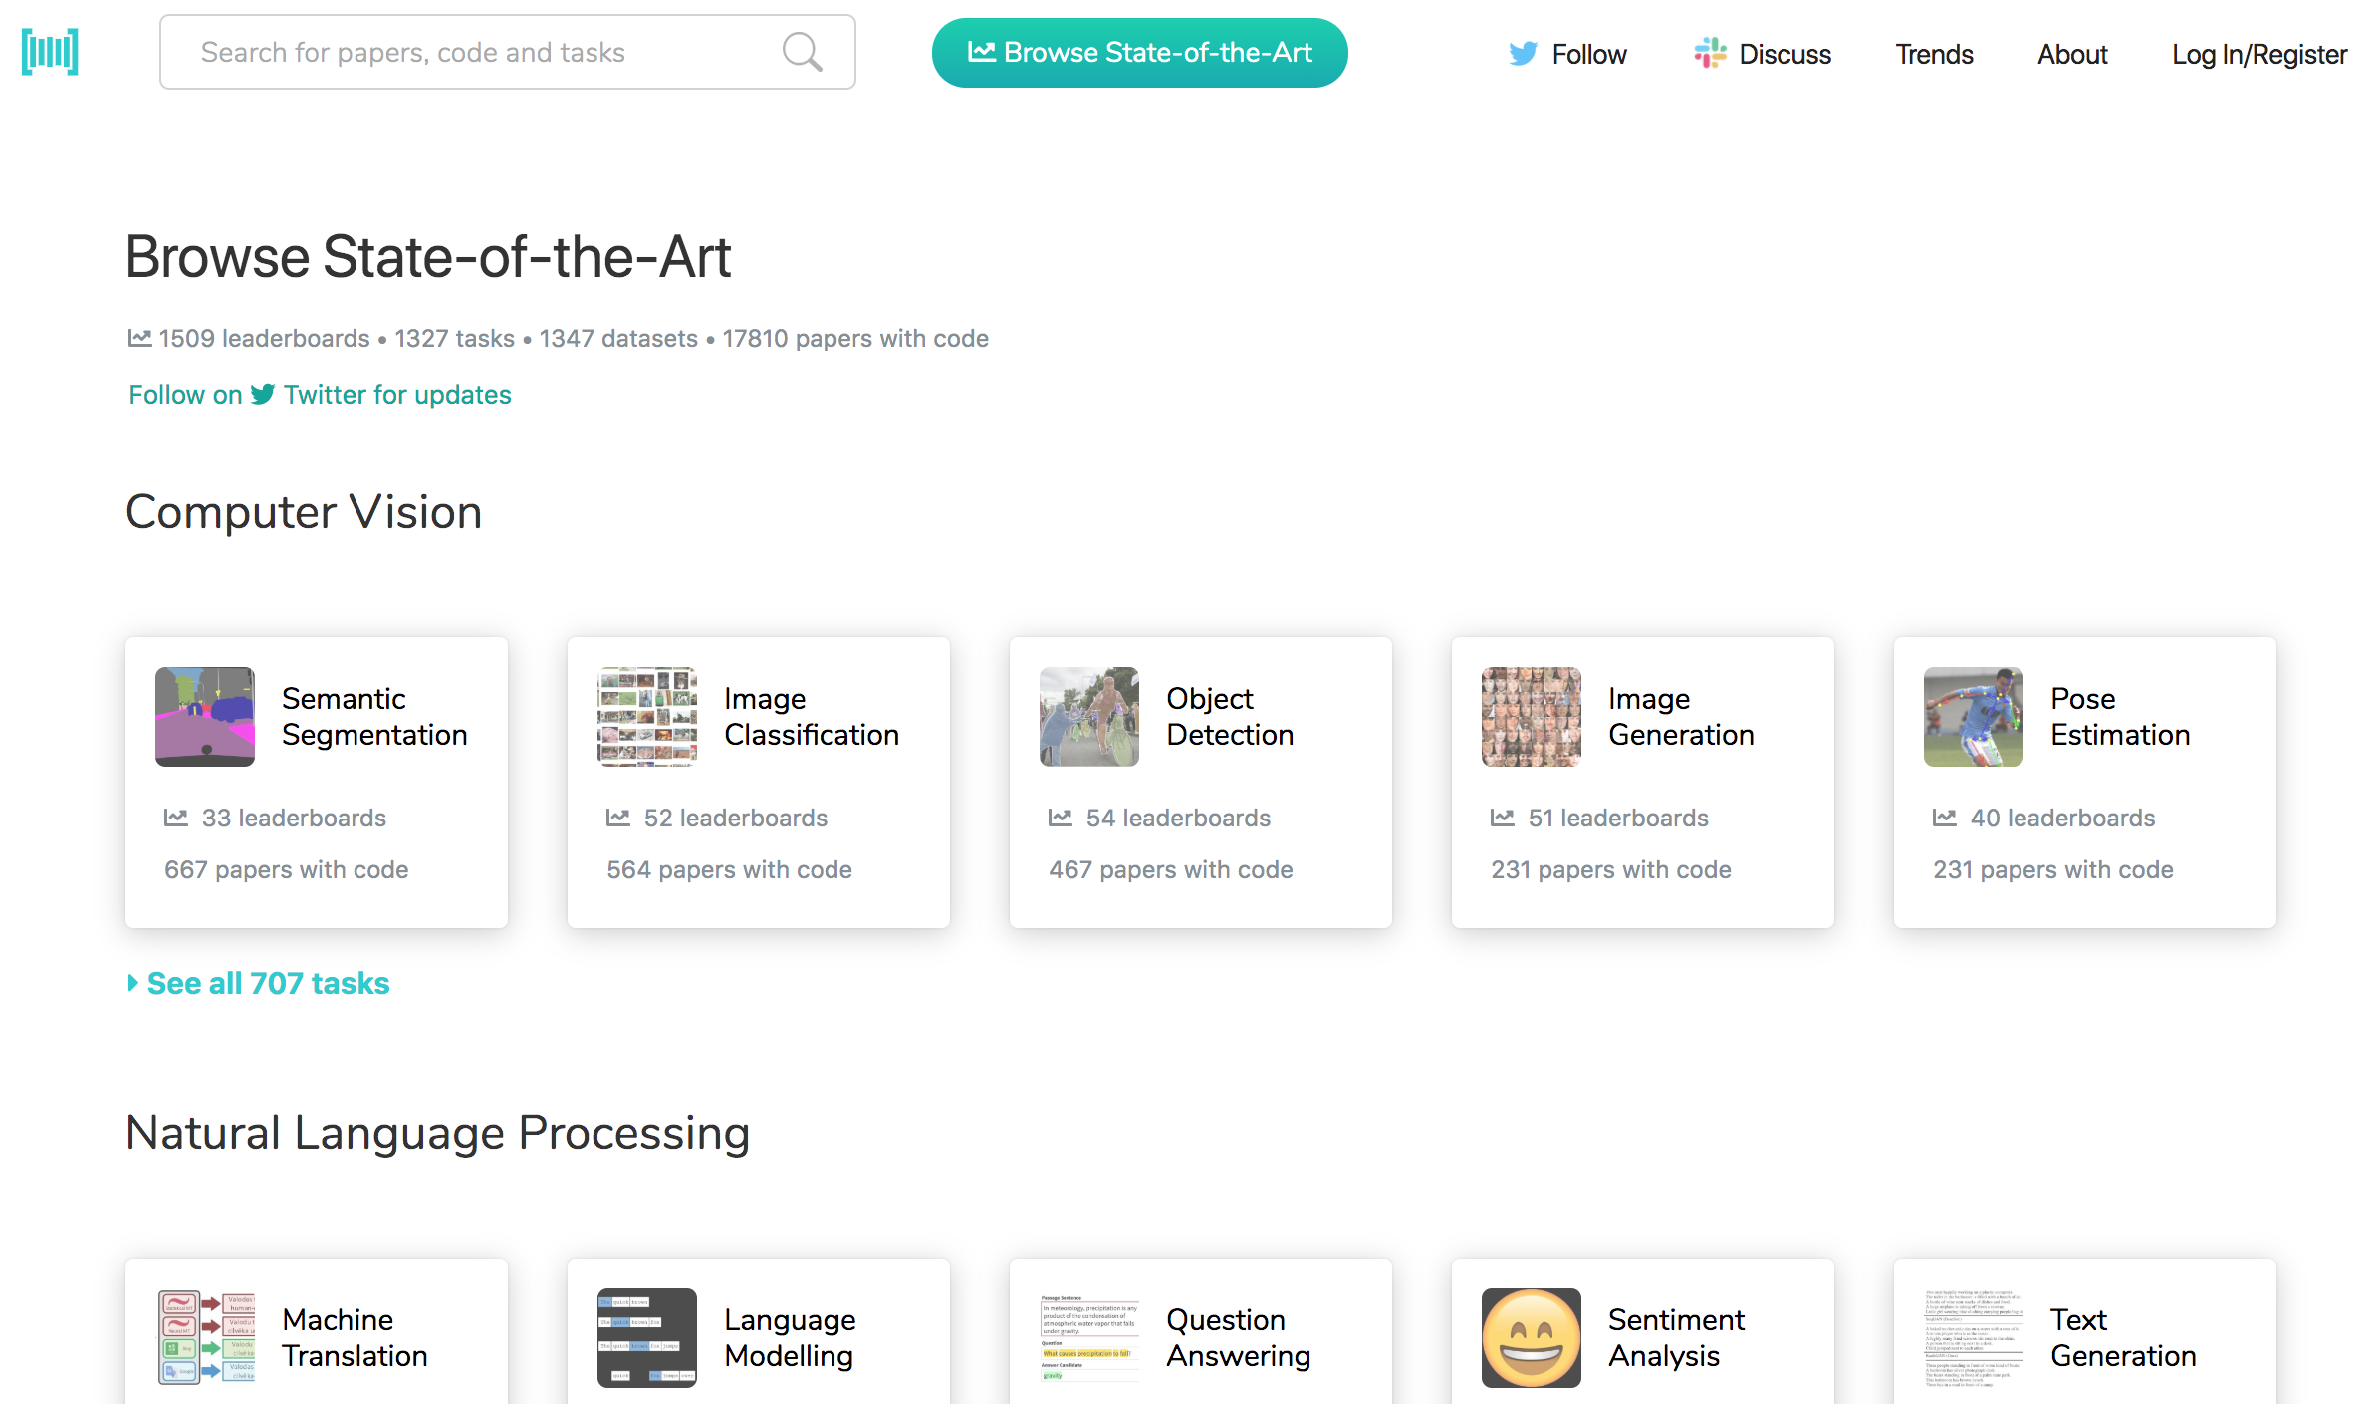
Papers with Code
State-of-the-Art (SOTA)
https://paperswithcode.com/sota

Slide 88
Aurélien Géron (2019),
Hands-On Machine Learning with Scikit-Learn, Keras, and TensorFlow: Concepts, Tools, and Techniques to Build Intelligent Systems, 2nd Edition
O’Reilly Media, 2019
https://github.com/ageron/handson-ml2
Source: https://www.amazon.com/Hands-Machine-Learning-Scikit-Learn-TensorFlow/dp/1492032646/

Slide 89
Hands-On Machine Learning with
Scikit-Learn, Keras, and TensorFlow
Notebooks
The Machine Learning landscape
End-to-end Machine Learning project
Classification
Training Models
Support Vector Machines
Decision Trees
Ensemble Learning and Random Forests
Dimensionality Reduction
Unsupervised Learning Techniques
Artificial Neural Nets with Keras
Training Deep Neural Networks
Custom Models and Training with TensorFlow
Loading and Preprocessing Data
Deep Computer Vision Using Convolutional Neural Networks
Processing Sequences Using RNNs and CNNs
Natural Language Processing with RNNs and Attention
Representation Learning Using Autoencoders
Reinforcement Learning
Training and Deploying TensorFlow Models at Scale
https://github.com/ageron/handson-ml2

Slide 90
Python in Google Colab (Python101)
https://colab.research.google.com/drive/1FEG6DnGvwfUbeo4zJ1zTunjMqf2RkCrT
https://tinyurl.com/aintpupython101

Slide 91
Summary
Machine Learning
Supervised Learning

Slide 92
References
Stuart Russell and Peter Norvig (2020), Artificial Intelligence: A Modern Approach, 4th Edition, Pearson.
Aurélien Géron (2019), Hands-On Machine Learning with Scikit-Learn, Keras, and TensorFlow: Concepts, Tools, and Techniques to Build Intelligent Systems, 2nd Edition, O’Reilly Media.

