Slide 1



資料探勘
(Data Mining)
資料探勘介紹
(Introduction to data mining)
1092DM01
MBA, IM, NTPU (M5026) (Spring 2021)
Tue 2, 3, 4 (9:10-12:00) (B8F40)
Min-Yuh Day
戴敏育
Associate Professor
副教授
Institute of Information Management, National Taipei University
國立臺北大學 資訊管理研究所
https://web.ntpu.edu.tw/~myday
2021-02-23

Slide 2



戴敏育 博士
(Min-Yuh Day, Ph.D.)
國立台北大學 資訊管理研究所 副教授
中央研究院 資訊科學研究所 訪問學人
國立台灣大學 資訊管理 博士
Publications Co-Chairs, IEEE/ACM International Conference on
Advances in Social Networks Analysis and Mining (ASONAM 2013- )
Program Co-Chair, IEEE International Workshop on
Empirical Methods for Recognizing Inference in TExt (IEEE EM-RITE 2012- )
Publications Chair, The IEEE International Conference on
Information Reuse and Integration (IEEE IRI)

Slide 3



資料探勘
(Data Mining)
Contact Information
戴敏育 博士 (Min-Yuh Day, Ph.D.)
副教授 (Associate Professor)
國立臺北大學 資訊管理研究所
Institute of Information Management, National Taipei University
電話： 02-86741111 ext. 66873
研究室： 商8F12
地址： 23741 新北市三峽區大學路 151 號
Email：myday@gm.ntpu.edu.tw
網址：http://web.ntpu.edu.tw/~myday/

Slide 4
國立臺北大學
109學年度第2學期
課程大綱
Spring 2021 (2021.02 - 2021.06)
課程名稱：資料探勘 (Data Mining)
授課教師：戴敏育 (Min-Yuh Day)
開課系所：資管所碩士班
開課資料：選修 半學年 3 學分 (3 Credits, Elective)
上課時間：週二 2, 3, 4 (9:10-12:00)
上課教室：商8F40 (台北大學三峽校區)

Slide 5
教學目標
瞭解資料探勘基本概念與
研究議題。。
具備資料探勘實務操作能力。
進行資料探勘相關之
資訊管理研究。

Slide 6
Course Objectives
Understand the fundamental concepts and research issues of data mining.
Equip with Hands-on practices of
data mining.
Conduct information systems research in the context of data mining.

Slide 7
內容綱要
本課程介紹資料探勘基本概念、研究議題、與實務操作。
課程內容包括
  資料探勘介紹
  ABC：人工智慧，大數據，雲端運算
  Python資料探勘的基礎
  資料科學與資料探勘：發現，分析，可視化和呈現數據
  非監督學習：關聯分析，購物籃分析
  非監督學習：集群分析，行銷市場區隔
  監督學習：分類和預測
  機器學習和深度學習
  卷積神經網絡、遞歸神經網絡、強化學習
  社交網絡分析
  資料探勘個案研究

Slide 8
Course Outline
This course introduces the fundamental concepts,
research issues, and hands-on practices of data mining.
Topics include
  Introduction to data mining
  ABC: AI, Big Data, Cloud Computing
  Foundations of Data Mining in Python
  Data Science and Data Mining: Discovering, Analyzing, Visualizing and Presenting Data
  Unsupervised Learning: Association Analysis, Market Basket Analysis
  Unsupervised Learning: Cluster Analysis, Market Segmentation
  Supervised Learning: Classification and Prediction
  Machine Learning and Deep Learning
  Convolutional Neural Networks, Recurrent Neural Networks, Reinforcement Learning
  Social Network Analysis
  Case Study on Data Mining

Slide 9
資訊管理研究所
系核心能力
(Core Competence)
資訊科技新知探索與系統開發應用 80 %
網路行銷企劃能力 10 %
論文寫作與獨立研究能力 10 %

Slide 10
校四大基本素養
(Four Fundamental Qualities)
專業 (Professionalism)
  創意思考與問題解決 (Creative thinking and Problem-solving) 30 %
  綜合統整(Comprehensive Integration) 30 %
人際 (Interpersonal Relationship)
  溝通協調 (Communication and Coordination) 10 %
  團隊合作 (Teamwork) 10 %
倫理 (Ethics)
  誠信正直(Honesty and Integrity) 5 %
  尊重自省(Self-Esteem and Self-reflection) 5 %
國際觀 (International Vision)
  多元關懷 (Caring for Diversity) 5 %
  跨界宏觀 (Interdisciplinary Vision) 5 %

Slide 11
商學院學習目標
(College Learning Goals)
Ethics/Corporate Social Responsibility
Global Knowledge/Awareness
Communication
Analytical and Critical Thinking

Slide 12
系所學習目標
(Department Learning Goals)
Information Technologies and System Development Capabilities
Internet Marketing Management Capabilities
Research capabilities

Slide 13
課程大綱 (Syllabus)
週次 (Week) 日期 (Date) 內容 (Subject/Topics)
1 2021/02/23 資料探勘介紹 (Introduction to data mining)
2 2021/03/02 ABC：人工智慧，大數據，雲端運算
(ABC: AI, Big Data, Cloud Computing)
3 2021/03/09 Python資料探勘的基礎
(Foundations of Data Mining in Python)
4 2021/03/16 資料科學與資料探勘：發現，分析，可視化和呈現數據
(Data Science and Data Mining:
Discovering, Analyzing, Visualizing and Presenting Data)
5 2021/03/23 非監督學習：關聯分析，購物籃分析
(Unsupervised Learning: Association Analysis,
Market Basket Analysis)
6 2021/03/30 資料探勘個案研究 I
(Case Study on Data Mining I)

Slide 14
課程大綱 (Syllabus)
週次 (Week) 日期 (Date) 內容 (Subject/Topics)
7 2021/04/06 非監督學習：集群分析，行銷市場區隔
(Unsupervised Learning: Cluster Analysis, Market Segmentation)
8 2021/04/13 監督學習：分類和預測
(Supervised Learning: Classification and Prediction)
9 2021/04/20 期中報告 (Midterm Project Report)
10 2021/04/27 監督學習：分類和預測
(Supervised Learning: Classification and Prediction)
11 2021/05/04 機器學習和深度學習
(Machine Learning and Deep Learning)
12 2021/05/11 卷積神經網絡
(Convolutional Neural Networks)

Slide 15
課程大綱 (Syllabus)
週次 (Week) 日期 (Date) 內容 (Subject/Topics)
13 2021/05/18 資料探勘個案研究 II
(Case Study on Data Mining II)
14 2021/05/25 遞歸神經網絡
(Recurrent Neural Networks)
15 2021/06/01 強化學習
(Reinforcement Learning)
16 2021/06/08 社交網絡分析
(Social Network Analysis)
17 2021/06/15 期末報告 I (Final Project Report I)
18 2021/06/22 期末報告 II (Final Project Report II)

Slide 16
教學方法與教學活動
(Teaching methods and activities)
講授 (Lecture)
討論 (Discussion)
實習 (Practicum)

Slide 17
評量方式
(Evaluation Methods)
個人報告 (Individual Presentation) 60 %
團體報告 (Group Presentation) 10 %
個案分析報告 (Case Report) 10 %
課堂參與 (Class Participation) 10 %
作業 (Assignment) 10 %

Slide 18
指定用書
(Required Texts)
Robert Layton (2017),
Learning Data Mining with Python,
Second Edition, Packt Publishing.

Slide 19
參考書目
(Reference Books)
Aurélien Géron (2019),
Hands-On Machine Learning with Scikit-Learn, Keras, and TensorFlow: Concepts, Tools, and Techniques to Build Intelligent Systems,
2nd Edition, O’Reilly Media.

Slide 20
Learning Data Mining with Python - Second Edition,
Robert Layton,
Packt Publishing, 2017
Source: https://www.amazon.com/Learning-Data-Mining-Python-Second/dp/1787126781

Slide 21
Data Mining: Concepts and Techniques, Third Edition,
Jiawei Han, MichelineKamber and Jian Pei,
Morgan Kaufmann, 2011
Source: https://www.amazon.com/Data-Mining-Concepts-Techniques-Management/dp/0123814790

Slide 22
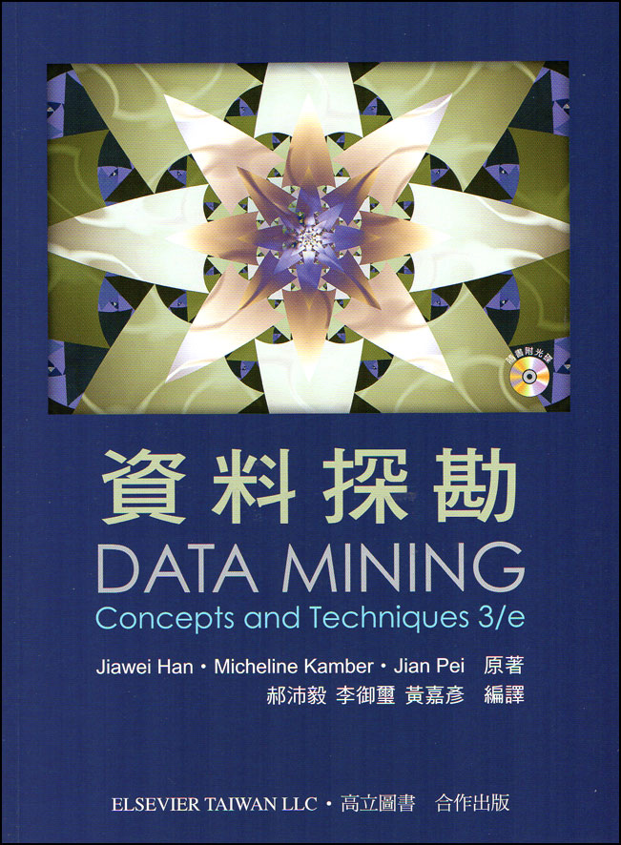
郝沛毅, 李御璽, 黃嘉彥 編譯, 資料探勘
(Jiawei Han, Micheline Kamber, Jian Pei, Data Mining - Concepts and Techniques 3/e),
高立圖書, 2014
Source: http://www.books.com.tw/products/0010646676

Slide 23
Big Data, Data Mining, and Machine Learning: Value Creation for Business Leaders and Practitioners,
Jared Dean,
Wiley, 2014.
Source: https://www.amazon.com/Data-Mining-Machine-Learning-Practitioners/dp/1118618041

Slide 24
Social Network Based Big Data Analysis and Applications,
Lecture Notes in Social Networks,
Mehmet Kaya, Jalal Kawash, Suheil Khoury, Min-Yuh Day,
Springer International Publishing, 2018.
Source: https://www.amazon.com/Network-Analysis-Applications-Lecture-Networks/dp/3319781952

Slide 25

Aurélien Géron (2019),
Hands-On Machine Learning with Scikit-Learn, Keras, and TensorFlow: Concepts, Tools, and Techniques to Build Intelligent Systems, 2nd Edition
O’Reilly Media, 2019
https://github.com/ageron/handson-ml2
Source: https://www.amazon.com/Hands-Machine-Learning-Scikit-Learn-TensorFlow/dp/1492032646/

Slide 26

Hands-On Machine Learning with
Scikit-Learn, Keras, and TensorFlow
Notebooks
The Machine Learning landscape
End-to-end Machine Learning project
Classification
Training Models
Support Vector Machines
Decision Trees
Ensemble Learning and Random Forests
Dimensionality Reduction
Unsupervised Learning Techniques
Artificial Neural Nets with Keras
Training Deep Neural Networks
Custom Models and Training with TensorFlow
Loading and Preprocessing Data
Deep Computer Vision Using Convolutional Neural Networks
Processing Sequences Using RNNs and CNNs
Natural Language Processing with RNNs and Attention
Representation Learning Using Autoencoders
Reinforcement Learning
Training and Deploying TensorFlow Models at Scale
https://github.com/ageron/handson-ml2

Slide 27
AI, Big Data, Cloud Computing
Evolution of Decision Support, Business Intelligence, and Analytics
AI
AI
Cloud Computing
Big Data
DM
BI
Source: Ramesh Sharda, Dursun Delen, and Efraim Turban (2017),
Business Intelligence, Analytics, and Data Science: A Managerial Perspective, 4th Edition, Pearson

Slide 28
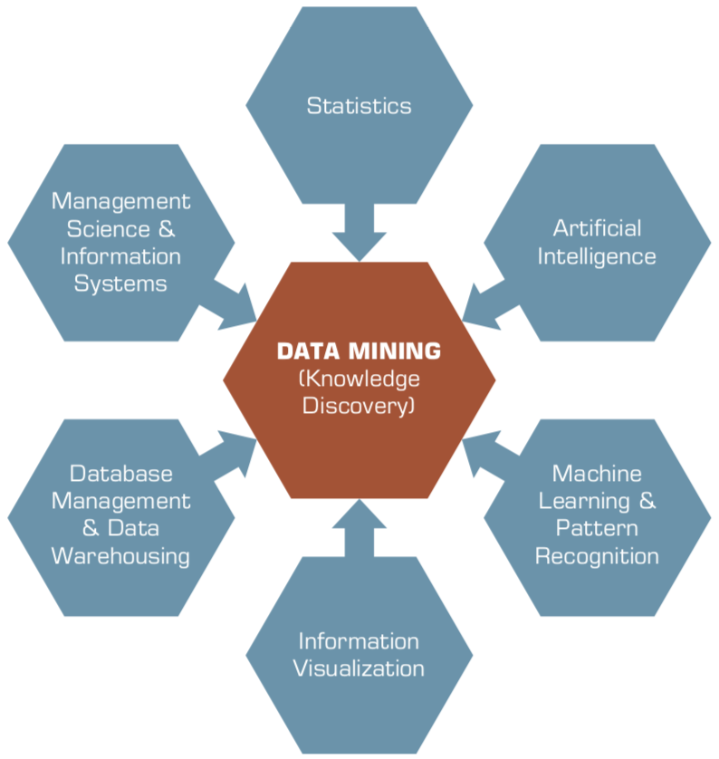
Data Mining
Is a Blend of Multiple Disciplines
Source: Ramesh Sharda, Dursun Delen, and Efraim Turban (2017), Business Intelligence, Analytics, and Data Science: A Managerial Perspective, 4th Edition, Pearson

Slide 29
Data Mining at the
Intersection of Many Disciplines
Source: Turban et al. (2011), Decision Support and Business Intelligence Systems

Slide 30
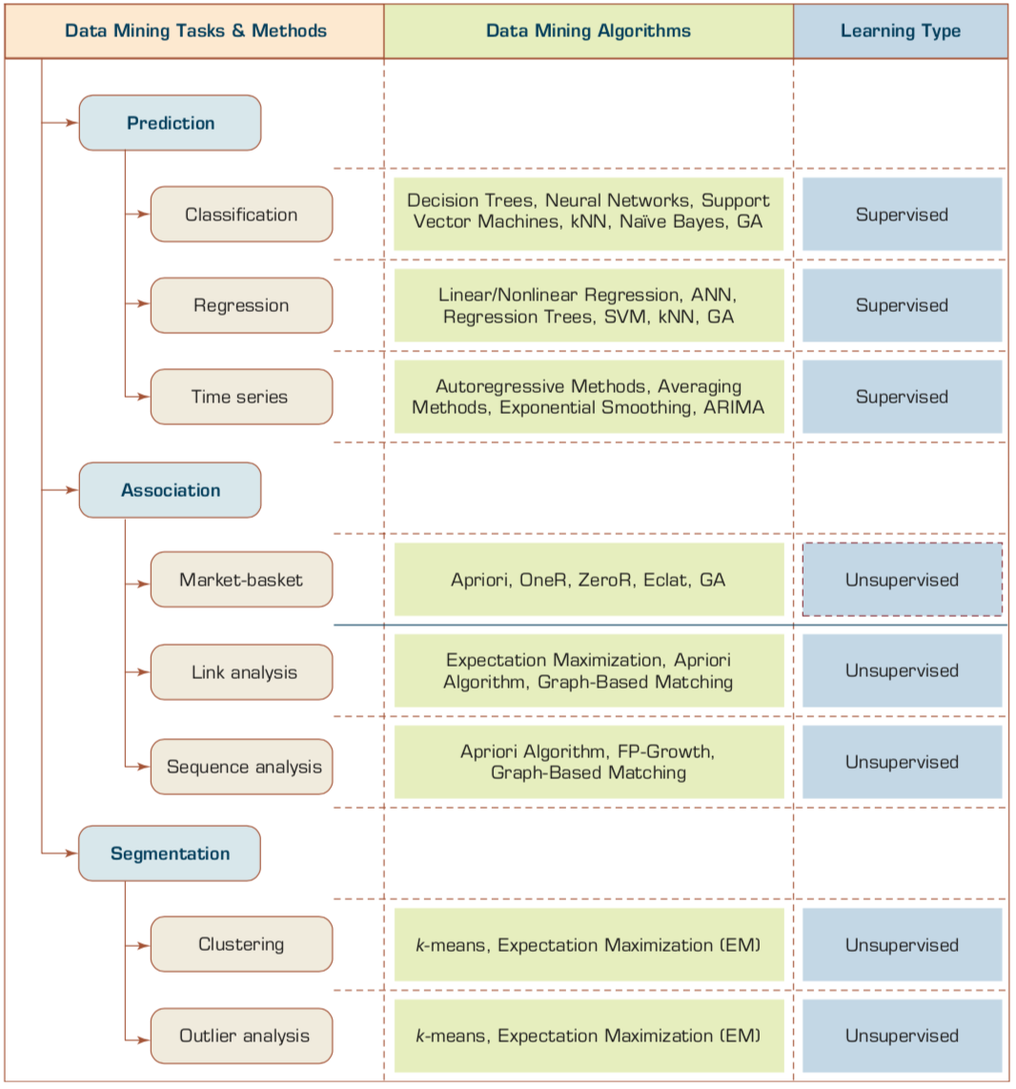
Data Mining Tasks & Methods
Prediction
Association
Segmentation
Source: Ramesh Sharda, Dursun Delen, and Efraim Turban (2017), Business Intelligence, Analytics, and Data Science: A Managerial Perspective, 4th Edition, Pearson

Slide 31
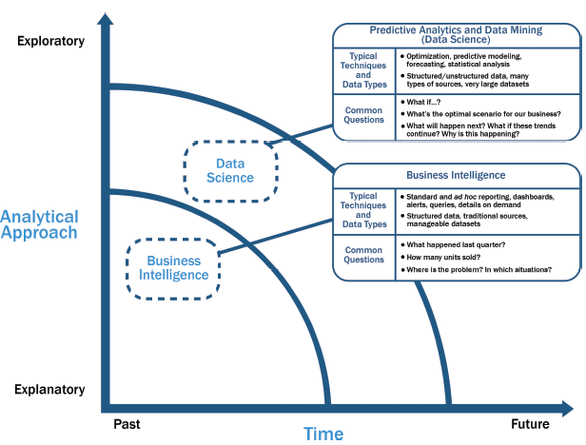
Data Science and
Business Intelligence
Source: EMC Education Services, Data Science and Big Data Analytics: Discovering, Analyzing, Visualizing and Presenting Data, Wiley, 2015

Slide 32
Data Science and
Business Intelligence
Predictive Analytics
and Data Mining
(Data Science)
Source: EMC Education Services, Data Science and Big Data Analytics: Discovering, Analyzing, Visualizing and Presenting Data, Wiley, 2015

Slide 33
Data Science and
Business Intelligence
Predictive Analytics
and Data Mining
(Data Science)
Structured/unstructured data, many types of sources,
very large datasets
Optimization, predictive modeling, forecasting statistical analysis
What if…?
What’s the optimal scenario for our business?
What will happen next?
What if these trends countinue?
Why is this happening?
Source: EMC Education Services, Data Science and Big Data Analytics: Discovering, Analyzing, Visualizing and Presenting Data, Wiley, 2015

Slide 34


Data Mining:
Core Analytics Process
The KDD Process for
Extracting Useful Knowledge from Volumes of Data
Source: Fayyad, U., Piatetsky-Shapiro, G., & Smyth, P. (1996). The KDD Process for Extracting Useful Knowledge from Volumes of Data. Communications of the ACM, 39(11), 27-34.

Slide 35
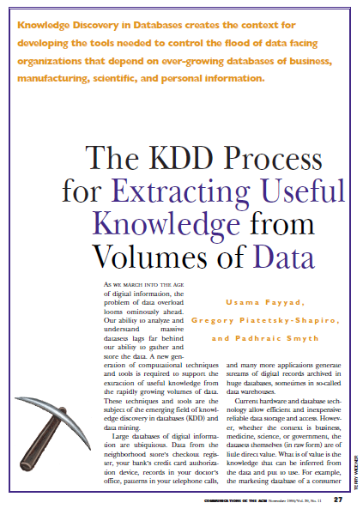
Fayyad, U., Piatetsky-Shapiro, G., & Smyth, P. (1996).
The KDD Process for
Extracting Useful Knowledge from Volumes of Data.
Communications of the ACM, 39(11), 27-34.

Slide 36
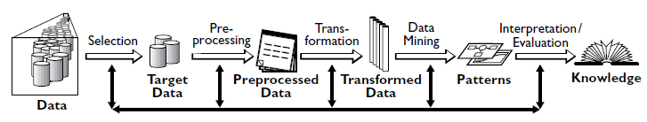
Data Mining
Knowledge Discovery in Databases (KDD) Process
(Fayyad et al., 1996)
Source: Fayyad, U., Piatetsky-Shapiro, G., & Smyth, P. (1996). The KDD Process for Extracting Useful Knowledge from Volumes of Data. Communications of the ACM, 39(11), 27-34.

Slide 37
Knowledge Discovery (KDD) Process
Knowledge
Data mining:
core of knowledge discovery process
Pattern Evaluation
Data Mining
Task-relevant Data
Data Warehouse
Selection
Data Cleaning
Data Integration
Databases
Source: Han & Kamber (2006)

Slide 38
Data Mining Processing Pipeline
(Charu Aggarwal, 2015)
Data Collection
Data Preprocessing
Analytical Processing
Output
for
Analyst
Feature Extraction
Cleaning
and
Integration
Building
Block 1
Building
Block 2
Feedback (Optional)
Feedback (Optional)
Source: Charu Aggarwal (2015), Data Mining: The Textbook Hardcover, Springer

Slide 39
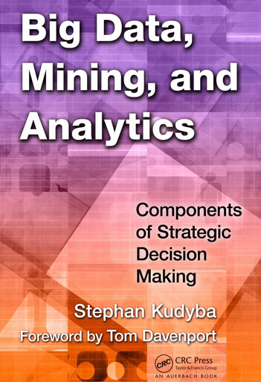
Stephan Kudyba (2014),
Big Data, Mining, and Analytics:
Components of Strategic Decision Making, Auerbach Publications
Source: http://www.amazon.com/gp/product/1466568704

Slide 40
Architecture of Big Data Analytics
Big Data
Analytics
Applications
Big Data
Sources
Big Data
Transformation
Big Data
Platforms & Tools
* Internal
* External
* Multiple formats
* Multiple
locations
* Multiple applications
Middleware
Hadoop
MapReduce
Pig
Hive
Jaql
Zookeeper
Hbase
Cassandra
Oozie
Avro
Mahout
Others
Queries
Raw
Data
Transformed
Data
Big Data
Analytics
Extract Transform Load
Reports
Data Warehouse
OLAP
Traditional Format
CSV, Tables
Data Mining
Source: Stephan Kudyba (2014), Big Data, Mining, and Analytics: Components of Strategic Decision Making, Auerbach Publications

Slide 41
Architecture of Big Data Analytics
Big Data
Analytics
Applications
Big Data
Sources
Big Data
Transformation
Big Data
Platforms & Tools
* Internal
* External
* Multiple formats
* Multiple
locations
* Multiple applications
Data Mining
Big Data Analytics Applications
Middleware
Hadoop
MapReduce
Pig
Hive
Jaql
Zookeeper
Hbase
Cassandra
Oozie
Avro
Mahout
Others
Queries
Raw
Data
Transformed
Data
Big Data
Analytics
Extract Transform Load
Reports
Data Warehouse
OLAP
Traditional Format
CSV, Tables
Data Mining
Source: Stephan Kudyba (2014), Big Data, Mining, and Analytics: Components of Strategic Decision Making, Auerbach Publications

Slide 42
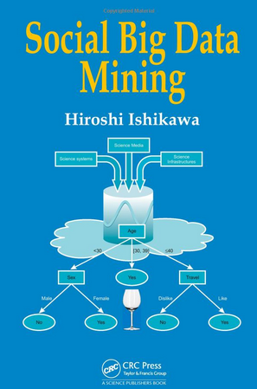
Social Big Data Mining
(Hiroshi Ishikawa, 2015)
Source: http://www.amazon.com/Social-Data-Mining-Hiroshi-Ishikawa/dp/149871093X

Slide 43
Architecture for
Social Big Data Mining
(Hiroshi Ishikawa, 2015)
Enabling Technologies
Analysts
Integrated analysis
Integrated analysis model
Model Construction
Explanation by Model
Conceptual Layer
Natural Language Processing
Information Extraction
Anomaly Detection
Discovery of relationships
among heterogeneous data
Large-scale visualization
Construction and
confirmation
of individual
hypothesis
Description and
execution of
application-specific
task
Data
Mining
Multivariate analysis
Application specific task
Logical Layer
Parallel distrusted processing
Software
Social Data
Hardware
Physical Layer
Source: Hiroshi Ishikawa (2015), Social Big Data Mining, CRC Press

Slide 44
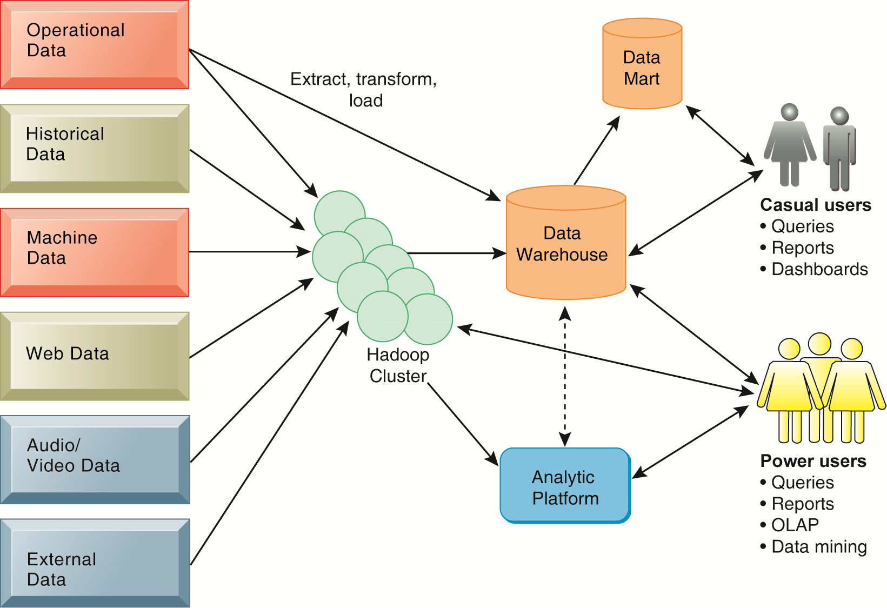
Business Intelligence (BI) Infrastructure

Slide 45
Data Warehouse
Data Mining and Business Intelligence
Increasing potential
to support
business decisions
End User
Decision Making
Data Presentation
Business
Analyst
Visualization Techniques
Data Mining
Data
Analyst
Information Discovery
Data Exploration
Statistical Summary, Querying, and Reporting
Data Preprocessing/Integration, Data Warehouses
Data Sources
DBA
Paper, Files, Web documents, Scientific experiments, Database Systems
Source: Jiawei Han and Micheline Kamber (2006), Data Mining: Concepts and Techniques, Second Edition, Elsevier

Slide 46
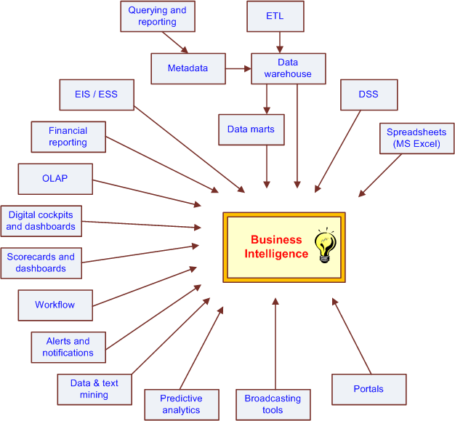
The Evolution of BI Capabilities
Source: Turban et al. (2011), Decision Support and Business Intelligence Systems

Slide 47
Three Types of Analytics
Source: Ramesh Sharda, Dursun Delen, and Efraim Turban (2017),
Business Intelligence, Analytics, and Data Science: A Managerial Perspective, 4th Edition, Pearson

Slide 48
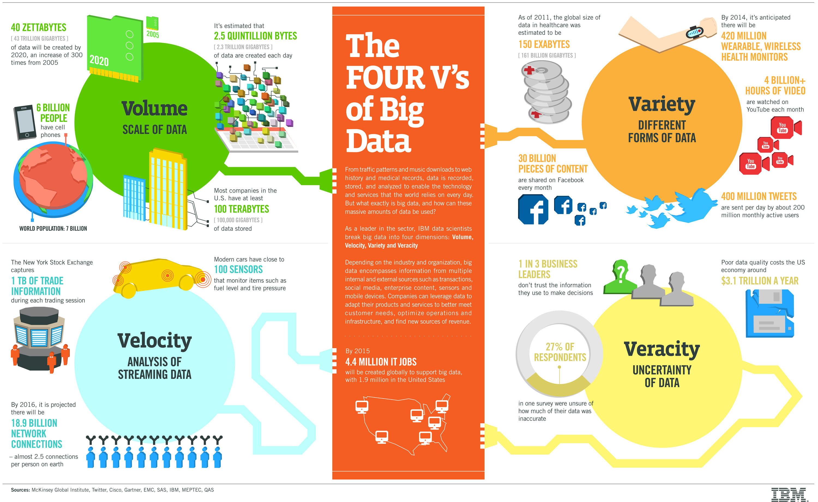
Big Data 4 V
Source: https://www-01.ibm.com/software/data/bigdata/

Slide 49
Value

Slide 50
Artificial Intelligence
Machine Learning & Deep Learning
Source: https://blogs.nvidia.com/blog/2016/07/29/whats-difference-artificial-intelligence-machine-learning-deep-learning-ai/

Slide 51
AI, ML, DL
Artificial Intelligence (AI)
Machine Learning (ML)
Supervised
Learning
Unsupervised Learning
Deep Learning (DL)
CNN
RNN LSTM GRU
GAN
Semi-supervised Learning
Reinforcement Learning
Source: https://leonardoaraujosantos.gitbooks.io/artificial-inteligence/content/deep_learning.html

Slide 52
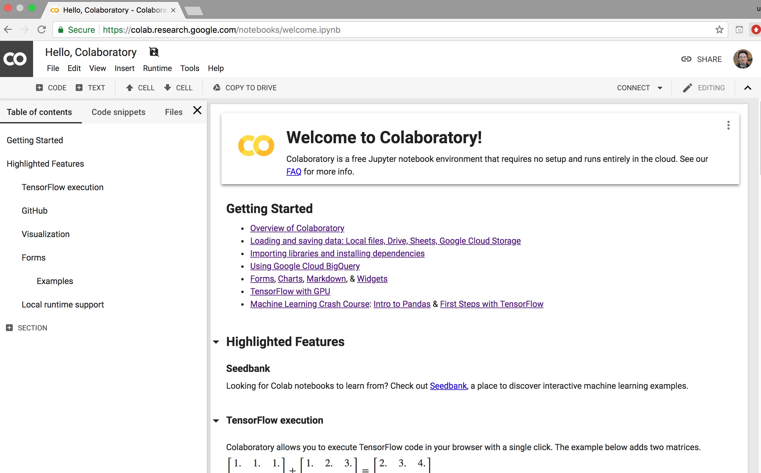
Google Colab
https://colab.research.google.com/notebooks/welcome.ipynb

Slide 53

Python in Google Colab (Python101)
https://colab.research.google.com/drive/1FEG6DnGvwfUbeo4zJ1zTunjMqf2RkCrT
https://tinyurl.com/aintpupython101

Slide 54
Summary
This course introduces the fundamental concepts,
research issues, and hands-on practices of data mining.
Topics include
  Introduction to data mining
  ABC: AI, Big Data, Cloud Computing
  Foundations of Data Mining in Python
  Data Science and Data Mining: Discovering, Analyzing, Visualizing and Presenting Data
  Unsupervised Learning: Association Analysis, Market Basket Analysis
  Unsupervised Learning: Cluster Analysis, Market Segmentation
  Supervised Learning: Classification and Prediction
  Machine Learning and Deep Learning
  Convolutional Neural Networks, Recurrent Neural Networks, Reinforcement Learning
  Social Network Analysis
  Case Study on Data Mining

Slide 55
資料探勘
(Data Mining)
Contact Information
戴敏育 博士 (Min-Yuh Day, Ph.D.)
副教授 (Associate Professor)
國立臺北大學 資訊管理研究所
Institute of Information Management, National Taipei University
電話： 02-86741111 ext. 66873
研究室： 商8F12
地址： 23741 新北市三峽區大學路 151 號
Email：myday@gm.ntpu.edu.tw
網址：http://web.ntpu.edu.tw/~myday/

