Slide 1



資料探勘
(Data Mining)
監督學習：分類和預測 (Supervised Learning:
Classification and Prediction)
1092DM07
MBA, IM, NTPU (M5026) (Spring 2021)
Tue 2, 3, 4 (9:10-12:00) (B8F40)
Min-Yuh Day
戴敏育
Associate Professor
副教授
Institute of Information Management, National Taipei University
國立臺北大學 資訊管理研究所
https://web.ntpu.edu.tw/~myday
2021-04-27

Slide 2
課程大綱 (Syllabus)
週次 (Week) 日期 (Date) 內容 (Subject/Topics)
1 2021/02/23 資料探勘介紹 (Introduction to data mining)
2 2021/03/02 ABC：人工智慧，大數據，雲端運算
(ABC: AI, Big Data, Cloud Computing)
3 2021/03/09 Python資料探勘的基礎
(Foundations of Data Mining in Python)
4 2021/03/16 資料科學與資料探勘：發現，分析，可視化和呈現數據
(Data Science and Data Mining:
Discovering, Analyzing, Visualizing and Presenting Data)
5 2021/03/23 非監督學習：關聯分析，購物籃分析
(Unsupervised Learning: Association Analysis,
Market Basket Analysis)
6 2021/03/30 資料探勘個案研究 I
(Case Study on Data Mining I)

Slide 3
課程大綱 (Syllabus)
週次 (Week) 日期 (Date) 內容 (Subject/Topics)
7 2021/04/06 放假一天 (Day off)
8 2021/04/13 非監督學習：集群分析，行銷市場區隔
(Unsupervised Learning: Cluster Analysis, Market Segmentation)
9 2021/04/20 期中報告 (Midterm Project Report)
10 2021/04/27 監督學習：分類和預測
(Supervised Learning: Classification and Prediction)
11 2021/05/04 機器學習和深度學習
(Machine Learning and Deep Learning)
12 2021/05/11 卷積神經網絡
(Convolutional Neural Networks)

Slide 4
課程大綱 (Syllabus)
週次 (Week) 日期 (Date) 內容 (Subject/Topics)
13 2021/05/18 資料探勘個案研究 II
(Case Study on Data Mining II)
14 2021/05/25 遞歸神經網絡
(Recurrent Neural Networks)
15 2021/06/01 強化學習
(Reinforcement Learning)
16 2021/06/08 社交網絡分析
(Social Network Analysis)
17 2021/06/15 期末報告 I (Final Project Report I)
18 2021/06/22 期末報告 II (Final Project Report II)

Slide 5
Supervised Learning: Classification and Prediction

Slide 6
Outline
Supervised Learning
Classification and Prediction
Decision Tree (DT)
  Information Gain (IG)
Support Vector Machine (SVM)
Data Mining Evaluation
  Accuracy
  Precision
  Recall
  F1 score (F-measure) (F-score)

Slide 7
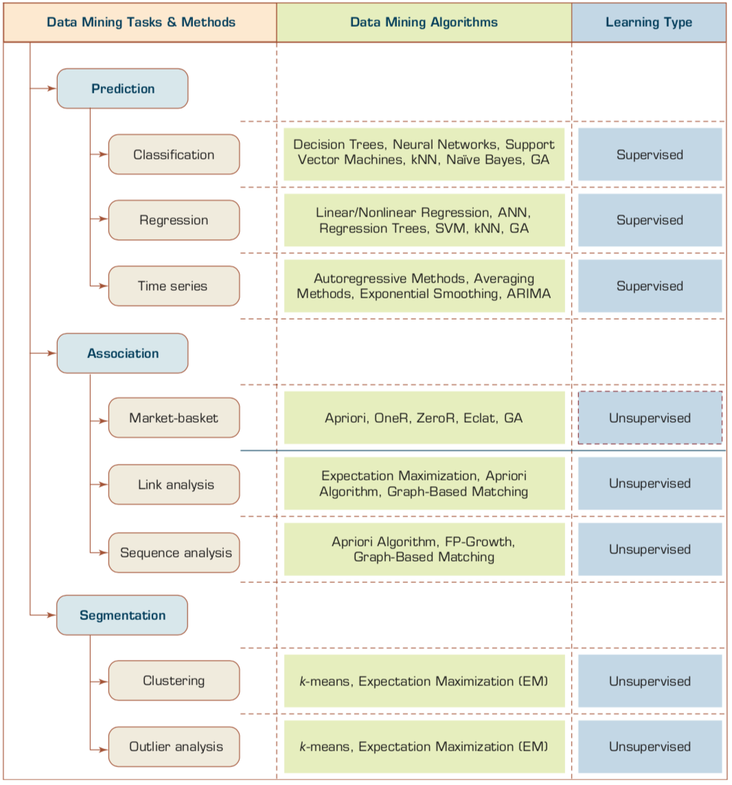
Data Mining Tasks & Methods
Prediction
Classification
Supervised Learning:
Classification
and
Prediction
Source: Ramesh Sharda, Dursun Delen, and Efraim Turban (2017), Business Intelligence, Analytics, and Data Science: A Managerial Perspective, 4th Edition, Pearson

Slide 8
AI, ML, DL
Artificial Intelligence (AI)
Machine Learning (ML)
Supervised
Learning
Unsupervised Learning
Deep Learning (DL)
CNN
RNN LSTM GRU
GAN
Semi-supervised Learning
Reinforcement Learning
Source: https://leonardoaraujosantos.gitbooks.io/artificial-inteligence/content/deep_learning.html

Slide 9
3 Machine Learning Algorithms
Source: Enrico Galimberti, http://blogs.teradata.com/data-points/tree-machine-learning-algorithms/

Slide 10
Machine Learning Models
Deep Learning
Kernel
Association rules
Ensemble
Decision tree
Dimensionality reduction
Clustering
Regression Analysis
Bayesian
Instance based
Source: Sunila Gollapudi (2016), Practical Machine Learning, Packt Publishing

Slide 11
Machine Learning (ML) / Deep Learning (DL)
Decision Tree Classifiers
Support Vector Machine (SVM)
Supervised Learning
Neural Network (NN)
Linear Classifiers
Deep Learning (DL)
Machine Learning
(ML)
Rule-based Classifiers
Naïve Bayes
(NB)
Unsupervised Learning
Probabilistic Classifiers
Bayesian Network (BN)
Maximum Entropy (ME)
Reinforcement Learning
Source: Jesus Serrano-Guerrero, Jose A. Olivas, Francisco P. Romero, and Enrique Herrera-Viedma (2015),
"Sentiment analysis: A review and comparative analysis of web services," Information Sciences, 311, pp. 18-38.

Slide 12
Scikit-Learn
Machine Learning in Python

Slide 13
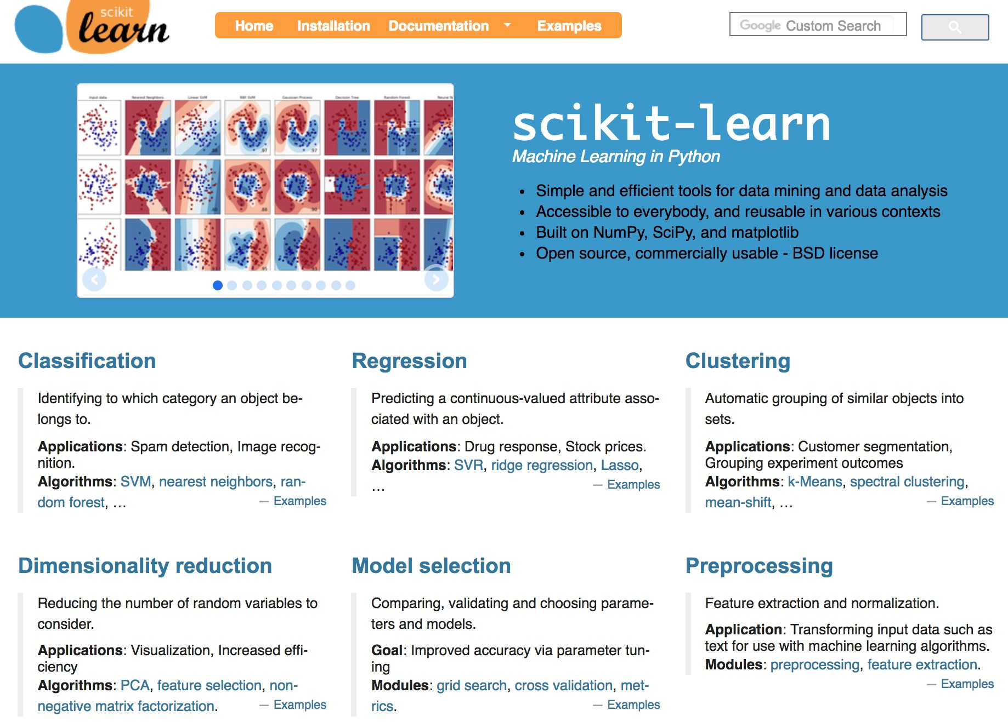
Scikit-Learn
Source: http://scikit-learn.org/

Slide 14
Scikit-Learn Machine Learning Map
Source: http://scikit-learn.org/stable/tutorial/machine_learning_map/index.html

Slide 15
Scikit-Learn Machine Learning Map
Source: http://scikit-learn.org/stable/tutorial/machine_learning_map/index.html

Slide 16
Scikit-Learn Machine Learning Map
Source: http://scikit-learn.org/stable/tutorial/machine_learning_map/index.html

Slide 17
Scikit-Learn Machine Learning Map
Source: http://scikit-learn.org/stable/tutorial/machine_learning_map/index.html

Slide 18
Classification vs. Prediction
Classification
  predicts categorical class labels (discrete or nominal)
  classifies data (constructs a model) based on the training set and the values (class labels) in a classifying attribute and uses it in classifying new data
Prediction
  models continuous-valued functions
    i.e., predicts unknown or missing values
Typical applications
  Credit approval
  Target marketing
  Medical diagnosis
  Fraud detection
Source: Han & Kamber (2006)

Slide 19
Data Mining Methods: Classification
Most frequently used DM method
Part of the machine-learning family
Employ supervised learning
Learn from past data, classify new data
The output variable is categorical
(nominal or ordinal) in nature
Classification versus regression?
Classification versus clustering?
Source: Turban et al. (2011), Decision Support and Business Intelligence Systems

Slide 20
Classification Techniques
Decision Tree analysis (DT)
Statistical analysis
Neural networks (NN)
Deep Learning (DL)
Support Vector Machines (SVM)
Case-based reasoning
Bayesian classifiers
Genetic algorithms (GA)
Rough sets
Source: Turban et al. (2011), Decision Support and Business Intelligence Systems

Slide 21
Example of Classification
Loan Application Data
  Which loan applicants are “safe” and which are “risky” for the bank?
  “Safe” or “risky” for load application data
Marketing Data
  Whether a customer with a given profile will buy a new computer?
  “yes” or “no” for marketing data
Classification
  Data analysis task
  A model or Classifier is constructed to predict categorical labels
    Labels: “safe” or “risky”; “yes” or “no”;
    “treatment A”, “treatment B”, “treatment C”
Source: Han & Kamber (2006)

Slide 22
What Is Prediction?
(Numerical) prediction is similar to classification
  construct a model
  use model to predict continuous or ordered value for a given input
Prediction is different from classification
  Classification refers to predict categorical class label
  Prediction models continuous-valued functions
Major method for prediction: regression
  model the relationship between one or more independent or predictor variables and a dependent or response variable
Regression analysis
  Linear and multiple regression
  Non-linear regression
  Other regression methods: generalized linear model, Poisson regression, log-linear models, regression trees
Source: Han & Kamber (2006)

Slide 23
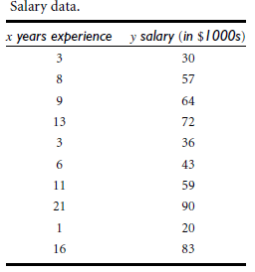
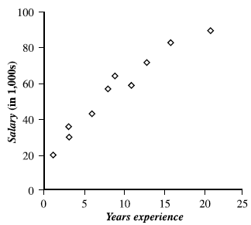
Prediction Methods
Linear Regression
Nonlinear Regression
Other Regression Methods
Source: Han & Kamber (2006)

Slide 24
Classification and Prediction
Classification and prediction are two forms of data analysis that can be used to extract models describing important data classes or to predict future data trends.
Classification
  Effective and scalable methods have been developed for decision trees induction, Naive Bayesian classification, Bayesian belief network, rule-based classifier, Backpropagation, Support Vector Machine (SVM), associative classification, nearest neighbor classifiers, and case-based reasoning, and other classification methods such as genetic algorithms, rough set and fuzzy set approaches.
Prediction
  Linear, nonlinear, and generalized linear models of regression can be used for prediction. Many nonlinear problems can be converted to linear problems by performing transformations on the predictor variables. Regression trees and model trees are also used for prediction.
Source: Han & Kamber (2006)

Slide 25
Classification
—A Two-Step Process
Model construction: describing a set of predetermined classes
  Each tuple/sample is assumed to belong to a predefined class, as determined by the class label attribute
  The set of tuples used for model construction is training set
  The model is represented as classification rules, decision trees, or mathematical formulae
Model usage: for classifying future or unknown objects
  Estimate accuracy of the model
    The known label of test sample is compared with the classified result from the model
    Accuracy rate is the percentage of test set samples that are correctly classified by the model
    Test set is independent of training set, otherwise over-fitting will occur
  If the accuracy is acceptable, use the model to classify data tuples whose class labels are not known
Source: Han & Kamber (2006)

Slide 26
Supervised Learning vs.
Unsupervised Learning
Supervised learning (classification)
  Supervision: The training data (observations, measurements, etc.) are accompanied by labels indicating the class of the observations
  New data is classified based on the training set
Unsupervised learning (clustering)
  The class labels of training data is unknown
  Given a set of measurements, observations, etc. with the aim of establishing the existence of classes or clusters in the data
Source: Han & Kamber (2006)

Slide 27
Issues Regarding Classification and Prediction:
Data Preparation
Data cleaning
  Preprocess data in order to reduce noise and handle missing values
Relevance analysis (feature selection)
  Remove the irrelevant or redundant attributes
  Attribute subset selection
    Feature Selection in machine learning
Data transformation
  Generalize and/or normalize data
  Example
    Income: low, medium, high
Source: Han & Kamber (2006)

Slide 28
Issues:
Evaluating Classification and Prediction Methods
Accuracy
  classifier accuracy: predicting class label
  predictor accuracy: guessing value of predicted attributes
  estimation techniques: cross-validation and bootstrapping
Speed
  time to construct the model (training time)
  time to use the model (classification/prediction time)
Robustness
  handling noise and missing values
Scalability
  ability to construct the classifier or predictor efficiently given large amounts of data
Interpretability
  understanding and insight provided by the model
Source: Han & Kamber (2006)

Slide 29
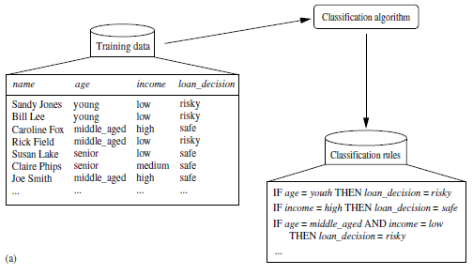
Data Classification Process 1: Learning (Training) Step
(a) Learning: Training data are analyzed by classification algorithm
y= f(X)
Source: Han & Kamber (2006)

Slide 30
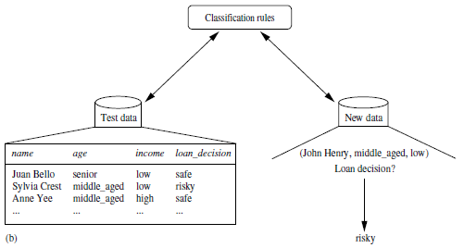
Data Classification Process 2
(b) Classification: Test data are used to estimate the accuracy of the classification rules.
Source: Han & Kamber (2006)

Slide 31
Process (1):
Model Construction
Classification
Algorithms
Training
Data
Classifier
(Model)
IF rank = ‘professor’
OR years > 6
THEN tenured = ‘yes’
Source: Han & Kamber (2006)

Slide 32
Process (2):
Using the Model in Prediction
Classifier
Testing
Data
Unseen Data
(Jeff, Professor, 4)
Tenured?
Source: Han & Kamber (2006)

Slide 33
Decision Trees

Slide 34
Decision Trees
A general algorithm for decision tree building
Employs the divide and conquer method
Recursively divides a training set until each division consists of examples from one class
  Create a root node and assign all of the training data to it
  Select the best splitting attribute
  Add a branch to the root node for each value of the split. Split the data into mutually exclusive subsets along the lines of the specific split
  Repeat the steps 2 and 3 for each and every leaf node until the stopping criteria is reached
Source: Turban et al. (2011), Decision Support and Business Intelligence Systems

Slide 35
Decision Trees
DT algorithms mainly differ on
  Splitting criteria
    Which variable to split first?
    What values to use to split?
    How many splits to form for each node?
  Stopping criteria
    When to stop building the tree
  Pruning (generalization method)
    Pre-pruning versus post-pruning
Most popular DT algorithms include
  ID3, C4.5, C5; CART; CHAID; M5
Source: Turban et al. (2011), Decision Support and Business Intelligence Systems

Slide 36
Decision Trees
Alternative splitting criteria
  Gini index determines the purity of a specific class as a result of a decision to branch along a particular attribute/value
    Used in CART
  Information gain uses entropy to measure the extent of uncertainty or randomness of a particular attribute/value split
    Used in ID3, C4.5, C5
  Chi-square statistics (used in CHAID)
Source: Turban et al. (2011), Decision Support and Business Intelligence Systems

Slide 37
Classification by Decision Tree Induction
Training Dataset
This follows an example of Quinlan’s ID3 (Playing Tennis)
Source: Han & Kamber (2006)

Slide 38
Output: A Decision Tree for “buys_computer”
Classification by Decision Tree Induction
age?
youth
<=30
middle_aged
31..40
senior
>40
student?
yes
credit rating?
no
yes
fair
excellent
no
yes
no
yes
buys_computer=“yes” or buys_computer=“no”
Source: Han & Kamber (2006)

Slide 39
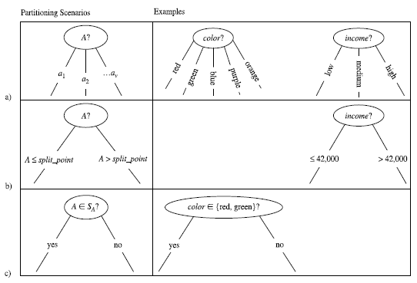
Three possibilities for partitioning tuples based on the splitting Criterion
Source: Han & Kamber (2006)

Slide 40
Algorithm for Decision Tree Induction
Basic algorithm (a greedy algorithm)
  Tree is constructed in a top-down recursive divide-and-conquer manner
  At start, all the training examples are at the root
  Attributes are categorical (if continuous-valued, they are discretized in advance)
  Examples are partitioned recursively based on selected attributes
  Test attributes are selected on the basis of a heuristic or statistical measure (e.g., information gain)
Conditions for stopping partitioning
  All samples for a given node belong to the same class
  There are no remaining attributes for further partitioning –
  majority voting is employed for classifying the leaf
  There are no samples left
Source: Han & Kamber (2006)

Slide 41
Attribute Selection Measure
Notation: Let D, the data partition, be a training set of class-labeled tuples.
Suppose the class label attribute has m distinct values defining m distinct classes, C_{i} (for i = 1, … , m).
Let C_{i,D} be the set of tuples of class C_{i} in D.
Let |D| and | C_{i,D} | denote the number of tuples in D and C_{i,D} , respectively.
Example:
  Class: buys_computer= “yes” or “no”
  Two distinct classes (m=2)
    Class C_{i} (i=1,2):
    C₁ = “yes”,
    C₂ = “no”
Source: Han & Kamber (2006)

Slide 42
Attribute Selection Measure:
Information Gain (ID3/C4.5)
Select the attribute with the highest information gain
Let p_{i} be the probability that an arbitrary tuple in D belongs to class C_{i}, estimated by |C_{i, D}|/|D|
Expected information (entropy) needed to classify a tuple in D:
Information needed (after using A to split D into v partitions) to classify D:
Information gained by branching on attribute A
Source: Han & Kamber (2006)
Notes:
I : the expected information needed to classify a given sample
E (entropy) : expected information based on the partitioning into subsets by A

Slide 43
log₂ (1) = 0
log₂ (2) = 1
log₂ (3) = 1.5850
log₂ (4) = 2
log₂ (5) = 2.3219
log₂ (6) = 2.5850
log₂ (7) = 2.8074
log₂ (8) = 3
log₂ (9) = 3.1699
log₂ (10) = 3.3219
log₂ (0.1) = -3.3219
log₂ (0.2) = -2.3219
log₂ (0.3) = -1.7370
log₂ (0.4) = -1.3219
log₂ (0.5) = -1
log₂ (0.6) = -0.7370
log₂ (0.7) = -0.5146
log₂ (0.8) = -0.3219
log₂ (0.9) = -0.1520
log₂ (1) = 0

Slide 44
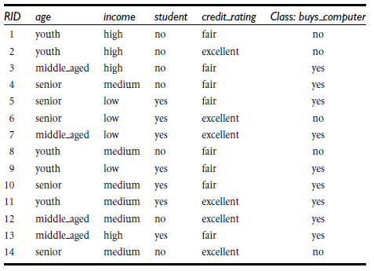
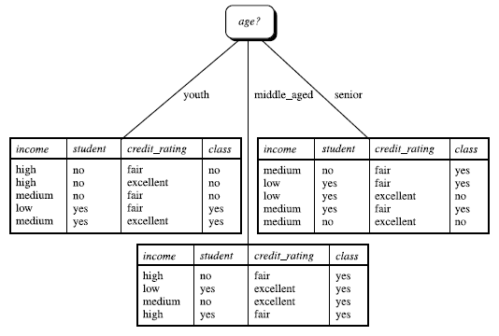
Class-labeled training tuples from the AllElectronics customer database
The attribute age has the highest information gain and therefore becomes the splitting attribute at the root node of the decision tree
Source: Han & Kamber (2006)

Slide 45
Attribute Selection: Information Gain
Class P: buys_computer = “yes”
Class N: buys_computer = “no”
means “age <=30” has 5 out of 14 samples, with 2 yes’es and 3 no’s. Hence
Similarly,
Source: Han & Kamber (2006)

Slide 46
Decision Tree
Information Gain

Slide 47
Customer database
ID | age | income | student | credit_rating | Class: buys_computer
1 | youth | high | no | fair | no
2 | middle_aged | high | no | fair | yes
3 | youth | high | no | excellent | no
4 | senior | medium | no | fair | yes
5 | senior | high | yes | fair | yes
6 | senior | low | yes | excellent | no
7 | middle_aged | low | yes | excellent | yes
8 | youth | medium | no | fair | no
9 | youth | low | yes | fair | yes
10 | senior | medium | yes | excellent | yes

Slide 48
What is the class
(buys_computer = “yes” or buys_computer = “no”) for a customer
(age=youth, income=medium, student =yes, credit= fair )?

Slide 49
Customer database
ID | age | income | student | credit_rating | Class: buys_computer
1 | youth | high | no | fair | no
2 | middle_aged | high | no | fair | yes
3 | youth | high | no | excellent | no
4 | senior | medium | no | fair | yes
5 | senior | high | yes | fair | yes
6 | senior | low | yes | excellent | no
7 | middle_aged | low | yes | excellent | yes
8 | youth | medium | no | fair | no
9 | youth | low | yes | fair | yes
10 | senior | medium | yes | excellent | yes
11 | youth | medium | yes | fair | ?

Slide 50
What is the class
(buys_computer = “yes” or buys_computer = “no”) for a customer
(age=youth, income=medium, student =yes, credit= fair )?
Yes = 0.0889
No = 0.0167

Slide 51
Table 1 shows the class-labeled training tuples from customer database.
Please calculate and illustrate the final decision tree returned by decision tree induction using information gain.
(1) What is the Information Gain of “age”?
(2) What is the Information Gain of “income”?
(3) What is the Information Gain of “student”?
(4) What is the Information Gain of “credit_rating”?
(5) What is the class (buys_computer = “yes” or buys_computer = “no”) for a customer (age=youth, income=medium, student =yes, credit= fair ) based on the classification result by decision three induction?
ID | age | income | student | credit_rating | Class: buys_computer
1 | youth | high | no | fair | no
2 | middle_aged | high | no | fair | yes
3 | youth | high | no | excellent | no
4 | senior | medium | no | fair | yes
5 | senior | high | yes | fair | yes
6 | senior | low | yes | excellent | no
7 | middle_aged | low | yes | excellent | yes
8 | youth | medium | no | fair | no
9 | youth | low | yes | fair | yes
10 | senior | medium | yes | excellent | yes

Slide 52
Attribute Selection Measure:
Information Gain (ID3/C4.5)
Select the attribute with the highest information gain
Let p_{i} be the probability that an arbitrary tuple in D belongs to class C_{i}, estimated by |C_{i, D}|/|D|
Expected information (entropy) needed to classify a tuple in D:
Information needed (after using A to split D into v partitions) to classify D:
Information gained by branching on attribute A
Source: Han & Kamber (2006)
Notes:
I : the expected information needed to classify a given sample
E (entropy) : expected information based on the partitioning into subsets by A

Slide 53
log₂ (1) = 0
log₂ (2) = 1
log₂ (3) = 1.5850
log₂ (4) = 2
log₂ (5) = 2.3219
log₂ (6) = 2.5850
log₂ (7) = 2.8074
log₂ (8) = 3
log₂ (9) = 3.1699
log₂ (10) = 3.3219
log₂ (0.1) = -3.3219
log₂ (0.2) = -2.3219
log₂ (0.3) = -1.7370
log₂ (0.4) = -1.3219
log₂ (0.5) = -1
log₂ (0.6) = -0.7370
log₂ (0.7) = -0.5146
log₂ (0.8) = -0.3219
log₂ (0.9) = -0.1520
log₂ (1) = 0

Slide 54
ID | age | income | student | credit_rating | Class: buys_computer
1 | youth | high | no | fair | no
2 | middle_aged | high | no | fair | yes
3 | youth | high | no | excellent | no
4 | senior | medium | no | fair | yes
5 | senior | high | yes | fair | yes
6 | senior | low | yes | excellent | no
7 | middle_aged | low | yes | excellent | yes
8 | youth | medium | no | fair | no
9 | youth | low | yes | fair | yes
10 | senior | medium | yes | excellent | yes
Class P (Positive): buys_computer = “yes”
Class N (Negative): buys_computer = “no”
P(buys = yes) = P_{i=1} = P₁ = 6/10 = 0.6
P(buys = no) = P_{i=2} = P₂ = 4/10 = 0.4
log₂ (0.1) = -3.3219
log₂ (0.2) = -2.3219
log₂ (0.3) = -1.7370
log₂ (0.4) = -1.3219
log₂ (0.5) = -1
log₂ (0.6) = -0.7370
log₂ (0.7) = -0.5146
log₂ (0.8) = -0.3219
log₂ (0.9) = -0.1520
log₂ (1) = 0
log₂ (1) = 0
log₂ (2) = 1
log₂ (3) = 1.5850
log₂ (4) = 2
log₂ (5) = 2.3219
log₂ (6) = 2.5850
log₂ (7) = 2.8074
log₂ (8) = 3
log₂ (9) = 3.1699
log₂ (10) = 3.3219
Step 1: Expected information
Info(D) = I(6,4) = 0.971

Slide 55
ID | age | income | student | credit_rating | Class: buys_computer
1 | youth | high | no | fair | no
2 | middle_aged | high | no | fair | yes
3 | youth | high | no | excellent | no
4 | senior | medium | no | fair | yes
5 | senior | high | yes | fair | yes
6 | senior | low | yes | excellent | no
7 | middle_aged | low | yes | excellent | yes
8 | youth | medium | no | fair | no
9 | youth | low | yes | fair | yes
10 | senior | medium | yes | excellent | yes
student | p_{i} | n_{i} | total
yes | 4 | 1 | 5
no | 2 | 3 | 5
age | p_{i} | n_{i} | total
youth | 1 | 3 | 4
middle_aged | 2 | 0 | 2
senior | 3 | 1 | 4
income | p_{i} | n_{i} | total
high | 2 | 2 | 4
medium | 2 | 1 | 3
low | 2 | 1 | 3
credit_ rating | p_{i} | n_{i} | total
excellent | 2 | 2 | 4
fair | 4 | 2 | 6

Slide 56
Step 2: Information
Step 3: Information Gain
age | p_{i} | n_{i} | total | I(p_{i}, n_{i}) | I(p_{i}, n_{i})
youth | 1 | 3 | 4 | I(1,3) | 0.8112
middle_aged | 2 | 0 | 2 | I(2,0) | 0
senior | 3 | 1 | 4 | I(3,1) | 0.8112
Info(D) = I(6,4) = 0.971
(1) Gain(age)= 0.3221

Slide 57
income | p_{i} | n_{i} | total | I(p_{i}, n_{i}) | I(p_{i}, n_{i})
high | 2 | 2 | 4 | I(2,2) | 1
medium | 2 | 1 | 3 | I(2,1) | 0.9182
low | 2 | 1 | 3 | I(2,1) | 0.9182
Info(D) = I(6,4) = 0.971
(2) Gain(income)= 0.02

Slide 58
student | p_{i} | n_{i} | total | I(p_{i}, n_{i}) | I(p_{i}, n_{i})
yes | 4 | 1 | 5 | I(4,1) | 0.7219
no | 2 | 3 | 5 | I(2,3) | 0.971
Info(D) = I(6,4) = 0.971
(3) Gain(student)= 0.1245

Slide 59
credit | p_{i} | n_{i} | total | I(p_{i}, n_{i}) | I(p_{i}, n_{i})
excellent | 2 | 2 | 4 | I(2,2) | 1
fair | 4 | 2 | 6 | I(4,2) | 0.9183
Info(D) = I(6,4) = 0.971
(4) Gain(credit)= 0.019

Slide 60
What is the class
(buys_computer = “yes” or buys_computer = “no”) for a customer
(age=youth, income=medium, student =yes, credit= fair )?

Slide 61
income | p_{i} | n_{i} | total
high | 2 | 2 | 4
midium | 2 | 1 | 3
low | 2 | 1 | 3
age | p_{i} | n_{i} | total
youth | 1 | 3 | 4
middle_aged | 2 | 0 | 2
senior | 3 | 1 | 4
student | p_{i} | n_{i} | total
yes | 4 | 1 | 5
no | 2 | 3 | 5
credit_ rating | p_{i} | n_{i} | total
excellent | 2 | 2 | 4
fair | 4 | 2 | 6
(5) What is the class (buys_computer = “yes” or buys_computer = “no”) for a customer (age=youth, income=medium, student =yes, credit= fair ) based on the classification result by decision three induction?
(5) Yes =0.0889 (No=0.0167)
age (0.3221) > student (0.1245) > income (0.02) > credit (0.019)
buys_computer = “yes”
age:youth (1/4) x student:yes (4/5) x income:medium (2/3) x credit:fair (4/6)
Yes: 1/4 x 4/5 x 2/3 x 4/6 = 4/45 = 0.0889
buys_computer = “no”
age:youth (3/4) x student:yes (1/5) x income:medium (1/3) x credit:fair (2/6)
No: 3/4 x 1/5 x 1/3 x 2/6 = 0.01667

Slide 62
What is the class
(buys_computer = “yes” or buys_computer = “no”) for a customer
(age=youth, income=medium, student =yes, credit= fair )?
Yes = 0.0889
No = 0.0167

Slide 63
Customer database
ID | age | income | student | credit_rating | Class: buys_computer
1 | youth | high | no | fair | no
2 | middle_aged | high | no | fair | yes
3 | youth | high | no | excellent | no
4 | senior | medium | no | fair | yes
5 | senior | high | yes | fair | yes
6 | senior | low | yes | excellent | no
7 | middle_aged | low | yes | excellent | yes
8 | youth | medium | no | fair | no
9 | youth | low | yes | fair | yes
10 | senior | medium | yes | excellent | yes

Slide 64
Customer database
ID | age | income | student | credit_rating | Class: buys_computer
1 | youth | high | no | fair | no
2 | middle_aged | high | no | fair | yes
3 | youth | high | no | excellent | no
4 | senior | medium | no | fair | yes
5 | senior | high | yes | fair | yes
6 | senior | low | yes | excellent | no
7 | middle_aged | low | yes | excellent | yes
8 | youth | medium | no | fair | no
9 | youth | low | yes | fair | yes
10 | senior | medium | yes | excellent | yes
11 | youth | medium | yes | fair | ?

Slide 65
Customer database
ID | age | income | student | credit_rating | Class: buys_computer
1 | youth | high | no | fair | no
2 | middle_aged | high | no | fair | yes
3 | youth | high | no | excellent | no
4 | senior | medium | no | fair | yes
5 | senior | high | yes | fair | yes
6 | senior | low | yes | excellent | no
7 | middle_aged | low | yes | excellent | yes
8 | youth | medium | no | fair | no
9 | youth | low | yes | fair | yes
10 | senior | medium | yes | excellent | yes
11 | youth | medium | yes | fair | Yes (0.0889)

Slide 66
Support Vector Machines
(SVM)

Slide 67
SVM—Support Vector Machines
A new classification method for both linear and nonlinear data
It uses a nonlinear mapping to transform the original training data into a higher dimension
With the new dimension, it searches for the linear optimal separating hyperplane (i.e., “decision boundary”)
With an appropriate nonlinear mapping to a sufficiently high dimension, data from two classes can always be separated by a hyperplane
SVM finds this hyperplane using support vectors (“essential” training tuples) and margins (defined by the support vectors)
Source: Han & Kamber (2006)

Slide 68
SVM—History and Applications
Vapnik and colleagues (1992)—groundwork from Vapnik & Chervonenkis’ statistical learning theory in 1960s
Features: training can be slow but accuracy is high owing to their ability to model complex nonlinear decision boundaries (margin maximization)
Used both for classification and prediction
Applications:
  handwritten digit recognition, object recognition, speaker identification, benchmarking time-series prediction tests, document classification
Source: Han & Kamber (2006)

Slide 69
SVM—General Philosophy
Small Margin
Large Margin
Support Vectors
Source: Han & Kamber (2006)

Slide 70
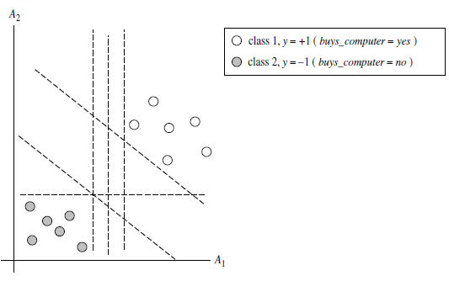
Classification (SVM)
The 2-D training data are linearly separable. There are an infinite number of (possible) separating hyperplanes or “decision boundaries.”Which one is best?
Source: Han & Kamber (2006)

Slide 71
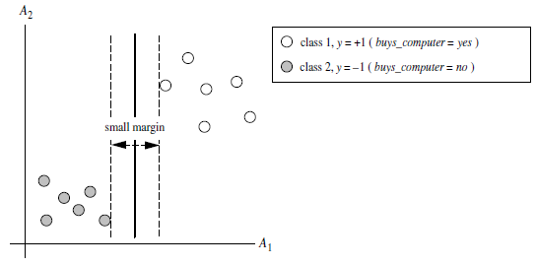
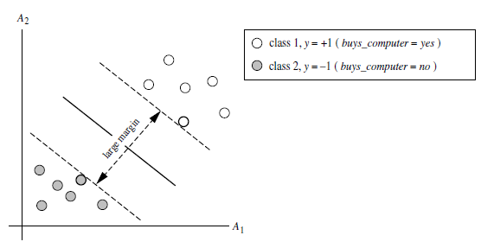
Classification (SVM)
Which one is better? The one with the larger margin should have greater generalization accuracy.
Source: Han & Kamber (2006)

Slide 72
SVM—When Data Is Linearly Separable
m
Let data D be (X₁, y₁), …, (X_{|D|}, y_{|D|}), where X_{i} is the set of training tuples associated with the class labels y_{i}
There are infinite lines (hyperplanes) separating the two classes but we want to find the best one (the one that minimizes classification error on unseen data)
SVM searches for the hyperplane with the largest margin, i.e., maximum marginal hyperplane (MMH)
Source: Han & Kamber (2006)

Slide 73
SVM—Linearly Separable
A separating hyperplane can be written as
    W ● X + b = 0
  where W={w₁, w₂, …, w_{n}} is a weight vector and b a scalar (bias)
For 2-D it can be written as
    w₀ + w₁ x₁ + w₂ x₂ = 0
The hyperplane defining the sides of the margin:
    H₁: w₀ + w₁ x₁ + w₂ x₂ ≥ 1 for y_{i} = +1, and
    H₂: w₀ + w₁ x₁ + w₂ x₂ ≤ – 1 for y_{i} = –1
Any training tuples that fall on hyperplanes H₁ or H₂ (i.e., the
sides defining the margin) are support vectors
This becomes a constrained (convex) quadratic optimization problem: Quadratic objective function and linear constraints → Quadratic Programming (QP) → Lagrangian multipliers
Source: Han & Kamber (2006)

Slide 74
Why Is SVM Effective on High Dimensional Data?
The complexity of trained classifier is characterized by the # of support vectors rather than the dimensionality of the data
The support vectors are the essential or critical training examples —they lie closest to the decision boundary (MMH)
If all other training examples are removed and the training is repeated, the same separating hyperplane would be found
The number of support vectors found can be used to compute an (upper) bound on the expected error rate of the SVM classifier, which is independent of the data dimensionality
Thus, an SVM with a small number of support vectors can have good generalization, even when the dimensionality of the data is high
Source: Han & Kamber (2006)

Slide 75
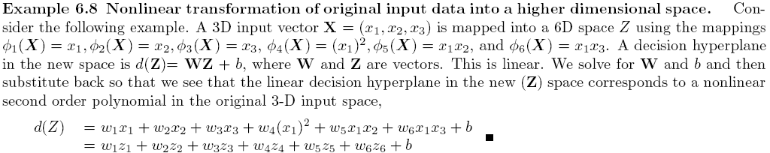
SVM—Linearly Inseparable
Transform the original input data into a higher dimensional space
Search for a linear separating hyperplane in the new space
Source: Han & Kamber (2006)

Slide 76
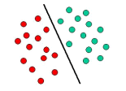
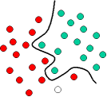
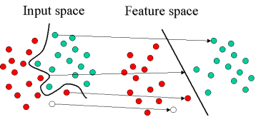
Mapping Input Space to Feature Space
Source: http://www.statsoft.com/textbook/support-vector-machines/

Slide 77
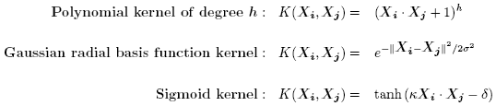
SVM—Kernel functions
Instead of computing the dot product on the transformed data tuples, it is mathematically equivalent to instead applying a kernel function K(X_{i}, X_{j}) to the original data, i.e., K(X_{i}, X_{j}) = Φ(X_{i}) Φ(X_{j})
Typical Kernel Functions
SVM can also be used for classifying multiple (> 2) classes and for regression analysis (with additional user parameters)
Source: Han & Kamber (2006)

Slide 78
Evaluation
(Accuracy of Classification Model)

Slide 79
Assessing the Classification Model
Predictive accuracy
  Hit rate
Speed
  Model building; predicting
Robustness
Scalability
Interpretability
  Transparency, explainability
Source: Ramesh Sharda, Dursun Delen, and Efraim Turban (2017), Business Intelligence, Analytics, and Data Science: A Managerial Perspective, 4th Edition, Pearson

Slide 80
Accuracy
Precision
Validity
Reliability

Slide 82
Accuracy vs. Precision
A
B
High Accuracy
High Precision
Low Accuracy
High Precision
C
D
High Accuracy
Low Precision
Low Accuracy
Low Precision

Slide 83
Accuracy vs. Precision
A
B
High Accuracy
High Precision
Low Accuracy
High Precision
High Validity
High Reliability
Low Validity
High Reliability
C
D
High Accuracy
Low Precision
Low Accuracy
Low Precision
High Validity
Low Reliability
Low Validity
Low Reliability

Slide 84
Accuracy vs. Precision
A
B
High Accuracy
High Precision
Low Accuracy
High Precision
High Validity
High Reliability
Low Validity
High Reliability
C
D
High Accuracy
Low Precision
Low Accuracy
Low Precision
High Validity
Low Reliability
Low Validity
Low Reliability

Slide 85
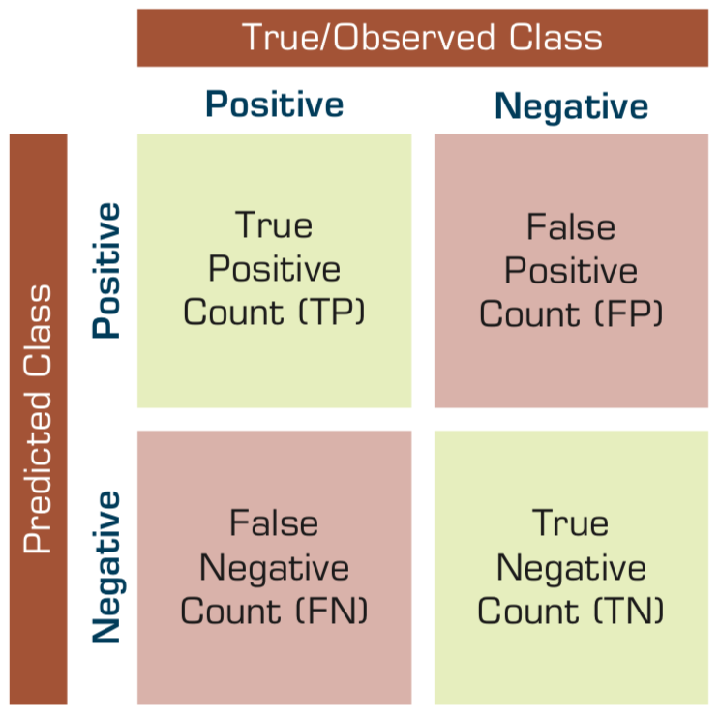
Confusion Matrix for Tabulation of Two-Class Classification Results
Source: Ramesh Sharda, Dursun Delen, and Efraim Turban (2017), Business Intelligence, Analytics, and Data Science: A Managerial Perspective, 4th Edition, Pearson

Slide 86
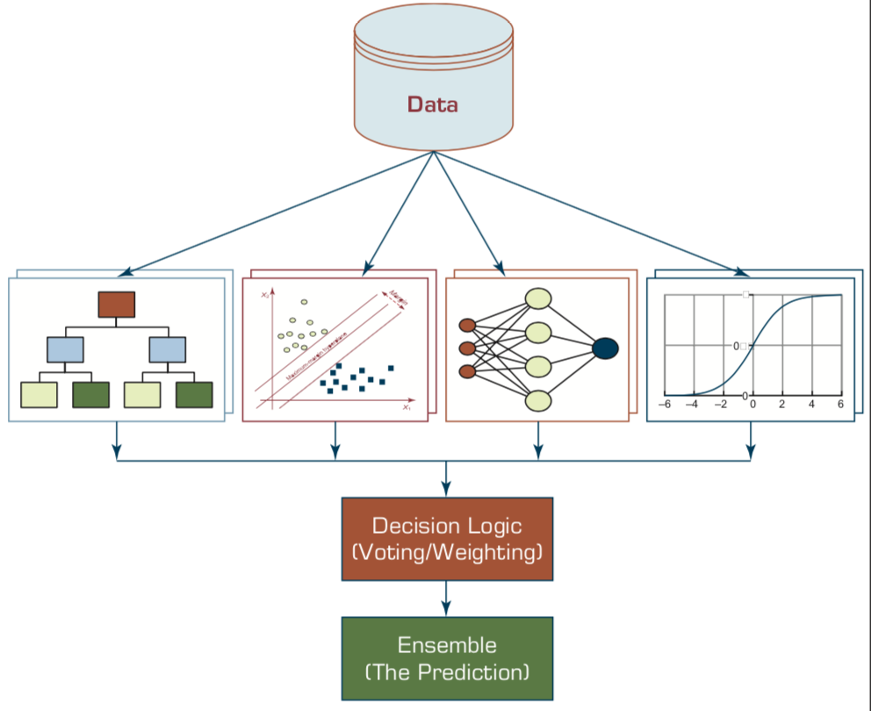
Ensemble Models
Heterogeneous Ensemble
Source: Ramesh Sharda, Dursun Delen, and Efraim Turban (2017), Business Intelligence, Analytics, and Data Science: A Managerial Perspective, 4th Edition, Pearson

Slide 87
Sensitivity
Specificity
=True Positive Rate
=True Negative Rate

Slide 88
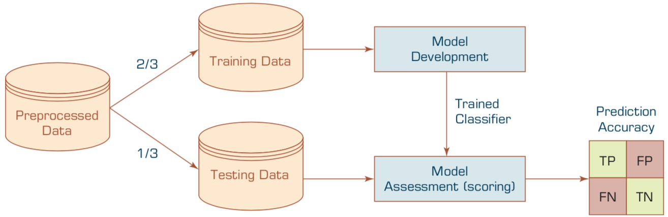
Estimation Methodologies for Classification
Simple split (or holdout or test sample estimation)
  Split the data into 2 mutually exclusive sets
  training (~70%) and testing (30%)
  For ANN, the data is split into three sub-sets
  (training [~60%], validation [~20%], testing [~20%])
Source: Ramesh Sharda, Dursun Delen, and Efraim Turban (2017), Business Intelligence, Analytics, and Data Science: A Managerial Perspective, 4th Edition, Pearson

Slide 89
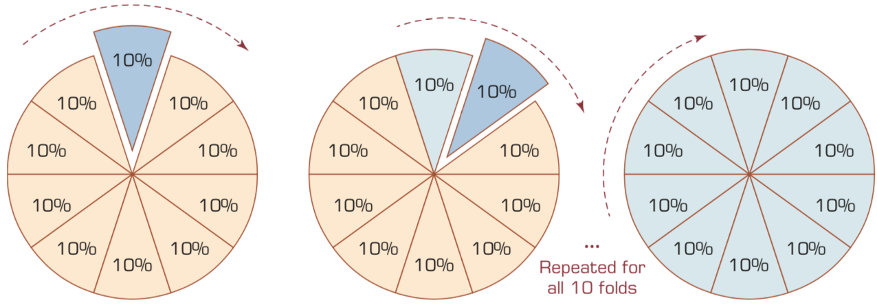
k-Fold Cross-Validation
Source: Ramesh Sharda, Dursun Delen, and Efraim Turban (2017), Business Intelligence, Analytics, and Data Science: A Managerial Perspective, 4th Edition, Pearson

Slide 90
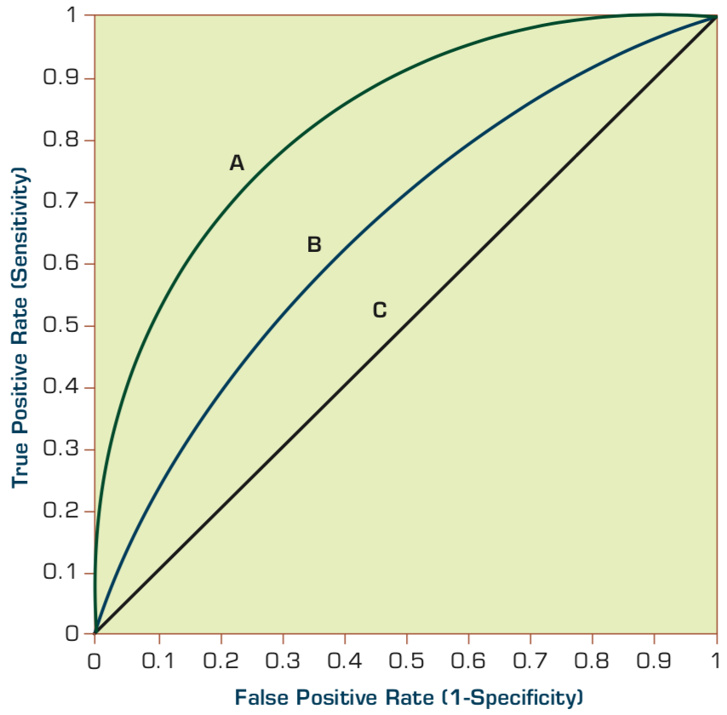
Estimation Methodologies for Classification
Area under the ROC curve
Source: Ramesh Sharda, Dursun Delen, and Efraim Turban (2017), Business Intelligence, Analytics, and Data Science: A Managerial Perspective, 4th Edition, Pearson

Slide 91
True Class
(actual value)
Positive
Negative
total
True
Positive
(TP)
False
Positive
(FP)
Positive
P’
Predictive Class
(prediction outcome)
False
Negative
(FN)
True
Negative
(TN)
Negative
N’
total
P
N
Source: http://en.wikipedia.org/wiki/Receiver_operating_characteristic

Slide 92
True Class
(actual value)
Positive
Negative
total
True
Positive
(TP)
False
Positive
(FP)
Positive
P’
Predictive Class
(prediction outcome)
False
Negative
(FN)
True
Negative
(TN)
Negative
N’
total
P
N
Sensitivity
= True Positive Rate
= Recall
= Hit rate
= TP / (TP + FN)
Source: http://en.wikipedia.org/wiki/Receiver_operating_characteristic

Slide 93
True Class
(actual value)
Positive
Negative
total
True
Positive
(TP)
False
Positive
(FP)
Positive
P’
Predictive Class
(prediction outcome)
False
Negative
(FN)
True
Negative
(TN)
Negative
N’
total
P
N
Specificity
= True Negative Rate
= TN / N
= TN / (TN+ FP)
Source: http://en.wikipedia.org/wiki/Receiver_operating_characteristic

Slide 94
True Class
(actual value)
Precision
= Positive Predictive Value (PPV)
Positive
Negative
total
True
Positive
(TP)
False
Positive
(FP)
Positive
P’
Recall
= True Positive Rate (TPR)
= Sensitivity
= Hit Rate
Predictive Class
(prediction outcome)
False
Negative
(FN)
True
Negative
(TN)
Negative
N’
total
P
N
F1 score (F-score)(F-measure)
is the harmonic mean of precision and recall
= 2TP / (P + P’)
= 2TP / (2TP + FP + FN)
Source: http://en.wikipedia.org/wiki/Receiver_operating_characteristic

Slide 95
A
63
(TP)
28
(FP)
Recall
= True Positive Rate (TPR)
= Sensitivity
= Hit Rate
= TP / (TP + FN)
Specificity
= True Negative Rate
= TN / N
= TN / (TN + FP)
91
37
(FN)
72
(TN)
109
100
100
200
TPR = 0.63
FPR = 0.28
PPV = 0.69
=63/(63+28)
=63/91
Precision
= Positive Predictive Value (PPV)
F1 = 0.66
= 2*(0.63*0.69)/(0.63+0.69)
= (2 * 63) /(100 + 91)
= (0.63 + 0.69) / 2 =1.32 / 2 =0.66
F1 score (F-score)
(F-measure)
is the harmonic mean of precision and recall
= 2TP / (P + P’)
= 2TP / (2TP + FP + FN)
ACC = 0.68
= (63 + 72) / 200
= 135/200 = 67.5
Source: http://en.wikipedia.org/wiki/Receiver_operating_characteristic

Slide 96
A
B
63
(TP)
28
(FP)
77
(TP)
77
(FP)
91
154
37
(FN)
72
(TN)
109
23
(FN)
23
(TN)
46
100
100
200
100
100
200
TPR = 0.63
TPR = 0.77
FPR = 0.77
PPV = 0.50
F1 = 0.61
ACC = 0.50
FPR = 0.28
PPV = 0.69
=63/(63+28)
=63/91
F1 = 0.66
= 2*(0.63*0.69)/(0.63+0.69)
= (2 * 63) /(100 + 91)
= (0.63 + 0.69) / 2 =1.32 / 2 =0.66
Recall
= True Positive Rate (TPR)
= Sensitivity
= Hit Rate
ACC = 0.68
= (63 + 72) / 200
= 135/200 = 67.5
Precision
= Positive Predictive Value (PPV)
Source: http://en.wikipedia.org/wiki/Receiver_operating_characteristic

Slide 97
C
C’
24
(TP)
88
(FP)
76
(TP)
12
(FP)
112
88
76
(FN)
12
(TN)
88
24
(FN)
88
(TN)
112
100
100
200
100
100
200
TPR = 0.24
FPR = 0.88
PPV = 0.21
F1 = 0.22
ACC = 0.18
TPR = 0.76
FPR = 0.12
PPV = 0.86
F1 = 0.81
ACC = 0.82
Recall
= True Positive Rate (TPR)
= Sensitivity
= Hit Rate
Precision
= Positive Predictive Value (PPV)
Source: http://en.wikipedia.org/wiki/Receiver_operating_characteristic

Slide 98
Iris flower data set
setosa
versicolor
virginica
Source: https://en.wikipedia.org/wiki/Iris_flower_data_set
Source: http://suruchifialoke.com/2016-10-13-machine-learning-tutorial-iris-classification/

Slide 99
Iris Classfication
Source: http://suruchifialoke.com/2016-10-13-machine-learning-tutorial-iris-classification/

Slide 100
iris.data
https://archive.ics.uci.edu/ml/machine-learning-databases/iris/iris.data
5.1,3.5,1.4,0.2,Iris-setosa 4.9,3.0,1.4,0.2,Iris-setosa 4.7,3.2,1.3,0.2,Iris-setosa 4.6,3.1,1.5,0.2,Iris-setosa 5.0,3.6,1.4,0.2,Iris-setosa 5.4,3.9,1.7,0.4,Iris-setosa 4.6,3.4,1.4,0.3,Iris-setosa 5.0,3.4,1.5,0.2,Iris-setosa 4.4,2.9,1.4,0.2,Iris-setosa 4.9,3.1,1.5,0.1,Iris-setosa 5.4,3.7,1.5,0.2,Iris-setosa 4.8,3.4,1.6,0.2,Iris-setosa 4.8,3.0,1.4,0.1,Iris-setosa 4.3,3.0,1.1,0.1,Iris-setosa 5.8,4.0,1.2,0.2,Iris-setosa 5.7,4.4,1.5,0.4,Iris-setosa 5.4,3.9,1.3,0.4,Iris-setosa 5.1,3.5,1.4,0.3,Iris-setosa 5.7,3.8,1.7,0.3,Iris-setosa 5.1,3.8,1.5,0.3,Iris-setosa 5.4,3.4,1.7,0.2,Iris-setosa 5.1,3.7,1.5,0.4,Iris-setosa 4.6,3.6,1.0,0.2,Iris-setosa 5.1,3.3,1.7,0.5,Iris-setosa 4.8,3.4,1.9,0.2,Iris-setosa 5.0,3.0,1.6,0.2,Iris-setosa 5.0,3.4,1.6,0.4,Iris-setosa 5.2,3.5,1.5,0.2,Iris-setosa 5.2,3.4,1.4,0.2,Iris-setosa 4.7,3.2,1.6,0.2,Iris-setosa 4.8,3.1,1.6,0.2,Iris-setosa 5.4,3.4,1.5,0.4,Iris-setosa 5.2,4.1,1.5,0.1,Iris-setosa 5.5,4.2,1.4,0.2,Iris-setosa 4.9,3.1,1.5,0.1,Iris-setosa 5.0,3.2,1.2,0.2,Iris-setosa 5.5,3.5,1.3,0.2,Iris-setosa 4.9,3.1,1.5,0.1,Iris-setosa 4.4,3.0,1.3,0.2,Iris-setosa 5.1,3.4,1.5,0.2,Iris-setosa 5.0,3.5,1.3,0.3,Iris-setosa 4.5,2.3,1.3,0.3,Iris-setosa 4.4,3.2,1.3,0.2,Iris-setosa 5.0,3.5,1.6,0.6,Iris-setosa 5.1,3.8,1.9,0.4,Iris-setosa 4.8,3.0,1.4,0.3,Iris-setosa 5.1,3.8,1.6,0.2,Iris-setosa 4.6,3.2,1.4,0.2,Iris-setosa 5.3,3.7,1.5,0.2,Iris-setosa 5.0,3.3,1.4,0.2,Iris-setosa 7.0,3.2,4.7,1.4,Iris-versicolor 6.4,3.2,4.5,1.5,Iris-versicolor 6.9,3.1,4.9,1.5,Iris-versicolor 5.5,2.3,4.0,1.3,Iris-versicolor 6.5,2.8,4.6,1.5,Iris-versicolor 5.7,2.8,4.5,1.3,Iris-versicolor 6.3,3.3,4.7,1.6,Iris-versicolor 4.9,2.4,3.3,1.0,Iris-versicolor 6.6,2.9,4.6,1.3,Iris-versicolor 5.2,2.7,3.9,1.4,Iris-versicolor 5.0,2.0,3.5,1.0,Iris-versicolor 5.9,3.0,4.2,1.5,Iris-versicolor 6.0,2.2,4.0,1.0,Iris-versicolor 6.1,2.9,4.7,1.4,Iris-versicolor 5.6,2.9,3.6,1.3,Iris-versicolor 6.7,3.1,4.4,1.4,Iris-versicolor 5.6,3.0,4.5,1.5,Iris-versicolor 5.8,2.7,4.1,1.0,Iris-versicolor 6.2,2.2,4.5,1.5,Iris-versicolor 5.6,2.5,3.9,1.1,Iris-versicolor 5.9,3.2,4.8,1.8,Iris-versicolor 6.1,2.8,4.0,1.3,Iris-versicolor 6.3,2.5,4.9,1.5,Iris-versicolor 6.1,2.8,4.7,1.2,Iris-versicolor 6.4,2.9,4.3,1.3,Iris-versicolor 6.6,3.0,4.4,1.4,Iris-versicolor 6.8,2.8,4.8,1.4,Iris-versicolor 6.7,3.0,5.0,1.7,Iris-versicolor 6.0,2.9,4.5,1.5,Iris-versicolor 5.7,2.6,3.5,1.0,Iris-versicolor 5.5,2.4,3.8,1.1,Iris-versicolor 5.5,2.4,3.7,1.0,Iris-versicolor 5.8,2.7,3.9,1.2,Iris-versicolor 6.0,2.7,5.1,1.6,Iris-versicolor 5.4,3.0,4.5,1.5,Iris-versicolor 6.0,3.4,4.5,1.6,Iris-versicolor 6.7,3.1,4.7,1.5,Iris-versicolor 6.3,2.3,4.4,1.3,Iris-versicolor 5.6,3.0,4.1,1.3,Iris-versicolor 5.5,2.5,4.0,1.3,Iris-versicolor 5.5,2.6,4.4,1.2,Iris-versicolor 6.1,3.0,4.6,1.4,Iris-versicolor 5.8,2.6,4.0,1.2,Iris-versicolor 5.0,2.3,3.3,1.0,Iris-versicolor 5.6,2.7,4.2,1.3,Iris-versicolor 5.7,3.0,4.2,1.2,Iris-versicolor 5.7,2.9,4.2,1.3,Iris-versicolor 6.2,2.9,4.3,1.3,Iris-versicolor 5.1,2.5,3.0,1.1,Iris-versicolor 5.7,2.8,4.1,1.3,Iris-versicolor 6.3,3.3,6.0,2.5,Iris-virginica 5.8,2.7,5.1,1.9,Iris-virginica 7.1,3.0,5.9,2.1,Iris-virginica 6.3,2.9,5.6,1.8,Iris-virginica 6.5,3.0,5.8,2.2,Iris-virginica 7.6,3.0,6.6,2.1,Iris-virginica 4.9,2.5,4.5,1.7,Iris-virginica 7.3,2.9,6.3,1.8,Iris-virginica 6.7,2.5,5.8,1.8,Iris-virginica 7.2,3.6,6.1,2.5,Iris-virginica 6.5,3.2,5.1,2.0,Iris-virginica 6.4,2.7,5.3,1.9,Iris-virginica 6.8,3.0,5.5,2.1,Iris-virginica 5.7,2.5,5.0,2.0,Iris-virginica 5.8,2.8,5.1,2.4,Iris-virginica 6.4,3.2,5.3,2.3,Iris-virginica 6.5,3.0,5.5,1.8,Iris-virginica 7.7,3.8,6.7,2.2,Iris-virginica 7.7,2.6,6.9,2.3,Iris-virginica 6.0,2.2,5.0,1.5,Iris-virginica 6.9,3.2,5.7,2.3,Iris-virginica 5.6,2.8,4.9,2.0,Iris-virginica 7.7,2.8,6.7,2.0,Iris-virginica 6.3,2.7,4.9,1.8,Iris-virginica 6.7,3.3,5.7,2.1,Iris-virginica 7.2,3.2,6.0,1.8,Iris-virginica 6.2,2.8,4.8,1.8,Iris-virginica 6.1,3.0,4.9,1.8,Iris-virginica 6.4,2.8,5.6,2.1,Iris-virginica 7.2,3.0,5.8,1.6,Iris-virginica 7.4,2.8,6.1,1.9,Iris-virginica 7.9,3.8,6.4,2.0,Iris-virginica 6.4,2.8,5.6,2.2,Iris-virginica 6.3,2.8,5.1,1.5,Iris-virginica 6.1,2.6,5.6,1.4,Iris-virginica 7.7,3.0,6.1,2.3,Iris-virginica 6.3,3.4,5.6,2.4,Iris-virginica 6.4,3.1,5.5,1.8,Iris-virginica 6.0,3.0,4.8,1.8,Iris-virginica 6.9,3.1,5.4,2.1,Iris-virginica 6.7,3.1,5.6,2.4,Iris-virginica 6.9,3.1,5.1,2.3,Iris-virginica 5.8,2.7,5.1,1.9,Iris-virginica 6.8,3.2,5.9,2.3,Iris-virginica 6.7,3.3,5.7,2.5,Iris-virginica 6.7,3.0,5.2,2.3,Iris-virginica 6.3,2.5,5.0,1.9,Iris-virginica 6.5,3.0,5.2,2.0,Iris-virginica 6.2,3.4,5.4,2.3,Iris-virginica 5.9,3.0,5.1,1.8,Iris-virginica
setosa
virginica
versicolor

Slide 101
Machine Learning
Supervised Learning (Classification)
Learning from Examples
5.1,3.5,1.4,0.2,Iris-setosa 4.9,3.0,1.4,0.2,Iris-setosa 4.7,3.2,1.3,0.2,Iris-setosa 7.0,3.2,4.7,1.4,Iris-versicolor 6.4,3.2,4.5,1.5,Iris-versicolor 6.9,3.1,4.9,1.5,Iris-versicolor 6.3,3.3,6.0,2.5,Iris-virginica 5.8,2.7,5.1,1.9,Iris-virginica 7.1,3.0,5.9,2.1,Iris-virginica

Slide 102
Machine Learning
Supervised Learning (Classification)
Learning from Examples
y = f(x)
5.1,3.5,1.4,0.2,Iris-setosa 4.9,3.0,1.4,0.2,Iris-setosa 4.7,3.2,1.3,0.2,Iris-setosa 7.0,3.2,4.7,1.4,Iris-versicolor 6.4,3.2,4.5,1.5,Iris-versicolor 6.9,3.1,4.9,1.5,Iris-versicolor 6.3,3.3,6.0,2.5,Iris-virginica 5.8,2.7,5.1,1.9,Iris-virginica 7.1,3.0,5.9,2.1,Iris-virginica
y
x

Slide 103
Machine Learning
Supervised Learning (Classification)
Learning from Examples
y = f(x)
x
y

Slide 104
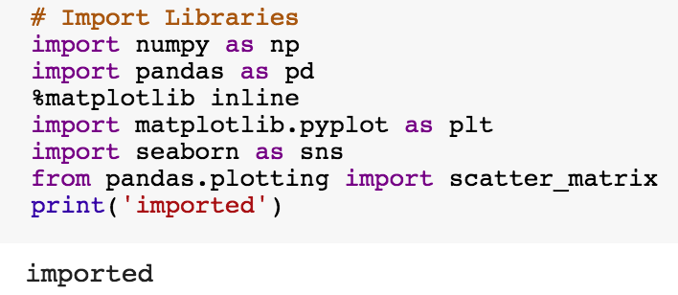
import numpy as np
import pandas as pd
%matplotlib inline
import matplotlib.pyplot as plt
import seaborn as sns
from pandas.plotting import scatter_matrix

Slide 105
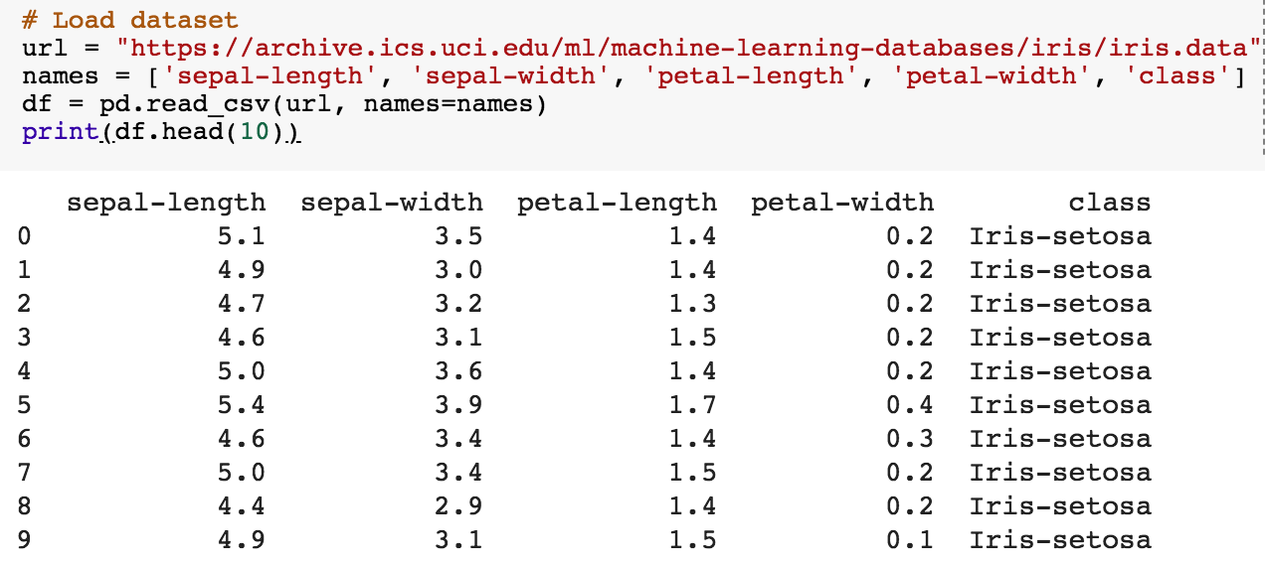
url = "https://archive.ics.uci.edu/ml/machine-learning-databases/iris/iris.data"
names = ['sepal-length', 'sepal-width', 'petal-length', 'petal-width', 'class']
df = pd.read_csv(url, names=names)
print(df.head(10))

Slide 106
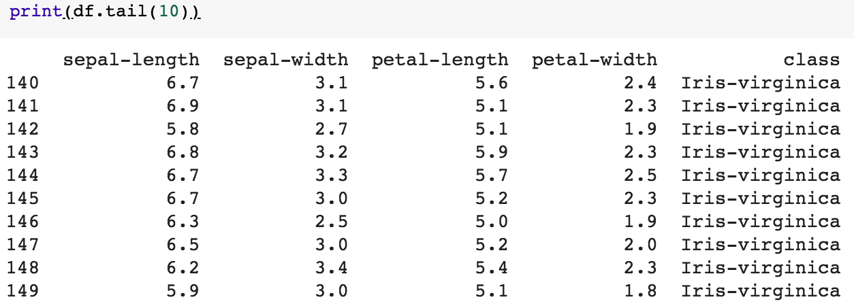
df.tail(10)

Slide 107
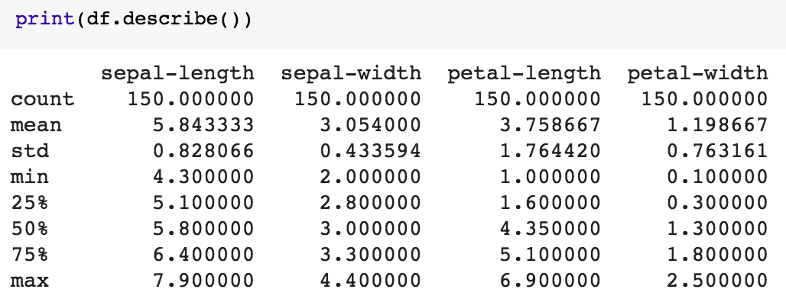
df.describe()

Slide 108
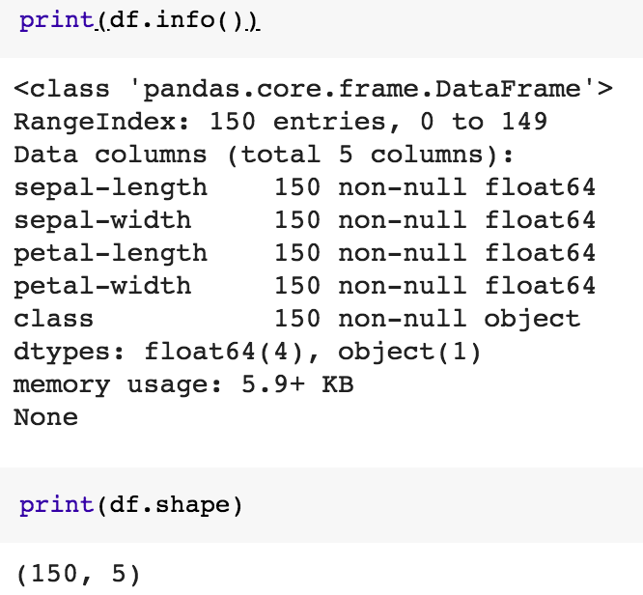
print(df.info())
print(df.shape)

Slide 109
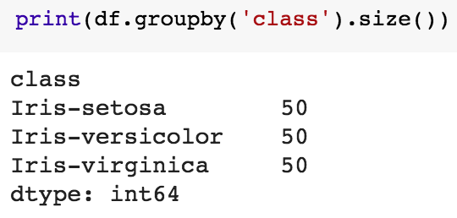
df.groupby('class').size()

Slide 110
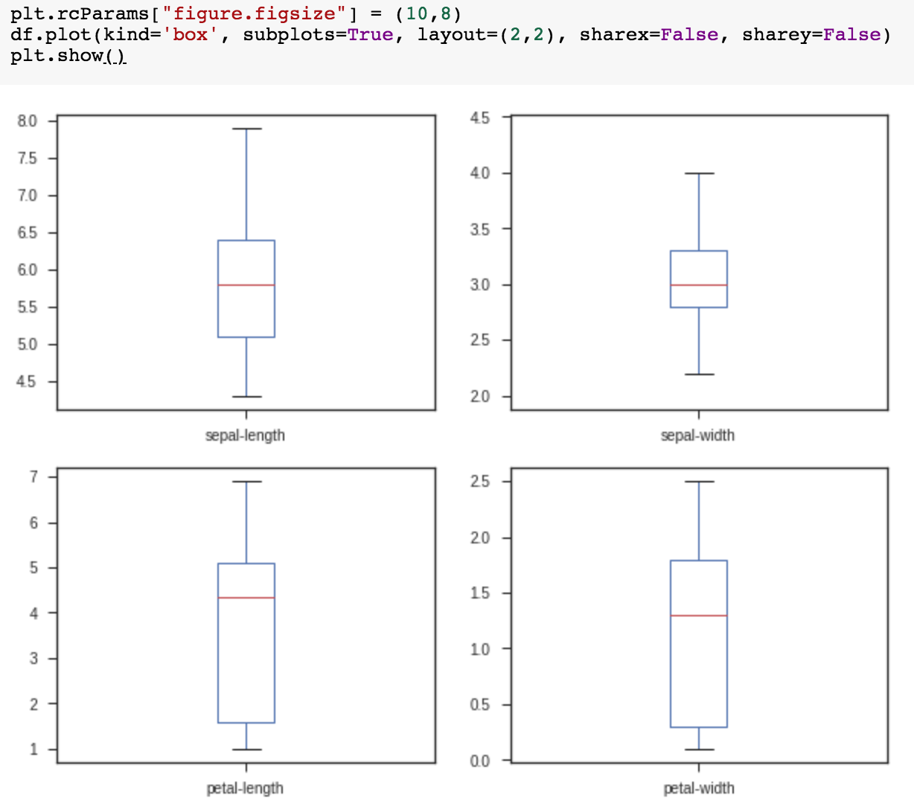
plt.rcParams["figure.figsize"] = (10,8)
df.plot(kind='box', subplots=True, layout=(2,2), sharex=False, sharey=False)
plt.show()

Slide 111
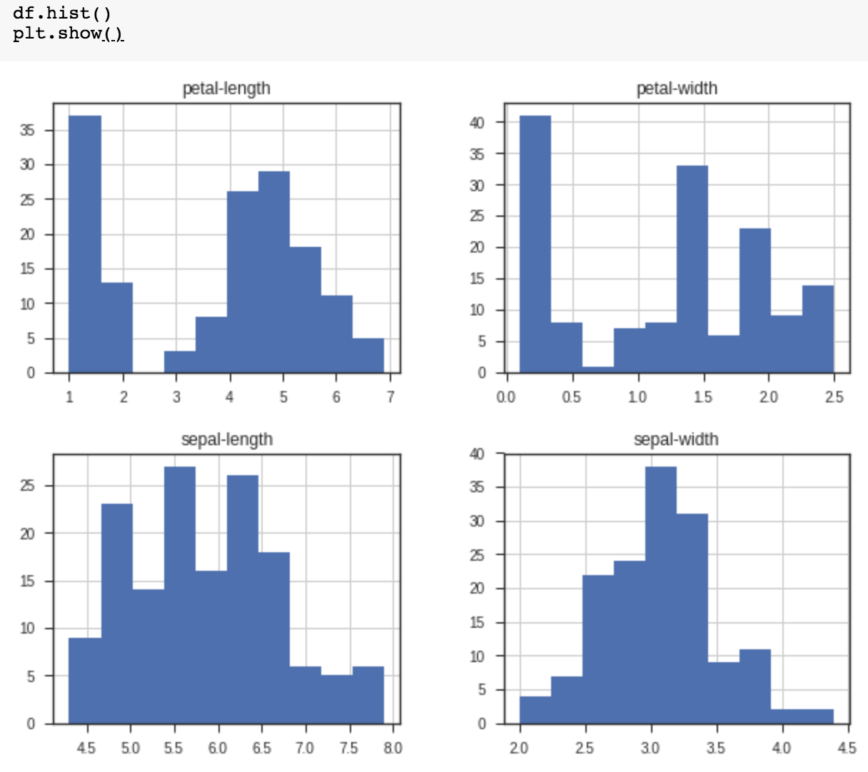
df.hist()
plt.show()

Slide 112
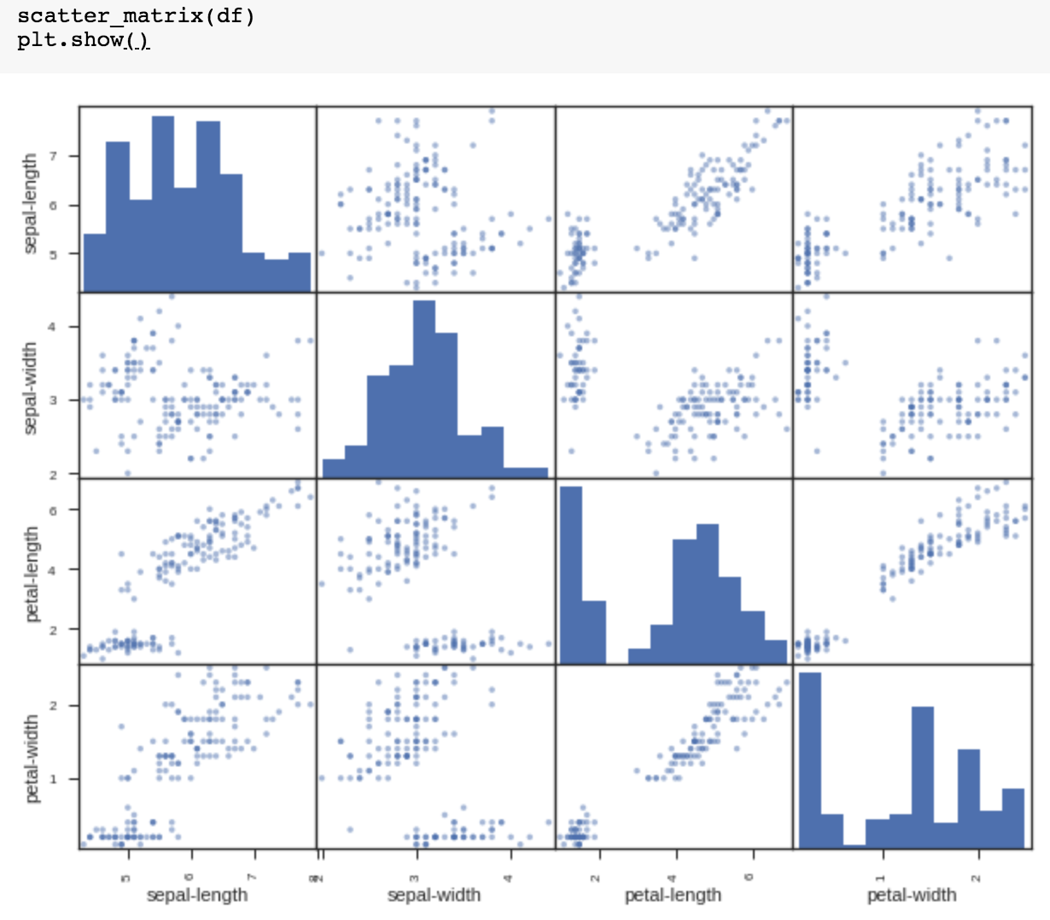
scatter_matrix(df)
plt.show()

Slide 113
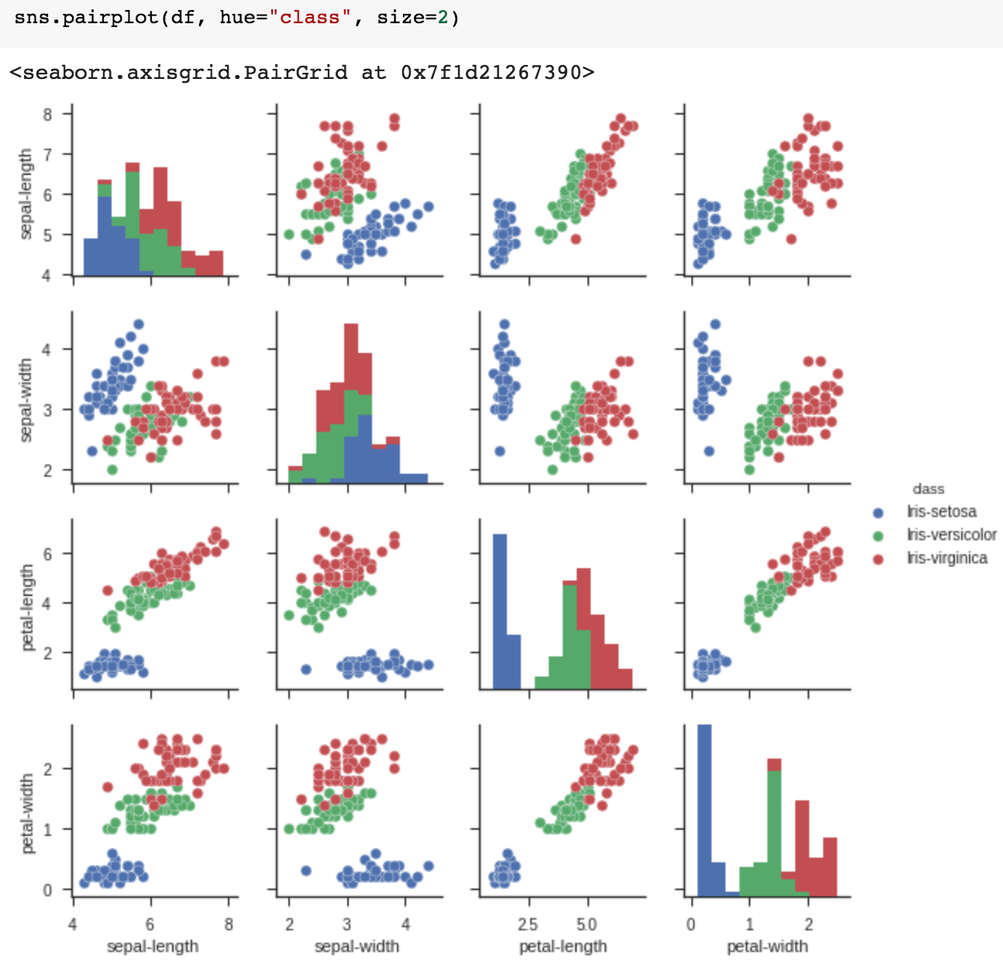
sns.pairplot(df, hue="class", size=2)

Slide 114
Machine Learning
Supervised Learning
Classification and
Prediction

Slide 115
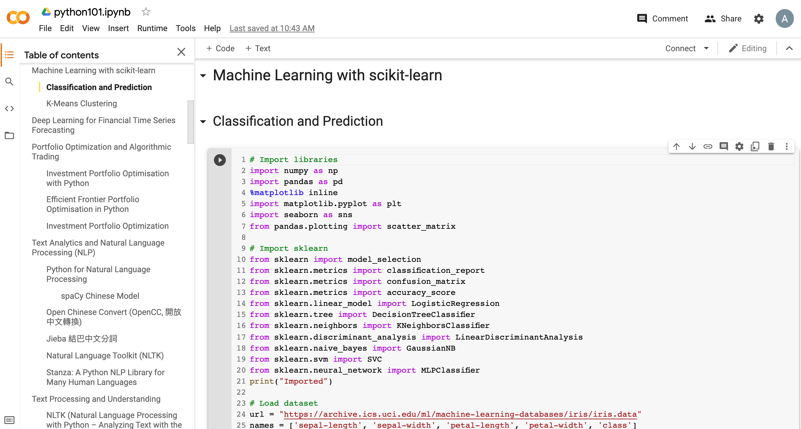
Machine Learning: Supervised Learning
Classification and Prediction
https://tinyurl.com/aintpupython101

Slide 116
# Import sklearn
from sklearn import model_selection
from sklearn.metrics import classification_report
from sklearn.metrics import confusion_matrix
from sklearn.metrics import accuracy_score
from sklearn.linear_model import LogisticRegression
from sklearn.tree import DecisionTreeClassifier
from sklearn.neighbors import KNeighborsClassifier
from sklearn.discriminant_analysis import LinearDiscriminantAnalysis
from sklearn.naive_bayes import GaussianNB
from sklearn.svm import SVC
from sklearn.neural_network import MLPClassifier
print("Imported")
https://tinyurl.com/aintpupython101

Slide 117
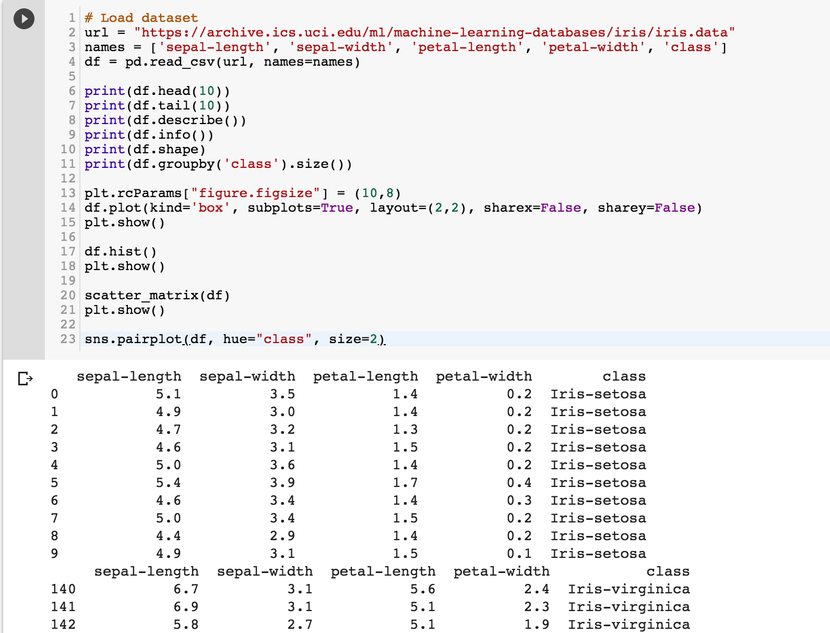
https://tinyurl.com/aintpupython101

Slide 118
https://tinyurl.com/aintpupython101

Slide 119
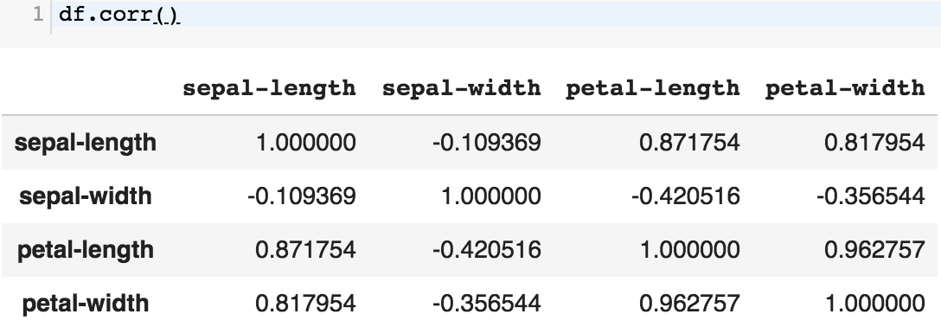
df.corr()
https://tinyurl.com/aintpupython101

Slide 120
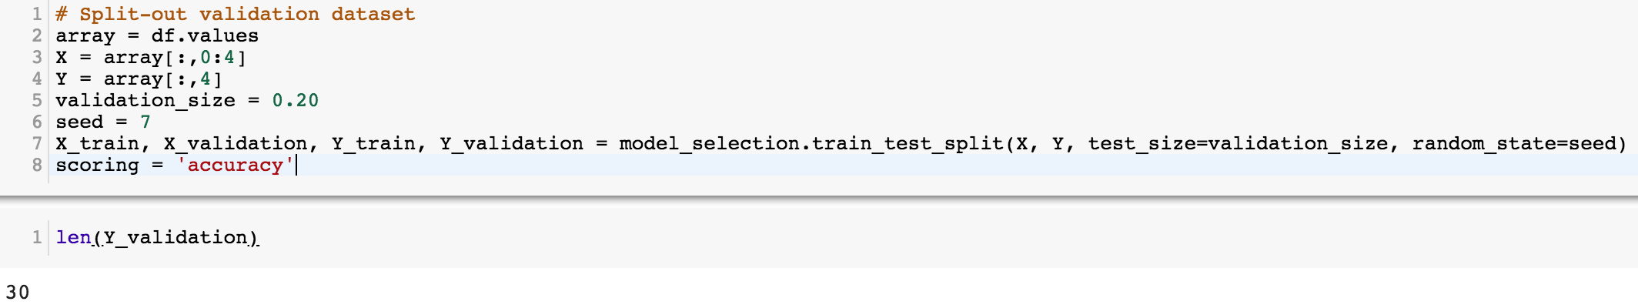
# Split-out validation dataset
array = df.values
X = array[:,0:4]
Y = array[:,4]
validation_size = 0.20
seed = 7
X_train, X_validation, Y_train, Y_validation = model_selection.train_test_split(X, Y, test_size=validation_size, random_state=seed)
scoring = 'accuracy'
https://tinyurl.com/aintpupython101

Slide 121
# Models
models = []
models.append(('LR', LogisticRegression()))
models.append(('LDA', LinearDiscriminantAnalysis()))
models.append(('KNN', KNeighborsClassifier()))
models.append(('DT', DecisionTreeClassifier()))
models.append(('NB', GaussianNB()))
models.append(('SVM', SVC()))
https://tinyurl.com/aintpupython101

Slide 122
# evaluate each model in turn
results = []
names = []
for name, model in models:
kfold = model_selection.KFold(n_splits=10, random_state=seed)
cv_results = model_selection.cross_val_score(model, X_train, Y_train, cv=kfold, scoring=scoring)
results.append(cv_results)
names.append(name)
msg = "%s: %.4f (%.4f)" % (name, cv_results.mean(), cv_results.std())
print(msg)
https://tinyurl.com/aintpupython101

Slide 123
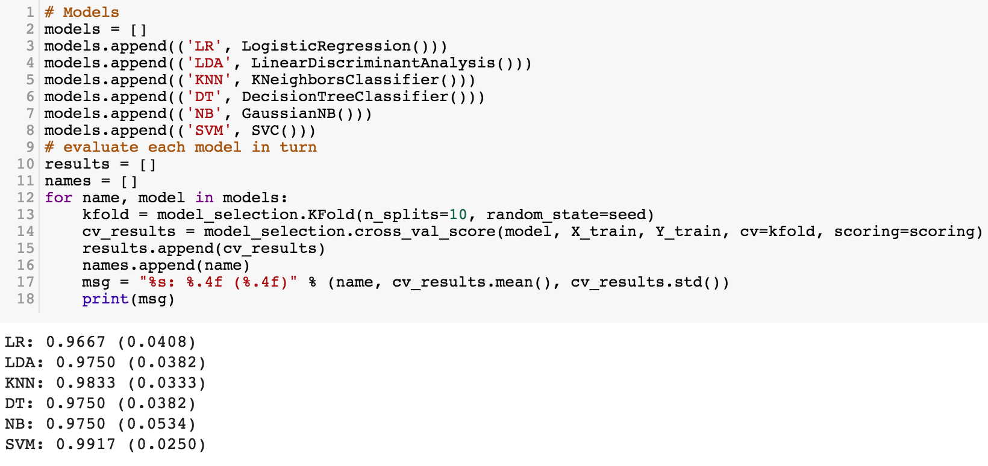
https://tinyurl.com/aintpupython101

Slide 124
# Make predictions on validation dataset
model = KNeighborsClassifier()
model.fit(X_train, Y_train)
predictions = model.predict(X_validation)
print("%.4f" % accuracy_score(Y_validation, predictions))
print(confusion_matrix(Y_validation, predictions))
print(classification_report(Y_validation, predictions))
print(model)
https://tinyurl.com/aintpupython101

Slide 125
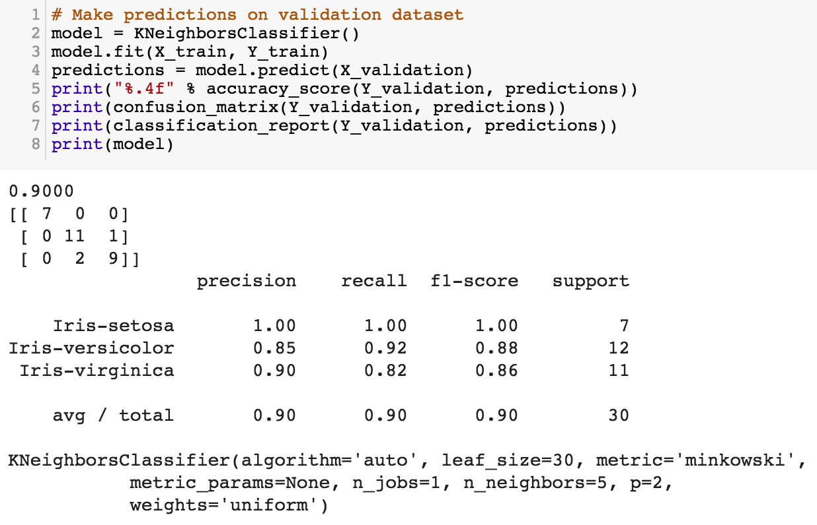
https://tinyurl.com/aintpupython101

Slide 126
# Make predictions on validation dataset
model = SVC()
model.fit(X_train, Y_train)
predictions = model.predict(X_validation)
print("%.4f" % accuracy_score(Y_validation, predictions))
print(confusion_matrix(Y_validation, predictions))
print(classification_report(Y_validation, predictions))
print(model)
https://tinyurl.com/aintpupython101

Slide 127
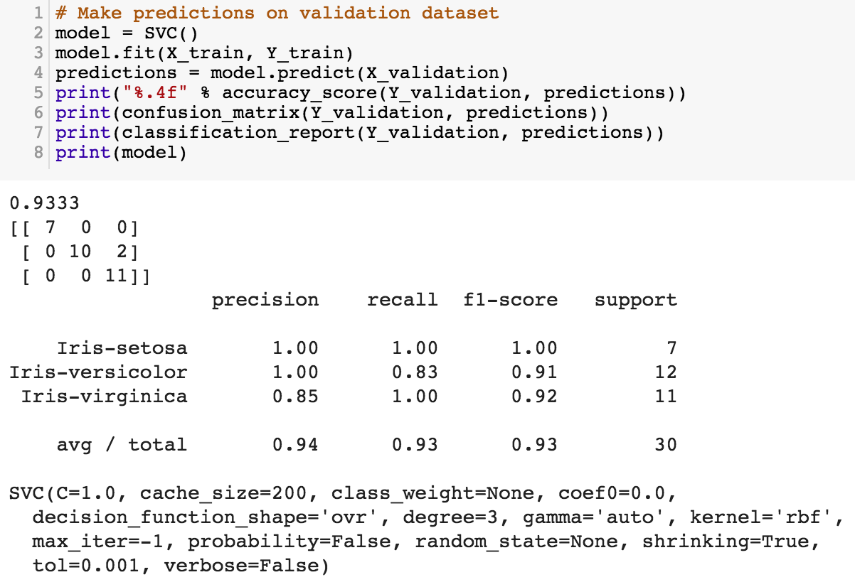
model = SVC()
model.fit(X_train, Y_train)
predictions = model.predict(X_validation)
https://tinyurl.com/aintpupython101

Slide 128
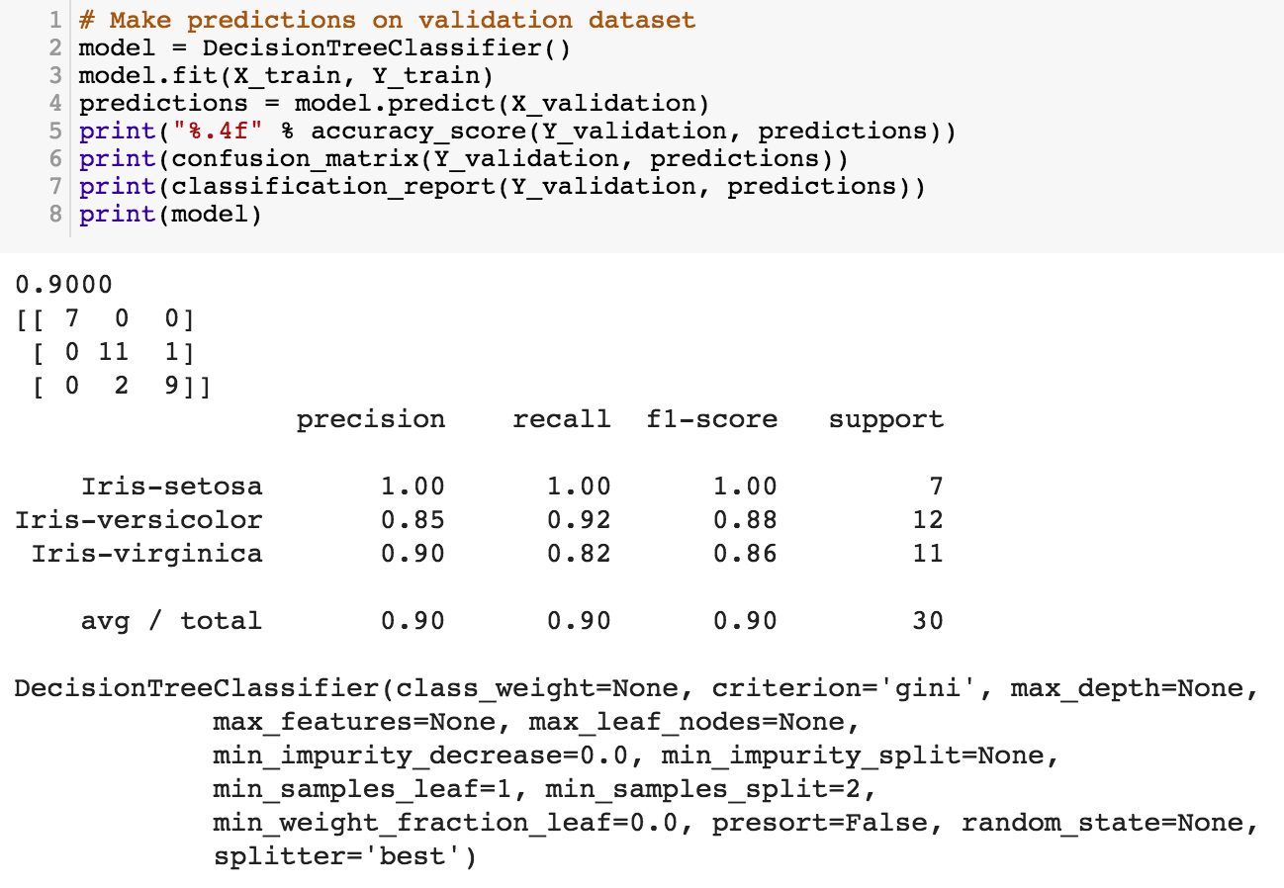
https://tinyurl.com/aintpupython101

Slide 129
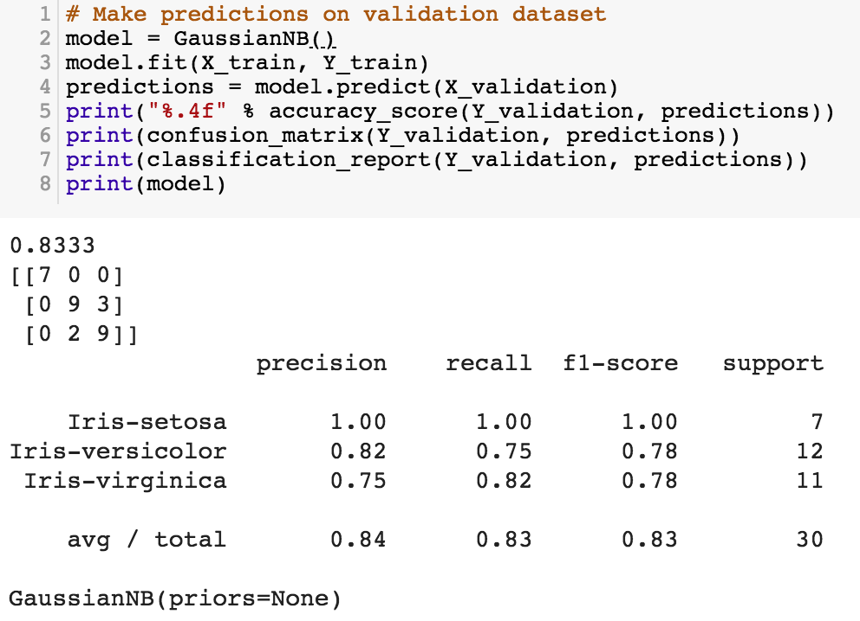
https://tinyurl.com/aintpupython101

Slide 130
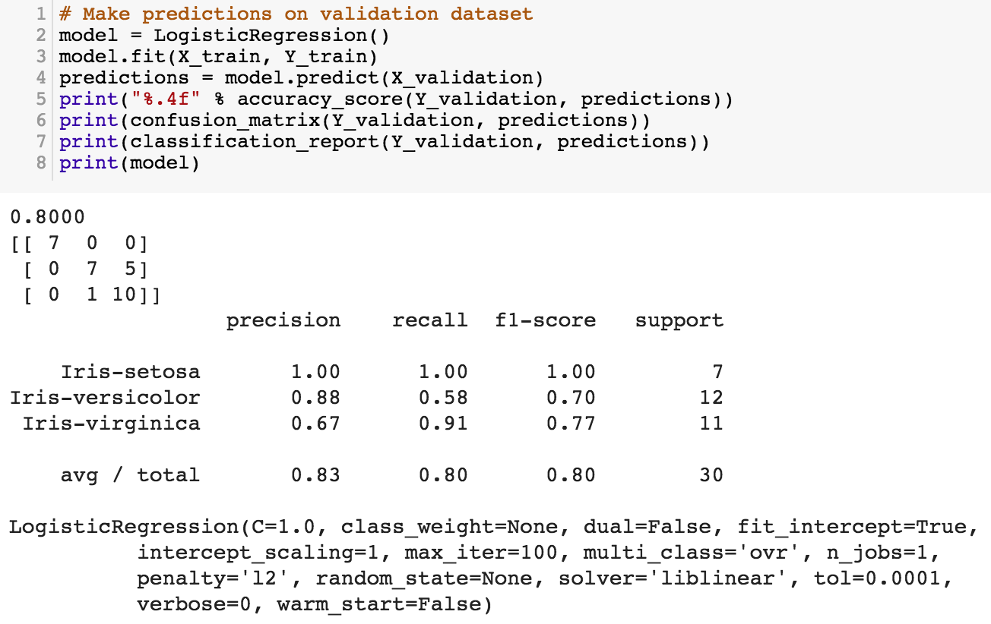
https://tinyurl.com/aintpupython101

Slide 131
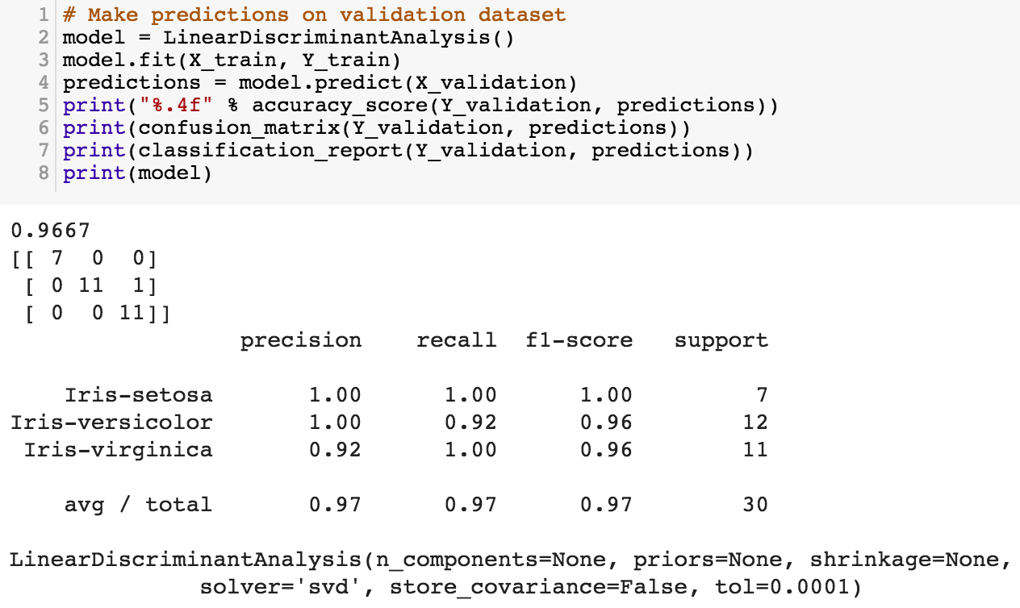
https://tinyurl.com/aintpupython101

Slide 132
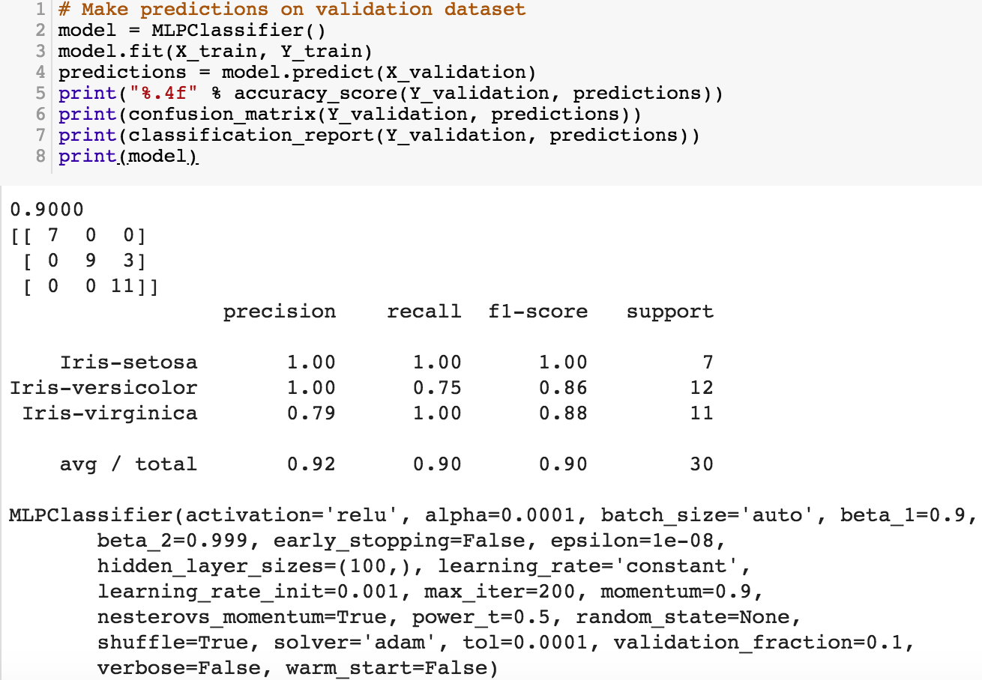
https://tinyurl.com/aintpupython101

Slide 133
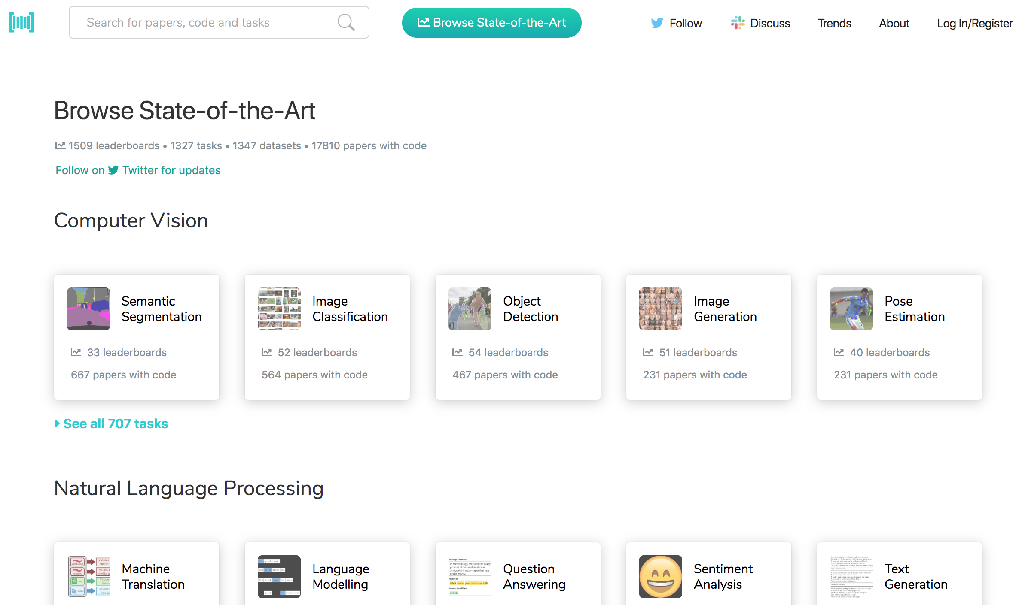
Papers with Code
State-of-the-Art (SOTA)
https://paperswithcode.com/sota

Slide 134

Aurélien Géron (2019),
Hands-On Machine Learning with Scikit-Learn, Keras, and TensorFlow: Concepts, Tools, and Techniques to Build Intelligent Systems, 2nd Edition
O’Reilly Media, 2019
https://github.com/ageron/handson-ml2
Source: https://www.amazon.com/Hands-Machine-Learning-Scikit-Learn-TensorFlow/dp/1492032646/

Slide 135

Hands-On Machine Learning with
Scikit-Learn, Keras, and TensorFlow
Notebooks
The Machine Learning landscape
End-to-end Machine Learning project
Classification
Training Models
Support Vector Machines
Decision Trees
Ensemble Learning and Random Forests
Dimensionality Reduction
Unsupervised Learning Techniques
Artificial Neural Nets with Keras
Training Deep Neural Networks
Custom Models and Training with TensorFlow
Loading and Preprocessing Data
Deep Computer Vision Using Convolutional Neural Networks
Processing Sequences Using RNNs and CNNs
Natural Language Processing with RNNs and Attention
Representation Learning Using Autoencoders
Reinforcement Learning
Training and Deploying TensorFlow Models at Scale
https://github.com/ageron/handson-ml2

Slide 136
Python in Google Colab (Python101)
https://colab.research.google.com/drive/1FEG6DnGvwfUbeo4zJ1zTunjMqf2RkCrT
https://tinyurl.com/aintpupython101

Slide 137
Summary
Supervised Learning
Classification and Prediction
Decision Tree (DT)
  Information Gain (IG)
Support Vector Machine (SVM)
Data Mining Evaluation
  Accuracy
  Precision
  Recall
  F1 score (F-measure) (F-score)

Slide 138
References
Jiawei Han and Micheline Kamber (2006), Data Mining: Concepts and Techniques, Second Edition, Elsevier, 2006.
Jiawei Han, Micheline Kamber and Jian Pei (2011), Data Mining: Concepts and Techniques, Third Edition, Morgan Kaufmann 2011.
Efraim Turban, Ramesh Sharda, Dursun Delen (2011), Decision Support and Business Intelligence Systems, Ninth Edition, Pearson.
Ramesh Sharda, Dursun Delen, and Efraim Turban (2017), Business Intelligence, Analytics, and Data Science: A Managerial Perspective, 4th Edition, Pearson.
Jake VanderPlas (2016), Python Data Science Handbook: Essential Tools for Working with Data, O'Reilly Media.
Robert Layton (2017), Learning Data Mining with Python - Second Edition, Packt Publishing.
Wes McKinney (2017), "Python for Data Analysis: Data Wrangling with Pandas, NumPy, and IPython", 2nd Edition, O'Reilly Media.
Aurélien Géron (2019), Hands-On Machine Learning with Scikit-Learn, Keras, and TensorFlow: Concepts, Tools, and Techniques to Build Intelligent Systems, 2nd Edition, O’Reilly Media.
https://github.com/wesm/pydata-book
Min-Yuh Day (2021), Python 101, https://tinyurl.com/aintpupython101

