Slide 1
投資心理學與行為財務學 (Investing Psychology and Behavioral Finance)
智慧金融量化分析 (Artificial Intelligence in Finance and Quantitative Analysis)
1101AIFQA03
MBA, IM, NTPU (M6132) (Fall 2021) Tue 2, 3, 4 (9:10-12:00) (8F40)
戴敏育 副教授
Min-Yuh Day, Ph.D, Associate Professor
國立臺北大學 資訊管理研究所
Institute of Information Management, National Taipei University
https://web.ntpu.edu.tw/~myday
2021-10-12

Slide 2
課程大綱 (Syllabus)
週次 (Week) 日期 (Date) 內容 (Subject/Topics)
1 2021/09/28 智慧金融量化分析概論 (Introduction to Artificial Intelligence in Finance and Quantitative Analysis)
2 2021/10/05 AI 金融科技: 金融服務創新應用 (AI in FinTech: Financial Services Innovation and Application)
3 2021/10/12 投資心理學與行為財務學 (Investing Psychology and Behavioral Finance)
4 2021/10/19 財務金融事件研究法 (Event Studies in Finance)
5 2021/10/26 智慧金融量化分析個案研究 I (Case Study on AI in Finance and Quantitative Analysis I)
6 2021/11/02 財務金融理論 (Finance Theory)

Slide 3
課程大綱 (Syllabus)
週次 (Week) 日期 (Date) 內容 (Subject/Topics)
7 2021/11/09 數據驅動財務金融 (Data-Driven Finance)
8 2021/11/16 期中報告 (Midterm Project Report)
9 2021/11/23 金融計量經濟學 (Financial Econometrics)
10 2021/11/30 人工智慧優先金融 (AI-First Finance)
11 2021/12/07 智慧金融量化分析產業實務 (Industry Practices of AI in Finance and Quantitative Analysis )
12 2021/12/14 智慧金融量化分析個案研究 II (Case Study on AI in Finance and Quantitative Analysis II)

Slide 4
課程大綱 (Syllabus)
週次 (Week) 日期 (Date) 內容 (Subject/Topics)
13 2021/12/21 財務金融深度學習(Deep Learning in Finance); 財務金融強化學習 (Reinforcement Learning in Finance)
14 2021/12/28 演算法交易 (Algorithmic Trading); 風險管理 (Risk Management); 交易機器人與基於事件的回測 (Trading Bot and Event-Based Backtesting)
15 2022/01/04 期末報告 I (Final Project Report I)
16 2022/01/11 期末報告 II (Final Project Report II)
17 2022/01/18 學生自主學習 (Self-learning)
18 2022/01/25 學生自主學習 (Self-learning)

Slide 5
Investing Psychology and Behavioral Finance

Slide 6
Investor Sentiment

Slide 7
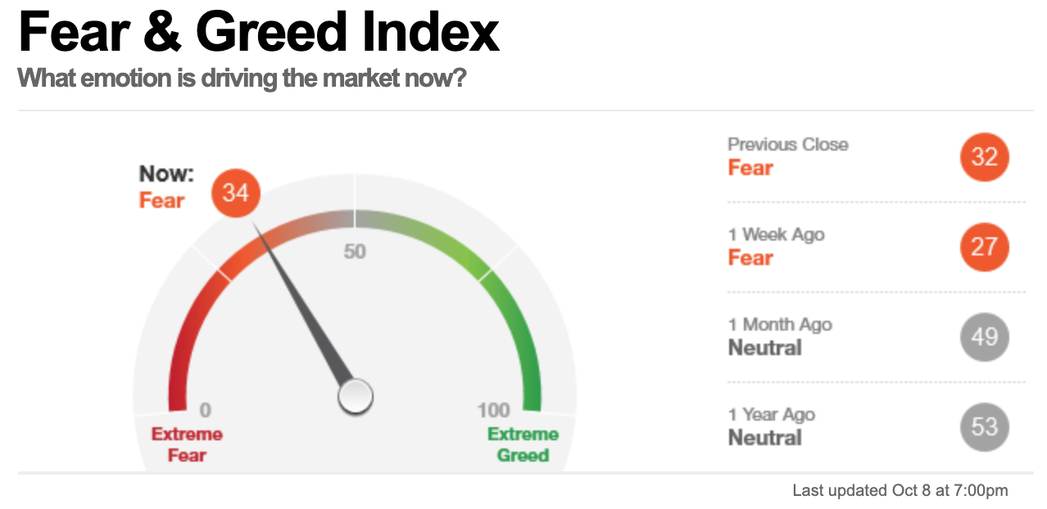
CNN Money Fear & Greed Index What emotion is driving the market now?
Source: https://money.cnn.com/data/fear-and-greed/

Slide 8
Consumer Psychology and Behavior

Slide 9
How consumers think, feel, and act
Source: Philip Kotler & Kevin Lane Keller, Marketing Management, 14th ed., Pearson, 2012

Slide 10
Fintech: Technology Innovation in Financial Services

Slide 11
Fintech Impact on Consumer Behavior
Source: http://bitcoinist.com/fintech-impact-consumer-behavior-mobile-payments/

Slide 12
Behavioral Finance

Slide 13
Richard H. Thaler (2016), Misbehaving: The Making of Behavioral Economics, ‎ W. W. Norton & Company
Richard H. Thaler
Source: https://www.amazon.com/Misbehaving-Behavioral-Economics-Richard-Thaler/dp/039335279X

Slide 14
Edwin Burton and Sunit N. Shah (2013) Behavioral Finance: Understanding the Social, Cognitive, and Economic Debates, Wiley
Source: https://www.amazon.com/Behavioral-Finance-Understanding-Cognitive-Economic/dp/111830019X

Slide 15
Lucy Ackert and Richard Deaves (2009), Behavioral Finance: Psychology, Decision-Making, and Markets, South-Western College Pub
Source: https://www.amazon.com/Behavioral-Finance-Psychology-Decision-Making-Markets/dp/0324661177

Slide 16
Hersh Shefrin (2007), Beyond Greed and Fear: Understanding Behavioral Finance and the Psychology of Investing, Oxford University Press
Source: https://www.amazon.com/Beyond-Greed-Fear-Understanding-Association/dp/0195304217

Slide 17
Andrei Shleifer (2000), Inefficient Markets: An Introduction to Behavioral Finance, Oxford University Press
Source: https://www.amazon.com/Inefficient-Markets-Introduction-Behavioral-Clarendon/dp/0198292279

Slide 18
H. Kent Baker and Victor Ricciardi (2014) Investor Behavior: The Psychology of Financial Planning and Investing, Wiley
Source: https://www.amazon.com/Investor-Behavior-Psychology-Financial-Investing/dp/1118492986

Slide 19
Marketing
“Meeting needs profitably”
Source: Philip Kotler & Kevin Lane Keller, Marketing Management, 14th ed., Pearson, 2012

Slide 20
Value
the sum of the tangible and intangible benefits and costs
Source: Philip Kotler & Kevin Lane Keller, Marketing Management, 14th ed., Pearson, 2012

Slide 21
Value
Total customer benefit
Customer perceived value
Total customer cost
Source: Philip Kotler & Kevin Lane Keller, Marketing Management, 14th ed., Pearson, 2012

Slide 22
Customer Perceived Value
Product benefit
Total customer benefit
Customer perceived value
Services benefit
Personnel benefit
Image benefit
Monetary cost
Total customer cost
Time cost
Energy cost
Psychological cost
Source: Philip Kotler & Kevin Lane Keller, Marketing Management, 14th ed., Pearson, 2012

Slide 23
Model of Consumer Behavior
Psychology
Marketing Stimuli
Other Stimuli
Buying
Decision Process
Purchase
Decision
Motivation
Perception
Learning
Memory
Products & Services
Price
Distribution
Communications
Economic
Technological
Political
Cultural
Problem Recognition
Information Search
Evaluation of Alternatives
Purchase decision
Post-purchase behavior
Product choice
Brand choice
Dealer choice
Purchase amount
Purchase timing
Payment method
Consumer Characteristics
Cultural
Social
Personal
Source: Philip Kotler & Kevin Lane Keller, Marketing Management, 14th ed., Pearson, 2012

Slide 24
Building Customer Value, Satisfaction, and Loyalty
Source: Philip Kotler & Kevin Lane Keller, Marketing Management, 14th ed., Pearson, 2012

Slide 25
Customer Perceived Value, Customer Satisfaction, and Loyalty
Customer Perceived Performance
Customer
Perceived Value
Customer
Satisfaction
Customer
Loyalty
Customer
Expectations
Source: Philip Kotler & Kevin Lane Keller, Marketing Management, 14th ed., Pearson, 2012

Slide 26
Theory of Reasoned Action (TRA)
Source: Fishbein, M., & Ajzen, I. (1975). Belief, Attitude, Intention, and Behavior: An Introduction to Theory and Research. Reading, MA: Addison-Wesley.

Slide 27
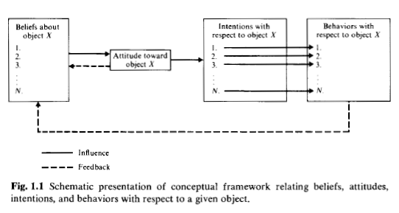
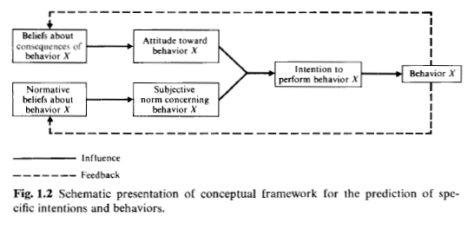
TRA (1975)
Source: Fishbein, M., & Ajzen, I. (1975). Belief, Attitude, Intention, and Behavior: An Introduction to Theory and Research. Reading, MA: Addison-Wesley.

Slide 28
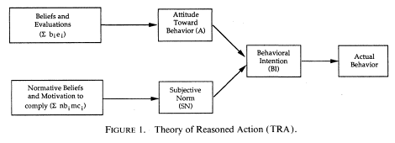
TRA (1989)
Davis,F.D.,R.P.Bagozzi and P.R.Warshaw,“User acceptance of computer technology : A comparison of two theoretical models ”,Management Science,35(8),August 1989,pp.982-1003

Slide 29
Theory of Planned Behavior (TPB)
Source: Ajzen, I., (1985) “From Intentions to Actions: A Theory of Planned Behavior,” in J. Kuhl and J. Beckmann (Eds.) Action Control: From Cognition to behavior, Springer Verlag, New york, 1985, pp.11-39.

Slide 30
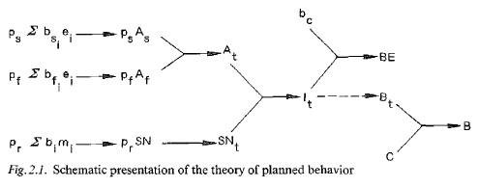
TPB (1985)
Ajzen, I., (1985) “From Intentions to Actions: A Theory of Planned Behavior,” in J. Kuhl and J. Beckmann (Eds.) Action Control: From Cognition to behavior, Springer Verlag, New york, 1985, pp.11-39.

Slide 31
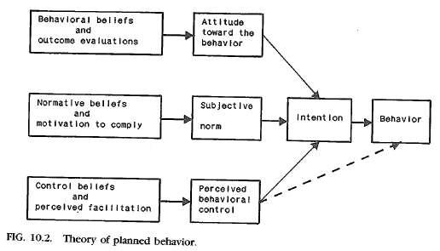
TPB (1989)
Ajzen, I., (1989) “Attitude Structure and Behavior,” in A. R. Pratkanis, S. J. Breckler, and A. G. Greenwald(Eds.), Attitude Structure and Function, Lawrence Erlbaum Associates, Hillsdale, NJ, 1989, pp.241-274.

Slide 32
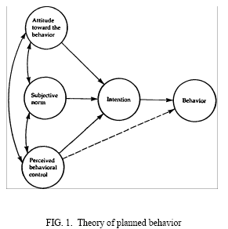
TPB (1991)
Ajzen, I. (1991). The theory of planned behavior. Organizational Behavior and Human Decision Processes, 50, 179-211.

Slide 33
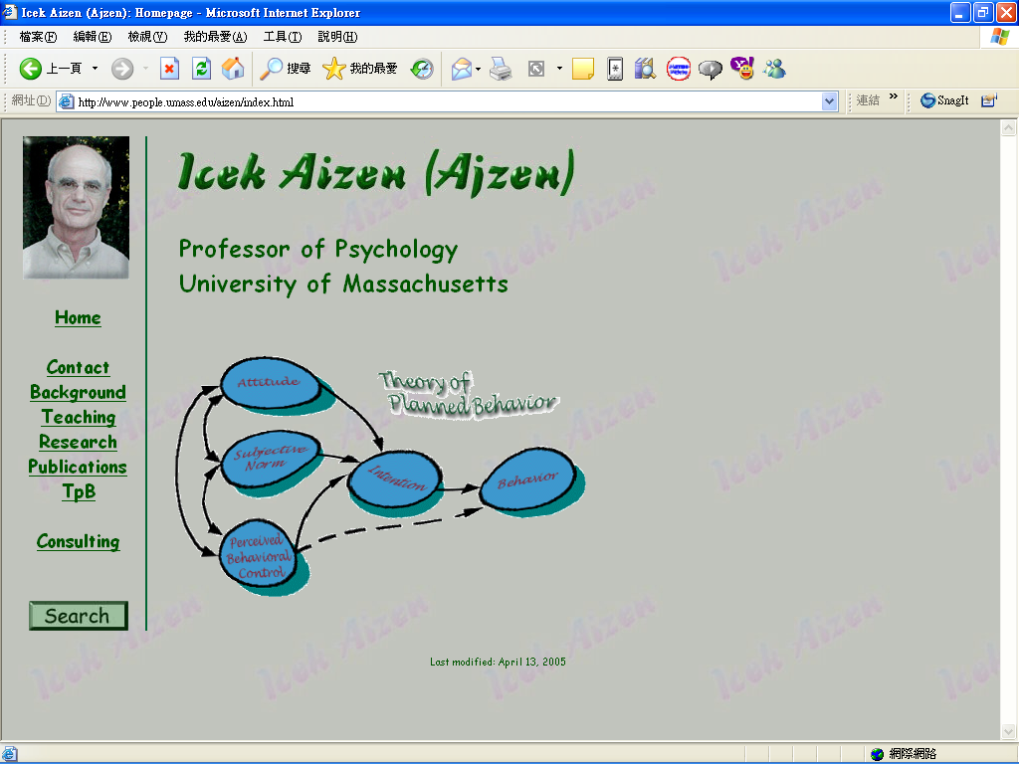
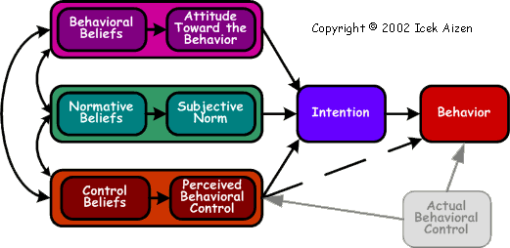
http://www.people.umass.edu/aizen/index.html

Slide 34
Technology Acceptance Model (TAM)
Source: Davis,F.D.,R.P.Bagozzi and P.R.Warshaw,“User acceptance of computer technology : A comparison of two theoretical models ”,Management Science,35(8),August 1989,pp.982-1003

Slide 35
TAM (1989)
Davis,F.D.,R.P.Bagozzi and P.R.Warshaw,“User acceptance of computer technology : A comparison of two theoretical models ”,Management Science,35(8),August 1989,pp.982-1003

Slide 36
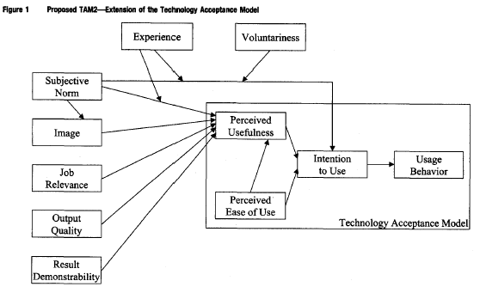
TAM2 (2000)
Venkatesh, V., & Davis, F. D. (2000) “A theoretical extension of the technology acceptance model: Four longitudinal field studies”, Management Science, 46(2), pp. 186-204.

Slide 37
Behavioral Finance

Slide 38
Rational Behavior Irrational Behavior

Slide 39
Emotion Sentiment

Slide 40
Modern Financial Research
Theoretical Finance
study of logical relationships among assets.
Empirical Finance
study of data in order to infer relationships.
Behavioral Finance
integrates psychology into the investment process.
Source: Robert A. Strong (2004), Practical Investment Management, South-Western

Slide 41
Psychology in Behavior Finance
Beliefs
Preferences
Prospect theory
Ambiguity aversion
Source: Barberis, Nicholas, and Richard Thaler. "A survey of behavioral finance." Handbook of the Economics of Finance 1 (2003): 1053-1128.

Slide 42
Behavioral Finance Themes
Heuristic-Driven Bias
Framing Dependence
Inefficient Markets
Source: Hersh Shefrin (2007), “Beyond Greed and Fear: Understanding Behavioral Finance and the Psychology of Investing”, Oxford University Press.

Slide 43
Herding Behavior
Herding refers to the lemming-like behavior of investors and analysts looking around, seeing what each other is doing, and heading in that direction.
There may not have been safety in numbers, but there probably was some comfort in them.
Source: Robert A. Strong (2004), Practical Investment Management, South-Western v

Slide 44
Herding Behavior in Finance
Manahov, V. (2021). Cryptocurrency liquidity during extreme price movements: is there a problem with virtual money? Quantitative Finance, 21(2), 341-360.
Hsieh, S. F., Chan, C. Y., & Wang, M. C. (2020). Retail investor attention and herding behavior. Journal of Empirical Finance, 59, 109-132.
Christoffersen, J., & Staehr, S. (2019). Individual risk tolerance and herding behaviors in financial forecasts. European Financial Management, 25(5), 1348-1377.
Frijns, B., & Huynh, T. D. (2018). Herding in analysts' recommendations: The role of media. Journal of Banking & Finance, 91, 1-18.

Slide 45
Efficient Market Hypothesis (EMH)
Source: Hersh Shefrin (2007), “Beyond Greed and Fear: Understanding Behavioral Finance and the Psychology of Investing”, Oxford University Press.

Slide 46
Expected Utility Theory (EUT)
Source: Kahneman, Daniel, and Amos Tversky. "Prospect theory: An analysis of decision under risk." Econometrica: Journal of the econometric society (1979): 263-291.

Slide 47
Prospect theory: An analysis of decision under risk
Source: Kahneman, Daniel, and Amos Tversky. "Prospect theory: An analysis of decision under risk." Econometrica: Journal of the econometric society (1979): 263-291.

Slide 48
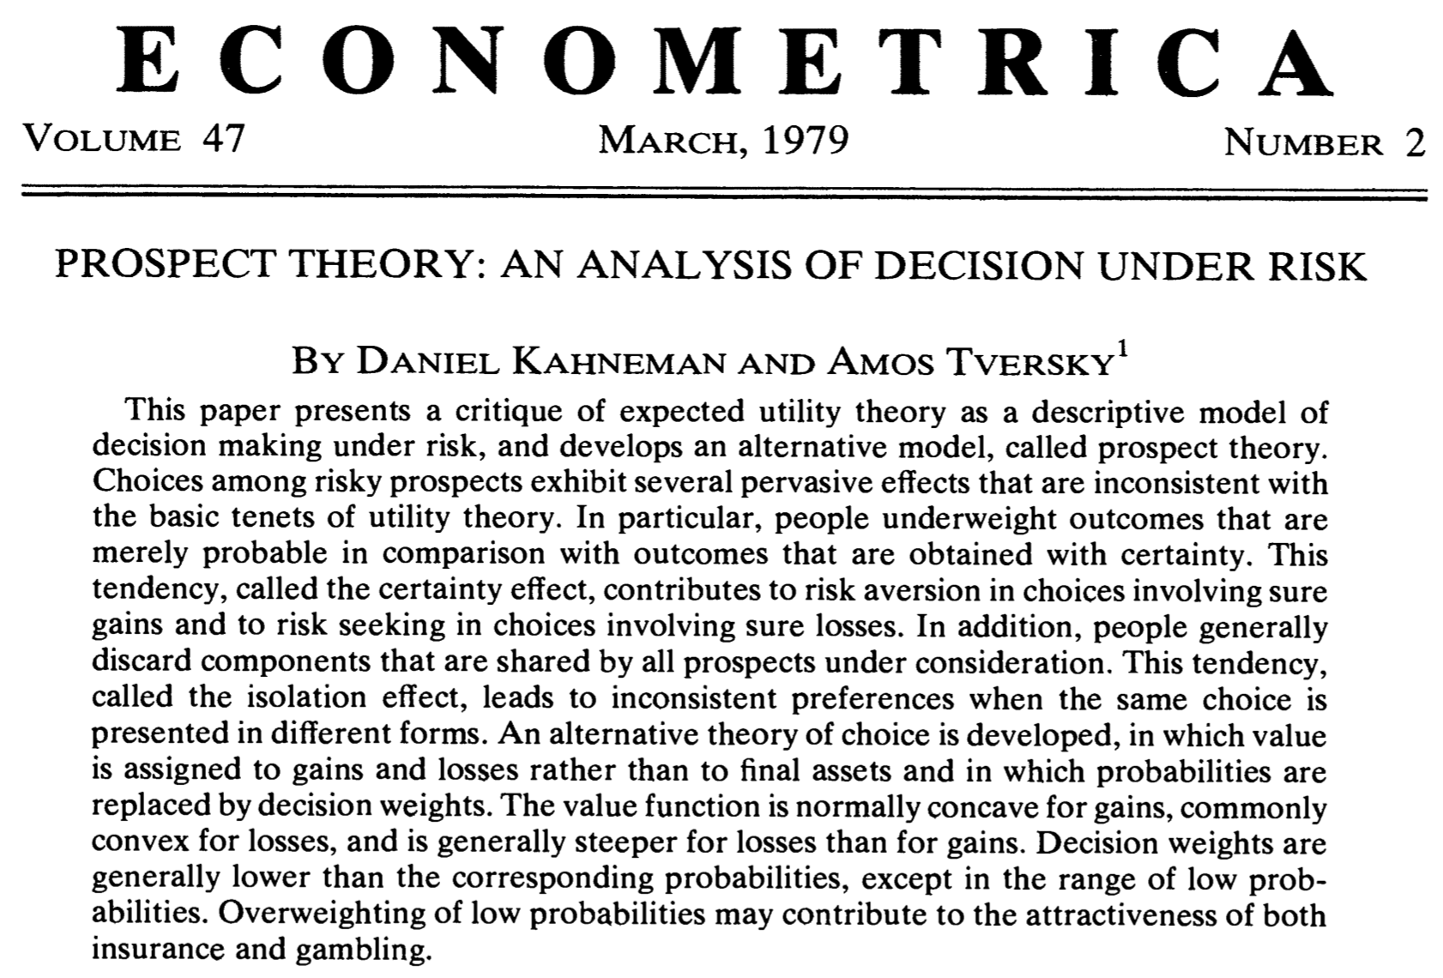
Prospect Theory (Kahneman and Tversky, 1979)
Source: Kahneman, Daniel, and Amos Tversky. "Prospect theory: An analysis of decision under risk." Econometrica: Journal of the econometric society (1979): 263-291.

Slide 49
Decision Making under Risk
Source: Kahneman, Daniel, and Amos Tversky. "Prospect theory: An analysis of decision under risk." Econometrica: Journal of the econometric society (1979): 263-291.

Slide 50
Which of the following would you prefer?
A:
50% chance to win 1,000,
50% chance to win nothing;
B:
450 for sure.
Source: Kahneman, Daniel, and Amos Tversky. "Prospect theory: An analysis of decision under risk." Econometrica: Journal of the econometric society (1979): 263-291.

Slide 51
Decision
Source: Kahneman, Daniel, and Amos Tversky. "Prospect theory: An analysis of decision under risk." Econometrica: Journal of the econometric society (1979): 263-291.

Slide 52
Decision
Source: Kahneman, Daniel, and Amos Tversky. "Prospect theory: An analysis of decision under risk." Econometrica: Journal of the econometric society (1979): 263-291.

Slide 53
Decision
Source: Kahneman, Daniel, and Amos Tversky. "Prospect theory: An analysis of decision under risk." Econometrica: Journal of the econometric society (1979): 263-291.

Slide 54
Decision
Source: Kahneman, Daniel, and Amos Tversky. "Prospect theory: An analysis of decision under risk." Econometrica: Journal of the econometric society (1979): 263-291.

Slide 55
Expected Utility
Source: Kahneman, Daniel, and Amos Tversky. "Prospect theory: An analysis of decision under risk." Econometrica: Journal of the econometric society (1979): 263-291.

Slide 56
Decision
Source: Kahneman, Daniel, and Amos Tversky. "Prospect theory: An analysis of decision under risk." Econometrica: Journal of the econometric society (1979): 263-291.

Slide 57
Decision
Source: Kahneman, Daniel, and Amos Tversky. "Prospect theory: An analysis of decision under risk." Econometrica: Journal of the econometric society (1979): 263-291.

Slide 58
Decision
Source: Kahneman, Daniel, and Amos Tversky. "Prospect theory: An analysis of decision under risk." Econometrica: Journal of the econometric society (1979): 263-291.

Slide 59
Decision
Source: Kahneman, Daniel, and Amos Tversky. "Prospect theory: An analysis of decision under risk." Econometrica: Journal of the econometric society (1979): 263-291.

Slide 60
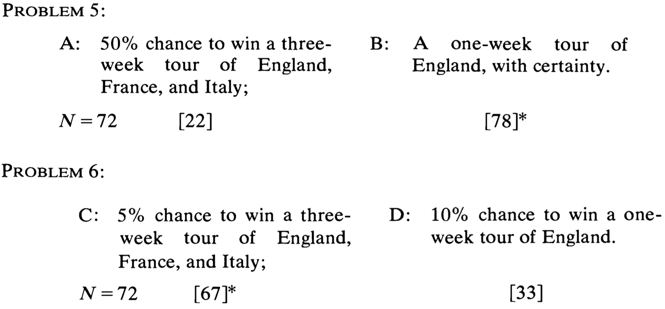
Decision
Source: Kahneman, Daniel, and Amos Tversky. "Prospect theory: An analysis of decision under risk." Econometrica: Journal of the econometric society (1979): 263-291.

Slide 61
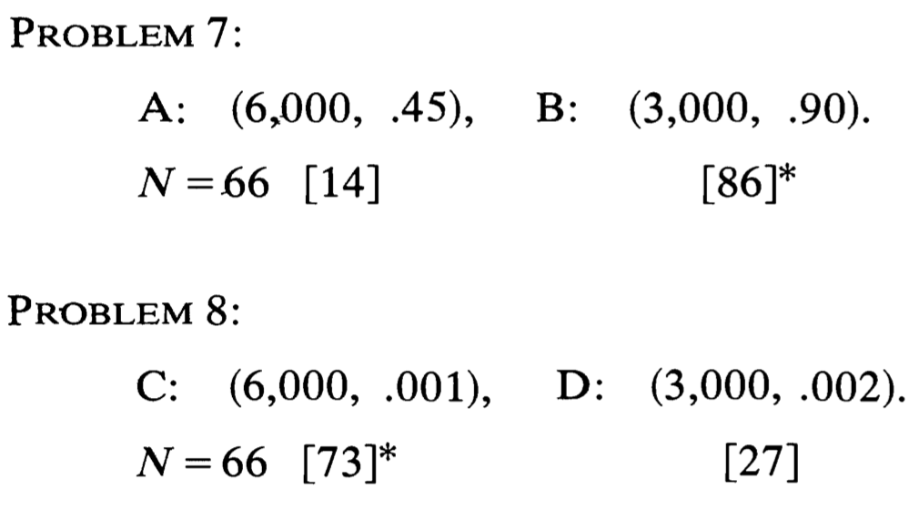
Decision
Source: Kahneman, Daniel, and Amos Tversky. "Prospect theory: An analysis of decision under risk." Econometrica: Journal of the econometric society (1979): 263-291.

Slide 62
Preferences Between Positive and Negative Prospects
Source: Kahneman, Daniel, and Amos Tversky. "Prospect theory: An analysis of decision under risk." Econometrica: Journal of the econometric society (1979): 263-291.

Slide 63
Certainty, Probability, and Possibility
Source: Kahneman, Daniel, and Amos Tversky. "Prospect theory: An analysis of decision under risk." Econometrica: Journal of the econometric society (1979): 263-291.

Slide 64
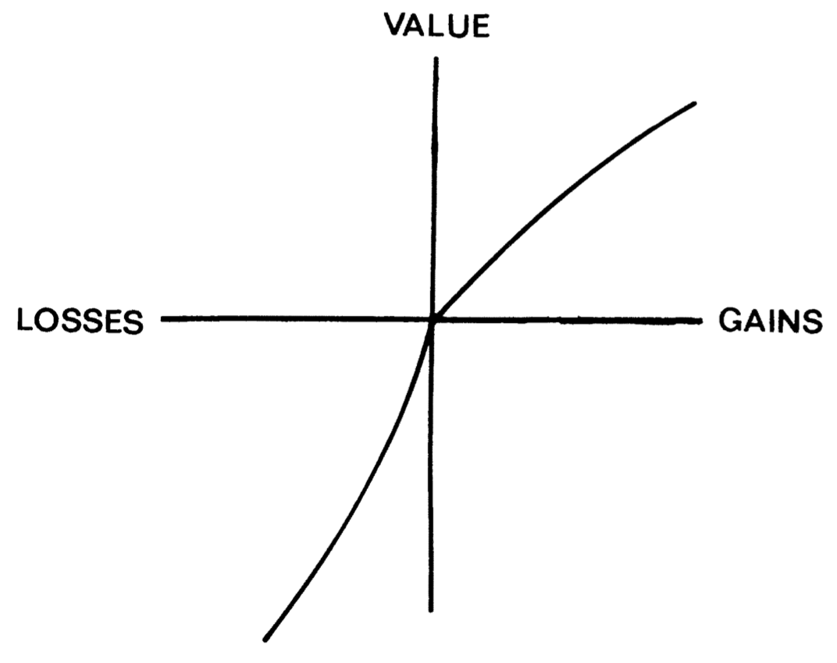
Prospect theory Value Function
Source: Kahneman, Daniel, and Amos Tversky. "Prospect theory: An analysis of decision under risk." Econometrica: Journal of the econometric society (1979): 263-291.

Slide 65
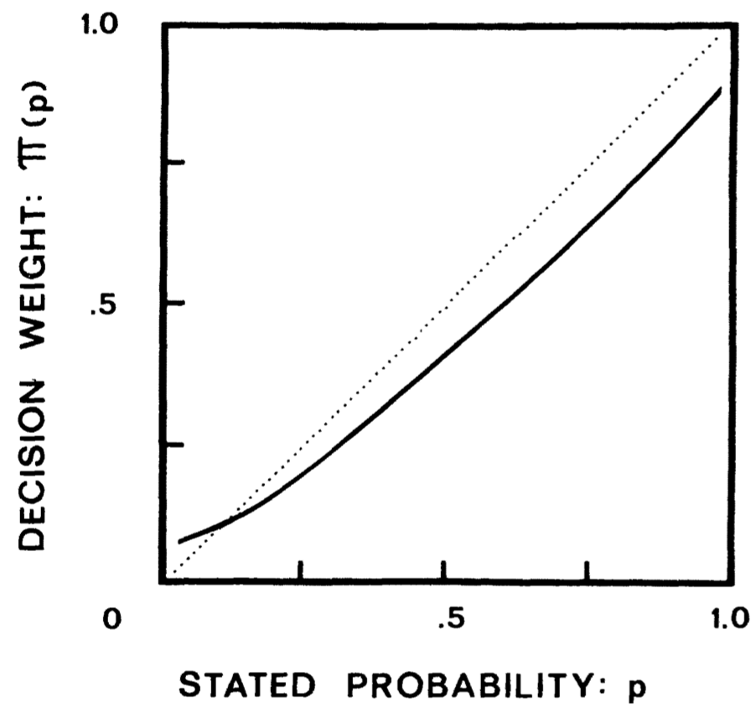
Prospect theory Weighting Function
Source: Kahneman, Daniel, and Amos Tversky. "Prospect theory: An analysis of decision under risk." Econometrica: Journal of the econometric society (1979): 263-291.

Slide 66
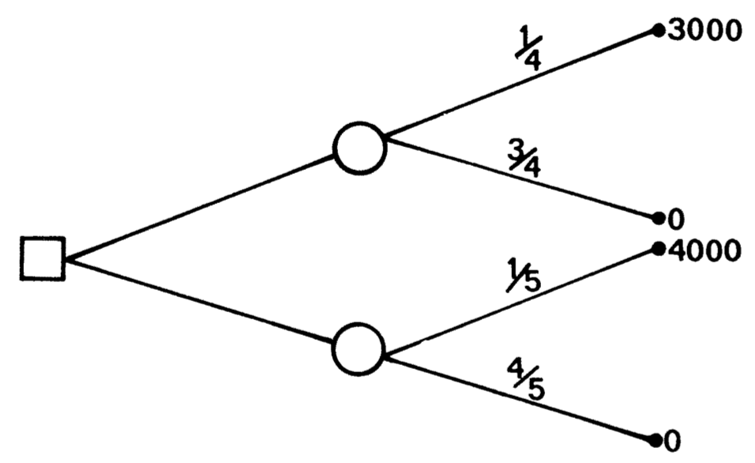
Problem 4 as a decision tree (standard formulation)
Source: Kahneman, Daniel, and Amos Tversky. "Prospect theory: An analysis of decision under risk." Econometrica: Journal of the econometric society (1979): 263-291.

Slide 67
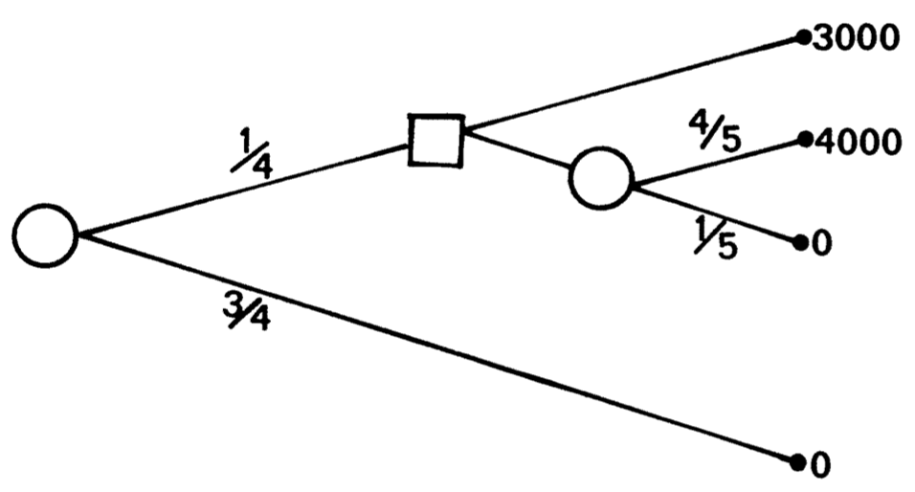
Problem 10 as a decision tree (sequential formulation)
Source: Kahneman, Daniel, and Amos Tversky. "Prospect theory: An analysis of decision under risk." Econometrica: Journal of the econometric society (1979): 263-291.

Slide 68
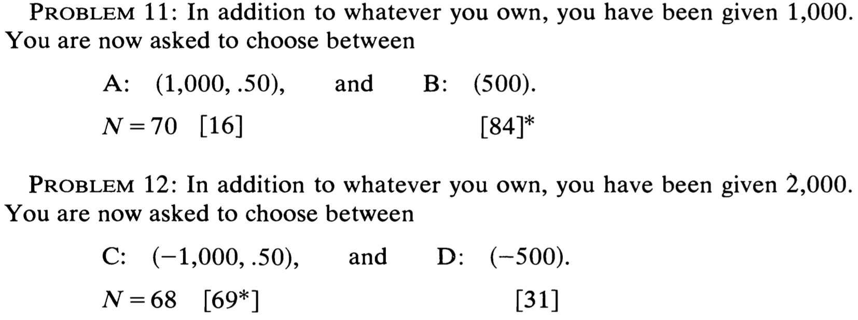
Decision
Source: Kahneman, Daniel, and Amos Tversky. "Prospect theory: An analysis of decision under risk." Econometrica: Journal of the econometric society (1979): 263-291.

Slide 69
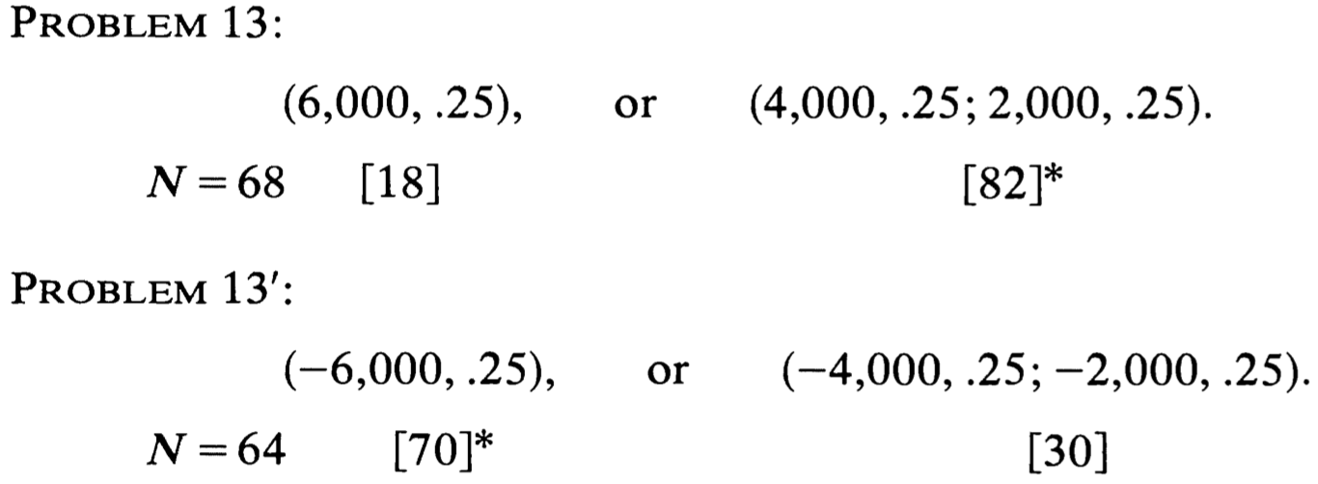
Decision
Source: Kahneman, Daniel, and Amos Tversky. "Prospect theory: An analysis of decision under risk." Econometrica: Journal of the econometric society (1979): 263-291.

Slide 70
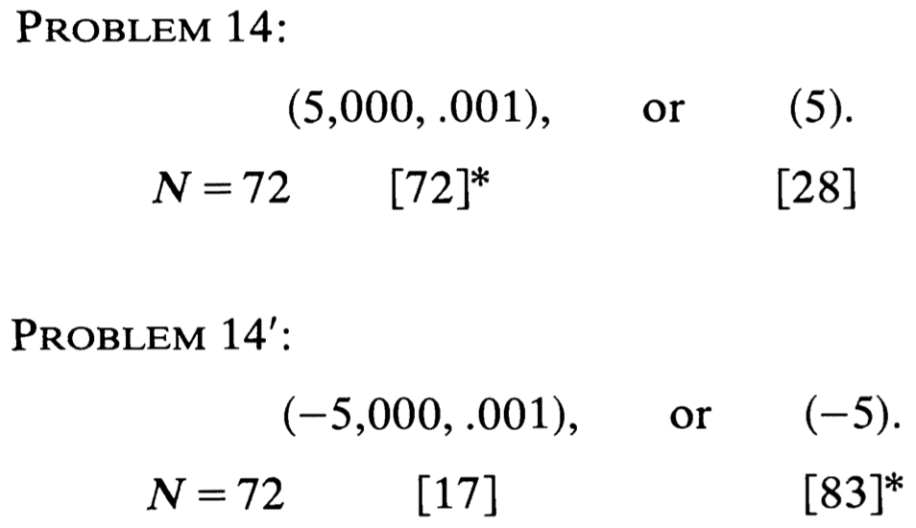
Decision
Source: Kahneman, Daniel, and Amos Tversky. "Prospect theory: An analysis of decision under risk." Econometrica: Journal of the econometric society (1979): 263-291.

Slide 71
Prospect theory
People underweight outcomes that are merely probable in comparison with outcomes that are obtained with certainty.
This tendency, called the certainty effect, contributes to risk aversion in choices involving sure gains and to risk seeking in choices involving sure losses.
Source: Kahneman, Daniel, and Amos Tversky. "Prospect theory: An analysis of decision under risk." Econometrica: Journal of the econometric society (1979): 263-291.

Slide 72
Prospect theory
People generally discard components that are shared by all prospects under consideration.
This tendency, called the isolation effect, leads to inconsistent preferences when the same choice is presented in different form .
Source: Kahneman, Daniel, and Amos Tversky. "Prospect theory: An analysis of decision under risk." Econometrica: Journal of the econometric society (1979): 263-291.

Slide 73
Prospect theory
People generally discard components that are shared by all prospects under consideration.
This tendency, called the isolation effect, leads to inconsistent preferences when the same choice is presented in different form .
Source: Kahneman, Daniel, and Amos Tversky. "Prospect theory: An analysis of decision under risk." Econometrica: Journal of the econometric society (1979): 263-291.

Slide 74
Prospect theory
Value is assigned to gains and losses rather than to final assets and in which probabilities are replaced by decision weights.
The value function is normally concave for gains, commonly convex for losses, and is generally steeper for losses than for gains.
Source: Kahneman, Daniel, and Amos Tversky. "Prospect theory: An analysis of decision under risk." Econometrica: Journal of the econometric society (1979): 263-291.

Slide 75
Prospect theory
Decision weights are generally lower than the corresponding probabilities, except in the range of low probabilities.
Overweighting of low probabilities may contribute to the attractiveness of both insurance and gambling.
Source: Kahneman, Daniel, and Amos Tversky. "Prospect theory: An analysis of decision under risk." Econometrica: Journal of the econometric society (1979): 263-291.

Slide 76
Behavioral Heuristics and Biases in Decision Making

Slide 77
Behavioral Finance Anomalies
The Rational Man
Consumer Choice with Certainty
Consumer Choice with Uncertainty
The Allais Paradox
Source: Edwin Burton and Sunit N. Shah (2013), “Behavioral Finance: Understanding the Social, Cognitive, and Economic Debates”, Wiley.

Slide 78
Prospect Theory
The Reference Point
The S-Curve
Loss Aversion
Source: Edwin Burton and Sunit N. Shah (2013), “Behavioral Finance: Understanding the Social, Cognitive, and Economic Debates”, Wiley.

Slide 79
Behavioral Finance Anomalies
Perception Biases
Inertial Effects
Causality and Statistics
Illusions
Source: Edwin Burton and Sunit N. Shah (2013), “Behavioral Finance: Understanding the Social, Cognitive, and Economic Debates”, Wiley.

Slide 80
Perception Biases
Saliency
Framing
Anchoring
Sunk Cost Bias
Source: Edwin Burton and Sunit N. Shah (2013), “Behavioral Finance: Understanding the Social, Cognitive, and Economic Debates”, Wiley.

Slide 81
Inertial Effects
Endowment Effect
Status Quo Effect
Disposition Effect
Source: Edwin Burton and Sunit N. Shah (2013), “Behavioral Finance: Understanding the Social, Cognitive, and Economic Debates”, Wiley.

Slide 82
Causality and Statistics
Representativeness
Conjunction Fallacy
Reading into Randomness
Small Sample Bias
Probability Neglect
Source: Edwin Burton and Sunit N. Shah (2013), “Behavioral Finance: Understanding the Social, Cognitive, and Economic Debates”, Wiley.

Slide 83
Illusions
Illusion of Talent
Illusion of Skill
Illusion of Superiority
Illusion of Validity
Source: Edwin Burton and Sunit N. Shah (2013), “Behavioral Finance: Understanding the Social, Cognitive, and Economic Debates”, Wiley.

Slide 84
Behavioral Finance: Two Major Foundations
Investor Sentiment
creates disturbances to efficient prices.
Limited arbitrage
arbitrage is never riskfree, hence it does not counter irrational disturbances.
Prices may not react to information by the “right” amount.
Prices may react to non-information.
Markets may remain efficient.

Slide 85
Arbitrage
Source: http://www.beliefnet.com/columnists/moviemom/2012/09/interview-nicholas-jarecki-of-arbitrage.html

Slide 86
Arbitrage
$120
Gain $20
$100
Sell High in Market B
Buy Low in Market A

Slide 87
Heuristics
Overconfidence
people overestimate the reliability of their knowledge.
Excessive trading
Framing Effect

Slide 88
Heuristics
Regret Aversion
anticipation of a future regret can influence current decision.
Disposition Effect
sell winners, hold on to the losers.
Anchoring and adjustment: can create under-reaction.

Slide 89
Fashions and Fads
People are influenced by each other. There is a social pressure to conform.
Herding behavior: “safety-in-numbers”.
Informational Cascades
Positive Feedback
Example: excessive demand for internet IPOs. Extremely high opening day returns.

Slide 90
Social Influences
Social norms
The informal opinions, rules, and procedures of a group.
Your piers and social groups influence your investment participation
Herding Behavior
The movement into or out of a stock or industry of companies by large groups of investors.

Slide 91
Psychology of Belief
Confirmation Bias
Source: https://www.interaction-design.org/literature/article/confirmation-bias-it-s-not-what-we-think-we-know-that-counts

Slide 92
Confirmation Bias
The
Facts
Your Beliefs
Overvalued
Source: Robert A. Strong (2004), Practical Investment Management, South-Western

Slide 93
Representativeness Heuristic
A
B
A & B
P (A & B) < P (A) or P (B)
Source: Robert A. Strong (2004), Practical Investment Management, South-Western

Slide 94
Katona’s Economic Psychology Model
Economic Conditions
(E)
Personal Characteristics
(P)
Economic
Behavior
(B)
Source: Van Raaij, W. Fred. "Economic psychology." Journal of Economic Psychology 1, no. 1 (1981): 1-24.

Slide 95
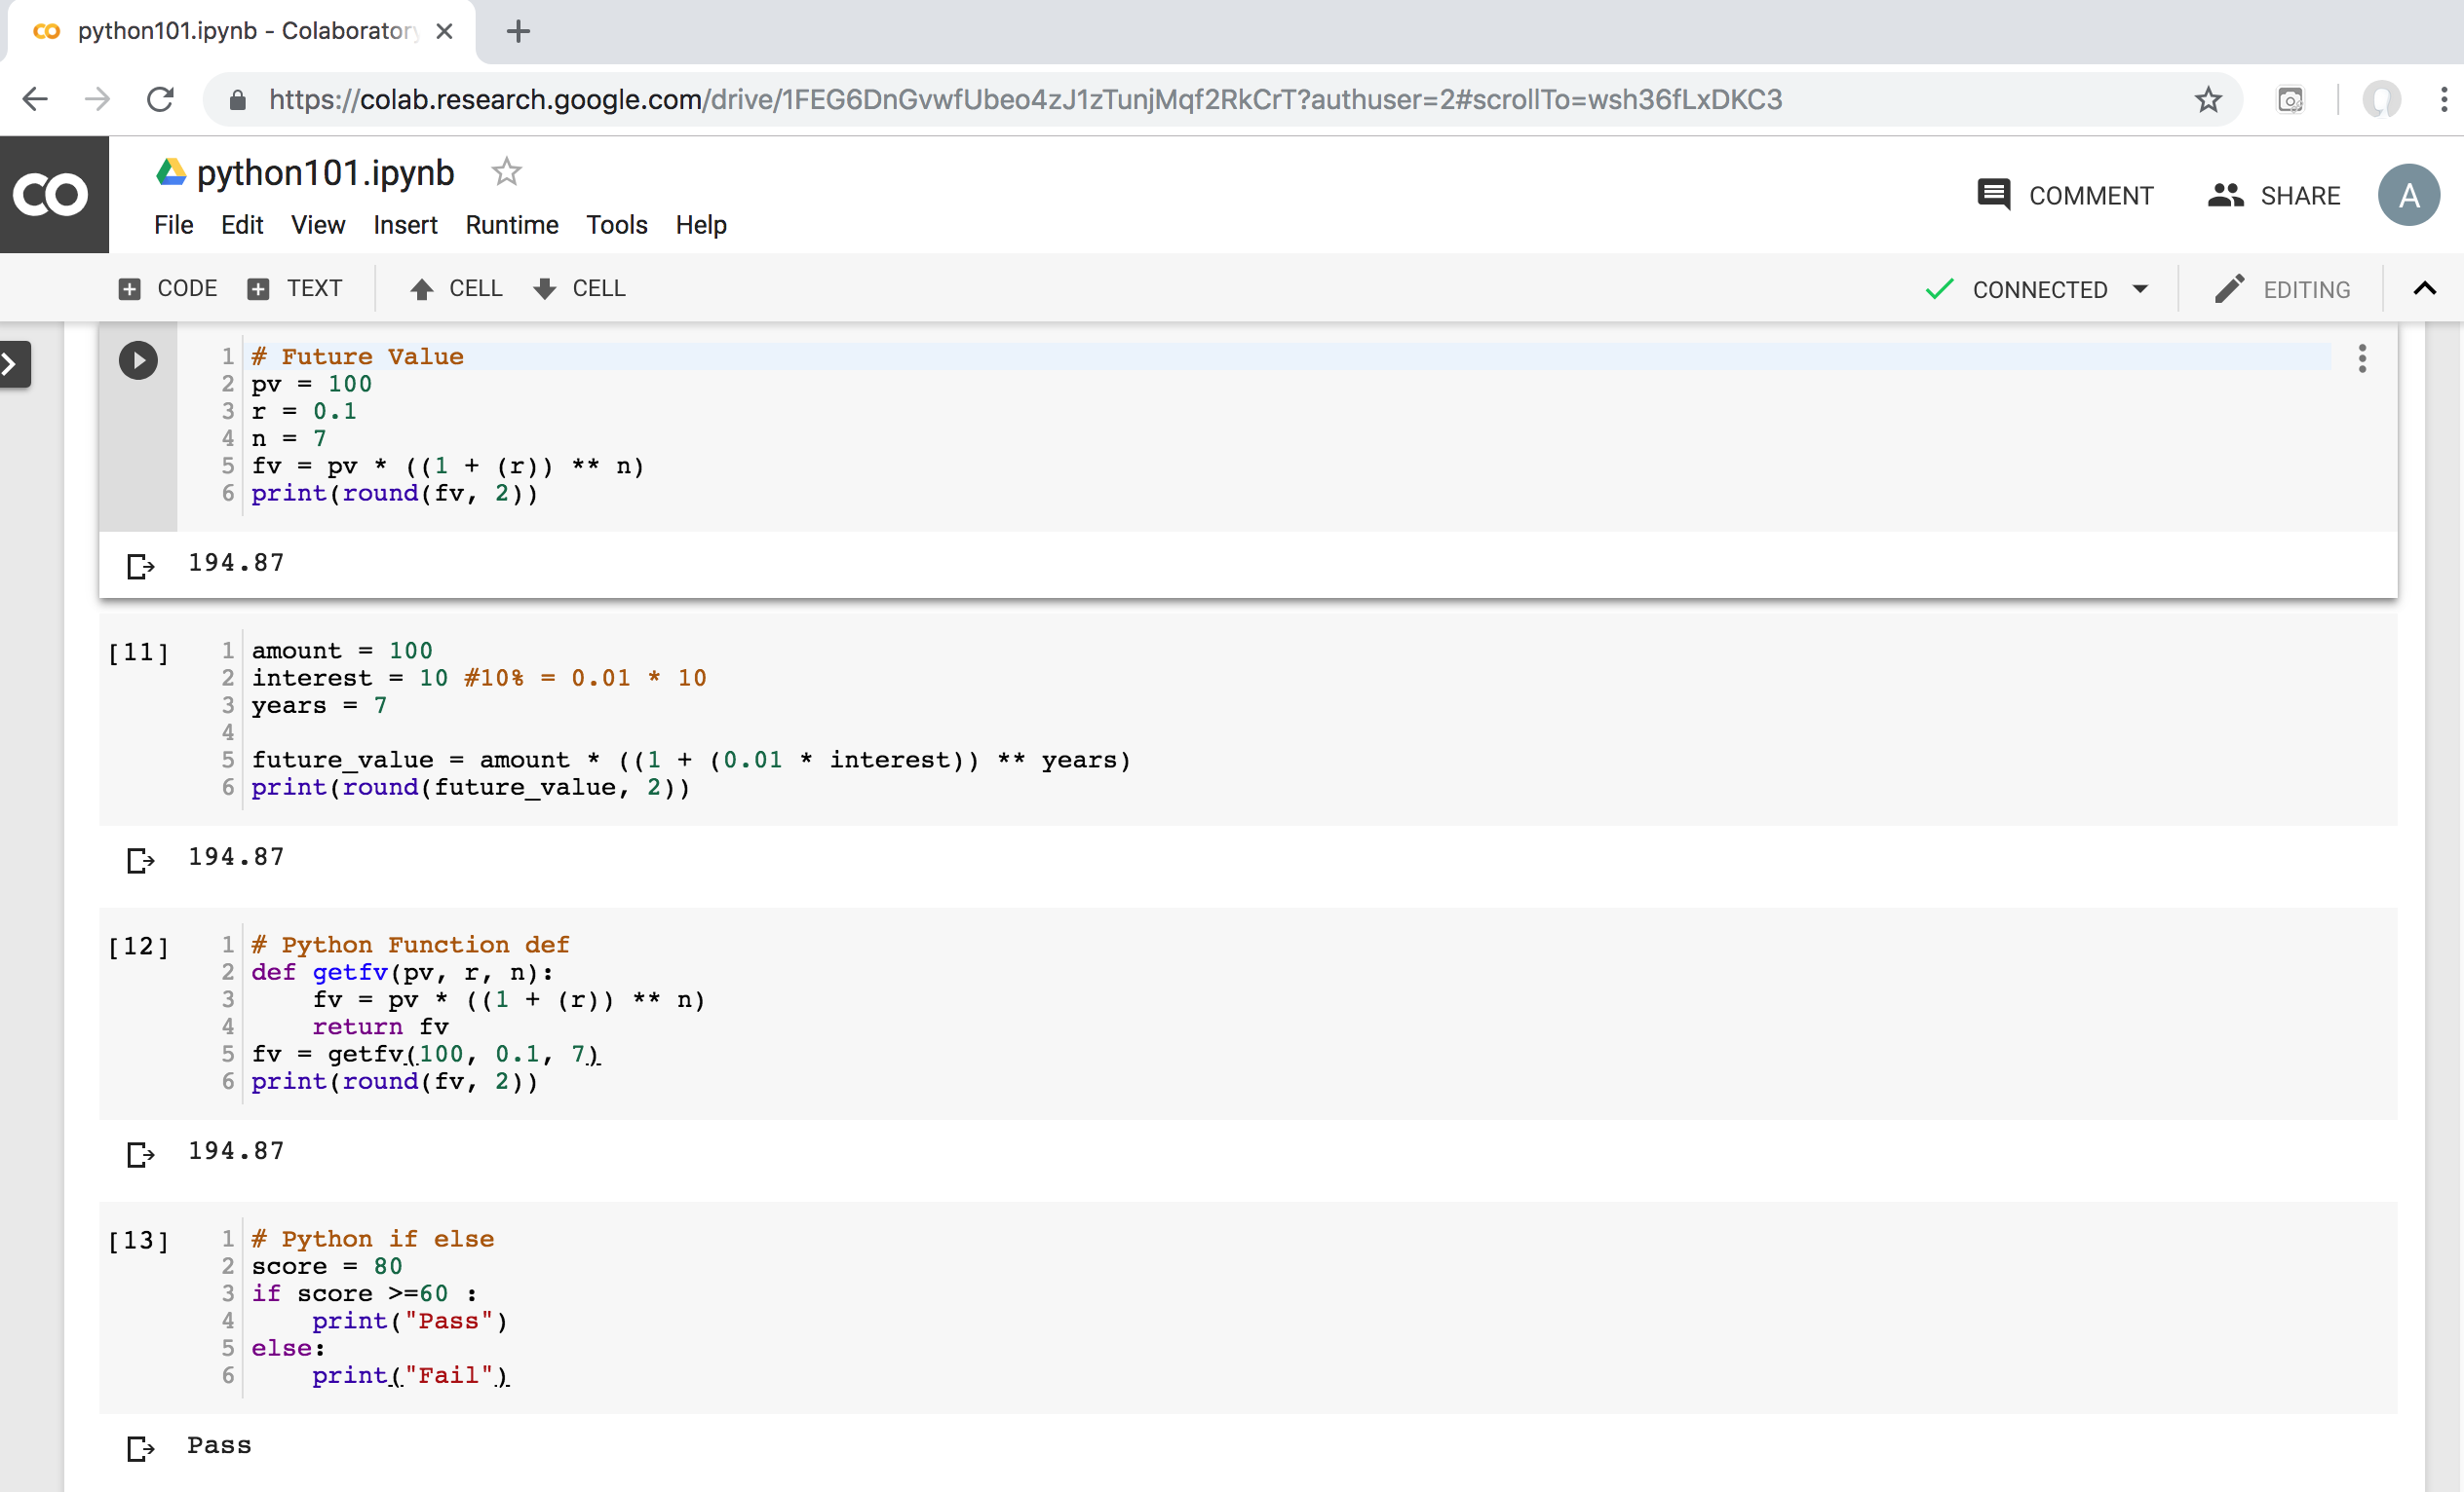
Python in Google Colab (Python101)
https://colab.research.google.com/drive/1FEG6DnGvwfUbeo4zJ1zTunjMqf2RkCrT
https://tinyurl.com/aintpupython101

Slide 96
References
Yves Hilpisch (2020), Artificial Intelligence in Finance: A Python-Based Guide, O’Reilly Media.
Aurélien Géron (2019), Hands-On Machine Learning with Scikit-Learn, Keras, and TensorFlow: Concepts, Tools, and Techniques to Build Intelligent Systems, 2nd Edition, O’Reilly Media.
Yves Hilpisch (2018), Python for Finance: Mastering Data-Driven Finance, 2nd Edition, O'Reilly Media.
Paolo Sironi (2016), “FinTech Innovation: From Robo-Advisors to Goal Based Investing and Gamification”, Wiley.
Susanne Chishti and Janos Barberis (2016), “The FINTECH Book: The Financial Technology Handbook for Investors, Entrepreneurs and Visionaries”, Wiley.
Richard H. Thaler (2016), Misbehaving: The Making of Behavioral Economics, W. W. Norton & Company
Lucy Ackert and Richard Deaves (2009), “Behavioral Finance: Psychology, Decision-Making, and Markets”, South-Western College Pub.
Hersh Shefrin (2007), “Beyond Greed and Fear: Understanding Behavioral Finance and the Psychology of Investing”, Oxford University Press.
Edwin Burton and Sunit N. Shah (2013), “Behavioral Finance: Understanding the Social, Cognitive, and Economic Debates”, Wiley.
Daniel Kahneman and Amos Tversky (1979), "Prospect theory: An analysis of decision under risk." Econometrica: Journal of the econometric society (1979): 263-291.
Manahov, V. (2021). Cryptocurrency liquidity during extreme price movements: is there a problem with virtual money? Quantitative Finance, 21(2), 341-360.
Hsieh, S. F., Chan, C. Y., & Wang, M. C. (2020). Retail investor attention and herding behavior. Journal of Empirical Finance, 59, 109-132.
Christoffersen, J., & Staehr, S. (2019). Individual risk tolerance and herding behaviors in financial forecasts. European Financial Management, 25(5), 1348-1377.
Frijns, B., & Huynh, T. D. (2018). Herding in analysts' recommendations: The role of media. Journal of Banking & Finance, 91, 1-18.

