Slide 1








Introduction to
Artificial Intelligence
Artificial Intelligence
1111AI01
MBA, IM, NTPU (M6132) (Fall 2022)
Wed 2, 3, 4 (9:10-12:00) (B8F40)
Min-Yuh Day, Ph.D,
Associate Professor
Institute of Information Management, National Taipei University
https://web.ntpu.edu.tw/~myday
https://meet.google.com/miy-fbif-max
2022-09-14

Slide 2











Min-Yuh Day, Ph.D.
Associate Professor, Information Management, NTPU
Visiting Scholar, IIS, Academia Sinica
Ph.D., Information Management, NTU
Director, Intelligent Financial Innovation Technology, IFIT Lab, IM, NTPU
Artificial Intelligence, Financial Technology, Big Data Analytics,
Data Mining and Text Mining, Electronic Commerce

Slide 3
Course Syllabus
National Taipei University
Academic Year 111, 1st Semester (Fall 2022)
Course Title: Artificial Intelligence
Instructor: Min-Yuh Day
Course Class: MBA, IM, NTPU (3 Credits, Elective)
Details
  In-Class and Distance Learning EMI Course
  (3 Credits, Elective, One Semester) (M6132)
Time & Place: Wed, 2, 3, 4, (9:10-12:00) (B8F40)
Google Meet: https://meet.google.com/miy-fbif-max
https://meet.google.com/miy-fbif-max

Slide 4
Course Objectives
Understand the fundamental concepts and research issues of Artificial Intelligence.
Equip with Hands-on practices of Artificial Intelligence.
Conduct information systems research in the context of Artificial Intelligence.

Slide 5
Course Outline
This course introduces the fundamental concepts, research issues, and hands-on practices of Artificial Intelligence.
Topics include:
  Introduction to Artificial Intelligence
  Artificial Intelligence and Intelligent Agents
  Problem Solving
  Knowledge, Reasoning and Knowledge Representation, Uncertain Knowledge and Reasoning
  Machine Learning: Supervised and Unsupervised Learning
  The Theory of Learning and Ensemble Learning
  Deep Learning, Reinforcement Learning
  Deep Learning for Natural Language Processing
  Computer Vision and Robotics
  Philosophy and Ethics of AI and the Future of AI
  Case Study on AI

Slide 6
Core Competence
Exploring new knowledge in information technology, system development and application 80 %
Internet marketing planning ability 10 %
Thesis writing and independent research skills 10 %

Slide 7
Four Fundamental Qualities
Professionalism
  Creative thinking and Problem-solving 40 %
  Comprehensive Integration 30 %
Interpersonal Relationship
  Communication and Coordination 5 %
  Teamwork 5 %
Ethics
  Honesty and Integrity 5 %
  Self-Esteem and Self-reflection 5 %
International Vision
  Caring for Diversity 5 %
  Interdisciplinary Vision 5 %

Slide 8
College Learning Goals
Ethics/Corporate Social Responsibility
Global Knowledge/Awareness
Communication
Analytical and Critical Thinking

Slide 9
Department Learning Goals
Information Technologies and
System Development Capabilities
Internet Marketing Management Capabilities
Research capabilities

Slide 10
Syllabus
Week Date Subject/Topics
1 2022/09/14 Introduction to Artificial Intelligence
2 2022/09/21 Artificial Intelligence and Intelligent Agents
3 2022/09/28 Problem Solving
4 2022/10/05 Knowledge, Reasoning and Knowledge Representation;
Uncertain Knowledge and Reasoning
5 2022/10/12 Case Study on Artificial Intelligence I
6 2022/10/19 Machine Learning: Supervised and Unsupervised Learning

Slide 11
Syllabus
Week Date Subject/Topics
7 2022/10/26 The Theory of Learning and Ensemble Learning
8 2022/11/02 Midterm Project Report
9 2022/11/09 Deep Learning and Reinforcement Learning
10 2022/11/16 Deep Learning for Natural Language Processing
11 2022/11/23 Invited Talk: AI for Information Retrieval
12 2022/11/30 Case Study on Artificial Intelligence II

Slide 12
Syllabus
Week Date Subject/Topics
13 2022/12/07 Computer Vision and Robotics
14 2022/12/14 Philosophy and Ethics of AI and the Future of AI
15 2022/12/21 Final Project Report I
16 2022/12/28 Final Project Report II
17 2023/01/04 Self-learning
18 2023/01/11 Self-learning

Slide 13
Teaching Methods and Activities
Lecture
Discussion
Practicum

Slide 14
Evaluation Methods
Individual Presentation 30 %
Group Presentation 30 %
Case Report 20 %
Class Participation 10 %
Assignment 10 %

Slide 15
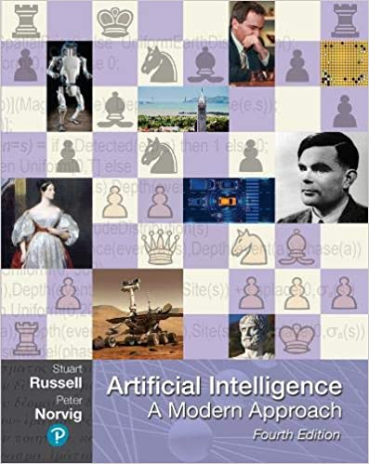
Required Texts
Stuart Russell and Peter Norvig (2020),
Artificial Intelligence: A Modern Approach,
4th Edition, Pearson.
https://www.amazon.com/Artificial-Intelligence-A-Modern-Approach/dp/0134610997/

Slide 16
Reference Books
Aurélien Géron (2019), Hands-On Machine Learning with Scikit-Learn, Keras, and TensorFlow: Concepts, Tools, and Techniques to Build Intelligent Systems, 2nd Edition, O’Reilly Media.
Steven D'Ascoli (2022), Artificial Intelligence and Deep Learning with Python: Every Line of Code Explained For Readers New to AI and New to Python, Independently published.
Nithin Buduma, Nikhil Buduma, Joe Papa (2022), Fundamentals of Deep Learning: Designing Next-Generation Machine Intelligence Algorithms, 2nd Edition, ‎O'Reilly Media.

Slide 17
Stuart Russell and Peter Norvig (2020),
Artificial Intelligence: A Modern Approach,
4th Edition, Pearson
Source: Stuart Russell and Peter Norvig (2020), Artificial Intelligence: A Modern Approach, 4th Edition, Pearson
https://www.amazon.com/Artificial-Intelligence-A-Modern-Approach/dp/0134610997/

Slide 18

Aurélien Géron (2019),
Hands-On Machine Learning with Scikit-Learn, Keras, and TensorFlow:
Concepts, Tools, and Techniques to Build Intelligent Systems,
2nd Edition, O’Reilly Media, 2019
https://github.com/ageron/handson-ml2
Source: https://www.amazon.com/Hands-Machine-Learning-Scikit-Learn-TensorFlow/dp/1492032646/

Slide 19

Hands-On Machine Learning with
Scikit-Learn, Keras, and TensorFlow
Notebooks
The Machine Learning landscape
End-to-end Machine Learning project
Classification
Training Models
Support Vector Machines
Decision Trees
Ensemble Learning and Random Forests
Dimensionality Reduction
Unsupervised Learning Techniques
Artificial Neural Nets with Keras
Training Deep Neural Networks
Custom Models and Training with TensorFlow
Loading and Preprocessing Data
Deep Computer Vision Using Convolutional Neural Networks
Processing Sequences Using RNNs and CNNs
Natural Language Processing with RNNs and Attention
Representation Learning Using Autoencoders
Reinforcement Learning
Training and Deploying TensorFlow Models at Scale
https://github.com/ageron/handson-ml2

Slide 20
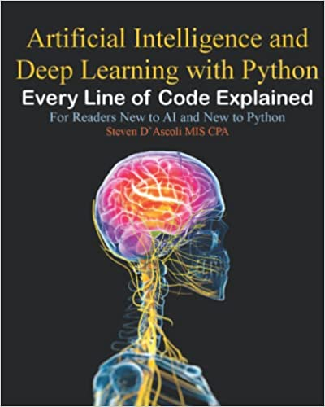
Steven D'Ascoli (2022),
Artificial Intelligence and Deep Learning with Python:
Every Line of Code Explained For Readers New to AI and New to Python,
Independently published.
Source: https://www.amazon.com/Artificial-Intelligence-Deep-Learning-Python/dp/B09QNZBZMN/

Slide 21
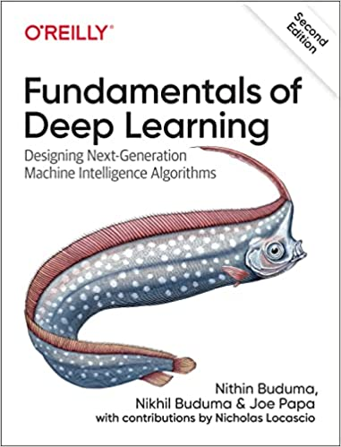
Nithin Buduma, Nikhil Buduma, Joe Papa (2022),
Fundamentals of Deep Learning:
Designing Next-Generation Machine Intelligence Algorithms,
2nd Edition, ‎O'Reilly Media.
Source: https://www.amazon.com/Fundamentals-Deep-Learning-Next-Generation-Intelligence/dp/149208218X/

Slide 22
Artificial Intelligence
(AI)

Slide 23
AI, Big Data, Cloud Computing
Evolution of Decision Support, Business Intelligence, and Analytics
AI
AI
Cloud Computing
Big Data
DM
BI
Source: Ramesh Sharda, Dursun Delen, and Efraim Turban (2017),
Business Intelligence, Analytics, and Data Science: A Managerial Perspective, 4th Edition, Pearson

Slide 24
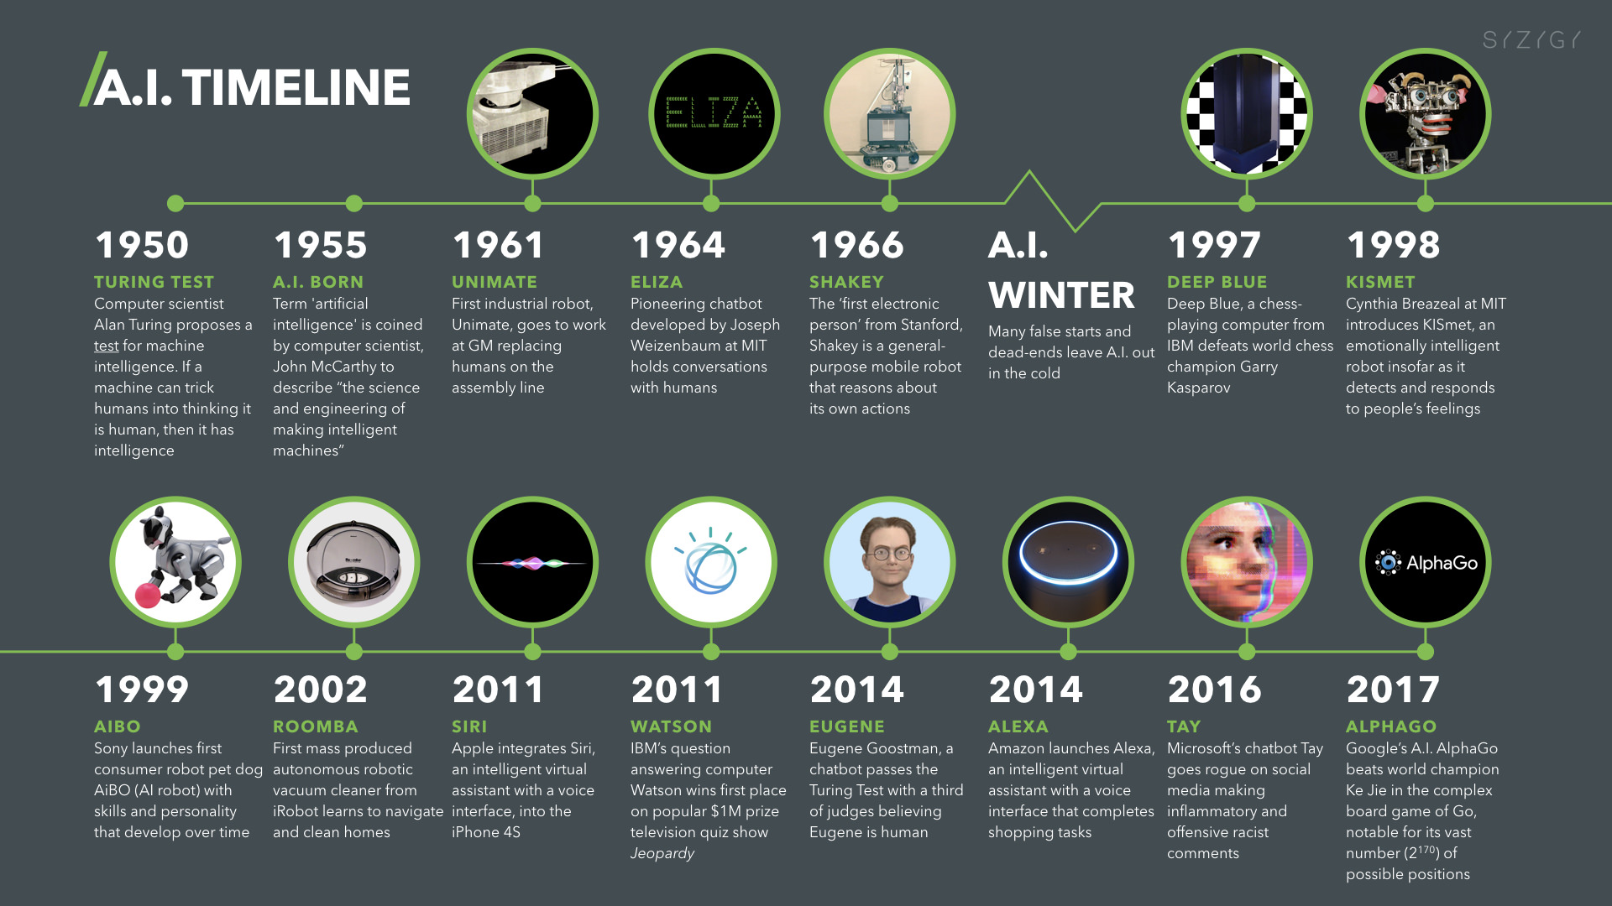
Artificial Intelligence (A.I.) Timeline
Source: https://digitalintelligencetoday.com/artificial-intelligence-timeline-infographic-from-eliza-to-tay-and-beyond/

Slide 25
The Rise of AI
Source: DHL (2018), Artificial Intelligence in Logistics,
http://www.globalhha.com/doclib/data/upload/doc_con/5e50c53c5bf67.pdf/

Slide 26
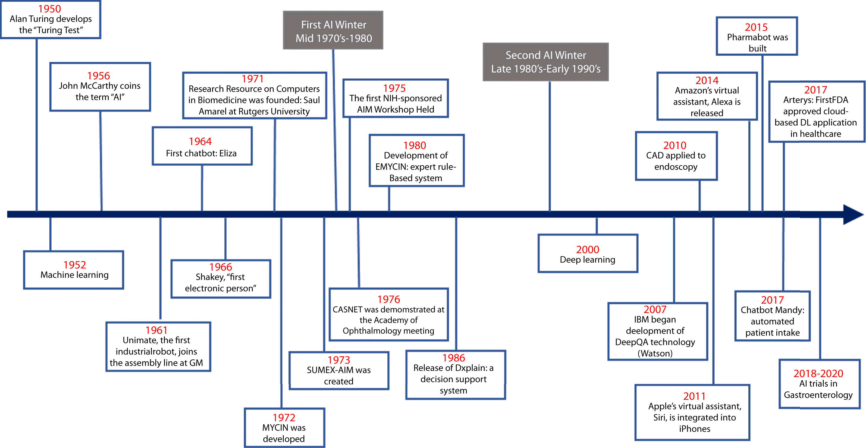
Artificial Intelligence in Medicine
Source: Vivek Kaul, Sarah Enslin, and Seth A. Gross (2020), "The history of artificial intelligence in medicine." Gastrointestinal endoscopy..

Slide 27
Definition of
Artificial Intelligence (A.I.)

Slide 28
Artificial Intelligence
“… the science and engineering of making intelligent machines”
(John McCarthy, 1955)
Source: https://digitalintelligencetoday.com/artificial-intelligence-defined-useful-list-of-popular-definitions-from-business-and-science/

Slide 29
Artificial Intelligence
“… technology that thinks and acts like humans”
Source: https://digitalintelligencetoday.com/artificial-intelligence-defined-useful-list-of-popular-definitions-from-business-and-science/

Slide 30
Artificial Intelligence
“… intelligence exhibited by machines or software”
Source: https://digitalintelligencetoday.com/artificial-intelligence-defined-useful-list-of-popular-definitions-from-business-and-science/

Slide 31
4 Approaches of AI
Thinking Humanly | Thinking Rationally
Acting Humanly | Acting Rationally
Source: Stuart Russell and Peter Norvig (2020), Artificial Intelligence: A Modern Approach, 4th Edition, Pearson

Slide 32
4 Approaches of AI
2. Thinking Humanly: The Cognitive Modeling Approach | 3. Thinking Rationally: The “Laws of Thought” Approach
1. Acting Humanly: The Turing Test Approach (1950) | 4. Acting Rationally: The Rational Agent Approach
Source: Stuart Russell and Peter Norvig (2020), Artificial Intelligence: A Modern Approach, 4th Edition, Pearson

Slide 33
AI Acting Humanly:
The Turing Test Approach
(Alan Turing, 1950)
Knowledge Representation
Automated Reasoning
Machine Learning (ML)
  Deep Learning (DL)
Computer Vision (Image, Video)
Natural Language Processing (NLP)
Robotics
Source: Stuart Russell and Peter Norvig (2020), Artificial Intelligence: A Modern Approach, 4th Edition, Pearson

Slide 34
Artificial Intelligence:
A Modern Approach
Artificial Intelligence
Problem Solving
Knowledge and Reasoning
Uncertain Knowledge and Reasoning
Machine Learning
Communicating, Perceiving, and Acting
Philosophy and Ethics of AI
Source: Stuart Russell and Peter Norvig (2020), Artificial Intelligence: A Modern Approach, 4th Edition, Pearson

Slide 35
Artificial Intelligence:
Intelligent Agents
Source: Stuart Russell and Peter Norvig (2020), Artificial Intelligence: A Modern Approach, 4th Edition, Pearson

Slide 36
Artificial Intelligence:
2. Problem Solving
Solving Problems by Searching
Search in Complex Environments
Adversarial Search and Games
Constraint Satisfaction Problems
Source: Stuart Russell and Peter Norvig (2020), Artificial Intelligence: A Modern Approach, 4th Edition, Pearson

Slide 37
Artificial Intelligence:
3. Knowledge and Reasoning
Logical Agents
First-Order Logic
Inference in First-Order Logic
Knowledge Representation
Automated Planning
Source: Stuart Russell and Peter Norvig (2020), Artificial Intelligence: A Modern Approach, 4th Edition, Pearson

Slide 38
Artificial Intelligence:
4. Uncertain Knowledge and Reasoning
Quantifying Uncertainty
Probabilistic Reasoning
Probabilistic Reasoning over Time
Probabilistic Programming
Making Simple Decisions
Making Complex Decisions
Multiagent Decision Making
Source: Stuart Russell and Peter Norvig (2020), Artificial Intelligence: A Modern Approach, 4th Edition, Pearson

Slide 39
Artificial Intelligence:
5. Machine Learning
Learning from Examples
Learning Probabilistic Models
Deep Learning
Reinforcement Learning
Source: Stuart Russell and Peter Norvig (2020), Artificial Intelligence: A Modern Approach, 4th Edition, Pearson

Slide 40
Artificial Intelligence:
6. Communicating, Perceiving, and Acting
Natural Language Processing
Deep Learning for Natural Language Processing
Computer Vision
Robotics
Source: Stuart Russell and Peter Norvig (2020), Artificial Intelligence: A Modern Approach, 4th Edition, Pearson

Slide 41
Artificial Intelligence:
Philosophy and Ethics of AI
The Future of AI
Source: Stuart Russell and Peter Norvig (2020), Artificial Intelligence: A Modern Approach, 4th Edition, Pearson

Slide 42
Artificial Intelligence
Machine Learning & Deep Learning
Source: https://blogs.nvidia.com/blog/2016/07/29/whats-difference-artificial-intelligence-machine-learning-deep-learning-ai/

Slide 43
AI, ML, DL
Artificial Intelligence (AI)
Machine Learning (ML)
Supervised
Learning
Unsupervised Learning
Deep Learning (DL)
CNN
RNN LSTM GRU
GAN
Semi-supervised Learning
Reinforcement Learning
Source: https://leonardoaraujosantos.gitbooks.io/artificial-inteligence/content/deep_learning.html

Slide 44
3 Machine Learning Algorithms
Source: Enrico Galimberti, http://blogs.teradata.com/data-points/tree-machine-learning-algorithms/

Slide 45
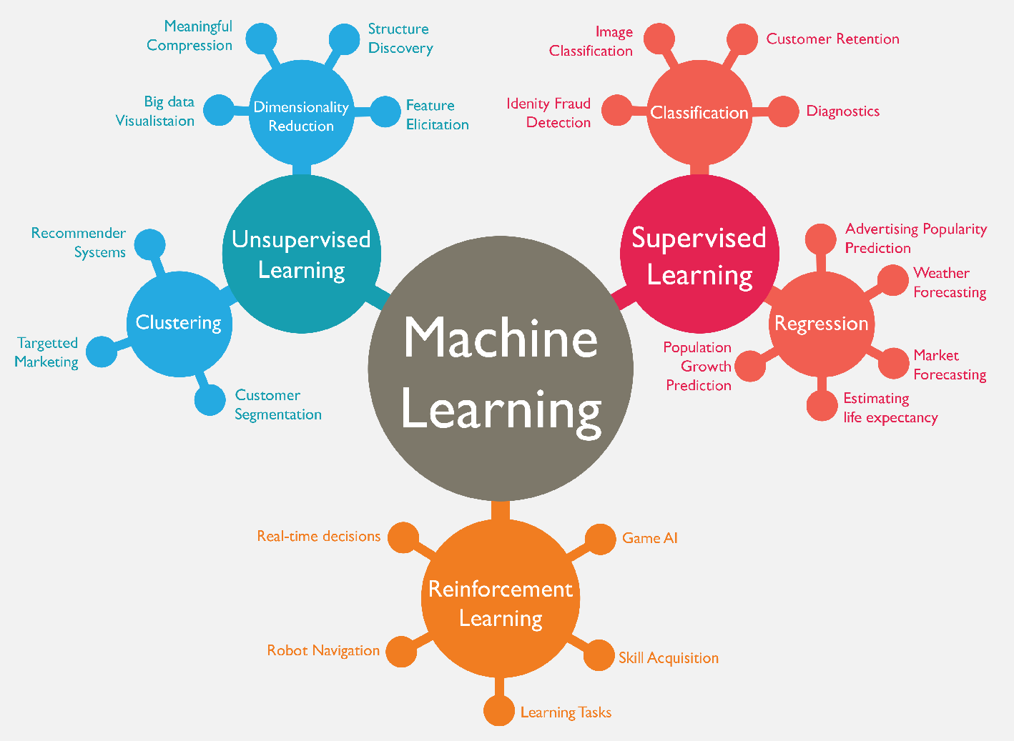
Machine Learning (ML)
Source: https://www.mactores.com/services/aws-big-data-machine-learning-cognitive-services/

Slide 46
Machine Learning (ML) / Deep Learning (DL)
Decision Tree Classifiers
Support Vector Machine (SVM)
Supervised Learning
Neural Network (NN)
Linear Classifiers
Deep Learning (DL)
Machine Learning
(ML)
Rule-based Classifiers
Naïve Bayes
(NB)
Unsupervised Learning
Probabilistic Classifiers
Bayesian Network (BN)
Maximum Entropy (ME)
Reinforcement Learning
Source: Jesus Serrano-Guerrero, Jose A. Olivas, Francisco P. Romero, and Enrique Herrera-Viedma (2015),
"Sentiment analysis: A review and comparative analysis of web services," Information Sciences, 311, pp. 18-38.

Slide 47
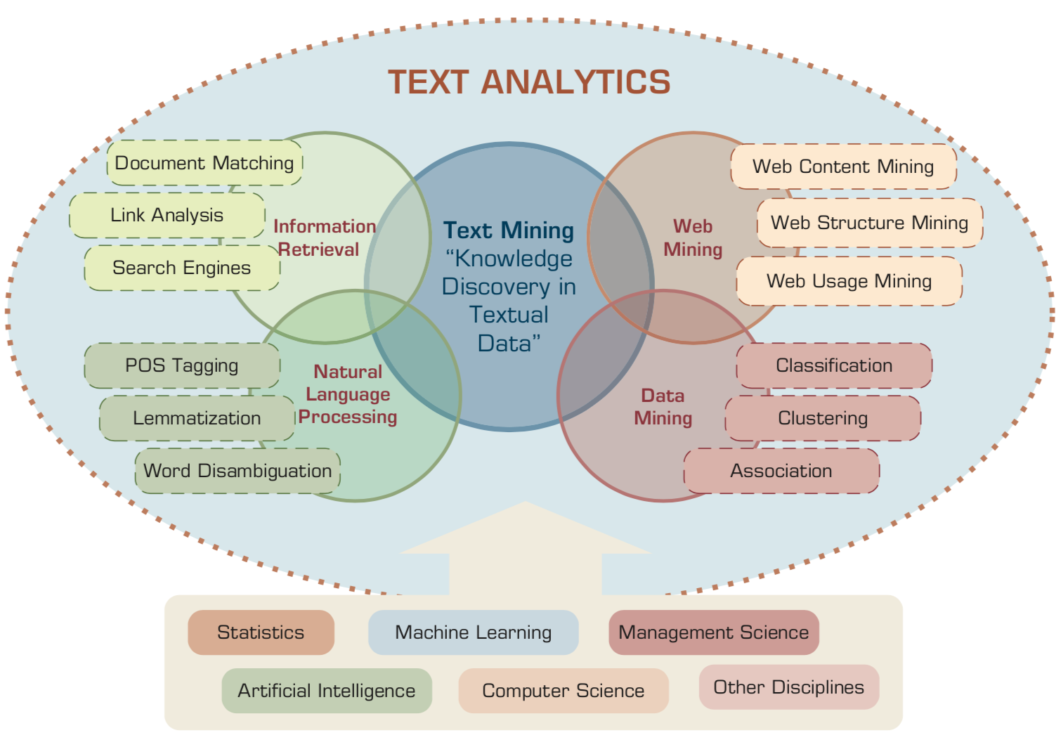
AI for Text Analytics
Source: Ramesh Sharda, Dursun Delen, and Efraim Turban (2017), Business Intelligence, Analytics, and Data Science: A Managerial Perspective, 4th Edition, Pearson

Slide 48
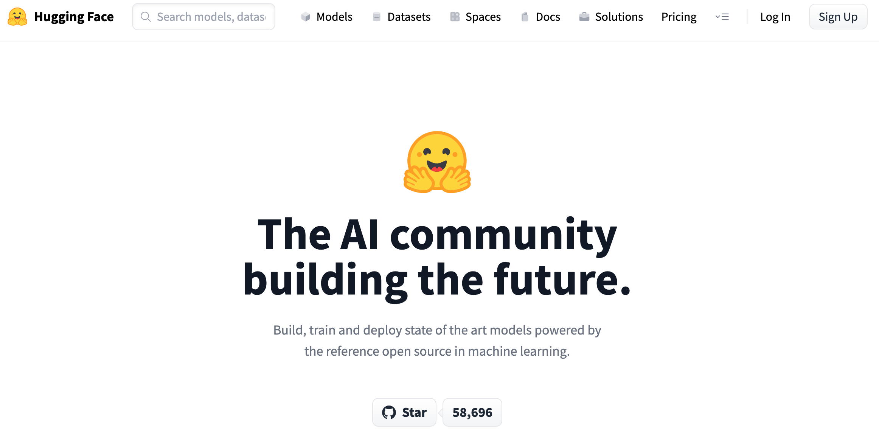
Hugging Face
https://huggingface.co/

Slide 49
The Transformers Timeline
ULMFit
BERT
RoBERTa
XLM-R
DeBERTa
GPT-Neo
T5
Transformer
GPT
GPT-2
DistrilBERT
GPT-3
GPT-J
2017
2018
2019
2020
2021
2022
Source: Lewis Tunstall, Leandro von Werra, and Thomas Wolf (2022), Natural Language Processing with Transformers: Building Language Applications with Hugging Face, O'Reilly Media.

Slide 50
Transformer Models
Transformer
Encoder
Decoder
DistilBERT
BERT
T5
GPT
RoBERTa
BART
GPT-2
CTRL
XLM-R
XLM
M2M-100
GPT-3
ALBERT
BigBird
GPT-Neo
GPT-J
ELECTRA
DeBERTa
Source: Lewis Tunstall, Leandro von Werra, and Thomas Wolf (2022), Natural Language Processing with Transformers: Building Language Applications with Hugging Face, O'Reilly Media.

Slide 51
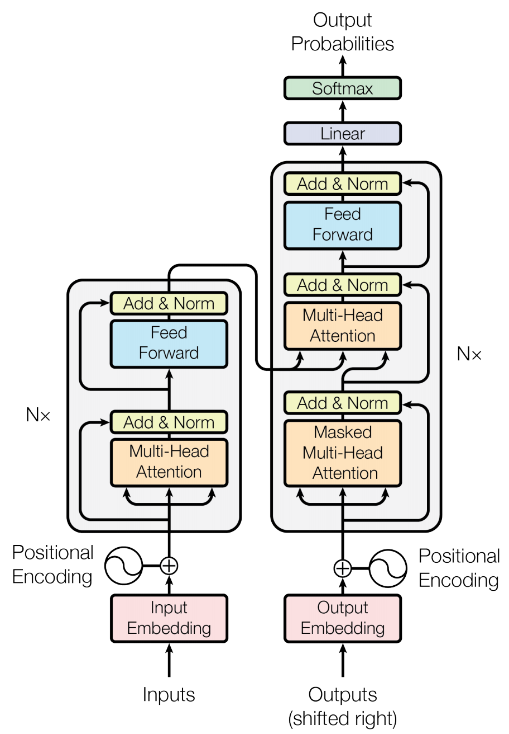
Transformer (Attention is All You Need)
(Vaswani et al., 2017)
Source: Vaswani, Ashish, Noam Shazeer, Niki Parmar, Jakob Uszkoreit, Llion Jones, Aidan N. Gomez, Łukasz Kaiser, and Illia Polosukhin. "Attention is all you need." In Advances in neural information processing systems, pp. 5998-6008. 2017.

Slide 52
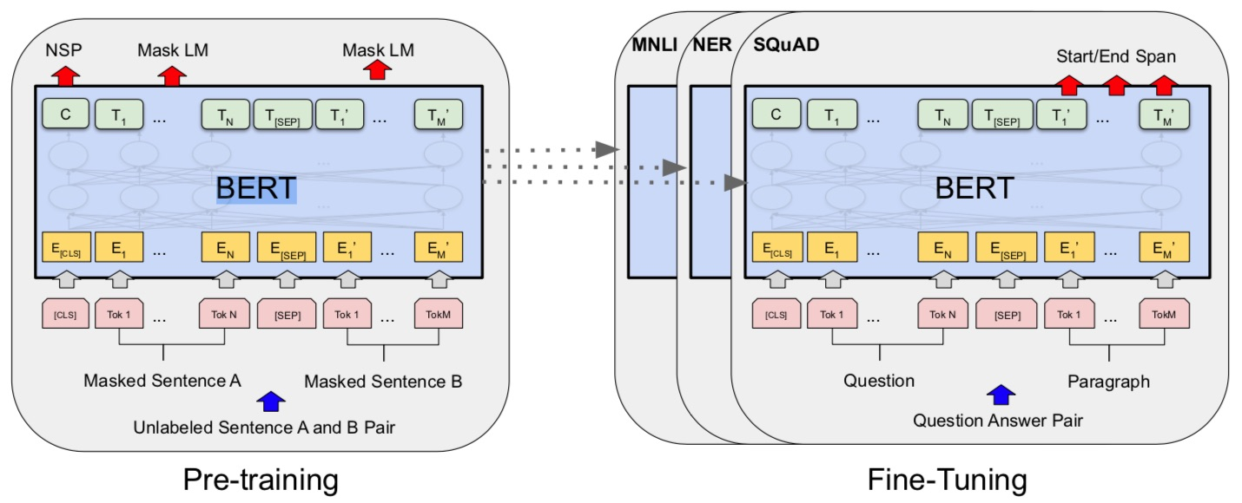
BERT: Pre-training of Deep Bidirectional Transformers for Language Understanding
BERT (Bidirectional Encoder Representations from Transformers)
Overall pre-training and fine-tuning procedures for BERT
Source: Devlin, Jacob, Ming-Wei Chang, Kenton Lee, and Kristina Toutanova (2018).
"Bert: Pre-training of deep bidirectional transformers for language understanding." arXiv preprint arXiv:1810.04805.

Slide 53
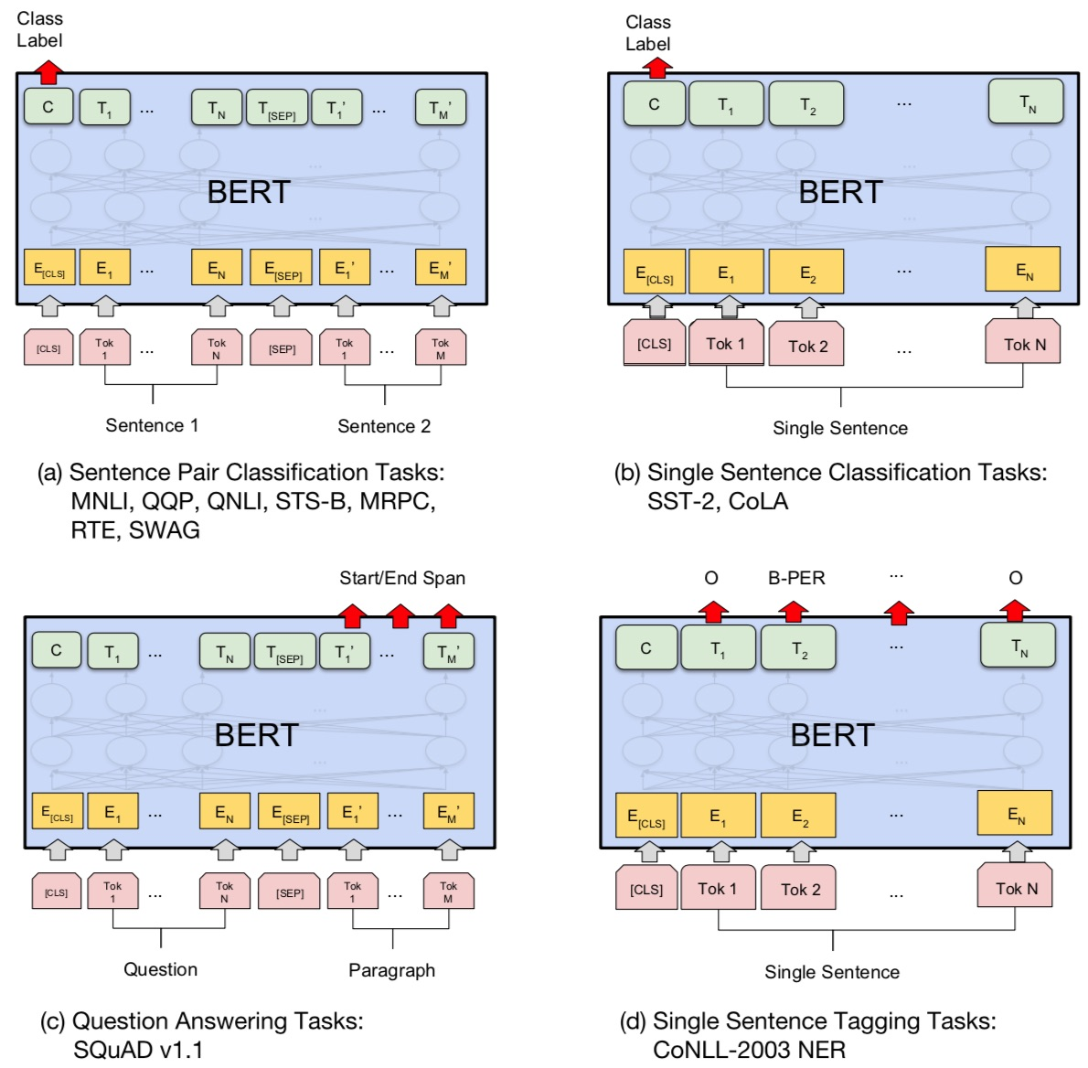
Fine-tuning BERT on Different Tasks
Source: Devlin, Jacob, Ming-Wei Chang, Kenton Lee, and Kristina Toutanova (2018).
"Bert: Pre-training of deep bidirectional transformers for language understanding." arXiv preprint arXiv:1810.04805.

Slide 54
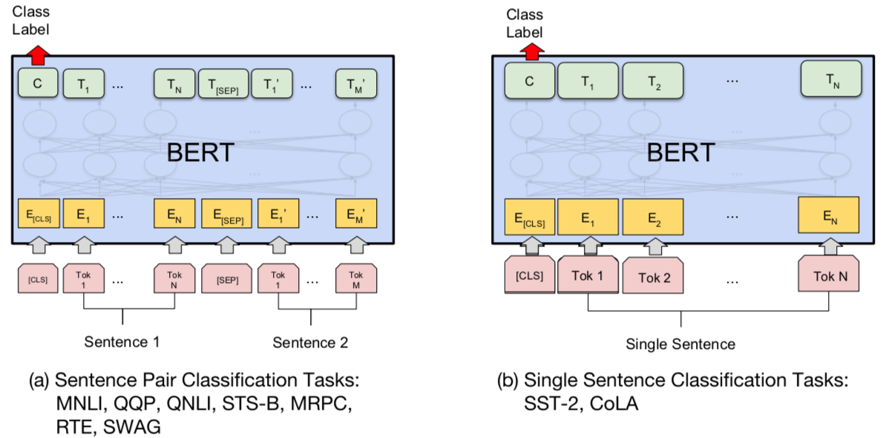
Sentiment Analysis:
Single Sentence Classification
Source: Devlin, Jacob, Ming-Wei Chang, Kenton Lee, and Kristina Toutanova (2018).
"BERT: Pre-training of Deep Bidirectional Transformers for Language Understanding." arXiv preprint arXiv:1810.04805

Slide 55
Fine-tuning BERT on
Question Answering (QA)
Source: Devlin, Jacob, Ming-Wei Chang, Kenton Lee, and Kristina Toutanova (2018).
"Bert: Pre-training of deep bidirectional transformers for language understanding." arXiv preprint arXiv:1810.04805.

Slide 56
Fine-tuning BERT on Dialogue
Intent Detection (ID; Classification)
Source: Devlin, Jacob, Ming-Wei Chang, Kenton Lee, and Kristina Toutanova (2018).
"Bert: Pre-training of deep bidirectional transformers for language understanding." arXiv preprint arXiv:1810.04805.

Slide 57
Fine-tuning BERT on Dialogue
Slot Filling (SF)
Source: Devlin, Jacob, Ming-Wei Chang, Kenton Lee, and Kristina Toutanova (2018).
"Bert: Pre-training of deep bidirectional transformers for language understanding." arXiv preprint arXiv:1810.04805.

Slide 58
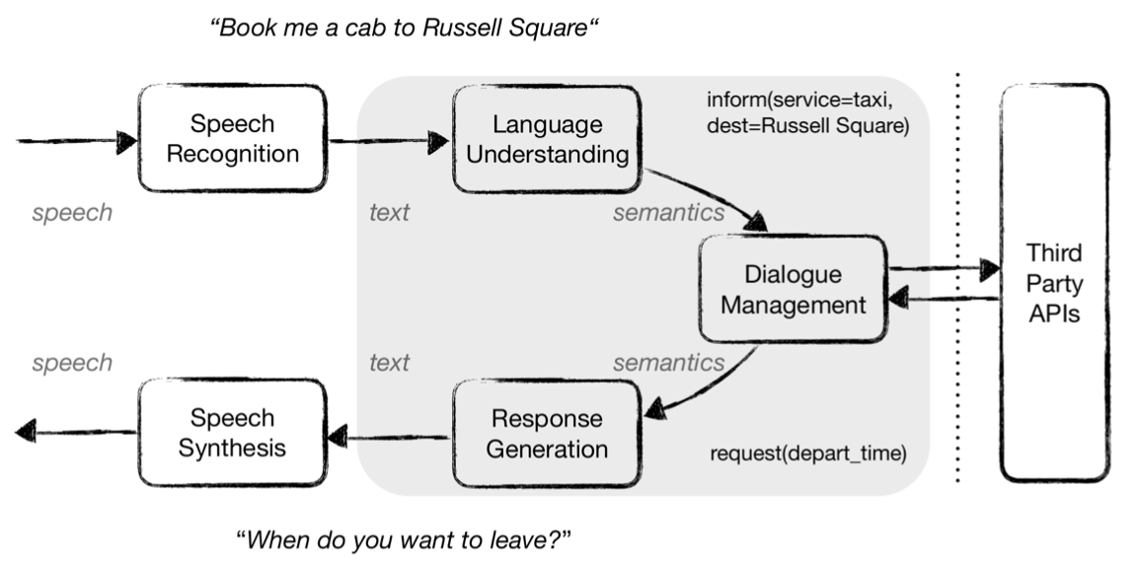
Task-Oriented Dialogue (ToD) System
Speech, Text, NLP
Source: Razumovskaia, Evgeniia, Goran Glavas, Olga Majewska, Edoardo M. Ponti, Anna Korhonen, and Ivan Vulic.
"Crossing the conversational chasm: A primer on natural language processing for multilingual task-oriented dialogue systems." Journal of Artificial Intelligence Research 74 (2022): 1351-1402.

Slide 59
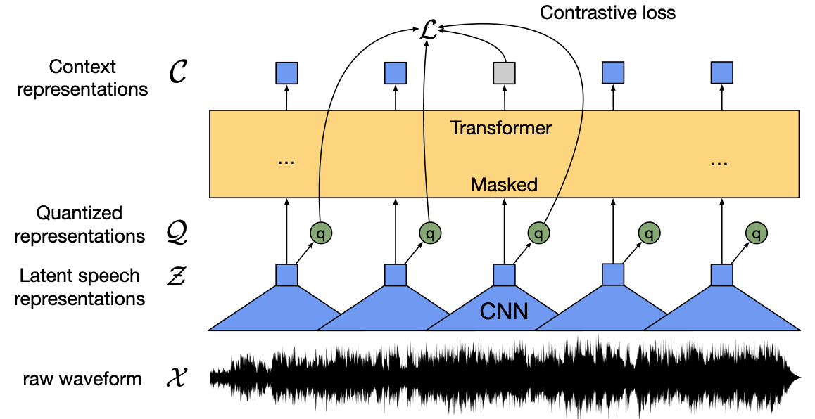
wav2vec 2.0:
A framework for self-supervised learning of speech representations
Source: Baevski, Alexei, Yuhao Zhou, Abdelrahman Mohamed, and Michael Auli.
"wav2vec 2.0: A framework for self-supervised learning of speech representations." Advances in Neural Information Processing Systems 33 (2020): 12449-12460.

Slide 60
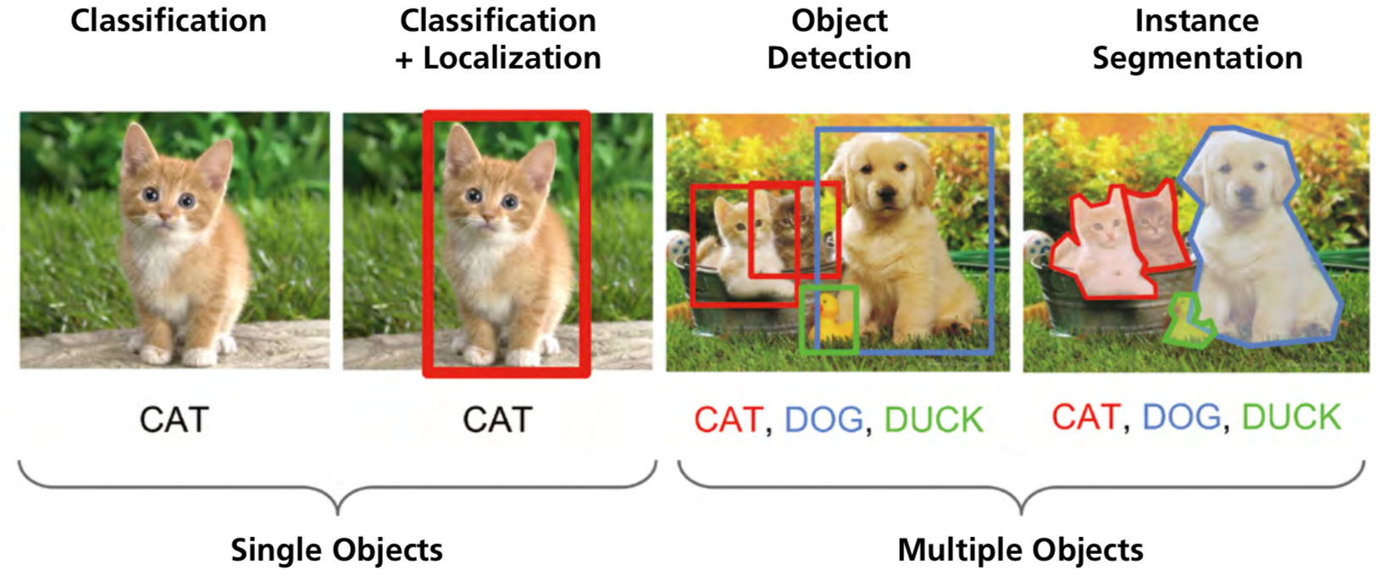
Computer Vision:
Image Classification, Object Detection,
Object Instance Segmentation
Source: DHL (2018), Artificial Intelligence in Logistics,
http://www.globalhha.com/doclib/data/upload/doc_con/5e50c53c5bf67.pdf/

Slide 61
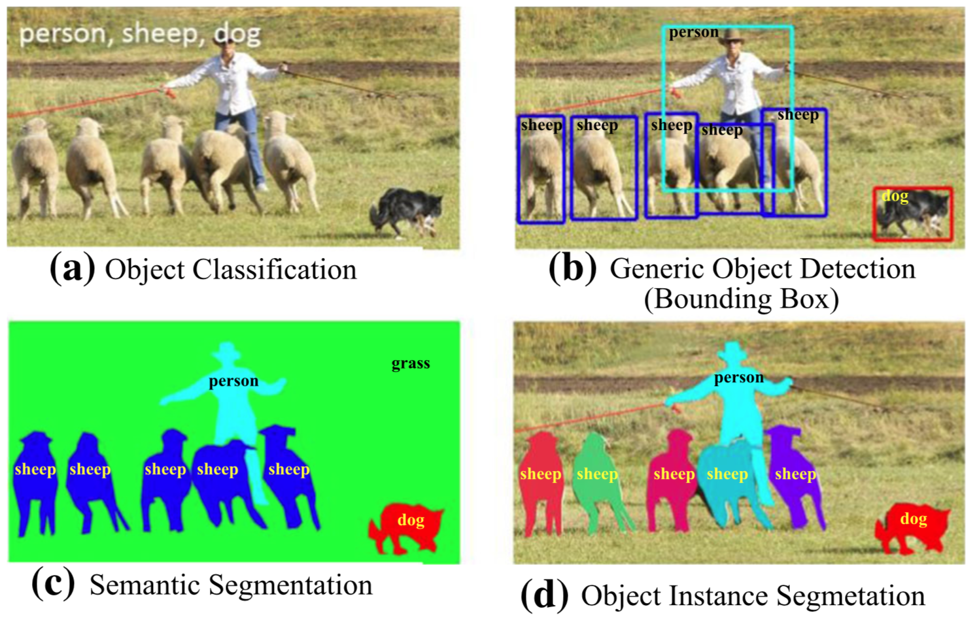
Computer Vision: Object Detection
Source: Li Liu, Wanli Ouyang, Xiaogang Wang, Paul Fieguth, Jie Chen, Xinwang Liu, and Matti Pietikäinen. "Deep learning for generic object detection: A survey." International journal of computer vision 128, no. 2 (2020): 261-318.

Slide 62
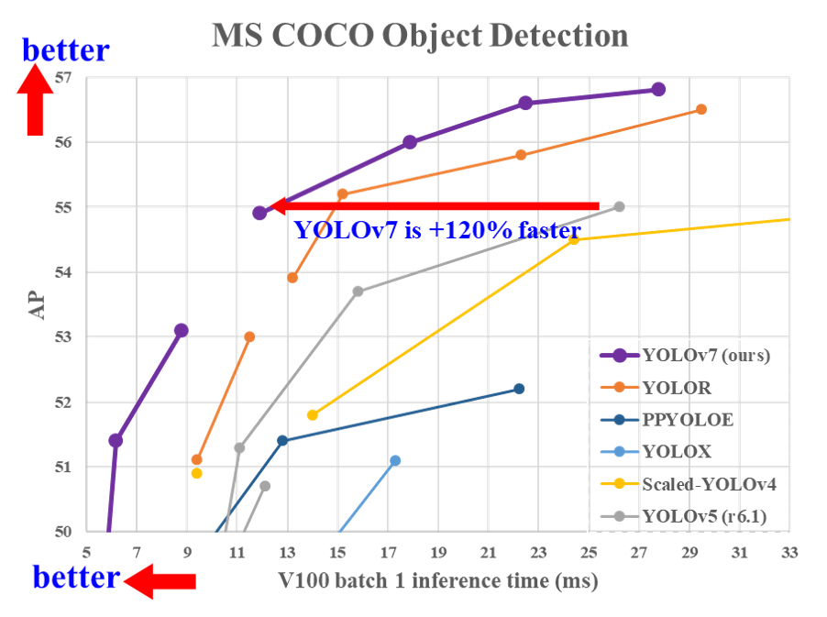
YOLOv7:
Trainable bag-of-freebies sets new state-of-the-art for real-time object detectors
Source: Wang, Chien-Yao, Alexey Bochkovskiy, and Hong-Yuan Mark Liao.
"YOLOv7: Trainable bag-of-freebies sets new state-of-the-art for real-time object detectors." arXiv preprint arXiv:2207.02696 (2022).

Slide 63
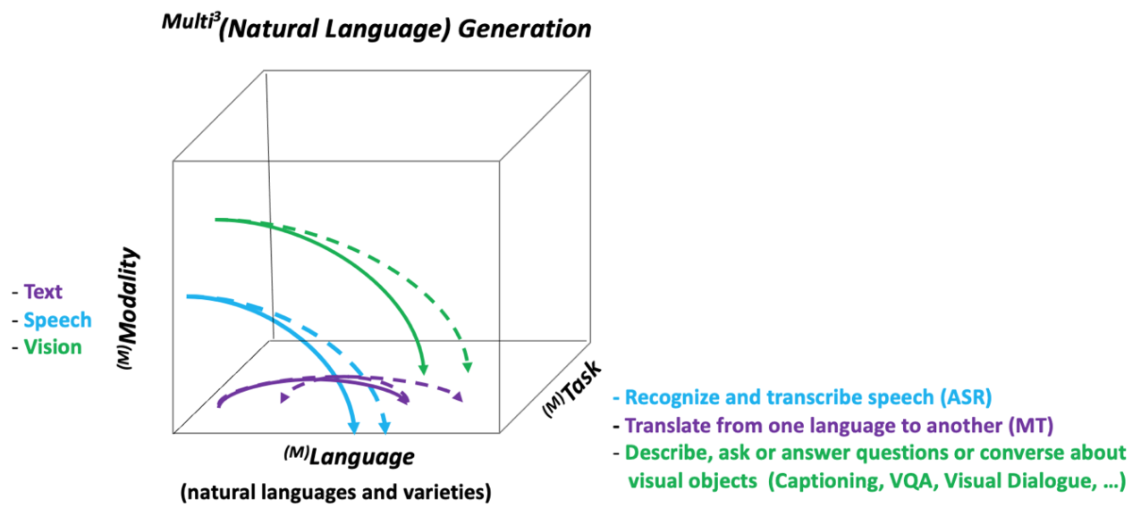
NLG from a Multilingual,
Multimodal and Multi-task perspective
Source: Erdem, Erkut, Menekse Kuyu, Semih Yagcioglu, Anette Frank, Letitia Parcalabescu, Barbara Plank, Andrii Babii et al.
"Neural Natural Language Generation: A Survey on Multilinguality, Multimodality, Controllability and Learning." Journal of Artificial Intelligence Research 73 (2022): 1131-1207.

Slide 64
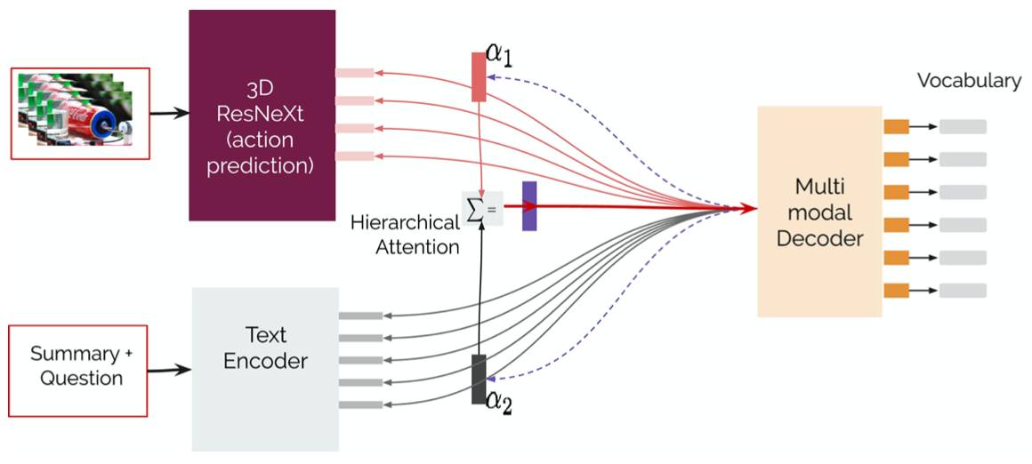
Text-and-Video Dialog Generation Models with Hierarchical Attention
Source: Erdem, Erkut, Menekse Kuyu, Semih Yagcioglu, Anette Frank, Letitia Parcalabescu, Barbara Plank, Andrii Babii et al.
"Neural Natural Language Generation: A Survey on Multilinguality, Multimodality, Controllability and Learning." Journal of Artificial Intelligence Research 73 (2022): 1131-1207.

Slide 65
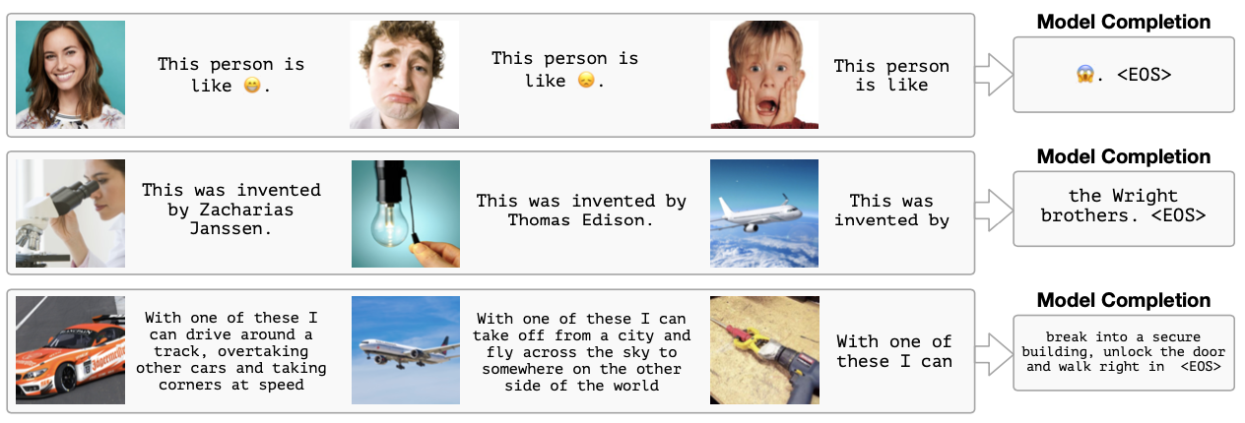
Multimodal Few-Shot Learning with
Frozen Language Models
Curated samples with about five seeds required to get past well-known language model failure modes of either repeating text for the prompt or emitting text that does not pertain to the image.
These samples demonstrate the ability to generate open-ended outputs that adapt to both images and text, and to make use of facts that it has learned during language-only pre-training.
Source: Maria Tsimpoukelli, Jacob L. Menick, Serkan Cabi, S. M. Eslami, Oriol Vinyals, and Felix Hill (2021). "Multimodal few-shot learning with frozen language models."
Advances in Neural Information Processing Systems 34 (2021): 200-212.

Slide 66
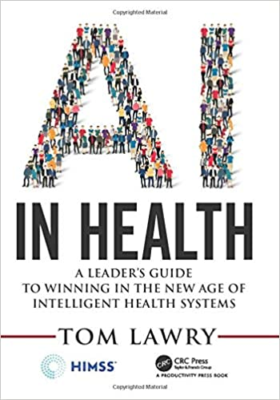
Tom Lawry (2020),
AI in Health:
A Leader’s Guide to Winning in the New Age of Intelligent Health Systems,
HIMSS Publishing
Source: Tom Lawry (2020), AI in Health: A Leader’s Guide to Winning in the New Age of Intelligent Health Systems, HIMSS Publishing
https://www.amazon.com/Health-HIMSS-Book-Tom-Lawry/dp/0367333716/

Slide 67
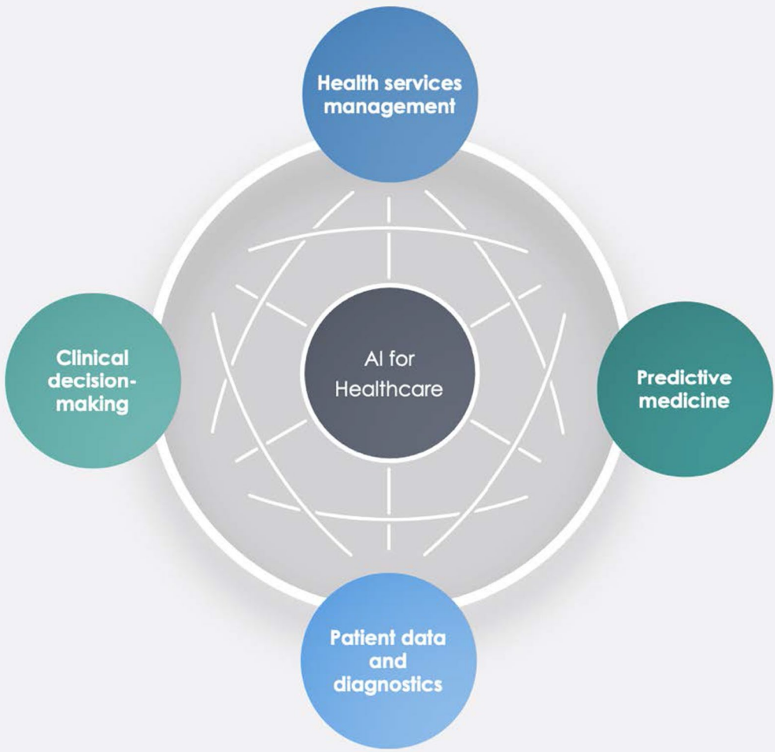
AI in Healthcare
Source: Secinaro, Silvana, Davide Calandra, Aurelio Secinaro, Vivek Muthurangu, and Paolo Biancone. "The role of artificial intelligence in healthcare: a structured literature review." BMC Medical Informatics and Decision Making 21, no. 1 (2021): 1-23.

Slide 68
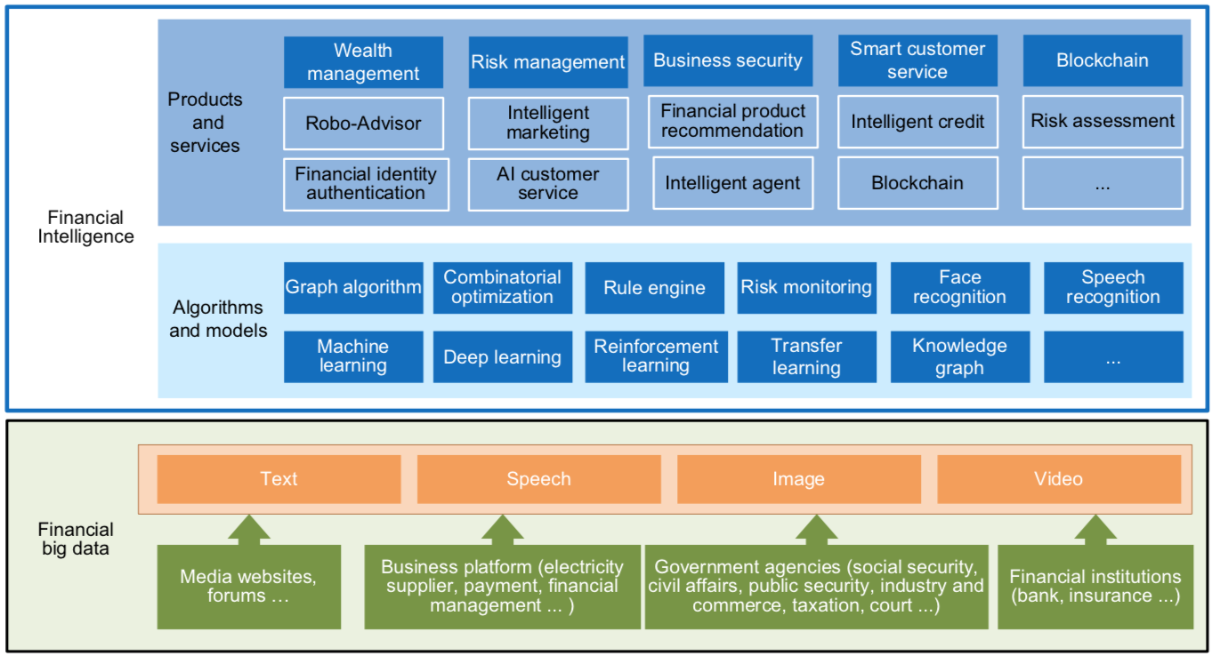
FinBrain: when Finance meets AI 2.0
(Zheng et al., 2019)
Source: Xiao-lin Zheng, Meng-ying Zhu, Qi-bing Li, Chao-chao Chen, and Yan-chao Tan (2019), "Finbrain: When finance meets AI 2.0." Frontiers of Information Technology & Electronic Engineering 20, no. 7, pp. 914-924

Slide 69
Technology-driven
Financial Industry Development
Development stage | Driving technology | Main landscape | Inclusive finance | Relationship between technology and finance
Fintech 1.0 (financial IT) | Computer | Credit card, ATM, and CRMS | Low | Technology as a tool
Fintech 2.0 (Internet finance) | Mobile Internet | Marketplace lending, third-party payment, crowdfunding, and Internet insurance | Medium | Technology-driven change
Fintech 3.0 (financial intelligence) | AI, Big Data, Cloud Computing, Blockchain | Intelligent finance | High | Deep fusion
Source: Xiao-lin Zheng, Meng-ying Zhu, Qi-bing Li, Chao-chao Chen, and Yan-chao Tan (2019), "Finbrain: When finance meets AI 2.0." Frontiers of Information Technology & Electronic Engineering 20, no. 7, pp. 914-924

Slide 70
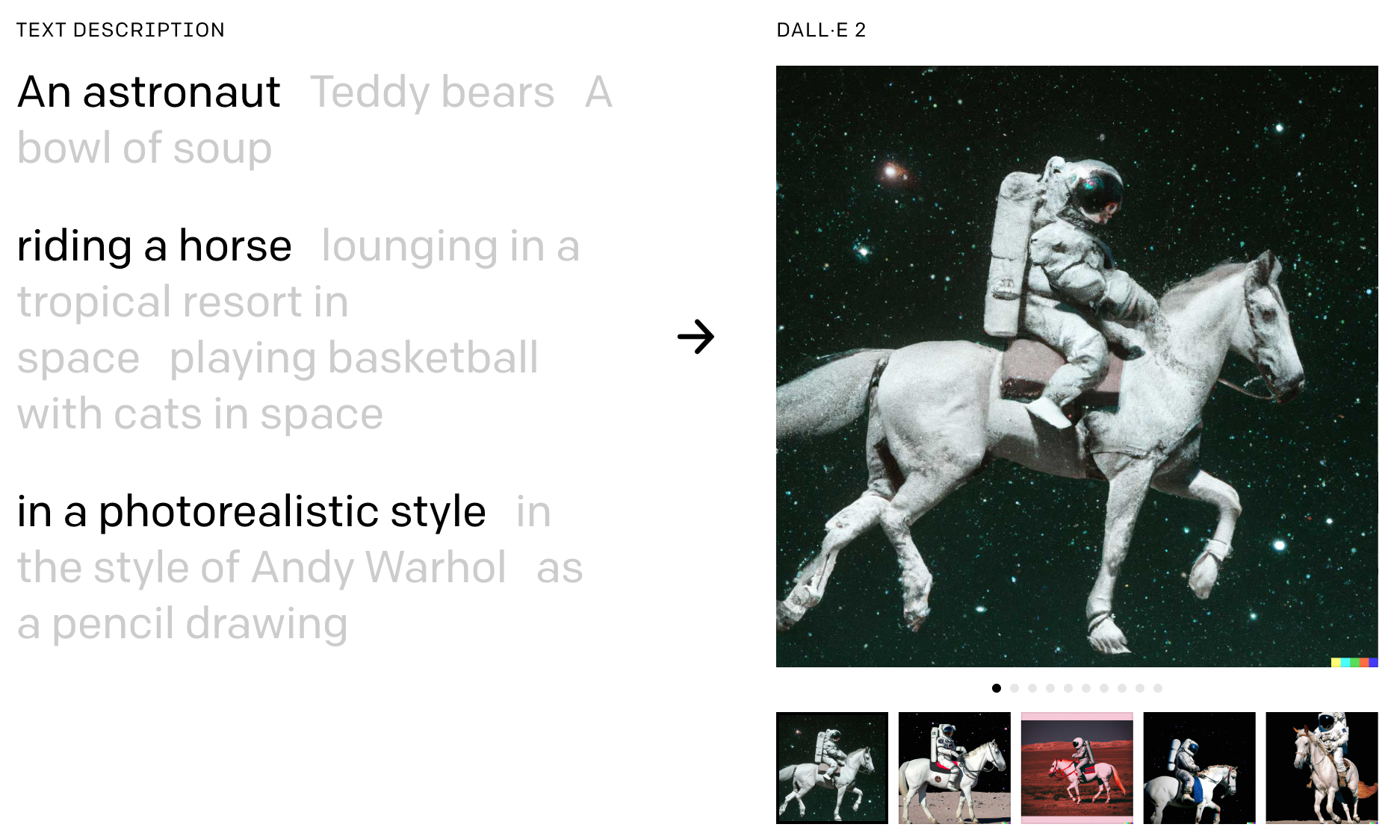
DALL-E 2
AI system that can create realistic images and art from a description in natural language
https://openai.com/dall-e-2/

Slide 71
Deep learning for financial applications:
A survey
Applied Soft Computing (2020)
Source:
Ahmet Murat Ozbayoglu, Mehmet Ugur Gudelek, and Omer Berat Sezer (2020). "Deep learning for financial applications: A survey."
Applied Soft Computing (2020): 106384.

Slide 72
Financial time series forecasting with deep learning:
A systematic literature review:
2005–2019
Applied Soft Computing (2020)
Source:
Omer Berat Sezer, Mehmet Ugur Gudelek, and Ahmet Murat Ozbayoglu (2020), "Financial time series forecasting with deep learning: A systematic literature review: 2005–2019." Applied Soft Computing 90 (2020): 106181.

Slide 73
Deep learning for financial applications: Topic-Model Heatmap
Source: Ahmet Murat Ozbayoglu, Mehmet Ugur Gudelek, and Omer Berat Sezer (2020). "Deep learning for financial applications: A survey." Applied Soft Computing (2020): 106384.

Slide 74
Deep learning for financial applications: Topic-Feature Heatmap
Source: Ahmet Murat Ozbayoglu, Mehmet Ugur Gudelek, and Omer Berat Sezer (2020). "Deep learning for financial applications: A survey." Applied Soft Computing (2020): 106384.

Slide 75
Deep learning for financial applications: Topic-Dataset Heatmap
Source: Ahmet Murat Ozbayoglu, Mehmet Ugur Gudelek, and Omer Berat Sezer (2020). "Deep learning for financial applications: A survey." Applied Soft Computing (2020): 106384.

Slide 76
Financial time series forecasting with deep learning: Topic-model heatmap
Source: Omer Berat Sezer, Mehmet Ugur Gudelek, and Ahmet Murat Ozbayoglu (2020), "Financial time series forecasting with deep learning:
A systematic literature review: 2005–2019." Applied Soft Computing 90 (2020): 106181.

Slide 77
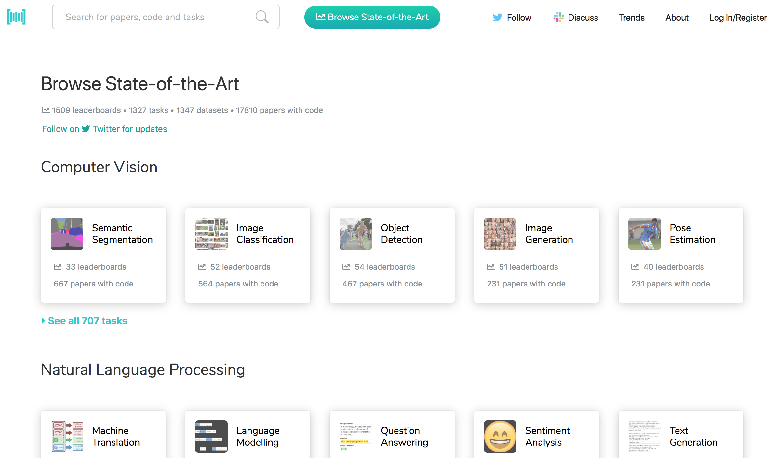
Papers with Code
State-of-the-Art (SOTA)
https://paperswithcode.com/sota

Slide 78

Python in Google Colab (Python101)
https://colab.research.google.com/drive/1FEG6DnGvwfUbeo4zJ1zTunjMqf2RkCrT
https://tinyurl.com/aintpupython101

Slide 79

Teaching
Artificial Intelligence
  Spring 2021, Fall 2022
Artificial Intelligence in Finance and Quantitative
  Fall 2021, Fall 2022
Software Engineering
  Fall 2020, Fall, 2021, Spring 2022, Spring 2023
Artificial Intelligence for Text Analytics
  Spring 2022
Data Mining
  Spring 2021
Big Data Analytics
  Fall 2020
Foundation of Business Cloud Computing
  Spring 2021, Spring 2022, Spring 2023
https://web.ntpu.edu.tw/~myday/teaching.htm

Slide 80
Research Project
Applying AI technology to construct knowledge graphs of cryptocurrency anti-money laundering: a few-shot learning model
  MOST, 110-2410-H-305-013-MY2, 2021/08/01~2023/07/31
Deepen Corporate Sustainability: Enhance the Performance of Corporate Sustainability from AI, Financial, and Strategic Perspectives. AI for Corporate Sustainability Assessment and Cross Language Corporate Sustainability Reports Generative Mode
  NTPU, 111-NTPU_ORDA-F-001，2022/01/01~2022/12/31
Artificial intelligence methods applied for analyzing the introduction of technological innovation: Patent text analysis and image analysis. Artificial Intelligence for FinTech Knowledge Graph from Patent Textual Analytics
  NTPU, 111-NTPU_ORDA-F-003, 2022/01/01~2022/12/31
Establishment and Implement of Smart Assistive Technology for Dementia Care and Its Socio-Economic Impacts. Intelligent, individualized and precise care with smart AT and system integration
  MOST, 111-2627-M-038-001-, 2022/08/01~2023/07/31
https://web.ntpu.edu.tw/~myday/cindex.htm#projects

Slide 81
Summary
This course introduces the fundamental concepts, research issues, and hands-on practices of Artificial Intelligence.
Topics include:
  Introduction to Artificial Intelligence
  Artificial Intelligence and Intelligent Agents
  Problem Solving
  Knowledge, Reasoning and Knowledge Representation, Uncertain Knowledge and Reasoning
  Machine Learning: Supervised and Unsupervised Learning
  The Theory of Learning and Ensemble Learning
  Deep Learning, Reinforcement Learning
  Deep Learning for Natural Language Processing
  Computer Vision and Robotics
  Philosophy and Ethics of AI and the Future of AI
  Case Study on AI

Slide 82

Artificial Intelligence
Contact Information
Min-Yuh Day, Ph.D.
Associate Professor
Institute of Information Management, National Taipei University
Tel: 02-86741111 ext. 66873
Office: B8F12
Address: 151, University Rd., San Shia District, New Taipei City, 23741 Taiwan
Email: myday@gm.ntpu.edu.tw
Web: http://web.ntpu.edu.tw/~myday/

