Slide 1


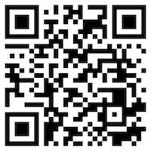





Deep Learning and
Reinforcement Learning
Artificial Intelligence
1111AI07
MBA, IM, NTPU (M6132) (Fall 2022)
Wed 2, 3, 4 (9:10-12:00) (B8F40)
Min-Yuh Day, Ph.D,
Associate Professor
Institute of Information Management, National Taipei University
https://web.ntpu.edu.tw/~myday
https://meet.google.com/miy-fbif-max
2022-11-09

Slide 2
Syllabus
Week Date Subject/Topics
1 2022/09/14 Introduction to Artificial Intelligence
2 2022/09/21 Artificial Intelligence and Intelligent Agents
3 2022/09/28 Problem Solving
4 2022/10/05 Knowledge, Reasoning and Knowledge Representation;
Uncertain Knowledge and Reasoning
5 2022/10/12 Case Study on Artificial Intelligence I
6 2022/10/19 Machine Learning: Supervised and Unsupervised Learning

Slide 3
Syllabus
Week Date Subject/Topics
7 2022/10/26 The Theory of Learning and Ensemble Learning
8 2022/11/02 Midterm Project Report
9 2022/11/09 Deep Learning and Reinforcement Learning
10 2022/11/16 Deep Learning for Natural Language Processing
11 2022/11/23 Invited Talk: AI for Information Retrieval
12 2022/11/30 Case Study on Artificial Intelligence II

Slide 4
Syllabus
Week Date Subject/Topics
13 2022/12/07 Computer Vision and Robotics
14 2022/12/14 Philosophy and Ethics of AI and the Future of AI
15 2022/12/21 Final Project Report I
16 2022/12/28 Final Project Report II
17 2023/01/04 Self-learning
18 2023/01/11 Self-learning

Slide 5
Deep Learning and
Reinforcement Learning

Slide 6
Outline
Deep Learning
  Neural Networks (NN)
  Convolutional Neural Networks (CNN)
  Recurrent Neural Networks (RNN)
Reinforcement Learning (RL)
  Markov Decision Processes (MDP)
Deep Reinforcement Learning (DRL) Algorithms
  SARSA
  Q-Learning
  DQN
  A3C
  Rainbow

Slide 7
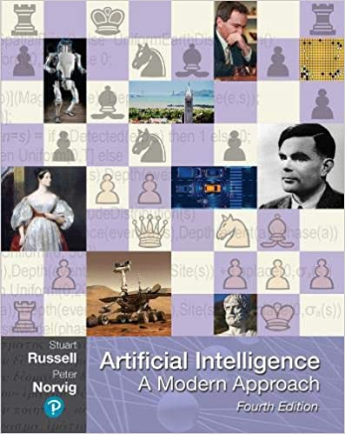
Stuart Russell and Peter Norvig (2020),
Artificial Intelligence: A Modern Approach,
4th Edition, Pearson
Source: Stuart Russell and Peter Norvig (2020), Artificial Intelligence: A Modern Approach, 4th Edition, Pearson
https://www.amazon.com/Artificial-Intelligence-A-Modern-Approach/dp/0134610997/

Slide 8
Artificial Intelligence:
A Modern Approach
Artificial Intelligence
Problem Solving
Knowledge and Reasoning
Uncertain Knowledge and Reasoning
Machine Learning
Communicating, Perceiving, and Acting
Philosophy and Ethics of AI
Source: Stuart Russell and Peter Norvig (2020), Artificial Intelligence: A Modern Approach, 4th Edition, Pearson

Slide 9
Artificial Intelligence:
Machine Learning
Source: Stuart Russell and Peter Norvig (2020), Artificial Intelligence: A Modern Approach, 4th Edition, Pearson

Slide 10
Artificial Intelligence:
5. Machine Learning
Learning from Examples
Learning Probabilistic Models
Deep Learning
Reinforcement Learning
Source: Stuart Russell and Peter Norvig (2020), Artificial Intelligence: A Modern Approach, 4th Edition, Pearson

Slide 11
Artificial Intelligence:
Reinforcement Learning
Learning from Rewards
Passive Reinforcement Learning
Active Reinforcement Learning
Generalization in Reinforcement Learning
Policy Search
Apprenticeship and Inverse Reinforcement Learning
Applications of Reinforcement Learning
Source: Stuart Russell and Peter Norvig (2020), Artificial Intelligence: A Modern Approach, 4th Edition, Pearson

Slide 12
Reinforcement Learning (DL)
Agent
Environment
Source: Richard S. Sutton & Andrew G. Barto (2018), Reinforcement Learning: An Introduction, 2nd Edition, A Bradford Book.

Slide 13
Reinforcement Learning (DL)
1
2
observation
Agent
action
3
reward
Environment
Source: Richard S. Sutton & Andrew G. Barto (2018), Reinforcement Learning: An Introduction, 2nd Edition, A Bradford Book.

Slide 14
Reinforcement Learning (DL)
1
2
observation
Agent
action
O_{t}
A_{t}
3
reward
R_{t}
Environment
Source: Richard S. Sutton & Andrew G. Barto (2018), Reinforcement Learning: An Introduction, 2nd Edition, A Bradford Book.

Slide 15
Agents interact with environments through sensors and actuators
Source: Stuart Russell and Peter Norvig (2020), Artificial Intelligence: A Modern Approach, 4th Edition, Pearson

Slide 16
AI Acting Humanly:
The Turing Test Approach
(Alan Turing, 1950)
Knowledge Representation
Automated Reasoning
Machine Learning (ML)
  Deep Learning (DL)
Computer Vision (Image, Video)
Natural Language Processing (NLP)
Robotics
Source: Stuart Russell and Peter Norvig (2020), Artificial Intelligence: A Modern Approach, 4th Edition, Pearson

Slide 17
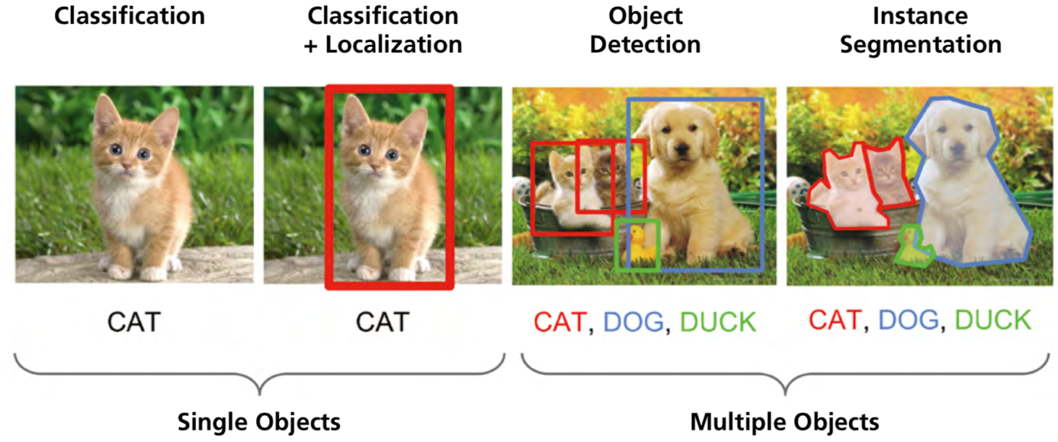
Computer Vision: Image Classification,
Object Detection,
Object Instance Segmentation
Source: DHL (2018), Artificial Intelligence in Logistics,
http://www.globalhha.com/doclib/data/upload/doc_con/5e50c53c5bf67.pdf/

Slide 18
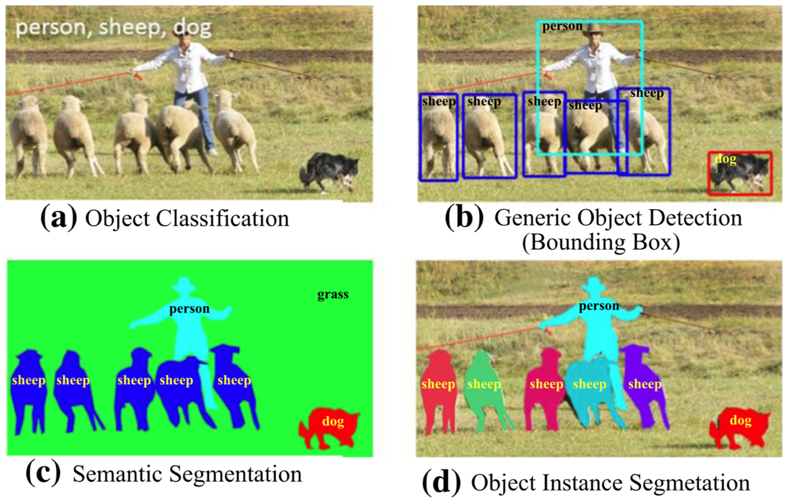
Computer Vision: Object Detection
Source: Li Liu, Wanli Ouyang, Xiaogang Wang, Paul Fieguth, Jie Chen, Xinwang Liu, and Matti Pietikäinen. "Deep learning for generic object detection: A survey." International journal of computer vision 128, no. 2 (2020): 261-318.

Slide 19
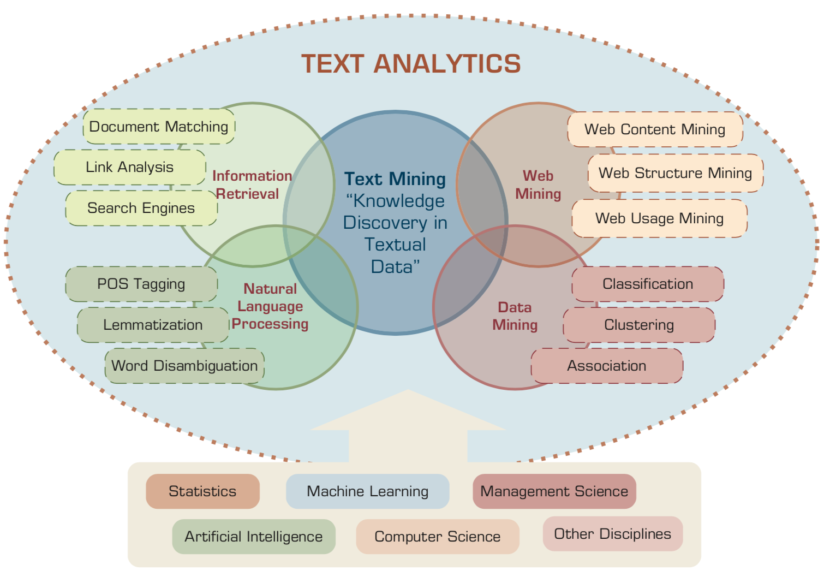
Text Analytics and Text Mining
Source: Ramesh Sharda, Dursun Delen, and Efraim Turban (2017), Business Intelligence, Analytics, and Data Science: A Managerial Perspective, 4th Edition, Pearson

Slide 20
Deep learning for financial applications:
A survey
Applied Soft Computing (2020)
Source:
Ahmet Murat Ozbayoglu, Mehmet Ugur Gudelek, and Omer Berat Sezer (2020). "Deep learning for financial applications: A survey."
Applied Soft Computing (2020): 106384.

Slide 21
Financial time series forecasting with deep learning:
A systematic literature review:
2005–2019
Applied Soft Computing (2020)
Source:
Omer Berat Sezer, Mehmet Ugur Gudelek, and Ahmet Murat Ozbayoglu (2020), "Financial time series forecasting with deep learning: A systematic literature review: 2005–2019." Applied Soft Computing 90 (2020): 106181.

Slide 22
Deep learning for financial applications: Topics
Source: Ahmet Murat Ozbayoglu, Mehmet Ugur Gudelek, and Omer Berat Sezer (2020). "Deep learning for financial applications: A survey." Applied Soft Computing (2020): 106384.

Slide 23
Deep learning for financial applications: Deep Learning Models
Source: Ahmet Murat Ozbayoglu, Mehmet Ugur Gudelek, and Omer Berat Sezer (2020). "Deep learning for financial applications: A survey." Applied Soft Computing (2020): 106384.

Slide 24
Deep learning for financial applications: Topic-Model Heatmap
Source: Ahmet Murat Ozbayoglu, Mehmet Ugur Gudelek, and Omer Berat Sezer (2020). "Deep learning for financial applications: A survey." Applied Soft Computing (2020): 106384.

Slide 25
Deep learning for financial applications: Topic-Feature Heatmap
Source: Ahmet Murat Ozbayoglu, Mehmet Ugur Gudelek, and Omer Berat Sezer (2020). "Deep learning for financial applications: A survey." Applied Soft Computing (2020): 106384.

Slide 26
Deep learning for financial applications: Topic-Dataset Heatmap
Source: Ahmet Murat Ozbayoglu, Mehmet Ugur Gudelek, and Omer Berat Sezer (2020). "Deep learning for financial applications: A survey." Applied Soft Computing (2020): 106384.

Slide 27
Deep learning for financial applications:
Algo-trading applications embedded with time series forecasting models
Source: Ahmet Murat Ozbayoglu, Mehmet Ugur Gudelek, and Omer Berat Sezer (2020). "Deep learning for financial applications: A survey." Applied Soft Computing (2020): 106384.

Slide 28
Deep learning for financial applications:
Algo-trading applications embedded with time series forecasting models
Source: Ahmet Murat Ozbayoglu, Mehmet Ugur Gudelek, and Omer Berat Sezer (2020). "Deep learning for financial applications: A survey." Applied Soft Computing (2020): 106384.

Slide 29
Deep learning for financial applications:
Classification (buy–sell signal, or trend detection) based algo-trading models
Source: Ahmet Murat Ozbayoglu, Mehmet Ugur Gudelek, and Omer Berat Sezer (2020). "Deep learning for financial applications: A survey." Applied Soft Computing (2020): 106384.

Slide 30
Deep learning for financial applications:
Stand-alone and/or other algorithmic models
Source: Ahmet Murat Ozbayoglu, Mehmet Ugur Gudelek, and Omer Berat Sezer (2020). "Deep learning for financial applications: A survey." Applied Soft Computing (2020): 106384.

Slide 31
Deep learning for financial applications:
Credit scoring or classification studies
Source: Ahmet Murat Ozbayoglu, Mehmet Ugur Gudelek, and Omer Berat Sezer (2020). "Deep learning for financial applications: A survey." Applied Soft Computing (2020): 106384.

Slide 32
Deep learning for financial applications:
Financial distress, bankruptcy, bank risk, mortgage risk, crisis forecasting studies.
Source: Ahmet Murat Ozbayoglu, Mehmet Ugur Gudelek, and Omer Berat Sezer (2020). "Deep learning for financial applications: A survey." Applied Soft Computing (2020): 106384.

Slide 33
Deep learning for financial applications:
Fraud detection studies
Source: Ahmet Murat Ozbayoglu, Mehmet Ugur Gudelek, and Omer Berat Sezer (2020). "Deep learning for financial applications: A survey." Applied Soft Computing (2020): 106384.

Slide 34
Deep learning for financial applications:
Portfolio management studies
Source: Ahmet Murat Ozbayoglu, Mehmet Ugur Gudelek, and Omer Berat Sezer (2020). "Deep learning for financial applications: A survey." Applied Soft Computing (2020): 106384.

Slide 35
Deep learning for financial applications:
Asset pricing and derivatives market studies
Source: Ahmet Murat Ozbayoglu, Mehmet Ugur Gudelek, and Omer Berat Sezer (2020). "Deep learning for financial applications: A survey." Applied Soft Computing (2020): 106384.

Slide 36
Deep learning for financial applications:
Cryptocurrency and blockchain studies
Source: Ahmet Murat Ozbayoglu, Mehmet Ugur Gudelek, and Omer Berat Sezer (2020). "Deep learning for financial applications: A survey." Applied Soft Computing (2020): 106384.

Slide 37
Deep learning for financial applications:
Financial sentiment studies coupled with text mining for forecasting
Source: Ahmet Murat Ozbayoglu, Mehmet Ugur Gudelek, and Omer Berat Sezer (2020). "Deep learning for financial applications: A survey." Applied Soft Computing (2020): 106384.

Slide 38
Deep learning for financial applications:
Text mining studies without sentiment analysis for forecasting
Source: Ahmet Murat Ozbayoglu, Mehmet Ugur Gudelek, and Omer Berat Sezer (2020). "Deep learning for financial applications: A survey." Applied Soft Computing (2020): 106384.

Slide 39
Deep learning for financial applications:
Text mining studies without sentiment analysis for forecasting
Source: Ahmet Murat Ozbayoglu, Mehmet Ugur Gudelek, and Omer Berat Sezer (2020). "Deep learning for financial applications: A survey." Applied Soft Computing (2020): 106384.

Slide 40
Deep learning for financial applications:
Financial sentiment studies coupled with text mining without forecasting
Source: Ahmet Murat Ozbayoglu, Mehmet Ugur Gudelek, and Omer Berat Sezer (2020). "Deep learning for financial applications: A survey." Applied Soft Computing (2020): 106384.

Slide 41
Deep learning for financial applications:
Other text mining studies
Source: Ahmet Murat Ozbayoglu, Mehmet Ugur Gudelek, and Omer Berat Sezer (2020). "Deep learning for financial applications: A survey." Applied Soft Computing (2020): 106384.

Slide 42
Deep learning for financial applications:
Other theoretical or conceptual studies
Source: Ahmet Murat Ozbayoglu, Mehmet Ugur Gudelek, and Omer Berat Sezer (2020). "Deep learning for financial applications: A survey." Applied Soft Computing (2020): 106384.

Slide 43
Deep learning for financial applications:
Other financial applications
Source: Ahmet Murat Ozbayoglu, Mehmet Ugur Gudelek, and Omer Berat Sezer (2020). "Deep learning for financial applications: A survey." Applied Soft Computing (2020): 106384.

Slide 44
Financial time series forecasting with deep learning: Topic-model heatmap
Source: Omer Berat Sezer, Mehmet Ugur Gudelek, and Ahmet Murat Ozbayoglu (2020), "Financial time series forecasting with deep learning:
A systematic literature review: 2005–2019." Applied Soft Computing 90 (2020): 106181.

Slide 45
Stock price forecasting using only raw time series data
Source: Omer Berat Sezer, Mehmet Ugur Gudelek, and Ahmet Murat Ozbayoglu (2020), "Financial time series forecasting with deep learning:
A systematic literature review: 2005–2019." Applied Soft Computing 90 (2020): 106181.

Slide 46
Stock price forecasting using various data
Source: Omer Berat Sezer, Mehmet Ugur Gudelek, and Ahmet Murat Ozbayoglu (2020), "Financial time series forecasting with deep learning:
A systematic literature review: 2005–2019." Applied Soft Computing 90 (2020): 106181.

Slide 47
Stock Market Movement Forecast:
Phases of the stock market modeling
Source: O. Bustos and A. Pomares-Quimbaya (2020), "Stock Market Movement Forecast: A Systematic Review."
Expert Systems with Applications (2020): 113464.

Slide 48
AI, ML, DL
Artificial Intelligence (AI)
Machine Learning (ML)
Supervised
Learning
Unsupervised Learning
Deep Learning (DL)
CNN
RNN LSTM GRU
GAN
Semi-supervised Learning
Reinforcement Learning
Source: https://leonardoaraujosantos.gitbooks.io/artificial-inteligence/content/deep_learning.html

Slide 49
3 Machine Learning Algorithms
Source: Enrico Galimberti, http://blogs.teradata.com/data-points/tree-machine-learning-algorithms/

Slide 50
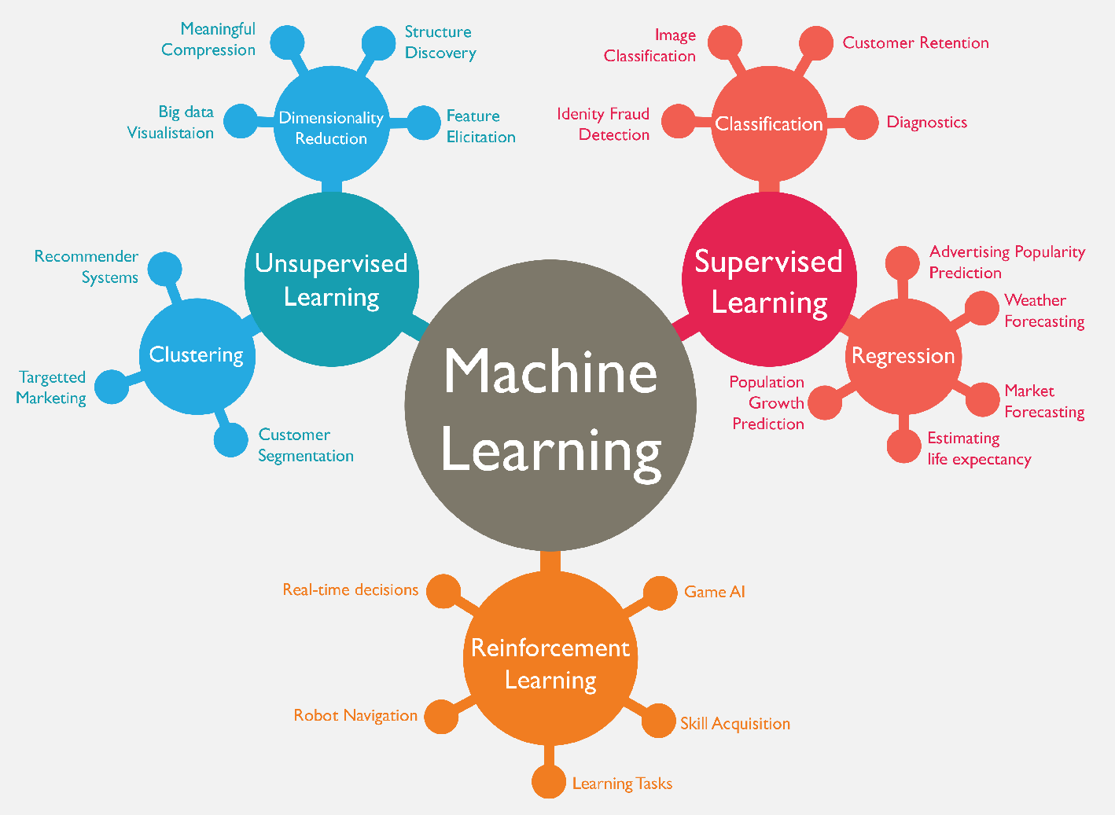
Machine Learning (ML)
Source: https://www.mactores.com/services/aws-big-data-machine-learning-cognitive-services/

Slide 51
Machine Learning Models
Deep Learning
Kernel
Association rules
Ensemble
Decision tree
Dimensionality reduction
Clustering
Regression Analysis
Bayesian
Instance based
Source: Sunila Gollapudi (2016), Practical Machine Learning, Packt Publishing

Slide 52
Machine Learning (ML) / Deep Learning (DL)
Decision Tree Classifiers
Support Vector Machine (SVM)
Supervised Learning
Neural Network (NN)
Linear Classifiers
Deep Learning (DL)
Machine Learning
(ML)
Rule-based Classifiers
Naïve Bayes
(NB)
Unsupervised Learning
Probabilistic Classifiers
Bayesian Network (BN)
Maximum Entropy (ME)
Reinforcement Learning
Source: Jesus Serrano-Guerrero, Jose A. Olivas, Francisco P. Romero, and Enrique Herrera-Viedma (2015),
"Sentiment analysis: A review and comparative analysis of web services," Information Sciences, 311, pp. 18-38.

Slide 53
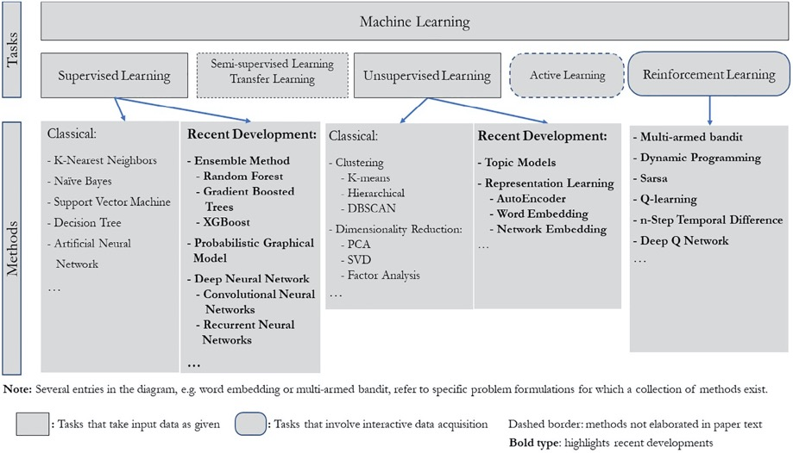
Machine Learning Tasks and Methods
Source: Liye Ma and Baohong Sun (2020), "Machine learning and AI in marketing – Connecting computing power to human insights." International Journal of Research in Marketing, 37, no. 3, 481-504.

Slide 54
Machine Learning

Slide 55
Scikit-Learn
Machine Learning in Python

Slide 56
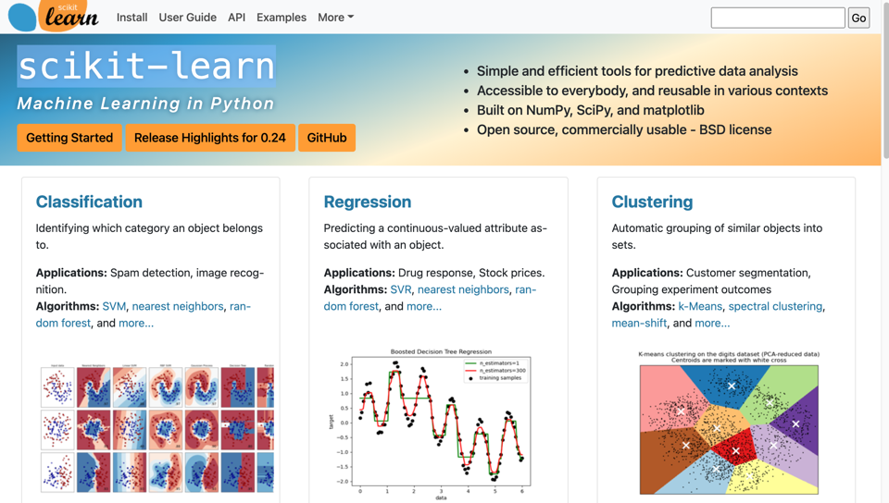
Scikit-Learn
Source: http://scikit-learn.org/

Slide 57
Machine Learning
Supervised Learning (Classification)
Learning from Examples
y = f(x)
x
y

Slide 58
Machine Learning
Supervised Learning (Classification)
Learning from Examples
y = f(x)
5.1,3.5,1.4,0.2,Iris-setosa 4.9,3.0,1.4,0.2,Iris-setosa 4.7,3.2,1.3,0.2,Iris-setosa 7.0,3.2,4.7,1.4,Iris-versicolor 6.4,3.2,4.5,1.5,Iris-versicolor 6.9,3.1,4.9,1.5,Iris-versicolor 6.3,3.3,6.0,2.5,Iris-virginica 5.8,2.7,5.1,1.9,Iris-virginica 7.1,3.0,5.9,2.1,Iris-virginica
y
x

Slide 59
Linear function
y = f(x)
y = w₁x + w₀
h_{w}(x) = w₁x + w₀
Source: Stuart Russell and Peter Norvig (2020), Artificial Intelligence: A Modern Approach, 4th Edition, Pearson

Slide 60
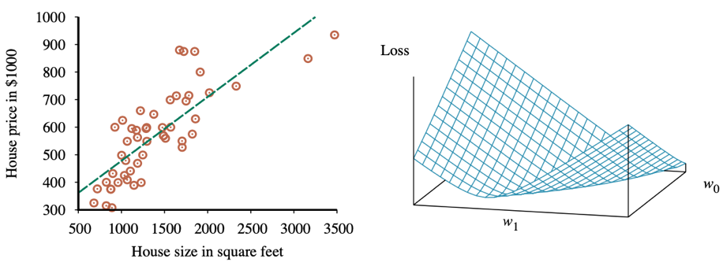
Linear Regression Weight Space
h_{w}(x) = w₁x + w₀
w* = argmin_{w} Loss(h_{w})
y = 0.232 x + 246
Loss function for Weights (w₁, w₀)
Source: Stuart Russell and Peter Norvig (2020), Artificial Intelligence: A Modern Approach, 4th Edition, Pearson

Slide 61
Deep Learning

Slide 62
Deep Learning and
Neural Networks

Slide 63

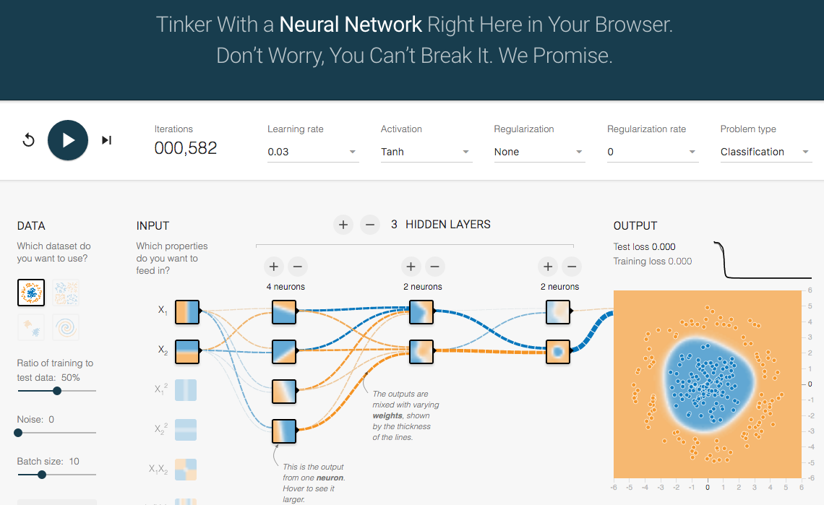
TensorFlow Playground
http://playground.tensorflow.org/

Slide 64
Tensor
3
  # a rank 0 tensor; this is a scalar with shape []
[1. ,2., 3.]
  # a rank 1 tensor; this is a vector with shape [3]
[[1., 2., 3.], [4., 5., 6.]]
  # a rank 2 tensor; a matrix with shape [2, 3]
[[[1., 2., 3.]], [[7., 8., 9.]]]
  # a rank 3 tensor with shape [2, 1, 3]
https://www.tensorflow.org/

Slide 65
Scalar
80
Vector
[50 60 70]
Matrix
50 60 70
55 65 75
[50 60 70] [70 80 90]
[55 65 75] [75 85 95]
Tensor

Slide 66
Deep Learning and
Neural Networks

Slide 67
Deep Learning Foundations:
Neural Networks

Slide 68
Deep Learning and
Neural Networks
Input Layer
(X)
Hidden Layer
(H)
Output Layer
(Y)
X1
Y
X2

Slide 69
Deep Learning and
Neural Networks
Input Layer
(X)
Hidden Layer
(H)
Output Layer
(Y)

Slide 70
Deep Learning and
Neural Networks
Input Layer
(X)
Hidden Layers
(H)
Output Layer
(Y)
Deep Neural Networks
Deep Learning

Slide 71
Deep Learning and
Deep Neural Networks

Slide 72
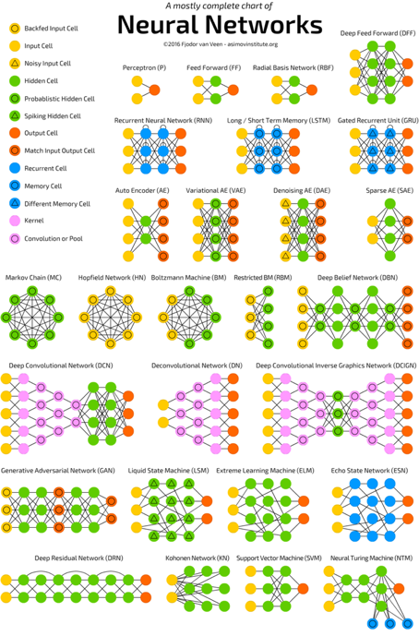
Neural Networks
(NN)
Source: http://www.asimovinstitute.org/neural-network-zoo/

Slide 73
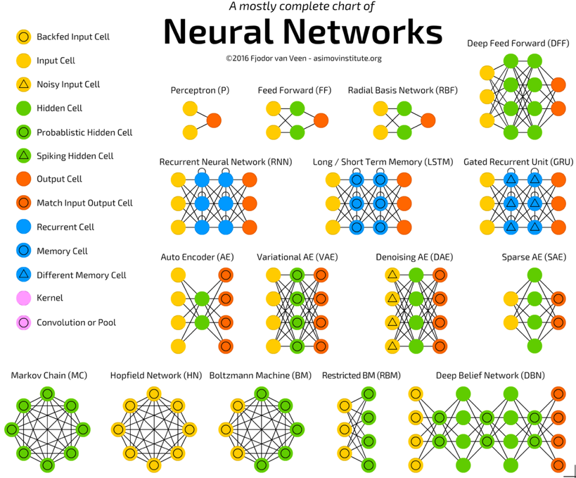
Source: http://www.asimovinstitute.org/neural-network-zoo/

Slide 74
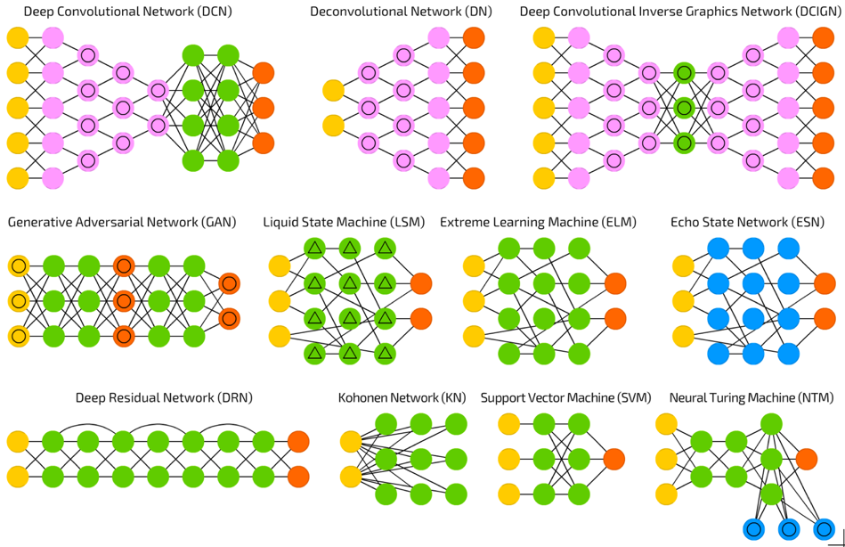
Source: http://www.asimovinstitute.org/neural-network-zoo/

Slide 75
Convolutional Neural Networks (CNN or Deep Convolutional Neural Networks, DCNN)
LeCun, Yann, et al. “Gradient-based learning applied to document recognition.” Proceedings of the IEEE 86.11 (1998): 2278-2324.
Source: http://www.asimovinstitute.org/neural-network-zoo/

Slide 76
Recurrent Neural Networks
(RNN)
Elman, Jeffrey L. “Finding structure in time.” Cognitive science 14.2 (1990): 179-211
Source: http://www.asimovinstitute.org/neural-network-zoo/

Slide 77
Long / Short Term Memory
(LSTM)
Hochreiter, Sepp, and Jürgen Schmidhuber. “Long short-term memory.” Neural computation 9.8 (1997): 1735-1780.
Source: http://www.asimovinstitute.org/neural-network-zoo/

Slide 78
Gated Recurrent Units
(GRU)
Chung, Junyoung, et al. “Empirical evaluation of gated recurrent neural networks on sequence modeling.” arXiv preprint arXiv:1412.3555 (2014).
Source: http://www.asimovinstitute.org/neural-network-zoo/

Slide 79
Generative Adversarial Networks (GAN)
Goodfellow, Ian, et al. “Generative adversarial nets.” Advances in Neural Information Processing Systems. 2014.
Source: http://www.asimovinstitute.org/neural-network-zoo/

Slide 80
Support Vector Machines
(SVM)
Cortes, Corinna, and Vladimir Vapnik. “Support-vector networks.” Machine learning 20.3 (1995): 273-297.
Source: http://www.asimovinstitute.org/neural-network-zoo/

Slide 81
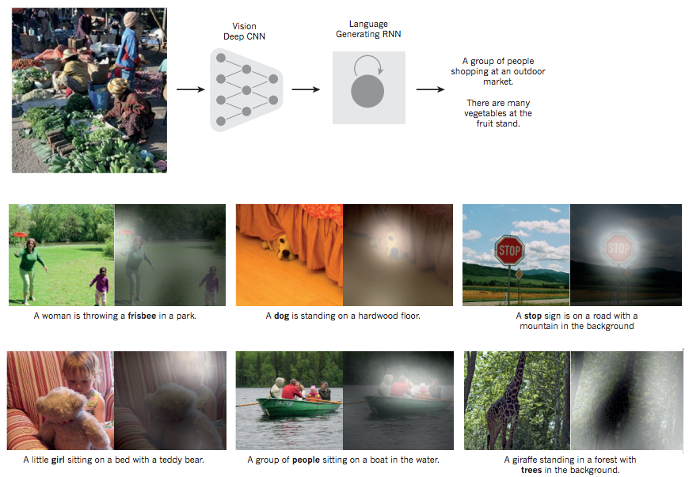
From image to text
Source: LeCun, Yann, Yoshua Bengio, and Geoffrey Hinton. "Deep learning." Nature 521, no. 7553 (2015): 436-444.

Slide 82
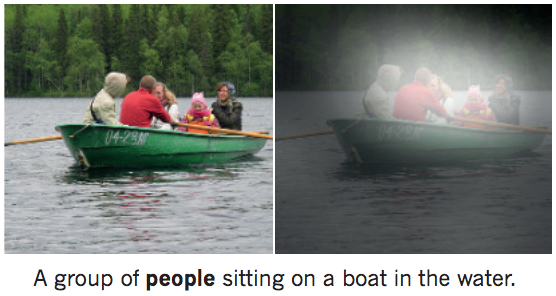
From image to text
Image: deep convolution neural network (CNN)
Text: recurrent neural network (RNN)
Source: LeCun, Yann, Yoshua Bengio, and Geoffrey Hinton. "Deep learning." Nature 521, no. 7553 (2015): 436-444.

Slide 83
Neural Networks
Input Layer
(X)
Hidden Layer
(H)
Output Layer
(Y)
X1
Y
X2
Source: https://www.youtube.com/watch?v=bxe2T-V8XRs&index=1&list=PLiaHhY2iBX9hdHaRr6b7XevZtgZRa1PoU

Slide 84
The Neuron
x₁
w₁
w₂
x₂
y
…
…
w_{n}
x_{n}
Source: Jeff Dean (2016), Large-Scale Deep Learning For Building Intelligent Computer Systems, WSDM 2016

Slide 85
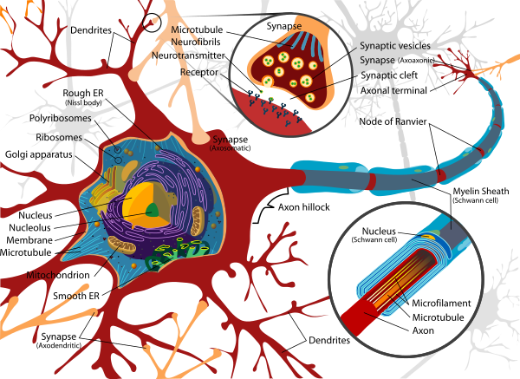
Neuron and Synapse
Source: https://en.wikipedia.org/wiki/Neuron

Slide 86
The Neuron
x₁
w₁
w₂
x₂
y
…
…
w_{n}
x_{n}
Source: Jeff Dean (2016), Large-Scale Deep Learning For Building Intelligent Computer Systems, WSDM 2016

Slide 87
y = max ( 0, -0.21 * x₁ + 0.3 * x₂ + 0.7 * x₃ )
Weights
x₁
-0.21
x₂
0.3
y
Inputs
0.7
x₃
Source: Jeff Dean (2016), Large-Scale Deep Learning For Building Intelligent Computer Systems, WSDM 2016

Slide 88
Neural Networks
Source: https://www.youtube.com/watch?v=bxe2T-V8XRs&index=1&list=PLiaHhY2iBX9hdHaRr6b7XevZtgZRa1PoU

Slide 89
Neural Networks
Input Layer
(X)
Hidden Layer
(H)
Output Layer
(Y)
X1
Y
X2
Source: https://www.youtube.com/watch?v=bxe2T-V8XRs&index=1&list=PLiaHhY2iBX9hdHaRr6b7XevZtgZRa1PoU

Slide 90
Neural Networks
Input Layer
(X)
Hidden Layers
(H)
Output Layer
(Y)
Deep Neural Networks
Deep Learning
Source: https://www.youtube.com/watch?v=bxe2T-V8XRs&index=1&list=PLiaHhY2iBX9hdHaRr6b7XevZtgZRa1PoU

Slide 91
Neural Networks
Input Layer
(X)
Hidden Layer
(H)
Output Layer
(Y)
Neuron
Synapse
Synapse
Neuron
X1
Y
X2
Source: https://www.youtube.com/watch?v=bxe2T-V8XRs&index=1&list=PLiaHhY2iBX9hdHaRr6b7XevZtgZRa1PoU

Slide 92
Neural Networks
Input Layer
(X)
Hidden Layer
(H)
Output Layer
(Y)
Hours
Sleep
Score
Hours
Study
Source: https://www.youtube.com/watch?v=bxe2T-V8XRs&index=1&list=PLiaHhY2iBX9hdHaRr6b7XevZtgZRa1PoU

Slide 93
Neural Networks
Input Layer
(X)
Hidden Layer
(H)
Output Layer
(Y)
Source: https://www.youtube.com/watch?v=P2HPcj8lRJE&list=PLjJh1vlSEYgvGod9wWiydumYl8hOXixNu&index=2

Slide 94
Neural Networks
Input Layer
(X)
Hidden Layer
(H)
Output Layer
(Y)
X1
Y
X2
Source: https://www.youtube.com/watch?v=bxe2T-V8XRs&index=1&list=PLiaHhY2iBX9hdHaRr6b7XevZtgZRa1PoU

Slide 95
X Y
Hours
Sleep
Hours
Study
Score
3 5 75
5 1 82
10 2 93
8 3 ?
Source: https://www.youtube.com/watch?v=bxe2T-V8XRs&index=1&list=PLiaHhY2iBX9hdHaRr6b7XevZtgZRa1PoU

Slide 96
X Y
Hours
Sleep
Hours
Study
Score
3 5 75
Training
5 1 82
10 2 93
8 3 ?
Testing
Source: https://www.youtube.com/watch?v=bxe2T-V8XRs&index=1&list=PLiaHhY2iBX9hdHaRr6b7XevZtgZRa1PoU

Slide 97
Y = W X + b
Source: https://www.youtube.com/watch?v=G8eNWzxOgqE

Slide 98
Output
input
Y = W X + b
Weights
bias
Trained
Source: https://www.youtube.com/watch?v=G8eNWzxOgqE

Slide 99
2.0
1.0
0.1
0.7
0.2
0.1
W X + b = Y
Scores
Probabilities
Source: https://www.youtube.com/watch?v=G8eNWzxOgqE

Slide 100
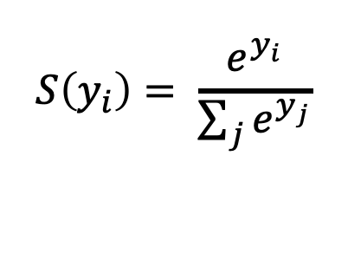
SoftMAX
2.0
1.0
0.1
0.7
0.2
0.1
W X + b = Y
$$S\left(y_{i}\right)= \frac{e^{y_{i}}}{\sum_{j}{e^{y_{j}}}}$$
Logits
Scores
Probabilities
Source: https://www.youtube.com/watch?v=G8eNWzxOgqE

Slide 101
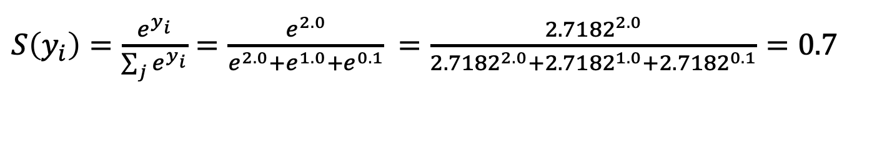
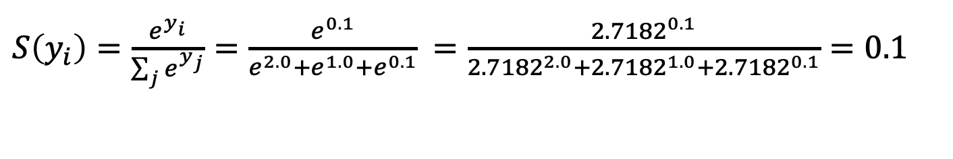
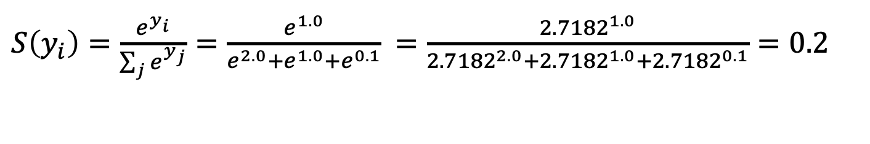
$S\left(y_{i}\right)=\frac{e^{y_{i}}}{\sum_{j}{e^{y_{i}}}}=\frac{e^{2.0}}{e^{2.0}+e^{1.0}+e^{0.1}}$ $=\frac{{2.7182}^{2.0}}{{2.7182}^{2.0}+{2.7182}^{1.0}+{2.7182}^{0.1}}=0.7$
$S\left(y_{i}\right)=\frac{e^{y_{i}}}{\sum_{j}{e^{y_{j}}}}=\frac{e^{1.0}}{e^{2.0}+e^{1.0}+e^{0.1}}$ $=\frac{{2.7182}^{1.0}}{{2.7182}^{2.0}+{2.7182}^{1.0}+{2.7182}^{0.1}}=0.2$
$S\left(y_{i}\right)=\frac{e^{y_{i}}}{\sum_{j}{e^{y_{j}}}}=\frac{e^{0.1}}{e^{2.0}+e^{1.0}+e^{0.1}}$ $=\frac{{2.7182}^{0.1}}{{2.7182}^{2.0}+{2.7182}^{1.0}+{2.7182}^{0.1}}=0.1$
2.0
1.0
0.1
0.7
0.2
0.1
W X + b = Y
$$S\left(y_{i}\right)= \frac{e^{y_{i}}}{\sum_{j}{e^{y_{j}}}}$$
Logits
Scores
Probabilities
Source: https://www.youtube.com/watch?v=G8eNWzxOgqE

Slide 102
Training a Network
=
Minimize the Cost Function
Source: https://www.youtube.com/watch?v=bxe2T-V8XRs&index=1&list=PLiaHhY2iBX9hdHaRr6b7XevZtgZRa1PoU

Slide 103
Training a Network
=
Minimize the Cost Function
Minimize the Loss Function
Source: https://www.youtube.com/watch?v=bxe2T-V8XRs&index=1&list=PLiaHhY2iBX9hdHaRr6b7XevZtgZRa1PoU

Slide 104



Error = Predict Y - Actual Y
Error : Cost : Loss
100
$$y$$
$$\hat{y}$$
75
$$e$$
50
25
Test1
Test2
Test3
Source: https://www.youtube.com/watch?v=bxe2T-V8XRs&index=1&list=PLiaHhY2iBX9hdHaRr6b7XevZtgZRa1PoU

Slide 105
Error = Predict Y - Actual Y
Error : Cost : Loss
100
$$y$$
$$\hat{y}$$
75
$$e$$
50
25
Test1
Test2
Test3
Source: https://www.youtube.com/watch?v=bxe2T-V8XRs&index=1&list=PLiaHhY2iBX9hdHaRr6b7XevZtgZRa1PoU

Slide 106
Error = Predict Y - Actual Y
Error : Cost : Loss
100
$$y$$
$$\hat{y}$$
75
$$e$$
50
25
Test1
Test2
Test3
Source: https://www.youtube.com/watch?v=bxe2T-V8XRs&index=1&list=PLiaHhY2iBX9hdHaRr6b7XevZtgZRa1PoU

Slide 107
Activation Functions

Slide 108
Activation Functions
Sigmoid
TanH
ReLU
(Rectified Linear Unit)
[0, 1]
[-1, 1]
f(x) = max(0, x)
Source: http://cs231n.github.io/neural-networks-1/

Slide 109
Activation Functions
Source: http://adilmoujahid.com/posts/2016/06/introduction-deep-learning-python-caffe/

Slide 110
Loss
Function

Slide 111
Binary Classification: 2 Class
Activation Function:
Sigmoid
Loss Function:
Binary Cross-Entropy

Slide 112
Multiple Classification: 10 Class
Activation Function:
SoftMAX
Loss Function:
Categorical Cross-Entropy

Slide 113
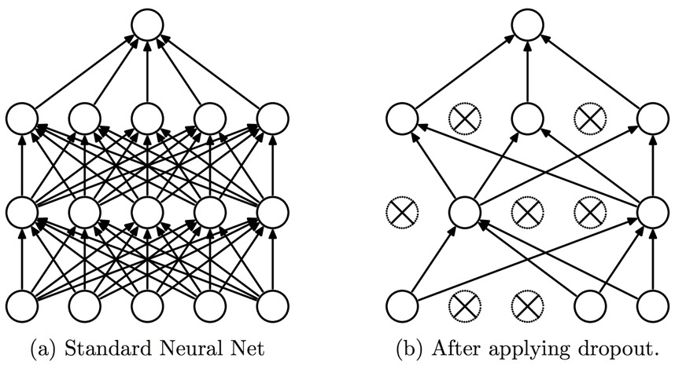
Dropout
Dropout: a simple way to prevent neural networks from overfitting
Source: Srivastava, Nitish, Geoffrey E. Hinton, Alex Krizhevsky, Ilya Sutskever, and Ruslan Salakhutdinov.
"Dropout: a simple way to prevent neural networks from overfitting." Journal of machine learning research 15, no. 1 (2014): 1929-1958.

Slide 114
Learning Algorithm
While not done:
  Pick a random training example “(input, label)”
  Run neural network on “input”
  Adjust weights on edges to make output closer to “label”
Source: Jeff Dean (2016), Large-Scale Deep Learning For Building Intelligent Computer Systems, WSDM 2016

Slide 115
y = max ( 0, -0.21 * x₁ + 0.3 * x₂ + 0.7 * x₃ )
Weights
x₁
-0.21
x₂
0.3
y
Inputs
0.7
x₃
Source: Jeff Dean (2016), Large-Scale Deep Learning For Building Intelligent Computer Systems, WSDM 2016

Slide 116
Next time:
y = max ( 0, -0.23 * x₁ + 0.31 * x₂ + 0.65 * x₃ )
y = max ( 0, -0.21 * x₁ + 0.3 * x₂ + 0.7 * x₃ )
Weights
-0.23
x₁
-0.21
0.31
x₂
0.3
y
Inputs
0.65
x₃
0.7
Source: Jeff Dean (2016), Large-Scale Deep Learning For Building Intelligent Computer Systems, WSDM 2016

Slide 117
Optimizer:
Stochastic Gradient Descent
(SGD)
J(w)
Initial
weight
Gradient
Global cost
minimum
w

Slide 118
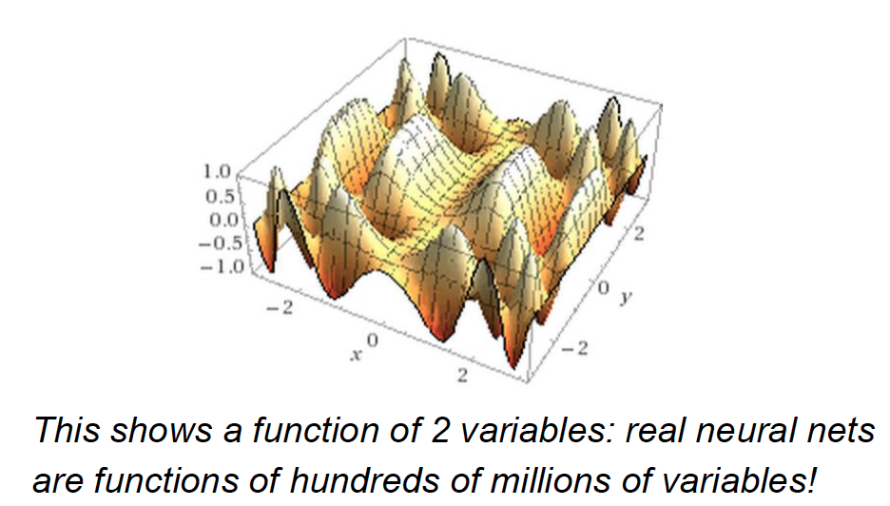
Source: Jeff Dean (2016), Large-Scale Deep Learning For Building Intelligent Computer Systems, WSDM 2016

Slide 119
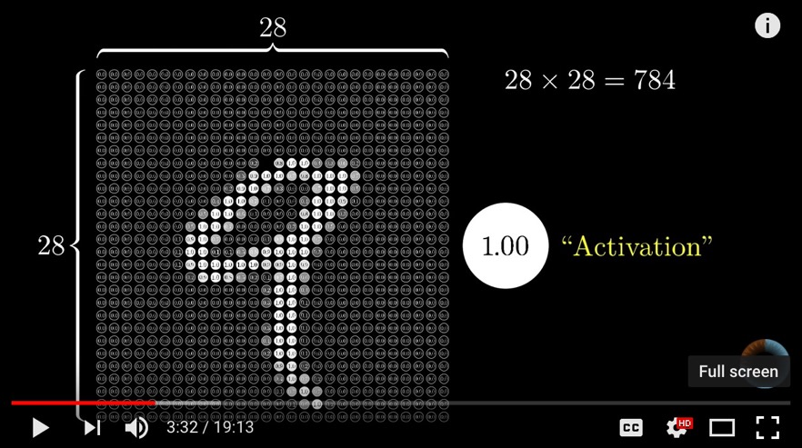
Neural Network and Deep Learning
Source: 3Blue1Brown (2017), But what *is* a Neural Network? | Chapter 1, deep learning, https://www.youtube.com/watch?v=aircAruvnKk

Slide 120
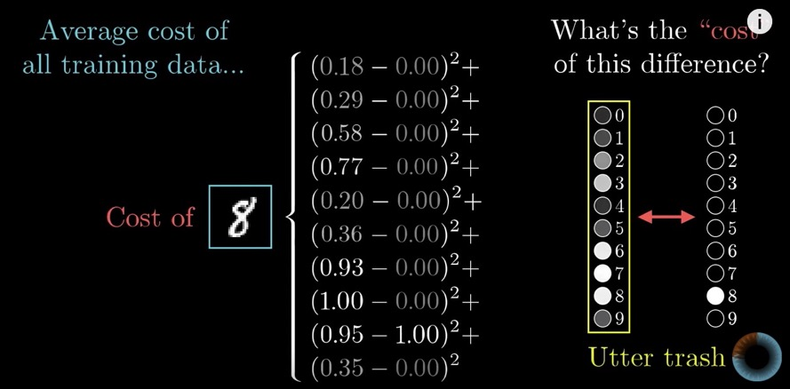
Gradient Descent how neural networks learn
Source: 3Blue1Brown (2017), Gradient descent, how neural networks learn | Chapter 2, deep learning, https://www.youtube.com/watch?v=IHZwWFHWa-w

Slide 121
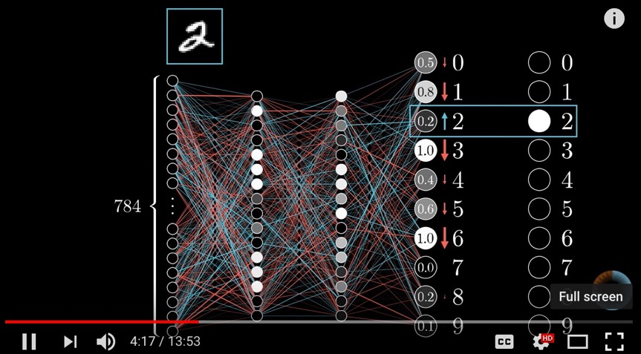
Backpropagation
Source: 3Blue1Brown (2017), What is backpropagation really doing? | Chapter 3, deep learning, https://www.youtube.com/watch?v=Ilg3gGewQ5U

Slide 122
Learning Algorithm
While not done:
  Pick a random training example “(input, label)”
  Run neural network on “input”
  Adjust weights on edges to make output closer to “label”
Source: Jeff Dean (2016), Large-Scale Deep Learning For Building Intelligent Computer Systems, WSDM 2016

Slide 123
Convolutional Neural Networks (CNN)

Slide 124
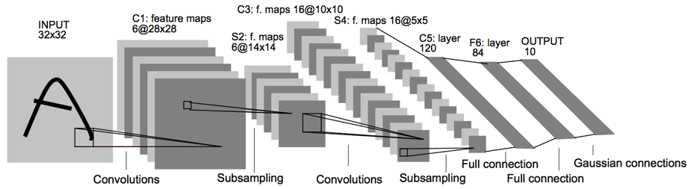
Convolutional Neural Networks
(CNN)
Architecture of LeNet-5 (7 Layers)
(LeCun et al., 1998)
Source: http://yann.lecun.com/exdb/publis/pdf/lecun-01a.pdf
Source: LeCun, Yann, Léon Bottou, Yoshua Bengio, and Patrick Haffner.
"Gradient-based learning applied to document recognition." Proceedings of the IEEE 86, no. 11 (1998): 2278-2324.

Slide 125
Convolutional Neural Networks
(CNN)
Convolution
Pooling
Fully Connection (FC) (Flattening)

Slide 126
A friendly introduction to
Convolutional Neural Networks and Image Recognition
+
-
4
-4
-
+
-4
4
1
-1
1
-1
1
-1
1
-1
1
-
+
-4
4
+
-
4
-4
Convolution Layer
Pooling Layer
Source: Luis Serrano (2017), A friendly introduction to Convolutional Neural Networks and Image Recognition,
https://www.youtube.com/watch?v=2-Ol7ZB0MmU

Slide 127
A friendly introduction to
Convolutional Neural Networks and Image Recognition
1
-1
1
1
-1
-1
1
-1
1
-1
1
-1
-1
1
1
-1
1
-1
1
-1
1
-1
1
-1
1
1
-1
-1
1
-1
1
-1
-1
1
-1
-1
1
-1
1
-1
-1
-1
-1
-1
1
-1
-1
-1
1
1
-1
1
-1
-1
-1
1
-1
1
-1
-1
1
-1
-1
1
-1
-1
-1
-1
Source: Luis Serrano (2017), A friendly introduction to Convolutional Neural Networks and Image Recognition,
https://www.youtube.com/watch?v=2-Ol7ZB0MmU

Slide 128
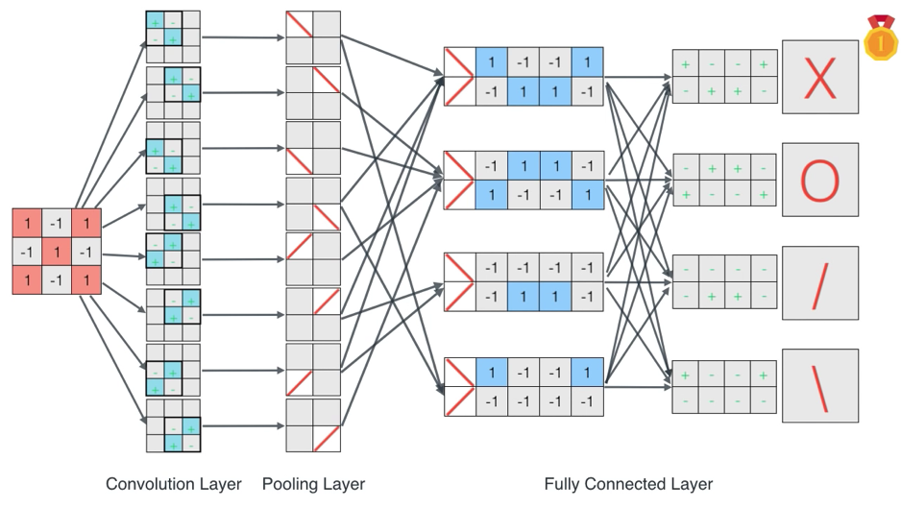
A friendly introduction to
Convolutional Neural Networks and Image Recognition
Source: Luis Serrano (2017), A friendly introduction to Convolutional Neural Networks and Image Recognition,
https://www.youtube.com/watch?v=2-Ol7ZB0MmU

Slide 129
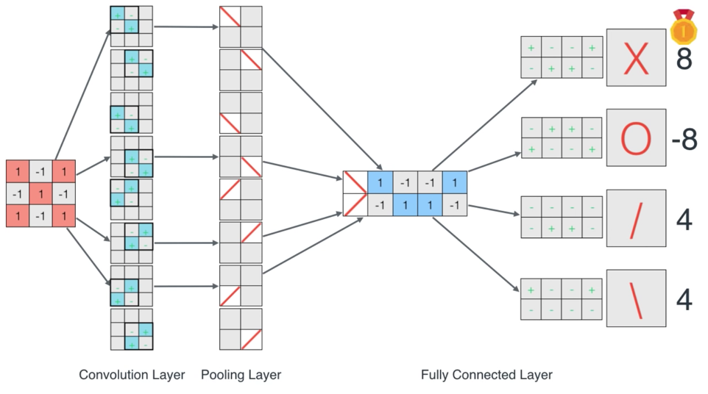
A friendly introduction to
Convolutional Neural Networks and Image Recognition
Source: Luis Serrano (2017), A friendly introduction to Convolutional Neural Networks and Image Recognition,
https://www.youtube.com/watch?v=2-Ol7ZB0MmU

Slide 130
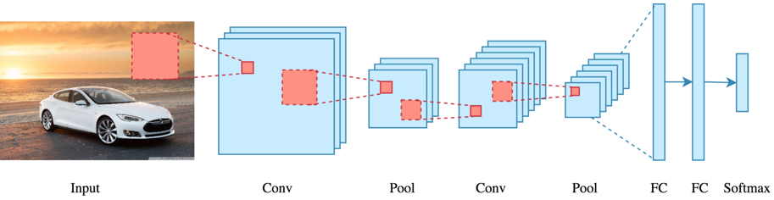
CNN Architecture
Source: Arden Dertat (2017), Applied Deep Learning - Part 4: Convolutional Neural Networks, https://towardsdatascience.com/applied-deep-learning-part-4-convolutional-neural-networks-584bc134c1e2

Slide 131
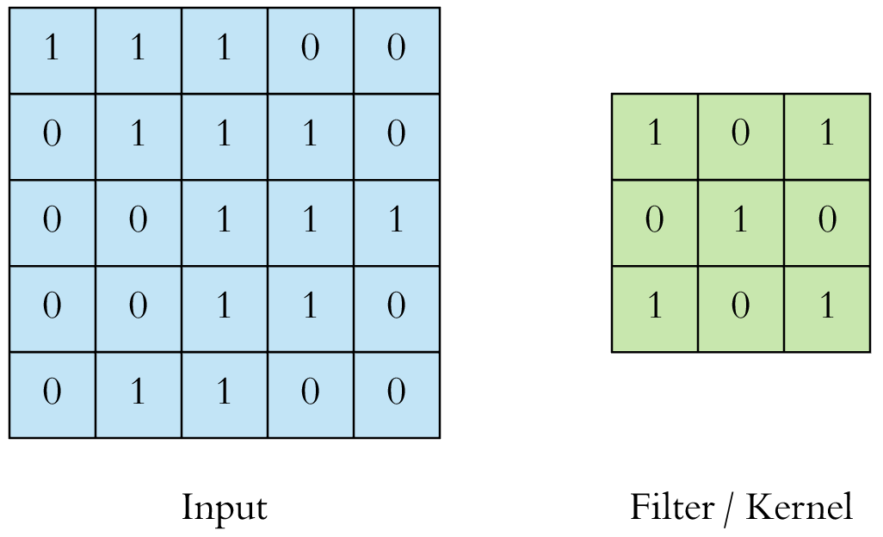
CNN Convolution Layer
Convolution is a mathematical operation to merge two sets of information
3x3 convolution
Source: Arden Dertat (2017), Applied Deep Learning - Part 4: Convolutional Neural Networks, https://towardsdatascience.com/applied-deep-learning-part-4-convolutional-neural-networks-584bc134c1e2

Slide 132
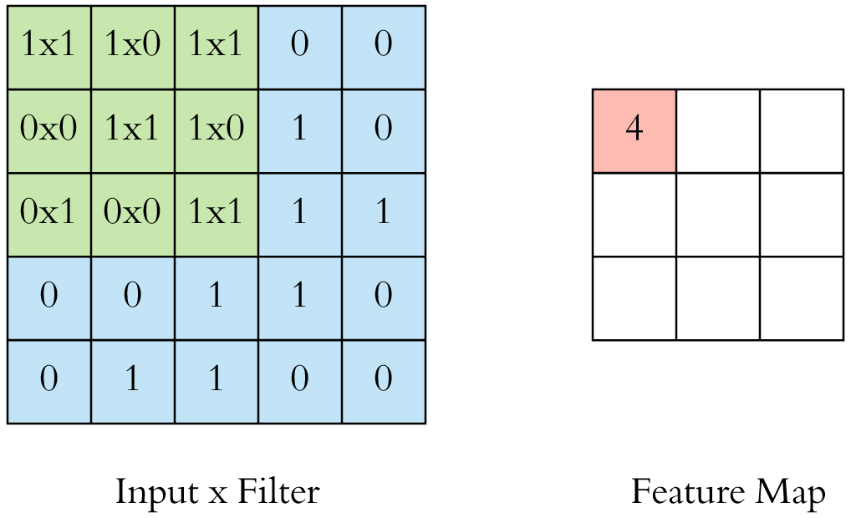
CNN Convolution Layer
Input x Filter --> Feature Map
receptive field: 3x3
Source: Arden Dertat (2017), Applied Deep Learning - Part 4: Convolutional Neural Networks, https://towardsdatascience.com/applied-deep-learning-part-4-convolutional-neural-networks-584bc134c1e2

Slide 133
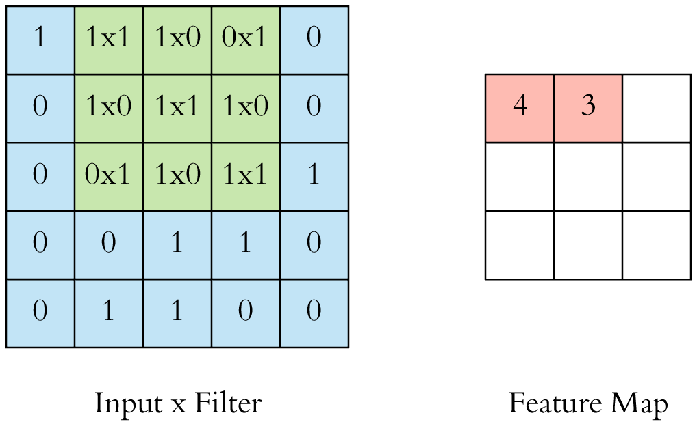
CNN Convolution Layer
Input x Filter --> Feature Map
receptive field: 3x3
Source: Arden Dertat (2017), Applied Deep Learning - Part 4: Convolutional Neural Networks, https://towardsdatascience.com/applied-deep-learning-part-4-convolutional-neural-networks-584bc134c1e2

Slide 134
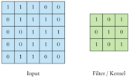
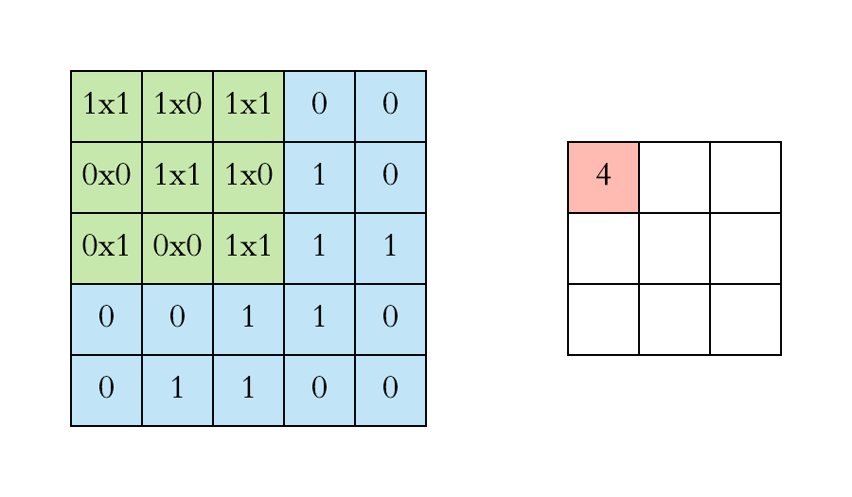
CNN Convolution Layer
Example convolution operation shown in 2D using a 3x3 filter
Source: Arden Dertat (2017), Applied Deep Learning - Part 4: Convolutional Neural Networks, https://towardsdatascience.com/applied-deep-learning-part-4-convolutional-neural-networks-584bc134c1e2

Slide 135
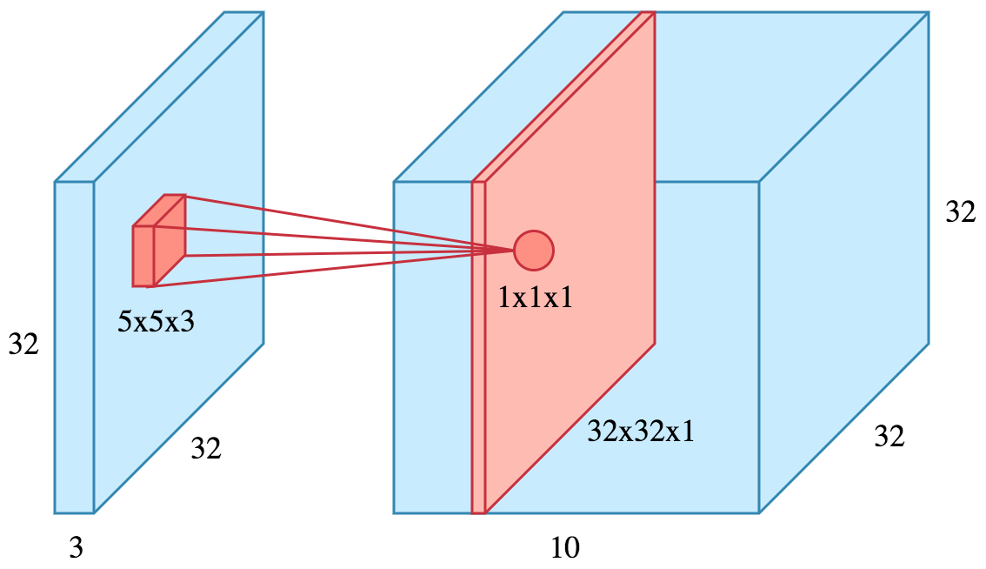
CNN Convolution Layer
10 different filters
10 feature maps of size 32x32x1
final output of the convolution layer:
a volume of size 32x32x10
Source: Arden Dertat (2017), Applied Deep Learning - Part 4: Convolutional Neural Networks, https://towardsdatascience.com/applied-deep-learning-part-4-convolutional-neural-networks-584bc134c1e2

Slide 136
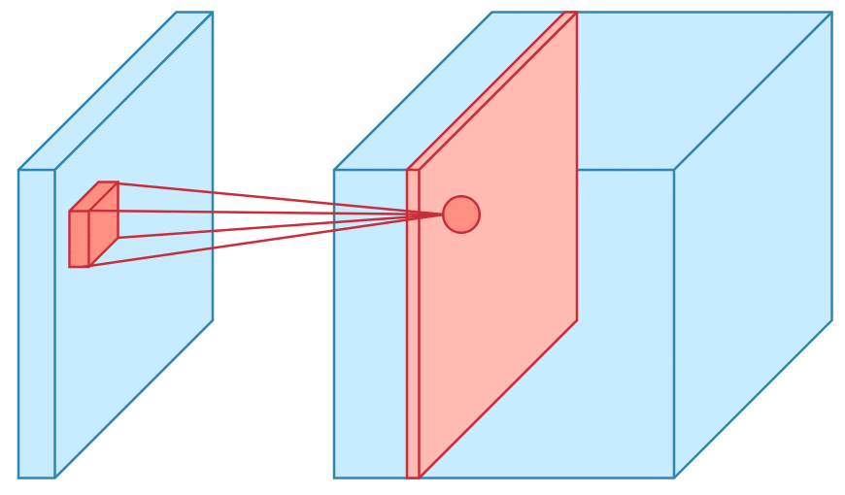
CNN Convolution Layer
Sliding operation at 4 locations
Source: Arden Dertat (2017), Applied Deep Learning - Part 4: Convolutional Neural Networks, https://towardsdatascience.com/applied-deep-learning-part-4-convolutional-neural-networks-584bc134c1e2

Slide 137
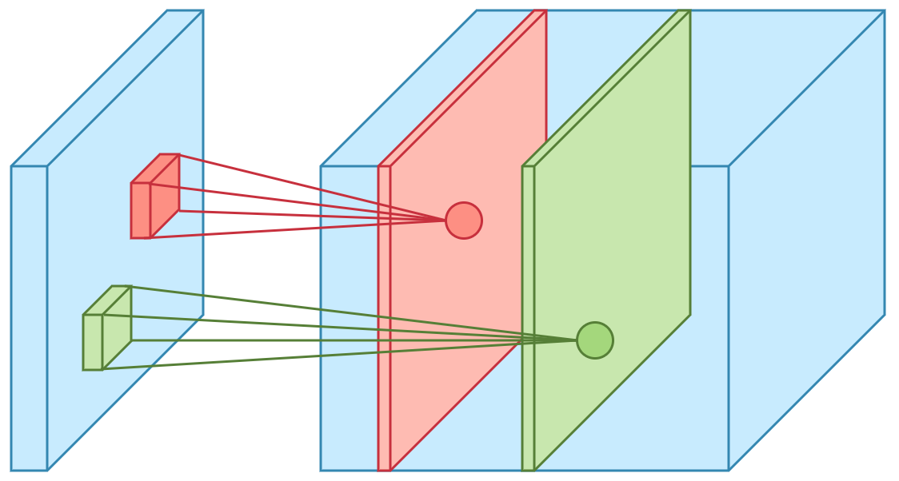
CNN Convolution Layer
two feature maps
Source: Arden Dertat (2017), Applied Deep Learning - Part 4: Convolutional Neural Networks, https://towardsdatascience.com/applied-deep-learning-part-4-convolutional-neural-networks-584bc134c1e2

Slide 138
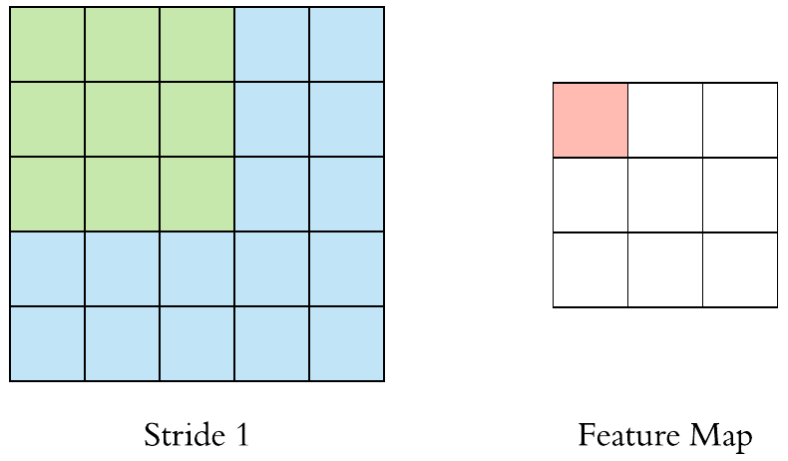
CNN Convolution Layer
Stride specifies how much
we move the convolution filter at each step
Source: Arden Dertat (2017), Applied Deep Learning - Part 4: Convolutional Neural Networks, https://towardsdatascience.com/applied-deep-learning-part-4-convolutional-neural-networks-584bc134c1e2

Slide 139
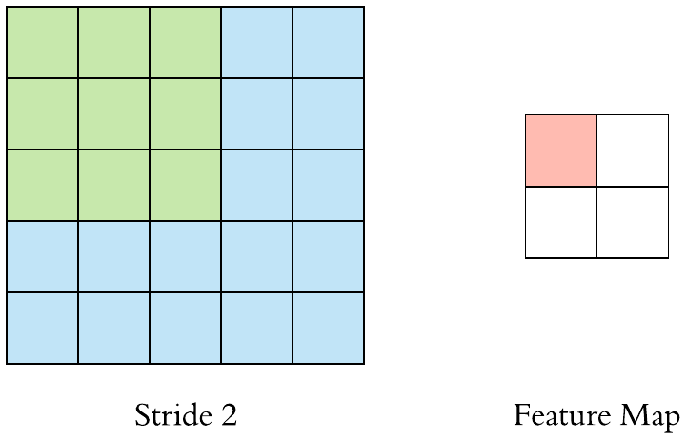
CNN Convolution Layer
Stride specifies how much
we move the convolution filter at each step
Source: Arden Dertat (2017), Applied Deep Learning - Part 4: Convolutional Neural Networks, https://towardsdatascience.com/applied-deep-learning-part-4-convolutional-neural-networks-584bc134c1e2

Slide 140
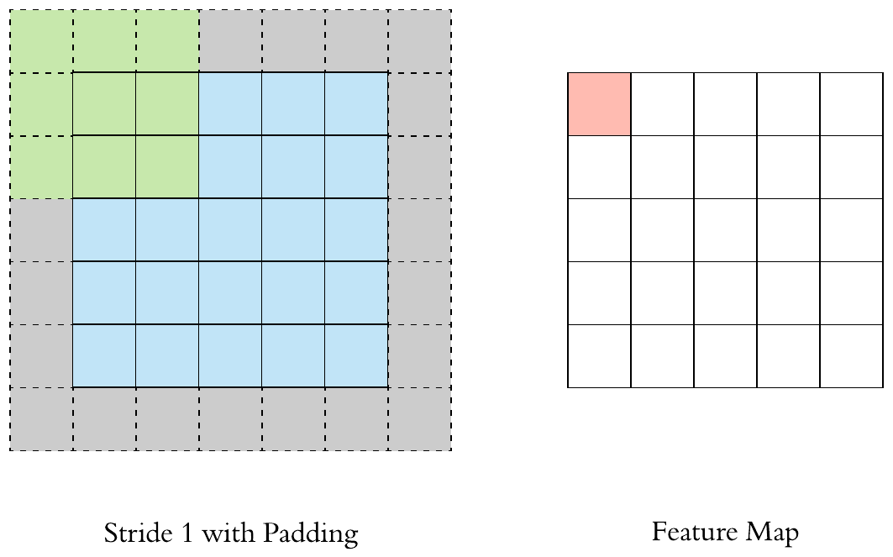
CNN Convolution Layer
Stride 1 with Padding
Source: Arden Dertat (2017), Applied Deep Learning - Part 4: Convolutional Neural Networks, https://towardsdatascience.com/applied-deep-learning-part-4-convolutional-neural-networks-584bc134c1e2

Slide 141
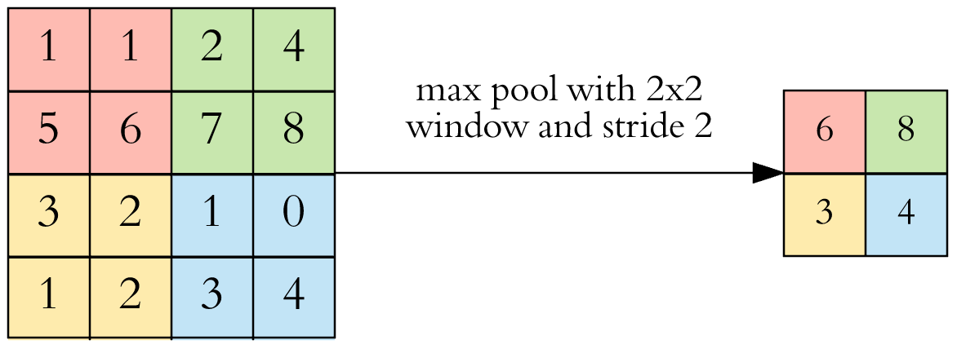
CNN Pooling Layer
Max Pooling
Source: Arden Dertat (2017), Applied Deep Learning - Part 4: Convolutional Neural Networks, https://towardsdatascience.com/applied-deep-learning-part-4-convolutional-neural-networks-584bc134c1e2

Slide 142
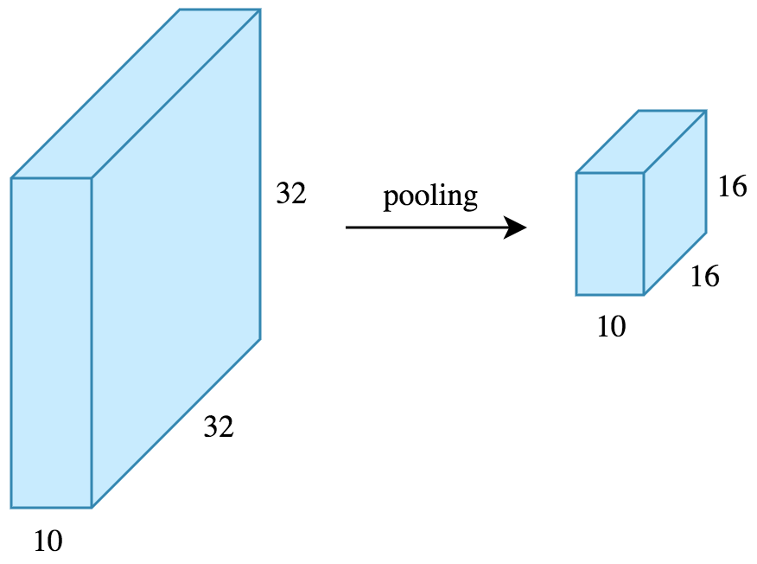
CNN Pooling Layer
Source: Arden Dertat (2017), Applied Deep Learning - Part 4: Convolutional Neural Networks, https://towardsdatascience.com/applied-deep-learning-part-4-convolutional-neural-networks-584bc134c1e2

Slide 143
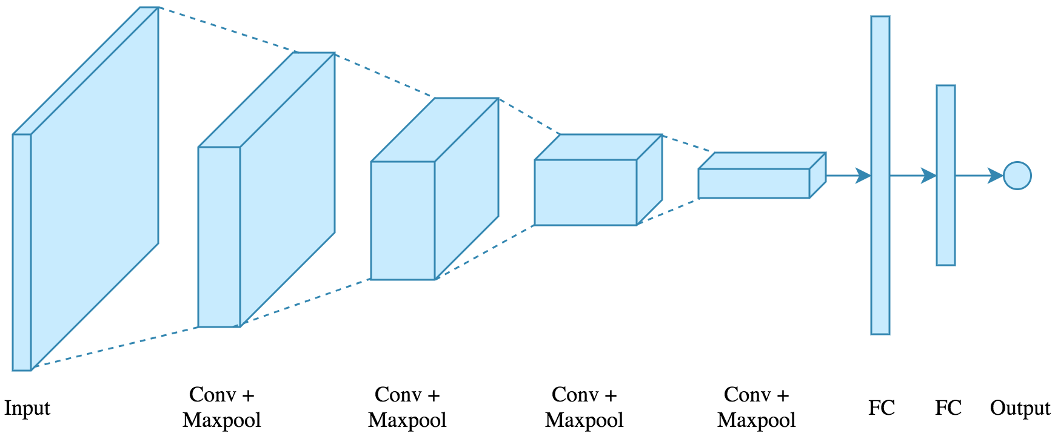
CNN Architecture
4 convolution + pooling layers,
followed by 2 fully connected layers
Source: Arden Dertat (2017), Applied Deep Learning - Part 4: Convolutional Neural Networks, https://towardsdatascience.com/applied-deep-learning-part-4-convolutional-neural-networks-584bc134c1e2

Slide 144
CNN Architecture
4 convolution + pooling layers,
followed by 2 fully connected layers
https://gist.github.com/ardendertat/0fc5515057c47e7386fe04e9334504e3
model = Sequential()
model.add(Conv2D(32, (3, 3), activation='relu', padding='same', name='conv_1',
input_shape=(150, 150, 3)))
model.add(MaxPooling2D((2, 2), name='maxpool_1'))
model.add(Conv2D(64, (3, 3), activation='relu', padding='same', name='conv_2'))
model.add(MaxPooling2D((2, 2), name='maxpool_2'))
model.add(Conv2D(128, (3, 3), activation='relu', padding='same', name='conv_3'))
model.add(MaxPooling2D((2, 2), name='maxpool_3'))
model.add(Conv2D(128, (3, 3), activation='relu', padding='same', name='conv_4'))
model.add(MaxPooling2D((2, 2), name='maxpool_4'))
model.add(Flatten())
model.add(Dropout(0.5))
model.add(Dense(512, activation='relu', name='dense_1'))
model.add(Dense(128, activation='relu', name='dense_2'))
model.add(Dense(1, activation='sigmoid', name='output'))
Source: Arden Dertat (2017), Applied Deep Learning - Part 4: Convolutional Neural Networks, https://towardsdatascience.com/applied-deep-learning-part-4-convolutional-neural-networks-584bc134c1e2

Slide 145
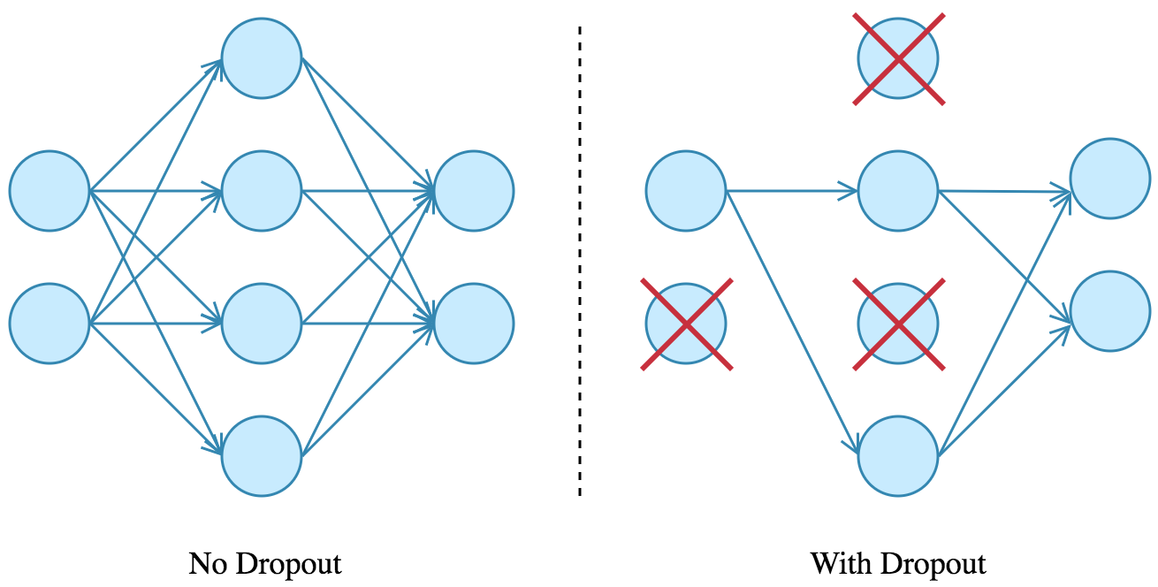
Dropout
Source: Arden Dertat (2017), Applied Deep Learning - Part 4: Convolutional Neural Networks, https://towardsdatascience.com/applied-deep-learning-part-4-convolutional-neural-networks-584bc134c1e2

Slide 146
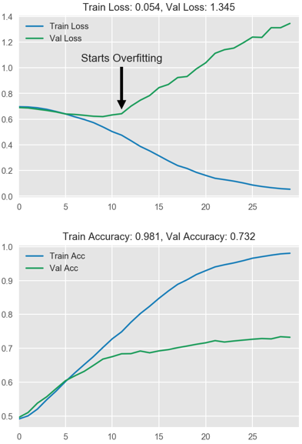
Model Performance
Source: Arden Dertat (2017), Applied Deep Learning - Part 4: Convolutional Neural Networks, https://towardsdatascience.com/applied-deep-learning-part-4-convolutional-neural-networks-584bc134c1e2

Slide 147
Visual Recognition
Image Classification

Slide 148
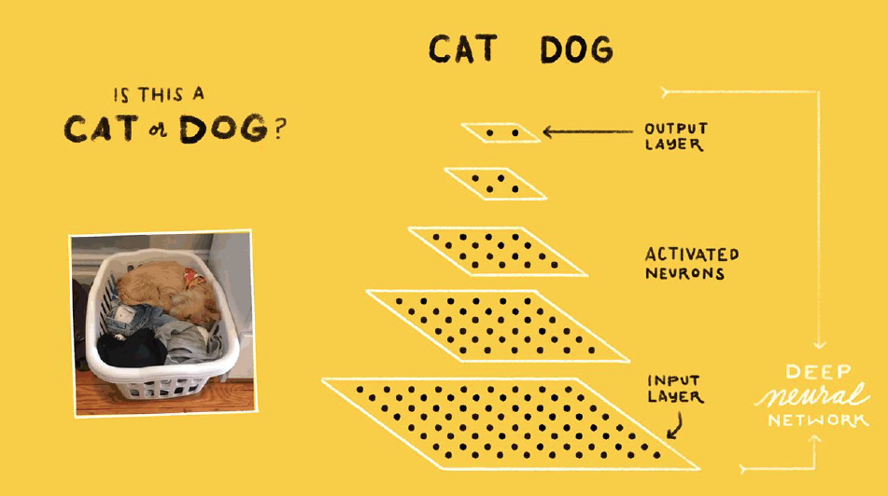
Source: Jeff Dean (2016), Large-Scale Deep Learning For Building Intelligent Computer Systems, WSDM 2016

Slide 149
Convolutional Neural Networks (CNNs / ConvNets)
http://cs231n.github.io/convolutional-networks/

Slide 150

A regular 3-layer Neural Network
http://cs231n.github.io/convolutional-networks/

Slide 151
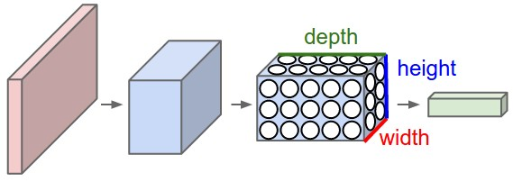
A ConvNet arranges its neurons in three dimensions
(width, height, depth)
http://cs231n.github.io/convolutional-networks/

Slide 152
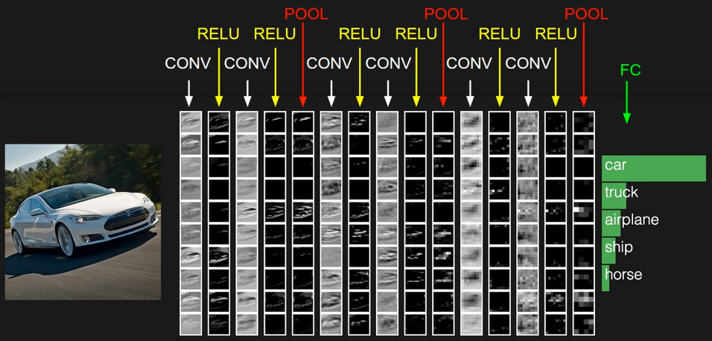
The activations of an example ConvNet architecture.
http://cs231n.github.io/convolutional-networks/

Slide 153
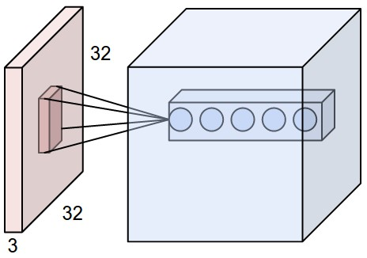
ConvNets
32x32x3 CIFAR-10 image
first Convolutional layer
http://cs231n.github.io/convolutional-networks/

Slide 154
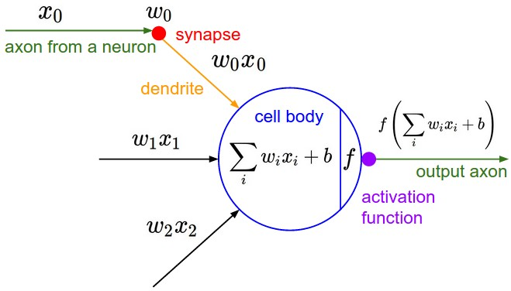
ConvNets
http://cs231n.github.io/convolutional-networks/

Slide 155

Convolution Demo
http://cs231n.github.io/convolutional-networks/

Slide 156

ConvNets
input volume of size [224x224x64]
is pooled with filter size 2, stride 2
into output volume of size [112x112x64]
http://cs231n.github.io/convolutional-networks/

Slide 157

ConvNets max pooling
http://cs231n.github.io/convolutional-networks/

Slide 158

Convolutional Neural Networks (CNN) (LeNet)
Source: http://deeplearning.net/tutorial/lenet.html

Slide 159
Recurrent
Neural Networks (RNN)

Slide 160
Recurrent Neural Networks (RNN)
y_{t-2}
y_{t-1}
y_{t}
y_{t+1}
y_{t+2}
output
h_{t-2}
h_{t-1}
h_{t}
h_{t+1}
h_{t+2}
hidden
X_{t-2}
X_{t-1}
X_{t}
X_{t+1}
X_{t+2}
Input

Slide 161
Recurrent Neural Networks (RNN)
Time Series Forecasting
110
120
130
140
150
y_{t-2}
y_{t-1}
y_{t}
y_{t+1}
y_{t+2}
output
h_{t-2}
h_{t-1}
h_{t}
h_{t+1}
h_{t+2}
hidden
X_{t-2}
X_{t-1}
X_{t}
X_{t+1}
X_{t+2}
Input
100
110
120
130
140

Slide 162
Recurrent Neural Networks (RNN)
y
output
h_{t-2}
h_{t-1}
h_{t}
h_{t+1}
h_{t+2}
hidden
X_{t-2}
X_{t-1}
X_{t}
X_{t+1}
X_{t+2}
Input

Slide 163

Recurrent Neural Networks (RNN)
Sentiment Analysis
y
output
h_{t-2}
h_{t-1}
h_{t}
h_{t+1}
h_{t+2}
hidden
X_{t-2}
X_{t-1}
X_{t}
X_{t+1}
X_{t+2}
Input
This
movie
is
very
good

Slide 164

Recurrent Neural Networks (RNN)
Sentiment Analysis
y
output
h_{t-2}
h_{t-1}
h_{t}
h_{t+1}
h_{t+2}
hidden
X_{t-2}
X_{t-1}
X_{t}
X_{t+1}
X_{t+2}
Input
This
movie
is
very
boring

Slide 165

Recurrent Neural Network (RNN)
Source: LeCun, Yann, Yoshua Bengio, and Geoffrey Hinton. "Deep learning." Nature 521, no. 7553 (2015): 436-444.

Slide 166
RNN
Source: Christopher Olah, (2015) Understanding LSTM Networks, http://colah.github.io/posts/2015-08-Understanding-LSTMs/

Slide 167
RNN long-term dependencies
I grew up in France… I speak fluent French.
Source: Christopher Olah, (2015) Understanding LSTM Networks, http://colah.github.io/posts/2015-08-Understanding-LSTMs/

Slide 168

Vanishing Gradient
Exploding Gradient
Source: https://medium.com/deep-math-machine-learning-ai/chapter-10-1-deepnlp-lstm-long-short-term-memory-networks-with-math-21477f8e4235

Slide 169
Recurrent Neural Networks (RNN)
y_{t-2}
y_{t-1}
y_{t}
y_{t+1}
y_{t+2}
output
V
V
V
V
W
W
W
W
h_{t-2}
h_{t-1}
h_{t}
h_{t+1}
h_{t+2}
hidden
U
U
U
U
X_{t-2}
X_{t-1}
X_{t}
X_{t+1}
X_{t+2}
Input

Slide 170
RNN
Vanishing Gradient problem
Exploding Gradient problem
Error
y_{t-2}
y_{t-1}
y_{t}
y_{t+1}
y_{t+2}
output
V
V
V
V
W
W
W
W
h_{t-2}
h_{t-1}
h_{t}
h_{t+1}
h_{t+2}
hidden
U
U
U
U
X_{t-2}
X_{t-1}
X_{t}
X_{t+1}
X_{t+2}
Input
if |W| < 1 (Vanishing)
if |W| > 1 (Exploding)
Source: https://medium.com/deep-math-machine-learning-ai/chapter-10-1-deepnlp-lstm-long-short-term-memory-networks-with-math-21477f8e4235

Slide 171
RNN
Vanishing Gradient problem
Error
y_{t-2}
y_{t-1}
y_{t}
y_{t+1}
y_{t+2}
output
V
V
V
V
0.9
0.9
0.9
0.9
h_{t-2}
h_{t-1}
h_{t}
h_{t+1}
h_{t+2}
hidden
U
U
U
U
X_{t-2}
X_{t-1}
X_{t}
X_{t+1}
X_{t+2}
Input
W = 0.9 < 1 (Vanishing)
Source: https://medium.com/deep-math-machine-learning-ai/chapter-10-1-deepnlp-lstm-long-short-term-memory-networks-with-math-21477f8e4235

Slide 172
RNN
Exploding Gradient problem
Error
y_{t-2}
y_{t-1}
y_{t}
y_{t+1}
y_{t+2}
output
V
V
V
V
1.1
1.1
1.1
1.1
h_{t-2}
h_{t-1}
h_{t}
h_{t+1}
h_{t+2}
hidden
U
U
U
U
X_{t-2}
X_{t-1}
X_{t}
X_{t+1}
X_{t+2}
Input
W = 1.1 > 1 (Exploding)
Source: https://medium.com/deep-math-machine-learning-ai/chapter-10-1-deepnlp-lstm-long-short-term-memory-networks-with-math-21477f8e4235

Slide 173
RNN LSTM
RNN
LSTM
Source: Christopher Olah, (2015) Understanding LSTM Networks, http://colah.github.io/posts/2015-08-Understanding-LSTMs/

Slide 174
Long Short Term Memory
(LSTM)
Source: Christopher Olah, (2015) Understanding LSTM Networks, http://colah.github.io/posts/2015-08-Understanding-LSTMs/

Slide 175
Long Short Term Memory
(LSTM)
forget
gate
input
gate
output
gate
Source: Christopher Olah, (2015) Understanding LSTM Networks, http://colah.github.io/posts/2015-08-Understanding-LSTMs/

Slide 176
Gated Recurrent Unit
(GRU)
Source: Christopher Olah, (2015) Understanding LSTM Networks, http://colah.github.io/posts/2015-08-Understanding-LSTMs/

Slide 177
Gated Recurrent Unit
(GRU)
reset
gate
update
gate
Source: Christopher Olah, (2015) Understanding LSTM Networks, http://colah.github.io/posts/2015-08-Understanding-LSTMs/

Slide 178

LSTM
Source: Shi Yan (2016), Understanding LSTM and its diagrams, https://medium.com/mlreview/understanding-lstm-and-its-diagrams-37e2f46f1714

Slide 179

LSTM vs GRU
LSTM
GRU
i, f and o are the input, forget and output gates, respectively.
c and c˜ denote the memory cell and the new memory cell content.
r and z are the reset and update gates, and h and h˜ are the activation and the candidate activation.
Source: Chung, Junyoung, Caglar Gulcehre, KyungHyun Cho, and Yoshua Bengio. "Empirical evaluation of gated recurrent neural networks on sequence modeling." arXiv preprint arXiv:1412.3555 (2014).

Slide 180
Long Short Term Memory
(LSTM)
h_{t}
C_{t-1}
C_{t}
X
+
tanh
f_{t}
i_{t}
X
o_{t}
X
∼
C_{t}
h_{t-1}
σ
σ
tanh
σ
h_{t}
x_{t}
Source: Christopher Olah, (2015) Understanding LSTM Networks, http://colah.github.io/posts/2015-08-Understanding-LSTMs/

Slide 181
Long Short Term Memory
(LSTM)
forget
gate
input
gate
output
gate
h_{t}
C_{t-1}
C_{t}
X
+
tanh
f_{t}
i_{t}
X
o_{t}
X
∼
C_{t}
h_{t-1}
σ
σ
tanh
σ
h_{t}
x_{t}
Source: Christopher Olah, (2015) Understanding LSTM Networks, http://colah.github.io/posts/2015-08-Understanding-LSTMs/

Slide 182

LSTM
Memory state (C)
Source: Christopher Olah, (2015) Understanding LSTM Networks, http://colah.github.io/posts/2015-08-Understanding-LSTMs/

Slide 183

LSTM forget gate (f)
Source: Christopher Olah, (2015) Understanding LSTM Networks, http://colah.github.io/posts/2015-08-Understanding-LSTMs/

Slide 184

LSTM input gate (i)
Source: Christopher Olah, (2015) Understanding LSTM Networks, http://colah.github.io/posts/2015-08-Understanding-LSTMs/

Slide 185

LSTM
Memory state (C)
Source: Christopher Olah, (2015) Understanding LSTM Networks, http://colah.github.io/posts/2015-08-Understanding-LSTMs/

Slide 186

LSTM output gate (o)
Source: Christopher Olah, (2015) Understanding LSTM Networks, http://colah.github.io/posts/2015-08-Understanding-LSTMs/

Slide 187

LSTM forget (f), input (i), output (o) gates
Source: Christopher Olah, (2015) Understanding LSTM Networks, http://colah.github.io/posts/2015-08-Understanding-LSTMs/

Slide 188

Gated Recurrent Unit
(GRU) update (z), reset (r) gates
Source: Christopher Olah, (2015) Understanding LSTM Networks, http://colah.github.io/posts/2015-08-Understanding-LSTMs/

Slide 189

LSTM Recurrent Neural Network
Traditional Neural Network
Music
Generation
Sentiment
Classification
Name
Entity
Recognition
Machine
Translation
Source: https://github.com/Vict0rSch/deep_learning/tree/master/keras/recurrent

Slide 190
Long Short Term Memory (LSTM) for Time Series Forecasting
h_{t-2}
h_{t-1}
h_{t}
h_{t+1}
h_{t+2}
LSTM
LSTM
LSTM
LSTM
LSTM
X_{t-2}
X_{t-1}
X_{t}
X_{t+1}
X_{t+2}

Slide 191
Time Series Data
[100, 110, 120, 130, 140, 150]
Y
X
Y
[100 110 120 130 140] 150
X_{t1}
X_{t2}
X_{t3}
X_{t4}
X_{t5}

Slide 192
Long Short Term Memory (LSTM) for Time Series Forecasting
h_{t-2}
h_{t-1}
h_{t}
h_{t+1}
h_{t+2}
LSTM
LSTM
LSTM
LSTM
LSTM
X_{t-2}
X_{t-1}
X_{t}
X_{t+1}
X_{t+2}

Slide 193
Time Series Data
[10, 20, 30, 40, 50, 60, 70, 80, 90]
X
Y
[10 20 30] 40
[20 30 40] 50
[30 40 50] 60
[40 50 60] 70
[50 60 70] 80
[60 70 80] 90

Slide 194


TensorFlow
https://www.tensorflow.org/

Slide 195

PyTorch
https://pytorch.org/

Slide 196

TensorFlow
An end-to-end open source
machine learning platform.
The core open source library to help you develop and train ML models.
Get started quickly by running
Colab notebooks directly in your browser.
https://www.tensorflow.org/

Slide 197

Why TensorFlow 2.0

Slide 198
TensorFlow 2.0 vs. 1.X
# TensorFlow 2.0
outputs = f(input)
# TensorFlow 1.X
outputs = session.run(f(placeholder), feed_dict={placeholder: input})
Source: https://www.tensorflow.org/guide/effective_tf2

Slide 199

TensorFlow 2.0
https://www.tensorflow.org/overview/

Slide 200

TensorFlow 2 Quick Start
https://colab.research.google.com/github/tensorflow/docs/blob/master/site/en/tutorials/quickstart/beginner.ipynb

Slide 201

TensorFlow
Image Classification
https://www.tensorflow.org/tutorials/keras/classification

Slide 202

Image Classification
Fashion MNIST dataset
https://www.tensorflow.org/tutorials/keras/classification

Slide 203

Text Classification with TF Hub
https://www.tensorflow.org/tutorials/keras/text_classification_with_hub

Slide 204

Text Classification with Pre Text
https://www.tensorflow.org/tutorials/keras/text_classification

Slide 205

Regression
https://www.tensorflow.org/tutorials/keras/regression

Slide 206

TensorFlow 2.0
Time Series Forecasting
https://www.tensorflow.org/tutorials/structured_data/time_series

Slide 207

Basic Classification
Fashion MNIST Image Classification
https://colab.research.google.com/drive/19PJOJi1vn1kjcutlzNHjRSLbeVl4kd5z
Source: https://colab.research.google.com/github/tensorflow/docs/blob/master/site/en/tutorials/keras/basic_classification.ipynb

Slide 208

Text Classification
IMDB Movie Reviews
https://colab.research.google.com/drive/1x16h1GhHsLIrLYtPCvCHaoO1W-i_gror
Source: https://colab.research.google.com/github/tensorflow/docs/blob/master/site/en/tutorials/keras/basic_text_classification.ipynb

Slide 209

Basic Regression
Predict House Prices
https://colab.research.google.com/drive/1v4c8ZHTnRtgd2_25K_AURjR6SCVBRdlj
Source: https://colab.research.google.com/github/tensorflow/docs/blob/master/site/en/tutorials/keras/basic_regression.ipynb

Slide 210

Python in Google Colab (Python101)
https://colab.research.google.com/drive/1FEG6DnGvwfUbeo4zJ1zTunjMqf2RkCrT
https://tinyurl.com/aintpupython101

Slide 211
Reinforcement Learning

Slide 212
Reinforcement Learning (RL)
Computer Science
Engineering
Machine
Learning
Neuroscience
Optimal
Control
Reward
System
Reinforcement
Learning
Operations
Research
Classical/Operant
Conditioning
Mathematics
Bounded
Rationality
Psychology
Economics
Source: David Silver (2015), Introduction to reinforcement learning, https://www.youtube.com/playlist?list=PLqYmG7hTraZDM-OYHWgPebj2MfCFzFObQ

Slide 213
Branches of Machine Learning (ML)
Reinforcement Learning (RL)
No Labels
No feedback
Find hidden structure
Labeled data
Direct feedback
Predict
Supervised
Learning
Unsupervised
Learning
Machine
Learning
Reinforcement
Learning
Decision process
Reward system
Learn series of actions
Source: David Silver (2015), Introduction to reinforcement learning, https://www.youtube.com/playlist?list=PLqYmG7hTraZDM-OYHWgPebj2MfCFzFObQ

Slide 214
David Silver (2015),
Introduction to reinforcement learning
Elementary Reinforcement Learning
  1: Introduction to Reinforcement Learning
  2: Markov Decision Processes
  3: Planning by Dynamic Programming
  4: Model-Free Prediction
  5: Model-Free Control
Reinforcement Learning in Practice
  6: Value Function Approximation
  7: Policy Gradient Methods
  8: Integrating Learning and Planning
  9: Exploration and Exploitation
  10: Case Study: RL in Classic Games
Source: David Silver (2015), Introduction to reinforcement learning, https://www.youtube.com/playlist?list=PLqYmG7hTraZDM-OYHWgPebj2MfCFzFObQ

Slide 215
Reinforcement Learning
AlphaZero (AZ) and AlphaGo Zero (AZ0)
AlphaZero (Silver et al., 2018)
  A general reinforcement learning algorithm that masters chess, shogi, and Go through self-play. (Science)
AlphaGo Zero (Silver et al., 2017)
  Mastering the game of Go without human knowledge (Nature)

Slide 216

AlphaZero:
Shedding new light on the grand games of chess, shogi and Go
https://www.youtube.com/watch?v=7L2sUGcOgh0

Slide 217

AlphaZero
A general reinforcement learning algorithm
that masters chess, shogi, and Go through self-play
Source: David Silver et al. (2018), "A general reinforcement learning algorithm that masters chess, shogi, and Go through self-play." Science 362, no. 6419 (2018): 1140-1144.

Slide 218

AlphaZero’s search procedure
Source: David Silver et al. (2018), "A general reinforcement learning algorithm that masters chess, shogi, and Go through self-play." Science 362, no. 6419 (2018): 1140-1144.

Slide 219

Self-play reinforcement learning in AlphaGo Zero
Source: David Silver et al. (2017), "Mastering the game of Go without human knowledge." Nature 550 (2017): 354–359.

Slide 220

Richard S. Sutton & Andrew G. Barto (2018),
Reinforcement Learning: An Introduction,
2nd Edition, A Bradford Book
Source: Richard S. Sutton & Andrew G. Barto (2018), Reinforcement Learning: An Introduction, 2nd Edition, A Bradford Book.
https://www.amazon.com/Reinforcement-Learning-Introduction-Adaptive-Computation/dp/0262039249

Slide 221
Reinforcement learning
Reinforcement learning is
learning what to do
—how to map situations to actions
—so as to maximize a numerical reward signal.
Source: Richard S. Sutton & Andrew G. Barto (2018), Reinforcement Learning: An Introduction, 2nd Edition, A Bradford Book.

Slide 222
Two most important distinguishing features of reinforcement learning
trial-and-error search
delayed reward
Source: Richard S. Sutton & Andrew G. Barto (2018), Reinforcement Learning: An Introduction, 2nd Edition, A Bradford Book.

Slide 223
Reinforcement Learning (DL)
Agent
Environment
Source: Richard S. Sutton & Andrew G. Barto (2018), Reinforcement Learning: An Introduction, 2nd Edition, A Bradford Book.

Slide 224
Reinforcement Learning (DL)
1
2
observation
Agent
action
3
reward
Environment
Source: Richard S. Sutton & Andrew G. Barto (2018), Reinforcement Learning: An Introduction, 2nd Edition, A Bradford Book.

Slide 225
Reinforcement Learning (DL)
1
2
observation
Agent
action
O_{t}
A_{t}
3
reward
R_{t}
Environment
Source: Richard S. Sutton & Andrew G. Barto (2018), Reinforcement Learning: An Introduction, 2nd Edition, A Bradford Book.

Slide 226
Agent and Environment
At each step t the agent:
  Executes action A_{t}
  Receives observation O_{t}
  Receives scalar reward R_{t}
The environment:
  Receives action A_{t}
  Emits observation O_{t+1}
  Emits scalar reward R_{t+1}
t increments at env. step
observation
action
Agent
O_{t}
A_{t}
reward
R_{t}
Environment
Source: David Silver (2015), Introduction to reinforcement learning, https://www.youtube.com/playlist?list=PLqYmG7hTraZDM-OYHWgPebj2MfCFzFObQ

Slide 227
History and State
The history is the sequence of observations, actions, rewards
  H_{t} = O₁, A₁, R₁,...,A_{t-1},O_{t},R_{t}
i.e. all observable variables up to time t
i.e. the sensorimotor stream of a robot or embodied agent
What happens next depends on the history:
  The agent selects actions
  The environment selects observations/rewards
State is the information used to determine what happens next
Formally, state is a function of the history:
  S_{t} =f(H_{t})
Source: David Silver (2015), Introduction to reinforcement learning, https://www.youtube.com/playlist?list=PLqYmG7hTraZDM-OYHWgPebj2MfCFzFObQ

Slide 228
Information State
An information state (a.k.a. Markov state) contains all useful information from the history.
Definition
    A state S_{t} is Markov if and only if
    P[S_{t+1} | S_{t}] = P[S_{t+1} | S₁,...,S_{t}]
“The future is independent of the past given the present”
  H_{1:t} → S_{t} → H_{t+1:∞}
Once the state is known, the history may be thrown away i.e. The state is a sufficient statistic of the future
The environment state S_{t}^{e} is Markov
The history H_{t} is Markov
Source: David Silver (2015), Introduction to reinforcement learning, https://www.youtube.com/playlist?list=PLqYmG7hTraZDM-OYHWgPebj2MfCFzFObQ

Slide 229
Fully Observable Environments
Full observability:
  agent directly observes environment state
  Agent state = environment state = information state
  Formally, this is a
  Markov decision process (MDP)
state
Agent
action
S_{t}
A_{t}
reward
R_{t}
Environment
Source: David Silver (2015), Introduction to reinforcement learning, https://www.youtube.com/playlist?list=PLqYmG7hTraZDM-OYHWgPebj2MfCFzFObQ

Slide 230
Partially Observable Environments
Partial observability: agent indirectly observes environment
  A robot with camera vision isn’t told its absolute location
  A trading agent only observes current prices
  A poker playing agent only observes public cards
Now agent state ≠ environment state
Formally this is a partially observable Markov decision process (POMDP)
Agent must construct its own state representation Sª_{t}, e.g.
  Complete history: Sª_{t} = H_{t}
  Beliefs of environment state: Sª_{t} = (P[S^{e}_{t} = s₁],...,P[S^{e}_{t} = s_{n}])
  Recurrent neural network: Sª_{t} = σ(Sª_{t-1} W_{s} + O_{t} W_{o} )
Source: David Silver (2015), Introduction to reinforcement learning, https://www.youtube.com/playlist?list=PLqYmG7hTraZDM-OYHWgPebj2MfCFzFObQ

Slide 231
Reinforcement Learning (DL)
The Agent-Environment Interaction in a Markov Decision Process (MDP)
Agent
state
reward
action
S_{t}
R_{t}
A_{t}
R_{t+1}
Environment
S_{t+1}
Source: Richard S. Sutton & Andrew G. Barto (2018), Reinforcement Learning: An Introduction, 2nd Edition, A Bradford Book.

Slide 232
Characteristics of
Reinforcement Learning
No supervisor, only a reward signal
Feedback is delayed, not instantaneous
Time really matters
(sequential, non i.i.d data)
Agent’s actions affect the subsequent data it receives
Source: David Silver (2015), Introduction to reinforcement learning, https://www.youtube.com/playlist?list=PLqYmG7hTraZDM-OYHWgPebj2MfCFzFObQ

Slide 233
Examples of Reinforcement Learning
Make a humanoid robot walk
Play may different Atari games better than humans
Manage an investment portfolio
Source: David Silver (2015), Introduction to reinforcement learning, https://www.youtube.com/playlist?list=PLqYmG7hTraZDM-OYHWgPebj2MfCFzFObQ

Slide 234
Examples of Rewards
Make a humanoid robot walk
  +ve reward for forward motion
  -ve reward for falling over
Play may different Atari games better than humans
  +/-ve reward for increasing/decreasing score
Manage an investment portfolio
  +ve reward for each $ in bank
Source: David Silver (2015), Introduction to reinforcement learning, https://www.youtube.com/playlist?list=PLqYmG7hTraZDM-OYHWgPebj2MfCFzFObQ

Slide 235
Sequential Decision Making
Goal: select actions to maximize total future reward
Actions may have long term consequence
Reward may be delayed
It may be better to sacrifice immediate reward to gain more long-term reward
Examples:
  A financial investment (may take months to mature)
  Blocking opponent moves (might help winning chances many moves from now)
Source: David Silver (2015), Introduction to reinforcement learning, https://www.youtube.com/playlist?list=PLqYmG7hTraZDM-OYHWgPebj2MfCFzFObQ

Slide 236
Elements of Reinforcement Learning
Agent
Environment
Policy
Reward signal
Value function
Model
Source: Richard S. Sutton & Andrew G. Barto (2018), Reinforcement Learning: An Introduction, 2nd Edition, A Bradford Book.

Slide 237
Elements of Reinforcement Learning
Policy
  Agent’s behavior
  It is a map from state to action
Reward signal
  The goal of a reinforcement learning problem
Value function
  How good is each state and/or action
  A prediction of future reward
Model
  Agent’s representation of the environment
Source: Richard S. Sutton & Andrew G. Barto (2018), Reinforcement Learning: An Introduction, 2nd Edition, A Bradford Book.

Slide 238
Major Components of an RL Agent
Policy: agent’s behaviour function
Value function: how good is each state and/or action
Model: agent’s representation of the environment
Source: David Silver (2015), Introduction to reinforcement learning, https://www.youtube.com/playlist?list=PLqYmG7hTraZDM-OYHWgPebj2MfCFzFObQ

Slide 239
Policy
A policy is the agent’s behaviour
It is a map from state to action, e.g.
  Deterministic policy: a = π(s)
  Stochastic policy: π(a|s) = P[A_{t} = a|S_{t} = s]
Source: David Silver (2015), Introduction to reinforcement learning, https://www.youtube.com/playlist?list=PLqYmG7hTraZDM-OYHWgPebj2MfCFzFObQ

Slide 240
Value Function
Value function is a prediction of future reward
Used to evaluate the goodness/badness of states
And therefore to select between actions, e.g.
      v_{π}(s)=E_{π} [R_{t+1}+γR_{t+2}+γ²R_{t+3}+...|S_{t} =s]
Source: David Silver (2015), Introduction to reinforcement learning, https://www.youtube.com/playlist?list=PLqYmG7hTraZDM-OYHWgPebj2MfCFzFObQ

Slide 241
Model
A model predicts what the environment will do next
P predicts the next state
R predicts the next (immediate) reward, e.g.
    Pª_{ss′} = P[S_{t+1} =s′ |S_{t+1}=s, A_{t}=a]
    Rª_{s} = E[R_{t+1} |S_{t} =s, A_{t} =a]
Source: David Silver (2015), Introduction to reinforcement learning, https://www.youtube.com/playlist?list=PLqYmG7hTraZDM-OYHWgPebj2MfCFzFObQ

Slide 242
Reinforcement Learning
Value Based
  No Policy (Implicit)
  Value Function
Policy Based
  Policy
  No Value Function
Actor Critic
  Policy
  Value Function
Source: David Silver (2015), Introduction to reinforcement learning, https://www.youtube.com/playlist?list=PLqYmG7hTraZDM-OYHWgPebj2MfCFzFObQ

Slide 243
Reinforcement Learning
Model Free
  Policy and/or Value Function
  No Model
Model Based
  Policy and/or Value Function
  Model
Source: David Silver (2015), Introduction to reinforcement learning, https://www.youtube.com/playlist?list=PLqYmG7hTraZDM-OYHWgPebj2MfCFzFObQ

Slide 244
Reinforcement Learning (RL) Taxonomy
Model-Free
Value Function
Actor
Critic
Policy
Model-Based
Policy-Based
Value-Based
Model
Source: David Silver (2015), Introduction to reinforcement learning, https://www.youtube.com/playlist?list=PLqYmG7hTraZDM-OYHWgPebj2MfCFzFObQ

Slide 245

Reinforcement Learning (RL)
A Taxonomy of RL Algorithms
Source: https://spinningup.openai.com/en/latest/spinningup/rl_intro2.html

Slide 246
Learning and Planning
Two fundamental problems in
sequential decision making
  Reinforcement Learning
    The environment is initially unknown
    The agent interacts with environment
    The agent improves its policy
  Planning
    A model of the environment is known
    The agent performs computations with its model
    (without any external interaction)
    The agent improves its policy
    a.k.a deliberation, reasoning, introspection, pondering, thought, search
Source: David Silver (2015), Introduction to reinforcement learning, https://www.youtube.com/playlist?list=PLqYmG7hTraZDM-OYHWgPebj2MfCFzFObQ

Slide 247

Atari Example:
Reinforcement Learning
Rules of the game are unknown
Learn directly from interactive game-play
Pick actions on joystick, see pixels and scores
Source: David Silver (2015), Introduction to reinforcement learning, https://www.youtube.com/playlist?list=PLqYmG7hTraZDM-OYHWgPebj2MfCFzFObQ

Slide 248

Atari Example:
Planning
Rules of the game are known
Can query emulator
  perfect model inside agent’s brain
If I take action a from state s:
  what would the next state be?
  what would the score be?
Plan ahead to find optimal policy
  e.g. tree search
Source: David Silver (2015), Introduction to reinforcement learning, https://www.youtube.com/playlist?list=PLqYmG7hTraZDM-OYHWgPebj2MfCFzFObQ

Slide 249
Exploration and Exploitation
Reinforcement learning is like trial-and-error learning
The agent should discover a good policy
From its experiences of the environment
Without losing too much reward along the way
Exploration finds more information about the environment
Exploitation exploits known information to maximise reward
It is usually important to explore as well as exploit
Source: David Silver (2015), Introduction to reinforcement learning, https://www.youtube.com/playlist?list=PLqYmG7hTraZDM-OYHWgPebj2MfCFzFObQ

Slide 250
Exploration and Exploitation
Examples
Restaurant Selection
  Exploitation: Go to your favorite restaurant
  Exploration: Try a new restaurant
Online Banner Advertisements
  Exploitation: Show the most successful advert
  Exploration: Show a different advert
Source: David Silver (2015), Introduction to reinforcement learning, https://www.youtube.com/playlist?list=PLqYmG7hTraZDM-OYHWgPebj2MfCFzFObQ

Slide 251
Exploration and Exploitation
Examples
Oil Drilling
  Exploitation: Drill at the best known location
  Exploration: Drill at a new location
Game Playing
  Exploitation: Play the move you believe is best
  Exploration: Play an experimental move
Source: David Silver (2015), Introduction to reinforcement learning, https://www.youtube.com/playlist?list=PLqYmG7hTraZDM-OYHWgPebj2MfCFzFObQ

Slide 252
Prediction and Control
Prediction: evaluate the future
  Given a policy
Control: optimize the future
  Find the best policy
Source: David Silver (2015), Introduction to reinforcement learning, https://www.youtube.com/playlist?list=PLqYmG7hTraZDM-OYHWgPebj2MfCFzFObQ

Slide 253

Markov Decision Processes (MDP)
Example: Student MDP
Source: David Silver (2015), Introduction to reinforcement learning, https://www.youtube.com/playlist?list=PLqYmG7hTraZDM-OYHWgPebj2MfCFzFObQ

Slide 254

Generalized Policy Iteration (GPI)
evaluation
V → v_{𝜋}
𝜋
V
𝜋 → greedy (V)
improvement
𝜋*
v*
Source: Richard S. Sutton & Andrew G. Barto (2018), Reinforcement Learning: An Introduction, 2nd Edition, A Bradford Book.

Slide 255
Generalized Policy Iteration (GPI)
Any iteration of policy evaluation and policy improvement,
independent of their granularity.
evaluation
Ｑ → q_{𝜋}
𝜋
Ｑ
𝜋 → greedy (Ｑ)
improvement
Source: Richard S. Sutton & Andrew G. Barto (2018), Reinforcement Learning: An Introduction, 2nd Edition, A Bradford Book.

Slide 256
Temporal-Difference (TD) Learning
Sarsa: On-policy TD Control
Q-learning: Off-policy TD Control
Source: Richard S. Sutton & Andrew G. Barto (2018), Reinforcement Learning: An Introduction, 2nd Edition, A Bradford Book.

Slide 257
SARSA
(state-action-reward-state-action)
On-policy TD Control
Q(S_{t}, A_{t}) ← Q(S_{t}, A_{t}) + α[R_{t+1} + γ Q(S_{t+1}, A_{t+1}) - Q(S_{t}, A_{t}) ]
S, A
R
S’
A’
SARSA
Source: Richard S. Sutton & Andrew G. Barto (2018), Reinforcement Learning: An Introduction, 2nd Edition, A Bradford Book.

Slide 258
Q-learning
Off-policy TD Control
(Watkins, 1989)
Q(S_{t}, A_{t}) ← Q(S_{t}, A_{t}) + α[R_{t+1} + γ max Q(S_{t+1}, a) - Q(S_{t}, A_{t}) ]
S, A
R
S’
A’
Q-learning
Source: Richard S. Sutton & Andrew G. Barto (2018), Reinforcement Learning: An Introduction, 2nd Edition, A Bradford Book.

Slide 259
Q-learning and Expected SARSA
S, A
S, A
R
R
S’
S’
A’
A’
Q-learning
Expected SARSA
Source: Richard S. Sutton & Andrew G. Barto (2018), Reinforcement Learning: An Introduction, 2nd Edition, A Bradford Book.

Slide 260

Q-learning and Double Q-learning
Source: Richard S. Sutton & Andrew G. Barto (2018), Reinforcement Learning: An Introduction, 2nd Edition, A Bradford Book.

Slide 261

n-step methods for sate-action value
Source: Richard S. Sutton & Andrew G. Barto (2018), Reinforcement Learning: An Introduction, 2nd Edition, A Bradford Book.

Slide 262

Reinforcement Learning
Actor-Critic (AC) Architecture
Source: https://www.kdnuggets.com/2018/03/5-things-reinforcement-learning.html

Slide 263
Reinforcement Learning
Actor-Critic (AC) Learning Methods
Policy
(Actor)
State
Action
Critique
Value Table
(Critic)
State
Reward
Environment

Slide 264

Reinforcement Learning Methods
Source: Richard S. Sutton & Andrew G. Barto (2018), Reinforcement Learning: An Introduction, 2nd Edition, A Bradford Book.

Slide 265

Monte Carlo Tree Search (MCTS)
Source: Richard S. Sutton & Andrew G. Barto (2018), Reinforcement Learning: An Introduction, 2nd Edition, A Bradford Book.

Slide 266

Monte Carlo Tree Search (MCTS)
MCTS in AlphaGo Zero
Source: David Silver et al. (2017), "Mastering the game of Go without human knowledge." Nature 550 (2017): 354–359.

Slide 267

MCTS in AlphaGo Zero
a: Each simulation traverses the tree by selecting the edge with maximum action value Q, plus an upper confidence bound U that depends on a stored prior probability P and visit count N for that edge (which is incremented once traversed).
Source: David Silver et al. (2017), "Mastering the game of Go without human knowledge." Nature 550 (2017): 354–359.

Slide 268

MCTS in AlphaGo Zero
b: The leaf node is expanded and the associated position s is evaluated by the neural network (P(s, ·),V(s)) = f_{θ}(s); the vector of P values are stored in the outgoing edges from s.
Source: David Silver et al. (2017), "Mastering the game of Go without human knowledge." Nature 550 (2017): 354–359.

Slide 269

MCTS in AlphaGo Zero
c: Action value Q is updated to track the mean of all evaluations V in the subtree below that action
Source: David Silver et al. (2017), "Mastering the game of Go without human knowledge." Nature 550 (2017): 354–359.

Slide 270

MCTS in AlphaGo Zero
d: Once the search is complete, search probabilities π are returned, proportional to N^{1/τ}, where N is the visit count of each move from the root state and τ is a parameter controlling temperature.
Source: David Silver et al. (2017), "Mastering the game of Go without human knowledge." Nature 550 (2017): 354–359.

Slide 271

Reinforcement Learning
Actor Critic ANN
Source: Richard S. Sutton & Andrew G. Barto (2018), Reinforcement Learning: An Introduction, 2nd Edition, A Bradford Book.

Slide 272
Reinforcement Learning
General Dyna Architecture
Policy/value functions
planning update
direct DL
update
simulated experience
real experience
model
learning
search
control
Model
Environment
Source: Richard S. Sutton & Andrew G. Barto (2018), Reinforcement Learning: An Introduction, 2nd Edition, A Bradford Book.

Slide 273
Dyna:
Integrated Planning, Acting, and Learning
value/policy
acting
planning
direct
RL
model
experience
model
learning
Source: Richard S. Sutton & Andrew G. Barto (2018), Reinforcement Learning: An Introduction, 2nd Edition, A Bradford Book.

Slide 274
Model-Based RL
value/policy
acting
planning
model
experience
model
learning
Source: Richard S. Sutton & Andrew G. Barto (2018), Reinforcement Learning: An Introduction, 2nd Edition, A Bradford Book.

Slide 275
Model-Free RL
(DQN, A3C)
value/policy
acting
planning
direct
RL
model
experience
model
learning
Source: Richard S. Sutton & Andrew G. Barto (2018), Reinforcement Learning: An Introduction, 2nd Edition, A Bradford Book.

Slide 276
Reinforcement Learning Algorithms
Deep Reinforcement Learning (DRL)
Dynamic Programming
Markov Decision Process (MDP)
Monte Carlo Method
Q-Learning
TD Learning
Partially Observable MDP
(POMDP)
Actor-Critic Methods
Deep Q Network (DQN)
Double DQN
Neural Fitted Q Learning
Deep Recurrent Q Network (DQRN)
A3C
Rainbow
Source: https://amitray.com/deep-learning-past-present-and-future-a-review/

Slide 277

Human-level control through deep reinforcement learning (DQN)
Schematic illustration of the convolutional neural network
Source: Volodymyr Mnih, Koray Kavukcuoglu, David Silver, Andrei A. Rusu, Joel Veness, Marc G. Bellemare, Alex Graves et al. "Human-level control through deep reinforcement learning." Nature 518, no. 7540 (2015): 529.

Slide 278
Deep Q-Network (DQN)
Q-value
Q-value 1
Q-value 2
Q-value 3
Network
Network
State
Action
State
State
State
Source: https://neuro.cs.ut.ee/demystifying-deep-reinforcement-learning/

Slide 279

Reinforcement Learning with policy represented via DNN
Source: Hongzi Mao, Mohammad Alizadeh, Ishai Menache, and Srikanth Kandula. (2016) "Resource management with deep reinforcement learning." In Proceedings of the 15th ACM Workshop on Hot Topics in Networks, pp. 50-56. ACM, 2016.

Slide 280

Reinforcement Learning
Deep Q-Learning in FIFA 18
Source: https://towardsdatascience.com/using-deep-q-learning-in-fifa-18-to-perfect-the-art-of-free-kicks-f2e4e979ee66

Slide 281

Asynchronous Advantage Actor-Critic
(A3C)
Source: https://medium.com/emergent-future/simple-reinforcement-learning-with-tensorflow-part-8-asynchronous-actor-critic-agents-a3c-c88f72a5e9f2

Slide 282

Training workflow of each worker agent in A3C
Source: https://medium.com/emergent-future/simple-reinforcement-learning-with-tensorflow-part-8-asynchronous-actor-critic-agents-a3c-c88f72a5e9f2

Slide 283

Reinforcement Learning
Example: PCMAN
Source: https://www.kdnuggets.com/2018/03/5-things-reinforcement-learning.html

Slide 284

Dueling Network Architectures for Deep Reinforcement Learning
Single stream Q-network
Dueling Q-network
Source: Ziyu Wang et al. (2015). "Dueling network architectures for deep reinforcement learning." arXiv preprint arXiv:1511.06581 (2015)

Slide 285

Rainbow: Combining improvements in deep reinforcement learning
Source: Matteo Hessel, Joseph Modayil, Hado Van Hasselt, Tom Schaul, Georg Ostrovski, Will Dabney, Dan Horgan, Bilal Piot, Mohammad Azar, and David Silver (2017). "Rainbow: Combining improvements in deep reinforcement learning." arXiv preprint arXiv:1710.02298 (2017).

Slide 286

A Typical Strategy Development Workflow
Source: http://www.wildml.com/2018/02/introduction-to-learning-to-trade-with-reinforcement-learning/

Slide 287

Reinforcement Learning (RL) in Trading Strategies
Source: http://www.wildml.com/2018/02/introduction-to-learning-to-trade-with-reinforcement-learning/

Slide 288

Portfolio management system in equity market neutral using reinforcement learning
(Wu et al., 2021)
Source: Mu-En Wu, Jia-Hao Syu, Jerry Chun-Wei Lin, and Jan-Ming Ho. "Portfolio management system in equity market neutral using reinforcement learning."
Applied Intelligence (2021): 1-13.

Slide 289

FinRL:
A Deep Reinforcement Learning Library for
Automated Stock Trading in Quantitative Finance
Source: Xiao-Yang Liu, Hongyang Yang, Qian Chen, Runjia Zhang, Liuqing Yang, Bowen Xiao, and Christina Dan Wang (2020). "FinRL: A Deep Reinforcement Learning Library for Automated Stock Trading in Quantitative Finance." arXiv preprint arXiv:2011.09607 (2020).

Slide 290

FinRL
Deep Reinforcement Learning Algorithms
Source: Xiao-Yang Liu, Hongyang Yang, Qian Chen, Runjia Zhang, Liuqing Yang, Bowen Xiao, and Christina Dan Wang (2020). "FinRL: A Deep Reinforcement Learning Library for Automated Stock Trading in Quantitative Finance." arXiv preprint arXiv:2011.09607 (2020).

Slide 291

FinRL:
A Deep Reinforcement Learning Library for
Automated Stock Trading in Quantitative Finance
Evaluation of Trading Performance
Training-Validation-Testing Flow
Source: Xiao-Yang Liu, Hongyang Yang, Qian Chen, Runjia Zhang, Liuqing Yang, Bowen Xiao, and Christina Dan Wang (2020). "FinRL: A Deep Reinforcement Learning Library for Automated Stock Trading in Quantitative Finance." arXiv preprint arXiv:2011.09607 (2020).

Slide 292

Reinforcement Learning (RL)
FinRL
Performance of single stock trading using Proximal policy optimization (PPO) in the FinRL library
Source: Xiao-Yang Liu, Hongyang Yang, Qian Chen, Runjia Zhang, Liuqing Yang, Bowen Xiao, and Christina Dan Wang (2020). "FinRL: A Deep Reinforcement Learning Library for Automated Stock Trading in Quantitative Finance." arXiv preprint arXiv:2011.09607 (2020).

Slide 293

Reinforcement Learning (RL)
FinRL
Performance of multiple stock trading and portfolio allocation using the FinRL library
Source: Xiao-Yang Liu, Hongyang Yang, Qian Chen, Runjia Zhang, Liuqing Yang, Bowen Xiao, and Christina Dan Wang (2020). "FinRL: A Deep Reinforcement Learning Library for Automated Stock Trading in Quantitative Finance." arXiv preprint arXiv:2011.09607 (2020).

Slide 294

Reinforcement Learning (RL)
FinRL
Performance of single stock trading using Proximal policy optimization (PPO) in the FinRL library
Source: Xiao-Yang Liu, Hongyang Yang, Qian Chen, Runjia Zhang, Liuqing Yang, Bowen Xiao, and Christina Dan Wang (2020). "FinRL: A Deep Reinforcement Learning Library for Automated Stock Trading in Quantitative Finance." arXiv preprint arXiv:2011.09607 (2020).

Slide 295

Reinforcement Learning (RL)
FinRL
Performance of multiple stock trading and portfolio allocation over the DJIA constituents stocks using the FinRL library
Source: Xiao-Yang Liu, Hongyang Yang, Qian Chen, Runjia Zhang, Liuqing Yang, Bowen Xiao, and Christina Dan Wang (2020). "FinRL: A Deep Reinforcement Learning Library for Automated Stock Trading in Quantitative Finance." arXiv preprint arXiv:2011.09607 (2020).

Slide 296
Deep Reinforcement Learning Library
OpenAI Gym
Google Dopamine
RLlib
Horizon
FinRL

Slide 297

Open AI Gym
https://gym.openai.com/

Slide 298

Google Dopamine
Dopamine is a research framework
for fast prototyping of
reinforcement learning algorithms.
https://github.com/google/dopamine

Slide 299

Deep Reinforcement Learning
Dopamine Colab Examples
DQN Rainbow
https://colab.research.google.com/github/google/dopamine/blob/master/dopamine/colab/agents.ipynb

Slide 300

RLlib:
Scalable Reinforcement Learning
https://docs.ray.io/en/master/rllib.html

Slide 301

Aurélien Géron (2019),
Hands-On Machine Learning with Scikit-Learn, Keras, and TensorFlow: Concepts, Tools, and Techniques to Build Intelligent Systems, 2nd Edition
O’Reilly Media, 2019
https://github.com/ageron/handson-ml2
Source: https://www.amazon.com/Hands-Machine-Learning-Scikit-Learn-TensorFlow/dp/1492032646/

Slide 302

Hands-On Machine Learning with
Scikit-Learn, Keras, and TensorFlow
Notebooks
The Machine Learning landscape
End-to-end Machine Learning project
Classification
Training Models
Support Vector Machines
Decision Trees
Ensemble Learning and Random Forests
Dimensionality Reduction
Unsupervised Learning Techniques
Artificial Neural Nets with Keras
Training Deep Neural Networks
Custom Models and Training with TensorFlow
Loading and Preprocessing Data
Deep Computer Vision Using Convolutional Neural Networks
Processing Sequences Using RNNs and CNNs
Natural Language Processing with RNNs and Attention
Representation Learning Using Autoencoders
Reinforcement Learning
Training and Deploying TensorFlow Models at Scale
https://github.com/ageron/handson-ml2

Slide 303
Stuart Russell and Peter Norvig (2020),
Artificial Intelligence: A Modern Approach,
4th Edition, Pearson
Source: Stuart Russell and Peter Norvig (2020), Artificial Intelligence: A Modern Approach, 4th Edition, Pearson
https://www.amazon.com/Artificial-Intelligence-A-Modern-Approach/dp/0134610997/

Slide 304
Artificial Intelligence: A Modern Approach (AIMA)
Artificial Intelligence: A Modern Approach (AIMA)
  http://aima.cs.berkeley.edu/
AIMA Python
  http://aima.cs.berkeley.edu/python/readme.html
  https://github.com/aimacode/aima-python
Learning
  http://aima.cs.berkeley.edu/python/learning.html
Source: Stuart Russell and Peter Norvig (2020), Artificial Intelligence: A Modern Approach, 4th Edition, Pearson

Slide 305

Artificial Intelligence: A Modern Approach (AIMA)
http://aima.cs.berkeley.edu/

Slide 306

Papers with Code
State-of-the-Art (SOTA)
https://paperswithcode.com/sota

Slide 307
Summary
Deep Learning
  Neural Networks (NN)
  Convolutional Neural Networks (CNN)
  Recurrent Neural Networks (RNN)
Reinforcement Learning (RL)
  Markov Decision Processes (MDP)
Deep Reinforcement Learning (DRL) Algorithms
  SARSA
  Q-Learning
  DQN
  A3C
  Rainbow

Slide 308
References
Stuart Russell and Peter Norvig (2020), Artificial Intelligence: A Modern Approach, 4th Edition, Pearson.
Aurélien Géron (2019), Hands-On Machine Learning with Scikit-Learn, Keras, and TensorFlow: Concepts, Tools, and Techniques to Build Intelligent Systems, 2nd Edition, O’Reilly Media.
Steven D'Ascoli (2022), Artificial Intelligence and Deep Learning with Python: Every Line of Code Explained For Readers New to AI and New to Python, Independently published.
Nithin Buduma, Nikhil Buduma, Joe Papa (2022), Fundamentals of Deep Learning: Designing Next-Generation Machine Intelligence Algorithms, 2nd Edition, ‎O'Reilly Media.
Ahmet Murat Ozbayoglu, Mehmet Ugur Gudelek, and Omer Berat Sezer (2020). "Deep learning for financial applications: A survey." Applied Soft Computing (2020): 106384.
Omer Berat Sezer, Mehmet Ugur Gudelek, and Ahmet Murat Ozbayoglu (2020), "Financial time series forecasting with deep learning: A systematic literature review: 2005–2019." Applied Soft Computing 90 (2020): 106181.
Deep Learning Basics: Neural Networks Demystified,
https://www.youtube.com/playlist?list=PLiaHhY2iBX9hdHaRr6b7XevZtgZRa1PoU
Deep Learning SIMPLIFIED,
https://www.youtube.com/playlist?list=PLjJh1vlSEYgvGod9wWiydumYl8hOXixNu
3Blue1Brown (2017), But what *is* a Neural Network? | Chapter 1, deep learning, https://www.youtube.com/watch?v=aircAruvnKk
3Blue1Brown (2017), Gradient descent, how neural networks learn | Chapter 2, deep learning, https://www.youtube.com/watch?v=IHZwWFHWa-w
3Blue1Brown (2017), What is backpropagation really doing? | Chapter 3, deep learning, https://www.youtube.com/watch?v=Ilg3gGewQ5U
Richard S. Sutton & Andrew G. Barto (2018), Reinforcement Learning: An Introduction, 2nd Edition, A Bradford Book.
David Silver (2015), Introduction to reinforcement learning, https://www.youtube.com/playlist?list=PLqYmG7hTraZDM-OYHWgPebj2MfCFzFObQ
David Silver, Thomas Hubert, Julian Schrittwieser, Ioannis Antonoglou, Matthew Lai, Arthur Guez, Marc Lanctot, Laurent Sifre, Dharshan Kumaran, Thore Graepel, Timothy Lillicrap, Karen Simonyan, Demis Hassabis (2018), "A general reinforcement learning algorithm that masters chess, shogi, and Go through self-play." Science 362, no. 6419 (2018): 1140-1144.
David Silver, Julian Schrittwieser, Karen Simonyan, Ioannis Antonoglou, Aja Huang, Arthur Guez, Thomas Hubert, Lucas Baker, Matthew Lai, Adrian Bolton, Yutian Chen, Timothy Lillicrap, Fan Hui, Laurent Sifre, George van den Driessche, Thore Graepel, and Demis Hassabis (2017), "Mastering the game of Go without human knowledge." Nature 550 (2017): 354–359.
Hado Van Hasselt, Arthur Guez, and David Silver (2016). "Deep Reinforcement Learning with Double Q-Learning." In AAAI, vol. 2, p. 5. 2016.
Matteo Hessel, Joseph Modayil, Hado Van Hasselt, Tom Schaul, Georg Ostrovski, Will Dabney, Dan Horgan, Bilal Piot, Mohammad Azar, and David Silver (2017). "Rainbow: Combining improvements in deep reinforcement learning." arXiv preprint arXiv:1710.02298 (2017).
Volodymyr Mnih, Koray Kavukcuoglu, David Silver, Andrei A. Rusu, Joel Veness, Marc G. Bellemare, Alex Graves et al. (2015) "Human-level control through deep reinforcement learning." Nature 518, no. 7540 (2015): 529.
Ziyu Wang, Tom Schaul, Matteo Hessel, Hado Van Hasselt, Marc Lanctot, and Nando De Freitas (2015). "Dueling network architectures for deep reinforcement learning." arXiv preprint arXiv:1511.06581 (2015).
Xiao-Yang Liu, Hongyang Yang, Qian Chen, Runjia Zhang, Liuqing Yang, Bowen Xiao, and Christina Dan Wang (2020). "FinRL: A Deep Reinforcement Learning Library for Automated Stock Trading in Quantitative Finance." arXiv preprint arXiv:2011.09607 (2020).
Mu-En Wu, Jia-Hao Syu, Jerry Chun-Wei Lin, and Jan-Ming Ho. "Portfolio management system in equity market neutral using reinforcement learning." Applied Intelligence (2021): 1-13.
Min-Yuh Day (2022), Python 101, https://tinyurl.com/aintpupython101

