Slide 1


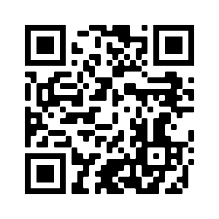





AI in FinTech: Metaverse, Web3, DeFi, NFT,
Financial Services Innovation and Applications
Artificial Intelligence in Finance and Quantitative Analysis
1111AIFQA02
MBA, IM, NTPU (M6132) (Fall 2022)
Tue 2, 3, 4 (9:10-12:00) (B8F40)
Min-Yuh Day, Ph.D,
Associate Professor
Institute of Information Management, National Taipei University
https://web.ntpu.edu.tw/~myday
https://meet.google.com/paj-zhhj-mya
2022-09-20

Slide 2
Syllabus
Week Date Subject/Topics
1 2022/09/13 Introduction to Artificial Intelligence in Finance and
Quantitative Analysis
2 2022/09/20 AI in FinTech: Metaverse, Web3, DeFi, NFT,
Financial Services Innovation and Applications
3 2022/09/27 Investing Psychology and Behavioral Finance
4 2022/10/04 Event Studies in Finance
5 2022/10/11 Case Study on AI in Finance and Quantitative Analysis I
6 2022/10/18 Finance Theory

Slide 3
Syllabus
Week Date Subject/Topics
7 2022/10/25 Data-Driven Finance
8 2022/11/01 Midterm Project Report
9 2022/11/08 Financial Econometrics
10 2022/11/15 AI-First Finance
11 2022/11/22 Industry Practices of AI in Finance and Quantitative
Analysis
12 2022/11/29 Case Study on AI in Finance and Quantitative Analysis II

Slide 4
Syllabus
Week Date Subject/Topics
13 2022/12/06 Deep Learning in Finance;
Reinforcement Learning in Finance
14 2022/12/13 Algorithmic Trading; Risk Management;
Trading Bot and Event-Based Backtesting
15 2022/12/20 Final Project Report I
16 2022/12/27 Final Project Report II
17 2023/01/03 Self-learning
18 2023/01/10 Self-learning

Slide 5
AI in FinTech:
Metaverse,
Web3, DeFi, NFT,
Financial Services
Innovation and Applications

Slide 6
FinTech ABCD
AI
Block Chain
Cloud Computing
Big Data

Slide 7
Decentralized Finance (DeFi)
Block Chain Financial Technology
Block Chain & Bitcoin
(BTC)
Smart Contract & Ethereum
(ETH)
Decentralized Application
(DApp)

Slide 8
Metaverse
Web3
DeFi
NFT

Slide 9
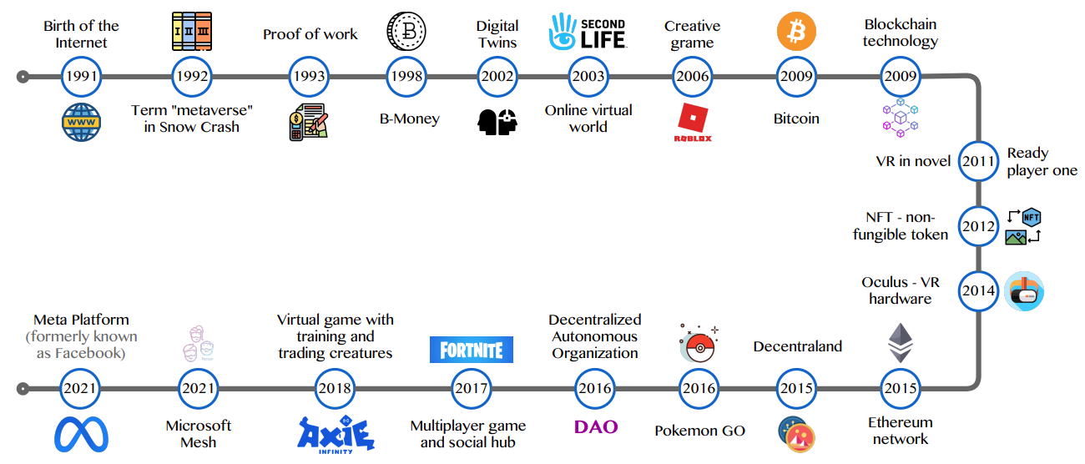
Metaverse Development from 1991 to 2021
Source: Huynh-The, Thien, Quoc-Viet Pham, Xuan-Qui Pham, Thanh Thi Nguyen, Zhu Han, and Dong-Seong Kim (2022).
"Artificial Intelligence for the Metaverse: A Survey." arXiv preprint arXiv:2202.10336.

Slide 10
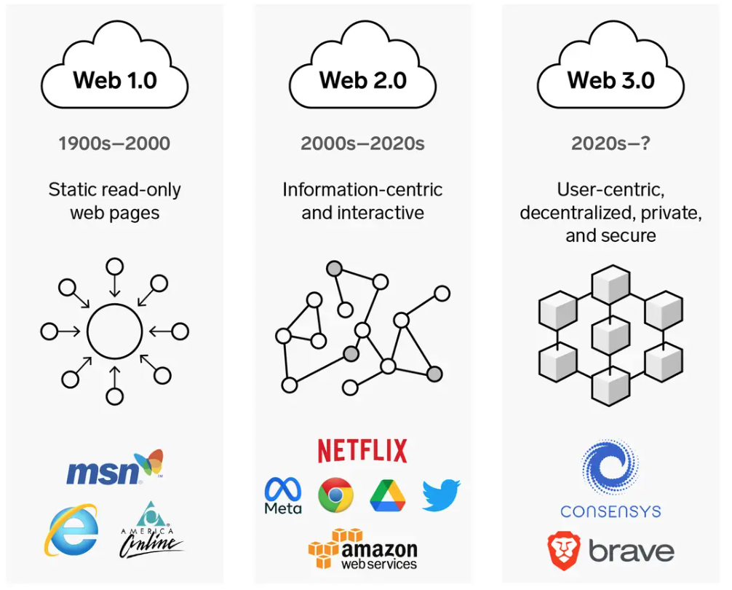
Web3: Decentralized Web
Internet Evolution
1990
2000
2020
Source: https://www.businessinsider.com/personal-finance/what-is-web3

Slide 11
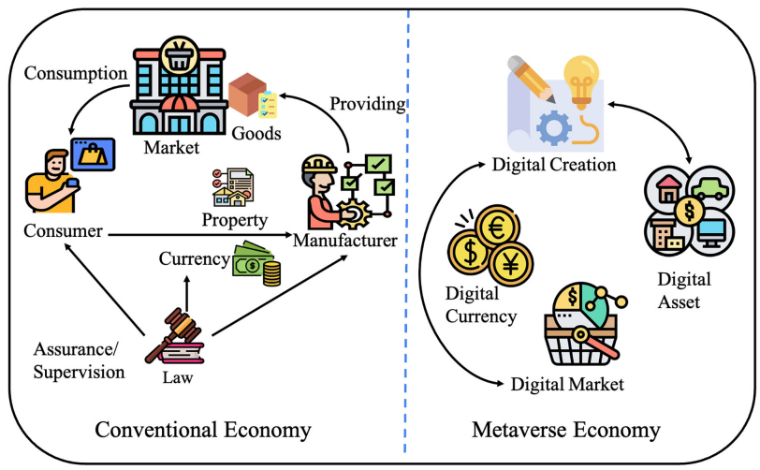
Metaverse Economy
Source: Yang, Qinglin, Yetong Zhao, Huawei Huang, Zehui Xiong, Jiawen Kang, and Zibin Zheng (2022).
"Fusing blockchain and AI with metaverse: A survey." IEEE Open Journal of the Computer Society 3 : 122-136.

Slide 12
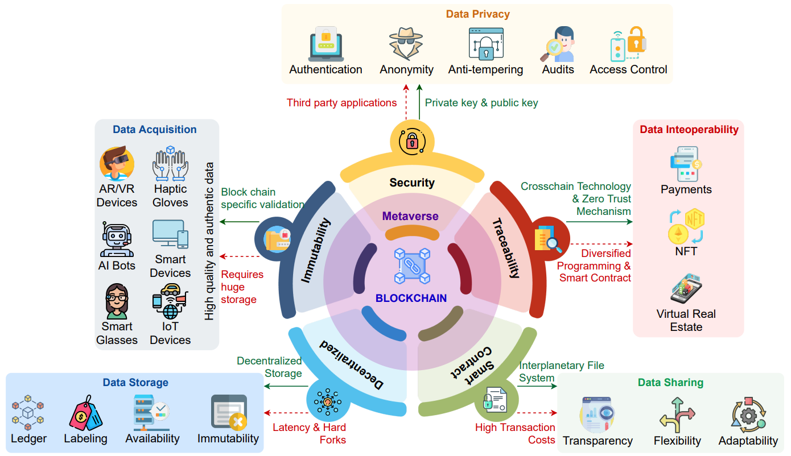
Blockchain in the Metaverse
Source: Gadekallu, Thippa Reddy, Thien Huynh-The, Weizheng Wang, Gokul Yenduri, Pasika Ranaweera, Quoc-Viet Pham, Daniel Benevides da Costa, and Madhusanka Liyanage (2022).
"Blockchain for the Metaverse: A Review." arXiv preprint arXiv:2203.09738..

Slide 13
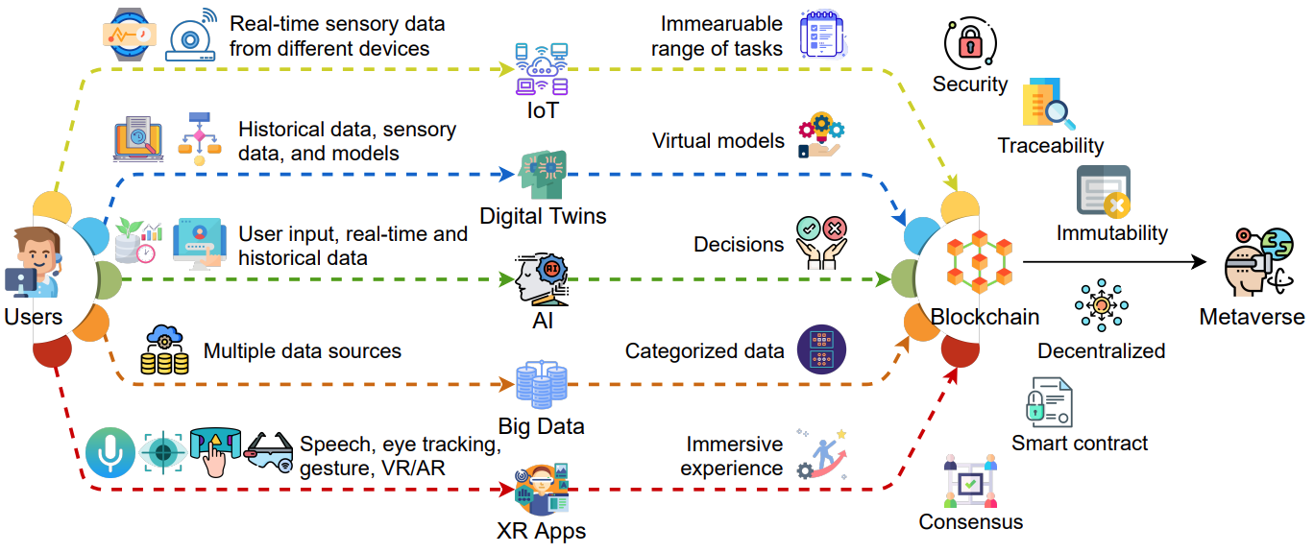
Blockchain for Key Enabling Technologies of the Metaverse
Source: Gadekallu, Thippa Reddy, Thien Huynh-The, Weizheng Wang, Gokul Yenduri, Pasika Ranaweera, Quoc-Viet Pham, Daniel Benevides da Costa, and Madhusanka Liyanage (2022).
"Blockchain for the Metaverse: A Review." arXiv preprint arXiv:2203.09738..

Slide 14
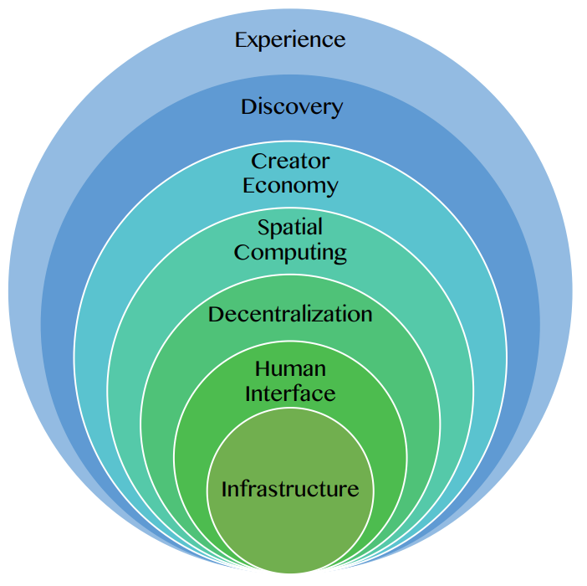
Seven Layers of a Metaverse Platform
Source: Huynh-The, Thien, Quoc-Viet Pham, Xuan-Qui Pham, Thanh Thi Nguyen, Zhu Han, and Dong-Seong Kim (2022).
"Artificial Intelligence for the Metaverse: A Survey." arXiv preprint arXiv:2202.10336.

Slide 15
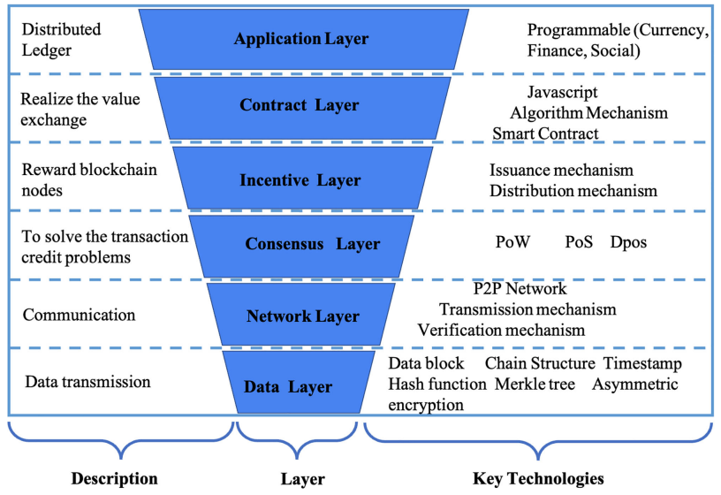
Layered Architecture of Blockchain
Source: Yang, Qinglin, Yetong Zhao, Huawei Huang, Zehui Xiong, Jiawen Kang, and Zibin Zheng (2022).
"Fusing blockchain and AI with metaverse: A survey." IEEE Open Journal of the Computer Society 3 : 122-136.

Slide 16
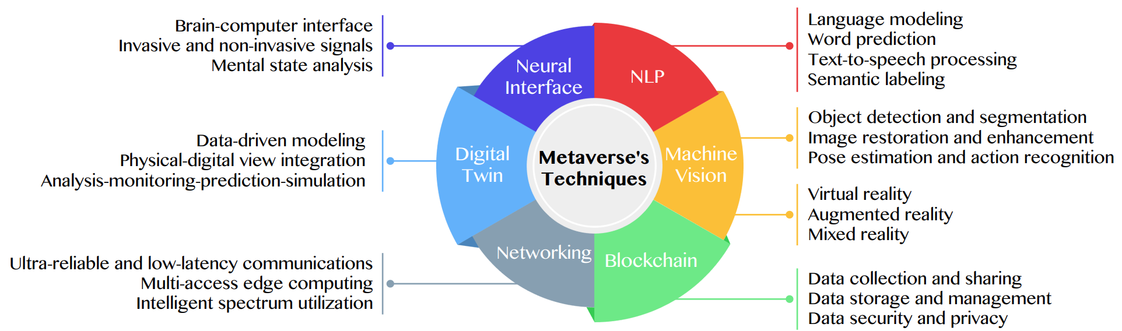
Primary Technical Aspects in the Metaverse
AI with ML algorithms and DL architectures is advancing the user experience in the virtual world
Source: Huynh-The, Thien, Quoc-Viet Pham, Xuan-Qui Pham, Thanh Thi Nguyen, Zhu Han, and Dong-Seong Kim (2022).
"Artificial Intelligence for the Metaverse: A Survey." arXiv preprint arXiv:2202.10336.

Slide 17
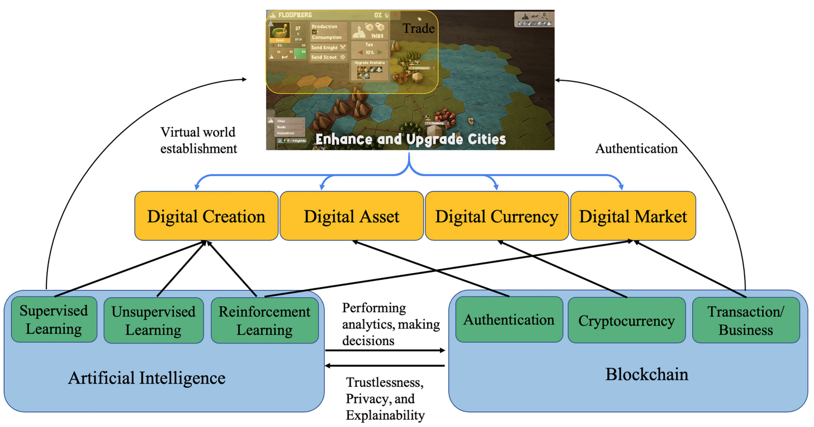
Fusion of AI and Blockchain in Metaverse
Source: Yang, Qinglin, Yetong Zhao, Huawei Huang, Zehui Xiong, Jiawen Kang, and Zibin Zheng (2022).
"Fusing blockchain and AI with metaverse: A survey." IEEE Open Journal of the Computer Society 3 : 122-136.

Slide 18
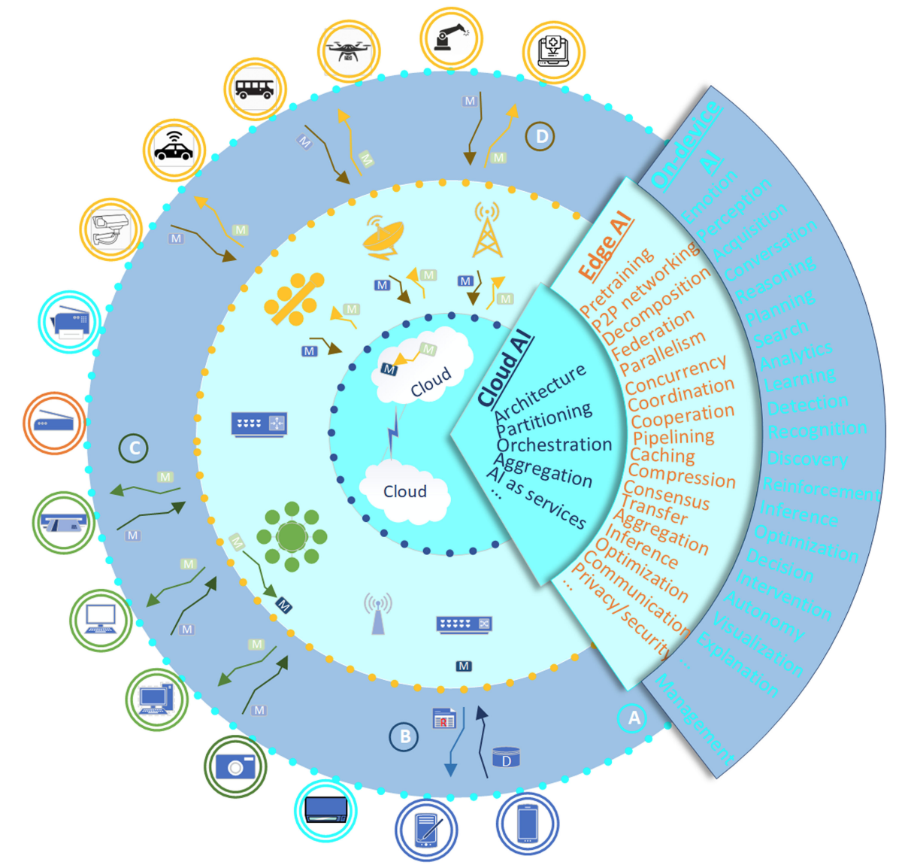
DeAI:
Synthesizing On-device AI, Edge AI, and Cloud AI
Source: Cao, Longbing (2022). "Decentralized ai: Edge intelligence and smart blockchain, metaverse, web3, and desci." IEEE Intelligent Systems 37, no. 3: 6-19.

Slide 19
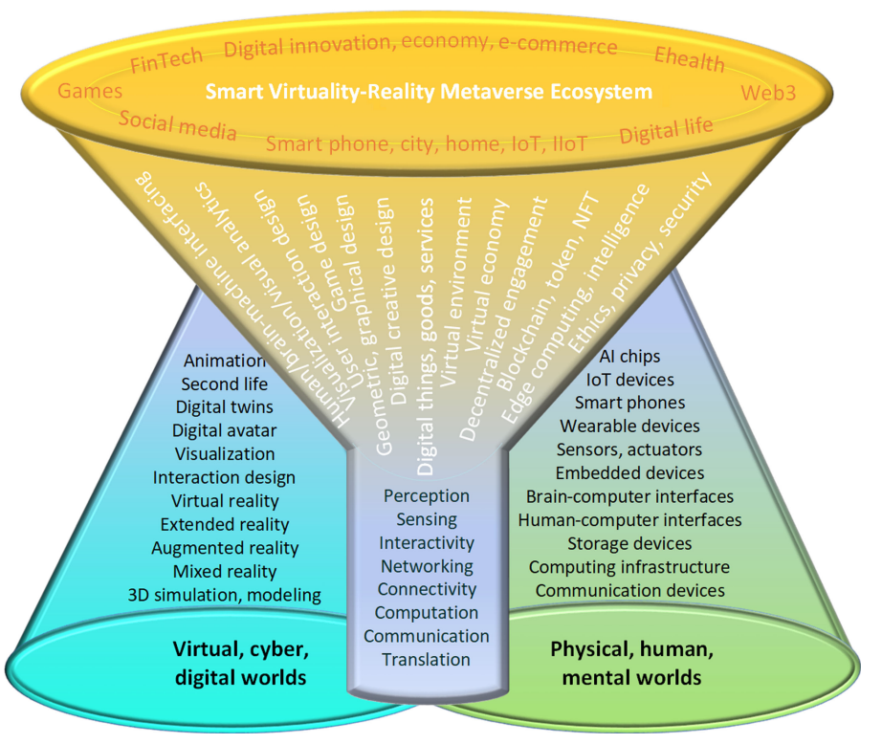
Smart Virtuality-Reality Metaverse Ecosystem: Metasynthesizing DeAI, Metaverse, Blockchain, Web3
Source: Cao, Longbing (2022). "Decentralized ai: Edge intelligence and smart blockchain, metaverse, web3, and desci." IEEE Intelligent Systems 37, no. 3: 6-19.

Slide 20
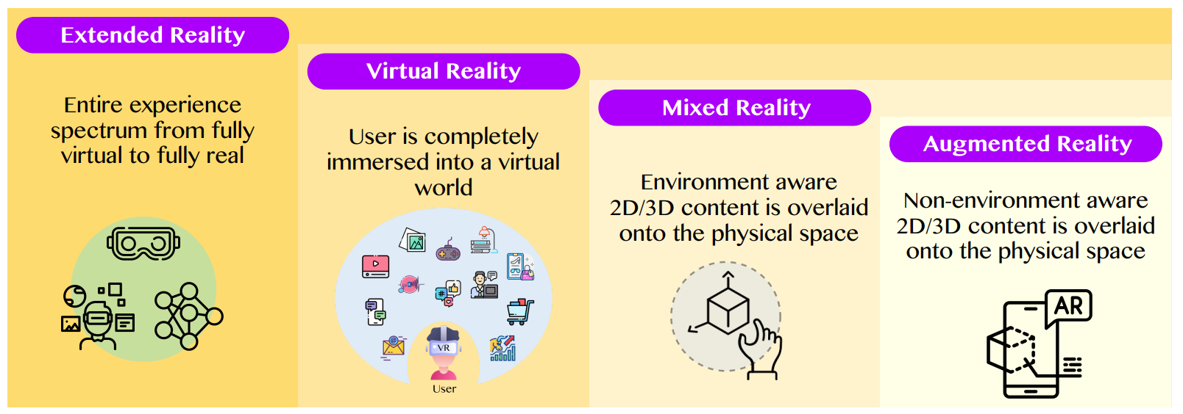
The difference between AR, MR, and VR under the umbrella of XR
XR
VR
MR
AR
Source: Huynh-The, Thien, Quoc-Viet Pham, Xuan-Qui Pham, Thanh Thi Nguyen, Zhu Han, and Dong-Seong Kim (2022).
"Artificial Intelligence for the Metaverse: A Survey." arXiv preprint arXiv:2202.10336.

Slide 21
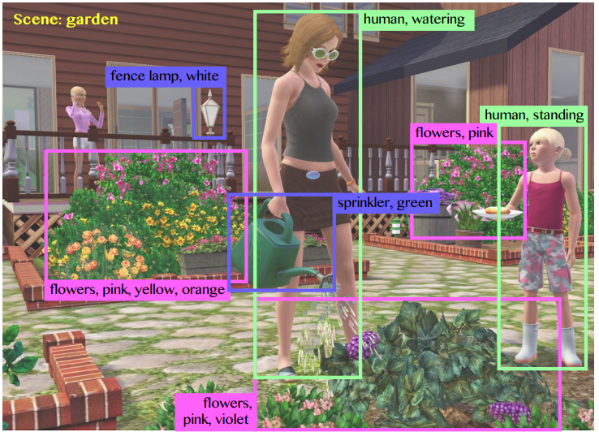
Computer vision in the metaverse with scene understanding, object detection, and human action/activity recognition
Source: Huynh-The, Thien, Quoc-Viet Pham, Xuan-Qui Pham, Thanh Thi Nguyen, Zhu Han, and Dong-Seong Kim (2022).
"Artificial Intelligence for the Metaverse: A Survey." arXiv preprint arXiv:2202.10336.

Slide 22
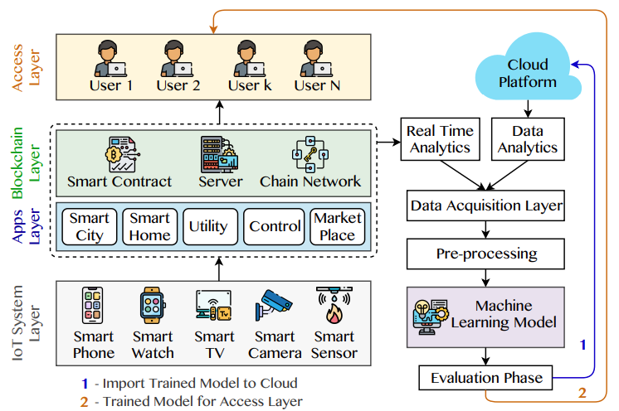
A Blockchain-based IoT Framework with ML to enhance security and privacy
Source: Huynh-The, Thien, Quoc-Viet Pham, Xuan-Qui Pham, Thanh Thi Nguyen, Zhu Han, and Dong-Seong Kim (2022).
"Artificial Intelligence for the Metaverse: A Survey." arXiv preprint arXiv:2202.10336.

Slide 23
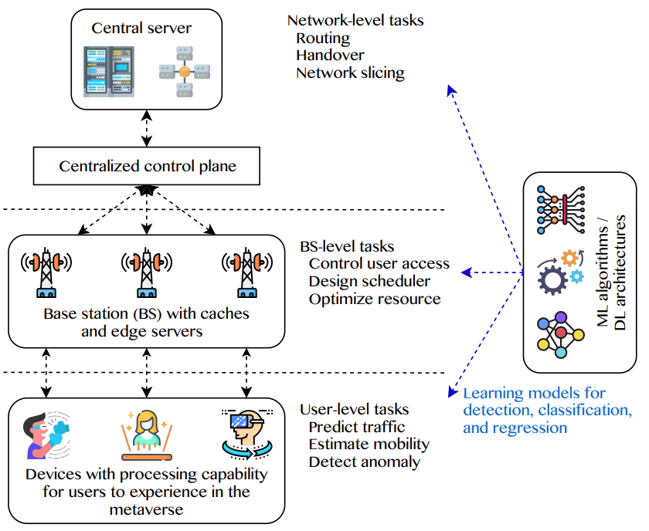
5G and beyond for Metaverse Services
AI with ML algorithms and DL models contribute in multi-level tasks
Source: Huynh-The, Thien, Quoc-Viet Pham, Xuan-Qui Pham, Thanh Thi Nguyen, Zhu Han, and Dong-Seong Kim (2022).
"Artificial Intelligence for the Metaverse: A Survey." arXiv preprint arXiv:2202.10336.

Slide 24
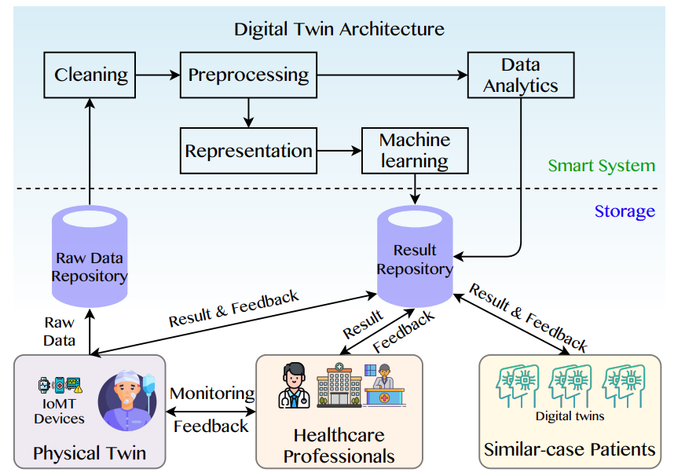
A Data-Driven Digital Twin Architecture for intelligent healthcare systems using ML to process raw data of IoMedicalThings devices
Source: Huynh-The, Thien, Quoc-Viet Pham, Xuan-Qui Pham, Thanh Thi Nguyen, Zhu Han, and Dong-Seong Kim (2022).
"Artificial Intelligence for the Metaverse: A Survey." arXiv preprint arXiv:2202.10336.

Slide 25
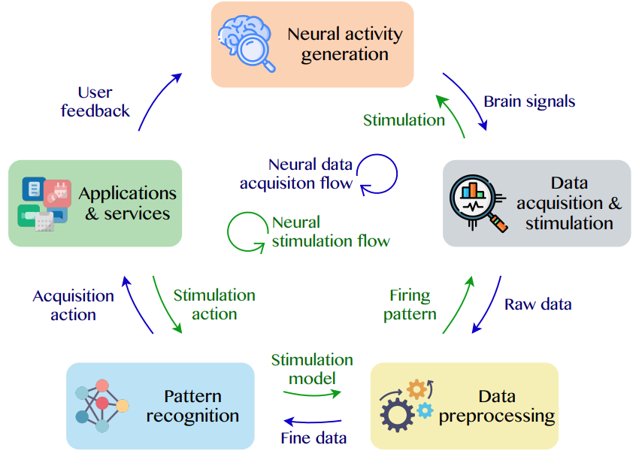
Brain-Machine Interfaces (BMIs) for processing neural signals and responding neural stimulations
Source: Huynh-The, Thien, Quoc-Viet Pham, Xuan-Qui Pham, Thanh Thi Nguyen, Zhu Han, and Dong-Seong Kim (2022).
"Artificial Intelligence for the Metaverse: A Survey." arXiv preprint arXiv:2202.10336.

Slide 26
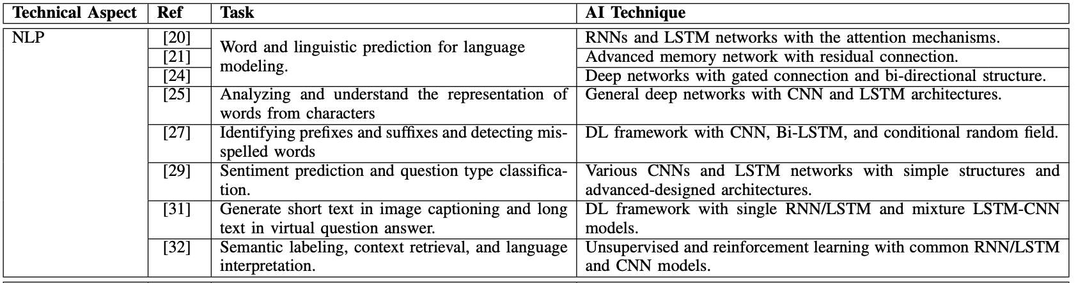
AI for the Metaverse
Source: Huynh-The, Thien, Quoc-Viet Pham, Xuan-Qui Pham, Thanh Thi Nguyen, Zhu Han, and Dong-Seong Kim (2022).
"Artificial Intelligence for the Metaverse: A Survey." arXiv preprint arXiv:2202.10336.

Slide 27
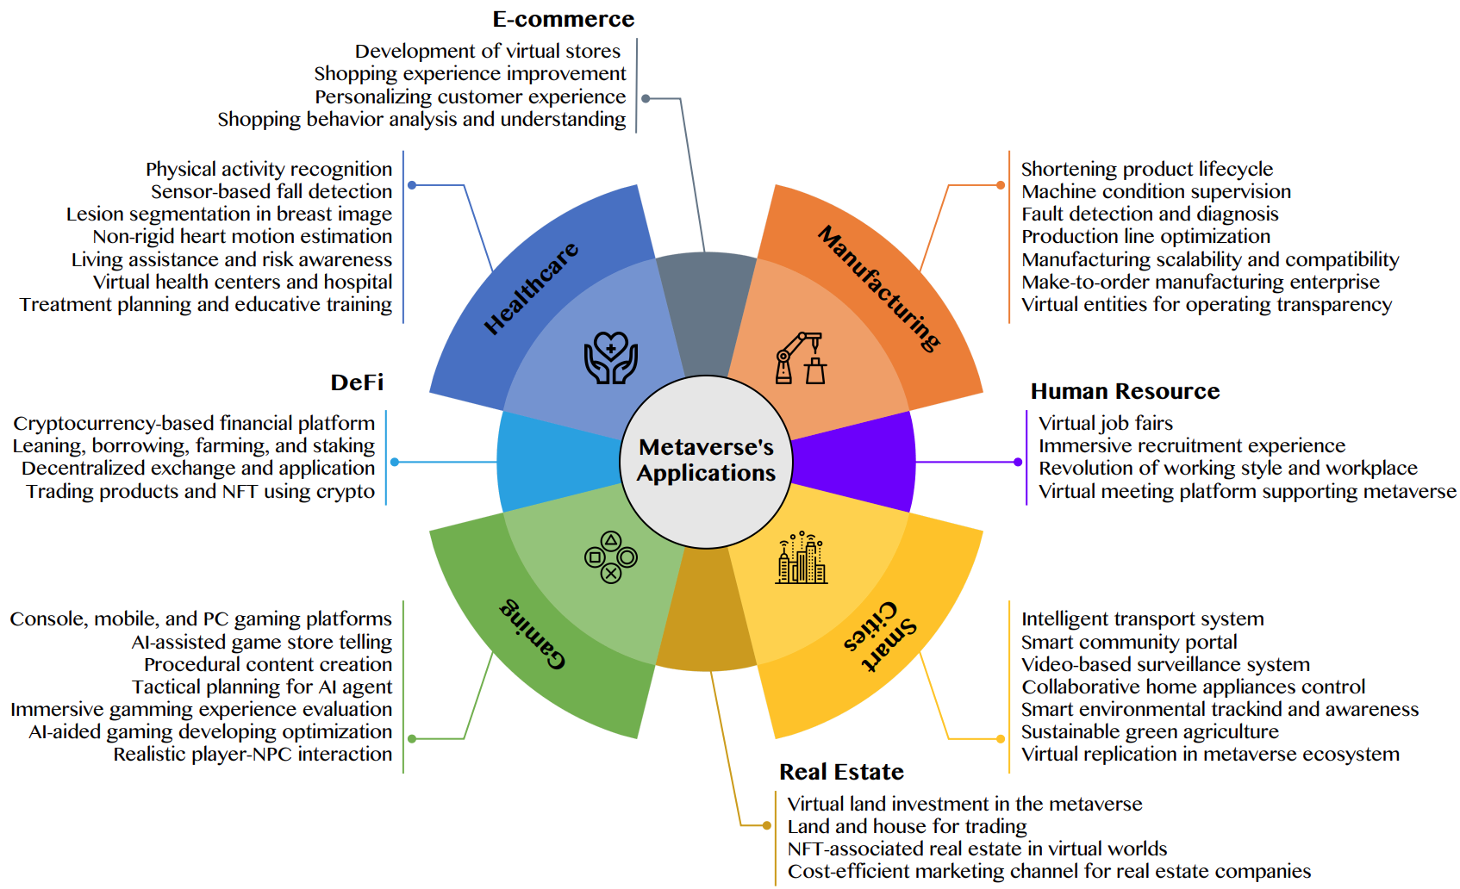
AI for the Metaverse in the Application Aspects healthcare, manufacturing, smart cities, gaming
E-commerce, human resources, real estate, and DeFi
Source: Huynh-The, Thien, Quoc-Viet Pham, Xuan-Qui Pham, Thanh Thi Nguyen, Zhu Han, and Dong-Seong Kim (2022).
"Artificial Intelligence for the Metaverse: A Survey." arXiv preprint arXiv:2202.10336.

Slide 28
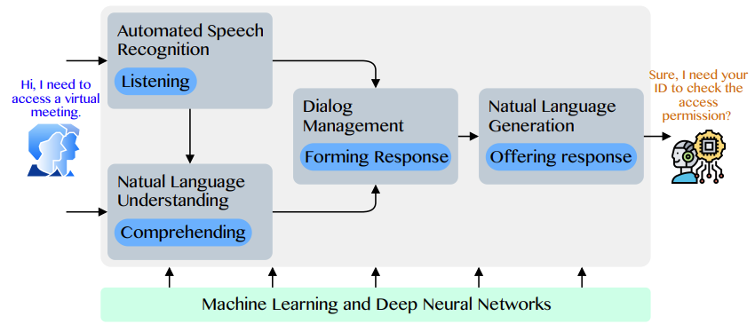
Conversational AI to deliver contextual and personal experience to users
Source: Huynh-The, Thien, Quoc-Viet Pham, Xuan-Qui Pham, Thanh Thi Nguyen, Zhu Han, and Dong-Seong Kim (2022).
"Artificial Intelligence for the Metaverse: A Survey." arXiv preprint arXiv:2202.10336.

Slide 29
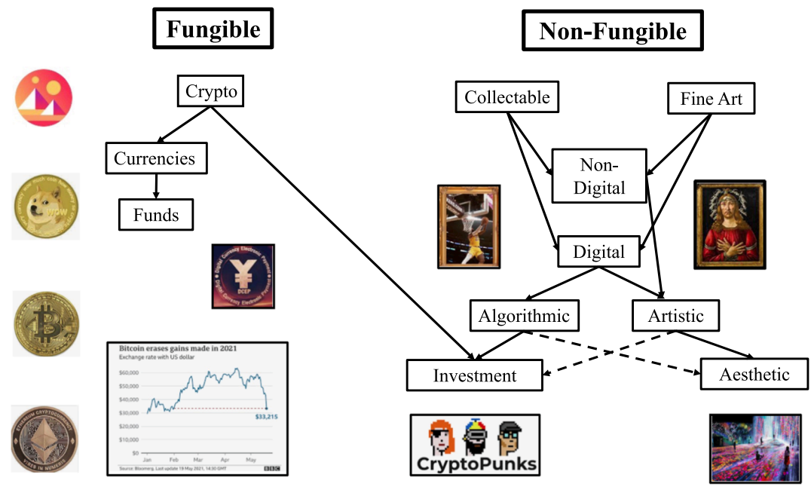
Blockchain-Registered:
Crypto, Collectables, and Art.
Source: Belk, Russell, Mariam Humayun, and Myriam Brouard. (2022)
"Money, possessions, and ownership in the Metaverse: NFTs, cryptocurrencies, Web3 and Wild Markets." Journal of Business Research 153: 198-205.

Slide 30
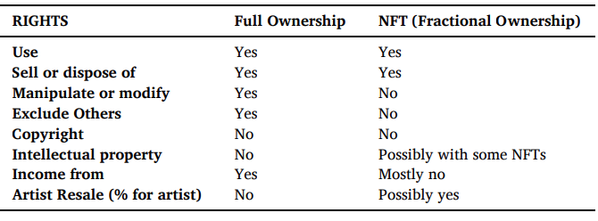
Full Versus Fractional [NFT]
Property Ownership Rights for an Artwork
Source: Belk, Russell, Mariam Humayun, and Myriam Brouard. (2022)
"Money, possessions, and ownership in the Metaverse: NFTs, cryptocurrencies, Web3 and Wild Markets." Journal of Business Research 153: 198-205.

Slide 31
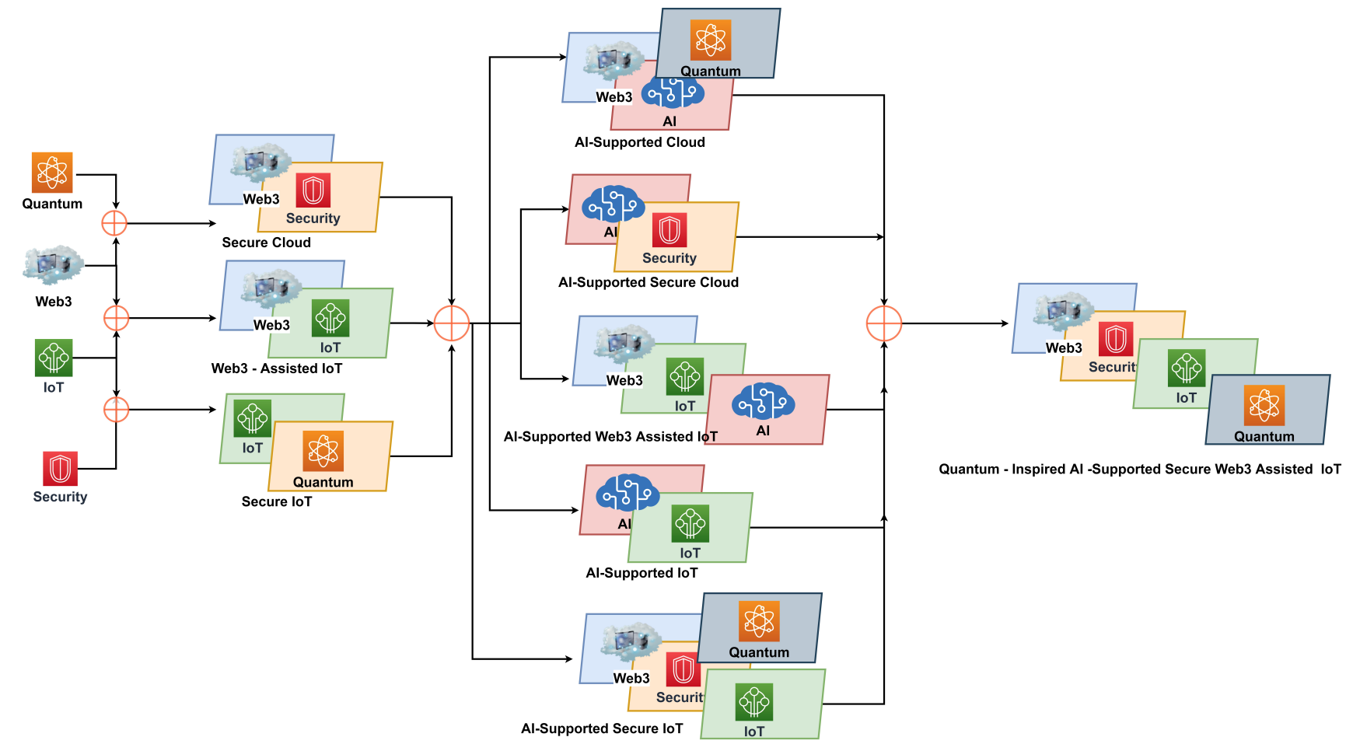
Combination of Web3 with other Technologies
Source: Sheridan, Dan, James Harris, Frank Wear, Jerry Cowell Jr, Easton Wong, and Abbas Yazdinejad. (2022)
"Web3 Challenges and Opportunities for the Market." arXiv preprint arXiv:2209.02446.

Slide 32
FinTech

Slide 33
Financial Technology
FinTech
“providing
financial services
by making use of software and
modern technology”
Source: https://www.fintechweekly.com/fintech-definition

Slide 34
Financial Technology

Slide 35
Financial Services

Slide 36
Artificial Intelligence
(AI)

Slide 37
AI, Big Data, Cloud Computing
Evolution of Decision Support, Business Intelligence, and Analytics
AI
AI
Cloud Computing
Big Data
DM
BI
Source: Ramesh Sharda, Dursun Delen, and Efraim Turban (2017),
Business Intelligence, Analytics, and Data Science: A Managerial Perspective, 4th Edition, Pearson

Slide 38
AI, ML, DL
Artificial Intelligence (AI)
Machine Learning (ML)
Supervised
Learning
Unsupervised Learning
Deep Learning (DL)
CNN
RNN LSTM GRU
GAN
Semi-supervised Learning
Reinforcement Learning
Source: https://leonardoaraujosantos.gitbooks.io/artificial-inteligence/content/deep_learning.html

Slide 39
Value Creation by Big Data Analytics
(Grover et al., 2018)
Source: Varun Grover, Roger HL Chiang, Ting-Peng Liang, and Dongsong Zhang (2018), "Creating Strategic Business Value from Big Data Analytics: A Research Framework", Journal of Management Information Systems, 35, no. 2, pp. 388-423.

Slide 40
Architecture of Big Data Analytics
Big Data
Analytics
Applications
Big Data
Sources
Big Data
Transformation
Big Data
Platforms & Tools
* Internal
* External
* Multiple formats
* Multiple
locations
* Multiple applications
Middleware
Hadoop
MapReduce
Pig
Hive
Jaql
Zookeeper
Hbase
Cassandra
Oozie
Avro
Mahout
Others
Queries
Raw
Data
Transformed
Data
Big Data
Analytics
Extract Transform Load
Reports
Data Warehouse
OLAP
Traditional Format
CSV, Tables
Data Mining
Source: Stephan Kudyba (2014), Big Data, Mining, and Analytics: Components of Strategic Decision Making, Auerbach Publications

Slide 41
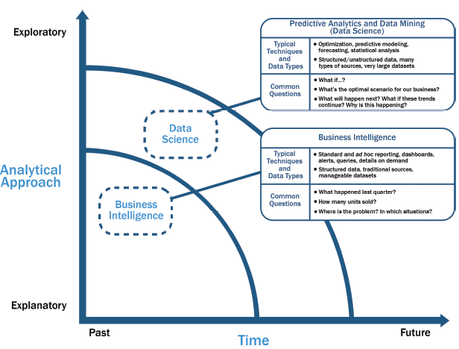
Data Science and
Business Intelligence
Source: EMC Education Services, Data Science and Big Data Analytics: Discovering, Analyzing, Visualizing and Presenting Data, Wiley, 2015

Slide 42
Data Science and
Business Intelligence
Predictive Analytics
and Data Mining
(Data Science)
Source: EMC Education Services, Data Science and Big Data Analytics: Discovering, Analyzing, Visualizing and Presenting Data, Wiley, 2015

Slide 43
Data Science and
Business Intelligence
Predictive Analytics
and Data Mining
(Data Science)
Structured/unstructured data, many types of sources,
very large datasets
Optimization, predictive modeling, forecasting statistical analysis
What if…?
What’s the optimal scenario for our business?
What will happen next?
What if these trends countinue?
Why is this happening?
Source: EMC Education Services, Data Science and Big Data Analytics: Discovering, Analyzing, Visualizing and Presenting Data, Wiley, 2015

Slide 44
Profile of a Data Scientist
Quantitative
  mathematics or statistics
Technical
  software engineering,
  machine learning,
  and programming skills
Skeptical mind-set and critical thinking
Curious and creative
Communicative and collaborative
Source: EMC Education Services, Data Science and Big Data Analytics: Discovering, Analyzing, Visualizing and Presenting Data, Wiley, 2015

Slide 45
Data Scientist Profile
Quantitative
Technical
Curious
and
Creative
Data Scientist
Skeptical
Communicative
and
Collaborative
Source: EMC Education Services, Data Science and Big Data Analytics: Discovering, Analyzing, Visualizing and Presenting Data, Wiley, 2015

Slide 46
Framework for BD and BI Research
Data Collection
Data Storage
Data Analytics
Infrastructure
Business
Medicate
Supply Chain
Engineering
Services
Technology
Application
Impact
Management
Value Creation
Individual Impact
Organizational Impact
Social Impact
Adoption of BD/BI
Cost Benefit
Security/Privacy
Human Resource
Source: Ting-Peng Liang and Yu-Hsi Liu (2018), "Research Landscape of Business Intelligence and Big Data analytics: A bibliometrics study”,
Expert Systems with Applications, Volume 111, 30, 2018, pp. 2-10

Slide 47
Definition of
Artificial Intelligence (A.I.)

Slide 48
Artificial Intelligence
“… the science and engineering of making intelligent machines”
(John McCarthy, 1955)
Source: https://digitalintelligencetoday.com/artificial-intelligence-defined-useful-list-of-popular-definitions-from-business-and-science/

Slide 49
Artificial Intelligence
“… technology that thinks and acts like humans”
Source: https://digitalintelligencetoday.com/artificial-intelligence-defined-useful-list-of-popular-definitions-from-business-and-science/

Slide 50
Artificial Intelligence
“… intelligence exhibited by machines or software”
Source: https://digitalintelligencetoday.com/artificial-intelligence-defined-useful-list-of-popular-definitions-from-business-and-science/

Slide 51
4 Approaches of AI
Thinking Humanly | Thinking Rationally
Acting Humanly | Acting Rationally
Source: Stuart Russell and Peter Norvig (2020), Artificial Intelligence: A Modern Approach, 4th Edition, Pearson

Slide 52
4 Approaches of AI
2. Thinking Humanly: The Cognitive Modeling Approach | 3. Thinking Rationally: The “Laws of Thought” Approach
1. Acting Humanly: The Turing Test Approach (1950) | 4. Acting Rationally: The Rational Agent Approach
Source: Stuart Russell and Peter Norvig (2020), Artificial Intelligence: A Modern Approach, 4th Edition, Pearson

Slide 53
AI Acting Humanly:
The Turing Test Approach
(Alan Turing, 1950)
Knowledge Representation
Automated Reasoning
Machine Learning (ML)
  Deep Learning (DL)
Computer Vision (Image, Video)
Natural Language Processing (NLP)
Robotics
Source: Stuart Russell and Peter Norvig (2020), Artificial Intelligence: A Modern Approach, 4th Edition, Pearson

Slide 54
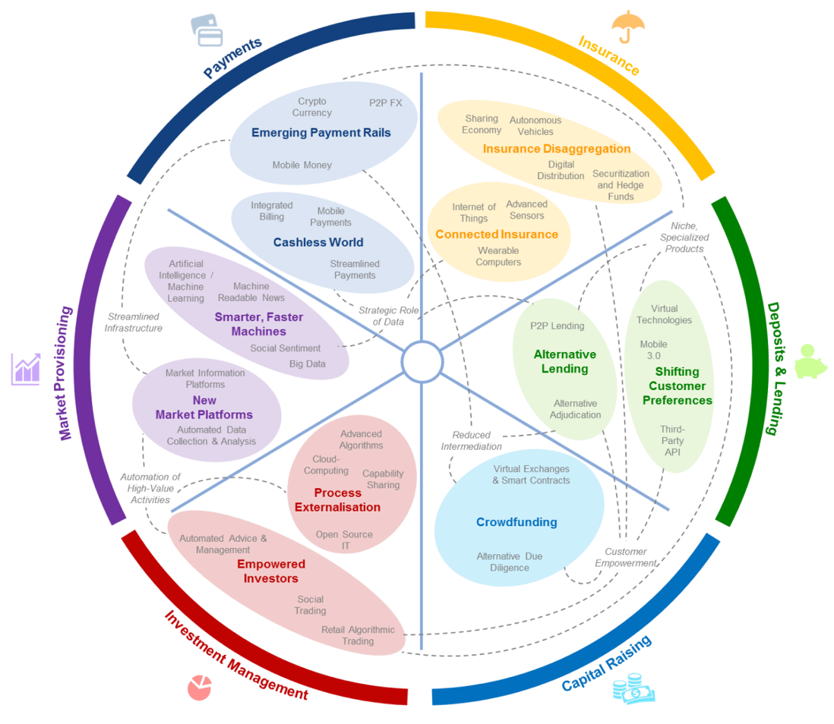
FinTech: Financial Services Innovation
Source: http://www3.weforum.org/docs/WEF_The_future__of_financial_services.pdf

Slide 55
FinTech:
Financial Services Innovation
1. Payments
2. Insurance
3. Deposits & Lending
4. Capital Raising
5. Investment Management
6. Market Provisioning
Source: http://www3.weforum.org/docs/WEF_The_future__of_financial_services.pdf

Slide 56
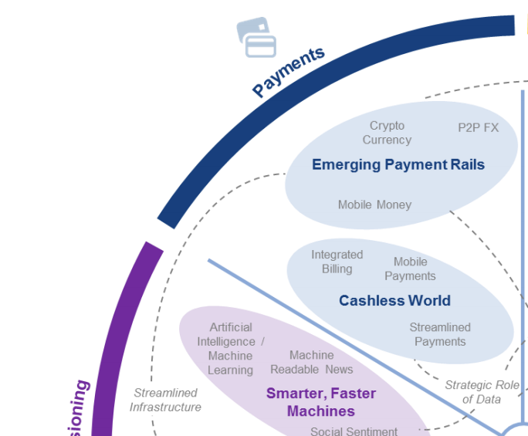
FinTech: Payment
1
Source: http://www3.weforum.org/docs/WEF_The_future__of_financial_services.pdf

Slide 57
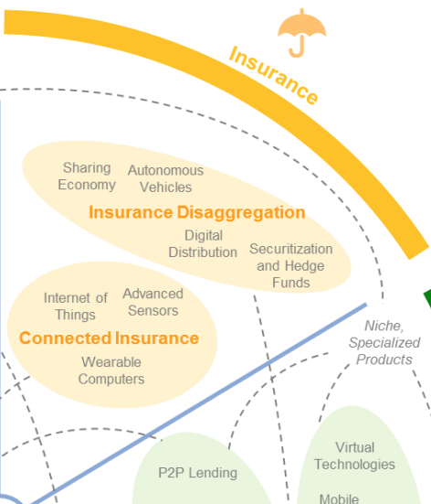
FinTech: Insurance
2
Source: http://www3.weforum.org/docs/WEF_The_future__of_financial_services.pdf

Slide 58
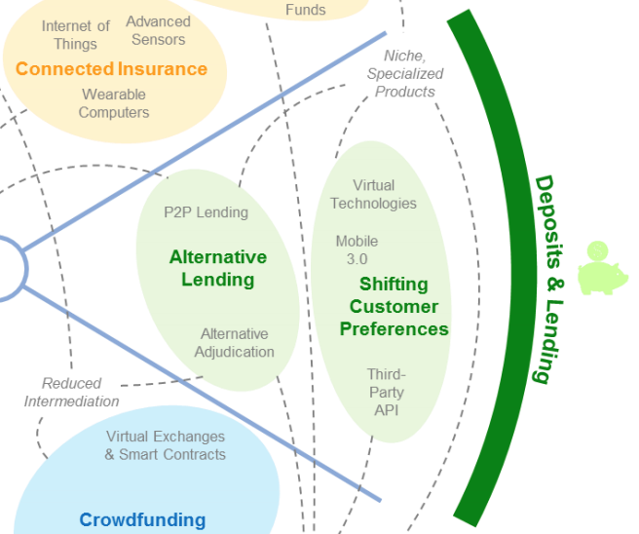
FinTech: Deposits & Lending
3
Source: http://www3.weforum.org/docs/WEF_The_future__of_financial_services.pdf

Slide 59
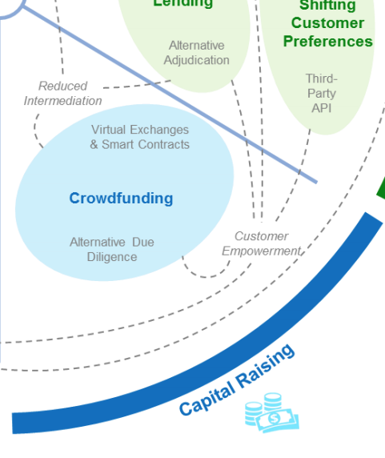
FinTech: Capital Raising
4
Source: http://www3.weforum.org/docs/WEF_The_future__of_financial_services.pdf

Slide 60
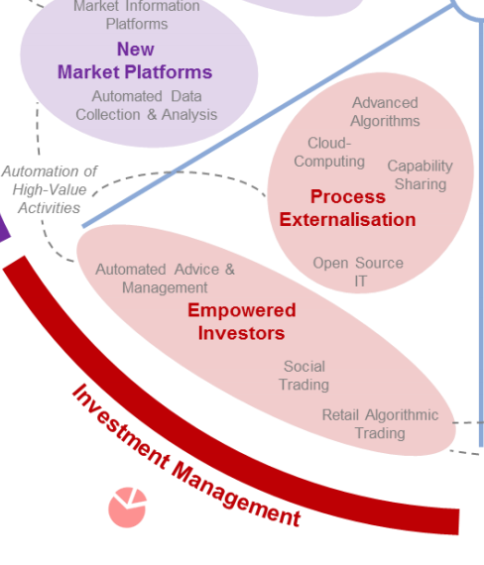
FinTech: Investment Management
5
Source: http://www3.weforum.org/docs/WEF_The_future__of_financial_services.pdf

Slide 61
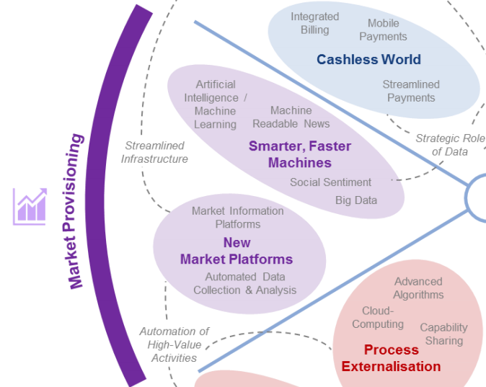
FinTech: Market Provisioning
6
Source: http://www3.weforum.org/docs/WEF_The_future__of_financial_services.pdf

Slide 62
AI in
FinTech

Slide 63
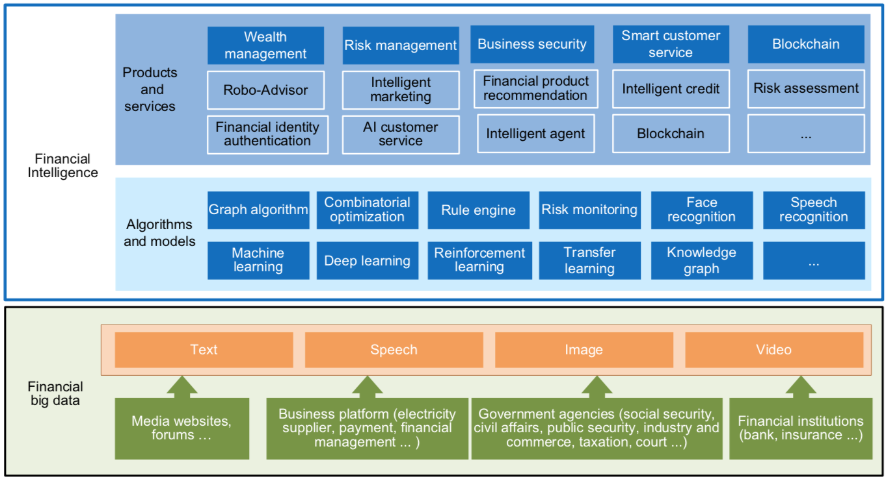
FinBrain: when Finance meets AI 2.0
(Zheng et al., 2019)
Source: Xiao-lin Zheng, Meng-ying Zhu, Qi-bing Li, Chao-chao Chen, and Yan-chao Tan (2019), "Finbrain: When finance meets AI 2.0." Frontiers of Information Technology & Electronic Engineering 20, no. 7, pp. 914-924

Slide 64
AI 2.0
a new generation of AI
based on the
novel information environment of
major changes and
the development of
new goals.
Yunhe Pan (2016), "Heading toward artificial intelligence 2.0." Engineering 2, no. 4, 409-413.

Slide 65
Technology-driven
Financial Industry Development
Development stage | Driving technology | Main landscape | Inclusive finance | Relationship between technology and finance
Fintech 1.0 (financial IT) | Computer | Credit card, ATM, and CRMS | Low | Technology as a tool
Fintech 2.0 (Internet finance) | Mobile Internet | Marketplace lending, third-party payment, crowdfunding, and Internet insurance | Medium | Technology-driven change
Fintech 3.0 (financial intelligence) | AI, Big Data, Cloud Computing, Blockchain | Intelligent finance | High | Deep fusion
Source: Xiao-lin Zheng, Meng-ying Zhu, Qi-bing Li, Chao-chao Chen, and Yan-chao Tan (2019), "Finbrain: When finance meets AI 2.0." Frontiers of Information Technology & Electronic Engineering 20, no. 7, pp. 914-924

Slide 66
Deep learning for financial applications: Topic-Model Heatmap
Source: Ahmet Murat Ozbayoglu, Mehmet Ugur Gudelek, and Omer Berat Sezer (2020). "Deep learning for financial applications: A survey." Applied Soft Computing (2020): 106384.

Slide 67
Deep learning for financial applications: Topic-Feature Heatmap
Source: Ahmet Murat Ozbayoglu, Mehmet Ugur Gudelek, and Omer Berat Sezer (2020). "Deep learning for financial applications: A survey." Applied Soft Computing (2020): 106384.

Slide 68
Deep learning for financial applications: Topic-Dataset Heatmap
Source: Ahmet Murat Ozbayoglu, Mehmet Ugur Gudelek, and Omer Berat Sezer (2020). "Deep learning for financial applications: A survey." Applied Soft Computing (2020): 106384.

Slide 69
Stock Market Movement Forecast:
Phases of the stock market modeling
Source: O. Bustos and A. Pomares-Quimbaya (2020), "Stock Market Movement Forecast: A Systematic Review."
Expert Systems with Applications (2020): 113464.

Slide 70
Decentralized Finance
(DeFi)
Block Chain FinTech

Slide 71
Decentralized Finance (DeFi)
A global, open alternative to the current financial system.
Products that let you borrow, save, invest, trade, and more.
Based on open-source technology that anyone can program with.
Source: https://ethereum.org/en/defi/

Slide 72
Traditional Finance
Centralized Finance (CeFi)
Some people aren't granted access to set up a bank account or use financial services.
Lack of access to financial services can prevent people from being employable.
Financial services can block you from getting paid.
A hidden charge of financial services is your personal data.
Governments and centralized institutions can close down markets at will.
Trading hours often limited to business hours of specific time zone.
Money transfers can take days due to internal human processes.
There's a premium to financial services because intermediary institutions need their cut.
Source: https://ethereum.org/en/defi/

Slide 73
DeFi vs. CeFi
Decentralized Finance (DeFi) | Traditional Finance (Centralized Finance; CeFi)
You hold your money. | Your money is held by companies.
You control where your money goes and how it's spent. | You have to trust companies not to mismanage your money, like lend to risky borrowers.
Transfers of funds happen in minutes. | Payments can take days due to manual processes.
Transaction activity is pseudonymous. | Financial activity is tightly coupled with your identity.
DeFi is open to anyone. | You must apply to use financial services.
The markets are always open. | Markets close because employees need breaks.
It's built on transparency – anyone can look at a product's data and inspect how the system works. | Financial institutions are closed books: you can't ask to see their loan history, a record of their managed assets, and so on.
Source: https://ethereum.org/en/defi/

Slide 74
(DeFi)
Decentralized Applications (Dapps)
Ethereum-powered tools and services
Dapps are a growing movement of applications that use Ethereum to disrupt business models or invent new ones
Source: https://ethereum.org/en/defi/

Slide 75
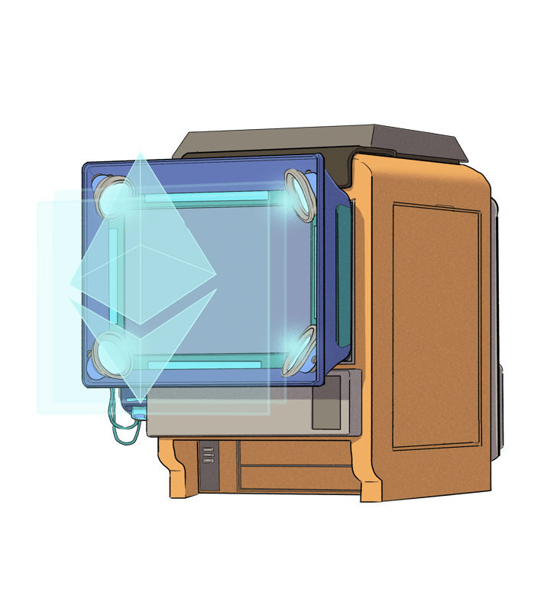
The Internet of Assets
Ethereum isn't just for
digital money.
Anything you can own can be represented,
traded and
put to use as
non-fungible tokens (NFTs).
Source: https://ethereum.org/en/defi/

Slide 76
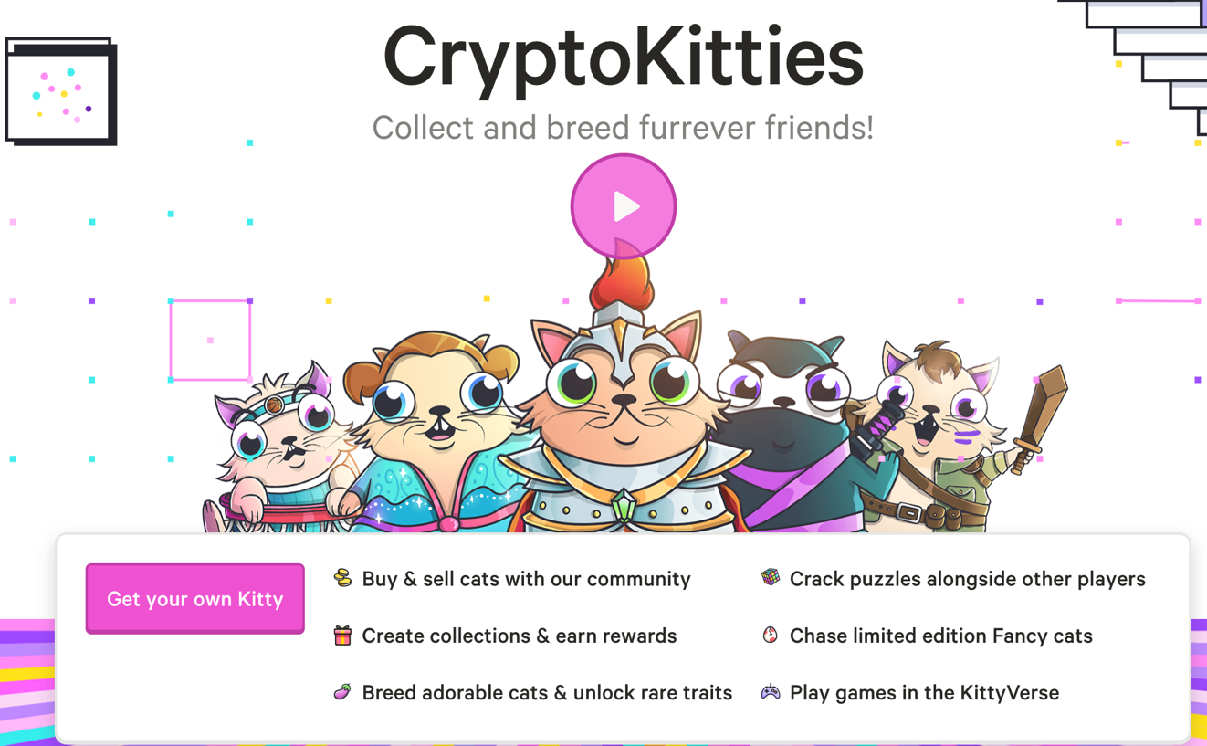
Non-Fungible Tokens (NFT)
CryptoKitties
https://www.cryptokitties.co/
Source: Matt Fortnow and QuHarrison Terry (2021), The NFT Handbook - How to Create, Sell and Buy Non-Fungible Tokens, Wiley

Slide 77
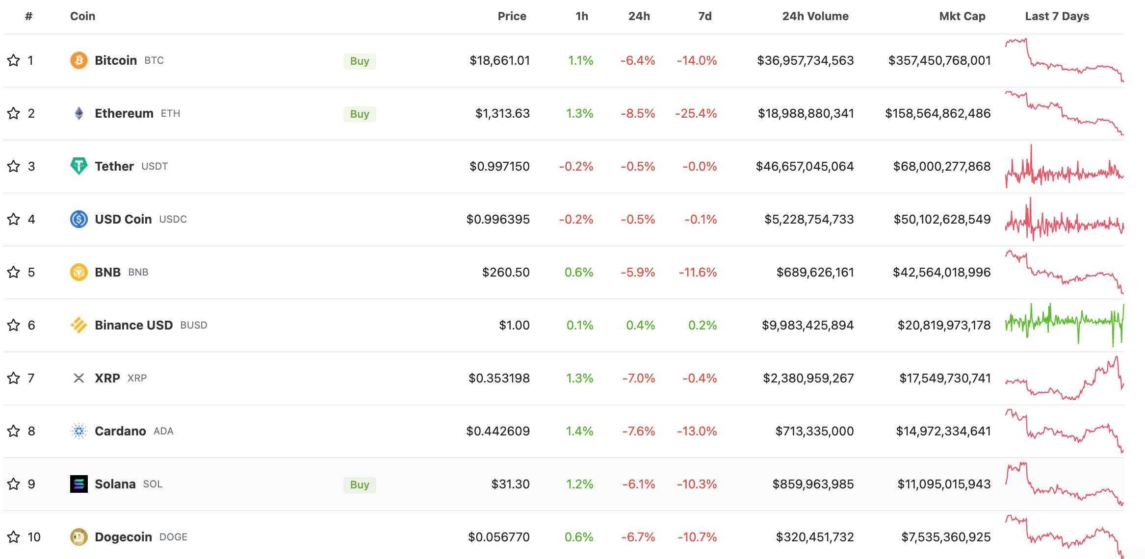
Top 10 Cryptocurrency Prices by Market Cap
The global cryptocurrency market cap today is $949 Billion (2022/09/19)
Source: https://www.coingecko.com/en

Slide 78
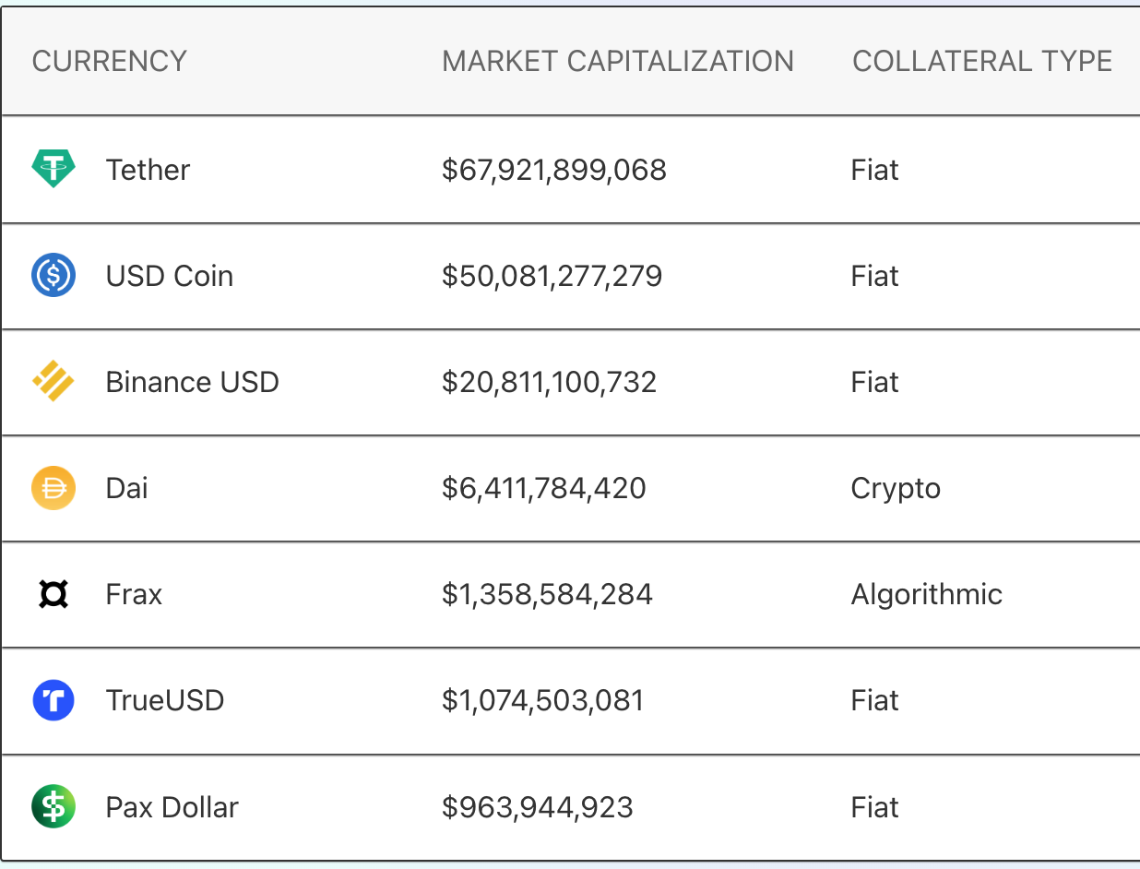
Top Stablecoins
(Tether USDT, USD Coin USDC, Dai)
Digital money for everyday use
Stablecoins are
Ethereum tokens designed to stay at a fixed value,
even when
the price of ETH changes.
Source: https://ethereum.org/en/stablecoins/

Slide 79
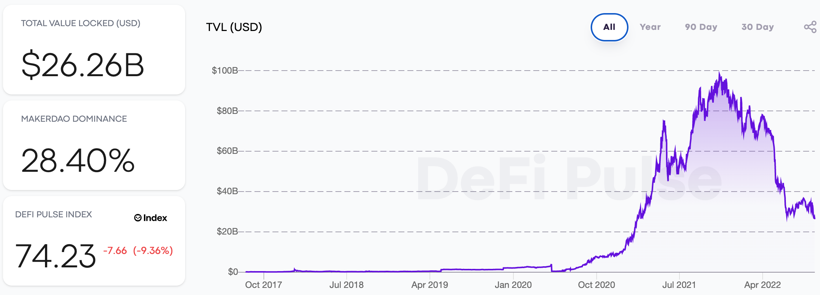
DeFi Total Value Locked (USD)
(DeFi Pulse)
Source: https://defipulse.com/

Slide 80
Top 10 DeFi Applications (DApps)
(DeFi Pulse)
Lending
DEXes (Decentralized Exchanges)
Derivatives
Assets
Payments
# | NAME | CHAIN | SECTOR | TVL (USD)
1 🏆 | MakerDAO | Ethereum | Lending | $7.25B
2 🥈 | Curve | Ethereum | DEXes | $4.22B
3 🥉 | Aave | Ethereum | Lending | $3.98B
4 | Uniswap | Ethereum | DEXes | $3.60B
5 | Compound | Ethereum | Lending | $2.10B
6 | InstaDApp | Ethereum | Lending | $1.19B
7 | Liquity | Ethereum | Lending | $643.3M
8 | Balancer | Ethereum | DEXes | $488.8M
9 | dYdX | Ethereum | Derivatives | $471.3M
10 | SushiSwap | Ethereum | DEXes | $305.1M
Source: https://defipulse.com/

Slide 81
Financial Stability Challenges
Crypto Ecosystem
Operational, cyber, and governance risks
Integrity (market and AML/CFT)
(Anti–Money Laundering / Combating the Financing of Terrorism)
Data availability / reliability
Challenges from cross-boarder activites
Stablecoins
How stable are stablecoins?
Domestic and global regulatory and supervisory
approaches
Macro-Financial
Cryptoization, capital flows, and restrictions
Monetary policy transmission
Bank disintermediation
Source: Parma Bains, Mohamed Diaby, Dimitris Drakopoulos, Julia Faltermeier, Federico Grinberg, Evan Papageorgiou, Dmitri Petrov, Patrick Schneider, and Nobu Sugimoto (2021),
The Crypto Ecosystem and Financial Stability Challenges, International Monetary Fund, October 2021

Slide 82
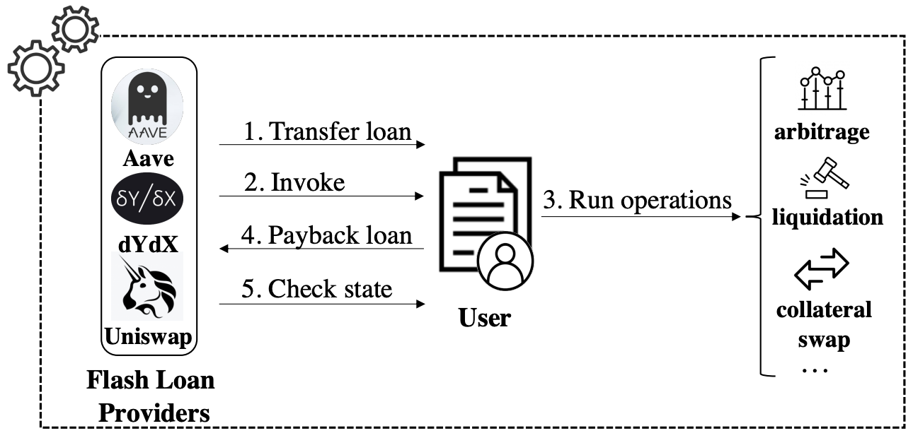
Decentralized Finance Applications (DApps):
Flash Loan Transaction
Source: Wang, Dabao, Siwei Wu, Ziling Lin, Lei Wu, Xingliang Yuan, Yajin Zhou, Haoyu Wang, and Kui Ren (2021). "Towards A First Step to Understand Flash Loan and Its Applications in DeFi Ecosystem." In Proceedings of the Ninth International Workshop on Security in Blockchain and Cloud Computing, pp. 23-28. 2021.

Slide 83
The Economics of Money,
Banking and Financial Markets
Source: Frederic S. Mishkin (2015), The Economics of Money, Banking and Financial Markets, 11th Edition, Pearson

Slide 84
Economics of Money,
Banking and Financial Markets
Money, Banking, and Financial System
Financial Markets
Financial Institutions
Central Banking and the Conduct of Monetary Policy
International Finance and Monetary Policy
Monetary Theory
Financial Services Industry
Source: Frederic S. Mishkin (2015), The Economics of Money, Banking and Financial Markets, 11th Edition, Pearson

Slide 85
INTRODUCTION
1. Why Study Money, Banking, and Financial Markets?
2. An Overview of the Financial System
3. What Is Money?
Source: Frederic S. Mishkin (2015), The Economics of Money, Banking and Financial Markets, 11th Edition, Pearson

Slide 86
FINANCIAL MARKETS
4. Understanding Interest Rates
5. The Behavior of Interest Rates
6. The Risk and Term Structure of Interest Rates
7. The Stock Market, the Theory of Rational Expectations, and the Efficient Market Hypothesis
Source: Frederic S. Mishkin (2015), The Economics of Money, Banking and Financial Markets, 11th Edition, Pearson

Slide 87
FINANCIAL INSTITUTIONS
8. An Economic Analysis of Financial Structure
9. Banking and the Management of Financial Institutions
10. Economic Analysis of Financial Regulation
11. Banking Industry: Structure and Competition
12. Financial Crises
Source: Frederic S. Mishkin (2015), The Economics of Money, Banking and Financial Markets, 11th Edition, Pearson

Slide 88
CENTRAL BANKING AND THE CONDUCT OF MONETARY POLICY
13. Central Banks and the Federal Reserve System
14. The Money Supply Process
15. The Tools of Monetary Policy
16. The Conduct of Monetary Policy: Strategy and Tactics
Source: Frederic S. Mishkin (2015), The Economics of Money, Banking and Financial Markets, 11th Edition, Pearson

Slide 89
MONETARY THEORY
19. Quantity Theory, Inflation, and the Demand for Money
20. The IS Curve
21. The Monetary Policy and Aggregate Demand Curves
22. Aggregate Demand and Supply Analysis
23. Monetary Policy Theory
24. The Role of Expectations in Monetary Policy
25. Transmission Mechanisms of Monetary Policy
Source: Frederic S. Mishkin (2015), The Economics of Money, Banking and Financial Markets, 11th Edition, Pearson

Slide 90
Financial Services Industry
26. Financial Crises in Emerging Market Economies
27. The ISLM Model
28. Nonbank Finance
29. Financial Derivatives
30. Conflicts of Interest in the Financial Services Industry
Source: Frederic S. Mishkin (2015), The Economics of Money, Banking and Financial Markets, 11th Edition, Pearson

Slide 91
Why Study Money,
Banking, and Financial Markets?
Source: Frederic S. Mishkin (2015), The Economics of Money, Banking and Financial Markets, 11th Edition, Pearson

Slide 92
Why Study Money, Banking, and Financial Markets?
To examine how financial markets
such as bond, stock and foreign exchange markets work
To examine how financial institutions such as banks and insurance companies work
To examine the role of money in the economy
Source: Frederic S. Mishkin (2015), The Economics of Money, Banking and Financial Markets, 11th Edition, Pearson

Slide 93
Financial Markets
Markets in which funds are transferred from people who have an excess of available funds to people who have a shortage of funds
  Bond market
  Stock market
  Foreign exchange market
Source: Frederic S. Mishkin (2015), The Economics of Money, Banking and Financial Markets, 11th Edition, Pearson

Slide 94
Financial Institutions
Financial Intermediaries: institutions that borrow funds from people who have saved and make loans to other people:
  Banks: accept deposits and make loans
  Other Financial Institutions: insurance companies, finance companies, pension funds, mutual funds and investment banks
Financial Innovation: the advent of the information age and e-finance
Source: Frederic S. Mishkin (2015), The Economics of Money, Banking and Financial Markets, 11th Edition, Pearson

Slide 95
Money and Business Cycles
Money plays an important role in generating business cycles
Recessions (unemployment) and expansions affect all of us
Monetary Theory ties changes in the money supply to changes in aggregate economic activity and the price level
Source: Frederic S. Mishkin (2015), The Economics of Money, Banking and Financial Markets, 11th Edition, Pearson

Slide 96
Overview of the Financial System
Indirect Finance
Financial
Intermediaries
Funds
Funds
Funds
Lender-Savers
1. Households
2. Business firms
3. Government
4. Foreigners
Financial Markets
Borrower-Senders
1. Business firms
2. Government
3. Households
4. Foreigners
Funds
Funds
Direct Finance
Source: Frederic S. Mishkin (2015), The Economics of Money, Banking and Financial Markets, 11th Edition, Pearson

Slide 97
What is Money?
Source: Frederic S. Mishkin (2015), The Economics of Money, Banking and Financial Markets, 11th Edition, Pearson

Slide 98

Money
Source: http://www.wpclipart.com/money/bills/bills_2/stack_of_bills_2.png.html

Slide 99
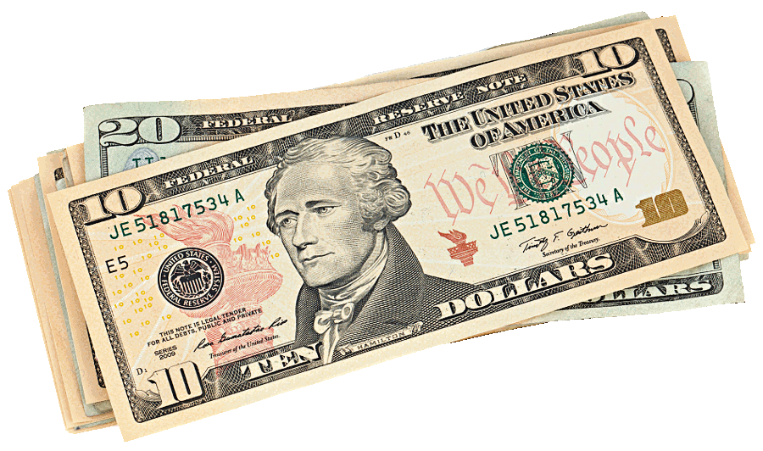
Bills
Source: http://www.wpclipart.com/money/bills/bills_2/stack_of_bills_2.png.html

Slide 100
Meaning of Money
Money (=money supply) any vehicle used as a means of exchange to pay for goods, services or debts.
In today’s society, any asset that can quickly be transferred into cash is considered money.
The more liquid an asset is, the closer it is to money.
In economics, money does not mean wealth nor does it mean income.
Source: Frederic S. Mishkin (2015), The Economics of Money, Banking and Financial Markets, 11th Edition, Pearson

Slide 101
Functions of Money
Medium of Exchange
Unit of Account
Store of Value
Source: Frederic S. Mishkin (2015), The Economics of Money, Banking and Financial Markets, 11th Edition, Pearson

Slide 102
Medium of Exchange
By eliminating barter, this function of money increases efficiency in a society.
As human societies started to engage in exchange money had to be invented.
Any technological change that
reduces transaction costs
increases the wealth of the society.
Any technological change that allows people to specialize also increases wealth.
Source: Frederic S. Mishkin (2015), The Economics of Money, Banking and Financial Markets, 11th Edition, Pearson

Slide 103
Unit of Account
We use money to measure the value of goods and services.
Suppose we had 4 goods and no money. How do we measure the price of each good?
  A in terms of B
  B in terms of C N!/2(N-2)!
  C in terms of D
  A in terms of C
  A in terms of D
  B in terms of D
Money allows to quote prices in terms of currency only.
Source: Frederic S. Mishkin (2015), The Economics of Money, Banking and Financial Markets, 11th Edition, Pearson

Slide 104
Store of Value
All assets are stored value.
Money, although without any return, is still desirable to hold because it allows purchases immediately.
Other assets take time (transaction costs) to use as a payment for purchases.
The more liquid an asset is, the less transaction cost it carries.
Inflation erodes the value of money.
Source: Frederic S. Mishkin (2015), The Economics of Money, Banking and Financial Markets, 11th Edition, Pearson

Slide 105
Evolution of the Payments System
Commodity Money:
  valuable, easily standardized and
  divisible commodities
  (e.g. precious metals, cigarettes).
Fiat Money:
  paper money decreed by governments
  as legal tender.
Source: Frederic S. Mishkin (2015), The Economics of Money, Banking and Financial Markets, 11th Edition, Pearson

Slide 106
Electronic Money
Debit Cards
  Instant transfer from your checking account to merchant’s checking account.
Stored Value Card
  Gift cards.
Electronic Cash
  Account set up on a person’s PC from her bank whereby she can buy products over the Internet.
Electronic Checks
  Checks written on PC and sent through the Internet.
Source: Frederic S. Mishkin (2015), The Economics of Money, Banking and Financial Markets, 11th Edition, Pearson

Slide 107
Benefits of Paper Checks
Cheaper than telecommunications network.
Provide receipts.
Allow float.
May be more secure; avoid hacker problems.
Do not leave a wealth of information trail.
Source: Frederic S. Mishkin (2015), The Economics of Money, Banking and Financial Markets, 11th Edition, Pearson

Slide 108
Measuring Money
M1:
  Currency, demand deposits, travelers checks.
M2:
  M1, saving deposits, small time deposits, retail MMMF.
M3:
  M2, large time deposits, repos, Eurodollar deposits, institutional MMMF.
MZM:
  M2, institutional MMMF minus small time deposits.
Growth rates of these aggregates do not always go hand in hand, making monetary policy difficult since signals are conflicting.
Source: Frederic S. Mishkin (2015), The Economics of Money, Banking and Financial Markets, 11th Edition, Pearson

Slide 109
The IS Curve
Source: Frederic S. Mishkin (2015), The Economics of Money, Banking and Financial Markets, 11th Edition, Pearson

Slide 110
The IS
(Investment/Saving)
Curve
Source: Frederic S. Mishkin (2015), The Economics of Money, Banking and Financial Markets, 11th Edition, Pearson

Slide 111
The IS (Investment/Saving) Curve
Goods Markets
Interest rate, i
i
IS
Y
Output (Income), Y
Source: Frederic S. Mishkin (2015), The Economics of Money, Banking and Financial Markets, 11th Edition, Pearson

Slide 112
Demand
Demand
Price (p)
P*
D
Q*
Quantity (q)
Source: Frederic S. Mishkin (2015), The Economics of Money, Banking and Financial Markets, 11th Edition, Pearson

Slide 113
The ISLM Model
Source: Frederic S. Mishkin (2015), The Economics of Money, Banking and Financial Markets, 11th Edition, Pearson

Slide 114
Goods and Financial Markets:
The ISLM Model
(Investment Saving –
Liquidity Preference Money Supply) model
Source: Frederic S. Mishkin (2015), The Economics of Money, Banking and Financial Markets, 11th Edition, Pearson

Slide 115
The ISLM Model
(Investment Saving –
Liquidity Preference Money Supply) model
LM
Goods Markets
Financial Markets
Interest rate, i
i
IS
Y
Output (Income), Y
Source: Frederic S. Mishkin (2015), The Economics of Money, Banking and Financial Markets, 11th Edition, Pearson

Slide 116
Supply and Demand
S
Demand
Supply
Price (p)
P*
Equilibrium
D
Q *
Quantity (q)
Source: Frederic S. Mishkin (2015), The Economics of Money, Banking and Financial Markets, 11th Edition, Pearson

Slide 117
Financial Services

Slide 118
Technology
Innovation

Slide 119
Innovation
Source: https://www.merriam-webster.com/dictionary/innovation

Slide 120
Innovation: a new idea, method, or device
Source: https://www.merriam-webster.com/dictionary/innovation

Slide 121
Innovation: something new
Source: https://www.merriam-webster.com/dictionary/innovation

Slide 122
Novelty : something new or unusual the novelty of a self-driving car
Source: https://www.merriam-webster.com/dictionary/novelty

Slide 123
Creativity is not a new Idea.
Creativity is an old belief you leave behind
Notes:
Creativity is not a new idea. Creativity is an old belief you leave behind.

Slide 124
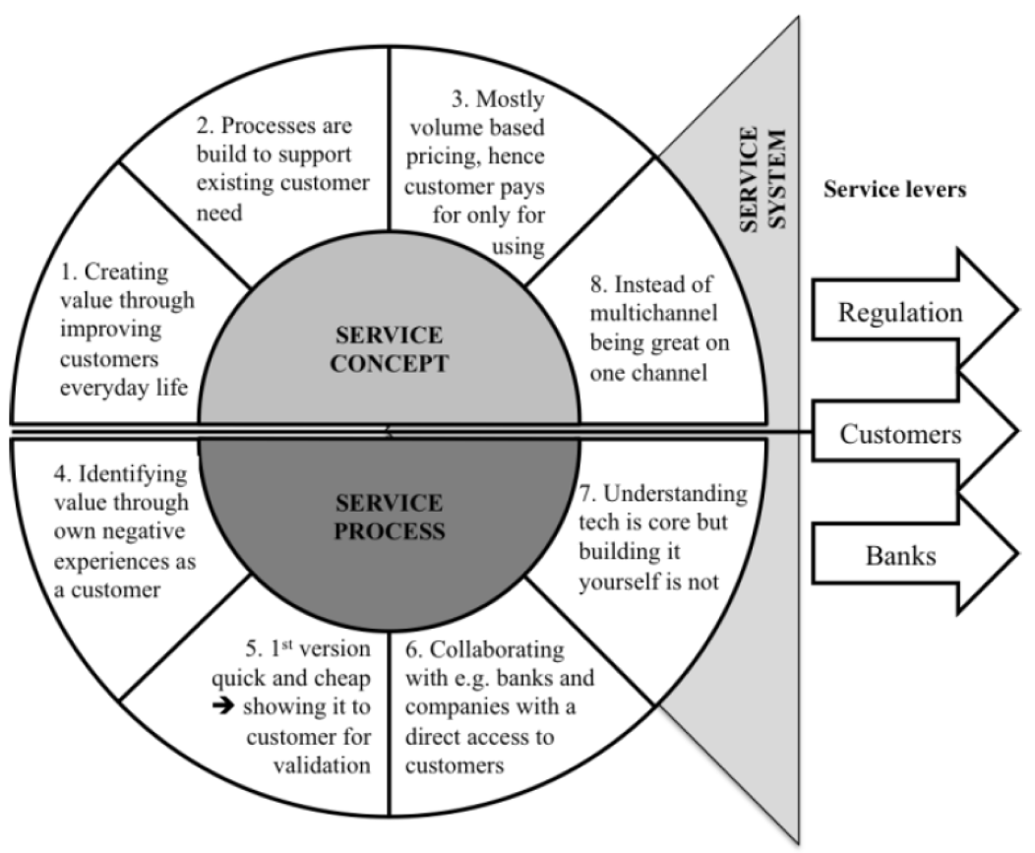
FinTechs as Service Innovators: Analysing Components of Innovation
Source: Riikkinen, Mikko, Kaisa Still, Saila Saraniemi, and Katri Kallio. "FinTechs as service innovators: analysing components of innovation." In ISPIM Innovation Symposium, The International Society for Professional Innovation Management (ISPIM), 2016.

Slide 125
Innovation
“a process of searching and recombining existing knowledge elements”
Source: Savino, Tommaso, Antonio Messeni Petruzzelli, and Vito Albino. "Search and recombination process to innovate:
A review of the empirical evidence and a research agenda." International Journal of Management Reviews (2017).

Slide 126
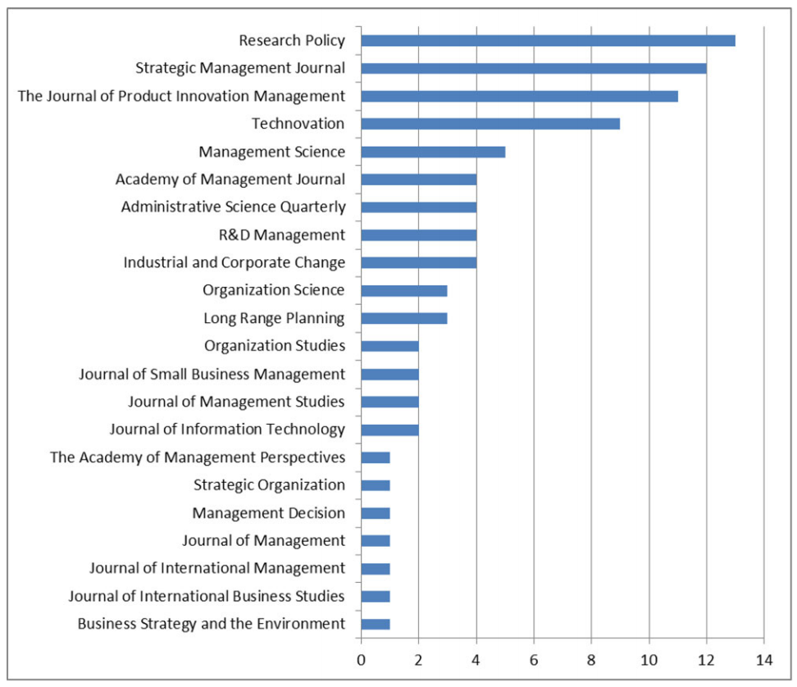
Search and recombination process to innovate:
A review of the empirical evidence and a research agenda
Source: Savino, Tommaso, Antonio Messeni Petruzzelli, and Vito Albino. "Search and recombination process to innovate:
A review of the empirical evidence and a research agenda." International Journal of Management Reviews (2017).

Slide 127
Innovation Research in
Economics,
Sociology and Technology Management
Source: Gopalakrishnan, Shanti, and Fariborz Damanpour.
"A review of innovation research in economics, sociology and technology management." Omega 25, no. 1 (1997): 15-28.

Slide 128
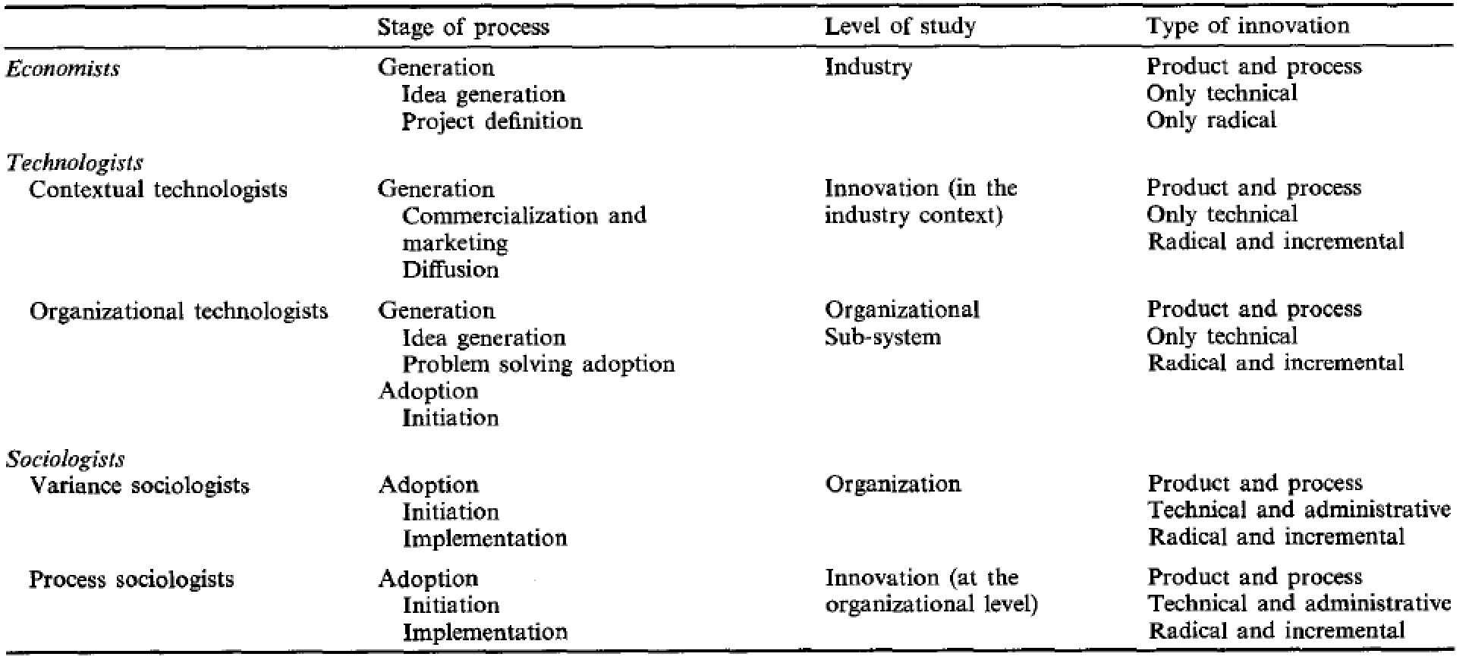
Innovation Research in Economics, Sociology and Technology Management
Source: Gopalakrishnan, Shanti, and Fariborz Damanpour.
"A review of innovation research in economics, sociology and technology management." Omega 25, no. 1 (1997): 15-28.

Slide 129
Business,
Innovation, and
Knowledge
Ecosystems
Source: Valkokari, Katri. "Business, innovation, and knowledge ecosystems: how they differ and how to survive and thrive within them." Technology Innovation Management Review 5, no. 8 (2015).

Slide 130
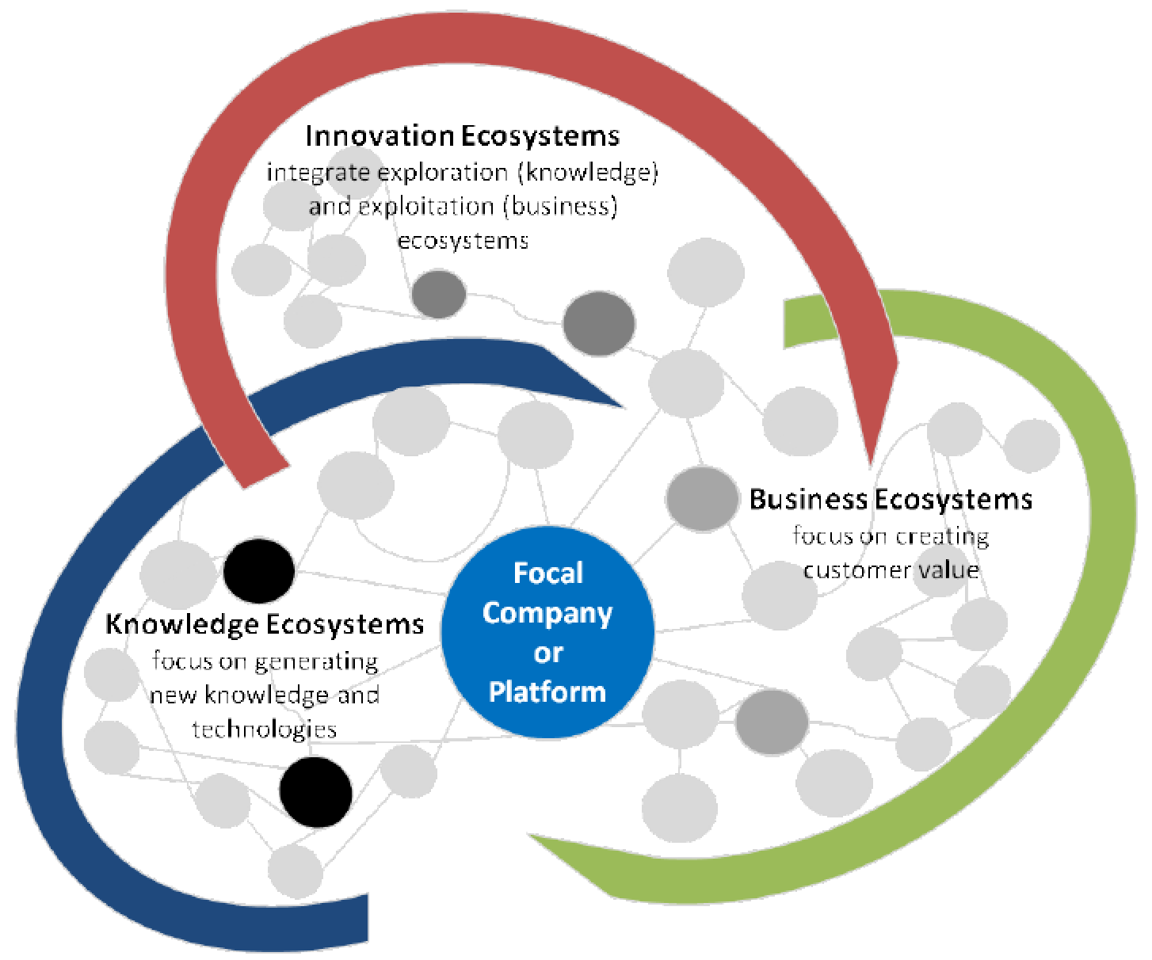
Business, Innovation, and Knowledge Ecosystems
Source: Valkokari, Katri. "Business, innovation, and knowledge ecosystems: how they differ and how to survive and thrive within them." Technology Innovation Management Review 5, no. 8 (2015).

Slide 131
Innovation Ecosystems
Characteristics
 | Business Ecosystems | Innovation Ecosystems | Knowledge Ecosystems
Baseline of Ecosystem | Resource exploitation for customer value | Co-creation of innovation | Knowledge exploration
Relationships and Connectivity | Global business relationships both competitive and co-operative | Geographically clustered actors, different levels of collaboration and openness | Decentralized and disturbed knowledge nodes, synergies through knowledge exchange
Actors and Roles | Suppliers, customers, and focal companies as a core, other actors more loosely involved | Innovation policymakers, local intermediators, innovation brokers, and funding organizations | Research institutes, innovators, and technology entrepreneurs serve as knowledge nodes
Logic of Action | A main actor that operates as a platform sharing resources, assets, and benefits or aggregates other actors together in the networked business operations | Geographically proximate actors interacting around hubs facilitated by intermediating actors | A large number of actors that are grouped around knowledge exchange or a central non-proprietary resource for the benefit of all actors
Source: Valkokari, Katri. "Business, innovation, and knowledge ecosystems: how they differ and how to survive and thrive within them." Technology Innovation Management Review 5, no. 8 (2015).

Slide 132
Diffusion of Innovation Theory
(DOI)
Source: Everett M. Rogers (2003), “Diffusion of Innovations”, Free Press, 5th Edition

Slide 133
Innovation
(Diffusion of Innovation)
1. Relative advantage
2. Compatibility
3. Complexity
4. Trialability
5. Observability
Source: Everett M. Rogers (2003), “Diffusion of Innovations”, Free Press, 5th Edition

Slide 134
Diffusion of Innovation
Source: https://en.wikipedia.org/wiki/Diffusion_of_innovations

Slide 135
Innovation Adoption Process
Initiation
Adoption Decision
Implementation
Source: Pichlak, Magdalena.
"The innovation adoption process: A multidimensional approach." Journal of Management and Organization 22, no. 4 (2016): 476.

Slide 136
Innovation Adoption Process
Initiation
Adoption Decision
Implementation
Environmental Characteristics
Organizational Characteristics
Top Managers Characteristics
Innovation Characteristics
User Acceptance Attributes
TAM=
Technology Acceptance Model
RBV=
Resource-Based View
DOI =
Diffusion of Innovation Theory
Source: Pichlak, Magdalena.
"The innovation adoption process: A multidimensional approach." Journal of Management and Organization 22, no. 4 (2016): 476.

Slide 137
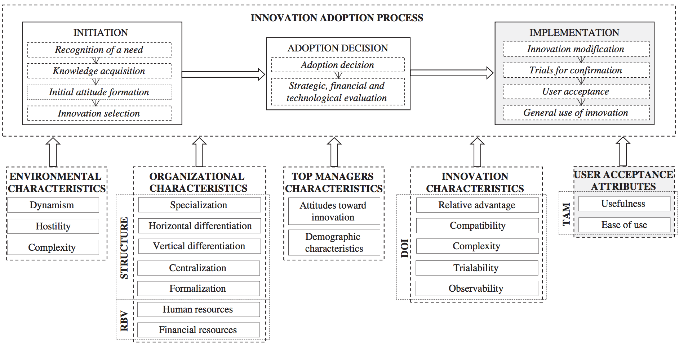
Innovation Adoption Process
TAM=
Technology Acceptance Model
RBV=
Resource-Based View
DOI =
Diffusion of Innovation Theory
Source: Pichlak, Magdalena.
"The innovation adoption process: A multidimensional approach." Journal of Management and Organization 22, no. 4 (2016): 476.

Slide 138
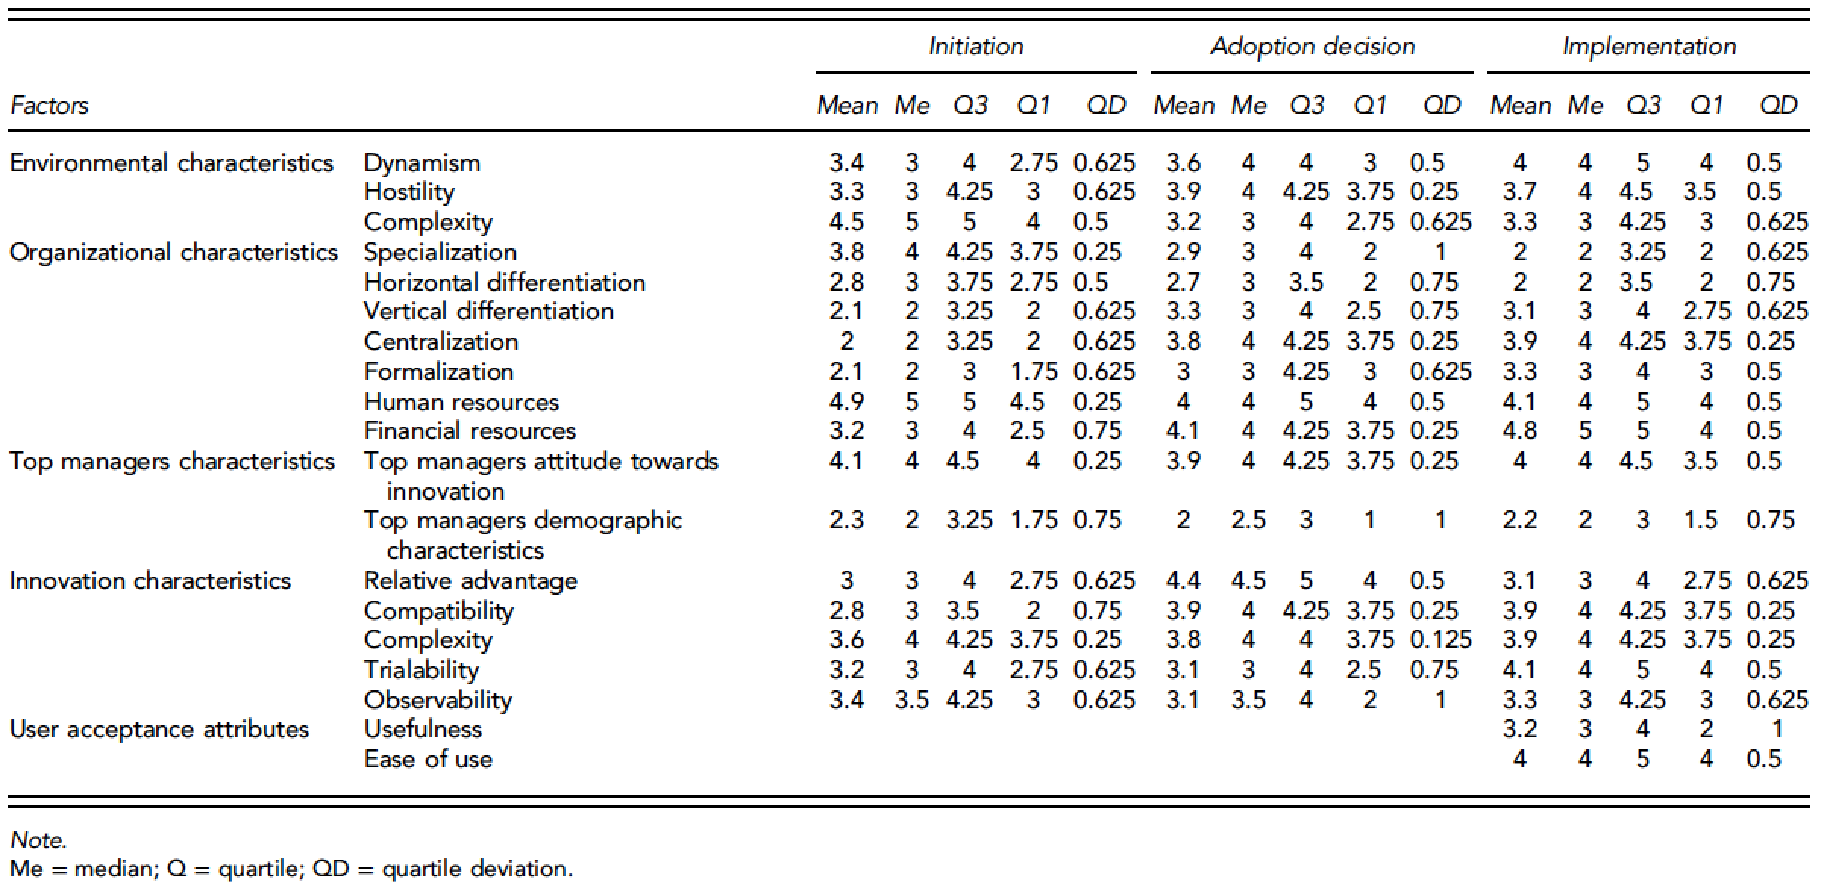
Innovation Adoption Process
Source: Pichlak, Magdalena.
"The innovation adoption process: A multidimensional approach." Journal of Management and Organization 22, no. 4 (2016): 476.

Slide 139
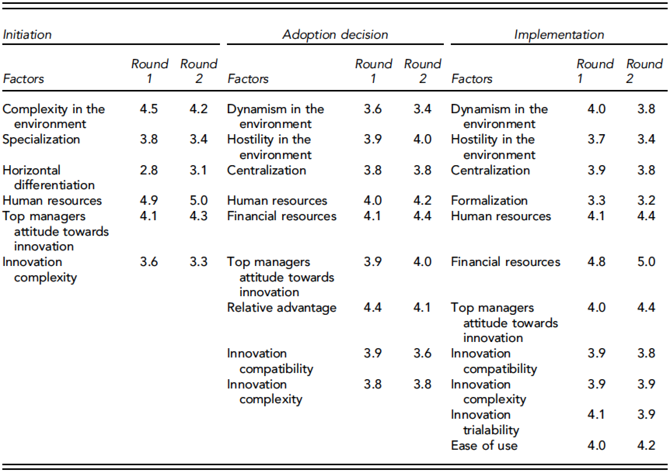
Innovation Adoption Process
Source: Pichlak, Magdalena.
"The innovation adoption process: A multidimensional approach." Journal of Management and Organization 22, no. 4 (2016): 476.

Slide 140
FinTech Innovation
FinTech high-level classification
Lending
Payments
Robo Advisors
Analytics
Others
Profile
Advice
Re-Balance
Indexing
Source: Paolo Sironi (2016), “FinTech Innovation: From Robo-Advisors to Goal Based Investing and Gamification”, Wiley.

Slide 141
Financial Technology (Fintech) Categories
Banking Infrastructure
Business Lending
Consumer and Commercial Banking
Consumer Lending
Consumer Payments
Crowdfunding
Equity Financing
Financial Research and Data
Financial Transaction Security
Institutional Investing
International Money Transfer
Payments Backend and Infrastructure
Personal Finance
Point of Sale Payments
Retail Investing
Small and Medium Business Tools
Source: http://www.venturescanner.com/financial-technology

Slide 142
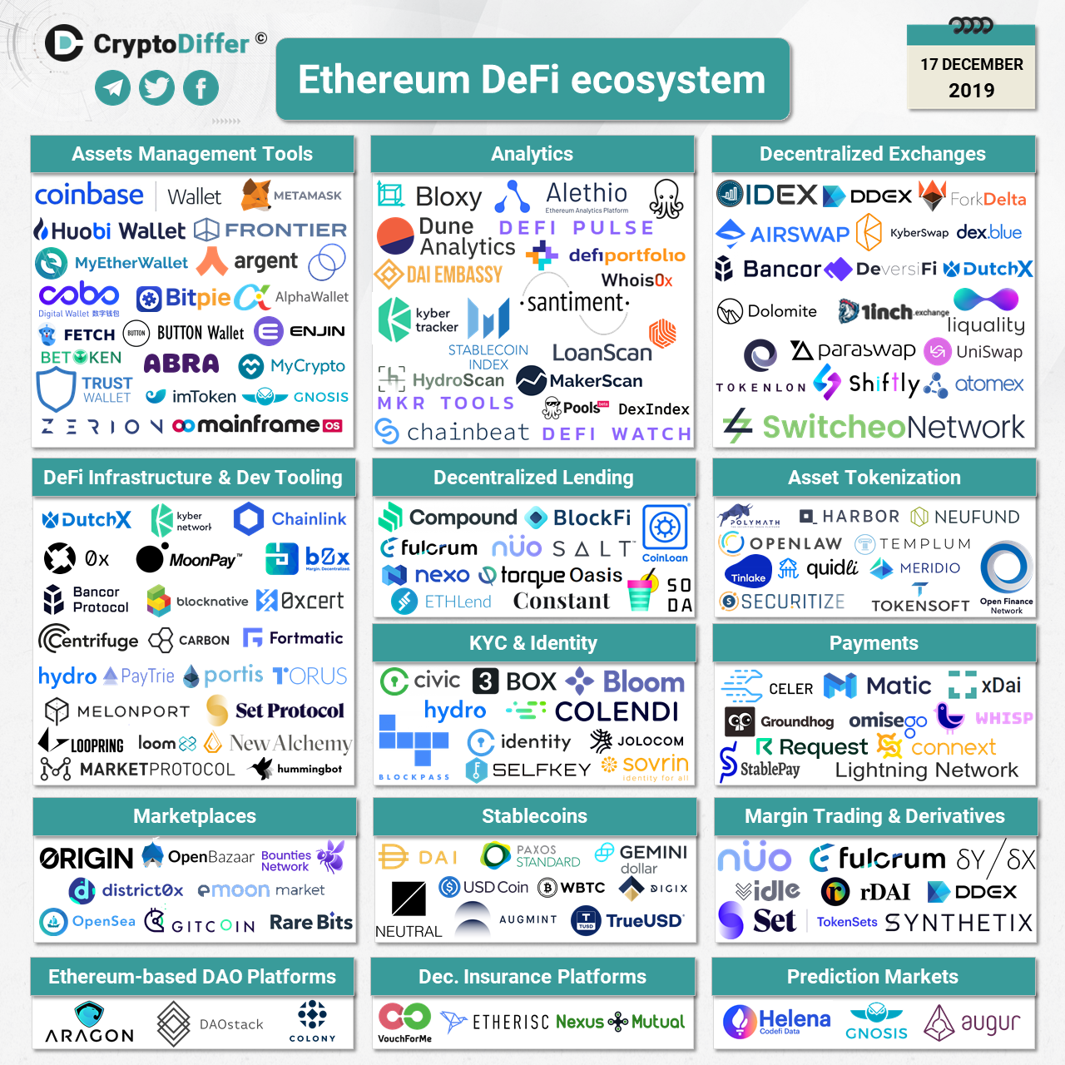
Ethereum DeFi Ecosystem
Source: https://cryptodiffer.com/news/ethereum-defi-ecosystem/

Slide 143
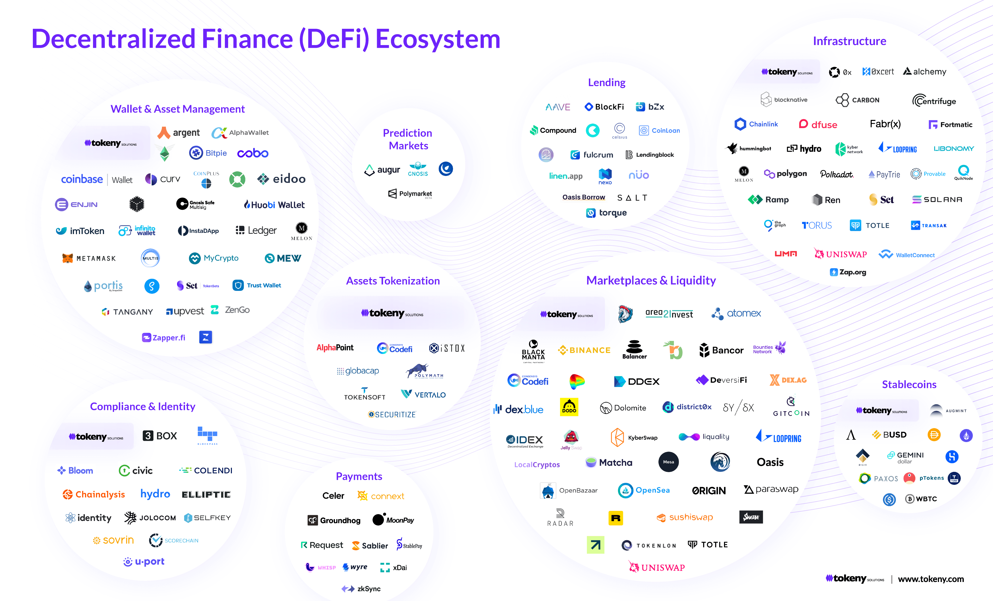
Decentralized Finance (DeFi) Ecosystem
Source: https://tokeny.com/defi-ecosystem/

Slide 144
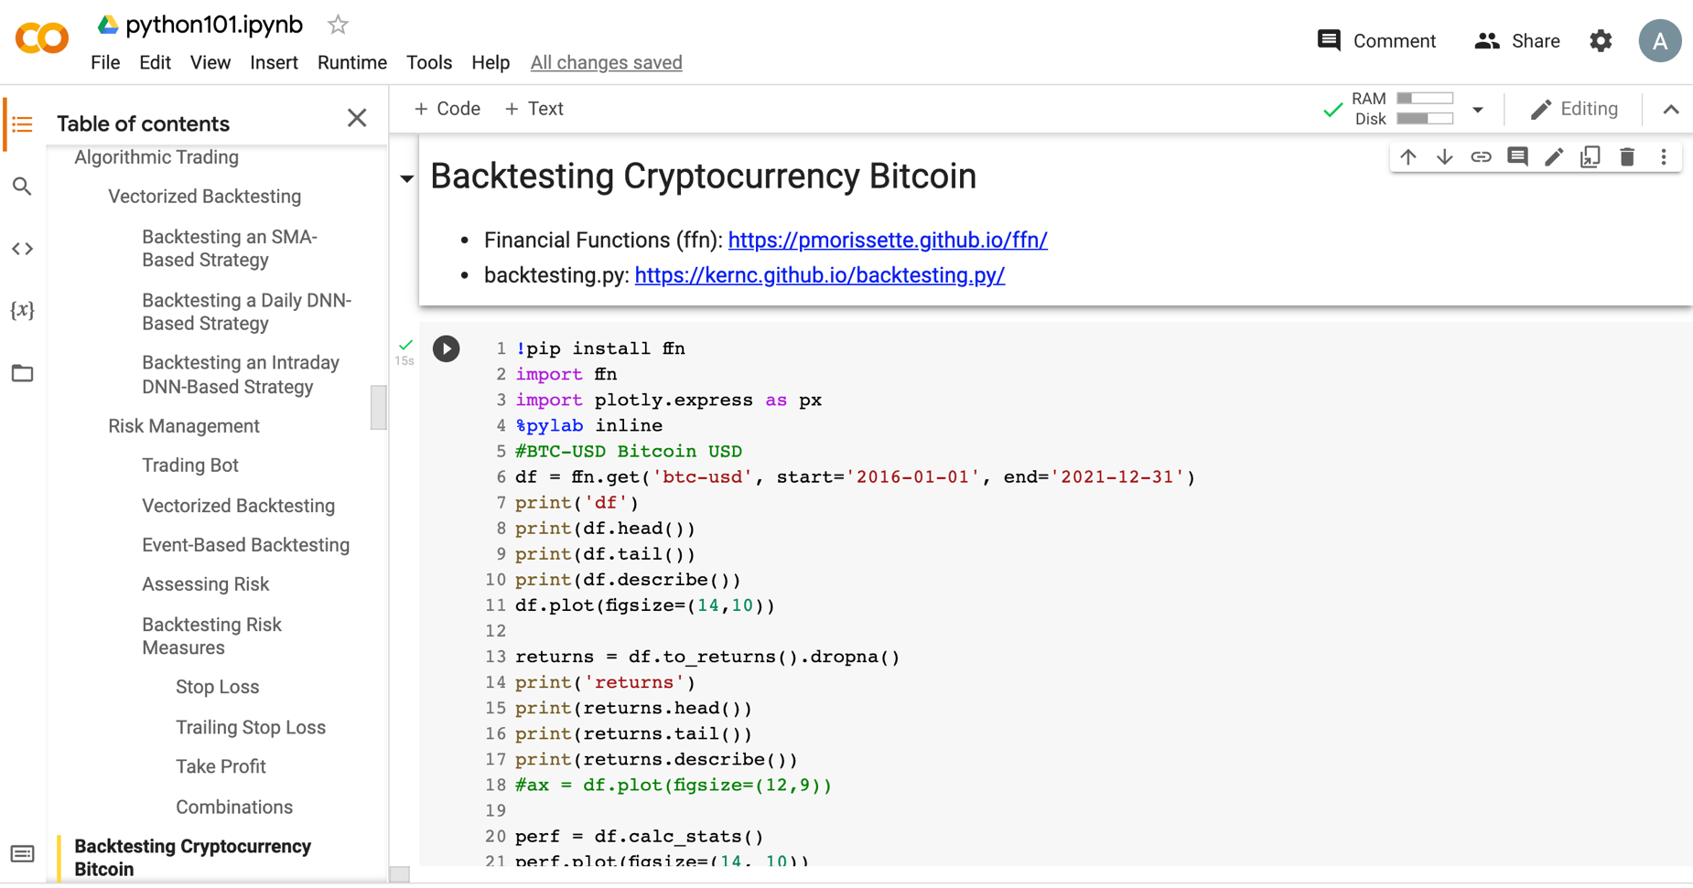
Python in Google Colab (Python101)
https://tinyurl.com/aintpupython101

Slide 145
References
Longbing Cao (2022). "Decentralized ai: Edge intelligence and smart blockchain, metaverse, web3, and desci." IEEE Intelligent Systems 37, no. 3: 6-19.
Qinglin Yang, Yetong Zhao, Huawei Huang, Zehui Xiong, Jiawen Kang, and Zibin Zheng (2022). "Fusing blockchain and AI with metaverse: A survey." IEEE Open Journal of the Computer Society 3 : 122-136.
Russell Belk, Mariam Humayun, and Myriam Brouard (2022). "Money, possessions, and ownership in the Metaverse: NFTs, cryptocurrencies, Web3 and Wild Markets." Journal of Business Research 153: 198-205.
Thien Huynh-The, Quoc-Viet Pham, Xuan-Qui Pham, Thanh Thi Nguyen, Zhu Han, and Dong-Seong Kim (2022). "Artificial Intelligence for the Metaverse: A Survey." arXiv preprint arXiv:2202.10336.
Thippa Reddy Gadekallu, Thien Huynh-The, Weizheng Wang, Gokul Yenduri, Pasika Ranaweera, Quoc-Viet Pham, Daniel Benevides da Costa, and Madhusanka Liyanage (2022). "Blockchain for the Metaverse: A Review." arXiv preprint arXiv:2203.09738.
Dan Sheridan, James Harris, Frank Wear, Jerry Cowell Jr, Easton Wong, and Abbas Yazdinejad (2022). "Web3 Challenges and Opportunities for the Market." arXiv preprint arXiv:2209.02446.
Yves Hilpisch (2020), Artificial Intelligence in Finance: A Python-Based Guide, O’Reilly Media.
Aurélien Géron (2019), Hands-On Machine Learning with Scikit-Learn, Keras, and TensorFlow: Concepts, Tools, and Techniques to Build Intelligent Systems, 2nd Edition, O’Reilly Media.
Yves Hilpisch (2018), Python for Finance: Mastering Data-Driven Finance, 2nd Edition, O'Reilly Media.
Paolo Sironi (2016), FinTech Innovation: From Robo-Advisors to Goal Based Investing and Gamification, Wiley.
Yuxing Yan (2017), Python for Finance: Apply powerful finance models and quantitative analysis with Python, Second Edition, Packt Publishing
Campbell R. Harvey, Ashwin Ramachandran, Joey Santoro, Fred Ehrsam (2021), DeFi and the Future of Finance, Wiley
Matt Fortnow and QuHarrison Terry (2021), The NFT Handbook - How to Create, Sell and Buy Non-Fungible Tokens, Wiley
Parma Bains, Mohamed Diaby, Dimitris Drakopoulos, Julia Faltermeier, Federico Grinberg, Evan Papageorgiou, Dmitri Petrov, Patrick Schneider, and Nobu Sugimoto (2021),
The Crypto Ecosystem and Financial Stability Challenges, International Monetary Fund, October 2021
Ramesh Sharda, Dursun Delen, and Efraim Turban (2017), “Business Intelligence, Analytics, and Data Science: A Managerial Perspective”, 4th Edition, Pearson
Frederic S. Mishkin (2015), “The Economics of Money, Banking and Financial Markets”, 11th Edition, Pearson
Susanne Chishti and Janos Barberis (2016), “The FINTECH Book: The Financial Technology Handbook for Investors, Entrepreneurs and Visionaries”, Wiley.
Paolo Sironi (2016), “FinTech Innovation: From Robo-Advisors to Goal Based Investing and Gamification”, Wiley.
Brett King (2014), “Breaking Banks: The Innovators, Rogues, and Strategists Rebooting Banking”, Wiley.
Brett King (2012), “Bank 3.0: Why banking is no longer somewhere you go, but something you do”, John Wiley & Sons
Gopalakrishnan, Shanti, and Fariborz Damanpour (1997). "A review of innovation research in economics, sociology and technology management." Omega 25, no. 1 : 15-28.
Pichlak, Magdalena (2016). "The innovation adoption process: A multidimensional approach." Journal of Management and Organization 22, no. 4 : 476.
Everett M. Rogers (2003), “Diffusion of Innovations”, Free Press, 5th Edition

