Slide 1
Data-Driven Finance
Artificial Intelligence in Finance and Quantitative Analysis
1111AIFQA06
MBA, IM, NTPU (M6132) (Fall 2022) Tue 2, 3, 4 (9:10-12:00) (B8F40)
Min-Yuh Day, Ph.D, Associate Professor
Institute of Information Management, National Taipei University
https://web.ntpu.edu.tw/~myday
https://meet.google.com/paj-zhhj-mya
2022-10-25

Slide 2
Syllabus
Week Date Subject/Topics
1 2022/09/13 Introduction to Artificial Intelligence in Finance and Quantitative Analysis
2 2022/09/20 AI in FinTech: Metaverse, Web3, DeFi, NFT, Financial Services Innovation and Applications
3 2022/09/27 Investing Psychology and Behavioral Finance
4 2022/10/04 Event Studies in Finance
5 2022/10/11 Case Study on AI in Finance and Quantitative Analysis I
6 2022/10/18 Finance Theory

Slide 3
Syllabus
Week Date Subject/Topics
7 2022/10/25 Data-Driven Finance
8 2022/11/01 Midterm Project Report
9 2022/11/08 Financial Econometrics
10 2022/11/15 AI-First Finance
11 2022/11/22 Industry Practices of AI in Finance and Quantitative Analysis
12 2022/11/29 Case Study on AI in Finance and Quantitative Analysis II

Slide 4
Syllabus
Week Date Subject/Topics
13 2022/12/06 Deep Learning in Finance; Reinforcement Learning in Finance
14 2022/12/13 Algorithmic Trading; Risk Management; Trading Bot and Event-Based Backtesting
15 2022/12/20 Final Project Report I
16 2022/12/27 Final Project Report II
17 2023/01/03 Self-learning
18 2023/01/10 Self-learning

Slide 5
Data-Driven Finance

Slide 6
Data-Driven Finance
Scientific Method
Financial Econometrics and Regression
Data Availability
Normative Theories Revisited
Debunking Central Assumptions in Finance
Source: Yves Hilpisch (2020), Artificial Intelligence in Finance: A Python-Based Guide, O’Reilly Media.

Slide 7
Data-driven finance
Financial context (theory, model, application) that is primarily driven by and based on insights gained from data.
Source: Yves Hilpisch (2020), Artificial Intelligence in Finance: A Python-Based Guide, O’Reilly Media.

Slide 8
Data-driven finance Robin Wigglesworth (2019)
Nowadays, analysts sift through non-traditional information such as satellite imagery and credit card data, or use artificial intelligence techniques such as machine learning and natural language processing to glean fresh insights from traditional sources such as economic data and earnings-call transcripts.
Source: Yves Hilpisch (2020), Artificial Intelligence in Finance: A Python-Based Guide, O’Reilly Media.

Slide 9
Scientific Method
Generally accepted principles that should guide scientific effort
The scientific method is an empirical method of acquiring knowledge that has characterized the development of science
It involves careful observation, applying rigorous skepticism about what is observed, given that cognitive assumptions can distort how one interprets the observation.
Source: Yves Hilpisch (2020), Artificial Intelligence in Finance: A Python-Based Guide, O’Reilly Media.

Slide 10
Scientific Method
It involves formulating hypotheses, via induction, based on such observations; experimental and measurement-based testing of deductions drawn from the hypotheses; and refinement (or elimination) of the hypotheses based on the experimental findings
Source: Yves Hilpisch (2020), Artificial Intelligence in Finance: A Python-Based Guide, O’Reilly Media.

Slide 11
Normative Finance and Scientific Method
Normative financial theories mostly rely on assumptions and axioms in combination with deduction as the major analytical method to arrive at their central results.
Expected utility theory (EUT) assumes that agents have the same utility function no matter what state of the world unfolds and that they maximize expected utility under conditions of uncertainty.
Mean-variance portfolio (MVP) theory describes how investors should invest under conditions of uncertainty assuming that only the expected return and the expected volatility of a portfolio over one period count.
Source: Yves Hilpisch (2020), Artificial Intelligence in Finance: A Python-Based Guide, O’Reilly Media.

Slide 12
Normative Finance and Scientific Method
The capital asset pricing model (CAPM) assumes that only the nondiversifiable market risk explains the expected return and the expected volatility of a stock over one period.
Arbitrage pricing theory (APT) assumes that a number of identifiable risk factors explains the expected return and the expected volatility of a stock over time; admittedly, compared to the other theories, the formulation of APT is rather broad and allows for wide-ranging interpretations.
Source: Yves Hilpisch (2020), Artificial Intelligence in Finance: A Python-Based Guide, O’Reilly Media.

Slide 13
Financial Econometrics and Regression
[Financial] econometrics is the quantitative application of statistical and mathematical models using [financial] data to develop financial theories or test existing hypotheses in finance and to forecast future trends from historical data.
It subjects real-world [financial] data to statistical trials and then compares and contrasts the results against the [financial] theory or theories being tested.
Source: Yves Hilpisch (2020), Artificial Intelligence in Finance: A Python-Based Guide, O’Reilly Media.

Slide 14
Financial Econometrics and Regression
One of the major tools in financial econometrics is regression, in both its univariate and multivariate forms
Regression is also a central tool in statistical learning in general
Source: Yves Hilpisch (2020), Artificial Intelligence in Finance: A Python-Based Guide, O’Reilly Media.

Slide 15
Data Availability
Types of (financial) data
Financial econometrics is driven by statistical methods, such as regression, and the availability of financial data
Theoretical and empirical financial research was mainly driven by relatively small data sets and was mostly comprised of end-of-day (EOD) data
Types of financial and other data available in ever increasing granularity, quantity, and velocity.
Quality and quantity via programmatic APIs
Finance professionals have relied on data terminals from Refinitiv or Bloomberg
Major breakthrough in data-driven finance via programmatic APIs
Source: Yves Hilpisch (2020), Artificial Intelligence in Finance: A Python-Based Guide, O’Reilly Media.

Slide 16
Relevant types of financial data
Time | Structured data | Unstructured data | Alternative data
Historical | Prices, fundamentals | News, texts | Web, social media, satellites
Streaming | Prices, volumes | News, filings | Web, social media, satellites, Internet of Things
Source: Yves Hilpisch (2020), Artificial Intelligence in Finance: A Python-Based Guide, O’Reilly Media.

Slide 17
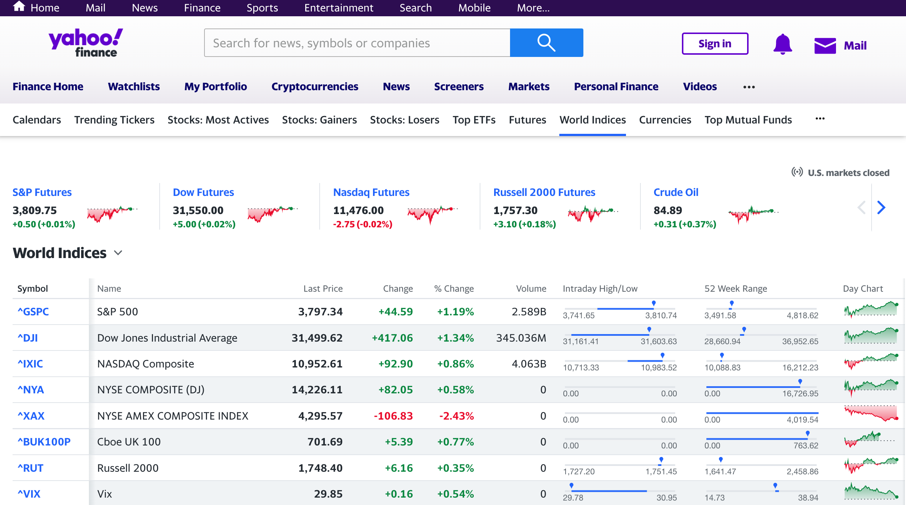
Yahoo Finance World Indices
https://finance.yahoo.com/world-indices/

Slide 18
World Indices
import io
import requests
import pandas as pd response = requests.get('https://finance.yahoo.com/world-indices/')
df = pd.read_html(io.StringIO(response.text))
worldidx = df[0]
worldidx.to_csv('world_indices.csv')
worldidx

Slide 19
ffn: Financial Functions for Python
#^GSPC S&P 500
#^DJI Dow 30
#^IXIC Nasdaq
!pip install ffn
import ffn
%pylab inline
df = ffn.get('^gspc, ^dji, ^ixic', start='2010-01-01', end='2022-01-01')
print(df.head())
print(df.tail())
print(df.describe())
ax = df.plot(figsize=(12,9))
gspc dji ixic
Date
2010-01-04 1132.989990 10583.959961 2308.419922
2010-01-05 1136.520020 10572.019531 2308.709961
2010-01-06 1137.140015 10573.679688 2301.090088
2010-01-07 1141.689941 10606.860352 2300.050049
2010-01-08 1144.979980 10618.190430 2317.169922
gspc dji ixic
Date
2021-12-27 4791.189941 36302.378906 15871.259766
2021-12-28 4786.350098 36398.210938 15781.719727
2021-12-29 4793.060059 36488.628906 15766.219727
2021-12-30 4778.729980 36398.078125 15741.559570
2021-12-31 4766.180176 36338.300781 15644.969727
gspc dji ixic
count 3021.000000 3021.000000 3021.000000
mean 2260.488112 19756.317518 6004.283709
std 890.501675 6927.100147 3438.840186
min 1022.580017 9686.480469 2091.790039
25% 1461.400024 13557.000000 3131.489990
50% 2088.479980 17851.509766 4984.620117
75% 2798.360107 25332.179688 7669.169922
max 4793.060059 36488.628906 16057.440430

Slide 20
^GSPC: S&P 500, ^DJI: Dow 30, ^IXIC: Nasdaq
df = ffn.get('^gspc, ^dji, ^ixic', start='2010-01-01', end='2022-01-01')
ax = df.plot(figsize=(12,9))

Slide 21
ffn: Financial Functions for Python
!pip install ffn
import ffn
%pylab inline
df = ffn.get('^gspc, ^dji, ^ixic', start='2010-01-01', end='2022-01-01')
print(df.head())
print(df.tail())
print(df.describe())
ax = df.plot(figsize=(12,9))
returns = df.to_returns().dropna()
ax = returns.hist(figsize=(14, 10))
returns.corr().as_format('.2f')
returns.plot_corr_heatmap()
ax = df.plot(figsize=(14,10))
perf = df.calc_stats()
perf.plot(figsize=(14, 10))
print(perf.display())

Slide 22
Normative Theories Revisited
Revisits the normative theories and analyzes them based on real financial time series data
Expected Utility and Reality
Mean-Variance Portfolio Theory (MVPT)
Capital Asset Pricing Model (CAPM)
Arbitrage Pricing Theory (APT)
Source: Yves Hilpisch (2020), Artificial Intelligence in Finance: A Python-Based Guide, O’Reilly Media.

Slide 23
Normalized financial time series data
Source: Yves Hilpisch (2020), Artificial Intelligence in Finance: A Python-Based Guide, O’Reilly Media.

Slide 24
Simulated portfolio volatilities, returns, and Sharpe ratios
Source: Yves Hilpisch (2020), Artificial Intelligence in Finance: A Python-Based Guide, O’Reilly Media.

Slide 25
Expected versus realized portfolio volatilities
Source: Yves Hilpisch (2020), Artificial Intelligence in Finance: A Python-Based Guide, O’Reilly Media.

Slide 26
Expected versus realized portfolio returns
Source: Yves Hilpisch (2020), Artificial Intelligence in Finance: A Python-Based Guide, O’Reilly Media.

Slide 27
Expected versus realized portfolio Sharpe ratios
Source: Yves Hilpisch (2020), Artificial Intelligence in Finance: A Python-Based Guide, O’Reilly Media.

Slide 28
CAPM-predicted versus realized stock returns for a single stock
Source: Yves Hilpisch (2020), Artificial Intelligence in Finance: A Python-Based Guide, O’Reilly Media.

Slide 29
Average CAPM-predicted versus average realized stock returns for multiple stocks
Source: Yves Hilpisch (2020), Artificial Intelligence in Finance: A Python-Based Guide, O’Reilly Media.

Slide 30
Arbitrage Pricing Theory (APT) Relevant types of financial data
Factor | Description
Market | MSCI World Gross Return Daily USD (PUS = Price Return)
Size | MSCI World Equal Weight Price Net Index EOD
Volatility | MSCI World Minimum Volatility Net Return
Value | MSCI World Value Weighted Gross (NUS for Net)
Risk | MSCI World Risk Weighted Gross USD EOD
Growth | MSCI World Quality Net Return USD
Momentum | MSCI World Momentum Gross Index USD EOD
factors = pd.read_csv('http://hilpisch.com/aiif_eikon_eod_factors.csv’, index_col=0, parse_dates=True)
Source: Yves Hilpisch (2020), Artificial Intelligence in Finance: A Python-Based Guide, O’Reilly Media.

Slide 31
APT-predicted versus realized stock returns for a stock
Source: Yves Hilpisch (2020), Artificial Intelligence in Finance: A Python-Based Guide, O’Reilly Media.

Slide 32
Average APT-predicted versus average realized stock returns for multiple stocks
Source: Yves Hilpisch (2020), Artificial Intelligence in Finance: A Python-Based Guide, O’Reilly Media.

Slide 33
Normalized factors time series data
Source: Yves Hilpisch (2020), Artificial Intelligence in Finance: A Python-Based Guide, O’Reilly Media.

Slide 34
APT-predicted returns based on typical factors compared to realized returns
Source: Yves Hilpisch (2020), Artificial Intelligence in Finance: A Python-Based Guide, O’Reilly Media.

Slide 35
APT-predicted performance and real performance over time (gross)
Source: Yves Hilpisch (2020), Artificial Intelligence in Finance: A Python-Based Guide, O’Reilly Media.

Slide 36
Debunking Central Assumptions in Finance
Debunks two of the most commonly found assumptions in financial models and theories
Normality of returns
Linear relationships
Source: Yves Hilpisch (2020), Artificial Intelligence in Finance: A Python-Based Guide, O’Reilly Media.

Slide 37
Standard normally distributed random numbers
Source: Yves Hilpisch (2020), Artificial Intelligence in Finance: A Python-Based Guide, O’Reilly Media.

Slide 38
Distribution with first and second moment of 0.0 and 1.0, respectively
Source: Yves Hilpisch (2020), Artificial Intelligence in Finance: A Python-Based Guide, O’Reilly Media.

Slide 39
Histogram and PDF for standard normally distributed numbers
Source: Yves Hilpisch (2020), Artificial Intelligence in Finance: A Python-Based Guide, O’Reilly Media.

Slide 40
Histogram and normal PDF for discrete numbers
Source: Yves Hilpisch (2020), Artificial Intelligence in Finance: A Python-Based Guide, O’Reilly Media.

Slide 41
Q-Q plot for standard normally distributed numbers
Source: Yves Hilpisch (2020), Artificial Intelligence in Finance: A Python-Based Guide, O’Reilly Media.

Slide 42
Q-Q plot for discrete numbers
Source: Yves Hilpisch (2020), Artificial Intelligence in Finance: A Python-Based Guide, O’Reilly Media.

Slide 43
Frequency distribution and normal PDF for S&P 500 log returns
Source: Yves Hilpisch (2020), Artificial Intelligence in Finance: A Python-Based Guide, O’Reilly Media.

Slide 44
Q-Q for S&P 500 log returns
Source: Yves Hilpisch (2020), Artificial Intelligence in Finance: A Python-Based Guide, O’Reilly Media.

Slide 45
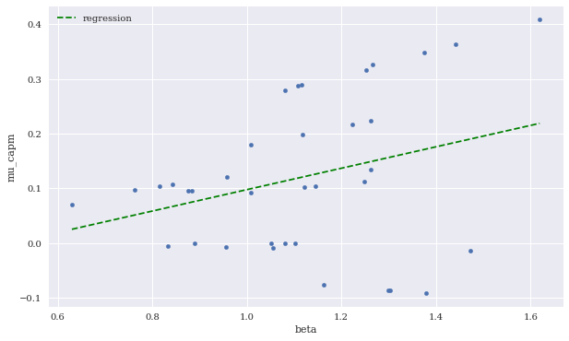
Expected CAPM return versus beta (including linear regression)
Source: Yves Hilpisch (2020), Artificial Intelligence in Finance: A Python-Based Guide, O’Reilly Media.

Slide 46
Expected CAPM return versus beta (including linear regression)
Source: Yves Hilpisch (2020), Artificial Intelligence in Finance: A Python-Based Guide, O’Reilly Media.

Slide 47
Theory-First to Data-Driven Finance
Finance used to be characterized by normative theories based on simplified mathematical models of the financial markets, relying on assumptions such as normality of returns and linear relationships.
The almost universal and comprehensive availability of (financial) data has led to a shift in focus from a theory-first approach to data-driven finance.
Several examples based on real financial data illustrate that many popular financial models and theories cannot survive a confrontation with financial market realities.
Although elegant, they might be too simplistic to capture the complexities, changing nature, and nonlinearities of financial markets.
Source: Yves Hilpisch (2020), Artificial Intelligence in Finance: A Python-Based Guide, O’Reilly Media.

Slide 48
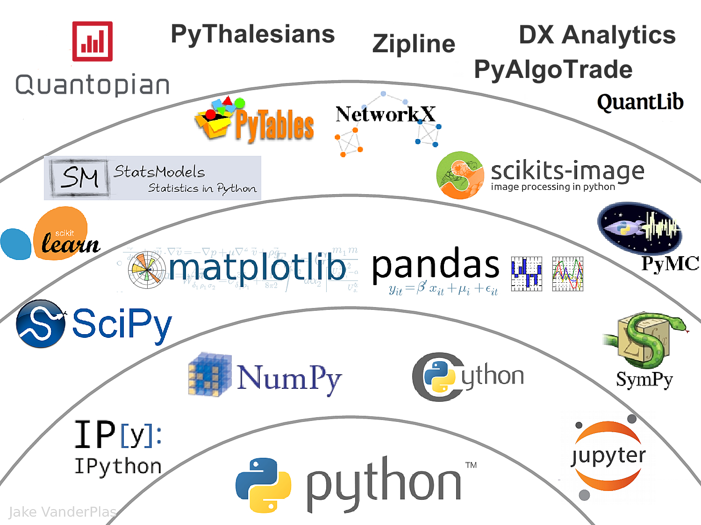
The Quant Finance PyData Stack
Source: http://nbviewer.jupyter.org/format/slides/github/quantopian/pyfolio/blob/master/pyfolio/examples/overview_slides.ipynb#/5

Slide 49
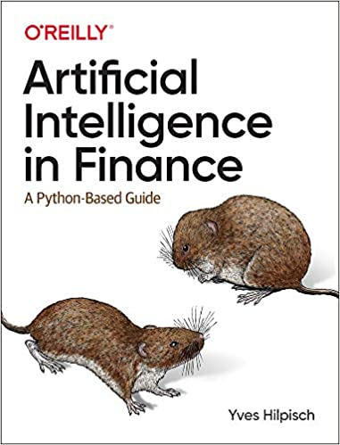
Yves Hilpisch (2020), Artificial Intelligence in Finance: A Python-Based Guide, O’Reilly
Source: https://www.amazon.com/Artificial-Intelligence-Finance-Python-Based-Guide/dp/1492055433

Slide 50
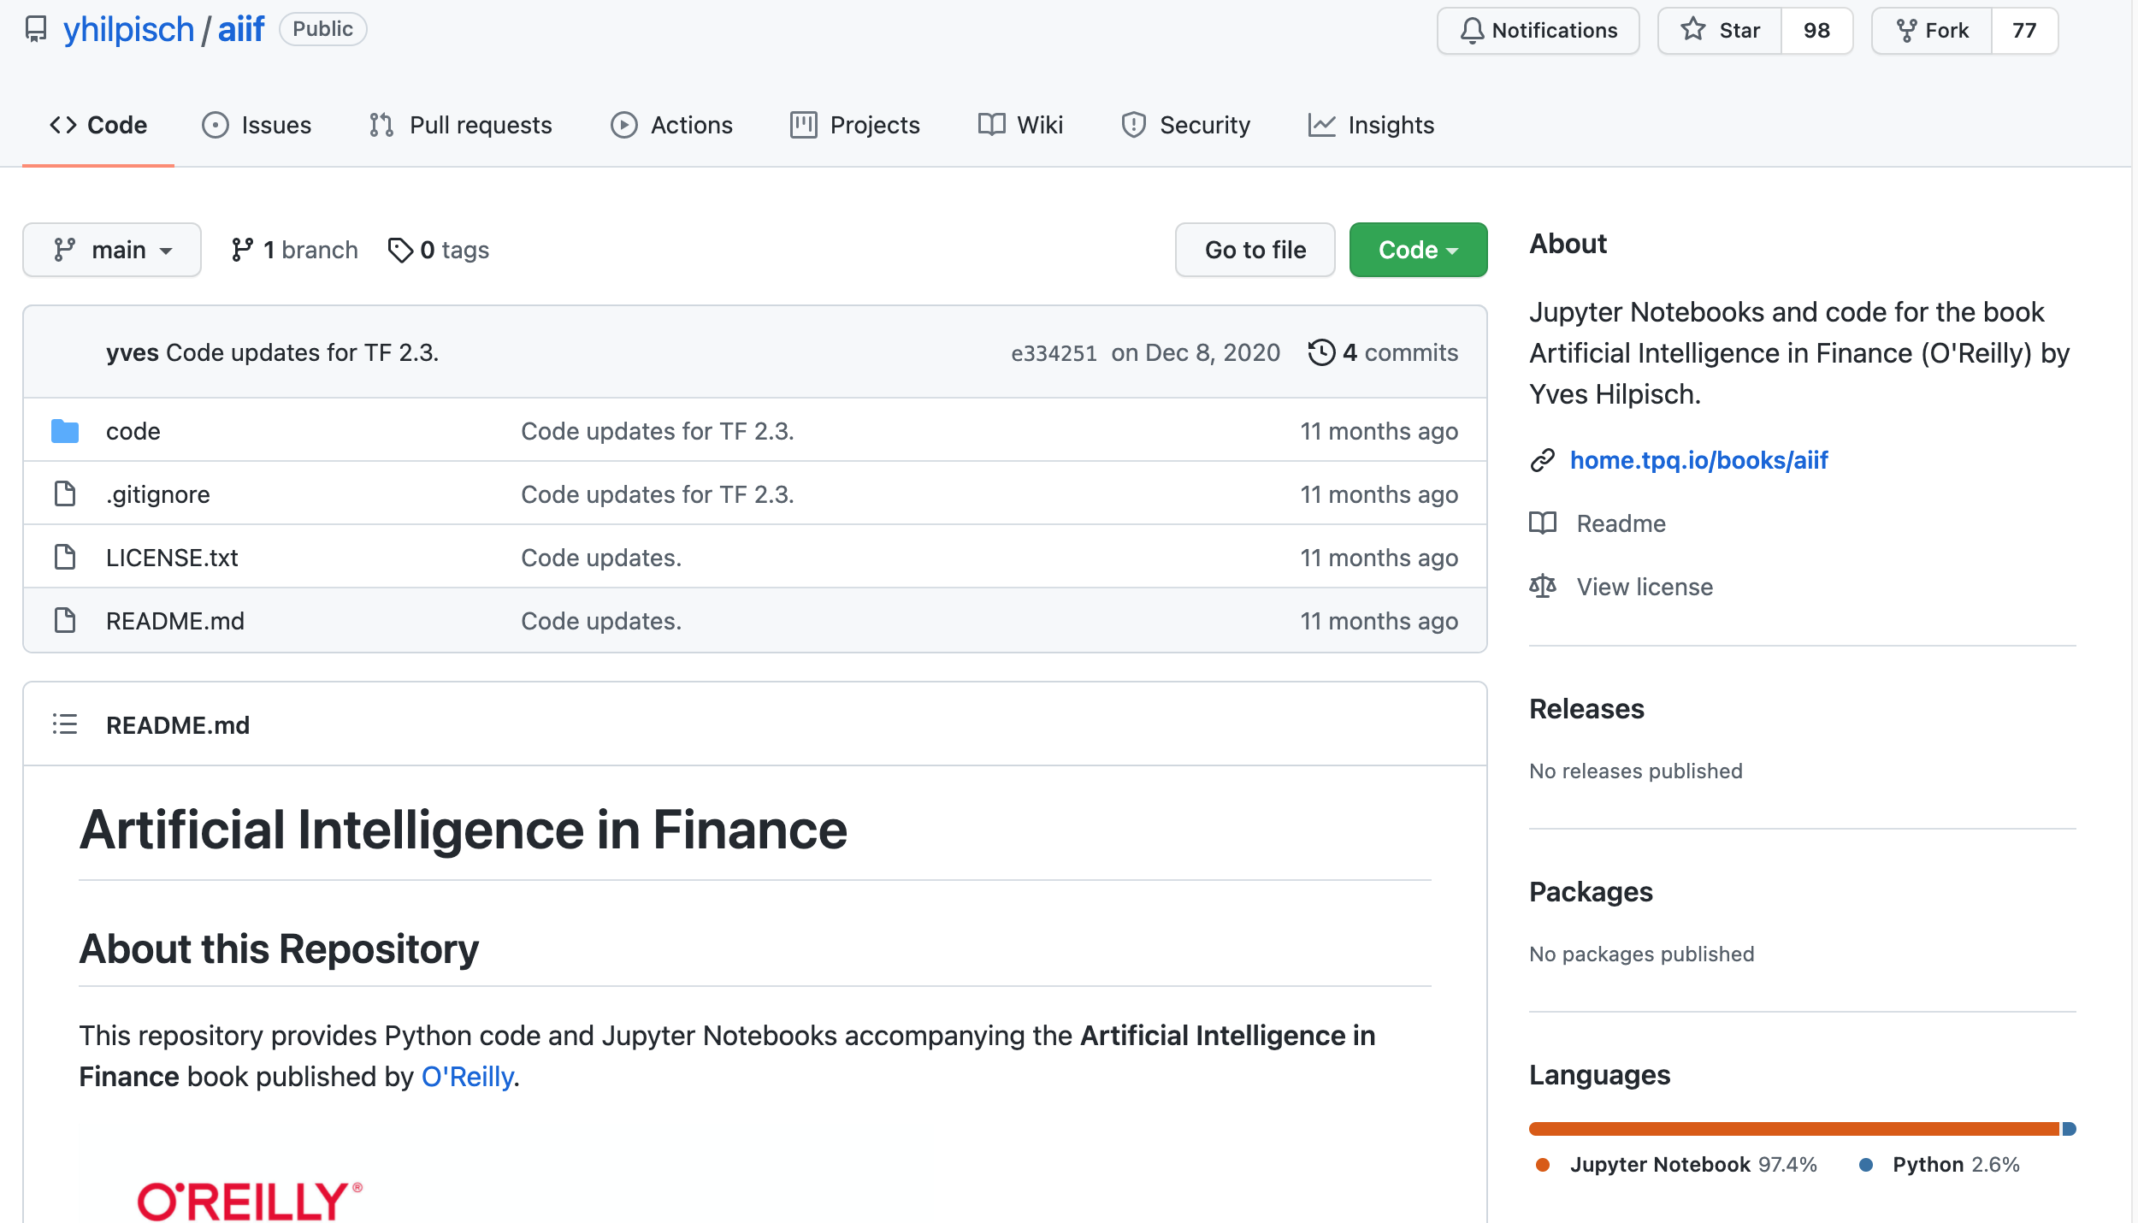
Yves Hilpisch (2020), Artificial Intelligence in Finance: A Python-Based Guide, O’Reilly
https://github.com/yhilpisch/aiif
Source: https://github.com/yhilpisch/aiif

Slide 51
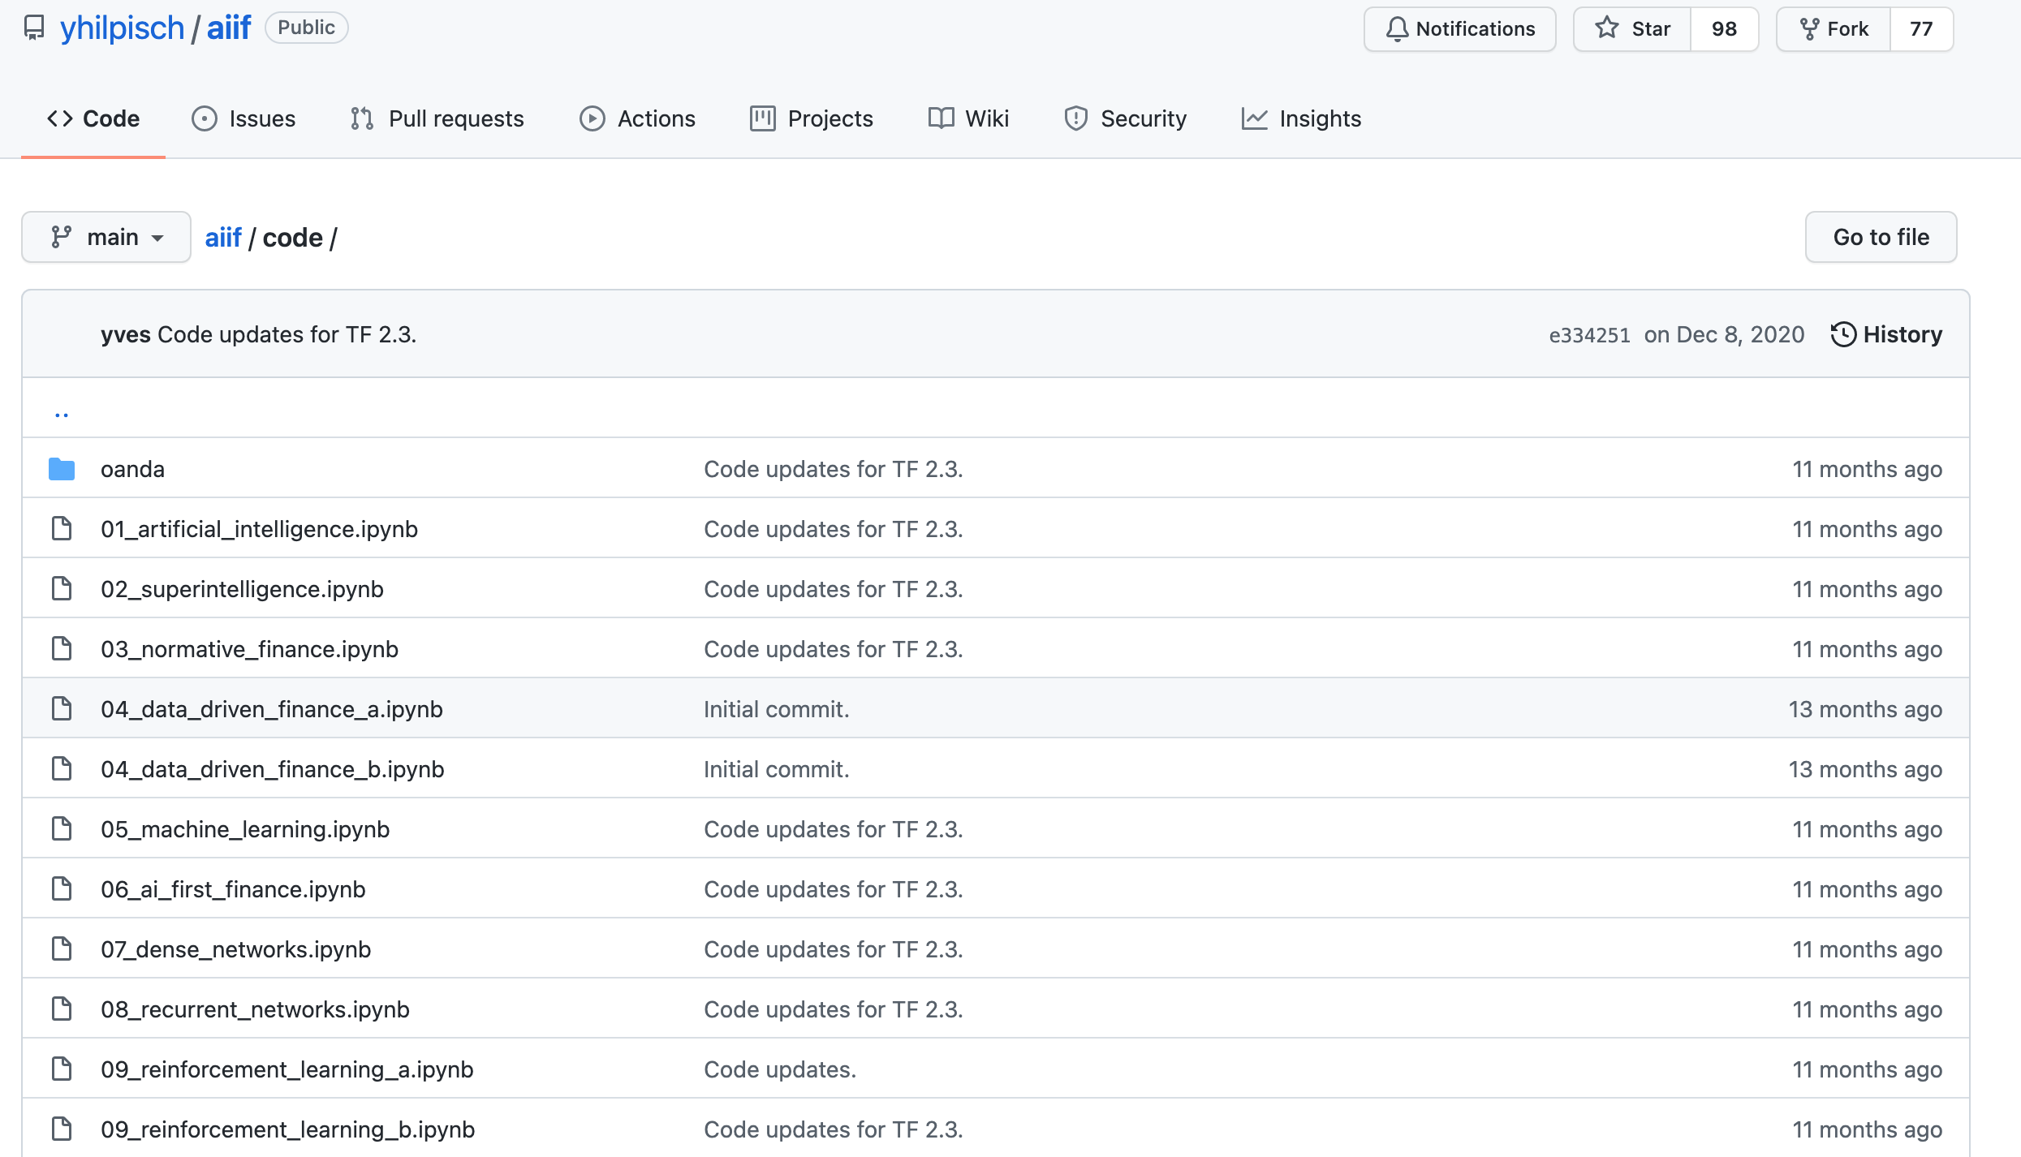
Yves Hilpisch (2020), Artificial Intelligence in Finance: A Python-Based Guide, O’Reilly
https://github.com/yhilpisch/aiif/tree/main/code
Source: https://github.com/yhilpisch/aiif/tree/main/code

Slide 52
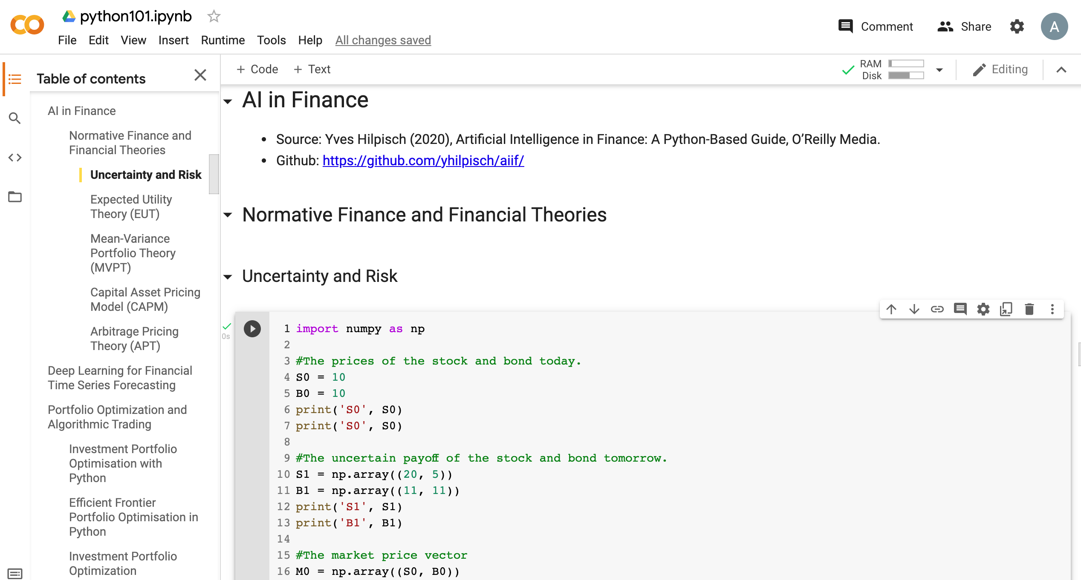
Python in Google Colab (Python101)
https://colab.research.google.com/drive/1FEG6DnGvwfUbeo4zJ1zTunjMqf2RkCrT
https://tinyurl.com/aintpupython101

Slide 53
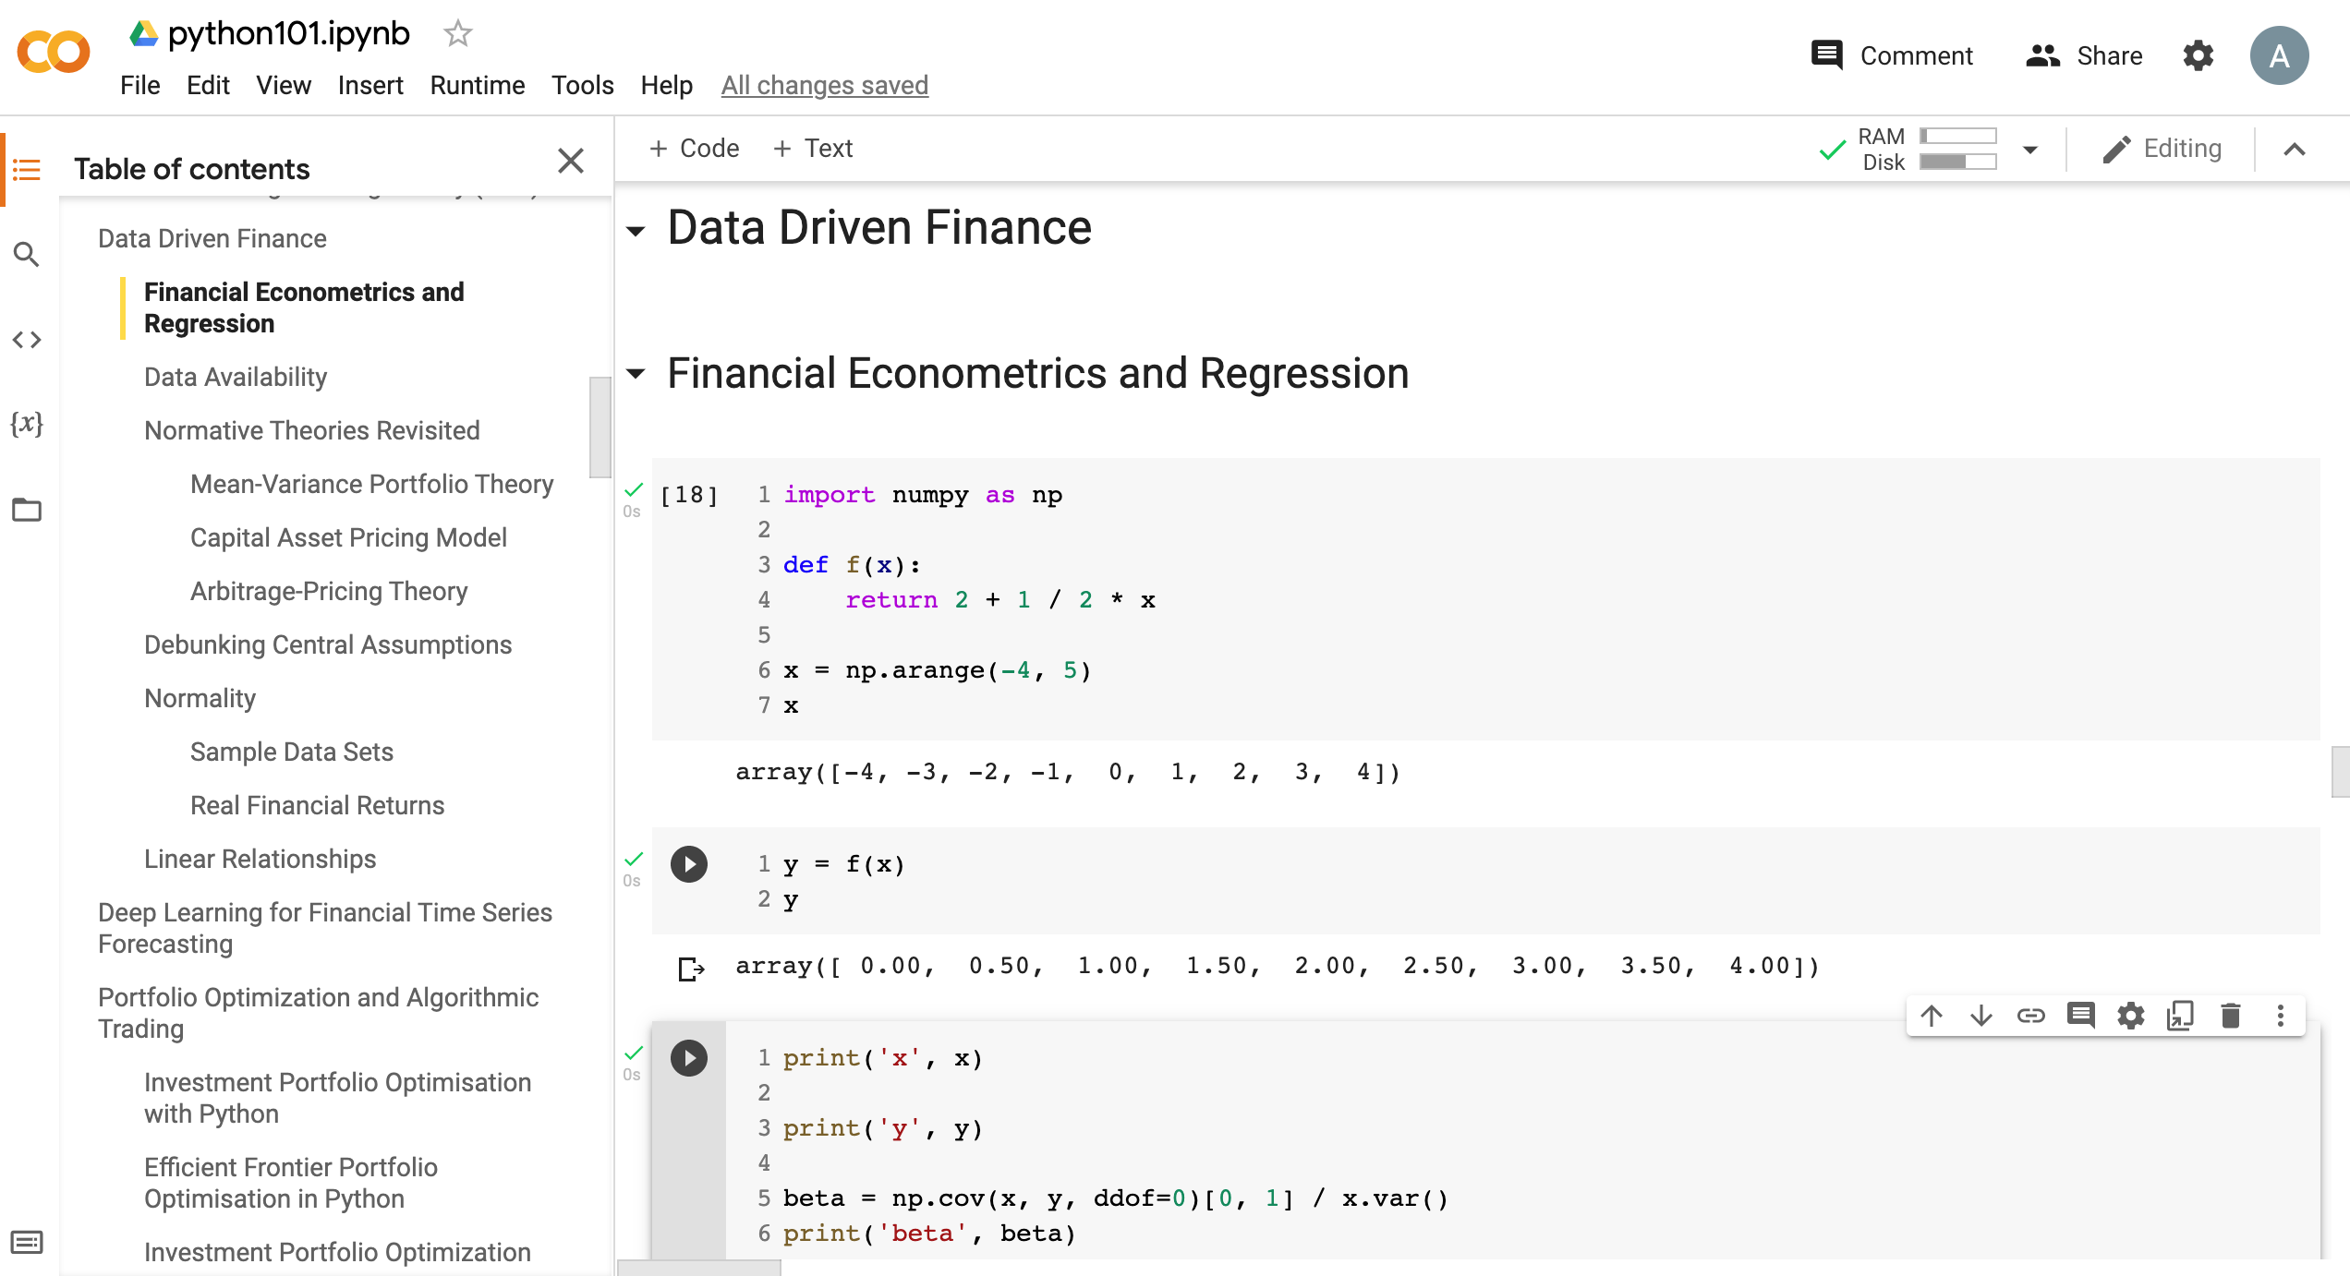
Python in Google Colab (Python101)
https://tinyurl.com/aintpupython101

Slide 54
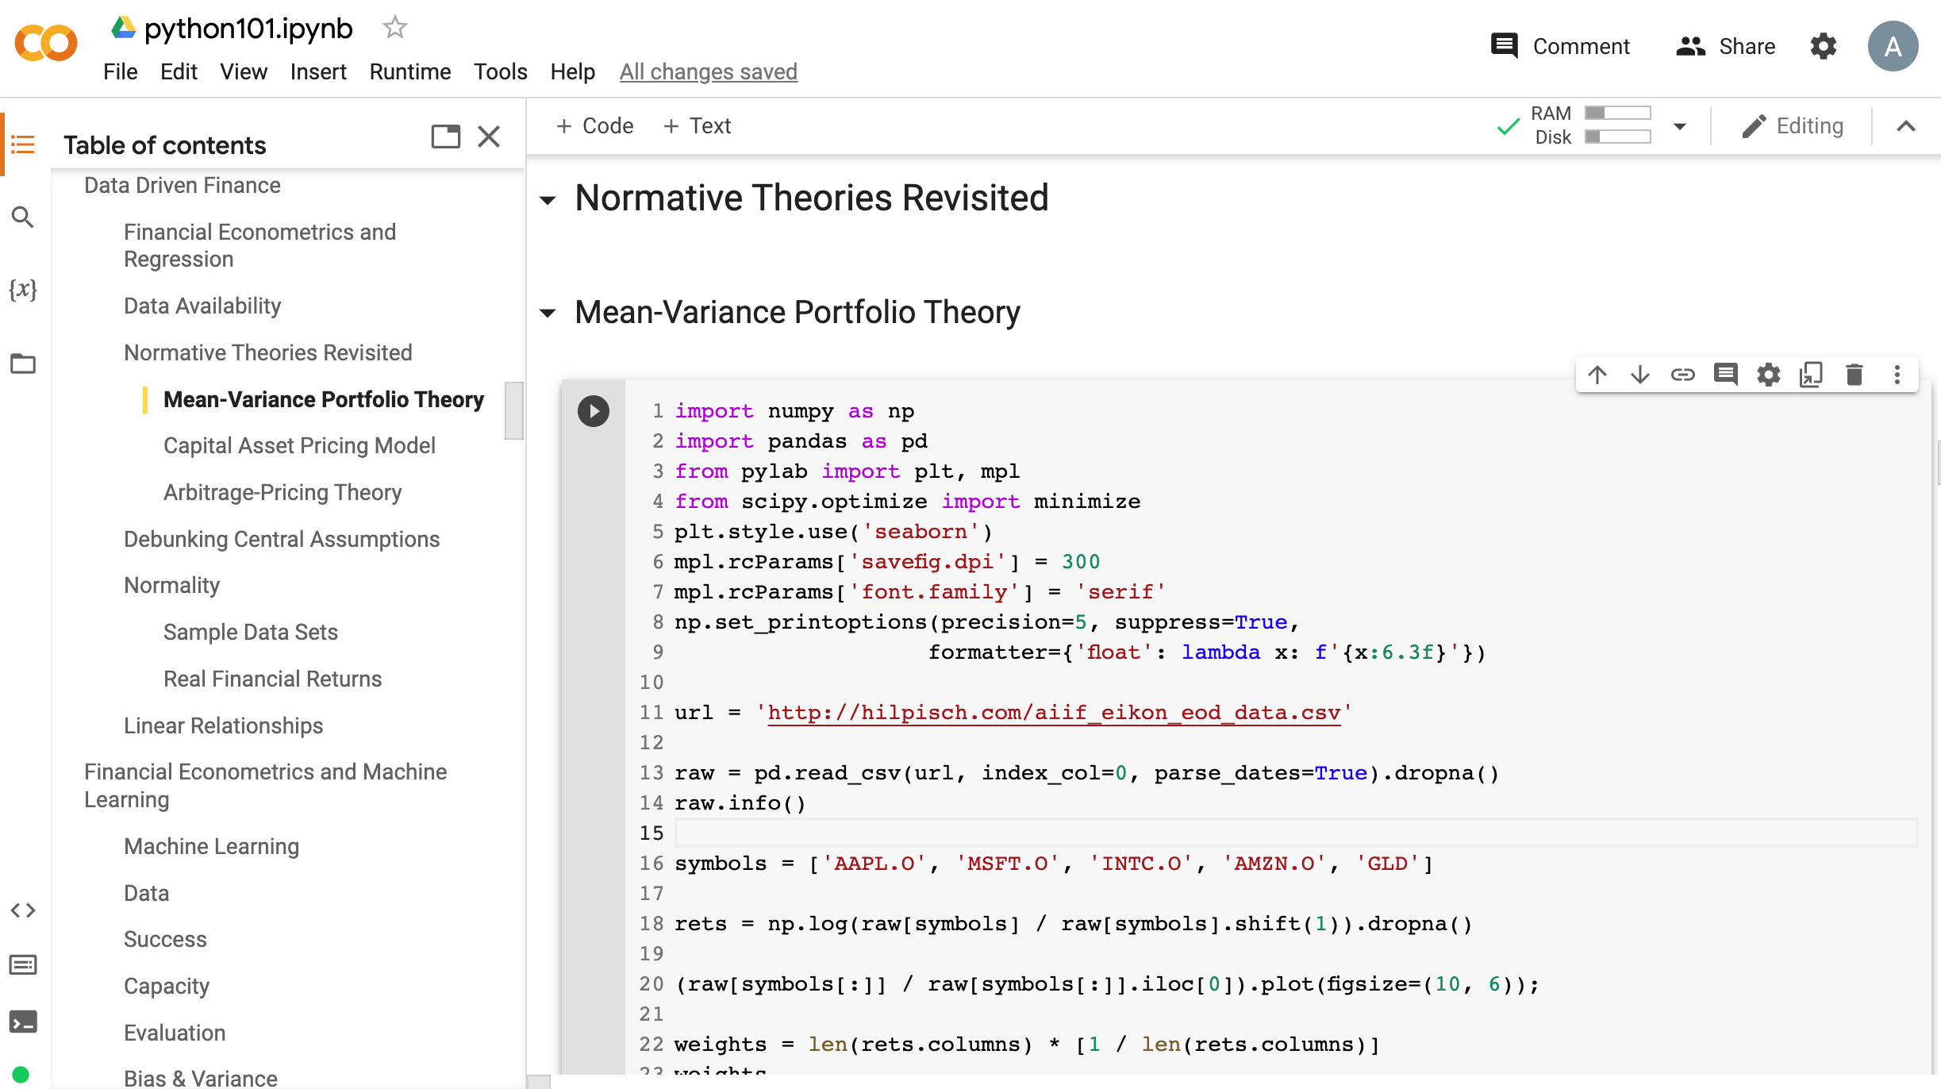
Python in Google Colab (Python101)
https://tinyurl.com/aintpupython101

Slide 55
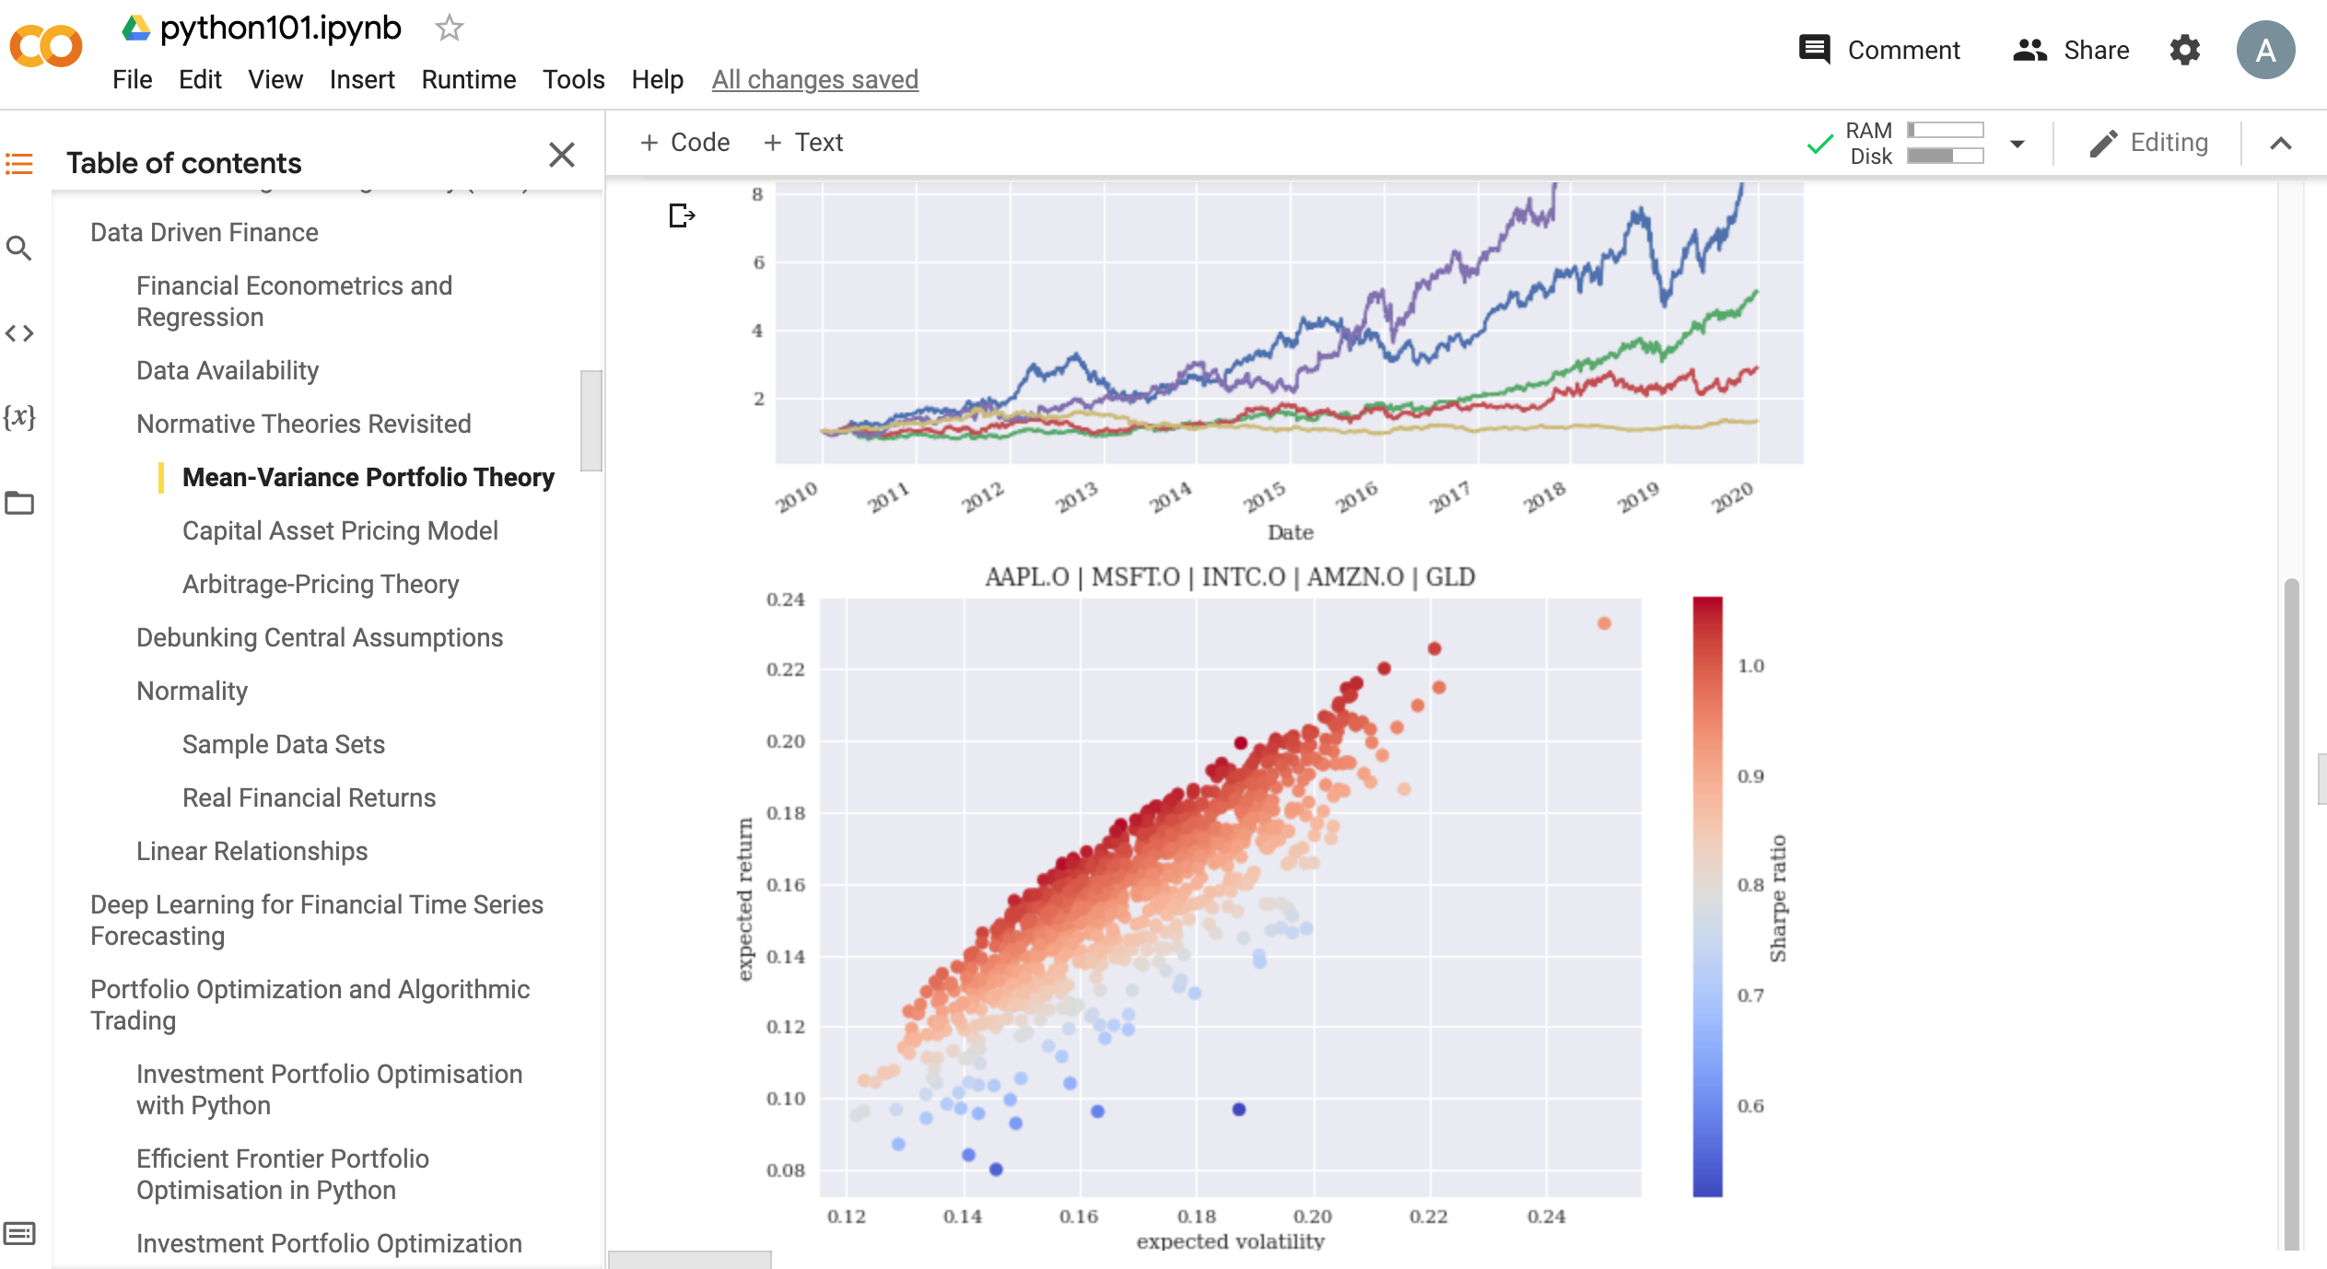
Python in Google Colab (Python101)
https://tinyurl.com/aintpupython101

Slide 56
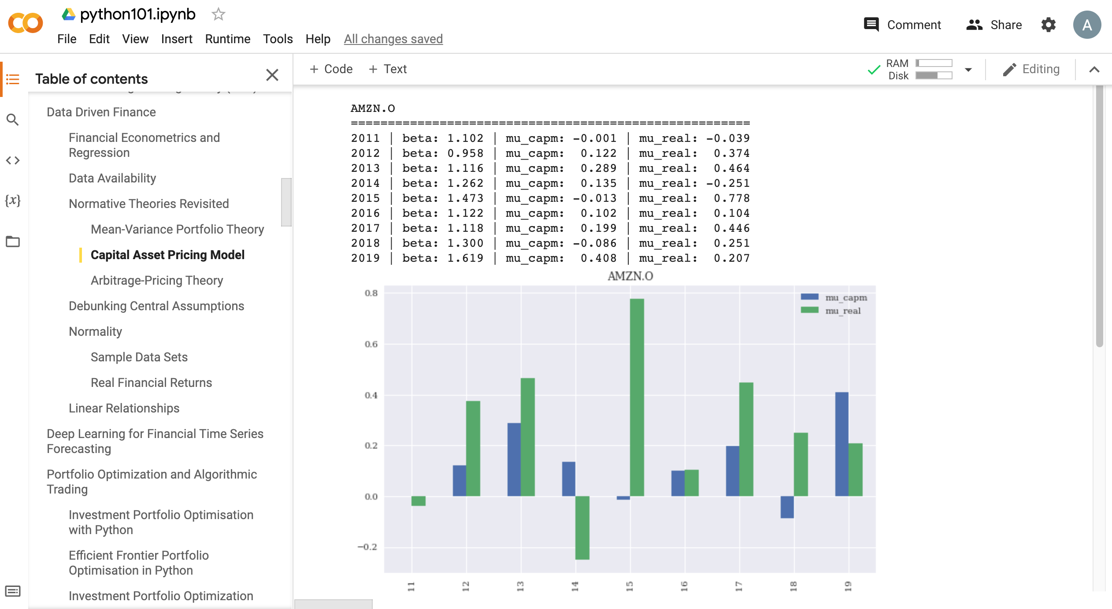
Python in Google Colab (Python101)
https://tinyurl.com/aintpupython101

Slide 57
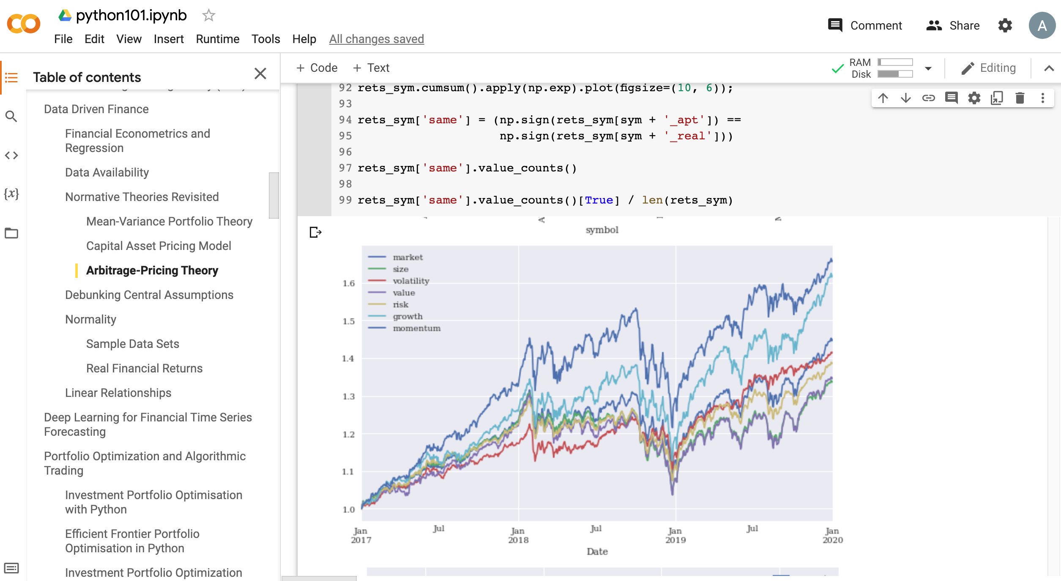
Python in Google Colab (Python101)
https://tinyurl.com/aintpupython101

Slide 58
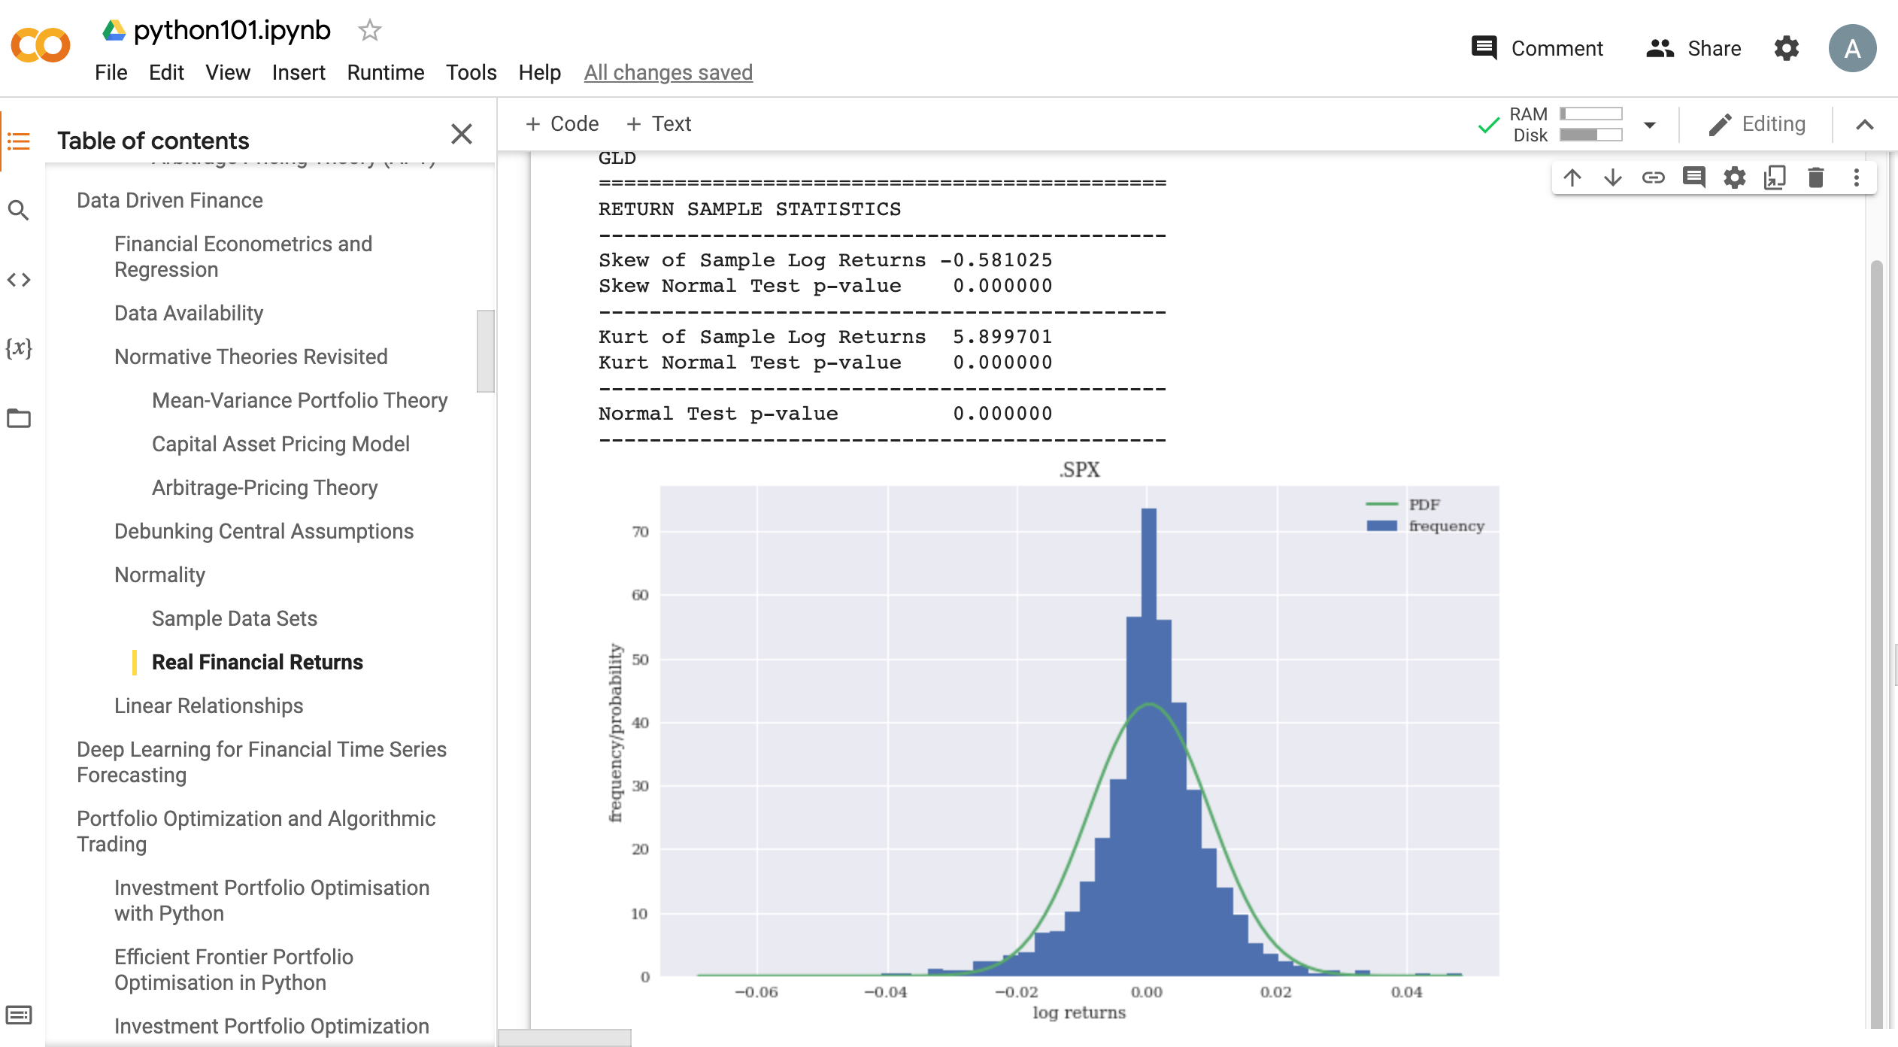
Python in Google Colab (Python101)
https://tinyurl.com/aintpupython101

Slide 59
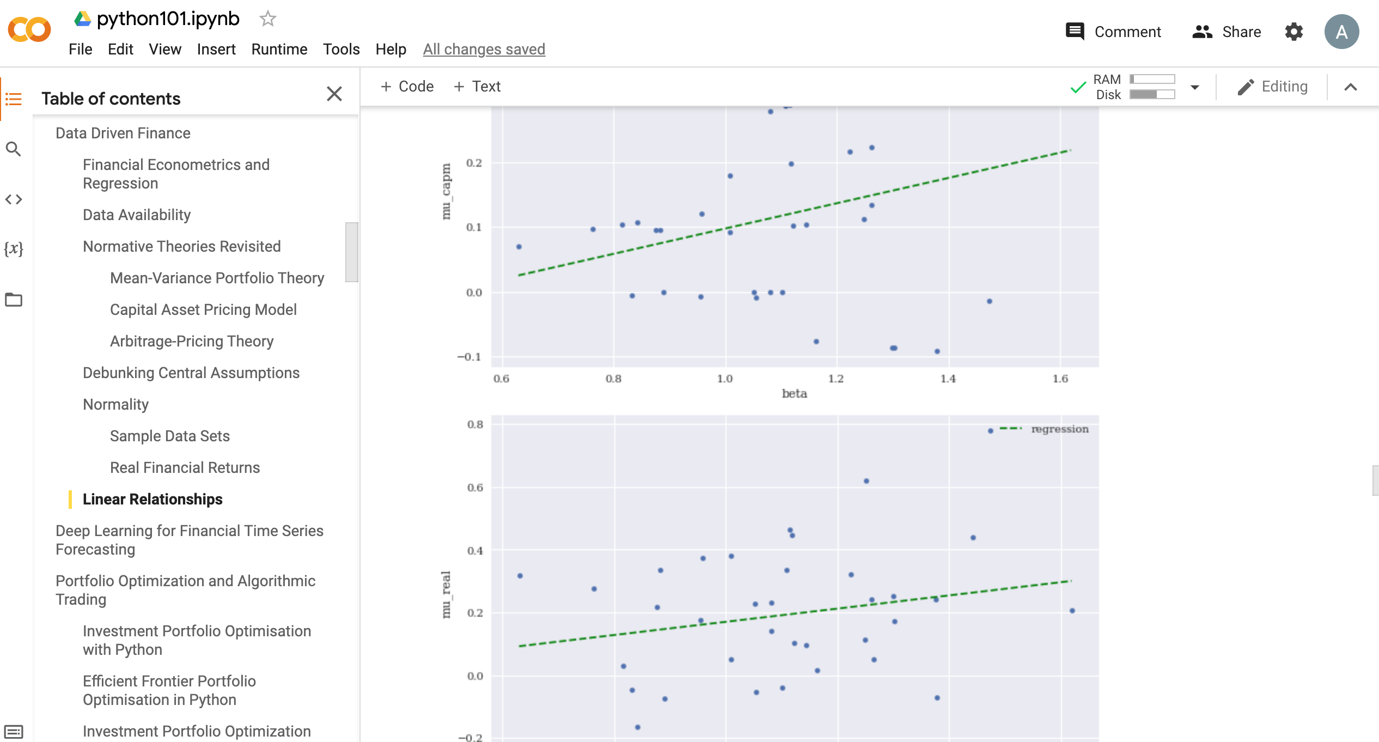
Python in Google Colab (Python101)
https://tinyurl.com/aintpupython101

Slide 60
Summary
Data-Driven Finance
Scientific Method
Financial Econometrics and Regression
Data Availability
Normative Theories Revisited
Debunking Central Assumptions in Finance
Source: Yves Hilpisch (2020), Artificial Intelligence in Finance: A Python-Based Guide, O’Reilly Media.

Slide 61
References
Yves Hilpisch (2020), Artificial Intelligence in Finance: A Python-Based Guide, O’Reilly Media, https://github.com/yhilpisch/aiif .
Fishburn, P. C. (1968). Utility theory. Management science, 14(5), 335-378.
Fama, E. F., & French, K. R. (2004). The capital asset pricing model: Theory and evidence. Journal of economic perspectives, 18(3), 25-46.
Markowitz, H. (1952). PORTFOLIO SELECTION. The Journal of Finance, 7(1), 77-91.
Pratt, J. W. (1964). Risk aversion in the small and in the large, econometrics 32, jan.
Ross, S. A. (1976). The arbitrage theory of capital asset pricing. Journal of Economic Theory, 13(3), 341-60.
Sharpe, W. F. (1964). Capital asset prices: A theory of market equilibrium under conditions of risk. The journal of finance, 19(3), 425-442.
Min-Yuh Day (2022), Python 101, https://tinyurl.com/aintpupython101

