Slide 1
AI-First Finance
Artificial Intelligence in Finance and Quantitative Analysis
1111AIFQA08
MBA, IM, NTPU (M6132) (Fall 2022) Tue 2, 3, 4 (9:10-12:00) (B8F40)
Min-Yuh Day, Ph.D, Associate Professor
Institute of Information Management, National Taipei University
https://web.ntpu.edu.tw/~myday
https://meet.google.com/paj-zhhj-mya
2022-11-08

Slide 2
Syllabus
Week Date Subject/Topics
1 2022/09/13 Introduction to Artificial Intelligence in Finance and Quantitative Analysis
2 2022/09/20 AI in FinTech: Metaverse, Web3, DeFi, NFT, Financial Services Innovation and Applications
3 2022/09/27 Investing Psychology and Behavioral Finance
4 2022/10/04 Event Studies in Finance
5 2022/10/11 Case Study on AI in Finance and Quantitative Analysis I
6 2022/10/18 Finance Theory

Slide 3
Syllabus
Week Date Subject/Topics
7 2022/10/25 Data-Driven Finance
8 2022/11/01 Midterm Project Report
9 2022/11/08 Financial Econometrics and Machine Learning
10 2022/11/15 AI-First Finance
11 2022/11/22 Industry Practices of AI in Finance and Quantitative Analysis
12 2022/11/29 Case Study on AI in Finance and Quantitative Analysis II

Slide 4
Syllabus
Week Date Subject/Topics
13 2022/12/06 Deep Learning in Finance; Reinforcement Learning in Finance
14 2022/12/13 Algorithmic Trading; Risk Management; Trading Bot and Event-Based Backtesting
15 2022/12/20 Final Project Report I
16 2022/12/27 Final Project Report II
17 2023/01/03 Self-learning
18 2023/01/10 Self-learning

Slide 5
AI-First Finance

Slide 6
AI-First Finance
Efficient Markets
Market Prediction Based on Returns Data
Market Prediction with More Features
Market Prediction Intraday
Source: Yves Hilpisch (2020), Artificial Intelligence in Finance: A Python-Based Guide, O’Reilly Media.

Slide 7
Life 3.0: Being human in the age of artificial intelligence Max Tegmark (2017)
A computation takes information and transforms it, implementing what mathematicians call a function.... If you’re in possession of a function that inputs all the world’s financial data and outputs the best stocks to buy, you’ll soon be extremely rich.
Source: Yves Hilpisch (2020), Artificial Intelligence in Finance: A Python-Based Guide, O’Reilly Media.

Slide 8
Efficient Markets
Efficient Market Hypothesis (EMH)
Random Walk Hypothesis (RWH)
Weak form of EMH
The information set θ_{t} only encompasses the past price and return history of the market.
Semi-strong form of EMH
The information set θ_{t} is taken to be all publicly available information, including not only the past price and return history but also financial reports, news articles, weather data, and so on.
Strong form of EMH
The information set θ_{t} includes all information available to anyone (that is, even private information).
Source: Yves Hilpisch (2020), Artificial Intelligence in Finance: A Python-Based Guide, O’Reilly Media.

Slide 9
import numpy as np
import pandas as pd
from pylab import plt, mpl
plt.style.use('seaborn')
mpl.rcParams['savefig.dpi'] = 300
mpl.rcParams['font.family'] = 'serif'
pd.set_option('precision', 4)
np.set_printoptions(suppress=True, precision=4)
url = 'http://hilpisch.com/aiif_eikon_eod_data.csv'
data = pd.read_csv(url, index_col=0, parse_dates=True).dropna()
(data / data.iloc[0]).plot(figsize=(10, 6), cmap='coolwarm')
Source: Yves Hilpisch (2020), Artificial Intelligence in Finance: A Python-Based Guide, O’Reilly Media.

Slide 10
Normalized time series data (end-of-day)
Source: Yves Hilpisch (2020), Artificial Intelligence in Finance: A Python-Based Guide, O’Reilly Media.

Slide 11
lags = 7
def add_lags(data, ric, lags):
cols = []
df = pd.DataFrame(data[ric])
for lag in range(1, lags + 1):
col = 'lag_{}'.format(lag)
df[col] = df[ric].shift(lag)
cols.append(col)
df.dropna(inplace=True)
return df, cols
dfs = {}
for sym in data.columns:
df, cols = add_lags(data, sym, lags)
dfs[sym] = df
dfs[sym].head(7)
Source: Yves Hilpisch (2020), Artificial Intelligence in Finance: A Python-Based Guide, O’Reilly Media.

Slide 12
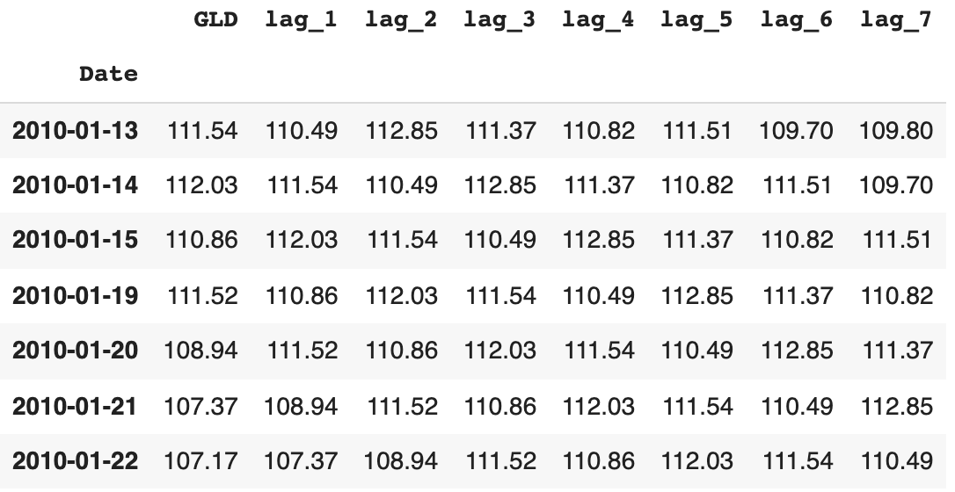
lagged prices
Source: Yves Hilpisch (2020), Artificial Intelligence in Finance: A Python-Based Guide, O’Reilly Media.

Slide 13
regs = {}
for sym in data.columns:
df = dfs[sym]
reg = np.linalg.lstsq(df[cols], df[sym], rcond=-1)[0]
#Return the least-squares solution to a linear matrix equation
regs[sym] = reg
rega = np.stack(tuple(regs.values()))
regd = pd.DataFrame(rega, columns=cols, index=data.columns)
regd
Source: Yves Hilpisch (2020), Artificial Intelligence in Finance: A Python-Based Guide, O’Reilly Media.

Slide 14
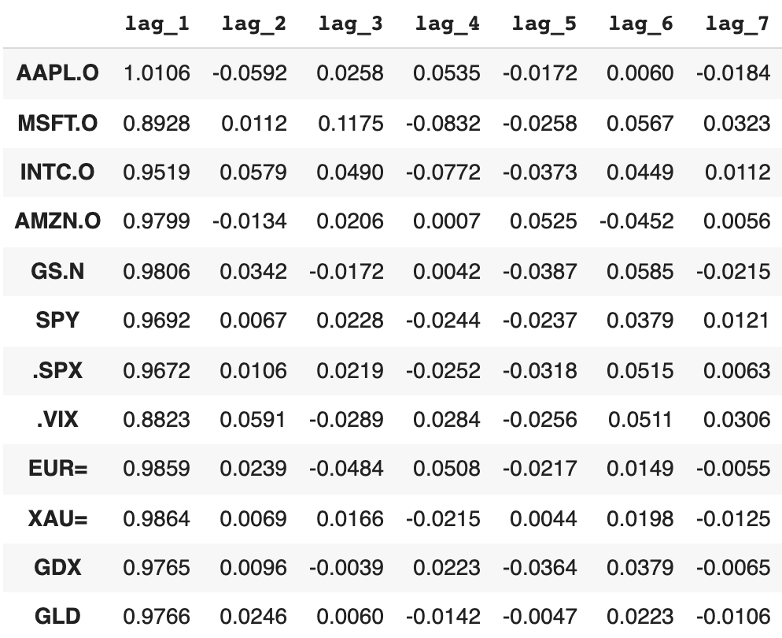
regression analysis
reg = np.linalg.lstsq(df[cols], df[sym], rcond=-1)[0]
Source: Yves Hilpisch (2020), Artificial Intelligence in Finance: A Python-Based Guide, O’Reilly Media.

Slide 15
Average optimal regression parameters for the lagged prices
regd.mean().plot(kind='bar', figsize=(10, 6))
Source: Yves Hilpisch (2020), Artificial Intelligence in Finance: A Python-Based Guide, O’Reilly Media.

Slide 16
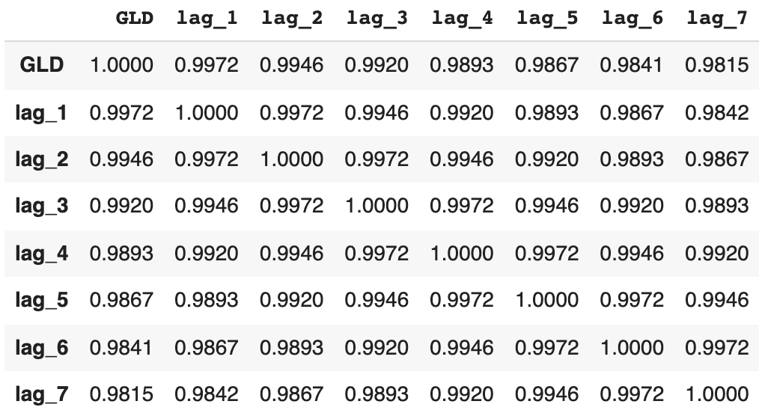
Correlations between the lagged time series
dfs[sym].corr()
Source: Yves Hilpisch (2020), Artificial Intelligence in Finance: A Python-Based Guide, O’Reilly Media.

Slide 17
from statsmodels.tsa.stattools import adfuller
#Tests for stationarity using the Augmented Dickey-Fuller (ADF) test
adfuller(data[sym].dropna())
(-1.9488969577009954,
0.3094193074034718,
0,
2515,
{'1%': -3.4329527780962255,
'10%': -2.567382133955709,
'5%': -2.8626898965523724},
8446.683102944744)
Source: Yves Hilpisch (2020), Artificial Intelligence in Finance: A Python-Based Guide, O’Reilly Media.

Slide 18
Market Prediction Based on Returns Data
Statistical inefficiencies
are given when a model is able to predict the direction of the future price movement with a certain edge (say, the prediction is correct in 55% or 60% of the cases)
Economic inefficiencies
would only be given if the statistical inefficiencies can be exploited profitably through a trading strategy that takes into account, for example, transaction costs.
Source: Yves Hilpisch (2020), Artificial Intelligence in Finance: A Python-Based Guide, O’Reilly Media.

Slide 19
Market Prediction Based on Returns Data
Create data sets with lagged log returns data
The normalized lagged log returns data is also tested for stationarity (given)
The features are tested for correlation (not correlated )
Time-series-related data
weak form market efficiency
Source: Yves Hilpisch (2020), Artificial Intelligence in Finance: A Python-Based Guide, O’Reilly Media.

Slide 20
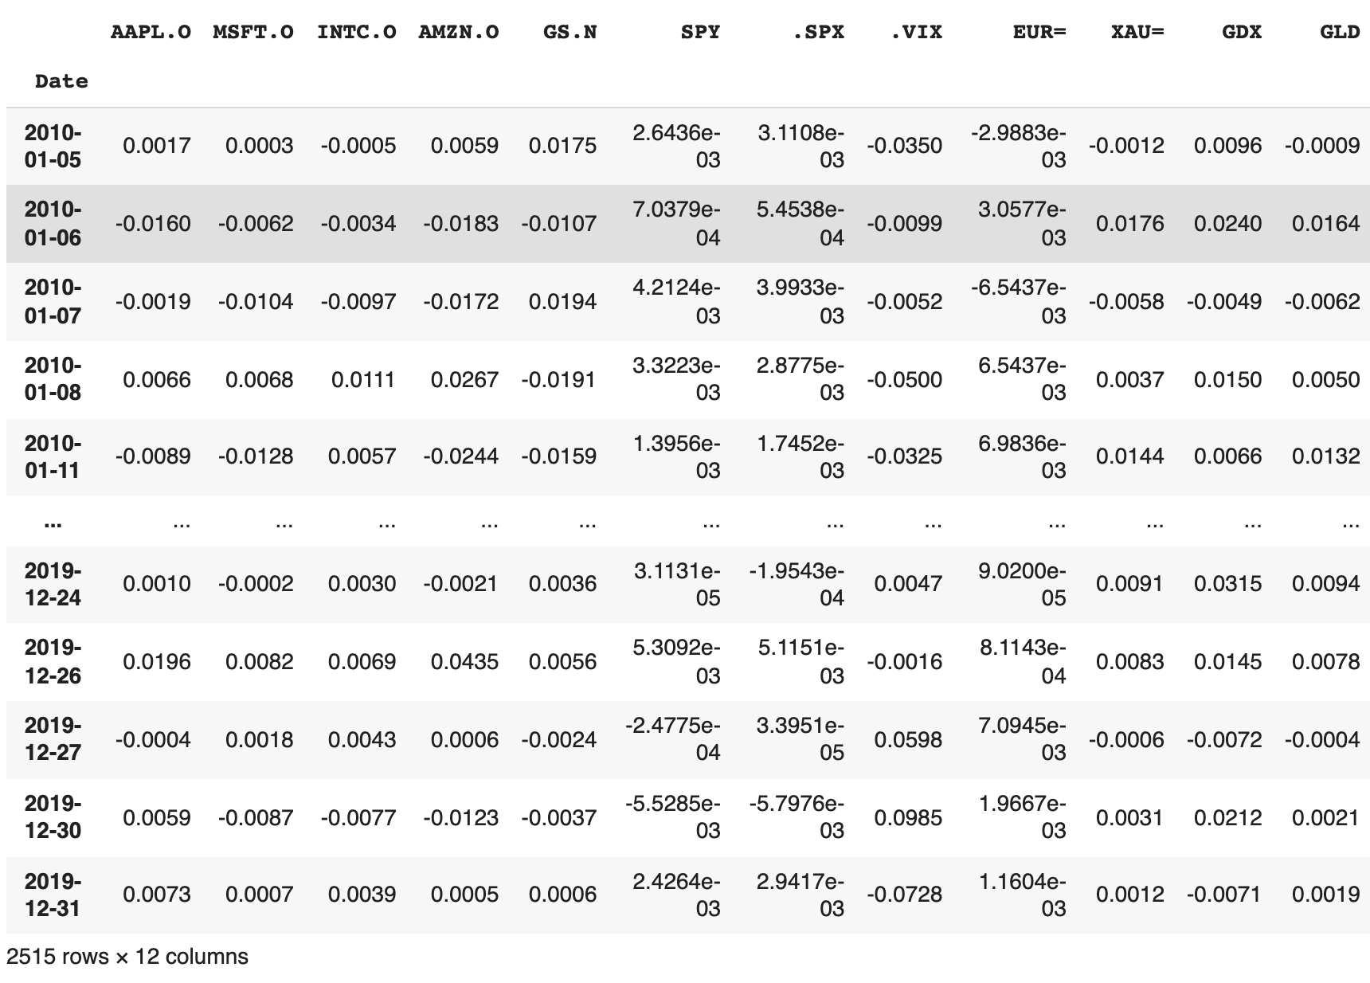
rets = np.log(data / data.shift(1)) rets.dropna(inplace=True)
rets
log returns
Source: Yves Hilpisch (2020), Artificial Intelligence in Finance: A Python-Based Guide, O’Reilly Media.

Slide 21
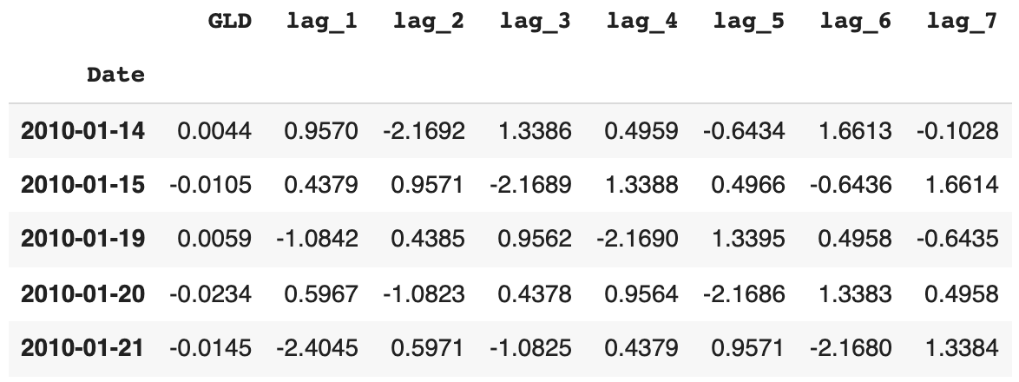
dfs = {}
for sym in data:
df, cols = add_lags(rets, sym, lags)
mu, std = df[cols].mean(), df[cols].std()
df[cols] = (df[cols] - mu) / std
dfs[sym] = df
dfs[sym].head()
Source: Yves Hilpisch (2020), Artificial Intelligence in Finance: A Python-Based Guide, O’Reilly Media.

Slide 22
Augmented Dickey-Fuller (ADF) Tests for stationarity of the time series data
adfuller(dfs[sym]['lag_1'])
(-51.568251505825536,
0.0,
0,
2507,
{'1%': -3.4329610922579095,
'10%': -2.567384088736619,
'5%': -2.8626935681060375},
7017.165474260225)
Source: Yves Hilpisch (2020), Artificial Intelligence in Finance: A Python-Based Guide, O’Reilly Media.

Slide 23
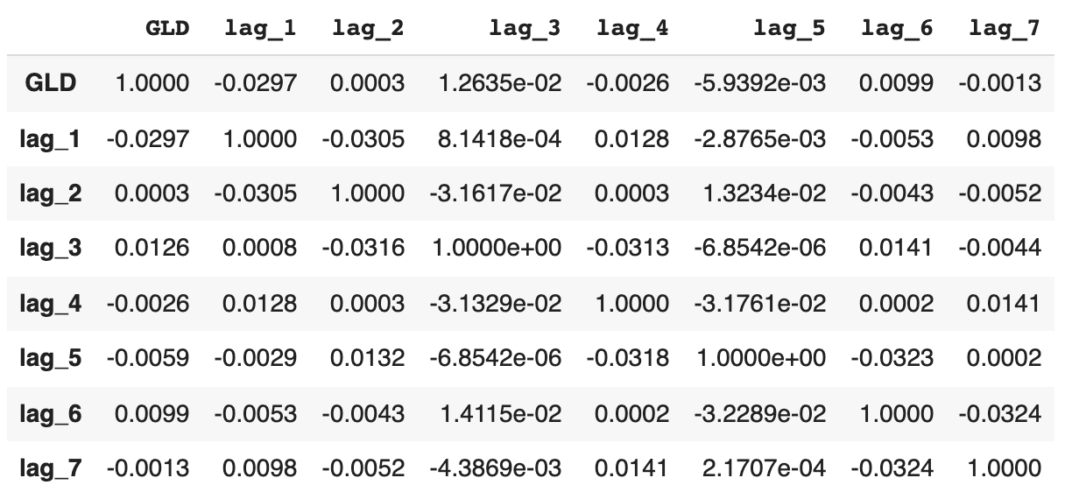
Shows the correlation data for the features
dfs[sym].corr()
Source: Yves Hilpisch (2020), Artificial Intelligence in Finance: A Python-Based Guide, O’Reilly Media.

Slide 24
OLS Regression
from sklearn.metrics import accuracy_score
%%time
for sym in data:
df = dfs[sym]
reg = np.linalg.lstsq(df[cols], df[sym], rcond=-1)[0]
pred = np.dot(df[cols], reg)
acc = accuracy_score(np.sign(df[sym]), np.sign(pred))
print(f'OLS | {sym:10s} | acc={acc:.4f}')
Source: Yves Hilpisch (2020), Artificial Intelligence in Finance: A Python-Based Guide, O’Reilly Media.

Slide 25
OLS Regression Accuracy
OLS | AAPL.O | acc=0.5056
OLS | MSFT.O | acc=0.5088
OLS | INTC.O | acc=0.5040
OLS | AMZN.O | acc=0.5048
OLS | GS.N | acc=0.5080
OLS | SPY | acc=0.5080
OLS | .SPX | acc=0.5167
OLS | .VIX | acc=0.5291
OLS | EUR= | acc=0.4984
OLS | XAU= | acc=0.5207
OLS | GDX | acc=0.5307
OLS | GLD | acc=0.5072
Source: Yves Hilpisch (2020), Artificial Intelligence in Finance: A Python-Based Guide, O’Reilly Media.

Slide 26
from sklearn.neural_network import MLPRegressor
%%time
for sym in data.columns:
df = dfs[sym]
model = MLPRegressor(hidden_layer_sizes=[512],
random_state=100,
max_iter=1000,
early_stopping=True,
validation_fraction=0.15,
shuffle=False)
model.fit(df[cols].values, df[sym].values)
pred = model.predict(df[cols].values)
acc = accuracy_score(np.sign(df[sym].values), np.sign(pred))
print(f'MLP | {sym:10s} | acc={acc:.4f}')
Source: Yves Hilpisch (2020), Artificial Intelligence in Finance: A Python-Based Guide, O’Reilly Media.

Slide 27
Scikit-learn MLPRegressor Accuracy
MLP | AAPL.O | acc=0.6005
MLP | MSFT.O | acc=0.5853
MLP | INTC.O | acc=0.5766
MLP | AMZN.O | acc=0.5510
MLP | GS.N | acc=0.6527
MLP | SPY | acc=0.5419
MLP | .SPX | acc=0.5399
MLP | .VIX | acc=0.6579
MLP | EUR= | acc=0.5642
MLP | XAU= | acc=0.5522
MLP | GDX | acc=0.6029
MLP | GLD | acc=0.5259
Source: Yves Hilpisch (2020), Artificial Intelligence in Finance: A Python-Based Guide, O’Reilly Media.

Slide 28
import tensorflow as tf
from keras.layers import Dense
from keras.models import Sequential
np.random.seed(100)
tf.random.set_seed(100)
def create_model(problem='regression'):
model = Sequential()
model.add(Dense(512, input_dim=len(cols), activation='relu'))
if problem == 'regression’:
model.add(Dense(1, activation='linear’))
model.compile(loss='mse', optimizer='adam')
else:
model.add(Dense(1, activation='sigmoid’))
model.compile(loss='binary_crossentropy', optimizer='adam')
return model
Source: Yves Hilpisch (2020), Artificial Intelligence in Finance: A Python-Based Guide, O’Reilly Media.

Slide 29
%%time
for sym in data.columns[:]:
df = dfs[sym]
model = create_model()
model.fit(df[cols], df[sym], epochs=25, verbose=False)
pred = model.predict(df[cols])
acc = accuracy_score(np.sign(df[sym]), np.sign(pred))
print(f'DNN | {sym:10s} | acc={acc:.4f}')
Source: Yves Hilpisch (2020), Artificial Intelligence in Finance: A Python-Based Guide, O’Reilly Media.

Slide 30
TF Keras DNN Accuracy
DNN | AAPL.O | acc=0.6069
DNN | MSFT.O | acc=0.6260
DNN | INTC.O | acc=0.6344
DNN | AMZN.O | acc=0.6316
DNN | GS.N | acc=0.6045
DNN | SPY | acc=0.5610
DNN | .SPX | acc=0.5435
DNN | .VIX | acc=0.6096
DNN | EUR= | acc=0.5817
DNN | XAU= | acc=0.6017
DNN | GDX | acc=0.6164
DNN | GLD | acc=0.5973
Source: Yves Hilpisch (2020), Artificial Intelligence in Finance: A Python-Based Guide, O’Reilly Media.

Slide 31
Train Data (0.8): In-Sample Test Data (0.2): Out-of-Sample
split = int(len(dfs[sym]) * 0.8)
%%time
for sym in data.columns:
df = dfs[sym]
train = df.iloc[:split]
reg = np.linalg.lstsq(train[cols], train[sym], rcond=-1)[0]
test = df.iloc[split:]
pred = np.dot(test[cols], reg)
acc = accuracy_score(np.sign(test[sym]), np.sign(pred))
print(f'OLS | {sym:10s} | acc={acc:.4f}')
Source: Yves Hilpisch (2020), Artificial Intelligence in Finance: A Python-Based Guide, O’Reilly Media.

Slide 32
OLS Out-of-Sample Accuracy
OLS | AAPL.O | acc=0.5219
OLS | MSFT.O | acc=0.4960
OLS | INTC.O | acc=0.5418
OLS | AMZN.O | acc=0.4841
OLS | GS.N | acc=0.4980
OLS | SPY | acc=0.5020
OLS | .SPX | acc=0.5120
OLS | .VIX | acc=0.5458
OLS | EUR= | acc=0.4482
OLS | XAU= | acc=0.5299
OLS | GDX | acc=0.5159
OLS | GLD | acc=0.5100
Source: Yves Hilpisch (2020), Artificial Intelligence in Finance: A Python-Based Guide, O’Reilly Media.

Slide 33
%%time
for sym in data.columns:
df = dfs[sym]
train = df.iloc[:split]
model = MLPRegressor(hidden_layer_sizes=[512],
random_state=100,
max_iter=1000,
early_stopping=True,
validation_fraction=0.15,
shuffle=False)
model.fit(train[cols].values, train[sym].values)
test = df.iloc[split:]
pred = model.predict(test[cols].values)
acc = accuracy_score(np.sign(test[sym].values), np.sign(pred))
print(f'MLP | {sym:10s} | acc={acc:.4f}')
Source: Yves Hilpisch (2020), Artificial Intelligence in Finance: A Python-Based Guide, O’Reilly Media.

Slide 34
MLP Out-of-Sample Accuracy
MLP | AAPL.O | acc=0.4920
MLP | MSFT.O | acc=0.5279
MLP | INTC.O | acc=0.5279
MLP | AMZN.O | acc=0.4641
MLP | GS.N | acc=0.5040
MLP | SPY | acc=0.5259
MLP | .SPX | acc=0.5478
MLP | .VIX | acc=0.5279
MLP | EUR= | acc=0.4980
MLP | XAU= | acc=0.5239
MLP | GDX | acc=0.4880
MLP | GLD | acc=0.5000
Source: Yves Hilpisch (2020), Artificial Intelligence in Finance: A Python-Based Guide, O’Reilly Media.

Slide 35
%%time
for sym in data.columns:
df = dfs[sym]
train = df.iloc[:split]
model = create_model()
model.fit(train[cols], train[sym], epochs=50, verbose=False)
test = df.iloc[split:]
pred = model.predict(test[cols])
acc = accuracy_score(np.sign(test[sym]), np.sign(pred))
print(f'DNN | {sym:10s} | acc={acc:.4f}')
Source: Yves Hilpisch (2020), Artificial Intelligence in Finance: A Python-Based Guide, O’Reilly Media.

Slide 36
DNN Out-of-Sample Accuracy
DNN | AAPL.O | acc=0.4701
DNN | MSFT.O | acc=0.4960
DNN | INTC.O | acc=0.5040
DNN | AMZN.O | acc=0.4920
DNN | GS.N | acc=0.5538
DNN | SPY | acc=0.5299
DNN | .SPX | acc=0.5458
DNN | .VIX | acc=0.5020
DNN | EUR= | acc=0.5100
DNN | XAU= | acc=0.4940
DNN | GDX | acc=0.4661
DNN | GLD | acc=0.4880
Source: Yves Hilpisch (2020), Artificial Intelligence in Finance: A Python-Based Guide, O’Reilly Media.

Slide 37
Market Prediction with More Features
In trading, there is a long tradition of using technical indicators to generate, based on observed patterns, buy or sell signals.
Such technical indicators, basically of any kind, can also be used as features for the training of neural networks.
SMA, rolling minimum and maximum values, momentum, and rolling volatility as features
Source: Yves Hilpisch (2020), Artificial Intelligence in Finance: A Python-Based Guide, O’Reilly Media.

Slide 38
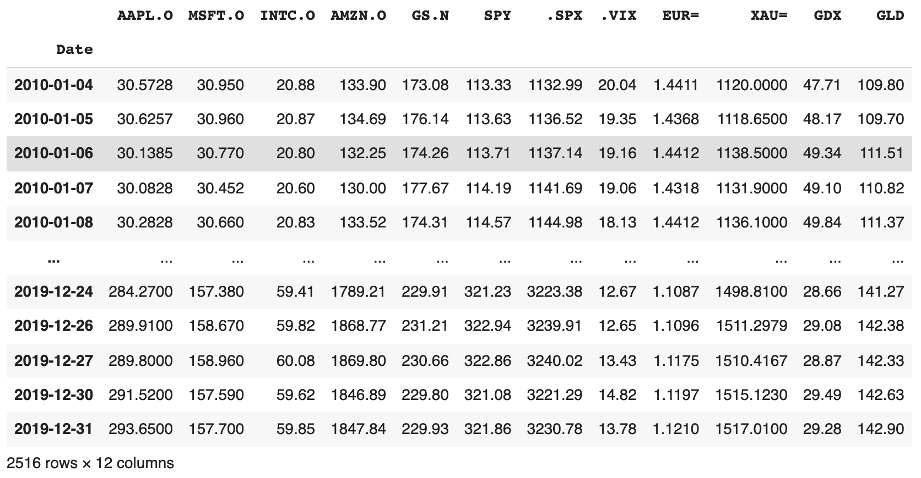
url = 'http://hilpisch.com/aiif_eikon_eod_data.csv'
data = pd.read_csv(url, index_col=0, parse_dates=True).dropna()
data
Source: Yves Hilpisch (2020), Artificial Intelligence in Finance: A Python-Based Guide, O’Reilly Media.

Slide 39
def add_lags(data, ric, lags, window=50):
cols = []
df = pd.DataFrame(data[ric])
df.dropna(inplace=True)
df['r'] = np.log(df / df.shift())
df['sma'] = df[ric].rolling(window).mean()
df['min'] = df[ric].rolling(window).min()
df['max'] = df[ric].rolling(window).max()
df['mom'] = df['r'].rolling(window).mean()
df['vol'] = df['r'].rolling(window).std()
df.dropna(inplace=True)
df['d'] = np.where(df['r'] > 0, 1, 0)
features = [ric, 'r', 'd', 'sma', 'min', 'max', 'mom', 'vol']
for f in features:
for lag in range(1, lags + 1):
col = f'{f}_lag_{lag}'
df[col] = df[f].shift(lag)
cols.append(col)
df.dropna(inplace=True)
return df, cols
Source: Yves Hilpisch (2020), Artificial Intelligence in Finance: A Python-Based Guide, O’Reilly Media.

Slide 40
lags = 5
dfs = {}
for ric in data:
df, cols = add_lags(data, ric, lags)
dfs[ric] = df.dropna(), cols
len(cols)
40
Source: Yves Hilpisch (2020), Artificial Intelligence in Finance: A Python-Based Guide, O’Reilly Media.

Slide 41
from sklearn.neural_network import MLPClassifier
%%time
for ric in data:
model = MLPClassifier(hidden_layer_sizes=[512],
random_state=100,
max_iter=1000,
early_stopping=True,
validation_fraction=0.15,
shuffle=False)
df, cols = dfs[ric]
df[cols] = (df[cols] - df[cols].mean()) / df[cols].std()
model.fit(df[cols].values, df['d'].values)
pred = model.predict(df[cols].values)
acc = accuracy_score(df['d'].values, pred)
print(f'IN-SAMPLE | {ric:7s} | acc={acc:.4f}')
Source: Yves Hilpisch (2020), Artificial Intelligence in Finance: A Python-Based Guide, O’Reilly Media.

Slide 42
MLP In-Sample Accuracy
IN-SAMPLE | AAPL.O | acc=0.5510
IN-SAMPLE | MSFT.O | acc=0.5376
IN-SAMPLE | INTC.O | acc=0.5607
IN-SAMPLE | AMZN.O | acc=0.5559
IN-SAMPLE | GS.N | acc=0.5794
IN-SAMPLE | SPY | acc=0.5729
IN-SAMPLE | .SPX | acc=0.5941
IN-SAMPLE | .VIX | acc=0.6940
IN-SAMPLE | EUR= | acc=0.5766
IN-SAMPLE | XAU= | acc=0.5672
IN-SAMPLE | GDX | acc=0.5847
IN-SAMPLE | GLD | acc=0.5567
Source: Yves Hilpisch (2020), Artificial Intelligence in Finance: A Python-Based Guide, O’Reilly Media.

Slide 43
%%time
for ric in data:
model = create_model('classification')
df, cols = dfs[ric]
df[cols] = (df[cols] - df[cols].mean()) / df[cols].std()
model.fit(df[cols], df['d'], epochs=50, verbose=False)
pred = np.where(model.predict(df[cols]) > 0.5, 1, 0)
acc = accuracy_score(df['d'], pred)
print(f'IN-SAMPLE | {ric:7s} | acc={acc:.4f}')
Source: Yves Hilpisch (2020), Artificial Intelligence in Finance: A Python-Based Guide, O’Reilly Media.

Slide 44
TF Keras DNN In-Sample Accuracy
IN-SAMPLE | AAPL.O | acc=0.7042
IN-SAMPLE | MSFT.O | acc=0.6928
IN-SAMPLE | INTC.O | acc=0.6969
IN-SAMPLE | AMZN.O | acc=0.6713
IN-SAMPLE | GS.N | acc=0.6924
IN-SAMPLE | SPY | acc=0.6806
IN-SAMPLE | .SPX | acc=0.6920
IN-SAMPLE | .VIX | acc=0.7347
IN-SAMPLE | EUR= | acc=0.6766
IN-SAMPLE | XAU= | acc=0.7038
IN-SAMPLE | GDX | acc=0.6806
IN-SAMPLE | GLD | acc=0.6936
Source: Yves Hilpisch (2020), Artificial Intelligence in Finance: A Python-Based Guide, O’Reilly Media.

Slide 45
def train_test_model(model):
for ric in data:
df, cols = dfs[ric]
split = int(len(df) * 0.85)
train = df.iloc[:split].copy()
mu, std = train[cols].mean(), train[cols].std()
train[cols] = (train[cols] - mu) / std
model.fit(train[cols].values, train['d'].values)
test = df.iloc[split:].copy()
test[cols] = (test[cols] - mu) / std
pred = model.predict(test[cols].values)
acc = accuracy_score(test['d'].values, pred)
print(f'OUT-OF-SAMPLE | {ric:7s} | acc={acc:.4f}')
Source: Yves Hilpisch (2020), Artificial Intelligence in Finance: A Python-Based Guide, O’Reilly Media.

Slide 46
model_mlp = MLPClassifier(hidden_layer_sizes=[512],
random_state=100,
max_iter=1000,
early_stopping=True,
validation_fraction=0.15,
shuffle=False)
train_test_model(model_mlp)
Source: Yves Hilpisch (2020), Artificial Intelligence in Finance: A Python-Based Guide, O’Reilly Media.

Slide 47
train_test_model(model_mlp)
OUT-OF-SAMPLE | AAPL.O | acc=0.4432
OUT-OF-SAMPLE | MSFT.O | acc=0.4595
OUT-OF-SAMPLE | INTC.O | acc=0.5000
OUT-OF-SAMPLE | AMZN.O | acc=0.5270
OUT-OF-SAMPLE | GS.N | acc=0.4838
OUT-OF-SAMPLE | SPY | acc=0.4811
OUT-OF-SAMPLE | .SPX | acc=0.5027
OUT-OF-SAMPLE | .VIX | acc=0.5676
OUT-OF-SAMPLE | EUR= | acc=0.4649
OUT-OF-SAMPLE | XAU= | acc=0.5514
OUT-OF-SAMPLE | GDX | acc=0.5162
OUT-OF-SAMPLE | GLD | acc=0.4946
Source: Yves Hilpisch (2020), Artificial Intelligence in Finance: A Python-Based Guide, O’Reilly Media.

Slide 48
from sklearn.ensemble import BaggingClassifier
base_estimator = MLPClassifier(hidden_layer_sizes=[256],
random_state=100,
max_iter=1000,
early_stopping=True,
validation_fraction=0.15,
shuffle=False)
model_bag = BaggingClassifier(base_estimator=base_estimator,
n_estimators=35,
max_samples=0.25,
max_features=0.5,
bootstrap=False,
bootstrap_features=True,
n_jobs=8,
random_state=100
)
Source: Yves Hilpisch (2020), Artificial Intelligence in Finance: A Python-Based Guide, O’Reilly Media.

Slide 49
train_test_model(model_bag)
OUT-OF-SAMPLE | AAPL.O | acc=0.5000
OUT-OF-SAMPLE | MSFT.O | acc=0.5703
OUT-OF-SAMPLE | INTC.O | acc=0.5054
OUT-OF-SAMPLE | AMZN.O | acc=0.5270
OUT-OF-SAMPLE | GS.N | acc=0.5135
OUT-OF-SAMPLE | SPY | acc=0.5568
OUT-OF-SAMPLE | .SPX | acc=0.5514
OUT-OF-SAMPLE | .VIX | acc=0.5432
OUT-OF-SAMPLE | EUR= | acc=0.5054
OUT-OF-SAMPLE | XAU= | acc=0.5351
OUT-OF-SAMPLE | GDX | acc=0.5054
OUT-OF-SAMPLE | GLD | acc=0.5189
Source: Yves Hilpisch (2020), Artificial Intelligence in Finance: A Python-Based Guide, O’Reilly Media.

Slide 50
Market Prediction Intraday
Weakly efficient on an end-of-day basis
Weakly inefficient intraday
Intraday Data
hourly data
Source: Yves Hilpisch (2020), Artificial Intelligence in Finance: A Python-Based Guide, O’Reilly Media.

Slide 51
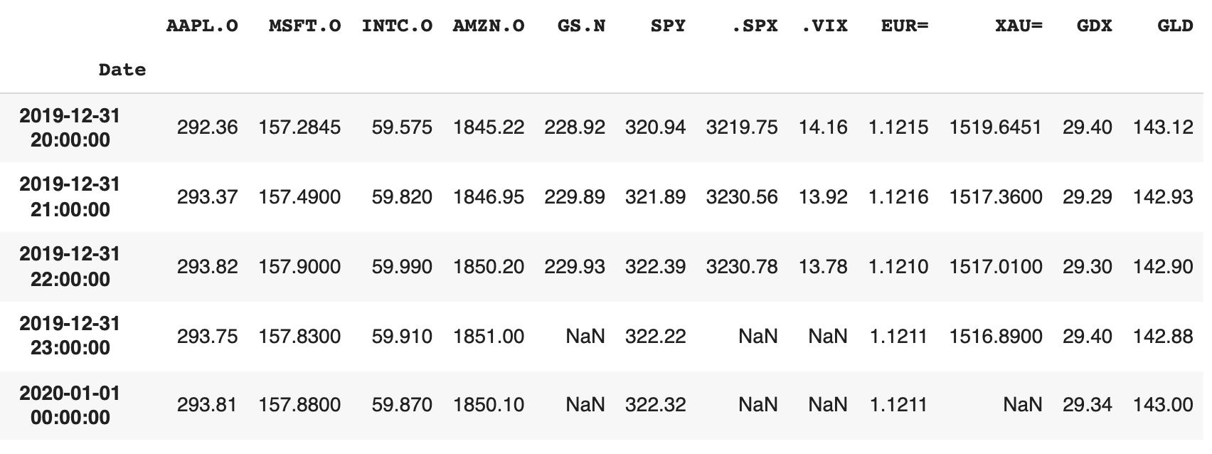
Intraday Data
url = 'http://hilpisch.com/aiif_eikon_id_data.csv'
data = pd.read_csv(url, index_col=0, parse_dates=True) # .dropna()
data.tail()
Source: Yves Hilpisch (2020), Artificial Intelligence in Finance: A Python-Based Guide, O’Reilly Media.

Slide 52
lags = 5
dfs = {}
for ric in data:
df, cols = add_lags(data, ric, lags)
dfs[ric] = df, cols
Source: Yves Hilpisch (2020), Artificial Intelligence in Finance: A Python-Based Guide, O’Reilly Media.

Slide 53
train_test_model(model_mlp)
OUT-OF-SAMPLE | AAPL.O | acc=0.5420
OUT-OF-SAMPLE | MSFT.O | acc=0.4930
OUT-OF-SAMPLE | INTC.O | acc=0.5549
OUT-OF-SAMPLE | AMZN.O | acc=0.4709
OUT-OF-SAMPLE | GS.N | acc=0.5184
OUT-OF-SAMPLE | SPY | acc=0.4860
OUT-OF-SAMPLE | .SPX | acc=0.5019
OUT-OF-SAMPLE | .VIX | acc=0.4885
OUT-OF-SAMPLE | EUR= | acc=0.5130
OUT-OF-SAMPLE | XAU= | acc=0.4824
OUT-OF-SAMPLE | GDX | acc=0.4765
OUT-OF-SAMPLE | GLD | acc=0.5455
Source: Yves Hilpisch (2020), Artificial Intelligence in Finance: A Python-Based Guide, O’Reilly Media.

Slide 54
train_test_model(model_bag)
OUT-OF-SAMPLE | AAPL.O | acc=0.5660
OUT-OF-SAMPLE | MSFT.O | acc=0.5551
OUT-OF-SAMPLE | INTC.O | acc=0.5072
OUT-OF-SAMPLE | AMZN.O | acc=0.4830
OUT-OF-SAMPLE | GS.N | acc=0.5020
OUT-OF-SAMPLE | SPY | acc=0.4680
OUT-OF-SAMPLE | .SPX | acc=0.4677
OUT-OF-SAMPLE | .VIX | acc=0.5161
OUT-OF-SAMPLE | EUR= | acc=0.5242
OUT-OF-SAMPLE | XAU= | acc=0.5229
OUT-OF-SAMPLE | GDX | acc=0.5107
OUT-OF-SAMPLE | GLD | acc=0.5475
Source: Yves Hilpisch (2020), Artificial Intelligence in Finance: A Python-Based Guide, O’Reilly Media.

Slide 55
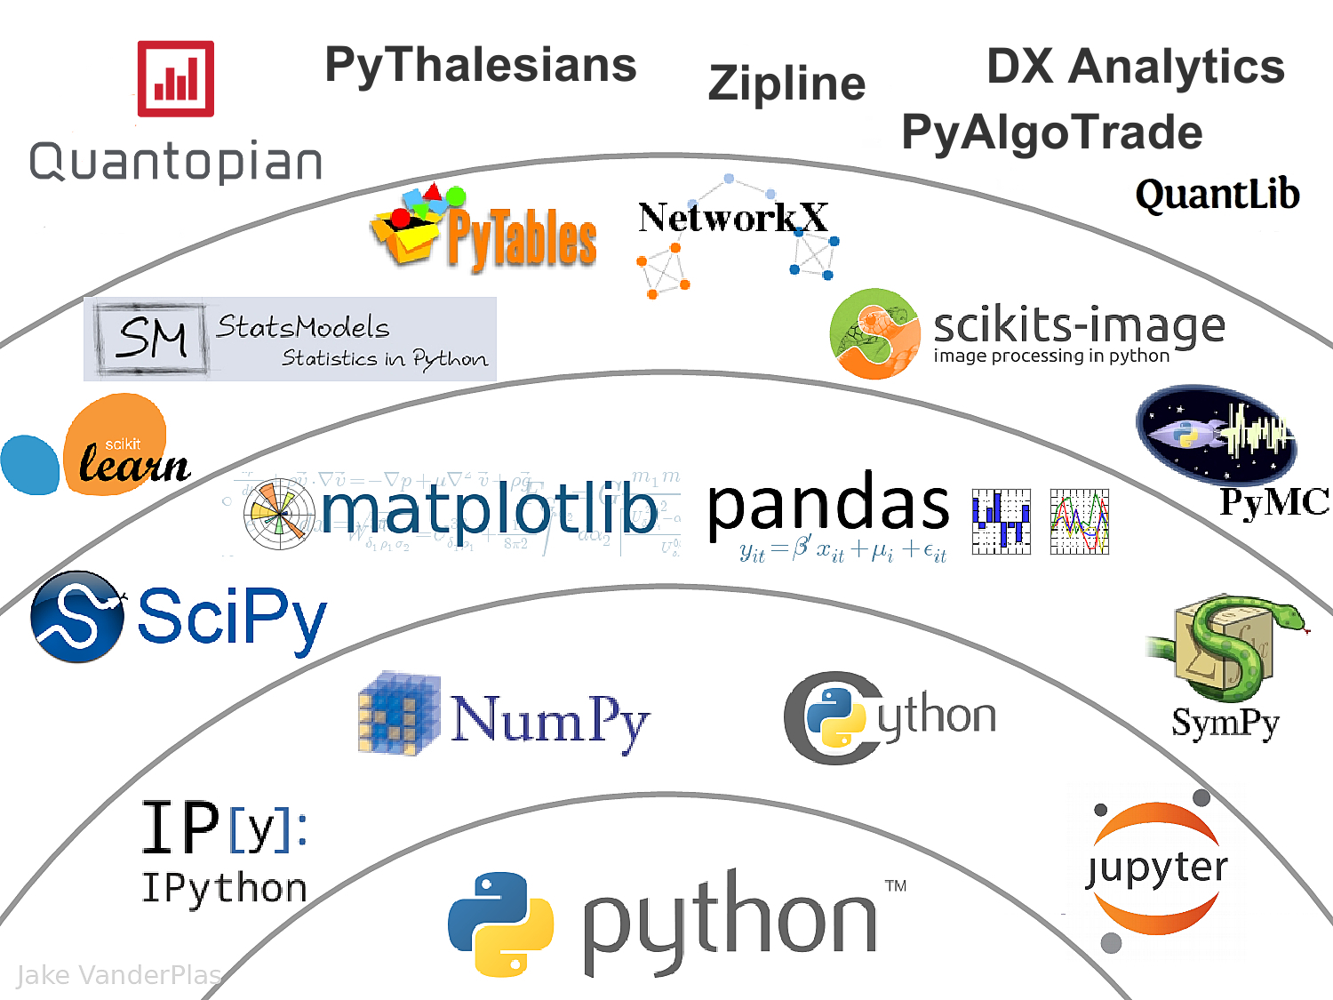
The Quant Finance PyData Stack
Source: http://nbviewer.jupyter.org/format/slides/github/quantopian/pyfolio/blob/master/pyfolio/examples/overview_slides.ipynb#/5

Slide 56
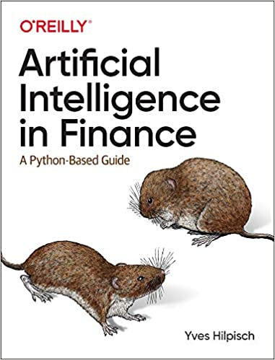
Yves Hilpisch (2020), Artificial Intelligence in Finance: A Python-Based Guide, O’Reilly
Source: https://www.amazon.com/Artificial-Intelligence-Finance-Python-Based-Guide/dp/1492055433

Slide 57
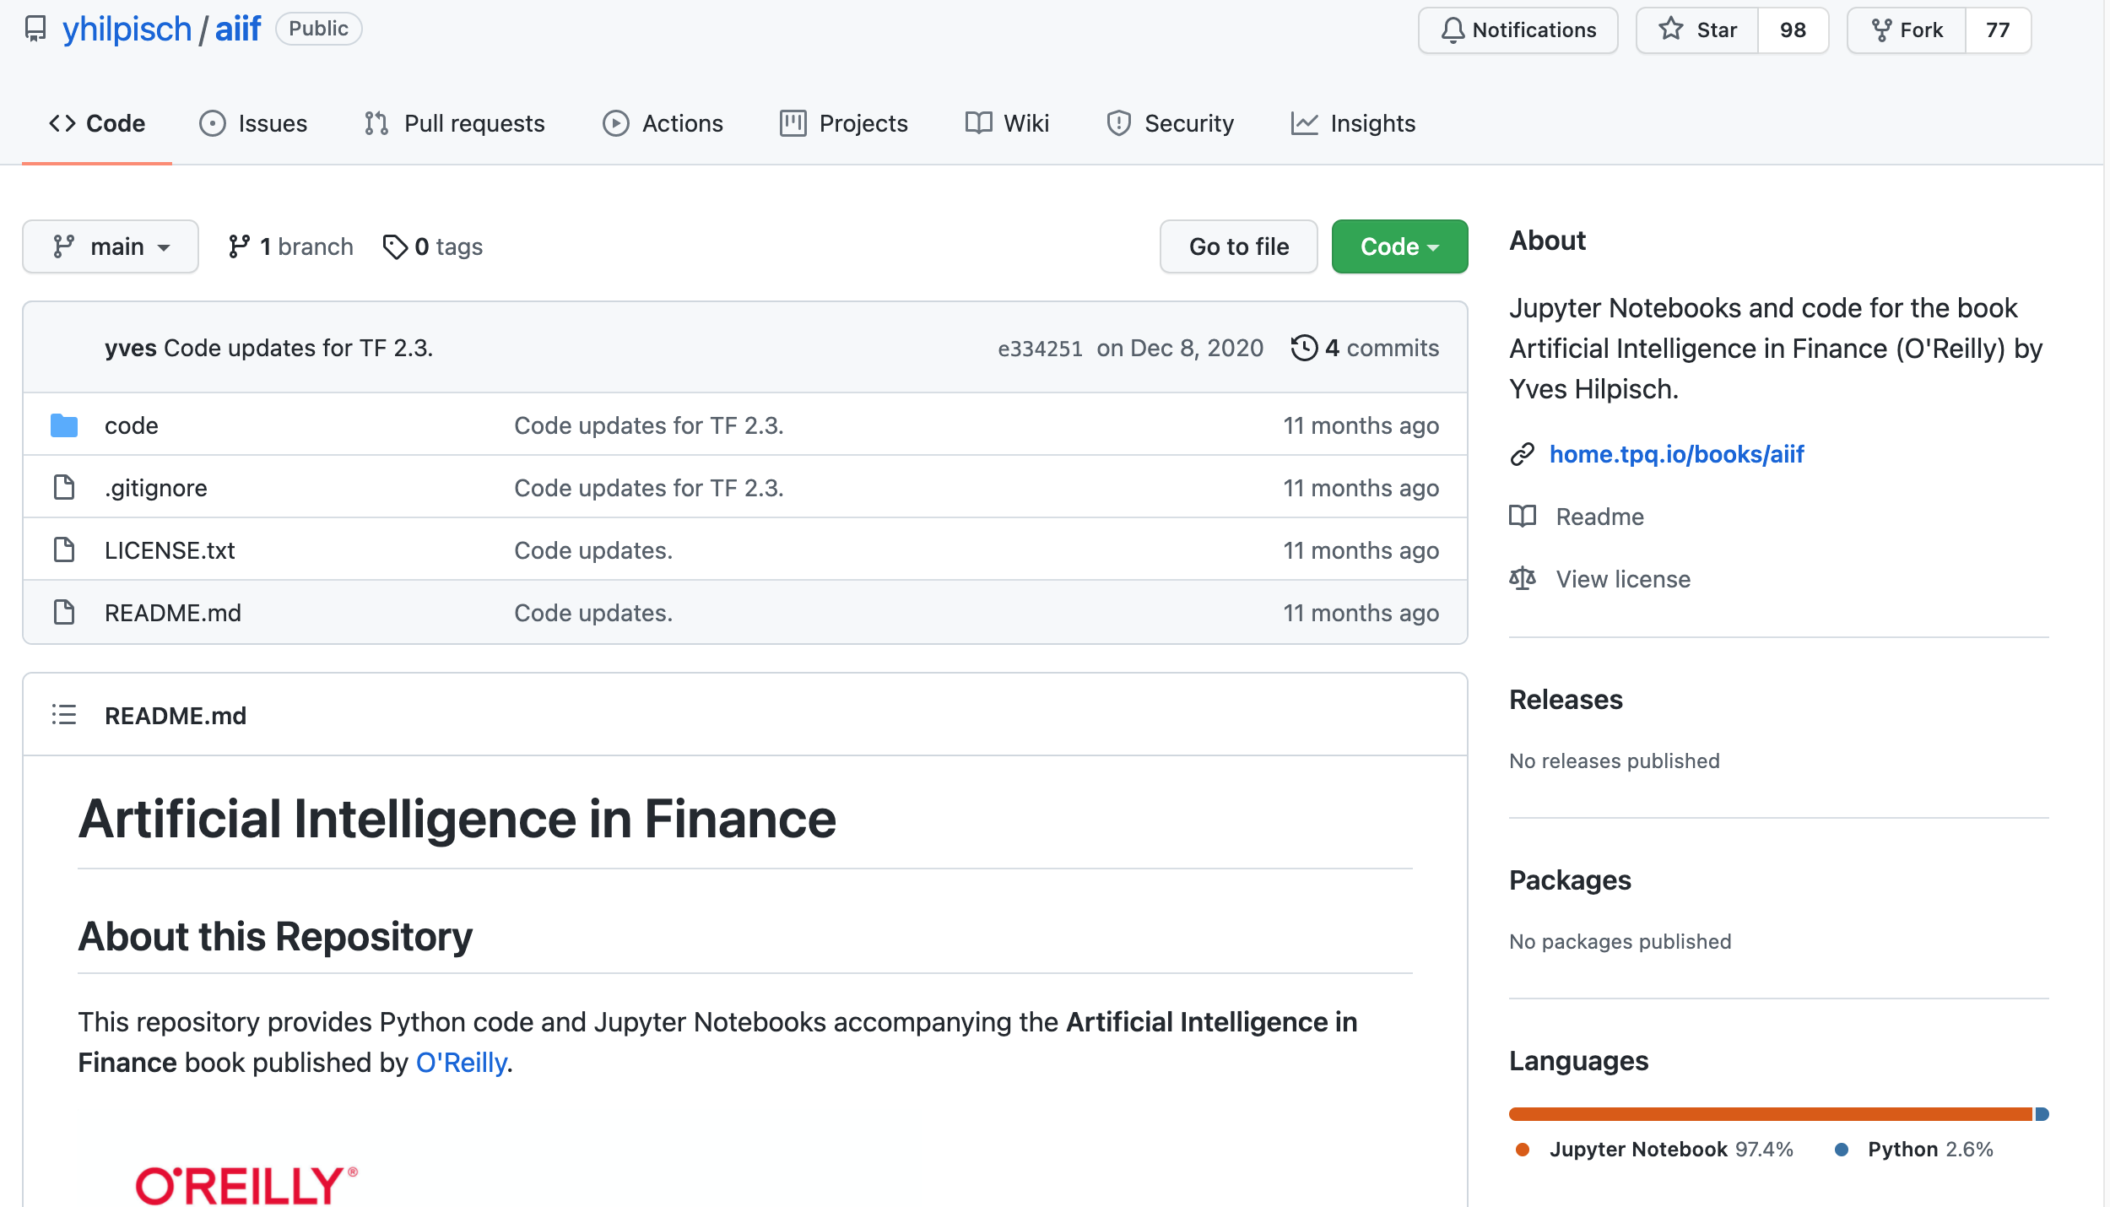
Yves Hilpisch (2020), Artificial Intelligence in Finance: A Python-Based Guide, O’Reilly
https://github.com/yhilpisch/aiif
Source: https://github.com/yhilpisch/aiif

Slide 58
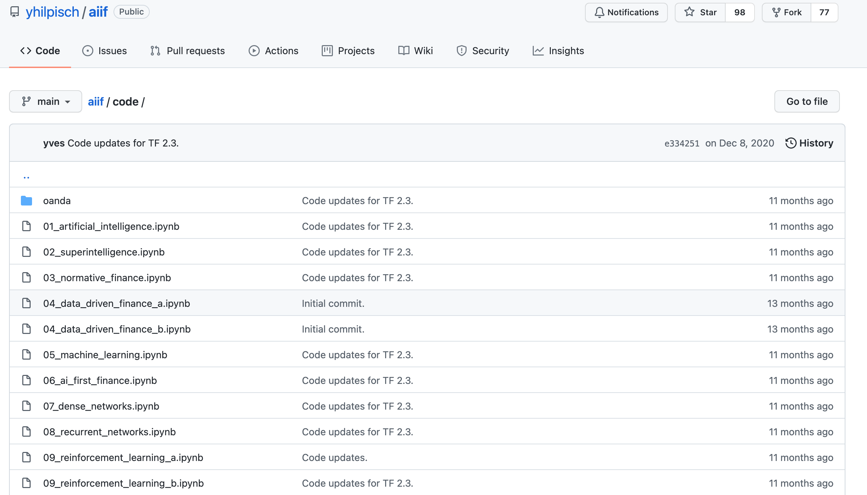
Yves Hilpisch (2020), Artificial Intelligence in Finance: A Python-Based Guide, O’Reilly
https://github.com/yhilpisch/aiif/tree/main/code
Source: https://github.com/yhilpisch/aiif/tree/main/code

Slide 59
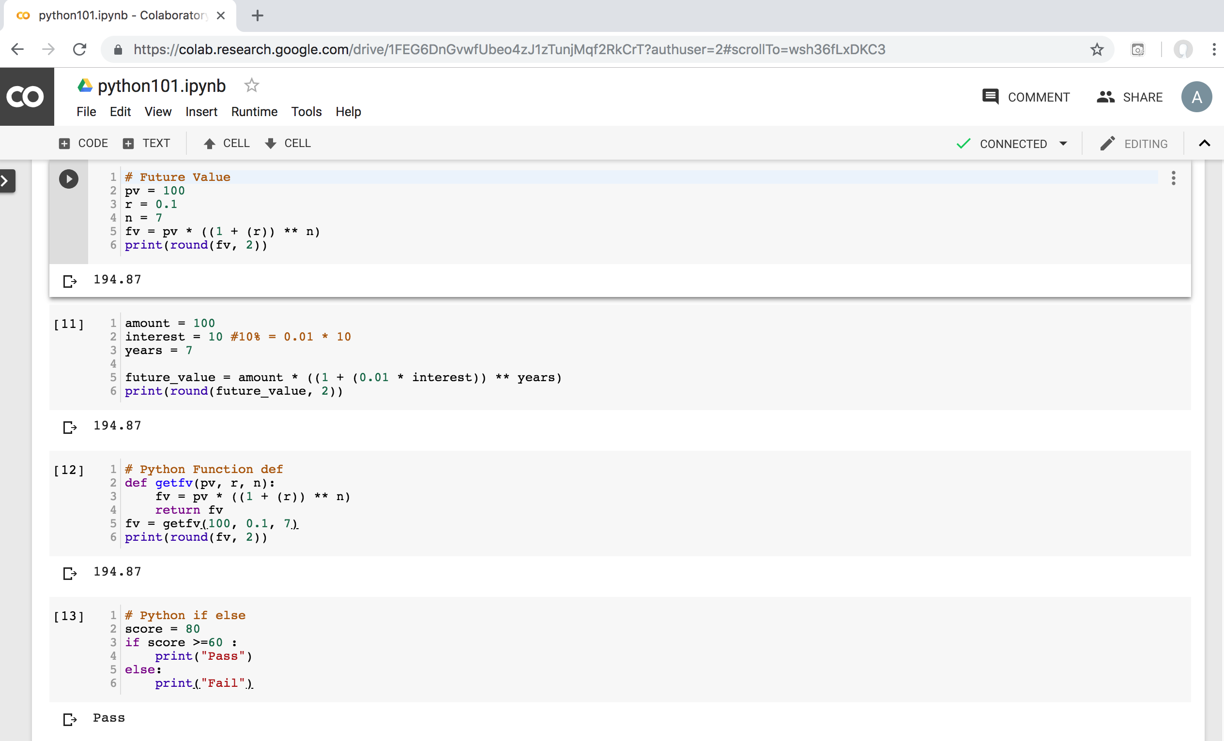
Python in Google Colab (Python101)
https://colab.research.google.com/drive/1FEG6DnGvwfUbeo4zJ1zTunjMqf2RkCrT
https://tinyurl.com/aintpupython101

Slide 60
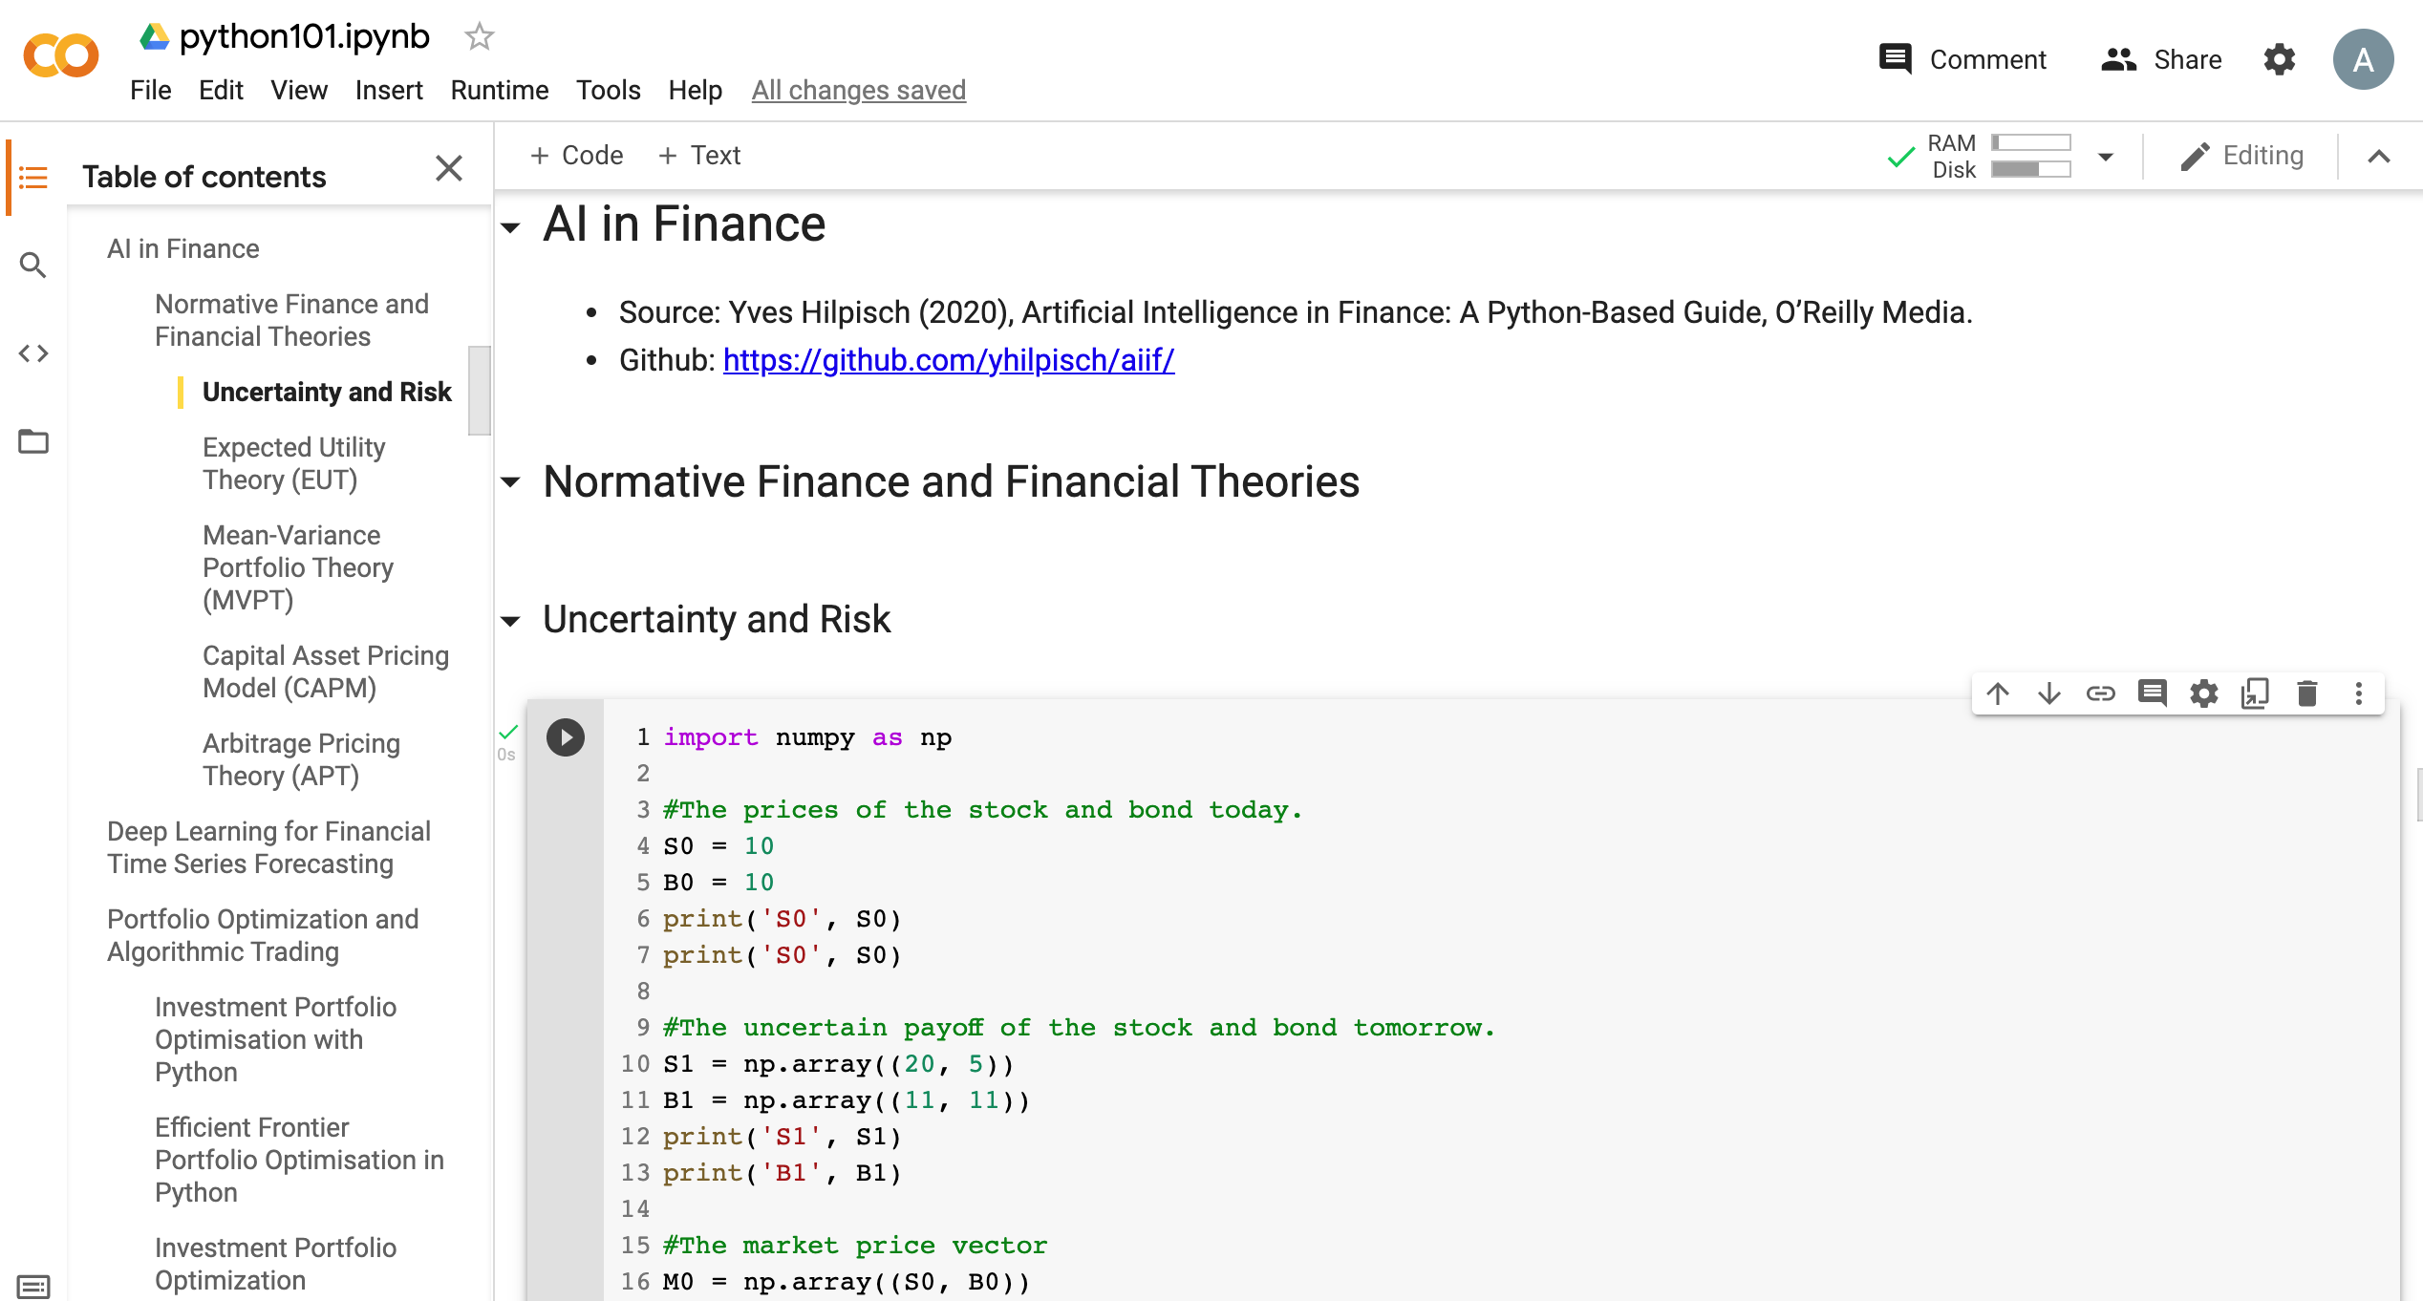
Python in Google Colab (Python101)
https://colab.research.google.com/drive/1FEG6DnGvwfUbeo4zJ1zTunjMqf2RkCrT
https://tinyurl.com/aintpupython101

Slide 61
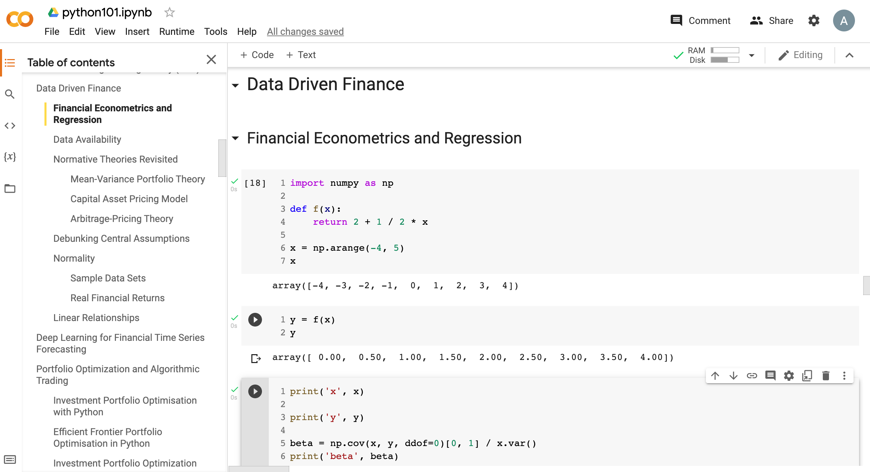
Python in Google Colab (Python101)
https://tinyurl.com/aintpupython101

Slide 62
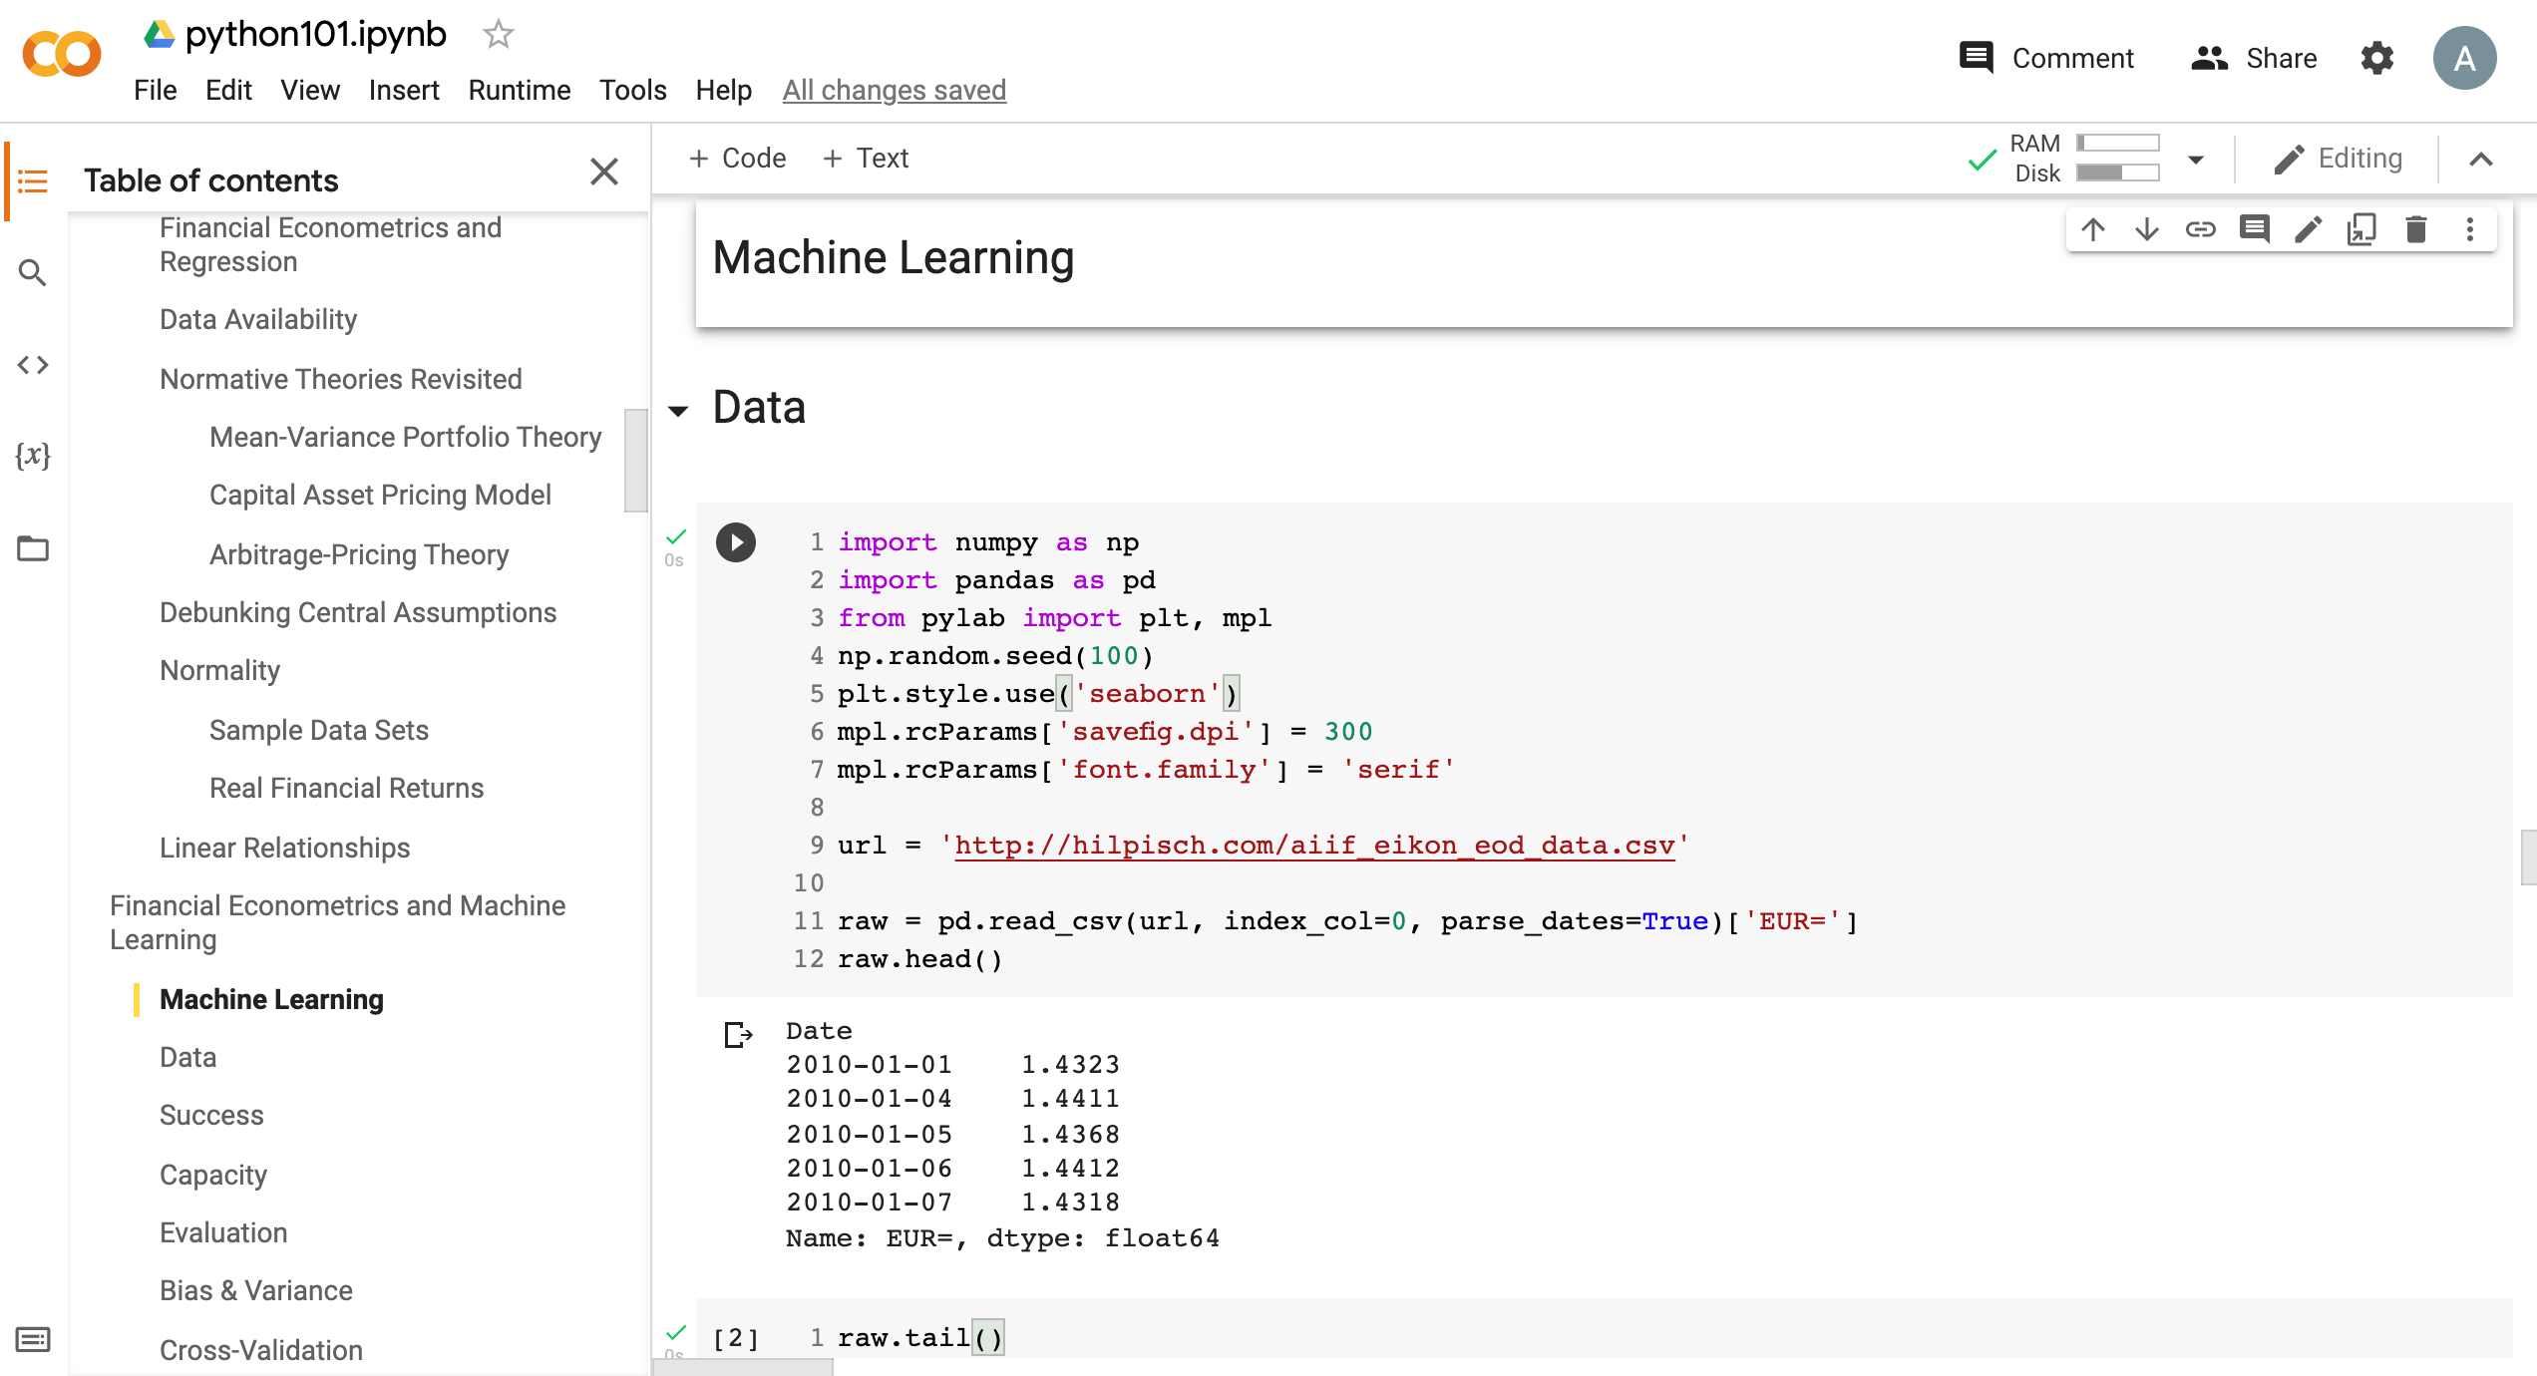
Python in Google Colab (Python101)
https://tinyurl.com/aintpupython101

Slide 63
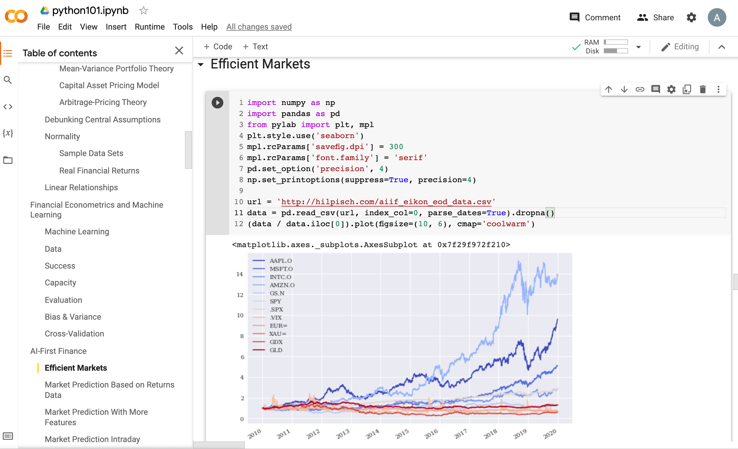
Python in Google Colab (Python101)
https://tinyurl.com/aintpupython101

Slide 64
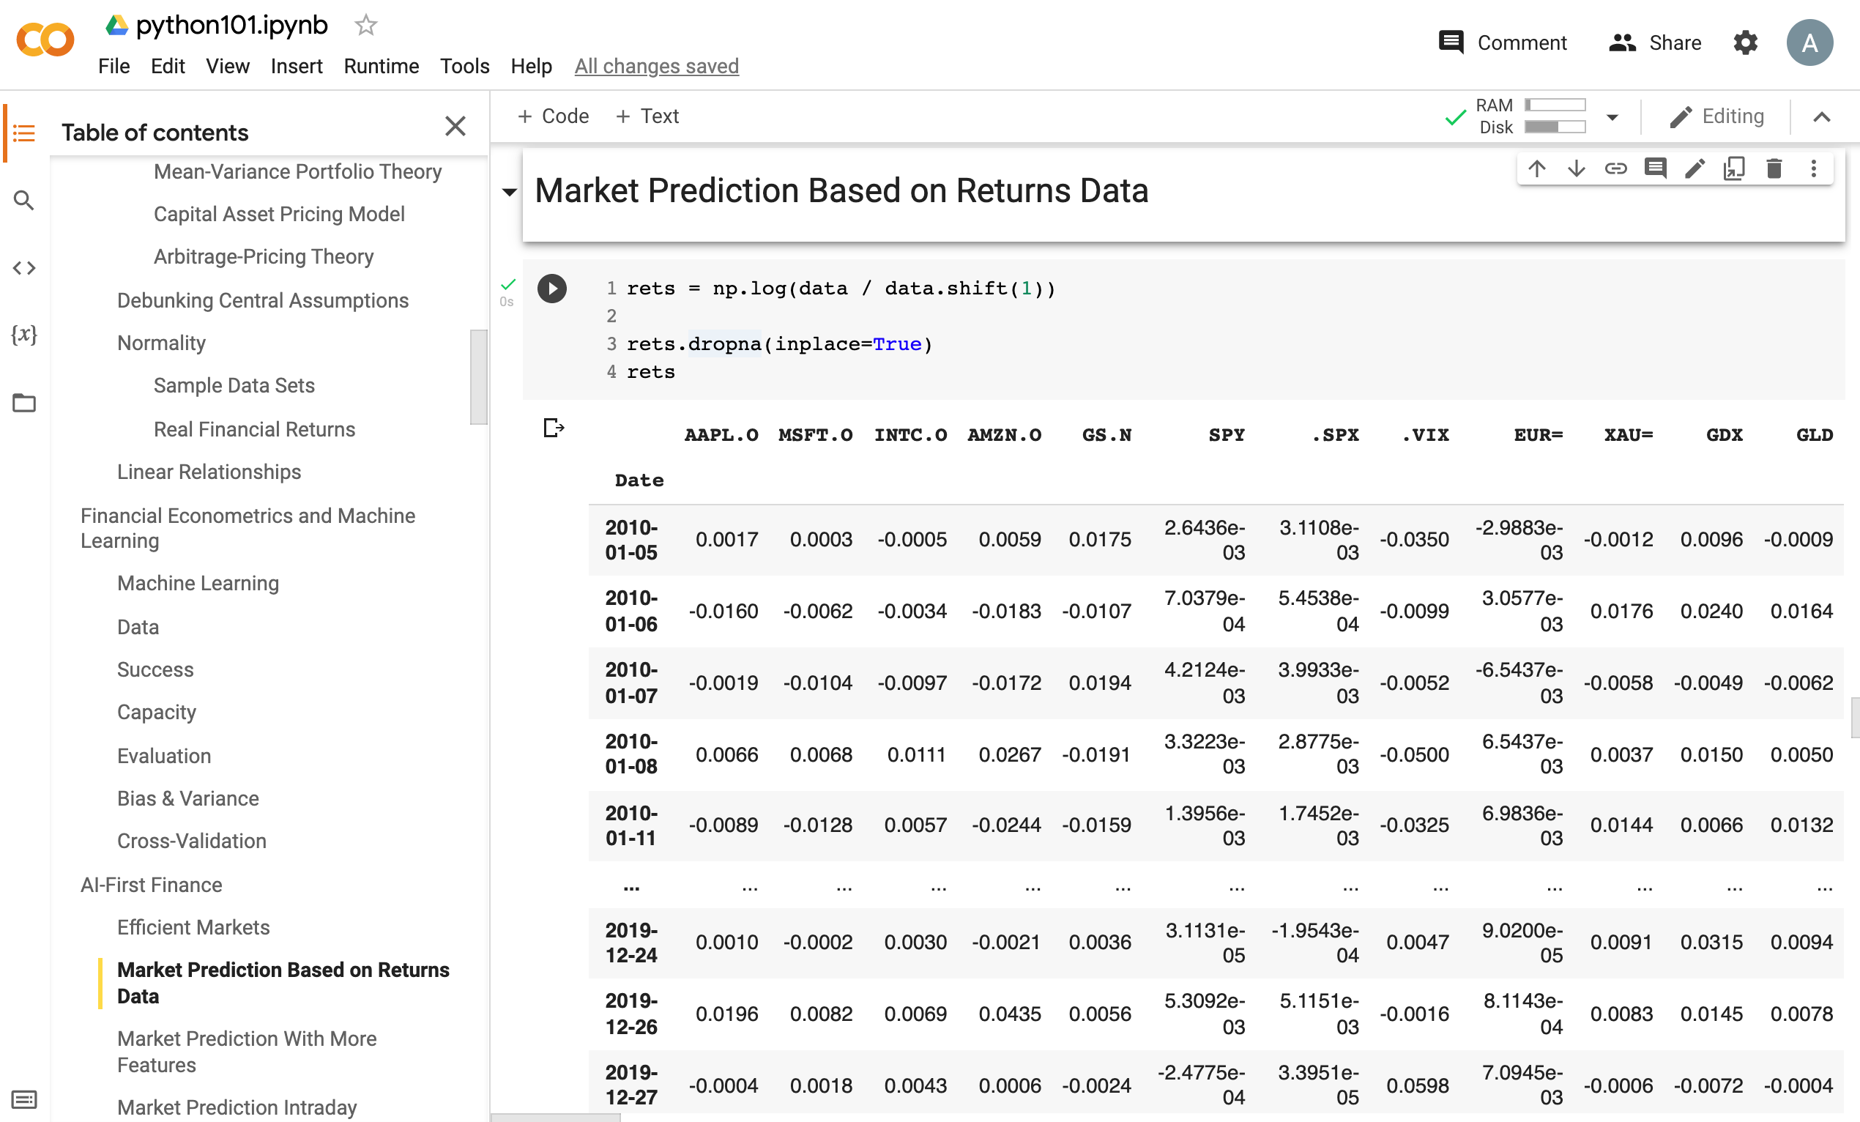
Python in Google Colab (Python101)
https://tinyurl.com/aintpupython101

Slide 65
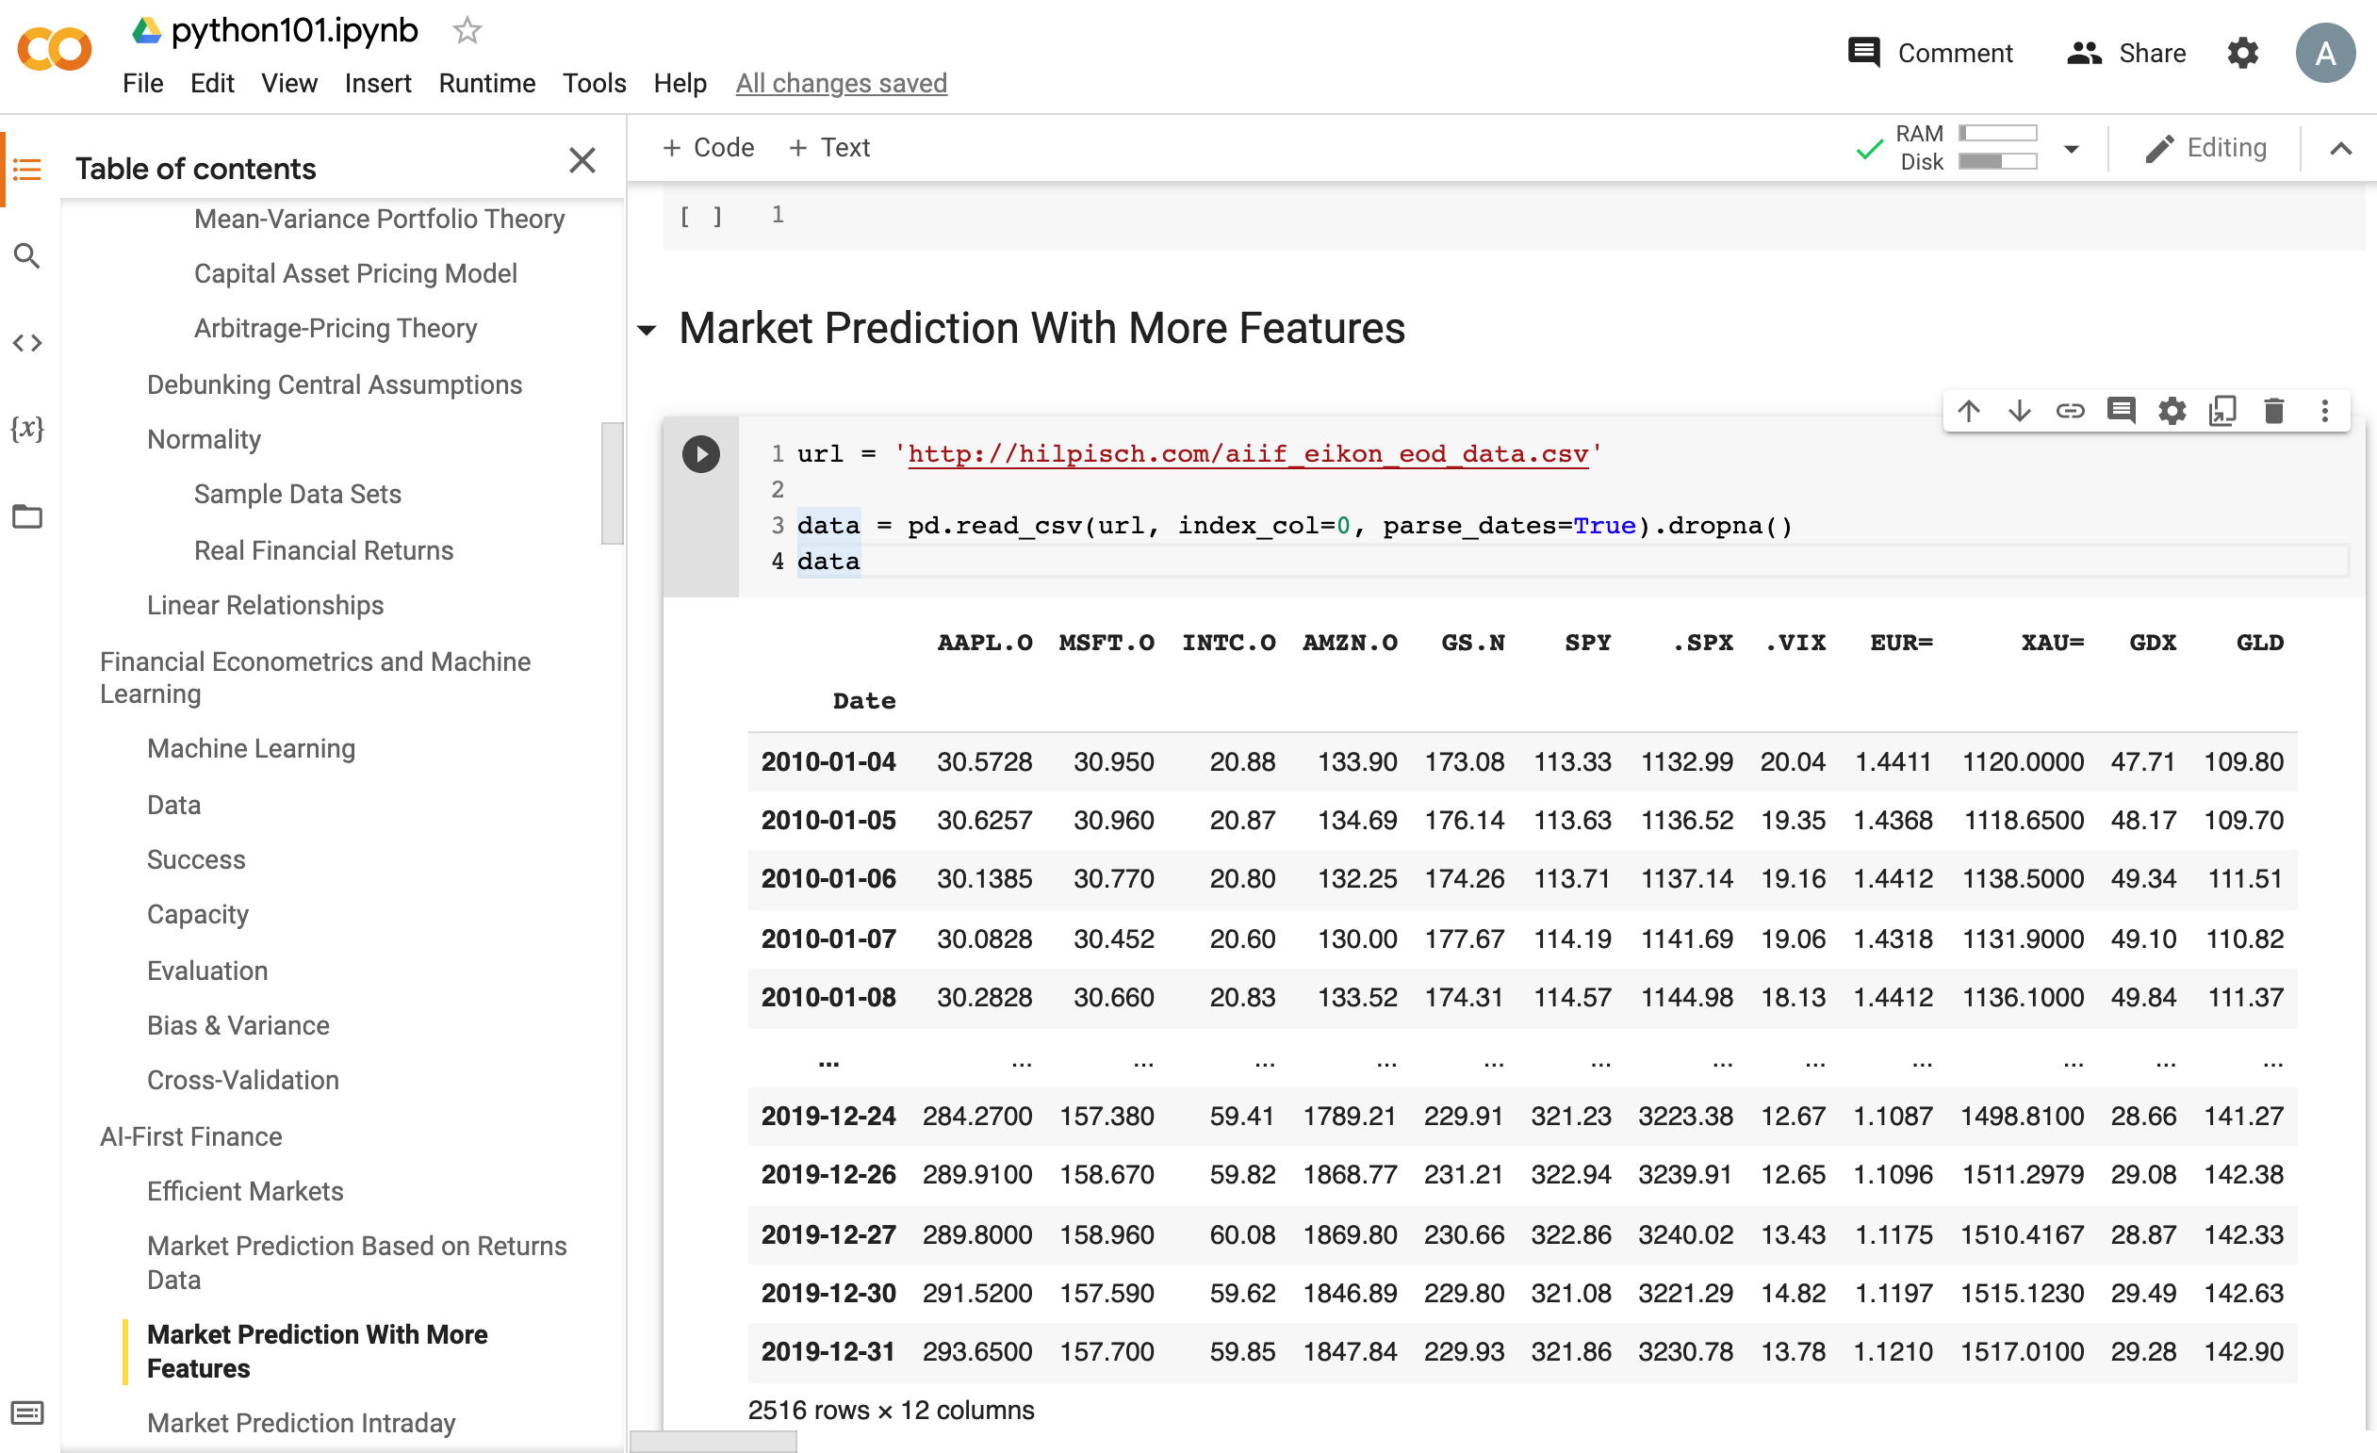
Python in Google Colab (Python101)
https://tinyurl.com/aintpupython101

Slide 66
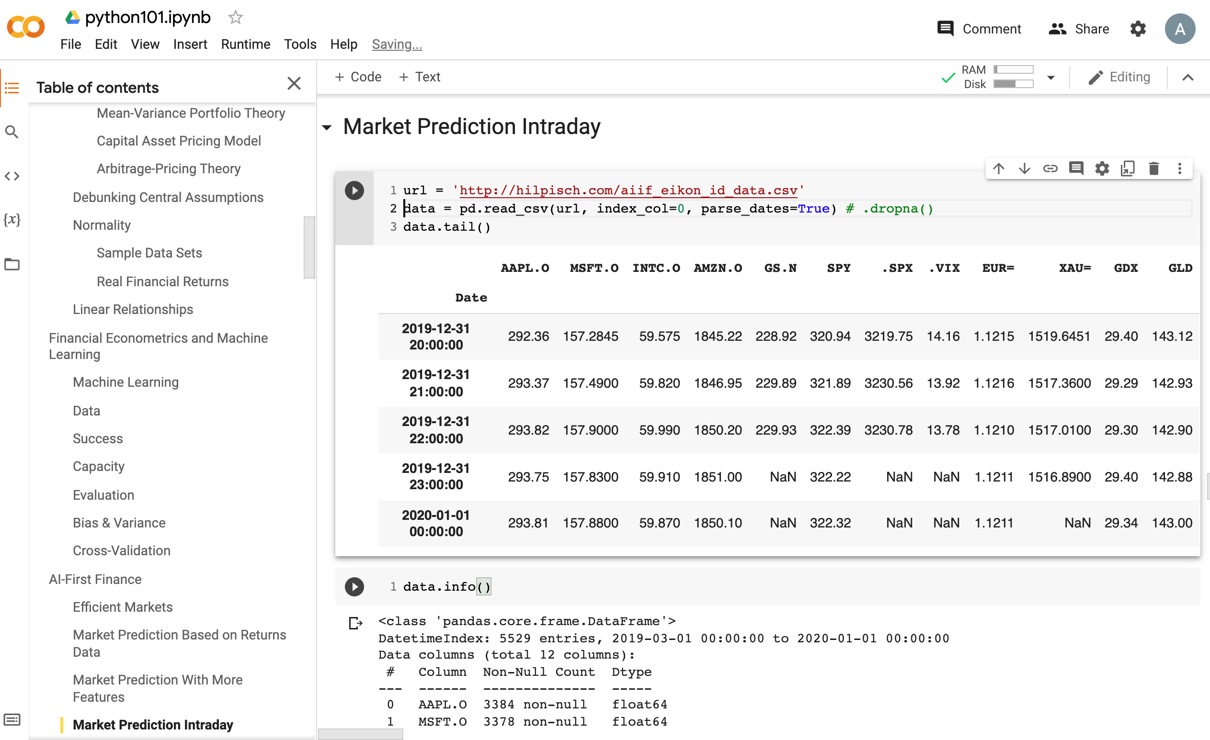
Python in Google Colab (Python101)
https://tinyurl.com/aintpupython101

Slide 67
Summary
Efficient Markets
Market Prediction Based on Returns Data
Market Prediction with More Features
Market Prediction Intraday
Source: Yves Hilpisch (2020), Artificial Intelligence in Finance: A Python-Based Guide, O’Reilly Media.

Slide 68
References
Yves Hilpisch (2020), Artificial Intelligence in Finance: A Python-Based Guide, O’Reilly Media, https://github.com/yhilpisch/aiif .
Max Tegmark (2017), Life 3.0: Being human in the age of artificial intelligence. Vintage.
Ajay Agrawal, Joshua Gans, and Avi Goldfarb (2018). Prediction machines: the simple economics of artificial intelligence. Harvard Business Press.
Eugene F. Fama (1995), "Random walks in stock market prices." Financial Analysts Journal 51, no. 1, 75-80.
Ruey S. Tsay (2005), Analysis of financial time series, Wiley.
Min-Yuh Day (2022), Python 101, https://tinyurl.com/aintpupython101

