Slide 1








Deep Learning in Finance
Reinforcement Learning in Finance
Artificial Intelligence in Finance and Quantitative Analysis
1111AIFQA09
MBA, IM, NTPU (M6132) (Fall 2022)
Tue 2, 3, 4 (9:10-12:00) (B8F40)
Min-Yuh Day, Ph.D,
Associate Professor
Institute of Information Management, National Taipei University
https://web.ntpu.edu.tw/~myday
https://meet.google.com/paj-zhhj-mya
2022-11-22

Slide 2
Syllabus
Week Date Subject/Topics
1 2022/09/13 Introduction to Artificial Intelligence in Finance and
Quantitative Analysis
2 2022/09/20 AI in FinTech: Metaverse, Web3, DeFi, NFT,
Financial Services Innovation and Applications
3 2022/09/27 Investing Psychology and Behavioral Finance
4 2022/10/04 Event Studies in Finance
5 2022/10/11 Case Study on AI in Finance and Quantitative Analysis I
6 2022/10/18 Finance Theory

Slide 3
Syllabus
Week Date Subject/Topics
7 2022/10/25 Data-Driven Finance
8 2022/11/01 Midterm Project Report
9 2022/11/08 Financial Econometrics and Machine Learning
10 2022/11/15 AI-First Finance
11 2022/11/22 Deep Learning in Finance;
Reinforcement Learning in Finance
12 2022/11/29 Case Study on AI in Finance and Quantitative Analysis II

Slide 4
Syllabus
Week Date Subject/Topics
13 2022/12/06 Industry Practices of AI in Finance and Quantitative
Analysis
14 2022/12/13 Algorithmic Trading; Risk Management;
Trading Bot and Event-Based Backtesting
15 2022/12/20 Final Project Report I
16 2022/12/27 Final Project Report II
17 2023/01/03 Self-learning
18 2023/01/10 Self-learning

Slide 5
Deep Learning in Finance
Reinforcement Learning in Finance

Slide 6
Outline
Deep Learning (DL) in Finance
  Dense Neural Networks (DNN)
  Recurrent Neural Networks (RNN)
  Convolutional Neural Networks (CNN)
Reinforcement Learning (RL) in Finance
  Q Learning (QL)
  Improved Finance Environment
  Improved Financial QL Agent
Source: Yves Hilpisch (2020), Artificial Intelligence in Finance: A Python-Based Guide, O’Reilly Media.

Slide 7
Deep Learning in Finance
Dense Neural Networks (DNN)
Recurrent Neural Networks (RNN)
Convolutional Neural Networks (CNN)
Source: Yves Hilpisch (2020), Artificial Intelligence in Finance: A Python-Based Guide, O’Reilly Media.

Slide 8
AI, ML, DL
Artificial Intelligence (AI)
Machine Learning (ML)
Supervised
Learning
Unsupervised Learning
Deep Learning (DL)
CNN
RNN LSTM GRU
GAN
Semi-supervised Learning
Reinforcement Learning
Source: https://leonardoaraujosantos.gitbooks.io/artificial-inteligence/content/deep_learning.html

Slide 9
Deep learning for financial applications: Topic-Model Heatmap
Source: Ahmet Murat Ozbayoglu, Mehmet Ugur Gudelek, and Omer Berat Sezer (2020). "Deep learning for financial applications: A survey." Applied Soft Computing (2020): 106384.

Slide 10
Deep learning for financial applications: Topic-Feature Heatmap
Source: Ahmet Murat Ozbayoglu, Mehmet Ugur Gudelek, and Omer Berat Sezer (2020). "Deep learning for financial applications: A survey." Applied Soft Computing (2020): 106384.

Slide 11
Deep learning for financial applications: Topic-Dataset Heatmap
Source: Ahmet Murat Ozbayoglu, Mehmet Ugur Gudelek, and Omer Berat Sezer (2020). "Deep learning for financial applications: A survey." Applied Soft Computing (2020): 106384.

Slide 12
Financial time series forecasting with deep learning: Topic-model heatmap
Source: Omer Berat Sezer, Mehmet Ugur Gudelek, and Ahmet Murat Ozbayoglu (2020), "Financial time series forecasting with deep learning:
A systematic literature review: 2005–2019." Applied Soft Computing 90 (2020): 106181.

Slide 13
Recurrent Neural Networks (RNN)
Time Series Forecasting
110
120
130
140
150
y_{t-2}
y_{t-1}
y_{t}
y_{t+1}
y_{t+2}
output
h_{t-2}
h_{t-1}
h_{t}
h_{t+1}
h_{t+2}
hidden
X_{t-2}
X_{t-1}
X_{t}
X_{t+1}
X_{t+2}
Input
100
110
120
130
140

Slide 14
Deep Learning

Slide 15
Deep Learning and
Neural Networks

Slide 16

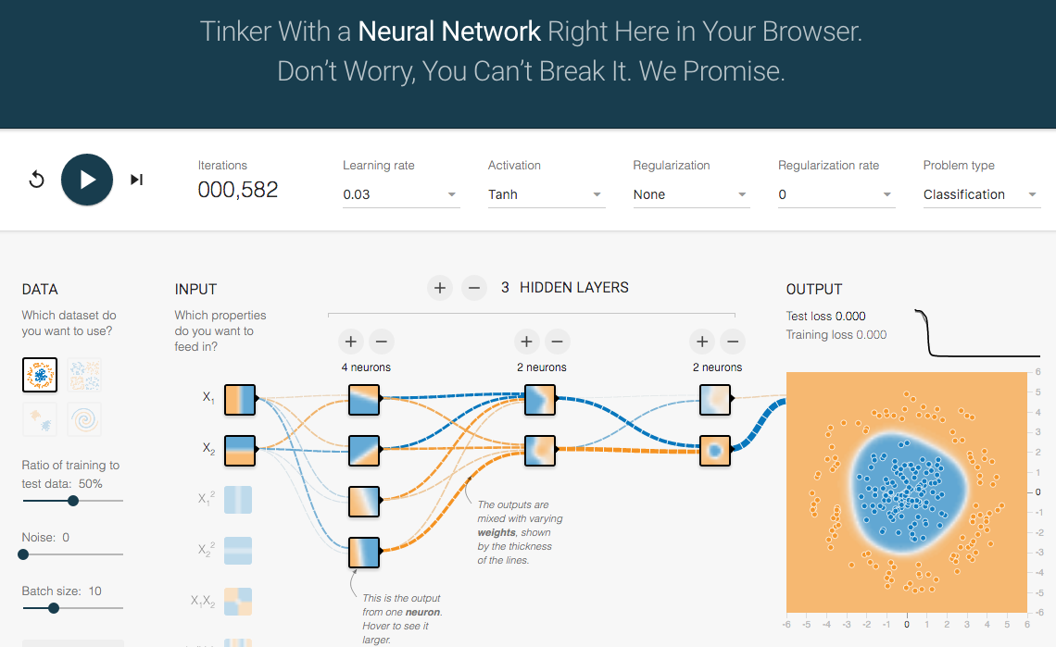
TensorFlow Playground
http://playground.tensorflow.org/

Slide 17
Tensor
3
  # a rank 0 tensor; this is a scalar with shape []
[1. ,2., 3.]
  # a rank 1 tensor; this is a vector with shape [3]
[[1., 2., 3.], [4., 5., 6.]]
  # a rank 2 tensor; a matrix with shape [2, 3]
[[[1., 2., 3.]], [[7., 8., 9.]]]
  # a rank 3 tensor with shape [2, 1, 3]
https://www.tensorflow.org/

Slide 18
Scalar
80
Vector
[50 60 70]
Matrix
50 60 70
55 65 75
[50 60 70] [70 80 90]
[55 65 75] [75 85 95]
Tensor

Slide 19
Deep Learning and
Neural Networks

Slide 20
Deep Learning Foundations:
Neural Networks

Slide 21
Deep Learning and
Neural Networks
Input Layer
(X)
Hidden Layer
(H)
Output Layer
(Y)
X1
Y
X2

Slide 22
Deep Learning and
Neural Networks
Input Layer
(X)
Hidden Layer
(H)
Output Layer
(Y)

Slide 23
Deep Learning and
Neural Networks
Input Layer
(X)
Hidden Layers
(H)
Output Layer
(Y)
Deep Neural Networks
Deep Learning

Slide 24
Deep Learning and
Deep Neural Networks

Slide 25
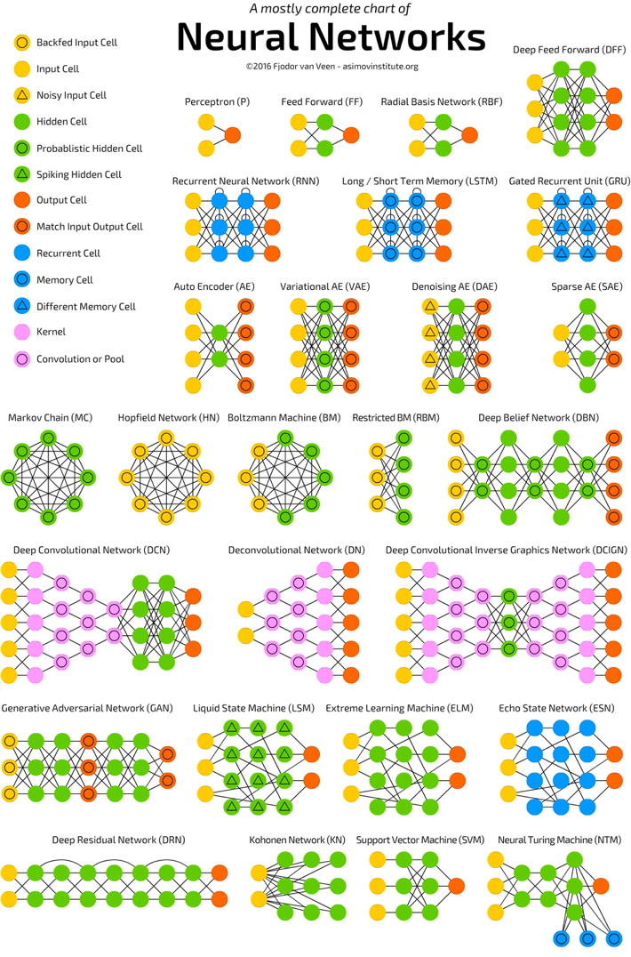
Neural Networks
(NN)
Source: http://www.asimovinstitute.org/neural-network-zoo/

Slide 26
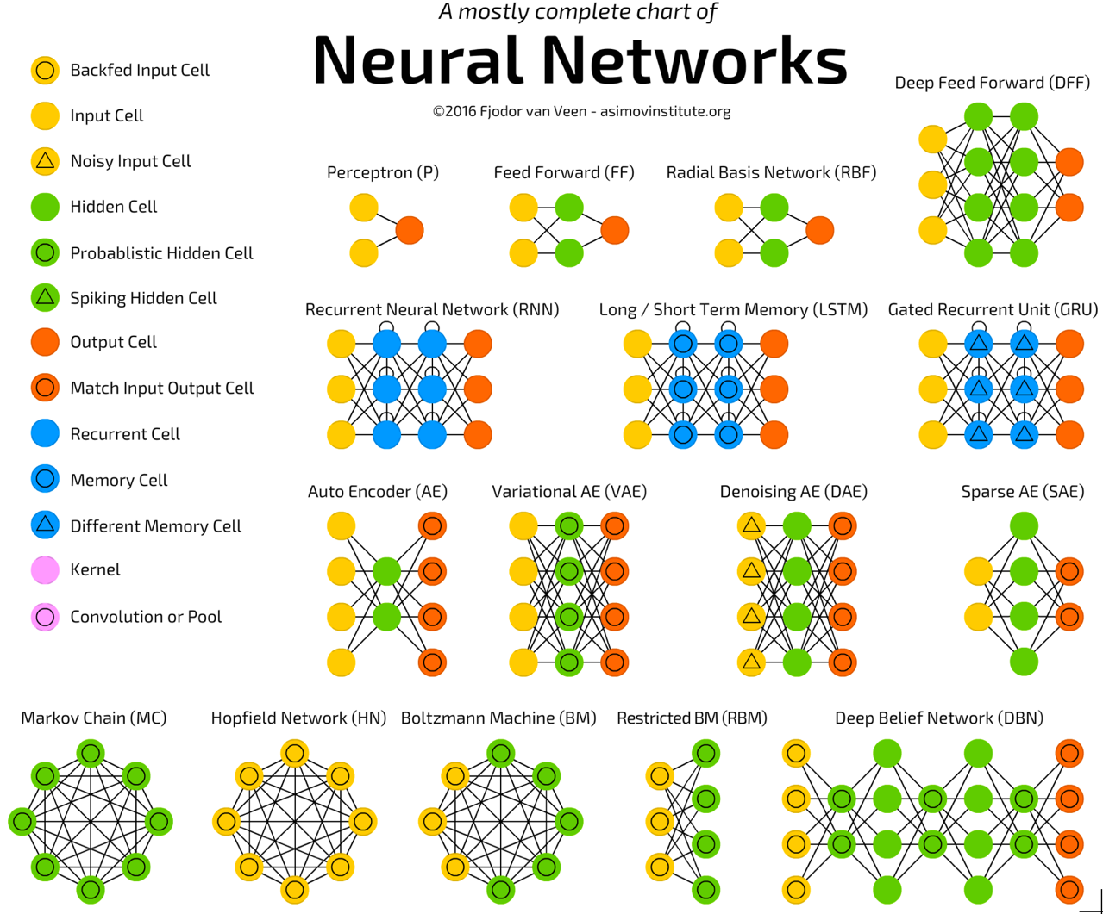
Source: http://www.asimovinstitute.org/neural-network-zoo/

Slide 27
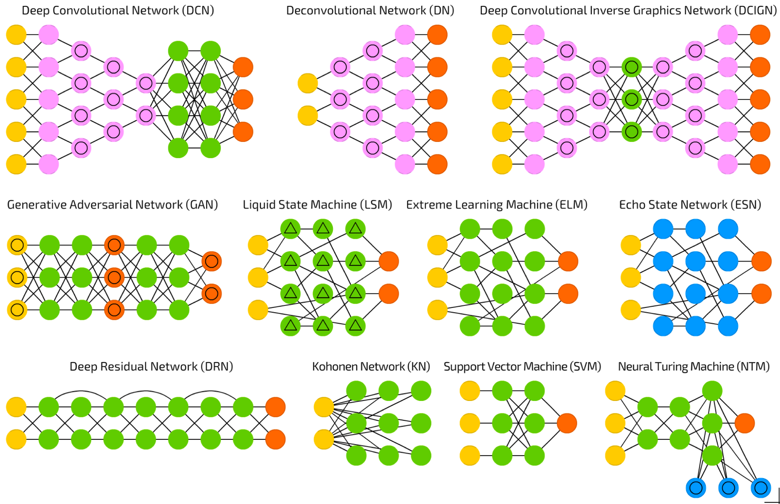
Source: http://www.asimovinstitute.org/neural-network-zoo/

Slide 28
Convolutional Neural Networks (CNN or Deep Convolutional Neural Networks, DCNN)
LeCun, Yann, et al. “Gradient-based learning applied to document recognition.” Proceedings of the IEEE 86.11 (1998): 2278-2324.
Source: http://www.asimovinstitute.org/neural-network-zoo/

Slide 29
Recurrent Neural Networks
(RNN)
Elman, Jeffrey L. “Finding structure in time.” Cognitive science 14.2 (1990): 179-211
Source: http://www.asimovinstitute.org/neural-network-zoo/

Slide 30
Long / Short Term Memory
(LSTM)
Hochreiter, Sepp, and Jürgen Schmidhuber. “Long short-term memory.” Neural computation 9.8 (1997): 1735-1780.
Source: http://www.asimovinstitute.org/neural-network-zoo/

Slide 31
Gated Recurrent Units
(GRU)
Chung, Junyoung, et al. “Empirical evaluation of gated recurrent neural networks on sequence modeling.” arXiv preprint arXiv:1412.3555 (2014).
Source: http://www.asimovinstitute.org/neural-network-zoo/

Slide 32
Generative Adversarial Networks (GAN)
Goodfellow, Ian, et al. “Generative adversarial nets.” Advances in Neural Information Processing Systems. 2014.
Source: http://www.asimovinstitute.org/neural-network-zoo/

Slide 33
Support Vector Machines
(SVM)
Cortes, Corinna, and Vladimir Vapnik. “Support-vector networks.” Machine learning 20.3 (1995): 273-297.
Source: http://www.asimovinstitute.org/neural-network-zoo/

Slide 34
Neural Networks
Input Layer
(X)
Hidden Layer
(H)
Output Layer
(Y)
X1
Y
X2
Source: https://www.youtube.com/watch?v=bxe2T-V8XRs&index=1&list=PLiaHhY2iBX9hdHaRr6b7XevZtgZRa1PoU

Slide 35
The Neuron
x₁
w₁
w₂
x₂
y
…
…
w_{n}
x_{n}
Source: Jeff Dean (2016), Large-Scale Deep Learning For Building Intelligent Computer Systems, WSDM 2016

Slide 36
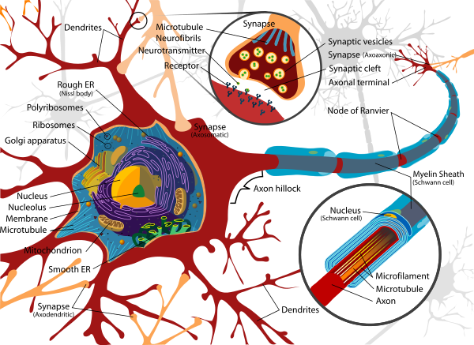
Neuron and Synapse
Source: https://en.wikipedia.org/wiki/Neuron

Slide 37
The Neuron
x₁
w₁
w₂
x₂
y
…
…
w_{n}
x_{n}
Source: Jeff Dean (2016), Large-Scale Deep Learning For Building Intelligent Computer Systems, WSDM 2016

Slide 38
y = max ( 0, -0.21 * x₁ + 0.3 * x₂ + 0.7 * x₃ )
Weights
x₁
-0.21
x₂
0.3
y
Inputs
0.7
x₃
Source: Jeff Dean (2016), Large-Scale Deep Learning For Building Intelligent Computer Systems, WSDM 2016

Slide 39
Neural Networks
Source: https://www.youtube.com/watch?v=bxe2T-V8XRs&index=1&list=PLiaHhY2iBX9hdHaRr6b7XevZtgZRa1PoU

Slide 40
Neural Networks
Input Layer
(X)
Hidden Layer
(H)
Output Layer
(Y)
X1
Y
X2
Source: https://www.youtube.com/watch?v=bxe2T-V8XRs&index=1&list=PLiaHhY2iBX9hdHaRr6b7XevZtgZRa1PoU

Slide 41
Neural Networks
Input Layer
(X)
Hidden Layers
(H)
Output Layer
(Y)
Deep Neural Networks
Deep Learning
Source: https://www.youtube.com/watch?v=bxe2T-V8XRs&index=1&list=PLiaHhY2iBX9hdHaRr6b7XevZtgZRa1PoU

Slide 42
Neural Networks
Input Layer
(X)
Hidden Layer
(H)
Output Layer
(Y)
Neuron
Synapse
Synapse
Neuron
X1
Y
X2
Source: https://www.youtube.com/watch?v=bxe2T-V8XRs&index=1&list=PLiaHhY2iBX9hdHaRr6b7XevZtgZRa1PoU

Slide 43
Neural Networks
Input Layer
(X)
Hidden Layer
(H)
Output Layer
(Y)
Source: https://www.youtube.com/watch?v=P2HPcj8lRJE&list=PLjJh1vlSEYgvGod9wWiydumYl8hOXixNu&index=2

Slide 44
Neural Networks
Input Layer
(X)
Hidden Layer
(H)
Output Layer
(Y)
X1
Y
X2
Source: https://www.youtube.com/watch?v=bxe2T-V8XRs&index=1&list=PLiaHhY2iBX9hdHaRr6b7XevZtgZRa1PoU

Slide 45
Linear function
y = f(x)
y = w₁x + w₀
h_{w}(x) = w₁x + w₀
Source: Stuart Russell and Peter Norvig (2020), Artificial Intelligence: A Modern Approach, 4th Edition, Pearson

Slide 46
Y = W X + b
Source: https://www.youtube.com/watch?v=G8eNWzxOgqE

Slide 47
Output
input
Y = W X + b
Weights
bias
Trained
Source: https://www.youtube.com/watch?v=G8eNWzxOgqE

Slide 48
2.0
1.0
0.1
0.7
0.2
0.1
W X + b = Y
Scores
Probabilities
Source: https://www.youtube.com/watch?v=G8eNWzxOgqE

Slide 49
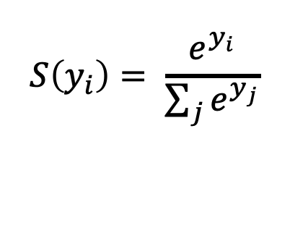
SoftMAX
2.0
1.0
0.1
0.7
0.2
0.1
W X + b = Y
$$S\left(y_{i}\right)= \frac{e^{y_{i}}}{\sum_{j}{e^{y_{j}}}}$$
Logits
Scores
Probabilities
Source: https://www.youtube.com/watch?v=G8eNWzxOgqE

Slide 50
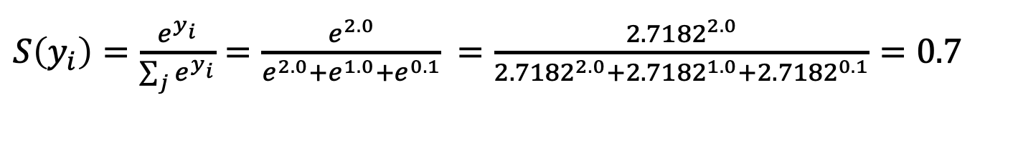
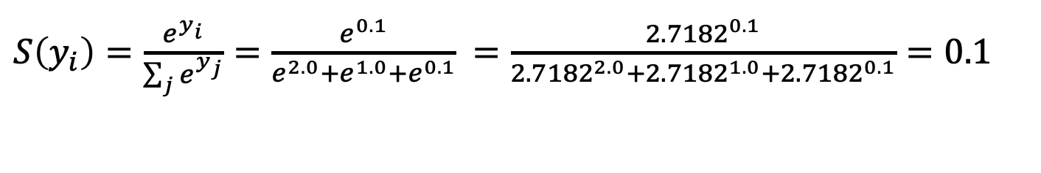
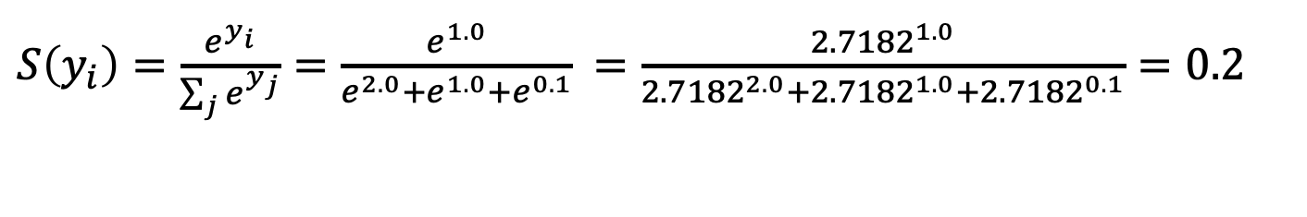
$S\left(y_{i}\right)=\frac{e^{y_{i}}}{\sum_{j}{e^{y_{i}}}}=\frac{e^{2.0}}{e^{2.0}+e^{1.0}+e^{0.1}}$ $=\frac{{2.7182}^{2.0}}{{2.7182}^{2.0}+{2.7182}^{1.0}+{2.7182}^{0.1}}=0.7$
$S\left(y_{i}\right)=\frac{e^{y_{i}}}{\sum_{j}{e^{y_{j}}}}=\frac{e^{1.0}}{e^{2.0}+e^{1.0}+e^{0.1}}$ $=\frac{{2.7182}^{1.0}}{{2.7182}^{2.0}+{2.7182}^{1.0}+{2.7182}^{0.1}}=0.2$
$S\left(y_{i}\right)=\frac{e^{y_{i}}}{\sum_{j}{e^{y_{j}}}}=\frac{e^{0.1}}{e^{2.0}+e^{1.0}+e^{0.1}}$ $=\frac{{2.7182}^{0.1}}{{2.7182}^{2.0}+{2.7182}^{1.0}+{2.7182}^{0.1}}=0.1$
2.0
1.0
0.1
0.7
0.2
0.1
W X + b = Y
$$S\left(y_{i}\right)= \frac{e^{y_{i}}}{\sum_{j}{e^{y_{j}}}}$$
Logits
Scores
Probabilities
Source: https://www.youtube.com/watch?v=G8eNWzxOgqE

Slide 51
Training a Network
=
Minimize the Cost Function
Source: https://www.youtube.com/watch?v=bxe2T-V8XRs&index=1&list=PLiaHhY2iBX9hdHaRr6b7XevZtgZRa1PoU

Slide 52
Training a Network
=
Minimize the Cost Function
Minimize the Loss Function
Source: https://www.youtube.com/watch?v=bxe2T-V8XRs&index=1&list=PLiaHhY2iBX9hdHaRr6b7XevZtgZRa1PoU

Slide 53



Error = Predict Y - Actual Y
Error : Cost : Loss
100
$$y$$
$$\hat{y}$$
75
$$e$$
50
25
Test1
Test2
Test3
Source: https://www.youtube.com/watch?v=bxe2T-V8XRs&index=1&list=PLiaHhY2iBX9hdHaRr6b7XevZtgZRa1PoU

Slide 54
Error = Predict Y - Actual Y
Error : Cost : Loss
100
$$y$$
$$\hat{y}$$
75
$$e$$
50
25
Test1
Test2
Test3
Source: https://www.youtube.com/watch?v=bxe2T-V8XRs&index=1&list=PLiaHhY2iBX9hdHaRr6b7XevZtgZRa1PoU

Slide 55
Error = Predict Y - Actual Y
Error : Cost : Loss
100
$$y$$
$$\hat{y}$$
75
$$e$$
50
25
Test1
Test2
Test3
Source: https://www.youtube.com/watch?v=bxe2T-V8XRs&index=1&list=PLiaHhY2iBX9hdHaRr6b7XevZtgZRa1PoU

Slide 56
Activation Functions

Slide 57
Activation Functions
Sigmoid
TanH
ReLU
(Rectified Linear Unit)
[0, 1]
[-1, 1]
f(x) = max(0, x)
Source: http://cs231n.github.io/neural-networks-1/

Slide 58
Activation Functions
Source: http://adilmoujahid.com/posts/2016/06/introduction-deep-learning-python-caffe/

Slide 59
Loss
Function

Slide 60
Binary Classification: 2 Class
Activation Function:
Sigmoid
Loss Function:
Binary Cross-Entropy

Slide 61
Multiple Classification: 10 Class
Activation Function:
SoftMAX
Loss Function:
Categorical Cross-Entropy

Slide 62
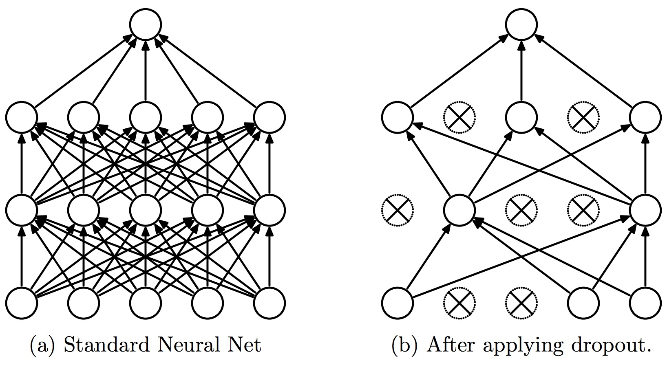
Dropout
Dropout: a simple way to prevent neural networks from overfitting
Source: Srivastava, Nitish, Geoffrey E. Hinton, Alex Krizhevsky, Ilya Sutskever, and Ruslan Salakhutdinov.
"Dropout: a simple way to prevent neural networks from overfitting." Journal of machine learning research 15, no. 1 (2014): 1929-1958.

Slide 63
Learning Algorithm
While not done:
  Pick a random training example “(input, label)”
  Run neural network on “input”
  Adjust weights on edges to make output closer to “label”
Source: Jeff Dean (2016), Large-Scale Deep Learning For Building Intelligent Computer Systems, WSDM 2016

Slide 64
y = max ( 0, -0.21 * x₁ + 0.3 * x₂ + 0.7 * x₃ )
Weights
x₁
-0.21
x₂
0.3
y
Inputs
0.7
x₃
Source: Jeff Dean (2016), Large-Scale Deep Learning For Building Intelligent Computer Systems, WSDM 2016

Slide 65
Next time:
y = max ( 0, -0.23 * x₁ + 0.31 * x₂ + 0.65 * x₃ )
y = max ( 0, -0.21 * x₁ + 0.3 * x₂ + 0.7 * x₃ )
Weights
-0.23
x₁
-0.21
0.31
x₂
0.3
y
Inputs
0.65
x₃
0.7
Source: Jeff Dean (2016), Large-Scale Deep Learning For Building Intelligent Computer Systems, WSDM 2016

Slide 66
Optimizer:
Stochastic Gradient Descent
(SGD)
J(w)
Initial
weight
Gradient
Global cost
minimum
w

Slide 67
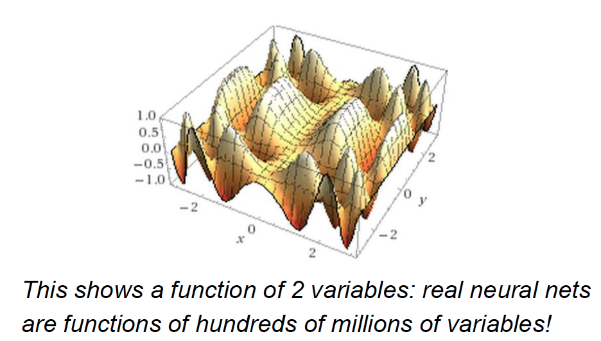
Source: Jeff Dean (2016), Large-Scale Deep Learning For Building Intelligent Computer Systems, WSDM 2016

Slide 68
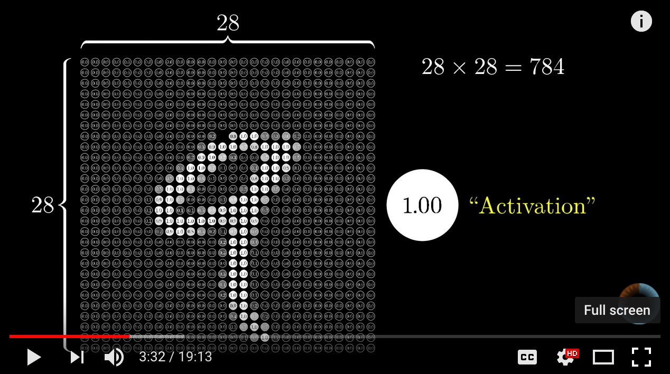
Neural Network and Deep Learning
Source: 3Blue1Brown (2017), But what *is* a Neural Network? | Chapter 1, deep learning, https://www.youtube.com/watch?v=aircAruvnKk

Slide 69
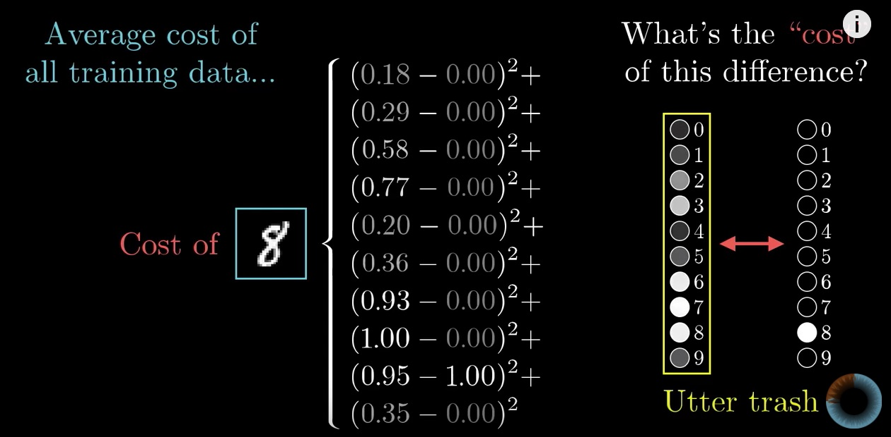
Gradient Descent how neural networks learn
Source: 3Blue1Brown (2017), Gradient descent, how neural networks learn | Chapter 2, deep learning, https://www.youtube.com/watch?v=IHZwWFHWa-w

Slide 70
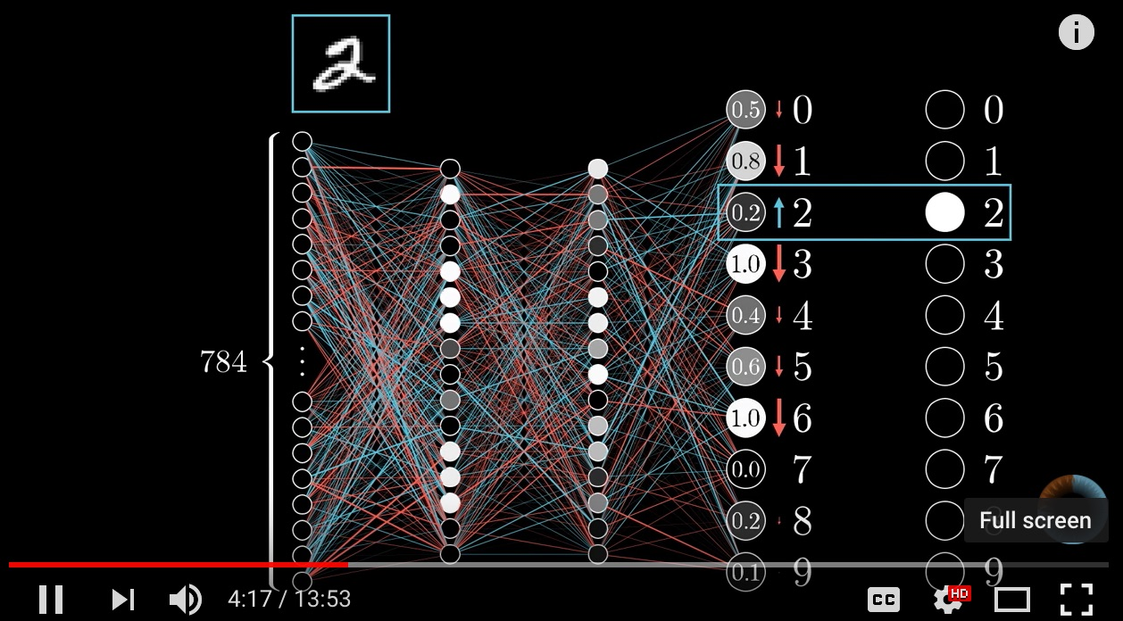
Backpropagation
Source: 3Blue1Brown (2017), What is backpropagation really doing? | Chapter 3, deep learning, https://www.youtube.com/watch?v=Ilg3gGewQ5U

Slide 71
Learning Algorithm
While not done:
  Pick a random training example “(input, label)”
  Run neural network on “input”
  Adjust weights on edges to make output closer to “label”
Source: Jeff Dean (2016), Large-Scale Deep Learning For Building Intelligent Computer Systems, WSDM 2016

Slide 72
Convolutional Neural Networks (CNN)

Slide 73
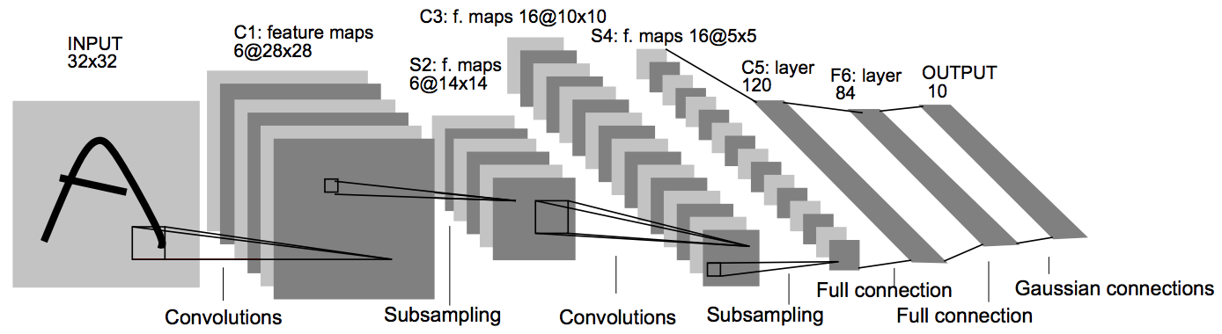
Convolutional Neural Networks
(CNN)
Architecture of LeNet-5 (7 Layers)
(LeCun et al., 1998)
Source: http://yann.lecun.com/exdb/publis/pdf/lecun-01a.pdf
Source: LeCun, Yann, Léon Bottou, Yoshua Bengio, and Patrick Haffner.
"Gradient-based learning applied to document recognition." Proceedings of the IEEE 86, no. 11 (1998): 2278-2324.

Slide 74
Convolutional Neural Networks
(CNN)
Convolution
Pooling
Fully Connection (FC) (Flattening)

Slide 75
A friendly introduction to
Convolutional Neural Networks and Image Recognition
+
-
4
-4
-
+
-4
4
1
-1
1
-1
1
-1
1
-1
1
-
+
-4
4
+
-
4
-4
Convolution Layer
Pooling Layer
Source: Luis Serrano (2017), A friendly introduction to Convolutional Neural Networks and Image Recognition,
https://www.youtube.com/watch?v=2-Ol7ZB0MmU

Slide 76
A friendly introduction to
Convolutional Neural Networks and Image Recognition
1
-1
1
1
-1
-1
1
-1
1
-1
1
-1
-1
1
1
-1
1
-1
1
-1
1
-1
1
-1
1
1
-1
-1
1
-1
1
-1
-1
1
-1
-1
1
-1
1
-1
-1
-1
-1
-1
1
-1
-1
-1
1
1
-1
1
-1
-1
-1
1
-1
1
-1
-1
1
-1
-1
1
-1
-1
-1
-1
Source: Luis Serrano (2017), A friendly introduction to Convolutional Neural Networks and Image Recognition,
https://www.youtube.com/watch?v=2-Ol7ZB0MmU

Slide 77
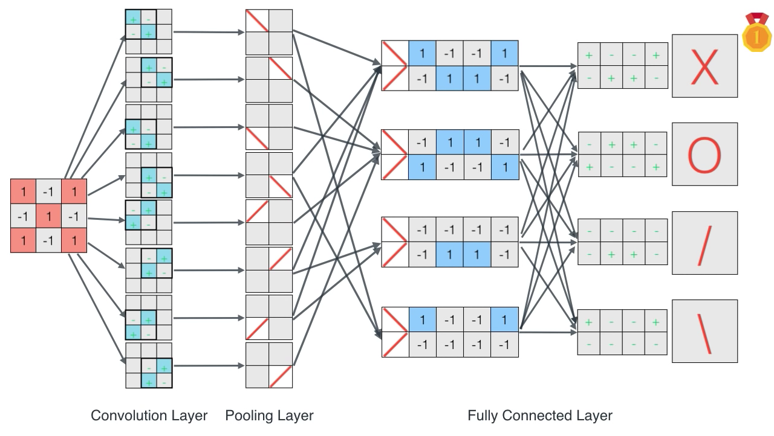
A friendly introduction to
Convolutional Neural Networks and Image Recognition
Source: Luis Serrano (2017), A friendly introduction to Convolutional Neural Networks and Image Recognition,
https://www.youtube.com/watch?v=2-Ol7ZB0MmU

Slide 78
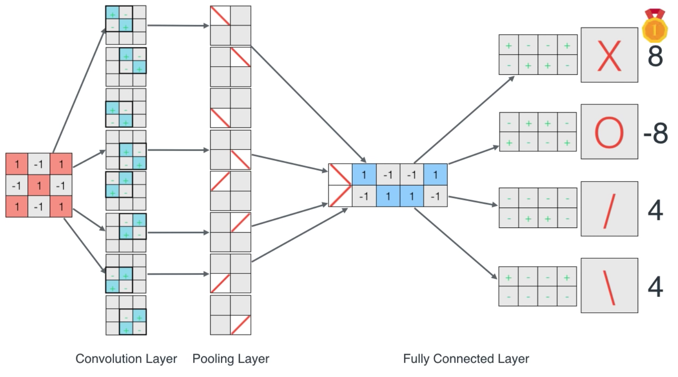
A friendly introduction to
Convolutional Neural Networks and Image Recognition
Source: Luis Serrano (2017), A friendly introduction to Convolutional Neural Networks and Image Recognition,
https://www.youtube.com/watch?v=2-Ol7ZB0MmU

Slide 79
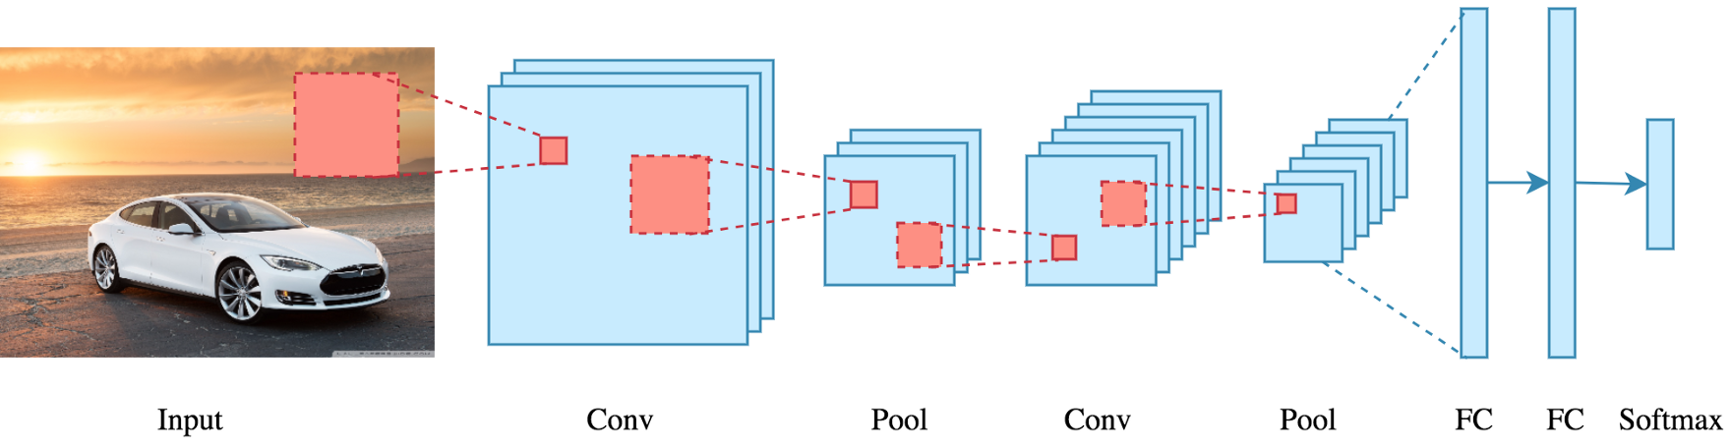
CNN Architecture
Source: Arden Dertat (2017), Applied Deep Learning - Part 4: Convolutional Neural Networks, https://towardsdatascience.com/applied-deep-learning-part-4-convolutional-neural-networks-584bc134c1e2

Slide 80
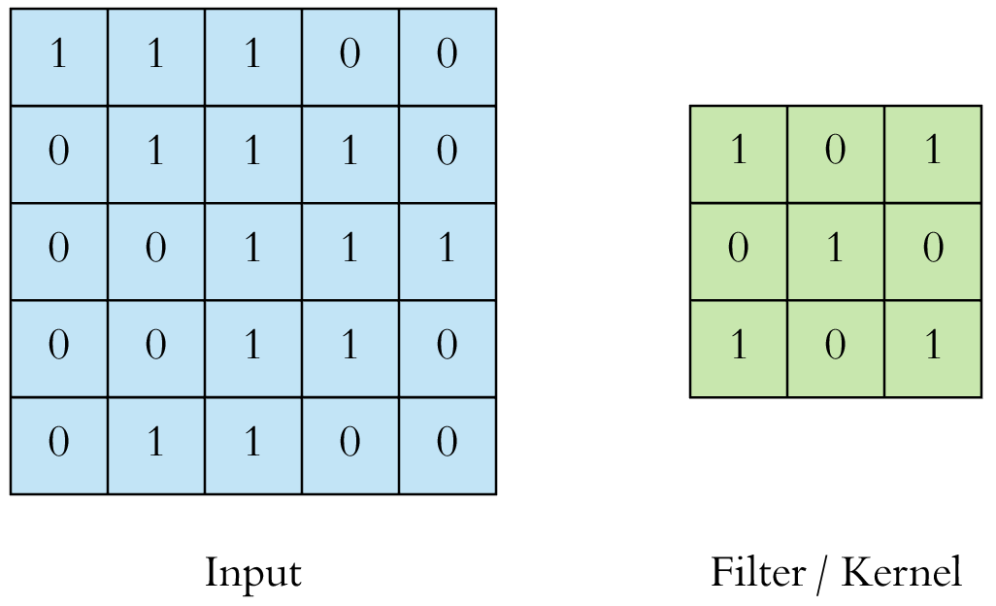
CNN Convolution Layer
Convolution is a mathematical operation to merge two sets of information
3x3 convolution
Source: Arden Dertat (2017), Applied Deep Learning - Part 4: Convolutional Neural Networks, https://towardsdatascience.com/applied-deep-learning-part-4-convolutional-neural-networks-584bc134c1e2

Slide 81
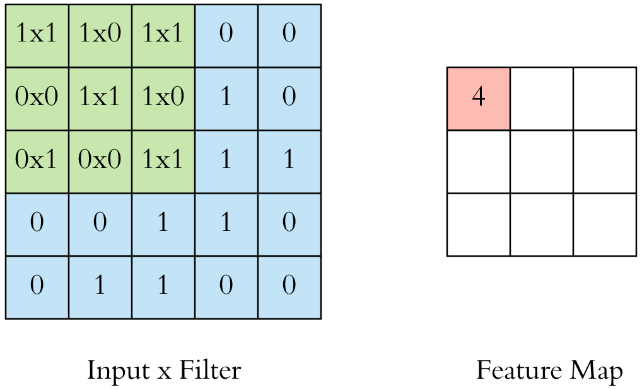
CNN Convolution Layer
Input x Filter --> Feature Map
receptive field: 3x3
Source: Arden Dertat (2017), Applied Deep Learning - Part 4: Convolutional Neural Networks, https://towardsdatascience.com/applied-deep-learning-part-4-convolutional-neural-networks-584bc134c1e2

Slide 82
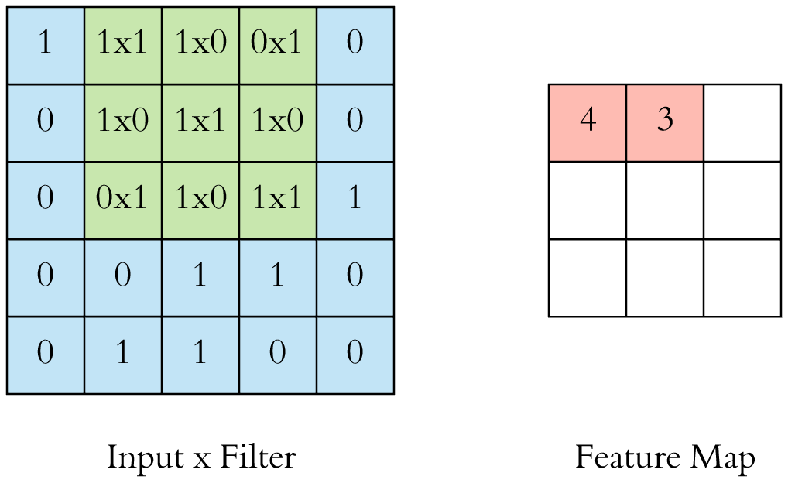
CNN Convolution Layer
Input x Filter --> Feature Map
receptive field: 3x3
Source: Arden Dertat (2017), Applied Deep Learning - Part 4: Convolutional Neural Networks, https://towardsdatascience.com/applied-deep-learning-part-4-convolutional-neural-networks-584bc134c1e2

Slide 83
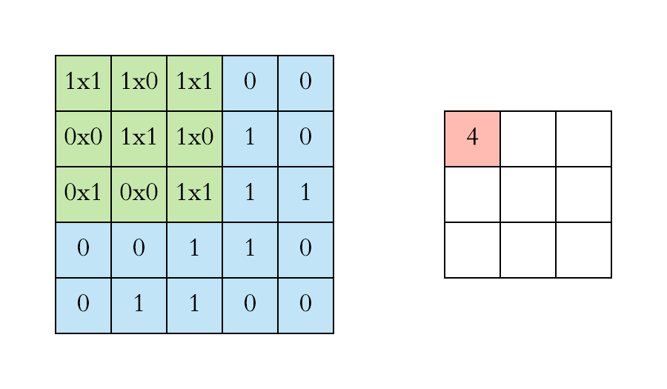
CNN Convolution Layer
Example convolution operation shown in 2D using a 3x3 filter
Source: Arden Dertat (2017), Applied Deep Learning - Part 4: Convolutional Neural Networks, https://towardsdatascience.com/applied-deep-learning-part-4-convolutional-neural-networks-584bc134c1e2

Slide 84
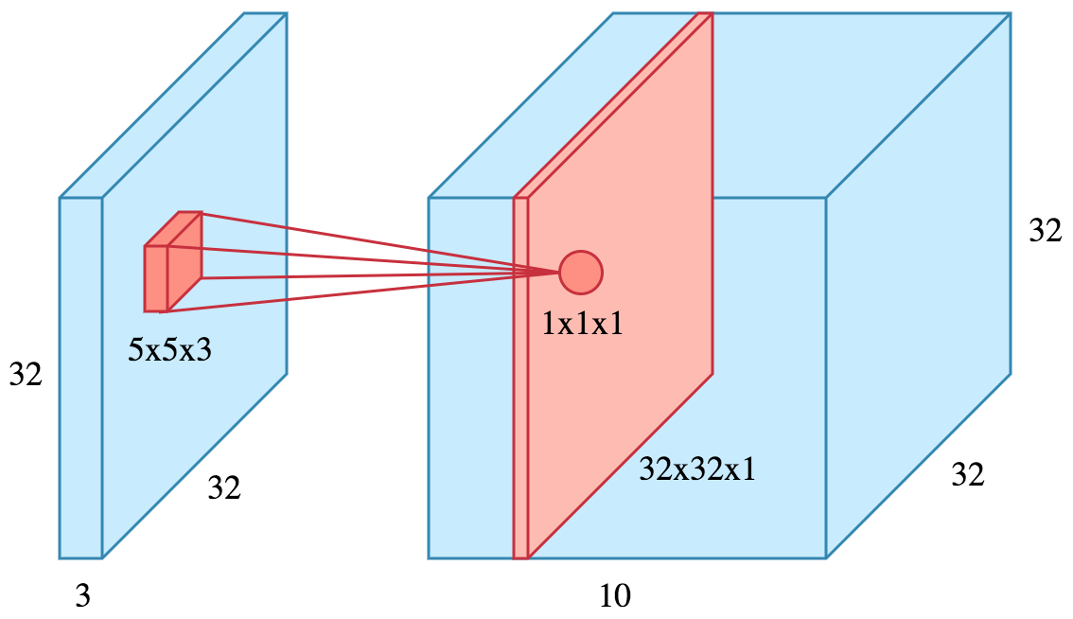
CNN Convolution Layer
10 different filters
10 feature maps of size 32x32x1
final output of the convolution layer:
a volume of size 32x32x10
Source: Arden Dertat (2017), Applied Deep Learning - Part 4: Convolutional Neural Networks, https://towardsdatascience.com/applied-deep-learning-part-4-convolutional-neural-networks-584bc134c1e2

Slide 85
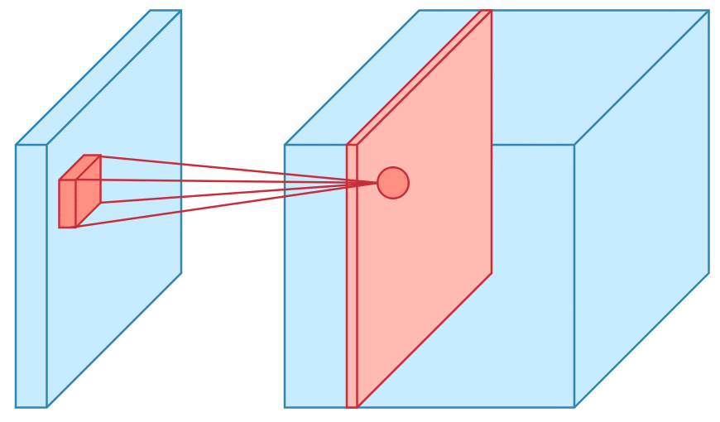
CNN Convolution Layer
Sliding operation at 4 locations
Source: Arden Dertat (2017), Applied Deep Learning - Part 4: Convolutional Neural Networks, https://towardsdatascience.com/applied-deep-learning-part-4-convolutional-neural-networks-584bc134c1e2

Slide 86
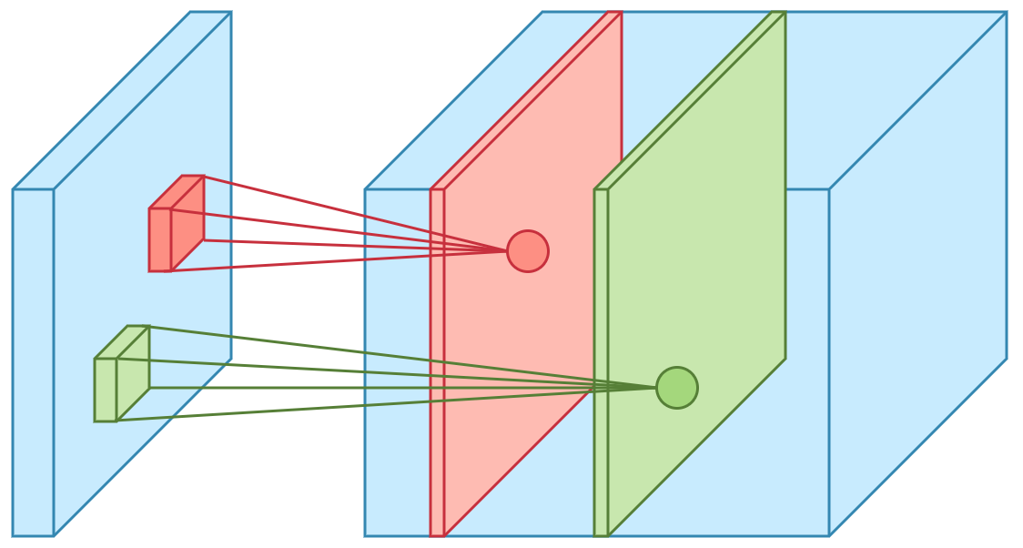
CNN Convolution Layer
two feature maps
Source: Arden Dertat (2017), Applied Deep Learning - Part 4: Convolutional Neural Networks, https://towardsdatascience.com/applied-deep-learning-part-4-convolutional-neural-networks-584bc134c1e2

Slide 87
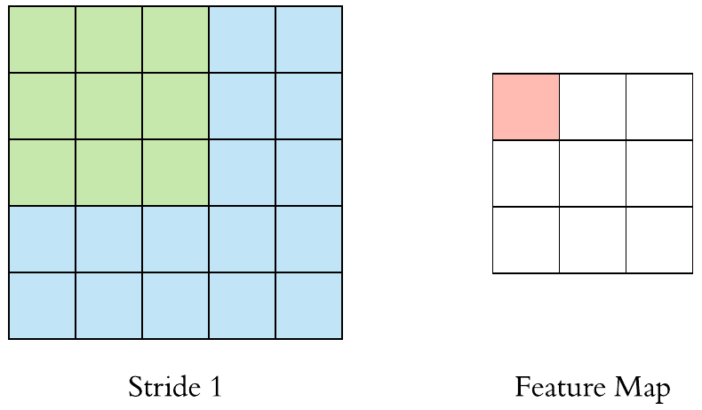
CNN Convolution Layer
Stride specifies how much
we move the convolution filter at each step
Source: Arden Dertat (2017), Applied Deep Learning - Part 4: Convolutional Neural Networks, https://towardsdatascience.com/applied-deep-learning-part-4-convolutional-neural-networks-584bc134c1e2

Slide 88
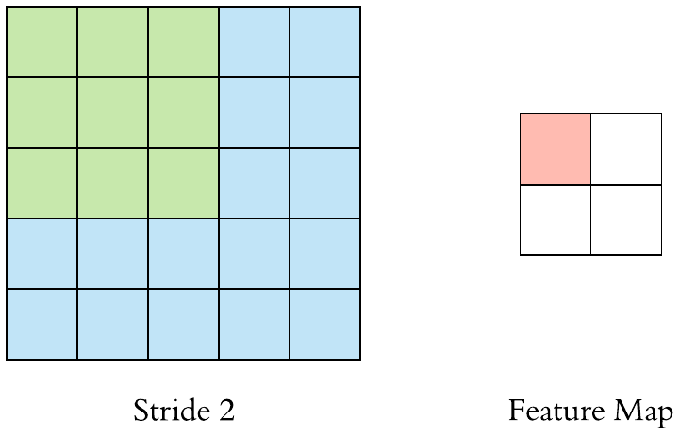
CNN Convolution Layer
Stride specifies how much
we move the convolution filter at each step
Source: Arden Dertat (2017), Applied Deep Learning - Part 4: Convolutional Neural Networks, https://towardsdatascience.com/applied-deep-learning-part-4-convolutional-neural-networks-584bc134c1e2

Slide 89
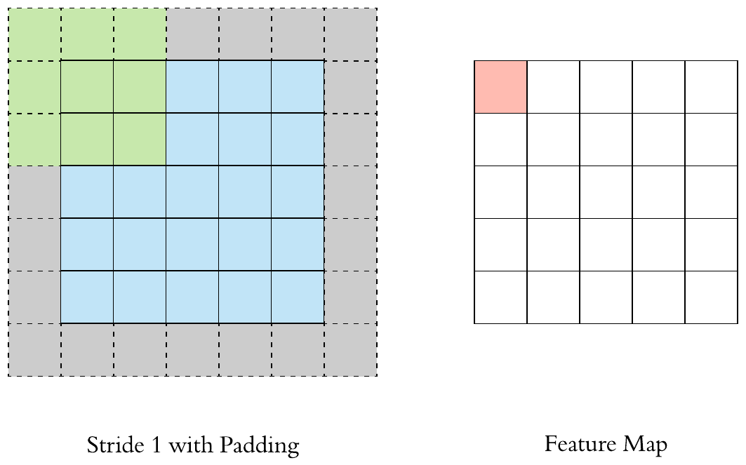
CNN Convolution Layer
Stride 1 with Padding
Source: Arden Dertat (2017), Applied Deep Learning - Part 4: Convolutional Neural Networks, https://towardsdatascience.com/applied-deep-learning-part-4-convolutional-neural-networks-584bc134c1e2

Slide 90
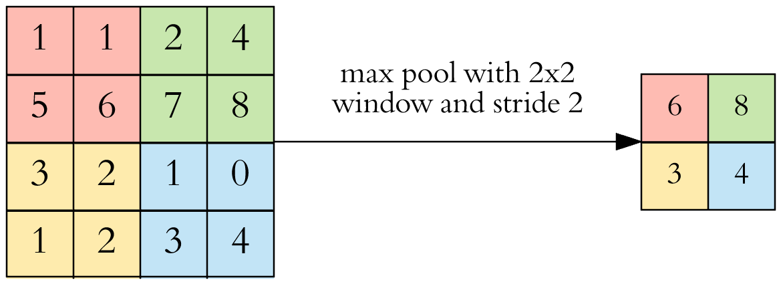
CNN Pooling Layer
Max Pooling
Source: Arden Dertat (2017), Applied Deep Learning - Part 4: Convolutional Neural Networks, https://towardsdatascience.com/applied-deep-learning-part-4-convolutional-neural-networks-584bc134c1e2

Slide 91
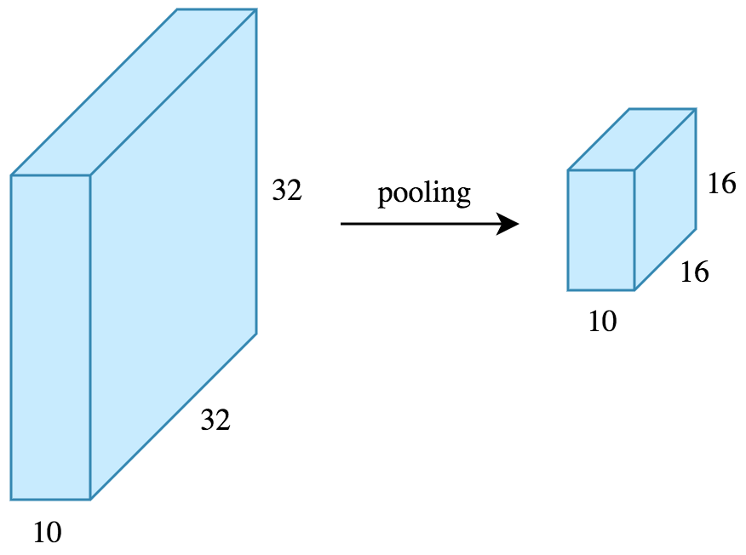
CNN Pooling Layer
Source: Arden Dertat (2017), Applied Deep Learning - Part 4: Convolutional Neural Networks, https://towardsdatascience.com/applied-deep-learning-part-4-convolutional-neural-networks-584bc134c1e2

Slide 92
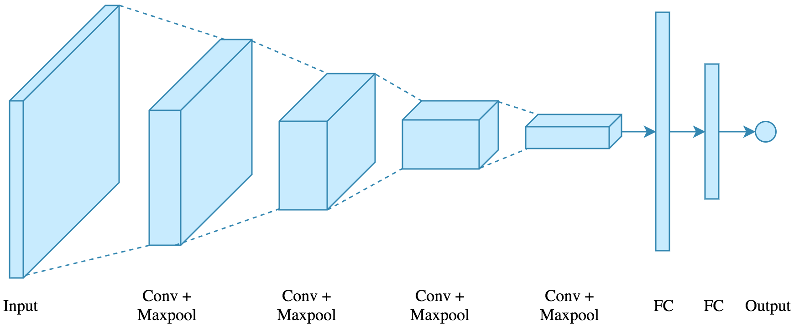
CNN Architecture
4 convolution + pooling layers,
followed by 2 fully connected layers
Source: Arden Dertat (2017), Applied Deep Learning - Part 4: Convolutional Neural Networks, https://towardsdatascience.com/applied-deep-learning-part-4-convolutional-neural-networks-584bc134c1e2

Slide 93
CNN Architecture
4 convolution + pooling layers,
followed by 2 fully connected layers
https://gist.github.com/ardendertat/0fc5515057c47e7386fe04e9334504e3
model = Sequential()
model.add(Conv2D(32, (3, 3), activation='relu', padding='same', name='conv_1',
input_shape=(150, 150, 3)))
model.add(MaxPooling2D((2, 2), name='maxpool_1'))
model.add(Conv2D(64, (3, 3), activation='relu', padding='same', name='conv_2'))
model.add(MaxPooling2D((2, 2), name='maxpool_2'))
model.add(Conv2D(128, (3, 3), activation='relu', padding='same', name='conv_3'))
model.add(MaxPooling2D((2, 2), name='maxpool_3'))
model.add(Conv2D(128, (3, 3), activation='relu', padding='same', name='conv_4'))
model.add(MaxPooling2D((2, 2), name='maxpool_4'))
model.add(Flatten())
model.add(Dropout(0.5))
model.add(Dense(512, activation='relu', name='dense_1'))
model.add(Dense(128, activation='relu', name='dense_2'))
model.add(Dense(1, activation='sigmoid', name='output'))
Source: Arden Dertat (2017), Applied Deep Learning - Part 4: Convolutional Neural Networks, https://towardsdatascience.com/applied-deep-learning-part-4-convolutional-neural-networks-584bc134c1e2

Slide 94
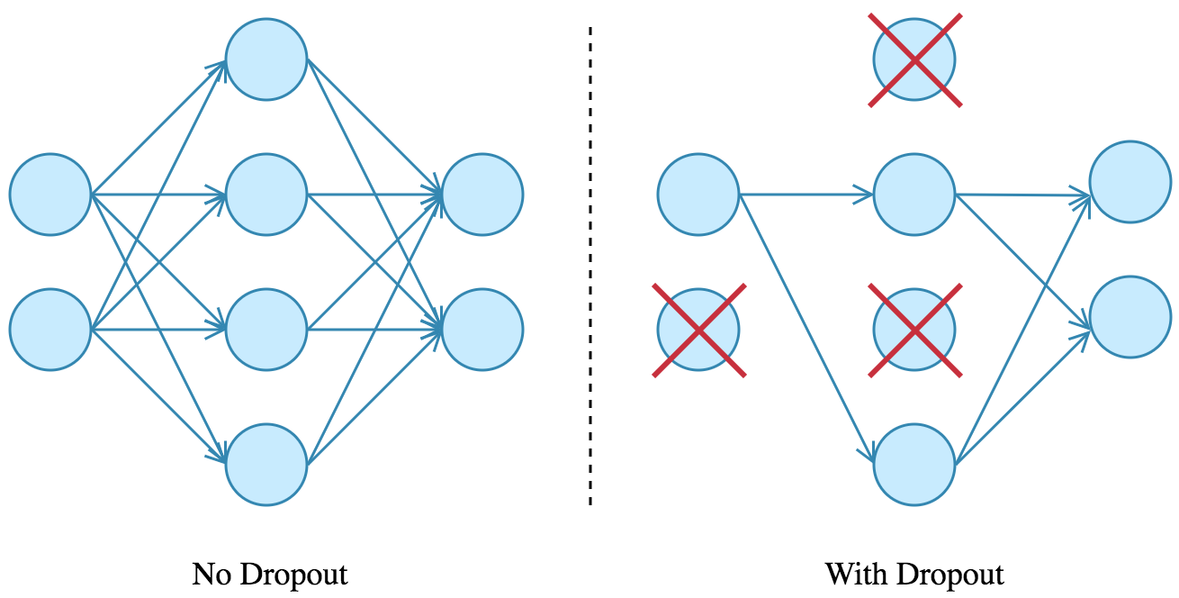
Dropout
Source: Arden Dertat (2017), Applied Deep Learning - Part 4: Convolutional Neural Networks, https://towardsdatascience.com/applied-deep-learning-part-4-convolutional-neural-networks-584bc134c1e2

Slide 95
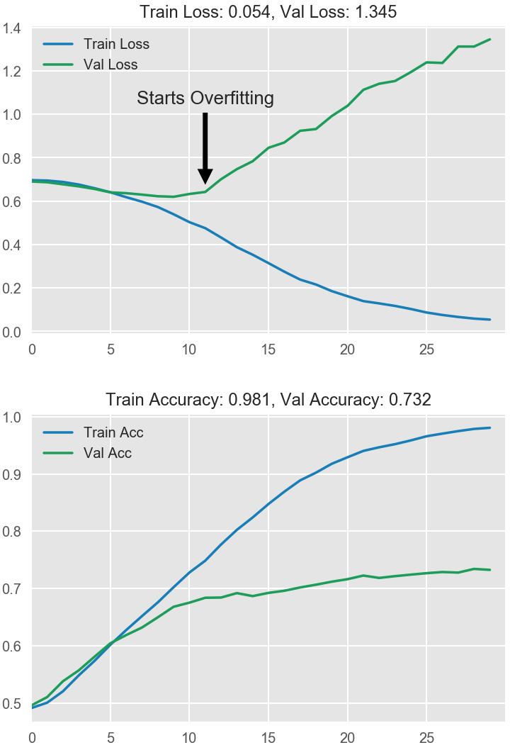
Model Performance
Source: Arden Dertat (2017), Applied Deep Learning - Part 4: Convolutional Neural Networks, https://towardsdatascience.com/applied-deep-learning-part-4-convolutional-neural-networks-584bc134c1e2

Slide 96
Recurrent
Neural Networks (RNN)

Slide 97
Recurrent Neural Networks (RNN)
y_{t-2}
y_{t-1}
y_{t}
y_{t+1}
y_{t+2}
output
h_{t-2}
h_{t-1}
h_{t}
h_{t+1}
h_{t+2}
hidden
X_{t-2}
X_{t-1}
X_{t}
X_{t+1}
X_{t+2}
Input

Slide 98
Recurrent Neural Networks (RNN)
Time Series Forecasting
110
120
130
140
150
y_{t-2}
y_{t-1}
y_{t}
y_{t+1}
y_{t+2}
output
h_{t-2}
h_{t-1}
h_{t}
h_{t+1}
h_{t+2}
hidden
X_{t-2}
X_{t-1}
X_{t}
X_{t+1}
X_{t+2}
Input
100
110
120
130
140

Slide 99
Recurrent Neural Networks (RNN)
y
output
h_{t-2}
h_{t-1}
h_{t}
h_{t+1}
h_{t+2}
hidden
X_{t-2}
X_{t-1}
X_{t}
X_{t+1}
X_{t+2}
Input

Slide 100

Recurrent Neural Networks (RNN)
Sentiment Analysis
y
output
h_{t-2}
h_{t-1}
h_{t}
h_{t+1}
h_{t+2}
hidden
X_{t-2}
X_{t-1}
X_{t}
X_{t+1}
X_{t+2}
Input
This
movie
is
very
good

Slide 101

Recurrent Neural Networks (RNN)
Sentiment Analysis
y
output
h_{t-2}
h_{t-1}
h_{t}
h_{t+1}
h_{t+2}
hidden
X_{t-2}
X_{t-1}
X_{t}
X_{t+1}
X_{t+2}
Input
This
movie
is
very
boring

Slide 102
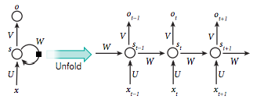
Recurrent Neural Network (RNN)
Source: LeCun, Yann, Yoshua Bengio, and Geoffrey Hinton. "Deep learning." Nature 521, no. 7553 (2015): 436-444.

Slide 103
RNN
Source: Christopher Olah, (2015) Understanding LSTM Networks, http://colah.github.io/posts/2015-08-Understanding-LSTMs/

Slide 104
RNN long-term dependencies
I grew up in France… I speak fluent French.
Source: Christopher Olah, (2015) Understanding LSTM Networks, http://colah.github.io/posts/2015-08-Understanding-LSTMs/

Slide 105
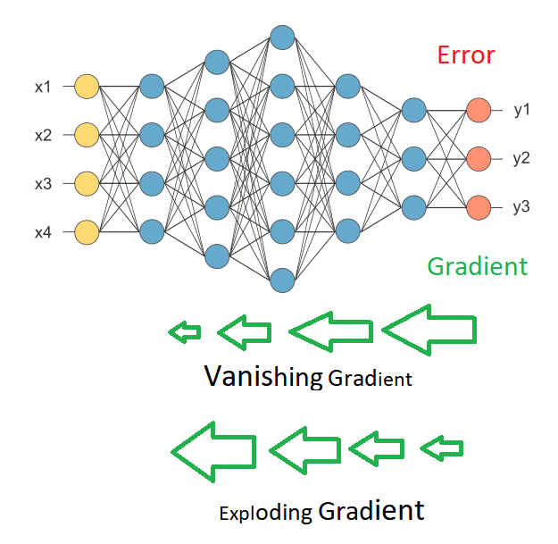
Vanishing Gradient
Exploding Gradient
Source: https://medium.com/deep-math-machine-learning-ai/chapter-10-1-deepnlp-lstm-long-short-term-memory-networks-with-math-21477f8e4235

Slide 106
Recurrent Neural Networks (RNN)
y_{t-2}
y_{t-1}
y_{t}
y_{t+1}
y_{t+2}
output
V
V
V
V
W
W
W
W
h_{t-2}
h_{t-1}
h_{t}
h_{t+1}
h_{t+2}
hidden
U
U
U
U
X_{t-2}
X_{t-1}
X_{t}
X_{t+1}
X_{t+2}
Input

Slide 107
RNN
Vanishing Gradient problem
Exploding Gradient problem
Error
y_{t-2}
y_{t-1}
y_{t}
y_{t+1}
y_{t+2}
output
V
V
V
V
W
W
W
W
h_{t-2}
h_{t-1}
h_{t}
h_{t+1}
h_{t+2}
hidden
U
U
U
U
X_{t-2}
X_{t-1}
X_{t}
X_{t+1}
X_{t+2}
Input
if |W| < 1 (Vanishing)
if |W| > 1 (Exploding)
Source: https://medium.com/deep-math-machine-learning-ai/chapter-10-1-deepnlp-lstm-long-short-term-memory-networks-with-math-21477f8e4235

Slide 108
RNN
Vanishing Gradient problem
Error
y_{t-2}
y_{t-1}
y_{t}
y_{t+1}
y_{t+2}
output
V
V
V
V
0.9
0.9
0.9
0.9
h_{t-2}
h_{t-1}
h_{t}
h_{t+1}
h_{t+2}
hidden
U
U
U
U
X_{t-2}
X_{t-1}
X_{t}
X_{t+1}
X_{t+2}
Input
W = 0.9 < 1 (Vanishing)
Source: https://medium.com/deep-math-machine-learning-ai/chapter-10-1-deepnlp-lstm-long-short-term-memory-networks-with-math-21477f8e4235

Slide 109
RNN
Exploding Gradient problem
Error
y_{t-2}
y_{t-1}
y_{t}
y_{t+1}
y_{t+2}
output
V
V
V
V
1.1
1.1
1.1
1.1
h_{t-2}
h_{t-1}
h_{t}
h_{t+1}
h_{t+2}
hidden
U
U
U
U
X_{t-2}
X_{t-1}
X_{t}
X_{t+1}
X_{t+2}
Input
W = 1.1 > 1 (Exploding)
Source: https://medium.com/deep-math-machine-learning-ai/chapter-10-1-deepnlp-lstm-long-short-term-memory-networks-with-math-21477f8e4235

Slide 110
RNN LSTM
RNN
LSTM
Source: Christopher Olah, (2015) Understanding LSTM Networks, http://colah.github.io/posts/2015-08-Understanding-LSTMs/

Slide 111
Long Short Term Memory
(LSTM)
Source: Christopher Olah, (2015) Understanding LSTM Networks, http://colah.github.io/posts/2015-08-Understanding-LSTMs/

Slide 112
Long Short Term Memory
(LSTM)
forget
gate
input
gate
output
gate
Source: Christopher Olah, (2015) Understanding LSTM Networks, http://colah.github.io/posts/2015-08-Understanding-LSTMs/

Slide 113
Gated Recurrent Unit
(GRU)
Source: Christopher Olah, (2015) Understanding LSTM Networks, http://colah.github.io/posts/2015-08-Understanding-LSTMs/

Slide 114
Gated Recurrent Unit
(GRU)
reset
gate
update
gate
Source: Christopher Olah, (2015) Understanding LSTM Networks, http://colah.github.io/posts/2015-08-Understanding-LSTMs/

Slide 115
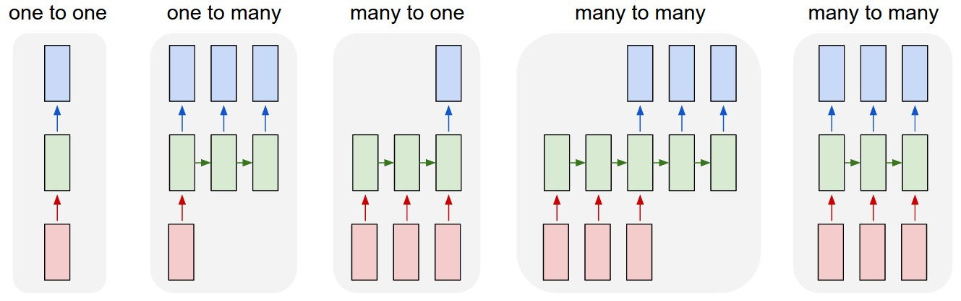
LSTM Recurrent Neural Network
Traditional Neural Network
Music
Generation
Sentiment
Classification
Name
Entity
Recognition
Machine
Translation
Source: https://github.com/Vict0rSch/deep_learning/tree/master/keras/recurrent

Slide 116
Long Short Term Memory (LSTM) for Time Series Forecasting
h_{t-2}
h_{t-1}
h_{t}
h_{t+1}
h_{t+2}
LSTM
LSTM
LSTM
LSTM
LSTM
X_{t-2}
X_{t-1}
X_{t}
X_{t+1}
X_{t+2}

Slide 117
Time Series Data
[100, 110, 120, 130, 140, 150]
Y
X
Y
[100 110 120 130 140] 150
X_{t1}
X_{t2}
X_{t3}
X_{t4}
X_{t5}

Slide 118
Time Series Data
[10, 20, 30, 40, 50, 60, 70, 80, 90]
X
Y
[10 20 30] 40
[20 30 40] 50
[30 40 50] 60
[40 50 60] 70
[50 60 70] 80
[60 70 80] 90

Slide 119
Reinforcement Learning (RL)
Computer Science
Engineering
Machine
Learning
Neuroscience
Optimal
Control
Reward
System
Reinforcement
Learning
Operations
Research
Classical/Operant
Conditioning
Mathematics
Bounded
Rationality
Psychology
Economics
Source: David Silver (2015), Introduction to reinforcement learning, https://www.youtube.com/playlist?list=PLqYmG7hTraZDM-OYHWgPebj2MfCFzFObQ

Slide 120
Branches of Machine Learning (ML)
Reinforcement Learning (RL)
No Labels
No feedback
Find hidden structure
Labeled data
Direct feedback
Predict
Supervised
Learning
Unsupervised
Learning
Machine
Learning
Reinforcement
Learning
Decision process
Reward system
Learn series of actions
Source: David Silver (2015), Introduction to reinforcement learning, https://www.youtube.com/playlist?list=PLqYmG7hTraZDM-OYHWgPebj2MfCFzFObQ

Slide 121
Reinforcement Learning (DL)
Agent
Environment
Source: Richard S. Sutton & Andrew G. Barto (2018), Reinforcement Learning: An Introduction, 2nd Edition, A Bradford Book.

Slide 122
Reinforcement Learning (DL)
1
2
observation
Agent
action
3
reward
Environment
Source: Richard S. Sutton & Andrew G. Barto (2018), Reinforcement Learning: An Introduction, 2nd Edition, A Bradford Book.

Slide 123
Reinforcement Learning (DL)
1
2
observation
Agent
action
O_{t}
A_{t}
3
reward
R_{t}
Environment
Source: Richard S. Sutton & Andrew G. Barto (2018), Reinforcement Learning: An Introduction, 2nd Edition, A Bradford Book.

Slide 124
Agent and Environment
At each step t the agent:
  Executes action A_{t}
  Receives observation O_{t}
  Receives scalar reward R_{t}
The environment:
  Receives action A_{t}
  Emits observation O_{t+1}
  Emits scalar reward R_{t+1}
t increments at env. step
observation
action
Agent
O_{t}
A_{t}
reward
R_{t}
Environment
Source: David Silver (2015), Introduction to reinforcement learning, https://www.youtube.com/playlist?list=PLqYmG7hTraZDM-OYHWgPebj2MfCFzFObQ

Slide 125
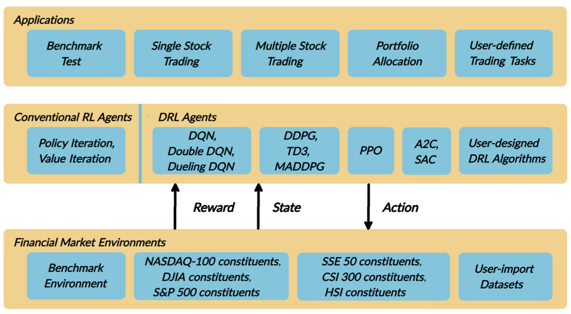
FinRL:
A Deep Reinforcement Learning Library for
Automated Stock Trading in Quantitative Finance
Source: Xiao-Yang Liu, Hongyang Yang, Qian Chen, Runjia Zhang, Liuqing Yang, Bowen Xiao, and Christina Dan Wang (2020). "FinRL: A Deep Reinforcement Learning Library for Automated Stock Trading in Quantitative Finance." arXiv preprint arXiv:2011.09607 (2020).

Slide 126
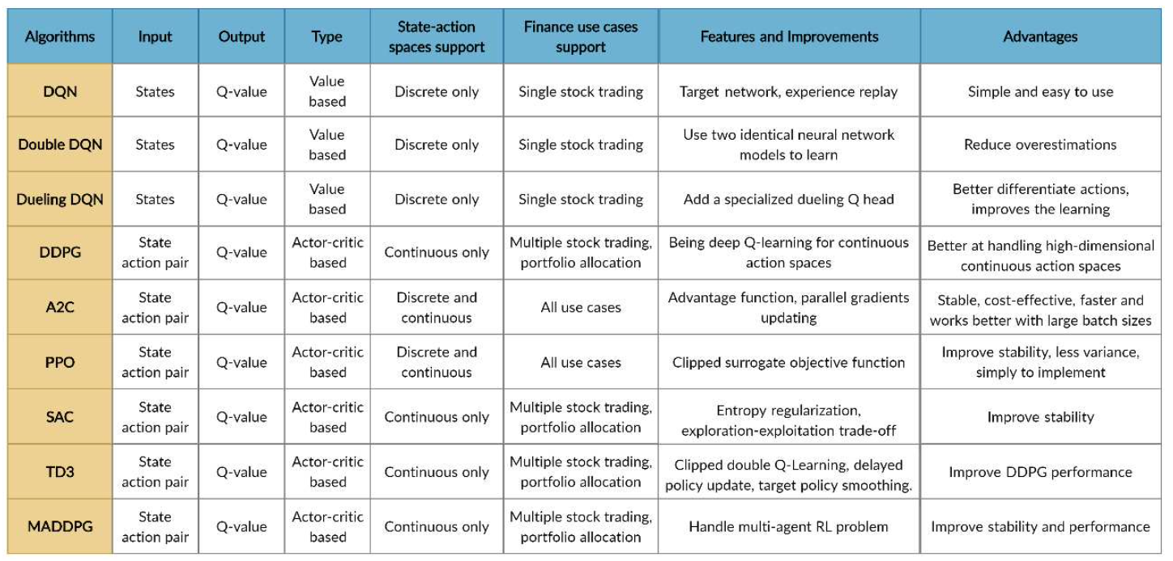
FinRL
Deep Reinforcement Learning Algorithms
Source: Xiao-Yang Liu, Hongyang Yang, Qian Chen, Runjia Zhang, Liuqing Yang, Bowen Xiao, and Christina Dan Wang (2020). "FinRL: A Deep Reinforcement Learning Library for Automated Stock Trading in Quantitative Finance." arXiv preprint arXiv:2011.09607 (2020).

Slide 127
import os
import numpy as np
import pandas as pd
from pylab import plt, mpl
plt.style.use('seaborn')
mpl.rcParams['savefig.dpi'] = 300
mpl.rcParams['font.family'] = 'serif'
pd.set_option('precision', 4)
np.set_printoptions(suppress=True, precision=4)
os.environ['PYTHONHASHSEED'] = '0'
url = 'http://hilpisch.com/aiif_eikon_id_eur_usd.csv'
symbol = 'EUR_USD'
raw = pd.read_csv(url, index_col=0, parse_dates=True)
raw.head()
Source: Yves Hilpisch (2020), Artificial Intelligence in Finance: A Python-Based Guide, O’Reilly Media.

Slide 128
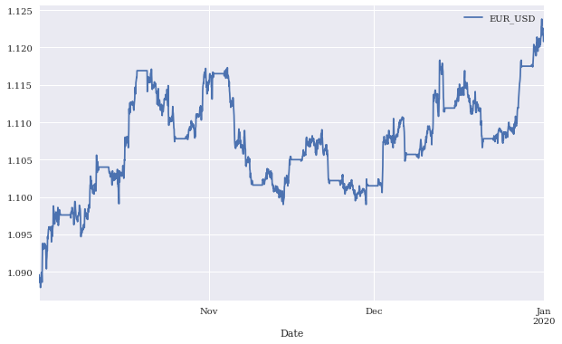
Mid-closing prices for EUR/USD (intraday)
Source: Yves Hilpisch (2020), Artificial Intelligence in Finance: A Python-Based Guide, O’Reilly Media.

Slide 129
optimizer = Adam(lr=0.001)
def create_model(hl=1, hu=128, optimizer=optimizer):
  model = Sequential()
  model.add(Dense(hu, input_dim=len(cols),
  activation='relu'))
  for _ in range(hl):
  model.add(Dense(hu, activation='relu'))
  model.add(Dense(1, activation='sigmoid'))
  model.compile(loss='binary_crossentropy',
              optimizer=optimizer,
              metrics=['accuracy'])
  return model
set_seeds()
model = create_model(hl=1, hu=128)
model.summary()
Source: Yves Hilpisch (2020), Artificial Intelligence in Finance: A Python-Based Guide, O’Reilly Media.

Slide 130
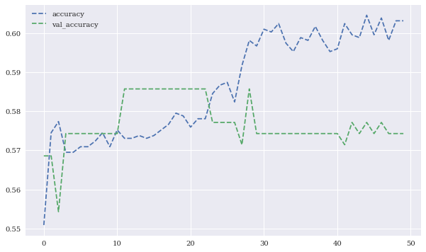
Training and validation accuracy values
Source: Yves Hilpisch (2020), Artificial Intelligence in Finance: A Python-Based Guide, O’Reilly Media.

Slide 131
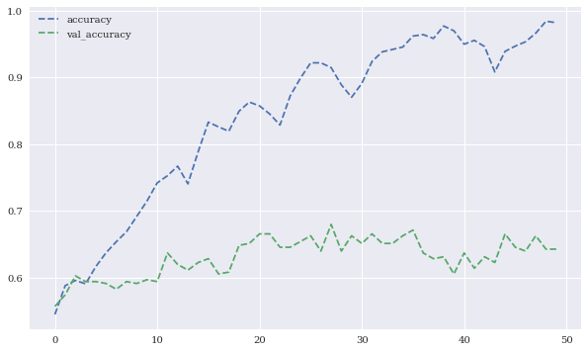
Training and validation accuracy values (normalized features data)
Source: Yves Hilpisch (2020), Artificial Intelligence in Finance: A Python-Based Guide, O’Reilly Media.

Slide 132
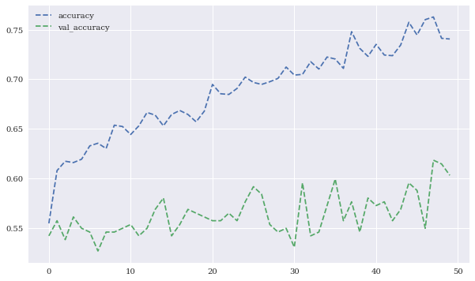
Training and validation accuracy values
(with dropout)
Source: Yves Hilpisch (2020), Artificial Intelligence in Finance: A Python-Based Guide, O’Reilly Media.

Slide 133
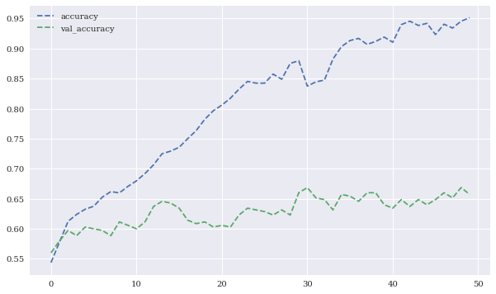
Training and validation accuracy values
(with regularization)
Source: Yves Hilpisch (2020), Artificial Intelligence in Finance: A Python-Based Guide, O’Reilly Media.

Slide 134
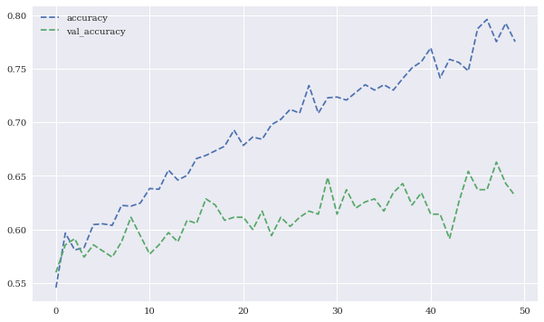
Training and validation accuracy values
(with dropout and regularization)
Source: Yves Hilpisch (2020), Artificial Intelligence in Finance: A Python-Based Guide, O’Reilly Media.

Slide 135
from keras.models import Sequential
from keras.layers import SimpleRNN, LSTM, Dense
model = Sequential()
model.add(SimpleRNN(100, activation='relu’,
input_shape=(lags, 1)))
model.add(Dense(1, activation='linear'))
model.compile(optimizer='adagrad', loss='mse’,
metrics=['mae'])
model.summary()
model.fit(g, epochs=1000, steps_per_epoch=5, verbose=False)
Source: Yves Hilpisch (2020), Artificial Intelligence in Finance: A Python-Based Guide, O’Reilly Media.

Slide 136
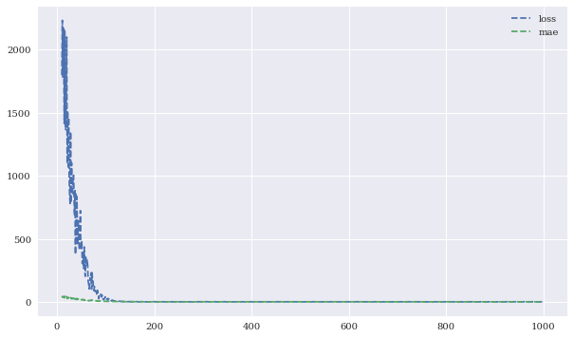
Performance metrics during RNN training
Source: Yves Hilpisch (2020), Artificial Intelligence in Finance: A Python-Based Guide, O’Reilly Media.

Slide 137
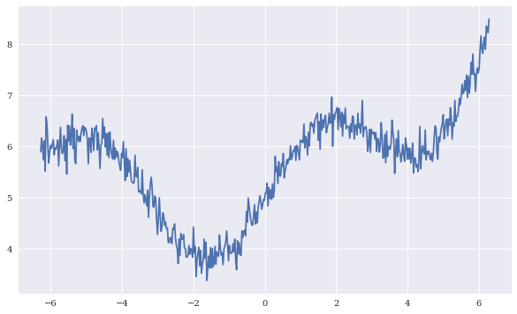
Sample sequence data
Source: Yves Hilpisch (2020), Artificial Intelligence in Finance: A Python-Based Guide, O’Reilly Media.

Slide 138
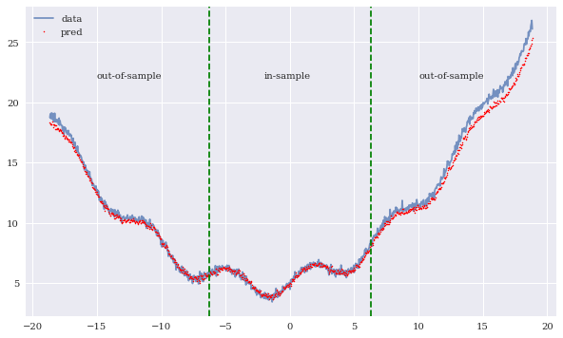
in-sample and out-of-sample predictions of the RNN
Source: Yves Hilpisch (2020), Artificial Intelligence in Finance: A Python-Based Guide, O’Reilly Media.

Slide 139
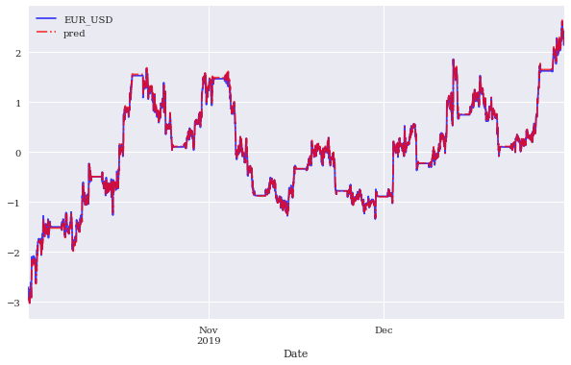
In-sample prediction for financial price series by the RNN (whole data set)
Source: Yves Hilpisch (2020), Artificial Intelligence in Finance: A Python-Based Guide, O’Reilly Media.

Slide 140
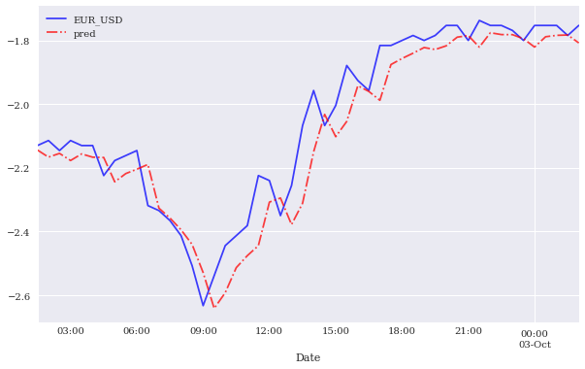
In-sample prediction for financial price series by the RNN (data sub-set)
Source: Yves Hilpisch (2020), Artificial Intelligence in Finance: A Python-Based Guide, O’Reilly Media.

Slide 141
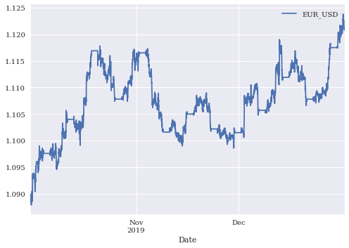
Financial Price Series
data = generate_data()
data.plot()
Source: Yves Hilpisch (2020), Artificial Intelligence in Finance: A Python-Based Guide, O’Reilly Media.

Slide 142

Financial Return Series
data['r'] = np.log(data / data.shift(1))
data['r'].plot()
Source: Yves Hilpisch (2020), Artificial Intelligence in Finance: A Python-Based Guide, O’Reilly Media.

Slide 143

Financial Price and Return Normalization Series
data.dropna(inplace=True)
data = (data - data.mean()) / data.std()
data.plot()
Source: Yves Hilpisch (2020), Artificial Intelligence in Finance: A Python-Based Guide, O’Reilly Media.

Slide 144

In-sample prediction for financial return series by the RNN (data sub-set)
Source: Yves Hilpisch (2020), Artificial Intelligence in Finance: A Python-Based Guide, O’Reilly Media.

Slide 145
model = Sequential()
model.add(Conv1D(filters=96, kernel_size=5,
              activation='relu',
              input_shape=(len(cols), 1)))
model.add(Flatten())
model.add(Dense(10, activation='relu'))
model.add(Dense(1, activation='sigmoid'))
model.compile(optimizer='adam',
            loss='binary_crossentropy',
            metrics=['accuracy'])
model.summary()
model.fit(np.atleast_3d(train[cols]), train['d'],
        epochs=60, batch_size=48, verbose=False,
        validation_split=0.15, shuffle=False)
Source: Yves Hilpisch (2020), Artificial Intelligence in Finance: A Python-Based Guide, O’Reilly Media.

Slide 146

Performance metrics for the training and validation of the CNN
Source: Yves Hilpisch (2020), Artificial Intelligence in Finance: A Python-Based Guide, O’Reilly Media.

Slide 147

Gross performance of passive benchmark investment and CNN strategy
(before/after transaction costs)
Source: Yves Hilpisch (2020), Artificial Intelligence in Finance: A Python-Based Guide, O’Reilly Media.

Slide 148
Reinforcement Learning in Finance
Simple Learning
DNN Learning
Q Learning
Finance Environment
Improved Finance Environment
Improved Financial QL Agent
Source: Yves Hilpisch (2020), Artificial Intelligence in Finance: A Python-Based Guide, O’Reilly Media.

Slide 149

Average total rewards of DQLAgent for CartPole
Source: Yves Hilpisch (2020), Artificial Intelligence in Finance: A Python-Based Guide, O’Reilly Media.

Slide 150

Average total rewards of DQLAgent for Finance
Source: Yves Hilpisch (2020), Artificial Intelligence in Finance: A Python-Based Guide, O’Reilly Media.

Slide 151

Training and validation performance of the FQLAgent per episode
Source: Yves Hilpisch (2020), Artificial Intelligence in Finance: A Python-Based Guide, O’Reilly Media.

Slide 152

The Quant Finance PyData Stack
Source: http://nbviewer.jupyter.org/format/slides/github/quantopian/pyfolio/blob/master/pyfolio/examples/overview_slides.ipynb#/5

Slide 153

Yves Hilpisch (2020),
Artificial Intelligence in Finance:
A Python-Based Guide,
O’Reilly
Source: https://www.amazon.com/Artificial-Intelligence-Finance-Python-Based-Guide/dp/1492055433

Slide 154

Yves Hilpisch (2020), Artificial Intelligence in Finance: A Python-Based Guide, O’Reilly
https://github.com/yhilpisch/aiif
Source: https://github.com/yhilpisch/aiif

Slide 155

Yves Hilpisch (2020), Artificial Intelligence in Finance: A Python-Based Guide, O’Reilly
https://github.com/yhilpisch/aiif/tree/main/code
Source: https://github.com/yhilpisch/aiif/tree/main/code

Slide 156

Python in Google Colab (Python101)
https://colab.research.google.com/drive/1FEG6DnGvwfUbeo4zJ1zTunjMqf2RkCrT
https://tinyurl.com/aintpupython101

Slide 157

Python in Google Colab (Python101)
https://colab.research.google.com/drive/1FEG6DnGvwfUbeo4zJ1zTunjMqf2RkCrT
https://tinyurl.com/aintpupython101

Slide 158

Python in Google Colab (Python101)
https://tinyurl.com/aintpupython101

Slide 159

Python in Google Colab (Python101)
https://tinyurl.com/aintpupython101

Slide 160

Python in Google Colab (Python101)
https://tinyurl.com/aintpupython101

Slide 161

Python in Google Colab (Python101)
https://tinyurl.com/aintpupython101

Slide 162

Python in Google Colab (Python101)
https://tinyurl.com/aintpupython101

Slide 163

Python in Google Colab (Python101)
https://tinyurl.com/aintpupython101

Slide 164

Python in Google Colab (Python101)
https://tinyurl.com/aintpupython101

Slide 165

Python in Google Colab (Python101)
https://tinyurl.com/aintpupython101

Slide 166

Python in Google Colab (Python101)
https://tinyurl.com/aintpupython101

Slide 167
Summary
Deep Learning (DL) in Finance
  Dense Neural Networks (DNN)
  Recurrent Neural Networks (RNN)
  Convolutional Neural Networks (CNN)
Reinforcement Learning (RL) in Finance
  Q Learning (QL)
  Improved Finance Environment
  Improved Financial QL Agent
Source: Yves Hilpisch (2020), Artificial Intelligence in Finance: A Python-Based Guide, O’Reilly Media.

Slide 168
References
Yves Hilpisch (2020), Artificial Intelligence in Finance: A Python-Based Guide, O’Reilly Media, https://github.com/yhilpisch/aiif .
Aurélien Géron (2019), Hands-On Machine Learning with Scikit-Learn, Keras, and TensorFlow: Concepts, Tools, and Techniques to Build Intelligent Systems, 2nd Edition, O’Reilly Media.
Ahmet Murat Ozbayoglu, Mehmet Ugur Gudelek, and Omer Berat Sezer (2020). "Deep learning for financial applications: A survey." Applied Soft Computing (2020): 106384.
Omer Berat Sezer, Mehmet Ugur Gudelek, and Ahmet Murat Ozbayoglu (2020), "Financial time series forecasting with deep learning: A systematic literature review: 2005–2019." Applied Soft Computing 90 (2020): 106181.
Min-Yuh Day (2022), Python 101, https://tinyurl.com/aintpupython101

