Slide 1
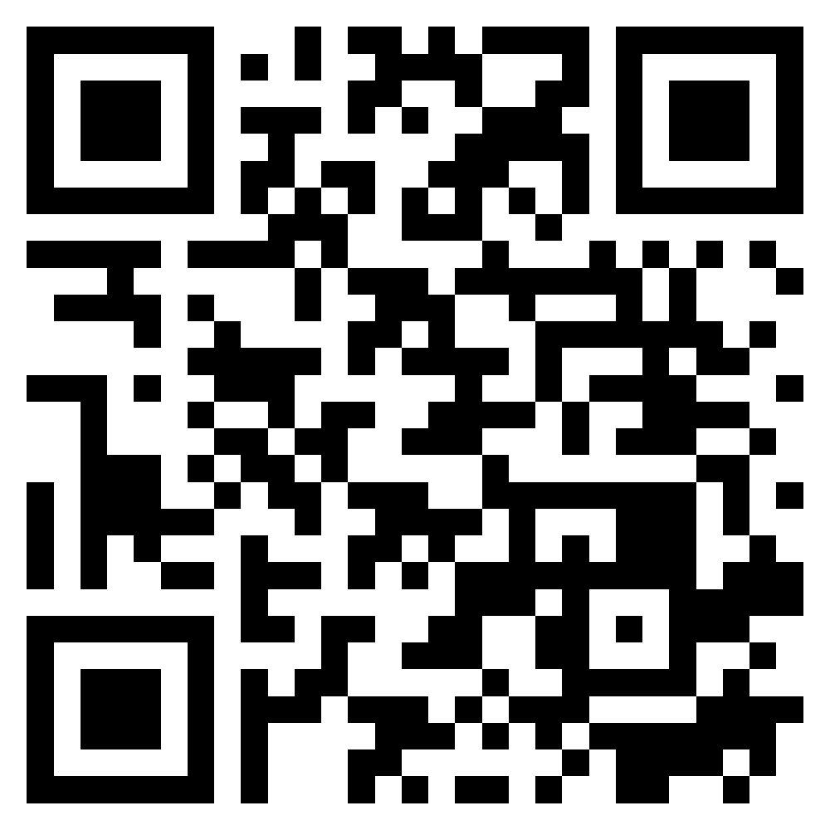
Security and Privacy; Reliable Programming; Testing: Test-driven development, and Code reviews; DevOps and Code Management: DevOps automation
Software Engineering
1112SE09
MBA, IM, NTPU (M5010) (Spring 2023) Wed 2, 3, 4 (9:10-12:00) (B8F40)
Min-Yuh Day, Ph.D, Associate Professor
Institute of Information Management, National Taipei University
https://web.ntpu.edu.tw/~myday
https://meet.google.com/ish-gzmy-pmo
2023-05-10

Slide 2
Syllabus
Week Date Subject/Topics
1 2023/02/22 Introduction to Software Engineering
2 2023/03/01 Software Products and Project Management: Software product management and prototyping
3 2023/03/08 Agile Software Engineering: Agile methods, Scrum, and Extreme Programming
4 2023/03/15 Features, Scenarios, and Stories
5 2023/03/22 Case Study on Software Engineering I
6 2023/03/29 Software Architecture: Architectural design, System decomposition, and Distribution architecture

Slide 3
Syllabus
Week Date Subject/Topics
7 2023/04/05 Tomb-Sweeping Day (Holiday, No Classes)
8 2023/04/12 Midterm Project Report
9 2023/04/19 Cloud-Based Software: Virtualization and containers, Everything as a service, Software as a service
10 2023/04/26 Cloud Computing and Cloud Software Architecture
11 2023/05/03 Microservices Architecture, RESTful services, Service deployment
12 2023/05/10 Security and Privacy; Reliable Programming; Testing: Test-driven development, and Code reviews; DevOps and Code Management: DevOps automation

Slide 4
Syllabus
Week Date Subject/Topics
13 2023/05/17 Industry Practices of Software Engineering
[Agile Principles Patterns and Practices using AI and ChatGPT, Invited Speaker: Shihyu (Alex) Chu, Division Director, Software Industry Research Center, Market Intelligence & Consulting Institute (MIC)]
14 2023/05/24 Case Study on Software Engineering II
15 2023/05/31 Final Project Report I
16 2023/06/07 Final Project Report II
17 2023/06/14 Self-learning
18 2023/06/21 Self-learning

Slide 5
Security and Privacy; Reliable Programming; Testing: Test-driven development, and Code reviews; DevOps and Code Management: DevOps automation

Slide 6
Software Engineering and Project Management
Analyze
Requirements definition
Design
System and Software design
Build
Implementation and
unit testing
Test
Integration and system testing
Deliver
Operation and maintenance
Project Management

Slide 7
Information Management (MIS) Information Systems
Organizations
Technology
Information Systems
Management

Slide 8
Fundamental MIS Concepts
Business Challenges
Management
Organization
Information System
Business Solutions
Technology

Slide 9
Project-based software engineering
CUSTOMER
Problem
generates
helps-with
Requirements
implemented-by
Software
1
CUSTOMER and DEVELOPER
DEVELOPER

Slide 10
Product software engineering
DEVELOPER
Opportunity
1
inspires
realizes
Product features
implemented-by
Software
DEVELOPER
DEVELOPER

Slide 11
Software execution models
Stand-alone execution
Hybrid execution
Software as a service
User’s computer
User’s computer
User’s computer
User interface
Product functionality
User data
User interface
Partial functionality
User data
User interface
(browser or app)
Product updates
Additional functionality
User data backups
Product updates
Product functionality
User data
Vendor’s servers
Vendor’s servers
Vendor’s servers

Slide 12
Product management concerns
Business needs
Product manager
Technology constraints
Customer experience

Slide 13
Technical interactions of product managers
Product vision management
Product backlog management
User stories and scenarios
Product manager
Acceptance testing
Customer testing
User interface design

Slide 14
Software Development Life Cycle (SDLC) The waterfall model
Requirements definition
System and Software design
Implementation and unit testing
Integration and system testing
Operation and maintenance

Slide 15
Plan-based and Agile development
Plan-based development
Requirements engineering
Requirements specification
Design and implementation
Requirements change requests
Agile development
Requirements engineering
Design and implementation

Slide 16
The Continuum of Life Cycles
High
Incremental
Agile
Frequency of Delivery
Predictive
Iterative
Low
Low
High
Degree of Change

Slide 17
Predictive Life Cycle
Analyze
Design
Build
Test
Deliver

Slide 18
Iterative Life Cycle
Prototype
Refine
Analyze
Analyze
Design
Build
Test
Deliver

Slide 19
A Life Cycle of Varying-Sized Increments
Analyze
Design
Build
Test
Deliver
Analyze
Design
Build
Test
Deliver
Analyze
Design
Build
Test
Deliver

Slide 20
Iteration-Based and Flow-Based Agile Life Cycles
Iteration-Based Agile
Requirements
Analysis
Design
Build
Test
Requirements
Analysis
Design
Build
Test
Requirements
Analysis
Design
Build
Test
Requirements
Analysis
Design
Build
Test
Repeat as needed
…
Requirements
Analysis
Design
Build
Test
Requirements
Analysis
Design
Build
Test
Flow-Based Agile
Requirements
Analysis
Design
Build
Test
the number of features in the WIP limit
Requirements
Analysis
Design
Build
Test
the number of features in the WIP limit
Requirements
Analysis
Design
Build
Test
the number of features in the WIP limit
Repeat as needed
…
Requirements
Analysis
Design
Build
Test
the number of features in the WIP limit
Requirements
Analysis
Design
Build
Test
the number of features in the WIP limit

Slide 21
From personas to features
1
Personas
A way of representing users
inspire
Natural language descriptions of a user interacting with a software product
2
Scenarios
are-developed-into
3
inspire
Stories
Natural language descriptions of something that is needed or wanted by users
4
Features
define
Fragments of product functionality

Slide 22
Multi-tier client-server architecture
Client 1
Client 2
Web Server
Application Server
Database Server
Client 3
Client …

Slide 23
Service-oriented Architecture
Client 1
S1
S2
Client 2
S3
Web Server
Service gateway
S4
Client 3
S5
Client …
S6
Services

Slide 24
VM
Container
Virtual web server
Virtual mail server
User 1 Container 1
User 2 Container 2
Server software
Server software
Application software
Application software
Guest OS
Guest OS
Server software
Server software
Hypervisor
Container manager
Host OS
Host OS
Server Hardware
Server Hardware

Slide 25
Everything as a service
Photo editing
Software as a service (SaaS)
Logistics management
Cloud management Monitoring
Platform as a service (PaaS)
Database
Software development
Storage Network
Infrastructure as a service (IaaS)
Computing Virtualization
Cloud data center

Slide 26
Software as a service
Software customers
Software provider
Software services
Cloud Infrastructure
Cloud provider

Slide 27
Microservices architecture – key design questions
What are the microservices that make up the system?
How should data be distributed and shared?
How should microservices communicate with each other?
Microservices architecture
design
How should the microservices in the system be coordinated?
How should service failure be detected, reported and managed?

Slide 28
Types of security threat
An attacker attempts to deny access to the system for legitimate users
An attacker attempts to damage the system or its data
Availability
threats
Integrity
threats
SOFTWARE PRODUCT
PROGRAM
Distributed denial of service (DDoS) attack
Virus
DATA
Ransomware
Data theft
Confidentiality threats
An attacker tries to gain access to private information held by the system

Slide 29
Software product quality attributes
Reliability
Availability
1
2
Software product quality attributes
Security
Resilience
7
3
Usability
Maintainability
6
4
Responsiveness
5

Slide 30
A refactoring process
1
2
Start
Identify code ‘smell’
Identify refactoring strategy
4
3
Run automated code tests
Make small
improvement until strategy completed

Slide 31
Functional testing
Start
1
Unit Testing
4
2
Release Testing
Feature Testing
3
System Testing

Slide 32
Test-driven development (TDD)
Start
1
Identify new functionality
2
Identify partial implementation
of functionality
3
Write code stub that will fail test
Functionality complete
Functionality incomplete
4
Run all automated test
7
Refactor code if required
5
Implement code that should cause failing test to pass
Test failure
6
Run all automated test
All tests pass

Slide 33
DevOps
Development
Deployment
Support
Multi-skilled DevOps team

Slide 34
Code management and DevOps
DevOps automation
Continuous integration
Continuous deployment
Continuous delivery
Infrastructure as code
Code management system
Branching and merging
Recover version information
Code repository
Save and retrieve versions
Transfer code to/from developer’s filestore
DevOps measurement
Data collection
Data analysis
Report generation

Slide 35
Security and Privacy

Slide 36
Outline
Security
Privacy

Slide 37
Software security
Software security should always be a high priority for product developers and their users.
If you don’t prioritize security, you and your customers will inevitably suffer losses from malicious attacks.
In the worst case, these attacks could can put product providers out of business.
If their product is unavailable or if customer data is compromised, customers are liable to cancel their subscriptions.
Even if they can recover from the attacks, this will take time and effort that would have been better spent working on their software.

Slide 38
Types of security threat
An attacker attempts to deny access to the system for legitimate users
An attacker attempts to damage the system or its data
Availability
threats
Integrity
threats
SOFTWARE PRODUCT
PROGRAM
Distributed denial of service (DDoS) attack
Virus
DATA
Ransomware
Data theft
Confidentiality threats
An attacker tries to gain access to private information held by the system

Slide 39
System infrastructure stack
Operational Environment
Application
Frameworks and application libraries
Browsers and messaging
System libraries
Database
Operating system
Software Infrastructure
Network

Slide 40
Security management
Authentication and authorization You should have authentication and authorization standards and procedures that ensure that all users have strong authentication and that they have properly access permissions properly.
System infrastructure management Infrastructure software should be properly configured and security updates that patch vulnerabilities should be applied as soon as they become available.
Attack monitoring The system should be regularly checked for possible unauthorized access. If attacks are detected, it may be possible to put resistance strategies in place that minimize the effects of the attack.
Backup Backup policies should be implemented to ensure that you keep undamaged copies of program and data files. These can then be restored after an attack.

Slide 41
Operational security
Operational security focuses on helping users to maintain security. User attacks try to trick users into disclosing their credentials or accessing a website that includes malware such as a key-logging system.
Operational security procedures and practices
Auto-logout, which addresses the common problem of users forgetting to logout from a computer used in a shared space.
User command logging, which makes it possible to discover actions taken by users that have deliberately or accidentally damaged some system resources.
Multi-factor authentication, which reduces the chances of an intruder gaining access to the system using stolen credentials.

Slide 42
Injection attacks
Injection attacks are a type of attack where a malicious user uses a valid input field to input malicious code or database commands.
These malicious instructions are then executed, causing some damage to the system. Code can be injected that leaks system data to the attackers.
Common types of injection attack include buffer overflow attacks and SQL poisoning attacks.

Slide 43
SQL poisoning attacks
SQL poisoning attacks are attacks on software products that use an SQL database.
They take advantage of a situation where a user input is used as part of an SQL command.
A malicious user uses a form input field to input a fragment of SQL that allows access to the database.
The form field is added to the SQL query, which is executed and returns the information to the attacker.

Slide 44
Cross-site scripting attacks
Cross-site scripting attacks are another form of injection attack.
An attacker adds malicious Javascript code to the web page that is returned from a server to a client and this script is executed when the page is displayed in the user’s browser.
The malicious script may steal customer information or direct them to another website.
This may try to capture personal data or display advertisements.
Cookies may be stolen, which makes a session hijacking attack possible.
As with other types of injection attack, cross-site scripting attacks may be avoided by input validation.

Slide 45
Cross-site scripting attack
1. Introduce malicious code
Product website
Attacker
Malicious code added to valid data
Browser
Website
3. Malware script sends session cookie to attacker
Valid request for data from website
Browser
2. Data delivered and malware script installed in victim’s browser
Victim

Slide 46
Session hijacking attacks
When a user authenticates themselves with a web application, a session is created.
A session is a time period during which the user’s authentication is valid. They don’t have to re-authenticate for each interaction with the system.
The authentication process involves placing a session cookie on the user’s device
Session hijacking is a type of attack where an attacker gets hold of a session cookie and uses this to impersonate a legitimate user.

Slide 47
Session hijacking attacks
There are several ways that an attacker can find out the session cookie value including cross-site scripting attacks and traffic monitoring.
In a cross-site scripting attack, the installed malware sends session cookies to the attackers.
Traffic monitoring involves attackers capturing the traffic between the client and server. The session cookie can then be identified by analyzing the data exchanged.

Slide 48
Actions to reduce the likelihood of hacking
Traffic encryption Always encrypt the network traffic between clients and your server. This means setting up sessions using https rather than http. If traffic is encrypted it is harder to monitor to find session cookies.
Multi-factor authentication Always use multi-factor authentication and require confirmation of new actions that may be damaging. For example, before a new payee request is accepted, you could ask the user to confirm their identity by inputting a code sent to their phone.
Short timeouts Use relatively short timeouts on sessions. If there has been no activity in a session for a few minutes, the session should be ended and future requests directed to an authentication page.

Slide 49
Authentication
Authentication is the process of ensuring that a user of your system is who they claim to be.
You need authentication in all software products that maintain user information, so that only the providers of that information can access and change it.
You also use authentication to learn about your users so that you can personalize their experience of using your product.

Slide 50
Authentication approaches
Authentication approach
Example
Knowledge
Password
Possession
Mobile
device
Authenticating user
Attribute
Fingerprint

Slide 51
Weaknesses of password-based authentication
Insecure passwords Users choose passwords that are easy to remember.
Phishing attacks Users click on an email link that points to a fake site that tries to collect their login and password details.
Password reuse Users use the same password for several sites.
Forgotten passwords Users regularly forget their passwords so that you need to set up a password recovery mechanism to allow these to be reset.

Slide 52
Federated identity
Federated identity is an approach to authentication where you use an external authentication service.
‘Login with Google’ and ‘Login with Facebook’ are widely used examples of authentication using federated identity.
The advantage of federated identity for a user is that they have a single set of credentials that are stored by a trusted identity service.
Instead of logging into a service directly, a user provides their credentials to a known service who confirms their identity to the authenticating service.
They don’t have to keep track of different user ids and passwords.

Slide 53
Federated identity
User
Service
Trusted authenticator
Request authentication
Deliver Request
Request credentials
Provide credentials
Return authentication token
Authentication response

Slide 54
Authorization
Authentication involves a user proving their identity to a software system.
Authorization is a complementary process in which that identity is used to control access to software system resources.
For example, if you use a shared folder on Dropbox, the folder’s owner may authorize you to read the contents of that folder, but not to add new files or overwrite files in the folder.
When a business wants to define the type of access that users get to resources, this is based on an access control policy.
This policy is a set of rules that define what information (data and programs) is controlled, who has access to that information and the type of access that is allowed

Slide 55
Access control policies
Explicit access control policies are important for both legal and technical reasons.
Data protection rules limit the access the personal data and this must be reflected in the defined access control policy.
If this policy is incomplete or does not conform to the data protection rules, then there may be subsequent legal action in the event of a data breach.
Technically, an access control policy can be a starting point for setting up the access control scheme for a system.
For example, if the access control policy defines the access rights of students, then when new students are registered, they all get these rights by default.

Slide 56
Access Control Lists (ACL)
Access control lists (ACLs) are used in most file and database systems to implement access control policies.
Access control lists are tables that link users with resources and specify what those users are permitted to do.
If access control lists are based on individual permissions, then these can become very large. However, you can dramatically cut their size by allocating users to groups and then assigning permissions to the group

Slide 57
Encryption
Encryption is the process of making a document unreadable by applying an algorithmic transformation to it.
A secret key is used by the encryption algorithm as the basis of this transformation. You can decode the encrypted text by applying the reverse transformation.
Modern encryption techniques are such that you can encrypt data so that it is practically uncrackable using currently available technology.
History has demonstrated that apparently strong encryption may be crackable when new technology becomes available.
If commercial quantum systems become available, we will have to use a completely different approach to encryption on the Internet.

Slide 58
Encryption and decryption
Secret key
Secret key
Plain text
Encrypt
Encrypted text
Decrypt
Plain text

Slide 59
Symmetric encryption
Alice
Bob
Encryption key
Encryption key
a7Dr6yYf9F…
a7Dr6yYf9F…
Encrypt
Decrypt
Secret message
Encrypted text
Secret message

Slide 60
Asymmetric encryption
Alice
Bob
Bob’s public key
Bob’s private key
dr5ts3TR9dt x4ztmRsYY…
hTr34BbfsDy 9r3g5HHt76…
Encrypt
Decrypt
Secret message
Encrypted text
Secret message

Slide 61
Encryption for authentication
Bob
Alice
Bob’s private key
Bob’s public key
hTr34BbfsDy 9r3g5HHt76…
dr5ts3TR9dt x4ztmRsYY…
Encrypt
Decrypt
I am really Bob
Encrypted text
I am really Bob

Slide 62
TLS and digital certificates
The https protocol is a standard protocol for securely exchanging texts on the web.
It is the standard http protocol plus an encryption layer called TLS (Transport Layer Security).
This encryption layer is used for 2 things:
to verify the identity of the web server;
to encrypt communications so that they cannot be read by an attacker who intercepts the messages between the client and the server

Slide 63
TLS and digital certificates
TLS encryption depends on a digital certificate that is sent from the web server to the client.
Digital certificates are issued by a certificate authority (CA), which is a trusted identity verification service.
The CA encrypts the information in the certificate using their private key to create a unique signature. This signature is included in the certificate along with the public key of the CA. To check that the certificate is valid, you can decrypt the signature using the CA’s public key.

Slide 64
Key management
Key management is the process of ensuring that encryption keys are securely generated, stored and accessed by authorized users.
Businesses may have to manage tens of thousands of encryption keys so it is impractical to do key management manually and you need to use some kind of automated key management system (KMS).

Slide 65
Digital certificates
Subject information Information about the company or individual whose web site is being visited. Applicants apply for a digital certificate from a certificate authority who checks that the applicant is a valid organization.
Certificate authority information Information about the certificate authority (CA) who has issued the certificate.
Certificate information Information about the certificate itself, including a unique serial number and a validity period, defined by start and end dates.

Slide 66
Digital certificates
Digital signature The combination of all of the above data uniquely identifies the digital certificate. The signature data is encrypted with the CA’s private key to confirm that the data is correct. The algorithm used to generate the digital signature is also specified.
Public key information The public key of the CA is included along with the key size and the encryption algorithm used. The public key may be used to decrypt the digital signature.

Slide 67
Data encryption
As a product provider you inevitably store information about your users and, for cloud-based products, user data.
Encryption can be used to reduce the damage that may occur from data theft. If information is encrypted, it is impossible, or very expensive, for thieves to access and use the unencrypted data.
Data in transit
Data at rest
Data in use

Slide 68
Encryption levels
Application
Database
Files
Media

Slide 69
Key management
Key management is important because, if you get it wrong, unauthorized users may be able to access your keys and so decrypt supposedly private data. Even worse, if you lose encryption keys, then your encrypted data may be permanently inaccessible.
A key management system (KMS) is a specialized database that is designed to securely store and manage encryption keys, digital certificates and other confidential information.

Slide 70
Using a KMS for encryption management
Application
Calls
Unencrypted data
API
Key
management
system (KMS)
Encryption
engine
Keys
Key store
Stored encrypted data

Slide 71
Long-term key storage
Business may be required by accounting and other regulations to keep copies of all of their data for several years.
For example, in the UK, tax and company data has to be maintained for at least six years, with a longer retention period for some types of data. Data protection regulations may require that this data be stored securely, so the data should be encrypted.
To reduce the risks of a security breach, encryption keys should be changed regularly. This means that archival data may be encrypted with a different key from the current data in your system.
Therefore, key management systems must maintain multiple, timestamped versions of keys so that system backups and archives can be decrypted if required.

Slide 72
Privacy
Privacy is a social concept that relates to the collection, dissemination and appropriate use of personal information held by a third-party such as a company or a hospital.
The importance of privacy has changed over time and individuals have their own views on what degree of privacy is important.
Culture and age also affect peoples’ views on what privacy means.
Younger people were early adopters of the first social networks and many of them seem to be less inhibited about sharing personal information on these platforms than older people.
In some countries, the level of income earned by an individual is seen as a private matter; in others, all tax returns are openly published.

Slide 73
Business reasons for privacy
If you are offering a product directly to consumers and you fail to conform to privacy regulations, then you may be subject to legal action by product buyers or by a data regulator. If your conformance is weaker than the protection offered by data protection regulations in some countries, you won’t be able to sell your product in these countries.
If your product is a business product, business customers require privacy safeguards so that they are not put at risk of privacy violations and legal action by users.
If personal information is leaked or misused, even if this is not seen as a violation of privacy regulations, this can lead to serious reputational damage. Customers may stop using your product because of this.

Slide 74
Data protection laws
In many countries, the right to individual privacy is protected by data protection laws.
These laws limit the collection, dissemination and use of personal data to the purposes for which it was collected.
For example, a travel insurance company may collect health information so that they can assess their level of risk. This is legal and permissible.
However, it would not be legal for those companies to use this information to target online advertising of health products, unless their users had given specific permission for this.

Slide 75
Data protection laws
Data protection law
Responsibilities of the data controller
Rights of
the data subject
Data storage
Data use
Security
Subject access
Data access
Error correction
Data deletion
Consent

Slide 76
Data protection principles
Awareness and control Users of your product must be made aware of what data is collected when they are using your product, and must have control over the personal information that you collect from them.
Purpose You must tell users why data is being collected and you must not use that data for other purposes.
Consent You must always have the consent of a user before you disclose their data to other people.
Data lifetime You must not keep data for longer than you need to. If a user deletes their account, you must delete the personal data associated with that account.

Slide 77
Data protection principles
Secure storage You must maintain data securely so that it cannot be tampered with or disclosed to unauthorized people.
Discovery and error correction You must allow users to find out what personal data that you store. You must provide a way for users to correct errors in their personal data.
Location You must not store data in countries where weaker data protection laws apply unless there is an explicit agreement that the stronger data protection rules will be upheld.

Slide 78
Privacy policy
You should to establish a privacy policy that defines how personal and sensitive information about users is collected, stored and managed.
Software products use data in different ways, so your privacy policy has to define the personal data that you will collect and how you will use that data.
Product users should be able to review your privacy policy and change their preferences regarding the information that you store.

Slide 79
Privacy policy
Your privacy policy is a legal document and it should be auditable to check that it is consistent with the data protection laws in countries where your software is sold.
Privacy policies should not be expressed to users in a long ‘terms and conditions’ document that, in practice, nobody reads.
The General Data Protection Regulation (GDPR) now require software companies to include a summary of their privacy policy, written in plain language rather than legal jargon, on their website.

Slide 80
Summary
Security is a technical concept that relates to a software system’s ability to protect itself from malicious attacks that may threaten its availability, the integrity of the system and/or its data, and the theft of confidential information.
Common types of attack on software products include
injection attacks,
cross-site scripting attacks,
session hijacking attacks,
denial of service attacks and
brute force attacks.

Slide 81
Summary
Authentication may be based on something a user knows, something a user has, or some physical attribute of the user.
Federated authentication involves devolving responsibility for authentication to a third-party such as Facebook or Google, or to a business’s authentication service.
Authorization involves controlling access to system resources based on the user’s authenticated identity. Access control lists are the most commonly-used mechanism to implement authorization.

Slide 82
Summary
Symmetric encryption involves encrypting and decrypting information with the same secret key.
Asymmetric encryption uses a key pair – a private key and a public key. Information encrypted using the public key can only be decrypted using the private key.
A major issue in symmetric encryption is key exchange.
The Transport Layer Security (TLS) protocol, which is used to secure web traffic, gets around this problem by using asymmetric encryption for transferring information used to generate a shared key.

Slide 83
Summary
If your product stores sensitive user data, you should encrypt that data when it is not in use.
A key management system (KMS) stores encryption keys. Using a KMS is essential because a business may have to manage thousands or even millions of keys and may have to decrypt historic data that was encrypted using an obsolete encryption key.

Slide 84
Summary
Privacy is a social concept that relates to how people feel about the release of their personal information to others. Different countries and cultures have different ideas on what information should and should not be private.
Data protection laws have been made in many countries to protect individual privacy. They require companies who manage user data to store it securely, to ensure that it is not used or sold without the permission of users, and to allow users to view and correct personal data held by the system.

Slide 85
Reliable Programming

Slide 86
Outline
Software quality
Programming for reliability
Design pattern
Refactoring

Slide 87
Software quality
Creating a successful software product does not simply mean providing useful features for users.
You need to create a high-quality product that people want to use.
Customers have to be confident that your product will not crash or lose information, and users have to be able to learn to use the software quickly and without mistakes.

Slide 88
Software product quality attributes
Reliability
Availability
1
2
Software product quality attributes
Security
Resilience
7
3
Usability
Maintainability
6
4
Responsiveness
5

Slide 89
Programming for reliability
There are three simple techniques for reliability improvement that can be applied in any software company.
Fault avoidance: You should program in such a way that you avoid introducing faults into your program.
Input validation: You should define the expected format for user inputs and validate that all inputs conform to that format.
Failure management: You should implement your software so that program failures have minimal impact on product users.

Slide 90
Underlying causes of program errors
Programmers make mistakes because they don’t properly understand the problem or the application domain
Programmers make mistakes because they use unsuitable technology or they don’t properly understand the technologies used
Problem
Technology
Programming language, libraries, database, IDE, etc.
Program
Programmers make mistakes because they make simple slips or they do not completely understand how multiple program components work together the program’s state.

Slide 91
Software complexity
The shaded node interacts, in some ways, with the linked nodes shown by the dotted line

Slide 92
Program complexity
Complexity is related to the number of relationships between elements in a program and the type and nature of these relationships
The number of relationships between entities is called the coupling. The higher the coupling, the more complex the system.
The shaded node has a relatively high coupling because it has relationships with six other nodes.

Slide 93
Software complexity
A static relationship is one that is stable and does not depend on program execution.
Whether or not one component is part of another component is a static relationship.
Dynamic relationships, which change over time, are more complex than static relationships.
An example of a dynamic relationship is the ‘calls’ relationship between functions.

Slide 94
Types of complexity
Reading complexity
This reflects how hard it is to read and understand the program.
Structural complexity
This reflects the number and types of relationship between the structures (classes, objects, methods or functions) in your program.
Data complexity
This reflects the representations of data used and relationships between the data elements in your program.
Decision complexity
This reflects the complexity of the decisions in your program

Slide 95
Complexity reduction guidelines
Structural complexity
Functions should do one thing and one thing only
Functions should never have side-effects
Every class should have a single responsibility
Minimize the depth of inheritance hierarchies
Avoid multiple inheritance
Avoid threads (parallelism) unless absolutely necessary

Slide 96
Complexity reduction guidelines
Data complexity
Define interfaces for all abstractions
Define abstract data types
Avoid using floating-point numbers
Never use data aliases

Slide 97
Complexity reduction guidelines
Conditional complexity
Avoid deeply nested conditional statements
Avoid complex conditional expressions

Slide 98
Ensure that every class has a single responsibility
You should design classes so that there is only a single reason to change a class.
If you adopt this approach, your classes will be smaller and more cohesive.
They will therefore be less complex and easier to understand and change.
The single responsibility principle
Gather together the things that change for the same reasons.
Separate those things that change for different reasons

Slide 99
The DeviceInventory class
DeviceInventory
DeviceInventory
laptops
tablets
phones
device_assignment
laptops
tablets
phones
device_assignment
addDevice
removeDevice
assignDevice
unassignDevice
getDeviceAssignment
addDevice
removeDevice
assignDevice
unassignDevice
getDeviceAssignment
printInventory
(a)
(b)

Slide 100
Adding a printInventory method
One way of making this change is to add a printInventory method
This change breaks the single responsibility principle as it then adds an additional ‘reason to change’ the class.
Instead of adding a printInventory method to DeviceInventory, it is better to add a new class to represent the printed report.

Slide 101
The DeviceInventory and InventoryReport classes
DeviceInventory
InventoryReport
laptops
tablets
phones
device_assignment
report_data
report_format
addDevice
removeDevice
assignDevice
unassignDevice
getDeviceAssignment
updateData
updateFormat
print

Slide 102
Avoid deeply nested conditional statements
Deeply nested conditional (if) statements are used when you need to identify which of a possible set of choices is to be made.
For example, the function ‘agecheck’ is a short Python function that is used to calculate an age multiplier for insurance premiums.
The insurance company’s data suggests that the age and experience of drivers affects the chances of them having an accident, so premiums are adjusted to take this into account.
It is good practice to name constants rather than using absolute numbers, so Program names all constants that are used.

Slide 103
Deeply nested if-then-else statements
YOUNG_DRIVER_AGE_LIMIT = 25 OLDER_DRIVER_AGE = 70 ELDERLY_DRIVER_AGE = 80
YOUNG_DRIVER_PREMIUM_MULTIPLIER = 2 OLDER_DRIVER_PREMIUM_MULTIPLIER = 1.5 ELDERLY_DRIVER_PREMIUM_MULTIPLIER = 2 YOUNG_DRIVER_EXPERIENCE_MULTIPLIER = 2 NO_MULTIPLIER = 1
YOUNG_DRIVER_EXPERIENCE = 2 OLDER_DRIVER_EXPERIENCE = 5
def agecheck(age, experience):
# Assigns a premium multiplier depending on the age and experience of the driver multiplier = NO_MULTIPLIER
if age <= YOUNG_DRIVER_AGE_LIMIT:
if experience <= YOUNG_DRIVER_EXPERIENCE:
multiplier = YOUNG_DRIVER_PREMIUM_MULTIPLIER * YOUNG_DRIVER_EXPERIENCE_MULTIPLIER
else:
multiplier = YOUNG_DRIVER_PREMIUM_MULTIPLIER
else:
if age > OLDER_DRIVER_AGE and age <= ELDERLY_DRIVER_AGE:
if experience <= OLDER_DRIVER_EXPERIENCE:
multiplier = OLDER_DRIVER_PREMIUM_MULTIPLIER
else:
multiplier = NO_MULTIPLIER
else:
if age > ELDERLY_DRIVER_AGE:
multiplier = ELDERLY_DRIVER_PREMIUM_MULTIPLIER
return multiplier

Slide 104
Using guards to make a selection
def agecheck_with_guards(age, experience):
if age <= YOUNG_DRIVER_AGE_LIMIT and experience <= YOUNG_DRIVER_EXPERIENCE:
return YOUNG_DRIVER_PREMIUM_MULTIPLIER * YOUNG_DRIVER_EXPERIENCE_MULTIPLIER
if age <= YOUNG_DRIVER_AGE_LIMIT:
return YOUNG_DRIVER_PREMIUM_MULTIPLIER
if (age > OLDER_DRIVER_AGE and age <= ELDERLY_DRIVER_AGE) and experience <= OLDER_DRIVER_EXPERIENCE:
return OLDER_DRIVER_PREMIUM_MULTIPLIER
if age > ELDERLY_DRIVER_AGE:
return ELDERLY_DRIVER_PREMIUM_MULTIPLIER
return NO_MULTIPLIER

Slide 105
Avoid deep inheritance hierarchies
Inheritance allows the attributes and methods of a class, such as RoadVehicle, can be inherited by sub-classes, such as Truck, Car and MotorBike.
Inheritance appears to be an effective and efficient way of reusing code and of making changes that affect all subclasses.
However, inheritance increases the structural complexity of code as it increases the coupling of subclasses.
The problem with deep inheritance is that if you want to make changes to a class, you have to look at all of its superclasses to see where it is best to make the change.
You also have to look at all of the related subclasses to check that the change does not have unwanted consequences. It’s easy to make mistakes when you are doing this analysis and introduce faults into your program.

Slide 106
Part of the inheritance hierarchy for hospital staff
Hospital staff
Technicians
Paramedics
Clinical staff
Scientist
Ancillary staff
Admin staff
Doctor
Nurse
Physiotherapist
Midwife
Ward nurse
Nurse
Manager

Slide 107
Design pattern definition
Definition
A general reusable solution to a commonly-occurring problem within a given context in software design.

Slide 108
Design pattern
Design patterns are object-oriented and describe solutions in terms of objects and classes.
They are not off-the-shelf solutions that can be directly expressed as code in an object-oriented language.
They describe the structure of a problem solution but have to be adapted to suit your application and the programming language that you are using.

Slide 109
Programming principles
Separation of concerns
This means that each abstraction in the program (class, method, etc.) should address a separate concern and that all aspects of that concern should be covered there.
Separate the ‘what’ from the ‘how
If a program component provides a particular service, you should make available only the information that is required to use that service (the ‘what’). The implementation of the service (‘the how’) should be of no interest to service users.

Slide 110
Common types of design patterns
Creational patterns
These are concerned with class and object creation. They define ways of instantiating and initializing objects and classes that are more abstract than the basic class and object creation mechanisms defined in a programming language.
Structural patterns
These are concerned with class and object composition. Structural design patterns are a description of how classes and objects may be combined to create larger structures.
Behavioural patterns
These are concerned with class and object communication. They show how objects interact by exchanging messages, the activities in a process and how these are distributed amongst the participating objects.

Slide 111
Pattern description
Design patterns are usually documented in the stylized way. This includes:
a meaningful name for the pattern and a brief description of what it does;
a description of the problem it solves;
a description of the solution and its implementation;
the consequences and trade-offs of using the pattern and other issues that you should consider.

Slide 112
Refactoring
Refactoring means changing a program to reduce its complexity without changing the external behaviour of that program.
Refactoring makes a program more readable (so reducing the ‘reading complexity’) and more understandable.
It also makes it easier to change, which means that you reduce the chances of making mistakes when you introduce new features.

Slide 113
Refactoring
The reality of programming is that as you make changes and additions to existing code, you inevitably increase its complexity.
The code becomes harder to understand and change.
The abstractions and operations that you started with become more and more complex because you modify them in ways that you did not originally anticipate.

Slide 114
A refactoring process
1
2
Start
Identify code ‘smell’
Identify refactoring strategy
4
3
Run automated code tests
Make small
improvement until strategy completed

Slide 115
Code smells
The starting point for refactoring should be to identify code ‘smells’.
Code smells are indicators in the code that there might be a deeper problem.
For example, very large classes may indicate that the class is trying to do too much. This probably means that its structural complexity is high.

Slide 116
Examples of code smells
Large classes Large classes may mean that the single responsibility principle is being violated. Break down large classes into easier-to-understand, smaller classes.
Long methods/functions Long methods or functions may indicate that the function is doing more than one thing. Split into smaller, more specific functions or methods.

Slide 117
Examples of code smells
Duplicated code Duplicated code may mean that when changes are needed, these have to be made everywhere the code is duplicated. Rewrite to create a single instance of the duplicated code that is used as required
Meaningless names Meaningless names are a sign of programmer haste. They make the code harder to understand. Replace with meaningful names and check for other shortcuts that the programmer may have taken.

Slide 118
Examples of code smells
Unused code This simply increases the reading complexity of the code. Delete it even if it has been commented out. If you find you need it later, you should be able to retrieve it from the code management system.

Slide 119
Examples of refactoring for complexity reduction
Reading complexity You can rename variable, function and class names throughout your program to make their purpose more obvious.
Structural complexity You can break long classes or functions into shorter units that are likely to be more cohesive than the original large class.

Slide 120
Examples of refactoring for complexity reduction
Data complexity You can simplify data by changing your database schema or reducing its complexity. For example, you can merge related tables in your database to remove duplicated data held in these tables.
Decision complexity You can replace a series of deeply nested if-then-else statements with guard clauses.

Slide 121
Exception handling
Exceptions are events that disrupt the normal flow of processing in a program.
When an exception occurs, control is automatically transferred to exception management code.
Most modern programming languages include a mechanism for exception handling.
In Python, you use **try-except** keywords to indicate exception handling code; in Java, the equivalent keywords are **try-catch.**

Slide 122
Exception handling
Executing code
Normal processing
Exception raised
Normal processing
Exit
Exception-handling block
Exception-handling code
Exception re-raised or abnormal exit

Slide 123
Python try: except: finally:
try:
f = open(”file1.txt")
f.write(”Hello World")
except:
print(”writing file error!")
finally:
f.close()

Slide 124
Auto-save and activity logging
Auto-save
Command
logger
Last saved state
Command executed
Crash
recovery
Restored state

Slide 125
Summary
The most important quality attributes for most software products are reliability, security, availability, usability, responsiveness and maintainability.
To avoid introducing faults into your program, you should use programming practices that reduce the probability that you will make mistakes.
You should always aim to minimize complexity in your programs. Complexity makes programs harder to understand. It increases the chances of programmer errors and makes the program more difficult to change.

Slide 126
Summary
Design patterns are tried and tested solutions to commonly occurring problems. Using patterns is an effective way of reducing program complexity.
Refactoring is the process of reducing the complexity of an existing program without changing its functionality. It is good practice to refactor your program regularly to make it easier to read and understand.
Input validation involves checking all user inputs to ensure that they are in the format that is expected by your program. Input validation helps avoid the introduction of malicious code into your system and traps user errors that can pollute your database.

Slide 127
Summary
Regular expressions are a way of defining patterns that can match a range of possible input strings. Regular expression matching is a compact and fast way of checking that an input string conforms to the rules you have defined.
You should check that numbers have sensible values depending on the type of input expected. You should also check number sequences for feasibility.
You should assume that your program may fail and to manage these failures so that they have minimal impact on the user.

Slide 128
Summary
Exception management is supported in most modern programming languages. Control is transferred to your own exception handler to deal with the failure when a program exception is detected.
You should log user updates and maintain user data snapshots as your program executes. In the event of a failure, you can use these to recover the work that the user has done. You should also include ways of recognizing and recovering from external service failures.

Slide 129
Testing: Functional testing, Test automation, Test-driven development, and Code reviews

Slide 130
Outline
Software testing
Functional testing
Test automation
Test-driven development
Code reviews

Slide 131
Software testing
Software testing is a process in which you execute your program using data that simulates user inputs.
You observe its behaviour to see whether or not your program is doing what it is supposed to do.
Tests pass if the behaviour is what you expect. Tests fail if the behaviour differs from that expected.
If your program does what you expect, this shows that for the inputs used, the program behaves correctly.
If these inputs are representative of a larger set of inputs, you can infer that the program will behave correctly for all members of this larger input set.

Slide 132
Program bugs
If the behaviour of the program does not match the behaviour that you expect, then this means that there are bugs in your program that need to be fixed.
There are two causes of program bugs:
Programming errors
You have accidentally included faults in your program code. For example: ‘off-by-1’ error
Understanding errors
You have misunderstood or have been unaware of some of the details of what the program is supposed to do.

Slide 133
Types of testing
Functional testing
Test the functionality of the overall system.
User testing
Test that the software product is useful to and usable by end-users.
Performance and load testing
Test that the software works quickly and can handle the expected load placed on the system by its users.
Security testing
Test that the software maintains its integrity and can protect user information from theft and damage.

Slide 134
Functional testing
Functional testing involves developing a large set of program tests so that, ideally, all of a program’s code is executed at least once.
The number of tests needed obviously depends on the size and the functionality of the application.
For a business-focused web application, you may have to develop thousands of tests to convince yourself that your product is ready for release to customers.

Slide 135
Functional testing
Functional testing is a staged activity in which you initially test individual units of code. You integrate code units with other units to create larger units then do more testing.
The process continues until you have created a complete system ready for release.

Slide 136
Functional testing
Start
1
Unit Testing
4
2
Release Testing
Feature Testing
3
System Testing

Slide 137
A name checking function
def namecheck(s):
# Checks that a name only includes alphabetic characters, - or
# a single quote. Names must be between 2 and 40 characters long
# quoted strings and -- are disallowed
namex = r"^[a-zA-Z][a-zA-Z-']{1,39}$"
if re.match(namex, s):
if re.search("'.*'", s) or re.search("--", s):
return False
else:
return True
else:
return False

Slide 138
Equivalence partitions for the name checking function
Correct names 1 The inputs only includes alphabetic characters and are between 2 and 40 characters long.
Correct names 2 The inputs only includes alphabetic characters, hyphens or apostrophes and are between 2 and 40 characters long.
Incorrect names 1 The inputs are between 2 and 40 characters long but include disallowed characters.
Incorrect names 2 The inputs include allowed characters but are either a single character or are more than 40 characters long.

Slide 139
Unit testing guidelines (1)
Test edge cases If your partition has upper and lower bounds (e.g. length of strings, numbers, etc.) choose inputs at the edges of the range.
Force errors Choose test inputs that force the system to generate all error messages. Choose test inputs that should generate invalid outputs.
Fill buffers Choose test inputs that cause all input buffers to overflow.
Repeat yourself Repeat the same test input or series of inputs several times.

Slide 140
Unit testing guidelines (2)
Overflow and underflow If your program does numeric calculations, choose test inputs that cause it to calculate very large or very small numbers.
Don’t forget null and zero If your program uses pointers or strings, always test with null pointers and strings.
Keep count When dealing with lists and list transformation, keep count of the number of elements in each list and check that these are consistent after each transformation.
One is different If your program deals with sequences, always test with sequences that have a single value.

Slide 141
Feature testing
Features have to be tested to show that the functionality is implemented as expected and that the functionality meets the real needs of users.
For example, if your product has a feature that allows users to login using their Google account, then you have to check that this registers the user correctly and informs them of what information will be shared with Google.
You may want to check that it gives users the option to sign up for email information about your product.

Slide 142
Feature testing
Normally, a feature that does several things is implemented by multiple, interacting, program units.
These units may be implemented by different developers and all of these developers should be involved in the feature testing process.

Slide 143
Types of feature test
Interaction tests
These test the interactions between the units that implement the feature. The developers of the units that are combined to make up the feature may have different understandings of what is required of that feature.
These misunderstandings will not show up in unit tests but may only come to light when the units are integrated.
The integration may also reveal bugs in program units, which were not exposed by unit testing.
Usefulness tests
These test that the feature implements what users are likely to want.

Slide 144
User stories for the sign-in with Google feature
User registration As a user, I want to be able to login without creating a new account so that I don’t have to remember another login id and password.
Information sharing As a user, I want to know what information you will share with other companies. I want to be able to cancel my registration if I don’t want to share this information.
Email choice As a user, I want to be able to choose the types of email that I’ll get from you when I register for an account.

Slide 145
Feature tests for sign-in with Google
Initial login screen Test that the screen displaying a request for Google account credentials is correctly displayed when a user clicks on the ‘Sign-in with Google’ link. Test that the login is completed if the user is already logged in to Google.
Incorrect credentials Test that the error message and retry screen is displayed if the user inputs incorrect Google credentials.

Slide 146
Feature tests for sign-in with Google
Shared information Test that the information shared with Google is displayed, along with a cancel or confirm option. Test that the registration is cancelled if the cancel option is chosen.
Email opt-in Test that the user is offered a menu of options for email information and can choose multiple items to opt-in to emails. Test that the user is not registered for any emails if no options are selected.

Slide 147
System and release testing
System testing involves testing the system as a whole, rather than the individual system features.

Slide 148
System testing
System testing should focus on four things:
Testing to discover if there are unexpected and unwanted interactions between the features in a system.
Testing to discover if the system features work together effectively to support what users really want to do with the system.
Testing the system to make sure it operates in the expected way in the different environments where it will be used.
Testing the responsiveness, throughput, security and other quality attributes of the system.

Slide 149
Scenario-based testing
The best way to systematically test a system is to start with a set of scenarios that describe possible uses of the system and then work through these scenarios each time a new version of the system is created.
Using the scenario, you identify a set of end-to-end pathways that users might follow when using the system.
An end-to-end pathway is a sequence of actions from starting to use the system for the task, through to completion of the task.

Slide 150
Choosing a holiday destination End-to-end pathways
User inputs departure airport and chooses to see only direct flights. User quits.
User inputs departure airport and chooses to see all flights. User quits.
User chooses destination country and chooses to see all flights. User quits.
User inputs departure airport and chooses to see direct flights. User sets filter specifying departure times and prices. User quits.
User inputs departure airport and chooses to see direct flights. User sets filter specifying departure times and prices. User selects a displayed flight and clicks through to airline website. User returns to holiday planner after booking flight.

Slide 151
Release testing
Release testing is a type of system testing where a system that’s intended for release to customers is tested.
Preparing a system for release involves packaging that system for deployment (e.g. in a container if it is a cloud service) and installing software and libraries that are used by your product.
You must define configuration parameters such as the name of a root directory, the database size limit per user and so on.

Slide 152
Release testing and System testing
The fundamental differences between release testing and system testing are:
Release testing tests the system in its real operational environment rather than in a test environment. Problems commonly arise with real user data, which is sometimes more complex and less reliable than test data.
The aim of release testing is to decide if the system is good enough to release, not to detect bugs in the system. Therefore, some tests that ‘fail’ may be ignored if these have minimal consequences for most users.

Slide 153
Test automation
Automated testing is based on the idea that tests should be executable.
An executable test includes the input data to the unit that is being tested, the expected result and a check that the unit returns the expected result.
You run the test and the test passes if the unit returns the expected result.
Normally, you should develop hundreds or thousands of executable tests for a software product.

Slide 154
Automated testing
Files of executable tests
Code being tested
Test runner
Testing framework
Test Report

Slide 155
Test methods for an interest calculator
# TestInterestCalculator inherits attributes and methods from the class
# TestCase in the testing framework unittest
class TestInterestCalculator(unittest.TestCase):
# Define a set of unit tests where each test tests one thing only
# Tests should start with test_ and the name should explain what is being tested
def test_zeroprincipal(self):
#Arrange - set up the test parameters
p = 0; r = 3; n = 31
result_should_be = 0
#Action - Call the method to be tested
interest = interest_calculator (p, r, n)
#Assert - test what should be true
self.assertEqual(result_should_be, interest)
def test_yearly_interest(self):
#Arrange - set up the test parameters
p = 17000; r = 3; n = 365
#Action - Call the method to be tested
result_should_be = 270.36
interest = interest_calculator(p, r, n)
#Assert - test what should be true
self.assertEqual(result_should_be, interest)

Slide 156
Automated tests
It is good practice to structure automated tests into three parts:
Arrange
You set up the system to run the test. This involves defining the test parameters and, if necessary, mock objects that emulate the functionality of code that has not yet been developed.
Action
You call the unit that is being tested with the test parameters.
Assert
You make an assertion about what should hold if the unit being tested has executed successfully. AssertEquals: checks if its parameters are equal.

Slide 157
Executable tests for the namecheck function (1)
import unittest
from RE_checker import namecheck
class TestNameCheck (unittest.TestCase):
def test_alphaname (self):
self.assertTrue (namecheck ('Sommerville'))
def test_doublequote (self):
self.assertFalse (namecheck ("Thisis'maliciouscode'"))
def test_namestartswithhyphen (self):
self.assertFalse (namecheck ('-Sommerville'))
def test_namestartswithquote (self):
self.assertFalse (namecheck ("'Reilly"))
def test_nametoolong (self):
self.assertFalse (namecheck ('Thisisalongstringwithmorethen40charactersfrombeginningtoend'))
def test_nametooshort (self):
self.assertFalse (namecheck ('S'))

Slide 158
Executable tests for the namecheck function (2)
def test_namewithdigit (self):
self.assertFalse (namecheck('C-3PO'))
def test_namewithdoublehyphen (self):
self.assertFalse (namecheck ('--badcode’))
def test_namewithhyphen (self):
self.assertTrue (namecheck ('Washington-Wilson'))
def test_namewithinvalidchar (self):
self.assertFalse (namecheck('Sommer_ville'))
def test_namewithquote (self):
self.assertTrue (namecheck ("O'Reilly"))
def test_namewithspaces (self):
self.assertFalse (namecheck ('Washington Wilson'))
def test_shortname (self):
self.assertTrue ('Sx')
def test_thiswillfail (self)
self.assertTrue (namecheck ("O Reilly"))

Slide 159
Code to run unit tests from files
import unittest
loader = unittest.TestLoader()
#Find the test files in the current directory
tests = loader.discover('.')
#Specify the level of information provided by the test runner
testRunner = unittest.runner.TextTestRunner(verbosity=2)
testRunner.run(tests)

Slide 160
The test pyramid
Increased automation
Reduced costs
System tests
Feature tests
Unit tests

Slide 161
Feature editing through an API
Browser or mobile app interface
Feature tests
API
Feature 1
Feature 2
Feature 3
Feature 4

Slide 162
Interaction recording and playback
Browser or mobile app interface
User action recording
Interaction session records
User action playback
System API
System being tested

Slide 163
Test-driven development (TDD)
Test-driven development (TDD) is an approach to program development that is based around the general idea that you should write an executable test or tests for code that you are writing before you write the code.
It was introduced by early users of the Extreme Programming agile method, but it can be used with any incremental development approach.
Test-driven development works best for the development of individual program units and it is more difficult to apply to system testing.
Even the strongest advocates of TDD accept that it is challenging to use this approach when you are developing and testing systems with graphical user interfaces.

Slide 164
Test-driven development (TDD)
Start
1
Identify new functionality
2
Identify partial implementation
of functionality
3
Write code stub that will fail test
Functionality complete
Functionality incomplete
4
Run all automated test
7
Refactor code if required
5
Implement code that should cause failing test to pass
Test failure
6
Run all automated test
All tests pass

Slide 165
Stages of test-driven development
Identify partial implementation Break down the implementation of the functionality required into smaller mini-units. Choose one of these mini-units for implementation.
Write mini-unit tests Write one or more automated tests for the mini-unit that you have chosen for implementation. The mini-unit should pass these tests if it is properly implemented.
Write a code stub that will fail test Write incomplete code that will be called to implement the mini-unit. You know this will fail.
Run all existing automated tests All previous tests should pass. The test for the incomplete code should fail.

Slide 166
Stages of test-driven development
Implement code that should cause the failing test to pass Write code to implement the mini-unit, which should cause it to operate correctly
Rerun all automated tests If any tests fail, your code is probably incorrect. Keep working on it until all tests pass.
Refactor code if necessary If all tests pass, you can move on to implementing the next mini-unit. If you see ways of improving your code, you should do this before the next stage of implementation.

Slide 167
Benefits of test-driven development
It is a systematic approach to testing in which tests are clearly linked to sections of the program code.
This means you can be confident that your tests cover all of the code that has been developed and that there are no untested code sections in the delivered code.
The tests act as a written specification for the program code. In principle at least, it should be possible to understand what the program does by reading the tests.
Debugging is simplified because, when a program failure is observed, you can immediately link this to the last increment of code that you added to the system.
TDD leads to simpler code as programmers only write code that’s necessary to pass tests. They don’t over-engineer their code with complex features that aren’t needed.

Slide 168
Reasons for not using TDD
TDD discourages radical program change
I focused on the tests rather than the problem I was trying to solve
I spent too much time thinking about implementation details rather than the programming problem
It is hard to write ‘bad data’ tests

Slide 169
Security testing
Security testing aims to find vulnerabilities that may be exploited by an attacker and to provide convincing evidence that the system is sufficiently secure.
The tests should demonstrate that the system can resist attacks on its availability, attacks that try to inject malware and attacks that try to corrupt or steal users’ data and identity.
Comprehensive security testing requires specialist knowledge of software vulnerabilities and approaches to testing that can find these vulnerabilities.

Slide 170
Risk-based security testing
A risk-based approach to security testing involves identifying common risks and developing tests to demonstrate that the system protects itself from these risks.
You may also use automated tools that scan your system to check for known vulnerabilities, such as unused HTTP ports being left open.
Based on the risks that have been identified, you then design tests and checks to see if the system is vulnerable.
It may be possible to construct automated tests for some of these checks, but others inevitably involve manual checking of the system’s behaviour and its files.

Slide 171
Risk analysis
Once you have identified security risks, you then analyze them to assess how they might arise.
The user has set weak passwords that can be guessed by an attacker.
The system’s password file has been stolen and passwords discovered by attacker.
Develop tests to check some of these possibilities.
For example, you might run a test to check that the code that allows users to set their passwords always checks the strength of passwords.

Slide 172
Code reviews
Code reviews involve one or more people examining the code to check for errors and anomalies and discussing issues with the developer.
If problems are identified, it is the developer’s responsibility to change the code to fix the problems.
Code reviews complement testing. They are effective in finding bugs that arise through misunderstandings and bugs that may only arise when unusual sequences of code are executed.
Many software companies insist that all code has to go through a process of code review before it is integrated into the product codebase.

Slide 173
Code reviews
Programmer
Reviewer
Programmer
Setup review
Check code
Reviewer
Prepare to-do list
Discussion
Prepare code
Write review report
Make code Changes
Distribute code/tests
Review preparation
Code checking
Review
Follow-up

Slide 174
Summary
The aim of program testing is to find bugs and to show that a program does what its developers expect it to do.
Four types of testing that are relevant to software products are functional testing, user testing, load and performance testing and security testing.
Unit testing involves testing program units such as functions or class methods that have a single responsibility.
Feature testing focuses on testing individual system features.

Slide 175
Summary
System testing tests the system as a whole to check for unwanted interactions between features and between the system and its environment.
Identifying equivalence partitions, in which all inputs have the same characteristics, and choosing test inputs at the boundaries of these partitions, is an effective way of finding bugs in a program.
User stories may be used as a basis for deriving feature tests.

Slide 176
Summary
Test automation is based on the idea that tests should be executable. You develop a set of executable tests and run these each time you make a change to a system.
The structure of an automated unit test should be arrange-action-assert. You set up the test parameters, call the function or method being tested, and make an assertion of what should be true after the action has been completed.

Slide 177
Summary
Test-driven development is an approach to development where executable tests are written before the code. Code is then developed to pass the tests.
A disadvantage of test-driven development is that programmers focus on the detail of passing tests rather than considering the broader structure of their code and algorithms used.

Slide 178
Summary
Security testing may be risk driven where a list of security risks is used to identify tests that may identify system vulnerabilities.
Code reviews are an effective supplement to testing. They involve people checking the code to comment on the code quality and to look for bugs.

Slide 179
DevOps and Code Management: Code management and DevOps automation

Slide 180
Outline
Source code management
DevOps automation
DevOps measurement

Slide 181
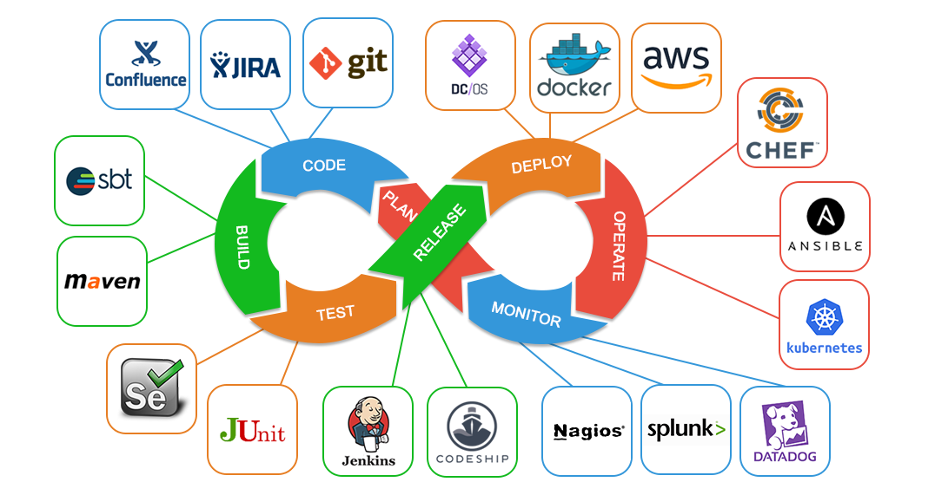
DevOps
Dev
Ops

Slide 182
Evaluating the Code Quality of AI-Assisted Code Generation Tools: An Empirical Study on GitHub Copilot, Amazon CodeWhisperer, and ChatGPT

Slide 183
AI-Assisted Code Generation Tools: GitHub Copilot, Amazon CodeWhisperer, and ChatGPT
RQ1 What is the quality of the code generated by the code generation tools?
RQ1.1 How valid are the code generation tools’ code suggestions?
RQ1.2 How correct are code generation tools’ code suggestions?
RQ1.3 How secure are code generation tools’ code suggestions?
RQ1.4 How reliable are code generation tools’ code suggestions?
RQ1.5 How maintainable are code generation tools’ code suggestions?
RQ2 What is the impact of using the docstrings on the generated code quality?
RQ3 What is the impact of using meaningful function names on the generated code quality?
RQ4 How did the code generation tools evolve over time?

Slide 184
AI-Assisted Code Generation Tools: GitHub Copilot, Amazon CodeWhisperer, and ChatGPT

Slide 185
AI-Assisted Code Generation Tools: Experiment Setup

Slide 186
AI-Assisted Code Generation Tools: Experiment Workflow

Slide 187
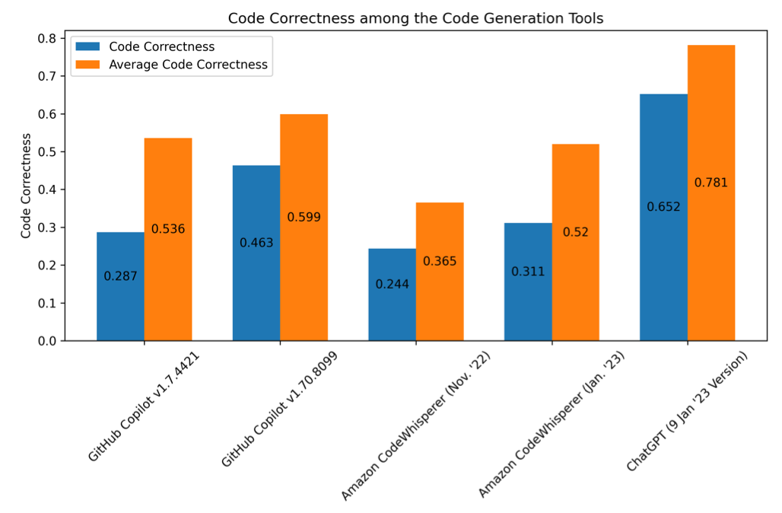
AI-Assisted Code Generation Tools: Code Correctness

Slide 188
AI-Assisted Code Generation Tools: Code Correctness
ChatGPT
GitHub Copilot

Slide 189
Code Generation Models: BERT, T5, GPT-3, CodeBERT CodeGPT, CodeX
Pretrained
Model
Backbone
Parameter
Pretrained Dataset
Size of Dataset
Trained Language

Slide 190
Software support
Traditionally, separate teams were responsible software development, software release and software support.
The development team passed over a ‘final’ version of the software to a release team.
Built a release version, tested this and prepared release documentation before releasing the software to customers.
A third team was responsible for providing customer support.
The original development team were sometimes also responsible for implementing software changes.
Alternatively, the software may have been maintained by a separate ‘maintenance team’.

Slide 191
Software Development, release and support
Problem and bug reports
Software Development
Software Release
Software Support
Tested software ready for release
Deployed software ready for use

Slide 192
DevOps
There are inevitable delays and overheads in the traditional support model.
To speed up the release and support processes, an alternative approach called DevOps (Development + Operations) has been developed.

Slide 193
DevOps
Three factors led to the development and widespread adoption of DevOps:
Agile software engineering reduced the development time for software, but the traditional release process introduced a bottleneck between development and deployment.
Amazon re-engineered their software around services and introduced an approach in which a service was developed and supported by the same team. Amazon’s claim that this led to significant improvements in reliability was widely publicized.
It became possible to release software as a service, running on a public or private cloud. Software products did not have to be released to users on physical media or downloads.

Slide 194
DevOps
Development
Deployment
Support
Multi-skilled DevOps team

Slide 195
DevOps principles
Everyone is responsible for everything All team members have joint responsibility for developing, delivering and supporting the software.
Everything that can be automated should be automated All activities involved in testing, deployment and support should be automated if it is possible to do so. There should be minimal manual involvement in deploying software.
Measure first, change later DevOps should be driven by a measurement program where you collect data about the system and its operation. You then use the collected data to inform decisions about changing DevOps processes and tools.

Slide 196
Benefits of DevOps
Faster deployment
Software can be deployed to production more quickly because communication delays between the people involved in the process are dramatically reduced.
Reduced risk
The increment of functionality in each release is small
so there is less chance of feature interactions and
other changes causing system failures and outages.
Faster repair
DevOps teams work together to get the software up and running again as soon as possible.
More productive teams
DevOps teams are happier and more productive than the teams involved in the separate activities.

Slide 197
Code management
Code management is a set of software-supported practices that is used to manage an evolving codebase.
During the development of a software product, the development team will probably create tens of thousands of lines of code and automated tests.
These will be organized into hundreds of files. Dozens of libraries may be used, and several, different programs may be involved in creating and running the code.

Slide 198
Code management
You need code management to ensure that changes made by different developers do not interfere with each other, and to create different product versions.
Code management tools make it easy to create an executable product from its source code files and to run automated tests on that product.

Slide 199
Code management and DevOps
Source code management, combined with automated system building, is essential for professional software engineering.
In companies that use DevOps, a modern code management system is a fundamental requirement for ‘automating everything’.
Not only does it store the project code that is ultimately deployed, it also stores all other information that is used in DevOps processes.
DevOps automation and measurement tools all interact with the code management system

Slide 200
Code management and DevOps
DevOps automation
Continuous integration
Continuous deployment
Continuous delivery
Infrastructure as code
Code management system
Branching and merging
Recover version information
Code repository
Save and retrieve versions
Transfer code to/from developer’s filestore
DevOps measurement
Data collection
Data analysis
Report generation

Slide 201
Code management fundamentals
Code management systems provide a set of features that support four general areas:
Code transfer
Developers take code into their personal file store to work on it then return it to the shared code management system.
Version storage and retrieval
Files may be stored in several different versions and specific versions of these files can be retrieved.
Merging and branching
Parallel development branches may be created for concurrent working. Changes made by developers in different branches may be merged.
Version information
Information about the different versions maintained in the system may be stored and retrieved

Slide 202
Code repository
All source code management systems have the general form with a shared repository and a set of features to manage the files in that repository:
All source code files and file versions are stored in the repository, as are other artefacts such as configuration files, build scripts, shared libraries and versions of tools used.
The repository includes a database of information about the stored files such as version information, information about who has changed the files, what changes were made at what times, and so on.

Slide 203
Code repository
Files can be transferred to and from the repository and information about the different versions of files and their relationships may be updated.
Specific versions of files and information about these versions can always be retrieved from the repository.

Slide 204
Features of code management systems
Version and release identification
Change history recording
Independent development
Project support
Storage management

Slide 205
Git
In 2005, Linus Torvalds, the developer of Linux, revolutionized source code management by developing a distributed version control system (DVCS) called Git to manage the code of the Linux kernel.
This was geared to supporting large-scale open source development. It took advantage of the fact that storage costs had fallen to such an extent that most users did not have to be concerned with local storage management.
Instead of only keeping the copies of the files that users are working on, Git maintains a clone of the repository on every user’s computer

Slide 206
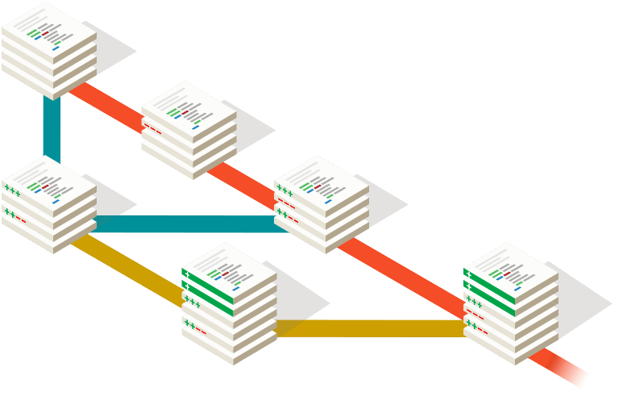
Source: https://git-scm.com/

Slide 207
Benefits of distributed code management
Resilience
Speed
Flexibility

Slide 208
Branching and merging
Branching and merging are fundamental ideas that are supported by all code management systems.
A branch is an independent, stand-alone version that is created when a developer wishes to change a file.
The changes made by developers in their own branches may be merged to create a new shared branch.
The repository ensures that branch files that have been changed cannot overwrite repository files without a merge operation.

Slide 209
Branching and merging
Feature experiment branch
Alice
Master branch
Merge
Bob
Bug fix branch

Slide 210
DevOps automation
By using DevOps with automated support, you can dramatically reduce the time and costs for integration, deployment and delivery.
Everything that can be, should be automated is a fundamental principle of DevOps.
As well as reducing the costs and time required for integration, deployment and delivery, process automation also makes these processes more reliable and reproducible.
Automation information is encoded in scripts and system models that can be checked, reviewed, versioned and stored in the project repository.

Slide 211
Aspects of DevOps automation
Continuous integration
Each time a developer commits a change to the project’s master branch, an executable version of the system is built and tested.
Continuous delivery
A simulation of the product’s operating environment is created and the executable software version is tested.
Continuous deployment
A new release of the system is made available
to users every time a change is made to the
master branch of the software.
Infrastructure as code
Machine-readable models of the infrastructure
(network, servers, routers, etc.)
on which the product executes are used by configuration management tools to build the software’s execution platform.

Slide 212
Characteristics of infrastructure as code
Visibility
Reproducibility
Reliability
Recovery

Slide 213
DevOps measurement
After you have adopted DevOps, you should try to continuously improve your DevOps process to achieve faster deployment of better-quality software.
There are four types of software development measurement:
Process measurement
Service measurement
Usage measurement
Business success measurement

Slide 214
Automating measurement
As far as possible, the DevOps principle of automating everything should be applied to software measurement.
You should instrument your software to collect data about itself and you should use a monitoring system to collect data about your software’s performance and availability.
Some process measurements can also be automated.
However, there are problems in process measurement because people are involved. They work in different ways, may record information differently and are affected by outside influences that affect the way they work.

Slide 215
Metrics used in the DevOps scorecard
Process metrics
Deployment frequency
Change volume
DevOps
metrics
Percentage of failed deployment
Lead time from development to deployment
Mean time to recovery
Percentage increase in customer numbers
Performance
Number of customer complaints
Availability
Service metrics

Slide 216
Summary
DevOps is the integration of software development and the management of that software once it has been deployed for use. The same team is responsible for development, deployment and software support.
The benefits of DevOps are faster deployment, reduced risk, faster repair of buggy code and more productive teams.
Source code management is essential to avoid changes made by different developers interfering with each other.

Slide 217
Summary
All code management systems are based around a shared code repository with a set of features that support code transfer, version storage and retrieval, branching and merging and maintaining version information.
Git is a distributed code management system that is the most widely used system for software product development. Each developer works with their own copy of the repository which may be merged with the shared project repository.

Slide 218
Summary
DevOps is the integration of software development and the management of that software once it has been deployed for use. The same team is responsible for development, deployment and software support.
The benefits of DevOps are faster deployment, reduced risk, faster repair of buggy code and more productive teams.
Source code management is essential to avoid changes made by different developers interfering with each other.

Slide 219
Summary
Continuous integration means that as soon as a change is committed to a project repository, it is integrated with existing code and a new version of the system is created for testing.
Automated system building tools reduce the time needed to compile and integrate the system by only recompiling those components and their dependents that have changed.
Continuous deployment means that as soon as a change is made, the deployed version of the system is automatically updated. This is only possible when the software product is delivered as a cloud-based service.

Slide 220
Summary
Infrastructure as code means that the infrastructure (network, installed software, etc.) on which software executes is defined as a machine-readable model. Automated tools, such as Chef and Puppet, can provision servers based on the infrastructure model.
Measurement is a fundamental principle of DevOps. You may make both process and product measurements. Important process metrics are deployment frequency, percentage of failed deployments, and mean time to recovery from failure.

Slide 221
References
Ian Sommerville (2019), Engineering Software Products: An Introduction to Modern Software Engineering, Pearson.
Ian Sommerville (2015), Software Engineering, 10th Edition, Pearson.
Titus Winters, Tom Manshreck, and Hyrum Wright (2020), Software Engineering at Google: Lessons Learned from Programming Over Time, O'Reilly Media.
Project Management Institute (2021), A Guide to the Project Management Body of Knowledge (PMBOK Guide) – Seventh Edition and The Standard for Project Management, PMI.
Project Management Institute (2017), A Guide to the Project Management Body of Knowledge (PMBOK Guide), Sixth Edition, Project Management Institute.
Project Management Institute (2017), Agile Practice Guide, Project Management Institute.

