Slide 1


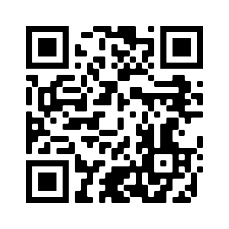





Introduction to Artificial Intelligence in Finance and Quantitative Analysis
Artificial Intelligence in Finance and Quantitative Analysis
1121AIFQA01
MBA, IM, NTPU (M5276) (Fall 2023)
Tue 2, 3, 4 (9:10-12:00) (B3F17)
Min-Yuh Day, Ph.D,
Associate Professor
Institute of Information Management, National Taipei University
https://web.ntpu.edu.tw/~myday
https://meet.google.com/paj-zhhj-mya
2023-09-12

Slide 2











Min-Yuh Day, Ph.D.
Associate Professor, Information Management, NTPU
Visiting Scholar, IIS, Academia Sinica
Ph.D., Information Management, NTU
Director, Intelligent Financial Innovation Technology, IFIT Lab, IM, NTPU
Associate Director, Fintech and Green Finance Center, NTPU
Artificial Intelligence, Financial Technology, Big Data Analytics,
Data Mining and Text Mining, Electronic Commerce

Slide 3
Course Syllabus
National Taipei University
Academic Year 112, 1st Semester (Fall 2023)
Course Title: Artificial Intelligence in Finance and Quantitative Analysis
Instructor: Min-Yuh Day
Course Class: MBA, IM, NTPU (3 Credits, Elective)
Details
  EMI Course
  (3 Credits, Elective, One Semester) (M5276)
Time & Place: Tue, 2, 3, 4, (9:10-12:00) (B3F17)
Google Meet: https://meet.google.com/paj-zhhj-mya
https://meet.google.com/paj-zhhj-mya

Slide 4
Course Objectives
Understand the fundamental concepts and research issues of Artificial Intelligence in Finance and Quantitative Analysis.
Equip with Hands-on practices of Artificial Intelligence in Finance and Quantitative Analysis.
Conduct information systems research in the context of Artificial Intelligence in Finance and Quantitative Analysis.

Slide 5
Course Outline
This course introduces the fundamental concepts, research issues, and hands-on practices of AI in Finance and Quantitative Analysis.
Topics include:
  Introduction to Artificial Intelligence in Finance and Quantitative Analysis
  AI in FinTech: Metaverse, Web3, DeFi, NFT, Financial Services Innovation and Applications
  Investing Psychology and Behavioral Finance
  Event Studies in Finance
  Finance Theory
  Data-Driven Finance
  Financial Econometrics
  AI-First Finance
  Deep Learning in Finance
  Reinforcement Learning in Finance
  Algorithmic Trading, Risk Management, Trading Bot and Event-Based Backtesting
  Case Study on AI in Finance and Quantitative Analysis.

Slide 6
Core Competence
Exploring new knowledge in information technology, system development and application 80 %
Internet marketing planning ability 10 %
Thesis writing and independent research skills 10 %

Slide 7
Four Fundamental Qualities
Professionalism
  Creative thinking and Problem-solving 40 %
  Comprehensive Integration 40 %
Interpersonal Relationship
  Communication and Coordination 10 %
  Teamwork 5 %
Ethics
  Honesty and Integrity 0 %
  Self-Esteem and Self-reflection 0 %
International Vision
  Caring for Diversity 0 %
  Interdisciplinary Vision 5 %

Slide 8
College Learning Goals
Ethics/Corporate Social Responsibility
Global Knowledge/Awareness
Communication
Analytical and Critical Thinking

Slide 9
Department Learning Goals
Information Technologies and
System Development Capabilities
Internet Marketing Management Capabilities
Research capabilities

Slide 10
Syllabus
Week Date Subject/Topics
1 2023/09/12 Introduction to Artificial Intelligence in Finance and
Quantitative Analysis
2 2023/09/19 AI in FinTech: Metaverse, Web3, DeFi, NFT,
Financial Services Innovation and Applications
3 2023/09/26 Investing Psychology and Behavioral Finance
4 2023/10/03 Event Studies in Finance
5 2023/10/10 National Day (Day off)
6 2023/10/17 Case Study on AI in Finance and Quantitative Analysis I

Slide 11
Syllabus
Week Date Subject/Topics
7 2023/10/24 Finance Theory and Data-Driven Finance
8 2023/10/31 Midterm Project Report
9 2023/11/07 Financial Econometrics
10 2023/11/14 AI-First Finance
11 2023/11/21 Industry Practices of AI in Finance and Quantitative
Analysis
12 2023/11/28 Case Study on AI in Finance and Quantitative Analysis II

Slide 12
Syllabus
Week Date Subject/Topics
13 2023/12/05 Deep Learning in Finance;
Reinforcement Learning in Finance
14 2023/12/12 Algorithmic Trading; Risk Management;
Trading Bot and Event-Based Backtesting
15 2023/12/19 Final Project Report I
16 2023/12/26 Final Project Report II

Slide 13
Teaching Methods and Activities
Lecture
Discussion
Practicum

Slide 14
Evaluation Methods
Individual Presentation 60 %
Group Presentation 10 %
Case Report 10 %
Class Participation 10 %
Assignment 10 %

Slide 15
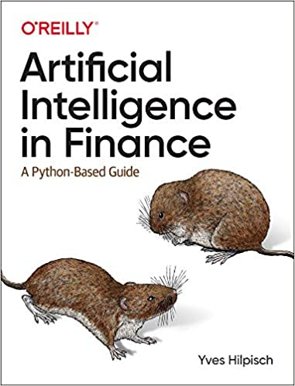
Required Texts
Yves Hilpisch (2020),
Artificial Intelligence in Finance: A Python-Based Guide,
O’Reilly Media.
Source: https://www.amazon.com/Artificial-Intelligence-Finance-Python-Based-Guide/dp/1492055433

Slide 16
Reference Books
Stefan Jansen (2020), Machine Learning for Algorithmic Trading: Predictive models to extract signals from market and alternative data for systematic trading strategies with Python, 2nd Edition, Packt Publishing.
Aurélien Géron (2022), Hands-On Machine Learning with Scikit-Learn, Keras, and TensorFlow: Concepts, Tools, and Techniques to Build Intelligent Systems, 3rd Edition, O’Reilly Media.
Hariom Tatsat, Sahil Puri, Brad Lookabaugh (2020), Machine Learning and Data Science Blueprints for Finance: From Building Trading Strategies to Robo-Advisors Using Python, O'Reilly Media
Chris Kelliher (2022), Quantitative Finance With Python: A Practical Guide to Investment Management, Trading, and Financial Engineering, Chapman and Hall/CRC.
Simon Thompson (2023), Green and Sustainable Finance: Principles and Practice in Banking, Investment and Insurance, 2nd Edition, Kogan Page.
Cino Robin Castelli, Cyril Shmatov (2022), Quantitative Methods for ESG Finance, Wiley
Abdullah Karasan (2021), Machine Learning for Financial Risk Management with Python: Algorithms for Modeling Risk, O’Reilly Media.
Yves Hilpisch (2018), Python for Finance: Mastering Data-Driven Finance, 2nd Edition, O'Reilly Media.

Slide 17
Other References
Paolo Sironi (2016), FinTech Innovation: From Robo-Advisors to Goal Based Investing and Gamification, Wiley.
Yves Hilpisch (2020), Financial Theory with Python: A Gentle Introduction, O’Reilly Media.
Yves Hilpisch (2020), Python for Algorithmic Trading: From Idea to Cloud Deployment, O’Reilly Media.
Yuxing Yan (2017), Python for Finance: Apply powerful finance models and quantitative analysis with Python, Second Edition, Packt Publishing.

Slide 18
Yves Hilpisch (2020),
Artificial Intelligence in Finance:
A Python-Based Guide,
O’Reilly
Source: https://www.amazon.com/Artificial-Intelligence-Finance-Python-Based-Guide/dp/1492055433

Slide 19
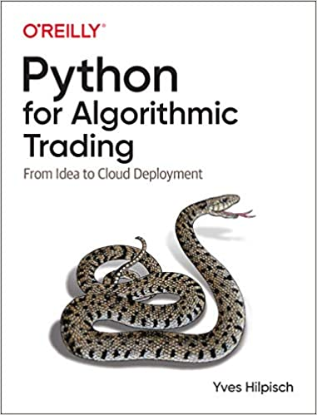
Yves Hilpisch (2020),
Python for Algorithmic Trading:
From Idea to Cloud Deployment,
O’Reilly
Source: https://www.amazon.com/Python-Algorithmic-Trading-Cloud-Deployment/dp/149205335X

Slide 20
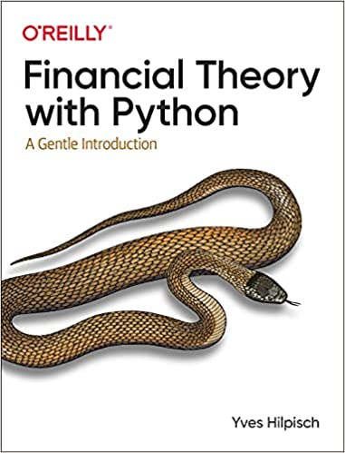
Yves Hilpisch (2021),
Financial Theory with Python:
A Gentle Introduction,
O’Reilly
Source: https://www.amazon.com/Financial-Theory-Python-Gentle-Introduction/dp/1098104358

Slide 21
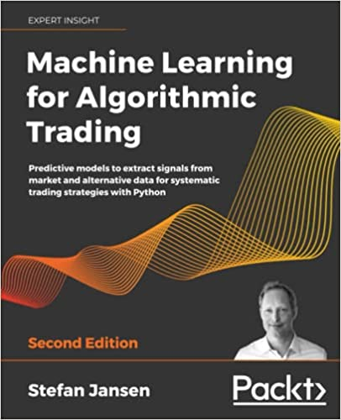
Stefan Jansen (2020),
Machine Learning for Algorithmic Trading:
Predictive models to extract signals from market and alternative data for systematic trading strategies with Python, 2nd Edition,
Packt Publishing.
Source: https://www.amazon.com/Machine-Learning-Algorithmic-Trading-alternative/dp/1839217715/

Slide 22
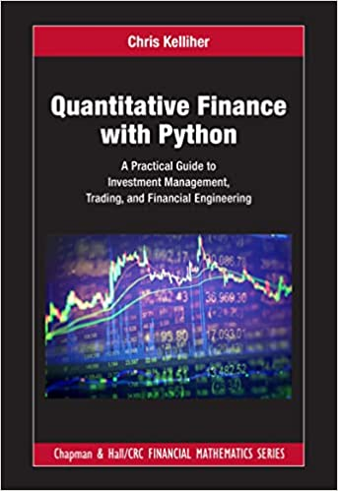
Chris Kelliher (2022),
Quantitative Finance With Python:
A Practical Guide to Investment Management, Trading, and Financial Engineering, Chapman and Hall/CRC.
Source: https://www.amazon.com/Quantitative-Finance-Python-Engineering-Mathematics/dp/1032014431/

Slide 23
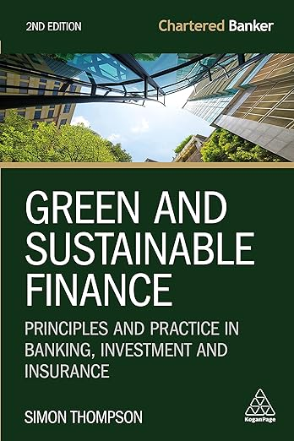
Simon Thompson (2023),
Green and Sustainable Finance:
Principles and Practice in Banking, Investment and Insurance, 2nd Edition,
Kogan Page
Source: https://www.amazon.com/Green-Sustainable-Finance-Principles-Investment/dp/1398609242/

Slide 24
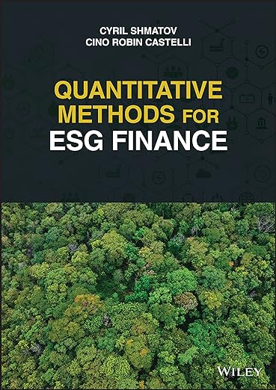
Cino Robin Castelli, Cyril Shmatov (2022),
Quantitative Methods for ESG Finance,
Wiley
Source: https://www.amazon.com/Quantitative-Methods-Finance-Robin-Castelli/dp/1119903807/

Slide 25
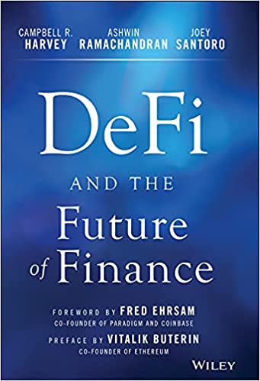
Campbell R. Harvey, Ashwin Ramachandran, Joey Santoro, Fred Ehrsam (2021),
DeFi and the Future of Finance,
Wiley
Source: https://www.amazon.com/DeFi-Future-Finance-Campbell-Harvey-ebook/dp/B09DJV2QLC

Slide 26
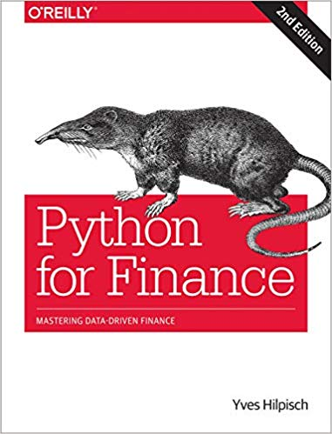
Yves Hilpisch (2018),
Python for Finance: Mastering Data-Driven Finance, O'Reilly
Source: https://www.amazon.com/Python-Finance-Mastering-Data-Driven/dp/1492024333

Slide 27
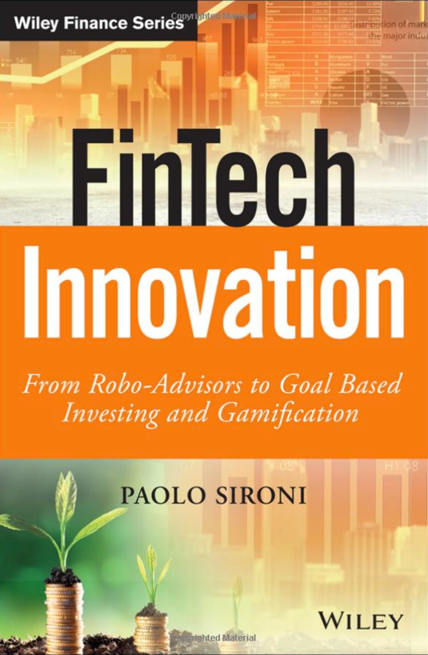
Paolo Sironi (2016)
FinTech Innovation:
From Robo-Advisors to Goal Based Investing and Gamification,
Wiley
Source: https://www.amazon.com/FinTech-Innovation-Robo-Advisors-Investing-Gamification/dp/1119226988

Slide 28
Doron Kliger and Gregory Gurevich (2014),
Event Studies for Financial Research:
A Comprehensive Guide,
Palgrave Macmillan
Source: https://www.amazon.com/Event-Studies-Financial-Research-Comprehensive/dp/1137435380/

Slide 29
Yuxing Yan (2017),
Python for Finance: Apply powerful finance models and quantitative analysis with Python, Second Edition, Packt Publishing
Source: https://www.amazon.com/Python-Finance-powerful-quantitative-analysis/dp/1787125696

Slide 30
Artificial Intelligence
(AI)

Slide 31
AI, Big Data, Cloud Computing
Evolution of Decision Support, Business Intelligence, and Analytics
AI
AI
Cloud Computing
Big Data
DM
BI
Source: Ramesh Sharda, Dursun Delen, and Efraim Turban (2017),
Business Intelligence, Analytics, and Data Science: A Managerial Perspective, 4th Edition, Pearson

Slide 32
The Rise of AI
Source: DHL (2018), Artificial Intelligence in Logistics,
http://www.globalhha.com/doclib/data/upload/doc_con/5e50c53c5bf67.pdf/

Slide 33
Definition of
Artificial Intelligence (A.I.)

Slide 34
Artificial Intelligence
“… the science and engineering of making intelligent machines”
(John McCarthy, 1955)
Source: https://digitalintelligencetoday.com/artificial-intelligence-defined-useful-list-of-popular-definitions-from-business-and-science/

Slide 35
Artificial Intelligence
“… technology that thinks and acts like humans”
Source: https://digitalintelligencetoday.com/artificial-intelligence-defined-useful-list-of-popular-definitions-from-business-and-science/

Slide 36
Artificial Intelligence
“… intelligence exhibited by machines or software”
Source: https://digitalintelligencetoday.com/artificial-intelligence-defined-useful-list-of-popular-definitions-from-business-and-science/

Slide 37
4 Approaches of AI
Thinking Humanly | Thinking Rationally
Acting Humanly | Acting Rationally
Source: Stuart Russell and Peter Norvig (2020), Artificial Intelligence: A Modern Approach, 4th Edition, Pearson

Slide 38
4 Approaches of AI
2. Thinking Humanly: The Cognitive Modeling Approach | 3. Thinking Rationally: The “Laws of Thought” Approach
1. Acting Humanly: The Turing Test Approach (1950) | 4. Acting Rationally: The Rational Agent Approach
Source: Stuart Russell and Peter Norvig (2020), Artificial Intelligence: A Modern Approach, 4th Edition, Pearson

Slide 39
AI Acting Humanly:
The Turing Test Approach
(Alan Turing, 1950)
Knowledge Representation
Automated Reasoning
Machine Learning (ML)
  Deep Learning (DL)
Computer Vision (Image, Video)
Natural Language Processing (NLP)
Robotics
Source: Stuart Russell and Peter Norvig (2020), Artificial Intelligence: A Modern Approach, 4th Edition, Pearson

Slide 40
FinTech

Slide 41
Financial Technology

Slide 42
FinTech

Slide 43
Financial Technology
FinTech
“providing
financial services
by making use of software and
modern technology”
Source: https://www.fintechweekly.com/fintech-definition

Slide 44
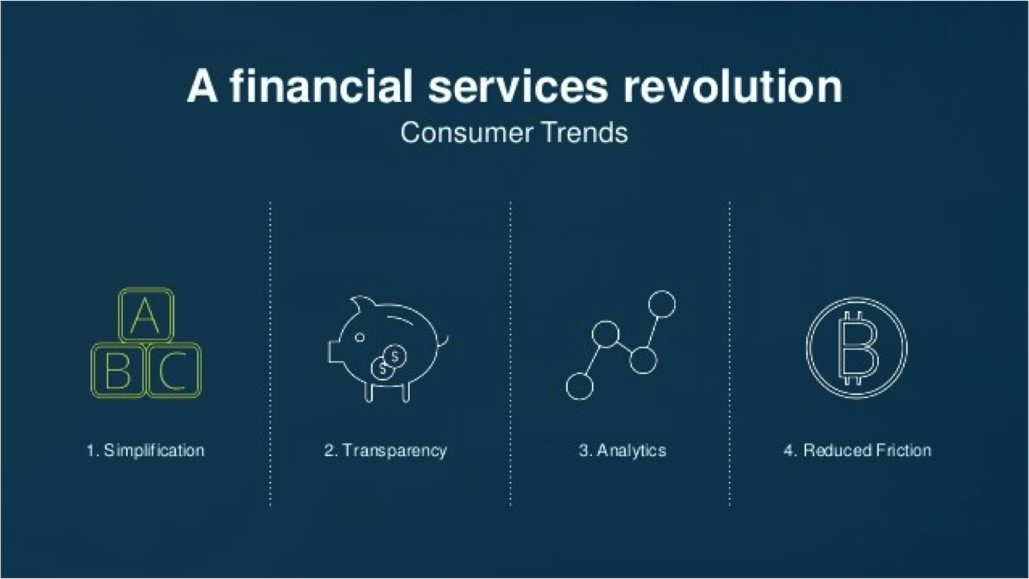
Financial Revolution with Fintech
Source: http://www.hedgethink.com/fintech/european-fintech-top-100/

Slide 45
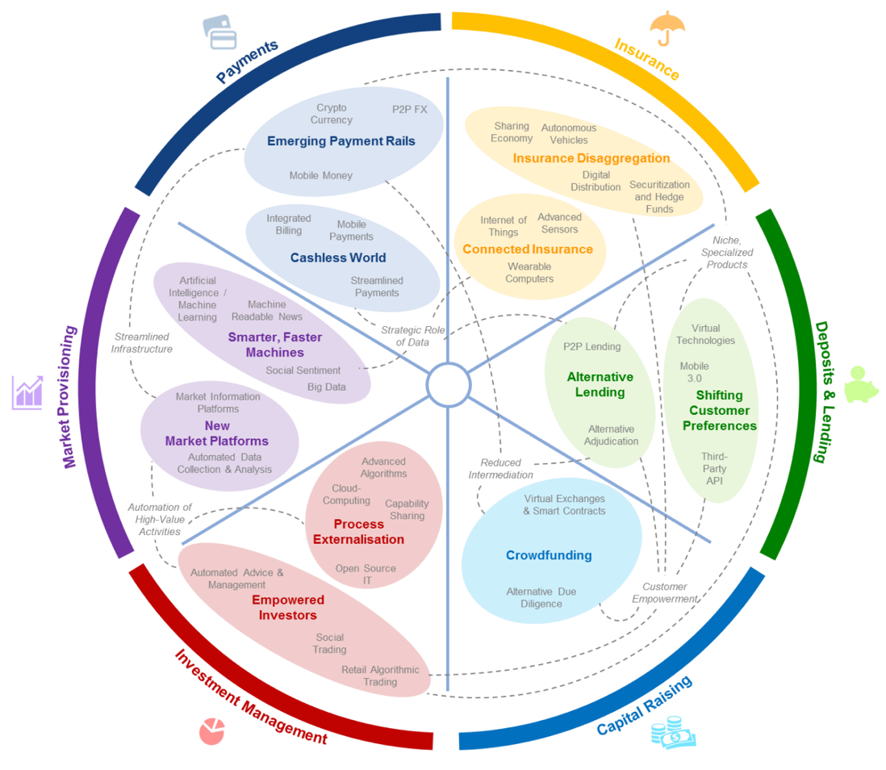
FinTech: Financial Services Innovation
Source: http://www3.weforum.org/docs/WEF_The_future__of_financial_services.pdf

Slide 46
FinTech:
Financial Services Innovation
1. Payments
2. Insurance
3. Deposits & Lending
4. Capital Raising
5. Investment Management
6. Market Provisioning
Source: http://www3.weforum.org/docs/WEF_The_future__of_financial_services.pdf

Slide 47
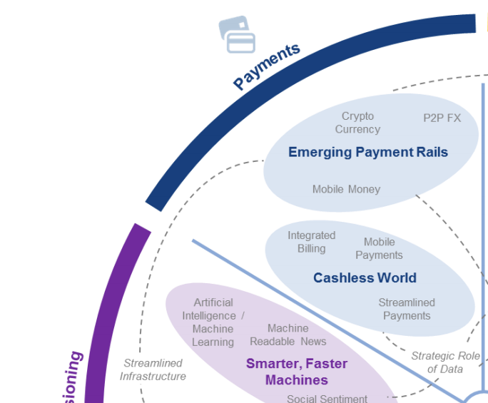
FinTech: Payment
1
Source: http://www3.weforum.org/docs/WEF_The_future__of_financial_services.pdf

Slide 48
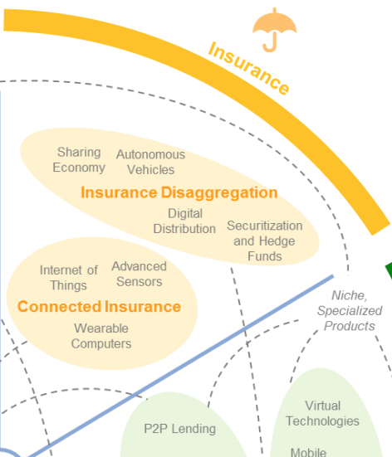
FinTech: Insurance
2
Source: http://www3.weforum.org/docs/WEF_The_future__of_financial_services.pdf

Slide 49
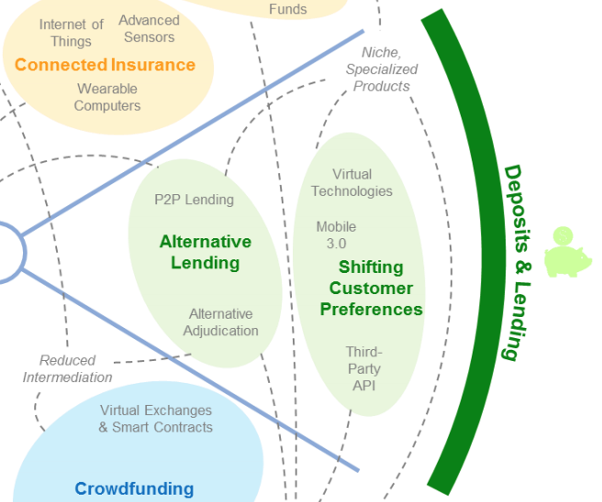
FinTech: Deposits & Lending
3
Source: http://www3.weforum.org/docs/WEF_The_future__of_financial_services.pdf

Slide 50
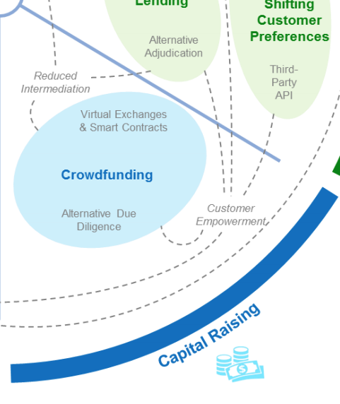
FinTech: Capital Raising
4
Source: http://www3.weforum.org/docs/WEF_The_future__of_financial_services.pdf

Slide 51
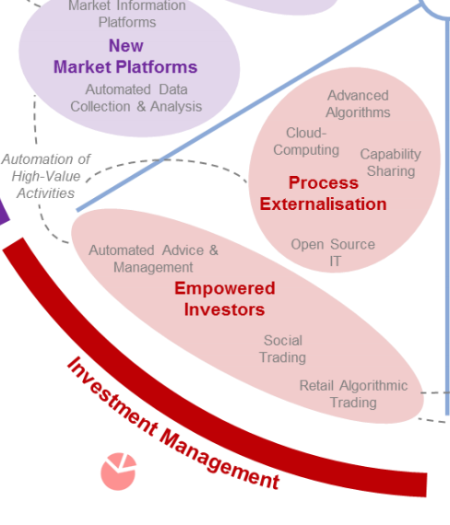
FinTech: Investment Management
5
Source: http://www3.weforum.org/docs/WEF_The_future__of_financial_services.pdf

Slide 52
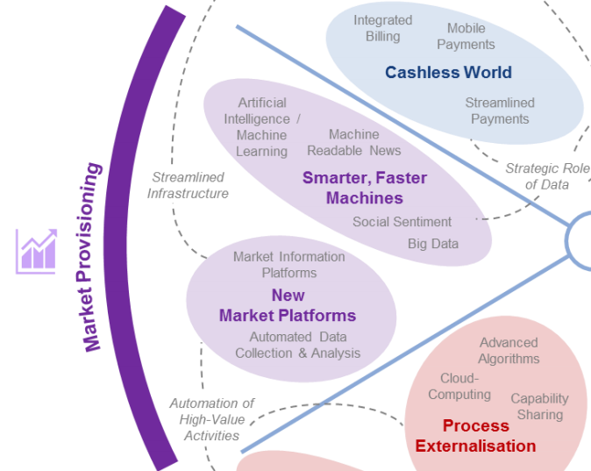
FinTech: Market Provisioning
6
Source: http://www3.weforum.org/docs/WEF_The_future__of_financial_services.pdf

Slide 53
AI in
FinTech

Slide 54
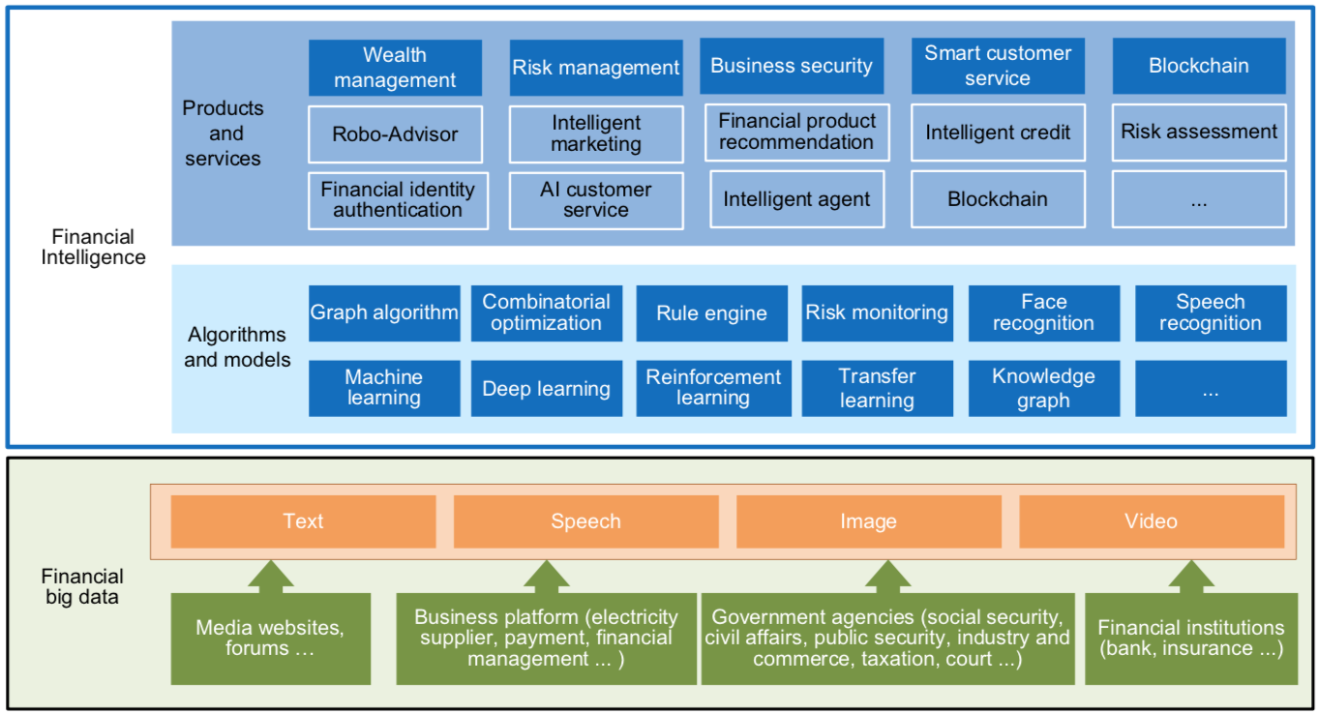
FinBrain: when Finance meets AI 2.0
(Zheng et al., 2019)
Source: Xiao-lin Zheng, Meng-ying Zhu, Qi-bing Li, Chao-chao Chen, and Yan-chao Tan (2019), "Finbrain: When finance meets AI 2.0." Frontiers of Information Technology & Electronic Engineering 20, no. 7, pp. 914-924

Slide 55
AI 2.0
a new generation of AI
based on the
novel information environment of
major changes and
the development of
new goals.
Yunhe Pan (2016), "Heading toward artificial intelligence 2.0." Engineering 2, no. 4, 409-413.

Slide 56
Technology-driven
Financial Industry Development
Development stage | Driving technology | Main landscape | Inclusive finance | Relationship between technology and finance
Fintech 1.0 (financial IT) | Computer | Credit card, ATM, and CRMS | Low | Technology as a tool
Fintech 2.0 (Internet finance) | Mobile Internet | Marketplace lending, third-party payment, crowdfunding, and Internet insurance | Medium | Technology-driven change
Fintech 3.0 (financial intelligence) | AI, Big Data, Cloud Computing, Blockchain | Intelligent finance | High | Deep fusion
Source: Xiao-lin Zheng, Meng-ying Zhu, Qi-bing Li, Chao-chao Chen, and Yan-chao Tan (2019), "Finbrain: When finance meets AI 2.0." Frontiers of Information Technology & Electronic Engineering 20, no. 7, pp. 914-924

Slide 57
Deep learning for financial applications: Topic-Model Heatmap
Source: Ahmet Murat Ozbayoglu, Mehmet Ugur Gudelek, and Omer Berat Sezer (2020). "Deep learning for financial applications: A survey." Applied Soft Computing (2020): 106384.

Slide 58
Deep learning for financial applications: Topic-Feature Heatmap
Source: Ahmet Murat Ozbayoglu, Mehmet Ugur Gudelek, and Omer Berat Sezer (2020). "Deep learning for financial applications: A survey." Applied Soft Computing (2020): 106384.

Slide 59
Deep learning for financial applications: Topic-Dataset Heatmap
Source: Ahmet Murat Ozbayoglu, Mehmet Ugur Gudelek, and Omer Berat Sezer (2020). "Deep learning for financial applications: A survey." Applied Soft Computing (2020): 106384.

Slide 60
Stock Market Movement Forecast:
Phases of the stock market modeling
Source: O. Bustos and A. Pomares-Quimbaya (2020), "Stock Market Movement Forecast: A Systematic Review."
Expert Systems with Applications (2020): 113464.

Slide 61
Green Finance and
Sustainable Finance

Slide 62
Evolution of Sustainable Finance Research
Topic
SDGs:
Sustainable Development Goals
SDGs
Innovative Financial Instrument
Impact Investing
ESG: Environmental, Social, and Governance
CSR: Corporate Social Responsibility
Conscious Capitalism
Climate Financing
Carbon Financing
Green Financing
Ethical Investing
Socially Responsible Investing
1986
1995
2005
2015
2020
Source: Kumar, S., Sharma, D., Rao, S., Lim, W. M., & Mangla, S. K. (2022). Past, present, and future of sustainable finance:
Insights from big data analytics through machine learning of scholarly research. Annals of Operations Research, 1-44.

Slide 63
AI for
Environmental,
Social, and
Governance
(AI4ESG)
Source: Nenad Tomašev, Julien Cornebise, Frank Hutter, Shakir Mohamed, Angela Picciariello, Bec Connelly, Danielle Belgrave et al. (2020)
"AI for social good: unlocking the opportunity for positive impact." Nature Communications 11, no. 1: 1-6.

Slide 64
AI for
Social Good
(AI4SG)
Source: Nenad Tomašev, Julien Cornebise, Frank Hutter, Shakir Mohamed, Angela Picciariello, Bec Connelly, Danielle Belgrave et al. (2020)
"AI for social good: unlocking the opportunity for positive impact." Nature Communications 11, no. 1: 1-6.

Slide 65
Sustainability
SDGs
CSR
ESG

Slide 66


















Sustainable Development Goals (SDGs)
Source: https://sdgs.un.org/goals

Slide 67
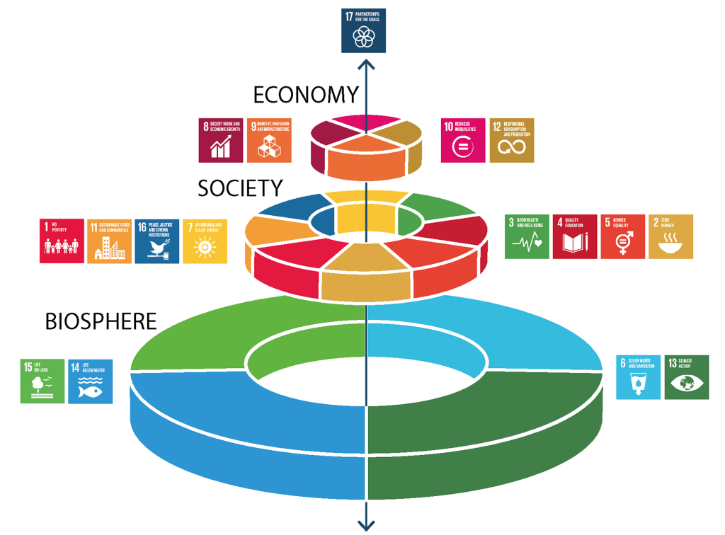
Sustainable Development Goals (SDGs) and 5P
Partnership
Peace
Prosperity
People
Planet
Source: Folke, Carl, Reinette Biggs, Albert V. Norström, Belinda Reyers, and Johan Rockström. "Social-ecological resilience and biosphere-based sustainability science.”Ecology and Society 21, no. 3 (2016).

Slide 68
Green Finance
Generic term implying use or diversion of financial resources to deploy and support projects with long term positive impact on the environment
Source: Bhattacharyya, Rupsha. "Green finance for energy transition, climate action and sustainable development: overview of concepts, applications, implementation and challenges." Green Finance 4, no. 1 (2022): 1-35.

Slide 69
Sustainable Finance
Finances deployed in support of projects that ensure just, sustainable and inclusive growth or attainment of one or more sustainable development goals
Source: Bhattacharyya, Rupsha. "Green finance for energy transition, climate action and sustainable development: overview of concepts, applications, implementation and challenges." Green Finance 4, no. 1 (2022): 1-35.

Slide 70
Carbon Finance
  Financial instruments
  based on
  economic value of carbon emissions
  which an organization cannot avoid but which
  it offsets by funding other compensatory projects that contribute to carbon emissions reduction
Source: Bhattacharyya, Rupsha. "Green finance for energy transition, climate action and sustainable development: overview of concepts, applications, implementation and challenges." Green Finance 4, no. 1 (2022): 1-35.

Slide 71
Climate Finance
  Finances deployed
  in support of low carbon and
  climate resilient projects
  that help in climate change mitigation and adaptation efforts,
  particularly in the
  energy and infrastructure sectors
Source: Bhattacharyya, Rupsha. "Green finance for energy transition, climate action and sustainable development: overview of concepts, applications, implementation and challenges." Green Finance 4, no. 1 (2022): 1-35.

Slide 72
ESG Investing
  Investments considering the broad range of
  environmental (e.g. climate change,
  pollution biodiversity loss),
  social (e.g. working conditions, human rights, salary or compensation structures)
  and governance (e.g. board composition, diversity and inclusion, taxes)
  characteristics of the projects or companies being invested in; ethical and business sustainability considerations are
  integral part of financing
Source: Bhattacharyya, Rupsha. "Green finance for energy transition, climate action and sustainable development: overview of concepts, applications, implementation and challenges." Green Finance 4, no. 1 (2022): 1-35.

Slide 73
Impact Investing
  Investing in projects
  that solve a social or environmental problem;
  the focus is on the positive impact
  rather than the
  means used to produce that impact
Source: Bhattacharyya, Rupsha. "Green finance for energy transition, climate action and sustainable development: overview of concepts, applications, implementation and challenges." Green Finance 4, no. 1 (2022): 1-35.

Slide 74
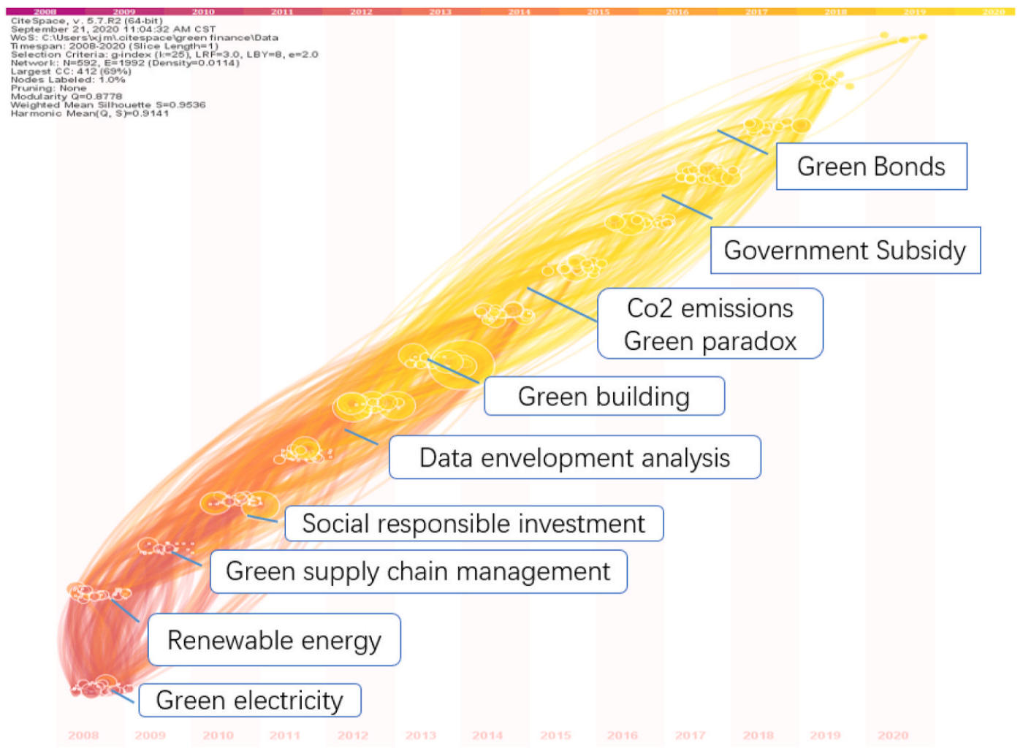
Dynamic Trends of Green Finance and Energy Policy
Source: Wang, Moran, Xuerong Li, and Shouyang Wang. (2021) "Discovering research trends and opportunities of green finance and energy policy: A data-driven scientometric analysis." Energy Policy 154 (2021): 112295.

Slide 75
ESG:
Environmental
Social
Governance

Slide 76
CSR:
Corporate
Social
Responsibility

Slide 77
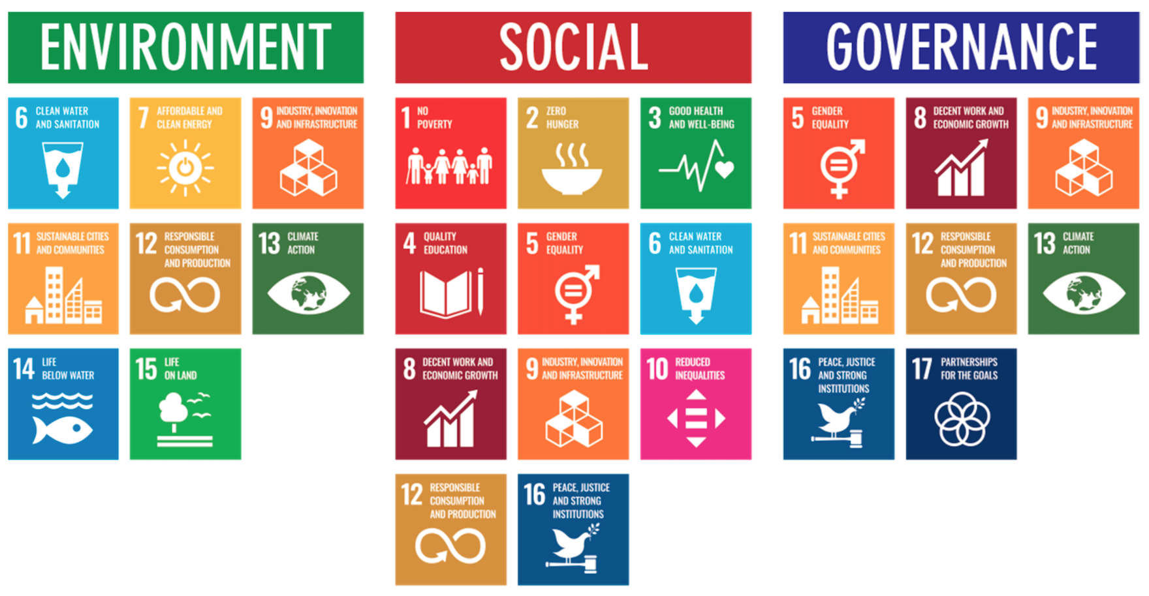
ESG to 17 SDGs
Source: Henrik Skaug Sætra (2021) "A Framework for Evaluating and Disclosing the ESG Related Impacts of AI with the SDGs." Sustainability 13, no. 15 (2021): 8503.

Slide 78
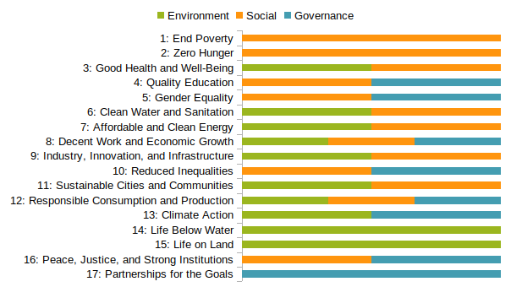
ESG to 17 SDGs
Source: https://sustainometric.com/esg-to-sdgs-connected-paths-to-a-sustainable-future/

Slide 79
Generative AI for
ESG Applications

Slide 80
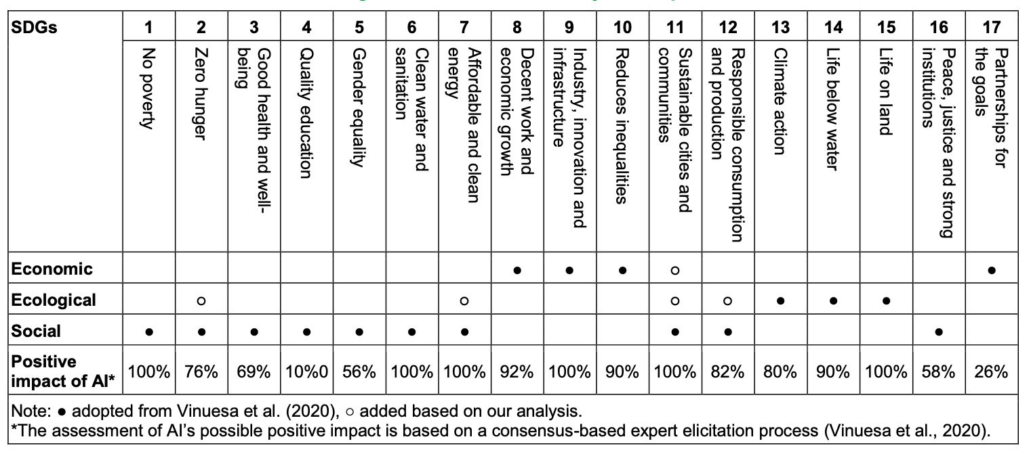
AI and Sustainability Development Goals (SDGs)
Source: Schoormann, T., Strobel, G., Möller, F., Petrik, D., & Zschech, P. (2023).
Artificial Intelligence for Sustainability—A Systematic Review of Information Systems Literature. Communications of the Association for Information Systems, 52(1), 8.

Slide 81
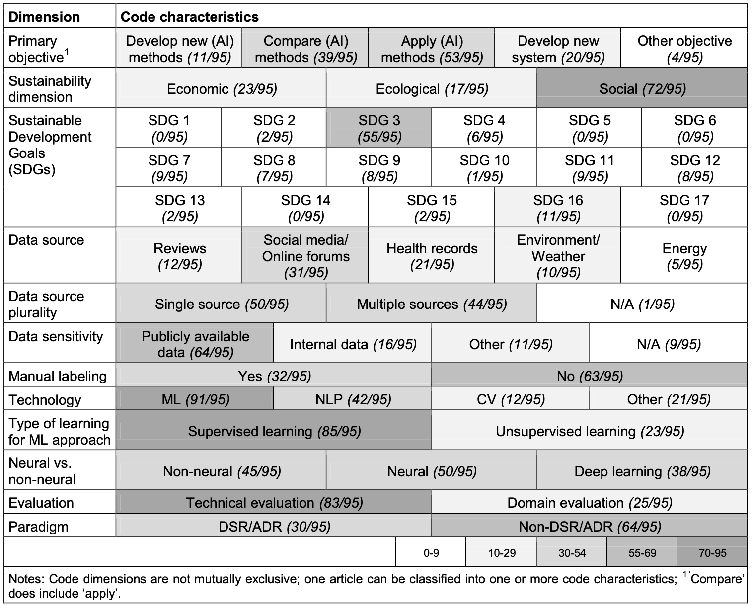
AI for Sustainability
Source: Schoormann, T., Strobel, G., Möller, F., Petrik, D., & Zschech, P. (2023).
Artificial Intelligence for Sustainability—A Systematic Review of Information Systems Literature. Communications of the Association for Information Systems, 52(1), 8.

Slide 82
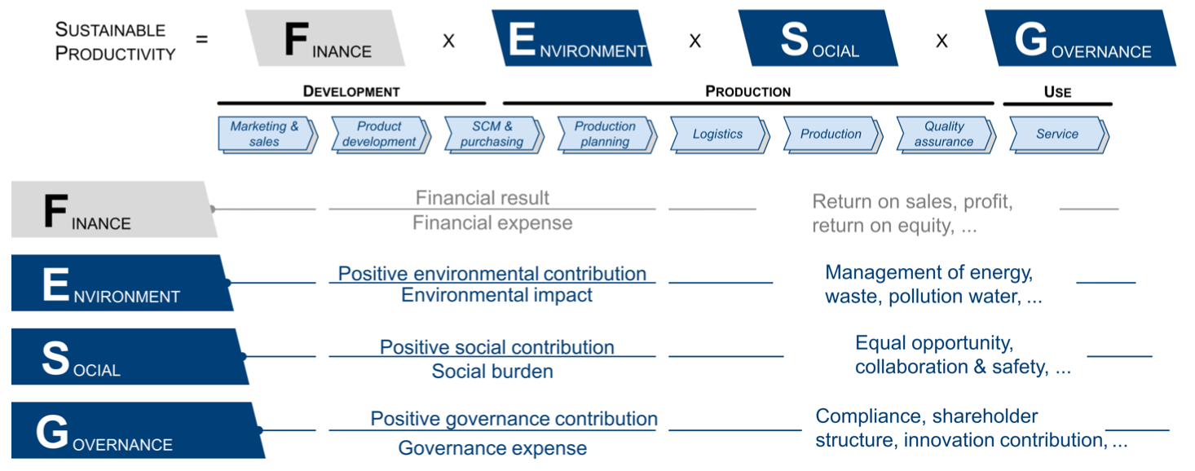
Sustainable Productivity:
Finance ESG
Source: Huang, Ziqi, Yang Shen, Jiayi Li, Marcel Fey, and Christian Brecher (2021). "A survey on AI-driven digital twins in Industry 4.0: Smart manufacturing and advanced robotics." Sensors 21, no. 19: 6340.

Slide 83
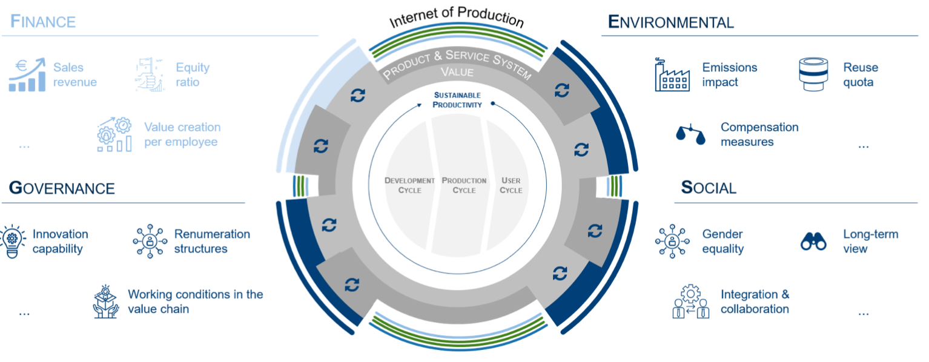
Sustainable Resilient Manufacturing
ESG
Source: Huang, Ziqi, Yang Shen, Jiayi Li, Marcel Fey, and Christian Brecher (2021). "A survey on AI-driven digital twins in Industry 4.0: Smart manufacturing and advanced robotics." Sensors 21, no. 19: 6340.

Slide 84
ESG Indexes
MSCI ESG Index
Dow Jones Sustainability Indices (DJSI)
FTSE ESG Index

Slide 85
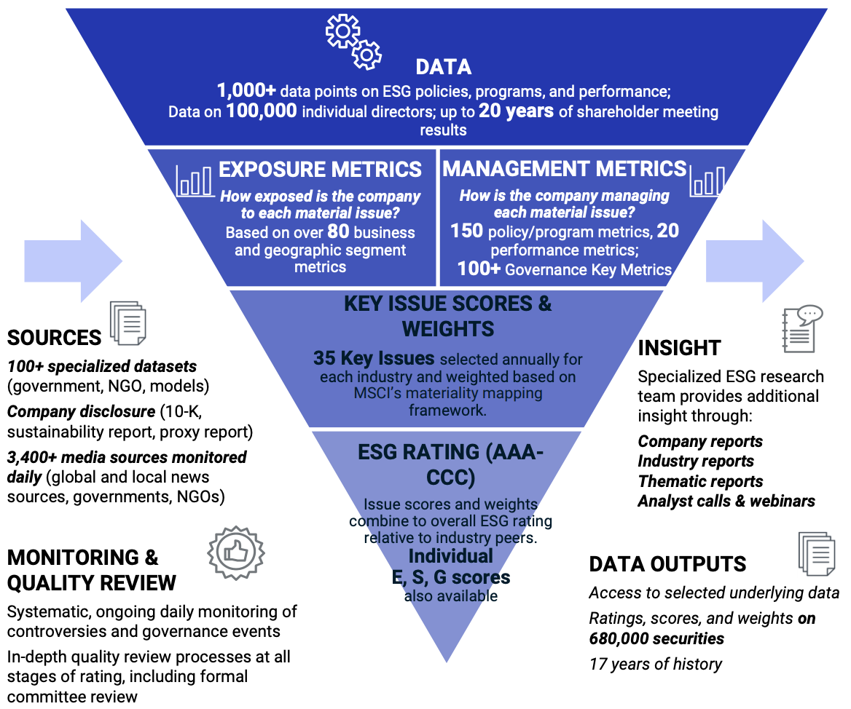
MSCI ESG Rating Framework
Source: https://www.msci.com/documents/1296102/21901542/ESG-Ratings-Methodology-Exec-Summary.pdf

Slide 86
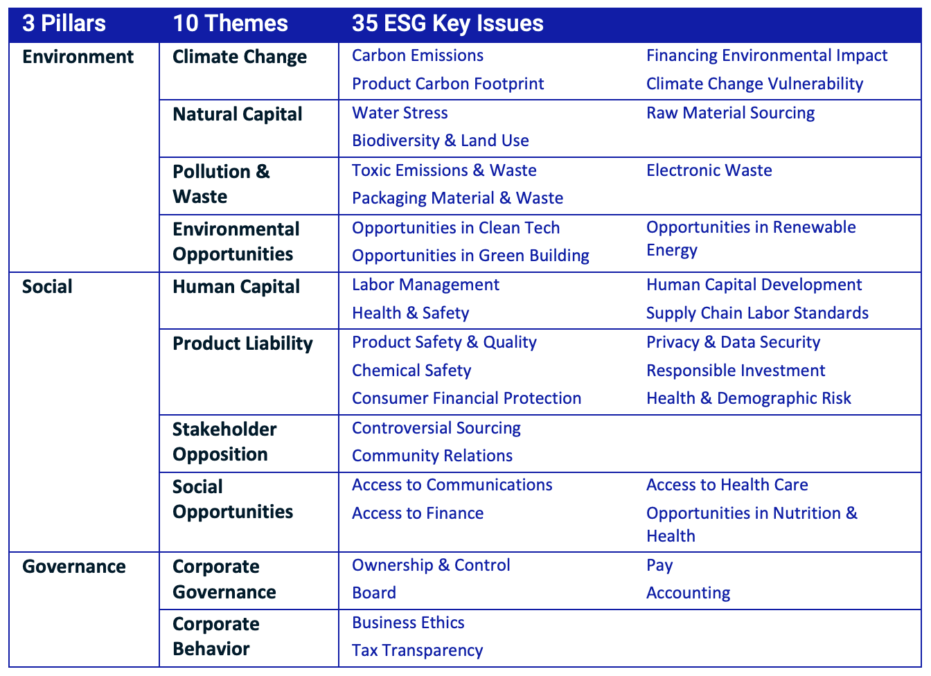
MSCI ESG Key Issue Hierarchy
Source: https://www.msci.com/documents/1296102/21901542/ESG-Ratings-Methodology-Exec-Summary.pdf

Slide 87
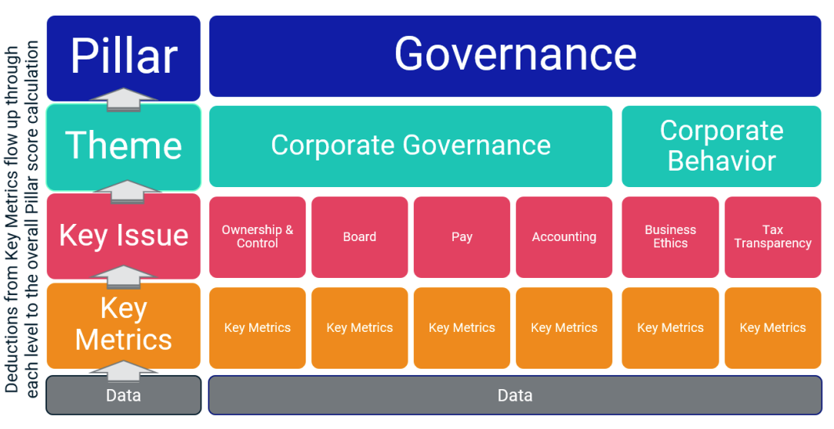
MSCI Governance Model Structure
Source: https://www.msci.com/documents/1296102/21901542/ESG-Ratings-Methodology-Exec-Summary.pdf

Slide 88
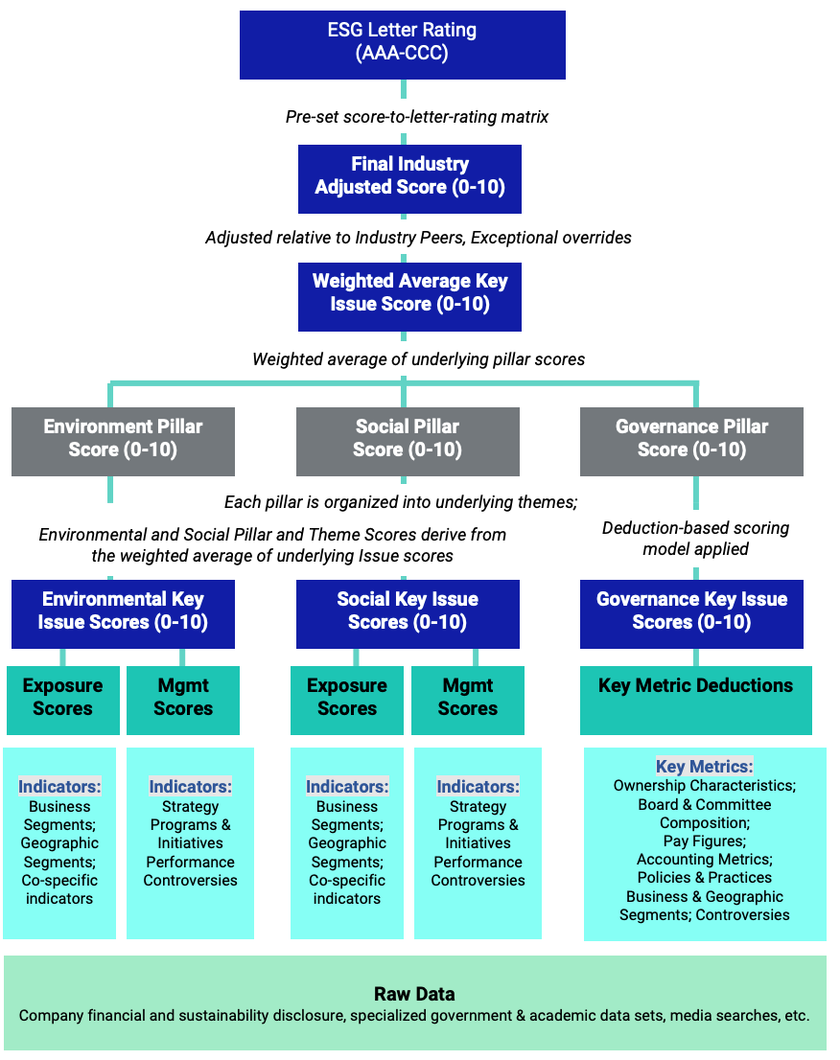
MSCI Hierarchy of ESG Scores
Source: https://www.msci.com/documents/1296102/21901542/ESG-Ratings-Methodology-Exec-Summary.pdf

Slide 89
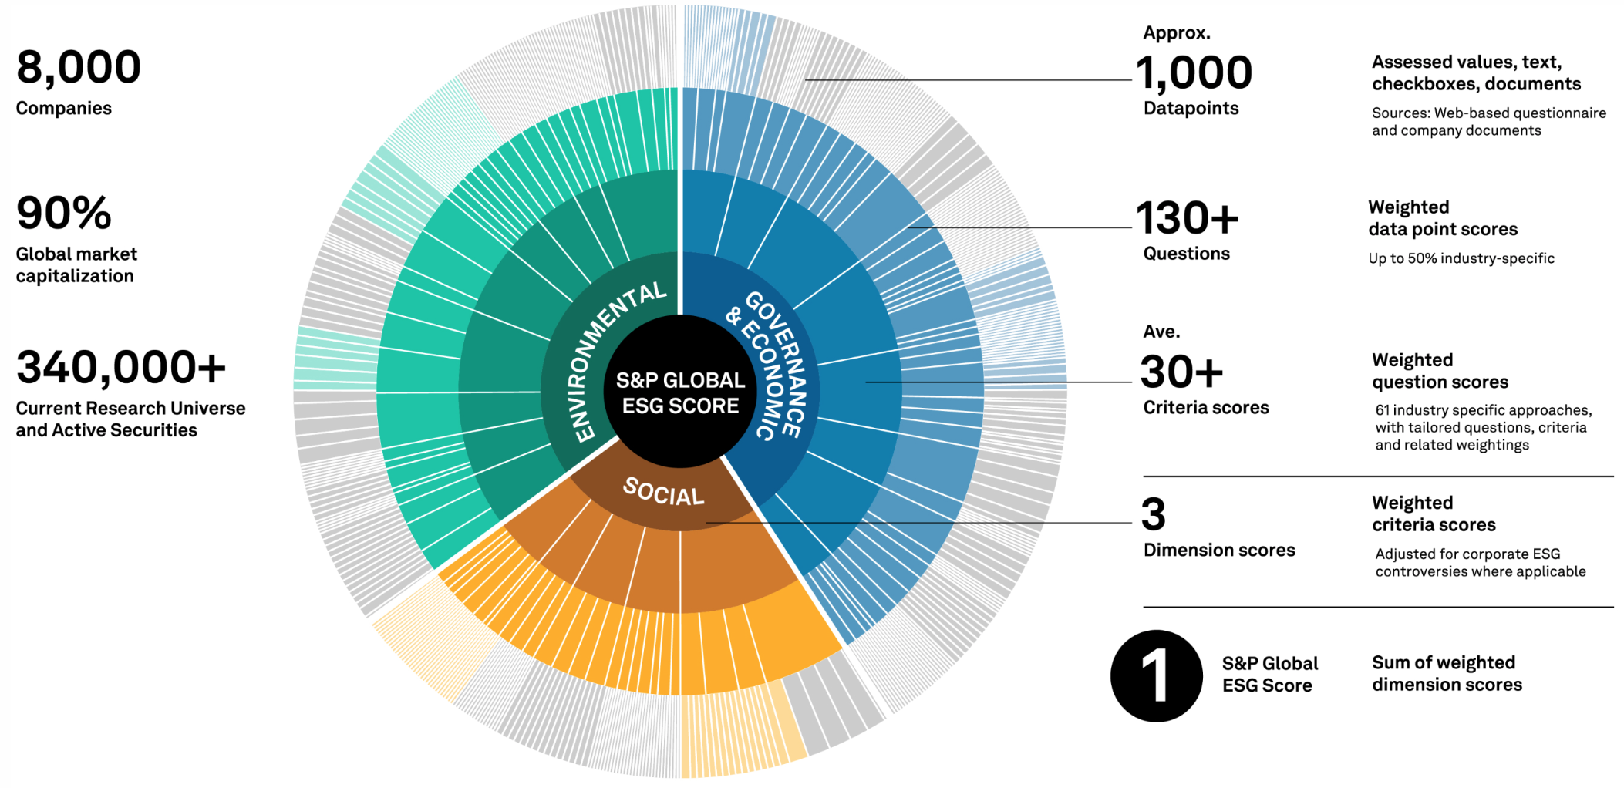
DJSI S&P Global ESG Score
Source: DJSI, S&P Global Corporate Sustainability Assessment (CSA), https://www.spglobal.com/esg/solutions/data-intelligence-esg-scores

Slide 90
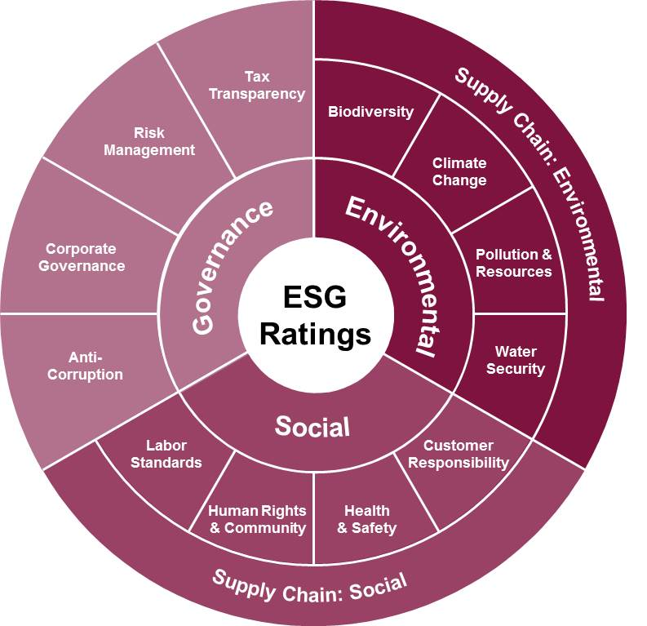
FTSE Russell ESG Ratings
Source: https://www.ftserussell.com/data/sustainability-and-esg-data/esg-ratings

Slide 91

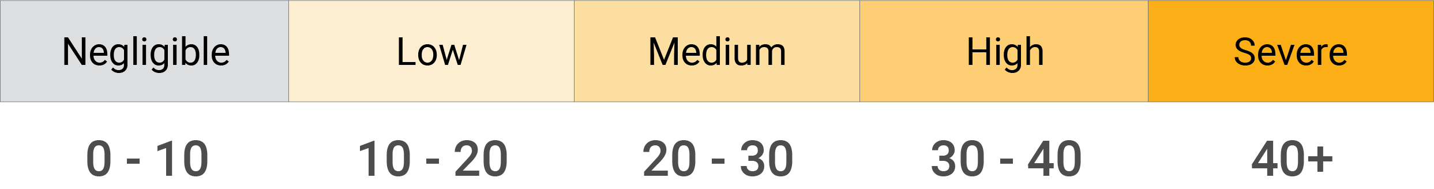
Sustainalytics
ESG Risk Ratings
Analyst-based
approach
Sustainalytics’ ESG Risk Ratings measure a company’s exposure to industry-specific material ESG risks and how well a company is managing those risks.
Source: https://www.sustainalytics.com/esg-data

Slide 92

Truvalue
ESG Ranks
TruValue Labs
Machine-based approach
Truvalue Labs applies AI to analyze over 100,000 sources and uncover ESG risks and opportunities hidden in unstructured text.
The ESG Ranks data service produces an overall company rank based on industry percentile leveraging the 26 ESG categories defined by the Sustainability Accounting Standards Board (SASB).
The data feed covers 20,000+ companies with more than 13 years of history.
Source: :https://developer.truvaluelabs.com/data/esg-ranks

Slide 93
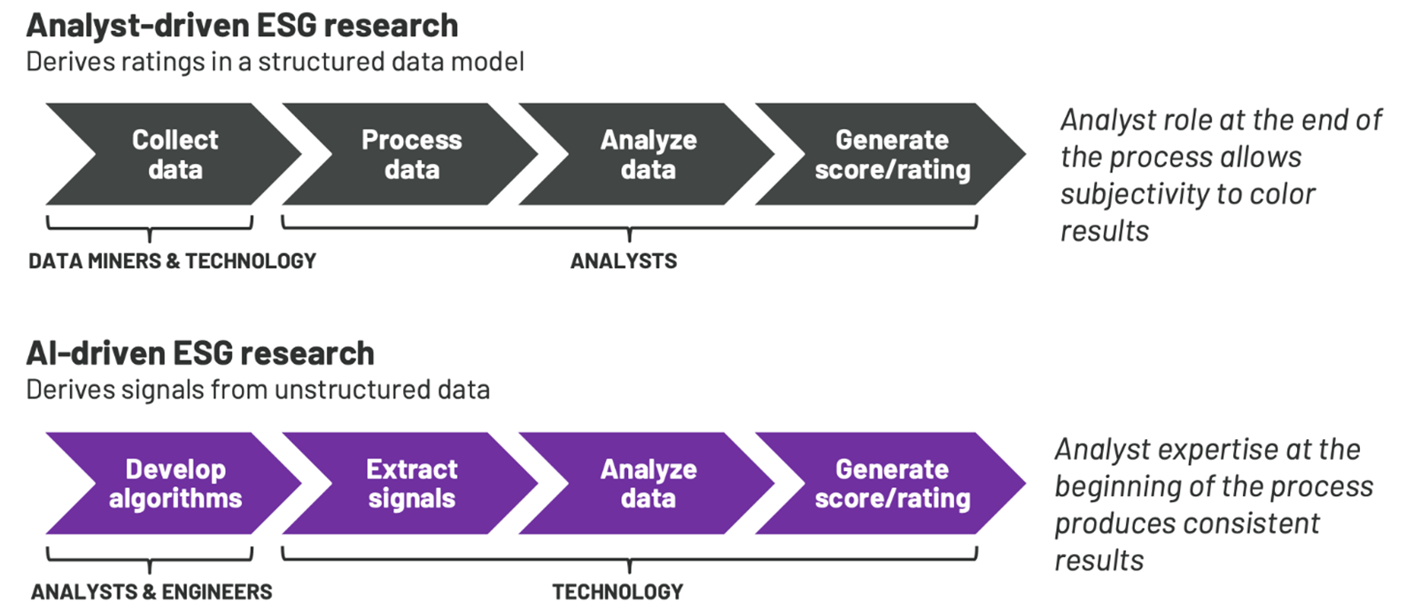
Analyst-driven vs. AI-driven ESG
Sustainalytics
Truvalue Labs
Source: Mark Tulay (2020), Man vs. machine: A tale of two sustainability ratings systems, GreenBiz, https://www.greenbiz.com/article/man-vs-machine-tale-two-sustainability-ratings-systems

Slide 94
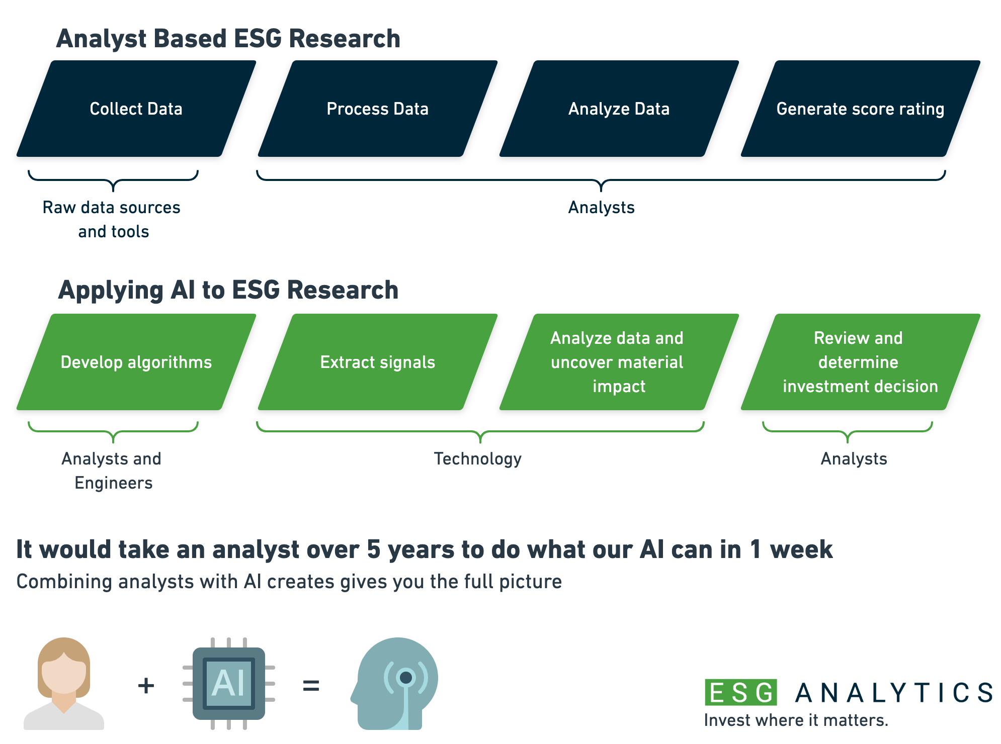
Analyst based
ESG Research
AI based
ESG Research
Source: https://www.esganalytics.io/insights/how-data-is-accelerating-esg

Slide 95
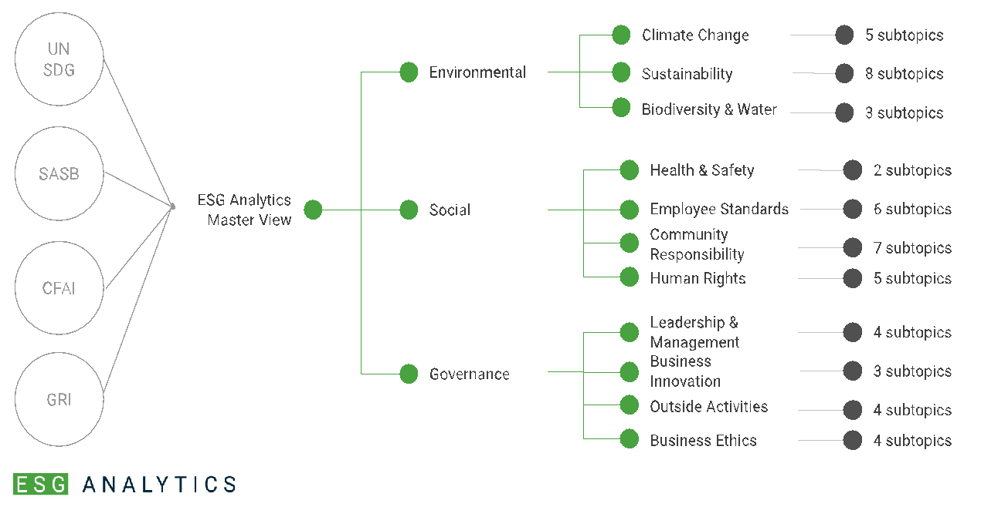
ESG Analytics: NLP Taxonomy
Source: https://www.esganalytics.io/insights/how-data-is-accelerating-esg

Slide 96
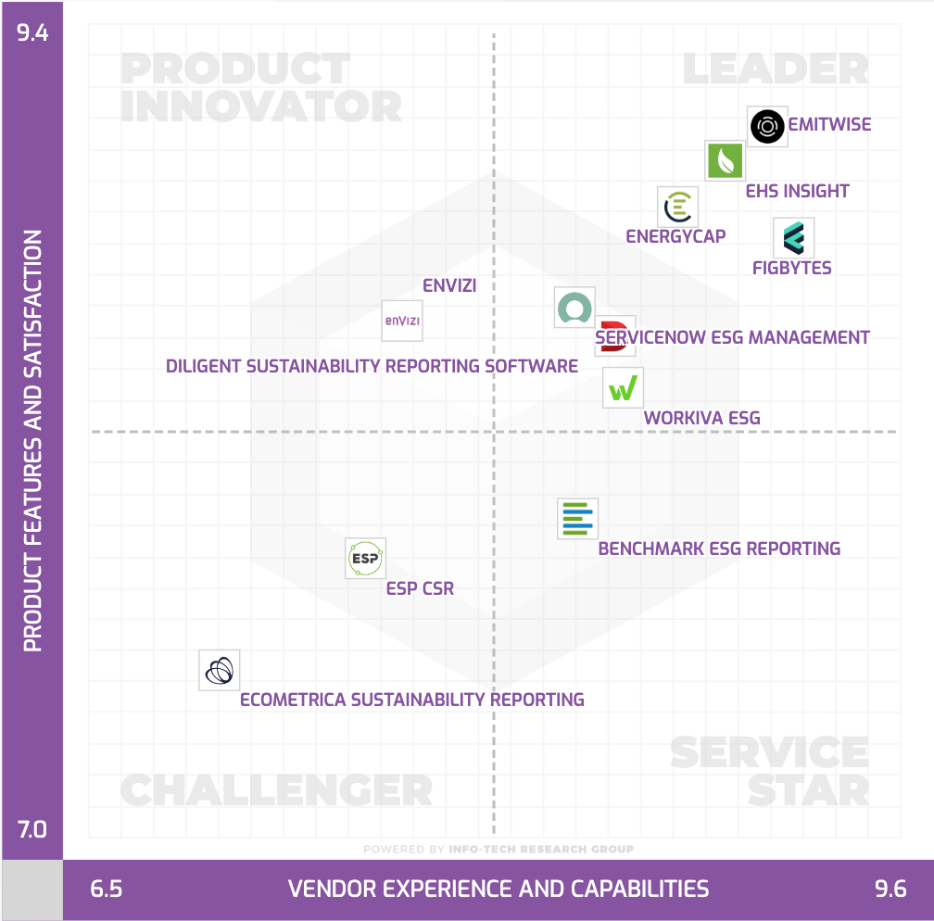
Top
ESG Reporting Software
Environmental, Social and Governance (ESG) Reporting software or Sustainability software helps organizations manage their operational data, evaluate their impact on the environment and provide reporting to perform audits.
Source: https://www.softwarereviews.com/categories/environmental-social-and-governance-reporting

Slide 97
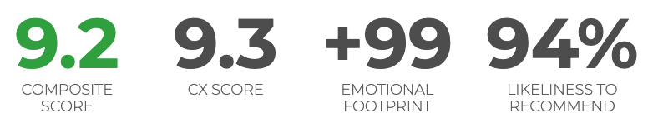
ESG Reporting Software: Emitwise
Emitwise is the carbon management platform for companies with complex manufacturing supply chains to confidently understand, track and reduce their complete carbon footprint.
Combining 100 years of carbon accounting experience and machine learning technology, we accelerate climate action by increasing the accuracy of scope 3 emissions.
The platform empowers manufacturers and their supply chains to make carbon-led business decisions that lower risk, increase profitability and deliver ambitious climate action.
Source: https://www.softwarereviews.com/categories/environmental-social-and-governance-reporting

Slide 98
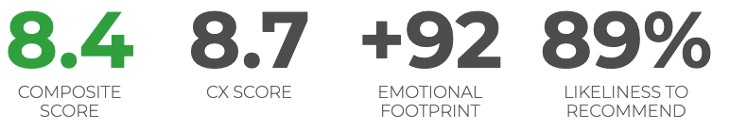
ESG Reporting Software: Workiva ESG
Workiva is a cloud native platform that simplifies the complexities of reporting and compliance.
Workiva ESG is the end-to-end platform that allows you to integrate financial data, nonfinancial data, and XBRL.
Workiva, the platform that streamlines your entire ESG process.
Automate data collection, utilize frameworks, and directly connect to all your ESG reports. in meaningful glossy reports, accurate survey responses, and regulatory filings with integrated XBRL tagging.
Source: https://www.softwarereviews.com/categories/environmental-social-and-governance-reporting

Slide 99
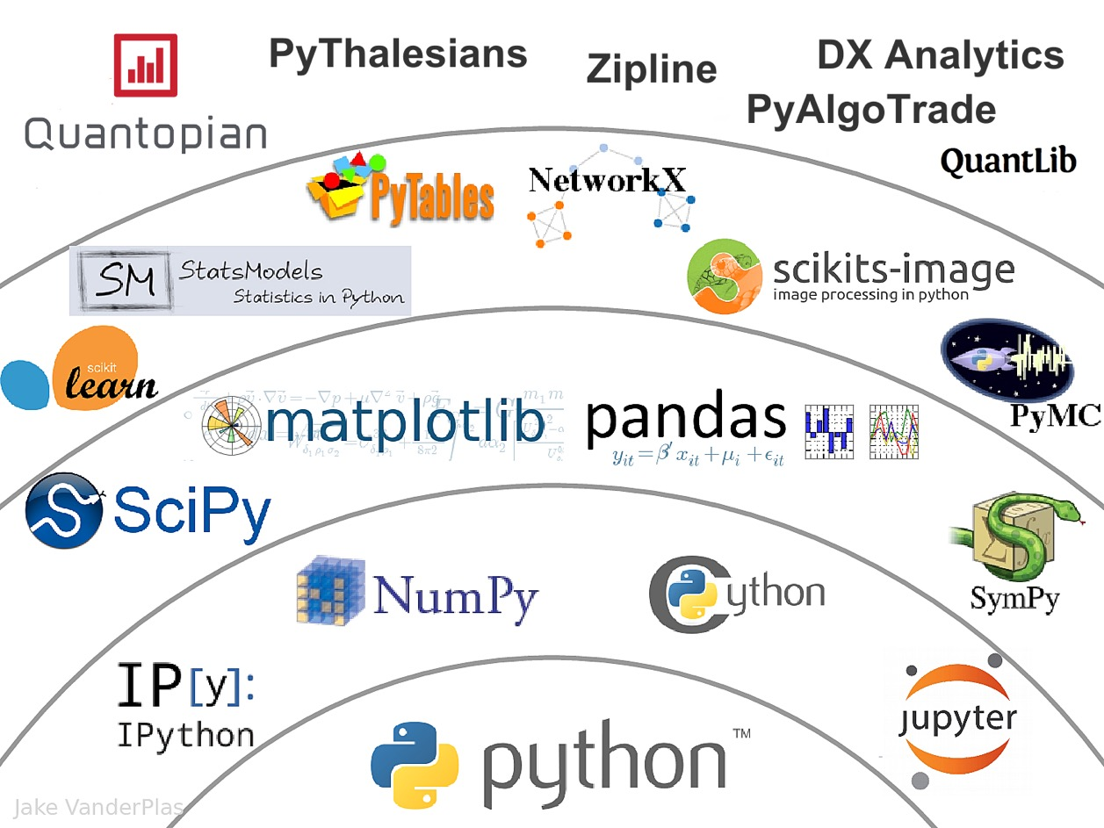
The Quant Finance PyData Stack
Source: http://nbviewer.jupyter.org/format/slides/github/quantopian/pyfolio/blob/master/pyfolio/examples/overview_slides.ipynb#/5

Slide 100
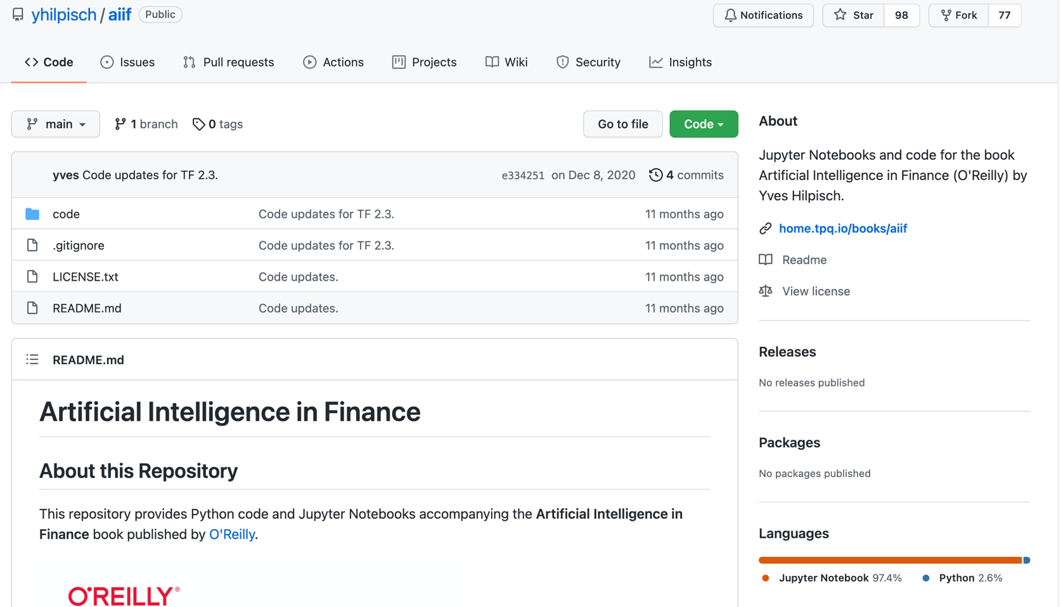
Yves Hilpisch (2020), Artificial Intelligence in Finance: A Python-Based Guide, O’Reilly
https://github.com/yhilpisch/aiif
Source: https://github.com/yhilpisch/aiif

Slide 101
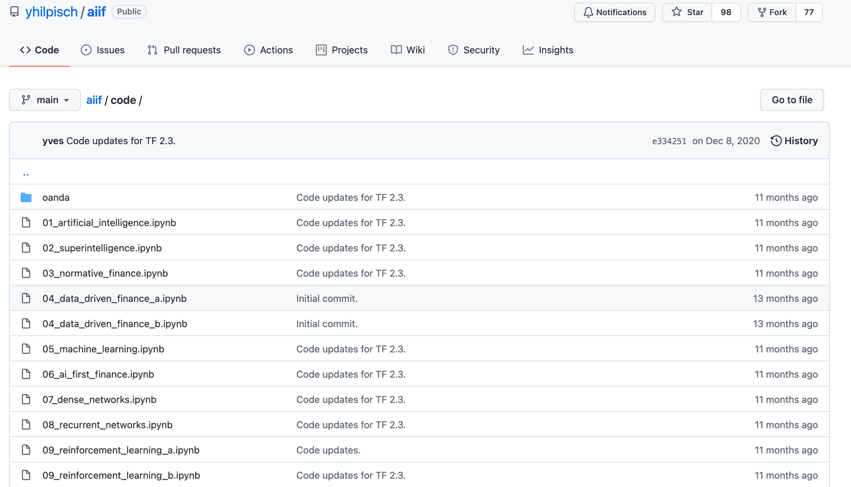
Yves Hilpisch (2020), Artificial Intelligence in Finance: A Python-Based Guide, O’Reilly
https://github.com/yhilpisch/aiif/tree/main/code
Source: https://github.com/yhilpisch/aiif/tree/main/code

Slide 102

Python in Google Colab (Python101)
https://colab.research.google.com/drive/1FEG6DnGvwfUbeo4zJ1zTunjMqf2RkCrT
https://tinyurl.com/aintpupython101

Slide 103
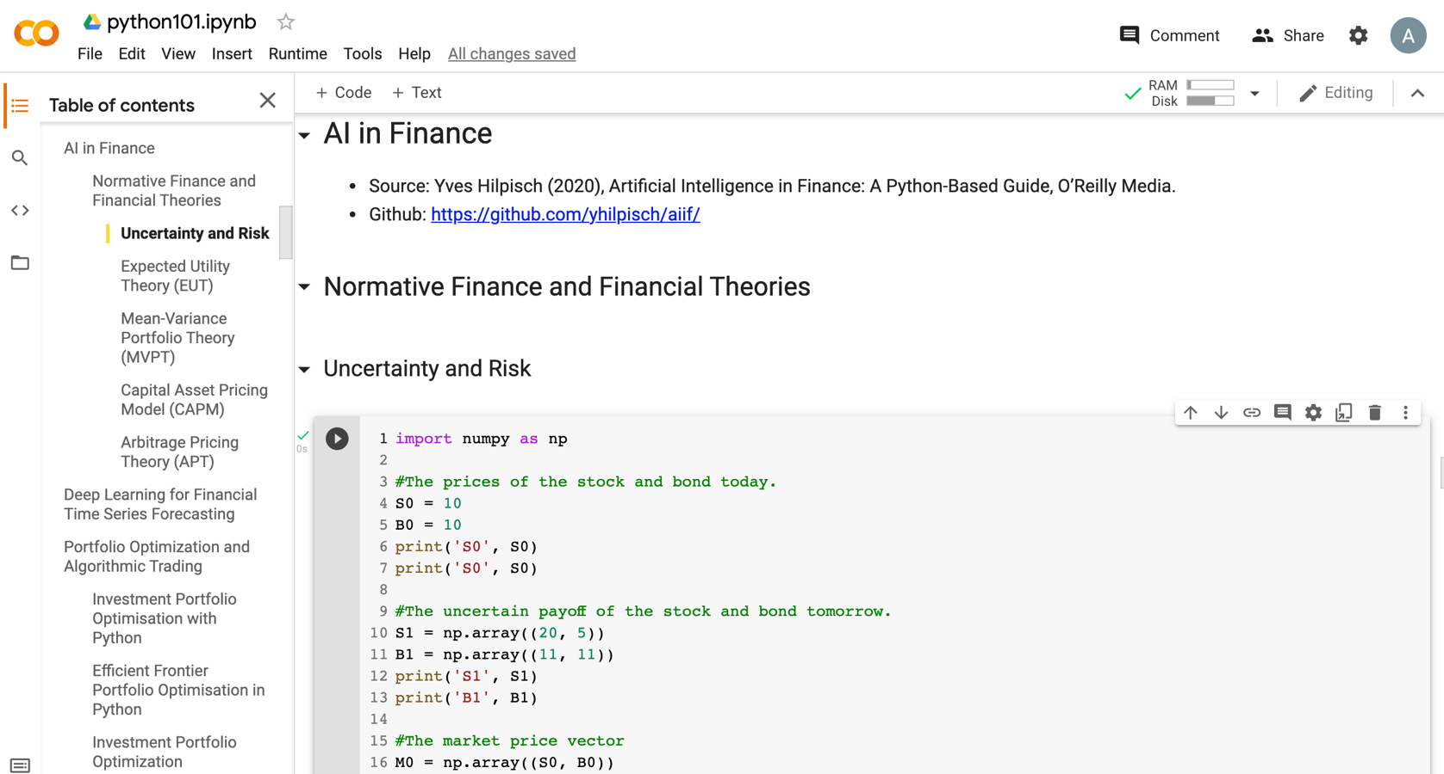
Python in Google Colab (Python101)
https://colab.research.google.com/drive/1FEG6DnGvwfUbeo4zJ1zTunjMqf2RkCrT
https://tinyurl.com/aintpupython101

Slide 104
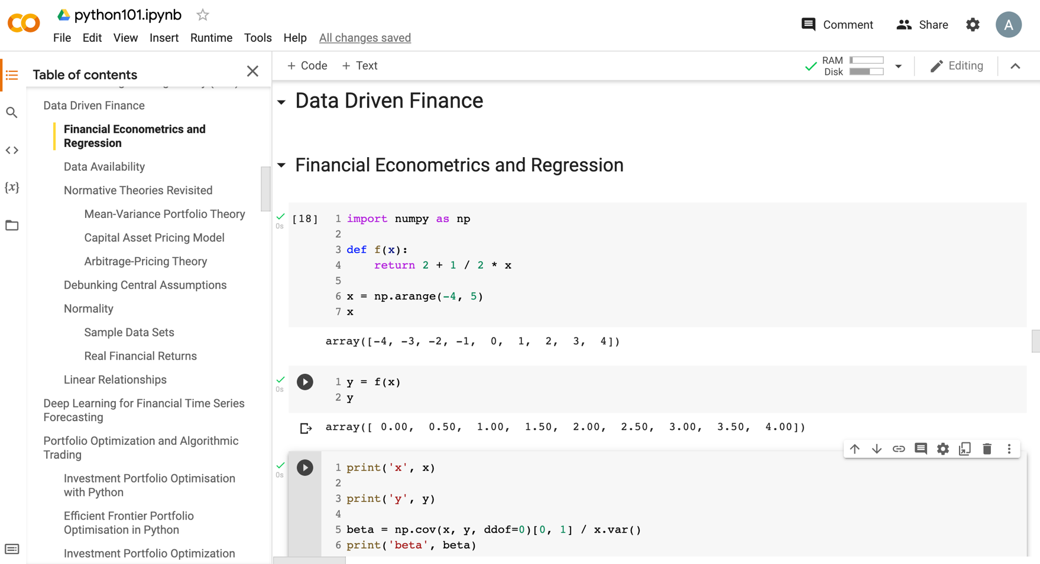
Python in Google Colab (Python101)
https://tinyurl.com/aintpupython101

Slide 105
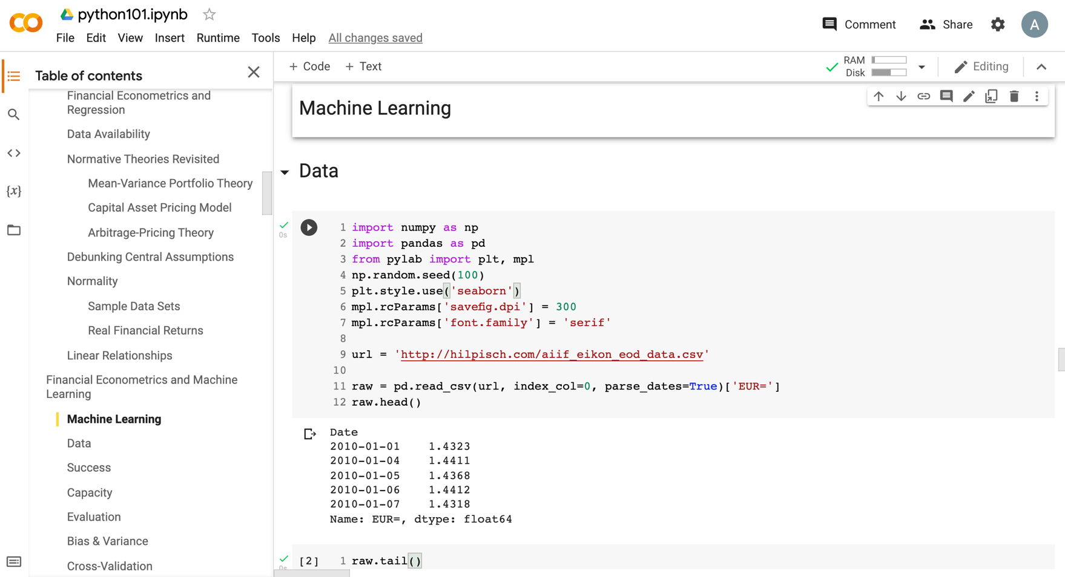
Python in Google Colab (Python101)
https://tinyurl.com/aintpupython101

Slide 106
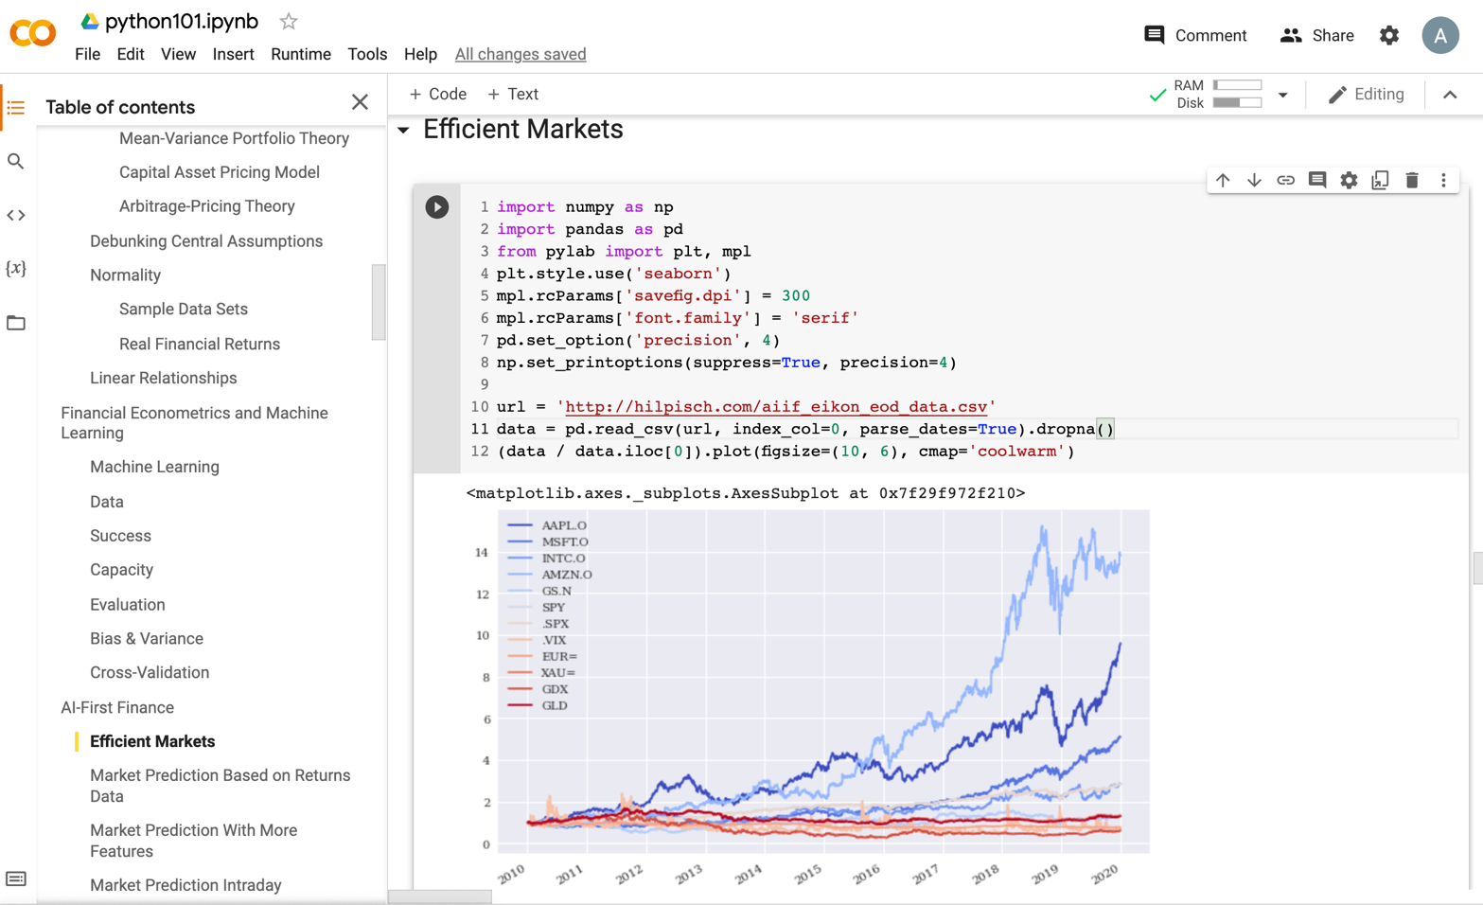
Python in Google Colab (Python101)
https://tinyurl.com/aintpupython101

Slide 107
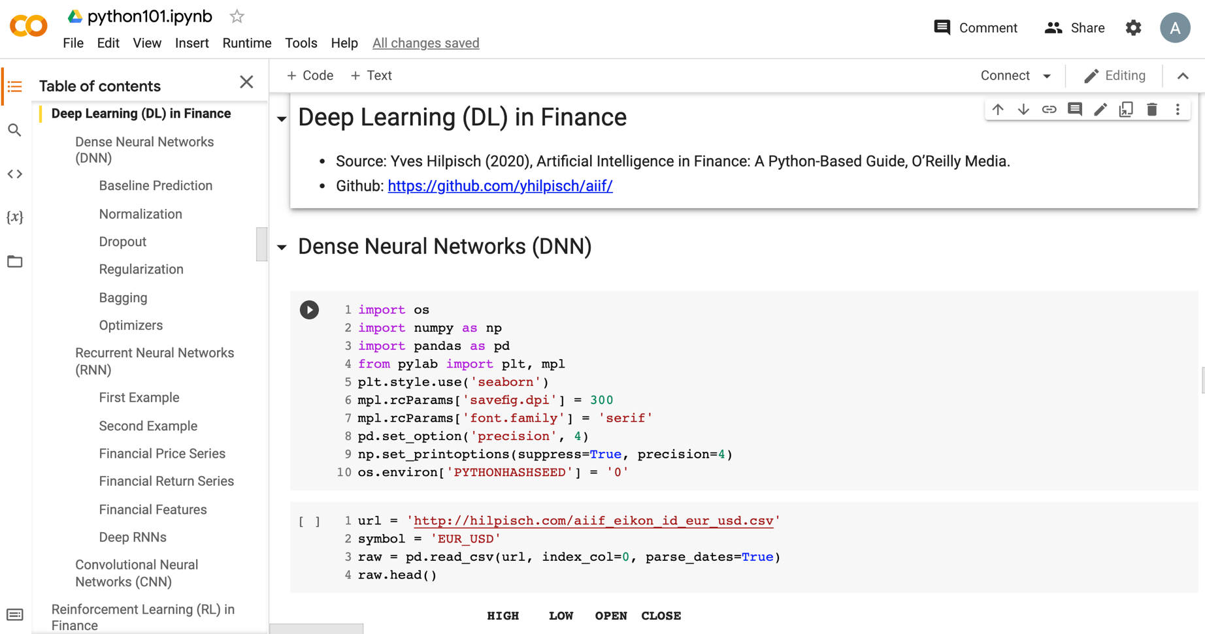
Python in Google Colab (Python101)
https://tinyurl.com/aintpupython101

Slide 108
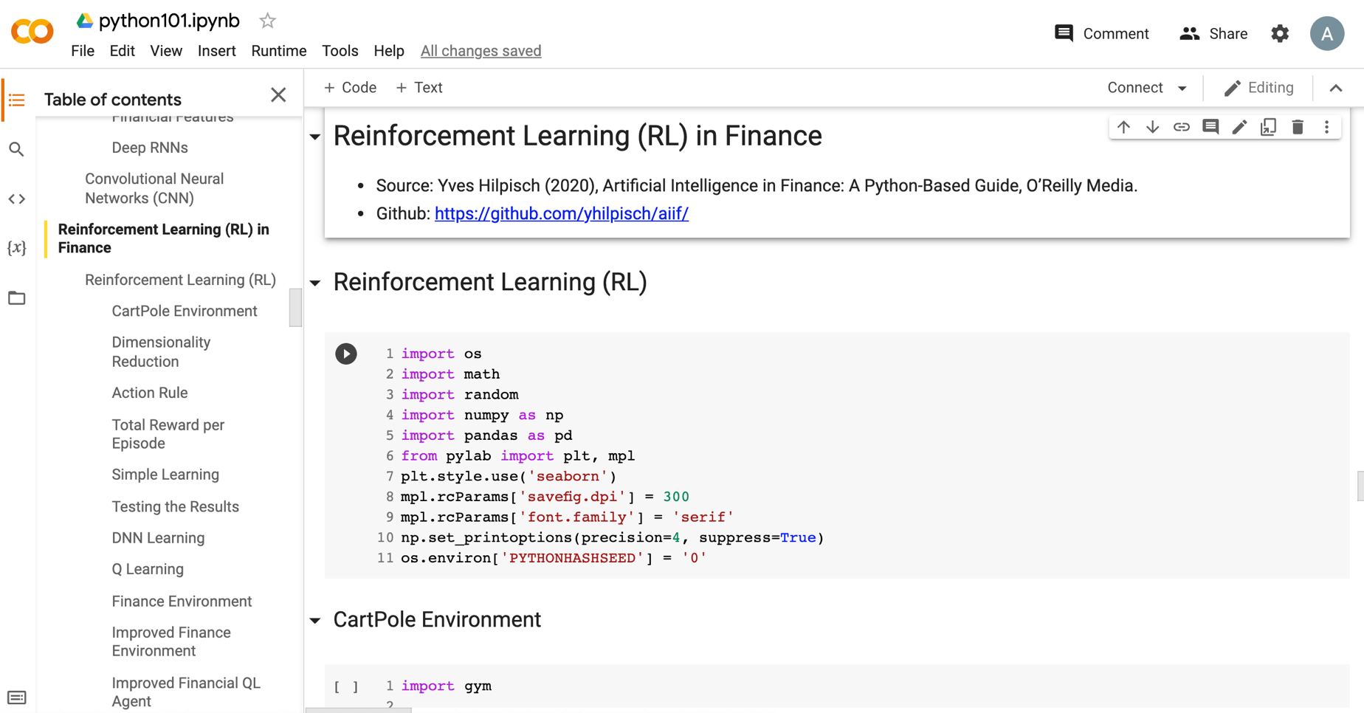
Python in Google Colab (Python101)
https://tinyurl.com/aintpupython101

Slide 109

Python in Google Colab (Python101)
https://tinyurl.com/aintpupython101

Slide 110

Python in Google Colab (Python101)
https://tinyurl.com/aintpupython101

Slide 111

Python in Google Colab (Python101)
https://tinyurl.com/aintpupython101

Slide 112

Python in Google Colab (Python101)
https://tinyurl.com/aintpupython101

Slide 113

Python in Google Colab (Python101)
https://tinyurl.com/aintpupython101

Slide 114

Python in Google Colab (Python101)
https://tinyurl.com/aintpupython101

Slide 115

Python in Google Colab (Python101)
https://tinyurl.com/aintpupython101

Slide 116

Python in Google Colab (Python101)
https://tinyurl.com/aintpupython101

Slide 117

Python in Google Colab (Python101)
https://tinyurl.com/aintpupython101

Slide 118

Python in Google Colab (Python101)
https://tinyurl.com/aintpupython101

Slide 119




https://tinyurl.com/aintpupython101

Slide 120

Teaching
Artificial Intelligence in Finance and Quantitative
  Fall 2021, Fall 2022, Fall 2023
Artificial Intelligence for Text Analytics
  Spring 2022, Fall 2023
Big Data Analytics
  Fall 2020, Spring 2023
Software Engineering
  Fall 2020, Fall, 2021, Spring 2022, Spring 2023
Artificial Intelligence
  Spring 2021, Fall 2022
Data Mining
  Spring 2021
Foundation of Business Cloud Computing
  Spring 2021, Spring 2022, Spring 2023
Python for Accounting Applications
  Fall 2023
https://web.ntpu.edu.tw/~myday/teaching.htm

Slide 121
Research Projects
Applying AI technology to construct knowledge graphs of cryptocurrency anti-money laundering: a few-shot learning model
  MOST, 110-2410-H-305-013-MY2, 2021/08/01~2023/07/31
Fintech Green Finance for Carbon Market Index, Corporate Finance, and Environmental Policies. Carbon Emission Sentiment Index with AI Text Analytics
  NTPU, 112-NTPU_ORDA-F-003，2023/01/01~2024/12/31
Digital Support, Unimpeded Communication: The Development, Support and Promotion of AI-assisted Communication Assistive Devices for Speech Impairment. Multimodal Cross-lingual Task-Oriented Dialogue System for Inclusive Communication Support
  NSTC 112-2425-H-305-002-, 2023/05/01-2026/04/30
Establishment and Implement of Smart Assistive Technology for Dementia Care and Its Socio-Economic Impacts. Intelligent, individualized and precise care with smart AT and system integration
  NSTC, NSTC, 112-2627-M-038-001-, 2023/08/01~2024/07/31
Use deep learning to identify commercially dental implant systems - observational study
  USTP-NTPU-TMU, USTP-NTPU-TMU-112-01, 2023/01/01~2023/12/31
Metaverse AI Multimodal Cross-Language Task-Oriented Dialogue System
  ATEC Group x NTPU, NTPU-112A413E01, 2023/05/01~2026/04/30
Metaverse Avatar Automatic Metadata Generation Module
  FormosaVerse x NTPU, NTPU-111A413E01, 2022/12/01~2023/11/30
Pilot Study on Universal Data Processing for Code Generation Engine
  III x NTPU, NTPU-112A513E01, 2023/08/01~2023/12/22
https://web.ntpu.edu.tw/~myday/cindex.htm#projects

Slide 122
Summary
This course introduces the fundamental concepts, research issues, and hands-on practices of AI in Finance and Quantitative Analysis.
Topics include:
  Introduction to Artificial Intelligence in Finance and Quantitative Analysis
  AI in FinTech: Metaverse, Web3, DeFi, NFT, Financial Services Innovation and Applications,
  Investing Psychology and Behavioral Finance
  Event Studies in Finance
  Finance Theory
  Data-Driven Finance
  Financial Econometrics
  AI-First Finance
  Deep Learning in Finance
  Reinforcement Learning in Finance
  Algorithmic Trading, Risk Management, Trading Bot and Event-Based Backtesting
  Case Study on AI in Finance and Quantitative Analysis.

Slide 123

AI in Finance and Quantitative Analysis
Contact Information
Min-Yuh Day, Ph.D.
Associate Professor
Institute of Information Management, National Taipei University
Tel: 02-86741111 ext. 66873
Office: B8F12
Address: 151, University Rd., San Shia District, New Taipei City, 23741 Taiwan
Email: myday@gm.ntpu.edu.tw
Web: http://web.ntpu.edu.tw/~myday/

