Slide 1








Foundations of Text Analytics:
Natural Language Processing (NLP)
Artificial Intelligence for Text Analytics
1121AITA02
MBA, IM, NTPU (M5265) (Fall 2023)
Tue 2, 3, 4 (9:10-12:00) (B3F17)
Min-Yuh Day, Ph.D,
Associate Professor
Institute of Information Management, National Taipei University
https://web.ntpu.edu.tw/~myday
https://meet.google.com/miy-fbif-max
2023-09-20

Slide 2
Syllabus
Week Date Subject/Topics
1 2023/09/13 Introduction to Artificial Intelligence for Text Analytics
2 2023/09/20 Foundations of Text Analytics:
Natural Language Processing (NLP)
3 2023/09/27 Python for Natural Language Processing
4 2023/10/04 Natural Language Processing with Transformers
5 2023/10/11 Case Study on Artificial Intelligence for Text Analytics I
6 2023/10/18 Text Classification and Sentiment Analysis

Slide 3
Syllabus
Week Date Subject/Topics
7 2023/10/25 Multilingual Named Entity Recognition (NER)
8 2023/11/01 Midterm Project Report
9 2023/11/08 Text Similarity and Clustering
10 2023/11/15 Text Summarization and Topic Models
11 2023/11/22 Text Generation with Large Language Models (LLMs)
12 2023/11/29 Case Study on Artificial Intelligence for Text Analytics II

Slide 4
Syllabus
Week Date Subject/Topics
13 2023/12/06 Question Answering and Dialogue Systems
14 2023/12/13 Deep Learning, Generative AI, Transfer Learning,
Zero-Shot, and Few-Shot Learning for Text Analytics
15 2023/12/20 Final Project Report I
16 2023/12/27 Final Project Report II

Slide 5
Foundations of
Text Analytics:
Natural Language Processing (NLP)

Slide 6
Outline
Text Analytics and Text Mining
Natural Language Processing (NLP)

Slide 7
Artificial Intelligence
(AI)

Slide 8
Text Analytics
(TA)

Slide 9
Text Mining
(TM)

Slide 10
Natural Language Processing
(NLP)

Slide 11
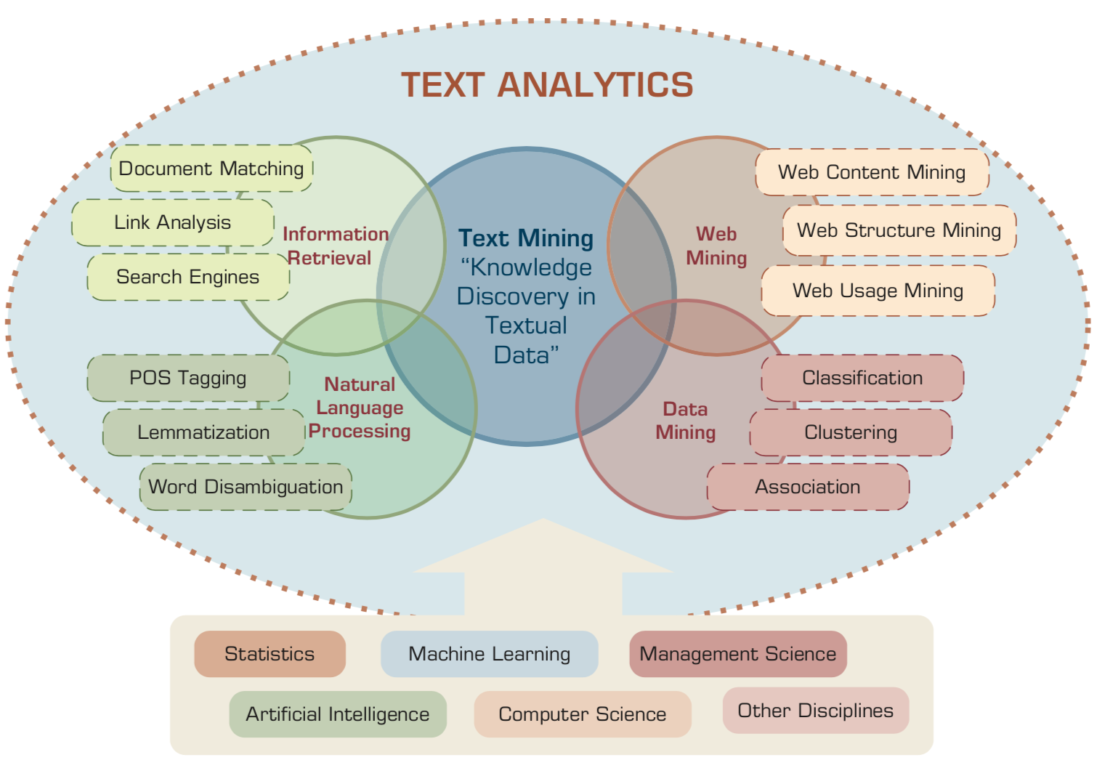
Text Analytics and Text Mining
Source: Ramesh Sharda, Dursun Delen, and Efraim Turban (2017), Business Intelligence, Analytics, and Data Science: A Managerial Perspective, 4th Edition, Pearson

Slide 12
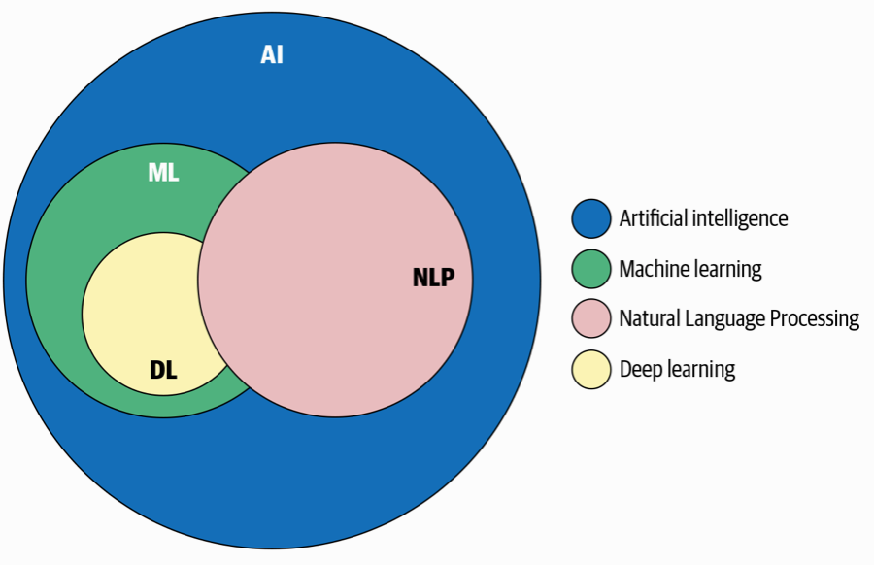
AI, NLP, ML, DL
Source: Sowmya Vajjala, Bodhisattwa Majumder, Anuj Gupta (2020), Practical Natural Language Processing: A Comprehensive Guide to Building Real-World NLP Systems, O'Reilly Media.

Slide 13
Artificial Intelligence
(AI)

Slide 14
AI, Big Data, Cloud Computing
Evolution of Decision Support, Business Intelligence, and Analytics
AI
AI
Cloud Computing
Big Data
DM
BI
Source: Ramesh Sharda, Dursun Delen, and Efraim Turban (2017),
Business Intelligence, Analytics, and Data Science: A Managerial Perspective, 4th Edition, Pearson

Slide 15
The Rise of AI
Source: DHL (2018), Artificial Intelligence in Logistics,
http://www.globalhha.com/doclib/data/upload/doc_con/5e50c53c5bf67.pdf/

Slide 16
AI, ML, DL
Artificial Intelligence (AI)
Machine Learning (ML)
Supervised
Learning
Unsupervised Learning
Deep Learning (DL)
CNN
RNN LSTM GRU
GAN
Semi-supervised Learning
Reinforcement Learning
Source: https://leonardoaraujosantos.gitbooks.io/artificial-inteligence/content/deep_learning.html

Slide 17
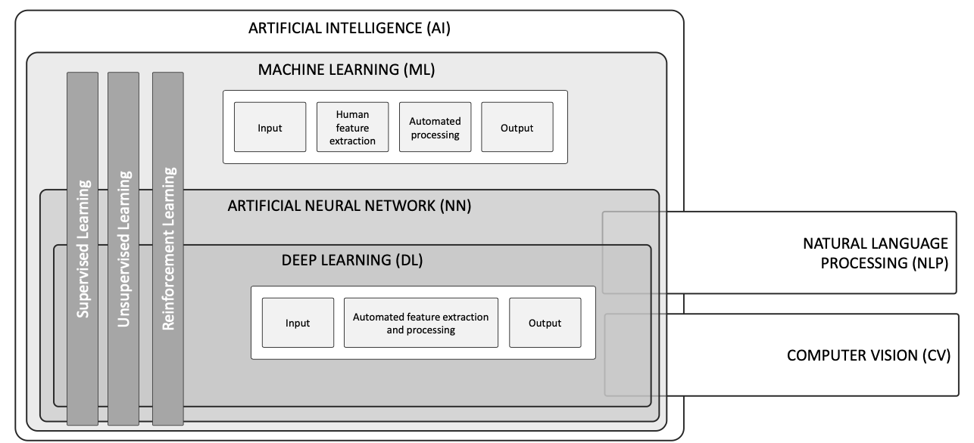
AI, ML, NN, DL
Source: Schoormann, T., Strobel, G., Möller, F., Petrik, D., & Zschech, P. (2023).
Artificial Intelligence for Sustainability—A Systematic Review of Information Systems Literature. Communications of the Association for Information Systems, 52(1), 8.

Slide 18
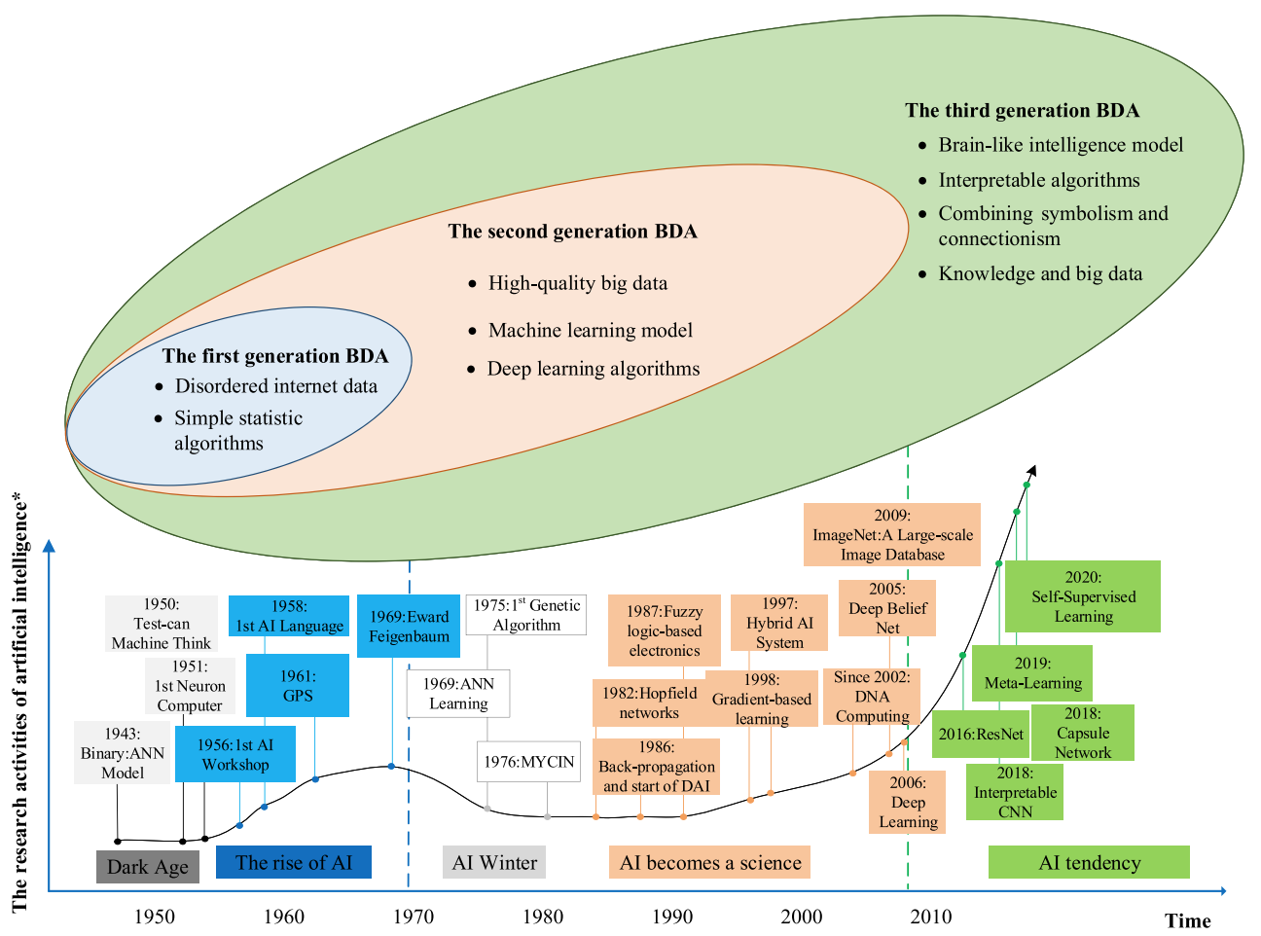
AI and Big Data Analytics (BDA)
Source: Wang, Junliang, Chuqiao Xu, Jie Zhang, and Ray Zhong (2022). "Big data analytics for intelligent manufacturing systems: A review." Journal of Manufacturing Systems 62 (2022): 738-752.

Slide 19
Definition of
Artificial Intelligence (A.I.)

Slide 20
Artificial Intelligence
“… the science and engineering of making intelligent machines”
(John McCarthy, 1955)
Source: https://digitalintelligencetoday.com/artificial-intelligence-defined-useful-list-of-popular-definitions-from-business-and-science/

Slide 21
Artificial Intelligence
“… technology that thinks and acts like humans”
Source: https://digitalintelligencetoday.com/artificial-intelligence-defined-useful-list-of-popular-definitions-from-business-and-science/

Slide 22
Artificial Intelligence
“… intelligence exhibited by machines or software”
Source: https://digitalintelligencetoday.com/artificial-intelligence-defined-useful-list-of-popular-definitions-from-business-and-science/

Slide 23
4 Approaches of AI
Thinking Humanly | Thinking Rationally
Acting Humanly | Acting Rationally
Source: Stuart Russell and Peter Norvig (2020), Artificial Intelligence: A Modern Approach, 4th Edition, Pearson

Slide 24
4 Approaches of AI
2. Thinking Humanly: The Cognitive Modeling Approach | 3. Thinking Rationally: The “Laws of Thought” Approach
1. Acting Humanly: The Turing Test Approach (1950) | 4. Acting Rationally: The Rational Agent Approach
Source: Stuart Russell and Peter Norvig (2020), Artificial Intelligence: A Modern Approach, 4th Edition, Pearson

Slide 25
AI Acting Humanly:
The Turing Test Approach
(Alan Turing, 1950)
Knowledge Representation
Automated Reasoning
Machine Learning (ML)
  Deep Learning (DL)
Computer Vision (Image, Video)
Natural Language Processing (NLP)
Robotics
Source: Stuart Russell and Peter Norvig (2020), Artificial Intelligence: A Modern Approach, 4th Edition, Pearson

Slide 26
Text Analytics and
Text Mining

Slide 27
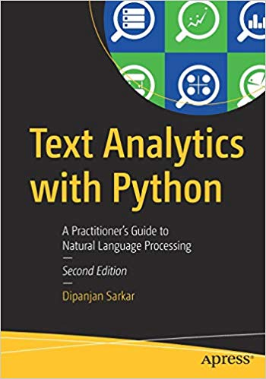
Dipanjan Sarkar (2019),
Text Analytics with Python:
A Practitioner’s Guide to Natural Language Processing,
Second Edition. APress.
Source: https://www.amazon.com/Text-Analytics-Python-Practitioners-Processing/dp/1484243536

Slide 28
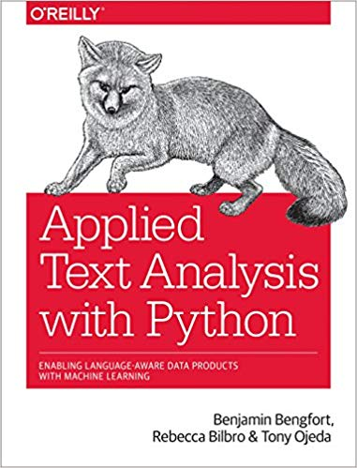
Benjamin Bengfort, Rebecca Bilbro, and Tony Ojeda (2018),
Applied Text Analysis with Python:
Enabling Language-Aware Data Products with Machine Learning, O’Reilly.
Source: https://www.amazon.com/Applied-Text-Analysis-Python-Language-Aware/dp/1491963042

Slide 29
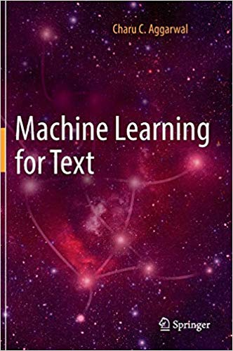
Charu C. Aggarwal (2018),
Machine Learning for Text,
Springer
Source: https://www.amazon.com/Machine-Learning-Text-Charu-Aggarwal/dp/3319735306

Slide 30
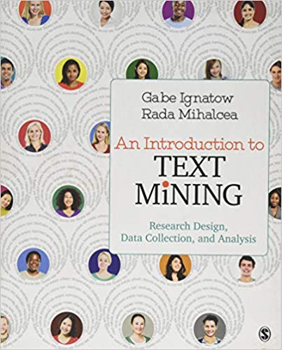
Gabe Ignatow and Rada F. Mihalcea (2017),
An Introduction to Text Mining:
Research Design, Data Collection, and Analysis,
SAGE Publications.
Source: https://www.amazon.com/Introduction-Text-Mining-Research-Collection/dp/1506337007

Slide 31
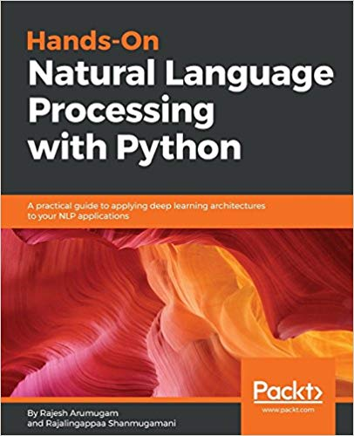
Rajesh Arumugam (2018),
Hands-On Natural Language Processing with Python:
A practical guide to applying deep learning architectures to your NLP applications, Packt
https://www.amazon.com/Hands-Natural-Language-Processing-Python/dp/178913949X

Slide 32
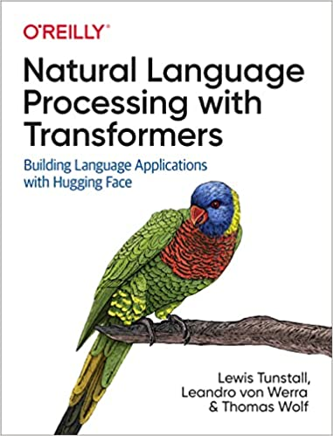
Lewis Tunstall, Leandro von Werra, and Thomas Wolf (2022),
Natural Language Processing with Transformers:
Building Language Applications with Hugging Face,
O'Reilly Media.
Source: https://www.amazon.com/Natural-Language-Processing-Transformers-Applications/dp/1098103246

Slide 33
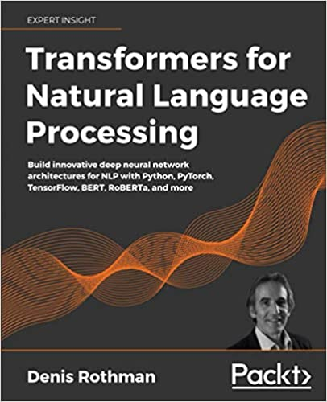
Denis Rothman (2021),
Transformers for Natural Language Processing:
Build innovative deep neural network architectures for NLP with Python, PyTorch, TensorFlow, BERT, RoBERTa, and more,
Packt Publishing.
Source: https://www.amazon.com/Transformers-Natural-Language-Processing-architectures/dp/1800565798

Slide 34
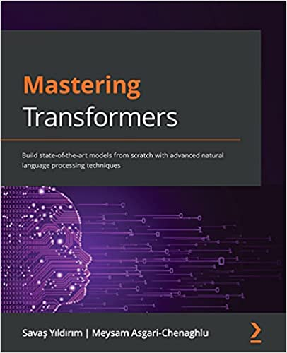
Savaş Yıldırım and Meysam Asgari-Chenaghlu (2021),
Mastering Transformers:
Build state-of-the-art models from scratch with advanced natural language processing techniques,
Packt Publishing.
Source: https://www.amazon.com/Mastering-Transformers-state-art-processing/dp/1801077657/

Slide 35
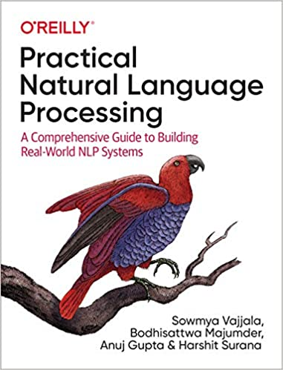
Sowmya Vajjala, Bodhisattwa Majumder, Anuj Gupta (2020), Practical Natural Language Processing:
A Comprehensive Guide to Building Real-World NLP Systems,
O'Reilly Media.
Source: https://www.amazon.com/Practical-Natural-Language-Processing-Pragmatic/dp/1492054054

Slide 36
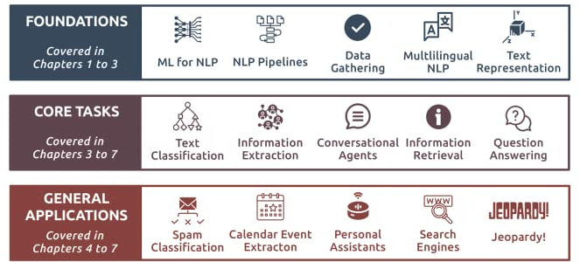
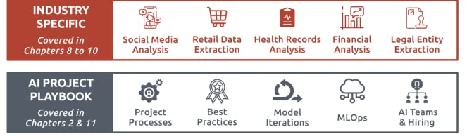
Source: Sowmya Vajjala, Bodhisattwa Majumder, Anuj Gupta (2020), Practical Natural Language Processing: A Comprehensive Guide to Building Real-World NLP Systems, O'Reilly Media.
Source: https://www.amazon.com/Practical-Natural-Language-Processing-Pragmatic/dp/1492054054

Slide 37
Text Analytics
(TA)

Slide 38
Text Analytics
Text Analytics =
Information Retrieval +
Information Extraction +
Data Mining +
Web Mining
Text Analytics =
Information Retrieval +
Text Mining
Source: Ramesh Sharda, Dursun Delen, and Efraim Turban (2017), Business Intelligence, Analytics, and Data Science: A Managerial Perspective, 4th Edition, Pearson

Slide 39
Text Mining
Text Data Mining
Knowledge Discovery in
Textual Databases
Source: Ramesh Sharda, Dursun Delen, and Efraim Turban (2017), Business Intelligence, Analytics, and Data Science: A Managerial Perspective, 4th Edition, Pearson

Slide 40
Text Mining Technologies
Statistics
Machine Learning
Pattern Recognition
Database Systems
Visualization
Text Mining
Natural Language Processing
Algorithms
Information Retrieval
Applications
High-performance Computing
Adapted from: Jiawei Han and Micheline Kamber (2011), Data Mining: Concepts and Techniques, Third Edition, Elsevier

Slide 41
Application Areas of Text Mining
Information extraction
Topic tracking
Summarization
Categorization
Clustering
Concept linking
Question answering
Source: Ramesh Sharda, Dursun Delen, and Efraim Turban (2017), Business Intelligence, Analytics, and Data Science: A Managerial Perspective, 4th Edition, Pearson

Slide 42


Emotions
Love
Anger
Joy
Sadness
Surprise
Fear
Source: Bing Liu (2011) , “Web Data Mining: Exploring Hyperlinks, Contents, and Usage Data,” Springer, 2nd Edition,

Slide 43
Example of Opinion: review segment on iPhone
“I bought an iPhone a few days ago.
It was such a nice phone.
The touch screen was really cool.
The voice quality was clear too.
However, my mother was mad with me as I did not tell her before I bought it.
She also thought the phone was too expensive, and wanted me to return it to the shop. … ”
Source: Bing Liu (2011) , “Web Data Mining: Exploring Hyperlinks, Contents, and Usage Data,” Springer, 2nd Edition,

Slide 44
Example of Opinion:
review segment on iPhone
“(1) I bought an iPhone a few days ago.
(2) It was such a nice phone.
(3) The touch screen was really cool.
(4) The voice quality was clear too.
(5) However, my mother was mad with me as I did not tell her before I bought it.
(6) She also thought the phone was too expensive, and wanted me to return it to the shop. … ”
+Positive Opinion
-Negative Opinion
Source: Bing Liu (2011) , “Web Data Mining: Exploring Hyperlinks, Contents, and Usage Data,” Springer, 2nd Edition,

Slide 45
Sentiment Analysis
Subjectivity
Classification
Polarity Determination
Approaches
Machine Learning based
Sentiment Classification
Vagueness resolution in opinionated text
Lexicon based
Sentiment Analysis
Review Usefulness Measurement
Multi- & Cross- Lingual SC
Hybrid
approaches
Opinion Spam Detection
Cross-domain SC
Lexicon Creation
Ontology based
Tasks
Non-Ontology based
Aspect Extraction
Application
Source: Kumar Ravi and Vadlamani Ravi (2015), "A survey on opinion mining and sentiment analysis: tasks, approaches and applications." Knowledge-Based Systems, 89, pp.14-46.

Slide 46
Sentiment Classification Techniques
Decision Tree Classifiers
Support Vector Machine (SVM)
Supervised Learning
Neural Network (NN
Machine Learning Approach
Linear Classifiers
Deep Learning (DL)
Rule-based Classifiers
Naïve Bayes
(NB)
Sentiment Analysis
Unsupervised Learning
Probabilistic Classifiers
Bayesian Network (BN)
Dictionary-based Approach
Maximum Entropy (ME)
Lexicon-based Approach
Statistical
Corpus-based Approach
Semantic
Source: Jesus Serrano-Guerrero, Jose A. Olivas, Francisco P. Romero, and Enrique Herrera-Viedma (2015),
"Sentiment analysis: A review and comparative analysis of web services," Information Sciences, 311, pp. 18-38.

Slide 47
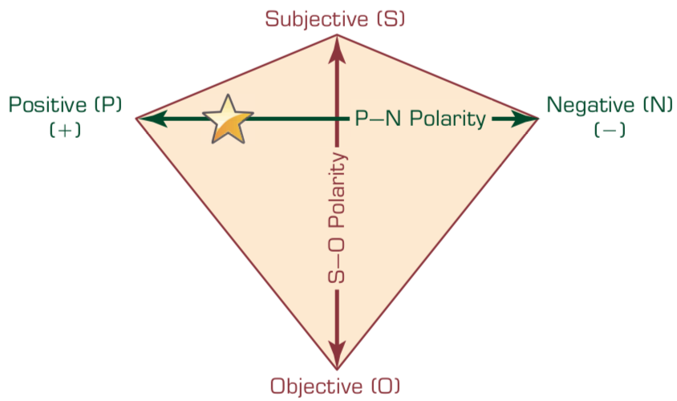
P–N Polarity and
S–O Polarity Relationship
Source: Ramesh Sharda, Dursun Delen, and Efraim Turban (2017), Business Intelligence, Analytics, and Data Science: A Managerial Perspective, 4th Edition, Pearson

Slide 48
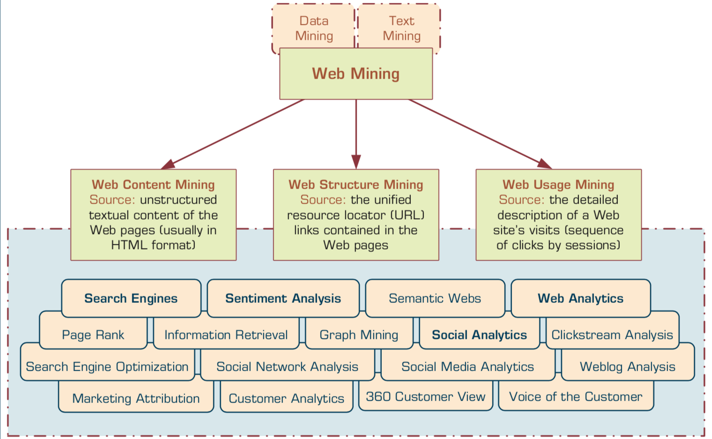
Taxonomy of Web Mining
Source: Ramesh Sharda, Dursun Delen, and Efraim Turban (2017), Business Intelligence, Analytics, and Data Science: A Managerial Perspective, 4th Edition, Pearson

Slide 49
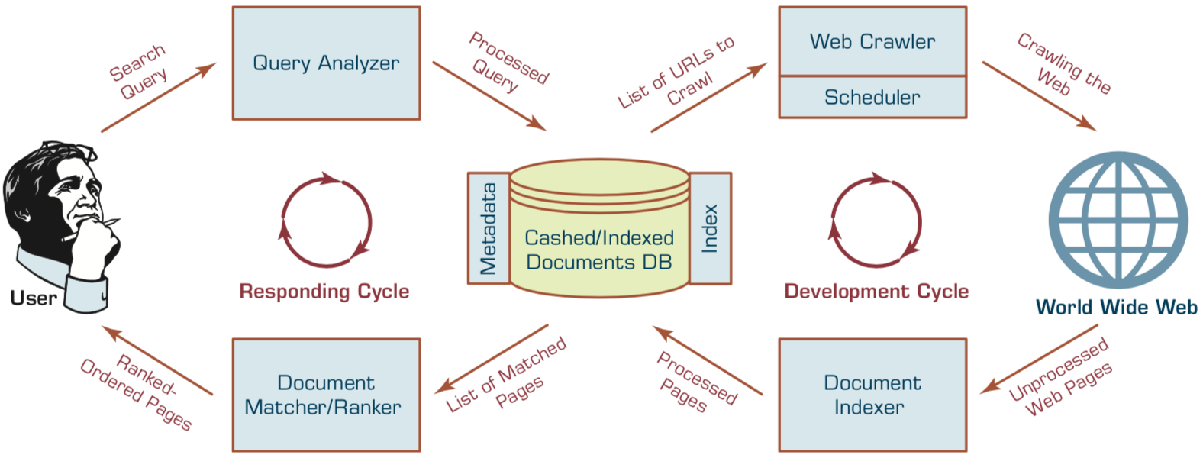
Structure of a
Typical Internet Search Engine
Source: Ramesh Sharda, Dursun Delen, and Efraim Turban (2017), Business Intelligence, Analytics, and Data Science: A Managerial Perspective, 4th Edition, Pearson

Slide 50
Web Usage Mining
(Web Analytics)
Web usage mining (Web analytics)
is the extraction of useful information
from data generated
through Web page visits and transactions.
Clickstream Analysis
Source: Ramesh Sharda, Dursun Delen, and Efraim Turban (2017), Business Intelligence, Analytics, and Data Science: A Managerial Perspective, 4th Edition, Pearson

Slide 51
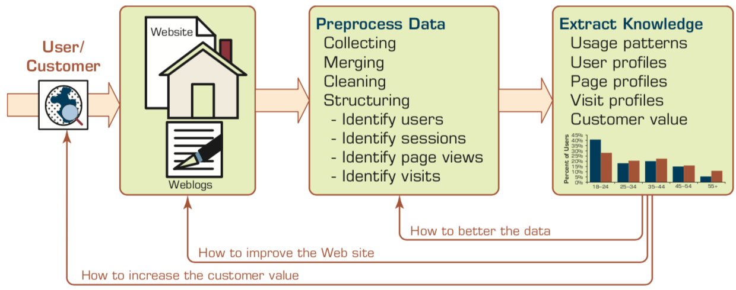
Extraction of Knowledge from Web Usage Data
Source: Ramesh Sharda, Dursun Delen, and Efraim Turban (2017), Business Intelligence, Analytics, and Data Science: A Managerial Perspective, 4th Edition, Pearson

Slide 52
Social Analytics
Social analytics is defined as
monitoring, analyzing,
measuring and interpreting
digital interactions and
relationships of people, topics, ideas and content.
Source: Ramesh Sharda, Dursun Delen, and Efraim Turban (2017), Business Intelligence, Analytics, and Data Science: A Managerial Perspective, 4th Edition, Pearson

Slide 53
Branches of Social Analytics
Social Network Analysis (SNA)
Social Analytics
Social Media Analytics
Source: Ramesh Sharda, Dursun Delen, and Efraim Turban (2017), Business Intelligence, Analytics, and Data Science: A Managerial Perspective, 4th Edition, Pearson

Slide 54
Text Mining
Technologies

Slide 55
Natural Language Processing
(NLP)
Text Mining
(TM)

Slide 56
Text mining
Text Data Mining
Intelligent Text Analysis
Knowledge-Discovery in Text (KDT)
Source: Vishal Gupta and Gurpreet S. Lehal (2009), "A survey of text mining techniques and applications,"
Journal of emerging technologies in web intelligence, vol. 1, no. 1, pp. 60-76.

Slide 57
Text Mining
(text data mining)
  the process of
  deriving
  high-quality information
  from text
http://en.wikipedia.org/wiki/Text_mining

Slide 58
Text Mining: the process of extracting interesting and non-trivial information and knowledge from unstructured text.
Source: Vishal Gupta and Gurpreet S. Lehal (2009), "A survey of text mining techniques and applications,"
Journal of emerging technologies in web intelligence, vol. 1, no. 1, pp. 60-76.

Slide 59
Text Mining: discovery by computer of new, previously unknown information, by automatically extracting information from different written resources.
Source: Vishal Gupta and Gurpreet S. Lehal (2009), "A survey of text mining techniques and applications,"
Journal of emerging technologies in web intelligence, vol. 1, no. 1, pp. 60-76.

Slide 60
An example of Text Mining
Knowledge
Analyze Text
Management Information System
Information Extraction
Classification
Summarization
Retrieve and preprocess document
Clustering
Document Collection
Source: Vishal Gupta and Gurpreet S. Lehal (2009), "A survey of text mining techniques and applications,"
Journal of emerging technologies in web intelligence, vol. 1, no. 1, pp. 60-76.

Slide 61
Overview of
Information Extraction based
Text Mining Framework
Text Data Mining
Text
Text
DB
Text
Information Extraction
Data Mining
Rule
Source: Vishal Gupta and Gurpreet S. Lehal (2009), "A survey of text mining techniques and applications,"
Journal of emerging technologies in web intelligence, vol. 1, no. 1, pp. 60-76.

Slide 62
Natural Language Processing (NLP)
Natural language processing (NLP)
is an important component of
text mining and
is a subfield of
artificial intelligence and
computational linguistics.
Source: Ramesh Sharda, Dursun Delen, and Efraim Turban (2017), Business Intelligence, Analytics, and Data Science: A Managerial Perspective, 4th Edition, Pearson

Slide 63
Natural Language Processing (NLP) and Text Mining
Raw text
Sentence Segmentation
Tokenization
Part-of-Speech (POS)
Stop word removal
word’s stem
am → am
having → hav
word’s lemma
am → be
having → have
Stemming / Lemmatization
Dependency Parser
String Metrics & Matching
Source: Nitin Hardeniya (2015), NLTK Essentials, Packt Publishing; Florian Leitner (2015), Text mining - from Bayes rule to dependency parsing

Slide 64
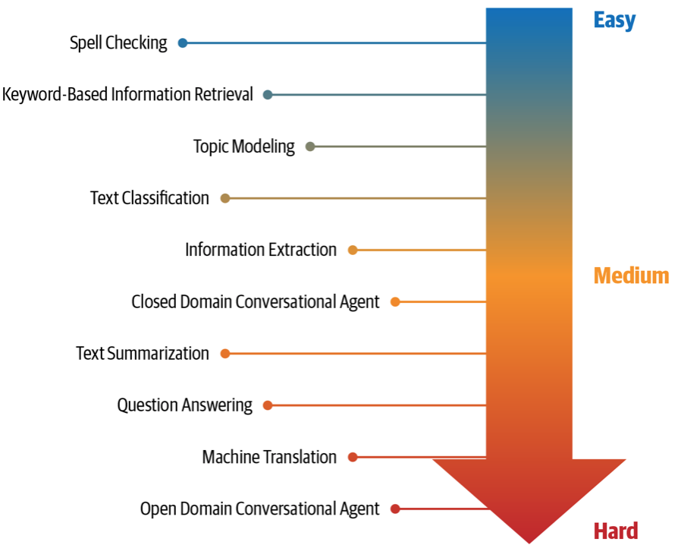
NLP Tasks
Source: Sowmya Vajjala, Bodhisattwa Majumder, Anuj Gupta (2020), Practical Natural Language Processing: A Comprehensive Guide to Building Real-World NLP Systems, O'Reilly Media.

Slide 65
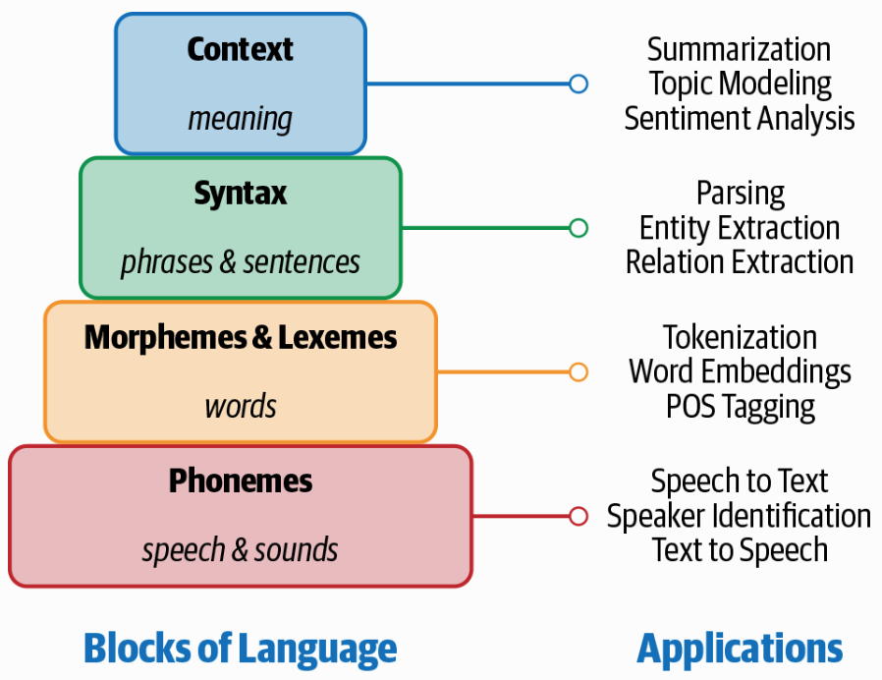
Building Blocks of Language and Applications
Source: Sowmya Vajjala, Bodhisattwa Majumder, Anuj Gupta (2020), Practical Natural Language Processing: A Comprehensive Guide to Building Real-World NLP Systems, O'Reilly Media.

Slide 66
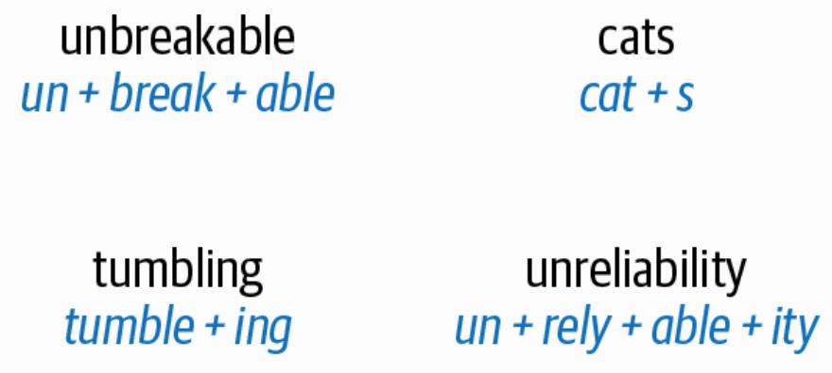
Morpheme Examples
Source: Sowmya Vajjala, Bodhisattwa Majumder, Anuj Gupta (2020), Practical Natural Language Processing: A Comprehensive Guide to Building Real-World NLP Systems, O'Reilly Media.

Slide 67
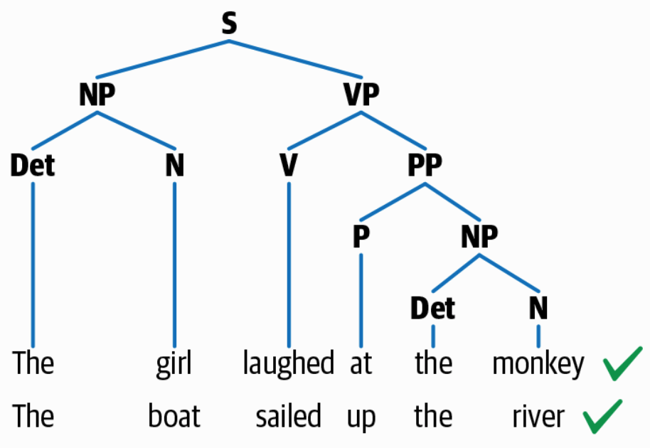
Syntactic Structure
Source: Sowmya Vajjala, Bodhisattwa Majumder, Anuj Gupta (2020), Practical Natural Language Processing: A Comprehensive Guide to Building Real-World NLP Systems, O'Reilly Media.

Slide 68
Text Summarization
Text Input
Dictionary / Thesaurus
Pre-processing
Text Structure Analysis
Word Segmentation
Occurrence Statistic
POS Tagging
Keyword Extraction
Weigh Words & Sentences
Sentences Selection
Rough Summary Generation
Smoothing
Summary Output
Source: Vishal Gupta and Gurpreet S. Lehal (2009), "A survey of text mining techniques and applications,"
Journal of emerging technologies in web intelligence, vol. 1, no. 1, pp. 60-76.

Slide 69
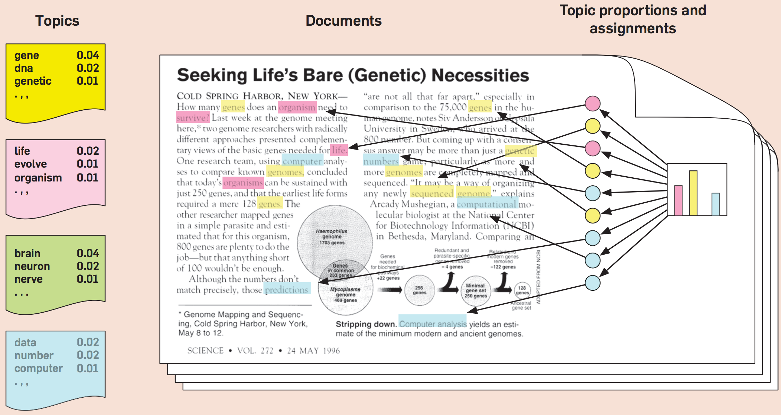
Topic Modeling
Source: Blei, David M. "Probabilistic topic models." Communications of the ACM 55, no. 4 (2012): 77-84.

Slide 70
Natural Language Processing (NLP)
Part-of-speech tagging
Text segmentation
Word sense disambiguation
Syntactic ambiguity
Imperfect or irregular input
Speech acts
Source: Ramesh Sharda, Dursun Delen, and Efraim Turban (2017), Business Intelligence, Analytics, and Data Science: A Managerial Perspective, 4th Edition, Pearson

Slide 71
NLP Tasks
Question answering
Automatic summarization
Natural language generation
Natural language understanding
Machine translation
Foreign language reading
Foreign language writing.
Speech recognition
Text-to-speech
Text proofing
Optical character recognition
Source: Ramesh Sharda, Dursun Delen, and Efraim Turban (2017), Business Intelligence, Analytics, and Data Science: A Managerial Perspective, 4th Edition, Pearson

Slide 72
NLP
Source: http://blog.aylien.com/leveraging-deep-learning-for-multilingual/

Slide 73
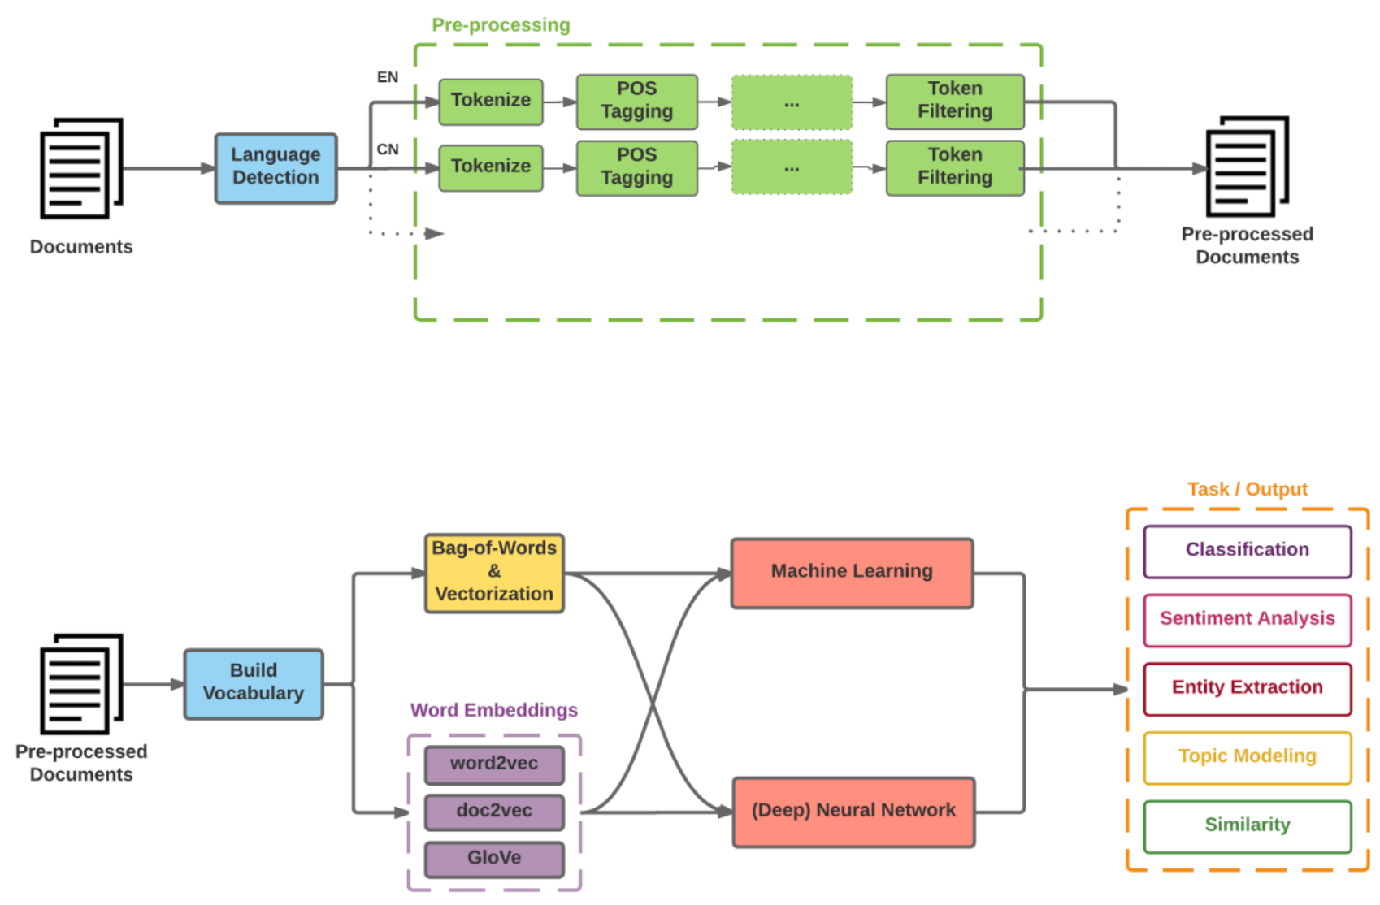
Modern NLP Pipeline
Source: https://github.com/fortiema/talks/blob/master/opendata2016sh/pragmatic-nlp-opendata2016sh.pdf

Slide 74
Modern NLP Pipeline
Source: http://mattfortier.me/2017/01/31/nlp-intro-pt-1-overview/

Slide 75
Deep Learning NLP
Source: http://mattfortier.me/2017/01/31/nlp-intro-pt-1-overview/

Slide 76
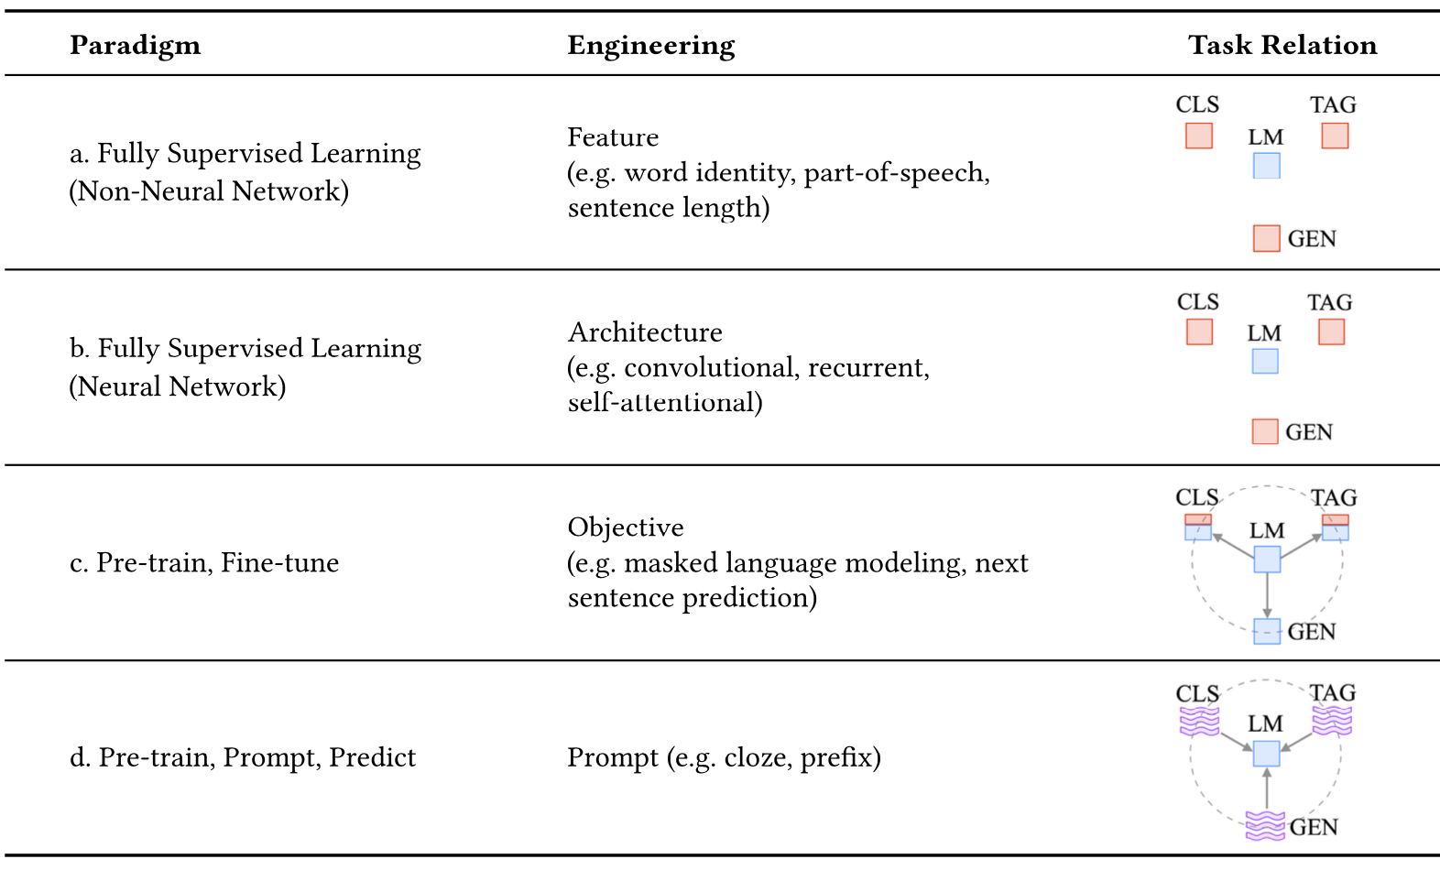
Four Paradigms in NLP
Source: Pengfei Liu, Weizhe Yuan, Jinlan Fu, Zhengbao Jiang, Hiroaki Hayashi, and Graham Neubig. (2023) "Pre-train, prompt, and predict: A systematic survey of prompting methods in natural language processing." ACM Computing Surveys 55, no. 9 (2023): 1-35.

Slide 77
Text Data for NLP
Representations of Words
Texts:
T1: ’The mouse ran up the clock'
T2: ’The mouse ran down’
Token Index:
{'the': 1, 'mouse’: 2, 'ran': 3, 'up': 4, 'clock': 5, 'down': 6,}.
  NOTE: 'the' occurs most frequently,
  so the index value of 1 is assigned to it.
  Some libraries reserve index 0 for unknown tokens,
  as is the case here.
Sequence of token indexes:
T1: ‘The mouse ran up the clock’ =
[1, 2, 3, 4, 1, 5]
T1: ’The mouse ran down’ =
[1, 2, 3, 6]
Source: https://developers.google.com/machine-learning/guides/text-classification/step-3

Slide 78
One-hot encoding
'The mouse ran up the clock’ =
[ [0, 1, 0, 0, 0, 0, 0],
[0, 0, 1, 0, 0, 0, 0],
[0, 0, 0, 1, 0, 0, 0],
[0, 0, 0, 0, 1, 0, 0],
[0, 1, 0, 0, 0, 0, 0],
[0, 0, 0, 0, 0, 1, 0] ]
The
mouse
ran
up
the
clock
1
2
3
4
1
5
[0, 1, 2, 3, 4, 5, 6]
Source: https://developers.google.com/machine-learning/guides/text-classification/step-3

Slide 79
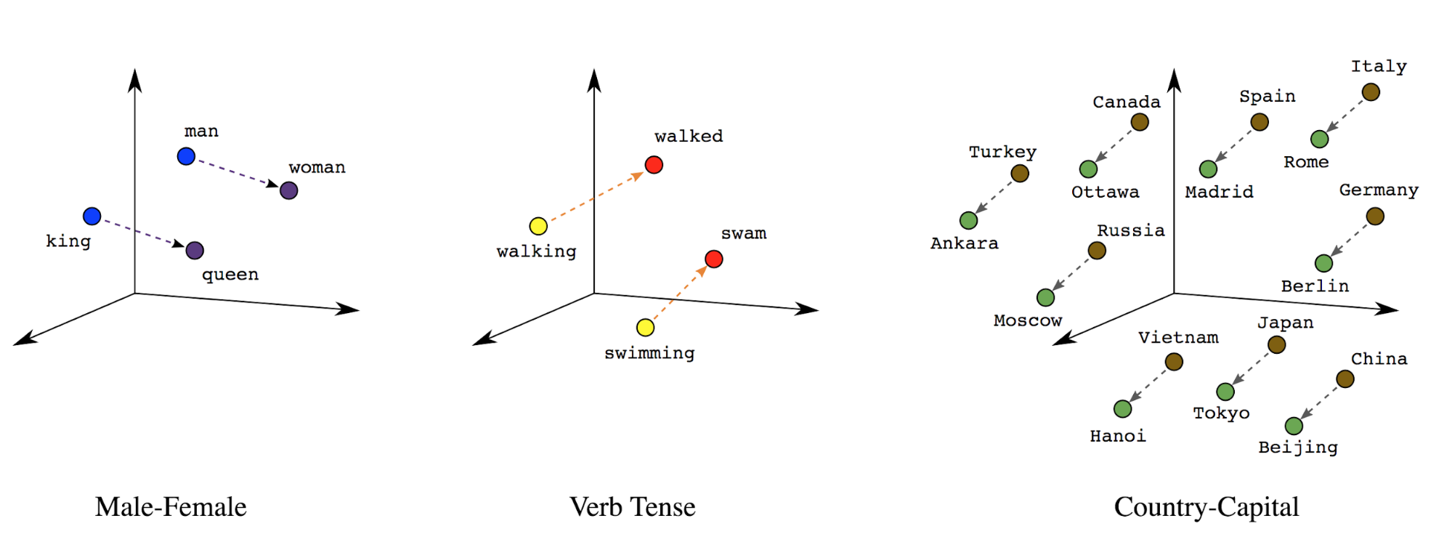
Word embeddings
Source: https://developers.google.com/machine-learning/guides/text-classification/step-3

Slide 80
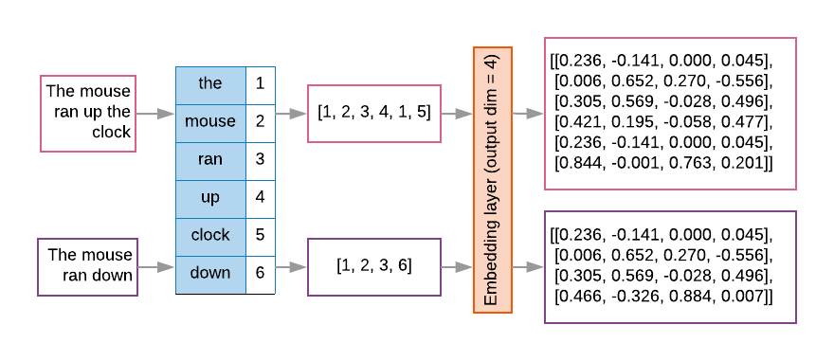
Word embeddings
Source: https://developers.google.com/machine-learning/guides/text-classification/step-3

Slide 81
Vector Representations of Words
Word Embeddings
Word2Vec
GloVe

Slide 82
Word Embeddings in LSTM RNN
Source: https://avisingh599.github.io/deeplearning/visual-qa/

Slide 83
Sequence to Sequence
(Seq2Seq)
Source: https://google.github.io/seq2seq/

Slide 84
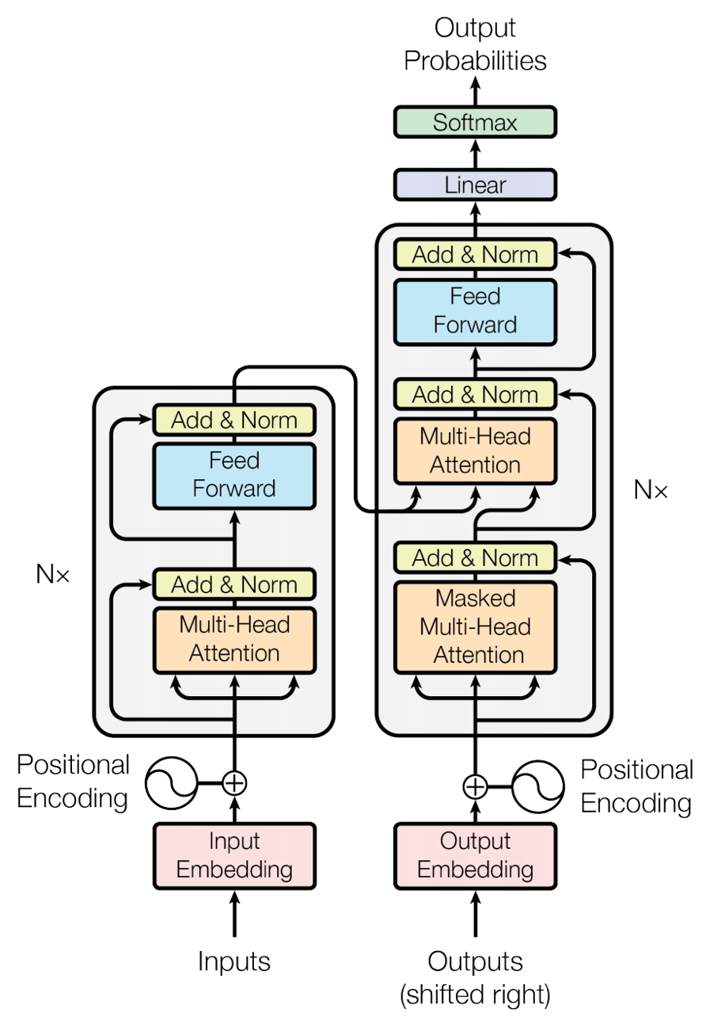
Transformer (Attention is All You Need)
(Vaswani et al., 2017)
Source: Vaswani, Ashish, Noam Shazeer, Niki Parmar, Jakob Uszkoreit, Llion Jones, Aidan N. Gomez, Łukasz Kaiser, and Illia Polosukhin. "Attention is all you need." In Advances in neural information processing systems, pp. 5998-6008. 2017.

Slide 85
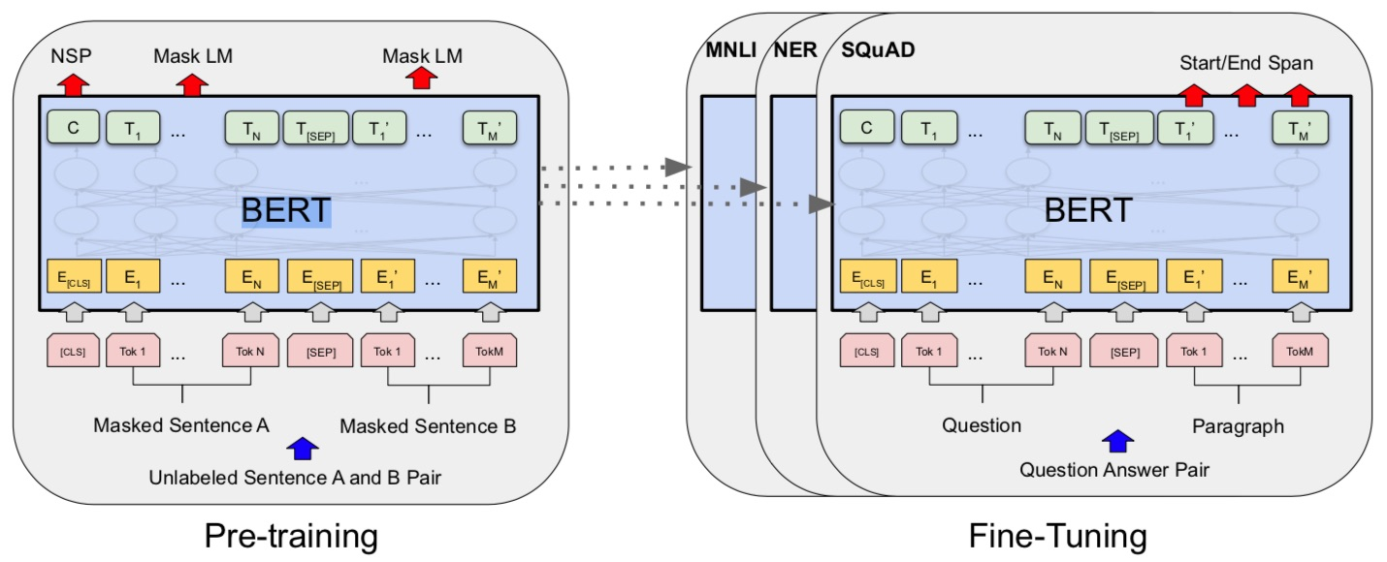
BERT: Pre-training of Deep Bidirectional Transformers for Language Understanding
BERT (Bidirectional Encoder Representations from Transformers)
Overall pre-training and fine-tuning procedures for BERT
Source: Devlin, Jacob, Ming-Wei Chang, Kenton Lee, and Kristina Toutanova (2018).
"Bert: Pre-training of deep bidirectional transformers for language understanding." arXiv preprint arXiv:1810.04805.

Slide 86
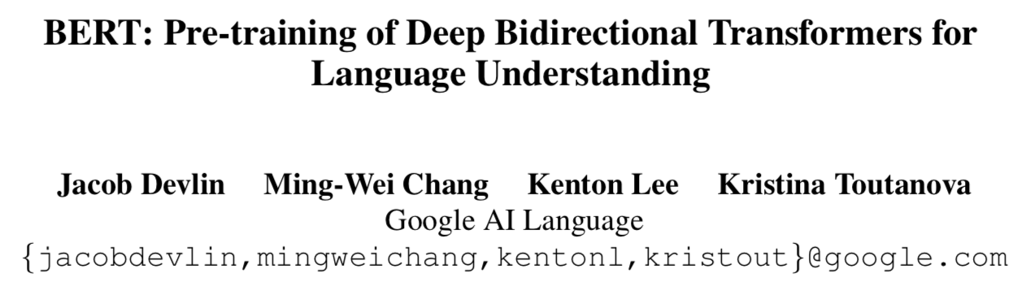
BERT:
Pre-training of Deep
Bidirectional Transformers for Language Understanding
Source: Devlin, Jacob, Ming-Wei Chang, Kenton Lee, and Kristina Toutanova (2018).
"BERT: Pre-training of Deep Bidirectional Transformers for Language Understanding." arXiv preprint arXiv:1810.04805

Slide 87
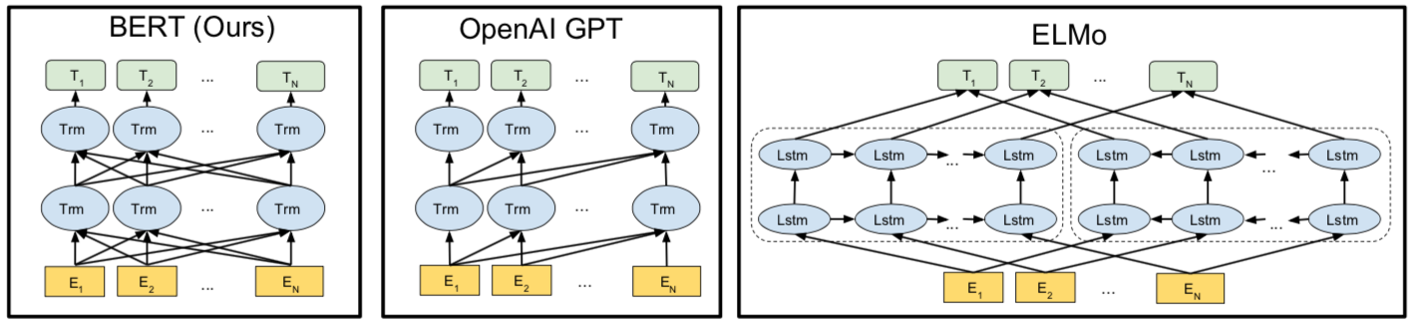
BERT
Bidirectional Encoder Representations from Transformers
Pre-training model architectures
BERT uses a bidirectional Transformer.
OpenAI GPT uses a left-to-right Transformer.
ELMo uses the concatenation of independently trained left-to-right and right- to-left LSTM to generate features for downstream tasks.
Among three, only BERT representations are jointly conditioned on both left and right context in all layers.
Source: Devlin, Jacob, Ming-Wei Chang, Kenton Lee, and Kristina Toutanova (2018).
"BERT: Pre-training of Deep Bidirectional Transformers for Language Understanding." arXiv preprint arXiv:1810.04805

Slide 88
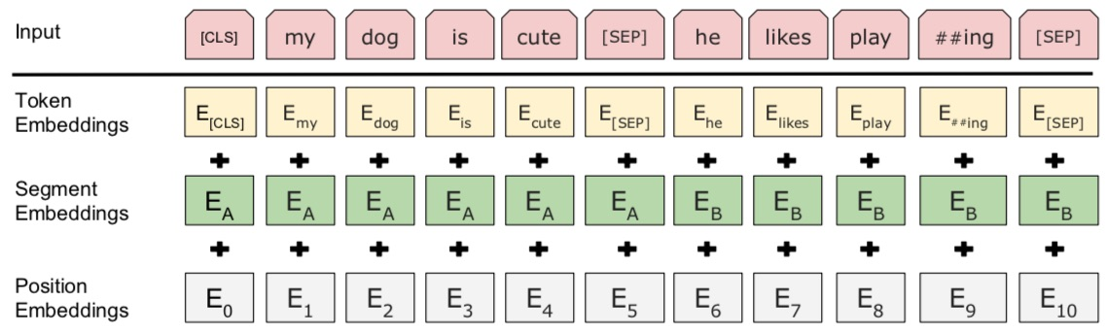
BERT: Pre-training of Deep Bidirectional Transformers for Language Understanding
BERT (Bidirectional Encoder Representations from Transformers)
BERT input representation
The input embeddings is the sum of the token embeddings,
the segmentation embeddings and the position embeddings.
Source: Devlin, Jacob, Ming-Wei Chang, Kenton Lee, and Kristina Toutanova (2018).
"Bert: Pre-training of deep bidirectional transformers for language understanding." arXiv preprint arXiv:1810.04805.

Slide 89
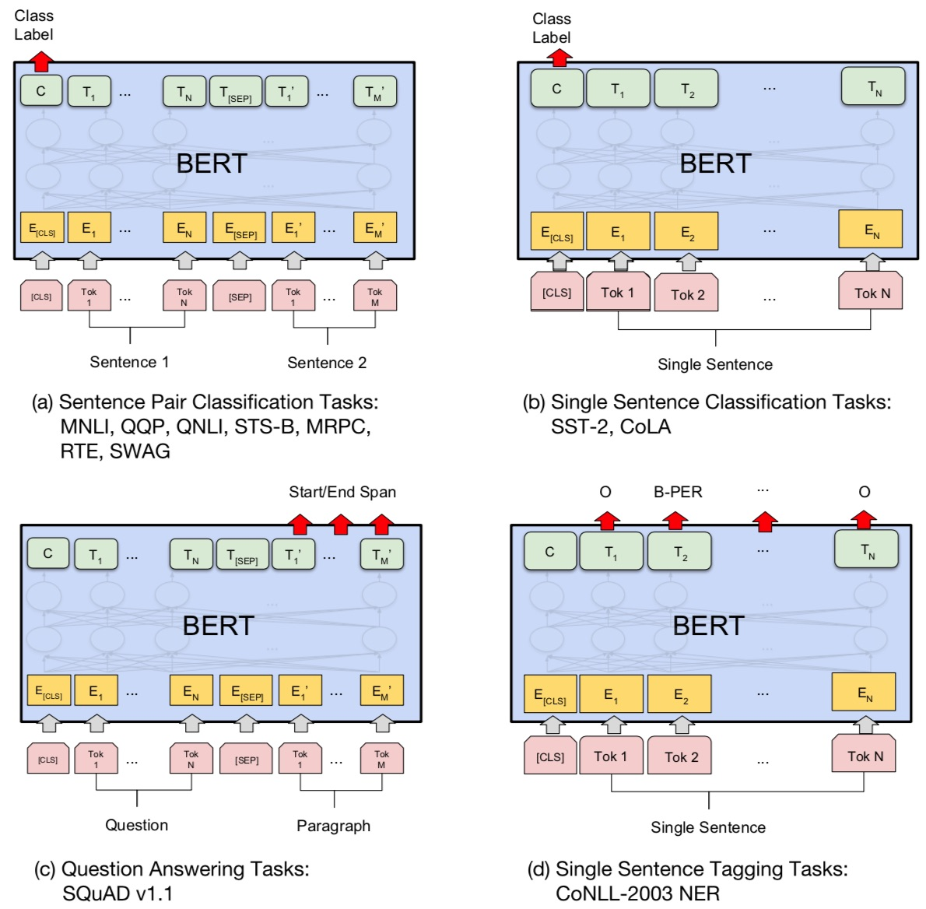
Fine-tuning BERT on NLP Tasks
Source: Devlin, Jacob, Ming-Wei Chang, Kenton Lee, and Kristina Toutanova (2018).
"BERT: Pre-training of Deep Bidirectional Transformers for Language Understanding." arXiv preprint arXiv:1810.04805

Slide 90
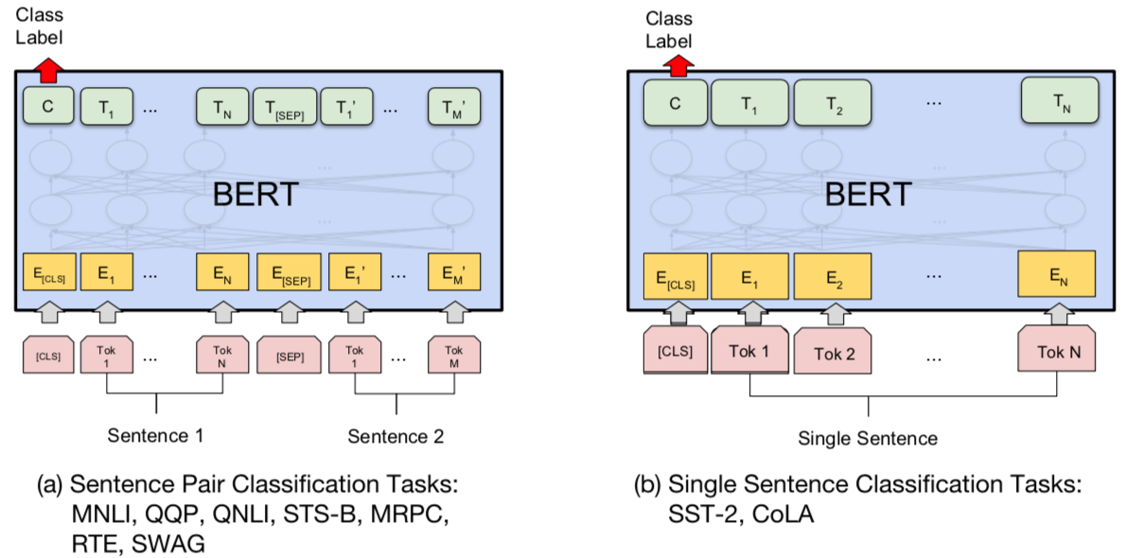
BERT Sequence-level tasks
Source: Devlin, Jacob, Ming-Wei Chang, Kenton Lee, and Kristina Toutanova (2018).
"BERT: Pre-training of Deep Bidirectional Transformers for Language Understanding." arXiv preprint arXiv:1810.04805

Slide 91
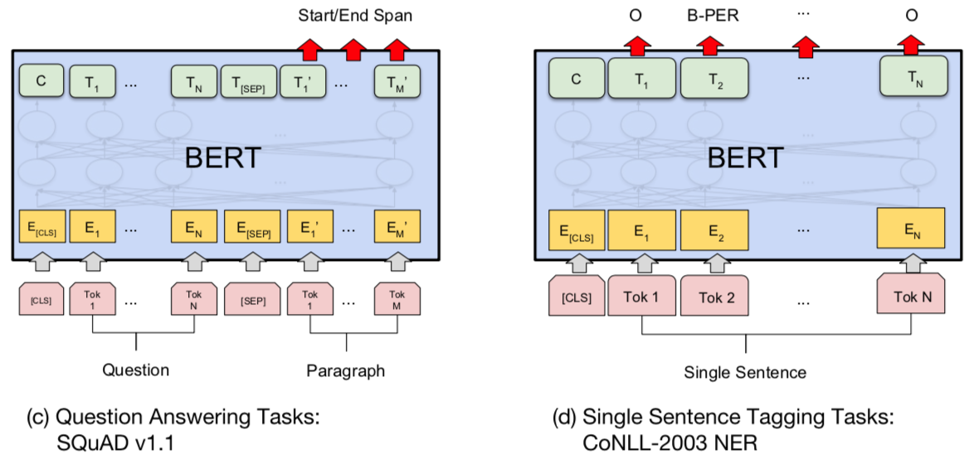
BERT Token-level tasks
Source: Devlin, Jacob, Ming-Wei Chang, Kenton Lee, and Kristina Toutanova (2018).
"BERT: Pre-training of Deep Bidirectional Transformers for Language Understanding." arXiv preprint arXiv:1810.04805

Slide 92
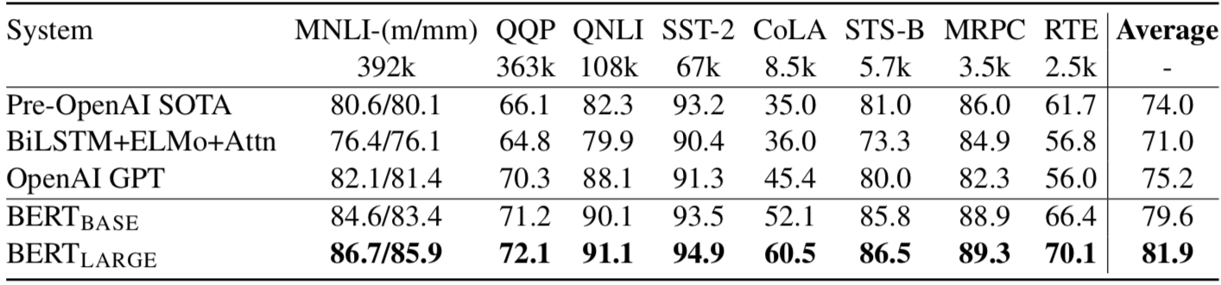
General Language Understanding Evaluation (GLUE) benchmark
GLUE Test results
MNLI: Multi-Genre Natural Language Inference
QQP: Quora Question Pairs
QNLI: Question Natural Language Inference
SST-2: The Stanford Sentiment Treebank
CoLA: The Corpus of Linguistic Acceptability
STS-B:The Semantic Textual Similarity Benchmark
MRPC: Microsoft Research Paraphrase Corpus
RTE: Recognizing Textual Entailment
Source: Devlin, Jacob, Ming-Wei Chang, Kenton Lee, and Kristina Toutanova (2018).
"BERT: Pre-training of Deep Bidirectional Transformers for Language Understanding." arXiv preprint arXiv:1810.04805

Slide 93
ChatGPT
Large Language Models (LLMs)
Foundation Models

Slide 94
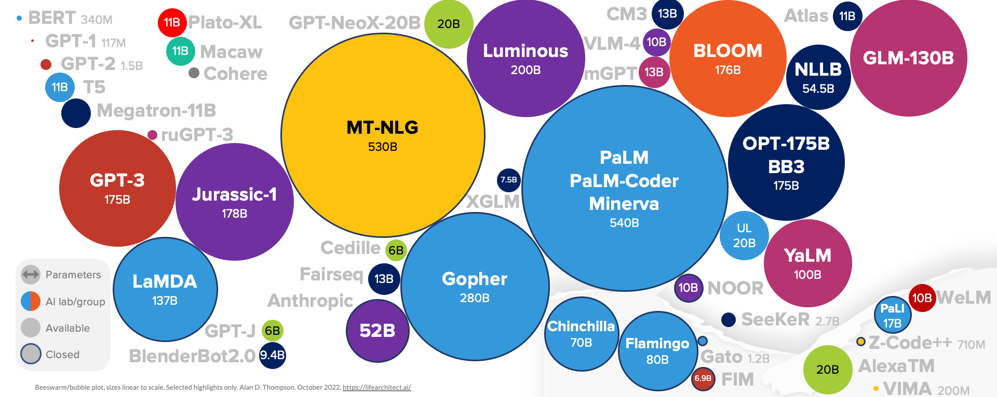
Large Language Models (LLM)
(GPT-3, ChatGPT, PaLM, BLOOM, OPT-175B, LLaMA)
ChatGPT
175B
LLaMA
65B
Source: https://lifearchitect.ai/models/

Slide 95
The Transformers Timeline
ULMFit
BERT
RoBERTa
XLM-R
DeBERTa
GPT-Neo
BLOOM
Alpaca
DistrilBERT
T5
PaLM
ChatGPT
Llama2
Transformer
GPT
GPT-2
GPT-3
GPT-J
OPT-175B
Llama
2017
2018
2019
2020
2021
2022
2023
Source: Lewis Tunstall, Leandro von Werra, and Thomas Wolf (2022), Natural Language Processing with Transformers: Building Language Applications with Hugging Face, O'Reilly Media.

Slide 96
Transformer Models
Transformer
Encoder
Decoder
DistilBERT
BERT
T5
GPT
RoBERTa
BART
GPT-2
CTRL
XLM-R
XLM
M2M-100
GPT-3
ALBERT
BigBird
GPT-Neo
GPT-J
ELECTRA
mT0
BLOOM
BLOOMZ
DeBERTa
ChatGPT
GPT-4
Source: Lewis Tunstall, Leandro von Werra, and Thomas Wolf (2022), Natural Language Processing with Transformers: Building Language Applications with Hugging Face, O'Reilly Media.

Slide 97
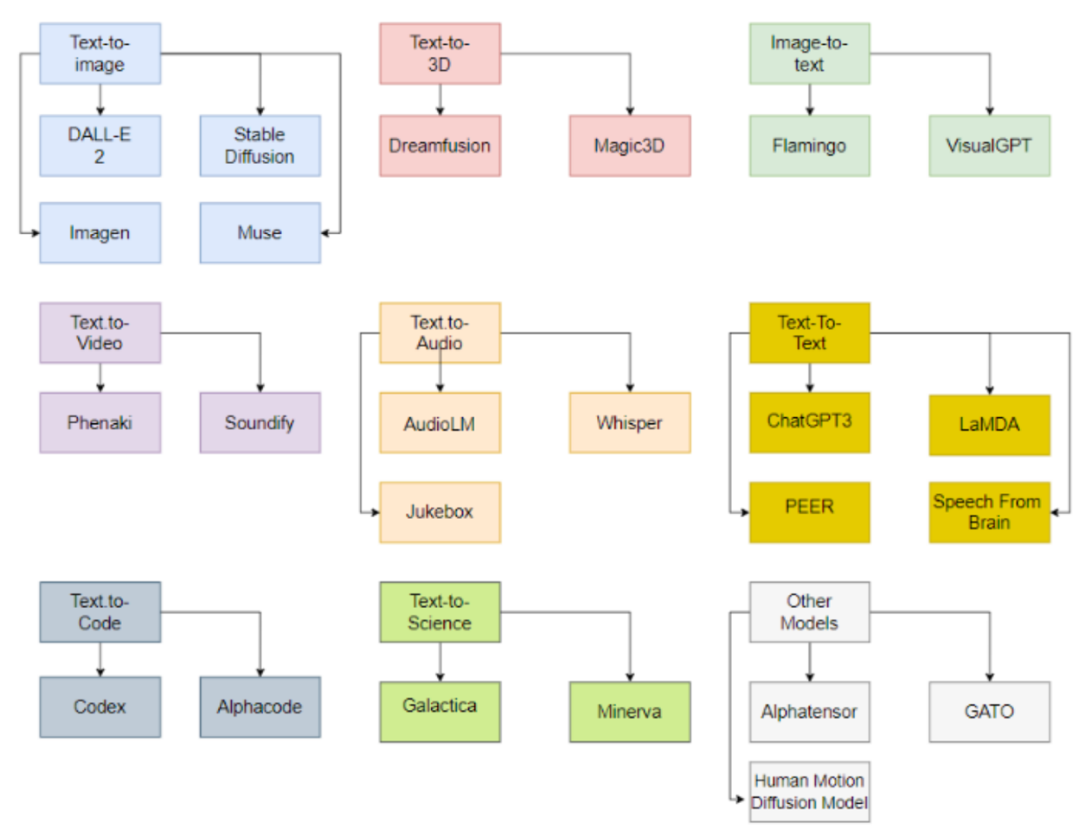
Generative AI Models
ChatGPT
is not
all you need
Attention
is
all you need
Source: Gozalo-Brizuela, Roberto, and Eduardo C. Garrido-Merchan (2023). "ChatGPT is not all you need. A State of the Art Review of large Generative AI models." arXiv preprint arXiv:2301.04655 (2023).

Slide 98
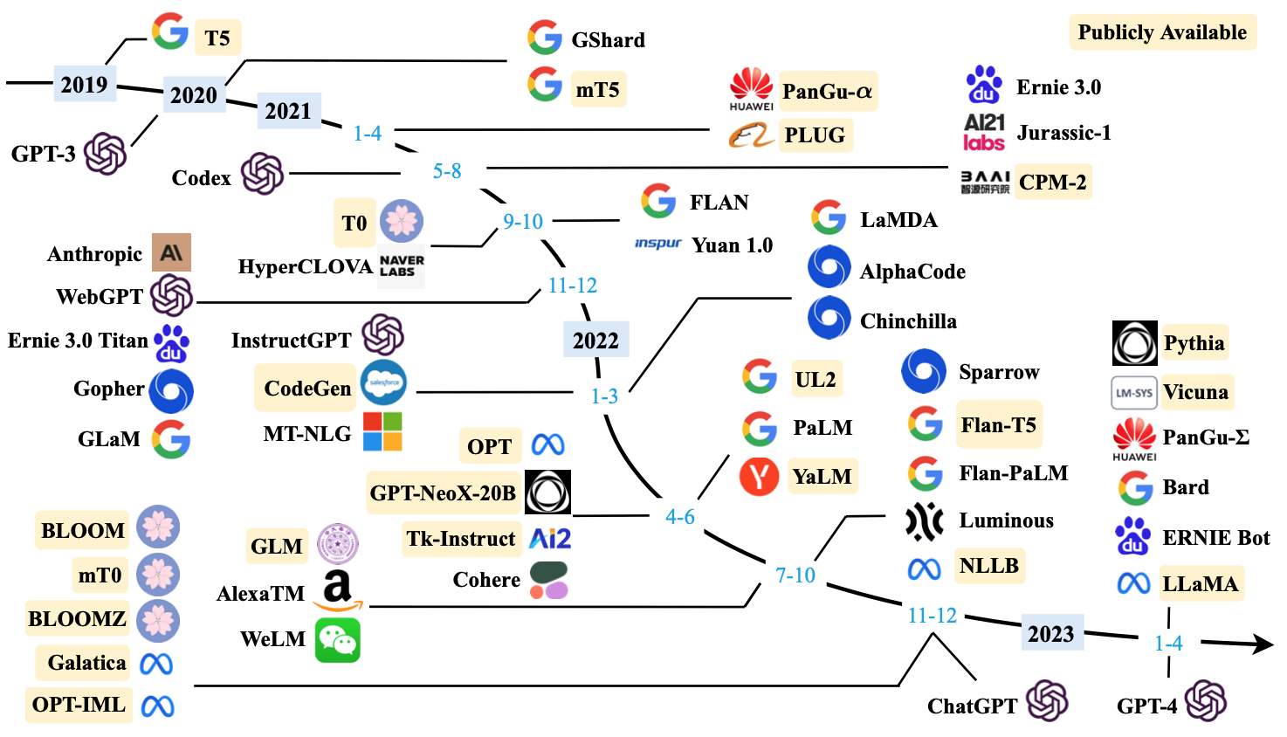
Large Language Models (LLMs) (larger than 10B)
Source: Wayne Xin Zhao, Kun Zhou, Junyi Li, Tianyi Tang, Xiaolei Wang, Yupeng Hou, Yingqian Min et al. (2023) "A Survey of Large Language Models." arXiv preprint arXiv:2303.18223.

Slide 99
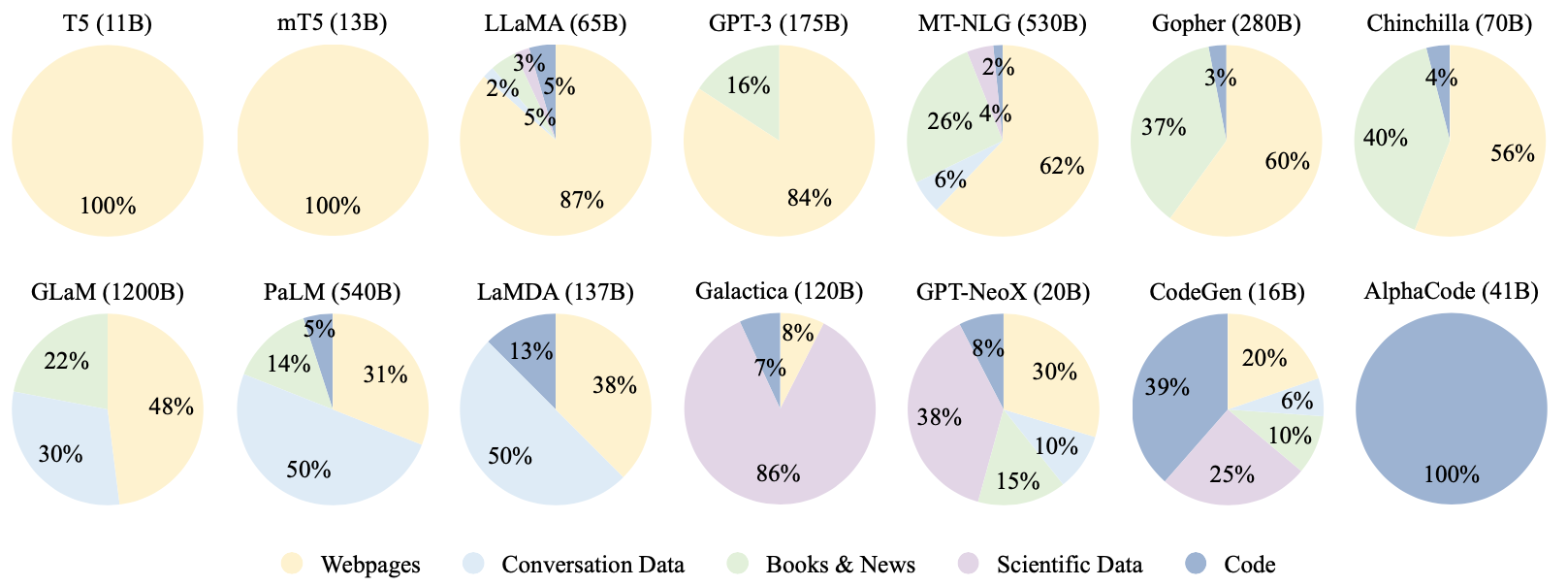
Ratios of various data sources in the pre-training data for existing LLMs
Source: Wayne Xin Zhao, Kun Zhou, Junyi Li, Tianyi Tang, Xiaolei Wang, Yupeng Hou, Yingqian Min et al. (2023) "A Survey of Large Language Models." arXiv preprint arXiv:2303.18223.

Slide 100
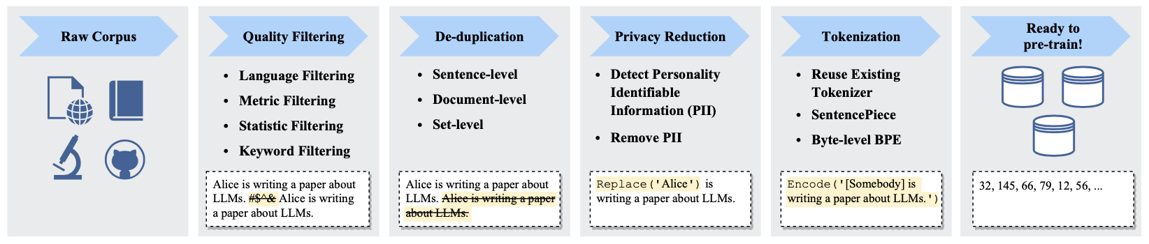
Typical Data Preprocessing Pipeline for
Pre-training Large Language Models (LLMs)
Source: Wayne Xin Zhao, Kun Zhou, Junyi Li, Tianyi Tang, Xiaolei Wang, Yupeng Hou, Yingqian Min et al. (2023) "A Survey of Large Language Models." arXiv preprint arXiv:2303.18223.

Slide 101
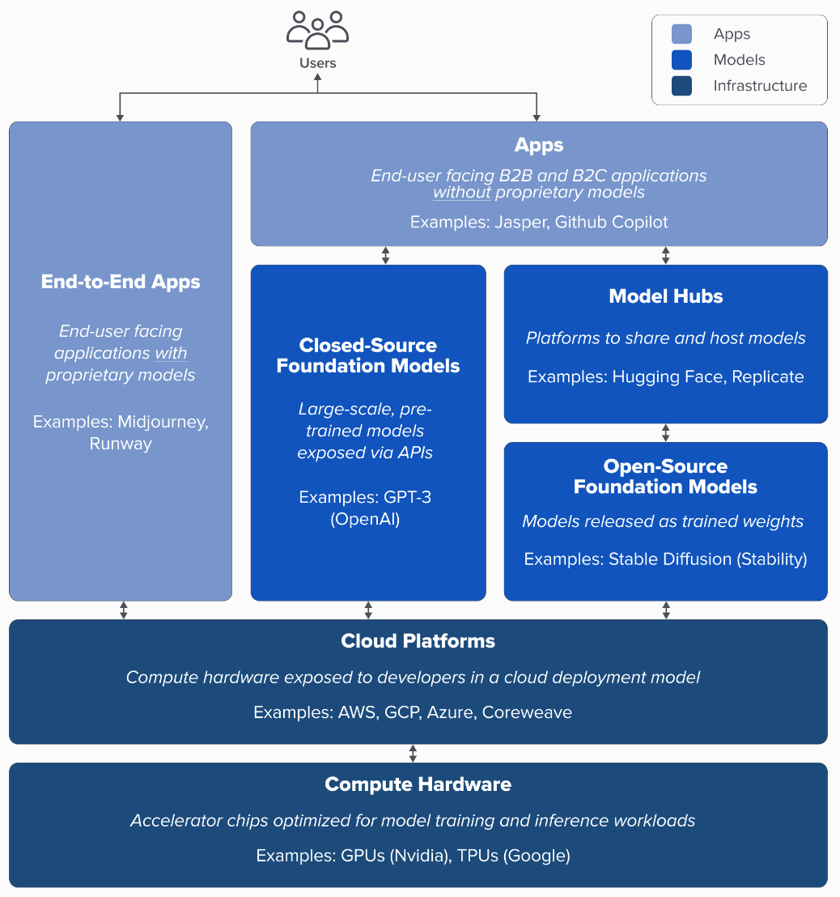
Generative AI
Tech Stack
Source: Matt Bornstein, Guido Appenzeller, and Martin Casado (2023), Who Owns the Generative AI Platform?, https://a16z.com/2023/01/19/who-owns-the-generative-ai-platform/

Slide 102
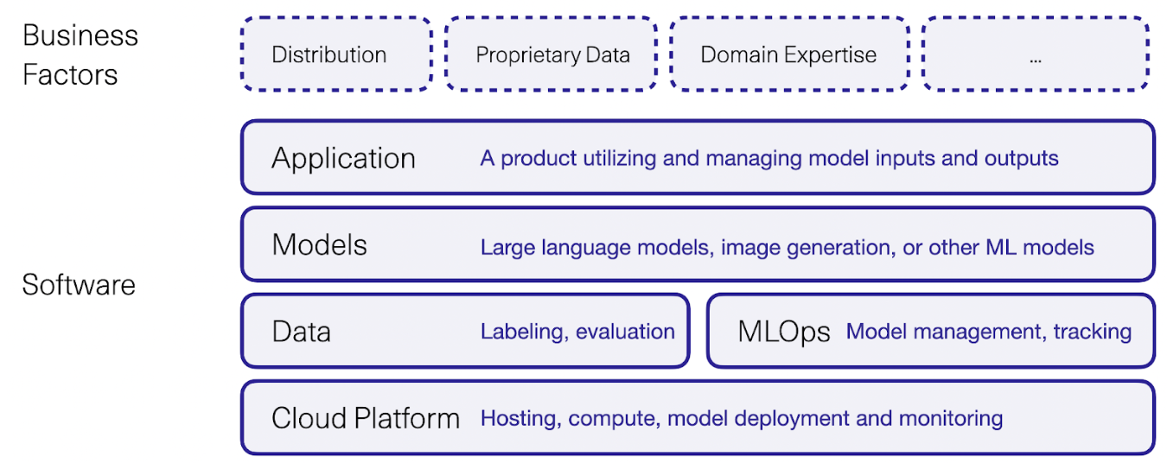
Generative AI Software and Business Factors
Source: Jay Alammar (2023), AI is Eating The World, https://txt.cohere.com/ai-is-eating-the-world/

Slide 103
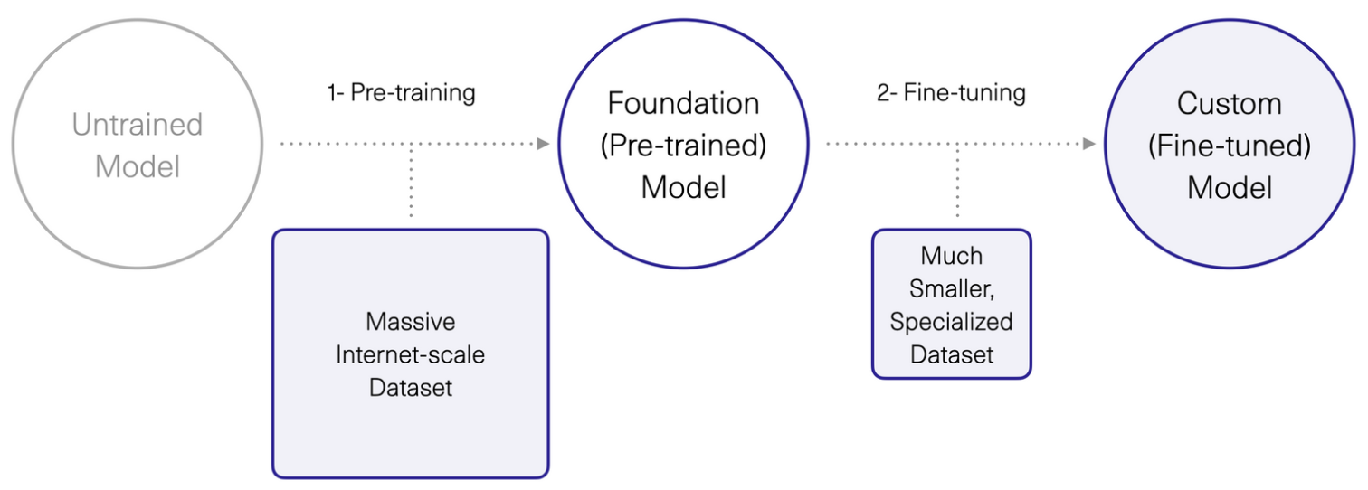
Generative AI
1. Pre-training Foundation (Pre-trained) Model
2. Fine-turning Custom (Fine-tuned) Model
Source: Jay Alammar (2023), AI is Eating The World, https://txt.cohere.com/ai-is-eating-the-world/

Slide 104
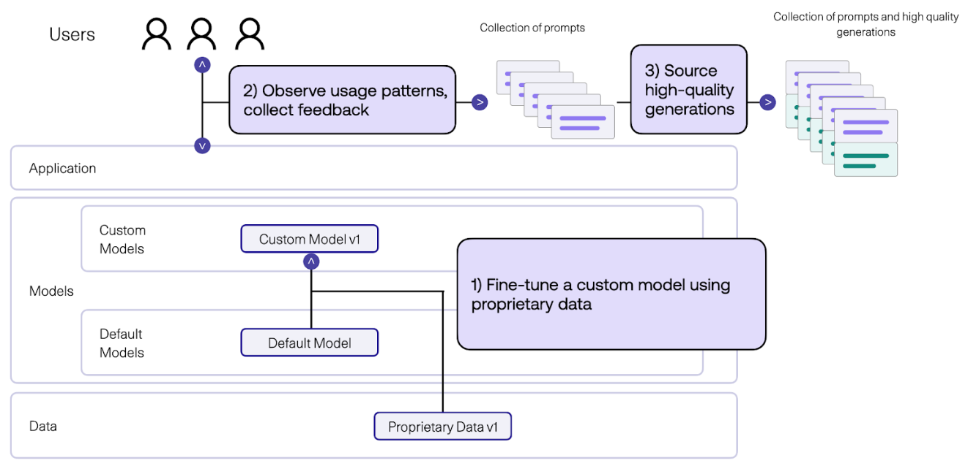
Generative AI
Fine-tune Custom Models using Proprietary Data
Source: Jay Alammar (2023), AI is Eating The World, https://txt.cohere.com/ai-is-eating-the-world/

Slide 105
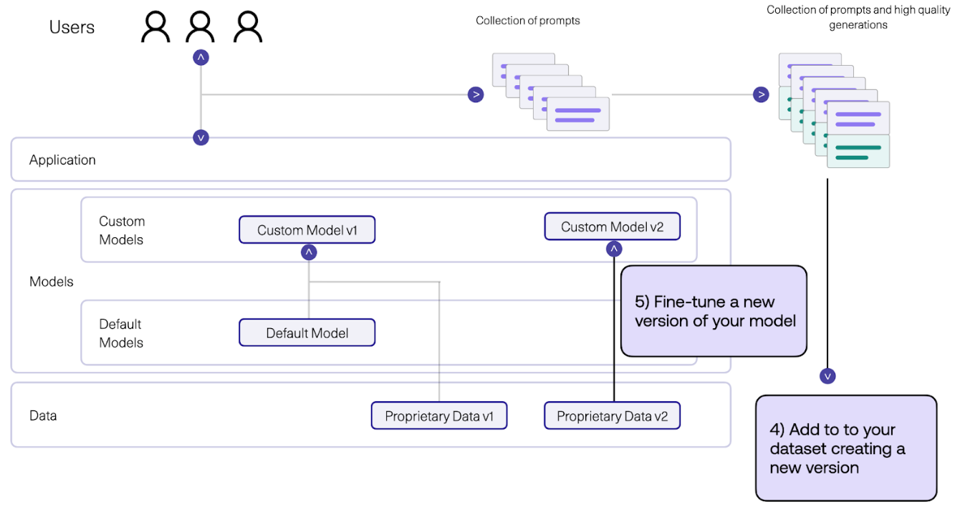
Generative AI
Fine-tune Custom Models using Proprietary Data
Source: Jay Alammar (2023), AI is Eating The World, https://txt.cohere.com/ai-is-eating-the-world/

Slide 106
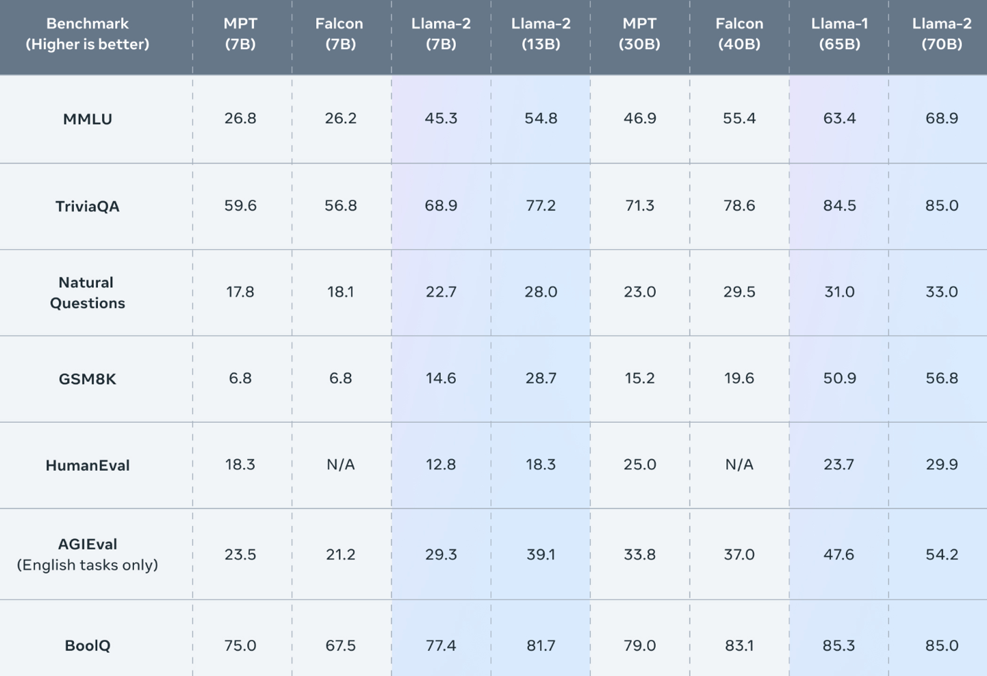
Meta
Llama-2 70B:
Best
Open Source and Commercial LLM
(Llama-2, Falcon, MPT)
Llama 2 outperforms other open source language models on many external benchmarks,
including reasoning, coding, proficiency, and knowledge tests.
Source: https://ai.meta.com/llama/

Slide 107
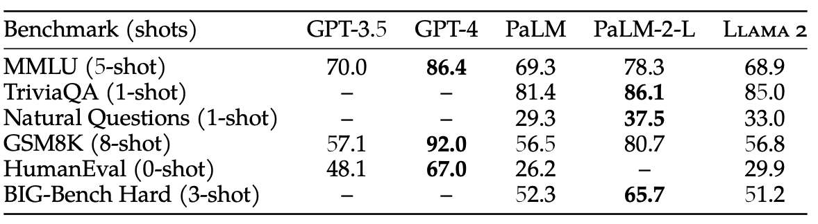
Llama-2: Comparison to closed-source models (GPT-3.5, GPT-4, PaLM) on academic benchmarks
Results for GPT-3.5 and GPT-4 are from OpenAI (2023).
Results for the PaLM model are from Chowdhery et al. (2022).
Results for the PaLM-2-L are from Anil et al. (2023).
Source: Touvron, Hugo, Louis Martin, Kevin Stone, Peter Albert, Amjad Almahairi, Yasmine Babaei, Nikolay Bashlykov et al. (2023) "Llama 2: Open Foundation and Fine-Tuned Chat Models." arXiv preprint arXiv:2307.09288 (2023).

Slide 108
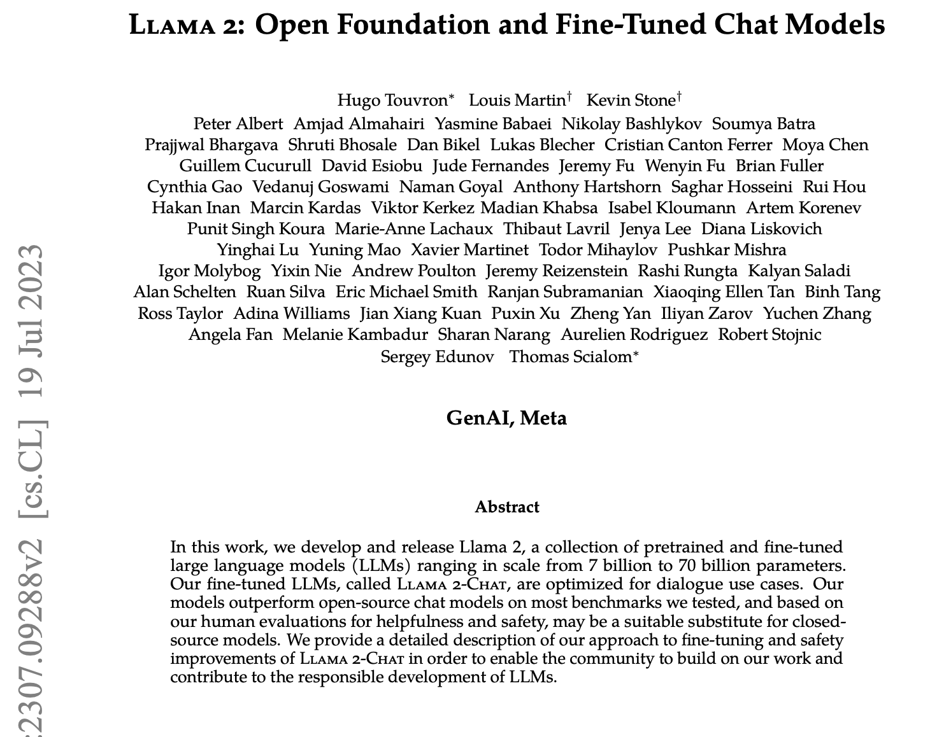
Llama 2:
Open Foundation and Fine-Tuned Chat Models
Source: Touvron, Hugo, Louis Martin, Kevin Stone, Peter Albert, Amjad Almahairi, Yasmine Babaei, Nikolay Bashlykov et al. (2023) "Llama 2: Open Foundation and Fine-Tuned Chat Models." arXiv preprint arXiv:2307.09288 (2023).

Slide 109


MPT-30B, MPT-7B
LLaMa-30B, LLaMa-7B
Source: https://www.mosaicml.com/blog/mpt-30b

Slide 110


Falcon 180B
Source: https://huggingface.co/blog/falcon-180b

Slide 111

Falcon 180B, LLaMA 65B, MPT 30B
Source: https://huggingface.co/blog/falcon-180b

Slide 112

Falcon 180B
Hardware requirements
NVIDIA A100 80 GB: $16,135
Source: https://huggingface.co/blog/falcon-180b

Slide 113

Hugging Face
https://huggingface.co/

Slide 114

Hugging Face Transformers
https://huggingface.co/docs/transformers/index

Slide 115

Hugging Face Tasks
Natural Language Processing
https://huggingface.co/tasks

Slide 116

NLP with Transformers Github
https://github.com/nlp-with-transformers/notebooks

Slide 117

NLP with Transformers Github Notebooks
https://github.com/nlp-with-transformers/notebooks

Slide 118
NLP with Transformers
!git clone https://github.com/nlp-with-transformers/notebooks.git
%cd notebooks
from install import *
install_requirements()
from utils import *
setup_chapter()
Source: Lewis Tunstall, Leandro von Werra, and Thomas Wolf (2022), Natural Language Processing with Transformers: Building Language Applications with Hugging Face, O'Reilly Media.
https://github.com/nlp-with-transformers/notebooks

Slide 119
Text Classification
text = """Dear Amazon, last week I ordered an Optimus Prime action figure \
from your online store in Germany. Unfortunately, when I opened the package, \
I discovered to my horror that I had been sent an action figure of Megatron \
instead! As a lifelong enemy of the Decepticons, I hope you can understand my \
dilemma. To resolve the issue, I demand an exchange of Megatron for the \
Optimus Prime figure I ordered. Enclosed are copies of my records concerning \
this purchase. I expect to hear from you soon. Sincerely, Bumblebee."""
Source: Lewis Tunstall, Leandro von Werra, and Thomas Wolf (2022), Natural Language Processing with Transformers: Building Language Applications with Hugging Face, O'Reilly Media.
https://github.com/nlp-with-transformers/notebooks

Slide 120
Text Classification
text = """Dear Amazon, last week I ordered an Optimus Prime action figure \
from your online store in Germany. Unfortunately, when I opened the package, \
I discovered to my horror that I had been sent an action figure of Megatron \
instead! As a lifelong enemy of the Decepticons, I hope you can understand my \
dilemma. To resolve the issue, I demand an exchange of Megatron for the \
Optimus Prime figure I ordered. Enclosed are copies of my records concerning \
this purchase. I expect to hear from you soon. Sincerely, Bumblebee."""
from transformers import pipeline
classifier = pipeline("text-classification")
import pandas as pd
outputs = classifier(text)
pd.DataFrame(outputs)
 | label | score
0 | NEGATIVE | 0.901546
Source: Lewis Tunstall, Leandro von Werra, and Thomas Wolf (2022), Natural Language Processing with Transformers: Building Language Applications with Hugging Face, O'Reilly Media.
https://github.com/nlp-with-transformers/notebooks

Slide 121
Text Classification
from transformers import pipeline
classifier = pipeline("text-classification")
import pandas as pd
outputs = classifier(text)
pd.DataFrame(outputs)
 | label | score
0 | NEGATIVE | 0.901546
Source: Lewis Tunstall, Leandro von Werra, and Thomas Wolf (2022), Natural Language Processing with Transformers: Building Language Applications with Hugging Face, O'Reilly Media.
https://github.com/nlp-with-transformers/notebooks

Slide 122

Named Entity Recognition
ner_tagger = pipeline("ner", aggregation_strategy="simple")
outputs = ner_tagger(text)
pd.DataFrame(outputs)
Source: Lewis Tunstall, Leandro von Werra, and Thomas Wolf (2022), Natural Language Processing with Transformers: Building Language Applications with Hugging Face, O'Reilly Media.
https://github.com/nlp-with-transformers/notebooks

Slide 123
Question Answering
reader = pipeline("question-answering")
question = "What does the customer want?"
outputs = reader(question=question, context=text)
pd.DataFrame([outputs])
 | score | start | end | answer
0 | 0.631292 | 335 | 358 | an exchange of Megatron
Source: Lewis Tunstall, Leandro von Werra, and Thomas Wolf (2022), Natural Language Processing with Transformers: Building Language Applications with Hugging Face, O'Reilly Media.
https://github.com/nlp-with-transformers/notebooks

Slide 124
Summarization
summarizer = pipeline("summarization")
outputs = summarizer(text, max_length=45, clean_up_tokenization_spaces=True)
print(outputs[0]['summary_text'])
Bumblebee ordered an Optimus Prime action figure from your online store in Germany. Unfortunately, when I opened the package, I discovered to my horror that I had been sent an action figure of Megatron instead.
Source: Lewis Tunstall, Leandro von Werra, and Thomas Wolf (2022), Natural Language Processing with Transformers: Building Language Applications with Hugging Face, O'Reilly Media.
https://github.com/nlp-with-transformers/notebooks

Slide 125
Translation
translator = pipeline("translation_en_to_de",
model="Helsinki-NLP/opus-mt-en-de")
outputs = translator(text, clean_up_tokenization_spaces=True, min_length=100)
print(outputs[0]['translation_text'])
Sehr geehrter Amazon, letzte Woche habe ich eine Optimus Prime Action Figur aus Ihrem Online-Shop in Deutschland bestellt. Leider, als ich das Paket öffnete, entdeckte ich zu meinem Entsetzen, dass ich stattdessen eine Action Figur von Megatron geschickt worden war! Als lebenslanger Feind der Decepticons, Ich hoffe, Sie können mein Dilemma verstehen. Um das Problem zu lösen, Ich fordere einen Austausch von Megatron für die Optimus Prime Figur habe ich bestellt. Anbei sind Kopien meiner Aufzeichnungen über diesen Kauf. Ich erwarte, bald von Ihnen zu hören. Aufrichtig, Bumblebee.
Source: Lewis Tunstall, Leandro von Werra, and Thomas Wolf (2022), Natural Language Processing with Transformers: Building Language Applications with Hugging Face, O'Reilly Media.
https://github.com/nlp-with-transformers/notebooks

Slide 126
Text Generation
from transformers import set_seed
set_seed(42) # Set the seed to get reproducible results
generator = pipeline("text-generation")
response = "Dear Bumblebee, I am sorry to hear that your order was mixed up."
prompt = text + "\n\nCustomer service response:\n" + response
outputs = generator(prompt, max_length=200)
print(outputs[0]['generated_text'])
Customer service response:
Dear Bumblebee, I am sorry to hear that your order was mixed up. The order was completely mislabeled, which is very common in our online store, but I can appreciate it because it was my understanding from this site and our customer service of the previous day that your order was not made correct in our mind and that we are in a process of resolving this matter. We can assure you that your order
Source: Lewis Tunstall, Leandro von Werra, and Thomas Wolf (2022), Natural Language Processing with Transformers: Building Language Applications with Hugging Face, O'Reilly Media.
https://github.com/nlp-with-transformers/notebooks

Slide 127
Text Generation
Dear Amazon, last week I ordered an Optimus Prime action figure from your online store in Germany. Unfortunately, when I opened the package, I discovered to my horror that I had been sent an action figure of Megatron instead! As a lifelong enemy of the Decepticons, I hope you can understand my dilemma. To resolve the issue, I demand an exchange of Megatron for the Optimus Prime figure I ordered. Enclosed are copies of my records concerning this purchase. I expect to hear from you soon. Sincerely, Bumblebee.
Customer service response:
Dear Bumblebee, I am sorry to hear that your order was mixed up. The order was completely mislabeled, which is very common in our online store, but I can appreciate it because it was my understanding from this site and our customer service of the previous day that your order was not made correct in our mind and that we are in a process of resolving this matter. We can assure you that your order
Source: Lewis Tunstall, Leandro von Werra, and Thomas Wolf (2022), Natural Language Processing with Transformers: Building Language Applications with Hugging Face, O'Reilly Media.
https://github.com/nlp-with-transformers/notebooks

Slide 128
Question Answering
!pip install transformers
from transformers import pipeline
qamodel = pipeline("question-answering")
question = "Where do I live?"
context = "My name is Michael and I live in Taipei."
qamodel(question = question, context = context)
{'answer': 'Taipei', 'end': 39, 'score': 0.9730741381645203, 'start': 33}
https://tinyurl.com/aintpupython101

Slide 129
Question Answering
from transformers import pipeline
qamodel = pipeline("question-answering", model ='deepset/roberta-base-squad2')
question = "Where do I live?"
context = "My name is Michael and I live in Taipei."
output = qamodel(question = question, context = context)
print(output['answer’])
Taipei
https://tinyurl.com/aintpupython101

Slide 130

Python in Google Colab (Python101)
https://colab.research.google.com/drive/1FEG6DnGvwfUbeo4zJ1zTunjMqf2RkCrT
https://tinyurl.com/aintpupython101

Slide 131

Python in Google Colab (Python101)
https://colab.research.google.com/drive/1FEG6DnGvwfUbeo4zJ1zTunjMqf2RkCrT
https://tinyurl.com/aintpupython101

Slide 132

Python in Google Colab (Python101)
https://colab.research.google.com/drive/1FEG6DnGvwfUbeo4zJ1zTunjMqf2RkCrT
https://tinyurl.com/aintpupython101

Slide 133

Python in Google Colab (Python101)
https://colab.research.google.com/drive/1FEG6DnGvwfUbeo4zJ1zTunjMqf2RkCrT
https://tinyurl.com/aintpupython101

Slide 134

Python in Google Colab (Python101)
https://colab.research.google.com/drive/1FEG6DnGvwfUbeo4zJ1zTunjMqf2RkCrT
https://tinyurl.com/aintpupython101

Slide 135

Python in Google Colab (Python101)
https://colab.research.google.com/drive/1FEG6DnGvwfUbeo4zJ1zTunjMqf2RkCrT
https://tinyurl.com/aintpupython101

Slide 136
Python in Google Colab (Python101)
https://colab.research.google.com/drive/1FEG6DnGvwfUbeo4zJ1zTunjMqf2RkCrT
https://tinyurl.com/aintpupython101

Slide 137

NLP Benchmark Datasets
Source: Amirsina Torfi, Rouzbeh A. Shirvani, Yaser Keneshloo, Nader Tavvaf, and Edward A. Fox (2020).
"Natural Language Processing Advancements By Deep Learning: A Survey." arXiv preprint arXiv:2003.01200.

Slide 138
Summary
Text Analytics and Text Mining
Natural Language Processing (NLP)

Slide 139
References
Lewis Tunstall, Leandro von Werra, and Thomas Wolf (2022), Natural Language Processing with Transformers: Building Language Applications with Hugging Face, O'Reilly Media.
Denis Rothman (2021), Transformers for Natural Language Processing: Build innovative deep neural network architectures for NLP with Python, PyTorch, TensorFlow, BERT, RoBERTa, and more, Packt Publishing.
Savaş Yıldırım and Meysam Asgari-Chenaghlu (2021), Mastering Transformers: Build state-of-the-art models from scratch with advanced natural language processing techniques, Packt Publishing.
Sowmya Vajjala, Bodhisattwa Majumder, Anuj Gupta (2020), Practical Natural Language Processing: A Comprehensive Guide to Building Real-World NLP Systems, O'Reilly Media.
Ramesh Sharda, Dursun Delen, and Efraim Turban (2017), Business Intelligence, Analytics, and Data Science: A Managerial Perspective, 4th Edition, Pearson.
Dipanjan Sarkar (2019), Text Analytics with Python: A Practitioner’s Guide to Natural Language Processing, Second Edition. APress.
Benjamin Bengfort, Rebecca Bilbro, and Tony Ojeda (2018), Applied Text Analysis with Python:
Enabling Language-Aware Data Products with Machine Learning, O’Reilly.
Charu C. Aggarwal (2018), Machine Learning for Text, Springer.
Gabe Ignatow and Rada F. Mihalcea (2017), An Introduction to Text Mining: Research Design, Data Collection, and Analysis, SAGE Publications.
Rajesh Arumugam (2018), Hands-On Natural Language Processing with Python: A practical guide to applying deep learning architectures to your NLP applications, Packt.
Jake VanderPlas (2016), Python Data Science Handbook: Essential Tools for Working with Data, O'Reilly Media.
Devlin, Jacob, Ming-Wei Chang, Kenton Lee, and Kristina Toutanova (2018). "BERT: Pre-training of Deep Bidirectional Transformers for Language Understanding." arXiv preprint arXiv:1810.04805.
Christopher D. Manning and Hinrich Schütze (1999), Foundations of Statistical Natural Language Processing, The MIT Press.
Bruce Croft, Donald Metzler, and Trevor Strohman (2008), Search Engines: Information Retrieval in Practice, Addison Wesley, http://www.search-engines-book.com/
Steven Bird, Ewan Klein and Edward Loper (2009), Natural Language Processing with Python, O'Reilly Media, http://www.nltk.org/book/ , http://www.nltk.org/book_1ed/
Bing Liu (2009), Web Data Mining: Exploring Hyperlinks, Contents, and Usage Data, Springer.
The Super Duper NLP Repo, https://notebooks.quantumstat.com/
Min-Yuh Day (2023), Python 101, https://tinyurl.com/aintpupython101

Slide 140
References
Yihan Cao, Siyu Li, Yixin Liu, Zhiling Yan, Yutong Dai, Philip S. Yu, and Lichao Sun (2023). "A Comprehensive Survey of AI-Generated Content (AIGC): A History of Generative AI from GAN to ChatGPT." arXiv preprint arXiv:2303.04226.
Pengfei Liu, Weizhe Yuan, Jinlan Fu, Zhengbao Jiang, Hiroaki Hayashi, and Graham Neubig. (2023) "Pre-train, prompt, and predict: A systematic survey of prompting methods in natural language processing." ACM Computing Surveys 55, no. 9 (2023): 1-35.
Wayne Xin Zhao, Kun Zhou, Junyi Li, Tianyi Tang, Xiaolei Wang, Yupeng Hou, Yingqian Min et al. (2023) "A Survey of Large Language Models." arXiv preprint arXiv:2303.18223.
Touvron, Hugo, Louis Martin, Kevin Stone, Peter Albert, Amjad Almahairi, Yasmine Babaei, Nikolay Bashlykov et al. (2023) "Llama 2: Open Foundation and Fine-Tuned Chat Models." arXiv preprint arXiv:2307.09288 (2023).
Junliang Wang, Chuqiao Xu, Jie Zhang, and Ray Zhong (2022). "Big data analytics for intelligent manufacturing systems: A review." Journal of Manufacturing Systems 62 (2022): 738-752.
Ouyang, L., Wu, J., Jiang, X., Almeida, D., Wainwright, C. L., Mishkin, P., ... & Lowe, R. (2022). Training language models to follow instructions with human feedback. arXiv preprint arXiv:2203.02155.
Gozalo-Brizuela, Roberto, and Eduardo C. Garrido-Merchan (2023). "ChatGPT is not all you need. A State of the Art Review of large Generative AI models." arXiv preprint arXiv:2301.04655 (2023).
Wenliang Dai, Junnan Li, Dongxu Li, Anthony Meng Huat Tiong, Junqi Zhao, Weisheng Wang, Boyang Li, Pascale Fung, and Steven Hoi. (2023) "InstructBLIP: Towards General-purpose Vision-Language Models with Instruction Tuning." arXiv preprint arXiv:2305.06500 (2023).
Shahab Saquib Sohail, Faiza Farhat, Yassine Himeur, Mohammad Nadeem, Dag Øivind Madsen, Yashbir Singh, Shadi Atalla, and Wathiq Mansoor (2023). "The Future of GPT: A Taxonomy of Existing ChatGPT Research, Current Challenges, and Possible Future Directions." Current Challenges, and Possible Future Directions (April 8, 2023) (2023).
Longbing Cao (2022). "Decentralized ai: Edge intelligence and smart blockchain, metaverse, web3, and desci." IEEE Intelligent Systems 37, no. 3: 6-19.
Qinglin Yang, Yetong Zhao, Huawei Huang, Zehui Xiong, Jiawen Kang, and Zibin Zheng (2022). "Fusing blockchain and AI with metaverse: A survey." IEEE Open Journal of the Computer Society 3 : 122-136.
Russell Belk, Mariam Humayun, and Myriam Brouard (2022). "Money, possessions, and ownership in the Metaverse: NFTs, cryptocurrencies, Web3 and Wild Markets." Journal of Business Research 153: 198-205.
Thien Huynh-The, Quoc-Viet Pham, Xuan-Qui Pham, Thanh Thi Nguyen, Zhu Han, and Dong-Seong Kim (2022). "Artificial Intelligence for the Metaverse: A Survey." arXiv preprint arXiv:2202.10336.
Thippa Reddy Gadekallu, Thien Huynh-The, Weizheng Wang, Gokul Yenduri, Pasika Ranaweera, Quoc-Viet Pham, Daniel Benevides da Costa, and Madhusanka Liyanage (2022). "Blockchain for the Metaverse: A Review." arXiv preprint arXiv:2203.09738.
Ouyang, L., Wu, J., Jiang, X., Almeida, D., Wainwright, C. L., Mishkin, P., ... & Lowe, R. (2022). Training language models to follow instructions with human feedback. arXiv preprint arXiv:2203.02155.

