Slide 1
Text Classification and Sentiment Analysis
Artificial Intelligence for Text Analytics
1121AITA05
MBA, IM, NTPU (M5265) (Fall 2023) Tue 2, 3, 4 (9:10-12:00) (B3F17)
Min-Yuh Day, Ph.D, Associate Professor
Institute of Information Management, National Taipei University
https://web.ntpu.edu.tw/~myday
https://meet.google.com/miy-fbif-max
2023-10-18

Slide 2
Syllabus
Week Date Subject/Topics
1 2023/09/13 Introduction to Artificial Intelligence for Text Analytics
2 2023/09/20 Foundations of Text Analytics: Natural Language Processing (NLP)
3 2023/09/27 Python for Natural Language Processing
4 2023/10/04 Natural Language Processing with Transformers
5 2023/10/11 Case Study on Artificial Intelligence for Text Analytics I
6 2023/10/18 Text Classification and Sentiment Analysis

Slide 3
Syllabus
Week Date Subject/Topics
7 2023/10/25 Multilingual Named Entity Recognition (NER)
8 2023/11/01 Midterm Project Report
9 2023/11/08 Text Similarity and Clustering
10 2023/11/15 Text Summarization and Topic Models
11 2023/11/22 Text Generation with Large Language Models (LLMs)
12 2023/11/29 Case Study on Artificial Intelligence for Text Analytics II

Slide 4
Syllabus
Week Date Subject/Topics
13 2023/12/06 Question Answering and Dialogue Systems
14 2023/12/13 Deep Learning, Generative AI, Transfer Learning, Zero-Shot, and Few-Shot Learning for Text Analytics
15 2023/12/20 Final Project Report I
16 2023/12/27 Final Project Report II

Slide 5
Text Classification and Sentiment Analysis

Slide 6
Outline
Text Classification and Sentiment Analysis
Dataset
Tokenizer
Training a Text Classifier
Fine-Tuning Transformers

Slide 7
Text Classification (TC) Tasks
Sentiment Analysis
News Categorization
Product Categorization
Topic Analysis
Topic Classification: “customer support” or “ease of use”
Natural language inference (NLI)
recognizing textual entailment (RTE)
entailment, contradiction, and neutral
Source: Shervin Minaee, Nal Kalchbrenner, Erik Cambria, Narjes Nikzad, Meysam Chenaghlu, and Jianfeng Gao (2021), "Deep learning--based text classification: a comprehensive review." ACM Computing Surveys (CSUR) 54, no. 3 (2021): 1-40.

Slide 8
The Transformers Timeline
ULMFit
BERT
RoBERTa
XLM-R
DeBERTa
GPT-Neo
BLOOM
Alpaca
DistrilBERT
T5
PaLM
ChatGPT
Llama2
Transformer
GPT
GPT-2
GPT-3
GPT-J
OPT-175B
Llama
2017
2018
2019
2020
2021
2022
2023
Source: Lewis Tunstall, Leandro von Werra, and Thomas Wolf (2022), Natural Language Processing with Transformers: Building Language Applications with Hugging Face, O'Reilly Media.

Slide 9
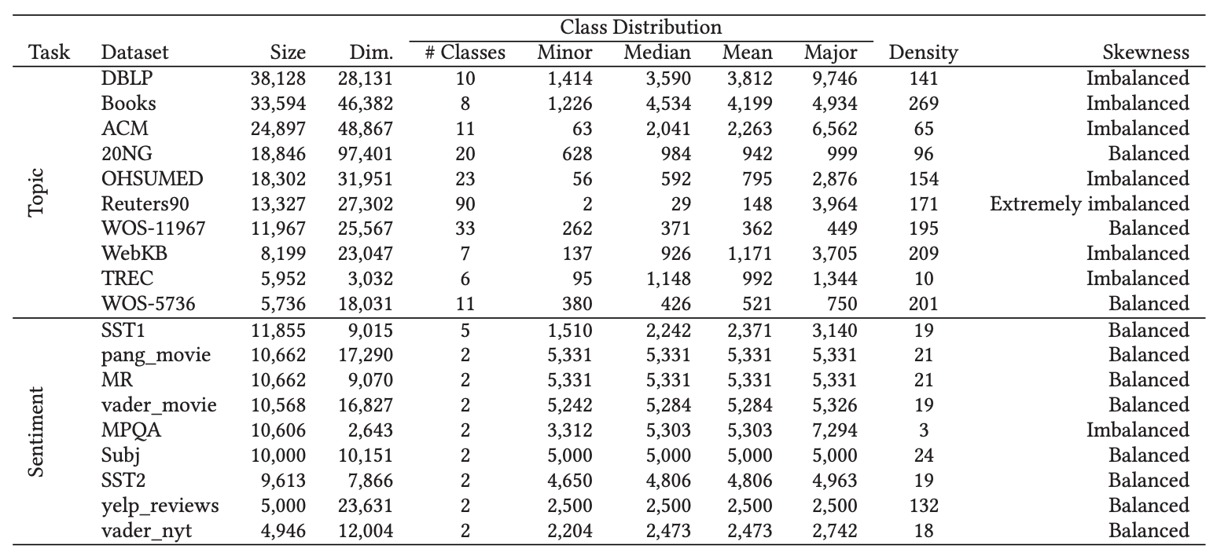
Text Classification Datasets
Source: Washington Cunha, Felipe Viegas, Celso França, Thierson Rosa, Leonardo Rocha, and Marcos André Gonçalves (2023). "A Comparative Survey of Instance Selection Methods applied to NonNeural and Transformer-Based Text Classification." ACM Computing Surveys.

Slide 10
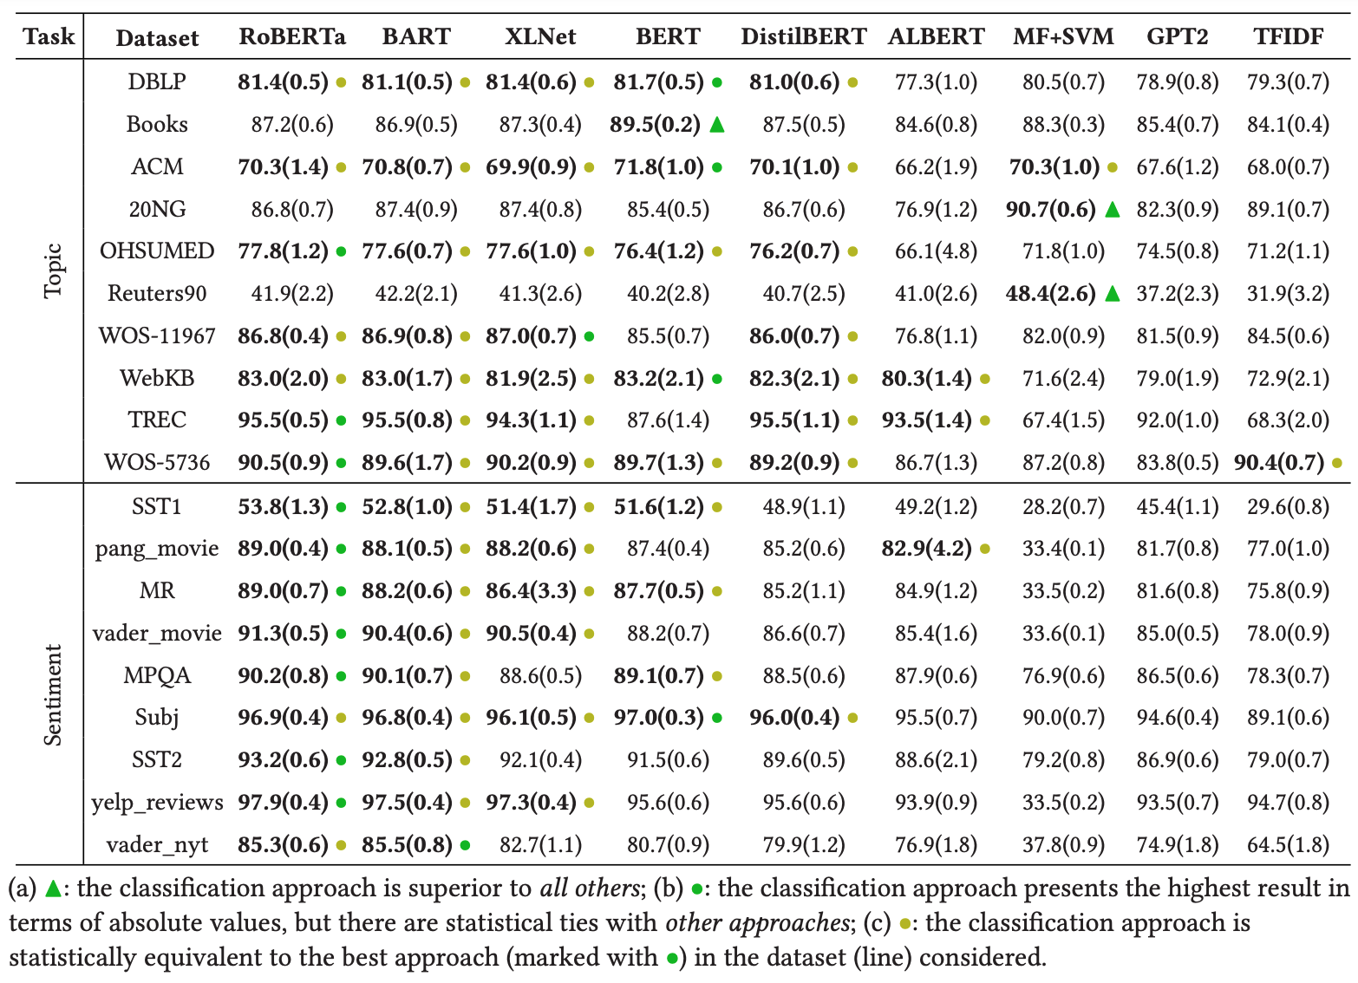
Text Classification Evaluation Metric MacroF1
Source: Washington Cunha, Felipe Viegas, Celso França, Thierson Rosa, Leonardo Rocha, and Marcos André Gonçalves (2023). "A Comparative Survey of Instance Selection Methods applied to NonNeural and Transformer-Based Text Classification." ACM Computing Surveys.

Slide 11
Deep learning models for text embedding and classification
Source: Shervin Minaee, Nal Kalchbrenner, Erik Cambria, Narjes Nikzad, Meysam Chenaghlu, and Jianfeng Gao (2021), "Deep learning--based text classification: a comprehensive review." ACM Computing Surveys (CSUR) 54, no. 3 (2021): 1-40.

Slide 12
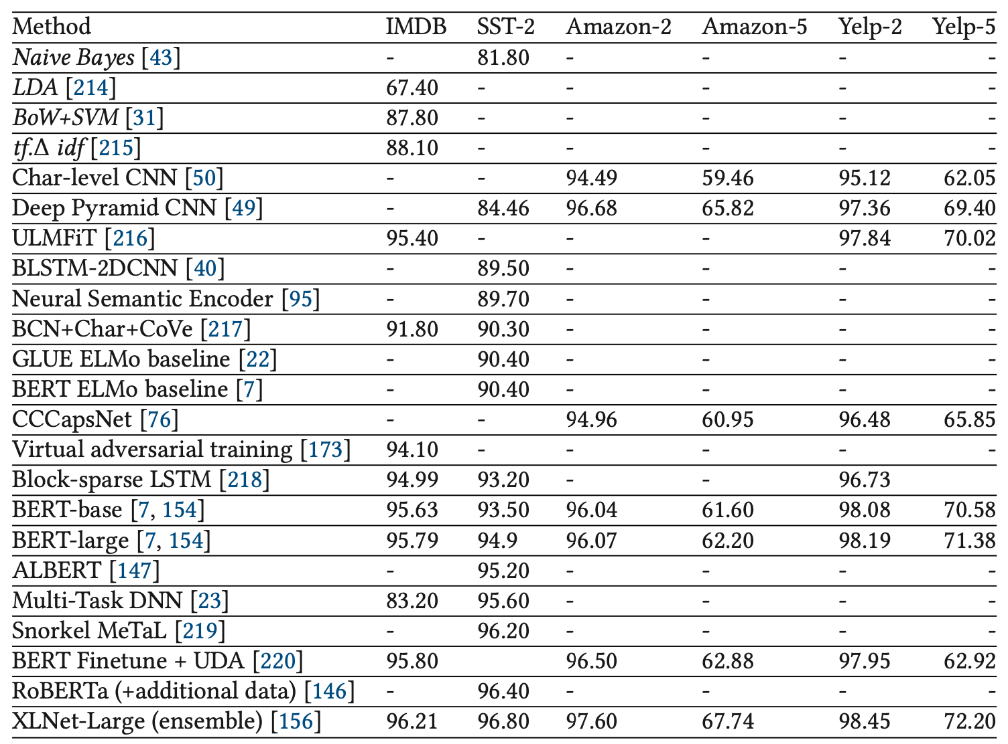
Text Classification Models on Sentiment Analysis
Source: Shervin Minaee, Nal Kalchbrenner, Erik Cambria, Narjes Nikzad, Meysam Chenaghlu, and Jianfeng Gao (2021), "Deep learning--based text classification: a comprehensive review." ACM Computing Surveys (CSUR) 54, no. 3 (2021): 1-40.

Slide 13
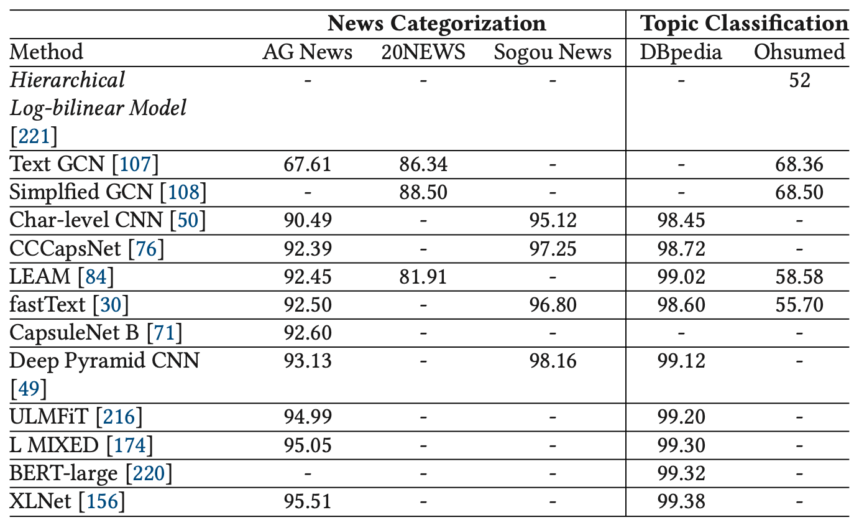
Classification Models on News Categorization, and Topic Classification
Source: Shervin Minaee, Nal Kalchbrenner, Erik Cambria, Narjes Nikzad, Meysam Chenaghlu, and Jianfeng Gao (2021), "Deep learning--based text classification: a comprehensive review." ACM Computing Surveys (CSUR) 54, no. 3 (2021): 1-40.

Slide 14
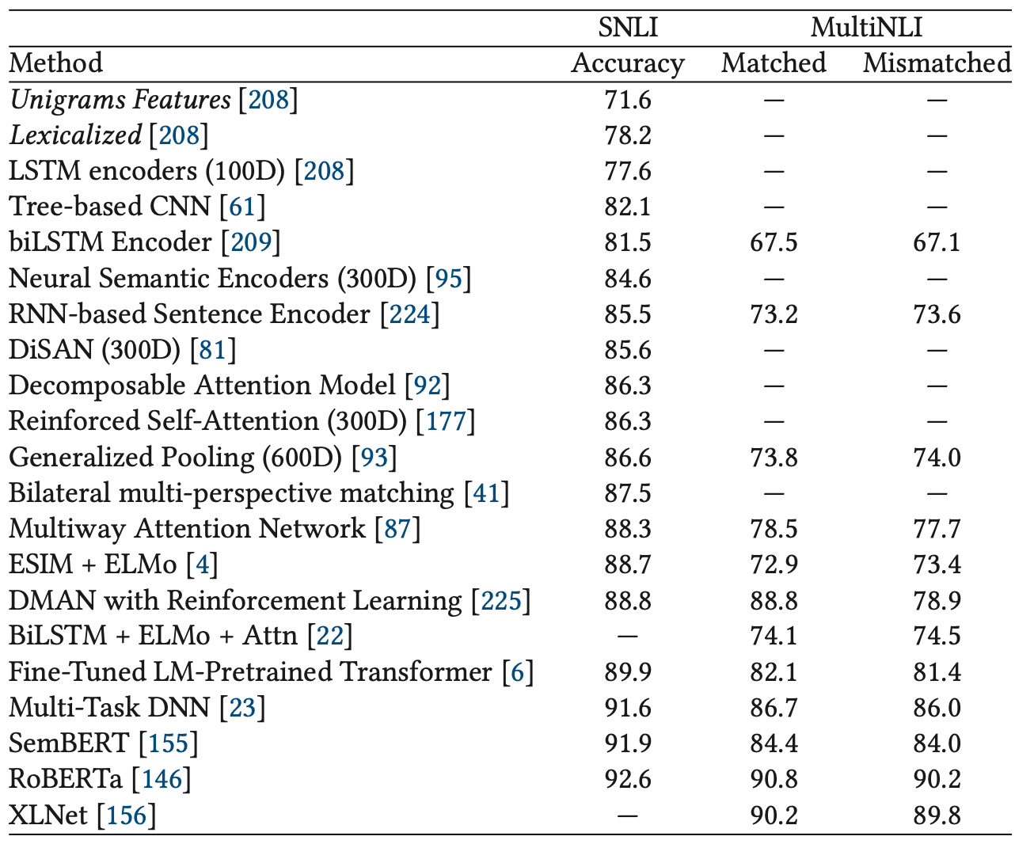
Classification Models on Natural Language Inference (NLI)
Source: Shervin Minaee, Nal Kalchbrenner, Erik Cambria, Narjes Nikzad, Meysam Chenaghlu, and Jianfeng Gao (2021), "Deep learning--based text classification: a comprehensive review." ACM Computing Surveys (CSUR) 54, no. 3 (2021): 1-40.

Slide 15
General Language Understanding Evaluation (GLUE) benchmark GLUE Test results
MNLI: Multi-Genre Natural Language Inference
QQP: Quora Question Pairs
QNLI: Question Natural Language Inference
SST-2: The Stanford Sentiment Treebank
CoLA: The Corpus of Linguistic Acceptability
STS-B:The Semantic Textual Similarity Benchmark
MRPC: Microsoft Research Paraphrase Corpus
RTE: Recognizing Textual Entailment
Source: Devlin, Jacob, Ming-Wei Chang, Kenton Lee, and Kristina Toutanova (2018). "BERT: Pre-training of Deep Bidirectional Transformers for Language Understanding." arXiv preprint arXiv:1810.04805

Slide 16
ChatGPT and fine-tuned BERT-style models on GLUE benchmark
MNLI: Multi-Genre Natural Language Inference
QQP: Quora Question Pairs
QNLI: Question Natural Language Inference
SST-2: The Stanford Sentiment Treebank
CoLA: The Corpus of Linguistic Acceptability
STS-B:The Semantic Textual Similarity Benchmark
MRPC: Microsoft Research Paraphrase Corpus
RTE: Recognizing Textual Entailment
Source: Qihuang Zhong, Liang Ding, Juhua Liu, Bo Du, and Dacheng Tao (2023). "Can chatgpt understand too? a comparative study on chatgpt and fine-tuned bert." arXiv preprint arXiv:2302.10198.

Slide 17
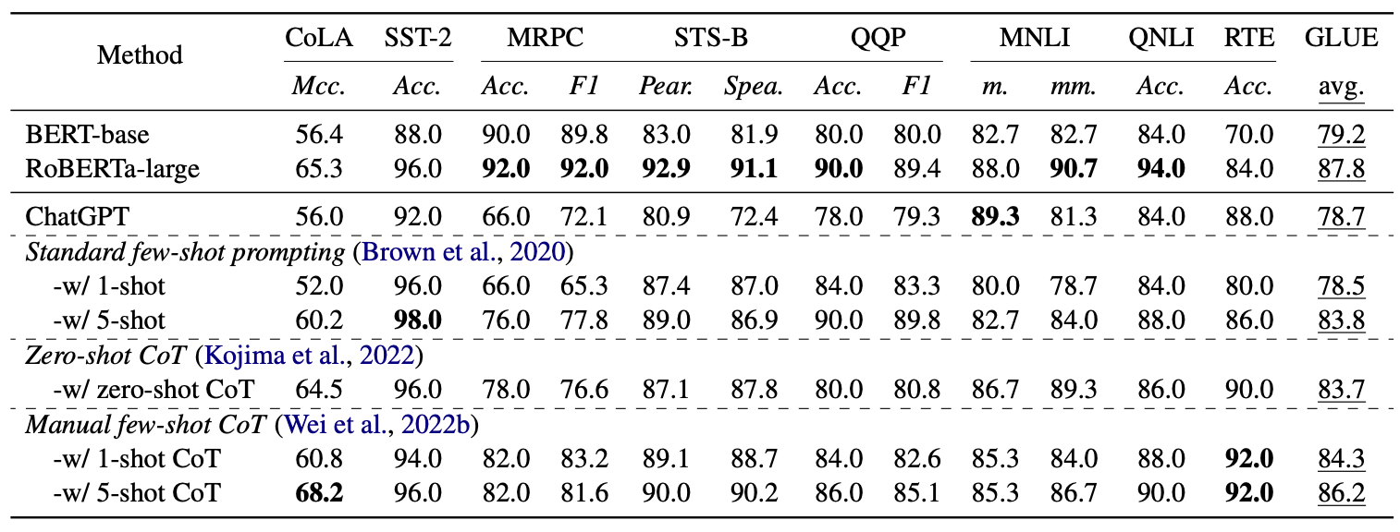
ChatGPT with Advanced Prompting Strategies
Source: Qihuang Zhong, Liang Ding, Juhua Liu, Bo Du, and Dacheng Tao (2023). "Can chatgpt understand too? a comparative study on chatgpt and fine-tuned bert." arXiv preprint arXiv:2302.10198.

Slide 18
Emotions
Love
Anger
Joy
Sadness
Surprise
Fear
Source: Bing Liu (2011) , “Web Data Mining: Exploring Hyperlinks, Contents, and Usage Data,” Springer, 2nd Edition,

Slide 19
Example of Opinion: review segment on iPhone
“I bought an iPhone a few days ago.
It was such a nice phone.
The touch screen was really cool.
The voice quality was clear too.
However, my mother was mad with me as I did not tell her before I bought it.
She also thought the phone was too expensive, and wanted me to return it to the shop. … ”
Source: Bing Liu (2011) , “Web Data Mining: Exploring Hyperlinks, Contents, and Usage Data,” Springer, 2nd Edition,

Slide 20
Example of Opinion: review segment on iPhone
“(1) I bought an iPhone a few days ago.
(2) It was such a nice phone.
(3) The touch screen was really cool.
(4) The voice quality was clear too.
(5) However, my mother was mad with me as I did not tell her before I bought it.
(6) She also thought the phone was too expensive, and wanted me to return it to the shop. … ”
+Positive Opinion
-Negative Opinion
Source: Bing Liu (2011) , “Web Data Mining: Exploring Hyperlinks, Contents, and Usage Data,” Springer, 2nd Edition,

Slide 21
Sentiment Analysis
Subjectivity Classification
Polarity Determination
Approaches
Machine Learning based
Sentiment Classification
Vagueness resolution in opinionated text
Lexicon based
Sentiment Analysis
Review Usefulness Measurement
Multi- & Cross- Lingual SC
Hybrid approaches
Opinion Spam Detection
Cross-domain SC
Lexicon Creation
Ontology based
Tasks
Non-Ontology based
Aspect Extraction
Application
Source: Kumar Ravi and Vadlamani Ravi (2015), "A survey on opinion mining and sentiment analysis: tasks, approaches and applications." Knowledge-Based Systems, 89, pp.14-46.

Slide 22
Sentiment Classification Techniques
Decision Tree Classifiers
Support Vector Machine (SVM)
Supervised Learning
Neural Network (NN)
Machine Learning Approach
Linear Classifiers
Deep Learning (DL)
Rule-based Classifiers
Naïve Bayes (NB)
Sentiment Analysis
Unsupervised Learning
Probabilistic Classifiers
Bayesian Network (BN)
Dictionary-based Approach
Maximum Entropy (ME)
Lexicon-based Approach
Statistical
Corpus-based Approach
Semantic
Source: Jesus Serrano-Guerrero, Jose A. Olivas, Francisco P. Romero, and Enrique Herrera-Viedma (2015), "Sentiment analysis: A review and comparative analysis of web services," Information Sciences, 311, pp. 18-38.

Slide 23
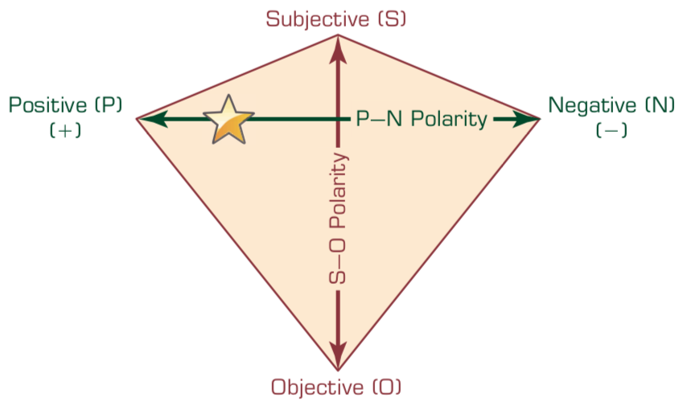
P–N Polarity and S–O Polarity Relationship
Source: Ramesh Sharda, Dursun Delen, and Efraim Turban (2017), Business Intelligence, Analytics, and Data Science: A Managerial Perspective, 4th Edition, Pearson

Slide 24
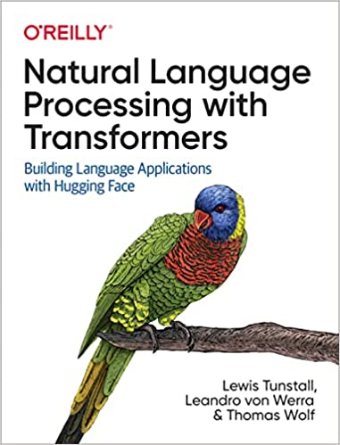
Lewis Tunstall, Leandro von Werra, and Thomas Wolf (2022), Natural Language Processing with Transformers: Building Language Applications with Hugging Face, O'Reilly Media.
Source: https://www.amazon.com/Natural-Language-Processing-Transformers-Applications/dp/1098103246

Slide 25
ULMFiT: 3 Steps Transfer Learning in NLP
Wikitet
103
IMDB
IMDB
Language Model
Language Model
Classifier
1. Pretraining
2. Domain adaptation
3. Fine-tuning
Source: Lewis Tunstall, Leandro von Werra, and Thomas Wolf (2022), Natural Language Processing with Transformers: Building Language Applications with Hugging Face, O'Reilly Media.

Slide 26
An overview of the Hugging Face Ecosystem
Hugging Face Hub
Models
Datasets
Metrics
Docs
Tokenizers
Transformers
Datasets
Accelerate
Source: Lewis Tunstall, Leandro von Werra, and Thomas Wolf (2022), Natural Language Processing with Transformers: Building Language Applications with Hugging Face, O'Reilly Media.

Slide 27
A typical pipeline for training transformer models with the Datasets, Tokenizers, and Transformers libraries
Datasets
Tokenizers
Transformers
Datasets
Load and process datasets
Tokenize input texts
Load models, train and infer
Load metrics evaluate models
Source: Lewis Tunstall, Leandro von Werra, and Thomas Wolf (2022), Natural Language Processing with Transformers: Building Language Applications with Hugging Face, O'Reilly Media.
https://github.com/nlp-with-transformers/notebooks

Slide 28
NLP with Transformers
!git clone https://github.com/nlp-with-transformers/notebooks.git
%cd notebooks
from install import *
install_requirements()
from utils import *
setup_chapter()
Source: Lewis Tunstall, Leandro von Werra, and Thomas Wolf (2022), Natural Language Processing with Transformers: Building Language Applications with Hugging Face, O'Reilly Media.
https://github.com/nlp-with-transformers/notebooks

Slide 29
Text Classification
text = """Dear Amazon, last week I ordered an Optimus Prime action figure \
from your online store in Germany. Unfortunately, when I opened the package, \
I discovered to my horror that I had been sent an action figure of Megatron \
instead! As a lifelong enemy of the Decepticons, I hope you can understand my \
dilemma. To resolve the issue, I demand an exchange of Megatron for the \
Optimus Prime figure I ordered. Enclosed are copies of my records concerning \
this purchase. I expect to hear from you soon. Sincerely, Bumblebee."""
Source: Lewis Tunstall, Leandro von Werra, and Thomas Wolf (2022), Natural Language Processing with Transformers: Building Language Applications with Hugging Face, O'Reilly Media.
https://github.com/nlp-with-transformers/notebooks

Slide 30
Text Classification
text = """Dear Amazon, last week I ordered an Optimus Prime action figure \
from your online store in Germany. Unfortunately, when I opened the package, \
I discovered to my horror that I had been sent an action figure of Megatron \
instead! As a lifelong enemy of the Decepticons, I hope you can understand my \
dilemma. To resolve the issue, I demand an exchange of Megatron for the \
Optimus Prime figure I ordered. Enclosed are copies of my records concerning \
this purchase. I expect to hear from you soon. Sincerely, Bumblebee."""
from transformers import pipeline classifier = pipeline("text-classification")
import pandas as pd outputs = classifier(text)
pd.DataFrame(outputs)
 | label | score
0 | NEGATIVE | 0.901546
Source: Lewis Tunstall, Leandro von Werra, and Thomas Wolf (2022), Natural Language Processing with Transformers: Building Language Applications with Hugging Face, O'Reilly Media.
https://github.com/nlp-with-transformers/notebooks

Slide 31
Text Classification
from transformers import pipeline classifier = pipeline("text-classification")
import pandas as pd outputs = classifier(text)
pd.DataFrame(outputs)
 | label | score
0 | NEGATIVE | 0.901546
Source: Lewis Tunstall, Leandro von Werra, and Thomas Wolf (2022), Natural Language Processing with Transformers: Building Language Applications with Hugging Face, O'Reilly Media.
https://github.com/nlp-with-transformers/notebooks

Slide 32
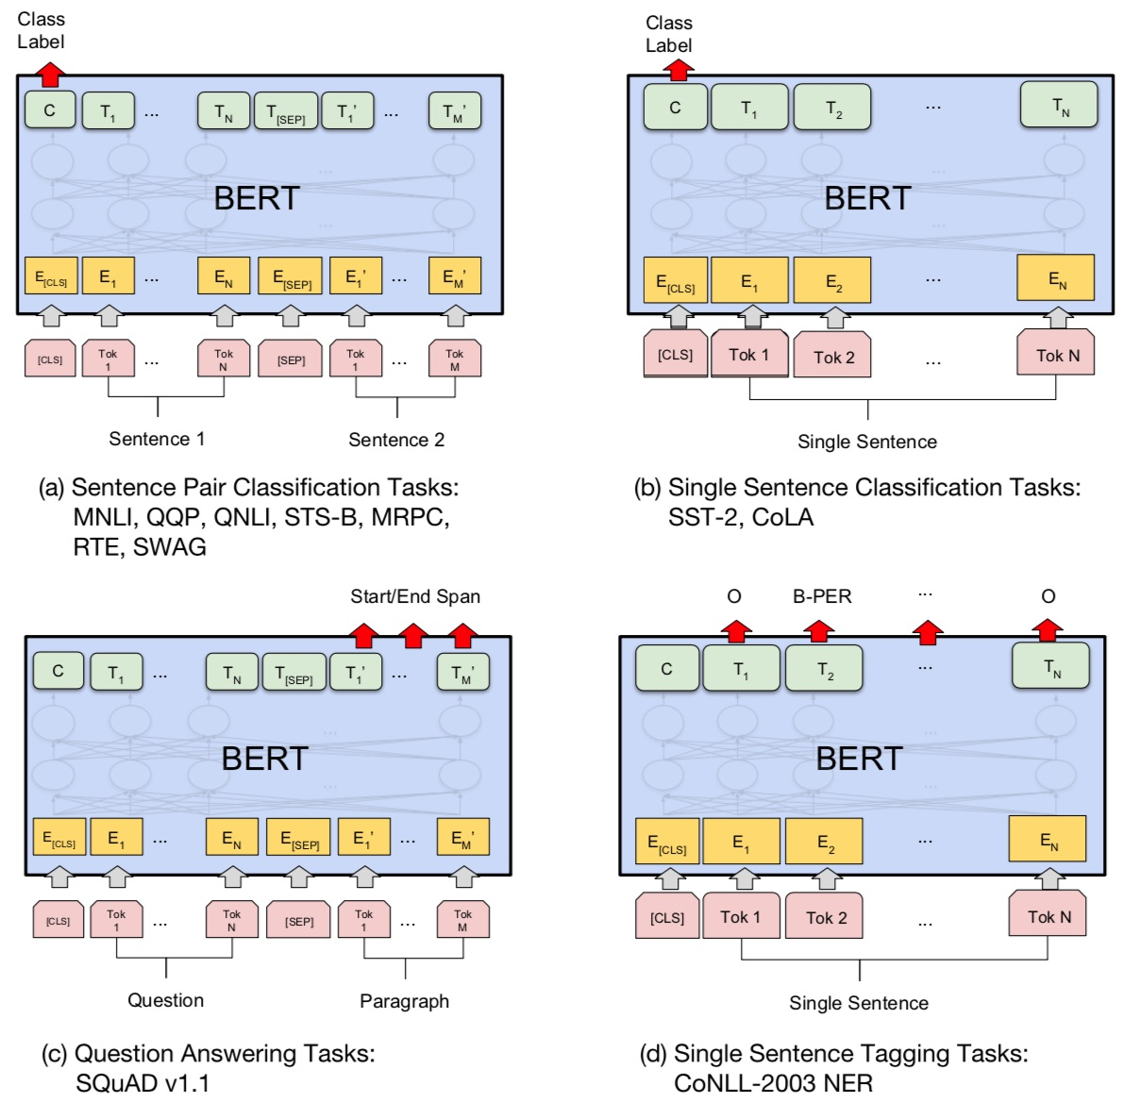
Fine-tuning BERT on NLP Tasks
Source: Devlin, Jacob, Ming-Wei Chang, Kenton Lee, and Kristina Toutanova (2018). "BERT: Pre-training of Deep Bidirectional Transformers for Language Understanding." arXiv preprint arXiv:1810.04805

Slide 33
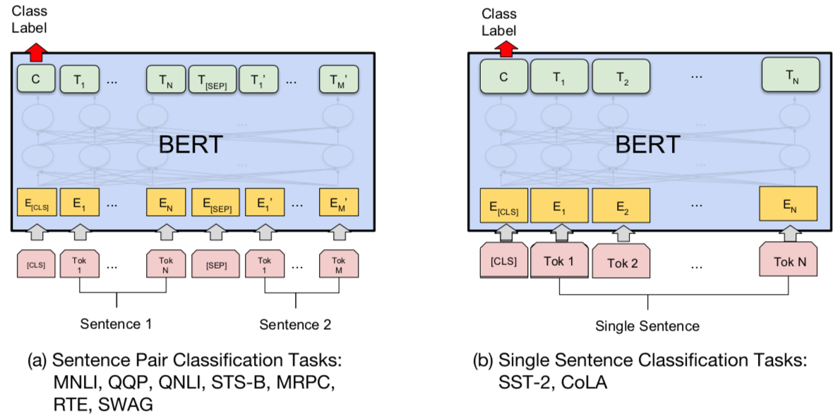
BERT Sequence-level tasks
Source: Devlin, Jacob, Ming-Wei Chang, Kenton Lee, and Kristina Toutanova (2018). "BERT: Pre-training of Deep Bidirectional Transformers for Language Understanding." arXiv preprint arXiv:1810.04805

Slide 34
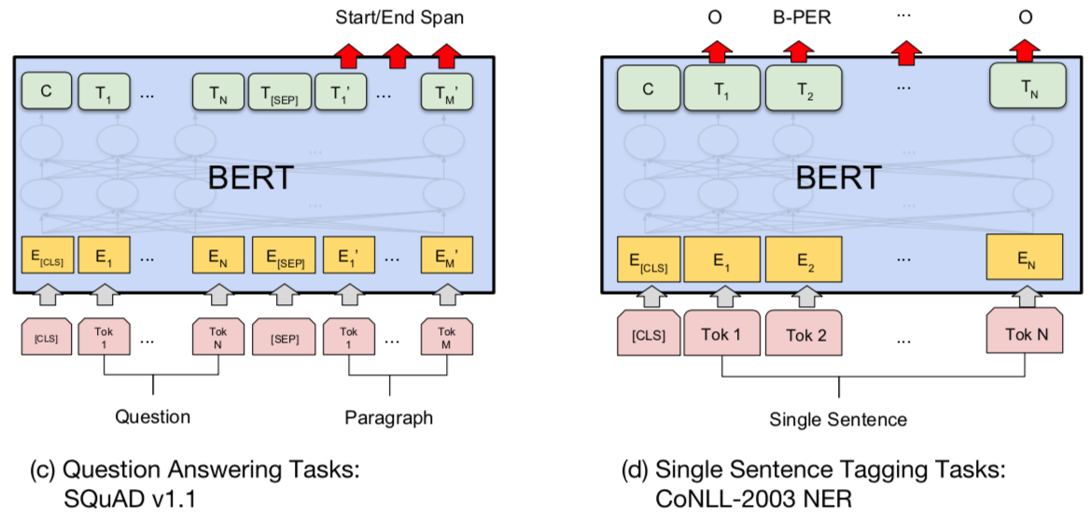
BERT Token-level tasks
Source: Devlin, Jacob, Ming-Wei Chang, Kenton Lee, and Kristina Toutanova (2018). "BERT: Pre-training of Deep Bidirectional Transformers for Language Understanding." arXiv preprint arXiv:1810.04805

Slide 35
Sentiment Analysis: Single Sentence Classification
Source: Devlin, Jacob, Ming-Wei Chang, Kenton Lee, and Kristina Toutanova (2018). "BERT: Pre-training of Deep Bidirectional Transformers for Language Understanding." arXiv preprint arXiv:1810.04805

Slide 36
Character Tokenization
text = "Tokenizing text is a core task of NLP."
tokenized_text = list(text)
print(tokenized_text)
['T', 'o', 'k', 'e', 'n', 'i', 'z', 'i', 'n', 'g', ' ', 't', 'e', 'x', 't', ' ', 'i', 's', ' ', 'a', ' ', 'c', 'o', 'r', 'e', ' ', 't', 'a', 's', 'k', ' ', 'o', 'f', ' ', 'N', 'L', 'P', '.']
token2idx = {ch: idx for idx, ch in enumerate(sorted(set(tokenized_text)))}
print(token2idx)
{' ': 0, '.': 1, 'L': 2, 'N': 3, 'P': 4, 'T': 5, 'a': 6, 'c': 7, 'e': 8, 'f': 9, 'g': 10, 'i': 11, 'k': 12, 'n': 13, 'o': 14, 'r': 15, 's': 16, 't': 17, 'x': 18, 'z': 19}
input_ids = [token2idx[token] for token in tokenized_text]
print(input_ids)
[5, 14, 12, 8, 13, 11, 19, 11, 13, 10, 0, 17, 8, 18, 17, 0, 11, 16, 0, 6, 0, 7, 14, 15, 8, 0, 17, 6, 16, 12, 0, 14, 9, 0, 3, 2, 4, 1]
Source: Lewis Tunstall, Leandro von Werra, and Thomas Wolf (2022), Natural Language Processing with Transformers: Building Language Applications with Hugging Face, O'Reilly Media.
https://github.com/nlp-with-transformers/notebooks

Slide 37
Word Tokenization
text = "Tokenizing text is a core task of NLP."
tokenized_text = text.split()
print(tokenized_text)
['Tokenizing', 'text', 'is', 'a', 'core', 'task', 'of', 'NLP.']
Source: Lewis Tunstall, Leandro von Werra, and Thomas Wolf (2022), Natural Language Processing with Transformers: Building Language Applications with Hugging Face, O'Reilly Media.
https://github.com/nlp-with-transformers/notebooks

Slide 38
Subword Tokenization
from transformers import AutoTokenizer model_ckpt = "distilbert-base-uncased"
tokenizer = AutoTokenizer.from_pretrained(model_ckpt)
text = "Tokenizing text is a core task of NLP."
encoded_text = tokenizer(text)
print(encoded_text)
{'input_ids': [101, 19204, 6026, 3793, 2003, 1037, 4563, 4708, 1997, 17953, 2361, 1012, 102], 'attention_mask': [1, 1, 1, 1, 1, 1, 1, 1, 1, 1, 1, 1, 1]}
tokens = tokenizer.convert_ids_to_tokens(encoded_text.input_ids)
print(tokens)
['[CLS]', 'token', '##izing', 'text', 'is', 'a', 'core', 'task', 'of', 'nl', '##p', '.', '[SEP]']
Source: Lewis Tunstall, Leandro von Werra, and Thomas Wolf (2022), Natural Language Processing with Transformers: Building Language Applications with Hugging Face, O'Reilly Media.
https://github.com/nlp-with-transformers/notebooks

Slide 39
Subword Tokenization
print(tokenizer.convert_tokens_to_string(tokens))
[CLS] tokenizing text is a core task of nlp. [SEP]
tokenizer.vocab_size
30522
tokenizer.model_max_length
512
Source: Lewis Tunstall, Leandro von Werra, and Thomas Wolf (2022), Natural Language Processing with Transformers: Building Language Applications with Hugging Face, O'Reilly Media.
https://github.com/nlp-with-transformers/notebooks

Slide 40
Tokenizing the Whole Dataset
def tokenize(batch):
return tokenizer(batch["text"], padding=True, truncation=True)
print(tokenize(emotions["train"][:2]))
{'input_ids': [[101, 1045, 2134, 2102, 2514, 26608, 102, 0, 0, 0, 0, 0, 0, 0, 0, 0, 0, 0, 0, 0, 0, 0, 0], [101, 1045, 2064, 2175, 2013, 3110, 2061, 20625, 2000, 2061, 9636, 17772, 2074, 2013, 2108, 2105, 2619, 2040, 14977, 1998, 2003, 8300, 102]], 'attention_mask': [[1, 1, 1, 1, 1, 1, 1, 0, 0, 0, 0, 0, 0, 0, 0, 0, 0, 0, 0, 0, 0, 0, 0], [1, 1, 1, 1, 1, 1, 1, 1, 1, 1, 1, 1, 1, 1, 1, 1, 1, 1, 1, 1, 1, 1, 1]]}
tokens2ids = list(zip(tokenizer.all_special_tokens, tokenizer.all_special_ids))
data = sorted(tokens2ids, key=lambda x : x[-1])
df = pd.DataFrame(data, columns=["Special Token", "Special Token ID"])
df.T
Source: Lewis Tunstall, Leandro von Werra, and Thomas Wolf (2022), Natural Language Processing with Transformers: Building Language Applications with Hugging Face, O'Reilly Media.
https://github.com/nlp-with-transformers/notebooks

Slide 41
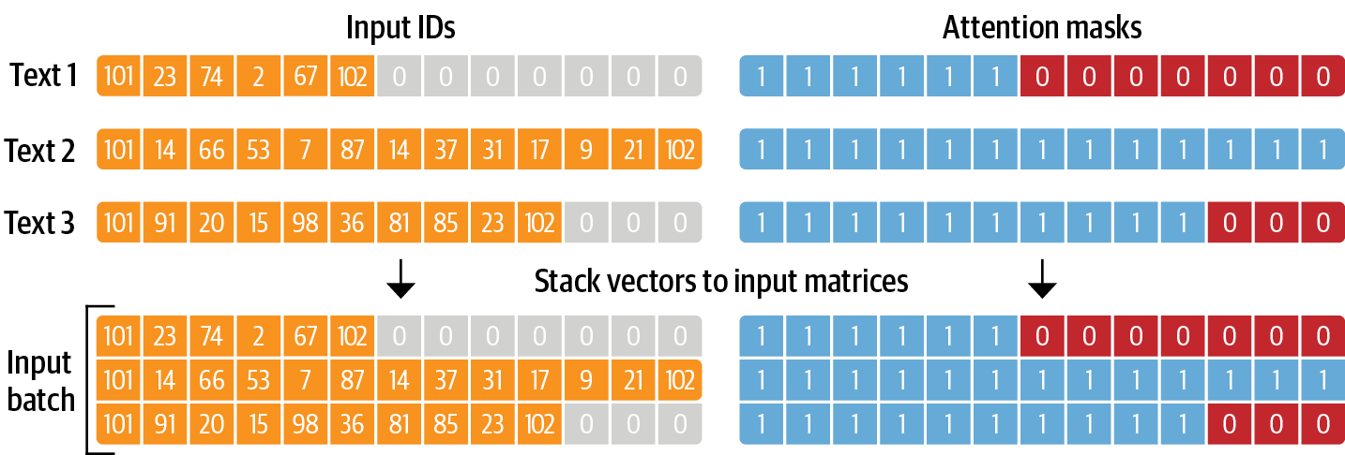
From Text to Tokens
For each batch, the input sequences are padded to the maximum sequence length in the batch; the attention mask is used in the model to ignore the padded areas of the input tensors
Source: Lewis Tunstall, Leandro von Werra, and Thomas Wolf (2022), Natural Language Processing with Transformers: Building Language Applications with Hugging Face, O'Reilly Media.
https://github.com/nlp-with-transformers/notebooks

Slide 42
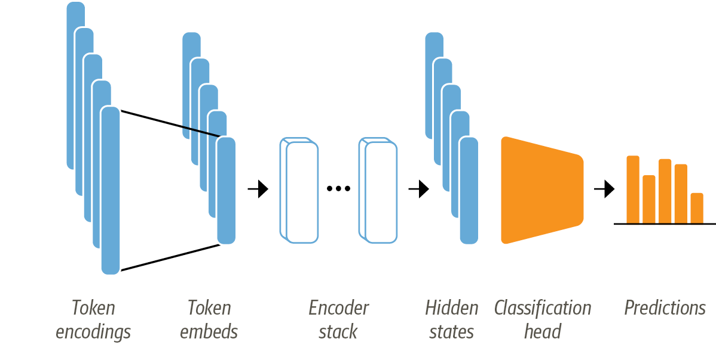
Training a Text Classifier
The architecture used for sequence classification with an encoder-based transformer ; it consists of the model’s pretrained body combined with a custom classification head
Source: Lewis Tunstall, Leandro von Werra, and Thomas Wolf (2022), Natural Language Processing with Transformers: Building Language Applications with Hugging Face, O'Reilly Media.
https://github.com/nlp-with-transformers/notebooks

Slide 43
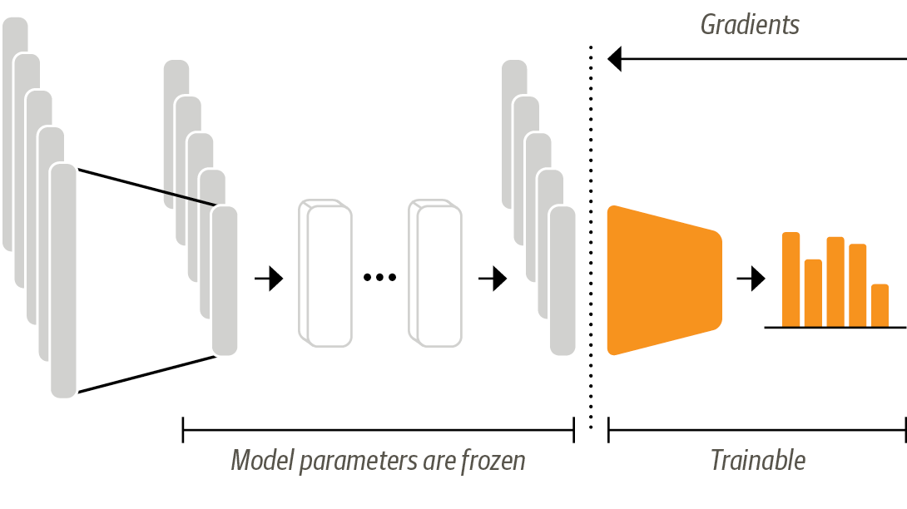
Transformers as Feature Extractors
In the feature-based approach, the DistilBERT model is frozen and just provides features for a classifier
Source: Lewis Tunstall, Leandro von Werra, and Thomas Wolf (2022), Natural Language Processing with Transformers: Building Language Applications with Hugging Face, O'Reilly Media.
https://github.com/nlp-with-transformers/notebooks

Slide 44
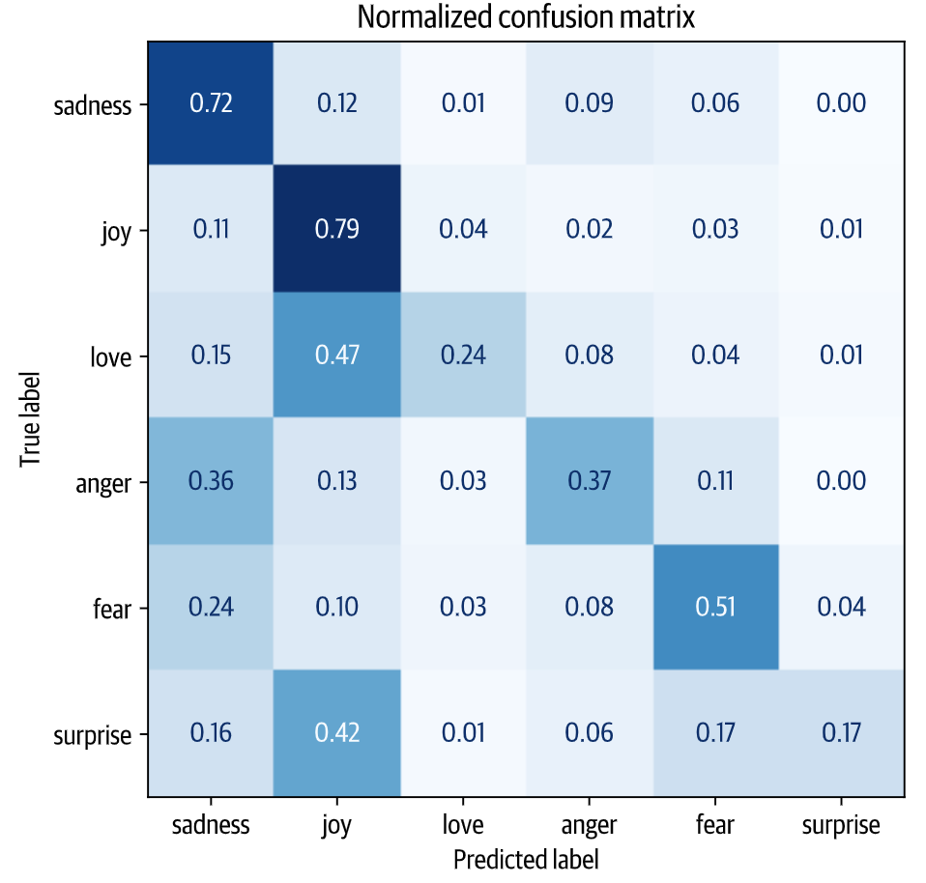
Training a Simple Classifier
Source: Lewis Tunstall, Leandro von Werra, and Thomas Wolf (2022), Natural Language Processing with Transformers: Building Language Applications with Hugging Face, O'Reilly Media.
https://github.com/nlp-with-transformers/notebooks

Slide 45
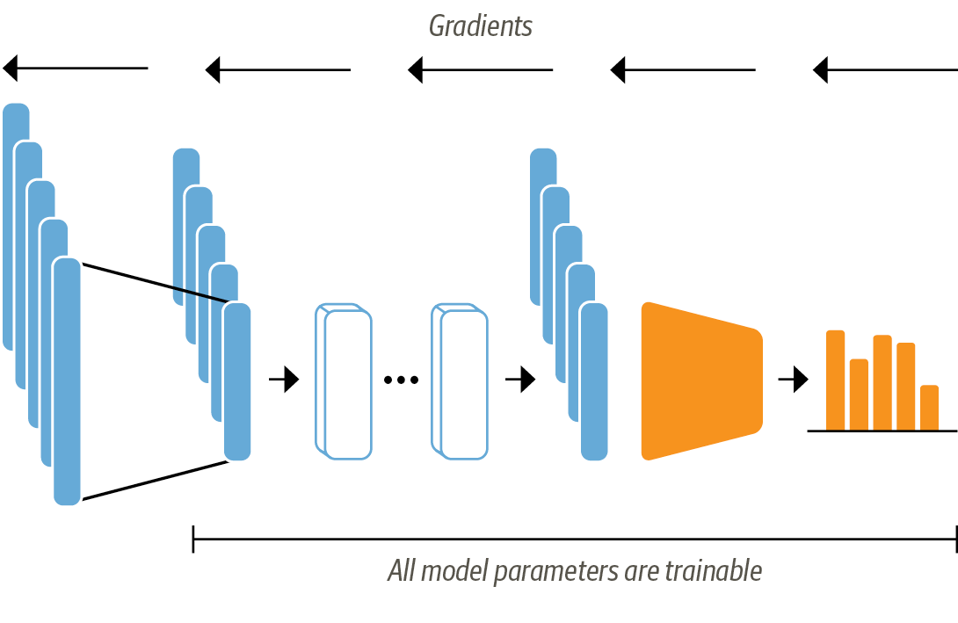
Fine-Tuning Transformers
When using the fine-tuning approach the whole DistilBERT model is trained along with the classification head
Source: Lewis Tunstall, Leandro von Werra, and Thomas Wolf (2022), Natural Language Processing with Transformers: Building Language Applications with Hugging Face, O'Reilly Media.
https://github.com/nlp-with-transformers/notebooks

Slide 46
Fine-Tuning Transformers Loading a pretrained model
from transformers import AutoModelForSequenceClassification
num_labels = 6
model = (AutoModelForSequenceClassification
.from_pretrained(model_ckpt, num_labels=num_labels)
.to(device))
Source: Lewis Tunstall, Leandro von Werra, and Thomas Wolf (2022), Natural Language Processing with Transformers: Building Language Applications with Hugging Face, O'Reilly Media.
https://github.com/nlp-with-transformers/notebooks

Slide 47
Defining the performance metrics
from sklearn.metrics import accuracy_score, f1_score
def compute_metrics(pred):
labels = pred.label_ids
preds = pred.predictions.argmax(-1)
f1 = f1_score(labels, preds, average="weighted")
acc = accuracy_score(labels, preds)
return {"accuracy": acc, "f1": f1}
Source: Lewis Tunstall, Leandro von Werra, and Thomas Wolf (2022), Natural Language Processing with Transformers: Building Language Applications with Hugging Face, O'Reilly Media.
https://github.com/nlp-with-transformers/notebooks

Slide 48
Train the model
from huggingface_hub import notebook_login
notebook_login()
Source: Lewis Tunstall, Leandro von Werra, and Thomas Wolf (2022), Natural Language Processing with Transformers: Building Language Applications with Hugging Face, O'Reilly Media.
https://github.com/nlp-with-transformers/notebooks

Slide 49
Train the model
from transformers import Trainer, TrainingArguments
batch_size = 64
logging_steps = len(emotions_encoded["train"]) // batch_size
model_name = f"{model_ckpt}-finetuned-emotion"
training_args = TrainingArguments(output_dir=model_name,
num_train_epochs=2,
learning_rate=2e-5,
per_device_train_batch_size=batch_size,
per_device_eval_batch_size=batch_size,
weight_decay=0.01,
evaluation_strategy="epoch",
disable_tqdm=False,
logging_steps=logging_steps,
push_to_hub=True,
log_level="error")
Source: Lewis Tunstall, Leandro von Werra, and Thomas Wolf (2022), Natural Language Processing with Transformers: Building Language Applications with Hugging Face, O'Reilly Media.
https://github.com/nlp-with-transformers/notebooks

Slide 50
Train the model
from transformers import Trainer
trainer = Trainer(model=model, args=training_args,
compute_metrics=compute_metrics,
train_dataset=emotions_encoded["train"],
eval_dataset=emotions_encoded["validation"],
tokenizer=tokenizer)
trainer.train();
Source: Lewis Tunstall, Leandro von Werra, and Thomas Wolf (2022), Natural Language Processing with Transformers: Building Language Applications with Hugging Face, O'Reilly Media.
https://github.com/nlp-with-transformers/notebooks

Slide 51
Train the model
preds_output = trainer.predict(emotions_encoded["validation"])
preds_output.metrics
{'test_loss': 0.22047173976898193, 'test_accuracy': 0.9225, 'test_f1': 0.9225500751072866, 'test_runtime': 1.6357, 'test_samples_per_second': 1222.725, 'test_steps_per_second': 19.564}
y_preds = np.argmax(preds_output.predictions, axis=1)
plot_confusion_matrix(y_preds, y_valid, labels)
Source: Lewis Tunstall, Leandro von Werra, and Thomas Wolf (2022), Natural Language Processing with Transformers: Building Language Applications with Hugging Face, O'Reilly Media.
https://github.com/nlp-with-transformers/notebooks

Slide 52
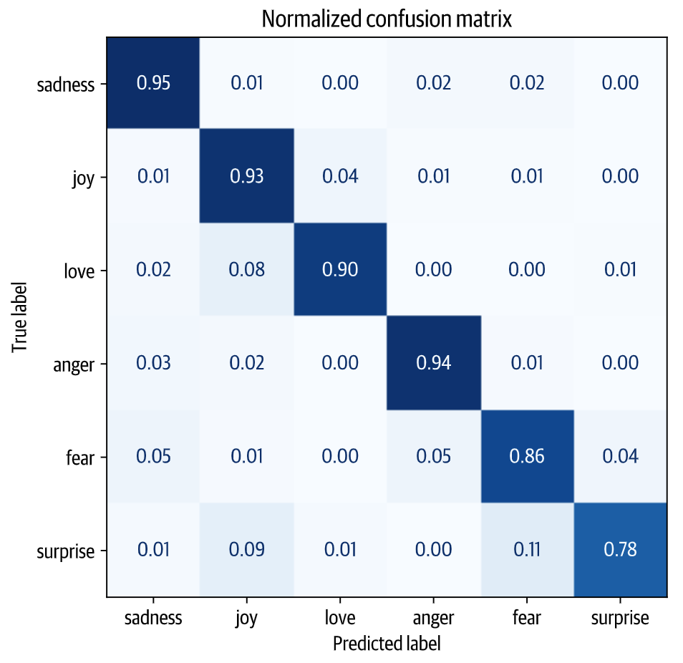
Fine-Tuning Transformers
Source: Lewis Tunstall, Leandro von Werra, and Thomas Wolf (2022), Natural Language Processing with Transformers: Building Language Applications with Hugging Face, O'Reilly Media.
https://github.com/nlp-with-transformers/notebooks

Slide 53
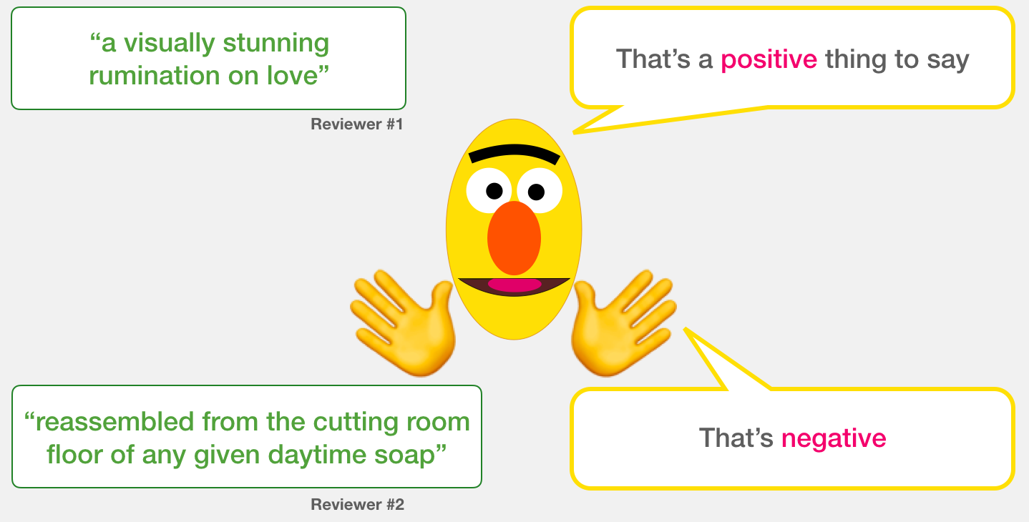
A Visual Guide to Using BERT for the First Time (Jay Alammar, 2019)
Source: Jay Alammar (2019), A Visual Guide to Using BERT for the First Time, http://jalammar.github.io/a-visual-guide-to-using-bert-for-the-first-time/

Slide 54
Sentiment Classification: SST2 Sentences from movie reviews
sentence | label
a stirring , funny and finally transporting re imagining of beauty and the beast and 1930s horror films | 1
apparently reassembled from the cutting room floor of any given daytime soap | 0
they presume their audience won't sit still for a sociology lesson | 0
this is a visually stunning rumination on love , memory , history and the war between art and commerce | 1
jonathan parker 's bartleby should have been the be all end all of the modern office anomie films | 1
Source: Jay Alammar (2019), A Visual Guide to Using BERT for the First Time, http://jalammar.github.io/a-visual-guide-to-using-bert-for-the-first-time/

Slide 55
Movie Review Sentiment Classifier
Source: Jay Alammar (2019), A Visual Guide to Using BERT for the First Time, http://jalammar.github.io/a-visual-guide-to-using-bert-for-the-first-time/

Slide 56
Movie Review Sentiment Classifier
Source: Jay Alammar (2019), A Visual Guide to Using BERT for the First Time, http://jalammar.github.io/a-visual-guide-to-using-bert-for-the-first-time/

Slide 57
Movie Review Sentiment Classifier Model Training
Source: Jay Alammar (2019), A Visual Guide to Using BERT for the First Time, http://jalammar.github.io/a-visual-guide-to-using-bert-for-the-first-time/

Slide 58
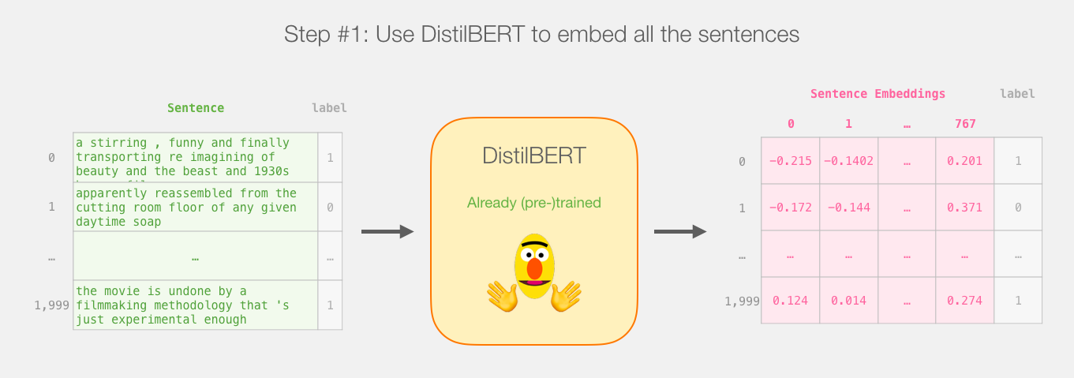
Step # 1 Use distilBERT to Generate Sentence Embeddings
Source: Jay Alammar (2019), A Visual Guide to Using BERT for the First Time, http://jalammar.github.io/a-visual-guide-to-using-bert-for-the-first-time/

Slide 59
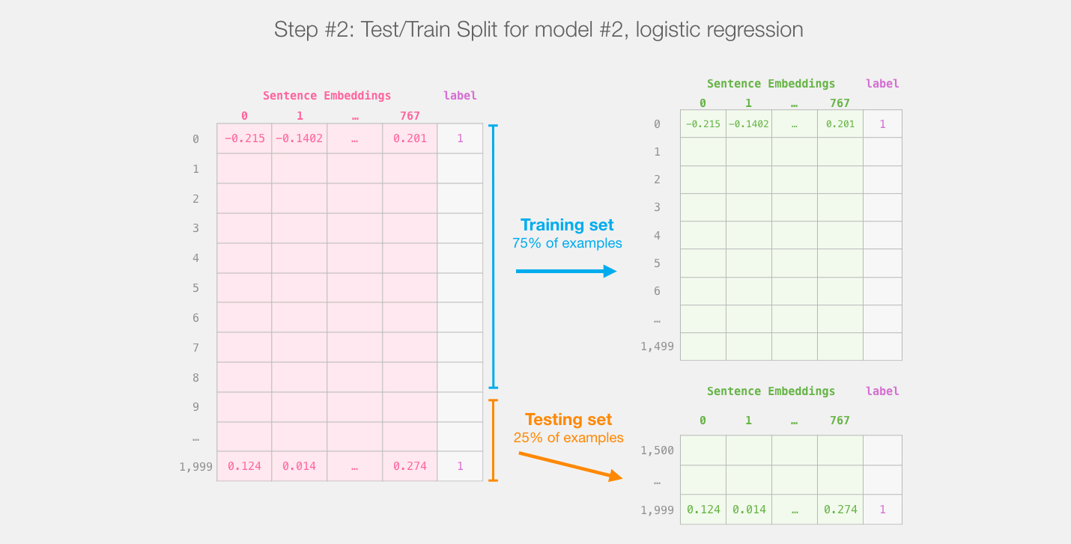
Step #2:Test/Train Split for Model #2, Logistic Regression
Source: Jay Alammar (2019), A Visual Guide to Using BERT for the First Time, http://jalammar.github.io/a-visual-guide-to-using-bert-for-the-first-time/

Slide 60
Step #3 Train the logistic regression model using the training set
Source: Jay Alammar (2019), A Visual Guide to Using BERT for the First Time, http://jalammar.github.io/a-visual-guide-to-using-bert-for-the-first-time/

Slide 61
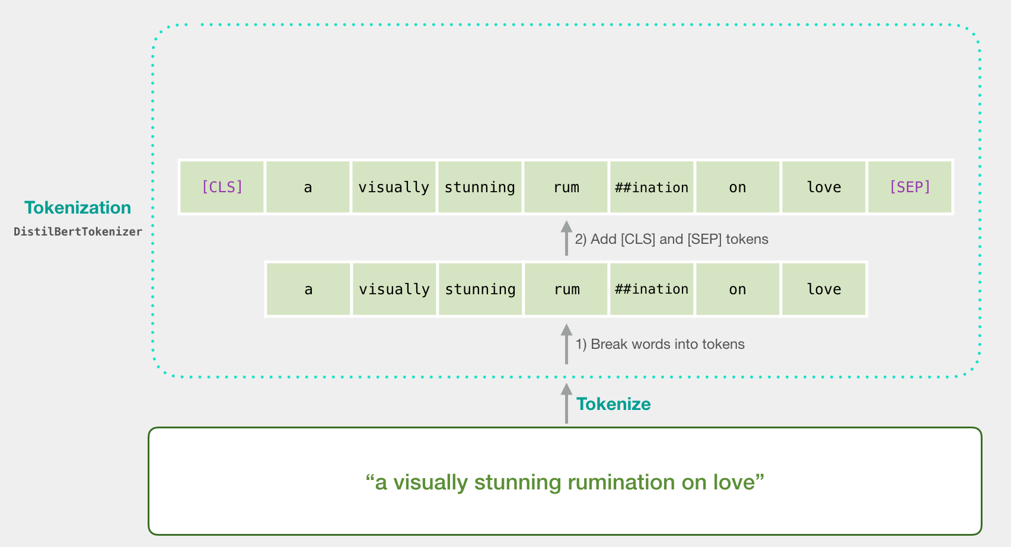
Tokenization
[CLS] a visually stunning rum ##ination on love [SEP]
a visually stunning rumination on love
Source: Jay Alammar (2019), A Visual Guide to Using BERT for the First Time, http://jalammar.github.io/a-visual-guide-to-using-bert-for-the-first-time/

Slide 62
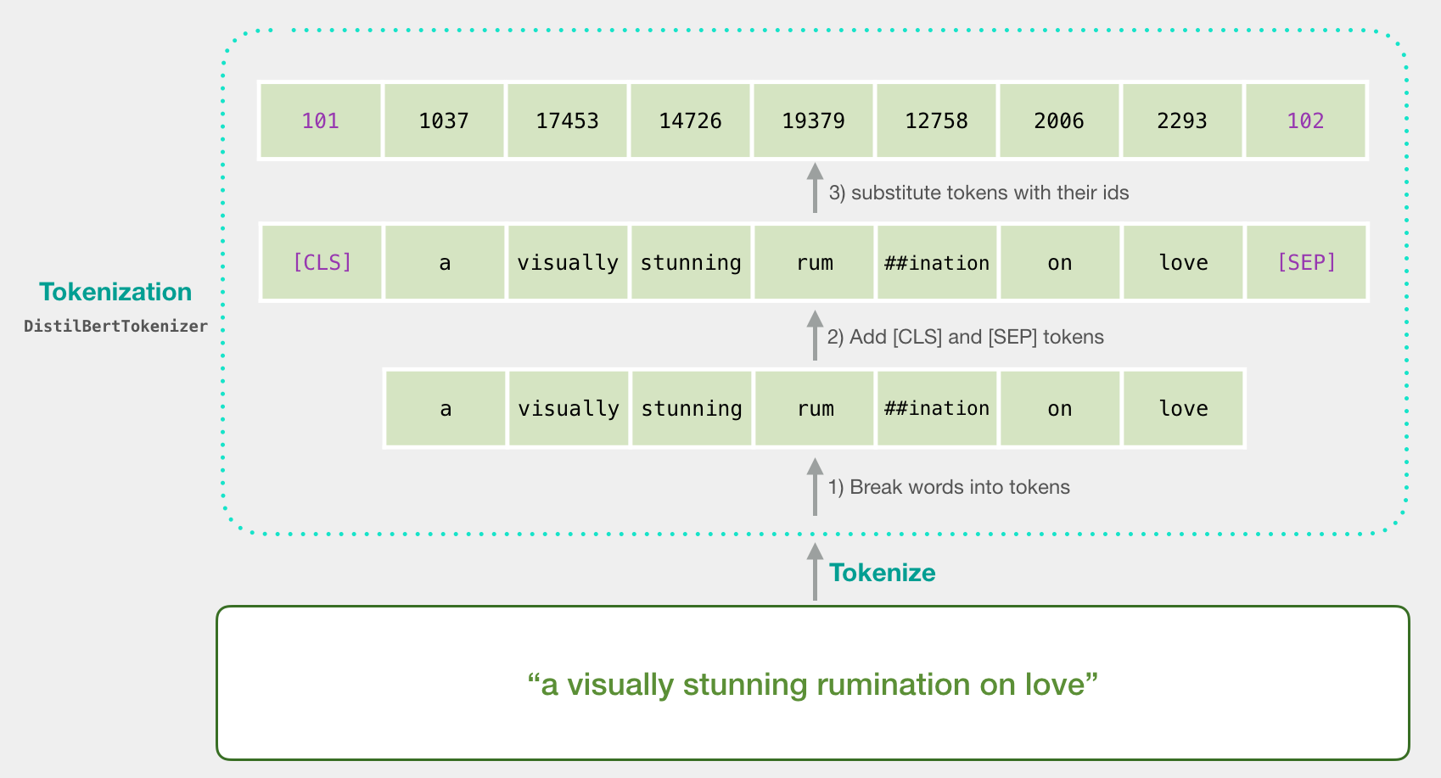
Tokenization
tokenizer.encode("a visually stunning rumination on love", add_special_tokens=True)
Source: Jay Alammar (2019), A Visual Guide to Using BERT for the First Time, http://jalammar.github.io/a-visual-guide-to-using-bert-for-the-first-time/

Slide 63
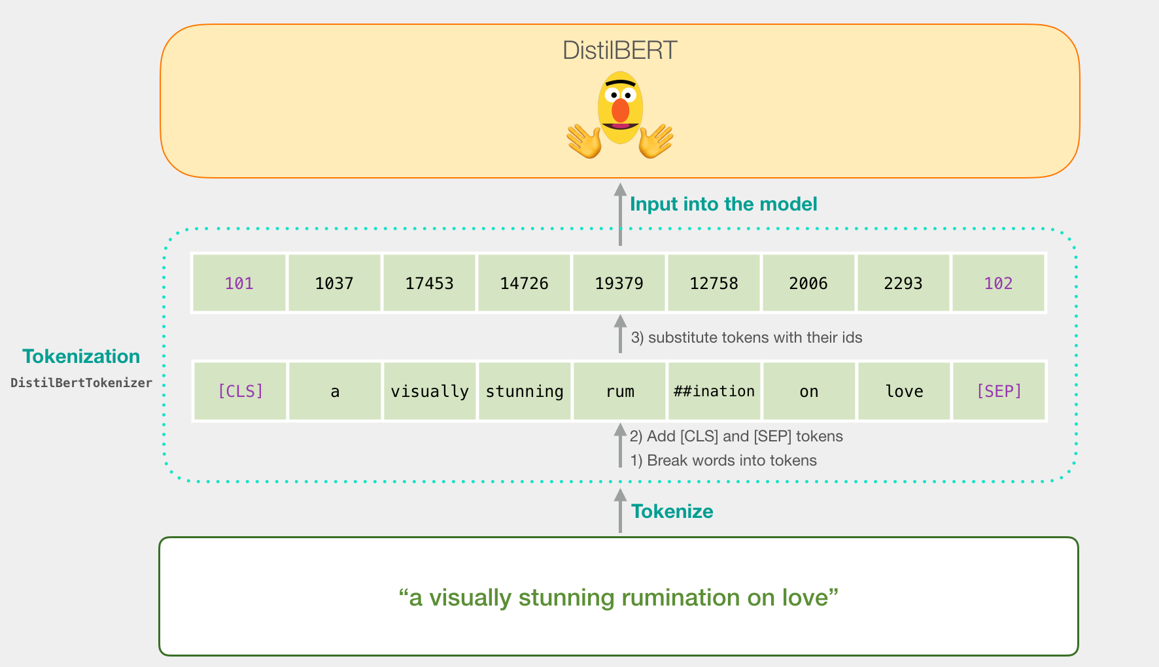
Tokenization for BERT Model
Source: Jay Alammar (2019), A Visual Guide to Using BERT for the First Time, http://jalammar.github.io/a-visual-guide-to-using-bert-for-the-first-time/

Slide 64
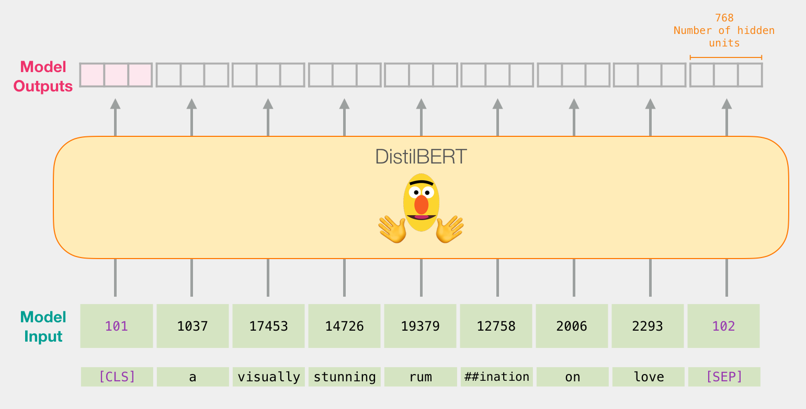
Flowing Through DistilBERT (768 features)
Source: Jay Alammar (2019), A Visual Guide to Using BERT for the First Time, http://jalammar.github.io/a-visual-guide-to-using-bert-for-the-first-time/

Slide 65
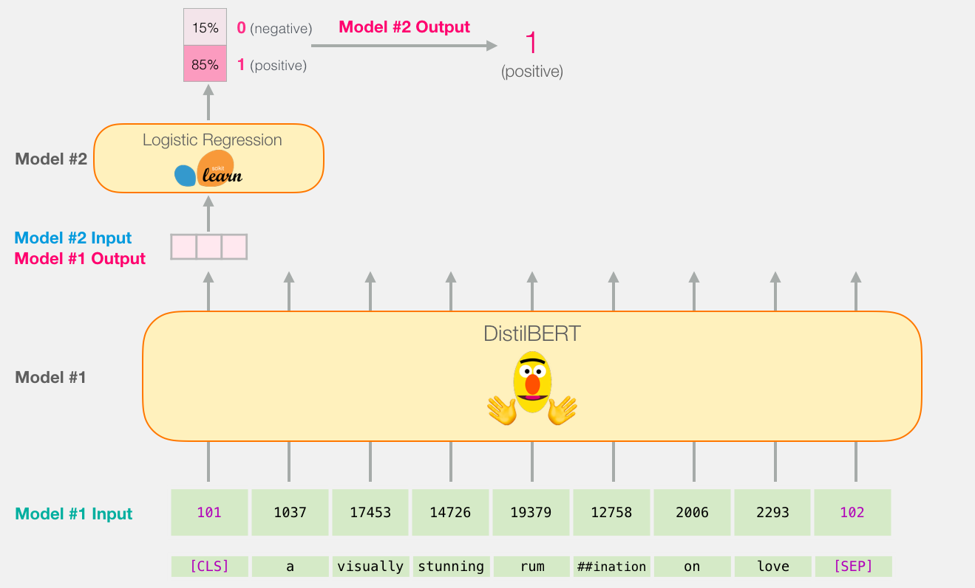
Model #1 Output Class vector as Model #2 Input
Source: Jay Alammar (2019), A Visual Guide to Using BERT for the First Time, http://jalammar.github.io/a-visual-guide-to-using-bert-for-the-first-time/

Slide 66
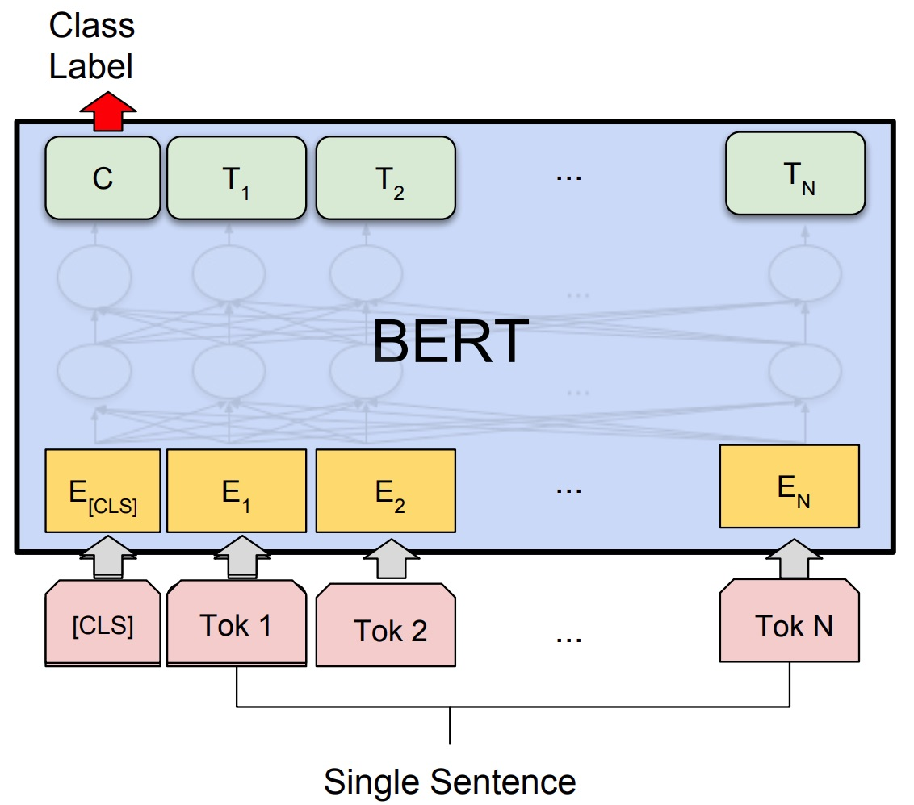
Fine-tuning BERT on Single Sentence Classification Tasks
Source: Devlin, Jacob, Ming-Wei Chang, Kenton Lee, and Kristina Toutanova (2018). "Bert: Pre-training of deep bidirectional transformers for language understanding." arXiv preprint arXiv:1810.04805.

Slide 67
Model #1 Output Class vector as Model #2 Input
Source: Jay Alammar (2019), A Visual Guide to Using BERT for the First Time, http://jalammar.github.io/a-visual-guide-to-using-bert-for-the-first-time/

Slide 68
Logistic Regression Model to classify Class vector
Source: Jay Alammar (2019), A Visual Guide to Using BERT for the First Time, http://jalammar.github.io/a-visual-guide-to-using-bert-for-the-first-time/

Slide 69
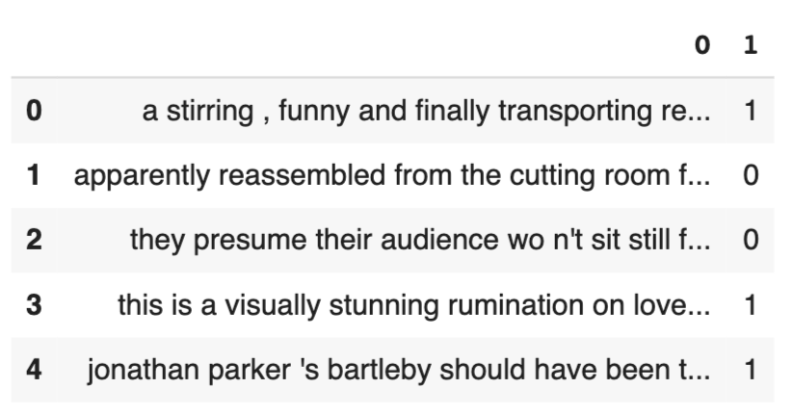
df = pd.read_csv('https://github.com/clairett/pytorch-sentiment-classification/raw/master/data/SST2/train.tsv', delimiter='\t', header=None)
df.head()
Source: Jay Alammar (2019), A Visual Guide to Using BERT for the First Time, http://jalammar.github.io/a-visual-guide-to-using-bert-for-the-first-time/

Slide 70
Tokenization
tokenized = df[0].apply((lambda x: tokenizer.encode(x, add_special_tokens=True)))
Source: Jay Alammar (2019), A Visual Guide to Using BERT for the First Time, http://jalammar.github.io/a-visual-guide-to-using-bert-for-the-first-time/

Slide 71
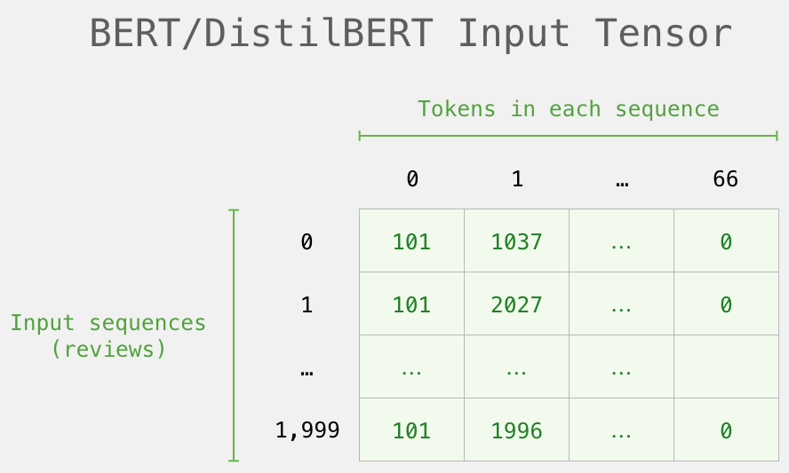
BERT Input Tensor
Source: Jay Alammar (2019), A Visual Guide to Using BERT for the First Time, http://jalammar.github.io/a-visual-guide-to-using-bert-for-the-first-time/

Slide 72
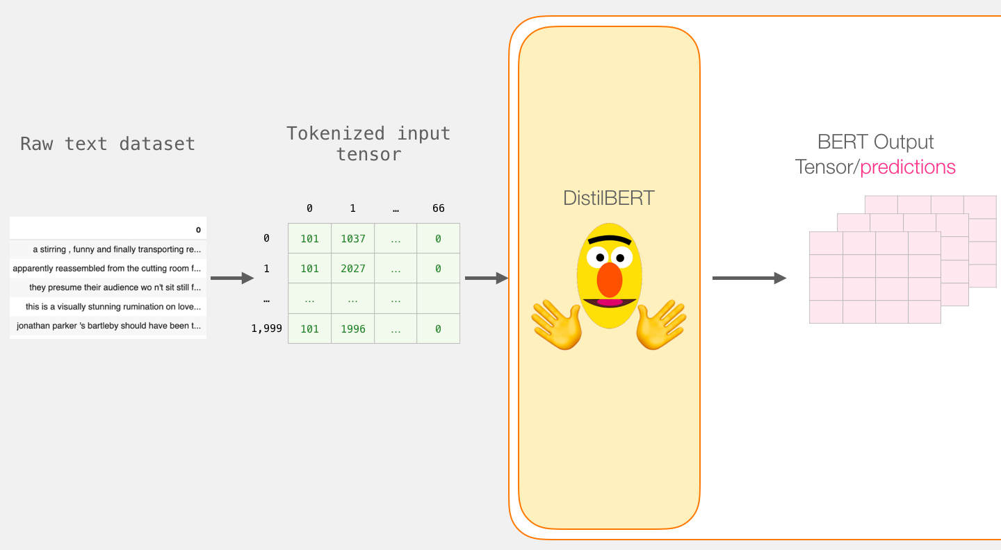
Processing with DistilBERT
input_ids = torch.tensor(np.array(padded))
last_hidden_states = model(input_ids)
Source: Jay Alammar (2019), A Visual Guide to Using BERT for the First Time, http://jalammar.github.io/a-visual-guide-to-using-bert-for-the-first-time/

Slide 73
Unpacking the BERT output tensor
Source: Jay Alammar (2019), A Visual Guide to Using BERT for the First Time, http://jalammar.github.io/a-visual-guide-to-using-bert-for-the-first-time/

Slide 74
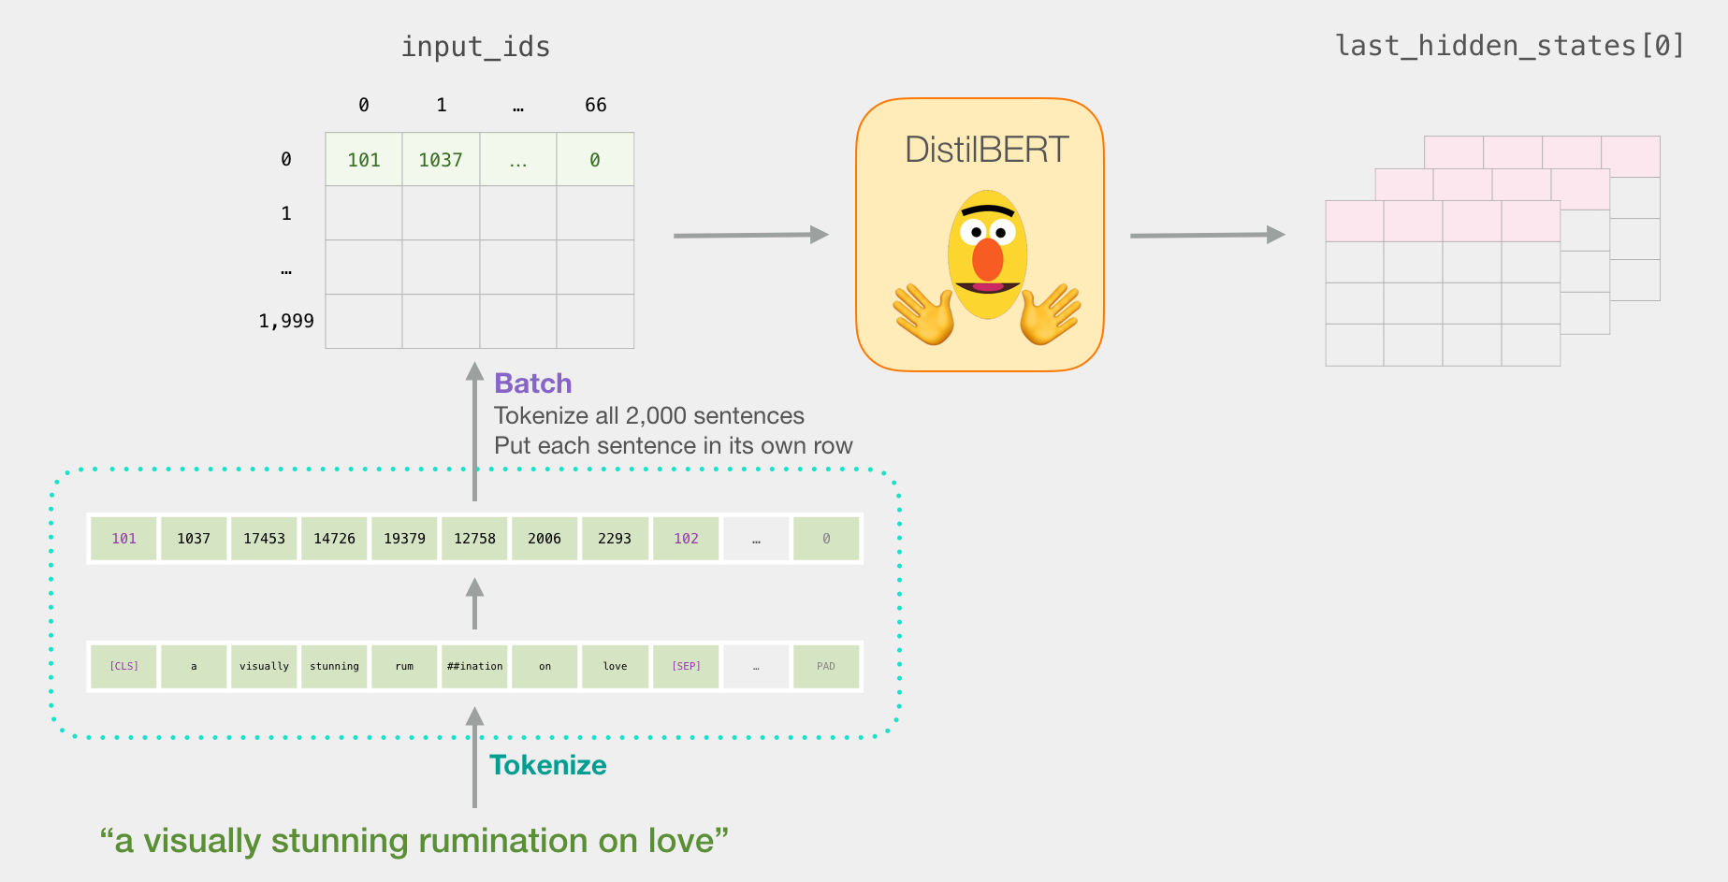
Sentence to last_hidden_state[0]
Source: Jay Alammar (2019), A Visual Guide to Using BERT for the First Time, http://jalammar.github.io/a-visual-guide-to-using-bert-for-the-first-time/

Slide 75
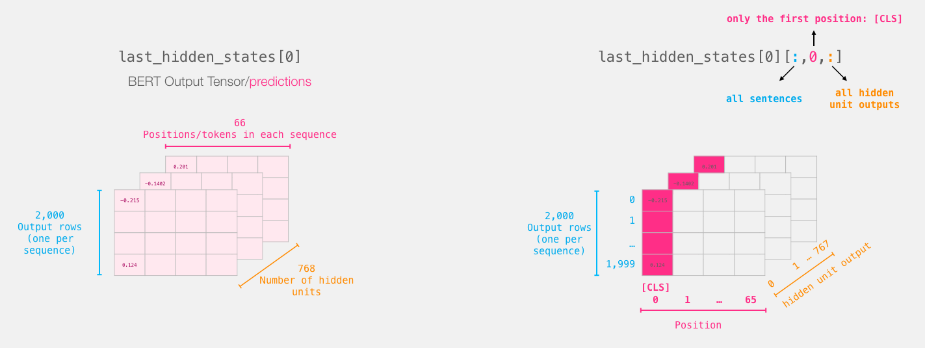
BERT’s output for the [CLS] tokens
# Slice the output for the first position for all the sequences, take all hidden unit outputs
features = last_hidden_states[0][:,0,:].numpy()
Source: Jay Alammar (2019), A Visual Guide to Using BERT for the First Time, http://jalammar.github.io/a-visual-guide-to-using-bert-for-the-first-time/

Slide 76
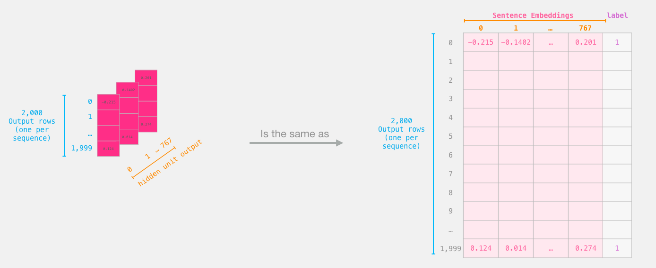
The tensor sliced from BERT's output Sentence Embeddings
Source: Jay Alammar (2019), A Visual Guide to Using BERT for the First Time, http://jalammar.github.io/a-visual-guide-to-using-bert-for-the-first-time/

Slide 77
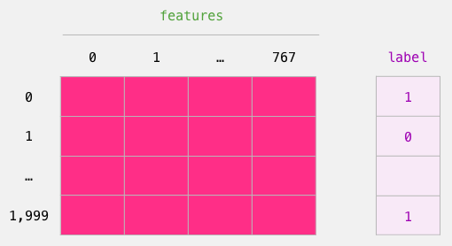
Dataset for Logistic Regression (768 Features)
The features are the output vectors of BERT for the [CLS] token (position #0)
Source: Jay Alammar (2019), A Visual Guide to Using BERT for the First Time, http://jalammar.github.io/a-visual-guide-to-using-bert-for-the-first-time/

Slide 78
labels = df[1]
train_features, test_features, train_labels, test_labels = train_test_split(features, labels)
Source: Jay Alammar (2019), A Visual Guide to Using BERT for the First Time, http://jalammar.github.io/a-visual-guide-to-using-bert-for-the-first-time/

Slide 79
Score Benchmarks Logistic Regression Model on SST-2 Dataset
# Training
lr_clf = LogisticRegression()
lr_clf.fit(train_features, train_labels)
#Testing
lr_clf.score(test_features, test_labels)
# Accuracy: 81%
# Highest accuracy: 96.8%
# Fine-tuned DistilBERT: 90.7%
# Full size BERT model: 94.9%
Source: Jay Alammar (2019), A Visual Guide to Using BERT for the First Time, http://jalammar.github.io/a-visual-guide-to-using-bert-for-the-first-time/

Slide 80
Sentiment Classification: SST2 Sentences from movie reviews
sentence | label
a stirring , funny and finally transporting re imagining of beauty and the beast and 1930s horror films | 1
apparently reassembled from the cutting room floor of any given daytime soap | 0
they presume their audience won't sit still for a sociology lesson | 0
this is a visually stunning rumination on love , memory , history and the war between art and commerce | 1
jonathan parker 's bartleby should have been the be all end all of the modern office anomie films | 1
Source: Jay Alammar (2019), A Visual Guide to Using BERT for the First Time, http://jalammar.github.io/a-visual-guide-to-using-bert-for-the-first-time/

Slide 81
A Visual Notebook to Using BERT for the First Time
https://colab.research.google.com/github/jalammar/jalammar.github.io/blob/master/notebooks/bert/A_Visual_Notebook_to_Using_BERT_for_the_First_Time.ipynb

Slide 82
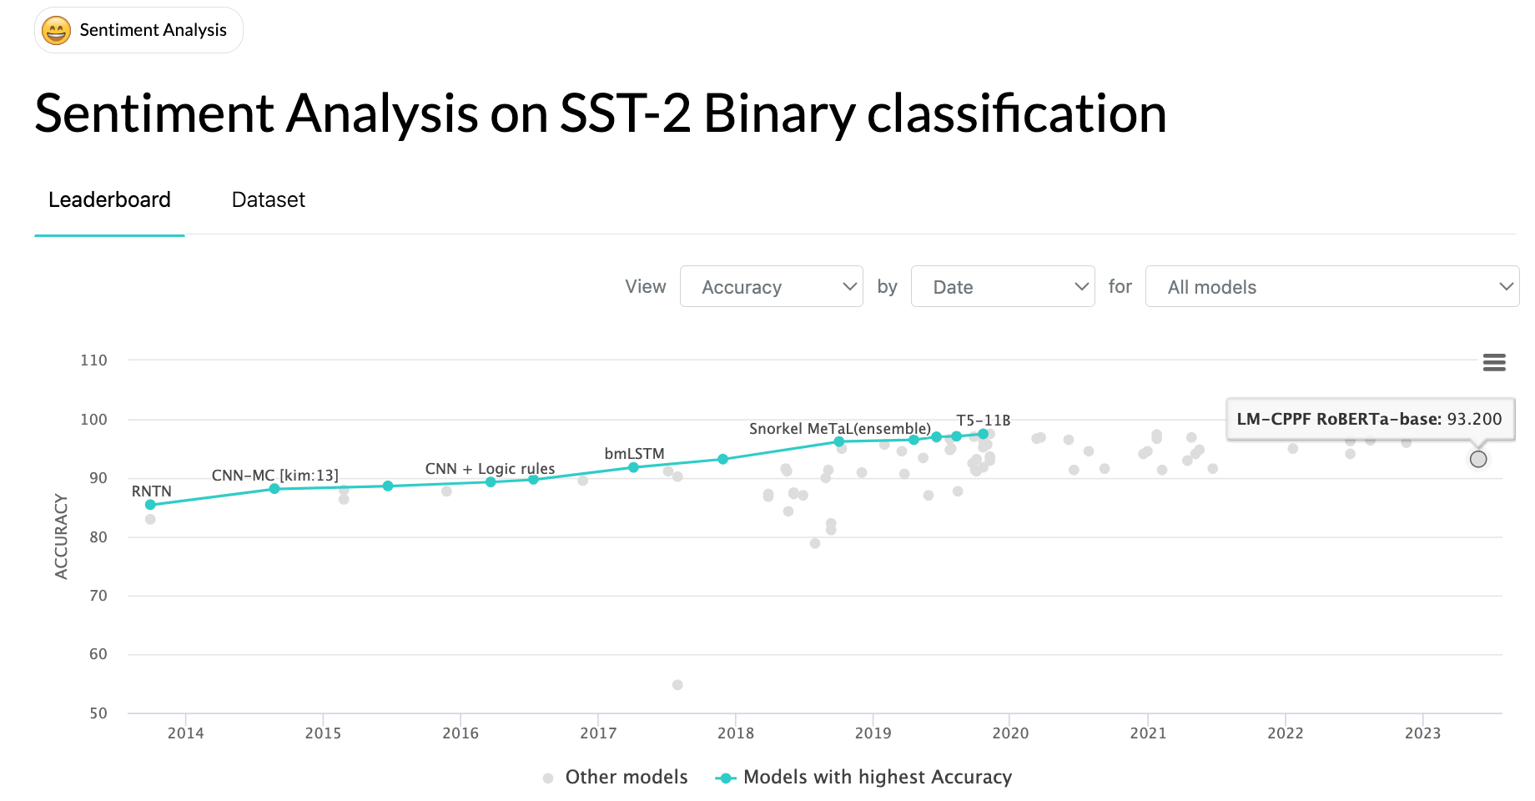
SOTA: Sentiment Analysis on SST-2 Binary classification
Source: https://paperswithcode.com/sota/sentiment-analysis-on-sst-2-binary

Slide 83
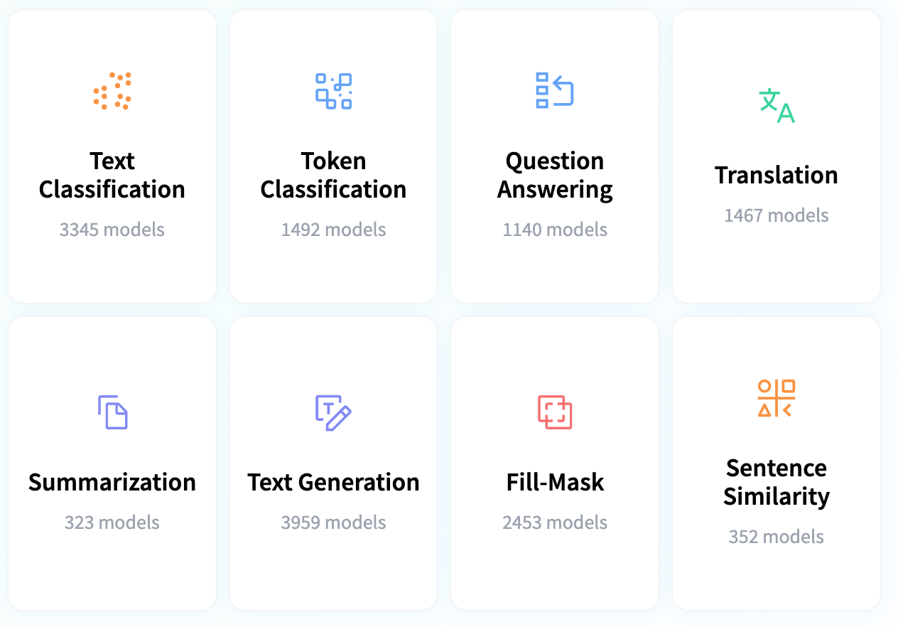
Hugging Face Tasks Natural Language Processing
https://huggingface.co/tasks

Slide 84
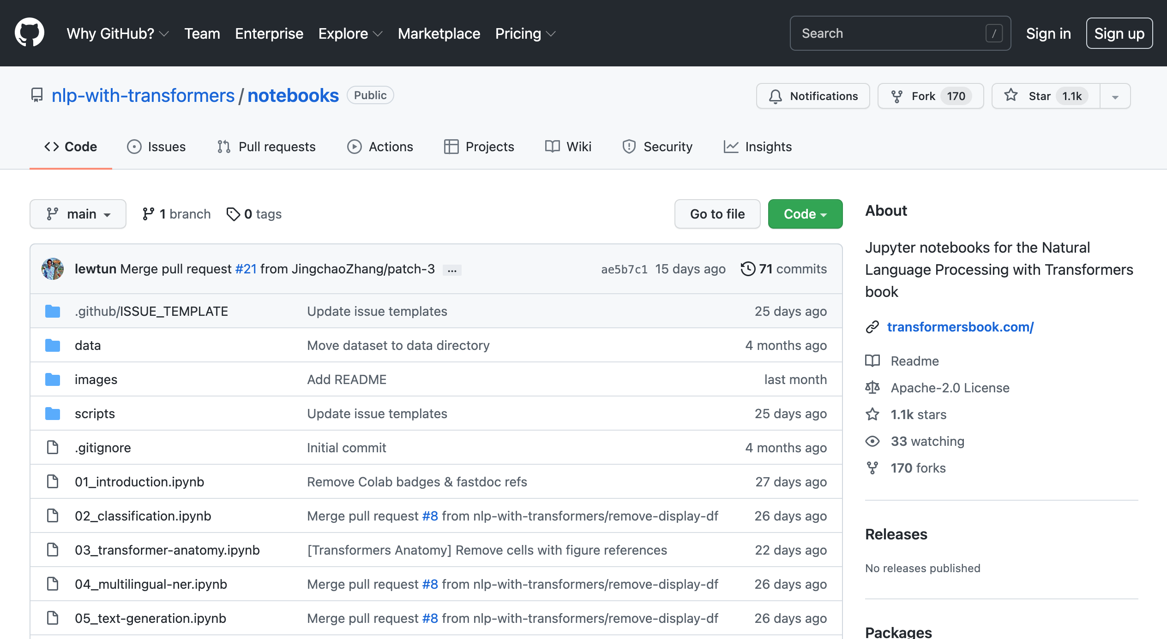
NLP with Transformers Github
https://github.com/nlp-with-transformers/notebooks

Slide 85
NLP with Transformers Github Notebooks
https://github.com/nlp-with-transformers/notebooks

Slide 86
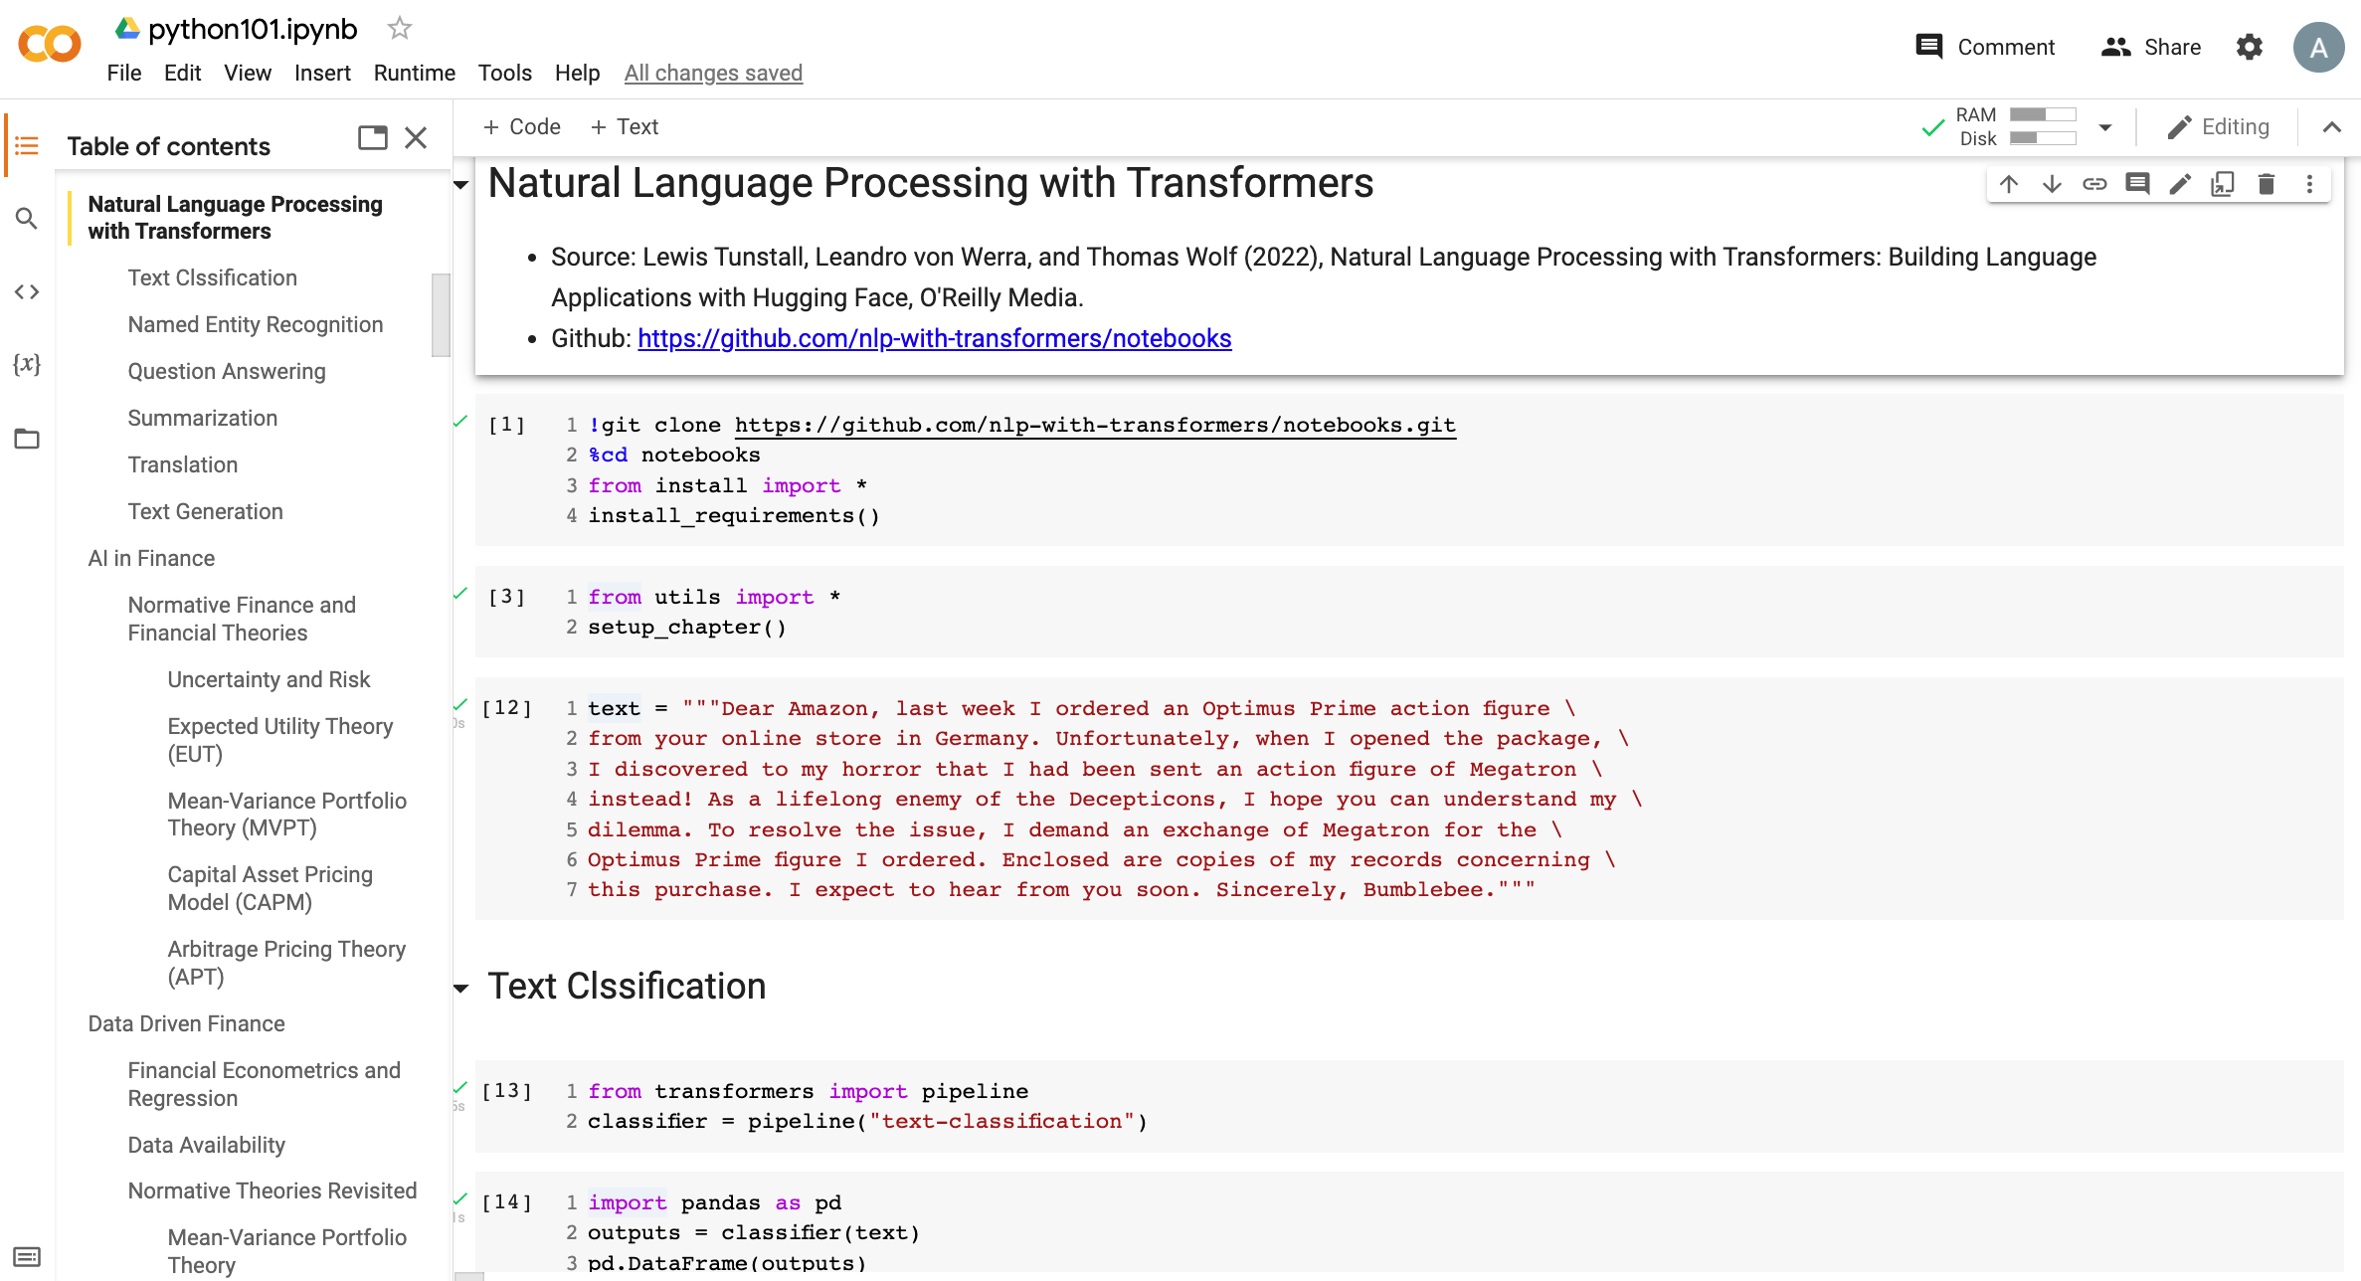
Python in Google Colab (Python101)
https://colab.research.google.com/drive/1FEG6DnGvwfUbeo4zJ1zTunjMqf2RkCrT
https://tinyurl.com/aintpupython101

Slide 87
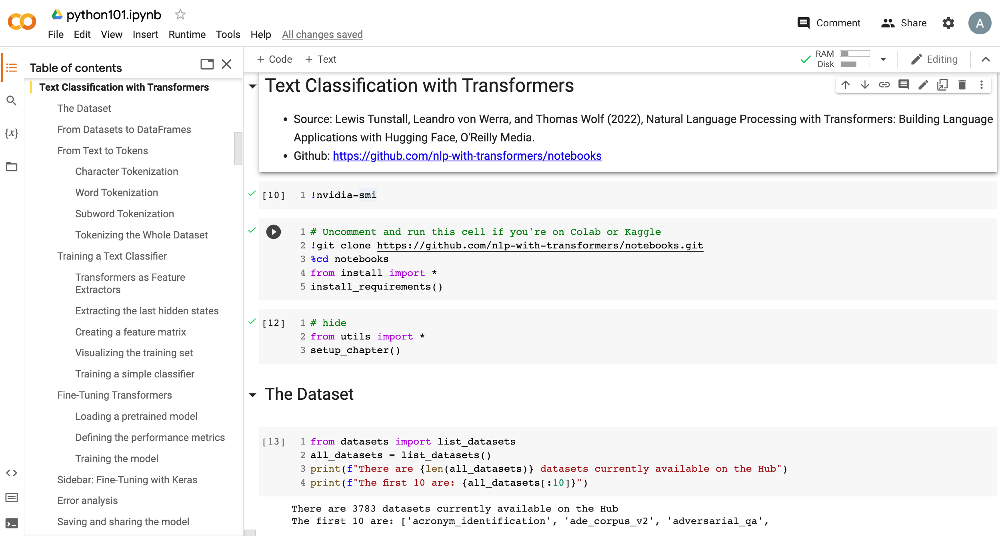
Python in Google Colab (Python101)
https://colab.research.google.com/drive/1FEG6DnGvwfUbeo4zJ1zTunjMqf2RkCrT
https://tinyurl.com/aintpupython101

Slide 88
Summary
Text Classification and Sentiment Analysis
Dataset
Tokenizer
Training a Text Classifier
Fine-Tuning Transformers

Slide 89
References
Lewis Tunstall, Leandro von Werra, and Thomas Wolf (2022), Natural Language Processing with Transformers: Building Language Applications with Hugging Face, O'Reilly Media.
Denis Rothman (2021), Transformers for Natural Language Processing: Build innovative deep neural network architectures for NLP with Python, PyTorch, TensorFlow, BERT, RoBERTa, and more, Packt Publishing.
Savaş Yıldırım and Meysam Asgari-Chenaghlu (2021), Mastering Transformers: Build state-of-the-art models from scratch with advanced natural language processing techniques, Packt Publishing.
Shervin Minaee, Nal Kalchbrenner, Erik Cambria, Narjes Nikzad, Meysam Chenaghlu, and Jianfeng Gao (2021), "Deep learning--based text classification: a comprehensive review." ACM Computing Surveys (CSUR) 54, no. 3 (2021): 1-40.
Sowmya Vajjala, Bodhisattwa Majumder, Anuj Gupta (2020), Practical Natural Language Processing: A Comprehensive Guide to Building Real-World NLP Systems, O'Reilly Media.
Ramesh Sharda, Dursun Delen, and Efraim Turban (2017), Business Intelligence, Analytics, and Data Science: A Managerial Perspective, 4th Edition, Pearson.
Dipanjan Sarkar (2019), Text Analytics with Python: A Practitioner’s Guide to Natural Language Processing, Second Edition. APress.
Benjamin Bengfort, Rebecca Bilbro, and Tony Ojeda (2018), Applied Text Analysis with Python: Enabling Language-Aware Data Products with Machine Learning, O’Reilly.
Charu C. Aggarwal (2018), Machine Learning for Text, Springer.
Gabe Ignatow and Rada F. Mihalcea (2017), An Introduction to Text Mining: Research Design, Data Collection, and Analysis, SAGE Publications.
Rajesh Arumugam (2018), Hands-On Natural Language Processing with Python: A practical guide to applying deep learning architectures to your NLP applications, Packt.
Jake VanderPlas (2016), Python Data Science Handbook: Essential Tools for Working with Data, O'Reilly Media.
Devlin, Jacob, Ming-Wei Chang, Kenton Lee, and Kristina Toutanova (2018). "BERT: Pre-training of Deep Bidirectional Transformers for Language Understanding." arXiv preprint arXiv:1810.04805.
Washington Cunha, Felipe Viegas, Celso França, Thierson Rosa, Leonardo Rocha, and Marcos André Gonçalves (2023). "A Comparative Survey of Instance Selection Methods applied to NonNeural and Transformer-Based Text Classification." ACM Computing Surveys.
Qihuang Zhong, Liang Ding, Juhua Liu, Bo Du, and Dacheng Tao (2023). "Can chatgpt understand too? a comparative study on chatgpt and fine-tuned bert." arXiv preprint arXiv:2302.10198.
The Super Duper NLP Repo, https://notebooks.quantumstat.com/
Jay Alammar (2018), The Illustrated Transformer, http://jalammar.github.io/illustrated-transformer/
Jay Alammar (2019), A Visual Guide to Using BERT for the First Time, http://jalammar.github.io/a-visual-guide-to-using-bert-for-the-first-time/
NLP with Transformer, https://github.com/nlp-with-transformers/notebooks
Min-Yuh Day (2023), Python 101, https://tinyurl.com/aintpupython101

