Slide 1
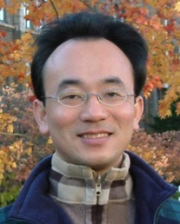
Text Generation with Large Language Models (LLMs)
Artificial Intelligence for Text Analytics
1121AITA08
MBA, IM, NTPU (M5265) (Fall 2023) Tue 2, 3, 4 (9:10-12:00) (B3F17)
Min-Yuh Day, Ph.D, Associate Professor
Institute of Information Management, National Taipei University
https://web.ntpu.edu.tw/~myday
https://meet.google.com/miy-fbif-max
2023-11-22

Slide 2
Syllabus
Week Date Subject/Topics
1 2023/09/13 Introduction to Artificial Intelligence for Text Analytics
2 2023/09/20 Foundations of Text Analytics: Natural Language Processing (NLP)
3 2023/09/27 Python for Natural Language Processing
4 2023/10/04 Natural Language Processing with Transformers
5 2023/10/11 Case Study on Artificial Intelligence for Text Analytics I
6 2023/10/18 Text Classification and Sentiment Analysis

Slide 3
Syllabus
Week Date Subject/Topics
7 2023/10/25 Multilingual Named Entity Recognition (NER)
8 2023/11/01 Midterm Project Report
9 2023/11/08 Text Similarity and Clustering
10 2023/11/15 Text Summarization and Topic Models
11 2023/11/22 Text Generation with Large Language Models (LLMs)
12 2023/11/29 Case Study on Artificial Intelligence for Text Analytics II

Slide 4
Syllabus
Week Date Subject/Topics
13 2023/12/06 Question Answering and Dialogue Systems
14 2023/12/13 Deep Learning, Generative AI, Transfer Learning, Zero-Shot, and Few-Shot Learning for Text Analytics
15 2023/12/20 Final Project Report I
16 2023/12/27 Final Project Report II
17 2024/01/03 Self-learning
18 2024/01/10 Self-learning

Slide 5
Text Generation with Large Language Models (LLMs)

Slide 6
Outline
Text Generation
Large Language Models (LLMs)
Prompt Engineering
Fine-tuning
Retrieval Augmented Generation (RAG)
Source: Dipanjan Sarkar (2019), Text Analytics with Python: A Practitioner’s Guide to Natural Language Processing, Second Edition. APress.

Slide 7
Zephyr-7B-β, Llama2-Chat-70B, GPT-4
Model | Size | Alignment | MT-Bench (score) | AlpacaEval (win rate %)
StableLM-Tuned-α | 7B | dSFT | 2.75 | -
MPT-Chat | 7B | dSFT | 5.42 | -
Xwin-LMv0.1 | 7B | dPPO | 6.19 | 87.83
Mistral-Instructv0.1 | 7B | - | 6.84 | -
Zephyr-7b-α | 7B | dDPO | 6.88 | -
Zephyr-7b-β 🪁 | 7B | dDPO | 7.34 | 90.60
Falcon-Instruct | 40B | dSFT | 5.17 | 45.71
Guanaco | 65B | SFT | 6.41 | 71.80
Llama2-Chat | 70B | RLHF | 6.86 | 92.66
Vicuna v1.3 | 33B | dSFT | 7.12 | 88.99
WizardLM v1.0 | 70B | dSFT | 7.71 | -
Xwin-LM v0.1 | 70B | dPPO | - | 95.57
GPT-3.5-turbo | - | RLHF | 7.94 | 89.37
Claude 2 | - | RLHF | 8.06 | 91.36
GPT-4 | - | RLHF | 8.99 | 95.28
Source: https://huggingface.co/HuggingFaceH4/zephyr-7b-beta

Slide 8
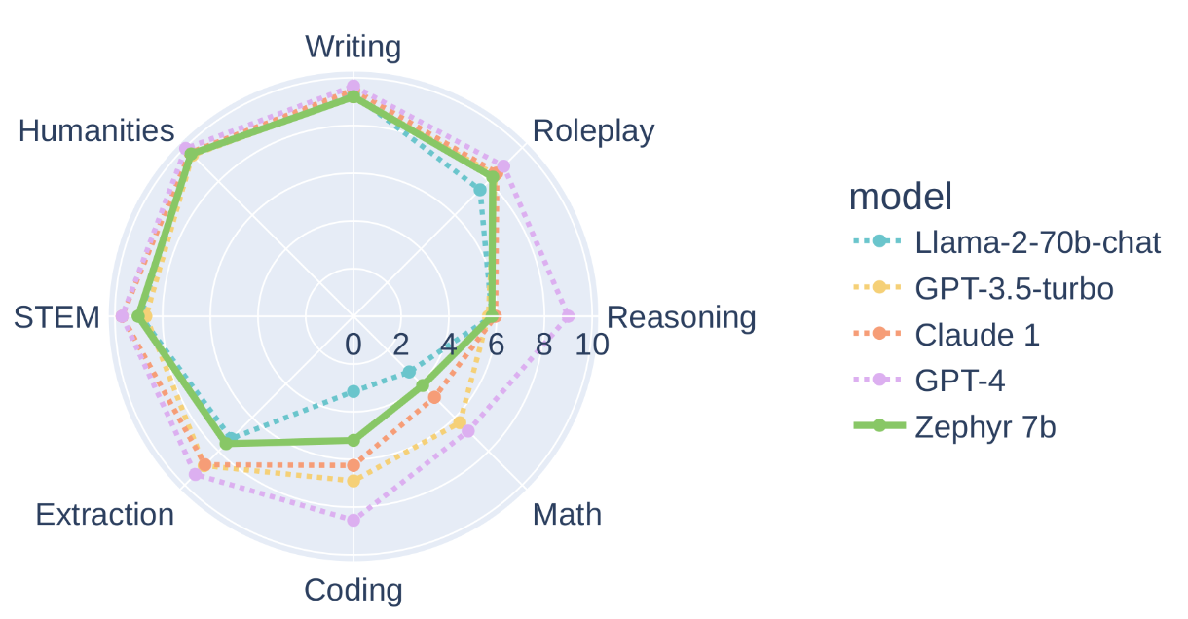
Zephyr-7B-β, Llama2-Chat-70B, GPT-4
Source: https://huggingface.co/HuggingFaceH4/zephyr-7b-beta

Slide 9
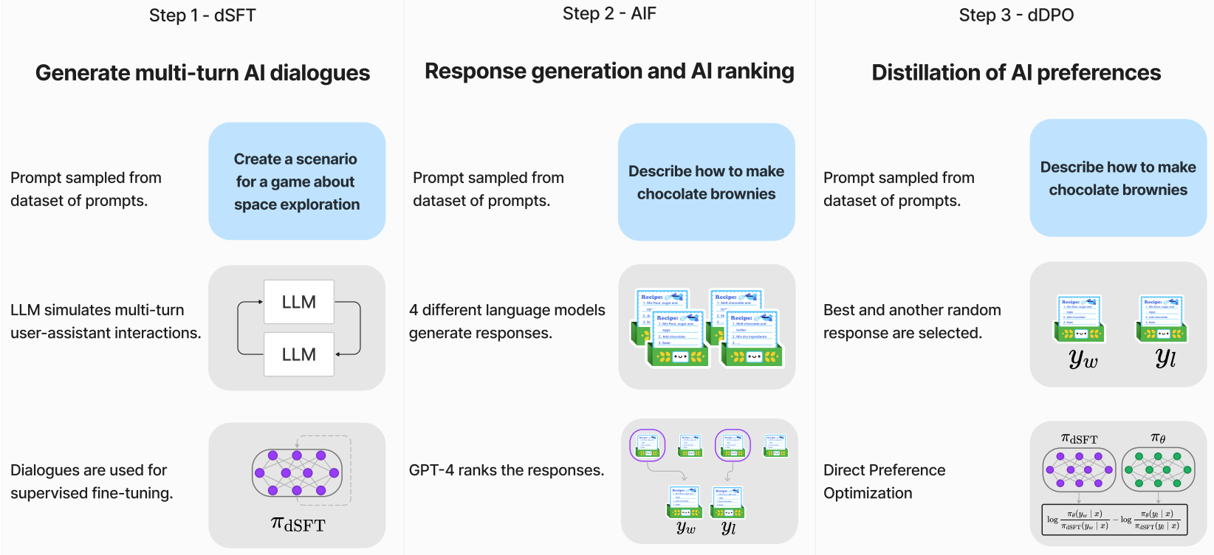
Zephyr: Direct Distillation of LM Alignment
distilled supervised fine-tuning (dSFT)
AI Feedback (AIF)
distilled Direct Preference Optimization (dDPO)
Source: Tunstall, L., Beeching, E., Lambert, N., Rajani, N., Rasul, K., Belkada, Y., ... & Wolf, T. (2023). Zephyr: Direct Distillation of LM Alignment. arXiv preprint arXiv:2310.16944.

Slide 10
Zephyr: Direct Distillation of LM Alignment
The three steps of Zephyr:
(1) large scale, self-instruct-style dataset construction
(UltraChat), followed by distilled supervised fine-tuning (dSFT),
(2) AI Feedback (AIF) collection
via an ensemble of chat model completions, followed by scoring by GPT-4 (UltraFeedback) and
binarization into preferences, and
(3) distilled direct preference optimization (dDPO) of the dSFT
model utilizing the feedback data.
Source: Tunstall, L., Beeching, E., Lambert, N., Rajani, N., Rasul, K., Belkada, Y., ... & Wolf, T. (2023). Zephyr: Direct Distillation of LM Alignment. arXiv preprint arXiv:2310.16944.

Slide 11
DPO optimizes for human preferences while avoiding reinforcement learning
Source: Rafailov, R., Sharma, A., Mitchell, E., Ermon, S., Manning, C. D., & Finn, C. (2023). Direct preference optimization: Your language model is secretly a reward model. arXiv preprint arXiv:2305.18290.

Slide 12
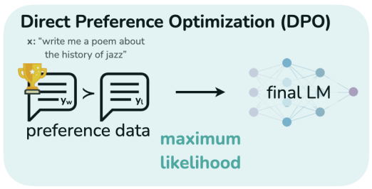
Direct Preference Optimization (DPO)
Source: Rafailov, R., Sharma, A., Mitchell, E., Ermon, S., Manning, C. D., & Finn, C. (2023). Direct preference optimization: Your language model is secretly a reward model. arXiv preprint arXiv:2305.18290.

Slide 13
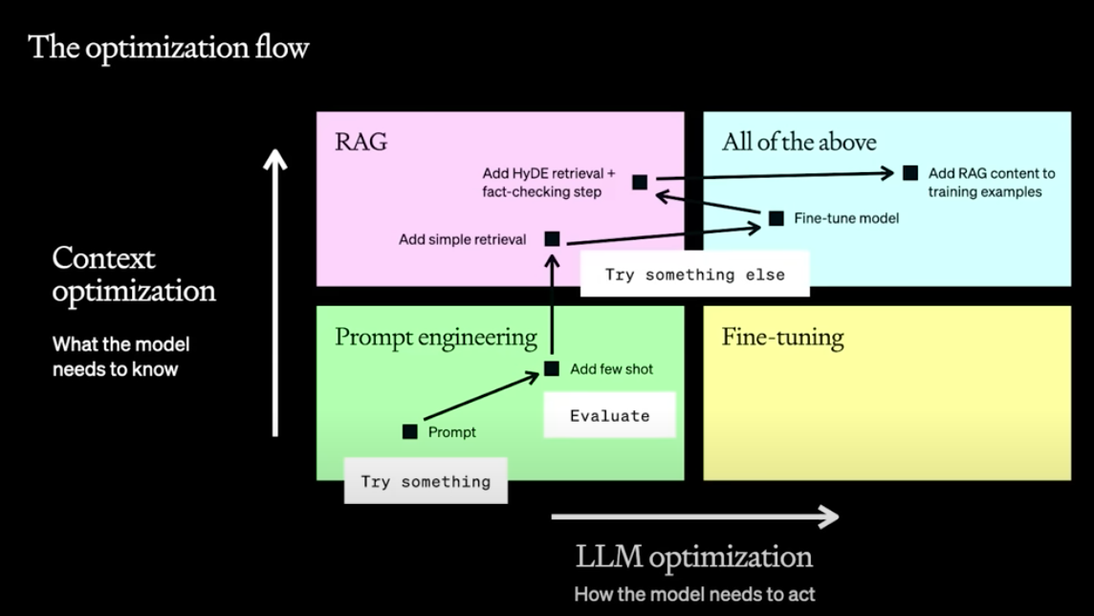
Maximizing LLM Performance
Source: OpenAI (2023), A Survey of Techniques for Maximizing LLM Performance, https://www.youtube.com/watch?v=ahnGLM-RC1Y

Slide 14
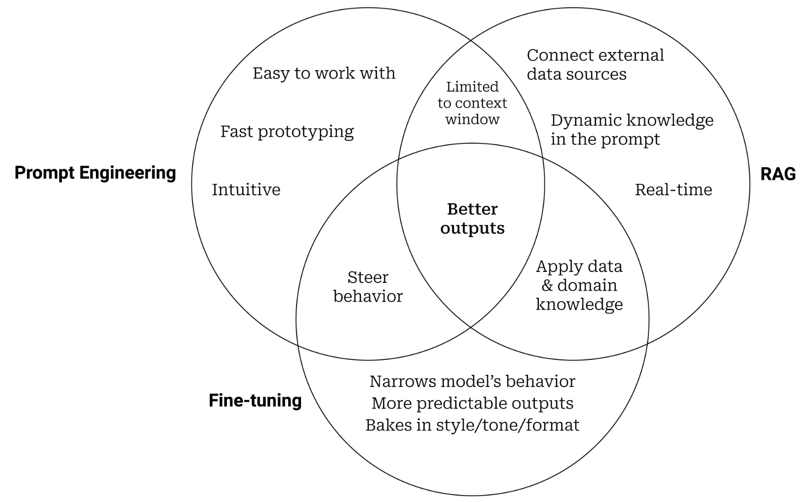
Prompt Engineering, Fine-tuning, and RAG
Source: https://www.entrypointai.com/blog/approaches-to-ai-prompt-engineering-embeddings-or-fine-tuning/

Slide 15
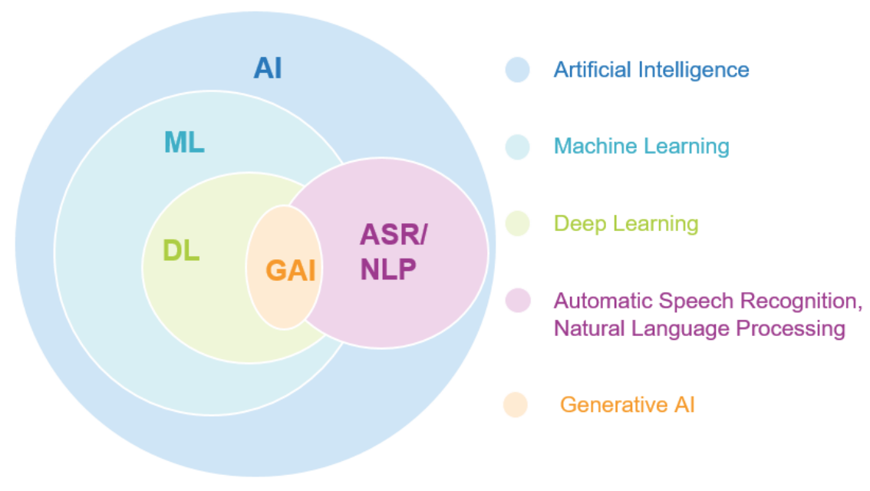
Generative AI
Source: Jeong, Cheonsu. "A Study on the Implementation of Generative AI Services Using an Enterprise Data-Based LLM Application Architecture." arXiv preprint arXiv:2309.01105 (2023).

Slide 16
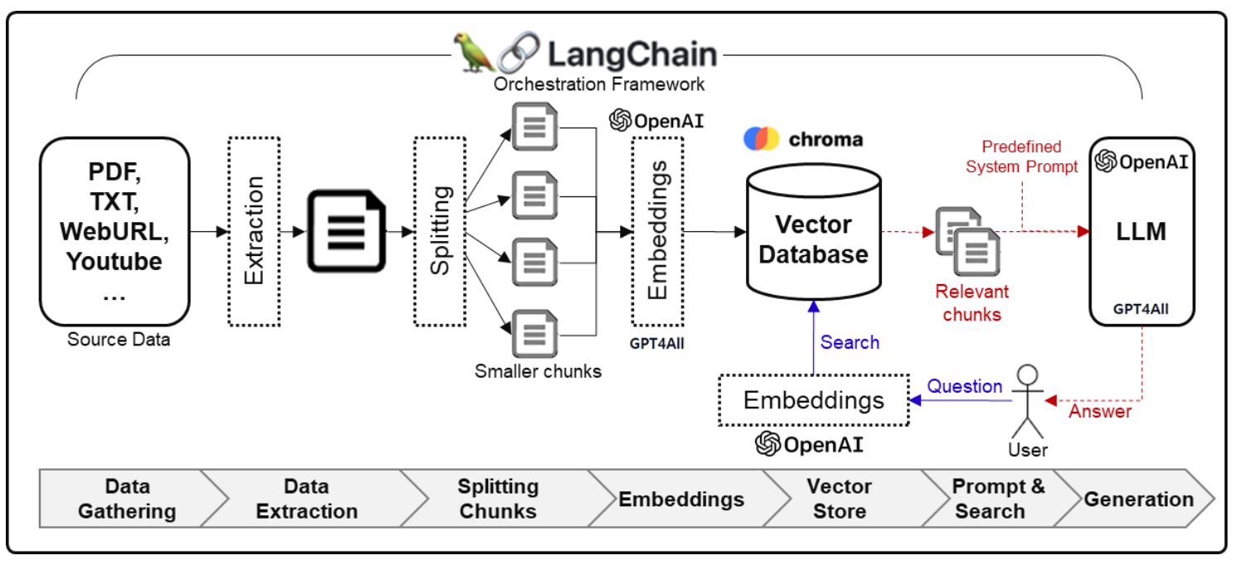
Framework for Implementing Generative AI Services using RAG Model
Source: Jeong, Cheonsu. "A Study on the Implementation of Generative AI Services Using an Enterprise Data-Based LLM Application Architecture." arXiv preprint arXiv:2309.01105 (2023).

Slide 17
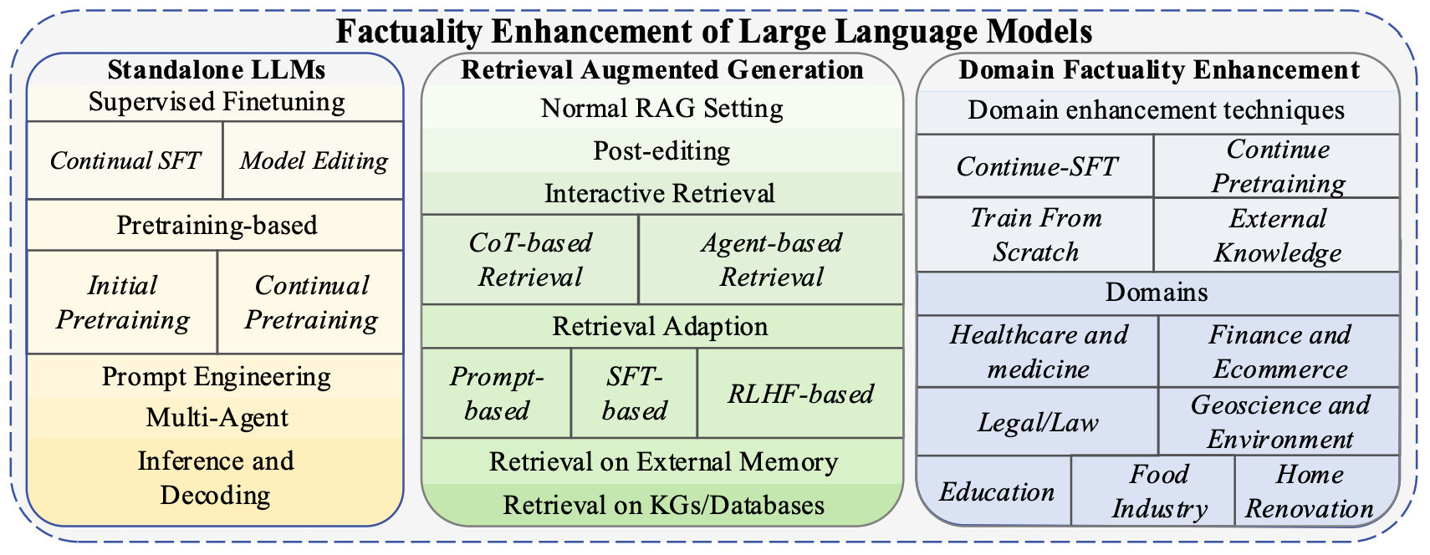
Factuality Enhancement of Large Language Models (LLMs)
Source: Wang, Cunxiang, Xiaoze Liu, Yuanhao Yue, Xiangru Tang, Tianhang Zhang, Cheng Jiayang, Yunzhi Yao et al. "Survey on factuality in large language models: Knowledge, retrieval and domain-specificity." arXiv preprint arXiv:2310.07521 (2023).

Slide 18
ChatGPT Large Language Models (LLMs) Foundation Models

Slide 19
Large Language Models (LLM) (GPT-3, ChatGPT, PaLM, BLOOM, OPT-175B, LLaMA)
ChatGPT
175B
LLaMA
65B
Source: https://lifearchitect.ai/models/

Slide 20
The Transformers Timeline
ULMFit
BERT
RoBERTa
XLM-R
DeBERTa
GPT-Neo
BLOOM
Alpaca
DistrilBERT
T5
PaLM
ChatGPT
Llama2
Transformer
GPT
GPT-2
GPT-3
GPT-J
OPT-175B
Llama
2017
2018
2019
2020
2021
2022
2023
Source: Lewis Tunstall, Leandro von Werra, and Thomas Wolf (2022), Natural Language Processing with Transformers: Building Language Applications with Hugging Face, O'Reilly Media.

Slide 21
Transformer Models
Transformer
Encoder
Decoder
DistilBERT
BERT
T5
GPT
RoBERTa
BART
GPT-2
CTRL
XLM-R
XLM
M2M-100
GPT-3
ALBERT
BigBird
GPT-Neo
GPT-J
ELECTRA
mT0
BLOOM
BLOOMZ
DeBERTa
ChatGPT
GPT-4
Source: Lewis Tunstall, Leandro von Werra, and Thomas Wolf (2022), Natural Language Processing with Transformers: Building Language Applications with Hugging Face, O'Reilly Media.

Slide 22
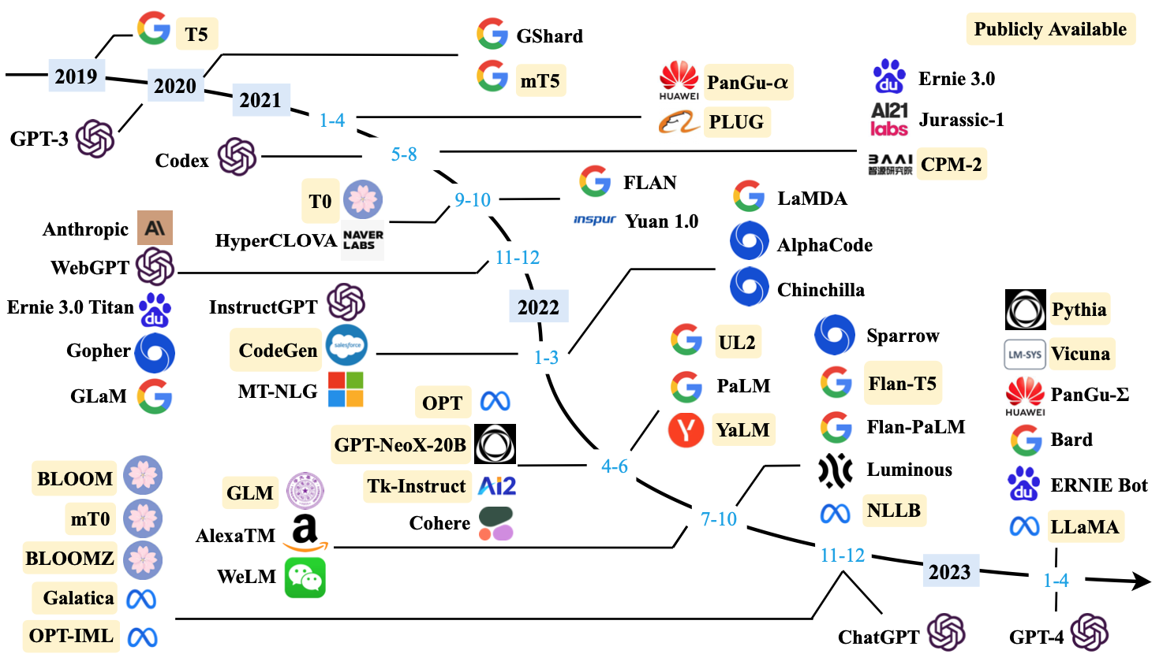
Large Language Models (LLMs) (larger than 10B)
Source: Wayne Xin Zhao, Kun Zhou, Junyi Li, Tianyi Tang, Xiaolei Wang, Yupeng Hou, Yingqian Min et al. (2023) "A Survey of Large Language Models." arXiv preprint arXiv:2303.18223.

Slide 23
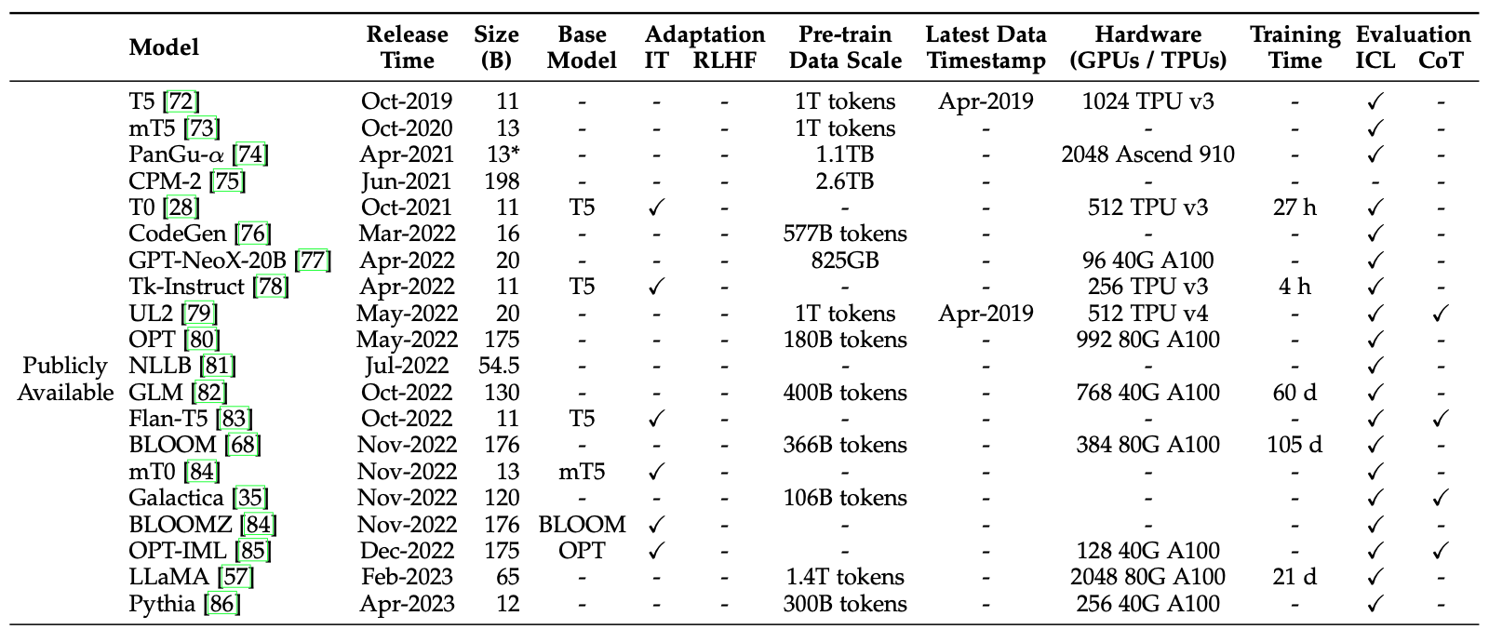
Large Language Models (LLMs) (larger than 10B)
Source: Wayne Xin Zhao, Kun Zhou, Junyi Li, Tianyi Tang, Xiaolei Wang, Yupeng Hou, Yingqian Min et al. (2023) "A Survey of Large Language Models." arXiv preprint arXiv:2303.18223.

Slide 24
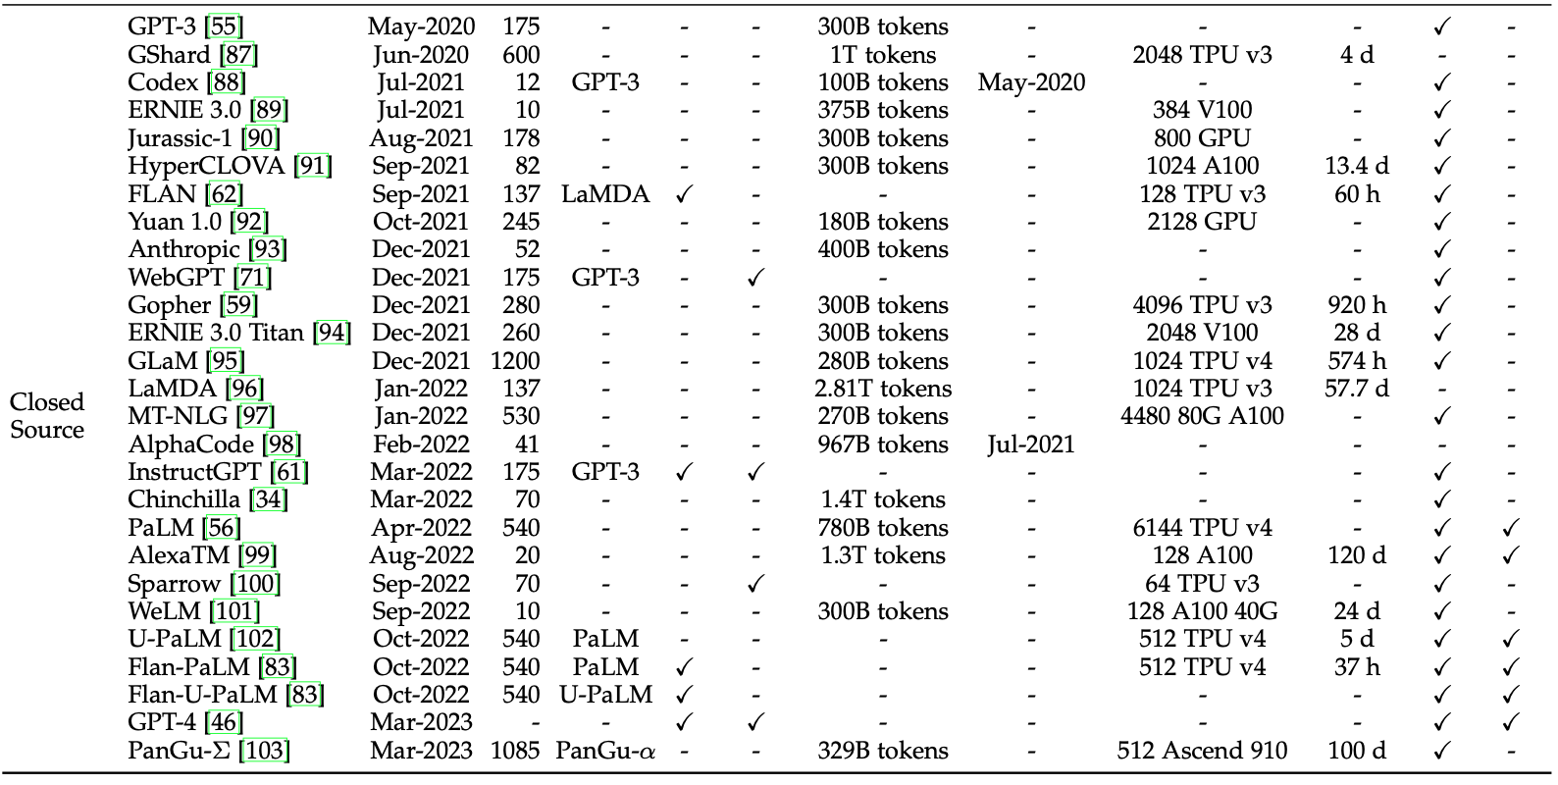
Large Language Models (LLMs) (larger than 10B)
Source: Wayne Xin Zhao, Kun Zhou, Junyi Li, Tianyi Tang, Xiaolei Wang, Yupeng Hou, Yingqian Min et al. (2023) "A Survey of Large Language Models." arXiv preprint arXiv:2303.18223.

Slide 25
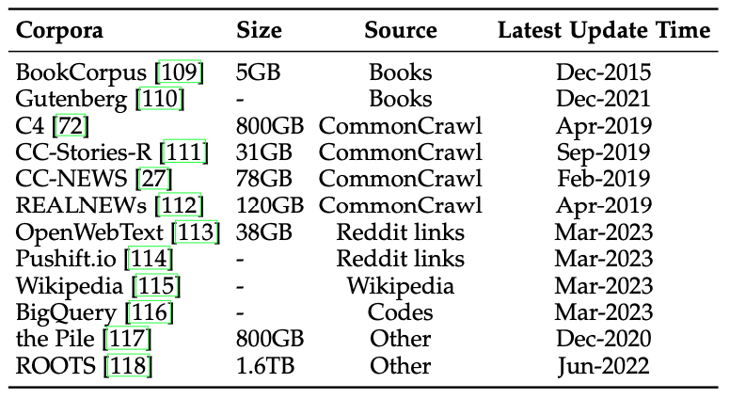
Statistics of Commonly-used Data Sources for LLMs
Source: Wayne Xin Zhao, Kun Zhou, Junyi Li, Tianyi Tang, Xiaolei Wang, Yupeng Hou, Yingqian Min et al. (2023) "A Survey of Large Language Models." arXiv preprint arXiv:2303.18223.

Slide 26
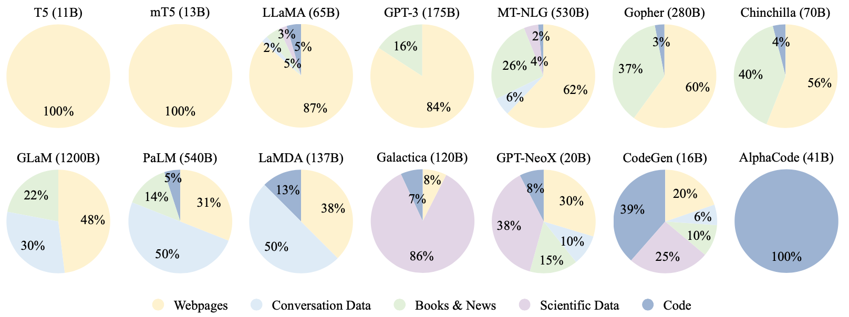
Ratios of various data sources in the pre-training data for existing LLMs
Source: Wayne Xin Zhao, Kun Zhou, Junyi Li, Tianyi Tang, Xiaolei Wang, Yupeng Hou, Yingqian Min et al. (2023) "A Survey of Large Language Models." arXiv preprint arXiv:2303.18223.

Slide 27
Typical Data Preprocessing Pipeline for Pre-training Large Language Models (LLMs)
Source: Wayne Xin Zhao, Kun Zhou, Junyi Li, Tianyi Tang, Xiaolei Wang, Yupeng Hou, Yingqian Min et al. (2023) "A Survey of Large Language Models." arXiv preprint arXiv:2303.18223.

Slide 28
LLMs with Public Configuration Details
Note: PE denotes position embedding, #L denotes the number of layers, #H denotes the number of attention heads, d_{model} denotes the size of hidden states, and MCL denotes the maximum context length during training.
Source: Wayne Xin Zhao, Kun Zhou, Junyi Li, Tianyi Tang, Xiaolei Wang, Yupeng Hou, Yingqian Min et al. (2023) "A Survey of Large Language Models." arXiv preprint arXiv:2303.18223.

Slide 29
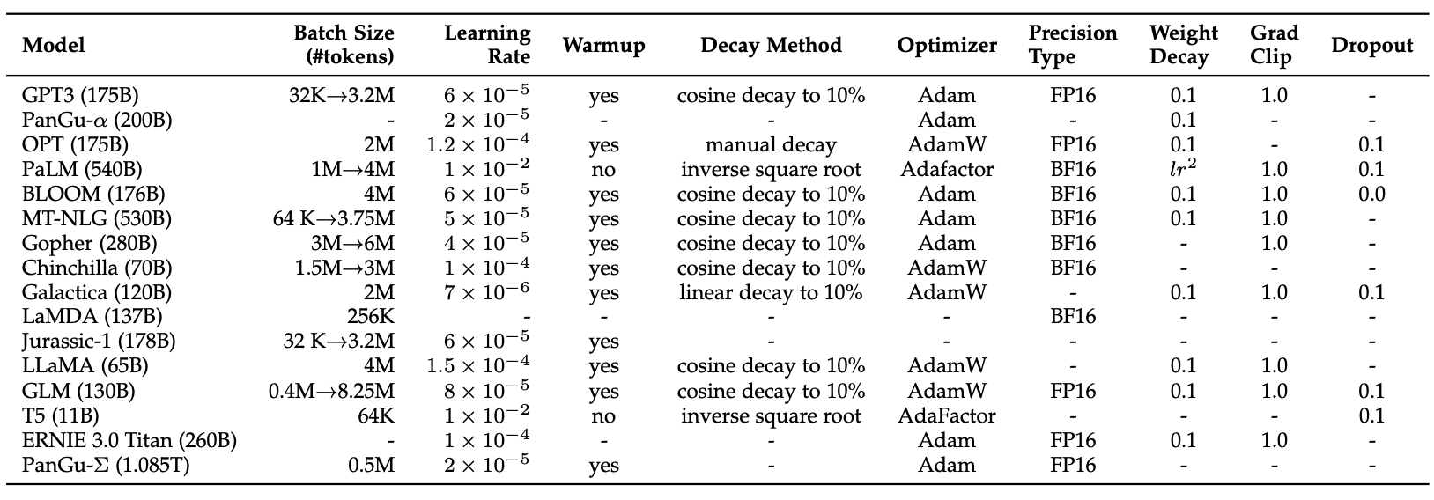
Detailed Optimization Settings of LLMs
Source: Wayne Xin Zhao, Kun Zhou, Junyi Li, Tianyi Tang, Xiaolei Wang, Yupeng Hou, Yingqian Min et al. (2023) "A Survey of Large Language Models." arXiv preprint arXiv:2303.18223.

Slide 30
Generative AI Text, Image, Video, Audio Applications

Slide 31
Popular Generative AI
OpenAI ChatGPT (GPT-3.5, GPT-4)
OpenAI DALL·E 3
Perplexity.ai
Chat.LMSys.org
Llama 2, Mistral, Zephyr, Vicuna, MPT, Falcon
ChatPDF
Stable Diffusion
Video: D-ID, Synthesia
Audio: Speechify

Slide 32
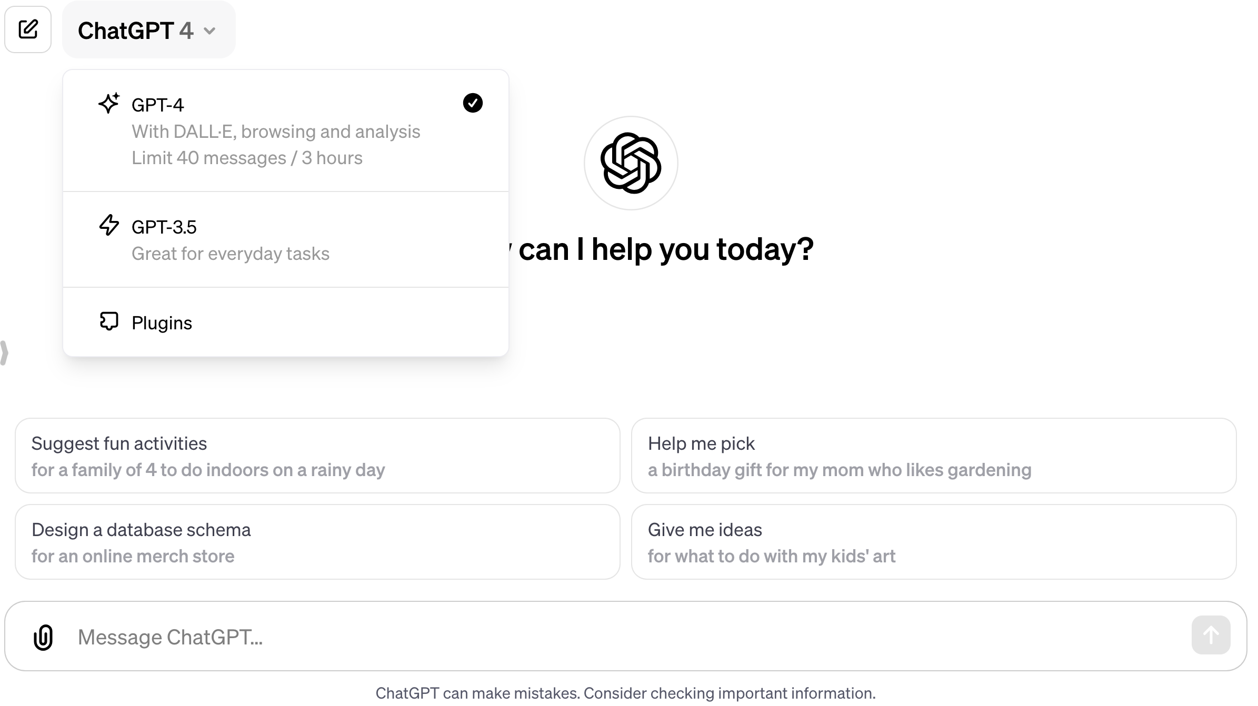
OpenAI ChatGPT (GPT-4, GPT-3.5)
https://chat.openai.com/

Slide 33
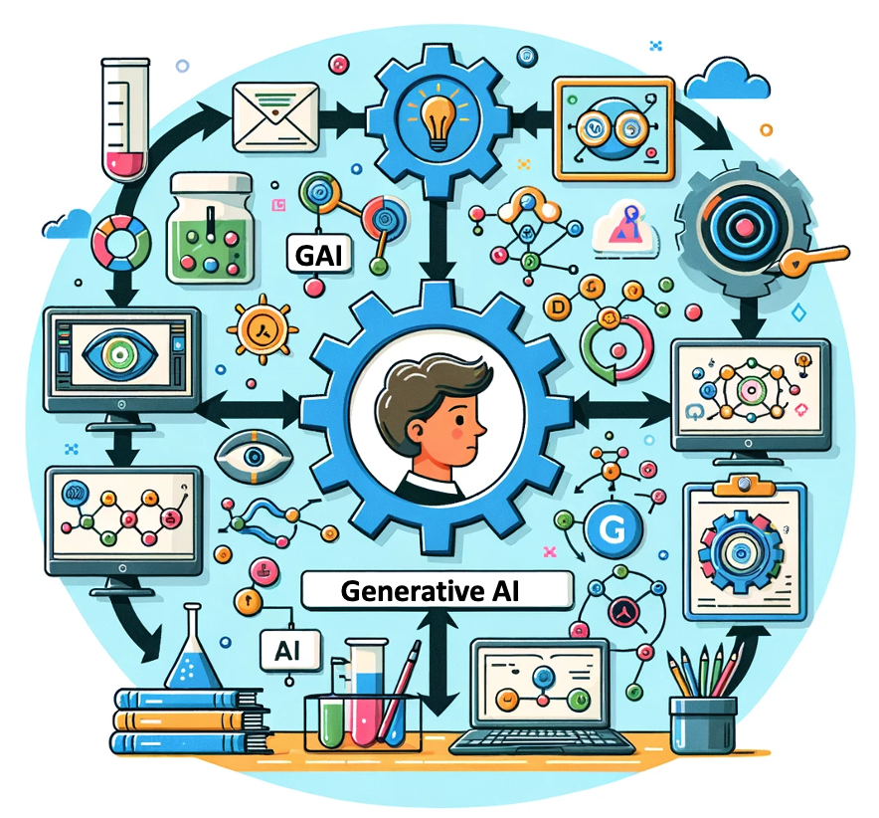
OpenAI ChatGPT (GPT-4) DALL·E 3
Vector graphic of a flowchart depicting the integration of generative AI in the education process, from content creation to virtual experiments, personalized learning, and innovative learning.
https://chat.openai.com/

Slide 34
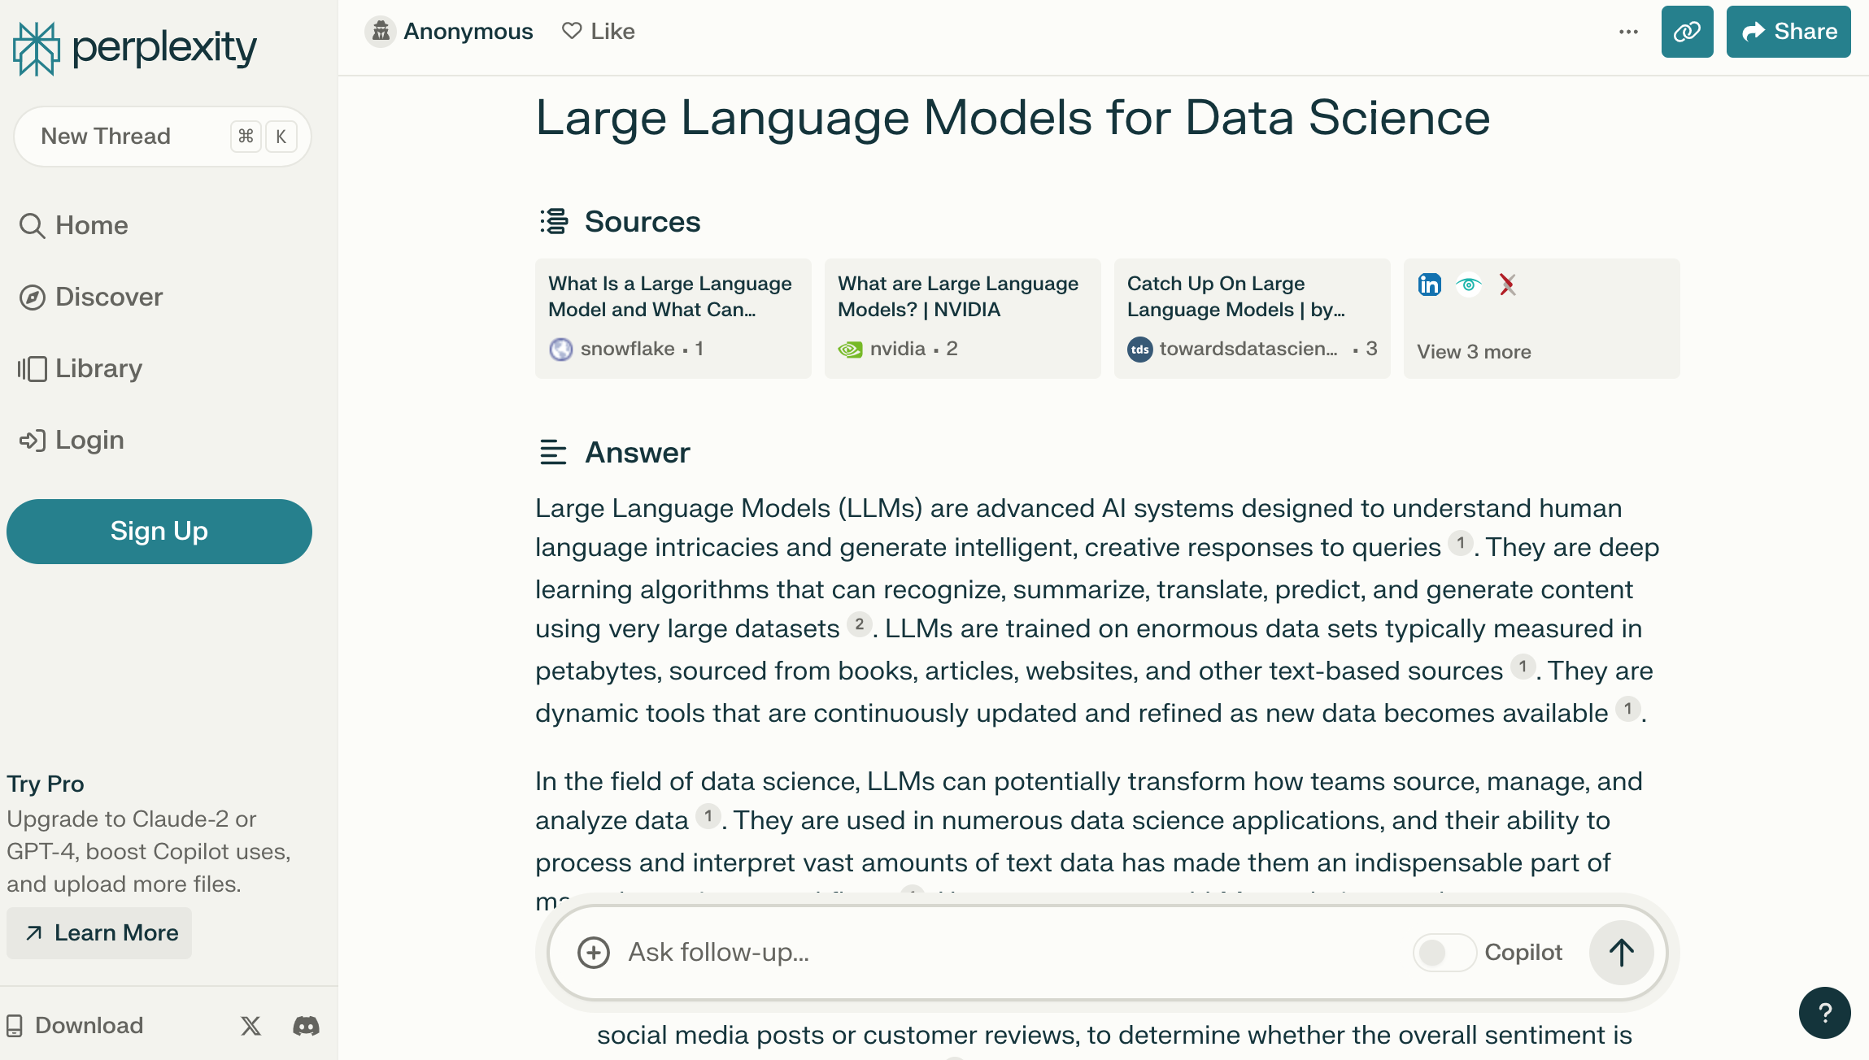
Perplexity.ai
https://www.perplexity.ai/

Slide 35
Chat with Open Large Language Models:
https://chat.lmsys.org/
Llama 2: open foundation and fine-tuned chat models by Meta
Mistral: a large language model by Mistral AI team
WizardLM: an instruction-following LLM using evol-instruct by Microsoft
Zephyr: a chatbot fine-tuned from Mistral by Hugging Face
Code Llama: open foundation models for code by Meta
ChatGLM: an open bilingual dialogue language model by Tsinghua University
Qwen: a large language model by Alibaba Cloud
Vicuna: a chat assistant fine-tuned on user-shared conversations by LMSYS
Falcon: TII’s flagship series of large language models

Slide 36
Chat with Open Large Language Models
chat.lmsys.org
⚔️ Chatbot Arena ⚔️ : Benchmarking LLMs in the Wild
GPT-3.5: GPT-3.5 by OpenAI | GPT-3.5-Turbo-1106: GPT-3.5-Turbo-1106 by OpenAI | GPT-4-Turbo: GPT-4-Turbo by OpenAI
GPT-4: ChatGPT-4 by OpenAI | Claude: Claude 2 by Anthropic | Claude Instant: Claude Instant by Anthropic
Vicuna: a chat assistant fine-tuned on user-shared conversations by LMSYS | Llama 2: open foundation and fine-tuned chat models by Meta | ChatGLM: an open bilingual dialogue language model by Tsinghua University
OpenChat 3.5: OpenChat 3.5 is a versatile, open-source language model fine-tuned using C-RLFT | Mistral: a large language model by Mistral AI team | Zephyr: a chatbot fine-tuned from Mistral by Hugging Face
Qwen: a large language model by Alibaba Cloud | Code Llama: open foundation models for code by Meta | WizardLM: an instruction-following LLM using evol-instruct by Microsoft
PaLM 2 Chat: PaLM 2 for Chat (chat-bison@001) by Google | Falcon: TII’s flagship series of large language models
https://chat.lmsys.org/

Slide 37
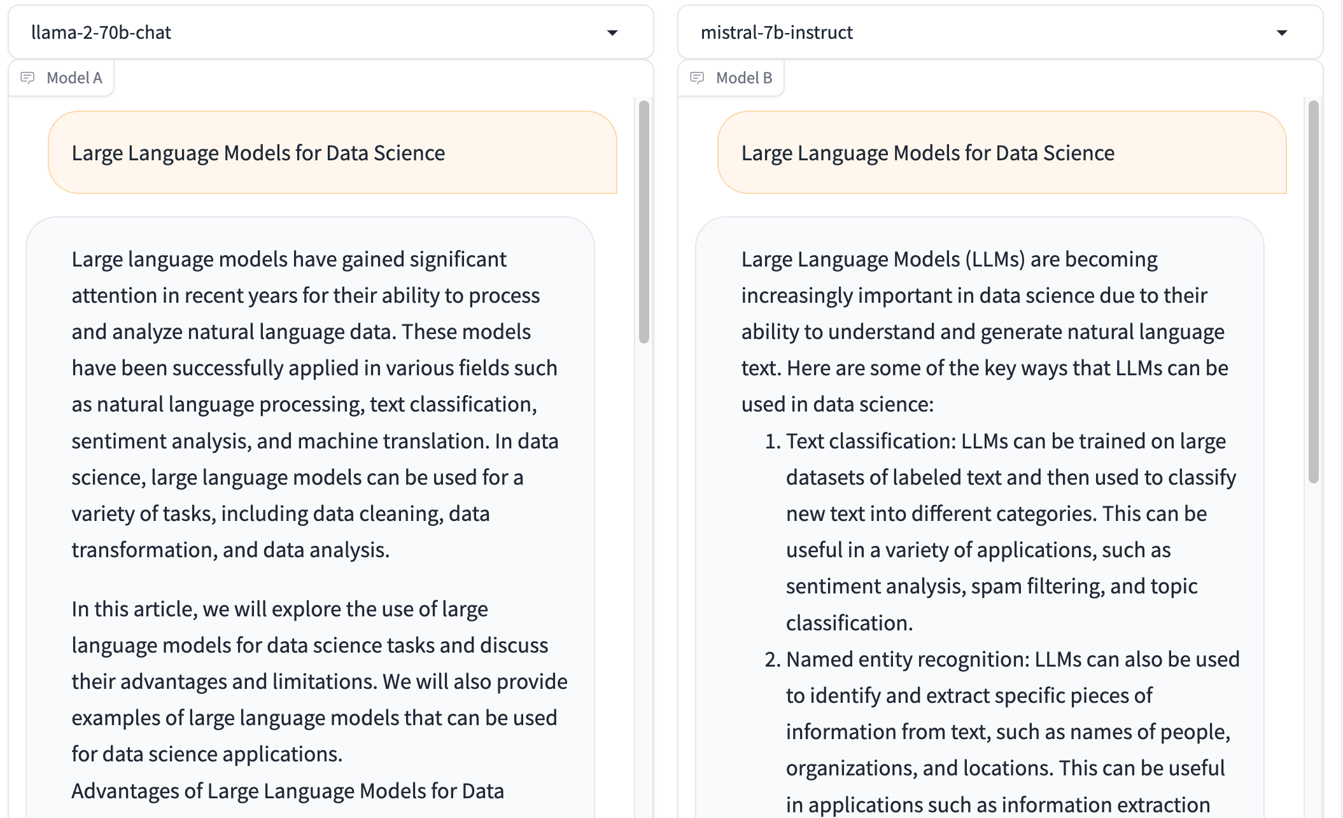
Chat with Open Large Language Models: Chatbot Arena
Large Language Models for Data Science
Llama 2-70b-chat
Mistral-7b-instruct
https://chat.lmsys.org/

Slide 38
Chatbot Arena Leaderboard LLM Leaderboard
Model | ⭐ Arena Elo rating | 📈 MT-bench (score) | MMLU | License
GPT-4-Turbo | 1210 | 9.32 |  | Proprietary
GPT-4 | 1159 | 8.99 | 86.4 | Proprietary
Claude-1 | 1146 | 7.9 | 77 | Proprietary
Claude-2 | 1125 | 8.06 | 78.5 | Proprietary
Claude-instant-1 | 1106 | 7.85 | 73.4 | Proprietary
GPT-3.5-turbo | 1103 | 7.94 | 70 | Proprietary
WizardLM-70b-v1.0 | 1093 | 7.71 | 63.7 | Llama 2 Community
Vicuna-33B | 1090 | 7.12 | 59.2 | Non-commercial
OpenChat-3.5 | 1070 | 7.81 | 64.3 | Apache-2.0
Llama-2-70b-chat | 1065 | 6.86 | 63 | Llama 2 Community
WizardLM-13b-v1.2 | 1047 | 7.2 | 52.7 | Llama 2 Community
zephyr-7b-beta | 1042 | 7.34 | 61.4 | MIT
MPT-30B-chat | 1031 | 6.39 | 50.4 | CC-BY-NC-SA-4.0
Vicuna-13B | 1031 | 6.57 | 55.8 | Llama 2 Community
QWen-Chat-14B | 1030 | 6.96 | 66.5 | Qianwen LICENSE
https://chat.lmsys.org/

Slide 39
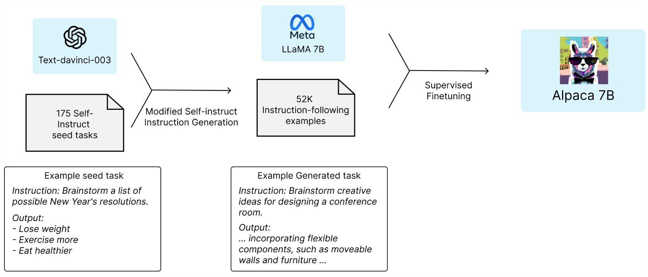
Stanford Alpaca: A Strong, Replicable Instruction-Following Model
Source: https://crfm.stanford.edu/2023/03/13/alpaca.html

Slide 40
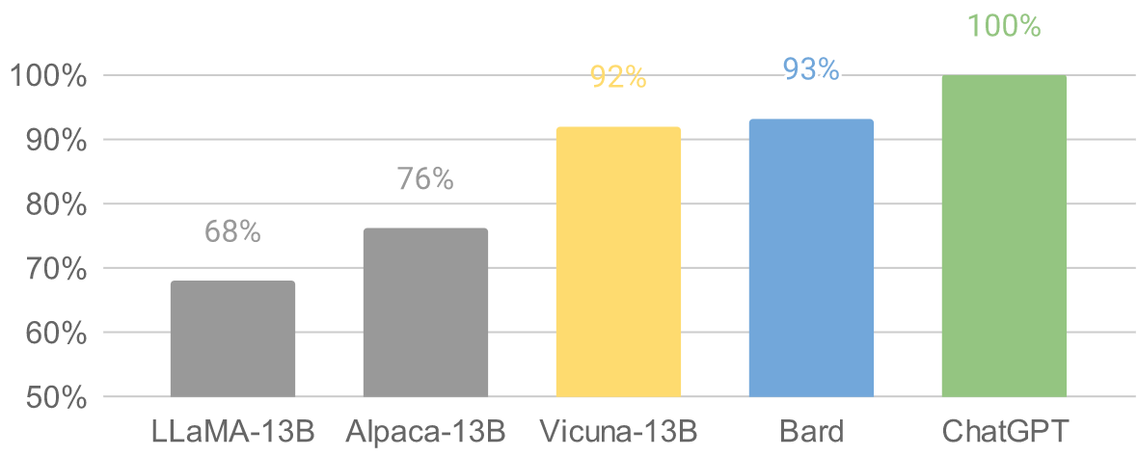
Vicuna: An Open-Source Chatbot Impressing GPT-4 with 90%* ChatGPT Quality by the Team with members from UC Berkeley, CMU, Stanford, and UC San Diego
Vicuna-13B: an open-source chatbot trained by fine-tuning LLaMA on user-shared conversations collected from ShareGPT.
The cost of training Vicuna-13B is around $300.
Source: https://vicuna.lmsys.org/

Slide 41
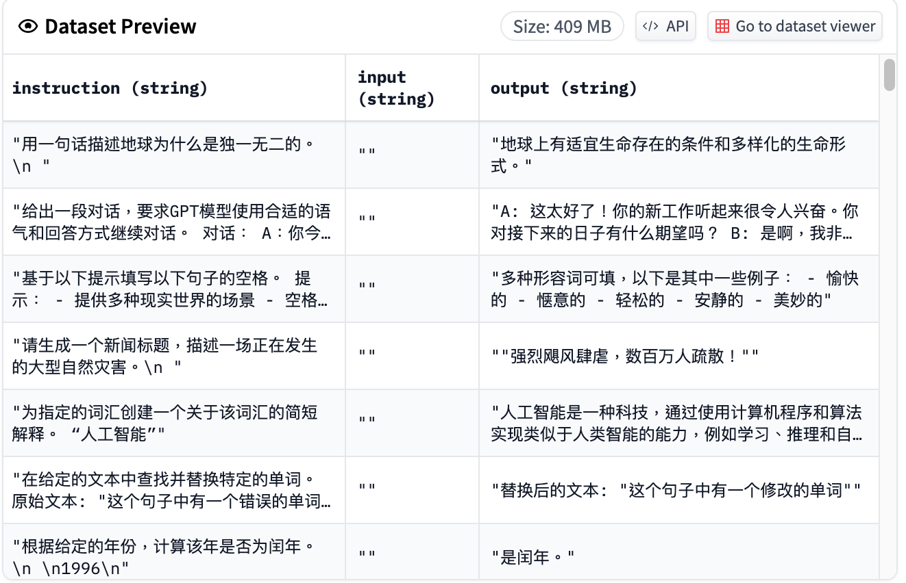
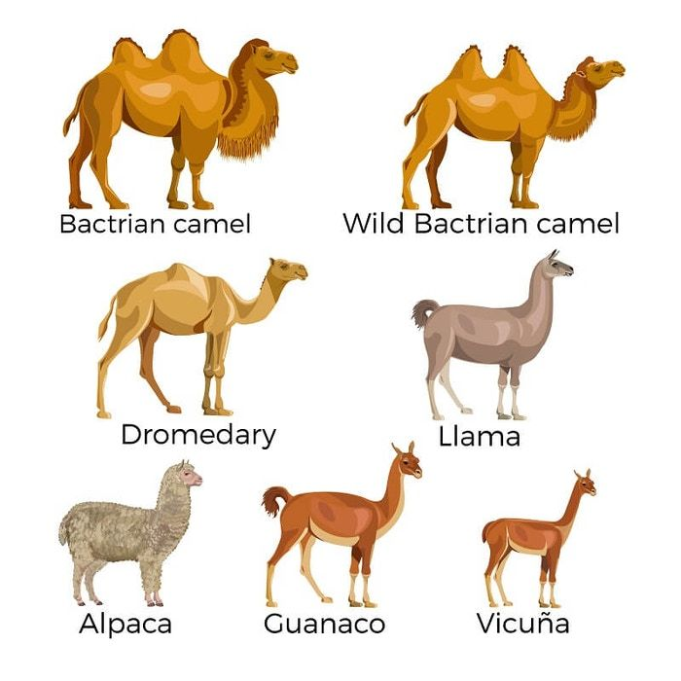
Chinese-Vicuna: A Chinese Instruction-following LLaMA-based Model 一個中文低資源的 llama+lora方案
Chinese-Vicuna based on Guanaco Dataset and Belle Dataset
Source: https://huggingface.co/datasets/Chinese-Vicuna/guanaco_belle_merge_v1.0
Source: https://github.com/Facico/Chinese-Vicuna

Slide 42
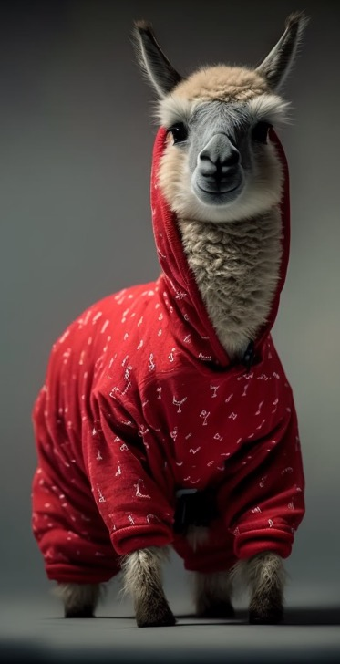
RedPajama a project to create leading open-source models, starts by reproducing LLaMA training dataset of over 1.2 trillion tokens
Dataset | RedPajama | LLaMA*
CommonCrawl | 878 billion | 852 billion
C4 | 175 billion | 190 billion
Github | 59 billion | 100 billion
Books | 26 billion | 25 billion
ArXiv | 28 billion | 33 billion
Wikipedia | 24 billion | 25 billion
StackExchange | 20 billion | 27 billion
Total Tokens | 1.2 trillion | 1.25 trillion
Source: https://github.com/togethercomputer/RedPajama-Data

Slide 43
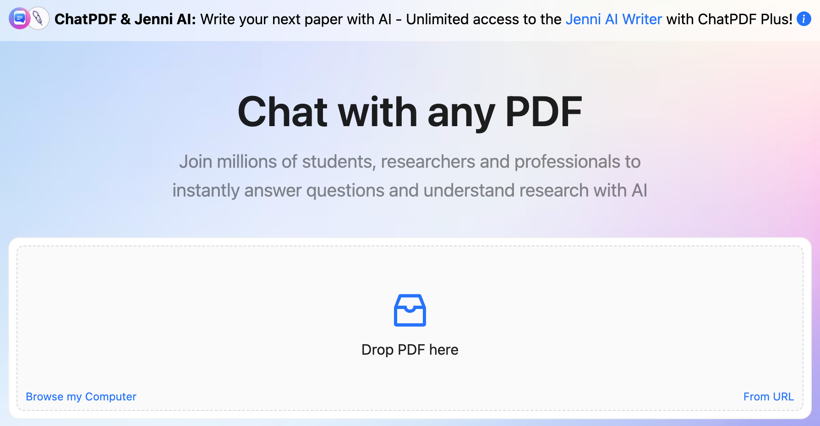
ChatPDF
www.chatpdf.com
https://www.chatpdf.com/

Slide 44
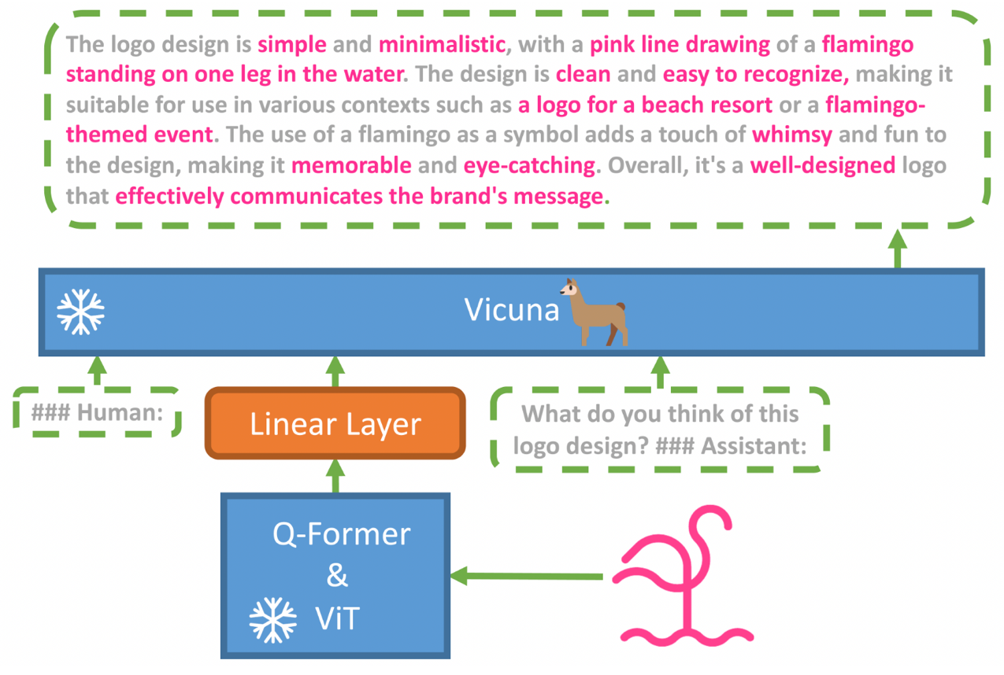
MiniGPT-4: Enhancing Vision-language Understanding with Advanced Large Language Models
Source: https://minigpt-4.github.io/

Slide 45
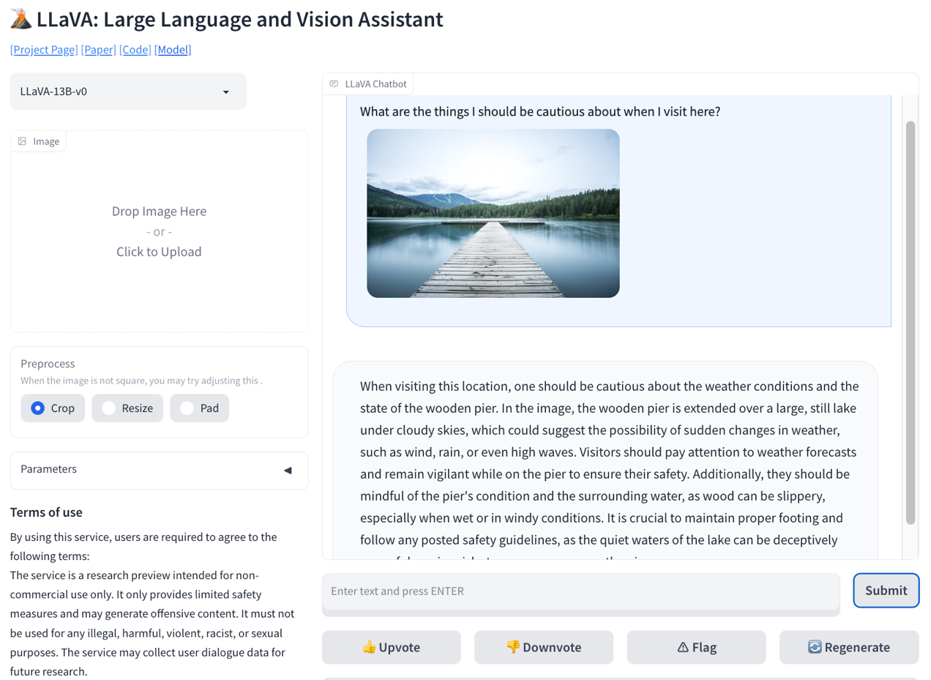
LLaVA: Large Language and Vision Assistant
llava-vl.github.io
Source: https://llava-vl.github.io/

Slide 46
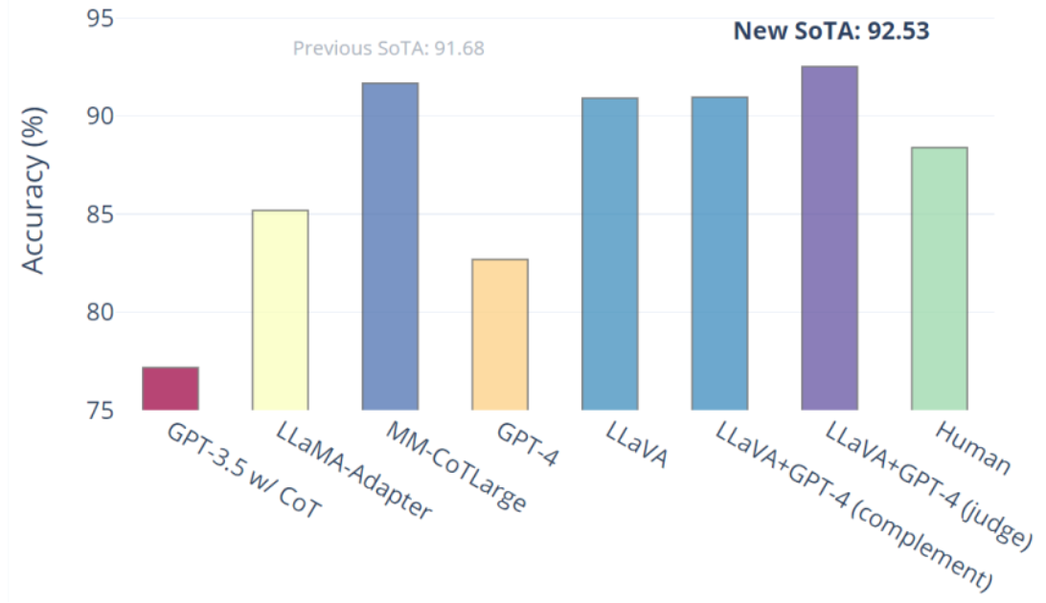
Visual Instruction Tuning LLaVA: Large Language and Vision Assistant University of Wisconsin-Madison, Microsoft Research, Columbia University
Science QA: New SoTA with the synergy of LLaVA with GPT-4
LLaVA represents a novel end-to-end trained large multimodal model that combines a vision encoder and Vicuna for general-purpose visual and language understanding, achieving impressive chat capabilities mimicking spirits of the multimodal GPT-4 and setting a new state-of-the-art accuracy on Science QA.
Source: https://llava-vl.github.io/

Slide 47
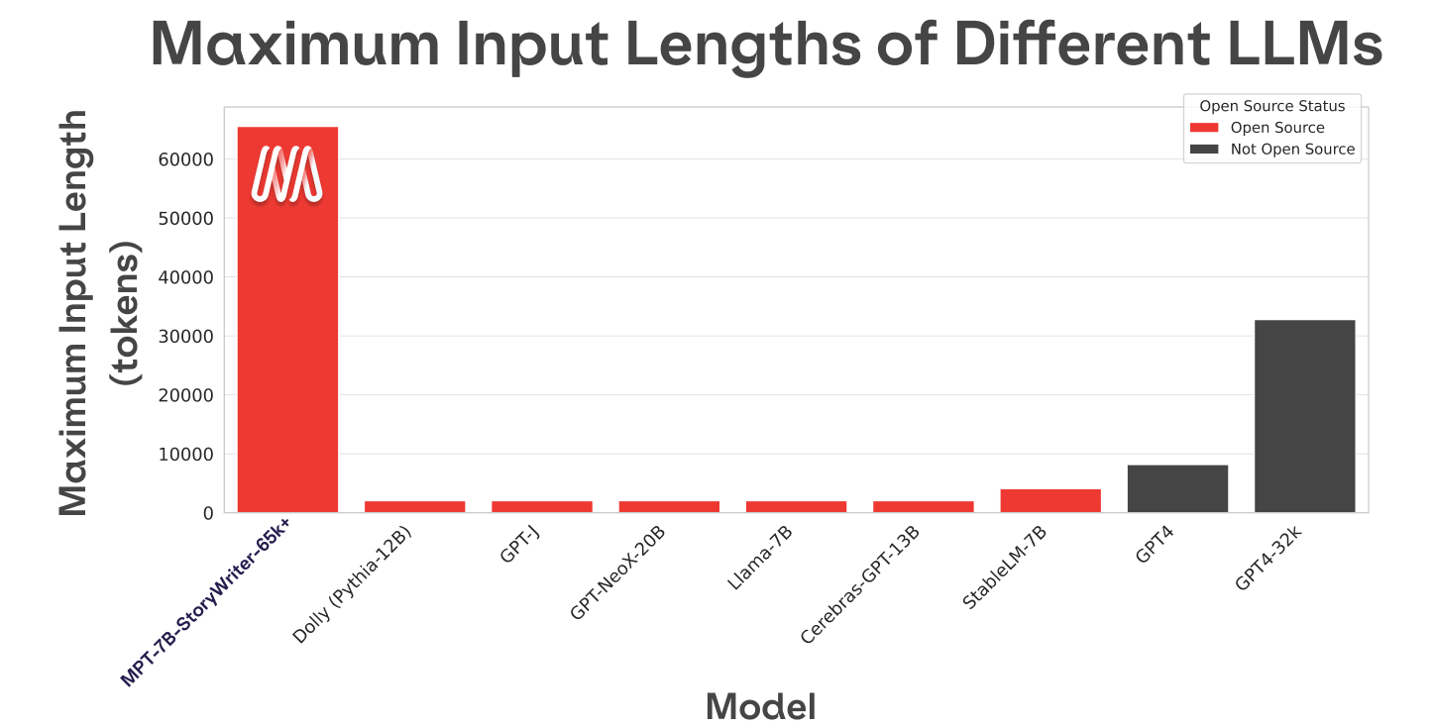
MPT-7B-StoryWriter-65k+
Source: https://www.mosaicml.com/blog/mpt-7b

Slide 48
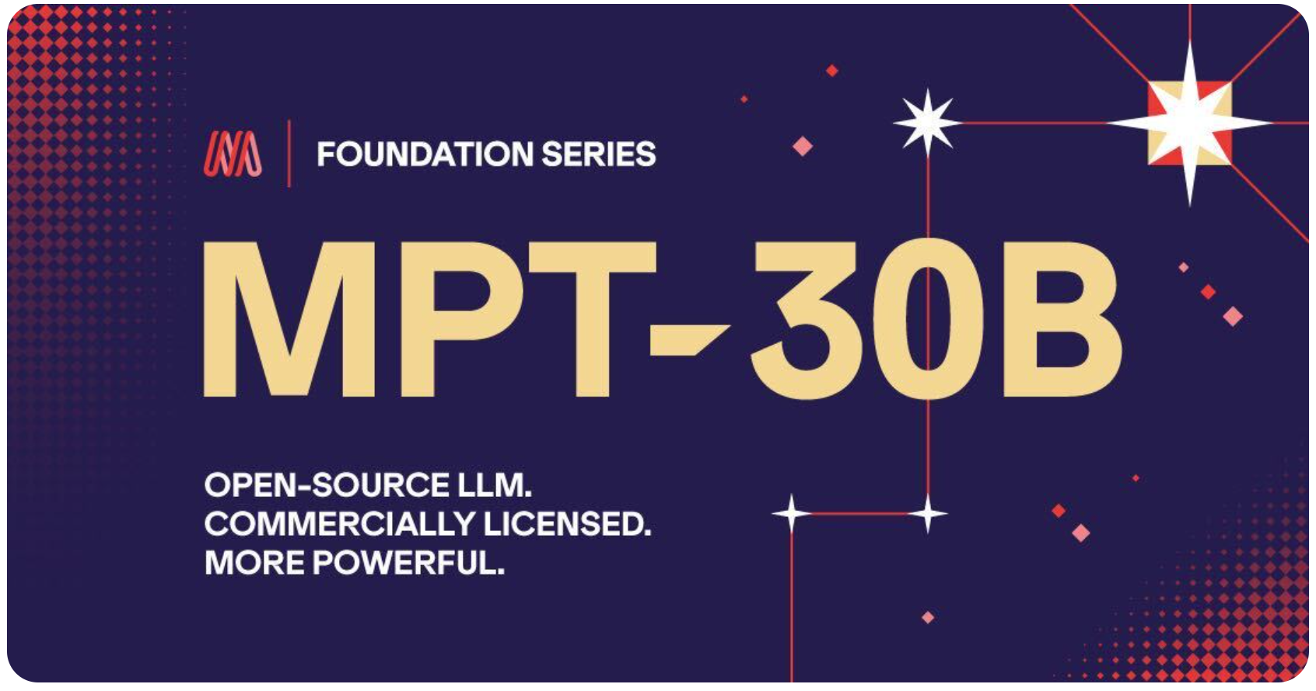
MPT-30B, MPT-7B LLaMa-30B, LLaMa-7B
Source: https://www.mosaicml.com/blog/mpt-30b

Slide 49
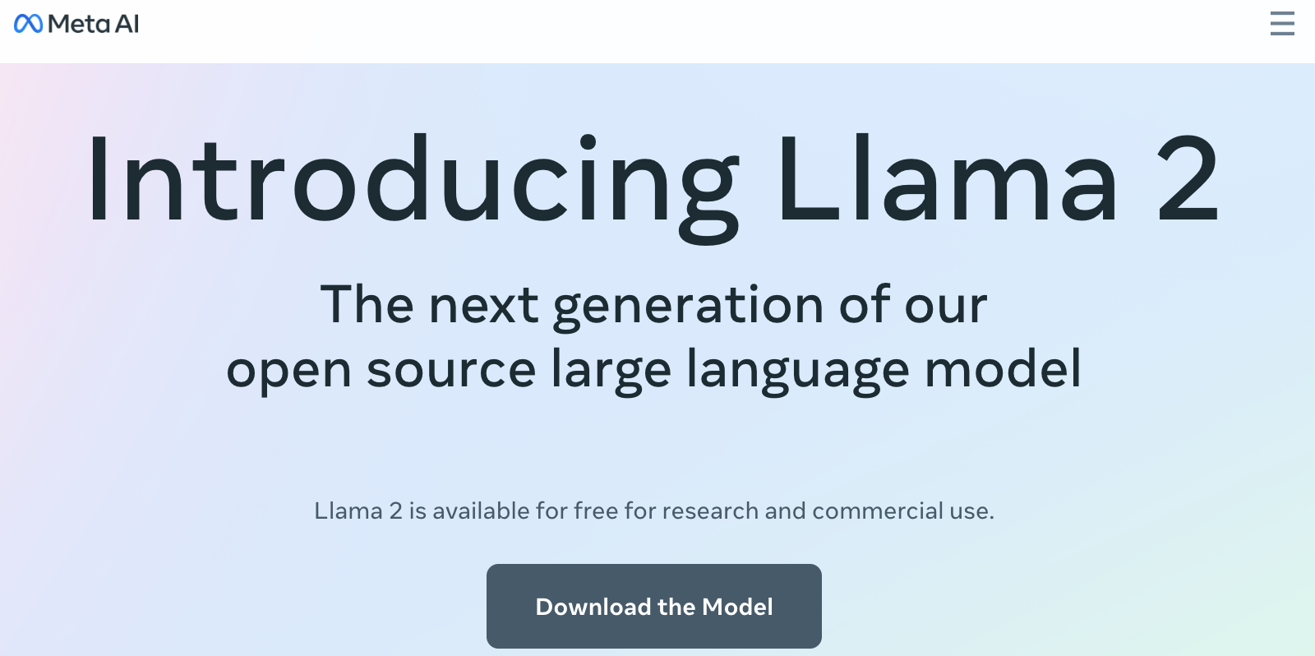
Meta Llama-2 70B: Best Open Source and Commercial LLM (Llama-2, Falcon, MPT)
Source: https://ai.meta.com/llama/

Slide 50
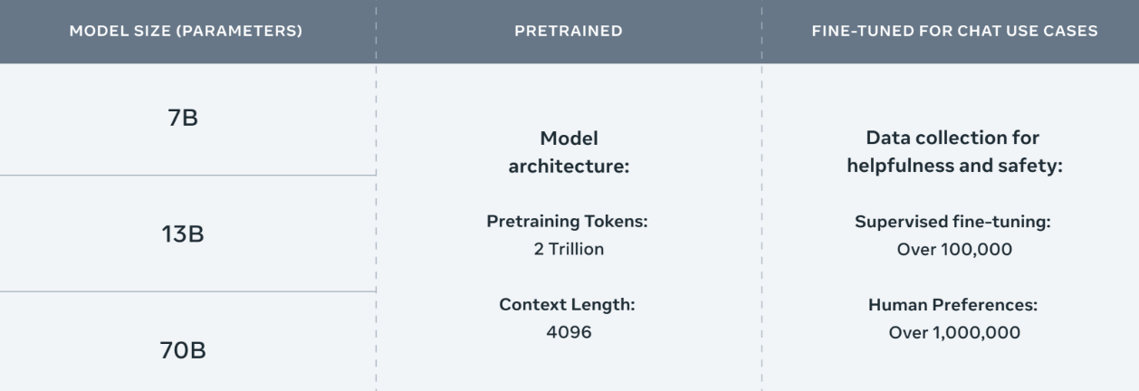
Meta Llama-2 70B: Best Open Source and Commercial LLM (Llama-2, Falcon, MPT)
Llama 2 pretrained models are trained on 2 trillion tokens, and have double the context length than Llama 1. Its fine-tuned models have been trained on over 1 million human annotations.
Source: https://ai.meta.com/llama/

Slide 51
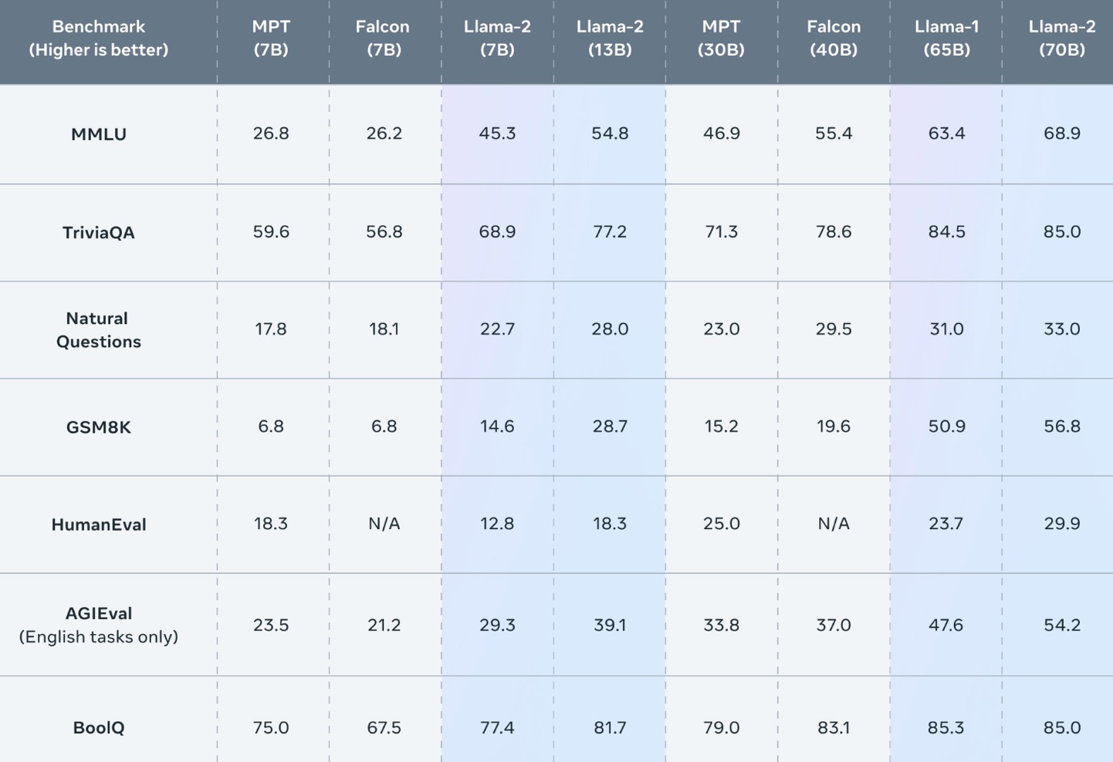
Meta Llama-2 70B: Best Open Source and Commercial LLM (Llama-2, Falcon, MPT)
Llama 2 outperforms other open source language models on many external benchmarks, including reasoning, coding, proficiency, and knowledge tests.
Source: https://ai.meta.com/llama/

Slide 52
Llama-2: Comparison to closed-source models (GPT-3.5, GPT-4, PaLM) on academic benchmarks
Results for GPT-3.5 and GPT-4 are from OpenAI (2023).
Results for the PaLM model are from Chowdhery et al. (2022).
Results for the PaLM-2-L are from Anil et al. (2023).
Source: Touvron, Hugo, Louis Martin, Kevin Stone, Peter Albert, Amjad Almahairi, Yasmine Babaei, Nikolay Bashlykov et al. (2023) "Llama 2: Open Foundation and Fine-Tuned Chat Models." arXiv preprint arXiv:2307.09288 (2023).

Slide 53
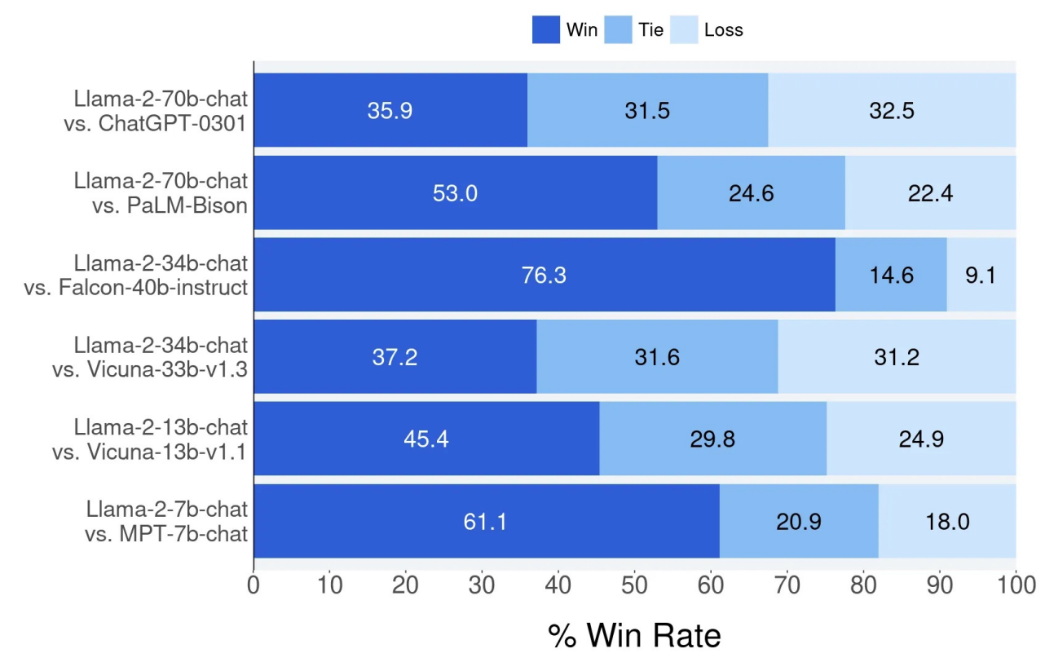
Llama-2 Chat: Helpfulness Human Evaluation
Source: Touvron, Hugo, Louis Martin, Kevin Stone, Peter Albert, Amjad Almahairi, Yasmine Babaei, Nikolay Bashlykov et al. (2023) "Llama 2: Open Foundation and Fine-Tuned Chat Models." arXiv preprint arXiv:2307.09288 (2023).

Slide 54
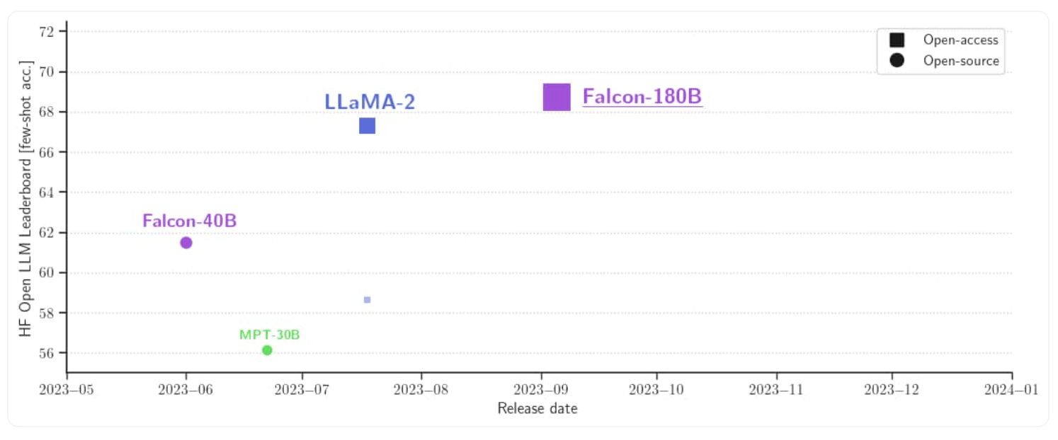
Falcon 180B
Source: https://huggingface.co/blog/falcon-180b

Slide 55
Falcon 180B, LLaMA 65B, MPT 30B
Source: https://huggingface.co/blog/falcon-180b

Slide 56
Falcon 180B Hardware requirements
NVIDIA A100 80 GB: $16,135
Source: https://huggingface.co/blog/falcon-180b

Slide 57
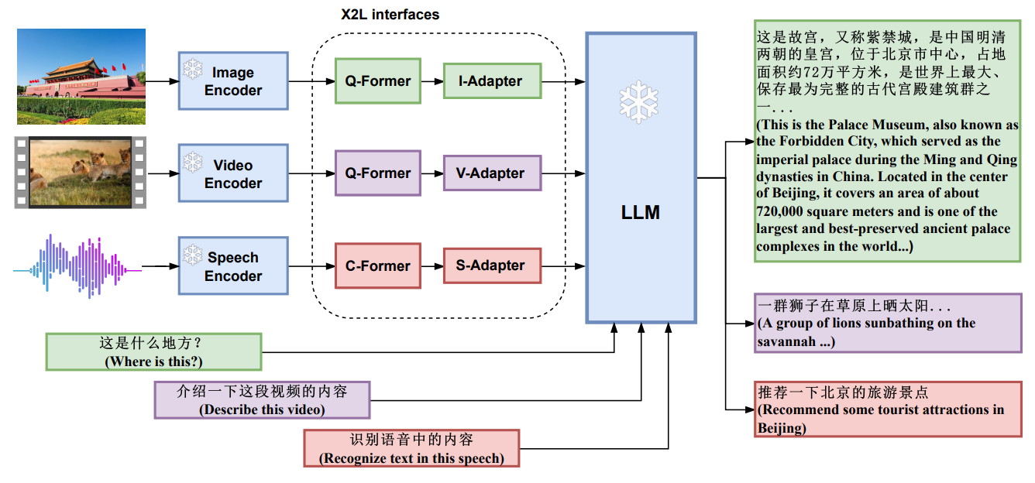
X-LLM: Bootstrapping Advanced Large Language Models by Treating Multi-Modalities as Foreign Languages
Source: Chen, Feilong, Minglun Han, Haozhi Zhao, Qingyang Zhang, Jing Shi, Shuang Xu, and Bo Xu. "X-LLM: Bootstrapping Advanced Large Language Models by Treating Multi-Modalities as Foreign Languages." arXiv preprint arXiv:2305.04160 (2023).

Slide 58
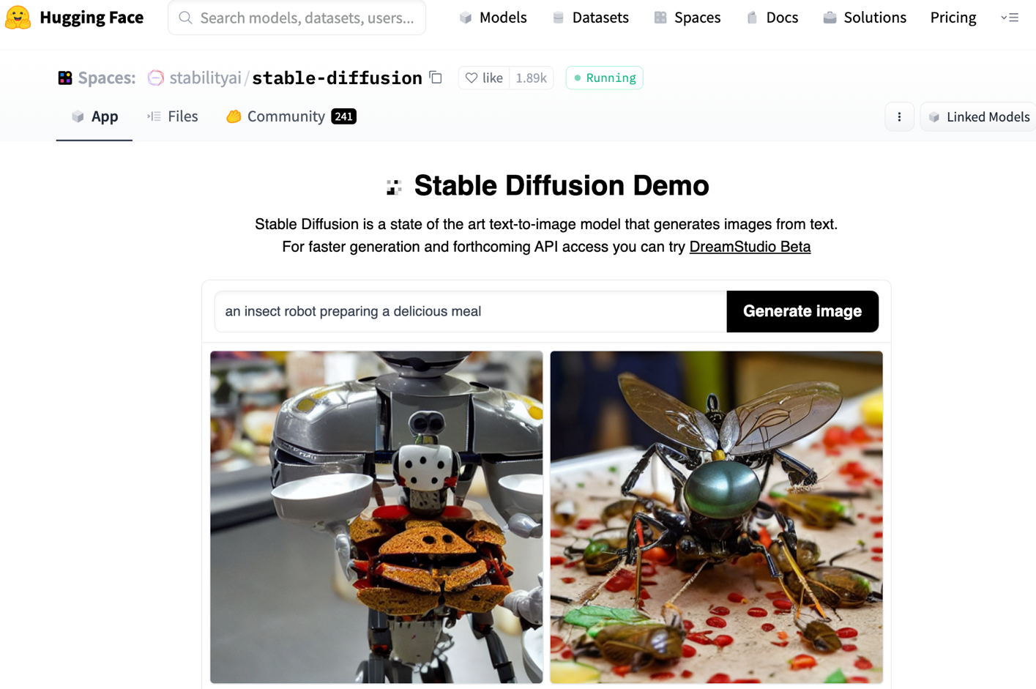
Stable Diffusion
https://huggingface.co/spaces/stabilityai/stable-diffusion

Slide 59
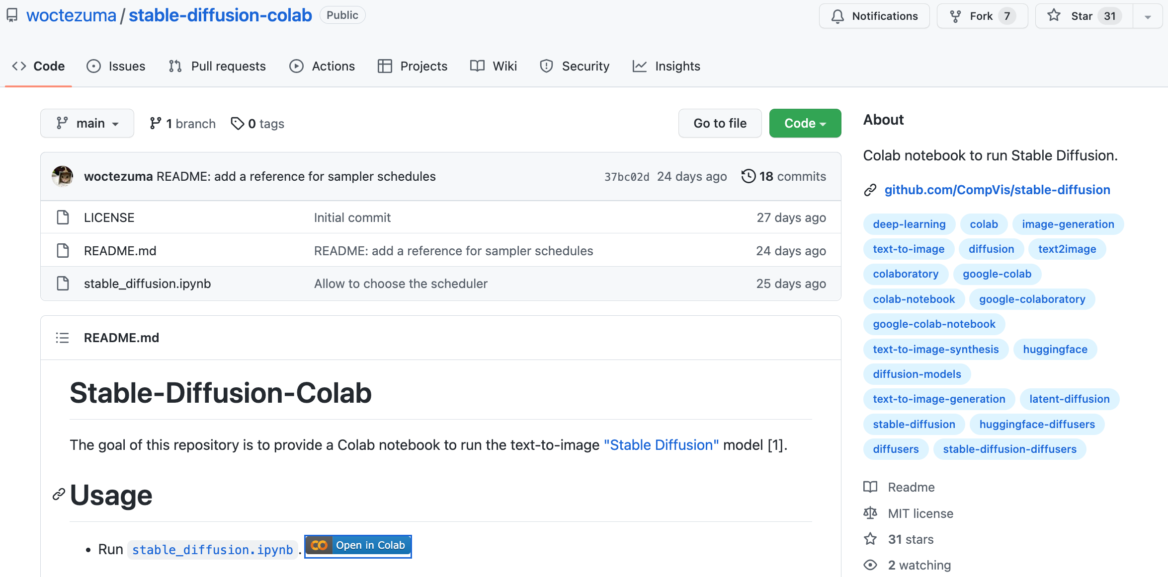
Stable Diffusion Colab
https://github.com/woctezuma/stable-diffusion-colab

Slide 60
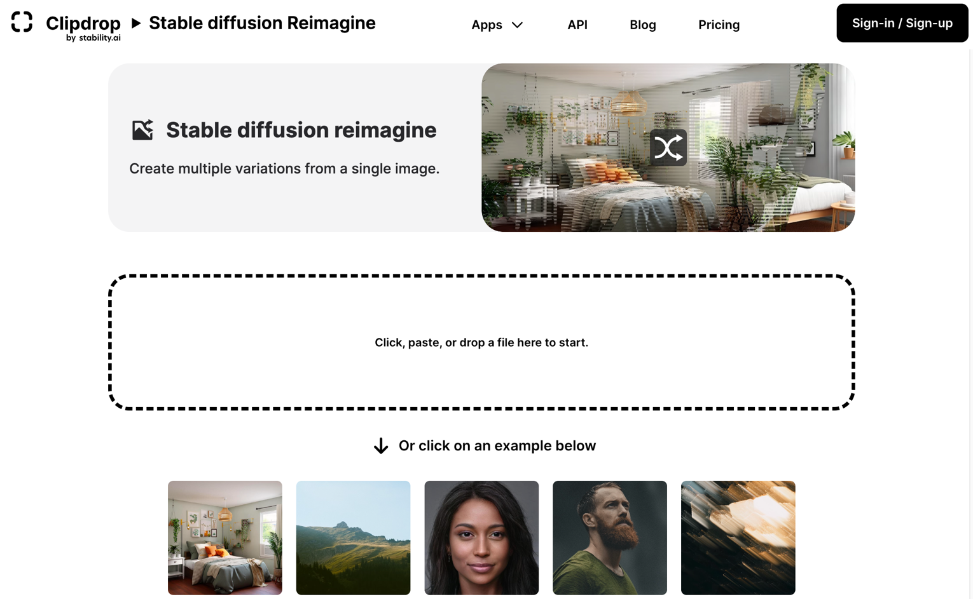
Stable Diffusion Reimagine
https://clipdrop.co/stable-diffusion-reimagine

Slide 61
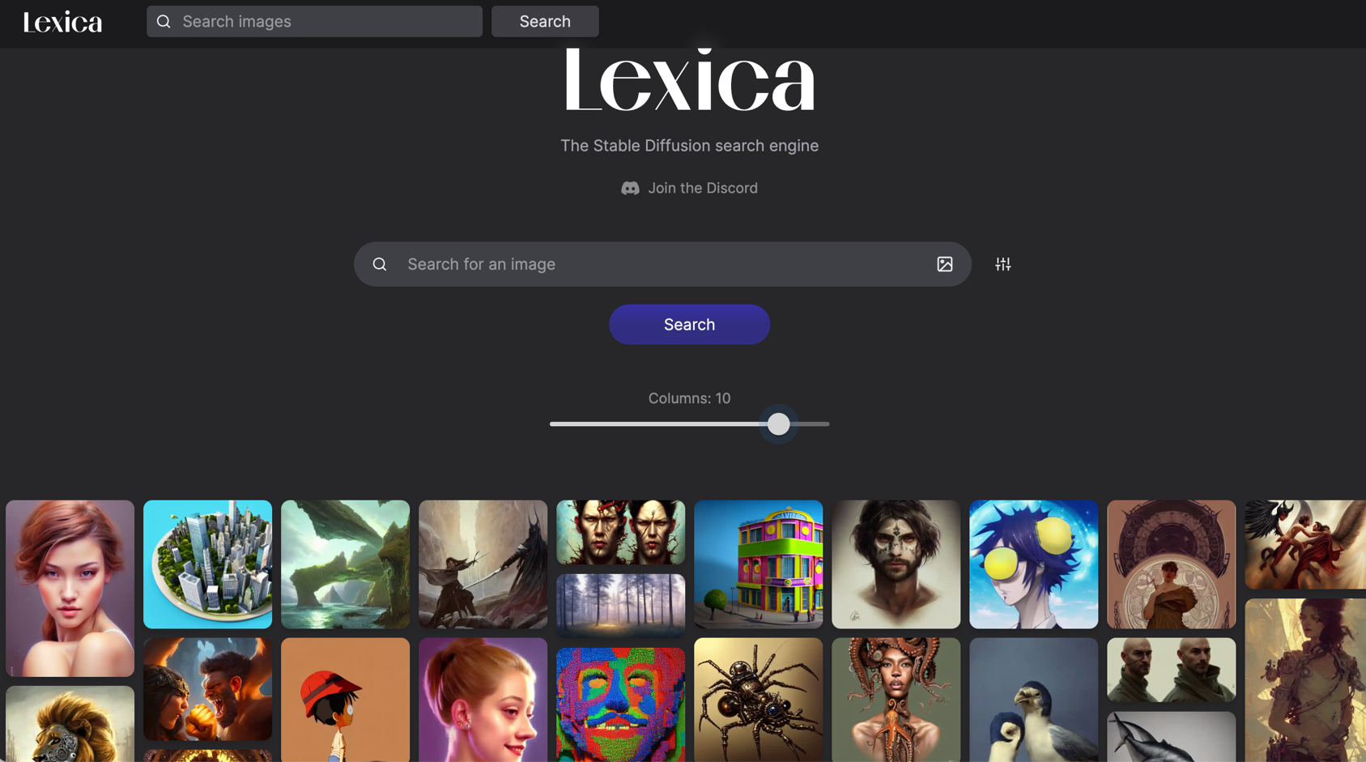
Lexica Art: Search Stable Diffusion images and prompts
https://lexica.art/

Slide 62
Civitai: Stable Diffusion AI Art Models
https://civitai.com/

Slide 63
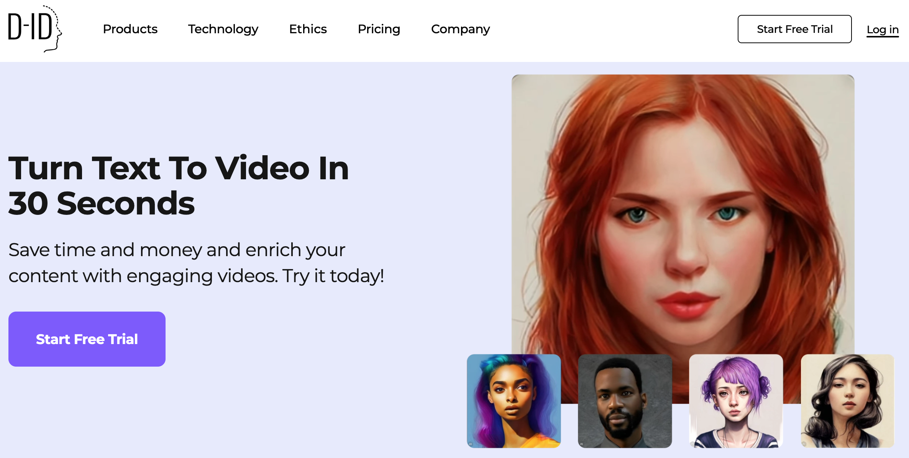
D-ID Text to Video
https://www.d-id.com/text-to-video/

Slide 64
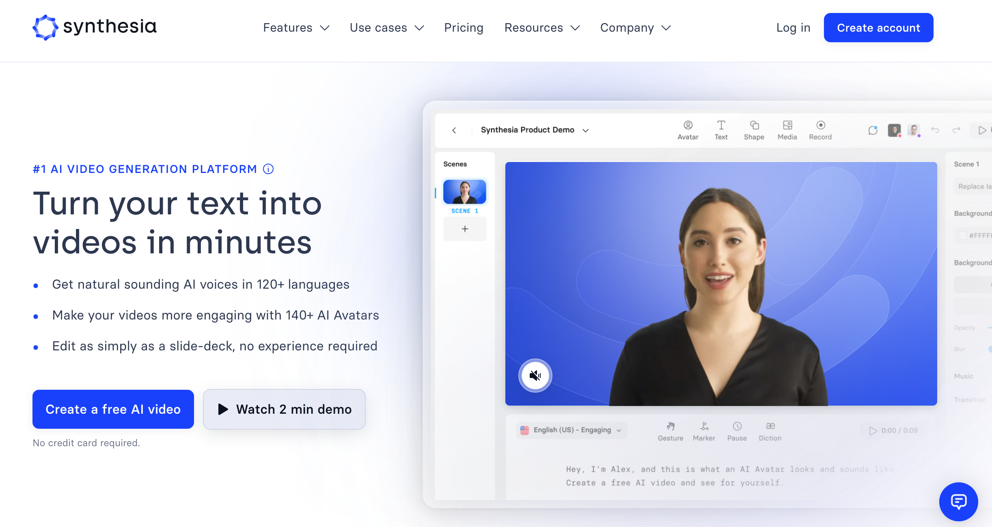
Synthesia: #1 AI Video Generation
https://www.synthesia.io/

Slide 65
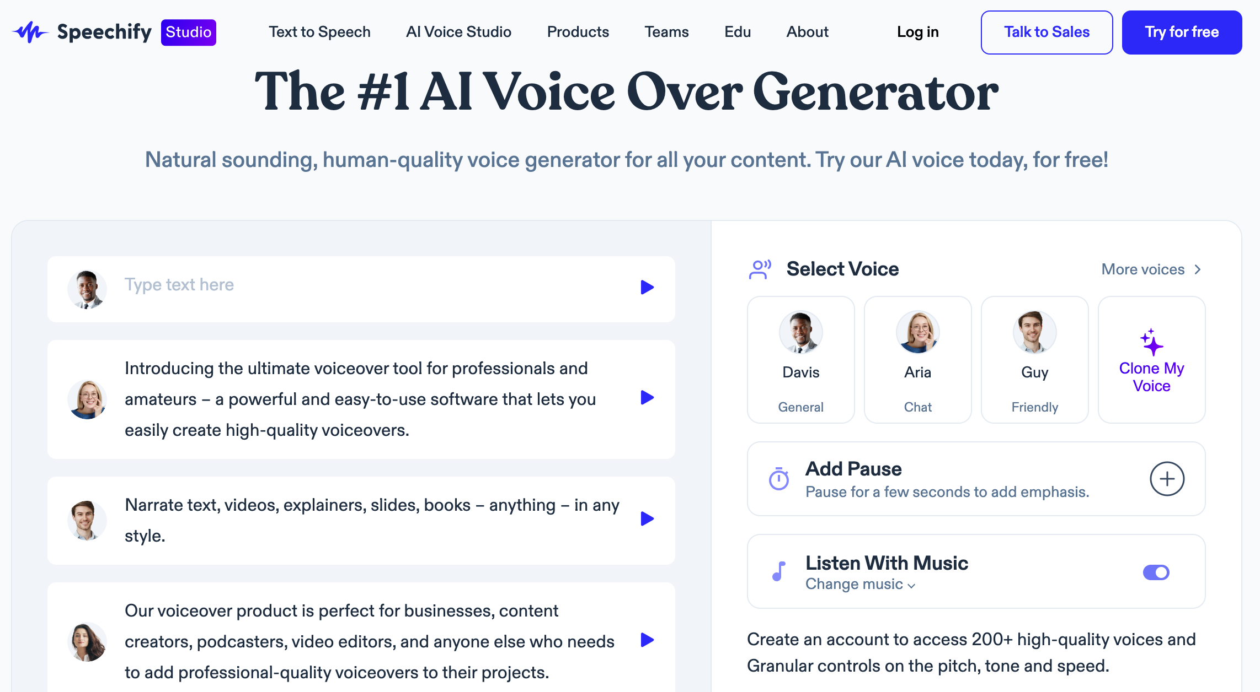
Speechify: #1 AI Voice Over Generator
https://speechify.com/voiceover/

Slide 66
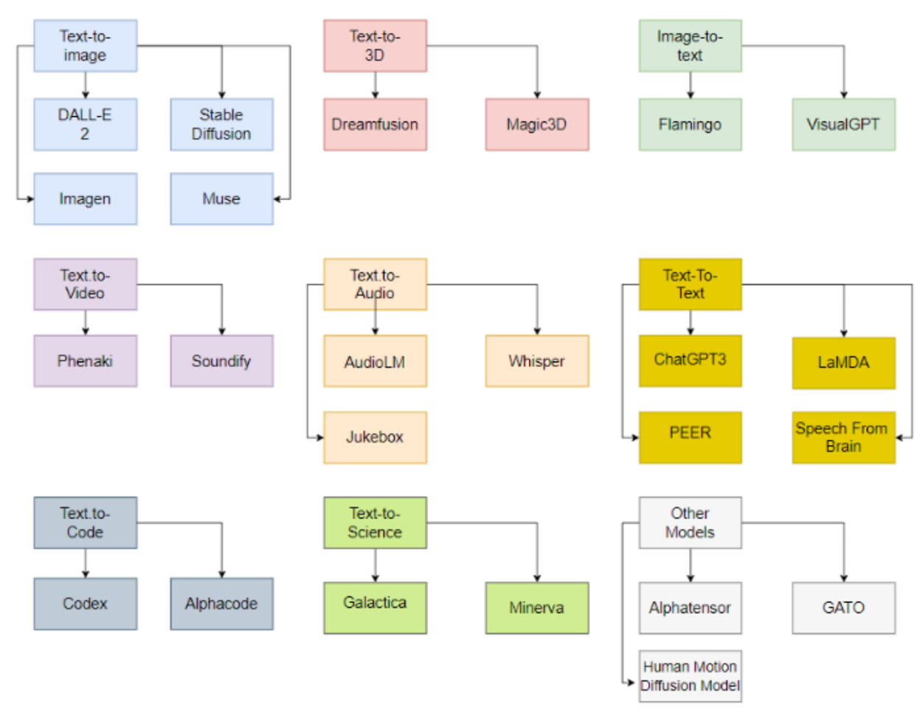
Generative AI Models
ChatGPT is not all you need
Attention is all you need
Source: Gozalo-Brizuela, Roberto, and Eduardo C. Garrido-Merchan (2023). "ChatGPT is not all you need. A State of the Art Review of large Generative AI models." arXiv preprint arXiv:2301.04655 (2023).

Slide 67
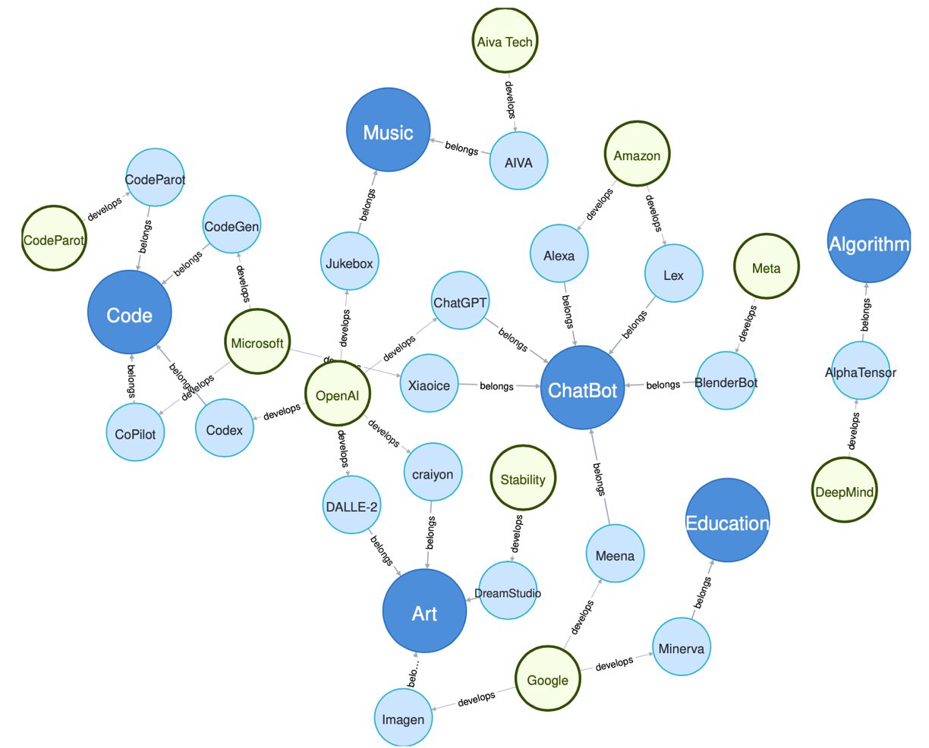
Generative AI Research Areas, Applications and Companies
Source: Yihan Cao, Siyu Li, Yixin Liu, Zhiling Yan, Yutong Dai, Philip S. Yu, and Lichao Sun (2023). "A Comprehensive Survey of AI-Generated Content (AIGC): A History of Generative AI from GAN to ChatGPT." arXiv preprint arXiv:2303.04226.

Slide 68
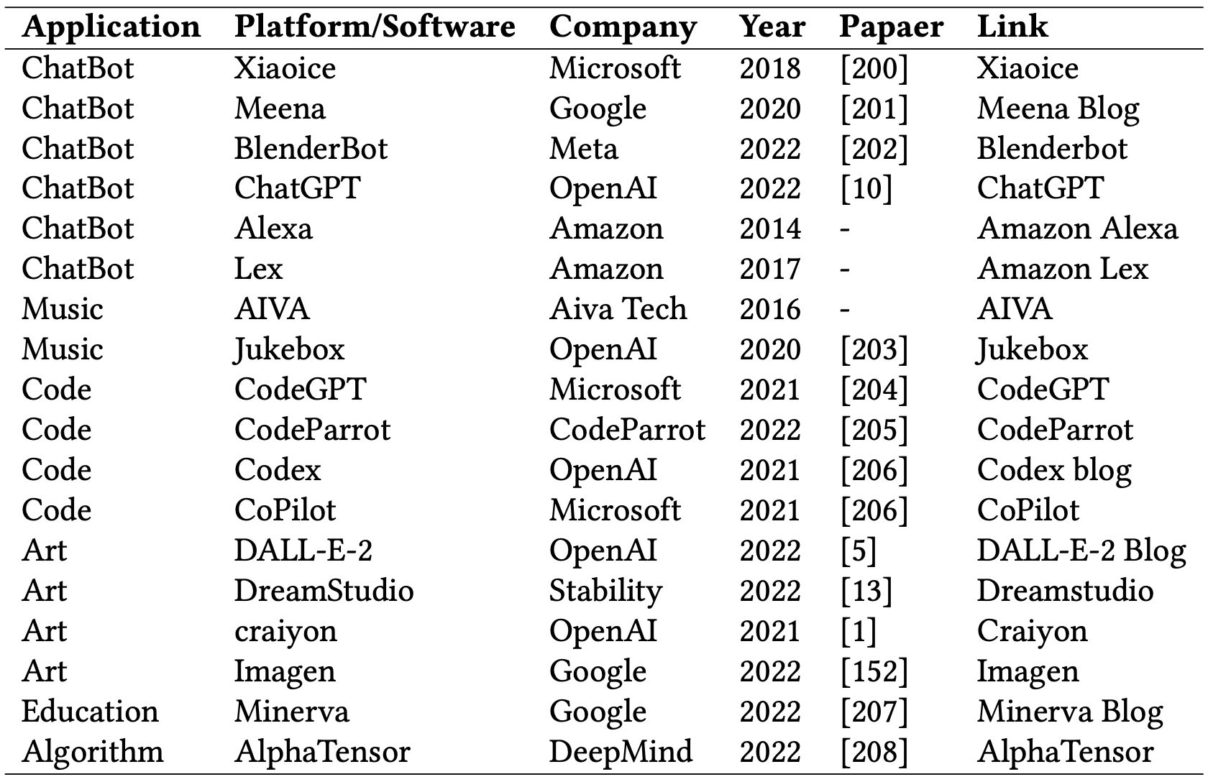
Applications of Generative AI Models
Source: Yihan Cao, Siyu Li, Yixin Liu, Zhiling Yan, Yutong Dai, Philip S. Yu, and Lichao Sun (2023). "A Comprehensive Survey of AI-Generated Content (AIGC): A History of Generative AI from GAN to ChatGPT." arXiv preprint arXiv:2303.04226.

Slide 69
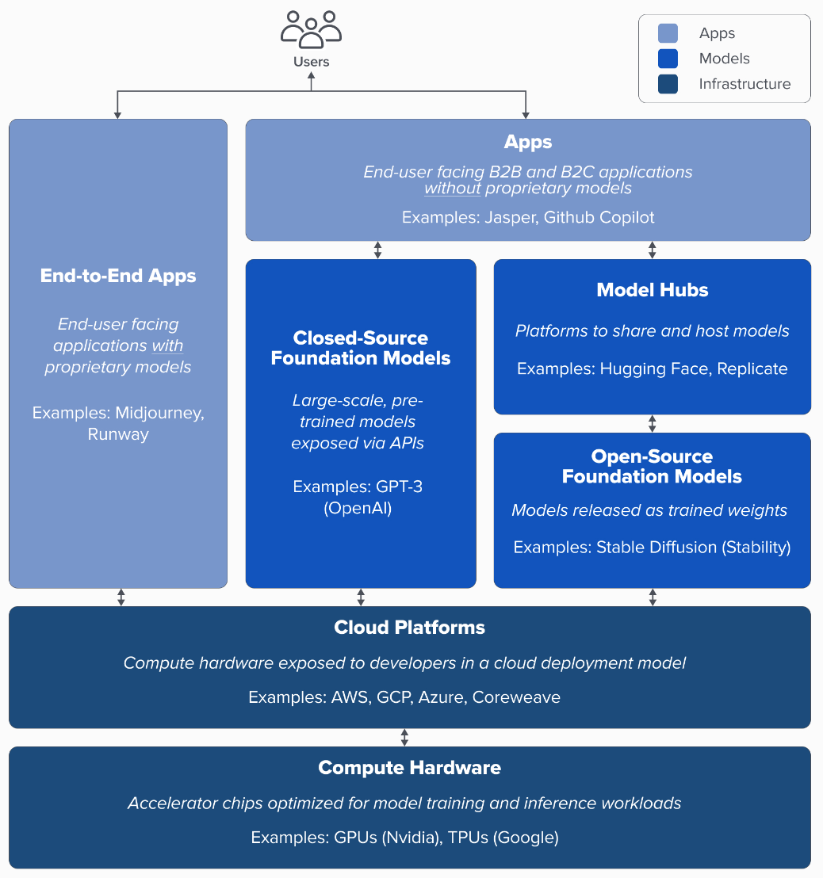
Generative AI Tech Stack
Source: Matt Bornstein, Guido Appenzeller, and Martin Casado (2023), Who Owns the Generative AI Platform?, https://a16z.com/2023/01/19/who-owns-the-generative-ai-platform/

Slide 70
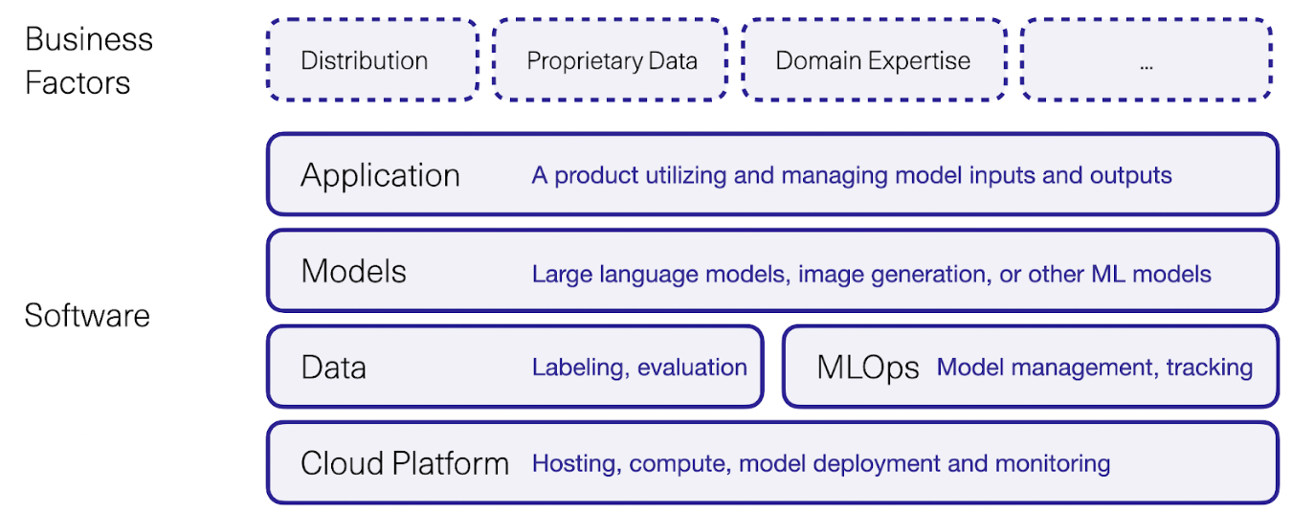
Generative AI Software and Business Factors
Source: Jay Alammar (2023), AI is Eating The World, https://txt.cohere.com/ai-is-eating-the-world/

Slide 71
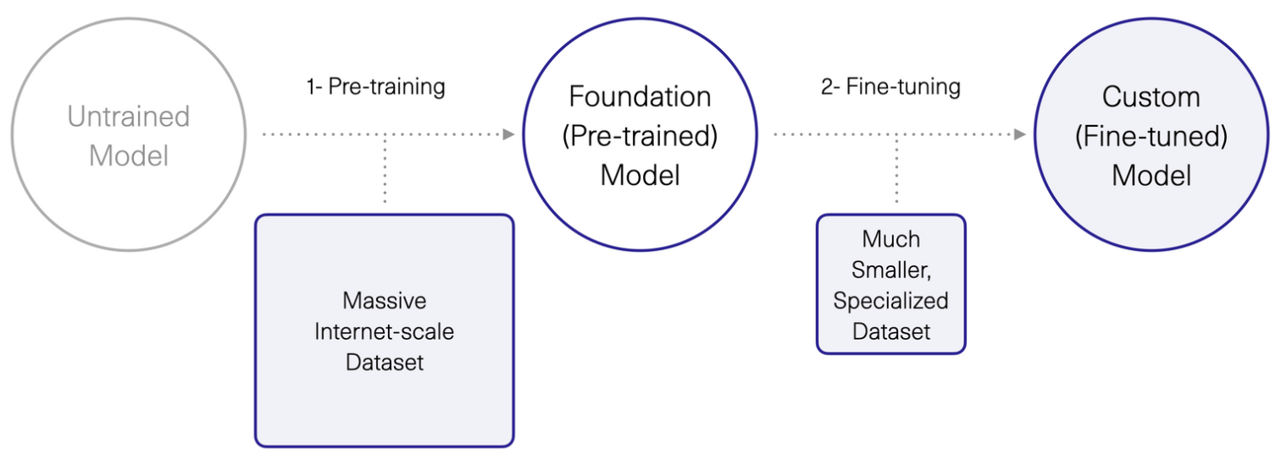
Generative AI 1. Pre-training Foundation (Pre-trained) Model 2. Fine-turning Custom (Fine-tuned) Model
Source: Jay Alammar (2023), AI is Eating The World, https://txt.cohere.com/ai-is-eating-the-world/

Slide 72
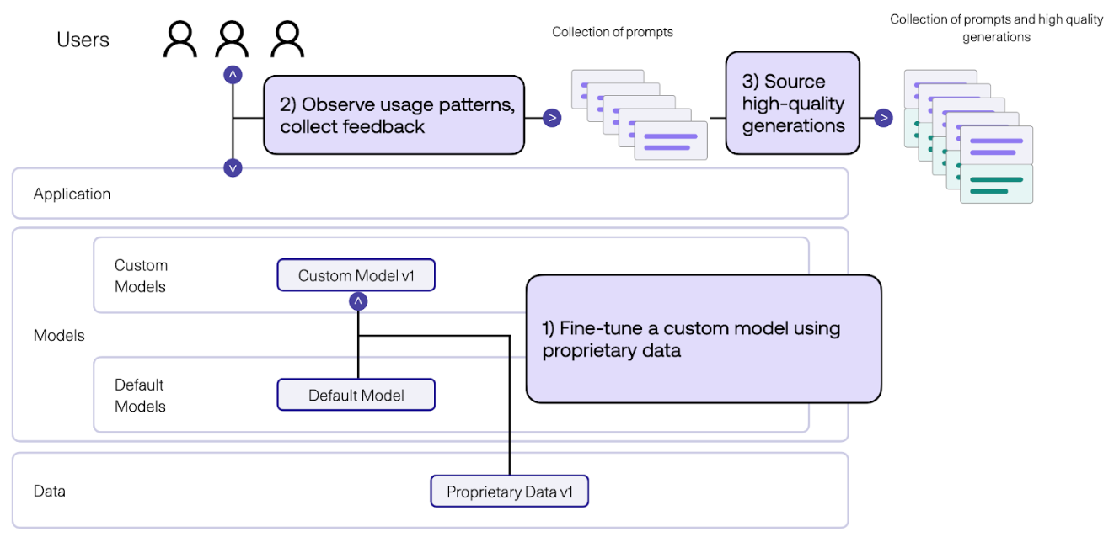
Generative AI Fine-tune Custom Models using Proprietary Data
Source: Jay Alammar (2023), AI is Eating The World, https://txt.cohere.com/ai-is-eating-the-world/

Slide 73
Generative AI Fine-tune Custom Models using Proprietary Data
Source: Jay Alammar (2023), AI is Eating The World, https://txt.cohere.com/ai-is-eating-the-world/

Slide 74
Pipeline of Instruction Tuning LLMs.
Source: Wang, Yidong, Zhuohao Yu, Zhengran Zeng, Linyi Yang, Cunxiang Wang, Hao Chen, Chaoya Jiang et al. "PandaLM: An Automatic Evaluation Benchmark for LLM Instruction Tuning Optimization." arXiv preprint arXiv:2306.05087 (2023).

Slide 75
Available Task Collections for Instruction Tuning
Source: Wayne Xin Zhao, Kun Zhou, Junyi Li, Tianyi Tang, Xiaolei Wang, Yupeng Hou, Yingqian Min et al. (2023) "A Survey of Large Language Models." arXiv preprint arXiv:2303.18223.

Slide 76
Instance Formatting and Two Different Methods for Constructing the Instruction-formatted Instances
Source: Wayne Xin Zhao, Kun Zhou, Junyi Li, Tianyi Tang, Xiaolei Wang, Yupeng Hou, Yingqian Min et al. (2023) "A Survey of Large Language Models." arXiv preprint arXiv:2303.18223.

Slide 77
In-context Learning (ICL) and Chain-of-thought (CoT) Prompting
Source: Wayne Xin Zhao, Kun Zhou, Junyi Li, Tianyi Tang, Xiaolei Wang, Yupeng Hou, Yingqian Min et al. (2023) "A Survey of Large Language Models." arXiv preprint arXiv:2303.18223.

Slide 78
Pre-train, Prompt, and Predict: Prompting Methods in Natural Language Processing (LLMs)
Source: Pengfei Liu, Weizhe Yuan, Jinlan Fu, Zhengbao Jiang, Hiroaki Hayashi, and Graham Neubig. (2023) "Pre-train, prompt, and predict: A systematic survey of prompting methods in natural language processing." ACM Computing Surveys 55, no. 9 (2023): 1-35.

Slide 79
Four Paradigms in NLP
Source: Pengfei Liu, Weizhe Yuan, Jinlan Fu, Zhengbao Jiang, Hiroaki Hayashi, and Graham Neubig. (2023) "Pre-train, prompt, and predict: A systematic survey of prompting methods in natural language processing." ACM Computing Surveys 55, no. 9 (2023): 1-35.

Slide 80
Typology of Prompting Methods
Source: Pengfei Liu, Weizhe Yuan, Jinlan Fu, Zhengbao Jiang, Hiroaki Hayashi, and Graham Neubig. (2023) "Pre-train, prompt, and predict: A systematic survey of prompting methods in natural language processing." ACM Computing Surveys 55, no. 9 (2023): 1-35.

Slide 81
Different Multi-Prompt Learning Strategies
Source: Pengfei Liu, Weizhe Yuan, Jinlan Fu, Zhengbao Jiang, Hiroaki Hayashi, and Graham Neubig. (2023) "Pre-train, prompt, and predict: A systematic survey of prompting methods in natural language processing." ACM Computing Surveys 55, no. 9 (2023): 1-35.

Slide 82
Examples of Input, Template, and Answer for Different Tasks
Source: Pengfei Liu, Weizhe Yuan, Jinlan Fu, Zhengbao Jiang, Hiroaki Hayashi, and Graham Neubig. (2023) "Pre-train, prompt, and predict: A systematic survey of prompting methods in natural language processing." ACM Computing Surveys 55, no. 9 (2023): 1-35.

Slide 83
Characteristics of Different Tuning Strategies
Source: Pengfei Liu, Weizhe Yuan, Jinlan Fu, Zhengbao Jiang, Hiroaki Hayashi, and Graham Neubig. (2023) "Pre-train, prompt, and predict: A systematic survey of prompting methods in natural language processing." ACM Computing Surveys 55, no. 9 (2023): 1-35.

Slide 84
Multi-prompt Learning for Multi-task, Multi-domain, or Multi-lingual Learning
Source: Pengfei Liu, Weizhe Yuan, Jinlan Fu, Zhengbao Jiang, Hiroaki Hayashi, and Graham Neubig. (2023) "Pre-train, prompt, and predict: A systematic survey of prompting methods in natural language processing." ACM Computing Surveys 55, no. 9 (2023): 1-35.

Slide 85
GPT-3.5 Prompt Engineering for Question Answering
Find the answer to the question from the given context.
When the question cannot be answered with the given context, say "unanswerable".
Just say the answer without repeating the question.
Context: {context}
Question:{question}
Answer:

Slide 86
Prompts and QA Inference For FLAN T5 Question Answering
Prompts and QA Inference For FLAN T5, we follow [41] and use the following prompt:
Context: {context}\nQuestion: {question}\nAnswer:
Context: {context}
Question: {question}
Answer:

Slide 87
Prompt Engineering
Prompts For FLAN models
Longpre, S., Hou, L., Vu, T., Webson, A., Chung, H. W., Tay, Y., ... & Roberts, A. (2023). The flan collection: Designing data and methods for effective instruction tuning. arXiv preprint arXiv:2301.13688.
MNLI, NLI-FEVER, VitaminC:
"Premise: {premise}\n\nHypothesis: {hypothesis}\n\nDoes the premise entail the hypothesis?\n\nA yes\nB it is not possible to tell\nC no"
ANLI:
"{context}\n\nBased on the paragraph above can we conclude that\"{hypothesis}\"?\n\nA Yes\nB It’s impossible to say\nC No"
SNLI:
"If \"{premise}\", does this mean that \"{hypothesis}\"?\n\nA yes\nB it is not possible to tell\nC no"

Slide 88
Fine-tuning LLM for Dialogue System Reinforcement Learning from Human Feedback (RLHF) ChatGPT: Optimizing Language Models for Dialogue

Slide 89
Reinforcement Learning from Human Feedback (RLHF)

Slide 90
ChatGPT: Optimizing Language Models for Dialogue
Source: https://openai.com/blog/chatgpt/

Slide 91
Training language models to follow instructions with human feedback
InstructGPT and GPT 3.5
Source: Ouyang, L., Wu, J., Jiang, X., Almeida, D., Wainwright, C. L., Mishkin, P., ... & Lowe, R. (2022). Training language models to follow instructions with human feedback. arXiv preprint arXiv:2203.02155.

Slide 92
Reinforcement Learning from Human Feedback (RLHF)
Pretraining a Language Model (LM)
Gathering Data and Training a Reward Model
Fine-tuning the LM with Reinforcement Learning
Source: https://huggingface.co/blog/rlhf

Slide 93
Reinforcement Learning from Human Feedback (RLHF) Step 1. Pretraining a Language Model (LM)
Source: https://huggingface.co/blog/rlhf

Slide 94
Reinforcement Learning from Human Feedback (RLHF) Step 2. Gathering Data and Training a Reward Model
Source: https://huggingface.co/blog/rlhf

Slide 95
Reinforcement Learning from Human Feedback (RLHF) Step 3. Fine-tuning the LM with Reinforcement Learning
Source: https://huggingface.co/blog/rlhf

Slide 96
Llama-2-chat uses RLHF to ensure safety and helpfulness
Source: https://ai.meta.com/resources/models-and-libraries/llama/

Slide 97
QLoRA: Efficient Finetuning of Quantized LLMs
Source: Dettmers, Tim, Artidoro Pagnoni, Ari Holtzman, and Luke Zettlemoyer. "QLoRA: Efficient Finetuning of Quantized LLMs." arXiv preprint arXiv:2305.14314 (2023).

Slide 98
QLoRA: Efficient Finetuning of Quantized LLMs
QLoRA reduces the average memory requirements of finetuning a 65B parameter model from >780GB of GPU memory to <48GB
Source: Dettmers, Tim, Artidoro Pagnoni, Ari Holtzman, and Luke Zettlemoyer. "QLoRA: Efficient Finetuning of Quantized LLMs." arXiv preprint arXiv:2305.14314 (2023).

Slide 99
QLoRA: Efficient Finetuning of Quantized LLMs
Source: Dettmers, Tim, Artidoro Pagnoni, Ari Holtzman, and Luke Zettlemoyer. "QLoRA: Efficient Finetuning of Quantized LLMs." arXiv preprint arXiv:2305.14314 (2023).

Slide 100
Prompt Engineering with ChatGPT for NLP
Source: https://www.predera.com/blog/prompt-engineering-for-nlp-tasks

Slide 101
NLP with Transformers Github
https://github.com/nlp-with-transformers/notebooks

Slide 102
NLP with Transformers Github Notebooks
https://github.com/nlp-with-transformers/notebooks

Slide 103
Python in Google Colab (Python101)
https://colab.research.google.com/drive/1FEG6DnGvwfUbeo4zJ1zTunjMqf2RkCrT
https://tinyurl.com/aintpupython101

Slide 104
NLP with Transformers
!git clone https://github.com/nlp-with-transformers/notebooks.git
%cd notebooks
from install import *
install_requirements()
from utils import *
setup_chapter()
Source: Lewis Tunstall, Leandro von Werra, and Thomas Wolf (2022), Natural Language Processing with Transformers: Building Language Applications with Hugging Face, O'Reilly Media.
https://github.com/nlp-with-transformers/notebooks

Slide 105
Text Classification
text = """Dear Amazon, last week I ordered an Optimus Prime action figure \
from your online store in Germany. Unfortunately, when I opened the package, \
I discovered to my horror that I had been sent an action figure of Megatron \
instead! As a lifelong enemy of the Decepticons, I hope you can understand my \
dilemma. To resolve the issue, I demand an exchange of Megatron for the \
Optimus Prime figure I ordered. Enclosed are copies of my records concerning \
this purchase. I expect to hear from you soon. Sincerely, Bumblebee."""
Source: Lewis Tunstall, Leandro von Werra, and Thomas Wolf (2022), Natural Language Processing with Transformers: Building Language Applications with Hugging Face, O'Reilly Media.
https://github.com/nlp-with-transformers/notebooks

Slide 106
Text Classification
text = """Dear Amazon, last week I ordered an Optimus Prime action figure \
from your online store in Germany. Unfortunately, when I opened the package, \
I discovered to my horror that I had been sent an action figure of Megatron \
instead! As a lifelong enemy of the Decepticons, I hope you can understand my \
dilemma. To resolve the issue, I demand an exchange of Megatron for the \
Optimus Prime figure I ordered. Enclosed are copies of my records concerning \
this purchase. I expect to hear from you soon. Sincerely, Bumblebee."""
from transformers import pipeline classifier = pipeline("text-classification")
import pandas as pd outputs = classifier(text)
pd.DataFrame(outputs)
 | label | score
0 | NEGATIVE | 0.901546
Source: Lewis Tunstall, Leandro von Werra, and Thomas Wolf (2022), Natural Language Processing with Transformers: Building Language Applications with Hugging Face, O'Reilly Media.
https://github.com/nlp-with-transformers/notebooks

Slide 107
Text Classification
from transformers import pipeline classifier = pipeline("text-classification")
import pandas as pd outputs = classifier(text)
pd.DataFrame(outputs)
 | label | score
0 | NEGATIVE | 0.901546
Source: Lewis Tunstall, Leandro von Werra, and Thomas Wolf (2022), Natural Language Processing with Transformers: Building Language Applications with Hugging Face, O'Reilly Media.
https://github.com/nlp-with-transformers/notebooks

Slide 108
Named Entity Recognition
ner_tagger = pipeline("ner", aggregation_strategy="simple")
outputs = ner_tagger(text)
pd.DataFrame(outputs)
Source: Lewis Tunstall, Leandro von Werra, and Thomas Wolf (2022), Natural Language Processing with Transformers: Building Language Applications with Hugging Face, O'Reilly Media.
https://github.com/nlp-with-transformers/notebooks

Slide 109
Question Answering
reader = pipeline("question-answering")
question = "What does the customer want?"
outputs = reader(question=question, context=text)
pd.DataFrame([outputs])
 | score | start | end | answer
0 | 0.631292 | 335 | 358 | an exchange of Megatron
Source: Lewis Tunstall, Leandro von Werra, and Thomas Wolf (2022), Natural Language Processing with Transformers: Building Language Applications with Hugging Face, O'Reilly Media.
https://github.com/nlp-with-transformers/notebooks

Slide 110
Summarization
summarizer = pipeline("summarization")
outputs = summarizer(text, max_length=45, clean_up_tokenization_spaces=True)
print(outputs[0]['summary_text'])
Bumblebee ordered an Optimus Prime action figure from your online store in Germany. Unfortunately, when I opened the package, I discovered to my horror that I had been sent an action figure of Megatron instead.
Source: Lewis Tunstall, Leandro von Werra, and Thomas Wolf (2022), Natural Language Processing with Transformers: Building Language Applications with Hugging Face, O'Reilly Media.
https://github.com/nlp-with-transformers/notebooks

Slide 111
Text Summarization
text = """Dear Amazon, last week I ordered an Optimus Prime action figure \
from your online store in Germany. Unfortunately, when I opened the package, \
I discovered to my horror that I had been sent an action figure of Megatron \
instead! As a lifelong enemy of the Decepticons, I hope you can understand my \
dilemma. To resolve the issue, I demand an exchange of Megatron for the \
Optimus Prime figure I ordered. Enclosed are copies of my records concerning \
this purchase. I expect to hear from you soon. Sincerely, Bumblebee."""
from transformers import pipeline
summarizer = pipeline("summarization")
outputs = summarizer(text, max_length=45, clean_up_tokenization_spaces=True)
print(outputs[0]['summary_text'])
Bumblebee ordered an Optimus Prime action figure from your online store in Germany. Unfortunately, when I opened the package, I discovered to my horror that I had been sent an action figure of Megatron instead.
https://tinyurl.com/aintpupython101

Slide 112
Translation
translator = pipeline("translation_en_to_de",
model="Helsinki-NLP/opus-mt-en-de")
outputs = translator(text, clean_up_tokenization_spaces=True, min_length=100)
print(outputs[0]['translation_text'])
Sehr geehrter Amazon, letzte Woche habe ich eine Optimus Prime Action Figur aus Ihrem Online-Shop in Deutschland bestellt. Leider, als ich das Paket öffnete, entdeckte ich zu meinem Entsetzen, dass ich stattdessen eine Action Figur von Megatron geschickt worden war! Als lebenslanger Feind der Decepticons, Ich hoffe, Sie können mein Dilemma verstehen. Um das Problem zu lösen, Ich fordere einen Austausch von Megatron für die Optimus Prime Figur habe ich bestellt. Anbei sind Kopien meiner Aufzeichnungen über diesen Kauf. Ich erwarte, bald von Ihnen zu hören. Aufrichtig, Bumblebee.
Source: Lewis Tunstall, Leandro von Werra, and Thomas Wolf (2022), Natural Language Processing with Transformers: Building Language Applications with Hugging Face, O'Reilly Media.
https://github.com/nlp-with-transformers/notebooks

Slide 113
Text Generation
from transformers import set_seed
set_seed(42) # Set the seed to get reproducible results
generator = pipeline("text-generation")
response = "Dear Bumblebee, I am sorry to hear that your order was mixed up."
prompt = text + "\n\nCustomer service response:\n" + response
outputs = generator(prompt, max_length=200)
print(outputs[0]['generated_text'])
Customer service response:
Dear Bumblebee, I am sorry to hear that your order was mixed up. The order was completely mislabeled, which is very common in our online store, but I can appreciate it because it was my understanding from this site and our customer service of the previous day that your order was not made correct in our mind and that we are in a process of resolving this matter. We can assure you that your order
Source: Lewis Tunstall, Leandro von Werra, and Thomas Wolf (2022), Natural Language Processing with Transformers: Building Language Applications with Hugging Face, O'Reilly Media.
https://github.com/nlp-with-transformers/notebooks

Slide 114
Text Generation
Dear Amazon, last week I ordered an Optimus Prime action figure from your online store in Germany. Unfortunately, when I opened the package, I discovered to my horror that I had been sent an action figure of Megatron instead! As a lifelong enemy of the Decepticons, I hope you can understand my dilemma. To resolve the issue, I demand an exchange of Megatron for the Optimus Prime figure I ordered. Enclosed are copies of my records concerning this purchase. I expect to hear from you soon. Sincerely, Bumblebee.
Customer service response:
Dear Bumblebee, I am sorry to hear that your order was mixed up. The order was completely mislabeled, which is very common in our online store, but I can appreciate it because it was my understanding from this site and our customer service of the previous day that your order was not made correct in our mind and that we are in a process of resolving this matter. We can assure you that your order
Source: Lewis Tunstall, Leandro von Werra, and Thomas Wolf (2022), Natural Language Processing with Transformers: Building Language Applications with Hugging Face, O'Reilly Media.
https://github.com/nlp-with-transformers/notebooks

Slide 115
Question Answering
!pip install transformers
from transformers import pipeline
qamodel = pipeline("question-answering")
question = "Where do I live?"
context = "My name is Michael and I live in Taipei."
qamodel(question = question, context = context)
{'answer': 'Taipei', 'end': 39, 'score': 0.9730741381645203, 'start': 33}
https://tinyurl.com/aintpupython101

Slide 116
Question Answering
from transformers import pipeline
qamodel = pipeline("question-answering", model ='deepset/roberta-base-squad2')
question = "Where do I live?"
context = "My name is Michael and I live in Taipei."
output = qamodel(question = question, context = context)
print(output['answer’])
Taipei
https://tinyurl.com/aintpupython101

Slide 117
Text Generation with LLM (zephyr-7b-beta)
# Install transformers from source - only needed for versions <= v4.34
!pip install git+https://github.com/huggingface/transformers.git
!pip install accelerate
https://huggingface.co/HuggingFaceH4/zephyr-7b-beta

Slide 118
Text Generation with LLM (zephyr-7b-beta)
import torch
from transformers import pipeline
pipe = pipeline("text-generation", model="HuggingFaceH4/zephyr-7b-beta", torch_dtype=torch.bfloat16, device_map="auto")
https://huggingface.co/HuggingFaceH4/zephyr-7b-beta

Slide 119
Text Generation with LLM (zephyr-7b-beta)
# We use the tokenizer's chat template to format each message - see https://huggingface.co/docs/transformers/main/en/chat_templating
messages = [
{
"role": "system",
"content": "You are a friendly chatbot who always responds in the style of a pirate",
},
{"role": "user", "content": "How many helicopters can a human eat in one sitting?"},
]
prompt = pipe.tokenizer.apply_chat_template(messages, tokenize=False, add_generation_prompt=True)
outputs = pipe(prompt, max_new_tokens=256, do_sample=True, temperature=0.7, top_k=50, top_p=0.95)
print(outputs[0]["generated_text"])
https://huggingface.co/HuggingFaceH4/zephyr-7b-beta

Slide 120
Text Generation with LLM (zephyr-7b-beta)
import torch
from transformers import pipeline
pipe = pipeline("text-generation", model="HuggingFaceH4/zephyr-7b-beta", torch_dtype=torch.bfloat16, device_map="auto")
# We use the tokenizer's chat template to format each message - see https://huggingface.co/docs/transformers/main/en/chat_templating
messages = [
{
"role": "system",
"content": "You are a friendly chatbot who always responds in the style of a pirate",
},
{"role": "user", "content": "How many helicopters can a human eat in one sitting?"},
]
prompt = pipe.tokenizer.apply_chat_template(messages, tokenize=False, add_generation_prompt=True)
outputs = pipe(prompt, max_new_tokens=256, do_sample=True, temperature=0.7, top_k=50, top_p=0.95)
print(outputs[0]["generated_text"])
https://huggingface.co/HuggingFaceH4/zephyr-7b-beta

Slide 121
Summary
Text Generation
Large Language Models (LLMs)
Prompt Engineering
Fine-tuning
Retrieval Augmented Generation (RAG)
Source: Dipanjan Sarkar (2019), Text Analytics with Python: A Practitioner’s Guide to Natural Language Processing, Second Edition. APress.

Slide 122
References
Lewis Tunstall, Leandro von Werra, and Thomas Wolf (2022), Natural Language Processing with Transformers: Building Language Applications with Hugging Face, O'Reilly Media.
Denis Rothman (2021), Transformers for Natural Language Processing: Build innovative deep neural network architectures for NLP with Python, PyTorch, TensorFlow, BERT, RoBERTa, and more, Packt Publishing.
Savaş Yıldırım and Meysam Asgari-Chenaghlu (2021), Mastering Transformers: Build state-of-the-art models from scratch with advanced natural language processing techniques, Packt Publishing.
Rafailov, R., Sharma, A., Mitchell, E., Ermon, S., Manning, C. D., & Finn, C. (2023). Direct preference optimization: Your language model is secretly a reward model. arXiv preprint arXiv:2305.18290.
Tunstall, Lewis, Edward Beeching, Nathan Lambert, Nazneen Rajani, Kashif Rasul, Younes Belkada, Shengyi Huang et al. "Zephyr: Direct Distillation of LM Alignment." arXiv preprint arXiv:2310.16944 (2023).
Yihan Cao, Siyu Li, Yixin Liu, Zhiling Yan, Yutong Dai, Philip S. Yu, and Lichao Sun (2023). "A Comprehensive Survey of AI-Generated Content (AIGC): A History of Generative AI from GAN to ChatGPT." arXiv preprint arXiv:2303.04226.
Pengfei Liu, Weizhe Yuan, Jinlan Fu, Zhengbao Jiang, Hiroaki Hayashi, and Graham Neubig. (2023) "Pre-train, prompt, and predict: A systematic survey of prompting methods in natural language processing." ACM Computing Surveys 55, no. 9 (2023): 1-35.
Wayne Xin Zhao, Kun Zhou, Junyi Li, Tianyi Tang, Xiaolei Wang, Yupeng Hou, Yingqian Min et al. (2023) "A Survey of Large Language Models." arXiv preprint arXiv:2303.18223.
Touvron, Hugo, Louis Martin, Kevin Stone, Peter Albert, Amjad Almahairi, Yasmine Babaei, Nikolay Bashlykov et al. (2023) "Llama 2: Open Foundation and Fine-Tuned Chat Models." arXiv preprint arXiv:2307.09288 (2023).
Junliang Wang, Chuqiao Xu, Jie Zhang, and Ray Zhong (2022). "Big data analytics for intelligent manufacturing systems: A review." Journal of Manufacturing Systems 62 (2022): 738-752.
Ouyang, L., Wu, J., Jiang, X., Almeida, D., Wainwright, C. L., Mishkin, P., ... & Lowe, R. (2022). Training language models to follow instructions with human feedback. arXiv preprint arXiv:2203.02155.
Gozalo-Brizuela, Roberto, and Eduardo C. Garrido-Merchan (2023). "ChatGPT is not all you need. A State of the Art Review of large Generative AI models." arXiv preprint arXiv:2301.04655 (2023).
Wenliang Dai, Junnan Li, Dongxu Li, Anthony Meng Huat Tiong, Junqi Zhao, Weisheng Wang, Boyang Li, Pascale Fung, and Steven Hoi. (2023) "InstructBLIP: Towards General-purpose Vision-Language Models with Instruction Tuning." arXiv preprint arXiv:2305.06500 (2023).
Shahab Saquib Sohail, Faiza Farhat, Yassine Himeur, Mohammad Nadeem, Dag Øivind Madsen, Yashbir Singh, Shadi Atalla, and Wathiq Mansoor (2023). "The Future of GPT: A Taxonomy of Existing ChatGPT Research, Current Challenges, and Possible Future Directions." Current Challenges, and Possible Future Directions (April 8, 2023) (2023).
Longbing Cao (2022). "Decentralized ai: Edge intelligence and smart blockchain, metaverse, web3, and desci." IEEE Intelligent Systems 37, no. 3: 6-19.
Qinglin Yang, Yetong Zhao, Huawei Huang, Zehui Xiong, Jiawen Kang, and Zibin Zheng (2022). "Fusing blockchain and AI with metaverse: A survey." IEEE Open Journal of the Computer Society 3 : 122-136.
Russell Belk, Mariam Humayun, and Myriam Brouard (2022). "Money, possessions, and ownership in the Metaverse: NFTs, cryptocurrencies, Web3 and Wild Markets." Journal of Business Research 153: 198-205.
Thien Huynh-The, Quoc-Viet Pham, Xuan-Qui Pham, Thanh Thi Nguyen, Zhu Han, and Dong-Seong Kim (2022). "Artificial Intelligence for the Metaverse: A Survey." arXiv preprint arXiv:2202.10336.
Thippa Reddy Gadekallu, Thien Huynh-The, Weizheng Wang, Gokul Yenduri, Pasika Ranaweera, Quoc-Viet Pham, Daniel Benevides da Costa, and Madhusanka Liyanage (2022). "Blockchain for the Metaverse: A Review." arXiv preprint arXiv:2203.09738.
Ouyang, L., Wu, J., Jiang, X., Almeida, D., Wainwright, C. L., Mishkin, P., ... & Lowe, R. (2022). Training language models to follow instructions with human feedback. arXiv preprint arXiv:2203.02155.
Devlin, Jacob, Ming-Wei Chang, Kenton Lee, and Kristina Toutanova (2018). "BERT: Pre-training of Deep Bidirectional Transformers for Language Understanding." arXiv preprint arXiv:1810.04805.
OpenAI (2023), A Survey of Techniques for Maximizing LLM Performance, https://www.youtube.com/watch?v=ahnGLM-RC1Y
The Super Duper NLP Repo, https://notebooks.quantumstat.com/
NLP with Transformer, https://github.com/nlp-with-transformers/notebooks
Min-Yuh Day (2023), Python 101, https://tinyurl.com/aintpupython101

