Slide 1
Introduction to Python for Accounting Applications
Python for Accounting Applications
1121PAA01
ACC2, NTPU (M5265) (Fall 2023) Wed 6, 7, 8, (14:10-17:00) (9:10-12:00) (B3F10)
Min-Yuh Day, Ph.D, Associate Professor
Institute of Information Management, National Taipei University
https://web.ntpu.edu.tw/~myday
2023-09-13

Slide 2
Min-Yuh Day, Ph.D.
Associate Professor, Information Management, NTPU
Visiting Scholar, IIS, Academia Sinica
Ph.D., Information Management, NTU
Director, Intelligent Financial Innovation Technology, IFIT Lab, IM, NTPU
Associate Director, Fintech and Green Finance Center, NTPU
Artificial Intelligence, Financial Technology, Big Data Analytics, Data Mining and Text Mining, Electronic Commerce

Slide 3
Course Syllabus National Taipei University Academic Year 112, 1st Semester (Fall 2023)
Course Title: Python for Accounting Applications
Instructor: Min-Yuh Day
Course Class: ACC2, NTPU (3 Credits, Elective)
Details
EMI Course (3 Credits, Elective, One Semester) (U2004)
Time & Place: Wed. 6, 7, 8, 14:10-17:00(B3F17)
Google Meet: https://meet.google.com/ofh-iosa-ehd

Slide 4
Course Objectives
Understand the fundamental concepts of Python for Accounting Applications.
Equip with Hands-on practices of Python for Accounting Applications.

Slide 5
Course Outline
This course introduces the fundamental concepts and hands-on practices of Python for Accounting Applications.
Topics include
Introduction to Python for Accounting Applications,
Python Programming and Data Science,
Foundations of Python Programming,
Data Structures,
Control Logic and Loops,
Functions and Modules,
Files and Exception Handling,
Data Analytics and Visualization with Python,
Obtaining Data From the Web with Python,
Statistical Analysis with Python,
Machine Learning with Python,
Text Analytics with Python and Large Language Models (LLMs),
Applications of Accounting Data Analytics with Python, and
Applications of ESG Data Analytics with Python.

Slide 6
Syllabus
Week Date Subject/Topics
1 2023/09/13 Introduction to Python for Accounting Applications
2 2023/09/20 Python Programming and Data Science
3 2023/09/27 Foundations of Python Programming
4 2023/10/04 Data Structures
5 2023/10/11 Control Logic and Loops
6 2023/10/18 Functions and Modules
7 2023/10/25 Files and Exception Handling
8 2023/11/01 Midterm Project Report

Slide 7
Syllabus
Week Date Subject/Topics
9 2023/11/08 Data Analytics and Visualization with Python
10 2023/11/15 Obtaining Data From the Web with Python
11 2023/11/22 Statistical Analysis with Python
12 2023/11/29 Machine Learning with Python
13 2023/12/06 Text Analytics with Python and Large Language Models (LLMs)
14 2023/12/13 Applications of Accounting Data Analytics with Python
15 2023/12/20 Applications of ESG Data Analytics with Python
16 2023/12/27 Final Project Report

Slide 8
Teaching Methods and Activities
Lecture
Discussion
Practicum

Slide 9
Evaluation Methods
Individual Presentation 30 %
Group Presentation 30 %
Case Report 20 %
Class Participation 10 %
Assignment 10 %

Slide 10
Required Texts
Allen B. Downey (2016), Think Python: How to Think Like a Computer Scientist, 2nd Edition, O’Reilly Media

Slide 11
Reference Books
1. Frederick Kaefer and Paul Kaefer (2020), Introduction to Python Programming for Business and Social Science Applications, SAGE Publications
2. Abdullah Karasan (2021), Machine Learning for Financial Risk Management with Python: Algorithms for Modeling Risk, O’Reilly Media
3. Vic Anand, Khrystyna Bochkay, and Roman Chychyla (2020), Using Python for Text Analysis in Accounting Research, Now Publishers
4. Aurélien Géron (2022), Hands-On Machine Learning with Scikit-Learn, Keras, and TensorFlow: Concepts, Tools, and Techniques to Build Intelligent Systems, 3rd Edition, O’Reilly Media.
5. Yves Hilpisch (2018), Python for Finance: Mastering Data-Driven Finance, 2nd Edition, O'Reilly Media.
6. Yves Hilpisch (2020), Artificial Intelligence in Finance: A Python-Based Guide, O’Reilly Media.

Slide 12
Other References
Python, https://www.python.org/

Slide 13
Green Finance and Sustainable Finance

Slide 14
Evolution of Sustainable Finance Research
Topic
SDGs: Sustainable Development Goals
SDGs
Innovative Financial Instrument
Impact Investing
ESG: Environmental, Social, and Governance
CSR: Corporate Social Responsibility
Conscious Capitalism
Climate Financing
Carbon Financing
Green Financing
Ethical Investing
Socially Responsible Investing
1986
1995
2005
2015
2020
Source: Kumar, S., Sharma, D., Rao, S., Lim, W. M., & Mangla, S. K. (2022). Past, present, and future of sustainable finance: Insights from big data analytics through machine learning of scholarly research. Annals of Operations Research, 1-44.

Slide 15
AI for Environmental, Social, and Governance (AI4ESG)
Source: Nenad Tomašev, Julien Cornebise, Frank Hutter, Shakir Mohamed, Angela Picciariello, Bec Connelly, Danielle Belgrave et al. (2020) "AI for social good: unlocking the opportunity for positive impact." Nature Communications 11, no. 1: 1-6.

Slide 16
AI for Social Good (AI4SG)
Source: Nenad Tomašev, Julien Cornebise, Frank Hutter, Shakir Mohamed, Angela Picciariello, Bec Connelly, Danielle Belgrave et al. (2020) "AI for social good: unlocking the opportunity for positive impact." Nature Communications 11, no. 1: 1-6.

Slide 17
Sustainability SDGs CSR ESG

Slide 18
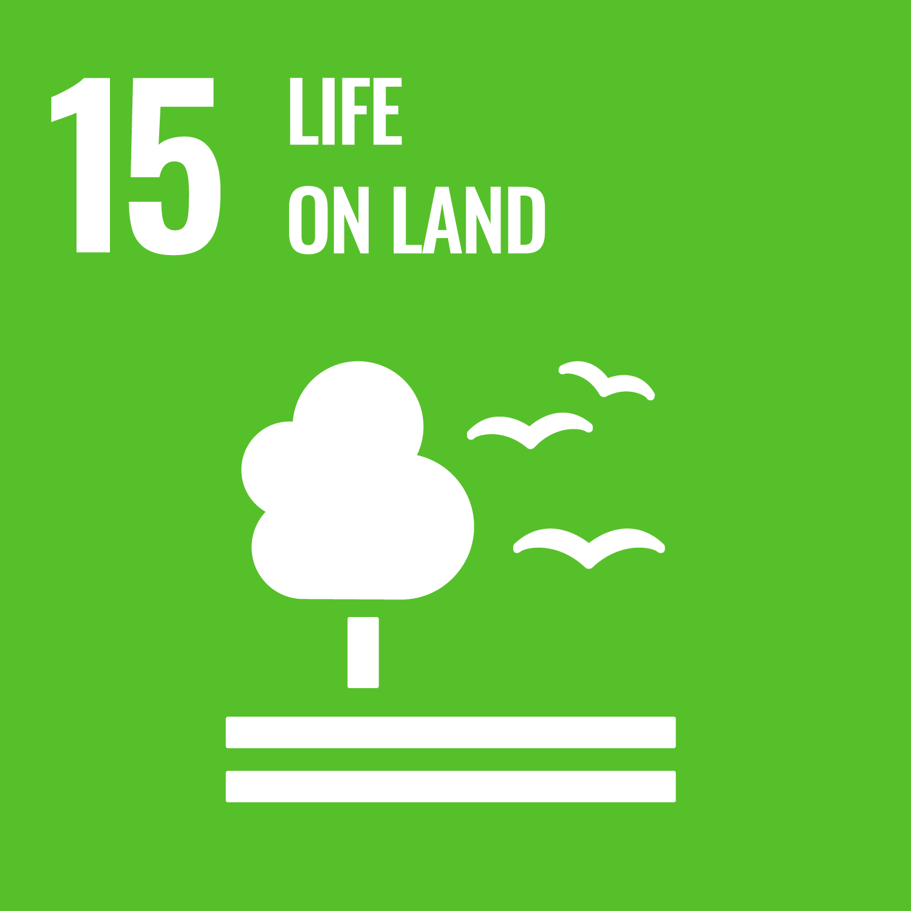
Sustainable Development Goals (SDGs)
Source: https://sdgs.un.org/goals

Slide 19
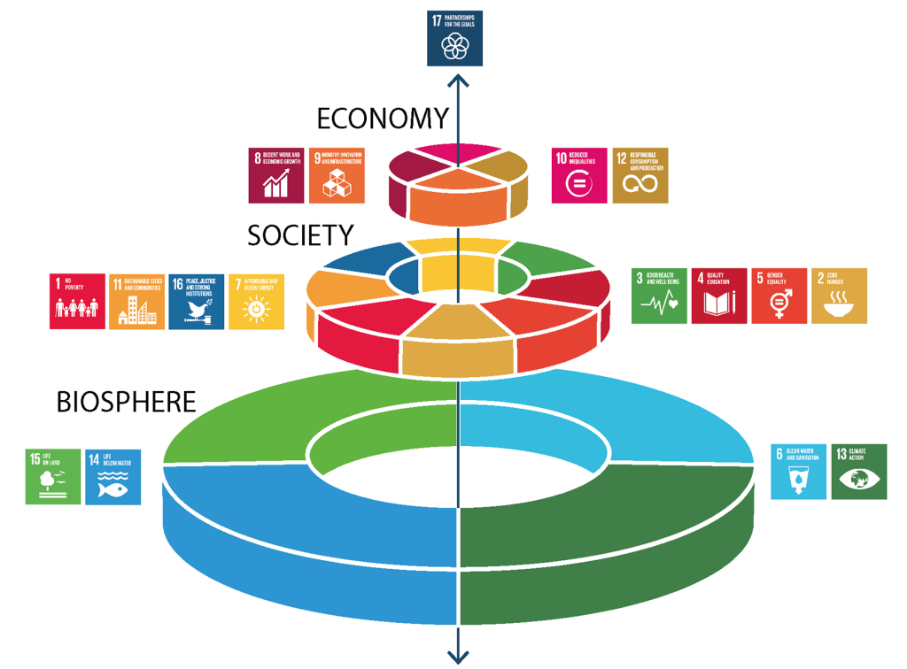
Sustainable Development Goals (SDGs) and 5P
Partnership
Peace
Prosperity
People
Planet
Source: Folke, Carl, Reinette Biggs, Albert V. Norström, Belinda Reyers, and Johan Rockström. "Social-ecological resilience and biosphere-based sustainability science.”Ecology and Society 21, no. 3 (2016).

Slide 20
Green Finance Generic term implying use or diversion of financial resources to deploy and support projects with long term positive impact on the environment
Source: Bhattacharyya, Rupsha. "Green finance for energy transition, climate action and sustainable development: overview of concepts, applications, implementation and challenges." Green Finance 4, no. 1 (2022): 1-35.

Slide 21
Sustainable Finance Finances deployed in support of projects that ensure just, sustainable and inclusive growth or attainment of one or more sustainable development goals
Source: Bhattacharyya, Rupsha. "Green finance for energy transition, climate action and sustainable development: overview of concepts, applications, implementation and challenges." Green Finance 4, no. 1 (2022): 1-35.

Slide 22
Carbon Finance
Financial instruments based on economic value of carbon emissions which an organization cannot avoid but which it offsets by funding other compensatory projects that contribute to carbon emissions reduction
Source: Bhattacharyya, Rupsha. "Green finance for energy transition, climate action and sustainable development: overview of concepts, applications, implementation and challenges." Green Finance 4, no. 1 (2022): 1-35.

Slide 23
Climate Finance
Finances deployed in support of low carbon and climate resilient projects that help in climate change mitigation and adaptation efforts, particularly in the energy and infrastructure sectors
Source: Bhattacharyya, Rupsha. "Green finance for energy transition, climate action and sustainable development: overview of concepts, applications, implementation and challenges." Green Finance 4, no. 1 (2022): 1-35.

Slide 24
ESG Investing
Investments considering the broad range of environmental (e.g. climate change, pollution biodiversity loss), social (e.g. working conditions, human rights, salary or compensation structures) and governance (e.g. board composition, diversity and inclusion, taxes) characteristics of the projects or companies being invested in; ethical and business sustainability considerations are integral part of financing
Source: Bhattacharyya, Rupsha. "Green finance for energy transition, climate action and sustainable development: overview of concepts, applications, implementation and challenges." Green Finance 4, no. 1 (2022): 1-35.

Slide 25
Impact Investing
Investing in projects that solve a social or environmental problem; the focus is on the positive impact rather than the means used to produce that impact
Source: Bhattacharyya, Rupsha. "Green finance for energy transition, climate action and sustainable development: overview of concepts, applications, implementation and challenges." Green Finance 4, no. 1 (2022): 1-35.

Slide 26
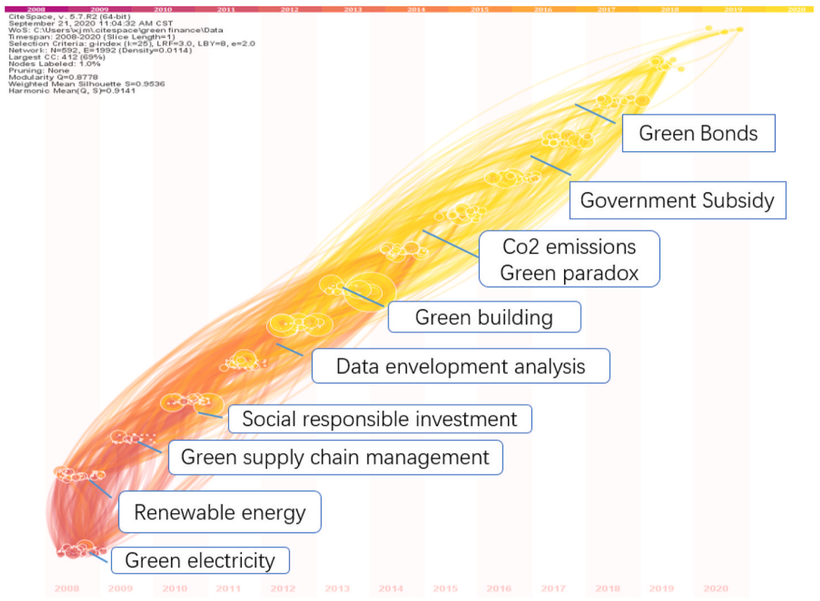
Dynamic Trends of Green Finance and Energy Policy
Source: Wang, Moran, Xuerong Li, and Shouyang Wang. (2021) "Discovering research trends and opportunities of green finance and energy policy: A data-driven scientometric analysis." Energy Policy 154 (2021): 112295.

Slide 27
ESG: Environmental Social Governance

Slide 28
CSR: Corporate Social Responsibility

Slide 29
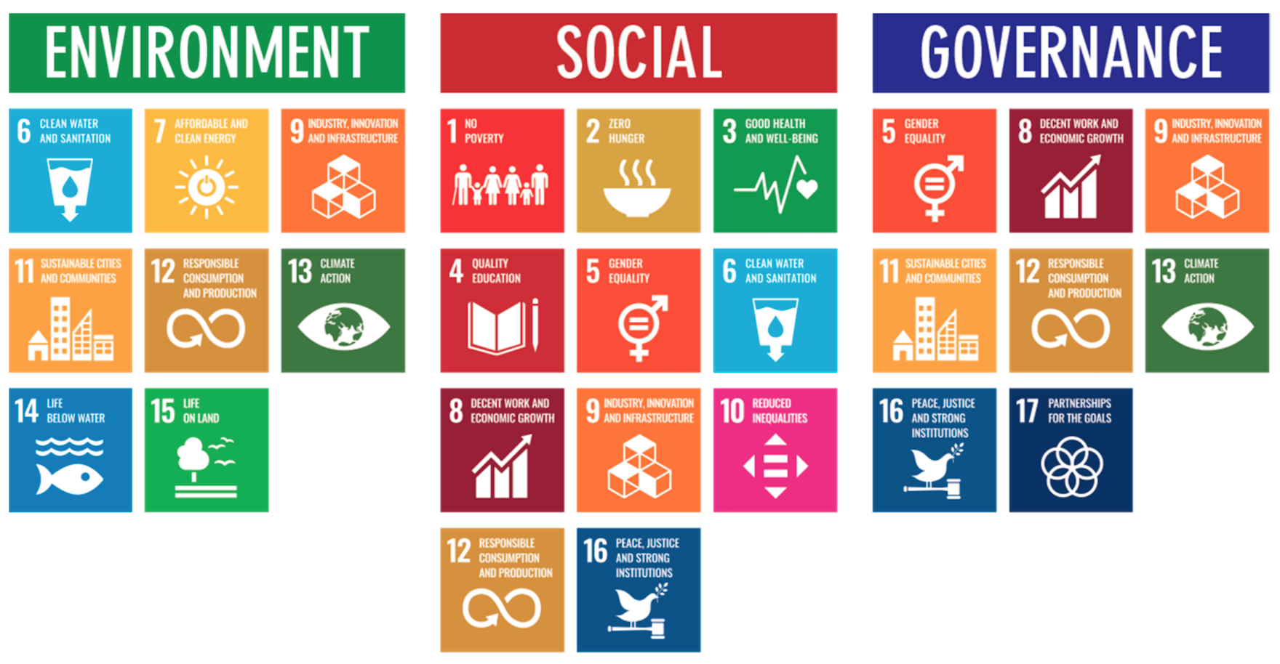
ESG to 17 SDGs
Source: Henrik Skaug Sætra (2021) "A Framework for Evaluating and Disclosing the ESG Related Impacts of AI with the SDGs." Sustainability 13, no. 15 (2021): 8503.

Slide 30
ESG to 17 SDGs
Source: https://sustainometric.com/esg-to-sdgs-connected-paths-to-a-sustainable-future/

Slide 31
Generative AI for ESG Applications

Slide 32
AI and Sustainability Development Goals (SDGs)
Source: Schoormann, T., Strobel, G., Möller, F., Petrik, D., & Zschech, P. (2023). Artificial Intelligence for Sustainability—A Systematic Review of Information Systems Literature. Communications of the Association for Information Systems, 52(1), 8.

Slide 33
AI for Sustainability
Source: Schoormann, T., Strobel, G., Möller, F., Petrik, D., & Zschech, P. (2023). Artificial Intelligence for Sustainability—A Systematic Review of Information Systems Literature. Communications of the Association for Information Systems, 52(1), 8.

Slide 34
Sustainable Productivity: Finance ESG
Source: Huang, Ziqi, Yang Shen, Jiayi Li, Marcel Fey, and Christian Brecher (2021). "A survey on AI-driven digital twins in Industry 4.0: Smart manufacturing and advanced robotics." Sensors 21, no. 19: 6340.

Slide 35
Sustainable Resilient Manufacturing ESG
Source: Huang, Ziqi, Yang Shen, Jiayi Li, Marcel Fey, and Christian Brecher (2021). "A survey on AI-driven digital twins in Industry 4.0: Smart manufacturing and advanced robotics." Sensors 21, no. 19: 6340.

Slide 36
ESG Indexes
MSCI ESG Index
Dow Jones Sustainability Indices (DJSI)
FTSE ESG Index

Slide 37
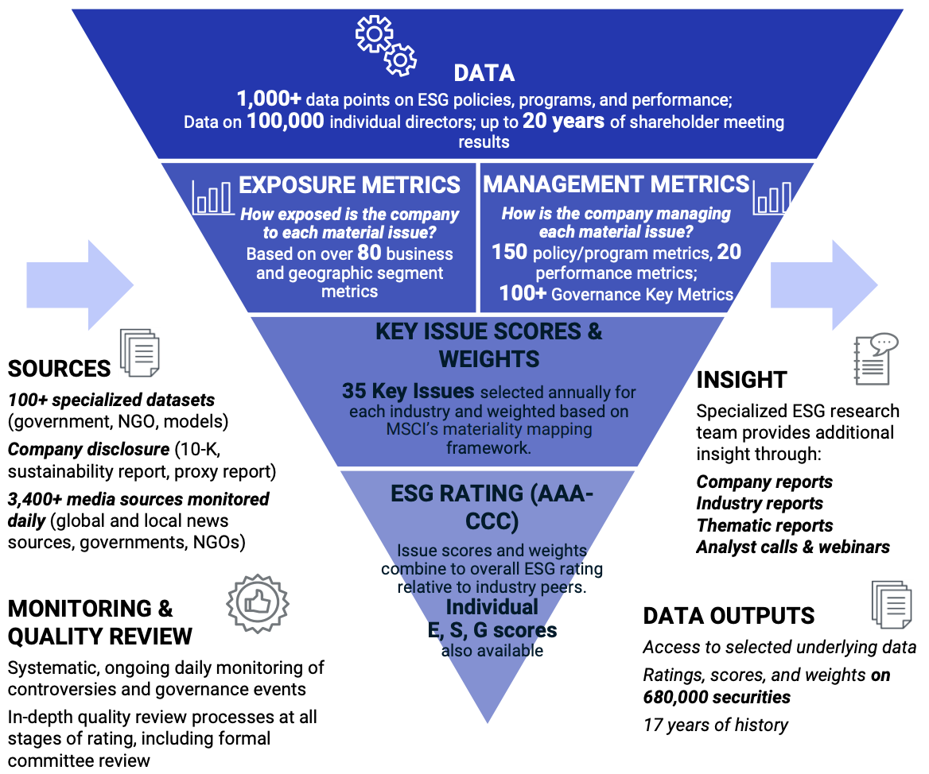
MSCI ESG Rating Framework
Source: https://www.msci.com/documents/1296102/21901542/ESG-Ratings-Methodology-Exec-Summary.pdf

Slide 38
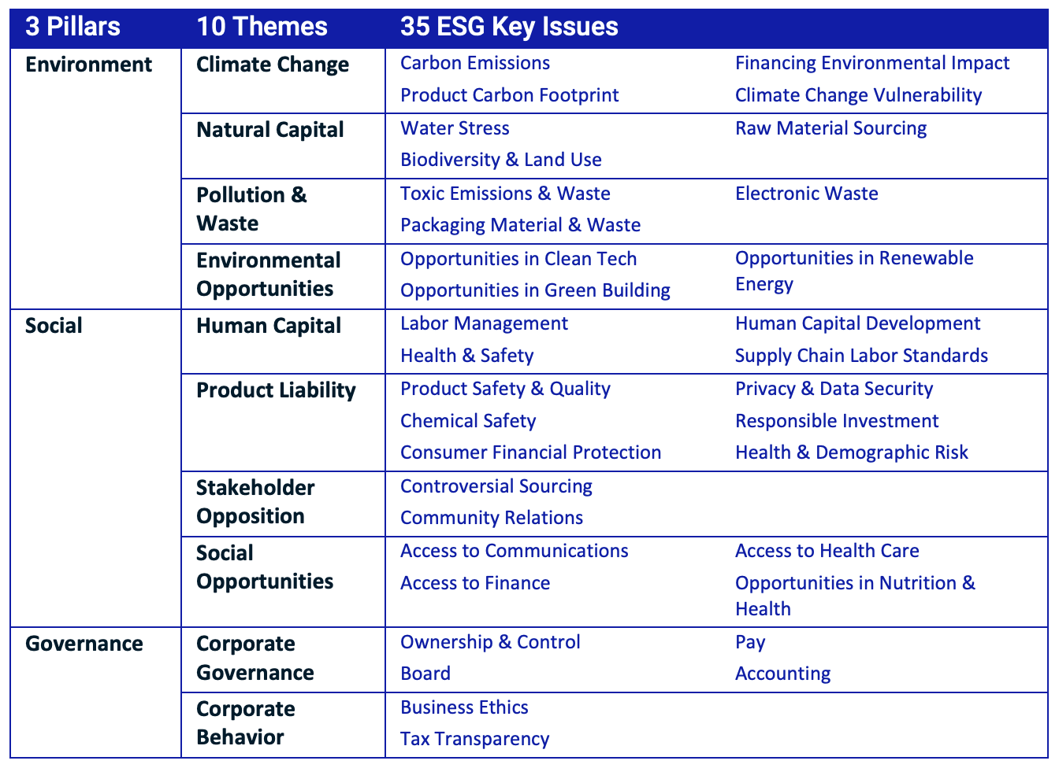
MSCI ESG Key Issue Hierarchy
Source: https://www.msci.com/documents/1296102/21901542/ESG-Ratings-Methodology-Exec-Summary.pdf

Slide 39
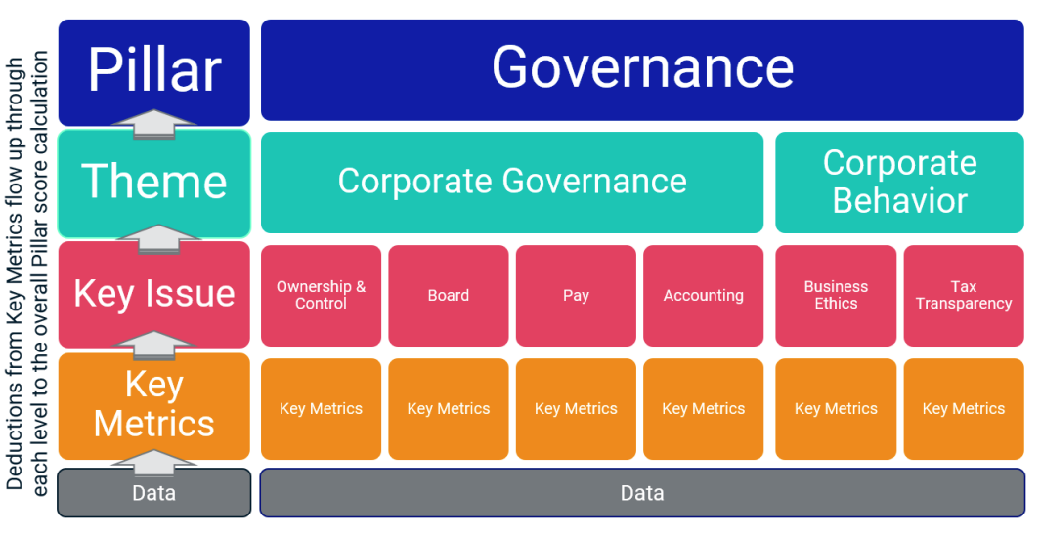
MSCI Governance Model Structure
Source: https://www.msci.com/documents/1296102/21901542/ESG-Ratings-Methodology-Exec-Summary.pdf

Slide 40
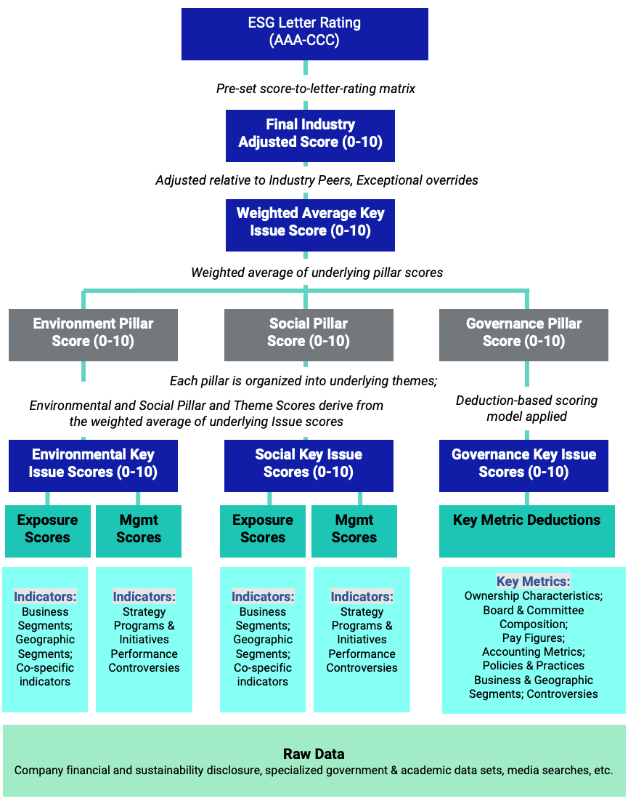
MSCI Hierarchy of ESG Scores
Source: https://www.msci.com/documents/1296102/21901542/ESG-Ratings-Methodology-Exec-Summary.pdf

Slide 41
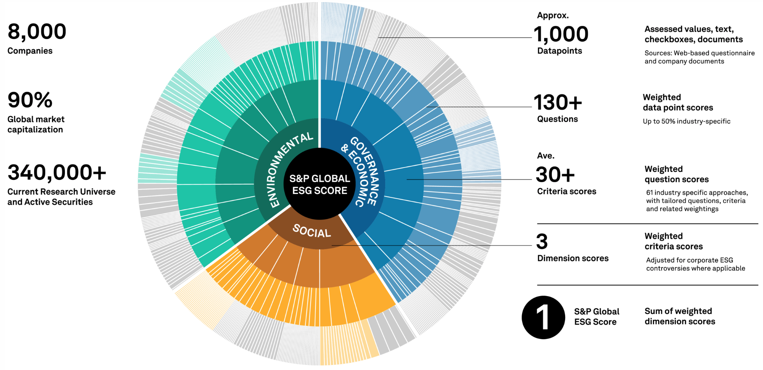
DJSI S&P Global ESG Score
Source: DJSI, S&P Global Corporate Sustainability Assessment (CSA), https://www.spglobal.com/esg/solutions/data-intelligence-esg-scores

Slide 42
FTSE Russell ESG Ratings
Source: https://www.ftserussell.com/data/sustainability-and-esg-data/esg-ratings

Slide 43
Sustainalytics ESG Risk Ratings
Analyst-based approach
Sustainalytics’ ESG Risk Ratings measure a company’s exposure to industry-specific material ESG risks and how well a company is managing those risks.
Source: https://www.sustainalytics.com/esg-data

Slide 44
Truvalue ESG Ranks
TruValue Labs
Machine-based approach
Truvalue Labs applies AI to analyze over 100,000 sources and uncover ESG risks and opportunities hidden in unstructured text.
The ESG Ranks data service produces an overall company rank based on industry percentile leveraging the 26 ESG categories defined by the Sustainability Accounting Standards Board (SASB).
The data feed covers 20,000+ companies with more than 13 years of history.
Source: :https://developer.truvaluelabs.com/data/esg-ranks

Slide 45
Analyst-driven vs. AI-driven ESG
Sustainalytics
Truvalue Labs
Source: Mark Tulay (2020), Man vs. machine: A tale of two sustainability ratings systems, GreenBiz, https://www.greenbiz.com/article/man-vs-machine-tale-two-sustainability-ratings-systems

Slide 46
Analyst based ESG Research AI based ESG Research
Source: https://www.esganalytics.io/insights/how-data-is-accelerating-esg

Slide 47
ESG Analytics: NLP Taxonomy
Source: https://www.esganalytics.io/insights/how-data-is-accelerating-esg

Slide 48
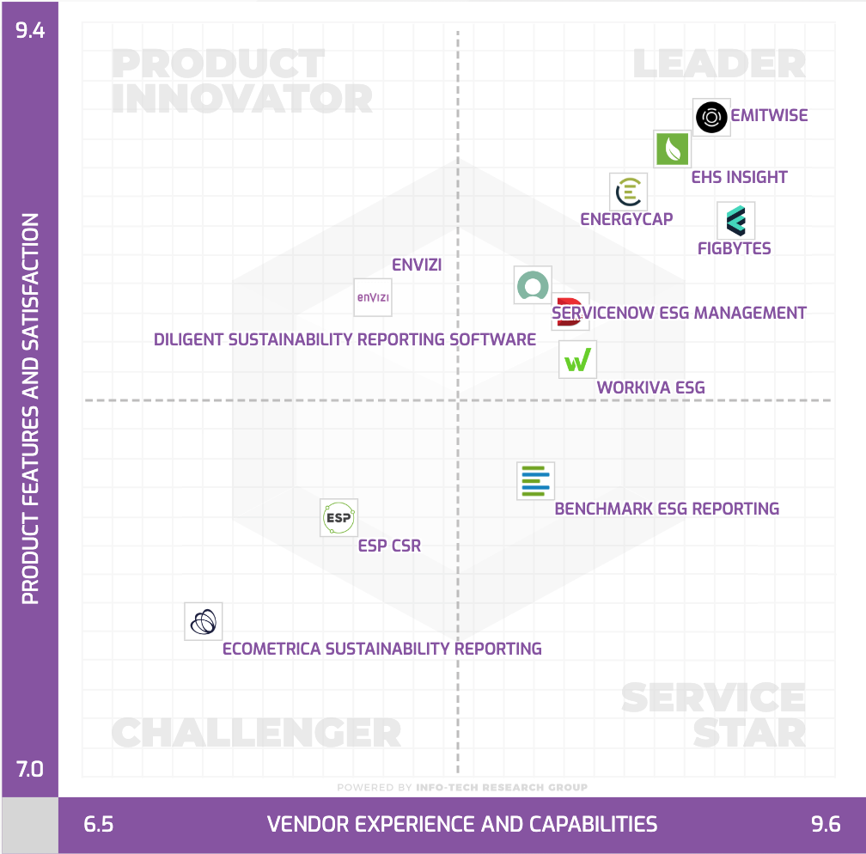
Top ESG Reporting Software
Environmental, Social and Governance (ESG) Reporting software or Sustainability software helps organizations manage their operational data, evaluate their impact on the environment and provide reporting to perform audits.
Source: https://www.softwarereviews.com/categories/environmental-social-and-governance-reporting

Slide 49
ESG Reporting Software: Emitwise
Emitwise is the carbon management platform for companies with complex manufacturing supply chains to confidently understand, track and reduce their complete carbon footprint.
Combining 100 years of carbon accounting experience and machine learning technology, we accelerate climate action by increasing the accuracy of scope 3 emissions.
The platform empowers manufacturers and their supply chains to make carbon-led business decisions that lower risk, increase profitability and deliver ambitious climate action.
Source: https://www.softwarereviews.com/categories/environmental-social-and-governance-reporting

Slide 50
ESG Reporting Software: Workiva ESG
Workiva is a cloud native platform that simplifies the complexities of reporting and compliance.
Workiva ESG is the end-to-end platform that allows you to integrate financial data, nonfinancial data, and XBRL.
Workiva, the platform that streamlines your entire ESG process.
Automate data collection, utilize frameworks, and directly connect to all your ESG reports. in meaningful glossy reports, accurate survey responses, and regulatory filings with integrated XBRL tagging.
Source: https://www.softwarereviews.com/categories/environmental-social-and-governance-reporting

Slide 51
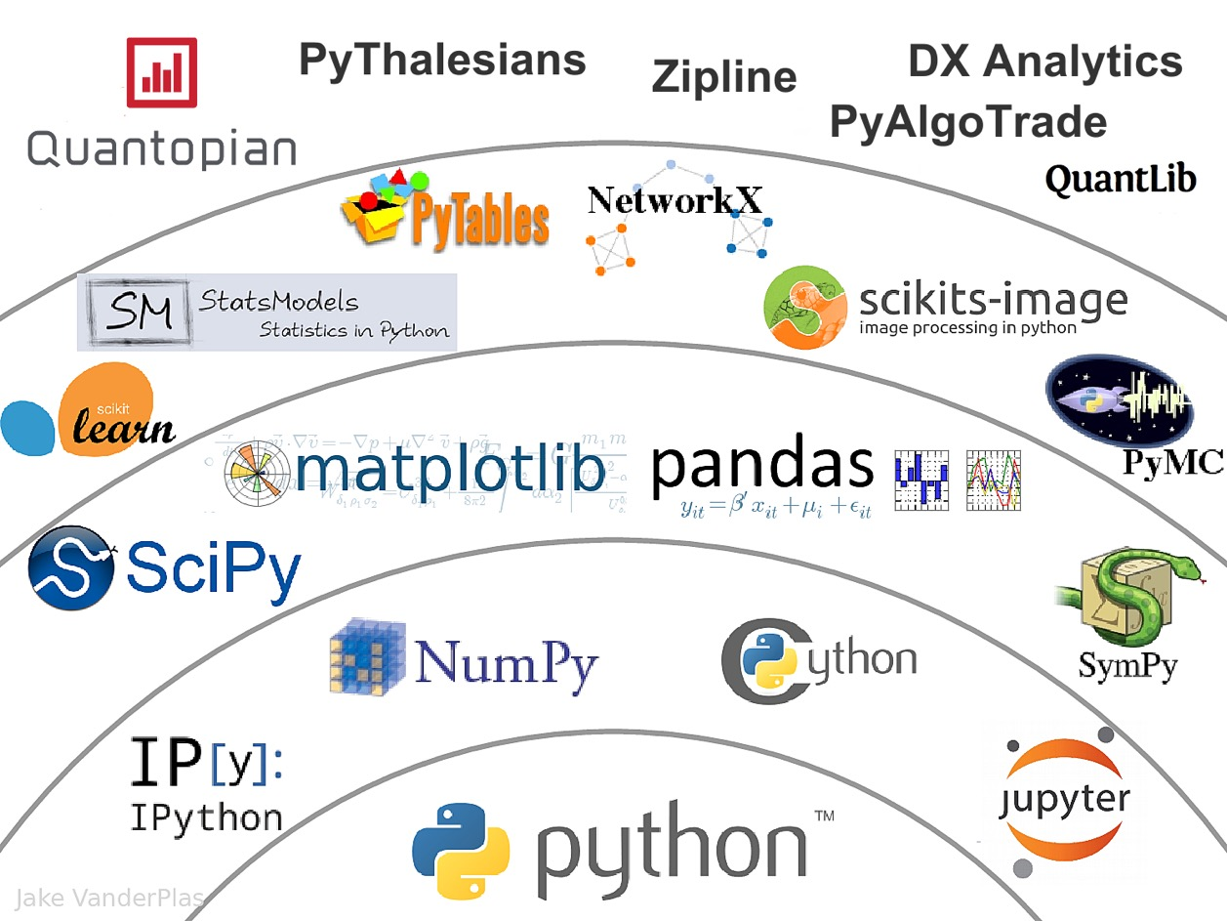
The Quant Finance PyData Stack
Source: http://nbviewer.jupyter.org/format/slides/github/quantopian/pyfolio/blob/master/pyfolio/examples/overview_slides.ipynb#/5

Slide 52
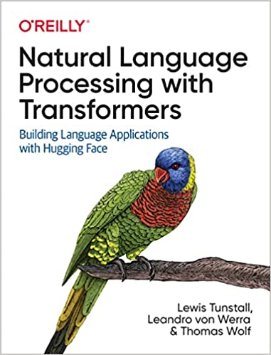
Lewis Tunstall, Leandro von Werra, and Thomas Wolf (2022), Natural Language Processing with Transformers: Building Language Applications with Hugging Face, O'Reilly Media.
Source: https://www.amazon.com/Natural-Language-Processing-Transformers-Applications/dp/1098103246

Slide 53
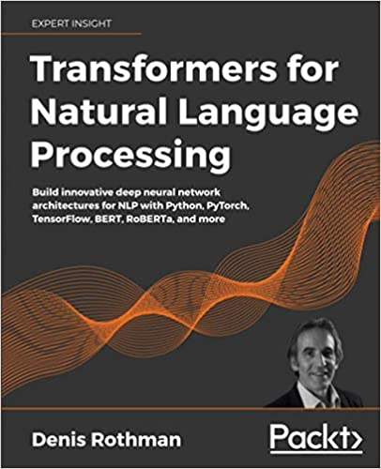
Denis Rothman (2021), Transformers for Natural Language Processing: Build innovative deep neural network architectures for NLP with Python, PyTorch, TensorFlow, BERT, RoBERTa, and more, Packt Publishing.
Source: https://www.amazon.com/Transformers-Natural-Language-Processing-architectures/dp/1800565798

Slide 54
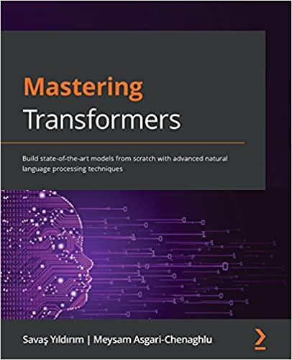
Savaş Yıldırım and Meysam Asgari-Chenaghlu (2021), Mastering Transformers: Build state-of-the-art models from scratch with advanced natural language processing techniques, Packt Publishing.
Source: https://www.amazon.com/Mastering-Transformers-state-art-processing/dp/1801077657/

Slide 55
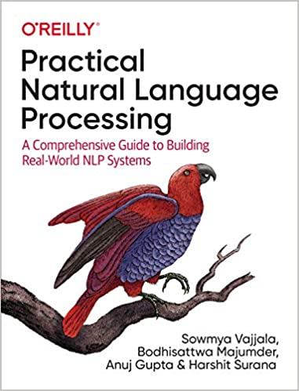
Sowmya Vajjala, Bodhisattwa Majumder, Anuj Gupta (2020), Practical Natural Language Processing: A Comprehensive Guide to Building Real-World NLP Systems, O'Reilly Media.
Source: https://www.amazon.com/Practical-Natural-Language-Processing-Pragmatic/dp/1492054054

Slide 56
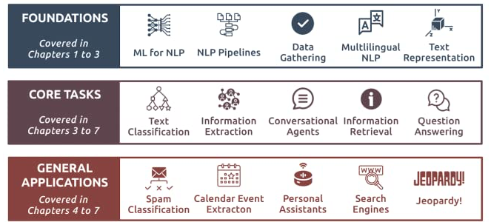
Source: Sowmya Vajjala, Bodhisattwa Majumder, Anuj Gupta (2020), Practical Natural Language Processing: A Comprehensive Guide to Building Real-World NLP Systems, O'Reilly Media.
Source: https://www.amazon.com/Practical-Natural-Language-Processing-Pragmatic/dp/1492054054

Slide 57
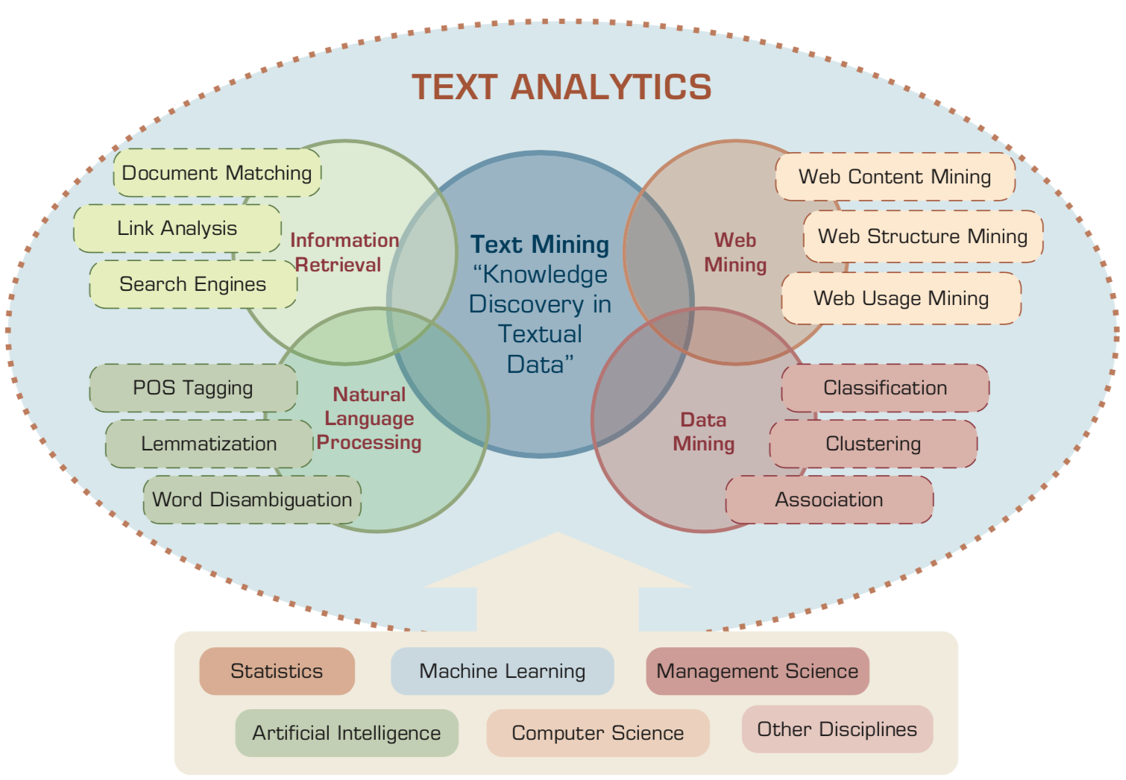
Text Analytics and Text Mining
Source: Ramesh Sharda, Dursun Delen, and Efraim Turban (2017), Business Intelligence, Analytics, and Data Science: A Managerial Perspective, 4th Edition, Pearson

Slide 58
Generative AI Text, Image, Video, Audio Applications

Slide 59
Generative AI (Gen AI) AI Generated Content (AIGC)
Image Generation
Source: Yihan Cao, Siyu Li, Yixin Liu, Zhiling Yan, Yutong Dai, Philip S. Yu, and Lichao Sun (2023). "A Comprehensive Survey of AI-Generated Content (AIGC): A History of Generative AI from GAN to ChatGPT." arXiv preprint arXiv:2303.04226.

Slide 60
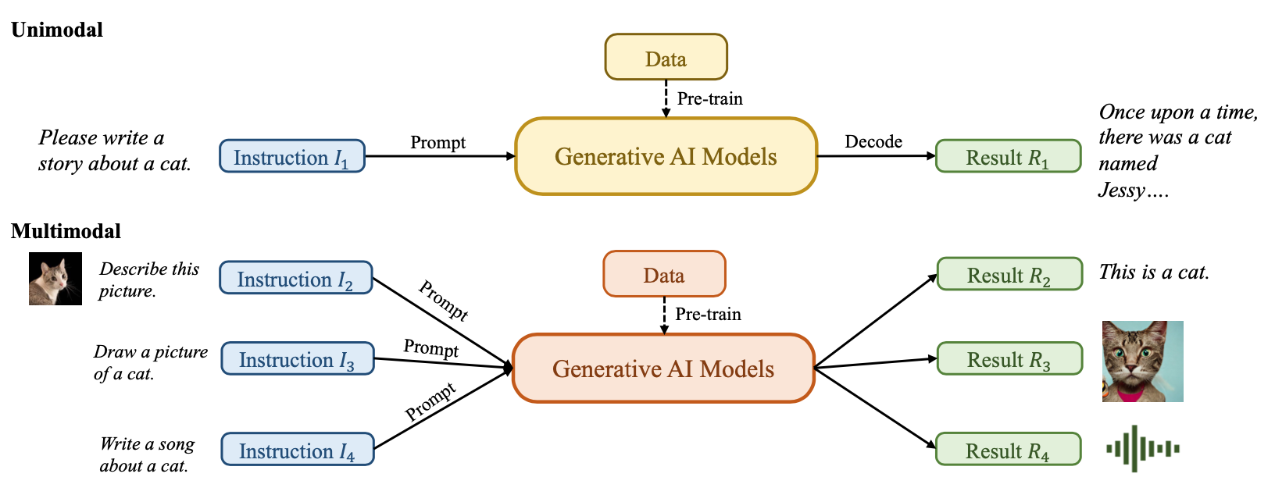
Generative AI (Gen AI) AI Generated Content (AIGC)
Source: Yihan Cao, Siyu Li, Yixin Liu, Zhiling Yan, Yutong Dai, Philip S. Yu, and Lichao Sun (2023). "A Comprehensive Survey of AI-Generated Content (AIGC): A History of Generative AI from GAN to ChatGPT." arXiv preprint arXiv:2303.04226.

Slide 61
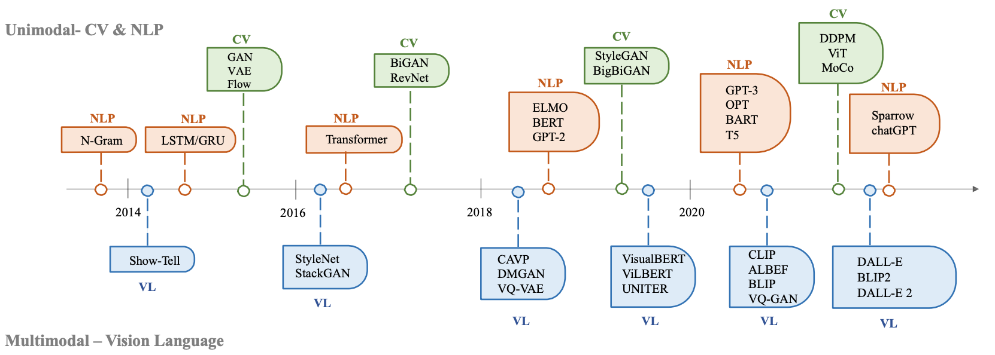
The history of Generative AI in CV, NLP and VL
Source: Yihan Cao, Siyu Li, Yixin Liu, Zhiling Yan, Yutong Dai, Philip S. Yu, and Lichao Sun (2023). "A Comprehensive Survey of AI-Generated Content (AIGC): A History of Generative AI from GAN to ChatGPT." arXiv preprint arXiv:2303.04226.

Slide 62
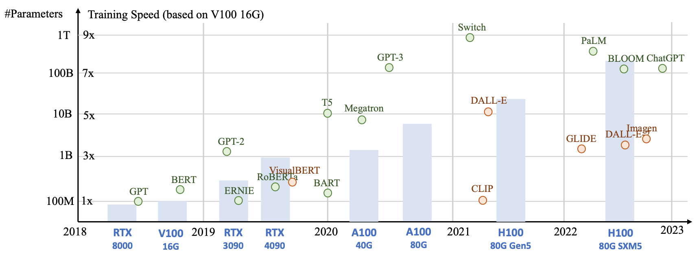
Generative AI Foundation Models
Source: Yihan Cao, Siyu Li, Yixin Liu, Zhiling Yan, Yutong Dai, Philip S. Yu, and Lichao Sun (2023). "A Comprehensive Survey of AI-Generated Content (AIGC): A History of Generative AI from GAN to ChatGPT." arXiv preprint arXiv:2303.04226.

Slide 63
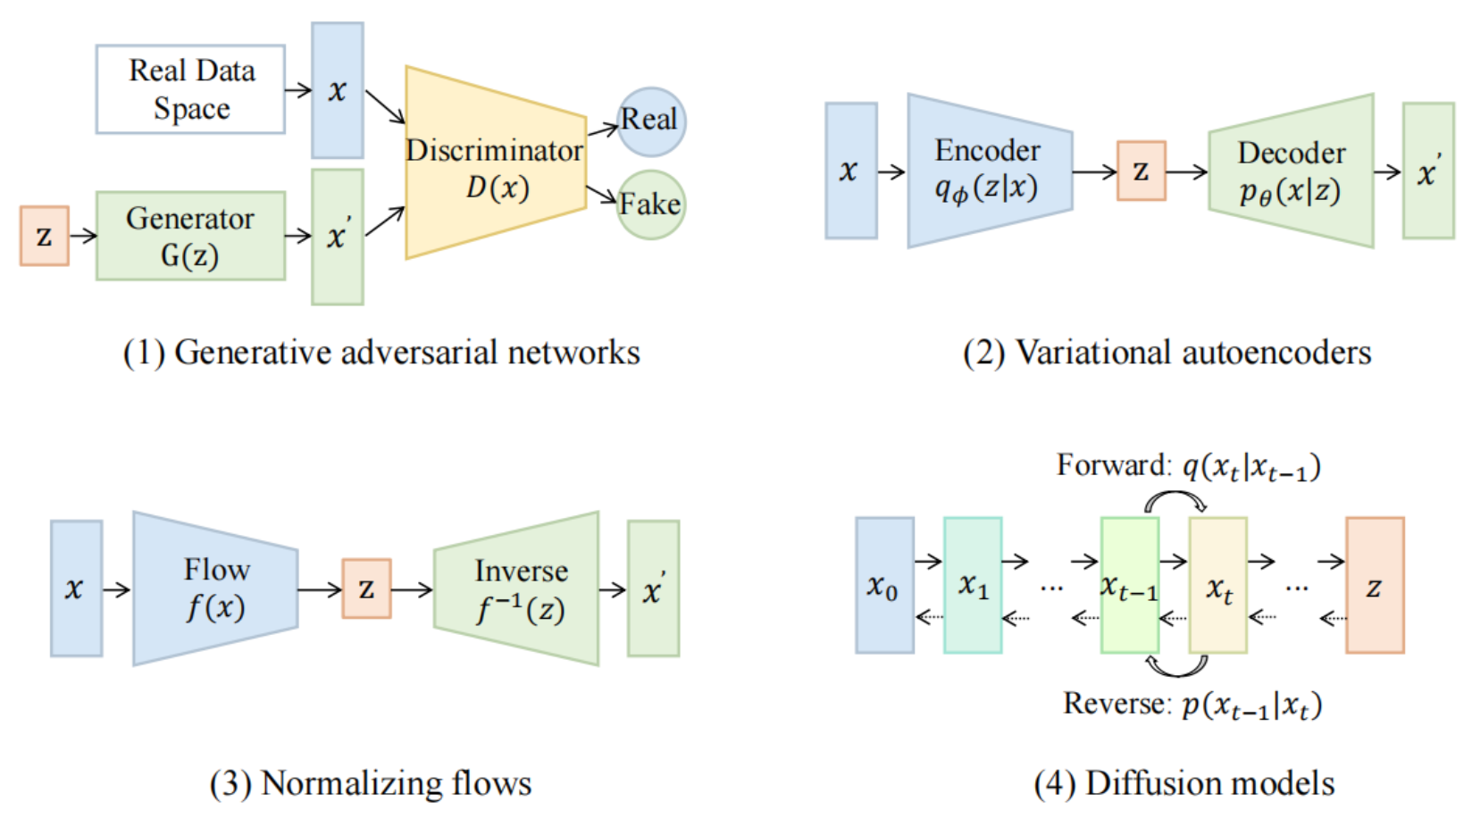
Categories of Vision Generative Models
Source: Yihan Cao, Siyu Li, Yixin Liu, Zhiling Yan, Yutong Dai, Philip S. Yu, and Lichao Sun (2023). "A Comprehensive Survey of AI-Generated Content (AIGC): A History of Generative AI from GAN to ChatGPT." arXiv preprint arXiv:2303.04226.

Slide 64
The General Structure of Generative Vision Language
Source: Yihan Cao, Siyu Li, Yixin Liu, Zhiling Yan, Yutong Dai, Philip S. Yu, and Lichao Sun (2023). "A Comprehensive Survey of AI-Generated Content (AIGC): A History of Generative AI from GAN to ChatGPT." arXiv preprint arXiv:2303.04226.

Slide 65
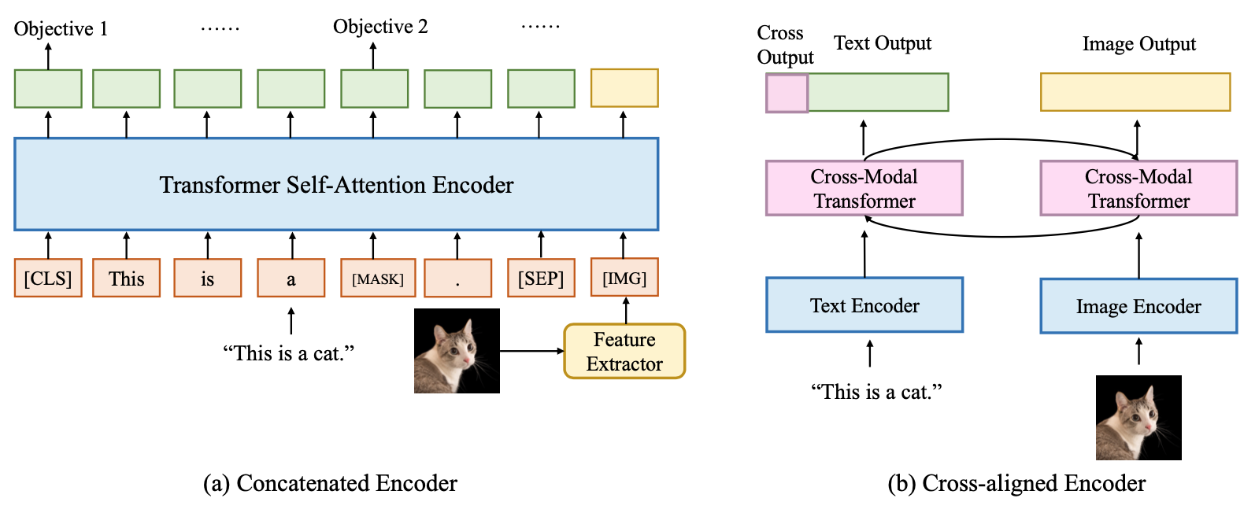
Two Types of Vision Language Encoders: Concatenated Encoders and Cross-aligned Encoders
Source: Yihan Cao, Siyu Li, Yixin Liu, Zhiling Yan, Yutong Dai, Philip S. Yu, and Lichao Sun (2023). "A Comprehensive Survey of AI-Generated Content (AIGC): A History of Generative AI from GAN to ChatGPT." arXiv preprint arXiv:2303.04226.

Slide 66
Two Types of to-language Decoder Models: Jointly-trained Models and Frozen Models
Source: Yihan Cao, Siyu Li, Yixin Liu, Zhiling Yan, Yutong Dai, Philip S. Yu, and Lichao Sun (2023). "A Comprehensive Survey of AI-Generated Content (AIGC): A History of Generative AI from GAN to ChatGPT." arXiv preprint arXiv:2303.04226.

Slide 67
ChatGPT Large Language Models (LLMs) Foundation Models

Slide 68
Large Language Models (LLM) (GPT-3, ChatGPT, PaLM, BLOOM, OPT-175B, LLaMA)
ChatGPT
175B
LLaMA
65B
Source: https://lifearchitect.ai/models/

Slide 69
The Transformers Timeline
ULMFit
BERT
RoBERTa
XLM-R
DeBERTa
GPT-Neo
BLOOM
Alpaca
DistrilBERT
T5
PaLM
ChatGPT
Llama2
Transformer
GPT
GPT-2
GPT-3
GPT-J
OPT-175B
Llama
2017
2018
2019
2020
2021
2022
2023
Source: Lewis Tunstall, Leandro von Werra, and Thomas Wolf (2022), Natural Language Processing with Transformers: Building Language Applications with Hugging Face, O'Reilly Media.

Slide 70
Transformer Models
Transformer
Encoder
Decoder
DistilBERT
BERT
T5
GPT
RoBERTa
BART
GPT-2
CTRL
XLM-R
XLM
M2M-100
GPT-3
ALBERT
BigBird
GPT-Neo
GPT-J
ELECTRA
mT0
BLOOM
BLOOMZ
DeBERTa
ChatGPT
GPT-4
Source: Lewis Tunstall, Leandro von Werra, and Thomas Wolf (2022), Natural Language Processing with Transformers: Building Language Applications with Hugging Face, O'Reilly Media.

Slide 71
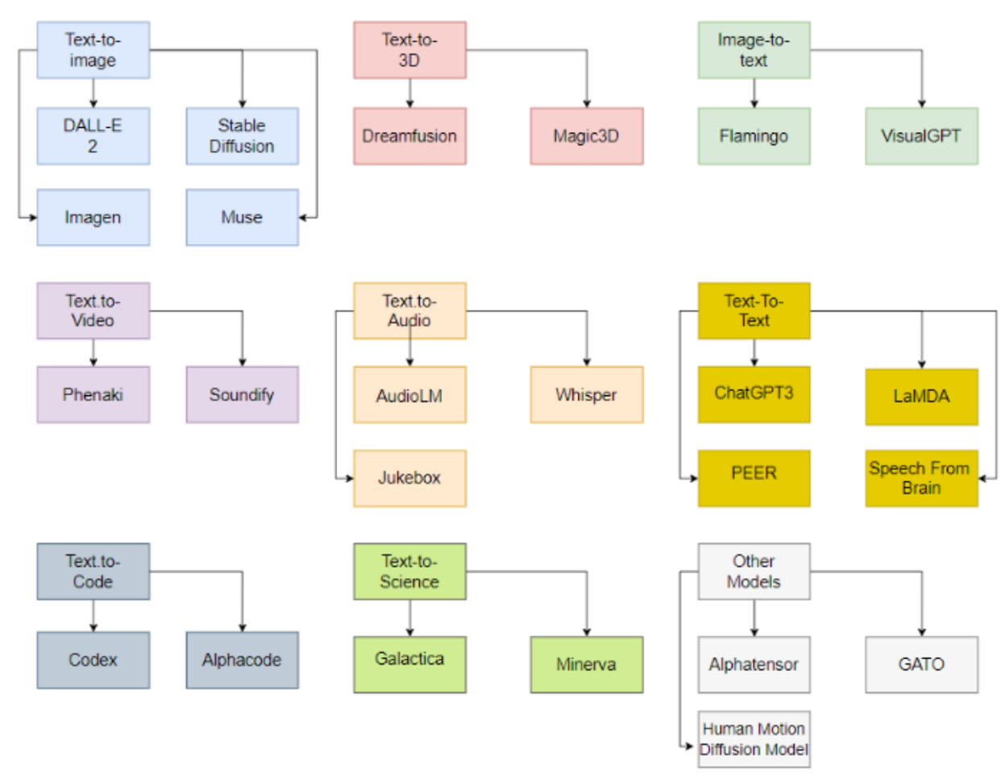
Generative AI Models
ChatGPT is not all you need
Attention is all you need
Source: Gozalo-Brizuela, Roberto, and Eduardo C. Garrido-Merchan (2023). "ChatGPT is not all you need. A State of the Art Review of large Generative AI models." arXiv preprint arXiv:2301.04655 (2023).

Slide 72
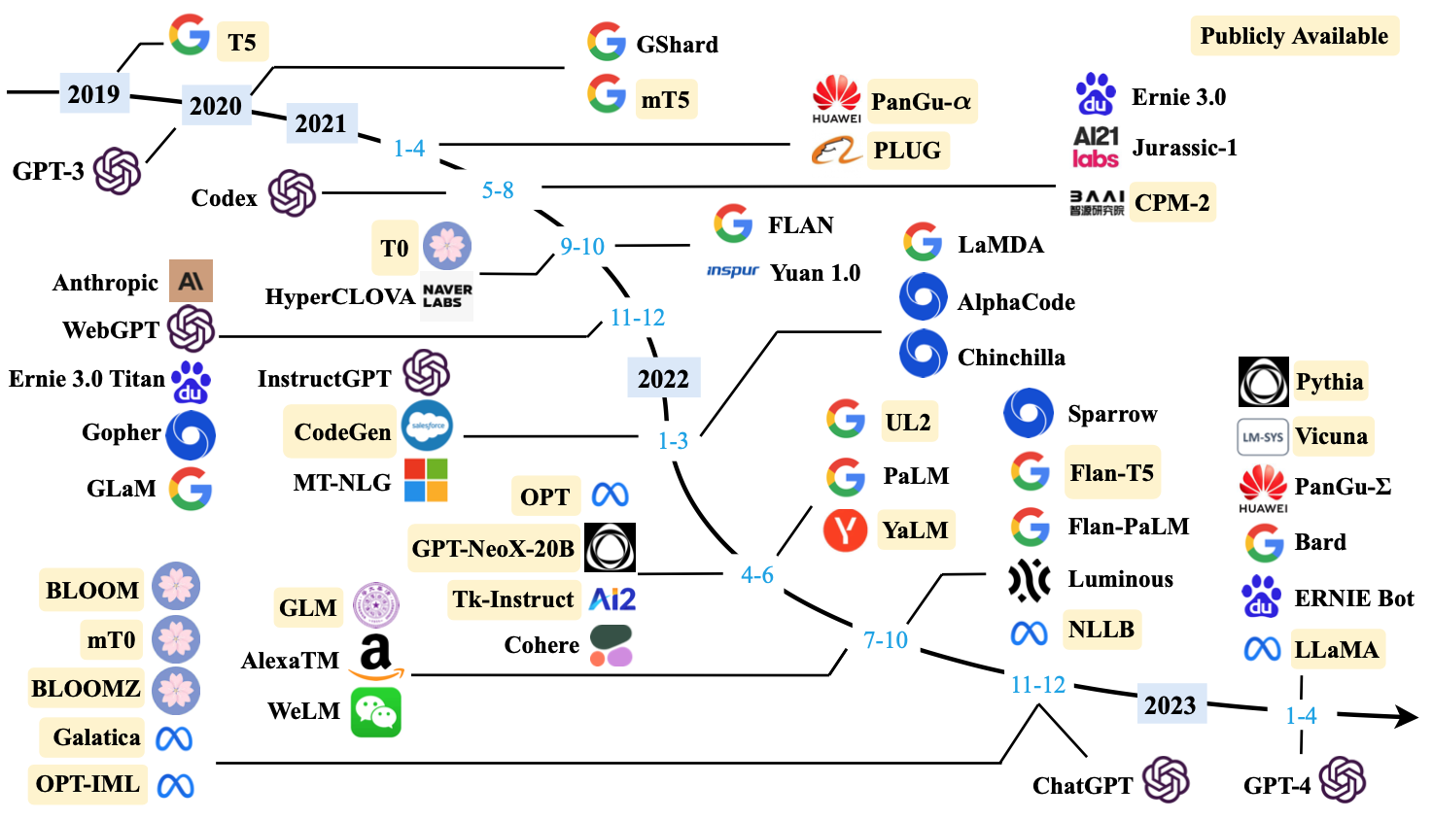
Large Language Models (LLMs) (larger than 10B)
Source: Wayne Xin Zhao, Kun Zhou, Junyi Li, Tianyi Tang, Xiaolei Wang, Yupeng Hou, Yingqian Min et al. (2023) "A Survey of Large Language Models." arXiv preprint arXiv:2303.18223.

Slide 73
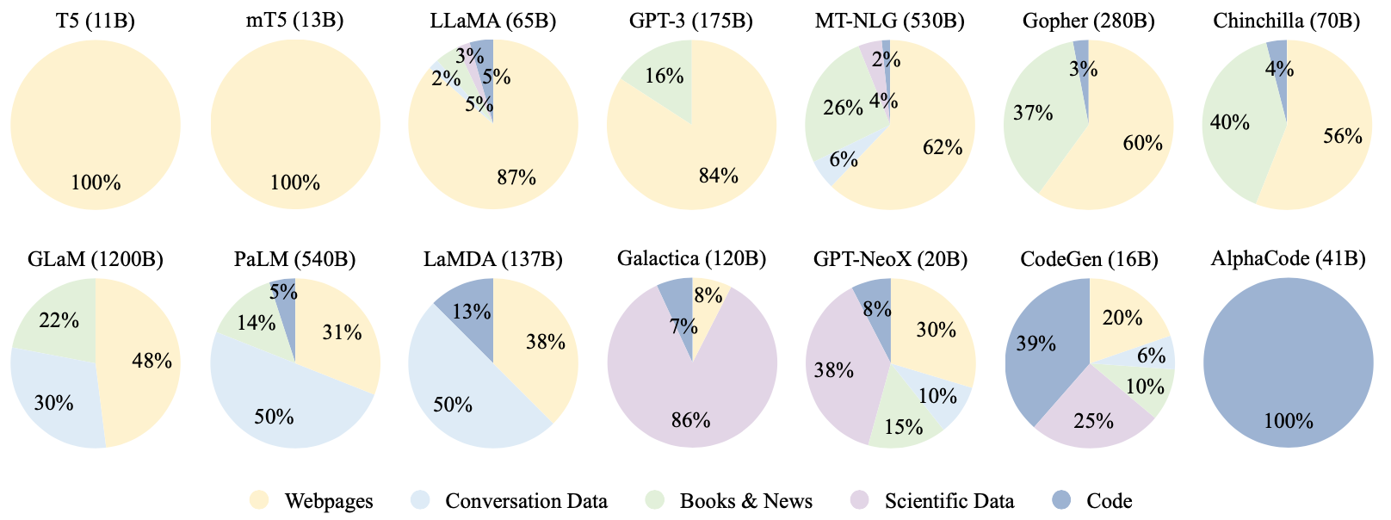
Ratios of various data sources in the pre-training data for existing LLMs
Source: Wayne Xin Zhao, Kun Zhou, Junyi Li, Tianyi Tang, Xiaolei Wang, Yupeng Hou, Yingqian Min et al. (2023) "A Survey of Large Language Models." arXiv preprint arXiv:2303.18223.

Slide 74
Typical Data Preprocessing Pipeline for Pre-training Large Language Models (LLMs)
Source: Wayne Xin Zhao, Kun Zhou, Junyi Li, Tianyi Tang, Xiaolei Wang, Yupeng Hou, Yingqian Min et al. (2023) "A Survey of Large Language Models." arXiv preprint arXiv:2303.18223.

Slide 75
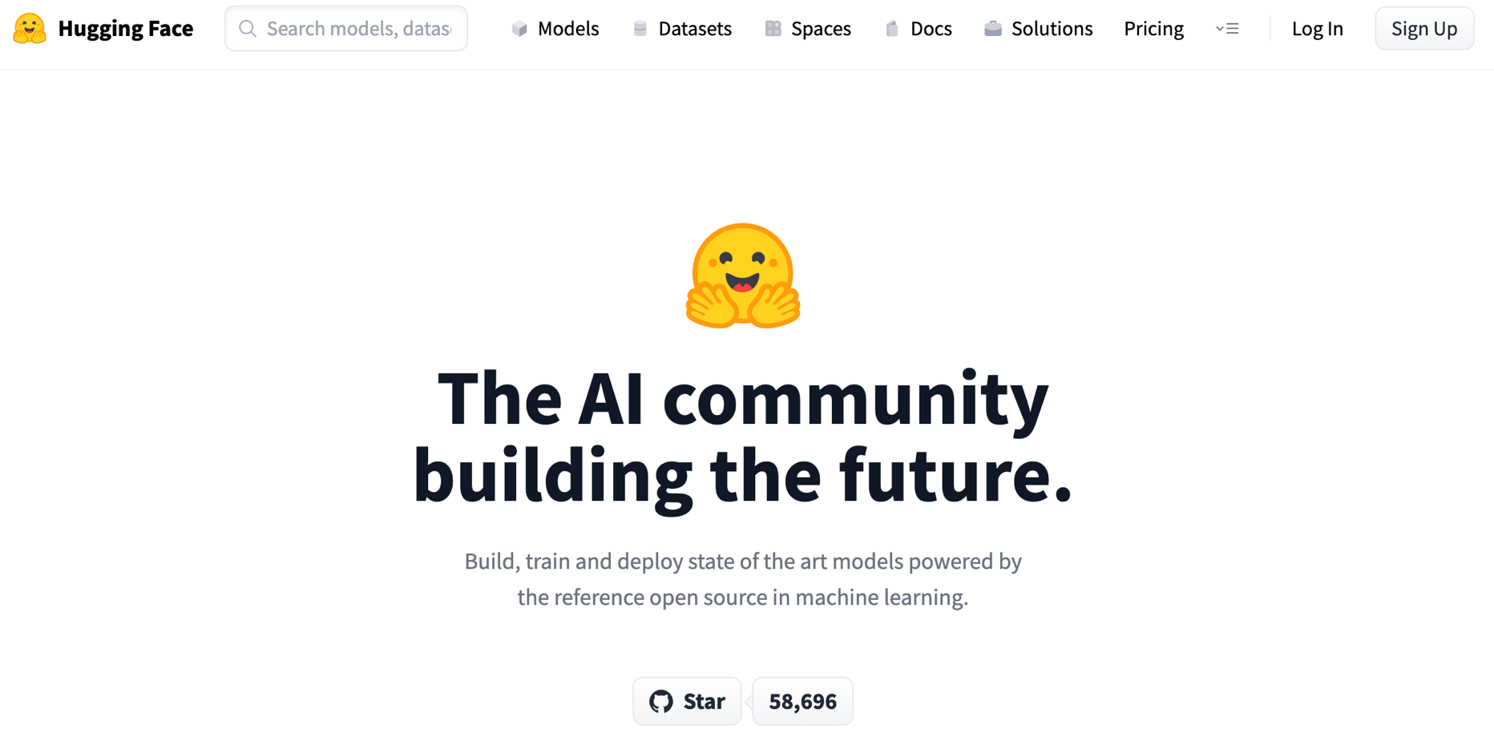
Hugging Face
https://huggingface.co/

Slide 76
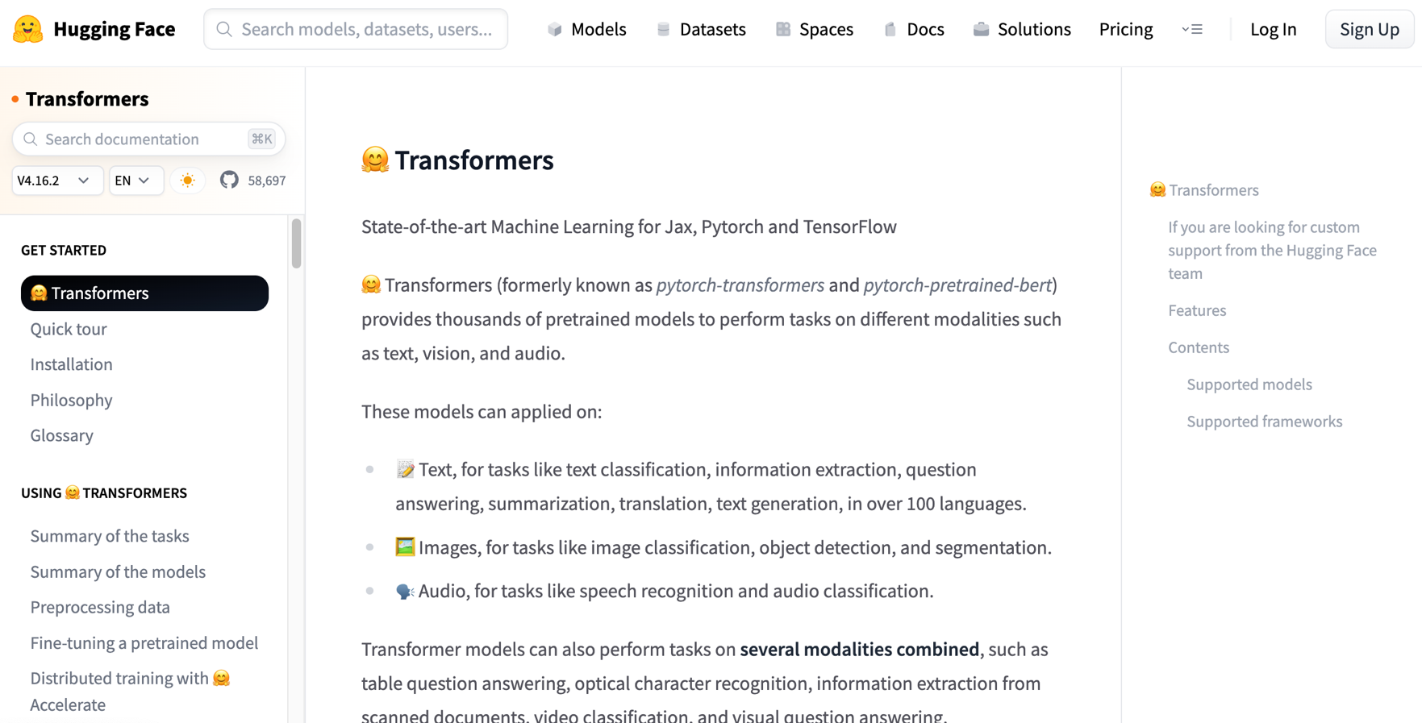
Hugging Face Transformers
https://huggingface.co/docs/transformers/index

Slide 77
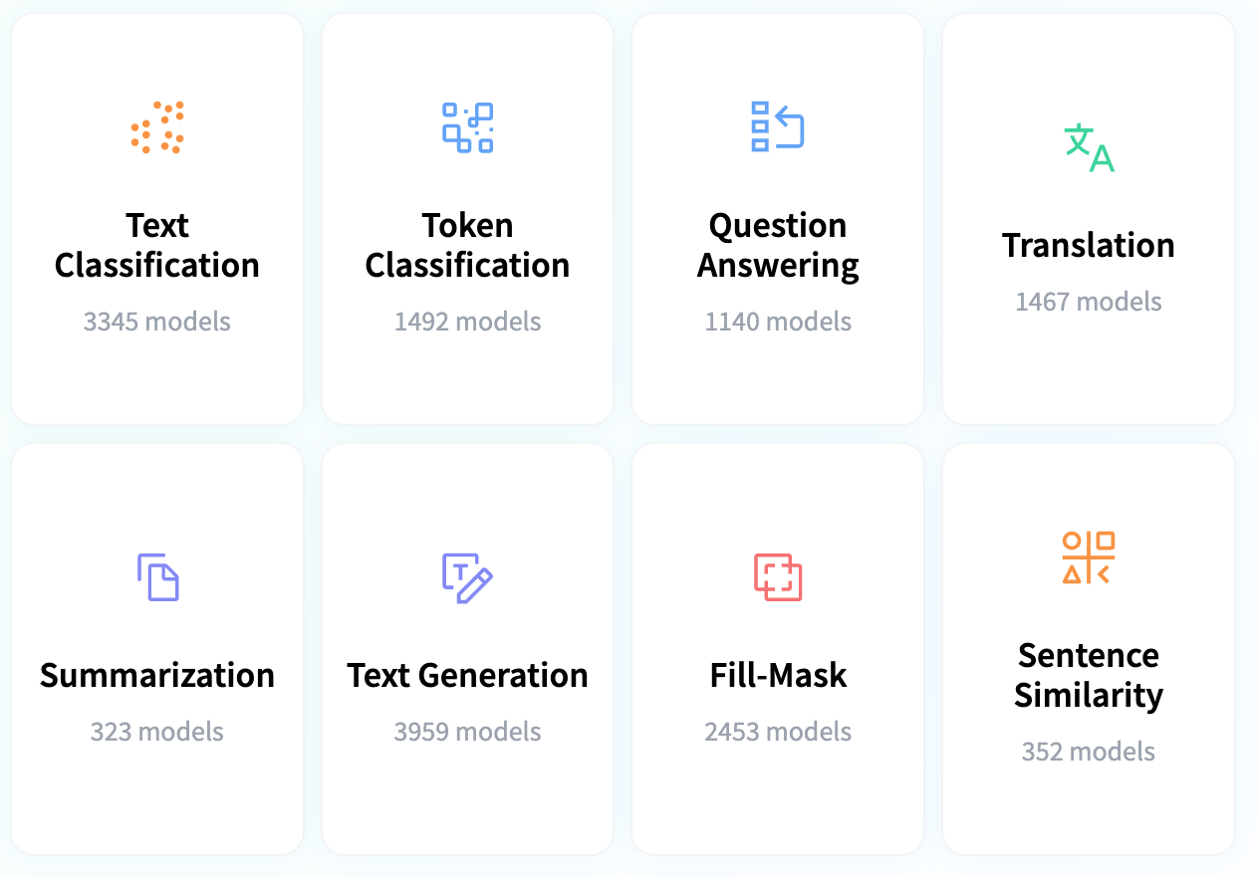
Hugging Face Tasks Natural Language Processing
https://huggingface.co/tasks

Slide 78
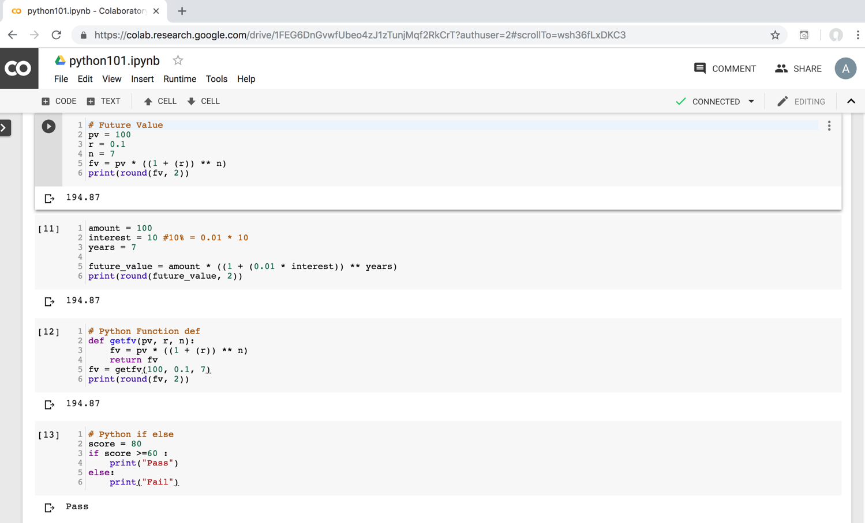
Python in Google Colab (Python101)
https://colab.research.google.com/drive/1FEG6DnGvwfUbeo4zJ1zTunjMqf2RkCrT
https://tinyurl.com/aintpupython101

Slide 79
Teaching
Artificial Intelligence in Finance and Quantitative
Fall 2021, Fall 2022, Fall 2023
Artificial Intelligence for Text Analytics
Spring 2022, Fall 2023
Big Data Analytics
Fall 2020, Spring 2023
Software Engineering
Fall 2020, Fall, 2021, Spring 2022, Spring 2023
Artificial Intelligence
Spring 2021, Fall 2022
Data Mining
Spring 2021
Foundation of Business Cloud Computing
Spring 2021, Spring 2022, Spring 2023
Python for Accounting Applications
Fall 2023
https://web.ntpu.edu.tw/~myday/teaching.htm

Slide 80
Research Projects
Applying AI technology to construct knowledge graphs of cryptocurrency anti-money laundering: a few-shot learning model
MOST, 110-2410-H-305-013-MY2, 2021/08/01~2023/07/31
Fintech Green Finance for Carbon Market Index, Corporate Finance, and Environmental Policies. Carbon Emission Sentiment Index with AI Text Analytics
NTPU, 112-NTPU_ORDA-F-003，2023/01/01~2024/12/31
Digital Support, Unimpeded Communication: The Development, Support and Promotion of AI-assisted Communication Assistive Devices for Speech Impairment. Multimodal Cross-lingual Task-Oriented Dialogue System for Inclusive Communication Support
NSTC 112-2425-H-305-002-, 2023/05/01-2026/04/30
Establishment and Implement of Smart Assistive Technology for Dementia Care and Its Socio-Economic Impacts. Intelligent, individualized and precise care with smart AT and system integration
NSTC, NSTC, 112-2627-M-038-001-, 2023/08/01~2024/07/31
Use deep learning to identify commercially dental implant systems - observational study
USTP-NTPU-TMU, USTP-NTPU-TMU-112-01, 2023/01/01~2023/12/31
Metaverse AI Multimodal Cross-Language Task-Oriented Dialogue System
ATEC Group x NTPU, NTPU-112A413E01, 2023/05/01~2026/04/30
Metaverse Avatar Automatic Metadata Generation Module
FormosaVerse x NTPU, NTPU-111A413E01, 2022/12/01~2023/11/30
Pilot Study on Universal Data Processing for Code Generation Engine
III x NTPU, NTPU-112A513E01, 2023/08/01~2023/12/22
https://web.ntpu.edu.tw/~myday/cindex.htm#projects

Slide 81
Summary
This course introduces the fundamental concepts and hands-on practices of Python for Accounting Applications.
Topics include
Introduction to Python for Accounting Applications,
Python Programming and Data Science,
Foundations of Python Programming,
Data Structures, Control Logic and Loops,
Functions and Modules,
Files and Exception Handling,
Data Analytics and Visualization with Python,
Obtaining Data From the Web with Python,
Statistical Analysis with Python, Machine Learning with Python,
Text Analytics with Python with LLMs,
Applications of Accounting Data Analytics with Python, and
Applications of ESG Data Analytics with Python.

Slide 82
Artificial Intelligence for Text Analytics
Contact Information
Min-Yuh Day, Ph.D.
Associate Professor
Institute of Information Management, National Taipei University
Tel: 02-86741111 ext. 66873
Office: B8F12
Address: 151, University Rd., San Shia District, New Taipei City, 23741 Taiwan
Email: myday@gm.ntpu.edu.tw
Web: http://web.ntpu.edu.tw/~myday/

