Slide 1
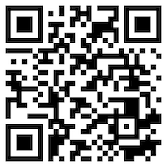
永續數據分析概論 (Introduction to Sustainability and ESG Data Analytics)
永續數據分析 (Sustainability and ESG Data Analytics)
1122ESGDA01
DM4, NTPU (N4084) (Spring 2024) Fri, 10, 11, 12 (18:30-21:15) (臺北大學民生校區 305)
戴敏育
Min-Yuh Day, Ph.D, Associate Professor
Institute of Information Management, National Taipei University
https://web.ntpu.edu.tw/~myday
https://meet.google.com/miy-fbif-max
2024-02-23

Slide 2
戴敏育 Min-Yuh Day, Ph.D.
Associate Professor, Information Management, NTPU
Visiting Scholar, IIS, Academia Sinica
Ph.D., Information Management, NTU
Director, Intelligent Financial Innovation Technology, IFIT Lab, IM, NTPU
Associate Director, Fintech and Green Finance Center, NTPU
Artificial Intelligence, Financial Technology, Big Data Analytics, Data Mining and Text Mining, Electronic Commerce

Slide 3
Course Syllabus National Taipei University Academic Year 112, 2nd Semester (Spring 2024)
Course Title: 永續數據分析概論 (Introduction to Sustainability and ESG Data Analytics)
Instructor: 戴敏育 (Min-Yuh Day)
Course Class: DM4, NTPU (3 Credits, Elective)
Details
USR Course @ Digital Marketing (3 Credits, Elective, One Semester) (N4084)
Time & Place: Fri, 10, 11, 12 (18:30-21:15) (民生校區305)
Google Meet: https://meet.google.com/miy-fbif-max
https://meet.google.com/miy-fbif-max

Slide 4
教學目標 (Course Objectives)
瞭解永續數據分析基本概念。
具備永續數據分析實務操作能力。
整合大數據分析的創新思維，提升永續發展運作模式。
在永續面向上，憑藉數據分析，研擬永續議題相關因應作為，並培養學生具有從資料中挖掘出具有管理意涵的數據分析基礎能力

Slide 5
Course Objectives
Understand the fundamental concepts of sustainability and ESG data analytics.
Equip with Hands-on practices of sustainability and ESG data analytics.
Integrate innovative thinking of big data analysis to enhance the operational model of sustainable development.
In the context of sustainability, use data analysis to formulate responses to sustainable issues and cultivate students' ability to extract management-relevant data analysis skills from the data.

Slide 6
課程包含永續發展(SDGs)目標
SDG4｜優質教育 (Quality Education)
SDG7｜可負擔的潔淨能源 (Affordable and Clean Energy)
SDG8｜尊嚴就業與經濟發展 (Decent Work and Economic Growth)
SDG9｜產業創新與基礎設施 (Industry, Innovation and Infrastructure)
SDG11｜永續城市與社區 (Sustainable Cities and Communities)
SDG12｜負責任的消費與生產 (Responsible Consumption and Production)
SDG13｜氣候行動 (Climate Action)
SDG17｜夥伴關係 (Partnerships for the Goals)

Slide 7
課程內容綱要 (Course Outline)
本課程介紹永續數據分析基本概念與實務操作。
課程內容包括
永續數據分析概論
環境、社會與治理 (ESG) 淨零數位轉型
永續與ESG 資料科學
Web 3.0 和大數據分析在金融科技、綠色永續金融
TCFD 氣候相關財務揭露與En-ROADS 氣候變遷模擬
ESG數據的收集、分析和視覺化
ESG數據報告、企業永續報告書
ESG數據驗證
能源之星報告與數據揭露
人工智慧物聯網在ESG永續應用
生成性AI於永續評等和報告生成
永續數據分析個案研究

Slide 8
Course Outline
This course introduces the fundamental concepts and hands-on practices of Sustainability and ESG Data Analytics.
Topics include
Introduction Sustainability and ESG Data Analytics
Environmental, Social, and Governance (ESG) in Net-Zero Digital Transformation
Data Science for Sustainability and ESG
Web 3.0 and Big Data Analysis in Fintech, Green Finance, Sustainable Finance
Task Force on Climate-Related Financial Disclosures (TCFD) and En-Roads Interactive
ESG Data Gathering, Analysis, and Visualization
ESG Data Reporting, Corporate Sustainability Reports
ESG Data Verification
Energy Star Reporting and Data Disclosure
Artificial Intelligence of things (AIoT) in ESG and Sustainability Applications
Generative AI for ESG Rating and Reporting Generation
Case Study on Sustainability and ESG Data Analytics

Slide 9
課程大綱 (Syllabus)
週次 (Week) 日期 (Date) 內容 (Subject/Topics)
1 2024/02/23 永續數據分析概論 (Introduction Sustainability and ESG Data Analytics)
2 2024/03/01 環境、社會與治理 (ESG) 淨零數位轉型 (Environmental, Social, and Governance (ESG) in Net-Zero Digital Transformation)
3 2024/03/08 永續與ESG 資料科學 (Data Science for Sustainability and ESG)
4 2024/03/15 永續數據分析個案研究 I (Case Study on Sustainability and ESG Data Analytics I)
5 2024/03/22 Web 3.0 和大數據分析在金融科技、綠色永續金融 (Web 3.0 and Big Data Analysis in Fintech, Green and Sustainable Finance)

Slide 10
課程大綱 (Syllabus)
週次 (Week) 日期 (Date) 內容 (Subject/Topics)
6 2024/03/29 TCFD 氣候相關財務揭露與En-ROADS 氣候變遷模擬 (Task Force on Climate-Related Financial Disclosures (TCFD) and En-Roads Interactive)
7 2024/04/05 放假 (No Classes)
8 2024/04/12 期中報告 (Midterm Project Report)
9 2024/04/19 ESG數據的收集、分析和視覺化 (ESG Data Gathering, Analysis, and Visualization)
10 2024/04/26 ESG數據報告 (ESG Data Reporting); 企業永續報告書 (Corporate Sustainability Reports)

Slide 11
課程大綱 (Syllabus)
週次 (Week) 日期 (Date) 內容 (Subject/Topics)
11 2024/05/03 ESG數據驗證 (ESG Data Verification)
12 2024/05/10 永續數據分析個案研究 II (Case Study on Sustainability and ESG Data Analytics II)
13 2024/05/17 能源之星報告與數據揭露 (Energy Star Reporting and Data Disclosure)
14 2024/05/24 人工智慧物聯網在ESG永續應用 (Artificial Intelligence of things (AIoT) in ESG and Sustainability Applications)
15 2024/05/31 生成式AI於永續評等和報告生成 (Generative AI for ESG Rating and Reporting Generation)
16 2024/06/07 期末報告 (Final Project Report)

Slide 12
課程與教學特色
結合 Web3.0介紹大數據分析基本概念、研究議題與實務操作。
提供數據整合溝通企劃的理論與實務概念及工具。
應用於分析各領域的資料，並透過資料視覺化的方式呈現分析結果。
預期社會影響：
由數據分析學習，培養面對永續議題與風險時，因應作為分析能力。
培養具備大數據分析基本概念、研究議題、實務操作以及永續數據分析實作能力的人才。

Slide 13
Course and Teaching Features
Combine Web3.0 to introduce basic concepts of big data analysis, research topics, and practical operations.
Provide theories and tools for data integration and communication planning.
Apply to analyze data from various domains and present analysis results through data visualization.
Expected Social Impact:
Learn from data analysis, cultivating the ability to analyze responses when facing sustainable issues and risks.
Train talents who possess basic concepts of big data analysis, research topics, practical operations, and practical abilities in sustainable data analysis.

Slide 14
教學策略創新
USR（大學社會責任）在地連結、合作
小組學習
問題取向教學
主題教學
學思達教學

Slide 15
校四大基本素養 (Four Fundamental Qualities)
專業 (Professionalism)
人際 (Interpersonal Relationship)
倫理 (Ethics)
國際觀 (International Vision)

Slide 16
商學院學習目標 (College Learning Goals)
Communication
Analytical and Critical Thinking
Ethics/Corporate Social Responsibility
Global Knowledge/Awareness

Slide 17
數位行銷進修學士學位學程 系核心能力
具有判斷商業問題並有系統地解決這些問題 40 %
能展現商業教育所需的基本技能 40 %
具有溝通能力 10 %
能意識道德問題及其影響 5 %
透過參與相關活動了解國際議題 5 %

Slide 18
教學方法與教學活動 (Teaching Methods and Activities)
講授 (Lecture)
討論 (Discussion)
實習 (Practicum)

Slide 19
評量方式 (Evaluation Methods)
個人報告 (Individual Presentation) 30 %
團體報告(Group Presentation) 30 %
個案分析報告 (Case Report) 20 %
課堂參與 (Class Participation) 10 %
作業 (Assignment) 10 %

Slide 20
指定用書 (Required Texts)
Cino Robin Castelli, Cyril Shmatov (2022), Quantitative Methods for ESG Finance, Wiley

Slide 21
參考書目 (Reference Books)
Simon Thompson (2023), Green and Sustainable Finance: Principles and Practice in Banking, Investment and Insurance, 2nd Edition, Kogan Page.
Chrissa Pagitsas (2023), Chief Sustainability Officers At Work: How CSOs Build Successful Sustainability and ESG Strategies, Apress.
Hariom Tatsat, Sahil Puri, Brad Lookabaugh (2020), Machine Learning and Data Science Blueprints for Finance: From Building Trading Strategies to Robo-Advisors Using Python, O'Reilly Media
Aurélien Géron (2022), Hands-On Machine Learning with Scikit-Learn, Keras, and TensorFlow: Concepts, Tools, and Techniques to Build Intelligent Systems, 3rd Edition, O’Reilly Media.
Chris Kelliher (2022), Quantitative Finance With Python: A Practical Guide to Investment Management, Trading, and Financial Engineering, Chapman and Hall/CRC.
Yves Hilpisch (2020), Artificial Intelligence in Finance: A Python-Based Guide, O’Reilly Media.
Abdullah Karasan (2021), Machine Learning for Financial Risk Management with Python: Algorithms for Modeling Risk, O’Reilly Media.
Yves Hilpisch (2018), Python for Finance: Mastering Data-Driven Finance, 2nd Edition, O'Reilly Media.

Slide 22
其他參考資料 (Other References)
GRI (Global Report Initiative): https://www.globalreporting.org/
CDP (Carbon Disclosure Project): https://www.cdp.net/
SASB (Sustainability Accounting Standards Board): https://sasb.org/
ISSB (International Sustainability Standards Board): https://www.ifrs.org/groups/international-sustainability-standards-board/
TCFD (Task Force on Climate-related Financial Disclosures): https://www.fsb-tcfd.org/
Research Papers

Slide 23
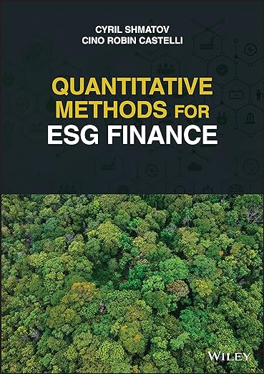
Cino Robin Castelli, Cyril Shmatov (2022), Quantitative Methods for ESG Finance, Wiley
Source: https://www.amazon.com/Quantitative-Methods-Finance-Robin-Castelli/dp/1119903807/

Slide 24
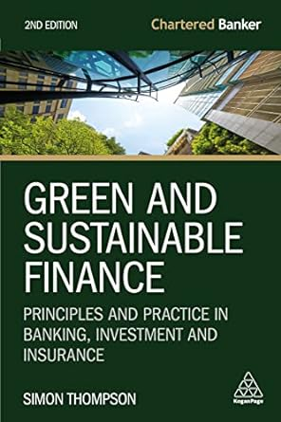
Simon Thompson (2023), Green and Sustainable Finance: Principles and Practice in Banking, Investment and Insurance, 2nd Edition, Kogan Page.
Source: https://www.amazon.com/Green-Sustainable-Finance-Principles-Investment/dp/1398609242/

Slide 25
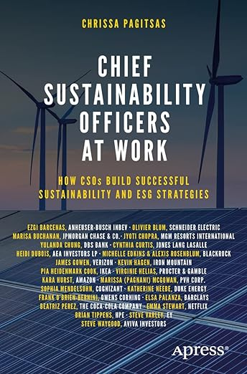
Chrissa Pagitsas (2023), Chief Sustainability Officers At Work: How CSOs Build Successful Sustainability and ESG Strategies, Apress.
Source: https://www.amazon.com/Chief-Sustainability-Officers-Work-Successful/dp/1484278658/

Slide 26
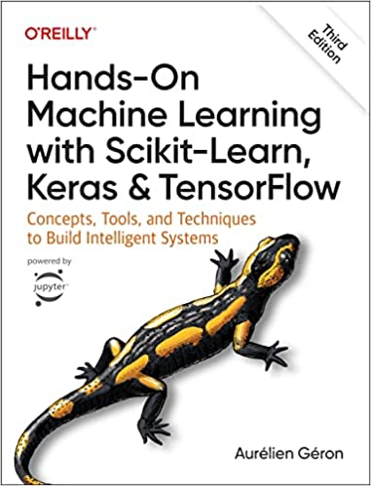
Aurélien Géron (2022), Hands-On Machine Learning with Scikit-Learn, Keras, and TensorFlow: Concepts, Tools, and Techniques to Build Intelligent Systems, 3rd Edition, O’Reilly Media.
Source: https://www.amazon.com/Hands-Machine-Learning-Scikit-Learn-TensorFlow/dp/1098125975

Slide 27
GRI (Global Report Initiative)
https://www.globalreporting.org/

Slide 28
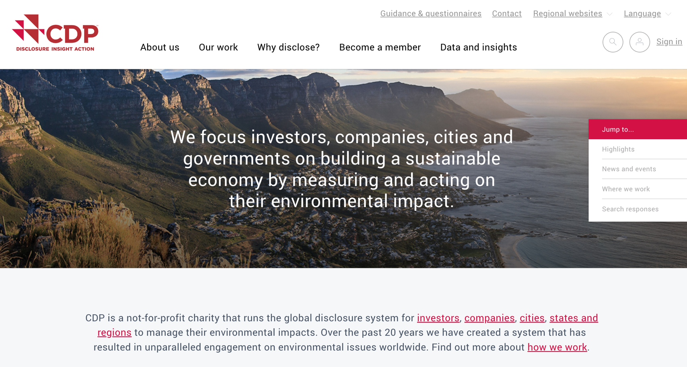
CDP (Carbon Disclosure Project)
https://www.cdp.net/

Slide 29
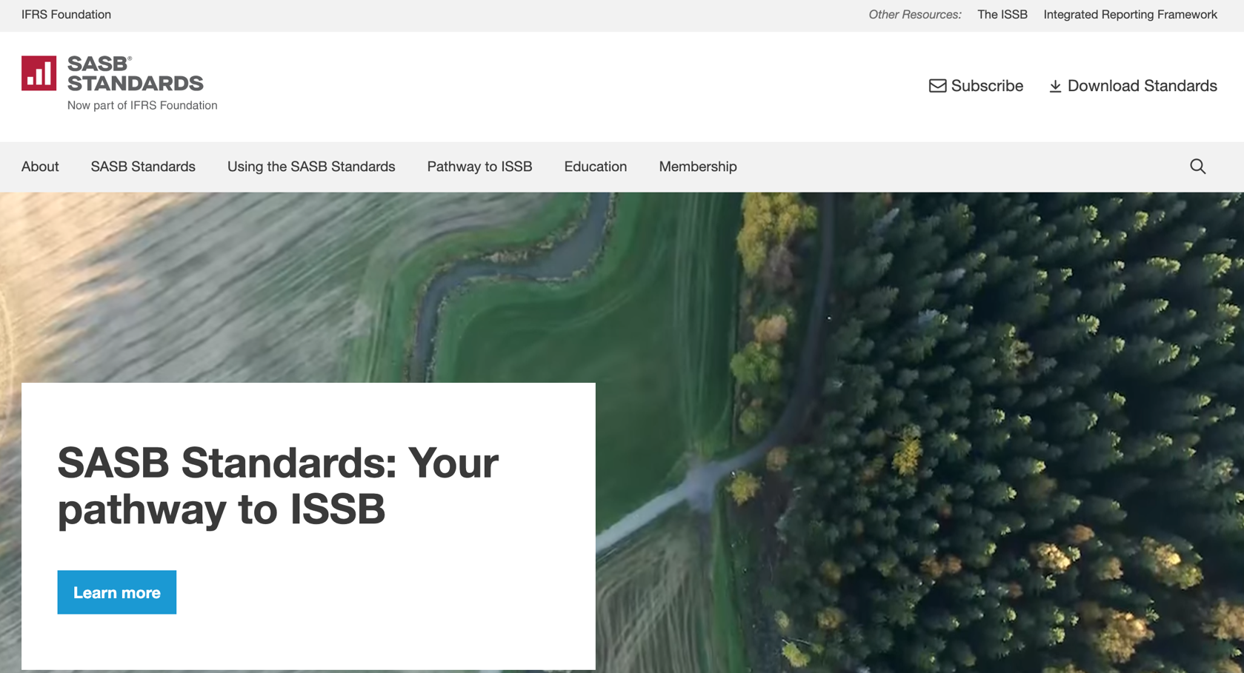
SASB (Sustainability Accounting Standards Board)
https://sasb.org/

Slide 30
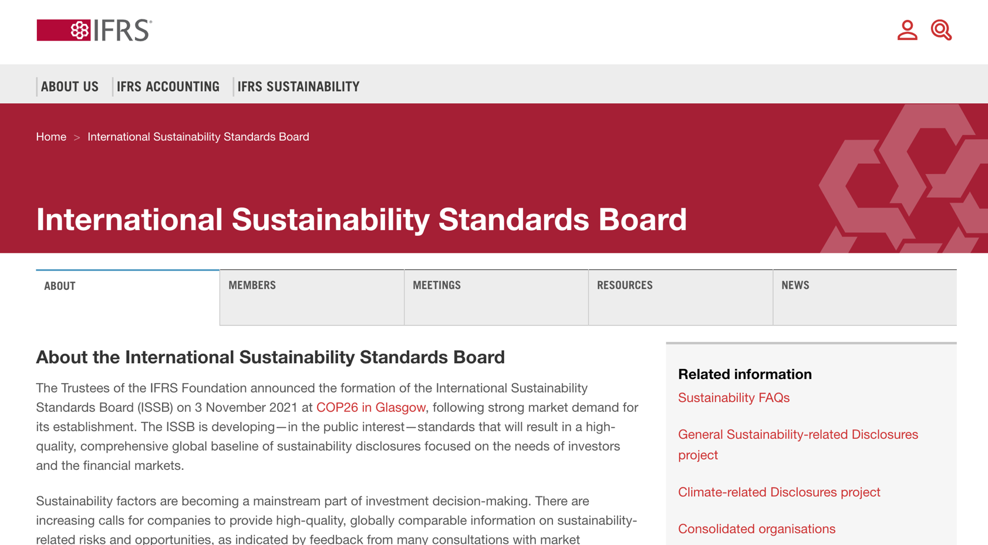
ISSB (International Sustainability Standards Board)
https://www.ifrs.org/groups/international-sustainability-standards-board/

Slide 31
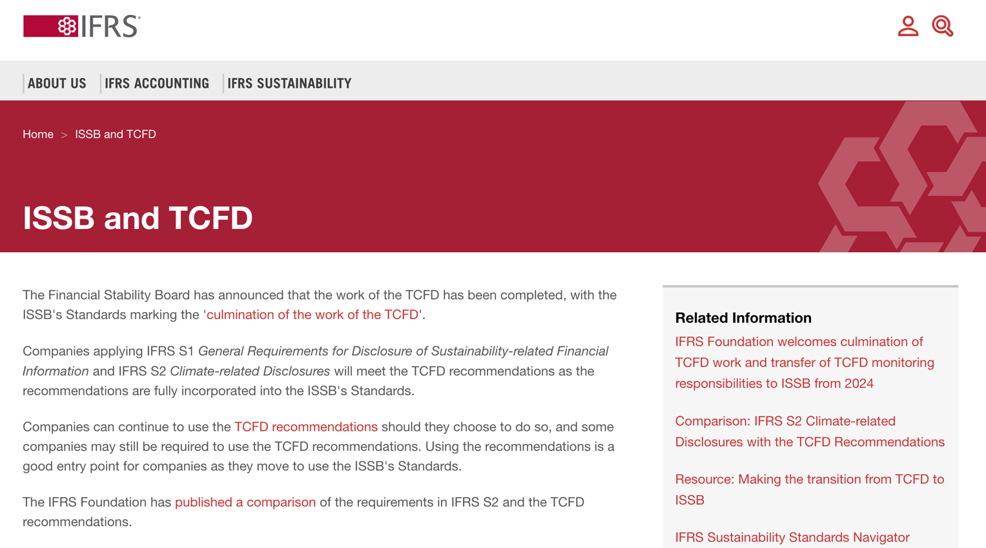
TCFD (Task Force on Climate-related Financial Disclosures)
https://www.ifrs.org/sustainability/tcfd/
https://www.fsb-tcfd.org/

Slide 32
Sustainability and ESG Data Analytics

Slide 33
Sustainable Development Goals (SDGs)
Source: https://sdgs.un.org/goals

Slide 34
Evolution of Sustainable Finance Research
Topic
SDGs: Sustainable Development Goals
SDGs
Innovative Financial Instrument
Impact Investing
ESG: Environmental, Social, and Governance
CSR: Corporate Social Responsibility
Conscious Capitalism
Climate Financing
Carbon Financing
Green Financing
Ethical Investing
Socially Responsible Investing
1986
1995
2005
2015
2020
Source: Kumar, S., Sharma, D., Rao, S., Lim, W. M., & Mangla, S. K. (2022). Past, present, and future of sustainable finance: Insights from big data analytics through machine learning of scholarly research. Annals of Operations Research, 1-44.

Slide 35
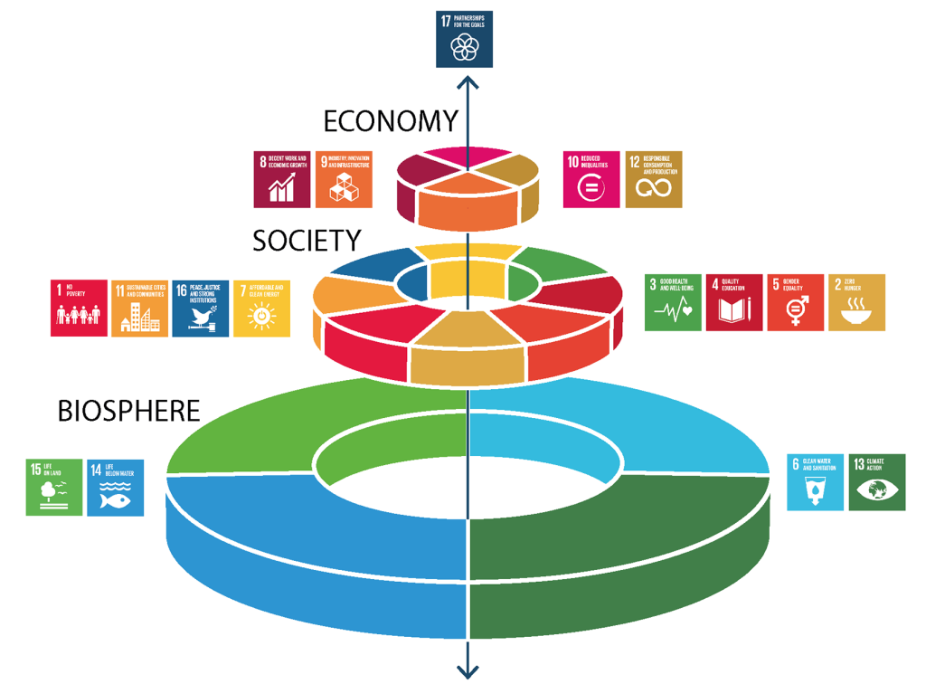
Sustainable Development Goals (SDGs) and 5P
Partnership
Peace
Prosperity
People
Planet
Source: Folke, Carl, Reinette Biggs, Albert V. Norström, Belinda Reyers, and Johan Rockström. "Social-ecological resilience and biosphere-based sustainability science.”Ecology and Society 21, no. 3 (2016).

Slide 36
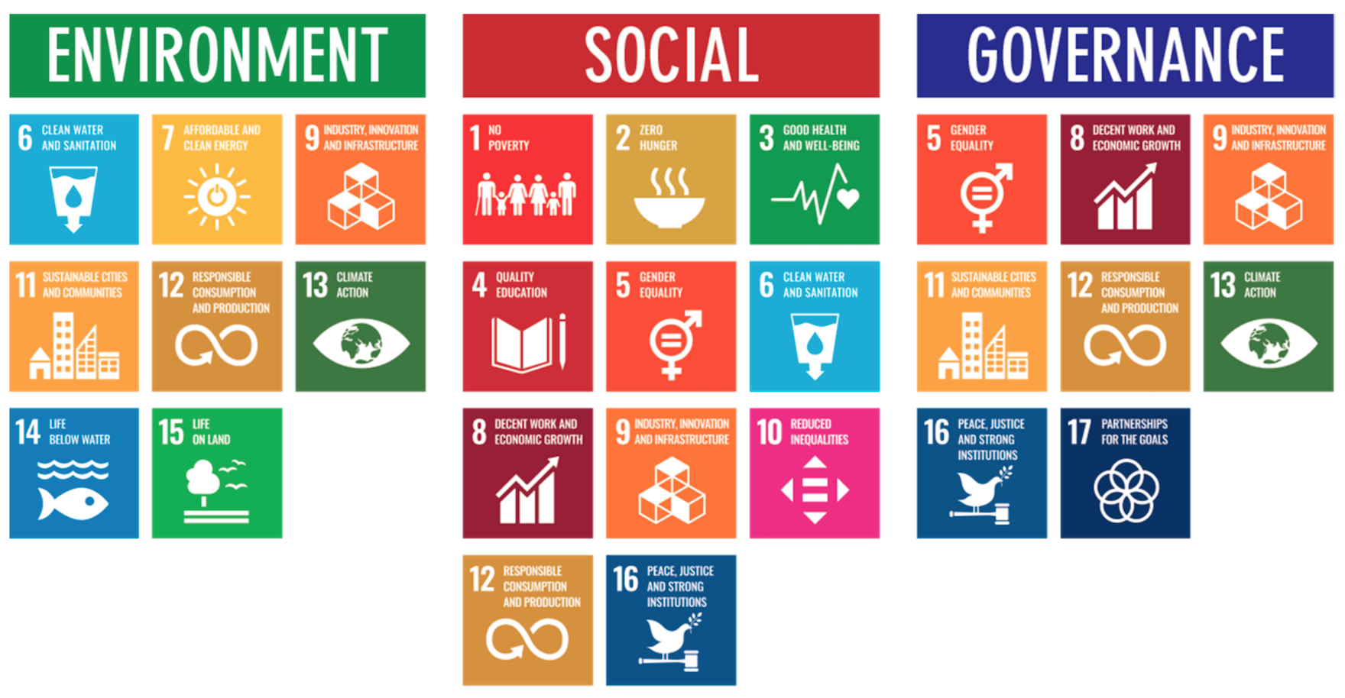
ESG to 17 SDGs
Source: Henrik Skaug Sætra (2021) "A Framework for Evaluating and Disclosing the ESG Related Impacts of AI with the SDGs." Sustainability 13, no. 15 (2021): 8503.

Slide 37
ESG to 17 SDGs
Source: https://sustainometric.com/esg-to-sdgs-connected-paths-to-a-sustainable-future/

Slide 38
Generative AI for ESG Applications

Slide 39
Sustainable Productivity: Finance ESG
Source: Huang, Ziqi, Yang Shen, Jiayi Li, Marcel Fey, and Christian Brecher (2021). "A survey on AI-driven digital twins in Industry 4.0: Smart manufacturing and advanced robotics." Sensors 21, no. 19: 6340.

Slide 40
Sustainable Resilient Manufacturing ESG
Source: Huang, Ziqi, Yang Shen, Jiayi Li, Marcel Fey, and Christian Brecher (2021). "A survey on AI-driven digital twins in Industry 4.0: Smart manufacturing and advanced robotics." Sensors 21, no. 19: 6340.

Slide 41
ESG Indexes
MSCI ESG Index
Dow Jones Sustainability Indices (DJSI)
FTSE ESG Index

Slide 42
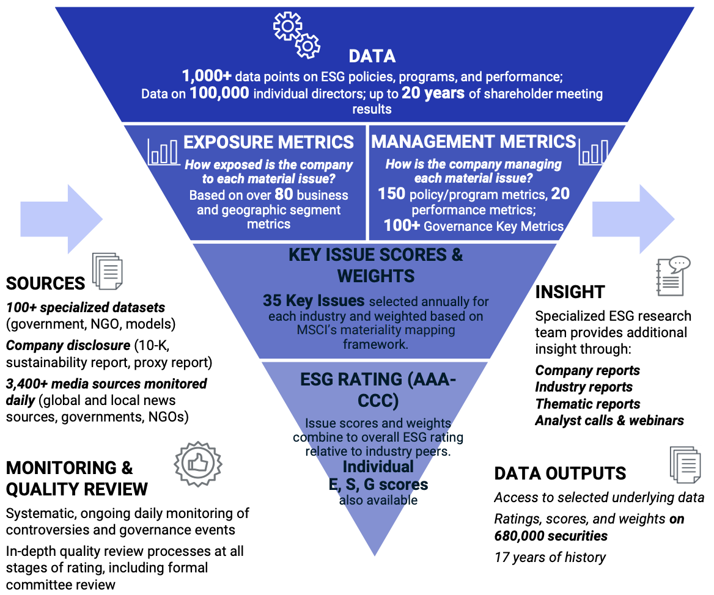
MSCI ESG Rating Framework
Source: https://www.msci.com/documents/1296102/21901542/ESG-Ratings-Methodology-Exec-Summary.pdf

Slide 43
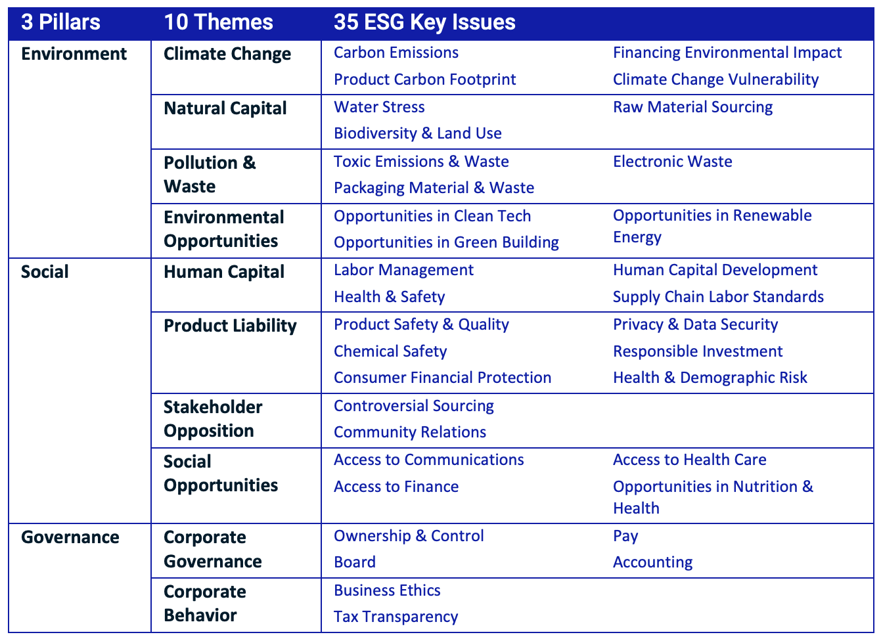
MSCI ESG Key Issue Hierarchy
Source: https://www.msci.com/documents/1296102/21901542/ESG-Ratings-Methodology-Exec-Summary.pdf

Slide 44
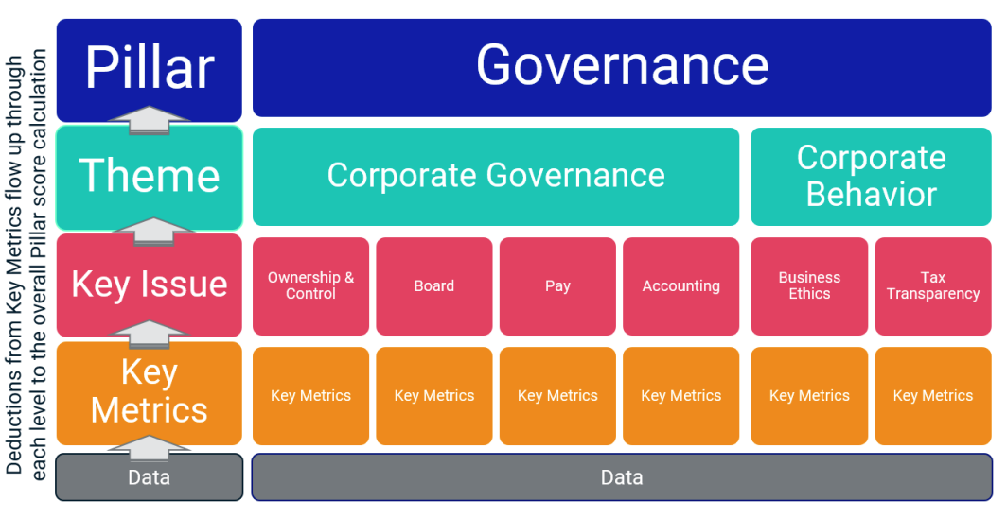
MSCI Governance Model Structure
Source: https://www.msci.com/documents/1296102/21901542/ESG-Ratings-Methodology-Exec-Summary.pdf

Slide 45
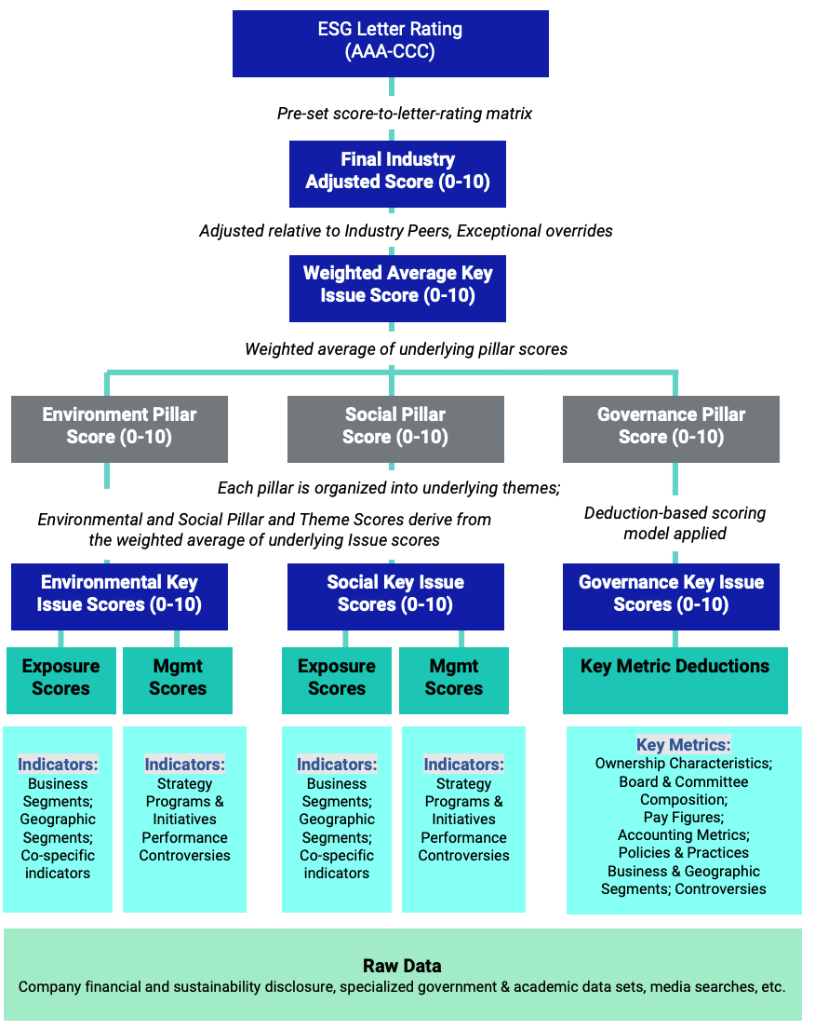
MSCI Hierarchy of ESG Scores
Source: https://www.msci.com/documents/1296102/21901542/ESG-Ratings-Methodology-Exec-Summary.pdf

Slide 46
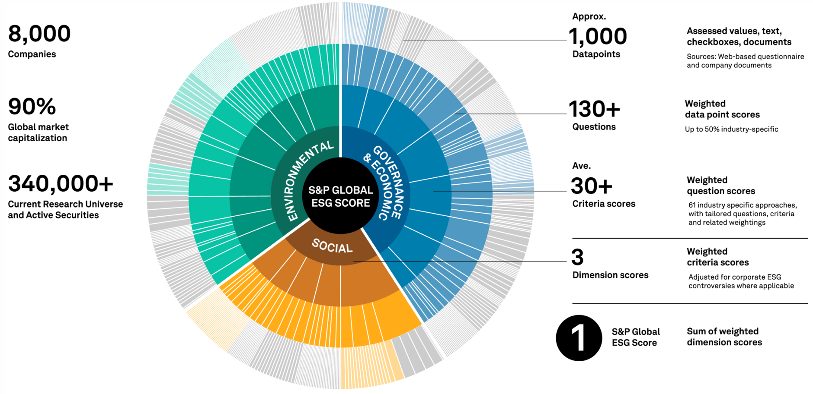
DJSI S&P Global ESG Score
Source: DJSI, S&P Global Corporate Sustainability Assessment (CSA), https://www.spglobal.com/esg/solutions/data-intelligence-esg-scores

Slide 47
FTSE Russell ESG Ratings
Source: https://www.ftserussell.com/data/sustainability-and-esg-data/esg-ratings

Slide 48
Sustainalytics ESG Risk Ratings
Analyst-based approach
Sustainalytics’ ESG Risk Ratings measure a company’s exposure to industry-specific material ESG risks and how well a company is managing those risks.
Source: https://www.sustainalytics.com/esg-data

Slide 49
Truvalue ESG Ranks
TruValue Labs
Machine-based approach
Truvalue Labs applies AI to analyze over 100,000 sources and uncover ESG risks and opportunities hidden in unstructured text.
The ESG Ranks data service produces an overall company rank based on industry percentile leveraging the 26 ESG categories defined by the Sustainability Accounting Standards Board (SASB).
The data feed covers 20,000+ companies with more than 13 years of history.
Source: :https://developer.truvaluelabs.com/data/esg-ranks

Slide 50
Analyst-driven vs. AI-driven ESG
Sustainalytics
Truvalue Labs
Source: Mark Tulay (2020), Man vs. machine: A tale of two sustainability ratings systems, GreenBiz, https://www.greenbiz.com/article/man-vs-machine-tale-two-sustainability-ratings-systems

Slide 51
Analyst based ESG Research AI based ESG Research
Source: https://www.esganalytics.io/insights/how-data-is-accelerating-esg

Slide 52
ESG Analytics: NLP Taxonomy
Source: https://www.esganalytics.io/insights/how-data-is-accelerating-esg

Slide 53
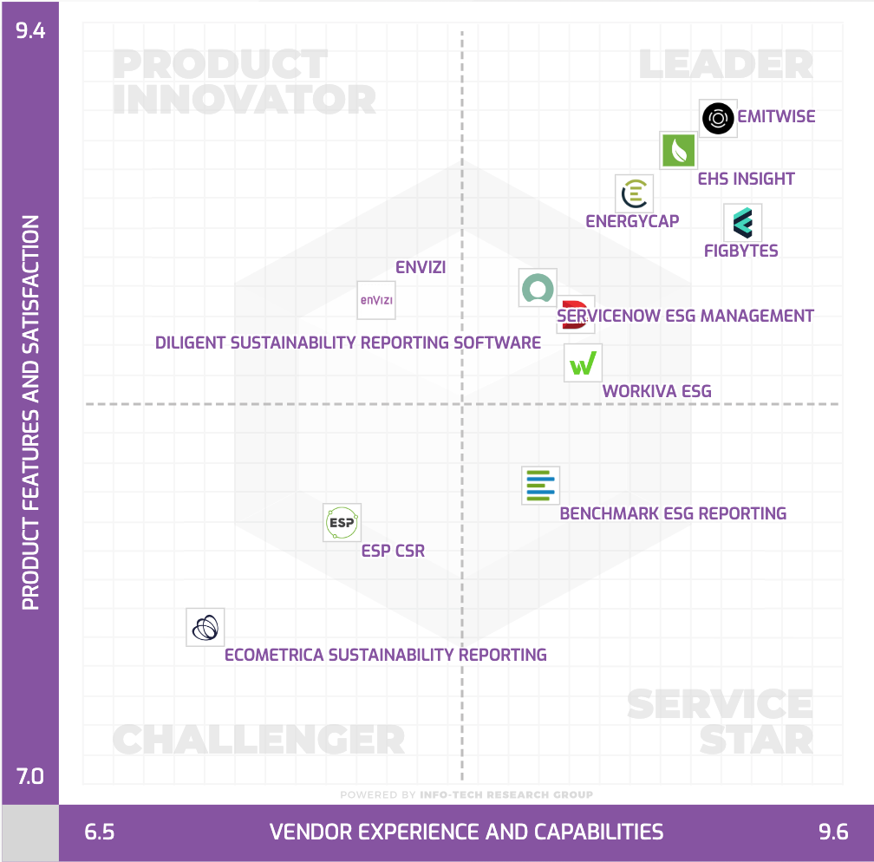
Top ESG Reporting Software
Environmental, Social and Governance (ESG) Reporting software or Sustainability software helps organizations manage their operational data, evaluate their impact on the environment and provide reporting to perform audits.
Source: https://www.softwarereviews.com/categories/environmental-social-and-governance-reporting

Slide 54
The Transformers Timeline
ULMFit
BERT
RoBERTa
XLM-R
DeBERTa
GPT-Neo
BLOOM
Alpaca
DistrilBERT
T5
PaLM
ChatGPT
Llama2
Transformer
GPT
GPT-2
GPT-3
GPT-J
OPT-175B
Llama
2017
2018
2019
2020
2021
2022
2023
Source: Lewis Tunstall, Leandro von Werra, and Thomas Wolf (2022), Natural Language Processing with Transformers: Building Language Applications with Hugging Face, O'Reilly Media.

Slide 55
Transformer Models
Transformer
Encoder
Decoder
DistilBERT
BERT
T5
GPT
RoBERTa
BART
GPT-2
CTRL
XLM-R
XLM
M2M-100
GPT-3
ALBERT
BigBird
GPT-Neo
GPT-J
ELECTRA
mT0
BLOOM
BLOOMZ
DeBERTa
ChatGPT
GPT-4
Source: Lewis Tunstall, Leandro von Werra, and Thomas Wolf (2022), Natural Language Processing with Transformers: Building Language Applications with Hugging Face, O'Reilly Media.

Slide 56
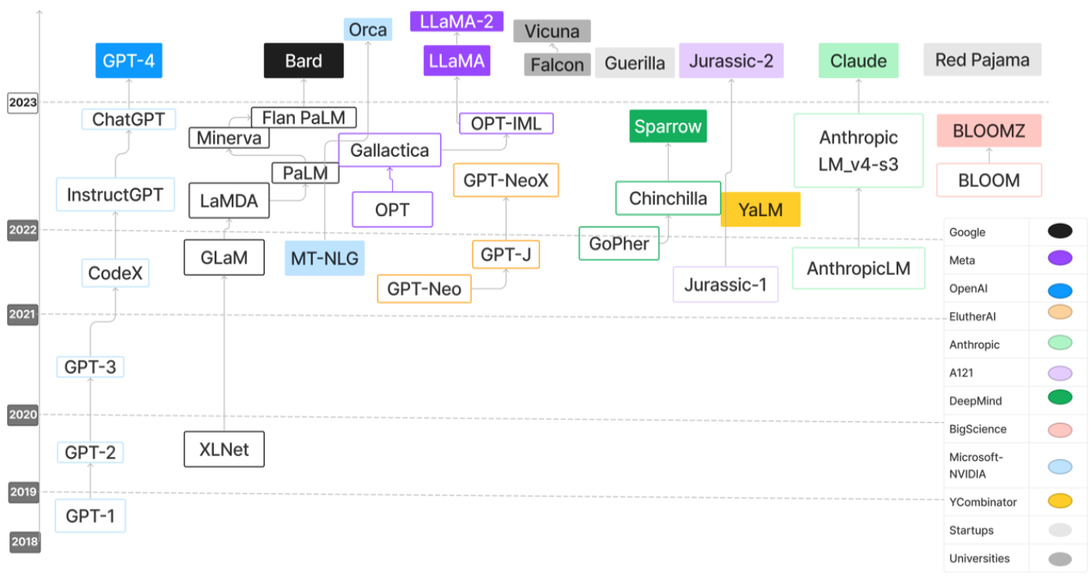
Large Language Models (LLMs)
Source: Hadi, Muhammad Usman, Rizwan Qureshi, Abbas Shah, Muhammad Irfan, Anas Zafar, Muhammad Bilal Shaikh, Naveed Akhtar, Jia Wu, and Seyedali Mirjalili. "Large language models: a comprehensive survey of its applications, challenges, limitations, and future prospects." Authorea Preprints (2023).

Slide 57
Four Paradigms in NLP (LM)
Transfer Learning: Pre-training, Fine-Tuning (FT)
GAI: Pre-train, Prompt, and Predict (Prompting)
Source: Pengfei Liu, Weizhe Yuan, Jinlan Fu, Zhengbao Jiang, Hiroaki Hayashi, and Graham Neubig. (2023) "Pre-train, prompt, and predict: A systematic survey of prompting methods in natural language processing." ACM Computing Surveys 55, no. 9 (2023): 1-35.

Slide 58
Generative AI Text, Image, Video, Audio Applications

Slide 59
Popular Generative AI
OpenAI ChatGPT (GPT-3.5, GPT-4)
OpenAI DALL·E 3
Perplexity.ai
Chat.LMSys.org
ChatPDF
Stable Diffusion
Video: D-ID, Synthesia
Audio: Speechify

Slide 60
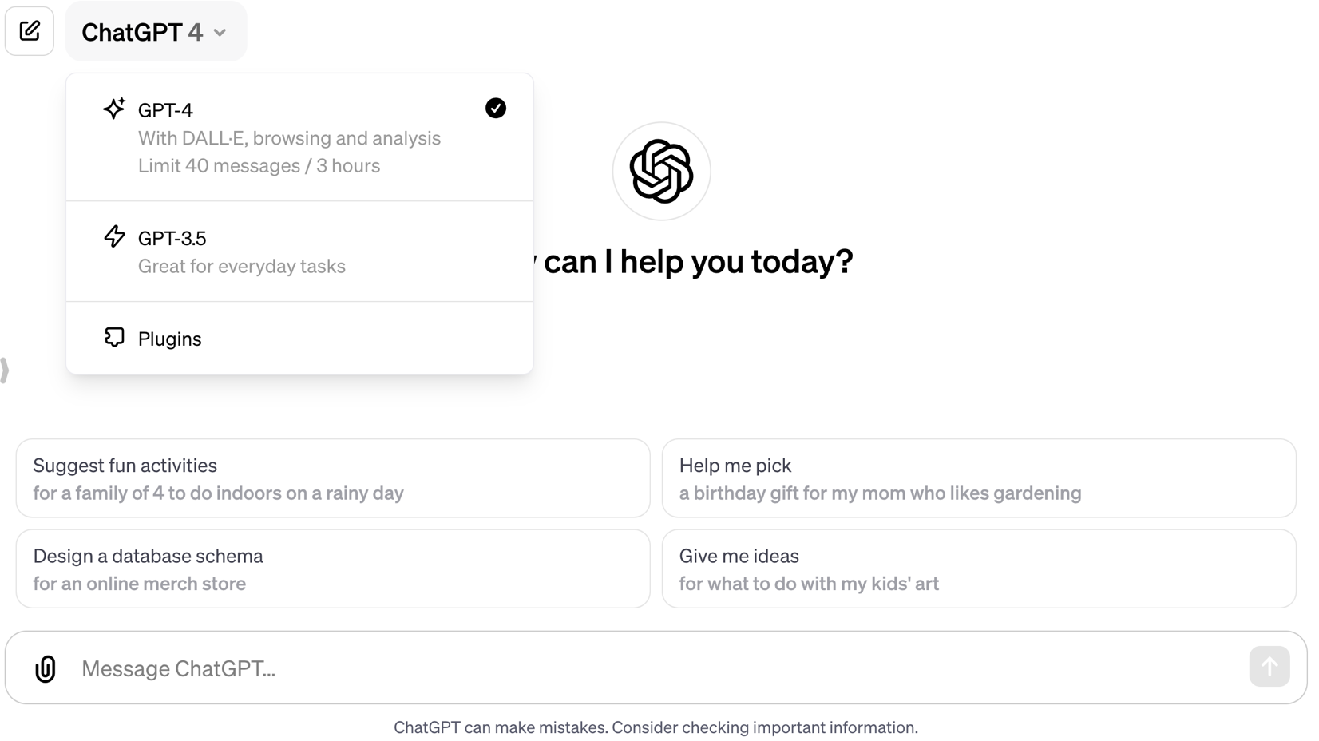
OpenAI ChatGPT (GPT-4, GPT-3.5)
https://chat.openai.com/

Slide 61
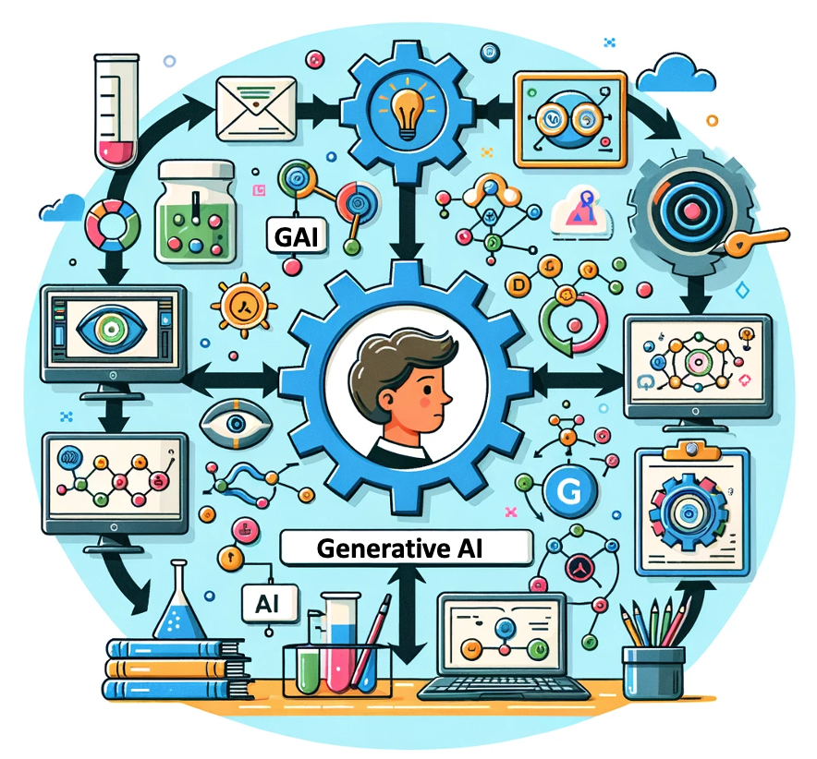
OpenAI ChatGPT (GPT-4) DALL·E 3
Vector graphic of a flowchart depicting the integration of generative AI in the education process, from content creation to virtual experiments, personalized learning, and innovative learning.
https://chat.openai.com/

Slide 62
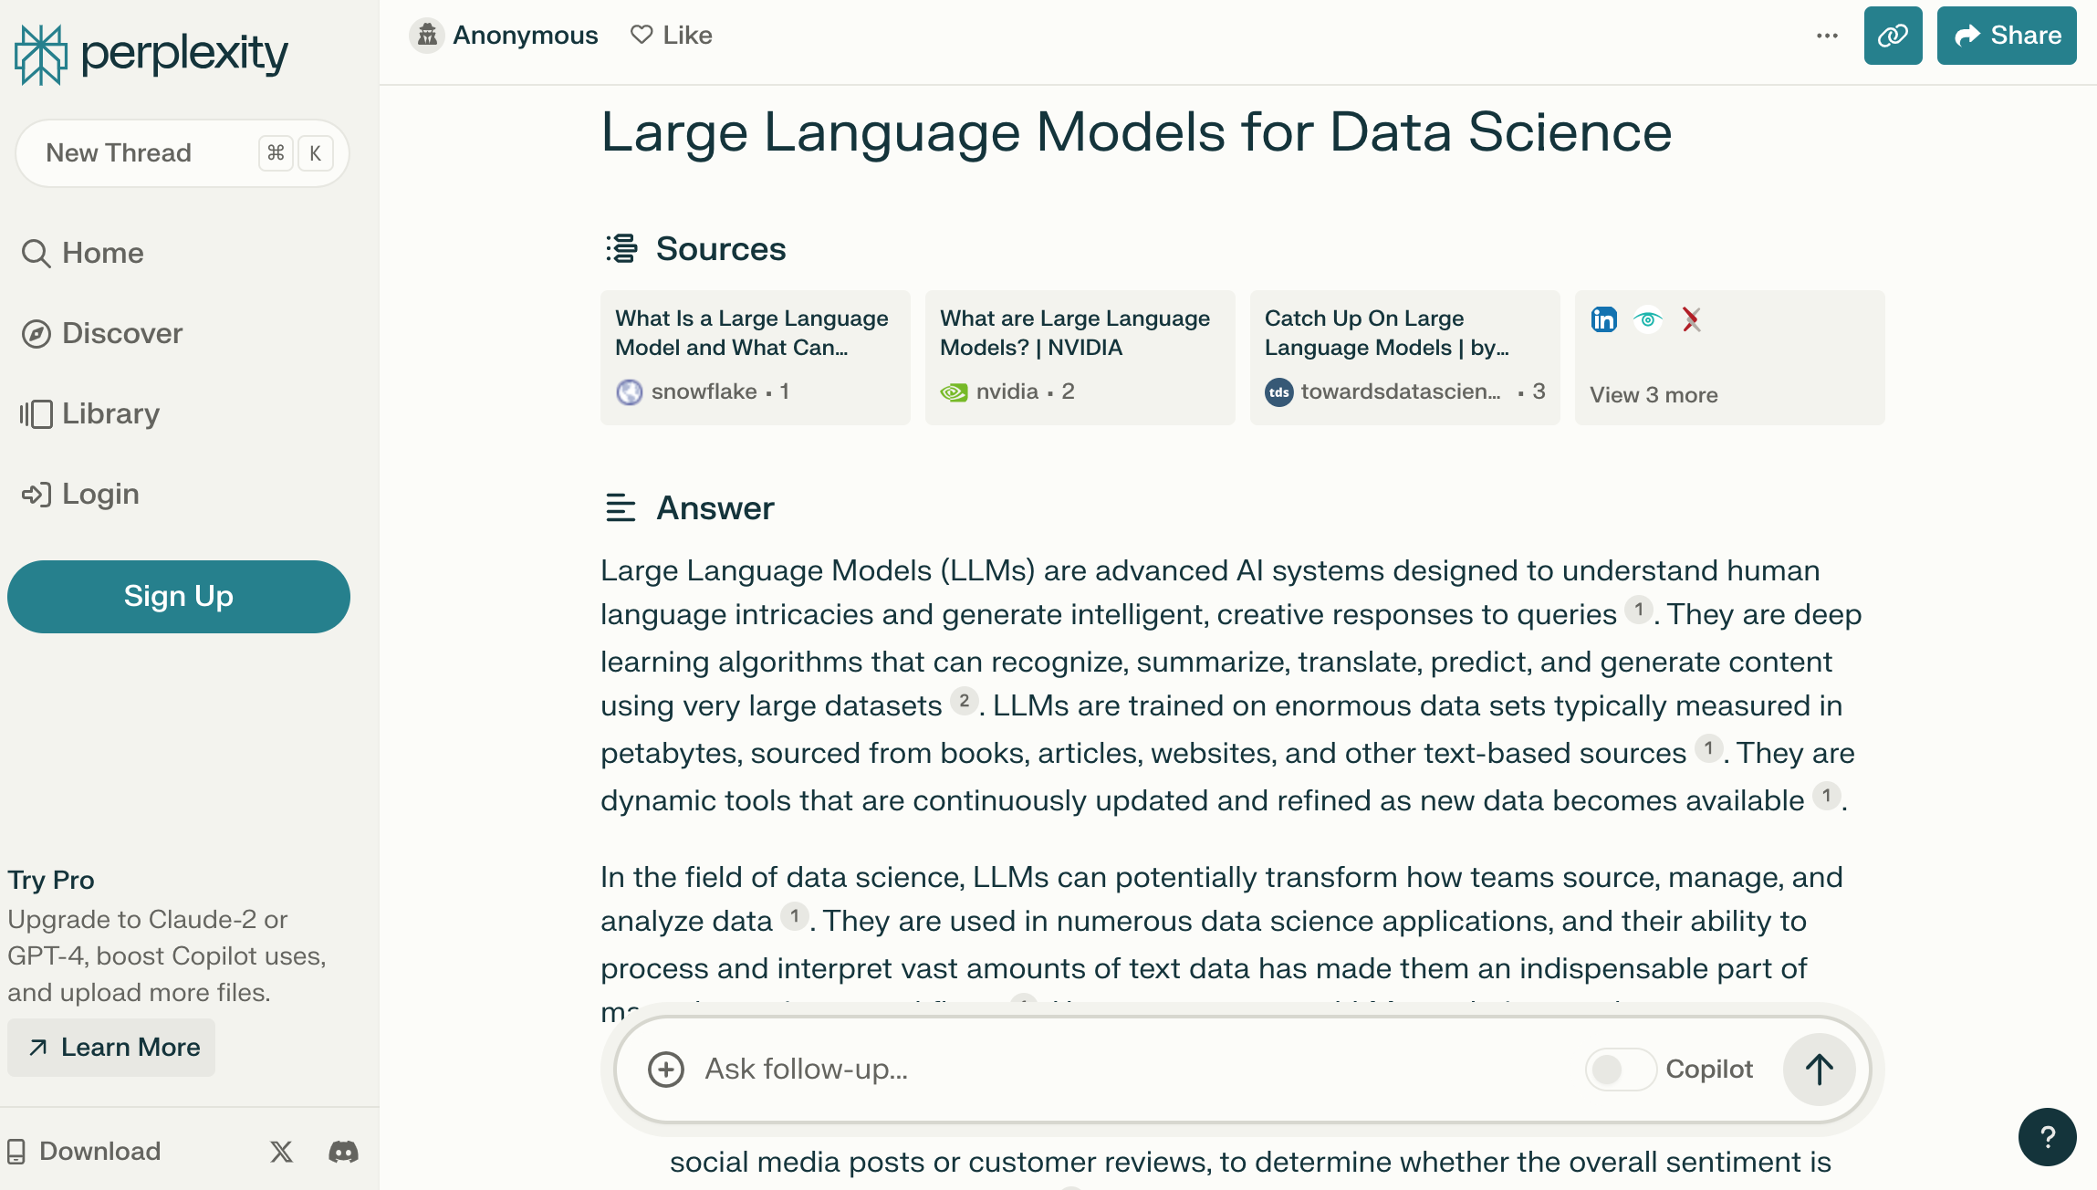
Perplexity.ai
https://www.perplexity.ai/

Slide 63
Chat with Open Large Language Models
chat.lmsys.org
⚔️ Chatbot Arena ⚔️ : Benchmarking LLMs in the Wild
Mixtral of experts: A Mixture-of-Experts model by Mistral AI | Qwen 1.5: A large language model by Alibaba Cloud | Bard: Bard by Google
Gemini: Gemini by Google | DeepSeek LLM: An advanced language model by DeepSeek | StripedHyena-Nous: A chat model developed by Together Research and Nous Research.
GPT-4-Turbo: GPT-4-Turbo by OpenAI | GPT-3.5: GPT-3.5-Turbo by OpenAI | Claude: Claude 2 by Anthropic
Claude Instant: Claude Instant by Anthropic | Nous-Hermes-2-Mixtral-8x7B-DPO: Nous Hermes finetuned from Mixtral 8x7B | OpenChat 3.5: An open model fine-tuned on Mistral-7B using C-RLFT
Llama2-70B-SteerLM-Chat: A Llama fine-tuned with SteerLM method by NVIDIA | pplx-online-llms: Online LLM API by Perplexity AI | OpenHermes-2.5-Mistral-7B: A mistral-based model fine-tuned on 1M GPT-4 outputs
Starling-LM-7B-alpha: An open model trained using RLAIF by Berkeley | Tulu 2: An instruction and RLHF model by UW/AllenAI | Yi-Chat: A large language model by 01 AI
Llama 2: Open foundation and fine-tuned chat models by Meta | Vicuna: A chat assistant fine-tuned on user-shared conversations by LMSYS | Zephyr: A chatbot fine-tuned from Mistral by Hugging Face
Code Llama: Open foundation models for code by Meta | WizardLM: An instruction-following LLM using evol-instruct by Microsoft
https://chat.lmsys.org/

Slide 64
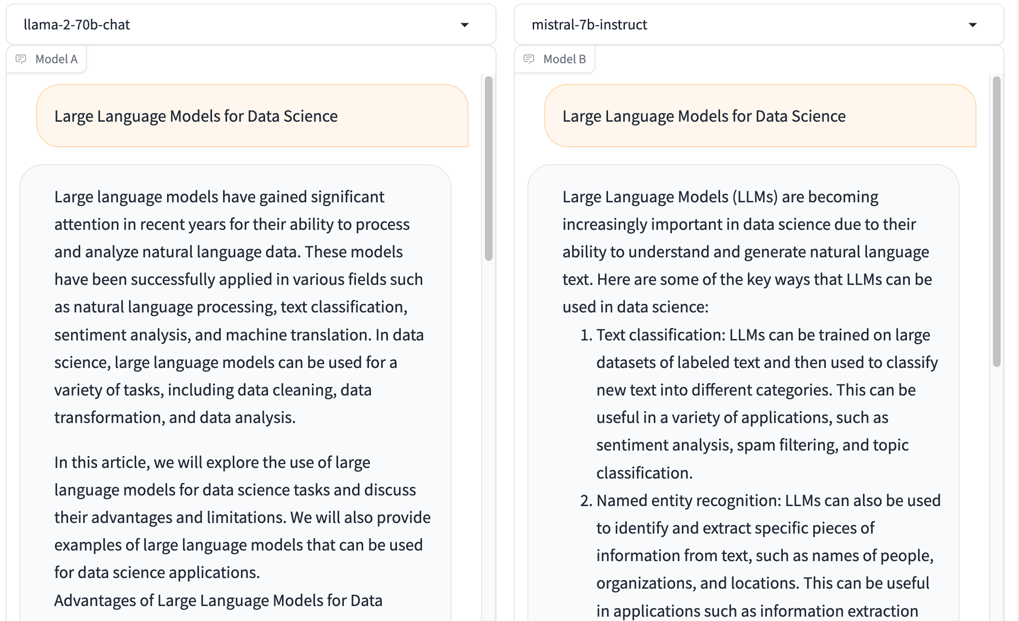
Chat with Open Large Language Models: Chatbot Arena
Large Language Models for Data Science
Llama 2-70b-chat
Mistral-7b-instruct
https://chat.lmsys.org/

Slide 65
Chatbot Arena Leaderboard LLM Leaderboard
Rank | 🤖 Model | ⭐ Arena Elo | 📊 95% CI | 🗳️ Votes | Organization | License
1 | GPT-4-1106-preview | 1254 | 5/-5 | 38745 | OpenAI | Proprietary
2 | GPT-4-0125-preview | 1253 | 10/-8 | 6308 | OpenAI | Proprietary
3 | Bard (Gemini Pro) | 1218 | 8/-7 | 10313 | Google | Proprietary
4 | GPT-4-0314 | 1191 | 6/-6 | 20430 | OpenAI | Proprietary
5 | GPT-4-0613 | 1164 | 5/-6 | 32941 | OpenAI | Proprietary
6 | Mistral Medium | 1152 | 5/-7 | 17847 | Mistral | Proprietary
7 | Claude-1 | 1150 | 7/-5 | 19017 | Anthropic | Proprietary
8 | Qwen1.5-72B-Chat | 1147 | 8/-8 | 5204 | Alibaba | Qianwen LICENSE
9 | Claude-2.0 | 1132 | 6/-8 | 12753 | Anthropic | Proprietary
10 | Gemini Pro (Dev API) | 1122 | 7/-7 | 9024 | Google | Proprietary
11 | Claude-2.1 | 1120 | 6/-4 | 27723 | Anthropic | Proprietary
12 | Mixtral-8x7b-Instruct-v0.1 | 1120 | 5/-6 | 18410 | Mistral | Apache 2.0
13 | GPT-3.5-Turbo-0613 | 1118 | 5/-5 | 36704 | OpenAI | Proprietary
14 | Gemini Pro | 1115 | 9/-9 | 6958 | Google | Proprietary
15 | Yi-34B-Chat | 1111 | 7/-8 | 7734 | 01 AI | Yi License
https://chat.lmsys.org/

Slide 66
Generative AI and LLMs for Sustainability and ESG Data Analytics

Slide 67
Sustainability and ESG Data Analytics

Slide 68
Generative AI for ESG Rating and Reporting Generation

Slide 69
Teaching
Big Data Analytics
Fall 2020, Spring 2023, Spring 2024
Software Engineering
Fall 2020, Fall, 2021, Spring 2022, Spring 2023, Spring 2024
Artificial Intelligence in Finance and Quantitative
Fall 2021, Fall 2022, Fall 2023
Artificial Intelligence
Spring 2021, Fall 2022
Artificial Intelligence for Text Analytics
Spring 2022, Fall 2023
Sustainability and ESG Data Analytics
Spring 2024
Python for Accounting Applications
Fall 2023
Foundation of Business Cloud Computing
Spring 2021, Spring 2022, Spring 2023, Spring 2024
https://web.ntpu.edu.tw/~myday/teaching.htm

Slide 70
Research Projects
Fintech Green Finance for Carbon Market Index, Corporate Finance, and Environmental Policies. Carbon Emission Sentiment Index with AI Text Analytics
NTPU, 113-NTPU_ORDA-F-003，2023/01/01~2024/12/31
Digital Support, Unimpeded Communication: The Development, Support and Promotion of AI-assisted Communication Assistive Devices for Speech Impairment (1/3). Multimodal Cross-lingual Task-Oriented Dialogue System for Inclusive Communication Support
NSTC 112-2425-H-305-002-, 3 Years (2023/05/01-2026/04/30) Year 1: 2023/05/01~2024/04/30
Research on speech processing, synthesis, recognition, and sentence construction of people with language disabilities. Multimodal Cross-lingual Task-Oriented Dialogue System
NTPU, 113-NTPU_ORDA-F-004, 2023/01/01~2025/12/31
Metaverse AI Multimodal Cross-Language Task-Oriented Dialogue System
ATEC Group, Fintech and Green Finance Center (FGFC, NTPU), NTPU-112A413E01, 3 Years (2023/05/01~2026/04/30)
Establishment and Implement of Smart Assistive Technology for Dementia Care and Its Socio-Economic Impacts (2/3). Intelligent, individualized and precise care with smart AT and system integration
NSTC, 112-2627-M-038-001-, 2023/08/01~2024/07/31
Prospective longitudinal study on peri-implant bone loss associated with peri-implantitis
USTP (NTPU, TMU), USTP-NTPU-TMU-113-03, 2024/01/01~2024/12/31
https://web.ntpu.edu.tw/~myday/cindex.htm#projects

Slide 71
總結 (Summary)
本課程介紹永續數據分析基本概念與實務操作。
課程內容包括
永續數據分析概論
環境、社會與治理 (ESG) 淨零數位轉型
永續與ESG 資料科學
Web 3.0 和大數據分析在金融科技、綠色永續金融
TCFD 氣候相關財務揭露與En-ROADS 氣候變遷模擬
ESG數據的收集、分析和視覺化
ESG數據報告、企業永續報告書
ESG數據驗證
能源之星報告與數據揭露
人工智慧物聯網在ESG永續應用
生成性AI於永續評等和報告生成
永續數據分析個案研究

Slide 72
永續數據分析 (Sustainability and ESG Data Analytics)
Contact Information
戴敏育 (Min-Yuh Day, Ph.D.)
Associate Professor
Institute of Information Management, National Taipei University
Tel: 02-86741111 ext. 66873
Office: B8F12
Address: 151, University Rd., San Shia District, New Taipei City, 23741 Taiwan
Email: myday@gm.ntpu.edu.tw
Web: http://web.ntpu.edu.tw/~myday/

