Slide 1


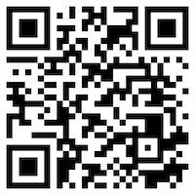





Web 3.0 和大數據分析在金融科技、綠色永續金融
(Web 3.0 and Big Data Analysis in
Fintech, Green and Sustainable Finance)
永續數據分析
(Sustainability and ESG Data Analytics)
1122ESGDA04
DM4, NTPU (N4084) (Spring 2024)
Fri, 10, 11, 12 (18:30-21:15) (臺北大學民生校區 305)
戴敏育 教授
Min-Yuh Day, Ph.D,
Professor
Institute of Information Management, National Taipei University
https://web.ntpu.edu.tw/~myday
https://meet.google.com/miy-fbif-max
2024-03-22

Slide 2
課程大綱 (Syllabus)
週次 (Week) 日期 (Date) 內容 (Subject/Topics)
1 2024/02/23 永續數據分析概論
(Introduction Sustainability and ESG Data Analytics)
2 2024/03/01 環境、社會與治理 (ESG) 淨零數位轉型
(Environmental, Social, and Governance (ESG) in Net-Zero Digital Transformation)
3 2024/03/08 永續與ESG 資料科學
(Data Science for Sustainability and ESG)
4 2024/03/15 永續數據分析個案研究 I
(Case Study on Sustainability and ESG Data Analytics I)
5 2024/03/22 Web 3.0 和大數據分析在金融科技、綠色永續金融
(Web 3.0 and Big Data Analysis in Fintech, Green and Sustainable Finance)

Slide 3
課程大綱 (Syllabus)
週次 (Week) 日期 (Date) 內容 (Subject/Topics)
6 2024/03/29 TCFD 氣候相關財務揭露與En-ROADS 氣候變遷模擬
(Task Force on Climate-Related Financial Disclosures (TCFD)
and En-Roads Interactive)
7 2024/04/05 放假 (No Classes)
8 2024/04/12 期中報告 (Midterm Project Report)
9 2024/04/19 ESG數據的收集、分析和視覺化
(ESG Data Gathering, Analysis, and Visualization)
10 2024/04/26 ESG數據報告 (ESG Data Reporting);
企業永續報告書 (Corporate Sustainability Reports)

Slide 4
課程大綱 (Syllabus)
週次 (Week) 日期 (Date) 內容 (Subject/Topics)
11 2024/05/03 ESG數據驗證 (ESG Data Verification)
12 2024/05/10 永續數據分析個案研究 II
(Case Study on Sustainability and ESG Data Analytics II)
13 2024/05/17 能源之星報告與數據揭露
(Energy Star Reporting and Data Disclosure)
14 2024/05/24 人工智慧物聯網在ESG永續應用
(Artificial Intelligence of things (AIoT) in ESG and Sustainability Applications)
15 2024/05/31 生成式AI於永續評等和報告生成
(Generative AI for ESG Rating and Reporting Generation)
16 2024/06/07 期末報告 (Final Project Report)

Slide 5
Web 3.0 and
Big Data Analysis in
Fintech, Green and Sustainable Finance

Slide 6
Outline
Web 3.0
Big Data Analysis
Fintech
Green and Sustainable Finance

Slide 7
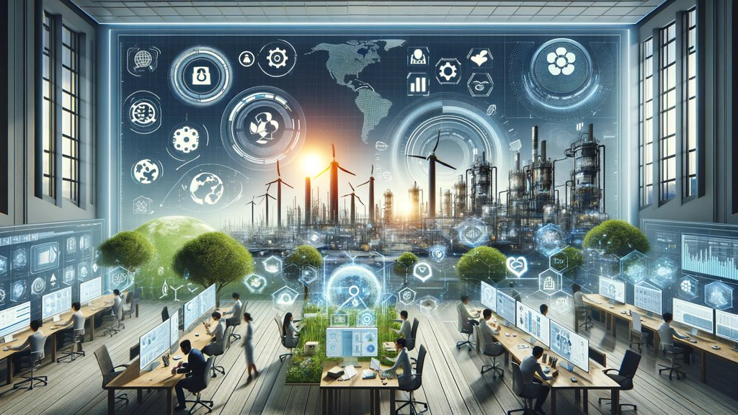
Sustainability and ESG Data Analytics

Slide 8
FinTech ABCD
AI
Block Chain
Cloud Computing
Big Data

Slide 9
Decentralized Finance (DeFi)
Block Chain Financial Technology
Block Chain & Bitcoin
(BTC)
Smart Contract & Ethereum
(ETH)
Decentralized Application
(DApp)

Slide 10
Artificial Intelligence
(AI)

Slide 11
AI, Big Data, Cloud Computing
Evolution of Decision Support, Business Intelligence, and Analytics
AI
AI
Cloud Computing
Big Data
DM
BI
Source: Ramesh Sharda, Dursun Delen, and Efraim Turban (2017),
Business Intelligence, Analytics, and Data Science: A Managerial Perspective, 4th Edition, Pearson

Slide 12
AI, ML, DL
Artificial Intelligence (AI)
Machine Learning (ML)
Supervised
Learning
Unsupervised Learning
Deep Learning (DL)
CNN
RNN LSTM GRU
GAN
Semi-supervised Learning
Reinforcement Learning
Source: https://leonardoaraujosantos.gitbooks.io/artificial-inteligence/content/deep_learning.html

Slide 13
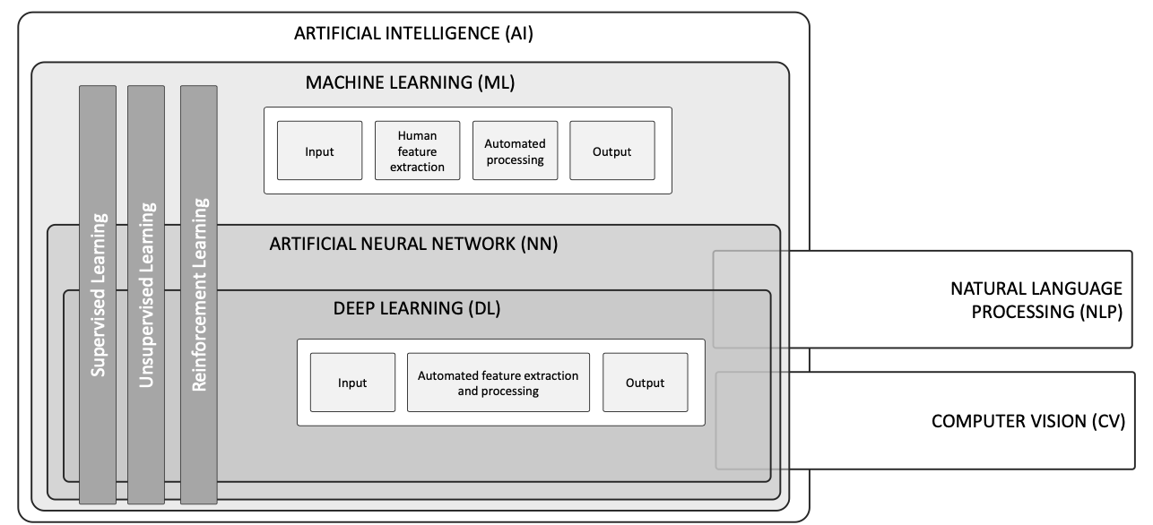
AI, ML, NN, DL
Source: Schoormann, T., Strobel, G., Möller, F., Petrik, D., & Zschech, P. (2023).
Artificial Intelligence for Sustainability—A Systematic Review of Information Systems Literature. Communications of the Association for Information Systems, 52(1), 8.

Slide 14
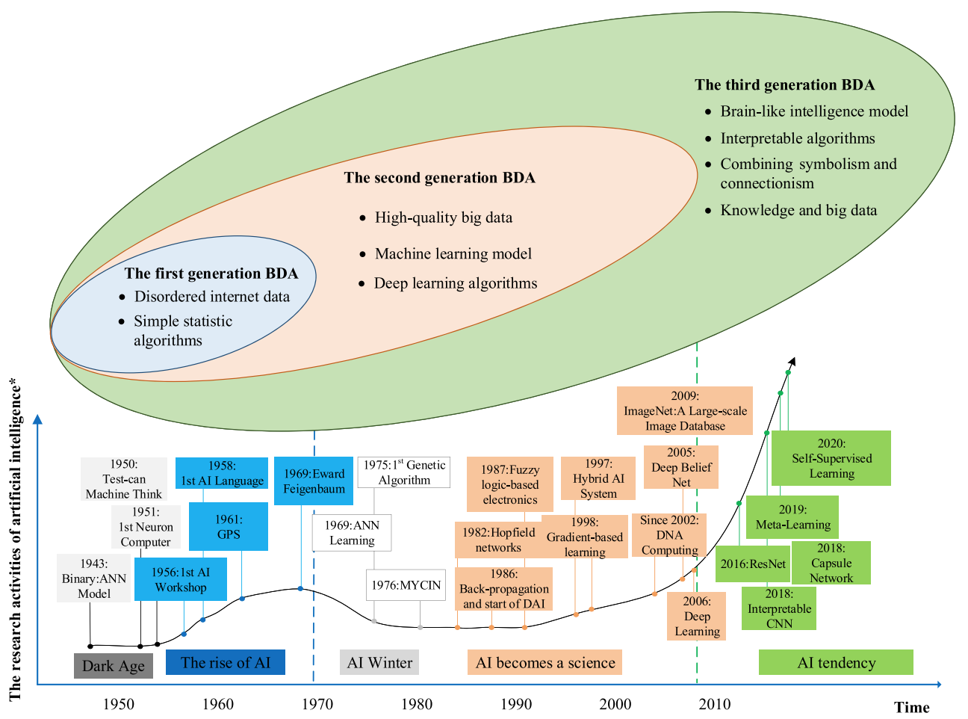
AI and Big Data Analytics (BDA)
Source: Wang, Junliang, Chuqiao Xu, Jie Zhang, and Ray Zhong (2022). "Big data analytics for intelligent manufacturing systems: A review." Journal of Manufacturing Systems 62 (2022): 738-752.

Slide 15
AI Acting Humanly:
The Turing Test Approach
(Alan Turing, 1950)
Knowledge Representation
Automated Reasoning
Machine Learning (ML)
  Deep Learning (DL)
Computer Vision (Image, Video)
Natural Language Processing (NLP)
Robotics
Source: Stuart Russell and Peter Norvig (2020), Artificial Intelligence: A Modern Approach, 4th Edition, Pearson

Slide 16
Web 3.0

Slide 17
Web3
Metaverse
DeFi
NFT

Slide 18
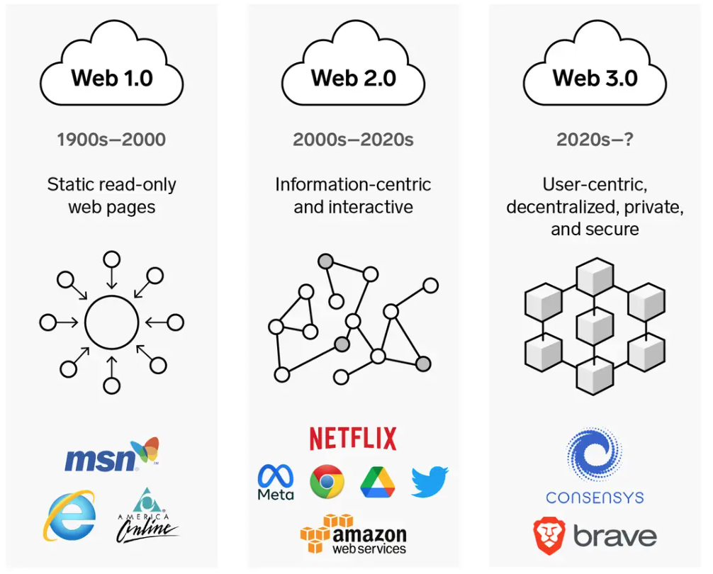
Web3: Decentralized Web
Internet Evolution
1990
2000
2020
Source: https://www.businessinsider.com/personal-finance/what-is-web3

Slide 19
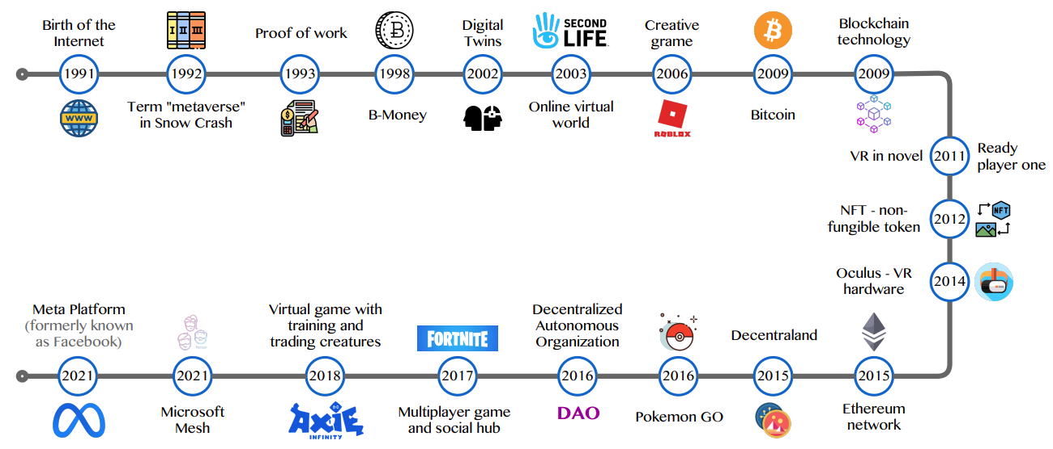
Metaverse Development from 1991 to 2021
Source: Huynh-The, Thien, Quoc-Viet Pham, Xuan-Qui Pham, Thanh Thi Nguyen, Zhu Han, and Dong-Seong Kim (2022).
"Artificial Intelligence for the Metaverse: A Survey." arXiv preprint arXiv:2202.10336.

Slide 20
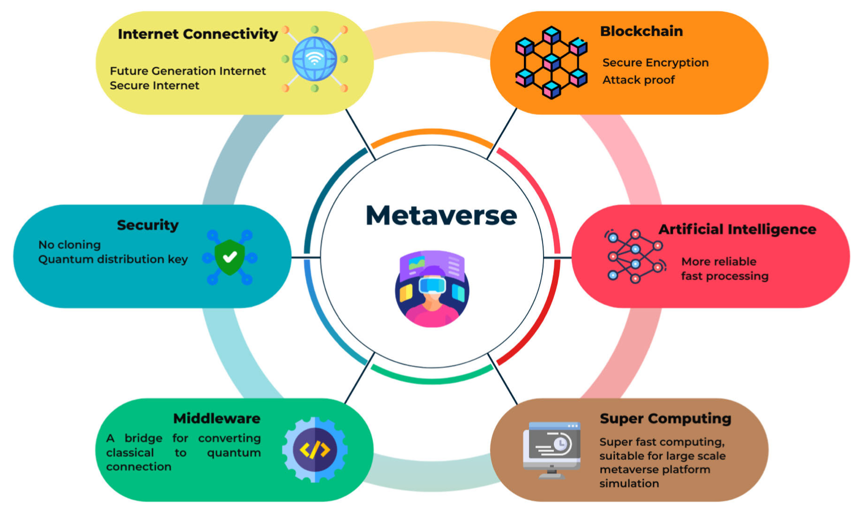
Quantum Computing in the Metaverse
Source: Tuli, Esmot Ara, Jae-Min Lee, and Dong-Seong Kim (2024). "Integration of Quantum Technologies into Metaverse: Applications, Potentials, and Challenges." IEEE Access 12 (2024): 29995-30019.

Slide 21
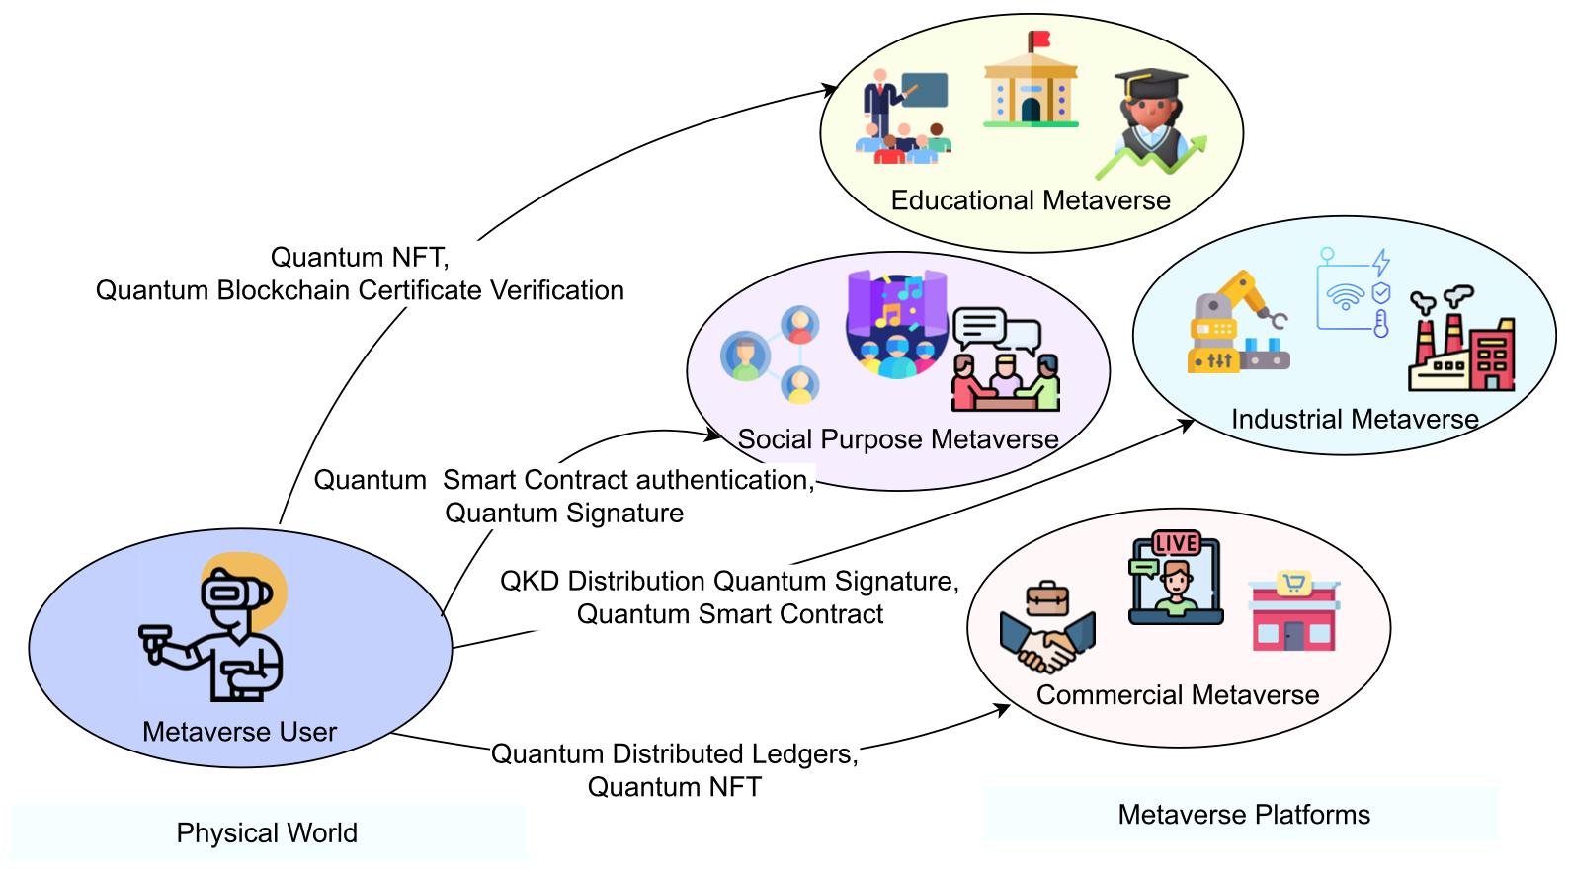
Quantum Blockchain: Bridging between the real world and metaverse
Source: Tuli, Esmot Ara, Jae-Min Lee, and Dong-Seong Kim (2024). "Integration of Quantum Technologies into Metaverse: Applications, Potentials, and Challenges." IEEE Access 12 (2024): 29995-30019.

Slide 22
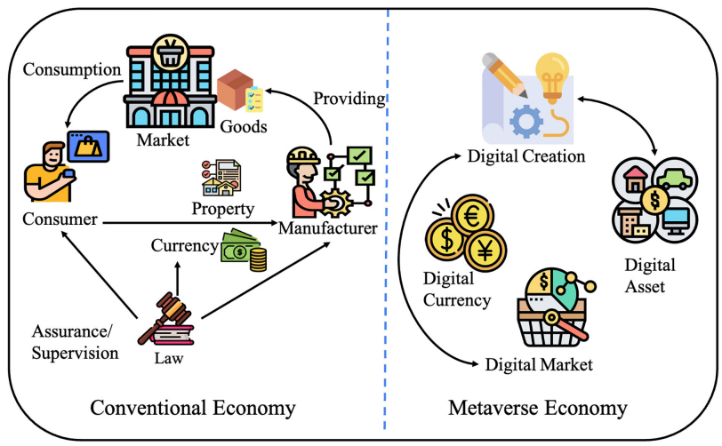
Metaverse Economy
Source: Yang, Qinglin, Yetong Zhao, Huawei Huang, Zehui Xiong, Jiawen Kang, and Zibin Zheng (2022).
"Fusing blockchain and AI with metaverse: A survey." IEEE Open Journal of the Computer Society 3 : 122-136.

Slide 23
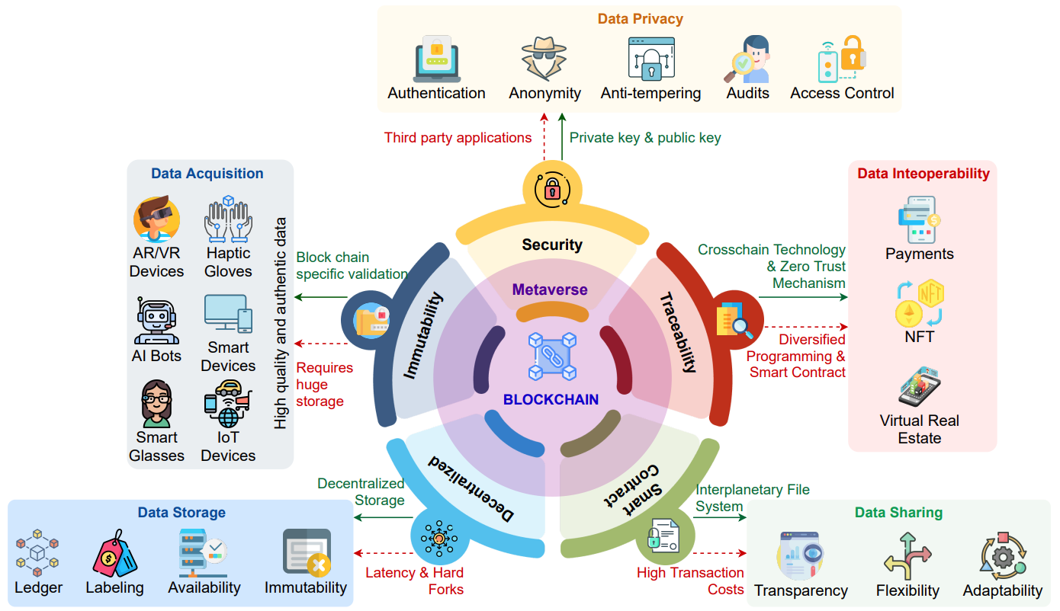
Blockchain in the Metaverse
Source: Gadekallu, Thippa Reddy, Thien Huynh-The, Weizheng Wang, Gokul Yenduri, Pasika Ranaweera, Quoc-Viet Pham, Daniel Benevides da Costa, and Madhusanka Liyanage (2022).
"Blockchain for the Metaverse: A Review." arXiv preprint arXiv:2203.09738..

Slide 24
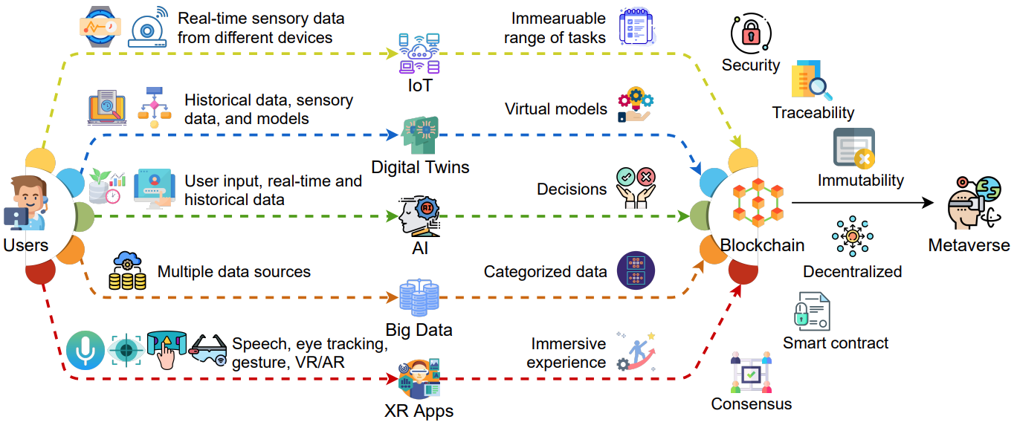
Blockchain for Key Enabling Technologies of the Metaverse
Source: Gadekallu, Thippa Reddy, Thien Huynh-The, Weizheng Wang, Gokul Yenduri, Pasika Ranaweera, Quoc-Viet Pham, Daniel Benevides da Costa, and Madhusanka Liyanage (2022).
"Blockchain for the Metaverse: A Review." arXiv preprint arXiv:2203.09738..

Slide 25
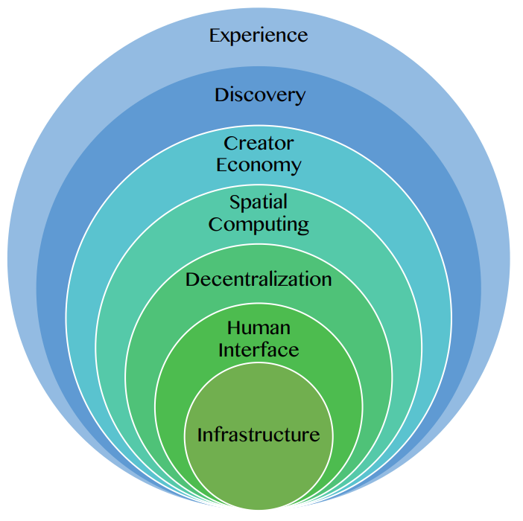
Seven Layers of a Metaverse Platform
Source: Huynh-The, Thien, Quoc-Viet Pham, Xuan-Qui Pham, Thanh Thi Nguyen, Zhu Han, and Dong-Seong Kim (2022).
"Artificial Intelligence for the Metaverse: A Survey." arXiv preprint arXiv:2202.10336.

Slide 26
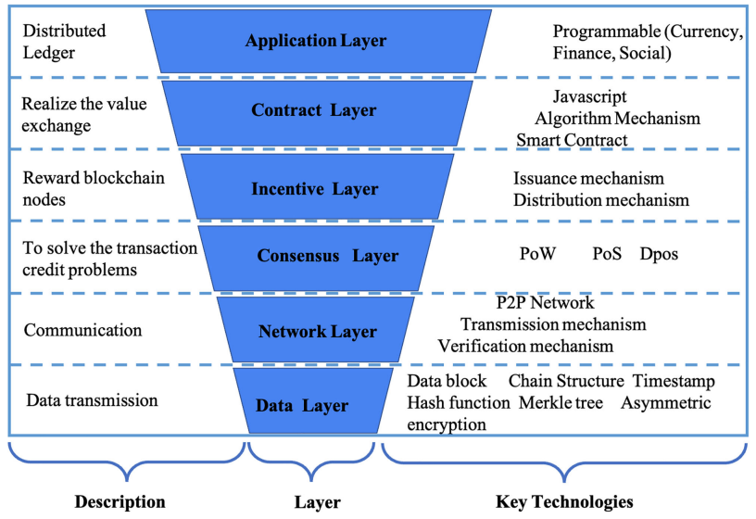
Layered Architecture of Blockchain
Source: Yang, Qinglin, Yetong Zhao, Huawei Huang, Zehui Xiong, Jiawen Kang, and Zibin Zheng (2022).
"Fusing blockchain and AI with metaverse: A survey." IEEE Open Journal of the Computer Society 3 : 122-136.

Slide 27
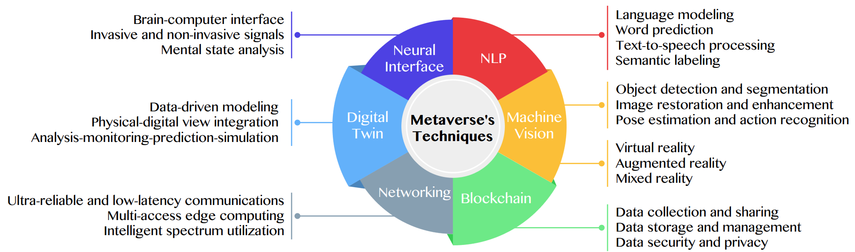
Primary Technical Aspects in the Metaverse
AI with ML algorithms and DL architectures is advancing the user experience in the virtual world
Source: Huynh-The, Thien, Quoc-Viet Pham, Xuan-Qui Pham, Thanh Thi Nguyen, Zhu Han, and Dong-Seong Kim (2022).
"Artificial Intelligence for the Metaverse: A Survey." arXiv preprint arXiv:2202.10336.

Slide 28
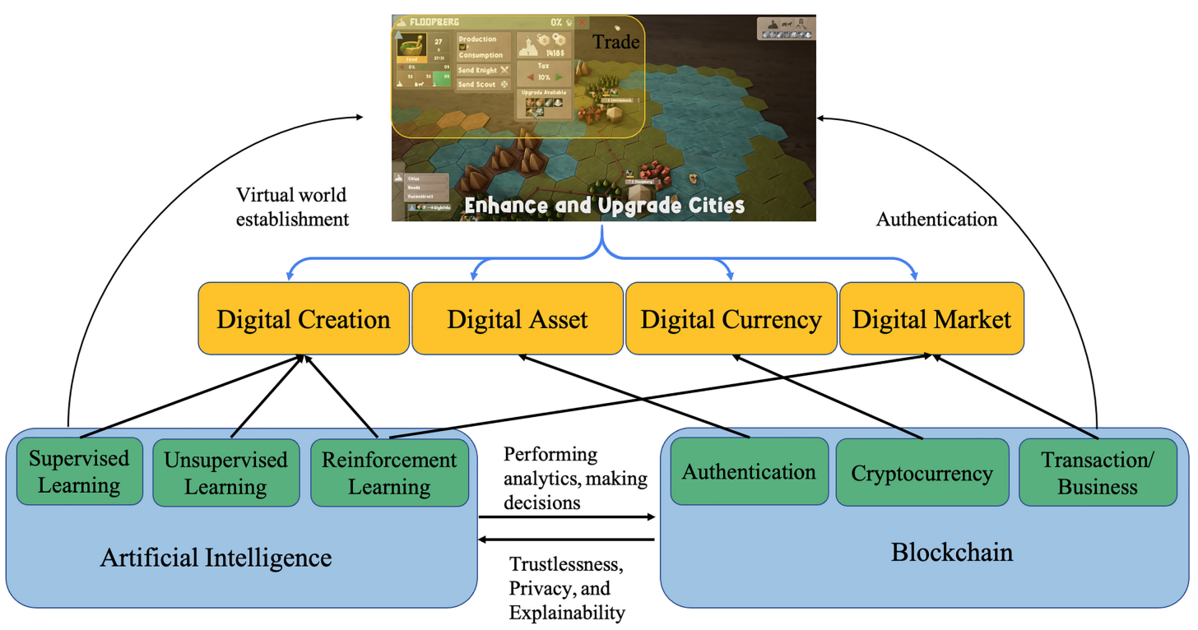
Fusion of AI and Blockchain in Metaverse
Source: Yang, Qinglin, Yetong Zhao, Huawei Huang, Zehui Xiong, Jiawen Kang, and Zibin Zheng (2022).
"Fusing blockchain and AI with metaverse: A survey." IEEE Open Journal of the Computer Society 3 : 122-136.

Slide 29
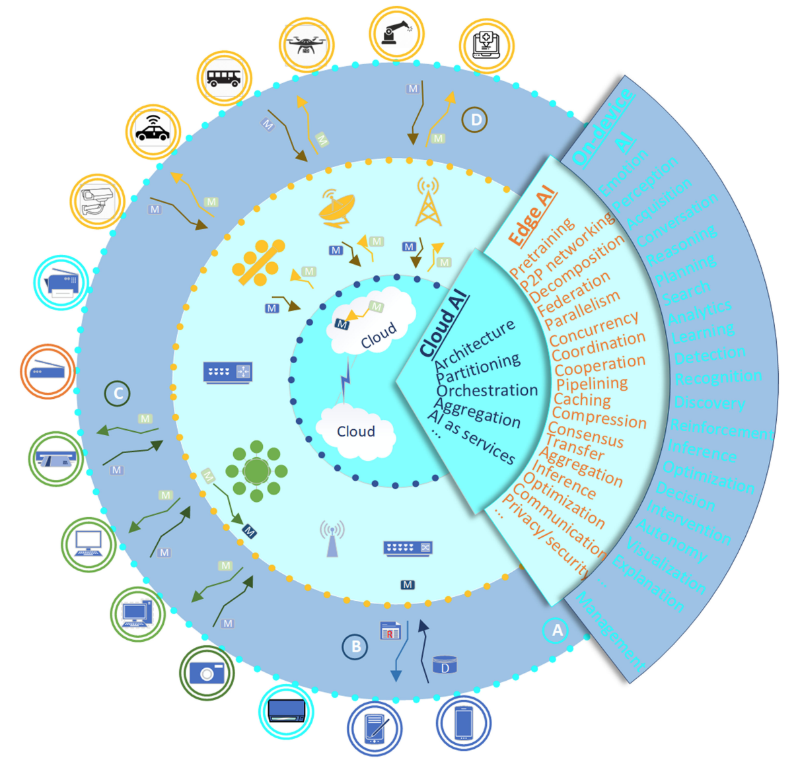
DeAI:
Synthesizing On-device AI, Edge AI, and Cloud AI
Source: Cao, Longbing (2022). "Decentralized ai: Edge intelligence and smart blockchain, metaverse, web3, and desci." IEEE Intelligent Systems 37, no. 3: 6-19.

Slide 30
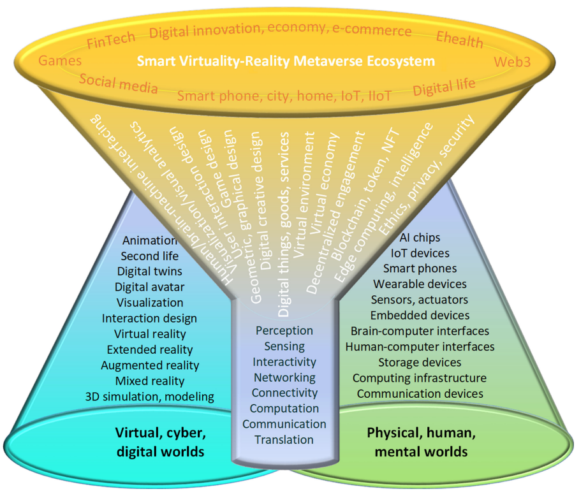
Smart Virtuality-Reality Metaverse Ecosystem: Metasynthesizing DeAI, Metaverse, Blockchain, Web3
Source: Cao, Longbing (2022). "Decentralized ai: Edge intelligence and smart blockchain, metaverse, web3, and desci." IEEE Intelligent Systems 37, no. 3: 6-19.

Slide 31
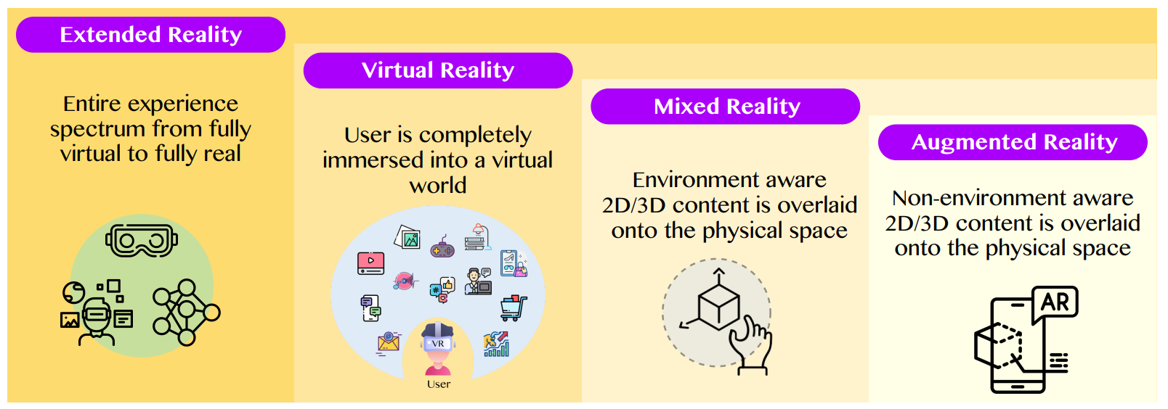
The difference between AR, MR, and VR under the umbrella of XR
XR
VR
MR
AR
Source: Huynh-The, Thien, Quoc-Viet Pham, Xuan-Qui Pham, Thanh Thi Nguyen, Zhu Han, and Dong-Seong Kim (2022).
"Artificial Intelligence for the Metaverse: A Survey." arXiv preprint arXiv:2202.10336.

Slide 32
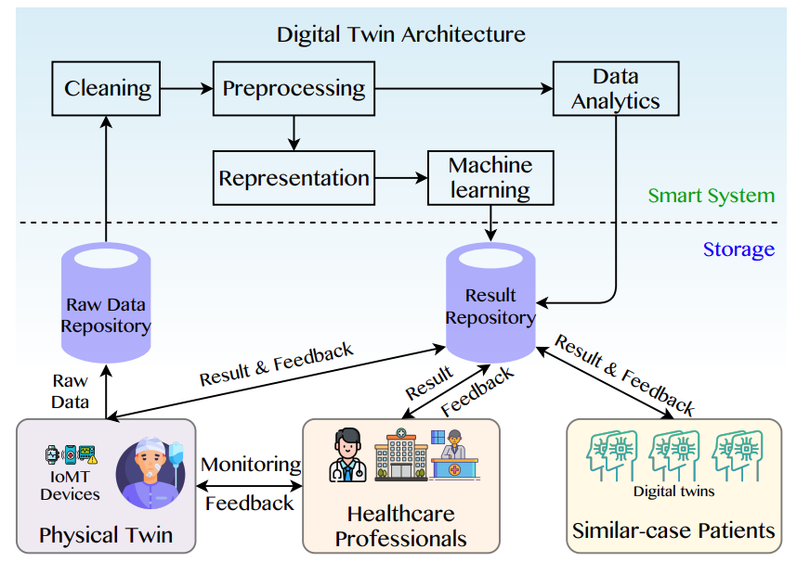
A Data-Driven Digital Twin Architecture for intelligent healthcare systems using ML to process raw data of IoMedicalThings devices
Source: Huynh-The, Thien, Quoc-Viet Pham, Xuan-Qui Pham, Thanh Thi Nguyen, Zhu Han, and Dong-Seong Kim (2022).
"Artificial Intelligence for the Metaverse: A Survey." arXiv preprint arXiv:2202.10336.

Slide 33
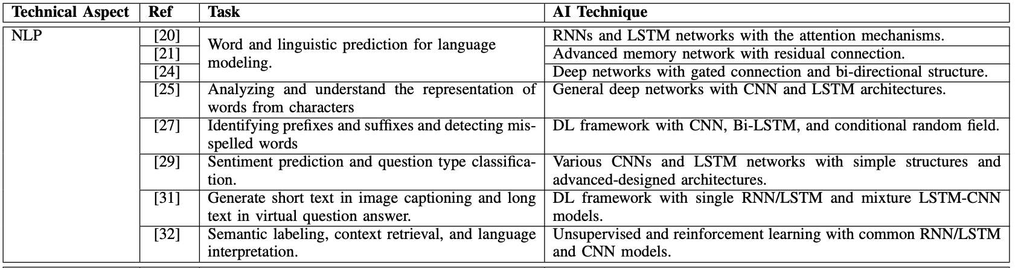
AI for the Metaverse
Source: Huynh-The, Thien, Quoc-Viet Pham, Xuan-Qui Pham, Thanh Thi Nguyen, Zhu Han, and Dong-Seong Kim (2022).
"Artificial Intelligence for the Metaverse: A Survey." arXiv preprint arXiv:2202.10336.

Slide 34
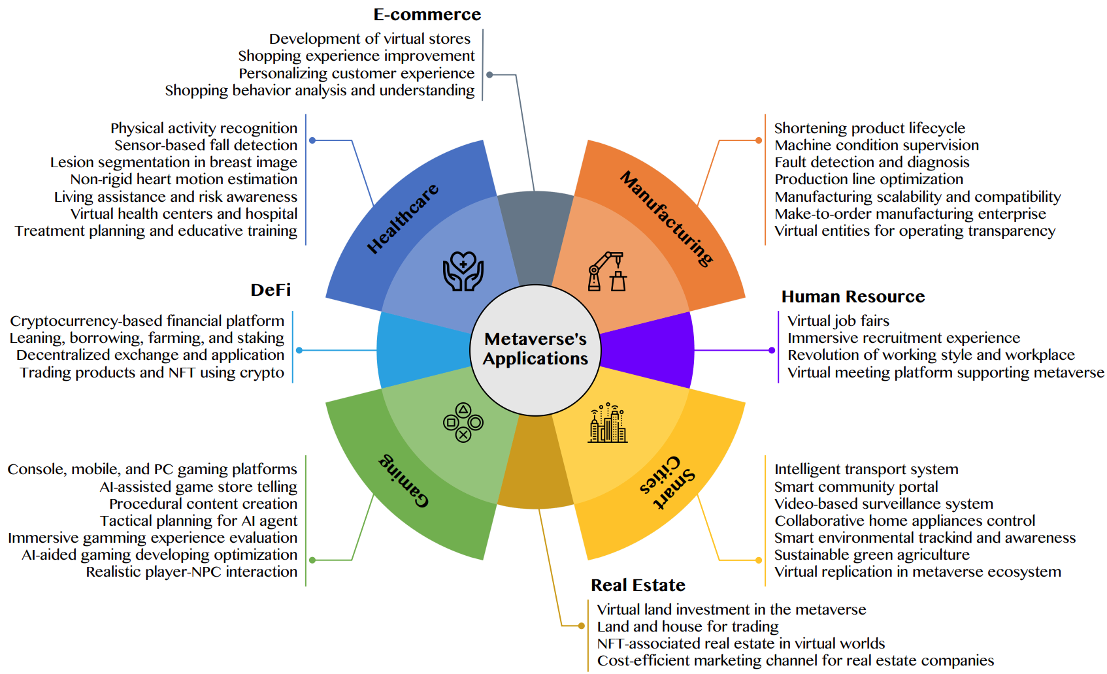
AI for the Metaverse in the Application Aspects healthcare, manufacturing, smart cities, gaming
E-commerce, human resources, real estate, and DeFi
Source: Huynh-The, Thien, Quoc-Viet Pham, Xuan-Qui Pham, Thanh Thi Nguyen, Zhu Han, and Dong-Seong Kim (2022).
"Artificial Intelligence for the Metaverse: A Survey." arXiv preprint arXiv:2202.10336.

Slide 35
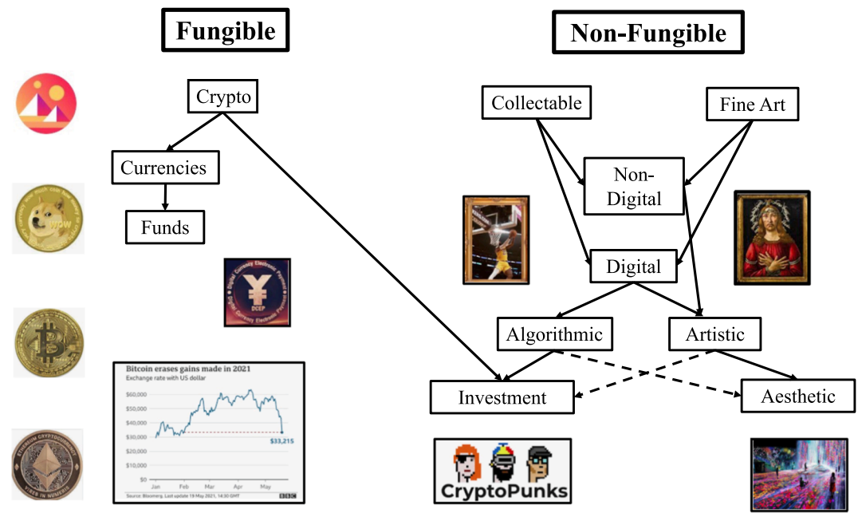
Blockchain-Registered:
Crypto, Collectables, and Art.
Source: Belk, Russell, Mariam Humayun, and Myriam Brouard. (2022)
"Money, possessions, and ownership in the Metaverse: NFTs, cryptocurrencies, Web3 and Wild Markets." Journal of Business Research 153: 198-205.

Slide 36
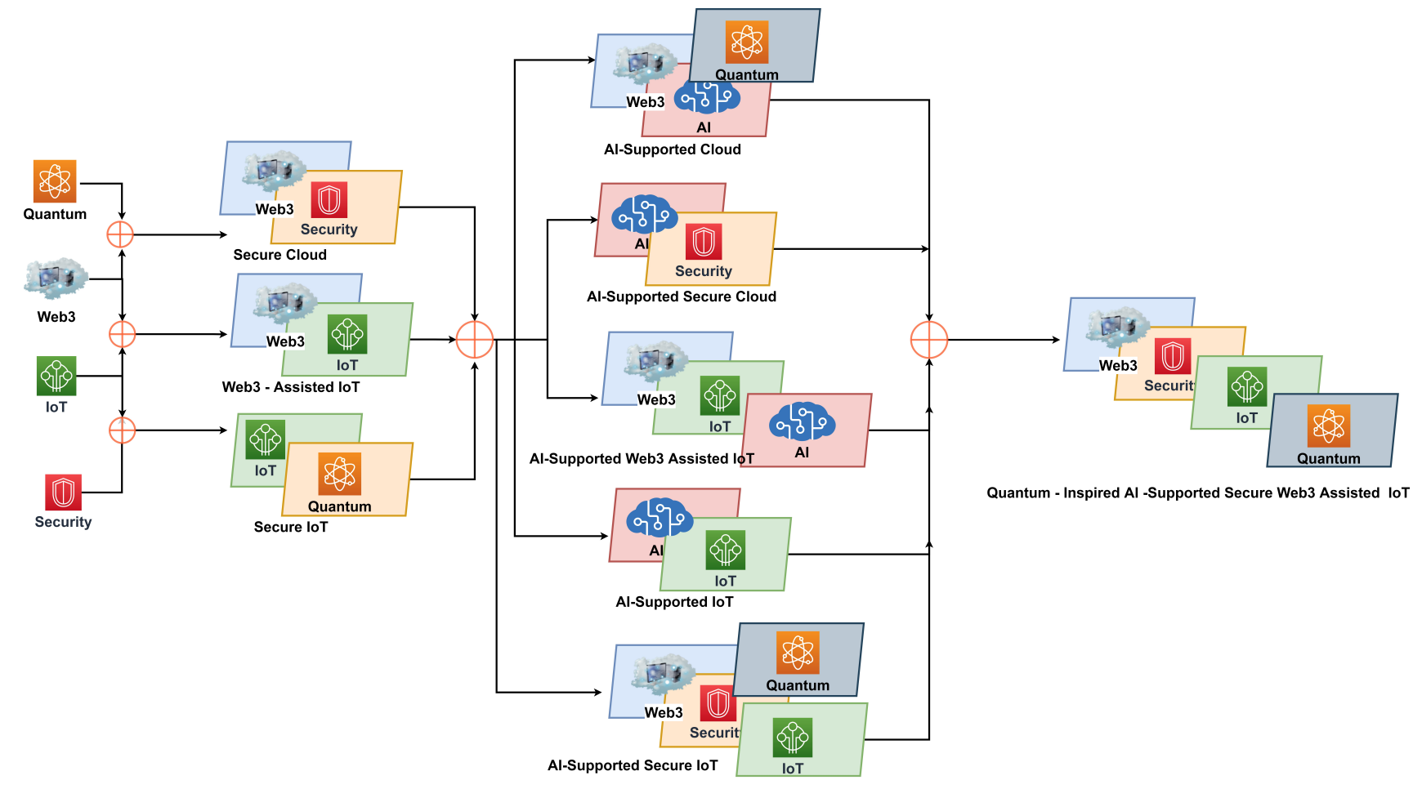
Combination of Web3 with other Technologies
Source: Sheridan, Dan, James Harris, Frank Wear, Jerry Cowell Jr, Easton Wong, and Abbas Yazdinejad. (2022)
"Web3 Challenges and Opportunities for the Market." arXiv preprint arXiv:2209.02446.

Slide 37
FinTech

Slide 38
Financial Technology
FinTech
“providing
financial services
by making use of software and
modern technology”
Source: https://www.fintechweekly.com/fintech-definition

Slide 39
Financial Technology

Slide 40
Financial Services

Slide 41
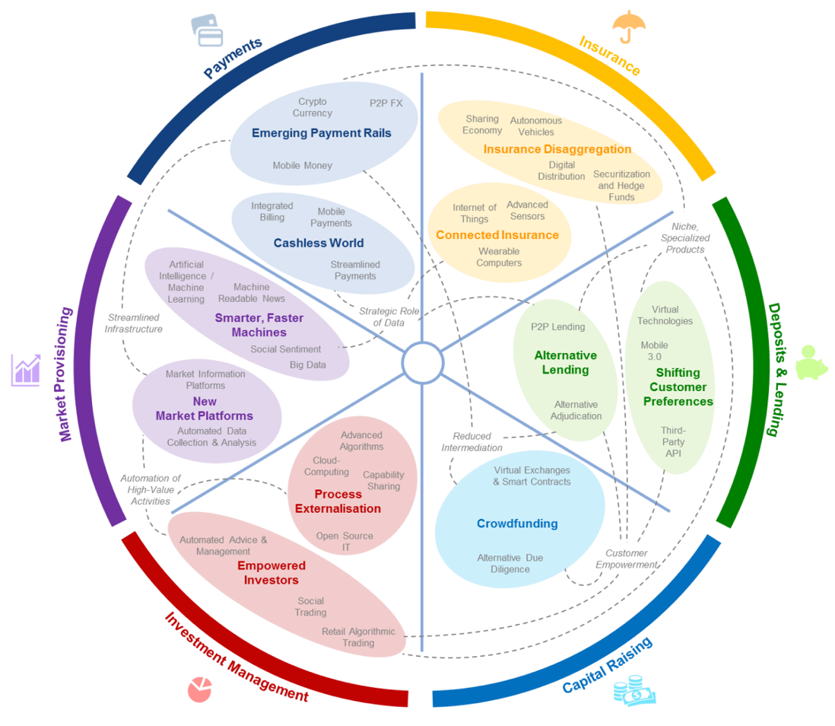
FinTech: Financial Services Innovation
Source: http://www3.weforum.org/docs/WEF_The_future__of_financial_services.pdf

Slide 42
FinTech:
Financial Services Innovation
1. Payments
2. Insurance
3. Deposits & Lending
4. Capital Raising
5. Investment Management
6. Market Provisioning
Source: http://www3.weforum.org/docs/WEF_The_future__of_financial_services.pdf

Slide 43
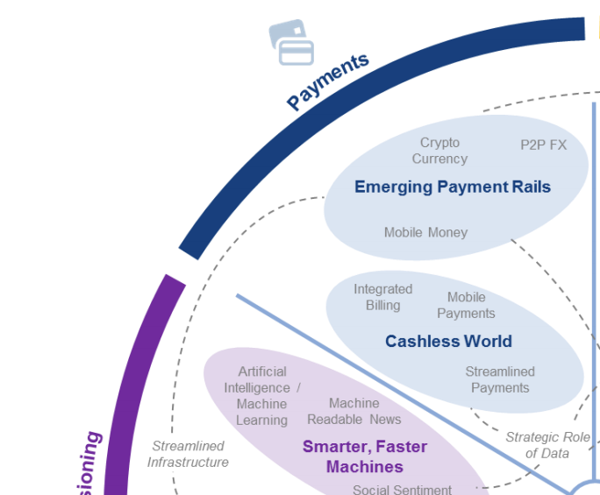
FinTech: Payment
1
Source: http://www3.weforum.org/docs/WEF_The_future__of_financial_services.pdf

Slide 44
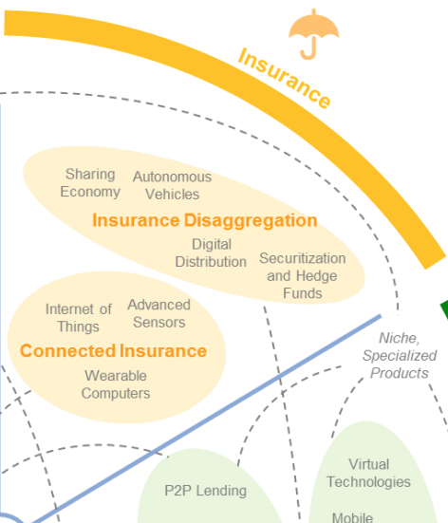
FinTech: Insurance
2
Source: http://www3.weforum.org/docs/WEF_The_future__of_financial_services.pdf

Slide 45
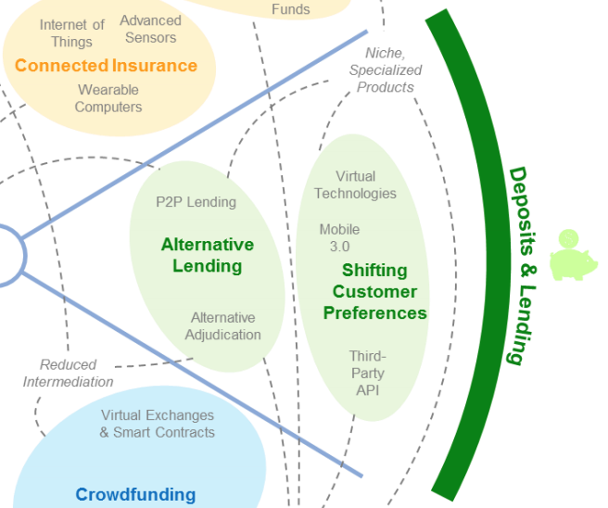
FinTech: Deposits & Lending
3
Source: http://www3.weforum.org/docs/WEF_The_future__of_financial_services.pdf

Slide 46
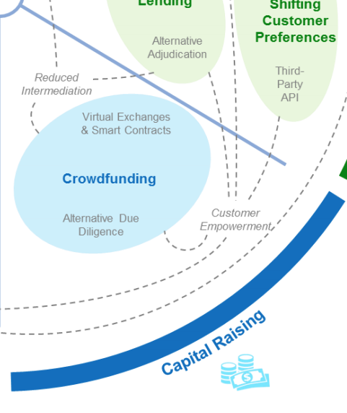
FinTech: Capital Raising
4
Source: http://www3.weforum.org/docs/WEF_The_future__of_financial_services.pdf

Slide 47
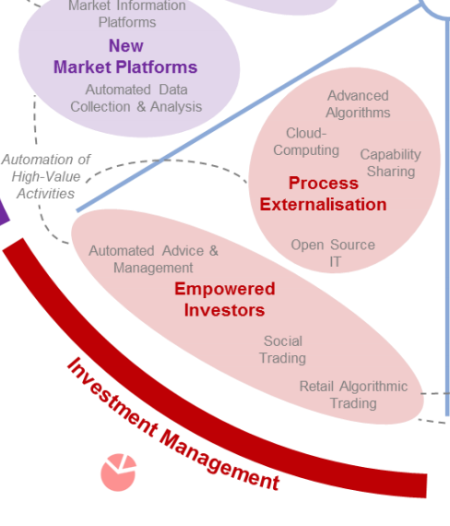
FinTech: Investment Management
5
Source: http://www3.weforum.org/docs/WEF_The_future__of_financial_services.pdf

Slide 48
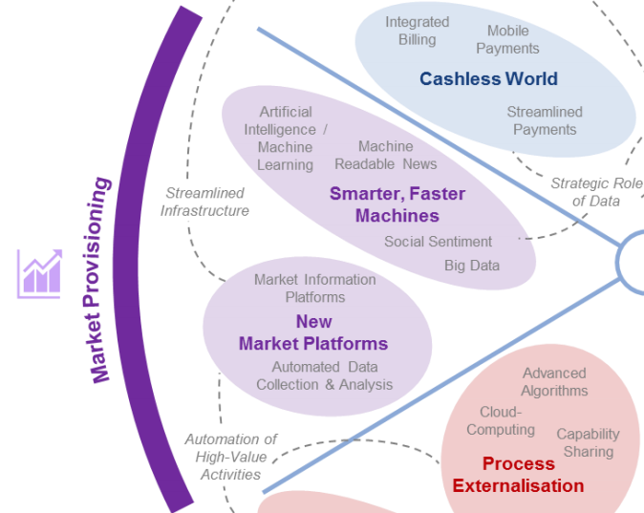
FinTech: Market Provisioning
6
Source: http://www3.weforum.org/docs/WEF_The_future__of_financial_services.pdf

Slide 49
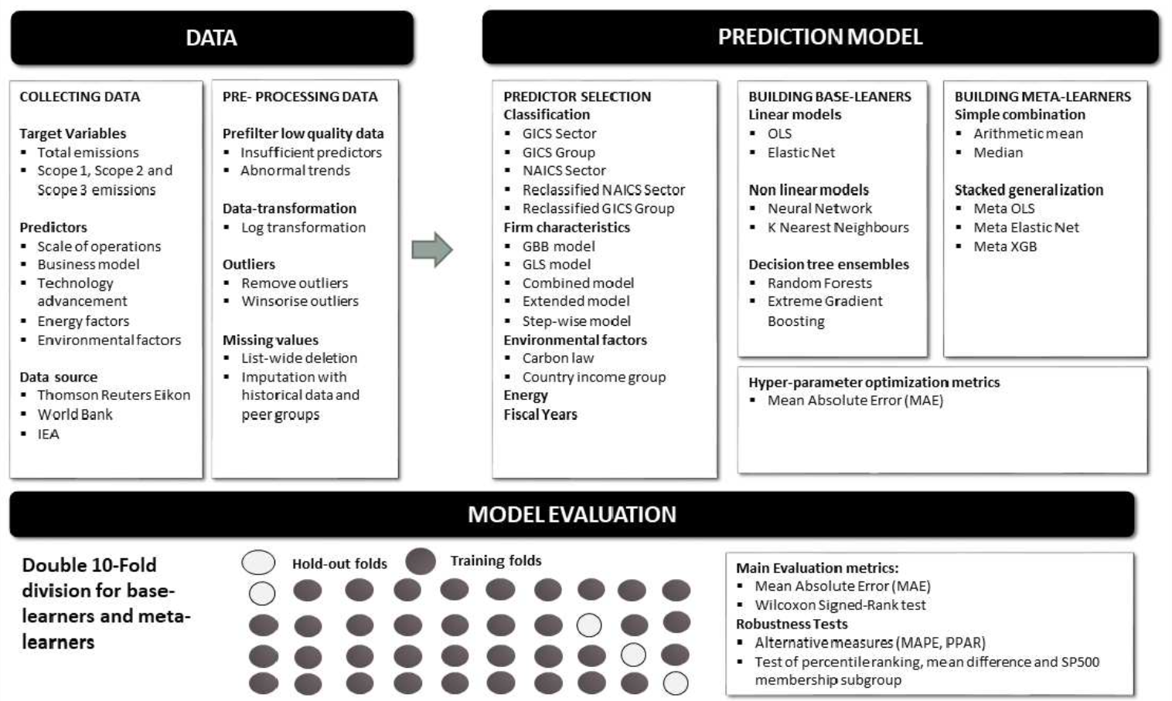
Modelling Strategy to Forecast Carbon Emissions with AI
Source: Brière, M., Keip, M., & Le Berthe, T. (2022). Artificial Intelligence for Sustainable Finance: Why it May Help. Available at SSRN 4252329.
Notes:
Modelling strategy to forecast carbon emisisons with Machine Learning methods
This figure illustrates the modelling framework that is used to train and evaluate the proposed machine learning approach. Block: Data shows the sample selection and data pre-processing process. Block: Prediction Model implements (1) Predictor Selection, where the optimal set of predictors from the listed alternative choices is selected based on OLS regression. (2): Build Base-Learners, where three groups of base-learners are tested, namely linear models, non-linear models, and decision ensembles, and (3) Building Meta-Learners, where predictions are combined using a simple combination or stacked generalization. Finally, block: Model Evaluation: describes the model evaluation with mean absolute error and a set of robustness tests via double-K fold validation.
Source: Nguyen, Diaz-Rainez and Kuruppuarachchi (2021)

Slide 50
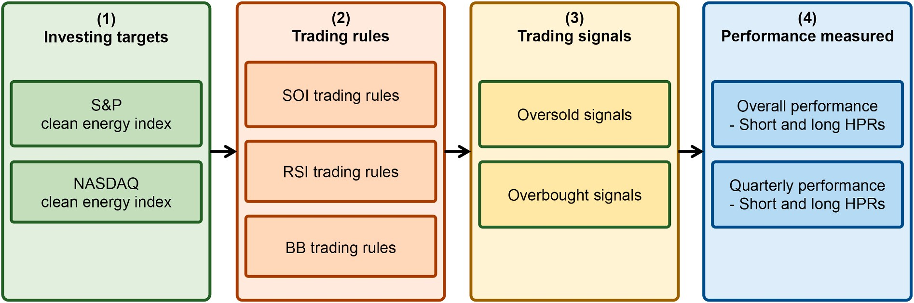
Research Framework
Do clean energy indices outperform using contrarian strategies
Source, Min-Yuh Day and Yensen Ni (2023), "Do clean energy indices outperform using contrarian strategies based on contrarian trading rules?", Energy, Volume 272, 1 June 2023, 127113.

Slide 51
Artificial Intelligence for Sustainable Finance
Why AI may help sustainable finance?
  Brière, M., Keip, M., & Le Berthe, T. (2022). Artificial Intelligence for Sustainable Finance: Why it May Help. Available at SSRN 4252329.
How does artificial intelligence boost sustainable development?
  Schoormann, T., Strobel, G., Möller, F., Petrik, D., & Zschech, P. (2023). Artificial Intelligence for Sustainability—A Systematic Review of Information Systems Literature. Communications of the Association for Information Systems, 52(1), 8.
Does sustainability generate better financial performance?
  Atz, U., Van Holt, T., Liu, Z. Z., & Bruno, C. C. (2023). Does sustainability generate better financial performance? review, meta-analysis, and propositions. Journal of Sustainable Finance & Investment, 13(1), 802-825.
What are the major research topics in AI for Sustainable finance?
  Kumar, S., Sharma, D., Rao, S., Lim, W. M., & Mangla, S. K. (2022). Past, present, and future of sustainable finance: Insights from big data analytics through machine learning of scholarly research. Annals of Operations Research, 1-44.

Slide 52
Decentralized Finance
(DeFi)
Block Chain FinTech

Slide 53
Decentralized Finance (DeFi)
A global, open alternative to the current financial system.
Products that let you borrow, save, invest, trade, and more.
Based on open-source technology that anyone can program with.
Source: https://ethereum.org/en/defi/

Slide 54
Traditional Finance
Centralized Finance (CeFi)
Some people aren't granted access to set up a bank account or use financial services.
Lack of access to financial services can prevent people from being employable.
Financial services can block you from getting paid.
A hidden charge of financial services is your personal data.
Governments and centralized institutions can close down markets at will.
Trading hours often limited to business hours of specific time zone.
Money transfers can take days due to internal human processes.
There's a premium to financial services because intermediary institutions need their cut.
Source: https://ethereum.org/en/defi/

Slide 55
DeFi vs. CeFi
Decentralized Finance (DeFi) | Traditional Finance (Centralized Finance; CeFi)
You hold your money. | Your money is held by companies.
You control where your money goes and how it's spent. | You have to trust companies not to mismanage your money, like lend to risky borrowers.
Transfers of funds happen in minutes. | Payments can take days due to manual processes.
Transaction activity is pseudonymous. | Financial activity is tightly coupled with your identity.
DeFi is open to anyone. | You must apply to use financial services.
The markets are always open. | Markets close because employees need breaks.
It's built on transparency – anyone can look at a product's data and inspect how the system works. | Financial institutions are closed books: you can't ask to see their loan history, a record of their managed assets, and so on.
Source: https://ethereum.org/en/defi/

Slide 56
(DeFi)
Decentralized Applications (Dapps)
Ethereum-powered tools and services
Dapps are a growing movement of applications that use Ethereum to disrupt business models or invent new ones
Source: https://ethereum.org/en/defi/

Slide 57
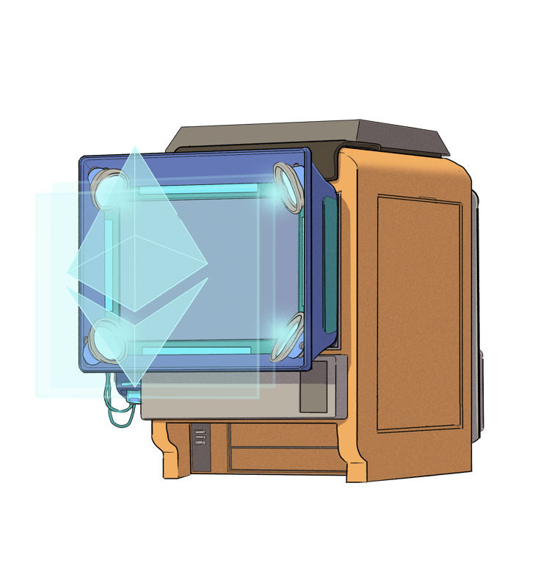
The Internet of Assets
Ethereum isn't just for
digital money.
Anything you can own can be represented,
traded and
put to use as
non-fungible tokens (NFTs).
Source: https://ethereum.org/en/defi/

Slide 58
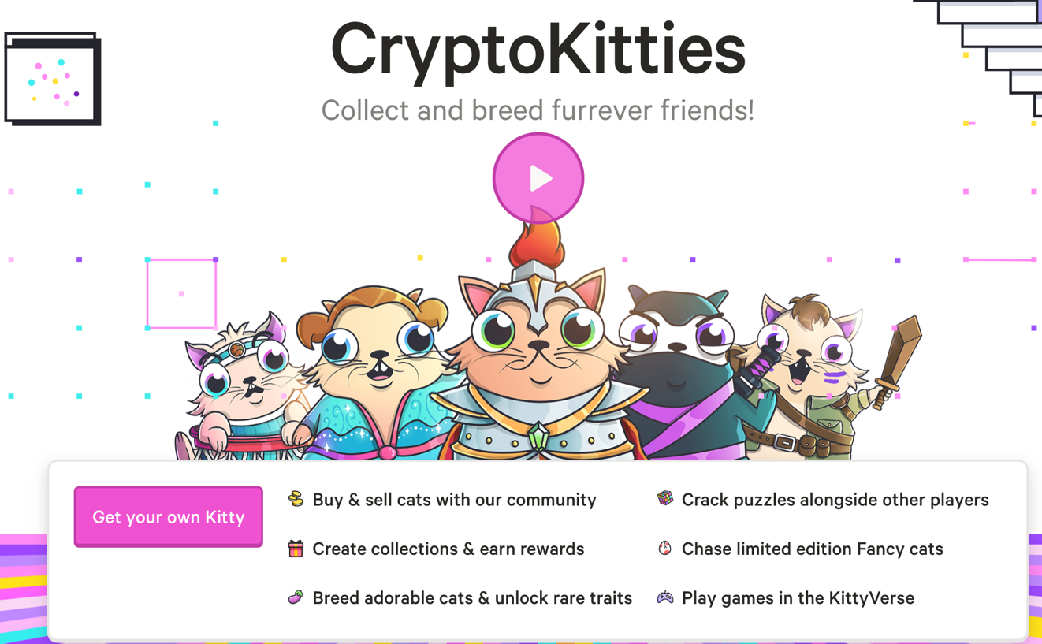
Non-Fungible Tokens (NFT)
CryptoKitties
https://www.cryptokitties.co/
Source: Matt Fortnow and QuHarrison Terry (2021), The NFT Handbook - How to Create, Sell and Buy Non-Fungible Tokens, Wiley

Slide 59
Financial Stability Challenges
Crypto Ecosystem
Operational, cyber, and governance risks
Integrity (market and AML/CFT)
(Anti–Money Laundering / Combating the Financing of Terrorism)
Data availability / reliability
Challenges from cross-boarder activites
Stablecoins
How stable are stablecoins?
Domestic and global regulatory and supervisory
approaches
Macro-Financial
Cryptoization, capital flows, and restrictions
Monetary policy transmission
Bank disintermediation
Source: Parma Bains, Mohamed Diaby, Dimitris Drakopoulos, Julia Faltermeier, Federico Grinberg, Evan Papageorgiou, Dmitri Petrov, Patrick Schneider, and Nobu Sugimoto (2021),
The Crypto Ecosystem and Financial Stability Challenges, International Monetary Fund, October 2021

Slide 60
Financial Services

Slide 61
Technology
Innovation

Slide 62
FinTech Innovation
FinTech high-level classification
Lending
Payments
Robo Advisors
Analytics
Others
Profile
Advice
Re-Balance
Indexing
Source: Paolo Sironi (2016), “FinTech Innovation: From Robo-Advisors to Goal Based Investing and Gamification”, Wiley.

Slide 63
Technology-driven
Financial Industry Development

Slide 64
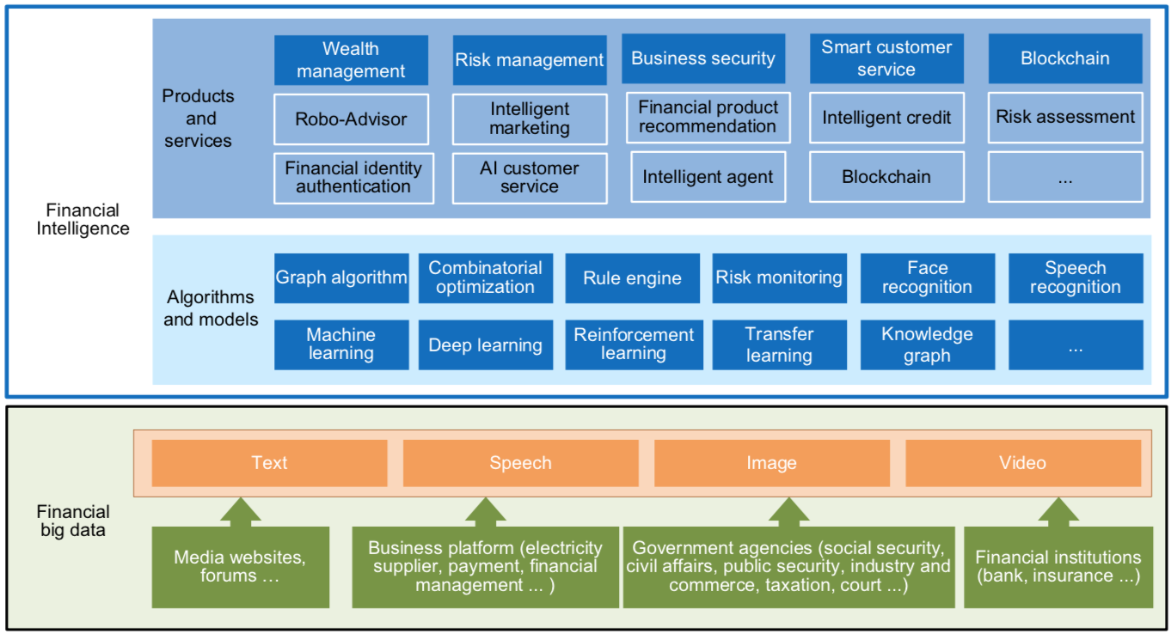
FinBrain: when Finance meets AI 2.0
(Zheng et al., 2019)
Source: Xiao-lin Zheng, Meng-ying Zhu, Qi-bing Li, Chao-chao Chen, and Yan-chao Tan (2019), "Finbrain: When finance meets AI 2.0." Frontiers of Information Technology & Electronic Engineering 20, no. 7, pp. 914-924

Slide 65
AI 2.0
a new generation of AI
based on the
novel information environment of
major changes and
the development of
new goals.
Yunhe Pan (2016), "Heading toward artificial intelligence 2.0." Engineering 2, no. 4, 409-413.

Slide 66
Technology-driven
Financial Industry Development
Development stage | Driving technology | Main landscape | Inclusive finance | Relationship between technology and finance
Fintech 1.0 (financial IT) | Computer | Credit card, ATM, and CRMS | Low | Technology as a tool
Fintech 2.0 (Internet finance) | Mobile Internet | Marketplace lending, third-party payment, crowdfunding, and Internet insurance | Medium | Technology-driven change
Fintech 3.0 (financial intelligence) | AI, Big Data, Cloud Computing, Blockchain | Intelligent finance | High | Deep fusion
Source: Xiao-lin Zheng, Meng-ying Zhu, Qi-bing Li, Chao-chao Chen, and Yan-chao Tan (2019), "Finbrain: When finance meets AI 2.0." Frontiers of Information Technology & Electronic Engineering 20, no. 7, pp. 914-924

Slide 67
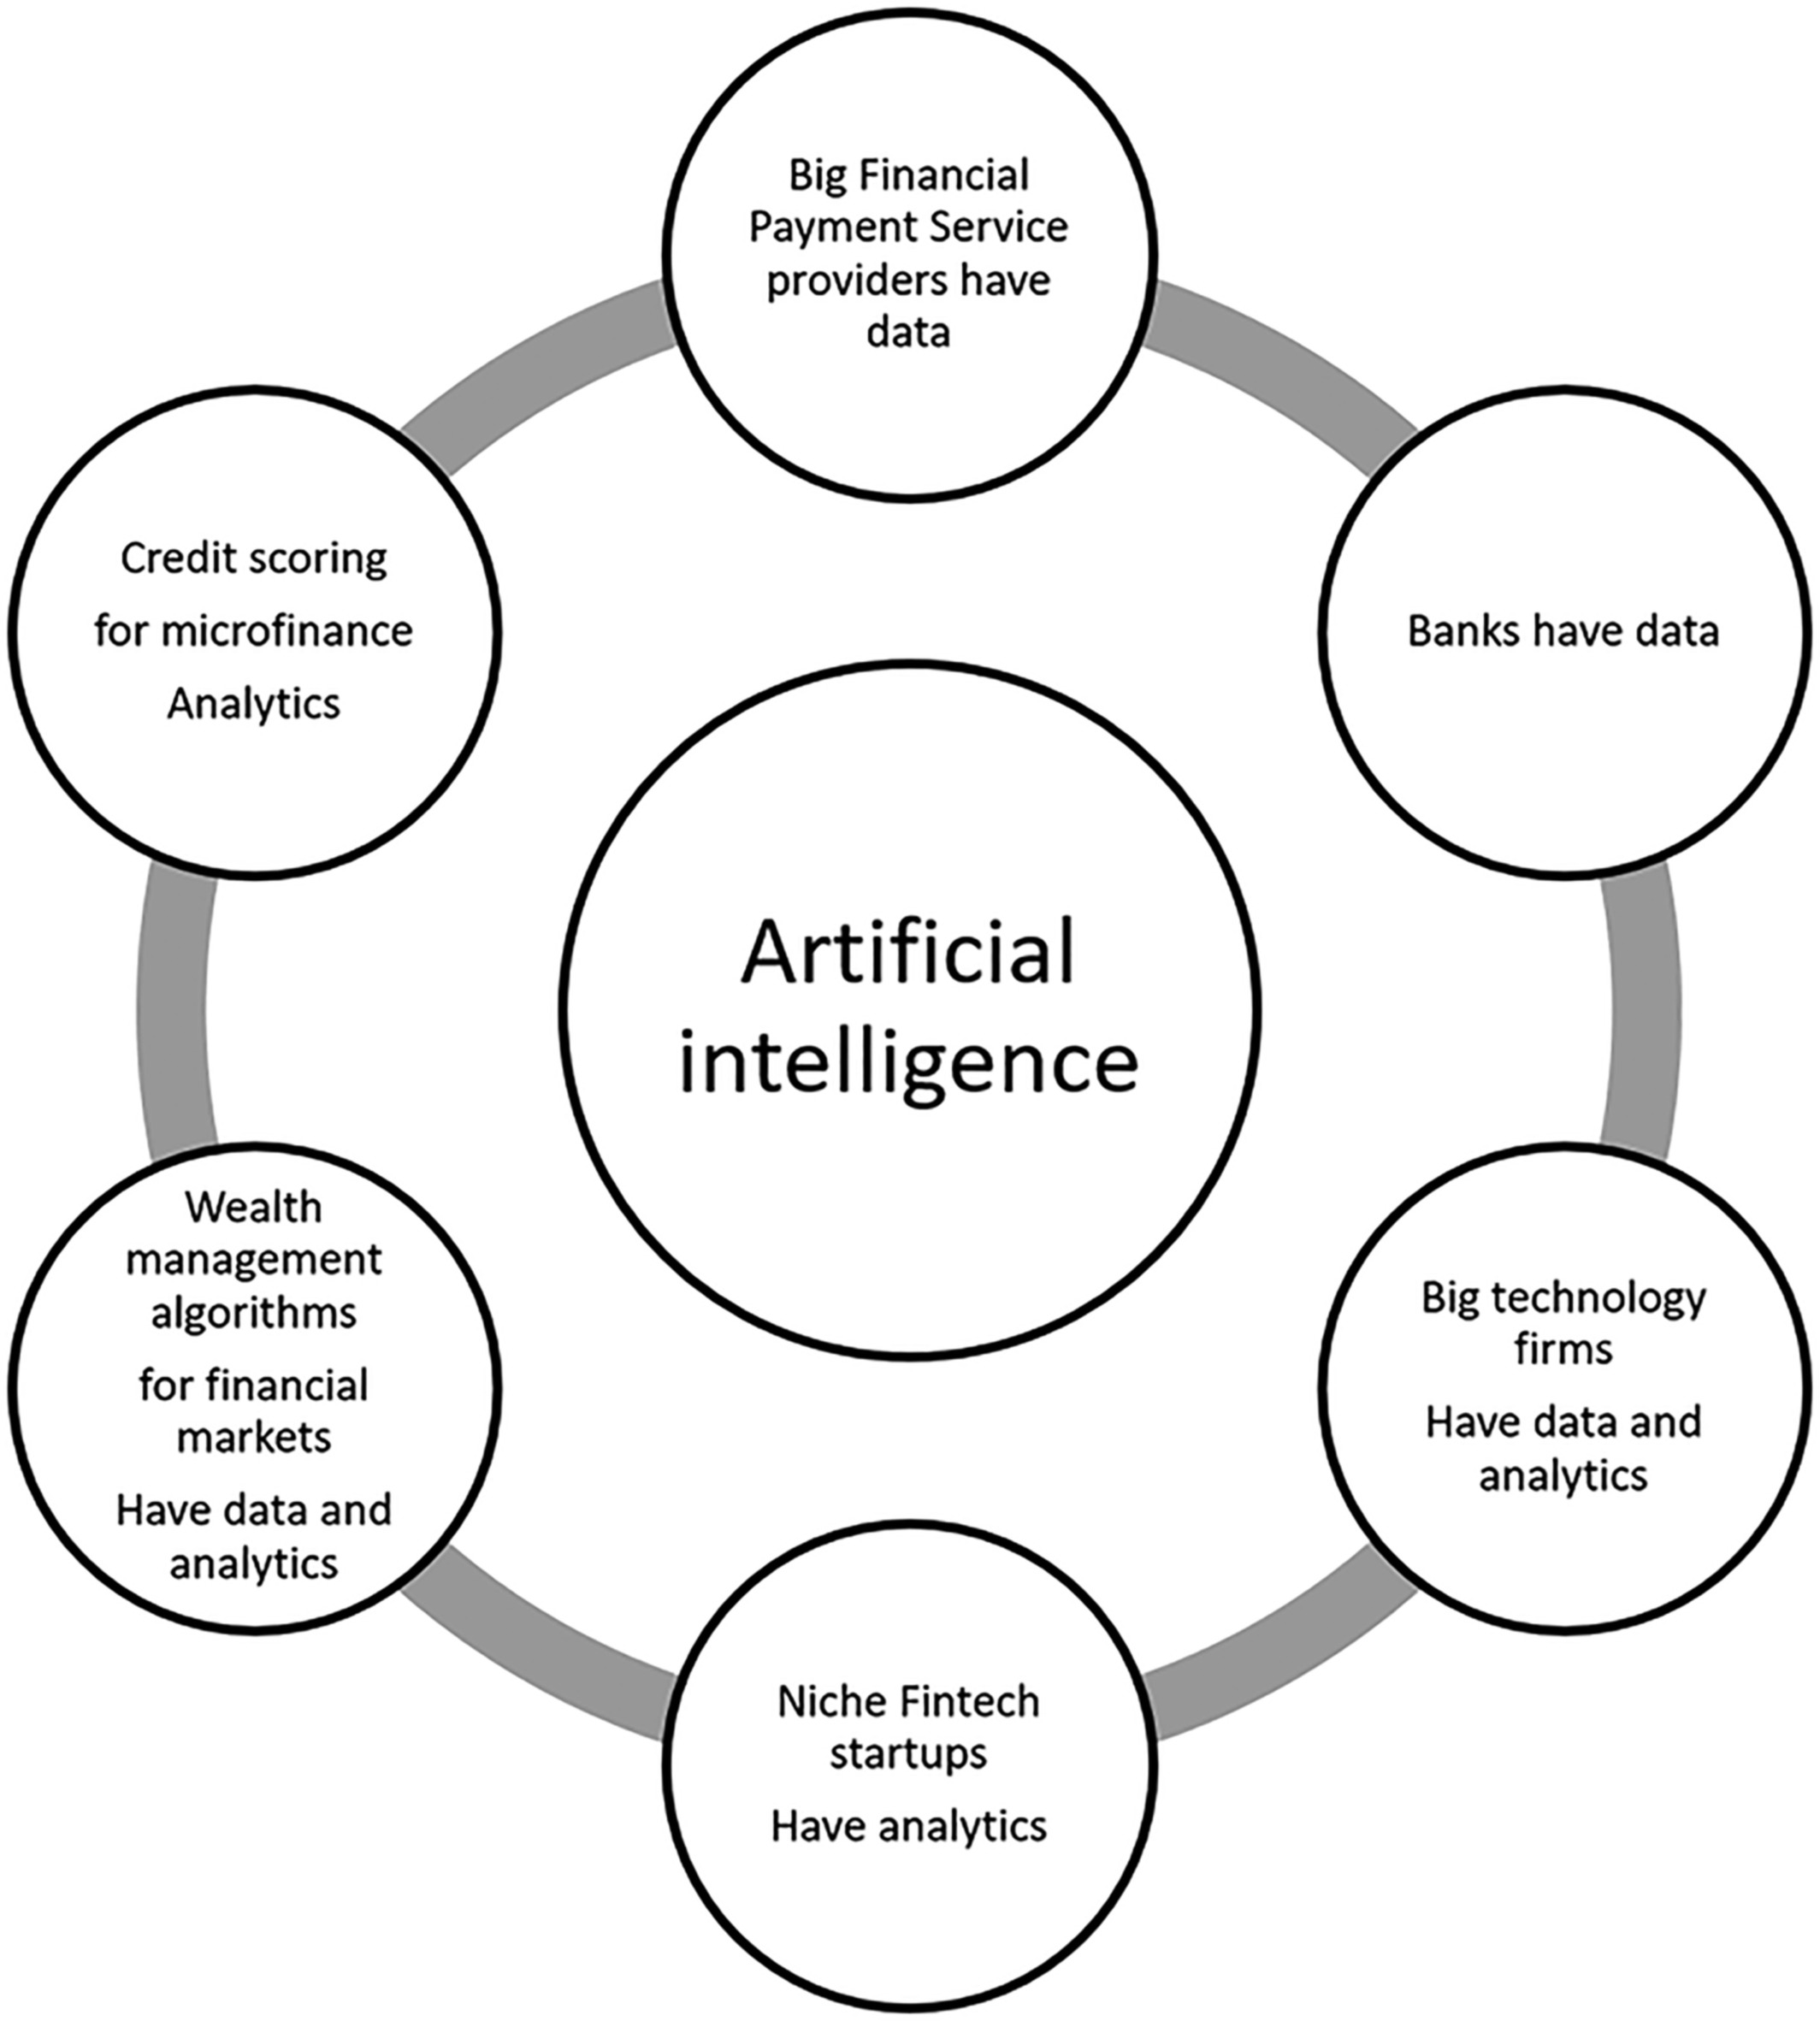
Artificial Intelligence in the Financial Markets
Source: Ashta, Arvind, and Heinz Herrmann (2021). "Artificial intelligence and fintech: An overview of opportunities and risks for banking, investments, and microfinance." Strategic Change 30, no. 3 (2021): 211-222.

Slide 68
Green Finance and
Sustainable Finance

Slide 69
Evolution of Sustainable Finance Research
Topic
SDGs:
Sustainable Development Goals
SDGs
Innovative Financial Instrument
Impact Investing
ESG: Environmental, Social, and Governance
CSR: Corporate Social Responsibility
Conscious Capitalism
Climate Financing
Carbon Financing
Green Financing
Ethical Investing
Socially Responsible Investing
1986
1995
2005
2015
2020
Source: Kumar, S., Sharma, D., Rao, S., Lim, W. M., & Mangla, S. K. (2022). Past, present, and future of sustainable finance:
Insights from big data analytics through machine learning of scholarly research. Annals of Operations Research, 1-44.

Slide 70
AI for
Environmental,
Social, and
Governance
(AI4ESG)
Source: Nenad Tomašev, Julien Cornebise, Frank Hutter, Shakir Mohamed, Angela Picciariello, Bec Connelly, Danielle Belgrave et al. (2020)
"AI for social good: unlocking the opportunity for positive impact." Nature Communications 11, no. 1: 1-6.

Slide 71
Sustainability
SDGs
CSR
ESG

Slide 72


















Sustainable Development Goals (SDGs)
Source: https://sdgs.un.org/goals

Slide 73
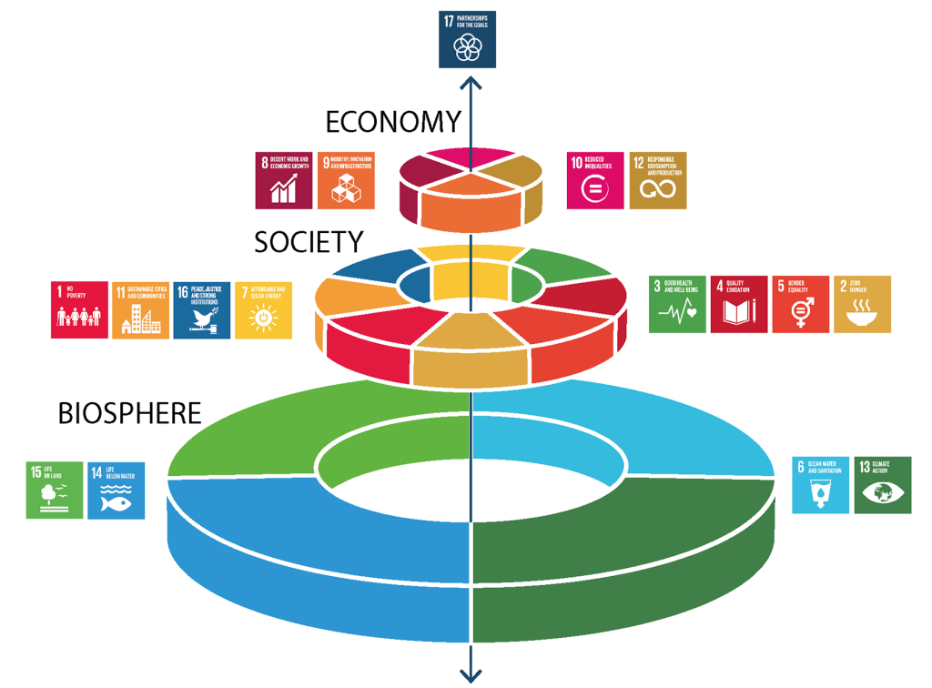
Sustainable Development Goals (SDGs) and 5P
Partnership
Peace
Prosperity
People
Planet
Source: Folke, Carl, Reinette Biggs, Albert V. Norström, Belinda Reyers, and Johan Rockström. "Social-ecological resilience and biosphere-based sustainability science.”Ecology and Society 21, no. 3 (2016).

Slide 74
Green Finance
Generic term implying use or diversion of financial resources to deploy and support projects with long term positive impact on the environment
Source: Bhattacharyya, Rupsha. "Green finance for energy transition, climate action and sustainable development: overview of concepts, applications, implementation and challenges." Green Finance 4, no. 1 (2022): 1-35.

Slide 75
Sustainable Finance
Finances deployed in support of projects that ensure just, sustainable and inclusive growth or attainment of one or more sustainable development goals
Source: Bhattacharyya, Rupsha. "Green finance for energy transition, climate action and sustainable development: overview of concepts, applications, implementation and challenges." Green Finance 4, no. 1 (2022): 1-35.

Slide 76
Carbon Finance
  Financial instruments
  based on
  economic value of carbon emissions
  which an organization cannot avoid but which
  it offsets by funding other compensatory projects that contribute to carbon emissions reduction
Source: Bhattacharyya, Rupsha. "Green finance for energy transition, climate action and sustainable development: overview of concepts, applications, implementation and challenges." Green Finance 4, no. 1 (2022): 1-35.

Slide 77
Climate Finance
  Finances deployed
  in support of low carbon and
  climate resilient projects
  that help in climate change mitigation and adaptation efforts,
  particularly in the
  energy and infrastructure sectors
Source: Bhattacharyya, Rupsha. "Green finance for energy transition, climate action and sustainable development: overview of concepts, applications, implementation and challenges." Green Finance 4, no. 1 (2022): 1-35.

Slide 78
ESG Investing
  Investments considering the broad range of
  environmental (e.g. climate change,
  pollution biodiversity loss),
  social (e.g. working conditions, human rights, salary or compensation structures)
  and governance (e.g. board composition, diversity and inclusion, taxes)
  characteristics of the projects or companies being invested in; ethical and business sustainability considerations are
  integral part of financing
Source: Bhattacharyya, Rupsha. "Green finance for energy transition, climate action and sustainable development: overview of concepts, applications, implementation and challenges." Green Finance 4, no. 1 (2022): 1-35.

Slide 79
Impact Investing
  Investing in projects
  that solve a social or environmental problem;
  the focus is on the positive impact
  rather than the
  means used to produce that impact
Source: Bhattacharyya, Rupsha. "Green finance for energy transition, climate action and sustainable development: overview of concepts, applications, implementation and challenges." Green Finance 4, no. 1 (2022): 1-35.

Slide 80
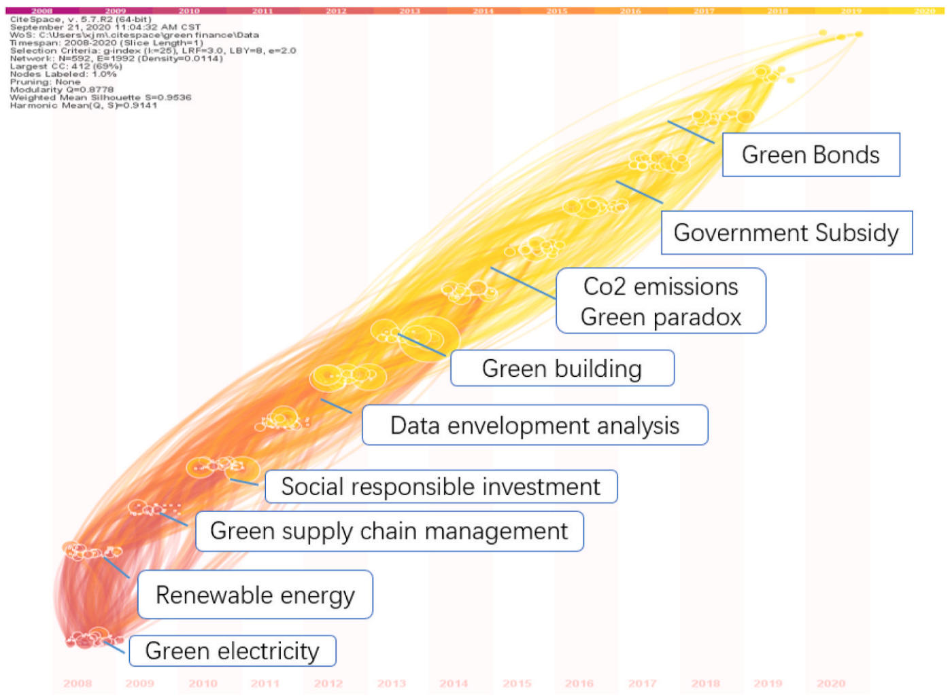
Dynamic Trends of Green Finance and Energy Policy
Source: Wang, Moran, Xuerong Li, and Shouyang Wang. (2021) "Discovering research trends and opportunities of green finance and energy policy: A data-driven scientometric analysis." Energy Policy 154 (2021): 112295.

Slide 81
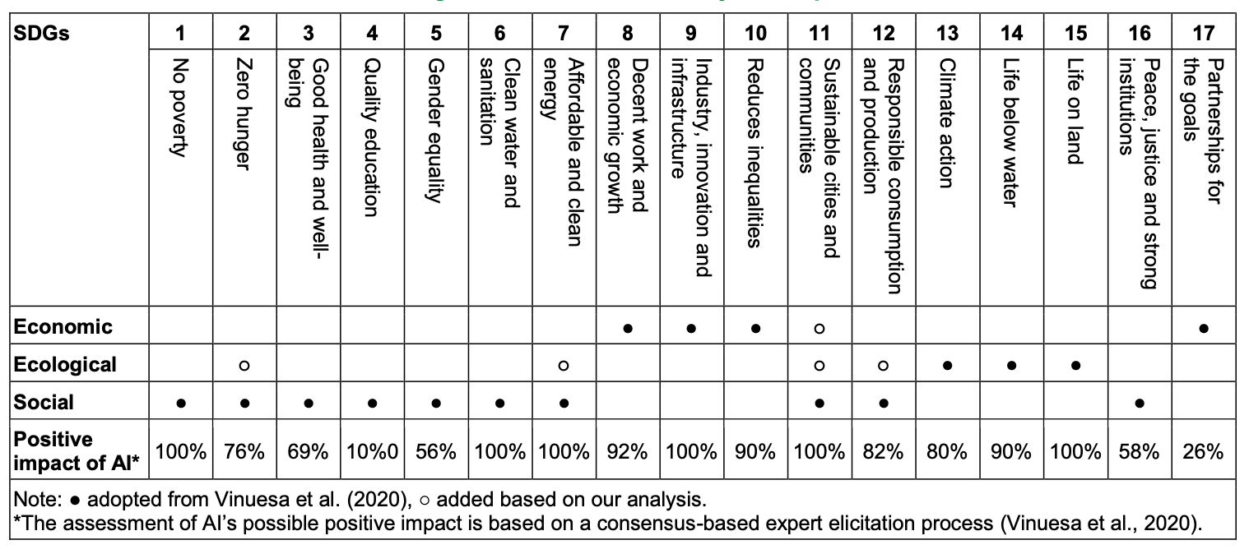
AI and Sustainability Development Goals (SDGs)
Source: Schoormann, T., Strobel, G., Möller, F., Petrik, D., & Zschech, P. (2023).
Artificial Intelligence for Sustainability—A Systematic Review of Information Systems Literature. Communications of the Association for Information Systems, 52(1), 8.

Slide 82
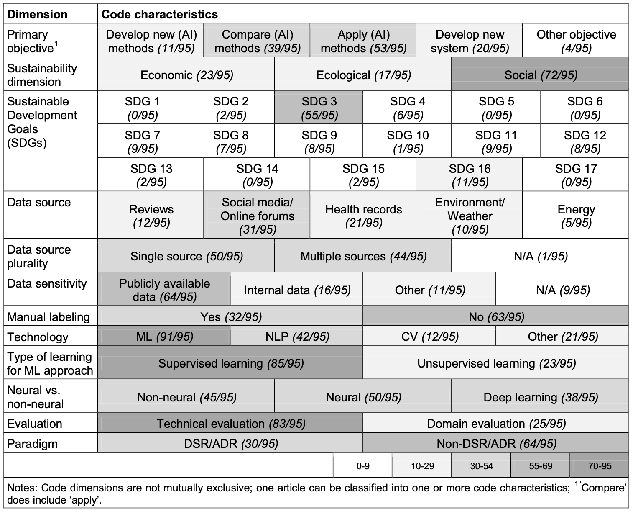
AI for Sustainability
Source: Schoormann, T., Strobel, G., Möller, F., Petrik, D., & Zschech, P. (2023).
Artificial Intelligence for Sustainability—A Systematic Review of Information Systems Literature. Communications of the Association for Information Systems, 52(1), 8.

Slide 83
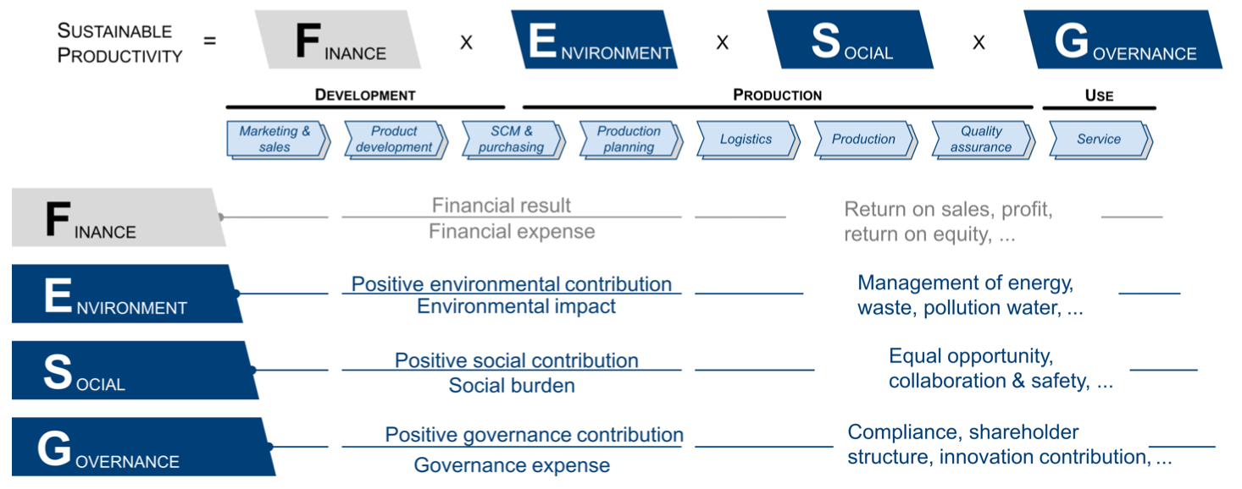
Sustainable Productivity:
Finance ESG
Source: Huang, Ziqi, Yang Shen, Jiayi Li, Marcel Fey, and Christian Brecher (2021). "A survey on AI-driven digital twins in Industry 4.0: Smart manufacturing and advanced robotics." Sensors 21, no. 19: 6340.

Slide 84
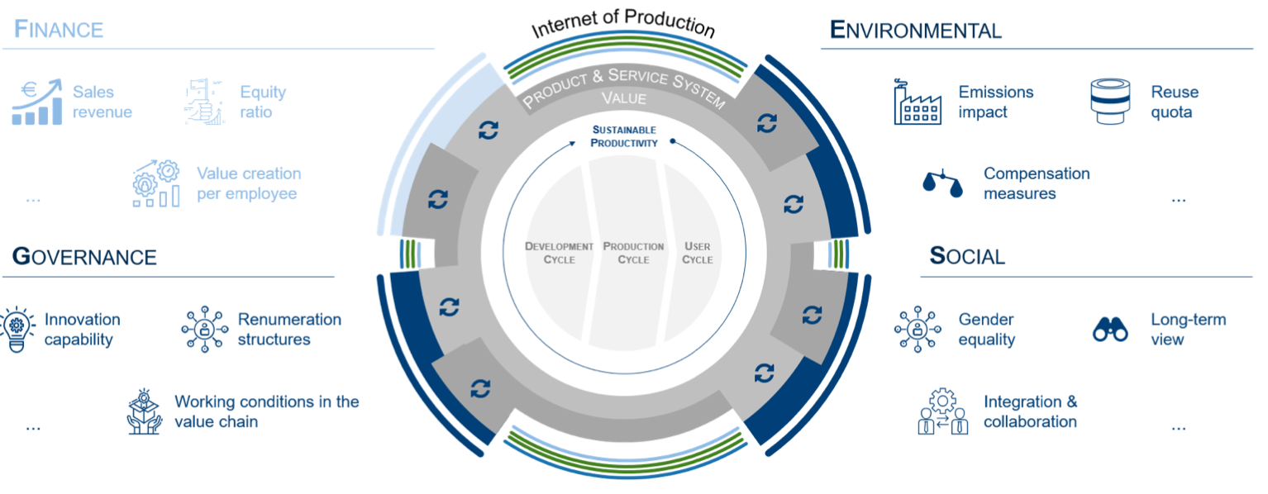
Sustainable Resilient Manufacturing
ESG
Source: Huang, Ziqi, Yang Shen, Jiayi Li, Marcel Fey, and Christian Brecher (2021). "A survey on AI-driven digital twins in Industry 4.0: Smart manufacturing and advanced robotics." Sensors 21, no. 19: 6340.

Slide 85
ESG Indexes
MSCI ESG Index
Dow Jones Sustainability Indices (DJSI)
FTSE ESG Index

Slide 86
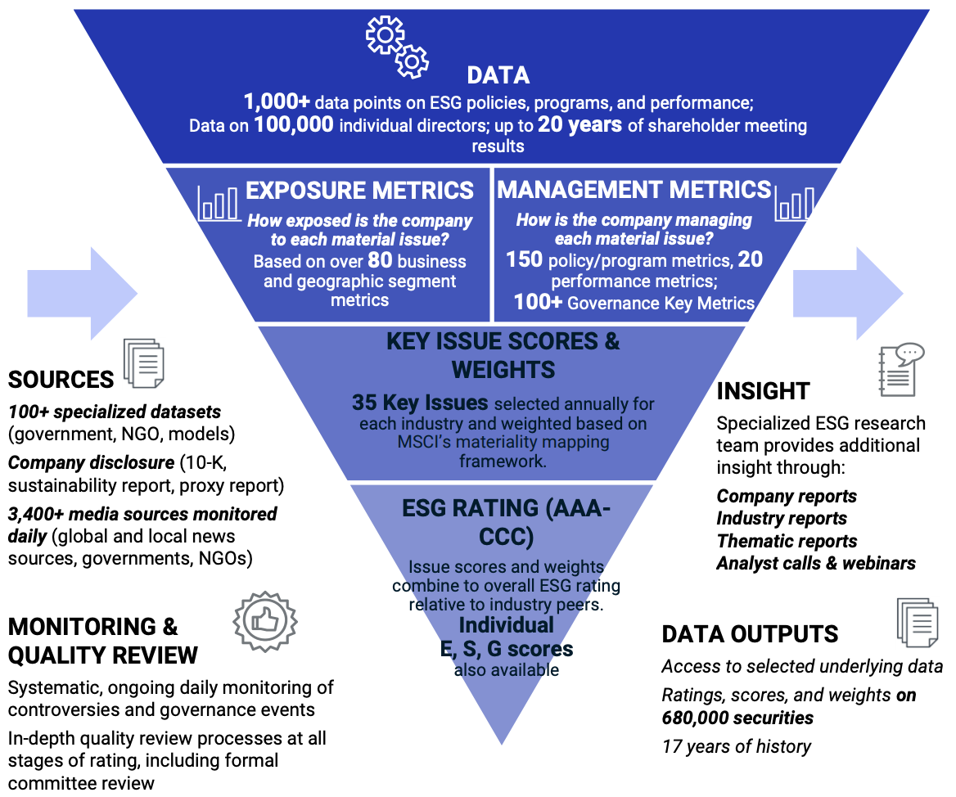
MSCI ESG Rating Framework
Source: https://www.msci.com/documents/1296102/21901542/ESG-Ratings-Methodology-Exec-Summary.pdf

Slide 87
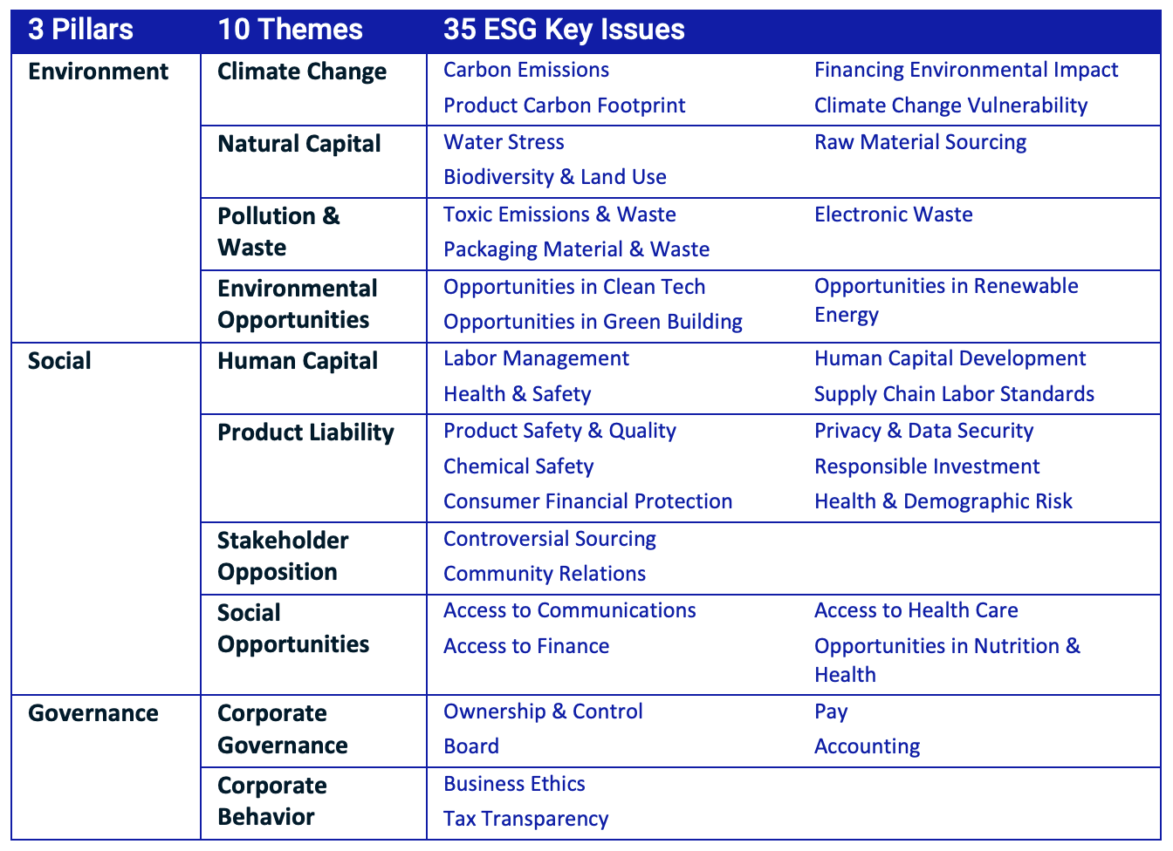
MSCI ESG Key Issue Hierarchy
Source: https://www.msci.com/documents/1296102/21901542/ESG-Ratings-Methodology-Exec-Summary.pdf

Slide 88
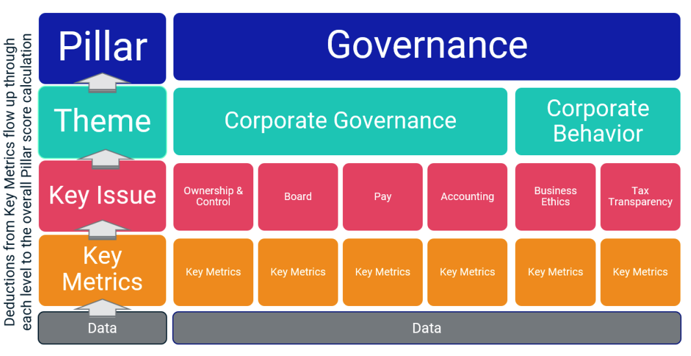
MSCI Governance Model Structure
Source: https://www.msci.com/documents/1296102/21901542/ESG-Ratings-Methodology-Exec-Summary.pdf

Slide 89
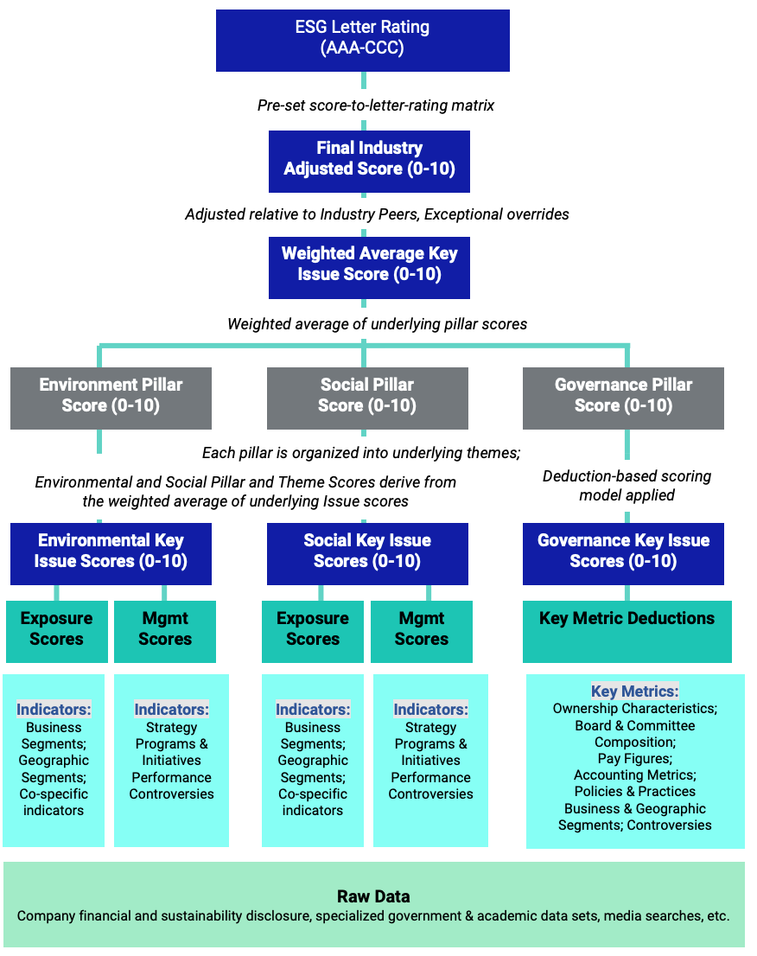
MSCI Hierarchy of ESG Scores
Source: https://www.msci.com/documents/1296102/21901542/ESG-Ratings-Methodology-Exec-Summary.pdf

Slide 90
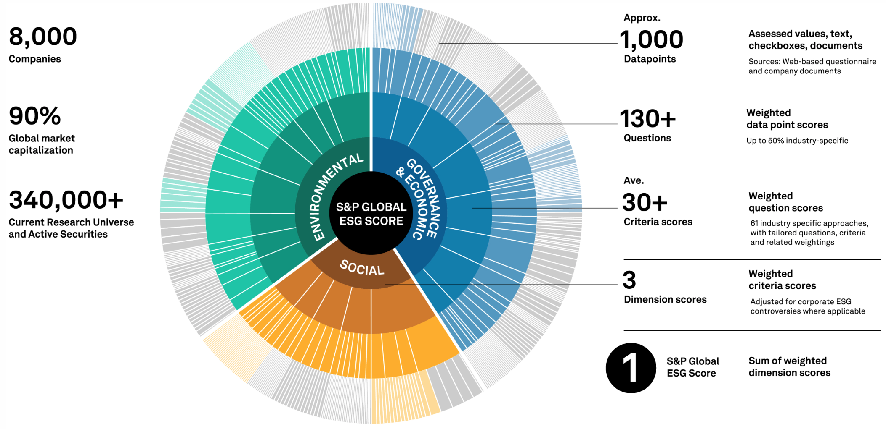
DJSI S&P Global ESG Score
Source: DJSI, S&P Global Corporate Sustainability Assessment (CSA), https://www.spglobal.com/esg/solutions/data-intelligence-esg-scores

Slide 91
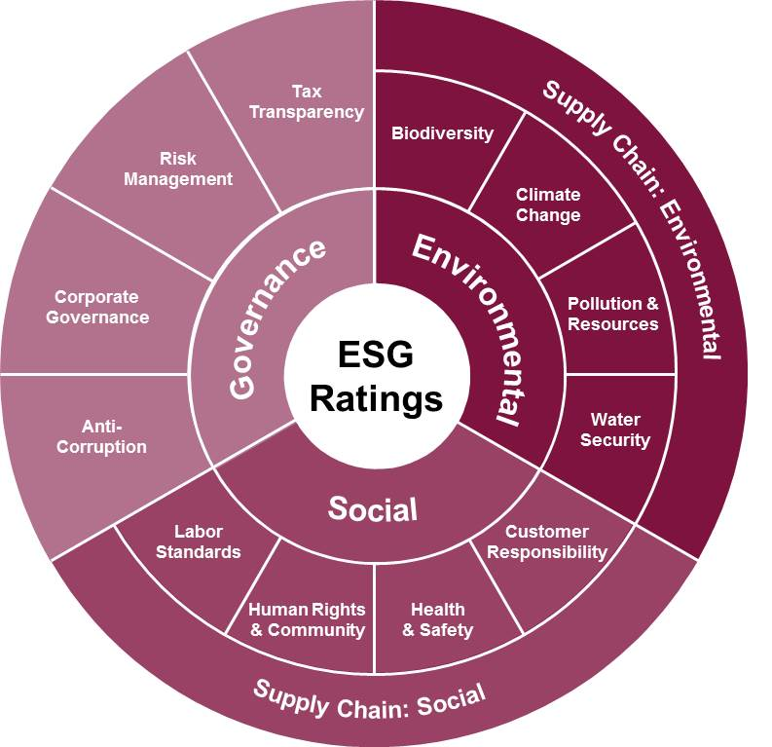
FTSE Russell ESG Ratings
Source: https://www.ftserussell.com/data/sustainability-and-esg-data/esg-ratings

Slide 92

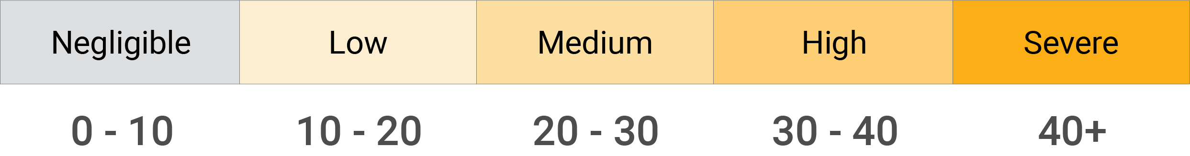
Sustainalytics
ESG Risk Ratings
Analyst-based
approach
Sustainalytics’ ESG Risk Ratings measure a company’s exposure to industry-specific material ESG risks and how well a company is managing those risks.
Source: https://www.sustainalytics.com/esg-data

Slide 93

Truvalue
ESG Ranks
TruValue Labs
Machine-based approach
Truvalue Labs applies AI to analyze over 100,000 sources and uncover ESG risks and opportunities hidden in unstructured text.
The ESG Ranks data service produces an overall company rank based on industry percentile leveraging the 26 ESG categories defined by the Sustainability Accounting Standards Board (SASB).
The data feed covers 20,000+ companies with more than 13 years of history.
Source: :https://developer.truvaluelabs.com/data/esg-ranks

Slide 94
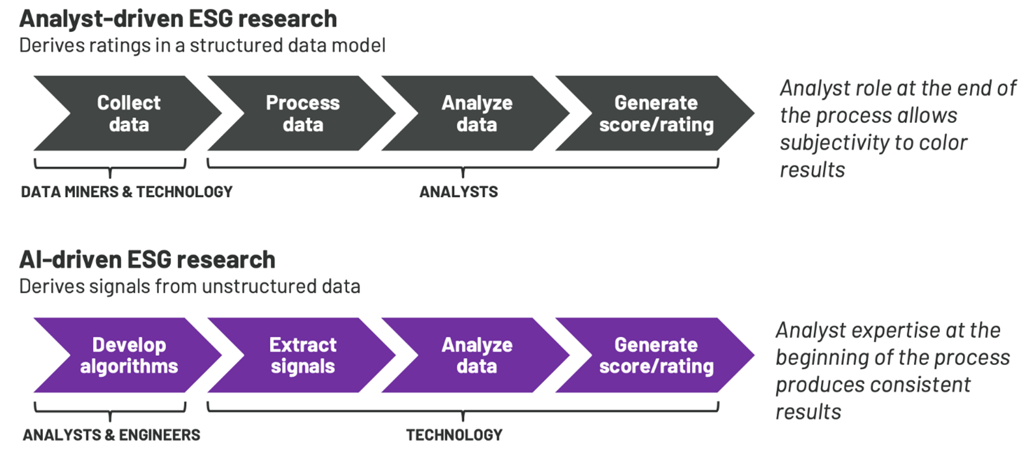
Analyst-driven vs. AI-driven ESG
Sustainalytics
Truvalue Labs
Source: Mark Tulay (2020), Man vs. machine: A tale of two sustainability ratings systems, GreenBiz, https://www.greenbiz.com/article/man-vs-machine-tale-two-sustainability-ratings-systems

Slide 95

Analyst based
ESG Research
AI based
ESG Research
Source: https://www.esganalytics.io/insights/how-data-is-accelerating-esg

Slide 96

ESG Analytics: NLP Taxonomy
Source: https://www.esganalytics.io/insights/how-data-is-accelerating-esg

Slide 97

Top
ESG Reporting Software
Environmental, Social and Governance (ESG) Reporting software or Sustainability software helps organizations manage their operational data, evaluate their impact on the environment and provide reporting to perform audits.
Source: https://www.softwarereviews.com/categories/environmental-social-and-governance-reporting

Slide 98

ESG Reporting Software: Emitwise
Emitwise is the carbon management platform for companies with complex manufacturing supply chains to confidently understand, track and reduce their complete carbon footprint.
Combining 100 years of carbon accounting experience and machine learning technology, we accelerate climate action by increasing the accuracy of scope 3 emissions.
The platform empowers manufacturers and their supply chains to make carbon-led business decisions that lower risk, increase profitability and deliver ambitious climate action.
Source: https://www.softwarereviews.com/categories/environmental-social-and-governance-reporting

Slide 99

ESG Reporting Software: Workiva ESG
Workiva is a cloud native platform that simplifies the complexities of reporting and compliance.
Workiva ESG is the end-to-end platform that allows you to integrate financial data, nonfinancial data, and XBRL.
Workiva, the platform that streamlines your entire ESG process.
Automate data collection, utilize frameworks, and directly connect to all your ESG reports. in meaningful glossy reports, accurate survey responses, and regulatory filings with integrated XBRL tagging.
Source: https://www.softwarereviews.com/categories/environmental-social-and-governance-reporting

Slide 100
Financial Technology (Fintech) Categories
Banking Infrastructure
Business Lending
Consumer and Commercial Banking
Consumer Lending
Consumer Payments
Crowdfunding
Equity Financing
Financial Research and Data
Financial Transaction Security
Institutional Investing
International Money Transfer
Payments Backend and Infrastructure
Personal Finance
Point of Sale Payments
Retail Investing
Small and Medium Business Tools
Source: http://www.venturescanner.com/financial-technology

Slide 101
Summary
Web 3.0
Big Data Analysis
Fintech
Green and Sustainable Finance

Slide 102
References
Thorsten Schoormann, Gero Strobel, Frederik Möller, Dimitri Petrik, and Patrick Zschech (2023). "Artificial Intelligence for Sustainability—A Systematic Review of Information Systems Literature." Communications of the Association for Information Systems 52, no. 1 (2023): 8.
Esmot Ara Tuli, Jae-Min Lee, and Dong-Seong Kim (2024). "Integration of Quantum Technologies into Metaverse: Applications, Potentials, and Challenges." IEEE Access 12 (2024): 29995-30019.
Longbing Cao (2022). "Decentralized ai: Edge intelligence and smart blockchain, metaverse, web3, and desci." IEEE Intelligent Systems 37, no. 3: 6-19.
Qinglin Yang, Yetong Zhao, Huawei Huang, Zehui Xiong, Jiawen Kang, and Zibin Zheng (2022). "Fusing blockchain and AI with metaverse: A survey." IEEE Open Journal of the Computer Society 3 : 122-136.
Russell Belk, Mariam Humayun, and Myriam Brouard (2022). "Money, possessions, and ownership in the Metaverse: NFTs, cryptocurrencies, Web3 and Wild Markets." Journal of Business Research 153: 198-205.
Thien Huynh-The, Quoc-Viet Pham, Xuan-Qui Pham, Thanh Thi Nguyen, Zhu Han, and Dong-Seong Kim (2022). "Artificial Intelligence for the Metaverse: A Survey." arXiv preprint arXiv:2202.10336.
Min-Yuh Day and Yensen Ni (2023), "Do clean energy indices outperform using contrarian strategies based on contrarian trading rules?", Energy, Volume 272, 1 June 2023, 127113.
Thippa Reddy Gadekallu, Thien Huynh-The, Weizheng Wang, Gokul Yenduri, Pasika Ranaweera, Quoc-Viet Pham, Daniel Benevides da Costa, and Madhusanka Liyanage (2022). "Blockchain for the Metaverse: A Review." arXiv preprint arXiv:2203.09738.
Dan Sheridan, James Harris, Frank Wear, Jerry Cowell Jr, Easton Wong, and Abbas Yazdinejad (2022). "Web3 Challenges and Opportunities for the Market." arXiv preprint arXiv:2209.02446.
Yves Hilpisch (2020), Artificial Intelligence in Finance: A Python-Based Guide, O’Reilly Media.
Aurélien Géron (2019), Hands-On Machine Learning with Scikit-Learn, Keras, and TensorFlow: Concepts, Tools, and Techniques to Build Intelligent Systems, 2nd Edition, O’Reilly Media.
Paolo Sironi (2016), FinTech Innovation: From Robo-Advisors to Goal Based Investing and Gamification, Wiley.
Campbell R. Harvey, Ashwin Ramachandran, Joey Santoro, Fred Ehrsam (2021), DeFi and the Future of Finance, Wiley
Matt Fortnow and QuHarrison Terry (2021), The NFT Handbook - How to Create, Sell and Buy Non-Fungible Tokens, Wiley
Parma Bains, Mohamed Diaby, Dimitris Drakopoulos, Julia Faltermeier, Federico Grinberg, Evan Papageorgiou, Dmitri Petrov, Patrick Schneider, and Nobu Sugimoto (2021),
The Crypto Ecosystem and Financial Stability Challenges, International Monetary Fund, October 2021
Ramesh Sharda, Dursun Delen, and Efraim Turban (2017), “Business Intelligence, Analytics, and Data Science: A Managerial Perspective”, 4th Edition, Pearson
Frederic S. Mishkin (2015), “The Economics of Money, Banking and Financial Markets”, 11th Edition, Pearson
Susanne Chishti and Janos Barberis (2016), “The FINTECH Book: The Financial Technology Handbook for Investors, Entrepreneurs and Visionaries”, Wiley.
Paolo Sironi (2016), “FinTech Innovation: From Robo-Advisors to Goal Based Investing and Gamification”, Wiley.
Brett King (2014), “Breaking Banks: The Innovators, Rogues, and Strategists Rebooting Banking”, Wiley.
Brett King (2012), “Bank 3.0: Why banking is no longer somewhere you go, but something you do”, John Wiley & Sons
Gopalakrishnan, Shanti, and Fariborz Damanpour (1997). "A review of innovation research in economics, sociology and technology management." Omega 25, no. 1 : 15-28.
Pichlak, Magdalena (2016). "The innovation adoption process: A multidimensional approach." Journal of Management and Organization 22, no. 4 : 476.
Everett M. Rogers (2003), “Diffusion of Innovations”, Free Press, 5th Edition

