Slide 1
Software Architecture: Architectural design, System decomposition, and Distribution architecture
Software Engineering
1122SE05
MBA, IM, NTPU (M5010) (Spring 2024) Wed 2, 3, 4 (9:10-12:00) (B3F17)
Min-Yuh Day, Ph.D, Professor
Institute of Information Management, National Taipei University
https://web.ntpu.edu.tw/~myday
https://meet.google.com/ish-gzmy-pmo
2024-04-17

Slide 2
Syllabus
Week Date Subject/Topics
1 2024/02/21 Introduction to Software Engineering
2 2024/02/28 Peace Memorial Day (Day Off)
3 2024/03/06 Software Products and Project Management: Software product management and prototyping
4 2024/03/13 Agile Software Engineering: Agile methods, Scrum, and Extreme Programming
5 2024/03/20 Case Study on Software Engineering I
6 2024/03/27 Features, Scenarios, and Stories
7 2024/04/03 Make-up holiday for NTPU Sports Day (No Classes)
8 2024/04/10 Midterm Project Report

Slide 3
Syllabus
Week Date Subject/Topics
9 2024/04/17 Software Architecture: Architectural design, System decomposition, and Distribution architecture
10 2024/04/24 Cloud-Based Software: Virtualization and containers, Everything as a service, Software as a service; Cloud Computing and Cloud Software Architecture
11 2024/05/01 Case Study on Software Engineering II
12 2024/05/08 Microservices Architecture, RESTful services, Service deployment

Slide 4
Syllabus
Week Date Subject/Topics
13 2024/05/15 Security and Privacy; Reliable Programming; Testing: Functional testing, Test automation, Test-driven development, and Code reviews; DevOps and Code Management: Code management and DevOps automation
14 2024/05/22 Industry Practices of Software Engineering
15 2024/05/29 Final Project Report I
16 2024/06/05 Final Project Report II

Slide 5
Software Architecture: Architectural design, System decomposition, and Distribution architecture

Slide 6
Software Engineering and Project Management
Analyze
Requirements definition
Design
System and Software design
Build
Implementation and
unit testing
Test
Integration and system testing
Deliver
Operation and maintenance
Project Management

Slide 7
Information Management (MIS) Information Systems
Organizations
Technology
Information Systems
Management

Slide 8
Fundamental MIS Concepts
Business Challenges
Management
Organization
Information System
Business Solutions
Technology

Slide 9
Project-based software engineering
CUSTOMER
Problem
generates
helps-with
Requirements
implemented-by
Software
1
CUSTOMER and DEVELOPER
DEVELOPER

Slide 10
Product software engineering
DEVELOPER
Opportunity
1
inspires
realizes
Product features
implemented-by
Software
DEVELOPER
DEVELOPER

Slide 11
Software execution models
Stand-alone execution
Hybrid execution
Software as a service
User’s computer
User’s computer
User’s computer
User interface
Product functionality
User data
User interface
Partial functionality
User data
User interface
(browser or app)
Product updates
Additional functionality
User data backups
Product updates
Product functionality
User data
Vendor’s servers
Vendor’s servers
Vendor’s servers

Slide 12
Product management concerns
Business needs
Product manager
Technology constraints
Customer experience

Slide 13
Technical interactions of product managers
Product vision management
Product backlog management
User stories and scenarios
Product manager
Acceptance testing
Customer testing
User interface design

Slide 14
Software Development Life Cycle (SDLC) The waterfall model
Requirements definition
System and Software design
Implementation and unit testing
Integration and system testing
Operation and maintenance

Slide 15
Plan-based and Agile development
Plan-based development
Requirements engineering
Requirements specification
Design and implementation
Requirements change requests
Agile development
Requirements engineering
Design and implementation

Slide 16
The Continuum of Life Cycles
High
Incremental
Agile
Frequency of Delivery
Predictive
Iterative
Low
Low
High
Degree of Change

Slide 17
Predictive Life Cycle
Analyze
Design
Build
Test
Deliver

Slide 18
Iterative Life Cycle
Prototype
Refine
Analyze
Analyze
Design
Build
Test
Deliver

Slide 19
A Life Cycle of Varying-Sized Increments
Analyze
Design
Build
Test
Deliver
Analyze
Design
Build
Test
Deliver
Analyze
Design
Build
Test
Deliver

Slide 20
Iteration-Based and Flow-Based Agile Life Cycles
Iteration-Based Agile
Requirements
Analysis
Design
Build
Test
Requirements
Analysis
Design
Build
Test
Requirements
Analysis
Design
Build
Test
Requirements
Analysis
Design
Build
Test
Repeat as needed
…
Requirements
Analysis
Design
Build
Test
Requirements
Analysis
Design
Build
Test
Flow-Based Agile
Requirements
Analysis
Design
Build
Test
the number of features in the WIP limit
Requirements
Analysis
Design
Build
Test
the number of features in the WIP limit
Requirements
Analysis
Design
Build
Test
the number of features in the WIP limit
Repeat as needed
…
Requirements
Analysis
Design
Build
Test
the number of features in the WIP limit
Requirements
Analysis
Design
Build
Test
the number of features in the WIP limit

Slide 21
From personas to features
1
Personas
A way of representing users
inspire
Natural language descriptions of a user interacting with a software product
2
Scenarios
are-developed-into
3
inspire
Stories
Natural language descriptions of something that is needed or wanted by users
4
Features
define
Fragments of product functionality

Slide 22
Multi-tier client-server architecture
Client 1
Client 2
Web Server
Application Server
Database Server
Client 3
Client …

Slide 23
Service-oriented Architecture
Client 1
S1
S2
Client 2
S3
Web Server
Service gateway
S4
Client 3
S5
Client …
S6
Services

Slide 24
VM
Container
Virtual web server
Virtual mail server
User 1 Container 1
User 2 Container 2
Server software
Server software
Application software
Application software
Guest OS
Guest OS
Server software
Server software
Hypervisor
Container manager
Host OS
Host OS
Server Hardware
Server Hardware

Slide 25
Everything as a service
Photo editing
Software as a service (SaaS)
Logistics management
Cloud management Monitoring
Platform as a service (PaaS)
Database
Software development
Storage Network
Infrastructure as a service (IaaS)
Computing Virtualization
Cloud data center

Slide 26
Software as a service
Software customers
Software provider
Software services
Cloud Infrastructure
Cloud provider

Slide 27
Microservices architecture – key design questions
What are the microservices that make up the system?
How should data be distributed and shared?
How should microservices communicate with each other?
Microservices architecture
design
How should the microservices in the system be coordinated?
How should service failure be detected, reported and managed?

Slide 28
Types of security threat
An attacker attempts to deny access to the system for legitimate users
An attacker attempts to damage the system or its data
Availability
threats
Integrity
threats
SOFTWARE PRODUCT
PROGRAM
Distributed denial of service (DDoS) attack
Virus
DATA
Ransomware
Data theft
Confidentiality threats
An attacker tries to gain access to private information held by the system

Slide 29
Software product quality attributes
Reliability
Availability
1
2
Software product quality attributes
Security
Resilience
7
3
Usability
Maintainability
6
4
Responsiveness
5

Slide 30
A refactoring process
1
2
Start
Identify code ‘smell’
Identify refactoring strategy
4
3
Run automated code tests
Make small
improvement until strategy completed

Slide 31
Functional testing
Start
1
Unit Testing
4
2
Release Testing
Feature Testing
3
System Testing

Slide 32
Test-driven development (TDD)
Start
1
Identify new functionality
2
Identify partial implementation
of functionality
3
Write code stub that will fail test
Functionality complete
Functionality incomplete
4
Run all automated test
7
Refactor code if required
5
Implement code that should cause failing test to pass
Test failure
6
Run all automated test
All tests pass

Slide 33
DevOps
Development
Deployment
Support
Multi-skilled DevOps team

Slide 34
Code management and DevOps
DevOps automation
Continuous integration
Continuous deployment
Continuous delivery
Infrastructure as code
Code management system
Branching and merging
Recover version information
Code repository
Save and retrieve versions
Transfer code to/from developer’s filestore
DevOps measurement
Data collection
Data analysis
Report generation

Slide 35
Software Architecture: Architectural design, System decomposition, and Distribution architecture

Slide 36
LLM-powered Multimodal Agents Large Multimodal Agents (LMAs)
2022
2023
2024
Source: Xie, Junlin, Zhihong Chen, Ruifei Zhang, Xiang Wan, and Guanbin Li. "Large Multimodal Agents: A Survey." arXiv preprint arXiv:2402.15116 (2024).

Slide 37
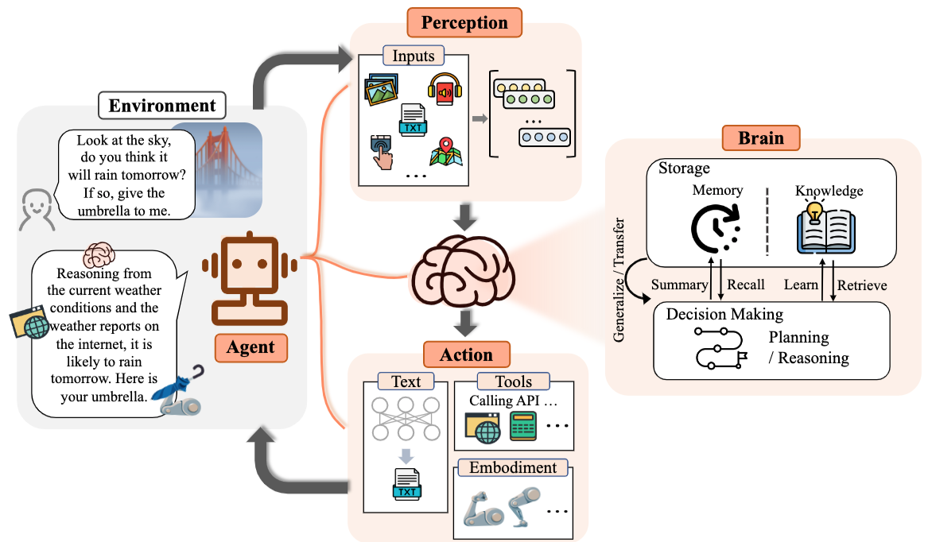
Large Language Model (LLM) Based Agents
Source: Guo, Taicheng, Xiuying Chen, Yaqi Wang, Ruidi Chang, Shichao Pei, Nitesh V. Chawla, Olaf Wiest, and Xiangliang Zhang. "Large language model based multi-agents: A survey of progress and challenges." arXiv preprint arXiv:2402.01680 (2024).

Slide 38
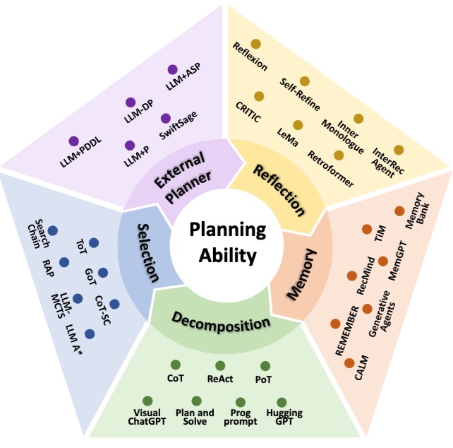
Taxonomy on LLM-Agent planning
Source: Huang, Xu, Weiwen Liu, Xiaolong Chen, Xingmei Wang, Hao Wang, Defu Lian, Yasheng Wang, Ruiming Tang, and Enhong Chen. "Understanding the planning of LLM agents: A survey." arXiv preprint arXiv:2402.02716 (2024).

Slide 39
Taxonomy on LLM-Agent planning
Source: Huang, Xu, Weiwen Liu, Xiaolong Chen, Xingmei Wang, Hao Wang, Defu Lian, Yasheng Wang, Ruiming Tang, and Enhong Chen. "Understanding the planning of LLM agents: A survey." arXiv preprint arXiv:2402.02716 (2024).

Slide 40
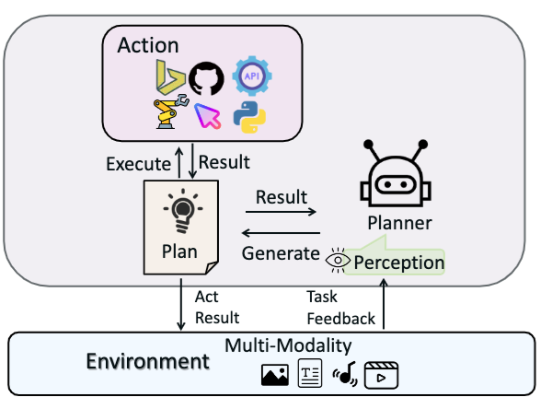
Large Multimodal Agents (LMAs) (a) Type I: Closed-source LLMs as Planners w/o Longterm Memory.
Use prompt techniques to guide closed-source LLMs in decision-making and planning to complete tasks without long memory.
Source: Xie, Junlin, Zhihong Chen, Ruifei Zhang, Xiang Wan, and Guanbin Li. "Large Multimodal Agents: A Survey." arXiv preprint arXiv:2402.15116 (2024).

Slide 41
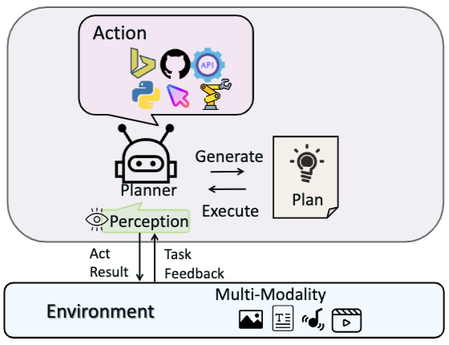
Large Multimodal Agents (LMAs) (b) Type II: Finetuned LLMs as Planners w/o long-term Memory.
Use action-related data to finetune existing open-source large models,
enabling them to achieve decision-making, planning, and tool invocation capabilities comparable
to closed-source LLMs
Source: Xie, Junlin, Zhihong Chen, Ruifei Zhang, Xiang Wan, and Guanbin Li. "Large Multimodal Agents: A Survey." arXiv preprint arXiv:2402.15116 (2024).

Slide 42
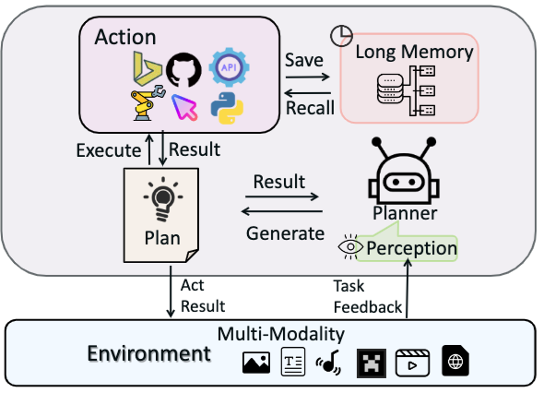
Large Multimodal Agents (LMAs) (c) Type III: Planners with Indirect Long-term Memory
Introduce indirect long-term memory functions,
further enhancing their generalization and adaptation abilities in environments closer to the real world.
Source: Xie, Junlin, Zhihong Chen, Ruifei Zhang, Xiang Wan, and Guanbin Li. "Large Multimodal Agents: A Survey." arXiv preprint arXiv:2402.15116 (2024).

Slide 43
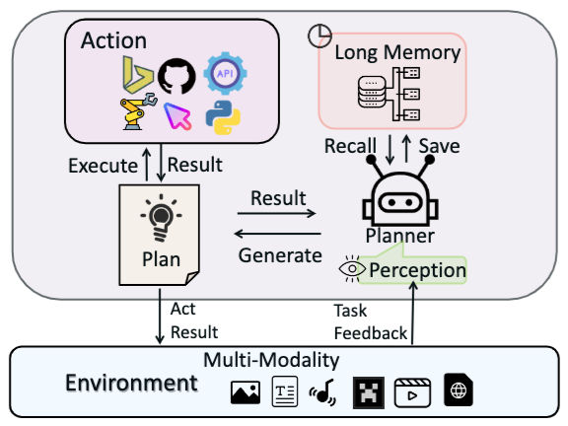
Large Multimodal Agents (LMAs) (d) Type IV: Planners with Native Long-term Memory
Introduce native long-term memory functions,
further enhancing their generalization and adaptation abilities in environments closer to the real world.
Source: Xie, Junlin, Zhihong Chen, Ruifei Zhang, Xiang Wan, and Guanbin Li. "Large Multimodal Agents: A Survey." arXiv preprint arXiv:2402.15116 (2024).

Slide 44
Multi-Agent Frameworks
Source: Xie, Junlin, Zhihong Chen, Ruifei Zhang, Xiang Wan, and Guanbin Li. "Large Multimodal Agents: A Survey." arXiv preprint arXiv:2402.15116 (2024).

Slide 45
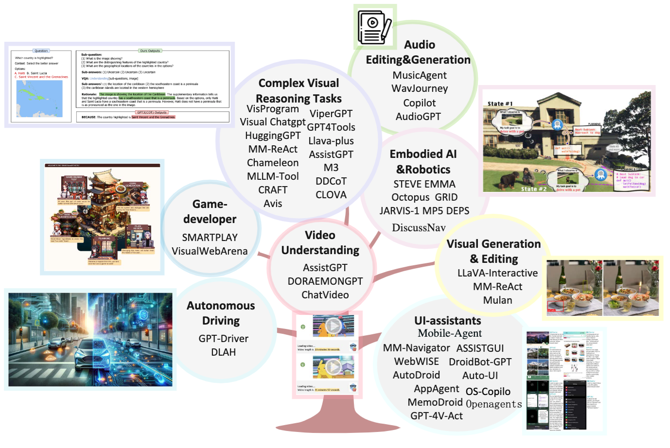
Applications of Large Multimodal Agents (LMAs)
Source: Xie, Junlin, Zhihong Chen, Ruifei Zhang, Xiang Wan, and Guanbin Li. "Large Multimodal Agents: A Survey." arXiv preprint arXiv:2402.15116 (2024).

Slide 46
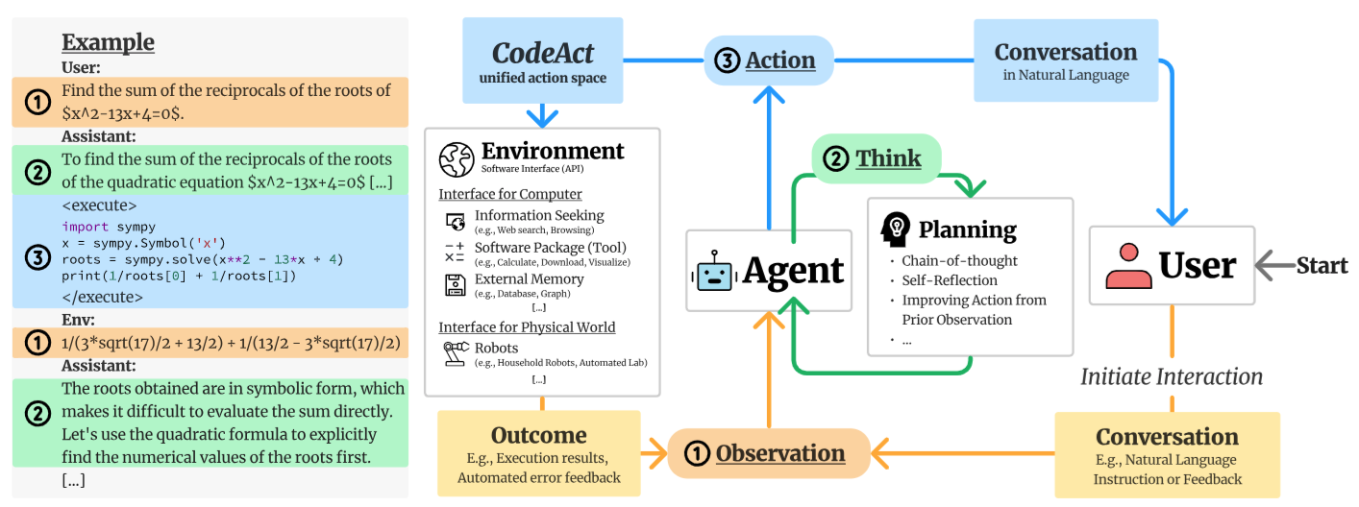
CodeActAgent: General Agent Multi-turn Interaction Framework
Source: Wang, Xingyao, Yangyi Chen, Lifan Yuan, Yizhe Zhang, Yunzhu Li, Hao Peng, and Heng Ji. "Executable code actions elicit better llm agents." arXiv preprint arXiv:2402.01030 (2024).

Slide 47
Software architecture
To create a reliable, secure and efficient product, you need to pay attention to architectural design which includes:
its overall organization,
how the software is decomposed into components,
the server organization
the technologies that you use to build the software. The architecture of a software product affects its performance, usability, security, reliability and maintainability.

Slide 48
Software architecture
There are many different interpretations of the term ‘software architecture’.
Some focus on ‘architecture’ as a noun - the structure of a system and others consider ‘architecture’ to be a verb - the process of defining these structures.

Slide 49
The IEEE definition of software architecture
Architecture is the fundamental organization of a software system embodied in its components, their relationships to each other and to the environment, and the principles guiding its design and evolution.

Slide 50
Software architecture and components
A component is an element that implements a coherent set of functionality or features.
Software component can be considered as a collection of one or more services that may be used by other components.
When designing software architecture, you don’t have to decide how an architectural element or component is to be implemented.
Rather, you design the component interface and leave the implementation of that interface to a later stage of the development process.

Slide 51
Access to services provided by software components
Services accessed through the component API
Services accessed directly by other components
API
S1
S2
S3
S4
S5
S6
Component 1
Component 2

Slide 52
Why is architecture important?
Architecture is important because the architecture of a system has a fundamental influence on the non-functional system properties.
Architectural design involves understanding the issues that affect the architecture of your product and creating an architectural description that shows the critical components and their relationships.
Minimizing complexity should be an important goal for architectural designers.

Slide 53
Non-functional system quality attributes
Responsiveness Does the system return results to users in a reasonable time?
Reliability Do the system features behave as expected by both developers and users?
Availability Can the system deliver its services when requested by users?
Security Does the system protect itself and users’ data from unauthorized attacks and intrusions?

Slide 54
Non-functional system quality attributes
Usability Can system users access the features that they need and use them quickly and without errors?
Maintainability Can the system be readily updated and new features added without undue costs?
Resilience Can the system continue to deliver user services in the event of partial failure or external attack?

Slide 55
Centralized security architectures
The benefits of a centralized security architecture are that it is easier to design and build protection and that the protected information can be accessed more efficiently.
However, if your security is breached, you lose everything.
If you distribute information, it takes longer to access all of the information and costs more to protect it.
If security is breached in one location, you only lose the information that you have stored there.

Slide 56
Shared database architecture
User interface
C1
C2
Shared database

Slide 57
Multiple database architecture
User interface
C1
C2
C1 database
C2 database
C3
Database reconciliation

Slide 58
Maintainability and performance
Shared database architecture:
system with two components (C1 and C2) that share a common database.
Multiple database architecture:
each component has its own copy of the parts of the database that it needs.
If one component needs to change the database organization, this does not affect the other component.
A multi-database architecture may run more slowly and may cost more to implement and change.
A multi-database architecture needs a mechanism (component C3) to ensure that the data shared by C1 and C2 is kept consistent when it is changed.

Slide 59
Issues that influence architectural decisions
1
Nonfunctional product characteristics
5
2
Software compatibility
Product
lifetime
Architectural influences
4
3
Number of users
Software reuse

Slide 60
The importance of architectural design issues
1
Nonfunctional product characteristics Nonfunctional product characteristics such as security and performance affect all users. If you get these wrong, your product will is unlikely to be a commercial success. Unfortunately, some characteristics are opposing, so you can only optimize the most important.

Slide 61
The importance of architectural design issues
2
Product lifetime If you anticipate a long product lifetime, you will need to create regular product revisions. You therefore need an architecture that is evolvable, so that it can be adapted to accommodate new features and technology.

Slide 62
The importance of architectural design issues
3
Software reuse You can save a lot of time and effort, if you can reuse large components from other products or open-source software. However, this constrains your architectural choices because you must fit your design around the software that is being reused.

Slide 63
The importance of architectural design issues
4
Number of users If you are developing consumer software delivered over the Internet, the number of users can change very quickly. This can lead to serious performance degradation unless you design your architecture so that your system can be quickly scaled up and down.

Slide 64
The importance of architectural design issues
5
Software compatibility For some products, it is important to maintain compatibility with other software so that users can adopt your product and use data prepared using a different system. This may limit architectural choices, such as the database software that you can use.

Slide 65
Trade off: Maintainability vs performance
System maintainability is an attribute that reflects how difficult and expensive it is to make changes to a system after it has been released to customers.
You improve maintainability by building a system from small self-contained parts, each of which can be replaced or enhanced if changes are required.
In architectural terms, this means that the system should be decomposed into fine-grain components, each of which does one thing and one thing only.
However, it takes time for components to communicate with each other. Consequently, if many components are involved in implementing a product feature, the software will be slower.

Slide 66
Trade off: Security vs usability
You can achieve security by designing the system protection as a series of layers.
An attacker has to penetrate all of those layers before the system is compromised.
Layers might include system authentication layers, a separate critical feature authentication layer, an encryption layer and so on.
Architecturally, you can implement each of these layers as separate components so that if one of these components is compromised by an attacker, then the other layers remain intact.

Slide 67
Authentication layers
IP authentication
Application authentication
Feature authentication
Encryption
Protect asset such as a database of user’s credit card

Slide 68
Usability issues
A layered approach to security affects the usability of the software.
Users have to remember information, like passwords, that is needed to penetrate a security layer. Their interaction with the system is inevitably slowed down by its security features.
Many users find this irritating and often look for work-arounds so that they do not have to re-authenticate to access system features or data.
To avoid this, you need an architecture:
that doesn’t have too many security layers
that doesn’t enforce unnecessary security
that provides helper components that reduce the load on users

Slide 69
An architectural model of a document retrieval system
Web browser
Local input validation
User interaction
Local printing
User interface management
Authentication and authorization
Form and query manager
Web page generation
Information retrieval
Document retrieval
Rights management
Search
Payments
Accounting
Document index
Index management
Index querying
Index creation
Basic services
Database
Query
Query validation
Logging
User account management
Databases
DB1
DB2
DB3
DB4
DB5

Slide 70
Examples of component relationships
C1 is part of C2
C1 uses C2
C1
C2
calls
C1
C2
C1 is-located-with C2
C1 shared-data-with C2
Data
C1
C2
C1
C2

Slide 71
Architectural design guidelines
Separation of concerns
Organize your architecture into components that focus on a single concern
Design
guidelines
Stable interfaces
Design component interfaces that are coherent and that changes slowly
Implement once
Avoid duplicating functionality at different places in your architecture

Slide 72
Cross-cutting concerns
Security
Performance
Reliability
User interface
Application
Infrastructure
Operating System
Hardware

Slide 73
A generic layered architecture for a web-based application
Browser-based or mobile user interface
Authentication and user interaction management
Application-specific functionality
Basic shared services
Transaction and database management

Slide 74
A layered architectural model of the iLearn system
User interface
Web browser
iLearn app
User interface management
Interface creation
Forms management
Interface delivery
Login
Configuration services
Group configuration
Application configuration
Security configuration
User interface configuration
Setup service
Application services
Archive access Word processor Video conf.
Email and messaging
User installed application
Blog Wiki Spreadsheet Presentation Drawing
Integrated services
Resource discovery
User analytics
Virtual Learning environment
Authentication and authorization
Shared infrastructure services
Authentication Logging and monitoring Application interfacing
User storage Application storage Search

Slide 75
Distribution architecture
The distribution architecture of a software system defines the servers in the system and the allocation of components to these servers.
Client-server architectures are a type of distribution architecture that is suited to applications where clients access a shared database and business logic operations on that data.
In this architecture, the user interface is implemented on the user’s own computer or mobile device.
Functionality is distributed between the client and one or more server computers.

Slide 76
Client-server architecture
Client 1
request
response
Client 2
request
response
request
Client 3
response
request
Servers
Client …
Load balancer
response

Slide 77
The Model-View-Controller (MVC) pattern
Browser
CLIENT
User inputs
Page to display
User changes
Controller
View
View update request
Change notification
View refresh request
Model
SERVER

Slide 78
Mobile Web App
HTML
Phone Data
Templates
CSS
JavaScript
External Data
Mobile frameworks and Libraries
Source: Scott Preston, Learn HTML5 and JavaScript for iOS: Web Standards-based Apps for iPhone, iPad, and iPod touch, Apress, 2012

Slide 79
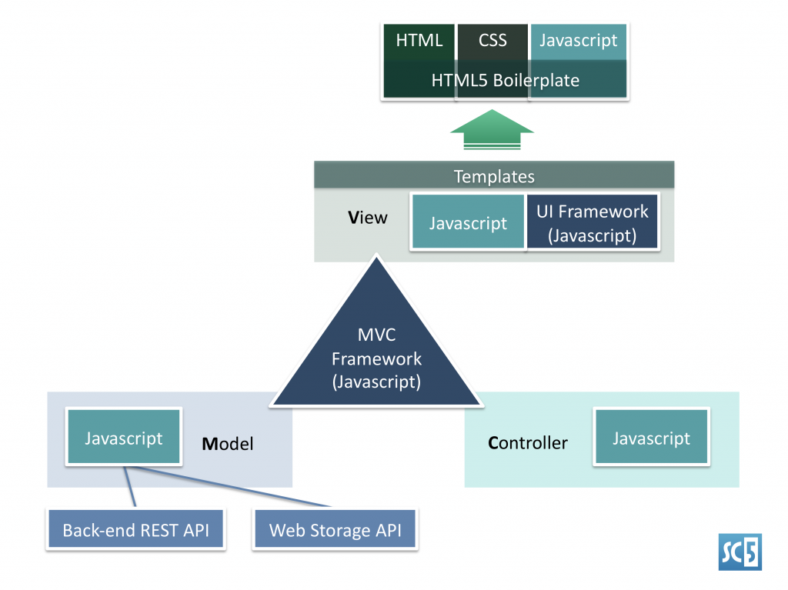
MVC Framework of Mobile Apps (HTML5, CSS3, JavaScript)
Source: http://sc5.io/blog/2012/02/anatomy-of-a-html5-app/

Slide 80
Multi-tier client-server architecture
Client 1
Client 2
Web Server
Application Server
Database Server
Client 3
Client …

Slide 81
Service-oriented Architecture
Services in a service-oriented architecture are stateless components, which means that they can be replicated and can migrate from one computer to another.
Many servers may be involved in providing services
A service-oriented architecture is usually easier to scale as demand increases and is resilient to failure.

Slide 82
Service-oriented Architecture
Client 1
S1
S2
Client 2
S3
Web Server
Service gateway
S4
Client 3
S5
Client …
S6
Services

Slide 83
Issues in architectural choice
Data type and data updates
Change frequency
The system execution platform

Slide 84
Issues in architectural choice
Data type and data updates
If you are mostly using structured data that may be updated by different system features, it is usually best to have a single shared database that provides locking and transaction management. If data is distributed across services, you need a way to keep it consistent and this adds overhead to your system.

Slide 85
Issues in architectural choice
Change frequency
If you anticipate that system components will be regularly changed or replaced, then isolating these components as separate services simplifies those changes.

Slide 86
Issues in architectural choice
The system execution platform
If you plan to run your system on the cloud with users accessing it over the Internet, it is usually best to implement it as a service-oriented architecture because scaling the system is simpler.
If your product is a business system that runs on local servers, a multi-tier architecture may be more appropriate.

Slide 87
Technology choices
Database Should you use a relational SQL database or an unstructured NOSQL database?
Platform Should you deliver your product on a mobile app and/or a web platform?
Server Should you use dedicated in-house servers or design your system to run on a public cloud? If a public cloud, should you use Amazon, Google, Microsoft, or some other option?
Open source Are there suitable open-source components that you could incorporate into your products?
Development tools Do your development tools embed architectural assumptions about the software being developed that limit your architectural choices

Slide 88
Summary
Software architecture is the fundamental organization of a system embodied in its components, their relationships to each other, and to the environment, and the principles guiding its design and evolution.
The architecture of a software system has a significant influence on non-functional system properties such as reliability, efficiency and security.
Architectural design involves understanding the issues that are critical for your product and creating system descriptions that shows components and their relationships.

Slide 89
Summary
The principal role of architectural descriptions is to provide a basis for the development team to discuss the system organization. Informal architectural diagrams are effective in architectural description because they are fast and easy to draw and share.
System decomposition involves analyzing architectural components and representing them as a set of finer-grain components.

Slide 90
Summary
To minimize complexity, you should separate concerns, avoid functional duplication and focus on component interfaces.
Web-based systems often have a common layered structure including user interface layers, application-specific layers and a database layer.
The distribution architecture in a system defines the organization of the servers in that system and the allocation of components to these servers.

Slide 91
Summary
Multi-tier client-server and service-oriented architectures are the most commonly used architectures for web-based systems.
Making decisions on technologies such as database and cloud technologies are an important part of the architectural design process.

Slide 92
References
Ian Sommerville (2019), Engineering Software Products: An Introduction to Modern Software Engineering, Pearson.
Ian Sommerville (2015), Software Engineering, 10th Edition, Pearson.
Titus Winters, Tom Manshreck, and Hyrum Wright (2020), Software Engineering at Google: Lessons Learned from Programming Over Time, O'Reilly Media.
Project Management Institute (2021), A Guide to the Project Management Body of Knowledge (PMBOK Guide) – Seventh Edition and The Standard for Project Management, PMI.
Project Management Institute (2017), A Guide to the Project Management Body of Knowledge (PMBOK Guide), Sixth Edition, Project Management Institute.
Project Management Institute (2017), Agile Practice Guide, Project Management Institute.

