Slide 1








The Theory of Learning and
Ensemble Learning
Artificial Intelligence
1131AI05
MBA, IM, NTPU (M5276) (Fall 2024)
Tue 2, 3, 4 (9:10-12:00) (B3F17)
Min-Yuh Day, Ph.D,
Professor
Institute of Information Management, National Taipei University
https://web.ntpu.edu.tw/~myday
https://meet.google.com/paj-zhhj-mya
2024-10-22

Slide 2
Syllabus
Week Date Subject/Topics
1 2024/09/10 Introduction to Artificial Intelligence
2 2024/09/17 Mid-Autumn Festival (Day off)
3 2024/09/24 Artificial Intelligence and Intelligent Agents; Problem Solving
4 2024/10/01 Knowledge, Reasoning and Knowledge Representation;
Uncertain Knowledge and Reasoning
5 2024/10/08 Case Study on Artificial Intelligence I
6 2024/10/15 Machine Learning: Supervised and Unsupervised Learning

Slide 3
Syllabus
Week Date Subject/Topics
7 2024/10/22 The Theory of Learning and Ensemble Learning
8 2024/10/29 Midterm Project Report
9 2024/11/05 Self-Learning
10 2024/11/12 Deep Learning, Reinforcement Learning
11 2024/11/19 Case Study on Artificial Intelligence II
12 2024/11/26 Deep Learning for Natural Language Processing

Slide 4
Syllabus
Week Date Subject/Topics
13 2024/12/03 Computer Vision and Robotics
14 2024/12/10 Generative AI,
Philosophy and Ethics of AI and the Future of AI
15 2024/12/17 Final Project Report I
16 2024/12/24 Final Project Report II

Slide 5
The Theory of Learning and
Ensemble Learning

Slide 6
Outline
The Theory of Learning
  Computational Learning Theory
  Probably Approximately Correct (PAC) Learning
Ensemble Learning
  Bagging: Random Forests (RF)
  Boosting: Gradient Boosting, XGBoost, LightGBM, CatBoost
  Stacking
  Online learning
Meta Learning: Learning to Learn

Slide 7

Stuart Russell and Peter Norvig (2020),
Artificial Intelligence: A Modern Approach,
4th Edition, Pearson
Source: Stuart Russell and Peter Norvig (2020), Artificial Intelligence: A Modern Approach, 4th Edition, Pearson
https://www.amazon.com/Artificial-Intelligence-A-Modern-Approach/dp/0134610997/

Slide 8
Artificial Intelligence:
A Modern Approach
Artificial Intelligence
Problem Solving
Knowledge and Reasoning
Uncertain Knowledge and Reasoning
Machine Learning
Communicating, Perceiving, and Acting
Philosophy and Ethics of AI
Source: Stuart Russell and Peter Norvig (2020), Artificial Intelligence: A Modern Approach, 4th Edition, Pearson

Slide 9
Artificial Intelligence:
Machine Learning
Source: Stuart Russell and Peter Norvig (2020), Artificial Intelligence: A Modern Approach, 4th Edition, Pearson

Slide 10
Artificial Intelligence:
5. Machine Learning
Learning from Examples
Learning Probabilistic Models
Deep Learning
Reinforcement Learning
Source: Stuart Russell and Peter Norvig (2020), Artificial Intelligence: A Modern Approach, 4th Edition, Pearson

Slide 11

Aurélien Géron (2022),
Hands-On Machine Learning with Scikit-Learn, Keras, and TensorFlow: Concepts, Tools, and Techniques to Build Intelligent Systems,
3rd Edition, O’Reilly Media
https://github.com/ageron/handson-ml3
Source: https://www.amazon.com/Hands-Machine-Learning-Scikit-Learn-TensorFlow/dp/1098125975

Slide 12
Hands-On Machine Learning with
Scikit-Learn, Keras, and TensorFlow
Notebooks
The Machine Learning landscape
End-to-end Machine Learning project
Classification
Training Models
Support Vector Machines
Decision Trees
Ensemble Learning and Random Forests
Dimensionality Reduction
Unsupervised Learning Techniques
Artificial Neural Nets with Keras
Training Deep Neural Networks
Custom Models and Training with TensorFlow
Loading and Preprocessing Data
Deep Computer Vision Using Convolutional Neural Networks
Processing Sequences Using RNNs and CNNs
Natural Language Processing with RNNs and Attention
Autoencoders, GANs, and Diffusion Models
Reinforcement Learning
Training and Deploying TensorFlow Models at Scale
https://github.com/ageron/handson-ml3

Slide 13
Reinforcement Learning (DL)
Agent
Environment
Source: Richard S. Sutton & Andrew G. Barto (2018), Reinforcement Learning: An Introduction, 2nd Edition, A Bradford Book.

Slide 14
Reinforcement Learning (DL)
1
2
observation
Agent
action
3
reward
Environment
Source: Richard S. Sutton & Andrew G. Barto (2018), Reinforcement Learning: An Introduction, 2nd Edition, A Bradford Book.

Slide 15
Reinforcement Learning (DL)
1
2
observation
Agent
action
O_{t}
A_{t}
3
reward
R_{t}
Environment
Source: Richard S. Sutton & Andrew G. Barto (2018), Reinforcement Learning: An Introduction, 2nd Edition, A Bradford Book.

Slide 16
Agents interact with environments through sensors and actuators
Source: Stuart Russell and Peter Norvig (2020), Artificial Intelligence: A Modern Approach, 4th Edition, Pearson

Slide 17
Machine Learning
Supervised Learning (Classification)
Learning from Examples
y = f(x)
x
y

Slide 18
Machine Learning
Supervised Learning (Classification)
Learning from Examples
y = f(x)
x
y
input
Output
label

Slide 19
Machine Learning
Supervised Learning (Classification)
Learning from Examples
y = f(x)
5.1,3.5,1.4,0.2,Iris-setosa 4.9,3.0,1.4,0.2,Iris-setosa 4.7,3.2,1.3,0.2,Iris-setosa 7.0,3.2,4.7,1.4,Iris-versicolor 6.4,3.2,4.5,1.5,Iris-versicolor 6.9,3.1,4.9,1.5,Iris-versicolor 6.3,3.3,6.0,2.5,Iris-virginica 5.8,2.7,5.1,1.9,Iris-virginica 7.1,3.0,5.9,2.1,Iris-virginica

Slide 20
Machine Learning
Supervised Learning (Classification)
Learning from Examples
y = f(x)
Example
5.1,3.5,1.4,0.2,Iris-setosa 4.9,3.0,1.4,0.2,Iris-setosa 4.7,3.2,1.3,0.2,Iris-setosa 7.0,3.2,4.7,1.4,Iris-versicolor 6.4,3.2,4.5,1.5,Iris-versicolor 6.9,3.1,4.9,1.5,Iris-versicolor 6.3,3.3,6.0,2.5,Iris-virginica 5.8,2.7,5.1,1.9,Iris-virginica 7.1,3.0,5.9,2.1,Iris-virginica

Slide 21
Machine Learning
Supervised Learning (Classification)
Learning from Examples
y = f(x)
Example
5.1,3.5,1.4,0.2,Iris-setosa 4.9,3.0,1.4,0.2,Iris-setosa 4.7,3.2,1.3,0.2,Iris-setosa 7.0,3.2,4.7,1.4,Iris-versicolor 6.4,3.2,4.5,1.5,Iris-versicolor 6.9,3.1,4.9,1.5,Iris-versicolor 6.3,3.3,6.0,2.5,Iris-virginica 5.8,2.7,5.1,1.9,Iris-virginica 7.1,3.0,5.9,2.1,Iris-virginica
y
x

Slide 22
Artificial Intelligence
Machine Learning & Deep Learning
Source: https://blogs.nvidia.com/blog/2016/07/29/whats-difference-artificial-intelligence-machine-learning-deep-learning-ai/

Slide 23
AI, ML, DL
Artificial Intelligence (AI)
Machine Learning (ML)
Supervised
Learning
Unsupervised Learning
Deep Learning (DL)
CNN
RNN LSTM GRU
GAN
Semi-supervised Learning
Reinforcement Learning
Source: https://leonardoaraujosantos.gitbooks.io/artificial-inteligence/content/deep_learning.html

Slide 24
The
Theory of Learning

Slide 25
The Theory of Learning
Computational Learning Theory
  Probably Approximately Correct (PAC) Learning
  Vapnik-Chervonenkis (VC) Dimension
  Bias-Variance Trade-off
Overfitting and Underfitting
  Avoid overfitting:
  Regularization, Cross-Validation
Source: Stuart Russell and Peter Norvig (2020), Artificial Intelligence: A Modern Approach, 4th Edition, Pearson

Slide 26
What is Learning in Machine Learning?
Learning involves finding patterns from data to make predictions.
Performance is measured through generalization to unseen data.
Three paradigms of learning:
  Supervised Learning (e.g., classification, regression)
  Unsupervised Learning (e.g., clustering, dimensionality reduction)
  Reinforcement Learning (e.g., learning through rewards)
Source: Stuart Russell and Peter Norvig (2020), Artificial Intelligence: A Modern Approach, 4th Edition, Pearson

Slide 27
The Theory of Learning
How can we be sure that our learned hypothesis will predict well for previously unseen inputs?
  How do we know that the hypothesis h is close to the target function f
  if we don’t know what is?
How many examples do we need to get a good h?
What hypothesis space should we use?
If the hypothesis space is very complex,
can we even find the best h or do we have to settle for a local maximum?
How complex should h be?
How do we avoid overfitting?
Source: Stuart Russell and Peter Norvig (2020), Artificial Intelligence: A Modern Approach, 4th Edition, Pearson

Slide 28
Computational Learning Theory
Intersection of AI, statistics, and
theoretical computer science.
Any hypothesis that is seriously wrong will almost certainly be “found out” with high probability after a small number of examples.
Source: Stuart Russell and Peter Norvig (2020), Artificial Intelligence: A Modern Approach, 4th Edition, Pearson

Slide 29
Probably Approximately Correct (PAC) Learning
Any hypothesis that is consistent with a sufficiently large set of training examples is unlikely to be seriously wrong.
PAC learning algorithm:
  Any learning algorithm that returns hypotheses that are probably approximately correct.
Source: Stuart Russell and Peter Norvig (2020), Artificial Intelligence: A Modern Approach, 4th Edition, Pearson

Slide 30
Probably Approximately Correct (PAC) Learning
PAC Learning provides a way to understand generalization
Key Components:
  Error threshold (ε)
  Confidence level (1 - δ)
Example: Linear models are PAC-learnable with enough data
Source: Stuart Russell and Peter Norvig (2020), Artificial Intelligence: A Modern Approach, 4th Edition, Pearson

Slide 31
Linear function
y = f(x)
y = w₁x + w₀
h_{w}(x) = w₁x + w₀
Source: Stuart Russell and Peter Norvig (2020), Artificial Intelligence: A Modern Approach, 4th Edition, Pearson

Slide 32
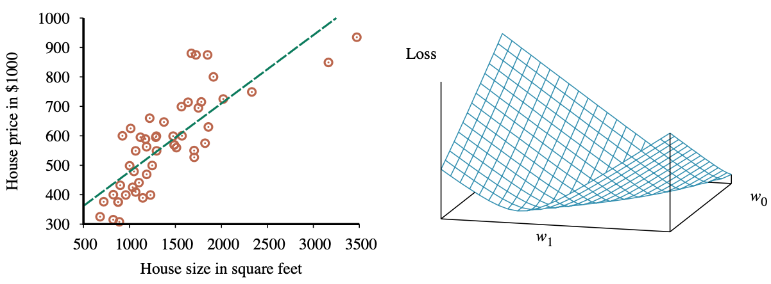
Linear Regression Weight Space
h_{w}(x) = w₁x + w₀
w* = argmin_{w} Loss(h_{w})
y = 0.232 x + 246
Loss function for Weights (w₁, w₀)
Source: Stuart Russell and Peter Norvig (2020), Artificial Intelligence: A Modern Approach, 4th Edition, Pearson

Slide 33
Vapnik-Chervonenkis (VC) Dimension
VC Dimension measures a model's capacity to fit various patterns
Higher VC Dimension
Higher model complexity
Balancing model complexity helps improve generalization
Source: Stuart Russell and Peter Norvig (2020), Artificial Intelligence: A Modern Approach, 4th Edition, Pearson

Slide 34
Bias-Variance Trade-off
Bias: Error due to simple models
(e.g., linear models)
Variance: Error from models too sensitive to noise (e.g., deep trees)
Bias-Variance Trade-off:
  Low bias-high variance: Risk of overfitting
  High bias-low variance: Risk of underfitting
Selecting the right model balances bias and variance
Source: Stuart Russell and Peter Norvig (2020), Artificial Intelligence: A Modern Approach, 4th Edition, Pearson

Slide 35
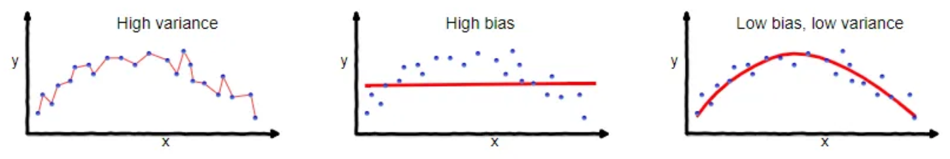
Overfitting vs. Underfitting
Overfitting
Underfitting
Good Balance

Slide 37
Bias vs. Variance
Low Bias
Low Variance
High Bias
Low Variance
Low
Variance
Low Bias
High Variance
High Bias
High Variance
High
Variance
Low Bias
High Bias

Slide 38
Bias vs. Variance
Truth
Low Bias
Low Variance
High Bias
Low Variance
Low
Variance
Underfitting
Low Bias
High Variance
High Bias
High Variance
High
Variance
Overfitting
Low Bias
High Bias

Slide 39
Bias vs. Variance
A
B
Low Bias
Low Variance
High Bias
Low Variance
Low
Variance
High Accuracy
High Precision
Low Accuracy
High Precision
C
D
Low Bias
High Variance
High Bias
High Variance
High
Variance
High Accuracy
Low Precision
Low Accuracy
Low Precision
Low Bias
High Bias

Slide 40
Accuracy vs. Precision
A
B
High Accuracy
High Precision
Low Accuracy
High Precision
High Validity
High Reliability
Low Validity
High Reliability
C
D
High Accuracy
Low Precision
Low Accuracy
Low Precision
High Validity
Low Reliability
Low Validity
Low Reliability

Slide 41
Accuracy (Validity) vs. Precision (Reliability)
A
B
High Accuracy
High Precision
Low Accuracy
High Precision
High Validity
High Reliability
Low Validity
High Reliability
C
D
High Accuracy
Low Precision
Low Accuracy
Low Precision
High Validity
Low Reliability
Low Validity
Low Reliability

Slide 42
Learning Theory
PAC Learning:
  Focuses on generalization
VC Dimension:
  Measures model capacity and impacts generalization
Bias-Variance Trade-off:
  Helps in model selection and tuning
Source: Stuart Russell and Peter Norvig (2020), Artificial Intelligence: A Modern Approach, 4th Edition, Pearson

Slide 43
Ensemble Learning

Slide 44
Ensemble Learning
Select a collection, or ensemble,
of hypotheses, h₁, h₂, …, h_{n}
, and combine their predictions
by averaging, voting, or
by another level of machine learning.
Source: Stuart Russell and Peter Norvig (2020), Artificial Intelligence: A Modern Approach, 4th Edition, Pearson

Slide 45
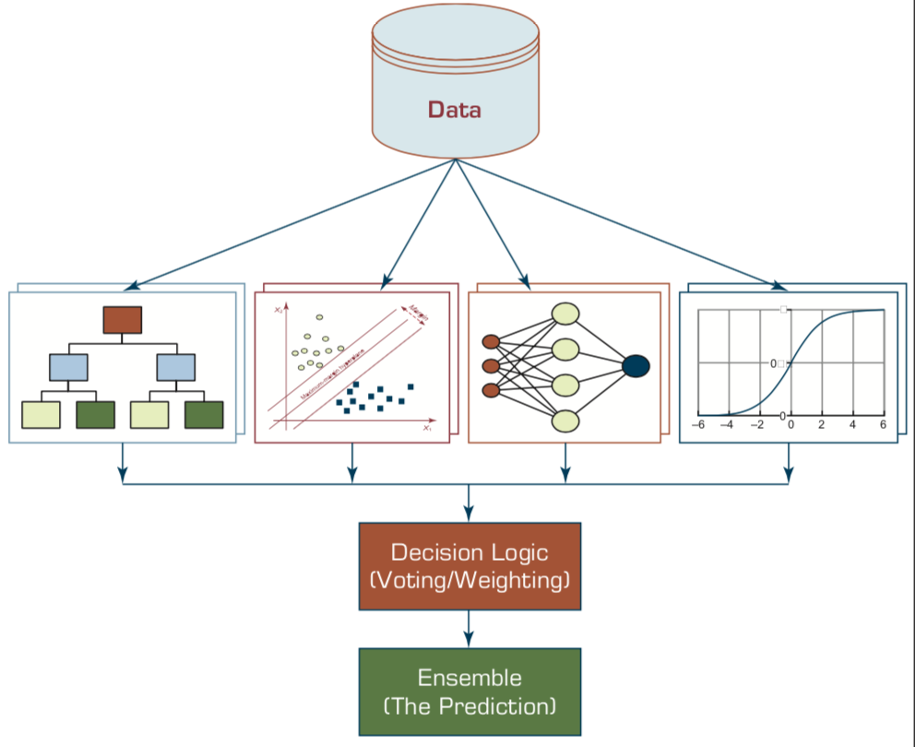
Ensemble Models
Heterogeneous Ensemble
Source: Ramesh Sharda, Dursun Delen, and Efraim Turban (2017), Business Intelligence, Analytics, and Data Science: A Managerial Perspective, 4th Edition, Pearson

Slide 46
Ensemble Learning:
Bagging, Boosting, Stacking, Voting
Ensemble
Learning
Bagging
Boosting
Stacking
Voting

Slide 47
Ensemble Learning
Base model
  individual hypotheses
  h₁, h₂, …, h_{n}
Ensemble model
  hypotheses combination
Source: Stuart Russell and Peter Norvig (2020), Artificial Intelligence: A Modern Approach, 4th Edition, Pearson

Slide 48
Why Ensemble Learning
Reduce bias
Reduce variance
Source: Stuart Russell and Peter Norvig (2020), Artificial Intelligence: A Modern Approach, 4th Edition, Pearson

Slide 49
Ensemble Learning
Bagging
  Random Forests (RF)
Boosting
  Gradient Boosting, XGBoost, LightGBM, CatBoost
Stacking
Online learning
Source: Stuart Russell and Peter Norvig (2020), Artificial Intelligence: A Modern Approach, 4th Edition, Pearson

Slide 50
Ensemble Learning:
Bagging (Bootstrap Aggregation)
Weak
Learner 1
Prediction
Subset 1
Input
(x)
Training
Set
Weak
Learner 2
Prediction
Aggregation
Subset 2
...
...
...
Weak
Learner m
Prediction
Subset m
Bootstrap
Samples
Parallel

Slide 51
Ensemble Learning:
Boosting
Weak
Learner 1
False
Prediction
Subset 1
Input
(x)
Training
Set
Weak
Learner 2
False
Prediction
Subset 2
...
...
...
Weak
Learner m
Overall Prediction
Subset m
Sequential

Slide 52
Ensemble Learning:
Stacking
Model 1
Input
(x)
Training
Set
New
Training
Dataset
Meta
Model
Model 2
Final
Prediction
Model 3

Slide 53
Ensemble Learning:
Voting
Model 1
Input
(x)
Training
Set
Voting
Model 2
Final
Prediction
Model 3

Slide 54
Ensemble Learning: Bagging
Bagging
  Generate distinct training sets by sampling with replacement from the original training set.
Classification:
  Plurality Vote (Majority Vote)
Regression:
  Average
Source: Stuart Russell and Peter Norvig (2020), Artificial Intelligence: A Modern Approach, 4th Edition, Pearson

Slide 55
Ensemble Learning: Random forests
Random forest model is a form of decision tree bagging in which we take extra steps to make the ensemble of trees more diverse, to reduce variance.
The key idea is to randomly vary the attribute choices (rather than the training examples)
Source: Stuart Russell and Peter Norvig (2020), Artificial Intelligence: A Modern Approach, 4th Edition, Pearson

Slide 56
Ensemble Learning: Random forests
Extremely randomized trees (ExtraTrees)
  Use randomness in selecting the split point value
  for each selected attribute, we randomly sample several candidate values from a uniform distribution over the attribute’s range
Source: Stuart Russell and Peter Norvig (2020), Artificial Intelligence: A Modern Approach, 4th Edition, Pearson

Slide 57
Ensemble Learning: Boosting
Boosting
  The most popular ensemble method
Weighted training set
Source: Stuart Russell and Peter Norvig (2020), Artificial Intelligence: A Modern Approach, 4th Edition, Pearson

Slide 58
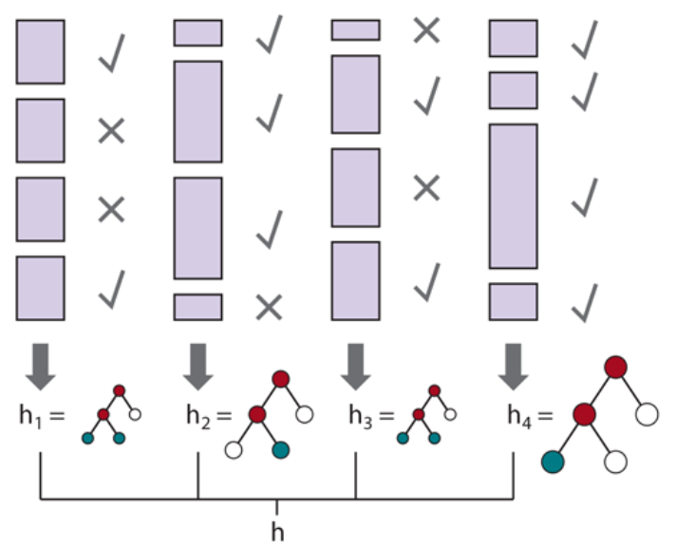
Ensemble Learning: Boosting
Source: Stuart Russell and Peter Norvig (2020), Artificial Intelligence: A Modern Approach, 4th Edition, Pearson

Slide 59
Ensemble Learning:
Gradient boosting
Gradient boosting
  Gradient boosting is a form of boosting using gradient descent
Gradient boosting machines (GBM)
Gradient boosted regression trees (GBRT)
Popular method for regression and classification of factored tabular data
Source: Stuart Russell and Peter Norvig (2020), Artificial Intelligence: A Modern Approach, 4th Edition, Pearson

Slide 60
Ensemble Learning: Stacking
Staking
  Stacked generalization combines multiple base models from different model classes trained on the same data.
Bagging
  Combines multiple base models of the same model class trained on different data.
Source: Stuart Russell and Peter Norvig (2020), Artificial Intelligence: A Modern Approach, 4th Edition, Pearson

Slide 61
Ensemble Learning:
Online learning
Online learning
  Data are not i.i.d.
  (independent and identically distributed)
  An agent receives an input x_{i} from nature, predicts the corresponding y_{i} and then is told the correct answer.
Source: Stuart Russell and Peter Norvig (2020), Artificial Intelligence: A Modern Approach, 4th Edition, Pearson

Slide 62
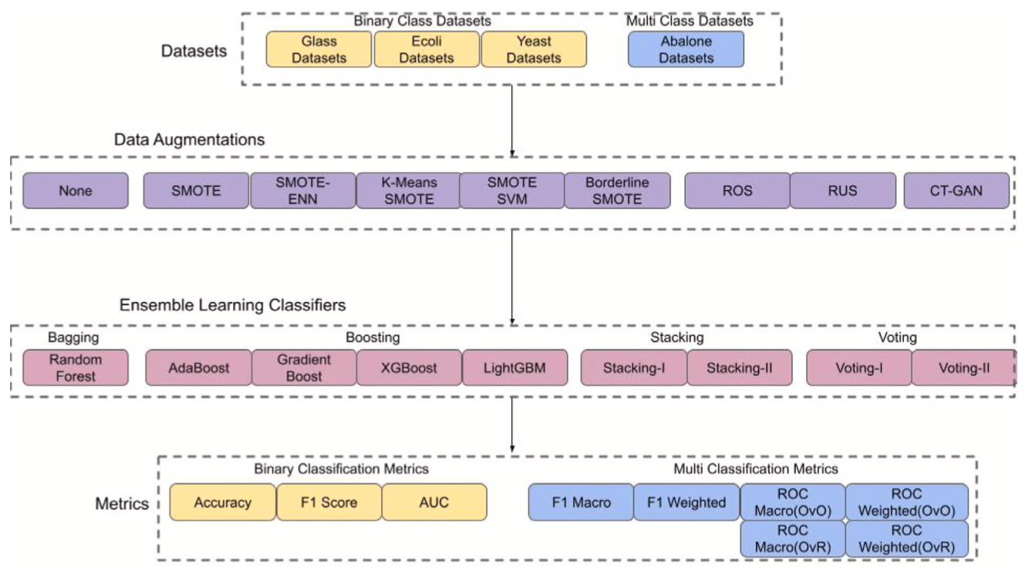
Ensemble Learning and Data Augmentations (DA)
Source: Khan, A. A., Chaudhari, O., & Chandra, R. (2023). A review of ensemble learning and data augmentation models for class imbalanced problems: combination, implementation and evaluation. Expert Systems with Applications, 122778.

Slide 63
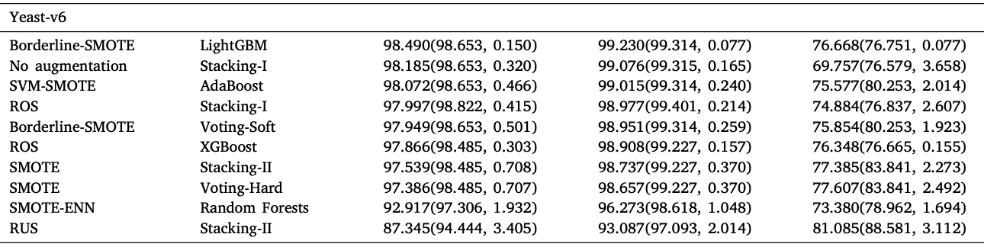
ML Evaluation of Imbalanced Dataset:
Ensemble Learning and Data Augmentations (DA)
Source: Khan, A. A., Chaudhari, O., & Chandra, R. (2023). A review of ensemble learning and data augmentation models for class imbalanced problems: combination, implementation and evaluation. Expert Systems with Applications, 122778.

Slide 64
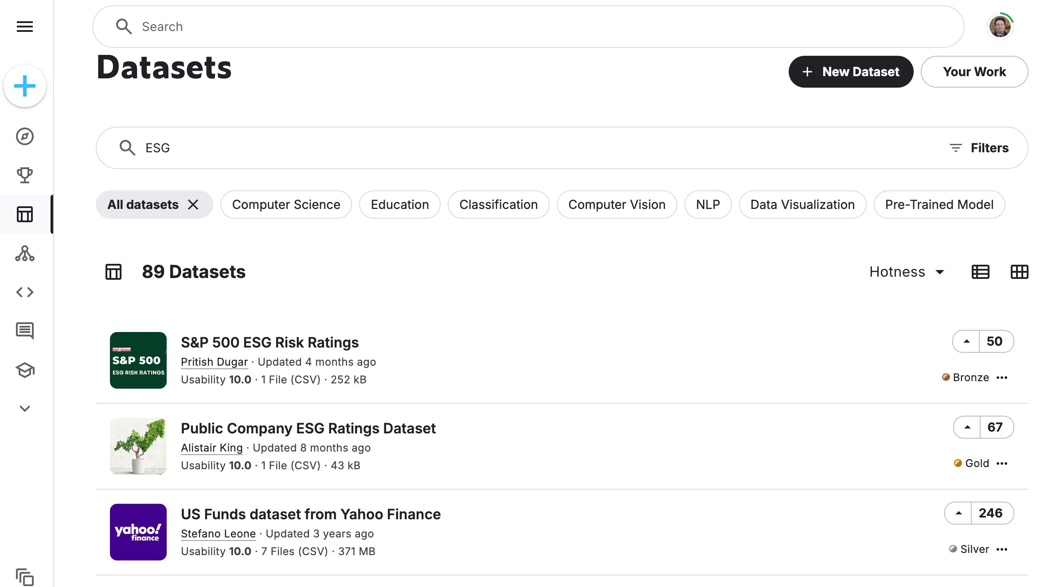
Kaggle Datasets for Machine Learning
Source: https://www.kaggle.com/datasets?search=ESG

Slide 65
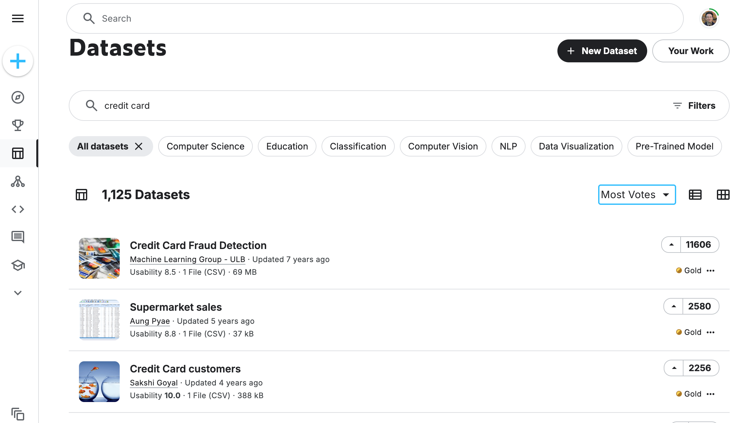
Kaggle Datasets for Machine Learning
Source: https://www.kaggle.com/datasets?search=credit+card&sort=votes

Slide 66
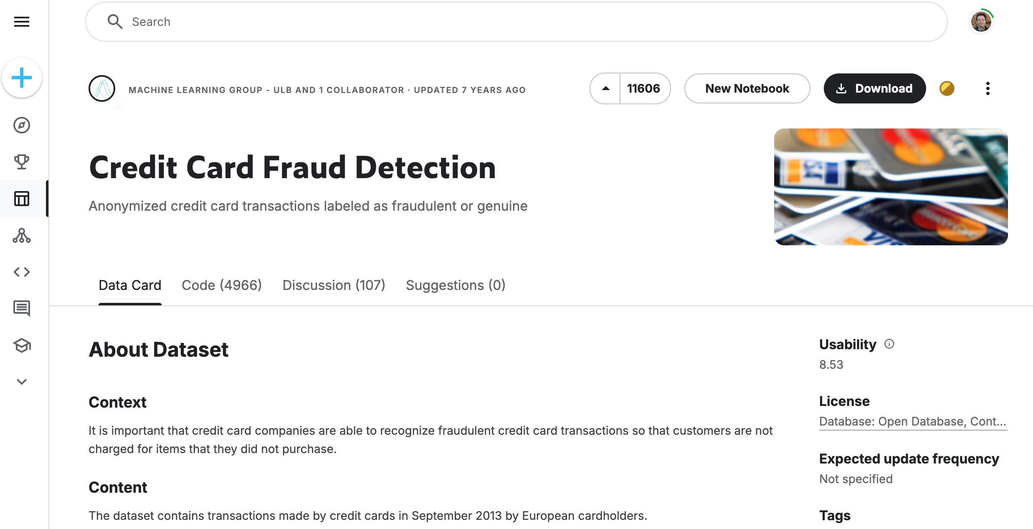
Kaggle Datasets: Credit Card Fraud Detection
Source: https://www.kaggle.com/datasets/mlg-ulb/creditcardfraud

Slide 67
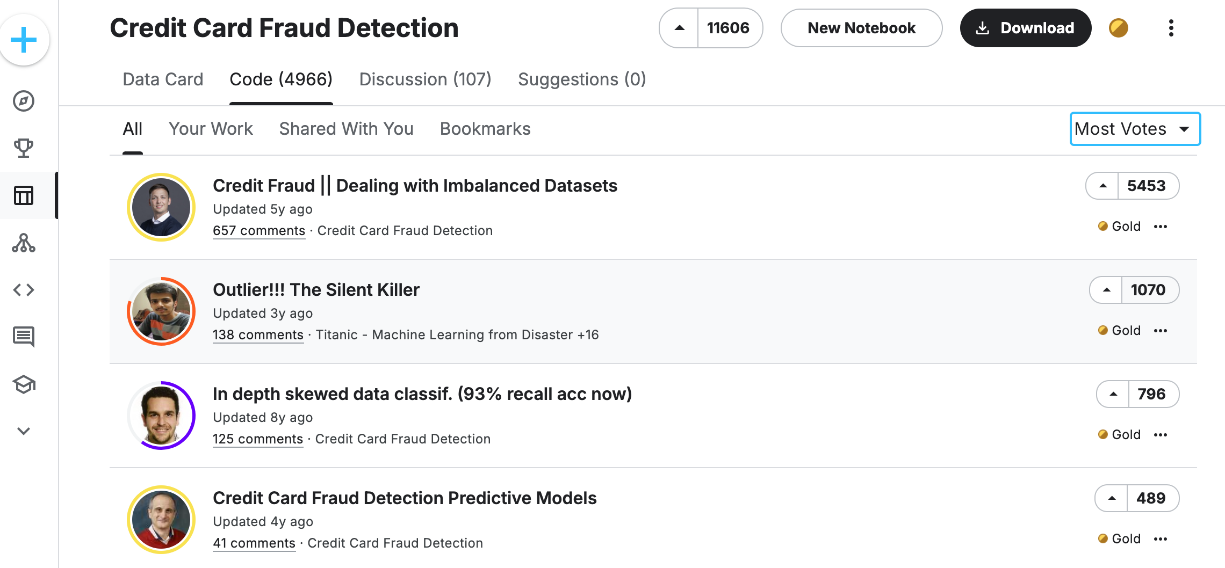
Kaggle Code: Credit Card Fraud Detection
Source: https://www.kaggle.com/datasets/mlg-ulb/creditcardfraud/code?datasetId=310&sortBy=voteCount

Slide 68
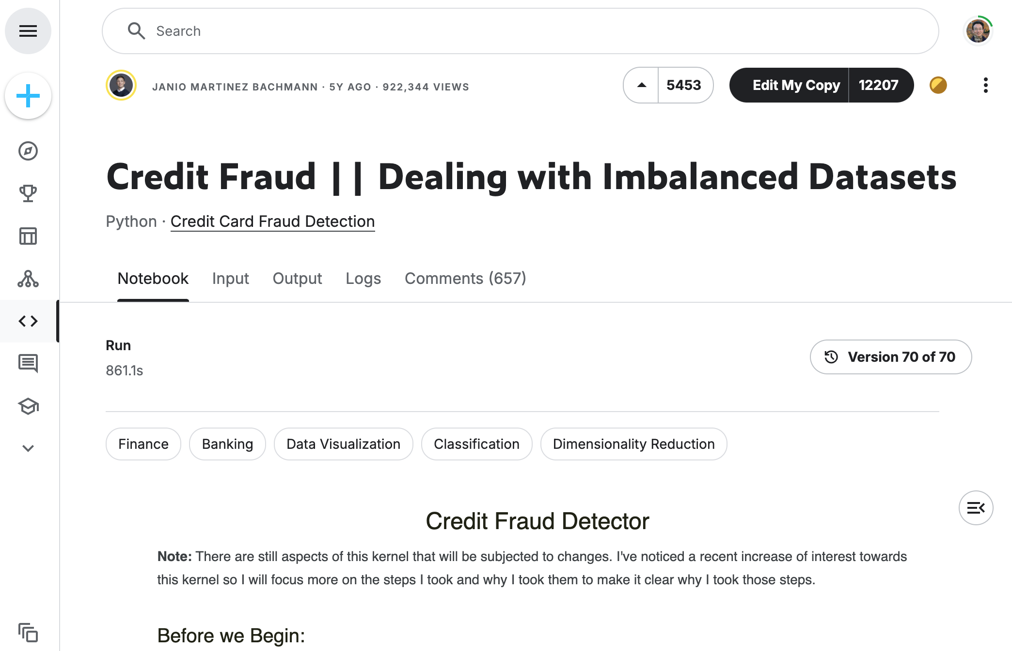
Kaggle Code: Credit Card Fraud Detection
Source: https://www.kaggle.com/code/janiobachmann/credit-fraud-dealing-with-imbalanced-datasets

Slide 69
Meta Learning:
Learning to Learn

Slide 70
Deep Learning
Transfer Learning
Few-Shot Learning
Meta Learning

Slide 71
Deep Learning, Transfer Learning,
Few-Shot Learning, Meta Learning
Deep Learning
  Transfer Learning
    Pre-training, Fine-Tuning (FT)
Meta Learning: Learning to Learn
Few-Shot Learning (FSL)
One-Shot Learning (1SL)
Zero-Shot Learning (0SL)(ZSL)

Slide 72
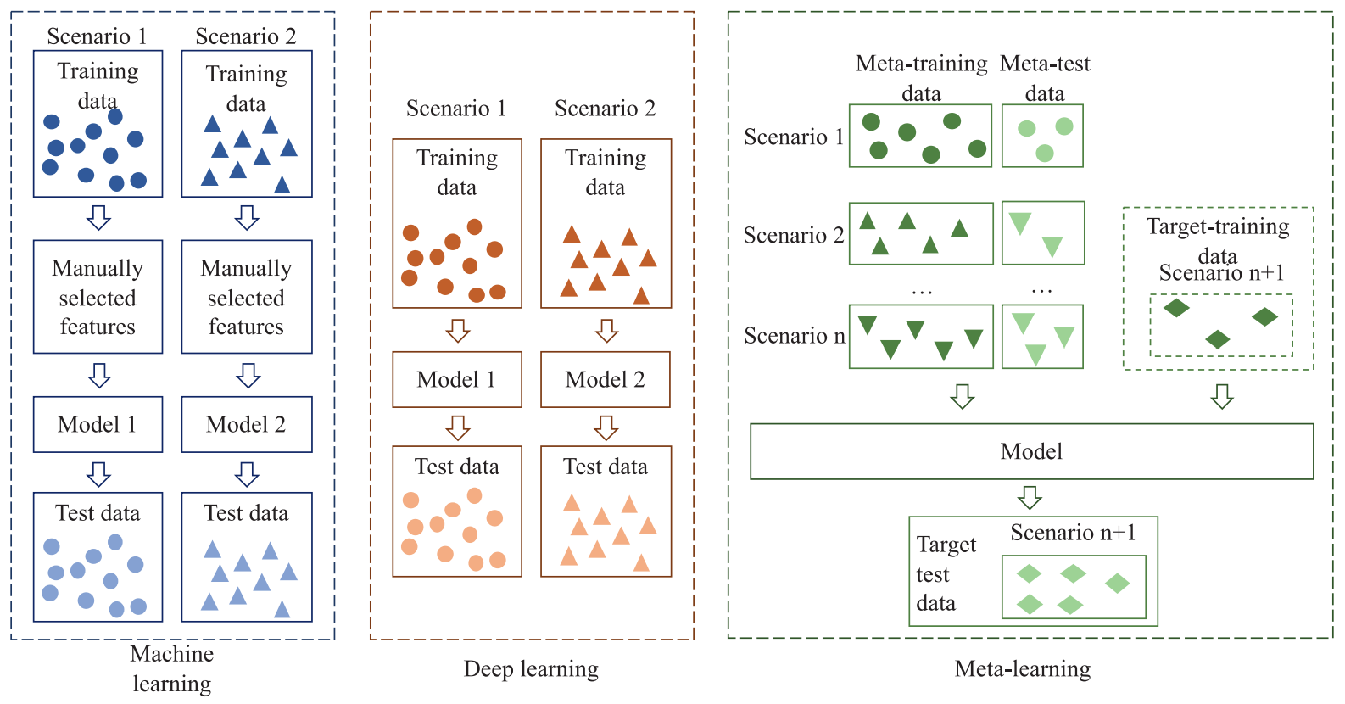
Machine Learning, Deep Learning, Meta Learning
Source: Luo, Shuai, Yujie Li, Pengxiang Gao, Yichuan Wang, and Seiichi Serikawa. "Meta-seg: A survey of meta-learning for image segmentation." Pattern Recognition (2022): 108586.

Slide 73
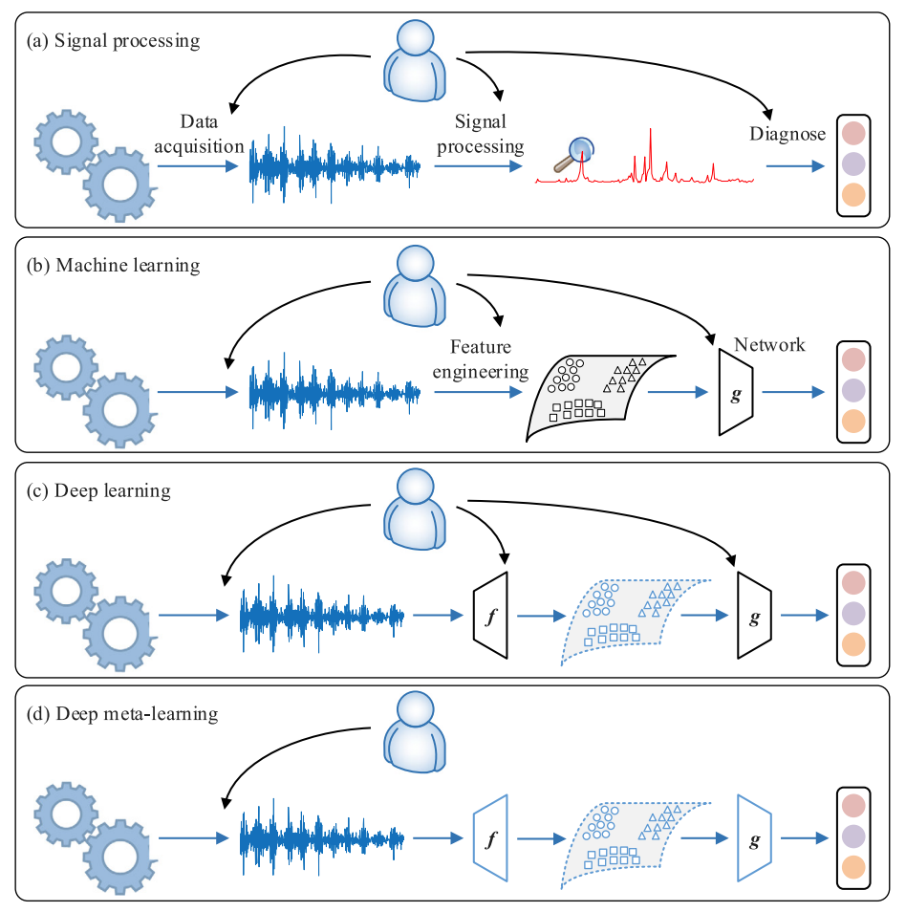
Machine Learning, Deep Learning, Meta Learning
Source: Feng, Yong, Jinglong Chen, Jingsong Xie, Tianci Zhang, Haixin Lv, and Tongyang Pan. "Meta-learning as a promising approach for few-shot cross-domain fault diagnosis: Algorithms, applications, and prospects." Knowledge-Based Systems 235 (2022): 107646.

Slide 74
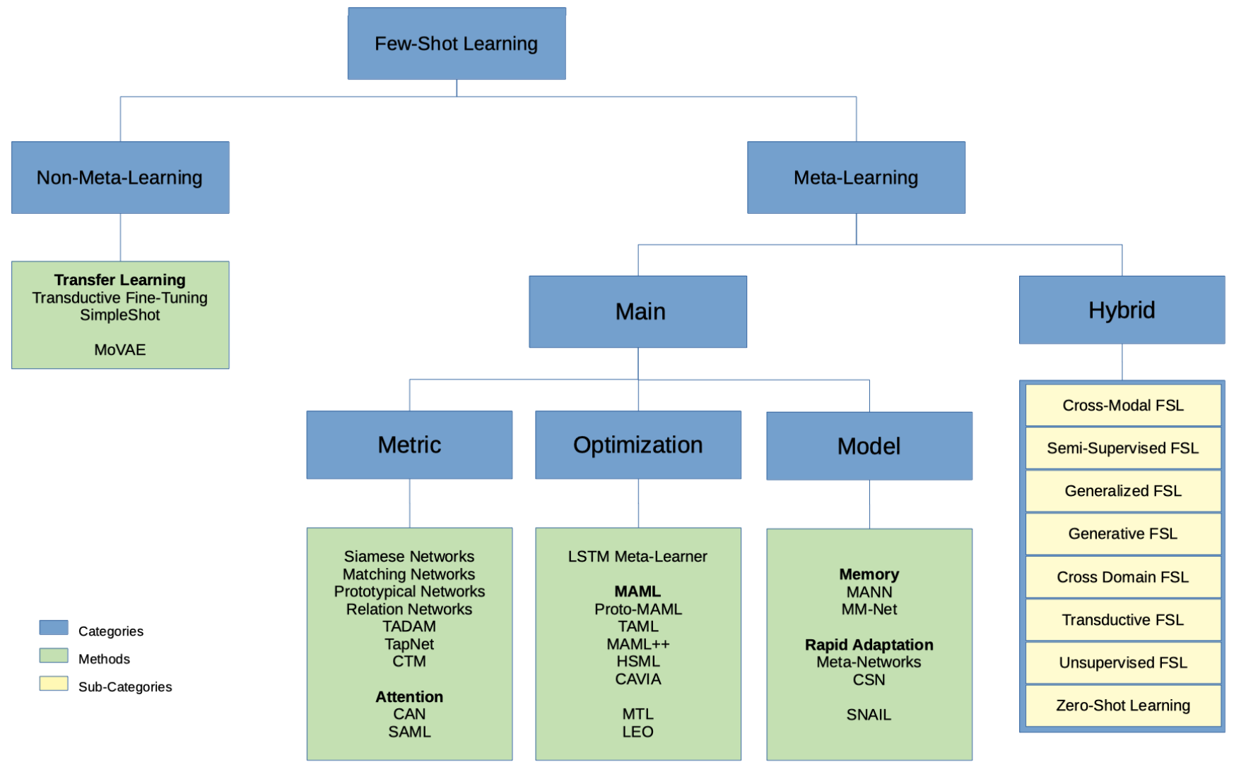
Few-Shot Learning (FSL) and Meta Learning
Machine learning from few training examples
Source: Parnami, Archit, and Minwoo Lee. "Learning from Few Examples: A Summary of Approaches to Few-Shot Learning." arXiv preprint arXiv:2203.04291 (2022).

Slide 75
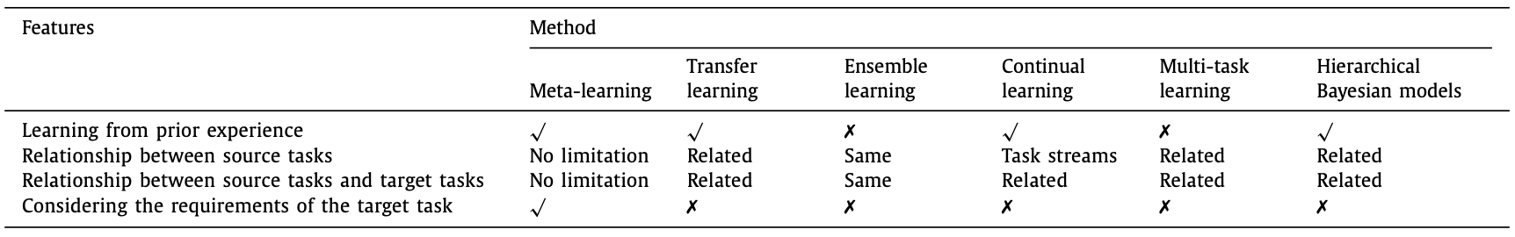
Meta Learning, Transfer Learning,
Ensemble Learning, Continual Learning,
Multi-Task Learning
Source: Luo, Shuai, Yujie Li, Pengxiang Gao, Yichuan Wang, and Seiichi Serikawa. "Meta-seg: A survey of meta-learning for image segmentation." Pattern Recognition (2022): 108586.

Slide 76
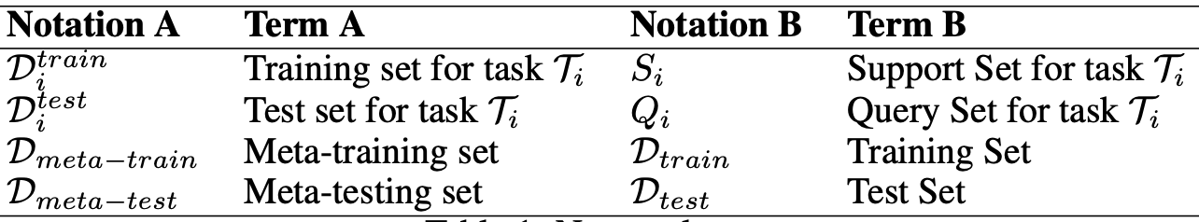
Meta-Learning and Few-shot Learning
Notations and Terms
Optimization-based
Meta-learning
Metric-based
Meta-learning
Source: Parnami, Archit, and Minwoo Lee. "Learning from Few Examples: A Summary of Approaches to Few-Shot Learning." arXiv preprint arXiv:2203.04291 (2022).

Slide 77
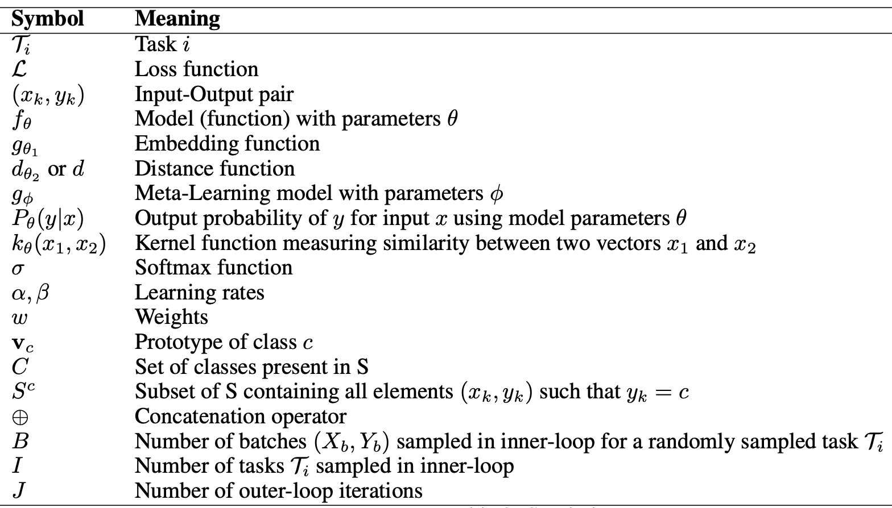
Meta-Learning Symbols
Source: Parnami, Archit, and Minwoo Lee. "Learning from Few Examples: A Summary of Approaches to Few-Shot Learning." arXiv preprint arXiv:2203.04291 (2022).

Slide 78
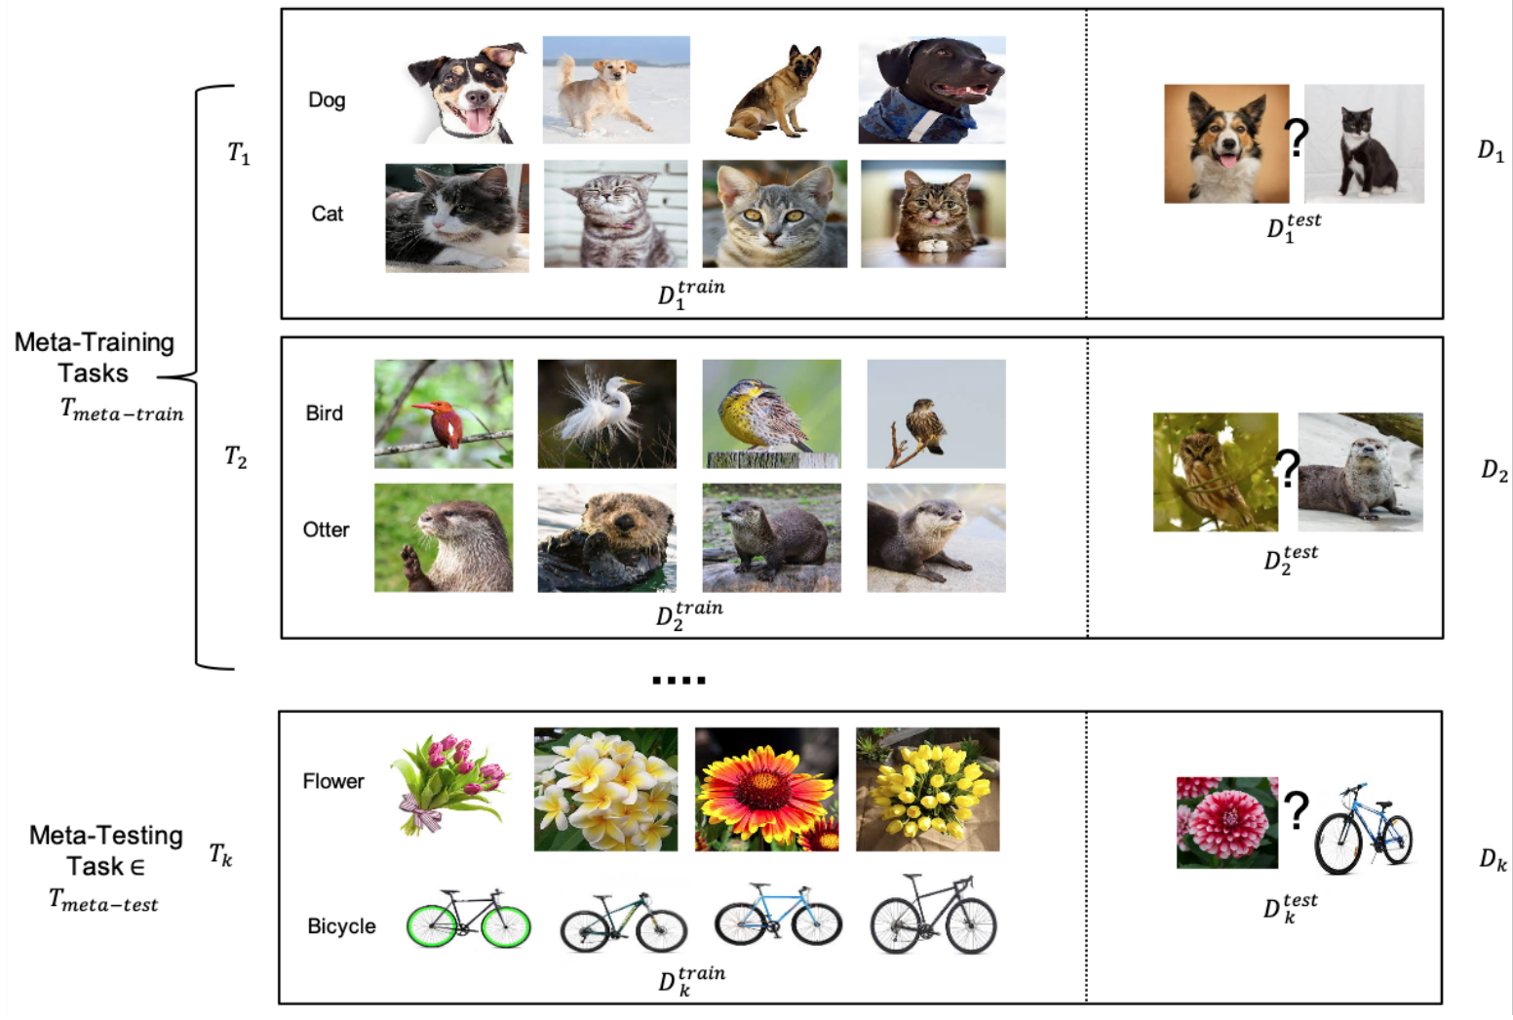
Meta-Learning Example Setup
Source: Parnami, Archit, and Minwoo Lee. "Learning from Few Examples: A Summary of Approaches to Few-Shot Learning." arXiv preprint arXiv:2203.04291 (2022).

Slide 79
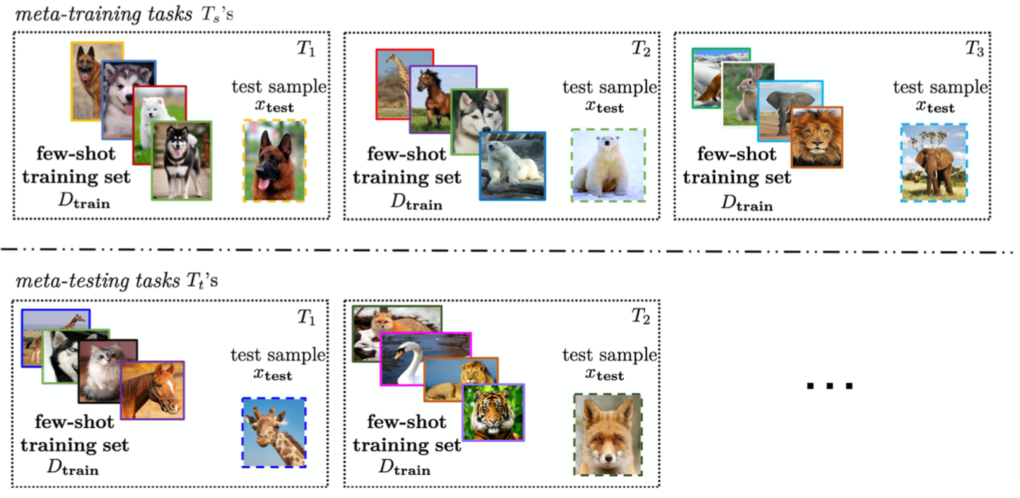
Few-Shot Learning (FSL)
Solving the FSL problem by meta-learning
Source: Yaqing Wang, Quanming Yao, James T. Kwok, and Lionel M. Ni (2020). "Generalizing from a few examples: A survey on few-shot learning." ACM computing surveys (csur) 53, no. 3 (2020): 1-34.

Slide 80
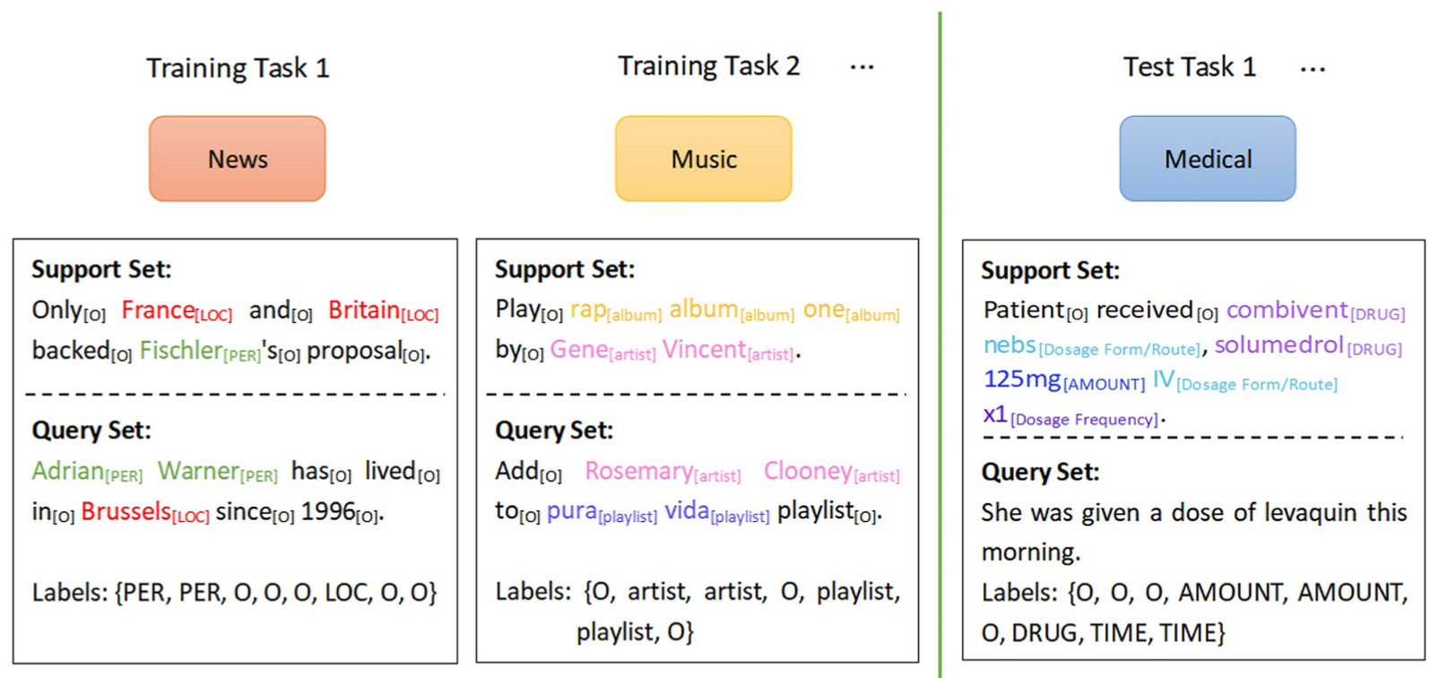
Few-Shot Learning (FSL)
Meta-learning
Each task mimics the few-shot scenario, and can be completely non-overlapping.
Support sets are used to train; query sets are used to evaluate the model
Source: Yao Ge, Yuting Guo, Yuan-Chi Yang, Mohammed Ali Al-Garadi, and Abeed Sarker (2022). "Few-shot learning for medical text: A systematic review." arXiv preprint arXiv:2204.14081 (2022).

Slide 81
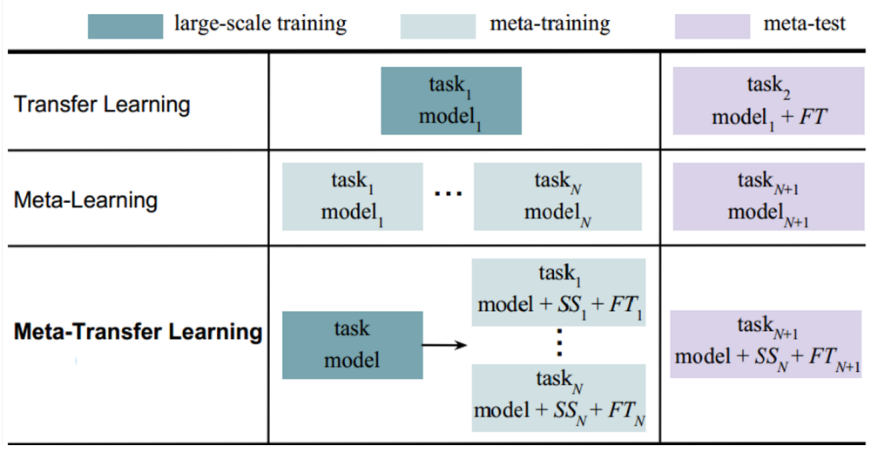
Meta-Task Learning (MTL)
Transfer Learning Strategy for Meta-Learning
Source: Parnami, Archit, and Minwoo Lee. "Learning from Few Examples: A Summary of Approaches to Few-Shot Learning." arXiv preprint arXiv:2203.04291 (2022).

Slide 82
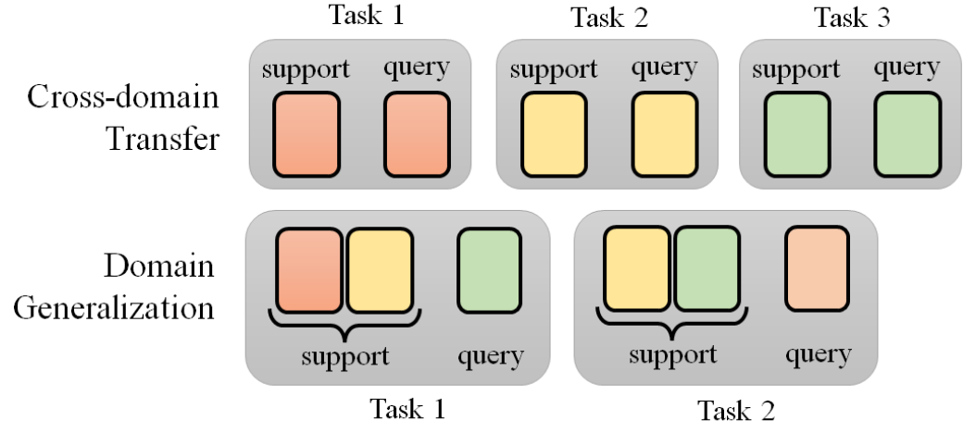
Meta Learning
The task construction of cross-domain transfer and domain generalization
Source: Lee, Hung-yi, Shang-Wen Li, and Ngoc Thang Vu. "Meta Learning for Natural Language Processing: A Survey." arXiv preprint arXiv:2205.01500 (2022).

Slide 83
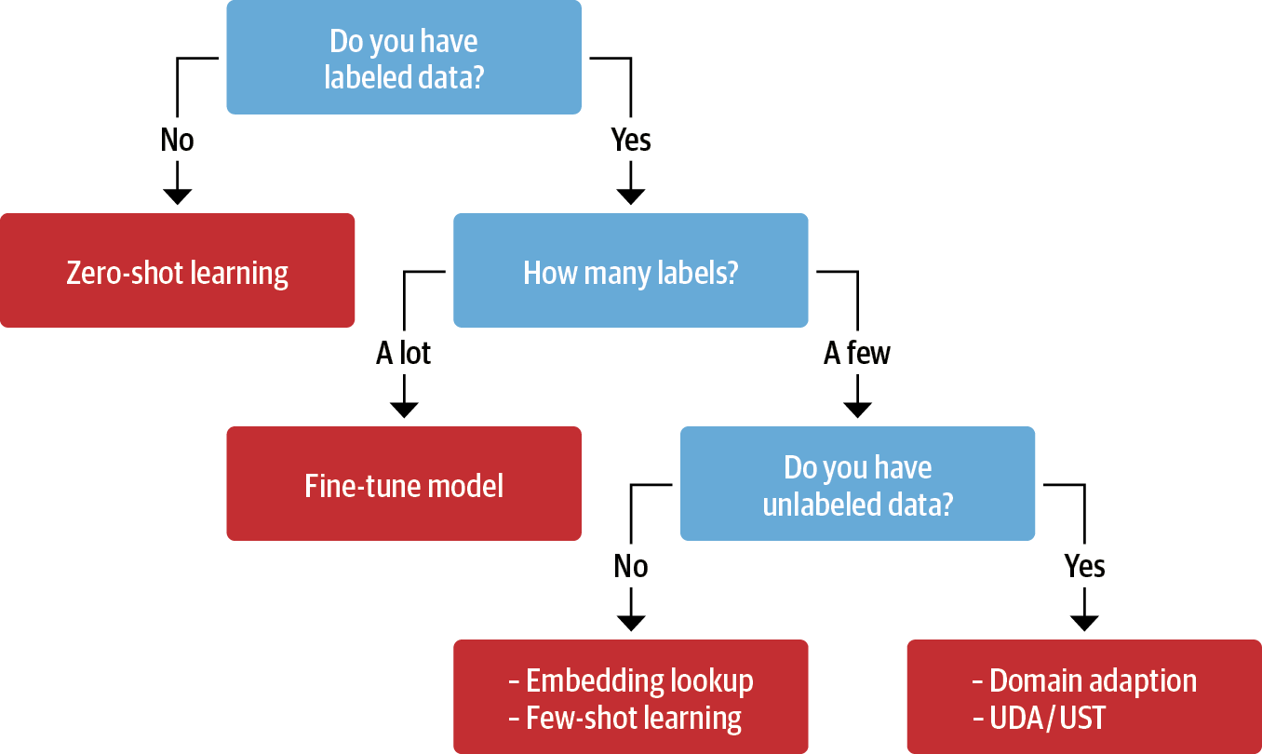
Transfer Learning, Fine-tuning, Few-shot learning
Unsupervised Data Augmentation
(UDA)
Uncertainty-aware Self-Training
(UST)
Source: Lewis Tunstall, Leandro von Werra, and Thomas Wolf (2022), Natural Language Processing with Transformers: Building Language Applications with Hugging Face, O'Reilly Media.

Slide 84
Transfer Learning
Pre-training
Fine-Tuning
Transfer Learning

Slide 85

BERT: Pre-training of Deep Bidirectional Transformers for Language Understanding
BERT (Bidirectional Encoder Representations from Transformers)
Overall pre-training and fine-tuning procedures for BERT
Source: Devlin, Jacob, Ming-Wei Chang, Kenton Lee, and Kristina Toutanova (2018).
"Bert: Pre-training of deep bidirectional transformers for language understanding." arXiv preprint arXiv:1810.04805.

Slide 86
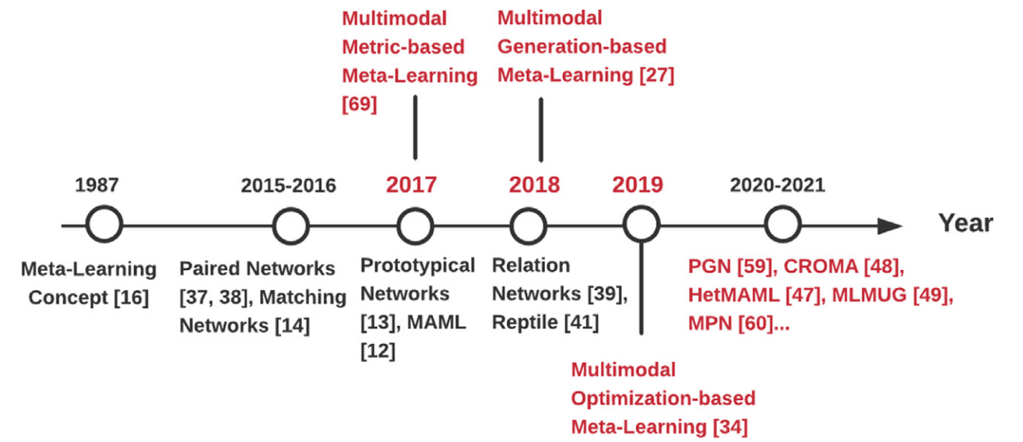
Meta Learning
Source: TMa, Yao, Shilin Zhao, Weixiao Wang, Yaoman Li, and Irwin King. "Multimodality in meta-learning: A comprehensive survey." Knowledge-Based Systems (2022): 108976.

Slide 87
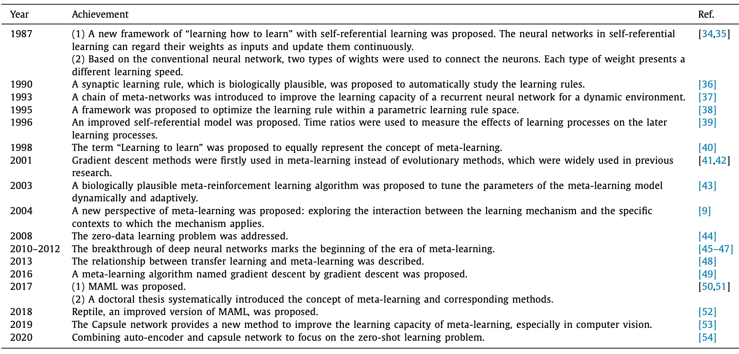
Meta Learning
Source: TMa, Yao, Shilin Zhao, Weixiao Wang, Yaoman Li, and Irwin King. "Multimodality in meta-learning: A comprehensive survey." Knowledge-Based Systems (2022): 108976.

Slide 88
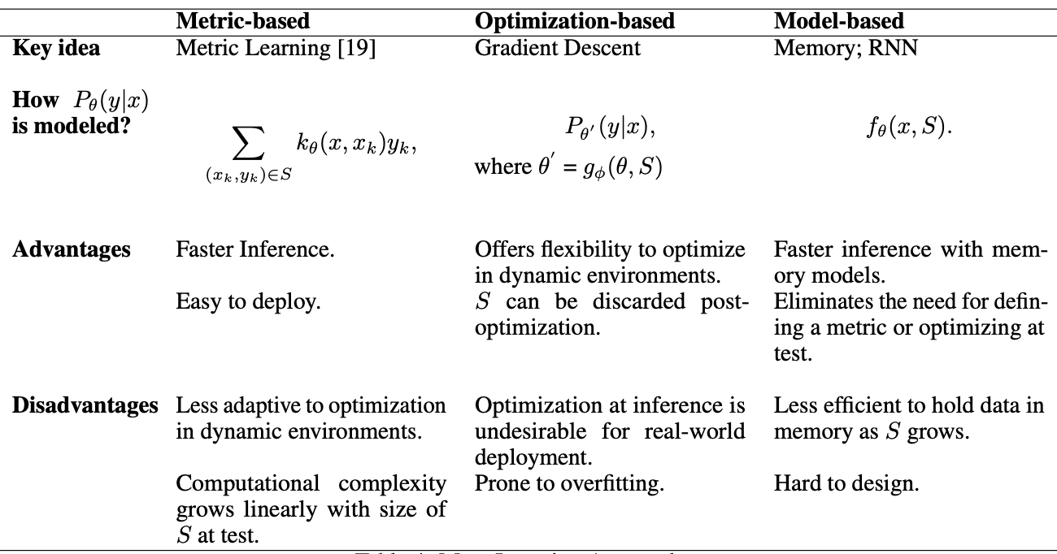
Meta-learning Approaches
Source: Parnami, Archit, and Minwoo Lee. "Learning from Few Examples: A Summary of Approaches to Few-Shot Learning." arXiv preprint arXiv:2203.04291 (2022).

Slide 89
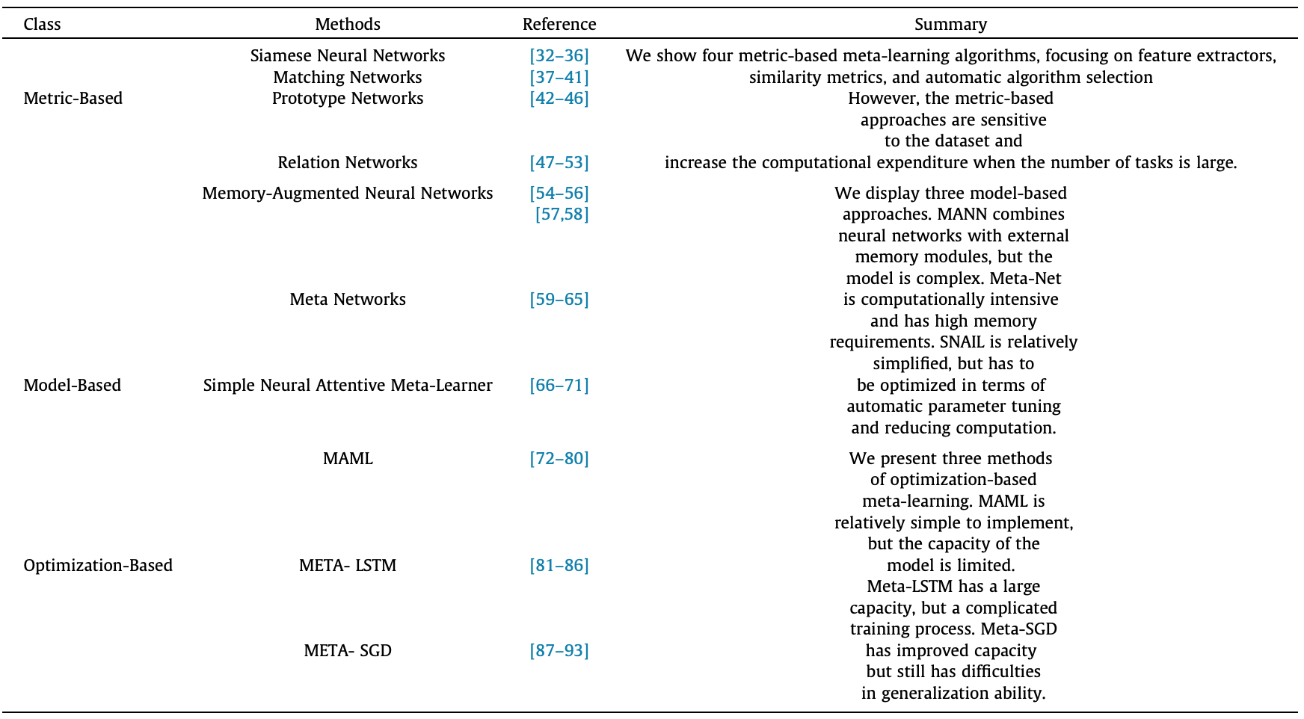
Meta Learning: Learning to Learn
Source: Tian, Yingjie, Xiaoxi Zhao, and Wei Huang. "Meta-learning approaches for learning-to-learn in deep learning: A survey." Neurocomputing 494 (2022): 203-223.

Slide 90
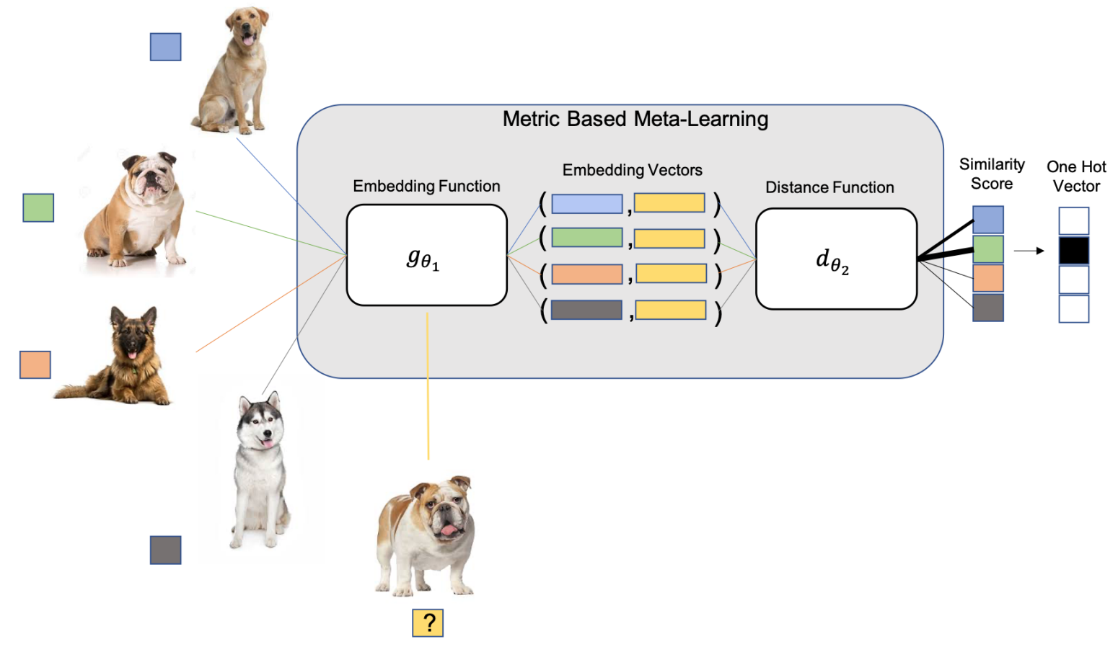
Metric-based Meta-learning
M-Way K-Shot Task (4-way-1-shot classification task)
Source: Parnami, Archit, and Minwoo Lee. "Learning from Few Examples: A Summary of Approaches to Few-Shot Learning." arXiv preprint arXiv:2203.04291 (2022).

Slide 91
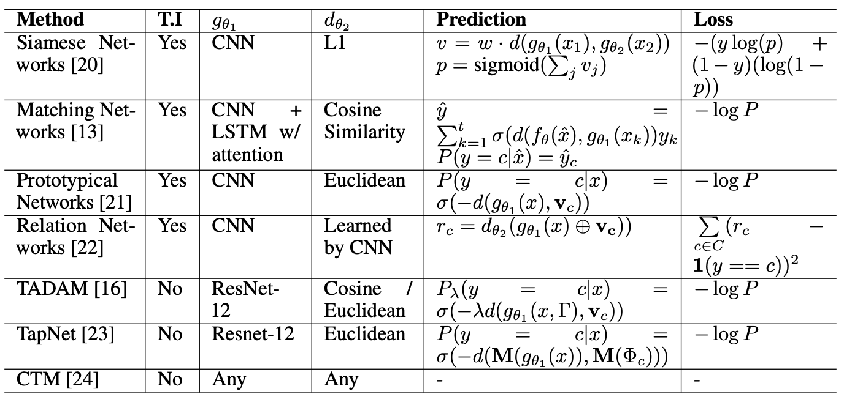
Metric-based Meta-Learning Methods
Source: Parnami, Archit, and Minwoo Lee. "Learning from Few Examples: A Summary of Approaches to Few-Shot Learning." arXiv preprint arXiv:2203.04291 (2022).

Slide 92
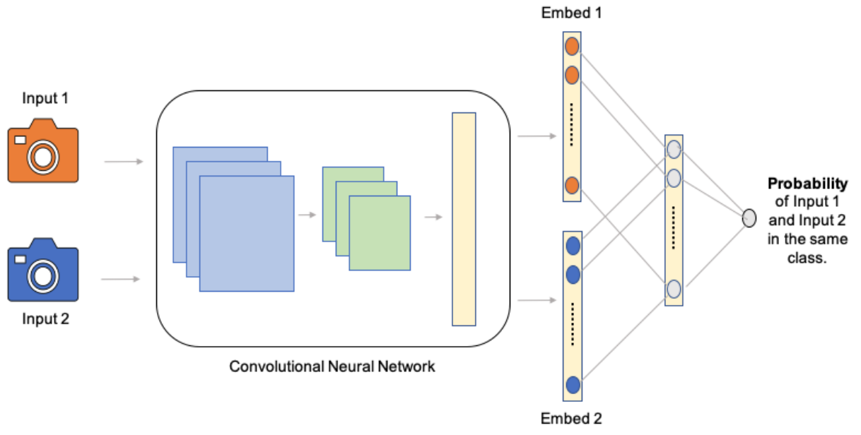
Convolutional Siamese Network
Source: Parnami, Archit, and Minwoo Lee. "Learning from Few Examples: A Summary of Approaches to Few-Shot Learning." arXiv preprint arXiv:2203.04291 (2022).

Slide 93
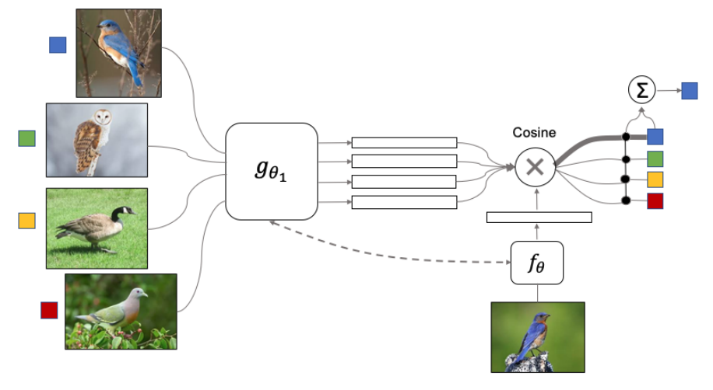
Meta Learning: Matching Networks
Source: Parnami, Archit, and Minwoo Lee. "Learning from Few Examples: A Summary of Approaches to Few-Shot Learning." arXiv preprint arXiv:2203.04291 (2022).

Slide 94
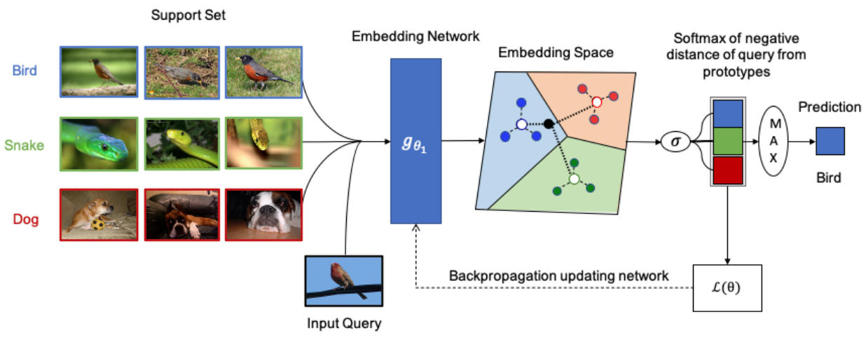
Few-shot Prototypes v_{c} are computed as the mean of embedded support examples for each class
Source: Parnami, Archit, and Minwoo Lee. "Learning from Few Examples: A Summary of Approaches to Few-Shot Learning." arXiv preprint arXiv:2203.04291 (2022).

Slide 95
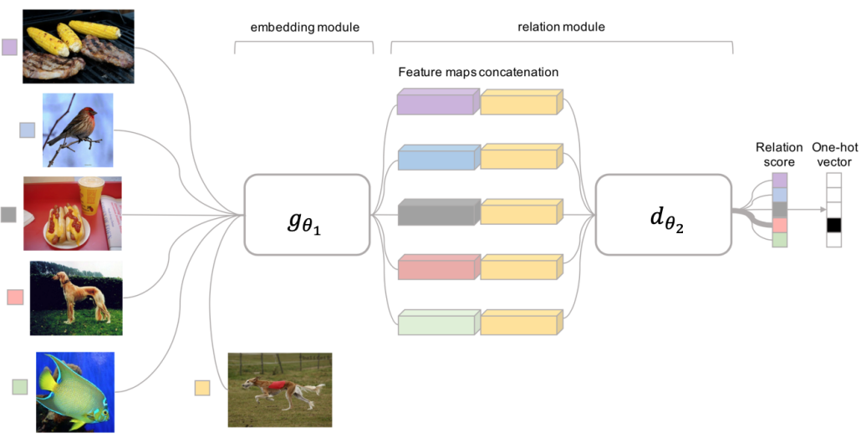
Meta Learning: Relation Network
Source: Parnami, Archit, and Minwoo Lee. "Learning from Few Examples: A Summary of Approaches to Few-Shot Learning." arXiv preprint arXiv:2203.04291 (2022).

Slide 96
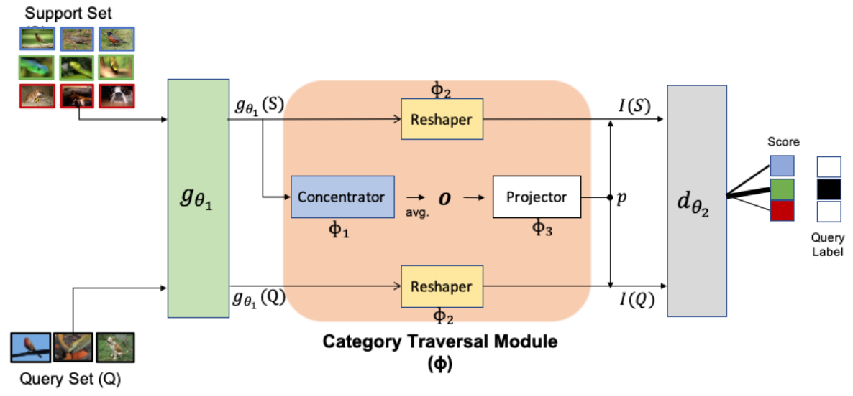
Meta Learning: Category Traversal Module (CTM)
Source: Parnami, Archit, and Minwoo Lee. "Learning from Few Examples: A Summary of Approaches to Few-Shot Learning." arXiv preprint arXiv:2203.04291 (2022).

Slide 97
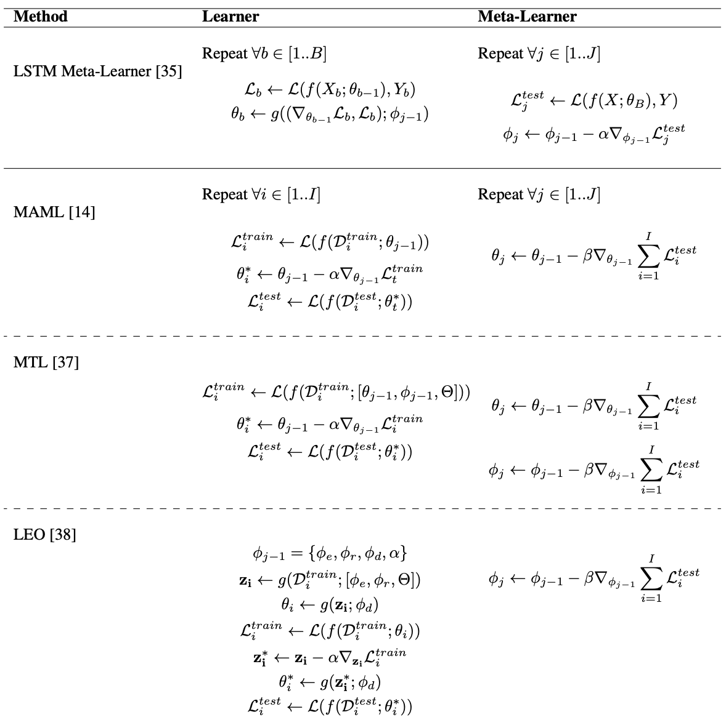
Optimization-based Meta-Learning Methods
Source: Parnami, Archit, and Minwoo Lee. "Learning from Few Examples: A Summary of Approaches to Few-Shot Learning." arXiv preprint arXiv:2203.04291 (2022).

Slide 98
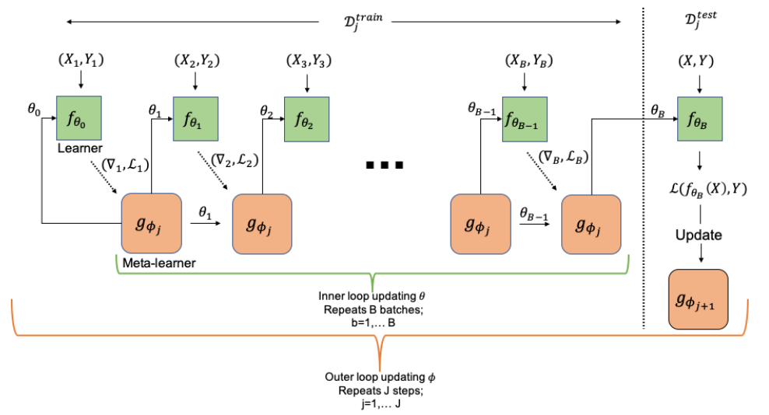
Computational Graph for the Forward Pass of the Meta-learner
Source: Parnami, Archit, and Minwoo Lee. "Learning from Few Examples: A Summary of Approaches to Few-Shot Learning." arXiv preprint arXiv:2203.04291 (2022).

Slide 99
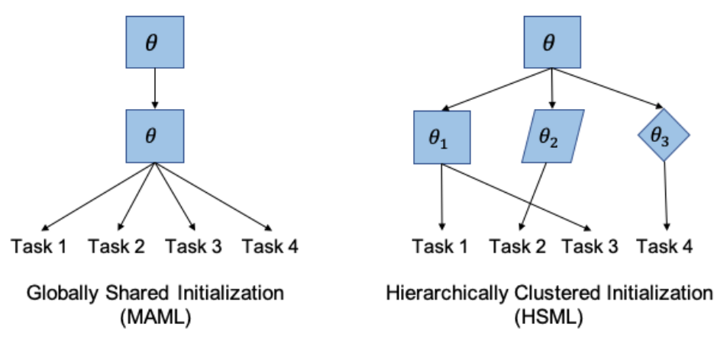
Model-Agnostic Meta-Learning (MAML)
Hierarchically Structured Meta-Learning (HSML)
Source: Parnami, Archit, and Minwoo Lee. "Learning from Few Examples: A Summary of Approaches to Few-Shot Learning." arXiv preprint arXiv:2203.04291 (2022).

Slide 100
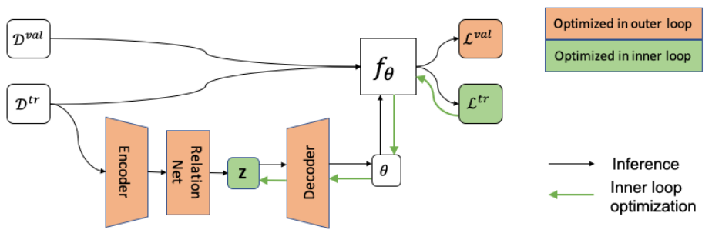
Latent Embedding Optimization (LEO)
Source: Parnami, Archit, and Minwoo Lee. "Learning from Few Examples: A Summary of Approaches to Few-Shot Learning." arXiv preprint arXiv:2203.04291 (2022).

Slide 101
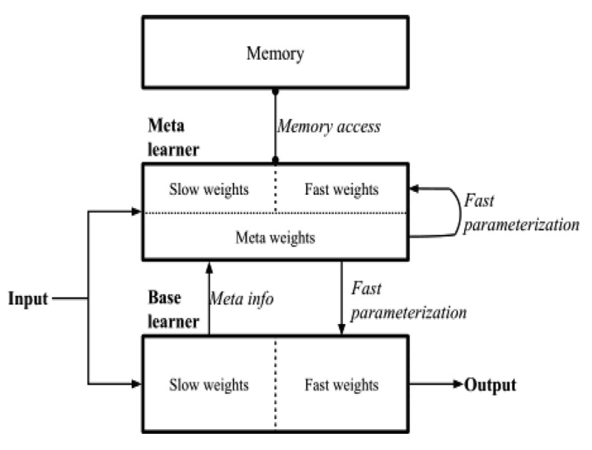
Overall Architecture of Meta Networks
Source: Tian, Yingjie, Xiaoxi Zhao, and Wei Huang. "Meta-learning approaches for learning-to-learn in deep learning: A survey." Neurocomputing 494 (2022): 203-223.

Slide 102
ULMFiT: 3 Steps
Transfer Learning in NLP
Wikitet
103
IMDB
IMDB
Language
Model
Language
Model
Classifier
1. Pretraining
2. Domain adaptation
3. Fine-tuning
Source: Lewis Tunstall, Leandro von Werra, and Thomas Wolf (2022), Natural Language Processing with Transformers: Building Language Applications with Hugging Face, O'Reilly Media.

Slide 103
A typical pipeline for training transformer models with the Datasets, Tokenizers, and Transformers libraries
Datasets
Tokenizers
Transformers
Datasets
Load and
process datasets
Tokenize
input texts
Load models,
train and infer
Load metrics
evaluate models
Source: Lewis Tunstall, Leandro von Werra, and Thomas Wolf (2022), Natural Language Processing with Transformers: Building Language Applications with Hugging Face, O'Reilly Media.
https://github.com/nlp-with-transformers/notebooks

Slide 104
Few-Shot Learning (FSL)
Typical Scenarios
Acting as a test bed for learning like human
Learning for rare cases
Reducing data gathering effort and computational cost
Source: Yaqing Wang, Quanming Yao, James T. Kwok, and Lionel M. Ni (2020). "Generalizing from a few examples: A survey on few-shot learning." ACM computing surveys (csur) 53, no. 3 (2020): 1-34.

Slide 105
Few-Shot Learning (FSL)
Few-Shot Learning (FSL) is a sub-area in machine learning.
Machine Learning Definition
  A computer program is said to learn from experience E with respect to some classes of task T and performance measure P if its performance can improve with E on T measured by P.
    Example: Image classification task (T ), a machine learning program can improve its classification accuracy (P) through E obtained by training on a large number of labeled images (e.g., the ImageNet data set).
Source: Yaqing Wang, Quanming Yao, James T. Kwok, and Lionel M. Ni (2020). "Generalizing from a few examples: A survey on few-shot learning." ACM computing surveys (csur) 53, no. 3 (2020): 1-34.

Slide 106
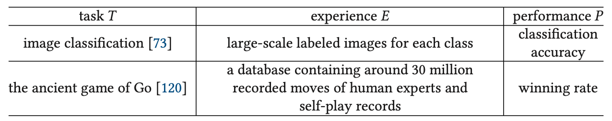
Machine Learning
Source: Yaqing Wang, Quanming Yao, James T. Kwok, and Lionel M. Ni (2020). "Generalizing from a few examples: A survey on few-shot learning." ACM computing surveys (csur) 53, no. 3 (2020): 1-34.

Slide 107
Few-Shot Learning (FSL)
Few-shot Learning (FSL) is a type of machine learning problems (specified by E, T, and P),
where E contains only a limited number of examples with supervised information for the target T.
  Existing FSL problems are mainly supervised learning problems.
  Few-shot classification learns classifiers given only
  a few labeled examples of each class.
    image classification
    sentiment classification from short text
    object recognition
Source: Yaqing Wang, Quanming Yao, James T. Kwok, and Lionel M. Ni (2020). "Generalizing from a few examples: A survey on few-shot learning." ACM computing surveys (csur) 53, no. 3 (2020): 1-34.

Slide 108
Few-Shot Learning (FSL)
Few-shot classification learns a classifier h,
which predicts label y_{i} for each input x_{i}.
Usually, one considers the N-way-K-shot classification,
in which D_{train} contains I = KN examples
from N classes each with K examples
Source: Yaqing Wang, Quanming Yao, James T. Kwok, and Lionel M. Ni (2020). "Generalizing from a few examples: A survey on few-shot learning." ACM computing surveys (csur) 53, no. 3 (2020): 1-34.

Slide 109
Few-Shot Learning (FSL)
Few-Shot Learning (FSL)
  K = 10 ~ 100 examples
One-Shot Learning (1SL)
  K = 1 example
Zero-Shot Learning (0SL)(ZSL)
  K = 0

Slide 110
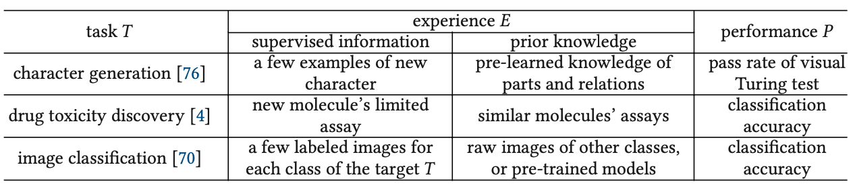
Few-Shot Learning (FSL)
Source: Yaqing Wang, Quanming Yao, James T. Kwok, and Lionel M. Ni (2020). "Generalizing from a few examples: A survey on few-shot learning." ACM computing surveys (csur) 53, no. 3 (2020): 1-34.

Slide 111
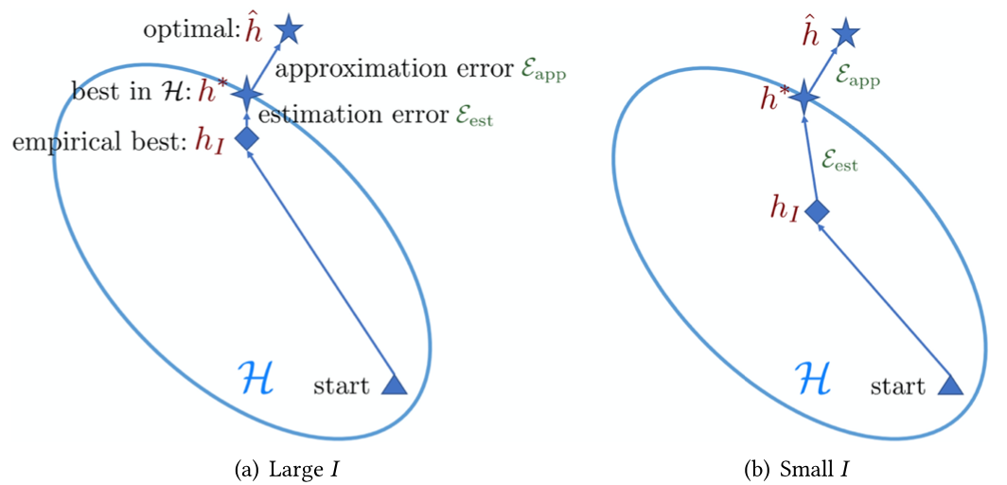
Few-Shot Learning (FSL)
Comparison of learning with sufficient and few training samples
Source: Yaqing Wang, Quanming Yao, James T. Kwok, and Lionel M. Ni (2020). "Generalizing from a few examples: A survey on few-shot learning." ACM computing surveys (csur) 53, no. 3 (2020): 1-34.

Slide 112
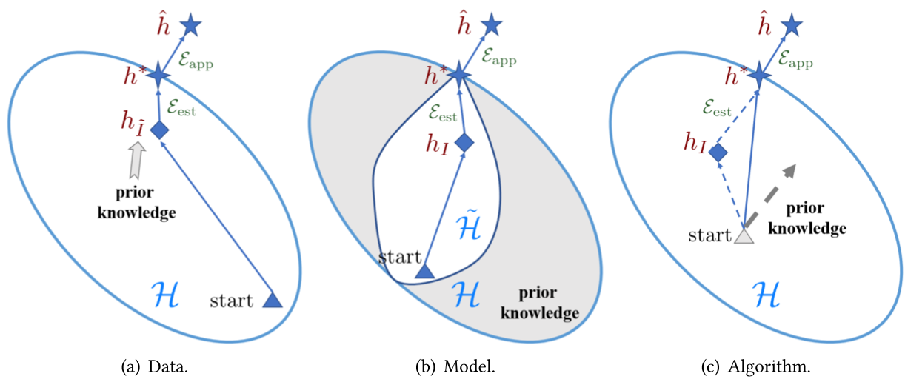
Few-Shot Learning (FSL)
Different perspectives on how FSL methods solve the few-shot problem
Source: Yaqing Wang, Quanming Yao, James T. Kwok, and Lionel M. Ni (2020). "Generalizing from a few examples: A survey on few-shot learning." ACM computing surveys (csur) 53, no. 3 (2020): 1-34.

Slide 113
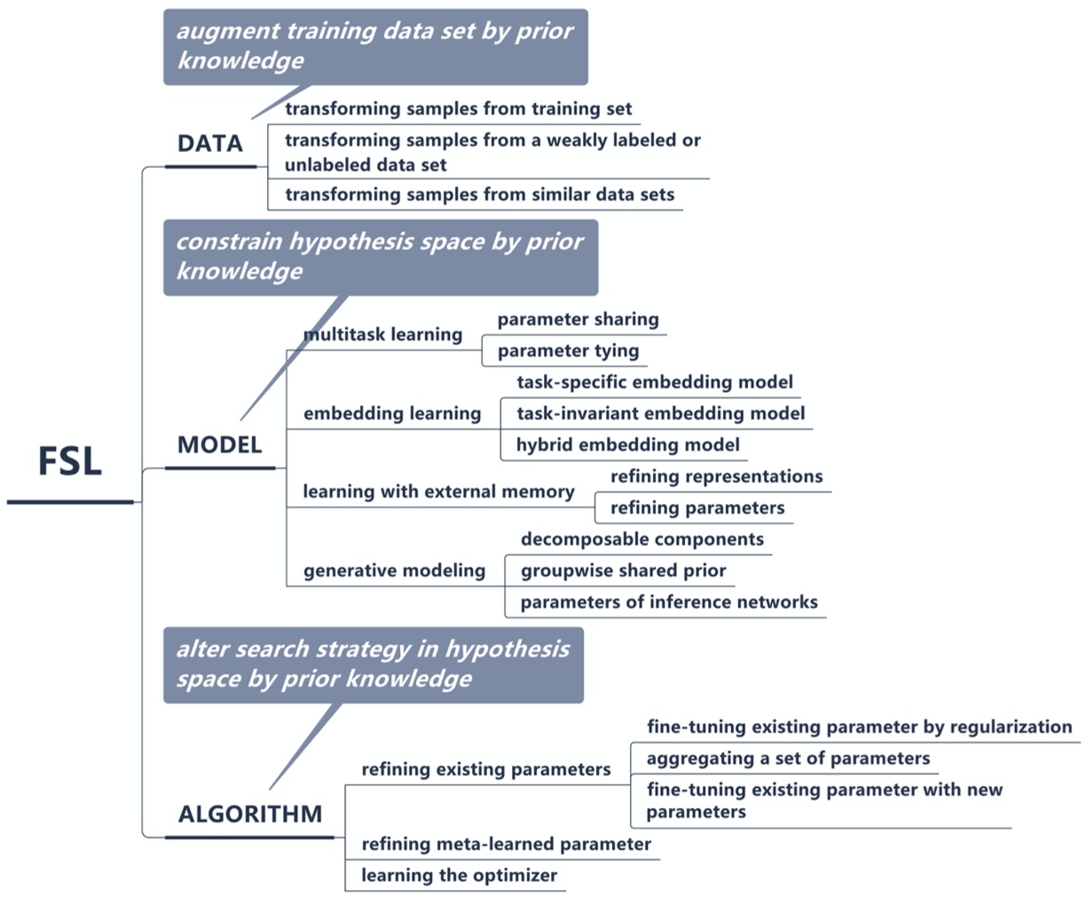
Few-Shot Learning (FSL)
A taxonomy of FSL methods
Source: Yaqing Wang, Quanming Yao, James T. Kwok, and Lionel M. Ni (2020). "Generalizing from a few examples: A survey on few-shot learning." ACM computing surveys (csur) 53, no. 3 (2020): 1-34.

Slide 114
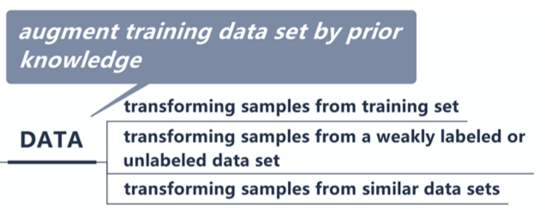
Few-Shot Learning (FSL)
Source: Yaqing Wang, Quanming Yao, James T. Kwok, and Lionel M. Ni (2020). "Generalizing from a few examples: A survey on few-shot learning." ACM computing surveys (csur) 53, no. 3 (2020): 1-34.

Slide 115
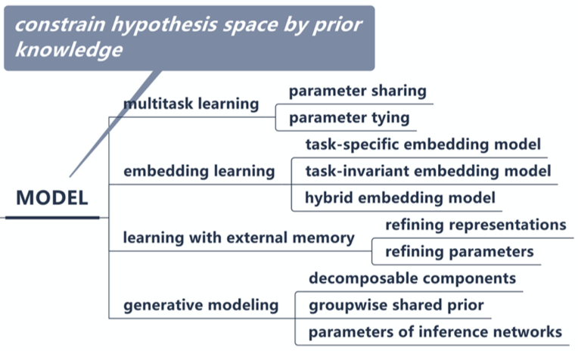
Few-Shot Learning (FSL)
Source: Yaqing Wang, Quanming Yao, James T. Kwok, and Lionel M. Ni (2020). "Generalizing from a few examples: A survey on few-shot learning." ACM computing surveys (csur) 53, no. 3 (2020): 1-34.

Slide 116
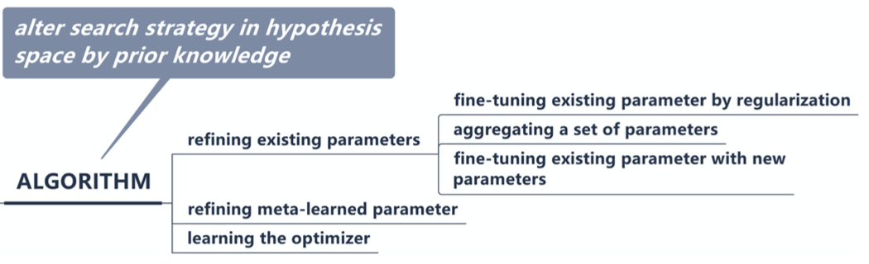
Few-Shot Learning (FSL)
Source: Yaqing Wang, Quanming Yao, James T. Kwok, and Lionel M. Ni (2020). "Generalizing from a few examples: A survey on few-shot learning." ACM computing surveys (csur) 53, no. 3 (2020): 1-34.

Slide 117
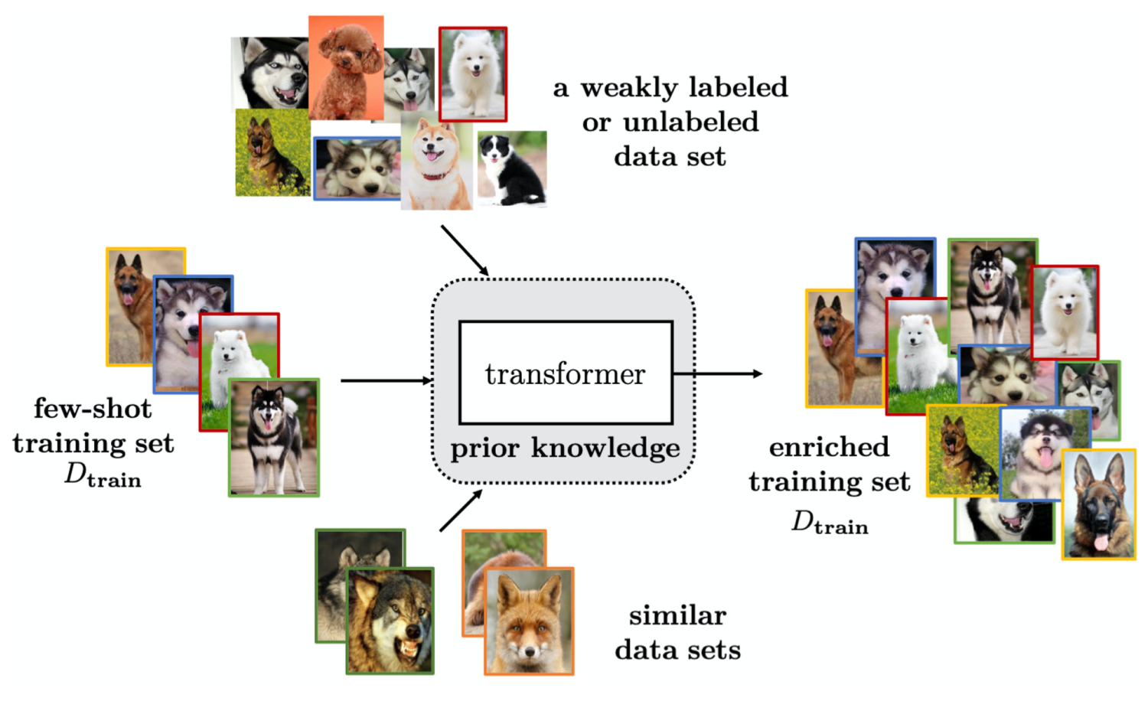
Few-Shot Learning (FSL)
Solving the FSL problem by data augmentation
Source: Yaqing Wang, Quanming Yao, James T. Kwok, and Lionel M. Ni (2020). "Generalizing from a few examples: A survey on few-shot learning." ACM computing surveys (csur) 53, no. 3 (2020): 1-34.

Slide 118
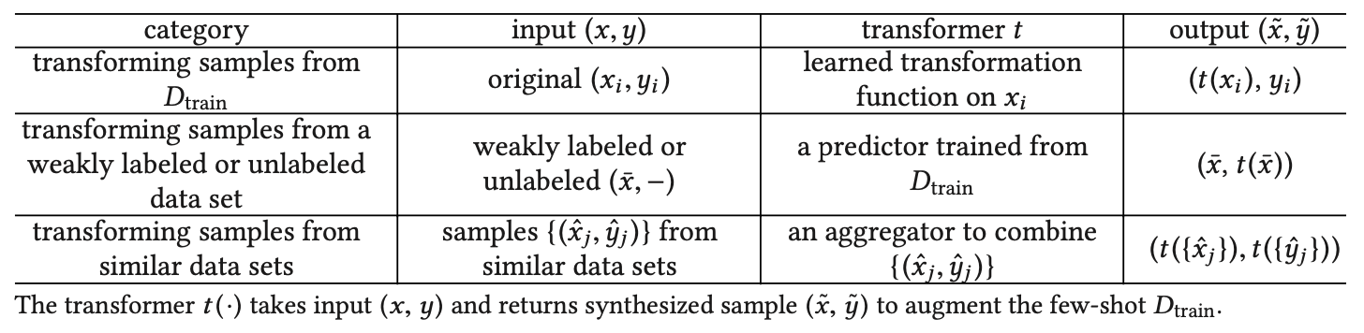
Few-Shot Learning (FSL)
Characteristics for FSL Methods Focusing on the Data Perspective
Source: Yaqing Wang, Quanming Yao, James T. Kwok, and Lionel M. Ni (2020). "Generalizing from a few examples: A survey on few-shot learning." ACM computing surveys (csur) 53, no. 3 (2020): 1-34.

Slide 119
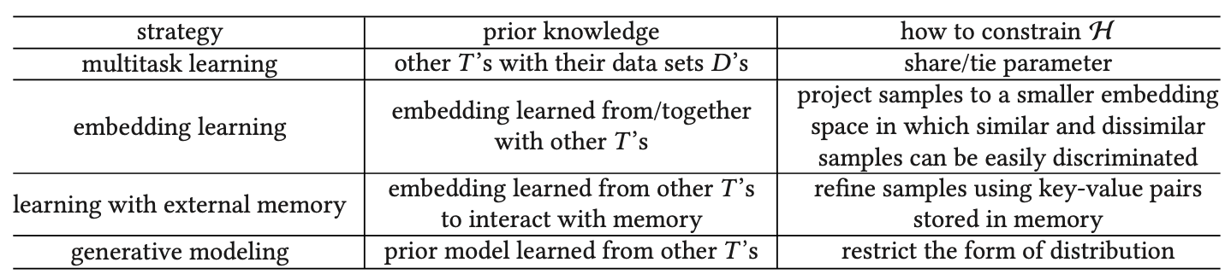
Few-Shot Learning (FSL)
Characteristics for FSL Methods Focusing on the Model Perspective
Source: Yaqing Wang, Quanming Yao, James T. Kwok, and Lionel M. Ni (2020). "Generalizing from a few examples: A survey on few-shot learning." ACM computing surveys (csur) 53, no. 3 (2020): 1-34.

Slide 120

Few-Shot Learning (FSL)
Solving the FSL problem by multitask learning with parameter sharing
Source: Yaqing Wang, Quanming Yao, James T. Kwok, and Lionel M. Ni (2020). "Generalizing from a few examples: A survey on few-shot learning." ACM computing surveys (csur) 53, no. 3 (2020): 1-34.

Slide 121

Few-Shot Learning (FSL)
Solving the FSL problem by multitask learning with parameter tying
Source: Yaqing Wang, Quanming Yao, James T. Kwok, and Lionel M. Ni (2020). "Generalizing from a few examples: A survey on few-shot learning." ACM computing surveys (csur) 53, no. 3 (2020): 1-34.

Slide 122

Few-Shot Learning (FSL)
Characteristics of Embedding Learning Methods
Source: Yaqing Wang, Quanming Yao, James T. Kwok, and Lionel M. Ni (2020). "Generalizing from a few examples: A survey on few-shot learning." ACM computing surveys (csur) 53, no. 3 (2020): 1-34.

Slide 123

Few-Shot Learning (FSL)
Solving the FSL problem by task-invariant embedding model
Source: Yaqing Wang, Quanming Yao, James T. Kwok, and Lionel M. Ni (2020). "Generalizing from a few examples: A survey on few-shot learning." ACM computing surveys (csur) 53, no. 3 (2020): 1-34.

Slide 124

Few-Shot Learning (FSL)
Solving the FSL problem by hybrid embedding model
Source: Yaqing Wang, Quanming Yao, James T. Kwok, and Lionel M. Ni (2020). "Generalizing from a few examples: A survey on few-shot learning." ACM computing surveys (csur) 53, no. 3 (2020): 1-34.

Slide 125

Few-Shot Learning (FSL)
Solving the FSL problem by learning with external memory
Source: Yaqing Wang, Quanming Yao, James T. Kwok, and Lionel M. Ni (2020). "Generalizing from a few examples: A survey on few-shot learning." ACM computing surveys (csur) 53, no. 3 (2020): 1-34.

Slide 126

Few-Shot Learning (FSL)
Characteristics of FSL Methods
Based on Learning with External Memory
Source: Yaqing Wang, Quanming Yao, James T. Kwok, and Lionel M. Ni (2020). "Generalizing from a few examples: A survey on few-shot learning." ACM computing surveys (csur) 53, no. 3 (2020): 1-34.

Slide 127

Few-Shot Learning (FSL)
Solving the FSL problem by generative modeling
Source: Yaqing Wang, Quanming Yao, James T. Kwok, and Lionel M. Ni (2020). "Generalizing from a few examples: A survey on few-shot learning." ACM computing surveys (csur) 53, no. 3 (2020): 1-34.

Slide 128

Few-Shot Learning (FSL)
Solving the FSL problem by fine-tuning existing parameter θ₀ by regularization
Source: Yaqing Wang, Quanming Yao, James T. Kwok, and Lionel M. Ni (2020). "Generalizing from a few examples: A survey on few-shot learning." ACM computing surveys (csur) 53, no. 3 (2020): 1-34.

Slide 129

Few-Shot Learning (FSL)
Characteristics for FSL Methods
Focusing on the Algorithm Perspective
Source: Yaqing Wang, Quanming Yao, James T. Kwok, and Lionel M. Ni (2020). "Generalizing from a few examples: A survey on few-shot learning." ACM computing surveys (csur) 53, no. 3 (2020): 1-34.

Slide 130
Few-Shot Learning (FSL)
Solving the FSL problem by meta-learning
Source: Yaqing Wang, Quanming Yao, James T. Kwok, and Lionel M. Ni (2020). "Generalizing from a few examples: A survey on few-shot learning." ACM computing surveys (csur) 53, no. 3 (2020): 1-34.

Slide 131
Few-Shot Learning (FSL)
Meta-learning
Each task mimics the few-shot scenario, and can be completely non-overlapping.
Support sets are used to train; query sets are used to evaluate the model
Source: Yao Ge, Yuting Guo, Yuan-Chi Yang, Mohammed Ali Al-Garadi, and Abeed Sarker (2022). "Few-shot learning for medical text: A systematic review." arXiv preprint arXiv:2204.14081 (2022).

Slide 132

Few-Shot Learning (FSL)
Matching networks
Source: Yao Ge, Yuting Guo, Yuan-Chi Yang, Mohammed Ali Al-Garadi, and Abeed Sarker (2022). "Few-shot learning for medical text: A systematic review." arXiv preprint arXiv:2204.14081 (2022).

Slide 133

Few-Shot Learning (FSL)
Prototypical network
Source: Yao Ge, Yuting Guo, Yuan-Chi Yang, Mohammed Ali Al-Garadi, and Abeed Sarker (2022). "Few-shot learning for medical text: A systematic review." arXiv preprint arXiv:2204.14081 (2022).

Slide 134

Few-Shot Learning (FSL) for medical text
Source: Yao Ge, Yuting Guo, Yuan-Chi Yang, Mohammed Ali Al-Garadi, and Abeed Sarker (2022). "Few-shot learning for medical text: A systematic review." arXiv preprint arXiv:2204.14081 (2022).

Slide 135

Few-Shot Learning (FSL) for medical text
Source: Yao Ge, Yuting Guo, Yuan-Chi Yang, Mohammed Ali Al-Garadi, and Abeed Sarker (2022). "Few-shot learning for medical text: A systematic review." arXiv preprint arXiv:2204.14081 (2022).

Slide 136

Multimodal Few-Shot Learning with
Frozen Language Models
Curated samples with about five seeds required to get past well-known language model failure modes of either repeating text for the prompt or emitting text that does not pertain to the image.
These samples demonstrate the ability to generate open-ended outputs that adapt to both images and text, and to make use of facts that it has learned during language-only pre-training.
Source: Maria Tsimpoukelli, Jacob L. Menick, Serkan Cabi, S. M. Eslami, Oriol Vinyals, and Felix Hill (2021). "Multimodal few-shot learning with frozen language models."
Advances in Neural Information Processing Systems 34 (2021): 200-212.

Slide 137

Multimodal Few-Shot Learning with
Frozen Language Models
Gradients through a frozen language model’s self attention layers are used to train the vision encoder.
Source: Maria Tsimpoukelli, Jacob L. Menick, Serkan Cabi, S. M. Eslami, Oriol Vinyals, and Felix Hill (2021). "Multimodal few-shot learning with frozen language models."
Advances in Neural Information Processing Systems 34 (2021): 200-212.

Slide 138

Multimodal Few-Shot Learning with
Frozen Language Models
Inference-Time interface for Frozen. The figure demonstrates how we can support (a) visual question answering,
(b) outside-knowledge question answering and (c) few-shot image classification via in-context learning.
Source: Maria Tsimpoukelli, Jacob L. Menick, Serkan Cabi, S. M. Eslami, Oriol Vinyals, and Felix Hill (2021). "Multimodal few-shot learning with frozen language models."
Advances in Neural Information Processing Systems 34 (2021): 200-212.

Slide 139

Multimodal Few-Shot Learning with
Frozen Language Models
Examples of (a) the Open-Ended miniImageNet evaluation (b) the Fast VQA evaluation.
Source: Maria Tsimpoukelli, Jacob L. Menick, Serkan Cabi, S. M. Eslami, Oriol Vinyals, and Felix Hill (2021). "Multimodal few-shot learning with frozen language models."
Advances in Neural Information Processing Systems 34 (2021): 200-212.

Slide 140

Transformer (Attention is All You Need)
(Vaswani et al., 2017)
Source: Vaswani, Ashish, Noam Shazeer, Niki Parmar, Jakob Uszkoreit, Llion Jones, Aidan N. Gomez, Łukasz Kaiser, and Illia Polosukhin. "Attention is all you need." In Advances in neural information processing systems, pp. 5998-6008. 2017.

Slide 141
BERT: Pre-training of Deep Bidirectional Transformers for Language Understanding
BERT (Bidirectional Encoder Representations from Transformers)
Overall pre-training and fine-tuning procedures for BERT
Source: Devlin, Jacob, Ming-Wei Chang, Kenton Lee, and Kristina Toutanova (2018).
"Bert: Pre-training of deep bidirectional transformers for language understanding." arXiv preprint arXiv:1810.04805.

Slide 142

Machine Learning: Ensemble Learning
Random Forest
https://tinyurl.com/aintpupython101

Slide 143

Machine Learning: Supervised Learning
Classification and Prediction
https://tinyurl.com/aintpupython101

Slide 144
Stuart Russell and Peter Norvig (2020),
Artificial Intelligence: A Modern Approach,
4th Edition, Pearson
Source: Stuart Russell and Peter Norvig (2020), Artificial Intelligence: A Modern Approach, 4th Edition, Pearson
https://www.amazon.com/Artificial-Intelligence-A-Modern-Approach/dp/0134610997/

Slide 145
Artificial Intelligence: A Modern Approach (AIMA)
Artificial Intelligence: A Modern Approach (AIMA)
  http://aima.cs.berkeley.edu/
AIMA Python
  http://aima.cs.berkeley.edu/python/readme.html
  https://github.com/aimacode/aima-python
Learning
  http://aima.cs.berkeley.edu/python/learning.html
Source: Stuart Russell and Peter Norvig (2020), Artificial Intelligence: A Modern Approach, 4th Edition, Pearson

Slide 146

Artificial Intelligence: A Modern Approach (AIMA)
http://aima.cs.berkeley.edu/

Slide 147

Papers with Code
State-of-the-Art (SOTA)
https://paperswithcode.com/sota

Slide 148
Summary
The Theory of Learning
  Computational Learning Theory
  Probably Approximately Correct (PAC) Learning
Ensemble Learning
  Bagging: Random Forests (RF)
  Boosting: Gradient Boosting, XGBoost, LightGBM, CatBoost
  Stacking
  Online learning
Meta Learning: Learning to Learn

Slide 149
References
Stuart Russell and Peter Norvig (2020), Artificial Intelligence: A Modern Approach, 4th Edition, Pearson.
Numa Dhamani and Maggie Engler (2024), Introduction to Generative AI, Manning
Denis Rothman (2024), Transformers for Natural Language Processing and Computer Vision - Third Edition: Explore Generative AI and Large Language Models with Hugging Face, ChatGPT, GPT-4V, and DALL-E 3, 3rd ed. Edition, Packt Publishing
Ben Auffarth (2023), Generative AI with LangChain: Build large language model (LLM) apps with Python, ChatGPT and other LLMs, Packt Publishing.
Aurélien Géron (2022), Hands-On Machine Learning with Scikit-Learn, Keras, and TensorFlow: Concepts, Tools, and Techniques to Build Intelligent Systems, 3rd Edition, O’Reilly Media.
Steven D'Ascoli (2022), Artificial Intelligence and Deep Learning with Python: Every Line of Code Explained For Readers New to AI and New to Python, Independently published.
Nithin Buduma, Nikhil Buduma, Joe Papa (2022), Fundamentals of Deep Learning: Designing Next-Generation Machine Intelligence Algorithms, 2nd Edition, ‎O'Reilly Media.
Aske Plaat, Annie Wong, Suzan Verberne, Joost Broekens, Niki van Stein, and Thomas Back. (2024) "Reasoning with Large Language Models, a Survey." arXiv preprint arXiv:2407.11511.
Madaan, Aman, Niket Tandon, Prakhar Gupta, Skyler Hallinan, Luyu Gao, Sarah Wiegreffe, Uri Alon et al. (2024) "Self-refine: Iterative refinement with self-feedback." Advances in Neural Information Processing Systems 36.

