Slide 1








Deep Learning and
Reinforcement Learning
Artificial Intelligence
1131AI06
MBA, IM, NTPU (M5276) (Fall 2024)
Tue 2, 3, 4 (9:10-12:00) (B3F17)
Min-Yuh Day, Ph.D.
Professor
Institute of Information Management, National Taipei University
https://web.ntpu.edu.tw/~myday
https://meet.google.com/paj-zhhj-mya
2024-11-12

Slide 2
Syllabus
Week Date Subject/Topics
1 2024/09/10 Introduction to Artificial Intelligence
2 2024/09/17 Mid-Autumn Festival (Day off)
3 2024/09/24 Artificial Intelligence and Intelligent Agents; Problem Solving
4 2024/10/01 Knowledge, Reasoning and Knowledge Representation;
Uncertain Knowledge and Reasoning
5 2024/10/08 Case Study on Artificial Intelligence I
6 2024/10/15 Machine Learning: Supervised and Unsupervised Learning

Slide 3
Syllabus
Week Date Subject/Topics
7 2024/10/22 The Theory of Learning and Ensemble Learning
8 2024/10/29 Midterm Project Report
9 2024/11/05 Self-Learning
10 2024/11/12 Deep Learning and Reinforcement Learning
11 2024/11/19 Case Study on Artificial Intelligence II
12 2024/11/26 Deep Learning for Natural Language Processing

Slide 4
Syllabus
Week Date Subject/Topics
13 2024/12/03 Computer Vision and Robotics
14 2024/12/10 Generative AI,
Philosophy and Ethics of AI and the Future of AI
15 2024/12/17 Final Project Report I
16 2024/12/24 Final Project Report II

Slide 5
Deep Learning and
Reinforcement Learning

Slide 6
Outline
Deep Learning (DL)
  Neural Networks (NN)
  Convolutional Neural Networks (CNN)
  Recurrent Neural Networks (RNN)
Reinforcement Learning (RL)
  Markov Decision Processes (MDP)
  Deep Reinforcement Learning (DRL) Algorithms
    SARSA
    Q-Learning
    DQN, A3C, Rainbow

Slide 7

Stuart Russell and Peter Norvig (2020),
Artificial Intelligence: A Modern Approach,
4th Edition, Pearson
Source: Stuart Russell and Peter Norvig (2020), Artificial Intelligence: A Modern Approach, 4th Edition, Pearson
https://www.amazon.com/Artificial-Intelligence-A-Modern-Approach/dp/0134610997/

Slide 8
Artificial Intelligence:
A Modern Approach
Artificial Intelligence
Problem Solving
Knowledge and Reasoning
Uncertain Knowledge and Reasoning
Machine Learning
Communicating, Perceiving, and Acting
Philosophy and Ethics of AI
Source: Stuart Russell and Peter Norvig (2020), Artificial Intelligence: A Modern Approach, 4th Edition, Pearson

Slide 9
Artificial Intelligence:
Machine Learning
Source: Stuart Russell and Peter Norvig (2020), Artificial Intelligence: A Modern Approach, 4th Edition, Pearson

Slide 10
Artificial Intelligence:
5. Machine Learning
Learning from Examples
Learning Probabilistic Models
Deep Learning
Reinforcement Learning
Source: Stuart Russell and Peter Norvig (2020), Artificial Intelligence: A Modern Approach, 4th Edition, Pearson

Slide 11
Artificial Intelligence:
Reinforcement Learning
Learning from Rewards
Passive Reinforcement Learning
Active Reinforcement Learning
Generalization in Reinforcement Learning
Policy Search
Apprenticeship and Inverse Reinforcement Learning
Applications of Reinforcement Learning
Source: Stuart Russell and Peter Norvig (2020), Artificial Intelligence: A Modern Approach, 4th Edition, Pearson

Slide 12

Aurélien Géron (2022),
Hands-On Machine Learning with Scikit-Learn, Keras, and TensorFlow: Concepts, Tools, and Techniques to Build Intelligent Systems,
3rd Edition, O’Reilly Media
https://github.com/ageron/handson-ml3
Source: https://www.amazon.com/Hands-Machine-Learning-Scikit-Learn-TensorFlow/dp/1098125975

Slide 13
Hands-On Machine Learning with
Scikit-Learn, Keras, and TensorFlow
Notebooks
The Machine Learning landscape
End-to-end Machine Learning project
Classification
Training Models
Support Vector Machines
Decision Trees
Ensemble Learning and Random Forests
Dimensionality Reduction
Unsupervised Learning Techniques
Artificial Neural Nets with Keras
Training Deep Neural Networks
Custom Models and Training with TensorFlow
Loading and Preprocessing Data
Deep Computer Vision Using Convolutional Neural Networks
Processing Sequences Using RNNs and CNNs
Natural Language Processing with RNNs and Attention
Autoencoders, GANs, and Diffusion Models
Reinforcement Learning
Training and Deploying TensorFlow Models at Scale
https://github.com/ageron/handson-ml3

Slide 14
Reinforcement Learning (DL)
Agent
Environment
Source: Richard S. Sutton & Andrew G. Barto (2018), Reinforcement Learning: An Introduction, 2nd Edition, A Bradford Book.

Slide 15
Reinforcement Learning (DL)
1
2
observation
Agent
action
3
reward
Environment
Source: Richard S. Sutton & Andrew G. Barto (2018), Reinforcement Learning: An Introduction, 2nd Edition, A Bradford Book.

Slide 16
Reinforcement Learning (DL)
1
2
observation
Agent
action
O_{t}
A_{t}
3
reward
R_{t}
Environment
Source: Richard S. Sutton & Andrew G. Barto (2018), Reinforcement Learning: An Introduction, 2nd Edition, A Bradford Book.

Slide 17
Agents interact with environments through sensors and actuators
Source: Stuart Russell and Peter Norvig (2020), Artificial Intelligence: A Modern Approach, 4th Edition, Pearson

Slide 18
AI Acting Humanly:
The Turing Test Approach
(Alan Turing, 1950)
Knowledge Representation
Automated Reasoning
Machine Learning (ML)
  Deep Learning (DL)
Computer Vision (Image, Video)
Natural Language Processing (NLP)
Robotics
Source: Stuart Russell and Peter Norvig (2020), Artificial Intelligence: A Modern Approach, 4th Edition, Pearson

Slide 19
Artificial Intelligence
Machine Learning & Deep Learning
Source: https://blogs.nvidia.com/blog/2016/07/29/whats-difference-artificial-intelligence-machine-learning-deep-learning-ai/

Slide 20
AI, ML, DL
Artificial Intelligence (AI)
Machine Learning (ML)
Supervised
Learning
Unsupervised Learning
Deep Learning (DL)
CNN
RNN LSTM GRU
GAN
Semi-supervised Learning
Reinforcement Learning
Source: https://leonardoaraujosantos.gitbooks.io/artificial-inteligence/content/deep_learning.html

Slide 21
3 Machine Learning Algorithms
Source: Enrico Galimberti, http://blogs.teradata.com/data-points/tree-machine-learning-algorithms/

Slide 22
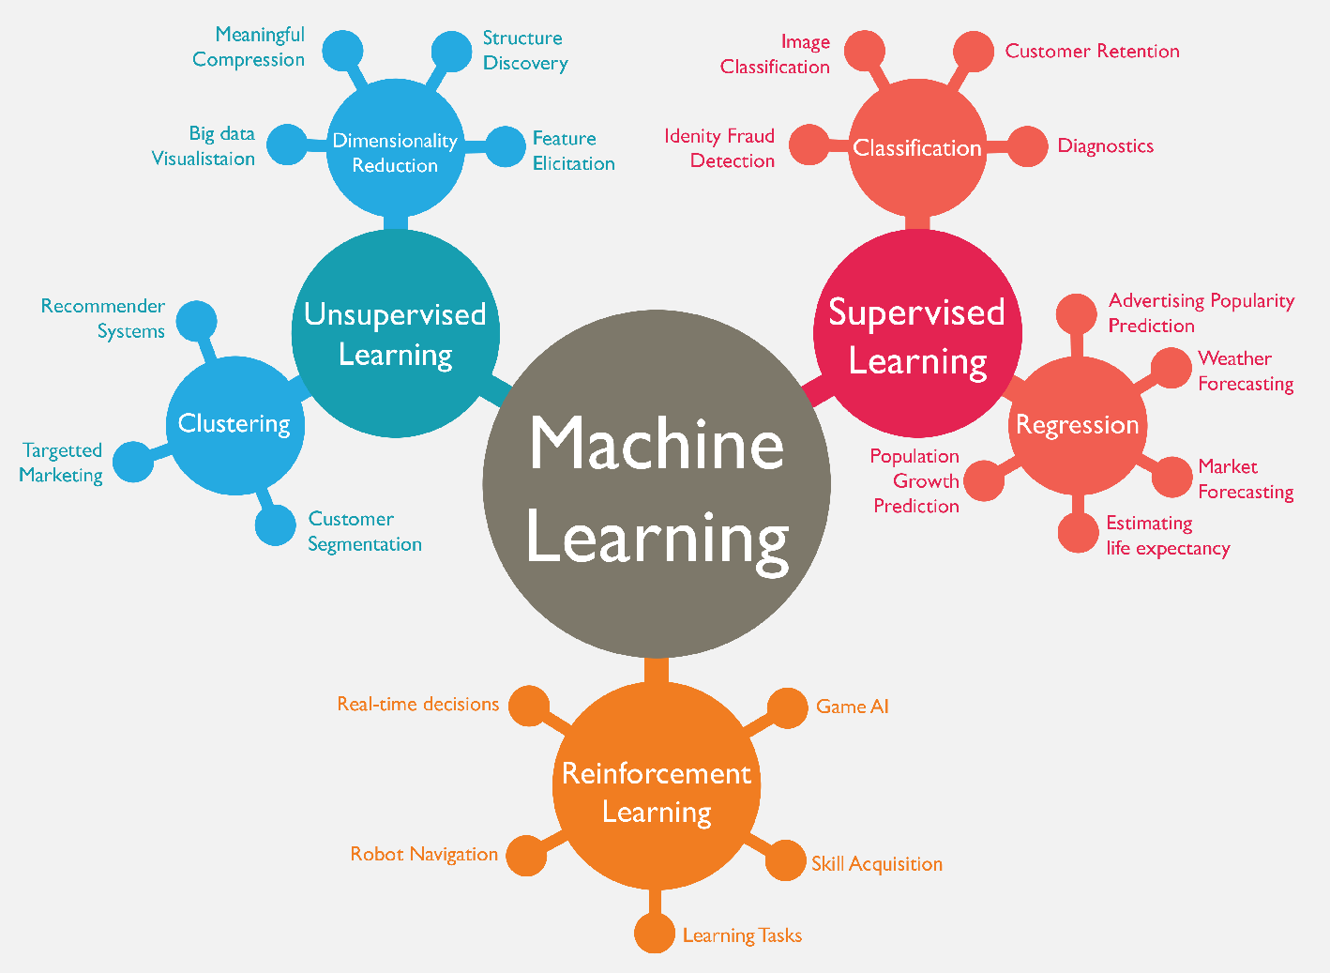
Machine Learning (ML)
Source: https://www.mactores.com/services/aws-big-data-machine-learning-cognitive-services/

Slide 23
Tristan Lim (2024).
"Environmental, social, and governance (ESG) and artificial intelligence in finance: State-of-the-art and research takeaways."
Artificial Intelligence Review
57, no. 4 (2024): 1-64.

Slide 24
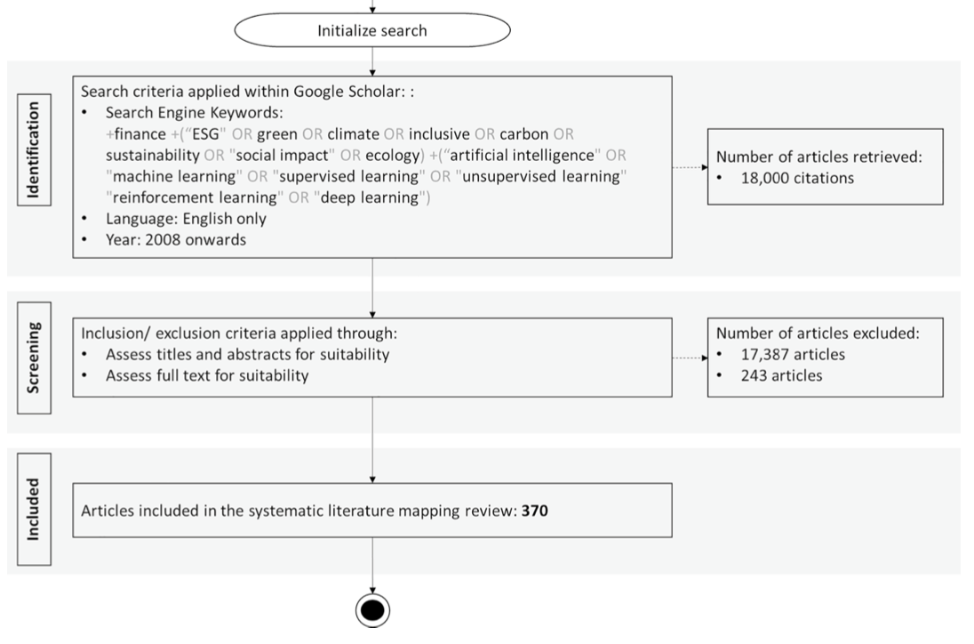
ESG and Artificial Intelligence in Finance
PRISMA—the systematic mapping process
Source: Tristan Lim (2024). "Environmental, social, and governance (ESG) and artificial intelligence in finance: State-of-the-art and research takeaways." Artificial Intelligence Review 57, no. 4 (2024): 1-64.

Slide 25
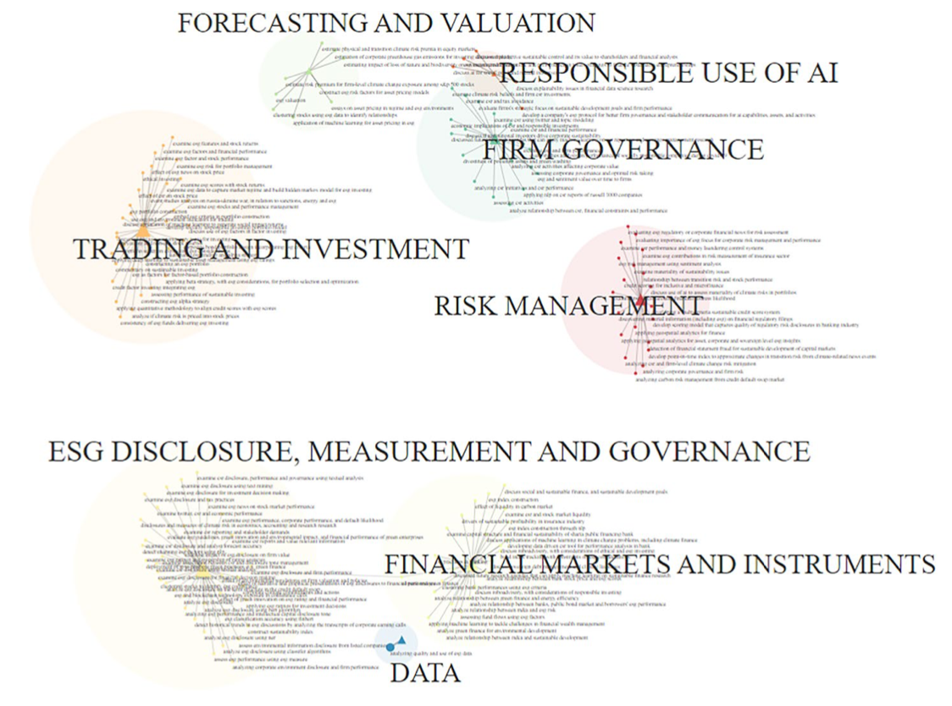
Network Analysis of ESG and AI in Finance
Source: Tristan Lim (2024). "Environmental, social, and governance (ESG) and artificial intelligence in finance: State-of-the-art and research takeaways." Artificial Intelligence Review 57, no. 4 (2024): 1-64.

Slide 26
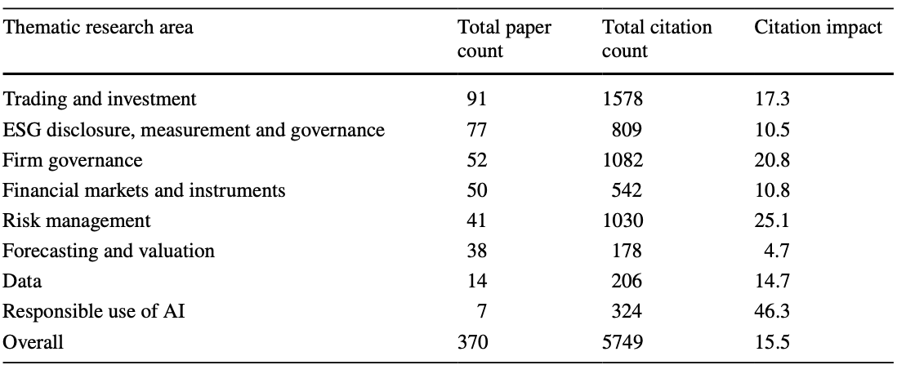
Research Area of ESG and AI in Finance
Source: Tristan Lim (2024). "Environmental, social, and governance (ESG) and artificial intelligence in finance: State-of-the-art and research takeaways." Artificial Intelligence Review 57, no. 4 (2024): 1-64.

Slide 27
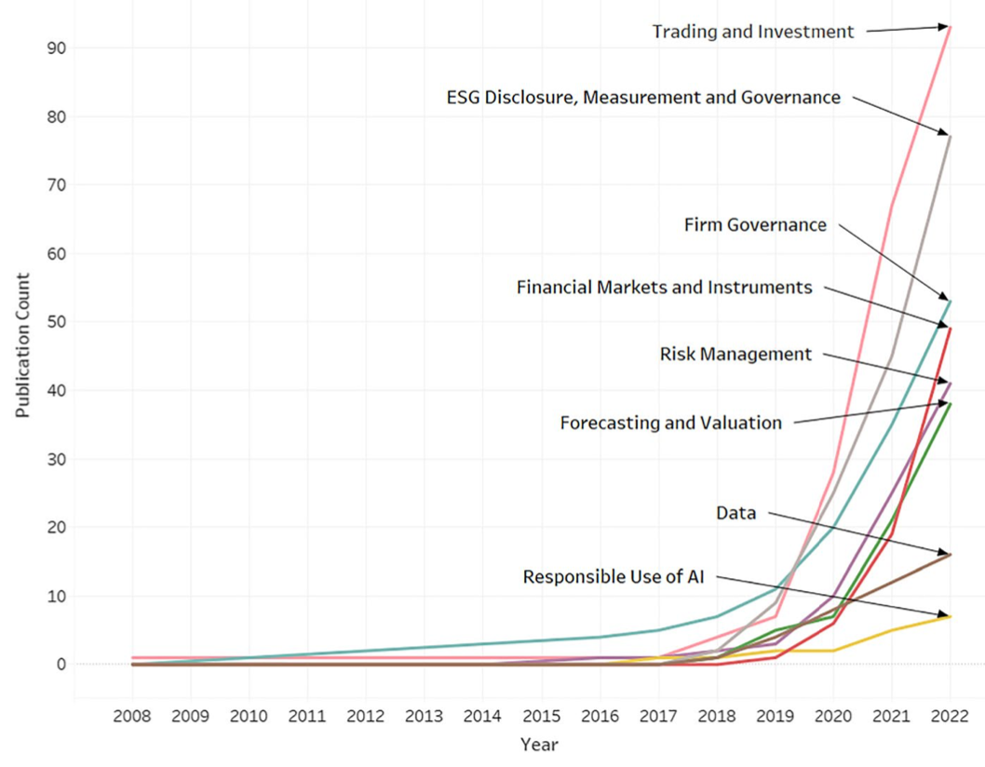
Total publication count by research thematic areas between 2008 and 2022
Source: Tristan Lim (2024). "Environmental, social, and governance (ESG) and artificial intelligence in finance: State-of-the-art and research takeaways." Artificial Intelligence Review 57, no. 4 (2024): 1-64.

Slide 28
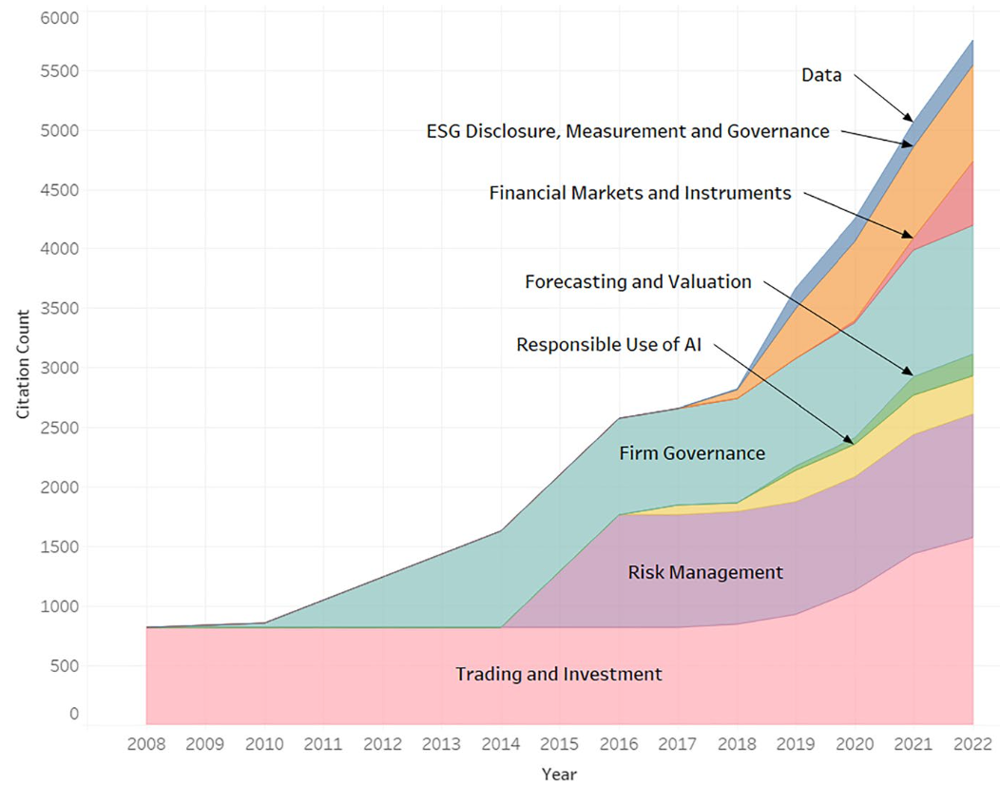
Total citation count by research thematic areas between 2008 and 2022
Source: Tristan Lim (2024). "Environmental, social, and governance (ESG) and artificial intelligence in finance: State-of-the-art and research takeaways." Artificial Intelligence Review 57, no. 4 (2024): 1-64.

Slide 29
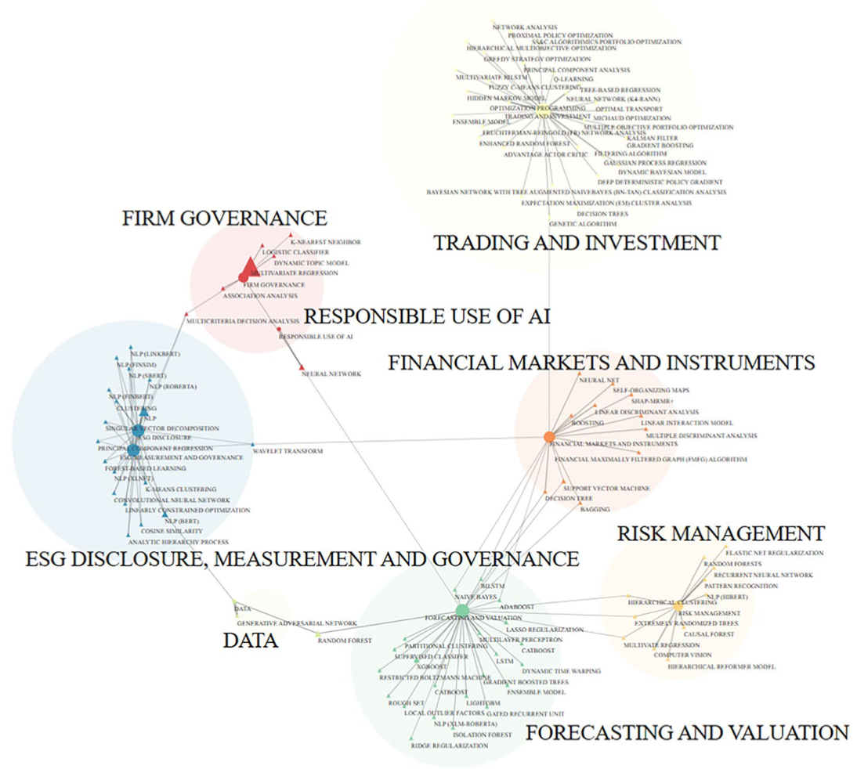
Network Analysis on Research Domains and AI Techniques
Source: Tristan Lim (2024). "Environmental, social, and governance (ESG) and artificial intelligence in finance: State-of-the-art and research takeaways." Artificial Intelligence Review 57, no. 4 (2024): 1-64.

Slide 30
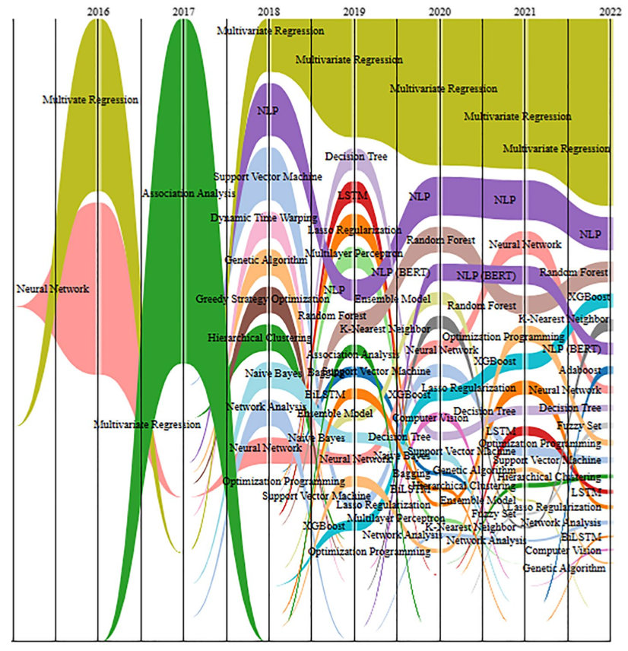
Bump Graph Analysis of dominant AI Techniques
Source: Tristan Lim (2024). "Environmental, social, and governance (ESG) and artificial intelligence in finance: State-of-the-art and research takeaways." Artificial Intelligence Review 57, no. 4 (2024): 1-64.

Slide 31
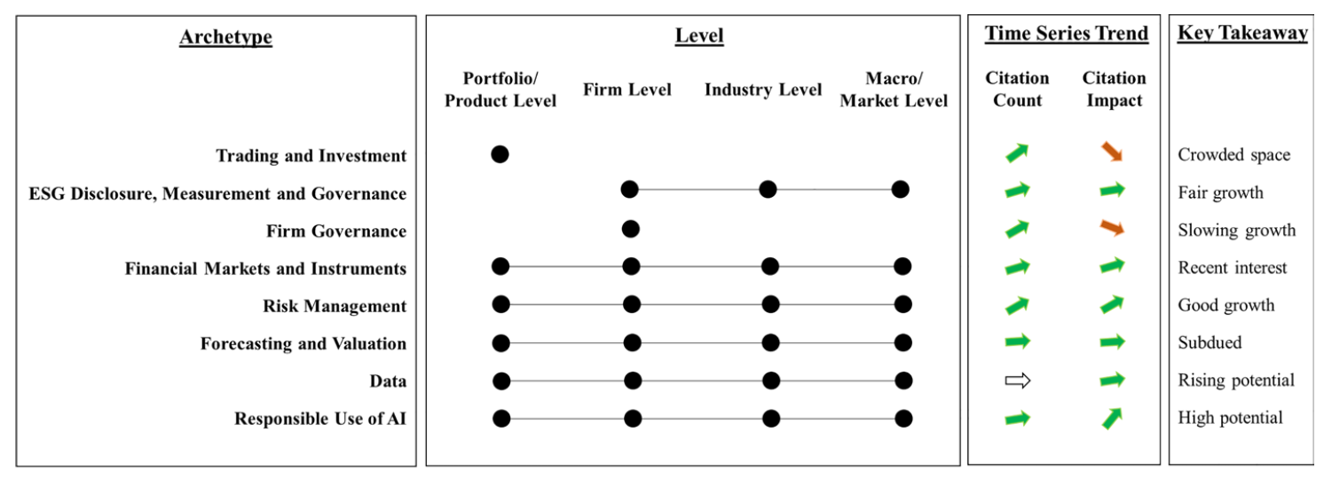
Environmental, Social, and Governance (ESG) and
Artificial Intelligence in Finance: Research Takeaways
Source: Tristan Lim (2024). "Environmental, social, and governance (ESG) and artificial intelligence in finance: State-of-the-art and research takeaways." Artificial Intelligence Review 57, no. 4 (2024): 1-64.

Slide 32
Applications of DL in Financial Economics
Deep learning for financial economics
Deep learning for macroeconomics and monetary economics
Deep learning for agricultural and natural resource economics
Deep learning for industrial organization
Deep learning for urban, rural, regional, real estate, and transportation economics
Deep learning for health, education, and welfare
Deep learning for business administration and microeconomics
Source: Zheng, Yuanhang, Zeshui Xu, and Anran Xiao. "Deep learning in economics: a systematic and critical review." Artificial Intelligence Review (2023): 1-43.

Slide 33
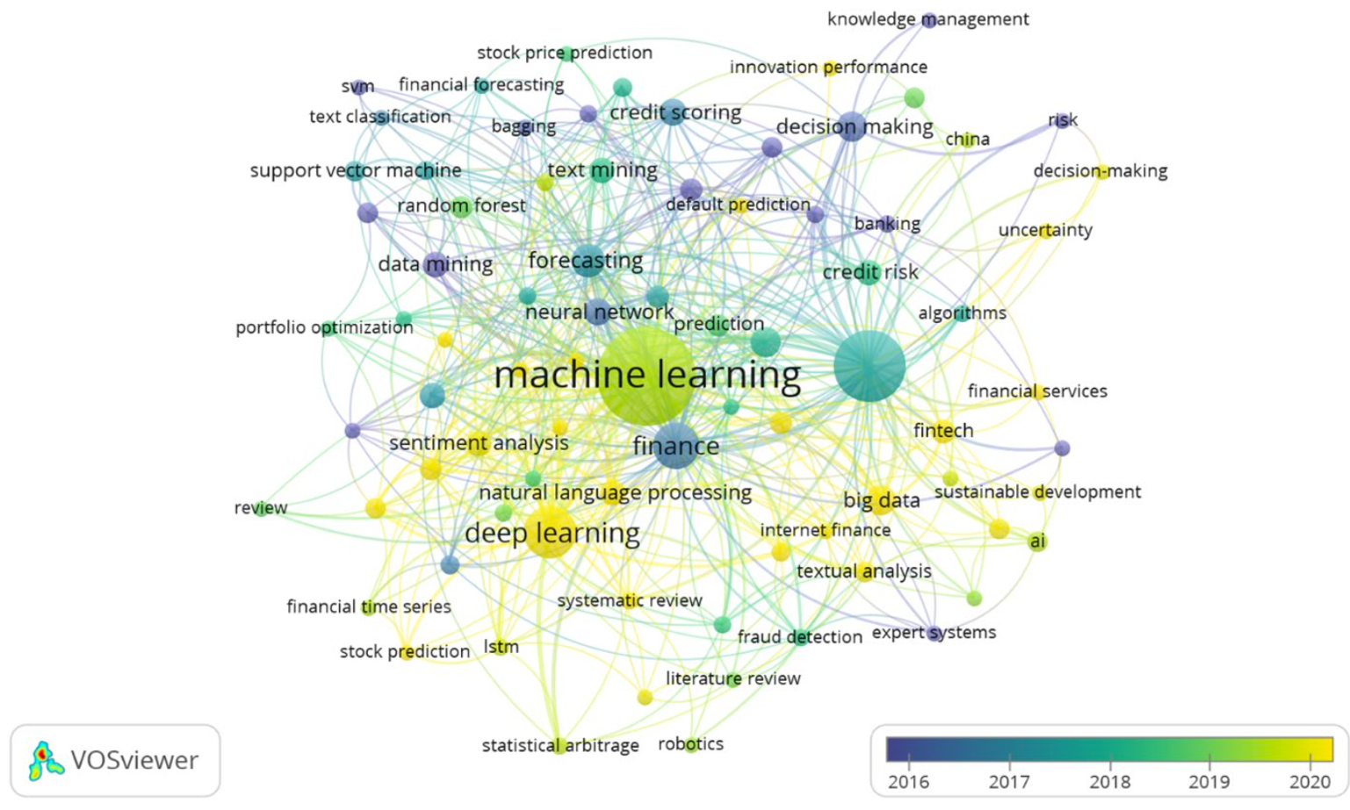
Machine Learning and Deep Learning in Finance
(2016-2022)
Source: Biju, Ajitha Kumari Vijayappan Nair, Ann Susan Thomas, and J. Thasneem. "Examining the research taxonomy of artificial intelligence, deep learning & machine learning in the financial sphere—
a bibliometric analysis." Quality & Quantity (2023): 1-30.

Slide 34
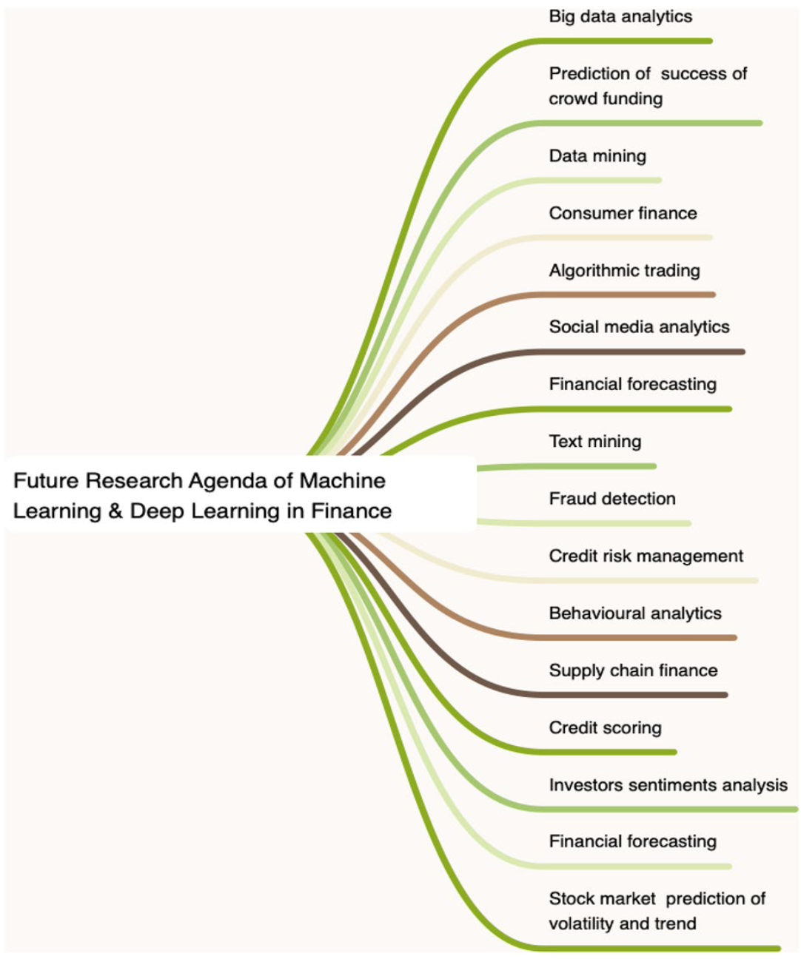
Machine Learning and Deep Learning in Finance
Source: Biju, Ajitha Kumari Vijayappan Nair, Ann Susan Thomas, and J. Thasneem. "Examining the research taxonomy of artificial intelligence, deep learning & machine learning in the financial sphere—
a bibliometric analysis." Quality & Quantity (2023): 1-30.

Slide 35
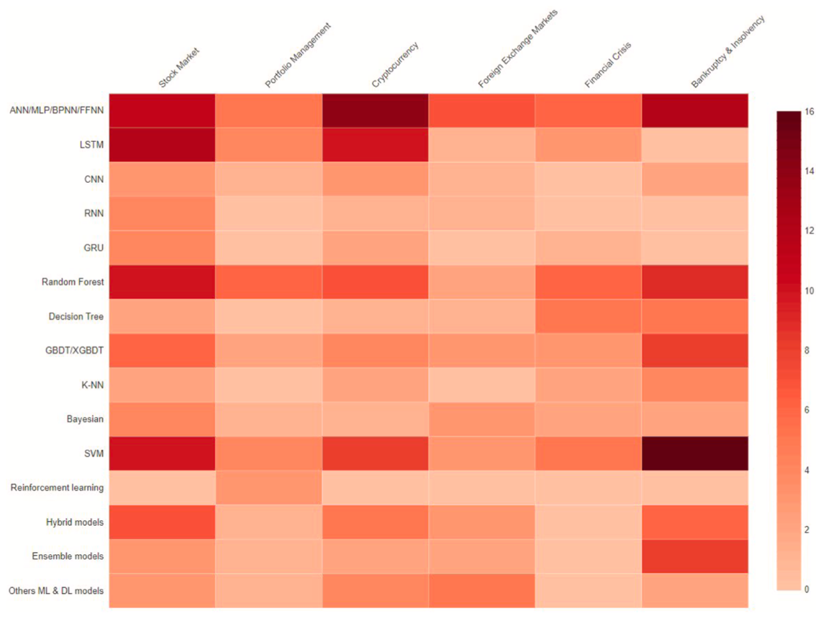
Financial Applications of Machine Learning
Application
– Model
Heatmap
Stock Market
Portfolio Management
Cryptocurrency
Foreign Exchange Market
Financial Crisis
Bankruptcy and Insolvency
Source: Nazareth, Noella, and Yeruva Yenkata Ramana Reddy. "Financial applications of machine learning: a literature review." Expert Systems with Applications (2023): 119640.

Slide 36
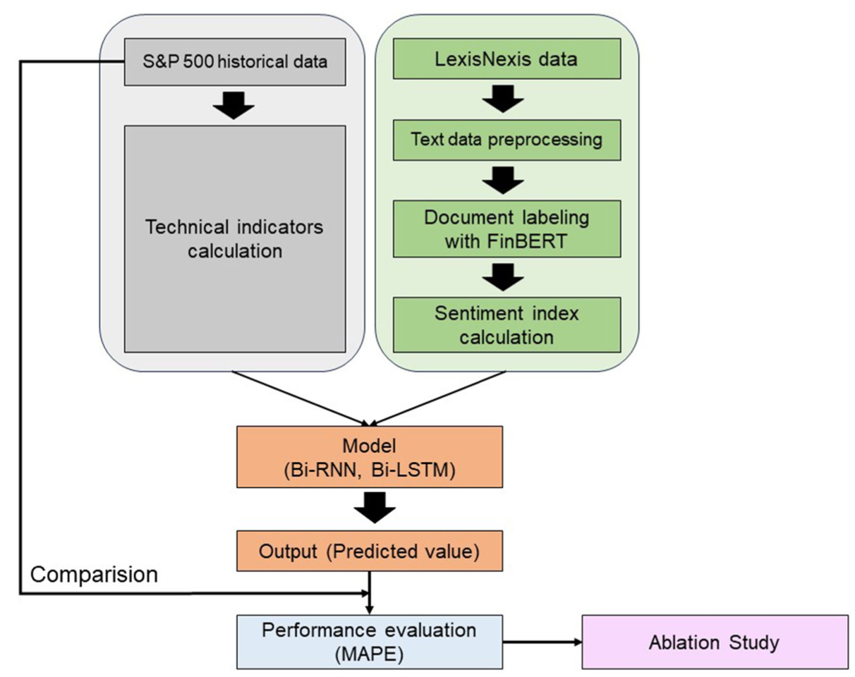
Deep-learning-based stock market prediction incorporating ESG sentiment and technical indicators
Source: Lee, Haein, Jang Hyun Kim, and Hae Sun Jung. "Deep-learning-based stock market prediction incorporating ESG sentiment and technical indicators." Scientific Reports 14, no. 1 (2024): 10262.

Slide 37
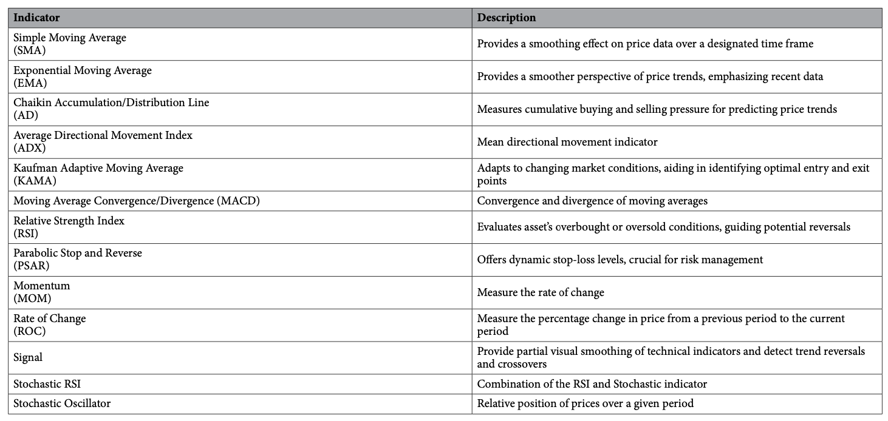
Technical indicators in stock market prediction
Source: Lee, Haein, Jang Hyun Kim, and Hae Sun Jung. "Deep-learning-based stock market prediction incorporating ESG sentiment and technical indicators." Scientific Reports 14, no. 1 (2024): 10262.

Slide 38
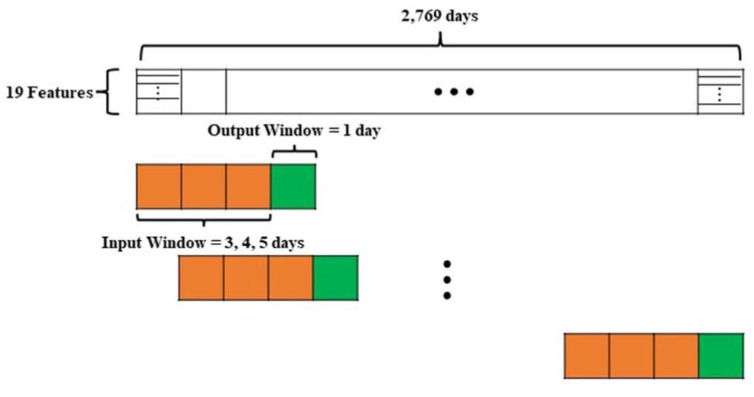
Technical indicators in stock market prediction
Source: Lee, Haein, Jang Hyun Kim, and Hae Sun Jung. "Deep-learning-based stock market prediction incorporating ESG sentiment and technical indicators." Scientific Reports 14, no. 1 (2024): 10262.

Slide 39
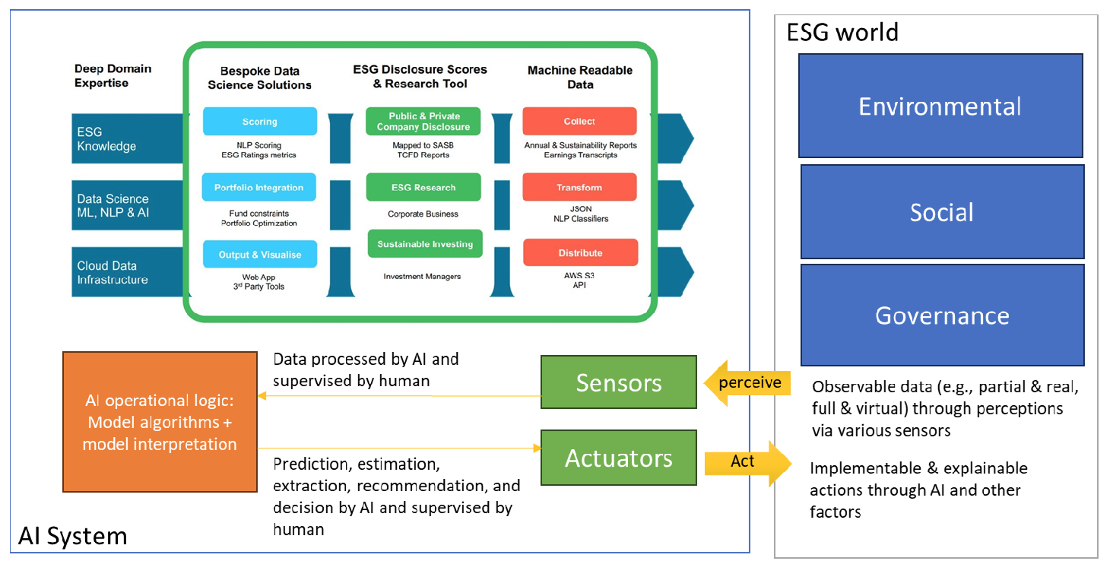
AI System and ESG World
Source: Xu, Jun. (2024) "AI in ESG for Financial Institutions: An Industrial Survey." arXiv preprint arXiv:2403.05541 (2024).

Slide 40
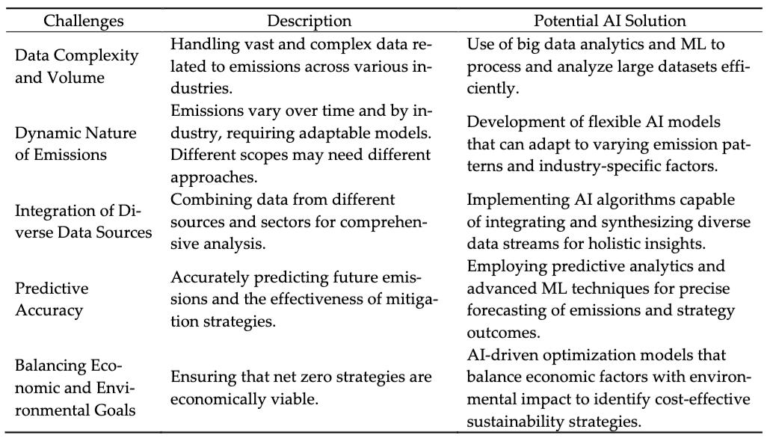
AI Solution for Net Zero Model
Source: Xu, Jun. (2024) "AI in ESG for Financial Institutions: An Industrial Survey." arXiv preprint arXiv:2403.05541 (2024).

Slide 41
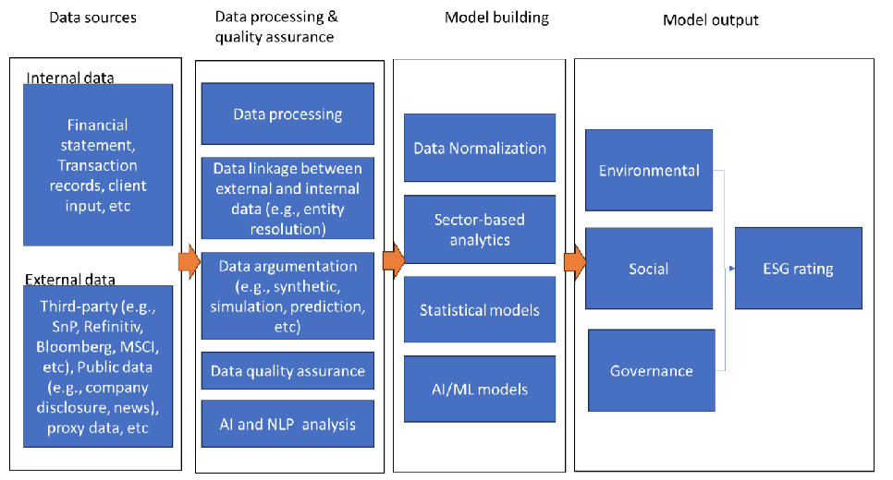
Data Analytics for ESG Ranking & Scoring
Source: Xu, Jun. (2024) "AI in ESG for Financial Institutions: An Industrial Survey." arXiv preprint arXiv:2403.05541 (2024).

Slide 42
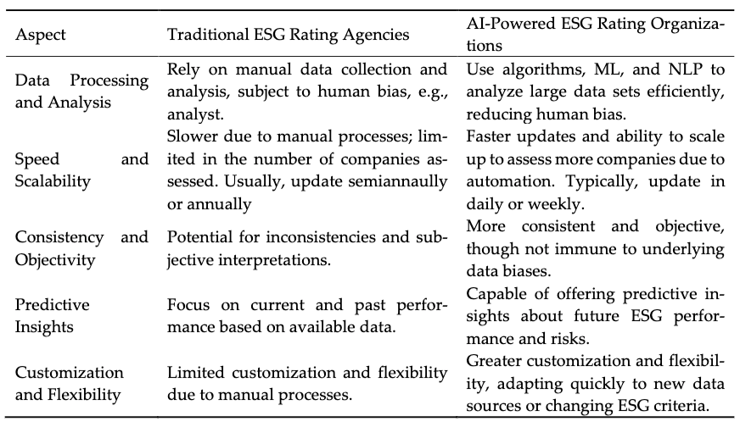
Traditional and AI-Power ESG Rating
Source: Xu, Jun. (2024) "AI in ESG for Financial Institutions: An Industrial Survey." arXiv preprint arXiv:2403.05541 (2024).

Slide 43
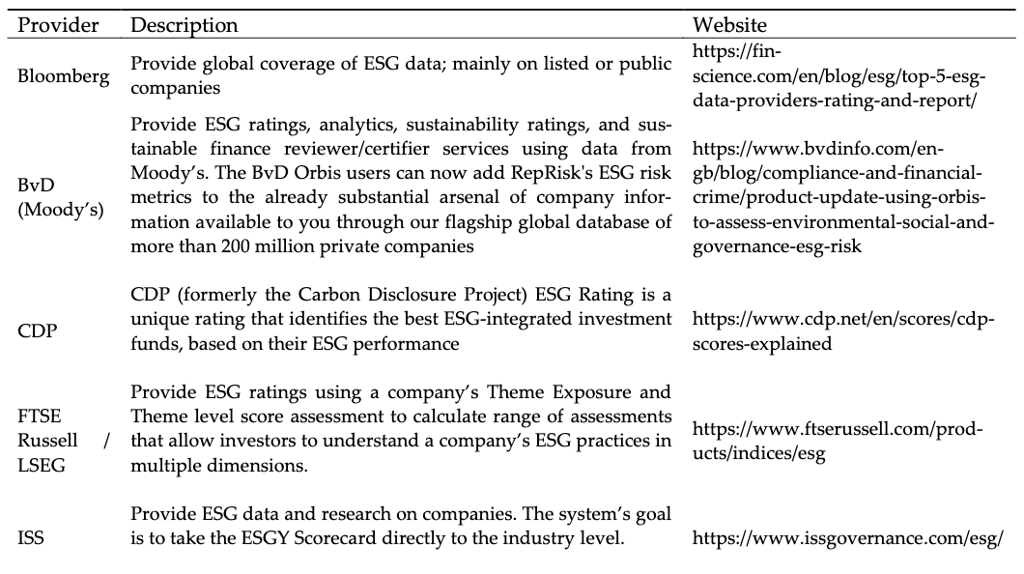
ESG Data Providers
Source: Xu, Jun. (2024) "AI in ESG for Financial Institutions: An Industrial Survey." arXiv preprint arXiv:2403.05541 (2024).

Slide 44
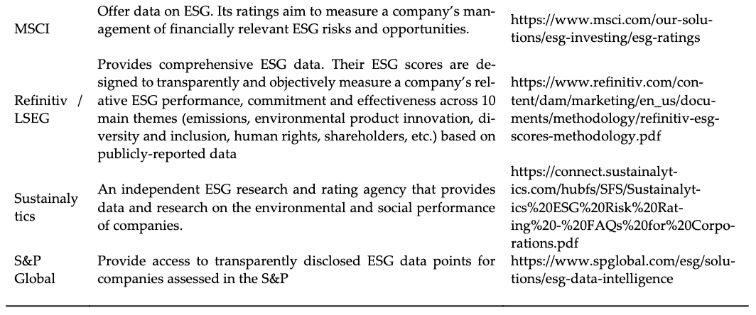
ESG Data Providers
Source: Xu, Jun. (2024) "AI in ESG for Financial Institutions: An Industrial Survey." arXiv preprint arXiv:2403.05541 (2024).

Slide 45
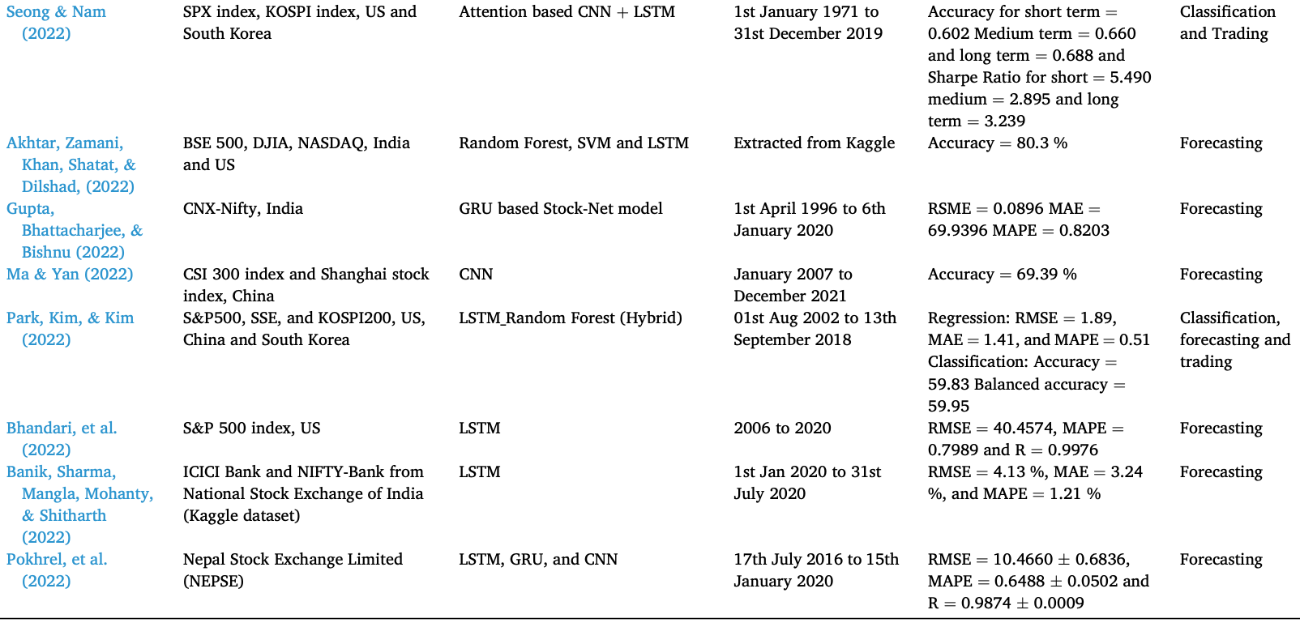
Machine Learning in Stock Market Prediction
Source: Nazareth, Noella, and Yeruva Yenkata Ramana Reddy. "Financial applications of machine learning: a literature review." Expert Systems with Applications (2023): 119640.

Slide 46
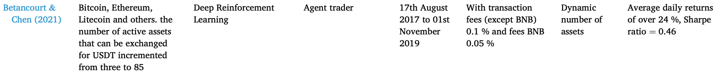
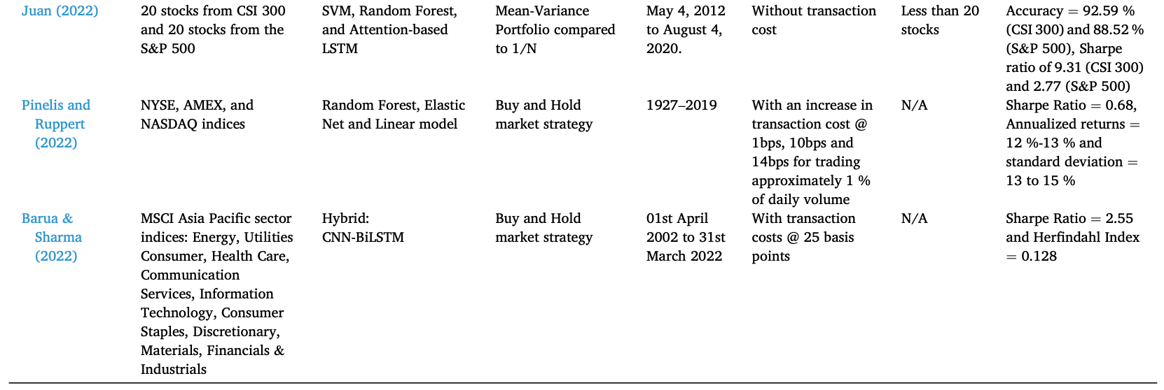
Machine Learning in Portfolio Management
Source: Nazareth, Noella, and Yeruva Yenkata Ramana Reddy. "Financial applications of machine learning: a literature review." Expert Systems with Applications (2023): 119640.

Slide 47
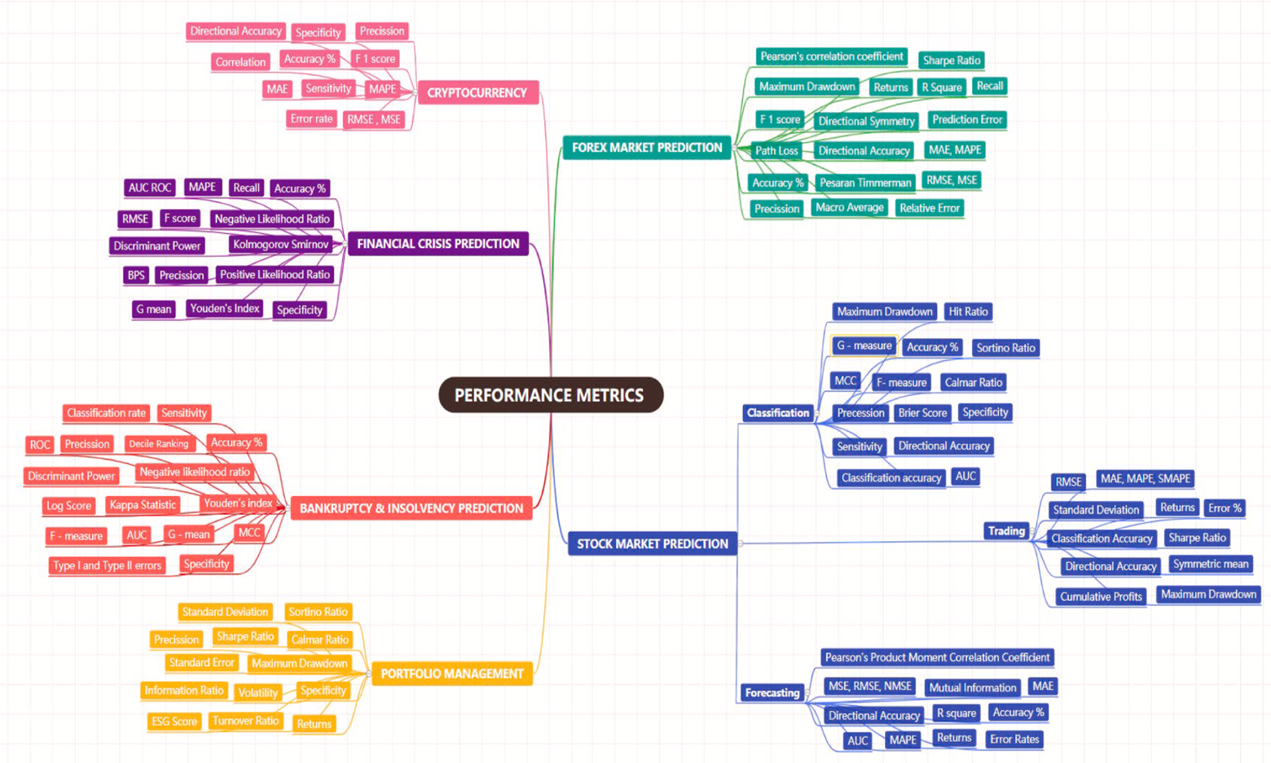
Performance Metrics of Financial Applications of ML
Source: Nazareth, Noella, and Yeruva Yenkata Ramana Reddy. "Financial applications of machine learning: a literature review." Expert Systems with Applications (2023): 119640.

Slide 48
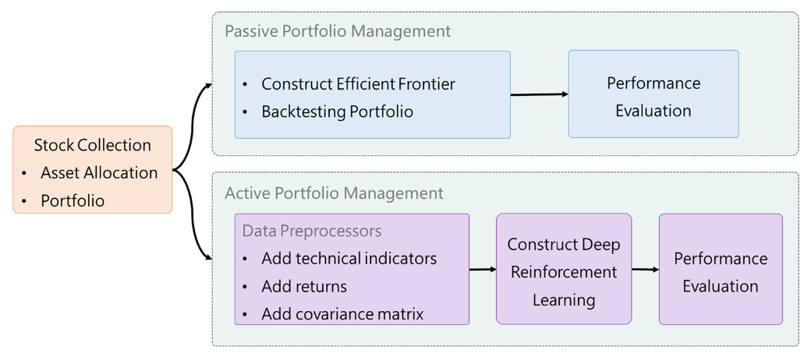
Deep Reinforcement Learning in Portfolio Management
Source: Min-Yuh Day, Ching-Ying Yang, and Yensen Ni (2024), "Portfolio Dynamic Trading Strategies Using Deep Reinforcement Learning", Soft Computing, Volume 28, August 2024, pp. 8715–8730.

Slide 49
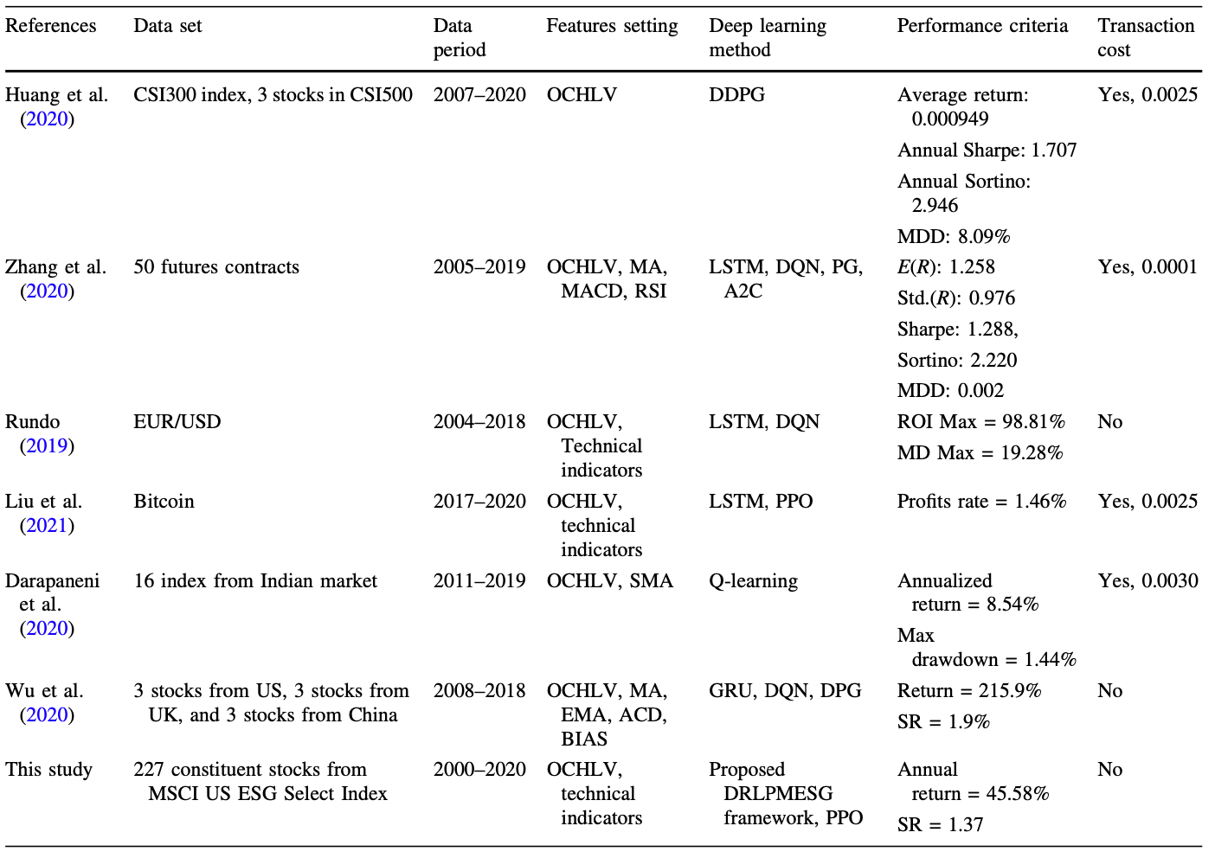
Deep Reinforcement Learning in Portfolio Management
Day et al.
(2023)
Source: Min-Yuh Day, Ching-Ying Yang, and Yensen Ni (2023), "Portfolio Dynamic Trading Strategies Using Deep Reinforcement Learning", Soft Computing, 30 July 2023, pp. 1-16.

Slide 50
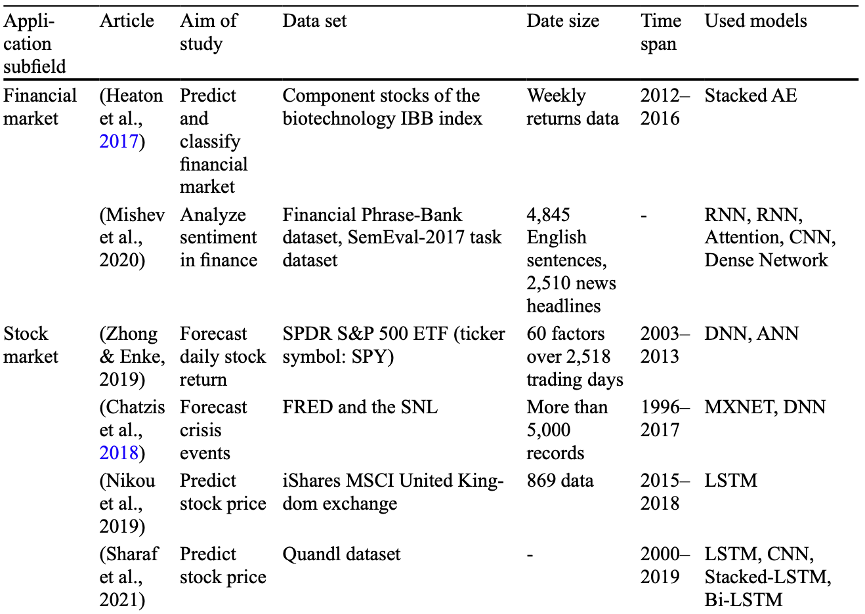
Deep learning for Financial Economics
Source: Zheng, Yuanhang, Zeshui Xu, and Anran Xiao. "Deep learning in economics: a systematic and critical review." Artificial Intelligence Review (2023): 1-43.

Slide 51
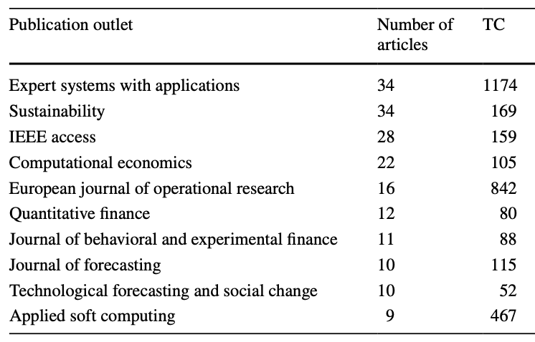
Journal Articles of ML and AI in Finance
Source: Biju, Ajitha Kumari Vijayappan Nair, Ann Susan Thomas, and J. Thasneem. "Examining the research taxonomy of artificial intelligence, deep learning & machine learning in the financial sphere—
a bibliometric analysis." Quality & Quantity (2023): 1-30.

Slide 52
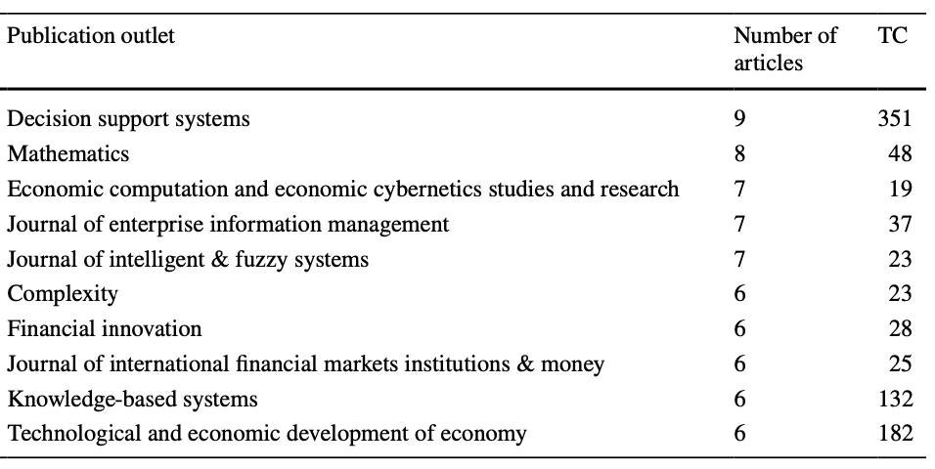
Journal Articles of ML and AI in Finance
Source: Biju, Ajitha Kumari Vijayappan Nair, Ann Susan Thomas, and J. Thasneem. "Examining the research taxonomy of artificial intelligence, deep learning & machine learning in the financial sphere—
a bibliometric analysis." Quality & Quantity (2023): 1-30.

Slide 53
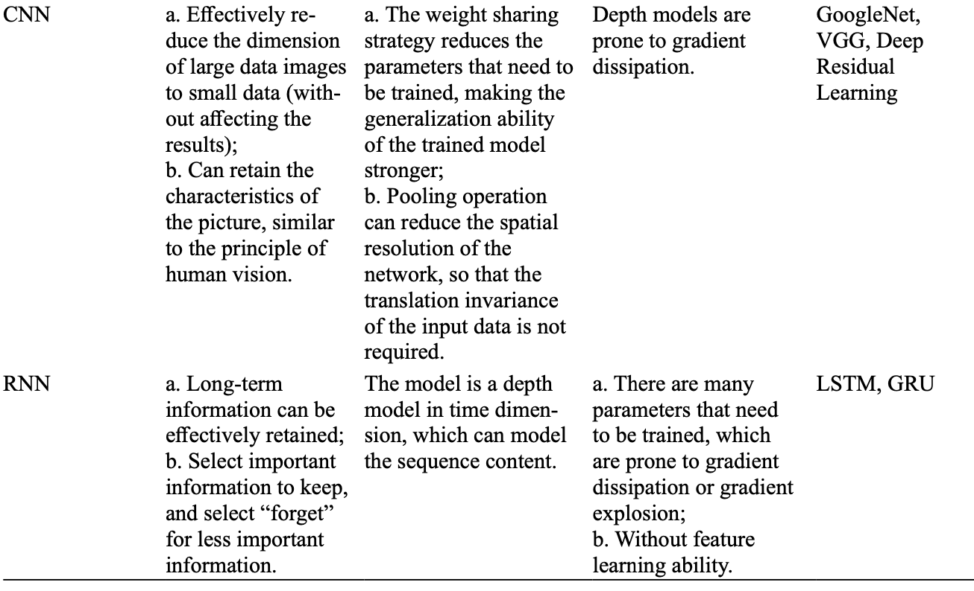
Deep learning: CNN, RNN
Source: Zheng, Yuanhang, Zeshui Xu, and Anran Xiao. "Deep learning in economics: a systematic and critical review." Artificial Intelligence Review (2023): 1-43.

Slide 54
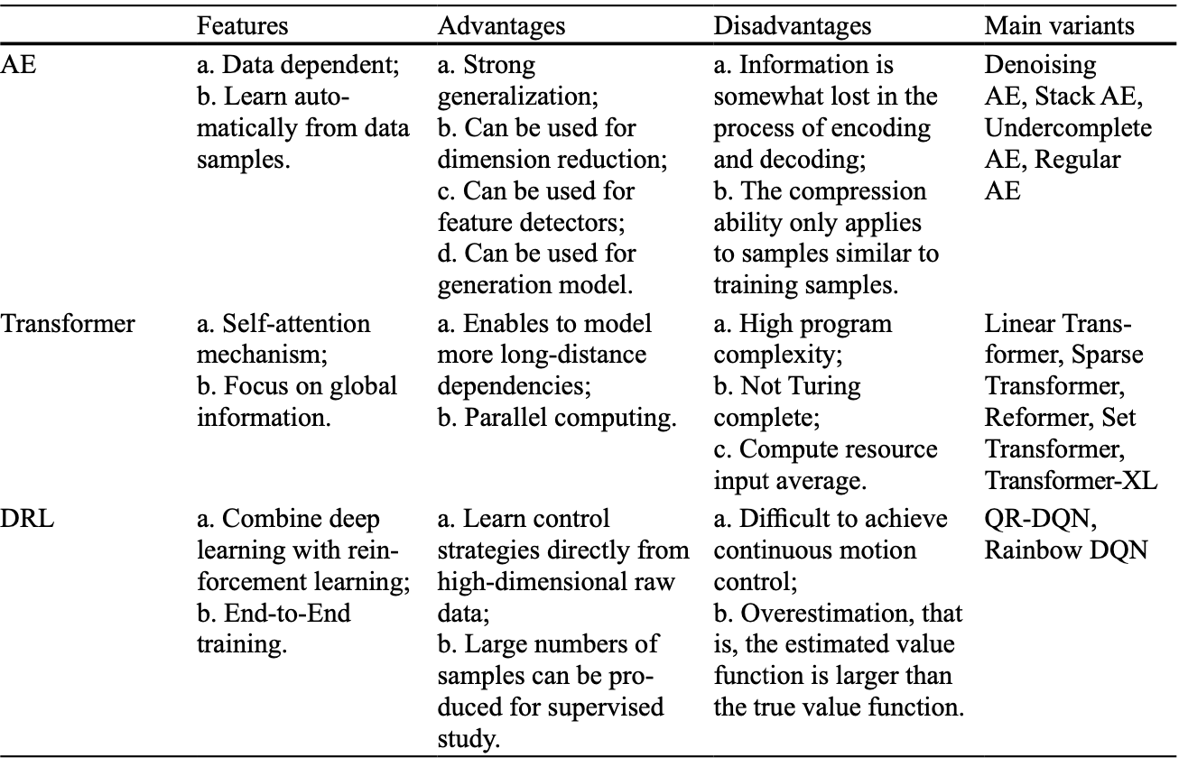
Deep learning: AE, Transformer, DRL
Source: Zheng, Yuanhang, Zeshui Xu, and Anran Xiao. "Deep learning in economics: a systematic and critical review." Artificial Intelligence Review (2023): 1-43.

Slide 55
Stock Market Movement Forecast:
ML Phases of the stock market modeling
Source: O. Bustos and A. Pomares-Quimbaya (2020), "Stock Market Movement Forecast: A Systematic Review." Expert Systems with Applications (2020): 113464.

Slide 56
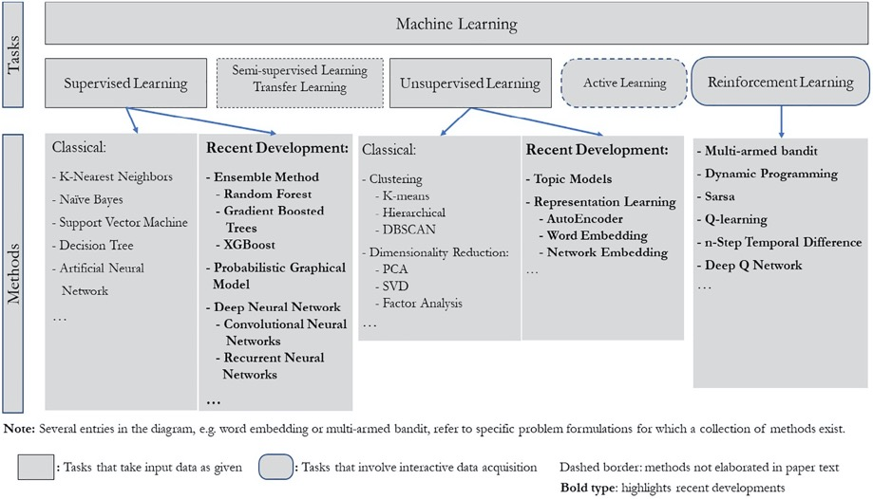
Machine Learning Tasks and Methods
Source: Liye Ma and Baohong Sun (2020), "Machine learning and AI in marketing – Connecting computing power to human insights." International Journal of Research in Marketing, 37, no. 3, 481-504.

Slide 57
Machine Learning

Slide 58
Machine Learning
Supervised Learning (Classification)
Learning from Examples
y = f(x)
x
y
input
Output
label

Slide 59
Machine Learning
Supervised Learning (Classification)
Learning from Examples
y = f(x)
Example
5.1,3.5,1.4,0.2,Iris-setosa 4.9,3.0,1.4,0.2,Iris-setosa 4.7,3.2,1.3,0.2,Iris-setosa 7.0,3.2,4.7,1.4,Iris-versicolor 6.4,3.2,4.5,1.5,Iris-versicolor 6.9,3.1,4.9,1.5,Iris-versicolor 6.3,3.3,6.0,2.5,Iris-virginica 5.8,2.7,5.1,1.9,Iris-virginica 7.1,3.0,5.9,2.1,Iris-virginica
y
x

Slide 60
Time Series Data
[10, 20, 30, 40, 50, 60, 70, 80, 90]
X
Y
[10 20 30] 40
[20 30 40] 50
[30 40 50] 60
[40 50 60] 70
[50 60 70] 80
[60 70 80] 90

Slide 61
Time Series Data
[100, 110, 120, 130, 140, 150]
Y
X
Y
[100 110 120 130 140] 150
X_{t1}
X_{t2}
X_{t3}
X_{t4}
X_{t5}

Slide 62
Linear function
y = f(x)
y = w₁x + w₀
h_{w}(x) = w₁x + w₀
Source: Stuart Russell and Peter Norvig (2020), Artificial Intelligence: A Modern Approach, 4th Edition, Pearson

Slide 63
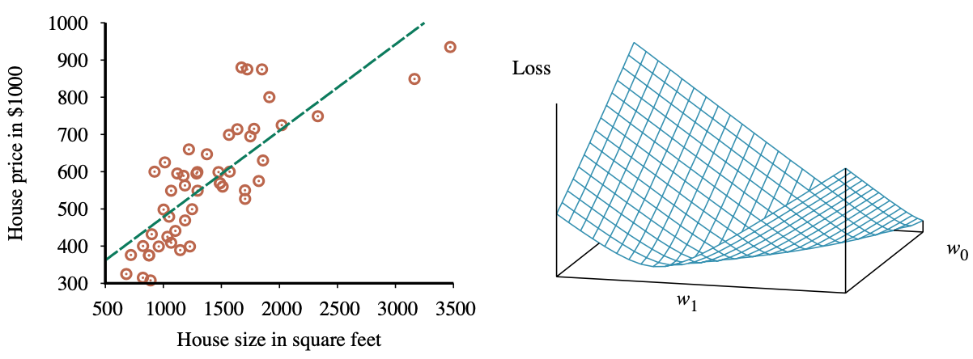
Linear Regression Weight Space
h_{w}(x) = w₁x + w₀
w* = argmin_{w} Loss(h_{w})
y = 0.232 x + 246
Loss function for Weights (w₁, w₀)
Source: Stuart Russell and Peter Norvig (2020), Artificial Intelligence: A Modern Approach, 4th Edition, Pearson

Slide 64
Deep Learning

Slide 65
Deep Learning and
Deep Neural Networks

Slide 66
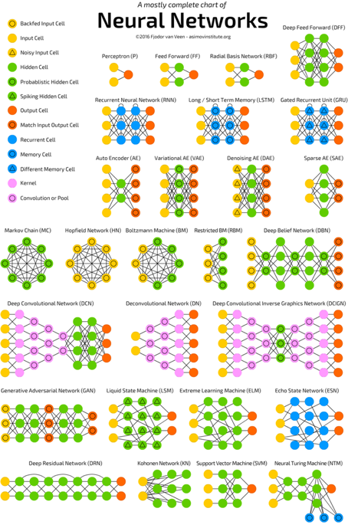
Neural Networks
(NN)
Source: http://www.asimovinstitute.org/neural-network-zoo/

Slide 67
Convolutional Neural Networks
(CNN or Deep Convolutional Neural Networks, DCNN)
LeCun, Yann, et al. “Gradient-based learning applied to document recognition.” Proceedings of the IEEE 86.11 (1998): 2278-2324.
Source: http://www.asimovinstitute.org/neural-network-zoo/

Slide 68
Recurrent Neural Networks
(RNN)
Elman, Jeffrey L. “Finding structure in time.” Cognitive science 14.2 (1990): 179-211
Source: http://www.asimovinstitute.org/neural-network-zoo/

Slide 69
Long / Short Term Memory
(LSTM)
Hochreiter, Sepp, and Jürgen Schmidhuber. “Long short-term memory.” Neural computation 9.8 (1997): 1735-1780.
Source: http://www.asimovinstitute.org/neural-network-zoo/

Slide 70
Gated Recurrent Units
(GRU)
Chung, Junyoung, et al. “Empirical evaluation of gated recurrent neural networks on sequence modeling.” arXiv preprint arXiv:1412.3555 (2014).
Source: http://www.asimovinstitute.org/neural-network-zoo/

Slide 71
Generative Adversarial Networks (GAN)
Goodfellow, Ian, et al. “Generative adversarial nets.” Advances in Neural Information Processing Systems. 2014.
Source: http://www.asimovinstitute.org/neural-network-zoo/

Slide 72

Tensor
3
  # a rank 0 tensor; this is a scalar with shape []
[1. ,2., 3.]
  # a rank 1 tensor; this is a vector with shape [3]
[[1., 2., 3.], [4., 5., 6.]]
  # a rank 2 tensor; a matrix with shape [2, 3]
[[[1., 2., 3.]], [[7., 8., 9.]]]
  # a rank 3 tensor with shape [2, 1, 3]
https://www.tensorflow.org/

Slide 73
Scalar
80
Vector
[50 60 70]
Matrix
50 60 70
55 65 75
[50 60 70] [70 80 90]
[55 65 75] [75 85 95]
Tensor

Slide 74
Deep Learning Foundations:
Neural Networks

Slide 75
Deep Learning and
Neural Networks
Input Layer
(X)
Hidden Layer
(H)
Output Layer
(Y)
X1
Y
X2

Slide 76
Deep Learning and
Neural Networks
Input Layer
(X)
Hidden Layer
(H)
Output Layer
(Y)

Slide 77
Deep Learning and
Neural Networks
Input Layer
(X)
Hidden Layers
(H)
Output Layer
(Y)
Deep Neural Networks
Deep Learning

Slide 78
The Neuron
x₁
w₁
w₂
x₂
y
…
…
w_{n}
x_{n}
Source: Jeff Dean (2016), Large-Scale Deep Learning For Building Intelligent Computer Systems, WSDM 2016

Slide 79
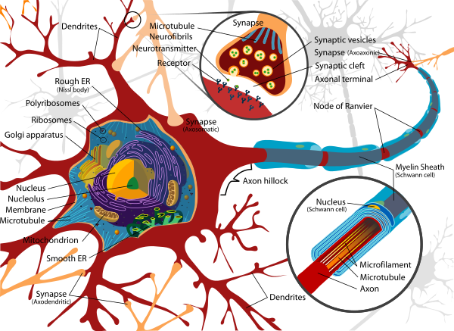
Neuron and Synapse
Source: https://en.wikipedia.org/wiki/Neuron

Slide 80
The Neuron
x₁
w₁
w₂
x₂
y
…
…
w_{n}
x_{n}
Source: Jeff Dean (2016), Large-Scale Deep Learning For Building Intelligent Computer Systems, WSDM 2016

Slide 81
y = max ( 0, -0.21 * x₁ + 0.3 * x₂ + 0.7 * x₃ )
Weights
x₁
-0.21
x₂
0.3
y
Inputs
0.7
x₃
Source: Jeff Dean (2016), Large-Scale Deep Learning For Building Intelligent Computer Systems, WSDM 2016

Slide 82
Neural Networks
Source: https://www.youtube.com/watch?v=bxe2T-V8XRs&index=1&list=PLiaHhY2iBX9hdHaRr6b7XevZtgZRa1PoU

Slide 83
Neural Networks
Input Layer
(X)
Hidden Layer
(H)
Output Layer
(Y)
X1
Y
X2
Source: https://www.youtube.com/watch?v=bxe2T-V8XRs&index=1&list=PLiaHhY2iBX9hdHaRr6b7XevZtgZRa1PoU

Slide 84
Neural Networks
Input Layer
(X)
Hidden Layers
(H)
Output Layer
(Y)
Deep Neural Networks
Deep Learning
Source: https://www.youtube.com/watch?v=bxe2T-V8XRs&index=1&list=PLiaHhY2iBX9hdHaRr6b7XevZtgZRa1PoU

Slide 85
Neural Networks
Input Layer
(X)
Hidden Layer
(H)
Output Layer
(Y)
Neuron
Synapse
Synapse
Neuron
X1
Y
X2
Source: https://www.youtube.com/watch?v=bxe2T-V8XRs&index=1&list=PLiaHhY2iBX9hdHaRr6b7XevZtgZRa1PoU

Slide 86
Neural Networks
Input Layer
(X)
Hidden Layer
(H)
Output Layer
(Y)
Source: https://www.youtube.com/watch?v=P2HPcj8lRJE&list=PLjJh1vlSEYgvGod9wWiydumYl8hOXixNu&index=2

Slide 87
Neural Networks
Input Layer
(X)
Hidden Layer
(H)
Output Layer
(Y)
X1
Y
X2
Source: https://www.youtube.com/watch?v=bxe2T-V8XRs&index=1&list=PLiaHhY2iBX9hdHaRr6b7XevZtgZRa1PoU

Slide 88
X Y
Hours
Sleep
Hours
Study
Score
3 5 75
5 1 82
10 2 93
8 3 ?
Source: https://www.youtube.com/watch?v=bxe2T-V8XRs&index=1&list=PLiaHhY2iBX9hdHaRr6b7XevZtgZRa1PoU

Slide 89
X Y
Hours
Sleep
Hours
Study
Score
3 5 75
Training
5 1 82
10 2 93
8 3 ?
Testing
Source: https://www.youtube.com/watch?v=bxe2T-V8XRs&index=1&list=PLiaHhY2iBX9hdHaRr6b7XevZtgZRa1PoU

Slide 90
Linear function
y = f(x)
y = w₁x + w₀
h_{w}(x) = w₁x + w₀
Source: Stuart Russell and Peter Norvig (2020), Artificial Intelligence: A Modern Approach, 4th Edition, Pearson

Slide 91
Y = W X + b
Source: https://www.youtube.com/watch?v=G8eNWzxOgqE

Slide 92
Output
input
Y = W X + b
Weights
bias
Trained
Source: https://www.youtube.com/watch?v=G8eNWzxOgqE

Slide 93
2.0
1.0
0.1
0.7
0.2
0.1
W X + b = Y
Scores
Probabilities
Source: https://www.youtube.com/watch?v=G8eNWzxOgqE

Slide 94
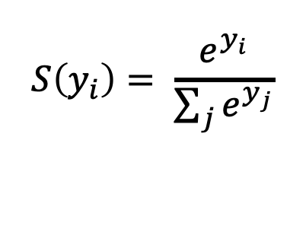
SoftMAX
2.0
1.0
0.1
0.7
0.2
0.1
W X + b = Y
$$S\left(y_{i}\right)= \frac{e^{y_{i}}}{\sum_{j}{e^{y_{j}}}}$$
Logits
Scores
Probabilities
Source: https://www.youtube.com/watch?v=G8eNWzxOgqE

Slide 95
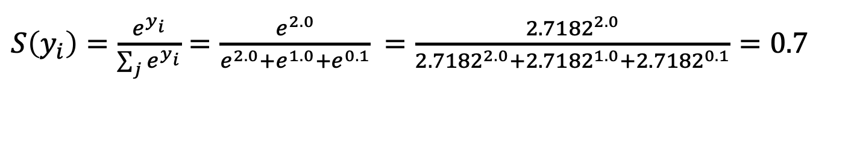
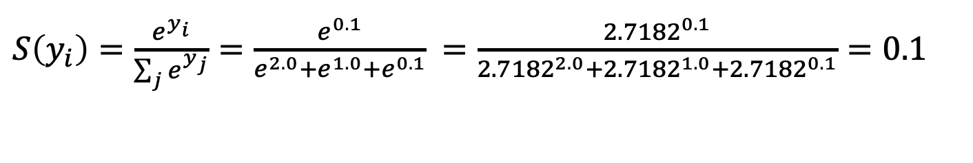
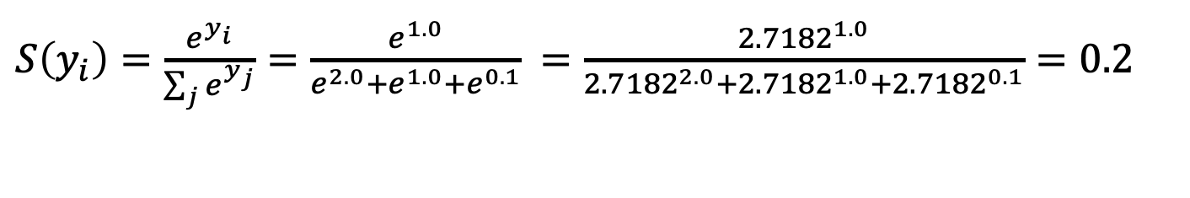
$S\left(y_{i}\right)=\frac{e^{y_{i}}}{\sum_{j}{e^{y_{i}}}}=\frac{e^{2.0}}{e^{2.0}+e^{1.0}+e^{0.1}}$ $=\frac{{2.7182}^{2.0}}{{2.7182}^{2.0}+{2.7182}^{1.0}+{2.7182}^{0.1}}=0.7$
$S\left(y_{i}\right)=\frac{e^{y_{i}}}{\sum_{j}{e^{y_{j}}}}=\frac{e^{1.0}}{e^{2.0}+e^{1.0}+e^{0.1}}$ $=\frac{{2.7182}^{1.0}}{{2.7182}^{2.0}+{2.7182}^{1.0}+{2.7182}^{0.1}}=0.2$
$S\left(y_{i}\right)=\frac{e^{y_{i}}}{\sum_{j}{e^{y_{j}}}}=\frac{e^{0.1}}{e^{2.0}+e^{1.0}+e^{0.1}}$ $=\frac{{2.7182}^{0.1}}{{2.7182}^{2.0}+{2.7182}^{1.0}+{2.7182}^{0.1}}=0.1$
2.0
1.0
0.1
0.7
0.2
0.1
W X + b = Y
$$S\left(y_{i}\right)= \frac{e^{y_{i}}}{\sum_{j}{e^{y_{j}}}}$$
Logits
Scores
Probabilities
Source: https://www.youtube.com/watch?v=G8eNWzxOgqE

Slide 96
Training a Network
=
Minimize the Cost Function
Source: https://www.youtube.com/watch?v=bxe2T-V8XRs&index=1&list=PLiaHhY2iBX9hdHaRr6b7XevZtgZRa1PoU

Slide 97
Training a Network
=
Minimize the Cost Function
Minimize the Loss Function
Source: https://www.youtube.com/watch?v=bxe2T-V8XRs&index=1&list=PLiaHhY2iBX9hdHaRr6b7XevZtgZRa1PoU

Slide 98



Error = Predict Y - Actual Y
Error : Cost : Loss
100
$$y$$
$$\hat{y}$$
75
$$e$$
50
25
Test1
Test2
Test3
Source: https://www.youtube.com/watch?v=bxe2T-V8XRs&index=1&list=PLiaHhY2iBX9hdHaRr6b7XevZtgZRa1PoU

Slide 99
Error = Predict Y - Actual Y
Error : Cost : Loss
100
$$y$$
$$\hat{y}$$
75
$$e$$
50
25
Test1
Test2
Test3
Source: https://www.youtube.com/watch?v=bxe2T-V8XRs&index=1&list=PLiaHhY2iBX9hdHaRr6b7XevZtgZRa1PoU

Slide 100
Error = Predict Y - Actual Y
Error : Cost : Loss
100
$$y$$
$$\hat{y}$$
75
$$e$$
50
25
Test1
Test2
Test3
Source: https://www.youtube.com/watch?v=bxe2T-V8XRs&index=1&list=PLiaHhY2iBX9hdHaRr6b7XevZtgZRa1PoU

Slide 101
Activation Functions

Slide 102
Activation Functions
Sigmoid
TanH
ReLU
(Rectified Linear Unit)
[0, 1]
[-1, 1]
f(x) = max(0, x)
Source: http://cs231n.github.io/neural-networks-1/

Slide 103
Activation Functions
Source: http://adilmoujahid.com/posts/2016/06/introduction-deep-learning-python-caffe/

Slide 104
Loss
Function

Slide 105
Binary Classification: 2 Class
Activation Function:
Sigmoid
Loss Function:
Binary Cross-Entropy

Slide 106
Multiple Classification: 10 Class
Activation Function:
SoftMAX
Loss Function:
Categorical Cross-Entropy

Slide 107
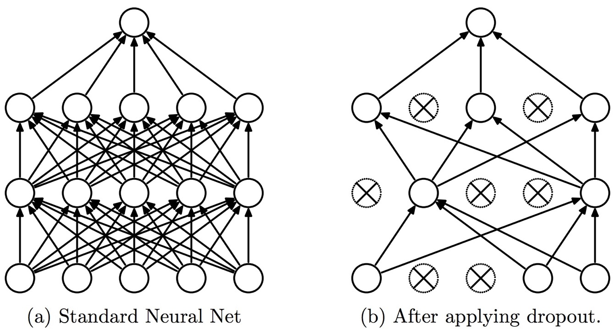
Dropout
Dropout: a simple way to prevent neural networks from overfitting
Source: Srivastava, Nitish, Geoffrey E. Hinton, Alex Krizhevsky, Ilya Sutskever, and Ruslan Salakhutdinov.
"Dropout: a simple way to prevent neural networks from overfitting." Journal of machine learning research 15, no. 1 (2014): 1929-1958.

Slide 108
Learning Algorithm
While not done:
  Pick a random training example “(input, label)”
  Run neural network on “input”
  Adjust weights on edges to make output closer to “label”
Source: Jeff Dean (2016), Large-Scale Deep Learning For Building Intelligent Computer Systems, WSDM 2016

Slide 109
y = max ( 0, -0.21 * x₁ + 0.3 * x₂ + 0.7 * x₃ )
Weights
x₁
-0.21
x₂
0.3
y
Inputs
0.7
x₃
Source: Jeff Dean (2016), Large-Scale Deep Learning For Building Intelligent Computer Systems, WSDM 2016

Slide 110
Next time:
y = max ( 0, -0.23 * x₁ + 0.31 * x₂ + 0.65 * x₃ )
y = max ( 0, -0.21 * x₁ + 0.3 * x₂ + 0.7 * x₃ )
Weights
-0.23
x₁
-0.21
0.31
x₂
0.3
y
Inputs
0.65
x₃
0.7
Source: Jeff Dean (2016), Large-Scale Deep Learning For Building Intelligent Computer Systems, WSDM 2016

Slide 111
Optimizer:
Stochastic Gradient Descent
(SGD)
J(w)
Initial
weight
Gradient
Global cost
minimum
w

Slide 112
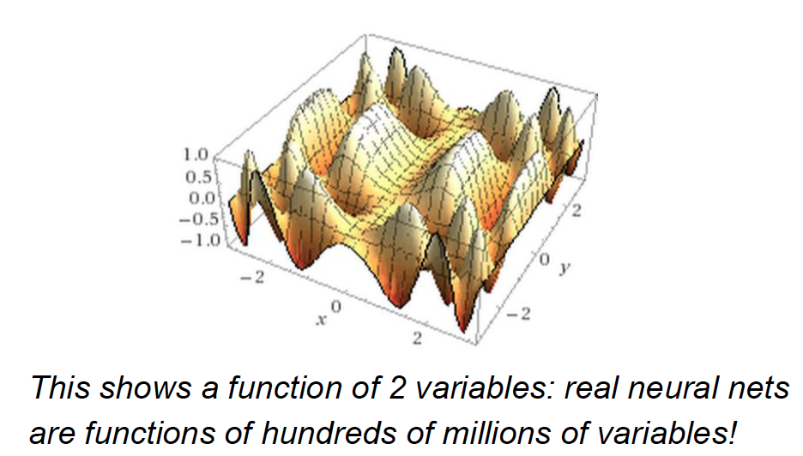
Source: Jeff Dean (2016), Large-Scale Deep Learning For Building Intelligent Computer Systems, WSDM 2016

Slide 113
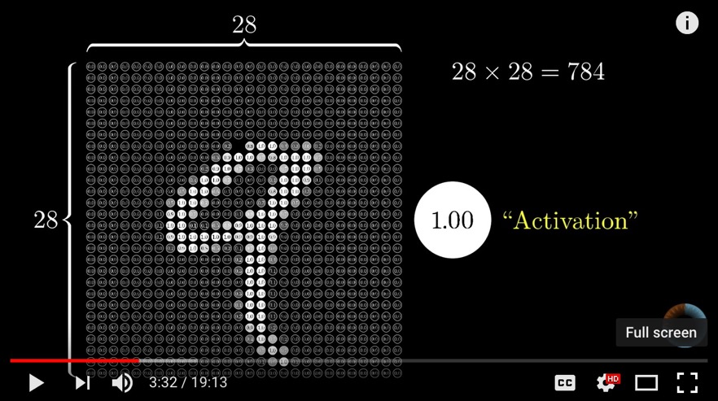
Neural Network and Deep Learning
Source: 3Blue1Brown (2017), But what *is* a Neural Network? | Chapter 1, deep learning, https://www.youtube.com/watch?v=aircAruvnKk

Slide 114
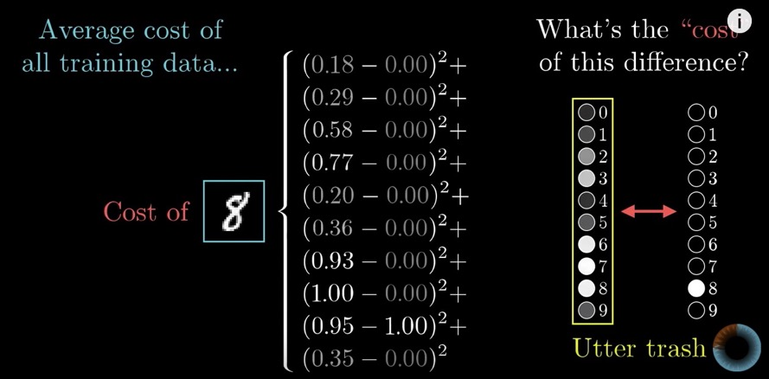
Gradient Descent how neural networks learn
Source: 3Blue1Brown (2017), Gradient descent, how neural networks learn | Chapter 2, deep learning, https://www.youtube.com/watch?v=IHZwWFHWa-w

Slide 115
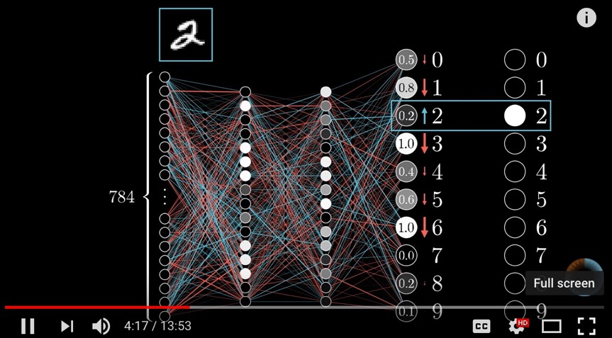
Backpropagation
Source: 3Blue1Brown (2017), What is backpropagation really doing? | Chapter 3, deep learning, https://www.youtube.com/watch?v=Ilg3gGewQ5U

Slide 116
Convolutional Neural Networks (CNN)

Slide 117
Convolutional Neural Networks
(CNN)
Convolution
Pooling
Fully Connection (FC) (Flattening)

Slide 118
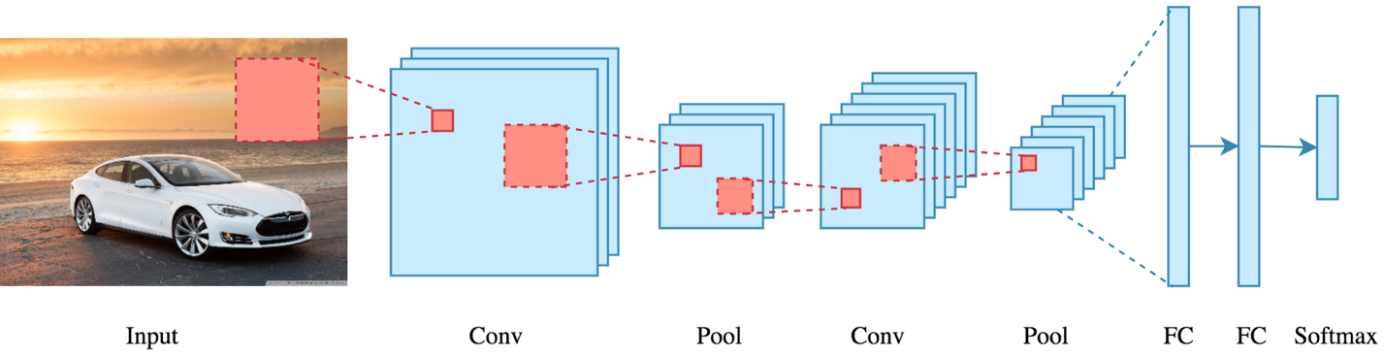
CNN Architecture
Source: Arden Dertat (2017), Applied Deep Learning - Part 4: Convolutional Neural Networks, https://towardsdatascience.com/applied-deep-learning-part-4-convolutional-neural-networks-584bc134c1e2

Slide 119
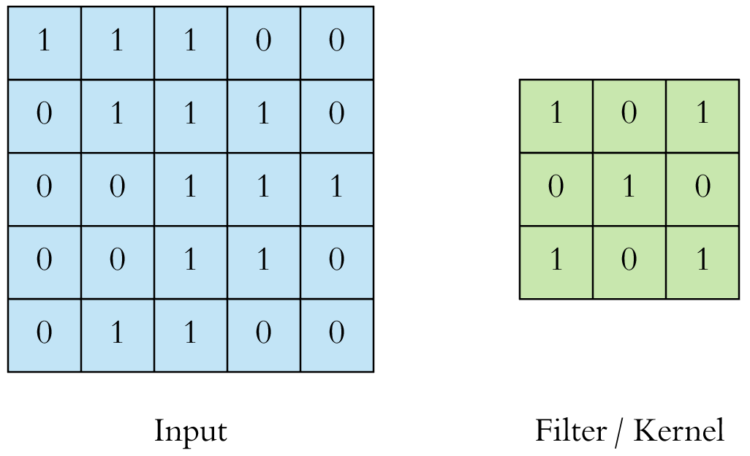
CNN Convolution Layer
Convolution is a mathematical operation to merge two sets of information
3x3 convolution
Source: Arden Dertat (2017), Applied Deep Learning - Part 4: Convolutional Neural Networks, https://towardsdatascience.com/applied-deep-learning-part-4-convolutional-neural-networks-584bc134c1e2

Slide 120
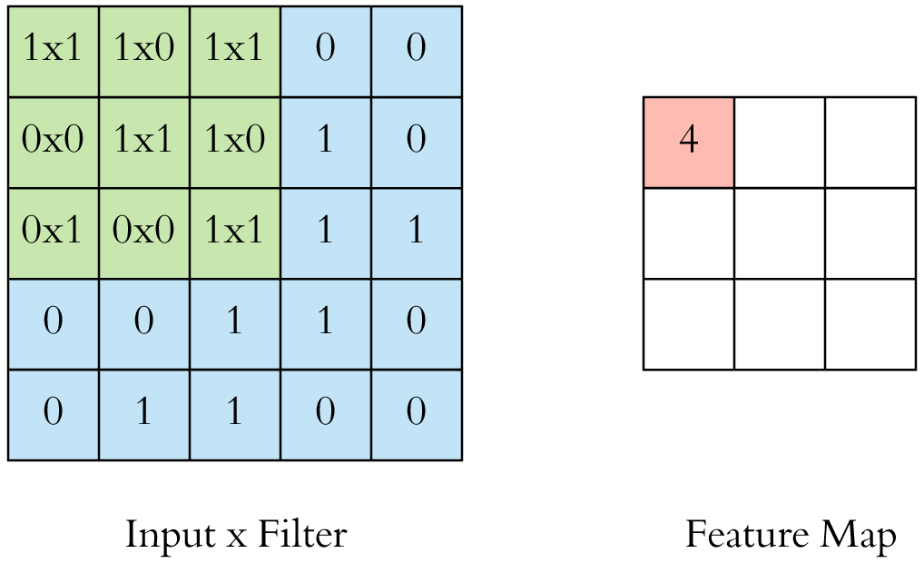
CNN Convolution Layer
Input x Filter --> Feature Map
receptive field: 3x3
Source: Arden Dertat (2017), Applied Deep Learning - Part 4: Convolutional Neural Networks, https://towardsdatascience.com/applied-deep-learning-part-4-convolutional-neural-networks-584bc134c1e2

Slide 121
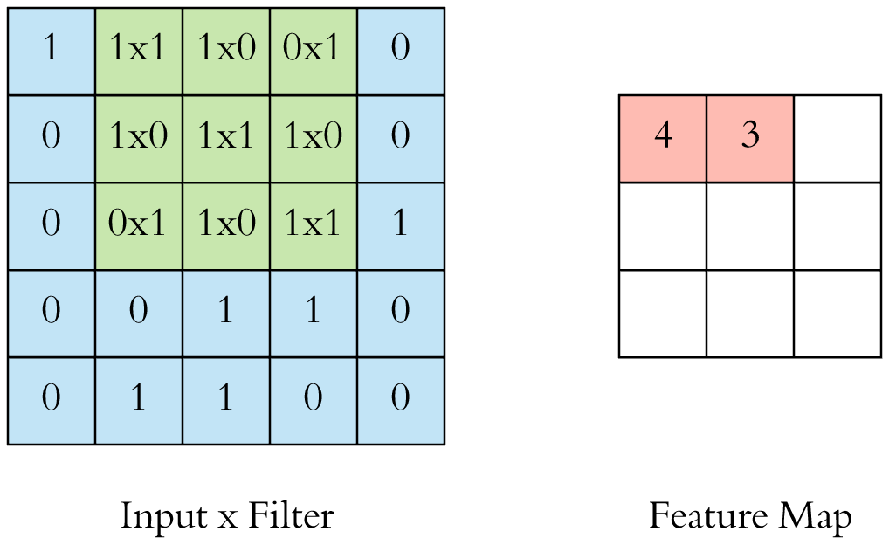
CNN Convolution Layer
Input x Filter --> Feature Map
receptive field: 3x3
Source: Arden Dertat (2017), Applied Deep Learning - Part 4: Convolutional Neural Networks, https://towardsdatascience.com/applied-deep-learning-part-4-convolutional-neural-networks-584bc134c1e2

Slide 122

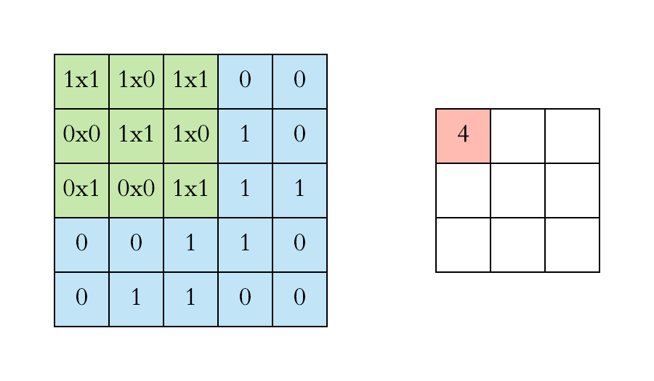
CNN Convolution Layer
Example convolution operation shown in 2D using a 3x3 filter
Source: Arden Dertat (2017), Applied Deep Learning - Part 4: Convolutional Neural Networks, https://towardsdatascience.com/applied-deep-learning-part-4-convolutional-neural-networks-584bc134c1e2

Slide 123

CNN Convolution Layer
10 different filters
10 feature maps of size 32x32x1
final output of the convolution layer:
a volume of size 32x32x10
Source: Arden Dertat (2017), Applied Deep Learning - Part 4: Convolutional Neural Networks, https://towardsdatascience.com/applied-deep-learning-part-4-convolutional-neural-networks-584bc134c1e2

Slide 124

CNN Convolution Layer
Sliding operation at 4 locations
Source: Arden Dertat (2017), Applied Deep Learning - Part 4: Convolutional Neural Networks, https://towardsdatascience.com/applied-deep-learning-part-4-convolutional-neural-networks-584bc134c1e2

Slide 125

CNN Convolution Layer
two feature maps
Source: Arden Dertat (2017), Applied Deep Learning - Part 4: Convolutional Neural Networks, https://towardsdatascience.com/applied-deep-learning-part-4-convolutional-neural-networks-584bc134c1e2

Slide 126

CNN Convolution Layer
Stride specifies how much
we move the convolution filter at each step
Source: Arden Dertat (2017), Applied Deep Learning - Part 4: Convolutional Neural Networks, https://towardsdatascience.com/applied-deep-learning-part-4-convolutional-neural-networks-584bc134c1e2

Slide 127

CNN Convolution Layer
Stride specifies how much
we move the convolution filter at each step
Source: Arden Dertat (2017), Applied Deep Learning - Part 4: Convolutional Neural Networks, https://towardsdatascience.com/applied-deep-learning-part-4-convolutional-neural-networks-584bc134c1e2

Slide 128

CNN Convolution Layer
Stride 1 with Padding
Source: Arden Dertat (2017), Applied Deep Learning - Part 4: Convolutional Neural Networks, https://towardsdatascience.com/applied-deep-learning-part-4-convolutional-neural-networks-584bc134c1e2

Slide 129

CNN Pooling Layer
Max Pooling
Source: Arden Dertat (2017), Applied Deep Learning - Part 4: Convolutional Neural Networks, https://towardsdatascience.com/applied-deep-learning-part-4-convolutional-neural-networks-584bc134c1e2

Slide 130

CNN Pooling Layer
Source: Arden Dertat (2017), Applied Deep Learning - Part 4: Convolutional Neural Networks, https://towardsdatascience.com/applied-deep-learning-part-4-convolutional-neural-networks-584bc134c1e2

Slide 131

CNN Architecture
4 convolution + pooling layers,
followed by 2 fully connected layers
Source: Arden Dertat (2017), Applied Deep Learning - Part 4: Convolutional Neural Networks, https://towardsdatascience.com/applied-deep-learning-part-4-convolutional-neural-networks-584bc134c1e2

Slide 132
CNN Architecture
4 convolution + pooling layers,
followed by 2 fully connected layers
https://gist.github.com/ardendertat/0fc5515057c47e7386fe04e9334504e3
model = Sequential()
model.add(Conv2D(32, (3, 3), activation='relu', padding='same', name='conv_1',
input_shape=(150, 150, 3)))
model.add(MaxPooling2D((2, 2), name='maxpool_1'))
model.add(Conv2D(64, (3, 3), activation='relu', padding='same', name='conv_2'))
model.add(MaxPooling2D((2, 2), name='maxpool_2'))
model.add(Conv2D(128, (3, 3), activation='relu', padding='same', name='conv_3'))
model.add(MaxPooling2D((2, 2), name='maxpool_3'))
model.add(Conv2D(128, (3, 3), activation='relu', padding='same', name='conv_4'))
model.add(MaxPooling2D((2, 2), name='maxpool_4'))
model.add(Flatten())
model.add(Dropout(0.5))
model.add(Dense(512, activation='relu', name='dense_1'))
model.add(Dense(128, activation='relu', name='dense_2'))
model.add(Dense(1, activation='sigmoid', name='output'))
Source: Arden Dertat (2017), Applied Deep Learning - Part 4: Convolutional Neural Networks, https://towardsdatascience.com/applied-deep-learning-part-4-convolutional-neural-networks-584bc134c1e2

Slide 133

Dropout
Source: Arden Dertat (2017), Applied Deep Learning - Part 4: Convolutional Neural Networks, https://towardsdatascience.com/applied-deep-learning-part-4-convolutional-neural-networks-584bc134c1e2

Slide 134

Model Performance
Source: Arden Dertat (2017), Applied Deep Learning - Part 4: Convolutional Neural Networks, https://towardsdatascience.com/applied-deep-learning-part-4-convolutional-neural-networks-584bc134c1e2

Slide 135
Recurrent
Neural Networks (RNN)

Slide 136
Recurrent Neural Networks (RNN)
y_{t-2}
y_{t-1}
y_{t}
y_{t+1}
y_{t+2}
output
h_{t-2}
h_{t-1}
h_{t}
h_{t+1}
h_{t+2}
hidden
X_{t-2}
X_{t-1}
X_{t}
X_{t+1}
X_{t+2}
Input

Slide 137
Recurrent Neural Networks (RNN)
Time Series Forecasting
110
120
130
140
150
y_{t-2}
y_{t-1}
y_{t}
y_{t+1}
y_{t+2}
output
h_{t-2}
h_{t-1}
h_{t}
h_{t+1}
h_{t+2}
hidden
X_{t-2}
X_{t-1}
X_{t}
X_{t+1}
X_{t+2}
Input
100
110
120
130
140

Slide 138
Recurrent Neural Networks (RNN)
y
output
h_{t-2}
h_{t-1}
h_{t}
h_{t+1}
h_{t+2}
hidden
X_{t-2}
X_{t-1}
X_{t}
X_{t+1}
X_{t+2}
Input

Slide 139

Recurrent Neural Networks (RNN)
Sentiment Analysis
y
output
h_{t-2}
h_{t-1}
h_{t}
h_{t+1}
h_{t+2}
hidden
X_{t-2}
X_{t-1}
X_{t}
X_{t+1}
X_{t+2}
Input
This
movie
is
very
good

Slide 140

Recurrent Neural Networks (RNN)
Sentiment Analysis
y
output
h_{t-2}
h_{t-1}
h_{t}
h_{t+1}
h_{t+2}
hidden
X_{t-2}
X_{t-1}
X_{t}
X_{t+1}
X_{t+2}
Input
This
movie
is
very
boring

Slide 141

Recurrent Neural Network (RNN)
Source: LeCun, Yann, Yoshua Bengio, and Geoffrey Hinton. "Deep learning." Nature 521, no. 7553 (2015): 436-444.

Slide 142
RNN
Source: Christopher Olah, (2015) Understanding LSTM Networks, http://colah.github.io/posts/2015-08-Understanding-LSTMs/

Slide 143
RNN long-term dependencies
I grew up in France… I speak fluent French.
Source: Christopher Olah, (2015) Understanding LSTM Networks, http://colah.github.io/posts/2015-08-Understanding-LSTMs/

Slide 144

Vanishing Gradient
Exploding Gradient
Source: https://medium.com/deep-math-machine-learning-ai/chapter-10-1-deepnlp-lstm-long-short-term-memory-networks-with-math-21477f8e4235

Slide 145
Recurrent Neural Networks (RNN)
y_{t-2}
y_{t-1}
y_{t}
y_{t+1}
y_{t+2}
output
V
V
V
V
W
W
W
W
h_{t-2}
h_{t-1}
h_{t}
h_{t+1}
h_{t+2}
hidden
U
U
U
U
X_{t-2}
X_{t-1}
X_{t}
X_{t+1}
X_{t+2}
Input

Slide 146
RNN
Vanishing Gradient problem
Exploding Gradient problem
Error
y_{t-2}
y_{t-1}
y_{t}
y_{t+1}
y_{t+2}
output
V
V
V
V
W
W
W
W
h_{t-2}
h_{t-1}
h_{t}
h_{t+1}
h_{t+2}
hidden
U
U
U
U
X_{t-2}
X_{t-1}
X_{t}
X_{t+1}
X_{t+2}
Input
if |W| < 1 (Vanishing)
if |W| > 1 (Exploding)
Source: https://medium.com/deep-math-machine-learning-ai/chapter-10-1-deepnlp-lstm-long-short-term-memory-networks-with-math-21477f8e4235

Slide 147
RNN
Vanishing Gradient problem
Error
y_{t-2}
y_{t-1}
y_{t}
y_{t+1}
y_{t+2}
output
V
V
V
V
0.9
0.9
0.9
0.9
h_{t-2}
h_{t-1}
h_{t}
h_{t+1}
h_{t+2}
hidden
U
U
U
U
X_{t-2}
X_{t-1}
X_{t}
X_{t+1}
X_{t+2}
Input
W = 0.9 < 1 (Vanishing)
Source: https://medium.com/deep-math-machine-learning-ai/chapter-10-1-deepnlp-lstm-long-short-term-memory-networks-with-math-21477f8e4235

Slide 148
RNN
Exploding Gradient problem
Error
y_{t-2}
y_{t-1}
y_{t}
y_{t+1}
y_{t+2}
output
V
V
V
V
1.1
1.1
1.1
1.1
h_{t-2}
h_{t-1}
h_{t}
h_{t+1}
h_{t+2}
hidden
U
U
U
U
X_{t-2}
X_{t-1}
X_{t}
X_{t+1}
X_{t+2}
Input
W = 1.1 > 1 (Exploding)
Source: https://medium.com/deep-math-machine-learning-ai/chapter-10-1-deepnlp-lstm-long-short-term-memory-networks-with-math-21477f8e4235

Slide 149
RNN LSTM
RNN
LSTM
Source: Christopher Olah, (2015) Understanding LSTM Networks, http://colah.github.io/posts/2015-08-Understanding-LSTMs/

Slide 150
Long Short Term Memory
(LSTM)
forget
gate
input
gate
output
gate
Source: Christopher Olah, (2015) Understanding LSTM Networks, http://colah.github.io/posts/2015-08-Understanding-LSTMs/

Slide 151
Gated Recurrent Unit
(GRU)
reset
gate
update
gate
Source: Christopher Olah, (2015) Understanding LSTM Networks, http://colah.github.io/posts/2015-08-Understanding-LSTMs/

Slide 152

LSTM Recurrent Neural Network
Traditional Neural Network
Music
Generation
Sentiment
Classification
Name
Entity
Recognition
Machine
Translation
Source: https://github.com/Vict0rSch/deep_learning/tree/master/keras/recurrent

Slide 153
Long Short Term Memory (LSTM) for Time Series Forecasting
h_{t-2}
h_{t-1}
h_{t}
h_{t+1}
h_{t+2}
LSTM
LSTM
LSTM
LSTM
LSTM
X_{t-2}
X_{t-1}
X_{t}
X_{t+1}
X_{t+2}

Slide 154
Time Series Data
[100, 110, 120, 130, 140, 150]
Y
X
Y
[100 110 120 130 140] 150
X_{t1}
X_{t2}
X_{t3}
X_{t4}
X_{t5}

Slide 155
Time Series Data
[10, 20, 30, 40, 50, 60, 70, 80, 90]
X
Y
[10 20 30] 40
[20 30 40] 50
[30 40 50] 60
[40 50 60] 70
[50 60 70] 80
[60 70 80] 90

Slide 156
Reinforcement Learning

Slide 157
Reinforcement Learning (RL)
Computer Science
Engineering
Machine
Learning
Neuroscience
Optimal
Control
Reward
System
Reinforcement
Learning
Operations
Research
Classical/Operant
Conditioning
Mathematics
Bounded
Rationality
Psychology
Economics
Source: David Silver (2015), Introduction to reinforcement learning, https://www.youtube.com/playlist?list=PLqYmG7hTraZDM-OYHWgPebj2MfCFzFObQ

Slide 158
Branches of Machine Learning (ML)
Reinforcement Learning (RL)
No Labels
No feedback
Find hidden structure
Labeled data
Direct feedback
Predict
Supervised
Learning
Unsupervised
Learning
Machine
Learning
Reinforcement
Learning
Decision process
Reward system
Learn series of actions
Source: David Silver (2015), Introduction to reinforcement learning, https://www.youtube.com/playlist?list=PLqYmG7hTraZDM-OYHWgPebj2MfCFzFObQ

Slide 159
Reinforcement Learning (DL)
Agent
Environment
Source: Richard S. Sutton & Andrew G. Barto (2018), Reinforcement Learning: An Introduction, 2nd Edition, A Bradford Book.

Slide 160
Reinforcement Learning (DL)
1
2
observation
Agent
action
3
reward
Environment
Source: Richard S. Sutton & Andrew G. Barto (2018), Reinforcement Learning: An Introduction, 2nd Edition, A Bradford Book.

Slide 161
Reinforcement Learning (DL)
1
2
observation
Agent
action
O_{t}
A_{t}
3
reward
R_{t}
Environment
Source: Richard S. Sutton & Andrew G. Barto (2018), Reinforcement Learning: An Introduction, 2nd Edition, A Bradford Book.

Slide 162
Agent and Environment
At each step t the agent:
  Executes action A_{t}
  Receives observation O_{t}
  Receives scalar reward R_{t}
The environment:
  Receives action A_{t}
  Emits observation O_{t+1}
  Emits scalar reward R_{t+1}
t increments at env. step
observation
action
Agent
O_{t}
A_{t}
reward
R_{t}
Environment
Source: David Silver (2015), Introduction to reinforcement learning, https://www.youtube.com/playlist?list=PLqYmG7hTraZDM-OYHWgPebj2MfCFzFObQ

Slide 163
David Silver (2015),
Introduction to reinforcement learning
Elementary Reinforcement Learning
  1: Introduction to Reinforcement Learning
  2: Markov Decision Processes
  3: Planning by Dynamic Programming
  4: Model-Free Prediction
  5: Model-Free Control
Reinforcement Learning in Practice
  6: Value Function Approximation
  7: Policy Gradient Methods
  8: Integrating Learning and Planning
  9: Exploration and Exploitation
  10: Case Study: RL in Classic Games
Source: David Silver (2015), Introduction to reinforcement learning, https://www.youtube.com/playlist?list=PLqYmG7hTraZDM-OYHWgPebj2MfCFzFObQ

Slide 164
Reinforcement learning
Reinforcement learning is
learning what to do
—how to map situations to actions
—so as to maximize a numerical reward signal.
Source: Richard S. Sutton & Andrew G. Barto (2018), Reinforcement Learning: An Introduction, 2nd Edition, A Bradford Book.

Slide 165
Two most important distinguishing features of reinforcement learning
trial-and-error search
delayed reward
Source: Richard S. Sutton & Andrew G. Barto (2018), Reinforcement Learning: An Introduction, 2nd Edition, A Bradford Book.

Slide 166
History and State
The history is the sequence of observations, actions, rewards
  H_{t} = O₁, A₁, R₁,...,A_{t-1},O_{t},R_{t}
i.e. all observable variables up to time t
i.e. the sensorimotor stream of a robot or embodied agent
What happens next depends on the history:
  The agent selects actions
  The environment selects observations/rewards
State is the information used to determine what happens next
Formally, state is a function of the history:
  S_{t} =f(H_{t})
Source: David Silver (2015), Introduction to reinforcement learning, https://www.youtube.com/playlist?list=PLqYmG7hTraZDM-OYHWgPebj2MfCFzFObQ

Slide 167
Information State
An information state (a.k.a. Markov state) contains all useful information from the history.
Definition
    A state S_{t} is Markov if and only if
    P[S_{t+1} | S_{t}] = P[S_{t+1} | S₁,...,S_{t}]
“The future is independent of the past given the present”
  H_{1:t} → S_{t} → H_{t+1:∞}
Once the state is known, the history may be thrown away i.e. The state is a sufficient statistic of the future
The environment state S_{t}^{e} is Markov
The history H_{t} is Markov
Source: David Silver (2015), Introduction to reinforcement learning, https://www.youtube.com/playlist?list=PLqYmG7hTraZDM-OYHWgPebj2MfCFzFObQ

Slide 168
Fully Observable Environments
Full observability:
  agent directly observes environment state
  Agent state = environment state = information state
  Formally, this is a
  Markov decision process (MDP)
state
Agent
action
S_{t}
A_{t}
reward
R_{t}
Environment
Source: David Silver (2015), Introduction to reinforcement learning, https://www.youtube.com/playlist?list=PLqYmG7hTraZDM-OYHWgPebj2MfCFzFObQ

Slide 169
Partially Observable Environments
Partial observability: agent indirectly observes environment
  A robot with camera vision isn’t told its absolute location
  A trading agent only observes current prices
  A poker playing agent only observes public cards
Now agent state ≠ environment state
Formally this is a partially observable Markov decision process (POMDP)
Agent must construct its own state representation Sª_{t}, e.g.
  Complete history: Sª_{t} = H_{t}
  Beliefs of environment state: Sª_{t} = (P[S^{e}_{t} = s₁],...,P[S^{e}_{t} = s_{n}])
  Recurrent neural network: Sª_{t} = σ(Sª_{t-1} W_{s} + O_{t} W_{o} )
Source: David Silver (2015), Introduction to reinforcement learning, https://www.youtube.com/playlist?list=PLqYmG7hTraZDM-OYHWgPebj2MfCFzFObQ

Slide 170
Reinforcement Learning (DL)
The Agent-Environment Interaction in a Markov Decision Process (MDP)
Agent
state
reward
action
S_{t}
R_{t}
A_{t}
R_{t+1}
Environment
S_{t+1}
Source: Richard S. Sutton & Andrew G. Barto (2018), Reinforcement Learning: An Introduction, 2nd Edition, A Bradford Book.

Slide 171
Characteristics of
Reinforcement Learning
No supervisor, only a reward signal
Feedback is delayed, not instantaneous
Time really matters
(sequential, non i.i.d data)
Agent’s actions affect the subsequent data it receives
Source: David Silver (2015), Introduction to reinforcement learning, https://www.youtube.com/playlist?list=PLqYmG7hTraZDM-OYHWgPebj2MfCFzFObQ

Slide 172
Examples of Reinforcement Learning
Make a humanoid robot walk
Play may different Atari games better than humans
Manage an investment portfolio
Source: David Silver (2015), Introduction to reinforcement learning, https://www.youtube.com/playlist?list=PLqYmG7hTraZDM-OYHWgPebj2MfCFzFObQ

Slide 173
Examples of Rewards
Make a humanoid robot walk
  +ve reward for forward motion
  -ve reward for falling over
Play may different Atari games better than humans
  +/-ve reward for increasing/decreasing score
Manage an investment portfolio
  +ve reward for each $ in bank
Source: David Silver (2015), Introduction to reinforcement learning, https://www.youtube.com/playlist?list=PLqYmG7hTraZDM-OYHWgPebj2MfCFzFObQ

Slide 174
Sequential Decision Making
Goal: select actions to maximize total future reward
Actions may have long term consequence
Reward may be delayed
It may be better to sacrifice immediate reward to gain more long-term reward
Examples:
  A financial investment (may take months to mature)
  Blocking opponent moves (might help winning chances many moves from now)
Source: David Silver (2015), Introduction to reinforcement learning, https://www.youtube.com/playlist?list=PLqYmG7hTraZDM-OYHWgPebj2MfCFzFObQ

Slide 175
Elements of Reinforcement Learning
Agent
Environment
Policy
Reward signal
Value function
Model
Source: Richard S. Sutton & Andrew G. Barto (2018), Reinforcement Learning: An Introduction, 2nd Edition, A Bradford Book.

Slide 176
Elements of Reinforcement Learning
Policy
  Agent’s behavior
  It is a map from state to action
Reward signal
  The goal of a reinforcement learning problem
Value function
  How good is each state and/or action
  A prediction of future reward
Model
  Agent’s representation of the environment
Source: Richard S. Sutton & Andrew G. Barto (2018), Reinforcement Learning: An Introduction, 2nd Edition, A Bradford Book.

Slide 177
Major Components of an RL Agent
Policy: agent’s behaviour function
Value function: how good is each state and/or action
Model: agent’s representation of the environment
Source: David Silver (2015), Introduction to reinforcement learning, https://www.youtube.com/playlist?list=PLqYmG7hTraZDM-OYHWgPebj2MfCFzFObQ

Slide 178
Policy
A policy is the agent’s behaviour
It is a map from state to action, e.g.
  Deterministic policy: a = π(s)
  Stochastic policy: π(a|s) = P[A_{t} = a|S_{t} = s]
Source: David Silver (2015), Introduction to reinforcement learning, https://www.youtube.com/playlist?list=PLqYmG7hTraZDM-OYHWgPebj2MfCFzFObQ

Slide 179
Value Function
Value function is a prediction of future reward
Used to evaluate the goodness/badness of states
And therefore to select between actions, e.g.
      v_{π}(s)=E_{π} [R_{t+1}+γR_{t+2}+γ²R_{t+3}+...|S_{t} =s]
Source: David Silver (2015), Introduction to reinforcement learning, https://www.youtube.com/playlist?list=PLqYmG7hTraZDM-OYHWgPebj2MfCFzFObQ

Slide 180
Model
A model predicts what the environment will do next
P predicts the next state
R predicts the next (immediate) reward, e.g.
    Pª_{ss′} = P[S_{t+1} =s′ |S_{t+1}=s, A_{t}=a]
    Rª_{s} = E[R_{t+1} |S_{t} =s, A_{t} =a]
Source: David Silver (2015), Introduction to reinforcement learning, https://www.youtube.com/playlist?list=PLqYmG7hTraZDM-OYHWgPebj2MfCFzFObQ

Slide 181
Reinforcement Learning
Value Based
  No Policy (Implicit)
  Value Function
Policy Based
  Policy
  No Value Function
Actor Critic
  Policy
  Value Function
Source: David Silver (2015), Introduction to reinforcement learning, https://www.youtube.com/playlist?list=PLqYmG7hTraZDM-OYHWgPebj2MfCFzFObQ

Slide 182
Reinforcement Learning
Model Free
  Policy and/or Value Function
  No Model
Model Based
  Policy and/or Value Function
  Model
Source: David Silver (2015), Introduction to reinforcement learning, https://www.youtube.com/playlist?list=PLqYmG7hTraZDM-OYHWgPebj2MfCFzFObQ

Slide 183

Reinforcement Learning (RL)
A Taxonomy of RL Algorithms
Source: https://spinningup.openai.com/en/latest/spinningup/rl_intro2.html

Slide 184
Learning and Planning
Two fundamental problems in sequential decision making
  Reinforcement Learning
    The environment is initially unknown
    The agent interacts with environment
    The agent improves its policy
  Planning
    A model of the environment is known
    The agent performs computations with its model
    (without any external interaction)
    The agent improves its policy
    a.k.a deliberation, reasoning, introspection, pondering, thought, search
Source: David Silver (2015), Introduction to reinforcement learning, https://www.youtube.com/playlist?list=PLqYmG7hTraZDM-OYHWgPebj2MfCFzFObQ

Slide 185
Exploration and Exploitation
Reinforcement learning is like trial-and-error learning
The agent should discover a good policy
From its experiences of the environment
Without losing too much reward along the way
Exploration finds more information about the environment
Exploitation exploits known information to maximise reward
It is usually important to explore as well as exploit
Source: David Silver (2015), Introduction to reinforcement learning, https://www.youtube.com/playlist?list=PLqYmG7hTraZDM-OYHWgPebj2MfCFzFObQ

Slide 186
Exploration and Exploitation
Examples
Restaurant Selection
  Exploitation: Go to your favorite restaurant
  Exploration: Try a new restaurant
Online Banner Advertisements
  Exploitation: Show the most successful advert
  Exploration: Show a different advert
Source: David Silver (2015), Introduction to reinforcement learning, https://www.youtube.com/playlist?list=PLqYmG7hTraZDM-OYHWgPebj2MfCFzFObQ

Slide 187
Exploration and Exploitation
Examples
Oil Drilling
  Exploitation: Drill at the best known location
  Exploration: Drill at a new location
Game Playing
  Exploitation: Play the move you believe is best
  Exploration: Play an experimental move
Source: David Silver (2015), Introduction to reinforcement learning, https://www.youtube.com/playlist?list=PLqYmG7hTraZDM-OYHWgPebj2MfCFzFObQ

Slide 188
Prediction and Control
Prediction: evaluate the future
  Given a policy
Control: optimize the future
  Find the best policy
Source: David Silver (2015), Introduction to reinforcement learning, https://www.youtube.com/playlist?list=PLqYmG7hTraZDM-OYHWgPebj2MfCFzFObQ

Slide 189

Markov Decision Processes (MDP)
Example: Student MDP
Source: David Silver (2015), Introduction to reinforcement learning, https://www.youtube.com/playlist?list=PLqYmG7hTraZDM-OYHWgPebj2MfCFzFObQ

Slide 190

Generalized Policy Iteration (GPI)
evaluation
V → v_{𝜋}
𝜋
V
𝜋 → greedy (V)
improvement
𝜋*
v*
Source: Richard S. Sutton & Andrew G. Barto (2018), Reinforcement Learning: An Introduction, 2nd Edition, A Bradford Book.

Slide 191
Generalized Policy Iteration (GPI)
Any iteration of policy evaluation and policy improvement,
independent of their granularity.
evaluation
Ｑ → q_{𝜋}
𝜋
Ｑ
𝜋 → greedy (Ｑ)
improvement
Source: Richard S. Sutton & Andrew G. Barto (2018), Reinforcement Learning: An Introduction, 2nd Edition, A Bradford Book.

Slide 192
Temporal-Difference (TD) Learning
SARSA: On-policy TD Control
Q-learning: Off-policy TD Control
Source: Richard S. Sutton & Andrew G. Barto (2018), Reinforcement Learning: An Introduction, 2nd Edition, A Bradford Book.

Slide 193
SARSA
(state-action-reward-state-action)
On-policy TD Control
Q(S_{t}, A_{t}) ← Q(S_{t}, A_{t}) + α[R_{t+1} + γ Q(S_{t+1}, A_{t+1}) - Q(S_{t}, A_{t}) ]
S, A
R
S’
A’
SARSA
Source: Richard S. Sutton & Andrew G. Barto (2018), Reinforcement Learning: An Introduction, 2nd Edition, A Bradford Book.

Slide 194
Q-learning
Off-policy TD Control
(Watkins, 1989)
Q(S_{t}, A_{t}) ← Q(S_{t}, A_{t}) + α[R_{t+1} + γ max Q(S_{t+1}, a) - Q(S_{t}, A_{t}) ]
S, A
R
S’
A’
Q-learning
Source: Richard S. Sutton & Andrew G. Barto (2018), Reinforcement Learning: An Introduction, 2nd Edition, A Bradford Book.

Slide 195
Q-learning and Expected SARSA
S, A
S, A
R
R
S’
S’
A’
A’
Q-learning
Expected SARSA
Source: Richard S. Sutton & Andrew G. Barto (2018), Reinforcement Learning: An Introduction, 2nd Edition, A Bradford Book.

Slide 196

Q-learning and Double Q-learning
Source: Richard S. Sutton & Andrew G. Barto (2018), Reinforcement Learning: An Introduction, 2nd Edition, A Bradford Book.

Slide 197

n-step methods for sate-action value
Source: Richard S. Sutton & Andrew G. Barto (2018), Reinforcement Learning: An Introduction, 2nd Edition, A Bradford Book.

Slide 198

Reinforcement Learning
Actor-Critic (AC) Architecture
Source: https://www.kdnuggets.com/2018/03/5-things-reinforcement-learning.html

Slide 199
Reinforcement Learning
Actor-Critic (AC) Learning Methods
Policy
(Actor)
State
Action
Critique
Value Table
(Critic)
State
Reward
Environment

Slide 200

Reinforcement Learning Methods
Source: Richard S. Sutton & Andrew G. Barto (2018), Reinforcement Learning: An Introduction, 2nd Edition, A Bradford Book.

Slide 201

Monte Carlo Tree Search (MCTS)
Source: Richard S. Sutton & Andrew G. Barto (2018), Reinforcement Learning: An Introduction, 2nd Edition, A Bradford Book.

Slide 202

Monte Carlo Tree Search (MCTS)
MCTS in AlphaGo Zero
Source: David Silver et al. (2017), "Mastering the game of Go without human knowledge." Nature 550 (2017): 354–359.

Slide 203

MCTS in AlphaGo Zero
a: Each simulation traverses the tree by selecting the edge with maximum action value Q, plus an upper confidence bound U that depends on a stored prior probability P and visit count N for that edge (which is incremented once traversed).
Source: David Silver et al. (2017), "Mastering the game of Go without human knowledge." Nature 550 (2017): 354–359.

Slide 204

MCTS in AlphaGo Zero
b: The leaf node is expanded and the associated position s is evaluated by the neural network (P(s, ·),V(s)) = f_{θ}(s); the vector of P values are stored in the outgoing edges from s.
Source: David Silver et al. (2017), "Mastering the game of Go without human knowledge." Nature 550 (2017): 354–359.

Slide 205

MCTS in AlphaGo Zero
c: Action value Q is updated to track the mean of all evaluations V in the subtree below that action
Source: David Silver et al. (2017), "Mastering the game of Go without human knowledge." Nature 550 (2017): 354–359.

Slide 206

MCTS in AlphaGo Zero
d: Once the search is complete, search probabilities π are returned, proportional to N^{1/τ}, where N is the visit count of each move from the root state and τ is a parameter controlling temperature.
Source: David Silver et al. (2017), "Mastering the game of Go without human knowledge." Nature 550 (2017): 354–359.

Slide 207

Reinforcement Learning
Actor Critic ANN
Source: Richard S. Sutton & Andrew G. Barto (2018), Reinforcement Learning: An Introduction, 2nd Edition, A Bradford Book.

Slide 208
Reinforcement Learning
General Dyna Architecture
Policy/value functions
planning update
direct DL
update
simulated experience
real experience
model
learning
search
control
Model
Environment
Source: Richard S. Sutton & Andrew G. Barto (2018), Reinforcement Learning: An Introduction, 2nd Edition, A Bradford Book.

Slide 209
Dyna:
Integrated Planning, Acting, and Learning
value/policy
acting
planning
direct
RL
model
experience
model
learning
Source: Richard S. Sutton & Andrew G. Barto (2018), Reinforcement Learning: An Introduction, 2nd Edition, A Bradford Book.

Slide 210
Model-Based RL
value/policy
acting
planning
model
experience
model
learning
Source: Richard S. Sutton & Andrew G. Barto (2018), Reinforcement Learning: An Introduction, 2nd Edition, A Bradford Book.

Slide 211
Model-Free RL
(DQN, A3C)
value/policy
acting
planning
direct
RL
model
experience
model
learning
Source: Richard S. Sutton & Andrew G. Barto (2018), Reinforcement Learning: An Introduction, 2nd Edition, A Bradford Book.

Slide 212
Reinforcement Learning Algorithms
Deep Reinforcement Learning (DRL)
Dynamic Programming
Markov Decision Process (MDP)
Monte Carlo Method
Q-Learning
TD Learning
Partially Observable MDP
(POMDP)
Actor-Critic Methods
Deep Q Network (DQN)
Double DQN
Neural Fitted Q Learning
Deep Recurrent Q Network (DQRN)
A3C
Rainbow
Source: https://amitray.com/deep-learning-past-present-and-future-a-review/

Slide 213
Deep Q-Network (DQN)
Q-value
Q-value 1
Q-value 2
Q-value 3
Network
Network
State
Action
State
State
State
Source: https://neuro.cs.ut.ee/demystifying-deep-reinforcement-learning/

Slide 214

Reinforcement Learning with policy represented via DNN
Source: Hongzi Mao, Mohammad Alizadeh, Ishai Menache, and Srikanth Kandula. (2016) "Resource management with deep reinforcement learning." In Proceedings of the 15th ACM Workshop on Hot Topics in Networks, pp. 50-56. ACM, 2016.

Slide 215

Asynchronous Advantage Actor-Critic
(A3C)
Source: https://medium.com/emergent-future/simple-reinforcement-learning-with-tensorflow-part-8-asynchronous-actor-critic-agents-a3c-c88f72a5e9f2

Slide 216

Training workflow of each worker agent in A3C
Source: https://medium.com/emergent-future/simple-reinforcement-learning-with-tensorflow-part-8-asynchronous-actor-critic-agents-a3c-c88f72a5e9f2

Slide 217

FinRL:
A Deep Reinforcement Learning Library for
Automated Stock Trading in Quantitative Finance
Source: Xiao-Yang Liu, Hongyang Yang, Qian Chen, Runjia Zhang, Liuqing Yang, Bowen Xiao, and Christina Dan Wang (2020). "FinRL: A Deep Reinforcement Learning Library for Automated Stock Trading in Quantitative Finance." arXiv preprint arXiv:2011.09607 (2020).

Slide 218

FinRL
Deep Reinforcement Learning Algorithms
Source: Xiao-Yang Liu, Hongyang Yang, Qian Chen, Runjia Zhang, Liuqing Yang, Bowen Xiao, and Christina Dan Wang (2020). "FinRL: A Deep Reinforcement Learning Library for Automated Stock Trading in Quantitative Finance." arXiv preprint arXiv:2011.09607 (2020).

Slide 219

Rainbow: Combining improvements in deep reinforcement learning
Source: Matteo Hessel, Joseph Modayil, Hado Van Hasselt, Tom Schaul, Georg Ostrovski, Will Dabney, Dan Horgan, Bilal Piot, Mohammad Azar, and David Silver (2017). "Rainbow: Combining improvements in deep reinforcement learning." arXiv preprint arXiv:1710.02298 (2017).

Slide 220

A Typical Strategy Development Workflow
Source: http://www.wildml.com/2018/02/introduction-to-learning-to-trade-with-reinforcement-learning/

Slide 221

Reinforcement Learning (RL) in Trading Strategies
Source: http://www.wildml.com/2018/02/introduction-to-learning-to-trade-with-reinforcement-learning/

Slide 222

Portfolio management system in equity market neutral using reinforcement learning
(Wu et al., 2021)
Source: Mu-En Wu, Jia-Hao Syu, Jerry Chun-Wei Lin, and Jan-Ming Ho. "Portfolio management system in equity market neutral using reinforcement learning."
Applied Intelligence (2021): 1-13.

Slide 223
Deep Reinforcement Learning Library
OpenAI Gym
Google Dopamine
RLlib
Horizon
FinRL

Slide 224

Open AI Gym
https://gym.openai.com/

Slide 225

Google Dopamine
Dopamine is a research framework
for fast prototyping of
reinforcement learning algorithms.
https://github.com/google/dopamine

Slide 226

Deep Reinforcement Learning
Dopamine Colab Examples
DQN Rainbow
https://colab.research.google.com/github/google/dopamine/blob/master/dopamine/colab/agents.ipynb

Slide 227

RLlib:
Scalable Reinforcement Learning
https://docs.ray.io/en/master/rllib.html

Slide 228
Hands-On Machine Learning with
Scikit-Learn, Keras, and TensorFlow
Notebooks
The Machine Learning landscape
End-to-end Machine Learning project
Classification
Training Models
Support Vector Machines
Decision Trees
Ensemble Learning and Random Forests
Dimensionality Reduction
Unsupervised Learning Techniques
Artificial Neural Nets with Keras
Training Deep Neural Networks
Custom Models and Training with TensorFlow
Loading and Preprocessing Data
Deep Computer Vision Using Convolutional Neural Networks
Processing Sequences Using RNNs and CNNs
Natural Language Processing with RNNs and Attention
Autoencoders, GANs, and Diffusion Models
Reinforcement Learning
Training and Deploying TensorFlow Models at Scale
https://github.com/ageron/handson-ml3

Slide 229

Papers with Code
State-of-the-Art (SOTA)
https://paperswithcode.com/sota

Slide 230
Summary
Deep Learning (DL)
  Neural Networks (NN)
  Convolutional Neural Networks (CNN)
  Recurrent Neural Networks (RNN)
Reinforcement Learning (RL)
  Markov Decision Processes (MDP)
  Deep Reinforcement Learning (DRL) Algorithms
    SARSA
    Q-Learning
    DQN, A3C, Rainbow

Slide 231
References
Stuart Russell and Peter Norvig (2020), Artificial Intelligence: A Modern Approach, 4th Edition, Pearson.
Tristan Lim (2024). "Environmental, social, and governance (ESG) and artificial intelligence in finance: State-of-the-art and research takeaways.” Artificial Intelligence Review, 57, no. 4 (2024): 1-64.
Min-Yuh Day, Ching-Ying Yang, and Yensen Ni (2024), "Portfolio Dynamic Trading Strategies Using Deep Reinforcement Learning", Soft Computing, Volume 28, August 2024, pp. 8715–8730.
Numa Dhamani and Maggie Engler (2024), Introduction to Generative AI, Manning
Denis Rothman (2024), Transformers for Natural Language Processing and Computer Vision - Third Edition: Explore Generative AI and Large Language Models with Hugging Face, ChatGPT, GPT-4V, and DALL-E 3, 3rd ed. Edition, Packt Publishing
Ben Auffarth (2023), Generative AI with LangChain: Build large language model (LLM) apps with Python, ChatGPT and other LLMs, Packt Publishing.
Aurélien Géron (2022), Hands-On Machine Learning with Scikit-Learn, Keras, and TensorFlow: Concepts, Tools, and Techniques to Build Intelligent Systems, 3rd Edition, O’Reilly Media.
Steven D'Ascoli (2022), Artificial Intelligence and Deep Learning with Python: Every Line of Code Explained For Readers New to AI and New to Python, Independently published.
Nithin Buduma, Nikhil Buduma, Joe Papa (2022), Fundamentals of Deep Learning: Designing Next-Generation Machine Intelligence Algorithms, 2nd Edition, ‎O'Reilly Media.
Aske Plaat, Annie Wong, Suzan Verberne, Joost Broekens, Niki van Stein, and Thomas Back. (2024) "Reasoning with Large Language Models, a Survey." arXiv preprint arXiv:2407.11511.
Line of Code Explained For Readers New to AI and New to Python, Independently published.
Nithin Buduma, Nikhil Buduma, Joe Papa (2022), Fundamentals of Deep Learning: Designing Next-Generation Machine Intelligence Algorithms, 2nd Edition, ‎O'Reilly Media.
Ahmet Murat Ozbayoglu, Mehmet Ugur Gudelek, and Omer Berat Sezer (2020). "Deep learning for financial applications: A survey." Applied Soft Computing (2020): 106384.
Omer Berat Sezer, Mehmet Ugur Gudelek, and Ahmet Murat Ozbayoglu (2020), "Financial time series forecasting with deep learning: A systematic literature review: 2005–2019." Applied Soft Computing 90 (2020): 106181.
Deep Learning Basics: Neural Networks Demystified, https://www.youtube.com/playlist?list=PLiaHhY2iBX9hdHaRr6b7XevZtgZRa1PoU
Deep Learning SIMPLIFIED, https://www.youtube.com/playlist?list=PLjJh1vlSEYgvGod9wWiydumYl8hOXixNu
3Blue1Brown (2017), But what *is* a Neural Network? | Chapter 1, deep learning, https://www.youtube.com/watch?v=aircAruvnKk
3Blue1Brown (2017), Gradient descent, how neural networks learn | Chapter 2, deep learning, https://www.youtube.com/watch?v=IHZwWFHWa-w
3Blue1Brown (2017), What is backpropagation really doing? | Chapter 3, deep learning, https://www.youtube.com/watch?v=Ilg3gGewQ5U
Richard S. Sutton & Andrew G. Barto (2018), Reinforcement Learning: An Introduction, 2nd Edition, A Bradford Book.
David Silver (2015), Introduction to reinforcement learning, https://www.youtube.com/playlist?list=PLqYmG7hTraZDM-OYHWgPebj2MfCFzFObQ
David Silver, Thomas Hubert, Julian Schrittwieser, Ioannis Antonoglou, Matthew Lai, Arthur Guez, Marc Lanctot, Laurent Sifre, Dharshan Kumaran, Thore Graepel, Timothy Lillicrap, Karen Simonyan, Demis Hassabis (2018), "A general reinforcement learning algorithm that masters chess, shogi, and Go through self-play." Science 362, no. 6419 (2018): 1140-1144.
David Silver, Julian Schrittwieser, Karen Simonyan, Ioannis Antonoglou, Aja Huang, Arthur Guez, Thomas Hubert, Lucas Baker, Matthew Lai, Adrian Bolton, Yutian Chen, Timothy Lillicrap, Fan Hui, Laurent Sifre, George van den Driessche, Thore Graepel, and Demis Hassabis (2017), "Mastering the game of Go without human knowledge." Nature 550 (2017): 354–359.
Hado Van Hasselt, Arthur Guez, and David Silver (2016). "Deep Reinforcement Learning with Double Q-Learning." In AAAI, vol. 2, p. 5. 2016.
Matteo Hessel, Joseph Modayil, Hado Van Hasselt, Tom Schaul, Georg Ostrovski, Will Dabney, Dan Horgan, Bilal Piot, Mohammad Azar, and David Silver (2017). "Rainbow: Combining improvements in deep reinforcement learning." arXiv preprint arXiv:1710.02298 (2017).
Volodymyr Mnih, Koray Kavukcuoglu, David Silver, Andrei A. Rusu, Joel Veness, Marc G. Bellemare, Alex Graves et al. (2015) "Human-level control through deep reinforcement learning." Nature 518, no. 7540 (2015): 529.
Ziyu Wang, Tom Schaul, Matteo Hessel, Hado Van Hasselt, Marc Lanctot, and Nando De Freitas (2015). "Dueling network architectures for deep reinforcement learning." arXiv preprint arXiv:1511.06581 (2015).
Xiao-Yang Liu, Hongyang Yang, Qian Chen, Runjia Zhang, Liuqing Yang, Bowen Xiao, and Christina Dan Wang (2020). "FinRL: A Deep Reinforcement Learning Library for Automated Stock Trading in Quantitative Finance." arXiv preprint arXiv:2011.09607 (2020).
Mu-En Wu, Jia-Hao Syu, Jerry Chun-Wei Lin, and Jan-Ming Ho. "Portfolio management system in equity market neutral using reinforcement learning." Applied Intelligence (2021): 1-13.
Min-Yuh Day (2024), Python 101, https://tinyurl.com/aintpupython101

