Slide 1








Deep Learning for
Natural Language Processing
Artificial Intelligence
1131AI07
MBA, IM, NTPU (M5276) (Fall 2024)
Tue 2, 3, 4 (9:10-12:00) (B3F17)
Min-Yuh Day, Ph.D.
Professor
Institute of Information Management, National Taipei University
https://web.ntpu.edu.tw/~myday
https://meet.google.com/paj-zhhj-mya
2024-11-26

Slide 2
Syllabus
Week Date Subject/Topics
1 2024/09/10 Introduction to Artificial Intelligence
2 2024/09/17 Mid-Autumn Festival (Day off)
3 2024/09/24 Artificial Intelligence and Intelligent Agents; Problem Solving
4 2024/10/01 Knowledge, Reasoning and Knowledge Representation;
Uncertain Knowledge and Reasoning
5 2024/10/08 Case Study on Artificial Intelligence I
6 2024/10/15 Machine Learning: Supervised and Unsupervised Learning

Slide 3
Syllabus
Week Date Subject/Topics
7 2024/10/22 The Theory of Learning and Ensemble Learning
8 2024/10/29 Midterm Project Report
9 2024/11/05 Self-Learning
10 2024/11/12 Deep Learning and Reinforcement Learning
11 2024/11/19 Case Study on Artificial Intelligence II
12 2024/11/26 Deep Learning for Natural Language Processing

Slide 4
Syllabus
Week Date Subject/Topics
13 2024/12/03 Computer Vision and Robotics
14 2024/12/10 Generative AI,
Philosophy and Ethics of AI and the Future of AI
15 2024/12/17 Final Project Report I
16 2024/12/24 Final Project Report II

Slide 5
Deep Learning for
Natural Language Processing

Slide 6
Outline
Word Embeddings
Recurrent Neural Networks for NLP
Sequence-to-Sequence Models
The Transformer Architecture
Pretraining and Transfer Learning
State of the art (SOTA)

Slide 7

Stuart Russell and Peter Norvig (2020),
Artificial Intelligence: A Modern Approach,
4th Edition, Pearson
Source: Stuart Russell and Peter Norvig (2020), Artificial Intelligence: A Modern Approach, 4th Edition, Pearson
https://www.amazon.com/Artificial-Intelligence-A-Modern-Approach/dp/0134610997/

Slide 8
Artificial Intelligence:
A Modern Approach
Artificial Intelligence
Problem Solving
Knowledge and Reasoning
Uncertain Knowledge and Reasoning
Machine Learning
Communicating, Perceiving, and Acting
Philosophy and Ethics of AI
Source: Stuart Russell and Peter Norvig (2020), Artificial Intelligence: A Modern Approach, 4th Edition, Pearson

Slide 9
Artificial Intelligence:
Communicating, perceiving, and acting
Source: Stuart Russell and Peter Norvig (2020), Artificial Intelligence: A Modern Approach, 4th Edition, Pearson

Slide 10
Artificial Intelligence:
6. Communicating, Perceiving, and Acting
Natural Language Processing
Deep Learning for Natural Language Processing
Computer Vision
Robotics
Source: Stuart Russell and Peter Norvig (2020), Artificial Intelligence: A Modern Approach, 4th Edition, Pearson

Slide 11
Artificial Intelligence:
Natural Language Processing
Language Models
Grammar
Parsing
Augmented Grammars
Complications of Real Natural Language
Natural Language Tasks
Source: Stuart Russell and Peter Norvig (2020), Artificial Intelligence: A Modern Approach, 4th Edition, Pearson

Slide 12
Artificial Intelligence:
Deep Learning for
Natural Language Processing
Word Embeddings
Recurrent Neural Networks for NLP
Sequence-to-Sequence Models
The Transformer Architecture
Pretraining and Transfer Learning
State of the art (SOTA)
Source: Stuart Russell and Peter Norvig (2020), Artificial Intelligence: A Modern Approach, 4th Edition, Pearson

Slide 13
Reinforcement Learning (DL)
Agent
Environment
Source: Richard S. Sutton & Andrew G. Barto (2018), Reinforcement Learning: An Introduction, 2nd Edition, A Bradford Book.

Slide 14
Reinforcement Learning (DL)
1
2
observation
Agent
action
3
reward
Environment
Source: Richard S. Sutton & Andrew G. Barto (2018), Reinforcement Learning: An Introduction, 2nd Edition, A Bradford Book.

Slide 15
Reinforcement Learning (DL)
1
2
observation
Agent
action
O_{t}
A_{t}
3
reward
R_{t}
Environment
Source: Richard S. Sutton & Andrew G. Barto (2018), Reinforcement Learning: An Introduction, 2nd Edition, A Bradford Book.

Slide 16
Agents interact with environments through sensors and actuators
Source: Stuart Russell and Peter Norvig (2020), Artificial Intelligence: A Modern Approach, 4th Edition, Pearson

Slide 17
AI Acting Humanly:
The Turing Test Approach
(Alan Turing, 1950)
Knowledge Representation
Automated Reasoning
Machine Learning (ML)
  Deep Learning (DL)
Computer Vision (Image, Video)
Natural Language Processing (NLP)
Robotics
Source: Stuart Russell and Peter Norvig (2020), Artificial Intelligence: A Modern Approach, 4th Edition, Pearson

Slide 18
Deep Learning for
Natural Language Processing

Slide 19
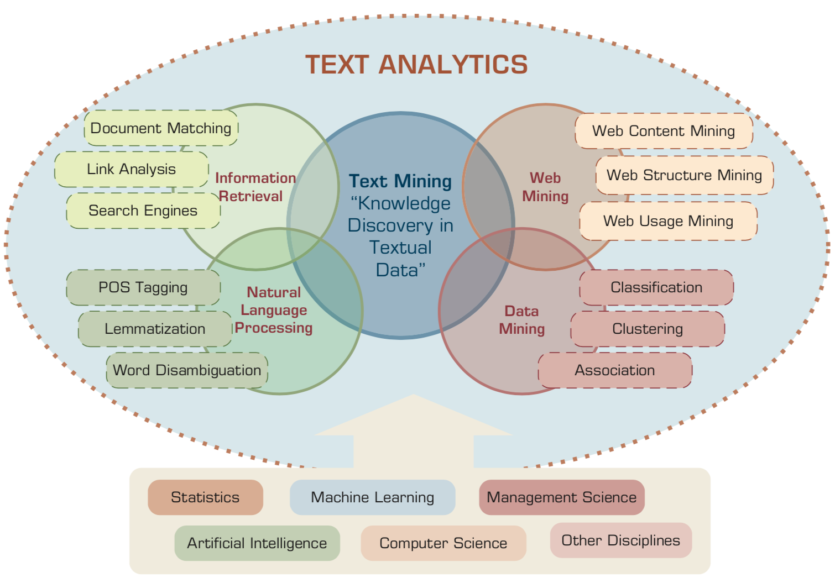
AI for Text Analytics
Source: Ramesh Sharda, Dursun Delen, and Efraim Turban (2017), Business Intelligence, Analytics, and Data Science: A Managerial Perspective, 4th Edition, Pearson

Slide 20
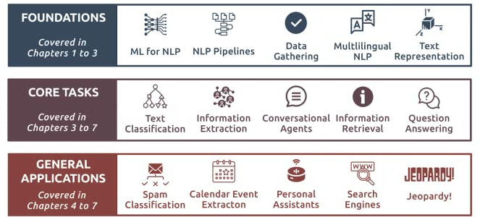
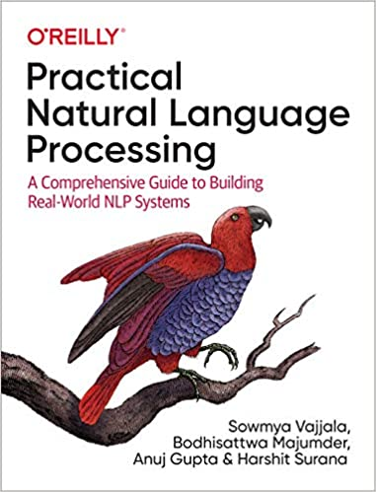
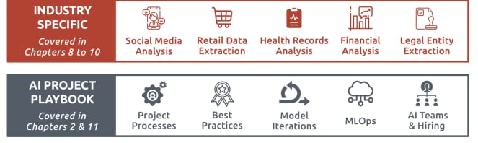
Source: Sowmya Vajjala, Bodhisattwa Majumder, Anuj Gupta (2020), Practical Natural Language Processing: A Comprehensive Guide to Building Real-World NLP Systems, O'Reilly Media.
Source: https://www.amazon.com/Practical-Natural-Language-Processing-Pragmatic/dp/1492054054

Slide 21
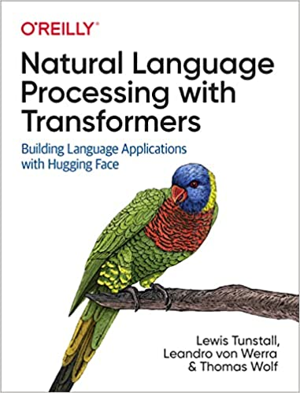
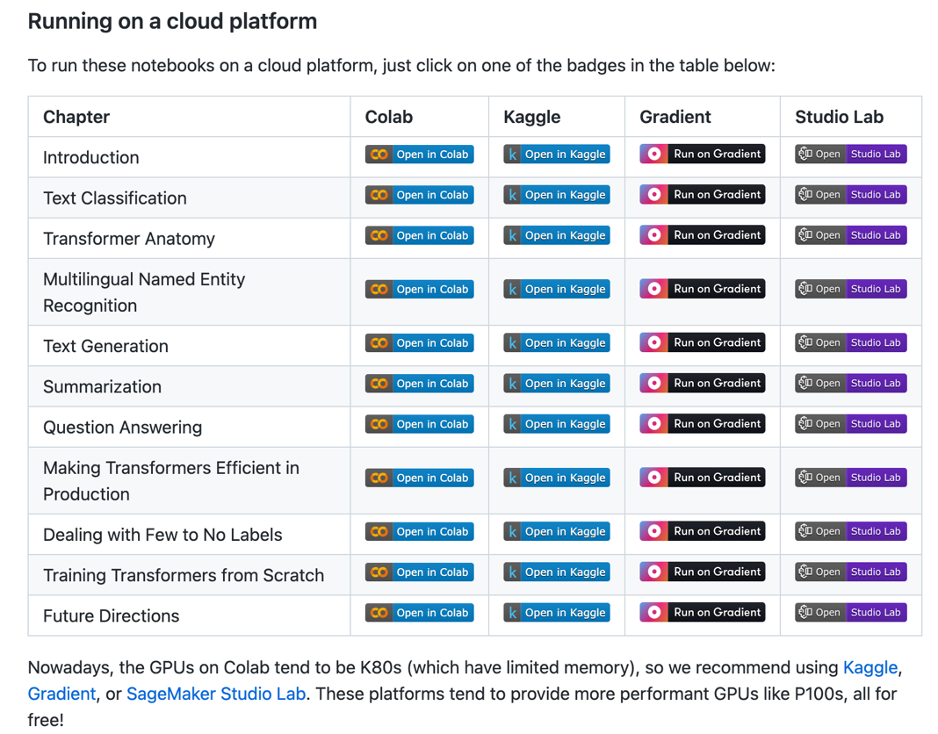
NLP with Transformers Github Notebooks
https://github.com/nlp-with-transformers/notebooks

Slide 22

Denis Rothman (2024),
Transformers for Natural Language Processing and Computer Vision:
Explore Generative AI and Large Language Models with Hugging Face, ChatGPT, GPT-4V, and DALL-E 3,
3rd Edition, Packt Publishing
Source: https://www.amazon.com/Transformers-Natural-Language-Processing-Computer/dp/1805128728

Slide 23
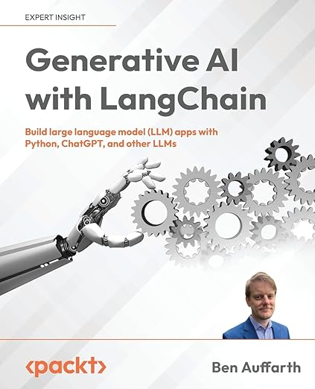
Ben Auffarth (2023),
Generative AI with LangChain:
Build large language model (LLM) apps with Python, ChatGPT and other LLMs,
Packt Publishing.
Source: https://www.amazon.com/Generative-AI-LangChain-language-ChatGPT/dp/1835083463

Slide 24
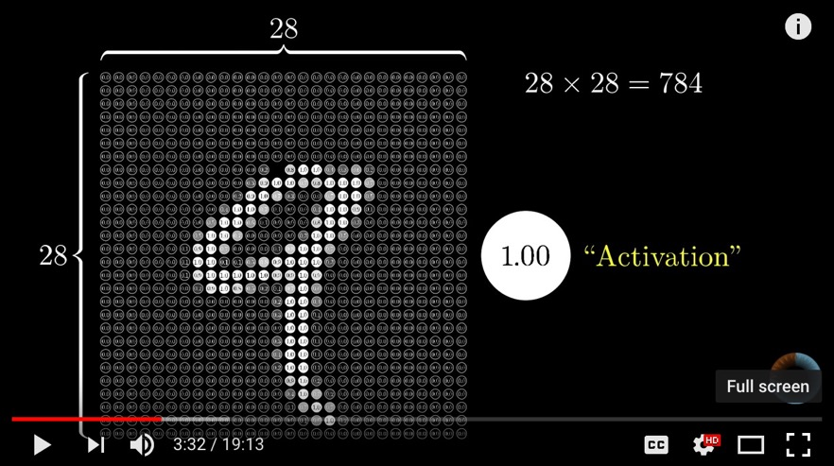
Neural Network and Deep Learning
Source: 3Blue1Brown (2017), But what *is* a Neural Network? | Chapter 1, deep learning, https://www.youtube.com/watch?v=aircAruvnKk

Slide 25
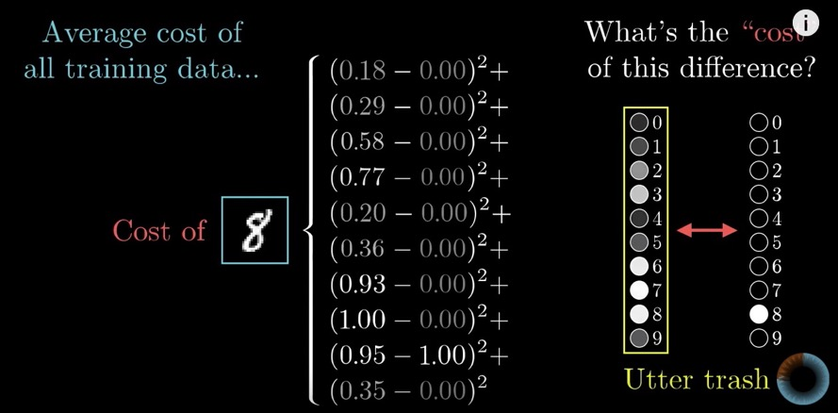
Gradient Descent how neural networks learn
Source: 3Blue1Brown (2017), Gradient descent, how neural networks learn | Chapter 2, deep learning, https://www.youtube.com/watch?v=IHZwWFHWa-w

Slide 26
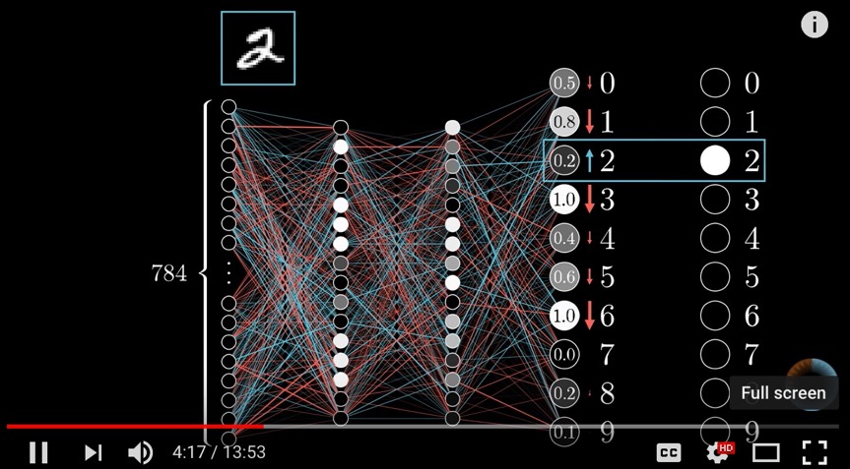
Backpropagation
Source: 3Blue1Brown (2017), What is backpropagation really doing? | Chapter 3, deep learning, https://www.youtube.com/watch?v=Ilg3gGewQ5U

Slide 27
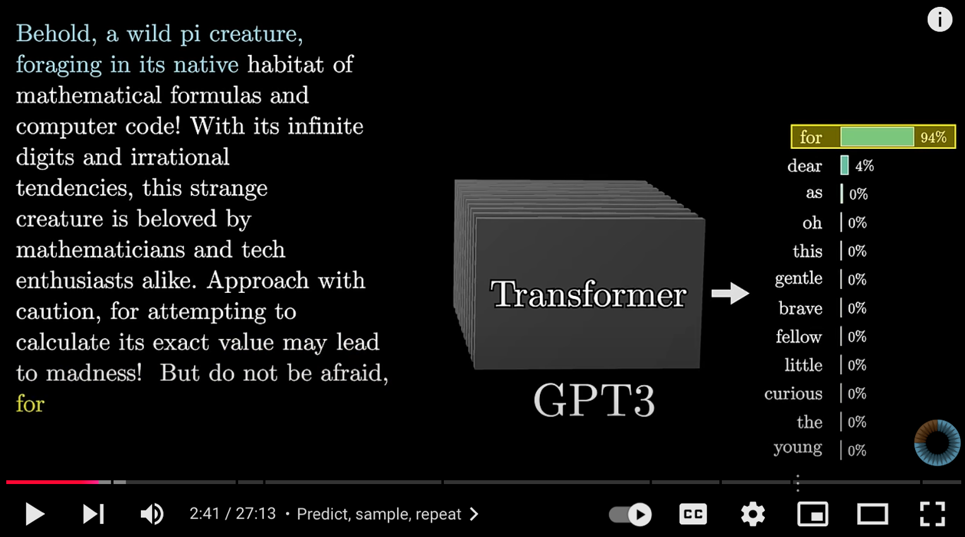
Transformers (how LLMs work)
Source: 3Blue1Brown (2024), Transformers (how LLMs work) explained visually | DL5, https://www.youtube.com/watch?v=wjZofJX0v4M

Slide 28
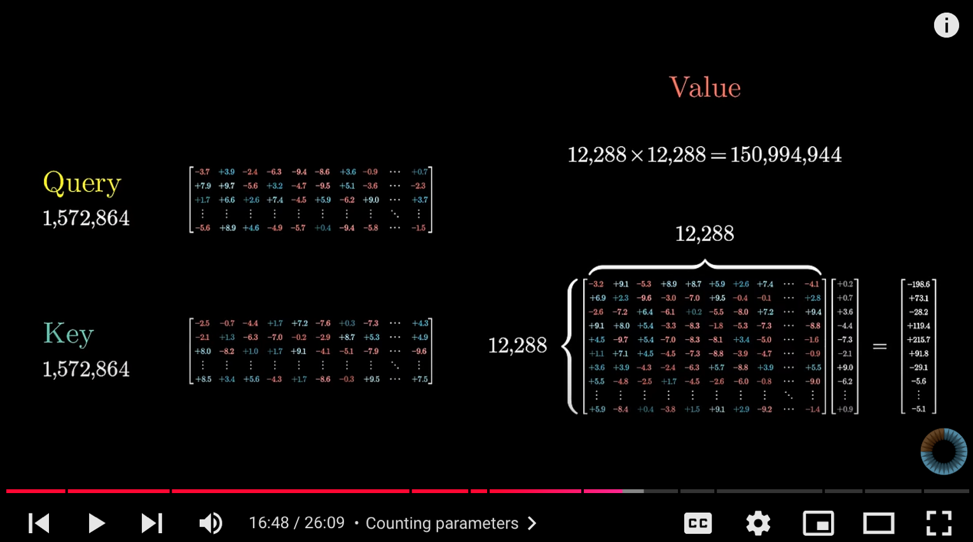
Attention in Transformers
Source: 3Blue1Brown (2024), Attention in transformers, visually explained | DL6, https://www.youtube.com/watch?v=eMlx5fFNoYc

Slide 29
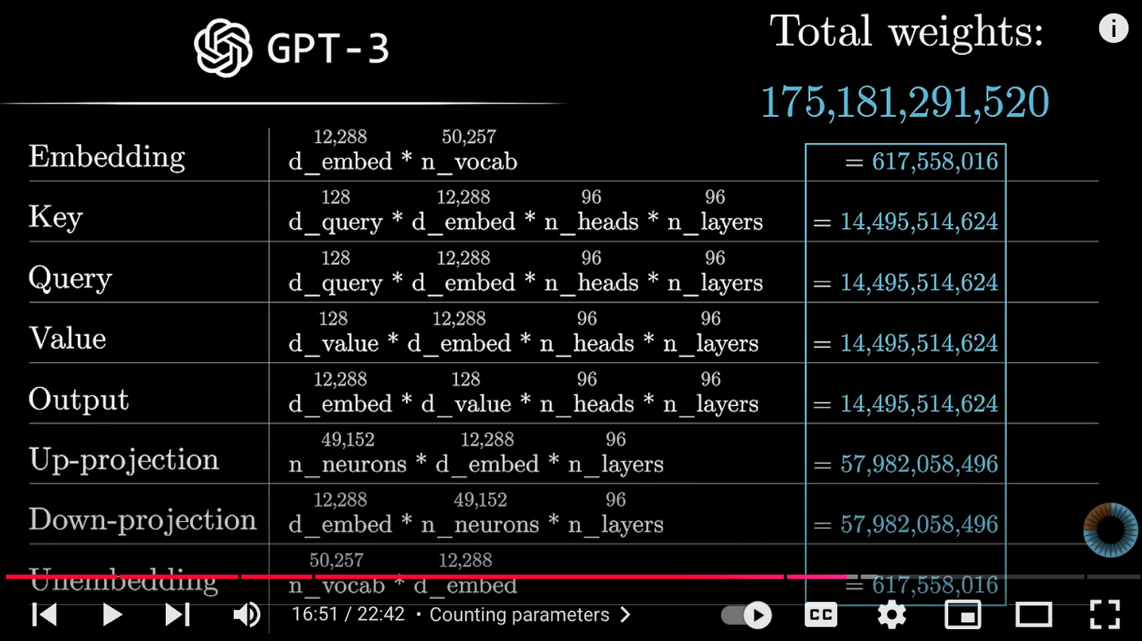
How might LLMs store facts
Source: 3Blue1Brown (2024), How might LLMs store facts | DL7,
https://www.youtube.com/watch?v=9-Jl0dxWQs8

Slide 30
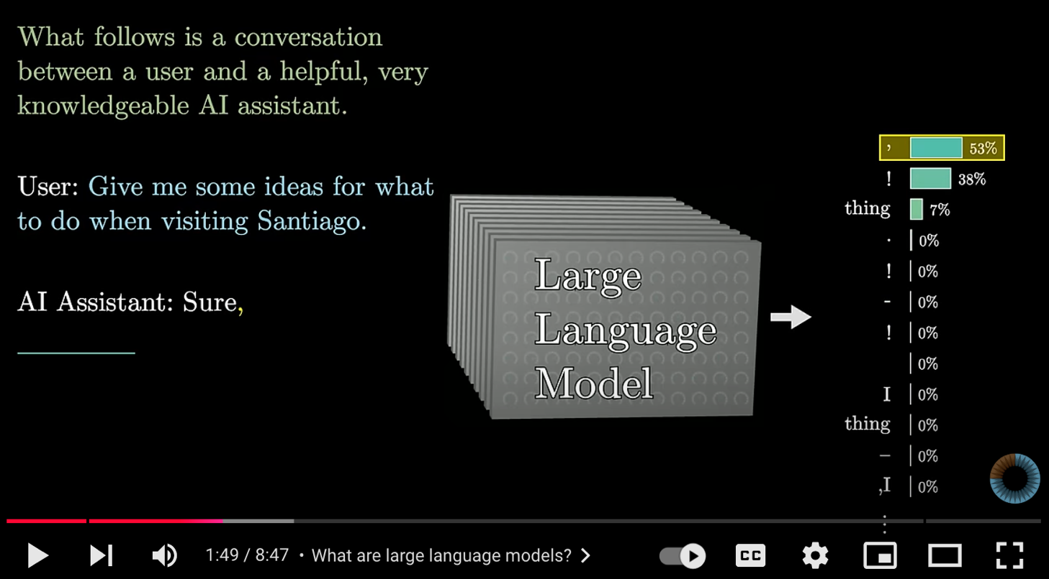
Large Language Models explained briefly
Source: 3Blue1Brown (2024), Large Language Models explained briefly, https://www.youtube.com/watch?v=LPZh9BOjkQs

Slide 31


Large Language Models (LLMs)
Foundation Models

Slide 32
Transformer Models
Transformer
Encoder
Decoder
DistilBERT
BERT
T5
GPT
RoBERTa
BART
GPT-2
CTRL
XLM-R
XLM
M2M-100
GPT-3
ALBERT
BigBird
GPT-Neo
GPT-J
ELECTRA
mT0
BLOOM
BLOOMZ
DeBERTa
ChatGPT
GPT-4
Source: Lewis Tunstall, Leandro von Werra, and Thomas Wolf (2022), Natural Language Processing with Transformers: Building Language Applications with Hugging Face, O'Reilly Media.

Slide 33

Large Language Models (LLMs)
Source: Hadi, Muhammad Usman, Rizwan Qureshi, Abbas Shah, Muhammad Irfan, Anas Zafar, Muhammad Bilal Shaikh, Naveed Akhtar, Jia Wu, and Seyedali Mirjalili. "Large language models: a comprehensive survey of its applications, challenges, limitations, and future prospects." Authorea Preprints (2023).

Slide 34
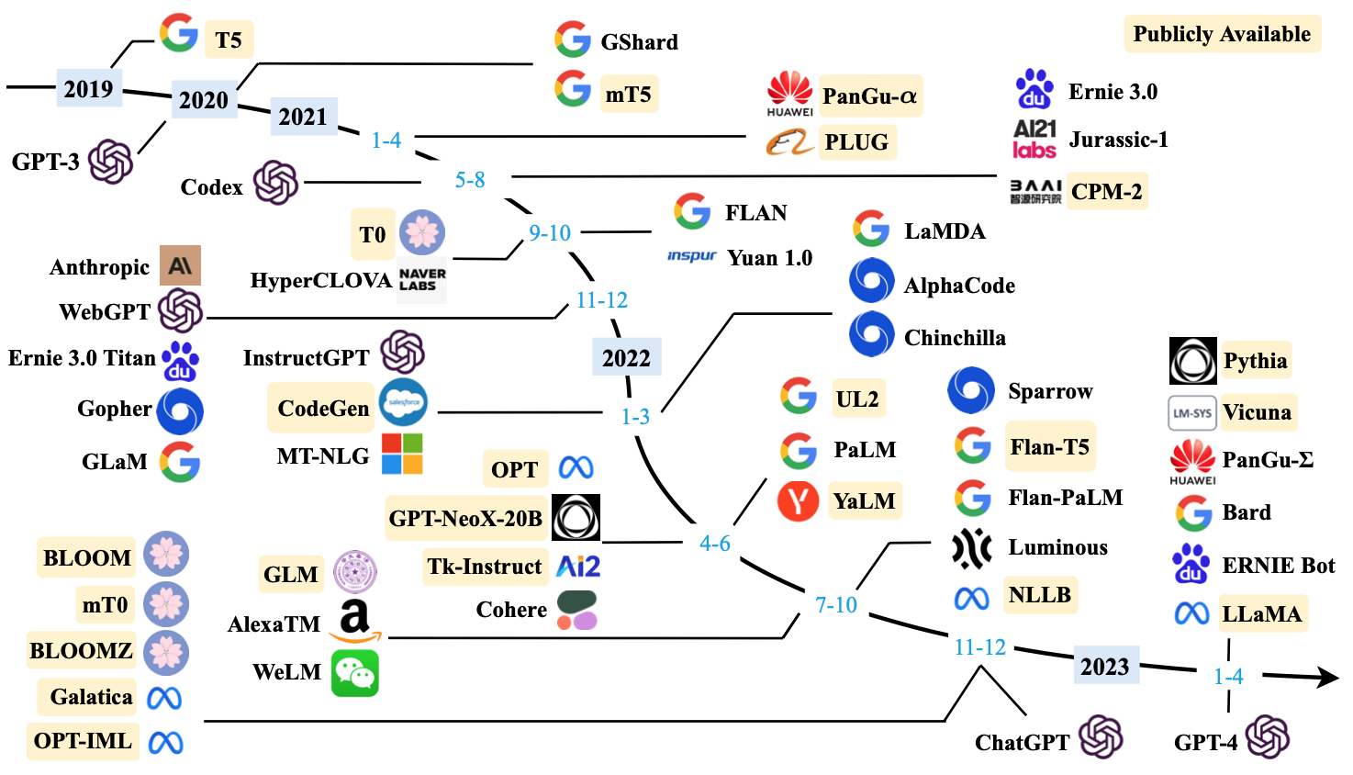
Large Language Models (LLMs) (larger than 10B)
Source: Wayne Xin Zhao, Kun Zhou, Junyi Li, Tianyi Tang, Xiaolei Wang, Yupeng Hou, Yingqian Min et al. (2023) "A Survey of Large Language Models." arXiv preprint arXiv:2303.18223.

Slide 35

The Development of LM-based Dialogue Systems
1) Early Stage (1966 - 2015)
2) The Independent Development of TOD and ODD (2015 - 2019)
3) Fusions of Dialogue Systems (2019 - 2022)
4) LLM-based DS (2022 - Now)
Task-oriented DS (TOD), Open-domain DS (ODD)
Source: Wang, Hongru, Lingzhi Wang, Yiming Du, Liang Chen, Jingyan Zhou, Yufei Wang, and Kam-Fai Wong. "A Survey of the Evolution of Language Model-Based Dialogue Systems." arXiv preprint arXiv:2311.16789 (2023).

Slide 36

Major GenAI LLMs Research Milestones
(2017-2024)
Source: https://github.com/Hannibal046/Awesome-LLM

Slide 37
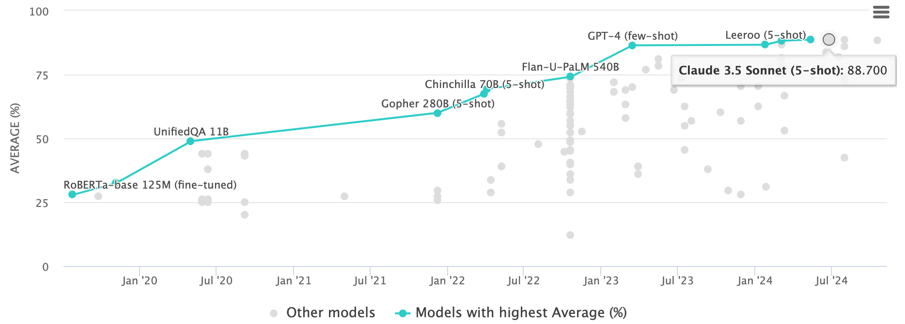
Multi-task Language Understanding on MMLU
GPT-4, Claude 3.5 Sonnet
Massive Multitask Language Understanding (MMLU)
Source: https://paperswithcode.com/sota/multi-task-language-understanding-on-mmlu

Slide 38

LLM Capabilities
Source: Minaee, Shervin, Tomas Mikolov, Narjes Nikzad, Meysam Chenaghlu, Richard Socher, Xavier Amatriain, and Jianfeng Gao. (2024) "Large language models: A survey." arXiv preprint arXiv:2402.06196 (2024).

Slide 39

LLM-powered Multimodal Agents
Large Multimodal Agents (LMAs)
2022
2023
2024
Source: Xie, Junlin, Zhihong Chen, Ruifei Zhang, Xiang Wan, and Guanbin Li. "Large Multimodal Agents: A Survey." arXiv preprint arXiv:2402.15116 (2024).

Slide 40

Four Paradigms in NLP (LM)
Transfer Learning: Pre-training, Fine-Tuning (FT)
GAI: Pre-train, Prompt, and Predict (Prompting)
Source: Pengfei Liu, Weizhe Yuan, Jinlan Fu, Zhengbao Jiang, Hiroaki Hayashi, and Graham Neubig. (2023) "Pre-train, prompt, and predict: A systematic survey of prompting methods in natural language processing." ACM Computing Surveys 55, no. 9 (2023): 1-35.

Slide 41
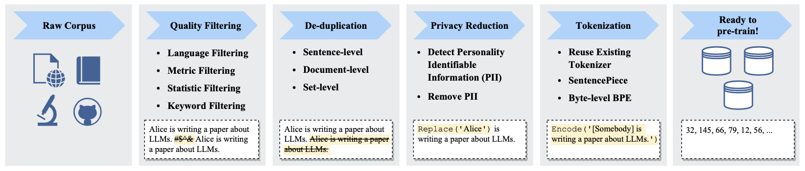
Typical Data Preprocessing Pipeline for
Pre-training Large Language Models (LLMs)
Source: Wayne Xin Zhao, Kun Zhou, Junyi Li, Tianyi Tang, Xiaolei Wang, Yupeng Hou, Yingqian Min et al. (2023) "A Survey of Large Language Models." arXiv preprint arXiv:2303.18223.

Slide 42
Popular Generative AI
OpenAI ChatGPT (GPT-4o, GPT-4)
Claude.ai (Claude 3.5)
Google Gemini
Meta Llama 3.2
Mixtral Pixtral (mistral.ai)
Chat.LMSys.org (lmarena.ai)
Perplexity.ai
Stable Diffusion
Video: D-ID, Synthesia
Audio: Speechify

Slide 43
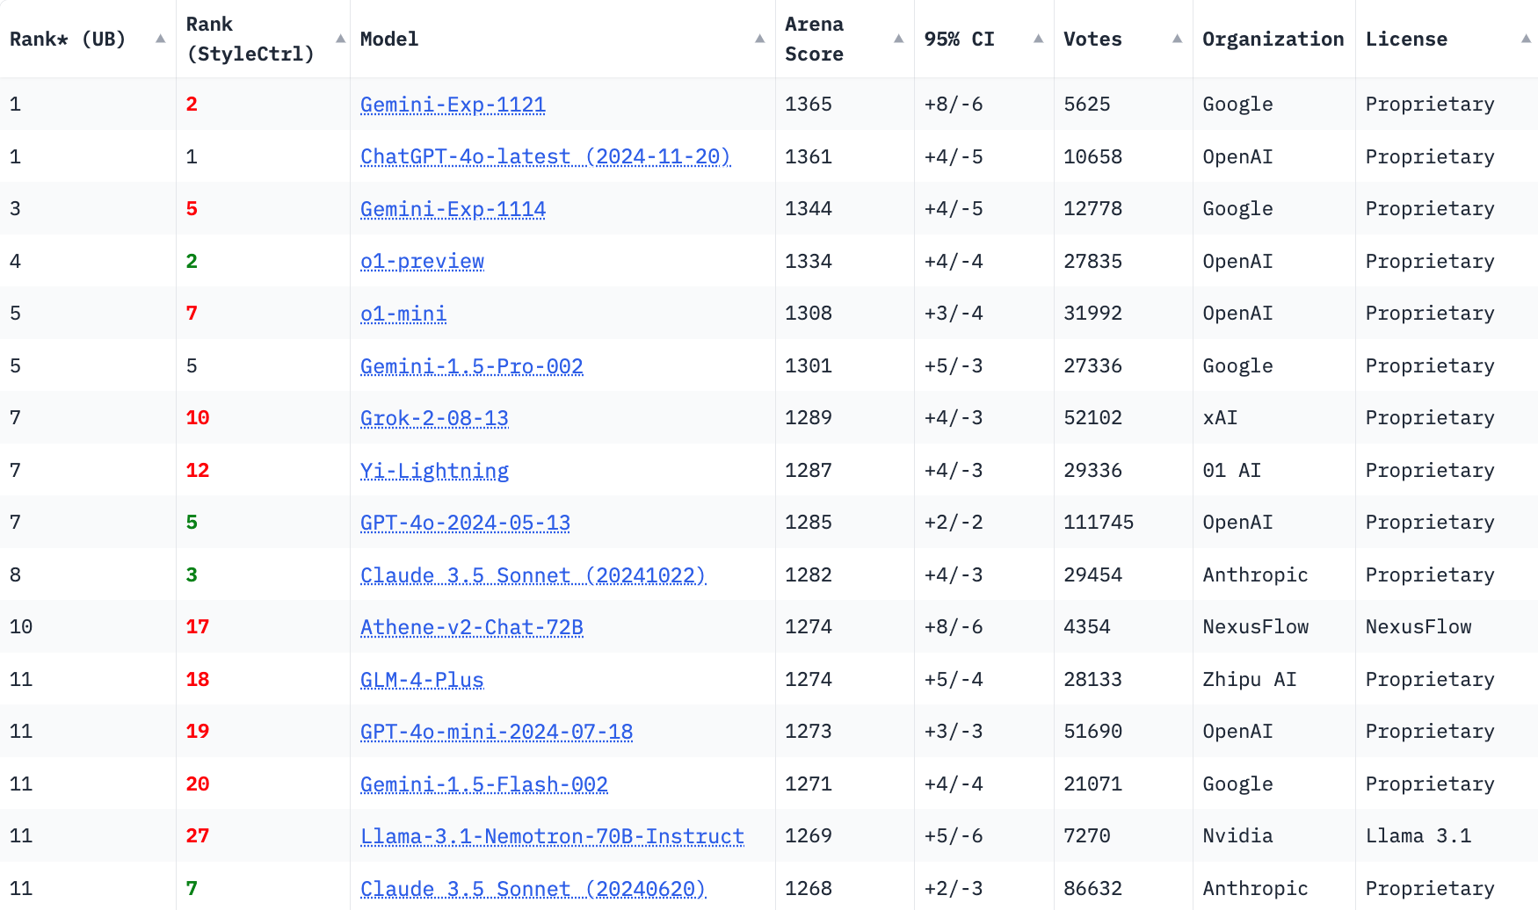
LMSYS Chatbot Arena Leaderboard
GPT-4o
Claude 3.5
https://lmarena.ai/

Slide 44
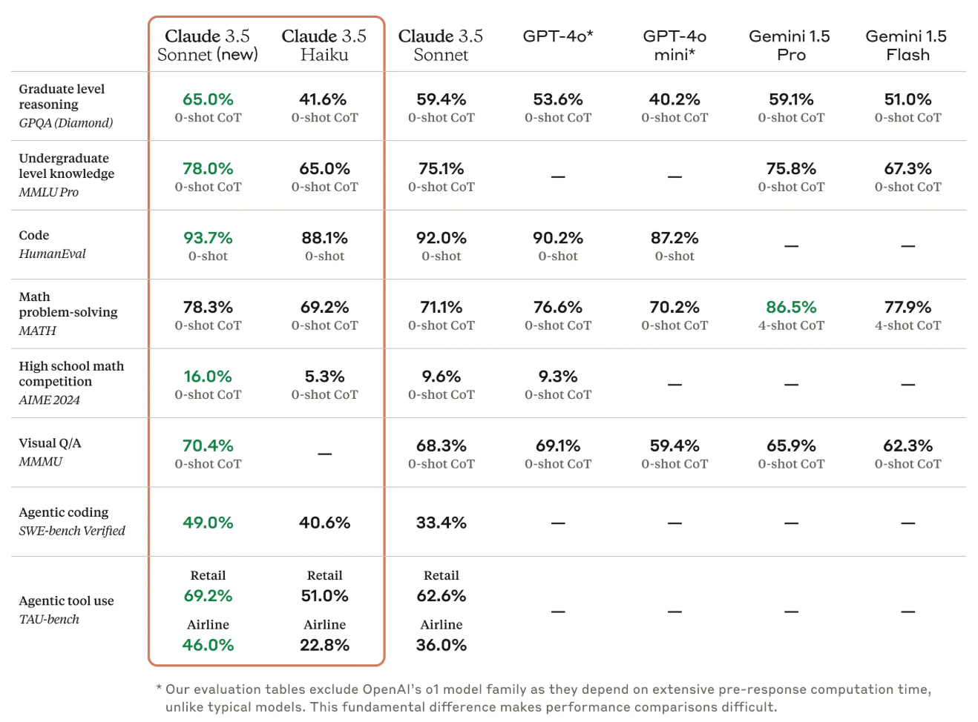
Claude 3.5 Sonnet State-of-the-art vision
Source: https://www.anthropic.com/news/3-5-models-and-computer-use

Slide 45
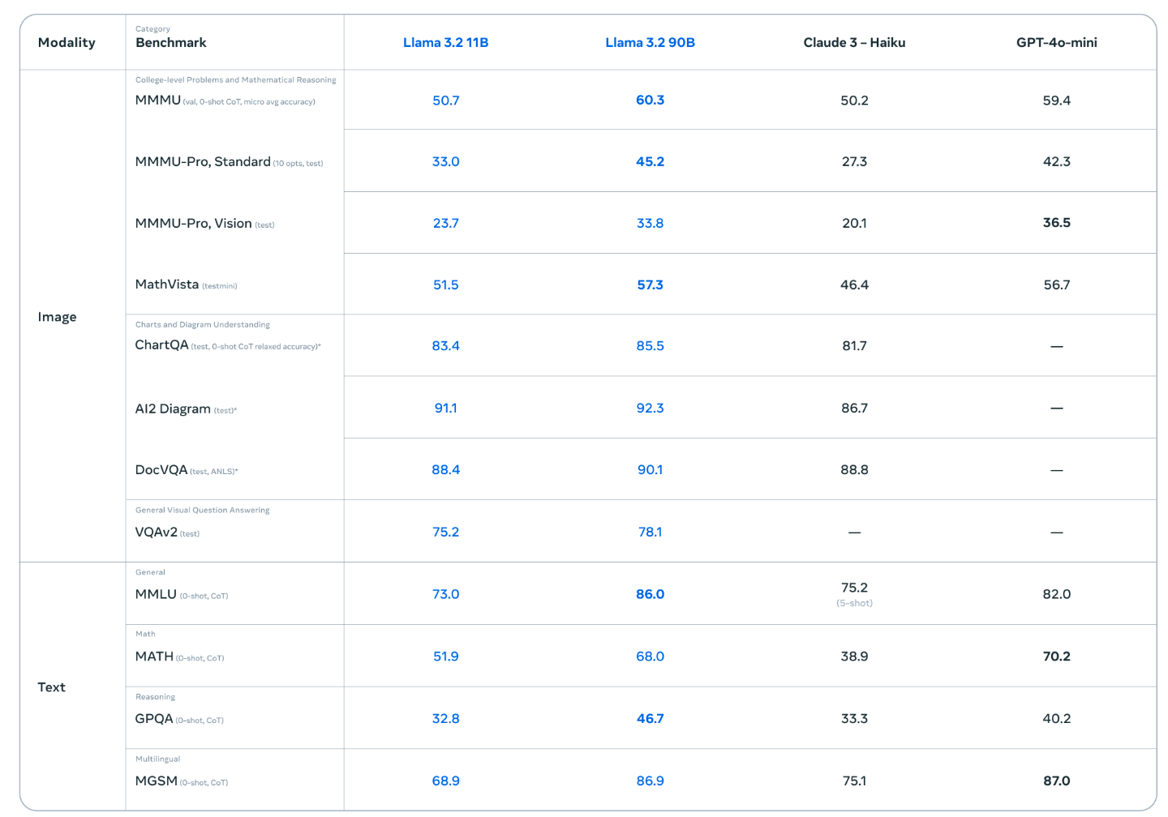
Llama 3.2 90B vision LLMs
Source: https://ai.meta.com/blog/llama-3-2-connect-2024-vision-edge-mobile-devices/

Slide 46
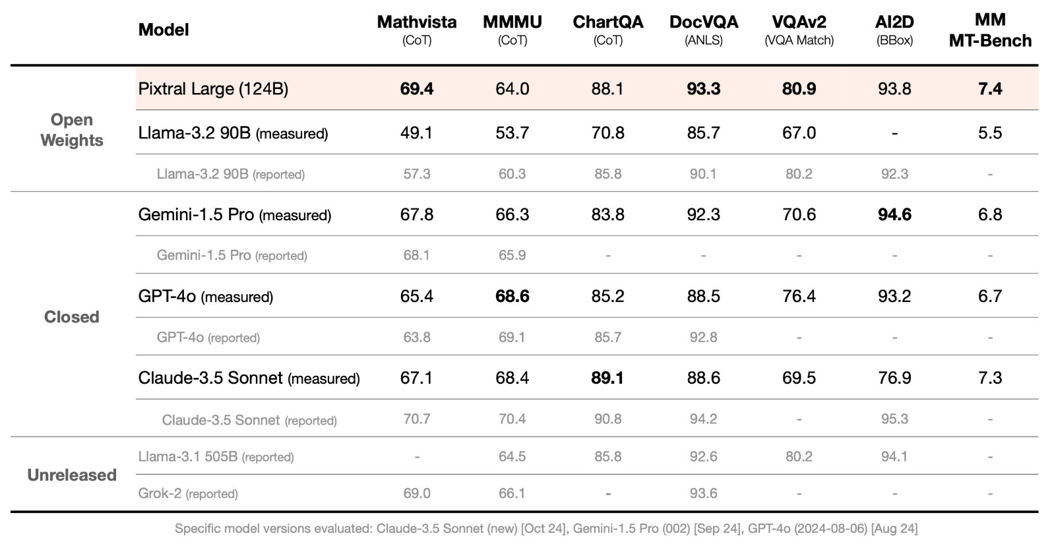
Mistral Pixtral Large (124B)
Frontier-class multimodal performance
Source: https://mistral.ai/news/pixtral-large/

Slide 47
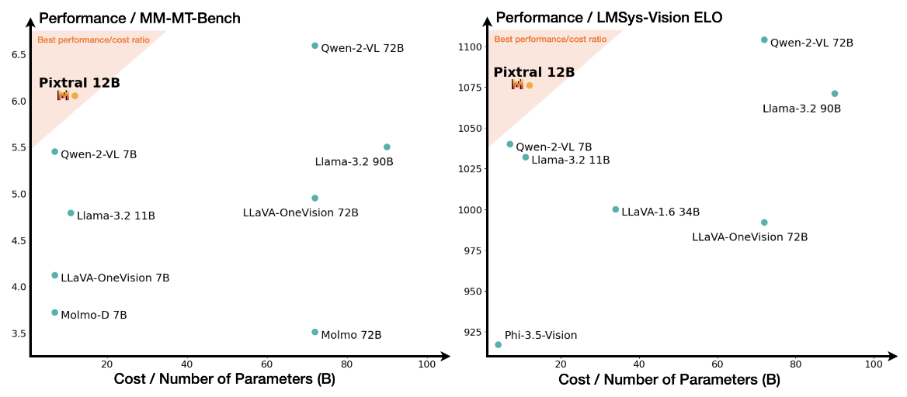
Mistral Pixtral 12B
Source: Agrawal, Pravesh, Szymon Antoniak, Emma Bou Hanna, Baptiste Bout, Devendra Chaplot, Jessica Chudnovsky, Diogo Costa et al. (2024) "Pixtral 12B." arXiv preprint arXiv:2410.07073.

Slide 48
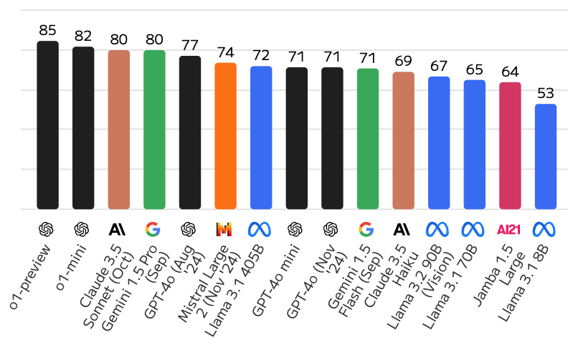
Large Language Models (LLMs)
Artificial Analysis Quality Index
Source: https://artificialanalysis.ai/

Slide 49
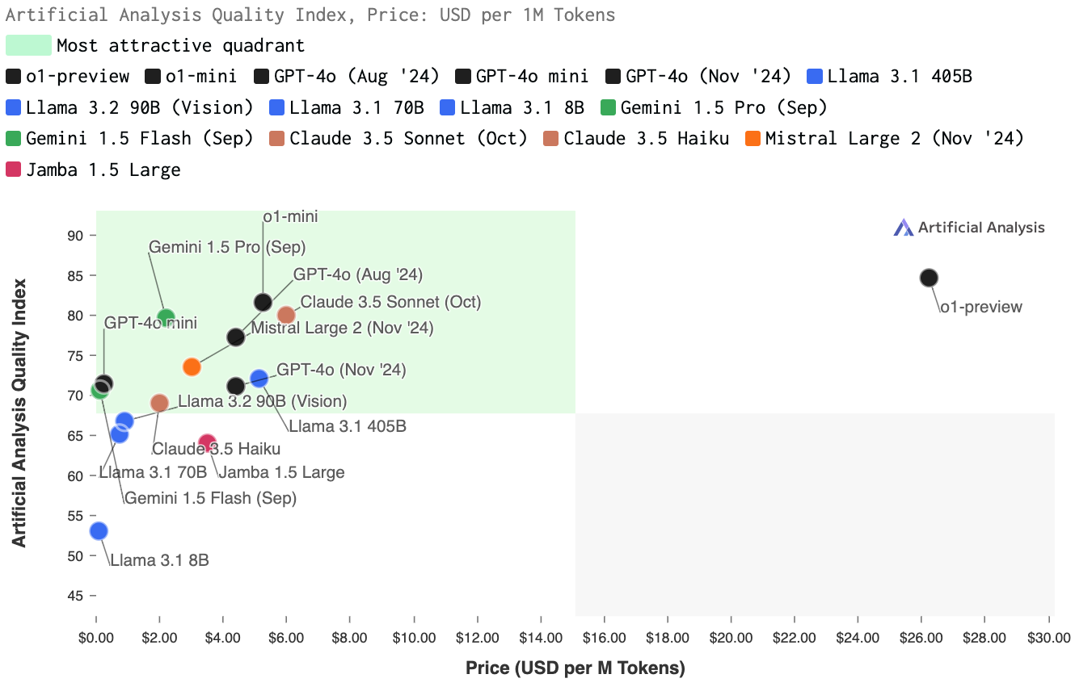
Large Language Models (LLMs)
Quality vs. Price
Source: https://artificialanalysis.ai/

Slide 50
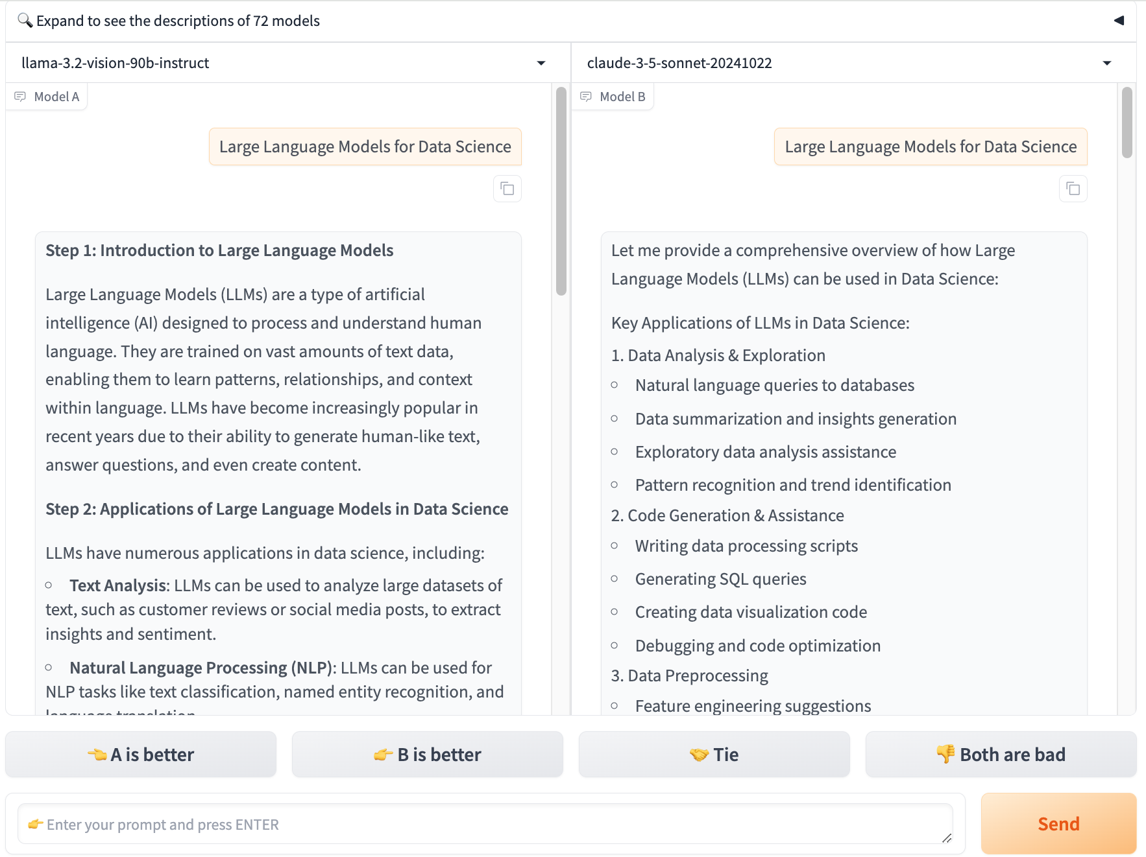
Chat with
Open
Large Language Models:
Chatbot Arena
Large Language Models for Data Science
llama 3.2
claude 3.5 sonnet
https://lmarena.ai/

Slide 51

Perplexity.ai
https://www.perplexity.ai/

Slide 52

Generative AI (Gen AI)
AI Generated Content (AIGC)
Image Generation
Source: Yihan Cao, Siyu Li, Yixin Liu, Zhiling Yan, Yutong Dai, Philip S. Yu, and Lichao Sun (2023). "A Comprehensive Survey of AI-Generated Content (AIGC): A History of Generative AI from GAN to ChatGPT." arXiv preprint arXiv:2303.04226.

Slide 53

Generative AI (Gen AI)
AI Generated Content (AIGC)
Source: Yihan Cao, Siyu Li, Yixin Liu, Zhiling Yan, Yutong Dai, Philip S. Yu, and Lichao Sun (2023). "A Comprehensive Survey of AI-Generated Content (AIGC): A History of Generative AI from GAN to ChatGPT." arXiv preprint arXiv:2303.04226.

Slide 54

The history of Generative AI in CV, NLP and VL
Source: Yihan Cao, Siyu Li, Yixin Liu, Zhiling Yan, Yutong Dai, Philip S. Yu, and Lichao Sun (2023). "A Comprehensive Survey of AI-Generated Content (AIGC): A History of Generative AI from GAN to ChatGPT." arXiv preprint arXiv:2303.04226.

Slide 55
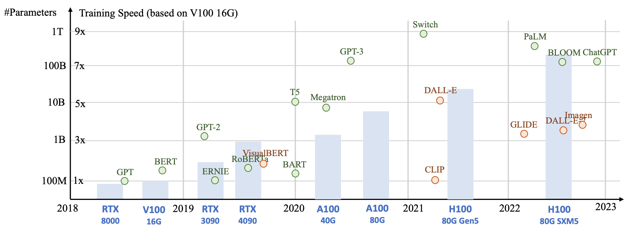
Generative AI
Foundation Models
Source: Yihan Cao, Siyu Li, Yixin Liu, Zhiling Yan, Yutong Dai, Philip S. Yu, and Lichao Sun (2023). "A Comprehensive Survey of AI-Generated Content (AIGC): A History of Generative AI from GAN to ChatGPT." arXiv preprint arXiv:2303.04226.

Slide 56

Categories of Vision Generative Models
Source: Yihan Cao, Siyu Li, Yixin Liu, Zhiling Yan, Yutong Dai, Philip S. Yu, and Lichao Sun (2023). "A Comprehensive Survey of AI-Generated Content (AIGC): A History of Generative AI from GAN to ChatGPT." arXiv preprint arXiv:2303.04226.

Slide 57

The General Structure of
Generative Vision Language
Source: Yihan Cao, Siyu Li, Yixin Liu, Zhiling Yan, Yutong Dai, Philip S. Yu, and Lichao Sun (2023). "A Comprehensive Survey of AI-Generated Content (AIGC): A History of Generative AI from GAN to ChatGPT." arXiv preprint arXiv:2303.04226.

Slide 58
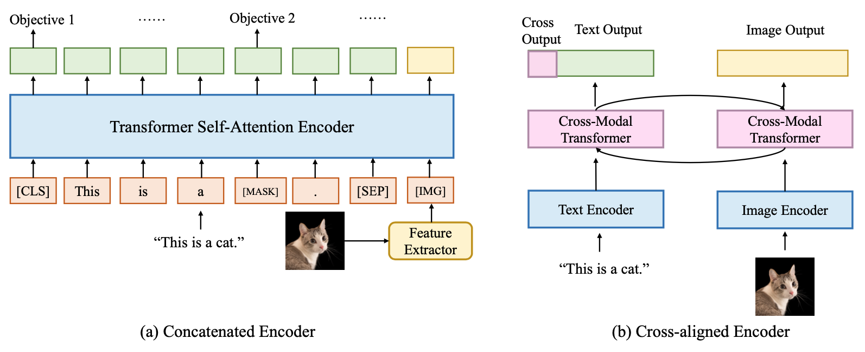
Two Types of Vision Language Encoders: Concatenated Encoders and Cross-aligned Encoders
Source: Yihan Cao, Siyu Li, Yixin Liu, Zhiling Yan, Yutong Dai, Philip S. Yu, and Lichao Sun (2023). "A Comprehensive Survey of AI-Generated Content (AIGC): A History of Generative AI from GAN to ChatGPT." arXiv preprint arXiv:2303.04226.

Slide 59
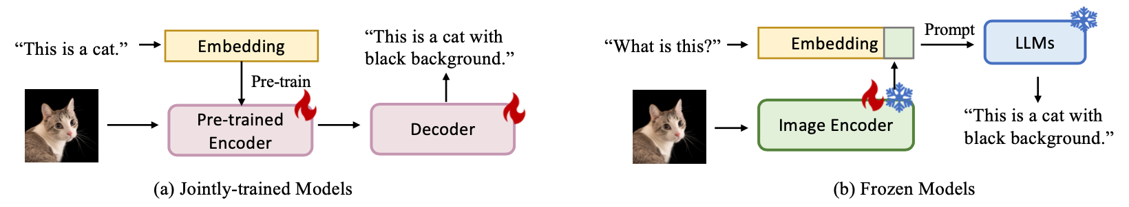
Two Types of to-language Decoder Models: Jointly-trained Models and Frozen Models
Source: Yihan Cao, Siyu Li, Yixin Liu, Zhiling Yan, Yutong Dai, Philip S. Yu, and Lichao Sun (2023). "A Comprehensive Survey of AI-Generated Content (AIGC): A History of Generative AI from GAN to ChatGPT." arXiv preprint arXiv:2303.04226.

Slide 60
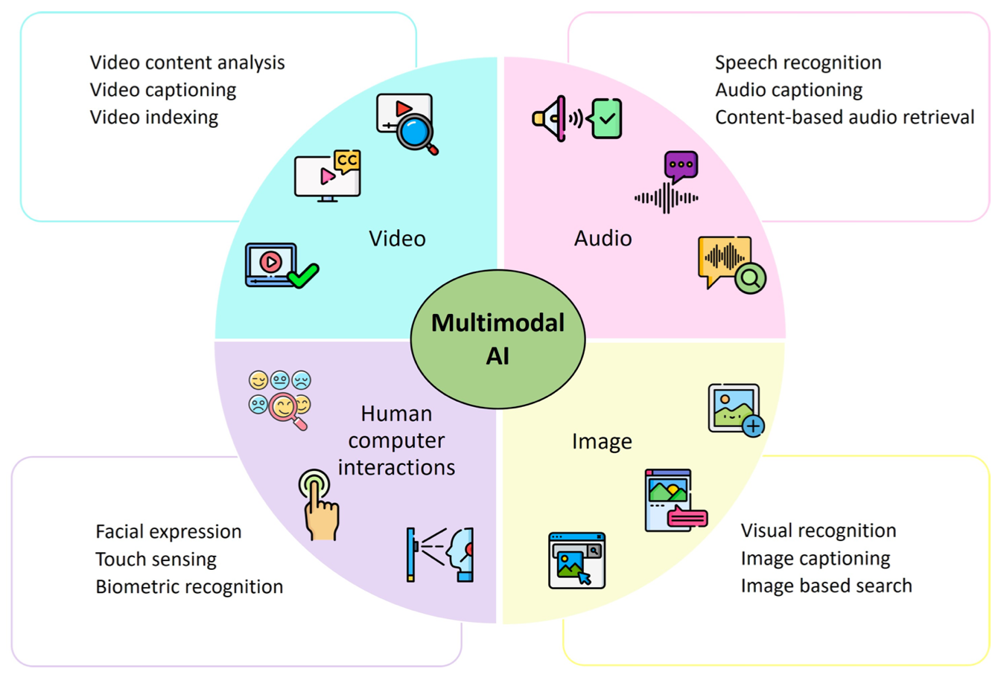
Technological Integration for Multimodal AI
Source: Sohail, Shahab Saquib, Faiza Farhat, Yassine Himeur, Mohammad Nadeem, Dag Øivind Madsen, Yashbir Singh, Shadi Atalla, and Wathiq Mansoor. "The Future of GPT: A Taxonomy of Existing ChatGPT Research, Current Challenges, and Possible Future Directions." Current Challenges, and Possible Future Directions (April 8, 2023) (2023).

Slide 61
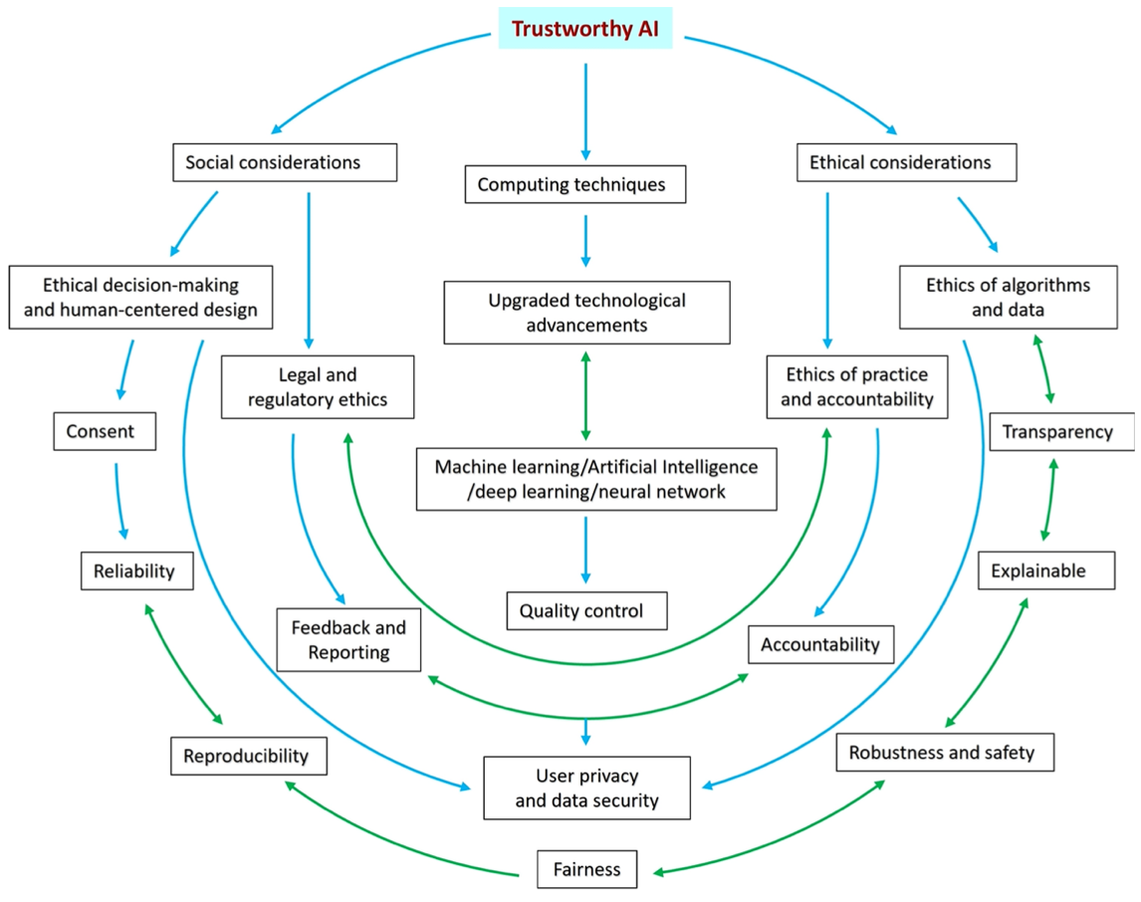
Trustworthy AI: Interplay of Various Factors
Source: Sohail, Shahab Saquib, Faiza Farhat, Yassine Himeur, Mohammad Nadeem, Dag Øivind Madsen, Yashbir Singh, Shadi Atalla, and Wathiq Mansoor. "The Future of GPT: A Taxonomy of Existing ChatGPT Research, Current Challenges, and Possible Future Directions." Current Challenges, and Possible Future Directions (April 8, 2023) (2023).

Slide 62
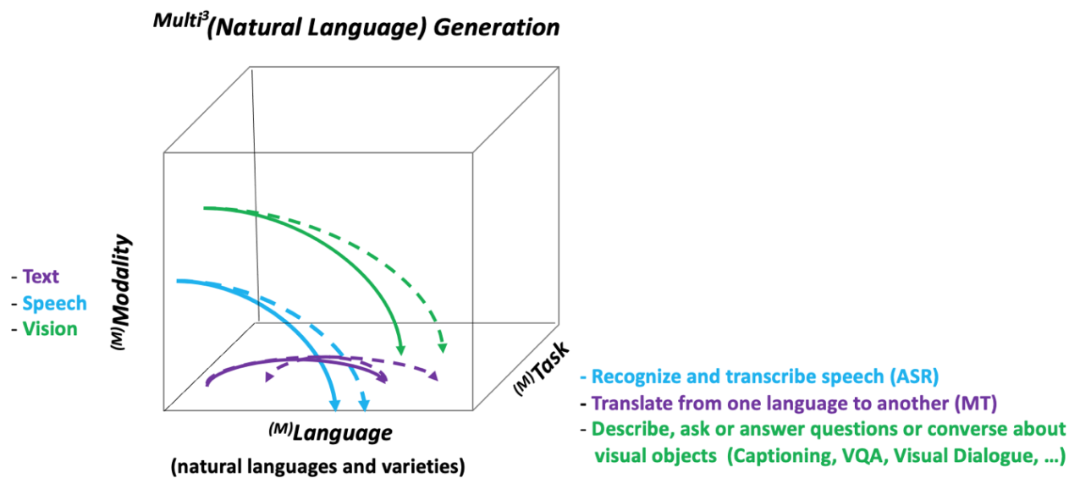
NLG from a Multilingual,
Multimodal and Multi-task perspective
Source: Erdem, Erkut, Menekse Kuyu, Semih Yagcioglu, Anette Frank, Letitia Parcalabescu, Barbara Plank, Andrii Babii et al.
"Neural Natural Language Generation: A Survey on Multilinguality, Multimodality, Controllability and Learning." Journal of Artificial Intelligence Research 73 (2022): 1131-1207.

Slide 63
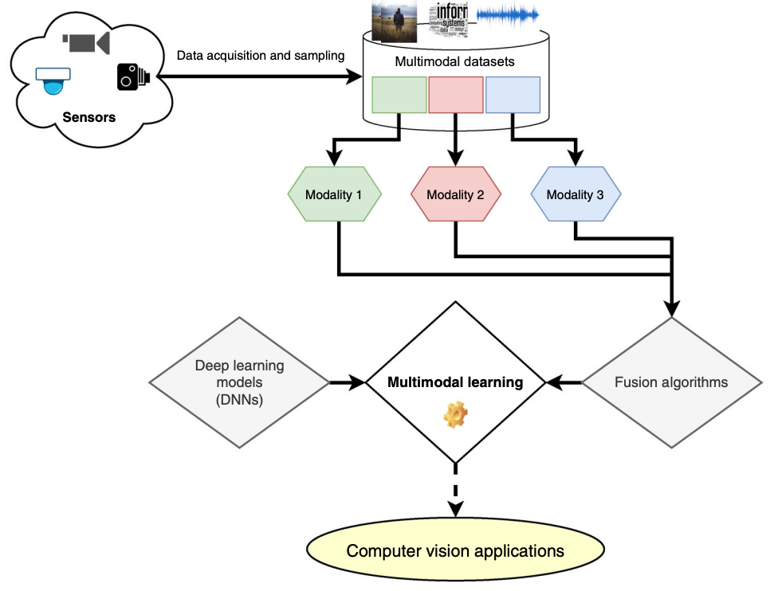
Multimodal Pipeline that includes three different modalities (Image, Text. Audio)
Source: Bayoudh, Khaled, Raja Knani, Fayçal Hamdaoui, and Abdellatif Mtibaa (2022).
"A survey on deep multimodal learning for computer vision: advances, trends, applications, and datasets." The Visual Computer 38, no. 8: 2939-2970.

Slide 64
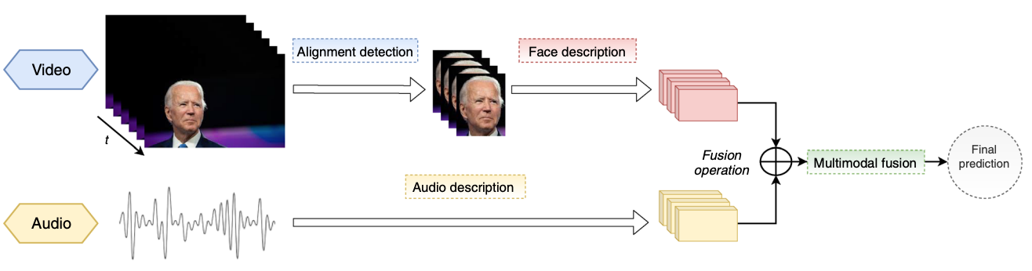
Video and Audio Multimodal Fusion
Source: Bayoudh, Khaled, Raja Knani, Fayçal Hamdaoui, and Abdellatif Mtibaa (2022).
"A survey on deep multimodal learning for computer vision: advances, trends, applications, and datasets." The Visual Computer 38, no. 8: 2939-2970.

Slide 65
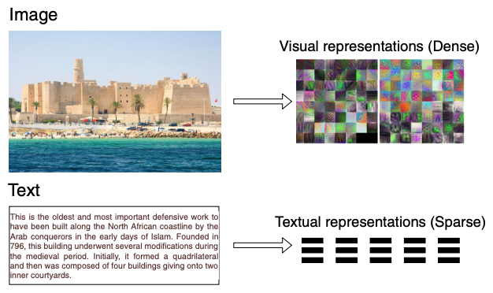
Visual and Textual Representation
Source: Bayoudh, Khaled, Raja Knani, Fayçal Hamdaoui, and Abdellatif Mtibaa (2022).
"A survey on deep multimodal learning for computer vision: advances, trends, applications, and datasets." The Visual Computer 38, no. 8: 2939-2970.

Slide 66
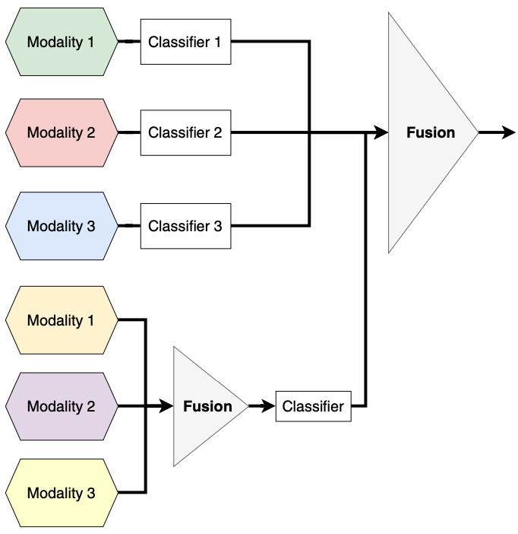
Hybrid Multimodal Data Fusion
Text
Audio
Image
Text
Speech
Video
Source: Bayoudh, Khaled, Raja Knani, Fayçal Hamdaoui, and Abdellatif Mtibaa (2022).
"A survey on deep multimodal learning for computer vision: advances, trends, applications, and datasets." The Visual Computer 38, no. 8: 2939-2970.

Slide 67
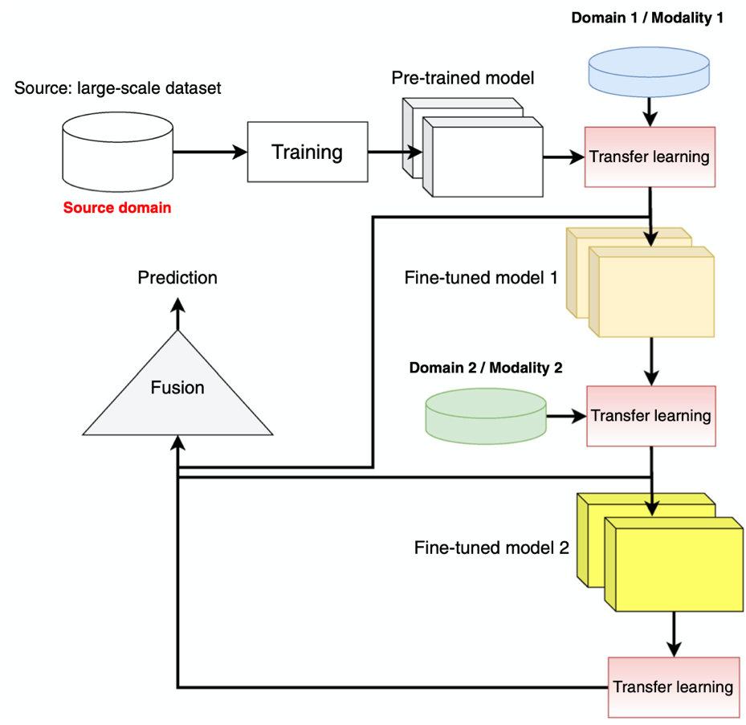
Multimodal Transfer Learning
Source: Bayoudh, Khaled, Raja Knani, Fayçal Hamdaoui, and Abdellatif Mtibaa (2022).
"A survey on deep multimodal learning for computer vision: advances, trends, applications, and datasets." The Visual Computer 38, no. 8: 2939-2970.

Slide 68
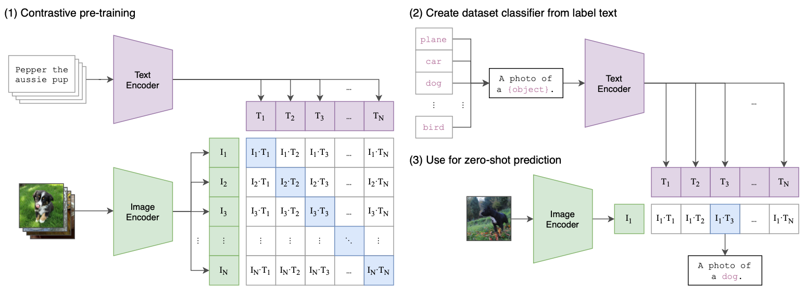
CLIP: Learning Transferable Visual Models From Natural Language Supervision
Source: Radford, Alec, Jong Wook Kim, Chris Hallacy, Aditya Ramesh, Gabriel Goh, Sandhini Agarwal, Girish Sastry et al. (2021) "Learning transferable visual models from natural language supervision." In International Conference on Machine Learning, pp. 8748-8763. PMLR.

Slide 69
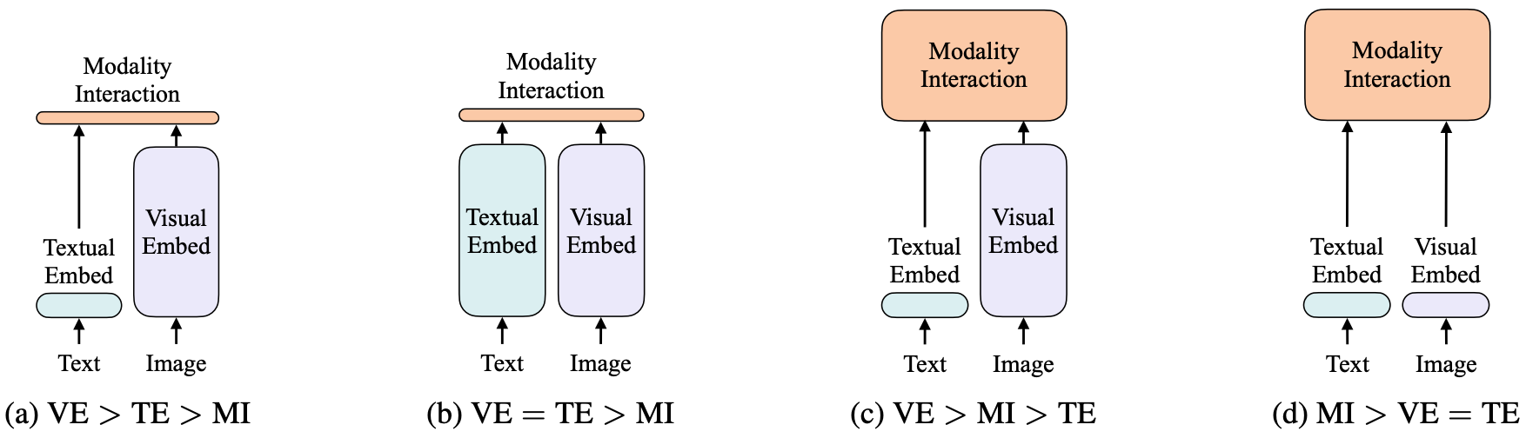
ViLT: Vision-and-Language Transformer Without Convolution or Region Supervision
Source: Kim, Wonjae, Bokyung Son, and Ildoo Kim (2021). "Vilt: Vision-and-language transformer without convolution or region supervision."
In International Conference on Machine Learning, pp. 5583-5594. PMLR.

Slide 70
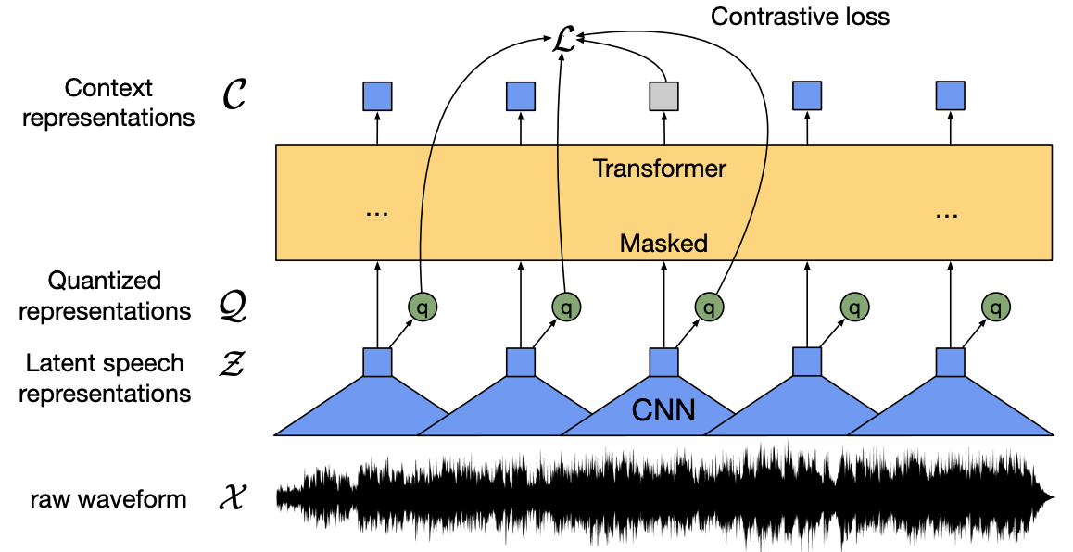
wav2vec 2.0:
A framework for self-supervised learning of speech representations
Source: Baevski, Alexei, Yuhao Zhou, Abdelrahman Mohamed, and Michael Auli.
"wav2vec 2.0: A framework for self-supervised learning of speech representations." Advances in Neural Information Processing Systems 33 (2020): 12449-12460.

Slide 71
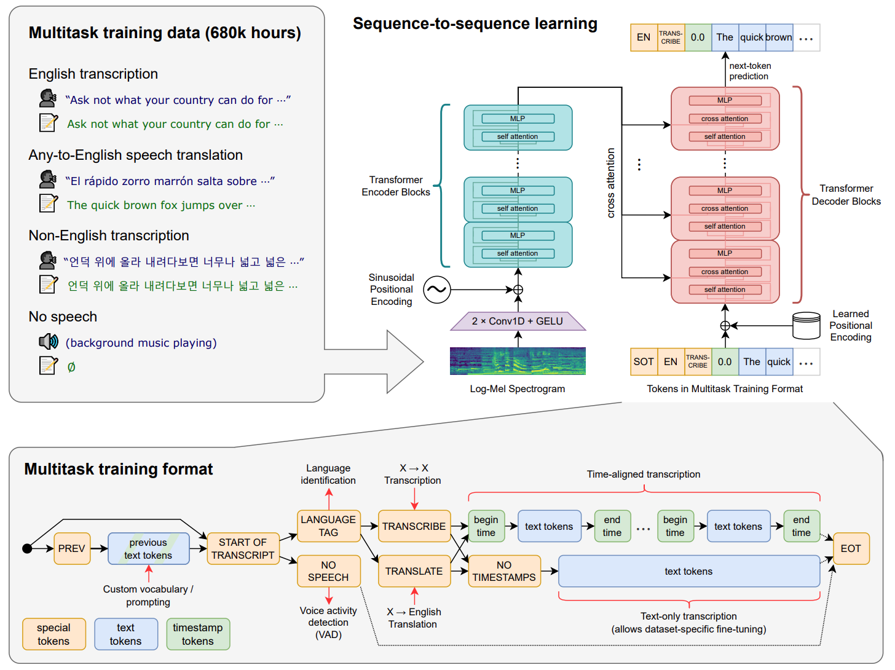
Whisper:
Robust Speech Recognition via Large-Scale Weak Supervision
Source: Radford, Alec, Jong Wook Kim, Tao Xu, Greg Brockman, Christine McLeavey, and Ilya Sutskever. Robust speech recognition via large-scale weak supervision. Tech. Rep., Technical report, OpenAI, 2022.

Slide 72
LLM-powered Multimodal Agents
Large Multimodal Agents (LMAs)
2022
2023
2024
Source: Xie, Junlin, Zhihong Chen, Ruifei Zhang, Xiang Wan, and Guanbin Li. "Large Multimodal Agents: A Survey." arXiv preprint arXiv:2402.15116 (2024).

Slide 73

Large Language Model (LLM) Based Agents
Source: Guo, Taicheng, Xiuying Chen, Yaqi Wang, Ruidi Chang, Shichao Pei, Nitesh V. Chawla, Olaf Wiest, and Xiangliang Zhang. "Large language model based multi-agents: A survey of progress and challenges." arXiv preprint arXiv:2402.01680 (2024).

Slide 74
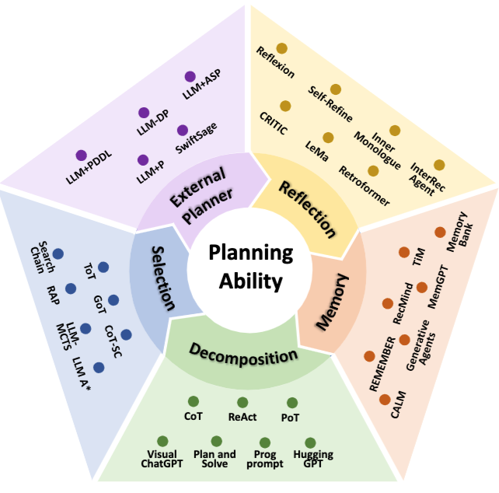
Taxonomy on LLM-Agent planning
Source: Huang, Xu, Weiwen Liu, Xiaolong Chen, Xingmei Wang, Hao Wang, Defu Lian, Yasheng Wang, Ruiming Tang, and Enhong Chen. "Understanding the planning of LLM agents: A survey." arXiv preprint arXiv:2402.02716 (2024).

Slide 75
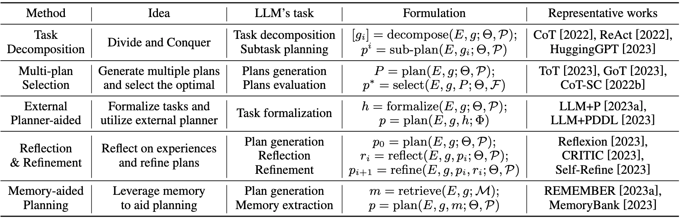
Taxonomy on LLM-Agent planning
Source: Huang, Xu, Weiwen Liu, Xiaolong Chen, Xingmei Wang, Hao Wang, Defu Lian, Yasheng Wang, Ruiming Tang, and Enhong Chen. "Understanding the planning of LLM agents: A survey." arXiv preprint arXiv:2402.02716 (2024).

Slide 76
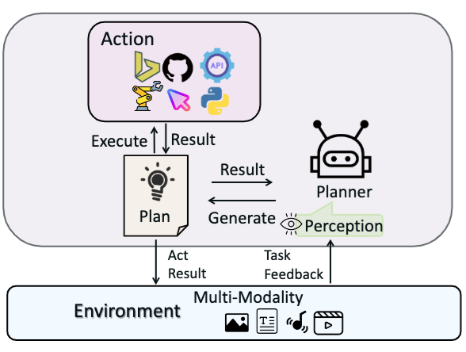
Large Multimodal Agents (LMAs)
(a) Type I: Closed-source LLMs as Planners w/o Longterm Memory.
Use prompt techniques to guide closed-source LLMs in decision-making
and planning to complete tasks without long memory.
Source: Xie, Junlin, Zhihong Chen, Ruifei Zhang, Xiang Wan, and Guanbin Li. "Large Multimodal Agents: A Survey." arXiv preprint arXiv:2402.15116 (2024).

Slide 77
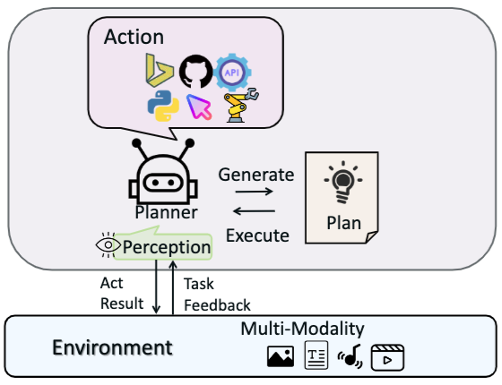
Large Multimodal Agents (LMAs)
(b) Type II: Finetuned LLMs as Planners w/o long-term Memory.
Use action-related data to finetune existing open-source large models,
enabling them to achieve decision-making, planning, and tool invocation capabilities comparable
to closed-source LLMs
Source: Xie, Junlin, Zhihong Chen, Ruifei Zhang, Xiang Wan, and Guanbin Li. "Large Multimodal Agents: A Survey." arXiv preprint arXiv:2402.15116 (2024).

Slide 78
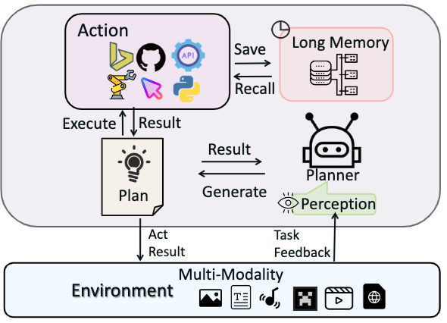
Large Multimodal Agents (LMAs)
(c) Type III: Planners with Indirect Long-term Memory
Introduce indirect
long-term memory functions,
further enhancing their generalization and adaptation abilities in environments closer to the real world.
Source: Xie, Junlin, Zhihong Chen, Ruifei Zhang, Xiang Wan, and Guanbin Li. "Large Multimodal Agents: A Survey." arXiv preprint arXiv:2402.15116 (2024).

Slide 79
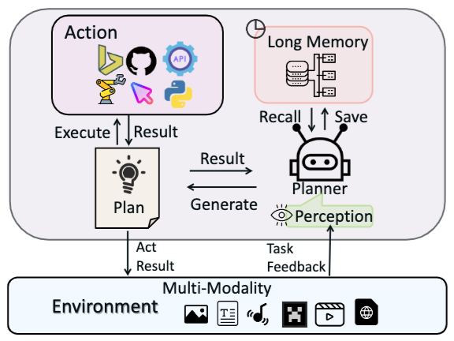
Large Multimodal Agents (LMAs)
(d) Type IV: Planners with Native Long-term Memory
Introduce native
long-term memory functions,
further enhancing their generalization and adaptation abilities in environments closer to the real world.
Source: Xie, Junlin, Zhihong Chen, Ruifei Zhang, Xiang Wan, and Guanbin Li. "Large Multimodal Agents: A Survey." arXiv preprint arXiv:2402.15116 (2024).

Slide 80
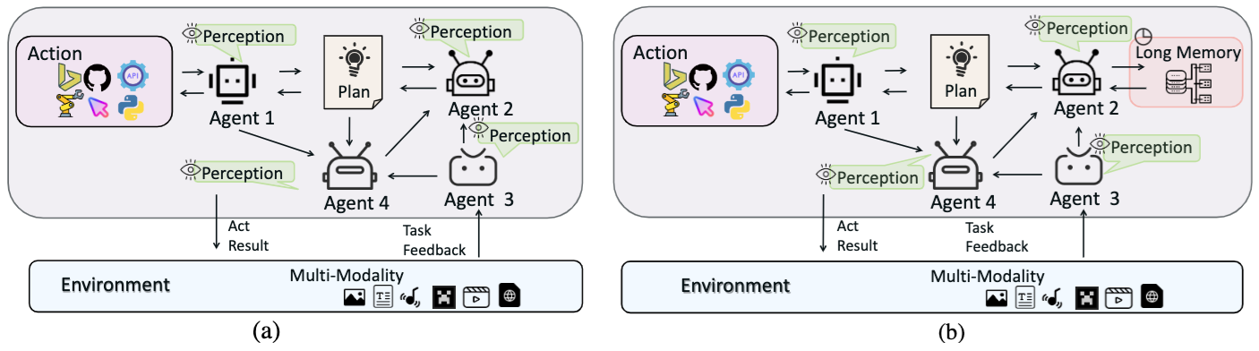
Multi-Agent Frameworks
Source: Xie, Junlin, Zhihong Chen, Ruifei Zhang, Xiang Wan, and Guanbin Li. "Large Multimodal Agents: A Survey." arXiv preprint arXiv:2402.15116 (2024).

Slide 81
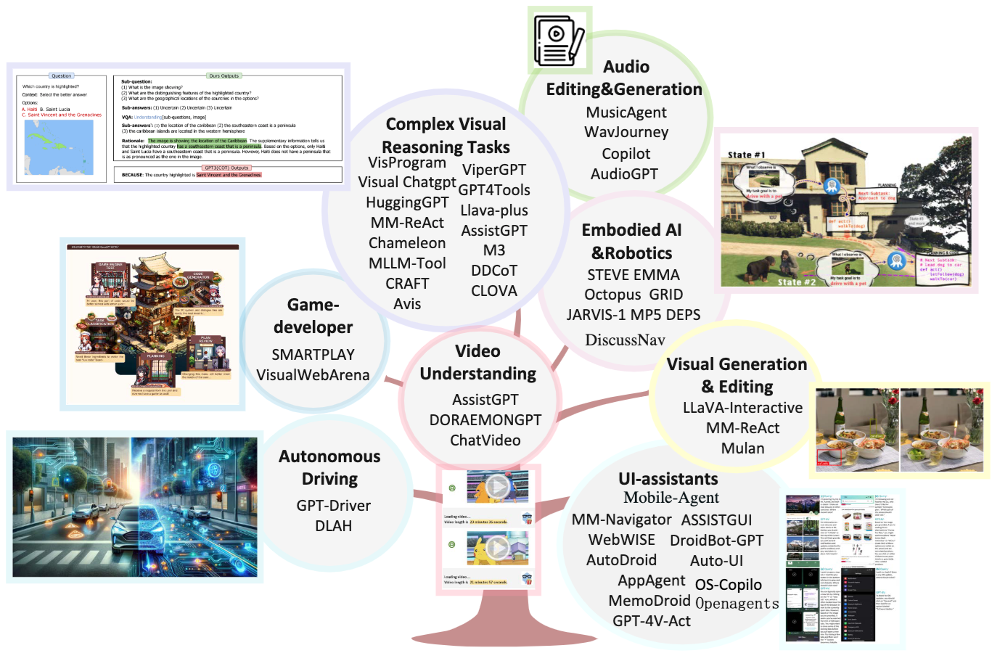
Applications of Large Multimodal Agents (LMAs)
Source: Xie, Junlin, Zhihong Chen, Ruifei Zhang, Xiang Wan, and Guanbin Li. "Large Multimodal Agents: A Survey." arXiv preprint arXiv:2402.15116 (2024).

Slide 82
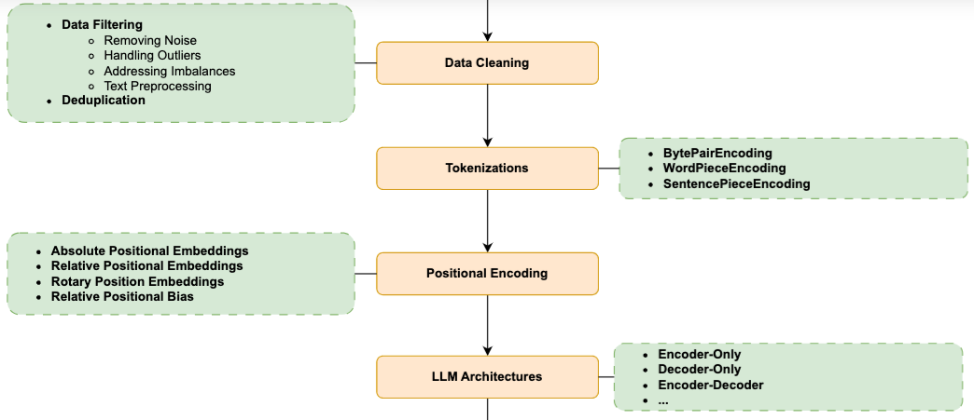
How LLMs Are Built?
1
2
3
4
Source: Minaee, Shervin, Tomas Mikolov, Narjes Nikzad, Meysam Chenaghlu, Richard Socher, Xavier Amatriain, and Jianfeng Gao. (2024) "Large language models: A survey." arXiv preprint arXiv:2402.06196 (2024).

Slide 83
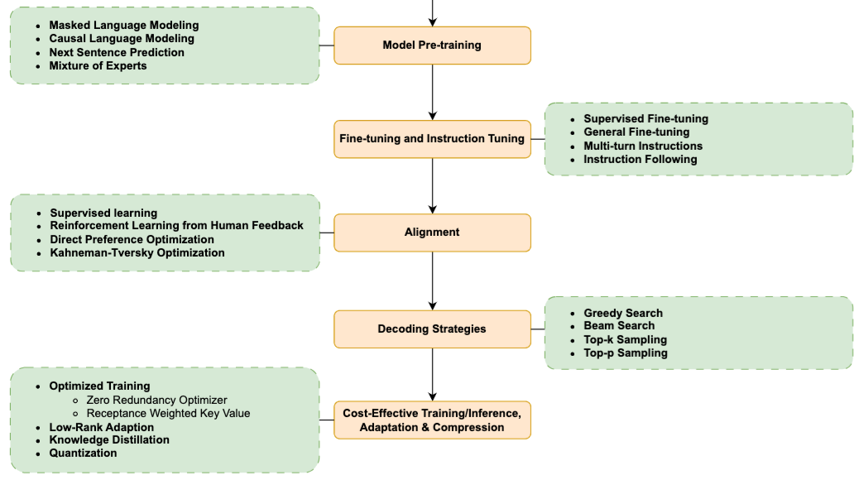
How LLMs Are Built?
5
6
7
8
9
Source: Minaee, Shervin, Tomas Mikolov, Narjes Nikzad, Meysam Chenaghlu, Richard Socher, Xavier Amatriain, and Jianfeng Gao. (2024) "Large language models: A survey." arXiv preprint arXiv:2402.06196 (2024).

Slide 84

How LLMs Are Used and Augmented
Source: Minaee, Shervin, Tomas Mikolov, Narjes Nikzad, Meysam Chenaghlu, Richard Socher, Xavier Amatriain, and Jianfeng Gao. (2024) "Large language models: A survey." arXiv preprint arXiv:2402.06196 (2024).

Slide 85

GPT Pretraining, and Fine-tuning Steps
Source: Minaee, Shervin, Tomas Mikolov, Narjes Nikzad, Meysam Chenaghlu, Richard Socher, Xavier Amatriain, and Jianfeng Gao. (2024) "Large language models: A survey." arXiv preprint arXiv:2402.06196 (2024).

Slide 86

Synthesizing RAG with LLMs for
Question Answering Application
Source: Minaee, Shervin, Tomas Mikolov, Narjes Nikzad, Meysam Chenaghlu, Richard Socher, Xavier Amatriain, and Jianfeng Gao. (2024) "Large language models: A survey." arXiv preprint arXiv:2402.06196 (2024).

Slide 87

Synthesizing the KG as a Retriever with LLMs
Source: Minaee, Shervin, Tomas Mikolov, Narjes Nikzad, Meysam Chenaghlu, Richard Socher, Xavier Amatriain, and Jianfeng Gao. (2024) "Large language models: A survey." arXiv preprint arXiv:2402.06196 (2024).

Slide 88

LLM-based Agent for
Conversational Information Seeking
Source: Minaee, Shervin, Tomas Mikolov, Narjes Nikzad, Meysam Chenaghlu, Richard Socher, Xavier Amatriain, and Jianfeng Gao. (2024) "Large language models: A survey." arXiv preprint arXiv:2402.06196 (2024).

Slide 89

Data Gathering and Pre-training for LLMs
Source: Linkon, Ahmed Ali, Mujiba Shaima, Md Shohail Uddin Sarker, Norun Nabi, Md Nasir Uddin Rana, Sandip Kumar Ghosh, Mohammad Anisur Rahman, Hammed Esa, and Faiaz Rahat Chowdhury (2024).
"Advancements and Applications of Generative Artificial Intelligence and Large Language Models on Business Management: A Comprehensive Review." Journal of Computer Science and Technology Studies 6, no. 1 (2024): 225-232.

Slide 90
Pre-train,
Prompt, and Predict:
Prompting Methods in Natural Language Processing
(LLMs)
Source: Pengfei Liu, Weizhe Yuan, Jinlan Fu, Zhengbao Jiang, Hiroaki Hayashi, and Graham Neubig. (2023) "Pre-train, prompt, and predict: A systematic survey of prompting methods in natural language processing." ACM Computing Surveys 55, no. 9 (2023): 1-35.

Slide 91

Instance Formatting and Two Different Methods for Constructing the
Instruction-formatted Instances
Source: Wayne Xin Zhao, Kun Zhou, Junyi Li, Tianyi Tang, Xiaolei Wang, Yupeng Hou, Yingqian Min et al. (2023) "A Survey of Large Language Models." arXiv preprint arXiv:2303.18223.

Slide 92

In-context Learning (ICL) and
Chain-of-thought (CoT) Prompting
Source: Wayne Xin Zhao, Kun Zhou, Junyi Li, Tianyi Tang, Xiaolei Wang, Yupeng Hou, Yingqian Min et al. (2023) "A Survey of Large Language Models." arXiv preprint arXiv:2303.18223.

Slide 93
Four Paradigms in NLP (LM)
Transfer Learning: Pre-training, Fine-Tuning (FT)
GAI: Pre-train, Prompt, and Predict (Prompting)
Source: Pengfei Liu, Weizhe Yuan, Jinlan Fu, Zhengbao Jiang, Hiroaki Hayashi, and Graham Neubig. (2023) "Pre-train, prompt, and predict: A systematic survey of prompting methods in natural language processing." ACM Computing Surveys 55, no. 9 (2023): 1-35.

Slide 94

Framework for Implementing Generative AI Services using RAG Model
Source: Jeong, Cheonsu. "A Study on the Implementation of Generative AI Services Using an Enterprise Data-Based LLM Application Architecture." arXiv preprint arXiv:2309.01105 (2023).

Slide 95

Maximizing LLM Performance
Source: OpenAI (2023), A Survey of Techniques for Maximizing LLM Performance, https://www.youtube.com/watch?v=ahnGLM-RC1Y

Slide 96

Prompt Engineering, Fine-tuning, and RAG
Source: https://www.entrypointai.com/blog/approaches-to-ai-prompt-engineering-embeddings-or-fine-tuning/

Slide 97

Typology of Prompting Methods
Source: Pengfei Liu, Weizhe Yuan, Jinlan Fu, Zhengbao Jiang, Hiroaki Hayashi, and Graham Neubig. (2023) "Pre-train, prompt, and predict: A systematic survey of prompting methods in natural language processing." ACM Computing Surveys 55, no. 9 (2023): 1-35.

Slide 98

Different Multi-Prompt Learning Strategies
Source: Pengfei Liu, Weizhe Yuan, Jinlan Fu, Zhengbao Jiang, Hiroaki Hayashi, and Graham Neubig. (2023) "Pre-train, prompt, and predict: A systematic survey of prompting methods in natural language processing." ACM Computing Surveys 55, no. 9 (2023): 1-35.

Slide 99

Examples of Input, Template, and Answer for Different Tasks
Source: Pengfei Liu, Weizhe Yuan, Jinlan Fu, Zhengbao Jiang, Hiroaki Hayashi, and Graham Neubig. (2023) "Pre-train, prompt, and predict: A systematic survey of prompting methods in natural language processing." ACM Computing Surveys 55, no. 9 (2023): 1-35.

Slide 100

Characteristics of Different Tuning Strategies
Source: Pengfei Liu, Weizhe Yuan, Jinlan Fu, Zhengbao Jiang, Hiroaki Hayashi, and Graham Neubig. (2023) "Pre-train, prompt, and predict: A systematic survey of prompting methods in natural language processing." ACM Computing Surveys 55, no. 9 (2023): 1-35.

Slide 101

Multi-prompt Learning for
Multi-task, Multi-domain, or Multi-lingual Learning
Source: Pengfei Liu, Weizhe Yuan, Jinlan Fu, Zhengbao Jiang, Hiroaki Hayashi, and Graham Neubig. (2023) "Pre-train, prompt, and predict: A systematic survey of prompting methods in natural language processing." ACM Computing Surveys 55, no. 9 (2023): 1-35.

Slide 102
GPT Prompt Engineering for
Question Answering
Find the answer to the question from the given context.
When the question cannot be answered with the given context, say "unanswerable".
Just say the answer without repeating the question.
Context: {context}
Question:{question}
Answer:

Slide 103
Prompts and QA Inference For FLAN T5
Question Answering
Prompts and QA Inference For FLAN T5, we follow [41] and use the following prompt:
Context: {context}\nQuestion: {question}\nAnswer:
Context: {context}
Question: {question}
Answer:

Slide 104
Prompt Engineering
Prompts For FLAN models
  Longpre, S., Hou, L., Vu, T., Webson, A., Chung, H. W., Tay, Y., ... & Roberts, A. (2023). The flan collection: Designing data and methods for effective instruction tuning. arXiv preprint arXiv:2301.13688.
MNLI, NLI-FEVER, VitaminC:
  "Premise: {premise}\n\nHypothesis: {hypothesis}\n\nDoes the premise entail the hypothesis?\n\nA yes\nB it is not possible to tell\nC no"
ANLI:
  "{context}\n\nBased on the paragraph above can we conclude that\"{hypothesis}\"?\n\nA Yes\nB It’s impossible to say\nC No"
SNLI:
  "If \"{premise}\", does this mean that \"{hypothesis}\"?\n\nA yes\nB it is not possible to tell\nC no"

Slide 105

Prompt Engineering with ChatGPT for NLP
Source: https://www.predera.com/blog/prompt-engineering-for-nlp-tasks

Slide 106

Hugging Face Tasks
Natural Language Processing
https://huggingface.co/tasks

Slide 107

Transformer (Attention is All You Need)
(Vaswani et al., 2017)
Source: Vaswani, Ashish, Noam Shazeer, Niki Parmar, Jakob Uszkoreit, Llion Jones, Aidan N. Gomez, Łukasz Kaiser, and Illia Polosukhin. "Attention is all you need." In Advances in neural information processing systems, pp. 5998-6008. 2017.

Slide 108

BERT: Pre-training of Deep Bidirectional Transformers for Language Understanding
BERT (Bidirectional Encoder Representations from Transformers)
Overall pre-training and fine-tuning procedures for BERT
Source: Devlin, Jacob, Ming-Wei Chang, Kenton Lee, and Kristina Toutanova (2018).
"Bert: Pre-training of deep bidirectional transformers for language understanding." arXiv preprint arXiv:1810.04805.

Slide 109

Fine-tuning BERT on Different Tasks
Source: Devlin, Jacob, Ming-Wei Chang, Kenton Lee, and Kristina Toutanova (2018).
"Bert: Pre-training of deep bidirectional transformers for language understanding." arXiv preprint arXiv:1810.04805.

Slide 110

Sentiment Analysis:
Single Sentence Classification
Source: Devlin, Jacob, Ming-Wei Chang, Kenton Lee, and Kristina Toutanova (2018).
"BERT: Pre-training of Deep Bidirectional Transformers for Language Understanding." arXiv preprint arXiv:1810.04805

Slide 111

Fine-tuning BERT on
Question Answering (QA)
Source: Devlin, Jacob, Ming-Wei Chang, Kenton Lee, and Kristina Toutanova (2018).
"Bert: Pre-training of deep bidirectional transformers for language understanding." arXiv preprint arXiv:1810.04805.

Slide 112

Fine-tuning BERT on Dialogue
Intent Detection (ID; Classification)
Source: Devlin, Jacob, Ming-Wei Chang, Kenton Lee, and Kristina Toutanova (2018).
"Bert: Pre-training of deep bidirectional transformers for language understanding." arXiv preprint arXiv:1810.04805.

Slide 113

Fine-tuning BERT on Dialogue
Slot Filling (SF)
Source: Devlin, Jacob, Ming-Wei Chang, Kenton Lee, and Kristina Toutanova (2018).
"Bert: Pre-training of deep bidirectional transformers for language understanding." arXiv preprint arXiv:1810.04805.

Slide 114

Task-Oriented Dialogue (ToD) System
Speech, Text, NLP
Source: Razumovskaia, Evgeniia, Goran Glavas, Olga Majewska, Edoardo M. Ponti, Anna Korhonen, and Ivan Vulic.
"Crossing the conversational chasm: A primer on natural language processing for multilingual task-oriented dialogue systems." Journal of Artificial Intelligence Research 74 (2022): 1351-1402.

Slide 115

Conversational AI to deliver contextual and personal experience to users
Source: Huynh-The, Thien, Quoc-Viet Pham, Xuan-Qui Pham, Thanh Thi Nguyen, Zhu Han, and Dong-Seong Kim (2022).
"Artificial Intelligence for the Metaverse: A Survey." arXiv preprint arXiv:2202.10336.

Slide 116
Fine-tuning LLM for
Dialogue System
Reinforcement Learning from
Human Feedback (RLHF)
ChatGPT:
Optimizing Language Models for Dialogue

Slide 117
Reinforcement Learning from Human Feedback (RLHF)

Slide 118

ChatGPT: Optimizing Language Models for Dialogue
Source: https://openai.com/blog/chatgpt/

Slide 119

Training language models to follow instructions with human feedback
InstructGPT and GPT 3.5
Source: Ouyang, L., Wu, J., Jiang, X., Almeida, D., Wainwright, C. L., Mishkin, P., ... & Lowe, R. (2022). Training language models to follow instructions with human feedback. arXiv preprint arXiv:2203.02155.

Slide 120
Reinforcement Learning from Human Feedback (RLHF)
Pretraining a Language Model (LM)
Gathering Data and Training a Reward Model
Fine-tuning the LM with Reinforcement Learning
Source: https://huggingface.co/blog/rlhf

Slide 121

Reinforcement Learning
from Human Feedback (RLHF)
Step 1. Pretraining a Language Model (LM)
Source: https://huggingface.co/blog/rlhf

Slide 122

Reinforcement Learning from Human Feedback (RLHF)
Step 2. Gathering Data and
Training a
Reward Model
Source: https://huggingface.co/blog/rlhf

Slide 123

Reinforcement Learning from Human Feedback (RLHF)
Step 3. Fine-tuning the LM with Reinforcement Learning
Source: https://huggingface.co/blog/rlhf

Slide 124

Llama-2-chat uses RLHF to ensure safety and helpfulness
Source: https://ai.meta.com/resources/models-and-libraries/llama/

Slide 125

QLoRA: Efficient Finetuning of Quantized LLMs
Source: Dettmers, Tim, Artidoro Pagnoni, Ari Holtzman, and Luke Zettlemoyer. "QLoRA: Efficient Finetuning of Quantized LLMs." arXiv preprint arXiv:2305.14314 (2023).

Slide 126

QLoRA: Efficient Finetuning of Quantized LLMs
QLoRA reduces the average memory requirements of finetuning a 65B parameter model from >780GB of GPU memory to <48GB
Source: Dettmers, Tim, Artidoro Pagnoni, Ari Holtzman, and Luke Zettlemoyer. "QLoRA: Efficient Finetuning of Quantized LLMs." arXiv preprint arXiv:2305.14314 (2023).

Slide 127

QLoRA: Efficient Finetuning of Quantized LLMs
Source: Dettmers, Tim, Artidoro Pagnoni, Ari Holtzman, and Luke Zettlemoyer. "QLoRA: Efficient Finetuning of Quantized LLMs." arXiv preprint arXiv:2305.14314 (2023).

Slide 128
Prompt Engineering with ChatGPT for NLP
Source: https://www.predera.com/blog/prompt-engineering-for-nlp-tasks

Slide 129

Generative AI
Tech Stack
Source: Matt Bornstein, Guido Appenzeller, and Martin Casado (2023), Who Owns the Generative AI Platform?, https://a16z.com/2023/01/19/who-owns-the-generative-ai-platform/

Slide 130

Generative AI Software and Business Factors
Source: Jay Alammar (2023), AI is Eating The World, https://txt.cohere.com/ai-is-eating-the-world/

Slide 131

Generative AI
1. Pre-training Foundation (Pre-trained) Model
2. Fine-turning Custom (Fine-tuned) Model
Source: Jay Alammar (2023), AI is Eating The World, https://txt.cohere.com/ai-is-eating-the-world/

Slide 132

Generative AI
Fine-tune Custom Models using Proprietary Data
Source: Jay Alammar (2023), AI is Eating The World, https://txt.cohere.com/ai-is-eating-the-world/

Slide 133

Generative AI
Fine-tune Custom Models using Proprietary Data
Source: Jay Alammar (2023), AI is Eating The World, https://txt.cohere.com/ai-is-eating-the-world/

Slide 134

Pipeline of Instruction Tuning LLMs
Source: Wang, Yidong, Zhuohao Yu, Zhengran Zeng, Linyi Yang, Cunxiang Wang, Hao Chen, Chaoya Jiang et al. "PandaLM: An Automatic Evaluation Benchmark for LLM Instruction Tuning Optimization." arXiv preprint arXiv:2306.05087 (2023).

Slide 135

Available Task Collections for Instruction Tuning
Source: Wayne Xin Zhao, Kun Zhou, Junyi Li, Tianyi Tang, Xiaolei Wang, Yupeng Hou, Yingqian Min et al. (2023) "A Survey of Large Language Models." arXiv preprint arXiv:2303.18223.

Slide 136
Instance Formatting and Two Different Methods for Constructing the
Instruction-formatted Instances
Source: Wayne Xin Zhao, Kun Zhou, Junyi Li, Tianyi Tang, Xiaolei Wang, Yupeng Hou, Yingqian Min et al. (2023) "A Survey of Large Language Models." arXiv preprint arXiv:2303.18223.

Slide 137
In-context Learning (ICL) and
Chain-of-thought (CoT) Prompting
Source: Wayne Xin Zhao, Kun Zhou, Junyi Li, Tianyi Tang, Xiaolei Wang, Yupeng Hou, Yingqian Min et al. (2023) "A Survey of Large Language Models." arXiv preprint arXiv:2303.18223.

Slide 138
Pre-train,
Prompt, and Predict:
Prompting Methods in Natural Language Processing
(LLMs)
Source: Pengfei Liu, Weizhe Yuan, Jinlan Fu, Zhengbao Jiang, Hiroaki Hayashi, and Graham Neubig. (2023) "Pre-train, prompt, and predict: A systematic survey of prompting methods in natural language processing." ACM Computing Surveys 55, no. 9 (2023): 1-35.

Slide 139
Four Paradigms in NLP
Source: Pengfei Liu, Weizhe Yuan, Jinlan Fu, Zhengbao Jiang, Hiroaki Hayashi, and Graham Neubig. (2023) "Pre-train, prompt, and predict: A systematic survey of prompting methods in natural language processing." ACM Computing Surveys 55, no. 9 (2023): 1-35.

Slide 140
Typology of Prompting Methods
Source: Pengfei Liu, Weizhe Yuan, Jinlan Fu, Zhengbao Jiang, Hiroaki Hayashi, and Graham Neubig. (2023) "Pre-train, prompt, and predict: A systematic survey of prompting methods in natural language processing." ACM Computing Surveys 55, no. 9 (2023): 1-35.

Slide 141
Different Multi-Prompt Learning Strategies
Source: Pengfei Liu, Weizhe Yuan, Jinlan Fu, Zhengbao Jiang, Hiroaki Hayashi, and Graham Neubig. (2023) "Pre-train, prompt, and predict: A systematic survey of prompting methods in natural language processing." ACM Computing Surveys 55, no. 9 (2023): 1-35.

Slide 142
Examples of Input, Template, and Answer for Different Tasks
Source: Pengfei Liu, Weizhe Yuan, Jinlan Fu, Zhengbao Jiang, Hiroaki Hayashi, and Graham Neubig. (2023) "Pre-train, prompt, and predict: A systematic survey of prompting methods in natural language processing." ACM Computing Surveys 55, no. 9 (2023): 1-35.

Slide 143
Characteristics of Different Tuning Strategies
Source: Pengfei Liu, Weizhe Yuan, Jinlan Fu, Zhengbao Jiang, Hiroaki Hayashi, and Graham Neubig. (2023) "Pre-train, prompt, and predict: A systematic survey of prompting methods in natural language processing." ACM Computing Surveys 55, no. 9 (2023): 1-35.

Slide 144
Multi-prompt Learning for
Multi-task, Multi-domain, or Multi-lingual Learning
Source: Pengfei Liu, Weizhe Yuan, Jinlan Fu, Zhengbao Jiang, Hiroaki Hayashi, and Graham Neubig. (2023) "Pre-train, prompt, and predict: A systematic survey of prompting methods in natural language processing." ACM Computing Surveys 55, no. 9 (2023): 1-35.

Slide 145
Prompt Engineering
Prompts For FLAN models
  Longpre, S., Hou, L., Vu, T., Webson, A., Chung, H. W., Tay, Y., ... & Roberts, A. (2023). The flan collection: Designing data and methods for effective instruction tuning. arXiv preprint arXiv:2301.13688.
MNLI, NLI-FEVER, VitaminC:
  "Premise: {premise}\n\nHypothesis: {hypothesis}\n\nDoes the premise entail the hypothesis?\n\nA yes\nB it is not possible to tell\nC no"
ANLI:
  "{context}\n\nBased on the paragraph above can we conclude that\"{hypothesis}\"?\n\nA Yes\nB It’s impossible to say\nC No"
SNLI:
  "If \"{premise}\", does this mean that \"{hypothesis}\"?\n\nA yes\nB it is not possible to tell\nC no"

Slide 146
Framework for Implementing Generative AI Services using RAG Model
Source: Jeong, Cheonsu. "A Study on the Implementation of Generative AI Services Using an Enterprise Data-Based LLM Application Architecture." arXiv preprint arXiv:2309.01105 (2023).

Slide 147

Factuality Enhancement of
Large Language Models (LLMs)
Source: Wang, Cunxiang, Xiaoze Liu, Yuanhao Yue, Xiangru Tang, Tianhang Zhang, Cheng Jiayang, Yunzhi Yao et al. "Survey on factuality in large language models: Knowledge, retrieval and domain-specificity."
arXiv preprint arXiv:2310.07521 (2023).

Slide 148
Large Language Model (LLM) based Agents
Source: Xi, Z., Chen, W., Guo, X., He, W., Ding, Y., Hong, B., ... & Gui, T. (2023). The rise and potential of large language model based agents: A survey. arXiv preprint arXiv:2309.07864.

Slide 149

LLM-based Agents
Source: Cheng, Yuheng, Ceyao Zhang, Zhengwen Zhang, Xiangrui Meng, Sirui Hong, Wenhao Li, Zihao Wang et al. "Exploring large language model based intelligent agents: Definitions, methods, and prospects." arXiv preprint arXiv:2401.03428 (2024).

Slide 150

Large Multimodal Agents (LMA)
Source: Xie, J., Chen, Z., Zhang, R., Wan, X., & Li, G. (2024). Large Multimodal Agents: A Survey. ArXiv, abs/2402.15116.

Slide 151

Large Multimodal Agents (LMA)
Source: Xie, J., Chen, Z., Zhang, R., Wan, X., & Li, G. (2024). Large Multimodal Agents: A Survey. ArXiv, abs/2402.15116.

Slide 152
NLP
Source: http://blog.aylien.com/leveraging-deep-learning-for-multilingual/

Slide 153

Modern NLP Pipeline
Source: https://github.com/fortiema/talks/blob/master/opendata2016sh/pragmatic-nlp-opendata2016sh.pdf

Slide 154
Modern NLP Pipeline
Source: http://mattfortier.me/2017/01/31/nlp-intro-pt-1-overview/

Slide 155
Deep Learning NLP
Source: http://mattfortier.me/2017/01/31/nlp-intro-pt-1-overview/

Slide 156
Natural Language Processing (NLP) and Text Mining
Raw text
Sentence Segmentation
Tokenization
Part-of-Speech (POS)
Stop word removal
word’s stem
am → am
having → hav
word’s lemma
am → be
having → have
Stemming / Lemmatization
Dependency Parser
String Metrics & Matching
Source: Nitin Hardeniya (2015), NLTK Essentials, Packt Publishing; Florian Leitner (2015), Text mining - from Bayes rule to dependency parsing

Slide 157
Outline
Word Embeddings
Recurrent Neural Networks for NLP
Sequence-to-Sequence Models
The Transformer Architecture
Pretraining and Transfer Learning
State of the art (SOTA)

Slide 158
One-hot encoding
'The mouse ran up the clock’ =
[ [0, 1, 0, 0, 0, 0, 0],
[0, 0, 1, 0, 0, 0, 0],
[0, 0, 0, 1, 0, 0, 0],
[0, 0, 0, 0, 1, 0, 0],
[0, 1, 0, 0, 0, 0, 0],
[0, 0, 0, 0, 0, 1, 0] ]
The
mouse
ran
up
the
clock
1
2
3
4
1
5
[0, 1, 2, 3, 4, 5, 6]
Source: https://developers.google.com/machine-learning/guides/text-classification/step-3

Slide 159

Word embedding
GloVe (trained on 6 billion words of text)
100-dimensional word vectors are projected down onto two dimensions
Source: Stuart Russell and Peter Norvig (2020), Artificial Intelligence: A Modern Approach, 4th Edition, Pearson

Slide 160

Word Embedding model answer the question “A is to B as C is to [what]?”
Source: Stuart Russell and Peter Norvig (2020), Artificial Intelligence: A Modern Approach, 4th Edition, Pearson

Slide 161

Word embeddings
Source: https://developers.google.com/machine-learning/guides/text-classification/step-3

Slide 162

Word embeddings
Source: https://developers.google.com/machine-learning/guides/text-classification/step-3

Slide 163

Feedforward part-of-speech (POS) tagging model
Source: Stuart Russell and Peter Norvig (2020), Artificial Intelligence: A Modern Approach, 4th Edition, Pearson

Slide 164
Universal Sentence Encoder (USE)
The Universal Sentence Encoder
encodes text into high-dimensional vectors that can be used for
text classification,
semantic similarity,
clustering and
other natural language tasks.
The universal-sentence-encoder model is trained with a deep averaging network (DAN) encoder.
Source: https://tfhub.dev/google/universal-sentence-encoder/4

Slide 165

Universal Sentence Encoder (USE)
Semantic Similarity
Source: https://tfhub.dev/google/universal-sentence-encoder/4

Slide 166

Universal Sentence Encoder (USE)
Classification
Source: https://tfhub.dev/google/universal-sentence-encoder/4

Slide 167

Universal Sentence Encoder (USE)
Source: Daniel Cer, Yinfei Yang, Sheng-yi Kong, Nan Hua, Nicole Limtiaco, Rhomni St. John, Noah Constant, Mario Guajardo-Céspedes, Steve Yuan, Chris Tar, Yun-Hsuan Sung, Brian Strope, Ray Kurzweil. Universal Sentence Encoder. arXiv:1803.11175, 2018.

Slide 168

Multilingual
Universal Sentence Encoder (MUSE)
Source: Yinfei Yang, Daniel Cer, Amin Ahmad, Mandy Guo, Jax Law, Noah Constant, Gustavo Hernandez Abrego , Steve Yuan, Chris Tar, Yun-hsuan Sung, Ray Kurzweil. Multilingual Universal Sentence Encoder for Semantic Retrieval. July 2019

Slide 169

Python in Google Colab (Python101)
https://colab.research.google.com/drive/1FEG6DnGvwfUbeo4zJ1zTunjMqf2RkCrT
https://tinyurl.com/aintpupython101

Slide 170

Python in Google Colab (Python101)
https://colab.research.google.com/drive/1FEG6DnGvwfUbeo4zJ1zTunjMqf2RkCrT
https://tinyurl.com/aintpupython101

Slide 171
Outline
Word Embeddings
Recurrent Neural Networks for NLP
Sequence-to-Sequence Models
The Transformer Architecture
Pretraining and Transfer Learning
State of the art (SOTA)

Slide 172

RNN
Source: Stuart Russell and Peter Norvig (2020), Artificial Intelligence: A Modern Approach, 4th Edition, Pearson

Slide 173

Bidirectional RNN network for POS tagging
Source: Stuart Russell and Peter Norvig (2020), Artificial Intelligence: A Modern Approach, 4th Edition, Pearson

Slide 174

LSTM Recurrent Neural Network
Traditional Neural Network
Music
Generation
Sentiment
Classification
Name
Entity
Recognition
Machine
Translation
Source: https://github.com/Vict0rSch/deep_learning/tree/master/keras/recurrent

Slide 175
Outline
Word Embeddings
Recurrent Neural Networks for NLP
Sequence-to-Sequence Models
The Transformer Architecture
Pretraining and Transfer Learning
State of the art (SOTA)

Slide 176

Sequence-to-Sequence model
Source: Stuart Russell and Peter Norvig (2020), Artificial Intelligence: A Modern Approach, 4th Edition, Pearson

Slide 177

Attentional Sequence-to-Sequence model for English-to-Spanish translation
Source: Stuart Russell and Peter Norvig (2020), Artificial Intelligence: A Modern Approach, 4th Edition, Pearson

Slide 178
The Sequence to Sequence model (seq2seq)
Source: http://suriyadeepan.github.io/2016-12-31-practical-seq2seq/

Slide 179
Sequence to Sequence
(Seq2Seq)
Source: https://google.github.io/seq2seq/

Slide 180
Outline
Word Embeddings
Recurrent Neural Networks for NLP
Sequence-to-Sequence Models
The Transformer Architecture
Pretraining and Transfer Learning
State of the art (SOTA)

Slide 181

Single-layer Transformer consists of self-attention, a feedforward network, and residual connection
Source: Stuart Russell and Peter Norvig (2020), Artificial Intelligence: A Modern Approach, 4th Edition, Pearson

Slide 182

Transformer Architecture for POS Tagging
Source: Stuart Russell and Peter Norvig (2020), Artificial Intelligence: A Modern Approach, 4th Edition, Pearson

Slide 183
Transformer (Attention is All You Need)
(Vaswani et al., 2017)
Source: Vaswani, Ashish, Noam Shazeer, Niki Parmar, Jakob Uszkoreit, Llion Jones, Aidan N. Gomez, Łukasz Kaiser, and Illia Polosukhin. "Attention is all you need." In Advances in neural information processing systems, pp. 5998-6008. 2017.

Slide 184

Transformer
Source: Jay Alammar (2019), The Illustrated Transformer, http://jalammar.github.io/illustrated-transformer/

Slide 185

Transformer
Encoder Decoder
Source: Jay Alammar (2019), The Illustrated Transformer, http://jalammar.github.io/illustrated-transformer/

Slide 186

Transformer
Encoder Decoder Stack
Source: Jay Alammar (2019), The Illustrated Transformer, http://jalammar.github.io/illustrated-transformer/

Slide 187

Transformer
Encoder Self-Attention
Source: Jay Alammar (2019), The Illustrated Transformer, http://jalammar.github.io/illustrated-transformer/

Slide 188

Transformer
Decoder
Source: Jay Alammar (2019), The Illustrated Transformer, http://jalammar.github.io/illustrated-transformer/

Slide 189

Transformer
Encoder with Tensors
Word Embeddings
Source: Jay Alammar (2019), The Illustrated Transformer, http://jalammar.github.io/illustrated-transformer/

Slide 190

Transformer
Self-Attention Visualization
Source: Jay Alammar (2019), The Illustrated Transformer, http://jalammar.github.io/illustrated-transformer/

Slide 191

Transformer
Positional Encoding Vectors
Source: Jay Alammar (2019), The Illustrated Transformer, http://jalammar.github.io/illustrated-transformer/

Slide 192

Transformer
Self-Attention Softmax Output
Source: Jay Alammar (2019), The Illustrated Transformer, http://jalammar.github.io/illustrated-transformer/

Slide 193
Outline
Word Embeddings
Recurrent Neural Networks for NLP
Sequence-to-Sequence Models
The Transformer Architecture
Pretraining and Transfer Learning
State of the art (SOTA)

Slide 194

Training Contextual Representations using a left-to-right Language Model
Source: Stuart Russell and Peter Norvig (2020), Artificial Intelligence: A Modern Approach, 4th Edition, Pearson

Slide 195

Masked Language Modeling:
Pretrain a Bidirectional Model
Source: Stuart Russell and Peter Norvig (2020), Artificial Intelligence: A Modern Approach, 4th Edition, Pearson

Slide 196

Illustrated BERT
Source: Jay Alammar (2019), The Illustrated BERT, ELMo, and co. (How NLP Cracked Transfer Learning), http://jalammar.github.io/illustrated-bert/

Slide 197

BERT Classification Input Output
Source: Jay Alammar (2019), The Illustrated BERT, ELMo, and co. (How NLP Cracked Transfer Learning), http://jalammar.github.io/illustrated-bert/

Slide 198

BERT Encoder Input
Source: Jay Alammar (2019), The Illustrated BERT, ELMo, and co. (How NLP Cracked Transfer Learning), http://jalammar.github.io/illustrated-bert/

Slide 199

BERT Classifier
Source: Jay Alammar (2019), The Illustrated BERT, ELMo, and co. (How NLP Cracked Transfer Learning), http://jalammar.github.io/illustrated-bert/

Slide 200
Sentiment Analysis:
Single Sentence Classification
Source: Devlin, Jacob, Ming-Wei Chang, Kenton Lee, and Kristina Toutanova (2018).
"BERT: Pre-training of Deep Bidirectional Transformers for Language Understanding." arXiv preprint arXiv:1810.04805

Slide 201

A Visual Guide to
Using BERT for the First Time
(Jay Alammar, 2019)
Source: Jay Alammar (2019), A Visual Guide to Using BERT for the First Time,
http://jalammar.github.io/a-visual-guide-to-using-bert-for-the-first-time/

Slide 202
Sentiment Classification: SST2
Sentences from movie reviews
sentence | label
a stirring , funny and finally transporting re imagining of beauty and the beast and 1930s horror films | 1
apparently reassembled from the cutting room floor of any given daytime soap | 0
they presume their audience won't sit still for a sociology lesson | 0
this is a visually stunning rumination on love , memory , history and the war between art and commerce | 1
jonathan parker 's bartleby should have been the be all end all of the modern office anomie films | 1
Source: Jay Alammar (2019), A Visual Guide to Using BERT for the First Time,
http://jalammar.github.io/a-visual-guide-to-using-bert-for-the-first-time/

Slide 203

Movie Review Sentiment Classifier
Source: Jay Alammar (2019), A Visual Guide to Using BERT for the First Time,
http://jalammar.github.io/a-visual-guide-to-using-bert-for-the-first-time/

Slide 204

Movie Review Sentiment Classifier
Source: Jay Alammar (2019), A Visual Guide to Using BERT for the First Time,
http://jalammar.github.io/a-visual-guide-to-using-bert-for-the-first-time/

Slide 205

Movie Review Sentiment Classifier
Model Training
Source: Jay Alammar (2019), A Visual Guide to Using BERT for the First Time,
http://jalammar.github.io/a-visual-guide-to-using-bert-for-the-first-time/

Slide 206

Step # 1 Use distilBERT to Generate Sentence Embeddings
Source: Jay Alammar (2019), A Visual Guide to Using BERT for the First Time,
http://jalammar.github.io/a-visual-guide-to-using-bert-for-the-first-time/

Slide 207

Step #2:Test/Train Split for
Model #2, Logistic Regression
Source: Jay Alammar (2019), A Visual Guide to Using BERT for the First Time,
http://jalammar.github.io/a-visual-guide-to-using-bert-for-the-first-time/

Slide 208

Step #3 Train the logistic regression model using the training set
Source: Jay Alammar (2019), A Visual Guide to Using BERT for the First Time,
http://jalammar.github.io/a-visual-guide-to-using-bert-for-the-first-time/

Slide 209

Tokenization
[CLS] a visually stunning rum ##ination on love [SEP]
a visually stunning rumination on love
Source: Jay Alammar (2019), A Visual Guide to Using BERT for the First Time,
http://jalammar.github.io/a-visual-guide-to-using-bert-for-the-first-time/

Slide 210

Tokenization
tokenizer.encode("a visually stunning rumination on love", add_special_tokens=True)
Source: Jay Alammar (2019), A Visual Guide to Using BERT for the First Time,
http://jalammar.github.io/a-visual-guide-to-using-bert-for-the-first-time/

Slide 211

Tokenization for BERT Model
Source: Jay Alammar (2019), A Visual Guide to Using BERT for the First Time,
http://jalammar.github.io/a-visual-guide-to-using-bert-for-the-first-time/

Slide 212

Flowing Through DistilBERT
(768 features)
Source: Jay Alammar (2019), A Visual Guide to Using BERT for the First Time,
http://jalammar.github.io/a-visual-guide-to-using-bert-for-the-first-time/

Slide 213

Model #1 Output Class vector as
Model #2 Input
Source: Jay Alammar (2019), A Visual Guide to Using BERT for the First Time,
http://jalammar.github.io/a-visual-guide-to-using-bert-for-the-first-time/

Slide 214

Fine-tuning BERT on
Single Sentence Classification Tasks
Source: Devlin, Jacob, Ming-Wei Chang, Kenton Lee, and Kristina Toutanova (2018).
"Bert: Pre-training of deep bidirectional transformers for language understanding." arXiv preprint arXiv:1810.04805.

Slide 215

Model #1 Output Class vector as
Model #2 Input
Source: Jay Alammar (2019), A Visual Guide to Using BERT for the First Time,
http://jalammar.github.io/a-visual-guide-to-using-bert-for-the-first-time/

Slide 216

Logistic Regression Model to classify Class vector
Source: Jay Alammar (2019), A Visual Guide to Using BERT for the First Time,
http://jalammar.github.io/a-visual-guide-to-using-bert-for-the-first-time/

Slide 217

df = pd.read_csv('https://github.com/clairett/pytorch-sentiment-classification/raw/master/data/SST2/train.tsv', delimiter='\t', header=None)
df.head()
Source: Jay Alammar (2019), A Visual Guide to Using BERT for the First Time,
http://jalammar.github.io/a-visual-guide-to-using-bert-for-the-first-time/

Slide 218

Tokenization
tokenized = df[0].apply((lambda x: tokenizer.encode(x, add_special_tokens=True)))
Source: Jay Alammar (2019), A Visual Guide to Using BERT for the First Time,
http://jalammar.github.io/a-visual-guide-to-using-bert-for-the-first-time/

Slide 219

BERT Input Tensor
Source: Jay Alammar (2019), A Visual Guide to Using BERT for the First Time,
http://jalammar.github.io/a-visual-guide-to-using-bert-for-the-first-time/

Slide 220

Processing with DistilBERT
input_ids = torch.tensor(np.array(padded))
last_hidden_states = model(input_ids)
Source: Jay Alammar (2019), A Visual Guide to Using BERT for the First Time,
http://jalammar.github.io/a-visual-guide-to-using-bert-for-the-first-time/

Slide 221

Unpacking the BERT output tensor
Source: Jay Alammar (2019), A Visual Guide to Using BERT for the First Time,
http://jalammar.github.io/a-visual-guide-to-using-bert-for-the-first-time/

Slide 222

Sentence to last_hidden_state[0]
Source: Jay Alammar (2019), A Visual Guide to Using BERT for the First Time,
http://jalammar.github.io/a-visual-guide-to-using-bert-for-the-first-time/

Slide 223

BERT’s output for the [CLS] tokens
# Slice the output for the first position for all the sequences, take all hidden unit outputs
features = last_hidden_states[0][:,0,:].numpy()
Source: Jay Alammar (2019), A Visual Guide to Using BERT for the First Time,
http://jalammar.github.io/a-visual-guide-to-using-bert-for-the-first-time/

Slide 224

The tensor sliced from BERT's output
Sentence Embeddings
Source: Jay Alammar (2019), A Visual Guide to Using BERT for the First Time,
http://jalammar.github.io/a-visual-guide-to-using-bert-for-the-first-time/

Slide 225

Dataset for Logistic Regression
(768 Features)
The features are the output vectors of BERT for the [CLS] token (position #0)
Source: Jay Alammar (2019), A Visual Guide to Using BERT for the First Time,
http://jalammar.github.io/a-visual-guide-to-using-bert-for-the-first-time/

Slide 226

labels = df[1]
train_features, test_features, train_labels, test_labels = train_test_split(features, labels)
Source: Jay Alammar (2019), A Visual Guide to Using BERT for the First Time,
http://jalammar.github.io/a-visual-guide-to-using-bert-for-the-first-time/

Slide 227
Score Benchmarks
Logistic Regression Model on SST-2 Dataset
# Training
lr_clf = LogisticRegression()
lr_clf.fit(train_features, train_labels)
#Testing
lr_clf.score(test_features, test_labels)
# Accuracy: 81%
# Highest accuracy: 96.8%
# Fine-tuned DistilBERT: 90.7%
# Full size BERT model: 94.9%
Source: Jay Alammar (2019), A Visual Guide to Using BERT for the First Time,
http://jalammar.github.io/a-visual-guide-to-using-bert-for-the-first-time/

Slide 228
Sentiment Classification: SST2
Sentences from movie reviews
sentence | label
a stirring , funny and finally transporting re imagining of beauty and the beast and 1930s horror films | 1
apparently reassembled from the cutting room floor of any given daytime soap | 0
they presume their audience won't sit still for a sociology lesson | 0
this is a visually stunning rumination on love , memory , history and the war between art and commerce | 1
jonathan parker 's bartleby should have been the be all end all of the modern office anomie films | 1
Source: Jay Alammar (2019), A Visual Guide to Using BERT for the First Time,
http://jalammar.github.io/a-visual-guide-to-using-bert-for-the-first-time/

Slide 229

A Visual Notebook to
Using BERT for the First Time
https://colab.research.google.com/github/jalammar/jalammar.github.io/blob/master/notebooks/bert/A_Visual_Notebook_to_Using_BERT_for_the_First_Time.ipynb

Slide 230
Outline
Word Embeddings
Recurrent Neural Networks for NLP
Sequence-to-Sequence Models
The Transformer Architecture
Pretraining and Transfer Learning
State of the art (SOTA)

Slide 231
LMSYS Chatbot Arena Leaderboard
GPT-4o
Claude 3.5
https://lmarena.ai/

Slide 232
Large Language Models (LLMs)
Artificial Analysis Quality Index
Source: https://artificialanalysis.ai/

Slide 233
NLP with Transformers Github Notebooks
https://github.com/nlp-with-transformers/notebooks

Slide 234
Hugging Face Tasks
Natural Language Processing
https://huggingface.co/tasks

Slide 235

Python in Google Colab (Python101)
https://colab.research.google.com/drive/1FEG6DnGvwfUbeo4zJ1zTunjMqf2RkCrT
NLP with Transformers
https://tinyurl.com/aintpupython101

Slide 236
NLP with Transformers
!git clone https://github.com/nlp-with-transformers/notebooks.git
%cd notebooks
from install import *
install_requirements()
from utils import *
setup_chapter()
Source: Lewis Tunstall, Leandro von Werra, and Thomas Wolf (2022), Natural Language Processing with Transformers: Building Language Applications with Hugging Face, O'Reilly Media.
https://github.com/nlp-with-transformers/notebooks

Slide 237
Text Classification
text = """Dear Amazon, last week I ordered an Optimus Prime action figure \
from your online store in Germany. Unfortunately, when I opened the package, \
I discovered to my horror that I had been sent an action figure of Megatron \
instead! As a lifelong enemy of the Decepticons, I hope you can understand my \
dilemma. To resolve the issue, I demand an exchange of Megatron for the \
Optimus Prime figure I ordered. Enclosed are copies of my records concerning \
this purchase. I expect to hear from you soon. Sincerely, Bumblebee."""
Source: Lewis Tunstall, Leandro von Werra, and Thomas Wolf (2022), Natural Language Processing with Transformers: Building Language Applications with Hugging Face, O'Reilly Media.
https://github.com/nlp-with-transformers/notebooks

Slide 238
Text Classification
text = """Dear Amazon, last week I ordered an Optimus Prime action figure \
from your online store in Germany. Unfortunately, when I opened the package, \
I discovered to my horror that I had been sent an action figure of Megatron \
instead! As a lifelong enemy of the Decepticons, I hope you can understand my \
dilemma. To resolve the issue, I demand an exchange of Megatron for the \
Optimus Prime figure I ordered. Enclosed are copies of my records concerning \
this purchase. I expect to hear from you soon. Sincerely, Bumblebee."""
from transformers import pipeline
classifier = pipeline("text-classification")
import pandas as pd
outputs = classifier(text)
pd.DataFrame(outputs)
 | label | score
0 | NEGATIVE | 0.901546
Source: Lewis Tunstall, Leandro von Werra, and Thomas Wolf (2022), Natural Language Processing with Transformers: Building Language Applications with Hugging Face, O'Reilly Media.
https://github.com/nlp-with-transformers/notebooks

Slide 239
Text Classification
from transformers import pipeline
classifier = pipeline("text-classification")
import pandas as pd
outputs = classifier(text)
pd.DataFrame(outputs)
 | label | score
0 | NEGATIVE | 0.901546
Source: Lewis Tunstall, Leandro von Werra, and Thomas Wolf (2022), Natural Language Processing with Transformers: Building Language Applications with Hugging Face, O'Reilly Media.
https://github.com/nlp-with-transformers/notebooks

Slide 240

Named Entity Recognition
ner_tagger = pipeline("ner", aggregation_strategy="simple")
outputs = ner_tagger(text)
pd.DataFrame(outputs)
Source: Lewis Tunstall, Leandro von Werra, and Thomas Wolf (2022), Natural Language Processing with Transformers: Building Language Applications with Hugging Face, O'Reilly Media.
https://github.com/nlp-with-transformers/notebooks

Slide 241
Question Answering
reader = pipeline("question-answering")
question = "What does the customer want?"
outputs = reader(question=question, context=text)
pd.DataFrame([outputs])
 | score | start | end | answer
0 | 0.631292 | 335 | 358 | an exchange of Megatron
Source: Lewis Tunstall, Leandro von Werra, and Thomas Wolf (2022), Natural Language Processing with Transformers: Building Language Applications with Hugging Face, O'Reilly Media.
https://github.com/nlp-with-transformers/notebooks

Slide 242
Summarization
summarizer = pipeline("summarization")
outputs = summarizer(text, max_length=45, clean_up_tokenization_spaces=True)
print(outputs[0]['summary_text'])
Bumblebee ordered an Optimus Prime action figure from your online store in Germany. Unfortunately, when I opened the package, I discovered to my horror that I had been sent an action figure of Megatron instead.
Source: Lewis Tunstall, Leandro von Werra, and Thomas Wolf (2022), Natural Language Processing with Transformers: Building Language Applications with Hugging Face, O'Reilly Media.
https://github.com/nlp-with-transformers/notebooks

Slide 243
Text Summarization
text = """Dear Amazon, last week I ordered an Optimus Prime action figure \
from your online store in Germany. Unfortunately, when I opened the package, \
I discovered to my horror that I had been sent an action figure of Megatron \
instead! As a lifelong enemy of the Decepticons, I hope you can understand my \
dilemma. To resolve the issue, I demand an exchange of Megatron for the \
Optimus Prime figure I ordered. Enclosed are copies of my records concerning \
this purchase. I expect to hear from you soon. Sincerely, Bumblebee."""
from transformers import pipeline
summarizer = pipeline("summarization")
outputs = summarizer(text, max_length=45, clean_up_tokenization_spaces=True)
print(outputs[0]['summary_text'])
Bumblebee ordered an Optimus Prime action figure from your online store in Germany. Unfortunately, when I opened the package, I discovered to my horror that I had been sent an action figure of Megatron instead.
https://tinyurl.com/aintpupython101

Slide 244
Translation
translator = pipeline("translation_en_to_de",
model="Helsinki-NLP/opus-mt-en-de")
outputs = translator(text, clean_up_tokenization_spaces=True, min_length=100)
print(outputs[0]['translation_text'])
Sehr geehrter Amazon, letzte Woche habe ich eine Optimus Prime Action Figur aus Ihrem Online-Shop in Deutschland bestellt. Leider, als ich das Paket öffnete, entdeckte ich zu meinem Entsetzen, dass ich stattdessen eine Action Figur von Megatron geschickt worden war! Als lebenslanger Feind der Decepticons, Ich hoffe, Sie können mein Dilemma verstehen. Um das Problem zu lösen, Ich fordere einen Austausch von Megatron für die Optimus Prime Figur habe ich bestellt. Anbei sind Kopien meiner Aufzeichnungen über diesen Kauf. Ich erwarte, bald von Ihnen zu hören. Aufrichtig, Bumblebee.
Source: Lewis Tunstall, Leandro von Werra, and Thomas Wolf (2022), Natural Language Processing with Transformers: Building Language Applications with Hugging Face, O'Reilly Media.
https://github.com/nlp-with-transformers/notebooks

Slide 245
Text Generation
from transformers import set_seed
set_seed(42) # Set the seed to get reproducible results
generator = pipeline("text-generation")
response = "Dear Bumblebee, I am sorry to hear that your order was mixed up."
prompt = text + "\n\nCustomer service response:\n" + response
outputs = generator(prompt, max_length=200)
print(outputs[0]['generated_text'])
Customer service response:
Dear Bumblebee, I am sorry to hear that your order was mixed up. The order was completely mislabeled, which is very common in our online store, but I can appreciate it because it was my understanding from this site and our customer service of the previous day that your order was not made correct in our mind and that we are in a process of resolving this matter. We can assure you that your order
Source: Lewis Tunstall, Leandro von Werra, and Thomas Wolf (2022), Natural Language Processing with Transformers: Building Language Applications with Hugging Face, O'Reilly Media.
https://github.com/nlp-with-transformers/notebooks

Slide 246
Text Generation
Dear Amazon, last week I ordered an Optimus Prime action figure from your online store in Germany. Unfortunately, when I opened the package, I discovered to my horror that I had been sent an action figure of Megatron instead! As a lifelong enemy of the Decepticons, I hope you can understand my dilemma. To resolve the issue, I demand an exchange of Megatron for the Optimus Prime figure I ordered. Enclosed are copies of my records concerning this purchase. I expect to hear from you soon. Sincerely, Bumblebee.
Customer service response:
Dear Bumblebee, I am sorry to hear that your order was mixed up. The order was completely mislabeled, which is very common in our online store, but I can appreciate it because it was my understanding from this site and our customer service of the previous day that your order was not made correct in our mind and that we are in a process of resolving this matter. We can assure you that your order
Source: Lewis Tunstall, Leandro von Werra, and Thomas Wolf (2022), Natural Language Processing with Transformers: Building Language Applications with Hugging Face, O'Reilly Media.
https://github.com/nlp-with-transformers/notebooks

Slide 247
Question Answering
!pip install transformers
from transformers import pipeline
qamodel = pipeline("question-answering")
question = "Where do I live?"
context = "My name is Michael and I live in Taipei."
qamodel(question = question, context = context)
{'answer': 'Taipei', 'end': 39, 'score': 0.9730741381645203, 'start': 33}
https://tinyurl.com/aintpupython101

Slide 248
Question Answering
from transformers import pipeline
qamodel = pipeline("question-answering", model ='deepset/roberta-base-squad2')
question = "Where do I live?"
context = "My name is Michael and I live in Taipei."
output = qamodel(question = question, context = context)
print(output['answer’])
Taipei
https://tinyurl.com/aintpupython101

Slide 249
Text Generation with LLM (zephyr-7b-beta)
# Install transformers from source - only needed for versions <= v4.34
!pip install git+https://github.com/huggingface/transformers.git
!pip install accelerate
https://huggingface.co/HuggingFaceH4/zephyr-7b-beta

Slide 250
Text Generation with LLM
import torch
from transformers import pipeline
pipe = pipeline("text-generation", model="HuggingFaceH4/zephyr-7b-beta", torch_dtype=torch.bfloat16, device_map="auto")
https://huggingface.co/HuggingFaceH4/zephyr-7b-beta

Slide 251
Text Generation with LLM
# We use the tokenizer's chat template to format each message - see https://huggingface.co/docs/transformers/main/en/chat_templating
messages = [
{
"role": "system",
"content": "You are a friendly chatbot who always responds in the style of a pirate",
},
{"role": "user", "content": "How many helicopters can a human eat in one sitting?"},
]
prompt = pipe.tokenizer.apply_chat_template(messages, tokenize=False, add_generation_prompt=True)
outputs = pipe(prompt, max_new_tokens=256, do_sample=True, temperature=0.7, top_k=50, top_p=0.95)
print(outputs[0]["generated_text"])
https://huggingface.co/HuggingFaceH4/zephyr-7b-beta

Slide 252
Text Generation with LLM
import torch
from transformers import pipeline
pipe = pipeline("text-generation", model="HuggingFaceH4/zephyr-7b-beta", torch_dtype=torch.bfloat16, device_map="auto")
# We use the tokenizer's chat template to format each message - see https://huggingface.co/docs/transformers/main/en/chat_templating
messages = [
{
"role": "system",
"content": "You are a friendly chatbot who always responds in the style of a pirate",
},
{"role": "user", "content": "How many helicopters can a human eat in one sitting?"},
]
prompt = pipe.tokenizer.apply_chat_template(messages, tokenize=False, add_generation_prompt=True)
outputs = pipe(prompt, max_new_tokens=256, do_sample=True, temperature=0.7, top_k=50, top_p=0.95)
print(outputs[0]["generated_text"])
https://huggingface.co/HuggingFaceH4/zephyr-7b-beta

Slide 253

Hands-On Machine Learning with
Scikit-Learn, Keras, and TensorFlow
Notebooks
The Machine Learning landscape
End-to-end Machine Learning project
Classification
Training Models
Support Vector Machines
Decision Trees
Ensemble Learning and Random Forests
Dimensionality Reduction
Unsupervised Learning Techniques
Artificial Neural Nets with Keras
Training Deep Neural Networks
Custom Models and Training with TensorFlow
Loading and Preprocessing Data
Deep Computer Vision Using Convolutional Neural Networks
Processing Sequences Using RNNs and CNNs
Natural Language Processing with RNNs and Attention
Autoencoders, GANs, and Diffusion Models
Reinforcement Learning
Training and Deploying TensorFlow Models at Scale
https://github.com/ageron/handson-ml3

Slide 254

Papers with Code
State-of-the-Art (SOTA)
https://paperswithcode.com/sota

Slide 255
Summary
Word Embeddings
Recurrent Neural Networks for NLP
Sequence-to-Sequence Models
The Transformer Architecture
Pretraining and Transfer Learning
State of the art (SOTA)

Slide 256
References
Stuart Russell and Peter Norvig (2020), Artificial Intelligence: A Modern Approach, 4th Edition, Pearson.
Numa Dhamani and Maggie Engler (2024), Introduction to Generative AI, Manning
Denis Rothman (2024), Transformers for Natural Language Processing and Computer Vision - Third Edition: Explore Generative AI and Large Language Models with Hugging Face, ChatGPT, GPT-4V, and DALL-E 3, 3rd ed. Edition, Packt Publishing
Ben Auffarth (2023), Generative AI with LangChain: Build large language model (LLM) apps with Python, ChatGPT and other LLMs, Packt Publishing.
Aurélien Géron (2022), Hands-On Machine Learning with Scikit-Learn, Keras, and TensorFlow: Concepts, Tools, and Techniques to Build Intelligent Systems, 3rd Edition, O’Reilly Media.
Steven D'Ascoli (2022), Artificial Intelligence and Deep Learning with Python: Every Line of Code Explained For Readers New to AI and New to Python, Independently published.
Nithin Buduma, Nikhil Buduma, Joe Papa (2022), Fundamentals of Deep Learning: Designing Next-Generation Machine Intelligence Algorithms, 2nd Edition, ‎O'Reilly Media.
Aske Plaat, Annie Wong, Suzan Verberne, Joost Broekens, Niki van Stein, and Thomas Back. (2024) "Reasoning with Large Language Models, a Survey." arXiv preprint arXiv:2407.11511.
Line of Code Explained For Readers New to AI and New to Python, Independently published.
Steven D'Ascoli (2022), Artificial Intelligence and Deep Learning with Python: Every Line of Code Explained For Readers New to AI and New to Python, Independently published.
Dipanjan Sarkar (2019), Text Analytics with Python: A Practitioner’s Guide to Natural Language Processing, Second Edition. APress. https://github.com/Apress/text-analytics-w-python-2e
Benjamin Bengfort, Rebecca Bilbro, and Tony Ojeda (2018),
Applied Text Analysis with Python, O'Reilly Media.
https://www.oreilly.com/library/view/applied-text-analysis/9781491963036/
Daniel Cer, Yinfei Yang, Sheng-yi Kong, Nan Hua, Nicole Limtiaco, Rhomni St. John, Noah Constant, Mario Guajardo-Céspedes, Steve Yuan, Chris Tar, Yun-Hsuan Sung, Brian Strope, Ray Kurzweil (2018). Universal Sentence Encoder. arXiv:1803.11175.
Yinfei Yang, Daniel Cer, Amin Ahmad, Mandy Guo, Jax Law, Noah Constant, Gustavo Hernandez Abrego , Steve Yuan, Chris Tar, Yun-hsuan Sung, Ray Kurzweil (2019). Multilingual Universal Sentence Encoder for Semantic Retrieval.
Xipeng Qiu, Tianxiang Sun, Yige Xu, Yunfan Shao, Ning Dai, and Xuanjing Huang (2020). "Pre-trained Models for Natural Language Processing: A Survey." arXiv preprint arXiv:2003.08271.
Jacob Devlin, Ming-Wei Chang, Kenton Lee, and Kristina Toutanova (2018). "Bert: Pre-training of deep bidirectional transformers for language understanding." arXiv preprint arXiv:1810.04805.
Jay Alammar (2019), The Illustrated Transformer, http://jalammar.github.io/illustrated-transformer/
Jay Alammar (2019), A Visual Guide to Using BERT for the First Time,
http://jalammar.github.io/a-visual-guide-to-using-bert-for-the-first-time/
Christopher Olah, (2015) Understanding LSTM Networks, http://colah.github.io/posts/2015-08-Understanding-LSTMs/
HuggingFace (2020), Transformers Notebook, https://huggingface.co/transformers/notebooks.html
The Super Duper NLP Repo, https://notebooks.quantumstat.com/
Ahmet Murat Ozbayoglu, Mehmet Ugur Gudelek, and Omer Berat Sezer (2020). "Deep learning for financial applications: A survey." Applied Soft Computing (2020): 106384.
Omer Berat Sezer, Mehmet Ugur Gudelek, and Ahmet Murat Ozbayoglu (2020), "Financial time series forecasting with deep learning: A systematic literature review: 2005–2019." Applied Soft Computing 90 (2020): 106181.
Deep Learning Basics: Neural Networks Demystified, https://www.youtube.com/playlist?list=PLiaHhY2iBX9hdHaRr6b7XevZtgZRa1PoU
Deep Learning SIMPLIFIED, https://www.youtube.com/playlist?list=PLjJh1vlSEYgvGod9wWiydumYl8hOXixNu
3Blue1Brown (2017), But what *is* a Neural Network? | Chapter 1, deep learning, https://www.youtube.com/watch?v=aircAruvnKk
3Blue1Brown (2017), Gradient descent, how neural networks learn | Chapter 2, deep learning, https://www.youtube.com/watch?v=IHZwWFHWa-w
3Blue1Brown (2017), What is backpropagation really doing? | Chapter 3, deep learning, https://www.youtube.com/watch?v=Ilg3gGewQ5U
3Blue1Brown (2024), Transformers (how LLMs work) explained visually | DL5, https://www.youtube.com/watch?v=wjZofJX0v4M
3Blue1Brown (2024), Attention in transformers, visually explained | DL6, https://www.youtube.com/watch?v=eMlx5fFNoYc
3Blue1Brown (2024), How might LLMs store facts | DL7, https://www.youtube.com/watch?v=9-Jl0dxWQs8
3Blue1Brown (2024), Large Language Models explained briefly, https://www.youtube.com/watch?v=LPZh9BOjkQs
Min-Yuh Day (2024), Python 101, https://tinyurl.com/aintpupython101

