Slide 1








Generative AI,
Philosophy and Ethics of AI and the Future of AI
Artificial Intelligence
1131AI09
MBA, IM, NTPU (M5276) (Fall 2024)
Tue 2, 3, 4 (9:10-12:00) (B3F17)
Min-Yuh Day, Ph.D.
Professor
Institute of Information Management, National Taipei University
https://web.ntpu.edu.tw/~myday
https://meet.google.com/paj-zhhj-mya
2024-12-10

Slide 2
Syllabus
Week Date Subject/Topics
1 2024/09/10 Introduction to Artificial Intelligence
2 2024/09/17 Mid-Autumn Festival (Day off)
3 2024/09/24 Artificial Intelligence and Intelligent Agents; Problem Solving
4 2024/10/01 Knowledge, Reasoning and Knowledge Representation;
Uncertain Knowledge and Reasoning
5 2024/10/08 Case Study on Artificial Intelligence I
6 2024/10/15 Machine Learning: Supervised and Unsupervised Learning

Slide 3
Syllabus
Week Date Subject/Topics
7 2024/10/22 The Theory of Learning and Ensemble Learning
8 2024/10/29 Midterm Project Report
9 2024/11/05 Self-Learning
10 2024/11/12 Deep Learning and Reinforcement Learning
11 2024/11/19 Case Study on Artificial Intelligence II
12 2024/11/26 Deep Learning for Natural Language Processing

Slide 4
Syllabus
Week Date Subject/Topics
13 2024/12/03 Computer Vision and Robotics
14 2024/12/10 Generative AI,
Philosophy and Ethics of AI and the Future of AI
15 2024/12/17 Final Project Report I
16 2024/12/24 Final Project Report II

Slide 5
Generative AI,
Philosophy and
Ethics of AI and the Future of AI

Slide 6
Outline
Generative AI
Philosophy, Ethics, and Safety of AI
  The Limits of AI
  Can Machines Really Think?
  The Ethics of AI
The Future of AI
  AI Components
  AI Architectures

Slide 7

Stuart Russell and Peter Norvig (2020),
Artificial Intelligence: A Modern Approach,
4th Edition, Pearson
Source: Stuart Russell and Peter Norvig (2020), Artificial Intelligence: A Modern Approach, 4th Edition, Pearson
https://www.amazon.com/Artificial-Intelligence-A-Modern-Approach/dp/0134610997/

Slide 8
Artificial Intelligence:
A Modern Approach
Artificial Intelligence
Problem Solving
Knowledge and Reasoning
Uncertain Knowledge and Reasoning
Machine Learning
Communicating, Perceiving, and Acting
Philosophy and Ethics of AI
Source: Stuart Russell and Peter Norvig (2020), Artificial Intelligence: A Modern Approach, 4th Edition, Pearson

Slide 9
Artificial Intelligence:
7. Philosophy and Ethics of AI
Philosophy, Ethics, and Safety of AI
  The Limits of AI
  Can Machines Really Think?
  The Ethics of AI
The Future of AI
  AI Components
  AI Architectures
Source: Stuart Russell and Peter Norvig (2020), Artificial Intelligence: A Modern Approach, 4th Edition, Pearson

Slide 10
Reinforcement Learning (DL)
Agent
Environment
Source: Richard S. Sutton & Andrew G. Barto (2018), Reinforcement Learning: An Introduction, 2nd Edition, A Bradford Book.

Slide 11
Reinforcement Learning (DL)
1
2
observation
Agent
action
3
reward
Environment
Source: Richard S. Sutton & Andrew G. Barto (2018), Reinforcement Learning: An Introduction, 2nd Edition, A Bradford Book.

Slide 12
Reinforcement Learning (DL)
1
2
observation
Agent
action
O_{t}
A_{t}
3
reward
R_{t}
Environment
Source: Richard S. Sutton & Andrew G. Barto (2018), Reinforcement Learning: An Introduction, 2nd Edition, A Bradford Book.

Slide 13
Agents interact with environments through sensors and actuators
Source: Stuart Russell and Peter Norvig (2020), Artificial Intelligence: A Modern Approach, 4th Edition, Pearson

Slide 14
AI Acting Humanly:
The Turing Test Approach
(Alan Turing, 1950)
Knowledge Representation
Automated Reasoning
Machine Learning (ML)
  Deep Learning (DL)
Computer Vision (Image, Video)
Natural Language Processing (NLP)
Robotics
Source: Stuart Russell and Peter Norvig (2020), Artificial Intelligence: A Modern Approach, 4th Edition, Pearson

Slide 15


Generative AI
Large Language Models (LLMs)
Foundation Models

Slide 16

NVIDIA Developer Program
NVIDIA
Deep Learning Institute (DLI)
https://developer.nvidia.com/join-nvidia-developer-program
https://learn.nvidia.com/

Slide 17

Join the NVIDIA Developer Program take one of the complimentary technical self-paced courses
(worth up to $90)
https://developer.nvidia.com/join-nvidia-developer-program

Slide 18
NVIDIA Deep Learning Institute (DLI)
Self-Paced Course
Generative AI Explained
Free
2 hours
Self-Paced Course
Getting Started With Deep Learning
Certificate available
$90
8 hours
Instructor-Led Workshop
Fundamentals of Deep Learning
Certificate available
$500
8 hours
Self-Paced Course
Introduction to Transformer-Based Natural Language Processing
Certificate available
$30
6 hours
Self-Paced Course
Building RAG Agents With LLMs
Certificate available
Free
8 hours
Instructor-Led Workshop
Building RAG Agents With LLMs
Certificate available
$500
8 hours
Self-Paced Course
Generative AI with Diffusion Models
Certificate available
$90
8 hours
Instructor-Led Workshop
Generative AI with Diffusion Models
Certificate available
$500
8 hours
https://www.nvidia.com/en-us/learn/learning-path/generative-ai-llm/

Slide 19

NVIDIA Deep Learning Institute (DLI)
Generative AI
https://learn.nvidia.com/en-us/training/find-training?q=Generative+AI

Slide 20

Generative AI Explained
https://learn.nvidia.com/courses/course-detail?course_id=course-v1:DLI+S-FX-15+V1

Slide 21

Introduction to Transformer-Based
Natural Language Processing
https://learn.nvidia.com/courses/course-detail?course_id=course-v1:DLI+S-FX-08+V1

Slide 22

Building RAG Agents with LLMs
https://learn.nvidia.com/courses/course-detail?course_id=course-v1:DLI+S-FX-15+V1

Slide 23

Generative AI with Diffusion Models
https://learn.nvidia.com/courses/course-detail?course_id=course-v1:DLI+S-FX-14+V1

Slide 24

Join the NVIDIA Developer Program take one of the complimentary technical self-paced courses (worth up to $90)
https://developer.nvidia.com/join-nvidia-developer-program

Slide 25

Join the NVIDIA Developer Program take one of the complimentary technical self-paced courses (worth up to $90)
https://developer.nvidia.com/join-nvidia-developer-program

Slide 26

Join the NVIDIA Developer Program take one of the complimentary technical self-paced courses (worth up to $90)
https://developer.nvidia.com/join-nvidia-developer-program

Slide 27

Join the NVIDIA Developer Program take one of the complimentary technical self-paced courses (worth up to $90)
https://developer.nvidia.com/join-nvidia-developer-program

Slide 28

Join the NVIDIA Developer Program take one of the complimentary technical self-paced courses (worth up to $90)
https://developer.nvidia.com/join-nvidia-developer-program

Slide 29

Join the NVIDIA Developer Program take one of the complimentary technical self-paced courses (worth up to $90)
https://developer.nvidia.com/join-nvidia-developer-program

Slide 30

NVIDIA Deep Learning Institute (DLI)
https://learn.nvidia.com/my-learning

Slide 31

NVIDIA Deep Learning Institute (DLI)
https://learn.nvidia.com/my-learning

Slide 32
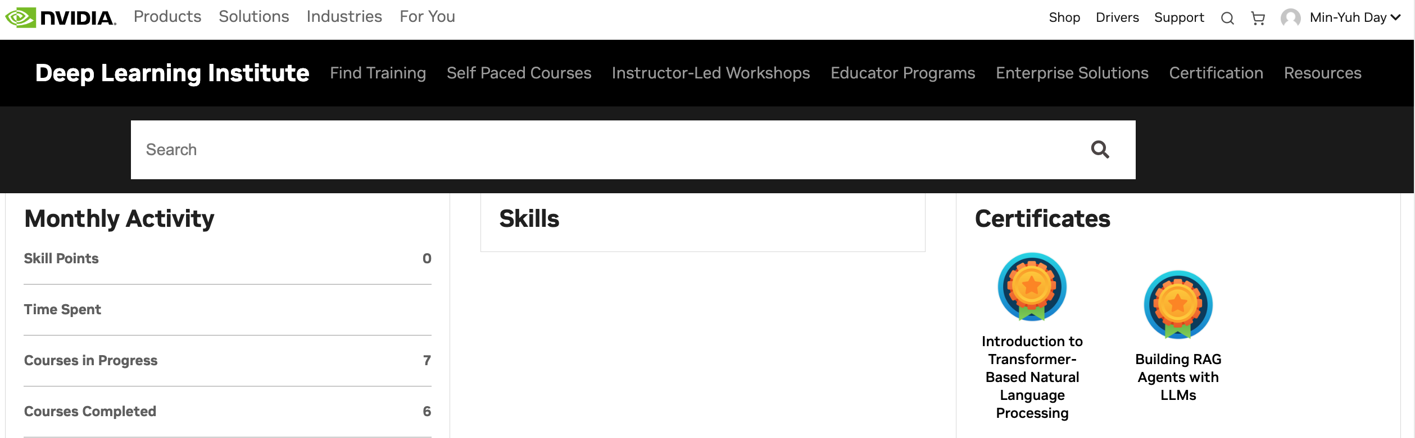

Deep Learning Institute (DLI)
https://learn.nvidia.com/my-learning

Slide 33

NVIDIA Deep Learning Institute (DLI)
https://learn.nvidia.com/en-us/training/self-paced-courses

Slide 34
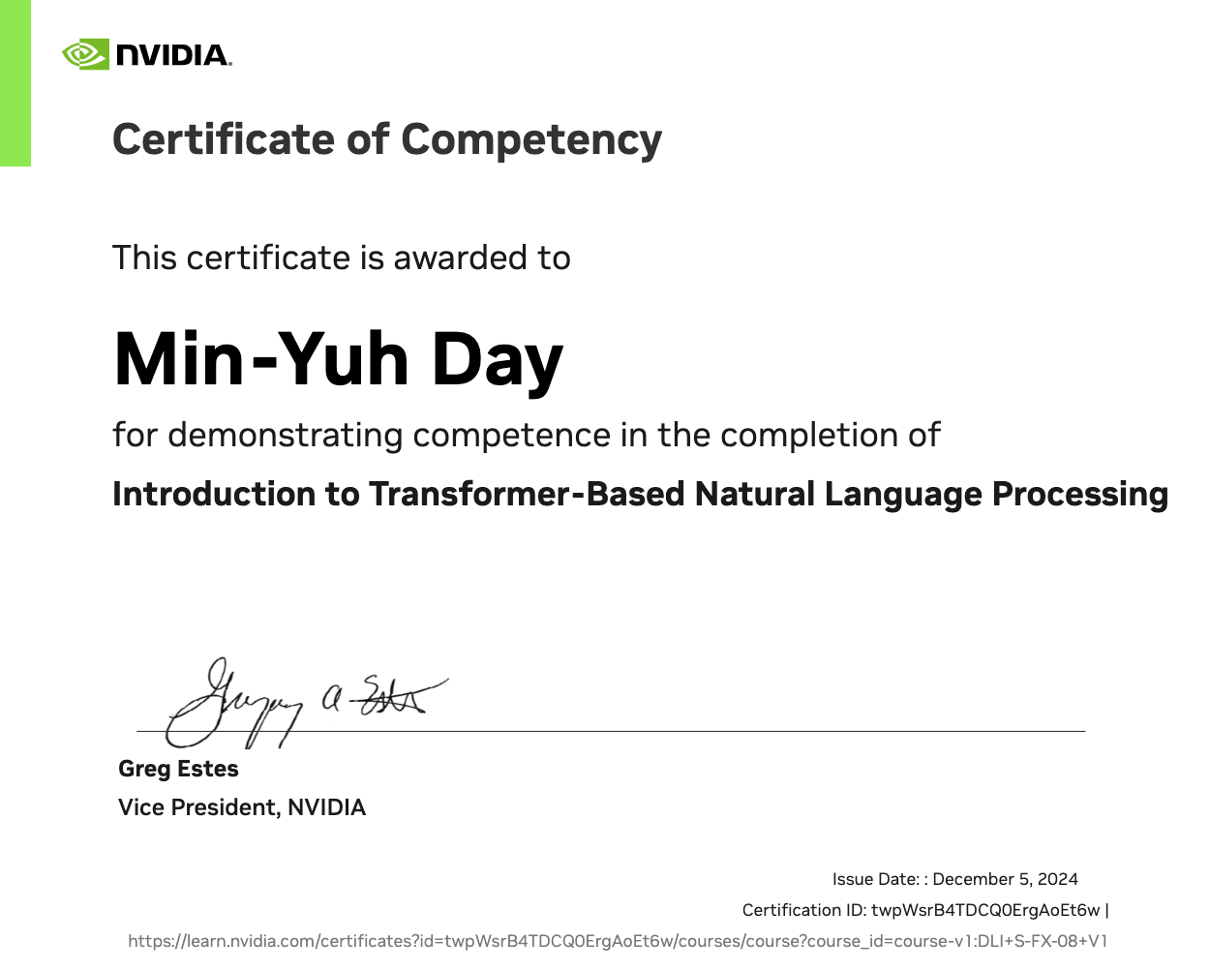
https://learn.nvidia.com/certificates?id=twpWsrB4TDCQ0ErgAoEt6w

Slide 35

https://learn.nvidia.com/certificates?id=ed-qOCIMQaatzU8SNUNxgw

Slide 36
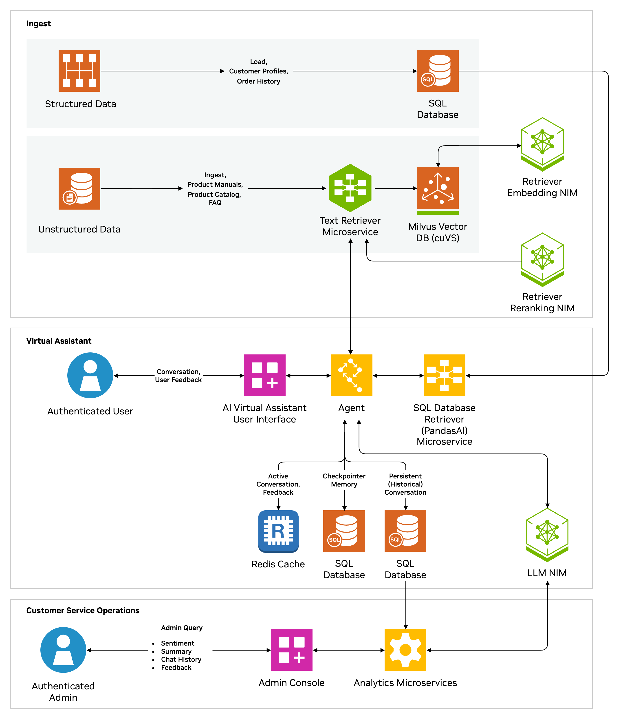
AI Virtual Assistant for Customer Service
AI Virtual Assistant to reduce handling time, boost customer satisfaction
Benefits
Personalized Responses: Handles structured and unstructured customer queries (e.g., order details, spending history).
Multi-Turn Dialogue: Offers context-aware, seamless interactions across multiple questions.
Custom Conversation Style: Adapts text responses to reflect corporate branding and tone.
Sentiment Analysis: Analyzes real-time customer interactions to gauge sentiment and adjust responses.
Multi-Session Support: Allows for multiple user sessions with conversation history and summaries.
Data Privacy: Integrates with on-premises or cloud-hosted knowledge bases to protect sensitive data.
Source: NVIDIA DLI (2024), Introduction to NVIDIA NIM™ Microservices, https://learn.nvidia.com/courses/course-detail?course_id=course-v1:DLI+S-FX-23+V1
Notes:
In today's fast-paced business environment, providing excellent customer service is critical.
Traditional solutions often fall short in delivering responses to complex customer queries in real time, leading to longer resolution times and limited customer satisfaction.
AI-based assistants can revolutionize industries by offering a streamlined process for enterprises to enhance these customer experiences, but integrating AI into existing systems can present challenges such as managing fragmented data sources and mitigating potential data security risks.
NVIDIA's AI virtual assistant NIM Agent Blueprint provides a centralized knowledge base that enables enterprises to improve the operational efficiency of existing solutions or build new customer service-centric systems that integrate seamlessly with internal applications and tools.
It enables organizations to meet unique business needs by delivering meaningful interactions and continuously improving their human-like responses over time.
It goes beyond automating routine tasks by analyzing customer profiles and tailoring responses to their specific requests, all while ensuring alignment with company goals, industry standards, and compliance requirements.
It is built using retrieval-augmented generation (RAG) and enterprise-ready NeMo Retriever and NIM microservices to enable the AI assistant to access proprietary data wherever it resides for highly personalized and compliant interactions.
Additional microservices like Nemotron-4-Hindi 4B Instruct allow for further customization and capabilities like synthetic data generation and model fine-tuning.
Ingestion and Retrieval Pipeline
Retrieval Pipeline ingests and retrieves the most up-to-date, relevant/accurate information in real-time from structured and unstructured data stores
AI Agent
provides personalized, context-aware, multi-turn human-like responses and faster resolution times
summarizes conversations to reduce call times and costs
sentiment analysis for continuous improvement of responses
Customer Service Operations
review chat history, user feedback, sentiment analysis data, and call summaries. This data can be used to generate analytics – such as average call time, time to resolution, and customer satisfaction – and also as user feedback to retrain the LLM models for accuracy improvement.
Scalable multi-session support to handle calls from large numbers of concurrent customers
Secure, compliant data management

Slide 37











Digital Humans for Customer Service
$125B market for digital human economy by 2035
Web Front End
Text Prompt
Audio In
Audio Out
User
Audio
Video
Audio/Video
Streaming
ACE Agent
Text Response
RAG
Application
Benefits
Increases engagement and satisfaction for user-facing applications
Creates a lifelike 3D digital human with accurate skin, hair, animation, and speech
Enables natural conversations with enterprise applications
and data
User Feedback
On Response
Digital Human
AV Out
3D Animation Pipeline
Audio Pipeline
Audio In
Text Response
Omniverse
Renderer
Animation Data
Text
Audio
Animation Graph
Audio2Face
Riva ASR
ElevenLabs TTS
Feedback Data
Source: NVIDIA DLI (2024), Introduction to NVIDIA NIM™ Microservices, https://learn.nvidia.com/courses/course-detail?course_id=course-v1:DLI+S-FX-23+V1
Notes:
When customers need service, they often just want to speak to a helpful person who can quickly resolve their issue, versus searching through knowledge base articles or navigating complex phone trees. Which is why application development teams are looking for ways to increase engagement with customer service applications to drive higher customer satisfaction.
Generative AI powered applications have changed the way customers are assisted by providing a more knowledgeable and responsive chat interface. But a text chat window is not always the best replacement for a knowledgeable and helpful person.
The Digital Humans for Customer Service NIM Blueprint brings enterprise applications to life with a 3D animated digital human interface. With an approachable, human-like interface, customer service applications can provide better user experiences with faster resolutions than traditional customer service options.
This workflow is designed to integrate within your existing generative AI applications built using retrieval-augmented generation (RAG).
Walking through the workflow, audio from the user comes in through the web front end and is processed by an audio/video engine and passed on to the NVIDIA ACE Agent. The Agent uses the audio pipeline to convert audio to text and text to audio as it interacts with the RAG-powered chatbot or copilot using its API. The audio is sent to the 3D animation pipeline to animate the avatar and render its features to be lifelike. As users engage the digital human, they can provide feedback, like thumbs up / thumbs down, on the response, which is fed back into the backend RAG application for improvement.
Source for $125B: https://drive.google.com/file/d/1EAiI03y1SczRiczpXFlVk2_mtDFiKEkC/view?usp=sharingn (Must keep the 2035 year in any reference to this $ projection, per Gartner. Approval from Gartner though this projection is more than 1 year old, stipulates we have to use the 2035 for clarity)

Slide 38








Multimodal PDF Data Extraction for Enterprise RAG
Unlocks Knowledge from trillions of PDFs
Response
Query
User
Front End
NeMo Retriever
Embedding
Vector
Database
NeMo Retriever
Reranking
LLM
User Feedback
On Response
Retrieval Pipeline
Feedback Data
NeMo Retriever
Embedding
Benefits
Unlocks the next level
of indexable enterprise data from text to images and charts
High-accuracy extraction and responses
Enterprise-scale
PDF ingestion
Ingestion Pipeline
Chart Extraction
Charts as Images
VLM
DePlot
Chart Element Detector
CACHED
OCR
PaddleOCR
Text
Pages as Images
Object Detection
YOLOX
Tables as
Images
Text
Documents
PDF Parser
Table Extraction
PaddleOCR
Post-Process Filtering
Chunking/Ingestion
Logic
Text Content and Metadata
Source: NVIDIA DLI (2024), Introduction to NVIDIA NIM™ Microservices, https://learn.nvidia.com/courses/course-detail?course_id=course-v1:DLI+S-FX-23+V1
Notes:
Trillions of PDF files are generated every year, each file likely consisting of multiple pages, filled with various content types, including text, images, charts, and tables. This goldmine of data can only be used as quickly as humans can read and understand it.
But with generative AI and retrieval-augmented generation (RAG) this untapped data can be used to uncover business insights that can help employees work more efficiently resulting in lower costs.
The multimodal PDF data extraction blueprint enables organizations to to accurately extract the knowledge contained in massive volumes of enterprise data, effectively talking to the data, to quickly make your digital human an expert on any topic, in turn enabling your employees to make smarter decisions faster.
Walking through the workflow, PDFs are parsed to separate out the modalities (text, images, charts, tables, plots and other diagrams). NIM microservices are leveraged to accurately extract textual metadata from charts and tables. The extracted information is filtered to avoid duplicate chunks. We leverage the NeMo Retriever embedding NIM to convert the chunks into embeddings and store them in a VectorStore.
When a user submits a query, relevant information is retrieved from the vast repository of ingested documents. NeMo Retriever embedding NIM embeds the user query, which is used to retrieve the most relevant chunks using vector similarity search from the VectorStore.
NeMo Retriever reranking NIM evaluates and reranks the results to ensure the most accurate and useful chunks are used to respond to the query.
With the most pertinent information at hand, the LLM NIM generates a response that is informed, accurate and contextually relevant.

Slide 39
Transformer Models
Transformer
Encoder
Decoder
DistilBERT
BERT
T5
GPT
RoBERTa
BART
GPT-2
CTRL
XLM-R
XLM
M2M-100
GPT-3
ALBERT
BigBird
GPT-Neo
GPT-J
ELECTRA
mT0
BLOOM
BLOOMZ
DeBERTa
ChatGPT
GPT-4
Source: Lewis Tunstall, Leandro von Werra, and Thomas Wolf (2022), Natural Language Processing with Transformers: Building Language Applications with Hugging Face, O'Reilly Media.

Slide 40

The Development of LM-based Dialogue Systems
1) Early Stage (1966 - 2015)
2) The Independent Development of TOD and ODD (2015 - 2019)
3) Fusions of Dialogue Systems (2019 - 2022)
4) LLM-based DS (2022 - Now)
Task-oriented DS (TOD), Open-domain DS (ODD)
Source: Wang, Hongru, Lingzhi Wang, Yiming Du, Liang Chen, Jingyan Zhou, Yufei Wang, and Kam-Fai Wong. "A Survey of the Evolution of Language Model-Based Dialogue Systems." arXiv preprint arXiv:2311.16789 (2023).

Slide 41

Major GenAI LLMs Research Milestones
(2017-2024)
Source: https://github.com/Hannibal046/Awesome-LLM

Slide 42
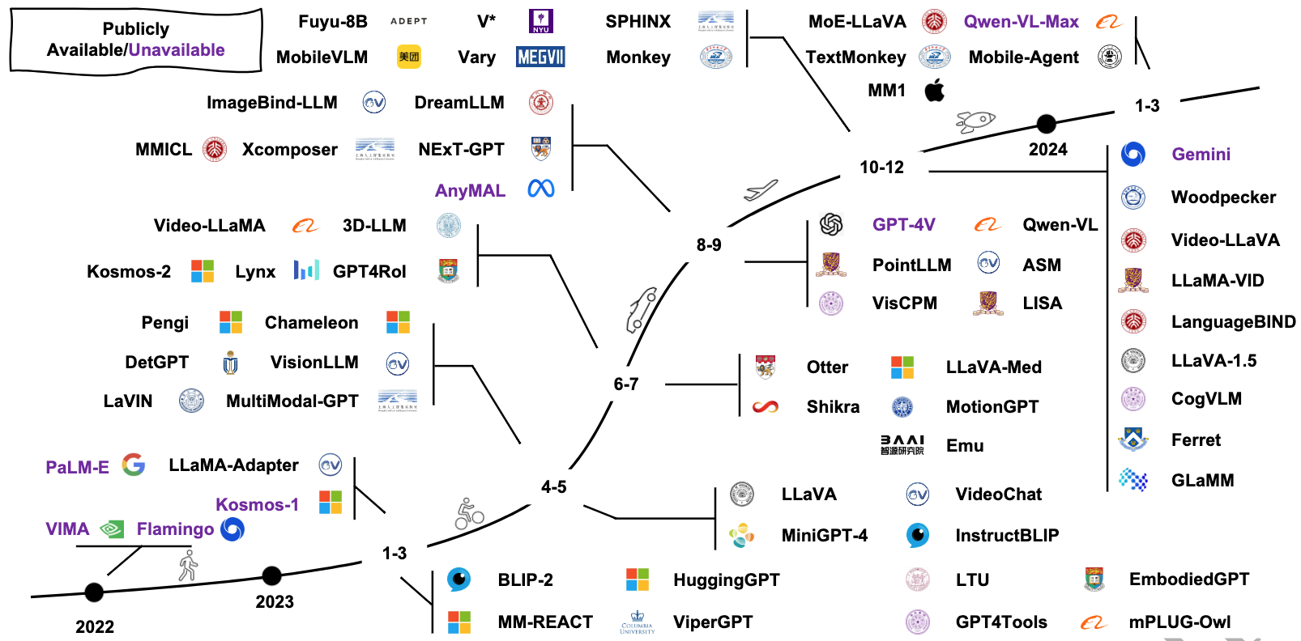
Multimodal Large Language Models (MLLM)
Source: Shukang Yin, Chaoyou Fu, Sirui Zhao, Ke Li, Xing Sun, Tong Xu, and Enhong Chen. (2024) "A survey on multimodal large language models." National Science Review (2024): nwae403.

Slide 43
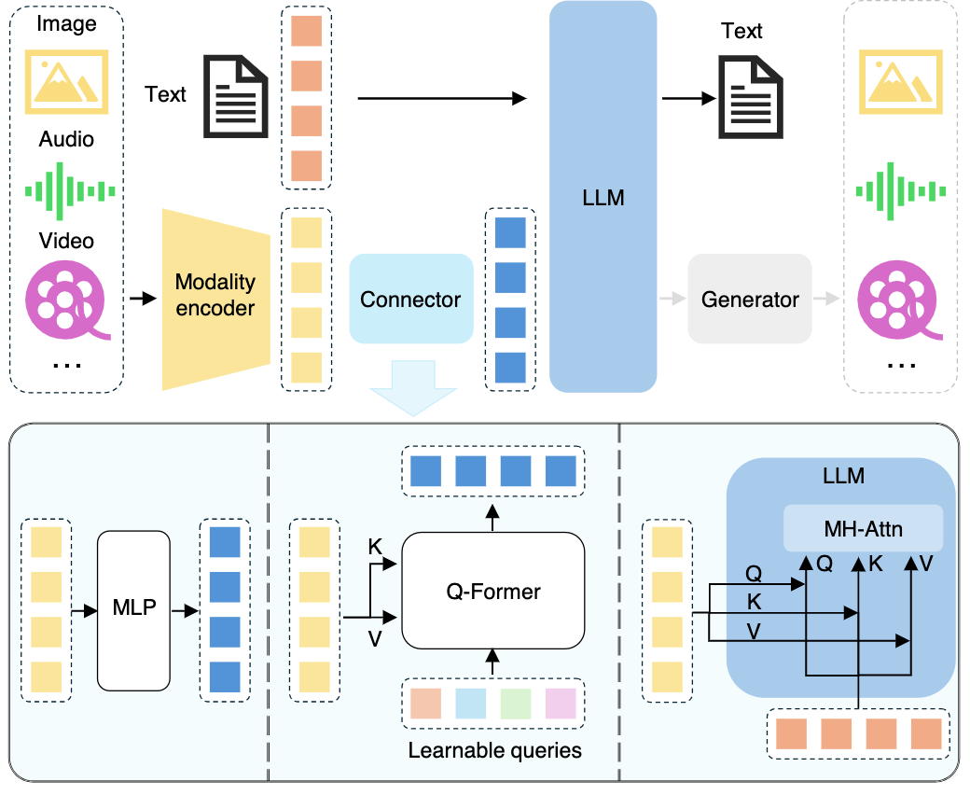
Multimodal Large Language Models (MLLM)
Multimodall LLM
Three types of connectors:
1. projection-based
2. query-based
3. fusion-based connectors
Source: Shukang Yin, Chaoyou Fu, Sirui Zhao, Ke Li, Xing Sun, Tong Xu, and Enhong Chen. (2024) "A survey on multimodal large language models." National Science Review (2024): nwae403.

Slide 44
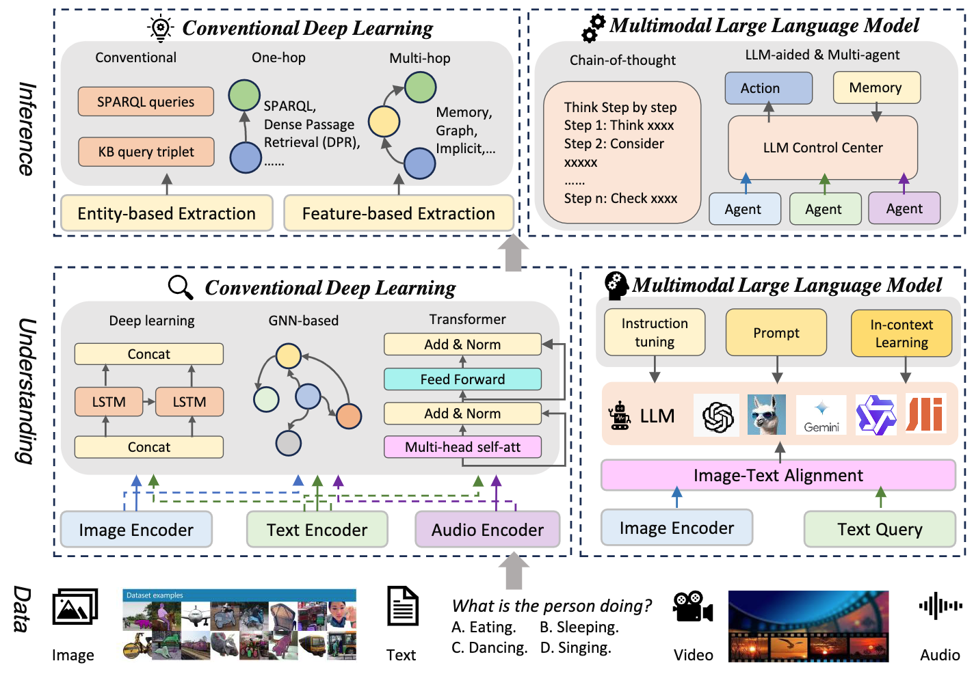
Multimodal Large Language Model (MLLM) for Vision Question Answering
Source: Jiayi Kuang, Jingyou Xie, Haohao Luo, Ronghao Li, Zhe Xu, Xianfeng Cheng, Yinghui Li, Xika Lin, and Ying Shen. (2024) "Natural Language Understanding and Inference with MLLM in Visual Question Answering: A Survey." arXiv preprint arXiv:2411.17558.

Slide 45
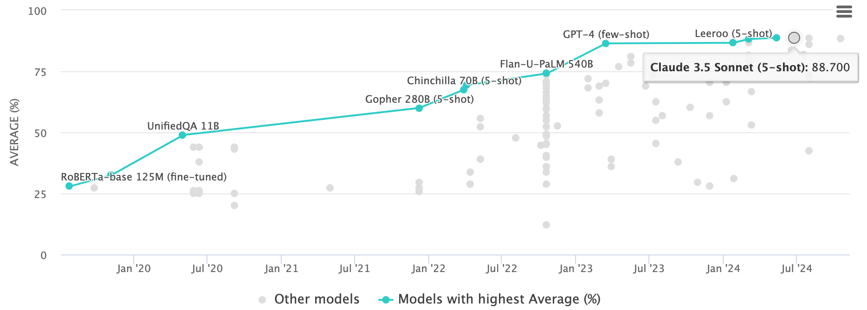
Multi-task Language Understanding on MMLU
GPT-4, Claude 3.5 Sonnet
Massive Multitask Language Understanding (MMLU)
Source: https://paperswithcode.com/sota/multi-task-language-understanding-on-mmlu

Slide 46

LLM Capabilities
Source: Minaee, Shervin, Tomas Mikolov, Narjes Nikzad, Meysam Chenaghlu, Richard Socher, Xavier Amatriain, and Jianfeng Gao. (2024) "Large language models: A survey." arXiv preprint arXiv:2402.06196 (2024).

Slide 47

LLM-powered Multimodal Agents
Large Multimodal Agents (LMAs)
2022
2023
2024
Source: Xie, Junlin, Zhihong Chen, Ruifei Zhang, Xiang Wan, and Guanbin Li. "Large Multimodal Agents: A Survey." arXiv preprint arXiv:2402.15116 (2024).

Slide 48

Four Paradigms in NLP (LM)
Transfer Learning: Pre-training, Fine-Tuning (FT)
GAI: Pre-train, Prompt, and Predict (Prompting)
Source: Pengfei Liu, Weizhe Yuan, Jinlan Fu, Zhengbao Jiang, Hiroaki Hayashi, and Graham Neubig. (2023) "Pre-train, prompt, and predict: A systematic survey of prompting methods in natural language processing." ACM Computing Surveys 55, no. 9 (2023): 1-35.

Slide 49

Large Language Models (LLM)
Three typical learning paradigms
Source: Shukang Yin, Chaoyou Fu, Sirui Zhao, Ke Li, Xing Sun, Tong Xu, and Enhong Chen. (2024) "A survey on multimodal large language models." National Science Review (2024): nwae403.

Slide 50
Popular Generative AI
OpenAI ChatGPT (GPT-o1, GPT-4o, GPT-4)
Claude.ai (Claude 3.5)
Google Gemini
Meta Llama 3.3, Llama 3.2 Vision
Mixtral Pixtral (mistral.ai)
Chat.LMSys.org (lmarena.ai)
Perplexity.ai
Stable Diffusion
Video: D-ID, Synthesia
Audio: Speechify

Slide 51
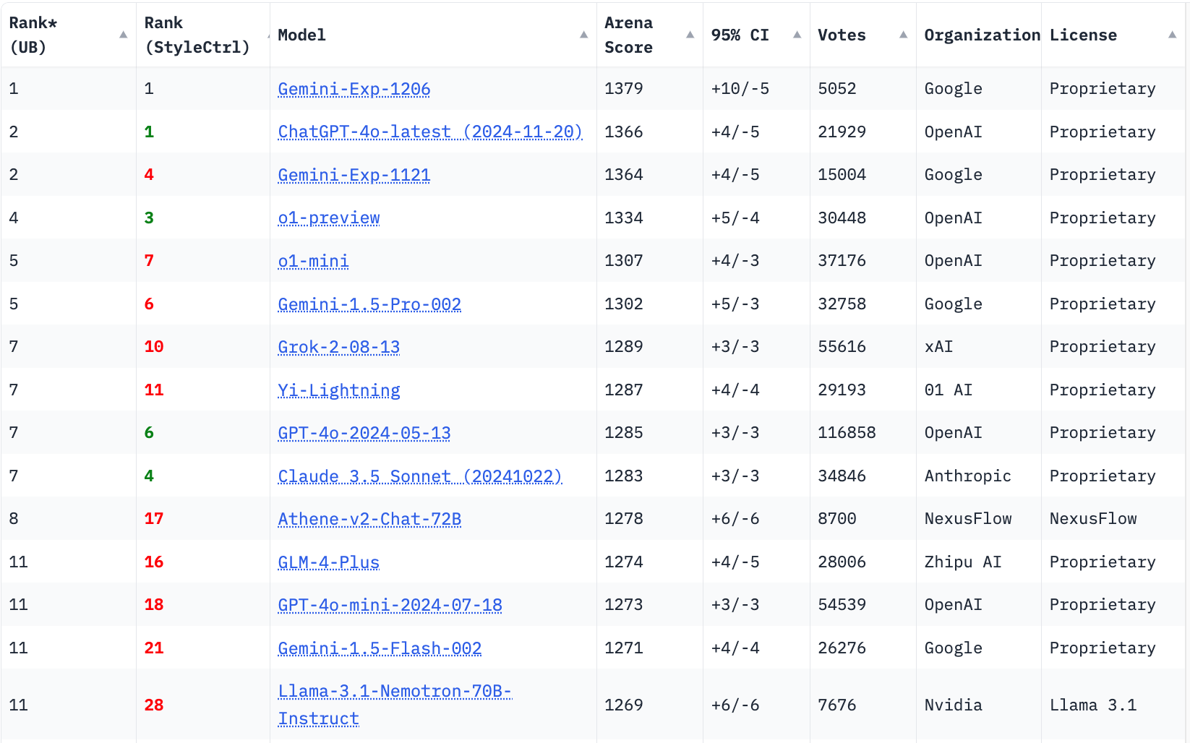
LMSYS Chatbot Arena Leaderboard
GPT-4o
Claude 3.5
https://lmarena.ai/

Slide 52
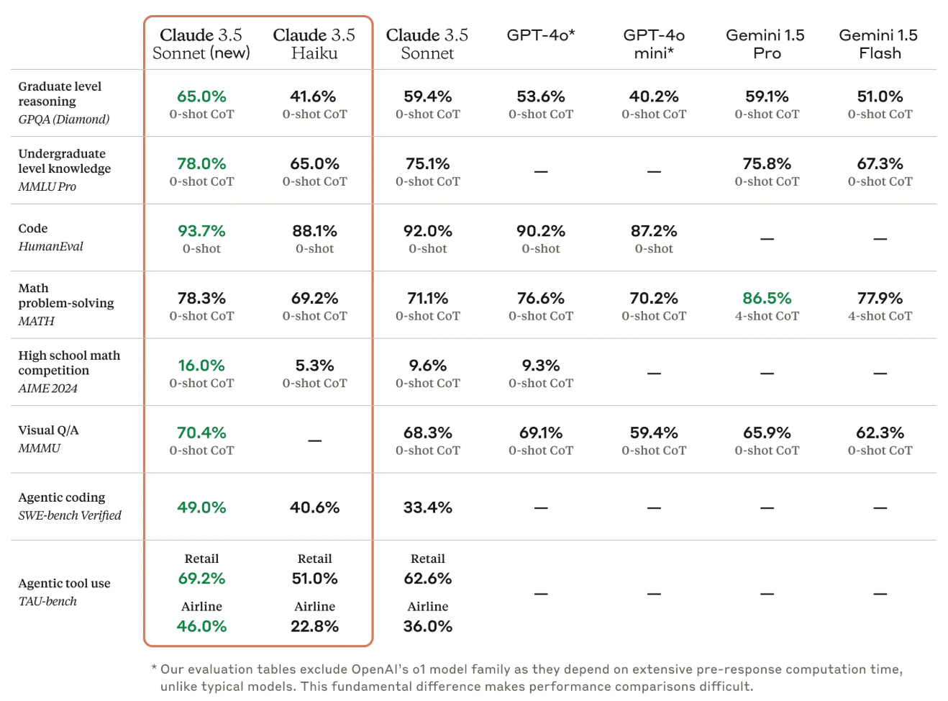
Claude 3.5 Sonnet State-of-the-art vision
Source: https://www.anthropic.com/news/3-5-models-and-computer-use

Slide 53
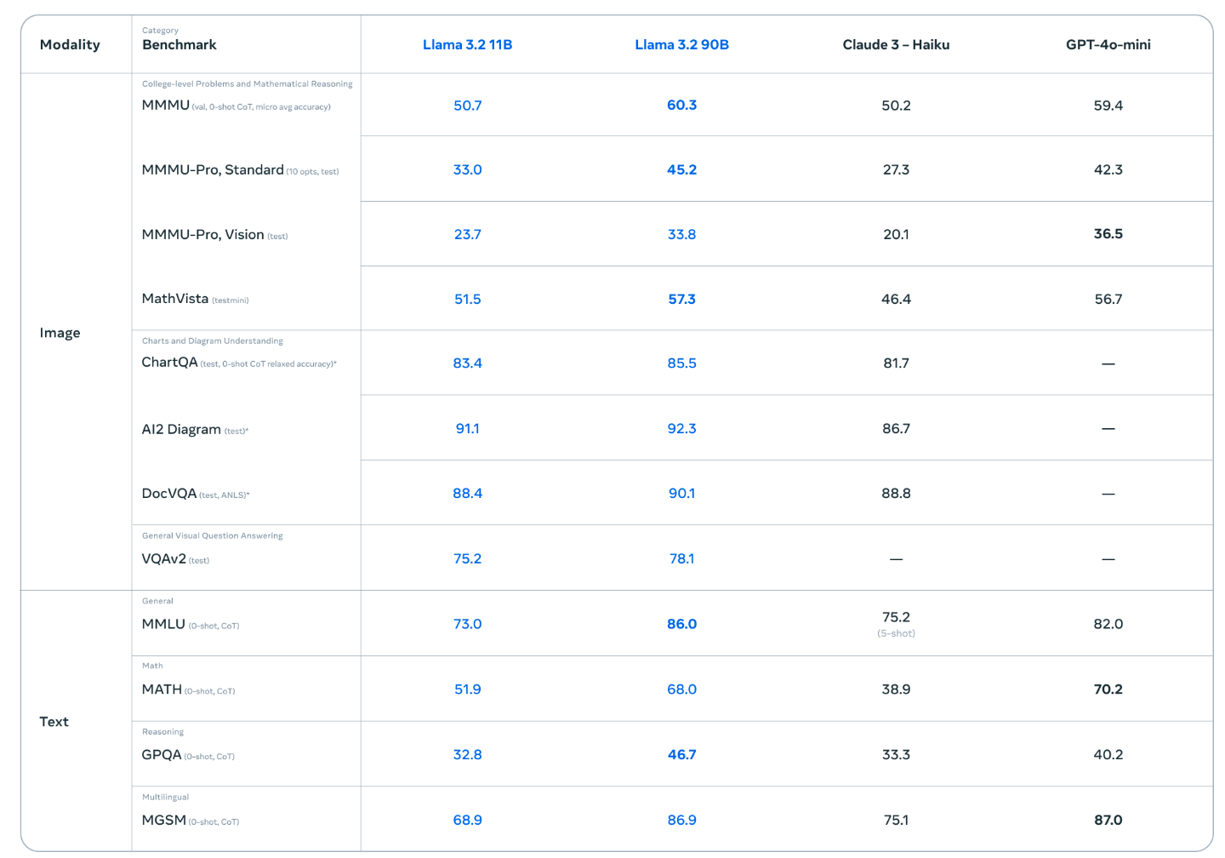
Llama 3.2 90B vision LLMs
Source: https://ai.meta.com/blog/llama-3-2-connect-2024-vision-edge-mobile-devices/

Slide 54
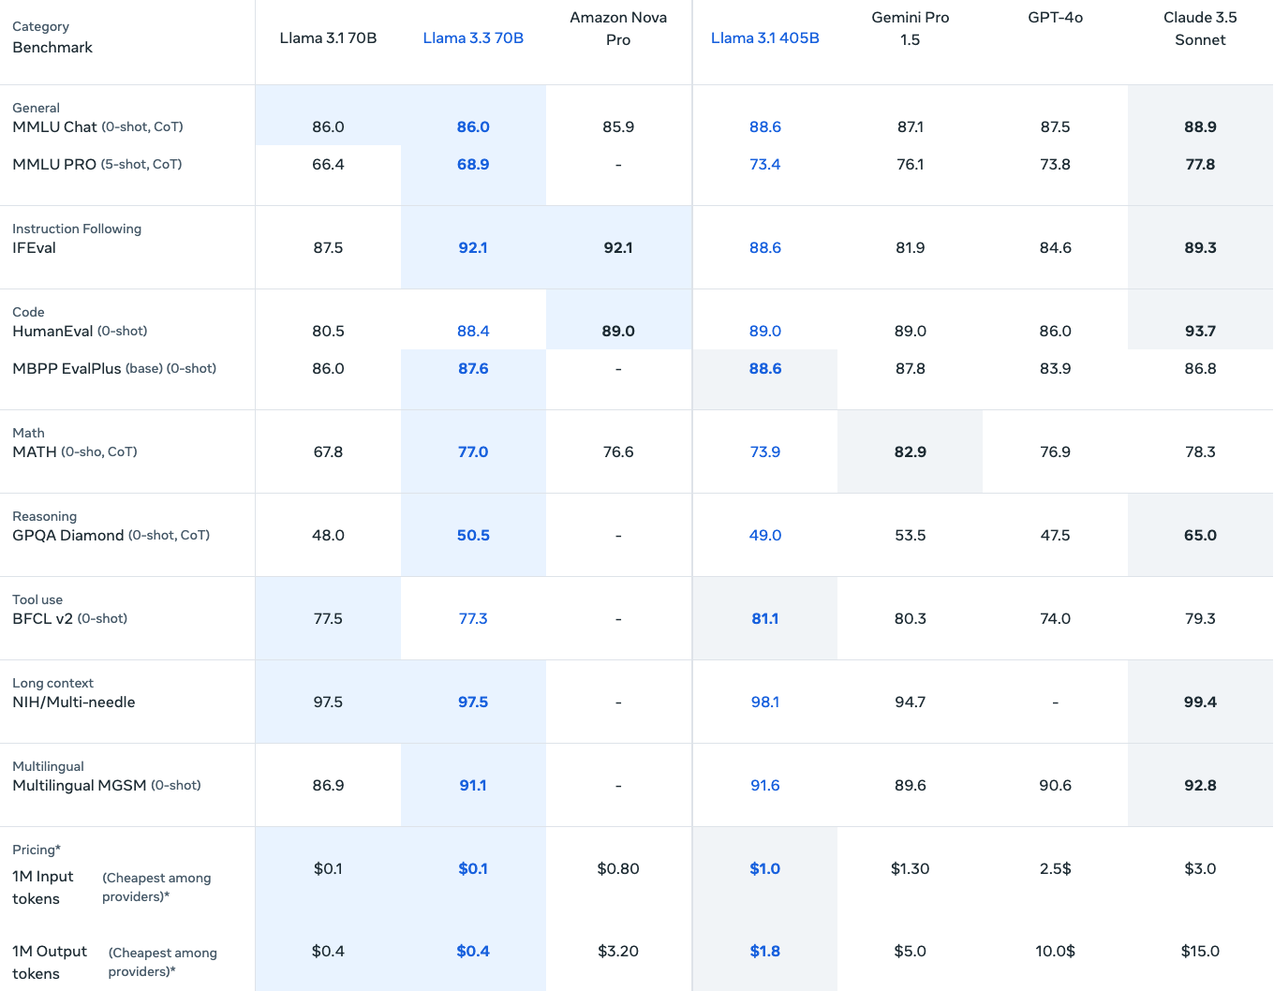
Llama 3.3 70B instruction-tuned
https://www.llama.com/

Slide 55
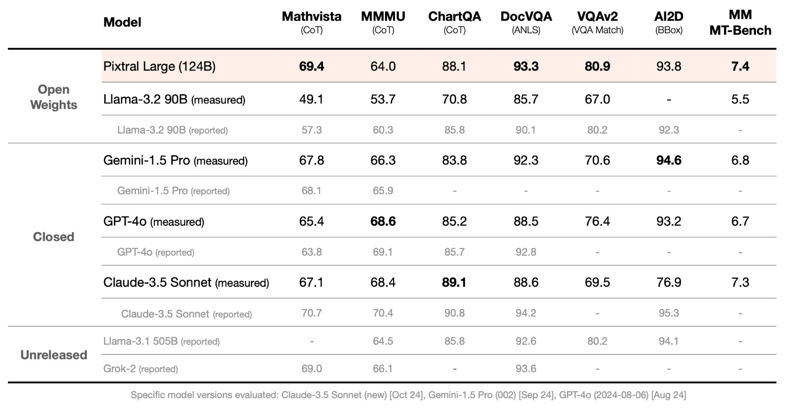
Mistral Pixtral Large (124B)
Frontier-class multimodal performance
Source: https://mistral.ai/news/pixtral-large/

Slide 56
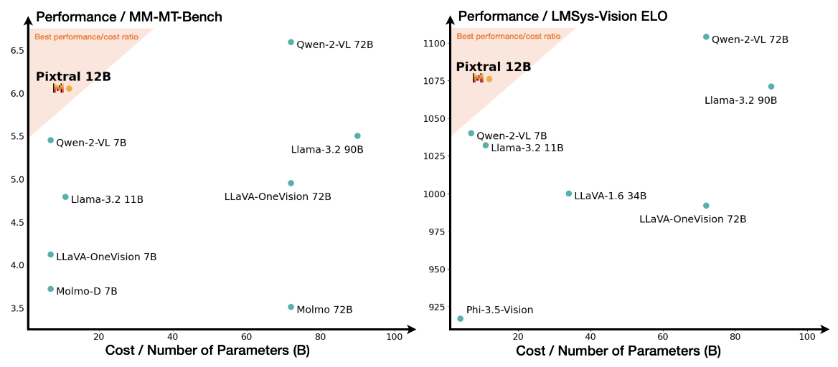
Mistral Pixtral 12B
Source: Agrawal, Pravesh, Szymon Antoniak, Emma Bou Hanna, Baptiste Bout, Devendra Chaplot, Jessica Chudnovsky, Diogo Costa et al. (2024) "Pixtral 12B." arXiv preprint arXiv:2410.07073.

Slide 57
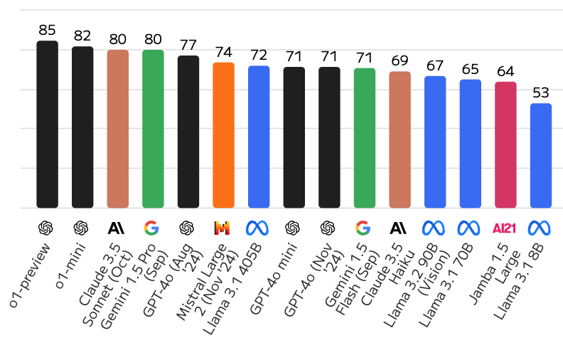
Large Language Models (LLMs)
Artificial Analysis Quality Index
Source: https://artificialanalysis.ai/

Slide 58
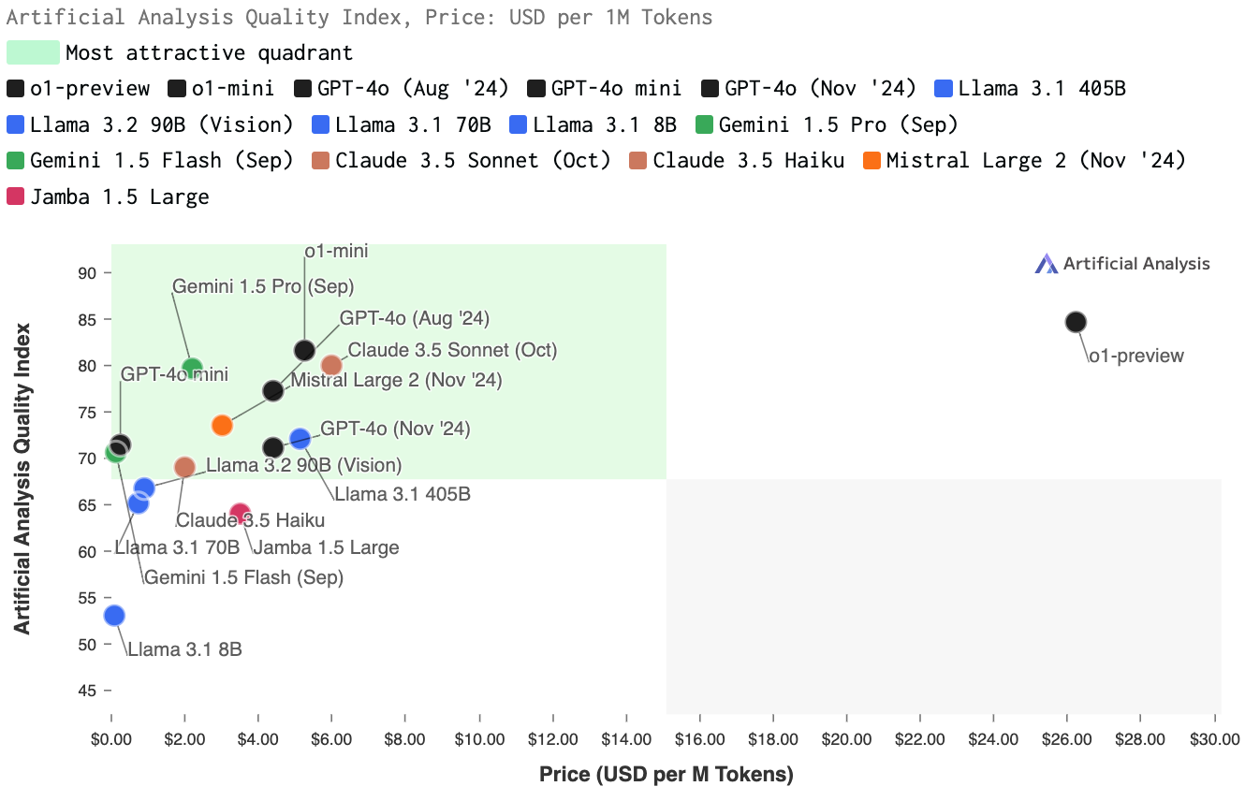
Large Language Models (LLMs)
Quality vs. Price
Source: https://artificialanalysis.ai/

Slide 59
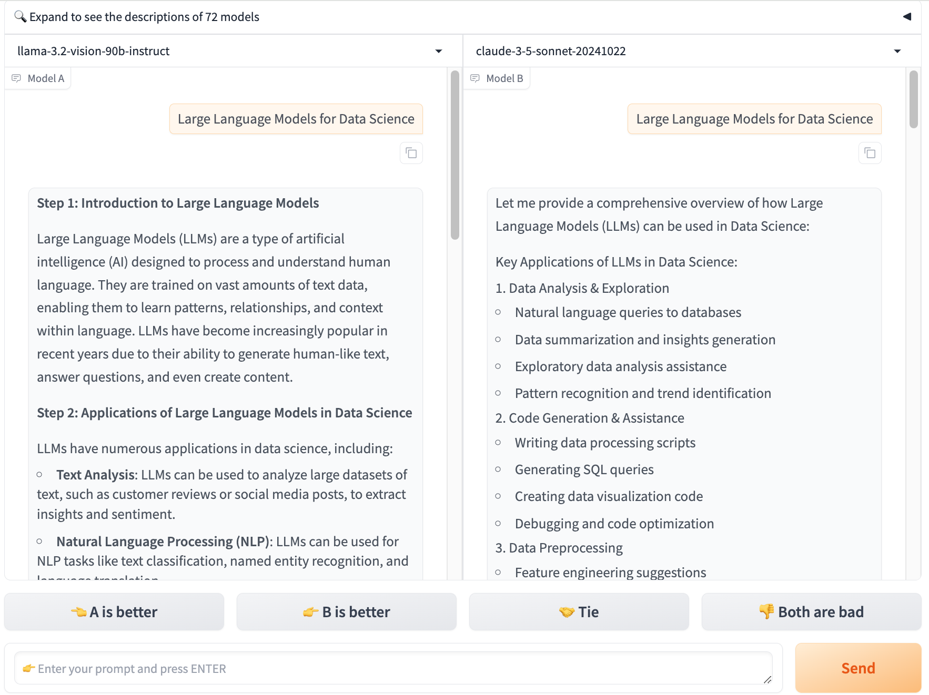
Chat with
Open
Large Language Models:
Chatbot Arena
Large Language Models for Data Science
llama 3.2
claude 3.5 sonnet
https://lmarena.ai/

Slide 60

Perplexity.ai
https://www.perplexity.ai/

Slide 61

Generative AI (Gen AI)
AI Generated Content (AIGC)
Image Generation
Source: Yihan Cao, Siyu Li, Yixin Liu, Zhiling Yan, Yutong Dai, Philip S. Yu, and Lichao Sun (2023). "A Comprehensive Survey of AI-Generated Content (AIGC): A History of Generative AI from GAN to ChatGPT." arXiv preprint arXiv:2303.04226.

Slide 62

Generative AI (Gen AI)
AI Generated Content (AIGC)
Source: Yihan Cao, Siyu Li, Yixin Liu, Zhiling Yan, Yutong Dai, Philip S. Yu, and Lichao Sun (2023). "A Comprehensive Survey of AI-Generated Content (AIGC): A History of Generative AI from GAN to ChatGPT." arXiv preprint arXiv:2303.04226.

Slide 63

The history of Generative AI in CV, NLP and VL
Source: Yihan Cao, Siyu Li, Yixin Liu, Zhiling Yan, Yutong Dai, Philip S. Yu, and Lichao Sun (2023). "A Comprehensive Survey of AI-Generated Content (AIGC): A History of Generative AI from GAN to ChatGPT." arXiv preprint arXiv:2303.04226.

Slide 64
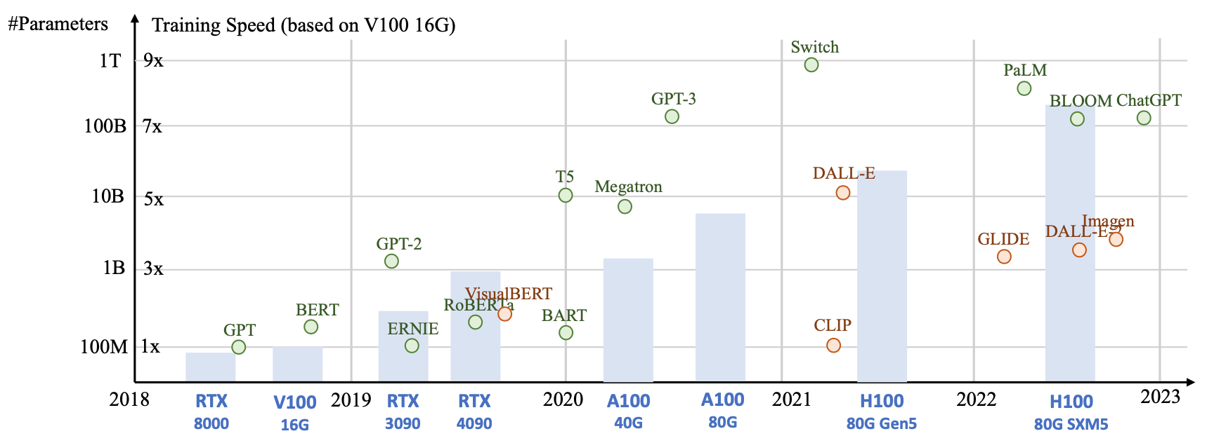
Generative AI
Foundation Models
Source: Yihan Cao, Siyu Li, Yixin Liu, Zhiling Yan, Yutong Dai, Philip S. Yu, and Lichao Sun (2023). "A Comprehensive Survey of AI-Generated Content (AIGC): A History of Generative AI from GAN to ChatGPT." arXiv preprint arXiv:2303.04226.

Slide 65

Categories of Vision Generative Models
Source: Yihan Cao, Siyu Li, Yixin Liu, Zhiling Yan, Yutong Dai, Philip S. Yu, and Lichao Sun (2023). "A Comprehensive Survey of AI-Generated Content (AIGC): A History of Generative AI from GAN to ChatGPT." arXiv preprint arXiv:2303.04226.

Slide 66

The General Structure of
Generative Vision Language
Source: Yihan Cao, Siyu Li, Yixin Liu, Zhiling Yan, Yutong Dai, Philip S. Yu, and Lichao Sun (2023). "A Comprehensive Survey of AI-Generated Content (AIGC): A History of Generative AI from GAN to ChatGPT." arXiv preprint arXiv:2303.04226.

Slide 67
Philosophy and
Ethics of AI

Slide 68
Philosophy, Ethics, and
Safety of AI
The Limits of AI
Can Machines Really Think?
The Ethics of AI
Source: Stuart Russell and Peter Norvig (2020), Artificial Intelligence: A Modern Approach, 4th Edition, Pearson

Slide 69
Philosophy of AI
Philosophers use the term
  weak AI for the hypothesis that machines could possibly behave intelligently
  strong AI for the hypothesis that such machines would count as having actual minds (as opposed to simulated minds)
Source: Stuart Russell and Peter Norvig (2020), Artificial Intelligence: A Modern Approach, 4th Edition, Pearson

Slide 70
4 Approaches of AI
Thinking Humanly | Thinking Rationally
Acting Humanly | Acting Rationally
Source: Stuart Russell and Peter Norvig (2020), Artificial Intelligence: A Modern Approach, 4th Edition, Pearson

Slide 71
4 Approaches of AI
2. Thinking Humanly: The Cognitive Modeling Approach | 3. Thinking Rationally: The “Laws of Thought” Approach
1. Acting Humanly: The Turing Test Approach (1950) | 4. Acting Rationally: The Rational Agent Approach
Source: Stuart Russell and Peter Norvig (2020), Artificial Intelligence: A Modern Approach, 4th Edition, Pearson

Slide 72
AI Acting Humanly:
The Turing Test Approach
(Alan Turing, 1950)
Knowledge Representation
Automated Reasoning
Machine Learning (ML)
  Deep Learning (DL)
Computer Vision (Image, Video)
Natural Language Processing (NLP)
Robotics
Source: Stuart Russell and Peter Norvig (2020), Artificial Intelligence: A Modern Approach, 4th Edition, Pearson

Slide 73
Can machines think?
Alan Turing rejected the question “Can machines think?” and replaced it with a behavioral test.
  Alan Turing anticipated many objections to the possibility of thinking machines.
Concentrate on their systems’ performance on practical tasks
  rather than the ability to imitate humans.
Consciousness remains a mystery.
Source: Stuart Russell and Peter Norvig (2020), Artificial Intelligence: A Modern Approach, 4th Edition, Pearson

Slide 74
The Ethics of AI
Given that AI is a powerful technology,
we have a moral obligation to use it well,
to promote the positive aspects and
avoid or mitigate the negative ones.
Source: Stuart Russell and Peter Norvig (2020), Artificial Intelligence: A Modern Approach, 4th Edition, Pearson

Slide 75
Principles of Robotics and AI
Ensure safety
Ensure fairness
Respect privacy
Promote collaboration
Provide transparency
Limit harmful uses of AI
Source: Stuart Russell and Peter Norvig (2020), Artificial Intelligence: A Modern Approach, 4th Edition, Pearson

Slide 76
Principles of Robotics and AI
Establish accountability
Uphold human rights and values
Reflect diversity/inclusion
Avoid concentration of power
Acknowledge legal/policy implications
Contemplate implications for employment
Source: Stuart Russell and Peter Norvig (2020), Artificial Intelligence: A Modern Approach, 4th Edition, Pearson

Slide 77
Safety of AI
AI is a powerful technology, and as such it poses potential dangers, through lethal autonomous weapons, security and privacy breaches, unintended side effects, unintentional errors, and malignant misuse.
Those who work with AI technology have an ethical imperative to responsibly reduce those dangers.
Source: Stuart Russell and Peter Norvig (2020), Artificial Intelligence: A Modern Approach, 4th Edition, Pearson

Slide 78
Robot Ethics
Laws of Robotics (Isaac Asimov, 1942, 1950)
A robot may not injure a human being or, through inaction, allow a human being to come to harm.
A robot must obey orders given to it by human beings, except where such orders would conflict with the First Law.
A robot must protect its own existence as long as such protection does not conflict with the First or Second Law.
Source: Stuart Russell and Peter Norvig (2020), Artificial Intelligence: A Modern Approach, 4th Edition, Pearson

Slide 79
Fair, trustworthy, and transparent of AI
AI systems must be able to demonstrate they are fair, trustworthy, and transparent.
There are multiple aspects of fairness, and it is impossible to maximize all of them at once.
So a first step is to decide what counts as fair.
Source: Stuart Russell and Peter Norvig (2020), Artificial Intelligence: A Modern Approach, 4th Edition, Pearson

Slide 80
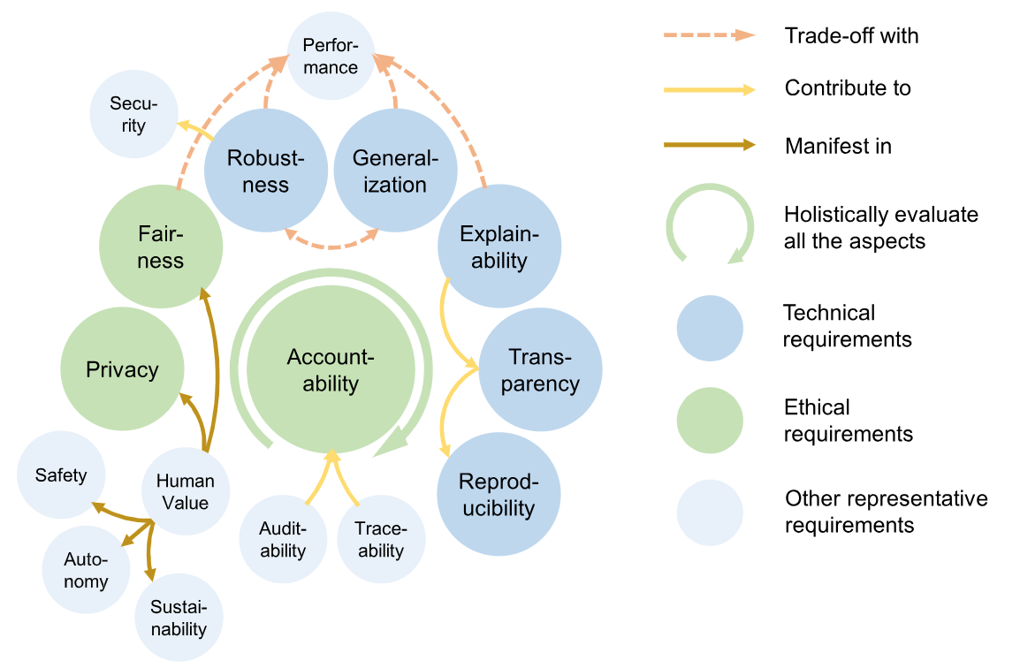
Trustworthy AI
Source: Bo Li, Peng Qi, Bo Liu, Shuai Di, Jingen Liu, Jiquan Pei, Jinfeng Yi, and Bowen Zhou. (2023) "Trustworthy AI: From principles to practices." ACM Computing Surveys 55, no. 9 (2023): 1-46.

Slide 81
Explainable AI (XAI)
When an AI system turns you down for a loan, you deserve an explanation.
  In Europe, the GDPR enforces this for you.
  An AI system that can explain itself is called explainable AI (XAI).
Source: Stuart Russell and Peter Norvig (2020), Artificial Intelligence: A Modern Approach, 4th Edition, Pearson

Slide 82
Explainable AI (XAI)
A good explanation properties of XAI
  it should be understandable and convincing to the user
  it should accurately reflect the reasoning of the system
  it should be complete
  it should be specific in that different users with different conditions or different outcomes should get different explanations
Source: Stuart Russell and Peter Norvig (2020), Artificial Intelligence: A Modern Approach, 4th Edition, Pearson

Slide 83
Automation
Automation is already changing the way people work.
As a society, we will have to deal with these changes.
Source: Stuart Russell and Peter Norvig (2020), Artificial Intelligence: A Modern Approach, 4th Edition, Pearson

Slide 84
The Future of AI

Slide 85
The Future of AI
AI Components
AI Architectures
Source: Stuart Russell and Peter Norvig (2020), Artificial Intelligence: A Modern Approach, 4th Edition, Pearson

Slide 86
AI Components
Sensors and actuators
Representing the state of the world
Selecting actions
Deciding what we want
Learning
Resources
  Shared data
  Shared model
Source: Stuart Russell and Peter Norvig (2020), Artificial Intelligence: A Modern Approach, 4th Edition, Pearson

Slide 87
Learning
Deep learning
Data science
Big data
Transfer learning
Apprenticeship learning
Differentiable programming
Weakly supervised learning
Predictive learning
Source: Stuart Russell and Peter Norvig (2020), Artificial Intelligence: A Modern Approach, 4th Edition, Pearson

Slide 88
AI Architectures
Which of the agent architectures
should an agent use?
  All of them!
Real-time AI
Anytime algorithm
Decision-theoretic metareasoning
Reflective architecture
Agent = Architecture + Program
Bounded optimality
Source: Stuart Russell and Peter Norvig (2020), Artificial Intelligence: A Modern Approach, 4th Edition, Pearson

Slide 89
Real-time AI
As AI systems move into
more complex domains,
all problems will become real-time,
because the agent will
never have long enough
to solve the decision problem exactly.
Source: Stuart Russell and Peter Norvig (2020), Artificial Intelligence: A Modern Approach, 4th Edition, Pearson

Slide 90
General AI
Narrow tasks AI
  DARPA Grand Challenge for autonomous cars
  ImageNet object recognition competition
  For each separate task, we build a separate AI system
  A separate machine learning model trained from scratch with data collected specifically for this task.
Human-level AI (HLAI)
Source: Stuart Russell and Peter Norvig (2020), Artificial Intelligence: A Modern Approach, 4th Edition, Pearson

Slide 91
AI Engineering
Powerful tools and frameworks
  TensorFlow, Keras, PyTorch, CAFFE,
  Scikit-Learn and SCIPY.
Promising approaches
  GANs
  Deep reinforcement learning
  Train properly in a new domain
Source: Stuart Russell and Peter Norvig (2020), Artificial Intelligence: A Modern Approach, 4th Edition, Pearson

Slide 92
Generative AI: Proprietary & Confidential
Valuable data needs to be private.
Need to maintain confidentiality with private data.
Need to consider industry-specific data norms.
Source: NVIDIA DLI (2024), Generative AI Explained, https://learn.nvidia.com/courses/course-detail?course_id=course-v1:DLI+S-FX-07+V1

Slide 93
Challenges of Generative AI
IP ownership
  Does the model have the right to reproduce and extrapolate from this data
IP attribution
  Can the output of the model be attributed to the proper sources
  Important for many businesses
Harmful application
  Is the output of the model used to manipulate or mislead
Harmful outputs
  Is the output of the model offensive
Source: NVIDIA DLI (2024), Generative AI Explained, https://learn.nvidia.com/courses/course-detail?course_id=course-v1:DLI+S-FX-07+V1

Slide 94
Training Generative AI Efficiently at Scale
NVIDIA NeMo enables efficient training of large language models at scale.
Full-stack optimization from networking to compute to frameworks and libraries.
Extraordinary throughput and flexibility.
NVIDIA invests heavily in the most important frameworks: JAX, PyTorch, TensorFlow and more.
Source: NVIDIA DLI (2024), Generative AI Explained, https://learn.nvidia.com/courses/course-detail?course_id=course-v1:DLI+S-FX-07+V1

Slide 95
The Future of AI
AI has made great progress in its short history.
We can see only a short distance ahead,
but we can see that much remains to be done.
(Alan Turing, 1950)
[Computing Machinery and Intelligence]
Source: Stuart Russell and Peter Norvig (2020), Artificial Intelligence: A Modern Approach, 4th Edition, Pearson

Slide 96
The Future of AI
Past: Build each new system from scratch
Future: Start with a single huge system
  For each new task, extract from it the parts that are relevant to the task.
Transformer language models
(e.g., BERT, GPT-2, GPT-3, ChatGPT) with billions of parameters
  An “outrageously large” ensemble neural network architecture that scales up to 175 billion parameters in one experiment.
  GPT-3 (175B), BLOOM (176B), PaLM (540B)
Source: Stuart Russell and Peter Norvig (2020), Artificial Intelligence: A Modern Approach, 4th Edition, Pearson

Slide 97
AI for
Social Good
(AI4SG)
Source: Nenad Tomašev, Julien Cornebise, Frank Hutter, Shakir Mohamed, Angela Picciariello, Bec Connelly, Danielle Belgrave et al. (2020)
"AI for social good: unlocking the opportunity for positive impact." Nature Communications 11, no. 1: 1-6.

Slide 98


















Sustainable Development Goals (SDGs)
Source: https://sdgs.un.org/goals

Slide 99

Sustainable Development Goals (SDGs) and 5P
Partnership
Peace
Prosperity
People
Planet
Source: Folke, Carl, Reinette Biggs, Albert V. Norström, Belinda Reyers, and Johan Rockström. "Social-ecological resilience and biosphere-based sustainability science.”Ecology and Society 21, no. 3 (2016).

Slide 100

ESG to 17 SDGs
Source: Henrik Skaug Sætra (2021) "A Framework for Evaluating and Disclosing the ESG Related Impacts of AI with the SDGs." Sustainability 13, no. 15 (2021): 8503.

Slide 101

ESG to 17 SDGs
Source: https://sustainometric.com/esg-to-sdgs-connected-paths-to-a-sustainable-future/

Slide 102
AI for Social Good (AI4SG)
AI for Sustainable Development
AI4SG 10 Guidelines
AI Technology (G1, G2, G3)
Applications (G4, G5, G6, G7, G8)
Data Handling (G9, G10)
Source: Nenad Tomašev, Julien Cornebise, Frank Hutter, Shakir Mohamed, Angela Picciariello, Bec Connelly, Danielle Belgrave et al. (2020)
"AI for social good: unlocking the opportunity for positive impact." Nature Communications 11, no. 1: 1-6.

Slide 103
AI4SG 10 Guidelines
AI Technology (G1, G2, G3)
G1: Expectations of what is possible with AI need to be well-grounded.
G2: There is value in simple solutions.
G3: Applications of AI need to be inclusive and accessible, and reviewed at every stage for ethics and human rights compliance.
Source: Nenad Tomašev, Julien Cornebise, Frank Hutter, Shakir Mohamed, Angela Picciariello, Bec Connelly, Danielle Belgrave et al. (2020)
"AI for social good: unlocking the opportunity for positive impact." Nature Communications 11, no. 1: 1-6.

Slide 104
AI4SG 10 Guidelines
Applications (G4, G5, G6, G7, G8)
G4: Goals and use cases should be clear and well-defined.
G5: Deep, long-term partnerships are required to solve large problems successfully.
G6: Planning needs to align incentives, and factor in the limitations of both communities.
G7: Establishing and maintaining trust is key to overcoming organisational barriers.
G8: Options for reducing the development cost of AI solutions should be explored.
Source: Nenad Tomašev, Julien Cornebise, Frank Hutter, Shakir Mohamed, Angela Picciariello, Bec Connelly, Danielle Belgrave et al. (2020)
"AI for social good: unlocking the opportunity for positive impact." Nature Communications 11, no. 1: 1-6.

Slide 105
AI4SG 10 Guidelines
Data Handling (G9, G10)
G9: Improving data readiness is key.
G10: Data must be processed securely, with utmost respect for human rights and privacy.
Source: Nenad Tomašev, Julien Cornebise, Frank Hutter, Shakir Mohamed, Angela Picciariello, Bec Connelly, Danielle Belgrave et al. (2020)
"AI for social good: unlocking the opportunity for positive impact." Nature Communications 11, no. 1: 1-6.

Slide 106
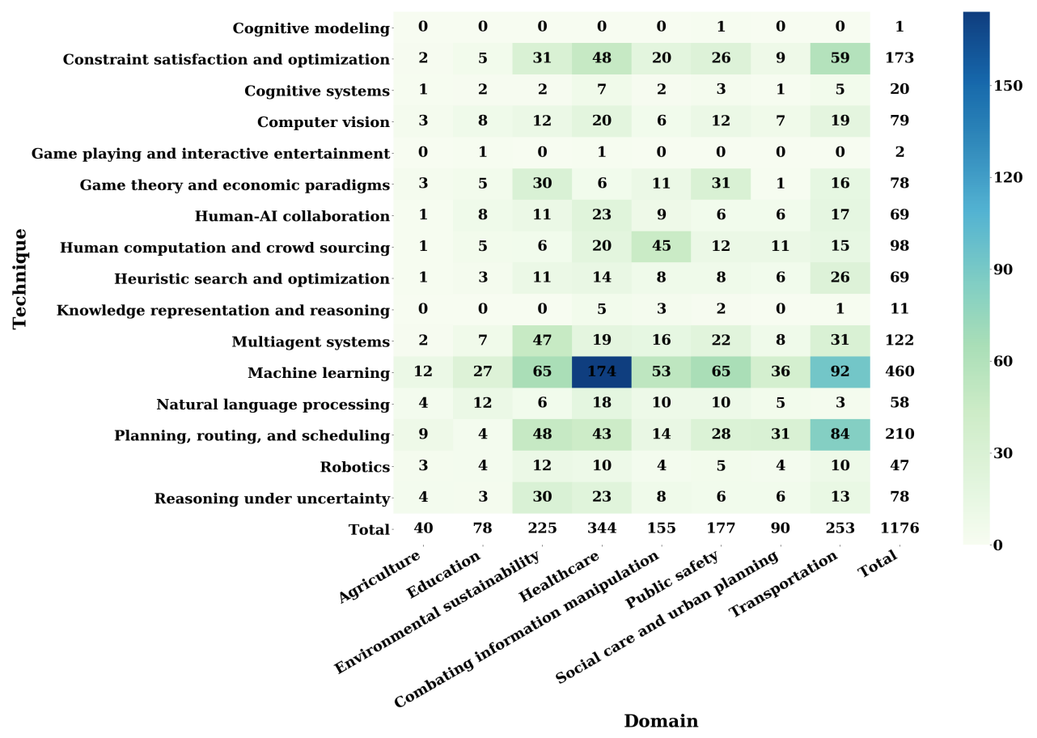
AI for Social Good (AI4SG)
Domains and Techniques
Source: Zheyuan Shi, Ryan, Claire Wang, and Fei Fang (2020). "Artificial intelligence for social good: A survey." arXiv preprint arXiv:2001.01818.

Slide 107
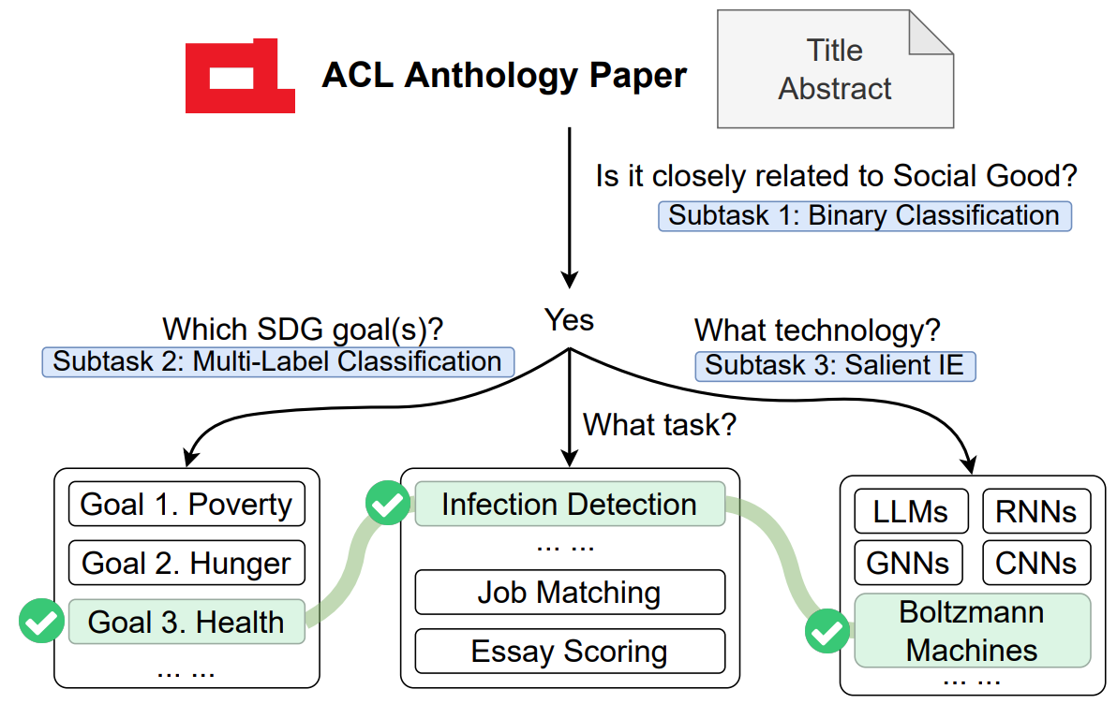
NLP for Social Good (NLP4SG)
Source: Fernando Gonzalez, Zhijing Jin, Jad Beydoun, Bernhard Schölkopf, Tom Hope, Rada Mihalcea, and Mrinmaya Sachan (2022).
"How Is NLP Addressing the 17 UN Sustainability Goals? A Challenge Set of Social Good Paper Classification and Information Extraction."

Slide 108
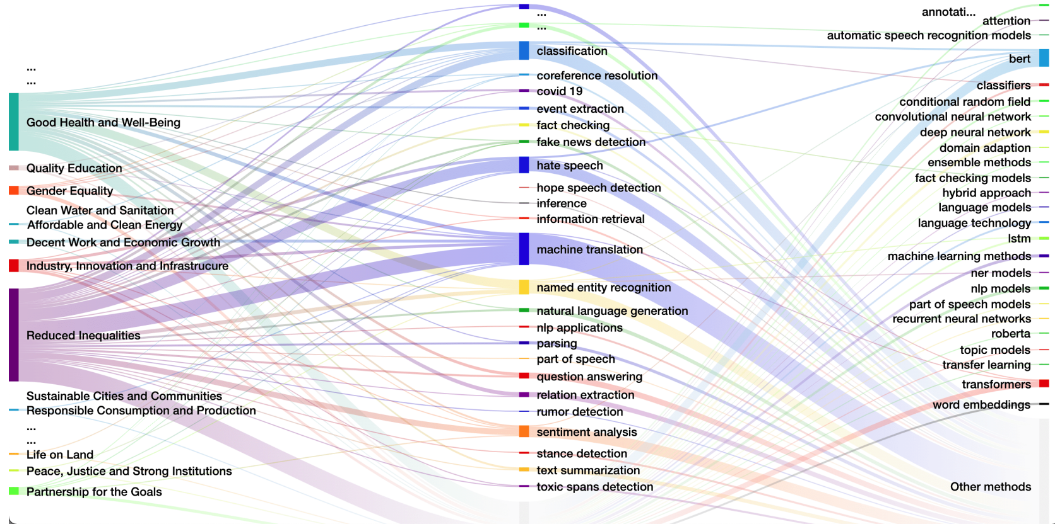
NLP for Social Good (NLP4SG)
Visualization
Source: Fernando Gonzalez, Zhijing Jin, Jad Beydoun, Bernhard Schölkopf, Tom Hope, Rada Mihalcea, and Mrinmaya Sachan (2022).
"How Is NLP Addressing the 17 UN Sustainability Goals? A Challenge Set of Social Good Paper Classification and Information Extraction."

Slide 109

Papers with Code
State-of-the-Art (SOTA)
https://paperswithcode.com/sota

Slide 110
Spring 2025
Generative AI
Innovative Applications

Slide 111
Summary
Generative AI
Philosophy, Ethics, and Safety of AI
  The Limits of AI
  Can Machines Really Think?
  The Ethics of AI
The Future of AI
  AI Components
  AI Architectures

Slide 112
References
Stuart Russell and Peter Norvig (2020), Artificial Intelligence: A Modern Approach, 4th Edition, Pearson.
Denis Rothman (2024), Transformers for Natural Language Processing and Computer Vision - Third Edition: Explore Generative AI and Large Language Models with Hugging Face, ChatGPT, GPT-4V, and DALL-E 3, 3rd ed. Edition, Packt Publishing
Aurélien Géron (2022), Hands-On Machine Learning with Scikit-Learn, Keras, and TensorFlow: Concepts, Tools, and Techniques to Build Intelligent Systems, 3rd Edition, O’Reilly Media.
Steven D'Ascoli (2022), Artificial Intelligence and Deep Learning with Python: Every Line of Code Explained For Readers New to AI and New to Python, Independently published.
Nenad Tomašev, Julien Cornebise, Frank Hutter, Shakir Mohamed, Angela Picciariello, Bec Connelly, Danielle Belgrave et al. (2020) "AI for social good: unlocking the opportunity for positive impact." Nature Communications 11, no. 1: 1-6.
Fernando Gonzalez, Zhijing Jin, Jad Beydoun, Bernhard Schölkopf, Tom Hope, Rada Mihalcea, and Mrinmaya Sachan (2022). "How Is NLP Addressing the 17 UN Sustainability Goals? A Challenge Set of Social Good Paper Classification and Information Extraction.”
Shukang Yin, Chaoyou Fu, Sirui Zhao, Ke Li, Xing Sun, Tong Xu, and Enhong Chen. (2024) "A survey on multimodal large language models." National Science Review (2024): nwae403.
Jiayi Kuang, Jingyou Xie, Haohao Luo, Ronghao Li, Zhe Xu, Xianfeng Cheng, Yinghui Li, Xika Lin, and Ying Shen. (2024) "Natural Language Understanding and Inference with MLLM in Visual Question Answering: A Survey." arXiv preprint arXiv:2411.17558.
Bo Li, Peng Qi, Bo Liu, Shuai Di, Jingen Liu, Jiquan Pei, Jinfeng Yi, and Bowen Zhou. (2023) "Trustworthy AI: From principles to practices." ACM Computing Surveys 55, no. 9 (2023): 1-46.
NVIDIA DLI (2024), Generative AI Explained, https://learn.nvidia.com/courses/course-detail?course_id=course-v1:DLI+S-FX-07+V1
NVIDIA DLI (2024), Introduction to Transformer-Based Natural Language Processing, https://learn.nvidia.com/courses/course-detail?course_id=course-v1:DLI+S-FX-08+V1
NVIDIA DLI (2024), Building RAG Agents with LLMs, https://learn.nvidia.com/courses/course-detail?course_id=course-v1:DLI+S-FX-15+V1
NVIDIA DLI (2024), Generative AI with Diffusion Models, https://learn.nvidia.com/courses/course-detail?course_id=course-v1:DLI+S-FX-14+V1
NVIDIA DLI (2024), Introduction to NVIDIA NIM™ Microservices, https://learn.nvidia.com/courses/course-detail?course_id=course-v1:DLI+S-FX-23+V1
Min-Yuh Day (2024), Python 101, https://tinyurl.com/aintpupython101

